Slide 1
Set Topology
MTH 251
Lecture # 31

Slide 2
Lecture Plan
Connected Spaces
Connected subsets

Slide 3
Some spaces are in a sense ‘disconnected’, being the union of two or more completely separate subspaces.
For example the space X ⊂ R consisting of the two intervals
A = [0, 1] and B = [2, 3] should certainly be disconnected

Slide 4
Definition (Connected Space)
A space X is connected

Slide 5
Definition (Connected Space)
A space X is connected
if it is not the union of two nonempty disjoint open sets.

Slide 6
Definition (Connected Space)
A space X is connected
if it is not the union of two nonempty disjoint open sets.
In other words,

Slide 7
Definition (Connected Space)
A space X is connected
if it is not the union of two nonempty disjoint open sets.
In other words,
if X is disconnected,

Slide 8
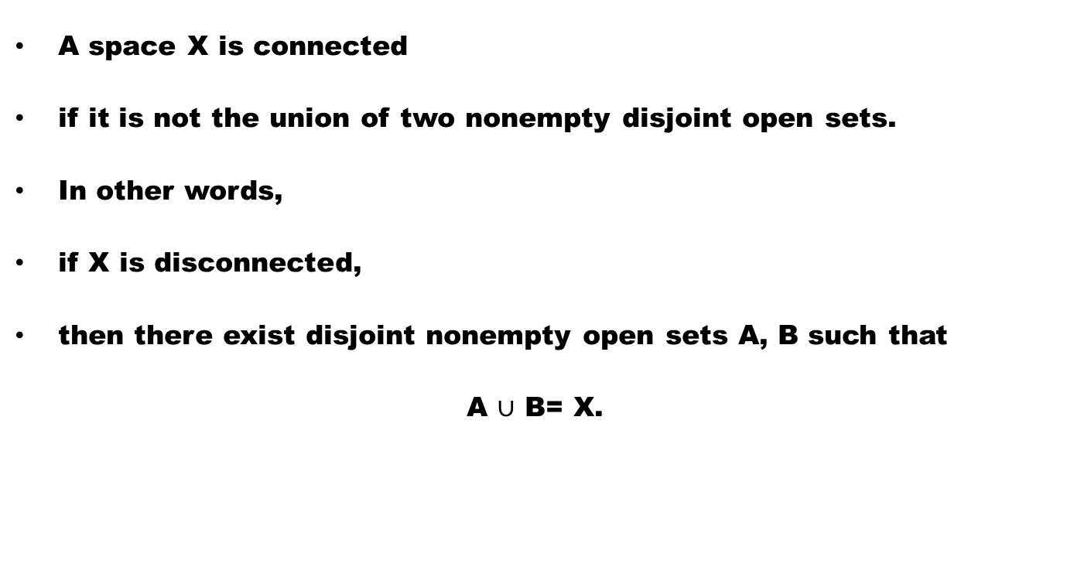
Definition (Connected Space)
A space X is connected
if it is not the union of two nonempty disjoint open sets.
In other words,
if X is disconnected,
then there exist disjoint nonempty open sets A, B such that
A $∪$ B= X.

Slide 9
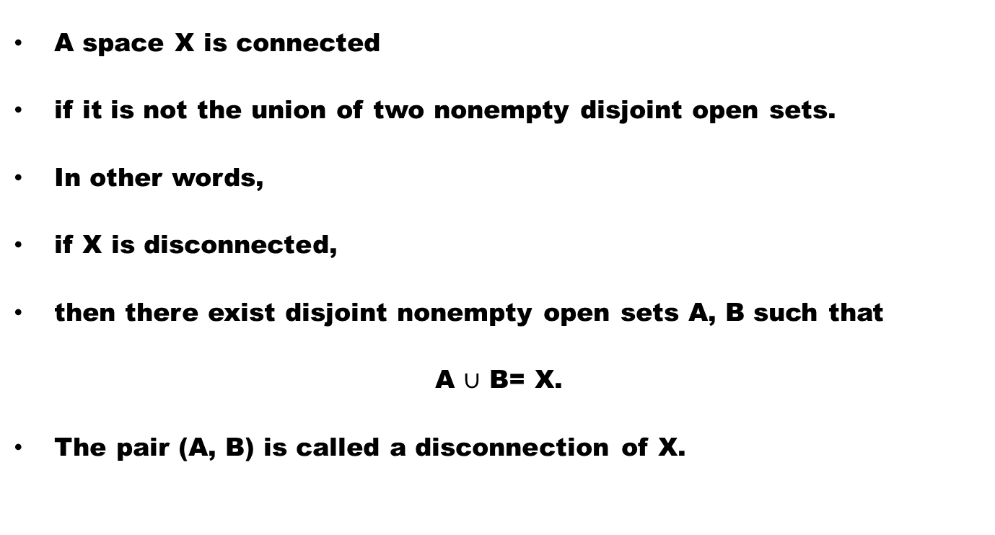
Definition (Connected Space)
A space X is connected
if it is not the union of two nonempty disjoint open sets.
In other words,
if X is disconnected,
then there exist disjoint nonempty open sets A, B such that
A $∪$ B= X.
The pair (A, B) is called a disconnection of X.

Slide 10
Example
(1) (0,1) – {1/2} is disconnected.

Slide 11
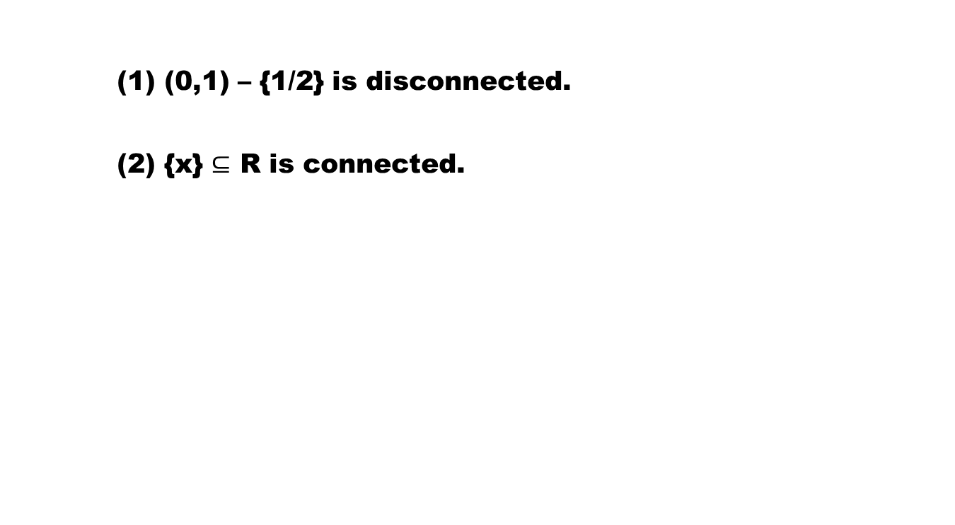
Example
(1) (0,1) – {1/2} is disconnected.
(2) {x} $⊆$ R is connected.

Slide 12
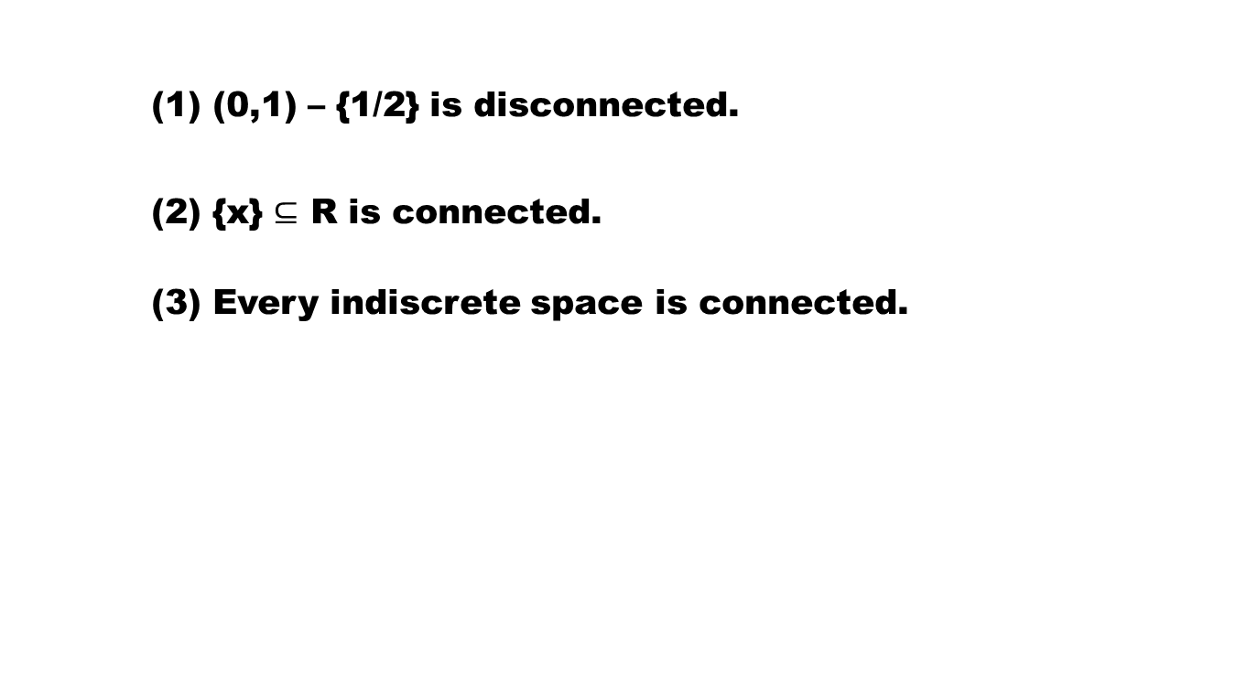
Example
(1) (0,1) – {1/2} is disconnected.
(2) {x} $⊆$ R is connected.
(3) Every indiscrete space is connected.

Slide 13
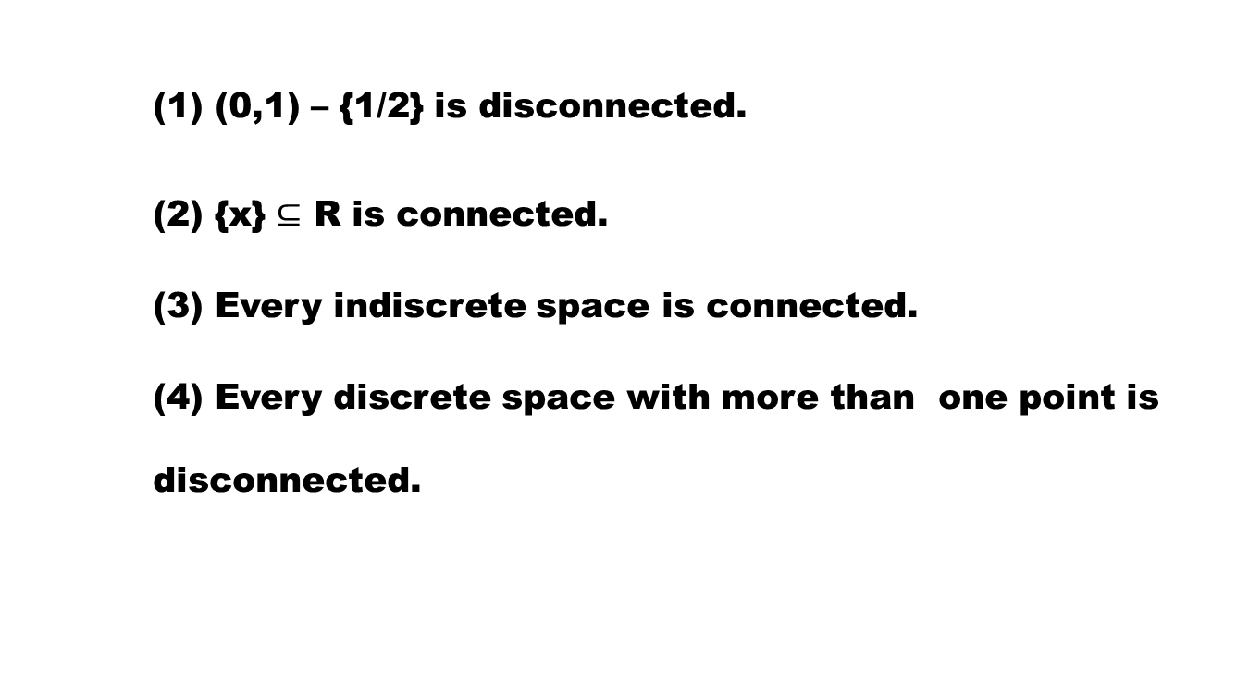
Example
(1) (0,1) – {1/2} is disconnected.
(2) {x} $⊆$ R is connected.
(3) Every indiscrete space is connected.
(4) Every discrete space with more than one point is disconnected.

Slide 14
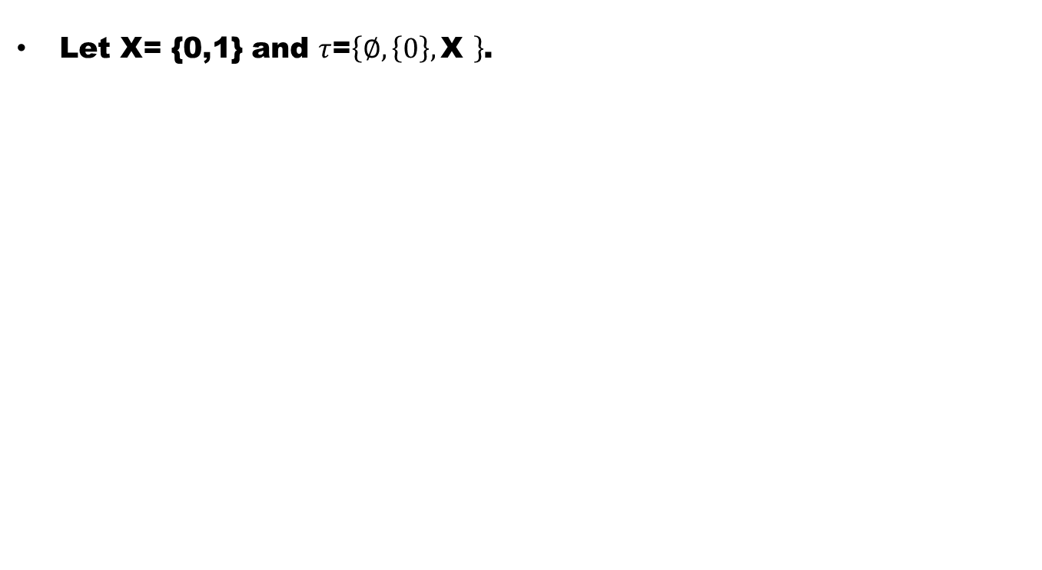
Example
Let X= {0,1} and $τ$=$\left\{∅,\left\{0\right\},\text{X} \right\}$.

Slide 15
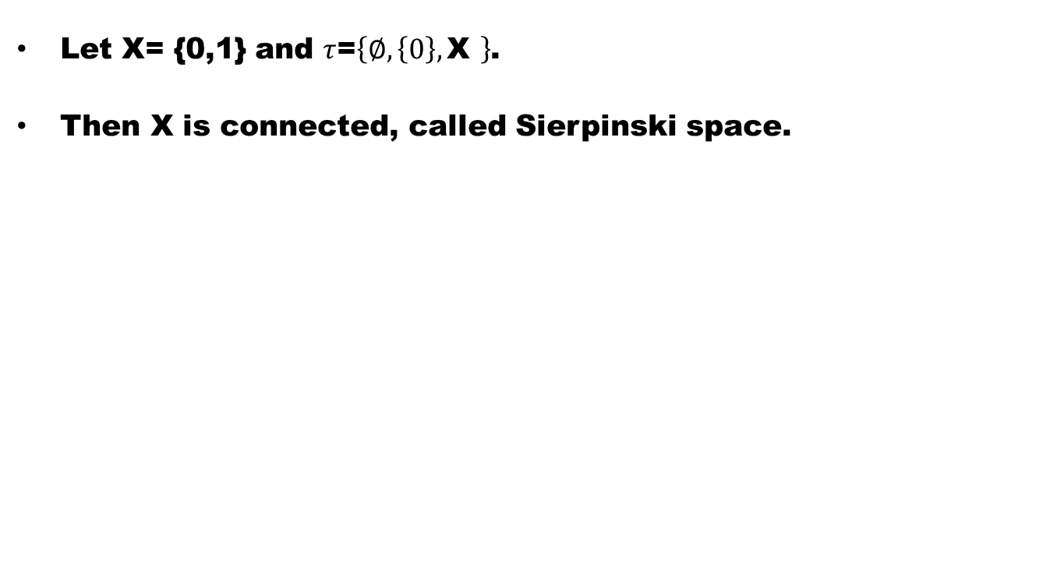
Example
Let X= {0,1} and $τ$=$\left\{∅,\left\{0\right\},\text{X} \right\}$.
Then X is connected, called Sierpinski space.

Slide 16
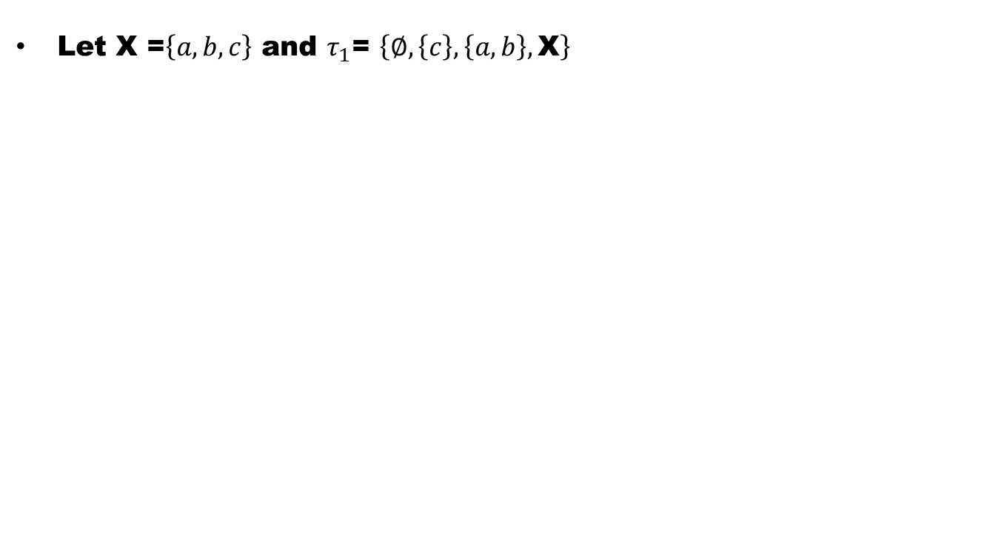
Example
Let X =$\left\{a,b,c\right\}$ and $τ_{1}$= $\left\{∅,\left\{c\right\},\left\{a,b\right\},\text{X}\right\}$

Slide 17
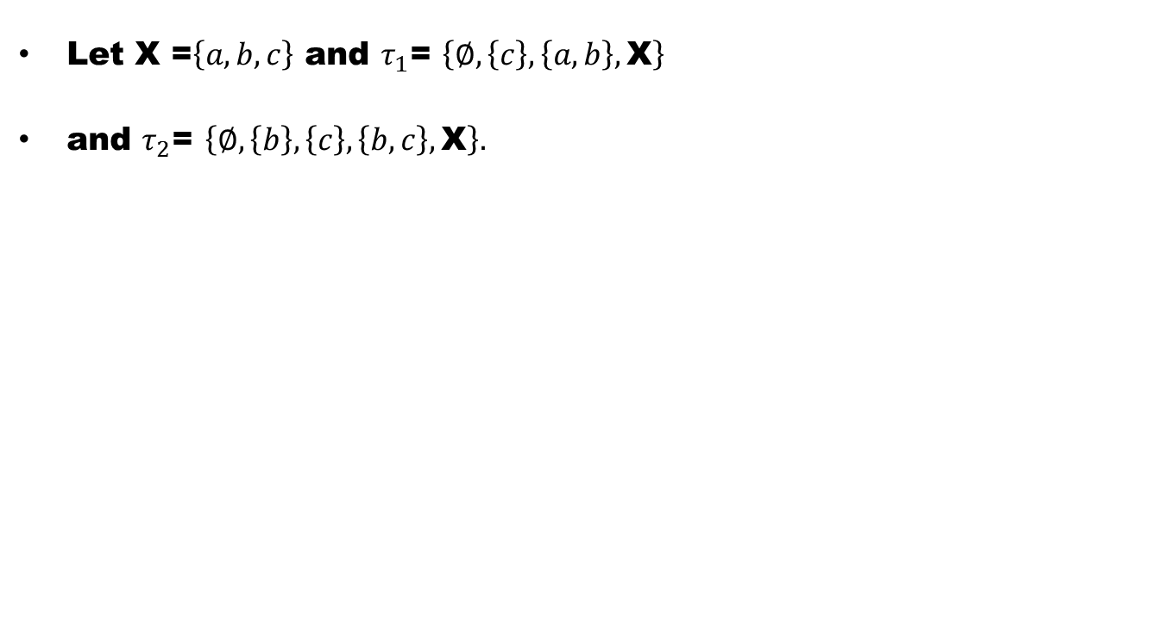
Example
Let X =$\left\{a,b,c\right\}$ and $τ_{1}$= $\left\{∅,\left\{c\right\},\left\{a,b\right\},\text{X}\right\}$
and $τ_{2}$= $\left\{∅,\left\{b\right\},\left\{c\right\},\left\{b,c\right\},\text{X}\right\}.$

Slide 18
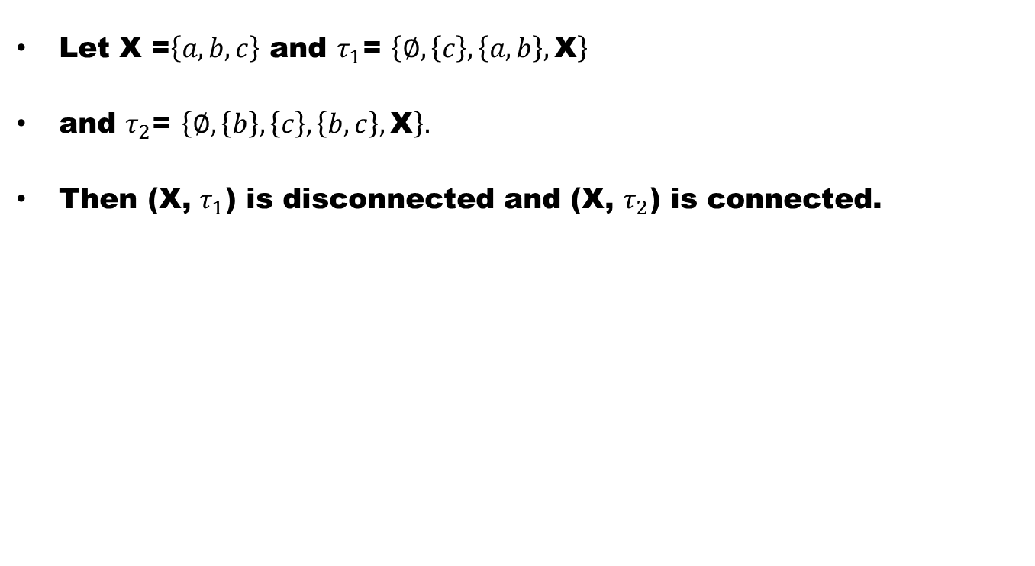
Example
Let X =$\left\{a,b,c\right\}$ and $τ_{1}$= $\left\{∅,\left\{c\right\},\left\{a,b\right\},\text{X}\right\}$
and $τ_{2}$= $\left\{∅,\left\{b\right\},\left\{c\right\},\left\{b,c\right\},\text{X}\right\}.$
Then (X, $τ_{1}$) is disconnected and (X, $τ_{2}$) is connected.

Slide 19
Theorem (characterization of Connected Space)
In a space X, the following are equivalent :

Slide 20
Theorem (characterization of Connected Space)
In a space X, the following are equivalent :
(1) X is connected.

Slide 21
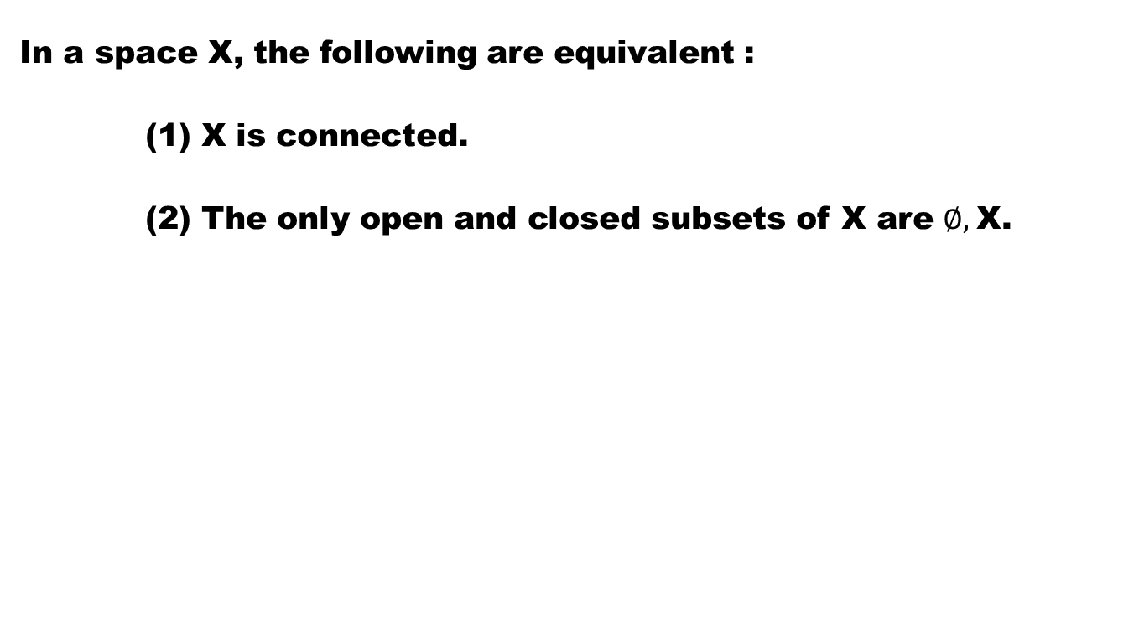
Theorem (characterization of Connected Space)
In a space X, the following are equivalent :
(1) X is connected.
(2) The only open and closed subsets of X are $∅,$X.

Slide 22
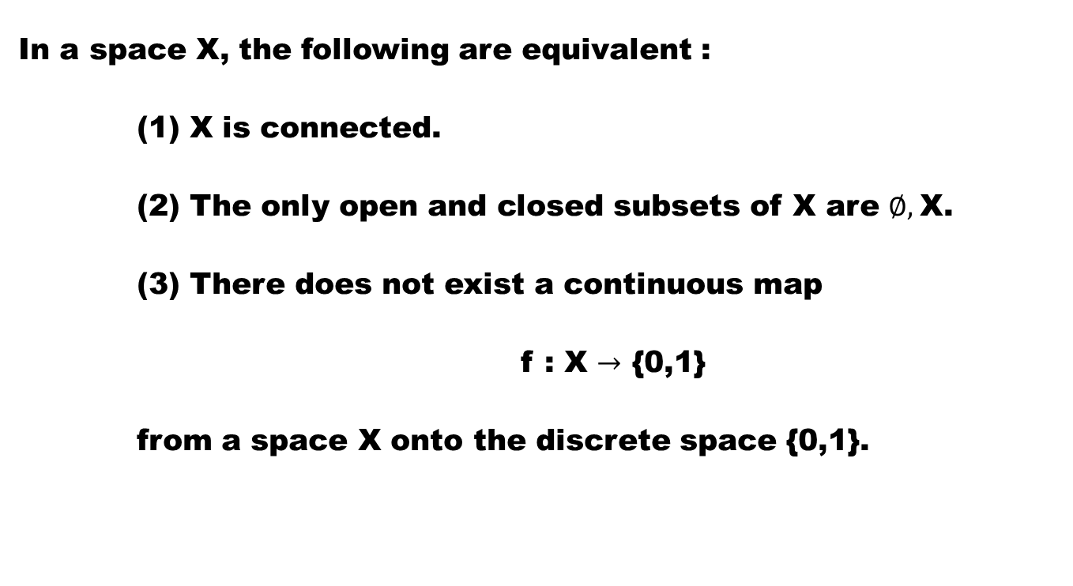
Theorem (characterization of Connected Space)
In a space X, the following are equivalent :
(1) X is connected.
(2) The only open and closed subsets of X are $∅,$X.
(3) There does not exist a continuous map
f : X $→$ {0,1}
from a space X onto the discrete space {0,1}.

Slide 26
Theorem. The continuous image of a connected space is connected.

Slide 28
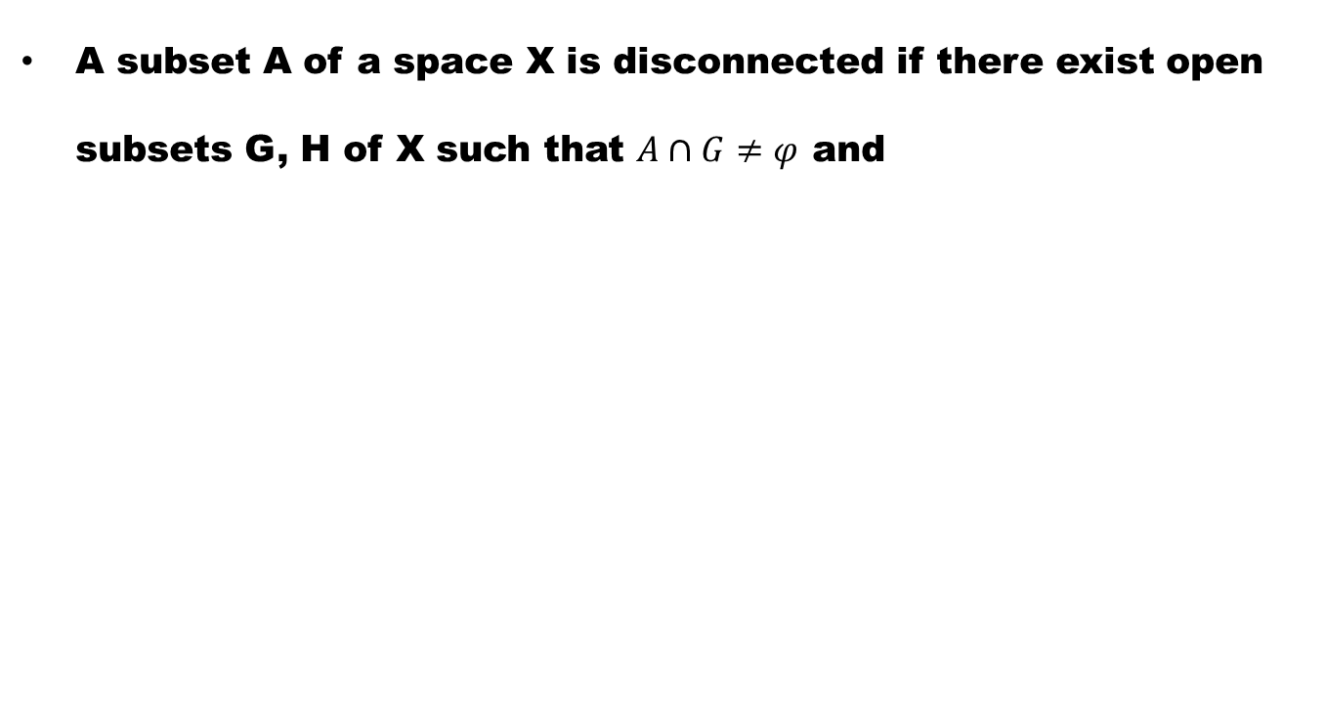
Definition
A subset A of a space X is disconnected if there exist open subsets G, H of X such that $A∩G≠φ$ and

Slide 29
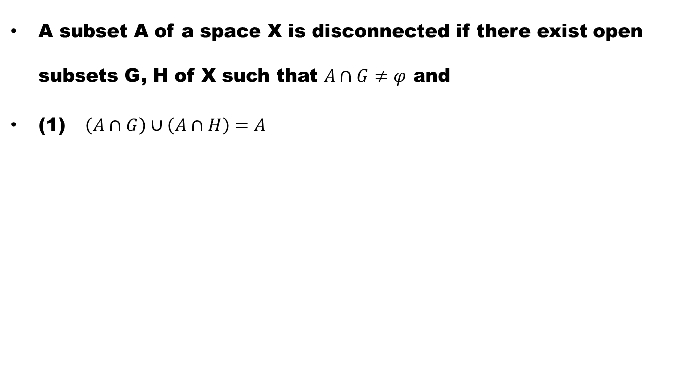
Definition
A subset A of a space X is disconnected if there exist open subsets G, H of X such that $A∩G≠φ$ and
(1) $\left(A∩G\right)∪\left(A∩H\right)=A$

Slide 30
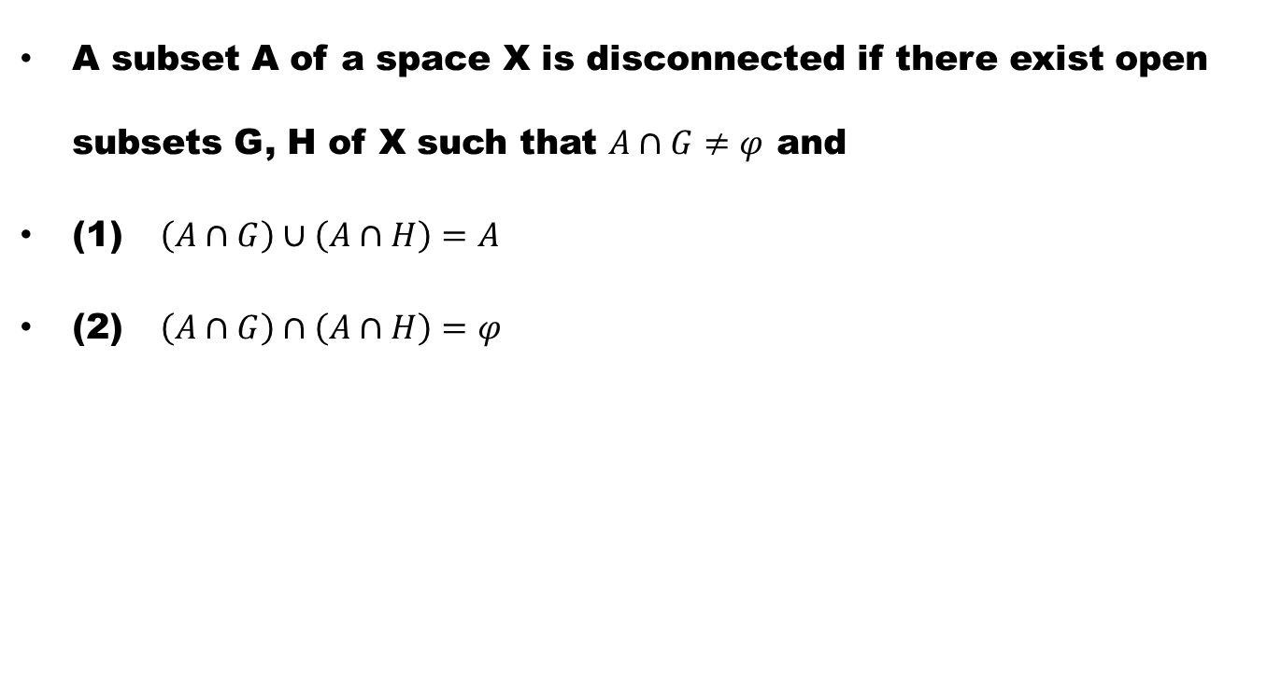
Definition
A subset A of a space X is disconnected if there exist open subsets G, H of X such that $A∩G≠φ$ and
(1) $\left(A∩G\right)∪\left(A∩H\right)=A$
(2) $\left(A∩G\right)∩\left(A∩H\right)=φ$

Slide 31
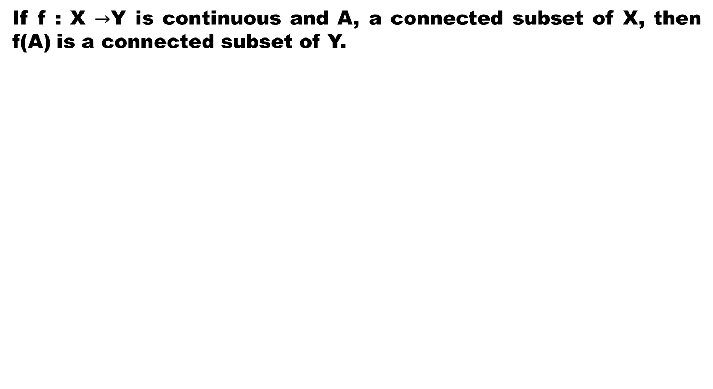
Theorem
If f : X $→$Y is continuous and A, a connected subset of X, then f(A) is a connected subset of Y.

Slide 33
Good Luck

