Slide 1
Set Topology
MTH 251
Lecture # 30

Slide 2
Lecture Plan
Compactness in Hausdorff spaces
Locally compact spaces

Slide 3
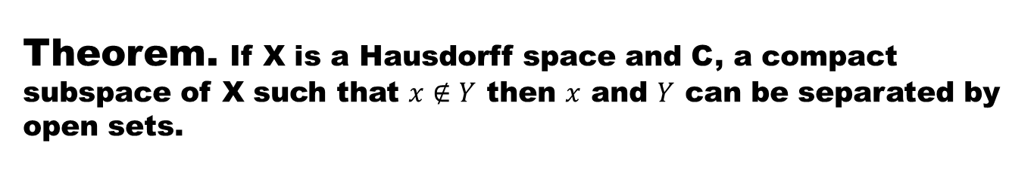
Theorem. If X is a Hausdorff space and C, a compact subspace of X such that $x∉Y$ then $x$ and $Y$ can be separated by open sets.

Slide 6
Theorem. Every compact subspace of a Hausdorff space is closed.

Slide 8
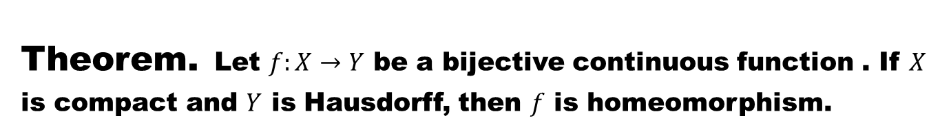
Theorem.Let $f:X→Y$ be a bijective continuous function . If $X$ is compact and $Y$ is Hausdorff, then $f$ is homeomorphism.
Discussion.

Slide 11
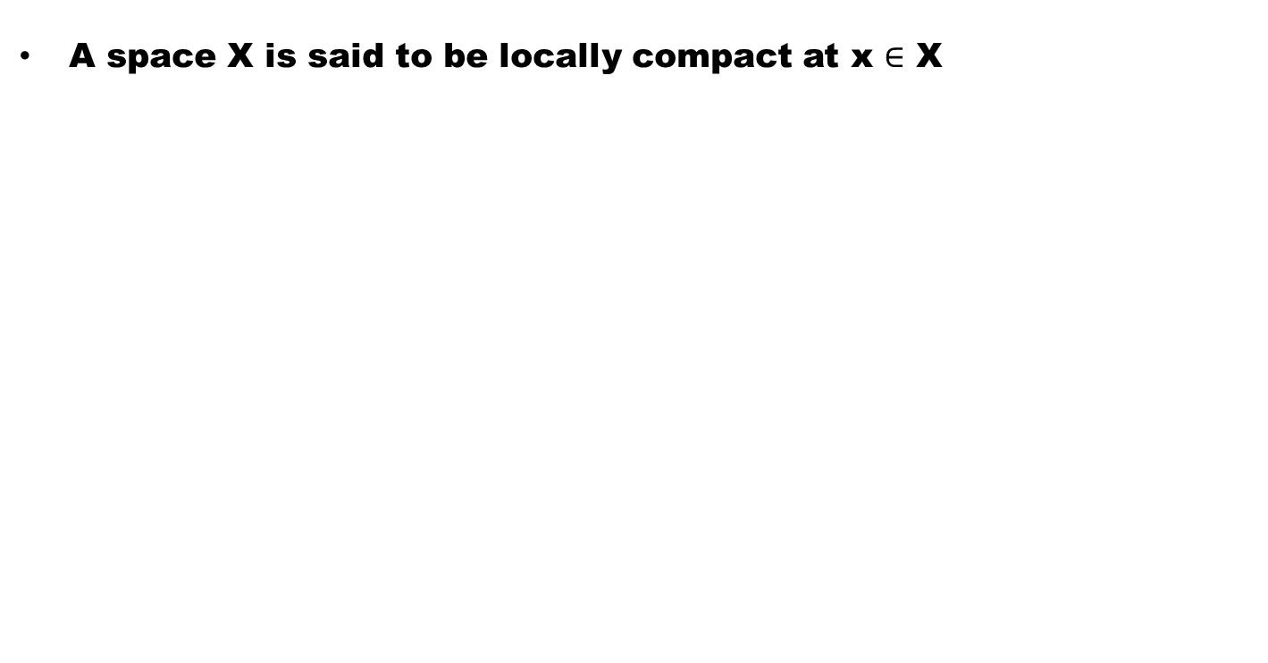
Definition 1 (Locally Compact)
A space X is said to be locally compact at x $∈$ X

Slide 12
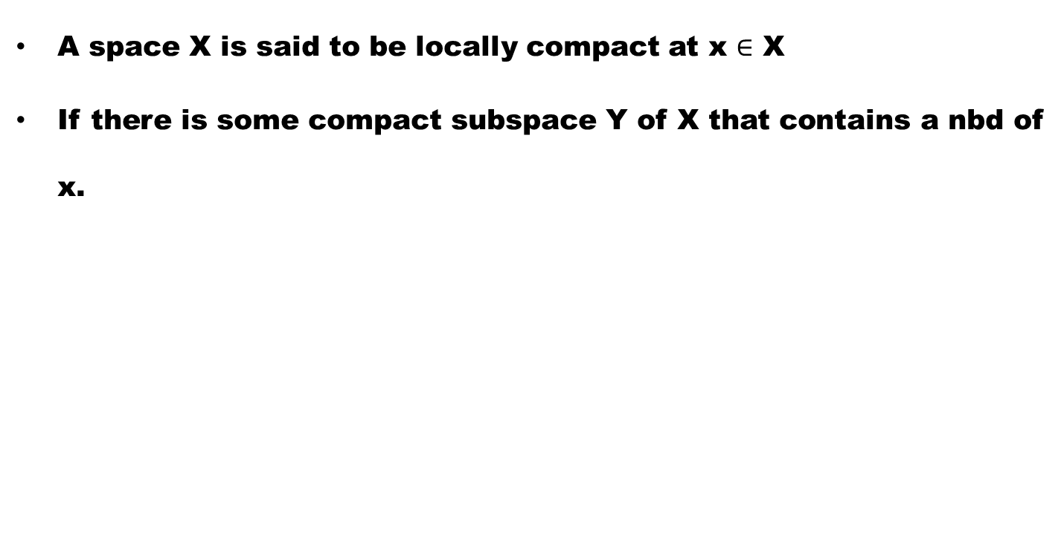
Definition 1 (Locally Compact)
A space X is said to be locally compact at x $∈$ X
If there is some compact subspace Y of X that contains a nbd of x.

Slide 13
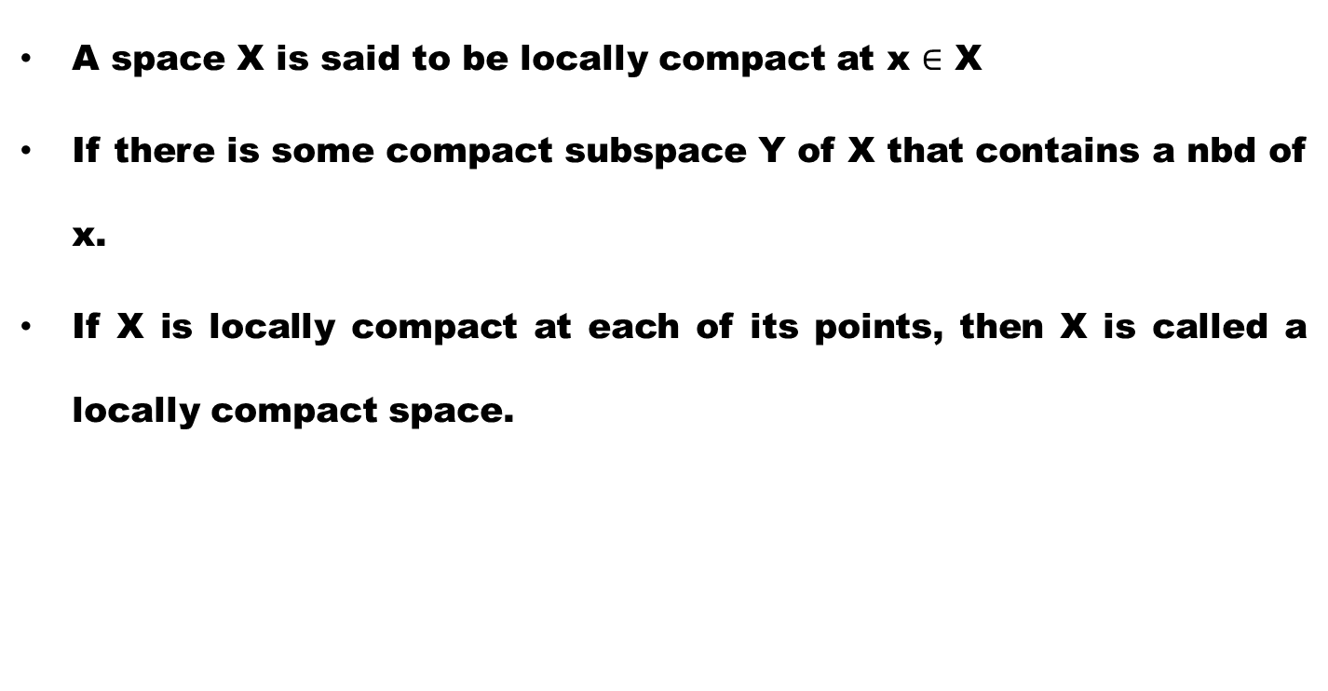
Definition 1 (Locally Compact)
A space X is said to be locally compact at x $∈$ X
If there is some compact subspace Y of X that contains a nbd of x.
If X is locally compact at each of its points, then X is called a locally compact space.

Slide 14
Renark. Every compact space is locally compact but converse is not true in general.

Slide 15
Renark. Every compact space is locally compact but converse is not true in general.
Example.

Slide 16
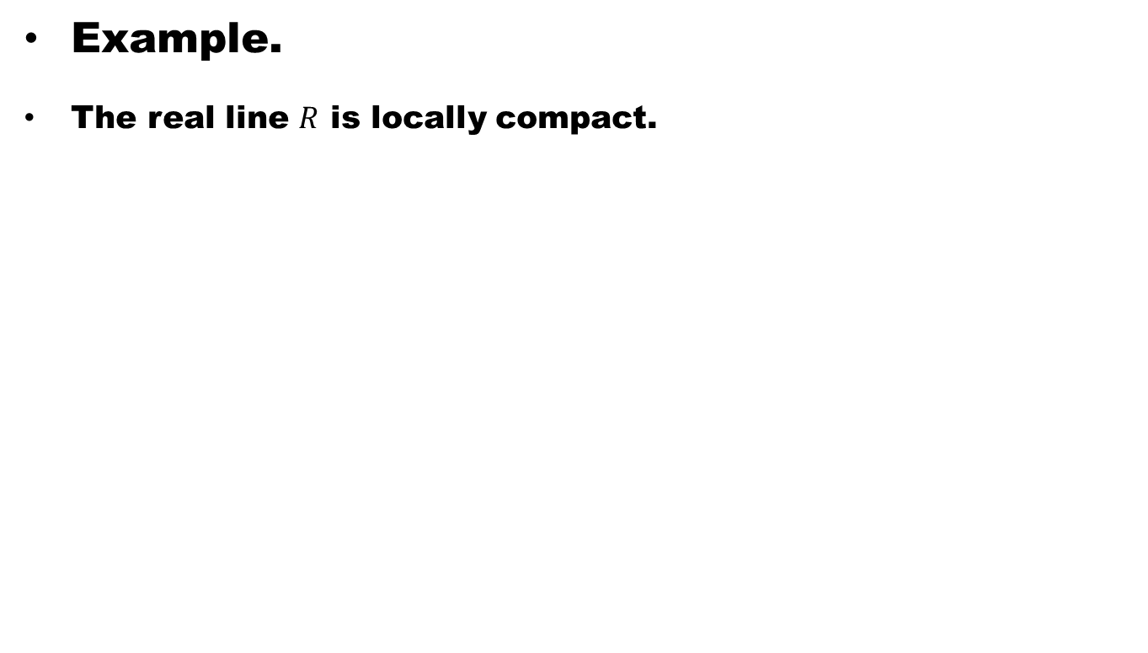
Renark. Every compact space is locally compact but converse is not true in general.
Example.
The real line $R$ is locally compact.

Slide 17
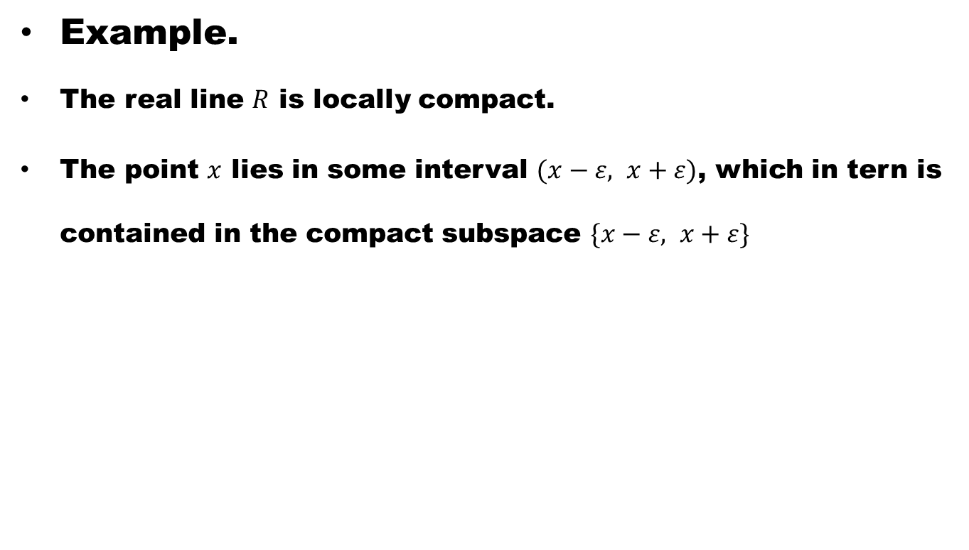
Renark. Every compact space is locally compact but converse is not true in general.
Example.
The real line $R$ is locally compact.
The point $x$ lies in some interval $(x−ε, x+ε)$, which in tern is contained in the compact subspace $\{x−ε, x+ε\}$

Slide 18
Theorem. Prove that every compact space is locally compact.

Slide 20
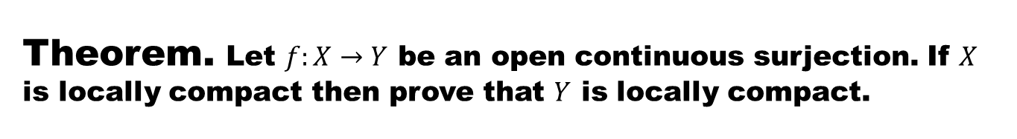
Theorem. Let $f:X→Y$ be an open continuous surjection. If $X$ is locally compact then prove that $Y$ is locally compact.

Slide 22
Good Luck

