Slide 1
Set Topology
MTH 251
Lecture # 29

Slide 2
Lecture Plan
Compact subsets
Finite Intersection Property
Examples
Basic open covers

Slide 3
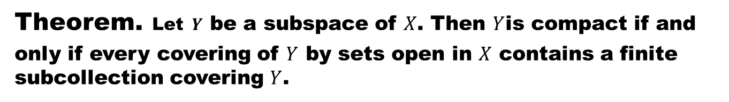
Theorem.Let$Y$ be a subspace of $X$. Then $Y$is compact if and only if every covering of $Y$ by sets open in $X$ contains a finite subcollection covering $Y$.

Slide 6
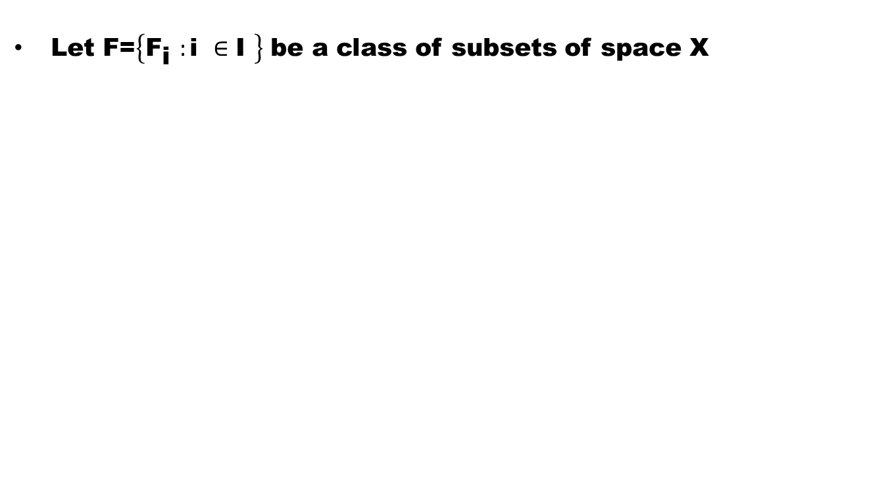
Definition (Finite Intersection Property)
Let F=$\left\{{\text{F}}_{\text{i} }:\text{i} ∈\text{I} \right\}$ be a class of subsets of space X

Slide 7
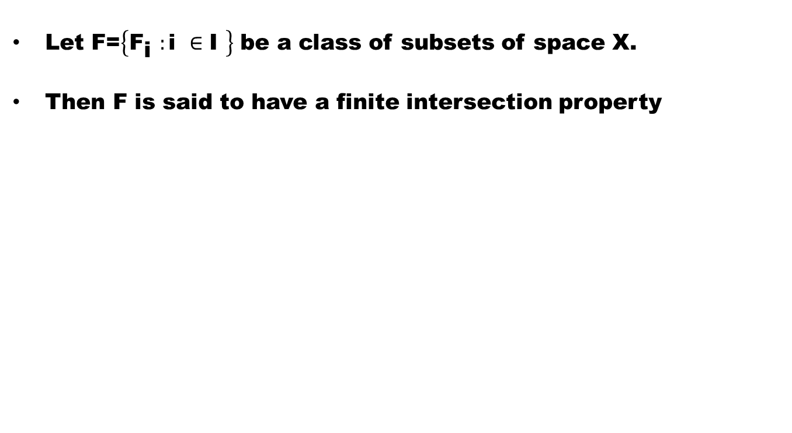
Definition (Finite Intersection Property)
Let F=$\left\{{\text{F}}_{\text{i} }:\text{i} ∈\text{I} \right\}$ be a class of subsets of space X.
Then F is said to have a finite intersection property

Slide 8
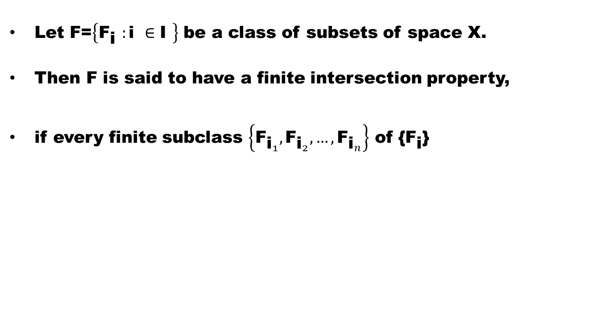
Definition (Finite Intersection Property)
Let F=$\left\{{\text{F}}_{\text{i} }:\text{i} ∈\text{I} \right\}$ be a class of subsets of space X.
Then F is said to have a finite intersection property,
if every finite subclass $\left\{{\text{F}}_{{\text{i}}_{1}},{\text{F}}_{{\text{i}}_{2}},…,{\text{F}}_{{\text{i}}_{n}}\right\}$ of {${\text{F}}_{\text{i}}$}

Slide 9
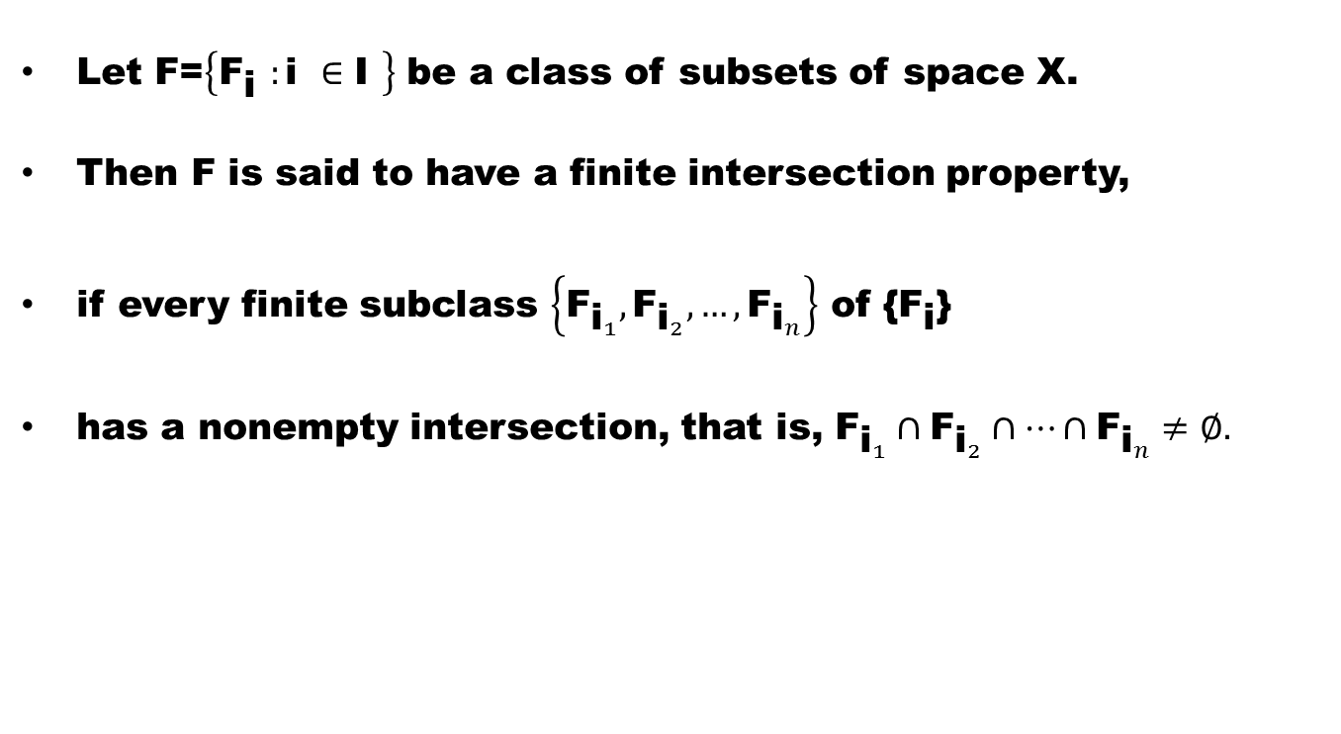
Definition (Finite Intersection Property)
Let F=$\left\{{\text{F}}_{\text{i} }:\text{i} ∈\text{I} \right\}$ be a class of subsets of space X.
Then F is said to have a finite intersection property,
if every finite subclass $\left\{{\text{F}}_{{\text{i}}_{1}},{\text{F}}_{{\text{i}}_{2}},…,{\text{F}}_{{\text{i}}_{n}}\right\}$ of {${\text{F}}_{\text{i}}$}
has a nonempty intersection, that is, ${\text{F}}_{{\text{i}}_{1}}∩{\text{F}}_{{\text{i}}_{2}}∩…∩{\text{F}}_{{\text{i}}_{n}}≠∅.$

Slide 10
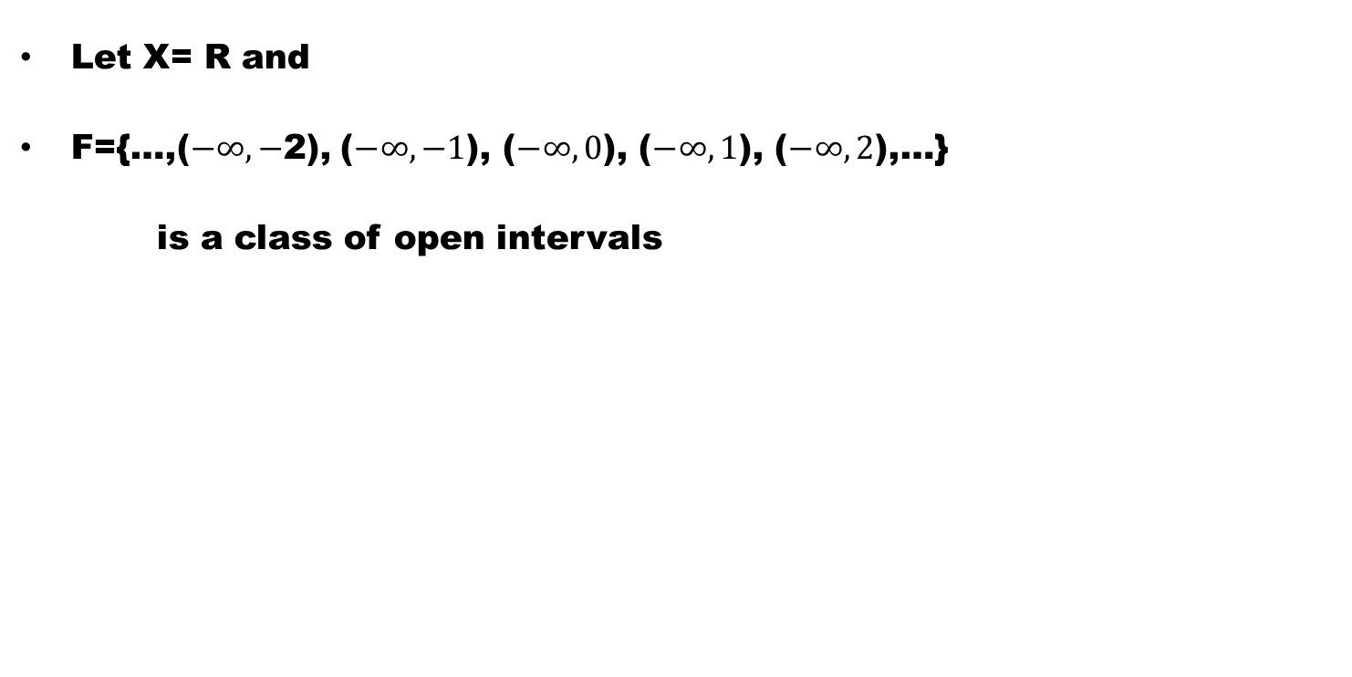
Example
Let X= R and
F={…,($−∞,−$2), ($−∞,−1$), ($−∞,0$), ($−∞,1$), ($−∞,2$),…}
is a class of open intervals

Slide 11
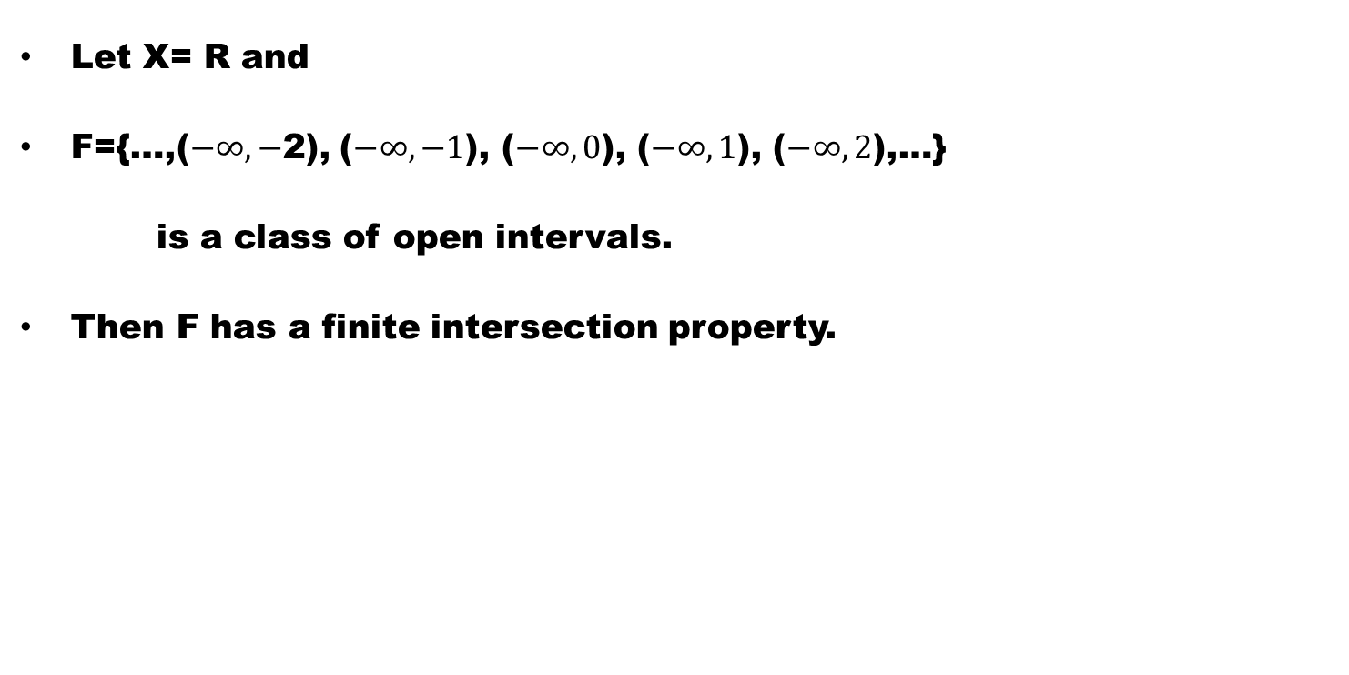
Example
Let X= R and
F={…,($−∞,−$2), ($−∞,−1$), ($−∞,0$), ($−∞,1$), ($−∞,2$),…}
is a class of open intervals.
Then F has a finite intersection property.

Slide 12
Example
Let X = R and

Slide 13
Example
Let X = R and
F = {(0,1), (0, ½), (0,1/4), …}

Slide 14
Example
Let X = R and
F = {(0,1), (0, ½), (0,1/4), …}.
Then F has a finite intersection property.

Slide 15
Note.
Remember that:

Slide 16
Note.
Remember that:
Every class of closed sets with f.i.p has a non empty intersection

Slide 17
Note.
Remember that:
Every class of closed sets with f.i.p has a non empty intersection
is equivalent to

Slide 18
Note.
Remember that:
Every class of closed sets with f.i.p has a non empty intersection
is equivalent to
Every class of closed sets with empty intersection has a finite subclass with empty intersection

Slide 19
Theorem (Characterization of Compactness)
The following are equivalent in a space :

Slide 20
Theorem (Characterization of Compactness)
The following are equivalent in a space :
(1) X is compact

Slide 21
Theorem (Characterization of Compactness)
The following are equivalent in a space :
(1) X is compact
(2) Every class of closed sets with empty intersection has a finite subclass with empty intersection.

Slide 24
Theorem (We can restate the last theorem as)
The following are equivalent in a space X :
(1) X is compact.
(2) Every class of closed sets having finite intersection property has a nonempty intersection.

Slide 25
Theorem. A space X is compact, if every basic open cover of X has a finite subcover.

Slide 28
Good Luck

