Slide 1
Set Topology
MTH 251
Lecture # 28

Slide 2
Lecture Plan
We will continue the study of Compactness
Union of compact subsets
Image of compact subsets
Hereditary property
Finite Intersection Property

Slide 3
Example
All finite spaces are compact and are called trivial compact spaces.

Slide 4
Example
All finite spaces are compact and are called trivial compact spaces.
Every cofinite space is compact. (verify)

Slide 6
Example
All finite spaces are compact and are called trivial compact spaces.
Every cofinite space is compact. (verify)
R with the usual topology is not compact.
No infinite discrete space is compact (verify)

Slide 8
Theorem. Any finite union of compact subsets of a space X is compact.

Slide 10
Theorem. A continuous image of a compact space is compact.

Slide 12
Theorem (Closed Hereditary Propety)
A closed subspace of a compact space is compact.

Slide 14
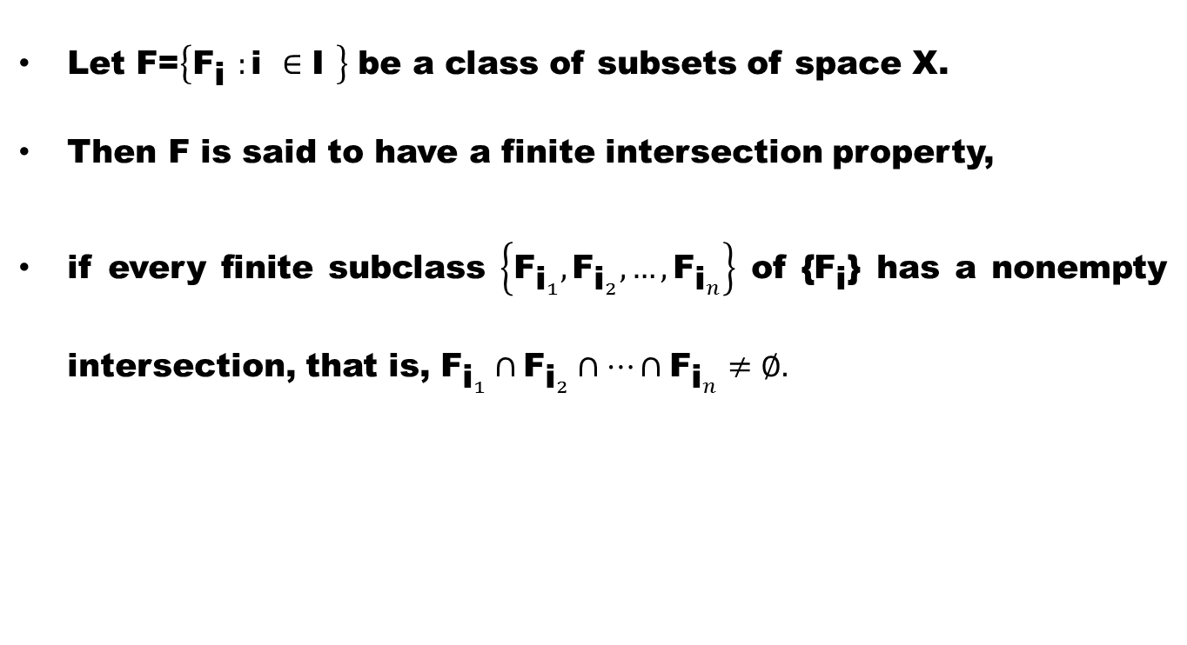
Definition (Finite Intersection Property)
Let F=$\left\{{\text{F}}_{\text{i} }:\text{i} ∈\text{I} \right\}$ be a class of subsets of space X.
Then F is said to have a finite intersection property,
if every finite subclass $\left\{{\text{F}}_{{\text{i}}_{1}},{\text{F}}_{{\text{i}}_{2}},…,{\text{F}}_{{\text{i}}_{n}}\right\}$ of {${\text{F}}_{\text{i}}$} has a nonempty intersection, that is, ${\text{F}}_{{\text{i}}_{1}}∩{\text{F}}_{{\text{i}}_{2}}∩…∩{\text{F}}_{{\text{i}}_{n}}≠∅.$

Slide 15
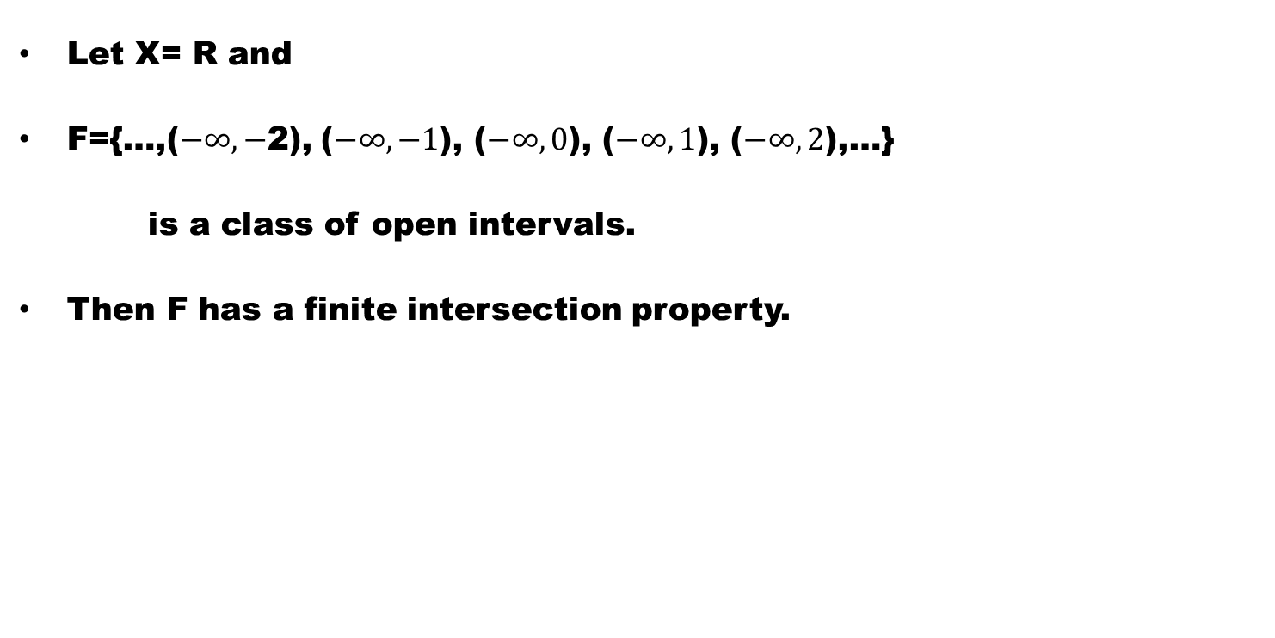
Example
Let X= R and
F={…,($−∞,−$2), ($−∞,−1$), ($−∞,0$), ($−∞,1$), ($−∞,2$),…}
is a class of open intervals.
Then F has a finite intersection property.

Slide 16
Example
Let X = R and
F = {(0,1), (0, ½), (0,1/4), …}.
Then F has a finite intersection property.

Slide 17
Theorem (Characterization of Compactness)
The following are equivalent in a space :
(1) X is compact
(2) Every class of closed sets with empty intersection has a finite subclass with empty intersection.

Slide 21
Theorem (Characterization)
The following are equivalent in a space X :
(1) X is compact.
(2) Every class of closed sets having finite intersection property has a nonempty intersection.

Slide 25
Theorem A space X is compact, if every basic open cover of X has a finite subcover.

Slide 26
Good Luck

