Slide 1
Set Topology
MTH 251
Lecture # 27

Slide 2
Lecture Plan
Compactness
Definition
Examples
Theorems

Slide 3
Compactness In Topological Spaces
Definition ( Open Cover )
Let X be a topological space

Slide 4
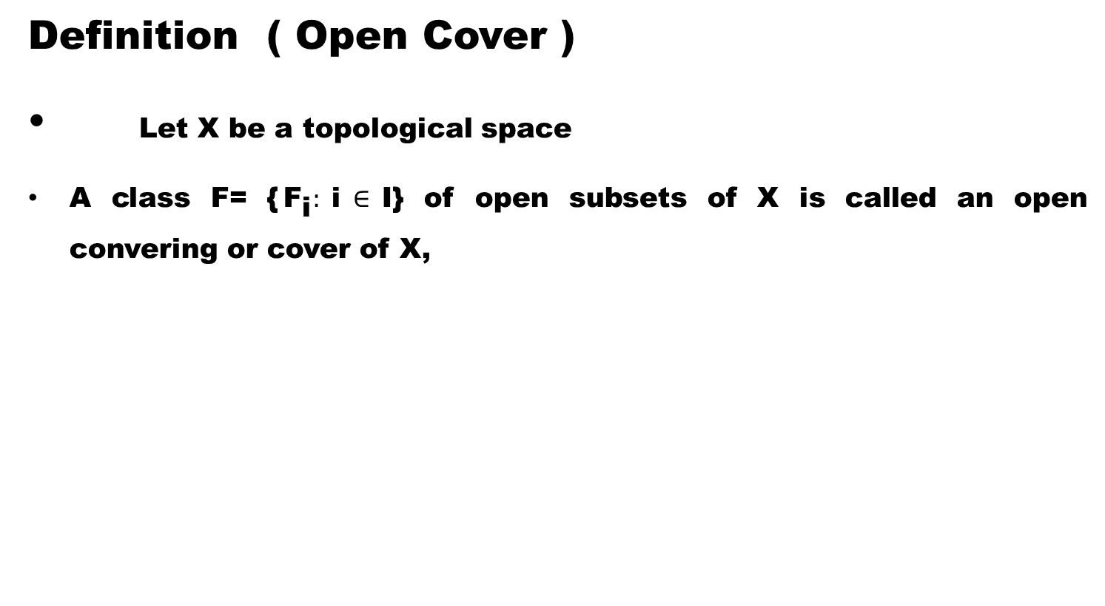
Compactness In Topological Spaces
Definition ( Open Cover )
Let X be a topological space
A class F= {${\text{F}}_{\text{i}}:$i$∈$I} of open subsets of X is called an open convering or cover of X,

Slide 5
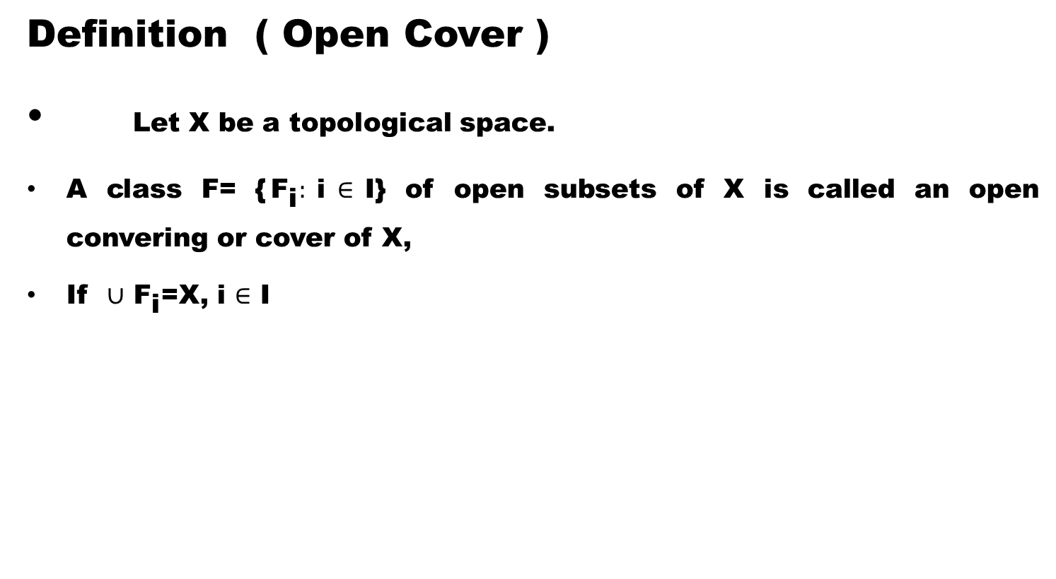
Compactness In Topological Spaces
Definition ( Open Cover )
Let X be a topological space.
A class F= {${\text{F}}_{\text{i}}:$i$∈$I} of open subsets of X is called an open convering or cover of X,
If $∪$ ${\text{F}}_{\text{i}}$=X, i $∈$ I

Slide 6
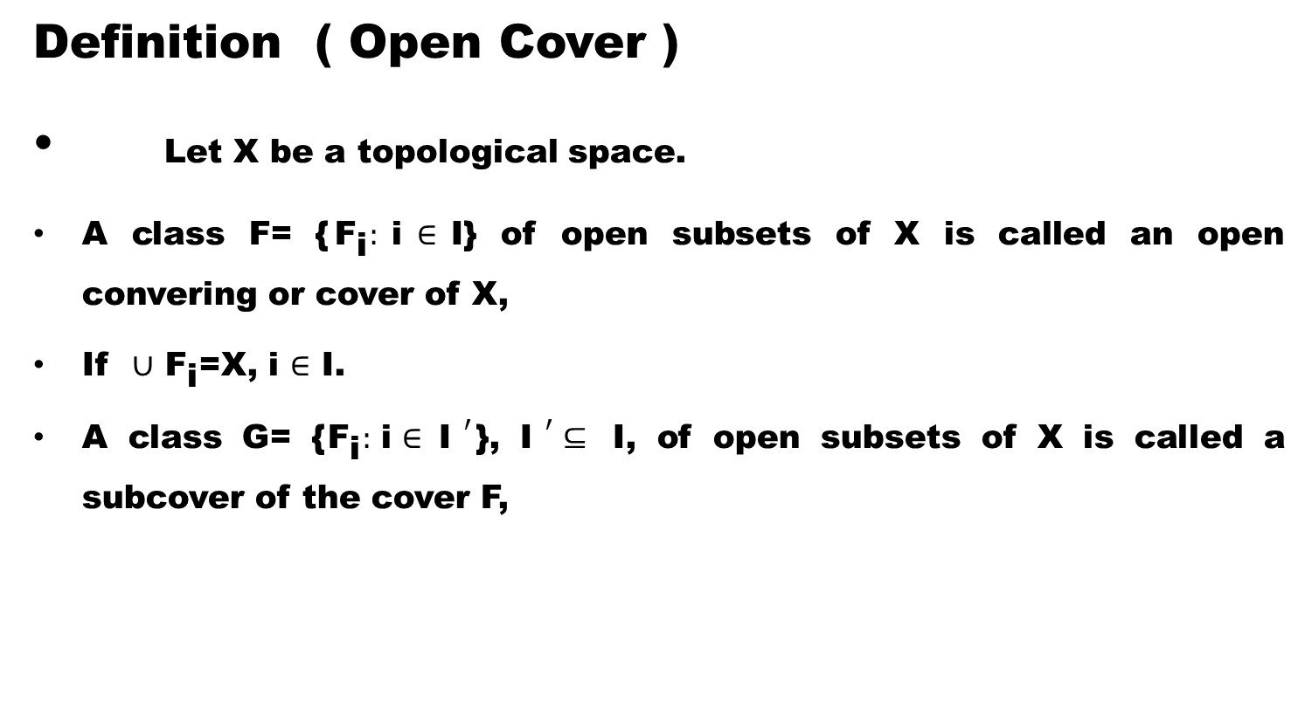
Compactness In Topological Spaces
Definition ( Open Cover )
Let X be a topological space.
A class F= {${\text{F}}_{\text{i}}:$i$∈$I} of open subsets of X is called an open convering or cover of X,
If $∪$ ${\text{F}}_{\text{i}}$=X, i $∈$ I.
A class G= {${\text{F}}_{\text{i}}:$i$∈ {\text{I} }^{′}$}, ${\text{I} }^{′}⊆$ I, of open subsets of X is called a subcover of the cover F,

Slide 7
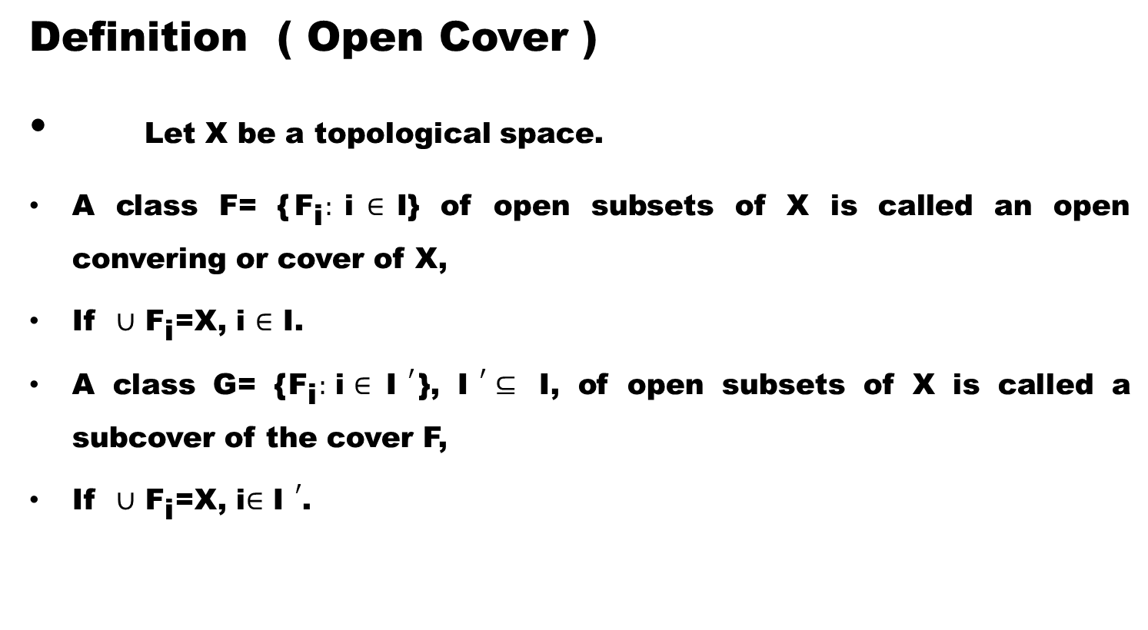
Compactness In Topological Spaces
Definition ( Open Cover )
Let X be a topological space.
A class F= {${\text{F}}_{\text{i}}:$i$∈$I} of open subsets of X is called an open convering or cover of X,
If $∪$ ${\text{F}}_{\text{i}}$=X, i $∈$ I.
A class G= {${\text{F}}_{\text{i}}:$i$∈ {\text{I} }^{′}$}, ${\text{I} }^{′}⊆$ I, of open subsets of X is called a subcover of the cover F,
If $∪$ ${\text{F}}_{\text{i}}$=X, i$∈$ ${\text{I} }^{′}$.

Slide 8
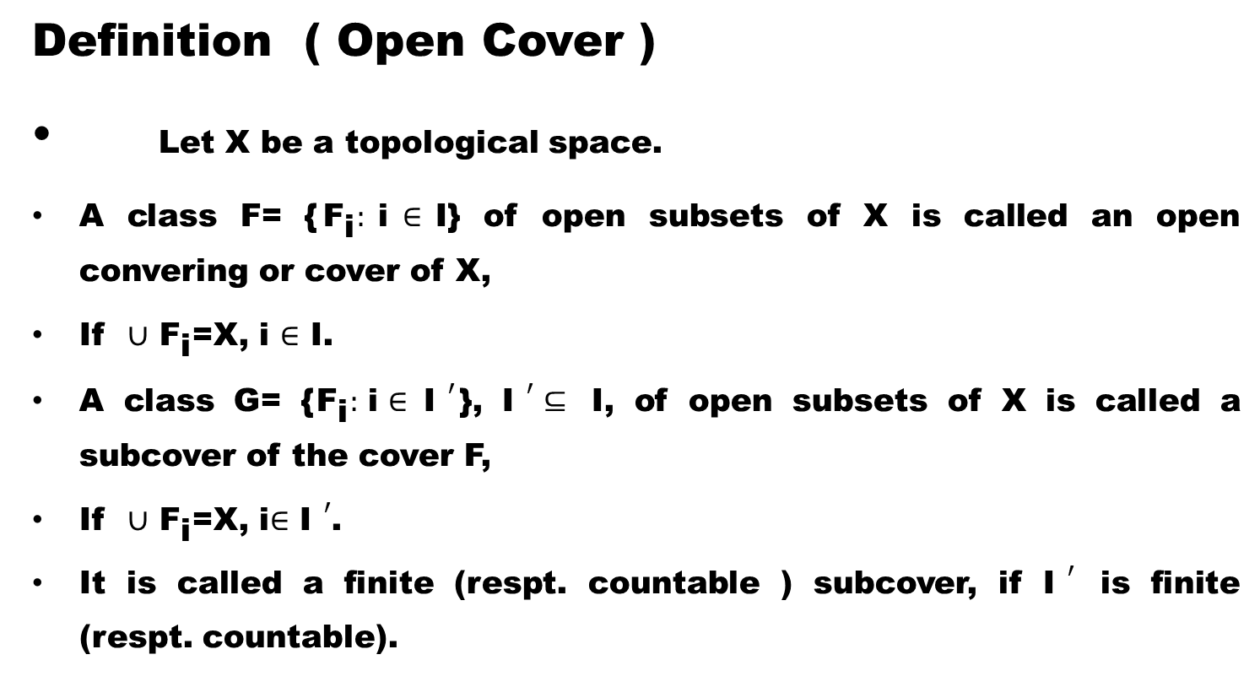
Compactness In Topological Spaces
Definition ( Open Cover )
Let X be a topological space.
A class F= {${\text{F}}_{\text{i}}:$i$∈$I} of open subsets of X is called an open convering or cover of X,
If $∪$ ${\text{F}}_{\text{i}}$=X, i $∈$ I.
A class G= {${\text{F}}_{\text{i}}:$i$∈ {\text{I} }^{′}$}, ${\text{I} }^{′}⊆$ I, of open subsets of X is called a subcover of the cover F,
If $∪$ ${\text{F}}_{\text{i}}$=X, i$∈$ ${\text{I} }^{′}$.
It is called a finite (respt. countable ) subcover, if ${\text{I} }^{′}$ is finite (respt. countable).

Slide 9
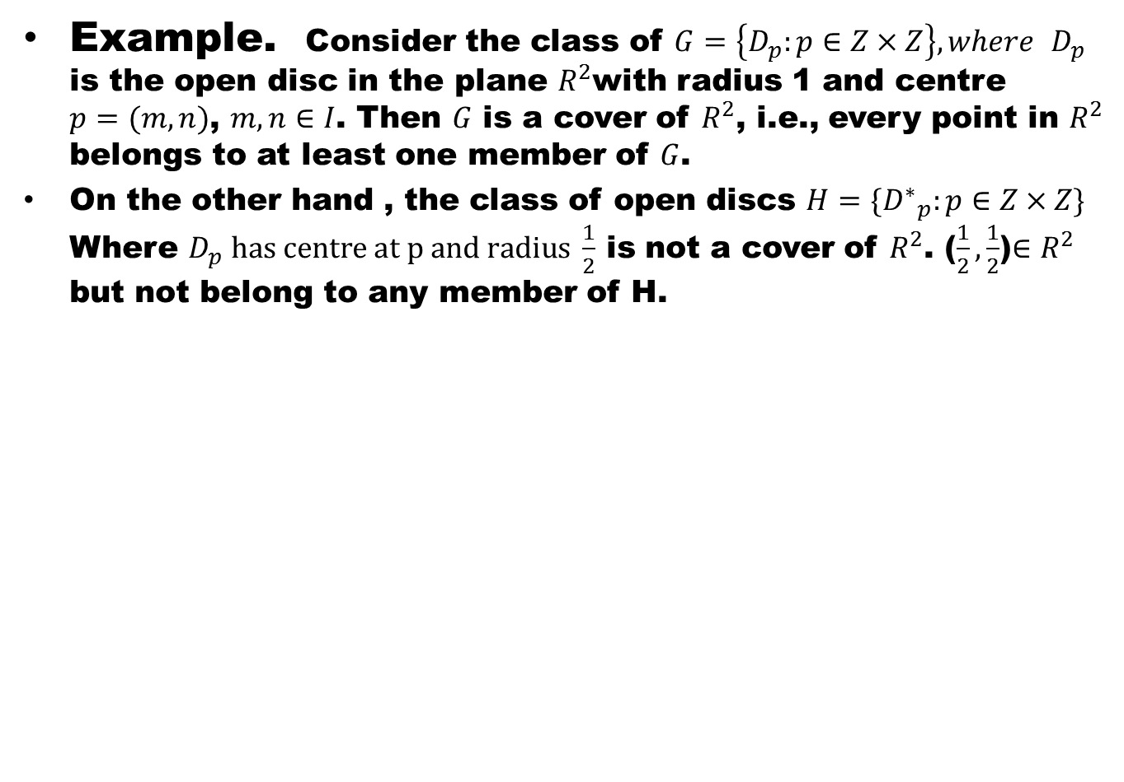
Example. Consider the class of $G=\left\{D_{p}:p∈Z×Z\right\}, where$ $D_{p}$ is the open disc in the plane $R^{2}$with radius 1 and centre $p=(m,n)$, $m,n∈I$. Then $G$ is a cover of $R^{2}$, i.e., every point in $R^{2}$ belongs to at least one member of $G$.
On the other hand , the class of open discs $H=\{{D^{∗}}_{p}^{}:p∈Z×Z\}$ Where $D_{p} has centre at p and radius \frac{1}{2}$ is not a cover of $R^{2}$. ($\frac{1}{2},\frac{1}{2}$)$∈R^{2}$ but not belong to any member of H.

Slide 11
Definition (Compactness)
A space X is said to be compact,
if every open cover of X has a finite subcover.

Slide 12
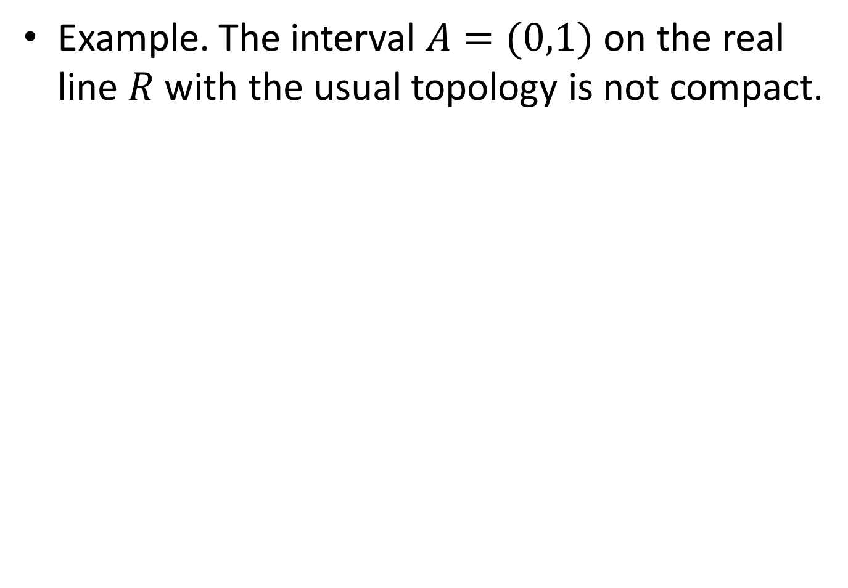
Example. The interval $A=(0,1)$ on the real line $R$ with the usual topology is not compact.

Slide 14
Definition (Compact subset)
A space X is said to be compact,

Slide 15
Definition (Compact subset)
A space X is said to be compact,
if every open cover of X has a finite subcover.

Slide 16
Definition (Compact subset)
A space X is said to be compact,
if every open cover of X has a finite subcover.
A subset A of a space X is compact,

Slide 17
Definition (Compact subset)
A space X is said to be compact,
if every open cover of X has a finite subcover.
A subset A of a space X is compact,
if it is compact as a subspace of X.

Slide 18
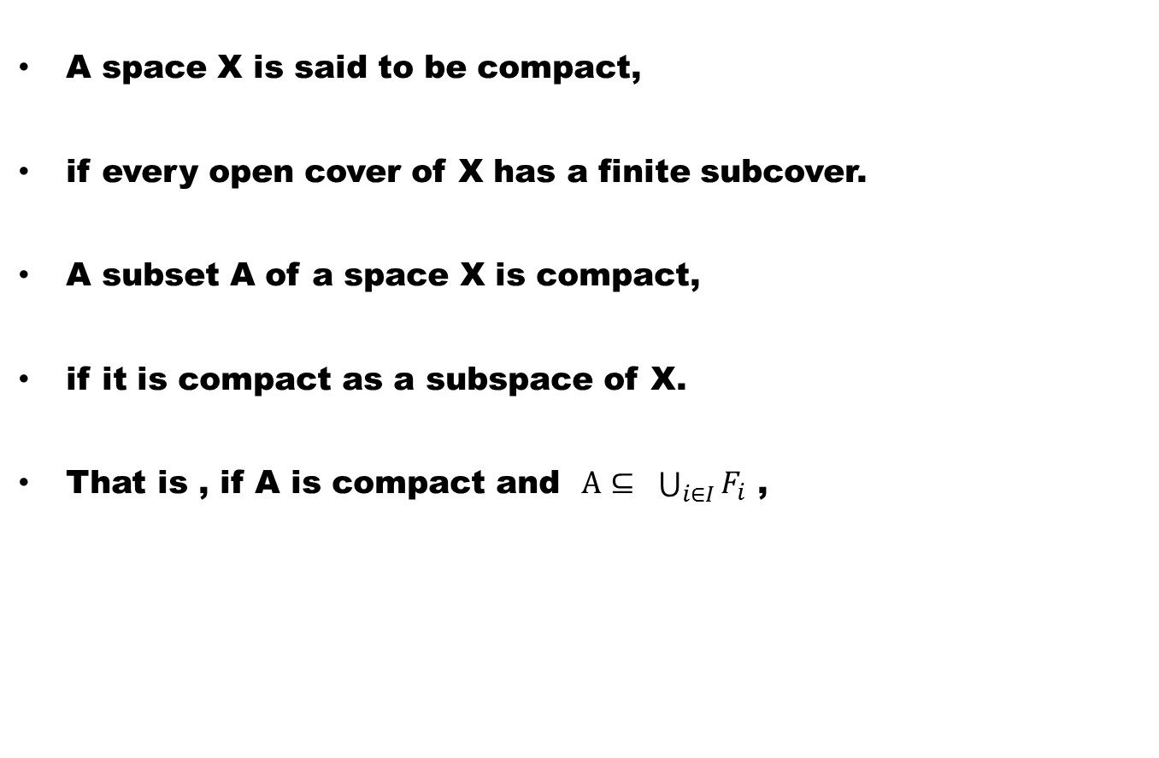
Definition (Compact subset)
A space X is said to be compact,
if every open cover of X has a finite subcover.
A subset A of a space X is compact,
if it is compact as a subspace of X.
That is , if A is compact and $A⊆ \bigcup_{i∈I}{F_{i}}$ ,

Slide 19
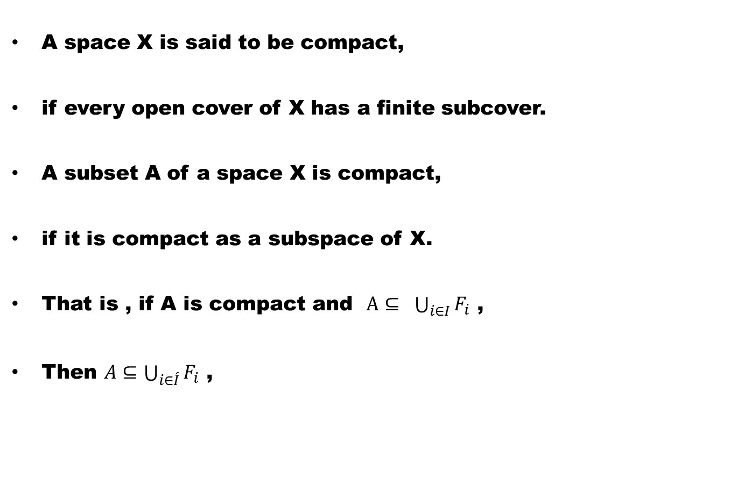
Definition (Compact subset)
A space X is said to be compact,
if every open cover of X has a finite subcover.
A subset A of a space X is compact,
if it is compact as a subspace of X.
That is , if A is compact and $A⊆ \bigcup_{i∈I}{F_{i}}$ ,
Then $A⊆\bigcup_{i∈\acute{I}}{F_{i}}$ ,

Slide 20
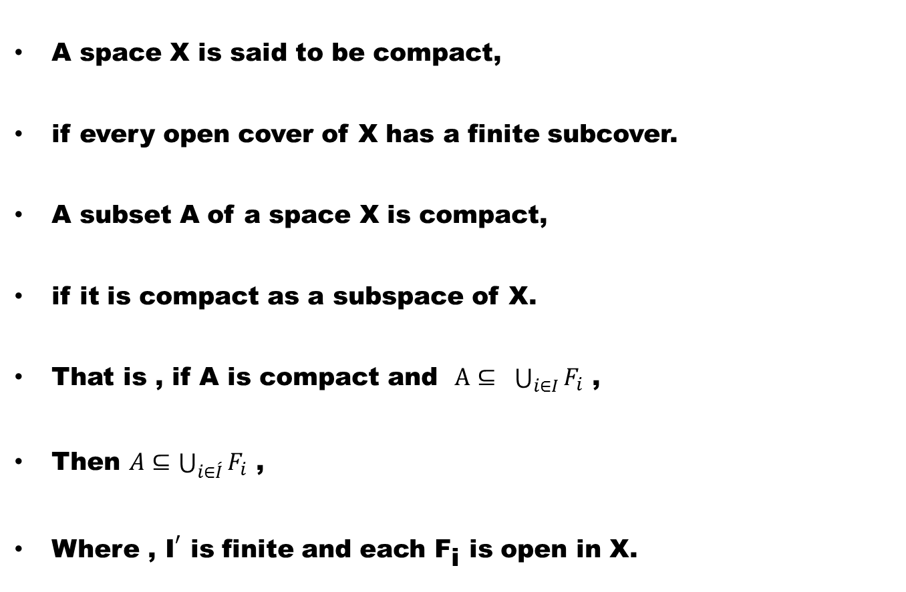
Definition (Compac subset)
A space X is said to be compact,
if every open cover of X has a finite subcover.
A subset A of a space X is compact,
if it is compact as a subspace of X.
That is , if A is compact and $A⊆ \bigcup_{i∈I}{F_{i}}$ ,
Then $A⊆\bigcup_{i∈\acute{I}}{F_{i}}$ ,
Where ${\text{, }\text{I}}^{′}$ is finite and each ${\text{F}}_{\text{i}}$ is open in X.

Slide 21
Example
All finite spaces are compact and are called trivial compact spaces.

Slide 22
Example
All finite spaces are compact and are called trivial compact spaces.
Every cofinite space is compact. (verify)

Slide 23
Example
All finite spaces are compact and are called trivial compact spaces.
Every cofinite space is compact. (verify)
R with the usual topology is not compact.

Slide 24
Example
All finite spaces are compact and are called trivial compact spaces.
Every cofinite space is compact. (verify)
R with the usual topology is not compact.
No infinite discrete space is compact (verify)

Slide 25
Theorem. Any finite union of compact subsets of a space X is compact.

Slide 27
Theorem. A continuous image of a compact space is compact.

Slide 29
Theorem. The continuous image of compact subset A of a space X is compact.

Slide 30
Theorem (Closed Hereditary Propety)
A closed subspace of a compact space is compact.

Slide 32
Good Luck

