Slide 1
Set Topology
MTH 251
Lecture # 26

Slide 2
Lecture Plan
We will continue our study on normal spaces
Hereditary of Normal Spaces
Urysohn Lemma

Slide 3
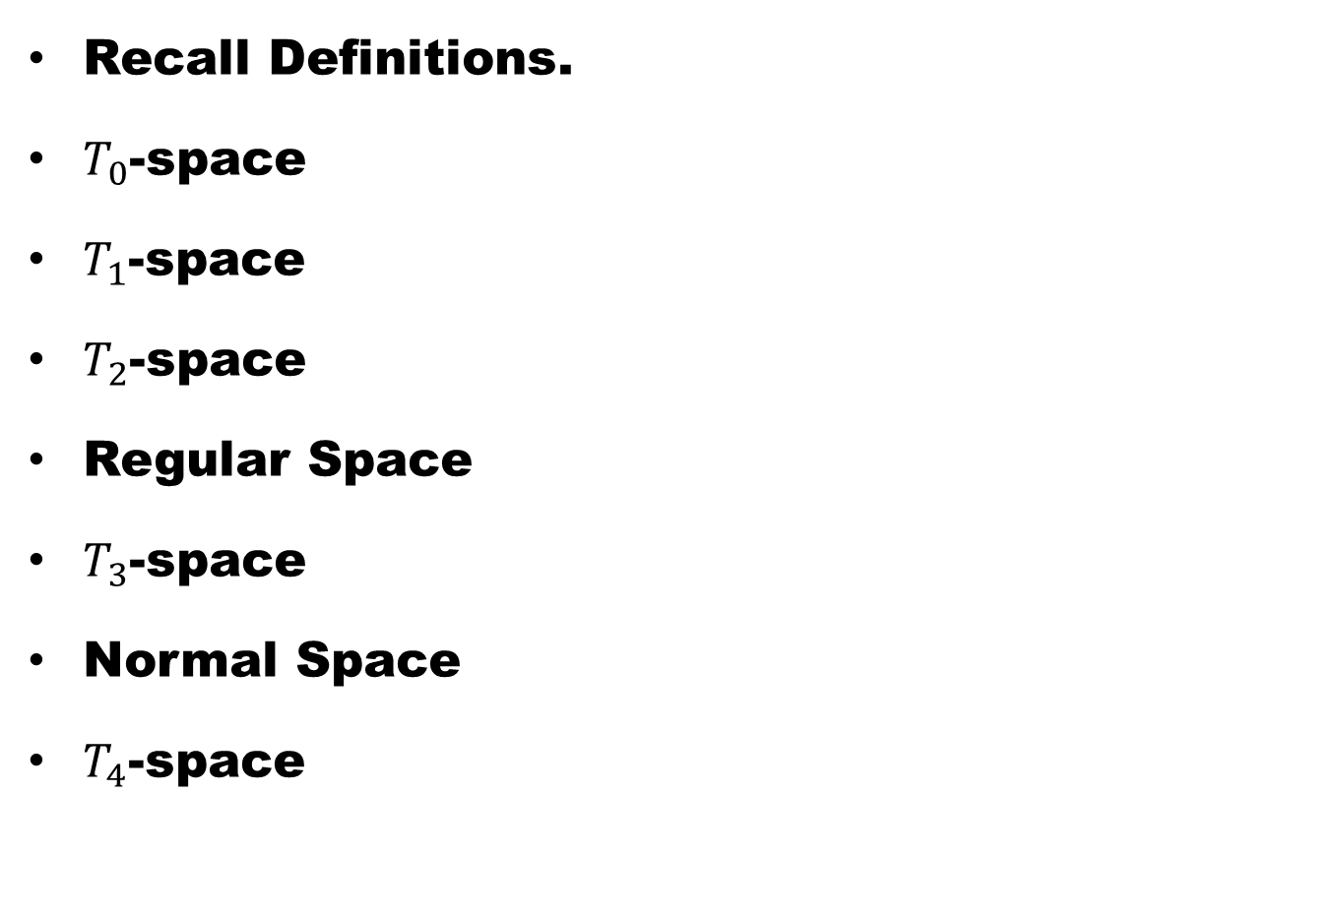
Recall Definitions.
$T_{0}$-space
$T_{1}$-space
$T_{2}$-space
Regular Space
$T_{3}$-space
Normal Space
$T_{4}$-space

Slide 5
Theorem. Normality is a closed hereditary property.

Slide 7
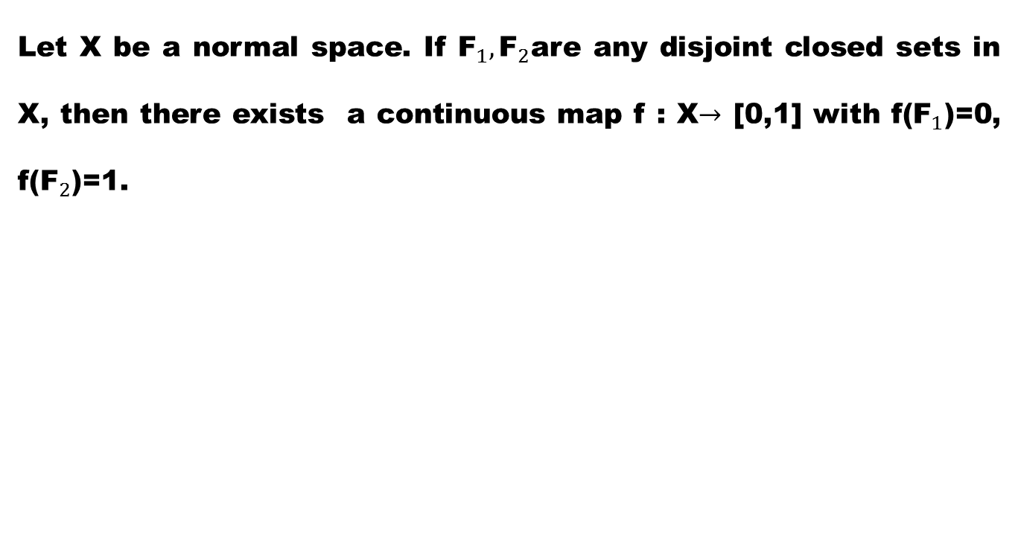
Theorem (Urysohn Lemma)
Let X be a normal space. If ${\text{F}}_{1}, {\text{F}}_{2}$are any disjoint closed sets in X, then there exists a continuous map f : X$→$ [0,1] with f(${\text{F}}_{1}$)=0, f(${\text{F}}_{2}$)=1.

Slide 8
Discussion

Slide 9
Proof.
Step I. Given X is a normal space

Slide 10
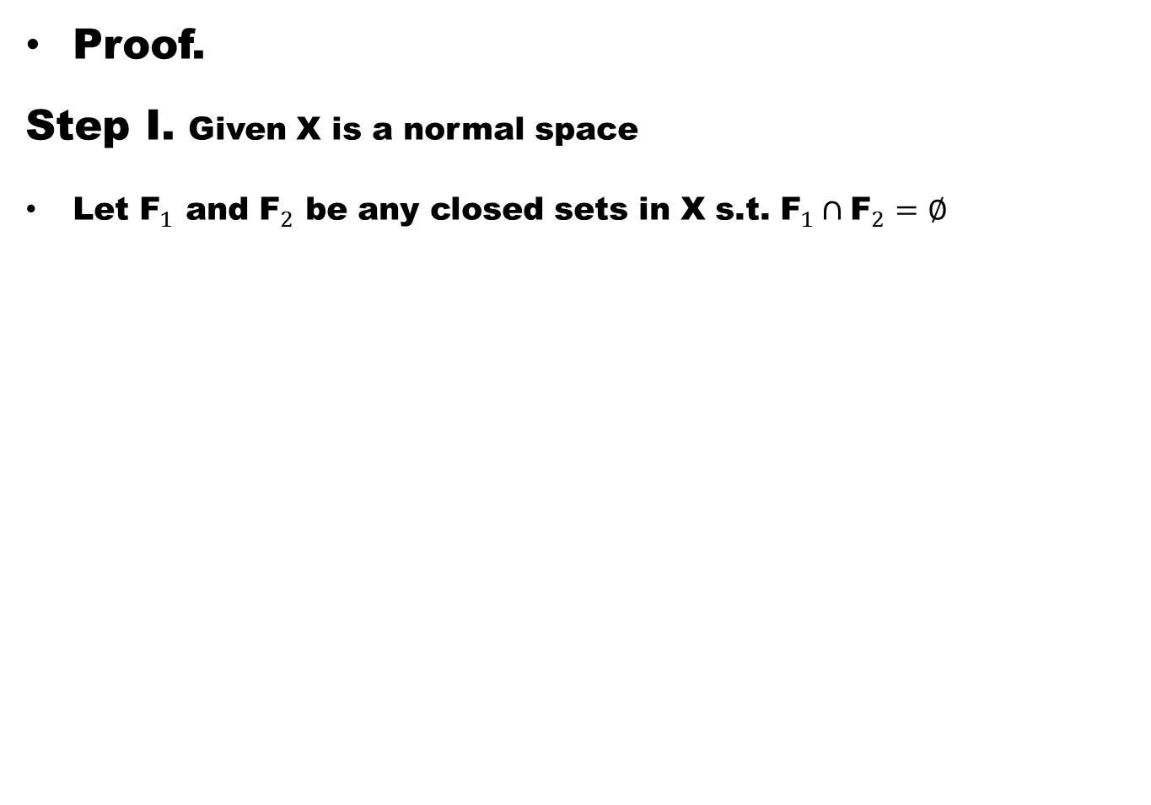
Proof.
Step I. Given X is a normal space
Let ${\text{F}}_{1}$ and ${\text{F}}_{2}$ be any closed sets in X s.t. ${\text{F}}_{1}∩{\text{F}}_{2}=∅$

Slide 11
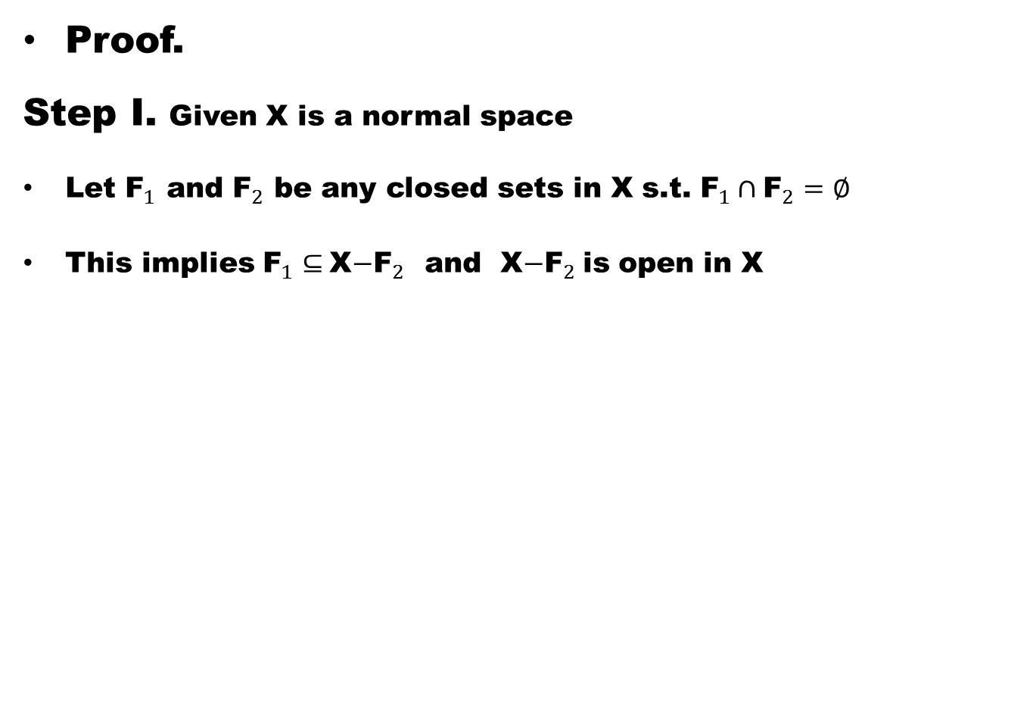
Proof.
Step I. Given X is a normal space
Let ${\text{F}}_{1}$ and ${\text{F}}_{2}$ be any closed sets in X s.t. ${\text{F}}_{1}∩{\text{F}}_{2}=∅$
This implies ${\text{F}}_{1}⊆$X$−{\text{F}}_{2}$ and X$−{\text{F}}_{2}$is open in X

Slide 12
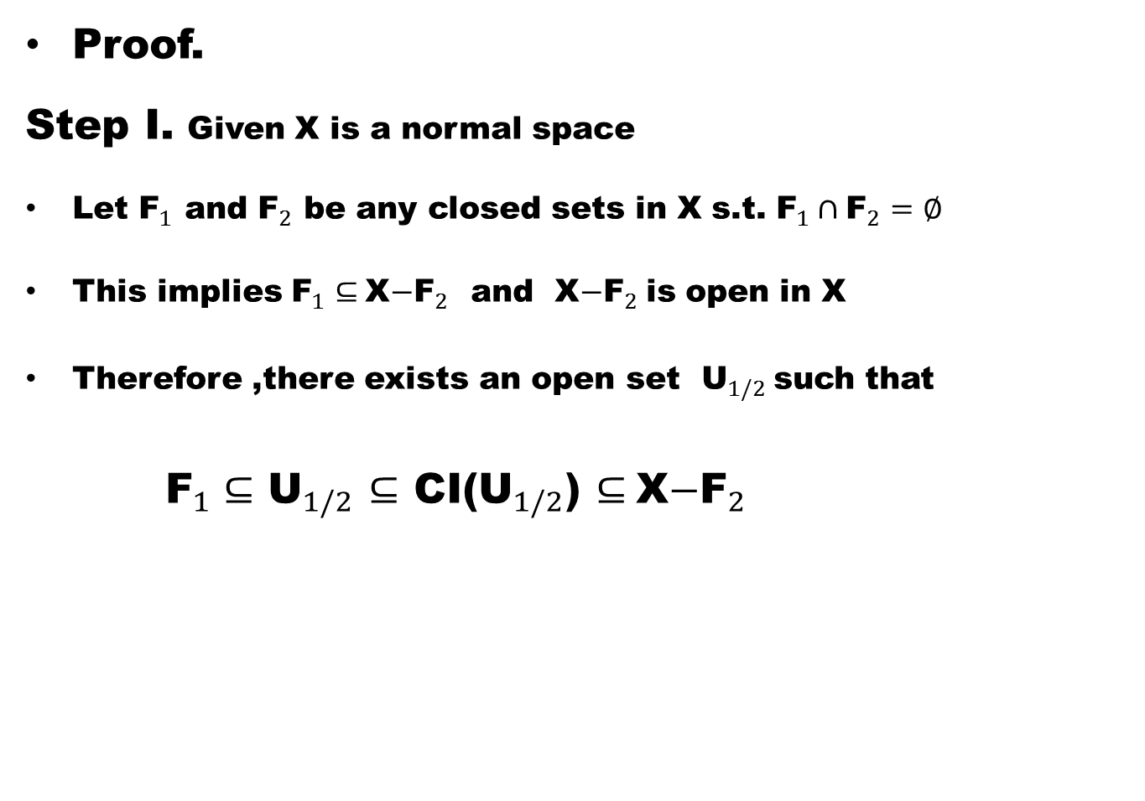
Proof.
Step I. Given X is a normal space
Let ${\text{F}}_{1}$ and ${\text{F}}_{2}$ be any closed sets in X s.t. ${\text{F}}_{1}∩{\text{F}}_{2}=∅$
This implies ${\text{F}}_{1}⊆$X$−{\text{F}}_{2}$ and X$−{\text{F}}_{2}$is open in X
Therefore ,there exists an open set ${\text{U}}_{1/2}$such that
${\text{F}}_{1}⊆$ ${\text{U}}_{1/2}$ $⊆$ CI(${\text{U}}_{1/2}$) $⊆$X$−{\text{F}}_{2}$

Slide 13
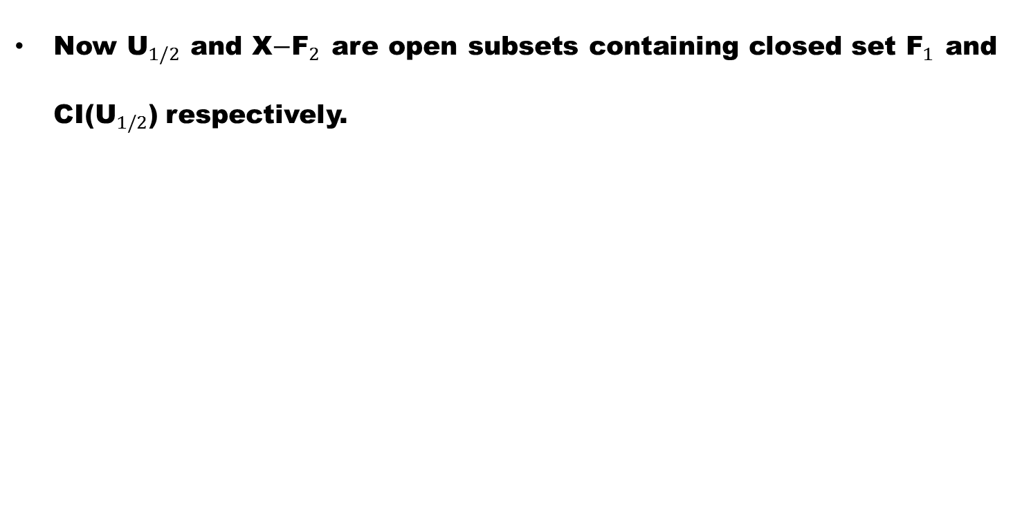
Step II
Now ${\text{U}}_{1/2}$ and X$−{\text{F}}_{2}$ are open subsets containing closed set ${\text{F}}_{1}$ and CI(${\text{U}}_{1/2}$) respectively.

Slide 14
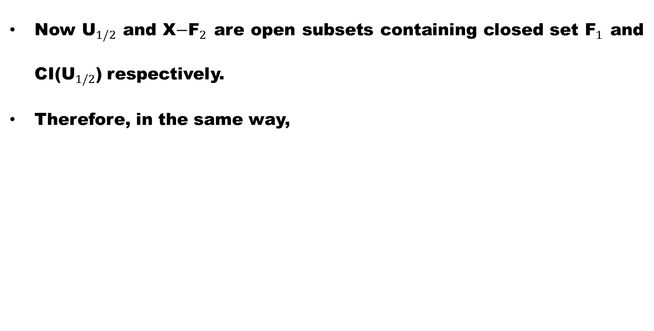
Step II
Now ${\text{U}}_{1/2}$ and X$−{\text{F}}_{2}$ are open subsets containing closed set ${\text{F}}_{1}$ and CI(${\text{U}}_{1/2}$) respectively.
Therefore, in the same way,

Slide 15
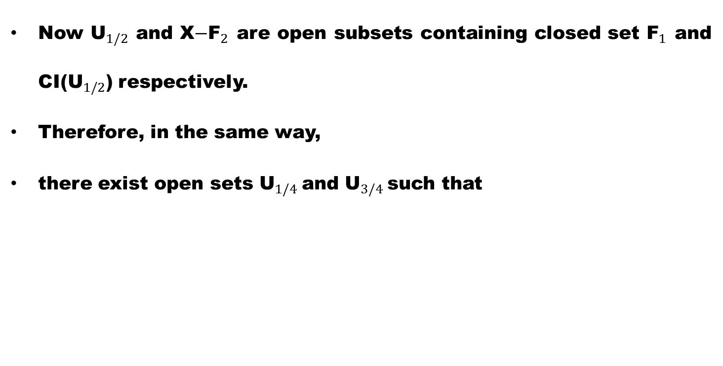
Step II
Now ${\text{U}}_{1/2}$ and X$−{\text{F}}_{2}$ are open subsets containing closed set ${\text{F}}_{1}$ and CI(${\text{U}}_{1/2}$) respectively.
Therefore, in the same way,
there exist open sets ${\text{U}}_{1/4}$and ${\text{U}}_{3/4}$such that

Slide 16
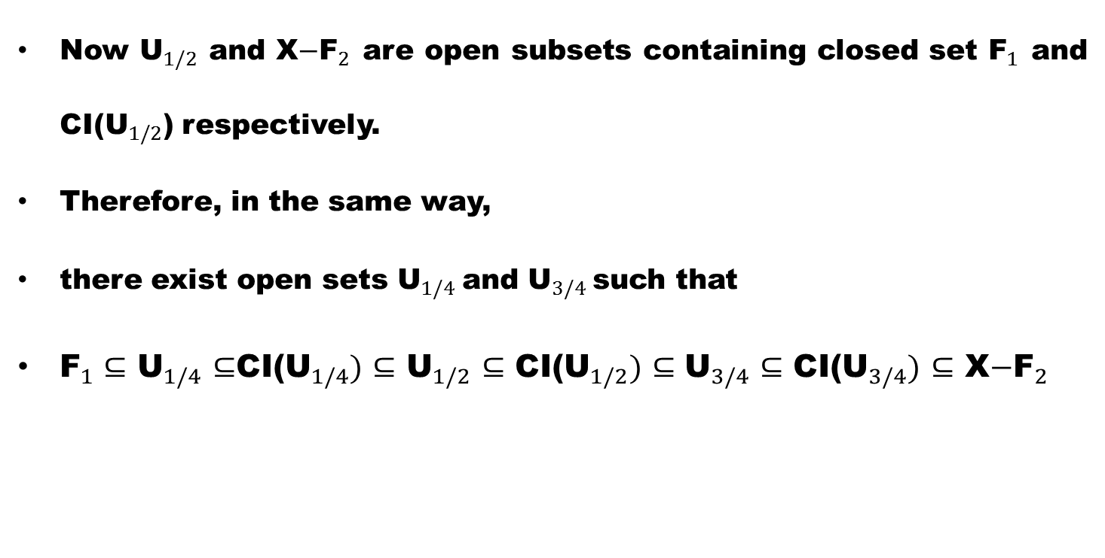
Step II
Now ${\text{U}}_{1/2}$ and X$−{\text{F}}_{2}$ are open subsets containing closed set ${\text{F}}_{1}$ and CI(${\text{U}}_{1/2}$) respectively.
Therefore, in the same way,
there exist open sets ${\text{U}}_{1/4}$and ${\text{U}}_{3/4}$such that
${\text{F}}_{1}⊆$ ${\text{U}}_{1/4}$ $⊆$CI(${\text{U}}_{1/4})$ $⊆$ ${\text{U}}_{1/2}$ $⊆$ CI(${\text{U}}_{1/2})$ $⊆{\text{U}}_{3/4}$ $⊆$ CI(${\text{U}}_{3/4})$ $⊆$ X$−{\text{F}}_{2}$

Slide 17
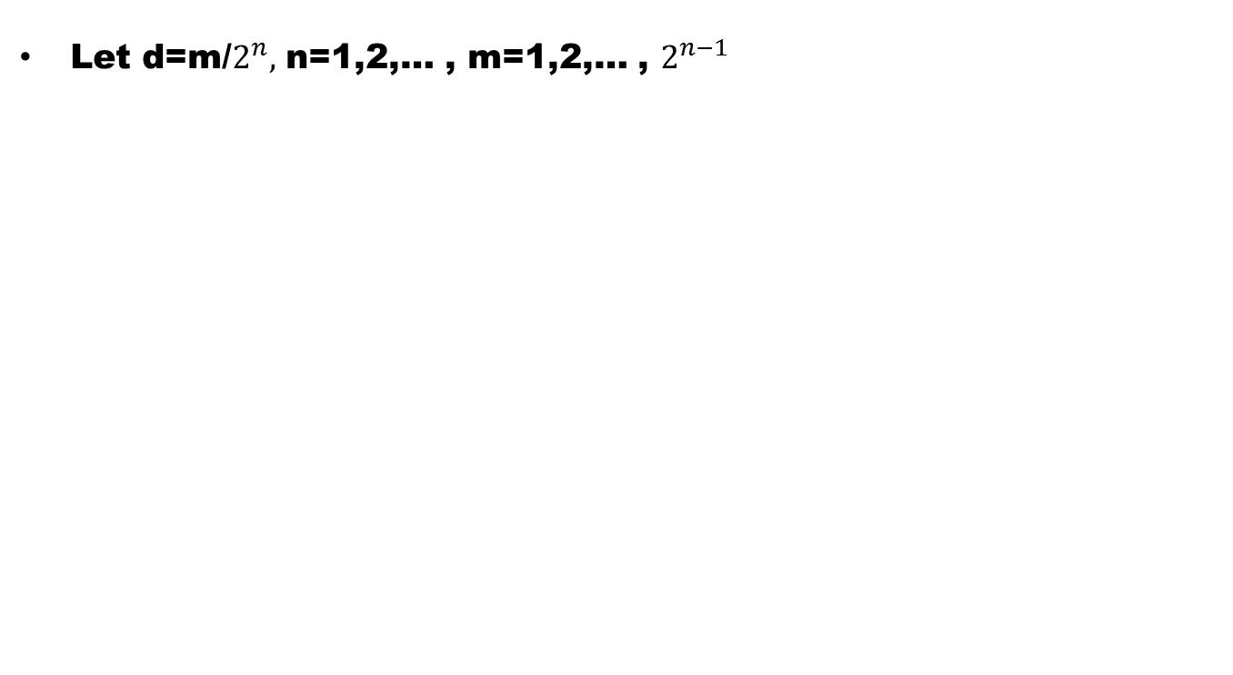
Step III
Let d=m/$2^{n},$ n=1,2,… , m=1,2,… , $2^{n−1}$

Slide 18
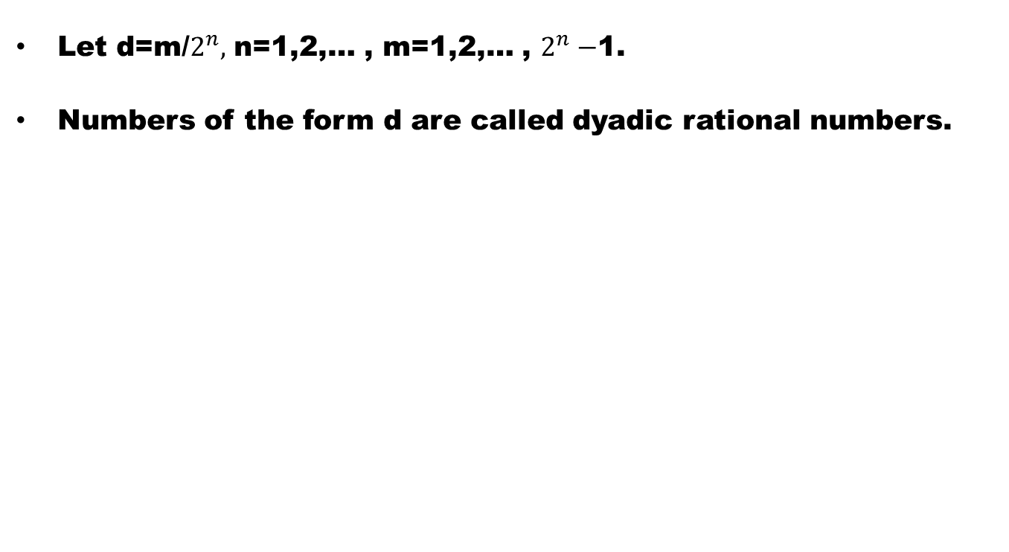
Step III
Let d=m/$2^{n},$ n=1,2,… , m=1,2,… , $2^{n}−$1.
Numbers of the form d are called dyadic rational numbers.

Slide 19
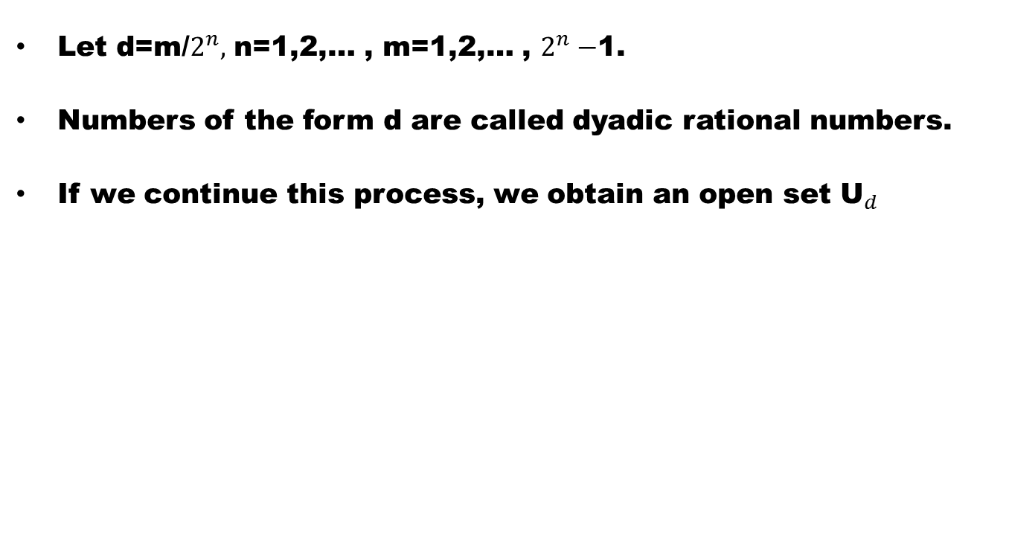
Step III
Let d=m/$2^{n},$ n=1,2,… , m=1,2,… , $2^{n}−$1.
Numbers of the form d are called dyadic rational numbers.
If we continue this process, we obtain an open set ${\text{U}}_{d}$

Slide 20
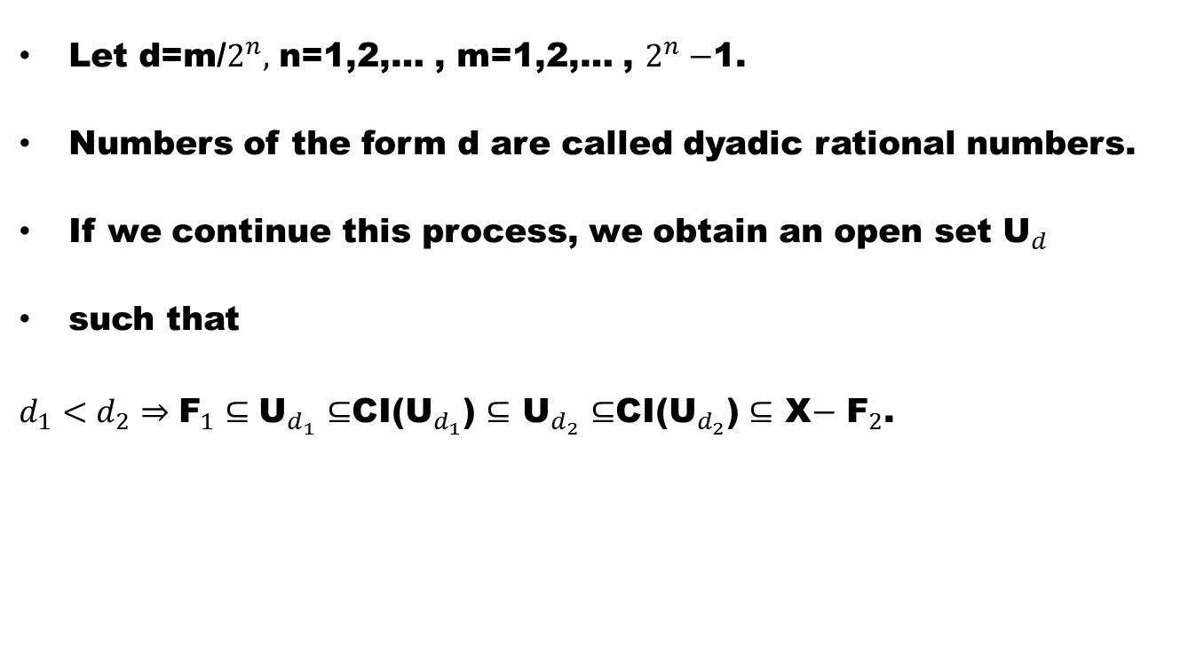
Step III
Let d=m/$2^{n},$ n=1,2,… , m=1,2,… , $2^{n}−$1.
Numbers of the form d are called dyadic rational numbers.
If we continue this process, we obtain an open set ${\text{U}}_{d}$
such that
$d_{1}<d_{2}⇒{\text{F}}_{1}⊆{\text{U}}_{d_{1}}$ $⊆$CI(${\text{U}}_{d_{1}}$) $⊆$ ${\text{U}}_{d_{2}}$ $⊆$CI(${\text{U}}_{d_{2}}$) $⊆$ X$−$ ${\text{F}}_{2}$.

Slide 21
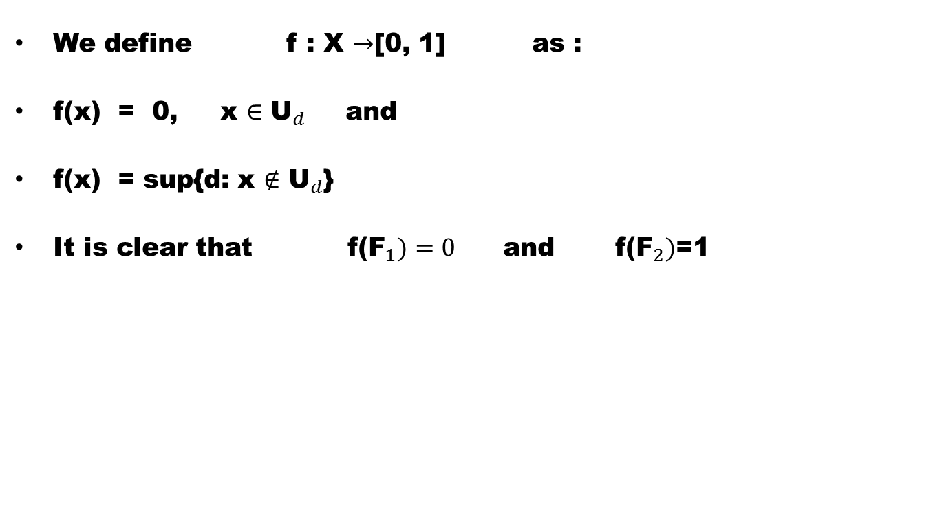
Step IV
We define f : X $→$[0, 1] as :
f(x) = 0, x $∈$ ${\text{U}}_{d}$and
f(x) = sup{d: x $∉$ ${\text{U}}_{d}$}
It is clear that f(${\text{F}}_{1})=0$ and f(${\text{F}}_{2})$=1

Slide 22
Step V
We show that f is continuous.

Slide 23
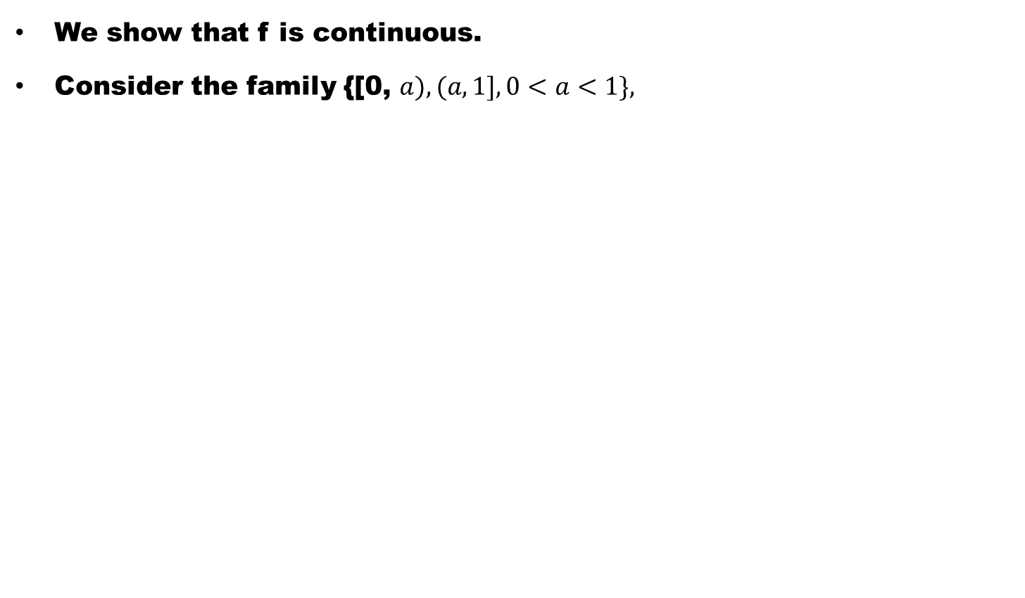
Step V
We show that f is continuous.
Consider the family {[0, $a),(a, 1],0<a<1\},$

Slide 24
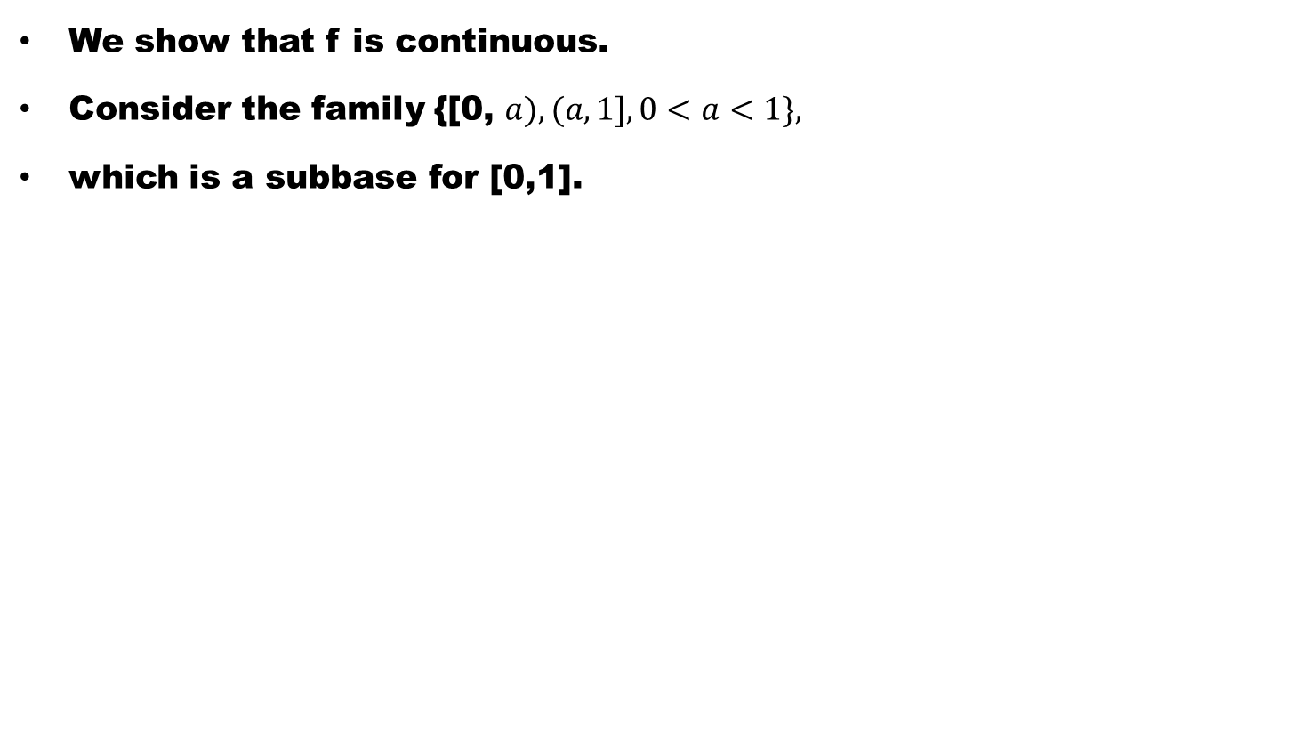
Step V
We show that f is continuous.
Consider the family {[0, $a),(a, 1],0<a<1\},$
which is a subbase for [0,1].

Slide 25
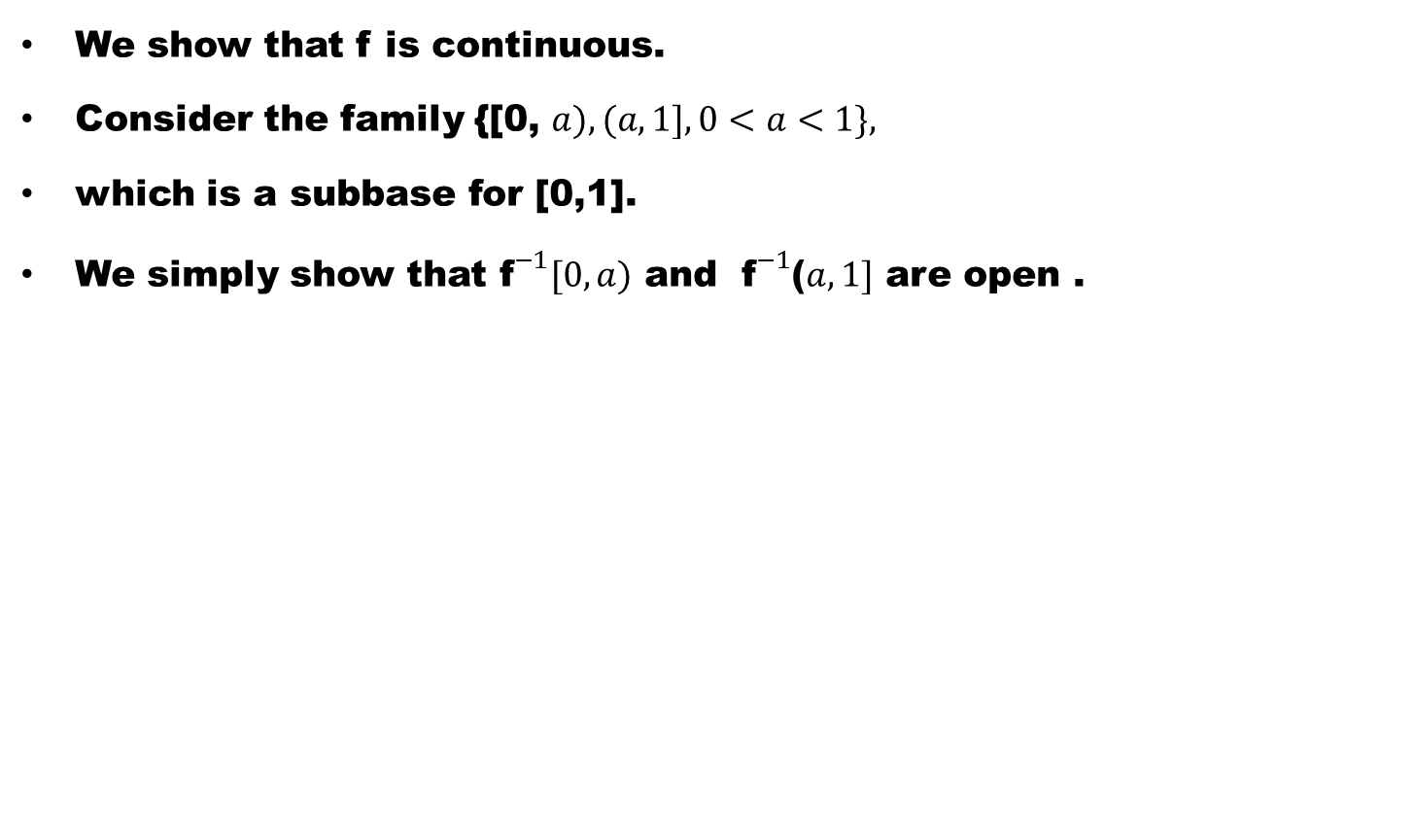
Step V
We show that f is continuous.
Consider the family {[0, $a),(a, 1],0<a<1\},$
which is a subbase for [0,1].
We simply show that${ \text{f}}^{−1}[0,a)$ and ${ \text{f}}^{−1}$($a,1]$ are open .

Slide 26
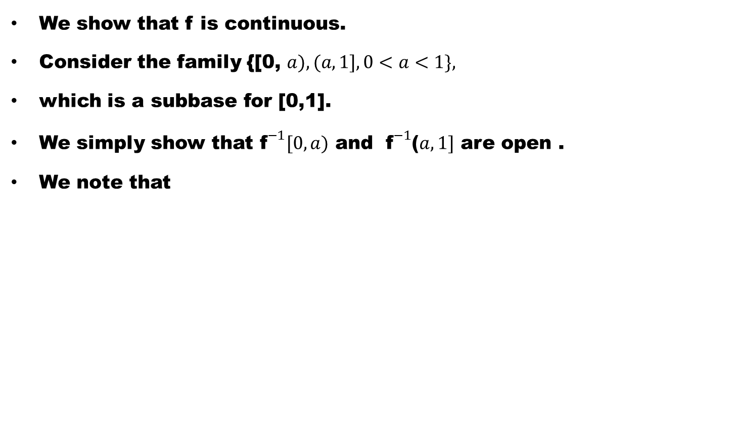
Step V
We show that f is continuous.
Consider the family {[0, $a),(a, 1],0<a<1\},$
which is a subbase for [0,1].
We simply show that${ \text{f}}^{−1}[0,a)$ and ${ \text{f}}^{−1}$($a,1]$ are open .
We note that

Slide 27
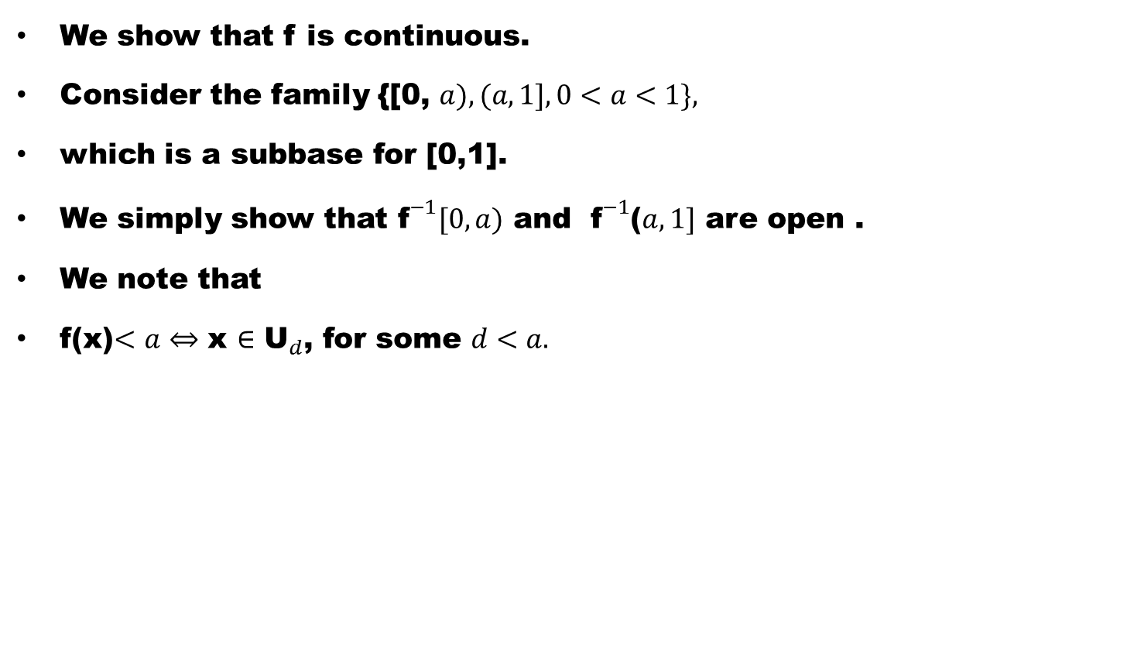
Step V
We show that f is continuous.
Consider the family {[0, $a),(a, 1],0<a<1\},$
which is a subbase for [0,1].
We simply show that${ \text{f}}^{−1}[0,a)$ and ${ \text{f}}^{−1}$($a,1]$ are open .
We note that
f(x)$<a⇔$ x $∈$ ${\text{U}}_{d}$, for some $d<a.$

Slide 28
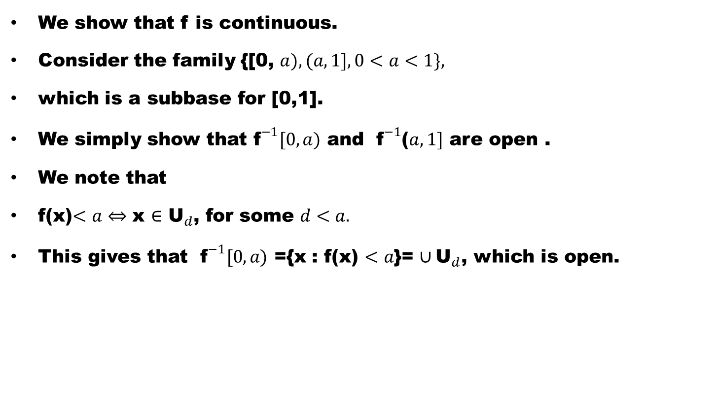
Step V
We show that f is continuous.
Consider the family {[0, $a),(a, 1],0<a<1\},$
which is a subbase for [0,1].
We simply show that${ \text{f}}^{−1}[0,a)$ and ${ \text{f}}^{−1}$($a,1]$ are open .
We note that
f(x)$<a⇔$ x $∈$ ${\text{U}}_{d}$, for some $d<a.$
This gives that ${ \text{f}}^{−1}[0,a)$ ={x : f(x) $<a$}= $∪{\text{U}}_{d}$, which is open.

Slide 29
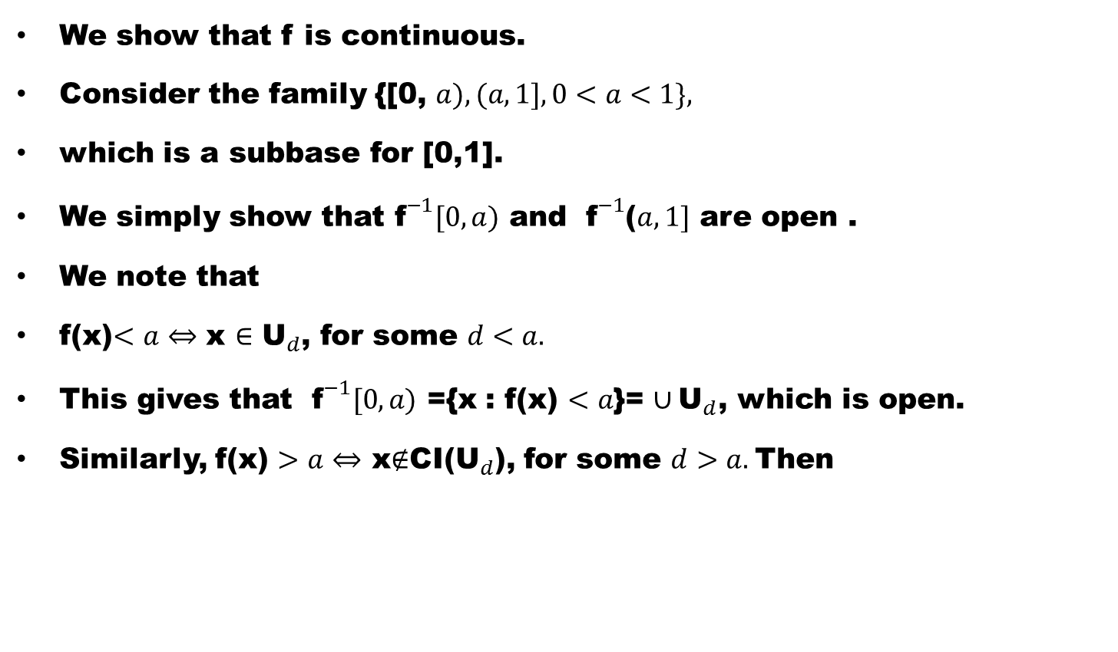
Step V
We show that f is continuous.
Consider the family {[0, $a),(a, 1],0<a<1\},$
which is a subbase for [0,1].
We simply show that${ \text{f}}^{−1}[0,a)$ and ${ \text{f}}^{−1}$($a,1]$ are open .
We note that
f(x)$<a⇔$ x $∈$ ${\text{U}}_{d}$, for some $d<a.$
This gives that ${ \text{f}}^{−1}[0,a)$ ={x : f(x) $<a$}= $∪{\text{U}}_{d}$, which is open.
Similarly, f(x) $>a⇔$ x$∉$CI(${\text{U}}_{d}$), for some $d>a.$Then

Slide 30
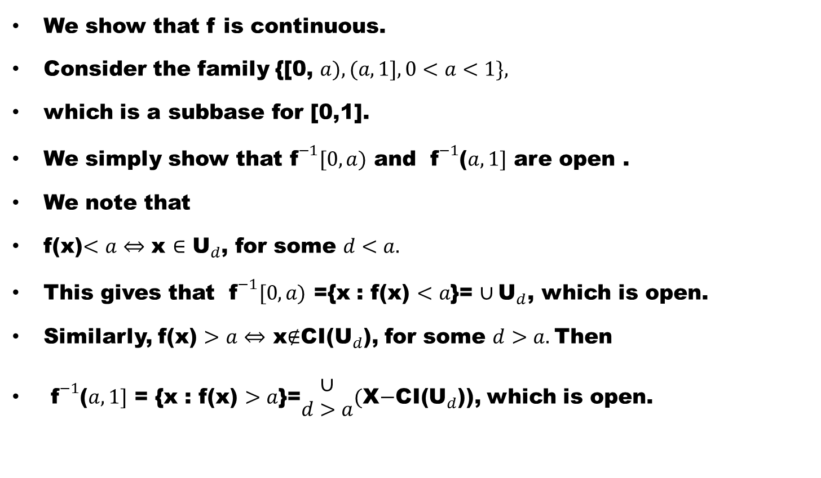
Step V
We show that f is continuous.
Consider the family {[0, $a),(a, 1],0<a<1\},$
which is a subbase for [0,1].
We simply show that${ \text{f}}^{−1}[0,a)$ and ${ \text{f}}^{−1}$($a,1]$ are open .
We note that
f(x)$<a⇔$ x $∈$ ${\text{U}}_{d}$, for some $d<a.$
This gives that ${ \text{f}}^{−1}[0,a)$ ={x : f(x) $<a$}= $∪{\text{U}}_{d}$, which is open.
Similarly, f(x) $>a⇔$ x$∉$CI(${\text{U}}_{d}$), for some $d>a.$Then
${ \text{f}}^{−1}$($a,1]$ = {x : f(x) $>a$}=$\begin{matrix}∪ \\ d>a\end{matrix}($X$−$CI(${\text{U}}_{d}$)), which is open.

Slide 31
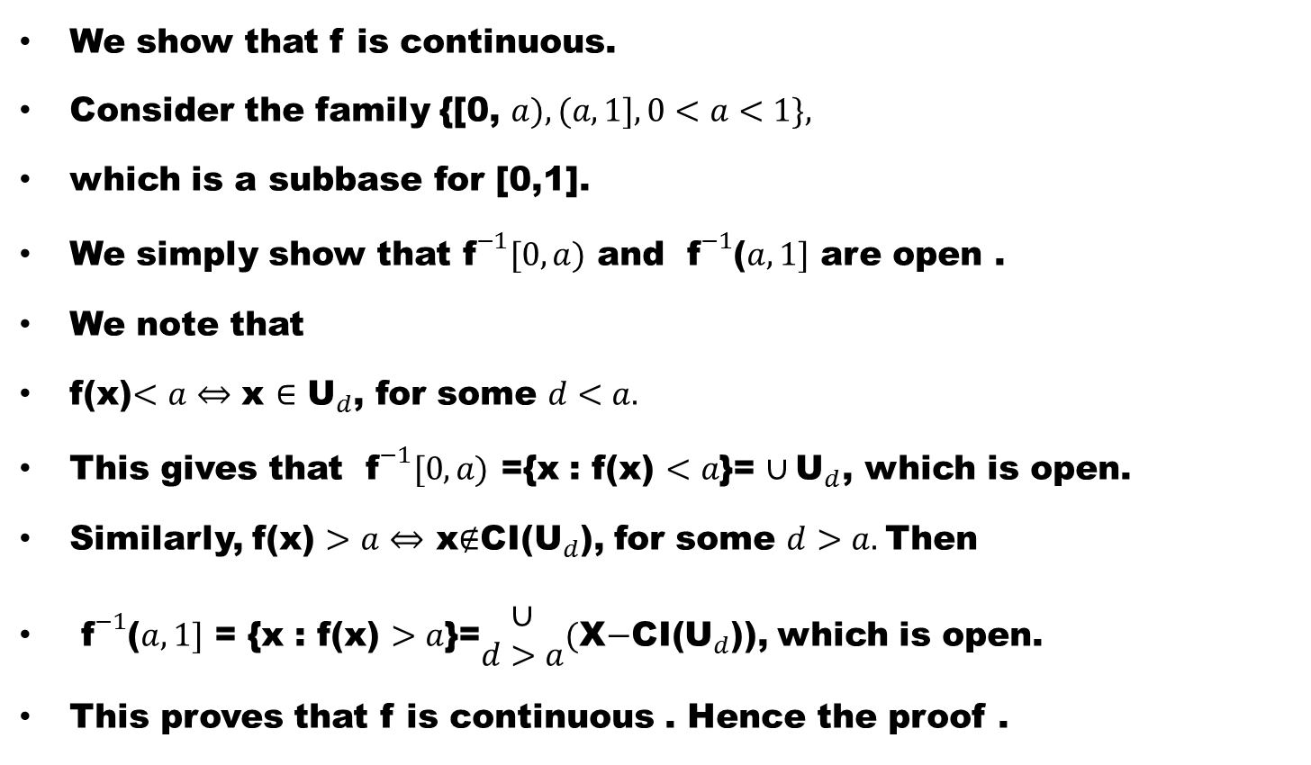
Step V
We show that f is continuous.
Consider the family {[0, $a),(a, 1],0<a<1\},$
which is a subbase for [0,1].
We simply show that${ \text{f}}^{−1}[0,a)$ and ${ \text{f}}^{−1}$($a,1]$ are open .
We note that
f(x)$<a⇔$ x $∈$ ${\text{U}}_{d}$, for some $d<a.$
This gives that ${ \text{f}}^{−1}[0,a)$ ={x : f(x) $<a$}= $∪{\text{U}}_{d}$, which is open.
Similarly, f(x) $>a⇔$ x$∉$CI(${\text{U}}_{d}$), for some $d>a.$Then
${ \text{f}}^{−1}$($a,1]$ = {x : f(x) $>a$}=$\begin{matrix}∪ \\ d>a\end{matrix}($X$−$CI(${\text{U}}_{d}$)), which is open.
This proves that f is continuous . Hence the proof .

Slide 32
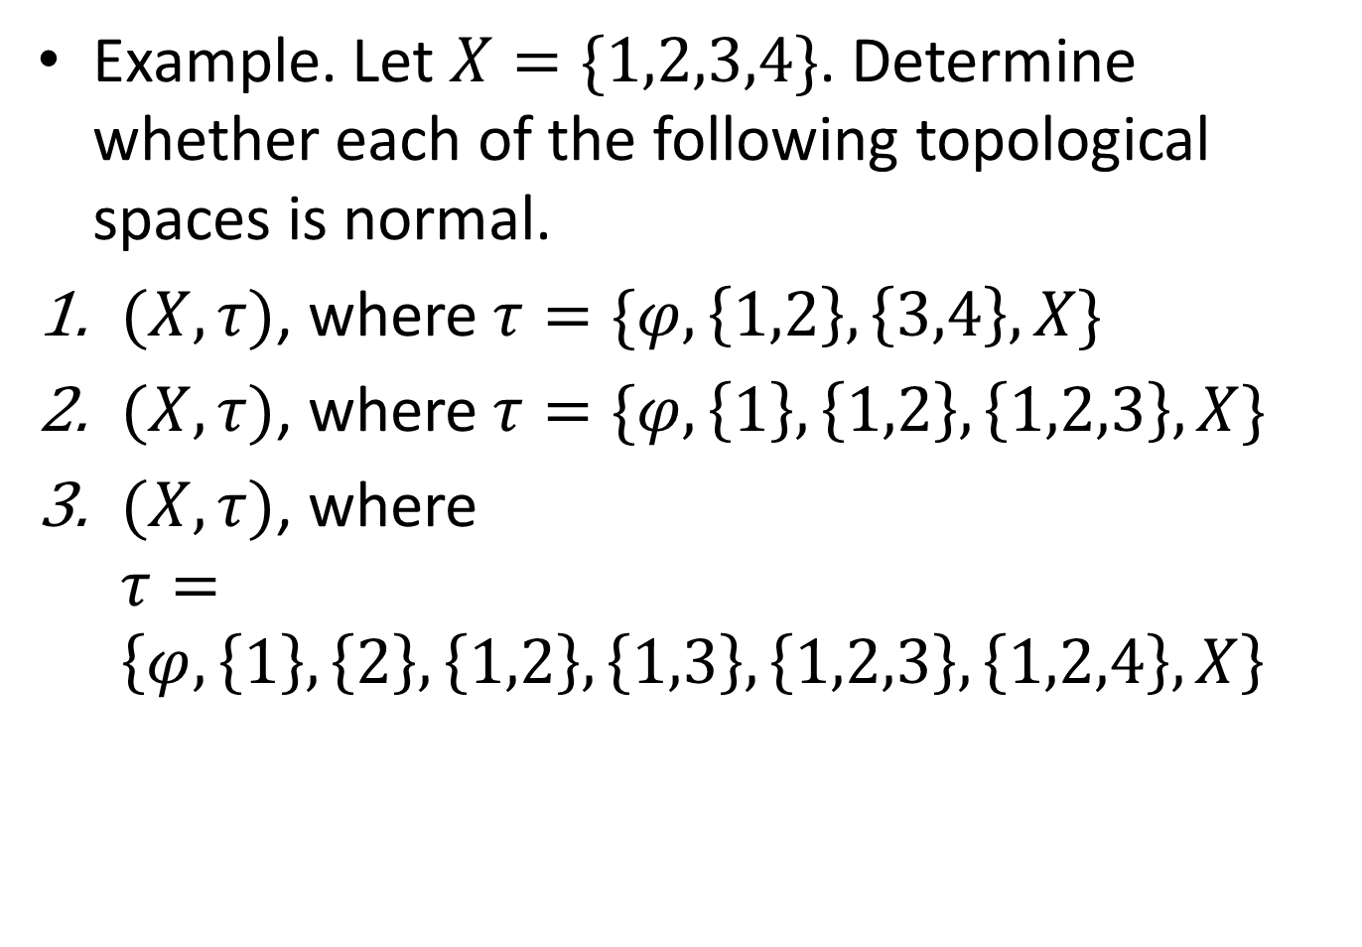
Example. Let $X=\{1,2,3,4\}$. Determine whether each of the following topological spaces is normal.
$(X,τ)$, where $τ=\{φ,\left\{1,2\right\},\left\{3,4\right\},X\}$
$(X,τ)$, where $τ=\{φ,\left\{1\right\},\left\{1,2\right\},\left\{1,2,3\right\},X\}$
$(X,τ)$, where $τ=\left\{φ,\left\{1\right\},\left\{2\right\},\left\{1,2\right\},\left\{1,3\right\},\left\{1,2,3\right\},\left\{1,2,4\right\},X\right\}$

Slide 35
.
Good Luck

