Slide 1
Set Topology
MTH 251
Lecture # 25

Slide 2
Lecture Plan
Characterization of Normal Spaces
Urysohn Lemma

Slide 3
Theorem. Prove that regularity is a topological property.
Proof.

Slide 5
Definition (Normal Space)
A space X is said to be normal if it satisfies the axiom:

Slide 6
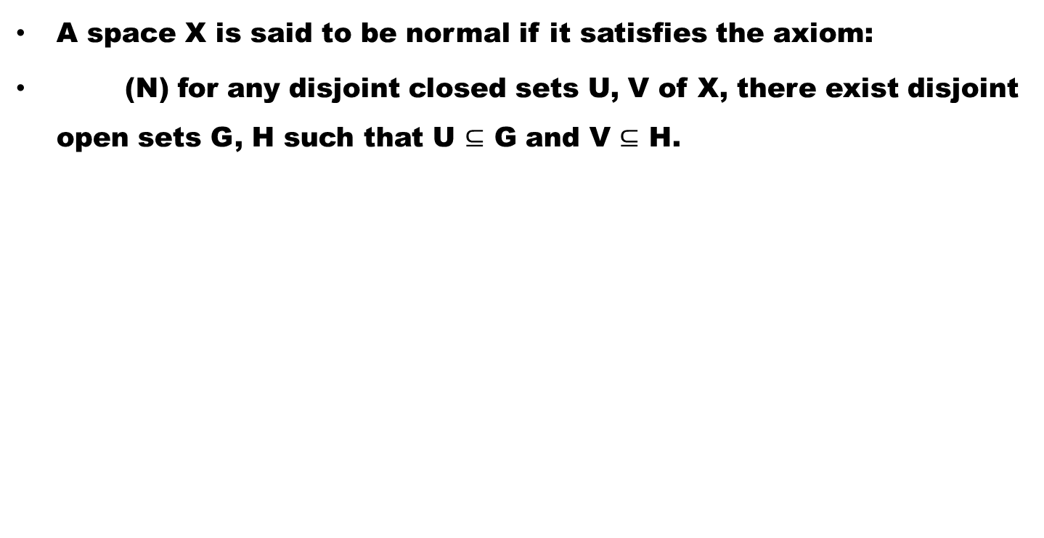
Definition (Normal Space)
A space X is said to be normal if it satisfies the axiom:
(N) for any disjoint closed sets U, V of X, there exist disjoint open sets G, H such that U $⊆$ G and V$⊆$ H.

Slide 7
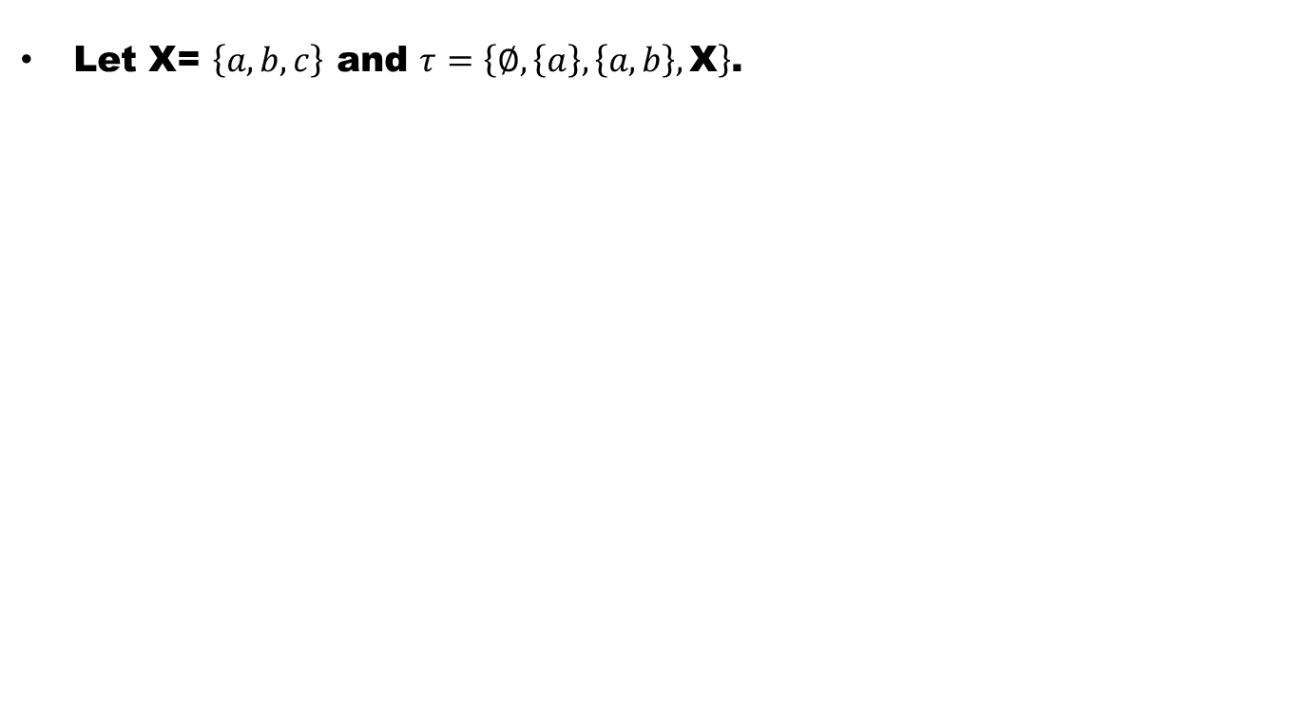
Example
Let X= $\left\{a,b,c\right\}$ and $τ=\left\{∅,\left\{a\right\},\left\{a,b\right\},\text{X}\right\}$.

Slide 8
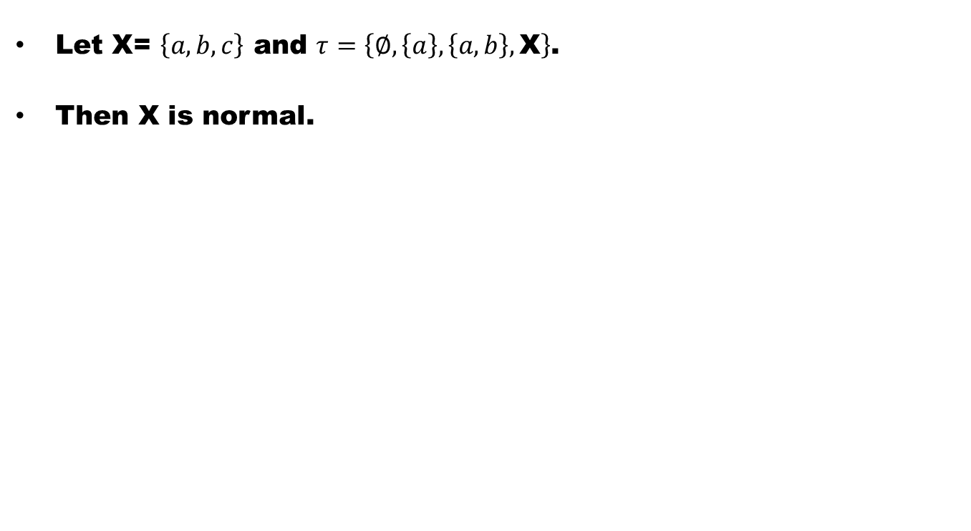
Example
Let X= $\left\{a,b,c\right\}$ and $τ=\left\{∅,\left\{a\right\},\left\{a,b\right\},\text{X}\right\}$.
Then X is normal.

Slide 9
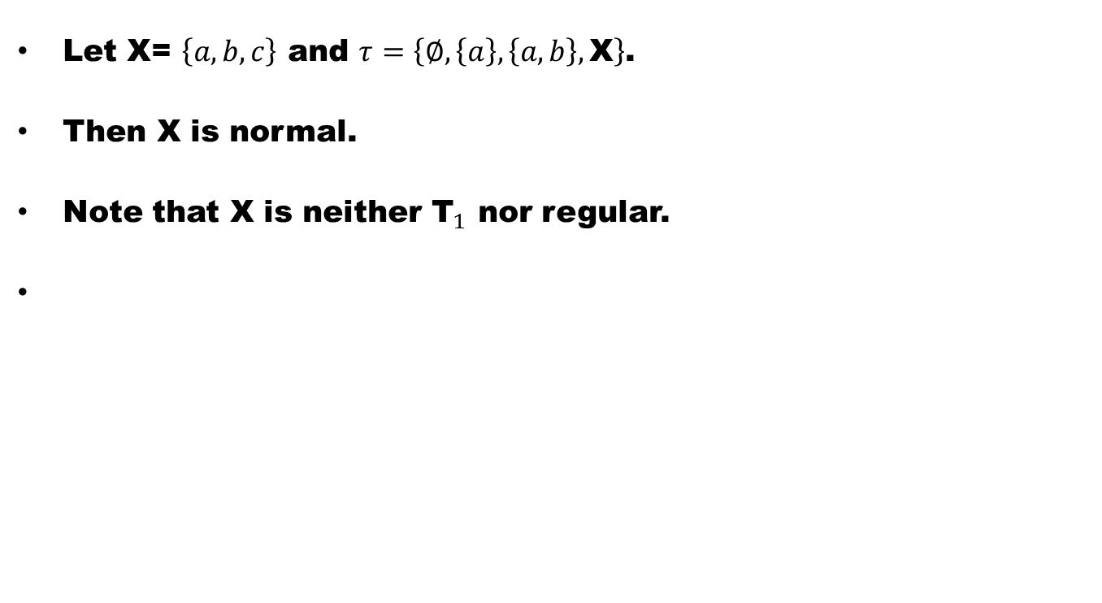
Example
Let X= $\left\{a,b,c\right\}$ and $τ=\left\{∅,\left\{a\right\},\left\{a,b\right\},\text{X}\right\}$.
Then X is normal.
Note that X is neither ${\text{T}}_{1}$ nor regular.

Slide 10
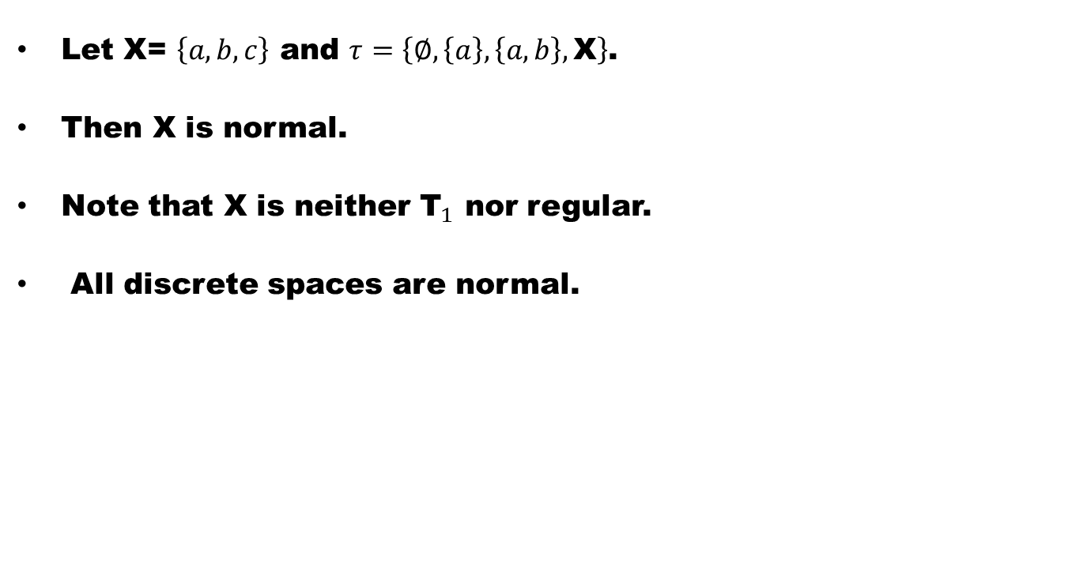
Example
Let X= $\left\{a,b,c\right\}$ and $τ=\left\{∅,\left\{a\right\},\left\{a,b\right\},\text{X}\right\}$.
Then X is normal.
Note that X is neither ${\text{T}}_{1}$ nor regular.
All discrete spaces are normal.

Slide 11
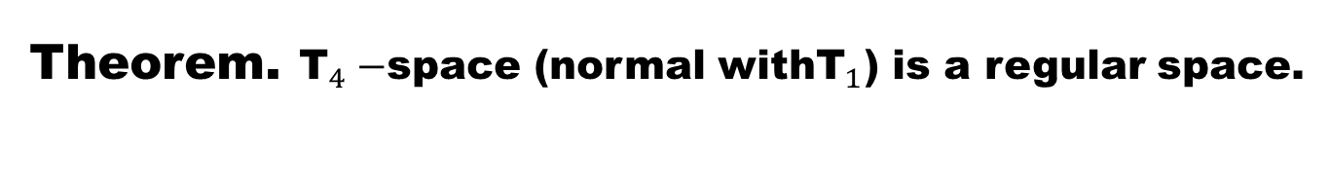
Theorem. ${\text{T}}_{4}−$space (normal with${\text{T}}_{1}$) is a regular space.

Slide 13
Theorem
The following are equivalent in a space X:

Slide 14
Theorem
The following are equivalent in a space X:
(1) X is a normal space.

Slide 15
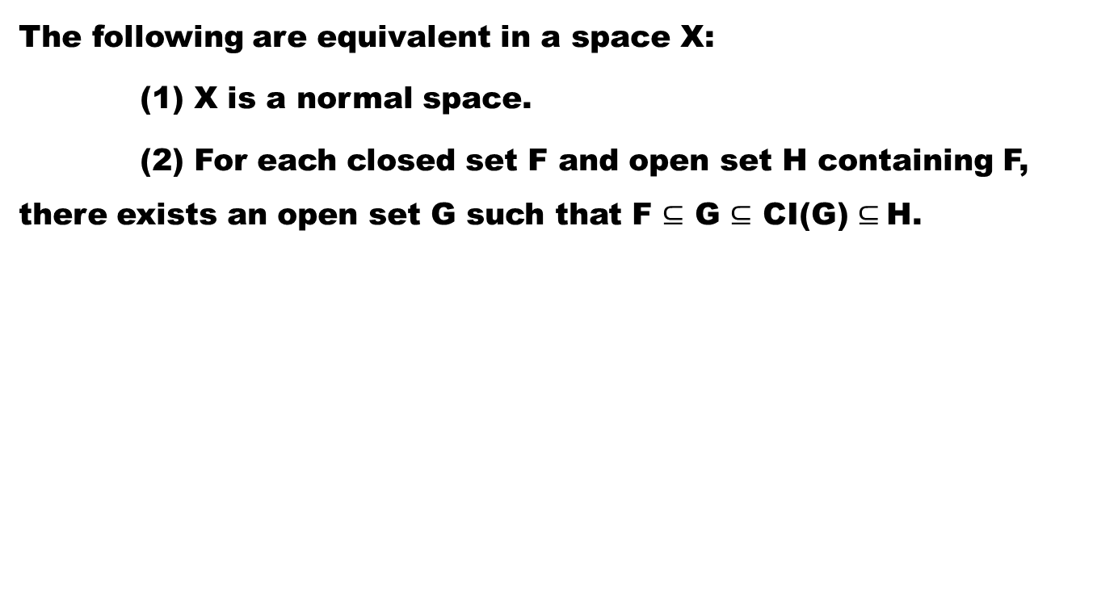
Theorem
The following are equivalent in a space X:
(1) X is a normal space.
(2) For each closed set F and open set H containing F, there exists an open set G such that F $⊆$ G $⊆$ CI(G) $⊆$H.

Slide 18
Theorem
The continuous closed surjective image of a normal space is normal.

Slide 20
Theorem
The continuous closed surjective image of a normal space is normal.
In other words, normality is invariant under continuous closed surjections and hence is a topological property.

Slide 23
Theorem. Normality is a closed hereditary property.

Slide 25
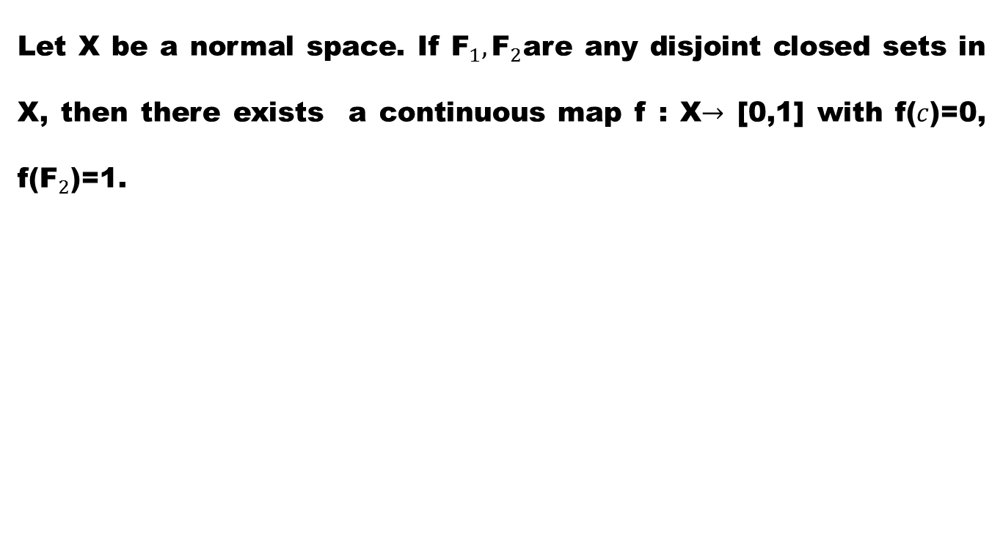
Theorem (Urysohn Lemma)
Let X be a normal space. If ${\text{F}}_{1}, {\text{F}}_{2}$are any disjoint closed sets in X, then there exists a continuous map f : X$→$ [0,1] with f($c$)=0, f(${\text{F}}_{2}$)=1.

Slide 26
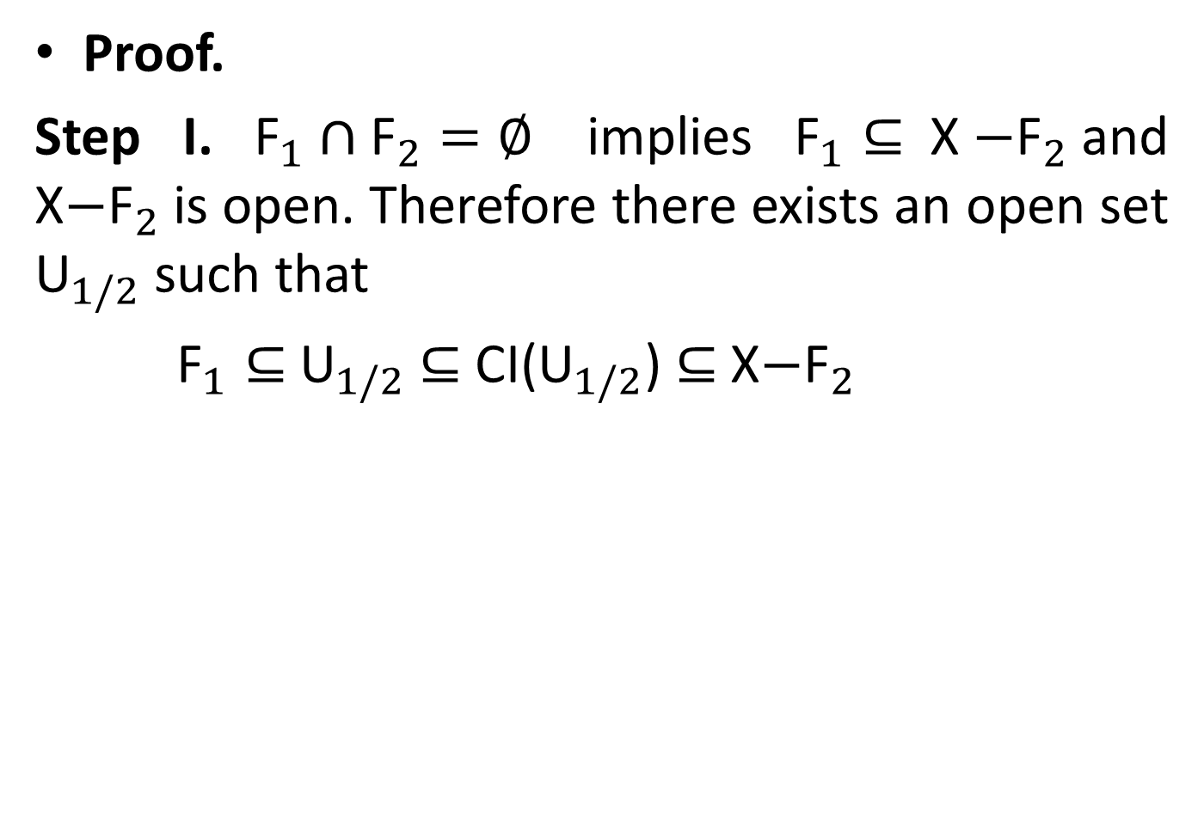
Proof.
Step I.${\text{F}}_{1}∩{\text{F}}_{2}=∅$ implies ${\text{F}}_{1}⊆$X$−{\text{F}}_{2}$and X$−{\text{F}}_{2}$is open. Therefore there exists an open set ${\text{U}}_{1/2}$such that
${\text{F}}_{1}⊆$${\text{U}}_{1/2}$$⊆$ CI(${\text{U}}_{1/2}$)$⊆$X$−{\text{F}}_{2}$

Slide 27
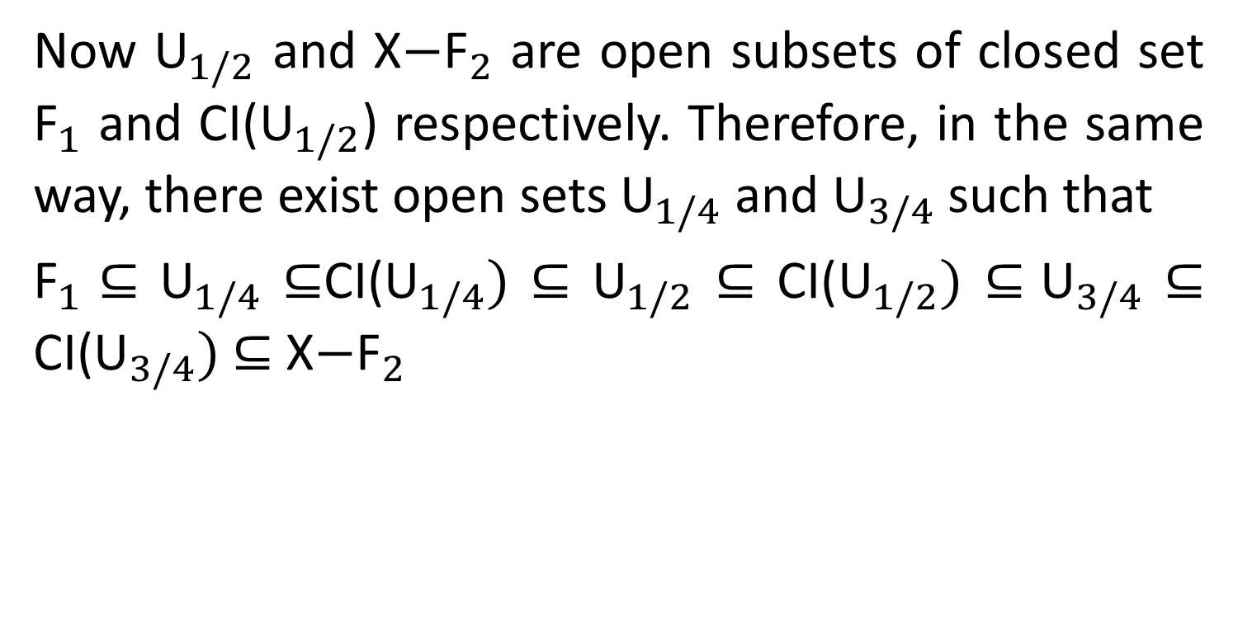
Step II
Now ${\text{U}}_{1/2}$ and X$−{\text{F}}_{2}$ are open subsets of closed set ${\text{F}}_{1}$ and CI(${\text{U}}_{1/2}$)respectively. Therefore, in the same way, there exist open sets ${\text{U}}_{1/4}$and ${\text{U}}_{3/4}$such that
${\text{F}}_{1}⊆$${\text{U}}_{1/4}$$⊆$CI(${\text{U}}_{1/4})$$⊆$${\text{U}}_{1/2}$$⊆$ CI(${\text{U}}_{1/2})$$⊆{\text{U}}_{3/4}$$⊆$ CI(${\text{U}}_{3/4})$$⊆$ X$−{\text{F}}_{2}$

Slide 28
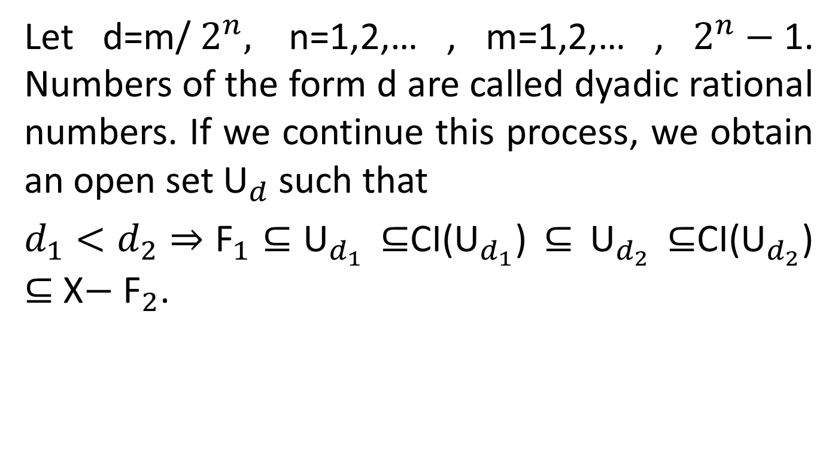
Step III
Let d=m/$2^{n},$ n=1,2,… , m=1,2,… ,$2^{n}−$1. Numbers of the form d are called dyadic rational numbers. If we continue this process, we obtain an open set ${\text{U}}_{d}$such that
$d_{1}<d_{2}⇒{\text{F}}_{1}⊆{\text{U}}_{d_{1}}$$⊆$CI(${\text{U}}_{d_{1}}$)$⊆$${\text{U}}_{d_{2}}$$⊆$CI(${\text{U}}_{d_{2}}$)$⊆$ X$−$${\text{F}}_{2}$.

Slide 29
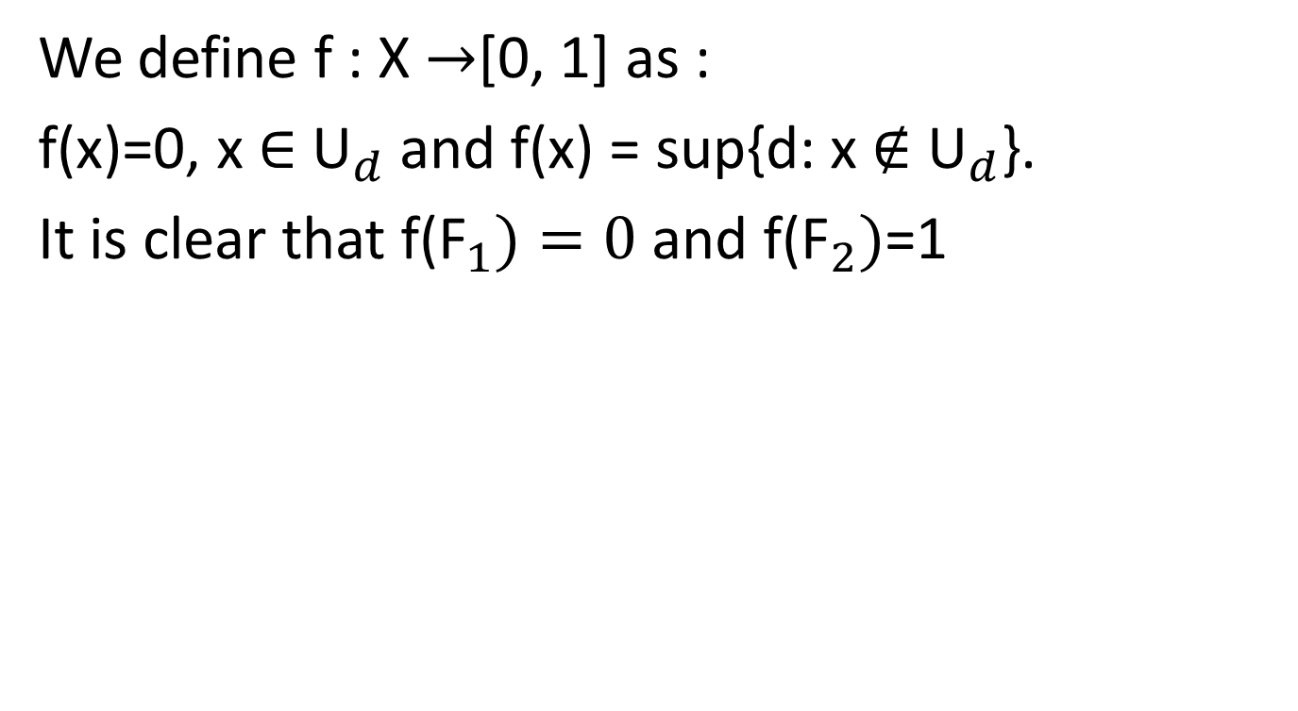
Step IV
We define f : X $→$[0, 1] as :
f(x)=0, x $∈$${\text{U}}_{d}$and f(x) = sup{d: x $∉$${\text{U}}_{d}$}.
It is clear that f(${\text{F}}_{1})=0$and f(${\text{F}}_{2})$=1

Slide 30
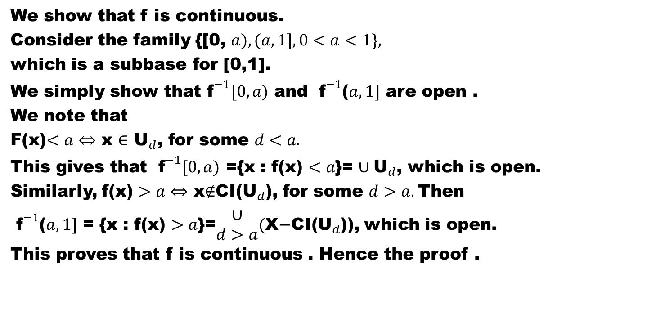
Step V
We show that f is continuous.
Consider the family {[0, $a),(a, 1],0<a<1\},$
which is a subbase for [0,1].
We simply show that${ \text{f}}^{−1}[0,a)$ and ${ \text{f}}^{−1}$($a,1]$ are open .
We note that
F(x)$<a⇔$ x $∈$${\text{U}}_{d}$, for some $d<a.$
This gives that ${ \text{f}}^{−1}[0,a)$={x : f(x) $<a$}= $∪{\text{U}}_{d}$, which is open.
Similarly, f(x) $>a⇔$ x$∉$CI(${\text{U}}_{d}$), for some $d>a.$Then
${ \text{f}}^{−1}$($a,1]$={x : f(x) $>a$}=$\begin{matrix}∪ \\ d>a\end{matrix}($X$−$CI(${\text{U}}_{d}$)), which is open.
This proves that f is continuous . Hence the proof .

Slide 31
.
Good Luck

