Slide 1
Set Topology
MTH 251
Lecture # 24

Slide 2
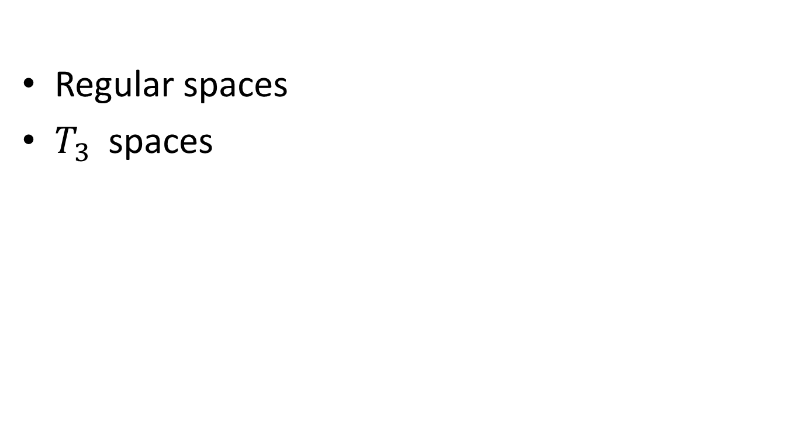
Lecture Plan
Regular spaces
$T_{3}$spaces

Slide 3
  Definition. (Regular Space)
  A space X is said to be a regular space if it satisfies the axiom:

Slide 4
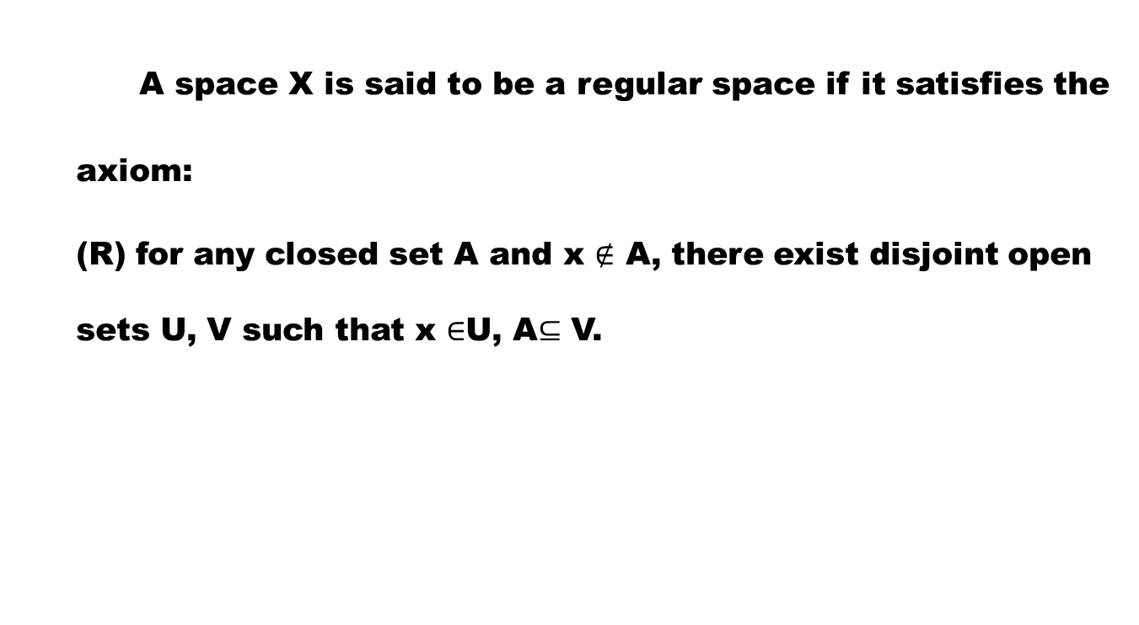
  Definition. (Regular Space)
  A space X is said to be a regular space if it satisfies the axiom:
  (R) for any closed set A and x $∉$ A, there exist disjoint open sets U, V such that x $∈$U, A$⊆$ V.

Slide 5
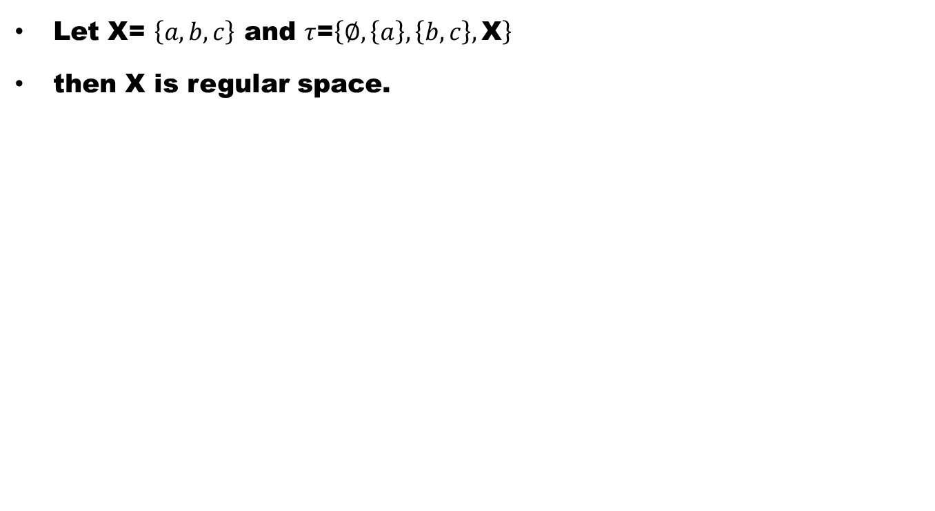
Example
Let X= $\left\{a,b,c\right\}$ and $τ$=$\left\{∅,\left\{a\right\},\left\{b,c\right\},\text{X}\right\}$
then X is regular space.

Slide 6
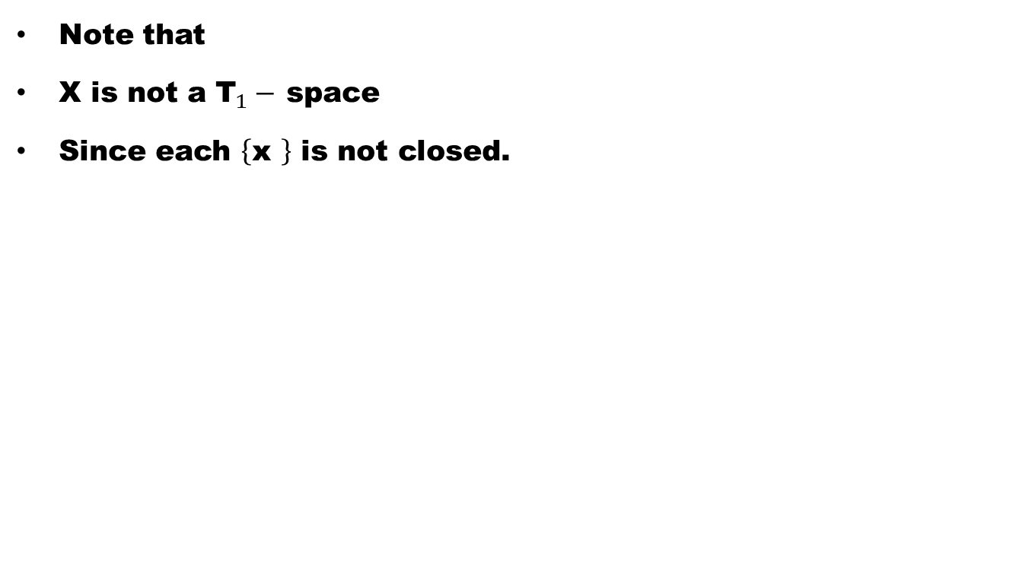
Remark
Note that
X is not a ${\text{T}}_{1}−$ space
Since each $\left\{\text{x} \right\}$ is not closed.

Slide 7
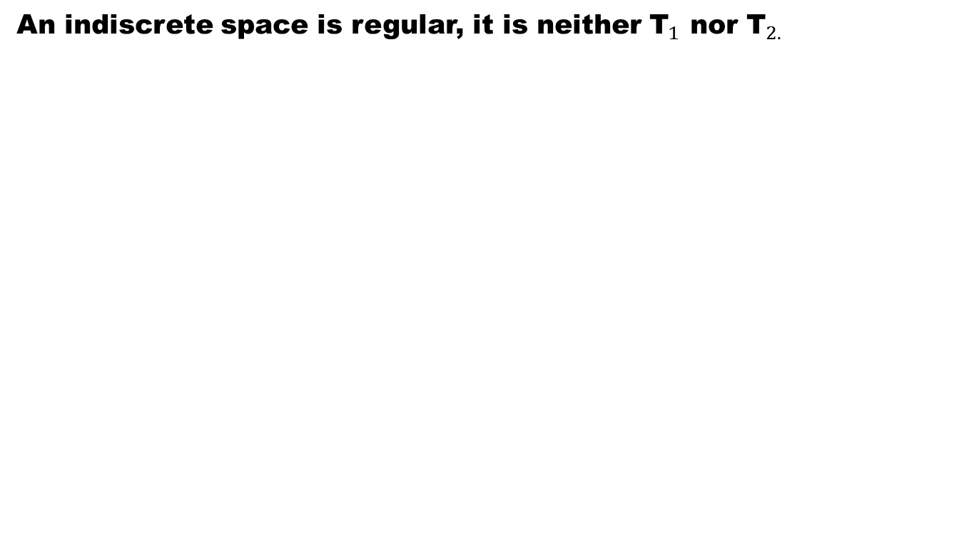
Example
An indiscrete space is regular, it is neither ${\text{T}}_{1}$ nor ${\text{T}}_{2.}$

Slide 8

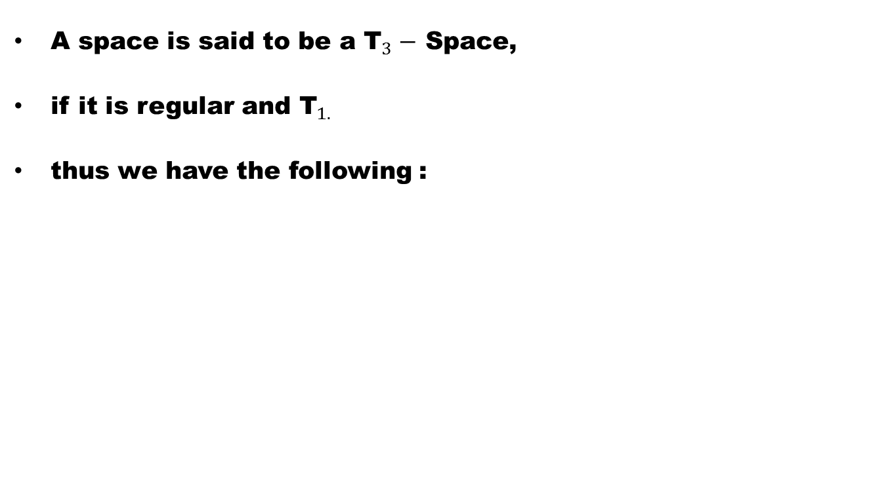
Definition 2 (${\text{T}}_{3}−$ Space)
A space is said to be a ${\text{T}}_{3}−$Space,
if it is regular and ${\text{T}}_{1. }$
thus we have the following :

Slide 9
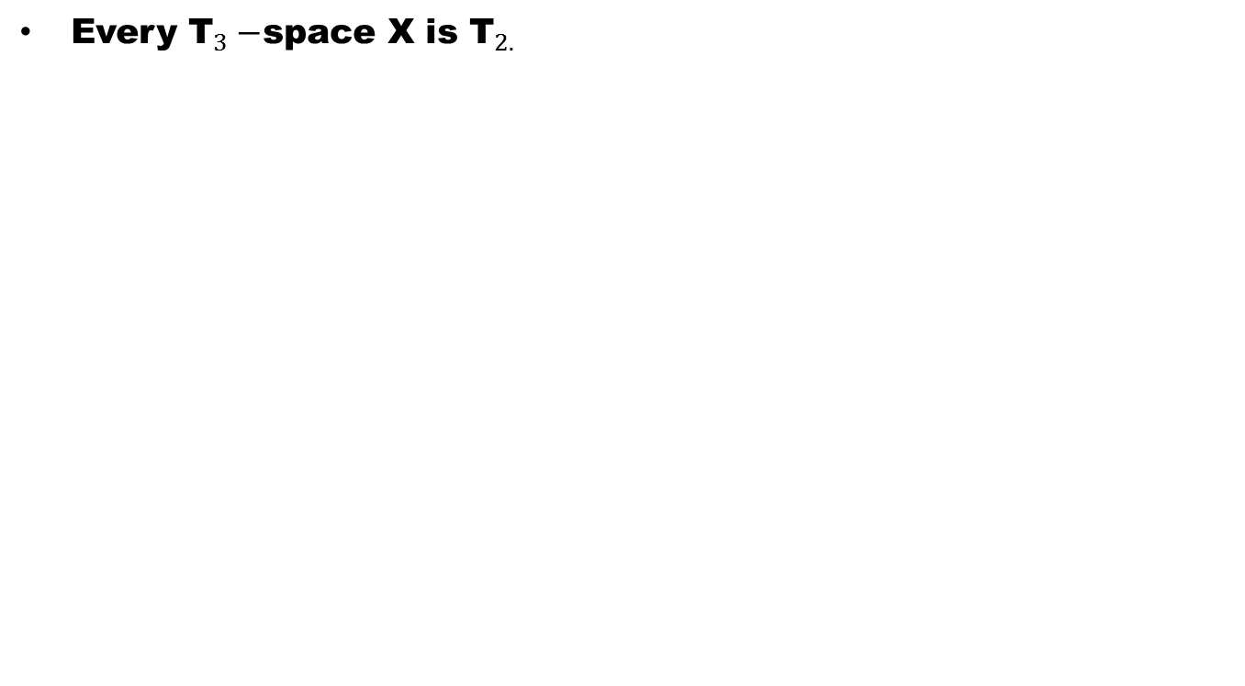
Theorem
Every ${\text{T}}_{3}−$space X is ${\text{T}}_{2.}$

Slide 11
Theorem
The following are equivalent for a space X:

Slide 12
Theorem
The following are equivalent for a space X:
X is regular.

Slide 13
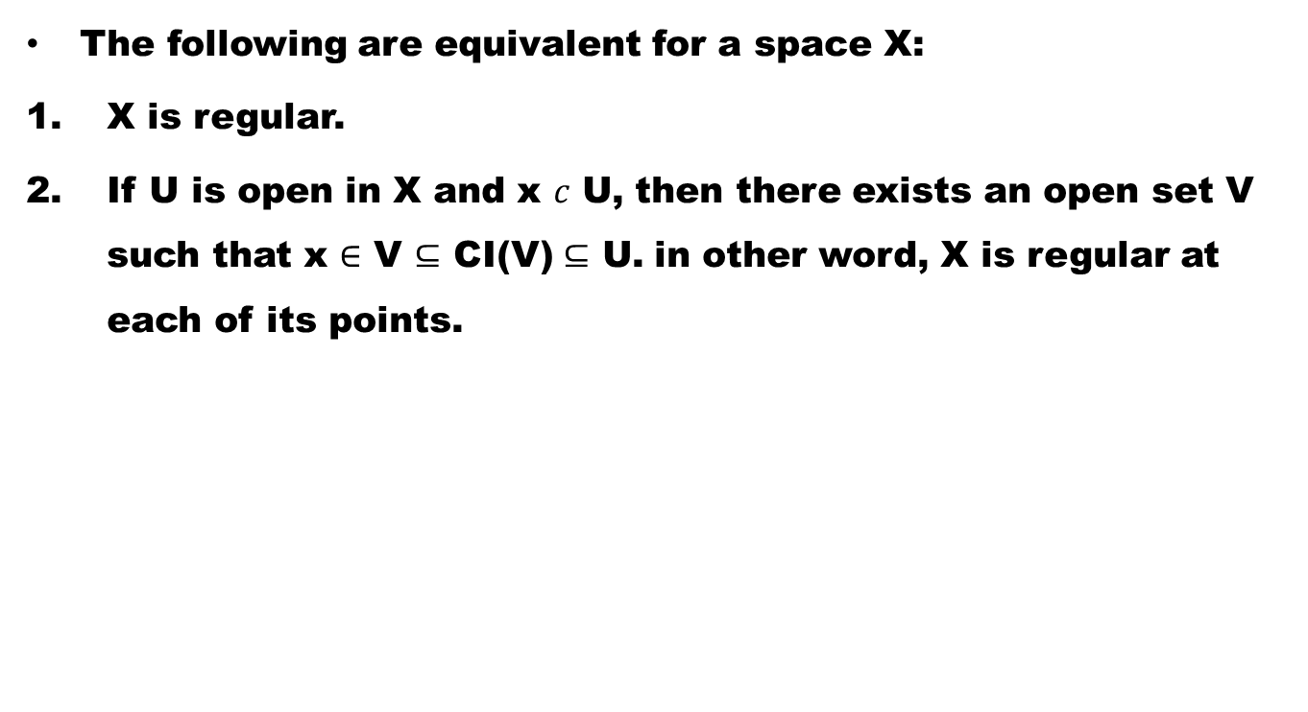
Theorem
The following are equivalent for a space X:
X is regular.
If U is open in X and x $c$ U, then there exists an open set V such that x $∈$V $⊆$ CI(V)$⊆$ U. in other word, X is regular at each of its points.

Slide 14
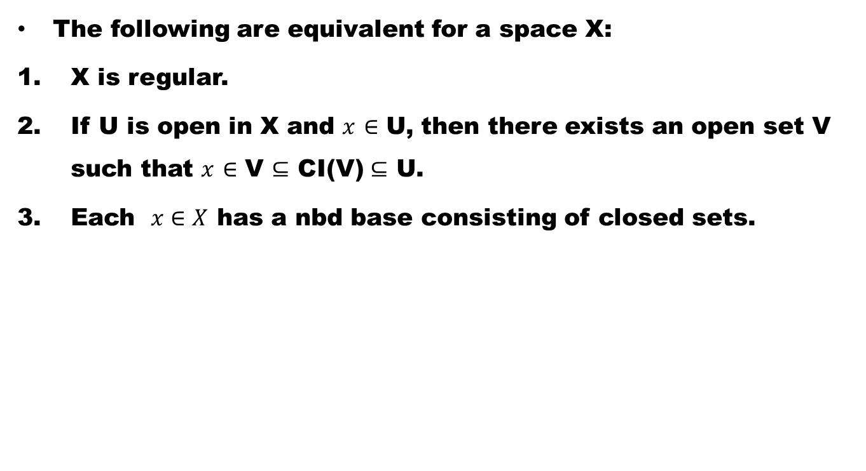
Theorem
The following are equivalent for a space X:
X is regular.
If U is open in X and $x$$∈$ U, then there exists an open set V such that $x$$∈$V $⊆$ CI(V)$⊆$ U.
Each $x∈X$ has a nbd base consisting of closed sets.

Slide 15
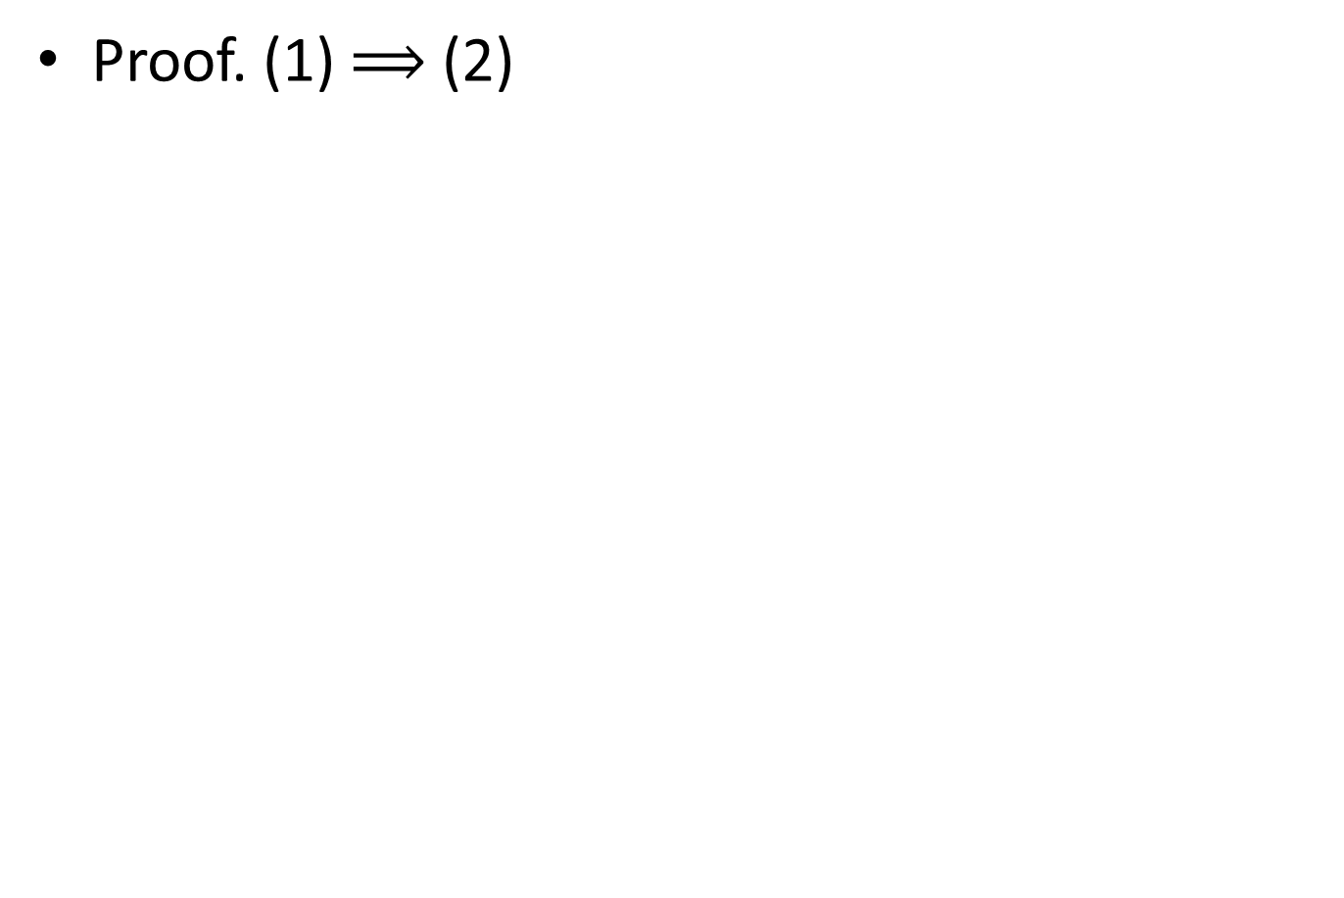
Proof. (1) $⟹$ (2)

Slide 16
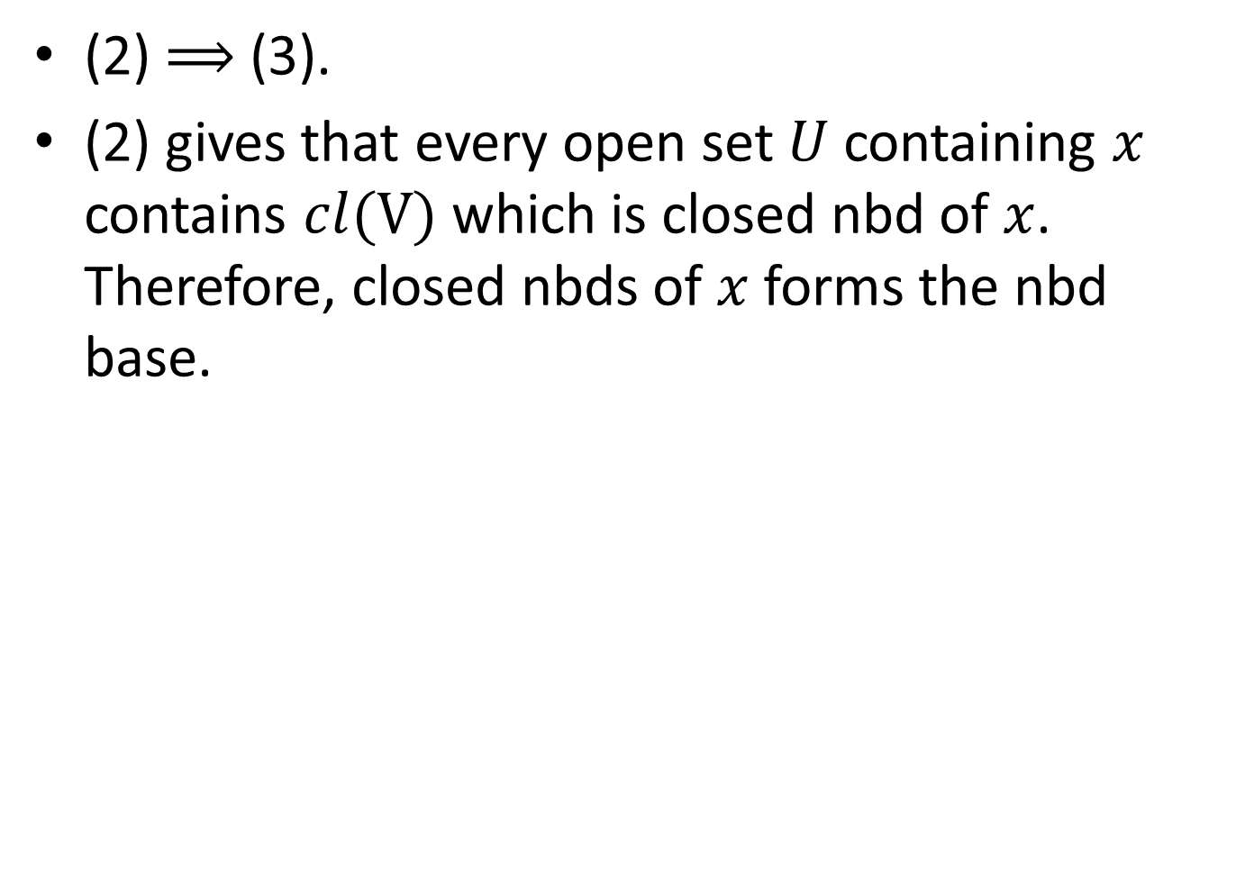
(2) $⟹$(3).
(2) gives that every open set $U$ containing $x$ contains $cl(V)$ which is closed nbd of $x$. Therefore, closed nbds of $x$ forms the nbd base.

Slide 17
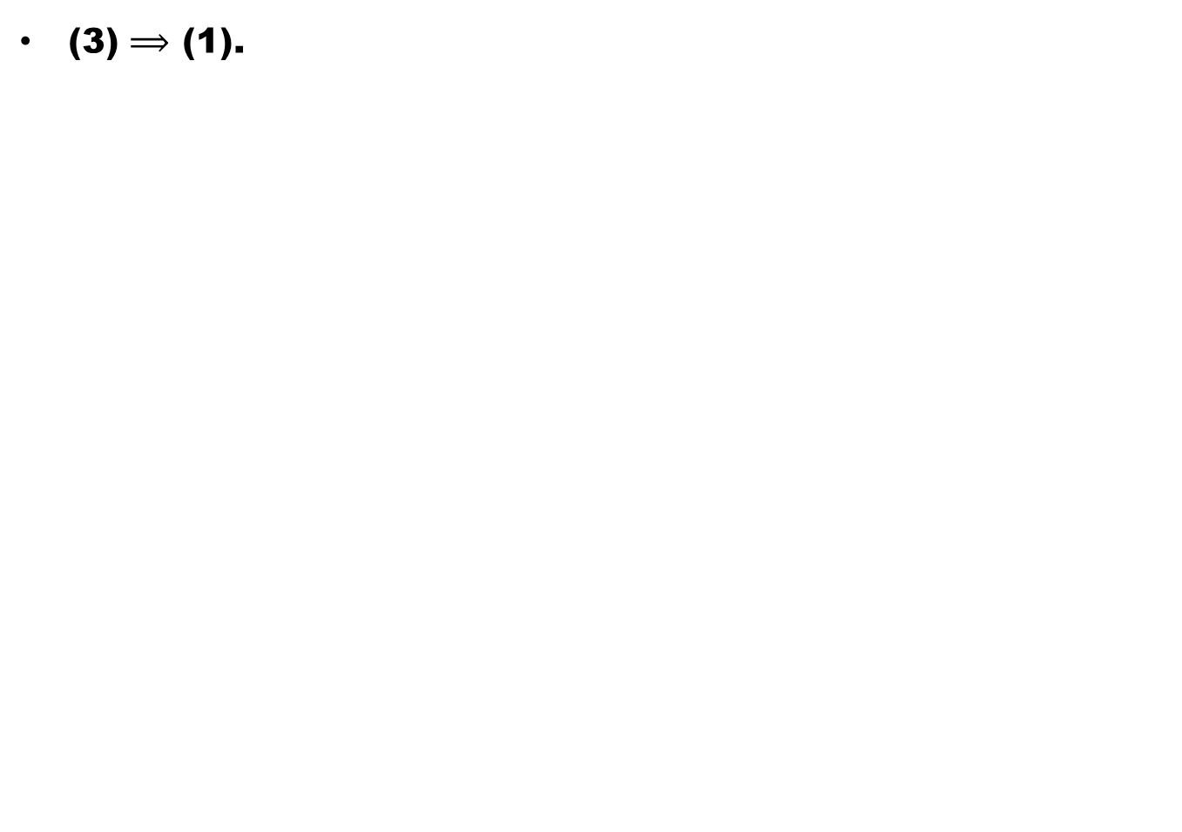
(3) $⟹$(1).

Slide 18
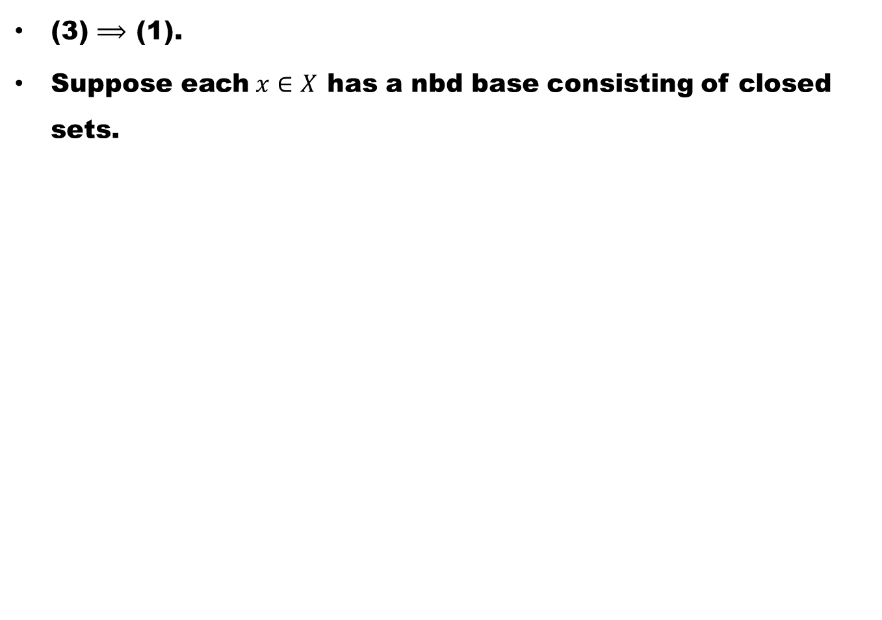
(3) $⟹$(1).
Suppose each $x∈X$ has a nbd base consisting of closed sets.

Slide 19
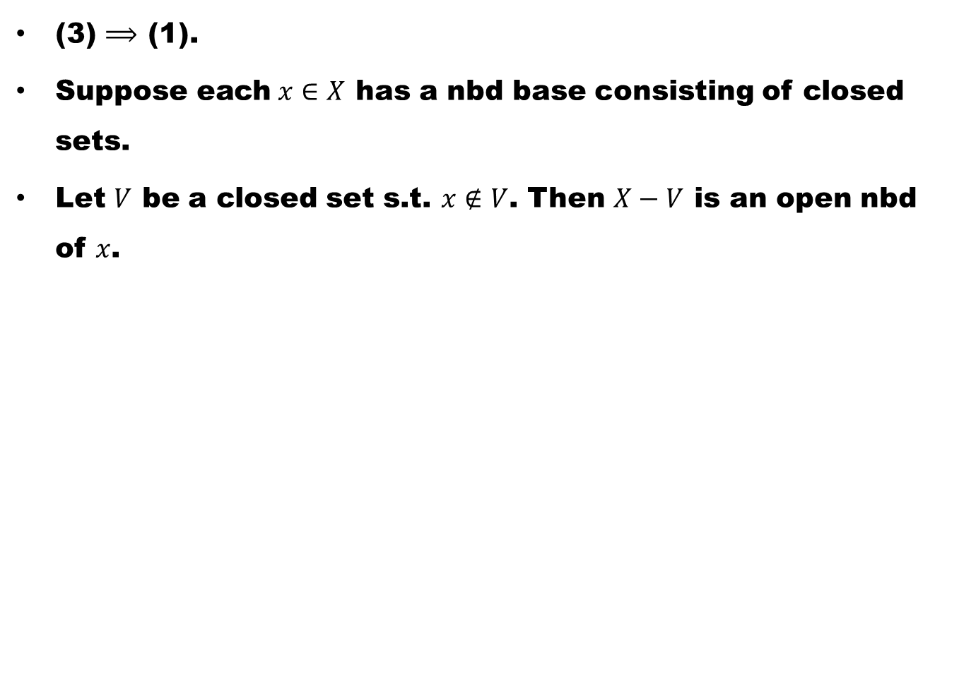
(3) $⟹$(1).
Suppose each $x∈X$ has a nbd base consisting of closed sets.
Let $V$ be a closed set s.t.$x∉V$. Then $X−V$ is an open nbd of $x$.

Slide 20
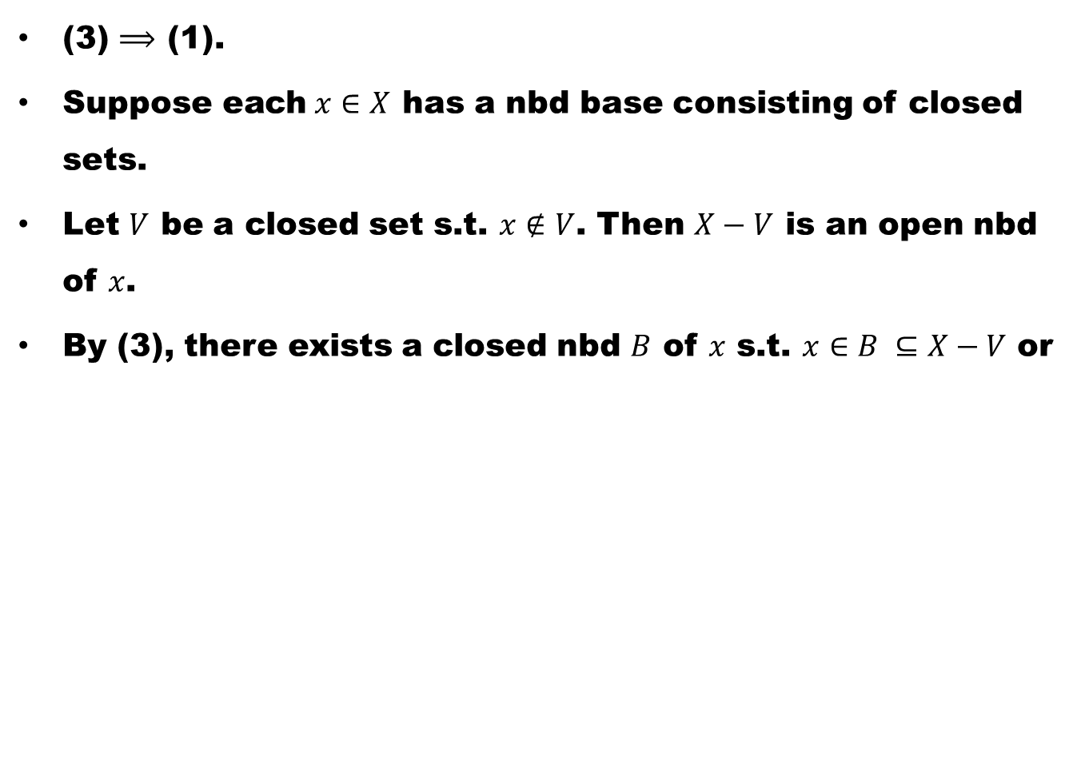
(3) $⟹$(1).
Suppose each $x∈X$ has a nbd base consisting of closed sets.
Let $V$ be a closed set s.t.$x∉V$. Then $X−V$ is an open nbd of $x$.
By (3), there exists a closed nbd $B$ of $x$s.t.$x∈B ⊆X−V$ or

Slide 21
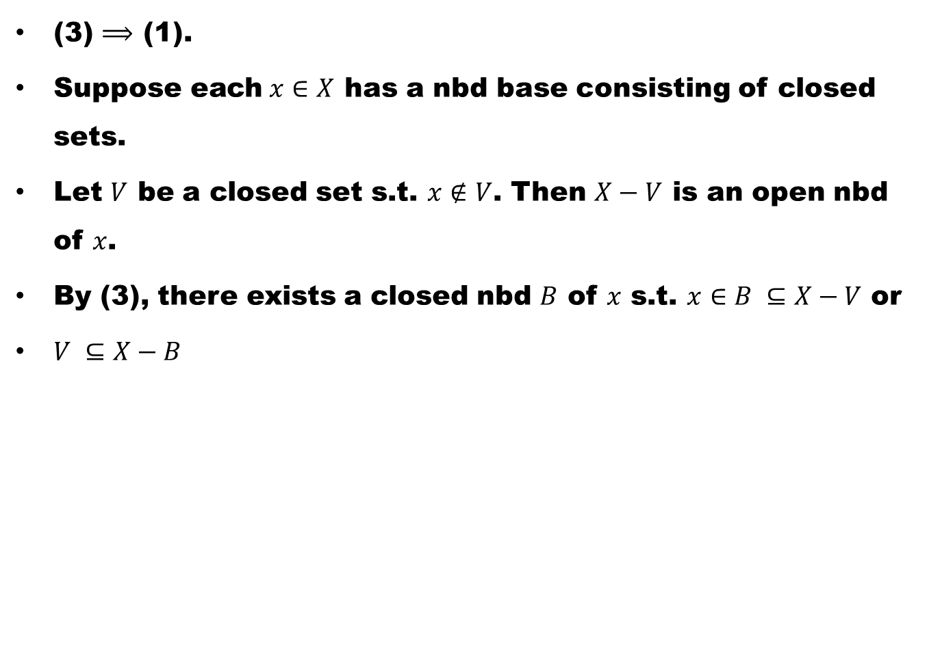
(3) $⟹$(1).
Suppose each $x∈X$ has a nbd base consisting of closed sets.
Let $V$ be a closed set s.t.$x∉V$. Then $X−V$ is an open nbd of $x$.
By (3), there exists a closed nbd $B$ of $x$s.t.$x∈B ⊆X−V$ or
$V ⊆X−B$

Slide 22
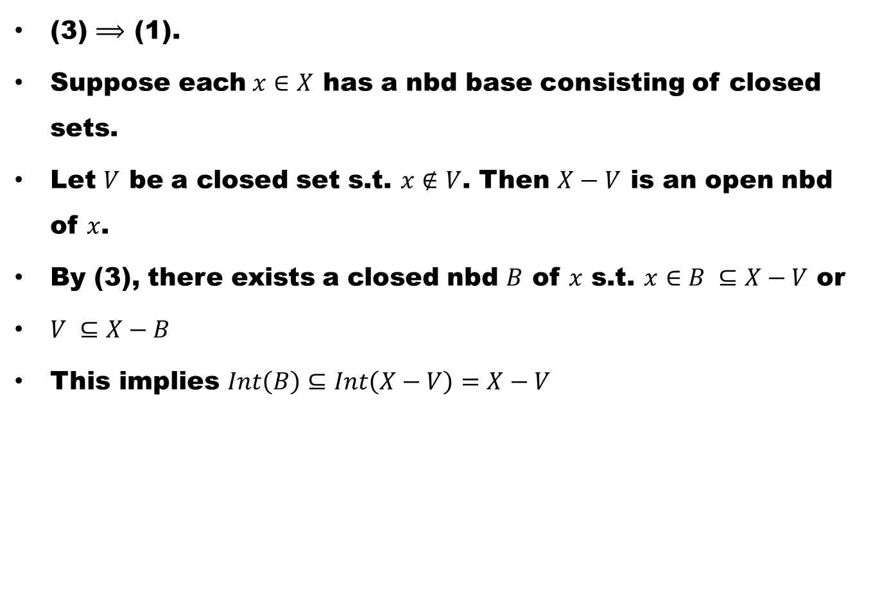
(3) $⟹$(1).
Suppose each $x∈X$ has a nbd base consisting of closed sets.
Let $V$ be a closed set s.t.$x∉V$. Then $X−V$ is an open nbd of $x$.
By (3), there exists a closed nbd $B$ of $x$s.t.$x∈B ⊆X−V$ or
$V ⊆X−B$
This implies $Int\left(B\right)⊆Int\left(X−V\right)=X−V$

Slide 23
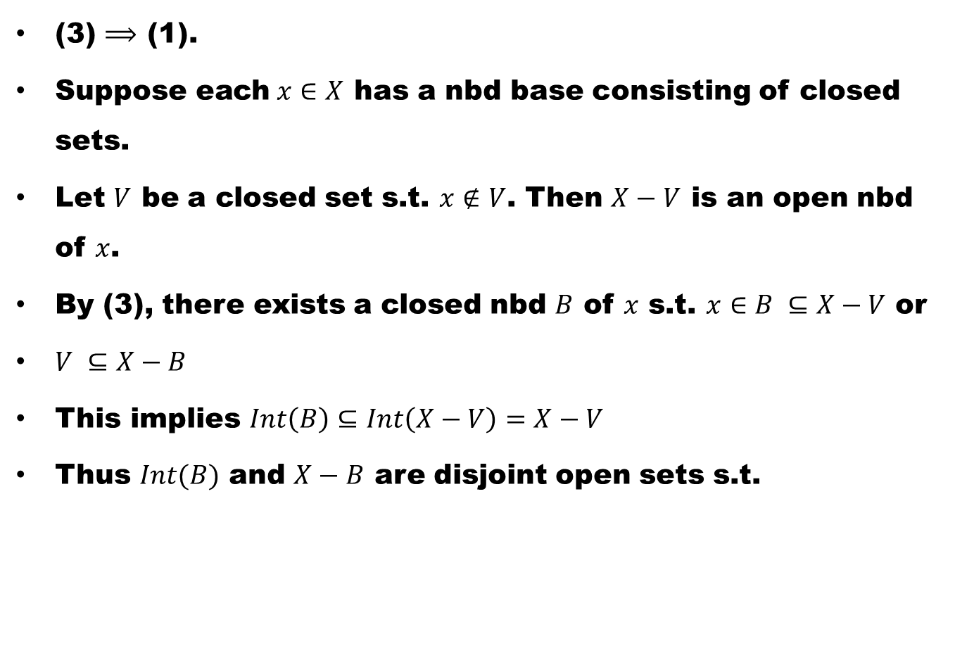
(3) $⟹$(1).
Suppose each $x∈X$ has a nbd base consisting of closed sets.
Let $V$ be a closed set s.t.$x∉V$. Then $X−V$ is an open nbd of $x$.
By (3), there exists a closed nbd $B$ of $x$s.t.$x∈B ⊆X−V$ or
$V ⊆X−B$
This implies $Int\left(B\right)⊆Int\left(X−V\right)=X−V$
Thus $Int(B)$ and $X−B$ are disjoint open sets s.t.

Slide 24
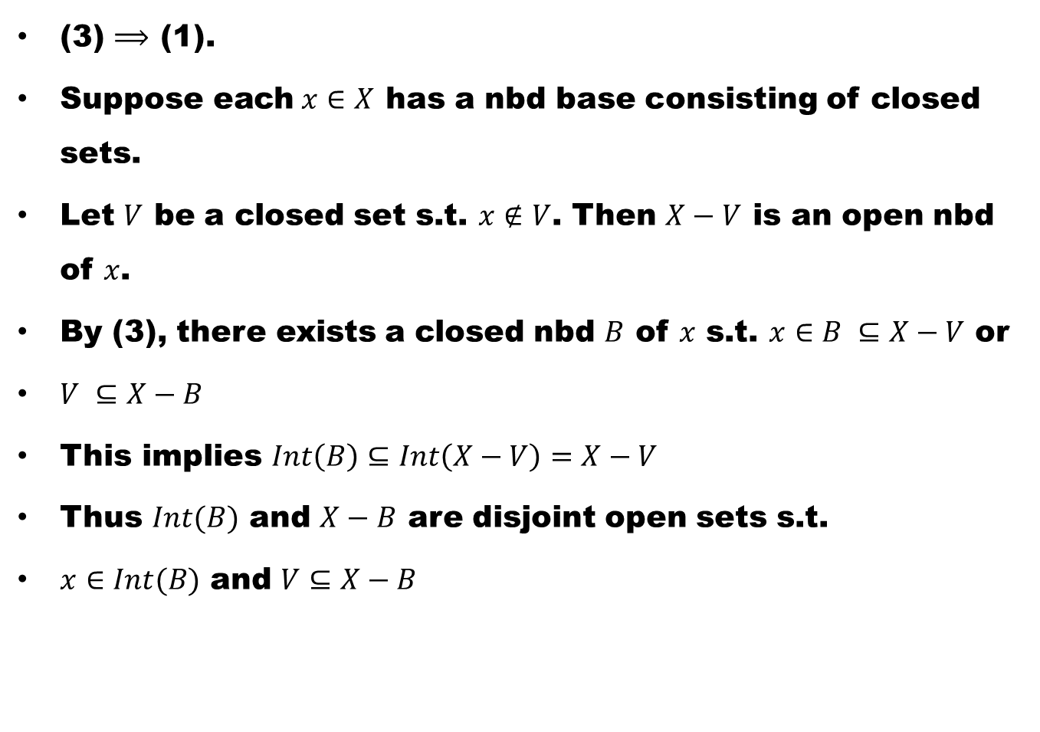
(3) $⟹$(1).
Suppose each $x∈X$ has a nbd base consisting of closed sets.
Let $V$ be a closed set s.t.$x∉V$. Then $X−V$ is an open nbd of $x$.
By (3), there exists a closed nbd $B$ of $x$s.t.$x∈B ⊆X−V$ or
$V ⊆X−B$
This implies $Int\left(B\right)⊆Int\left(X−V\right)=X−V$
Thus $Int(B)$ and $X−B$ are disjoint open sets s.t.
$x∈Int(B)$ and $V⊆X−B$

Slide 25
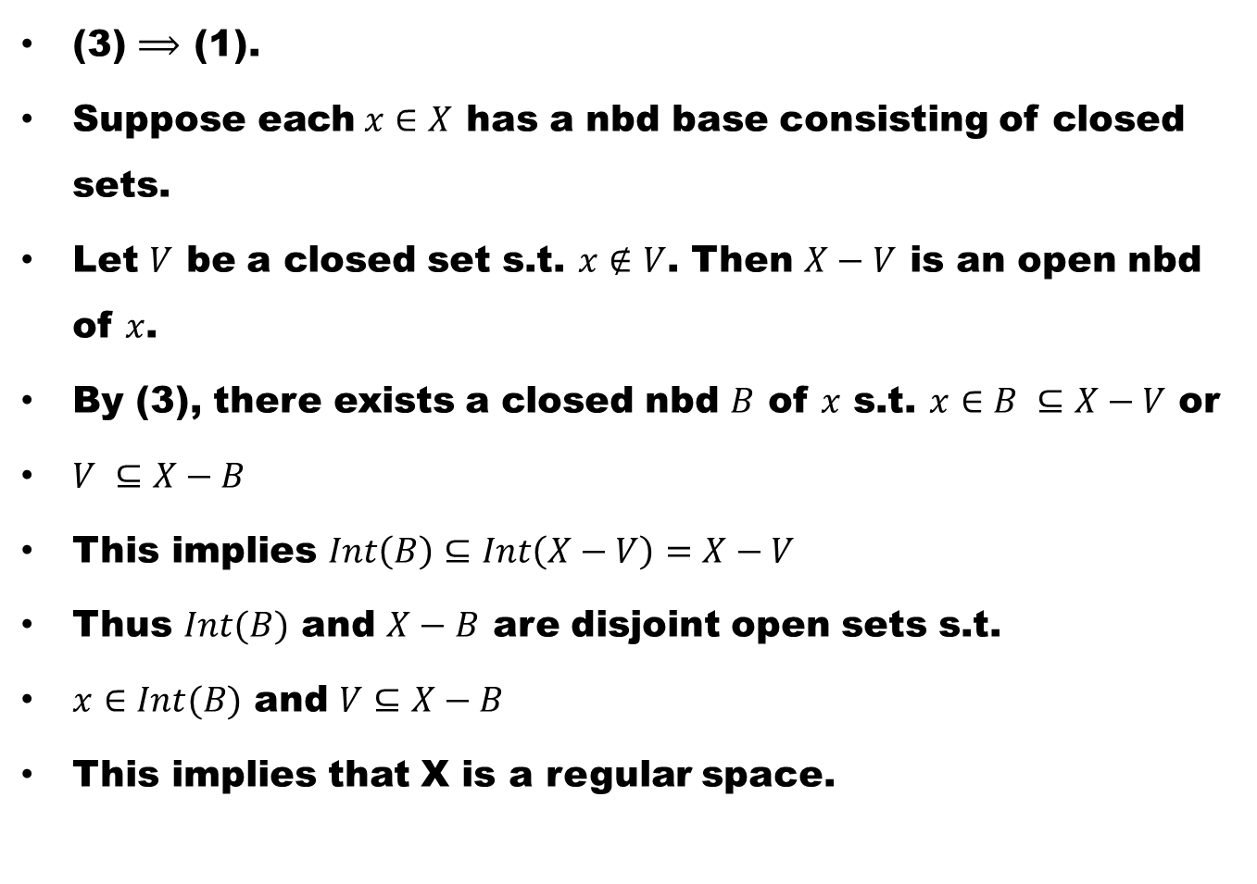
(3) $⟹$(1).
Suppose each $x∈X$ has a nbd base consisting of closed sets.
Let $V$ be a closed set s.t.$x∉V$. Then $X−V$ is an open nbd of $x$.
By (3), there exists a closed nbd $B$ of $x$s.t.$x∈B ⊆X−V$ or
$V ⊆X−B$
This implies $Int\left(B\right)⊆Int\left(X−V\right)=X−V$
Thus $Int(B)$ and $X−B$ are disjoint open sets s.t.
$x∈Int(B)$ and $V⊆X−B$
This implies that X is a regular space.

Slide 26
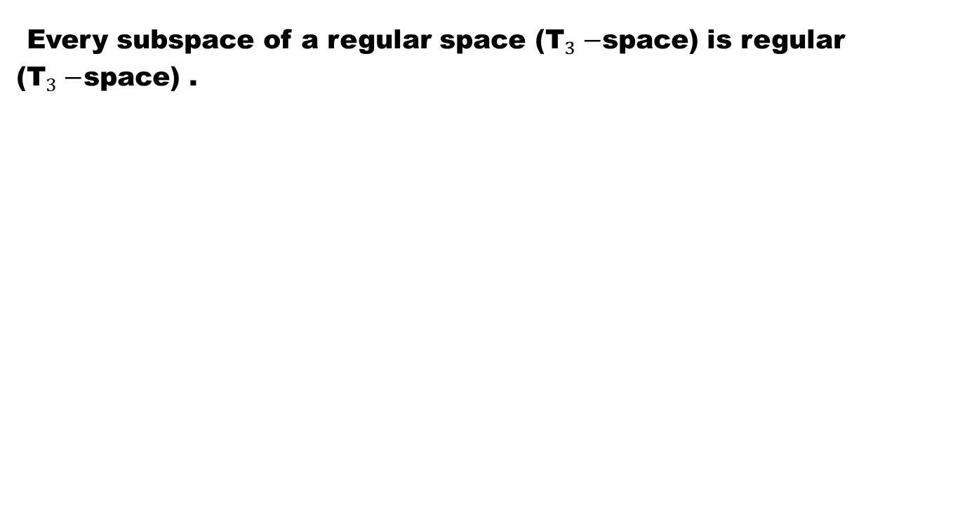
Theorem
Every subspace of a regular space (${\text{T}}_{3}−$space) is regular (${\text{T}}_{3}−$space) .

Slide 28
Good Luck to You

