Slide 1
Set Topology
MTH 251
Lecture # 23

Slide 2
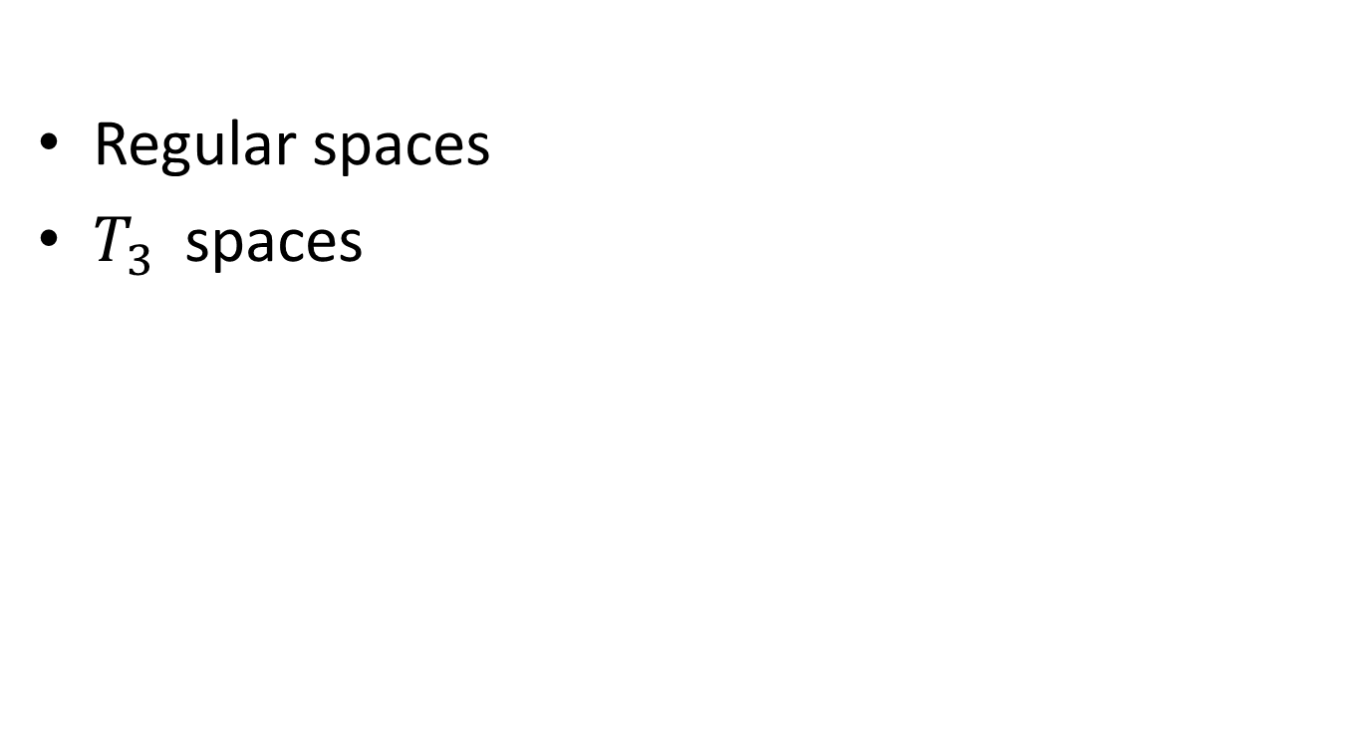
Lecture Plan
Regular spaces
$T_{3}$spaces

Slide 3
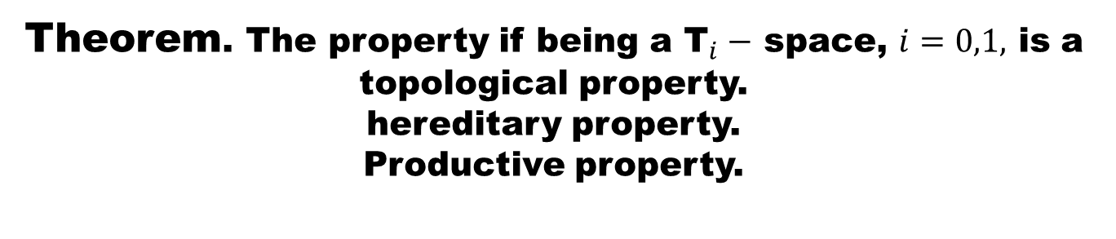

Slide 7
Theorem
A bijective closed or open image of a Hausdorff space is Hausdorff. Hence the property of being a Hausdorff is topological.
Hausdorff property is hereditary.
Hausdorff property is productive.

Slide 12
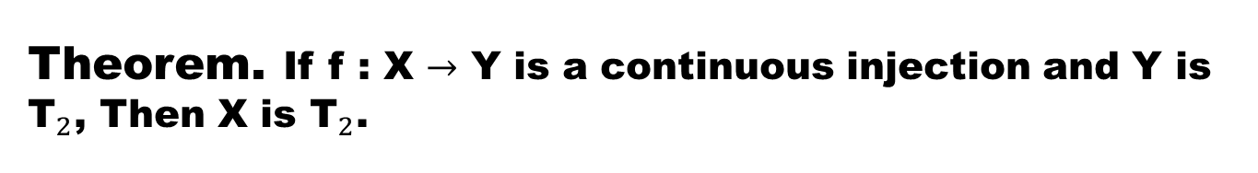
Theorem. If f : X $→$ Y is a continuous injection and Y is ${\text{T}}_{2}$, Then X is ${\text{T}}_{2}$.

Slide 14
  Definition. (Regular Space)
  A space X is said to be a regular space if it satisfies the axiom:

Slide 15
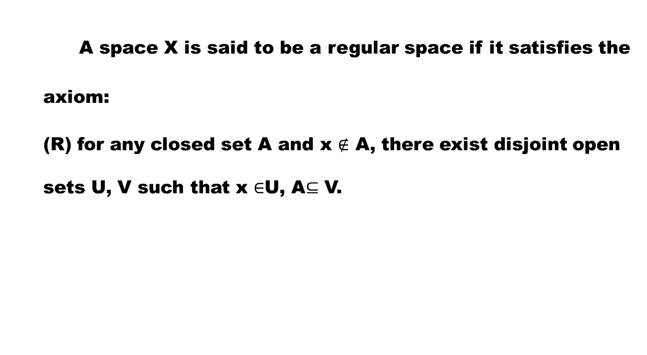
  Definition. (Regular Space)
  A space X is said to be a regular space if it satisfies the axiom:
  (R) for any closed set A and x $∉$ A, there exist disjoint open sets U, V such that x $∈$U, A$⊆$ V.

Slide 16
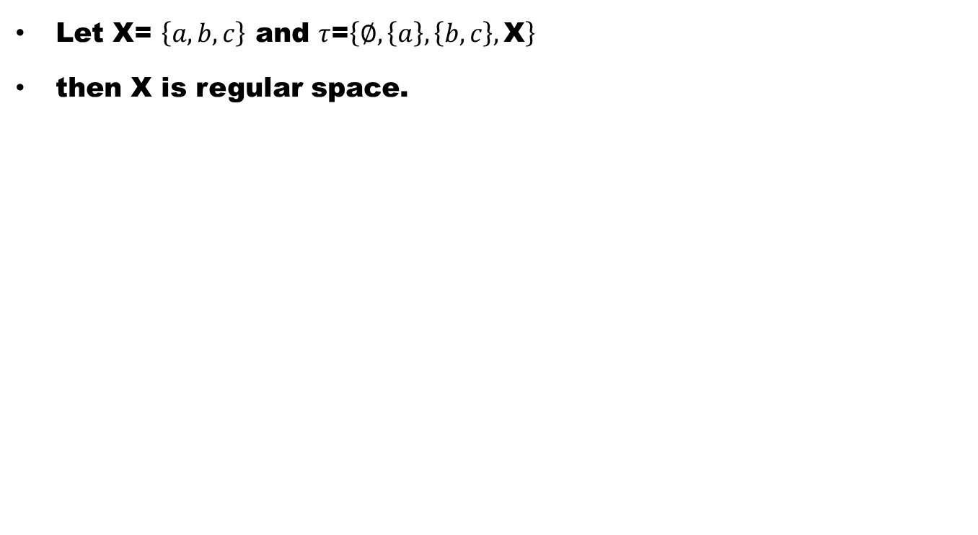
Example
Let X= $\left\{a,b,c\right\}$ and $τ$=$\left\{∅,\left\{a\right\},\left\{b,c\right\},\text{X}\right\}$
then X is regular space.

Slide 17
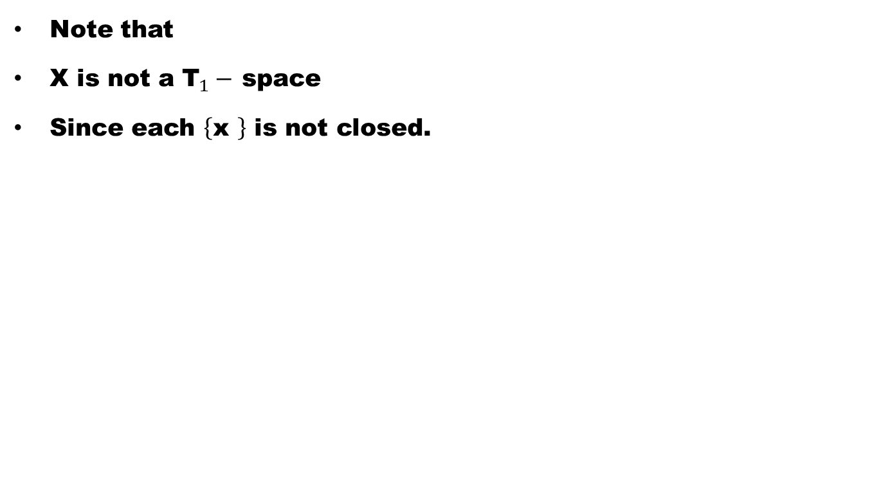
Remark
Note that
X is not a ${\text{T}}_{1}−$ space
Since each $\left\{\text{x} \right\}$ is not closed.

Slide 18
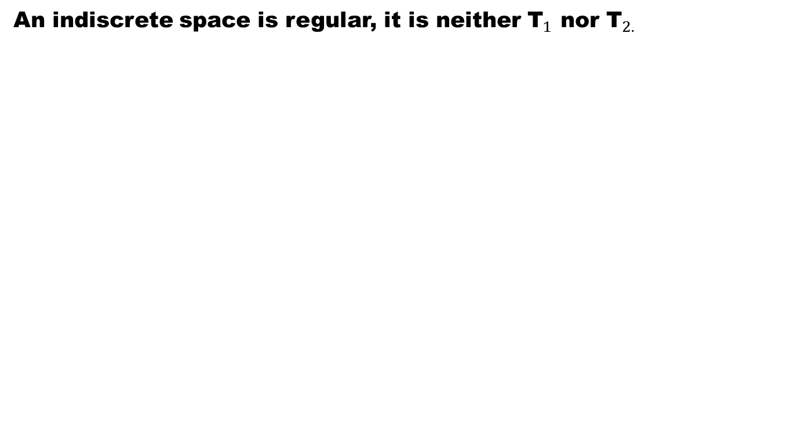
Example
An indiscrete space is regular, it is neither ${\text{T}}_{1}$ nor ${\text{T}}_{2.}$

Slide 19
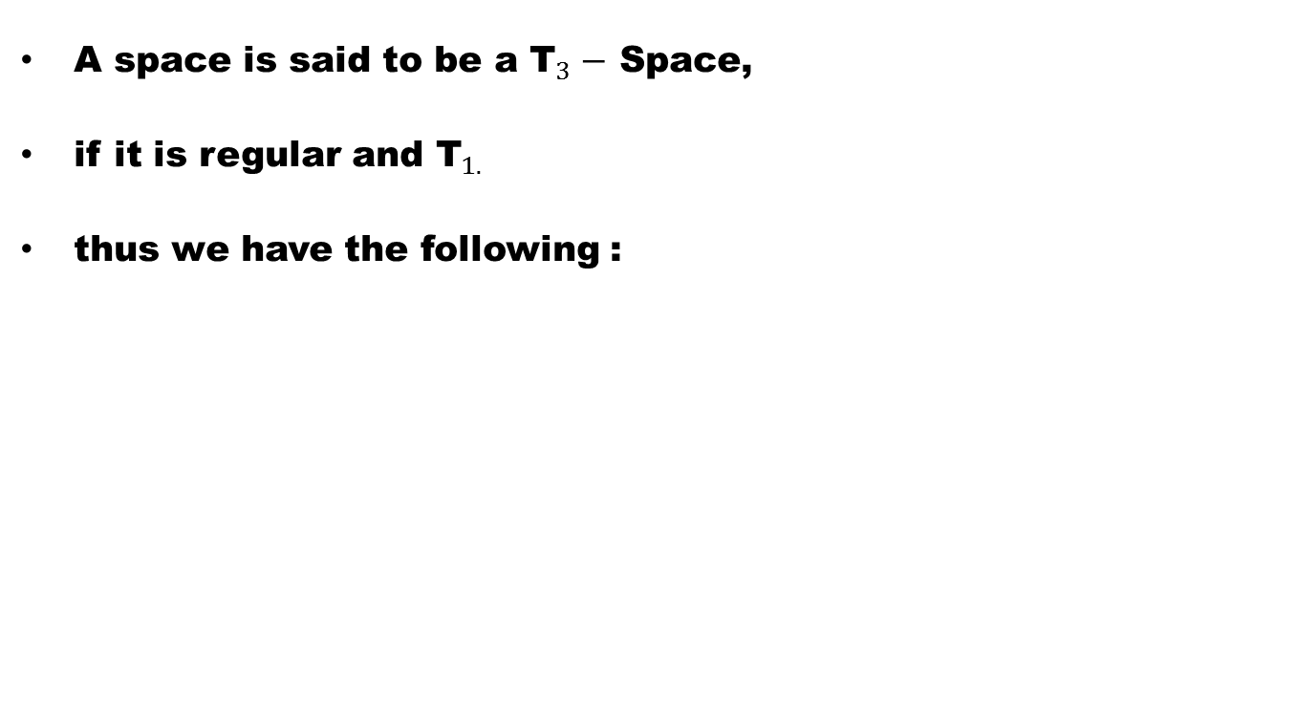
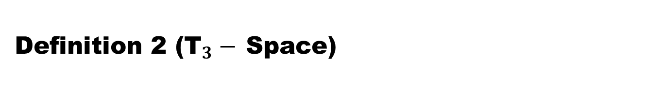
Definition 2 (${\text{T}}_{3}−$ Space)
A space is said to be a ${\text{T}}_{3}−$Space,
if it is regular and ${\text{T}}_{1. }$
thus we have the following :

Slide 20
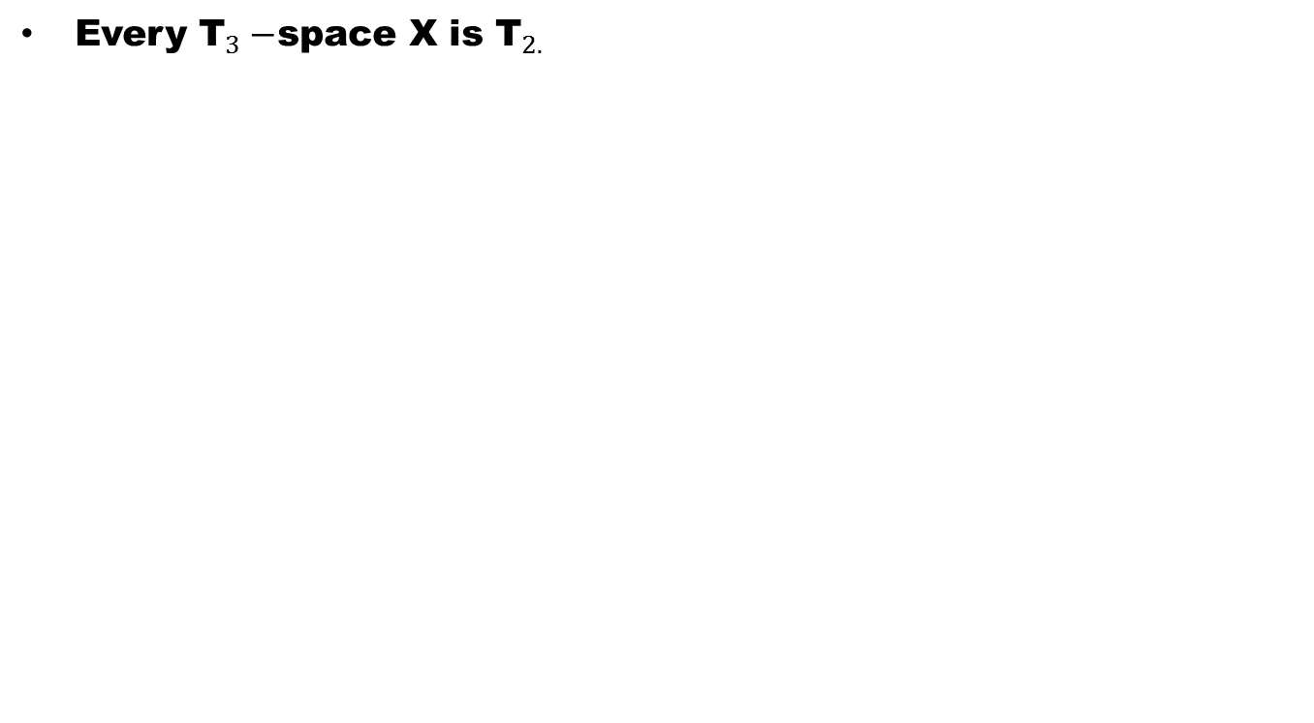
Theorem
Every ${\text{T}}_{3}−$space X is ${\text{T}}_{2.}$

Slide 22
Theorem
The following are equivalent for a space X:

Slide 23
Theorem
The following are equivalent for a space X:
X is regular.

Slide 24
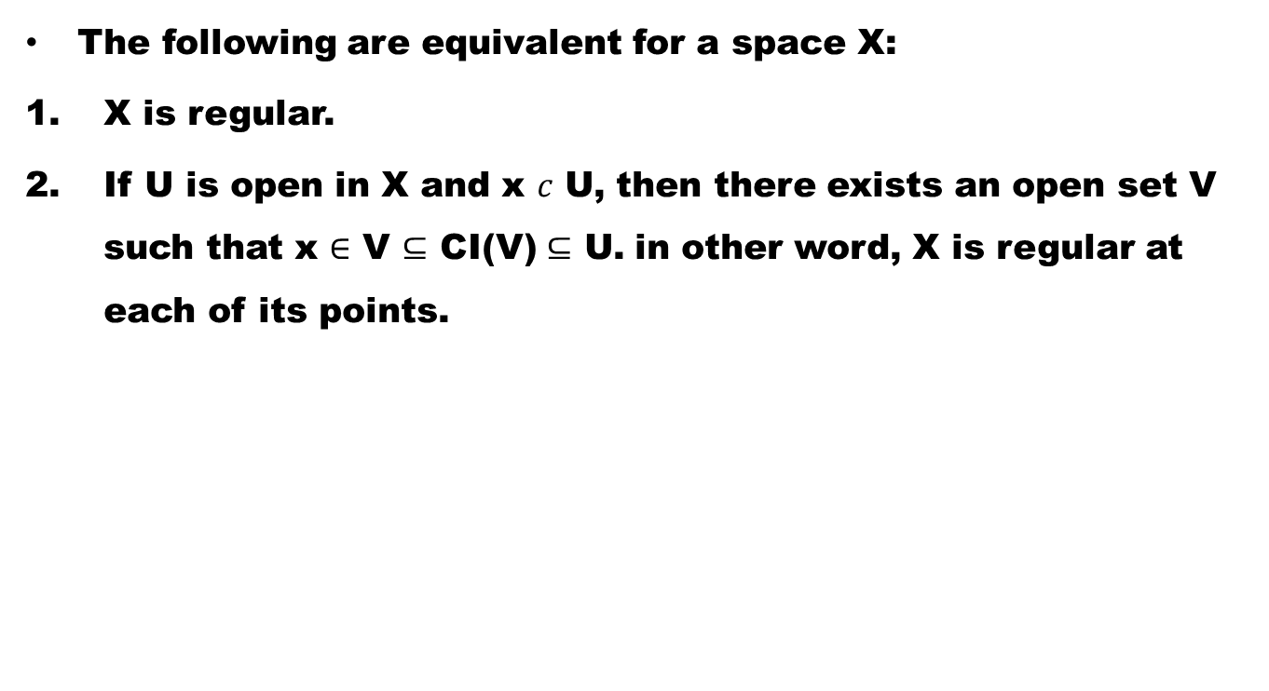
Theorem
The following are equivalent for a space X:
X is regular.
If U is open in X and x $c$ U, then there exists an open set V such that x $∈$V $⊆$ CI(V)$⊆$ U. in other word, X is regular at each of its points.

Slide 25
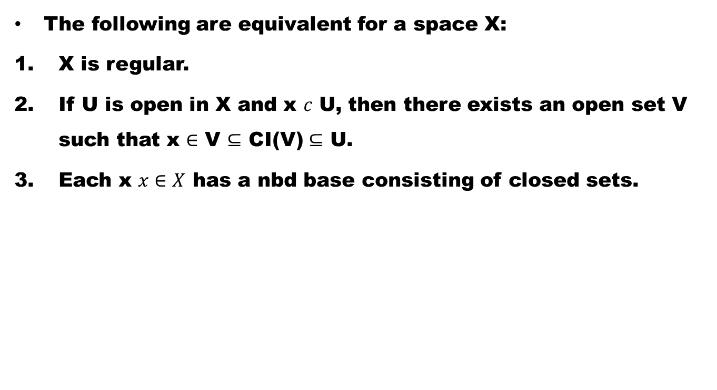
Theorem
The following are equivalent for a space X:
X is regular.
If U is open in X and x $c$ U, then there exists an open set V such that x $∈$V $⊆$ CI(V)$⊆$ U.
Each x $x∈X$ has a nbd base consisting of closed sets.

Slide 30
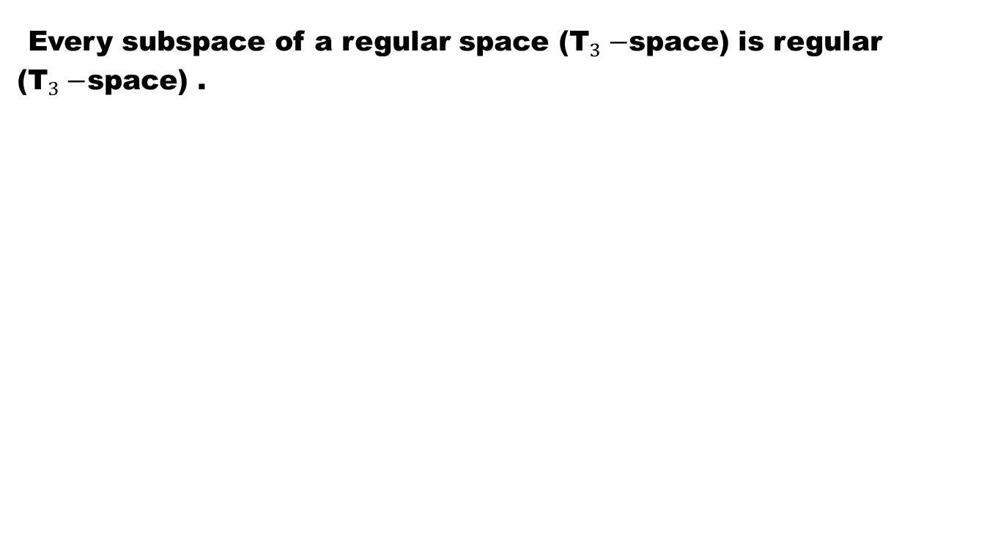
Theorem
Every subspace of a regular space (${\text{T}}_{3}−$space) is regular (${\text{T}}_{3}−$space) .

Slide 32
Good Luck to You

