Slide 1
Set Topology
MTH 251
Lecture # 22

Slide 2
Lecture Plan
First Countable Space
Hereditary Property
Separation Axioms

Slide 3
Theorem. First countability is preserved under open continuous surjection OR
The continuous open surjective image of a first countable space is first countable.

Slide 6
Definition
A property of a space X is said to be hereditary

Slide 7
Definition
A property of a space X is said to be hereditary
if every subspace of X also possesses the same property.

Slide 8

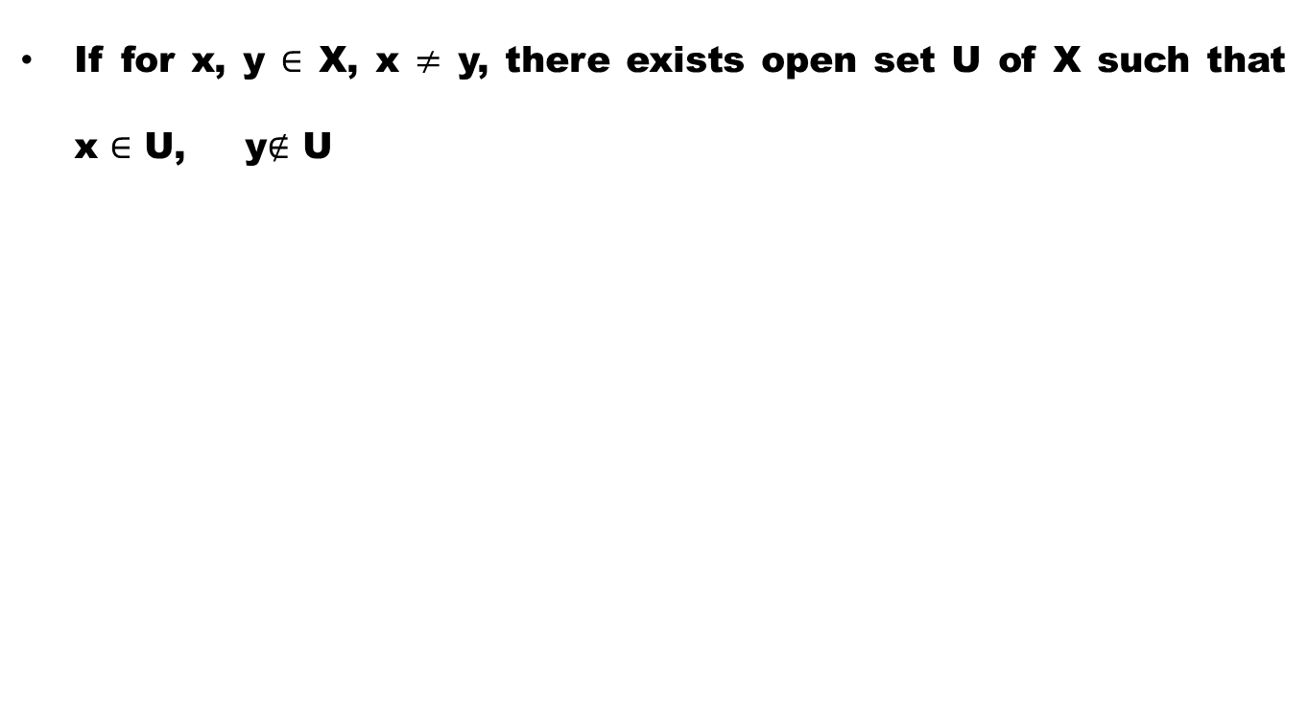
Definition ($T_{0}−$Space)
If for x, y $∈$ X, x $≠$ y, there exists open set U of X such that x $∈$ U, y$∉$ U

Slide 9
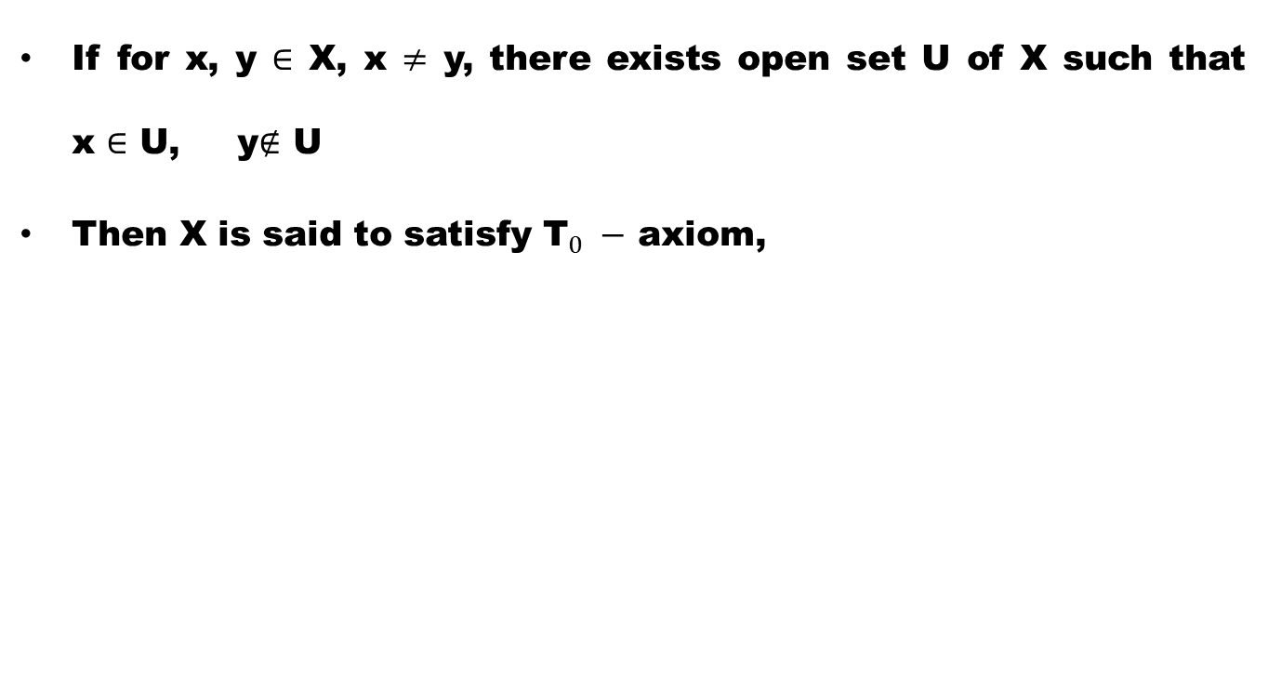
Definition ($T_{0}−$Space)
If for x, y $∈$ X, x $≠$ y, there exists open set U of X such that x $∈$ U, y$∉$ U
Then X is said to satisfy ${\text{T}}_{0} −$ axiom,

Slide 10
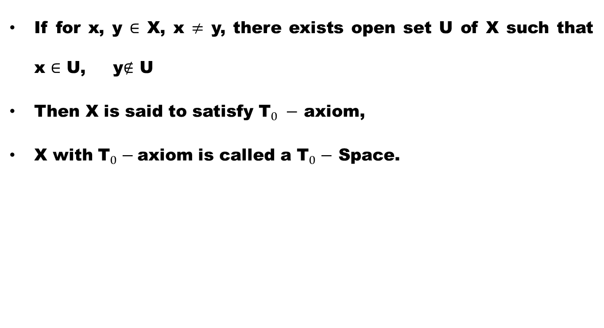
Definition ($T_{0}−$Space)
If for x, y $∈$ X, x $≠$ y, there exists open set U of X such that x $∈$ U, y$∉$ U
Then X is said to satisfy ${\text{T}}_{0} −$ axiom,
X with ${\text{T}}_{0}−$axiom is called a ${\text{T}}_{0}−$ Space.

Slide 11
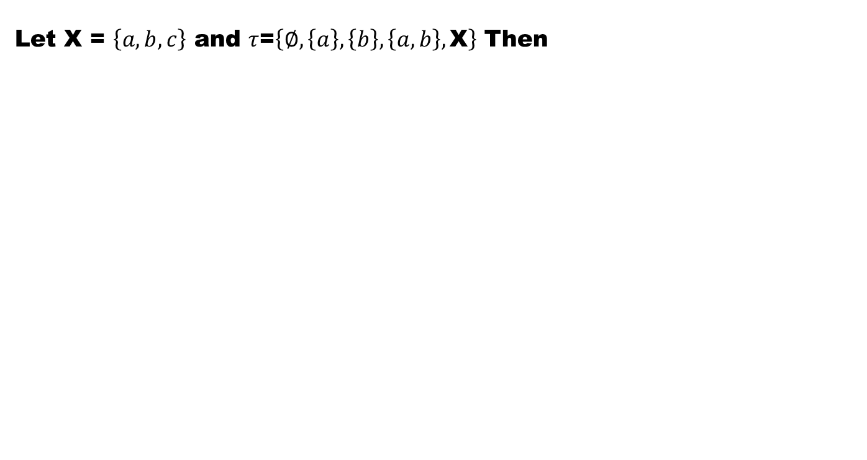
Example
Let X = $\left\{a,b,c\right\}$ and $τ$=$\left\{∅,\left\{a\right\},\left\{b\right\},\left\{a,b\right\},\text{X}\right\}$ Then

Slide 12
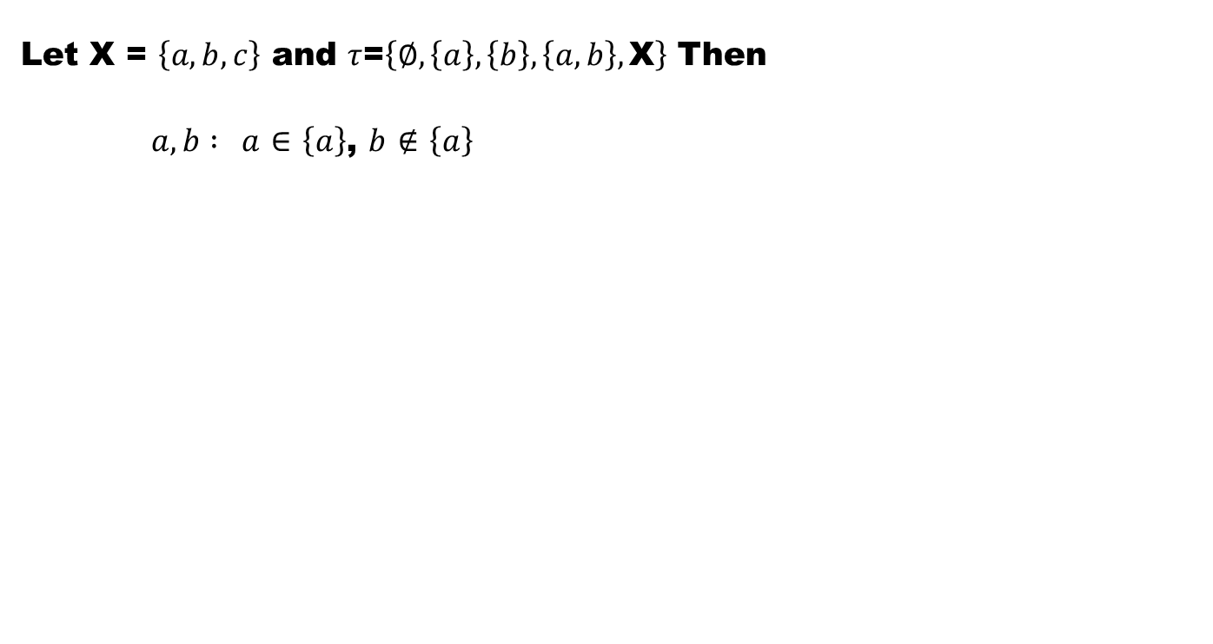
Example
Let X = $\left\{a,b,c\right\}$ and $τ$=$\left\{∅,\left\{a\right\},\left\{b\right\},\left\{a,b\right\},\text{X}\right\}$ Then
$a,b :$$a$$∈$$\left\{a\right\}$, $b$$∉$$\left\{a\right\}$

Slide 13
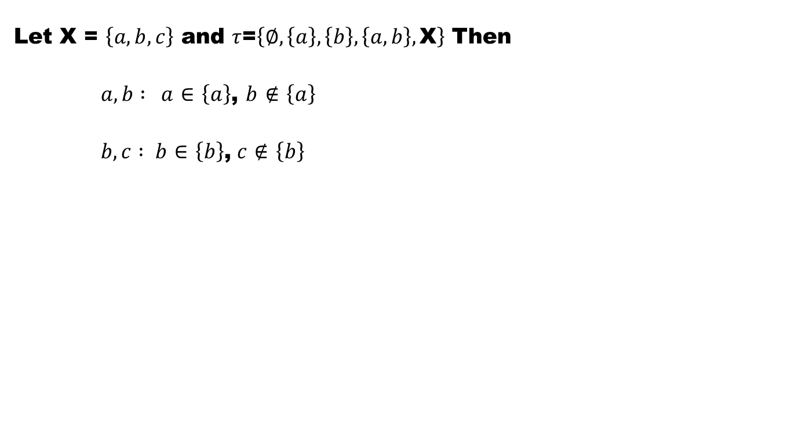
Example
Let X = $\left\{a,b,c\right\}$ and $τ$=$\left\{∅,\left\{a\right\},\left\{b\right\},\left\{a,b\right\},\text{X}\right\}$ Then
$a,b :$$a$$∈$$\left\{a\right\}$, $b$$∉$$\left\{a\right\}$
$b,c : b$$∈$$\left\{b\right\}$,$c$$∉$$\left\{b\right\}$

Slide 14
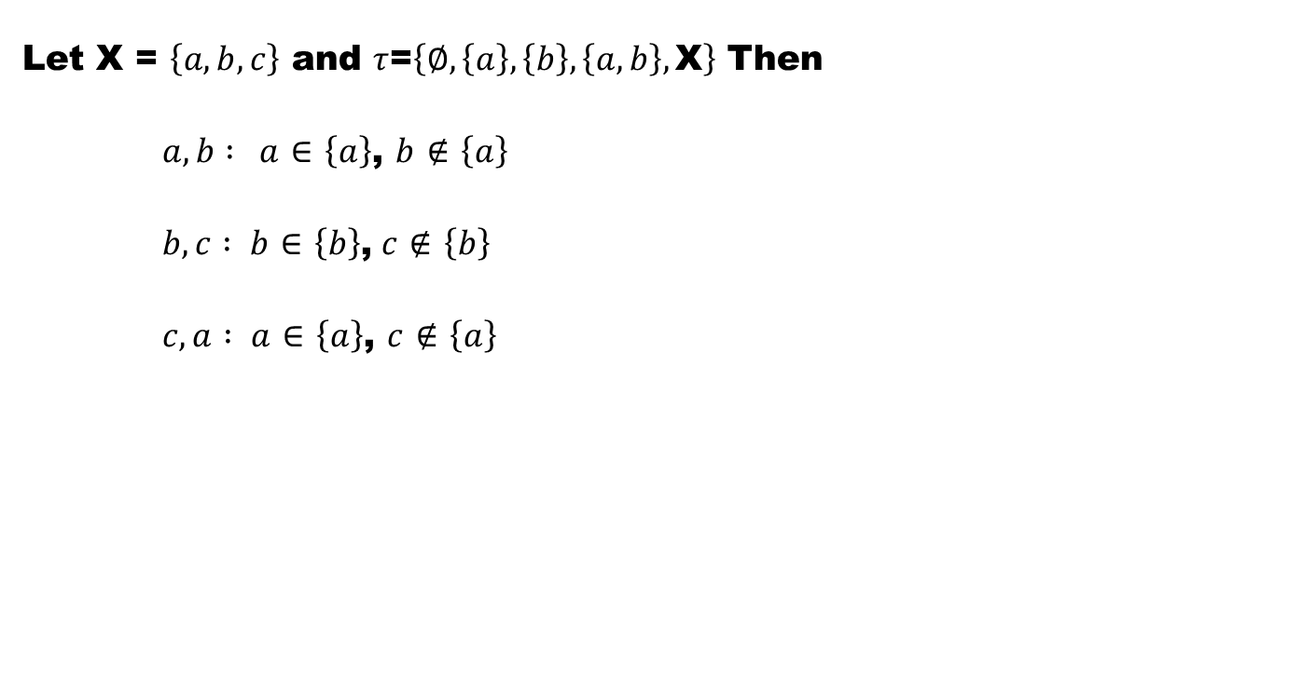
Example
Let X = $\left\{a,b,c\right\}$ and $τ$=$\left\{∅,\left\{a\right\},\left\{b\right\},\left\{a,b\right\},\text{X}\right\}$ Then
$a,b :$$a$$∈$$\left\{a\right\}$, $b$$∉$$\left\{a\right\}$
$b,c : b$$∈$$\left\{b\right\}$,$c$$∉$$\left\{b\right\}$
$c,a : a$$∈$$\left\{a\right\}$,$c$$∉$$\left\{a\right\}$

Slide 15
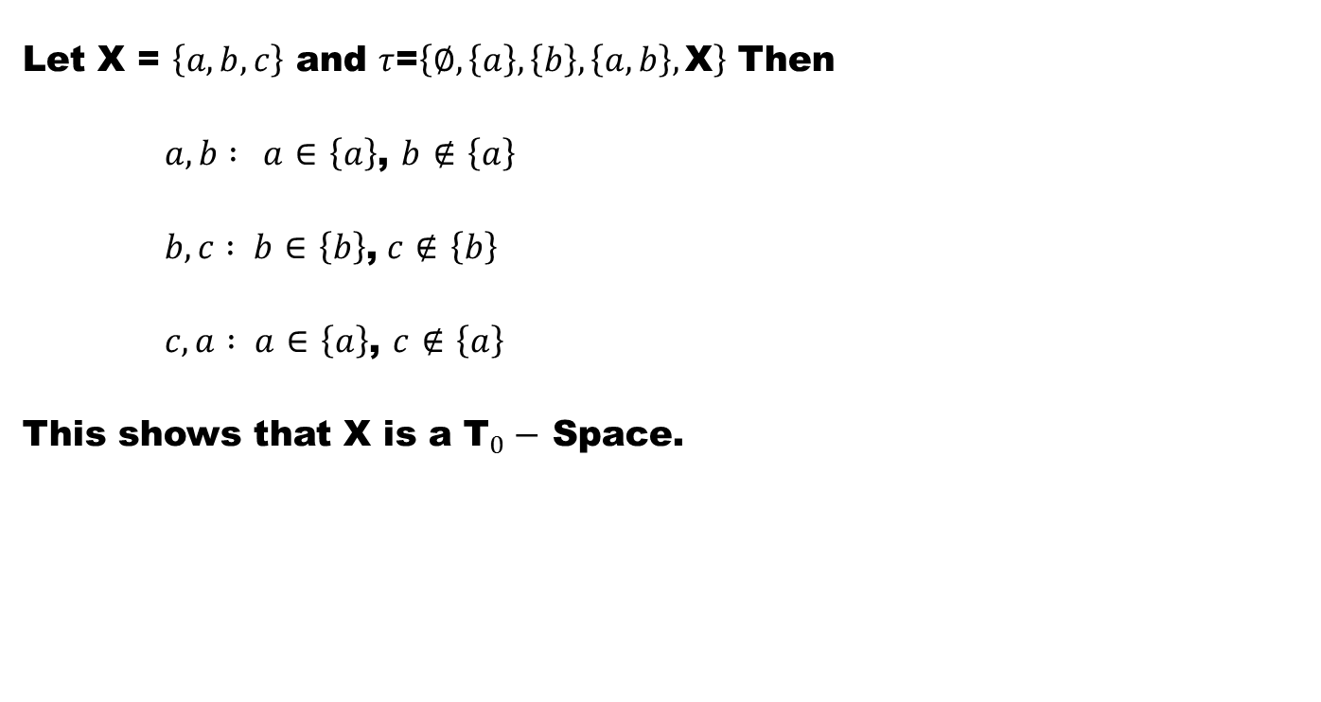
Example
Let X = $\left\{a,b,c\right\}$ and $τ$=$\left\{∅,\left\{a\right\},\left\{b\right\},\left\{a,b\right\},\text{X}\right\}$ Then
$a,b :$$a$$∈$$\left\{a\right\}$, $b$$∉$$\left\{a\right\}$
$b,c : b$$∈$$\left\{b\right\}$,$c$$∉$$\left\{b\right\}$
$c,a : a$$∈$$\left\{a\right\}$,$c$$∉$$\left\{a\right\}$
This shows that X is a ${\text{T}}_{0}−$ Space.

Slide 16
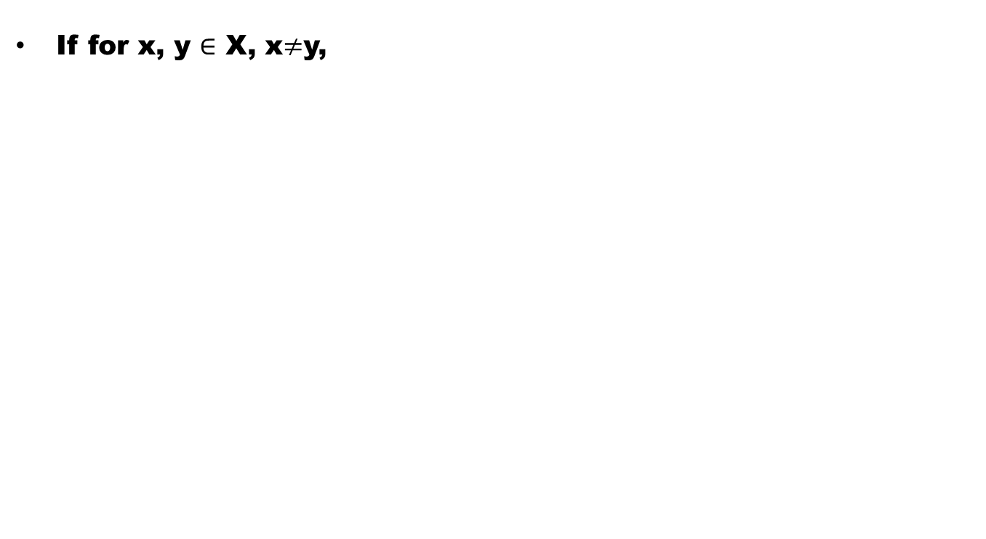

Definition ($T_{1}−$Space)
If for x, y $∈$ X, x$≠$y,

Slide 17
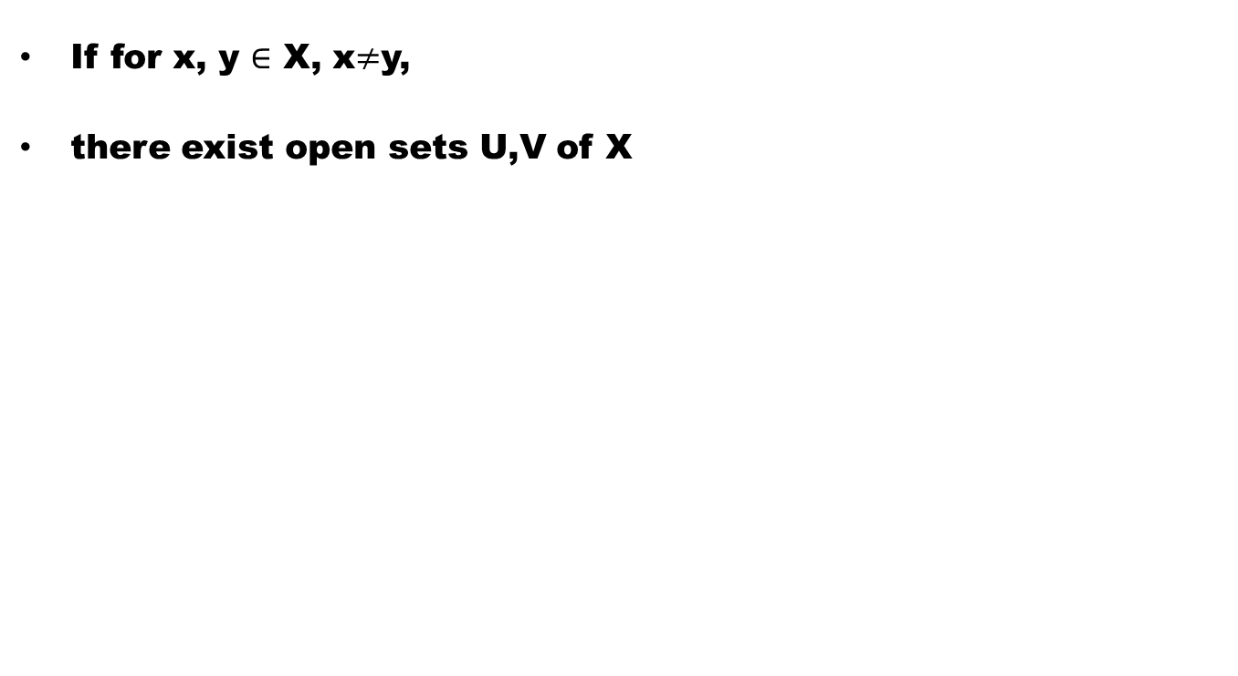
Definition ($T_{1}−$Space)
If for x, y $∈$ X, x$≠$y,
there exist open sets U,V of X

Slide 18
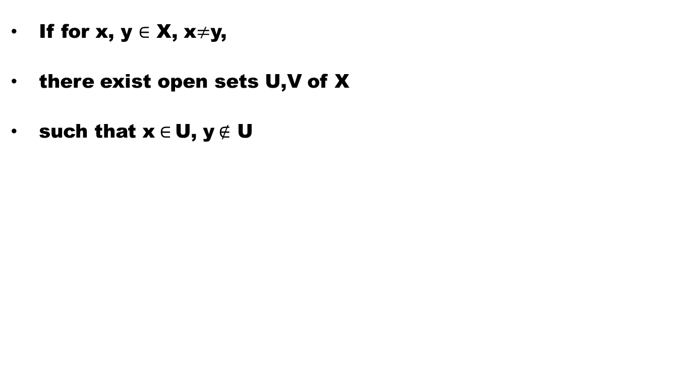
Definition ($T_{1}−$Space)
If for x, y $∈$ X, x$≠$y,
there exist open sets U,V of X
such that x$∈$U, y$∉$ U

Slide 19
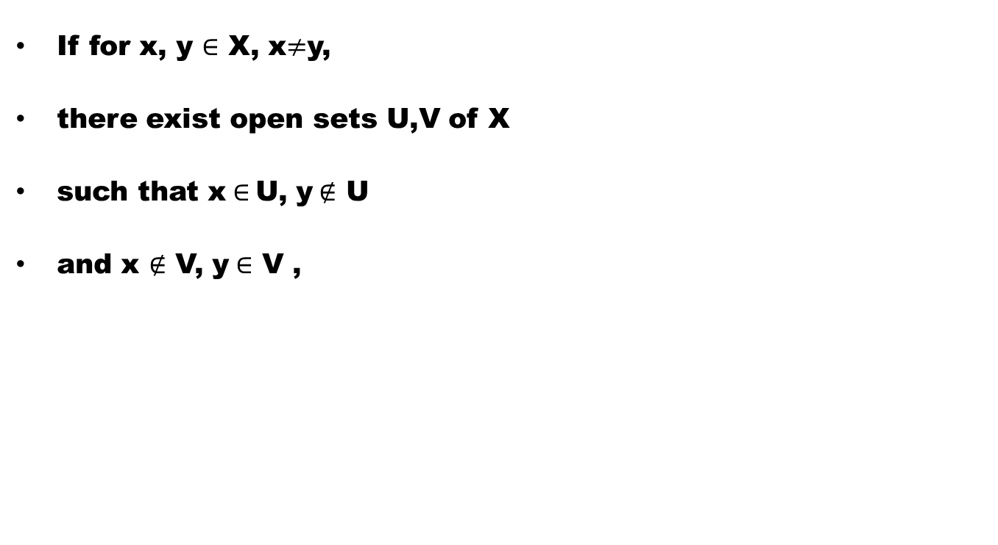
Definition ($T_{1}−$Space)
If for x, y $∈$ X, x$≠$y,
there exist open sets U,V of X
such that x$∈$U, y$∉$ U
and x$∉$V, y$∈$ V ,

Slide 20
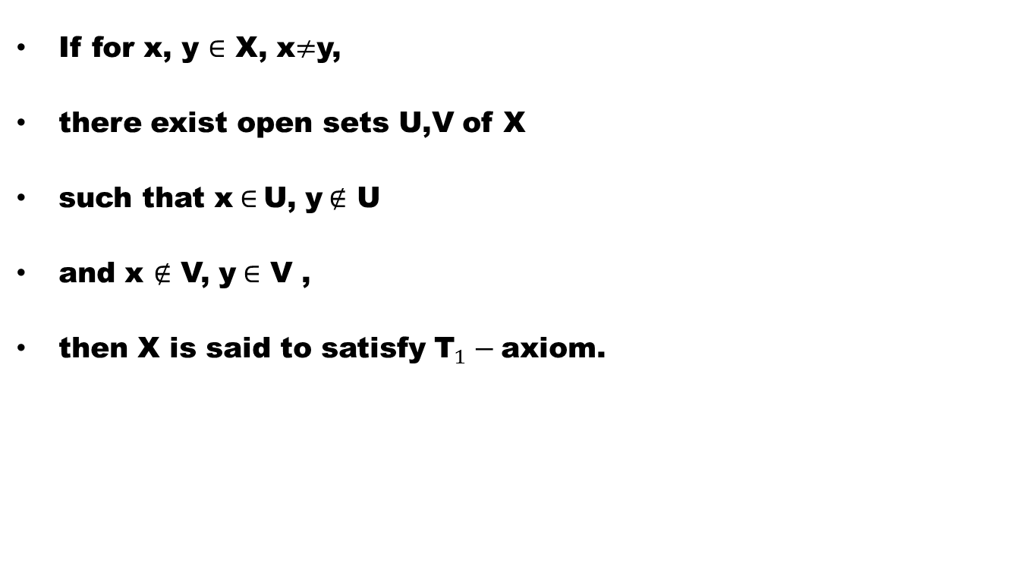
Definition ($T_{1}−$Space)
If for x, y $∈$ X, x$≠$y,
there exist open sets U,V of X
such that x$∈$U, y$∉$ U
and x$∉$V, y$∈$ V ,
then X is said to satisfy ${\text{T}}_{1}−$axiom.

Slide 21
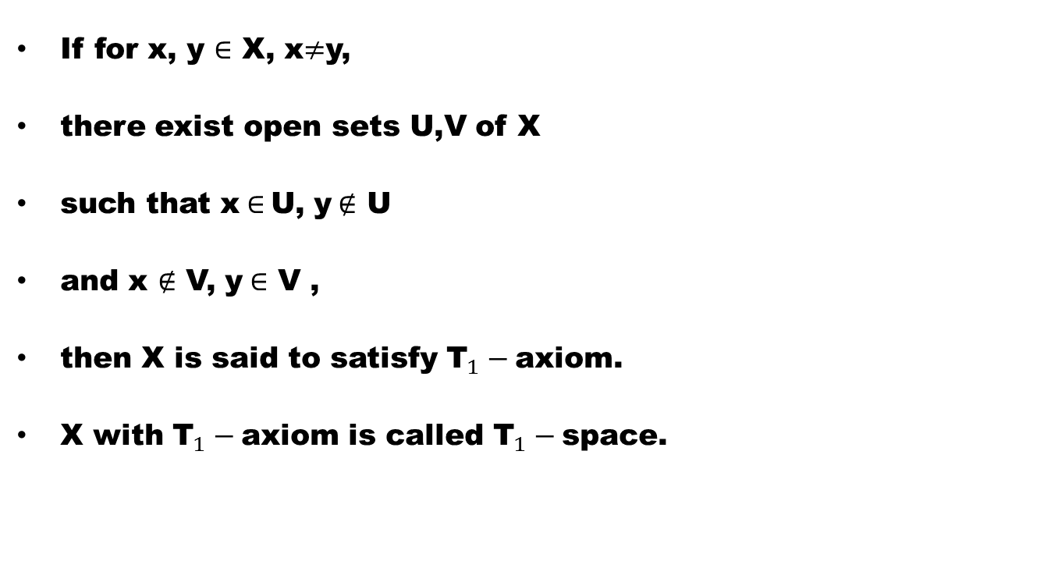
Definition ($T_{1}−$Space)
If for x, y $∈$ X, x$≠$y,
there exist open sets U,V of X
such that x$∈$U, y$∉$ U
and x$∉$V, y$∈$ V ,
then X is said to satisfy ${\text{T}}_{1}−$axiom.
X with ${\text{T}}_{1}−$axiom is called ${\text{T}}_{1}−$space.

Slide 22
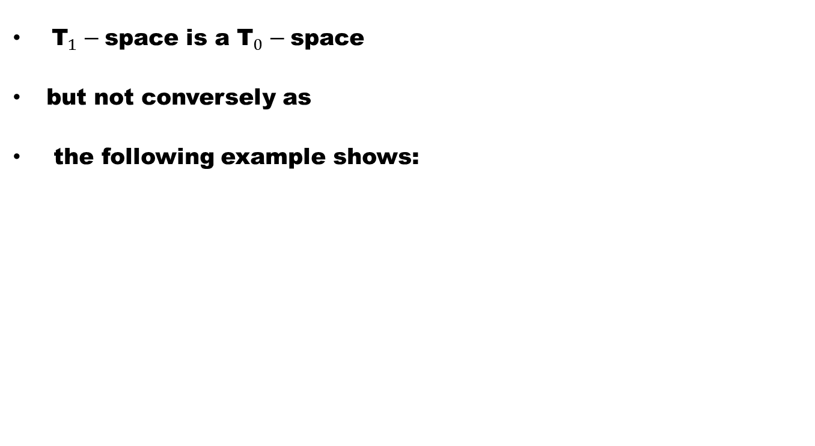
Remark
${\text{T}}_{1}−$space is a ${\text{T}}_{0}−$space
but not conversely as
the following example shows:

Slide 23
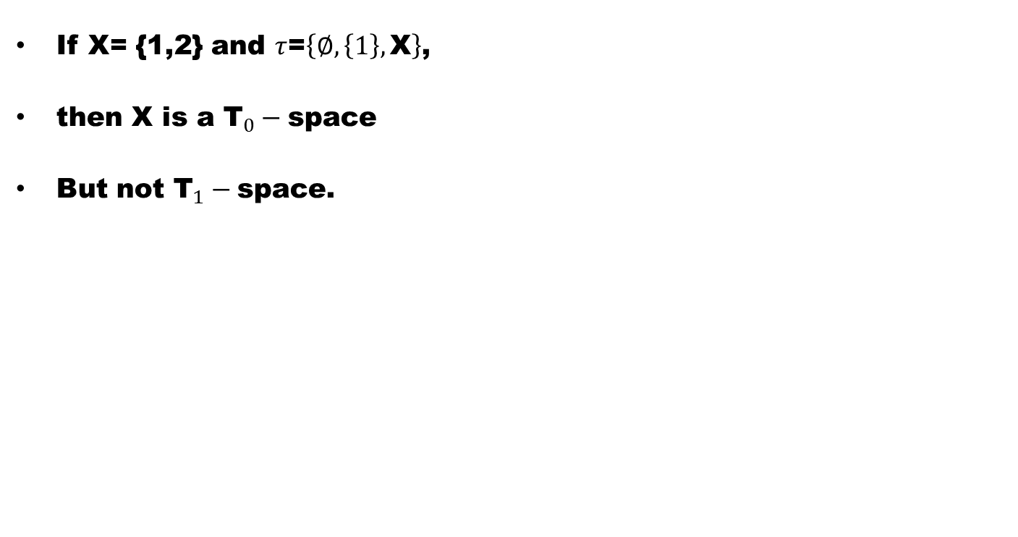
Example
If X= {1,2} and $τ$=$\left\{∅,\left\{1\right\},\text{X}\right\}$,
then X is a ${\text{T}}_{0}−$space
But not ${\text{T}}_{1}−$space.

Slide 24
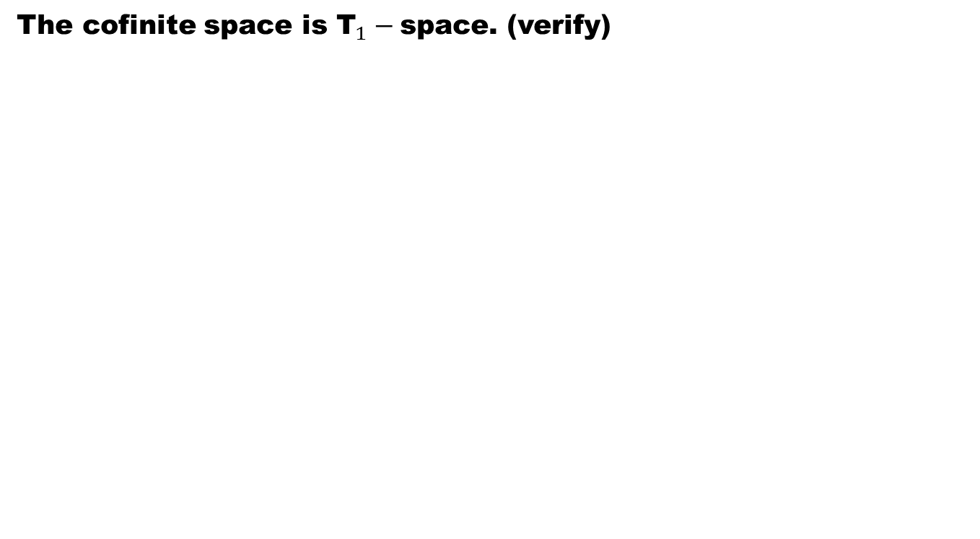
Example
The cofinite space is ${\text{T}}_{1}−$space. (verify)

Slide 25
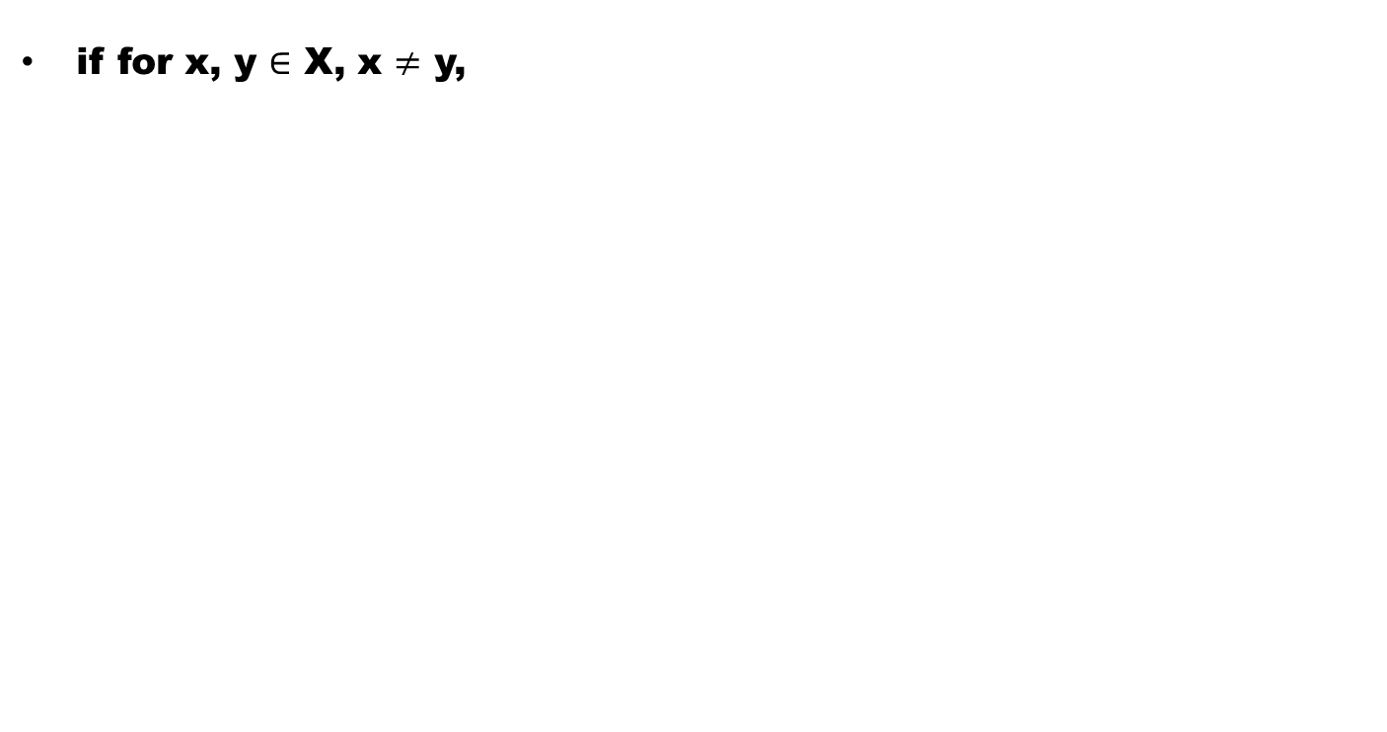

Definition (${\text{T}}_{2}−$space)
if for x, y $∈$ X, x $≠$ y,

Slide 26
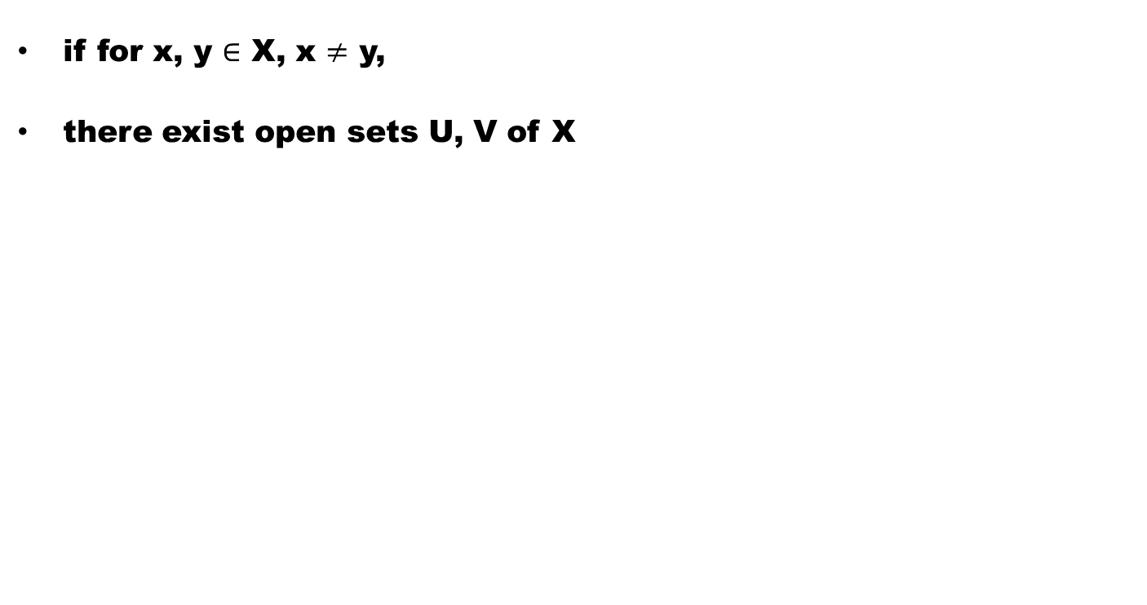
Definition (${\text{T}}_{2}−$space)
if for x, y $∈$ X, x $≠$ y,
there exist open sets U, V of X

Slide 27
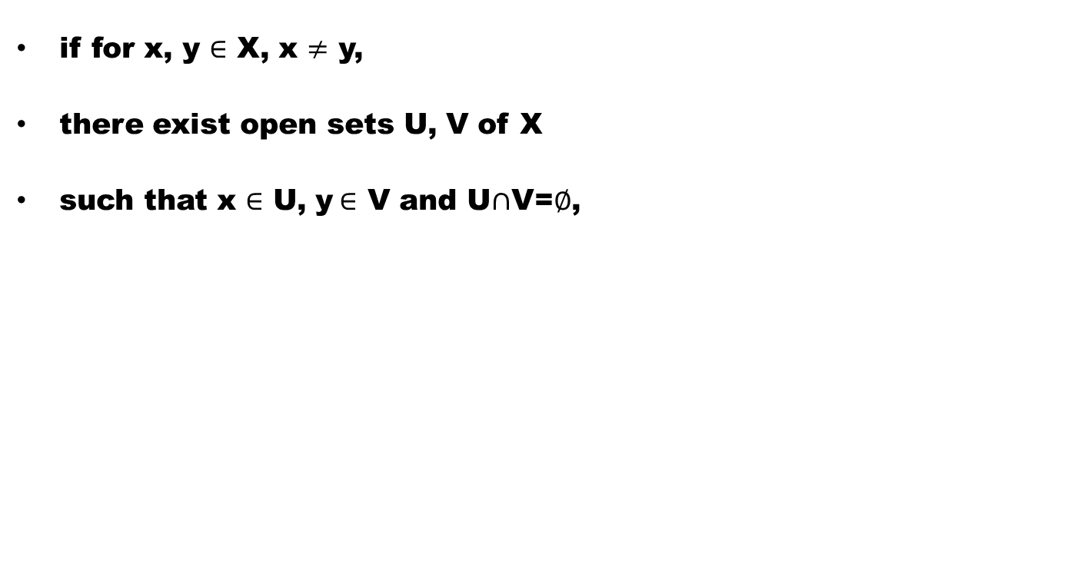
Definition (${\text{T}}_{2}−$space)
if for x, y $∈$ X, x $≠$ y,
there exist open sets U, V of X
such that x $∈$ U, y$∈$ V and U$∩$V=$∅$,

Slide 28
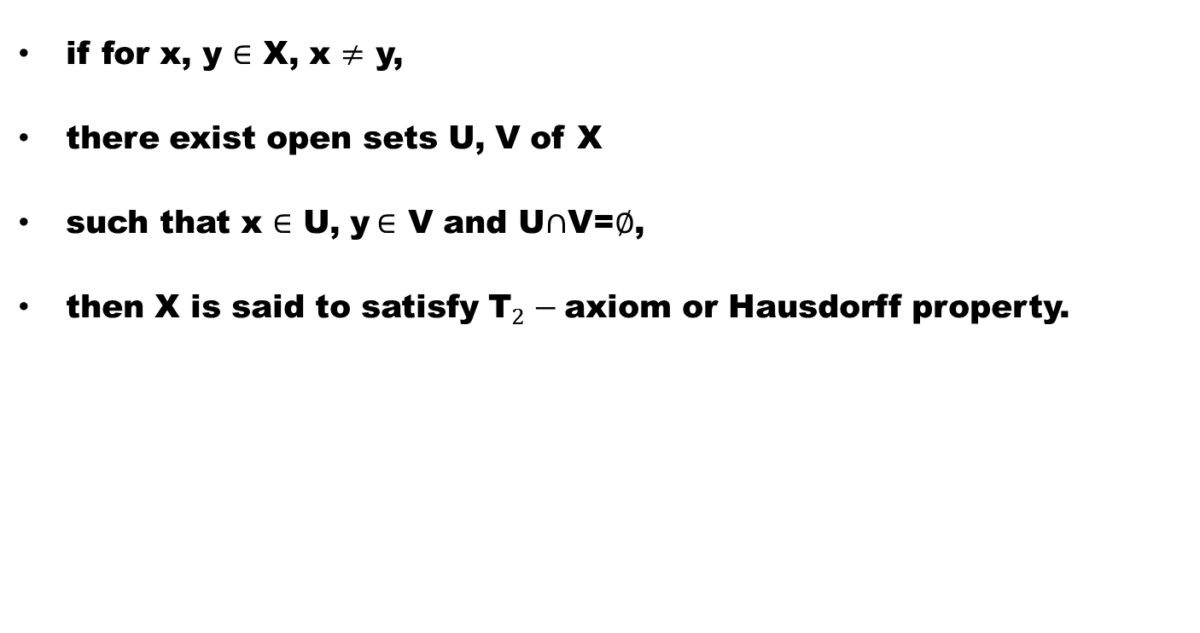
Definition (${\text{T}}_{2}−$space)
if for x, y $∈$ X, x $≠$ y,
there exist open sets U, V of X
such that x $∈$ U, y$∈$ V and U$∩$V=$∅$,
then X is said to satisfy ${\text{T}}_{2}−$axiom or Hausdorff property.

Slide 29
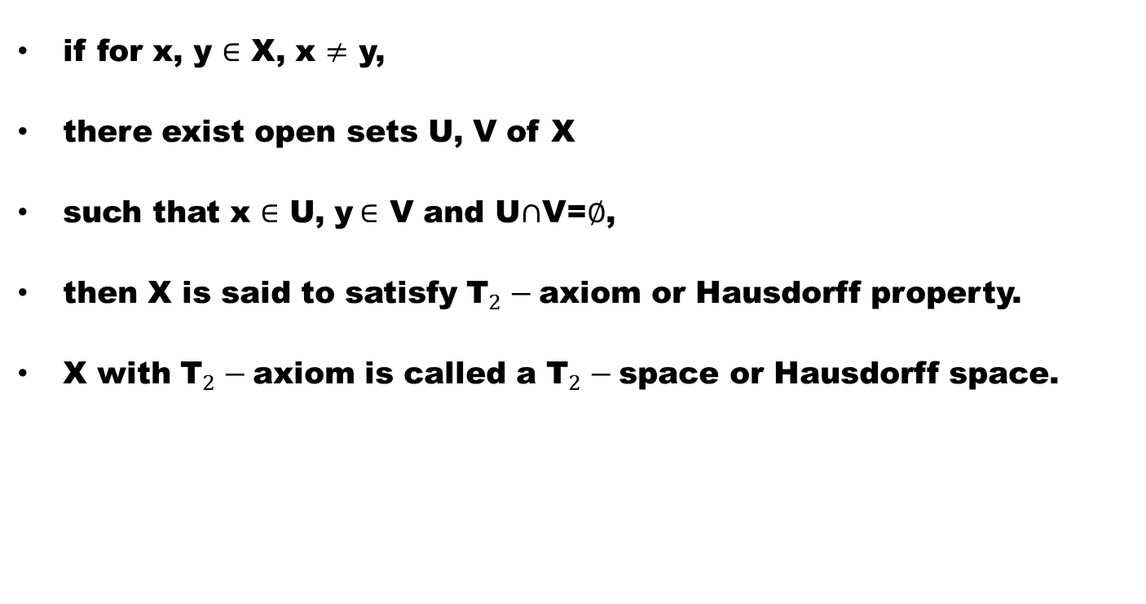
Definition (${\text{T}}_{2}−$space)
if for x, y $∈$ X, x $≠$ y,
there exist open sets U, V of X
such that x $∈$ U, y$∈$ V and U$∩$V=$∅$,
then X is said to satisfy ${\text{T}}_{2}−$axiom or Hausdorff property.
X with ${\text{T}}_{2}−$axiom is called a ${\text{T}}_{2}−$space or Hausdorff space.

Slide 30
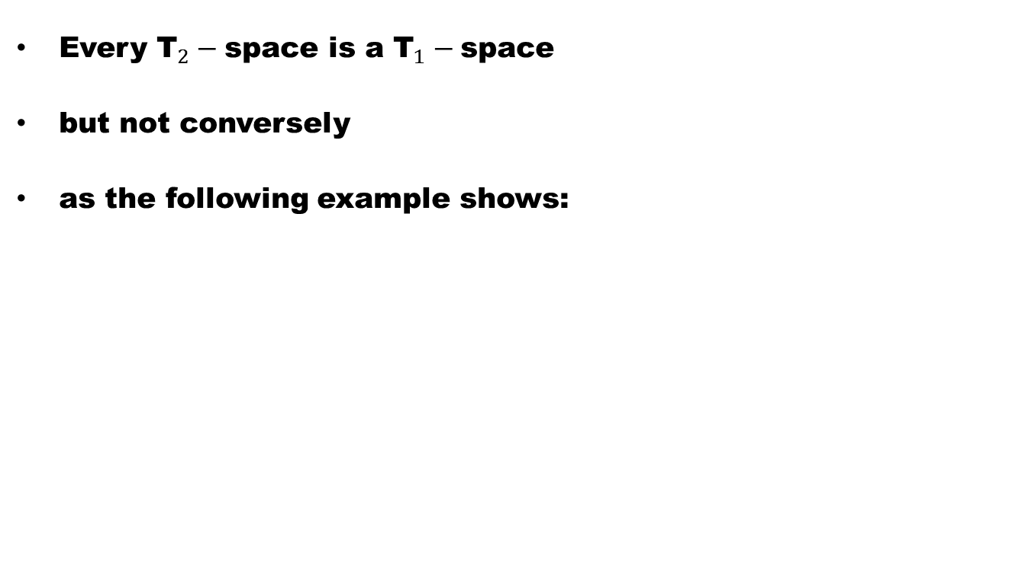
Remark
Every ${\text{T}}_{2}−$space is a ${\text{T}}_{1}−$space
but not conversely
as the following example shows:

Slide 31
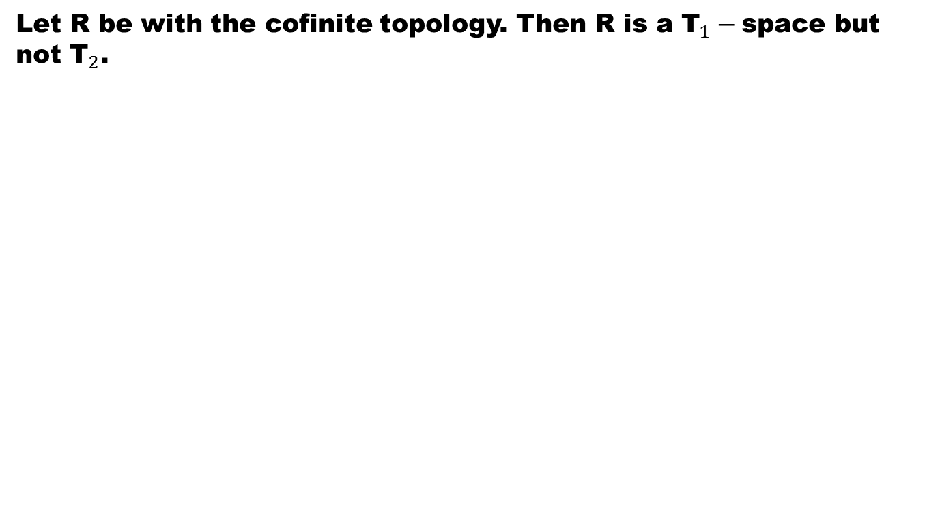
Example
Let R be with the cofinite topology. Then R is a ${\text{T}}_{1}−$space but not ${\text{T}}_{2}$.

Slide 32
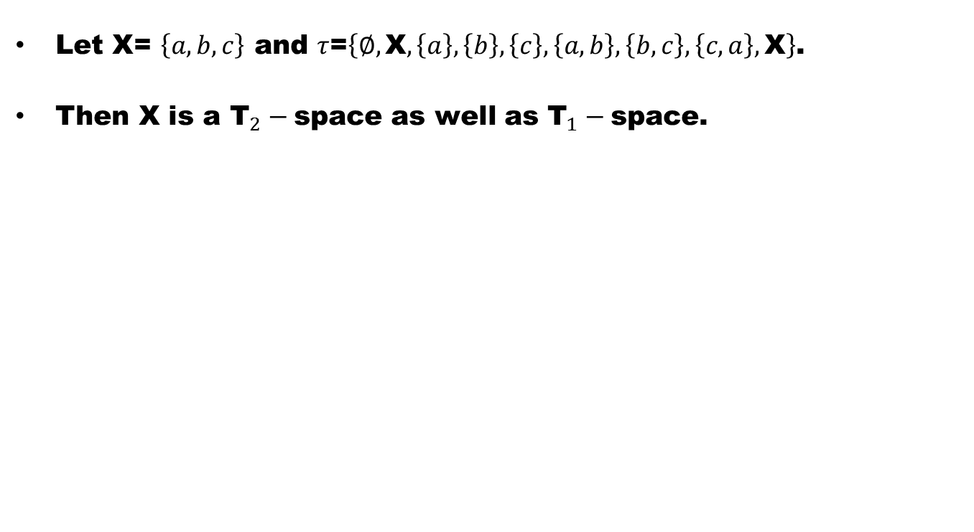
Example
Let X= $\left\{a,b,c\right\}$ and $τ$=$\left\{∅,\text{X},\left\{a\right\},\left\{b\right\},\left\{c\right\},\left\{a,b\right\},\left\{b,c\right\},\left\{c,a\right\},\text{X}\right\}$.
Then X is a ${\text{T}}_{2}−$space as well as ${\text{T}}_{1}−$space.

Slide 33
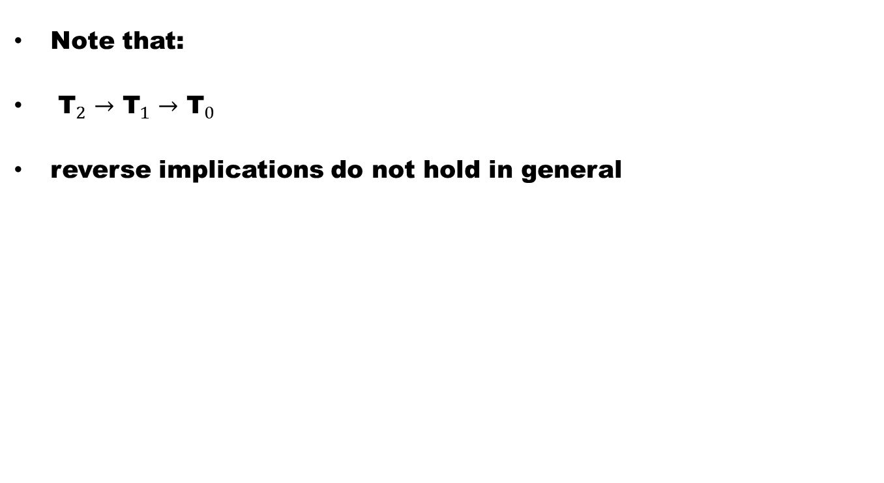
Remark
Note that:
${\text{T}}_{2}→$${\text{T}}_{1}→$${\text{T}}_{0}$
reverse implications do not hold in general

Slide 34
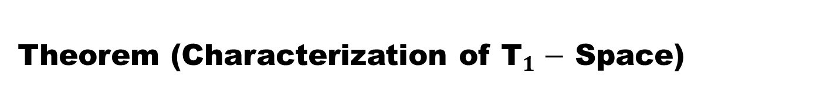
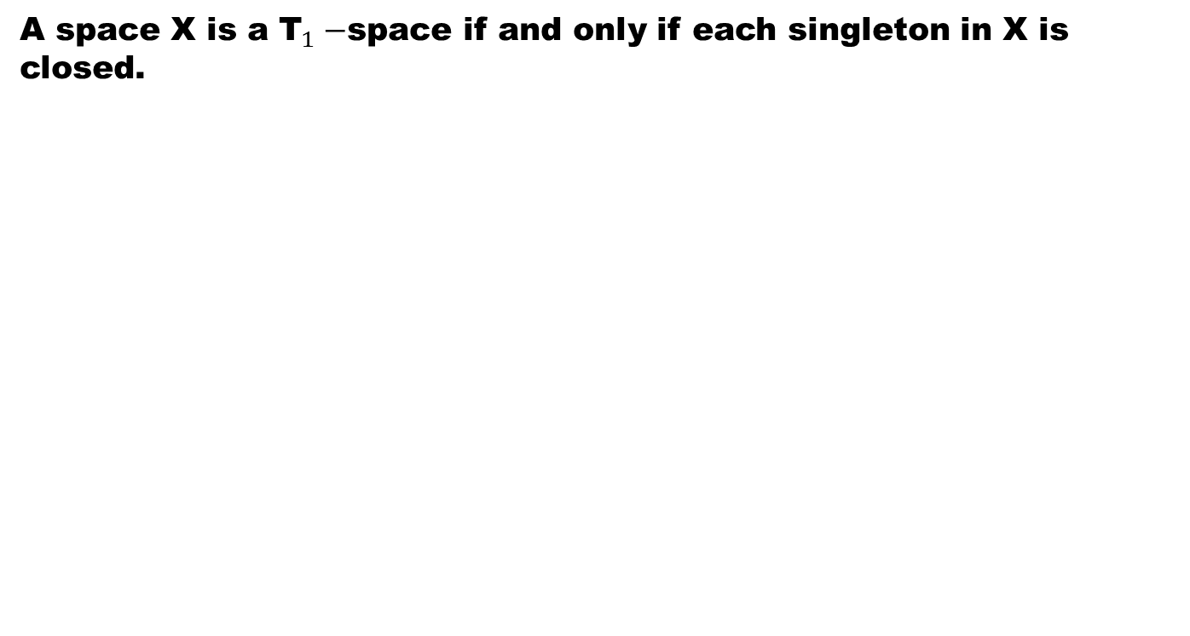
Theorem (Characterization of ${\text{T}}_{1}−$ Space)
A space X is a ${\text{T}}_{1}−$space if and only if each singleton in X is closed.

Slide 37
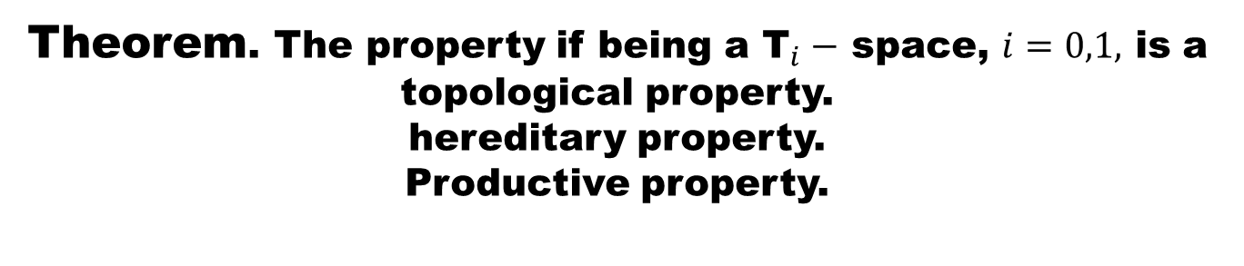
Theorem. The property if being a ${\text{T}}_{i}−$ space, $i=0,1,$ is a topological property. hereditary property.
Productive property.

Slide 42
Theorem
A bijective closed or open image of a Hausdorff space is Hausdorff. Hence the property of being a Hausdorff is topological.
Hausdorff property is hereditary.
Hausdorff property is productive.

Slide 47
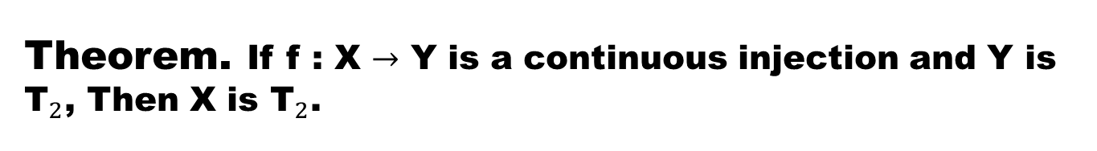
Theorem. If f : X $→$ Y is a continuous injection and Y is ${\text{T}}_{2}$, Then X is ${\text{T}}_{2}$.

Slide 49
Good Luck to You
Dear Students

