Slide 1
Set Topology
MTH 251
Lecture # 21

Slide 2
Lecture Plan
First Countable Space
Second Countable Space

Slide 3
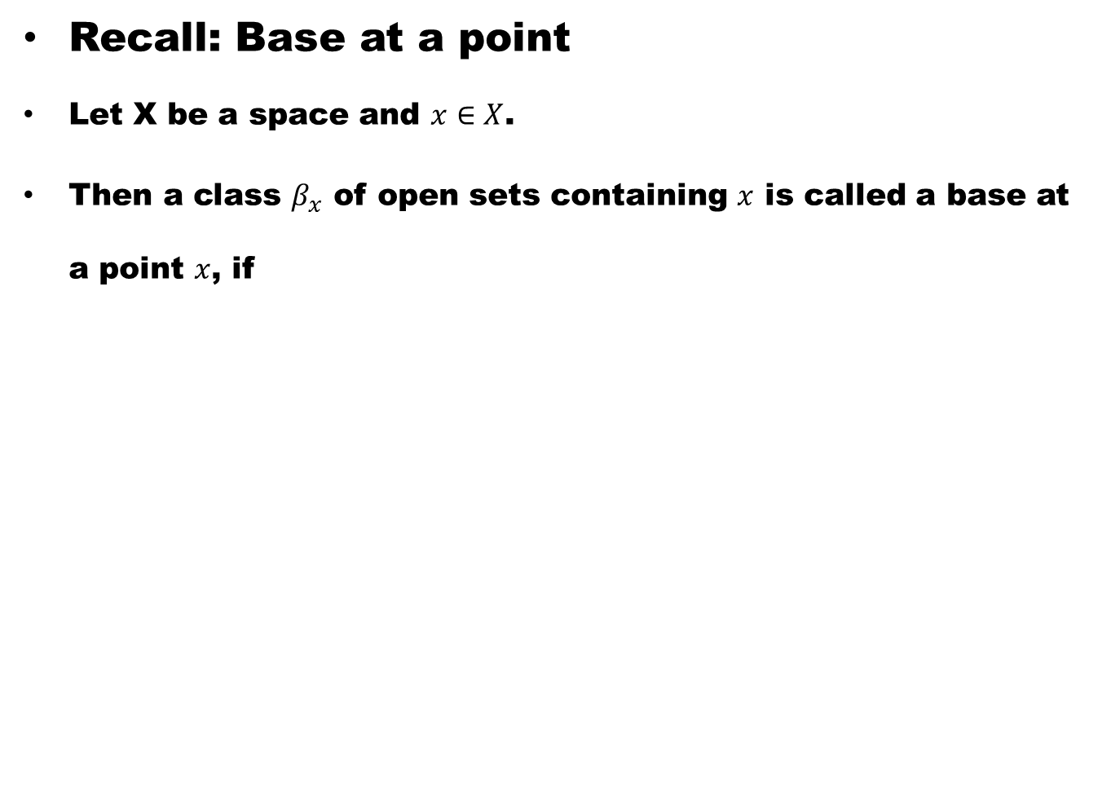
Recall: Base at a point
Let X be a space and $x∈X$.
Then a class $β_{x}$ of open sets containing $x$ is called a base at a point $x$, if

Slide 4
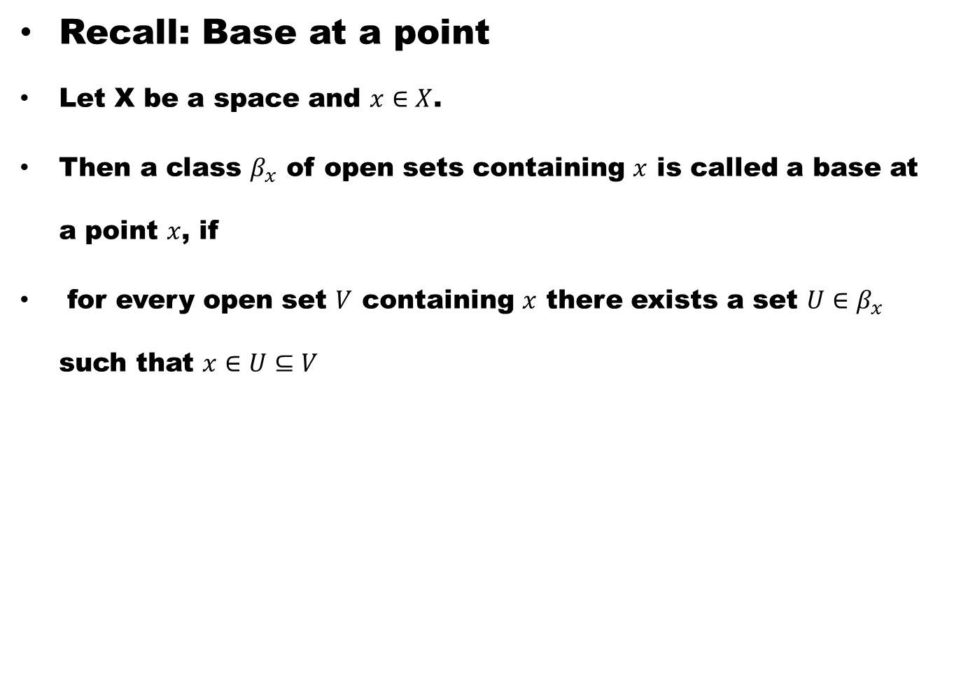
Recall: Base at a point
Let X be a space and $x∈X$.
Then a class $β_{x}$ of open sets containing $x$ is called a base at a point $x$, if
for every open set $V$ containing $x$ there exists a set $U∈β_{x}$ such that $x∈U⊆V$

Slide 5
Definition. First Countable Space
A space X is said to be first countable

Slide 6
Definition. First Countable Space
A space X is said to be first countable
(or to satisfy the first axiom of countability)

Slide 7
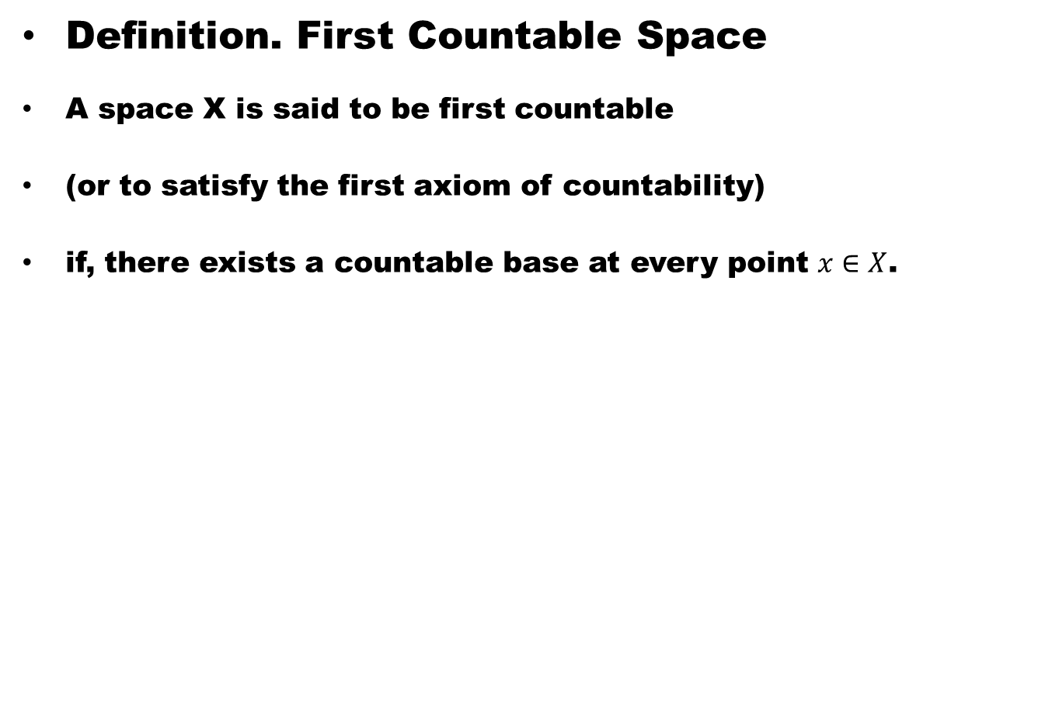
Definition. First Countable Space
A space X is said to be first countable
(or to satisfy the first axiom of countability)
if, there exists a countable base at every point $x∈X$.

Slide 8
Example.
Let X be a discrete space.

Slide 9
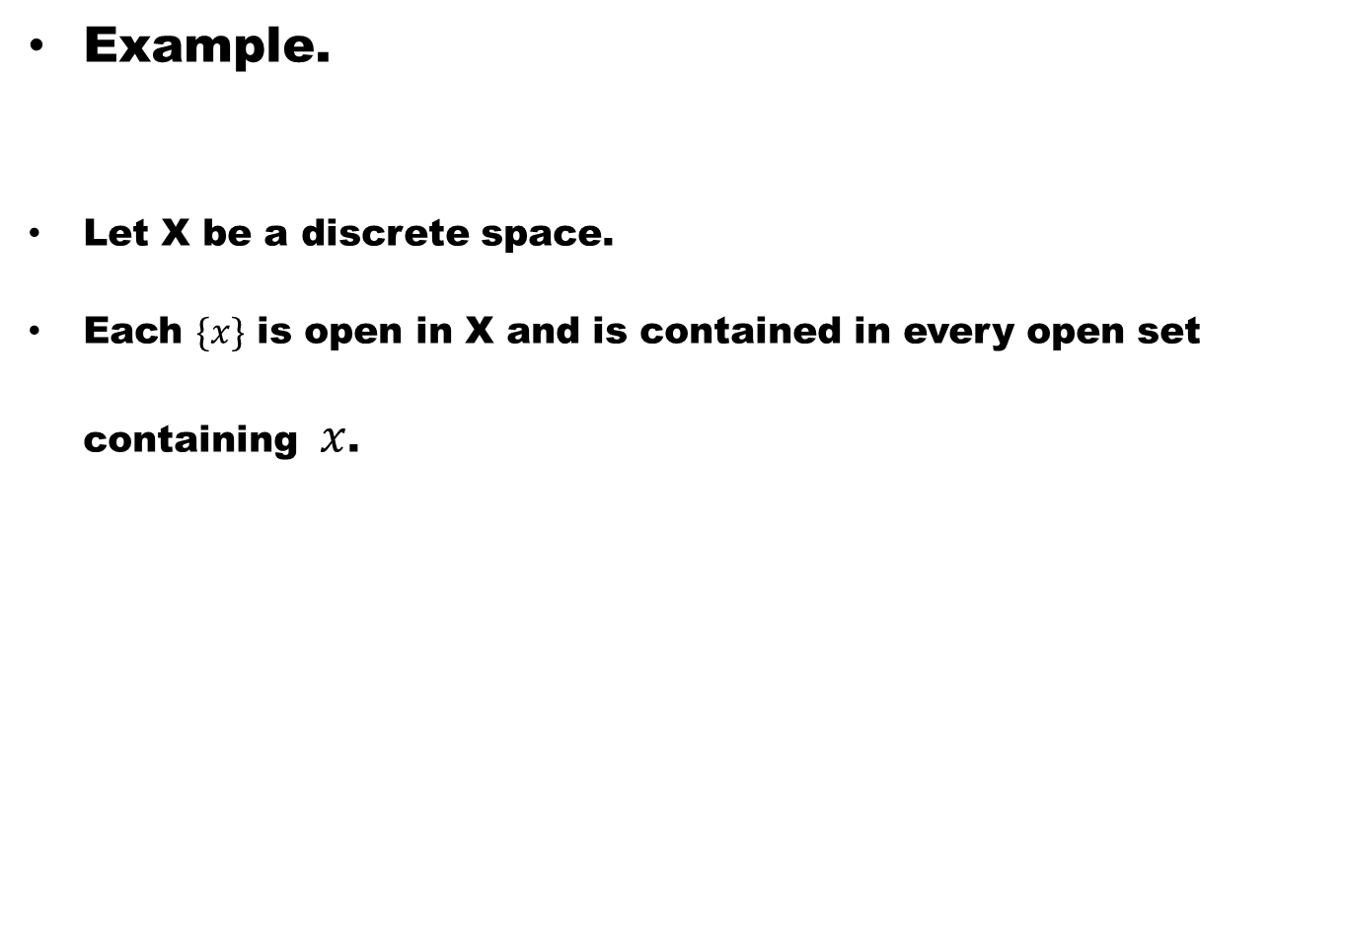
Example.
Let X be a discrete space.
Each $\{x\}$ is open in X and is contained in every open set containing $x$.

Slide 10
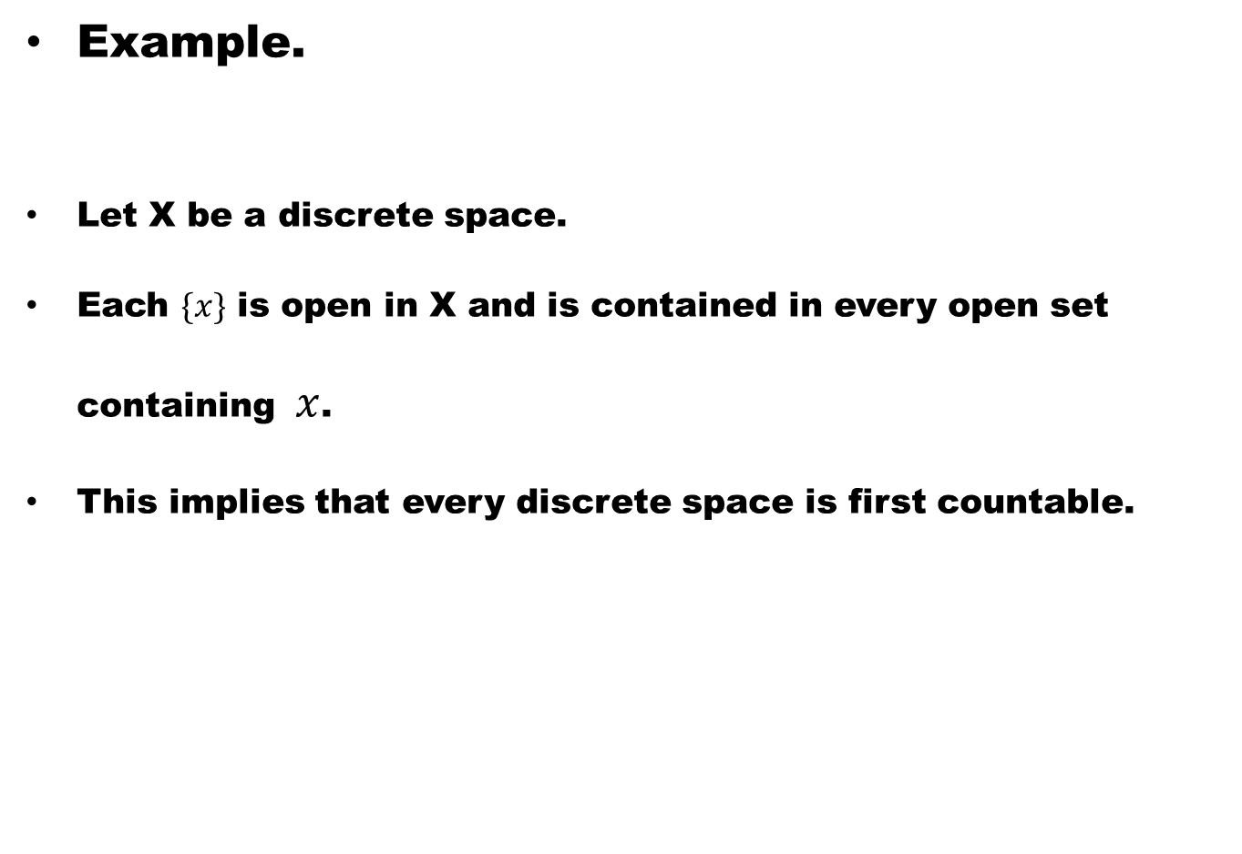
Example.
Let X be a discrete space.
Each $\{x\}$ is open in X and is contained in every open set containing $x$.
This implies that every discrete space is first countable.

Slide 11

$Definition$ (second Countable Space)
A space X is said to be second countable

Slide 12
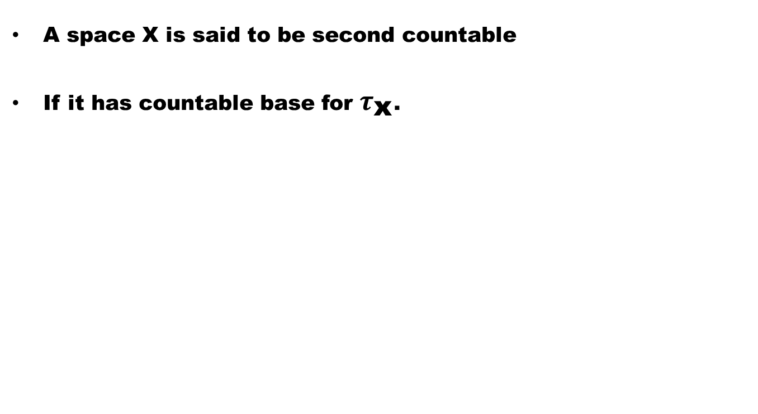
$Definition$ (second Countable Space)
A space X is said to be second countable
If it has countable base for $τ_{\text{x}}$.

Slide 13
Remark
Every second countable space is first countable.

Slide 14
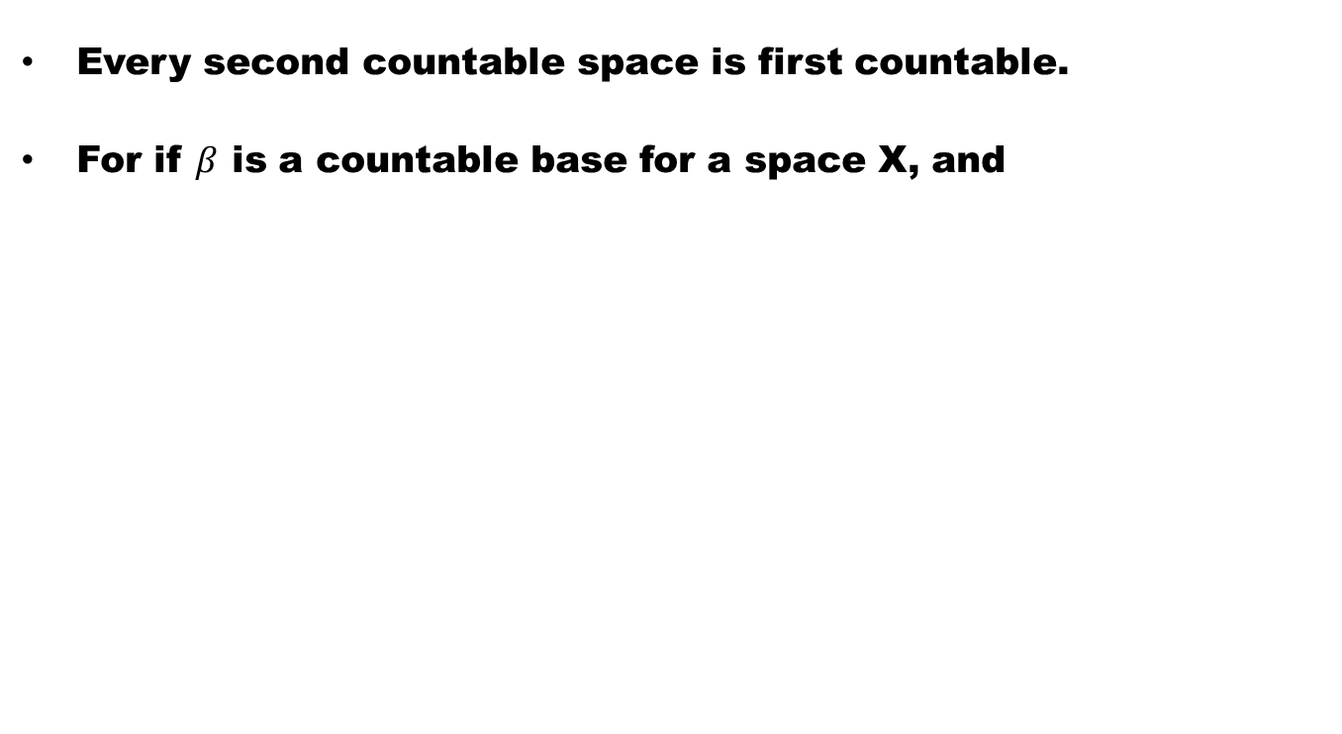
Remark
Every second countable space is first countable.
For if $β$ is a countable base for a space X, and

Slide 15
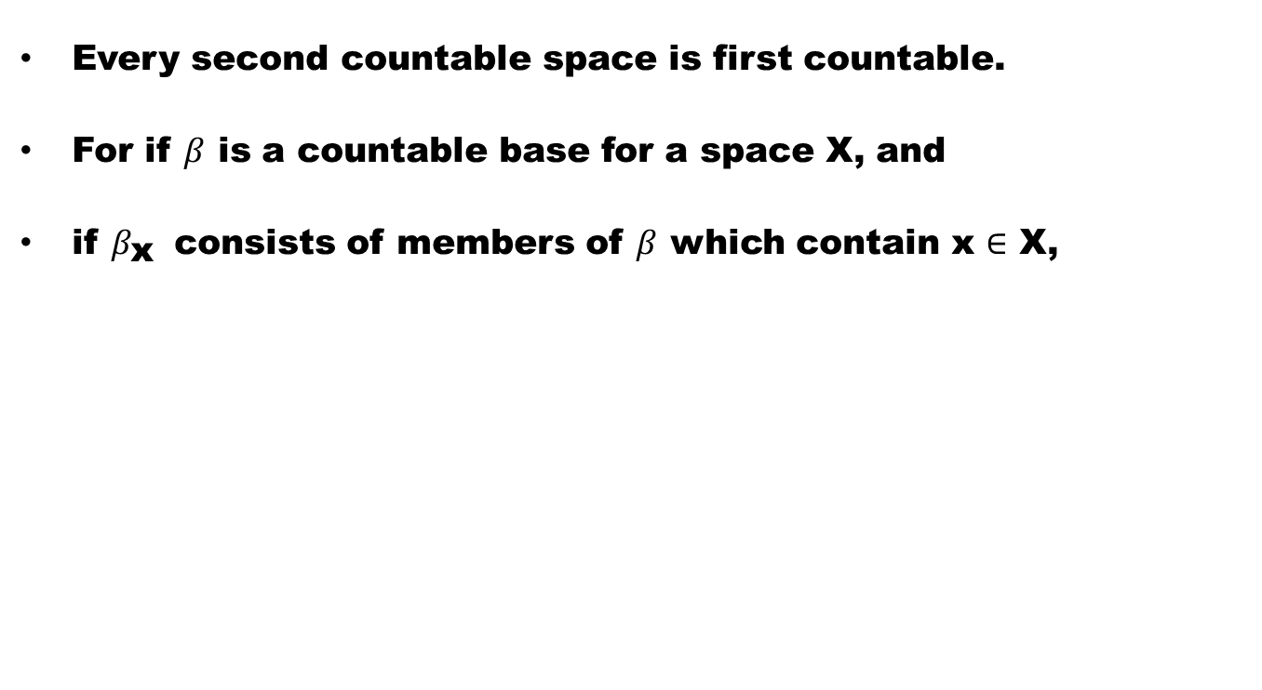
Remark
Every second countable space is first countable.
For if $β$ is a countable base for a space X, and
if $β_{\text{x}}$ consists of members of $β$ which contain x $∈$ X,

Slide 16
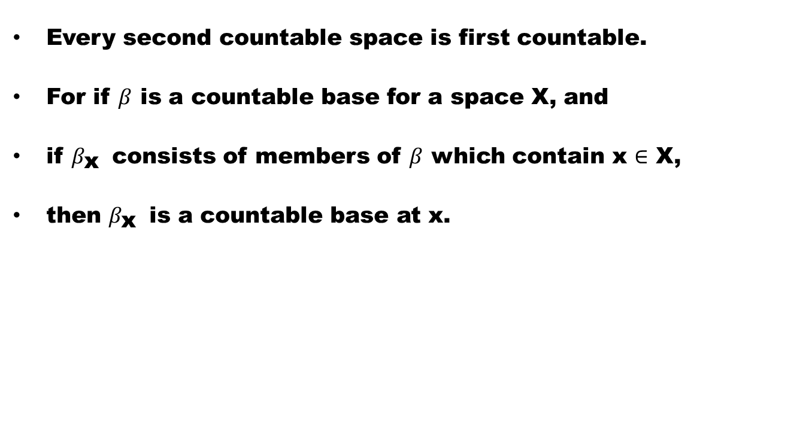
Remark
Every second countable space is first countable.
For if $β$ is a countable base for a space X, and
if $β_{\text{x}}$ consists of members of $β$ which contain x $∈$ X,
then $β_{\text{x}}$ is a countable base at x.

Slide 17
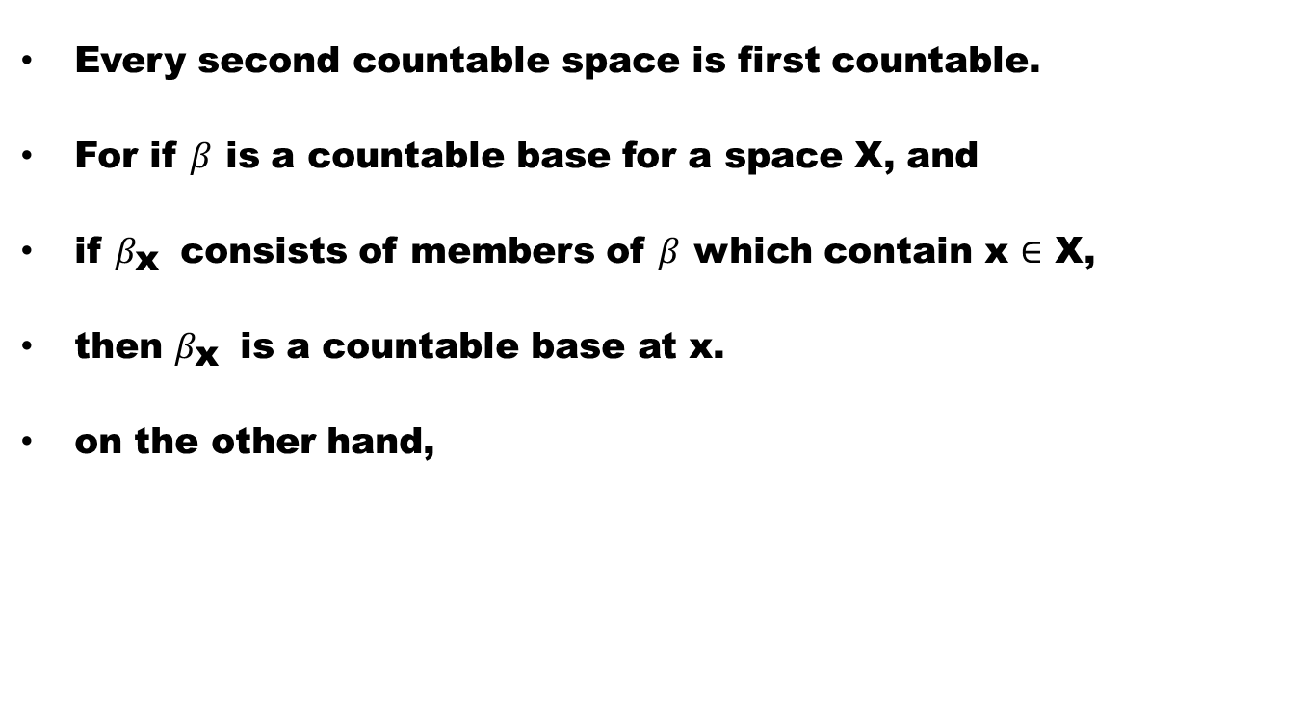
Remark
Every second countable space is first countable.
For if $β$ is a countable base for a space X, and
if $β_{\text{x}}$ consists of members of $β$ which contain x $∈$ X,
then $β_{\text{x}}$ is a countable base at x.
on the other hand,

Slide 18
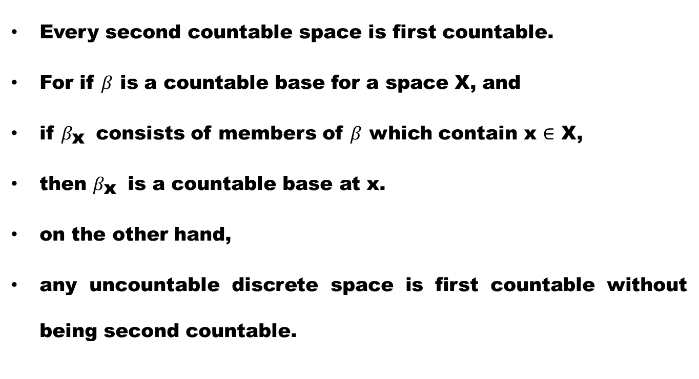
Remark
Every second countable space is first countable.
For if $β$ is a countable base for a space X, and
if $β_{\text{x}}$ consists of members of $β$ which contain x $∈$ X,
then $β_{\text{x}}$ is a countable base at x.
on the other hand,
any uncountable discrete space is first countable without being second countable.

Slide 19
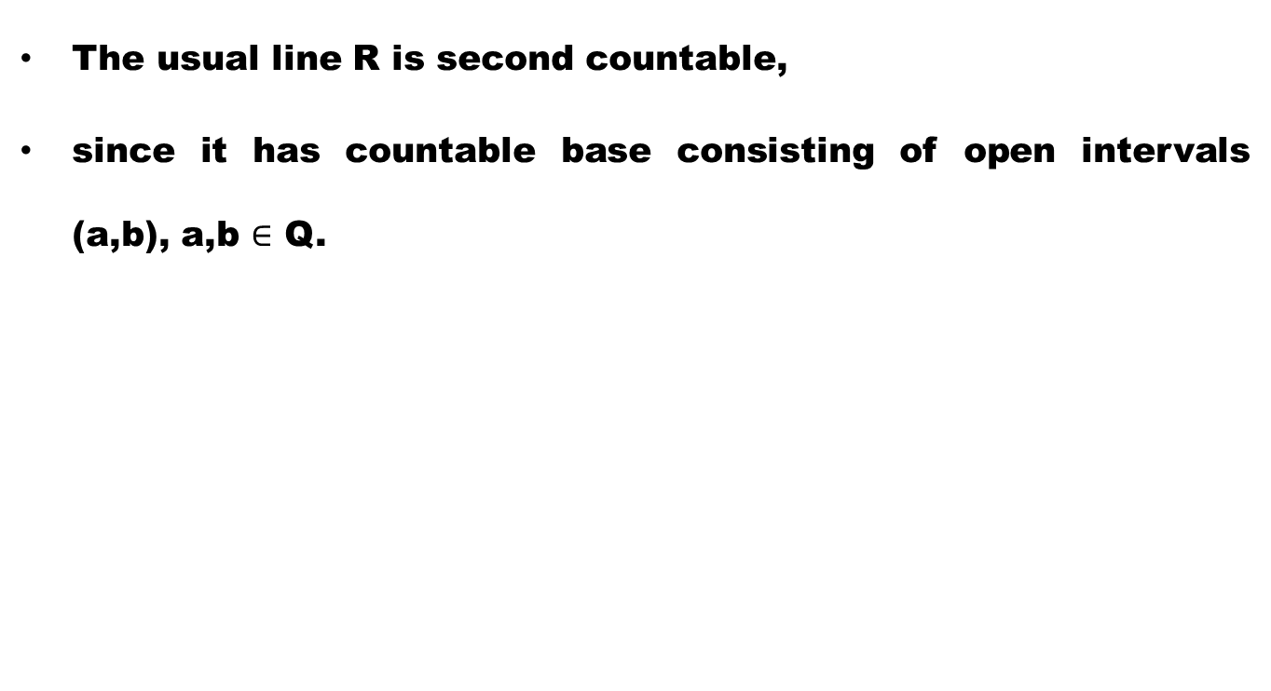
Example
The usual line R is second countable,
since it has countable base consisting of open intervals (a,b), a,b $∈$ Q.

Slide 20
Example
Let R have the discrete topology.
Then any base for this topology contains singletons
and hence cannot be a second countable space.

Slide 21
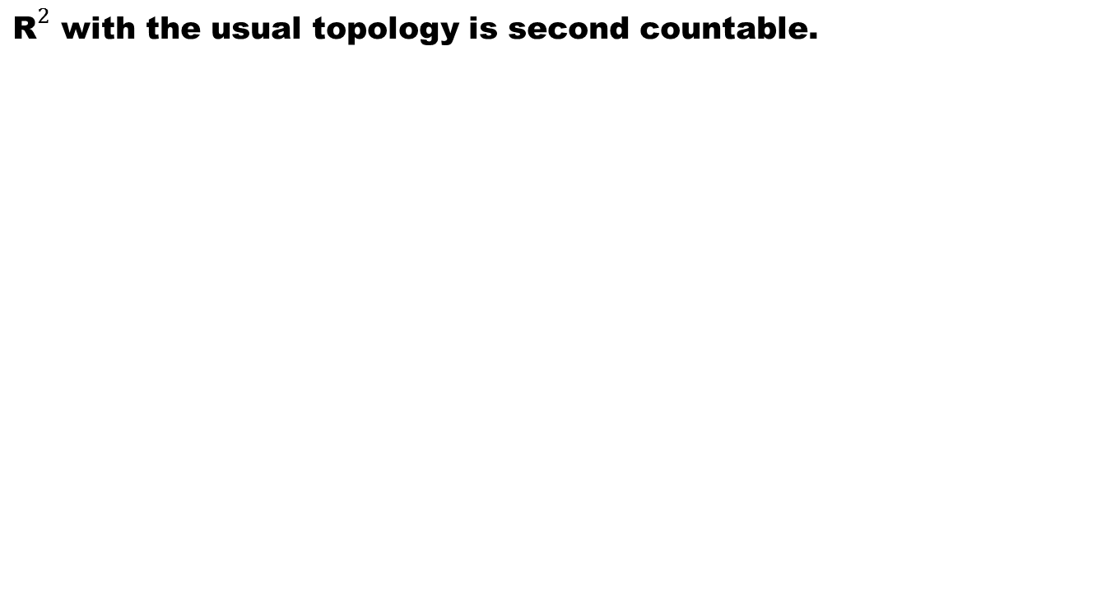
Example
${\text{R}}^{2}$ with the usual topology is second countable.

Slide 22
Theorem. The continuous open surjective image of a second countable space is second countable.

Slide 24
Corolary
Second countability is a topological property

Slide 25
Theorem. First countability is preserved under open continuous surjection

Slide 27
Good Luck To You
Dear Students

