Slide 1
Set Topology
MTH 251
Lecture # 20

Slide 2
Lecture Plan
Topological property
Subspaces
Continuity w.r.t. spaces and subspaces

Slide 3
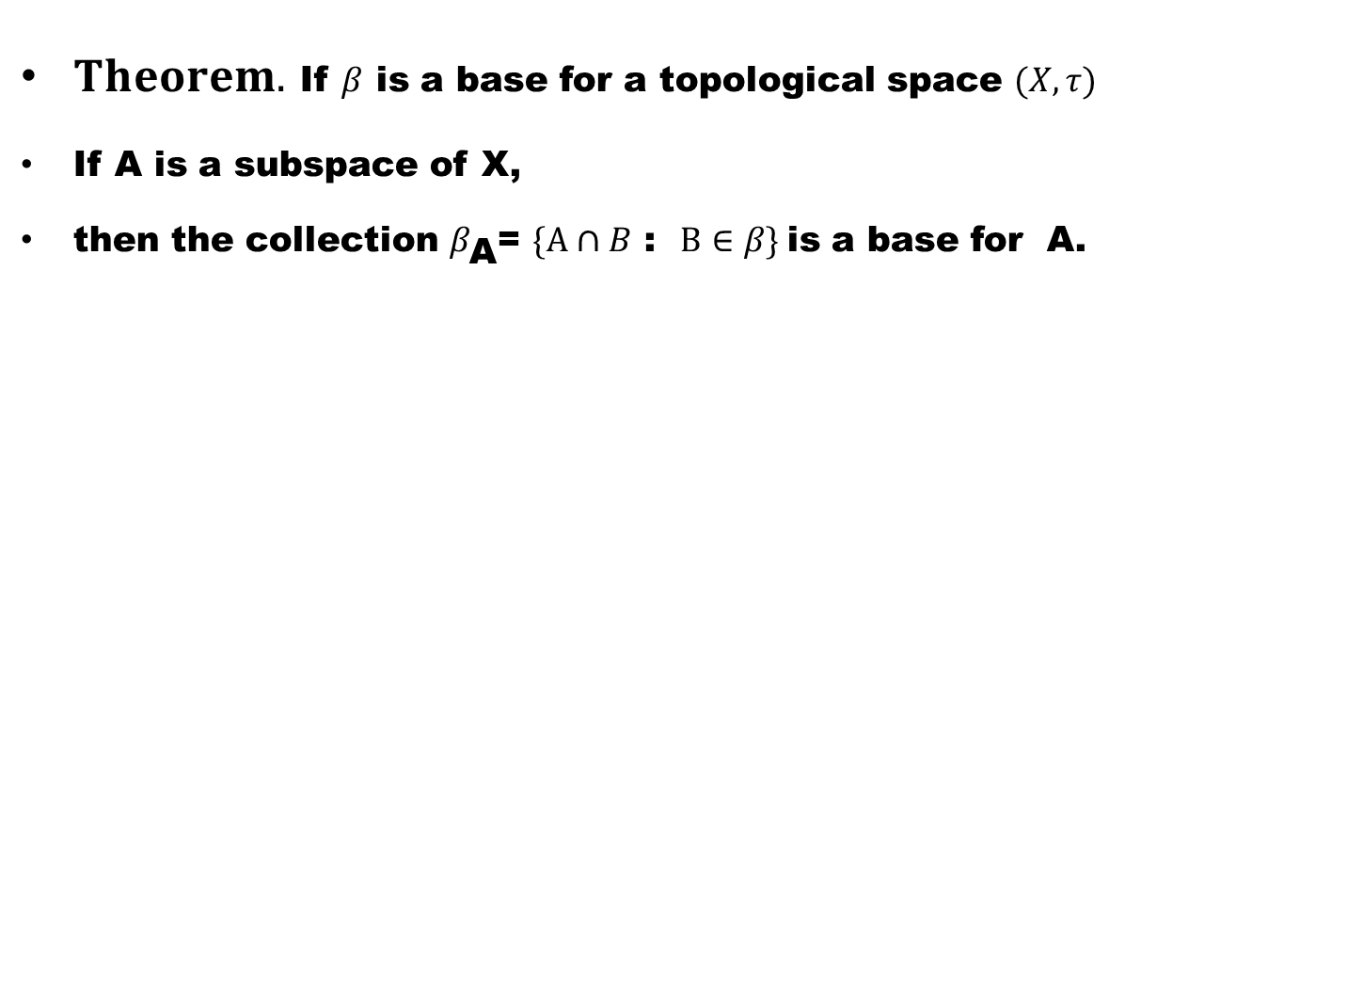
$Theorem.$ If $β$ is a base for a topological space $(X,τ)$
If A is a subspace of X,
then the collection $β_{\text{A}}$= $\{A∩B$ : $B∈β\}$is a base for A.

Slide 4
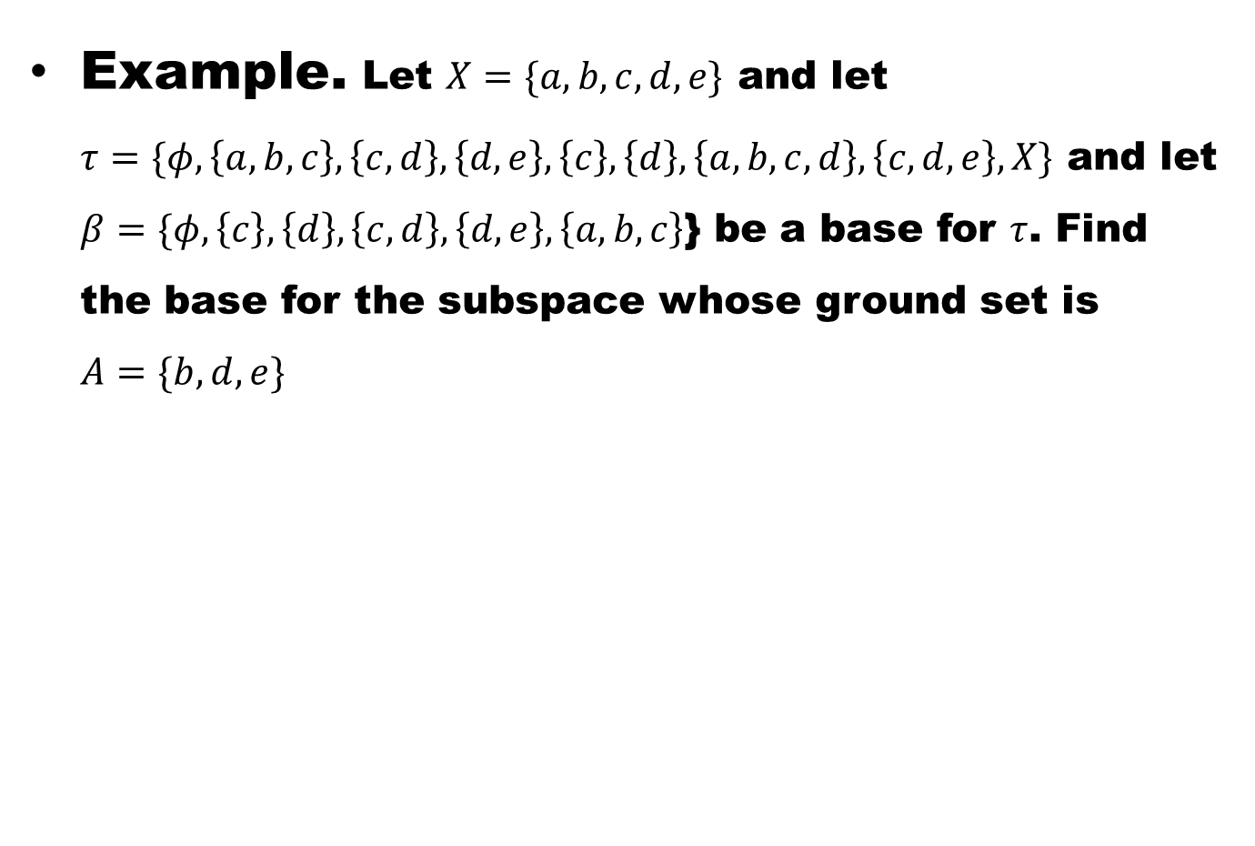
Example. Let $X=\{a,b,c,d,e\}$ and let $τ=\{φ,\left\{a,b,c\right\},\left\{c,d\right\},\left\{d,e\right\},\left\{c\right\},\left\{d\right\},\left\{a,b,c,d\right\}, \left\{c,d,e\right\},X\}$ and let $β=\{φ,\left\{c\right\},\left\{d\right\},\left\{c,d\right\},\left\{d,e\right\},\left\{a,b,c\right\}$} be a base for $τ$. Find the base for the subspace whose ground set is $A=\{b,d,e\}$

Slide 5
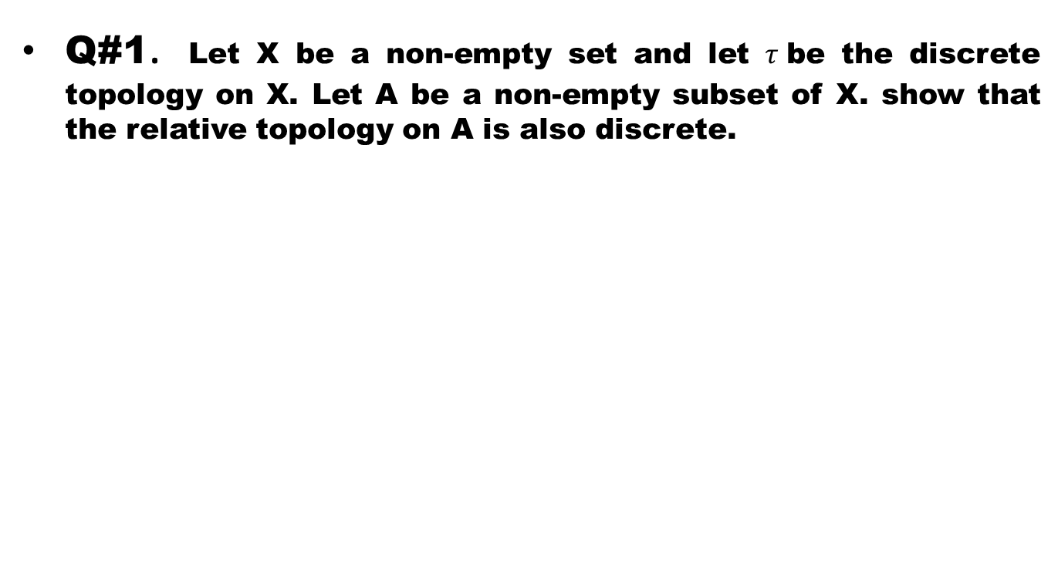
Exercise
Q#1. Let X be a non-empty set and let $τ$be the discrete topology on X. Let A be a non-empty subset of X. show that the relative topology on A is also discrete.

Slide 6
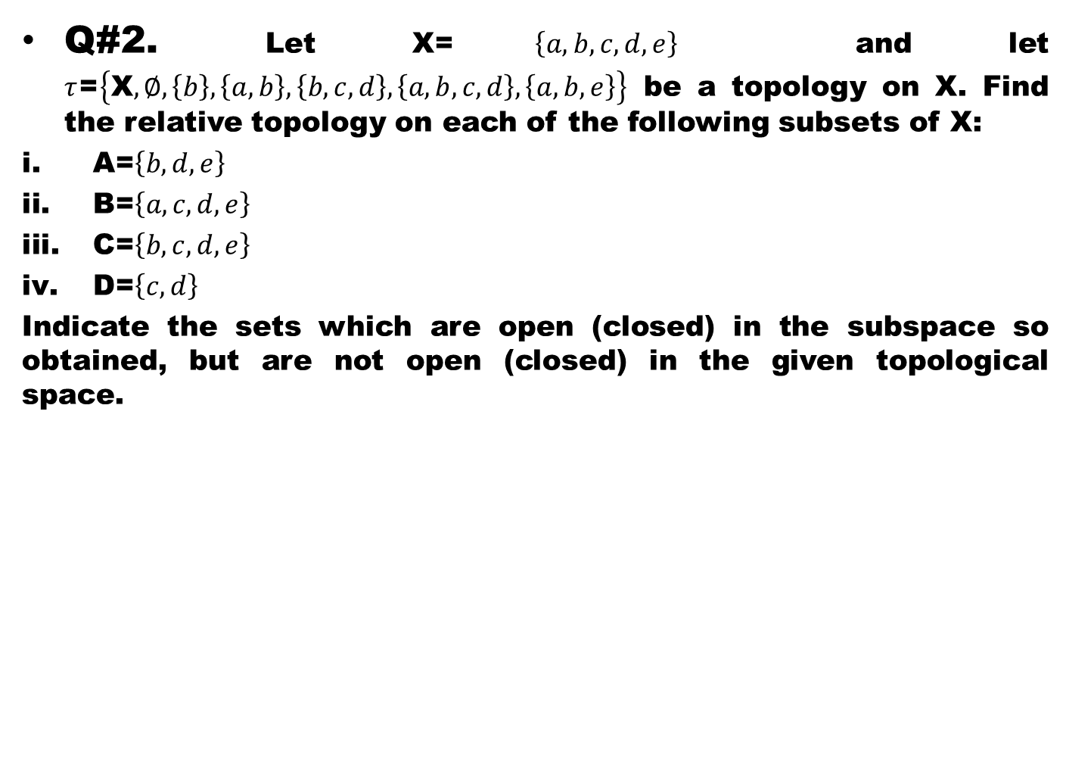
Q#2. Let X=$\left\{a,b,c,d,e\right\}$ and let $τ$=$\left\{\text{X},∅,\left\{b\right\},\left\{a,b\right\},\left\{b,c,d\right\},\left\{a,b,c,d\right\},\left\{a,b,e\right\}\right\}$ be a topology on X. Find the relative topology on each of the following subsets of X:
A=$\left\{b,d,e\right\}$
B=$\left\{a,c,d,e\right\}$
C=$\left\{b,c,d,e\right\}$
D=$\left\{c,d\right\}$
Indicate the sets which are open (closed) in the subspace so obtained, but are not open (closed) in the given topological space.

Slide 7
Q#3. if A is a subspace of X and B is a subspace of A, prove that B is subspace of X.

Slide 8
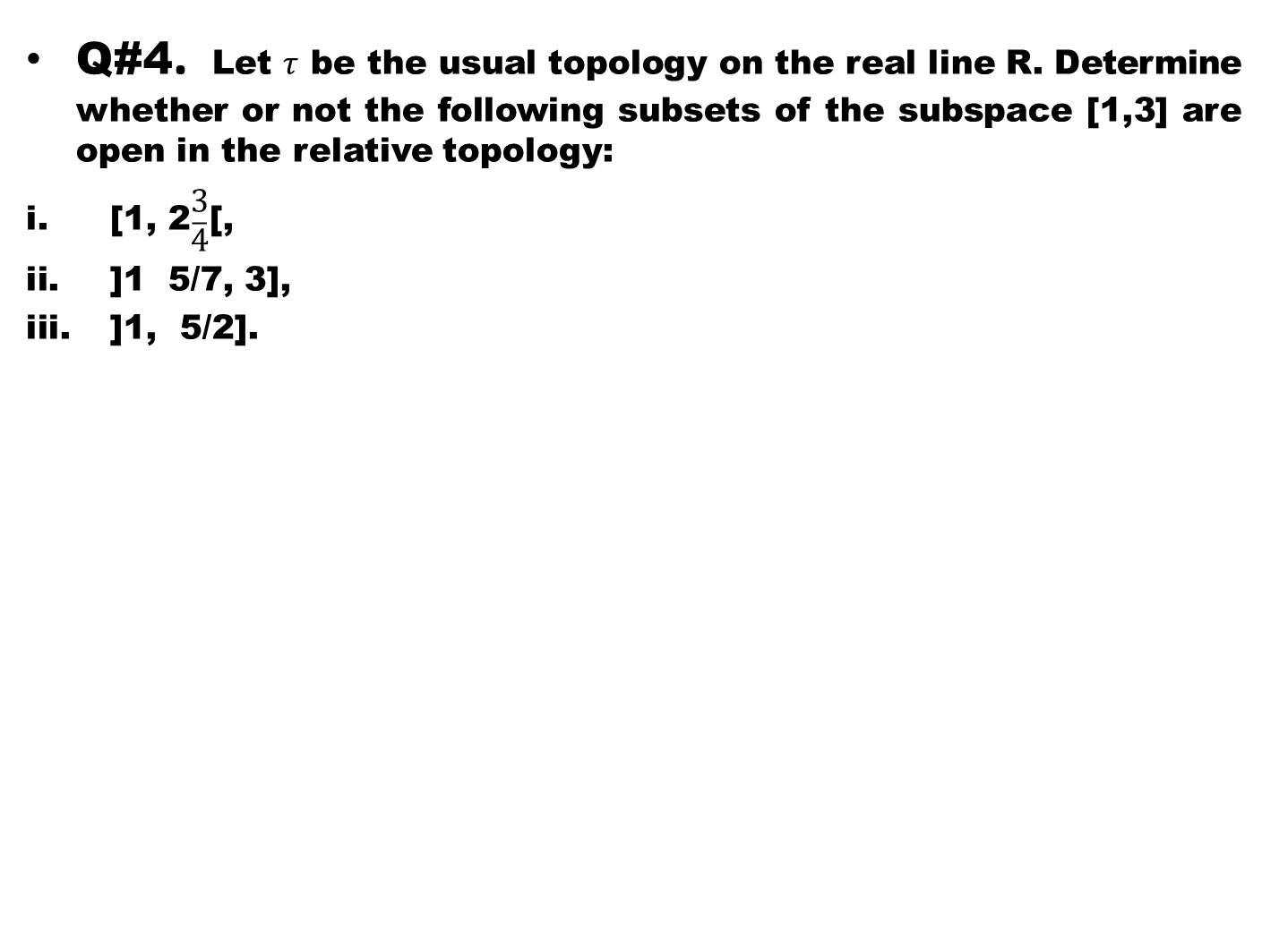
Q#4. Let $τ$ be the usual topology on the real line R. Determine whether or not the following subsets of the subspace [1,3] are open in the relative topology:
[1, 2$\begin{matrix}3 \\ \overline{4}\end{matrix}$[,
]1 5/7, 3],
]1, 5/2].

Slide 9
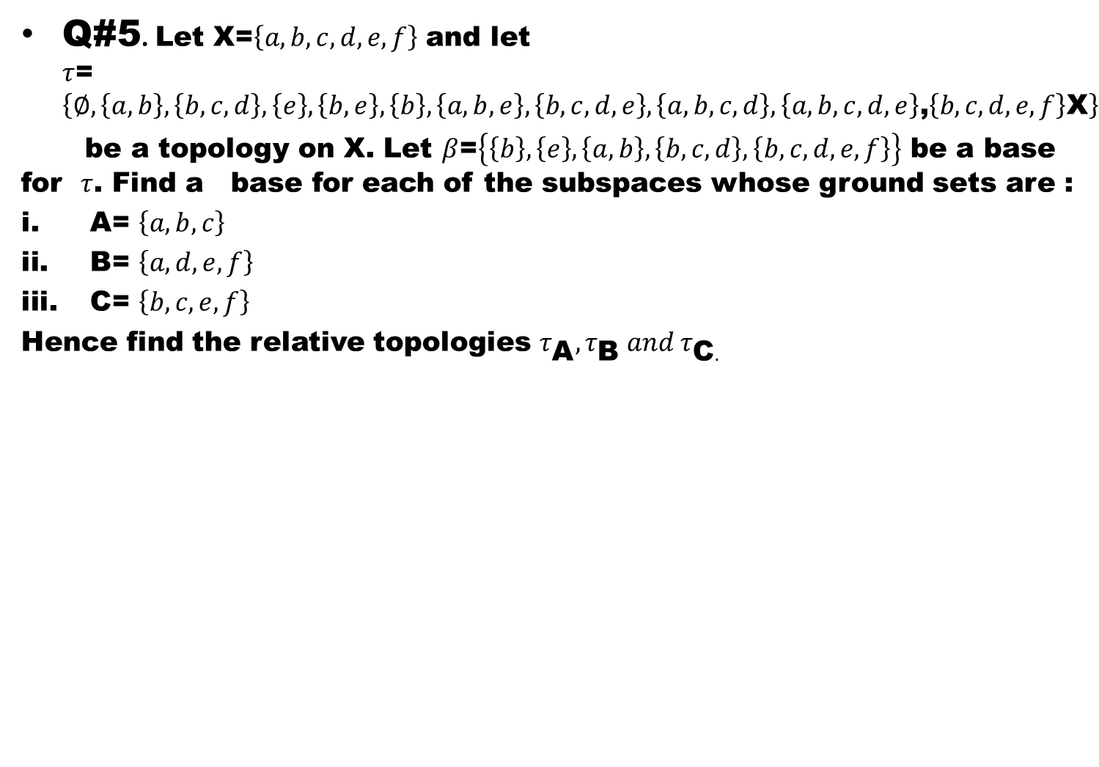
Q#5. Let X=$\left\{a,b,c,d,e,f\right\}$ and let $τ$=$\left\{∅,\left\{a,b\right\},\left\{b,c,d\right\},\left\{e\right\},\left\{b,e\right\},\left\{b\right\},\left\{a,b,e\right\},\left\{b,c,d,e\right\},\left\{a,b,c,d\right\},\left\{a,b,c,d,e\right\}\text{,}\left\{b,c,d,e,f\right\}\text{X}\right\}$
be a topology on X. Let $β$=$\left\{\left\{b\right\},\left\{e\right\},\left\{a,b\right\},\left\{b,c,d\right\},\left\{b,c,d,e,f\right\}\right\}$ be a base for $τ$. Find a base for each of the subspaces whose ground sets are :
A= $\left\{a,b,c\right\}$
B= $\left\{a,d,e,f\right\}$
C= $\left\{b,c,e,f\right\}$
Hence find the relative topologies $τ_{\text{A}},τ_{\text{B}} and τ_{\text{C}.}$

Slide 10
TOPOLOGICAL Property
Recall that if X, Y are homeomorphic, then open sets of Y are the images of the open sets of X and open sets of X are the inverse images of the open sets of Y. Therefore any property of X expressed entirely in terms of set operations and open sets is also possessed by each space homeomorphic to X.

Slide 11
TOPOLOGICAL Property
Recall that if X, Y are homeomorphic, then open sets of Y are the images of the open sets of X and open sets of X are the inverse images of the open sets of Y. Therefore any property of X expressed entirely in terms of set operations and open sets is also possessed by each space homeomorphic to X.
length, angle, boundedness, Cauchy sequences, straightness and being triangular or circular are not topological properties.

Slide 12
TOPOLOGICAL Property
Recall that if X, Y are homeomorphic, then open sets of Y are the images of the open sets of X and open sets of X are the inverse images of the open sets of Y. Therefore any property of X expressed entirely in terms of set operations and open sets is also possessed by each space homeomorphic to X.
length angle, boundedness, Cauchy sequences, straightness and being triangular or circular are not topological properties.
Whereas limit point, interior, nbd, boundary and first/second countability are topological properties.

Slide 13
Definition (Topological property)
  A topological property is a property which,

Slide 14
Definition (Topological property)
  A topological property is a property which,
  if possessed by a topological space,

Slide 15
Definition (Topological property)
  A topological property is a property which,
  if possessed by a topological space,
  is also possessed by all topological spaces homeomorphic to that space.

Slide 16
Example
Let X =(-1,1) and

Slide 17
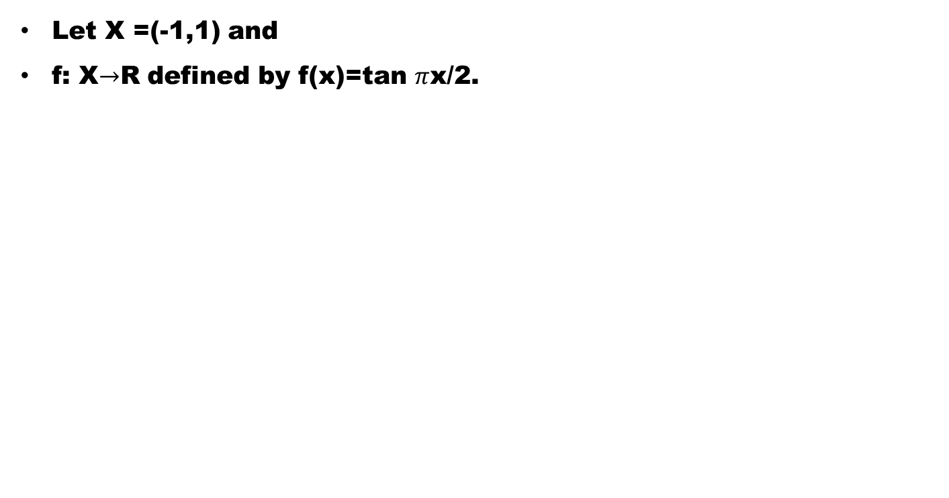
Example
Let X =(-1,1) and
f: X$→$R defined by f(x)=tan $π$x/2.

Slide 18
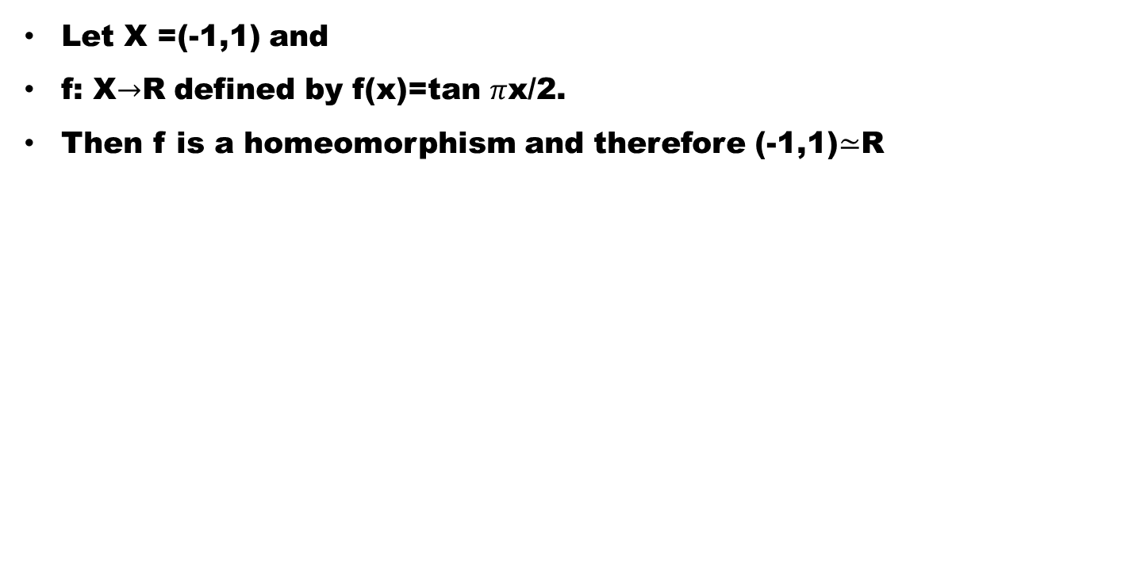
Example
Let X =(-1,1) and
f: X$→$R defined by f(x)=tan $π$x/2.
Then f is a homeomorphism and therefore (-1,1)$≃$R

Slide 19
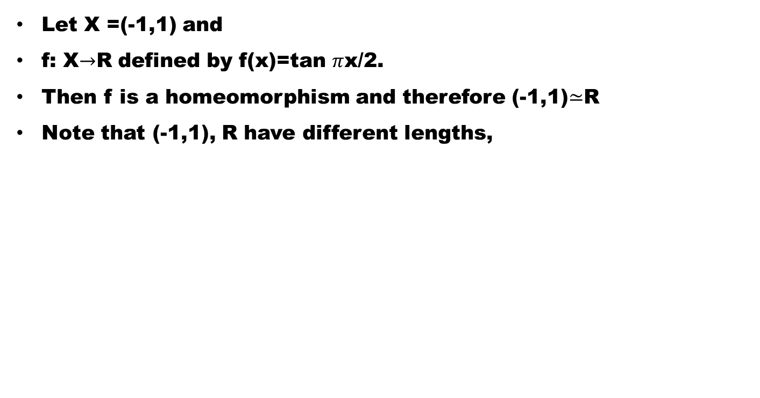
Example
Let X =(-1,1) and
f: X$→$R defined by f(x)=tan $π$x/2.
Then f is a homeomorphism and therefore (-1,1)$≃$R
Note that (-1,1), R have different lengths,

Slide 20
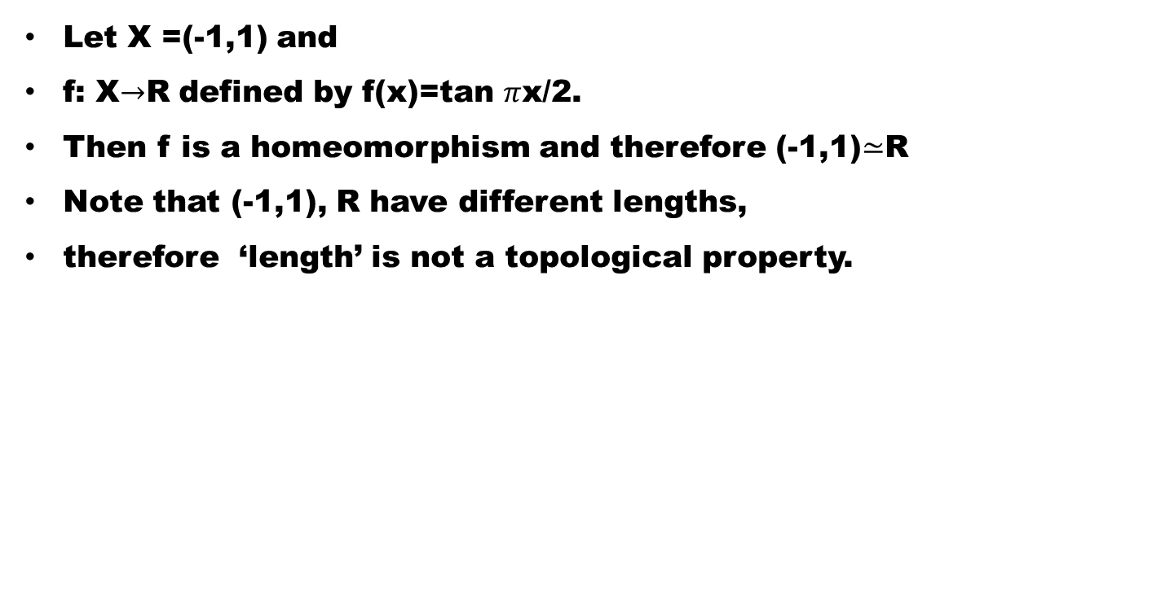
Example
Let X =(-1,1) and
f: X$→$R defined by f(x)=tan $π$x/2.
Then f is a homeomorphism and therefore (-1,1)$≃$R
Note that (-1,1), R have different lengths,
therefore ‘length’ is not a topological property.

Slide 21
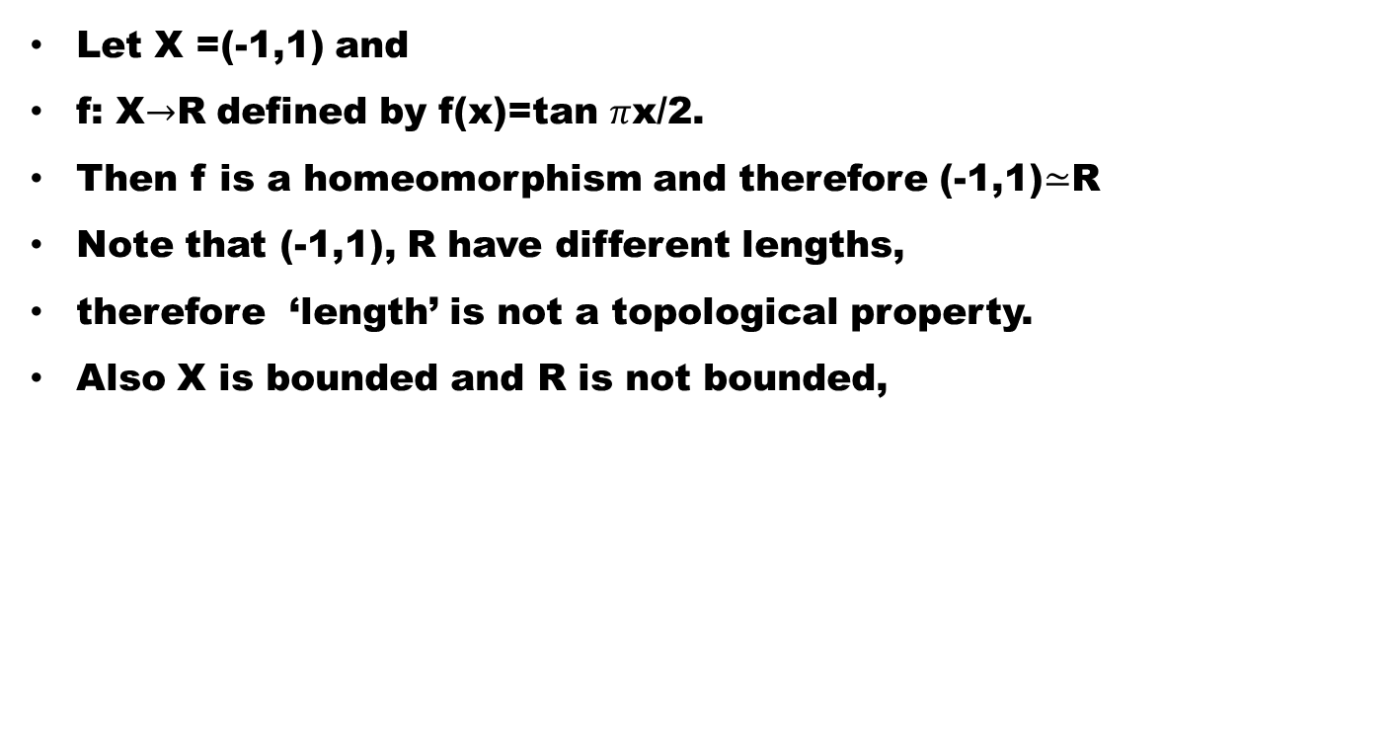
Example
Let X =(-1,1) and
f: X$→$R defined by f(x)=tan $π$x/2.
Then f is a homeomorphism and therefore (-1,1)$≃$R
Note that (-1,1), R have different lengths,
therefore ‘length’ is not a topological property.
Also X is bounded and R is not bounded,

Slide 22
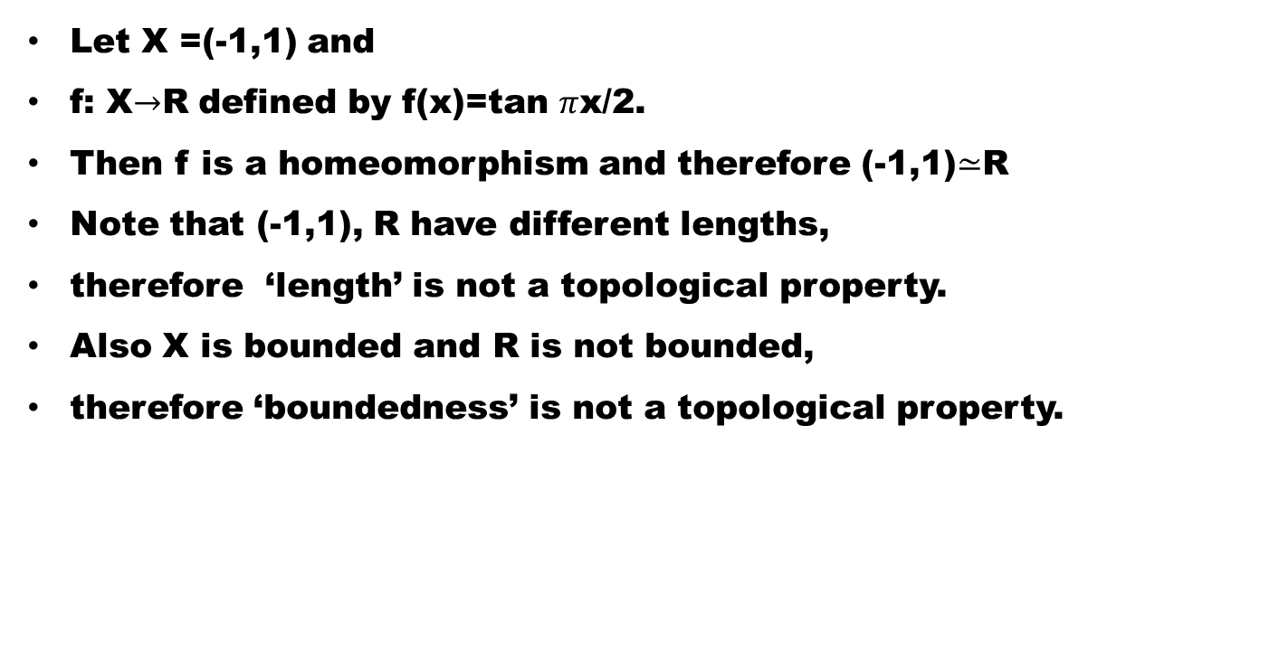
Example
Let X =(-1,1) and
f: X$→$R defined by f(x)=tan $π$x/2.
Then f is a homeomorphism and therefore (-1,1)$≃$R
Note that (-1,1), R have different lengths,
therefore ‘length’ is not a topological property.
Also X is bounded and R is not bounded,
therefore ‘boundedness’ is not a topological property.

Slide 23
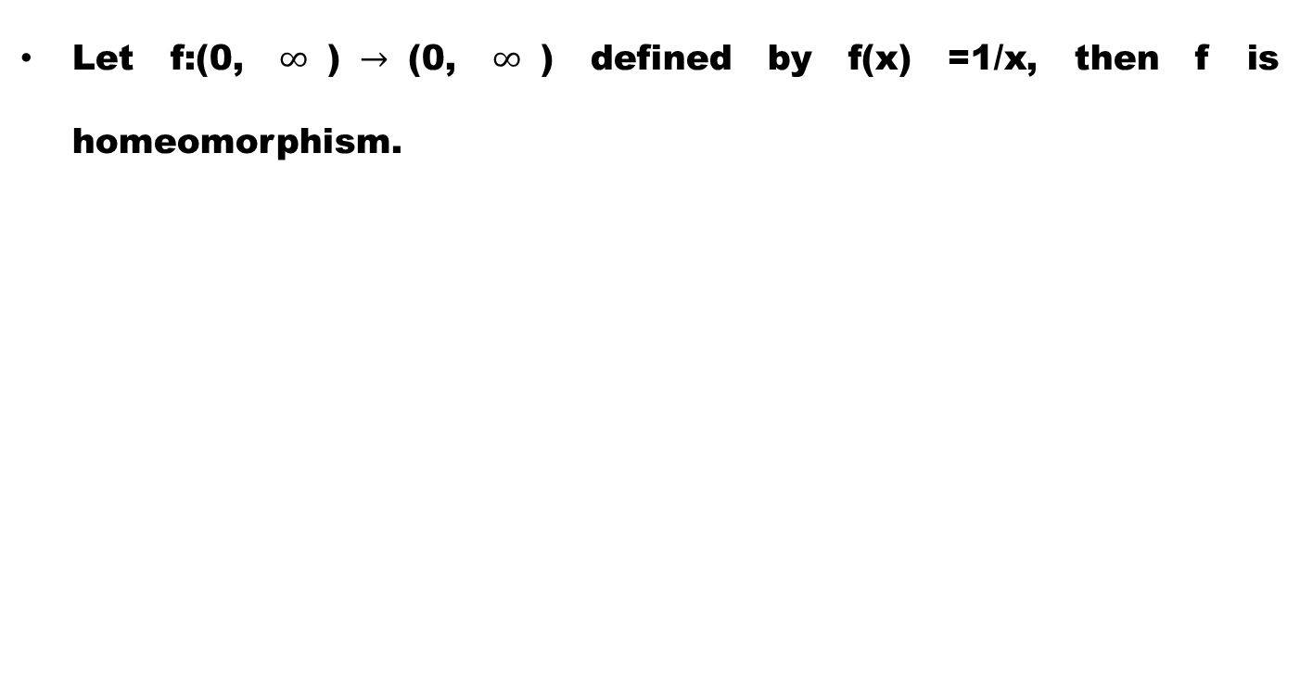
Example.
Let f:(0, $∞$)$→$(0, $∞$) defined by f(x) =1/x, then f is homeomorphism.

Slide 24
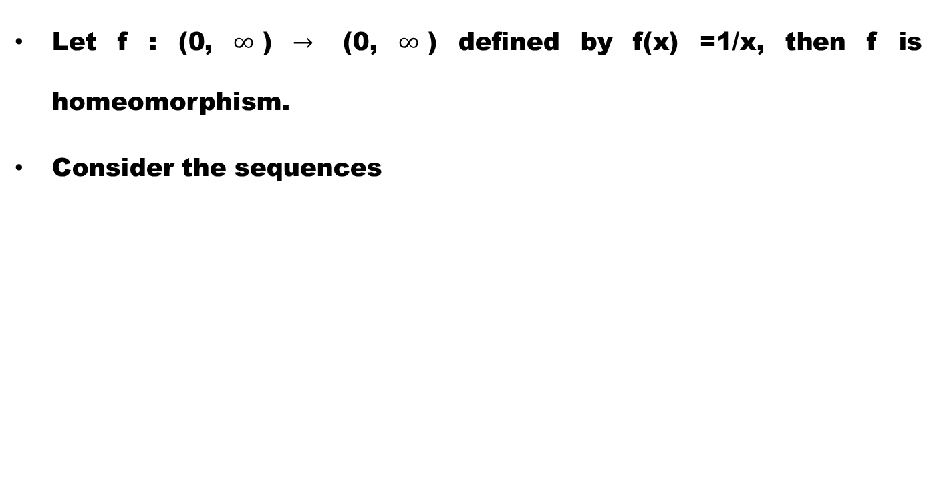
Example.
Let f : (0, $∞$) $→$ (0, $∞$) defined by f(x) =1/x, then f is homeomorphism.
Consider the sequences

Slide 25
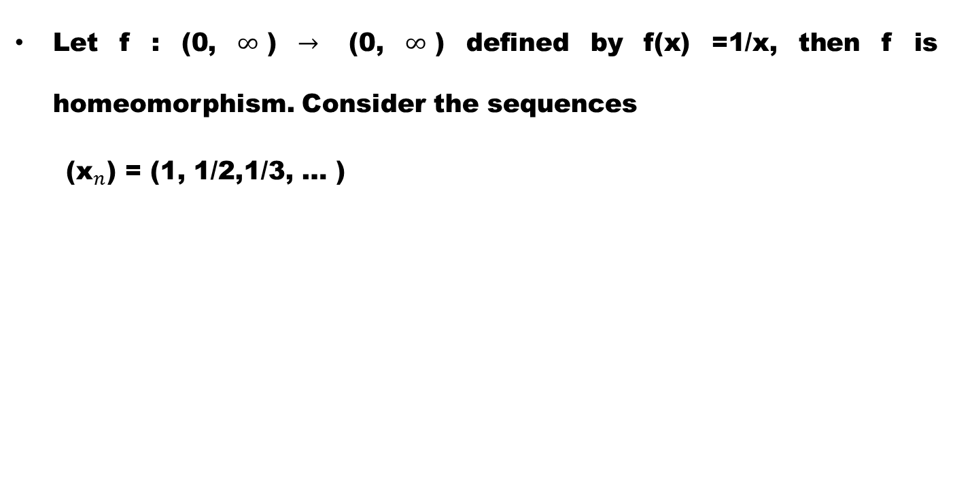
Example.
Let f : (0, $∞$) $→$ (0, $∞$) defined by f(x) =1/x, then f is homeomorphism. Consider the sequences
  (${\text{x}}_{n}$) = (1, 1/2,1/3, … )

Slide 26
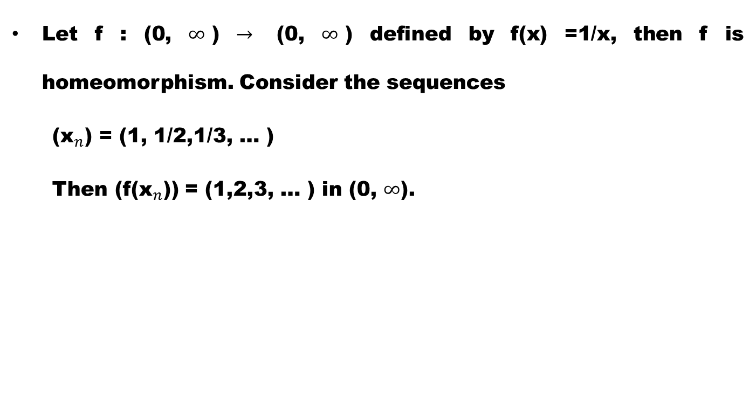
Example.
Let f : (0, $∞$) $→$ (0, $∞$) defined by f(x) =1/x, then f is homeomorphism. Consider the sequences
  (${\text{x}}_{n}$) = (1, 1/2,1/3, … )
  Then (f(${\text{x}}_{n}$)) = (1,2,3, … ) in (0, $∞$).

Slide 27
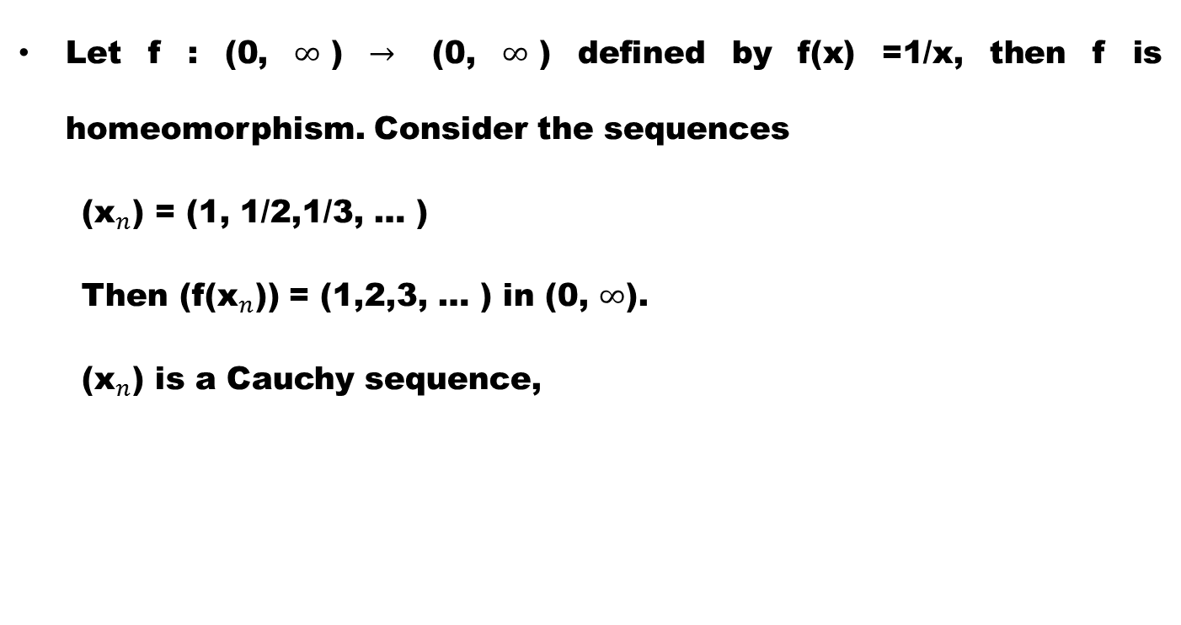
Example.
Let f : (0, $∞$) $→$ (0, $∞$) defined by f(x) =1/x, then f is homeomorphism. Consider the sequences
  (${\text{x}}_{n}$) = (1, 1/2,1/3, … )
  Then (f(${\text{x}}_{n}$)) = (1,2,3, … ) in (0, $∞$).
  (${\text{x}}_{n}$) is a Cauchy sequence,

Slide 28
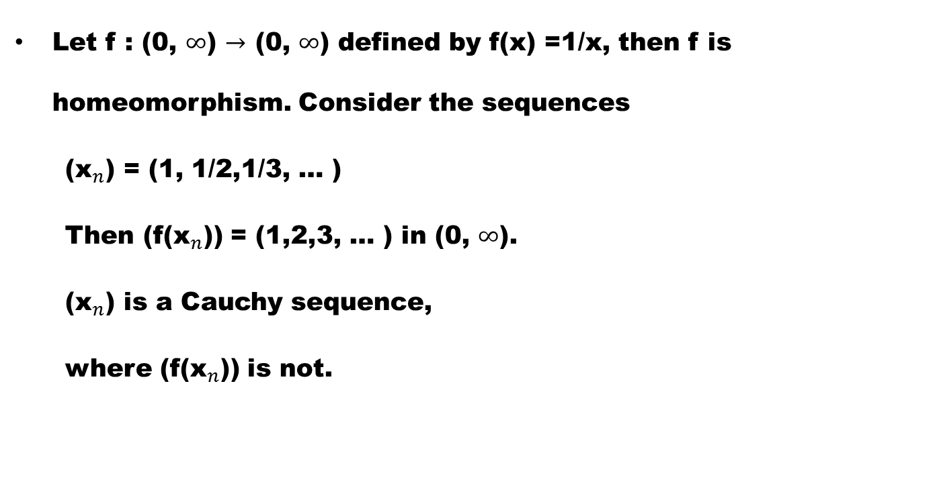
Example.
Let f : (0, $∞$) $→$ (0, $∞$) defined by f(x) =1/x, then f is homeomorphism. Consider the sequences
  (${\text{x}}_{n}$) = (1, 1/2,1/3, … )
  Then (f(${\text{x}}_{n}$)) = (1,2,3, … ) in (0, $∞$).
  (${\text{x}}_{n}$) is a Cauchy sequence,
  where (f(${\text{x}}_{n}$)) is not.

Slide 29
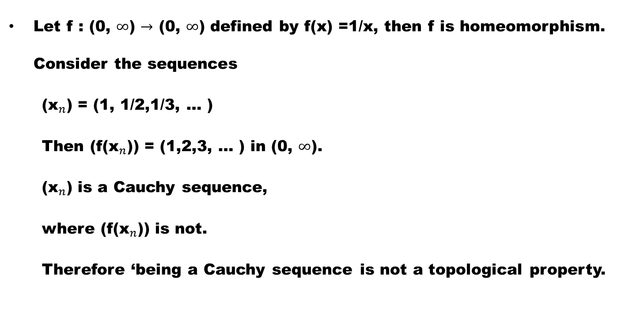
Example.
Let f : (0, $∞$) $→$ (0, $∞$) defined by f(x) =1/x, then f is homeomorphism. Consider the sequences
  (${\text{x}}_{n}$) = (1, 1/2,1/3, … )
  Then (f(${\text{x}}_{n}$)) = (1,2,3, … ) in (0, $∞$).
  (${\text{x}}_{n}$) is a Cauchy sequence,
  where (f(${\text{x}}_{n}$)) is not.
  Therefore ‘being a Cauchy sequence is not a topological property.

Slide 30
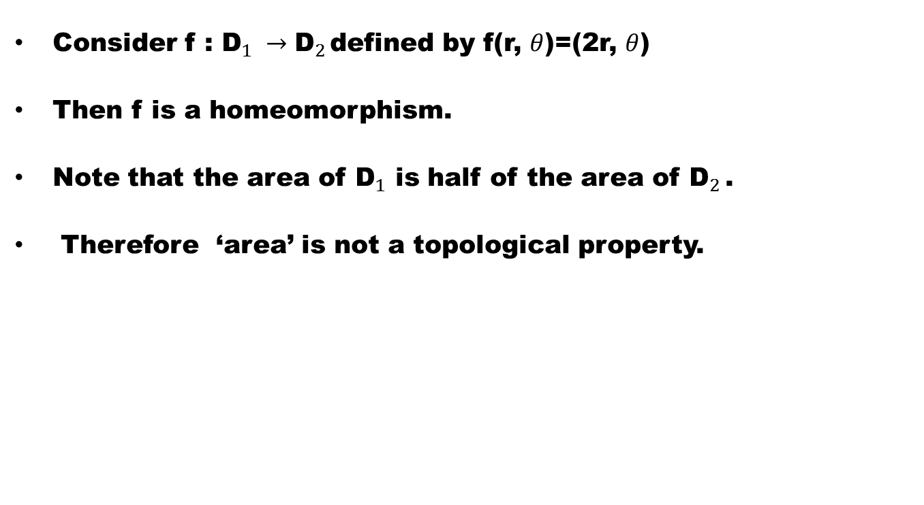
Example.
Consider f : ${\text{D}}_{1} →{\text{D}}_{2 }$defined by f(r, $θ$)=(2r, $θ$)
Then f is a homeomorphism.
Note that the area of ${\text{D}}_{1}$ is half of the area of ${\text{D}}_{2 }$.
Therefore ‘area’ is not a topological property.

Slide 31
Example
Being ‘triangular’ is not topological property

Slide 32
Example
Being ‘triangular’ is not topological property
since a triangle can be continuously deformed into a circle and conversely.

Slide 33
Example
Being ‘triangular’ is not topological property
since a triangle can be continuously deformed into a circle and conversely.
Whereas limit point, interior point, boundary, nbd and first/second countability are topological properties

Slide 34
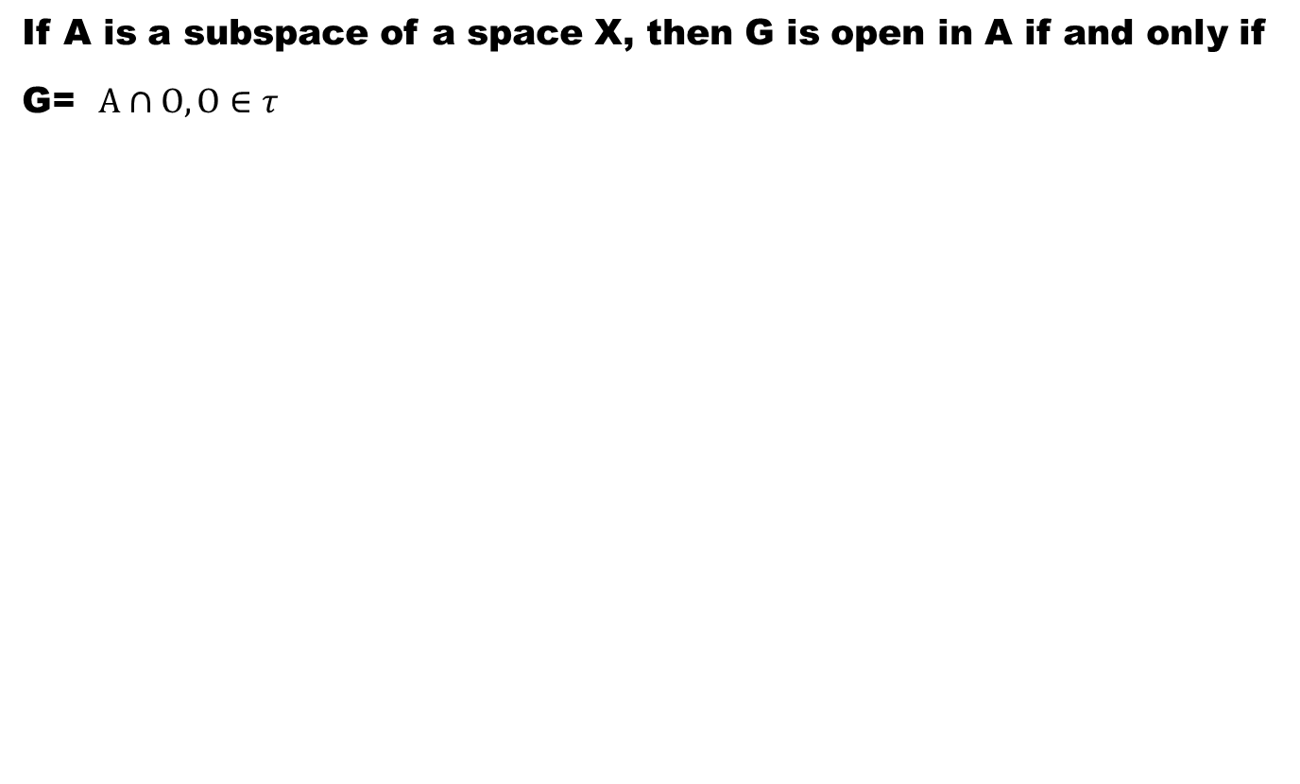
Theorem#1
If A is a subspace of a space X, then G is open in A if and only if G= $A∩O,O∈τ$

Slide 35
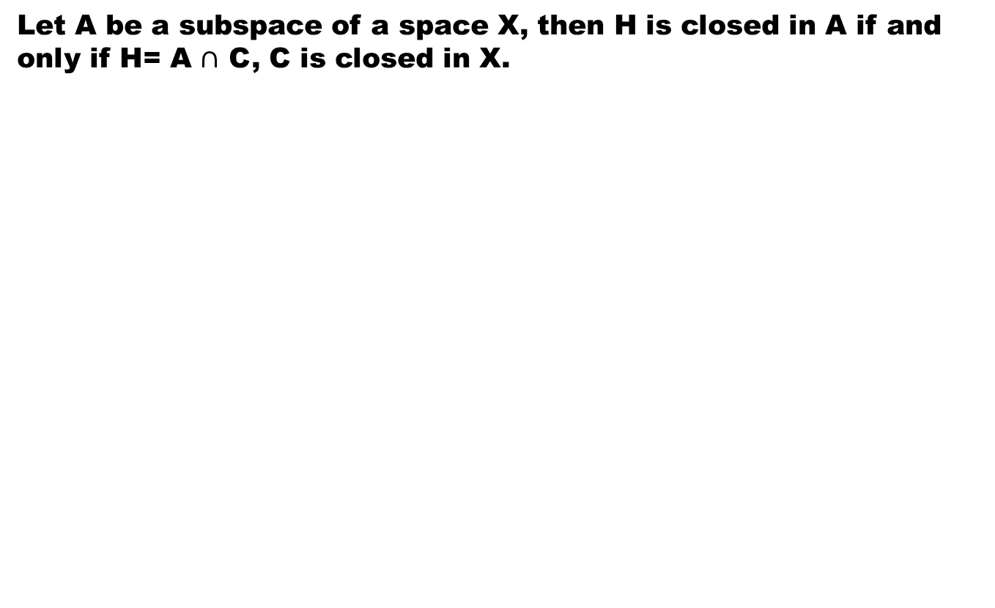
Theorem#2
Let A be a subspace of a space X, then H is closed in A if and only if H= A $∩$ C, C is closed in X.

Slide 37
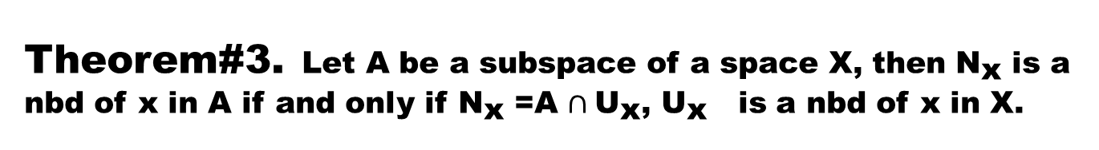
Theorem#3. Let A be a subspace of a space X, then ${\text{N}}_{\text{x} }$is a nbd of x in A if and only if ${\text{N}}_{\text{x} }$=A $∩{\text{U}}_{\text{x}}$, ${\text{U}}_{\text{x}}$ is a nbd of x in X.

Slide 38
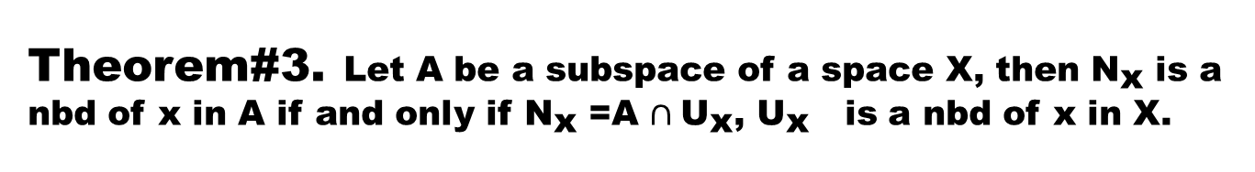
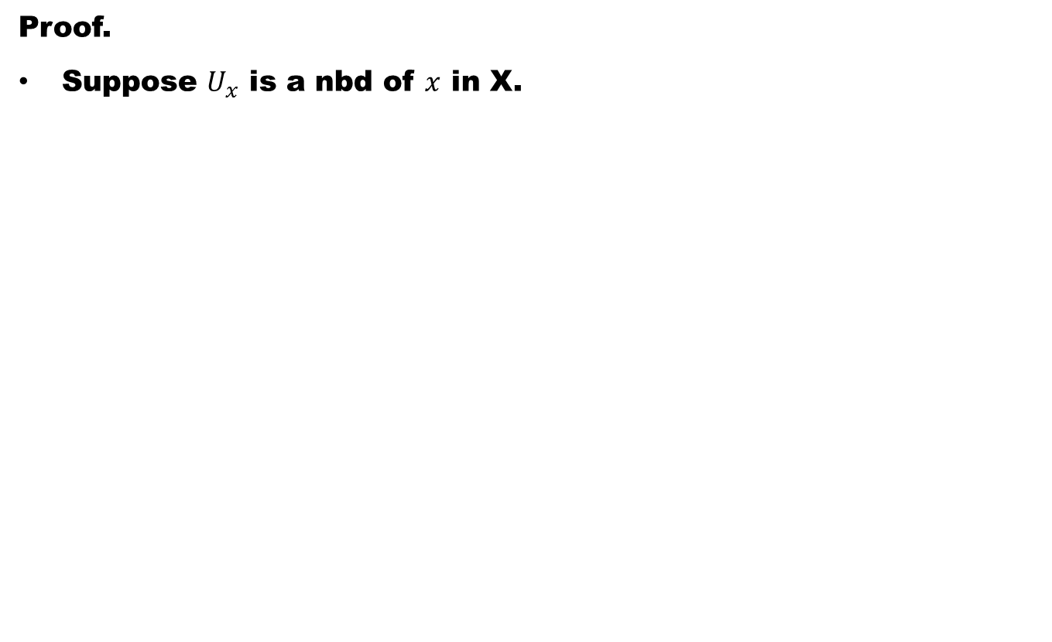
Theorem#3. Let A be a subspace of a space X, then ${\text{N}}_{\text{x} }$is a nbd of x in A if and only if ${\text{N}}_{\text{x} }$=A $∩{\text{U}}_{\text{x}}$, ${\text{U}}_{\text{x}}$ is a nbd of x in X.
Proof.
Suppose $U_{x}$ is a nbd of $x$ in X.

Slide 39
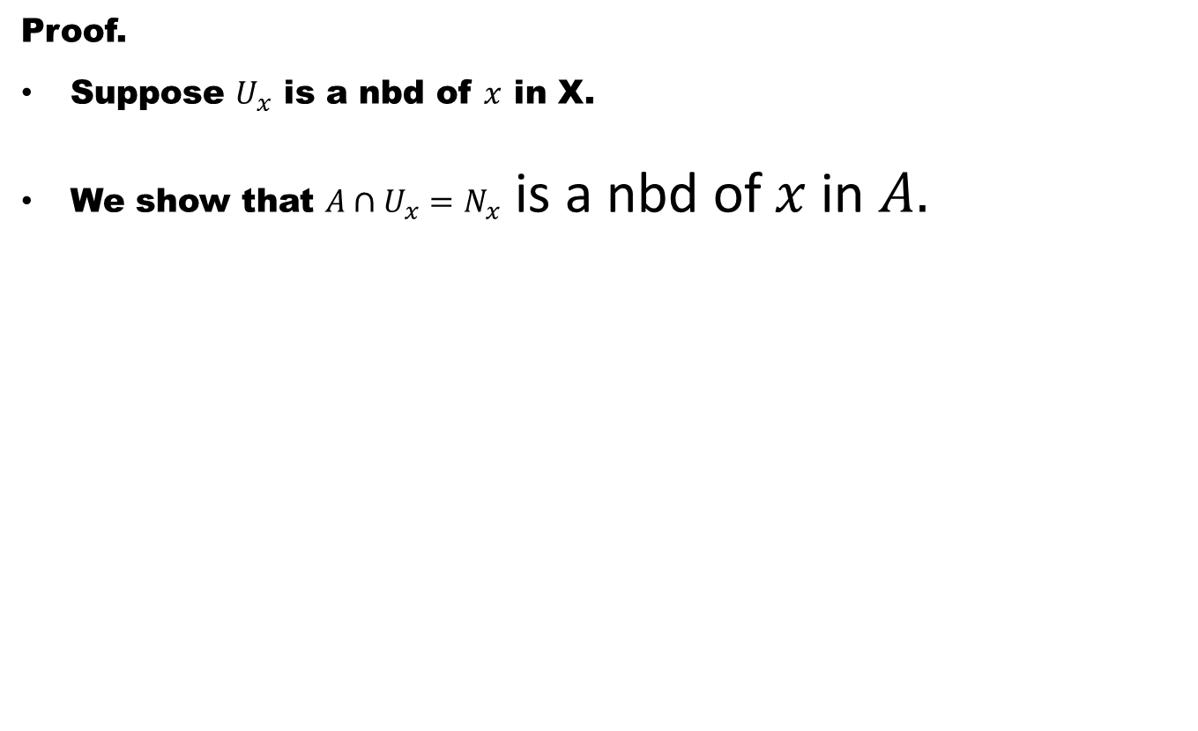
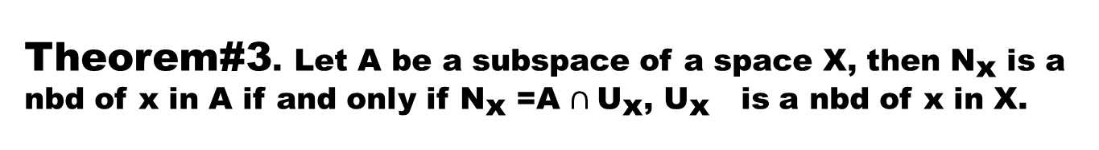
Theorem#3. Let A be a subspace of a space X, then ${\text{N}}_{\text{x} }$is a nbd of x in A if and only if ${\text{N}}_{\text{x} }$=A $∩{\text{U}}_{\text{x}}$, ${\text{U}}_{\text{x}}$ is a nbd of x in X.
Proof.
Suppose $U_{x}$ is a nbd of $x$ in X.
We show that $A∩U_{x}=N_{x}$ is a nbd of $x$ in $A.$

Slide 40
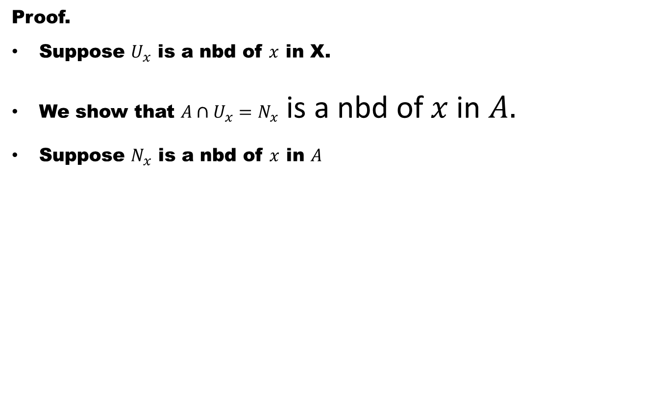
Theorem#3. Let A be a subspace of a space X, then ${\text{N}}_{\text{x} }$is a nbd of x in A if and only if ${\text{N}}_{\text{x} }$=A $∩{\text{U}}_{\text{x}}$, ${\text{U}}_{\text{x}}$ is a nbd of x in X.
Proof.
Suppose $U_{x}$ is a nbd of $x$ in X.
We show that $A∩U_{x}=N_{x}$ is a nbd of $x$ in $A.$
Suppose $N_{x}$ is a nbd of $x$ in $A$

Slide 41
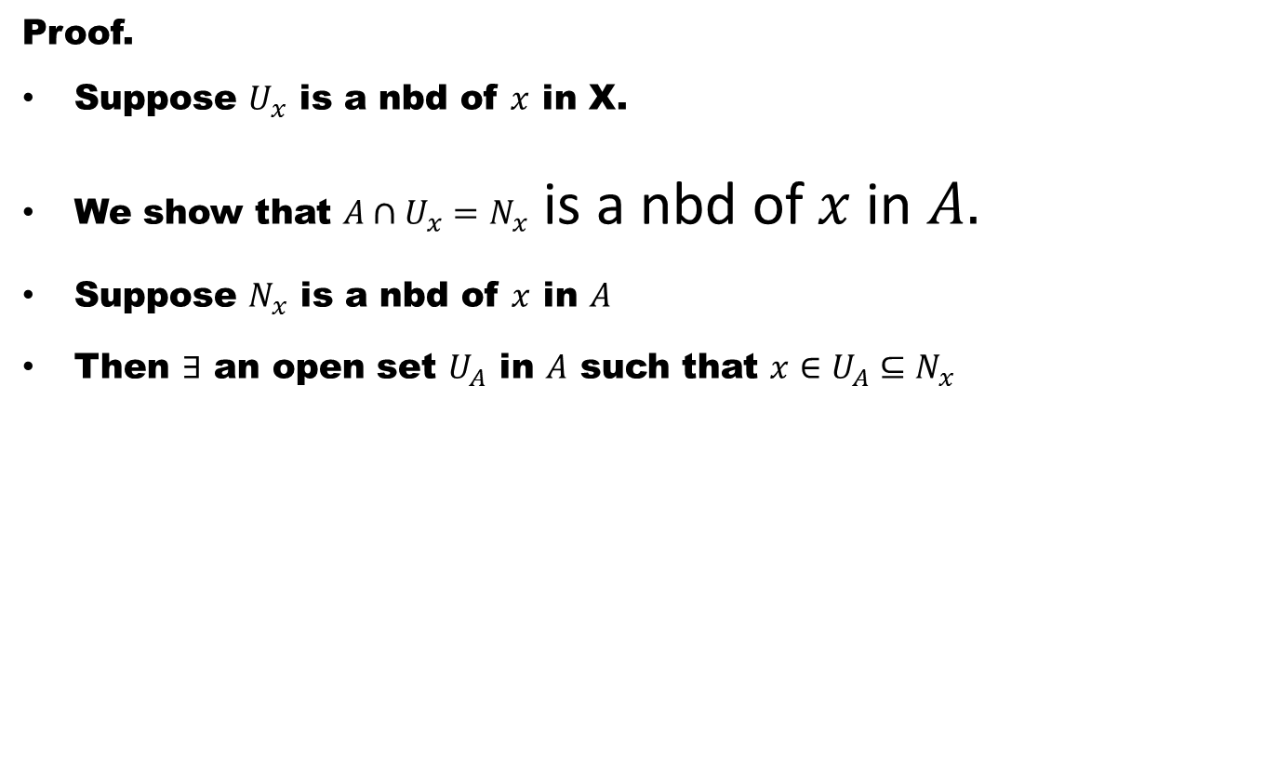
Theorem#3. Let A be a subspace of a space X, then ${\text{N}}_{\text{x} }$is a nbd of x in A if and only if ${\text{N}}_{\text{x} }$=A $∩{\text{U}}_{\text{x}}$, ${\text{U}}_{\text{x}}$ is a nbd of x in X.
Proof.
Suppose $U_{x}$ is a nbd of $x$ in X.
We show that $A∩U_{x}=N_{x}$ is a nbd of $x$ in $A.$
Suppose $N_{x}$ is a nbd of $x$ in $A$
Then $∃$ an open set $U_{A}$ in $A$ such that $x∈U_{A}⊆N_{x}$

Slide 42
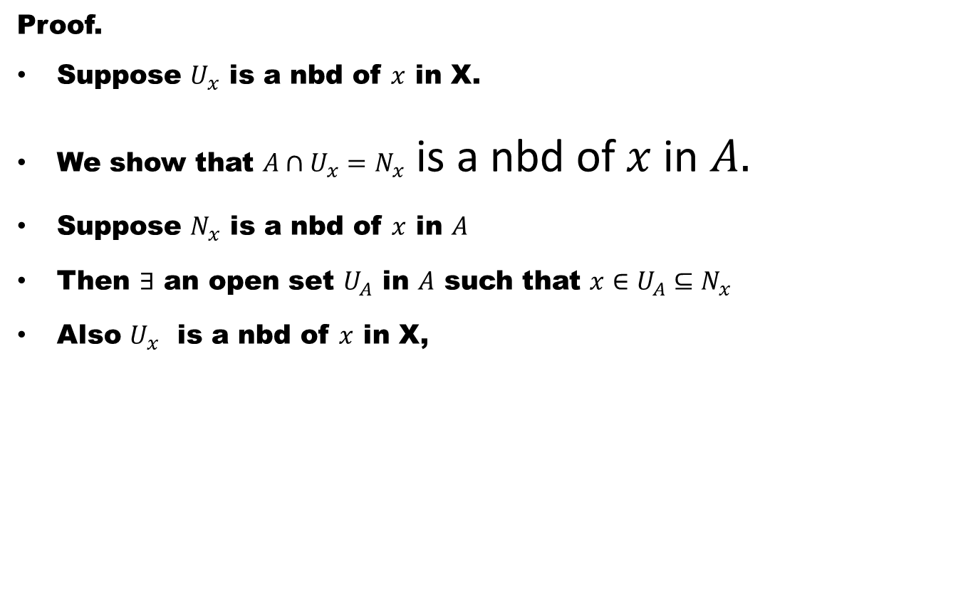
Theorem#3. Let A be a subspace of a space X, then ${\text{N}}_{\text{x} }$is a nbd of x in A if and only if ${\text{N}}_{\text{x} }$=A $∩{\text{U}}_{\text{x}}$, ${\text{U}}_{\text{x}}$ is a nbd of x in X.
Proof.
Suppose $U_{x}$ is a nbd of $x$ in X.
We show that $A∩U_{x}=N_{x}$ is a nbd of $x$ in $A.$
Suppose $N_{x}$ is a nbd of $x$ in $A$
Then $∃$ an open set $U_{A}$ in $A$ such that $x∈U_{A}⊆N_{x}$
Also $U_{x}$ is a nbd of $x$ in X,

Slide 43
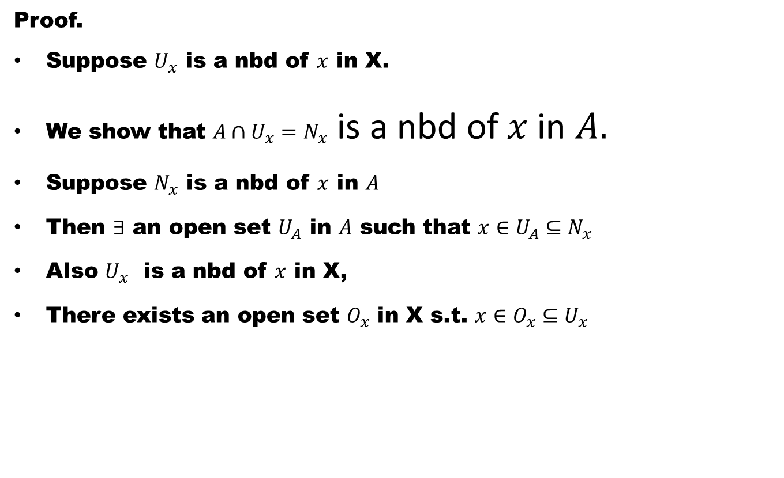
Theorem#3. Let A be a subspace of a space X, then ${\text{N}}_{\text{x} }$is a nbd of x in A if and only if ${\text{N}}_{\text{x} }$=A $∩{\text{U}}_{\text{x}}$, ${\text{U}}_{\text{x}}$ is a nbd of x in X.
Proof.
Suppose $U_{x}$ is a nbd of $x$ in X.
We show that $A∩U_{x}=N_{x}$ is a nbd of $x$ in $A.$
Suppose $N_{x}$ is a nbd of $x$ in $A$
Then $∃$ an open set $U_{A}$ in $A$ such that $x∈U_{A}⊆N_{x}$
Also $U_{x}$ is a nbd of $x$ in X,
There exists an open set $O_{x}$ in X s.t. $x∈O_{x}⊆U_{x}$

Slide 44
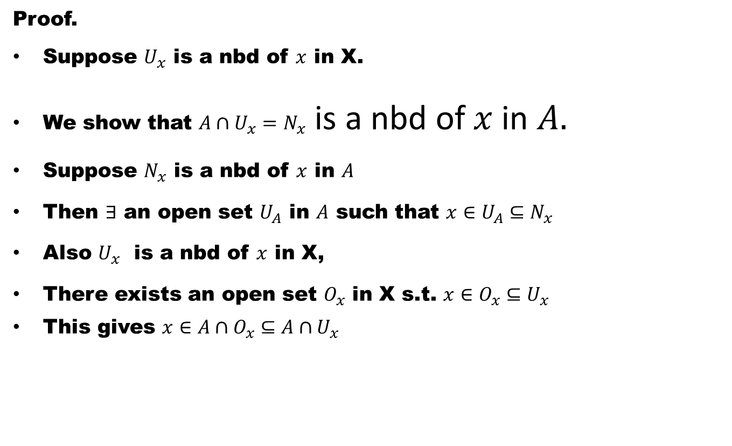
Theorem#3. Let A be a subspace of a space X, then ${\text{N}}_{\text{x} }$is a nbd of x in A if and only if ${\text{N}}_{\text{x} }$=A $∩{\text{U}}_{\text{x}}$, ${\text{U}}_{\text{x}}$ is a nbd of x in X.
Proof.
Suppose $U_{x}$ is a nbd of $x$ in X.
We show that $A∩U_{x}=N_{x}$ is a nbd of $x$ in $A.$
Suppose $N_{x}$ is a nbd of $x$ in $A$
Then $∃$ an open set $U_{A}$ in $A$ such that $x∈U_{A}⊆N_{x}$
Also $U_{x}$ is a nbd of $x$ in X,
There exists an open set $O_{x}$ in X s.t. $x∈O_{x}⊆U_{x}$
This gives $x∈A∩O_{x}⊆A∩U_{x}$

Slide 45
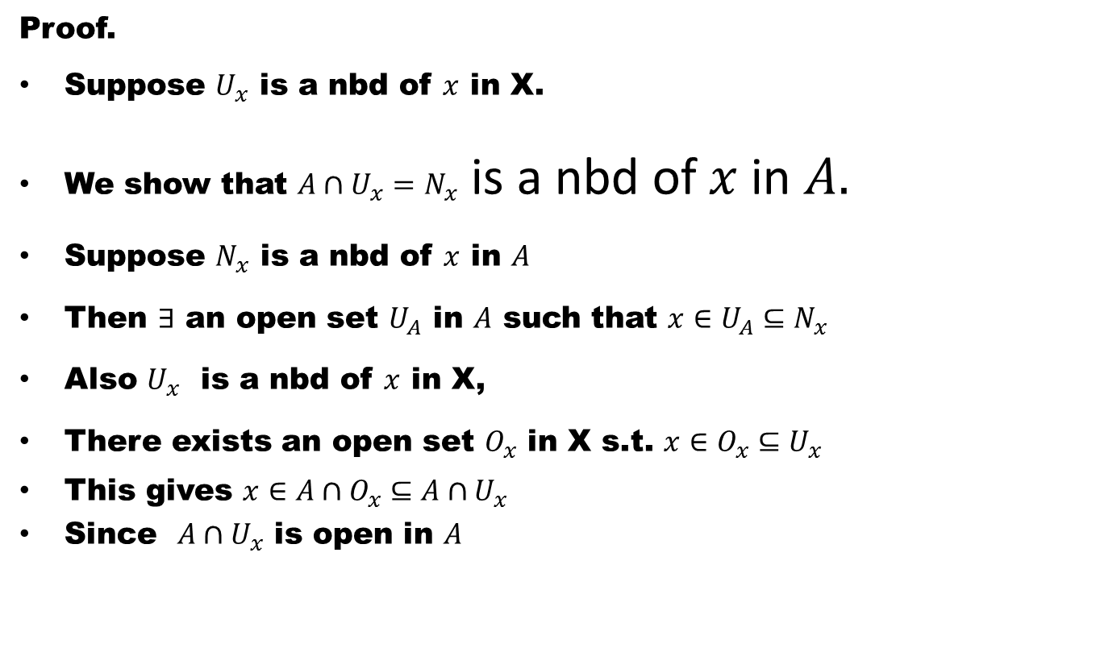
Theorem#3. Let A be a subspace of a space X, then ${\text{N}}_{\text{x} }$is a nbd of x in A if and only if ${\text{N}}_{\text{x} }$=A $∩{\text{U}}_{\text{x}}$, ${\text{U}}_{\text{x}}$ is a nbd of x in X.
Proof.
Suppose $U_{x}$ is a nbd of $x$ in X.
We show that $A∩U_{x}=N_{x}$ is a nbd of $x$ in $A.$
Suppose $N_{x}$ is a nbd of $x$ in $A$
Then $∃$ an open set $U_{A}$ in $A$ such that $x∈U_{A}⊆N_{x}$
Also $U_{x}$ is a nbd of $x$ in X,
There exists an open set $O_{x}$ in X s.t. $x∈O_{x}⊆U_{x}$
This gives $x∈A∩O_{x}⊆A∩U_{x}$
Since $A∩U_{x}$ is open in $A$

Slide 46
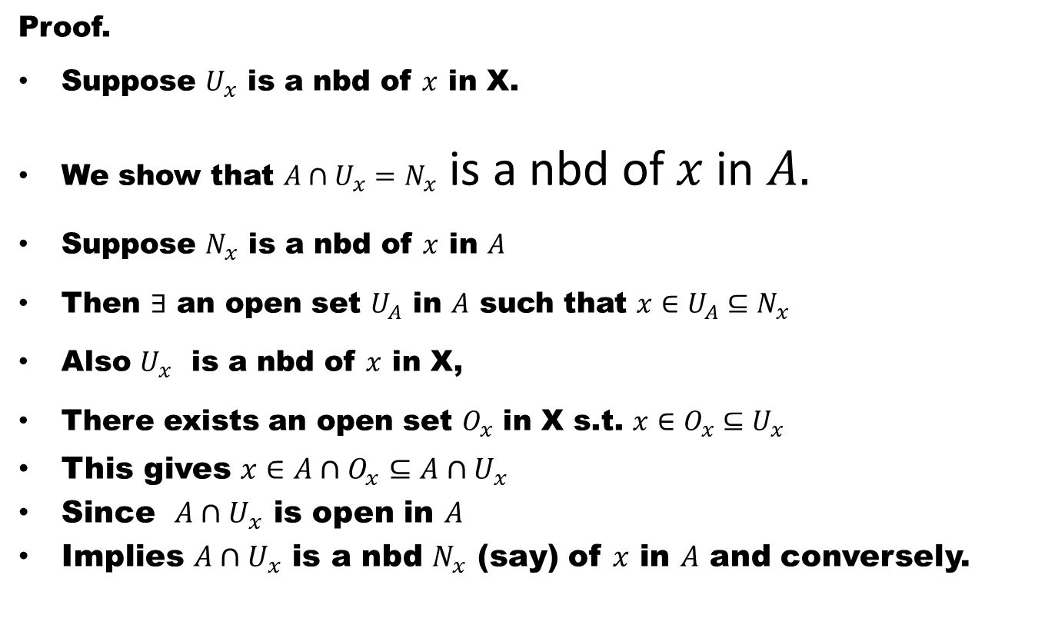
Theorem#3. Let A be a subspace of a space X, then ${\text{N}}_{\text{x} }$is a nbd of x in A if and only if ${\text{N}}_{\text{x} }$=A $∩{\text{U}}_{\text{x}}$, ${\text{U}}_{\text{x}}$ is a nbd of x in X.
Proof.
Suppose $U_{x}$ is a nbd of $x$ in X.
We show that $A∩U_{x}=N_{x}$ is a nbd of $x$ in $A.$
Suppose $N_{x}$ is a nbd of $x$ in $A$
Then $∃$ an open set $U_{A}$ in $A$ such that $x∈U_{A}⊆N_{x}$
Also $U_{x}$ is a nbd of $x$ in X,
There exists an open set $O_{x}$ in X s.t. $x∈O_{x}⊆U_{x}$
This gives $x∈A∩O_{x}⊆A∩U_{x}$
Since $A∩U_{x}$ is open in $A$
Implies $A∩U_{x}$ is a nbd $N_{x}$ (say) of $x$ in $A$ and conversely.

Slide 47
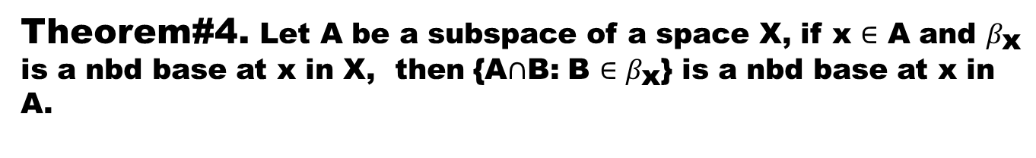
Theorem#4. Let A be a subspace of a space X, if x $∈$ A and $β_{\text{x}}$ is a nbd base at x in X, then {A$∩$B: B $∈β_{\text{x}}$} is a nbd base at x in A.
Proof.

Slide 48
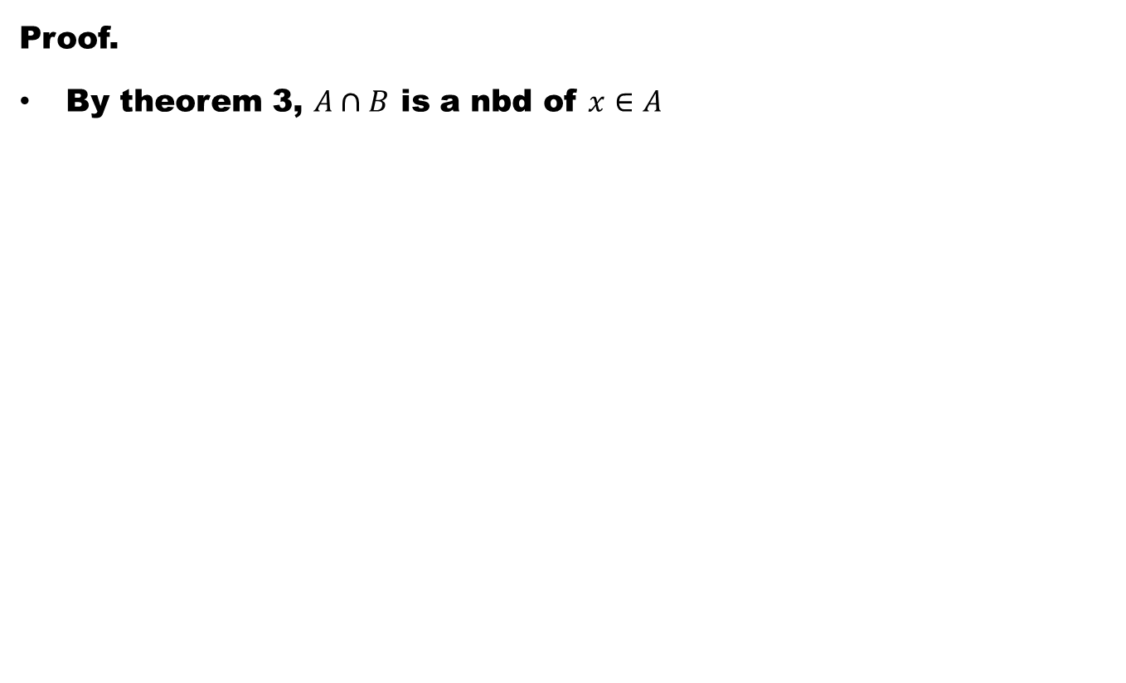
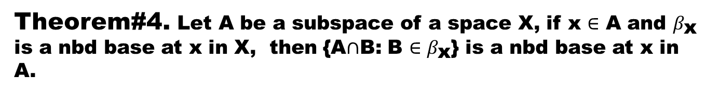
Theorem#4. Let A be a subspace of a space X, if x $∈$ A and $β_{\text{x}}$ is a nbd base at x in X, then {A$∩$B: B $∈β_{\text{x}}$} is a nbd base at x in A.
Proof.
By theorem 3, $A∩B$ is a nbd of $x∈A$

Slide 49
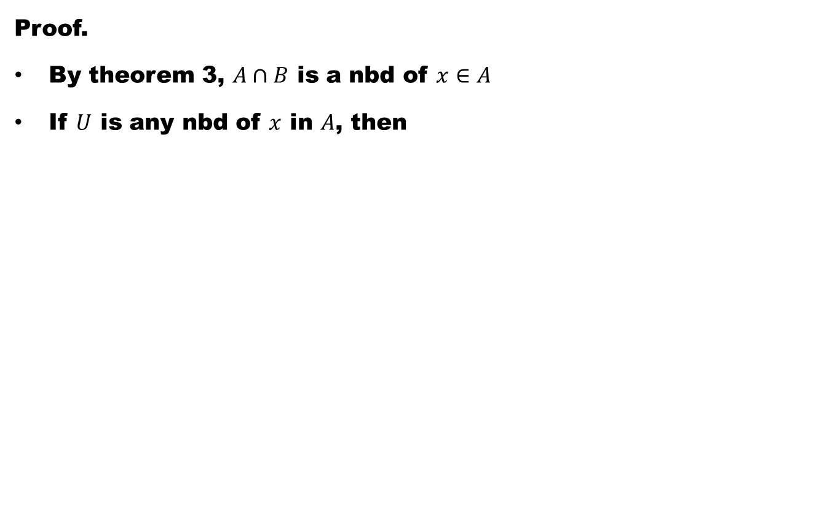
Theorem#4. Let A be a subspace of a space X, if x $∈$ A and $β_{\text{x}}$ is a nbd base at x in X, then {A$∩$B: B $∈β_{\text{x}}$} is a nbd base at x in A.
Proof.
By theorem 3, $A∩B$ is a nbd of $x∈A$
If $U$ is any nbd of $x$ in $A$, then

Slide 50
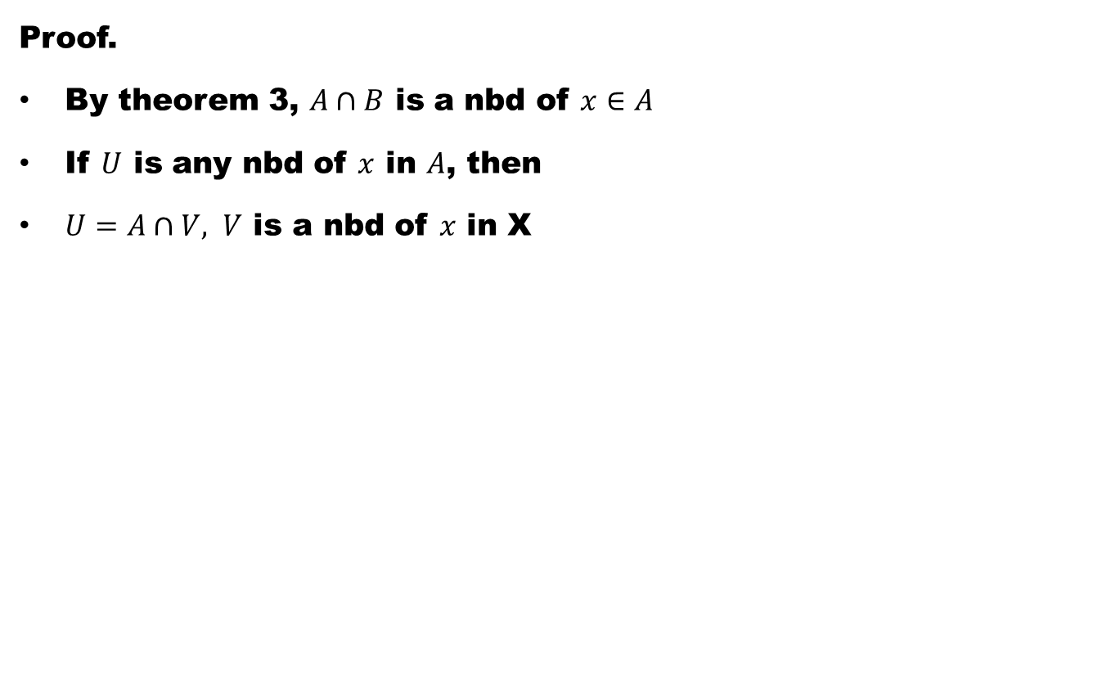
Theorem#4. Let A be a subspace of a space X, if x $∈$ A and $β_{\text{x}}$ is a nbd base at x in X, then {A$∩$B: B $∈β_{\text{x}}$} is a nbd base at x in A.
Proof.
By theorem 3, $A∩B$ is a nbd of $x∈A$
If $U$ is any nbd of $x$ in $A$, then
$U=A∩V, V$ is a nbd of $x$ in X

Slide 51
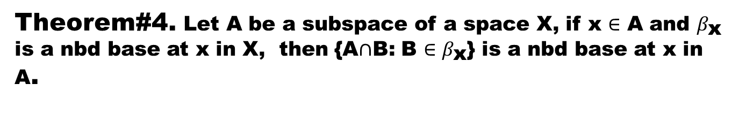
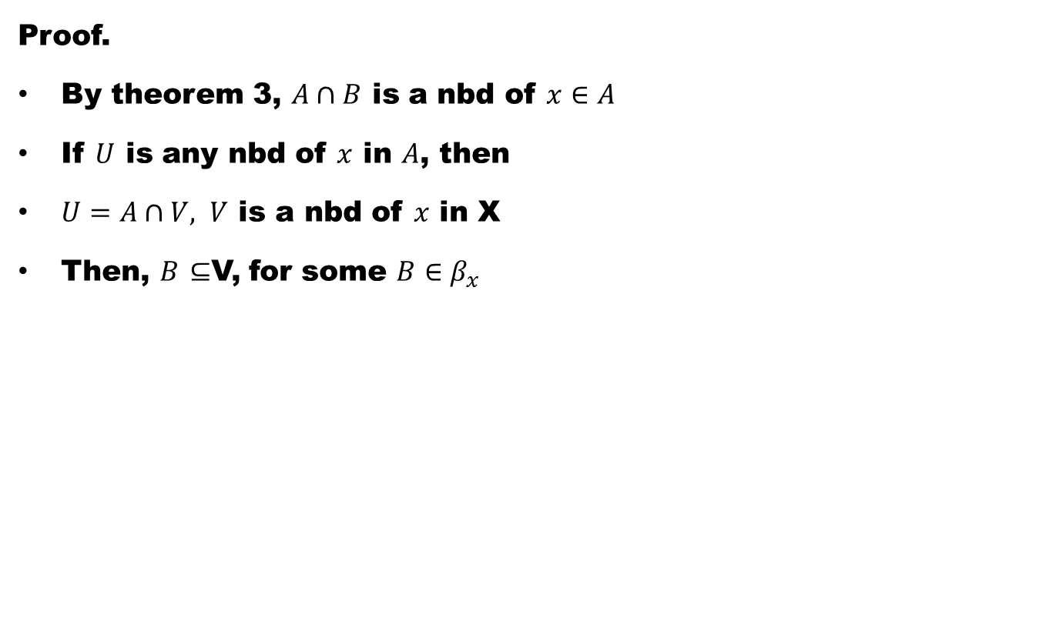
Theorem#4. Let A be a subspace of a space X, if x $∈$ A and $β_{\text{x}}$ is a nbd base at x in X, then {A$∩$B: B $∈β_{\text{x}}$} is a nbd base at x in A.
Proof.
By theorem 3, $A∩B$ is a nbd of $x∈A$
If $U$ is any nbd of $x$ in $A$, then
$U=A∩V, V$ is a nbd of $x$ in X
Then, $B$ $⊆$V, for some $B∈β_{x}$

Slide 52
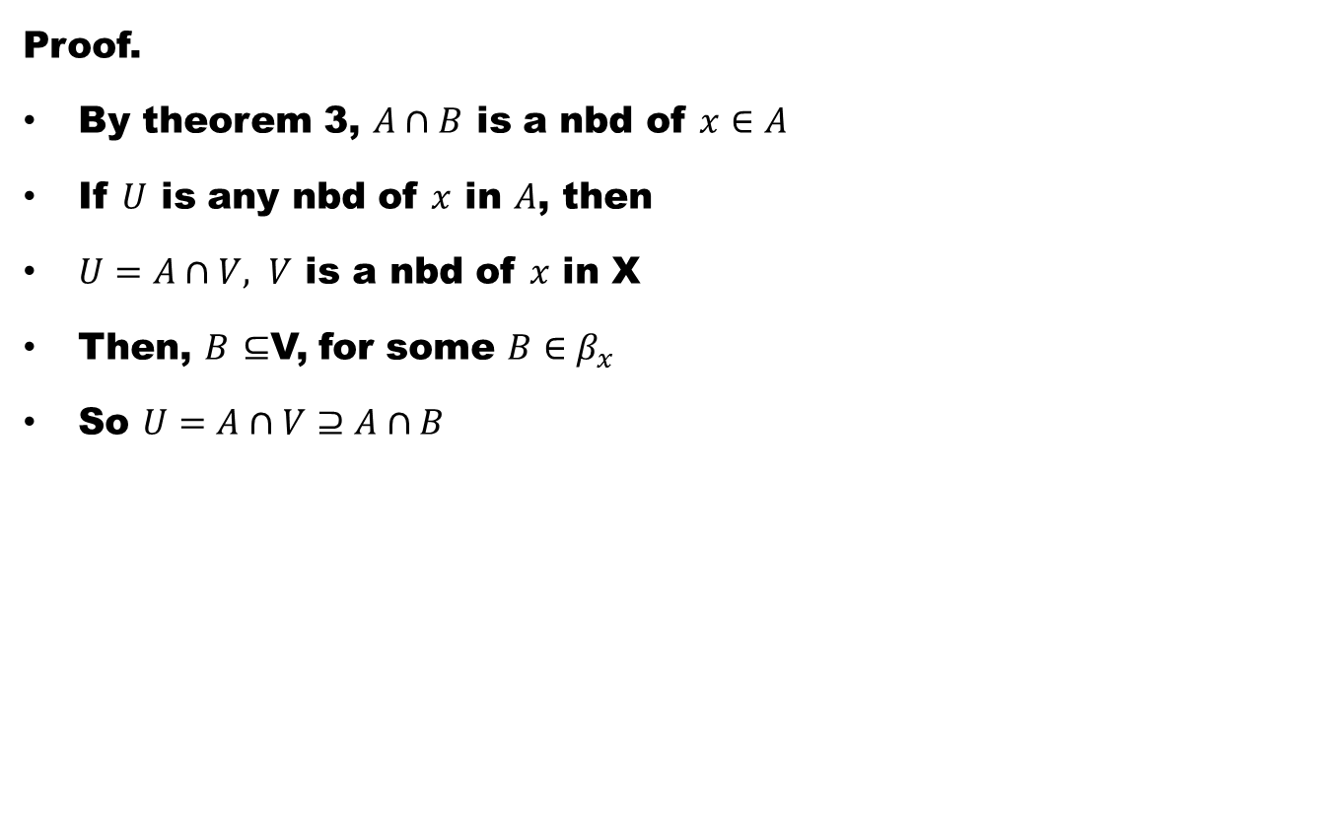
Theorem#4. Let A be a subspace of a space X, if x $∈$ A and $β_{\text{x}}$ is a nbd base at x in X, then {A$∩$B: B $∈β_{\text{x}}$} is a nbd base at x in A.
Proof.
By theorem 3, $A∩B$ is a nbd of $x∈A$
If $U$ is any nbd of $x$ in $A$, then
$U=A∩V, V$ is a nbd of $x$ in X
Then, $B$ $⊆$V, for some $B∈β_{x}$
So $U=A∩V⊇A∩B$

Slide 53
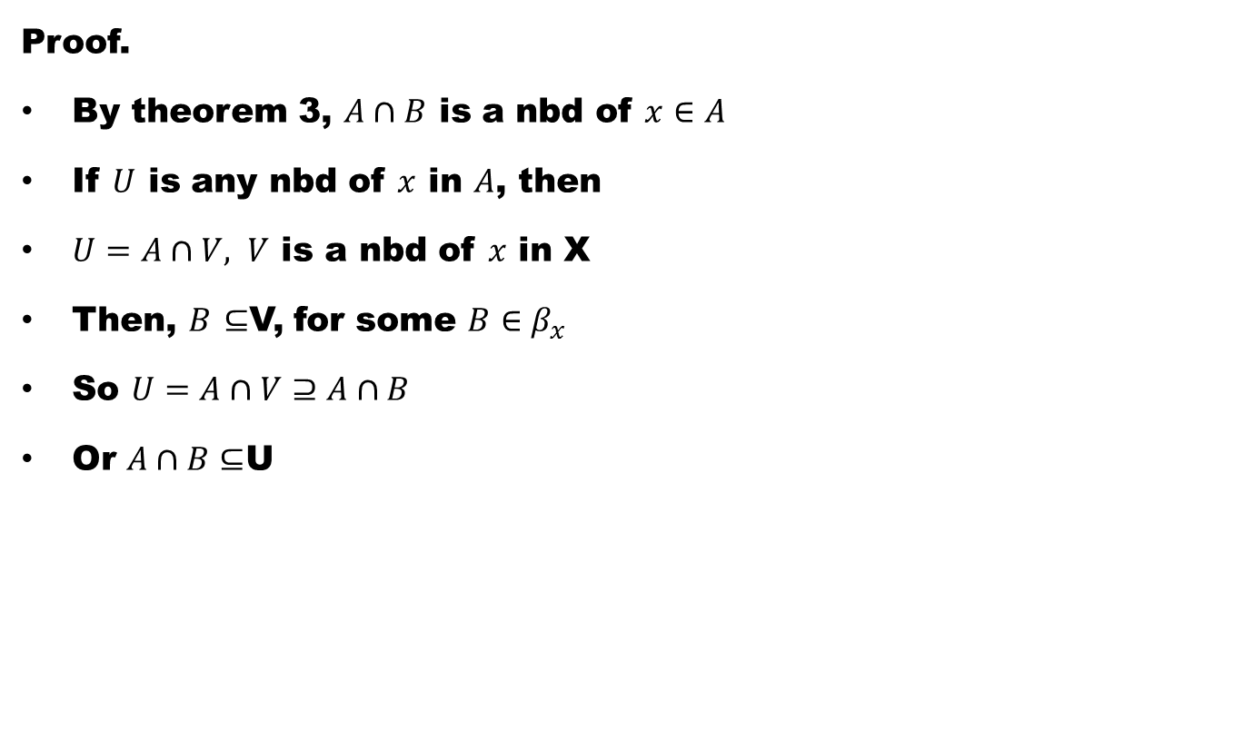
Theorem#4. Let A be a subspace of a space X, if x $∈$ A and $β_{\text{x}}$ is a nbd base at x in X, then {A$∩$B: B $∈β_{\text{x}}$} is a nbd base at x in A.
Proof.
By theorem 3, $A∩B$ is a nbd of $x∈A$
If $U$ is any nbd of $x$ in $A$, then
$U=A∩V, V$ is a nbd of $x$ in X
Then, $B$ $⊆$V, for some $B∈β_{x}$
So $U=A∩V⊇A∩B$
Or $A∩B⊆$U

Slide 54
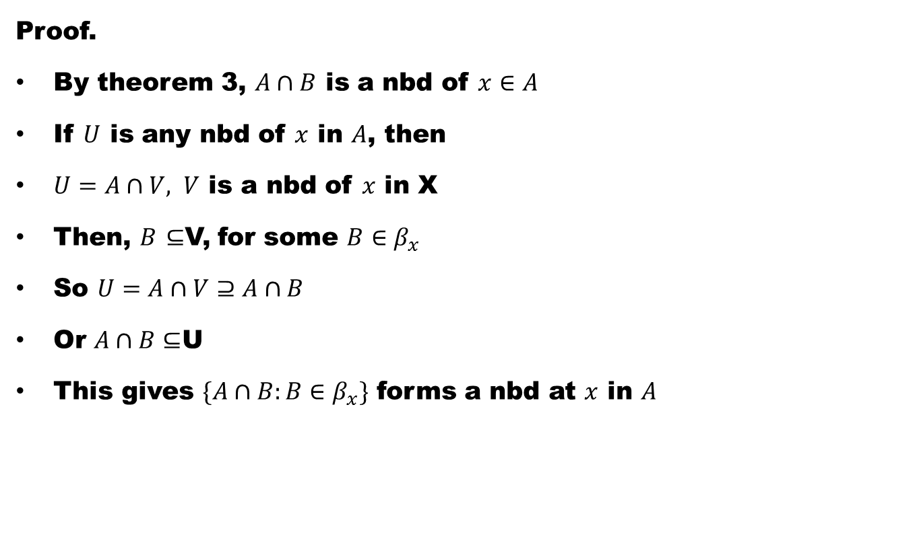
Theorem#4. Let A be a subspace of a space X, if x $∈$ A and $β_{\text{x}}$ is a nbd base at x in X, then {A$∩$B: B $∈β_{\text{x}}$} is a nbd base at x in A.
Proof.
By theorem 3, $A∩B$ is a nbd of $x∈A$
If $U$ is any nbd of $x$ in $A$, then
$U=A∩V, V$ is a nbd of $x$ in X
Then, $B$ $⊆$V, for some $B∈β_{x}$
So $U=A∩V⊇A∩B$
Or $A∩B⊆$U
This gives $\{A∩B:B∈β_{x}\}$ forms a nbd at $x$ in $A$

Slide 55
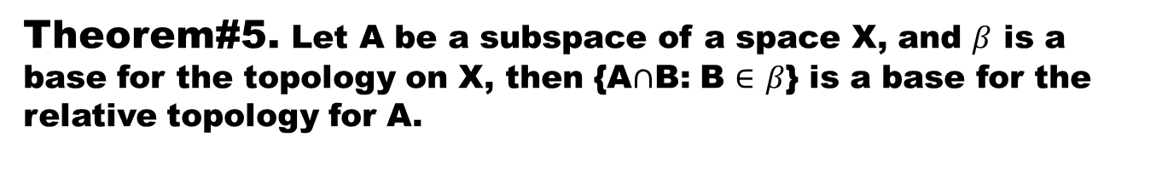
Theorem#5. Let A be a subspace of a space X, and $β$ is a base for the topology on X, then {A$∩$B: B $∈$ $β$} is a base for the relative topology for A.
Proof.

Slide 56
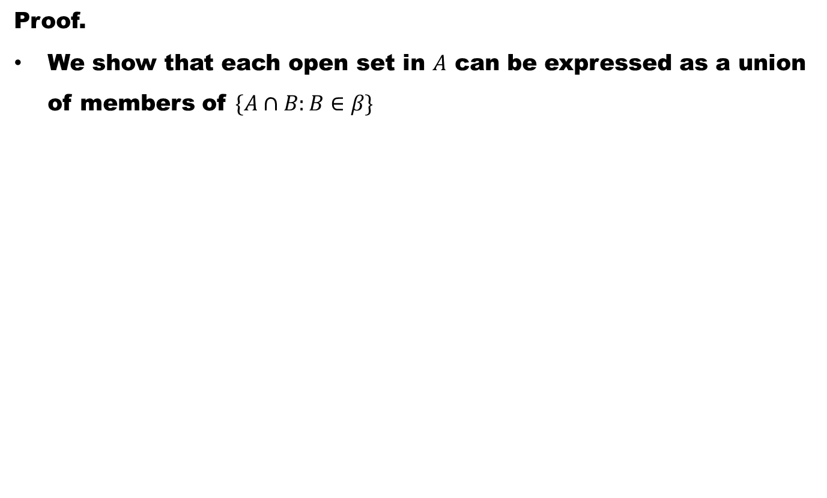
Theorem#5. Let A be a subspace of a space X, and $β$ is a base for the topology on X, then {A$∩$B: B $∈$ $β$} is a base for the relative topology for A.
Proof.
We show that each open set in $A$ can be expressed as a union of members of $\{A∩B:B∈β\}$

Slide 57
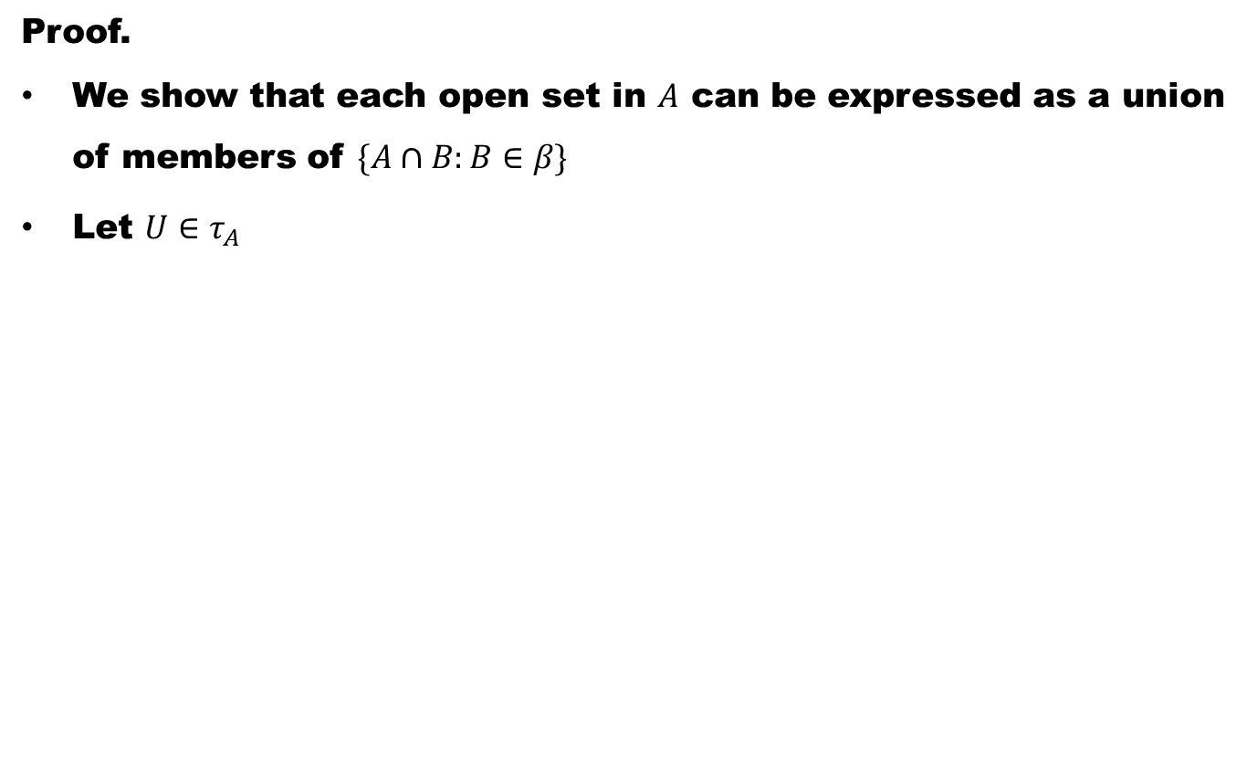
Theorem#5. Let A be a subspace of a space X, and $β$ is a base for the topology on X, then {A$∩$B: B $∈$ $β$} is a base for the relative topology for A.
Proof.
We show that each open set in $A$ can be expressed as a union of members of $\{A∩B:B∈β\}$
Let $U∈τ_{A}$

Slide 58
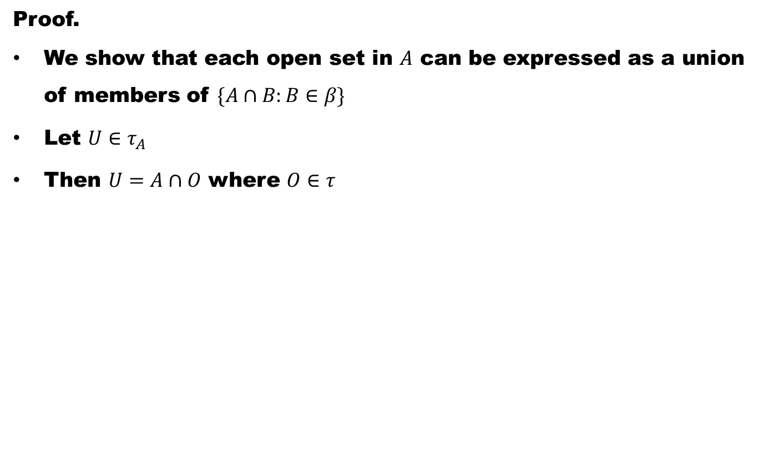
Theorem#5. Let A be a subspace of a space X, and $β$ is a base for the topology on X, then {A$∩$B: B $∈$ $β$} is a base for the relative topology for A.
Proof.
We show that each open set in $A$ can be expressed as a union of members of $\{A∩B:B∈β\}$
Let $U∈τ_{A}$
Then $U=A∩O$ where $O∈τ$

Slide 59
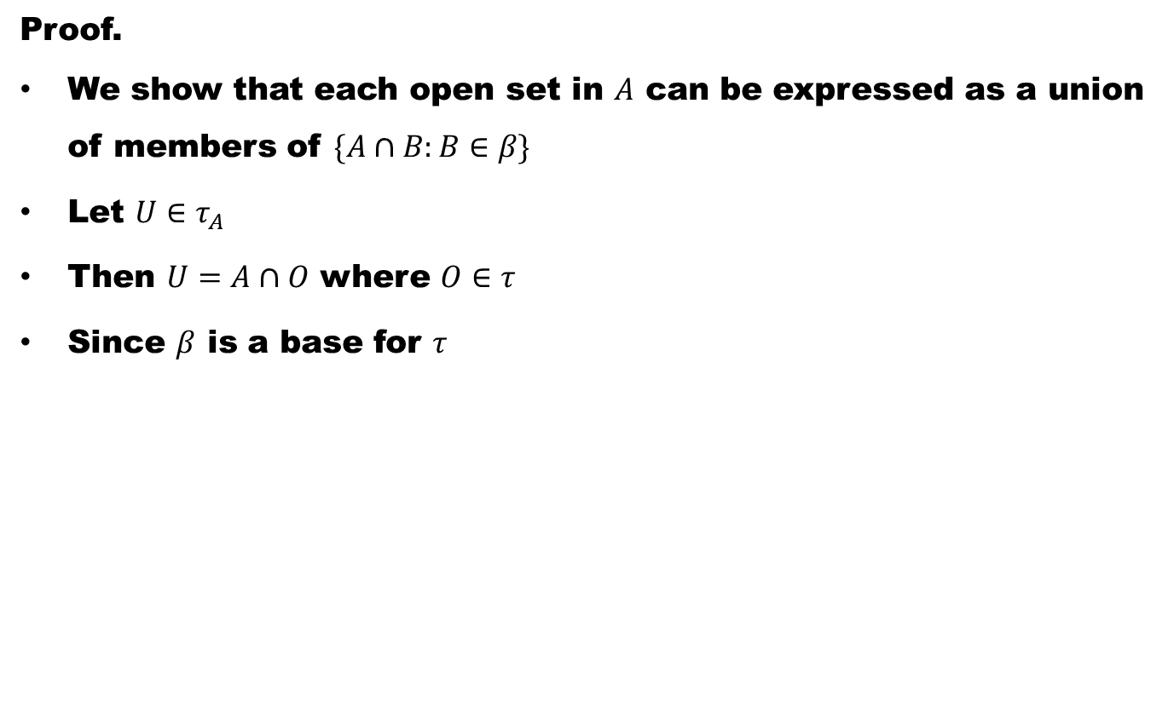
Theorem#5. Let A be a subspace of a space X, and $β$ is a base for the topology on X, then {A$∩$B: B $∈$ $β$} is a base for the relative topology for A.
Proof.
We show that each open set in $A$ can be expressed as a union of members of $\{A∩B:B∈β\}$
Let $U∈τ_{A}$
Then $U=A∩O$ where $O∈τ$
Since $β$ is a base for $τ$

Slide 60
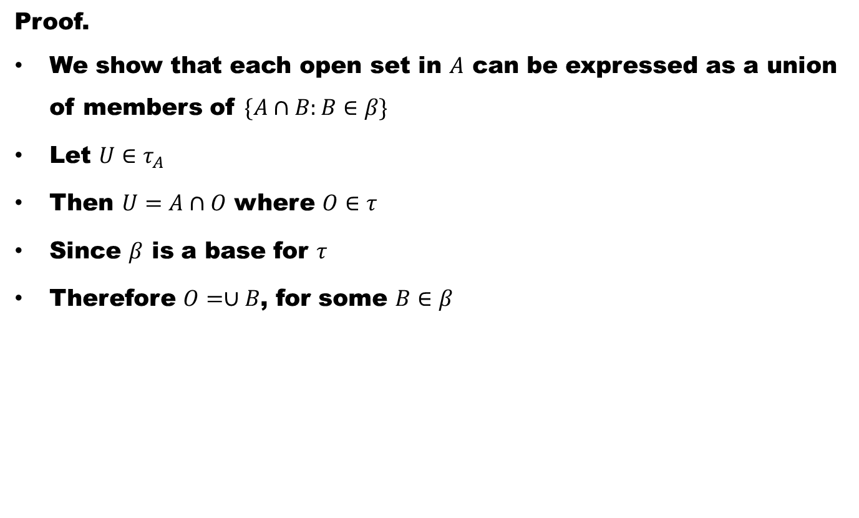
Theorem#5. Let A be a subspace of a space X, and $β$ is a base for the topology on X, then {A$∩$B: B $∈$ $β$} is a base for the relative topology for A.
Proof.
We show that each open set in $A$ can be expressed as a union of members of $\{A∩B:B∈β\}$
Let $U∈τ_{A}$
Then $U=A∩O$ where $O∈τ$
Since $β$ is a base for $τ$
Therefore $O=∪B$, for some $B∈β$

Slide 61

Theorem#5. Let A be a subspace of a space X, and $β$ is a base for the topology on X, then {A$∩$B: B $∈$ $β$} is a base for the relative topology for A.
Proof.
We show that each open set in $A$ can be expressed as a union of members of $\{A∩B:B∈β\}$
Let $U∈τ_{A}$
Then $U=A∩O$ where $O∈τ$
Since $β$ is a base for $τ$
Therefore $O=∪B$, for some $B∈β$
Thus $U=A∩O=A∩\left(∪B\right)=∪(A∩B)$, $B∈β$

Slide 62

Theorem#5. Let A be a subspace of a space X, and $β$ is a base for the topology on X, then {A$∩$B: B $∈$ $β$} is a base for the relative topology for A.
Proof.
We show that each open set in $A$ can be expressed as a union of members of $\{A∩B:B∈β\}$
Let $U∈τ_{A}$
Then $U=A∩O$ where $O∈τ$
Since $β$ is a base for $τ$
Therefore $O=∪B$, for some $B∈β$
Thus $U=A∩O=A∩\left(∪B\right)=∪(A∩B)$, $B∈β$
This completes the proof

Slide 63


Theorem#6. Let A be a subspace of a space X, and E $⊆$ A, then C$I_{\text{A}}($E) = A $∩$C${\text{I}}_{\text{x}}($E), where C$I_{\text{A}}($E) denotes the closure of E in A.
Proof.
Let $x∈A∩{cl}_{X}(E)$

Slide 64

Theorem#6. Let A be a subspace of a space X, and E $⊆$ A, then C$I_{\text{A}}($E) = A $∩$C${\text{I}}_{\text{x}}($E), where C$I_{\text{A}}($E) denotes the closure of E in A.
Proof.
Let $x∈A∩{cl}_{X}(E)$
Then for all $N_{x}$, $N_{x}∩E≠φ$

Slide 65

Theorem#6. Let A be a subspace of a space X, and E $⊆$ A, then C$I_{\text{A}}($E) = A $∩$C${\text{I}}_{\text{x}}($E), where C$I_{\text{A}}($E) denotes the closure of E in A.
Proof.
Let $x∈A∩{cl}_{X}(E)$
Then for all $N_{x}$, $N_{x}∩E≠φ$
Since $E⊆A,$

Slide 66

Theorem#6. Let A be a subspace of a space X, and E $⊆$ A, then C$I_{\text{A}}($E) = A $∩$C${\text{I}}_{\text{x}}($E), where C$I_{\text{A}}($E) denotes the closure of E in A.
Proof.
Let $x∈A∩{cl}_{X}(E)$
Then for all $N_{x}$, $N_{x}∩E≠φ$
Since $E⊆A,$
Therefore${ N}_{x}∩(E∩A)≠φ$

Slide 67

Theorem#6. Let A be a subspace of a space X, and E $⊆$ A, then C$I_{\text{A}}($E) = A $∩$C${\text{I}}_{\text{x}}($E), where C$I_{\text{A}}($E) denotes the closure of E in A.
Proof.
Let $x∈A∩{cl}_{X}(E)$
Then for all $N_{x}$, $N_{x}∩E≠φ$
Since $E⊆A,$
Therefore${ N}_{x}∩(E∩A)≠φ$
Or ${ (N}_{x}∩E)∩A≠φ$

Slide 68

Theorem#6. Let A be a subspace of a space X, and E $⊆$ A, then C$I_{\text{A}}($E) = A $∩$C${\text{I}}_{\text{x}}($E), where C$I_{\text{A}}($E) denotes the closure of E in A.
Proof.
Let $x∈A∩{cl}_{X}(E)$
Then for all $N_{x}$, $N_{x}∩E≠φ$
Since $E⊆A,$
Therefore${ N}_{x}∩(E∩A)≠φ$
Or ${ (N}_{x}∩E)∩A≠φ$
This implies $x∈{cl}_{A}(E)$ and conversely.

Slide 69

Theorem#7. Let f : X $→$ Y be continuous and A $⊆$ X. Then ${\text{f}}_{\text{A} }:$A $→$ Y is continuous, where ${\text{f}}_{\text{A} }$denote the restriction of f to A.
Proof.

Slide 70
Good Luck to You
Dear Students

