Slide 1
Set Topology
MTH 251
Lecture # 19

Slide 2
Lecture Plan
Subspaces
Relative Topologies

Slide 3
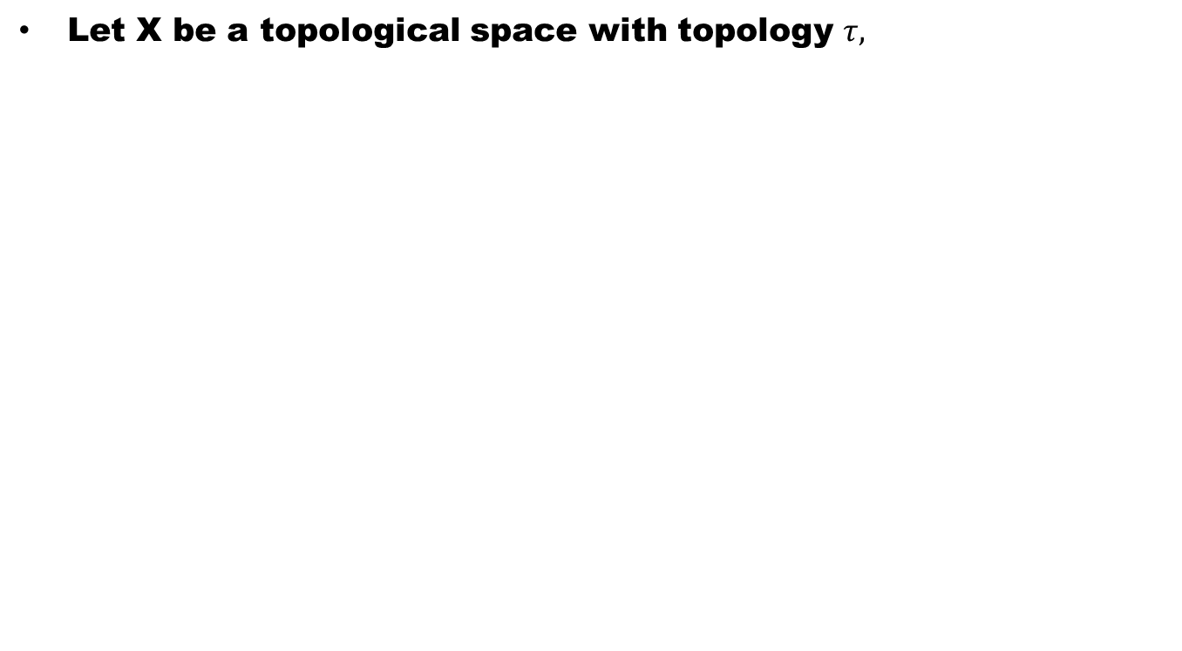
subspaces
Let X be a topological space with topology $τ,$

Slide 4
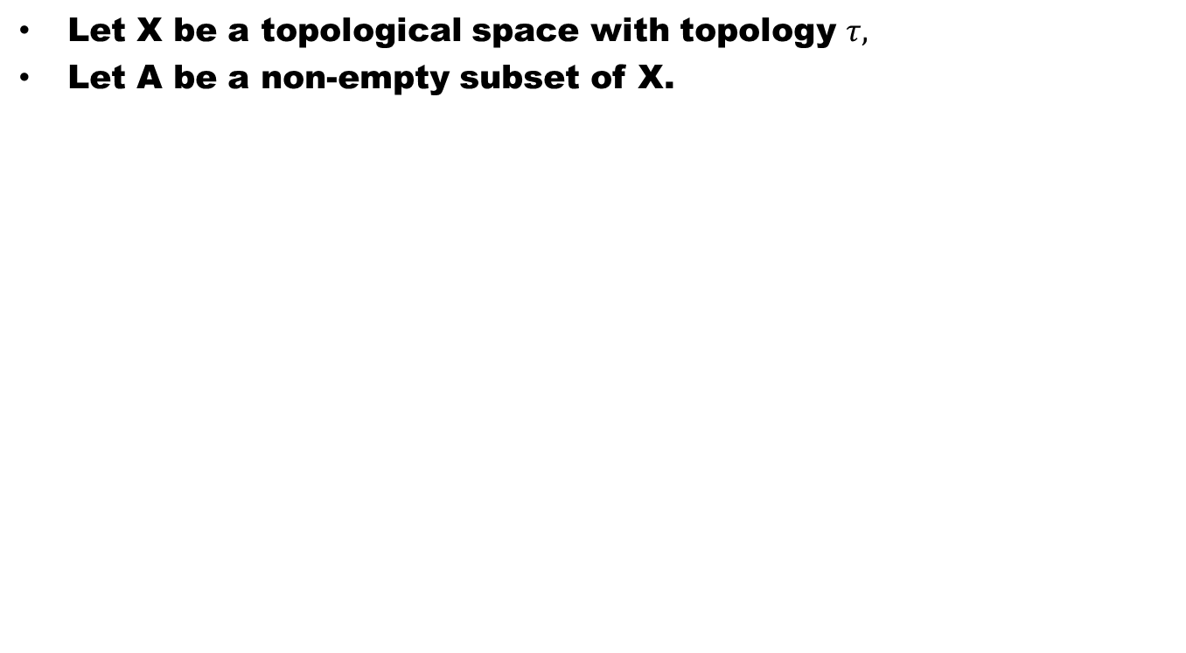
subspaces
Let X be a topological space with topology $τ,$
Let A be a non-empty subset of X.

Slide 5
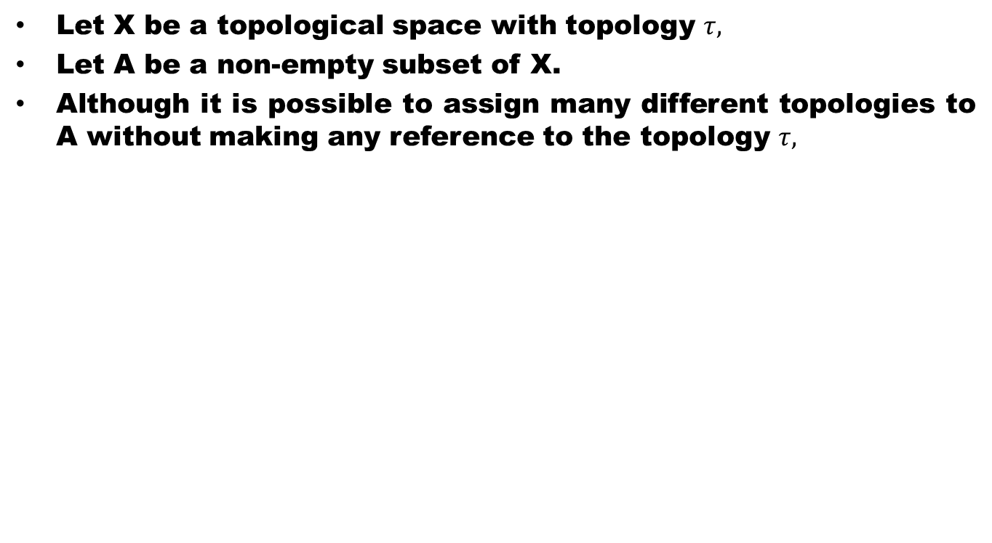
subspaces
Let X be a topological space with topology $τ,$
Let A be a non-empty subset of X.
Although it is possible to assign many different topologies to A without making any reference to the topology $τ,$

Slide 6
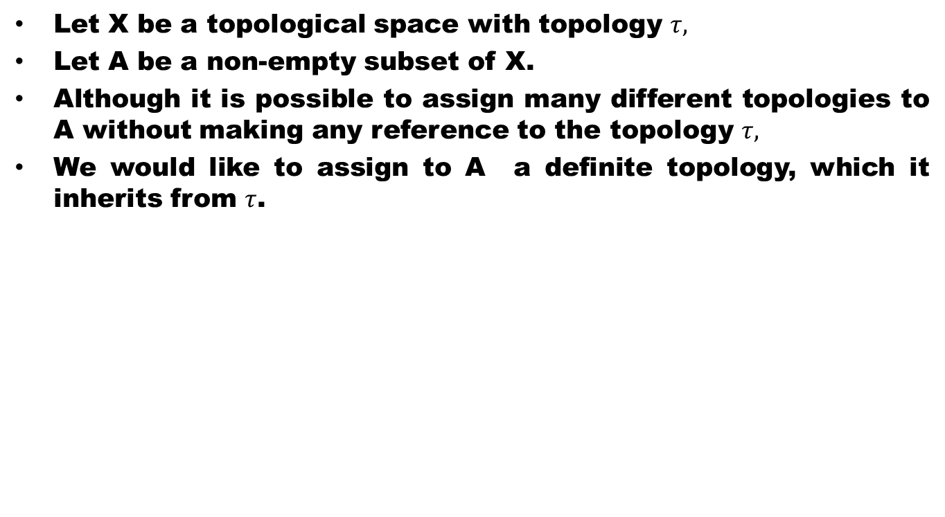
subspaces
Let X be a topological space with topology $τ,$
Let A be a non-empty subset of X.
Although it is possible to assign many different topologies to A without making any reference to the topology $τ,$
We would like to assign to A a definite topology, which it inherits from $τ$.

Slide 7
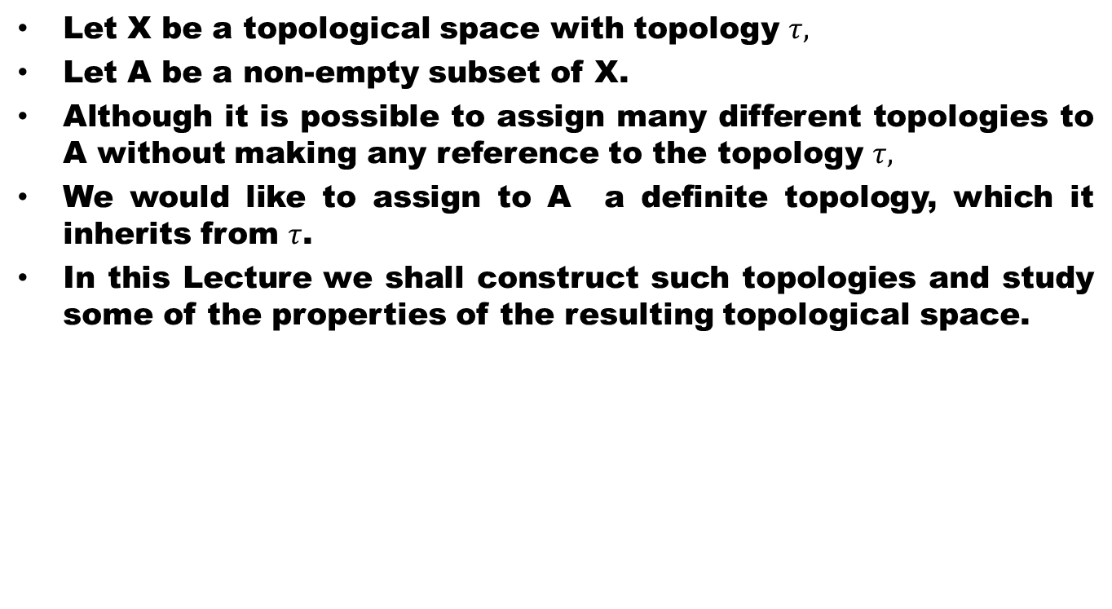
subspaces
Let X be a topological space with topology $τ,$
Let A be a non-empty subset of X.
Although it is possible to assign many different topologies to A without making any reference to the topology $τ,$
We would like to assign to A a definite topology, which it inherits from $τ$.
In this Lecture we shall construct such topologies and study some of the properties of the resulting topological space.

Slide 8
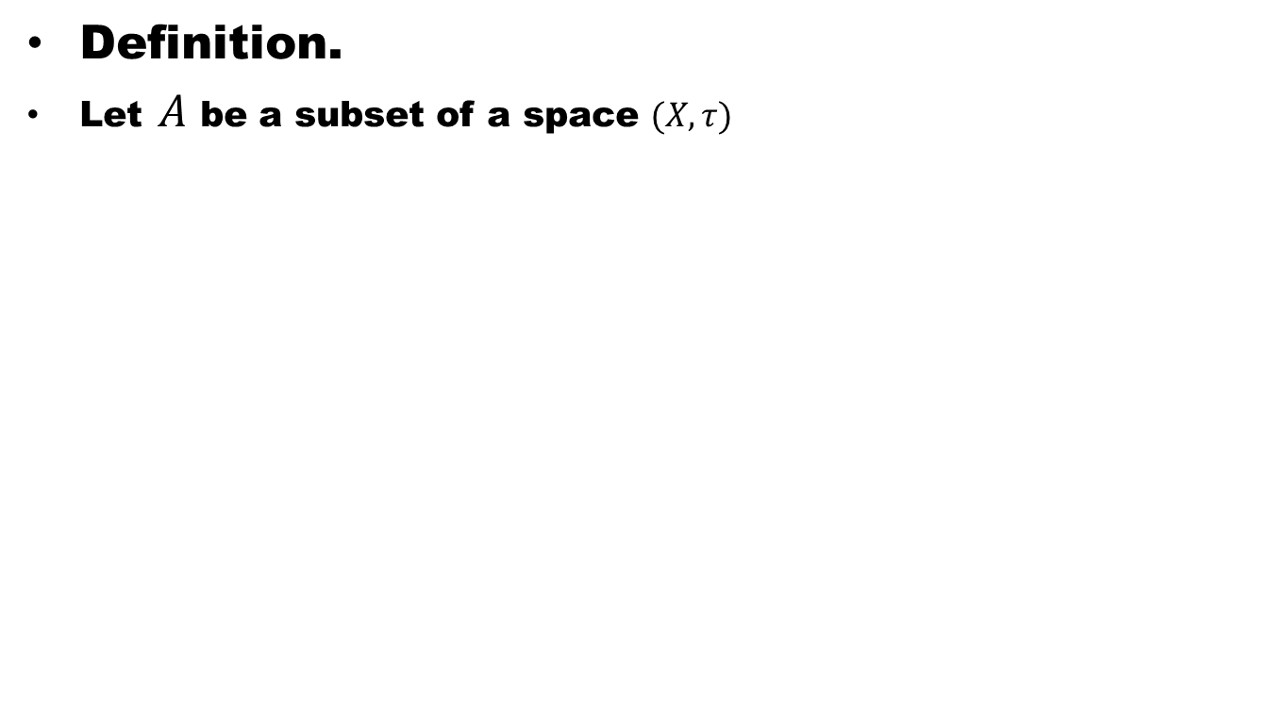
Relative Topology
Definition.
Let $A$ be a subset of a space $(X, τ)$

Slide 9
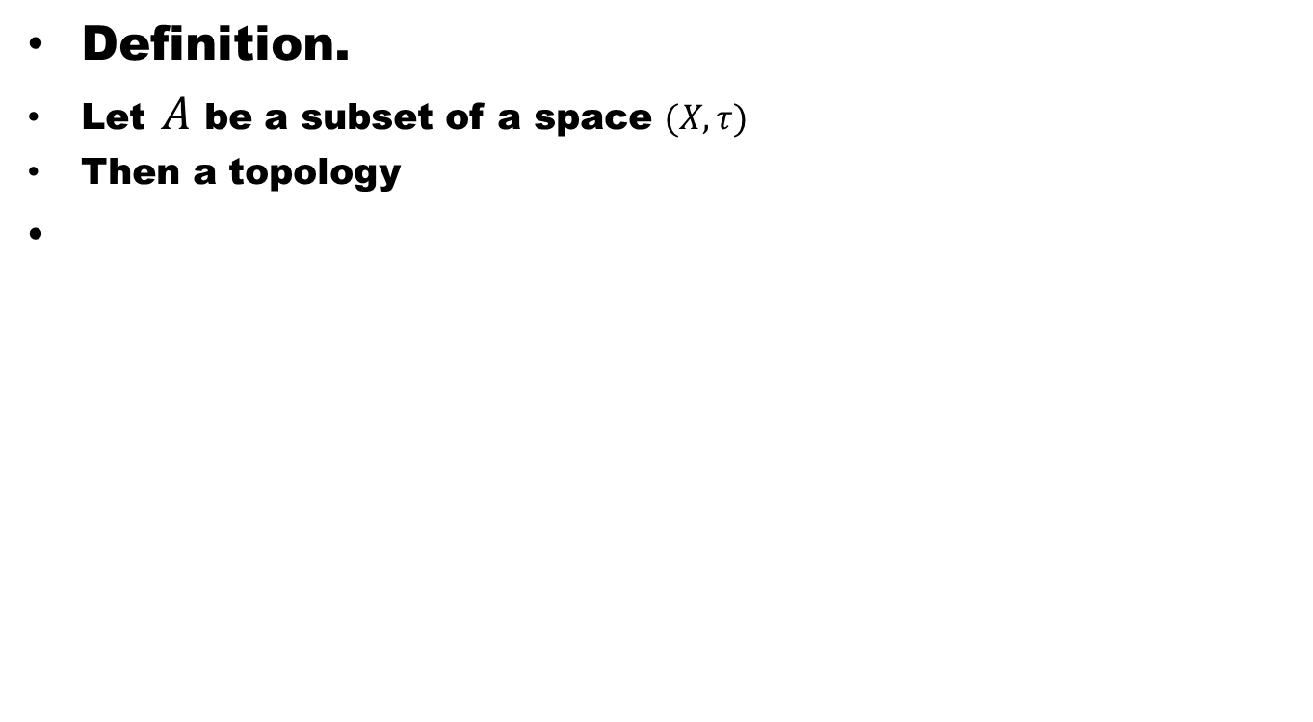
Relative Topology
Definition.
Let $A$ be a subset of a space $(X, τ)$
Then a topology

Slide 10
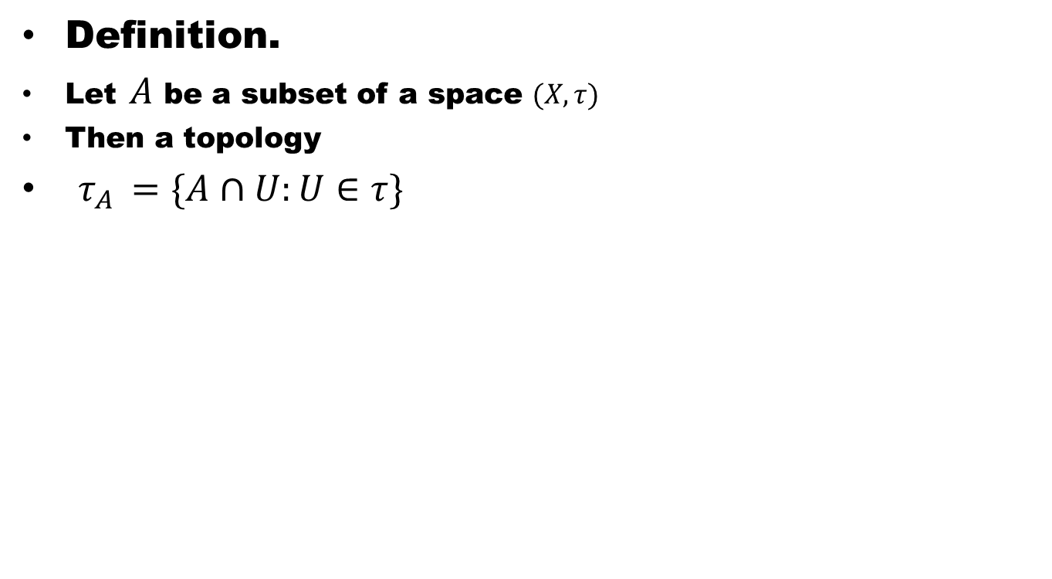
Relative Topology
Definition.
Let $A$ be a subset of a space $(X, τ)$
Then a topology
$τ_{A }=\{A∩U:U∈τ\}$

Slide 11
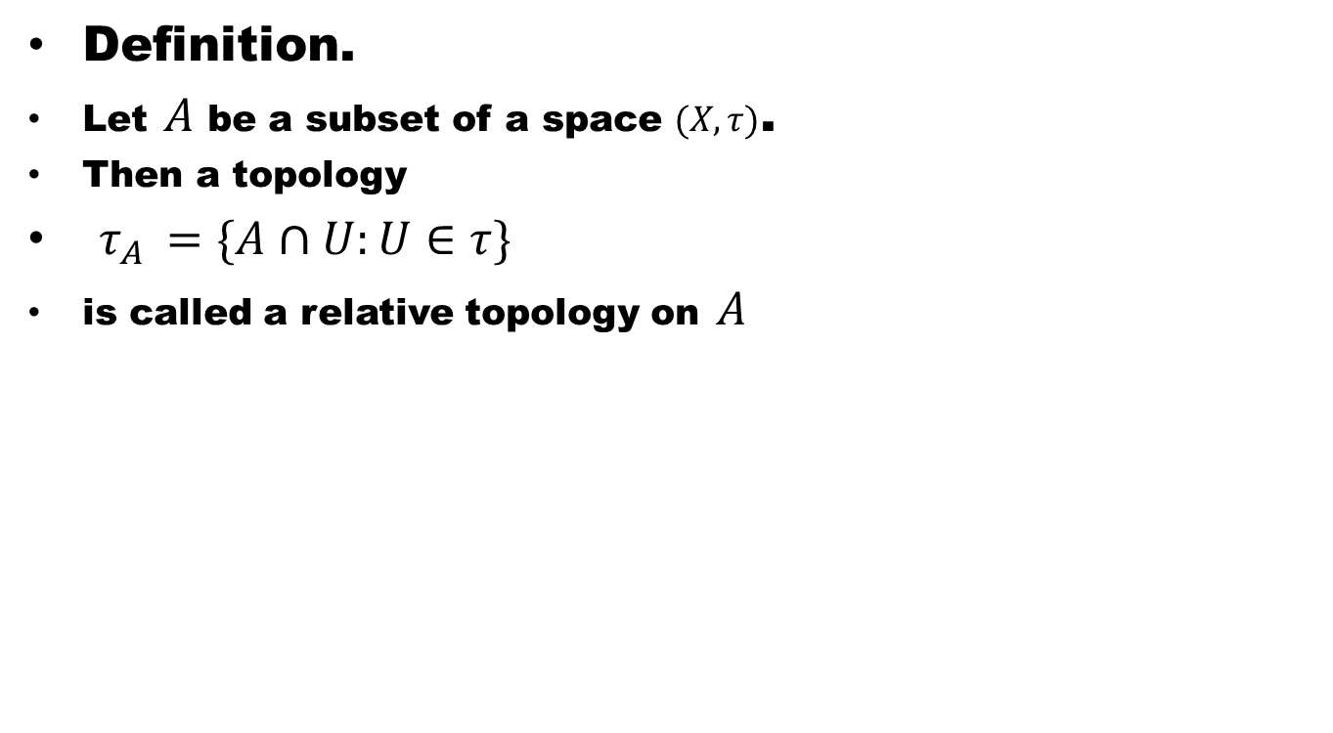
Relative Topology
Definition.
Let $A$ be a subset of a space $(X, τ)$.
Then a topology
$τ_{A }=\{A∩U:U∈τ\}$
is called a relative topology on $A$

Slide 12
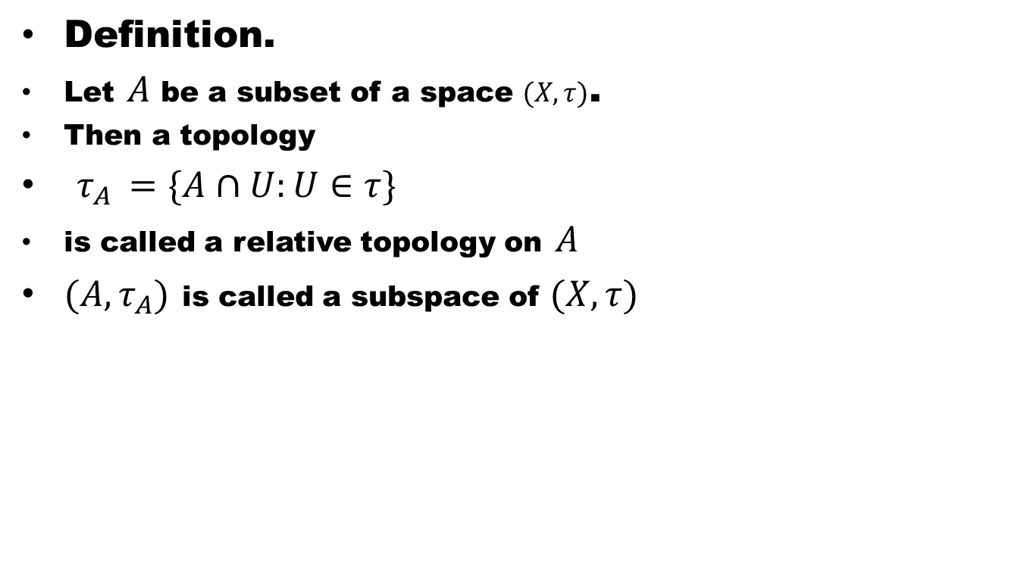
Relative Topology
Definition.
Let $A$ be a subset of a space $(X, τ)$.
Then a topology
$τ_{A }=\{A∩U:U∈τ\}$
is called a relative topology on $A$
$(A,τ_{A})$ is called a subspace of $(X,τ)$

Slide 13
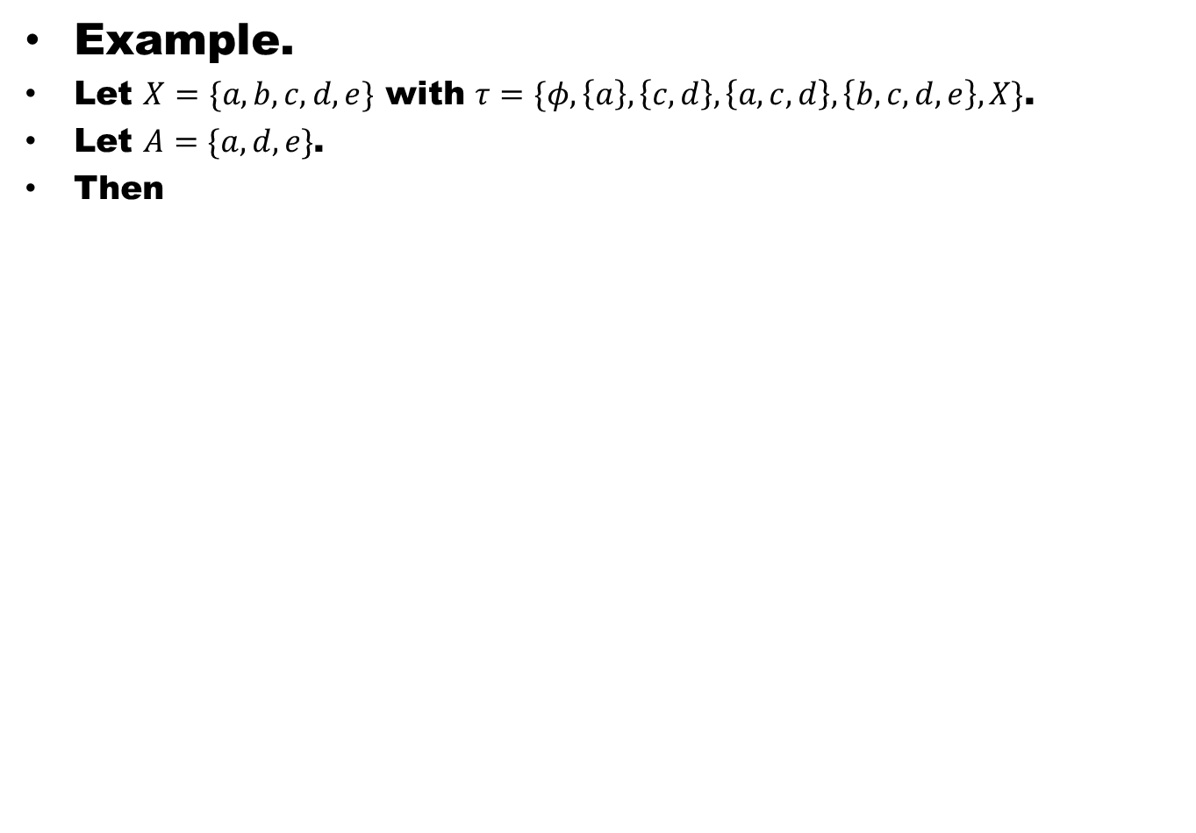
Example.
Let $X=\{a,b,c,d,e\}$ with $τ=\{φ,\left\{a\right\},\left\{c,d\right\},\left\{a,c,d\right\},\left\{b,c,d,e\right\},X\}$.
Let $A=\{a,d,e\}$.
Then

Slide 14
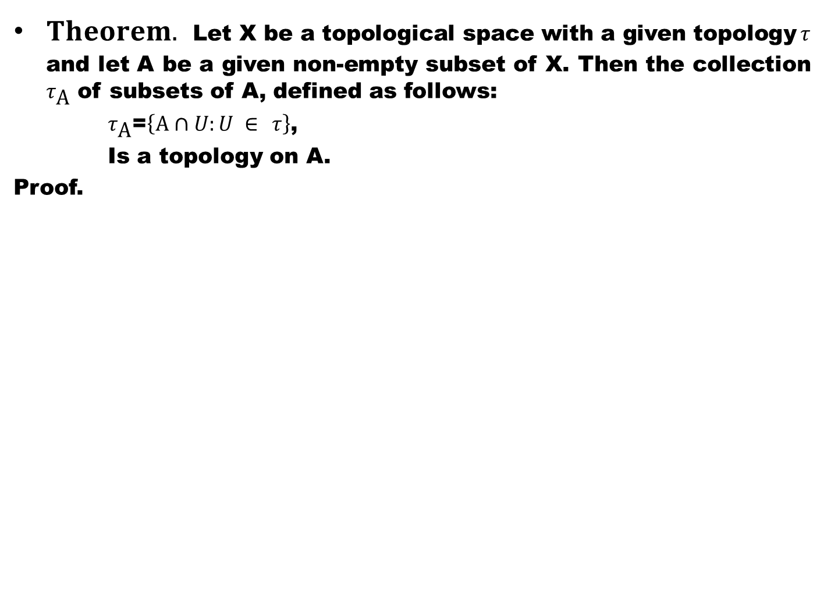
$Theorem.$ Let X be a topological space with a given topology $τ$ and let A be a given non-empty subset of X. Then the collection $τ_{\text{A}}$ of subsets of A, defined as follows:
$τ_{\text{A}}$=$\left\{\text{A}∩U:U ∈ τ\right\}$,
Is a topology on A.
Proof.

Slide 16
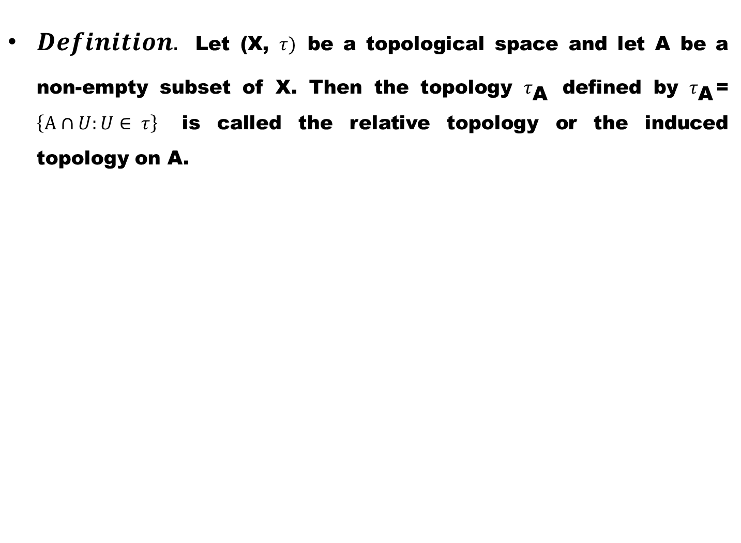
$Definition.$ Let (X, $τ)$ be a topological space and let A be a non-empty subset of X. Then the topology $τ_{\text{A}}$ defined by $τ_{\text{A}}$= $\left\{\text{A}∩U:U∈ τ\right\}$ is called the relative topology or the induced topology on A.

Slide 17
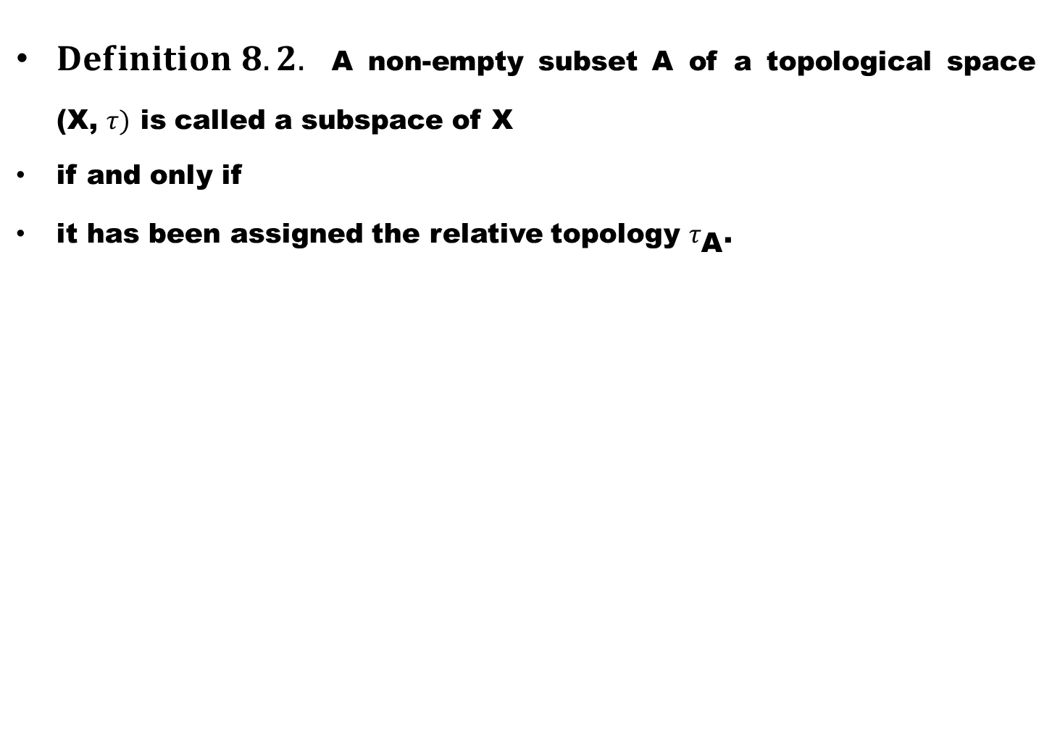
$Definition 8.2.$ A non-empty subset A of a topological space (X, $τ)$ is called a subspace of X
if and only if
it has been assigned the relative topology $τ_{\text{A}}$.

Slide 18
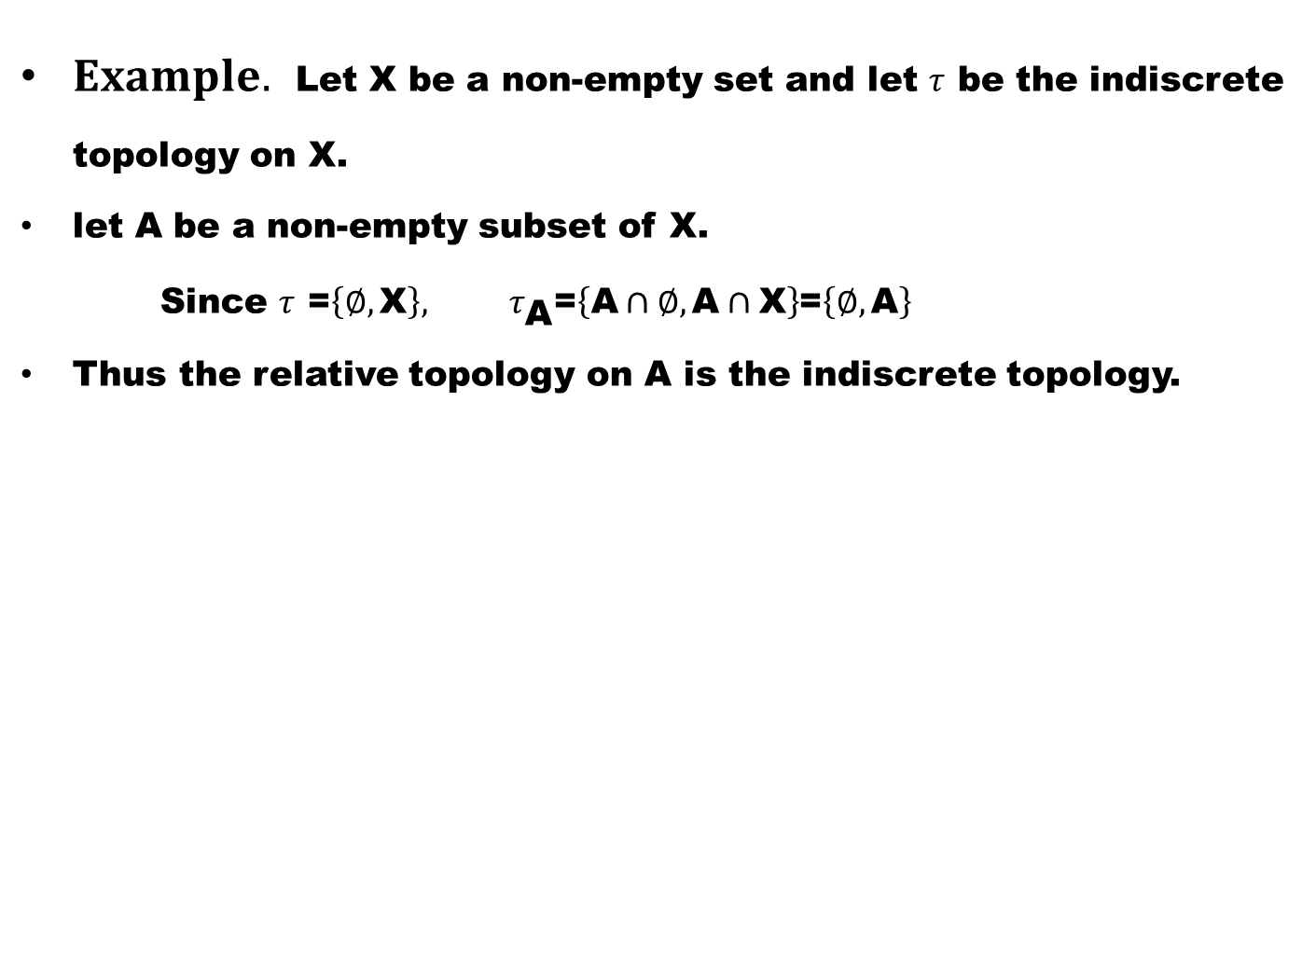
$Example.$ Let X be a non-empty set and let $τ$ be the indiscrete topology on X.
let A be a non-empty subset of X.
Since $τ$ =$\left\{∅,\text{X}\right\},$ $τ_{\text{A}}$=$\left\{\text{A}∩∅,\text{A}∩\text{X}\right\}$=$\left\{∅,\text{A}\right\}$
Thus the relative topology on A is the indiscrete topology.

Slide 19
Note.
A subspace of a discrete space is discrete

Slide 20
Note.
A subspace of a discrete space is discrete
A subspace of indiscrete space is indiscrete

Slide 21
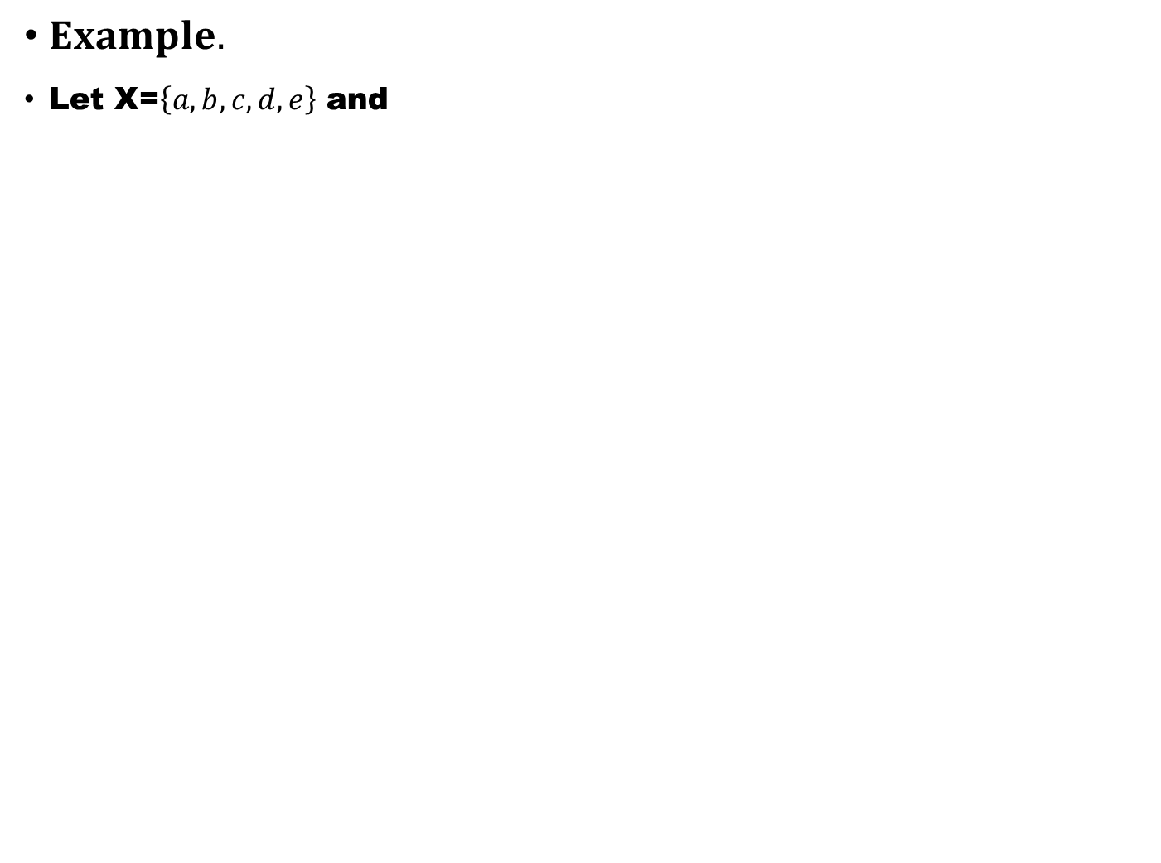
$Example.$
Let X=$\left\{a,b,c,d,e\right\}$ and

Slide 22
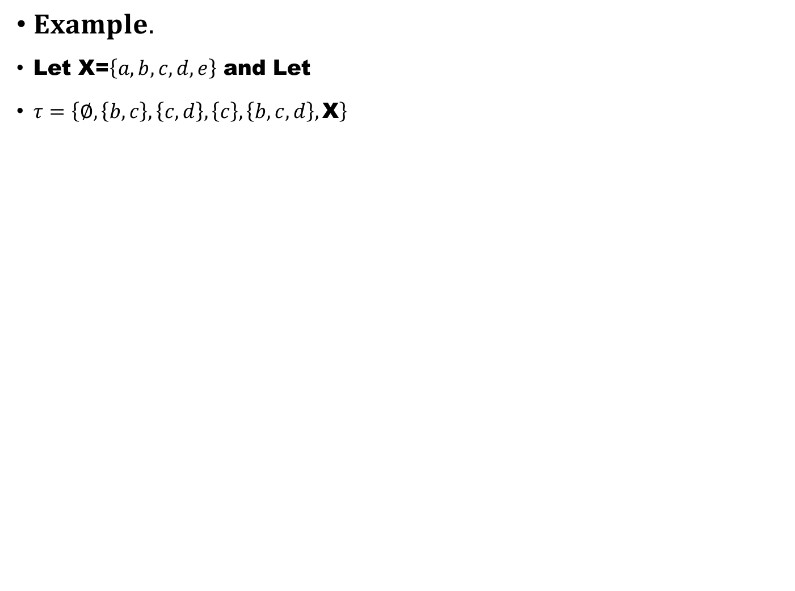
$Example.$
Let X=$\left\{a,b,c,d,e\right\}$ and Let
$τ=\left\{∅,\left\{b,c\right\},\left\{c,d\right\},\left\{c\right\},\left\{b,c,d\right\},\text{X}\right\}$

Slide 23
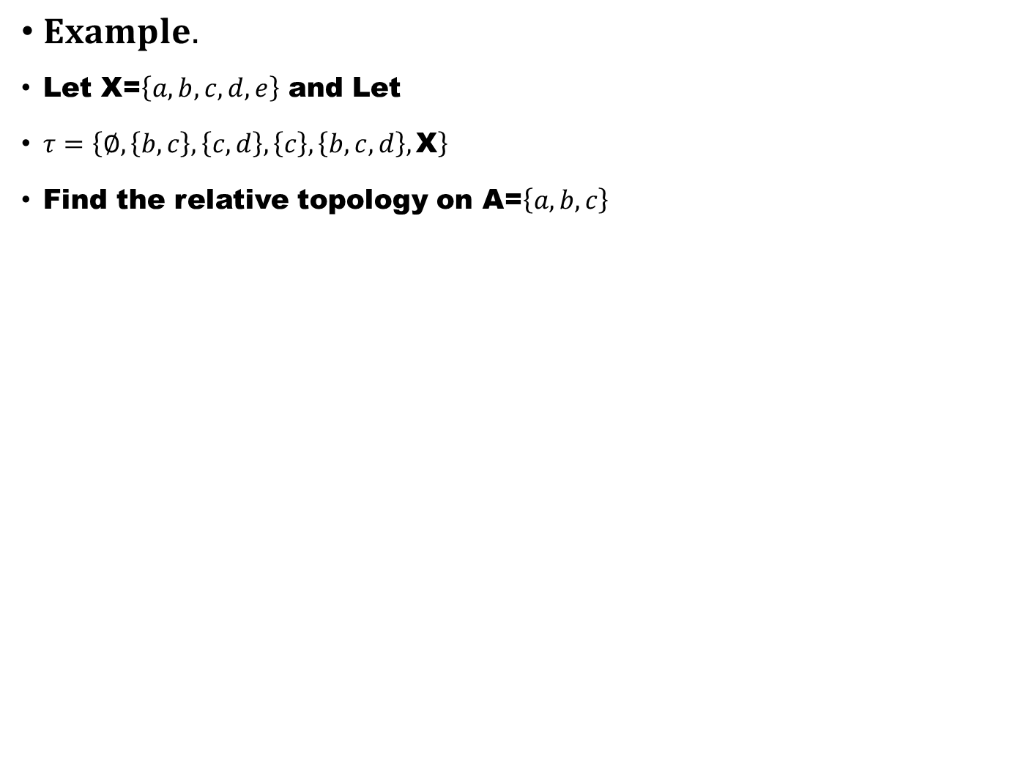
$Example.$
Let X=$\left\{a,b,c,d,e\right\}$ and Let
$τ=\left\{∅,\left\{b,c\right\},\left\{c,d\right\},\left\{c\right\},\left\{b,c,d\right\},\text{X}\right\}$
Find the relative topology on A=$\left\{a,b,c\right\}$

Slide 24
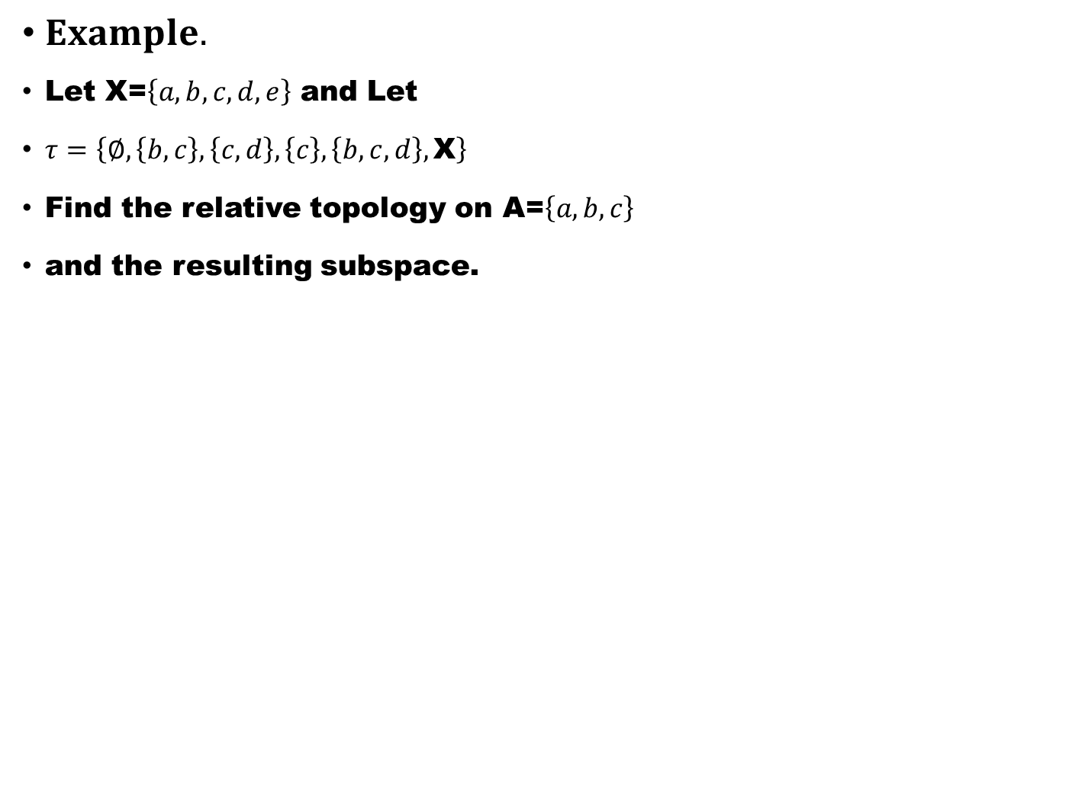
$Example.$
Let X=$\left\{a,b,c,d,e\right\}$ and Let
$τ=\left\{∅,\left\{b,c\right\},\left\{c,d\right\},\left\{c\right\},\left\{b,c,d\right\},\text{X}\right\}$
Find the relative topology on A=$\left\{a,b,c\right\}$
and the resulting subspace.

Slide 25
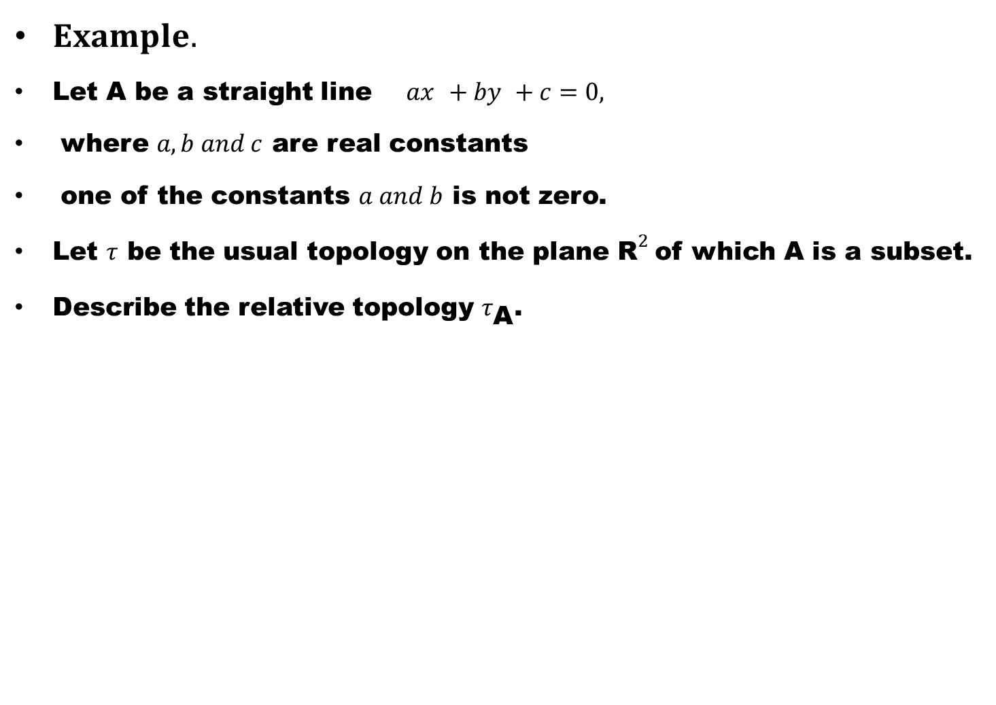
$Example.$
Let A be a straight line ${ax}_{ }+{by}_{ }+c=0,$
where $a,b and c$ are real constants
one of the constants $a and b$ is not zero.
Let $τ$ be the usual topology on the plane ${\text{R}}^{2}$of which A is a subset.
Describe the relative topology $τ_{\text{A}}$.

Slide 26
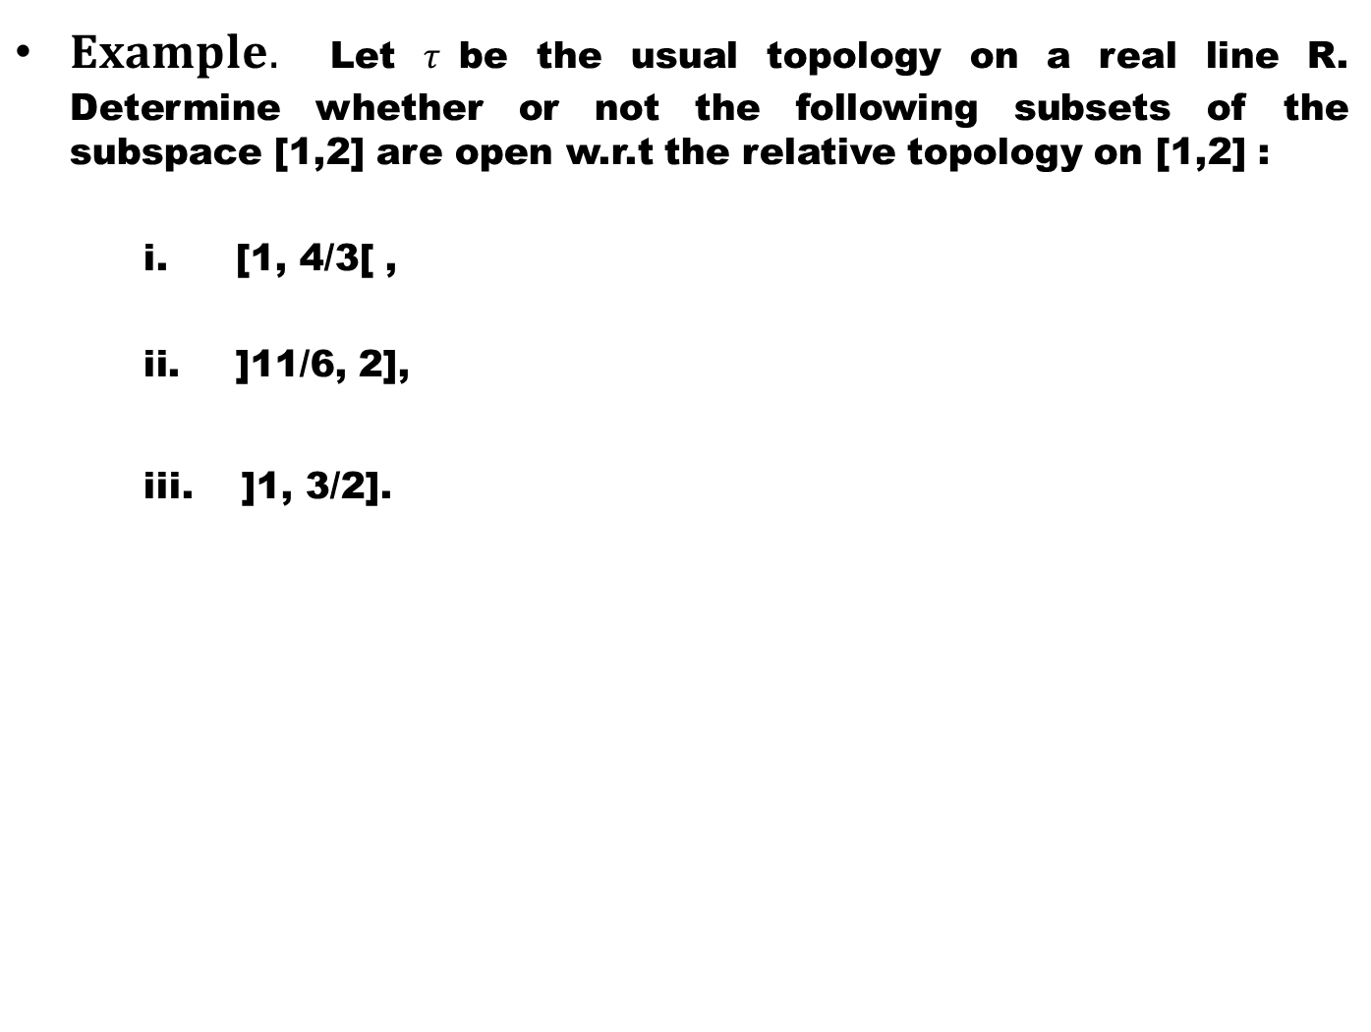
$Example.$ Let $τ$be the usual topology on a real line R. Determine whether or not the following subsets of the subspace [1,2] are open w.r.t the relative topology on [1,2] :
    [1, 4/3[ ,
    ]11/6, 2],
    iii. ]1, 3/2].

Slide 27
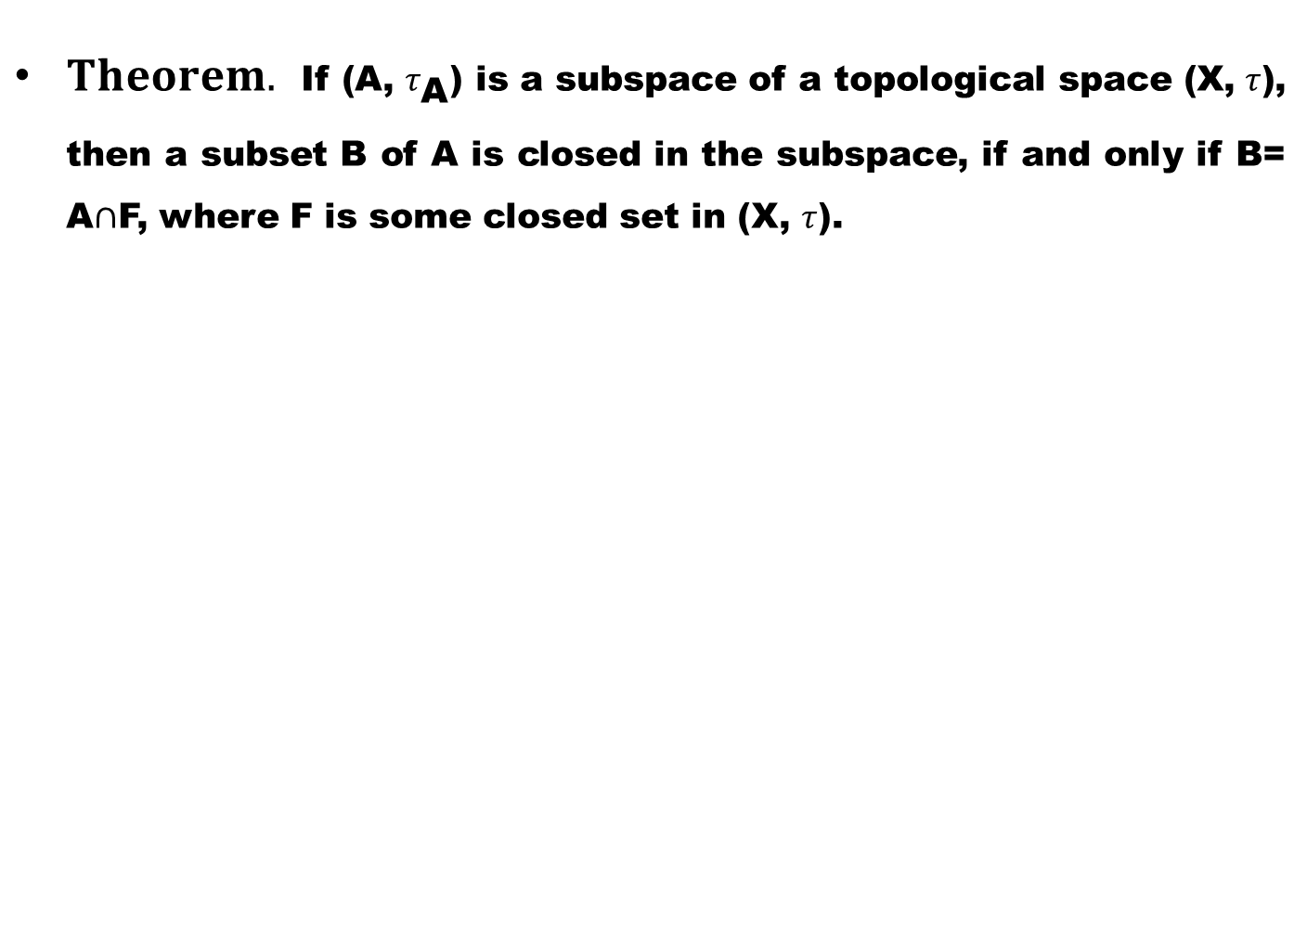
$Theorem.$ If (A, $τ_{\text{A}}$) is a subspace of a topological space (X, $τ$), then a subset B of A is closed in the subspace, if and only if B= A$∩$F, where F is some closed set in (X, $τ$).

Slide 29
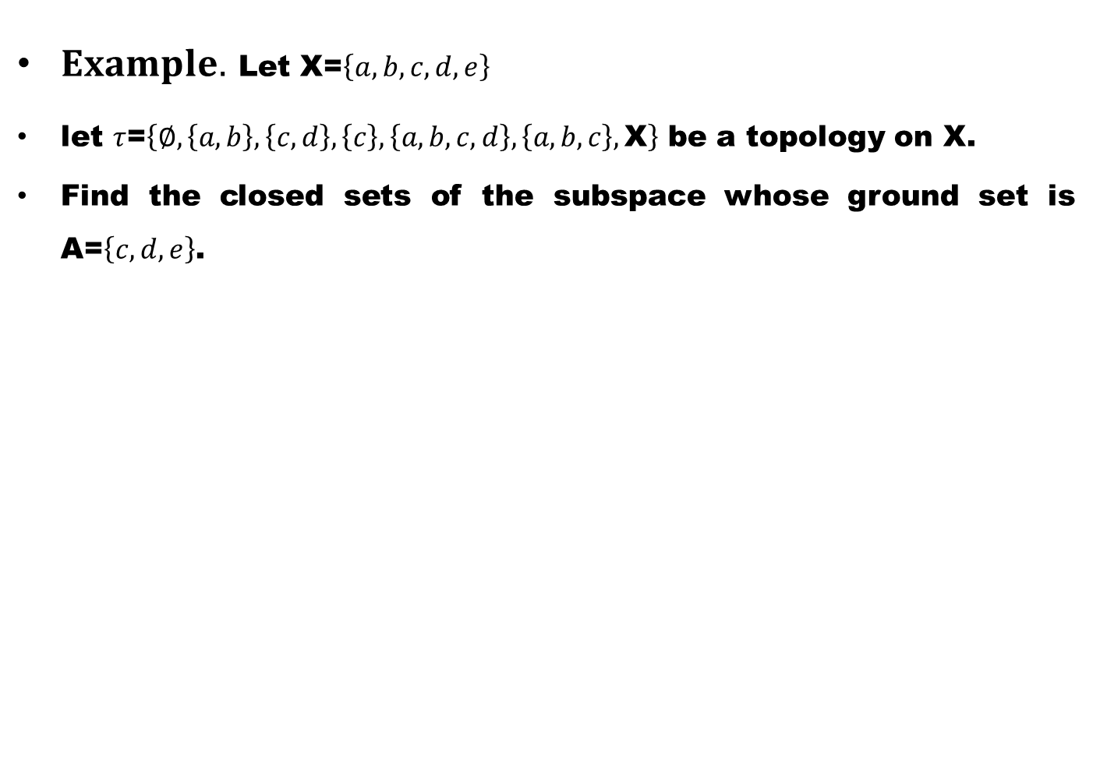
$Example.$ Let X=$\left\{a,b,c,d,e\right\}$
let $τ$=$\left\{∅,\left\{a,b\right\},\left\{c,d\right\},\left\{c\right\},\left\{a,b,c,d\right\},\left\{a,b,c\right\},\text{X}\right\}$ be a topology on X.
Find the closed sets of the subspace whose ground set is A=$\left\{c,d,e\right\}$.

Slide 30
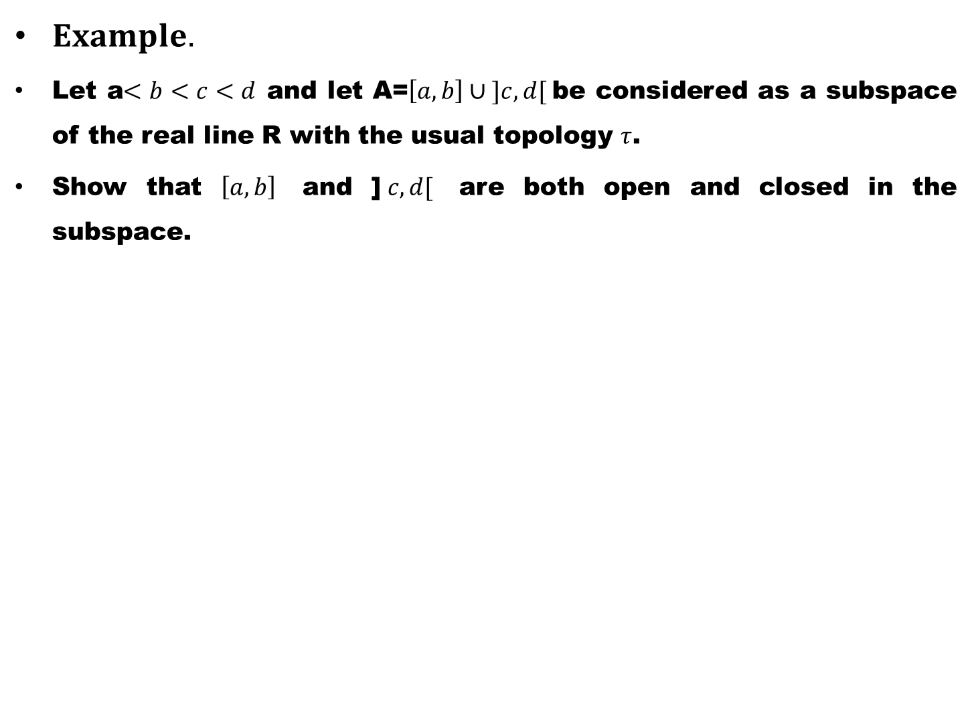
$Example.$
Let a$<b<c<d$and let A=$\left[a,b\right]∪ ]c,d[$be considered as a subspace of the real line R with the usual topology $τ$.
Show that $\left[a,b\right]$ and ]$c,d[$ are both open and closed in the subspace.

