Slide 1
Set Topology
MTH 251
Lecture # 18

Slide 2
Lecture Plan
Continuity
Homeomorphism

Slide 3
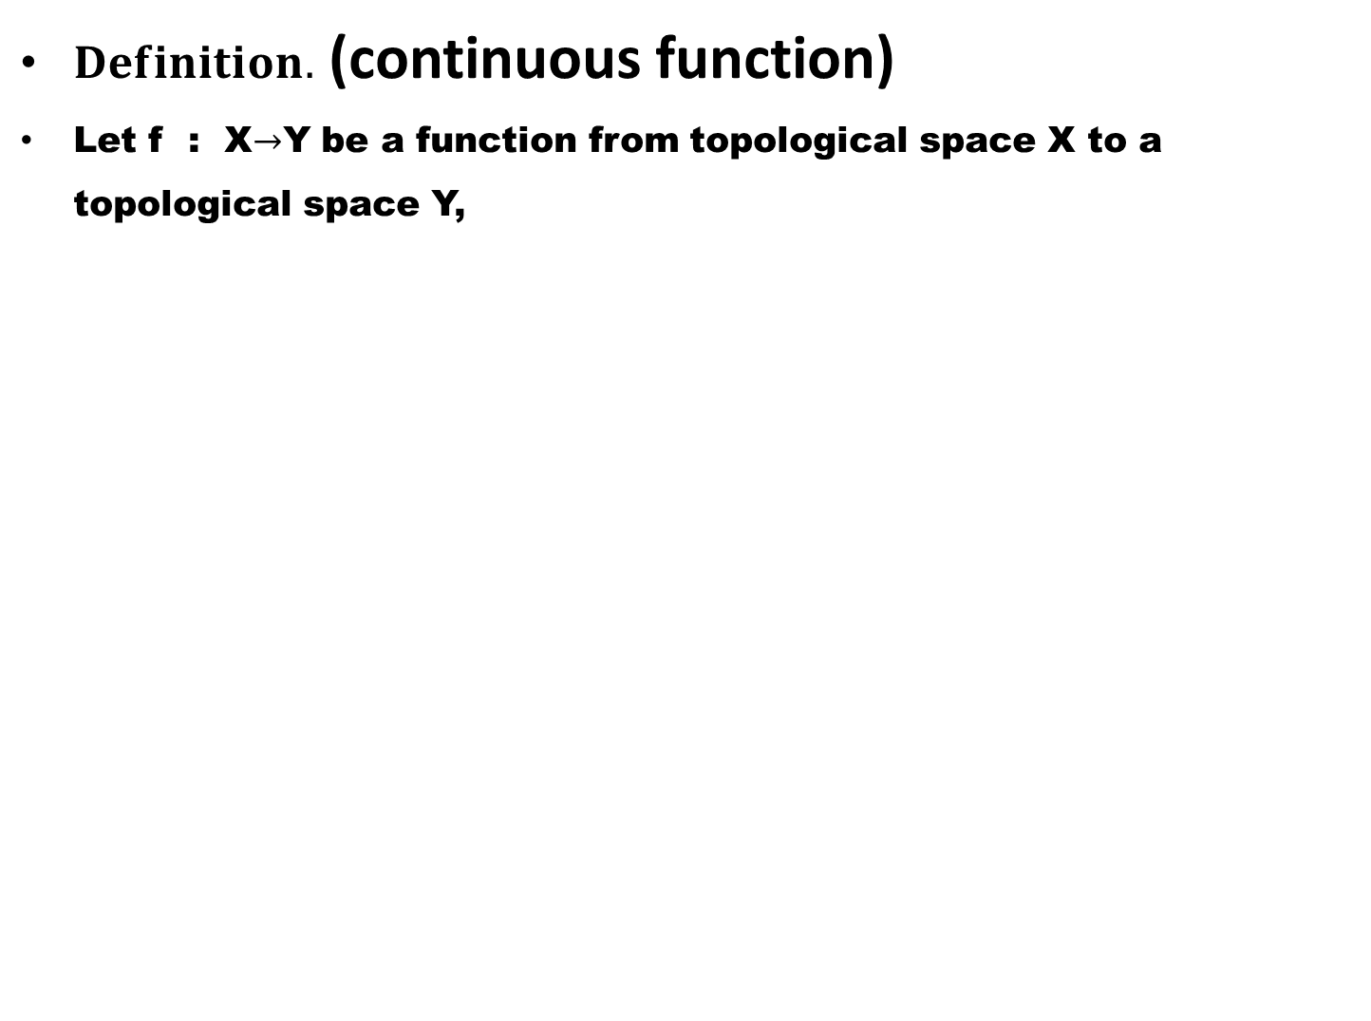
$Definition.$ (continuous function)
Let f : X$→$Y be a function from topological space X to a topological space Y,

Slide 4
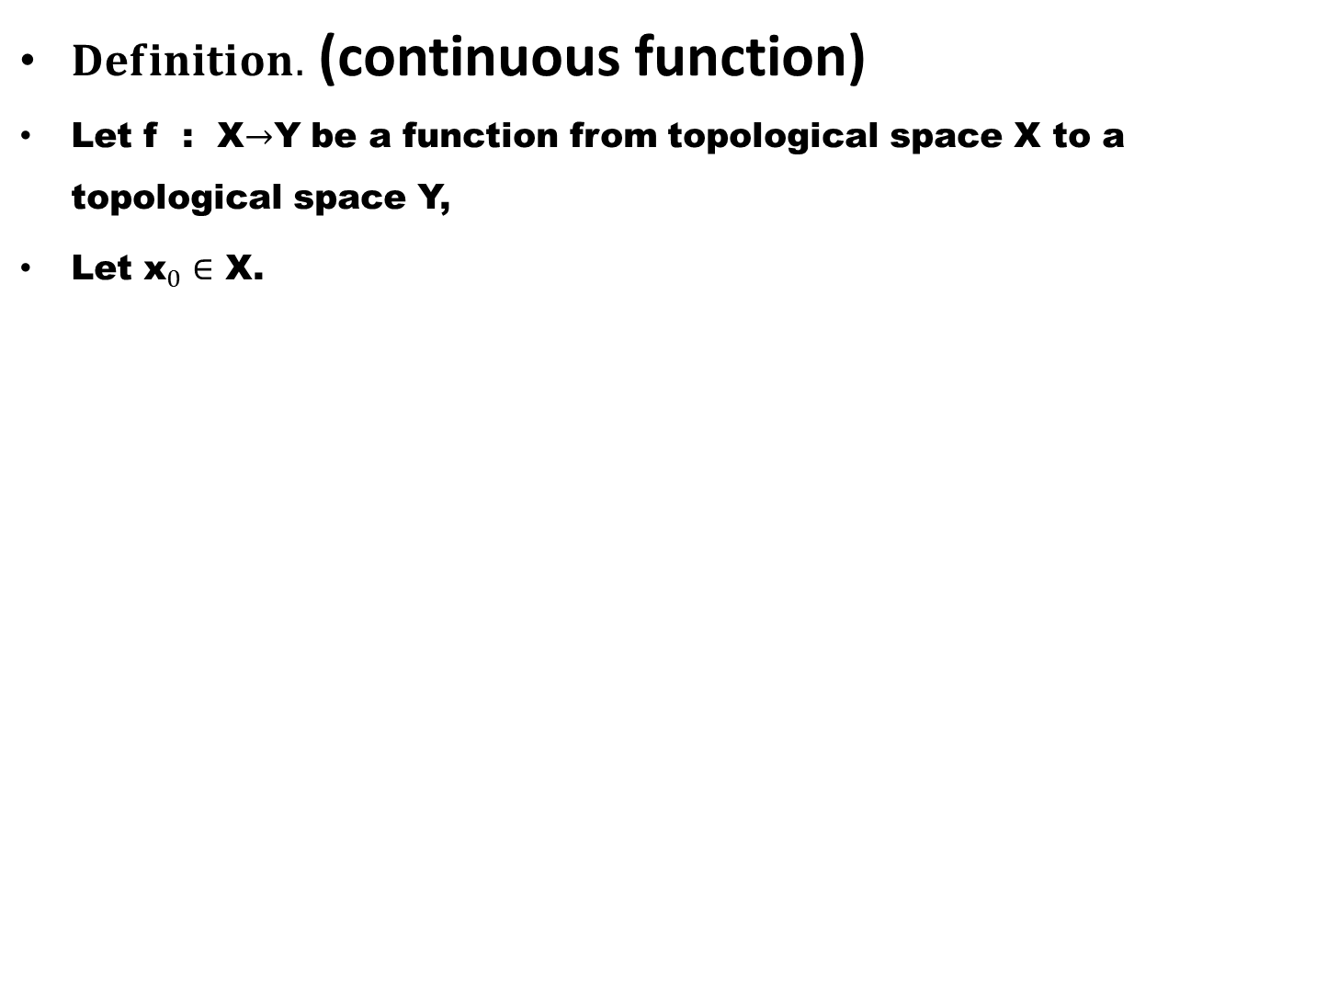
$Definition.$ (continuous function)
Let f : X$→$Y be a function from topological space X to a topological space Y,
Let ${\text{x}}_{0}∈$ X.

Slide 5
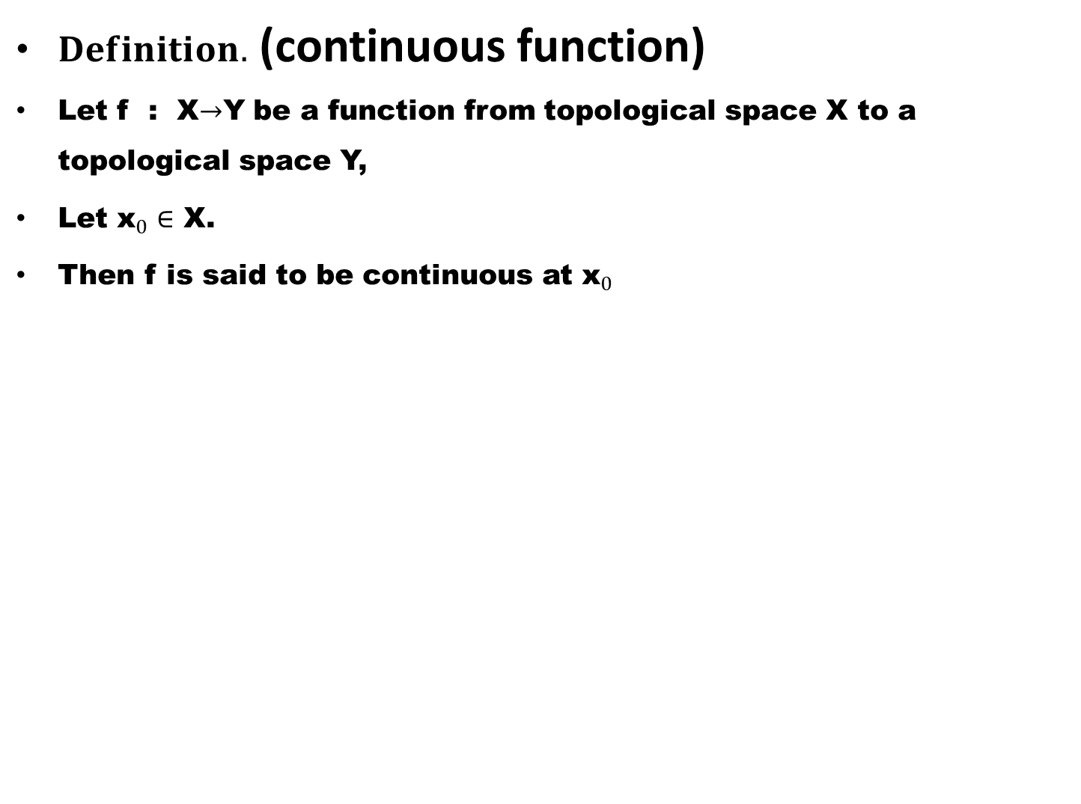
$Definition.$ (continuous function)
Let f : X$→$Y be a function from topological space X to a topological space Y,
Let ${\text{x}}_{0}∈$ X.
Then f is said to be continuous at ${\text{x}}_{0}$

Slide 6
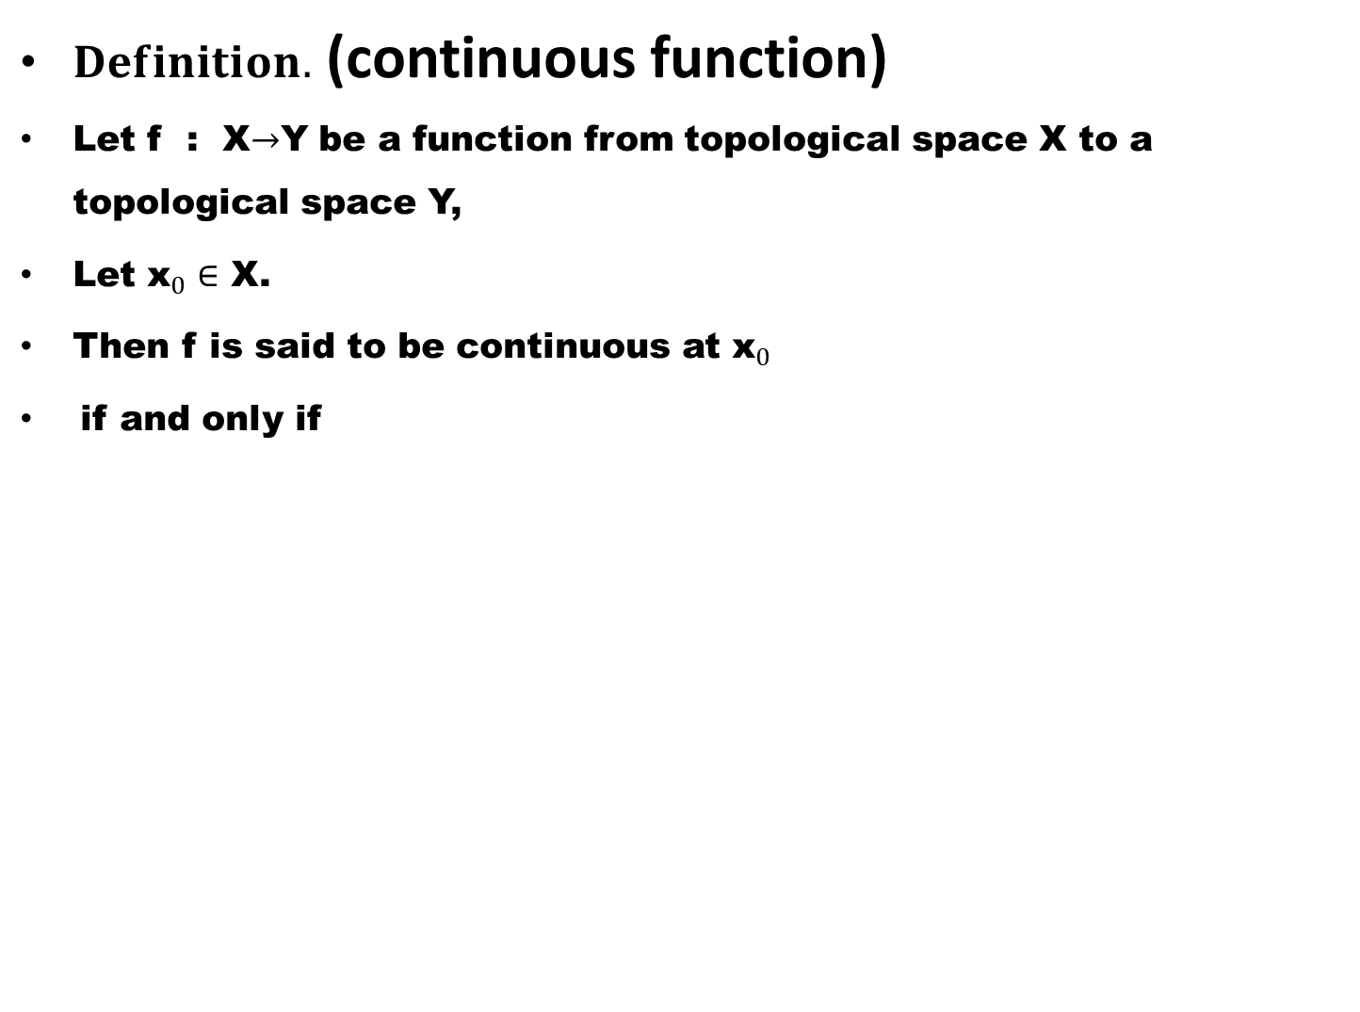
$Definition.$ (continuous function)
Let f : X$→$Y be a function from topological space X to a topological space Y,
Let ${\text{x}}_{0}∈$ X.
Then f is said to be continuous at ${\text{x}}_{0}$
if and only if

Slide 7
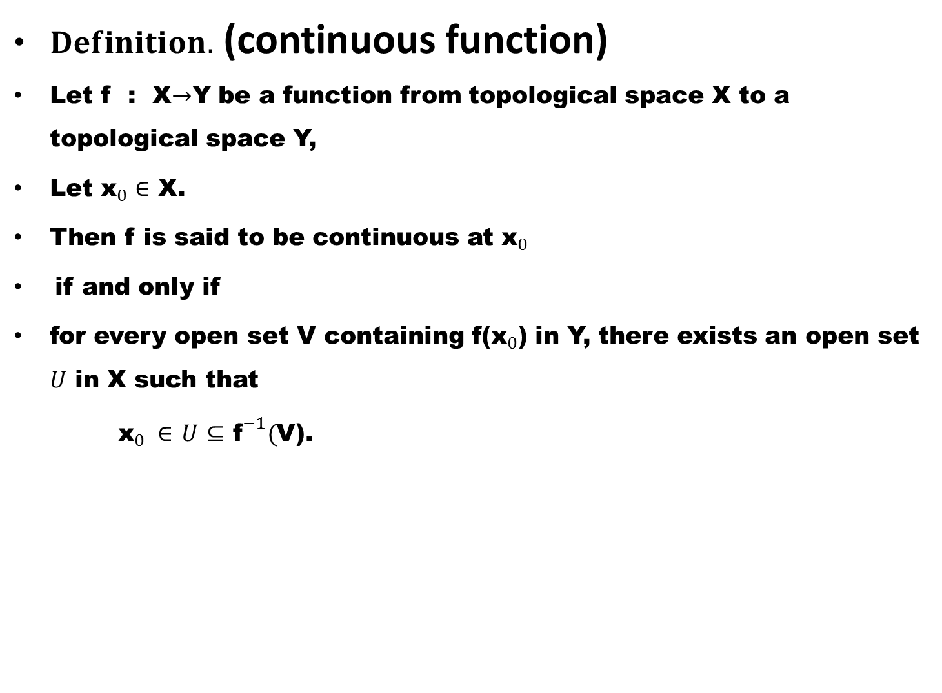
$Definition.$ (continuous function)
Let f : X$→$Y be a function from topological space X to a topological space Y,
Let ${\text{x}}_{0}∈$ X.
Then f is said to be continuous at ${\text{x}}_{0}$
if and only if
for every open set V containing f(${\text{x}}_{0}$) in Y, there exists an open set $U$ in X such that
${\text{x}}_{0} ∈$$U$$⊆$${\text{f}}^{−1}($V).

Slide 8
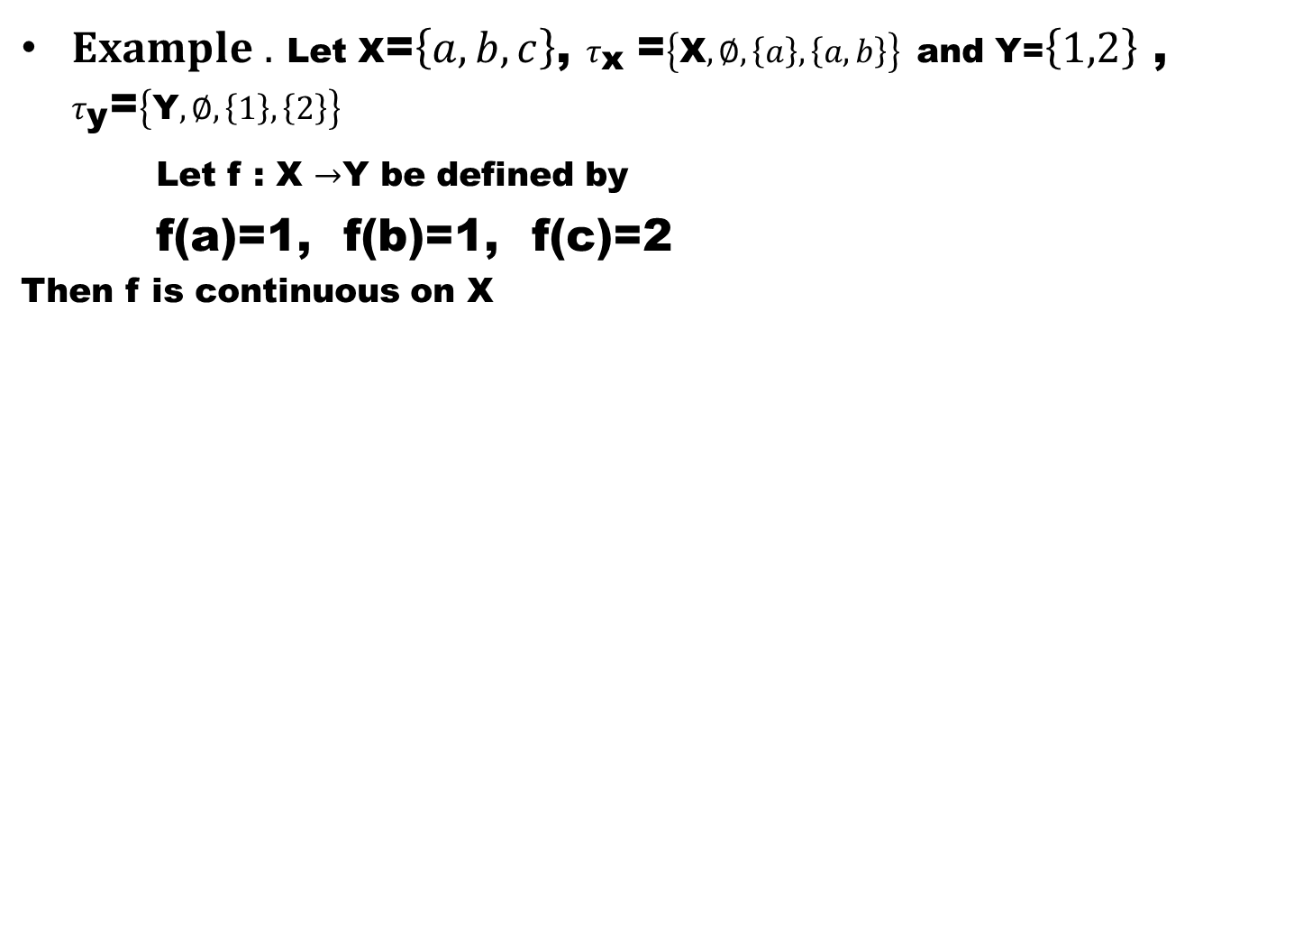
$Example .$Let X=$\left\{a,b,c\right\}$, $τ_{\text{x} }$=$\left\{\text{X},∅,\left\{a\right\},\left\{a,b\right\}\right\}$and Y=$\left\{1,2\right\}$ , $τ_{\text{y}}$=$\left\{\text{Y},∅,\left\{1\right\},\left\{2\right\}\right\}$
Let f : X $→$Y be defined by
f(a)=1, f(b)=1, f(c)=2
Then f is continuous on X

Slide 9
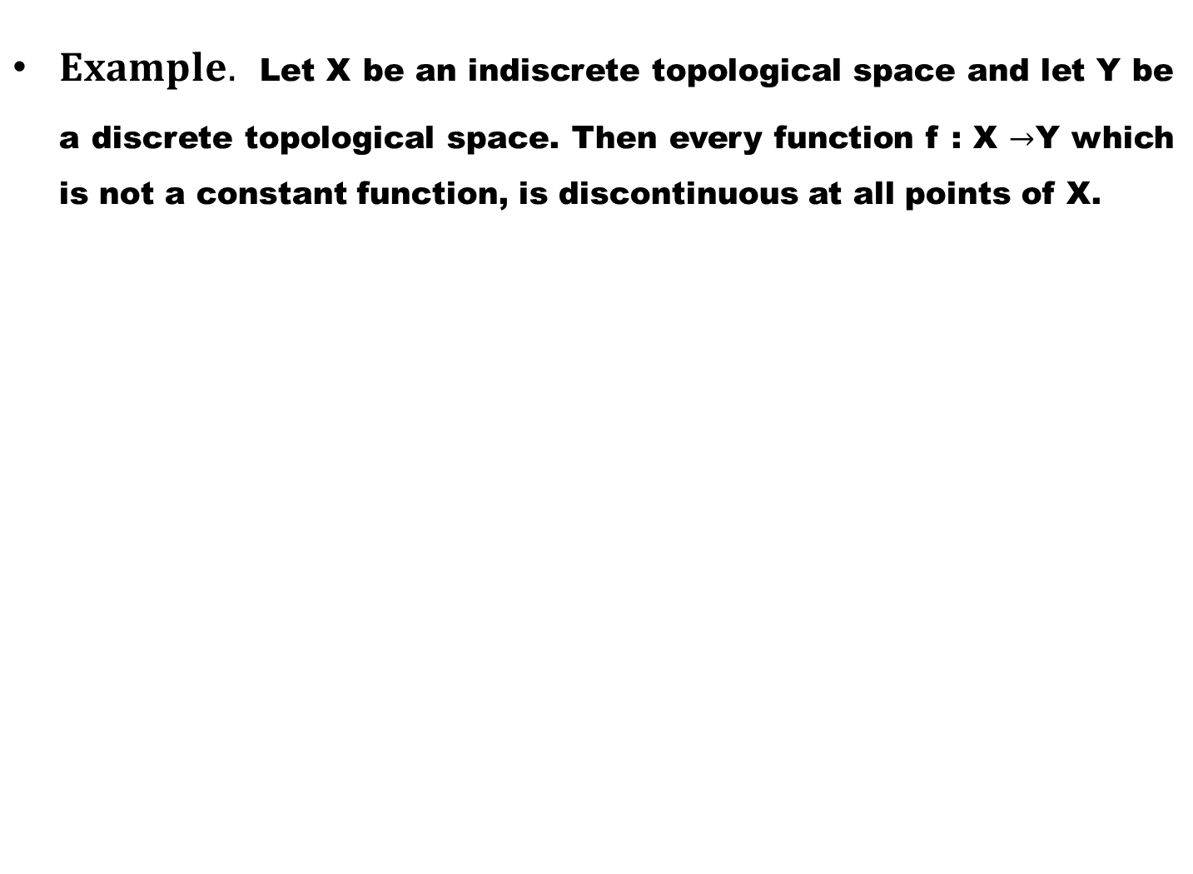
$Example.$Let X be an indiscrete topological space and let Y be a discrete topological space. Then every function f : X $→$Y which is not a constant function, is discontinuous at all points of X.

Slide 10
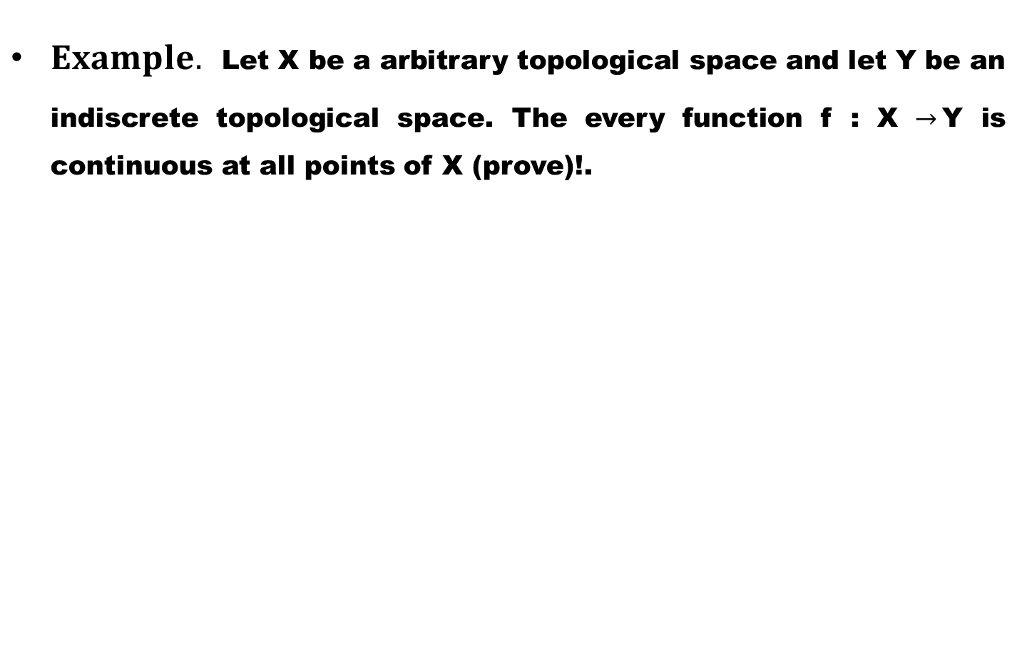
$Example.$Let X be a arbitrary topological space and let Y be an indiscrete topological space. The every function f : X $→$Y is continuous at all points of X (prove)!.

Slide 11
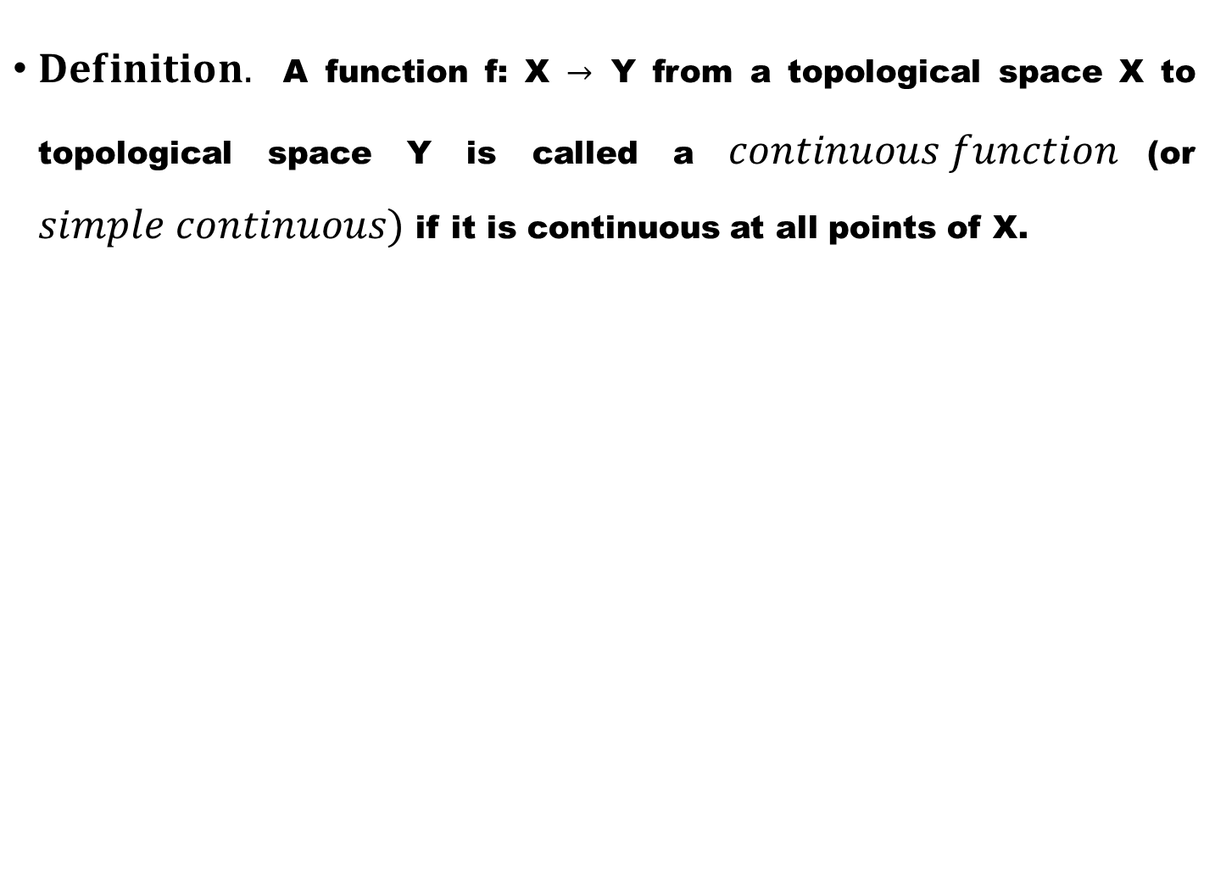
$Definition.$A function f: X $→$Y from a topological space X to topological space Y is called a $continuous function$(or $simple continuous)$ if it is continuous at all points of X.

Slide 12
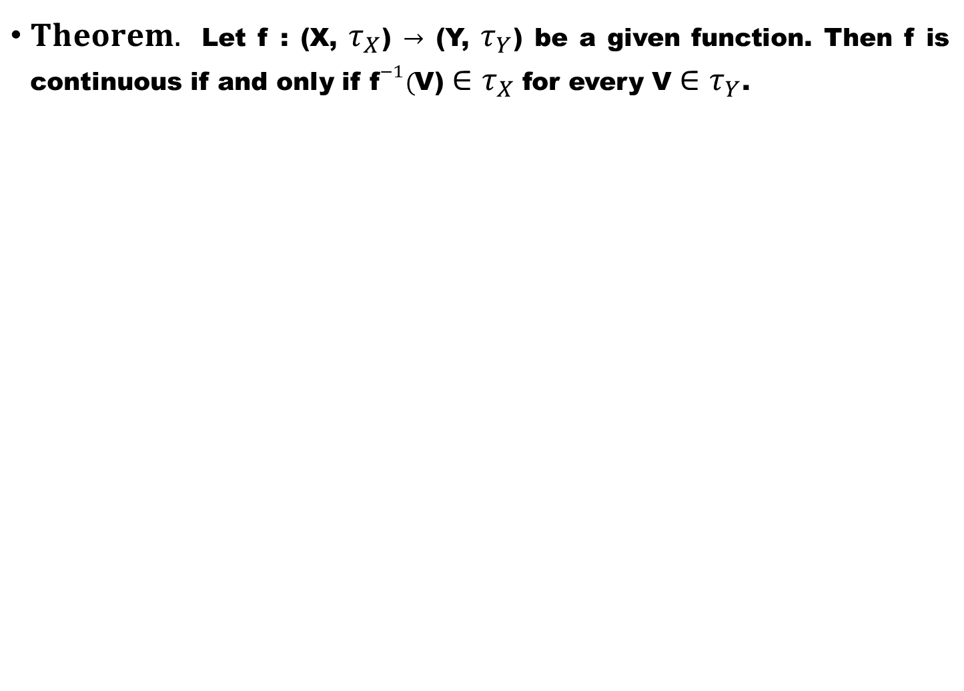
$Theorem.$Let f : (X, $τ_{X}$) $→$ (Y, $τ_{Y}$) be a given function. Then f is continuous if and only if ${\text{f}}^{−1}($V)$∈τ_{X}$ for every V $∈τ_{Y}$.

Slide 15
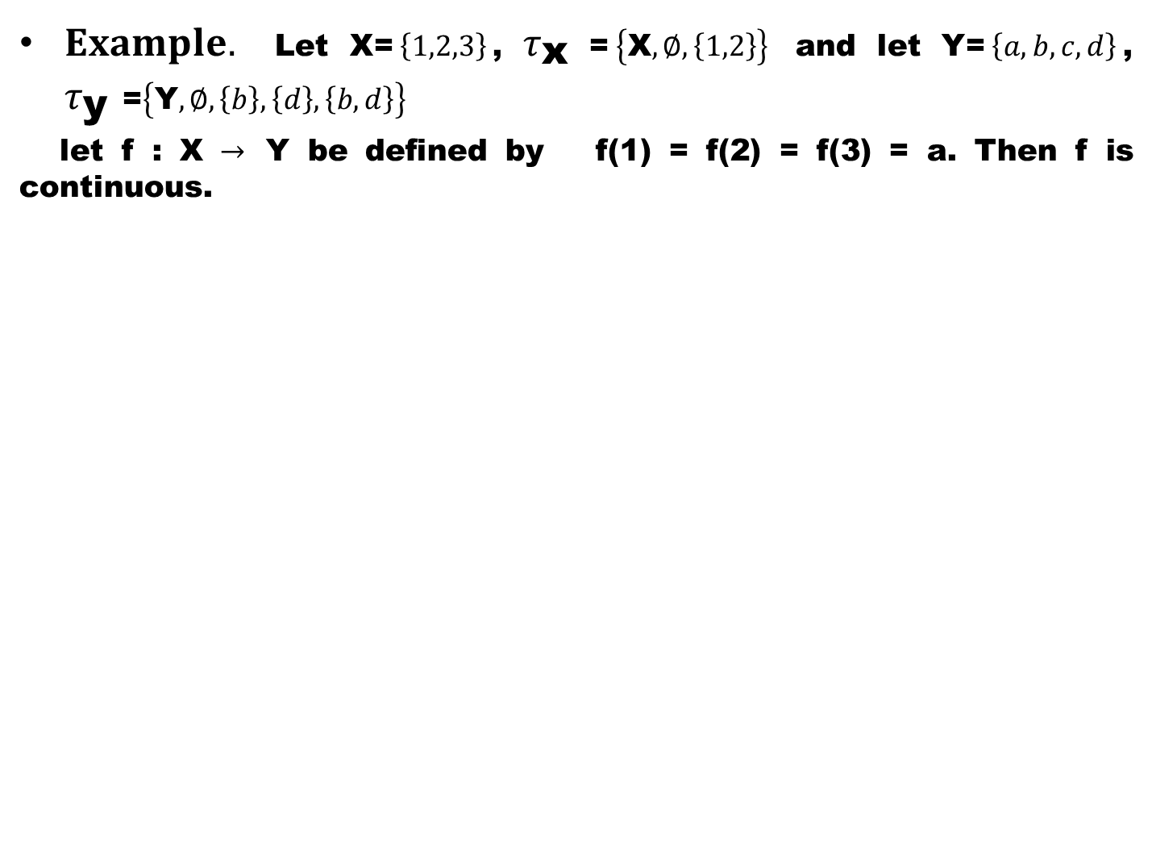
$Example.$Let X=$\left\{1,2,3\right\}$, $τ_{\text{x} }$=$\left\{\text{X},∅,\left\{1,2\right\}\right\}$ and let Y=$\left\{a,b,c,d\right\}$, $τ_{\text{y} }$=$\left\{\text{Y},∅,\left\{b\right\},\left\{d\right\},\left\{b,d\right\}\right\}$
let f : X $→$ Y be defined by f(1) = f(2) = f(3) = a. Then f is continuous.

Slide 16
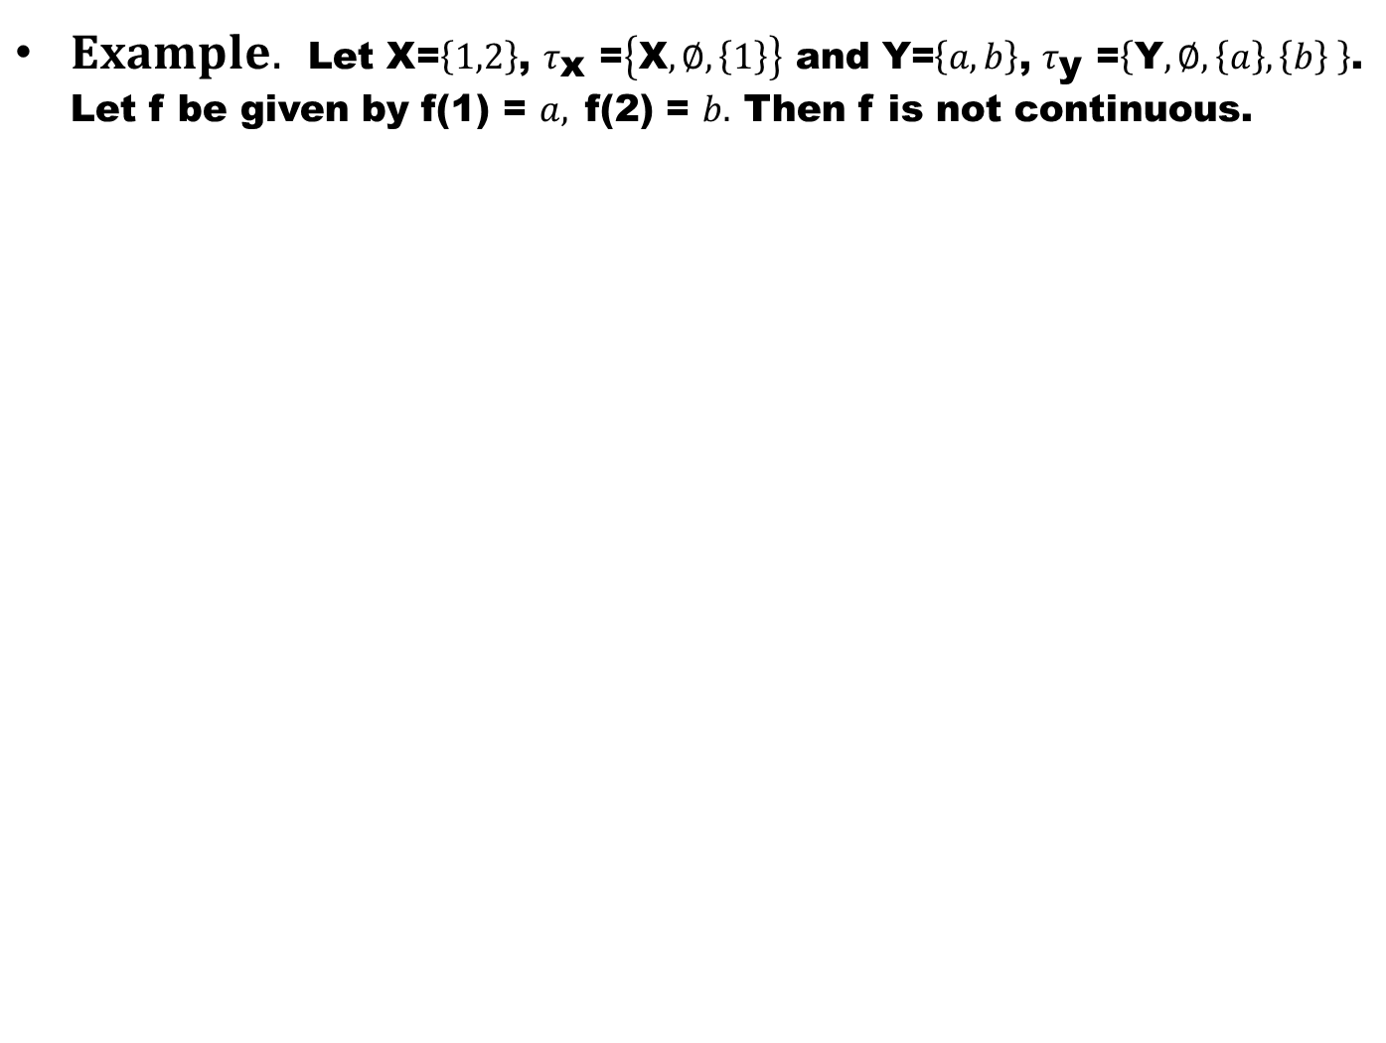
$Example.$Let X=$\left\{1,2\right\}$, $τ_{\text{x} }$=$\left\{\text{X},∅,\left\{1\right\}\right\}$ and Y=$\left\{a,b\right\}$, $τ_{\text{y} }$=$\left\{\text{Y},∅,\left\{a\right\},\left\{b\right\} \right\}$. Let f be given by f(1) = $a,$f(2) = $b.$ Then f is not continuous.

Slide 17
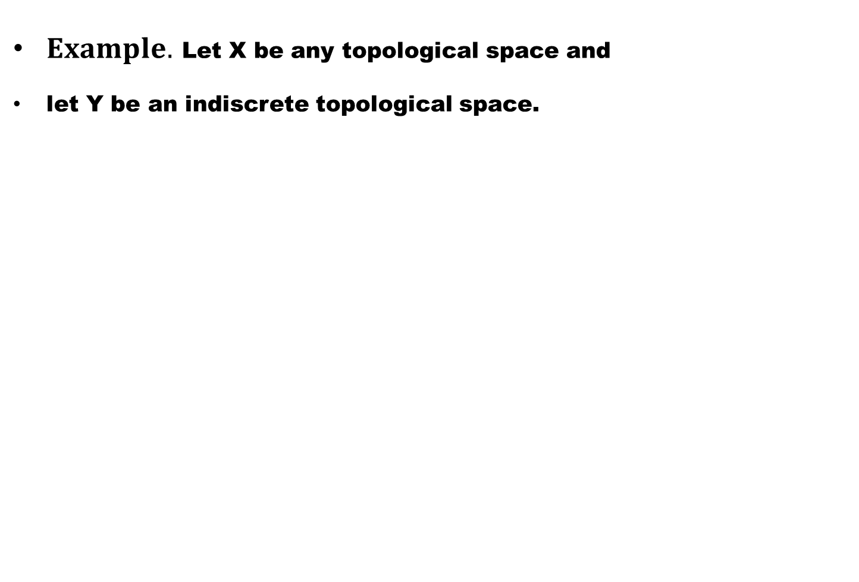
$Example.$Let X be any topological space and
let Y be an indiscrete topological space.

Slide 18
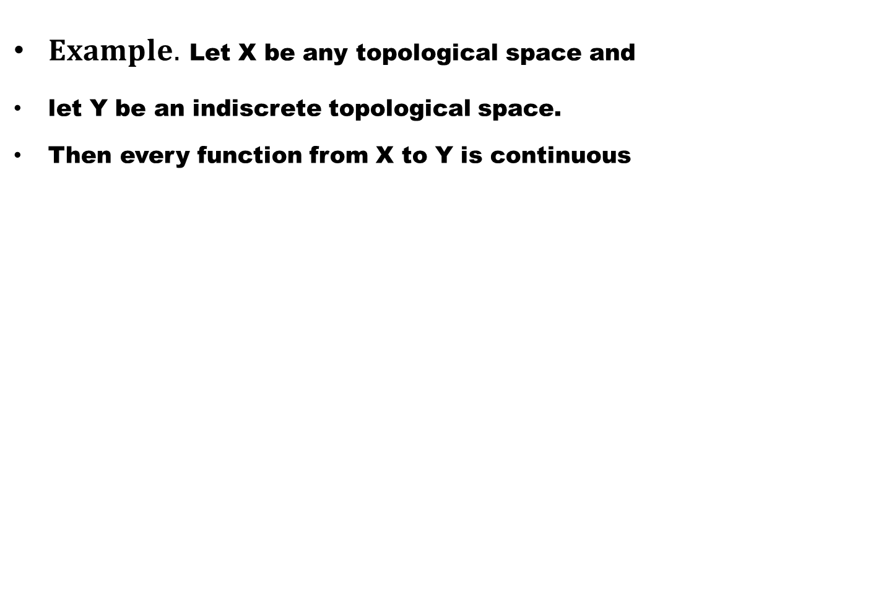
$Example.$Let X be any topological space and
let Y be an indiscrete topological space.
Then every function from X to Y is continuous

Slide 19
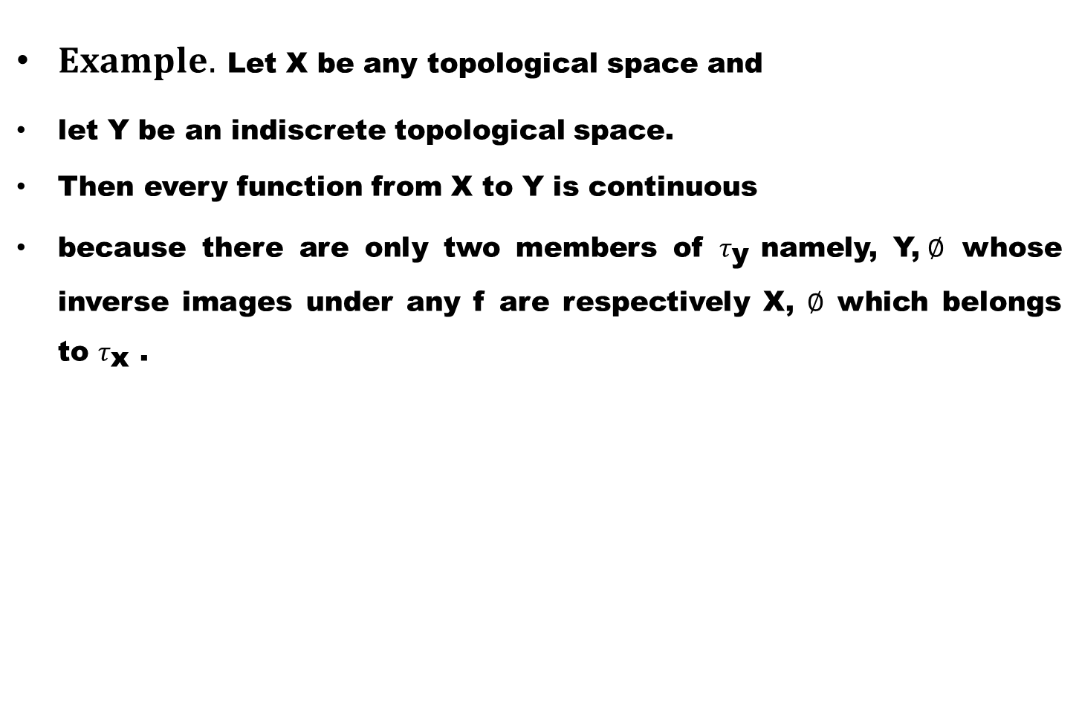
$Example.$Let X be any topological space and
let Y be an indiscrete topological space.
Then every function from X to Y is continuous
because there are only two members of $τ_{\text{y} }$namely, Y,$∅$ whose inverse images under any f are respectively X, $∅$ which belongs to $τ_{\text{x} }$.

Slide 20
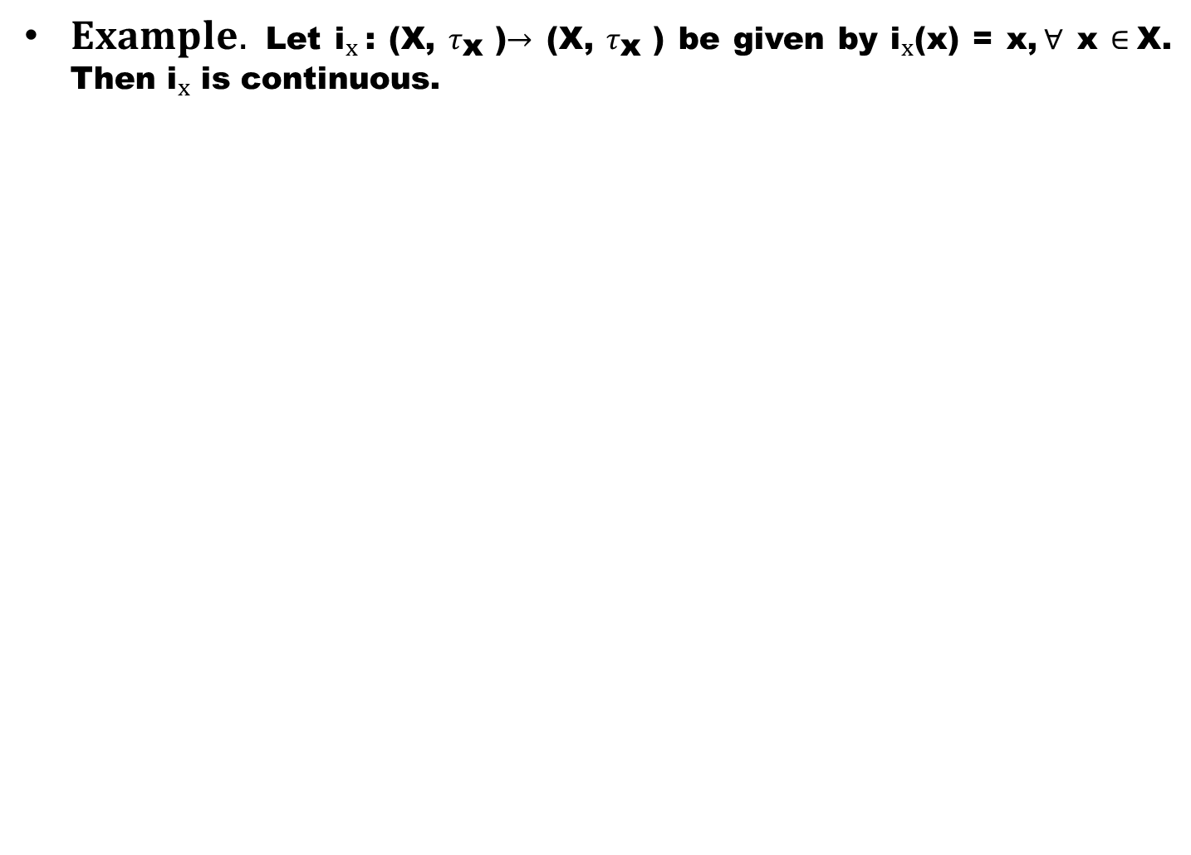
$Example.$Let ${\text{i}}_{x}$: (X, $τ_{\text{x} }$)$→$ (X, $τ_{\text{x} }$) be given by ${\text{i}}_{x}$(x) = x,$∀$ x $∈$X. Then ${\text{i}}_{x}$ is continuous.

Slide 21
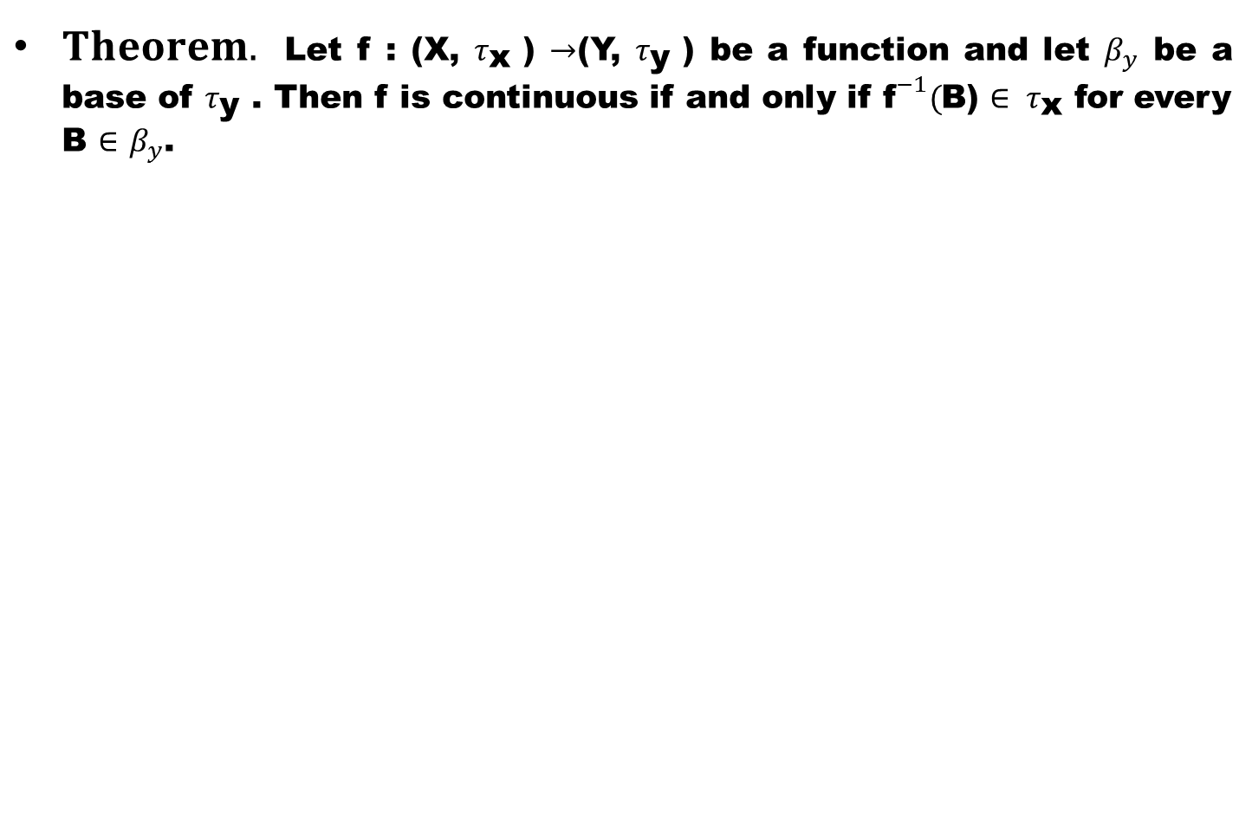
$Theorem.$Letf : (X, $τ_{\text{x} }$) $→$(Y, $τ_{\text{y} }$) be a function and let $β_{y}$ be a base of $τ_{\text{y} }$. Then f is continuous if and only if ${\text{f}}^{−1}($B) $∈ τ_{\text{x} }$for every B $∈$$β_{y}$.

Slide 23
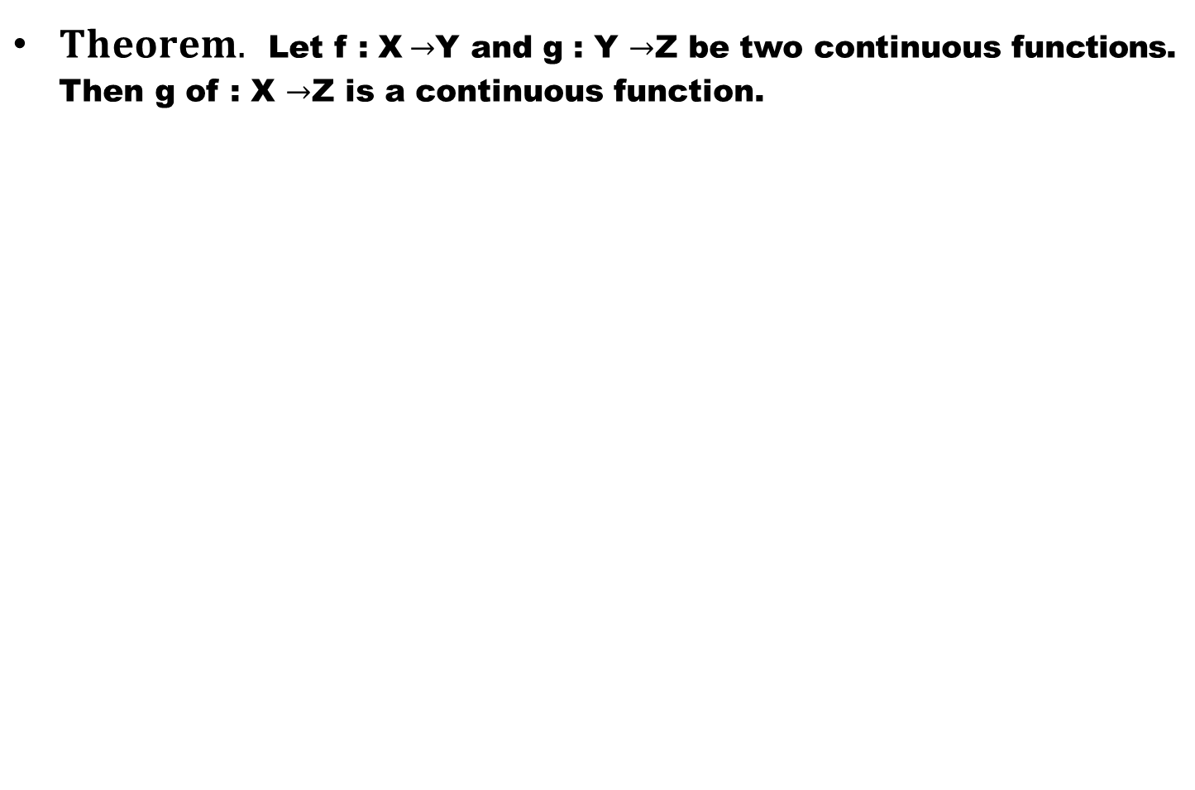
$Theorem.$Let f : X$→$Y and g : Y $→$Z be two continuous functions. Then g of : X$→$Z is a continuous function.

Slide 24
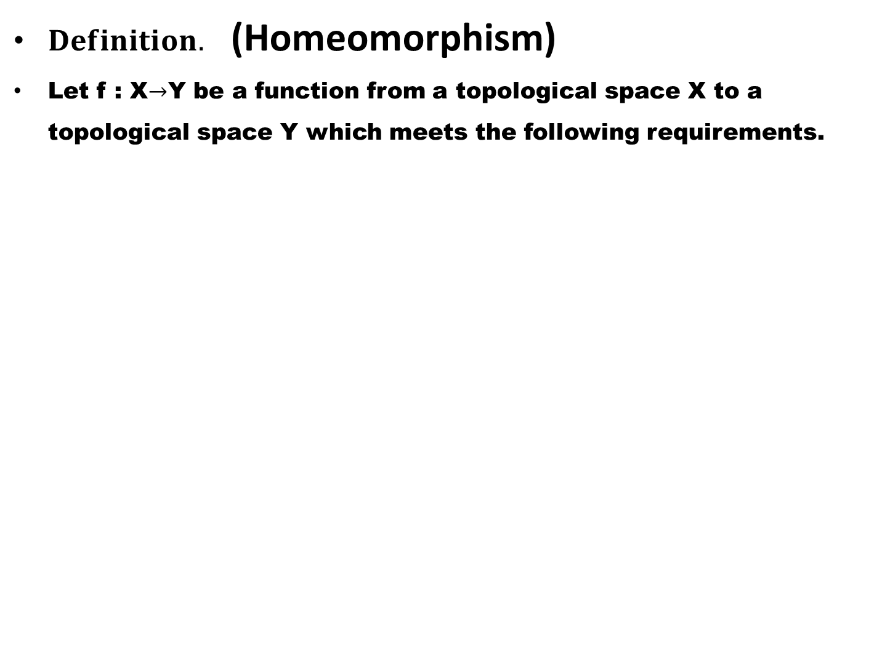
$Definition.$(Homeomorphism)
Let f : X$→$Y be a function from a topological space X to a topological space Y which meets the following requirements.

Slide 25
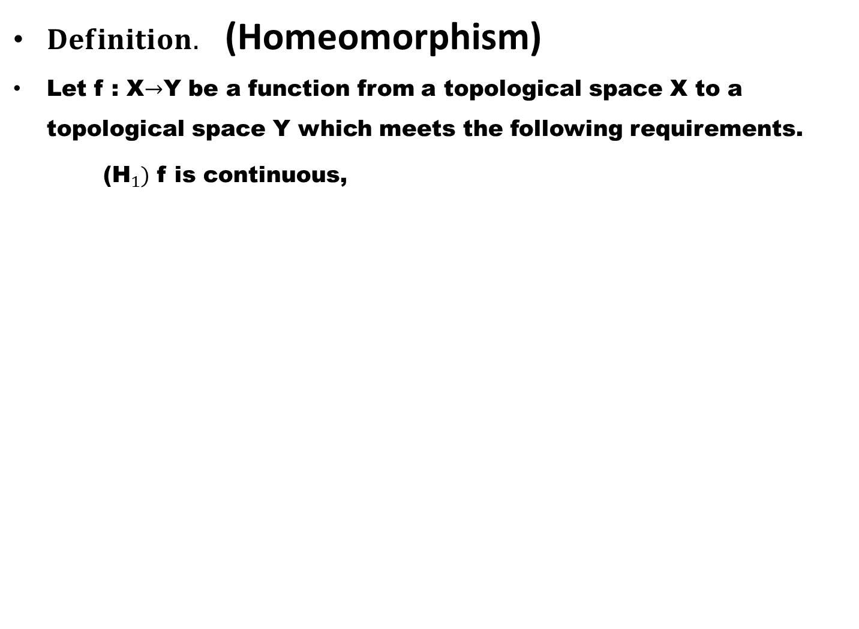
$Definition.$(Homeomorphism)
Let f : X$→$Y be a function from a topological space X to a topological space Y which meets the following requirements.
(${\text{H}}_{1})$ f is continuous,

Slide 26
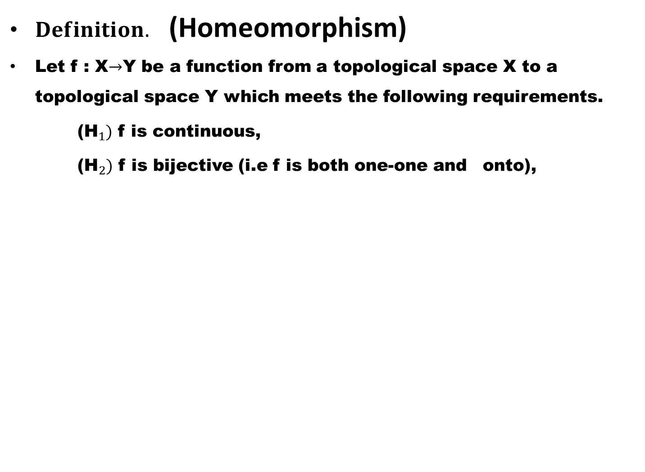
$Definition.$(Homeomorphism)
Let f : X$→$Y be a function from a topological space X to a topological space Y which meets the following requirements.
(${\text{H}}_{1})$ f is continuous,
(${\text{H}}_{2})$ f is bijective (i.e f is both one-one and onto),

Slide 27
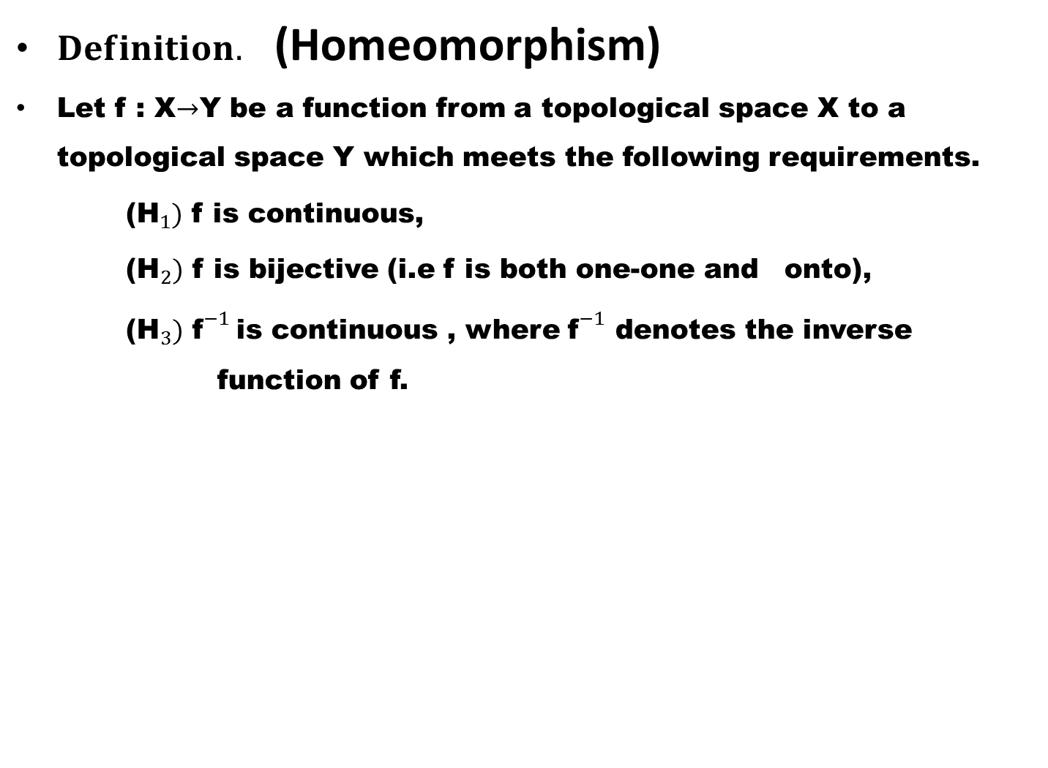
$Definition.$(Homeomorphism)
Let f : X$→$Y be a function from a topological space X to a topological space Y which meets the following requirements.
(${\text{H}}_{1})$ f is continuous,
(${\text{H}}_{2})$ f is bijective (i.e f is both one-one and onto),
(${\text{H}}_{3})$${\text{f}}^{−1}$is continuous , where ${\text{f}}^{−1}$ denotes the inverse function of f.

Slide 28
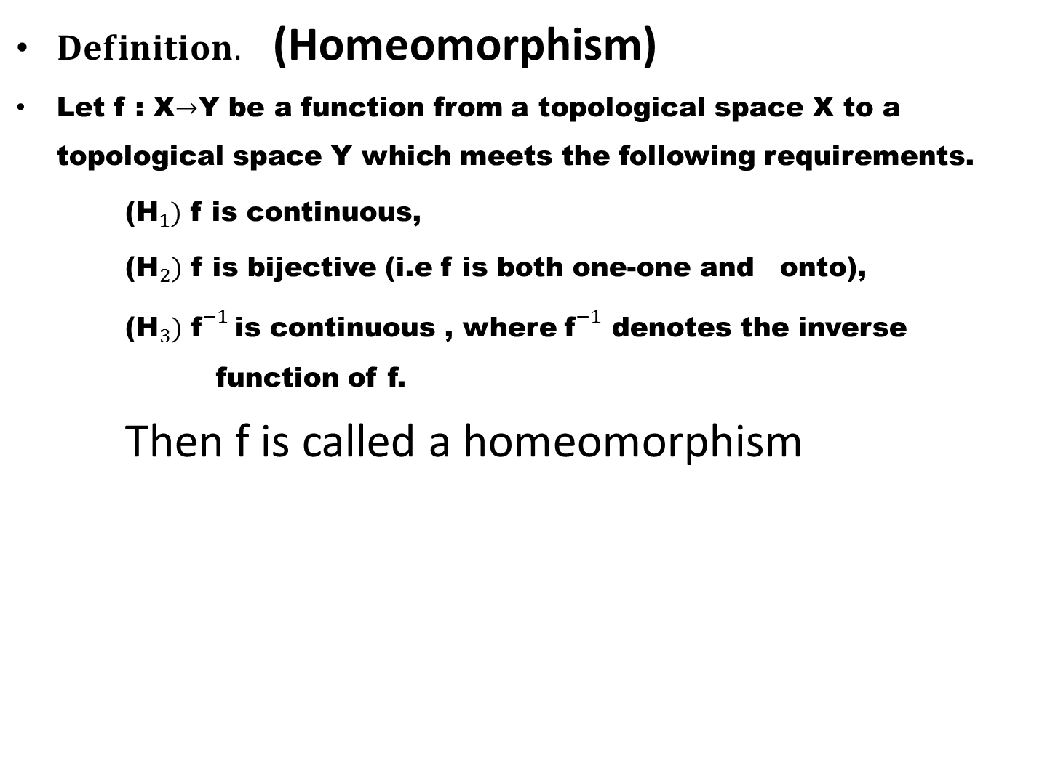
$Definition.$(Homeomorphism)
Let f : X$→$Y be a function from a topological space X to a topological space Y which meets the following requirements.
(${\text{H}}_{1})$ f is continuous,
(${\text{H}}_{2})$ f is bijective (i.e f is both one-one and onto),
(${\text{H}}_{3})$${\text{f}}^{−1}$is continuous , where ${\text{f}}^{−1}$ denotes the inverse function of f.
Then f is called a homeomorphism

Slide 29
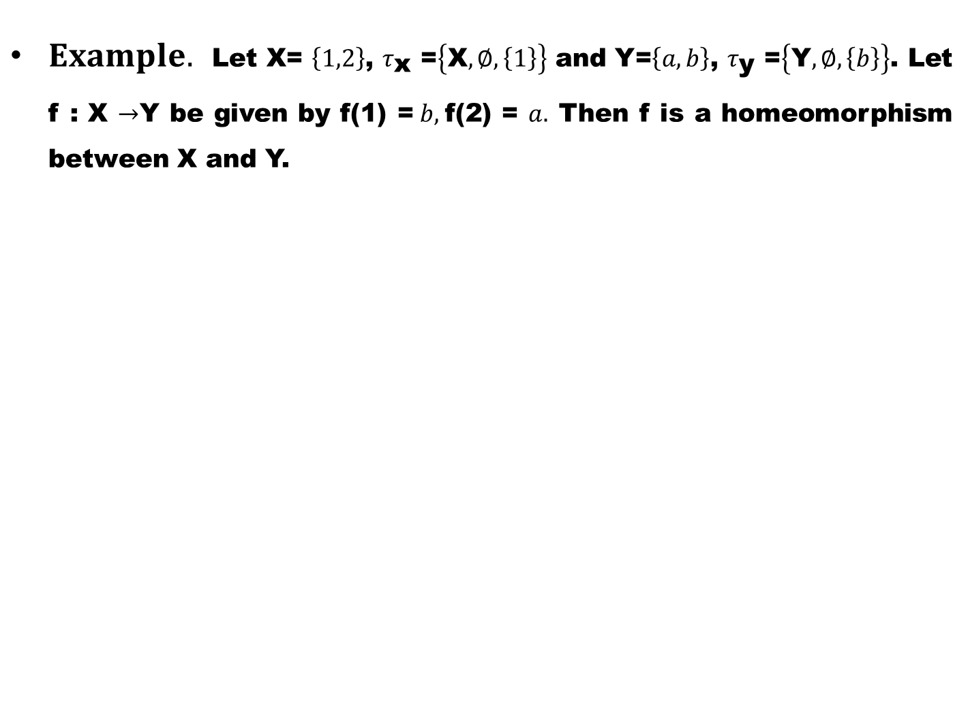
$Example.$Let X= $\left\{1,2\right\}$, $τ_{\text{x} }$=$\left\{\text{X},∅,\left\{1\right\}\right\}$ and Y=$\left\{a,b\right\}$, $τ_{\text{y} }$=$\left\{\text{Y},∅,\left\{b\right\}\right\}$. Let f : X $→$Y be given by f(1) =$b,$f(2) = $a.$ Then f is a homeomorphism between X and Y.

Slide 30
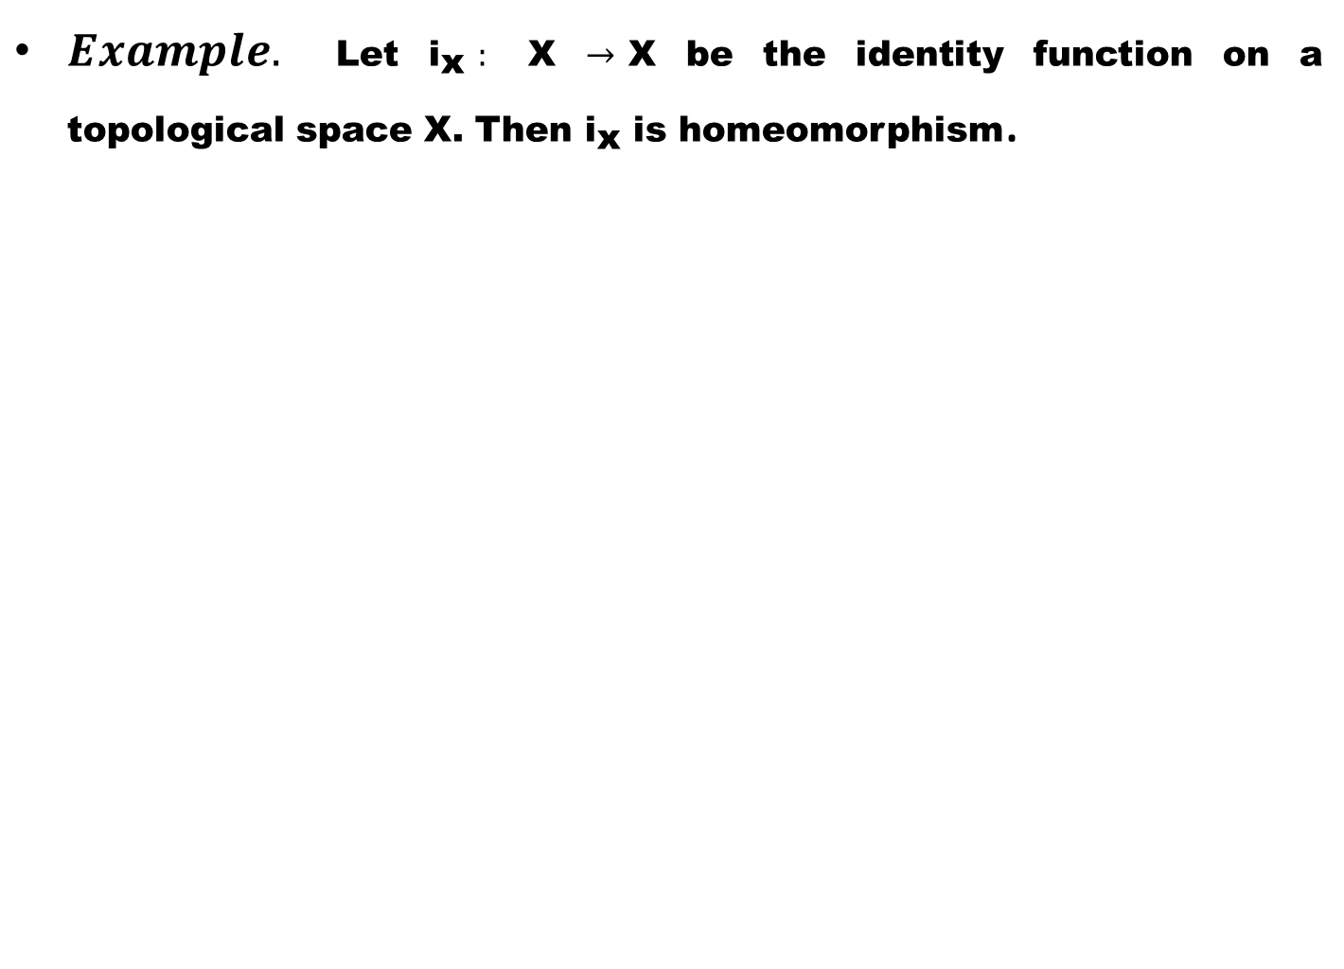
$Example.$Let ${\text{i}}_{\text{x} }:$ X $→$X be the identity function on a topological space X. Then ${\text{i}}_{\text{x}}$ is homeomorphism.

Slide 31
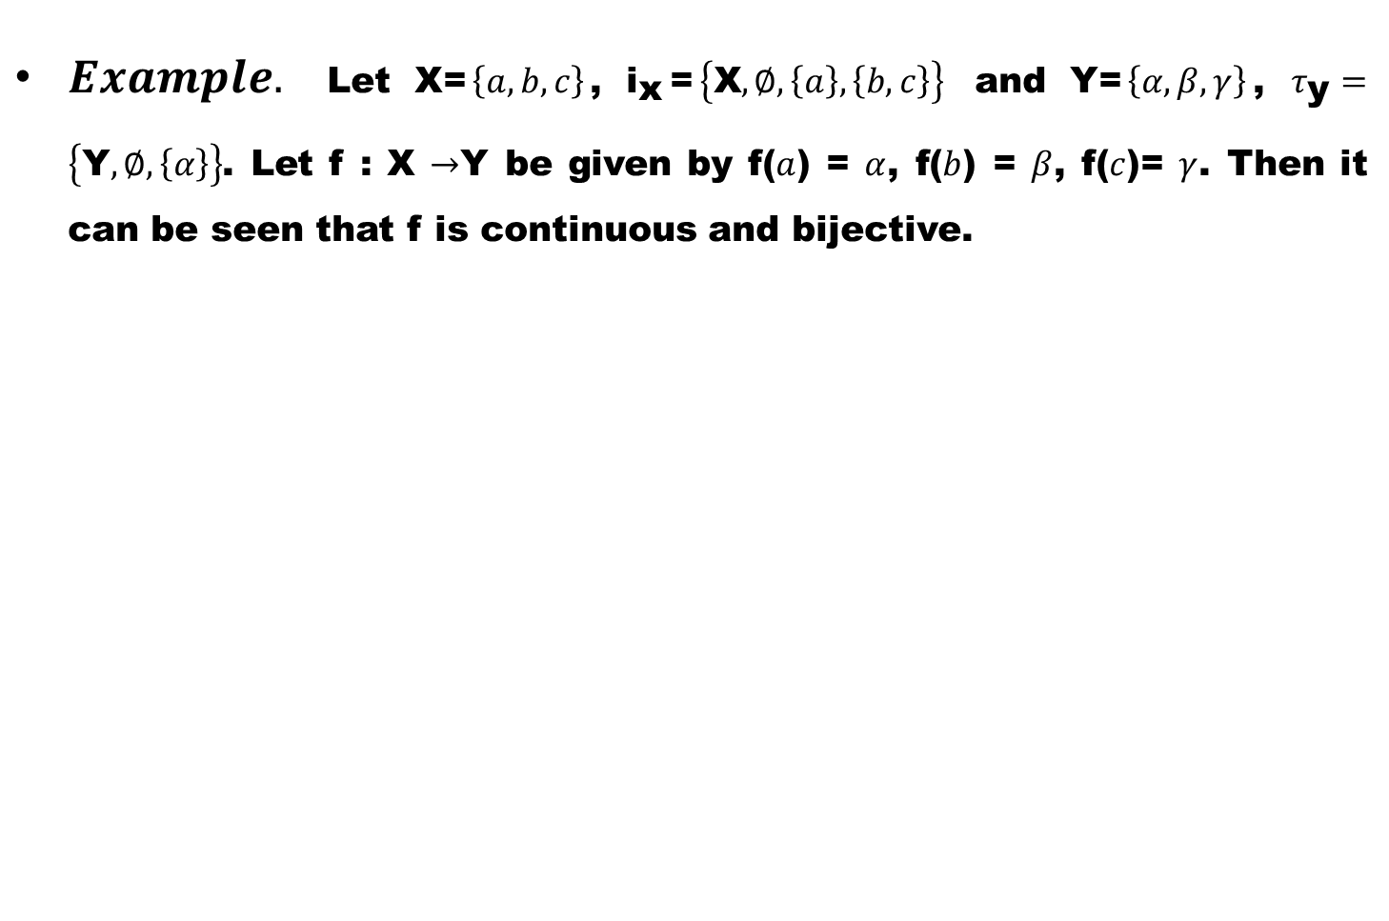
$Example.$Let X=$\left\{a,b,c\right\}$, ${\text{i}}_{\text{x}}$=$\left\{\text{X},∅,\left\{a\right\},\left\{b,c\right\}\right\}$ and Y=$\left\{α,β,γ\right\}$, $τ_{\text{y}}=\left\{\text{Y},∅,\left\{α\right\}\right\}$. Let f : X $→$Y be given by f($a$) =$α$, f($b$) =$β$, f($c$)=$γ$. Then it can be seen that f is continuous and bijective.

Slide 32
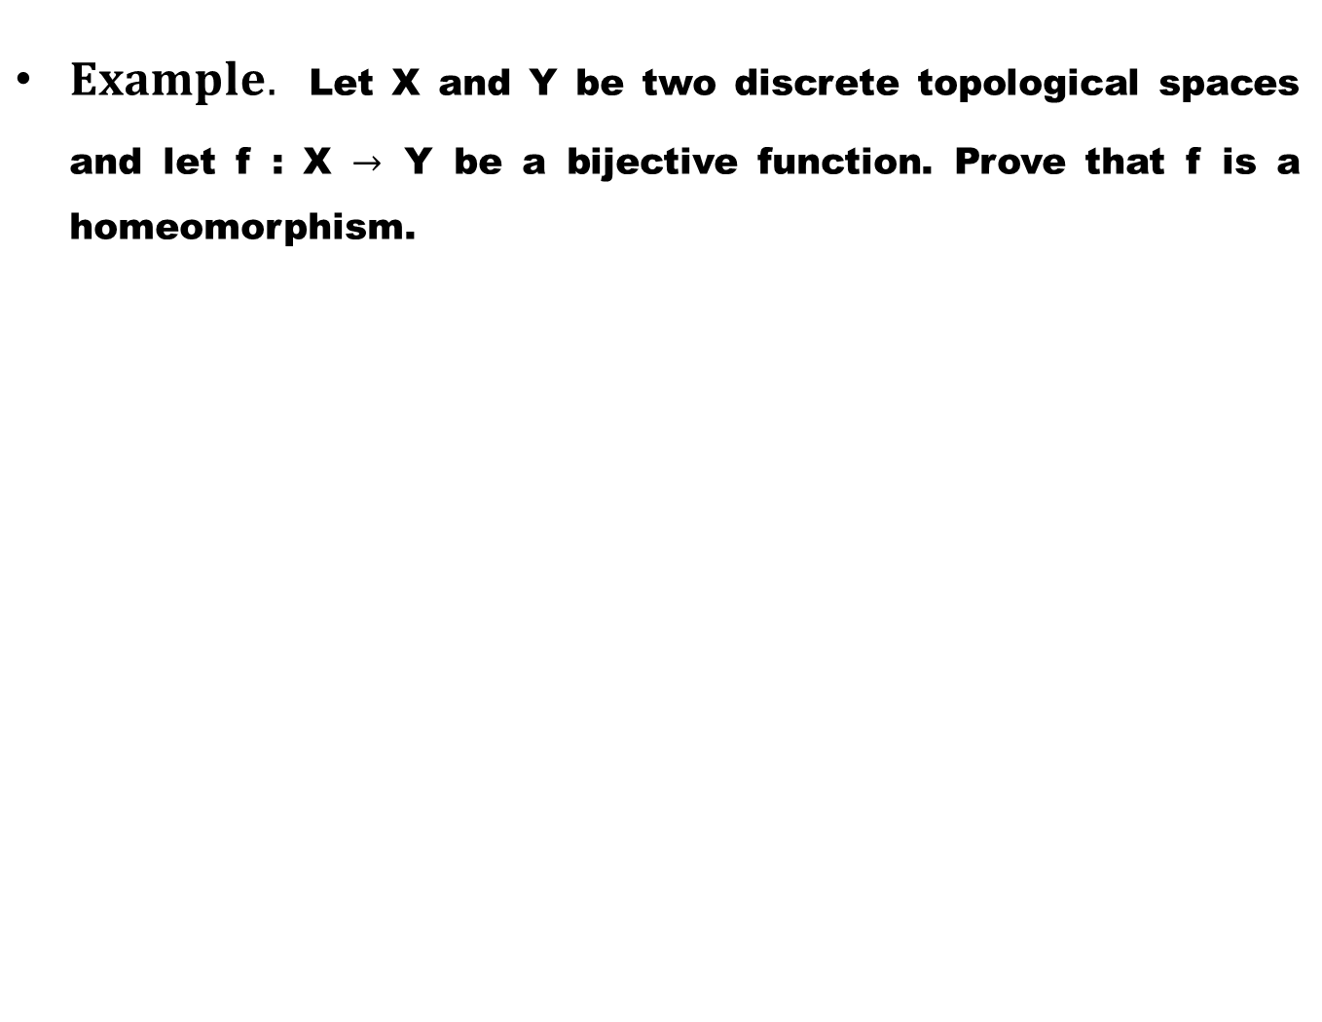
$Example.$Let X and Y be two discrete topological spaces and let f : X $→$Y be a bijective function. Prove that f is a homeomorphism.

Slide 33
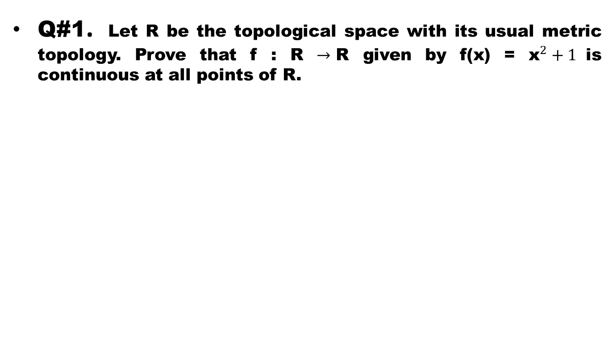
Exercises
Q#1. Let R be the topological space with its usual metric topology. Prove that f : R $→$R given by f(x) = ${\text{x}}^{2}+1$is continuous at all points of R.

Slide 34
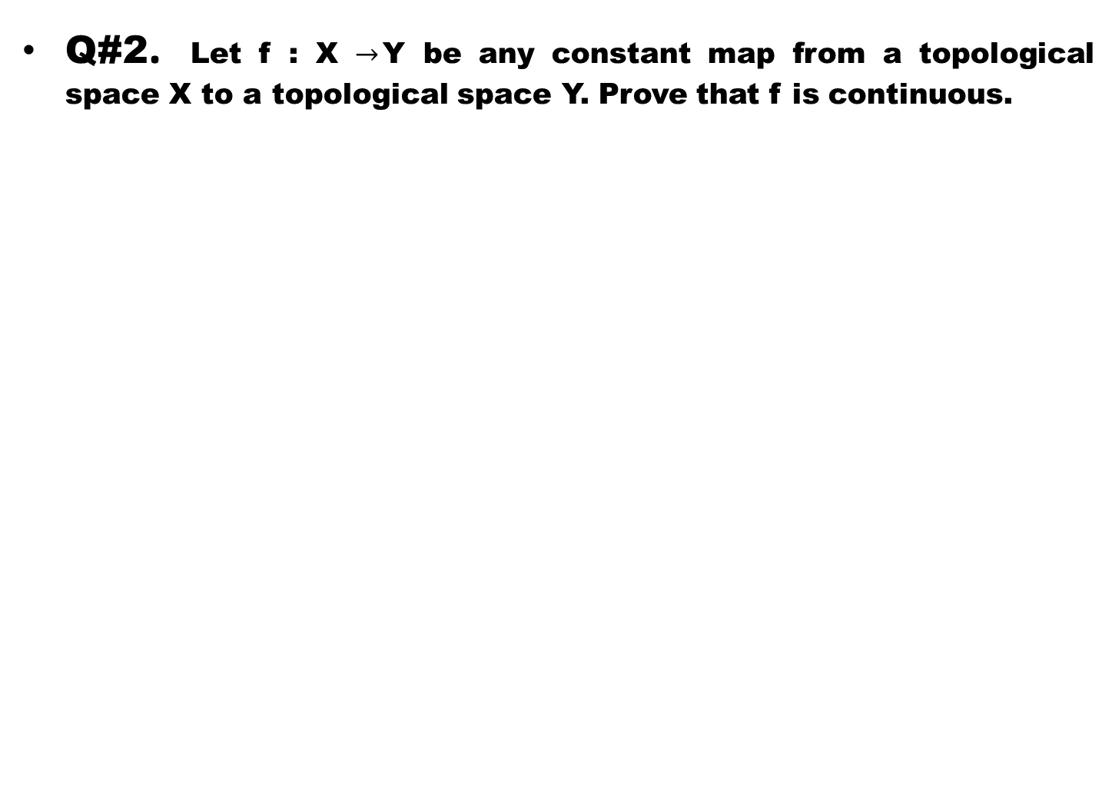
Q#2. Let f : X$→$Y be any constant map from a topological space X to a topological space Y. Prove that f is continuous.

Slide 35
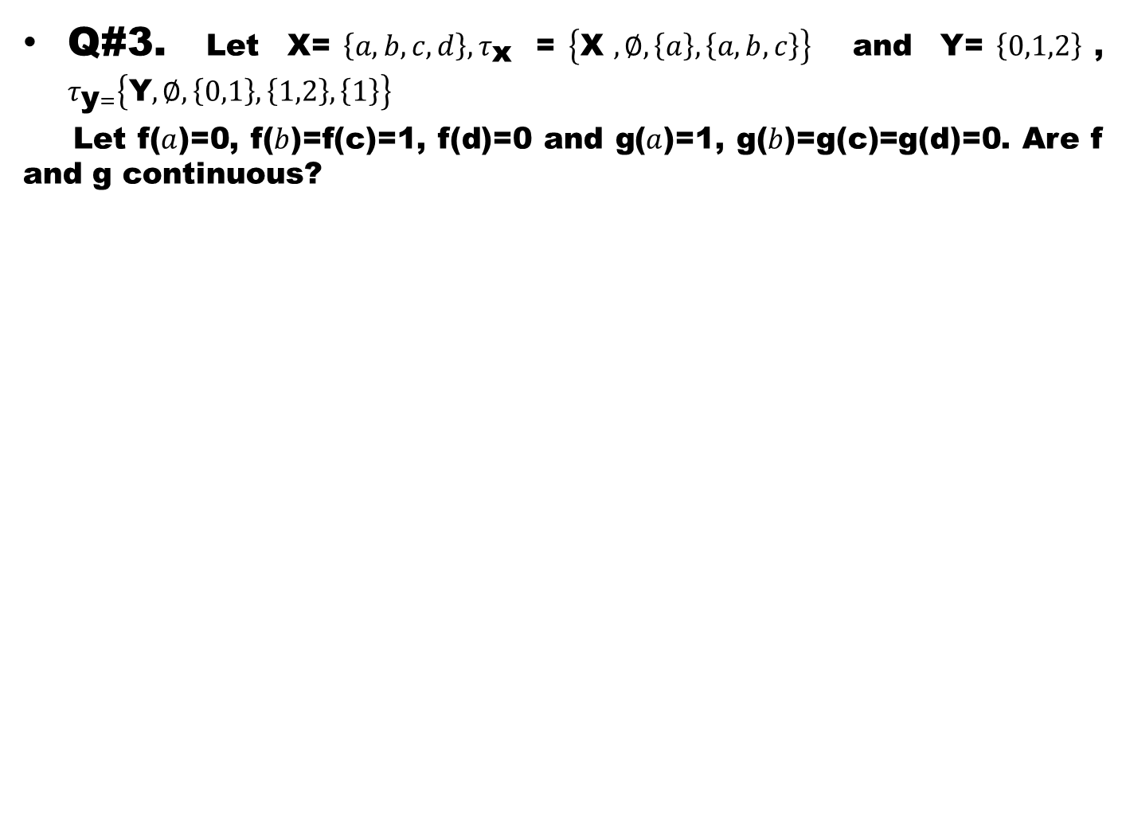
Q#3.Let X=$\left\{a,b,c,d\right\}, τ_{\text{x} }$=$\left\{\text{X} ,∅,\left\{a\right\},\left\{a,b,c\right\}\right\}$ and Y=$\left\{0,1,2\right\}$, $τ_{\text{y}=}\left\{\text{Y},∅,\left\{0,1\right\},\left\{1,2\right\},\left\{1\right\}\right\}$
Let f($a$)=0, f($b$)=f(c)=1, f(d)=0 and g($a$)=1, g($b$)=g(c)=g(d)=0. Are f and g continuous?

Slide 36
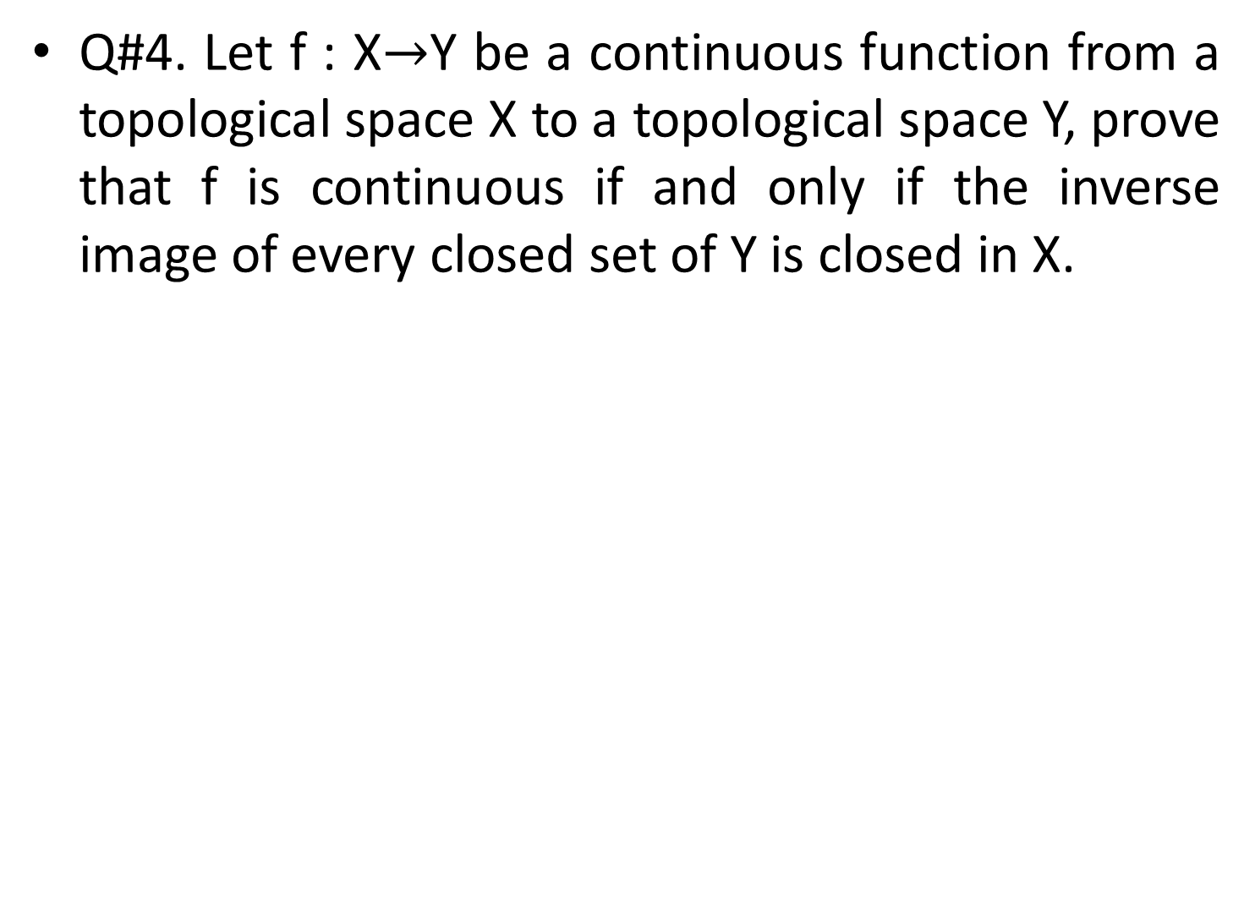
Q#4. Let f : X$→$Y be a continuous function from a topological space X to a topological space Y, prove that f is continuous if and only if the inverse image of every closed set of Y is closed in X.

Slide 37
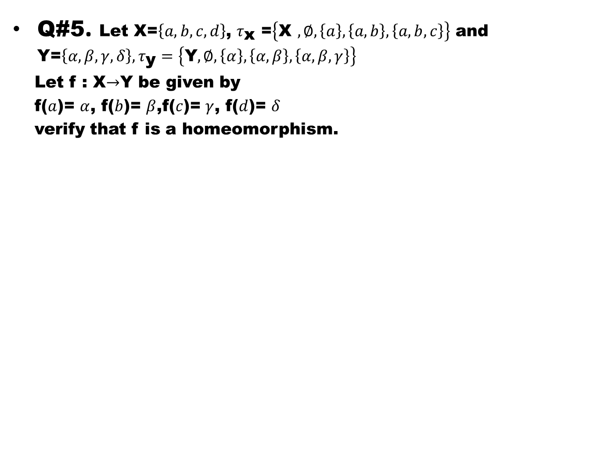
Q#5. Let X=$\left\{a,b,c,d\right\}$, $τ_{\text{x} }$=$\left\{\text{X} ,∅,\left\{a\right\},\left\{a,b\right\},\left\{a,b,c\right\}\right\}$ and Y=$\left\{α,β,γ,δ\right\}, τ_{\text{y}}=\left\{\text{Y},∅,\left\{α\right\},\left\{α,β\right\},\left\{α,β,γ\right\}\right\}$
Let f : X$→$Y be given by
f($a$)=$α$, f($b$)=$β$,f($c$)=$γ$, f($d$)=$δ$
verify that f is a homeomorphism.

