Slide 1
Set Topology
MTH 251
Lecture # 17

Slide 2
Lecture Plan
Bases
subbases

Slide 3
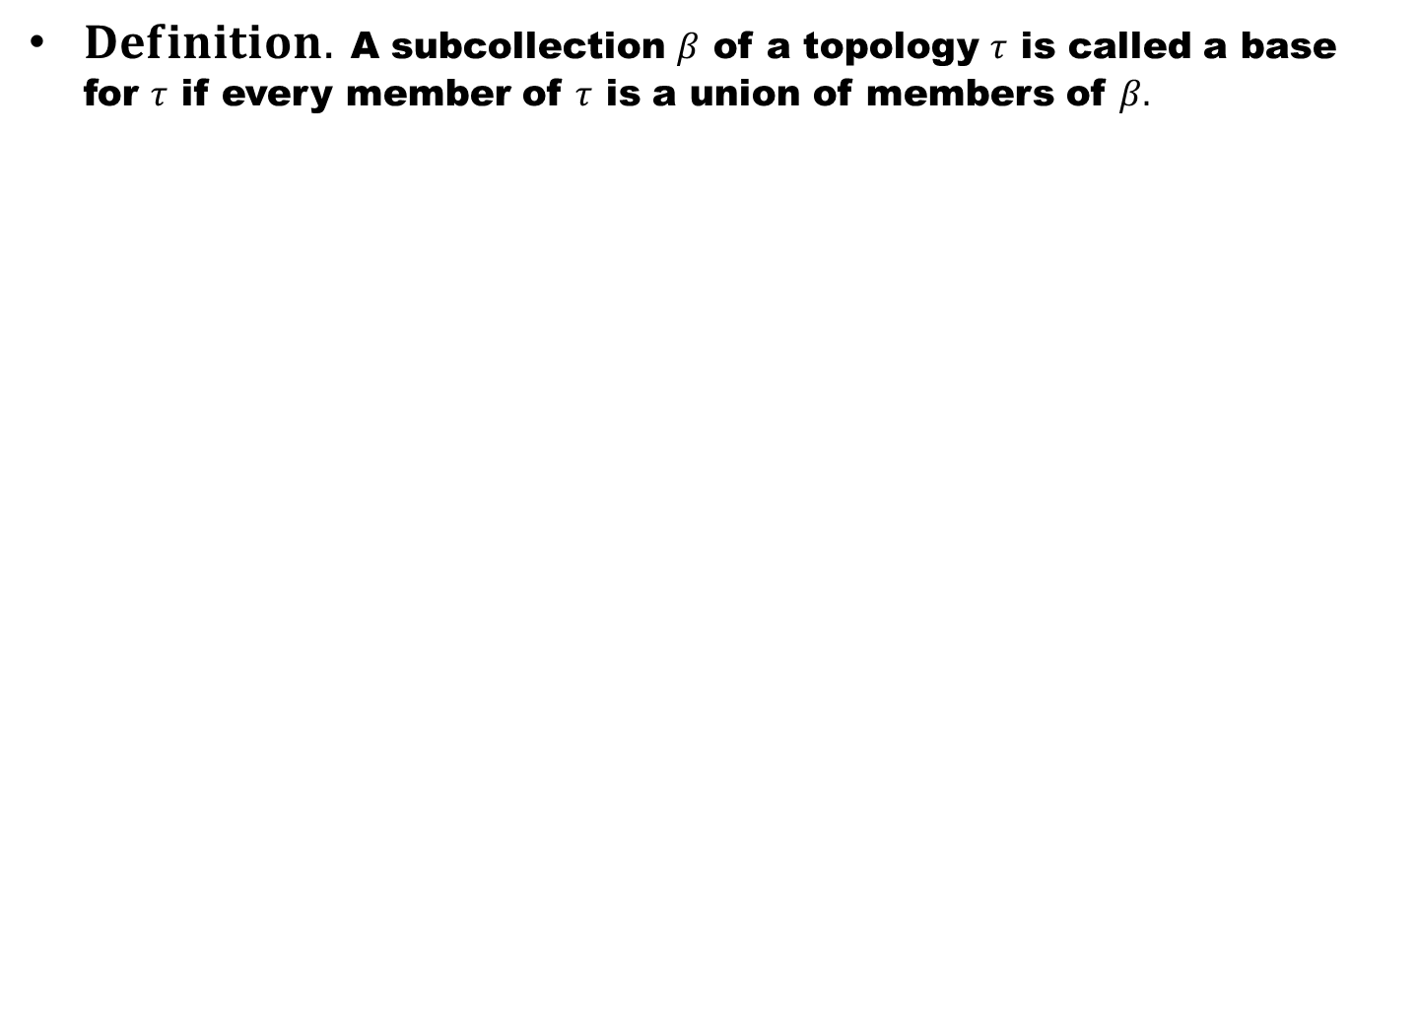
$Definition.$A subcollection $β$ of a topology $τ$ is called a base for $τ$ if every member of $τ$ is a union of members of $β.$

Slide 4
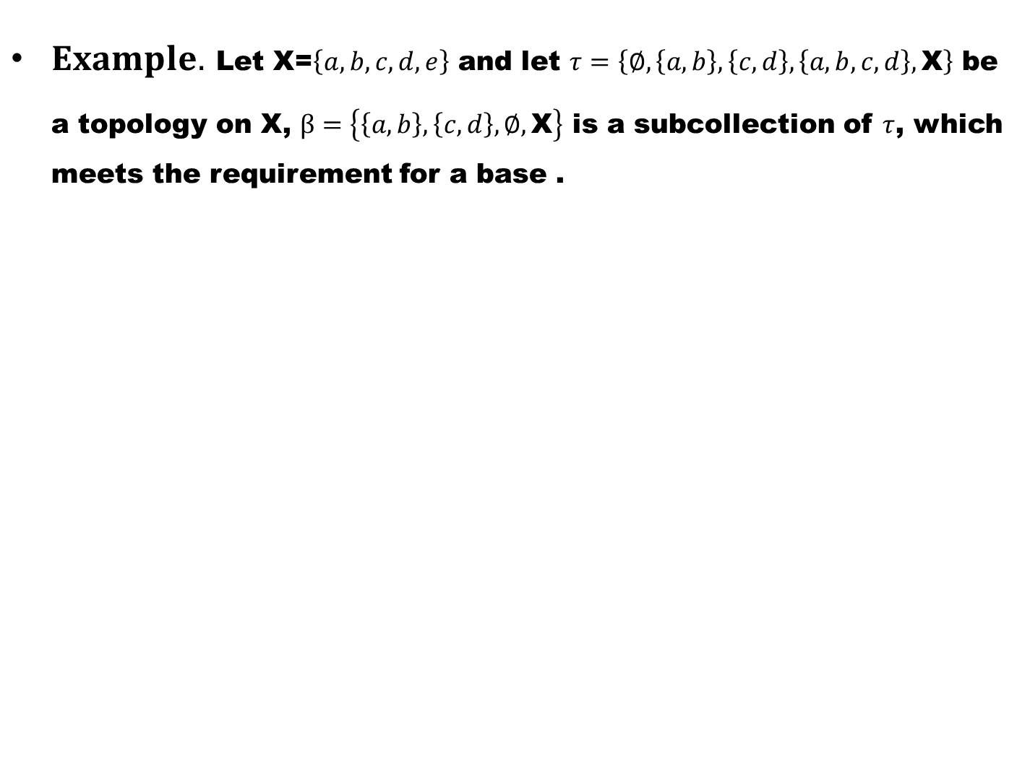
$Example.$Let X=$\left\{a,b,c,d,e\right\}$ and let $τ=\left\{∅,\left\{a,b\right\},\left\{c,d\right\},\left\{a,b,c,d\right\},\text{X}\right\}$ be a topology on X, $β=\left\{\left\{a,b\right\},\left\{c,d\right\},∅,\text{X}\right\}$ is a subcollection of $τ$, which meets the requirement for a base .

Slide 5
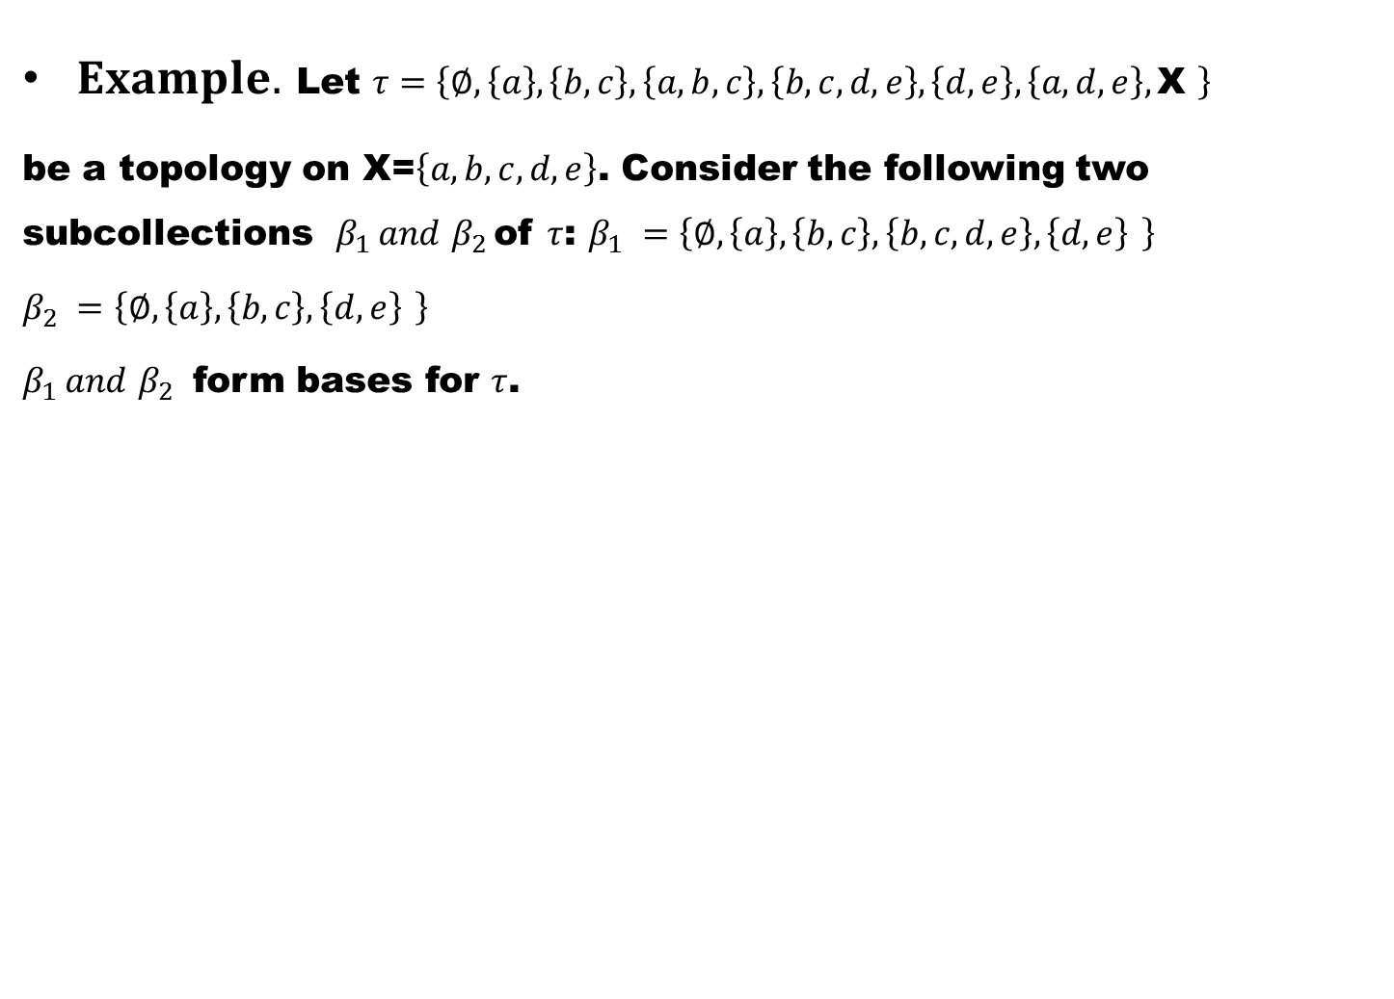
$Example.$Let $τ=\left\{∅,\left\{a\right\},\left\{b,c\right\},\left\{a,b,c\right\},\left\{b,c,d,e\right\},\left\{d,e\right\},\left\{a,d,e\right\},\text{X} \right\}$
be a topology on X=$\left\{a,b,c,d,e\right\}$. Consider the following two subcollections$β_{1 }and$$β_{2 }$of $τ$: $β_{1 }$$=\left\{∅,\left\{a\right\},\left\{b,c\right\}, \left\{b,c,d,e\right\},\left\{d,e\right\} \right\}$
$β_{2 }$$=\left\{∅,\left\{a\right\},\left\{b,c\right\},\left\{d,e\right\} \right\}$
$β_{1 }and$$β_{2 }$ form bases for $τ$.

Slide 6
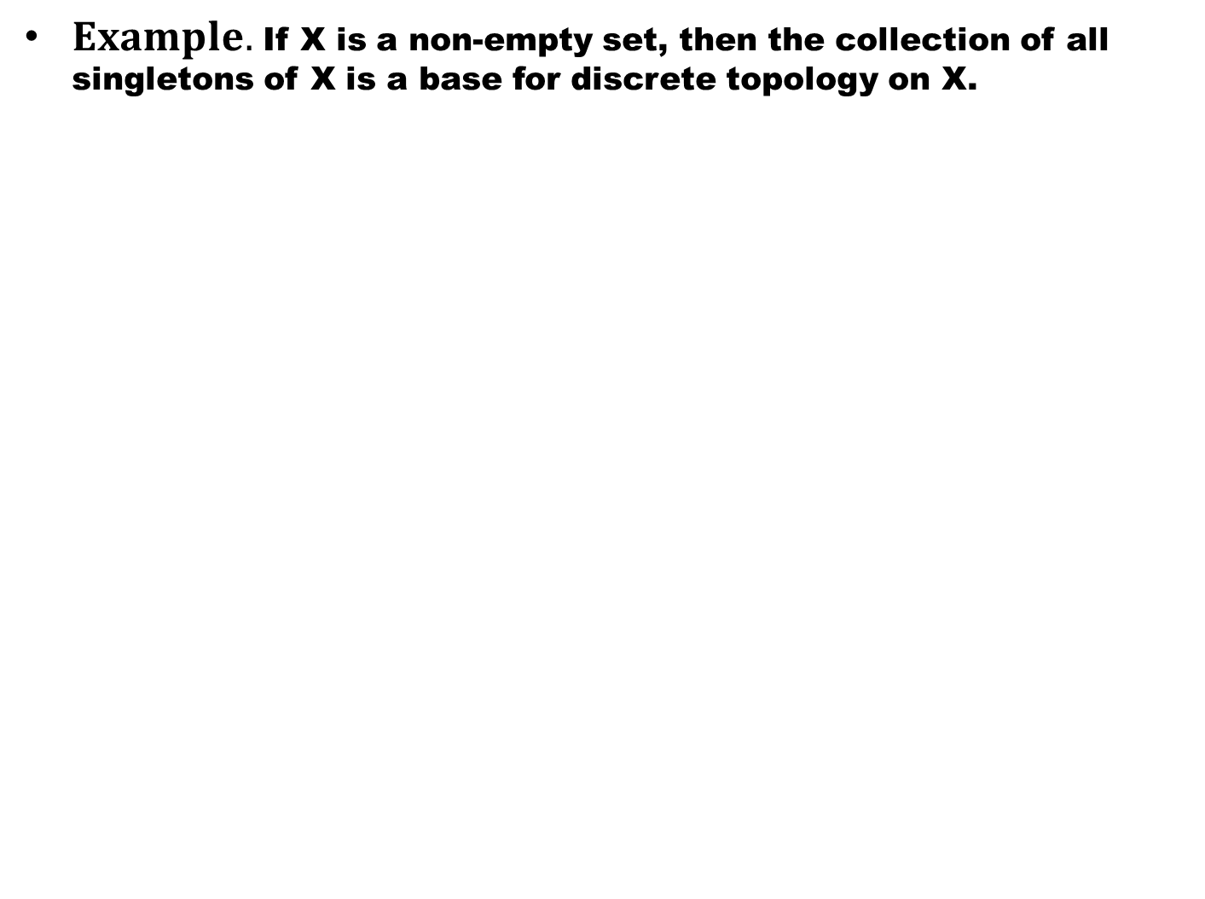
$Example.$If X is a non-empty set, then the collection of all singletons of X is a base for discrete topology on X.

Slide 7
The following theorem gives a condition under which a collection of sets is a base for given topology.

Slide 8
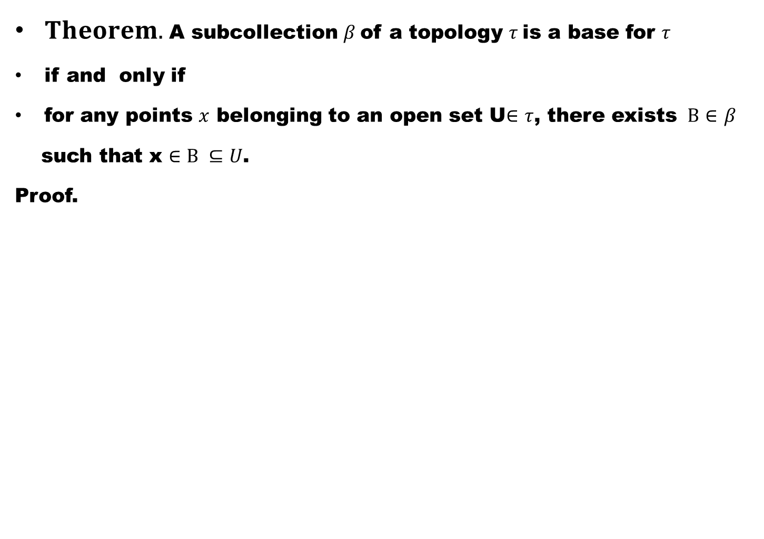
$Theorem.$A subcollection $β$of a topology $τ$is a base for $τ$
if and only if
for any points $x$ belonging to an open set U$∈$$τ$, there exists $B∈$$β$
such that x$∈B ⊆U$.
Proof.

Slide 11
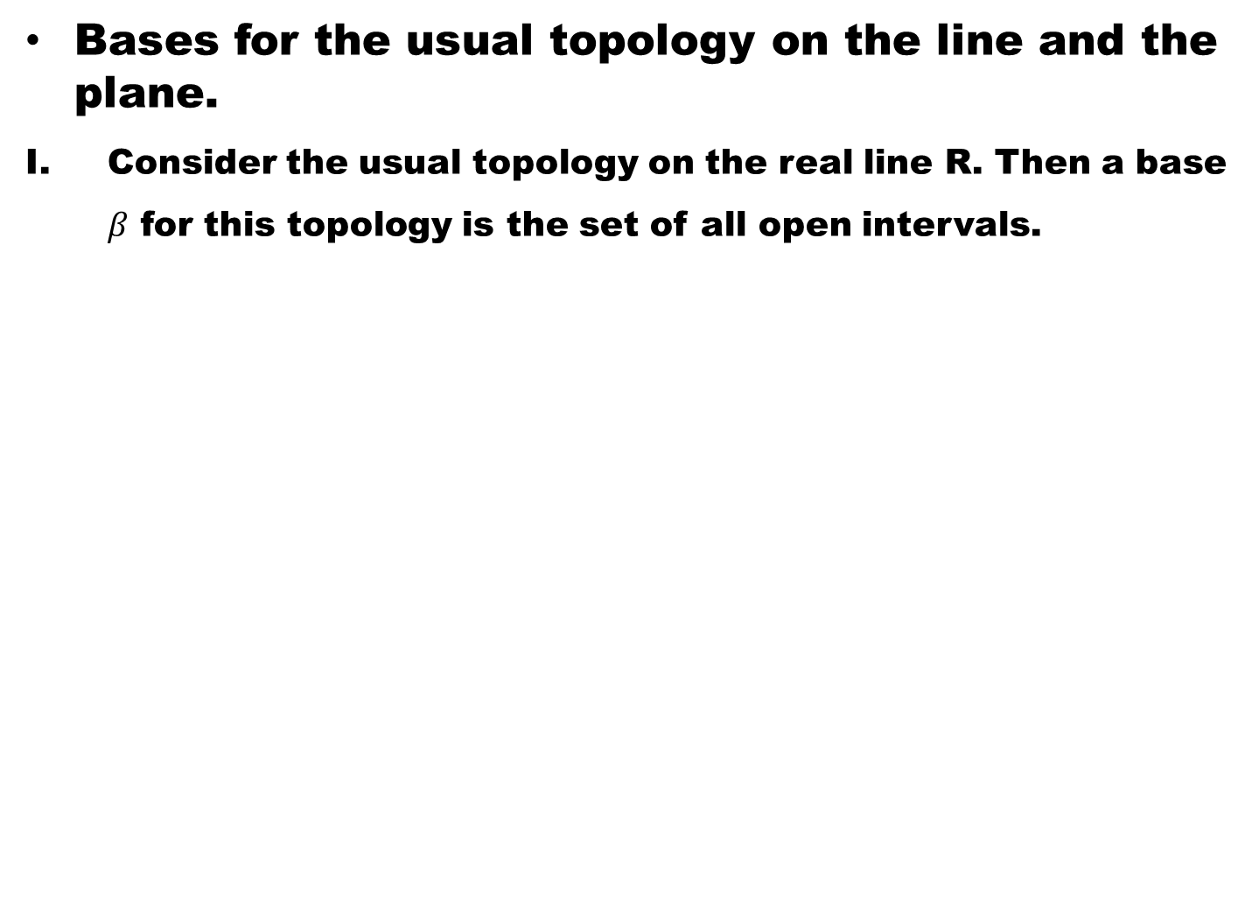
Bases for the usual topology on the line and the plane.
Consider the usual topology on the real line R. Then a base $β$ for this topology is the set of all open intervals.

Slide 12
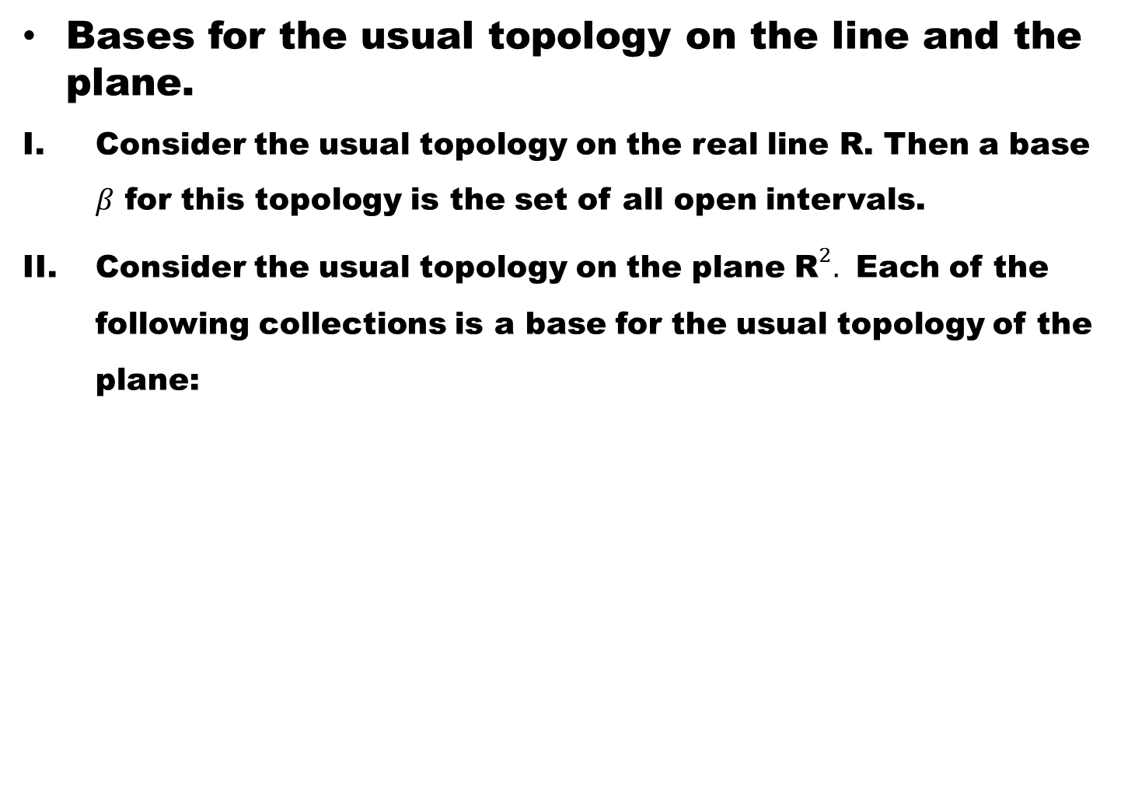
Bases for the usual topology on the line and the plane.
Consider the usual topology on the real line R. Then a base $β$ for this topology is the set of all open intervals.
Consider the usual topology on the plane ${\text{R}}^{2}.$ Each of the following collections is a base for the usual topology of the plane:

Slide 13
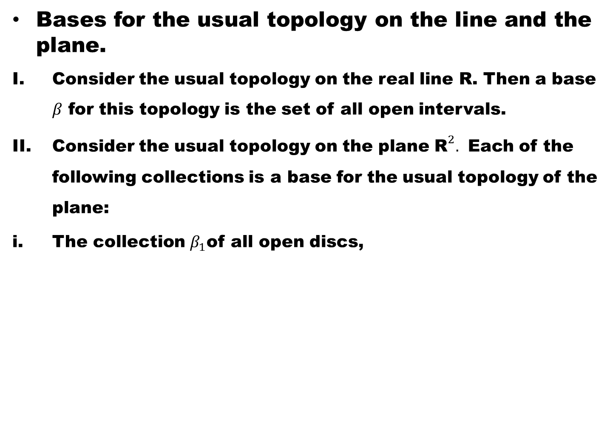
Bases for the usual topology on the line and the plane.
Consider the usual topology on the real line R. Then a base $β$ for this topology is the set of all open intervals.
Consider the usual topology on the plane ${\text{R}}^{2}.$ Each of the following collections is a base for the usual topology of the plane:
The collection $β_{1}$of all open discs,

Slide 14
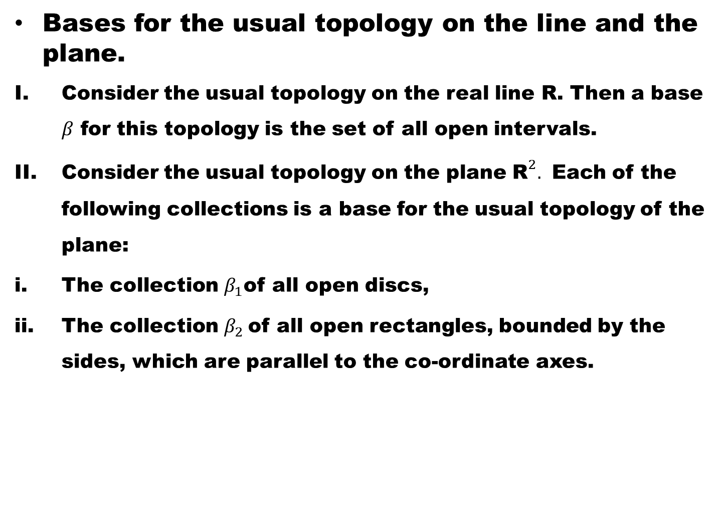
Bases for the usual topology on the line and the plane.
Consider the usual topology on the real line R. Then a base $β$ for this topology is the set of all open intervals.
Consider the usual topology on the plane ${\text{R}}^{2}.$ Each of the following collections is a base for the usual topology of the plane:
The collection $β_{1}$of all open discs,
The collection $β_{2}$of all open rectangles, bounded by the sides, which are parallel to the co-ordinate axes.

Slide 15
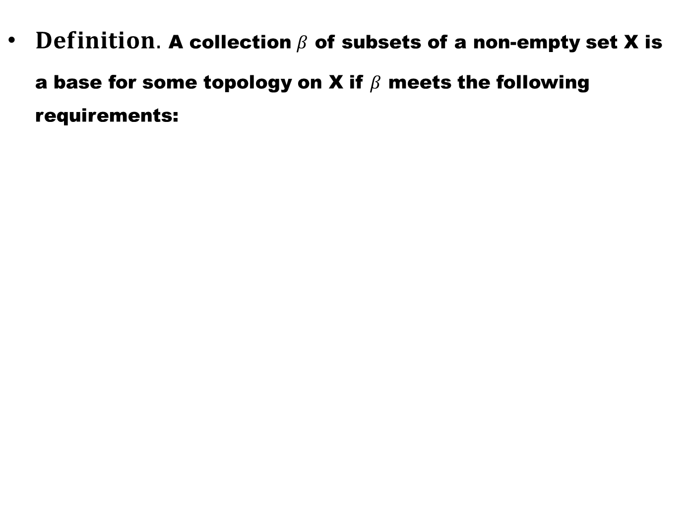
$Definition.$A collection $β$of subsets of a non-empty set X is a base for some topology on X if $β$meets the following requirements:

Slide 16
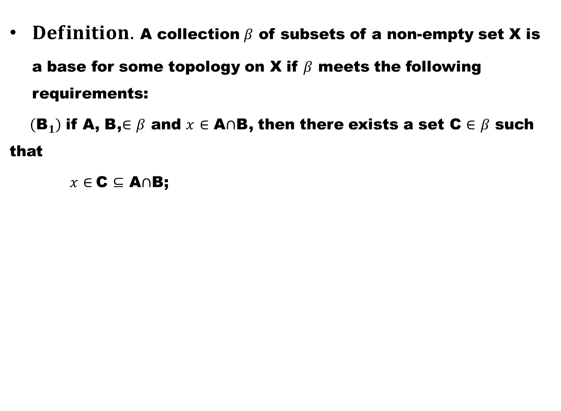
$Definition.$A collection $β$of subsets of a non-empty set X is a base for some topology on X if $β$meets the following requirements:
$\left({\text{B}}_{1}\right)$ if A, B,$∈$$β$ and $x$$∈$ A$∩$B, then there exists a set C $∈$$β$ such that
$x$$∈$C $⊆$ A$∩$B;

Slide 17
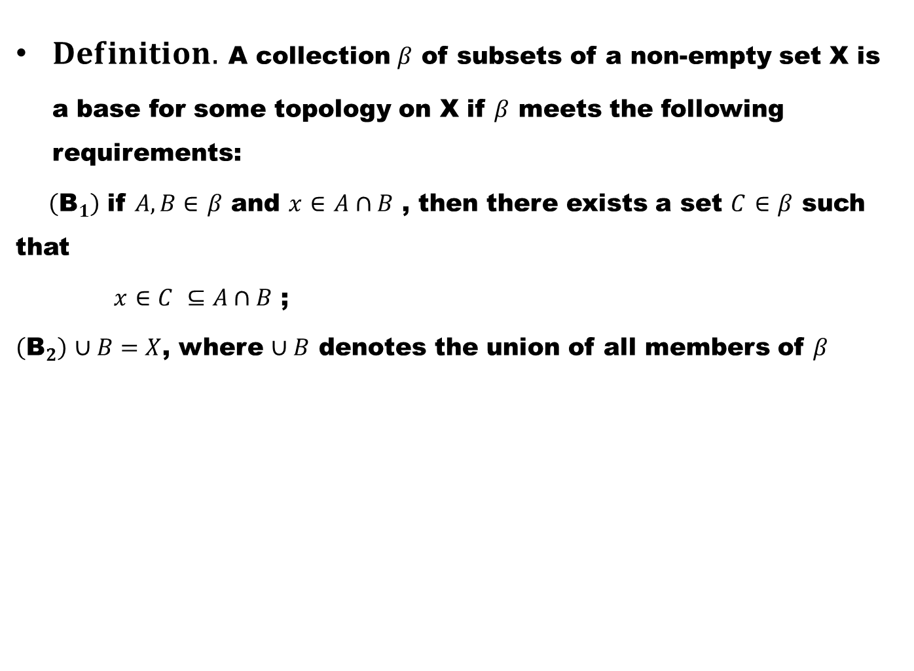
$Definition.$A collection $β$of subsets of a non-empty set X is a base for some topology on X if $β$meets the following requirements:
$\left({\text{B}}_{1}\right)$ if $A, B∈$$β$ and $x$$∈$$A∩B$ , then there exists a set $C$$∈$$β$ such that
$x$$∈C$$⊆A∩B$;
$\left({\text{B}}_{2}\right)$$∪B=X$, where $∪B$denotes the union of all members of $β$

Slide 18
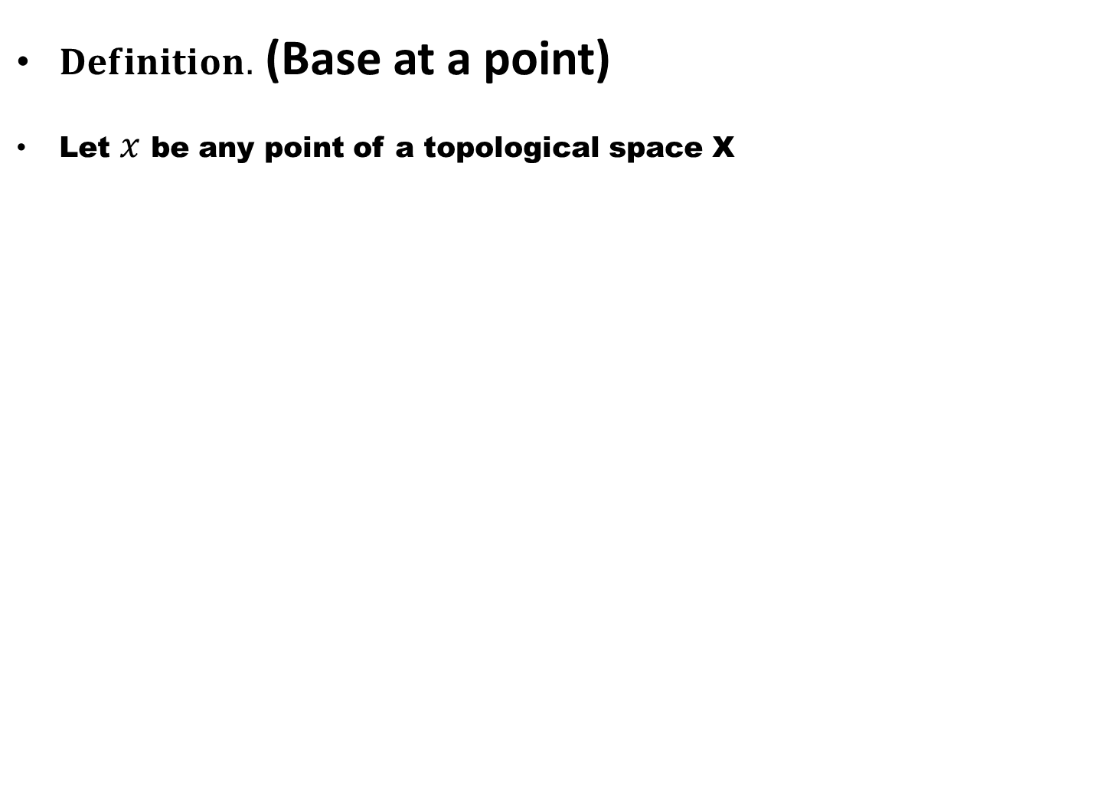
$Definition.$ (Base at a point)
Let $x$ be any point of a topological space X

Slide 19
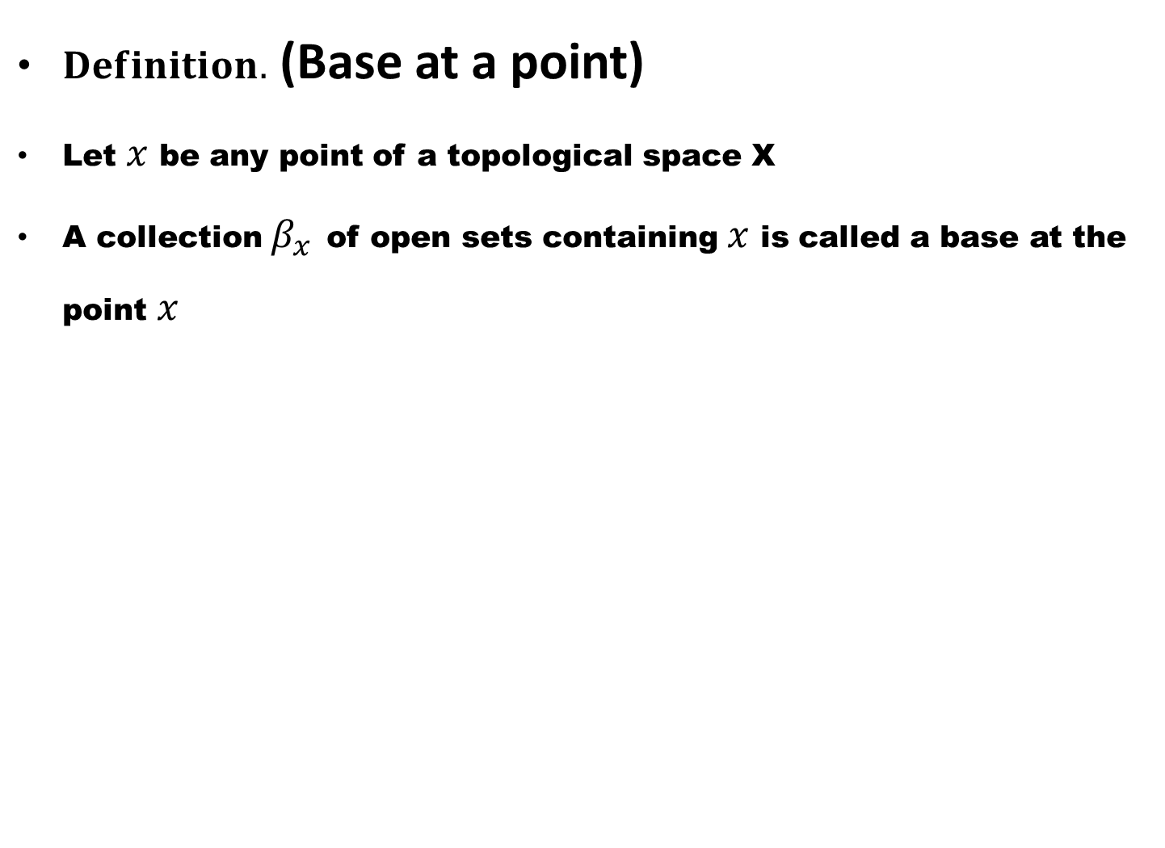
$Definition.$ (Base at a point)
Let $x$ be any point of a topological space X
A collection $β_{x}$of open sets containing $x$ is called a base at the point $x$

Slide 20
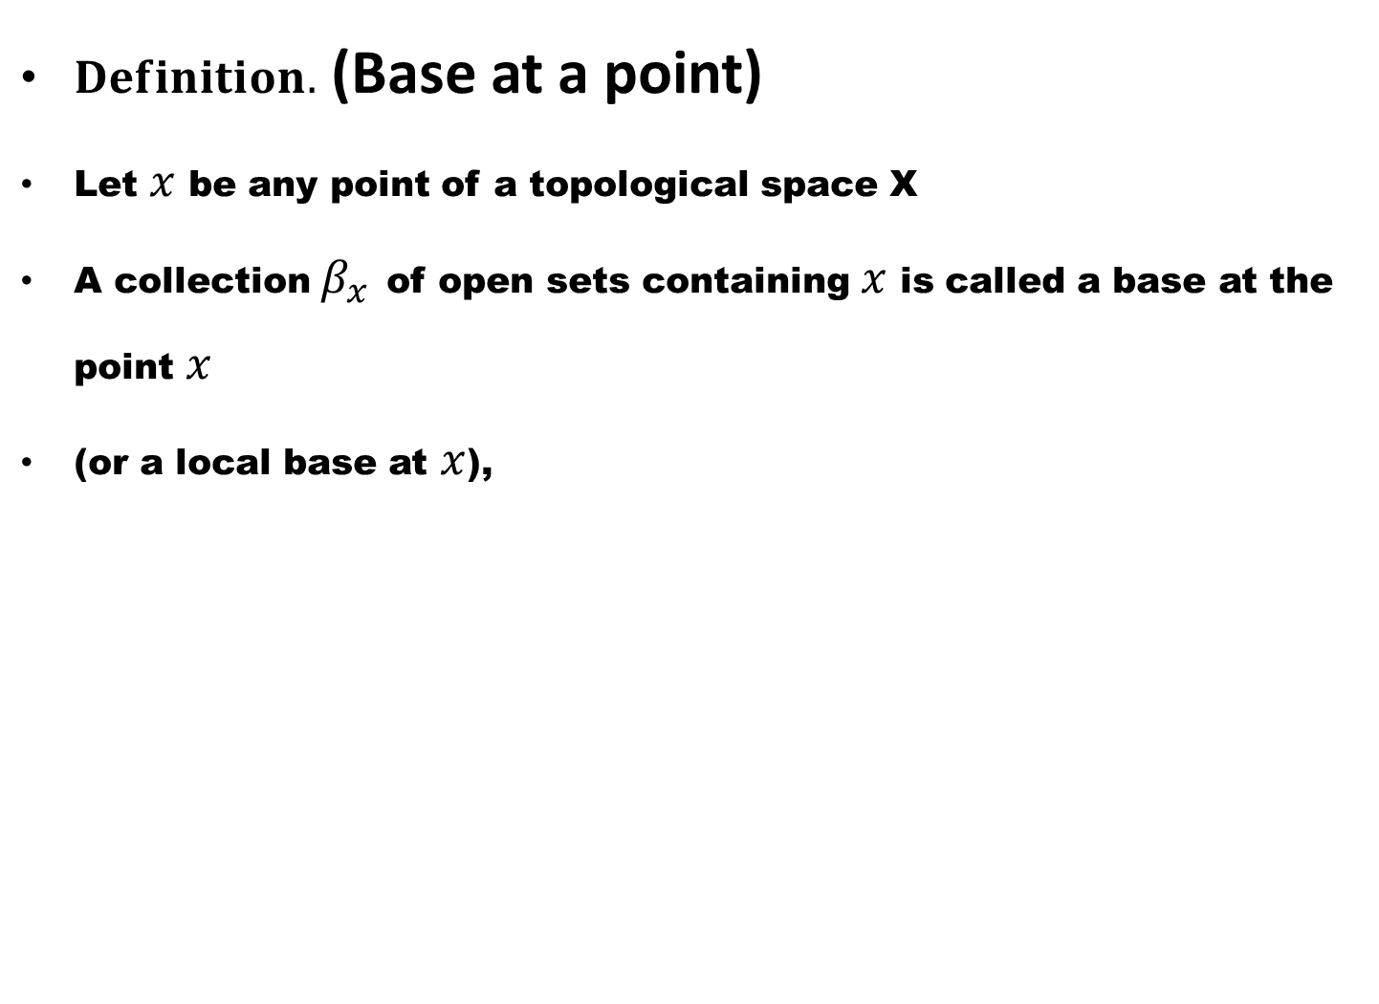
$Definition.$ (Base at a point)
Let $x$ be any point of a topological space X
A collection $β_{x}$of open sets containing $x$ is called a base at the point $x$
(or a local base at $x$),

Slide 21
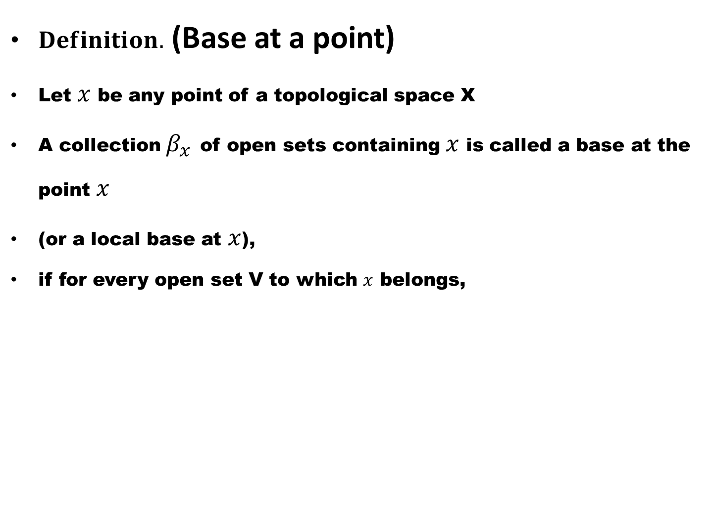
$Definition.$ (Base at a point)
Let $x$ be any point of a topological space X
A collection $β_{x}$of open sets containing $x$ is called a base at the point $x$
(or a local base at $x$),
if for every open set V to which $x$ belongs,

Slide 22
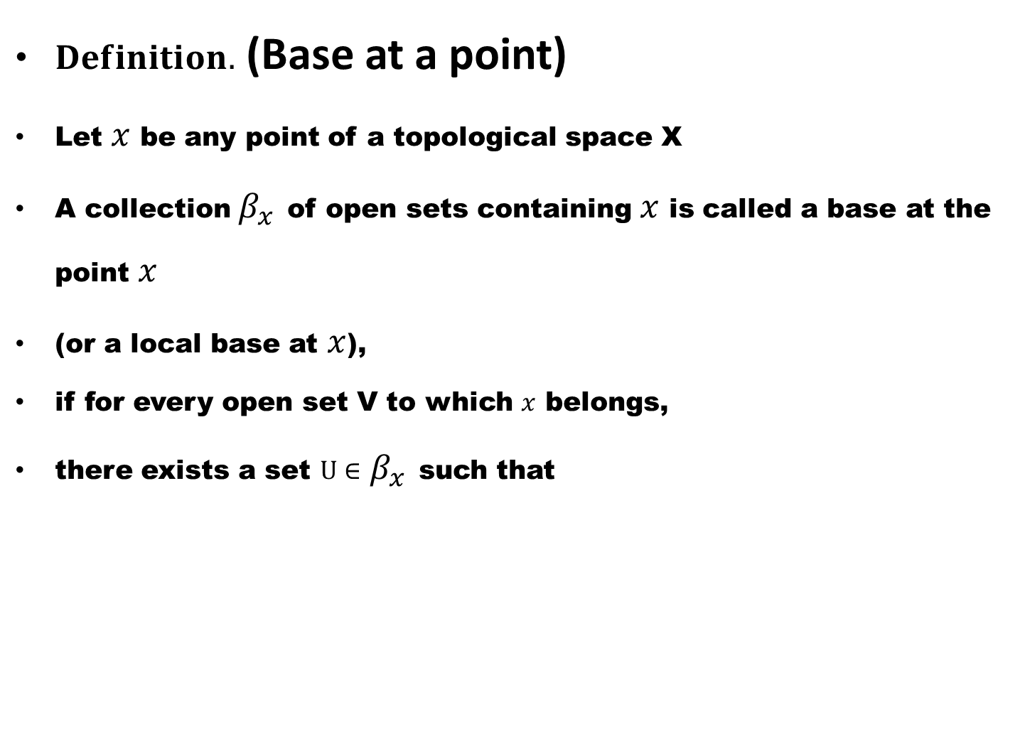
$Definition.$ (Base at a point)
Let $x$ be any point of a topological space X
A collection $β_{x}$of open sets containing $x$ is called a base at the point $x$
(or a local base at $x$),
if for every open set V to which $x$ belongs,
there exists a set $U∈$$β_{x}$such that

Slide 23
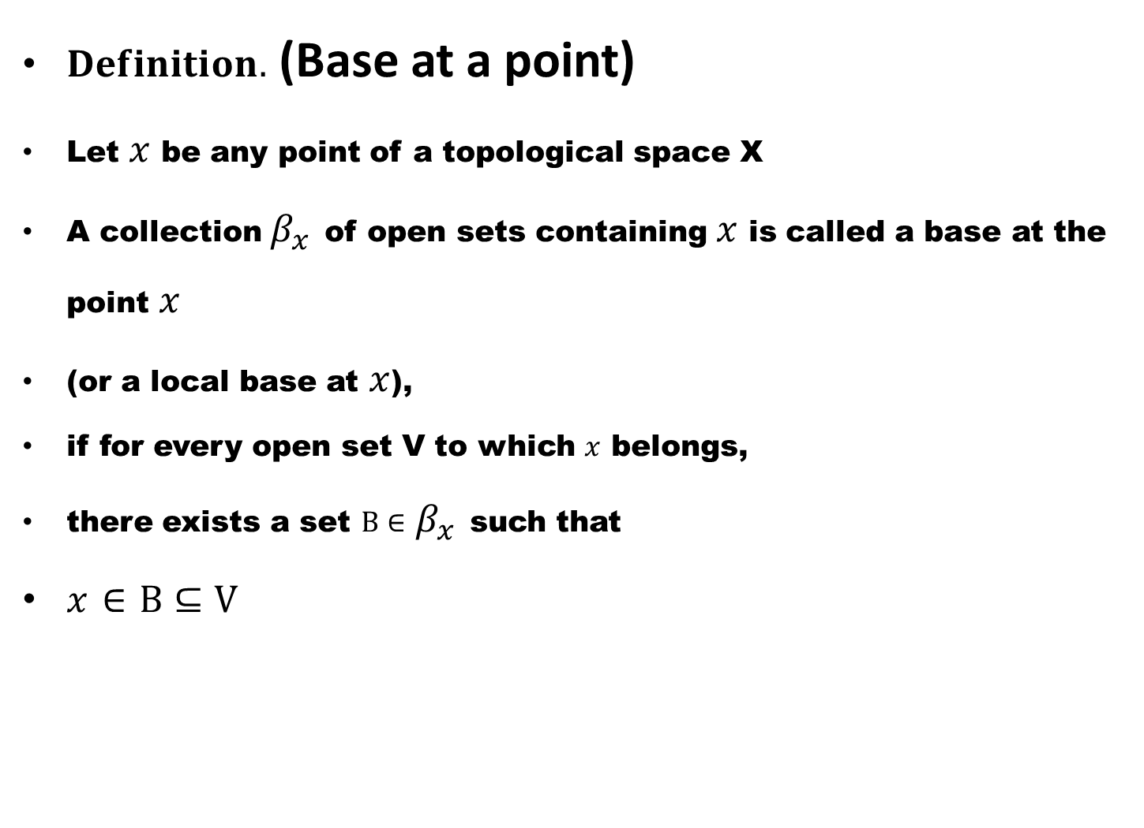
$Definition.$ (Base at a point)
Let $x$ be any point of a topological space X
A collection $β_{x}$of open sets containing $x$ is called a base at the point $x$
(or a local base at $x$),
if for every open set V to which $x$ belongs,
there exists a set $B∈$$β_{x}$such that
$x$$∈$$B⊆V$

Slide 24
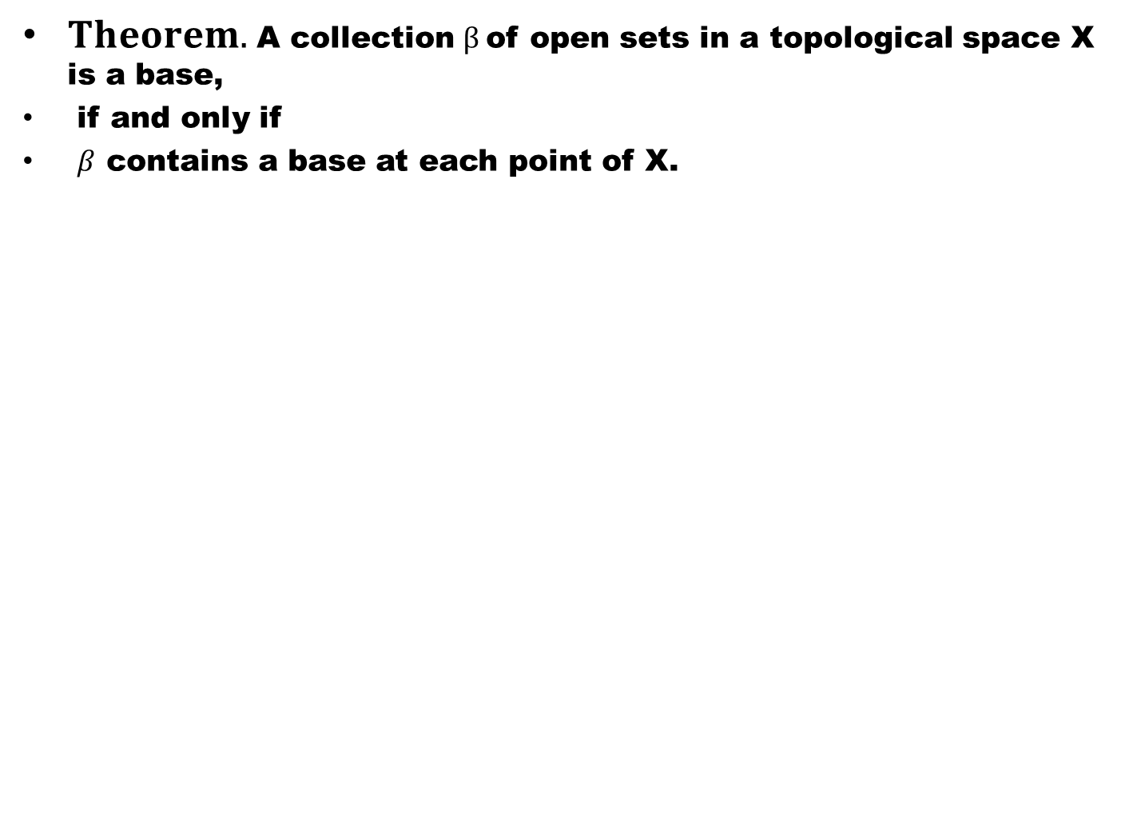
$Theorem.$A collection $β$of open sets in a topological space X is a base,
if and only if
$β$ contains a base at each point of X.

Slide 27
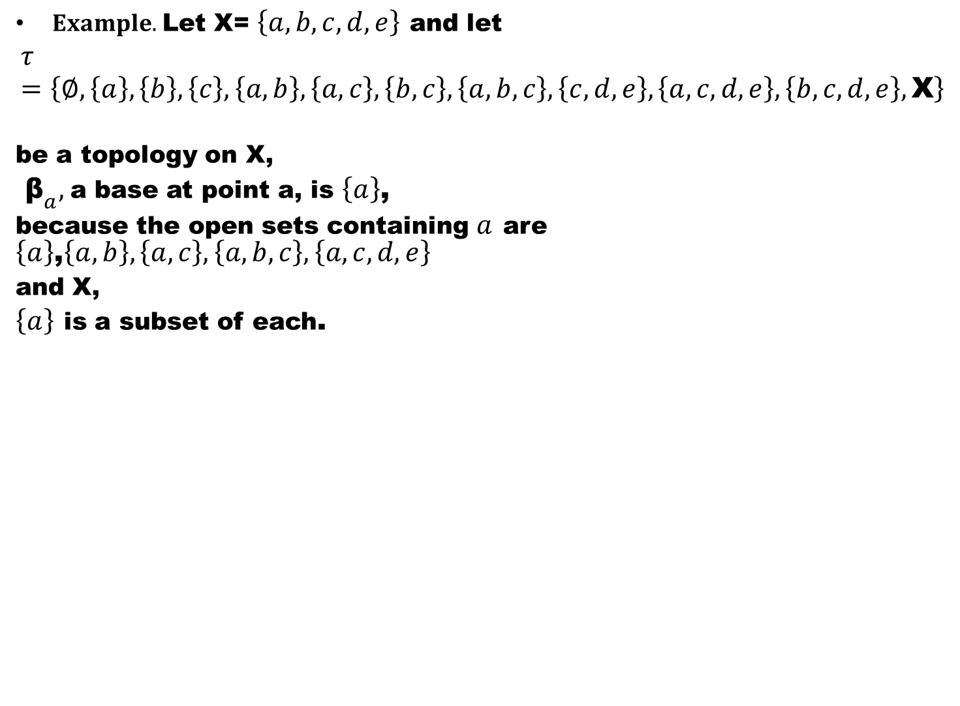
$Example.$Let X= $\left\{a,b,c,d,e\right\}$and let
$$τ=\left\{∅,\left\{a\right\},\left\{b\right\},\left\{c\right\},\left\{a,b\right\},\left\{a,c\right\},\left\{b,c\right\},\left\{a,b,c\right\},\left\{c,d,e\right\},\left\{a,c,d,e\right\},\left\{b,c,d,e\right\},\text{X}\right\}$$
be a topology on X,
${\text{β}}_{a},$a base at point a, is $\left\{a\right\}$,
because the open sets containing $a$are$\left\{a\right\}$,$\left\{a,b\right\},\left\{a,c\right\},\left\{a,b,c\right\},\left\{a,c,d,e\right\}$
and X,
$\left\{a\right\}$is a subset of each.

Slide 28
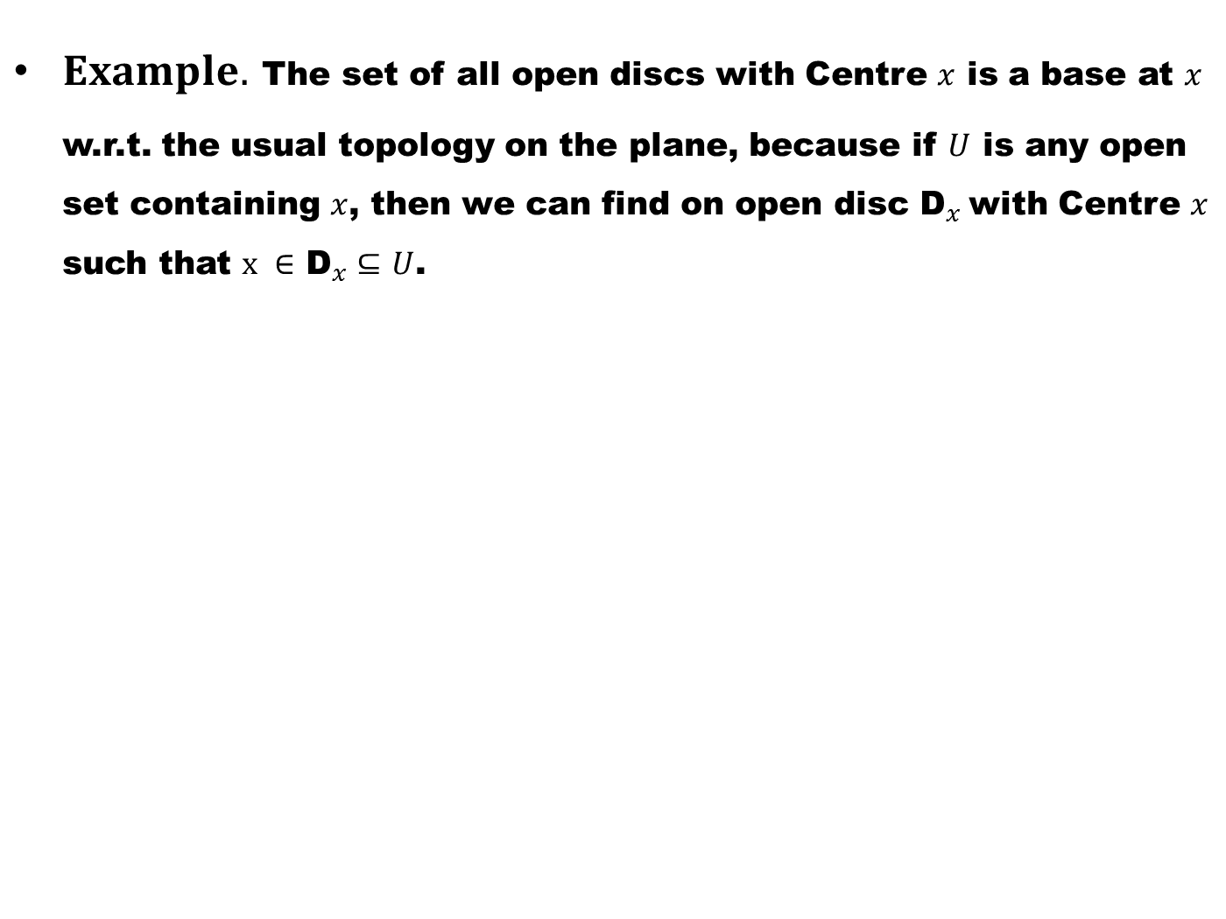
$Example.$The set of all open discs with Centre $x$ is a base at $x$ w.r.t. the usual topology on the plane, because if $U$is any open set containing $x$, then we can find on open disc ${\text{D}}_{x}$with Centre $x$ such that $x ∈$${\text{D}}_{x}⊆$$U$.

Slide 29
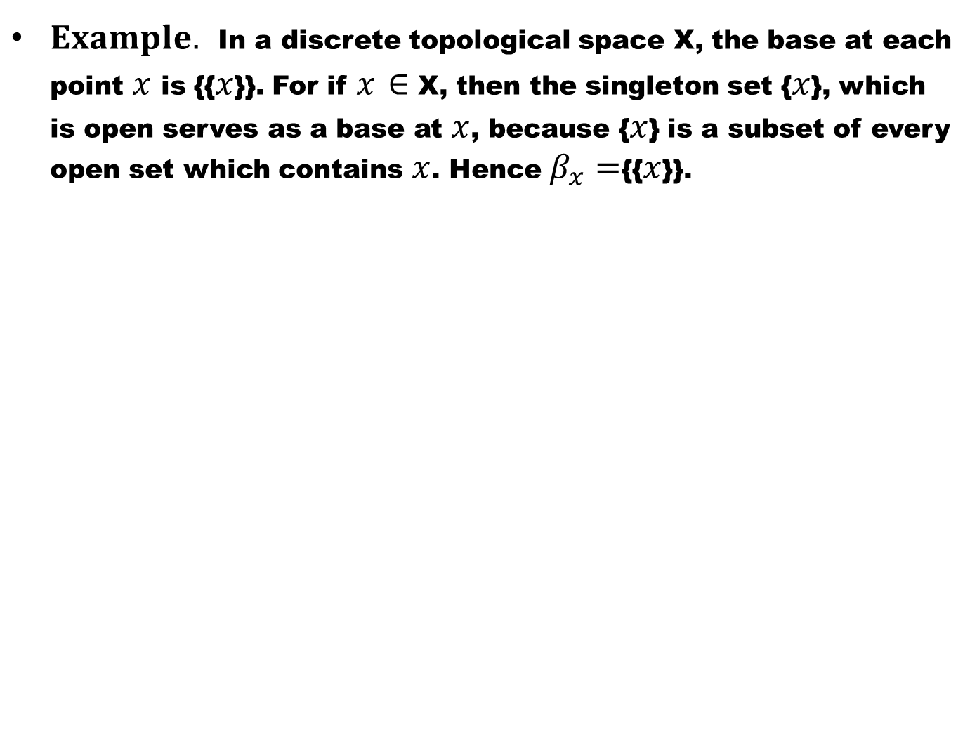
$Example.$In a discrete topological space X, the base at each point $x$ is {{$x$}}. For if $x$$∈$ X, then the singleton set {$x$}, which is open serves as a base at $x$, because {$x$} is a subset of every open set which contains $x$. Hence $β_{x}=${{$x$}}.

Slide 30
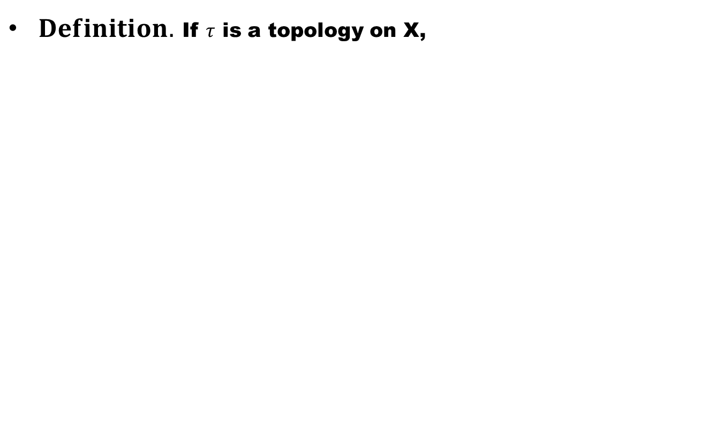
Subbases
$Definition.$If $τ$is a topology on X,

Slide 31
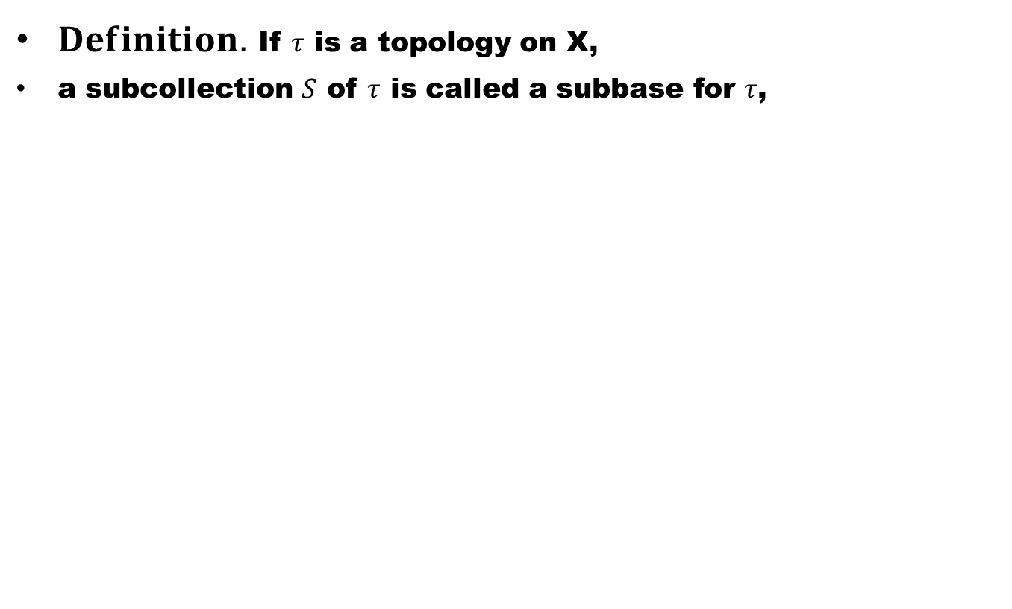
Subbases
$Definition.$If $τ$is a topology on X,
a subcollection $S$of $τ$is called a subbase for $τ$,

Slide 32
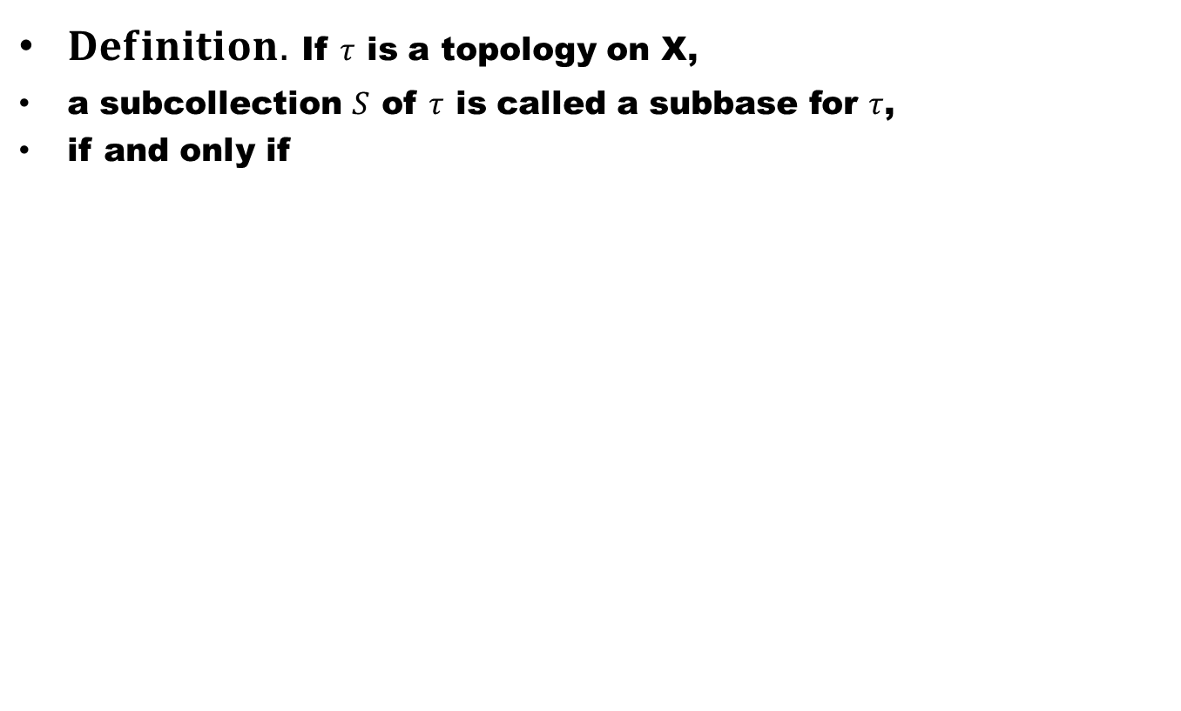
Subbases
$Definition.$If $τ$is a topology on X,
a subcollection $S$of $τ$is called a subbase for $τ$,
if and only if

Slide 33
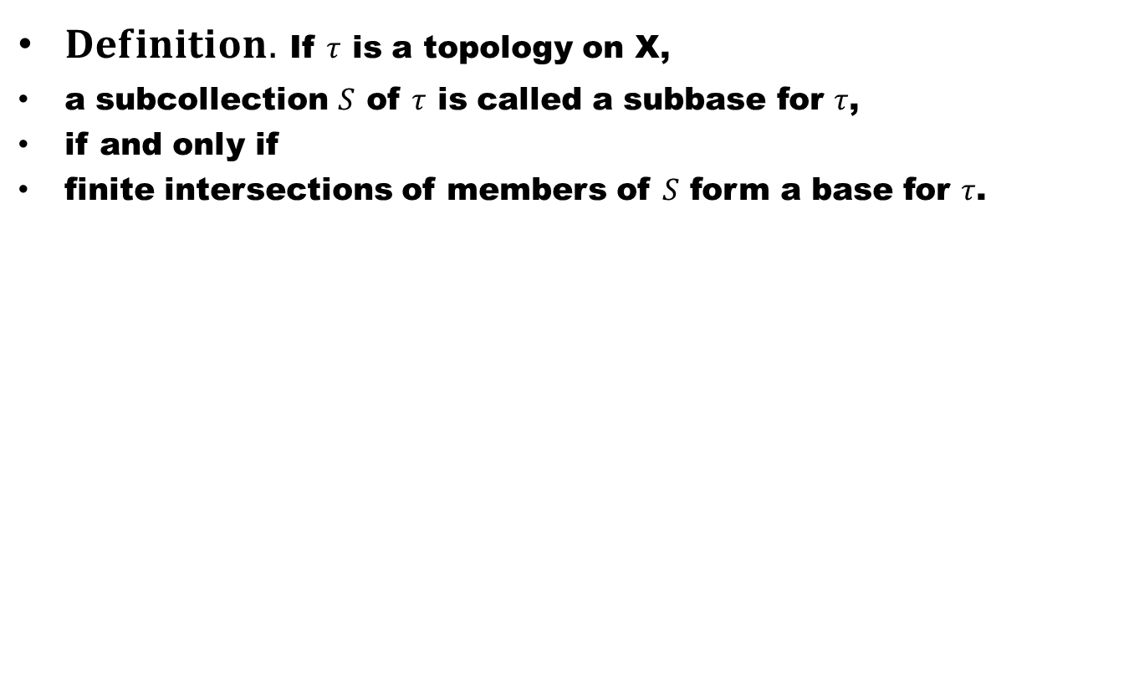
Subbases
$Definition.$If $τ$is a topology on X,
a subcollection $S$of $τ$is called a subbase for $τ$,
if and only if
finite intersections of members of $S$form a base for $τ$.

Slide 34
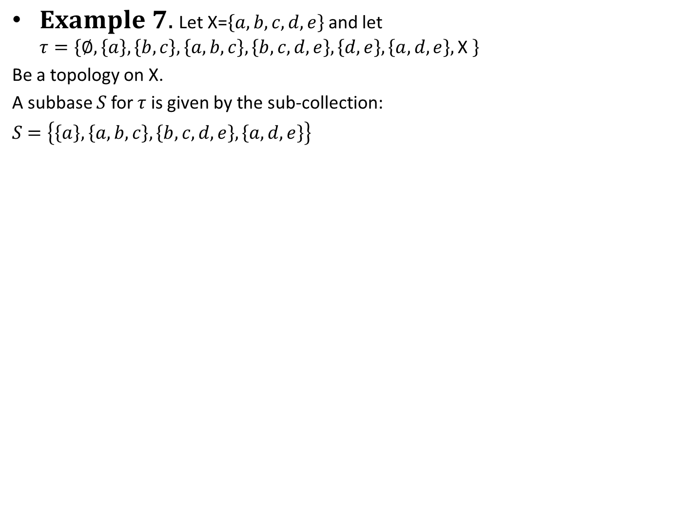
$Example 7.$Let X=$\left\{a,b,c,d,e\right\}$and let $τ=\left\{∅,\left\{a\right\},\left\{b,c\right\},\left\{a,b,c\right\},\left\{b,c,d,e\right\},\left\{d,e\right\},\left\{a,d,e\right\},\text{X} \right\}$
Be a topology on X.
A subbase $S$for $τ$ is given by the sub-collection:
$S$$=\left\{\left\{a\right\},\left\{a,b,c\right\},\left\{b,c,d,e\right\}, \left\{a,d,e\right\}\right\}$

Slide 35
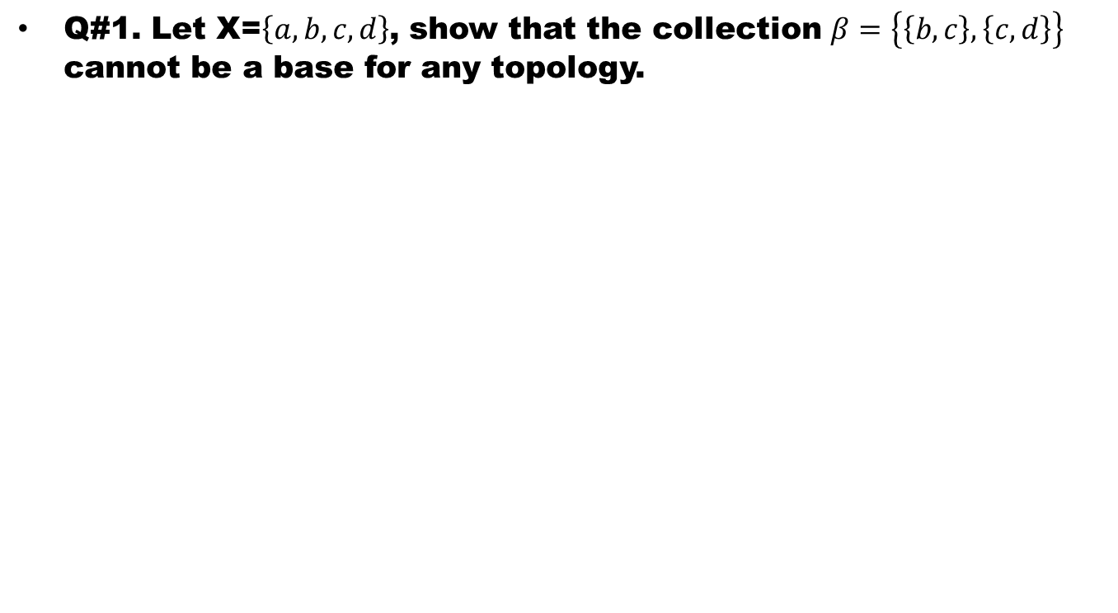
Exercises
Q#1. Let X=$\left\{a,b,c,d\right\}$, show that the collection $β=\left\{\left\{b,c\right\},\left\{c,d\right\}\right\}$cannot be a base for any topology.

Slide 36
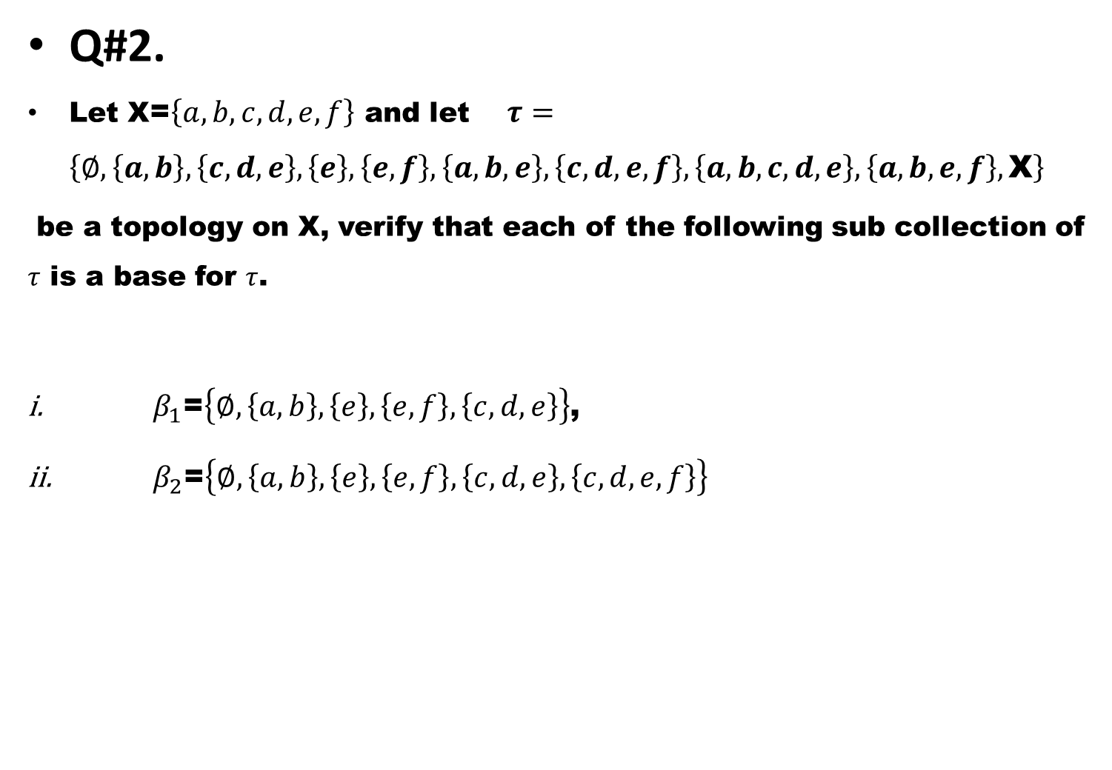
Q#2.
Let X=$\left\{a,b,c,d,e,f\right\}$and let $τ=$$\left\{∅,\left\{a,b\right\},\left\{c,d,e\right\},\left\{e\right\},\left\{e,f\right\},\left\{a,b,e\right\},\left\{c,d,e,f\right\},\left\{a,b,c,d,e\right\},\left\{a,b,e,f\right\},\text{X}\right\}$
be a topology on X, verify that each of the following sub collection of $τ$is a base for $τ$.
$β_{1}$=$\left\{∅,\left\{a,b\right\},\left\{e\right\},\left\{e,f\right\},\left\{c,d,e\right\}\right\}$,
$β_{2}$=$\left\{∅,\left\{a,b\right\},\left\{e\right\},\left\{e,f\right\},\left\{c,d,e\right\},\left\{c,d,e,f\right\}\right\}$

Slide 37
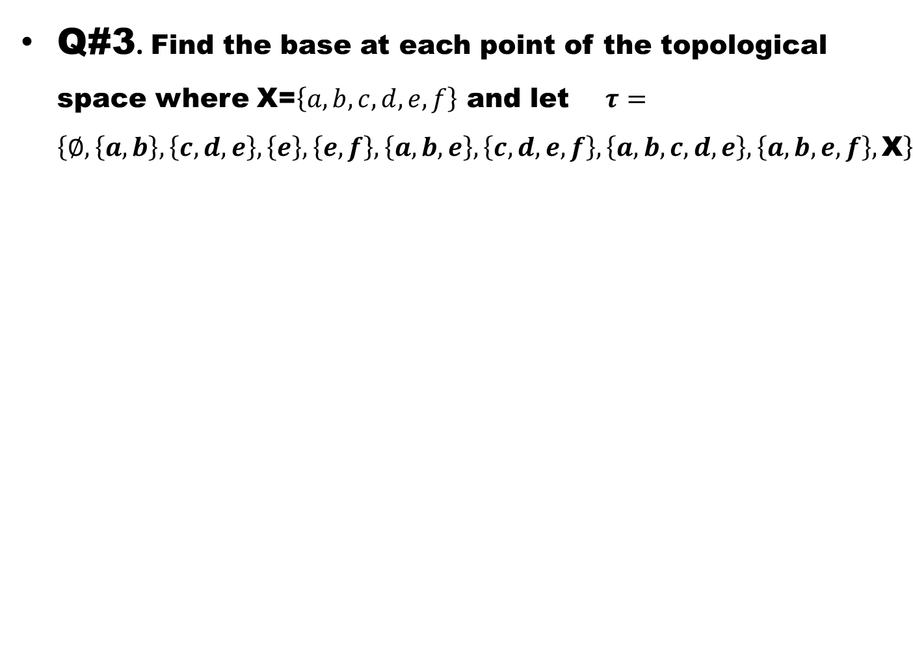
Q#3. Find the base at each point of the topological space where X=$\left\{a,b,c,d,e,f\right\}$and let $τ=$$\left\{∅,\left\{a,b\right\},\left\{c,d,e\right\},\left\{e\right\},\left\{e,f\right\},\left\{a,b,e\right\},\left\{c,d,e,f\right\},\left\{a,b,c,d,e\right\},\left\{a,b,e,f\right\},\text{X}\right\}$

Slide 38
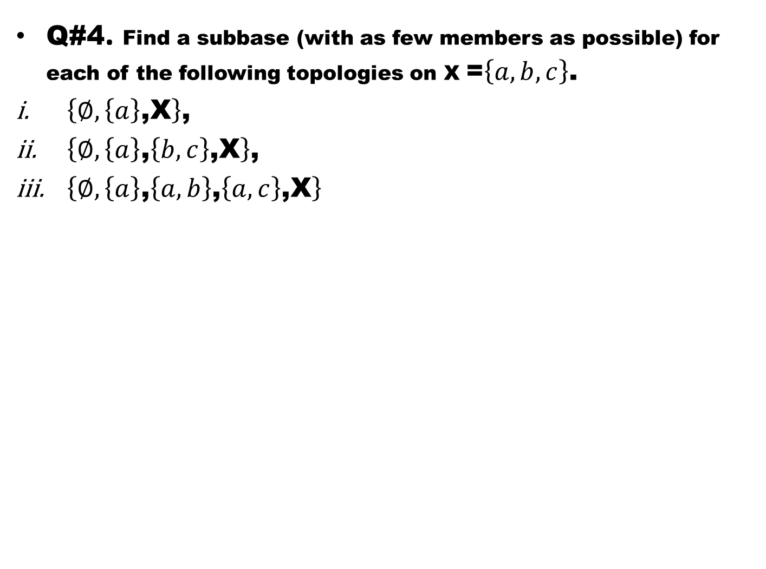
Q#4. Find a subbase (with as few members as possible) for each of the following topologies on X =$\left\{a,b,c\right\}$.
$\left\{∅,\left\{a\right\}\text{,}\text{X}\right\}$,
$\left\{∅,\left\{a\right\}\text{,}\left\{b,c\right\}\text{,}\text{X}\right\}$,
$\left\{∅,\left\{a\right\}\text{,}\left\{a,b\right\}\text{,}\left\{a,c\right\}\text{,}\text{X}\right\}$

Slide 39
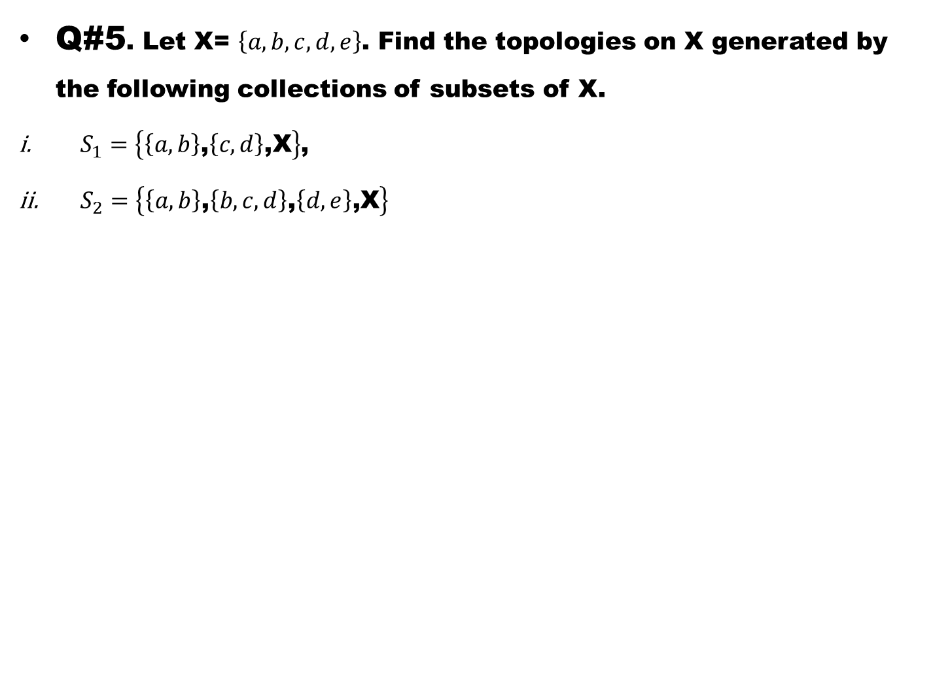
Q#5. Let X= $\left\{a,b,c,d,e\right\}$. Find the topologies on X generated by the following collections of subsets of X.
$S_{1}=\left\{\left\{a,b\right\}\text{,}\left\{c,d\right\}\text{,}\text{X}\right\}$,
$S_{2}=\left\{\left\{a,b\right\}\text{,}\left\{b,c,d\right\}\text{,}\left\{d,e\right\}\text{,}\text{X}\right\}$

Slide 40
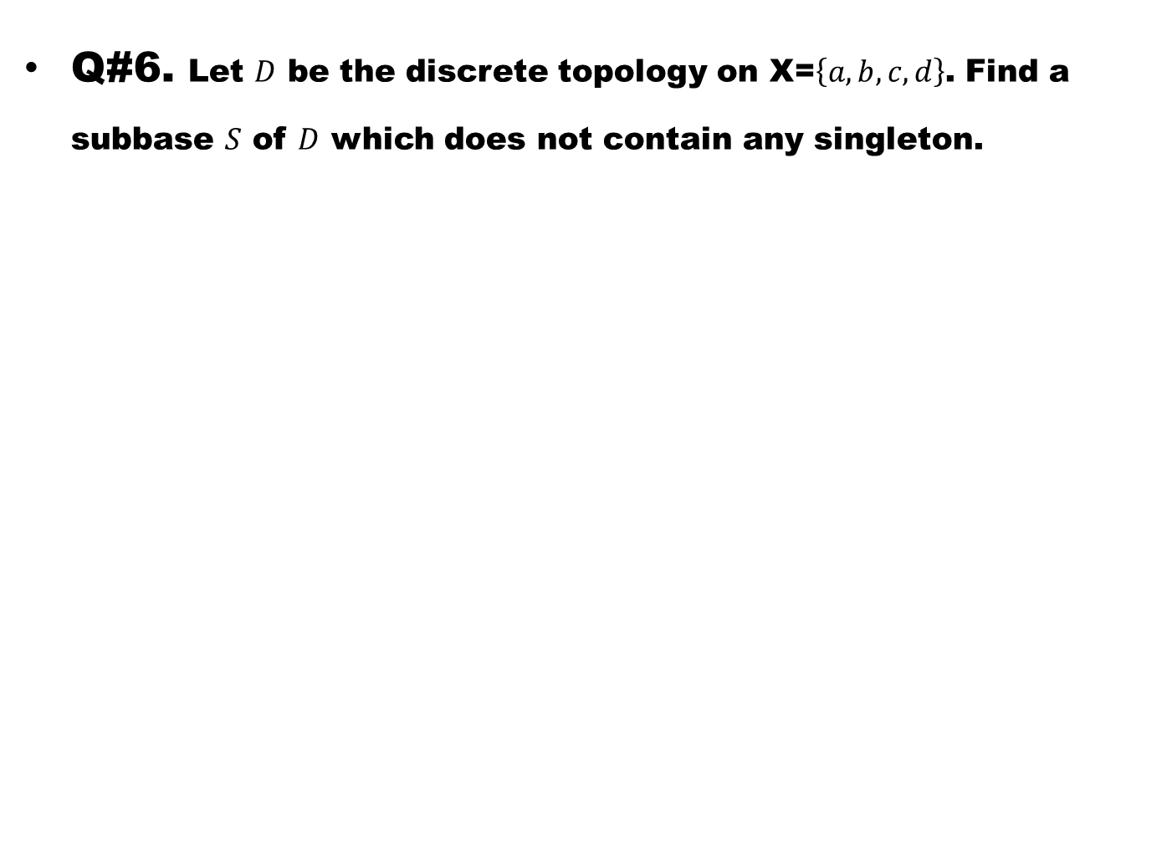
Q#6.Let $D$be the discrete topology on X=$\left\{a,b,c,d\right\}$. Find a subbase $S$of $D$ which does not contain any singleton.

Slide 41
Good Luck to you

Slide 42
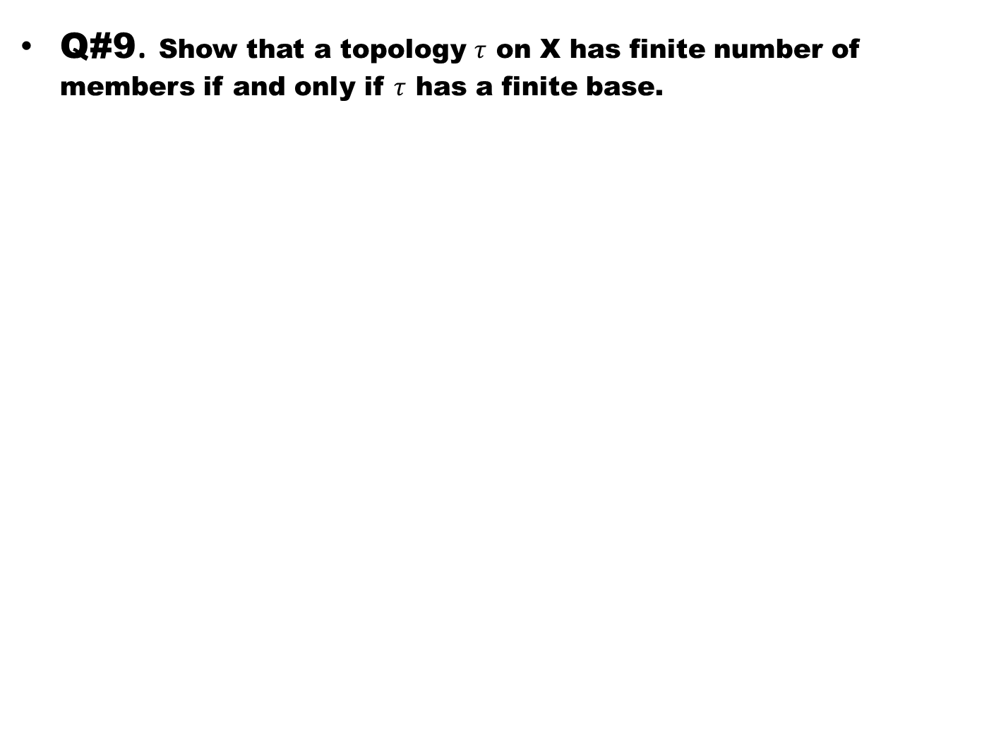
Q#9. Show that a topology $τ$ on X has finite number of members if and only if $τ$ has a finite base.

Slide 43
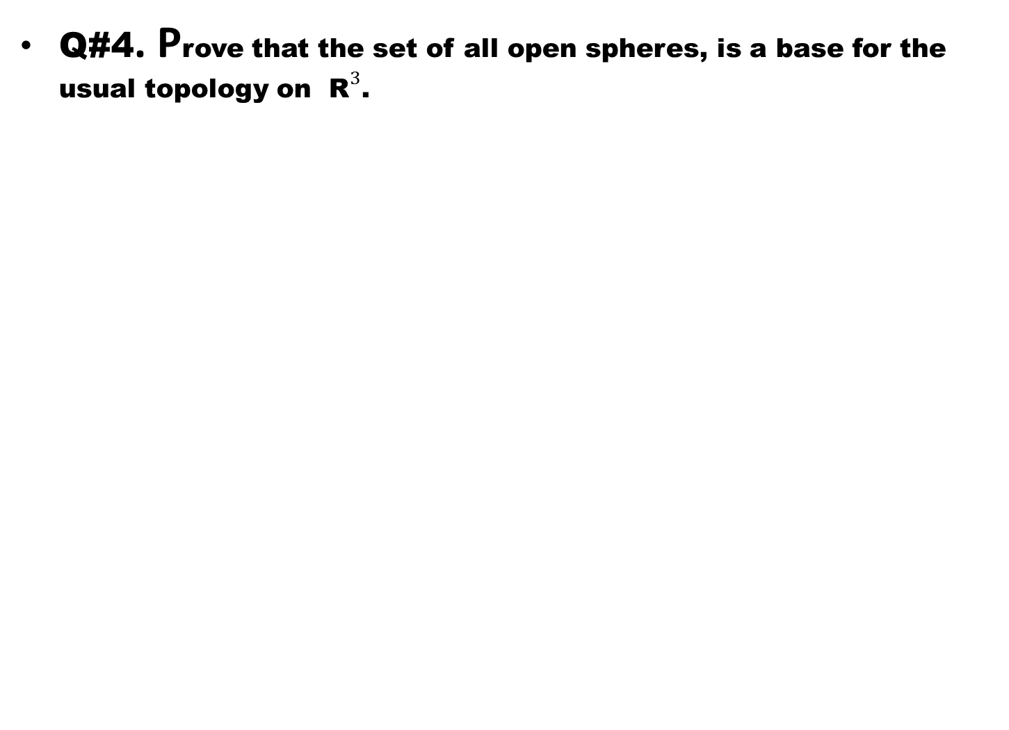
Q#4. Prove that the set of all open spheres, is a base for the usual topology on ${\text{R}}^{3}$.

