Slide 1
Set Topology
MTH 251
Lecture # 16

Slide 2
Lecture Plan
Limit point of a set
Derived set
Examples
Theorem on
Limit point
Exercise problems

Slide 3
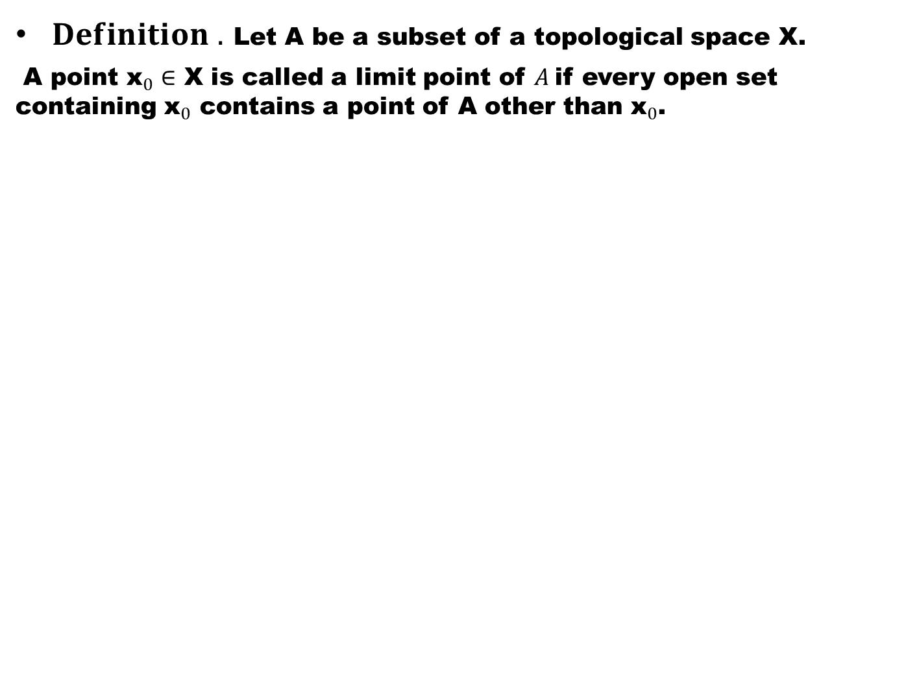
$Definition .$ Let A be a subset of a topological space X.
A point ${\text{x}}_{0}∈$ X is called a limit point of $A$if every open set containing ${\text{x}}_{0}$ contains a point of A other than ${\text{x}}_{0}$.

Slide 4
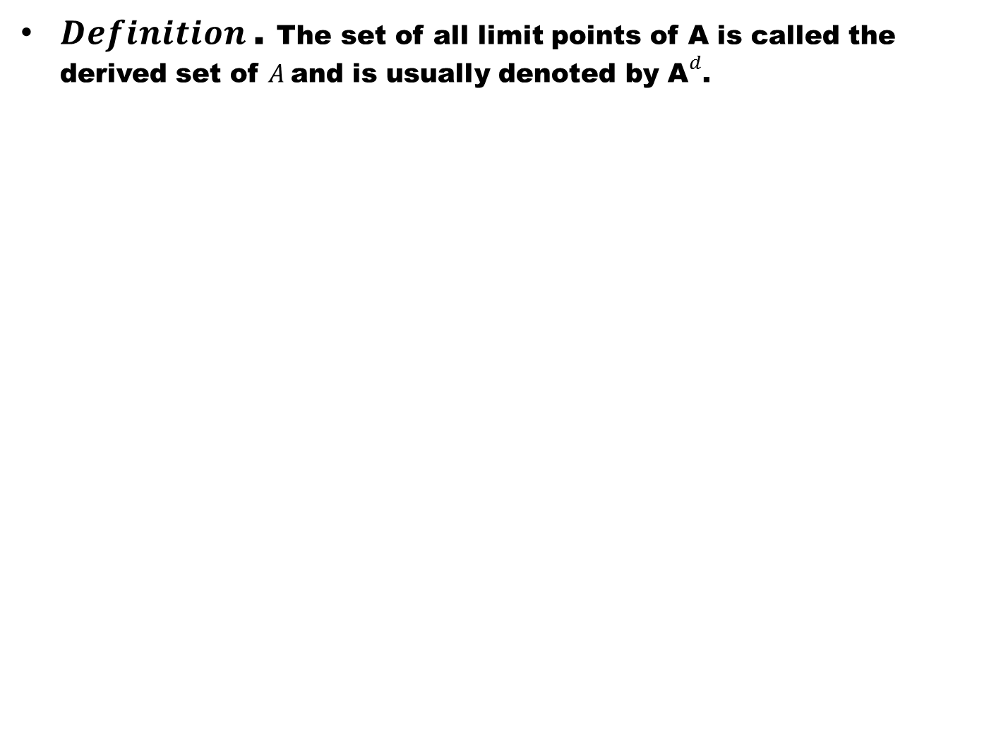
$Definition$. The set of all limit points of A is called the derived set of $A$and is usually denoted by ${\text{A}}^{d}$.

Slide 5
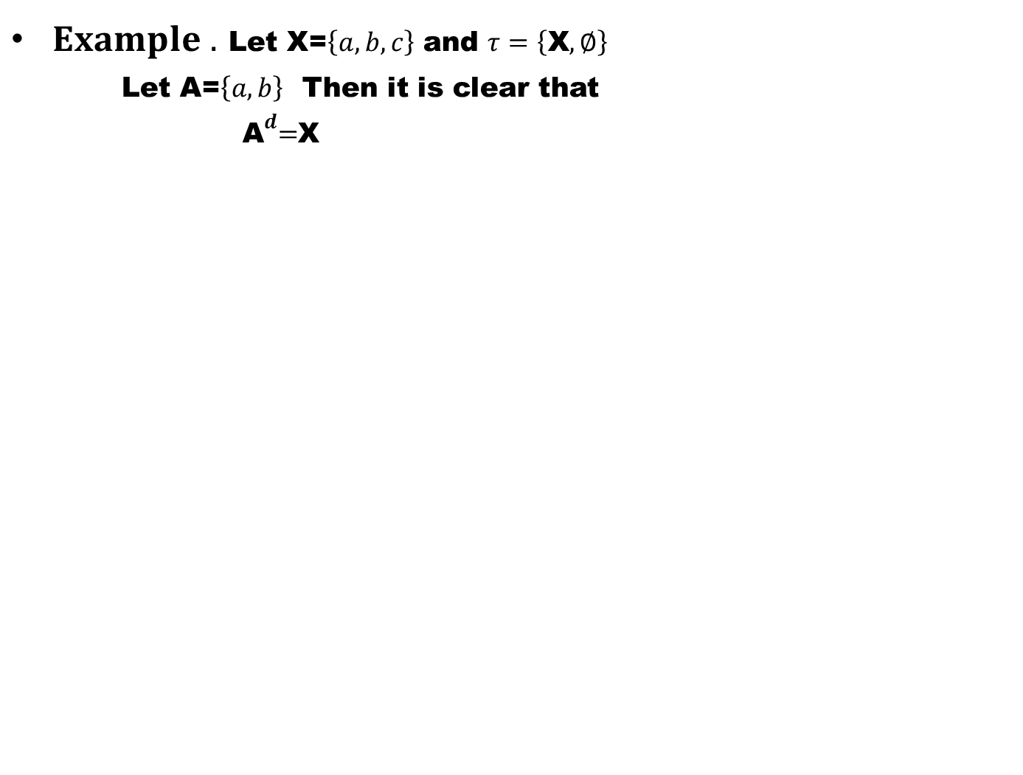
$Example .$ Let X=$\left\{a,b,c\right\}$ and $τ=\left\{\text{X},∅\right\}$
Let A=$\left\{a,b\right\}$ Then it is clear that
${ \text{A}}^{d}=$X

Slide 6
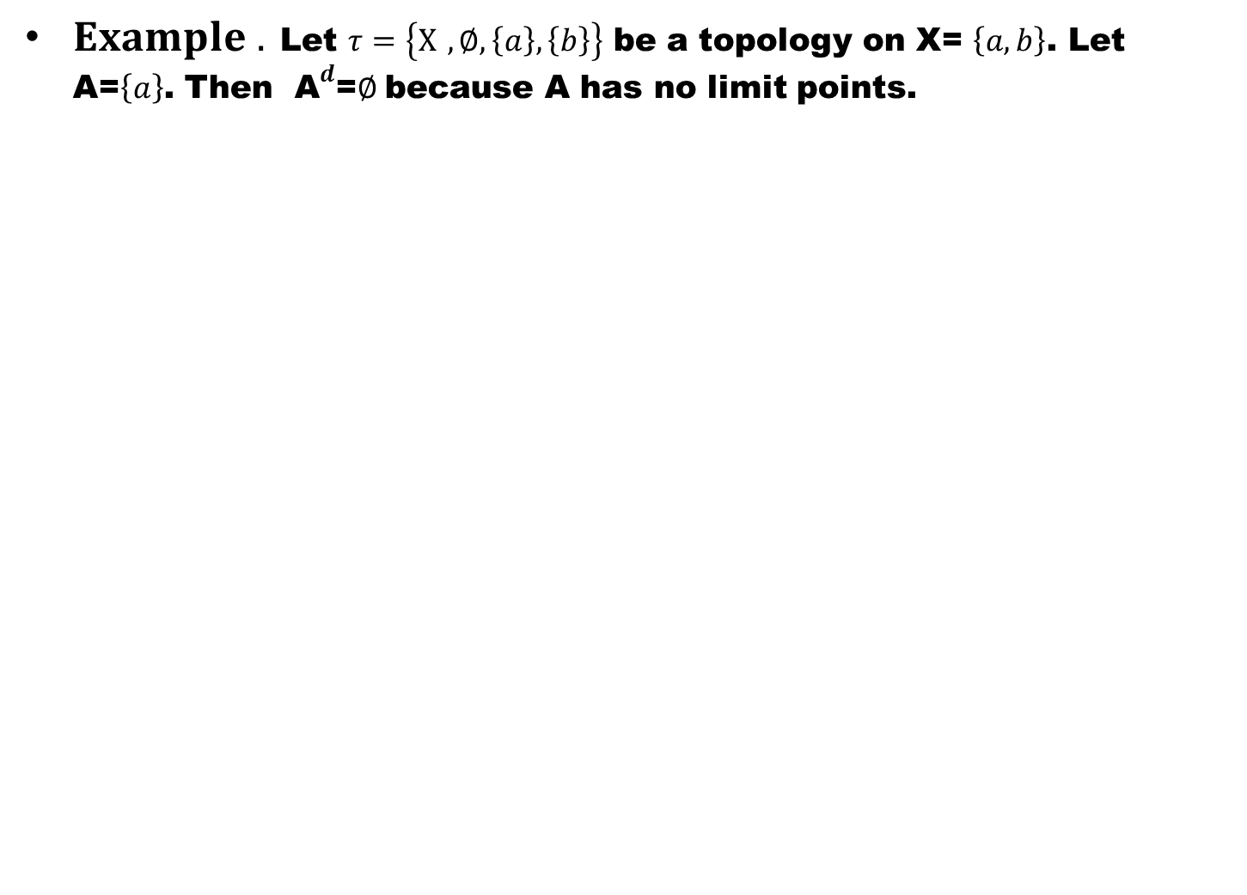
$Example .$ Let $τ=\left\{X ,∅,\left\{a\right\},\left\{b\right\}\right\}$ be a topology on X= $\left\{a,b\right\}$. Let A=$\left\{a\right\}$. Then ${ \text{A}}^{d}$=$∅$because A has no limit points.

Slide 7
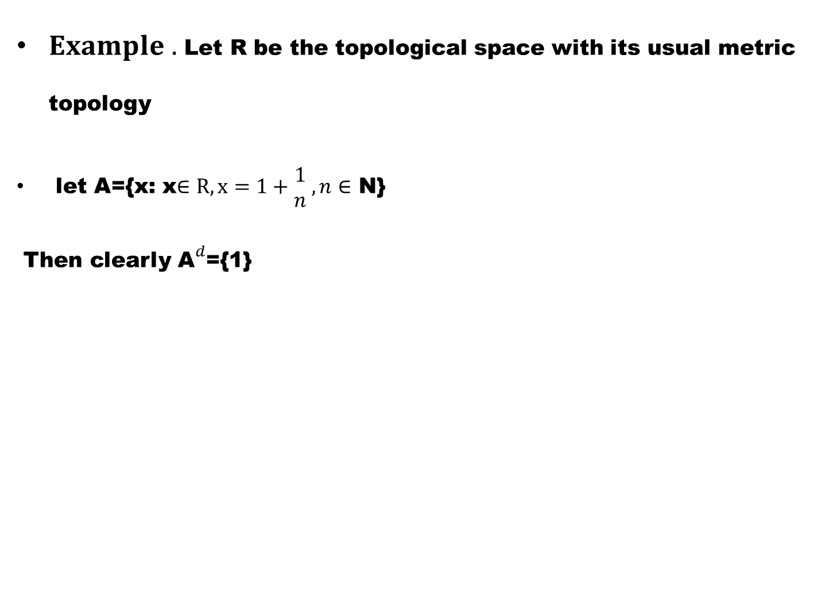
$Example .$ Let R be the topological space with its usual metric topology
let A={x: x$∈R,x=1+\begin{matrix}1 \\ n\end{matrix} ,n∈$ N}
Then clearly ${\text{A}}^{d}$={1}

Slide 8
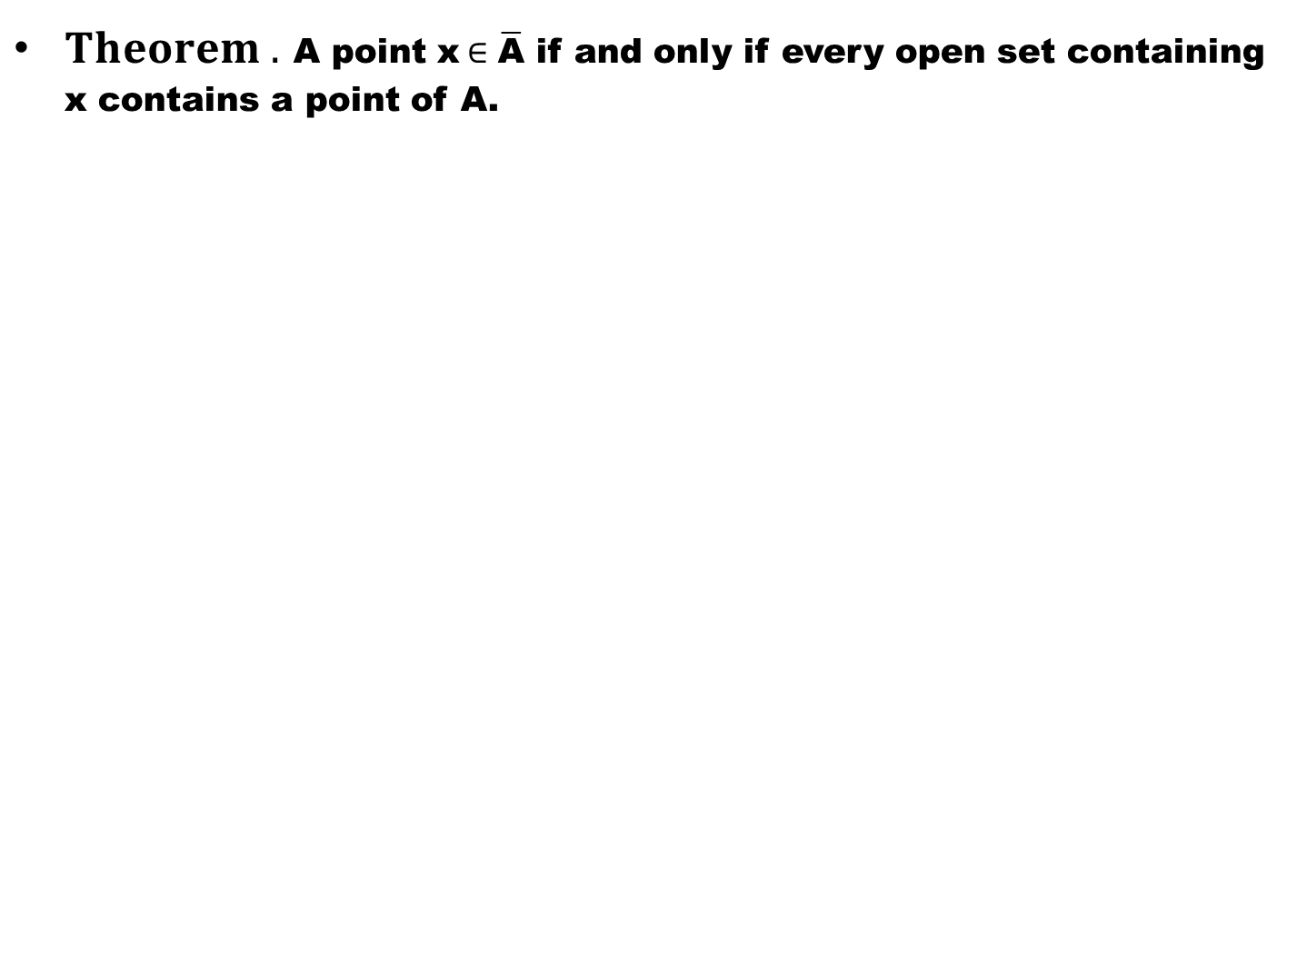
$Theorem .$ A point x$∈\overline{\text{A}}$ if and only if every open set containing x contains a point of A.

Slide 9
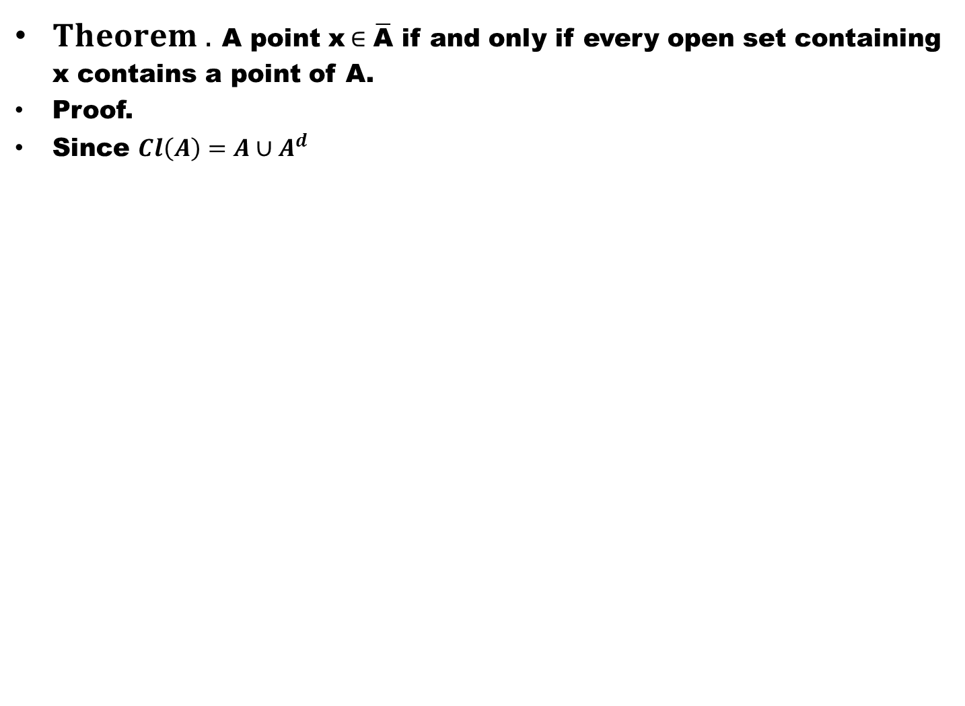
$Theorem .$ A point x$∈\overline{\text{A}}$ if and only if every open set containing x contains a point of A.
Proof.
Since $Cl\left(A\right)=A∪A^{d}$

Slide 10
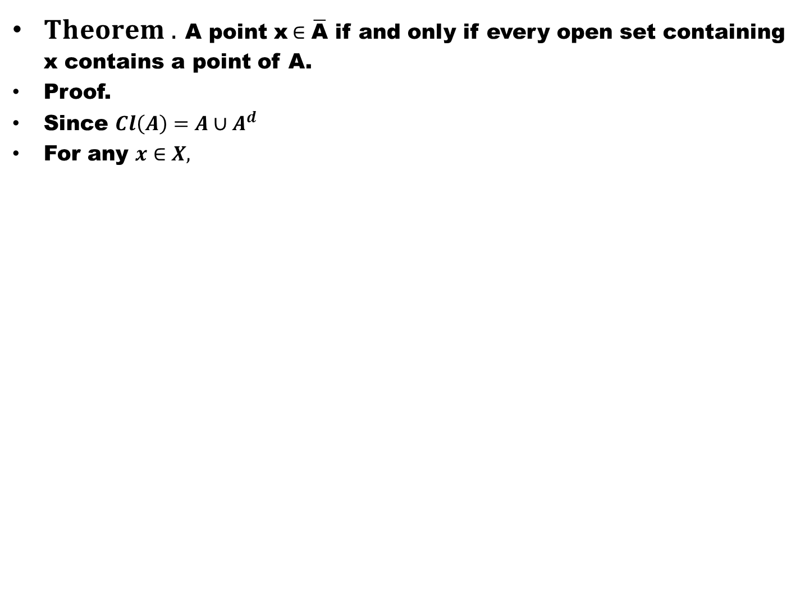
$Theorem .$ A point x$∈\overline{\text{A}}$ if and only if every open set containing x contains a point of A.
Proof.
Since $Cl\left(A\right)=A∪A^{d}$
For any $x∈X,$

Slide 11
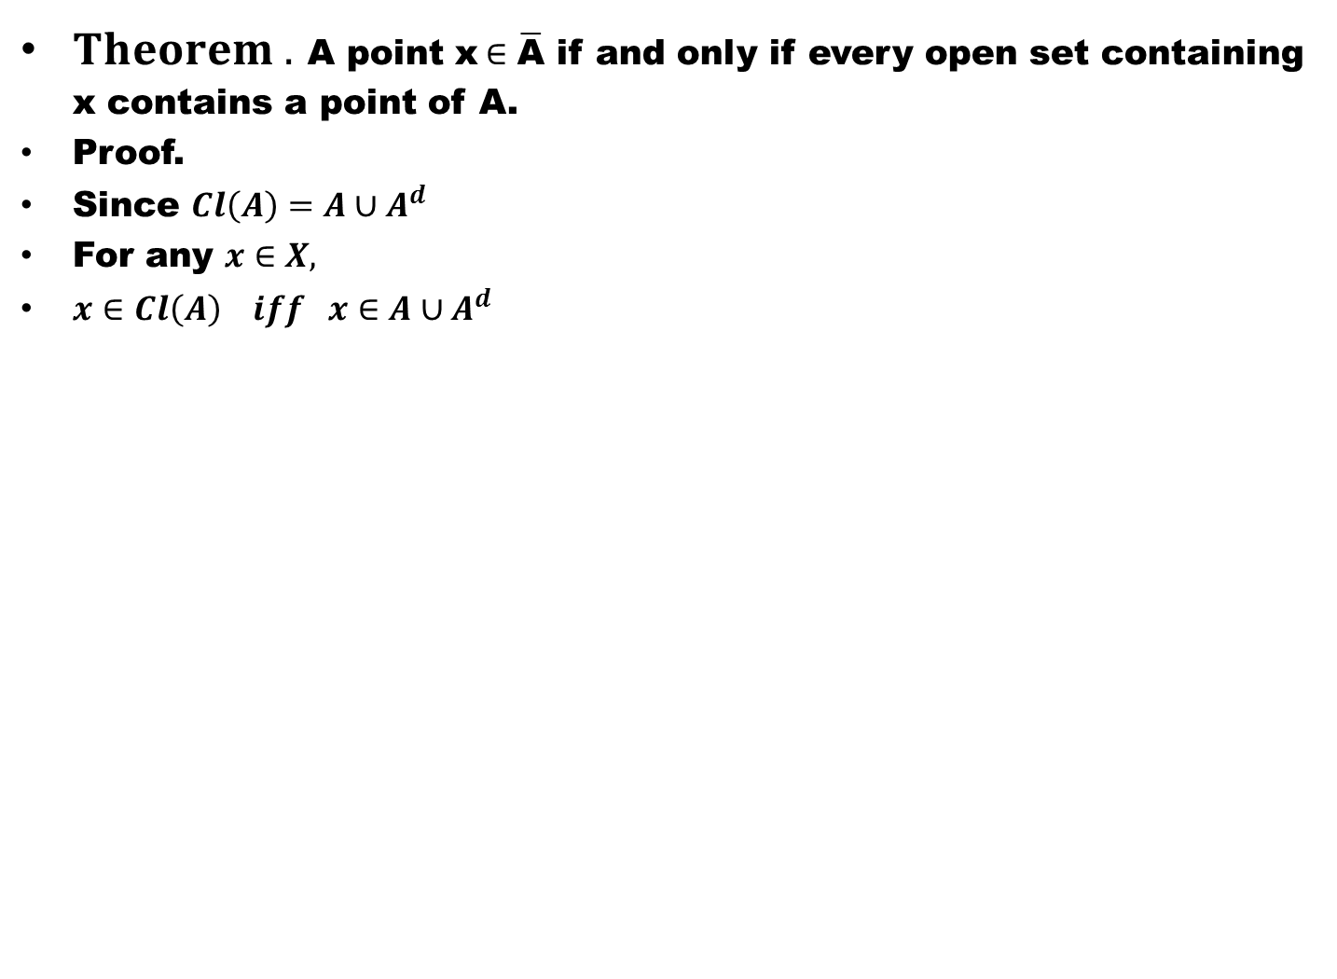
$Theorem .$ A point x$∈\overline{\text{A}}$ if and only if every open set containing x contains a point of A.
Proof.
Since $Cl\left(A\right)=A∪A^{d}$
For any $x∈X,$
$x∈Cl\left(A\right) iff x∈A∪A^{d}$

Slide 12
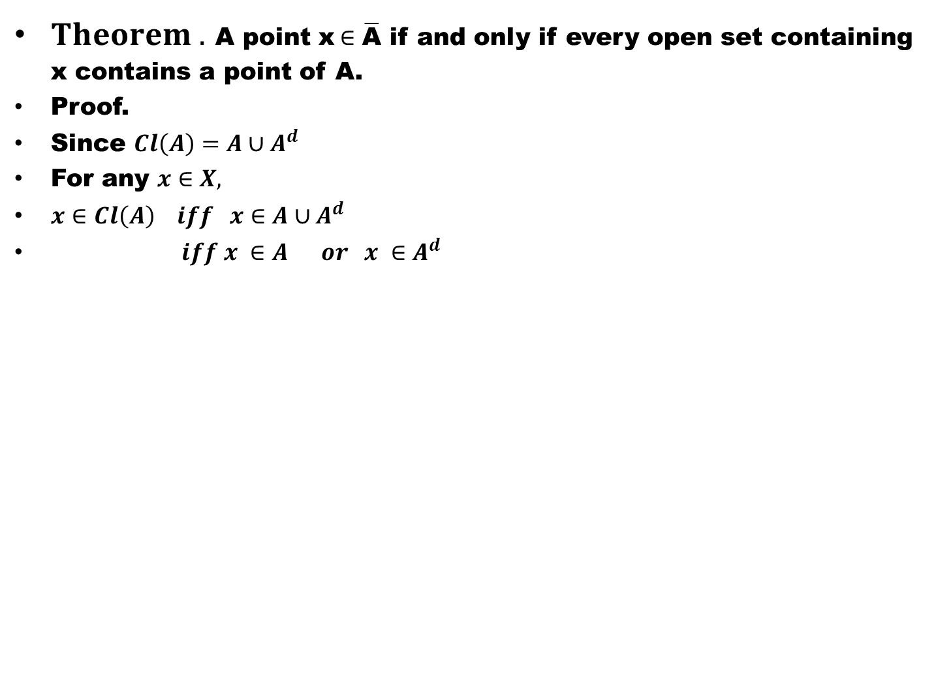
$Theorem .$ A point x$∈\overline{\text{A}}$ if and only if every open set containing x contains a point of A.
Proof.
Since $Cl\left(A\right)=A∪A^{d}$
For any $x∈X,$
$x∈Cl\left(A\right) iff x∈A∪A^{d}$
$iff x ∈A or x ∈A^{d}$

Slide 13
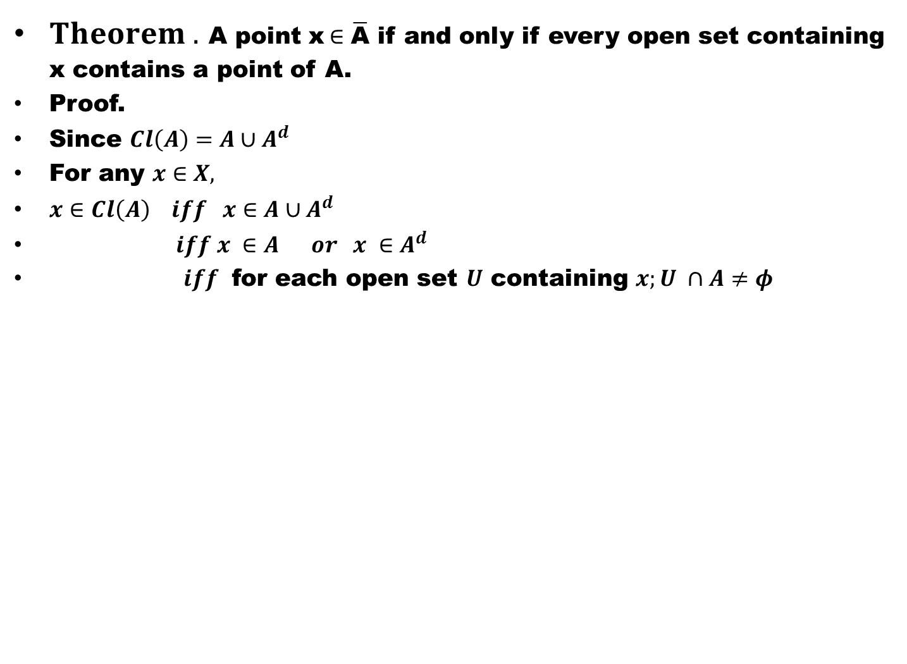
$Theorem .$ A point x$∈\overline{\text{A}}$ if and only if every open set containing x contains a point of A.
Proof.
Since $Cl\left(A\right)=A∪A^{d}$
For any $x∈X,$
$x∈Cl\left(A\right) iff x∈A∪A^{d}$
$iff x ∈A or x ∈A^{d}$
$iff$ for each open set $U$ containing $x;U ∩A≠φ$

Slide 14
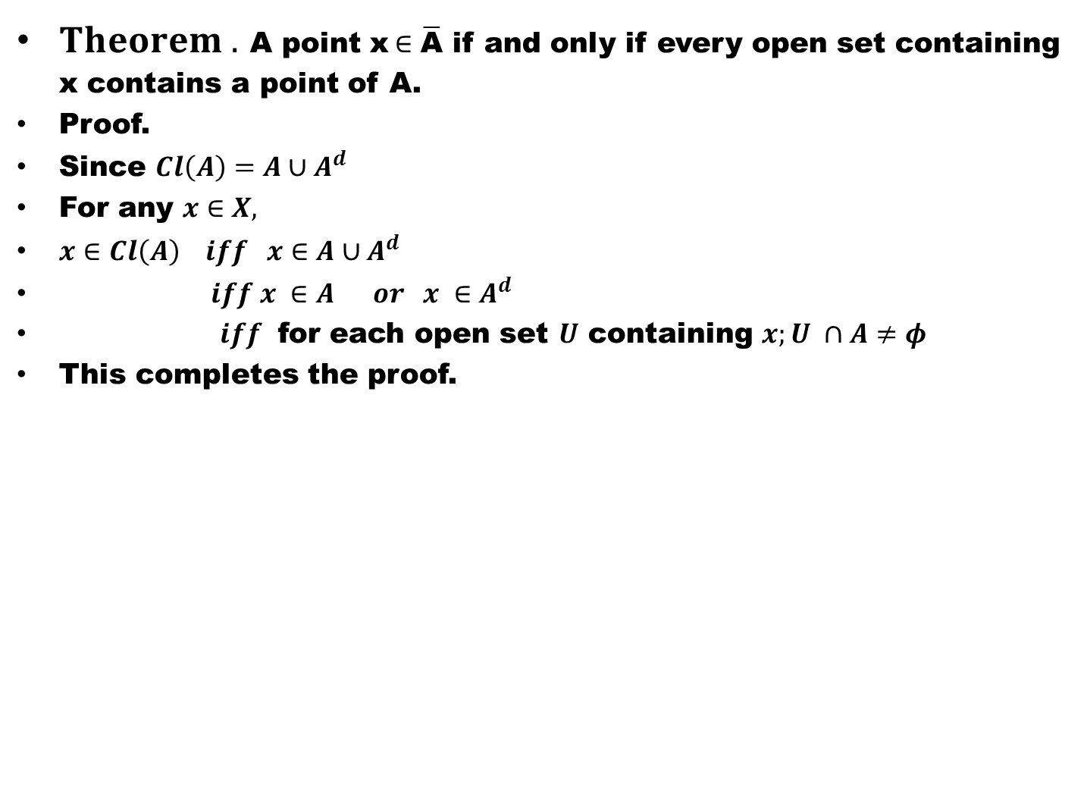
$Theorem .$ A point x$∈\overline{\text{A}}$ if and only if every open set containing x contains a point of A.
Proof.
Since $Cl\left(A\right)=A∪A^{d}$
For any $x∈X,$
$x∈Cl\left(A\right) iff x∈A∪A^{d}$
$iff x ∈A or x ∈A^{d}$
$iff$ for each open set $U$ containing $x;U ∩A≠φ$
This completes the proof.

Slide 15
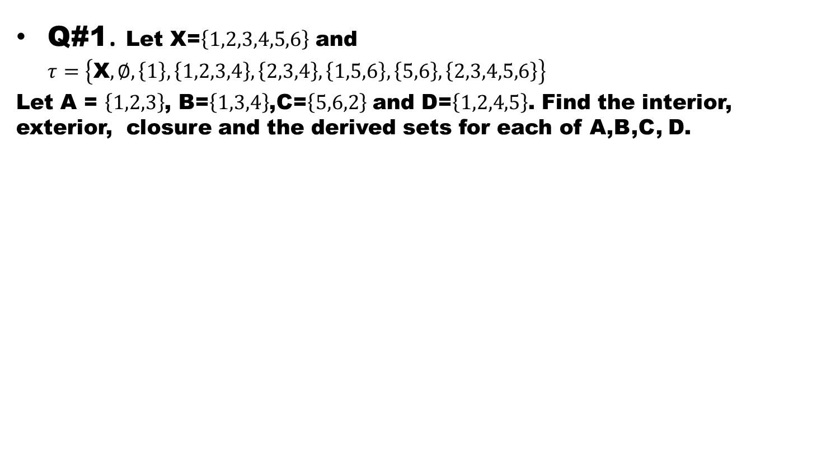
Exercise
Q#1. Let X=$\left\{1,2,3,4,5,6\right\}$ and $τ=\left\{\text{X},∅,\left\{1\right\},\left\{1,2,3,4\right\},\left\{2,3,4\right\},\left\{1,5,6\right\},\left\{5,6\right\},\left\{2,3,4,5,6\right\}\right\}$
Let A = $\left\{1,2,3\right\}$, B=$\left\{1,3,4\right\}$,C=$\left\{5,6,2\right\}$ and D=$\left\{1,2,4,5\right\}$. Find the interior, exterior, closure and the derived sets for each of A,B,C, D.

Slide 18
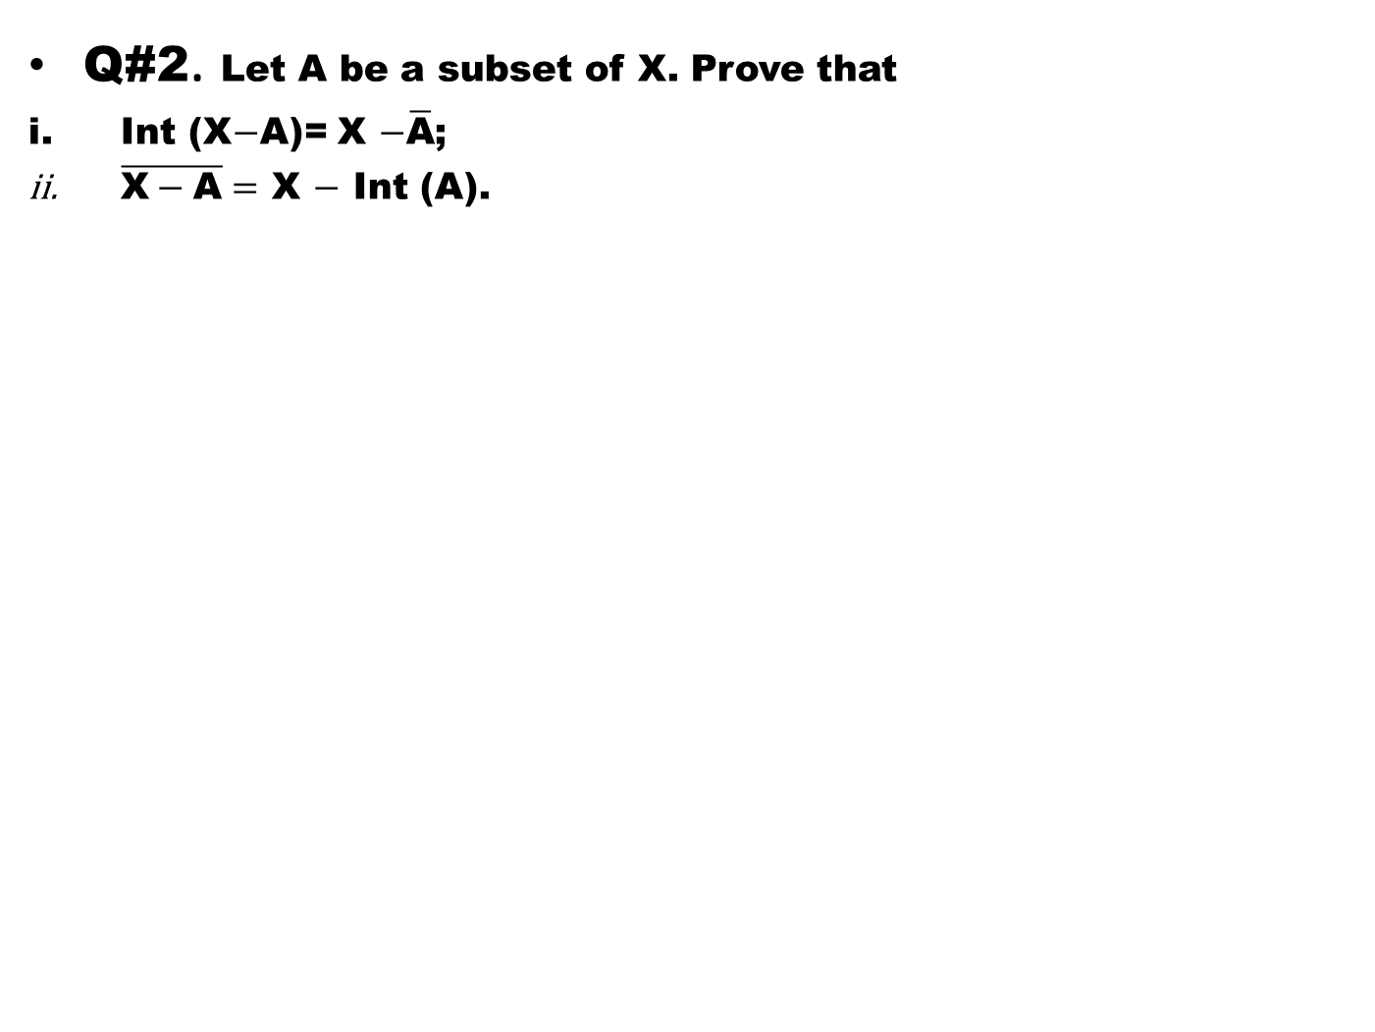
Q#2. Let A be a subset of X. Prove that
Int (X$−$A)= X $−\overline{\text{A}}$;
$\overline{\text{X}−\text{A}}=$ X $−$ Int (A).

Slide 21
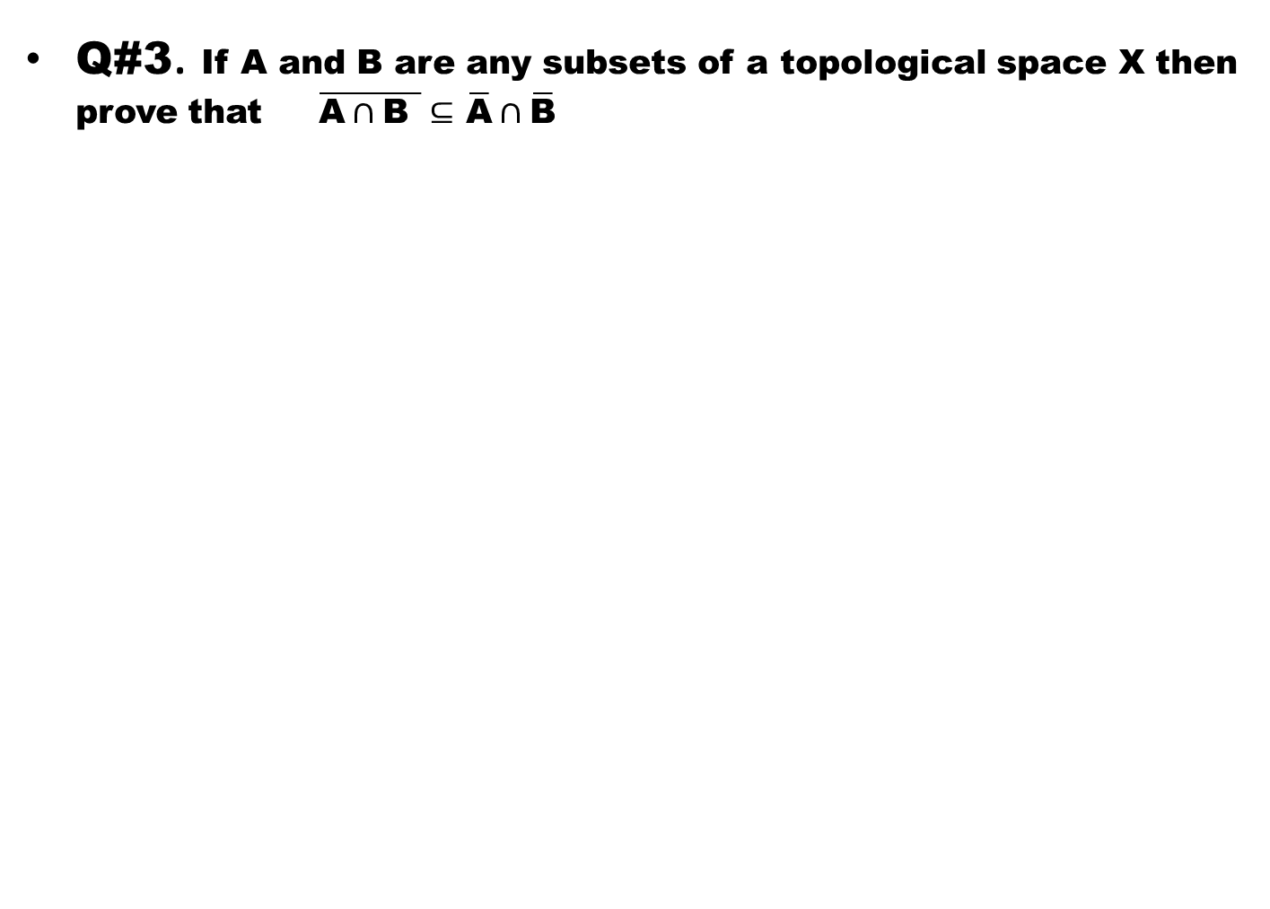
Q#3. If A and B are any subsets of a topological space X then prove that $\overline{\text{A}∩\text{B} }⊆$ $\overline{\text{A}}∩\overline{\text{B}}$

Slide 22
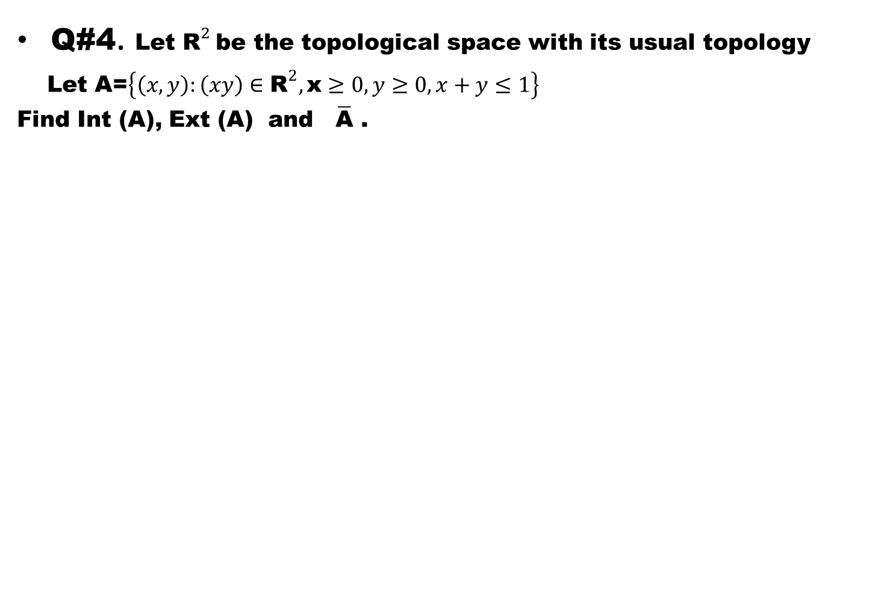
Q#4. Let ${\text{R}}^{2}$be the topological space with its usual topology
Let A=$\left\{\left(x,y\right):\left(xy\right)∈{\text{R}}^{2},\text{x}≥0,y≥0,x+y≤1\right\}$
Find Int (A), Ext (A) and $\overline{\text{A}}$ .

Slide 23
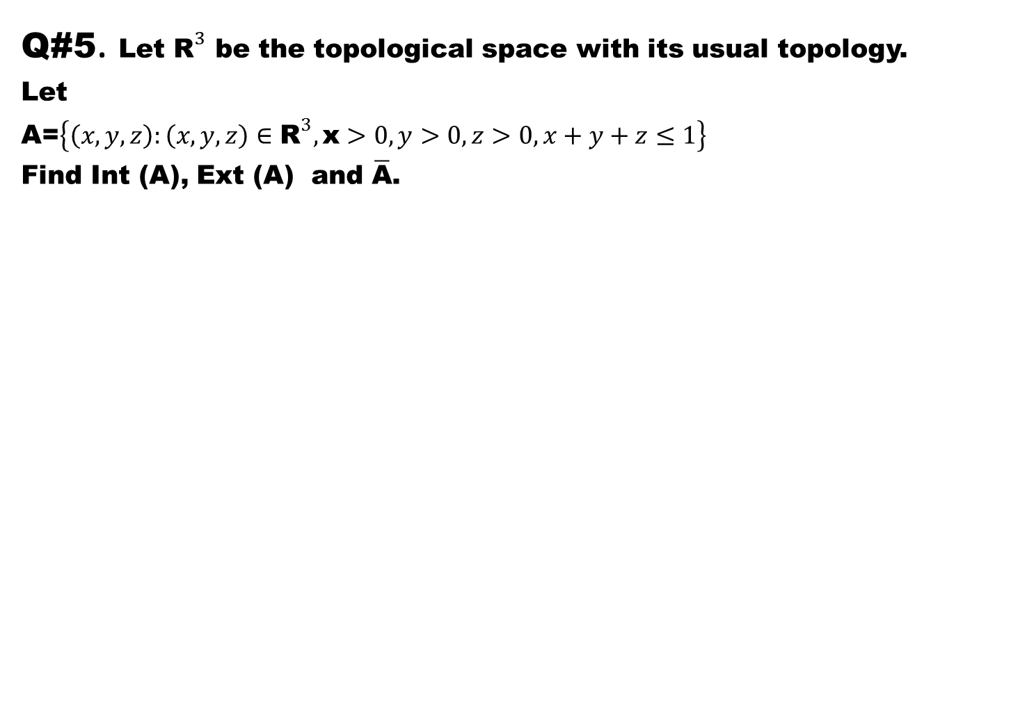
Q#5. Let ${\text{R}}^{3}$ be the topological space with its usual topology.
Let
A=$\left\{\left(x,y,z\right):\left(x,y,z\right)∈{\text{R}}^{3},\text{x}>0,y>0,z>0,x+y+z≤1\right\}$
Find Int (A), Ext (A) and $\overline{\text{A}}$.

Slide 24
Good Luck to You

