Slide 1
Set Topology
MTH 251
Lecture # 15

Slide 2
Lecture Plan
Exterior Points
Closure of a set
Theorems
Worked Examples

Slide 3
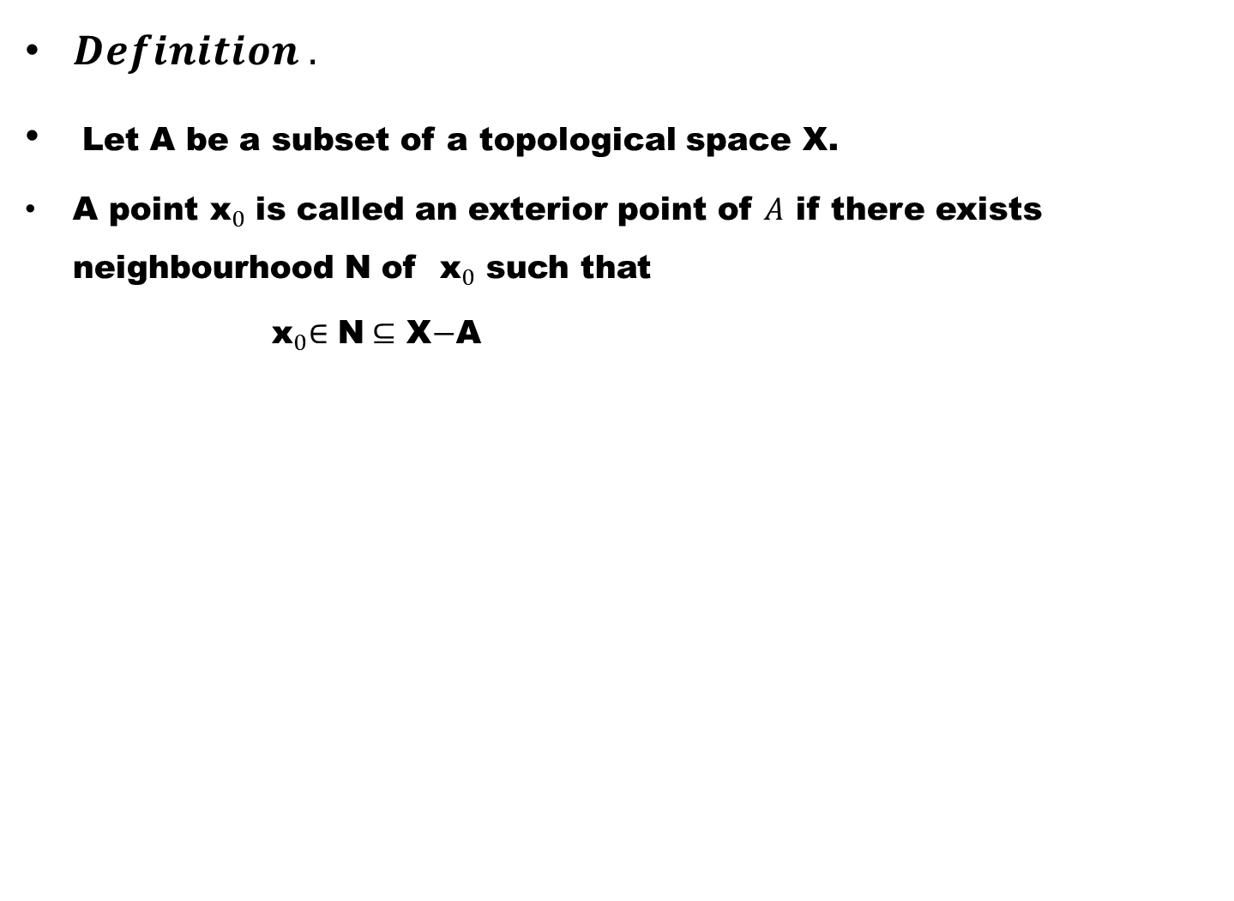
$Definition .$
Let A be a subset of a topological space X.
A point${ \text{x}}_{0}$is called an exterior point of $A$if there exists neighbourhood N of ${ \text{x}}_{0}$such that
${ \text{x}}_{0}∈$ N$⊆$ X$−$A

Slide 4
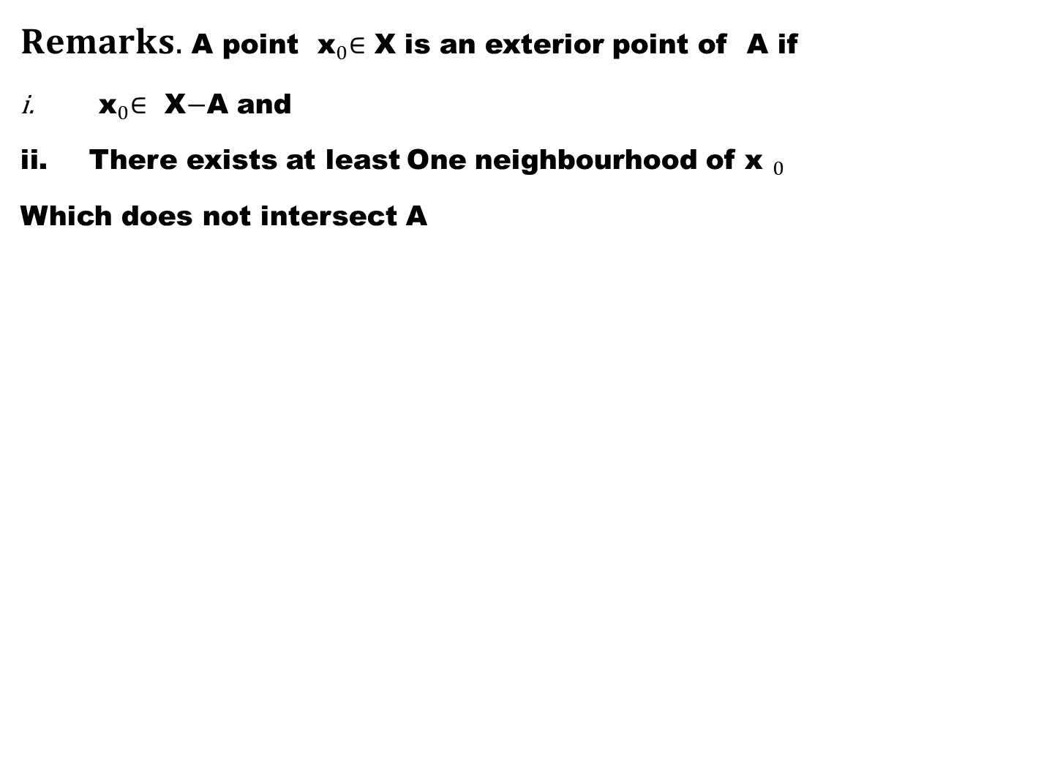
$Remarks.$ A point ${ \text{x}}_{0}∈$X is an exterior point of A if
${ \text{x}}_{0}∈$X$−$A and
There exists at least One neighbourhood of${ \text{x} }_{0}$
Which does not intersect A

Slide 5
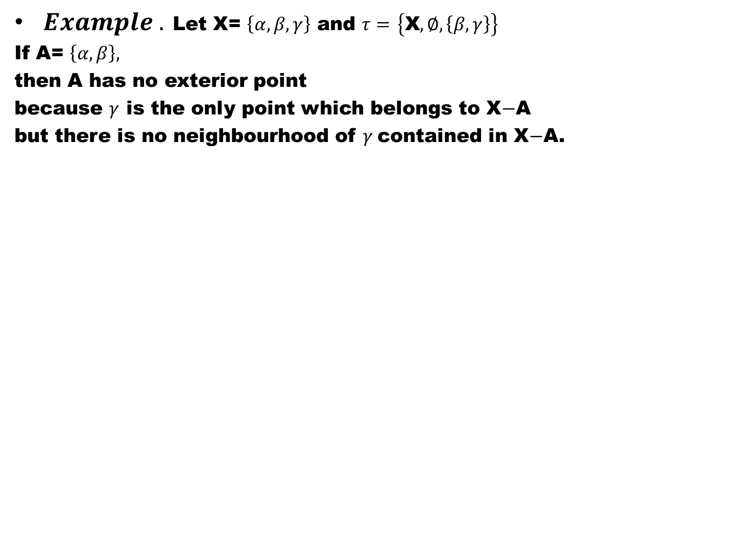
$Example .$Let X= $\left\{α,β,γ\right\}$and $τ=$$\left\{\text{X},∅,\left\{β,γ\right\}\right\}$
IfA= $\left\{α,β\right\},$
then A has no exterior point
because $γ$ is the only point which belongs to X$−$A
but there is no neighbourhood of $γ$contained in X$−$A.

Slide 6
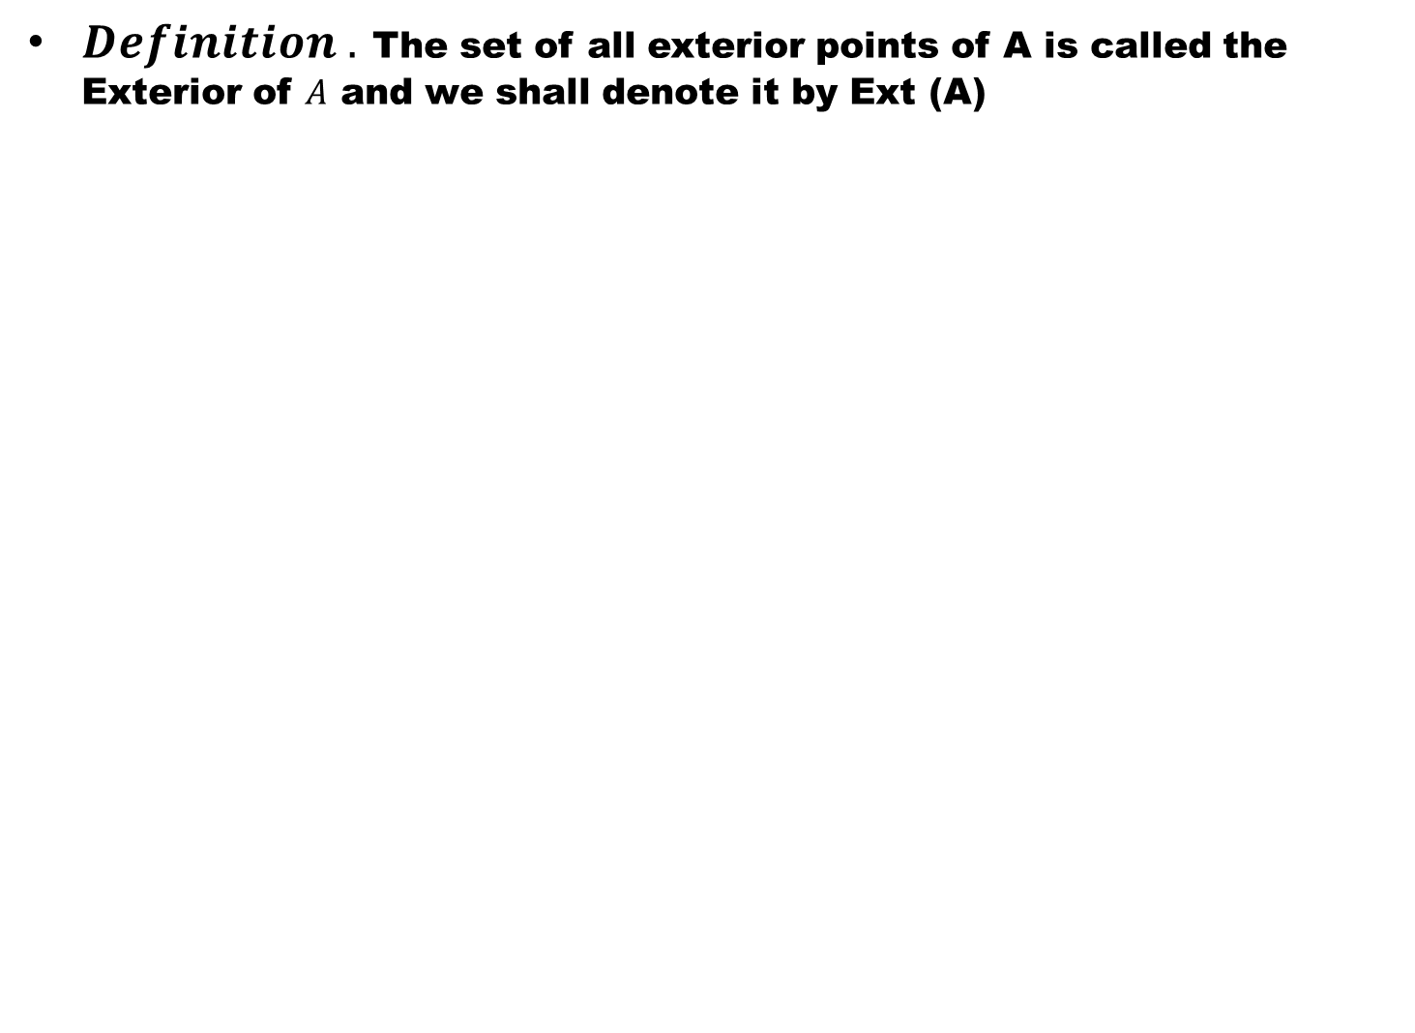
$Definition .$The set of all exterior points of A is called the Exterior of $A$and we shall denote it by Ext (A)

Slide 7
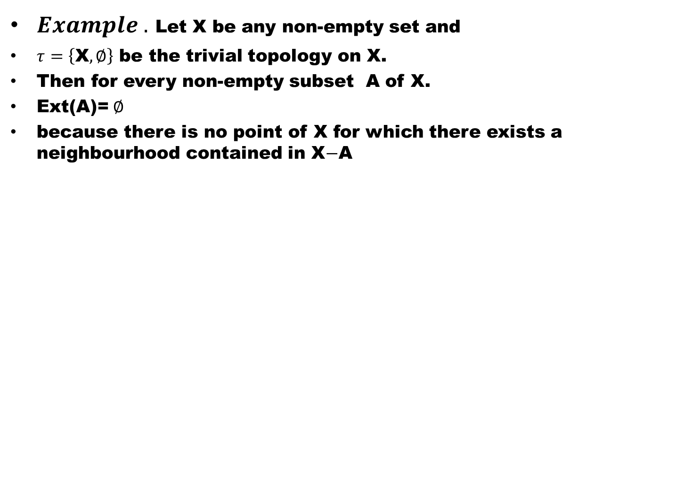
$Example .$Let X be any non-empty set and
$τ=\left\{\text{X},∅\right\}$ be the trivial topology on X.
Then for every non-empty subset A of X.
Ext(A)=$∅$
because there is no point of X for which there exists a neighbourhood contained in X$−$A

Slide 8
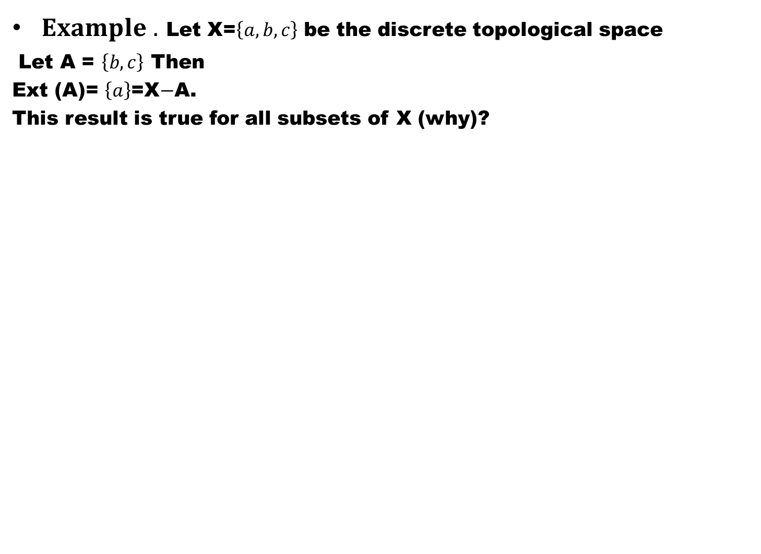
$Example .$Let X=$\left\{a,b,c\right\}$be the discrete topological space
Let A = $\left\{b,c\right\}$ Then
Ext (A)= $\left\{a\right\}$=X$−$A.
This result is true for all subsets of X (why)?

Slide 9
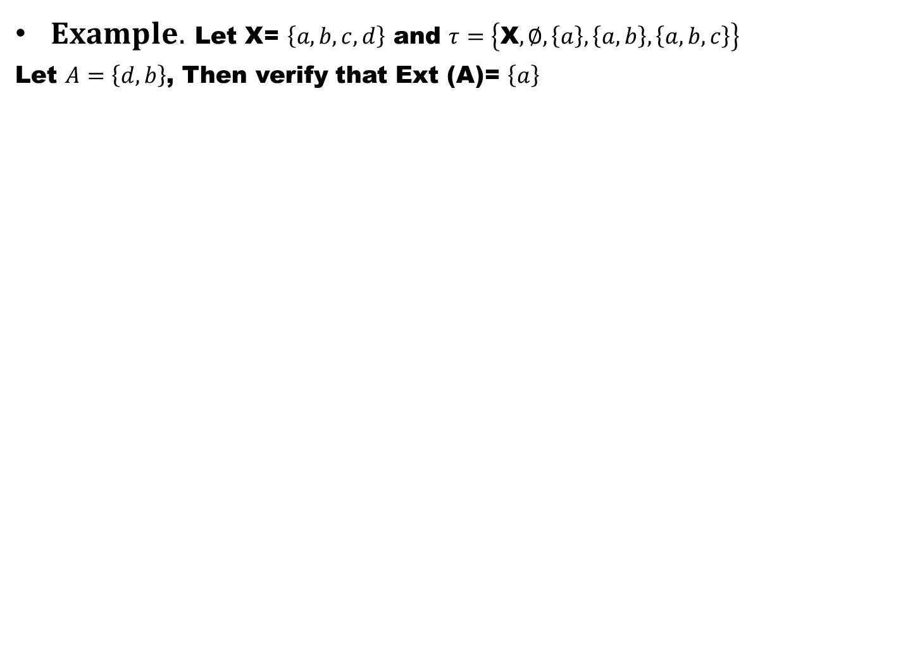
$Example.$Let X= $\left\{a,b,c,d\right\}$and $τ=\left\{\text{X},∅,\left\{a\right\},\left\{a,b\right\},\left\{a,b,c\right\}\right\}$
Let $A=\left\{d,b\right\}$, Then verify that Ext (A)= $\left\{a\right\}$

Slide 10
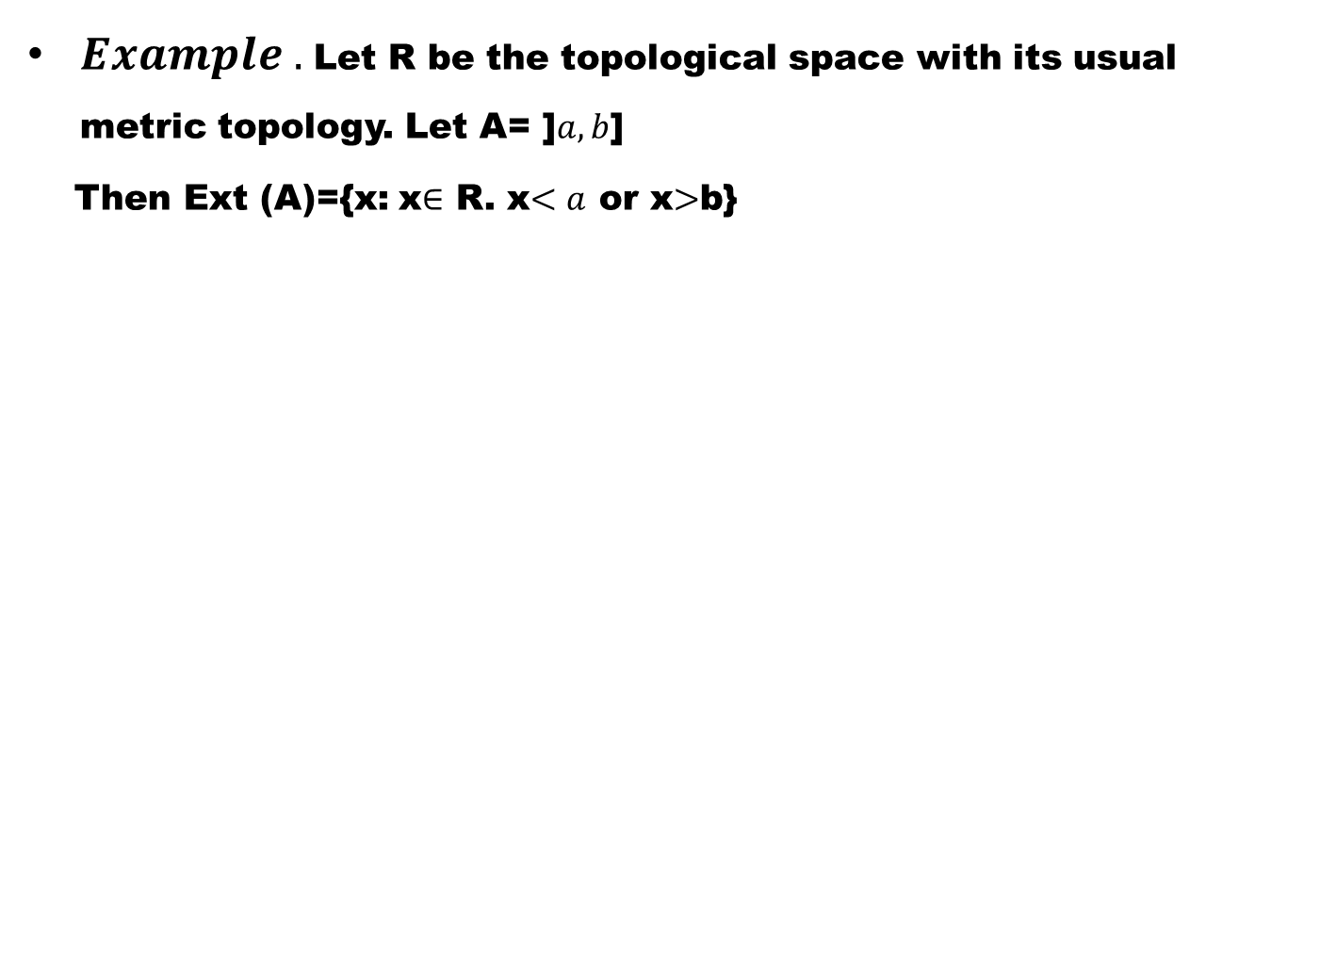
$Example .$Let R be the topological space with its usual metric topology. Let A= ]$a,b$]
Then Ext (A)={x: x$∈$ R. x$<a$ or x$>$b}

Slide 11
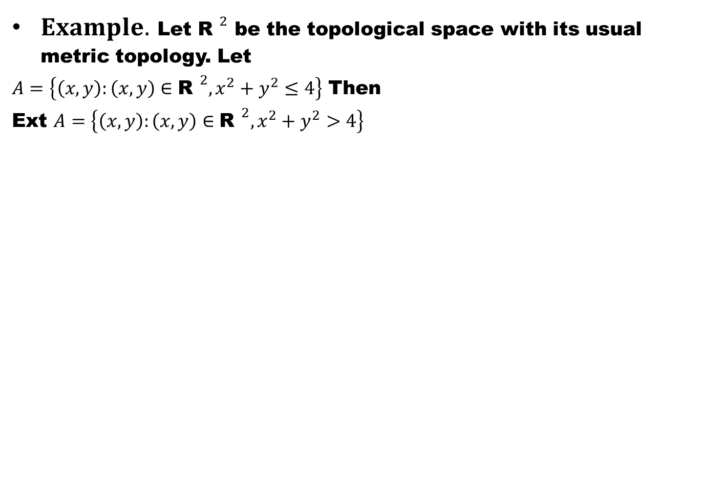
$Example.$Let ${\text{R} }^{2}$be the topological space with its usual metric topology. Let
$A=\left\{\left(x,y\right):\left(x,y\right)∈{\text{R} }^{2},x^{2}+y^{2}≤4\right\}$ Then
Ext $A=\left\{\left(x,y\right):\left(x,y\right)∈{\text{R} }^{2},x^{2}+y^{2}>4\right\}$

Slide 12
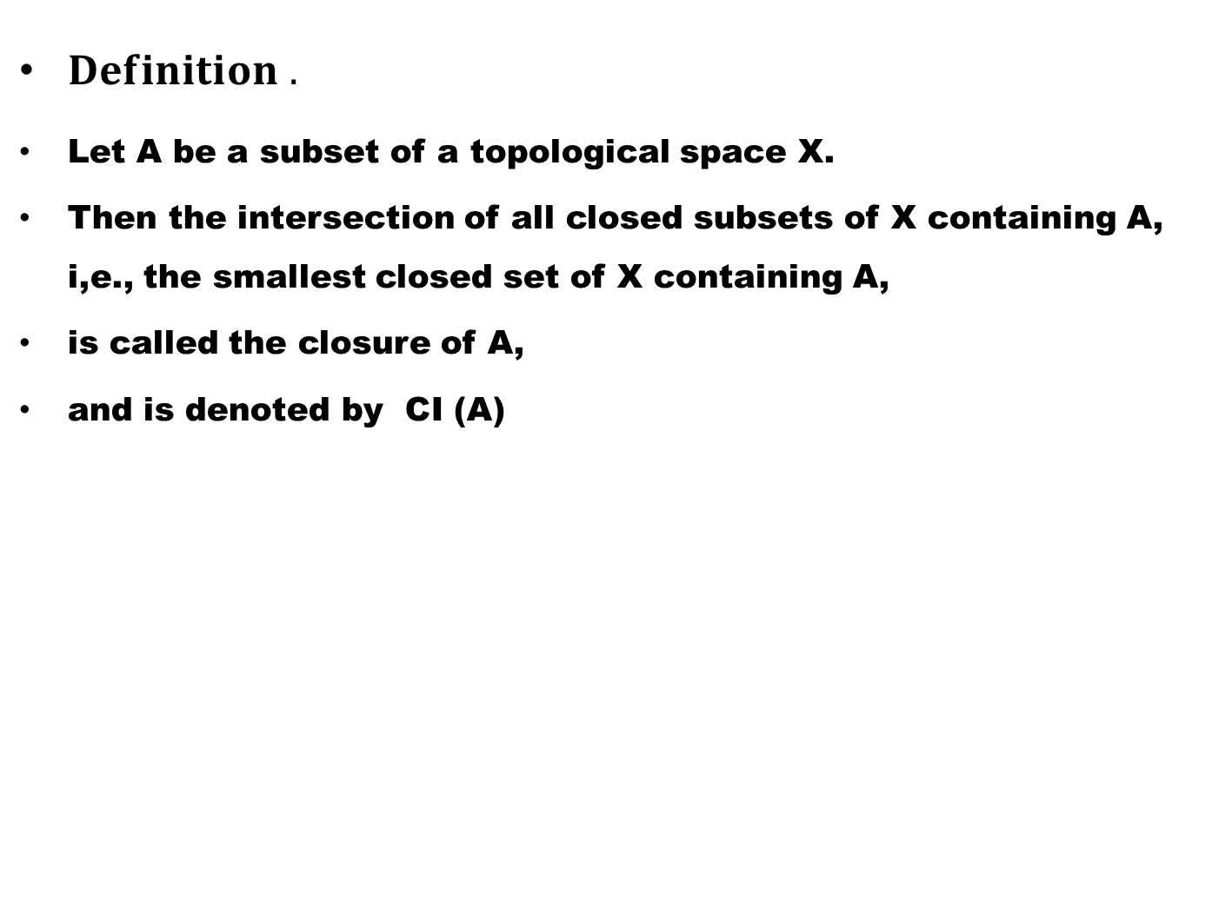
$Definition .$
Let A be a subset of a topological space X.
Then the intersection of all closed subsets of X containing A, i,e., the smallest closed set of X containing A,
is called the closure of A,
and is denoted by CI (A)

Slide 13
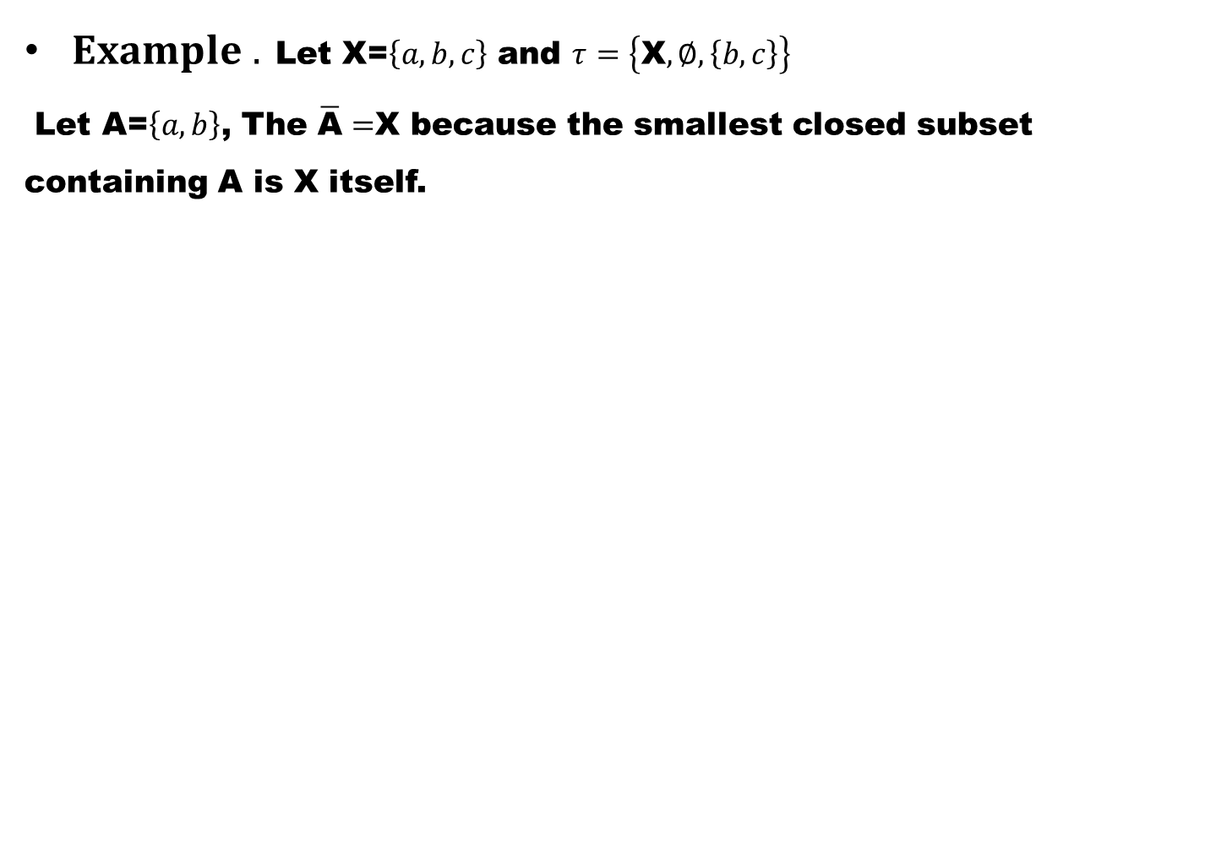
$Example .$Let X=$\left\{a,b,c\right\}$and $τ=\left\{\text{X},∅,\left\{b,c\right\}\right\}$
Let A=$\left\{a,b\right\}$, The $\overline{\text{A}}=$X because the smallest closed subset containing A is X itself.

Slide 14
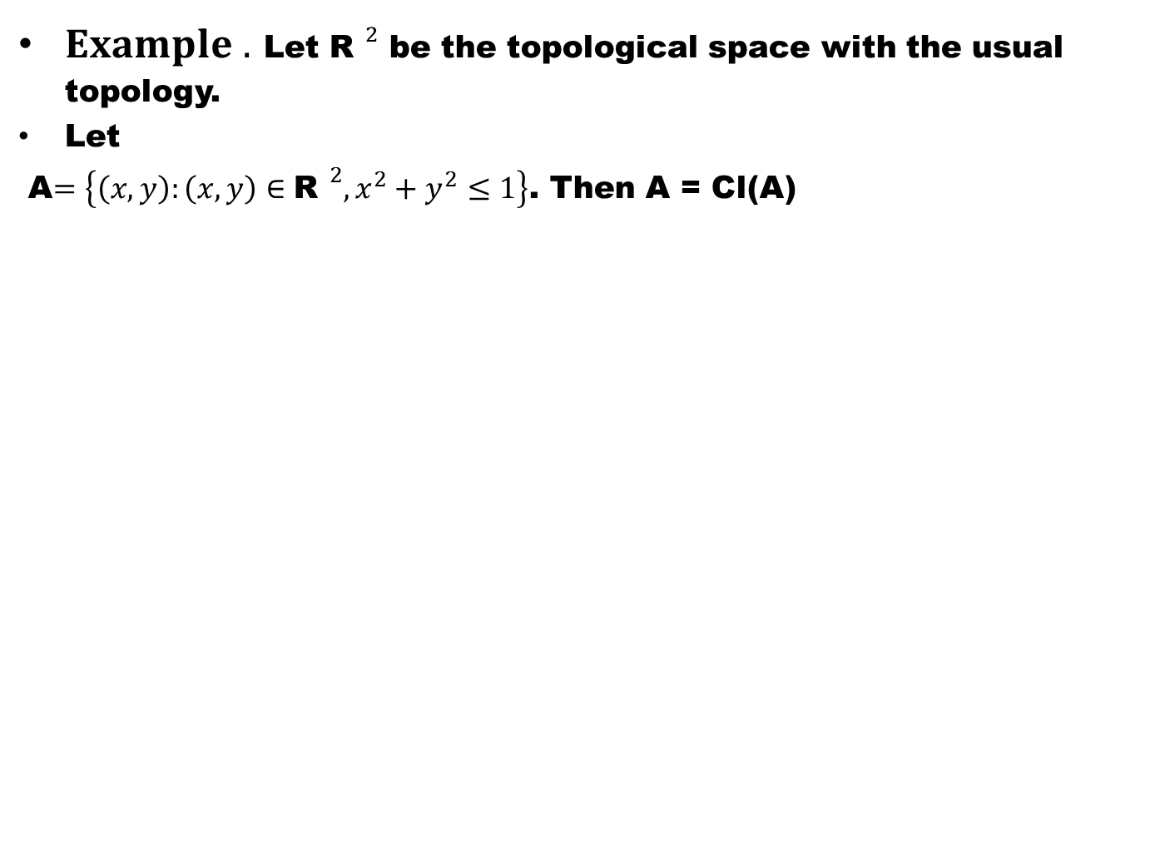
$Example .$Let ${\text{R} }^{2}$be the topological space with the usual topology.
Let
A$=\left\{\left(x,y\right):\left(x,y\right)∈{\text{R} }^{2},x^{2}+y^{2}≤1\right\}$. Then A = Cl(A)

Slide 15
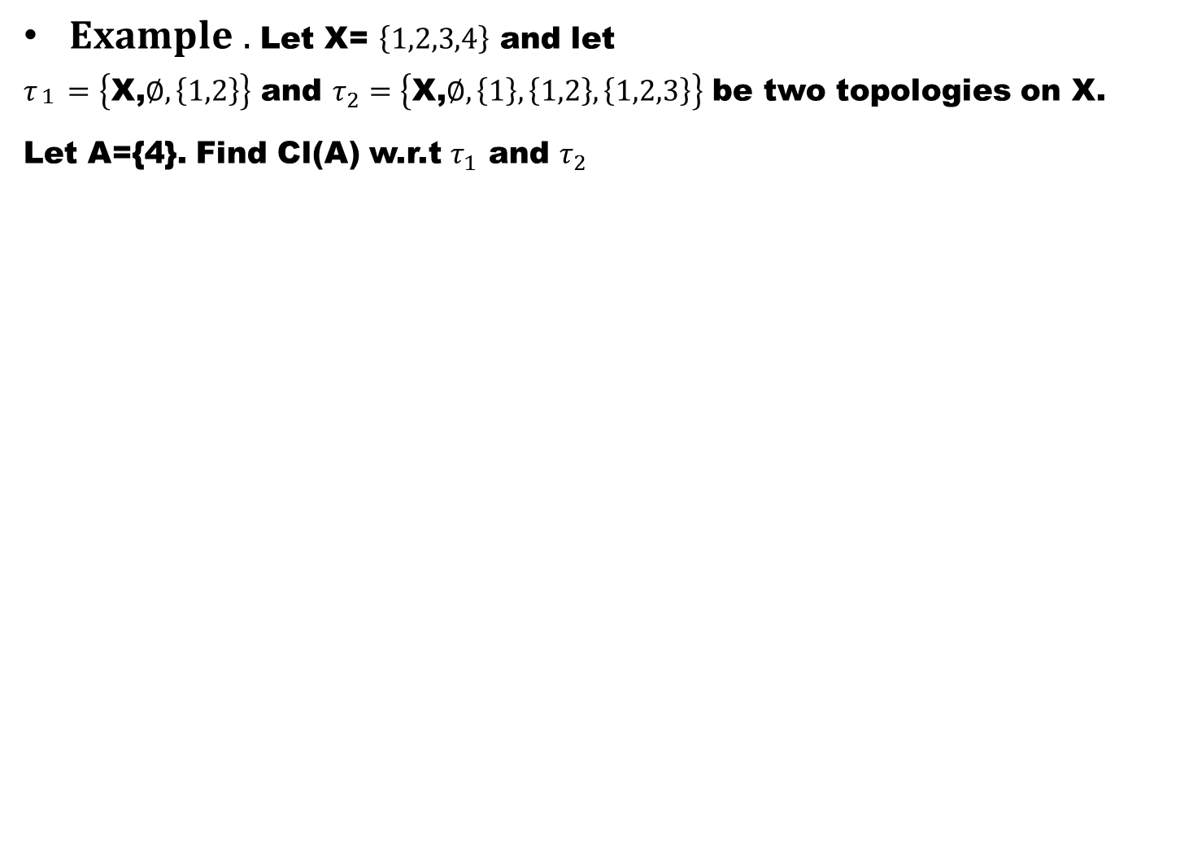
$Example .$Let X= $\left\{1,2,3,4\right\}$ and let
$τ_{\begin{aligned}1 \\ \end{aligned}}=\left\{\text{X}\text{,}∅,\left\{1,2\right\}\right\}$ and $τ_{2}=\left\{\text{X}\text{,}∅,\left\{1\right\},\left\{1,2\right\},\left\{1,2,3\right\}\right\}$ be two topologies on X.
Let A={4}. Find Cl(A) w.r.t $τ_{1}$ and $τ_{2}$

Slide 16
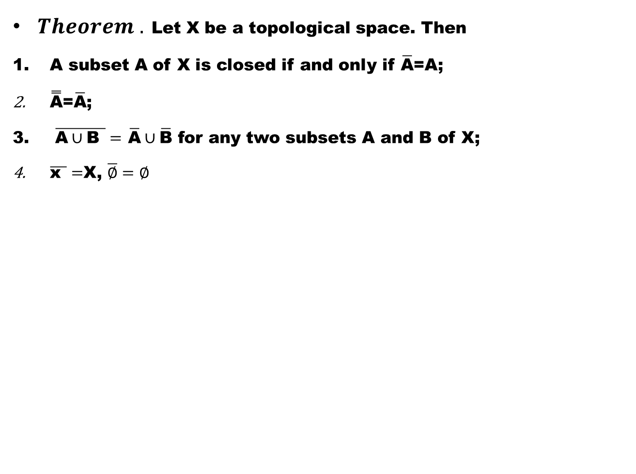
$Theorem .$Let X be a topological space. Then
A subset A of X is closed if and only if $\overline{\text{A}}$=A;
$\overset{̿}{\text{A}}$=$\overline{\text{A}}$;
$\overline{\text{A}∪\text{B} }=$$\overline{\text{A}}∪\overline{\text{B}}$ for any two subsets A and B of X;
$\overline{\text{x} }=$X, $\overline{∅}=∅$

Slide 19
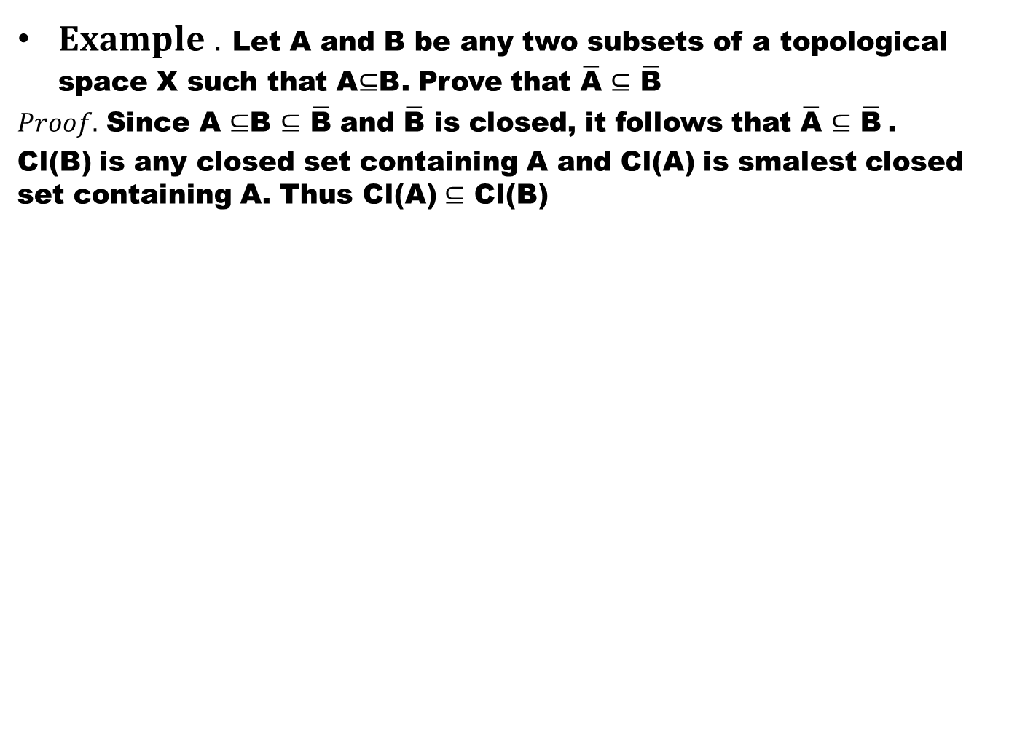
$Example .$Let A and B be any two subsets of a topological space X such that A$⊆$B. Prove that $\overline{\text{A}}$$⊆$$\overline{\text{B}}$
$Proof.$ Since A$⊆$B$⊆$$\overline{\text{B}}$ and $\overline{\text{B}}$ is closed, it follows that $\overline{\text{A}}$$⊆$$\overline{\text{B}}$.
Cl(B) is any closed set containing A and Cl(A) is smalest closed set containing A. Thus Cl(A) $⊆$ Cl(B)

Slide 20
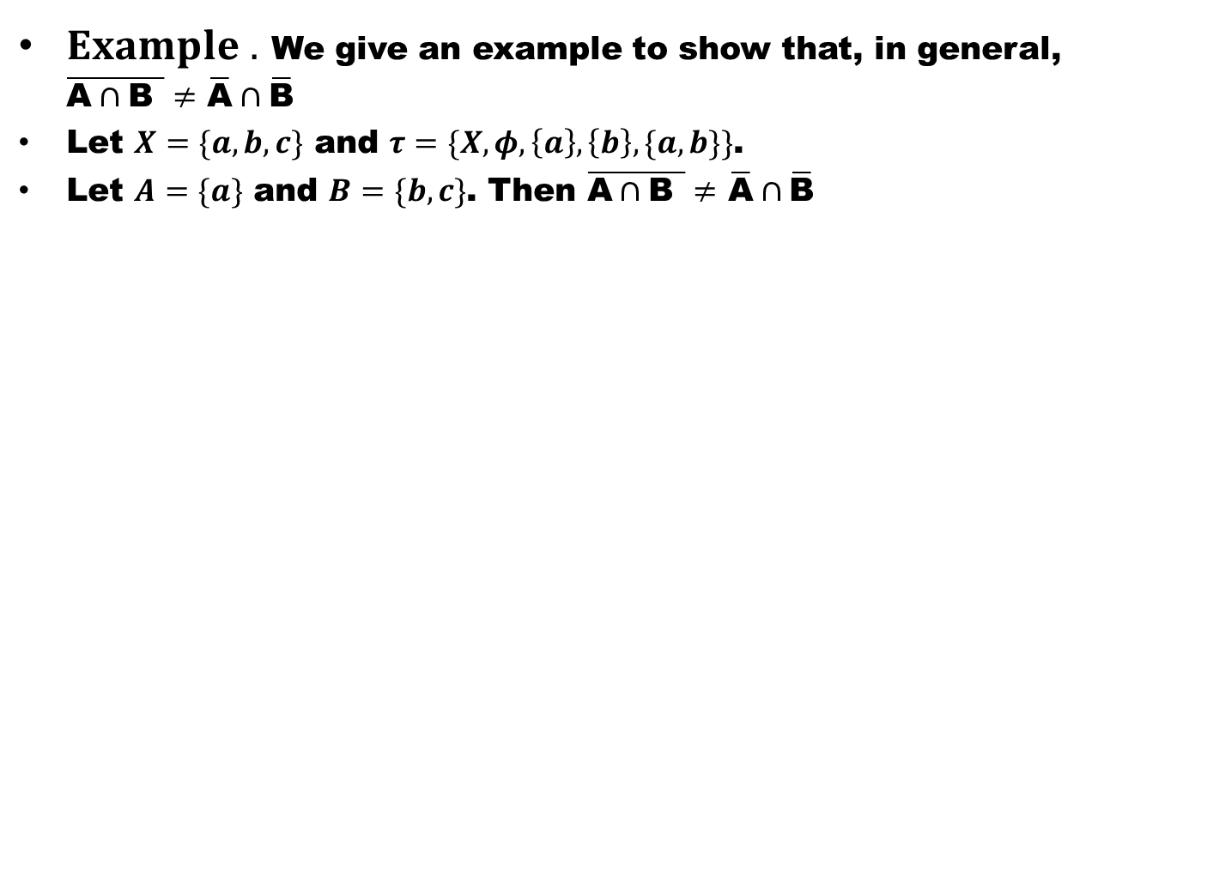
$Example .$We give an example to show that, in general, $\overline{\text{A}∩\text{B} }≠$$\overline{\text{A}}∩\overline{\text{B}}$
Let $X=\{a,b,c\}$ and $τ=\{X,φ,\left\{a\right\}, \left\{b\right\},\{a,b\}\}$.
Let $A=\{a\}$ and $B=\{b,c\}$. Then $\overline{\text{A}∩\text{B} }≠$$\overline{\text{A}}∩\overline{\text{B}}$

Slide 21
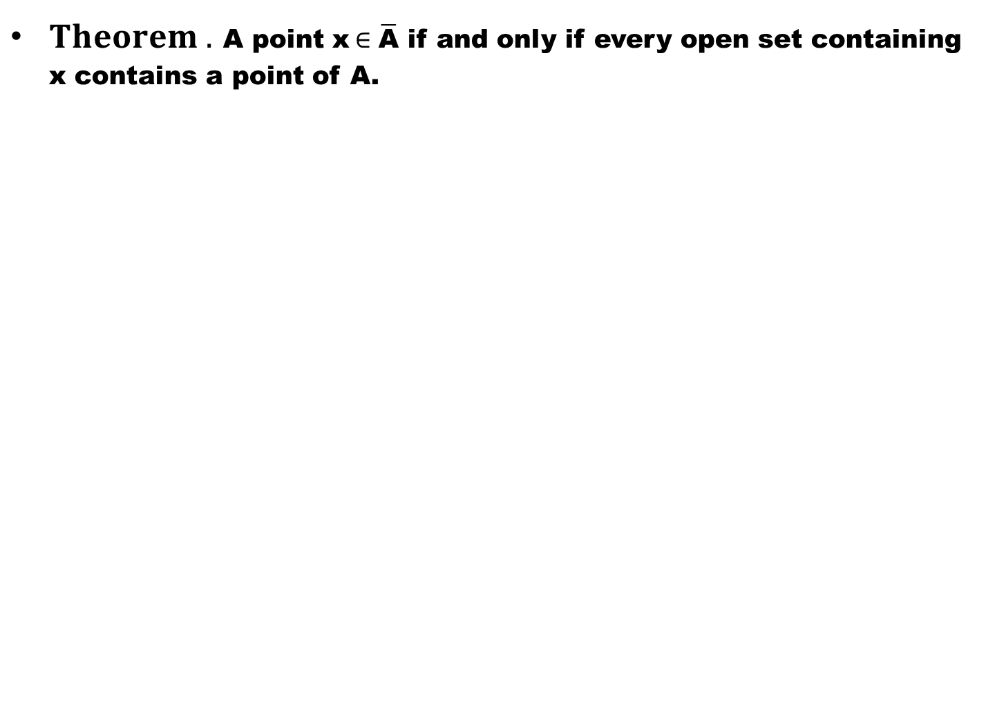
$Theorem .$A point x$∈\overline{\text{A}}$if and only if every open set containing x contains a point of A.

Slide 22
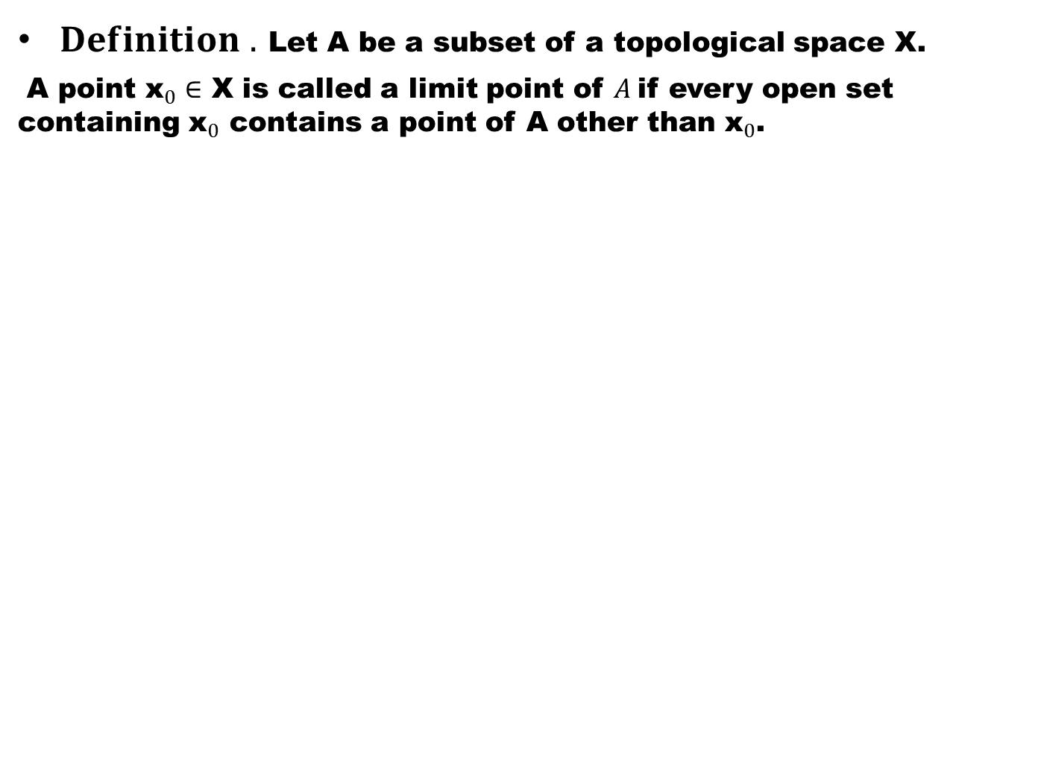
$Definition .$Let A be a subset of a topological space X.
A point ${\text{x}}_{0}∈$ X is called a limit point of $A$if every open set containing ${\text{x}}_{0}$ contains a point of A other than ${\text{x}}_{0}$.

Slide 23
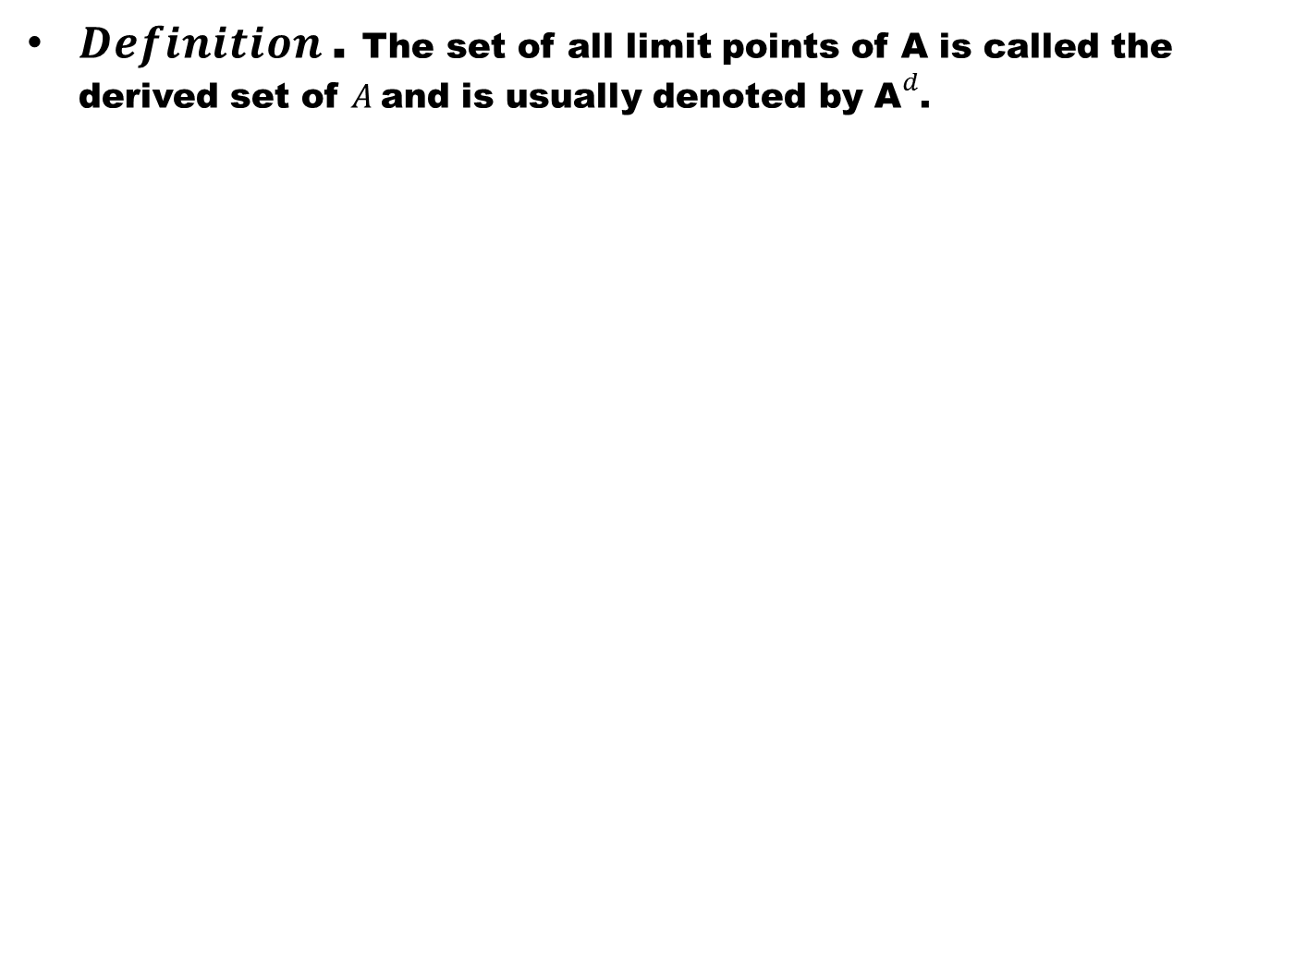
$Definition$. The set of all limit points of A is called the derived set of $A$and is usually denoted by ${\text{A}}^{d}$.

Slide 24
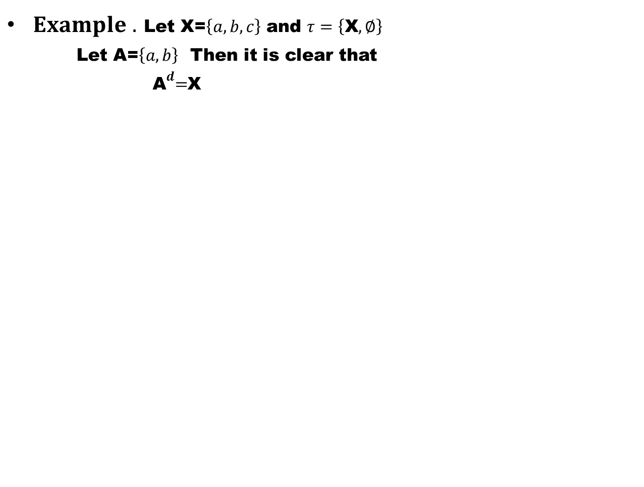
$Example .$Let X=$\left\{a,b,c\right\}$and $τ=\left\{\text{X},∅\right\}$
Let A=$\left\{a,b\right\}$Then it is clear that
${ \text{A}}^{d}=$X

Slide 25
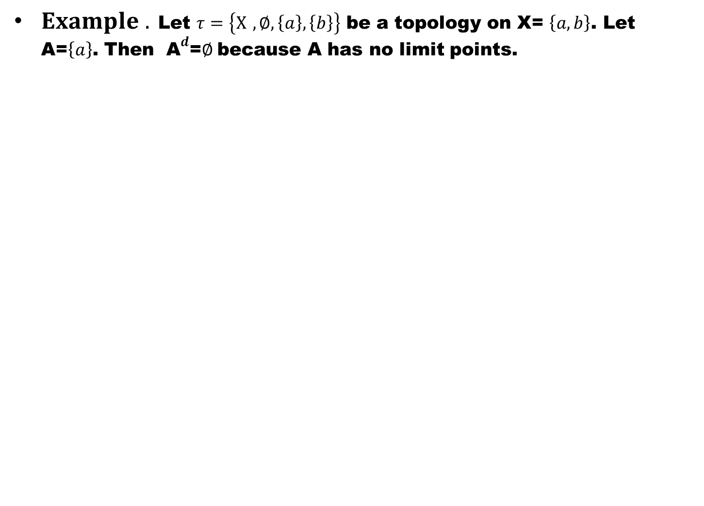
$Example .$Let $τ=\left\{X ,∅,\left\{a\right\},\left\{b\right\}\right\}$ be a topology on X= $\left\{a,b\right\}$. Let A=$\left\{a\right\}$. Then ${ \text{A}}^{d}$=$∅$because A has no limit points.

Slide 26
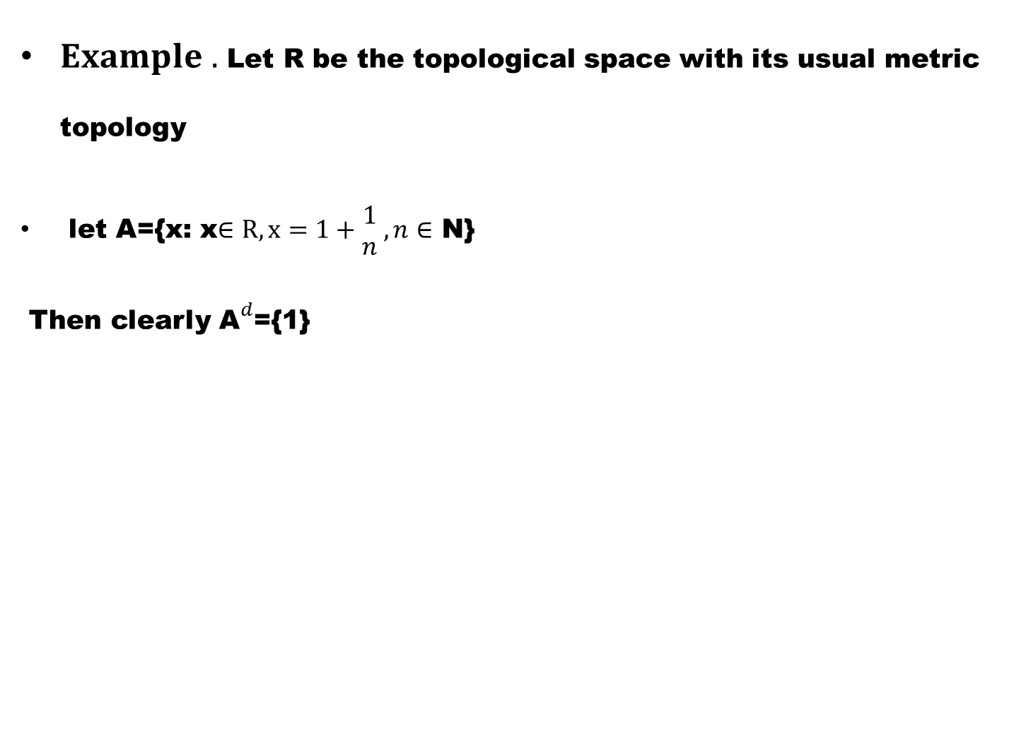
$Example .$Let R be the topological space with its usual metric topology
let A={x: x$∈R,x=1+\begin{matrix}1 \\ n\end{matrix} ,n∈$ N}
Then clearly ${\text{A}}^{d}$={1}

Slide 27
Good Luck to You

Slide 28
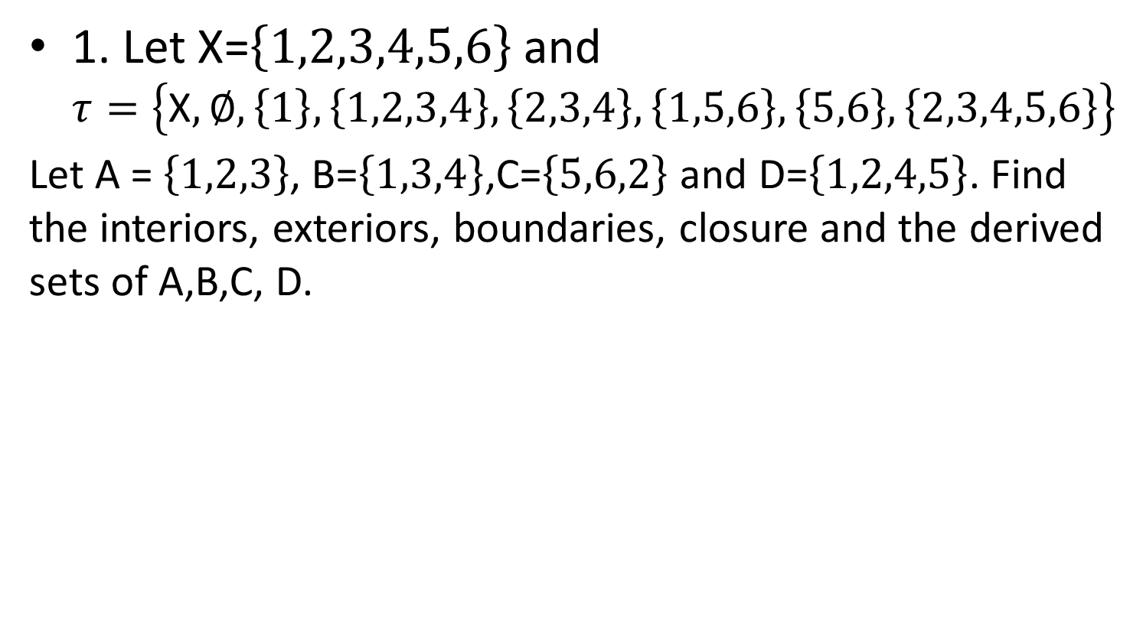
Exercise
1. Let X=$\left\{1,2,3,4,5,6\right\}$ and $τ=\left\{\text{X},∅,\left\{1\right\},\left\{1,2,3,4\right\},\left\{2,3,4\right\},\left\{1,5,6\right\},\left\{5,6\right\},\left\{2,3,4,5,6\right\}\right\}$
Let A =$\left\{1,2,3\right\}$, B=$\left\{1,3,4\right\}$,C=$\left\{5,6,2\right\}$ and D=$\left\{1,2,4,5\right\}$. Find the interiors, exteriors, boundaries, closure and the derived sets of A,B,C, D.

Slide 29
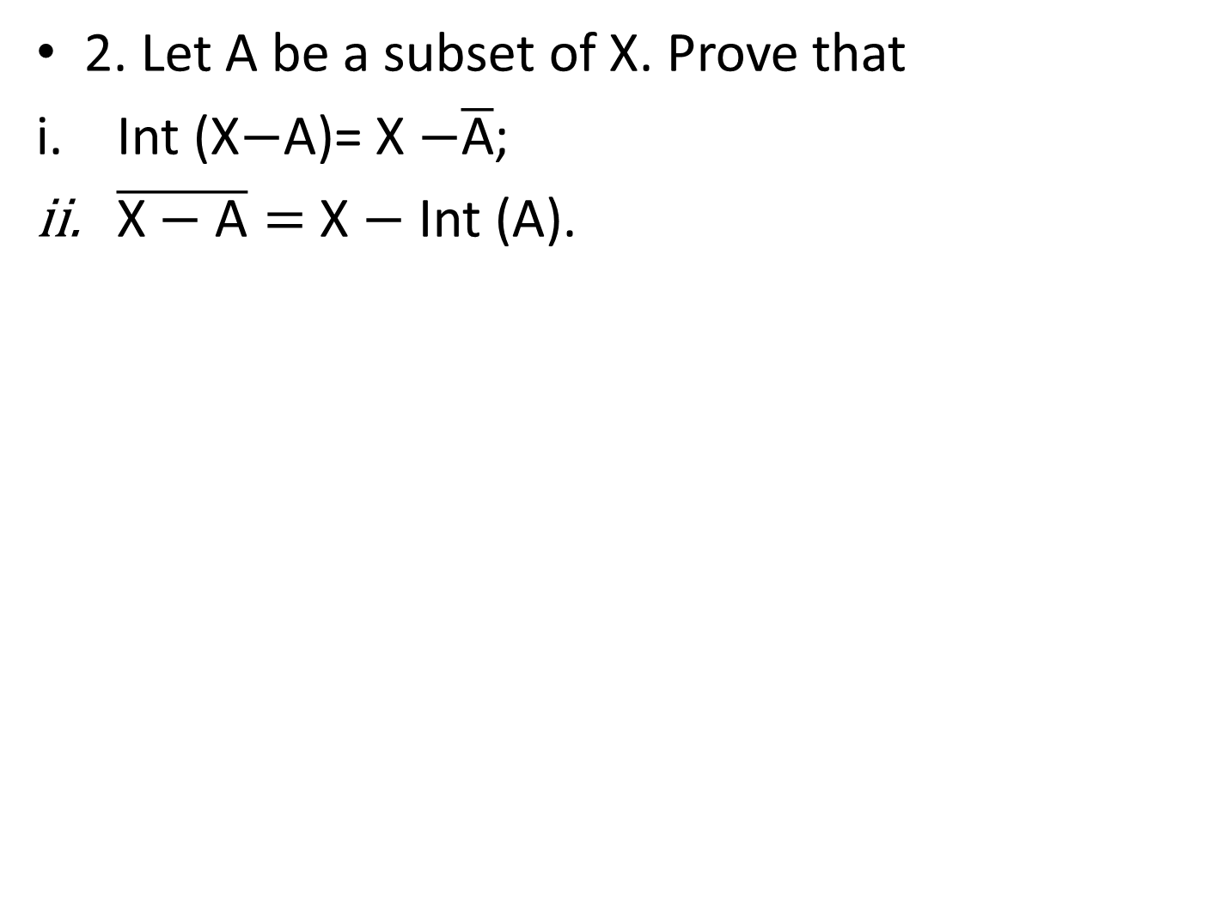
2. Let A be a subset of X. Prove that
Int (X$−$A)= X$−\overline{\text{A}}$;
$\overline{\text{X}−\text{A}}=$ X$−$ Int (A).

Slide 30
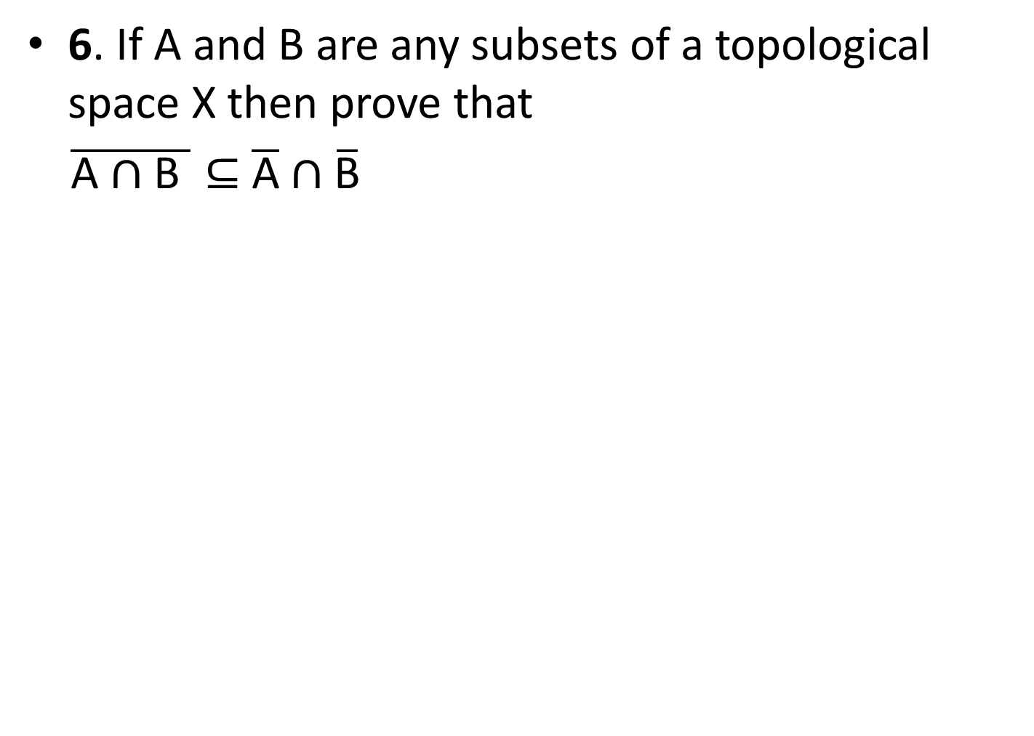
6. If A and B are any subsets of a topological space X then prove that
$\overline{\text{A}∩\text{B} }⊆$$\overline{\text{A}}∩\overline{\text{B}}$

Slide 31
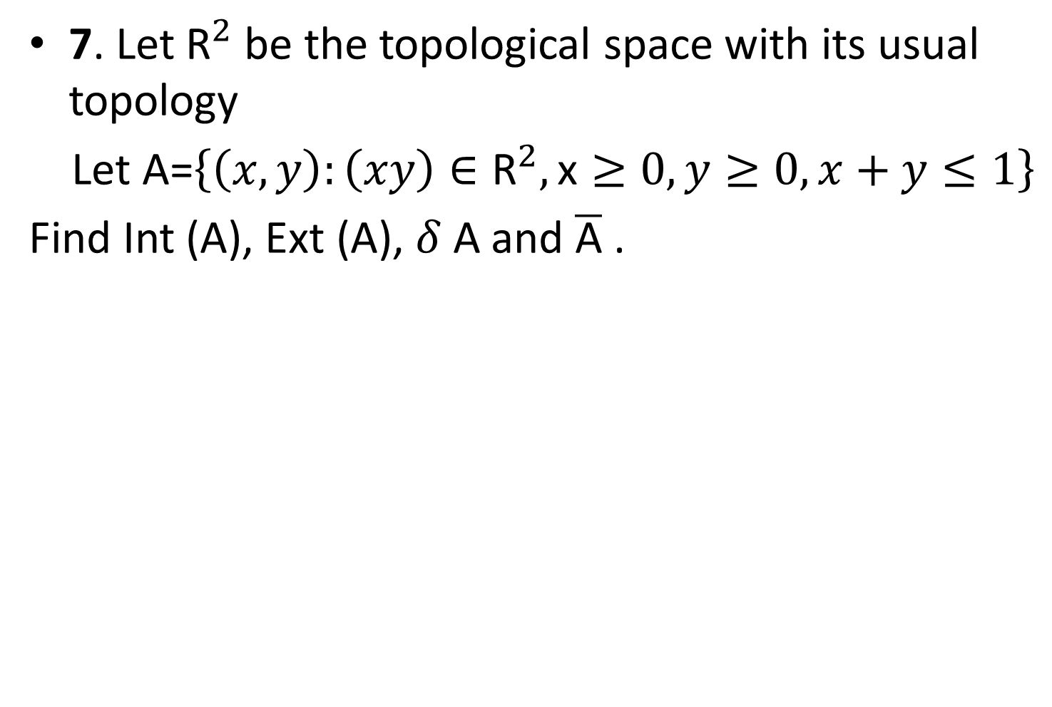
7. Let ${\text{R}}^{2}$be the topological space with its usual topology
Let A=$\left\{\left(x,y\right):\left(xy\right)∈{\text{R}}^{2},\text{x}≥0,y≥0,x+y≤1\right\}$
Find Int (A), Ext (A), $δ$A and $\overline{\text{A}}$ .

Slide 32
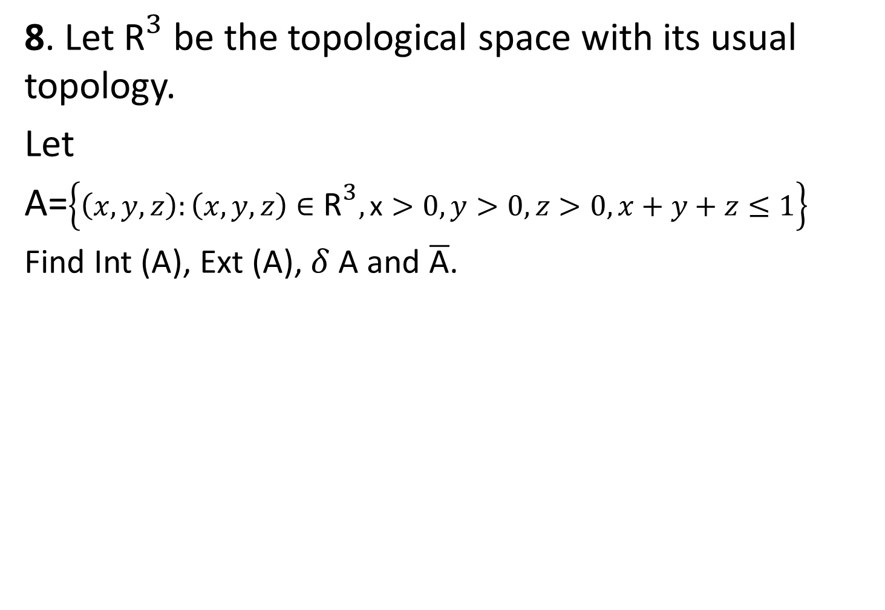
8. Let ${\text{R}}^{3}$ be the topological space with its usual topology.
Let
A=$\left\{\left(x,y,z\right):\left(x,y,z\right)∈{\text{R}}^{3},\text{x}>0,y>0,z>0,x+y+z≤1\right\}$
Find Int (A), Ext (A), $δ$A and $\overline{\text{A}}$.

