Slide 1
Set Topology
MTH 251
Lecture # 13

Slide 2
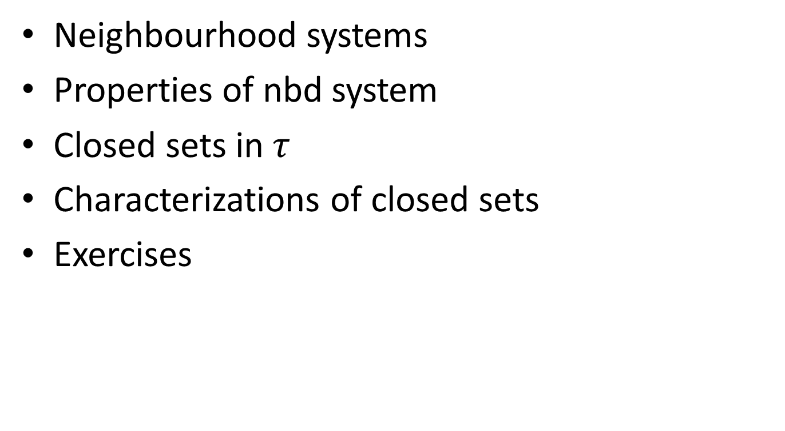
Lecture Plan
Neighbourhood systems
Properties of nbd system
Closed sets in $τ$
Characterizations of closed sets
Exercises

Slide 3
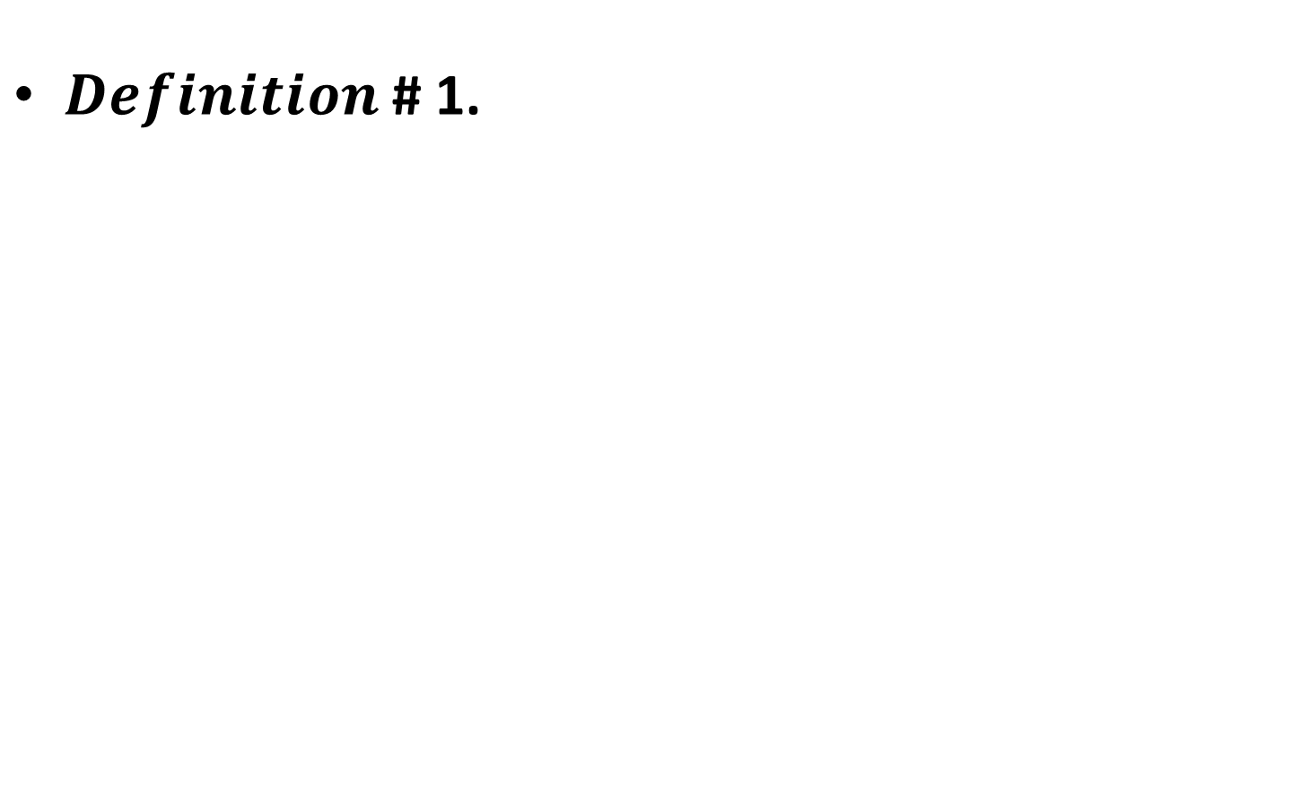
Neighbourhood systems:
$Definition$# 1.

Slide 4
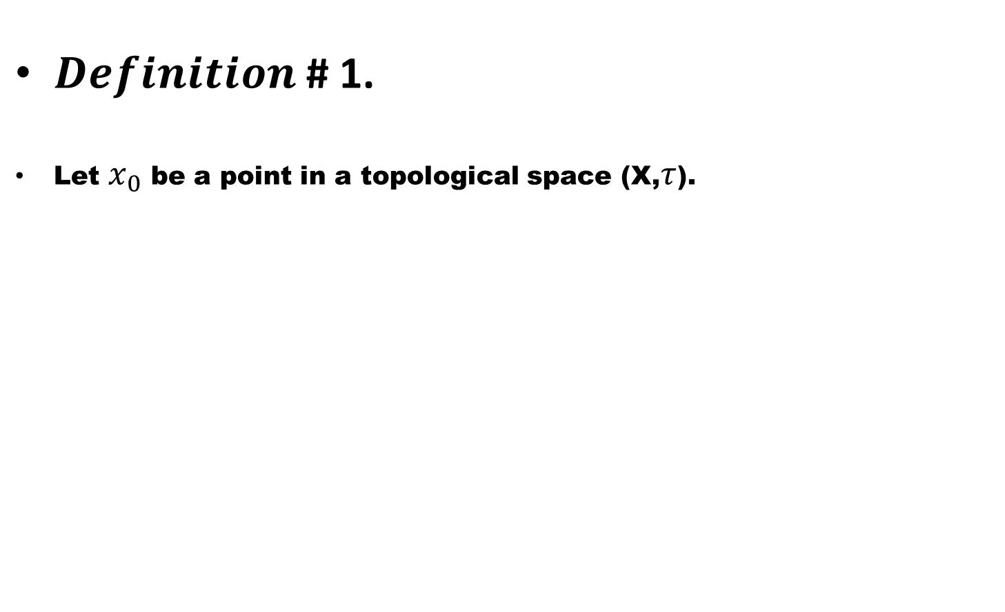
Neighbourhood systems:
$Definition$# 1.
Let $x_{0}$be a point in a topological space (X,$τ$).

Slide 5
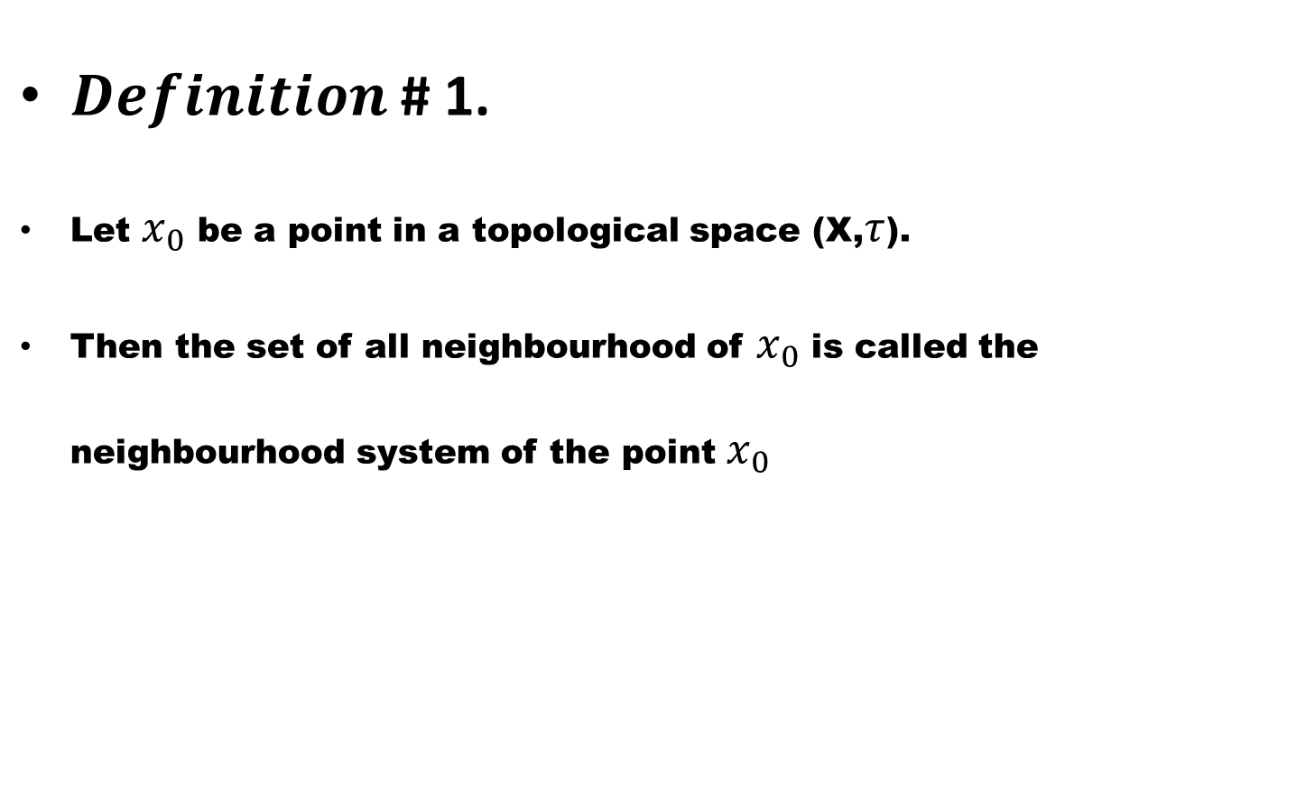
Neighbourhood systems:
$Definition$# 1.
Let $x_{0}$be a point in a topological space (X,$τ$).
Then the set of all neighbourhood of $x_{0}$ is called the neighbourhood system of the point $x_{0}$

Slide 6
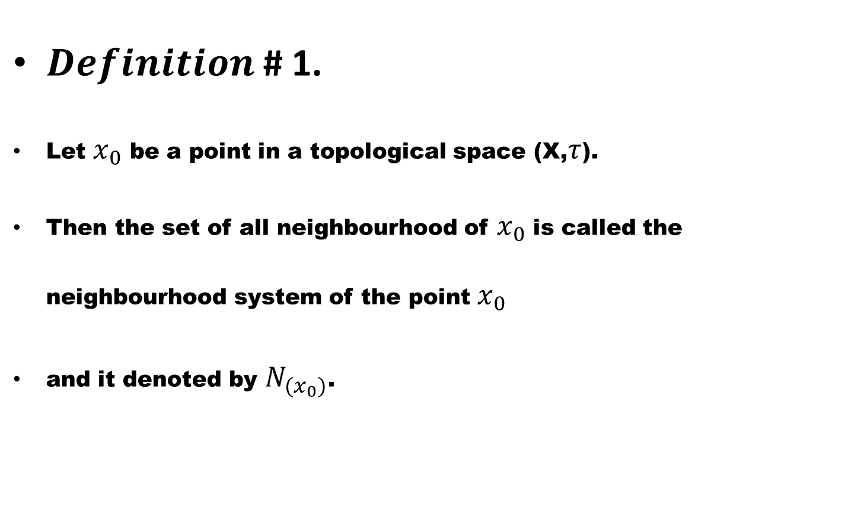
Neighbourhood systems:
$Definition$# 1.
Let $x_{0}$be a point in a topological space (X,$τ$).
Then the set of all neighbourhood of $x_{0}$ is called the neighbourhood system of the point $x_{0}$
and it denoted by $N_{{(x}_{0})}$.

Slide 7
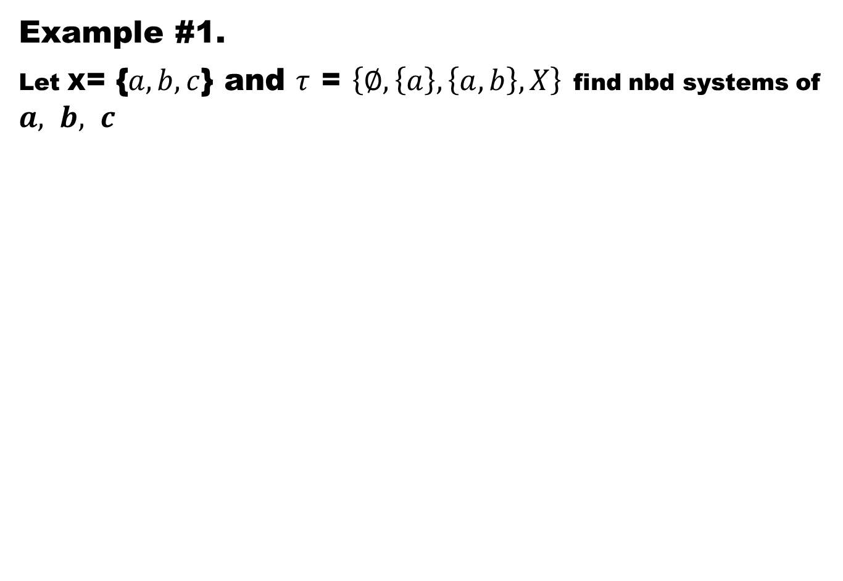
Example #1.
Let X= {$a,b,c$} and $τ$= $\left\{∅,\left\{a\right\},\left\{a,b\right\},X\right\}$find nbd systems of $a, b, c$

Slide 8
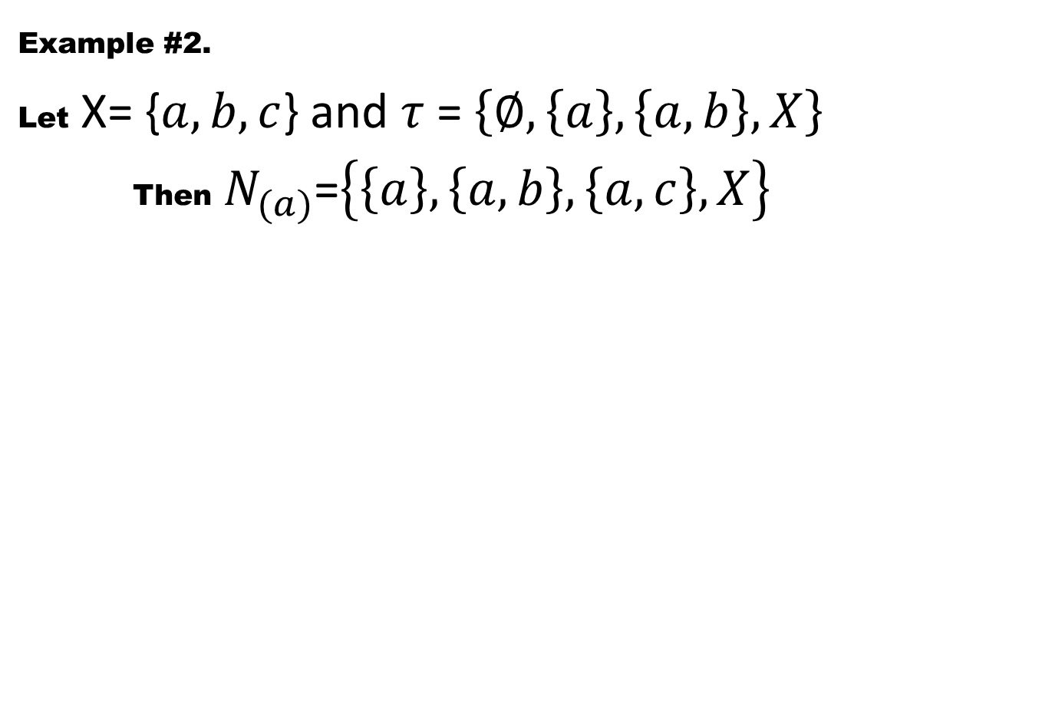
Example #2.
LetX= {$a,b,c$} and $τ$= $\left\{∅,\left\{a\right\},\left\{a,b\right\},X\right\}$
Then$N_{(a)}$=$\left\{\left\{a\right\},\left\{a,b\right\},\left\{a,c\right\},X\right\}$

Slide 9
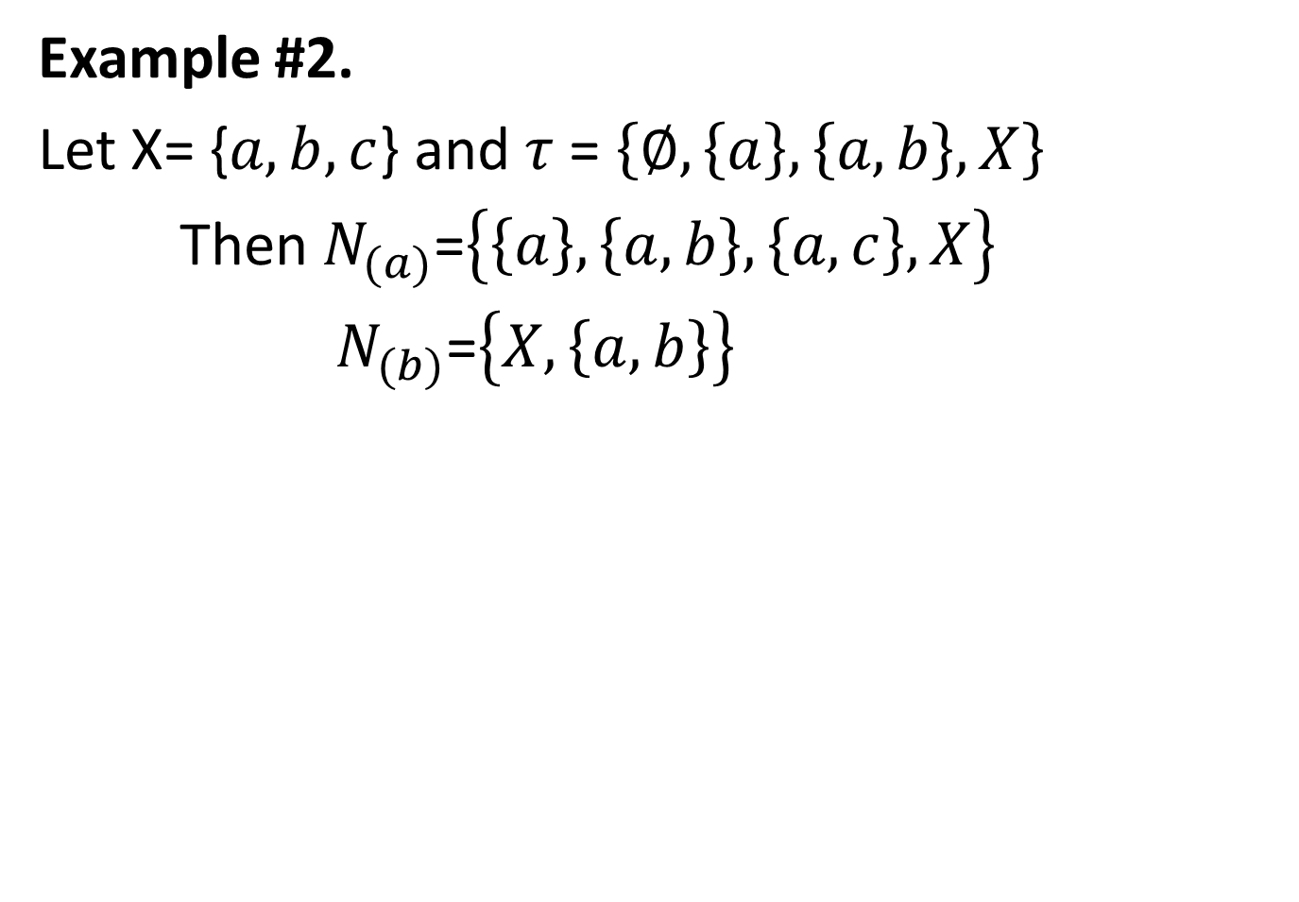
Example #2.
Let X= {$a,b,c$} and $τ$= $\left\{∅,\left\{a\right\},\left\{a,b\right\},X\right\}$
Then $N_{(a)}$=$\left\{\left\{a\right\},\left\{a,b\right\},\left\{a,c\right\},X\right\}$
$N_{(b)}$=$\left\{X,\left\{a,b\right\}\right\}$

Slide 10
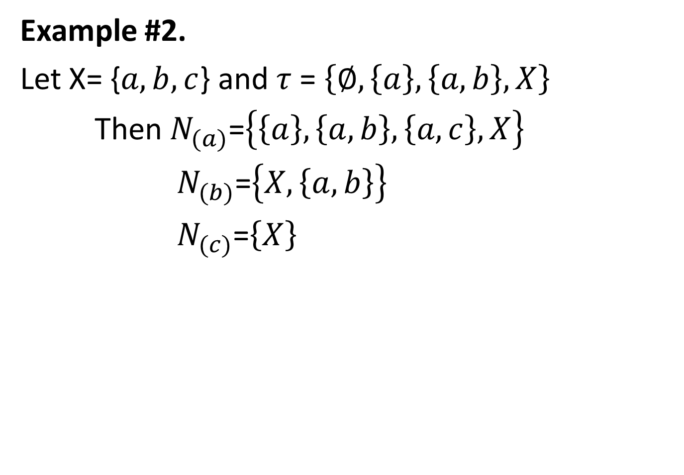
Example #2.
Let X= {$a,b,c$} and $τ$= $\left\{∅,\left\{a\right\},\left\{a,b\right\},X\right\}$
Then $N_{(a)}$=$\left\{\left\{a\right\},\left\{a,b\right\},\left\{a,c\right\},X\right\}$
$N_{(b)}$=$\left\{X,\left\{a,b\right\}\right\}$
$N_{(c)}$=$\left\{X\right\}$

Slide 11
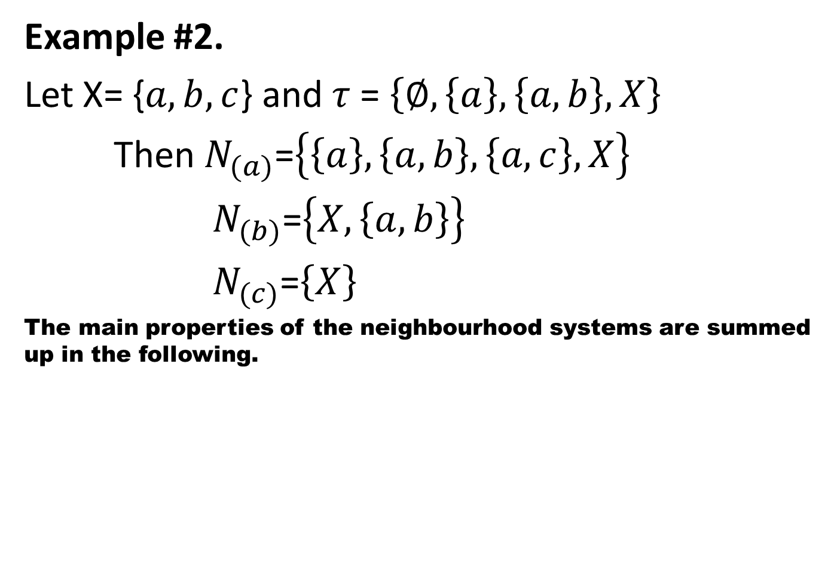
Example #2.
Let X= {$a,b,c$} and $τ$= $\left\{∅,\left\{a\right\},\left\{a,b\right\},X\right\}$
Then $N_{(a)}$=$\left\{\left\{a\right\},\left\{a,b\right\},\left\{a,c\right\},X\right\}$
$N_{(b)}$=$\left\{X,\left\{a,b\right\}\right\}$
$N_{(c)}$=$\left\{X\right\}$
The main properties of the neighbourhood systems are summed up in the following.

Slide 12
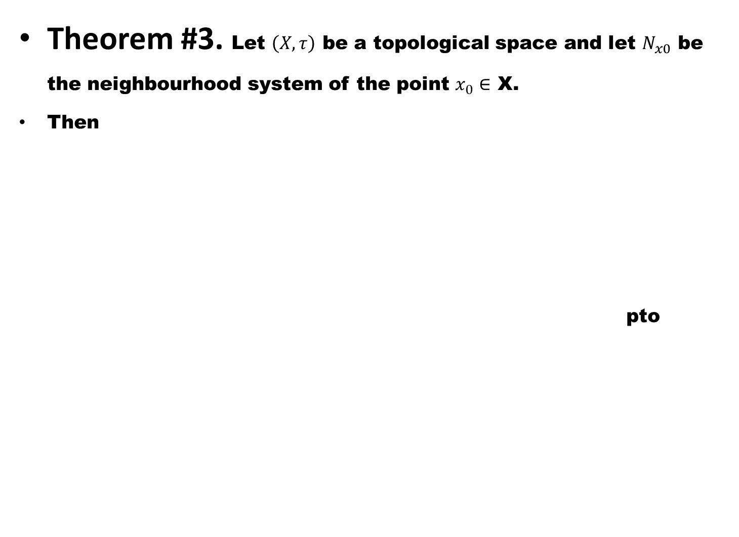
Theorem #3. Let $\left(X,τ\right)$be a topological space and let $N_{x0}$be the neighbourhood system of the point $x_{0}∈$ X.
Then
pto

Slide 13
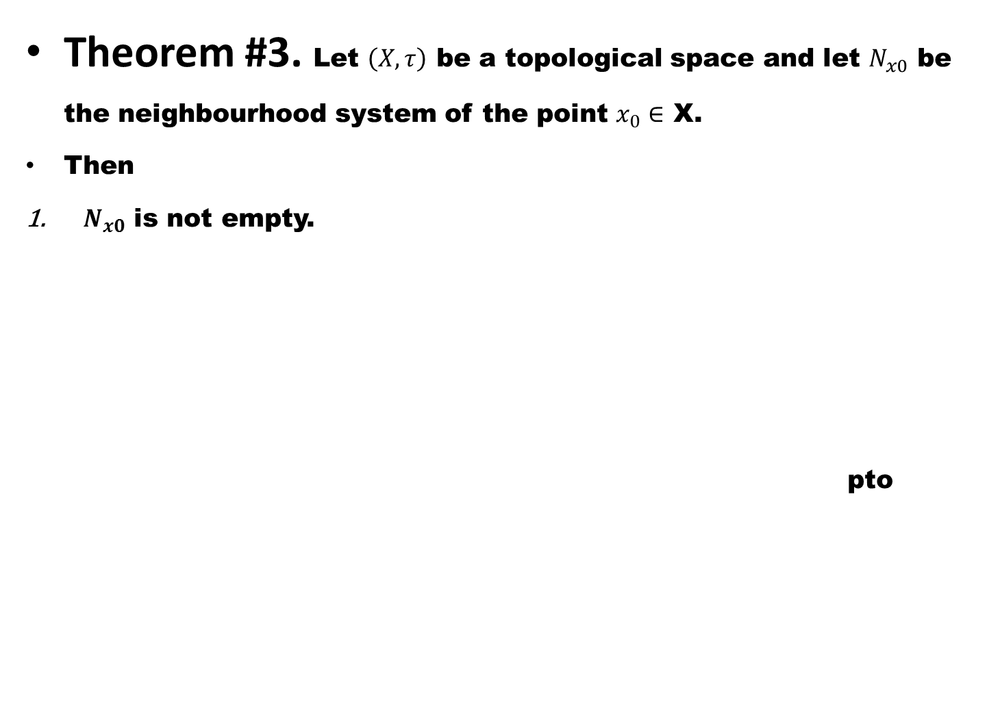
Theorem #3. Let $\left(X,τ\right)$be a topological space and let $N_{x0}$be the neighbourhood system of the point $x_{0}∈$ X.
Then
$N_{x0}$ is not empty.
pto

Slide 14
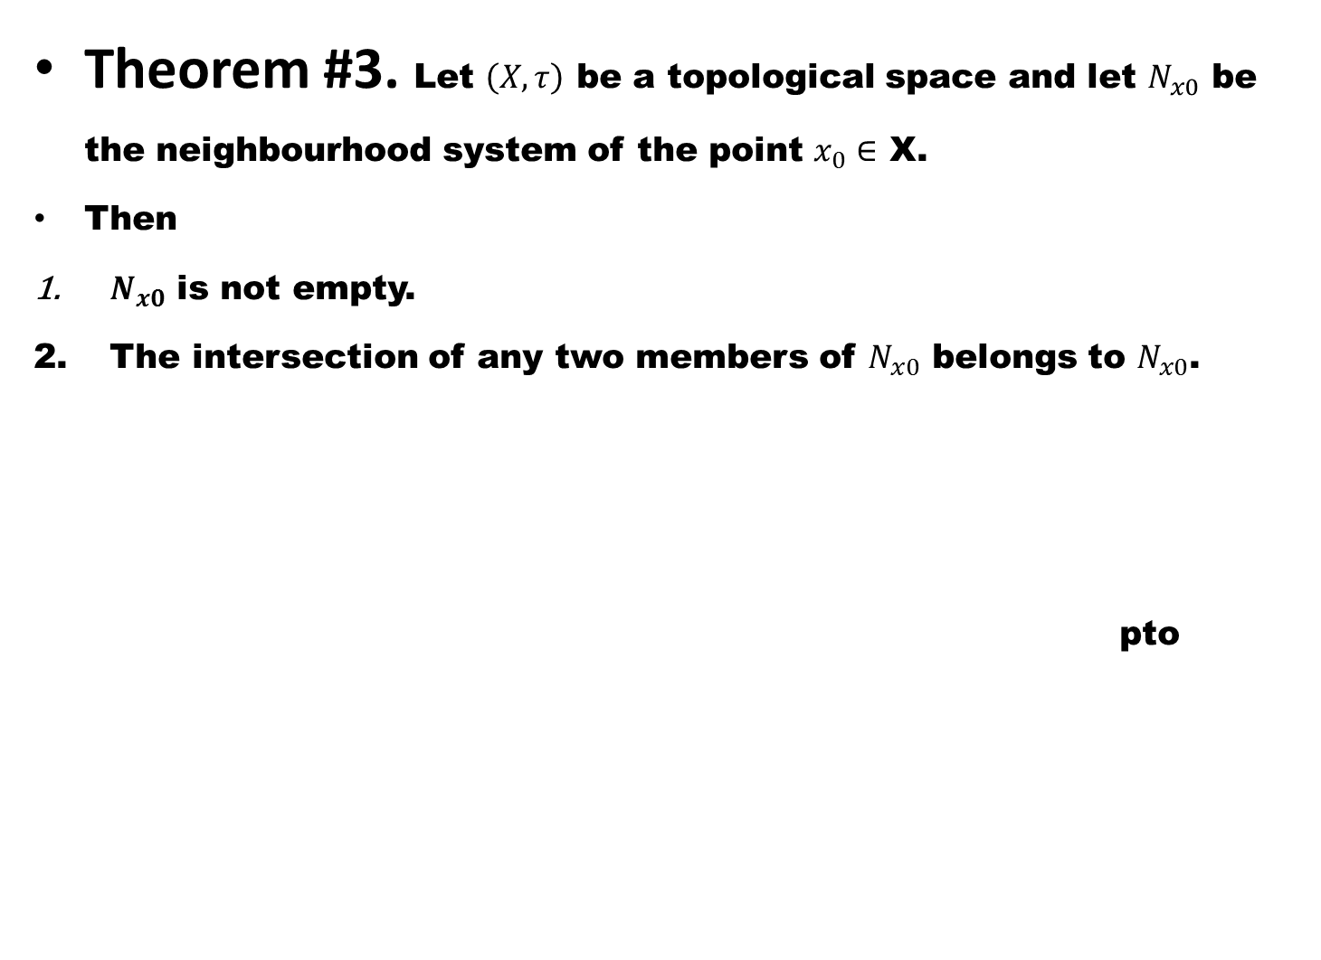
Theorem #3. Let $\left(X,τ\right)$be a topological space and let $N_{x0}$be the neighbourhood system of the point $x_{0}∈$ X.
Then
$N_{x0}$ is not empty.
The intersection of any two members of $N_{x0}$ belongs to $N_{x0}$.
pto

Slide 15
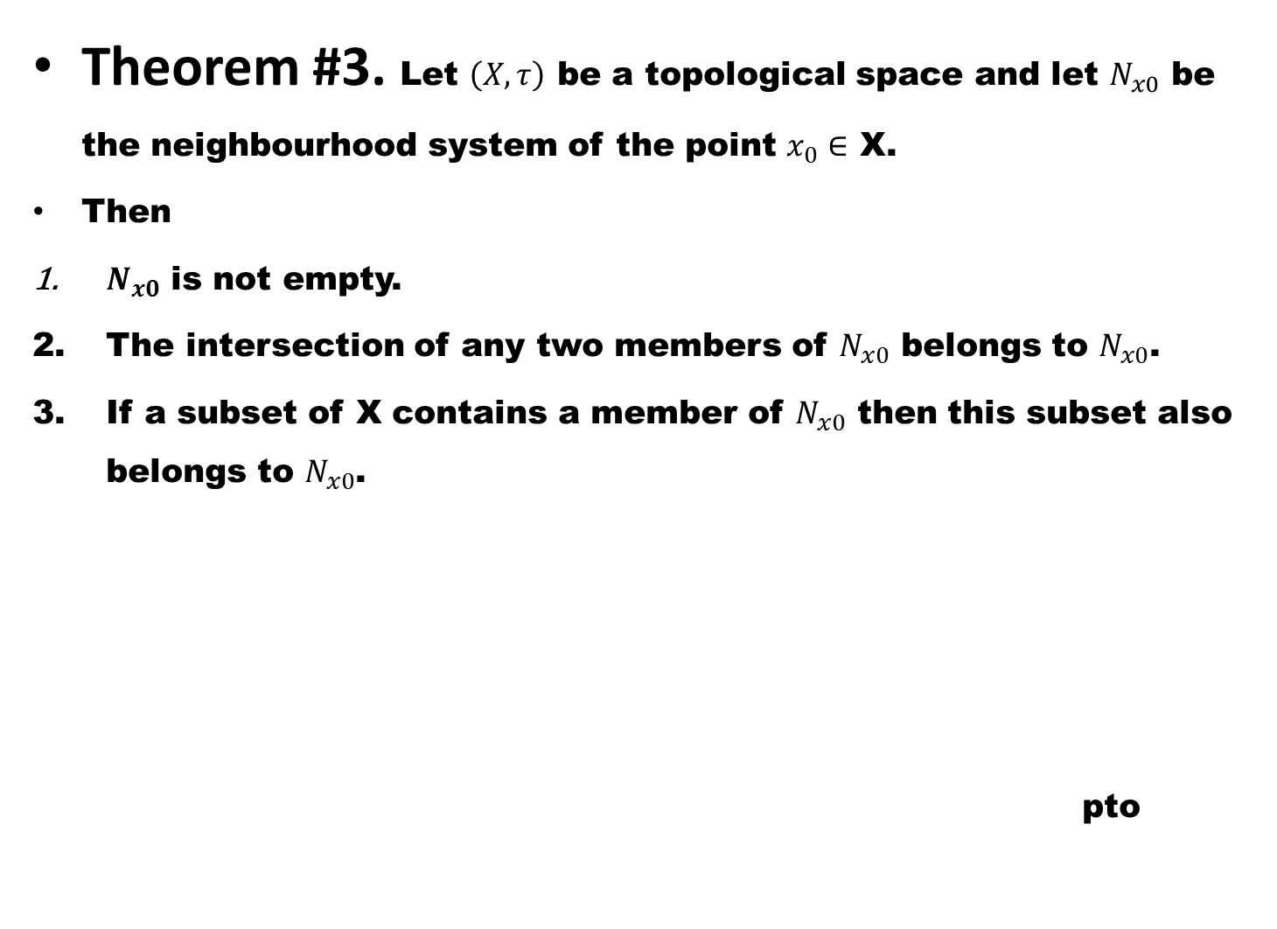
Theorem #3. Let $\left(X,τ\right)$be a topological space and let $N_{x0}$be the neighbourhood system of the point $x_{0}∈$ X.
Then
$N_{x0}$ is not empty.
The intersection of any two members of $N_{x0}$ belongs to $N_{x0}$.
If a subset of X contains a member of $N_{x0}$ then this subset also belongs to $N_{x0}$.
pto

Slide 16
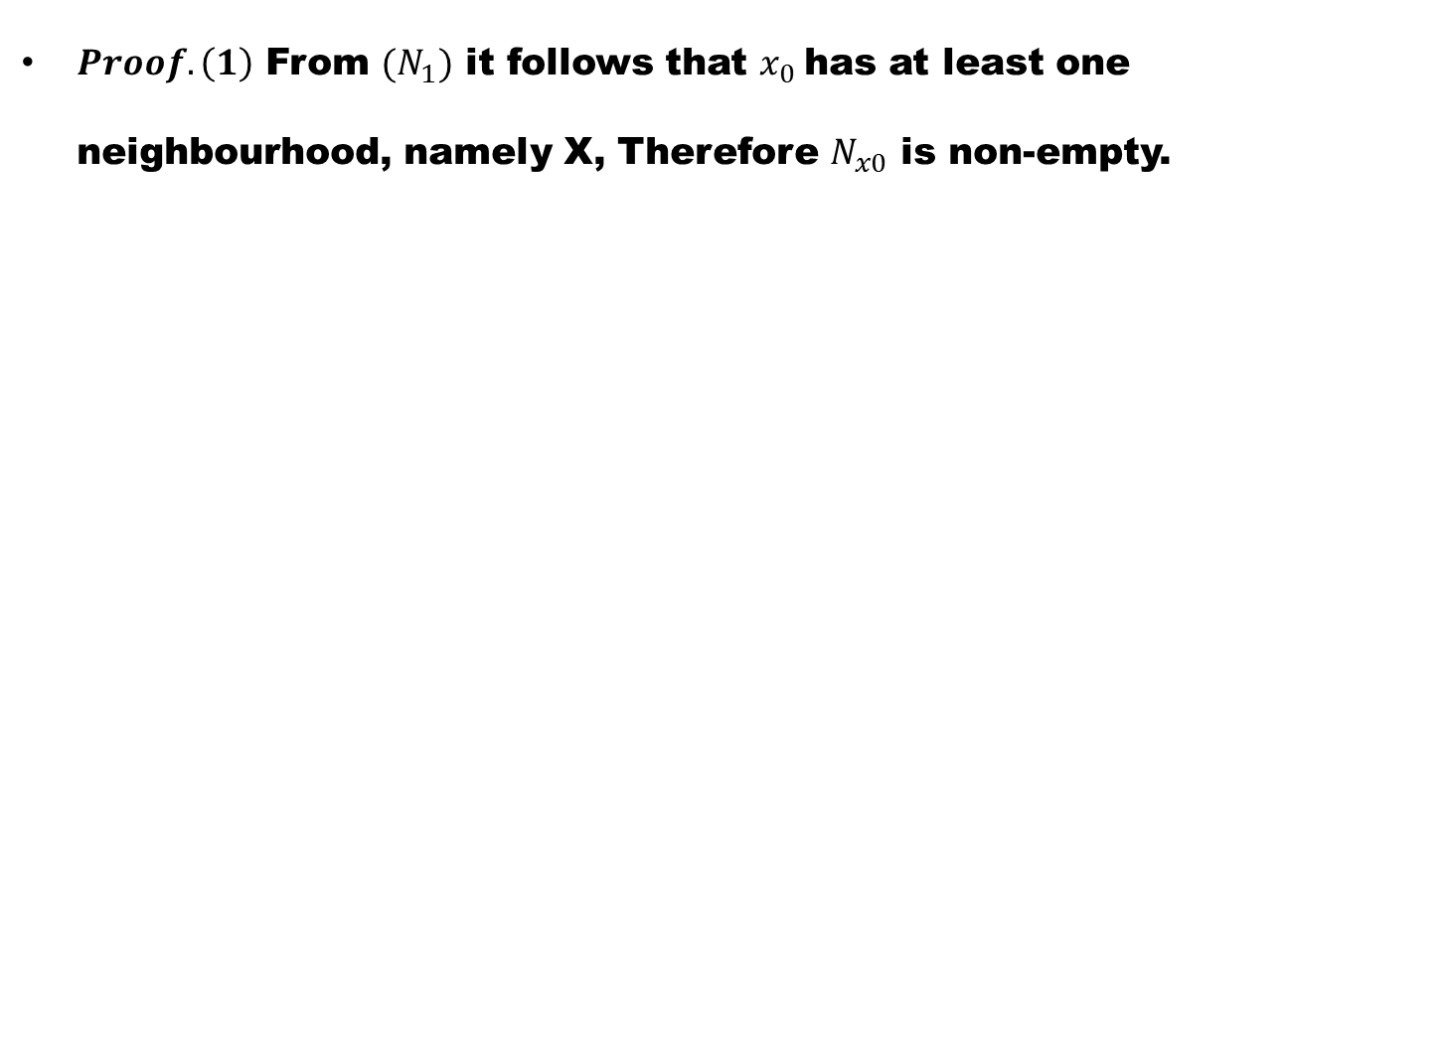
$Proof.\left(1\right)$From ${(N}_{1})$it follows that $x_{0}$hasat least one neighbourhood, namely X, Therefore $N_{x0}$is non-empty.

Slide 17
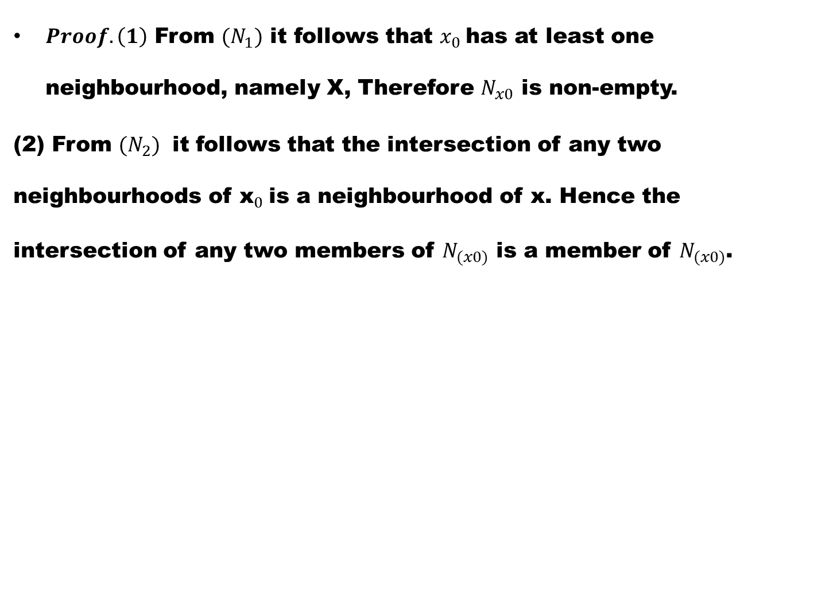
$Proof.\left(1\right)$From ${(N}_{1})$it follows that $x_{0}$hasat least one neighbourhood, namely X, Therefore $N_{x0}$is non-empty.
(2) From ${(N}_{2})$it follows that the intersection of any two neighbourhoods of ${\text{x}}_{0}$is a neighbourhood of x. Hence the intersection of any two members of $N_{(x0)}$ is a member of $N_{(x0)}$.

Slide 18
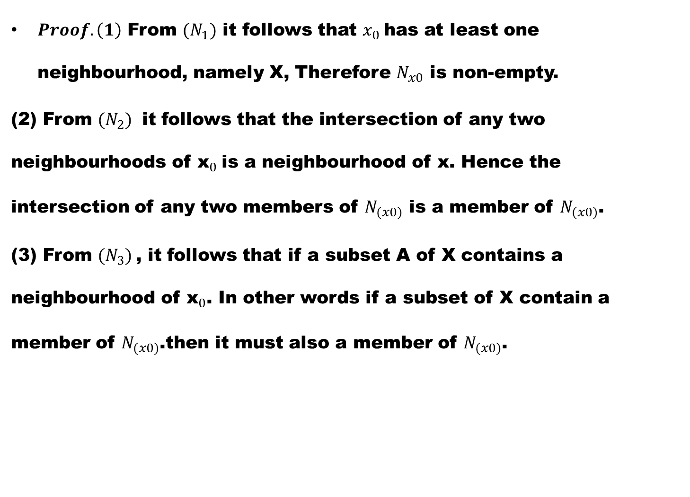
$Proof.\left(1\right)$From ${(N}_{1})$it follows that $x_{0}$hasat least one neighbourhood, namely X, Therefore $N_{x0}$is non-empty.
(2) From ${(N}_{2})$it follows that the intersection of any two neighbourhoods of ${\text{x}}_{0}$is a neighbourhood of x. Hence the intersection of any two members of $N_{(x0)}$ is a member of $N_{(x0)}$.
(3) From ${(N}_{3})$, it follows that if a subset A of X contains a neighbourhood of ${\text{x}}_{0}$. In other words if a subset of X contain a member of $N_{(x0)}$.then it must also a member of $N_{(x0)}$.

Slide 19
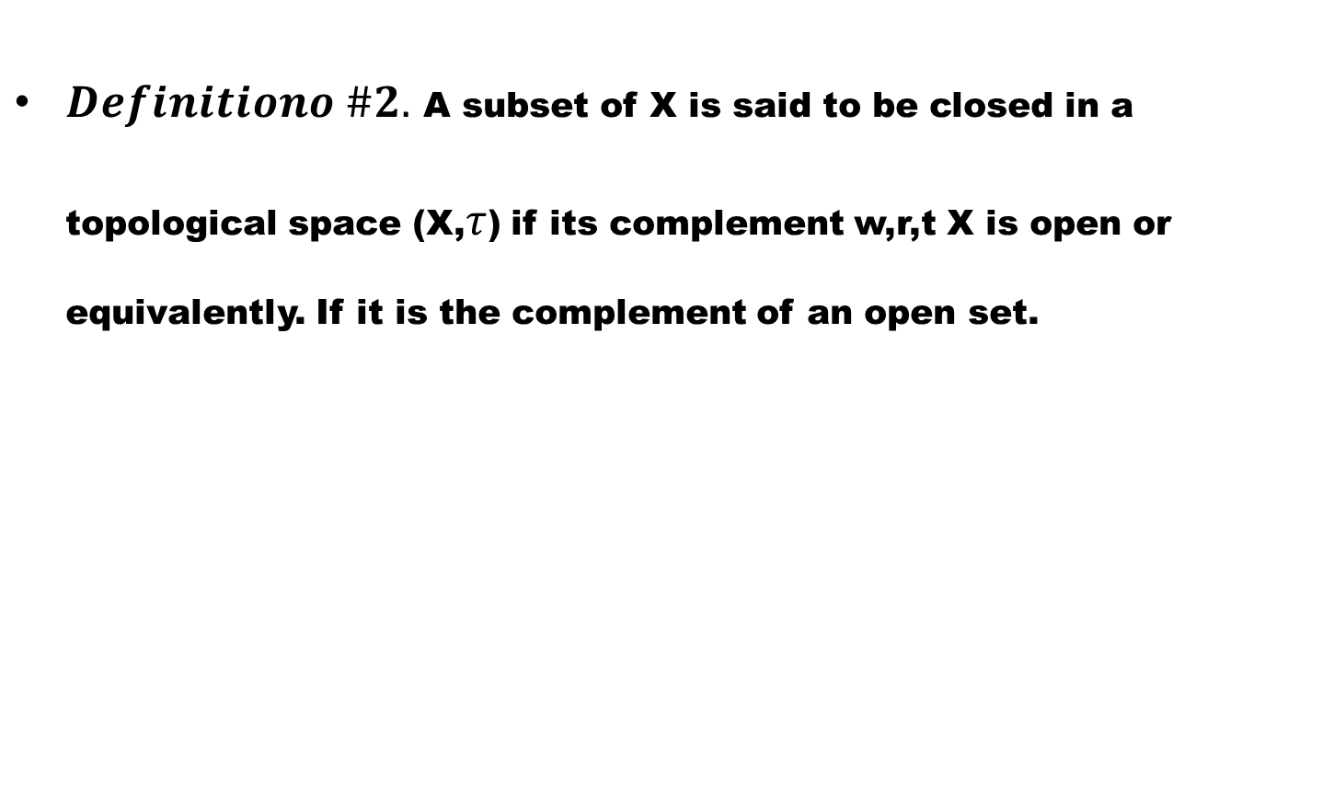
Closed sets
$Definitiono \#2.$A subset of X is said to be closed in a topological space (X,$τ$) if its complement w,r,t X is open or equivalently. If it is the complement of an open set.

Slide 20
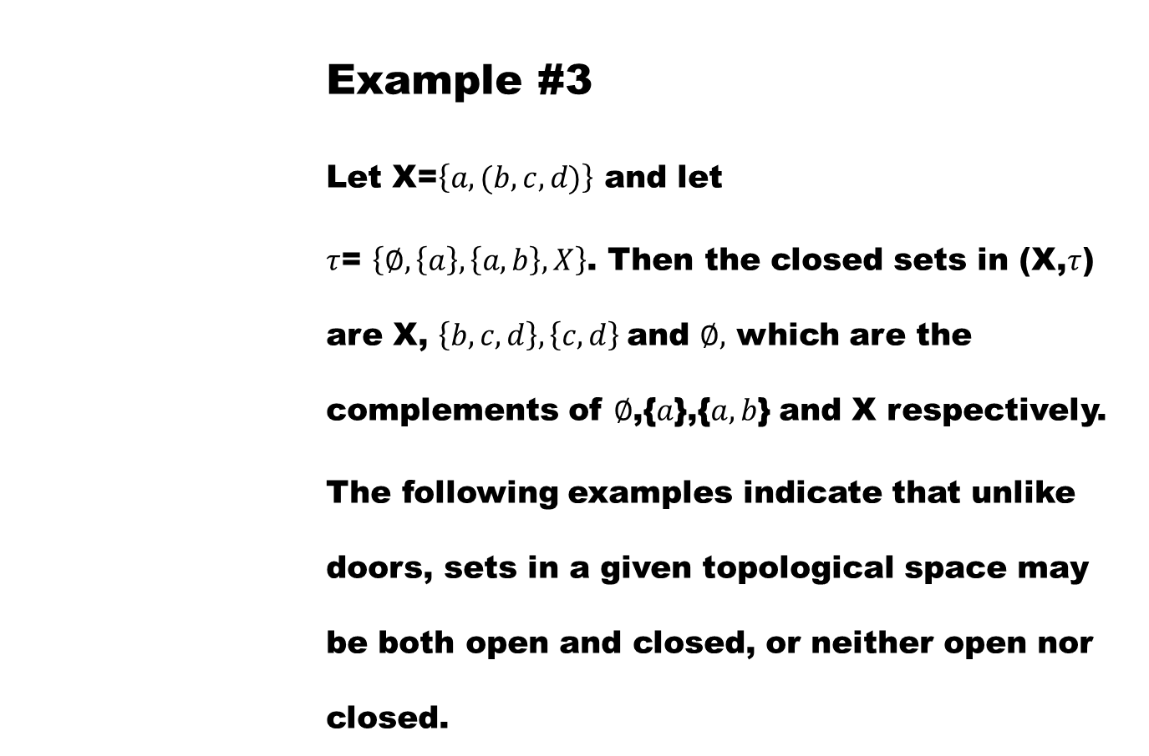
          Example #3
          Let X=$\left\{a,(b,c,d)\right\}$and let
          $τ$= $\left\{∅,\left\{a\right\},\left\{a,b\right\},X\right\}$. Then the closed sets in (X,$τ$) are X, $\left\{b,c,d\right\},\left\{c,d\right\}$and $∅,$ which are the complements of $∅$,{$a$},{$a,b$} and X respectively.
          The following examples indicate that unlike doors, sets in a given topological space may be both open and closed, or neither open nor closed.

Slide 21
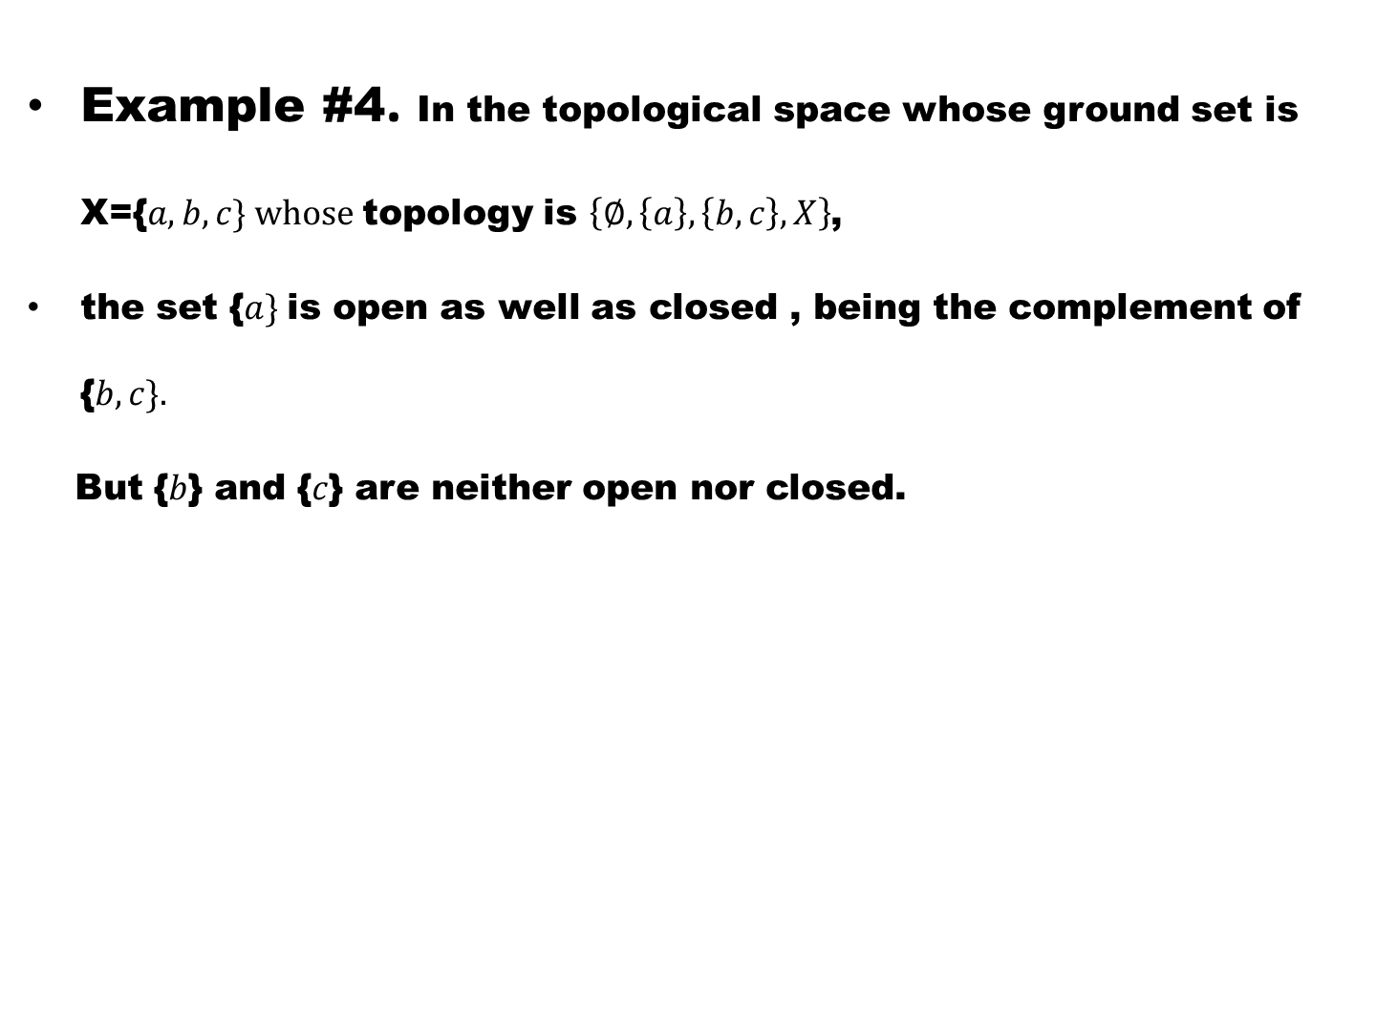
Example #4. In the topological space whose ground set is X={$a,b,c\} whose$topology is $\left\{∅,\left\{a\right\},\left\{b,c\right\},X\right\}$,
the set {$a\}$is open as well as closed , being the complement of {$b,c\}.$
But {$b$} and {$c$} are neither open nor closed.

Slide 22
Example #5. In any topological space, the empty set and the ground set are both open and closed, because both belong to the topology and are complements of each other.

Slide 23
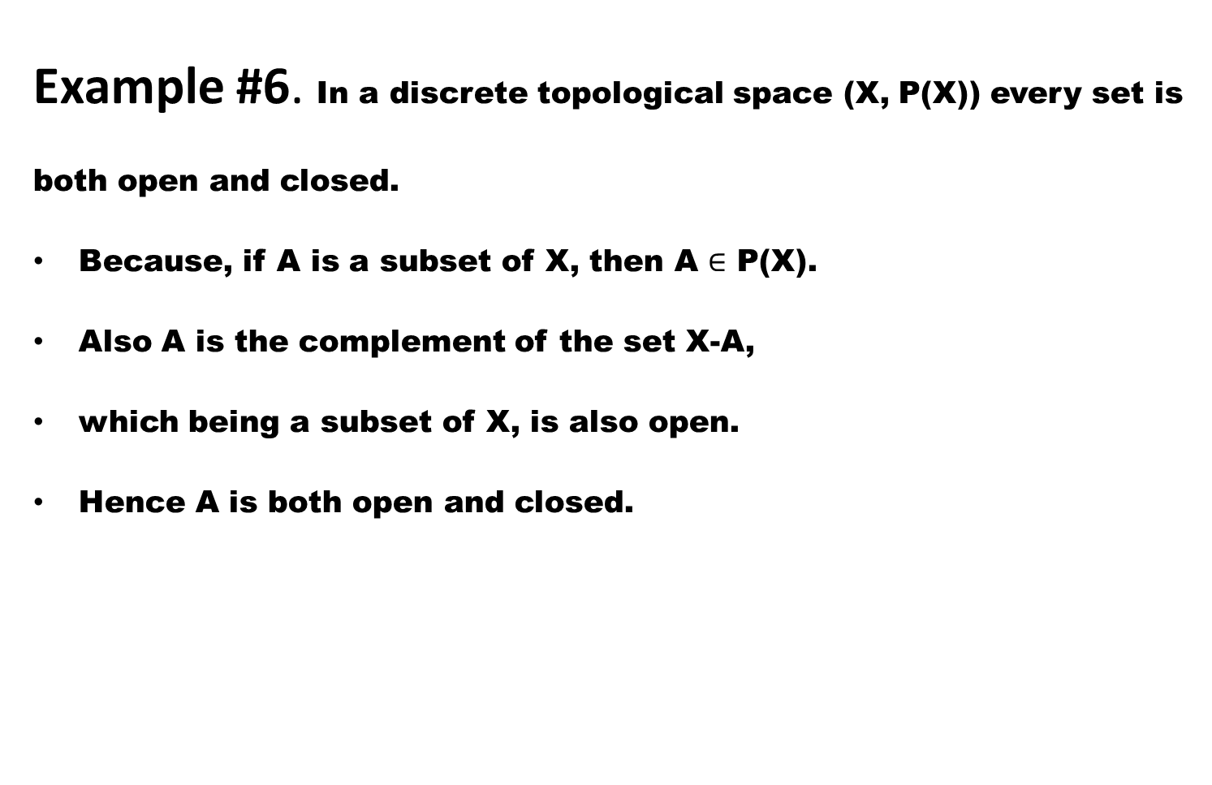
Example #6.In a discrete topological space (X, P(X)) every set is both open and closed.
Because, if A is a subset of X, then A $∈$ P(X).
Also A is the complement of the set X-A,
which being a subset of X, is also open.
Hence A is both open and closed.

Slide 24
Example #7. In an indiscrete topological space,
any non empty set different from the ground set is neither open nor closed,

Slide 25
Example #7. In an indiscrete topological space,
any non empty set different from the ground set is neither open nor closed,
It can be easily verified.

Slide 26
Example #7. In an indiscrete topological space,
any non empty set different from the ground set is neither open nor closed,
It can be easily verified.
The collection G of all closed sets in any topological space has three basic properties,

Slide 27
Example #7. In an indiscrete topological space,
any non empty set different from the ground set is neither open nor closed,
It can be easily verified.
The collection G of all closed sets in any topological space has three basic properties,
These are summed up in the following theorem.

Slide 28
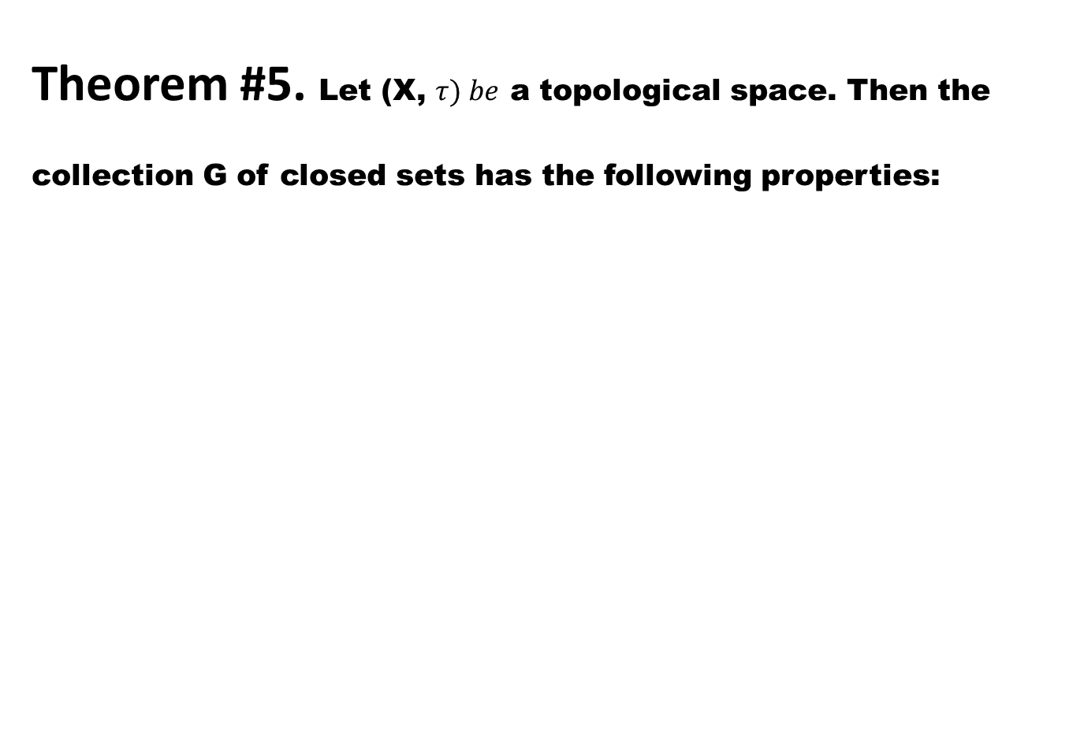
Theorem #5. Let (X, $τ) be$a topological space. Then the collection G of closed sets has the following properties:

Slide 29
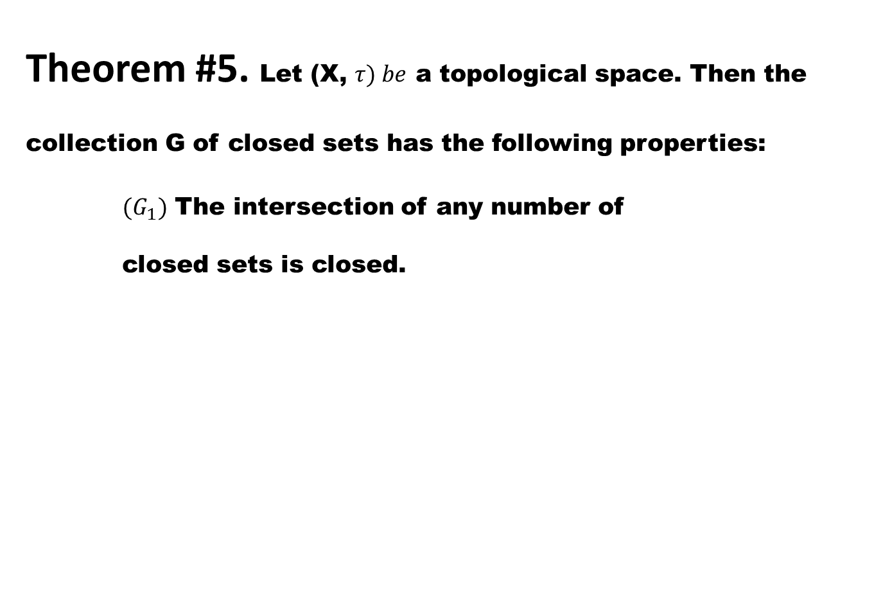
Theorem #5. Let (X, $τ) be$a topological space. Then the collection G of closed sets has the following properties:
${(G}_{1})$ The intersection of any number of closed sets is closed.

Slide 30
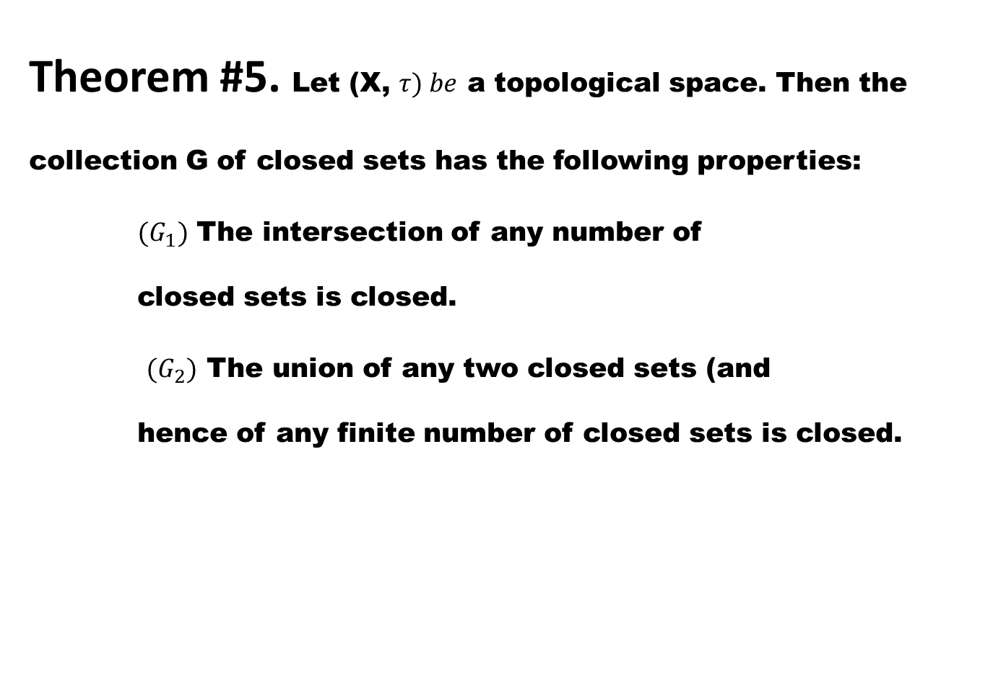
Theorem #5. Let (X, $τ) be$a topological space. Then the collection G of closed sets has the following properties:
${(G}_{1})$ The intersection of any number of closed sets is closed.
${(G}_{2})$ The union of any two closed sets (and hence of any finite number of closed sets is closed.

Slide 31
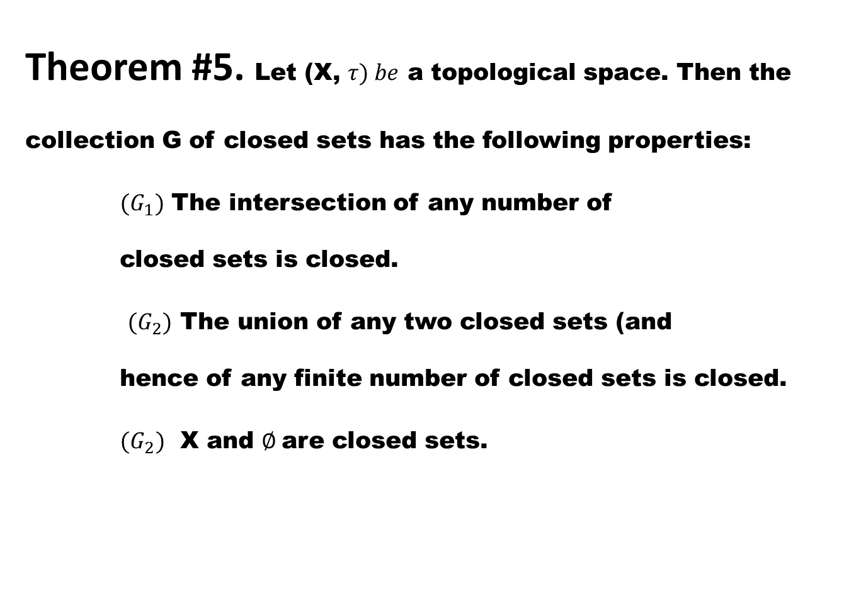
Theorem #5. Let (X, $τ) be$a topological space. Then the collection G of closed sets has the following properties:
${(G}_{1})$ The intersection of any number of closed sets is closed.
${(G}_{2})$ The union of any two closed sets (and hence of any finite number of closed sets is closed.
${(G}_{2})$ X and $∅$are closed sets.

Slide 32
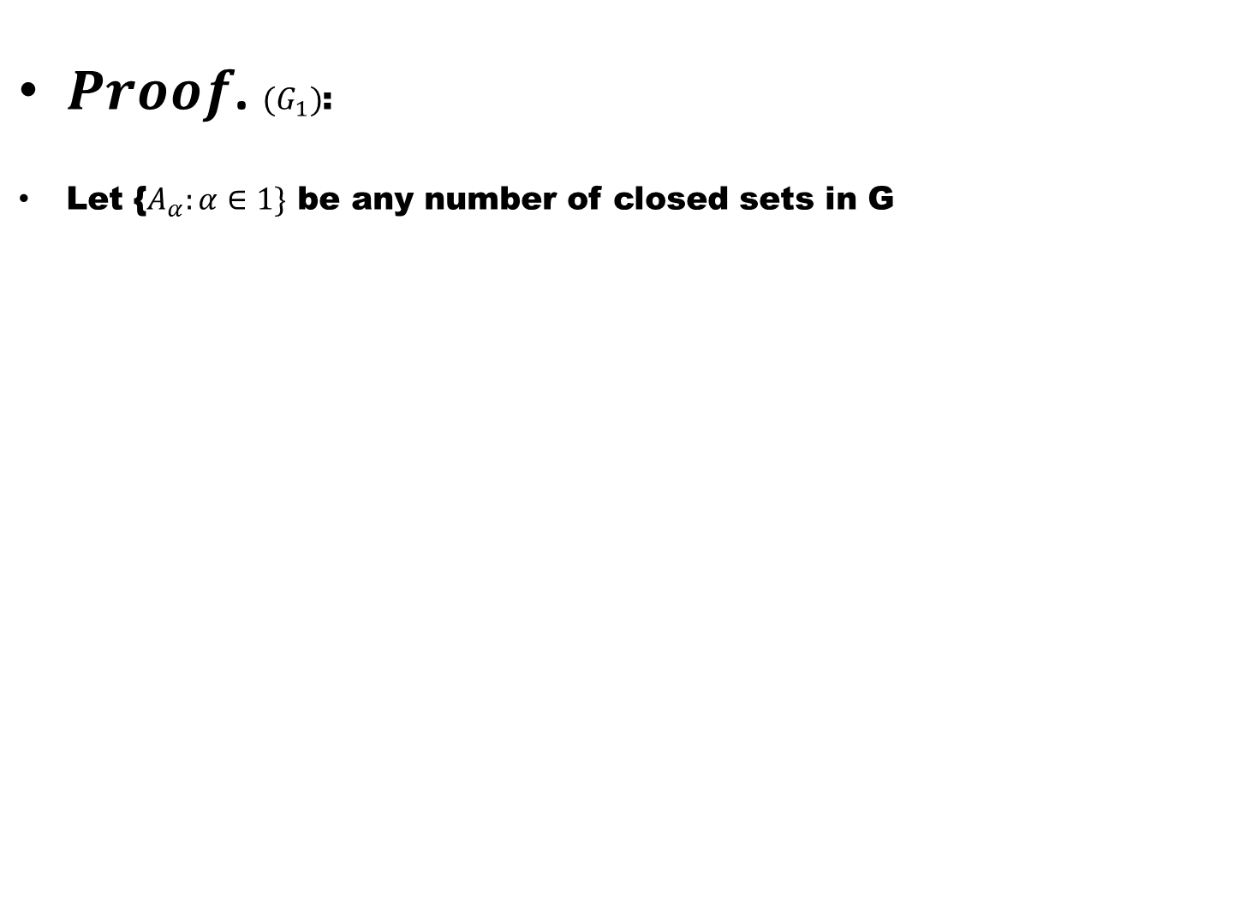
$Proof$. ${(G}_{1})$:
Let {$A_{α}:α∈1\}$be any number of closed sets in G

Slide 33
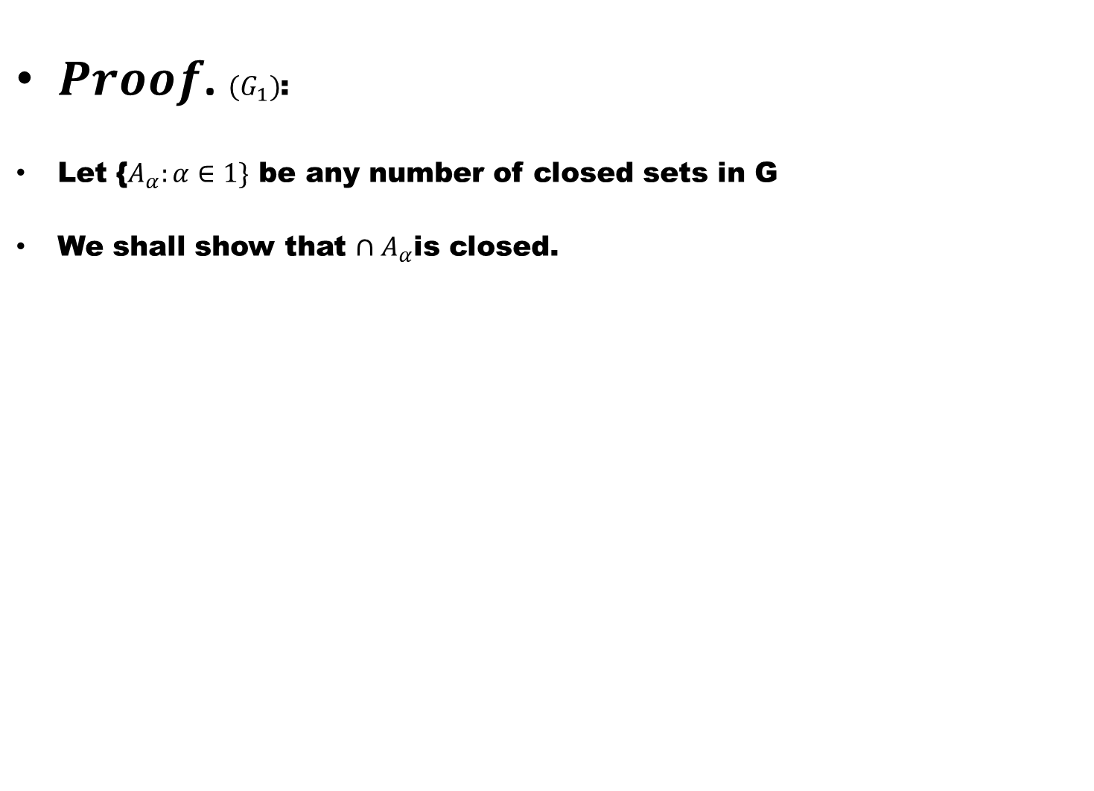
$Proof$. ${(G}_{1})$:
Let {$A_{α}:α∈1\}$be any number of closed sets in G
We shall show that $∩A_{α}$is closed.

Slide 34
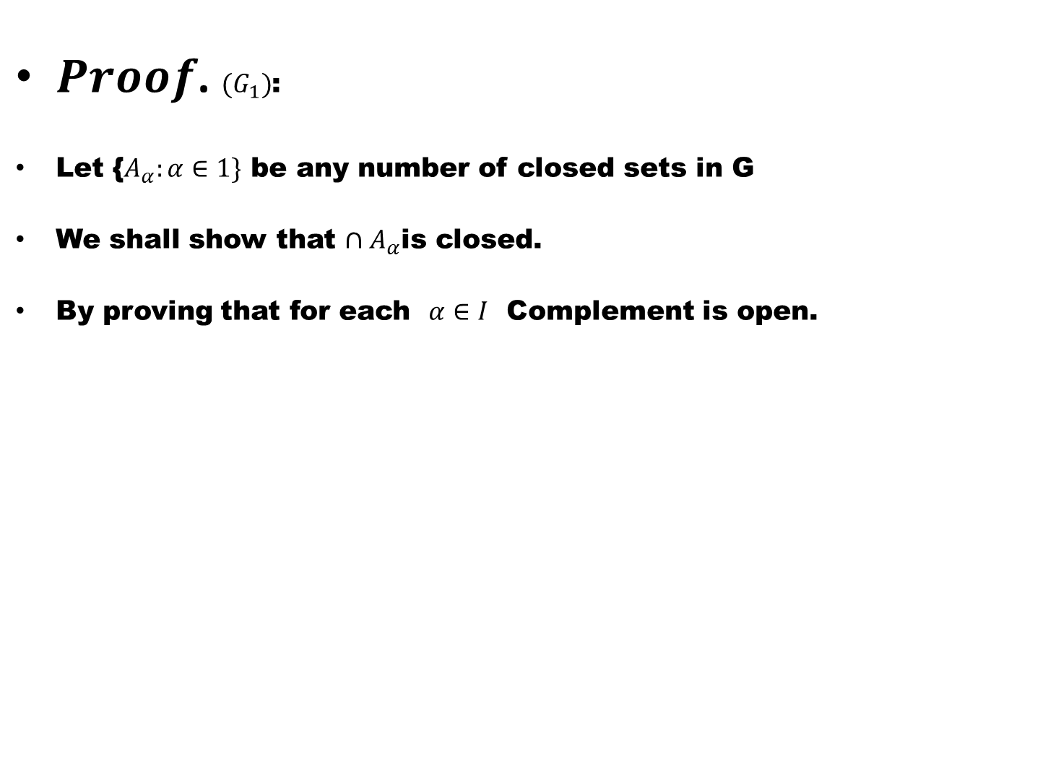
$Proof$. ${(G}_{1})$:
Let {$A_{α}:α∈1\}$be any number of closed sets in G
We shall show that $∩A_{α}$is closed.
By proving that for each $α∈I$ Complement is open.

Slide 35
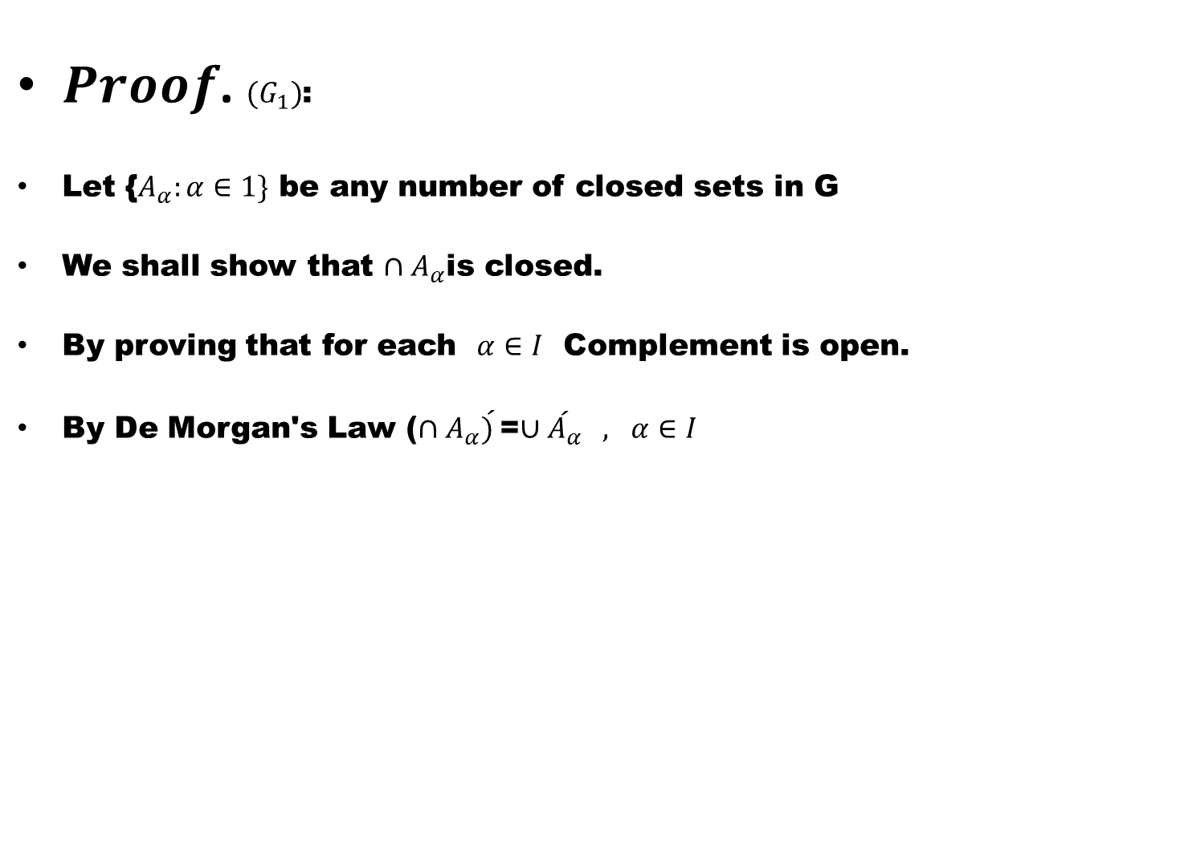
$Proof$. ${(G}_{1})$:
Let {$A_{α}:α∈1\}$be any number of closed sets in G
We shall show that $∩A_{α}$is closed.
By proving that for each $α∈I$ Complement is open.
By De Morgan's Law ($∩A_{α}\acute{) }$=$∪\acute{A_{α}}$$, α∈I$

Slide 36
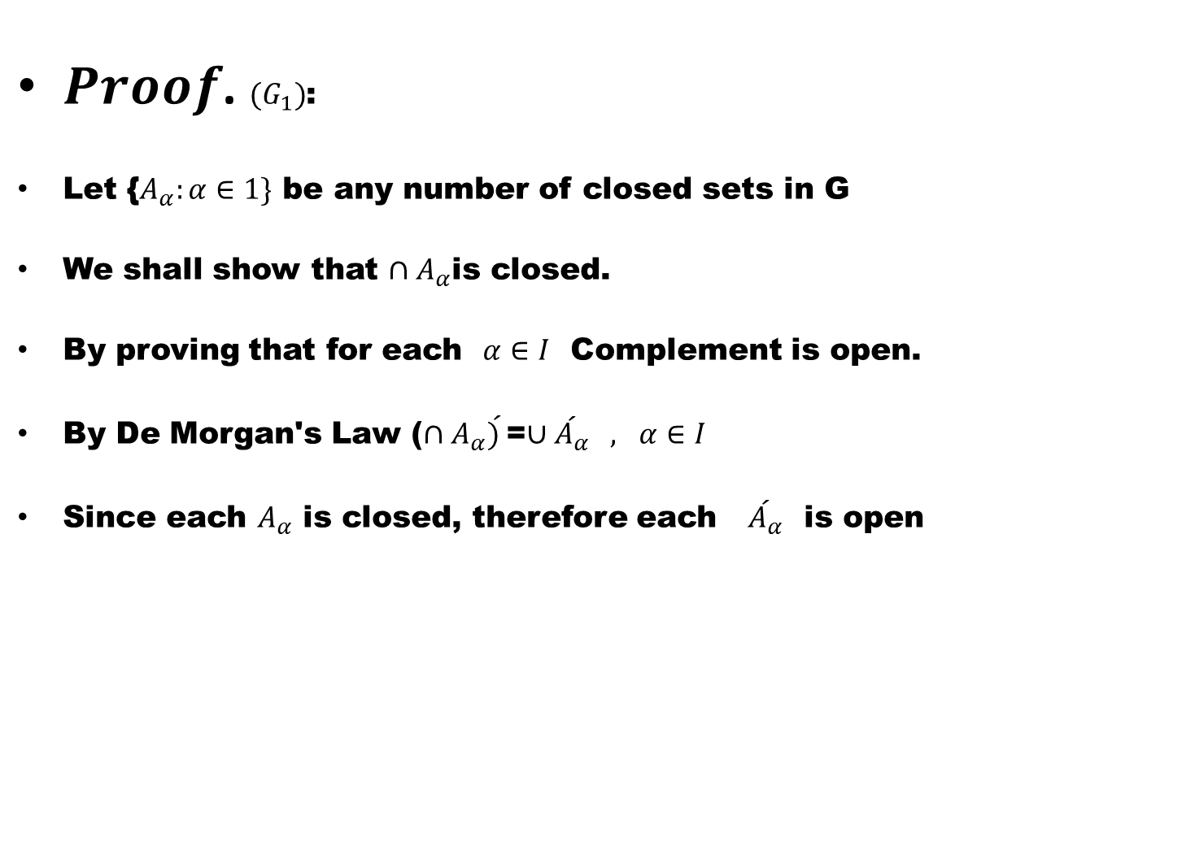
$Proof$. ${(G}_{1})$:
Let {$A_{α}:α∈1\}$be any number of closed sets in G
We shall show that $∩A_{α}$is closed.
By proving that for each $α∈I$ Complement is open.
By De Morgan's Law ($∩A_{α}\acute{) }$=$∪\acute{A_{α}}$$, α∈I$
Since each $A_{α}$ is closed, therefore each $\acute{A_{α}}$ is open

Slide 37
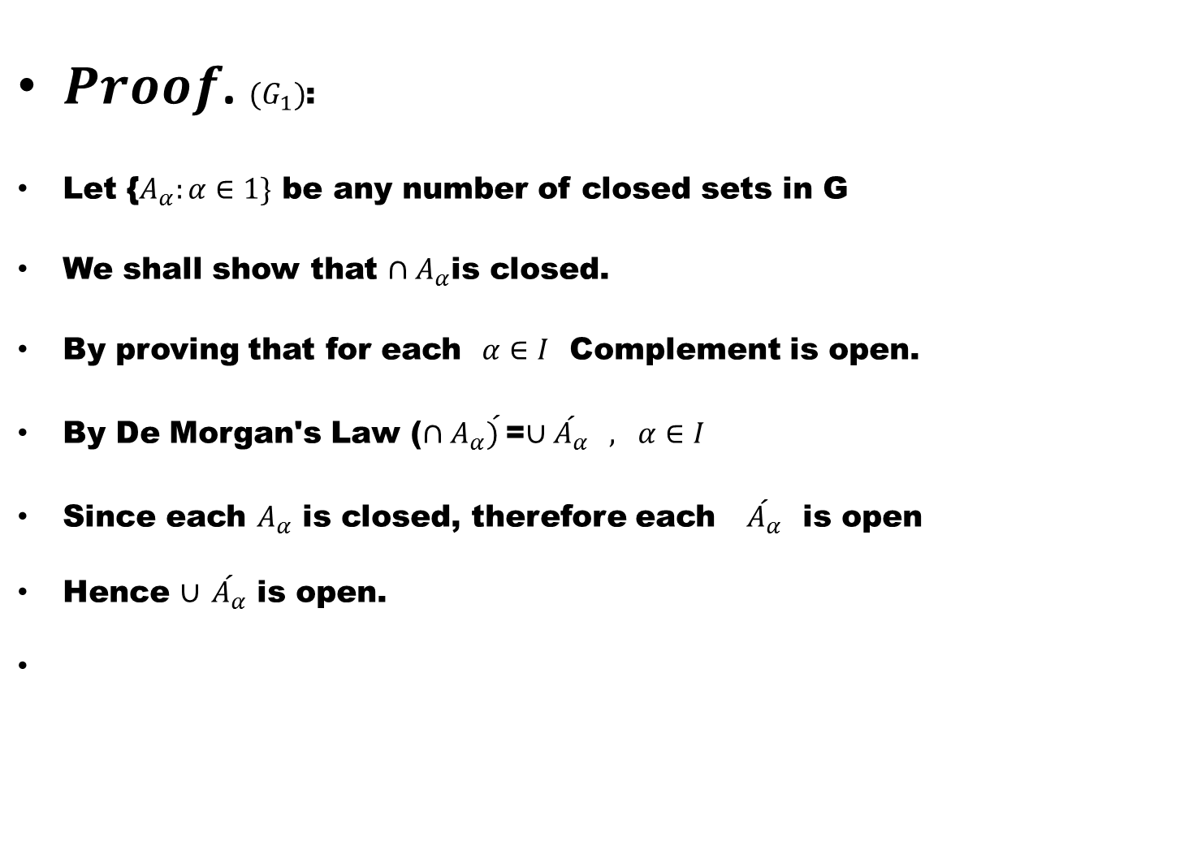
$Proof$. ${(G}_{1})$:
Let {$A_{α}:α∈1\}$be any number of closed sets in G
We shall show that $∩A_{α}$is closed.
By proving that for each $α∈I$ Complement is open.
By De Morgan's Law ($∩A_{α}\acute{) }$=$∪\acute{A_{α}}$$, α∈I$
Since each $A_{α}$ is closed, therefore each $\acute{A_{α}}$ is open
Hence $∪$$\acute{A_{α}}$ is open.

Slide 38
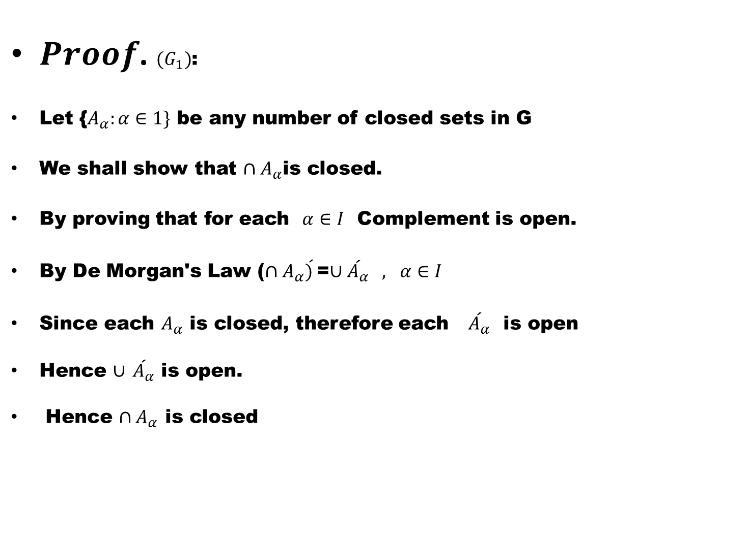
$Proof$. ${(G}_{1})$:
Let {$A_{α}:α∈1\}$be any number of closed sets in G
We shall show that $∩A_{α}$is closed.
By proving that for each $α∈I$ Complement is open.
By De Morgan's Law ($∩A_{α}\acute{) }$=$∪\acute{A_{α}}$$, α∈I$
Since each $A_{α}$ is closed, therefore each $\acute{A_{α}}$ is open
Hence $∪$$\acute{A_{α}}$ is open.
Hence $∩A_{α}$ is closed

Slide 39
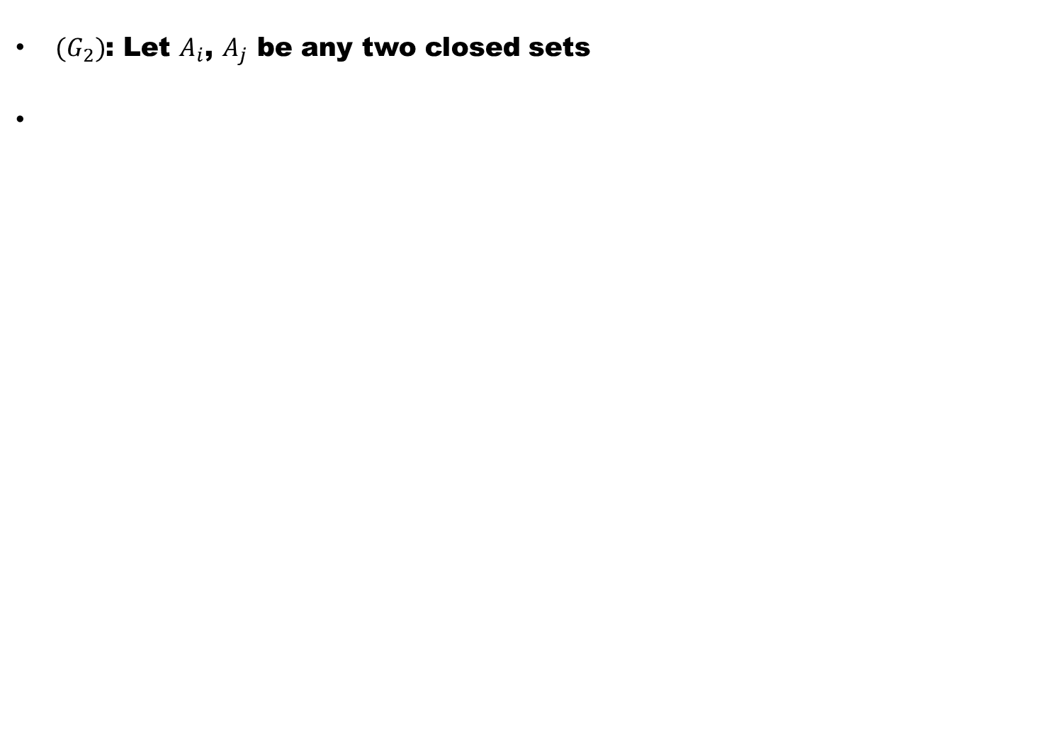
${(G}_{2})$: Let $A_{i}$,$A_{j}$ be any two closed sets

Slide 40
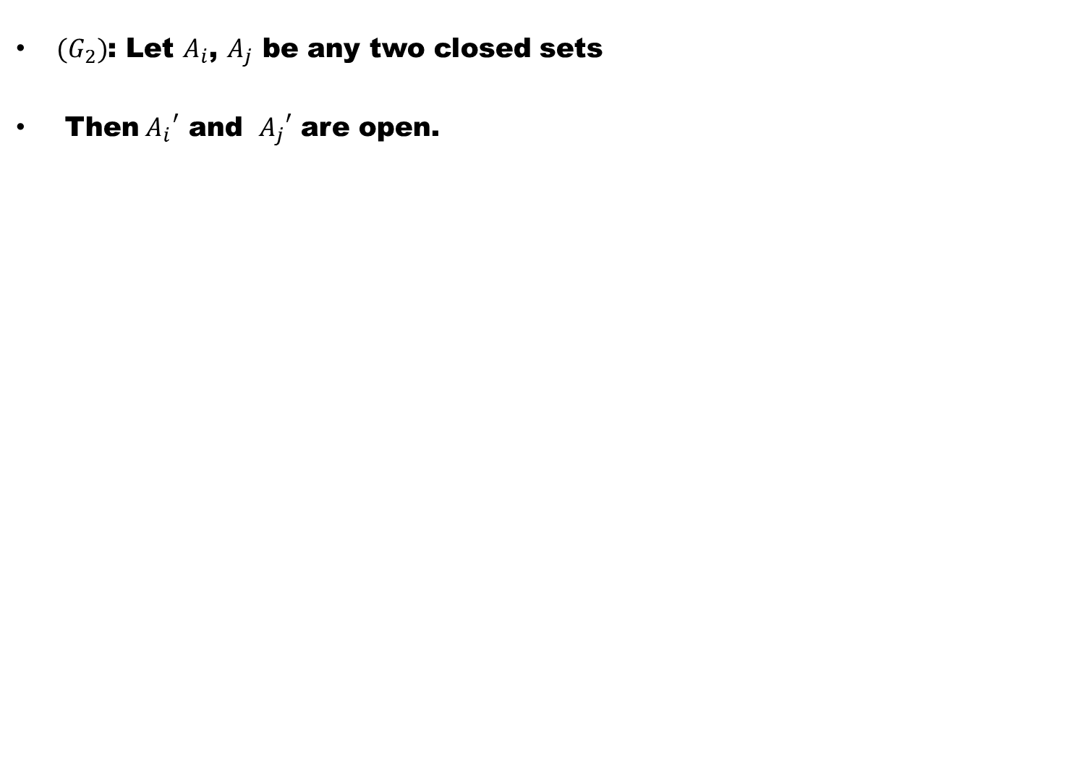
${(G}_{2})$: Let $A_{i}$,$A_{j}$ be any two closed sets
Then${{ A}_{i}}^{′}$ and ${{ A}_{j}}^{′}$are open.

Slide 41
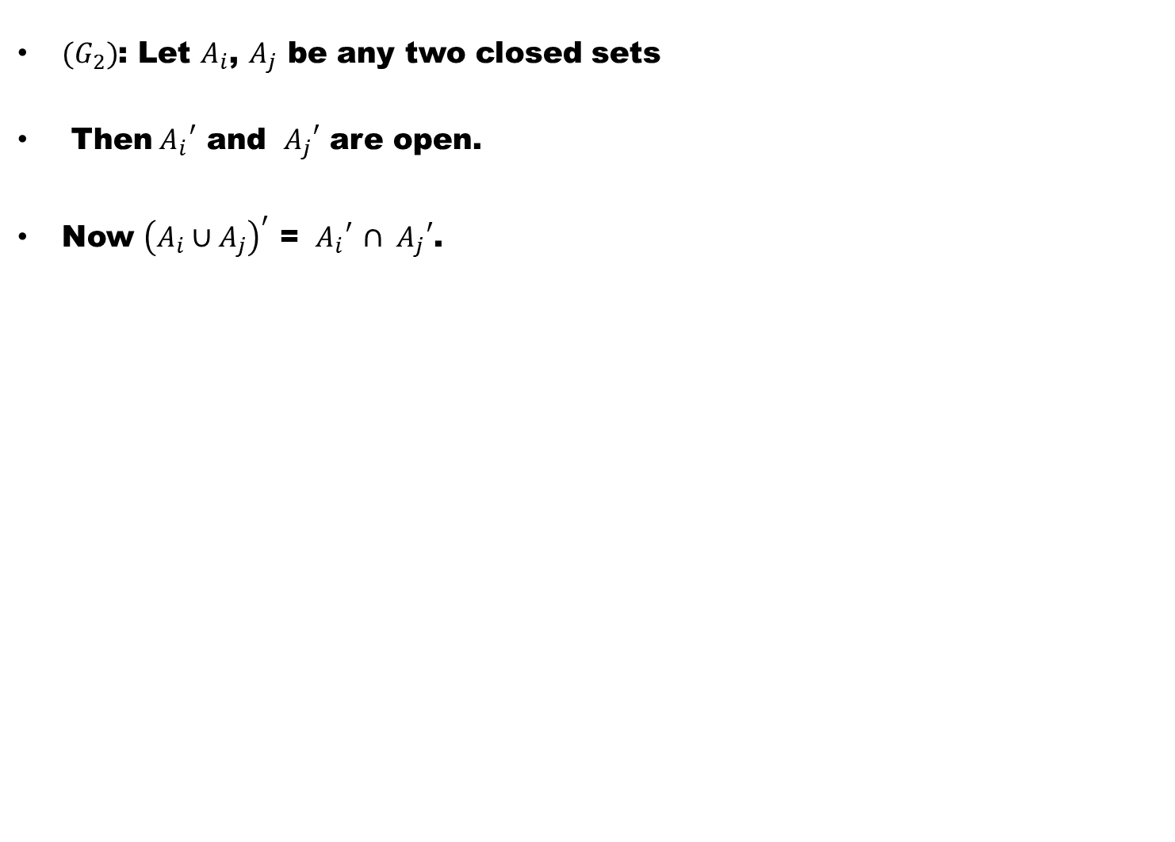
${(G}_{2})$: Let $A_{i}$,$A_{j}$ be any two closed sets
Then${{ A}_{i}}^{′}$ and ${{ A}_{j}}^{′}$are open.
Now ${\left(A_{i}∪A_{j}\right)}^{′}$ = ${{ A}_{i}}^{′}$$∩{{ A}_{j}}^{′}$.

Slide 42
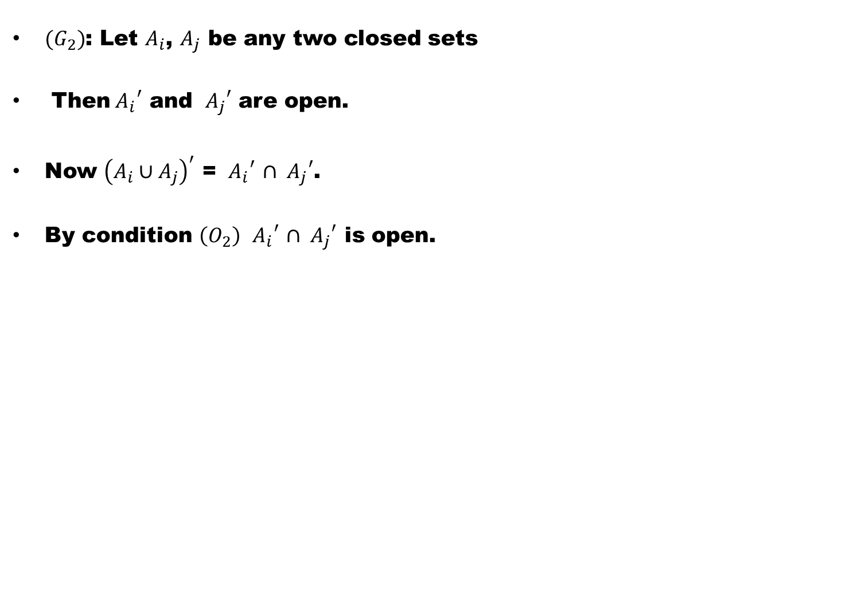
${(G}_{2})$: Let $A_{i}$,$A_{j}$ be any two closed sets
Then${{ A}_{i}}^{′}$ and ${{ A}_{j}}^{′}$are open.
Now ${\left(A_{i}∪A_{j}\right)}^{′}$ = ${{ A}_{i}}^{′}$$∩{{ A}_{j}}^{′}$.
By condition $\left(O_{2}\right)$${{ A}_{i}}^{′}$$∩{{ A}_{j}}^{′}$ is open.

Slide 43
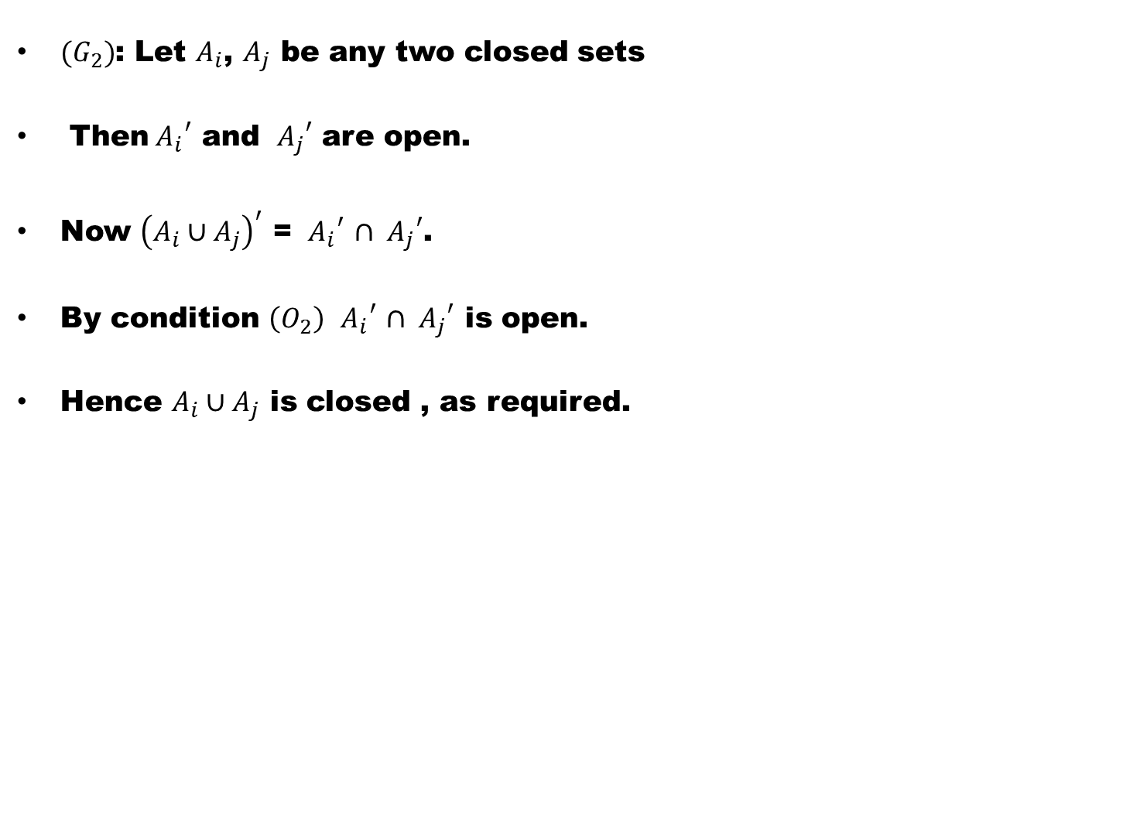
${(G}_{2})$: Let $A_{i}$,$A_{j}$ be any two closed sets
Then${{ A}_{i}}^{′}$ and ${{ A}_{j}}^{′}$are open.
Now ${\left(A_{i}∪A_{j}\right)}^{′}$ = ${{ A}_{i}}^{′}$$∩{{ A}_{j}}^{′}$.
By condition $\left(O_{2}\right)$${{ A}_{i}}^{′}$$∩{{ A}_{j}}^{′}$ is open.
Hence $A_{i}∪A_{j}$ is closed , as required.

Slide 44
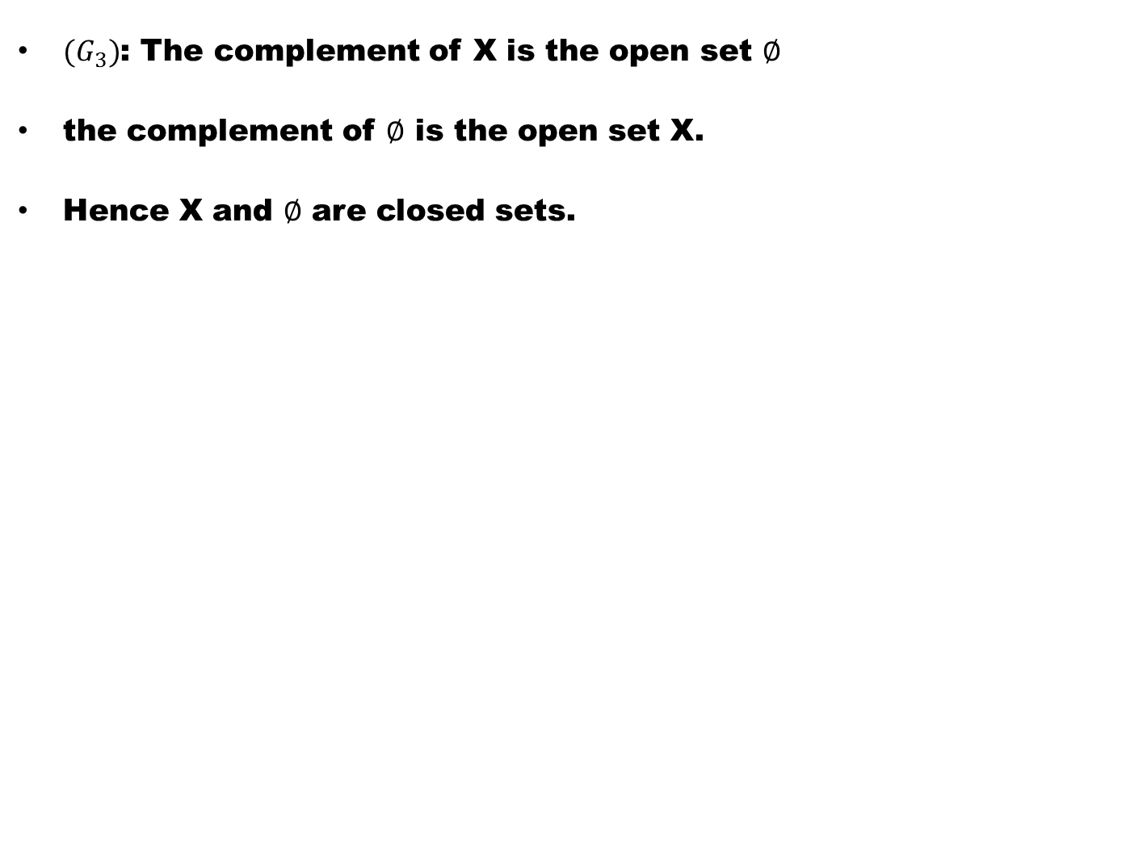
${(G}_{3})$: The complement of X is the open set $∅$
the complement of $∅$ is the open set X.
Hence X and $∅$ are closed sets.

Slide 45
${(G}_{3})$: The complement of X is the open set $∅$
the complement of $∅$ is the open set X.
Hence X and $∅$ are closed sets.

Slide 46
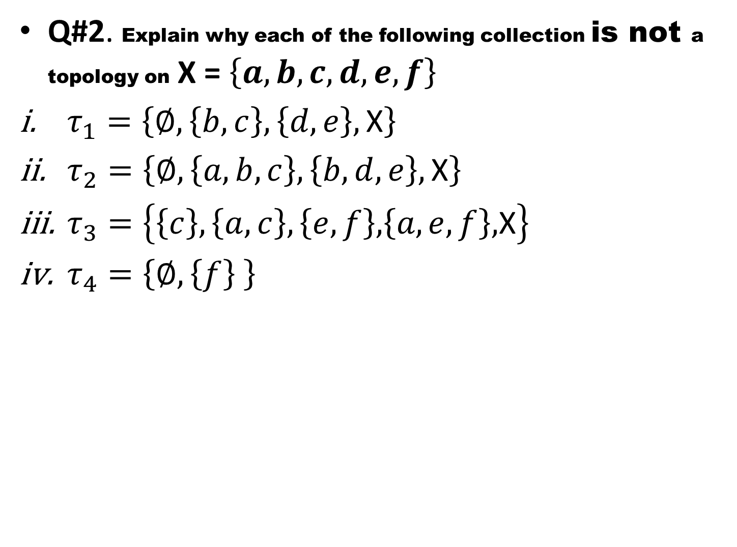
Q#2. Explain why each of the following collection is not a topology on X = $\left\{a,b,c,d,e,f\right\}$
$τ_{1}=\left\{∅,\left\{b,c\right\},\left\{d,e\right\},\text{X}\right\}$
$τ_{2}=\left\{∅,\left\{a,b,c\right\},\left\{b,d,e\right\},\text{X}\right\}$
$τ_{3}=\left\{\left\{c\right\},\left\{a,c\right\},\left\{e,f\right\}\text{,}\left\{a,e,f\right\}\text{,}\text{X}\right\}$
$τ_{4}=\left\{∅,\left\{f\right\} \right\}$

Slide 48
Q#3. Explain why each of the following collections is not a topology on the set Z of all integers:
The collection of all finite subsets of Z,
The collection of all infinite subsets of Z,
The collection of all subsets of Z whose complements are finite,
The collection of all subsets of Z of which 0 is an element,
The collection of all subsets of Z of which 0 is not an element.

Slide 51
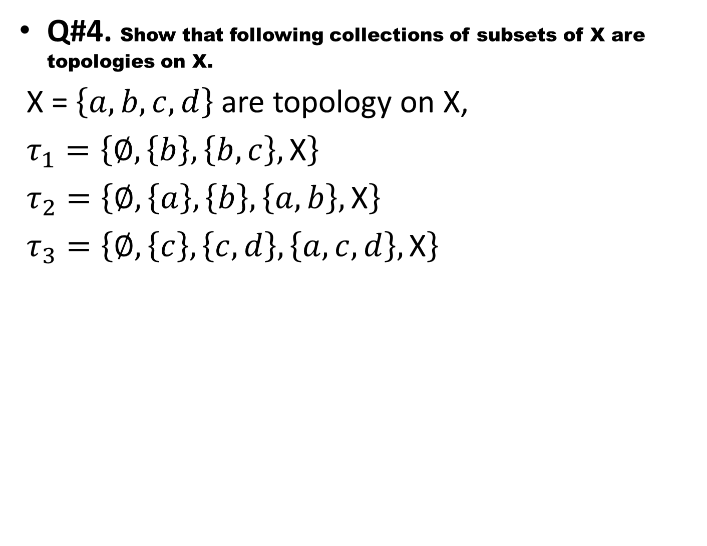
Q#4. Show that following collections of subsets of X are topologies on X.
X = $\left\{a,b,c,d\right\}$ are topology on X,
$τ_{1}=\left\{∅,\left\{b\right\},\left\{b,c\right\},\text{X}\right\}$
$τ_{2}=\left\{∅,\left\{a\right\},\left\{b\right\},\left\{a,b\right\},\text{X}\right\}$
$τ_{3}=\left\{∅,\left\{c\right\},\left\{c,d\right\},\left\{a,c,d\right\},\text{X}\right\}$

Slide 53
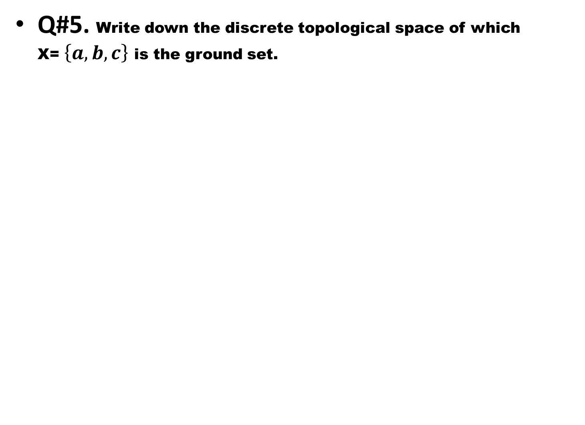
Q#5. Write down the discrete topological space of which X= $\left\{a,b,c\right\}$ is the ground set.

Slide 54
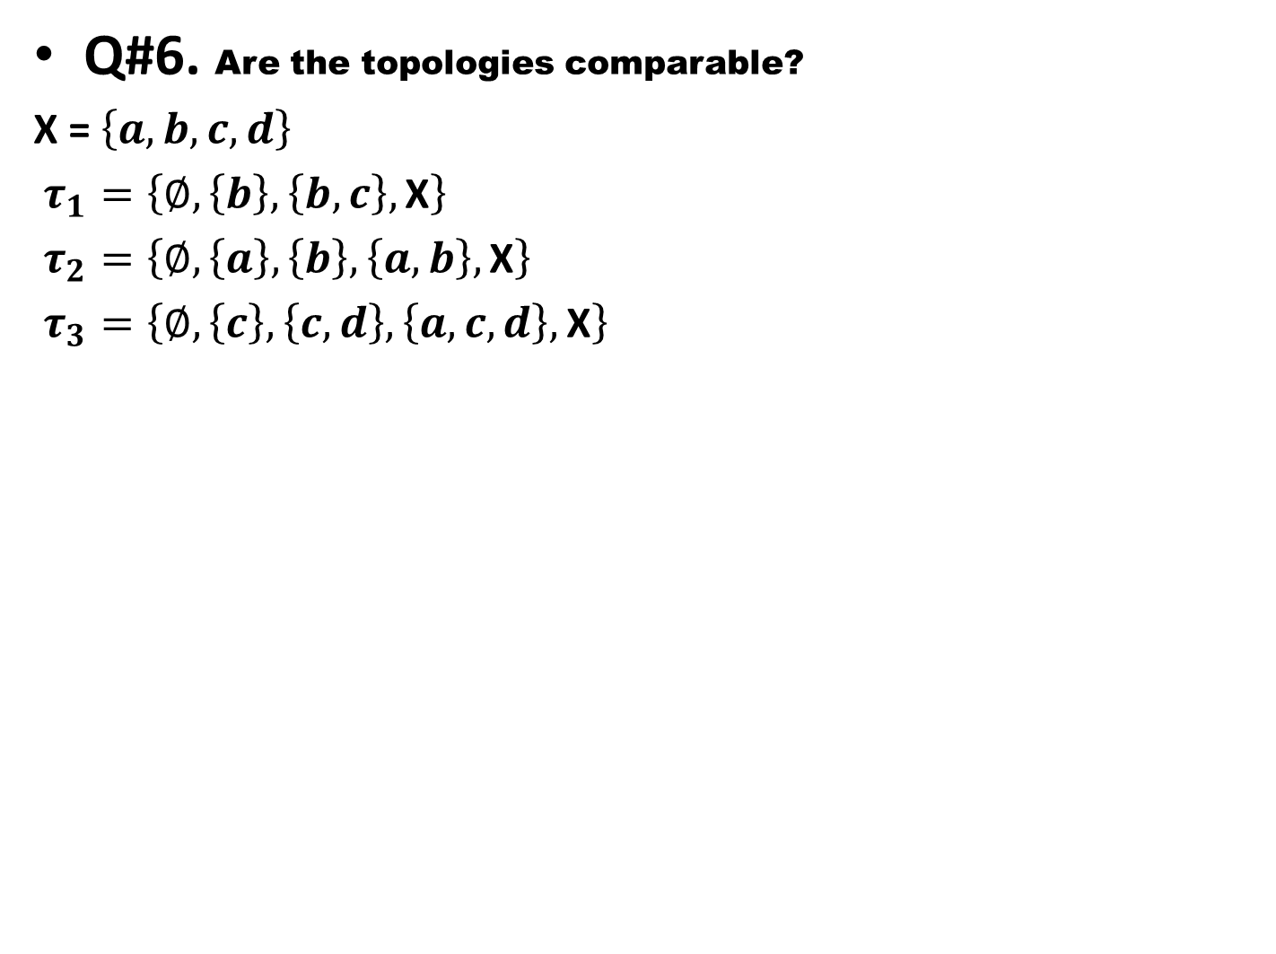
Q#6. Are the topologies comparable?
X = $\left\{a,b,c,d\right\}$
$τ_{1}=\left\{∅,\left\{b\right\},\left\{b,c\right\},\text{X}\right\}$
$τ_{2}=\left\{∅,\left\{a\right\},\left\{b\right\},\left\{a,b\right\},\text{X}\right\}$
$τ_{3}=\left\{∅,\left\{c\right\},\left\{c,d\right\},\left\{a,c,d\right\},\text{X}\right\}$

Slide 55
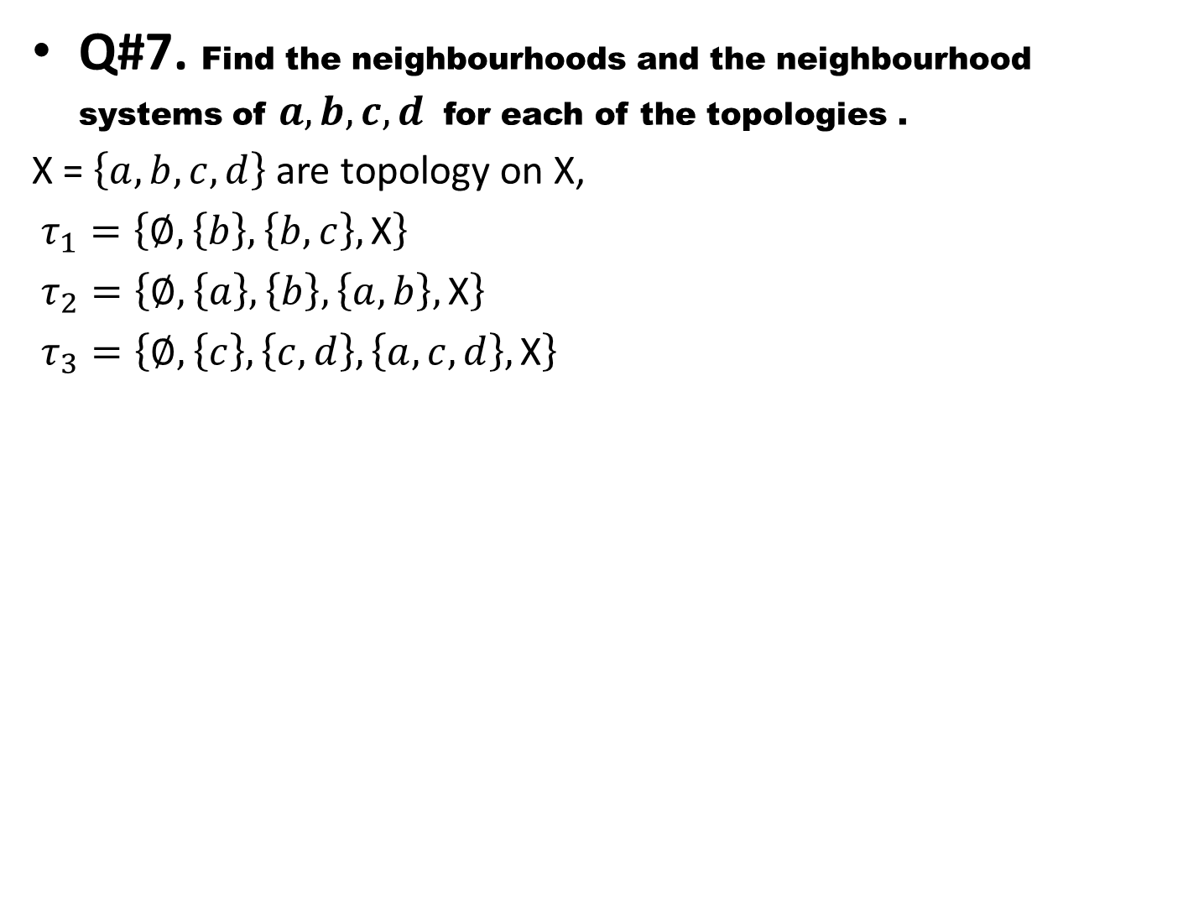
Q#7. Find the neighbourhoods and the neighbourhood systems of $a,b,c,d$ for each of the topologies .
X = $\left\{a,b,c,d\right\}$ are topology on X,
$τ_{1}=\left\{∅,\left\{b\right\},\left\{b,c\right\},\text{X}\right\}$
$τ_{2}=\left\{∅,\left\{a\right\},\left\{b\right\},\left\{a,b\right\},\text{X}\right\}$
$τ_{3}=\left\{∅,\left\{c\right\},\left\{c,d\right\},\left\{a,c,d\right\},\text{X}\right\}$

Slide 57
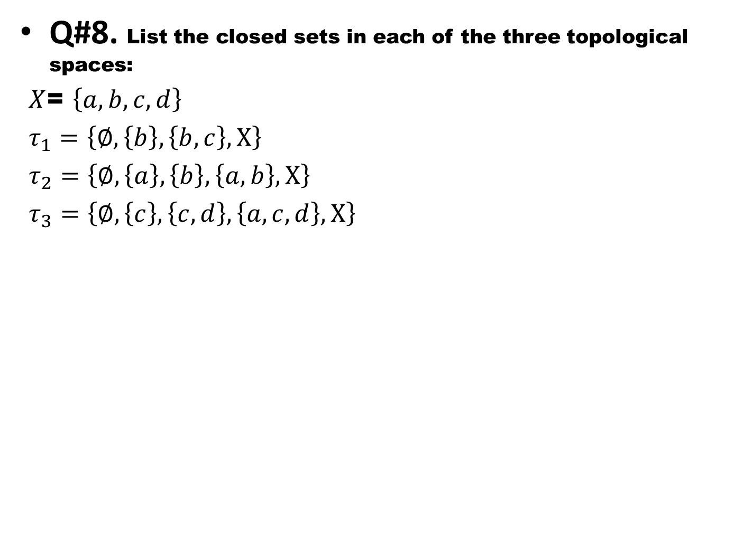
Q#8. List the closed sets in each of the three topological spaces:
$X$= $\left\{a,b,c,d\right\}$
$τ_{1}=\left\{∅,\left\{b\right\},\left\{b,c\right\},\text{X}\right\}$
$τ_{2}=\left\{∅,\left\{a\right\},\left\{b\right\},\left\{a,b\right\},\text{X}\right\}$
$τ_{3}=\left\{∅,\left\{c\right\},\left\{c,d\right\},\left\{a,c,d\right\},\text{X}\right\}$

Slide 58
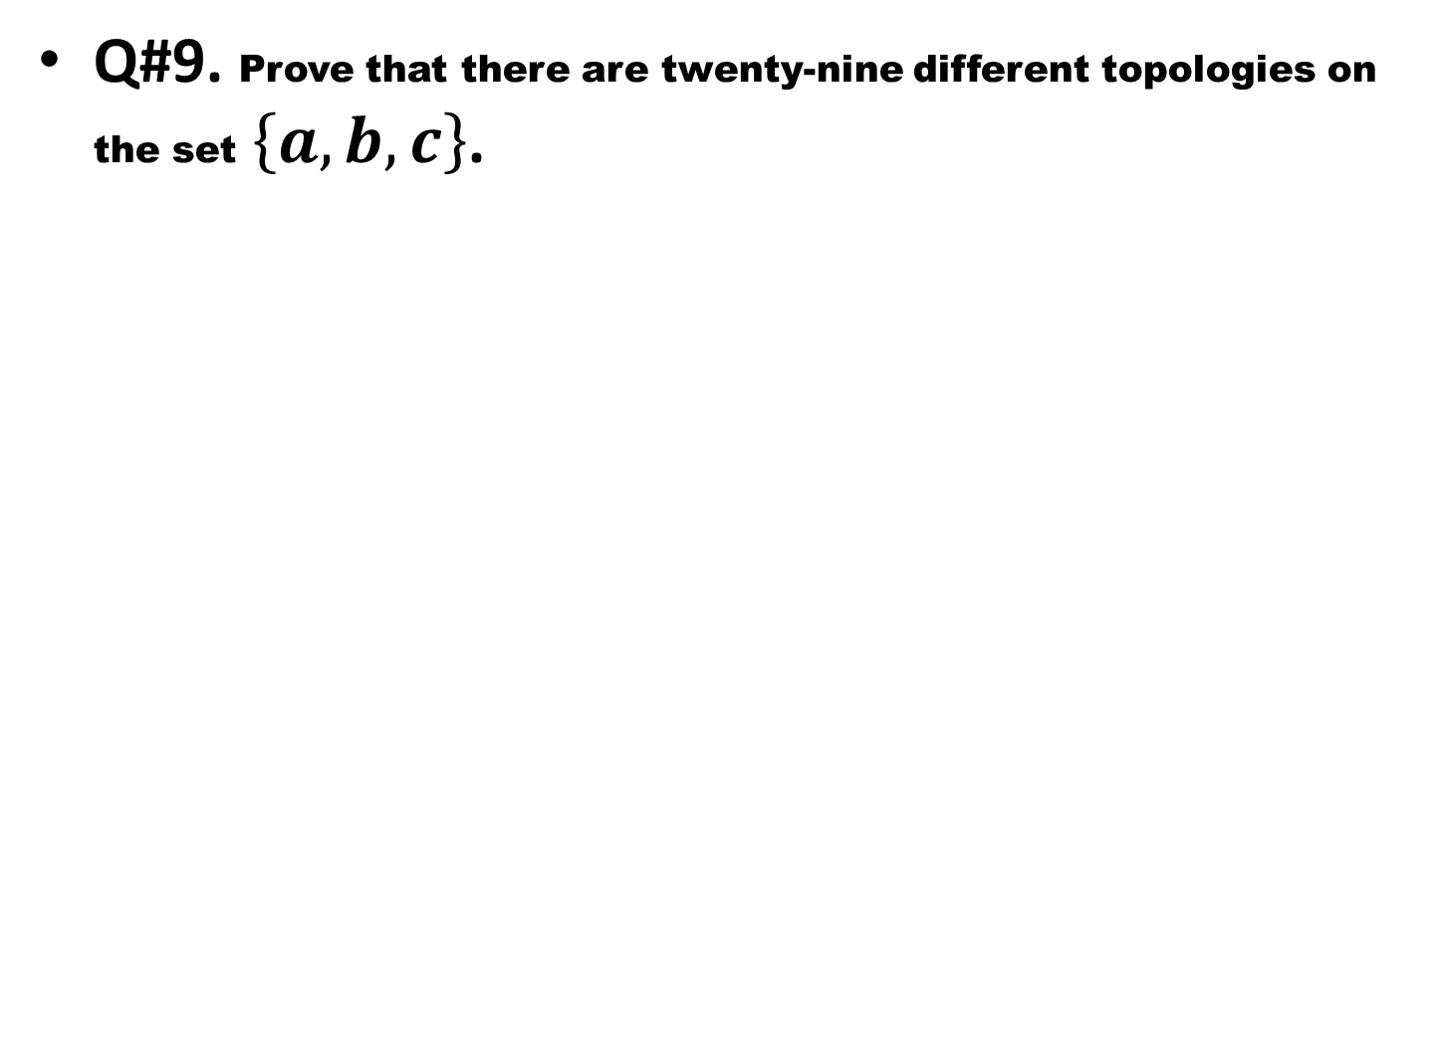
Q#9. Prove that there are twenty-nine different topologies on the set$\left\{a,b,c\right\}$.

Slide 59
Good Luck to You

