Slide 1
Set Topology
MTH 251
Lecture # 12

Slide 2
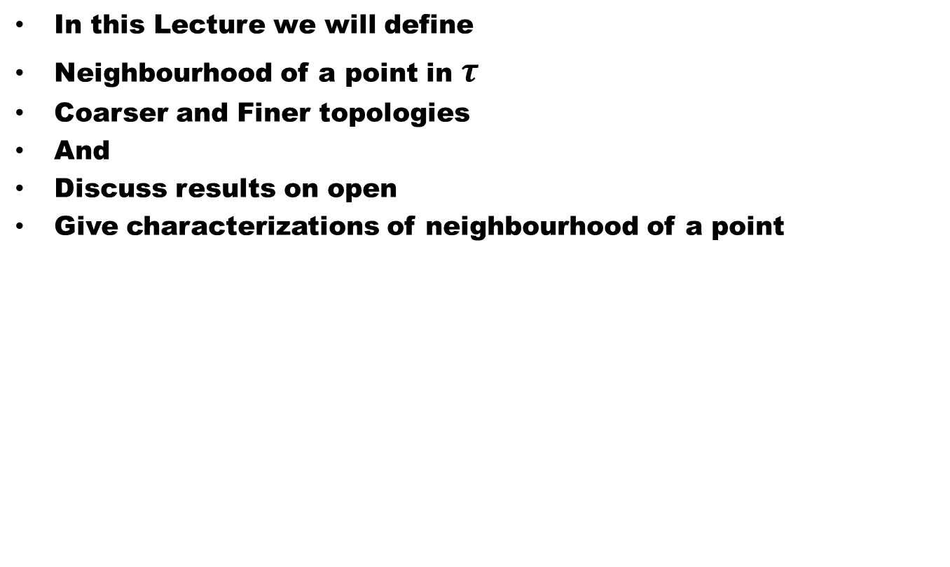
Lecture Outline
In this Lecture we will define
Neighbourhood of a point in $τ$
Coarser and Finer topologies
And
Discuss results on open
Give characterizations of neighbourhood of a point

Slide 3
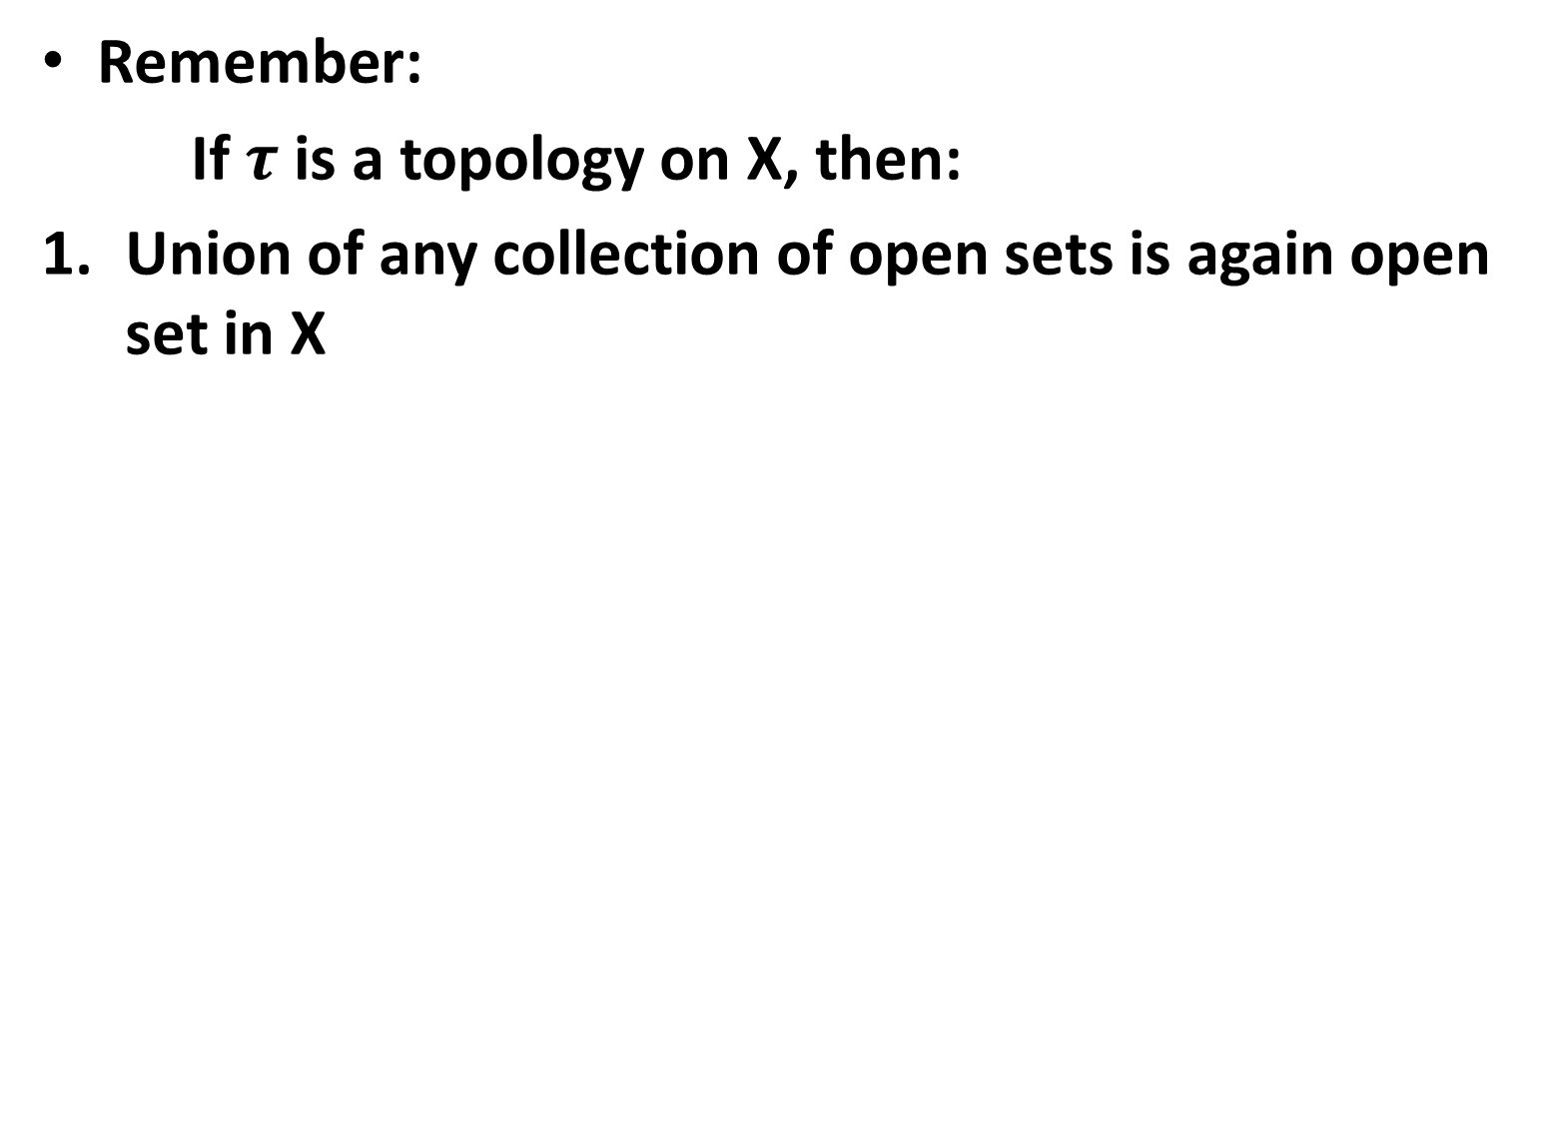
Remember:
If $τ$is a topology on X, then:
Union of any collection of open sets is again open set in X

Slide 4
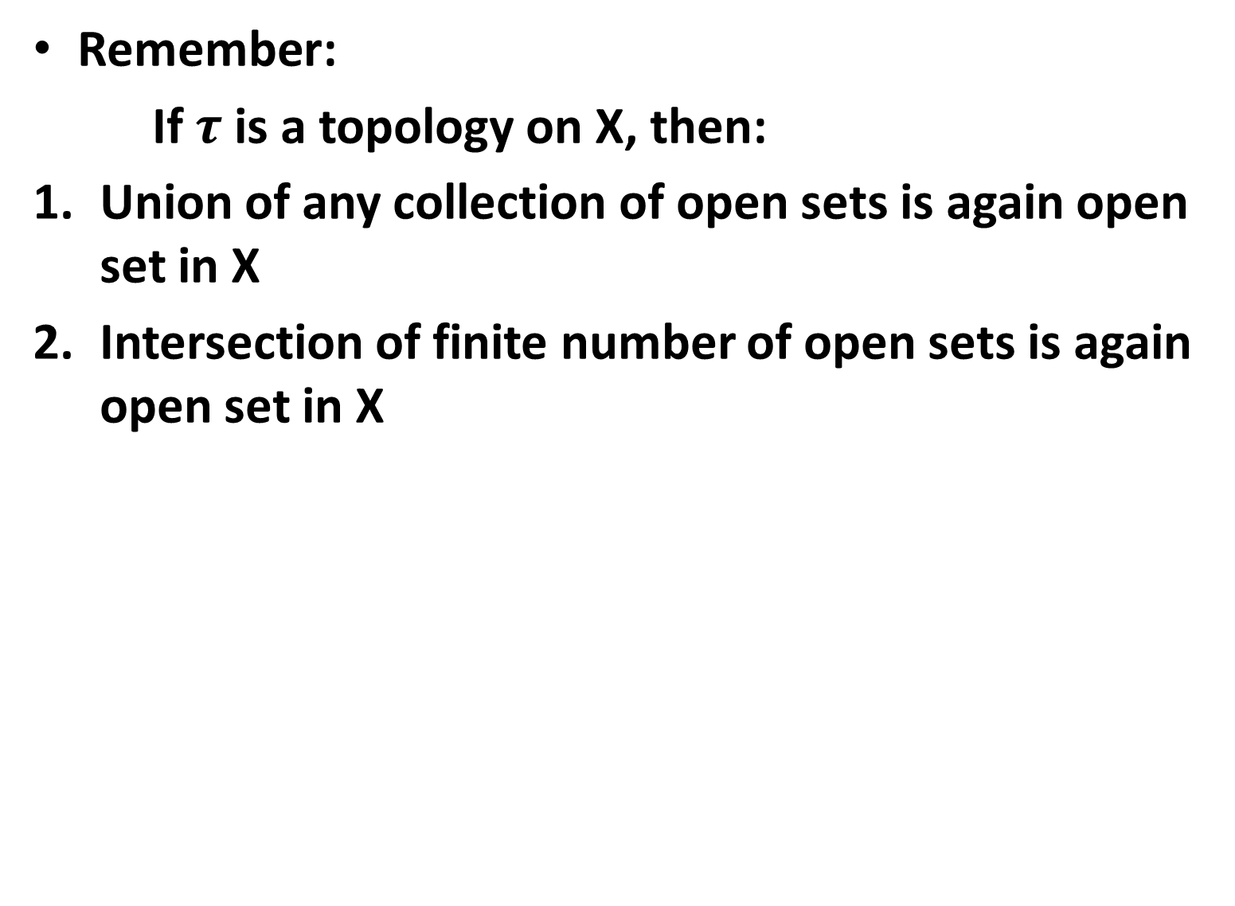
Remember:
If $τ$is a topology on X, then:
Union of any collection of open sets is again open set in X
Intersection of finite number of open sets is again open set in X

Slide 5
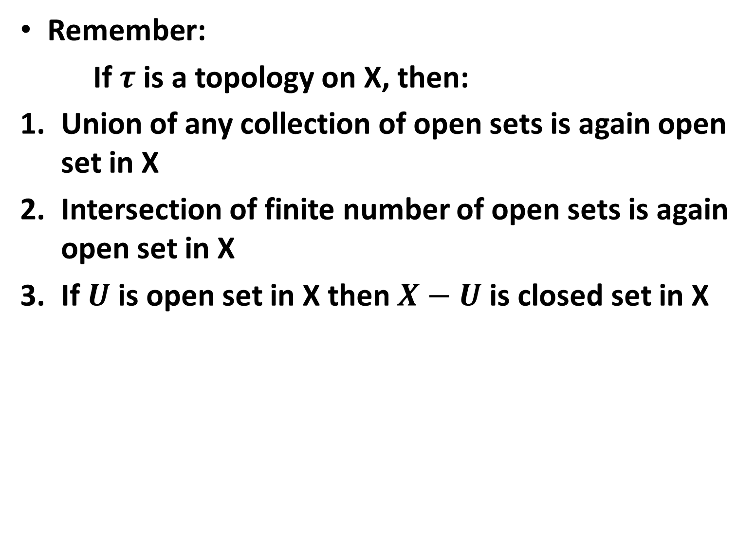
Remember:
If $τ$is a topology on X, then:
Union of any collection of open sets is again open set in X
Intersection of finite number of open sets is again open set in X
If $U$ is open set in X then $X−U$ is closed set in X

Slide 6
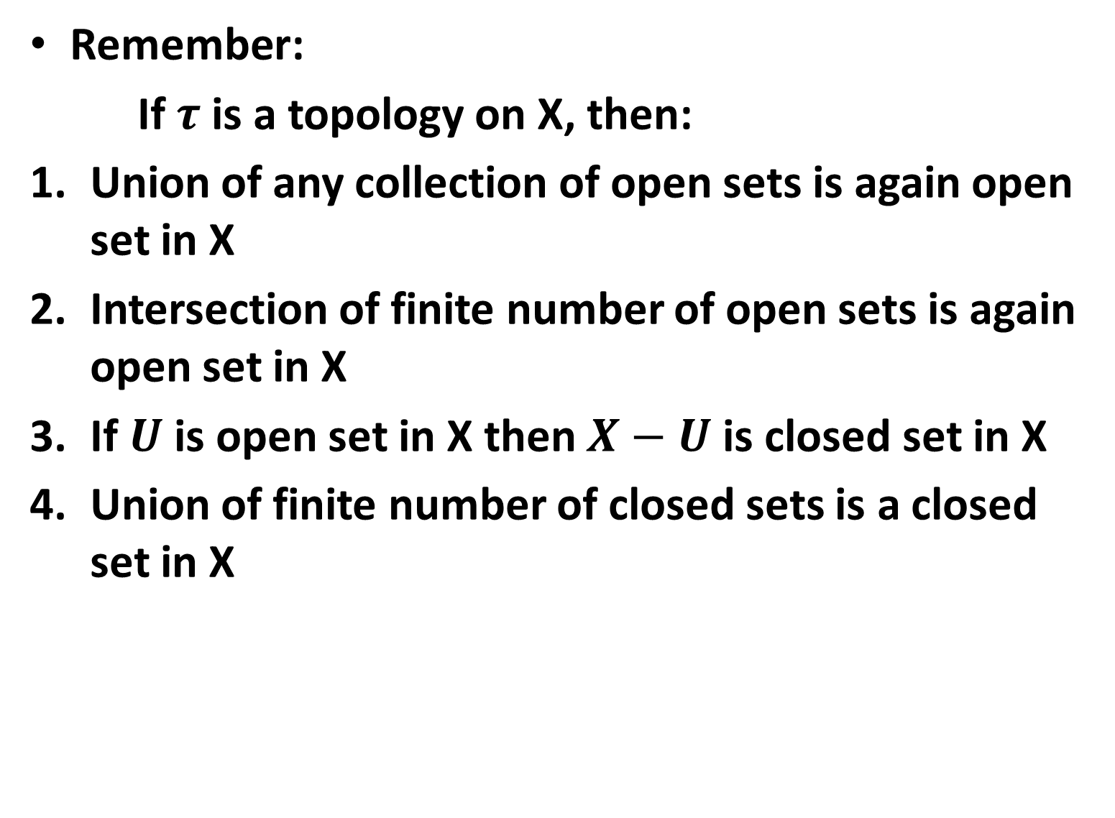
Remember:
If $τ$is a topology on X, then:
Union of any collection of open sets is again open set in X
Intersection of finite number of open sets is again open set in X
If $U$ is open set in X then $X−U$ is closed set in X
Union of finite number of closed sets is a closed set in X

Slide 7
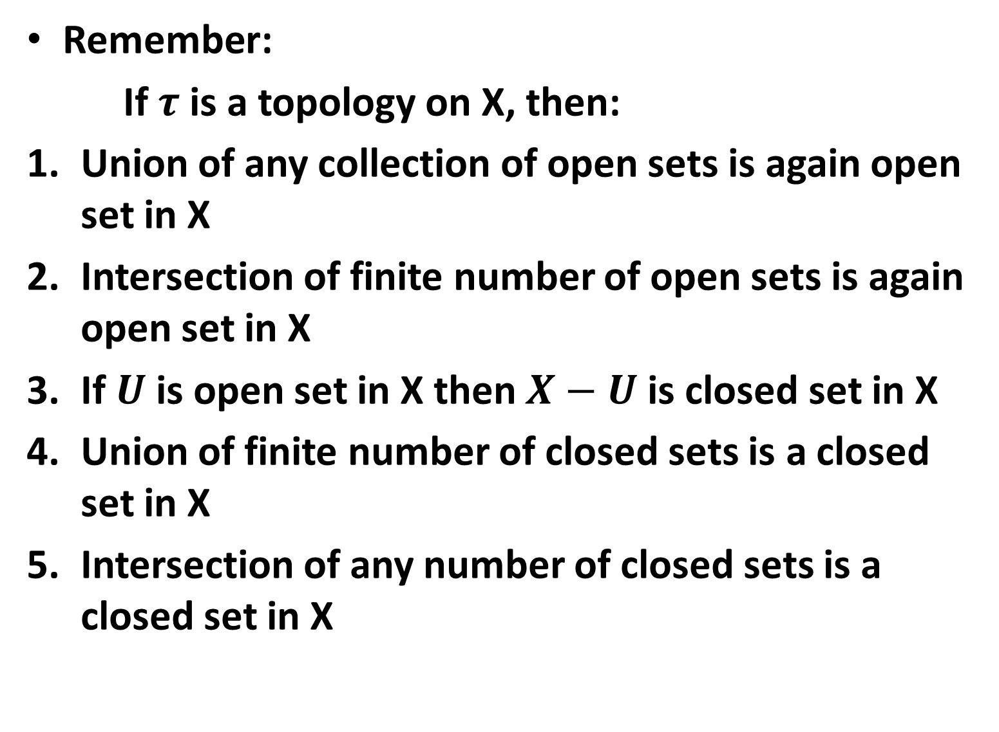
Remember:
If $τ$is a topology on X, then:
Union of any collection of open sets is again open set in X
Intersection of finite number of open sets is again open set in X
If $U$ is open set in X then $X−U$ is closed set in X
Union of finite number of closed sets is a closed set in X
Intersection of any number of closed sets is a closed set in X

Slide 8
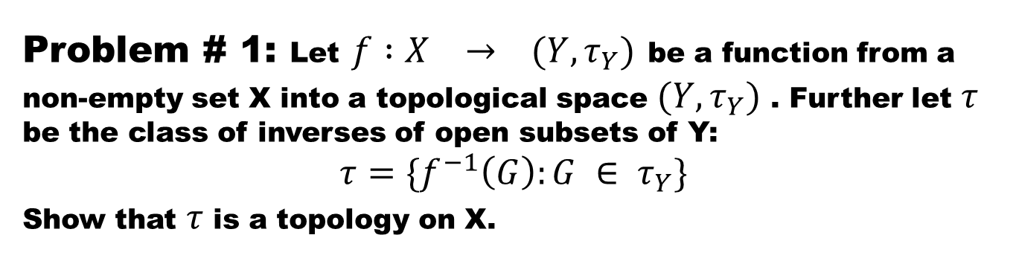
Problem # 1: Let$f :X → (Y, τ_{Y})$be a function from a non-empty set X into a topological space $(Y, τ_{Y})$ . Further let $τ$ be the class of inverses of open subsets of Y:
$$τ=\{f^{−1}\left(G\right):G ∈ τ_{Y}\}$$
Show that $τ$ is a topology on X.

Slide 10
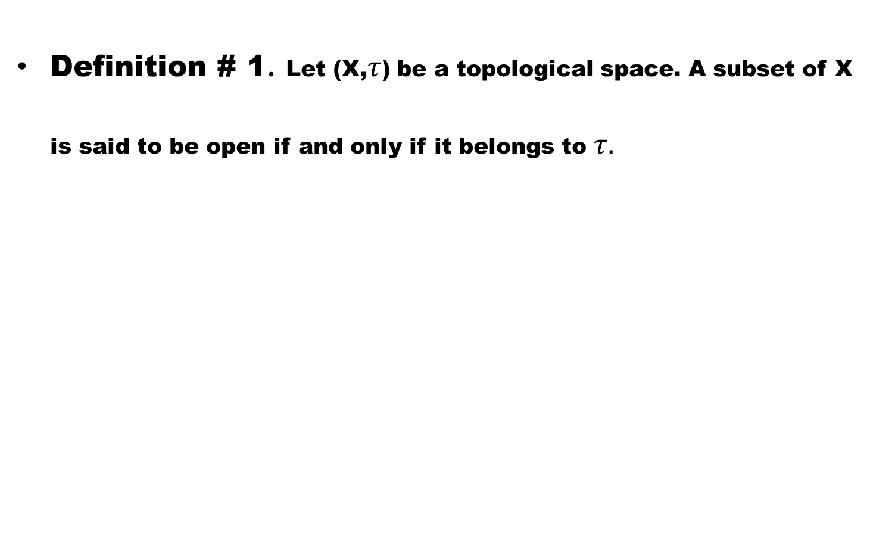
Open sets and Neighbourhoods
Definition # 1. Let (X,$τ$) be a topological space. A subset of X is said to be open if and only if it belongs to $τ.$

Slide 11
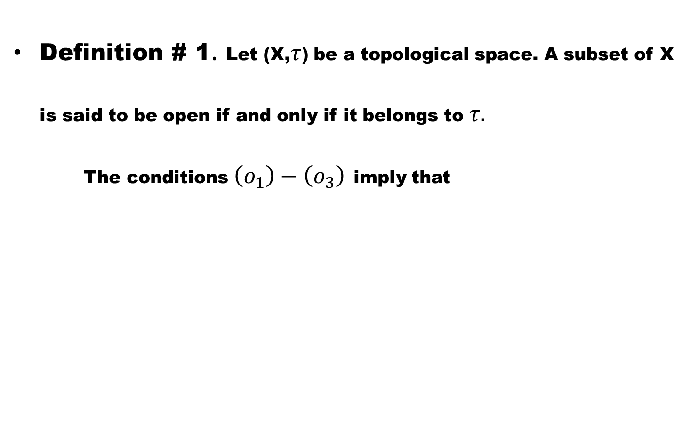
Open sets and Neighbourhoods
Definition # 1. Let (X,$τ$) be a topological space. A subset of X is said to be open if and only if it belongs to $τ.$
The conditions $\left(o_{1}\right)−\left(o_{3}\right)$imply that

Slide 12
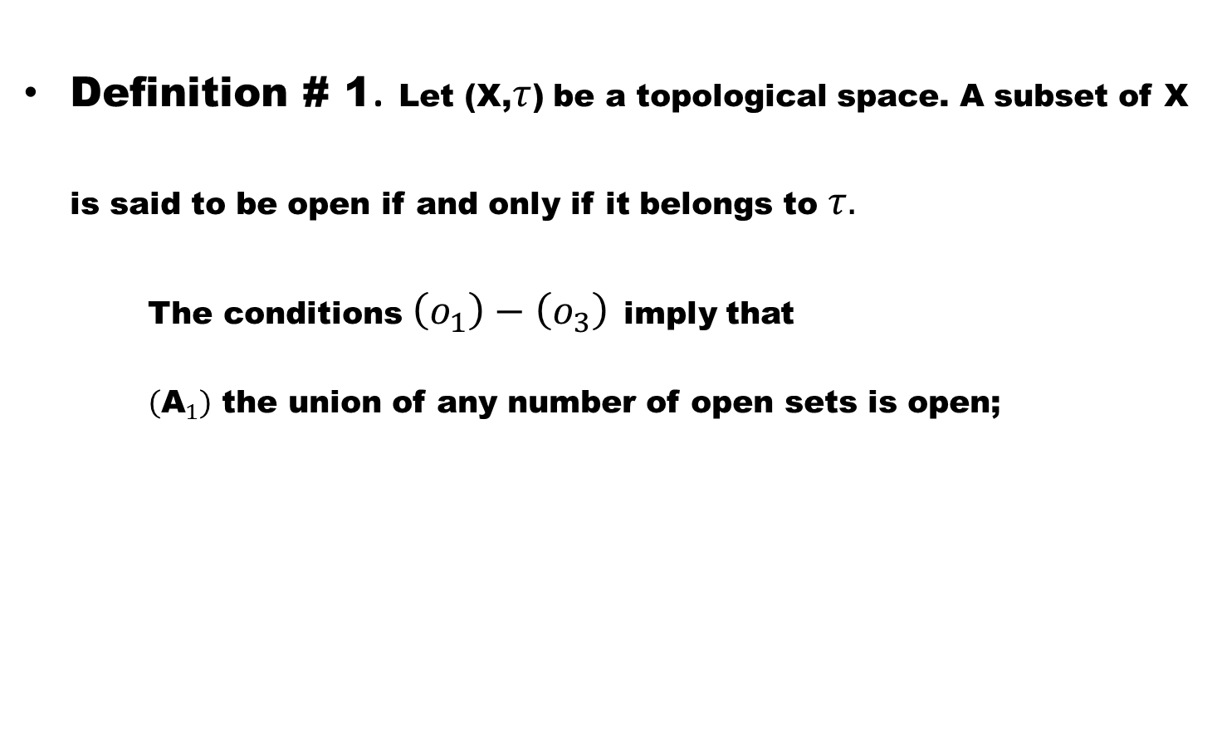
Open sets and Neighbourhoods
Definition # 1. Let (X,$τ$) be a topological space. A subset of X is said to be open if and only if it belongs to $τ.$
The conditions $\left(o_{1}\right)−\left(o_{3}\right)$imply that
$\left({\text{A}}_{1}\right)$ the union of any number of open sets is open;

Slide 13
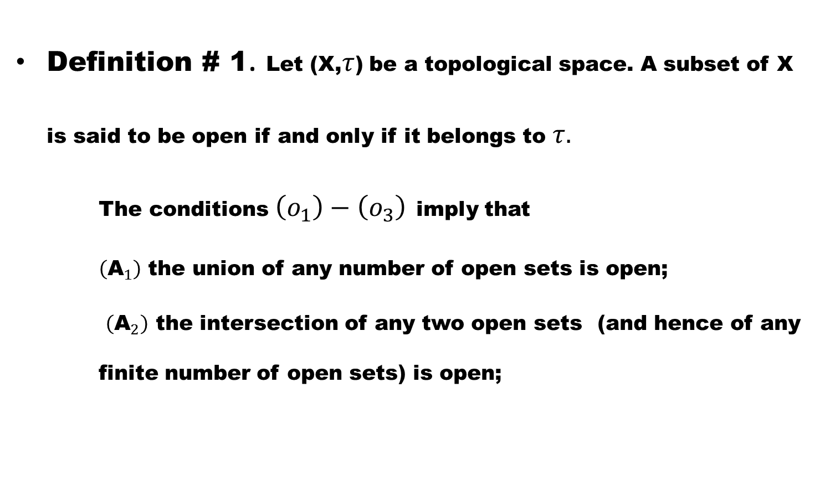
Open sets and Neighbourhoods
Definition # 1. Let (X,$τ$) be a topological space. A subset of X is said to be open if and only if it belongs to $τ.$
The conditions $\left(o_{1}\right)−\left(o_{3}\right)$imply that
$\left({\text{A}}_{1}\right)$ the union of any number of open sets is open;
$\left({\text{A}}_{2}\right)$ the intersection of any two open sets (and hence of any finite number of open sets) is open;

Slide 14
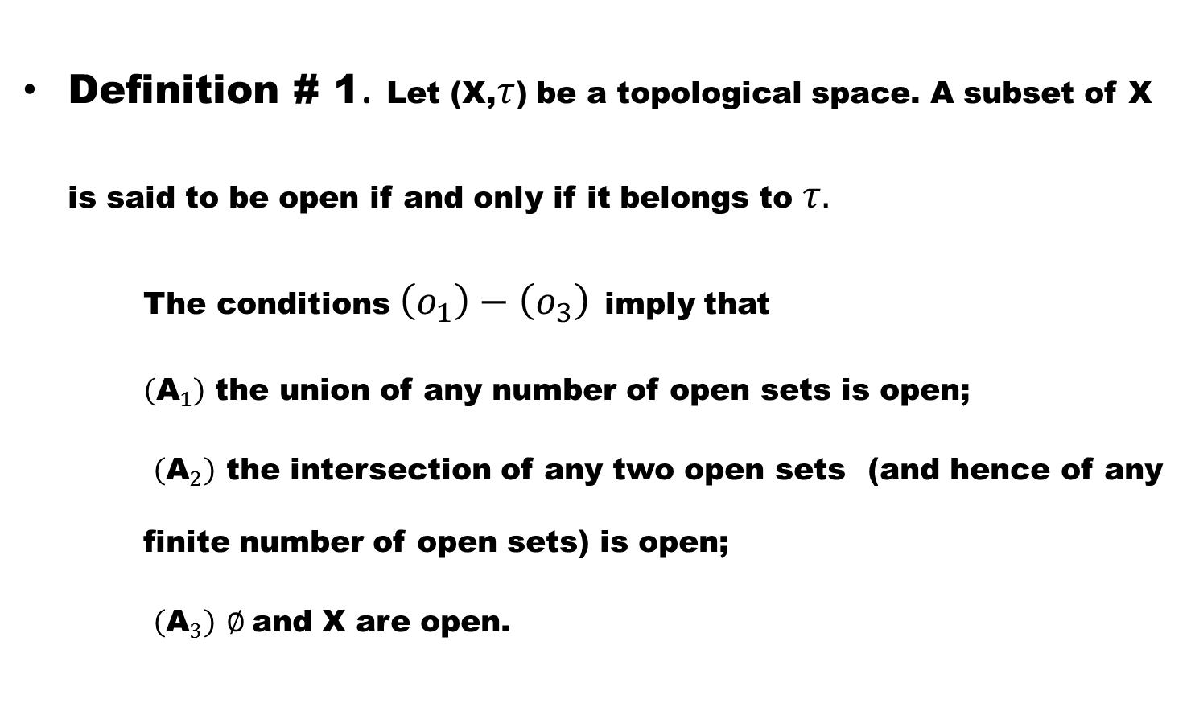
Open sets and Neighbourhoods
Definition # 1. Let (X,$τ$) be a topological space. A subset of X is said to be open if and only if it belongs to $τ.$
The conditions $\left(o_{1}\right)−\left(o_{3}\right)$imply that
$\left({\text{A}}_{1}\right)$ the union of any number of open sets is open;
$\left({\text{A}}_{2}\right)$ the intersection of any two open sets (and hence of any finite number of open sets) is open;
$\left({\text{A}}_{3}\right)$$∅$and X are open.

Slide 15
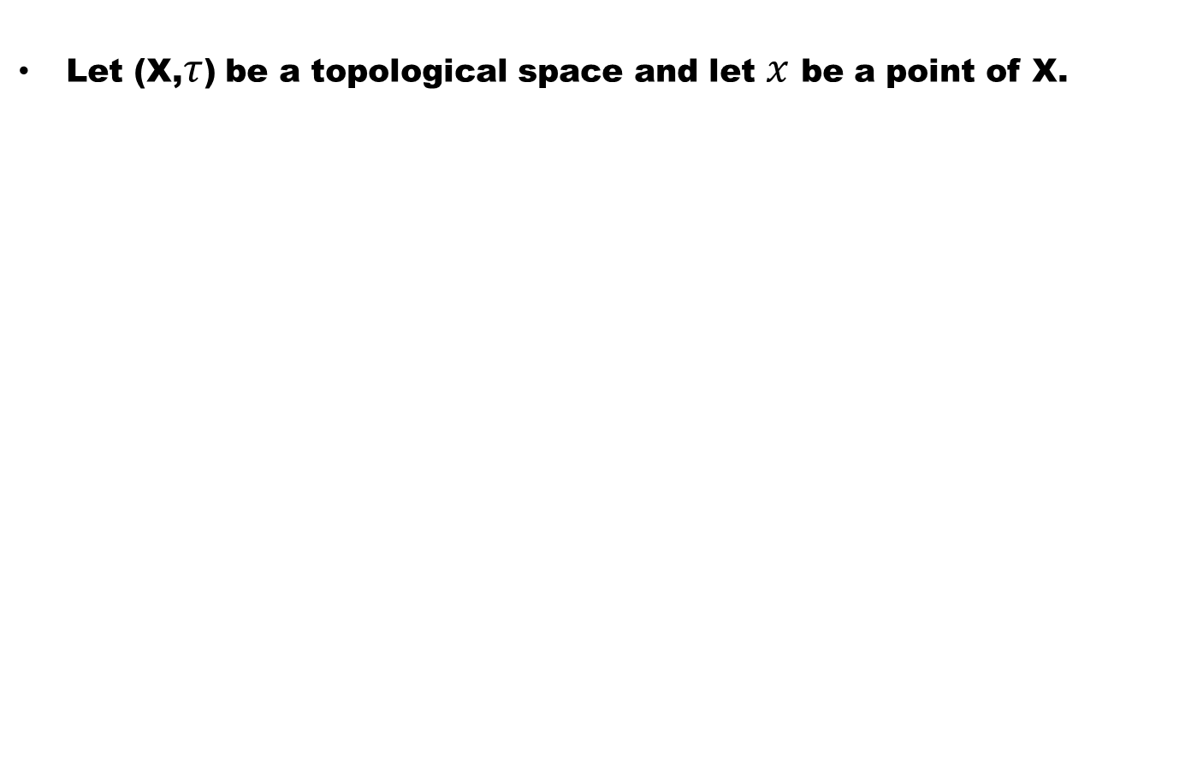
Definition # 2 (Neighbourhood of a point)
Let (X,$τ$) be a topological space and let $x$ be a point of X.

Slide 16
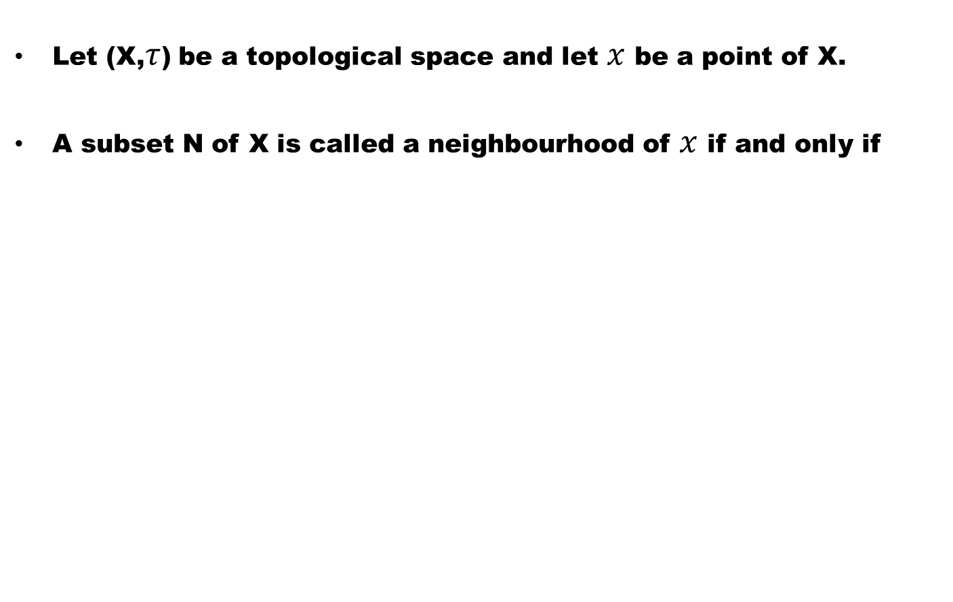
Definition # 2 (Neighbourhood of a point)
Let (X,$τ$) be a topological space and let $x$ be a point of X.
A subset N of X is called a neighbourhood of $x$ if and only if

Slide 17
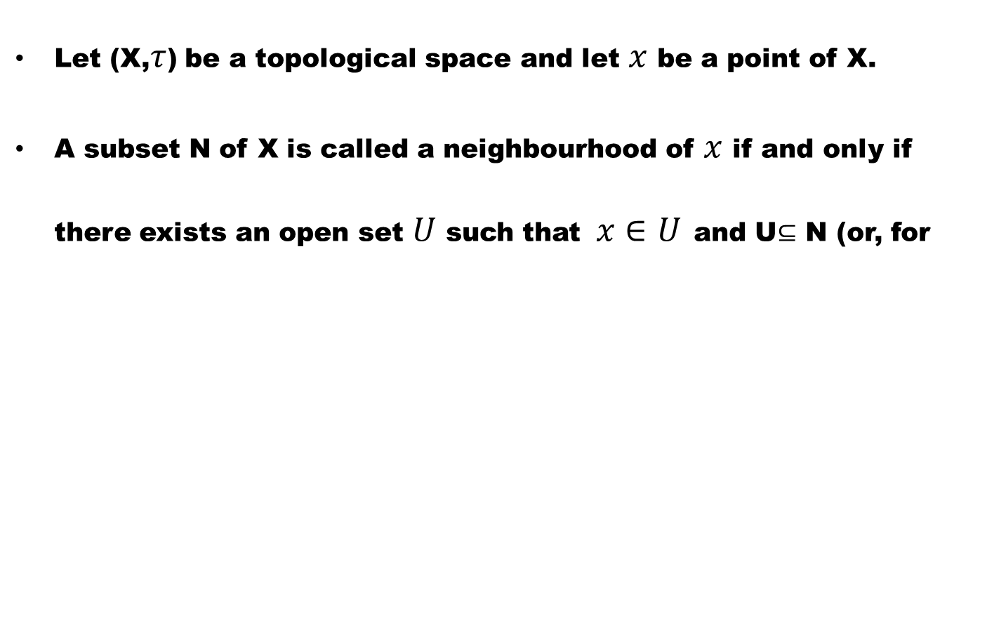
Definition # 2 (Neighbourhood of a point)
Let (X,$τ$) be a topological space and let $x$ be a point of X.
A subset N of X is called a neighbourhood of $x$ if and only if there exists an open set $U$ such that$x∈U$and U$⊆$ N (or, for

Slide 18
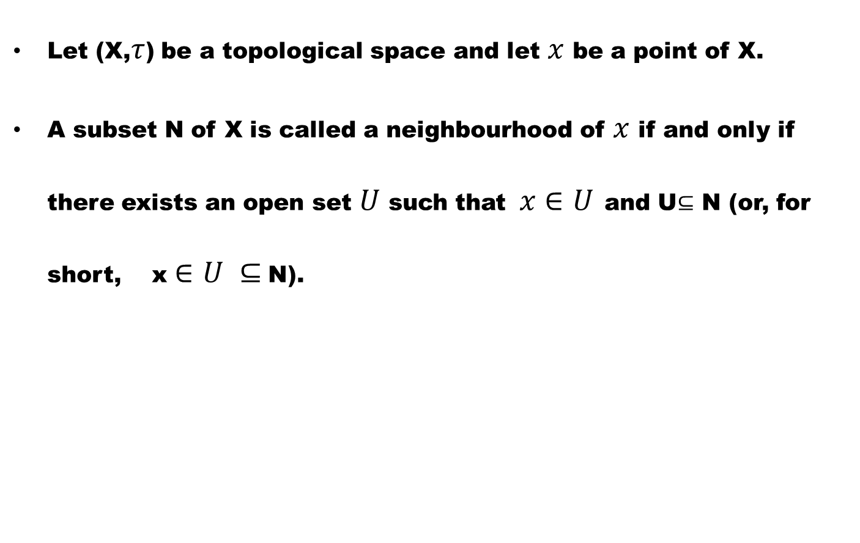
Definition # 2 (Neighbourhood of a point)
Let (X,$τ$) be a topological space and let $x$ be a point of X.
A subset N of X is called a neighbourhood of $x$ if and only if there exists an open set $U$ such that$x∈U$and U$⊆$ N (or, for short, x $∈U ⊆$N).

Slide 19
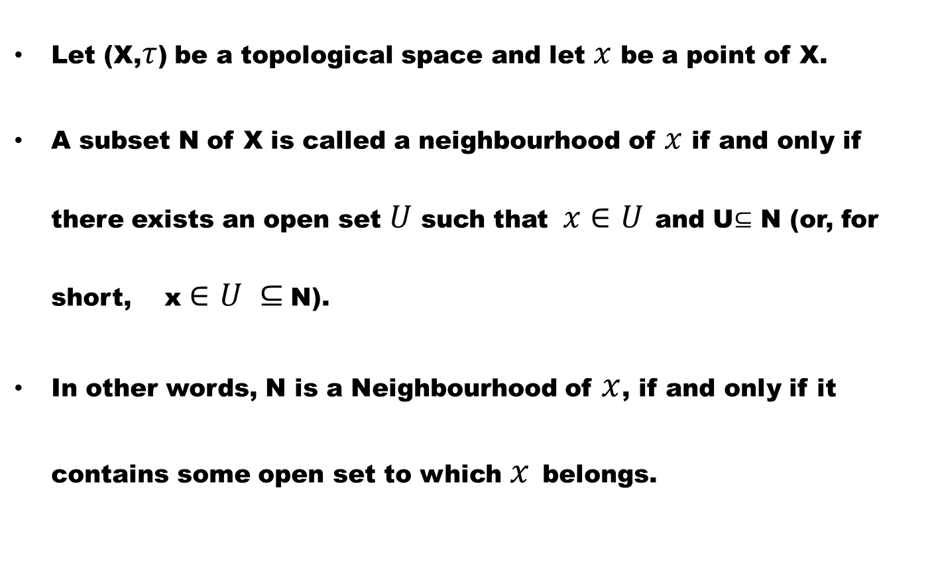
Definition # 2 (Neighbourhood of a point)
Let (X,$τ$) be a topological space and let $x$ be a point of X.
A subset N of X is called a neighbourhood of $x$ if and only if there exists an open set $U$ such that$x∈U$and U$⊆$ N (or, for short, x $∈U ⊆$N).
In other words, N is a Neighbourhood of $x$, if and only if it contains some open set to which $x$belongs.

Slide 20
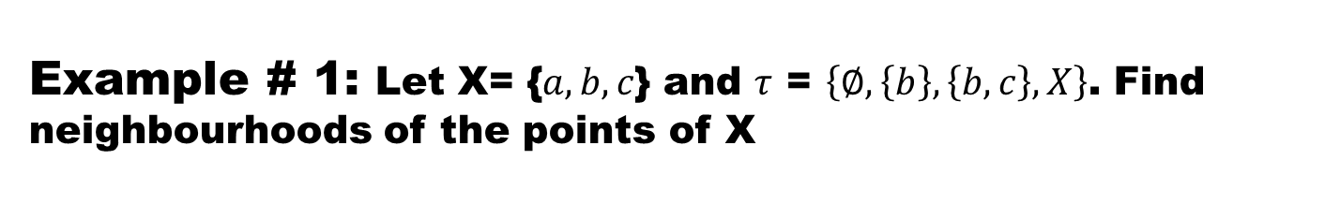
Example # 1: Let X= {$a,b,c$} and $τ$= $\left\{∅,\left\{b\right\},\left\{b,c\right\},X\right\}$. Find neighbourhoods of the points of X
Solution.

Slide 21
Example # 2.
In an indiscrete topological space, each point has a single neighbourhood which is the ground itself.

Slide 22
The following example illustrate that a neighbourhood of a point may not be an open set.

Slide 23
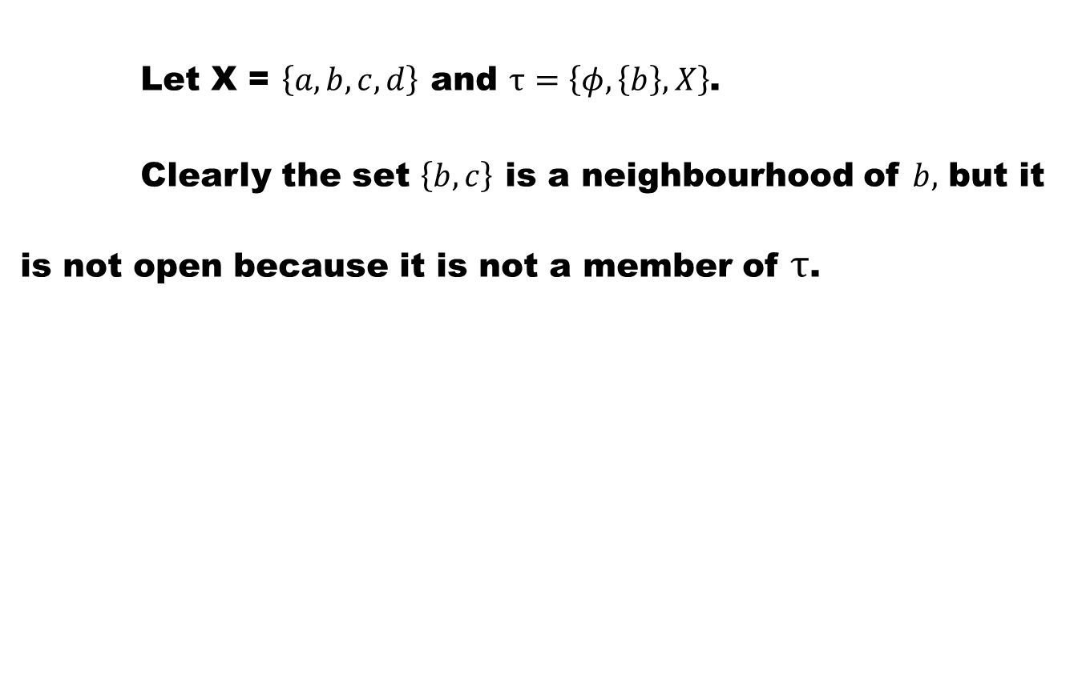
Example # 3:
  Let X = $\left\{a,b,c,d\right\}$ and $τ=\left\{φ,\left\{b\right\},X\right\}$.
Clearly the set $\left\{b,c\right\}$ is a neighbourhood of $b,$ but it is not open because it is not a member of $τ$.

Slide 24
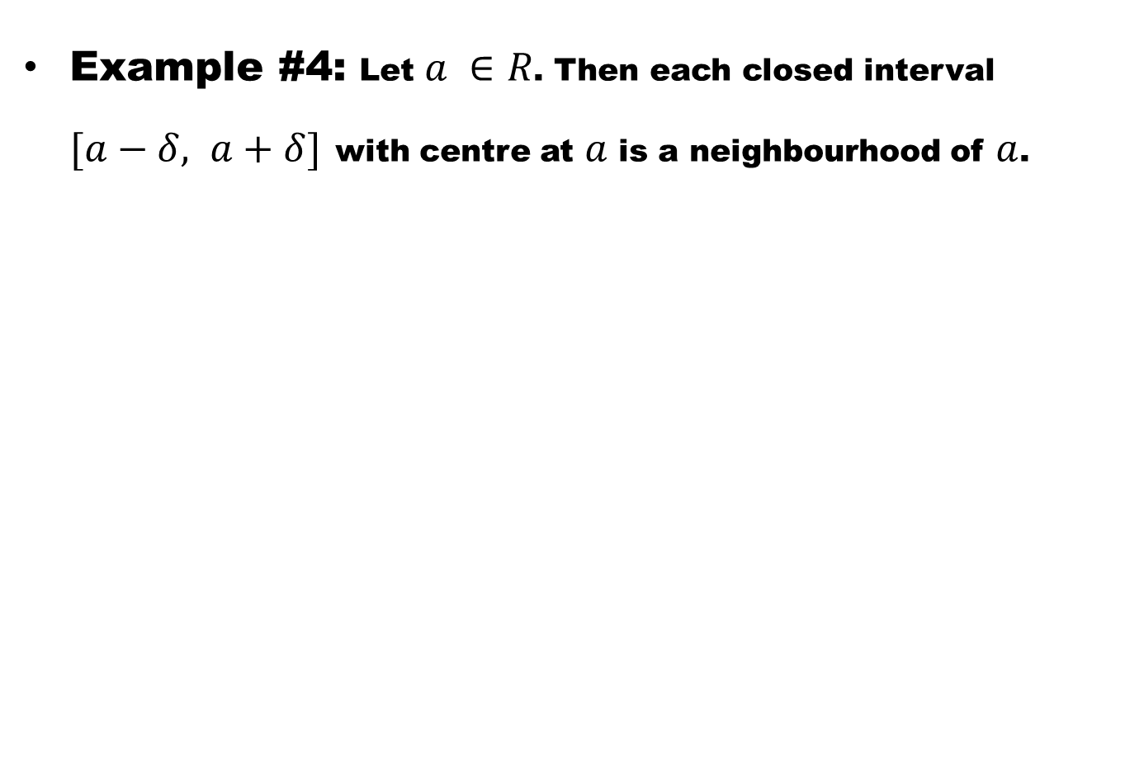
Example #4:Let $a ∈R$. Then each closed interval $[a−δ, a+δ]$with centre at $a$ is a neighbourhood of $a$.

Slide 25
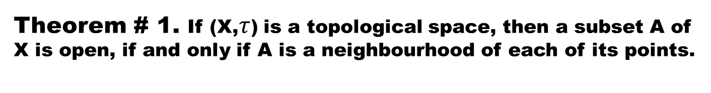
Theorem # 1. If (X,$τ$) is a topological space, then a subset A of X is open, if and only if A is a neighbourhood of each of its points.

Slide 26

Theorem # 1. If (X,$τ$) is a topological space, then a subset A of X is open, if and only if A is a neighbourhood of each of its points.
  $Proof$. Suppose that A is open.

Slide 27
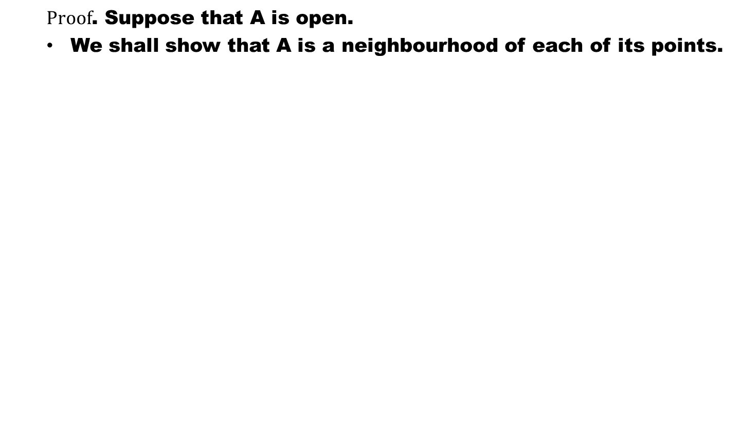
Theorem # 1. If (X,$τ$) is a topological space, then a subset A of X is open, if and only if A is a neighbourhood of each of its points.
  $Proof$. Suppose that A is open.
  We shall show that A is a neighbourhood of each of its points.

Slide 28
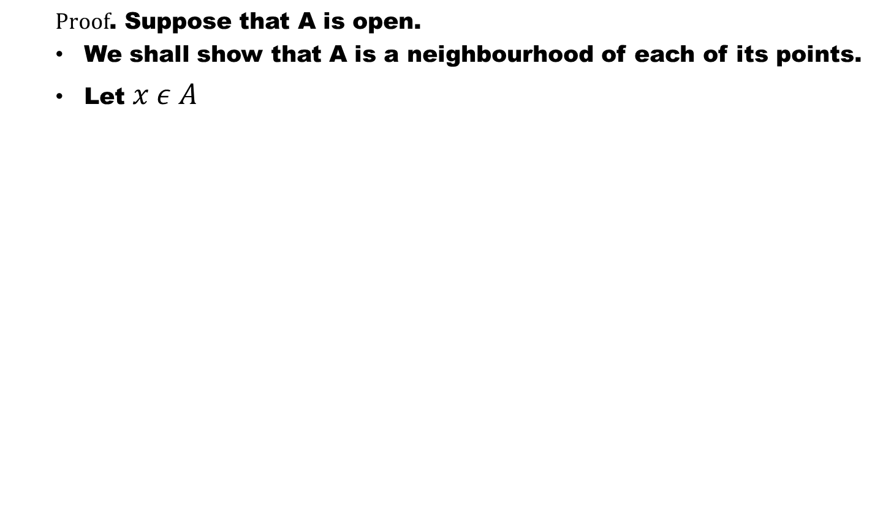
Theorem # 1. If (X,$τ$) is a topological space, then a subset A of X is open, if and only if A is a neighbourhood of each of its points.
  $Proof$. Suppose that A is open.
  We shall show that A is a neighbourhood of each of its points.
  Let $x ε A$

Slide 29
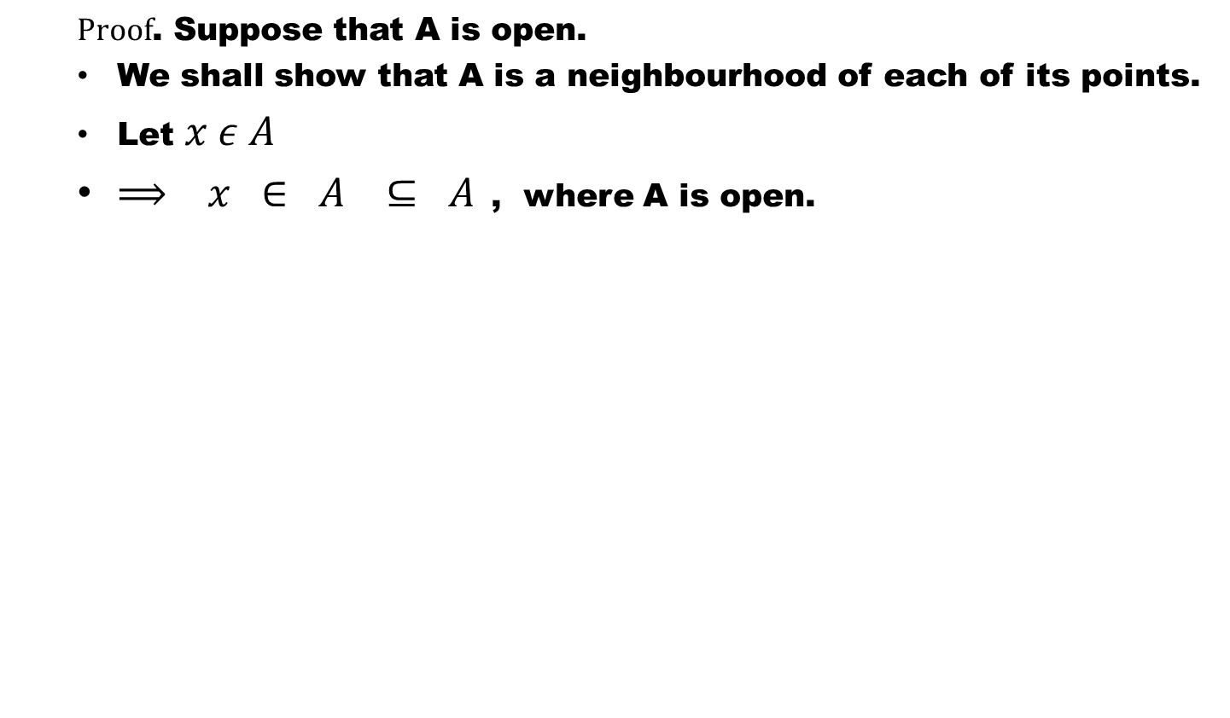
Theorem # 1. If (X,$τ$) is a topological space, then a subset A of X is open, if and only if A is a neighbourhood of each of its points.
  $Proof$. Suppose that A is open.
  We shall show that A is a neighbourhood of each of its points.
  Let $x ε A$
  $⟹ x ∈ A ⊆ A$, where A is open.

Slide 30
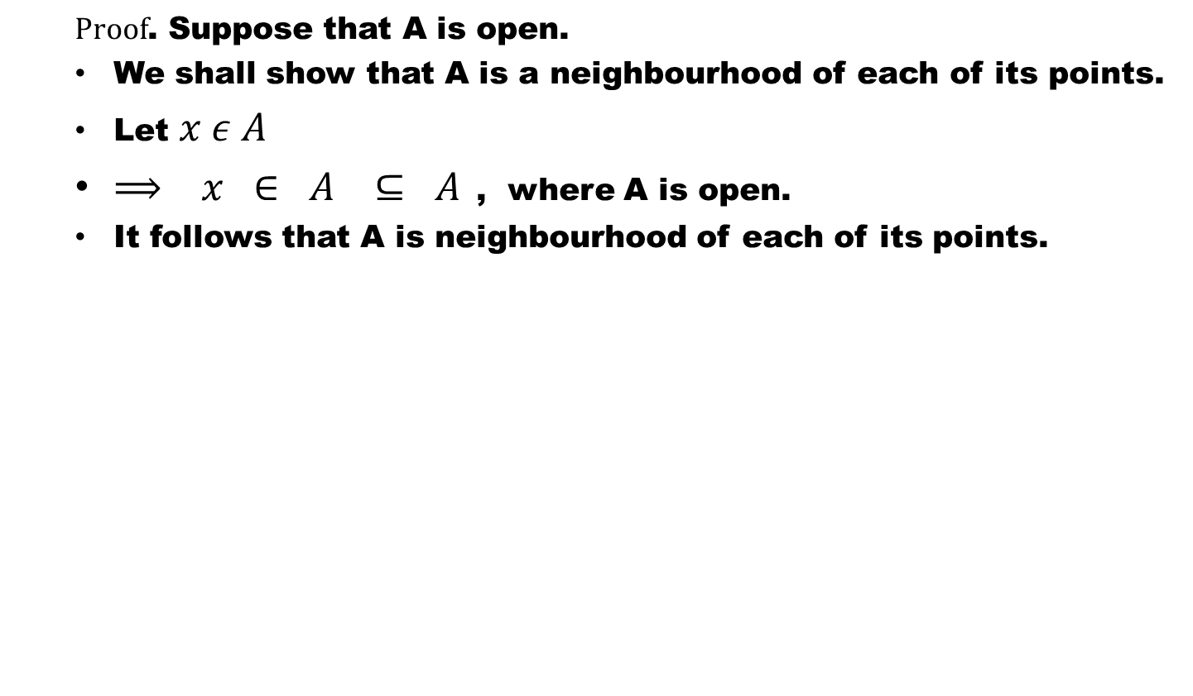
Theorem # 1. If (X,$τ$) is a topological space, then a subset A of X is open, if and only if A is a neighbourhood of each of its points.
  $Proof$. Suppose that A is open.
  We shall show that A is a neighbourhood of each of its points.
  Let $x ε A$
  $⟹ x ∈ A ⊆ A$, where A is open.
  It follows that A is neighbourhood of each of its points.

Slide 31
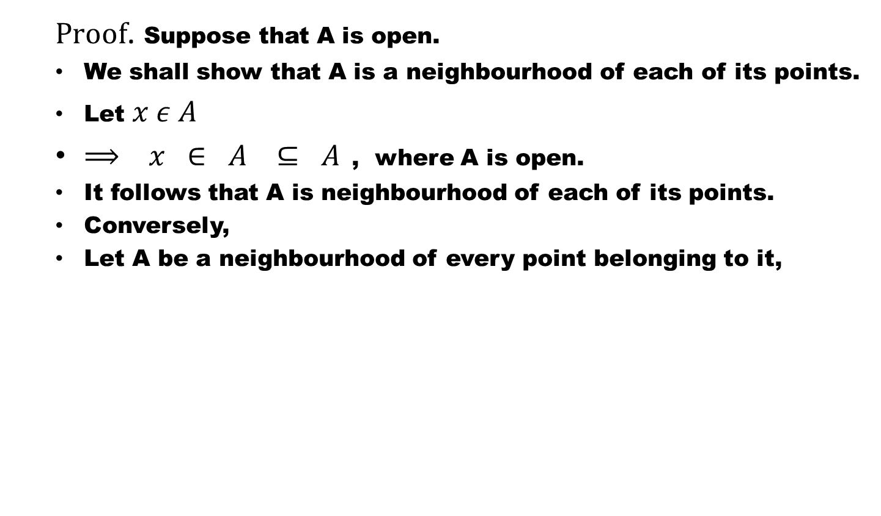
Theorem # 1. If (X,$τ$) is a topological space, then a subset A of X is open, if and only if A is a neighbourhood of each of its points.
  $Proof$. Suppose that A is open.
  We shall show that A is a neighbourhood of each of its points.
  Let $x ε A$
  $⟹ x ∈ A ⊆ A$, where A is open.
  It follows that A is neighbourhood of each of its points.
  Conversely,
  Let A bea neighbourhood of every point belonging to it,

Slide 32
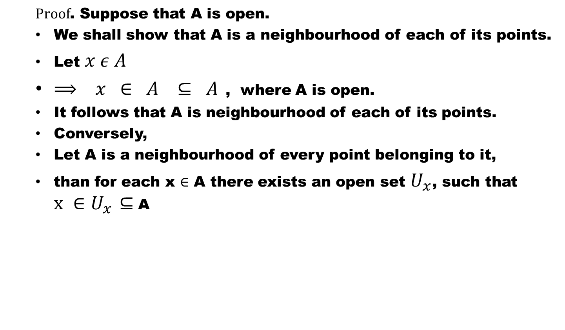
Theorem # 1. If (X,$τ$) is a topological space, then a subset A of X is open, if and only if A is a neighbourhood of each of its points.
  $Proof$. Suppose that A is open.
  We shall show that A is a neighbourhood of each of its points.
  Let $x ε A$
  $⟹ x ∈ A ⊆ A$, where A is open.
  It follows that A is neighbourhood of each of its points.
  Conversely,
  Let A is a neighbourhood of every point belonging to it,
  than for each x $∈$ A there exists an open set $U_{x}$, such that $x ∈U_{x}$$⊆$A

Slide 33
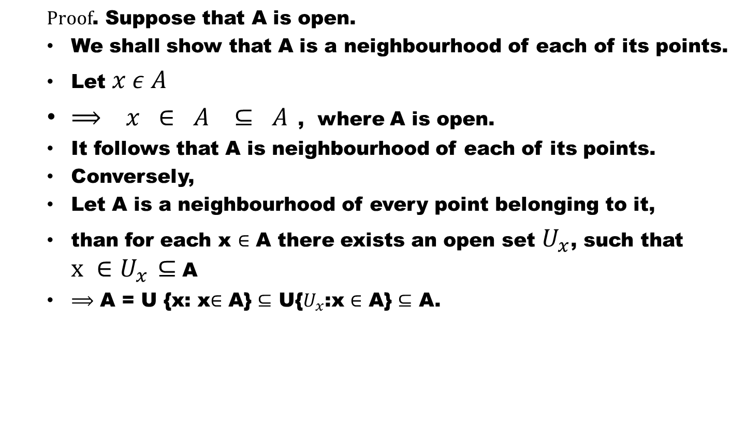
Theorem # 1. If (X,$τ$) is a topological space, then a subset A of X is open, if and only if A is a neighbourhood of each of its points.
  $Proof$. Suppose that A is open.
  We shall show that A is a neighbourhood of each of its points.
  Let $x ε A$
  $⟹ x ∈ A ⊆ A$, where A is open.
  It follows that A is neighbourhood of each of its points.
  Conversely,
  Let A is a neighbourhood of every point belonging to it,
  than for each x $∈$ A there exists an open set $U_{x}$, such that $x ∈U_{x}$$⊆$A
  $⟹$ A = U {x: x$∈$ A} $⊆$ U{$U_{x}$:x$∈$ A}$⊆$ A.

Slide 34
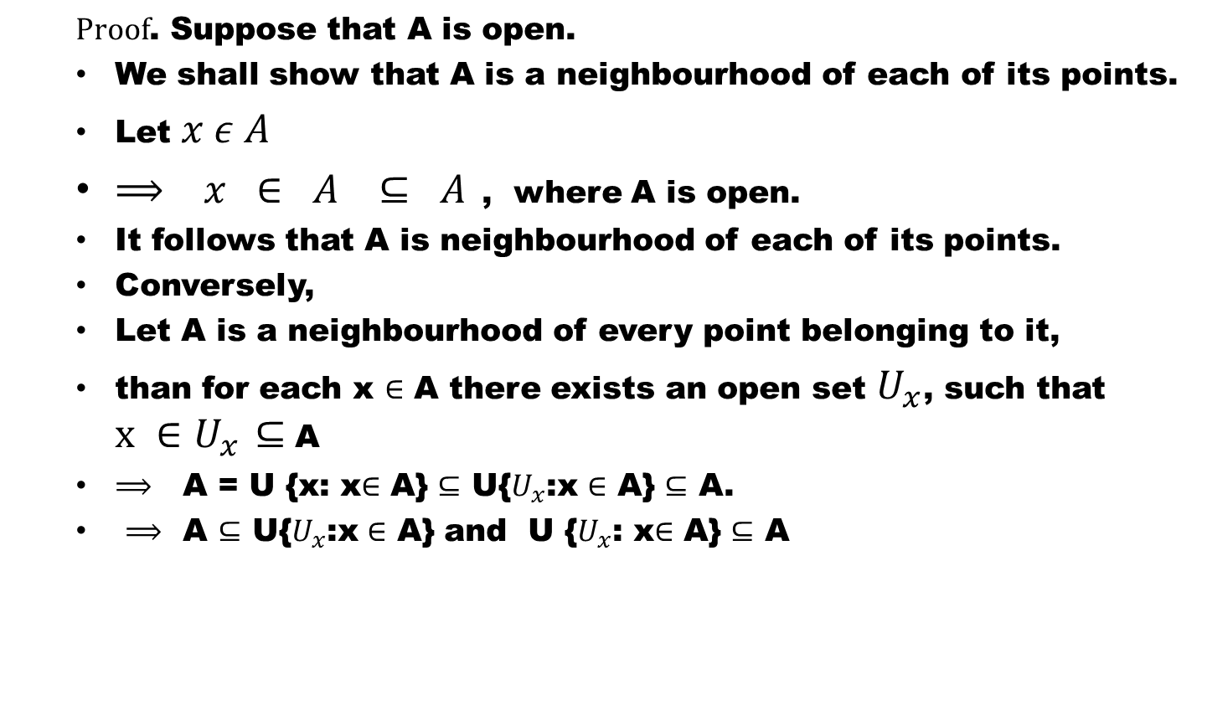
Theorem # 1. If (X,$τ$) is a topological space, then a subset A of X is open, if and only if A is a neighbourhood of each of its points.
  $Proof$. Suppose that A is open.
  We shall show that A is a neighbourhood of each of its points.
  Let $x ε A$
  $⟹ x ∈ A ⊆ A$, where A is open.
  It follows that A is neighbourhood of each of its points.
  Conversely,
  Let A is a neighbourhood of every point belonging to it,
  than for each x $∈$ A there exists an open set $U_{x}$, such that $x ∈U_{x}$$⊆$A
  $⟹$ A = U {x: x$∈$ A} $⊆$ U{$U_{x}$:x$∈$ A}$⊆$ A.
  $⟹$ A $⊆$ U{$U_{x}$:x$∈$ A} and U {$U_{x}$: x$∈$ A} $⊆$ A

Slide 35
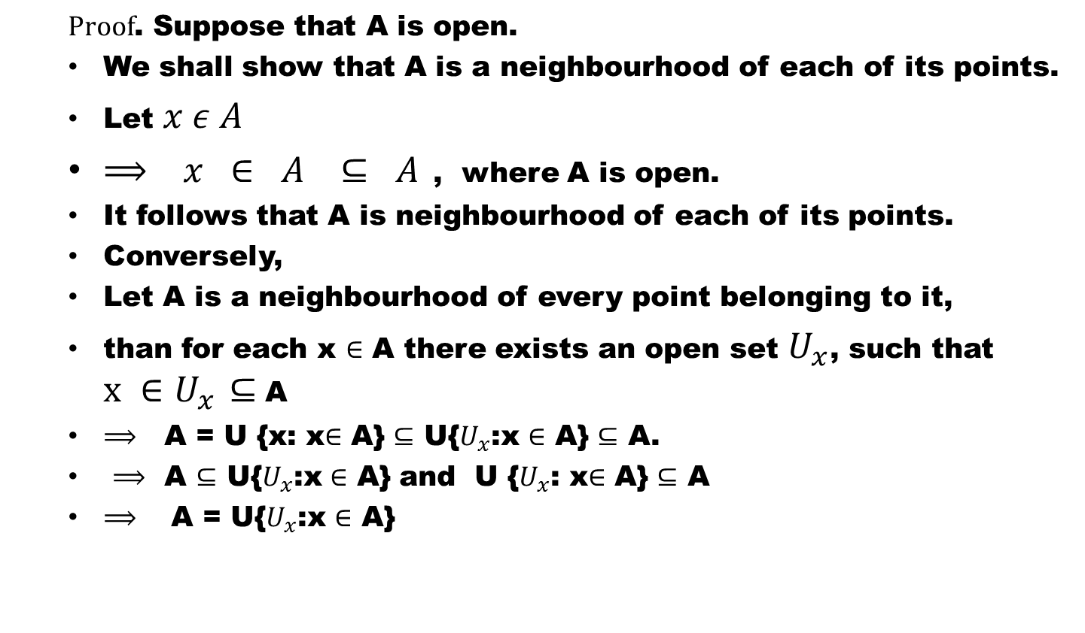
Theorem # 1. If (X,$τ$) is a topological space, then a subset A of X is open, if and only if A is a neighbourhood of each of its points.
  $Proof$. Suppose that A is open.
  We shall show that A is a neighbourhood of each of its points.
  Let $x ε A$
  $⟹ x ∈ A ⊆ A$, where A is open.
  It follows that A is neighbourhood of each of its points.
  Conversely,
  Let A is a neighbourhood of every point belonging to it,
  than for each x $∈$ A there exists an open set $U_{x}$, such that $x ∈U_{x}$$⊆$A
  $⟹$ A = U {x: x$∈$ A} $⊆$ U{$U_{x}$:x$∈$ A}$⊆$ A.
  $⟹$ A $⊆$ U{$U_{x}$:x$∈$ A} and U {$U_{x}$: x$∈$ A} $⊆$ A
  $⟹$ A = U{$U_{x}$:x$∈$ A}

Slide 36
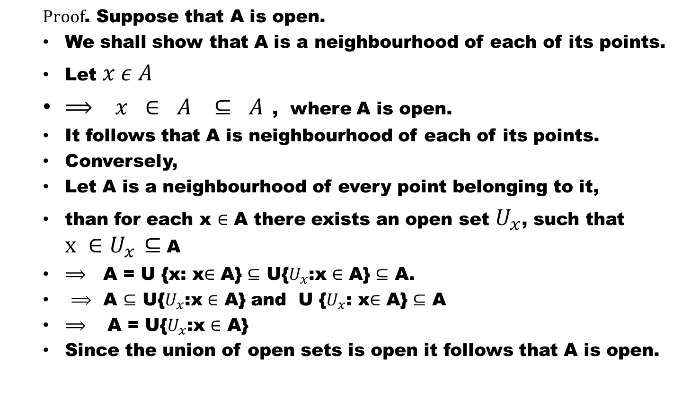
Theorem # 1. If (X,$τ$) is a topological space, then a subset A of X is open, if and only if A is a neighbourhood of each of its points.
  $Proof$. Suppose that A is open.
  We shall show that A is a neighbourhood of each of its points.
  Let $x ε A$
  $⟹ x ∈ A ⊆ A$, where A is open.
  It follows that A is neighbourhood of each of its points.
  Conversely,
  Let A is a neighbourhood of every point belonging to it,
  than for each x $∈$ A there exists an open set $U_{x}$, such that $x ∈U_{x}$$⊆$A
  $⟹$ A = U {x: x$∈$ A} $⊆$ U{$U_{x}$:x$∈$ A}$⊆$ A.
  $⟹$ A $⊆$ U{$U_{x}$:x$∈$ A} and U {$U_{x}$: x$∈$ A} $⊆$ A
  $⟹$ A = U{$U_{x}$:x$∈$ A}
  Since the union of open sets is open it follows that A is open.

Slide 37
The most important properties of neighbourhoods in a topological space are established in the following Theorem.

Slide 38
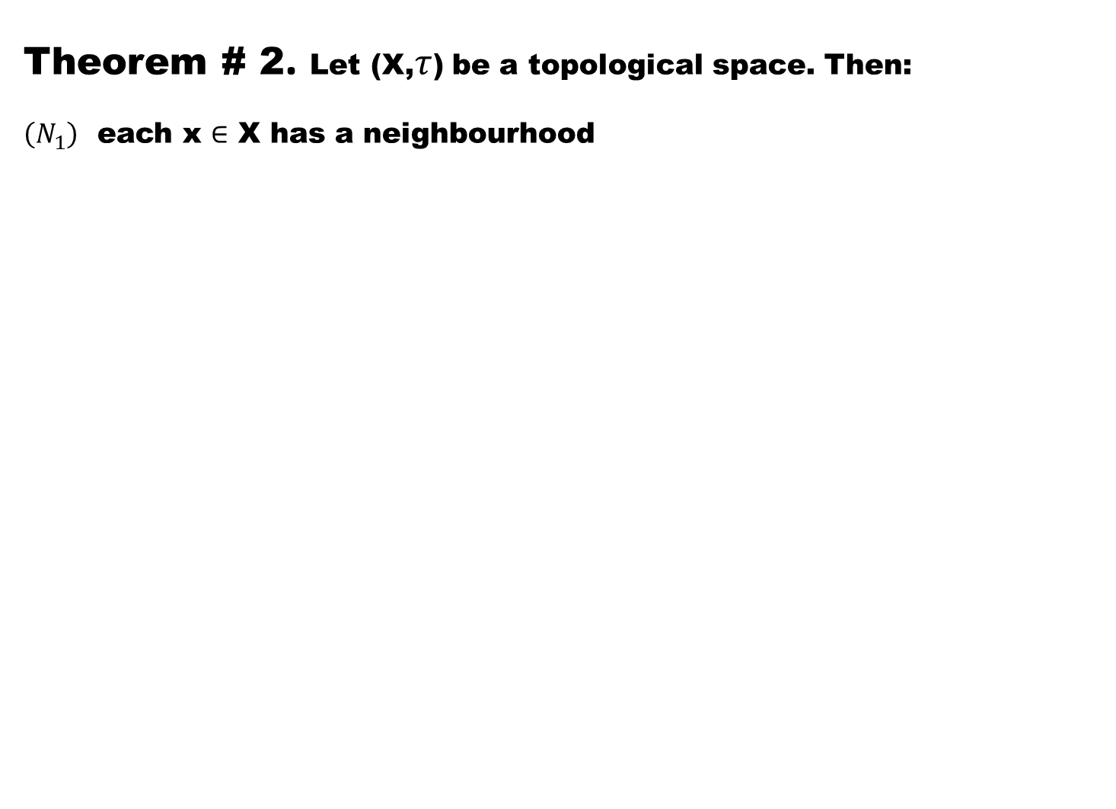
Theorem # 2. Let (X,$τ$) be a topological space. Then:
$\left(N_{1}\right)$each x $∈$X has a neighbourhood

Slide 39
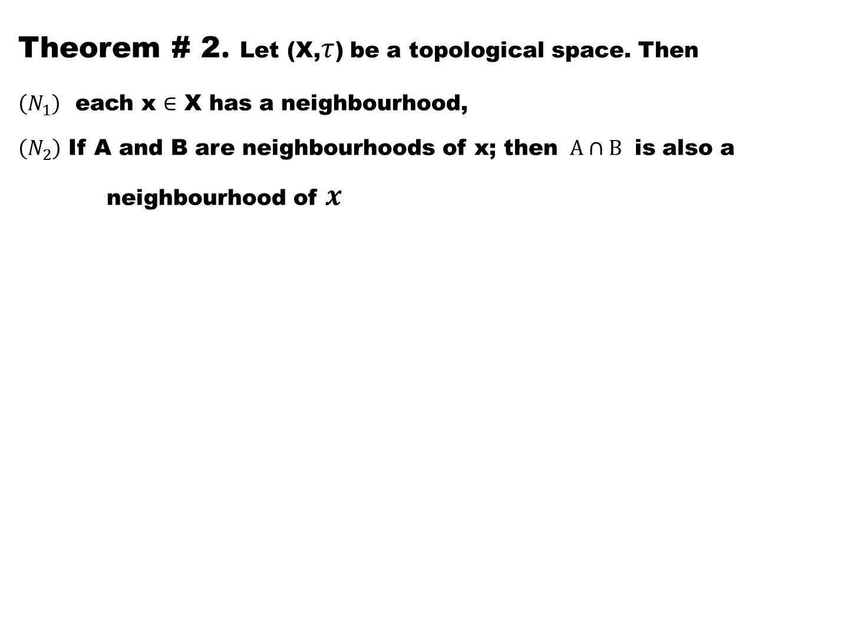
Theorem # 2. Let (X,$τ$) be a topological space. Then
$\left(N_{1}\right)$each x $∈$X has a neighbourhood,
$\left(N_{2}\right)$If A and B are neighbourhoods of x; then $A∩B$ is also a neighbourhood of $x$

Slide 40
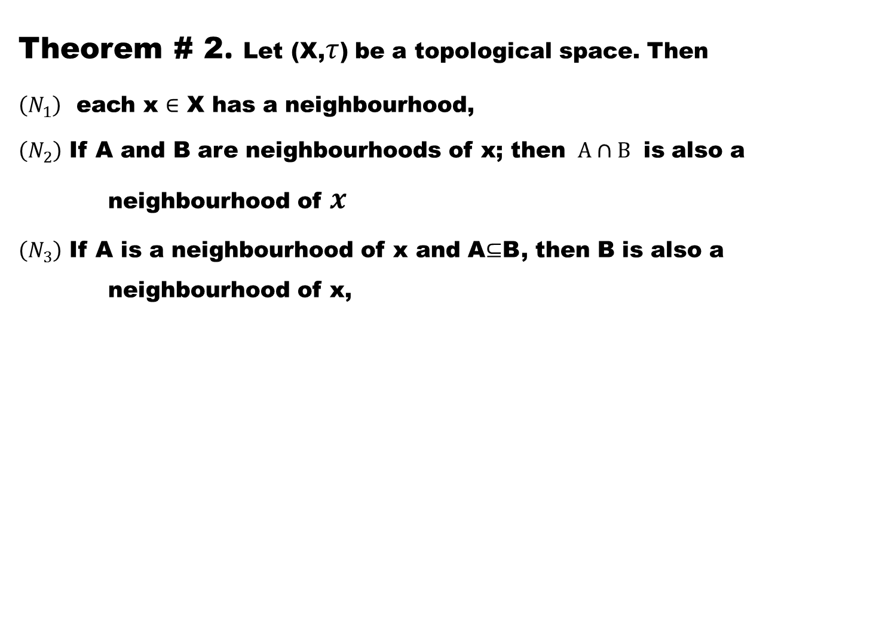
Theorem # 2. Let (X,$τ$) be a topological space. Then
$\left(N_{1}\right)$each x $∈$X has a neighbourhood,
$\left(N_{2}\right)$If A and B are neighbourhoods of x; then $A∩B$ is also a neighbourhood of $x$
$\left(N_{3}\right)$If A is a neighbourhood of x and A$⊆$B, then B is also a neighbourhood of x,

Slide 41
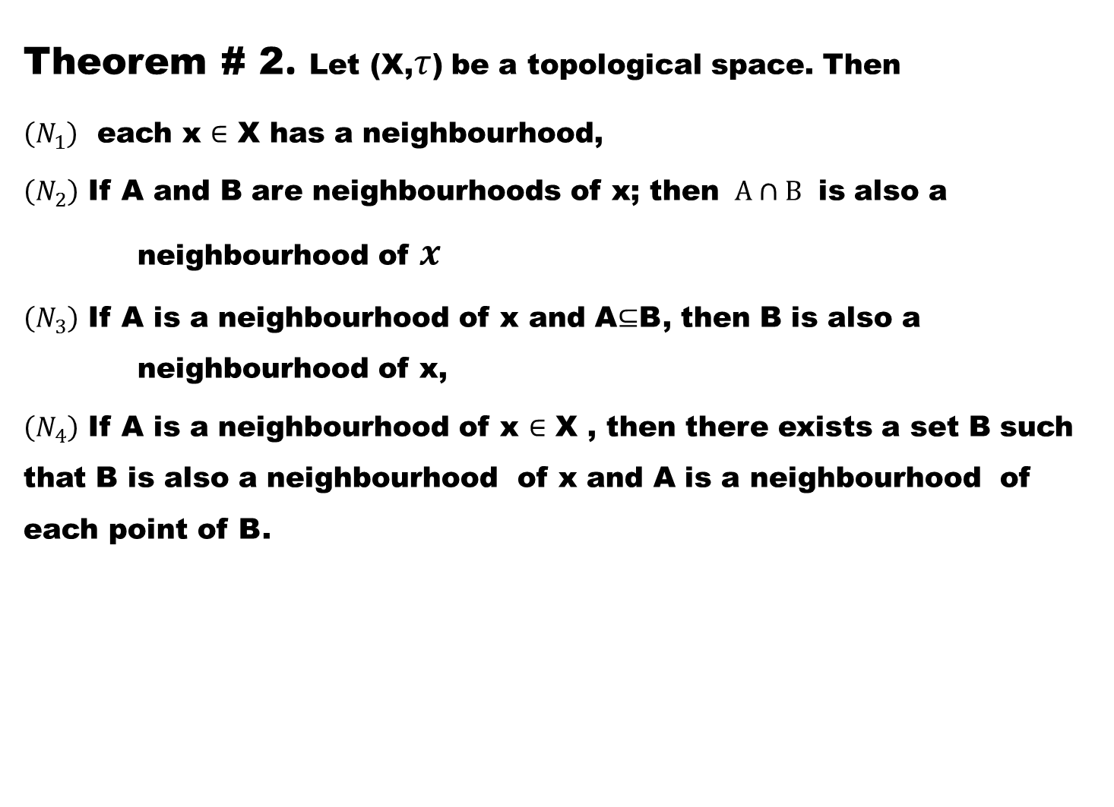
Theorem # 2. Let (X,$τ$) be a topological space. Then
$\left(N_{1}\right)$each x $∈$X has a neighbourhood,
$\left(N_{2}\right)$If A and B are neighbourhoods of x; then $A∩B$ is also a neighbourhood of $x$
$\left(N_{3}\right)$If A is a neighbourhood of x and A$⊆$B, then B is also a neighbourhood of x,
$\left(N_{4}\right)$ If A is a neighbourhood of x $∈$X , then there exists a set B such that B is also a neighbourhood of x and A is a neighbourhood of each point of B.

Slide 42
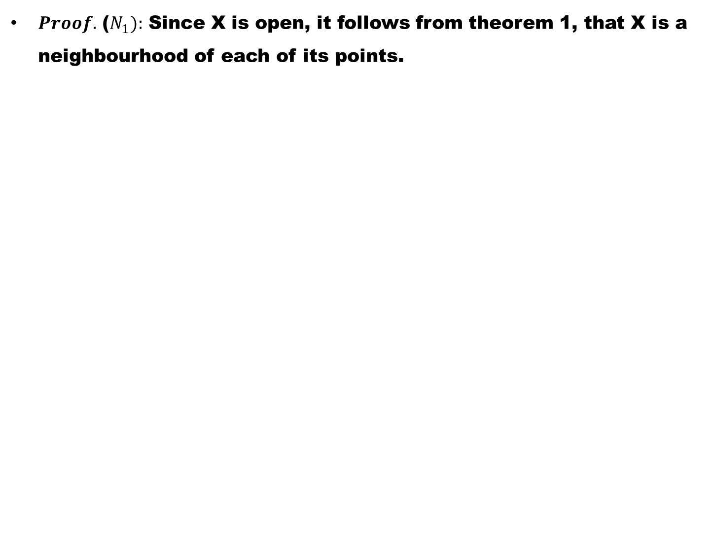
$Proof.$($N_{1}):$Since X is open, it follows from theorem 1, that X is a neighbourhood of each of its points.

Slide 43
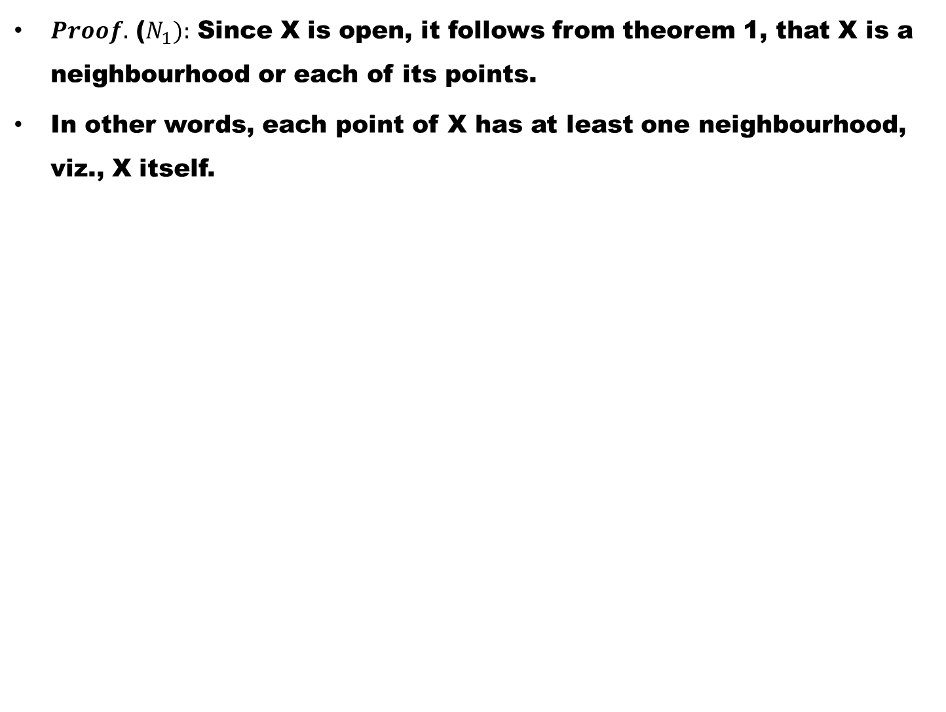
$Proof.$($N_{1}):$Since X is open, it follows from theorem 1, that X is a neighbourhood or each of its points.
In other words, each point of X has at least one neighbourhood, viz., X itself.

Slide 44
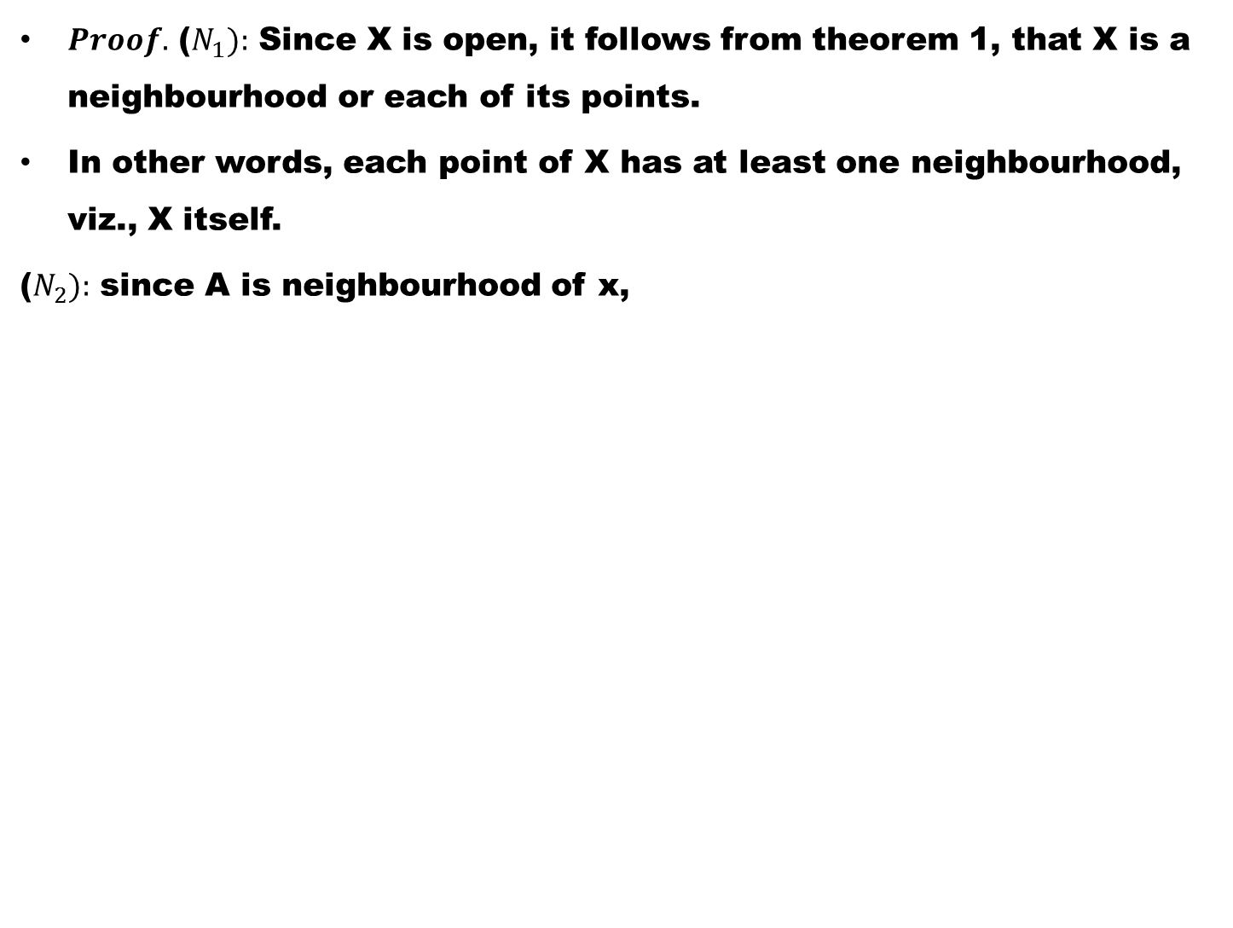
$Proof.$($N_{1}):$Since X is open, it follows from theorem 1, that X is a neighbourhood or each of its points.
In other words, each point of X has at least one neighbourhood, viz., X itself.
($N_{2}):$ since A is neighbourhood of x,

Slide 45
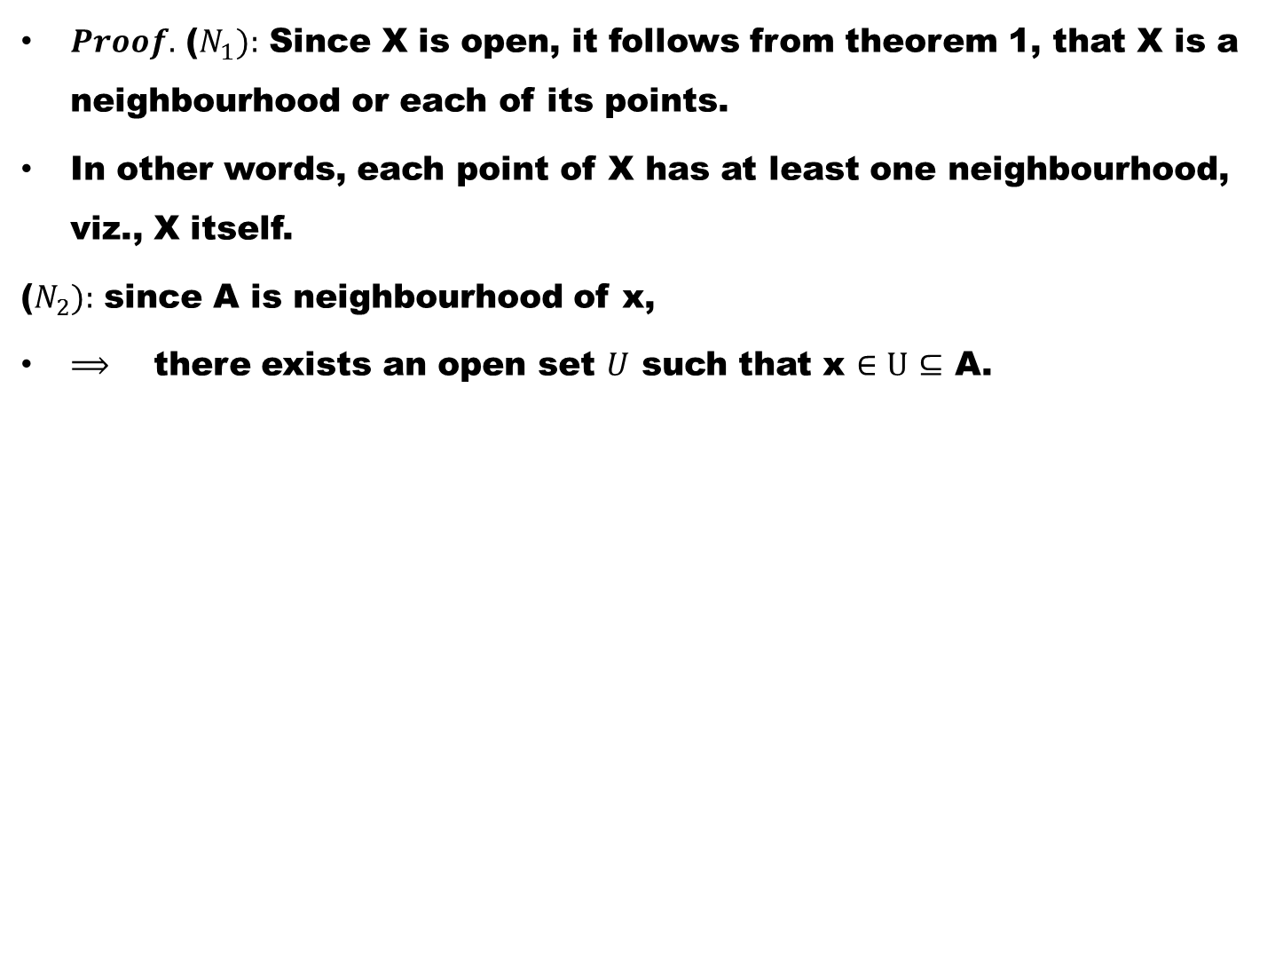
$Proof.$($N_{1}):$Since X is open, it follows from theorem 1, that X is a neighbourhood or each of its points.
In other words, each point of X has at least one neighbourhood, viz., X itself.
($N_{2}):$ since A is neighbourhood of x,
$⟹$there exists an open set $U$ such that x $∈U$$⊆$ A.

Slide 46
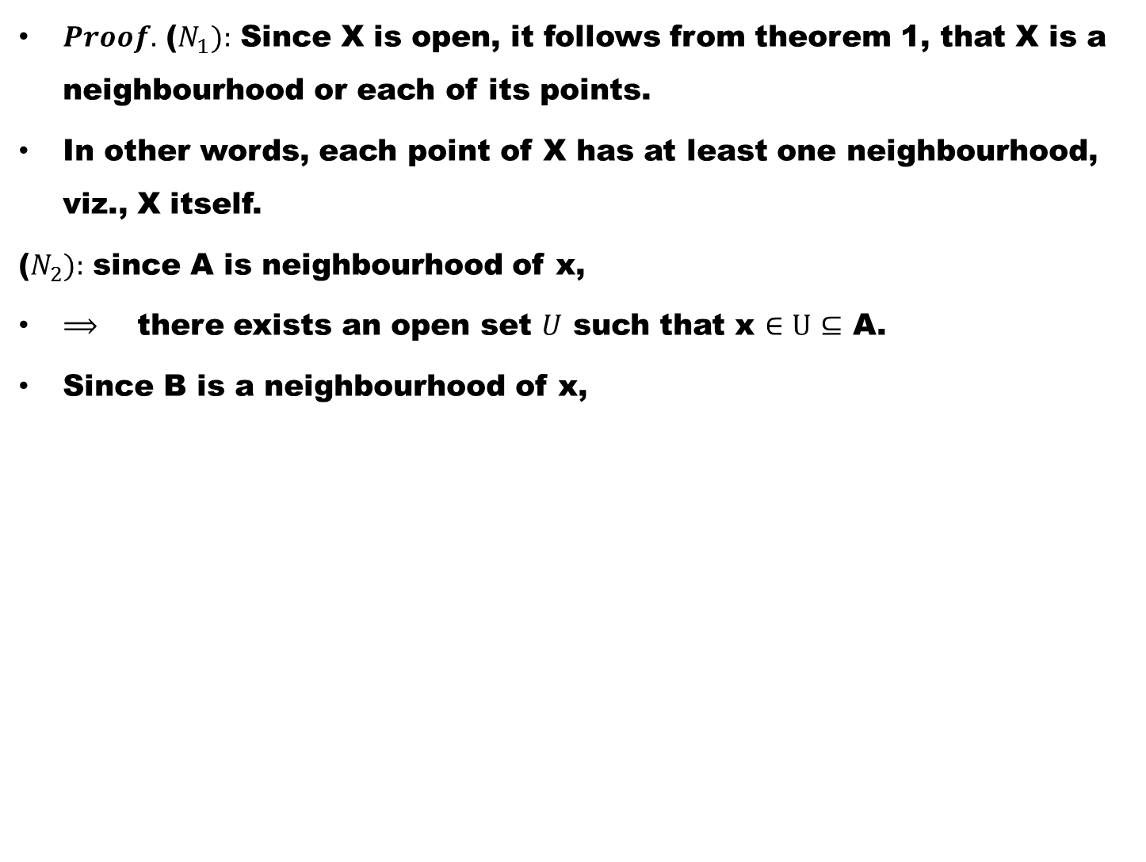
$Proof.$($N_{1}):$Since X is open, it follows from theorem 1, that X is a neighbourhood or each of its points.
In other words, each point of X has at least one neighbourhood, viz., X itself.
($N_{2}):$ since A is neighbourhood of x,
$⟹$there exists an open set $U$ such that x $∈U$$⊆$ A.
Since B is a neighbourhood of x,

Slide 47
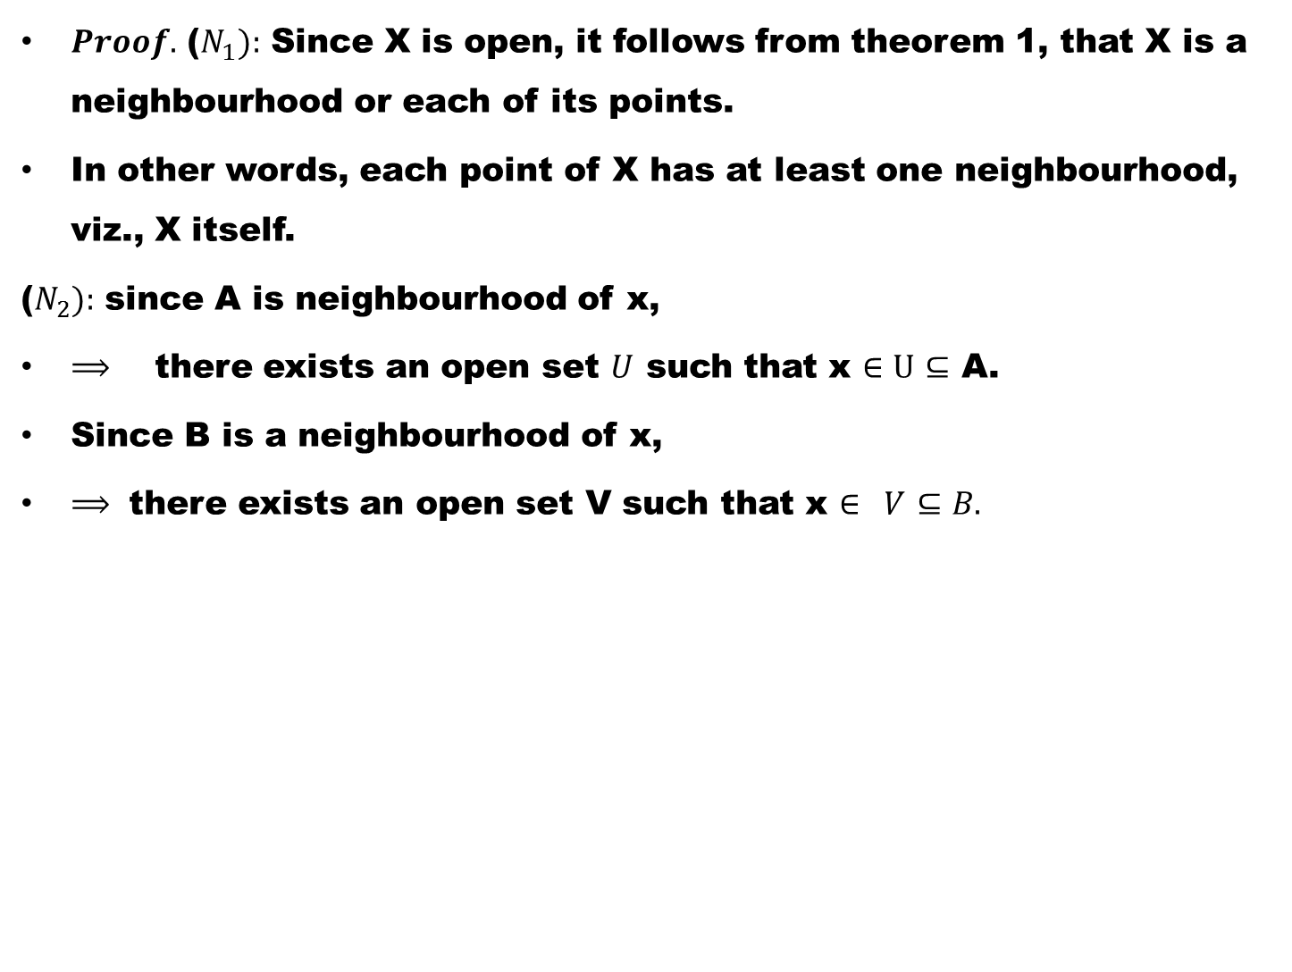
$Proof.$($N_{1}):$Since X is open, it follows from theorem 1, that X is a neighbourhood or each of its points.
In other words, each point of X has at least one neighbourhood, viz., X itself.
($N_{2}):$ since A is neighbourhood of x,
$⟹$there exists an open set $U$ such that x $∈U$$⊆$ A.
Since B is a neighbourhood of x,
$⟹$ there exists an open set V such that x $∈ V$$⊆B.$

Slide 48
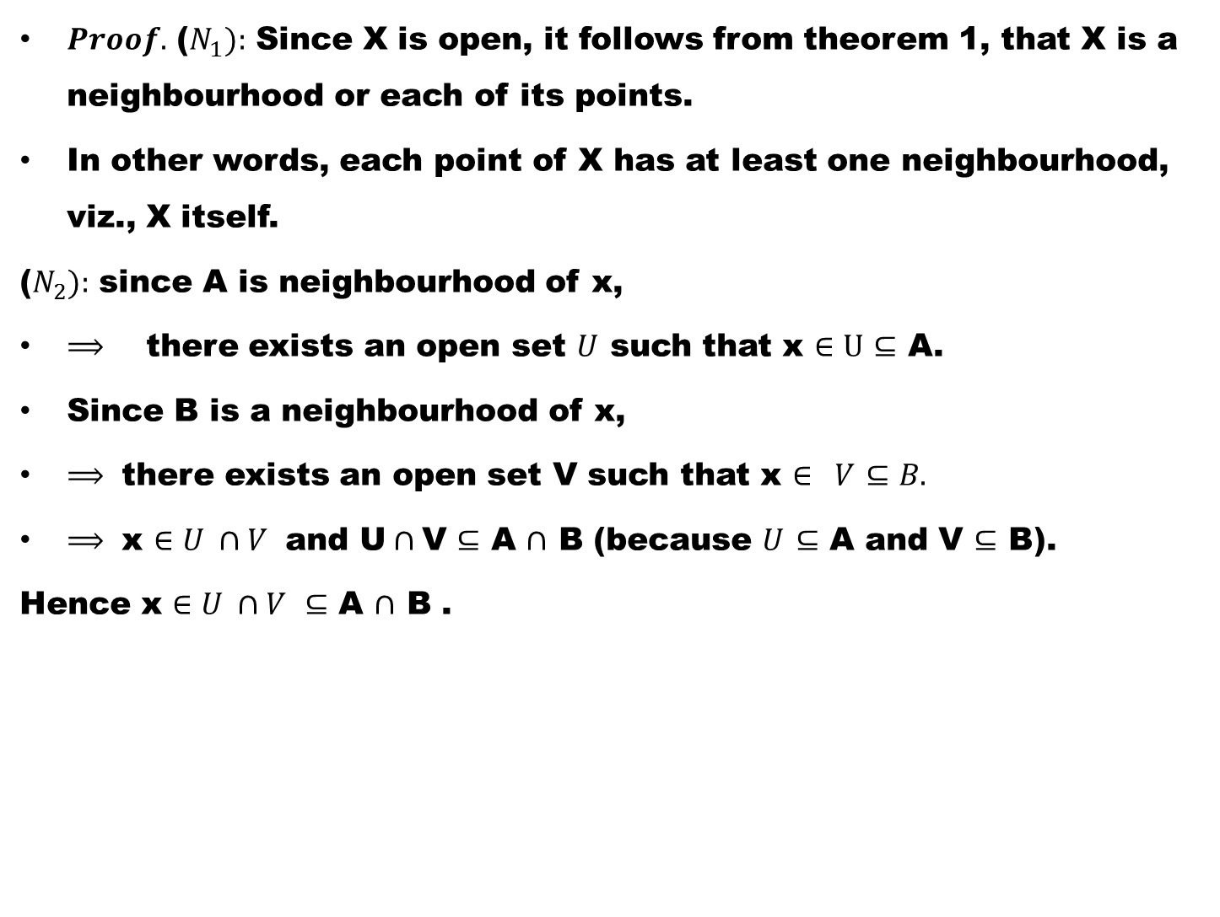
$Proof.$($N_{1}):$Since X is open, it follows from theorem 1, that X is a neighbourhood or each of its points.
In other words, each point of X has at least one neighbourhood, viz., X itself.
($N_{2}):$ since A is neighbourhood of x,
$⟹$there exists an open set $U$ such that x $∈U$$⊆$ A.
Since B is a neighbourhood of x,
$⟹$ there exists an open set V such that x $∈ V$$⊆B.$
$⟹$ x $∈U ∩V$ and U$∩$V $⊆$ A$∩$ B (because $U$$⊆$A and V $⊆$B).
Hence x $∈U ∩V$$⊆$A$∩$ B .

Slide 49
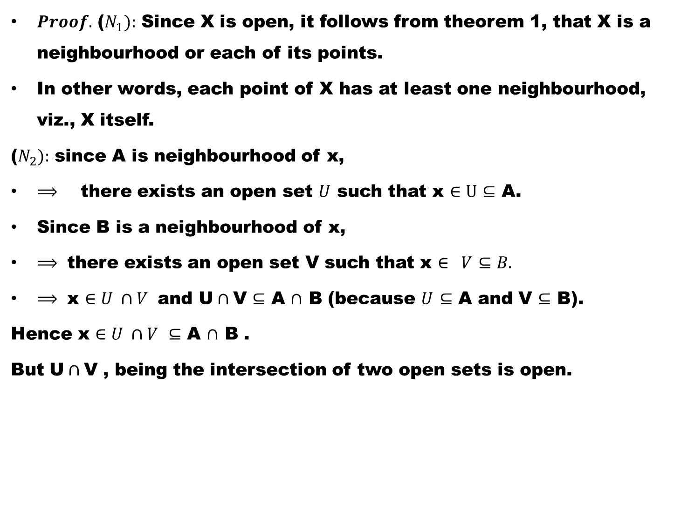
$Proof.$($N_{1}):$Since X is open, it follows from theorem 1, that X is a neighbourhood or each of its points.
In other words, each point of X has at least one neighbourhood, viz., X itself.
($N_{2}):$ since A is neighbourhood of x,
$⟹$there exists an open set $U$ such that x $∈U$$⊆$ A.
Since B is a neighbourhood of x,
$⟹$ there exists an open set V such that x $∈ V$$⊆B.$
$⟹$ x $∈U ∩V$ and U$∩$V $⊆$ A$∩$ B (because $U$$⊆$A and V $⊆$B).
Hence x $∈U ∩V$$⊆$A$∩$ B .
But U$∩$V , being the intersection of two open sets is open.

Slide 50
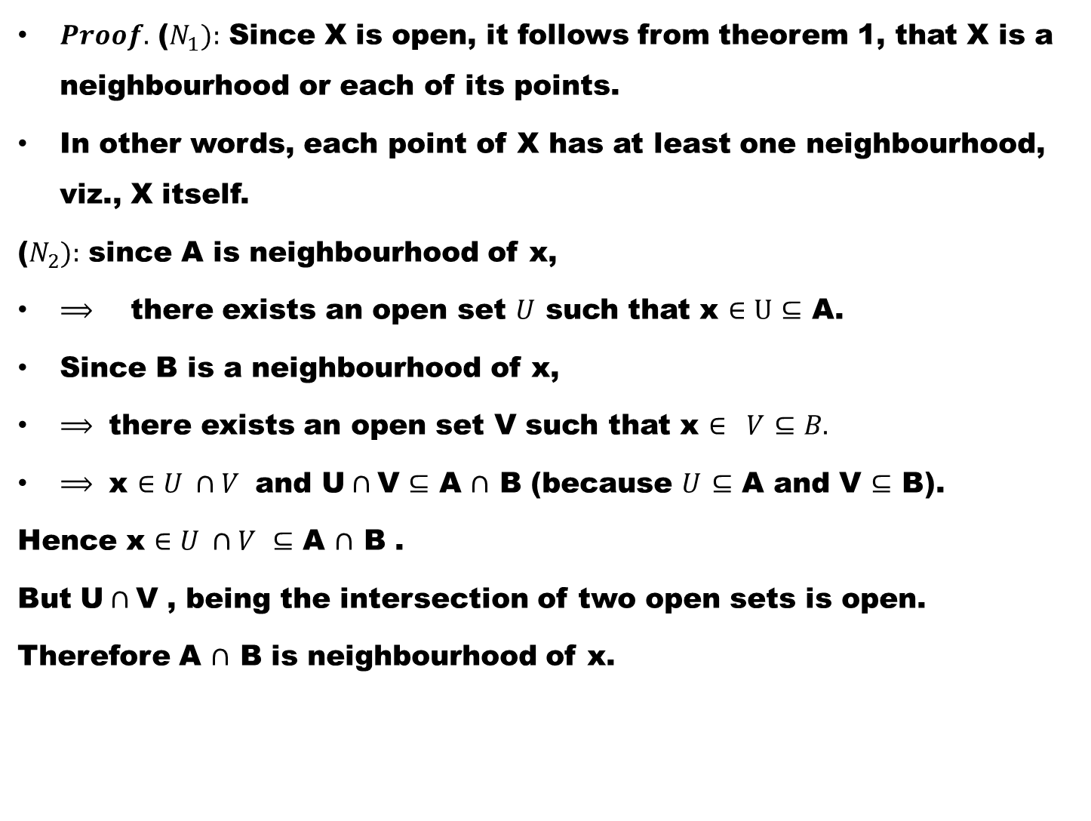
$Proof.$($N_{1}):$Since X is open, it follows from theorem 1, that X is a neighbourhood or each of its points.
In other words, each point of X has at least one neighbourhood, viz., X itself.
($N_{2}):$ since A is neighbourhood of x,
$⟹$there exists an open set $U$ such that x $∈U$$⊆$ A.
Since B is a neighbourhood of x,
$⟹$ there exists an open set V such that x $∈ V$$⊆B.$
$⟹$ x $∈U ∩V$ and U$∩$V $⊆$ A$∩$ B (because $U$$⊆$A and V $⊆$B).
Hence x $∈U ∩V$$⊆$A$∩$ B .
But U$∩$V , being the intersection of two open sets is open.
Therefore A$∩$ B is neighbourhood of x.

Slide 51
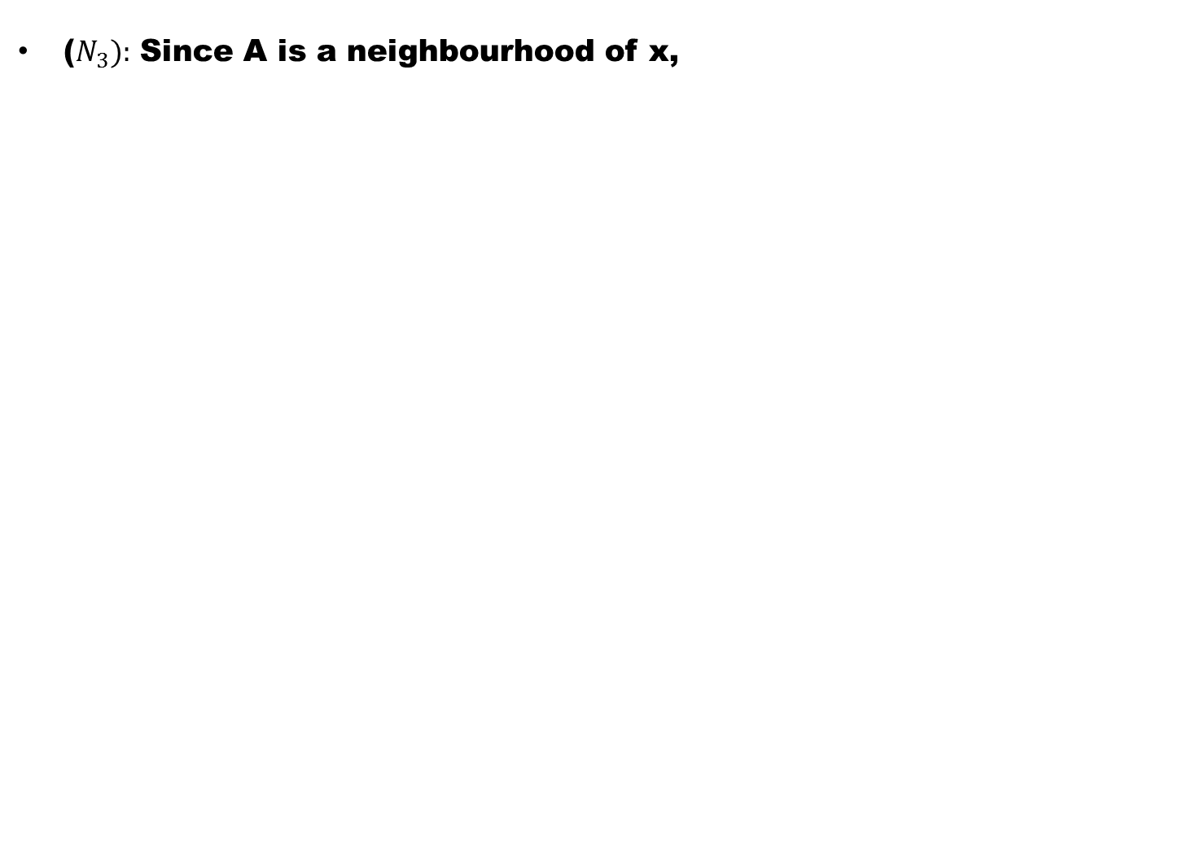
($N_{3}):$Since A is a neighbourhood of x,

Slide 52
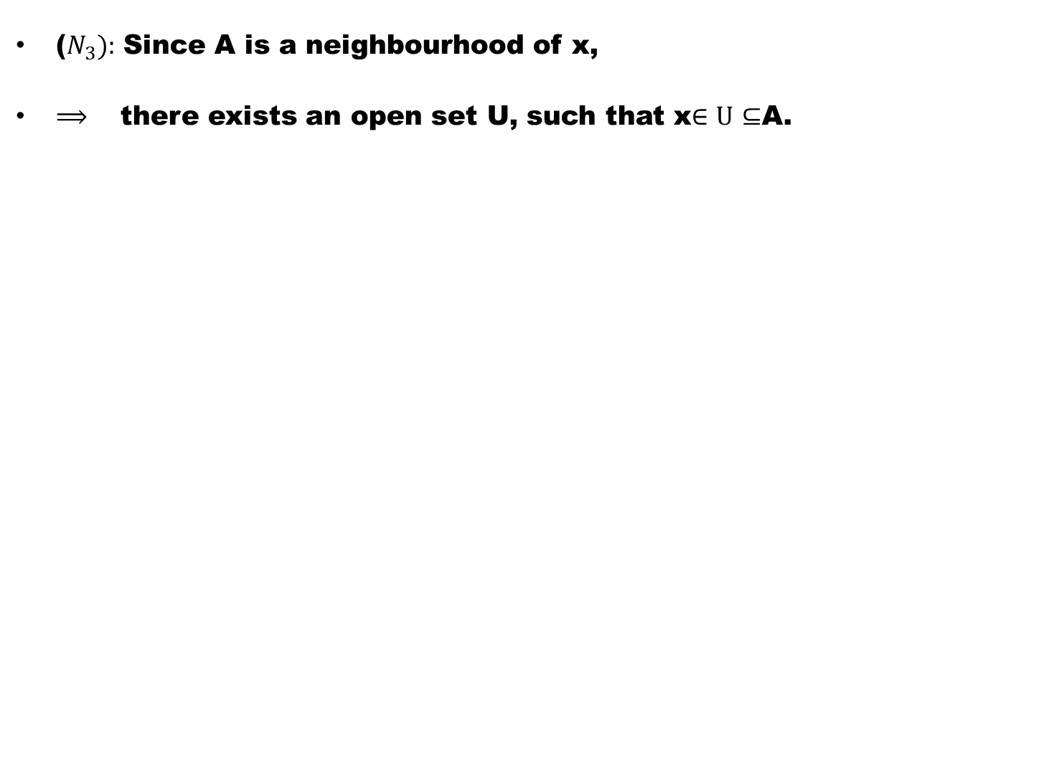
($N_{3}):$Since A is a neighbourhood of x,
$⟹$ there exists an open set U, such that x$∈U$$⊆$A.

Slide 53
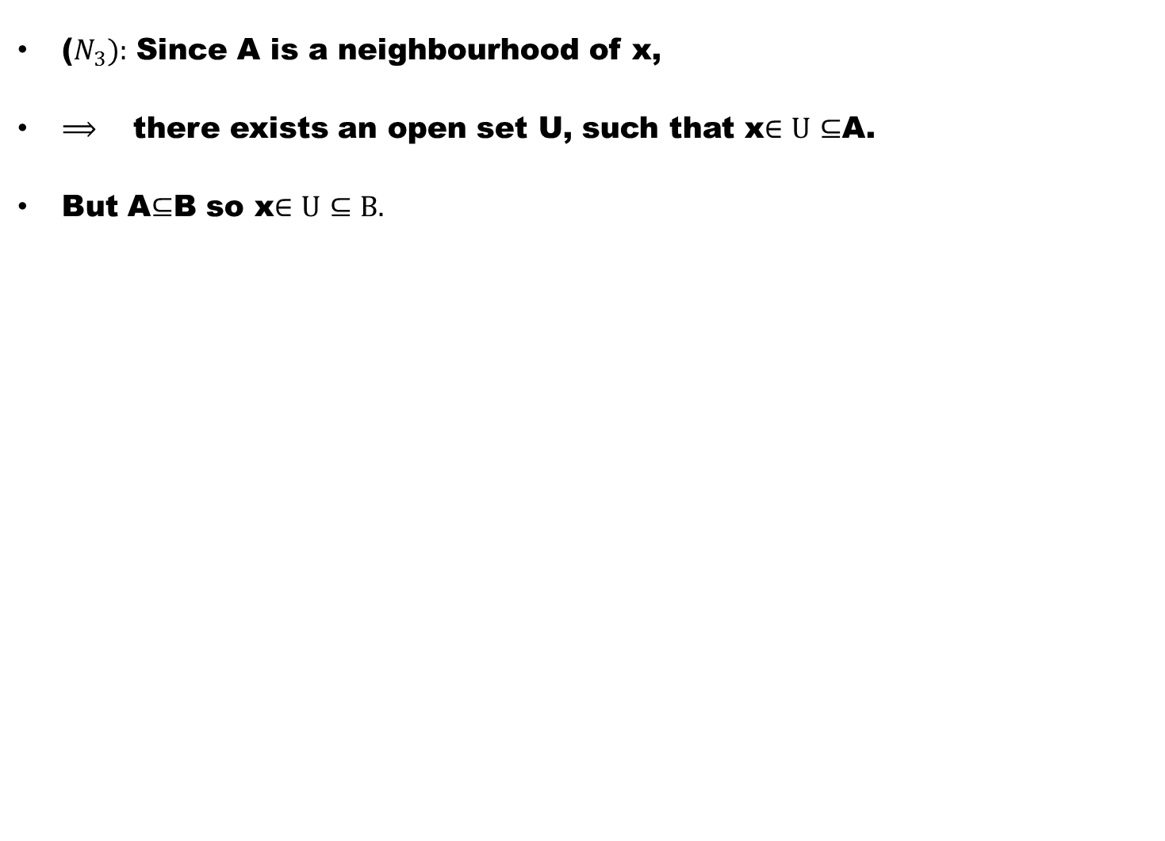
($N_{3}):$Since A is a neighbourhood of x,
$⟹$ there exists an open set U, such that x$∈U$$⊆$A.
But A$⊆$B so x$∈U$$⊆B.$

Slide 54
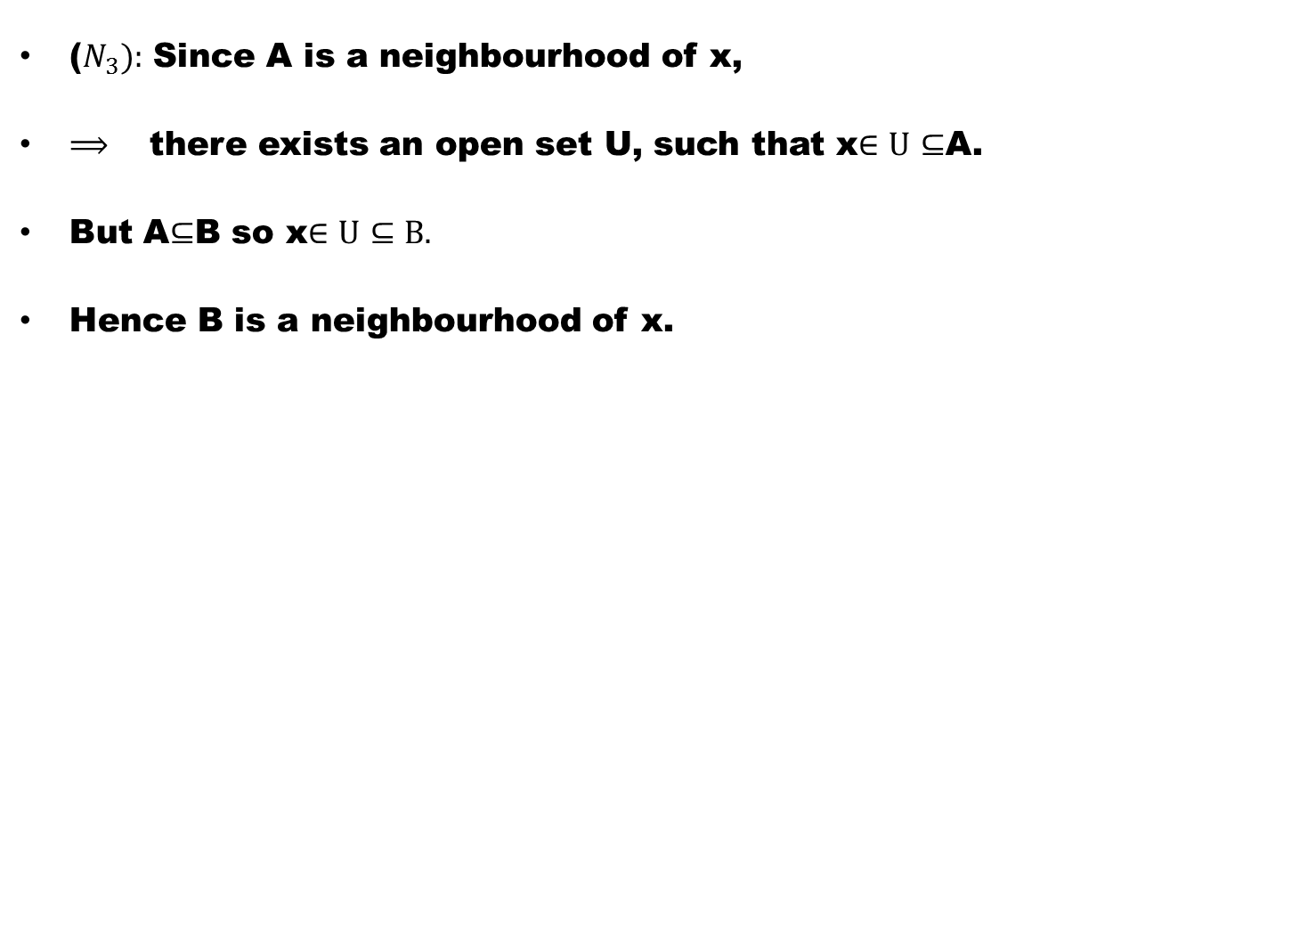
($N_{3}):$Since A is a neighbourhood of x,
$⟹$ there exists an open set U, such that x$∈U$$⊆$A.
But A$⊆$B so x$∈U$$⊆B.$
Hence B is a neighbourhood of x.

Slide 55
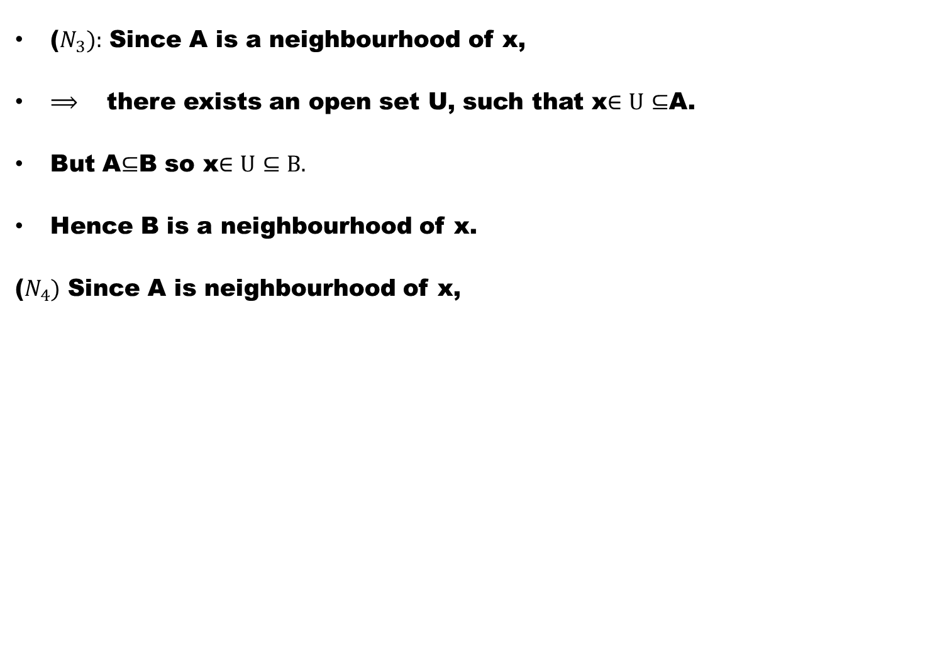
($N_{3}):$Since A is a neighbourhood of x,
$⟹$ there exists an open set U, such that x$∈U$$⊆$A.
But A$⊆$B so x$∈U$$⊆B.$
Hence B is a neighbourhood of x.
($N_{4})$ Since A is neighbourhood of x,

Slide 56
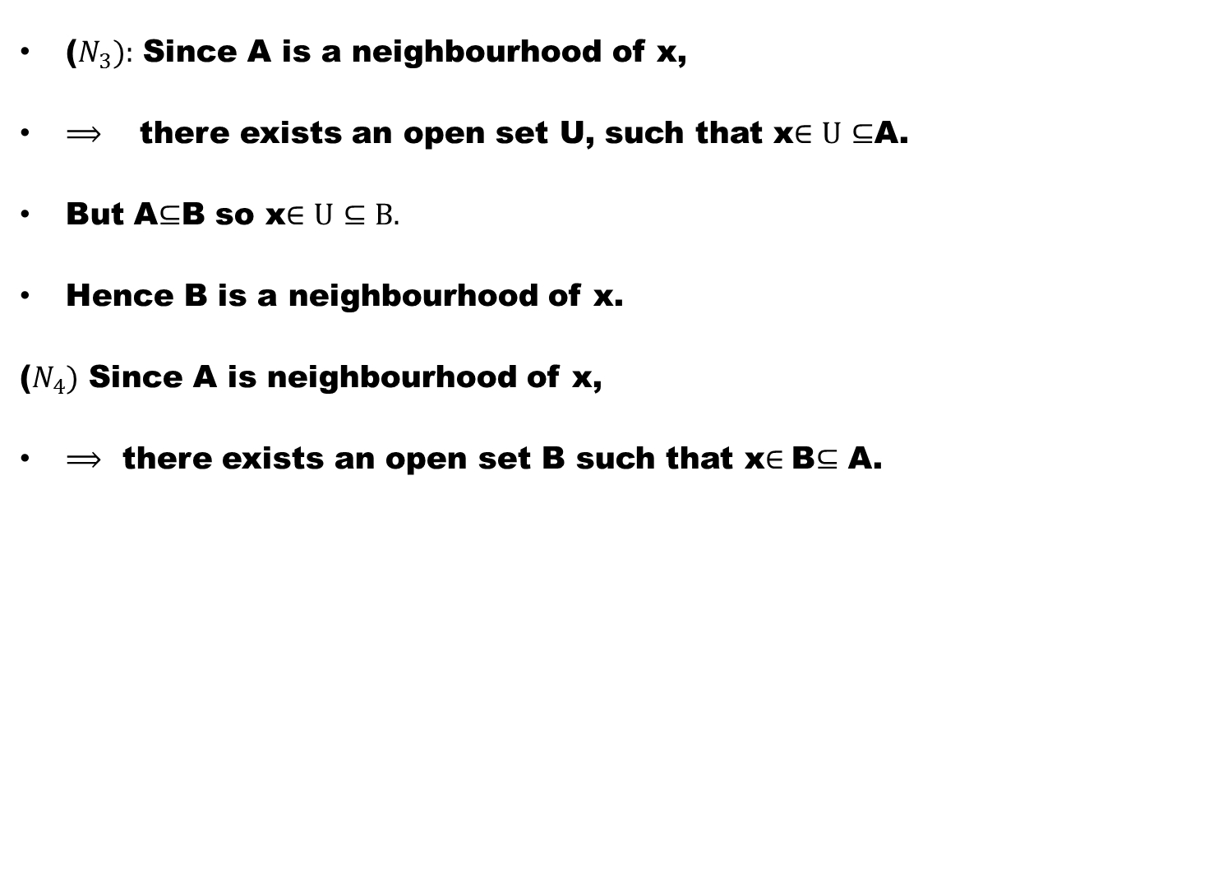
($N_{3}):$Since A is a neighbourhood of x,
$⟹$ there exists an open set U, such that x$∈U$$⊆$A.
But A$⊆$B so x$∈U$$⊆B.$
Hence B is a neighbourhood of x.
($N_{4})$ Since A is neighbourhood of x,
$⟹$there exists an open set B such that x$∈$B$⊆$ A.

Slide 57

($N_{3}):$Since A is a neighbourhood of x,
$⟹$ there exists an open set U, such that x$∈U$$⊆$A.
But A$⊆$B so x$∈U$$⊆B.$
Hence B is a neighbourhood of x.
($N_{4})$ Since A is neighbourhood of x,
$⟹$there exists an open set B such that x$∈$B$⊆$ A.
Since x is a point of B and B is open, by theorem 1, B is a neighbourhood of x.

Slide 58

($N_{3}):$Since A is a neighbourhood of x,
$⟹$ there exists an open set U, such that x$∈U$$⊆$A.
But A$⊆$B so x$∈U$$⊆B.$
Hence B is a neighbourhood of x.
($N_{4})$ Since A is neighbourhood of x,
$⟹$there exists an open set B such that x$∈$B$⊆$ A.
Since x is a point of B and B is open, by theorem 1, B is a neighbourhood of x.
If y $∈$ B, then because B is open. (Theorem 1). B is a neighbourhood of y .

Slide 59

($N_{3}):$Since A is a neighbourhood of x,
$⟹$ there exists an open set U, such that x$∈U$$⊆$A.
But A$⊆$B so x$∈U$$⊆B.$
Hence B is a neighbourhood of x.
($N_{4})$ Since A is neighbourhood of x,
$⟹$there exists an open set B such that x$∈$B$⊆$ A.
Since x is a point of B and B is open, by theorem 1, B is a neighbourhood of x.
If y $∈$ B, then because B is open. (Theorem 1). B is a neighbourhood of y .
Since B$⊂$A therefore A is also a neighbourhood of y by ($N_{3}$).

Slide 60

($N_{3}):$Since A is a neighbourhood of x,
$⟹$ there exists an open set U, such that x$∈U$$⊆$A.
But A$⊆$B so x$∈U$$⊆B.$
Hence B is a neighbourhood of x.
($N_{4})$ Since A is neighbourhood of x,
$⟹$there exists an open set B such that x$∈$B$⊆$ A.
Since x is a point of B and B is open, by theorem 1, B is a neighbourhood of x.
If y $∈$ B, then because B is open. (Theorem 1). B is a neighbourhood of y .
Since B$⊂$A therefore A is also a neighbourhood of y by ($N_{3}$).
A is therefore a neighbourhood of each point of B.

Slide 61

Definition # 1.
If $τ_{1 }and τ_{2}$are two topologies on X,

Slide 62

Definition # 1.
If $τ_{1 }and τ_{2}$are two topologies on X,
and $τ_{1 }⊆$$τ_{2 }$,

Slide 63

Definition # 3.
If $τ_{1 }and τ_{2}$are two topologies on X,
and $τ_{1 }⊆$$τ_{2 }$,
then $τ_{1 }$is said to be coarser (or weaker) than $τ_{2}:$

Slide 64

Definition # 3.
If $τ_{1 }and τ_{2}$are two topologies on X,
and $τ_{1 }⊆$$τ_{2 }$,
then $τ_{1 }$is said to be coarser (or weaker) than $τ_{2}:$
alternatively

Slide 65

Definition # 3.
If $τ_{1 }and τ_{2}$are two topologies on X,
and $τ_{1 }⊆$$τ_{2 }$,
then $τ_{1 }$is said to be coarser (or weaker) than $τ_{2}:$
alternatively
$τ_{2 }is said to be finer \left(or stronger\right)than τ_{1 }$.

Slide 66
Definition # 4. Two topologies on X are called incomparable if neither is coarser than the other.

Slide 67
Note:
The indiscrete topology is contained in any topology on X

Slide 68
Note:
The indiscrete topology is contained in any topology on X
and is, therefore, the coarsest topology on X.

Slide 69
Note:
The indiscrete topology is contained in any topology on X
and is, therefore, the coarsest topology on X.
At the other extreme

Slide 70
Note:
The indiscrete topology is contained in any topology on X
and is, therefore, the coarsest topology on X.
At the other extreme
is the discrete topology

Slide 71
Note:
The indiscrete topology is contained in any topology on X
and is, therefore, the coarsest topology on X.
At the other extreme
is the discrete topology
which contains any topology on X

Slide 72
Note:
The indiscrete topology is contained in any topology on X
and is, therefore, the coarsest topology on X.
At the other extreme
is the discrete topology
which contains any topology on X
and is , therefore, the finest topology on X.

Slide 73

Example # 5. The topologies$τ_{2 }and{ τ}_{3 }on X=\left\{a,b\right\}$given in example below are not comparable:

Slide 74

Example # 5. The topologies$τ_{2 }and{ τ}_{3 }on X=\left\{a,b\right\}$given in example below are not comparable:
  $τ_{1}$=$\{φ,\{a,b\} \}$

Slide 75

Example # 5. The topologies$τ_{2 }and{ τ}_{3 }on X=\left\{a,b\right\}$given in example below are not comparable:
  $τ_{1}$=$\{φ,\{a,b\} \}$
  $τ_{2}$=$\left\{φ,\{a\right\},\{a,b\} \}$

Slide 76

Example # 5. The topologies$τ_{2 }and{ τ}_{3 }on X=\left\{a,b\right\}$given in example below are not comparable:
  $τ_{1}$=$\{φ,\{a,b\} \}$
  $τ_{2}$=$\left\{φ,\{a\right\},\{a,b\} \}$
  $τ_{3}$=$\left\{φ,\{b\right\},\{a,b\} \}$

Slide 77

Example # 5. The topologies$τ_{2 }and{ τ}_{3 }on X=\left\{a,b\right\}$given in example below are not comparable:
  $τ_{1}$=$\{φ,\{a,b\} \}$
  $τ_{2}$=$\left\{φ,\{a\right\},\{a,b\} \}$
  $τ_{3}$=$\left\{φ,\{b\right\},\{a,b\} \}$
  $τ_{4}$=$\left\{φ,\{a\right\},\left\{b\right\},$$\{a,b\} \}$

Slide 78

Example # 6. Let X= $\left\{a,b,c\right\}$and let
$$τ_{1 }=\left\{∅,\left\{a,b\right\},X\right\}$$
and $τ_{2}=\left\{∅,\left\{a,b\right\},\left\{b,c\right\},\left\{b\right\},X\right\}$

Slide 79

Example # 6. Let X= $\left\{a,b,c\right\}$and let
$$τ_{1 }=\left\{∅,\left\{a,b\right\},X\right\}$$
and $τ_{2}=\left\{∅,\left\{a,b\right\},\left\{b,c\right\},\left\{b\right\},X\right\}$
$τ_{1}$ and $τ_{2}$ are topologies on X.

Slide 80

Example # 6. Let X= $\left\{a,b,c\right\}$and let
$$τ_{1 }=\left\{∅,\left\{a,b\right\},X\right\}$$
and $τ_{2}=\left\{∅,\left\{a,b\right\},\left\{b,c\right\},\left\{b\right\},X\right\}$
$τ_{1}$ and $τ_{2}$ are topologies on X.
Since every member of $τ_{1}$ is also a member of $τ_{2}.$

Slide 81

Example # 6. Let X= $\left\{a,b,c\right\}$and let
$$τ_{1 }=\left\{∅,\left\{a,b\right\},X\right\}$$
and $τ_{2}=\left\{∅,\left\{a,b\right\},\left\{b,c\right\},\left\{b\right\},X\right\}$
$τ_{1}$ and $τ_{2}$ are topologies on X.
Since every member of $τ_{1}$ is also a member of $τ_{2}.$
$$⟹ τ_{1} ⊆ τ_{2}$$

Slide 82

Example # 6. Let X= $\left\{a,b,c\right\}$and let
$$τ_{1 }=\left\{∅,\left\{a,b\right\},X\right\}$$
and $τ_{2}=\left\{∅,\left\{a,b\right\},\left\{b,c\right\},\left\{b\right\},X\right\}$
$τ_{1}$ and $τ_{2}$ are topologies on X.
Since every member of $τ_{1}$ is also a member of $τ_{2}.$
$$⟹ τ_{1} ⊆ τ_{2}$$
$⟹$$τ_{1}$ is coarser than $τ_{2}$

Slide 83

Example # 6. Let X= $\left\{a,b,c\right\}$and let
$$τ_{1 }=\left\{∅,\left\{a,b\right\},X\right\}$$
and $τ_{2}=\left\{∅,\left\{a,b\right\},\left\{b,c\right\},\left\{b\right\},X\right\}$
$τ_{1}$ and $τ_{2}$ are topologies on X.
Since every member of $τ_{1}$ is also a member of $τ_{2}.$
$$⟹ τ_{1} ⊆ τ_{2}$$
$⟹$$τ_{1}$ is coarser than $τ_{2}$
$⟹$$τ_{2}$ is finer than $τ_{1}$

Slide 84

Theorem # 3 .
Let${ τ}_{1 }and{ τ}_{2 }be any two topologies on a non empty set X. Then$$τ_{1 }∩τ_{2 }is also a topology on X.$

Slide 86

Example # 7. Let X= {a,b,c,d} . Then each of the collections:
$τ_{1 }=\left\{∅,\left\{a,b\right\},X\right\}$and
$τ_{2}=\left\{∅,\left\{c\right\},X\right\}$is a topology on X.
$⟹$$τ_{1}∪τ_{2}$ is not topology on X.

Slide 87
Good Luck

