Slide 1
Set Topology
MTH 251
Lecture # 11

Slide 2
Lecture Outline
In this Lecture we will define
Topology on a set
Topological space
Open and closed sets in topology
We will discuss several examples of topologies on a set.

Slide 3
Topological Spaces

Slide 4
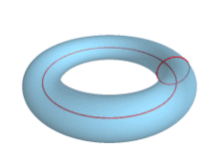
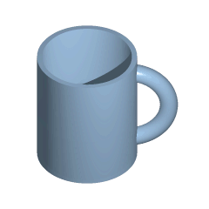

Slide 5
Introduction:
One way to describe the subject of Topology is to say that it is qualitative geometry

Slide 6
Introduction:
One way to describe the subject of Topology is to say that it is qualitative geometry
The idea is that if one geometric object can be continuously transformed into

Slide 7
Introduction:
One way to describe the subject of Topology is to say that it is qualitative geometry
The idea is that if one geometric object can be continuously transformed into
another, then the two objects are to be viewed as being topologically the same

Slide 8
Introduction:
One way to describe the subject of Topology is to say that it is qualitative geometry
The idea is that if one geometric object can be continuously transformed into
another, then the two objects are to be viewed as being topologically the same
For example, a circle and a square are topologically equivalent

Slide 9
Introduction:
One way to describe the subject of Topology is to say that it is qualitative geometry
The idea is that if one geometric object can be continuously transformed into
another, then the two objects are to be viewed as being topologically the same
For example, a circle and a square are topologically equivalent
Physically, a rubber band can be stretched into the form of either a circle or a square

Slide 10
Introduction:
One way to describe the subject of Topology is to say that it is qualitative geometry
The idea is that if one geometric object can be continuously transformed into
another, then the two objects are to be viewed as being topologically the same
For example, a circle and a square are topologically equivalent
Physically, a rubber band can be stretched into the form of either a circle or a square
A figure eight curve formed by two circles touching at a point is to be regarded as topologically distinct from a circle or square

Slide 11
Introduction:
One way to describe the subject of Topology is to say that it is qualitative geometry
The idea is that if one geometric object can be continuously transformed into
another, then the two objects are to be viewed as being topologically the same
For example, a circle and a square are topologically equivalent
Physically, a rubber band can be stretched into the form of either a circle or a square
A figure eight curve formed by two circles touching at a point is to be regarded as topologically distinct from a circle or square
A qualitative property that distinguishes the circle from the figure eight is the number of connected pieces that remain when a single point is removed

Slide 12
Introduction:
One way to describe the subject of Topology is to say that it is qualitative geometry
The idea is that if one geometric object can be continuously transformed into
another, then the two objects are to be viewed as being topologically the same
For example, a circle and a square are topologically equivalent
Physically, a rubber band can be stretched into the form of either a circle or a square
A figure eight curve formed by two circles touching at a point is to be regarded as topologically distinct from a circle or square
A qualitative property that distinguishes the circle from the figure eight is the number of connected pieces that remain when a single point is removed
When a point is removed from a circle what remains is still connected, a single arc, whereas for a figure eight if one removes the point of contact of its two circles, what remains is two separate arcs, two separate pieces.

Slide 13
The term used to describe two geometric objects that are topologically equivalent is homeomorphic

Slide 14
The term used to describe two geometric objects that are topologically equivalent is homeomorphic
Thus a circle and a square are homeomorphic

Slide 15
The term used to describe two geometric objects that are topologically equivalent is homeomorphic
Thus a circle and a square are homeomorphic
if we place a circle C inside a square S with the same center point, then projecting the circle radially outward to the square defines a function f :C→S , and this function is continuous: small changes in x produce small changes in f (x). The function f has an inverse f −1 : S→C obtained by projecting the square radially inward to the circle, and this is continuous as well. One says that f is a homeomorphism between C and S .

Slide 16
The term used to describe two geometric objects that are topologically equivalent is homeomorphic
Thus a circle and a square are homeomorphic
if we place a circle C inside a square S with the same center point, then projecting the circle radially outward to the square defines a function f :C→S , and this function is continuous: small changes in x produce small changes in f (x). The function f has an inverse f −1 : S→C obtained by projecting the square radially inward to the circle, and this is continuous as well. One says that f is a homeomorphism between C and S .
One of the basic problems of Topology is to determine when two given geometric objects are homeomorphic

Slide 17
The term used to describe two geometric objects that are topologically equivalent is homeomorphic
Thus a circle and a square are homeomorphic
if we place a circle C inside a square S with the same center point, then projecting the circle radially outward to the square defines a function f :C→S , and this function is continuous: small changes in x produce small changes in f (x). The function f has an inverse f −1 : S→C obtained by projecting the square radially inward to the circle, and this is continuous as well. One says that f is a homeomorphism between C and S .
One of the basic problems of Topology is to determine when two given geometric objects are homeomorphic
Our first goal will be to define exactly what the ‘geometric objects’ are that one studies in Topology.

Slide 18
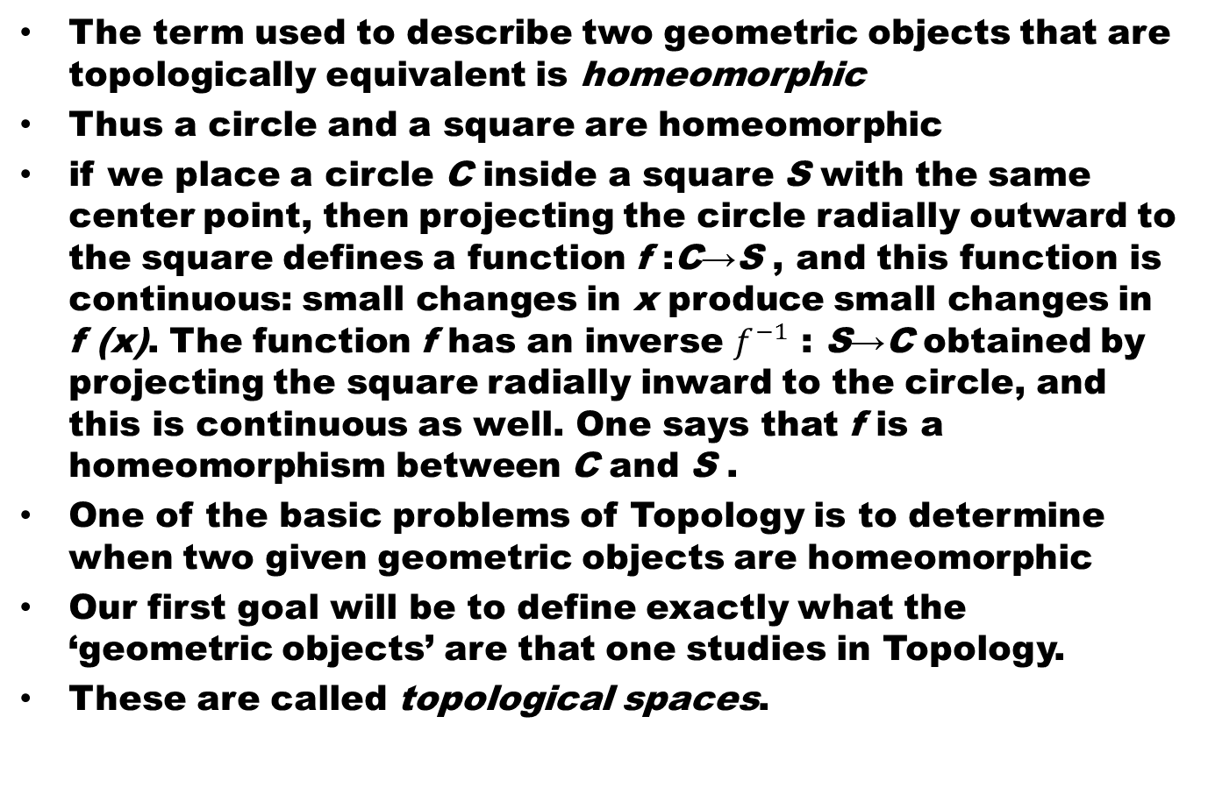
The term used to describe two geometric objects that are topologically equivalent is homeomorphic
Thus a circle and a square are homeomorphic
if we place a circle C inside a square S with the same center point, then projecting the circle radially outward to the square defines a function f :C→S , and this function is continuous: small changes in x produce small changes in f (x). The function f has an inverse $f^{−1}$: S→C obtained by projecting the square radially inward to the circle, and this is continuous as well. One says that f is a homeomorphism between C and S .
One of the basic problems of Topology is to determine when two given geometric objects are homeomorphic
Our first goal will be to define exactly what the ‘geometric objects’ are that one studies in Topology.
These are called topological spaces.

Slide 19
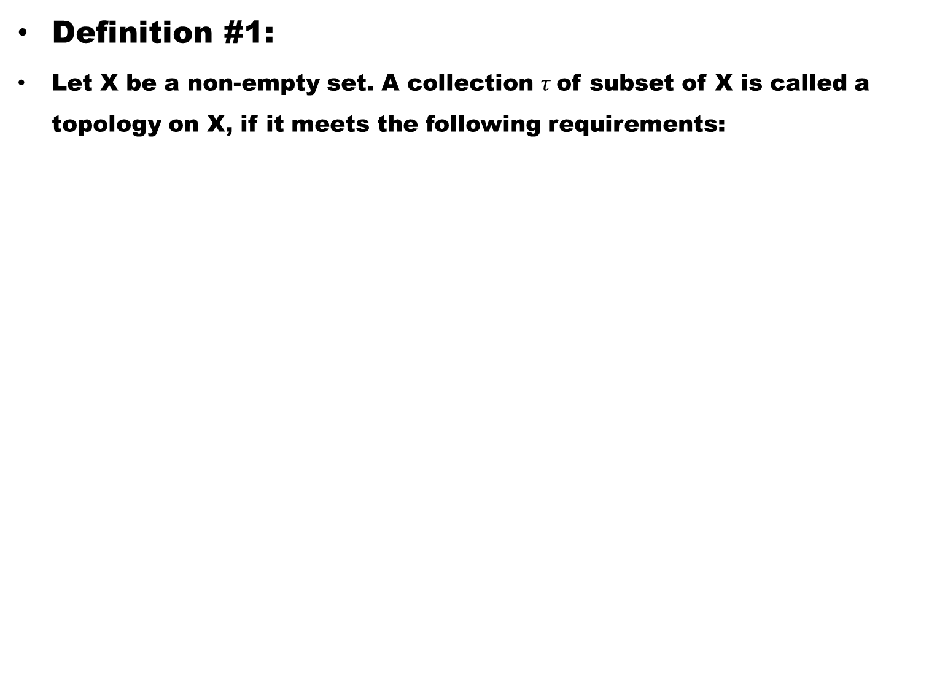
Definition #1:
Let X be a non-empty set. A collection $τ$of subset of X is called a topology on X, if it meets the following requirements:

Slide 20
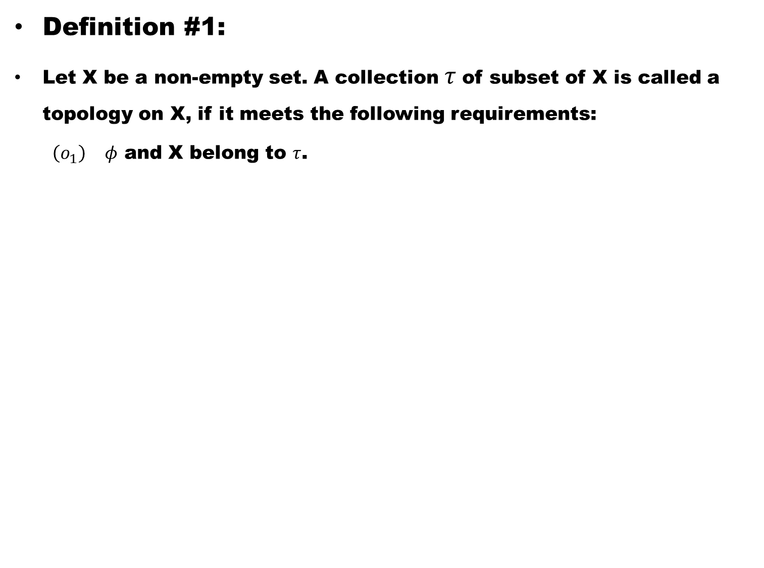
Definition #1:
Let X be a non-empty set. A collection $τ$of subset of X is called a topology on X, if it meets the following requirements:
  $\left(o_{1}\right)$$φ$ and X belong to $τ$.

Slide 21
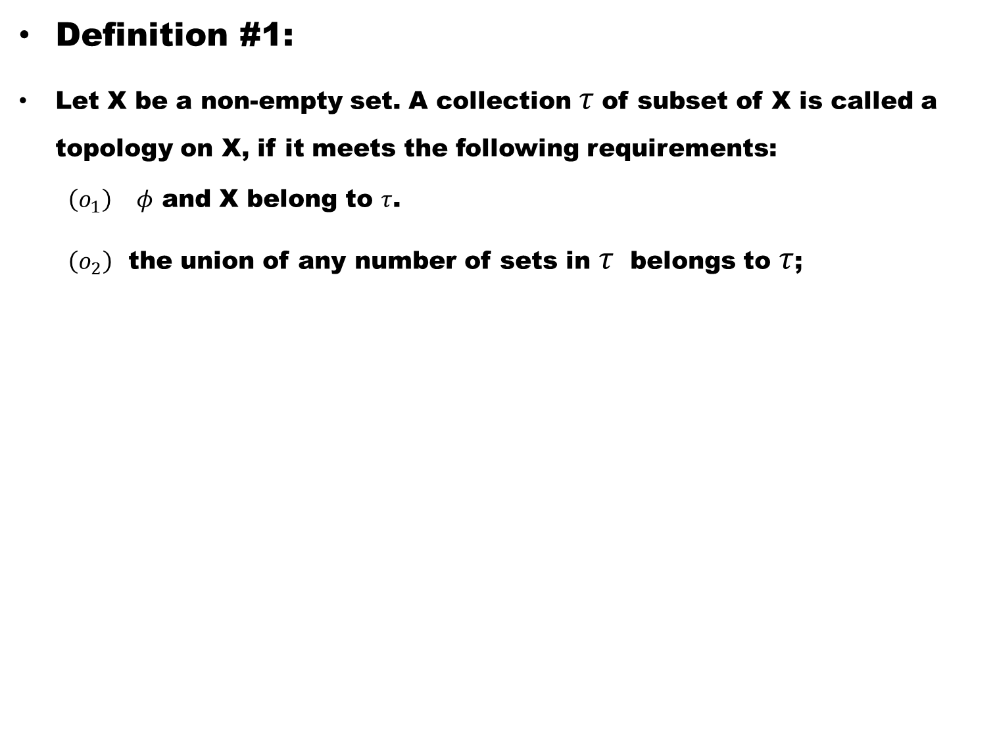
Definition #1:
Let X be a non-empty set. A collection $τ$of subset of X is called a topology on X, if it meets the following requirements:
  $\left(o_{1}\right)$$φ$ and X belong to $τ$.
  $\left(o_{2}\right)$ the union of any number of sets in $τ$ belongs to $τ$;

Slide 22
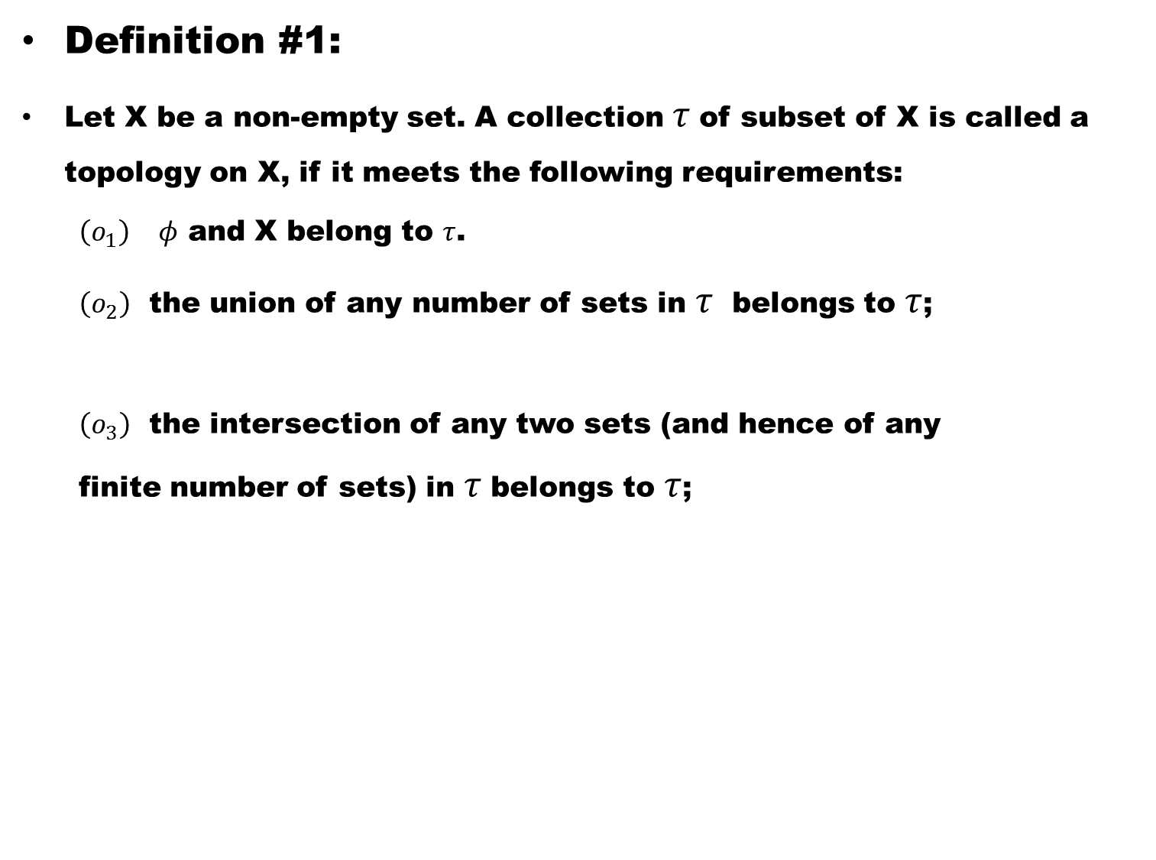
Definition #1:
Let X be a non-empty set. A collection $τ$of subset of X is called a topology on X, if it meets the following requirements:
  $\left(o_{1}\right)$$φ$ and X belong to $τ$.
  $\left(o_{2}\right)$ the union of any number of sets in $τ$ belongs to $τ$;
  $\left(o_{3}\right)$ the intersection of any two sets (and hence of any finite number of sets) in $τ$belongs to $τ$;

Slide 23
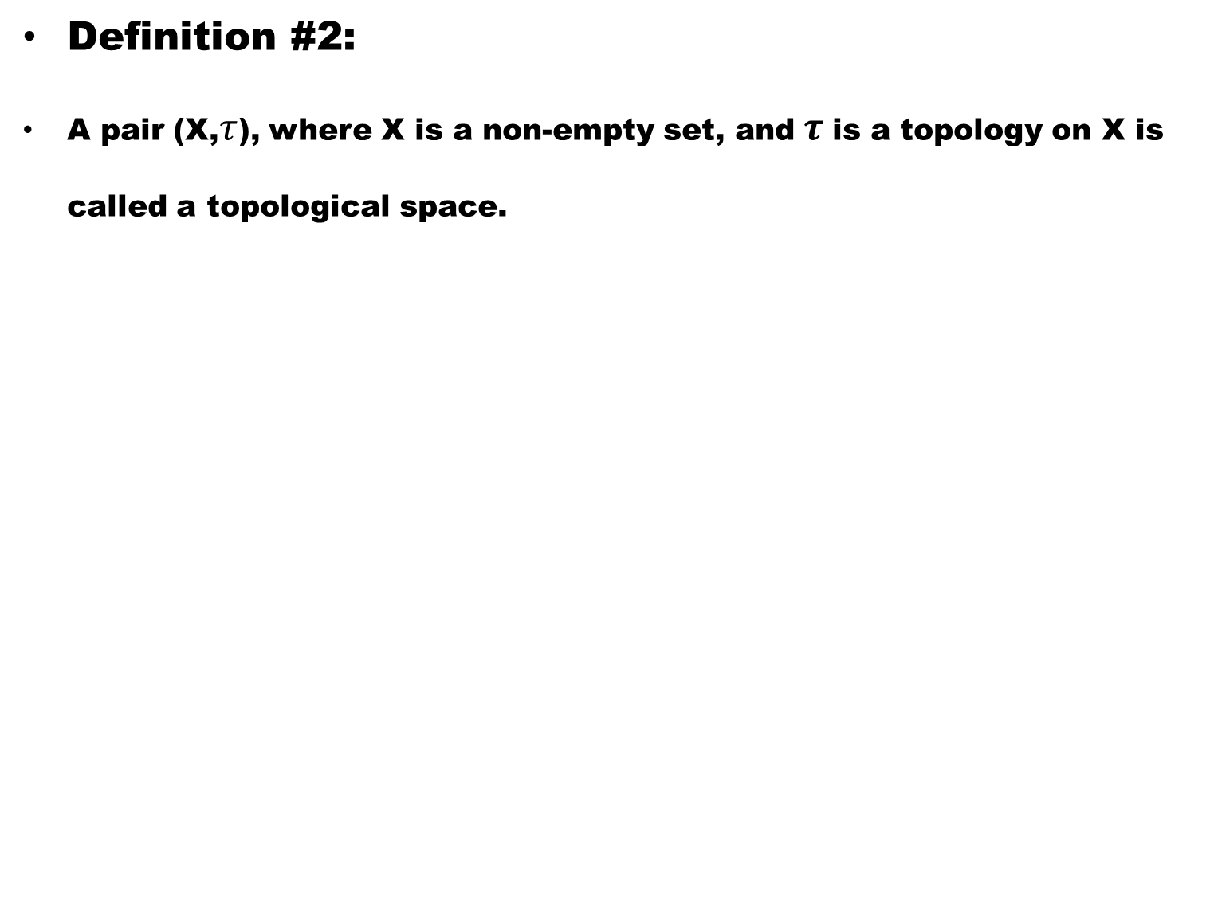
Definition #2:
A pair (X,$τ$), where X is a non-empty set, and$τ$is a topology on X is called a topological space.

Slide 24
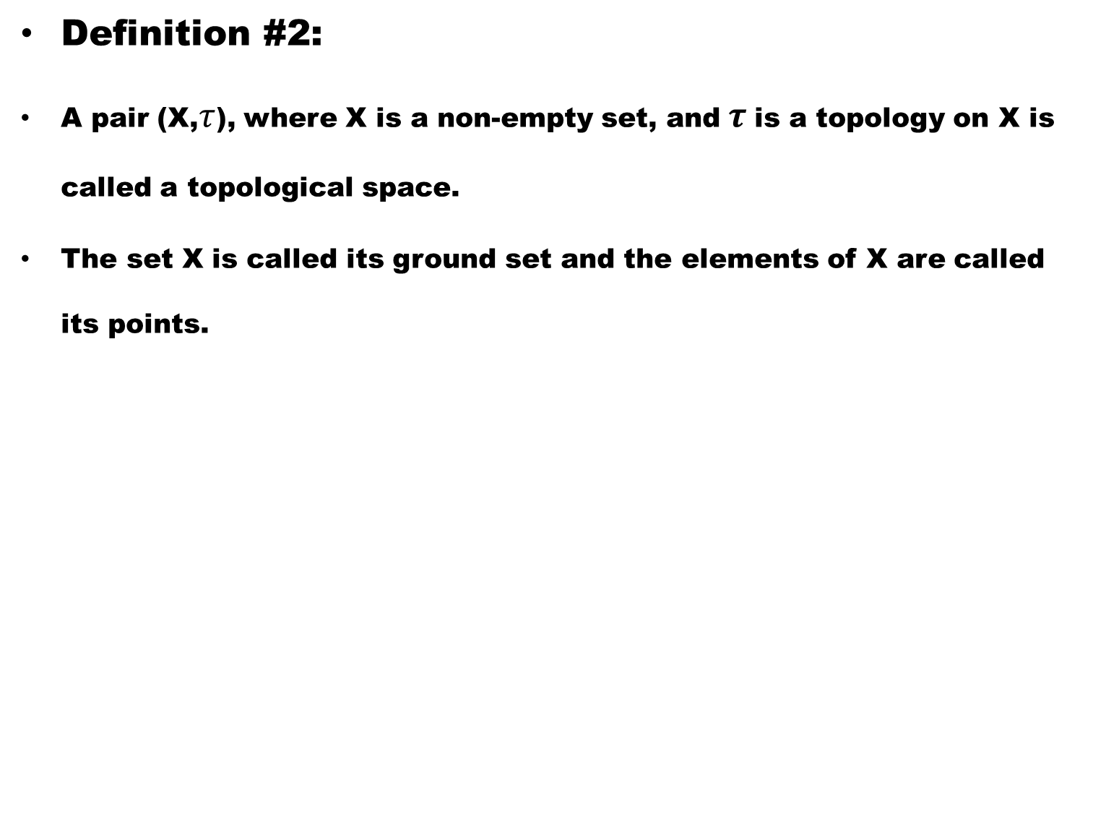
Definition #2:
A pair (X,$τ$), where X is a non-empty set, and$τ$is a topology on X is called a topological space.
The set X is called its ground set and the elements of X are called its points.

Slide 25
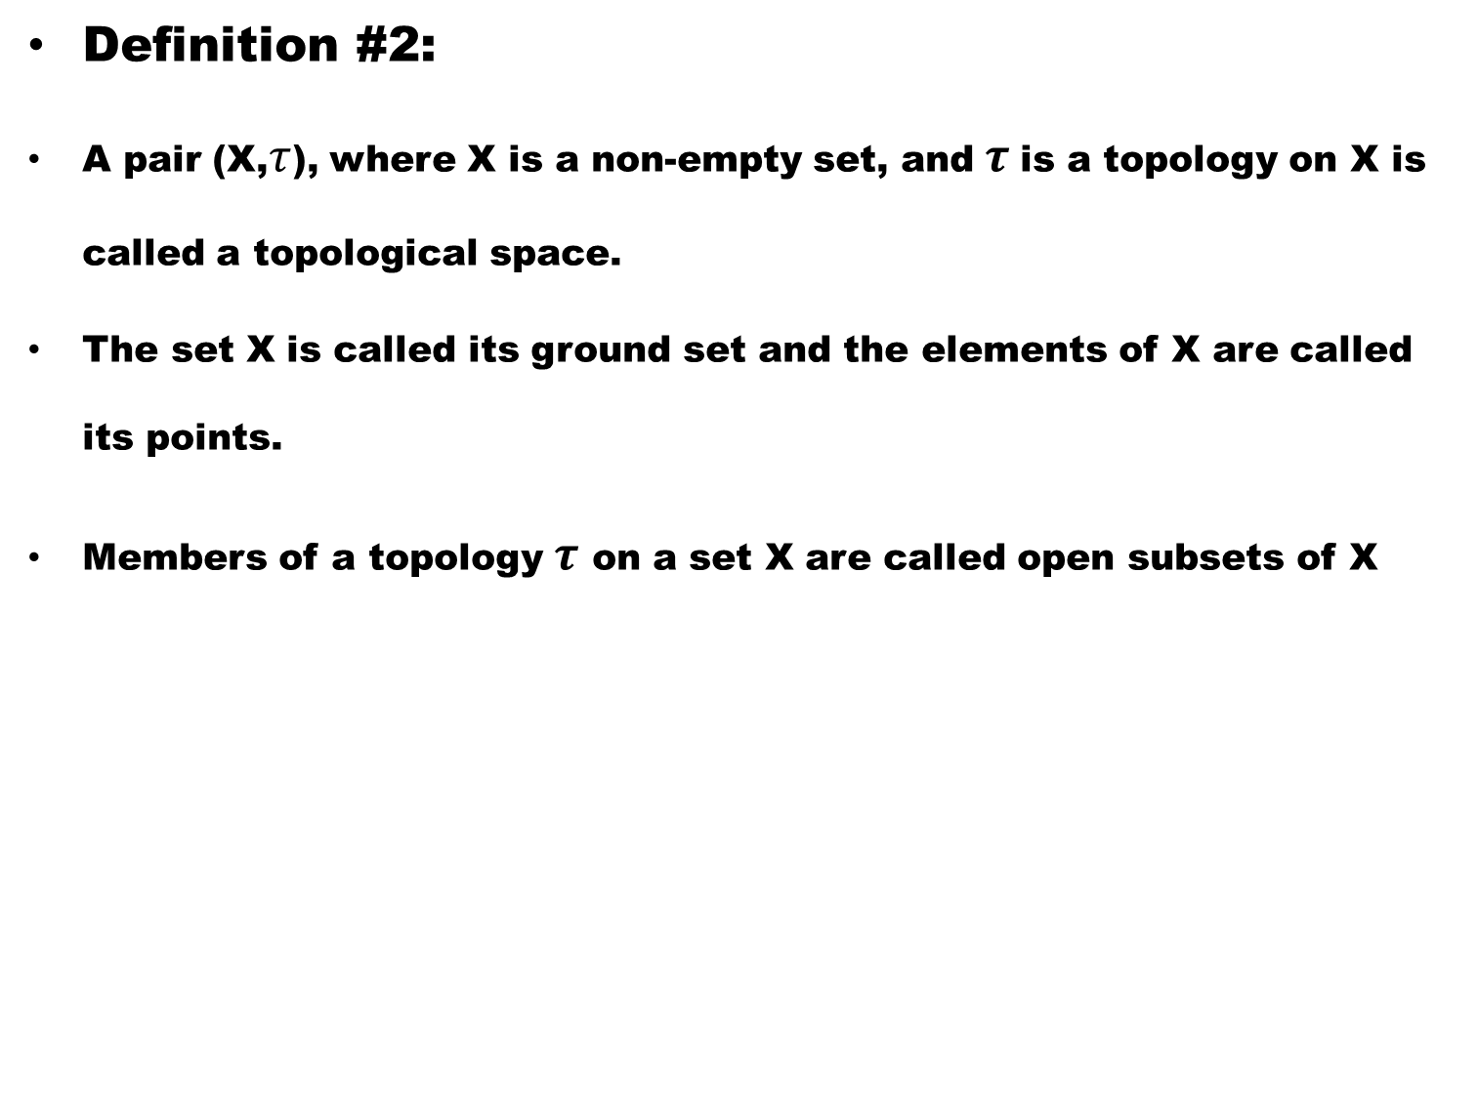
Definition #2:
A pair (X,$τ$), where X is a non-empty set, and$τ$is a topology on X is called a topological space.
The set X is called its ground set and the elements of X are called its points.
Members of a topology $τ$ on a set X are called open subsets of X

Slide 26
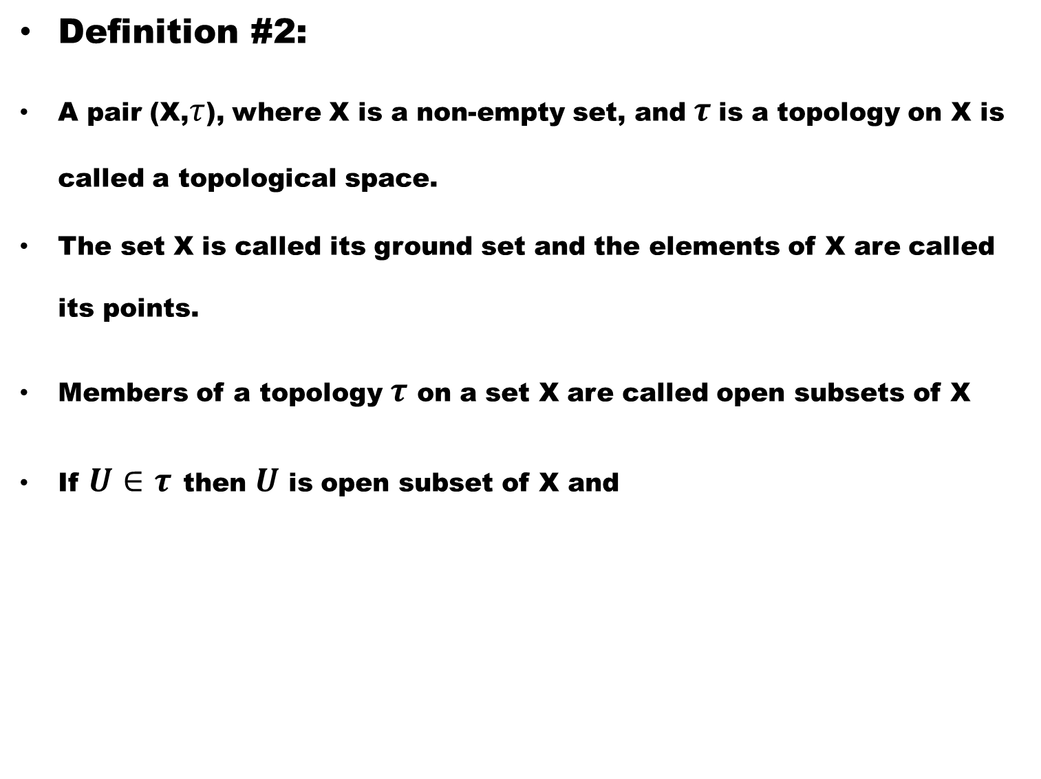
Definition #2:
A pair (X,$τ$), where X is a non-empty set, and$τ$is a topology on X is called a topological space.
The set X is called its ground set and the elements of X are called its points.
Members of a topology $τ$ on a set X are called open subsets of X
If $U∈τ$then $U$ is open subset of X and

Slide 27
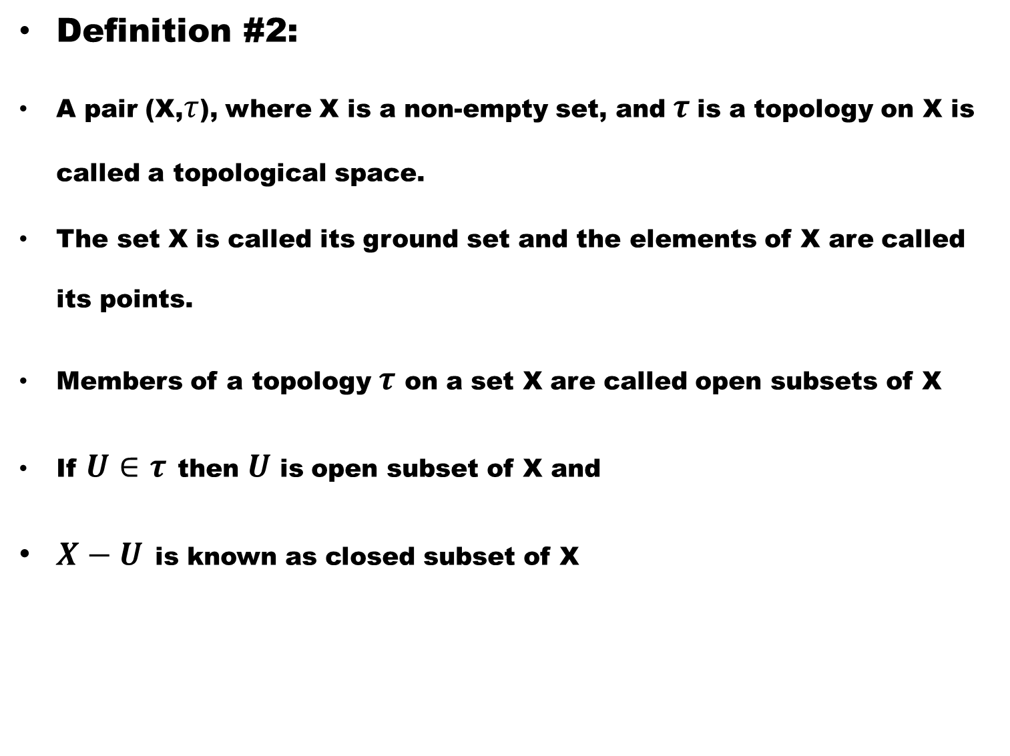
Definition #2:
A pair (X,$τ$), where X is a non-empty set, and$τ$is a topology on X is called a topological space.
The set X is called its ground set and the elements of X are called its points.
Members of a topology $τ$ on a set X are called open subsets of X
If $U∈τ$then $U$ is open subset of X and
$X−U$is known as closed subset of X

Slide 28
Example #1.
Let X={a,b}. Consider the following four collection of subsets of X:

Slide 29
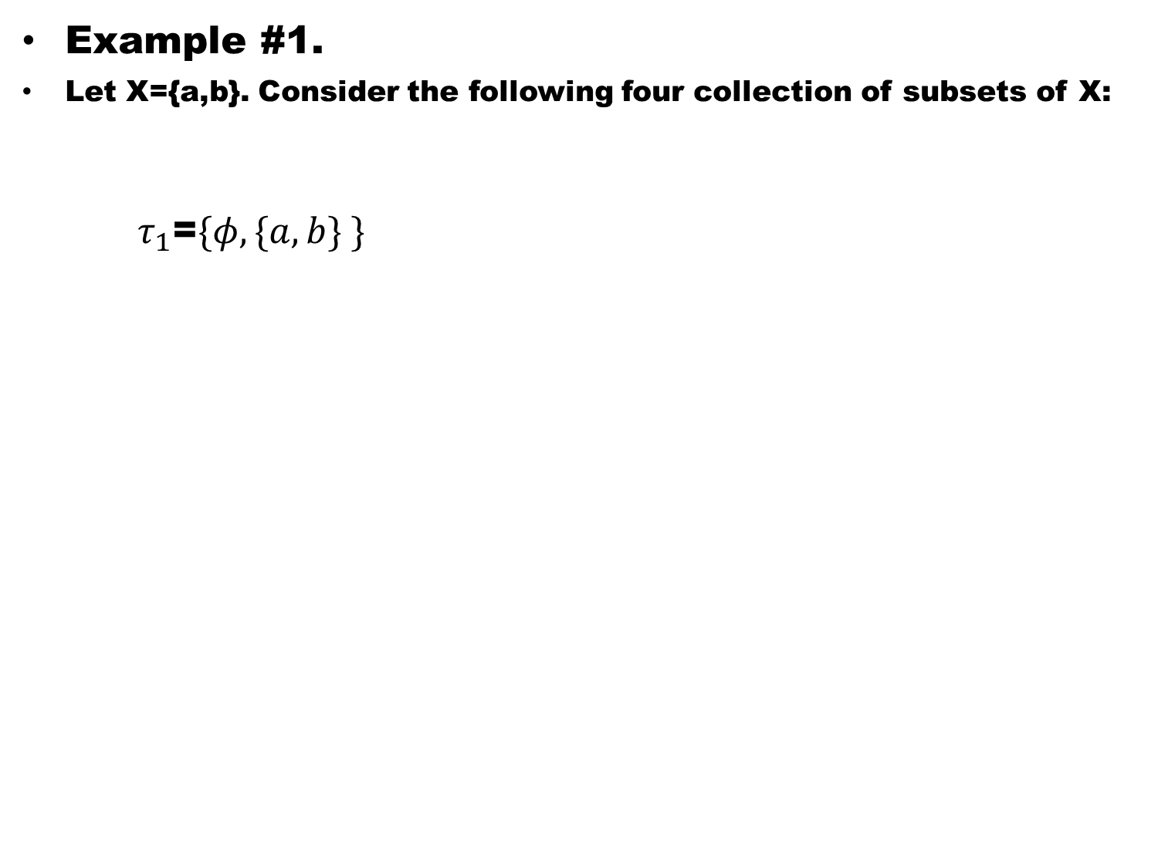
Example #1.
Let X={a,b}. Consider the following four collection of subsets of X:
  $τ_{1}$=$\{φ,\{a,b\} \}$

Slide 30
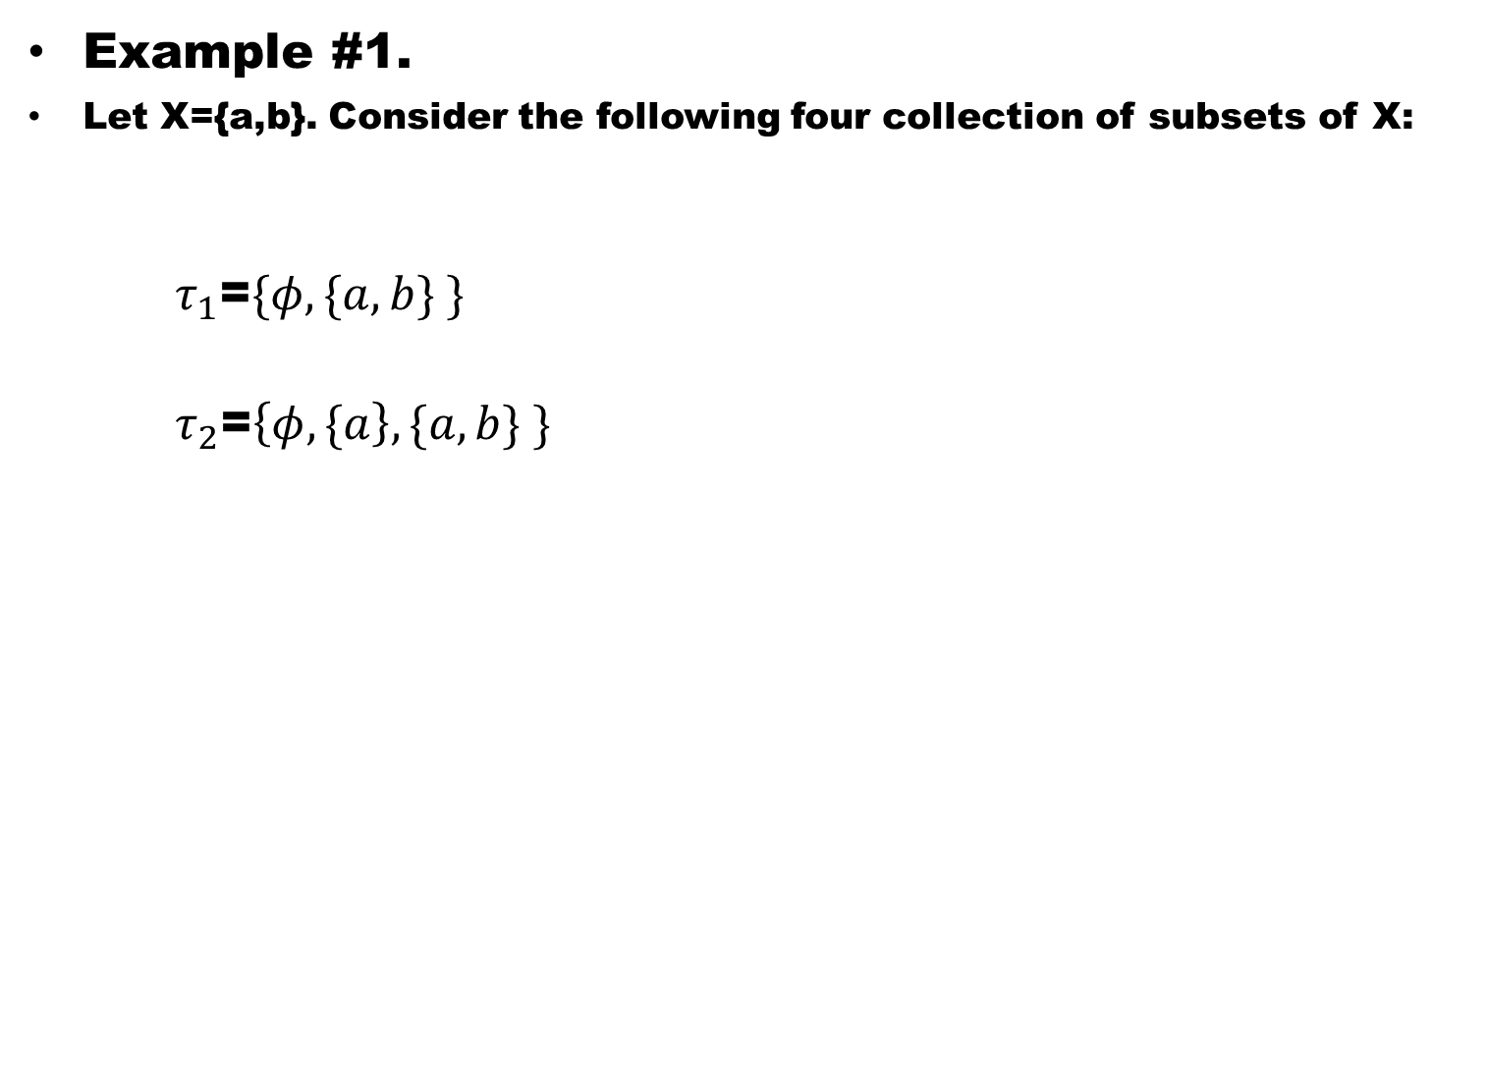
Example #1.
Let X={a,b}. Consider the following four collection of subsets of X:
  $τ_{1}$=$\{φ,\{a,b\} \}$
  $τ_{2}$=$\left\{φ,\{a\right\},\{a,b\} \}$

Slide 31
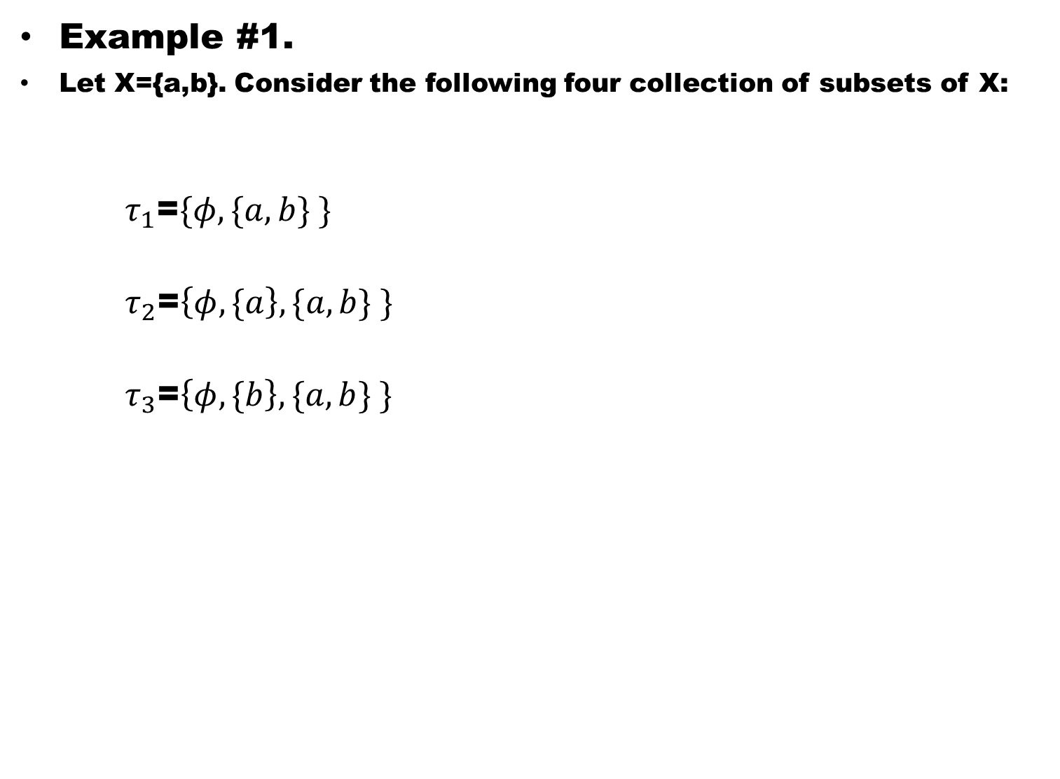
Example #1.
Let X={a,b}. Consider the following four collection of subsets of X:
  $τ_{1}$=$\{φ,\{a,b\} \}$
  $τ_{2}$=$\left\{φ,\{a\right\},\{a,b\} \}$
  $τ_{3}$=$\left\{φ,\{b\right\},\{a,b\} \}$

Slide 32
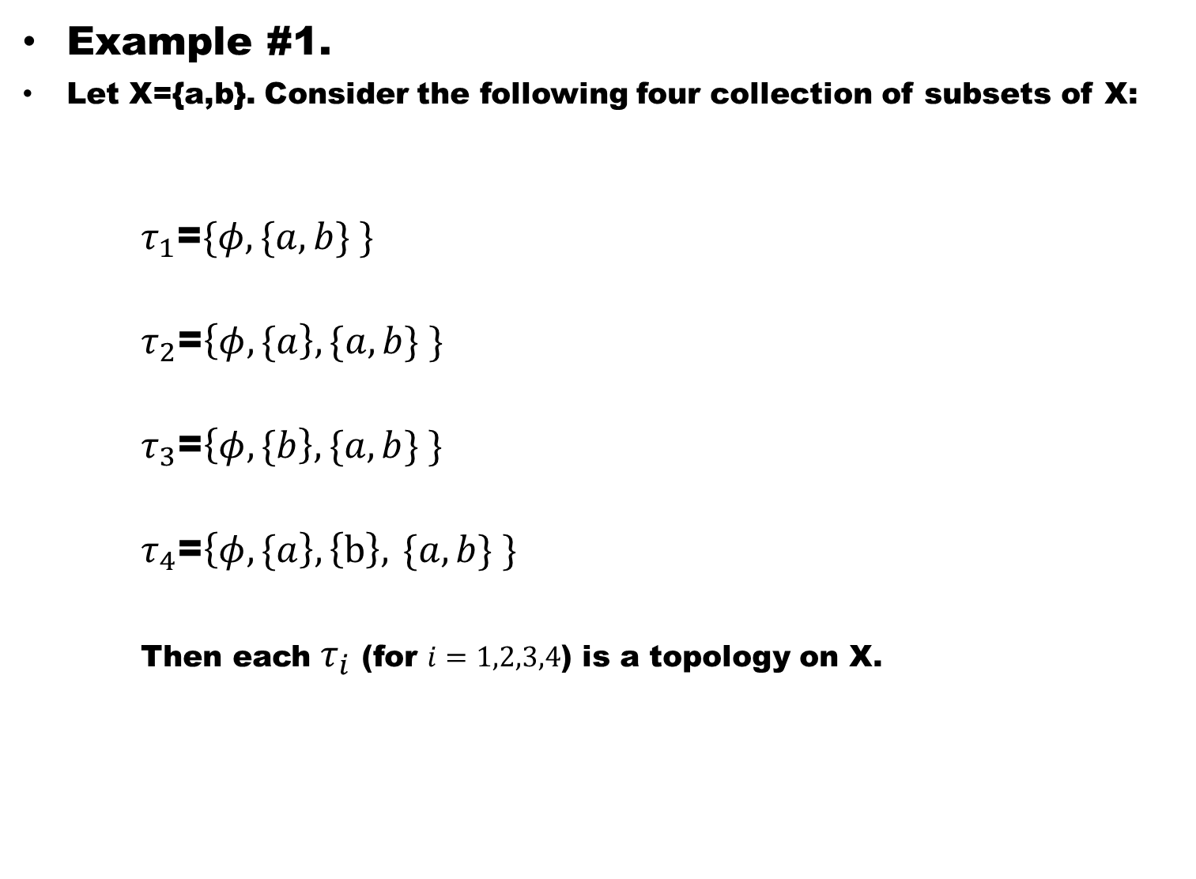
Example #1.
Let X={a,b}. Consider the following four collection of subsets of X:
  $τ_{1}$=$\{φ,\{a,b\} \}$
  $τ_{2}$=$\left\{φ,\{a\right\},\{a,b\} \}$
  $τ_{3}$=$\left\{φ,\{b\right\},\{a,b\} \}$
  $τ_{4}$=$\left\{φ,\{a\right\},\left\{b\right\},$$\{a,b\} \}$
  Then each $τ_{i}$ (for $i=1,2,3,4$) is a topology on X.

Slide 33
Remark :
From the above example it is clear:
There may be more than one topologies on a set X
therefore, more than one topological spaces of which X is the ground set.

Slide 34
Example #2:
Let X={a,b,c,d}. Consider the following collection of subsets of X.

Slide 35
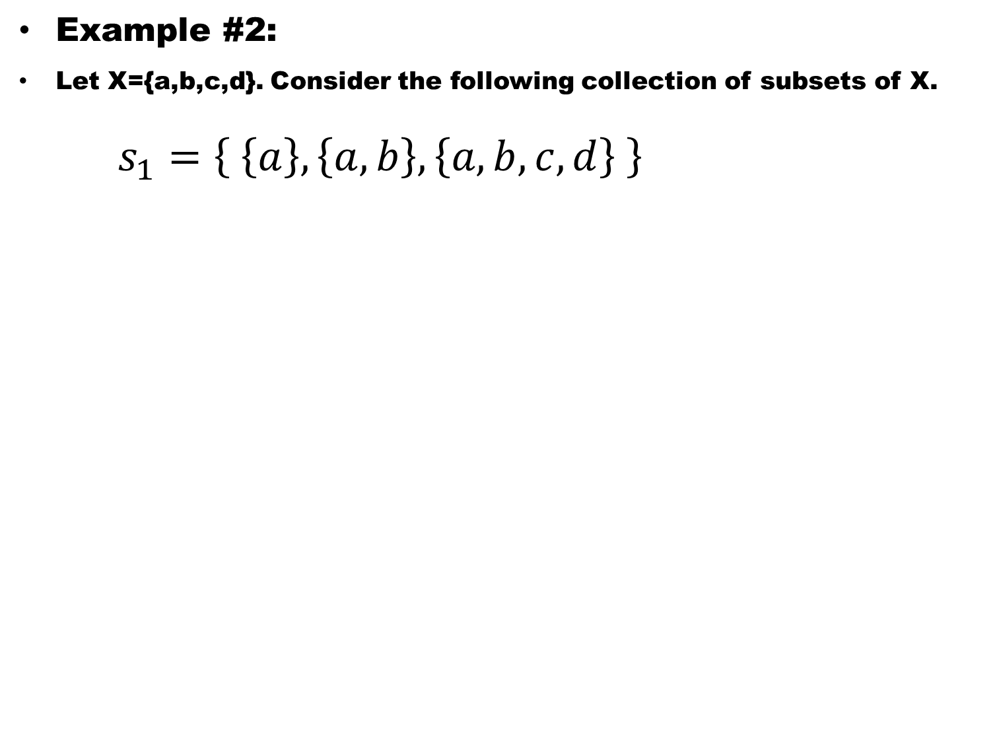
Example #2:
Let X={a,b,c,d}. Consider the following collection of subsets of X.
$s_{1}=\left\{ \left\{a\right\},\left\{a,b\right\},\left\{a,b,c,d\right\} \right\}$

Slide 36
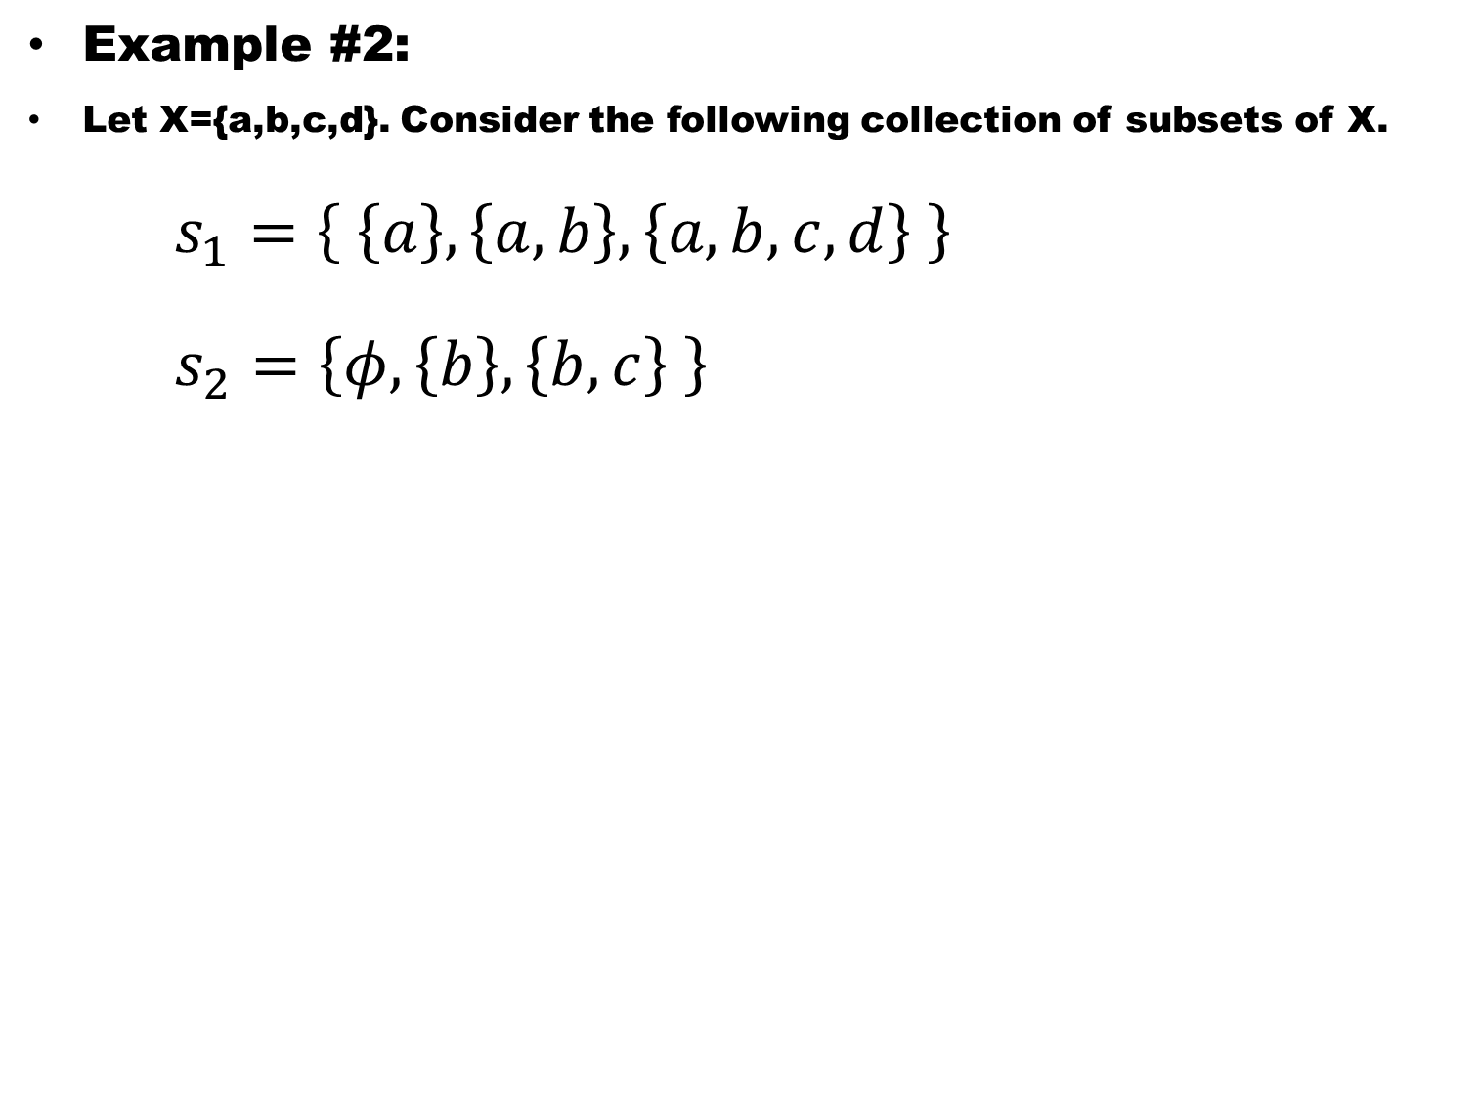
Example #2:
Let X={a,b,c,d}. Consider the following collection of subsets of X.
$s_{1}=\left\{ \left\{a\right\},\left\{a,b\right\},\left\{a,b,c,d\right\} \right\}$
$s_{2}=\left\{φ,\left\{b\right\},\left\{b,c\right\} \right\}$

Slide 37
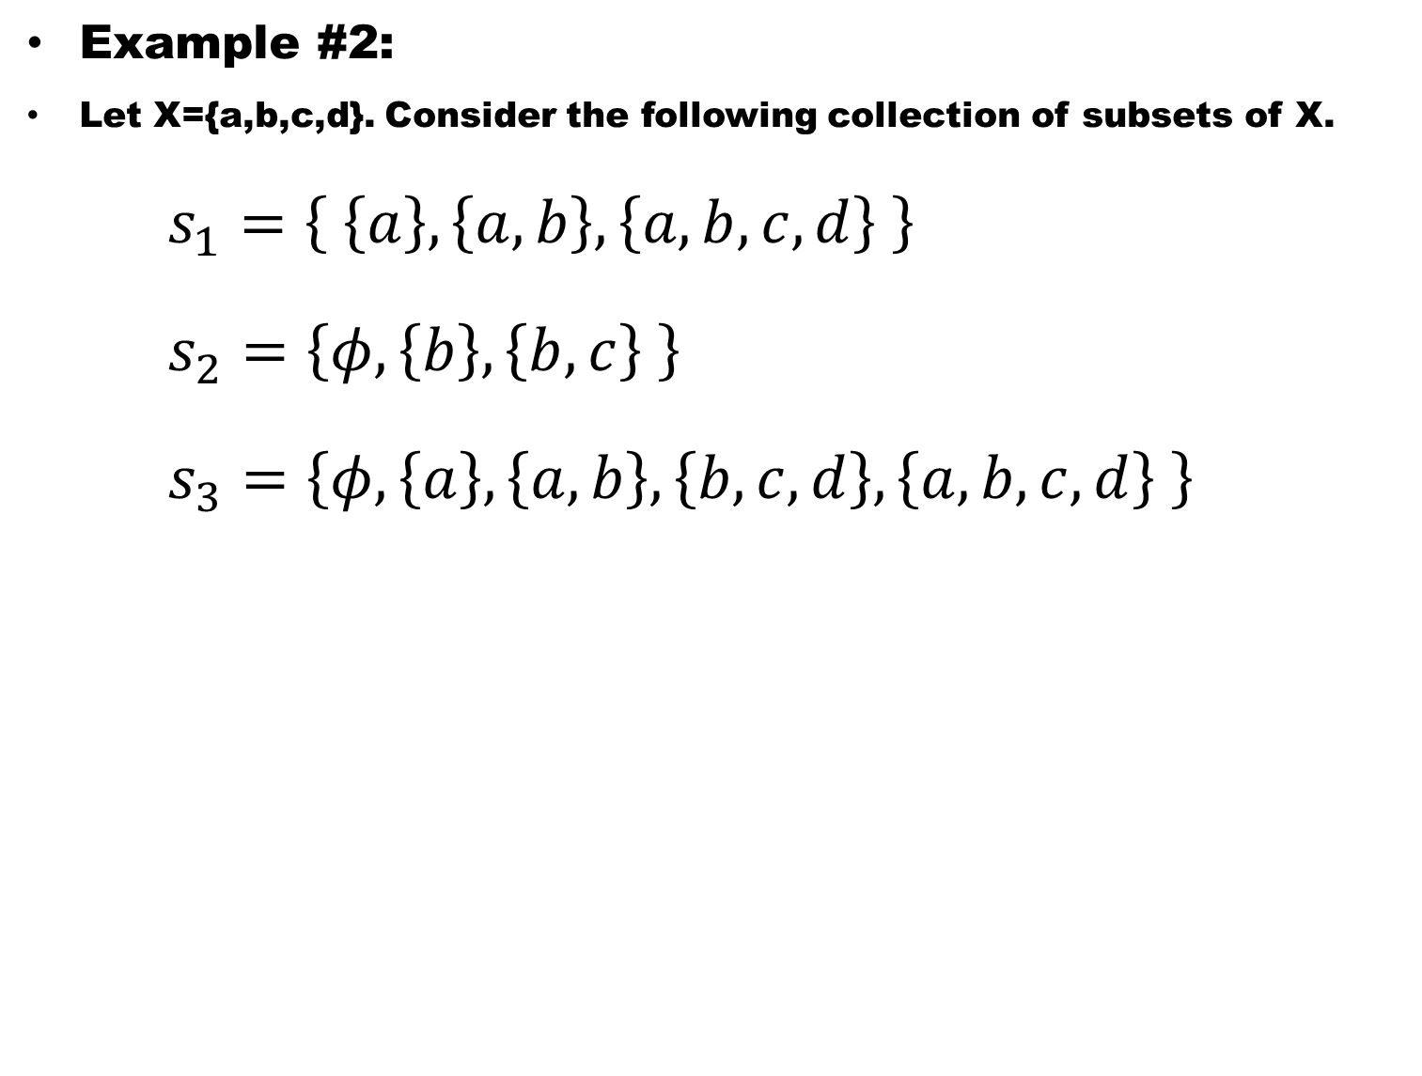
Example #2:
Let X={a,b,c,d}. Consider the following collection of subsets of X.
$s_{1}=\left\{ \left\{a\right\},\left\{a,b\right\},\left\{a,b,c,d\right\} \right\}$
$s_{2}=\left\{φ,\left\{b\right\},\left\{b,c\right\} \right\}$
$s_{3}=\left\{φ,\left\{a\right\},\left\{a,b\right\},\left\{b,c,d\right\},\left\{a,b,c,d\right\} \right\}$

Slide 38
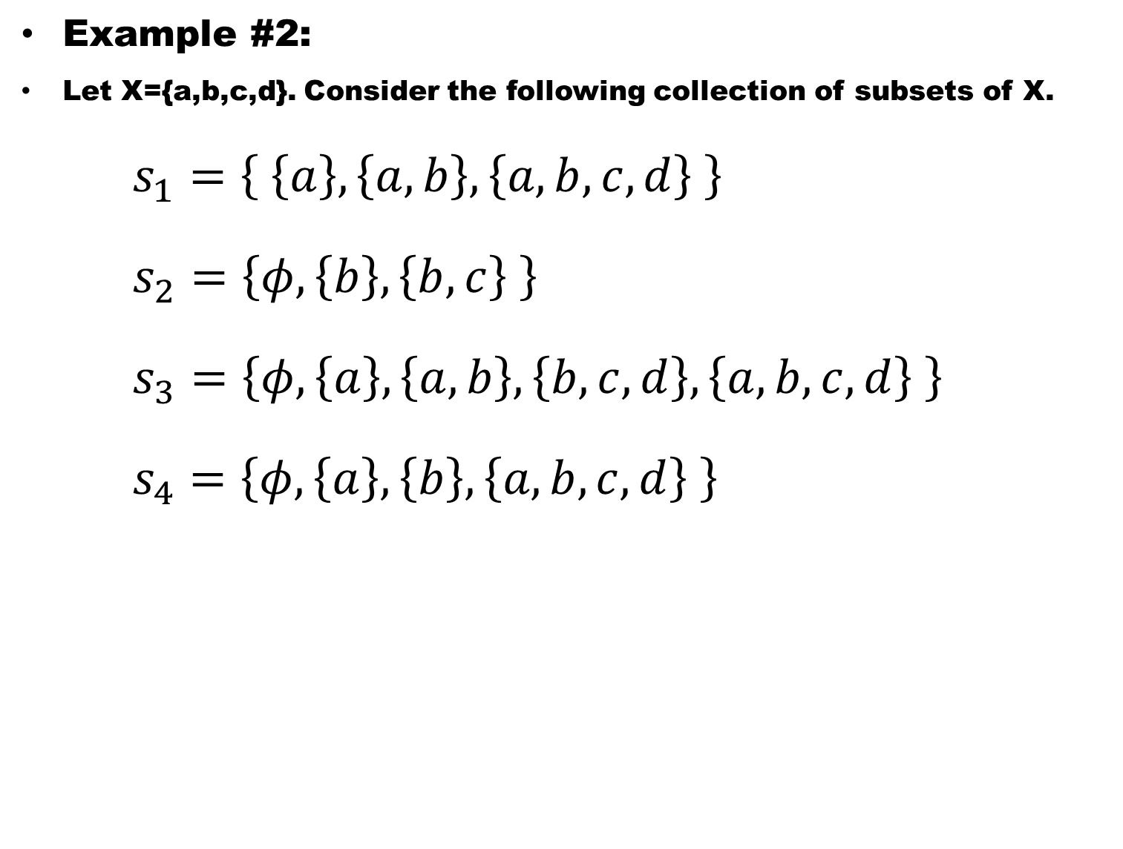
Example #2:
Let X={a,b,c,d}. Consider the following collection of subsets of X.
$s_{1}=\left\{ \left\{a\right\},\left\{a,b\right\},\left\{a,b,c,d\right\} \right\}$
$s_{2}=\left\{φ,\left\{b\right\},\left\{b,c\right\} \right\}$
$s_{3}=\left\{φ,\left\{a\right\},\left\{a,b\right\},\left\{b,c,d\right\},\left\{a,b,c,d\right\} \right\}$
$s_{4}=\left\{φ,\left\{a\right\},\left\{b\right\}, \left\{a,b,c,d\right\} \right\}$

Slide 39
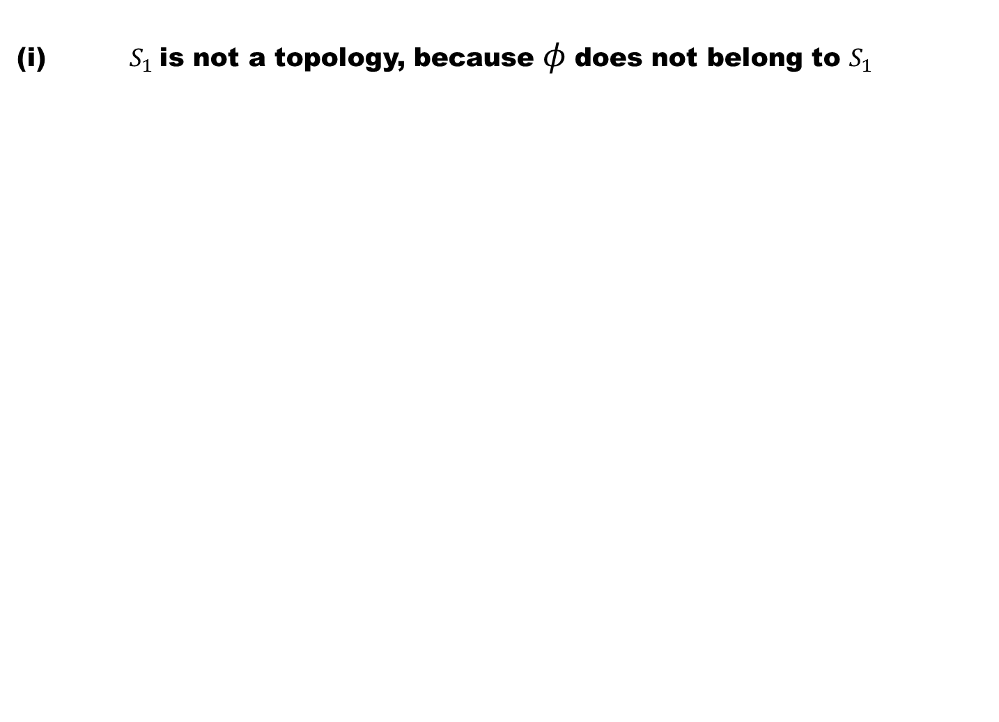
(i)$S_{1}$is not a topology, because $φ$does not belong to $S_{1}$

Slide 40
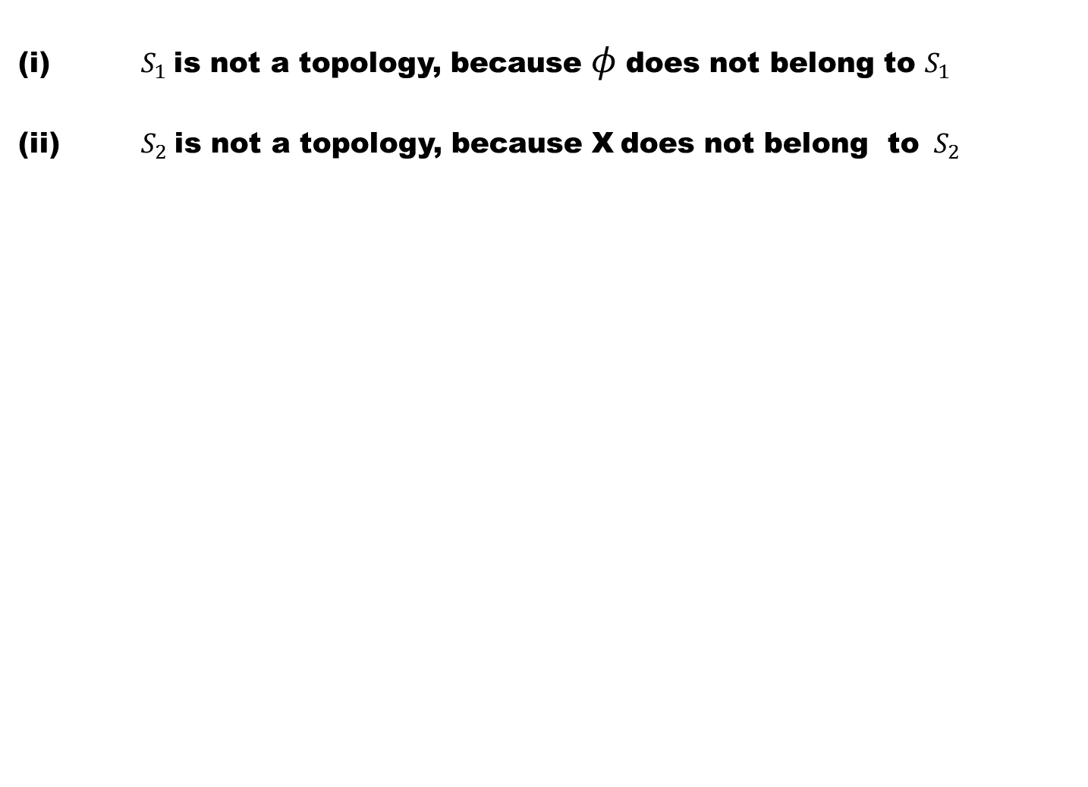
(i)$S_{1}$is not a topology, because $φ$does not belong to $S_{1}$
(ii) $S_{2}$is not a topology, because X does not belong to ${ S}_{2}$

Slide 41
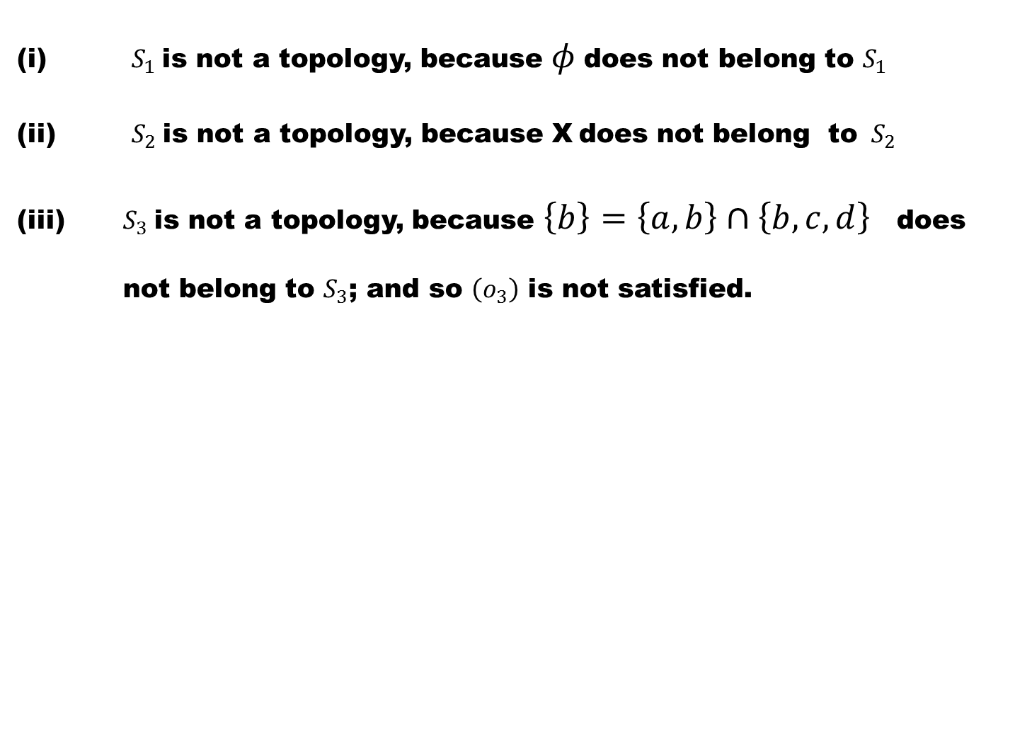
(i)$S_{1}$is not a topology, because $φ$does not belong to $S_{1}$
(ii) $S_{2}$is not a topology, because X does not belong to ${ S}_{2}$
(iii) $S_{3}$is not a topology, because $\left\{b\right\}=\left\{a,b\right\}∩\left\{b,c,d\right\}$ does not belong to $S_{3}$; and so $\left(o_{3}\right)$ is not satisfied.

Slide 42
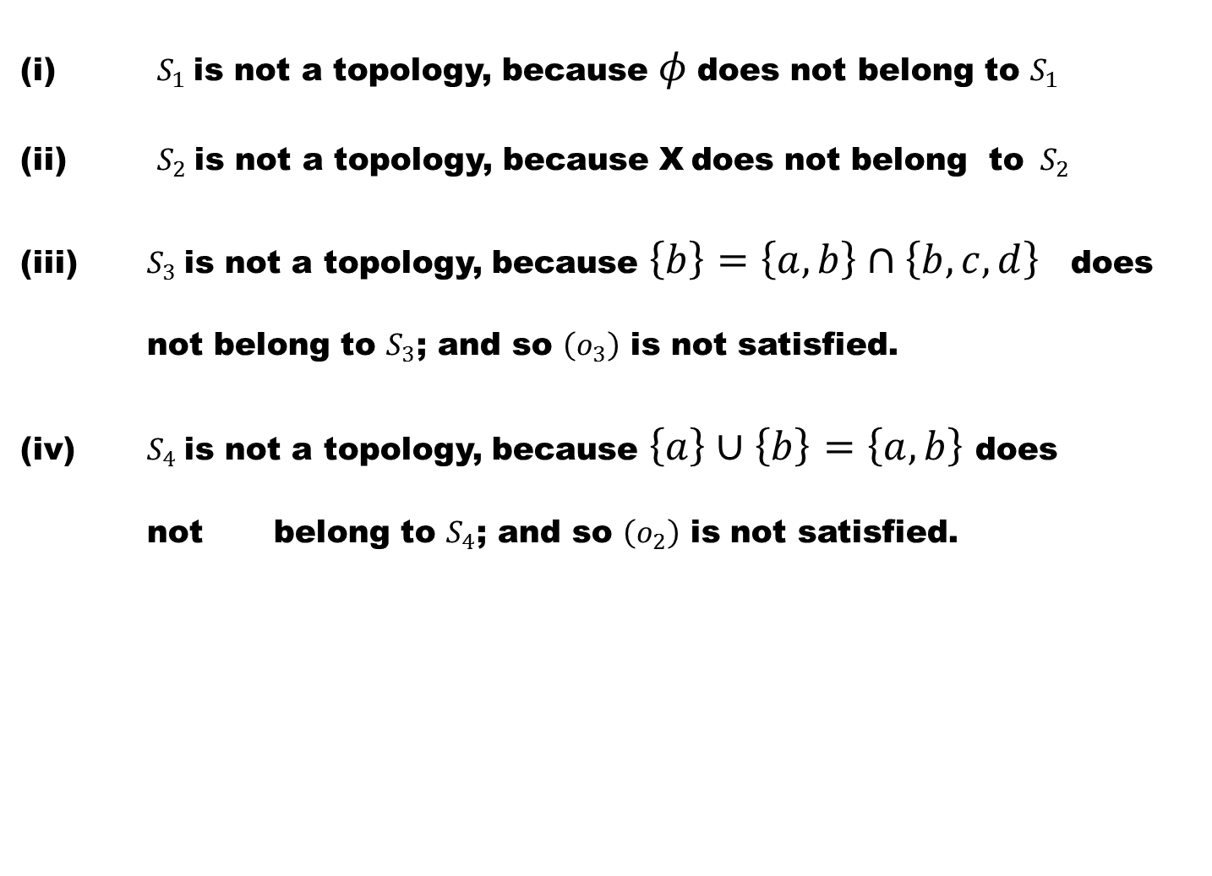
(i)$S_{1}$is not a topology, because $φ$does not belong to $S_{1}$
(ii) $S_{2}$is not a topology, because X does not belong to ${ S}_{2}$
(iii) $S_{3}$is not a topology, because $\left\{b\right\}=\left\{a,b\right\}∩\left\{b,c,d\right\}$ does not belong to $S_{3}$; and so $\left(o_{3}\right)$ is not satisfied.
(iv) $S_{4}$is not a topology, because $\left\{a\right\}∪\left\{b\right\}$$=\left\{a,b\right\}$ does not belong to $S_{4}$; and so $\left(o_{2}\right)$ is not satisfied.

Slide 43
Remark:
The above example shows that not every collection of subsets of X is a topology on X.

Slide 44
Example #3: (Co-finite topology)
Let X be a non-empty set

Slide 45
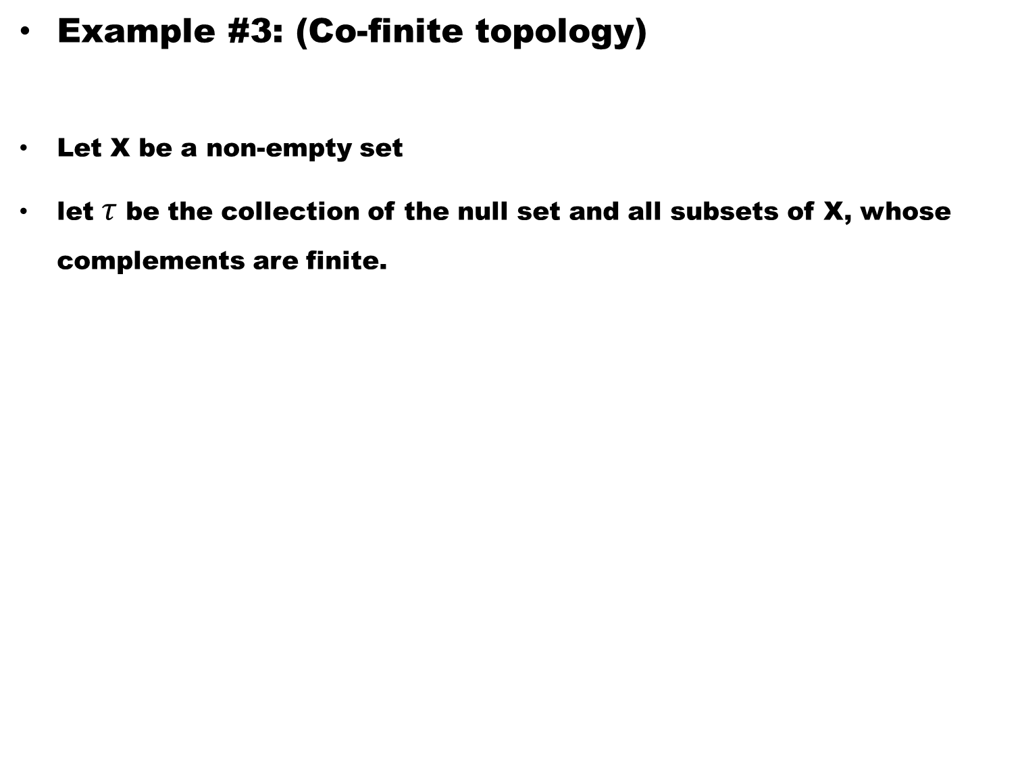
Example #3: (Co-finite topology)
Let X be a non-empty set
let$τ$be the collection of the null set and all subsets of X, whose complements are finite.

Slide 46
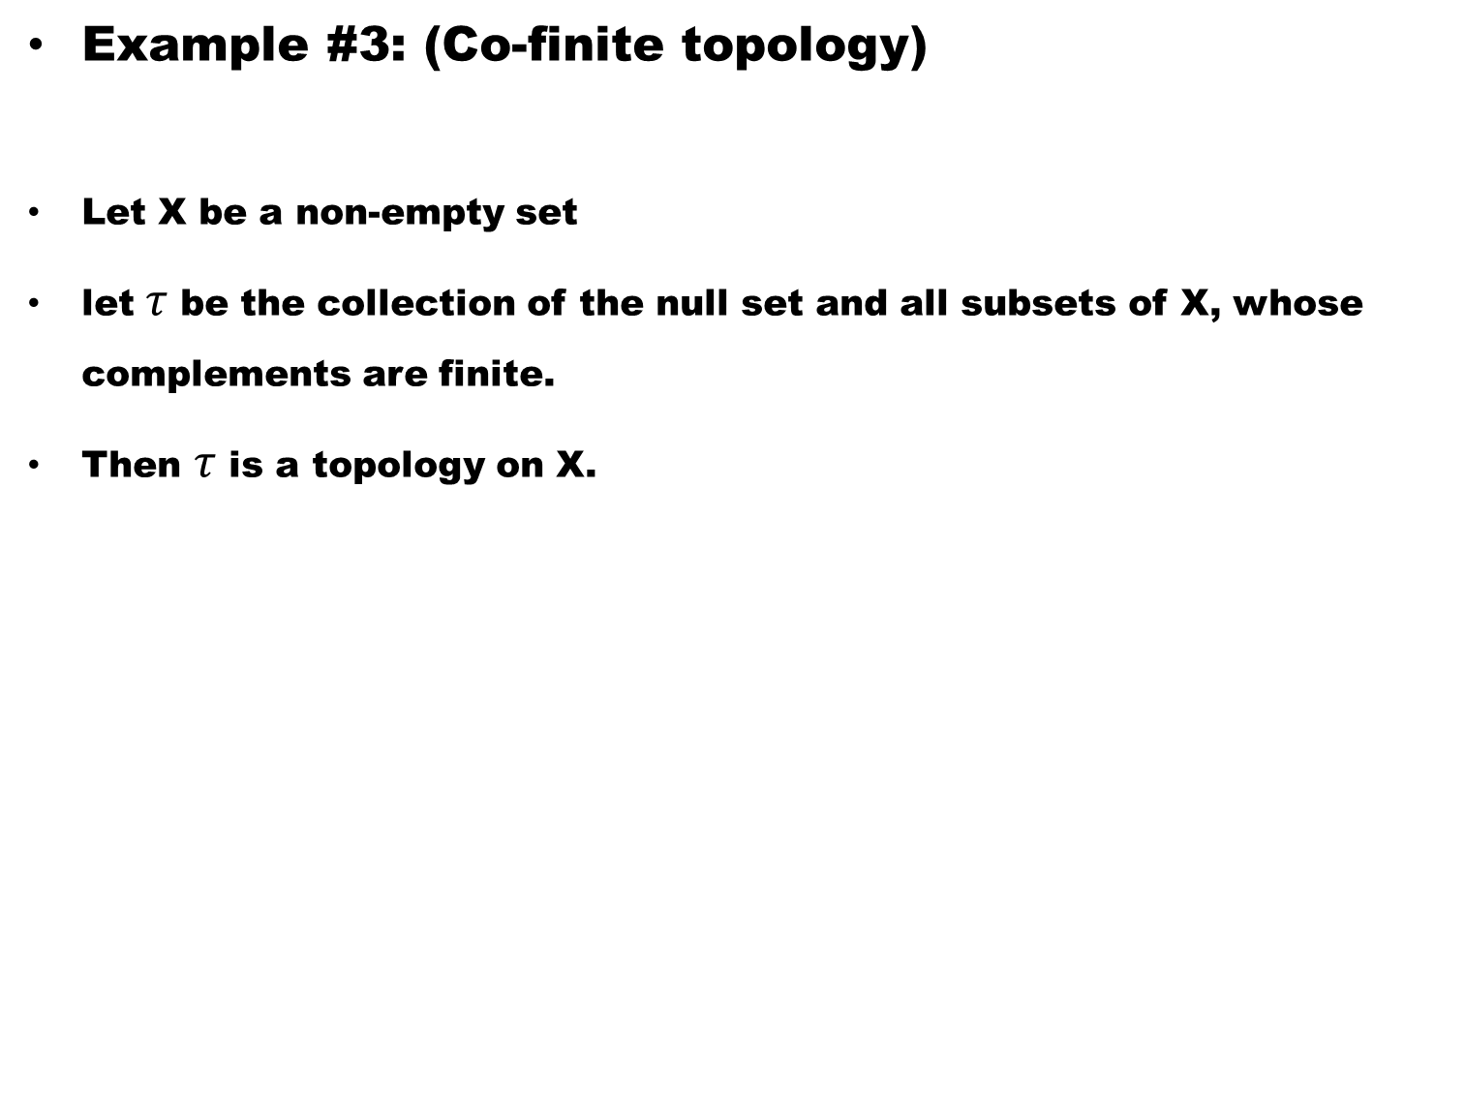
Example #3: (Co-finite topology)
Let X be a non-empty set
let$τ$be the collection of the null set and all subsets of X, whose complements are finite.
Then $τ$is a topology on X.

Slide 47
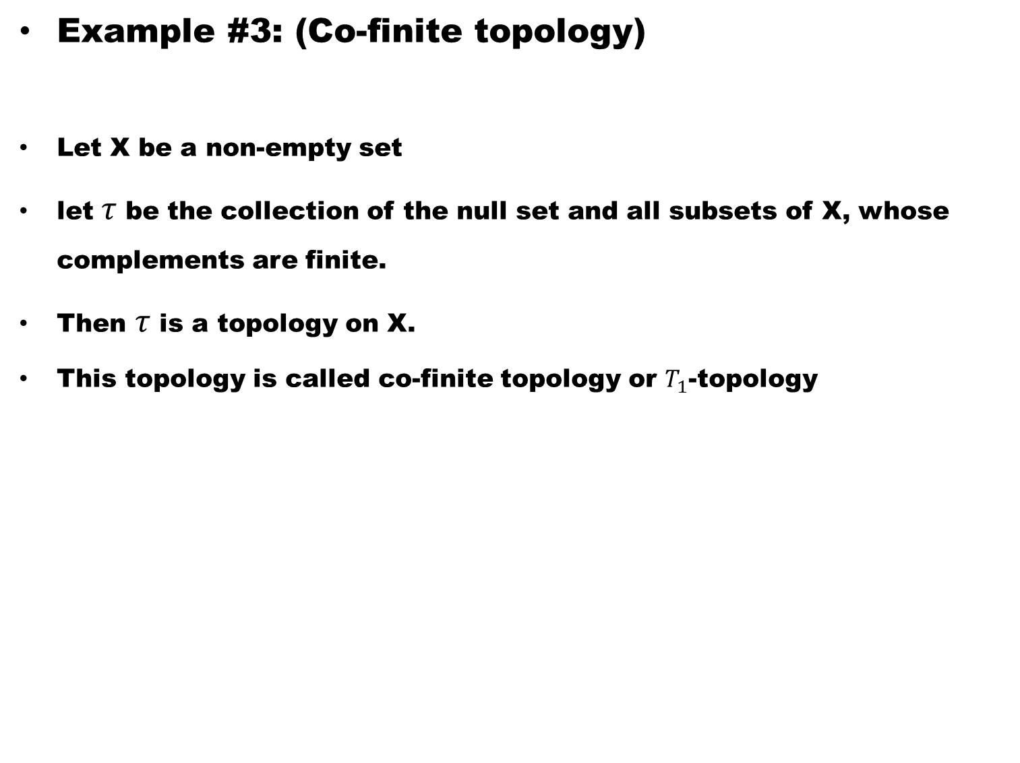
Example #3: (Co-finite topology)
Let X be a non-empty set
let$τ$be the collection of the null set and all subsets of X, whose complements are finite.
Then $τ$is a topology on X.
This topology is called co-finite topology or $T_{1}$-topology

Slide 48
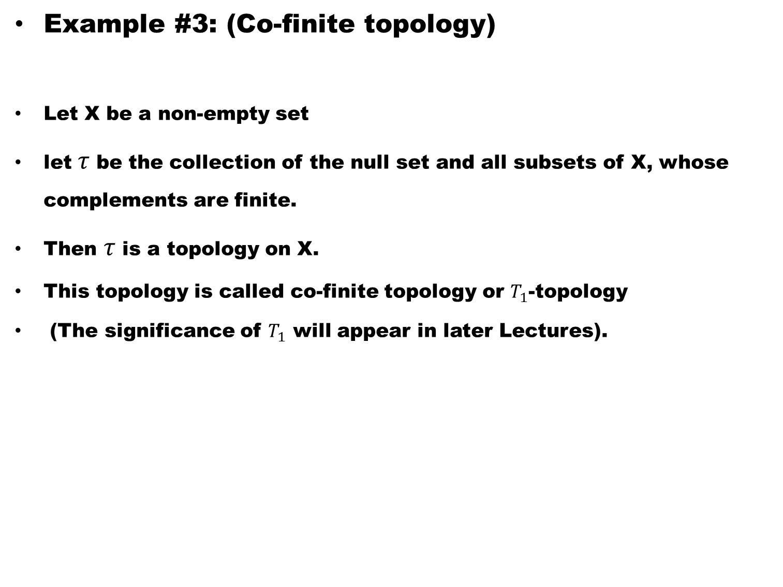
Example #3: (Co-finite topology)
Let X be a non-empty set
let$τ$be the collection of the null set and all subsets of X, whose complements are finite.
Then $τ$is a topology on X.
This topology is called co-finite topology or $T_{1}$-topology
(The significance of $T_{1}$ will appear in later Lectures).

Slide 49
Example #4:
Let X be a non-empty set

Slide 50
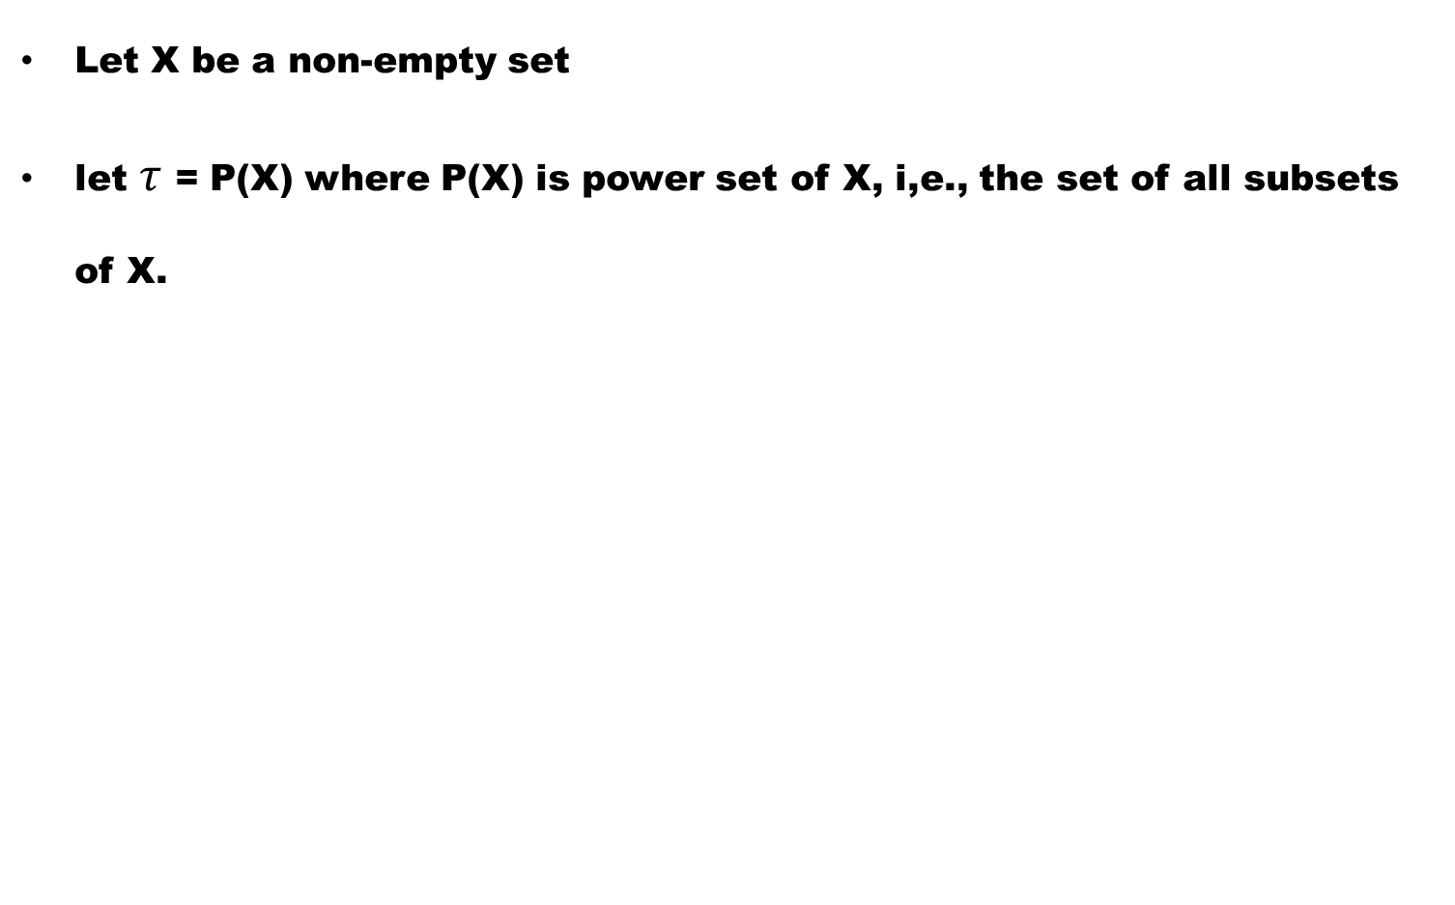
Example #4:
Let X be a non-empty set
let $τ$ = P(X) where P(X) is power set of X, i,e., the set of all subsets of X.

Slide 51
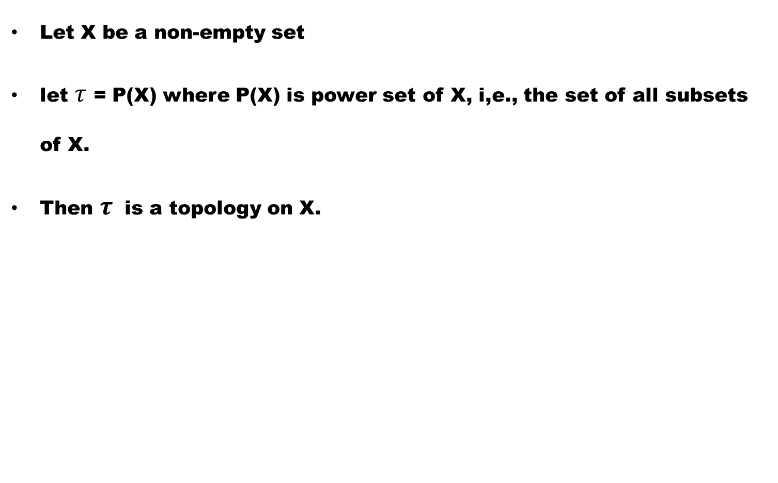
Example #4:
Let X be a non-empty set
let $τ$ = P(X) where P(X) is power set of X, i,e., the set of all subsets of X.
Then $τ$ is a topology on X.

Slide 52
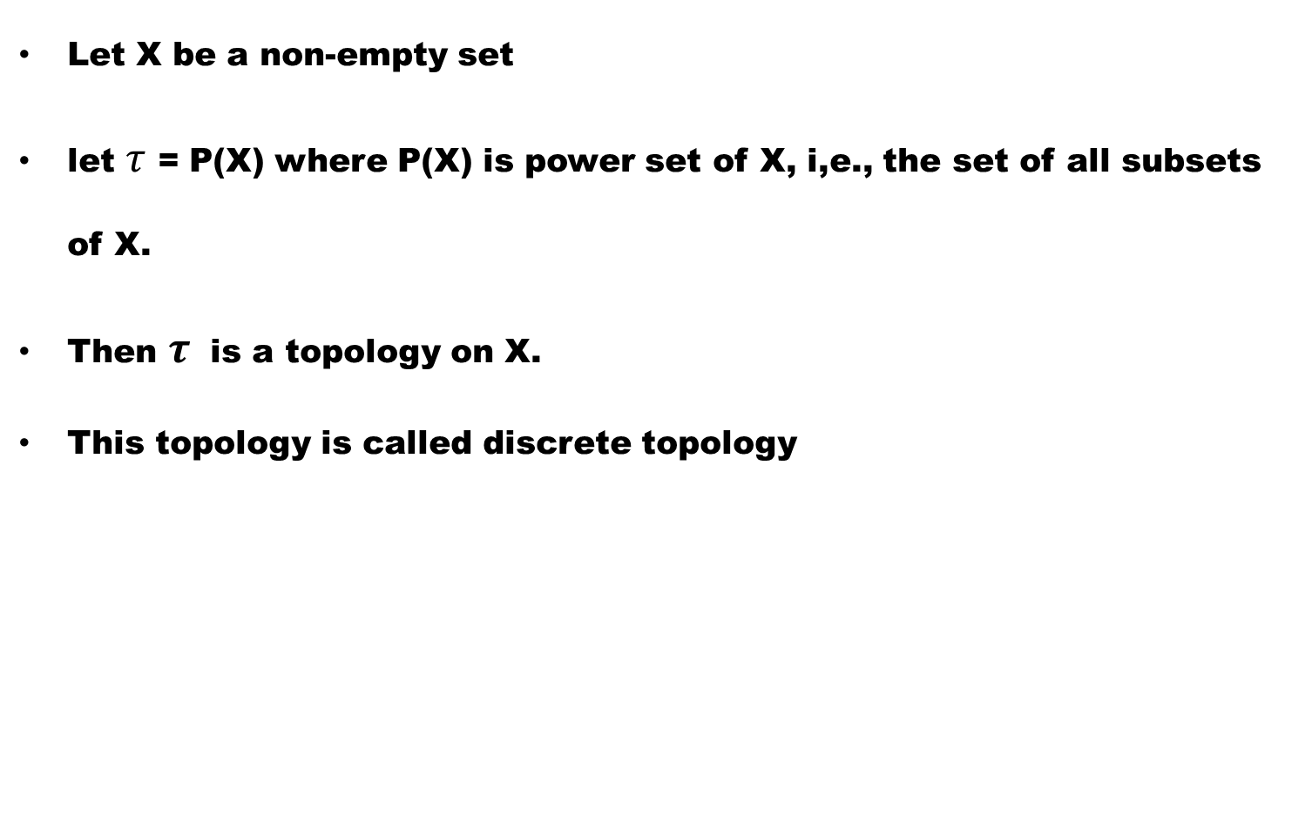
Example #4:
Let X be a non-empty set
let $τ$ = P(X) where P(X) is power set of X, i,e., the set of all subsets of X.
Then $τ$ is a topology on X.
This topology is called discrete topology

Slide 53
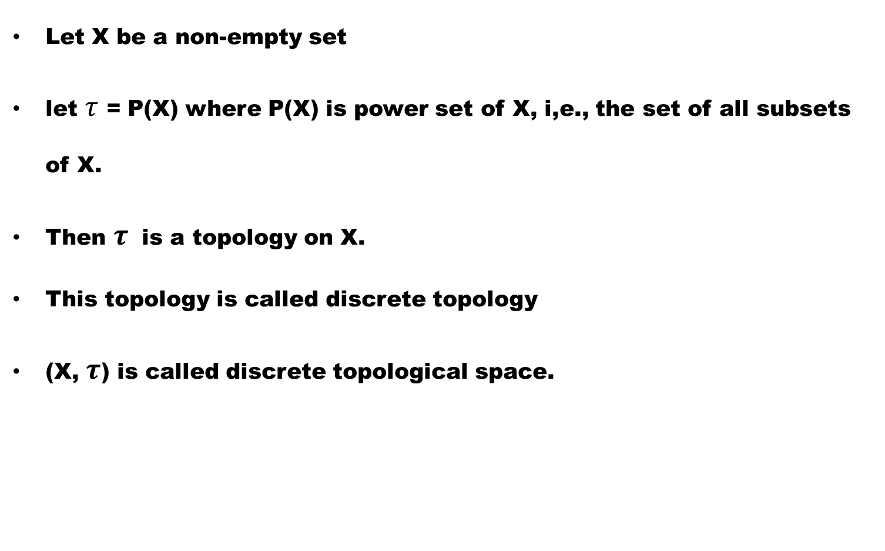
Example #4:
Let X be a non-empty set
let $τ$ = P(X) where P(X) is power set of X, i,e., the set of all subsets of X.
Then $τ$ is a topology on X.
This topology is called discrete topology
(X, $τ$) is called discrete topological space.

Slide 54
Example # 5:
The Co-finite topology on X is discrete if X is a finite set.

Slide 55
Example # 6: (Indiscrete Space)
For any non-empty set X,

Slide 56
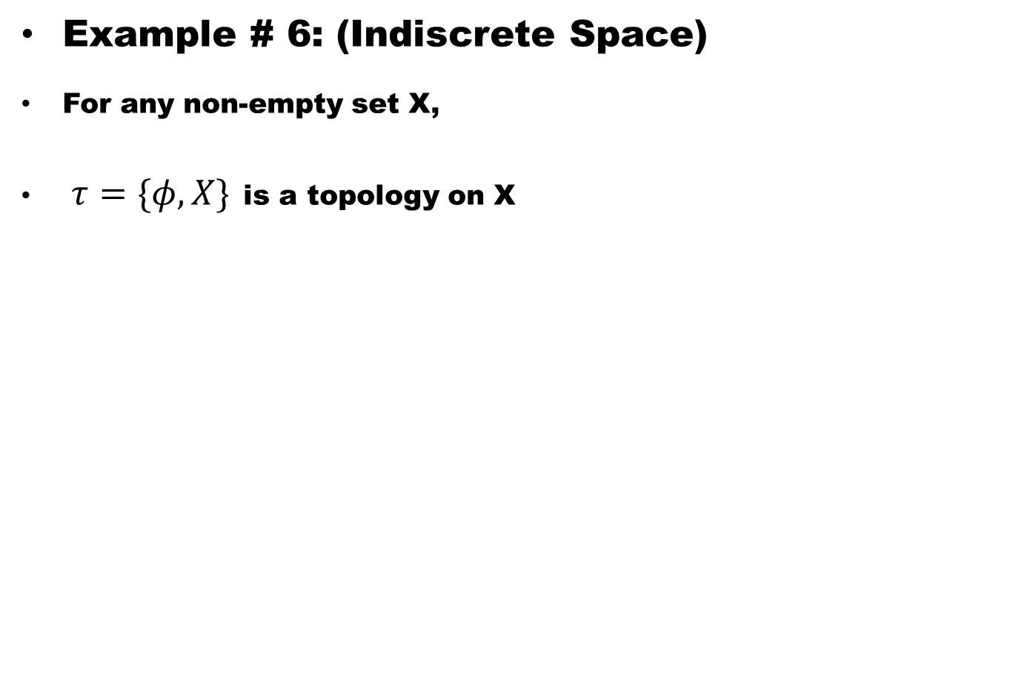
Example # 6: (Indiscrete Space)
For any non-empty set X,
$τ=\{φ, X\}$is a topology on X

Slide 57
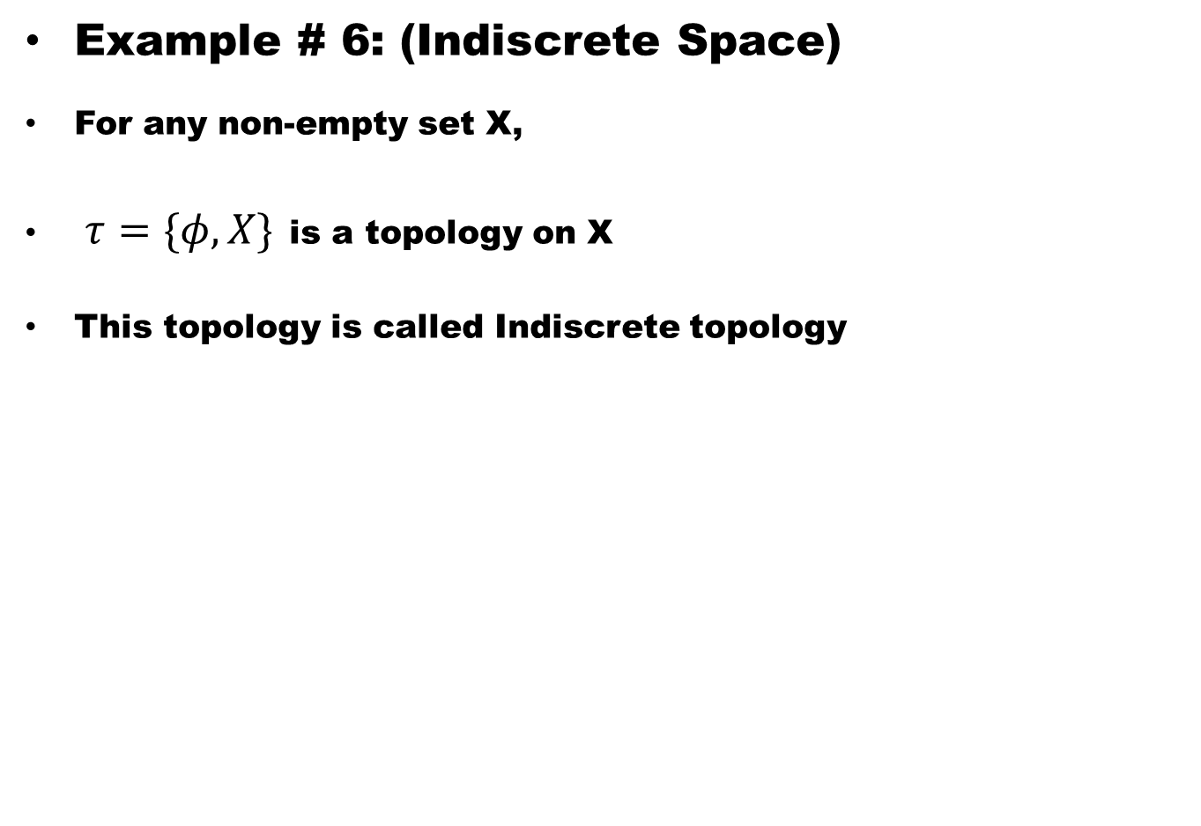
Example # 6: (Indiscrete Space)
For any non-empty set X,
$τ=\{φ, X\}$is a topology on X
This topology is called Indiscrete topology

Slide 58
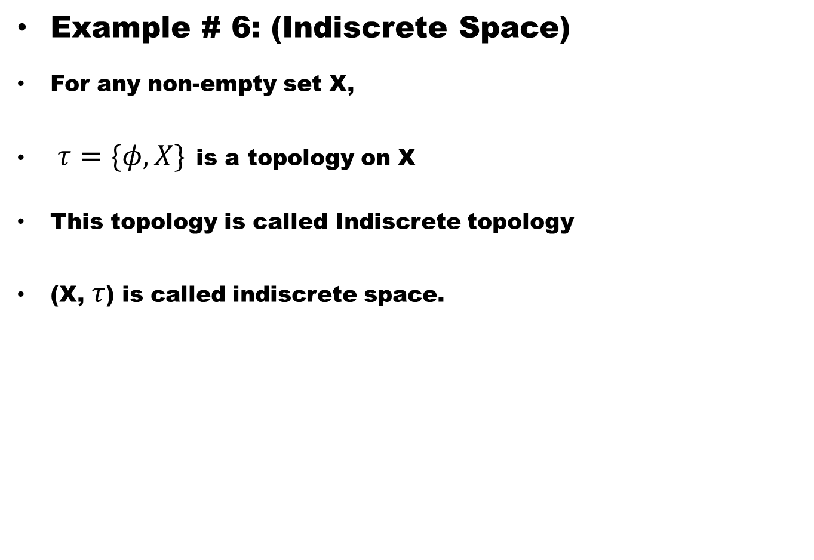
Example # 6: (Indiscrete Space)
For any non-empty set X,
$τ=\{φ, X\}$is a topology on X
This topology is called Indiscrete topology
(X, $τ$) is called indiscrete space.

Slide 59
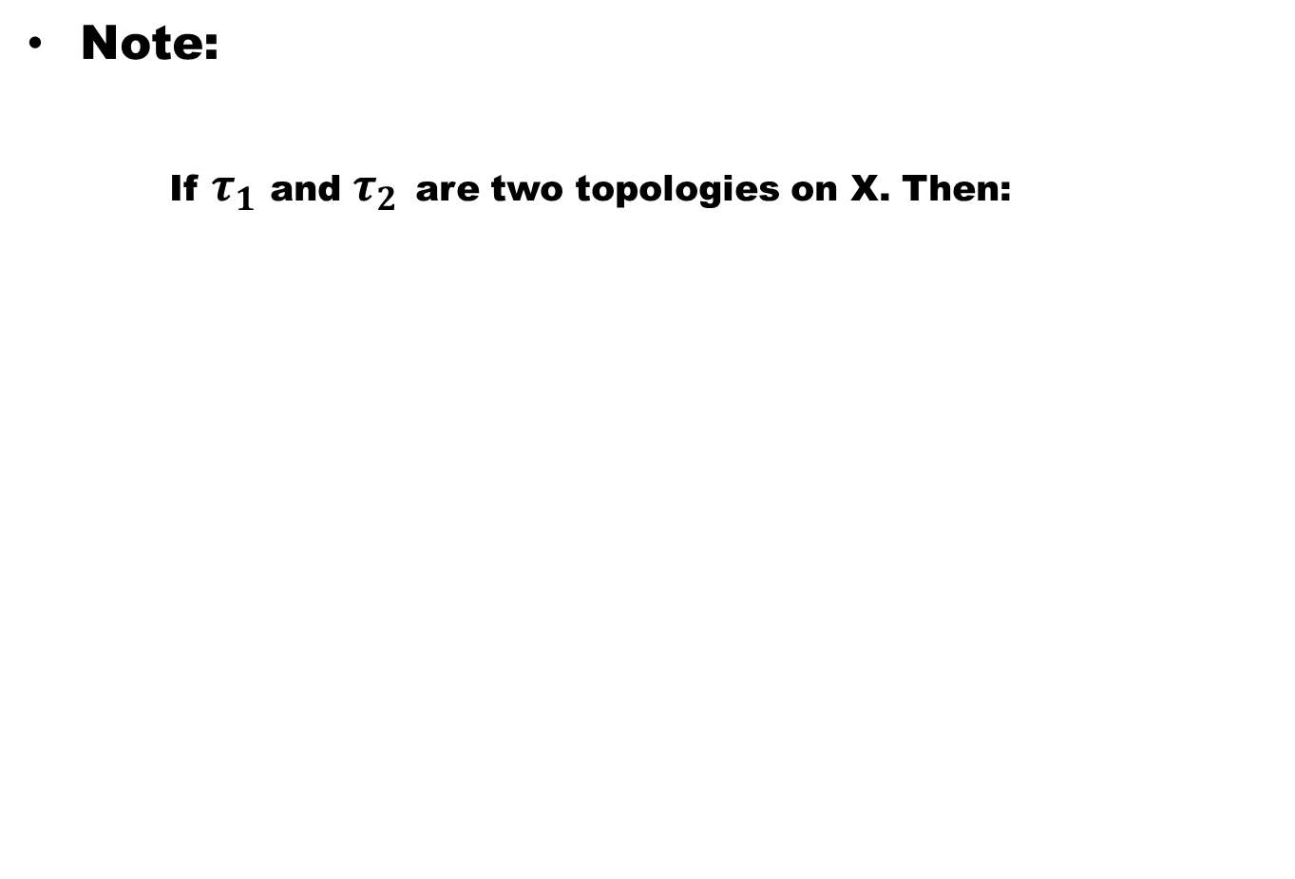
Note:
If $τ_{1}$ and $τ_{2}$are two topologies on X. Then:

Slide 60
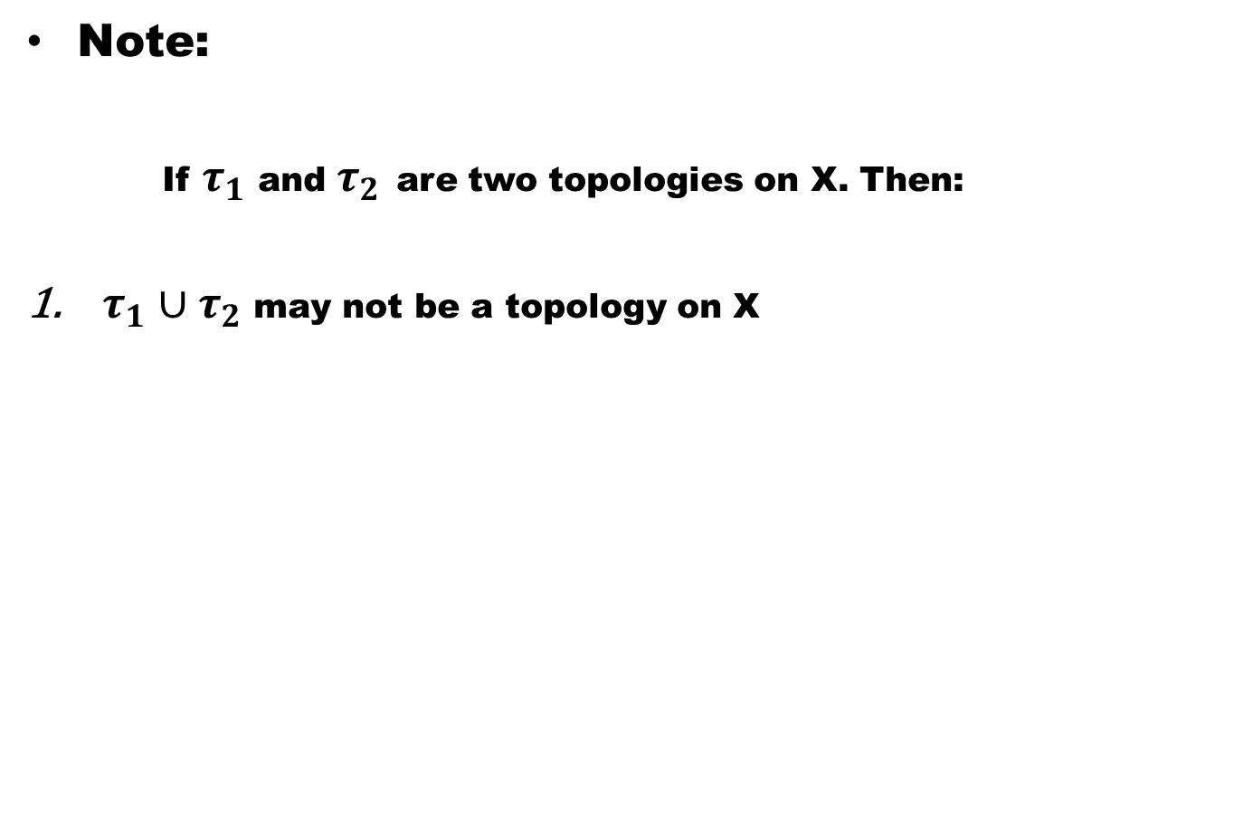
Note:
If $τ_{1}$ and $τ_{2}$are two topologies on X. Then:
$τ_{1}∪τ_{2}$ may not be a topology on X

Slide 61
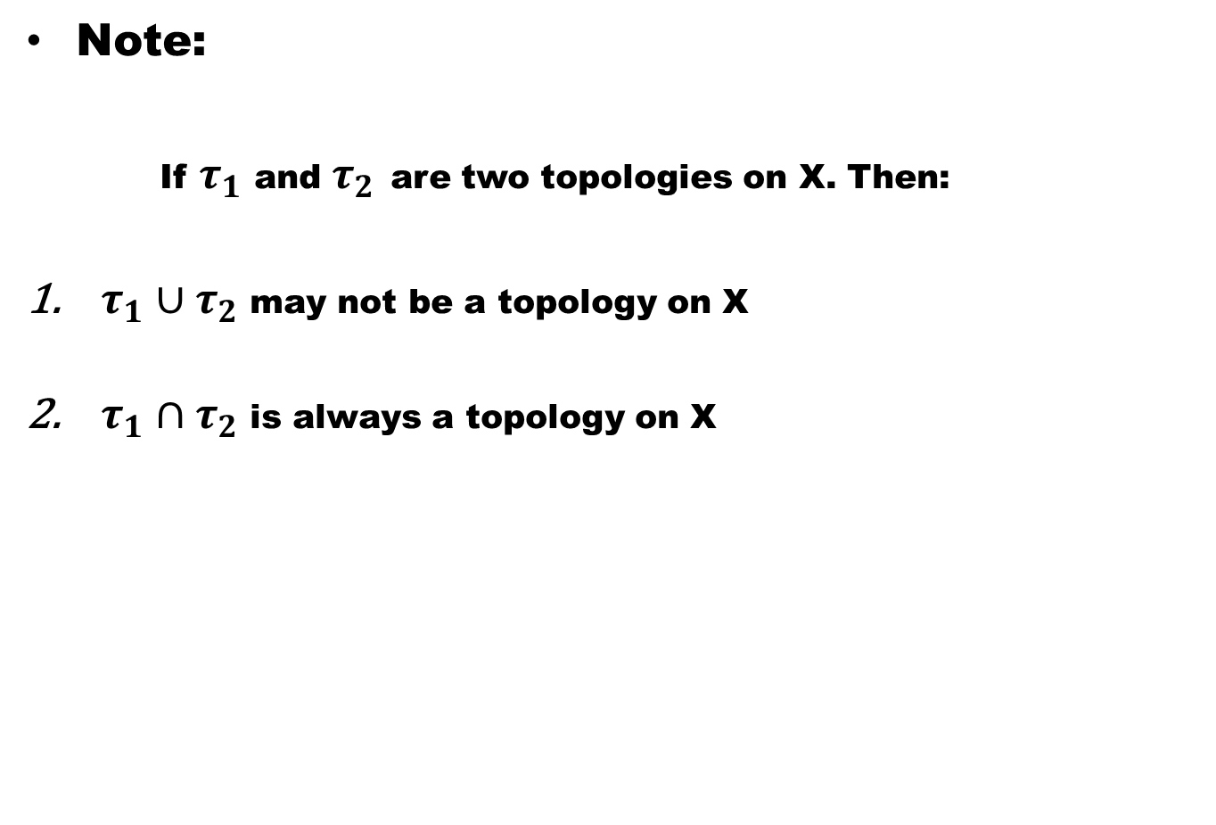
Note:
If $τ_{1}$ and $τ_{2}$are two topologies on X. Then:
$τ_{1}∪τ_{2}$ may not be a topology on X
$τ_{1}∩τ_{2}$ is always a topology on X

Slide 62
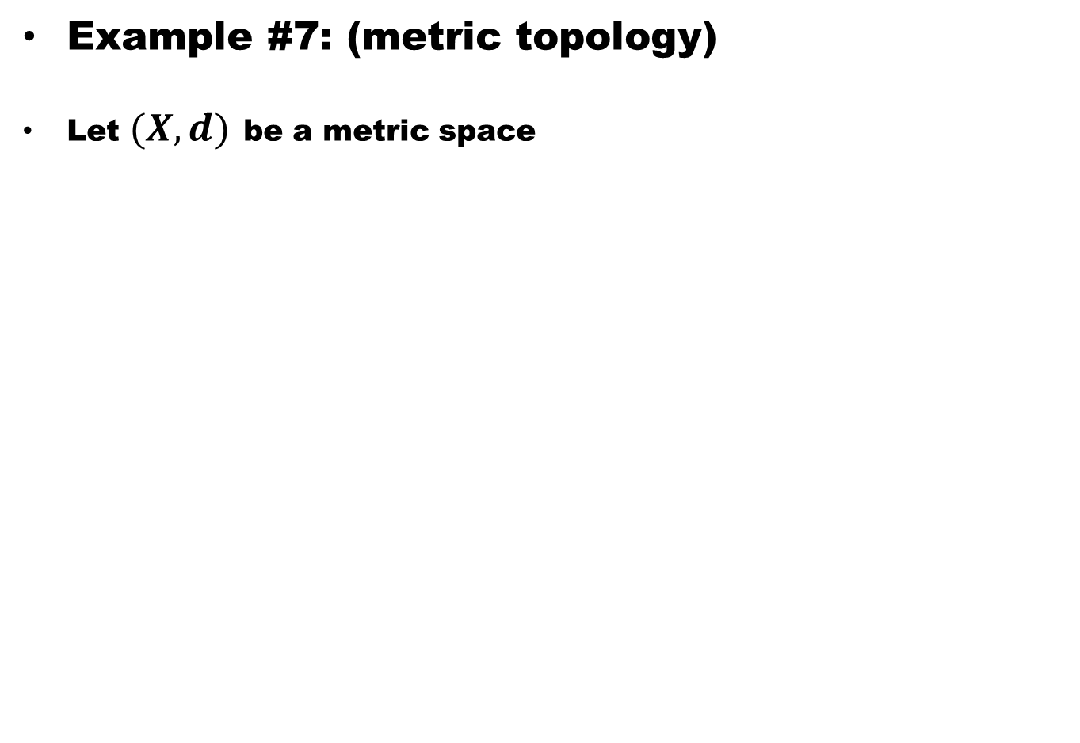
Example #7: (metric topology)
Let $(X, d)$be a metric space

Slide 63
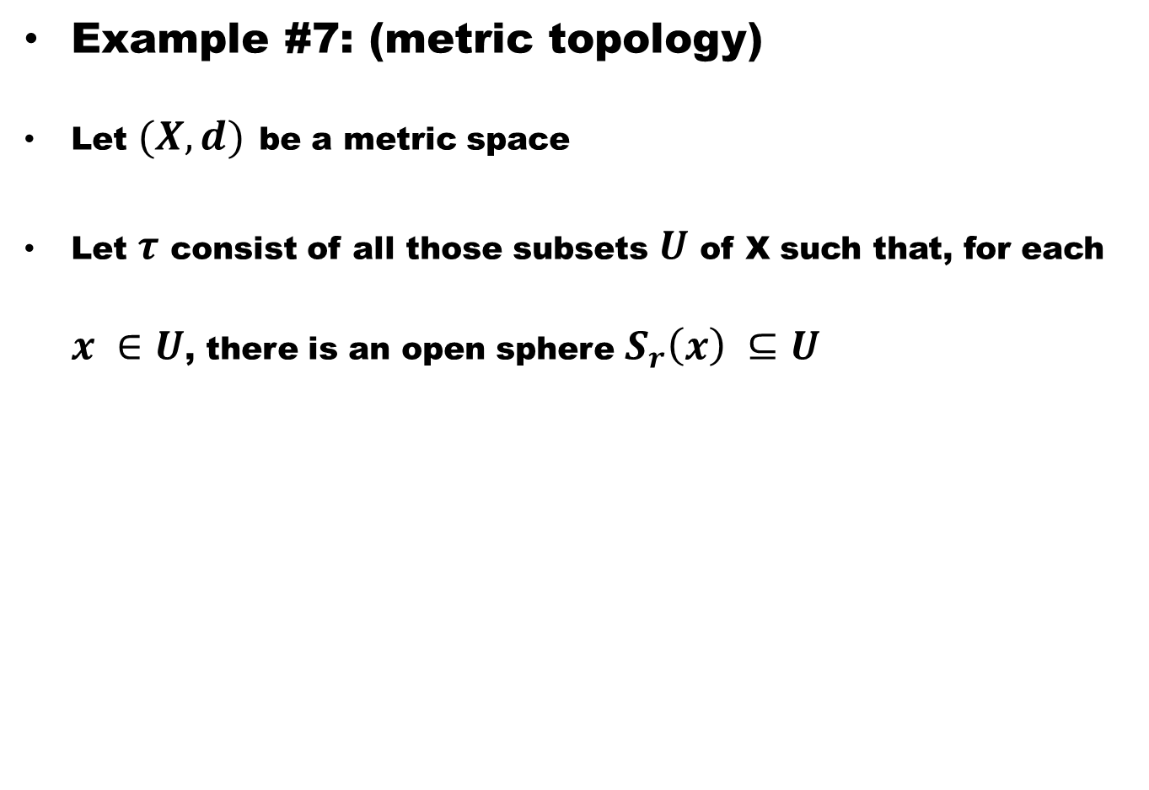
Example #7: (metric topology)
Let $(X, d)$be a metric space
Let $τ$ consist of all those subsets $U$ of X such that, for each $x ∈U$, there is an open sphere $S_{r}\left(x\right) ⊆U$

Slide 64
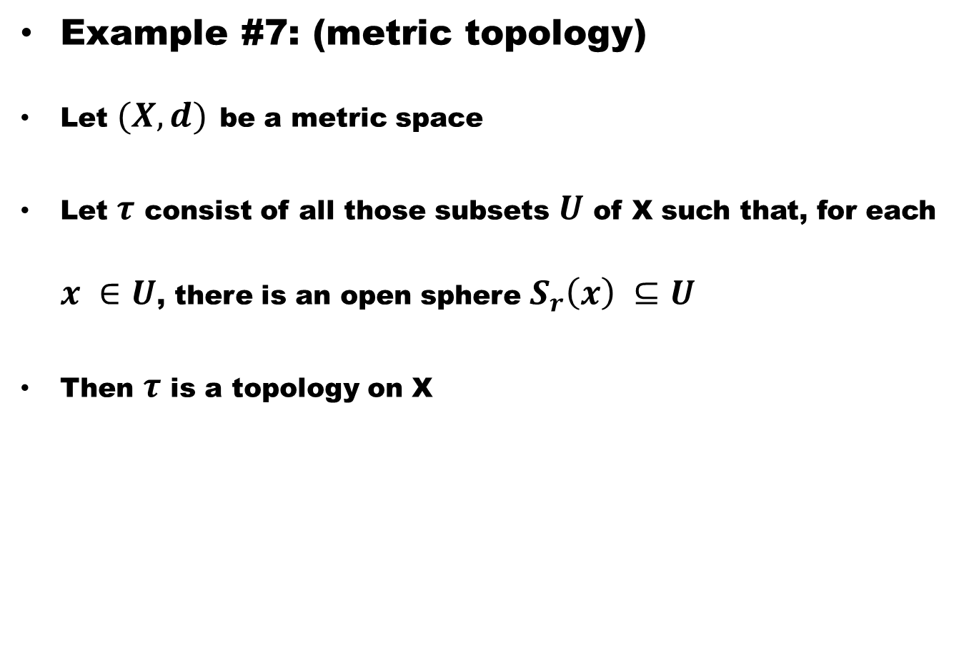
Example #7: (metric topology)
Let $(X, d)$be a metric space
Let $τ$ consist of all those subsets $U$ of X such that, for each $x ∈U$, there is an open sphere $S_{r}\left(x\right) ⊆U$
Then $τ$ is a topology on X

Slide 65
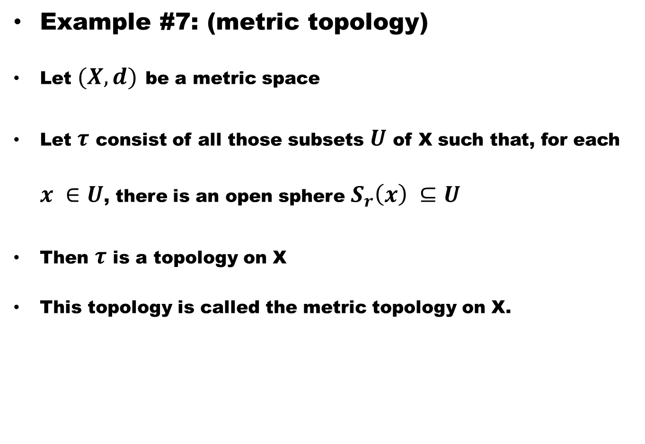
Example #7: (metric topology)
Let $(X, d)$be a metric space
Let $τ$ consist of all those subsets $U$ of X such that, for each $x ∈U$, there is an open sphere $S_{r}\left(x\right) ⊆U$
Then $τ$ is a topology on X
This topology is called the metric topology on X.

Slide 66
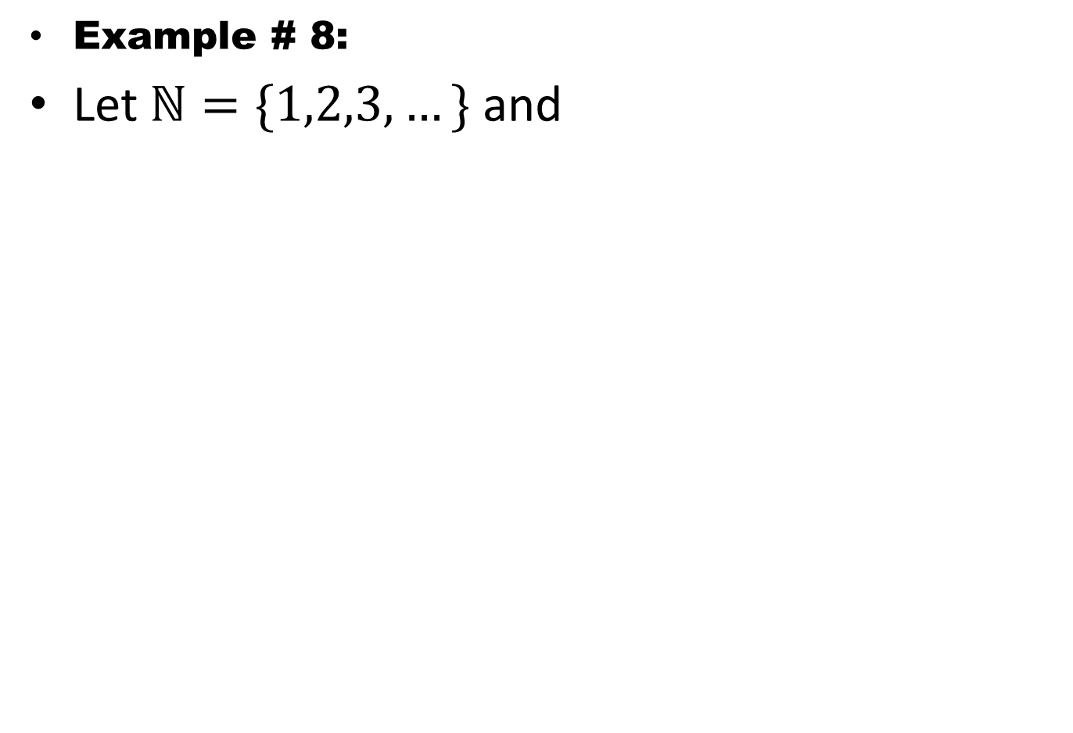
Example # 8:
Let $ℕ=\{1,2,3,…\}$ and

Slide 67
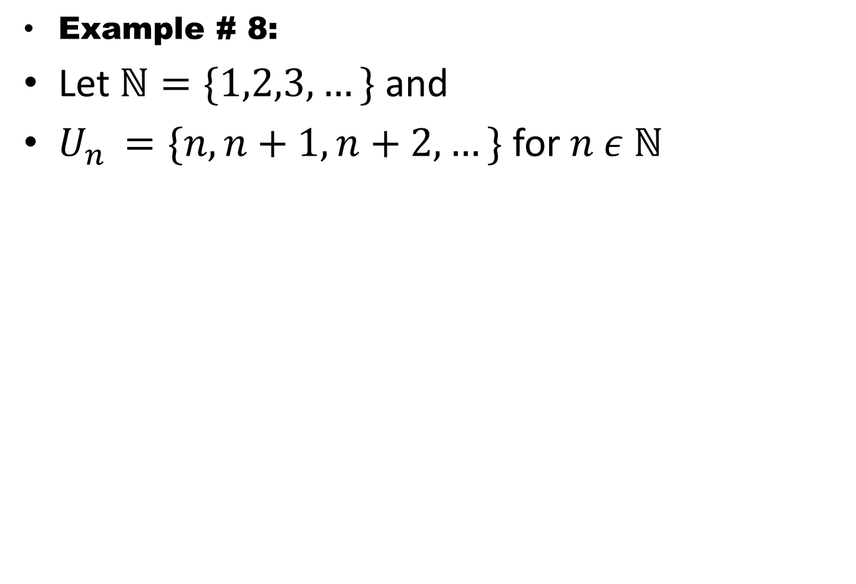
Example # 8:
Let $ℕ=\{1,2,3,…\}$ and
$U_{n }=\{n, n+1, n+2, …\}$ for $n ε ℕ$

Slide 68
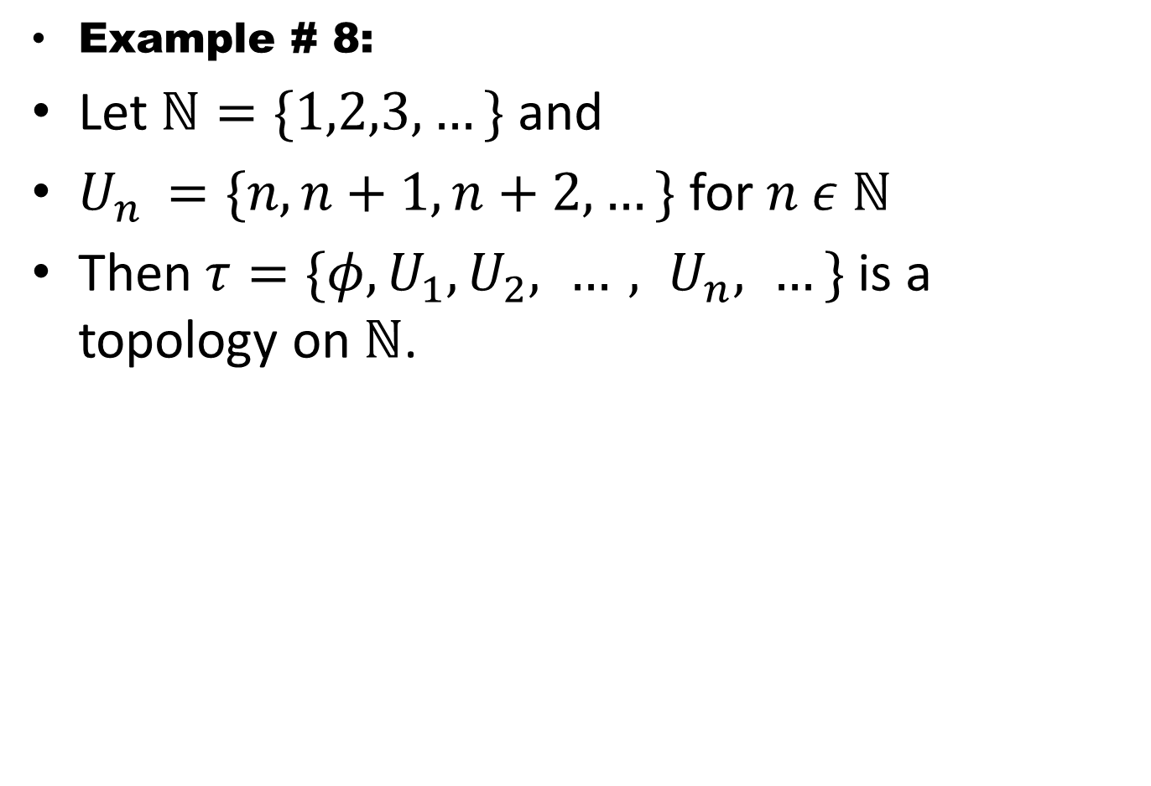
Example # 8:
Let $ℕ=\{1,2,3,…\}$ and
$U_{n }=\{n, n+1, n+2, …\}$ for $n ε ℕ$
Then $τ=\{φ, U_{1}, U_{2}, …, U_{n}, …\}$ is a topology on $ℕ$.

Slide 69
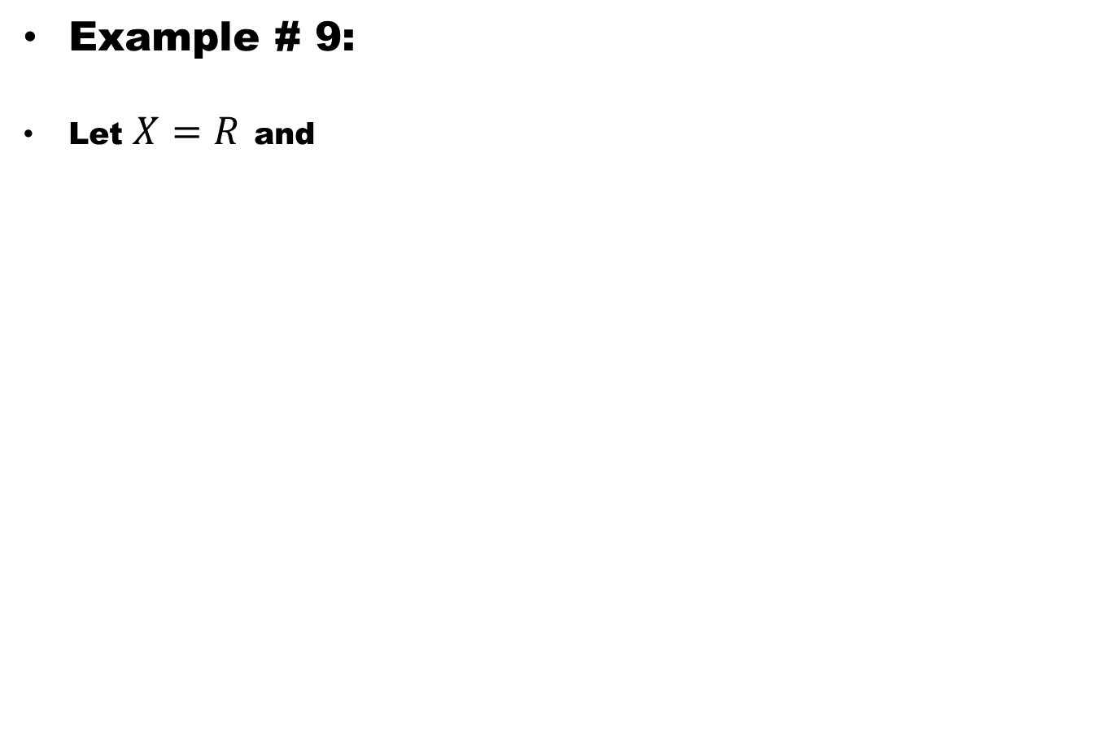
Example # 9:
Let $X=R$and

Slide 70
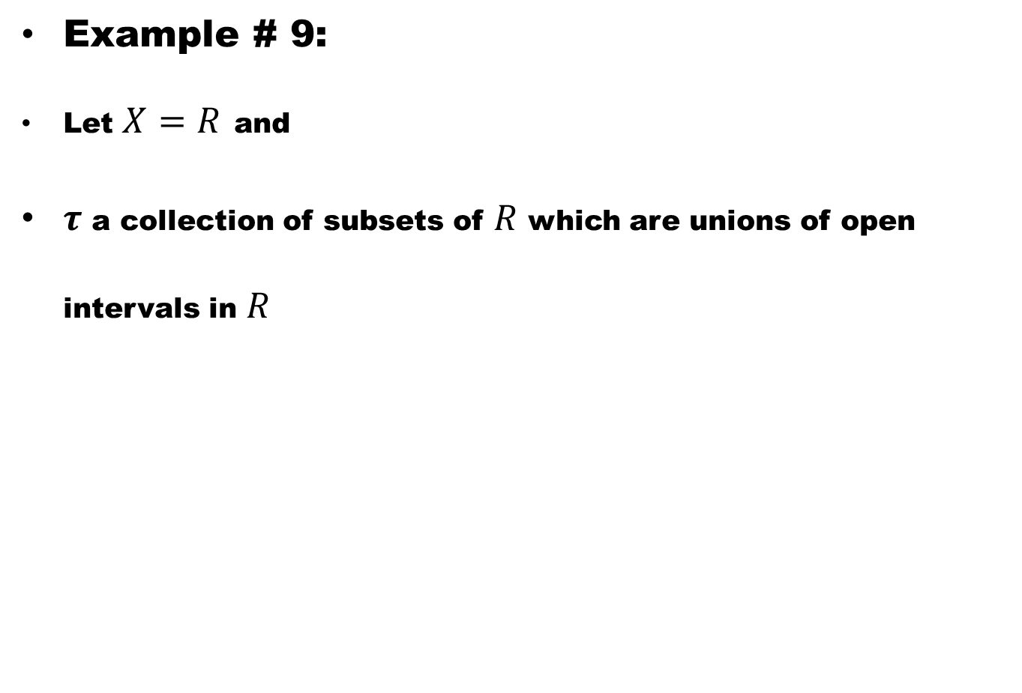
Example # 9:
Let $X=R$and
$τ$ a collection of subsets of $R$ which are unions of open intervals in $R$

Slide 71
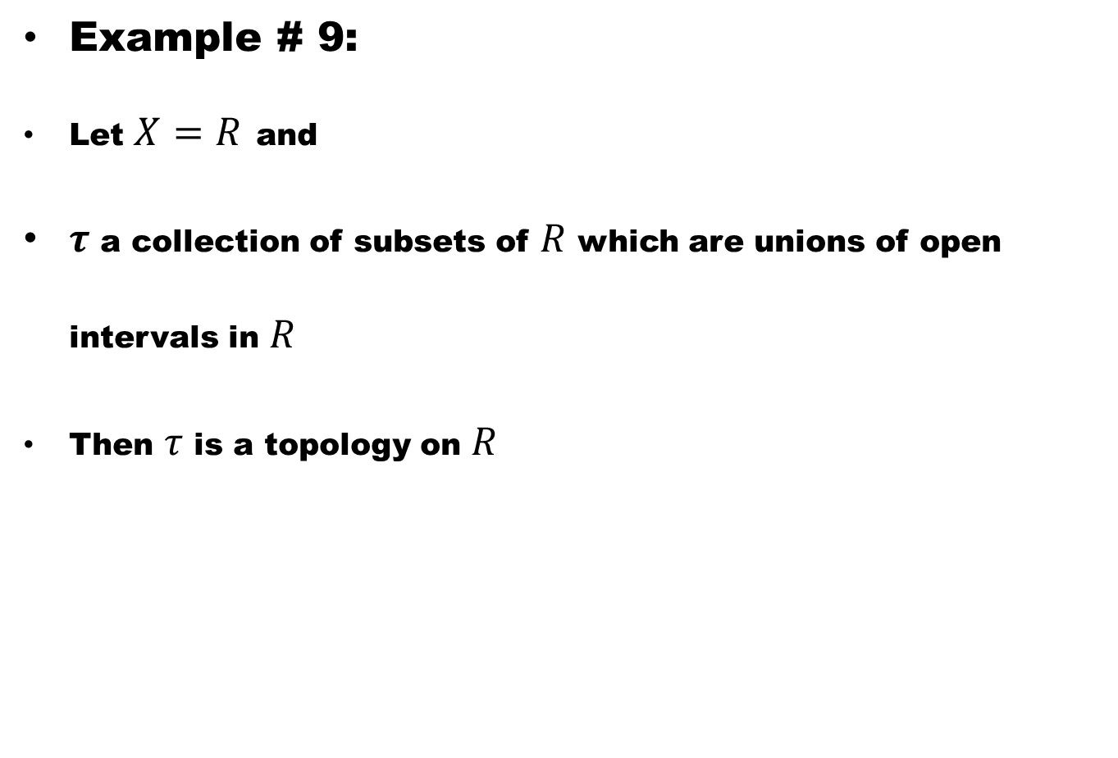
Example # 9:
Let $X=R$and
$τ$ a collection of subsets of $R$ which are unions of open intervals in $R$
Then $τ$ is a topology on $R$

Slide 72
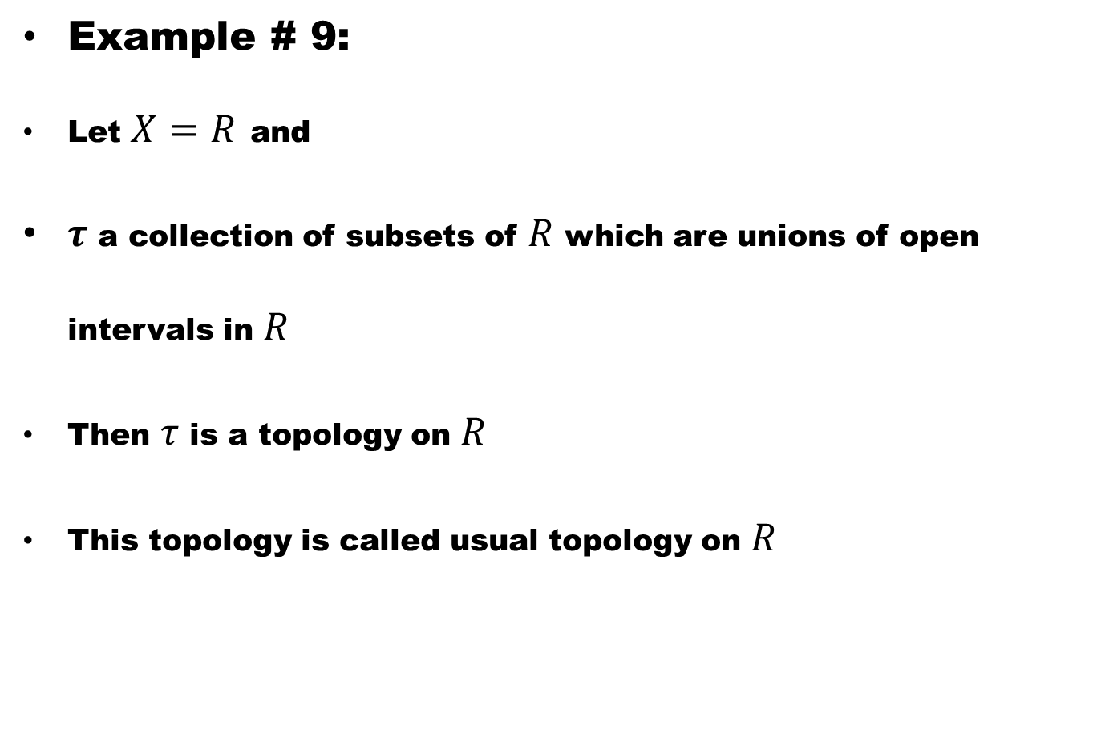
Example # 9:
Let $X=R$and
$τ$ a collection of subsets of $R$ which are unions of open intervals in $R$
Then $τ$ is a topology on $R$
This topology is called usual topology on $R$

Slide 73
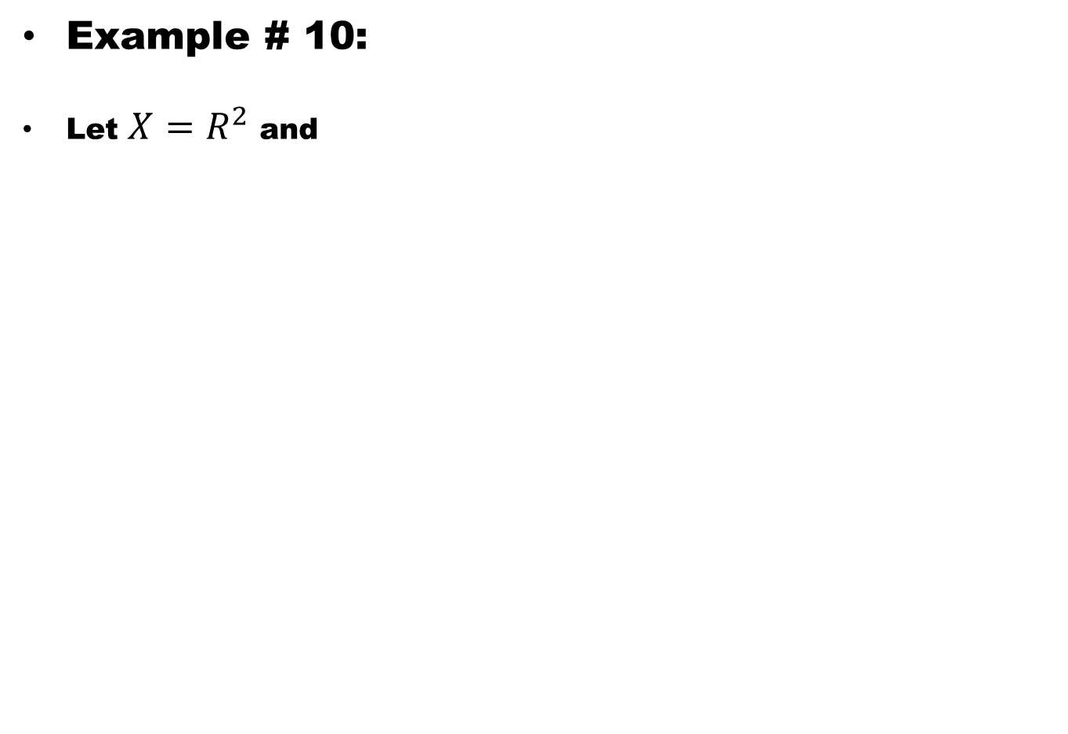
Example # 10:
Let $X=R^{2}$ and

Slide 74

Example # 10:
Let $X=R^{2}$ and
$τ$ a collection of subsets of $R^{2}$ which are unions of open discs in $R^{2}$

Slide 75

Example # 10:
Let $X=R^{2}$ and
$τ$ a collection of subsets of $R^{2}$ which are unions of open discs in $R^{2}$
Then $τ$ is a topology on $R^{2}$

Slide 76

Example # 10:
Let $X=R^{2}$ and
$τ$ a collection of subsets of $R^{2}$ which are unions of open discs in $R^{2}$
Then $τ$ is a topology on $R^{2}$
This topology is called usual topology on $R^{2}$

Slide 77

Example # 11:
Let $X=\{a,b\}$and $τ=\{φ, \left\{a\right\}, X\}$.

Slide 78

Example # 11:
Let $X=\{a,b\}$and $τ=\{φ, \left\{a\right\}, X\}$.
Then $τ$ is a topology on X.

Slide 79

Example # 11:
Let $X=\{a,b\}$and $τ=\{φ, \left\{a\right\}, X\}$.
Then $τ$ is a topology on X.
This topology is call Sierpinski topology

Slide 80

Example # 11:
Let $X=\{a,b\}$and $τ=\{φ, \left\{a\right\}, X\}$.
Then $τ$ is a topology on X.
This topology is call Sierpinski topology
(X, $τ$) is called Sierpinski space.

Slide 81
Good Luck

