Slide 1
Set Topology
MTH 251
Lecture # 10

Slide 2
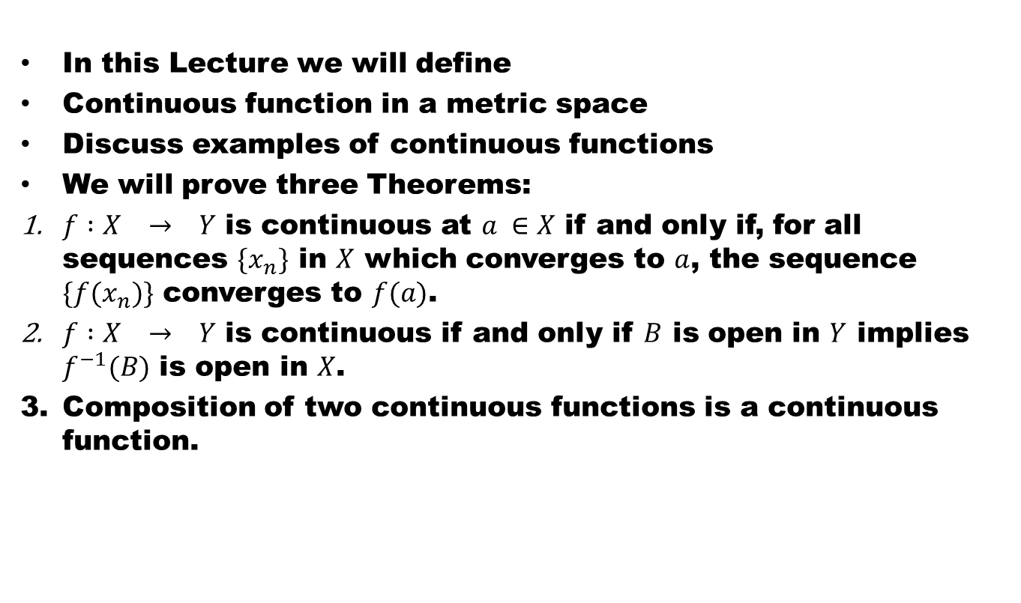
Lecture Outline
In this Lecture we will define
Continuous function in a metric space
Discuss examples of continuous functions
We will prove three Theorems:
$f :X → Y$ is continuous at $a ∈X$ if and only if, for all sequences $\{x_{n}\}$ in $X$ which converges to $a$, the sequence $\{f(x_{n})\}$ converges to $f(a)$.
$f :X → Y$ is continuous if and only if $B$ is open in $Y$ implies $f^{−1}(B)$ is open in $X$.
Composition of two continuous functions is a continuous function.

Slide 3
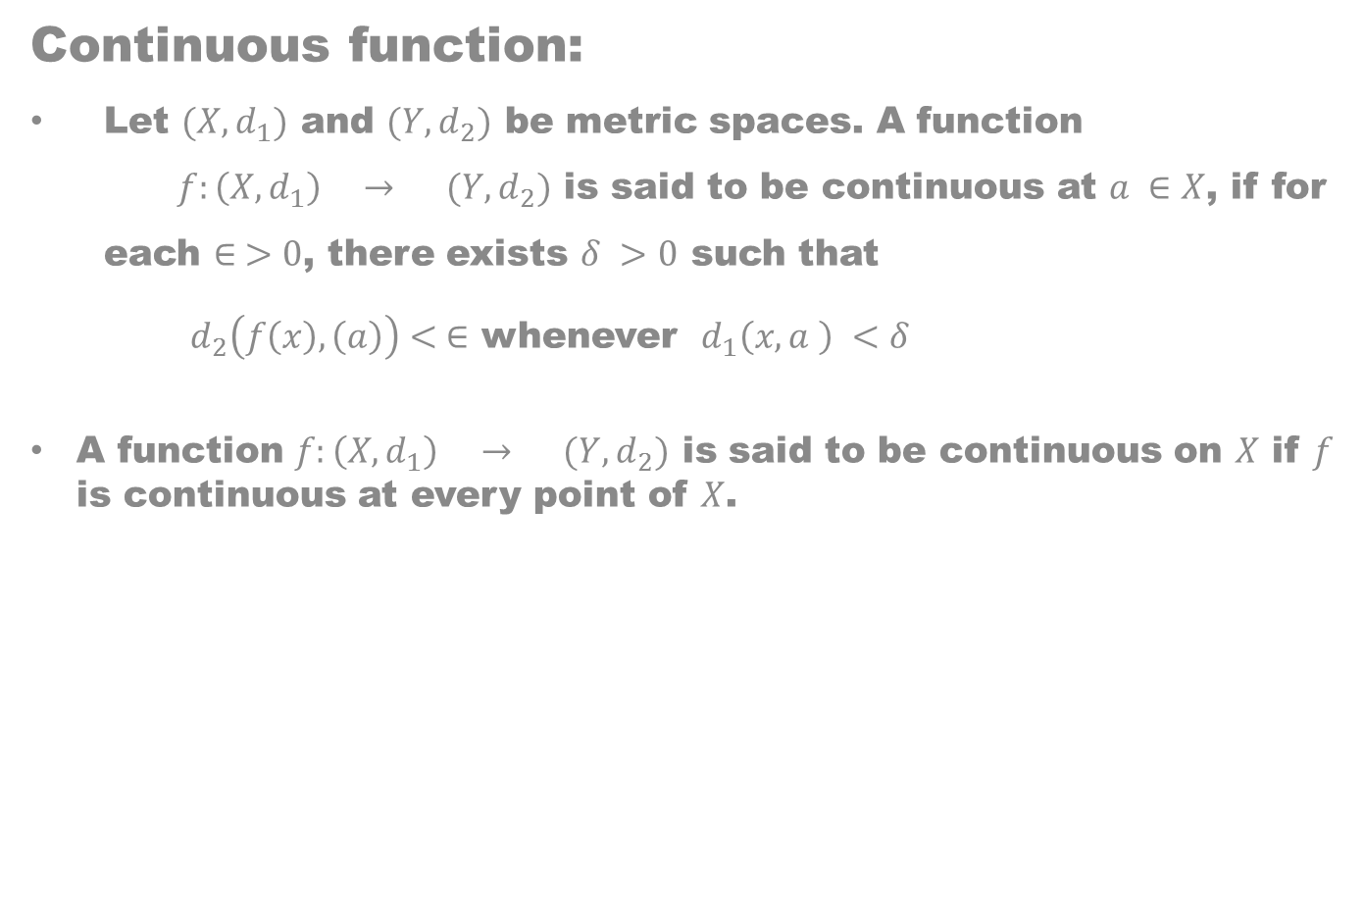
Continuous function:
Let $(X,d_{1})$ and $(Y, d_{2})$ be metric spaces. A function $f:\left(X, d_{1}\right) → (Y, d_{2})$ is said to be continuous at $a ∈X$, if for each $∈ >0$, there exists $δ >0$ such that
$d_{2}\left(f\left(x\right),\left(a\right)\right)< ∈$ whenever $d_{1}\left(x,a \right) <δ$
A function $f:\left(X, d_{1}\right) → (Y, d_{2})$ is said to be continuous on $X$ if $f$ is continuous at every point of $X$.

Slide 6
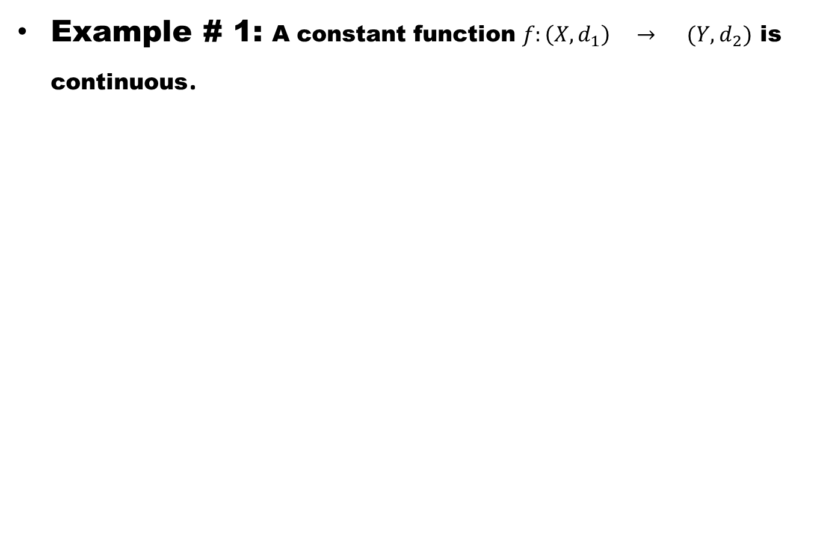
Example # 1: A constant function $f:\left(X, d_{1}\right) → (Y, d_{2})$ is continuous.

Slide 7
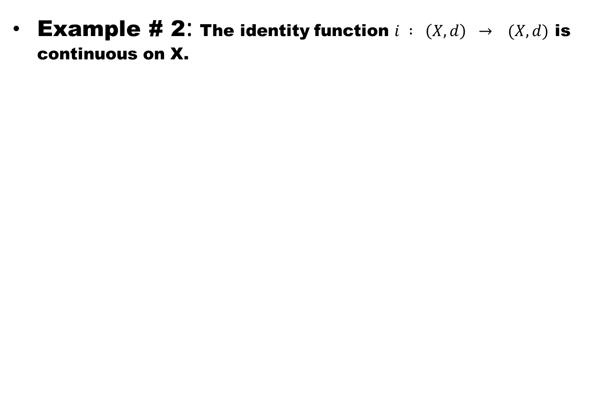
Example # 2: The identity function $i : \left(X,d\right) → (X,d)$ is continuous on X.

Slide 8
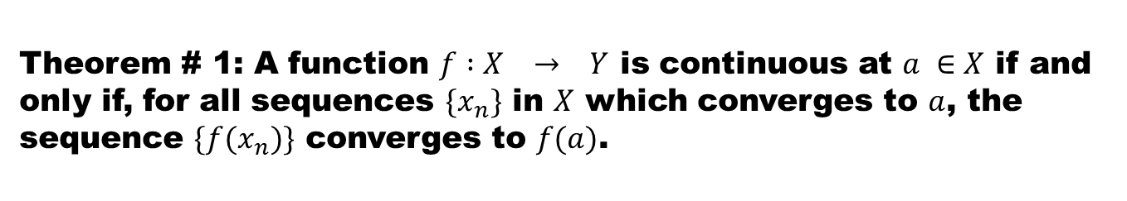
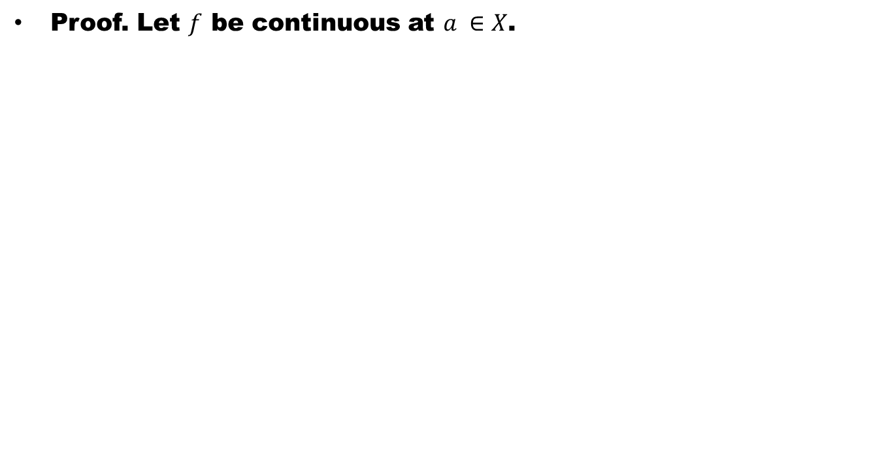
Theorem # 1: A function $f :X → Y$ is continuous at $a ∈X$ if and only if, for all sequences $\{x_{n}\}$ in $X$ which converges to $a$, the sequence $\{f(x_{n})\}$ converges to $f(a)$.
Proof. Let $f$ be continuous at $a ∈X$.

Slide 9
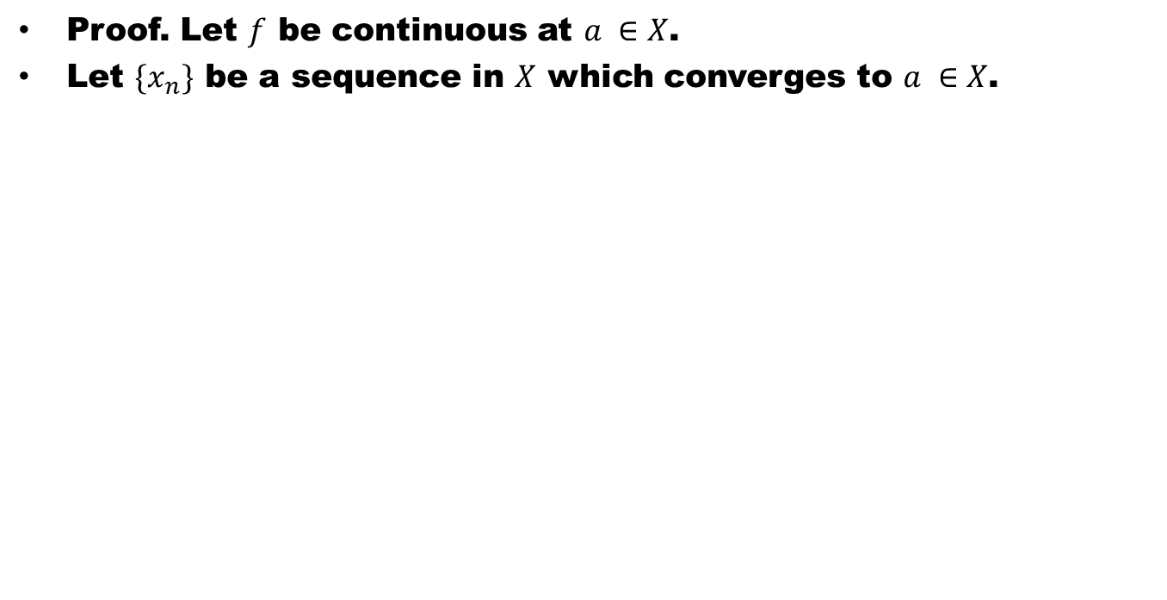
Theorem # 1: A function $f :X → Y$ is continuous at $a ∈X$ if and only if, for all sequences $\{x_{n}\}$ in $X$ which converges to $a$, the sequence $\{f(x_{n})\}$ converges to $f(a)$.
Proof. Let $f$ be continuous at $a ∈X$.
Let $\{x_{n}\}$ be a sequence in $X$ which converges to $a ∈X$.

Slide 10
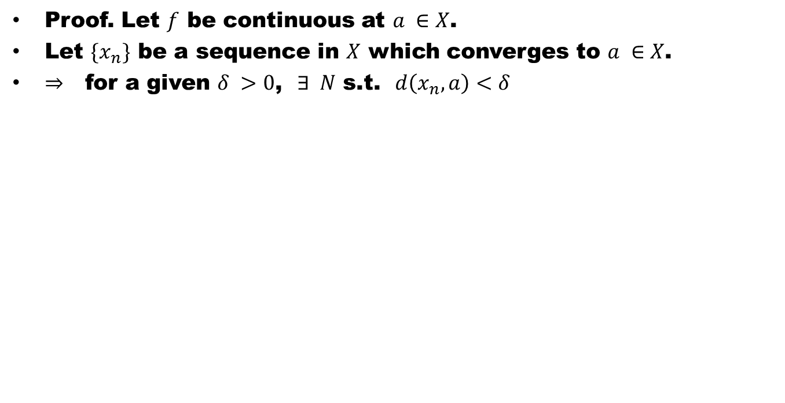
Theorem # 1: A function $f :X → Y$ is continuous at $a ∈X$ if and only if, for all sequences $\{x_{n}\}$ in $X$ which converges to $a$, the sequence $\{f(x_{n})\}$ converges to $f(a)$.
Proof. Let $f$ be continuous at $a ∈X$.
Let $\{x_{n}\}$ be a sequence in $X$ which converges to $a ∈X$.
$⇒$ for a given $δ >0$, $∃ N$ s.t. $d\left(x_{n},a\right)<δ$

Slide 11
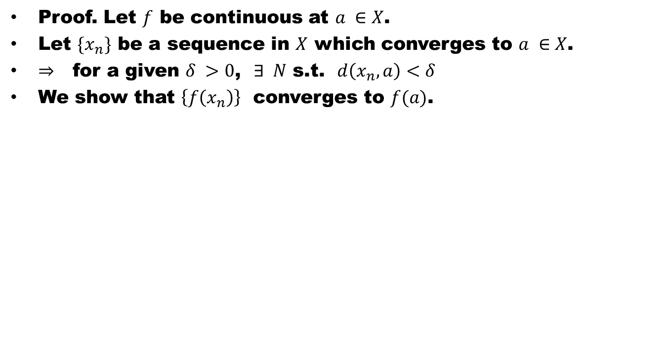
Theorem # 1: A function $f :X → Y$ is continuous at $a ∈X$ if and only if, for all sequences $\{x_{n}\}$ in $X$ which converges to $a$, the sequence $\{f(x_{n})\}$ converges to $f(a)$.
Proof. Let $f$ be continuous at $a ∈X$.
Let $\{x_{n}\}$ be a sequence in $X$ which converges to $a ∈X$.
$⇒$ for a given $δ >0$, $∃ N$ s.t. $d\left(x_{n},a\right)<δ$
We show that $\left\{f\left(x_{n}\right)\right\}$ converges to $f(a)$.

Slide 12
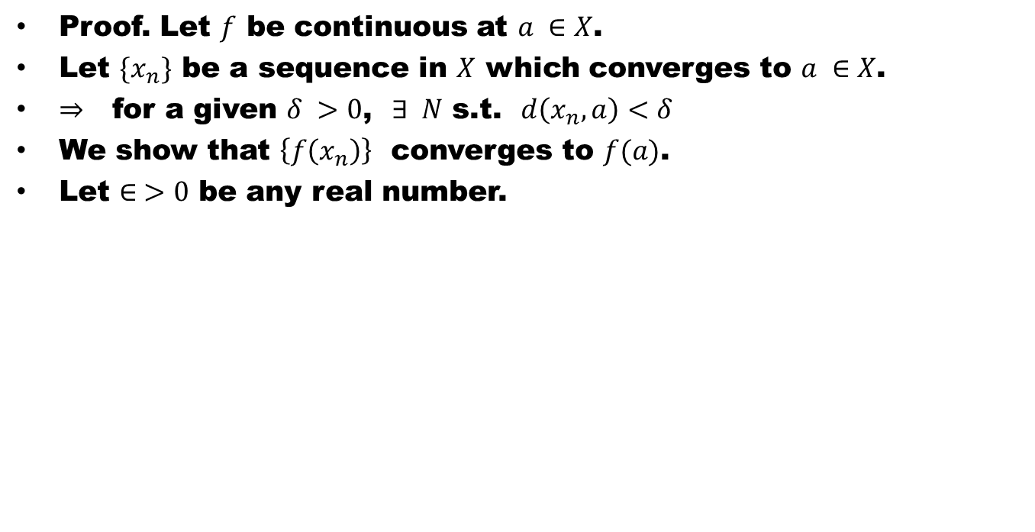
Theorem # 1: A function $f :X → Y$ is continuous at $a ∈X$ if and only if, for all sequences $\{x_{n}\}$ in $X$ which converges to $a$, the sequence $\{f(x_{n})\}$ converges to $f(a)$.
Proof. Let $f$ be continuous at $a ∈X$.
Let $\{x_{n}\}$ be a sequence in $X$ which converges to $a ∈X$.
$⇒$ for a given $δ >0$, $∃ N$ s.t. $d\left(x_{n},a\right)<δ$
We show that $\left\{f\left(x_{n}\right)\right\}$ converges to $f(a)$.
Let $∈ >0$ be any real number.

Slide 13
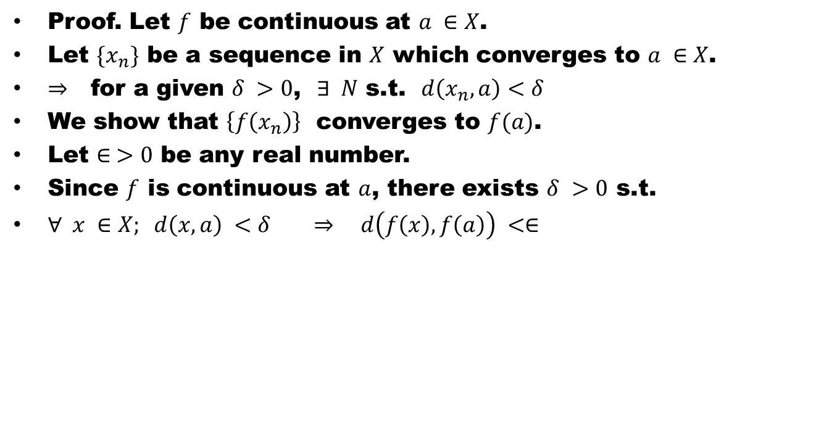
Theorem # 1: A function $f :X → Y$ is continuous at $a ∈X$ if and only if, for all sequences $\{x_{n}\}$ in $X$ which converges to $a$, the sequence $\{f(x_{n})\}$ converges to $f(a)$.
Proof. Let $f$ be continuous at $a ∈X$.
Let $\{x_{n}\}$ be a sequence in $X$ which converges to $a ∈X$.
$⇒$ for a given $δ >0$, $∃ N$ s.t. $d\left(x_{n},a\right)<δ$
We show that $\left\{f\left(x_{n}\right)\right\}$ converges to $f(a)$.
Let $∈ >0$ be any real number.
Since $f$ is continuous at $a$, there exists $δ >0$ s.t.
$∀ x ∈X; d\left(x,a\right) <δ ⇒ d\left(f\left(x\right), f\left(a\right)\right) <∈$

Slide 14
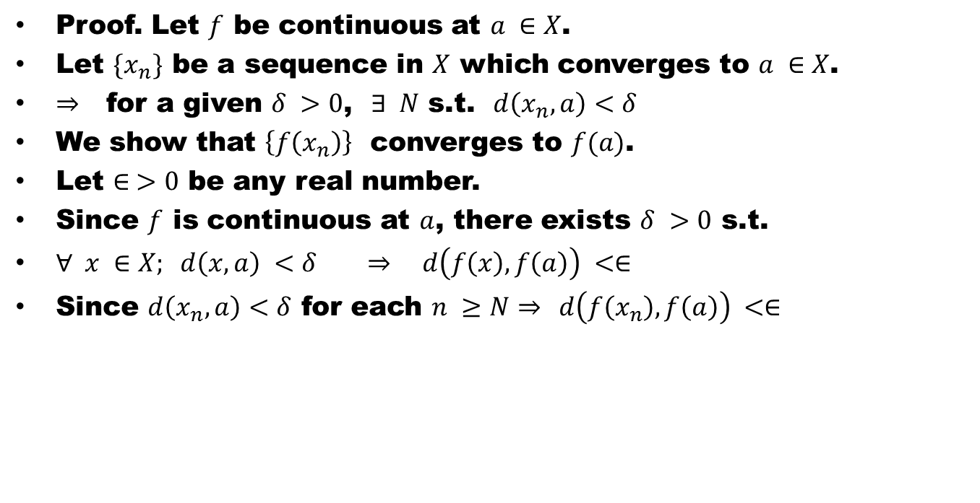
Theorem # 1: A function $f :X → Y$ is continuous at $a ∈X$ if and only if, for all sequences $\{x_{n}\}$ in $X$ which converges to $a$, the sequence $\{f(x_{n})\}$ converges to $f(a)$.
Proof. Let $f$ be continuous at $a ∈X$.
Let $\{x_{n}\}$ be a sequence in $X$ which converges to $a ∈X$.
$⇒$ for a given $δ >0$, $∃ N$ s.t. $d\left(x_{n},a\right)<δ$
We show that $\left\{f\left(x_{n}\right)\right\}$ converges to $f(a)$.
Let $∈ >0$ be any real number.
Since $f$ is continuous at $a$, there exists $δ >0$ s.t.
$∀ x ∈X; d\left(x,a\right) <δ ⇒ d\left(f\left(x\right), f\left(a\right)\right) <∈$
Since $d\left(x_{n},a\right)<δ$ for each $n ≥N⇒$ $d\left(f\left(x_{n}\right), f\left(a\right)\right) <∈$

Slide 15
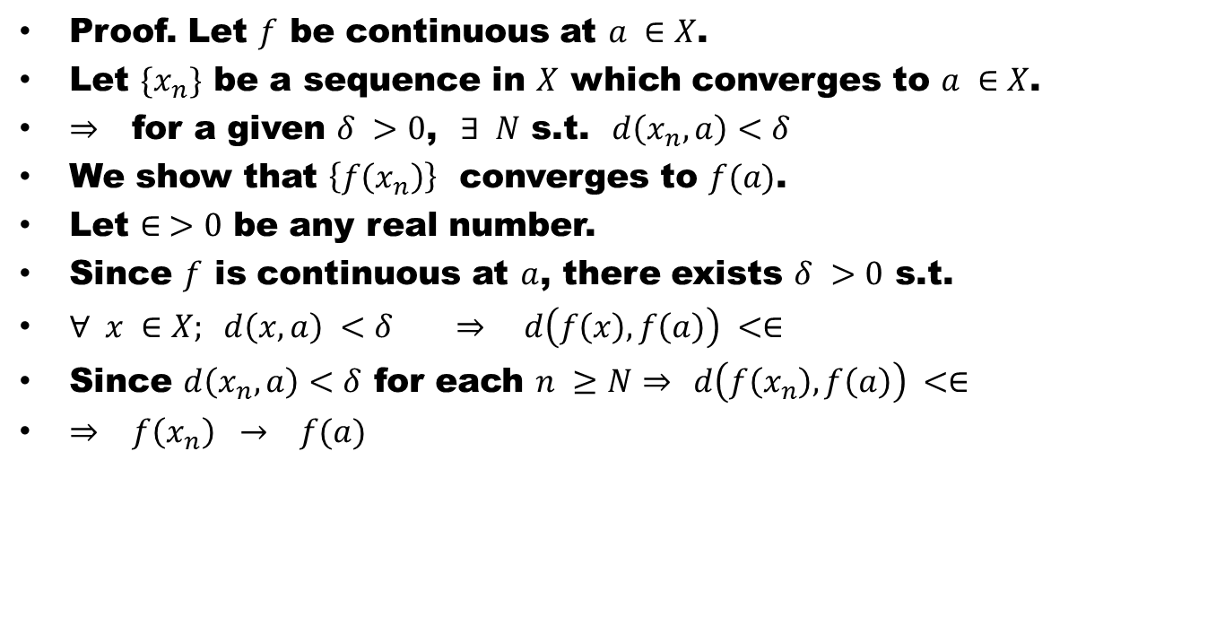
Theorem # 1: A function $f :X → Y$ is continuous at $a ∈X$ if and only if, for all sequences $\{x_{n}\}$ in $X$ which converges to $a$, the sequence $\{f(x_{n})\}$ converges to $f(a)$.
Proof. Let $f$ be continuous at $a ∈X$.
Let $\{x_{n}\}$ be a sequence in $X$ which converges to $a ∈X$.
$⇒$ for a given $δ >0$, $∃ N$ s.t. $d\left(x_{n},a\right)<δ$
We show that $\left\{f\left(x_{n}\right)\right\}$ converges to $f(a)$.
Let $∈ >0$ be any real number.
Since $f$ is continuous at $a$, there exists $δ >0$ s.t.
$∀ x ∈X; d\left(x,a\right) <δ ⇒ d\left(f\left(x\right), f\left(a\right)\right) <∈$
Since $d\left(x_{n},a\right)<δ$ for each $n ≥N⇒$ $d\left(f\left(x_{n}\right), f\left(a\right)\right) <∈$
$⇒$ $f\left(x_{n}\right) → f(a)$

Slide 16
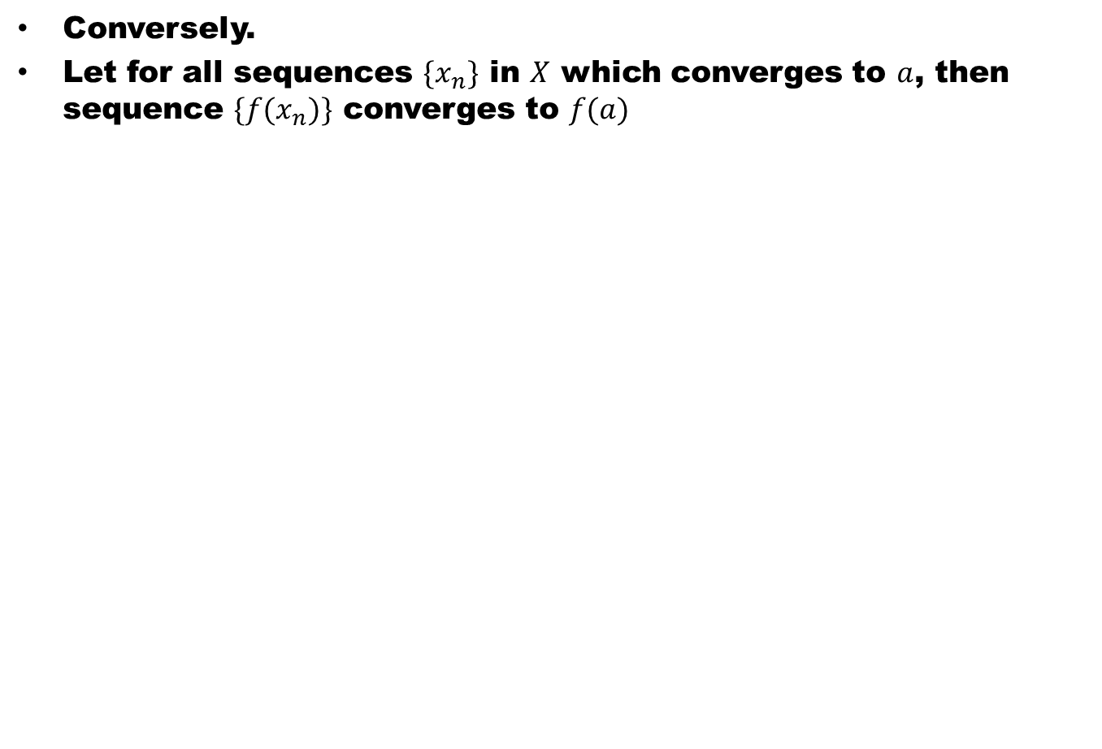
Conversely.
Let for all sequences $\{x_{n}\}$ in $X$ which converges to $a$, then sequence $\{f(x_{n})\}$ converges to $f(a)$

Slide 17
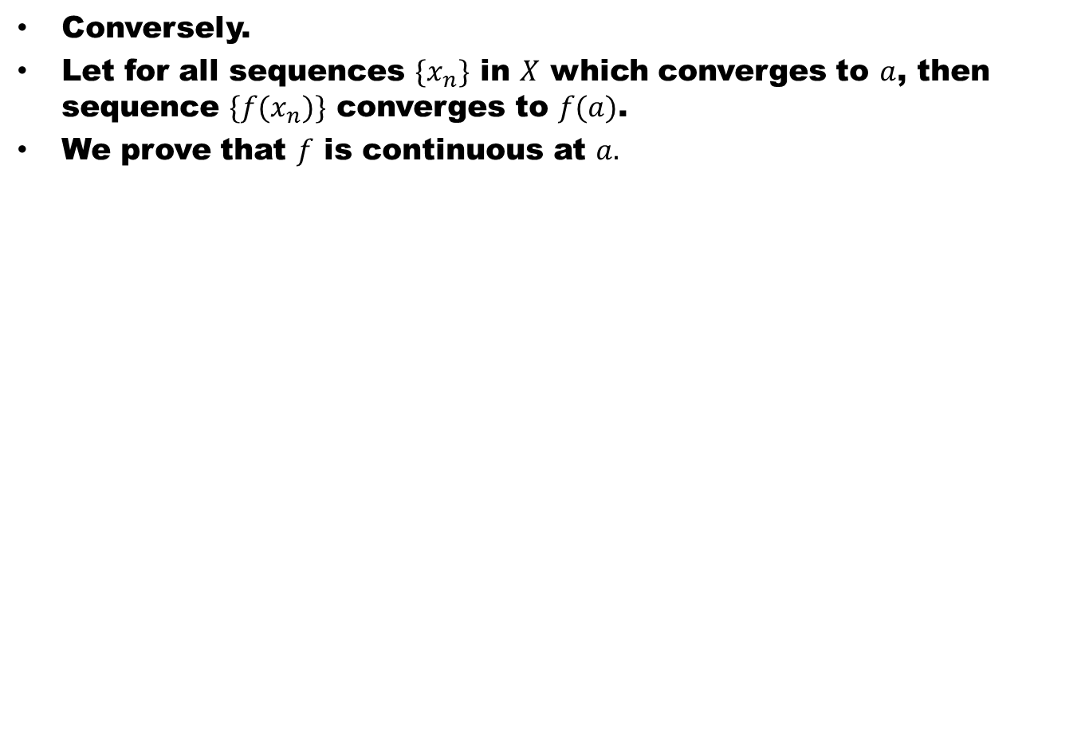
Conversely.
Let for all sequences $\{x_{n}\}$ in $X$ which converges to $a$, then sequence $\{f(x_{n})\}$ converges to $f(a)$.
We prove that $f$ is continuous at $a.$

Slide 18
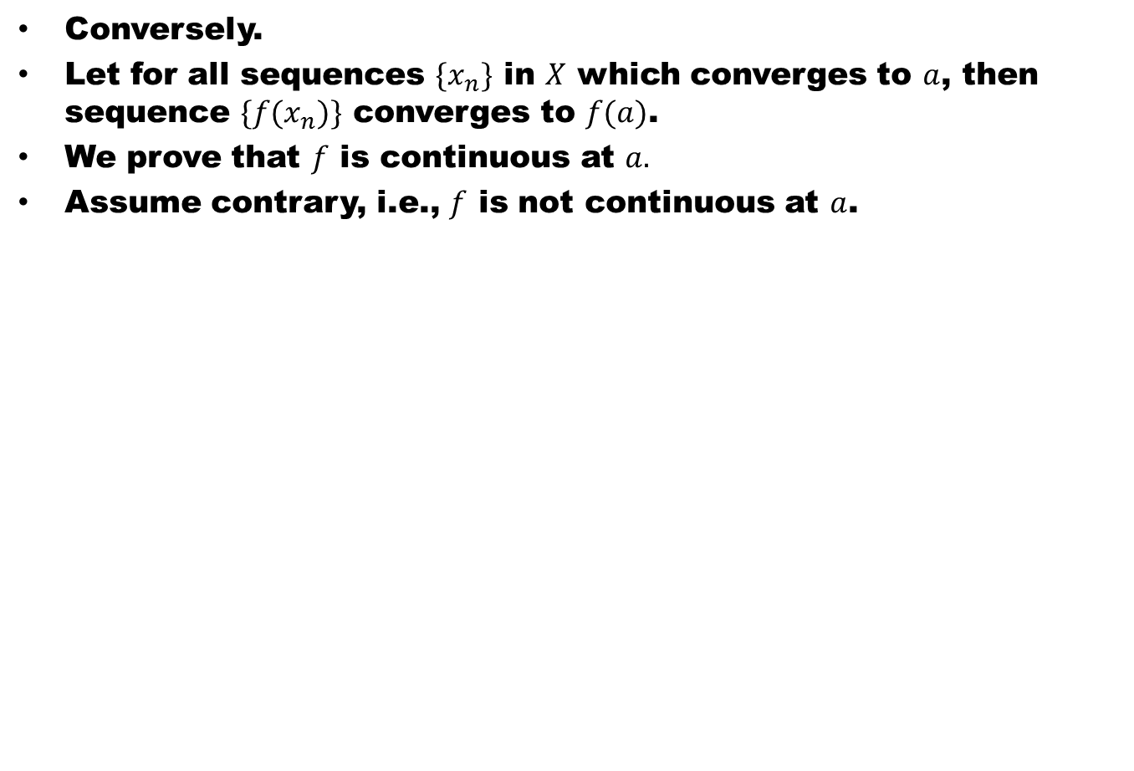
Conversely.
Let for all sequences $\{x_{n}\}$ in $X$ which converges to $a$, then sequence $\{f(x_{n})\}$ converges to $f(a)$.
We prove that $f$ is continuous at $a.$
Assume contrary, i.e., $f$ is not continuous at $a$.

Slide 19
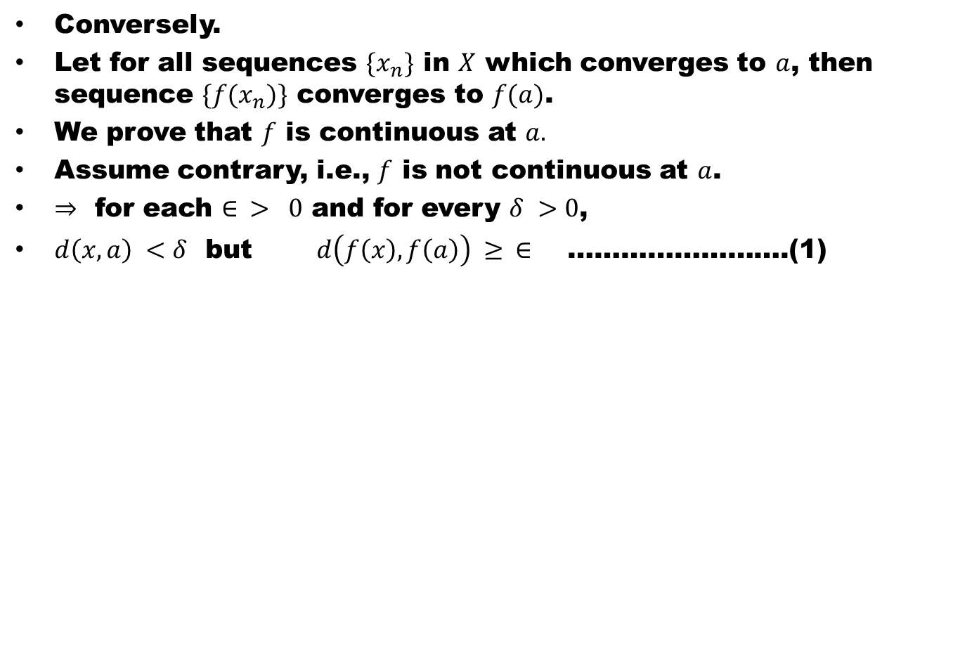
Conversely.
Let for all sequences $\{x_{n}\}$ in $X$ which converges to $a$, then sequence $\{f(x_{n})\}$ converges to $f(a)$.
We prove that $f$ is continuous at $a.$
Assume contrary, i.e., $f$ is not continuous at $a$.
$⇒$ for each $∈ > 0$ and for every $δ >0$,
$d\left(x,a\right) <δ$ but$d\left(f\left(x\right), f\left(a\right)\right) ≥ ∈$ …………………….(1)

Slide 20
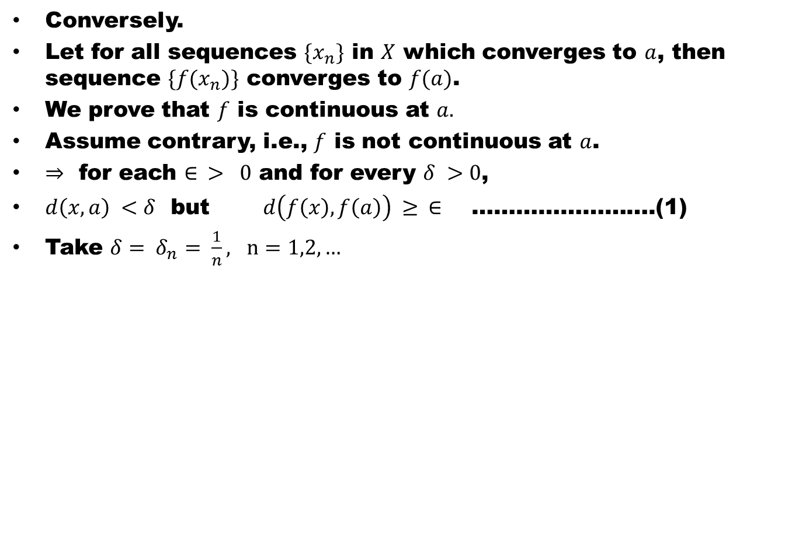
Conversely.
Let for all sequences $\{x_{n}\}$ in $X$ which converges to $a$, then sequence $\{f(x_{n})\}$ converges to $f(a)$.
We prove that $f$ is continuous at $a.$
Assume contrary, i.e., $f$ is not continuous at $a$.
$⇒$ for each $∈ > 0$ and for every $δ >0$,
$d\left(x,a\right) <δ$ but$d\left(f\left(x\right), f\left(a\right)\right) ≥ ∈$ …………………….(1)
Take $δ= δ_{n}= \frac{1}{n}, n=1,2, …$

Slide 21
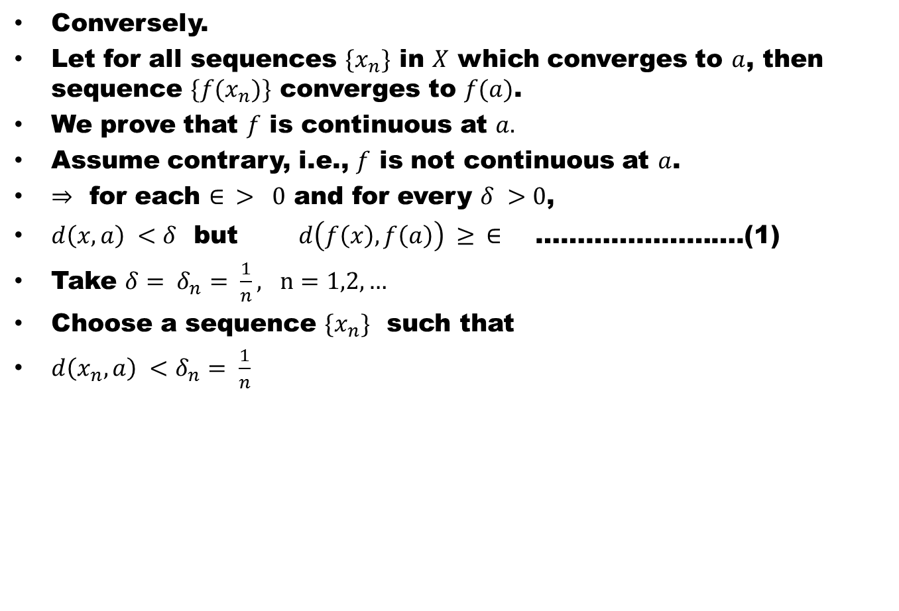
Conversely.
Let for all sequences $\{x_{n}\}$ in $X$ which converges to $a$, then sequence $\{f(x_{n})\}$ converges to $f(a)$.
We prove that $f$ is continuous at $a.$
Assume contrary, i.e., $f$ is not continuous at $a$.
$⇒$ for each $∈ > 0$ and for every $δ >0$,
$d\left(x,a\right) <δ$ but$d\left(f\left(x\right), f\left(a\right)\right) ≥ ∈$ …………………….(1)
Take $δ= δ_{n}= \frac{1}{n}, n=1,2, …$
Choose a sequence $\{x_{n}\}$ such that
$d\left(x_{n},a\right) <δ_{n}= \frac{1}{n}$

Slide 22
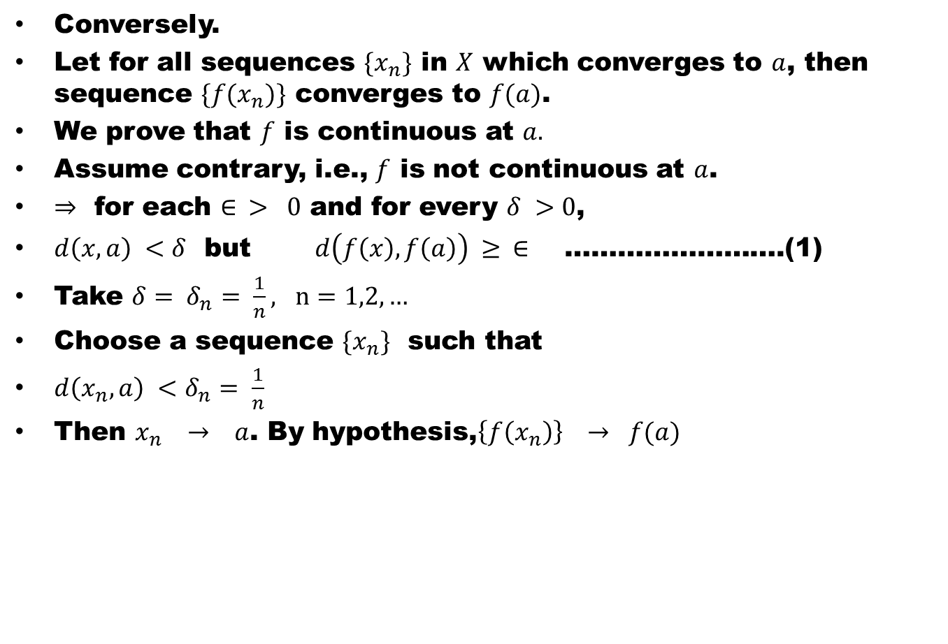
Conversely.
Let for all sequences $\{x_{n}\}$ in $X$ which converges to $a$, then sequence $\{f(x_{n})\}$ converges to $f(a)$.
We prove that $f$ is continuous at $a.$
Assume contrary, i.e., $f$ is not continuous at $a$.
$⇒$ for each $∈ > 0$ and for every $δ >0$,
$d\left(x,a\right) <δ$ but$d\left(f\left(x\right), f\left(a\right)\right) ≥ ∈$ …………………….(1)
Take $δ= δ_{n}= \frac{1}{n}, n=1,2, …$
Choose a sequence $\{x_{n}\}$ such that
$d\left(x_{n},a\right) <δ_{n}= \frac{1}{n}$
Then $x_{n} → a$. By hypothesis,$\left\{f\left(x_{n}\right)\right\} → f(a)$

Slide 23
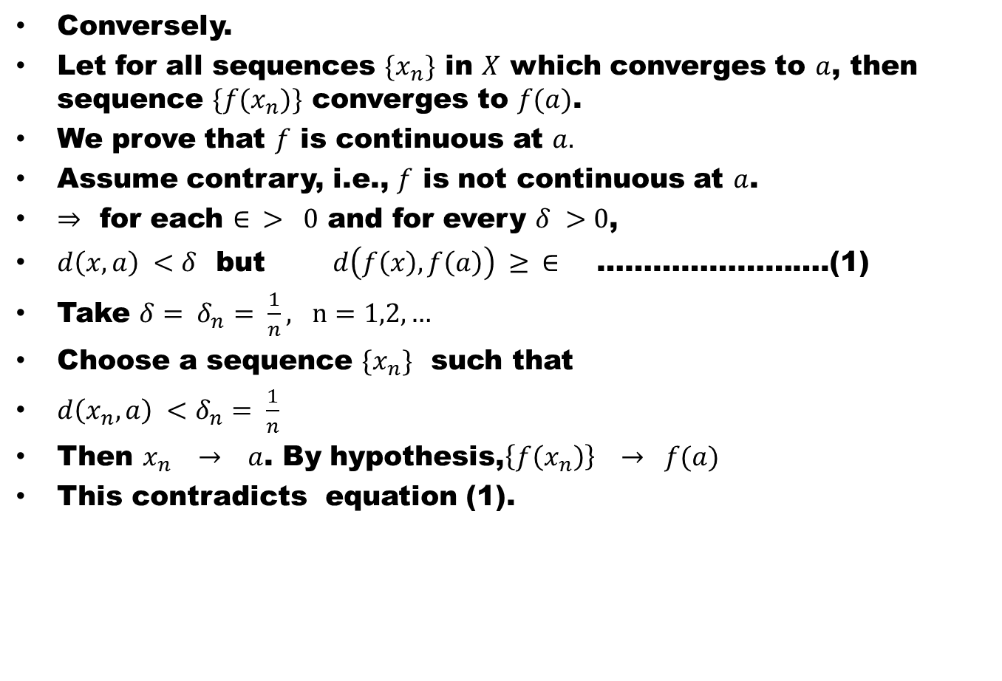
Conversely.
Let for all sequences $\{x_{n}\}$ in $X$ which converges to $a$, then sequence $\{f(x_{n})\}$ converges to $f(a)$.
We prove that $f$ is continuous at $a.$
Assume contrary, i.e., $f$ is not continuous at $a$.
$⇒$ for each $∈ > 0$ and for every $δ >0$,
$d\left(x,a\right) <δ$ but$d\left(f\left(x\right), f\left(a\right)\right) ≥ ∈$ …………………….(1)
Take $δ= δ_{n}= \frac{1}{n}, n=1,2, …$
Choose a sequence $\{x_{n}\}$ such that
$d\left(x_{n},a\right) <δ_{n}= \frac{1}{n}$
Then $x_{n} → a$. By hypothesis,$\left\{f\left(x_{n}\right)\right\} → f(a)$
This contradicts equation (1).

Slide 24
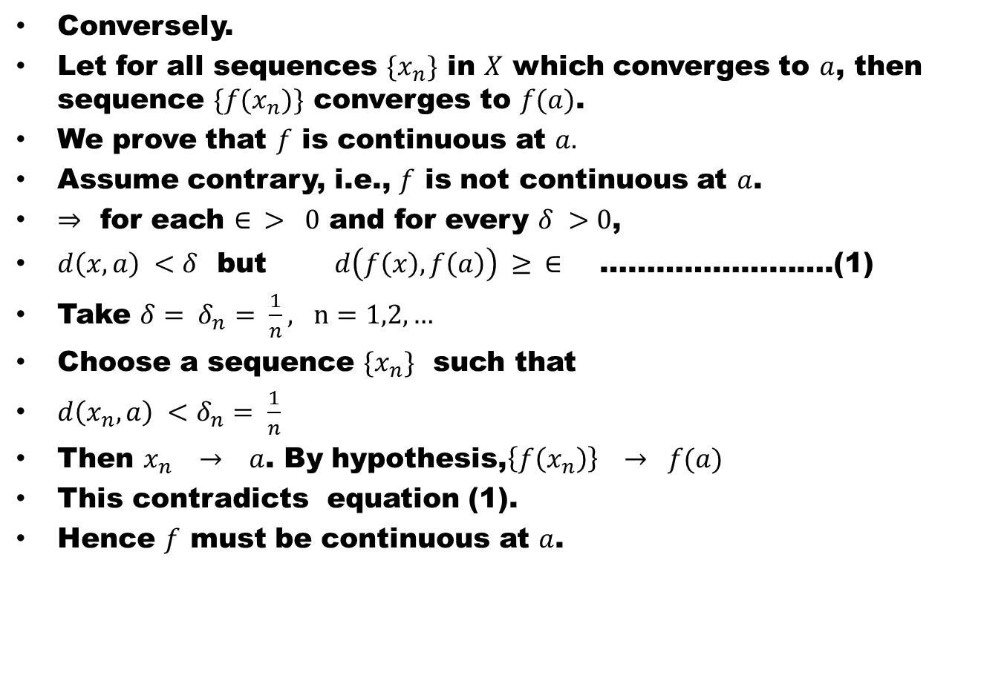
Conversely.
Let for all sequences $\{x_{n}\}$ in $X$ which converges to $a$, then sequence $\{f(x_{n})\}$ converges to $f(a)$.
We prove that $f$ is continuous at $a.$
Assume contrary, i.e., $f$ is not continuous at $a$.
$⇒$ for each $∈ > 0$ and for every $δ >0$,
$d\left(x,a\right) <δ$ but$d\left(f\left(x\right), f\left(a\right)\right) ≥ ∈$ …………………….(1)
Take $δ= δ_{n}= \frac{1}{n}, n=1,2, …$
Choose a sequence $\{x_{n}\}$ such that
$d\left(x_{n},a\right) <δ_{n}= \frac{1}{n}$
Then $x_{n} → a$. By hypothesis,$\left\{f\left(x_{n}\right)\right\} → f(a)$
This contradicts equation (1).
Hence $f$ must be continuous at $a$.

Slide 25
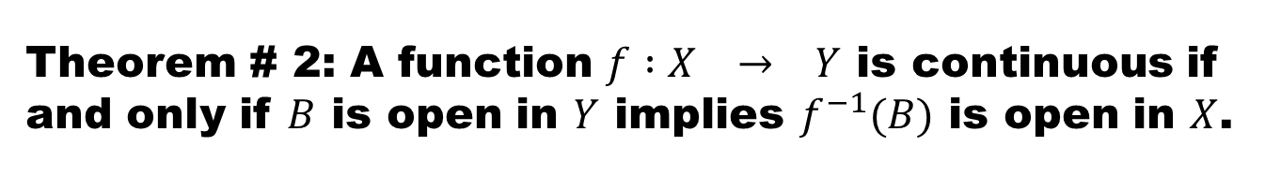
Theorem # 2: A function $f :X → Y$ is continuous if and only if $B$ is open in $Y$ implies $f^{−1}(B)$ is open in $X$.
Proof.

Slide 28
Theorem # 3: Composition of two continuous functions is a continuous function.

Slide 31
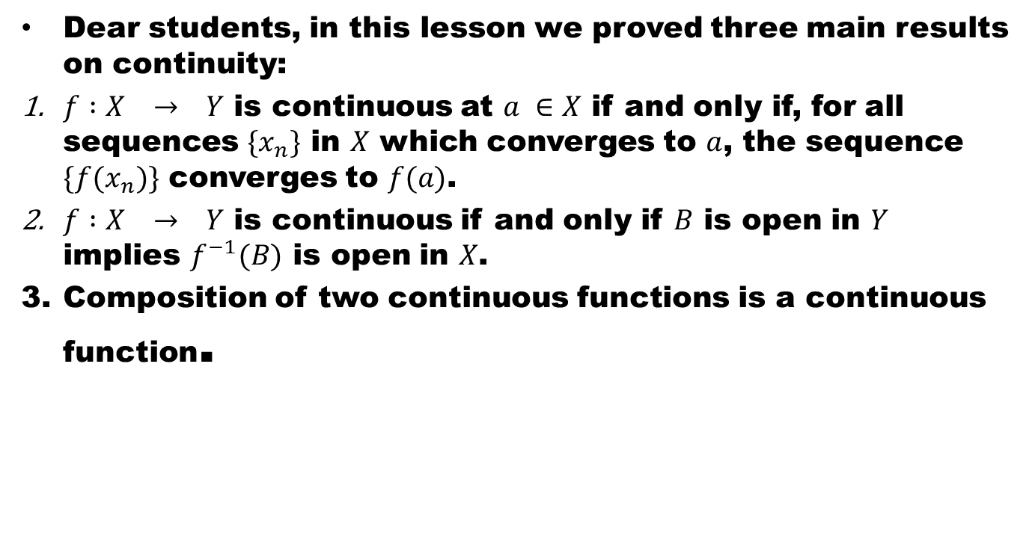
Lecture summery
Dear students, in this lesson we proved three main results on continuity:
$f :X → Y$ is continuous at $a ∈X$ if and only if, for all sequences $\{x_{n}\}$ in $X$ which converges to $a$, the sequence $\{f(x_{n})\}$ converges to $f(a)$.
$f :X → Y$ is continuous if and only if $B$ is open in $Y$ implies $f^{−1}(B)$ is open in $X$.
Composition of two continuous functions is a continuous function.

Slide 32
Thank You
And
Good Luck

