Slide 1
Set Topology
MTH 251
Lecture # 9

Slide 2
Lecture Outline
In this Lecture we will define
Convergence of sequences
Cauch sequences
Completeness of the metric spaces

Slide 3
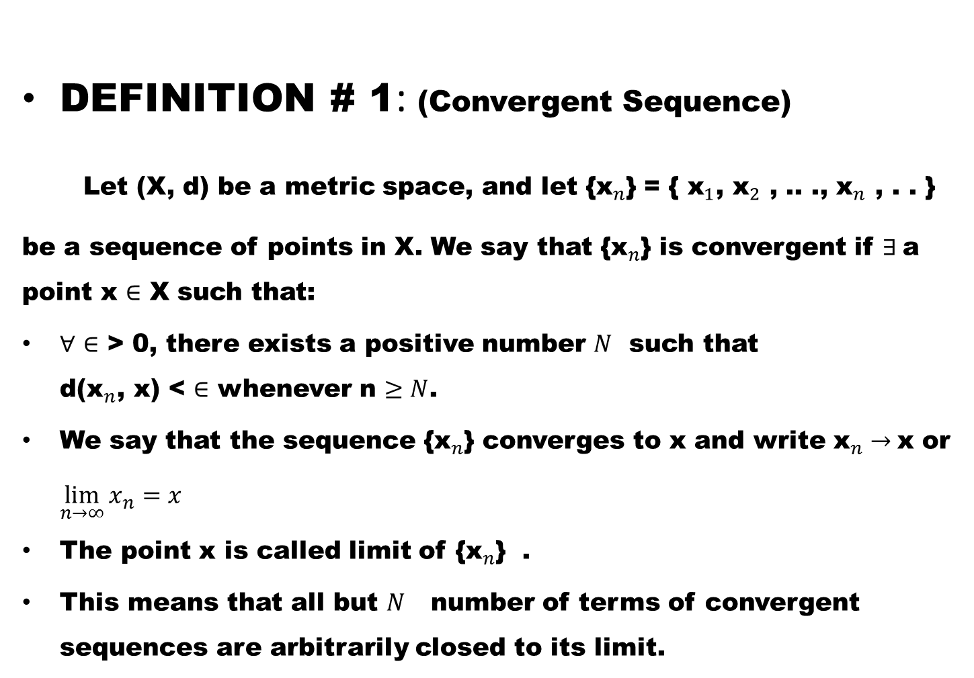
DEFINITION # 1: (Convergent Sequence)
Let (X, d) be a metric space, and let {${\text{x}}_{n}$} = { ${\text{x}}_{1}$, ${\text{x}}_{2}$ , .. ., ${\text{x}}_{n}$ , . . }
be a sequence of points in X. We say that {${\text{x}}_{n}$} is convergent if $∃$a point x $∈$ X such that:
$∀$ $∈$ > 0, there exists a positive number $N$ such that d(${\text{x}}_{n}$, x) < $∈$ whenever n $≥N$.
We say that the sequence {${\text{x}}_{n}$} converges to x and write ${\text{x}}_{n}→$x or $\lim_{n→∞}{x_{n}=x}$
The point x is called limit of {${\text{x}}_{n}$} .
This means that all but $N$ number of terms of convergent sequences are arbitrarily closed to its limit.

Slide 4
A sequence is called divergent if it is not convergent.

Slide 5
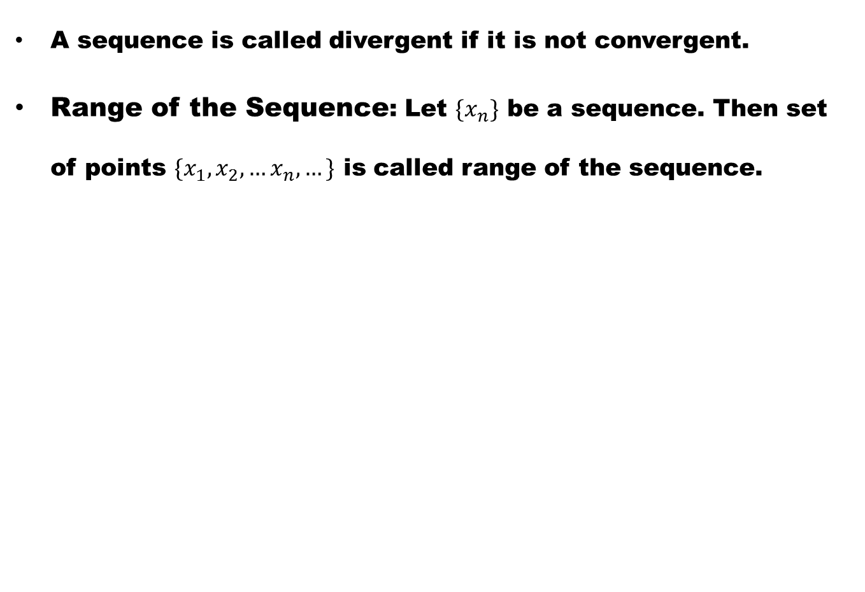
A sequence is called divergent if it is not convergent.
Range of the Sequence: Let $\{x_{n}\}$ be a sequence. Then set of points $\{x_{1},x_{2},…x_{n}, …\}$ is called range of the sequence.

Slide 6
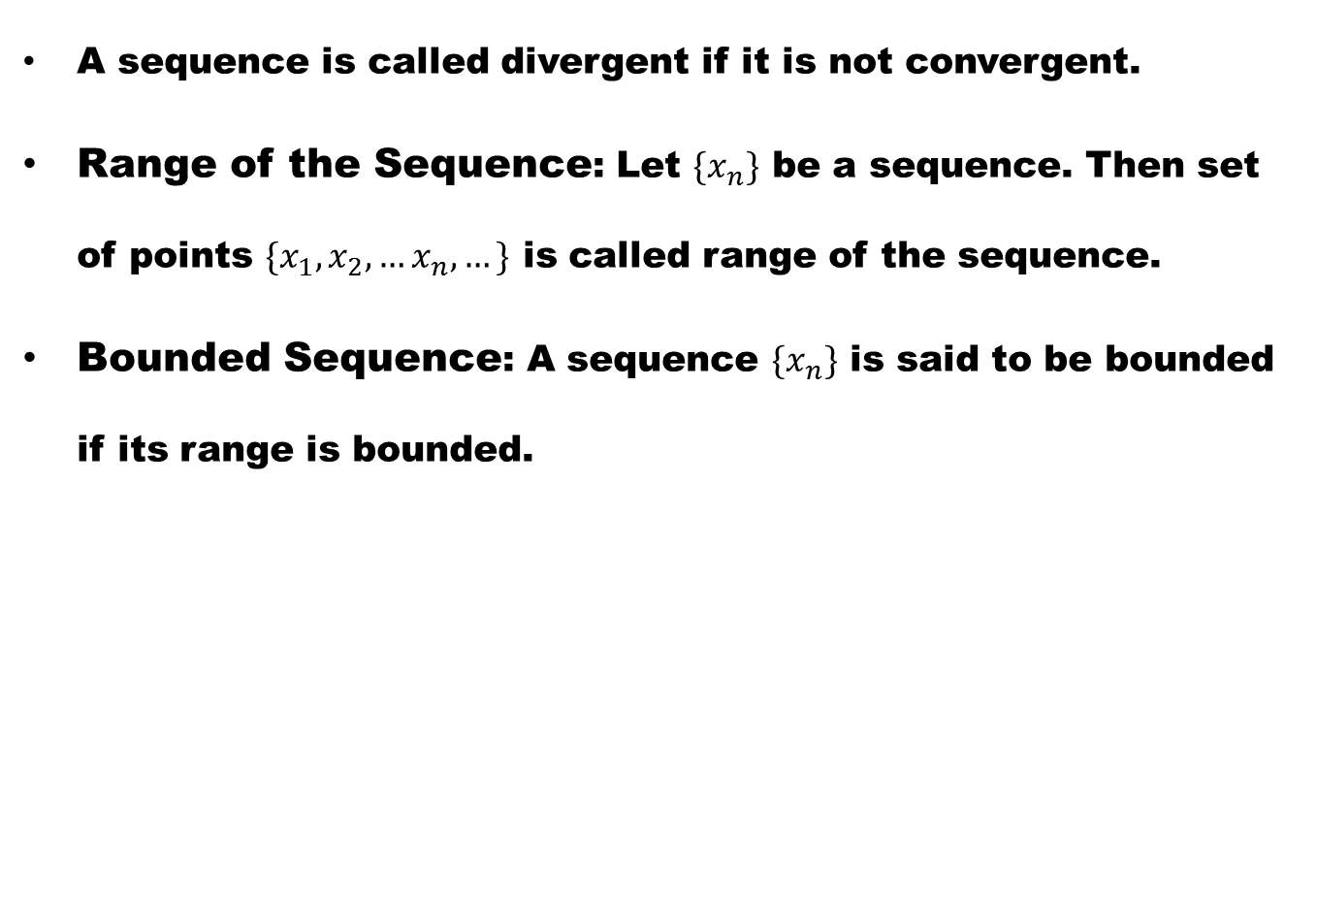
A sequence is called divergent if it is not convergent.
Range of the Sequence: Let $\{x_{n}\}$ be a sequence. Then set of points $\{x_{1},x_{2},…x_{n}, …\}$ is called range of the sequence.
Bounded Sequence: A sequence $\{x_{n}\}$ is said to be bounded if its range is bounded.

Slide 7
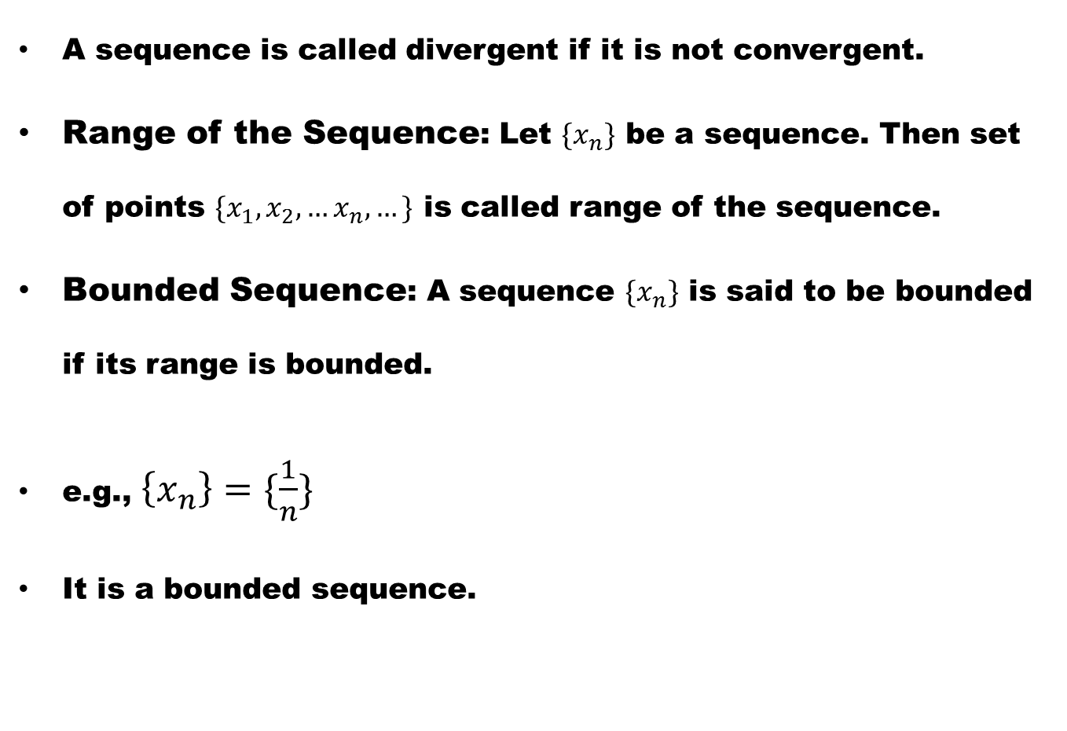
A sequence is called divergent if it is not convergent.
Range of the Sequence: Let $\{x_{n}\}$ be a sequence. Then set of points $\{x_{1},x_{2},…x_{n}, …\}$ is called range of the sequence.
Bounded Sequence: A sequence $\{x_{n}\}$ is said to be bounded if its range is bounded.
e.g., $\left\{x_{n}\right\}=\{\frac{1}{n}\}$
It is a bounded sequence.

Slide 8
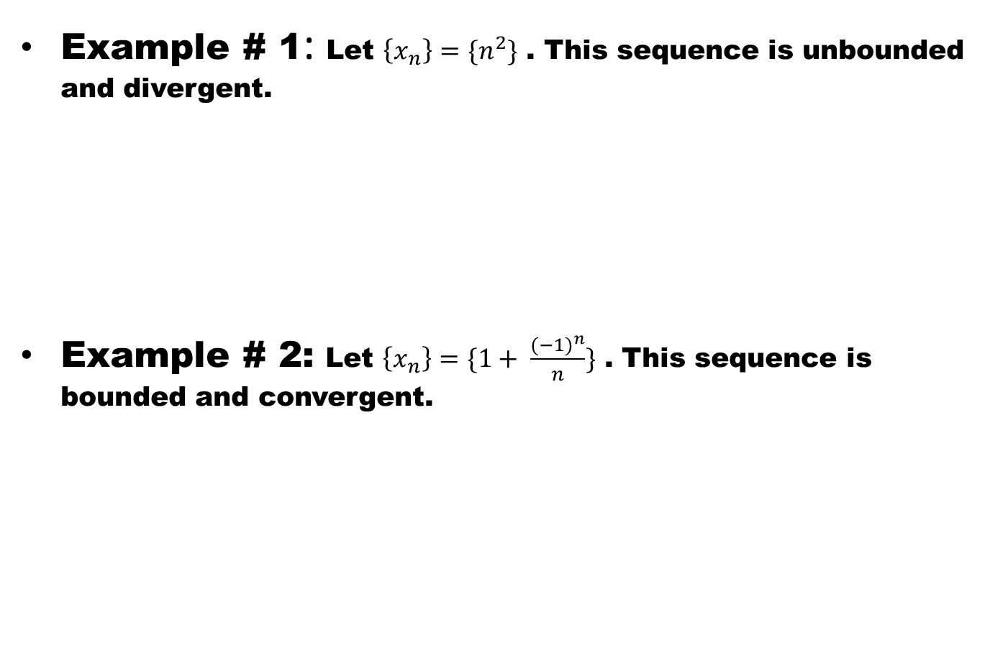
Example # 1: Let $\left\{x_{n}\right\}=\{n^{2}\}$ . This sequence is unbounded and divergent.
Example # 2: Let $\left\{x_{n}\right\}=\{1+ \frac{{(−1)}^{n}}{n}\}$ . This sequence is bounded and convergent.

Slide 9
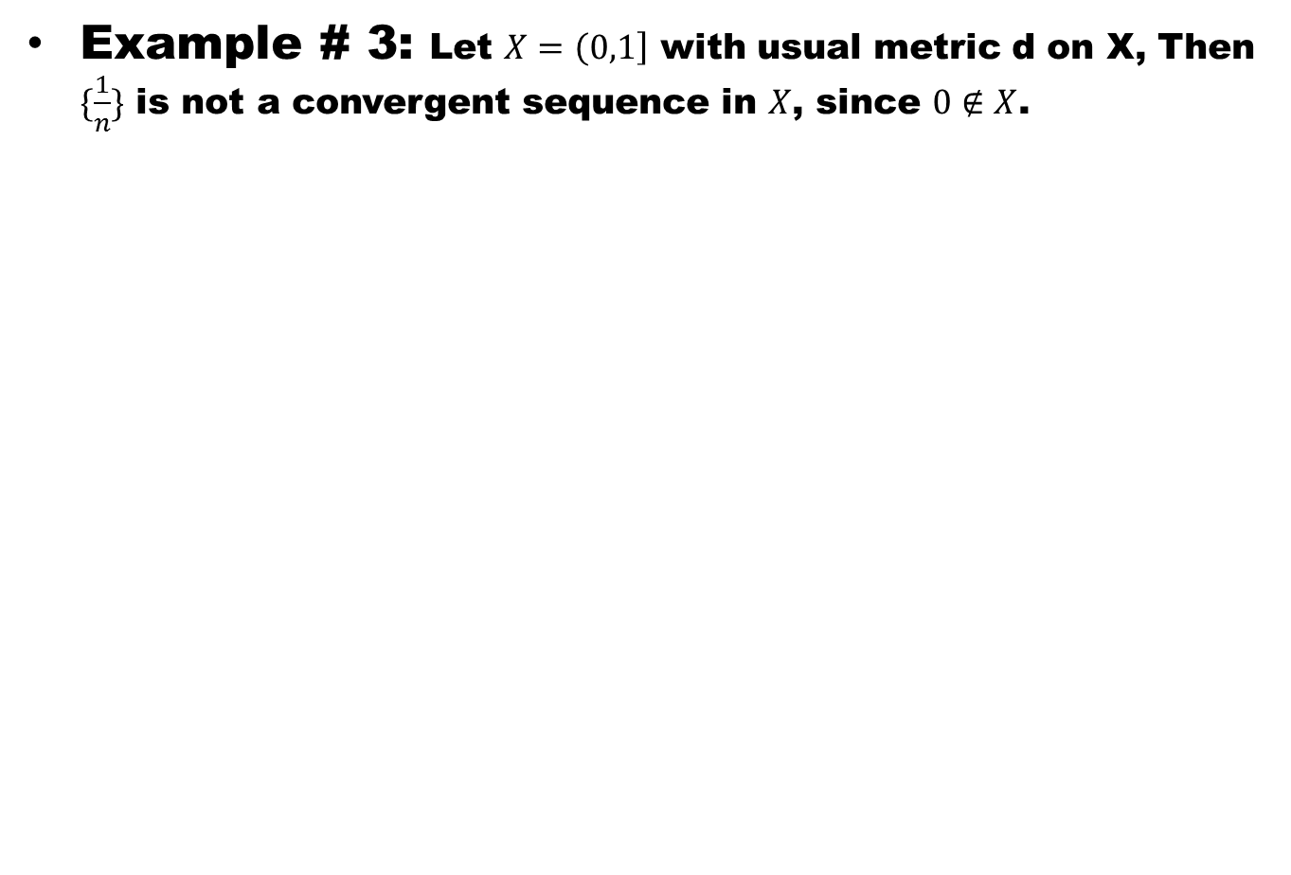
Example # 3: Let $X=\left(0,1\right]$ with usual metric d on X, Then $\{\frac{1}{n}\}$ is not a convergent sequence in $X$, since $0∉X$.

Slide 10
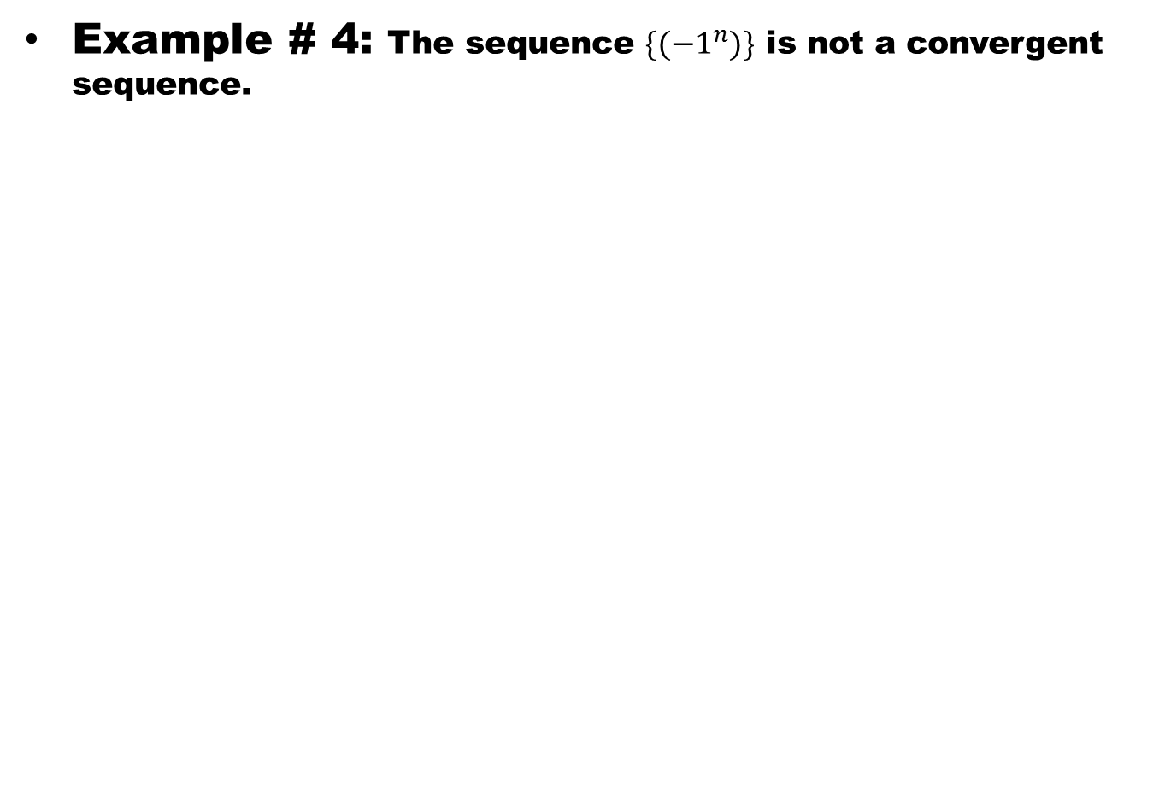
Example # 4: The sequence $\{({−1}^{n})\}$ is not a convergent sequence.

Slide 11
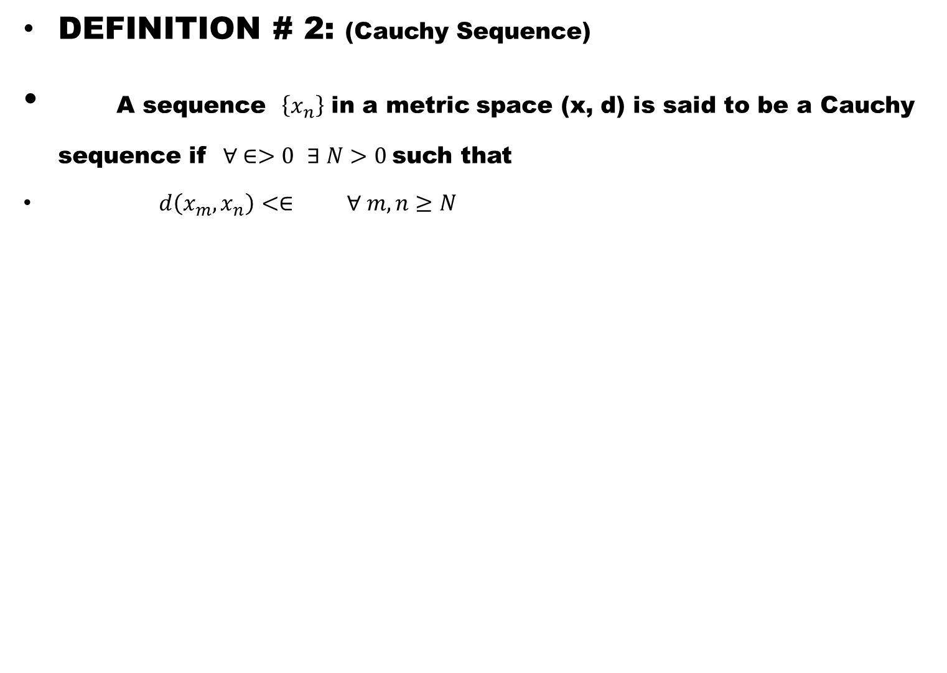
DEFINITION # 2: (Cauchy Sequence)
A sequence $\left\{x_{n}\right\}$ in a metric space (x, d) is said to be a Cauchy sequence if $∀ ∈>0$ $∃ N>0$such that
$d\left(x_{m},x_{n}\right)<∈ ∀ m,n≥N$

Slide 12
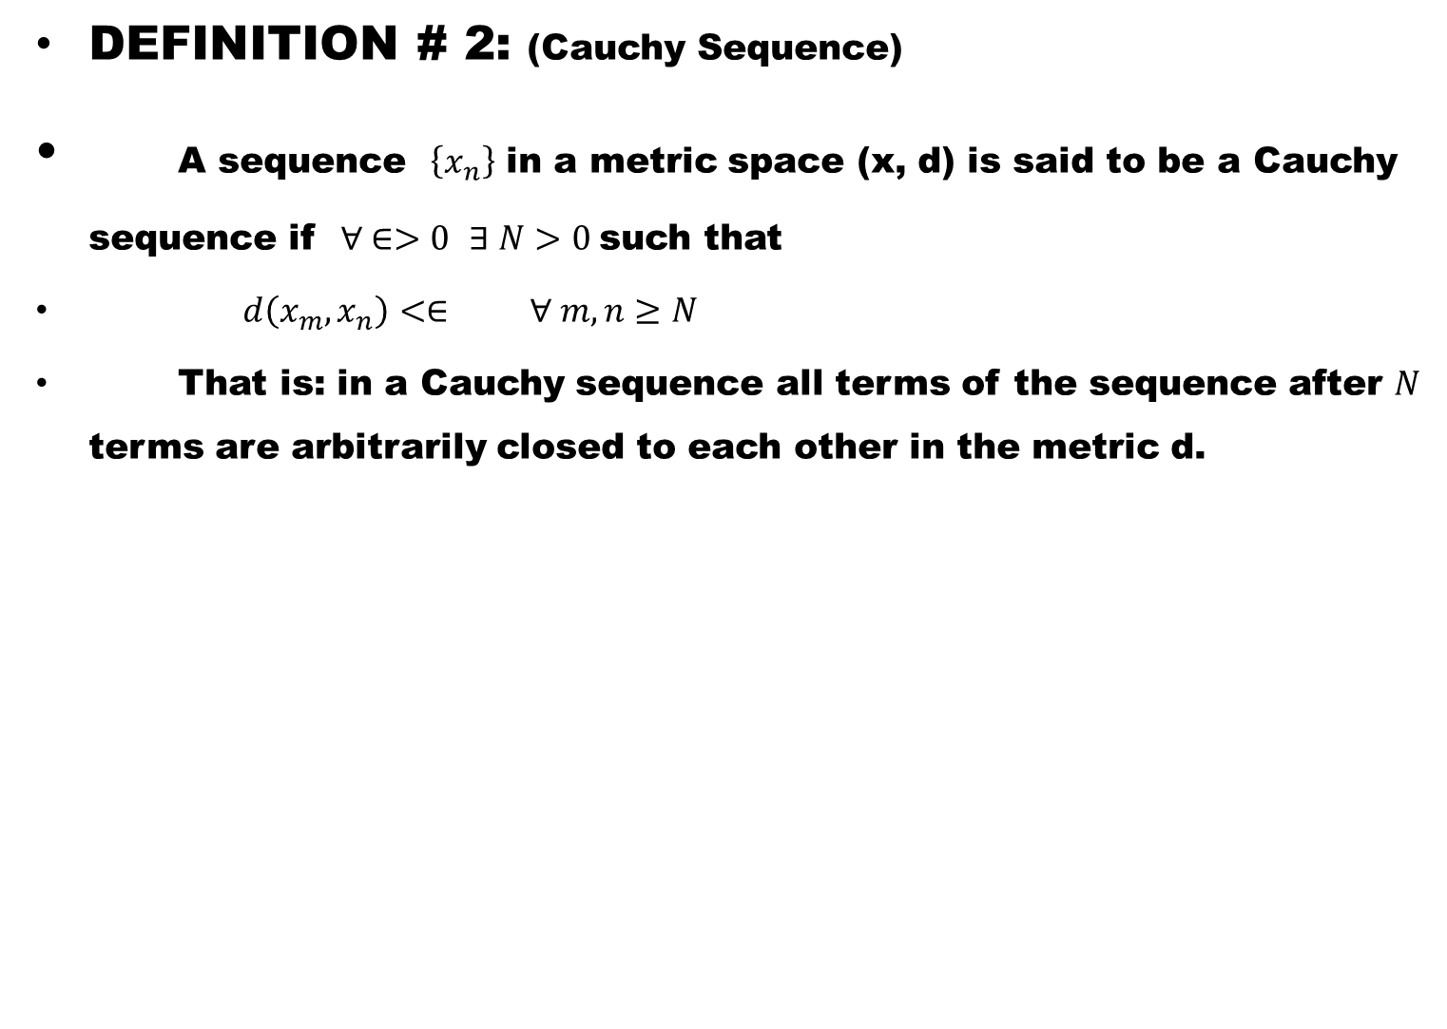
DEFINITION # 2: (Cauchy Sequence)
A sequence $\left\{x_{n}\right\}$ in a metric space (x, d) is said to be a Cauchy sequence if $∀ ∈>0$ $∃ N>0$such that
$d\left(x_{m},x_{n}\right)<∈ ∀ m,n≥N$
That is: in a Cauchy sequence all terms of the sequence after $N$ terms are arbitrarily closed to each other in the metric d.

Slide 13
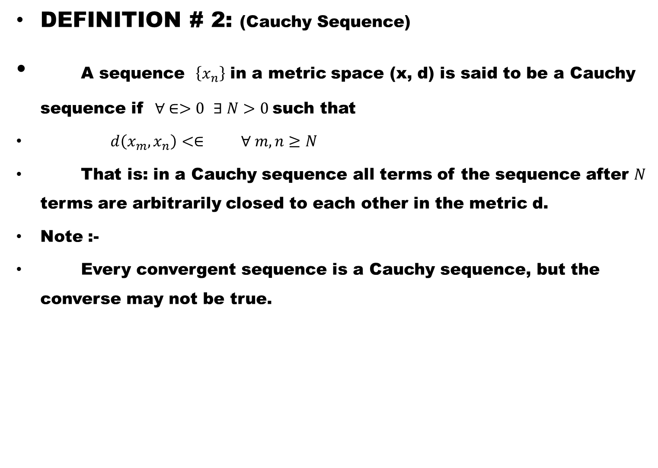
DEFINITION # 2: (Cauchy Sequence)
A sequence $\left\{x_{n}\right\}$ in a metric space (x, d) is said to be a Cauchy sequence if $∀ ∈>0$ $∃ N>0$such that
$d\left(x_{m},x_{n}\right)<∈ ∀ m,n≥N$
That is: in a Cauchy sequence all terms of the sequence after $N$ terms are arbitrarily closed to each other in the metric d.
Note :-
Every convergent sequence is a Cauchy sequence, but the converse may not be true.

Slide 14
    Definition # 3:
A metric space (X,d) is called a complete metric space if every Cauchy sequence in X, converges to a point of X.

Slide 15
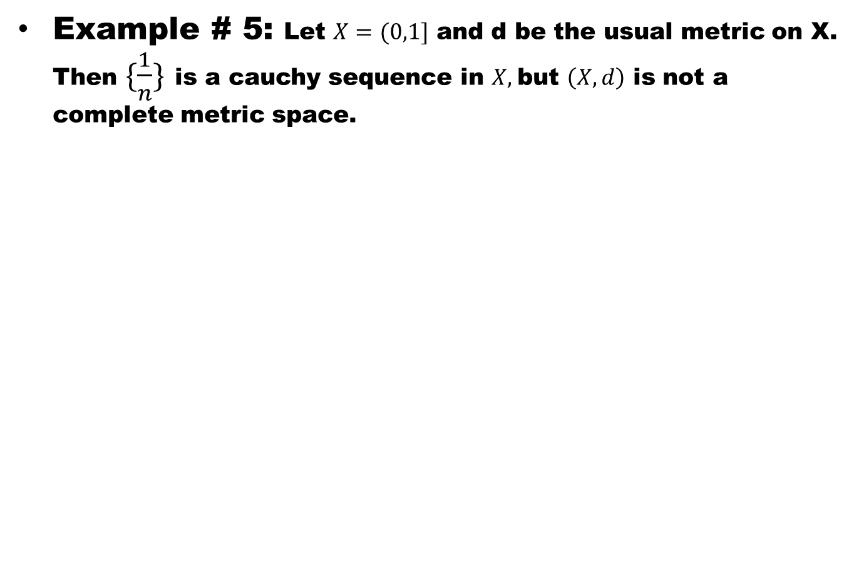
Example # 5: Let $X=(0,1]$ and d be the usual metric on X. Then $\{\frac{1}{n}\}$ is a cauchy sequence in $X,$but $\left(X,d\right)$ is not a complete metric space.

Slide 16
    Examples # 6:
1). R with usual metric is complete.
2). C is complete and the completeness follows from the completeness of R.

Slide 17
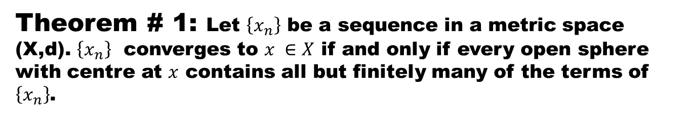
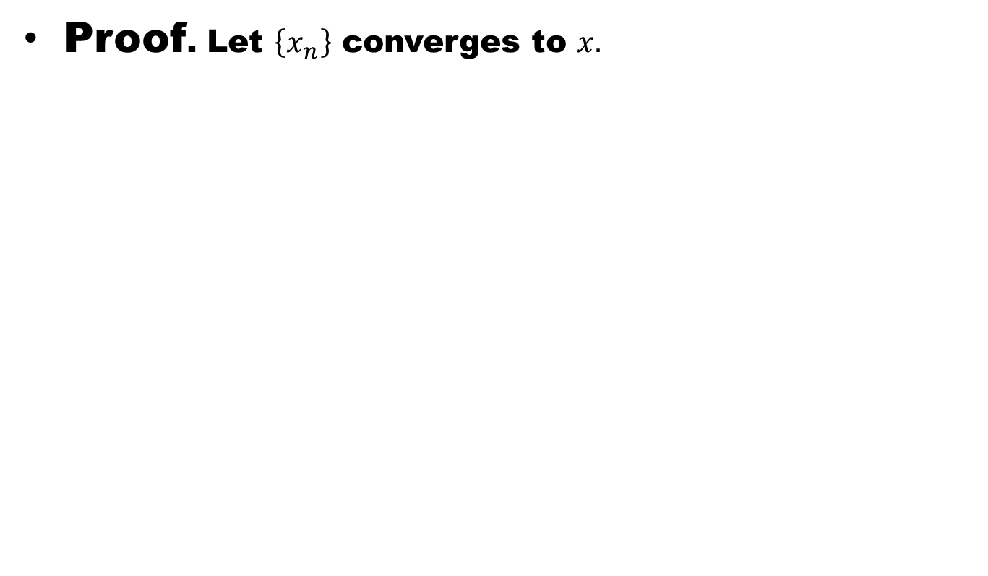
Theorem # 1: Let $\left\{x_{n}\right\}$ be a sequence in a metric space (X,d). $\left\{x_{n}\right\}$ converges to $x ∈X$ if and only if every open sphere with centre at $x$ contains all but finitely many of the terms of $\left\{x_{n}\right\}$.
Proof. Let $\left\{x_{n}\right\}$ converges to $x.$

Slide 18
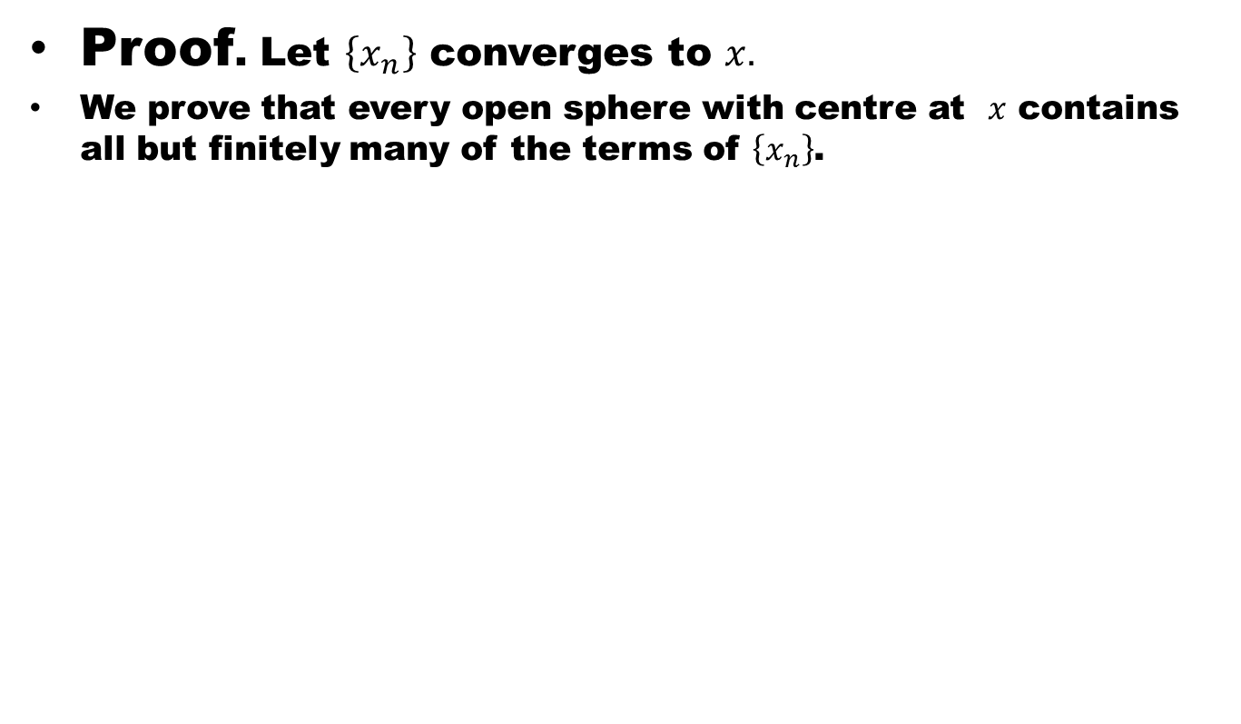
Theorem # 1: Let $\left\{x_{n}\right\}$ be a sequence in a metric space (X,d). $\left\{x_{n}\right\}$ converges to $x ∈X$ if and only if every open sphere with centre at $x$ contains all but finitely many of the terms of $\left\{x_{n}\right\}$.
Proof. Let $\left\{x_{n}\right\}$ converges to $x.$
We prove that every open sphere with centre at $x$ contains all but finitely many of the terms of $\left\{x_{n}\right\}$.

Slide 19
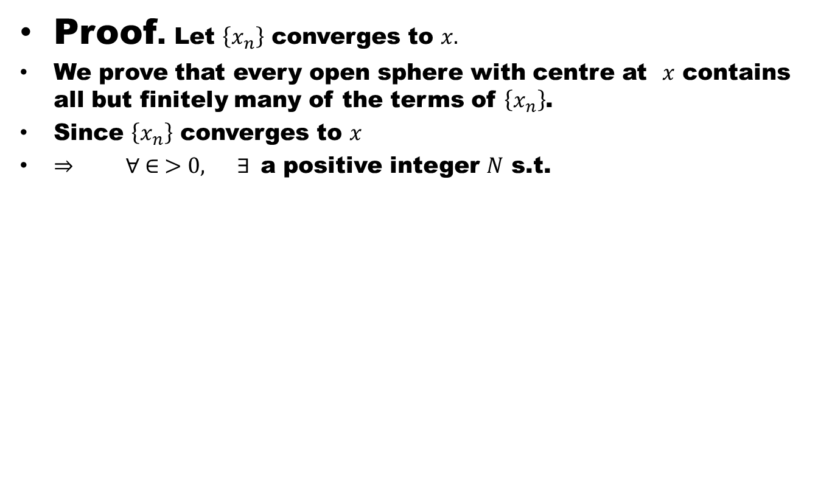
Theorem # 1: Let $\left\{x_{n}\right\}$ be a sequence in a metric space (X,d). $\left\{x_{n}\right\}$ converges to $x ∈X$ if and only if every open sphere with centre at $x$ contains all but finitely many of the terms of $\left\{x_{n}\right\}$.
Proof. Let $\left\{x_{n}\right\}$ converges to $x.$
We prove that every open sphere with centre at $x$ contains all but finitely many of the terms of $\left\{x_{n}\right\}$.
Since $\left\{x_{n}\right\}$ converges to $x$
$⇒ ∀ ∈ >0, ∃$a positive integer $N$ s.t.

Slide 20
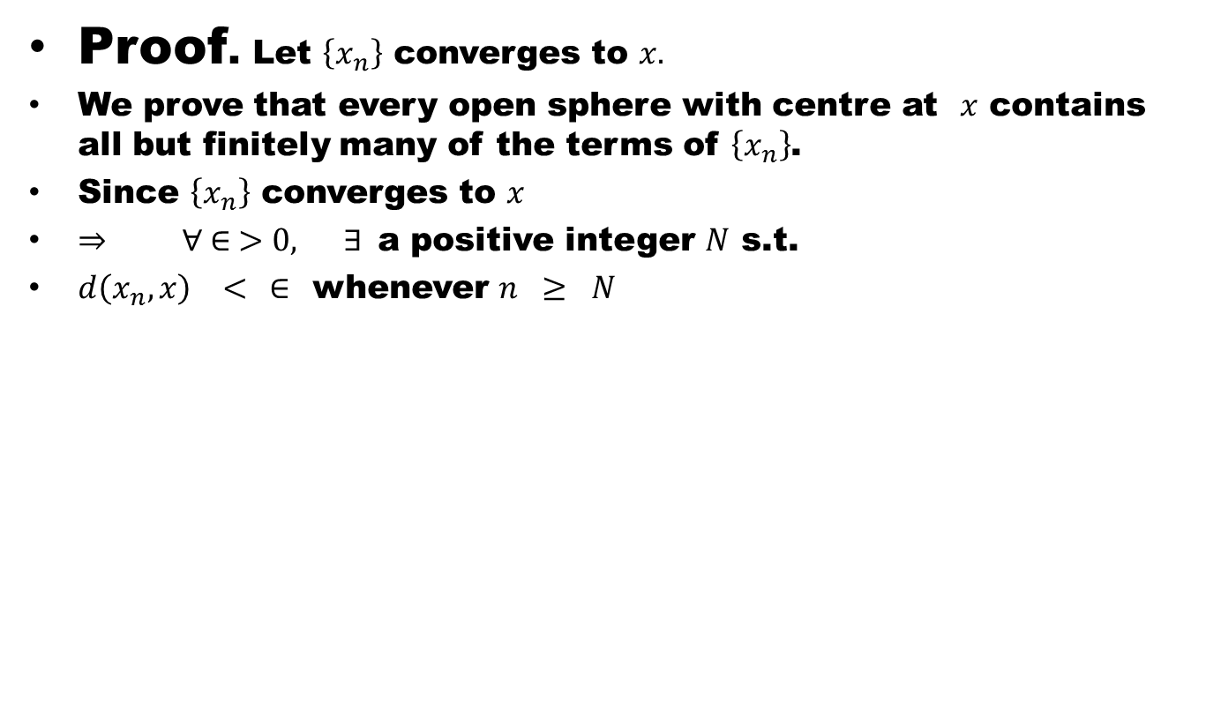
Theorem # 1: Let $\left\{x_{n}\right\}$ be a sequence in a metric space (X,d). $\left\{x_{n}\right\}$ converges to $x ∈X$ if and only if every open sphere with centre at $x$ contains all but finitely many of the terms of $\left\{x_{n}\right\}$.
Proof. Let $\left\{x_{n}\right\}$ converges to $x.$
We prove that every open sphere with centre at $x$ contains all but finitely many of the terms of $\left\{x_{n}\right\}$.
Since $\left\{x_{n}\right\}$ converges to $x$
$⇒ ∀ ∈ >0, ∃$a positive integer $N$ s.t.
$d\left(x_{n},x\right) < ∈$ whenever $n ≥ N$

Slide 21
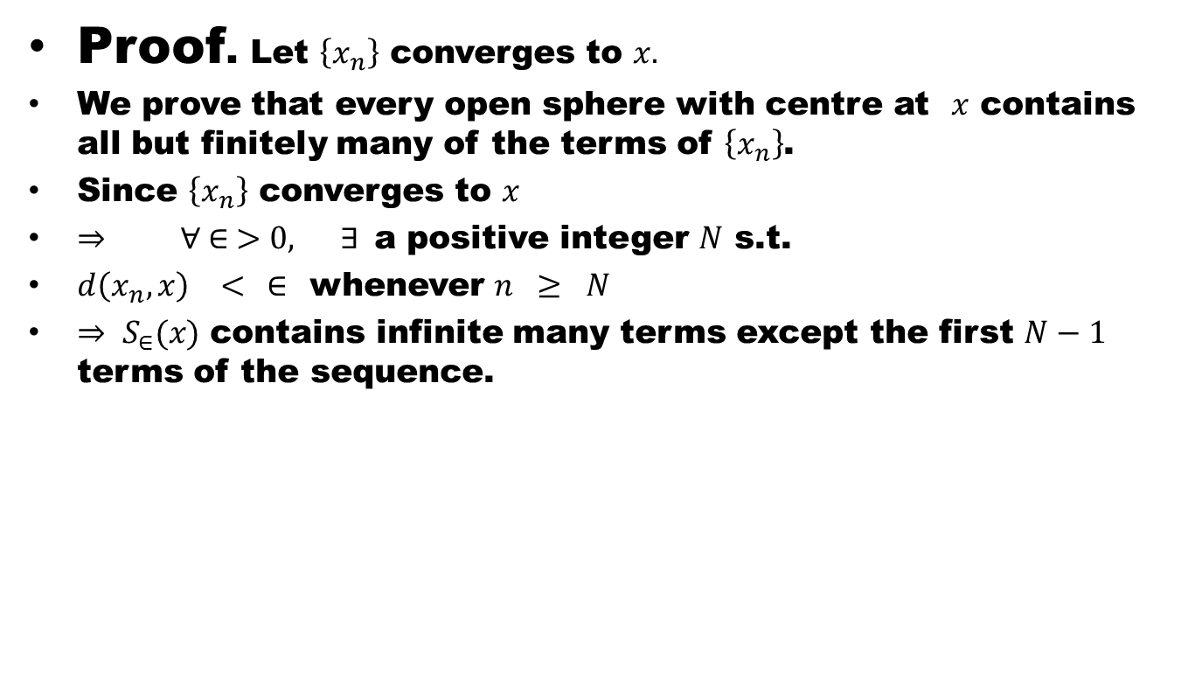
Theorem # 1: Let $\left\{x_{n}\right\}$ be a sequence in a metric space (X,d). $\left\{x_{n}\right\}$ converges to $x ∈X$ if and only if every open sphere with centre at $x$ contains all but finitely many of the terms of $\left\{x_{n}\right\}$.
Proof. Let $\left\{x_{n}\right\}$ converges to $x.$
We prove that every open sphere with centre at $x$ contains all but finitely many of the terms of $\left\{x_{n}\right\}$.
Since $\left\{x_{n}\right\}$ converges to $x$
$⇒ ∀ ∈ >0, ∃$a positive integer $N$ s.t.
$d\left(x_{n},x\right) < ∈$ whenever $n ≥ N$
$⇒ S_{∈}(x)$ contains infinite many terms except the first $N−1$ terms of the sequence.

Slide 22
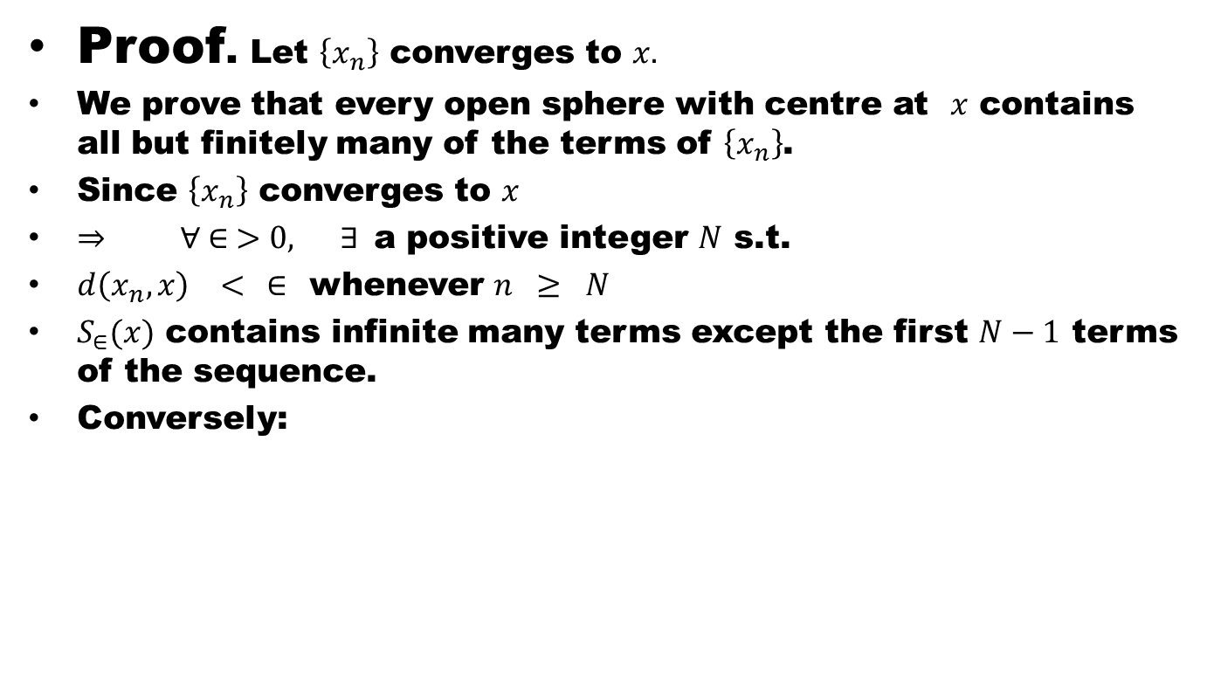
Theorem # 1: Let $\left\{x_{n}\right\}$ be a sequence in a metric space (X,d). $\left\{x_{n}\right\}$ converges to $x ∈X$ if and only if every open sphere with centre at $x$ contains all but finitely many of the terms of $\left\{x_{n}\right\}$.
Proof. Let $\left\{x_{n}\right\}$ converges to $x.$
We prove that every open sphere with centre at $x$ contains all but finitely many of the terms of $\left\{x_{n}\right\}$.
Since $\left\{x_{n}\right\}$ converges to $x$
$⇒ ∀ ∈ >0, ∃$a positive integer $N$ s.t.
$d\left(x_{n},x\right) < ∈$ whenever $n ≥ N$
$S_{∈}(x)$ contains infinite many terms except the first $N−1$ terms of the sequence.
Conversely:

Slide 23
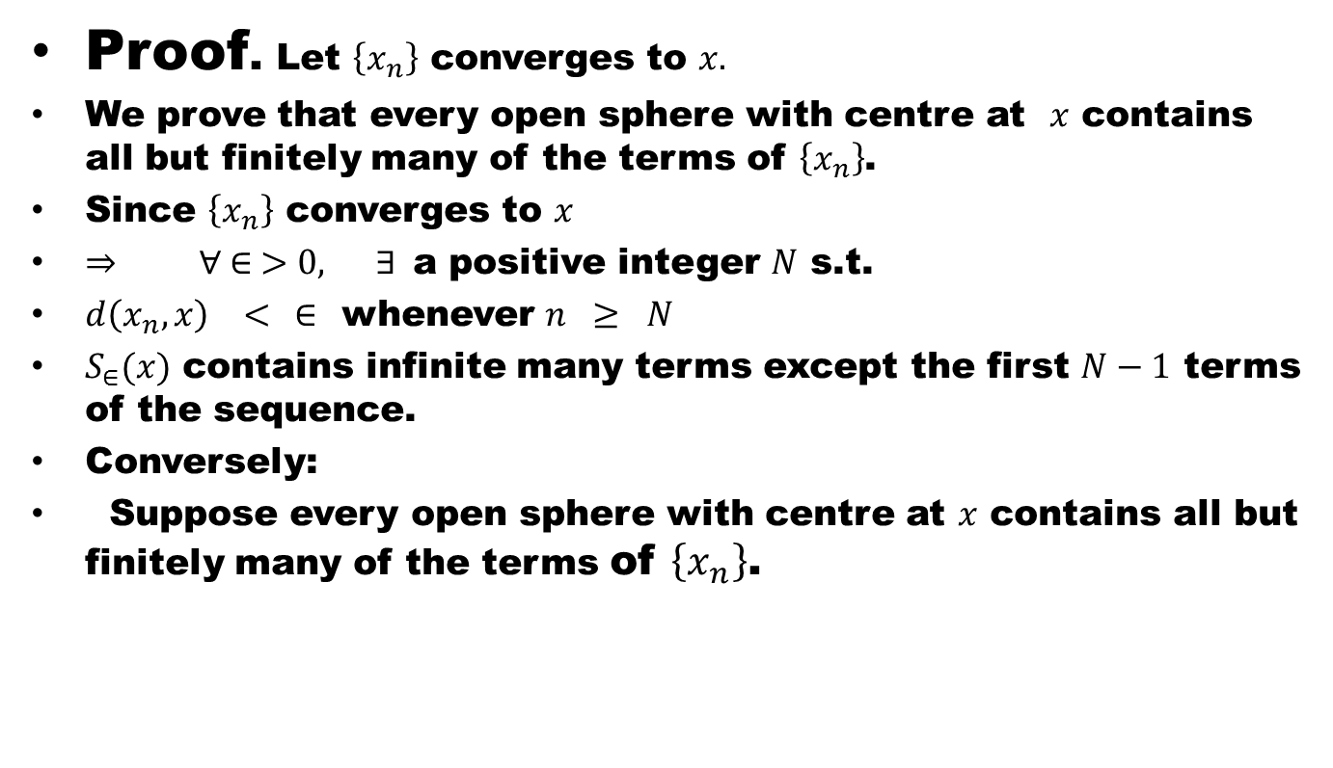
Theorem # 1: Let $\left\{x_{n}\right\}$ be a sequence in a metric space (X,d). $\left\{x_{n}\right\}$ converges to $x ∈X$ if and only if every open sphere with centre at $x$ contains all but finitely many of the terms of $\left\{x_{n}\right\}$.
Proof. Let $\left\{x_{n}\right\}$ converges to $x.$
We prove that every open sphere with centre at $x$ contains all but finitely many of the terms of $\left\{x_{n}\right\}$.
Since $\left\{x_{n}\right\}$ converges to $x$
$⇒ ∀ ∈ >0, ∃$a positive integer $N$ s.t.
$d\left(x_{n},x\right) < ∈$ whenever $n ≥ N$
$S_{∈}(x)$ contains infinite many terms except the first $N−1$ terms of the sequence.
Conversely:
Suppose every open sphere with centre at $x$ contains all but finitely many of the terms of $\left\{x_{n}\right\}$.

Slide 24
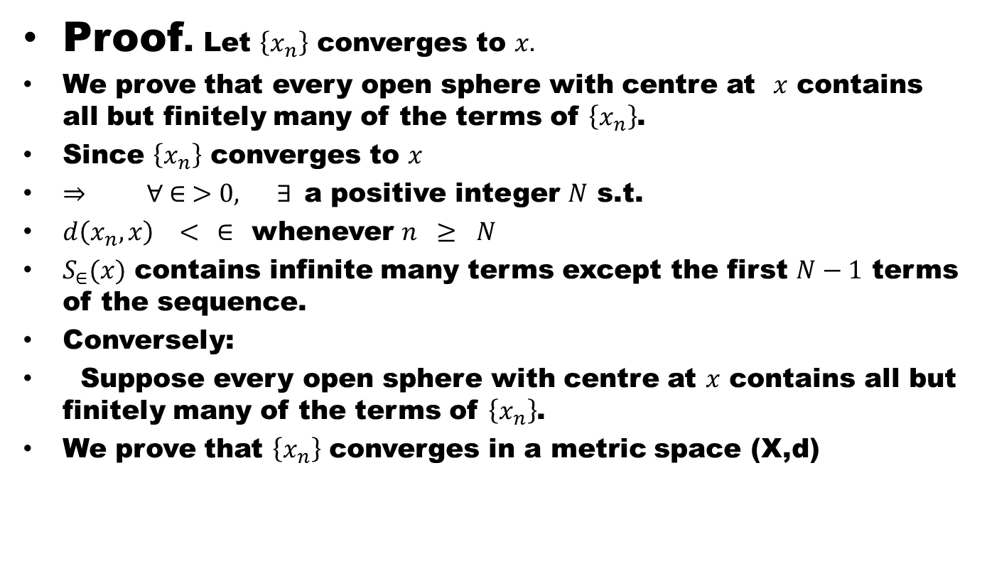
Theorem # 1: Let $\left\{x_{n}\right\}$ be a sequence in a metric space (X,d). $\left\{x_{n}\right\}$ converges to $x ∈X$ if and only if every open sphere with centre at $x$ contains all but finitely many of the terms of $\left\{x_{n}\right\}$.
Proof. Let $\left\{x_{n}\right\}$ converges to $x.$
We prove that every open sphere with centre at $x$ contains all but finitely many of the terms of $\left\{x_{n}\right\}$.
Since $\left\{x_{n}\right\}$ converges to $x$
$⇒ ∀ ∈ >0, ∃$a positive integer $N$ s.t.
$d\left(x_{n},x\right) < ∈$ whenever $n ≥ N$
$S_{∈}(x)$ contains infinite many terms except the first $N−1$ terms of the sequence.
Conversely:
Suppose every open sphere with centre at $x$ contains all but finitely many of the terms of $\left\{x_{n}\right\}$.
We prove that $\left\{x_{n}\right\}$ converges in a metric space (X,d)

Slide 25
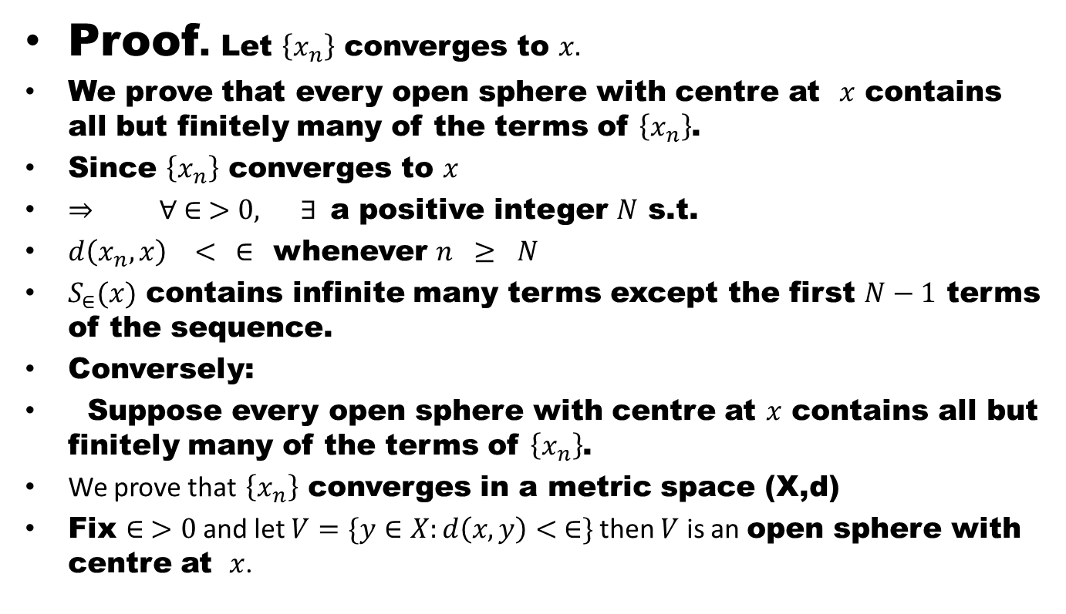
Theorem # 1: Let $\left\{x_{n}\right\}$ be a sequence in a metric space (X,d). $\left\{x_{n}\right\}$ converges to $x ∈X$ if and only if every open sphere with centre at $x$ contains all but finitely many of the terms of $\left\{x_{n}\right\}$.
Proof. Let $\left\{x_{n}\right\}$ converges to $x.$
We prove that every open sphere with centre at $x$ contains all but finitely many of the terms of $\left\{x_{n}\right\}$.
Since $\left\{x_{n}\right\}$ converges to $x$
$⇒ ∀ ∈ >0, ∃$a positive integer $N$ s.t.
$d\left(x_{n},x\right) < ∈$ whenever $n ≥ N$
$S_{∈}(x)$ contains infinite many terms except the first $N−1$ terms of the sequence.
Conversely:
Suppose every open sphere with centre at $x$ contains all but finitely many of the terms of $\left\{x_{n}\right\}$.
We prove that $\left\{x_{n}\right\}$ converges in a metric space (X,d)
Fix $∈ >0$ and let $V=\{y∈X:d\left(x,y\right)< ∈\}$ then $V$ is an open sphere with centre at $x$.

Slide 26
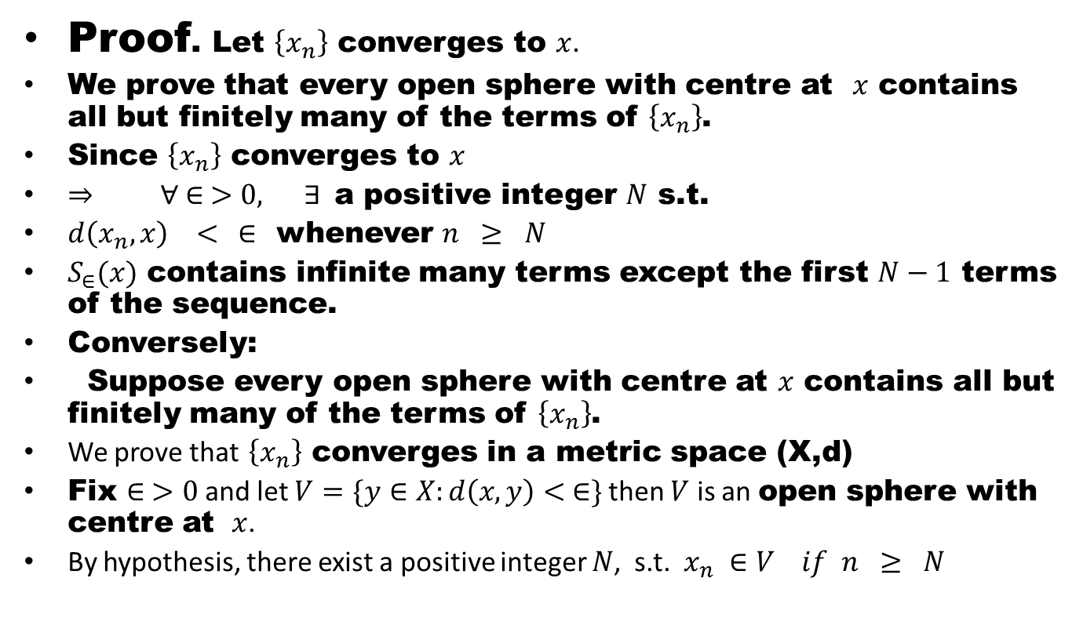
Theorem # 1: Let $\left\{x_{n}\right\}$ be a sequence in a metric space (X,d). $\left\{x_{n}\right\}$ converges to $x ∈X$ if and only if every open sphere with centre at $x$ contains all but finitely many of the terms of $\left\{x_{n}\right\}$.
Proof. Let $\left\{x_{n}\right\}$ converges to $x.$
We prove that every open sphere with centre at $x$ contains all but finitely many of the terms of $\left\{x_{n}\right\}$.
Since $\left\{x_{n}\right\}$ converges to $x$
$⇒ ∀ ∈ >0, ∃$a positive integer $N$ s.t.
$d\left(x_{n},x\right) < ∈$ whenever $n ≥ N$
$S_{∈}(x)$ contains infinite many terms except the first $N−1$ terms of the sequence.
Conversely:
Suppose every open sphere with centre at $x$ contains all but finitely many of the terms of $\left\{x_{n}\right\}$.
We prove that $\left\{x_{n}\right\}$ converges in a metric space (X,d)
Fix $∈ >0$ and let $V=\{y∈X:d\left(x,y\right)< ∈\}$ then $V$ is an open sphere with centre at $x$.
By hypothesis, there exist a positive integer $N$, s.t. $x_{n} ∈V if n ≥ N$

Slide 27
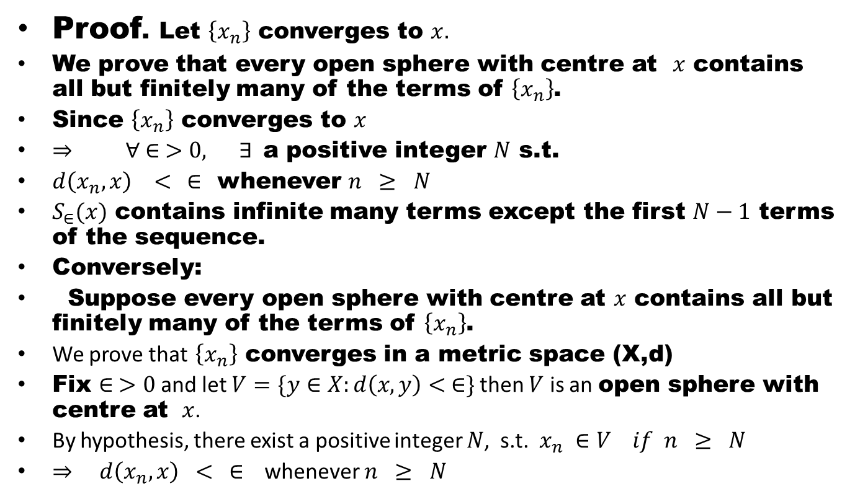
Theorem # 1: Let $\left\{x_{n}\right\}$ be a sequence in a metric space (X,d). $\left\{x_{n}\right\}$ converges to $x ∈X$ if and only if every open sphere with centre at $x$ contains all but finitely many of the terms of $\left\{x_{n}\right\}$.
Proof. Let $\left\{x_{n}\right\}$ converges to $x.$
We prove that every open sphere with centre at $x$ contains all but finitely many of the terms of $\left\{x_{n}\right\}$.
Since $\left\{x_{n}\right\}$ converges to $x$
$⇒ ∀ ∈ >0, ∃$a positive integer $N$ s.t.
$d\left(x_{n},x\right) < ∈$ whenever $n ≥ N$
$S_{∈}(x)$ contains infinite many terms except the first $N−1$ terms of the sequence.
Conversely:
Suppose every open sphere with centre at $x$ contains all but finitely many of the terms of $\left\{x_{n}\right\}$.
We prove that $\left\{x_{n}\right\}$ converges in a metric space (X,d)
Fix $∈ >0$ and let $V=\{y∈X:d\left(x,y\right)< ∈\}$ then $V$ is an open sphere with centre at $x$.
By hypothesis, there exist a positive integer $N$, s.t. $x_{n} ∈V if n ≥ N$
$⇒$ $d\left(x_{n}, x\right) < ∈$ whenever $n ≥ N$

Slide 28
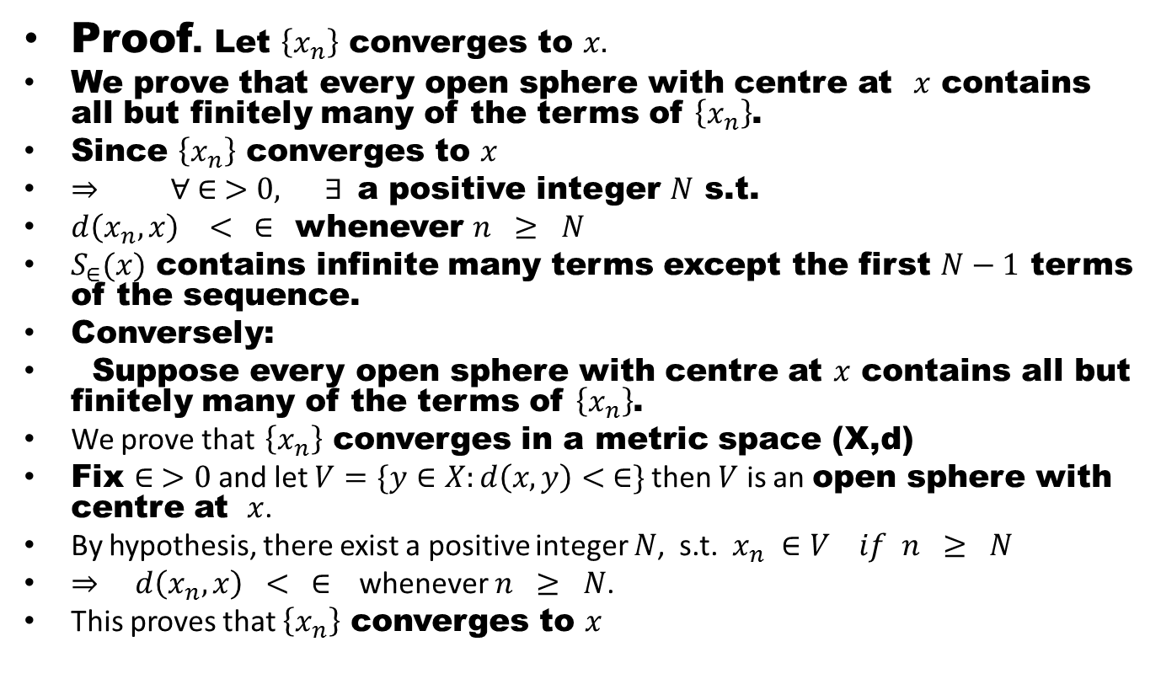
Theorem # 1: Let $\left\{x_{n}\right\}$ be a sequence in a metric space (X,d). $\left\{x_{n}\right\}$ converges to $x ∈X$ if and only if every open sphere with centre at $x$ contains all but finitely many of the terms of $\left\{x_{n}\right\}$.
Proof. Let $\left\{x_{n}\right\}$ converges to $x.$
We prove that every open sphere with centre at $x$ contains all but finitely many of the terms of $\left\{x_{n}\right\}$.
Since $\left\{x_{n}\right\}$ converges to $x$
$⇒ ∀ ∈ >0, ∃$a positive integer $N$ s.t.
$d\left(x_{n},x\right) < ∈$ whenever $n ≥ N$
$S_{∈}(x)$ contains infinite many terms except the first $N−1$ terms of the sequence.
Conversely:
Suppose every open sphere with centre at $x$ contains all but finitely many of the terms of $\left\{x_{n}\right\}$.
We prove that $\left\{x_{n}\right\}$ converges in a metric space (X,d)
Fix $∈ >0$ and let $V=\{y∈X:d\left(x,y\right)< ∈\}$ then $V$ is an open sphere with centre at $x$.
By hypothesis, there exist a positive integer $N$, s.t. $x_{n} ∈V if n ≥ N$
$⇒$ $d\left(x_{n}, x\right) < ∈$ whenever $n ≥ N$.
This proves that $\left\{x_{n}\right\}$ converges to $x$

Slide 29
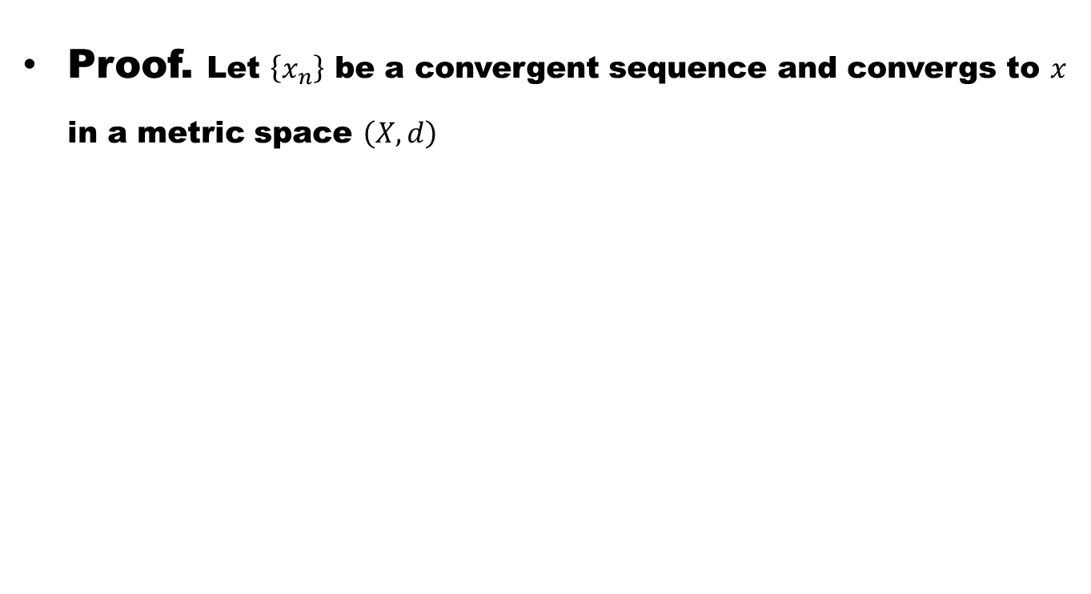
Theorem # 2: Prove that every convergent sequence in a metric space is bounded.
Proof. Let $\left\{x_{n}\right\}$ be a convergent sequence and convergs to $x$ in a metric space $\left(X,d\right)$

Slide 30
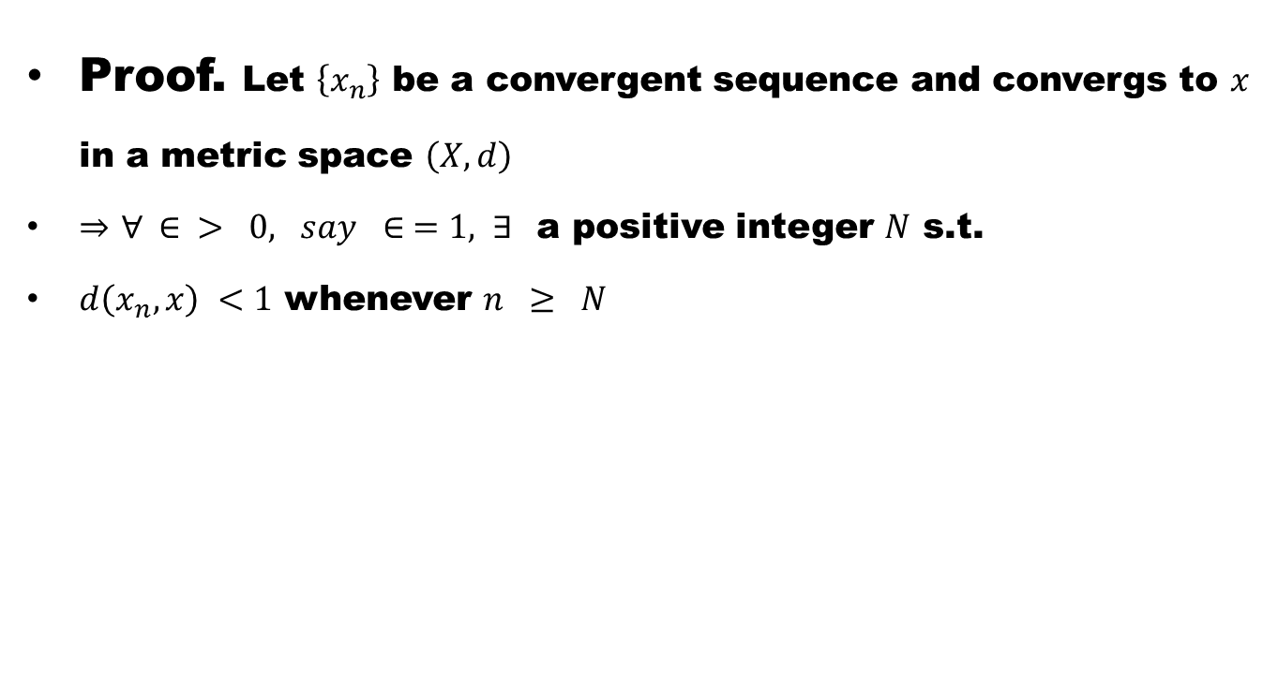
Theorem # 2: Prove that every convergent sequence in a metric space is bounded.
Proof. Let $\left\{x_{n}\right\}$ be a convergent sequence and convergs to $x$ in a metric space $\left(X,d\right)$
$⇒$ $∀ ∈ > 0, say ∈ =1, ∃$a positive integer $N$ s.t.
$d\left(x_{n},x\right) <1$ whenever $n ≥ N$

Slide 31
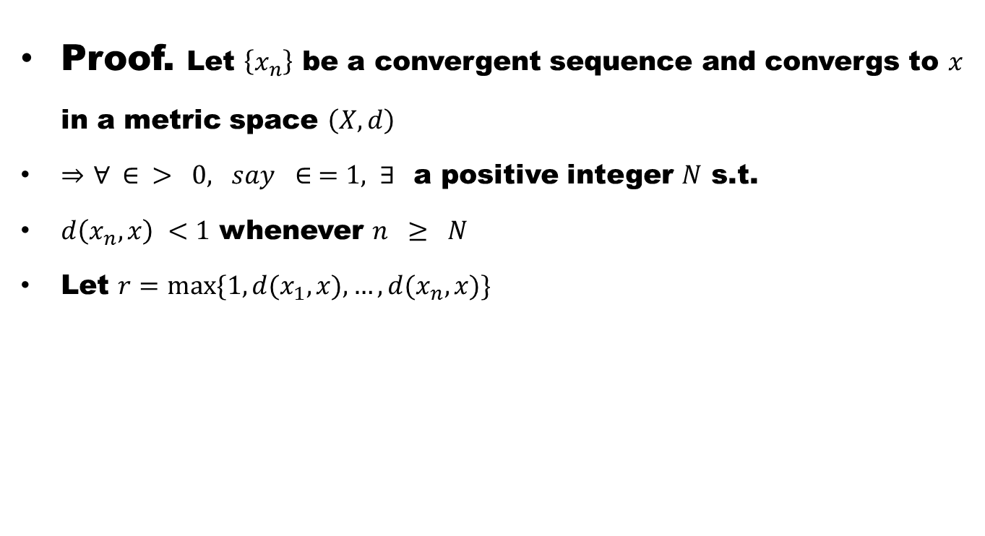
Theorem # 2: Prove that every convergent sequence in a metric space is bounded.
Proof. Let $\left\{x_{n}\right\}$ be a convergent sequence and convergs to $x$ in a metric space $\left(X,d\right)$
$⇒$ $∀ ∈ > 0, say ∈ =1, ∃$a positive integer $N$ s.t.
$d\left(x_{n},x\right) <1$ whenever $n ≥ N$
Let $r=max⁡\{1, d(x_{1},x), …, d(x_{n},x)\}$

Slide 32
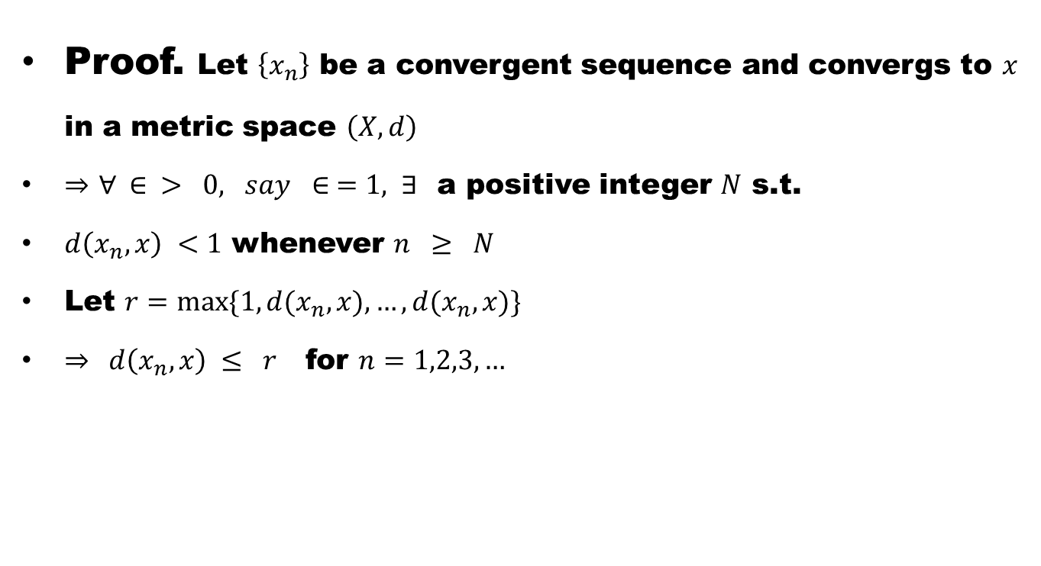
Theorem # 2: Prove that every convergent sequence in a metric space is bounded.
Proof. Let $\left\{x_{n}\right\}$ be a convergent sequence and convergs to $x$ in a metric space $\left(X,d\right)$
$⇒$ $∀ ∈ > 0, say ∈ =1, ∃$a positive integer $N$ s.t.
$d\left(x_{n},x\right) <1$ whenever $n ≥ N$
Let $r=max⁡\{1, d(x_{n},x), …, d(x_{n},x)\}$
$⇒$ $d\left(x_{n},x\right) ≤ r$ for $n=1,2,3, …$

Slide 33
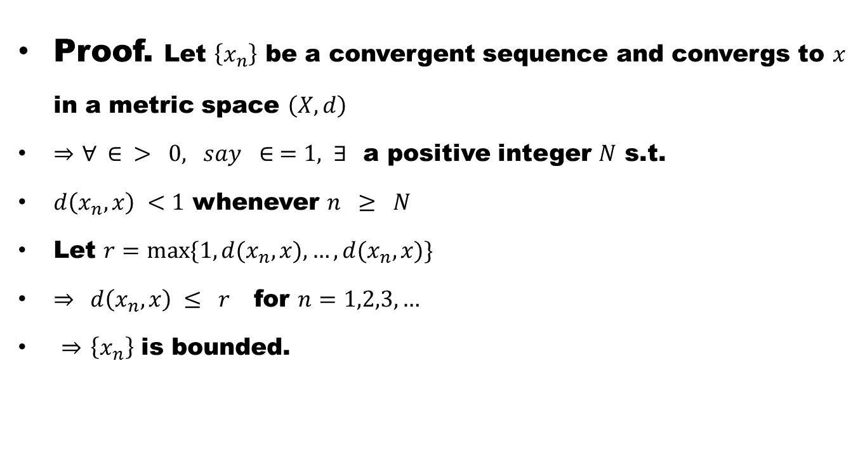
Theorem # 2: Prove that every convergent sequence in a metric space is bounded.
Proof. Let $\left\{x_{n}\right\}$ be a convergent sequence and convergs to $x$ in a metric space $\left(X,d\right)$
$⇒$ $∀ ∈ > 0, say ∈ =1, ∃$a positive integer $N$ s.t.
$d\left(x_{n},x\right) <1$ whenever $n ≥ N$
Let $r=max⁡\{1, d(x_{n},x), …, d(x_{n},x)\}$
$⇒$ $d\left(x_{n},x\right) ≤ r$ for $n=1,2,3, …$
$⇒$ $\left\{x_{n}\right\}$ is bounded.

Slide 34
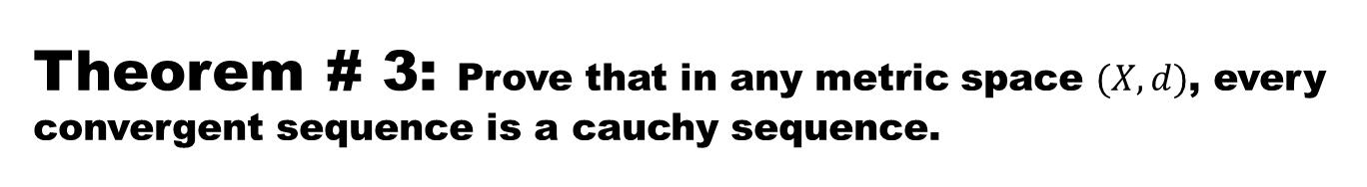
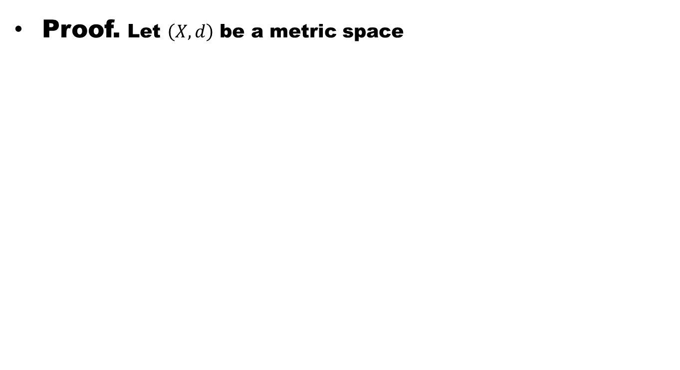
Theorem # 3: Prove that in any metric space $(X,d)$, every convergent sequence is a cauchy sequence.
Proof. Let $\left(X,d\right)$ be a metric space

Slide 35
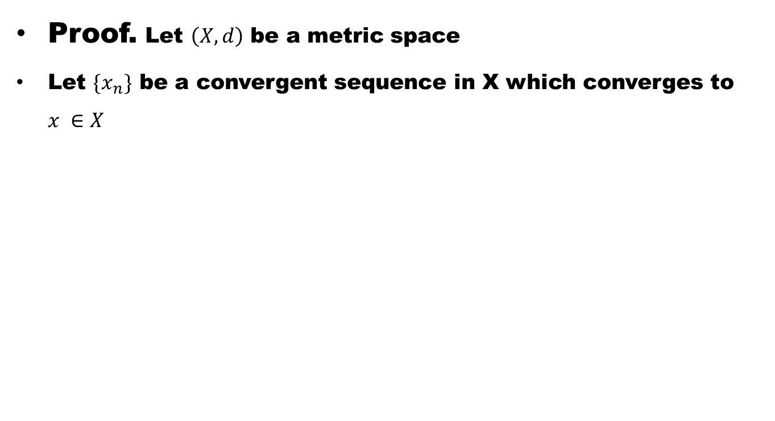
Theorem # 3: Prove that in any metric space $(X,d)$, every convergent sequence is a cauchy sequence.
Proof. Let $\left(X,d\right)$ be a metric space
Let $\{x_{n}\}$ be a convergent sequence in X which converges to $x ∈X$

Slide 36
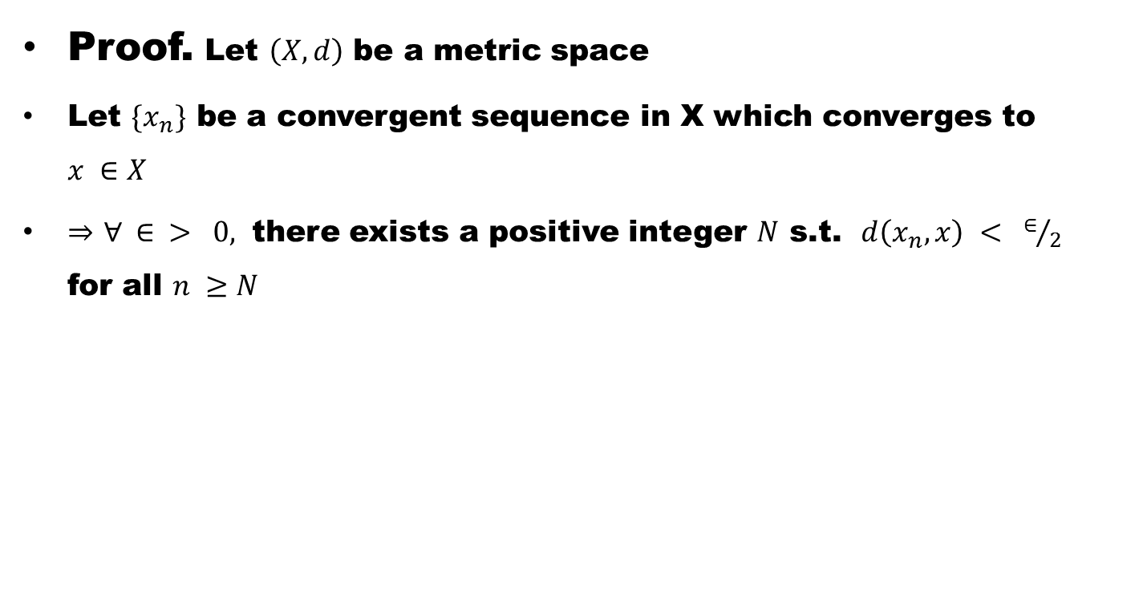
Theorem # 3: Prove that in any metric space $(X,d)$, every convergent sequence is a cauchy sequence.
Proof. Let $\left(X,d\right)$ be a metric space
Let $\{x_{n}\}$ be a convergent sequence in X which converges to $x ∈X$
$⇒$ $∀ ∈ > 0,$ there exists a positive integer $N$ s.t. $d\left(x_{n},x\right) < ∈/2$ for all $n ≥N$

Slide 37
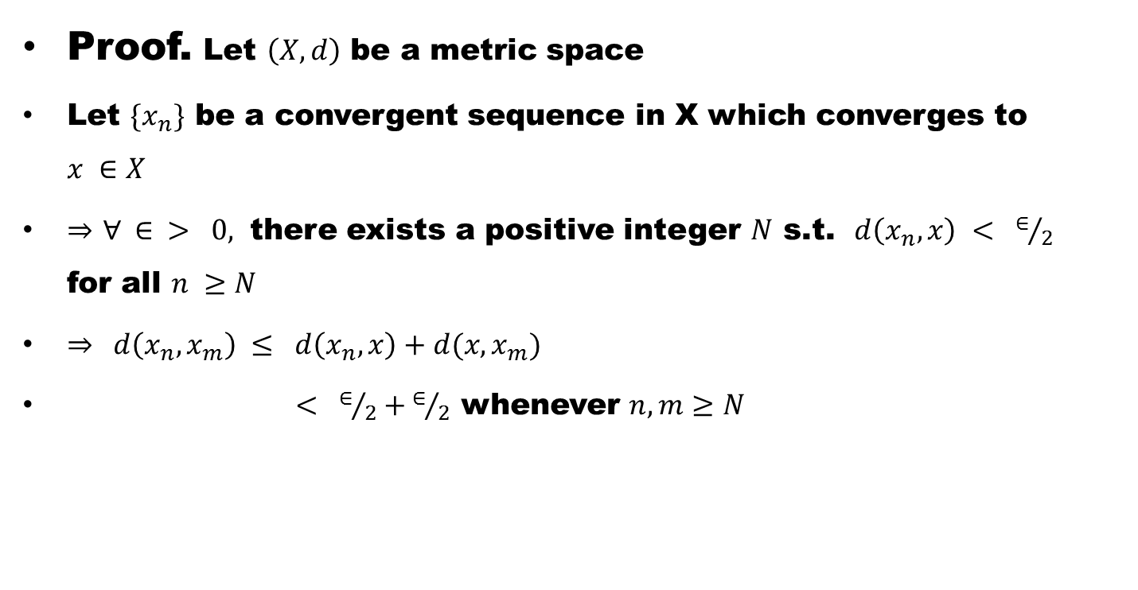
Theorem # 3: Prove that in any metric space $(X,d)$, every convergent sequence is a cauchy sequence.
Proof. Let $\left(X,d\right)$ be a metric space
Let $\{x_{n}\}$ be a convergent sequence in X which converges to $x ∈X$
$⇒$ $∀ ∈ > 0,$ there exists a positive integer $N$ s.t. $d\left(x_{n},x\right) < ∈/2$ for all $n ≥N$
$⇒$ $d\left(x_{n},x_{m}\right) ≤ d\left(x_{n},x\right)+d(x,x_{m})$
$< ∈/2+∈/2$ whenever $n,m≥N$

Slide 38
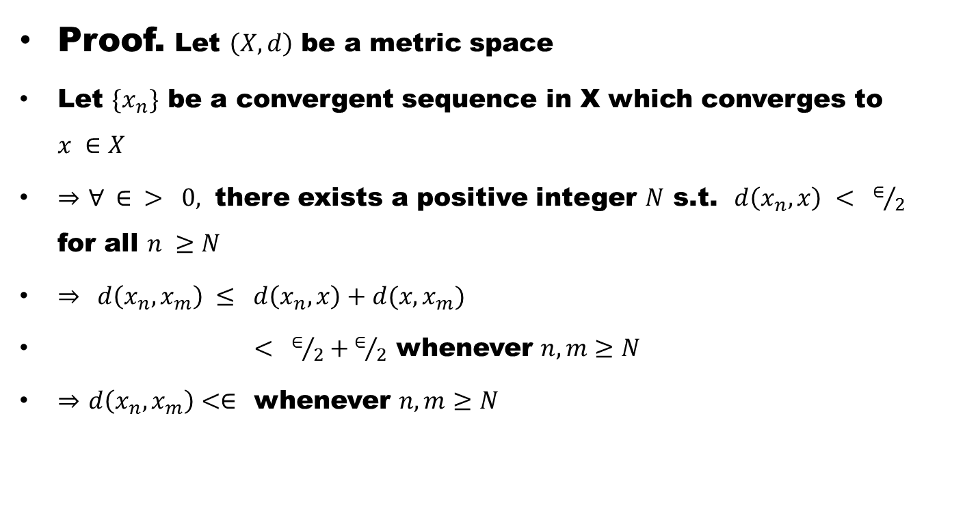
Theorem # 3: Prove that in any metric space $(X,d)$, every convergent sequence is a cauchy sequence.
Proof. Let $\left(X,d\right)$ be a metric space
Let $\{x_{n}\}$ be a convergent sequence in X which converges to $x ∈X$
$⇒$ $∀ ∈ > 0,$ there exists a positive integer $N$ s.t. $d\left(x_{n},x\right) < ∈/2$ for all $n ≥N$
$⇒$ $d\left(x_{n},x_{m}\right) ≤ d\left(x_{n},x\right)+d(x,x_{m})$
$< ∈/2+∈/2$ whenever $n,m≥N$
$⇒$ $d\left(x_{n},x_{m}\right)<∈$ whenever $n,m≥N$

Slide 39
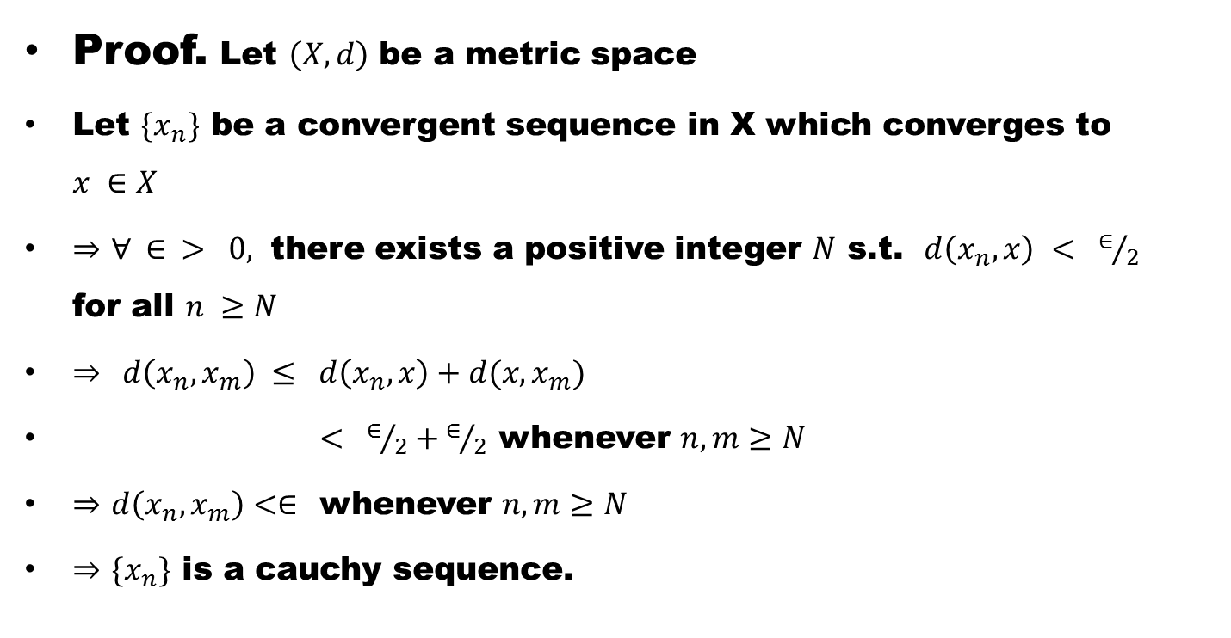
Theorem # 3: Prove that in any metric space $(X,d)$, every convergent sequence is a cauchy sequence.
Proof. Let $\left(X,d\right)$ be a metric space
Let $\{x_{n}\}$ be a convergent sequence in X which converges to $x ∈X$
$⇒$ $∀ ∈ > 0,$ there exists a positive integer $N$ s.t. $d\left(x_{n},x\right) < ∈/2$ for all $n ≥N$
$⇒$ $d\left(x_{n},x_{m}\right) ≤ d\left(x_{n},x\right)+d(x,x_{m})$
$< ∈/2+∈/2$ whenever $n,m≥N$
$⇒$ $d\left(x_{n},x_{m}\right)<∈$ whenever $n,m≥N$
$⇒$ $\{x_{n}\}$ is a cauchy sequence.

Slide 40
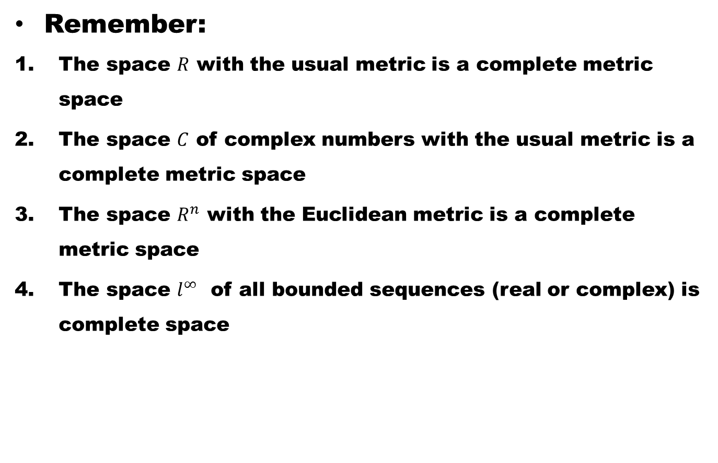
Remember:
The space $R$ with the usual metric is a complete metric space
The space $C$ of complex numbers with the usual metric is a complete metric space
The space $R^{n}$ with the Euclidean metric is a complete metric space
The space $l^{∞}$ of all bounded sequences (real or complex) is complete space

Slide 41
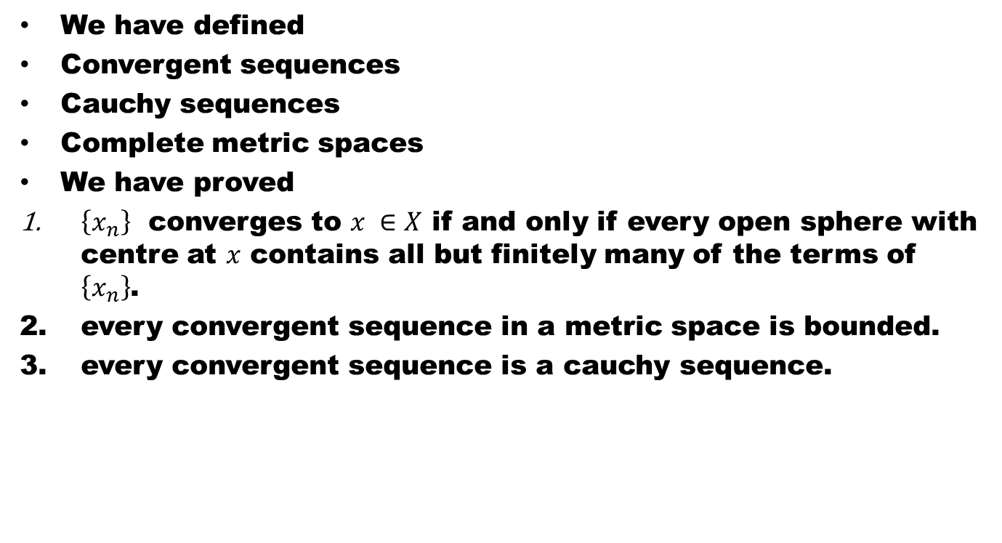
Summary of Lecture
We have defined
Convergent sequences
Cauchy sequences
Complete metric spaces
We have proved
$\left\{x_{n}\right\}$ converges to $x ∈X$ if and only if every open sphere with centre at $x$ contains all but finitely many of the terms of $\left\{x_{n}\right\}$.
every convergent sequence in a metric space is bounded.
every convergent sequence is a cauchy sequence.

Slide 42
Dear Students
Good Luck

