Slide 1
Set Topology
MTH 251
Lecture # 8

Slide 2
Lecture Outline
In this Lecture we will define
Limit point of a set.
Closed set
Discuss some examples related to limit points and closed sets
Closure of a point
Prove a theorem on closed sets

Slide 3
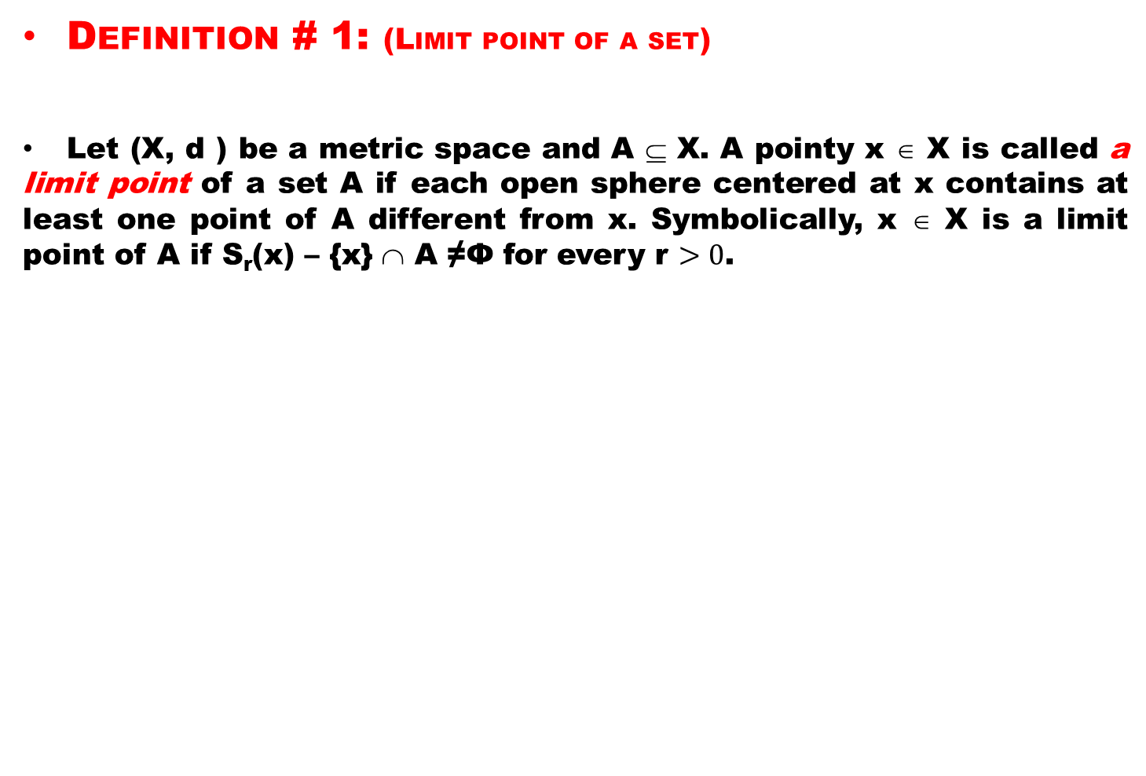
Definition # 1: (Limit point of a set)
Let (X, d ) be a metric space and A ⊆ X. A pointy x ∈ X is called a limit point of a set A if each open sphere centered at x contains at least one point of A different from x. Symbolically, x ∈ X is a limit point of A if S_{r}(x) – {x} ∩ A ≠Ф for every r $>0$.

Slide 4
Example # 1:
Let A = { 1, ½ , ¹/₃, . . . } ⊆ R. Then 0 is the only limit point of A.

Slide 5
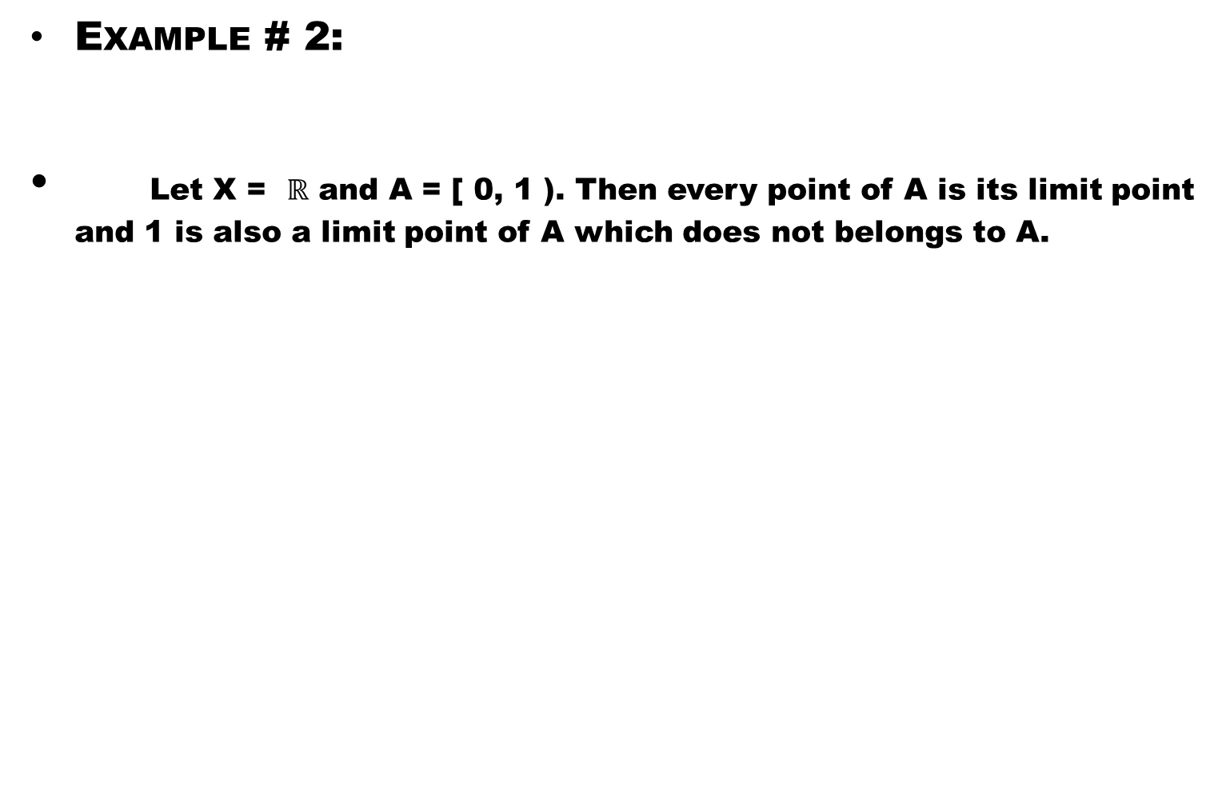
Example # 2:
Let X = $ℝ$ and A = [ 0, 1 ). Then every point of A is its limit point and 1 is also a limit point of A which does not belongs to A.

Slide 6
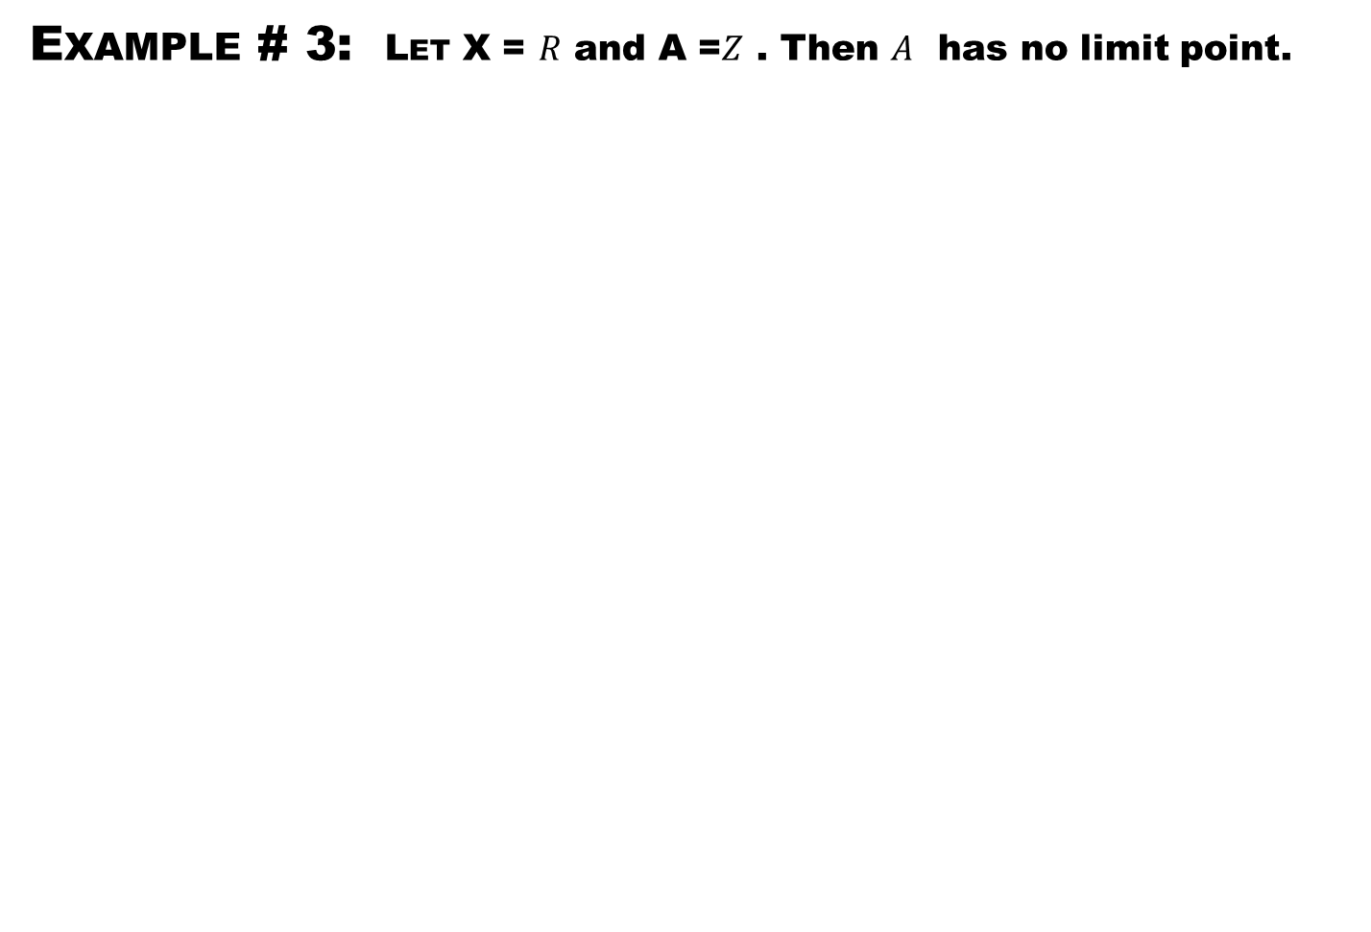
Example # 3: Let X = $R$and A =$Z$ . Then $A$ has no limit point.

Slide 7
Definition # 2:
A subset F of a metric space X is called a closed set if it contains each of its limit points.

Slide 8
EXAMPLE # 4:
X = R, F = [a, b] is a closed set and U = (a, b) is not closed. Where as [a, b) is neither open nor closed.

Slide 9
Example # 5:
The set F_{x} = {y ∈ X | d( x, y ) ≤ r } is a closed set called the closed sphere, denoted by S_{r} [x].

Slide 10
Theorem # 1:
Let X be a metric space. A subset F of X is closed if and only if its complement F′ = X – F is open.
Proof. We assume first that F is closed. We show that F′ is open.

Slide 11
Theorem # 1:
Let X be a metric space. A subset F of X is closed if and only if its complement F′ = X – F is open.
Proof. We assume first that F is closed. We show that F′ is open.
If F′ = φ , then it is open. We may assume that F′ is non-empty .

Slide 12
Theorem # 1:
Let X be a metric space. A subset F of X is closed if and only if its complement F′ = X – F is open.
Proof. We assume first that F is closed. We show that F′ is open.
If F′ = φ , then it is open. We may assume that F′ is non-empty .
Let x ∈ F′ . Since F is closed and x ∉ F

Slide 13
Theorem # 1:
Let X be a metric space. A subset F of X is closed if and only if its complement F′ = X – F is open.
Proof. We assume first that F is closed. We show that F′ is open.
If F′ = φ , then it is open. We may assume that F′ is non-empty .
Let x ∈ F′ . Since F is closed and x ∉ F
⇒ x is not a limit point of F (as F is closed)

Slide 14
Theorem # 1:
Let X be a metric space. A subset F of X is closed if and only if its complement F′ = X – F is open.
Proof. We assume first that F is closed. We show that F′ is open.
If F′ = φ , then it is open. We may assume that F′ is non-empty .
Let x ∈ F′ . Since F is closed and x ∉ F
⇒ x is not a limit point of F (as F is closed)
⇒ ∃ r > 0 such that S_{r}(x) ∩ F = φ

Slide 15
Theorem # 1:
Let X be a metric space. A subset F of X is closed if and only if its complement F′ = X – F is open.
Proof. We assume first that F is closed. We show that F′ is open.
If F′ = φ , then it is open. We may assume that F′ is non-empty .
Let x ∈ F′ . Since F is closed and x ∉ F
⇒ x is not a limit point of F (as F is closed)
⇒ ∃ r > 0 such that S_{r}(x) ∩ F = φ
⇒ S_{r}(x) ⊆ F′.

Slide 16
Theorem # 1:
Let X be a metric space. A subset F of X is closed if and only if its complement F′ = X – F is open.
Proof. We assume first that F is closed. We show that F′ is open.
If F′ = φ , then it is open. We may assume that F′ is non-empty .
Let x ∈ F′ . Since F is closed and x ∉ F
⇒ x is not a limit point of F (as F is closed)
⇒ ∃ r > 0 such that S_{r}(x) ∩ F = φ
⇒ S_{r}(x) ⊆ F′.
Since x is arbitrary point. Therefore F′ is open.

Slide 17
Theorem # 1:
Let X be a metric space. A subset F of X is closed if and only if its complement F′ = X – F is open.
Proof. We assume first that F is closed. We show that F′ is open.
If F′ = φ , then it is open. We may assume that F′ is non-empty .
Let x ∈ F′ . Since F is closed and x ∉ F
⇒ x is not a limit point of F (as F is closed)
⇒ ∃ r > 0 such that S_{r}(x) ∩ F = φ
⇒ S_{r}(x) ⊆ F′.
Since x is arbitrary point. Therefore F′ is open.
Now assume that F′ is open. We show that F is closed.

Slide 18
Theorem # 1:
Let X be a metric space. A subset F of X is closed if and only if its complement F′ = X – F is open.
Proof. We assume first that F is closed. We show that F′ is open.
If F′ = φ , then it is open. We may assume that F′ is non-empty .
Let x ∈ F′ . Since F is closed and x ∉ F
⇒ x is not a limit point of F (as F is closed)
⇒ ∃ r > 0 such that S_{r}(x) ∩ F = φ
⇒ S_{r}(x) ⊆ F′.
Since x is arbitrary point. Therefore F′ is open.
Now assume that F′ is open. We show that F is closed.
For this, we show that every limit point of F is in F

Slide 19
Theorem # 1:
Let X be a metric space. A subset F of X is closed if and only if its complement F′ = X – F is open.
Proof. We assume first that F is closed. We show that F′ is open.
If F′ = φ , then it is open. We may assume that F′ is non-empty .
Let x ∈ F′ . Since F is closed and x ∉ F
⇒ x is not a limit point of F (as F is closed)
⇒ ∃ r > 0 such that S_{r}(x) ∩ F = φ
⇒ S_{r}(x) ⊆ F′.
Since x is arbitrary point. Therefore F′ is open.
Now assume that F′ is open. We show that F is closed.
For this, we show that every limit point of F is in F
Let x be a limit point of F.

Slide 20
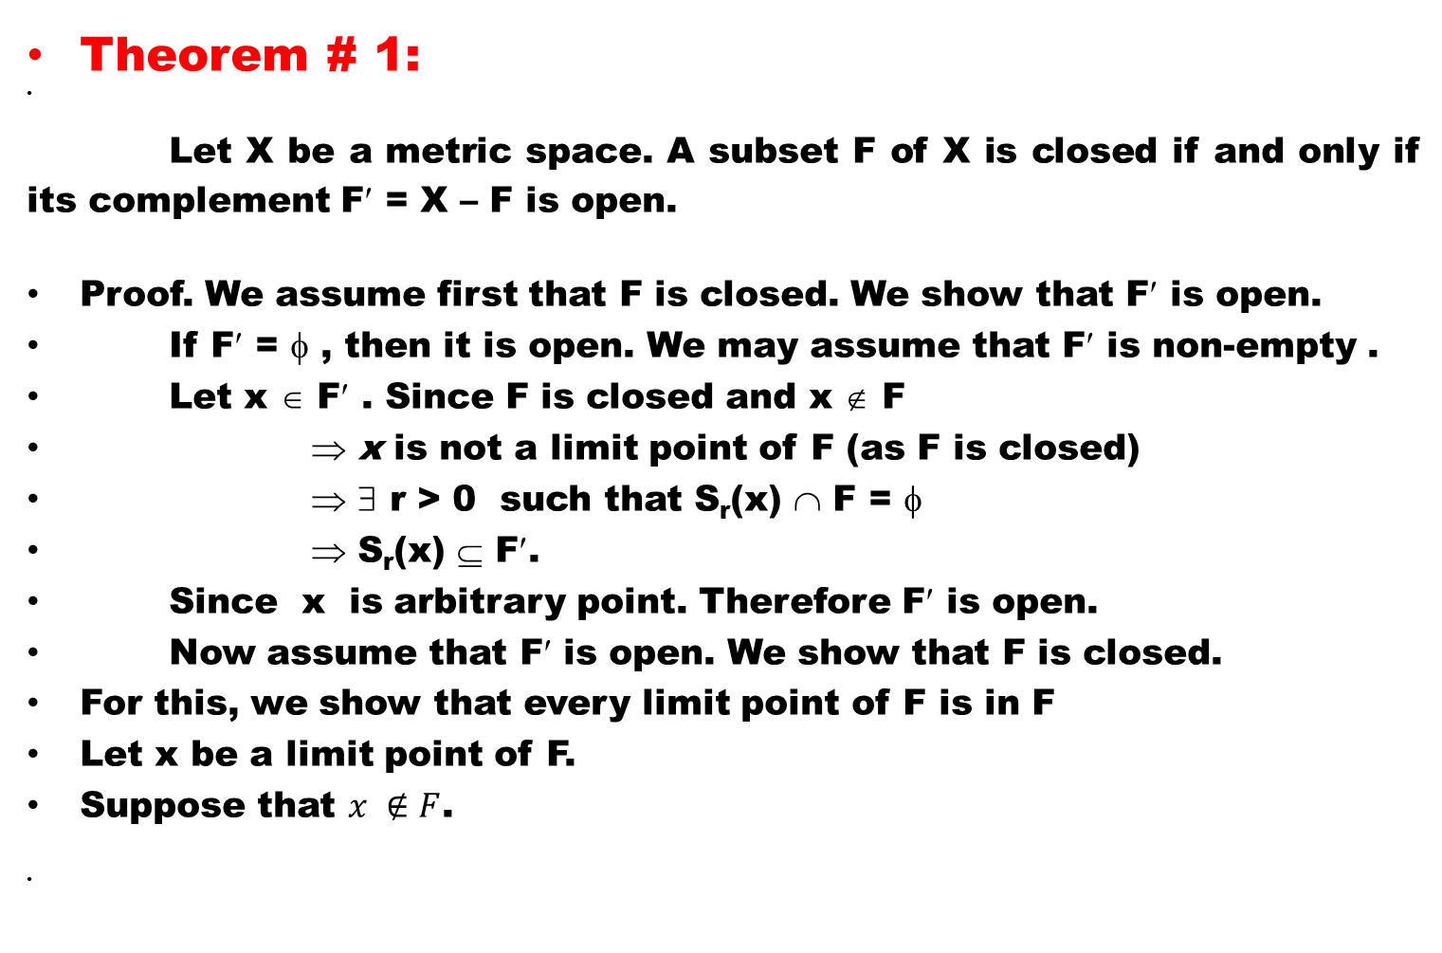
Theorem # 1:
Let X be a metric space. A subset F of X is closed if and only if its complement F′ = X – F is open.
Proof. We assume first that F is closed. We show that F′ is open.
If F′ = φ , then it is open. We may assume that F′ is non-empty .
Let x ∈ F′ . Since F is closed and x ∉ F
⇒x is not a limit point of F (as F is closed)
⇒∃ r > 0 such that S_{r}(x) ∩ F = φ
⇒ S_{r}(x) ⊆ F′.
Since x is arbitrary point. Therefore F′ is open.
Now assume that F′ is open. We show that F is closed.
For this, we show that every limit point of F is in F
Let x be a limit point of F.
Suppose that $x ∉F$.

Slide 21

Theorem # 1:
Let X be a metric space. A subset F of X is closed if and only if its complement F′ = X – F is open.
Proof. We assume first that F is closed. We show that F′ is open.
If F′ = φ , then it is open. We may assume that F′ is non-empty .
Let x ∈ F′ . Since F is closed and x ∉ F
⇒x is not a limit point of F (as F is closed)
⇒∃ r > 0 such that S_{r}(x) ∩ F = φ
⇒ S_{r}(x) ⊆ F′.
Since x is arbitrary point. Therefore F′ is open.
Now assume that F′ is open. We show that F is closed.
For this, we show that every limit point of F is in F
Let x be a limit point of F.
Suppose that $x ∉F$.
Then $x∈F^{′}$

Slide 22
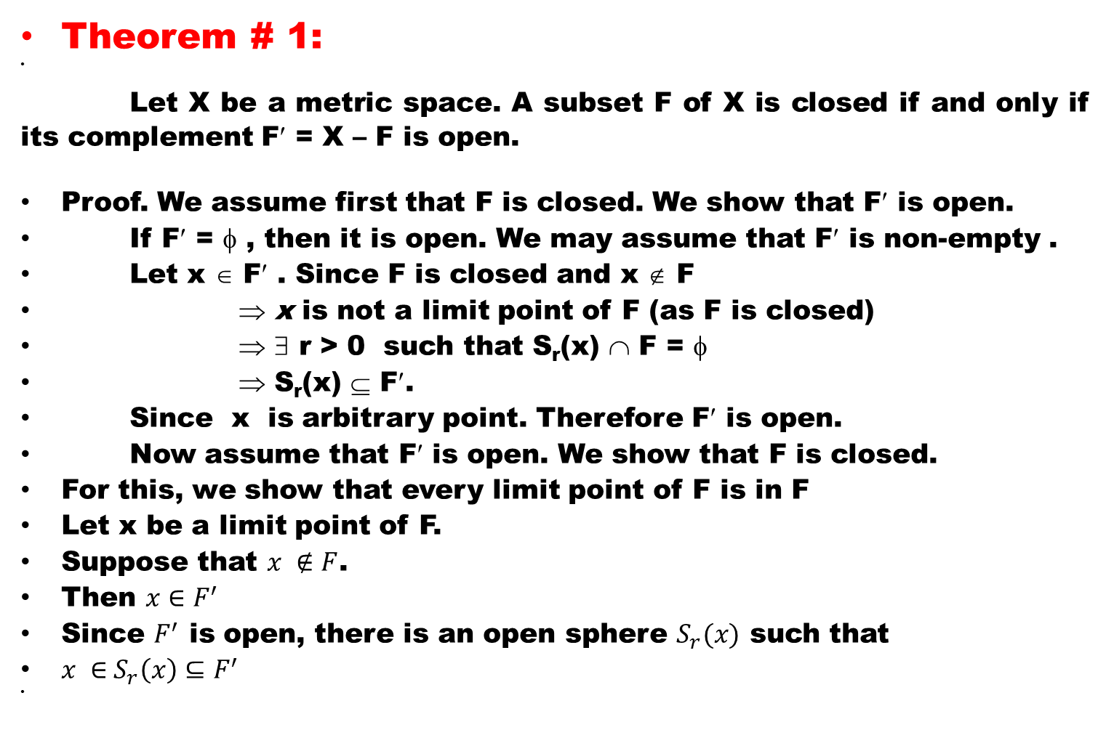
Theorem # 1:
Let X be a metric space. A subset F of X is closed if and only if its complement F′ = X – F is open.
Proof. We assume first that F is closed. We show that F′ is open.
If F′ = φ , then it is open. We may assume that F′ is non-empty .
Let x ∈ F′ . Since F is closed and x ∉ F
⇒x is not a limit point of F (as F is closed)
⇒∃ r > 0 such that S_{r}(x) ∩ F = φ
⇒ S_{r}(x) ⊆ F′.
Since x is arbitrary point. Therefore F′ is open.
Now assume that F′ is open. We show that F is closed.
For this, we show that every limit point of F is in F
Let x be a limit point of F.
Suppose that $x ∉F$.
Then $x∈F^{′}$
Since $F^{′}$ is open, there is an open sphere $S_{r}(x)$ such that
$x ∈$$S_{r}\left(x\right)⊆F^{′}$

Slide 23
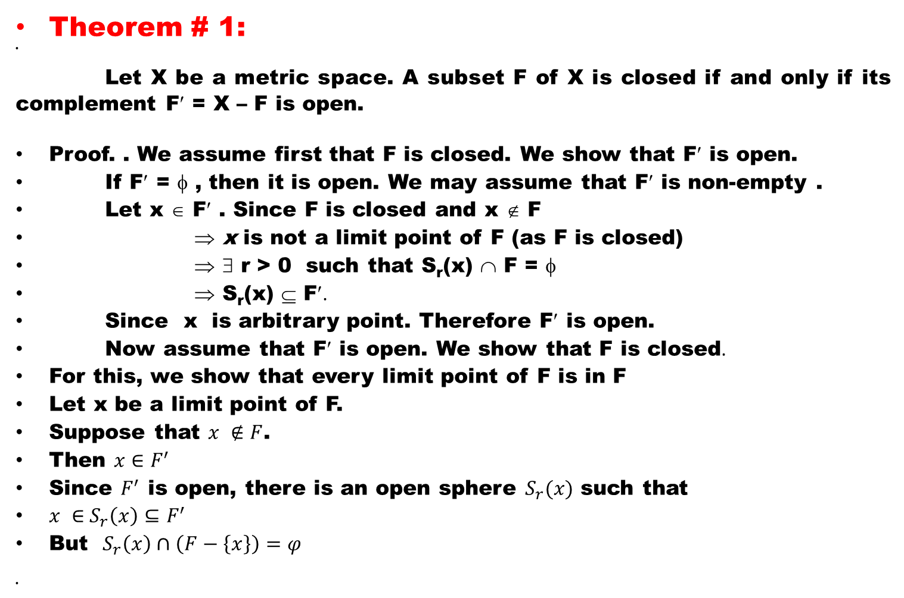
Theorem # 1:
Let X be a metric space. A subset F of X is closed if and only if its complement F′ = X – F is open.
Proof. . We assume first that F is closed. We show that F′ is open.
If F′ = φ , then it is open. We may assume that F′ is non-empty .
Let x ∈ F′ . Since F is closed and x ∉ F
⇒x is not a limit point of F (as F is closed)
⇒∃ r > 0 such that S_{r}(x) ∩ F = φ
⇒ S_{r}(x) ⊆ F′.
Since x is arbitrary point. Therefore F′ is open.
Now assume that F′ is open. We show that F is closed.
For this, we show that every limit point of F is in F
Let x be a limit point of F.
Suppose that $x ∉F$.
Then $x∈F^{′}$
Since $F^{′}$ is open, there is an open sphere $S_{r}(x)$ such that
$x ∈$$S_{r}\left(x\right)⊆F^{′}$
But $S_{r}\left(x\right)∩\left(F−\left\{x\right\}\right)=φ$

Slide 24
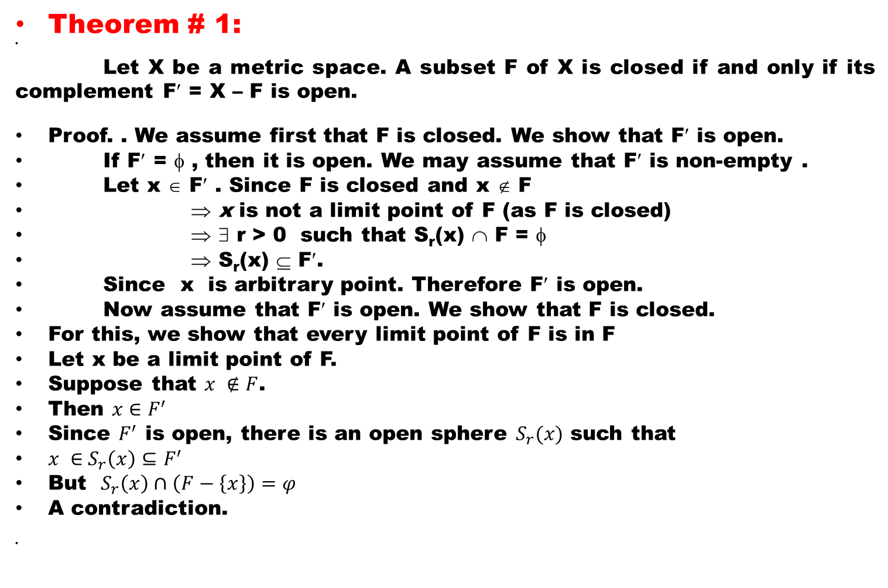
Theorem # 1:
Let X be a metric space. A subset F of X is closed if and only if its complement F′ = X – F is open.
Proof. . We assume first that F is closed. We show that F′ is open.
If F′ = φ , then it is open. We may assume that F′ is non-empty .
Let x ∈ F′ . Since F is closed and x ∉ F
⇒x is not a limit point of F (as F is closed)
⇒∃ r > 0 such that S_{r}(x) ∩ F = φ
⇒ S_{r}(x) ⊆ F′.
Since x is arbitrary point. Therefore F′ is open.
Now assume that F′ is open. We show that F is closed.
For this, we show that every limit point of F is in F
Let x be a limit point of F.
Suppose that $x ∉F$.
Then $x∈F^{′}$
Since $F^{′}$ is open, there is an open sphere $S_{r}(x)$ such that
$x ∈$$S_{r}\left(x\right)⊆F^{′}$
But $S_{r}\left(x\right)∩\left(F−\left\{x\right\}\right)=φ$
A contradiction.

Slide 25

Theorem # 1:
Proof. We assume first that F is closed. We show that F′ is open.
If F′ = φ , then it is open. We may assume that F′ is non-empty .
Let x ∈ F′ . Since F is closed and x ∉ F
⇒x is not a limit point of F (as F is closed)
⇒∃ r > 0 such that S_{r}(x) ∩ F = φ
⇒ S_{r}(x) ⊆ F′.
Since x is arbitrary point. Therefore F′ is open.
Now assume that F′ is open. We show that F is closed.
For this, we show that every limit point of F is in F
Let x be a limit point of F.
Suppose that $x ∉F$.
Then $x∈F^{′}$
Since $F^{′}$ is open, there is an open sphere $S_{r}(x)$ such that
$x ∈$$S_{r}\left(x\right)⊆F^{′}$
But $S_{r}\left(x\right)∩\left(F−\left\{x\right\}\right)=φ$
A contradiction.
Hence $x∈F$

Slide 26

Theorem # 1:
Proof. We assume first that F is closed. We show that F′ is open.
If F′ = φ , then it is open. We may assume that F′ is non-empty .
Let x ∈ F′ . Since F is closed and x ∉ F
⇒x is not a limit point of F (as F is closed)
⇒∃ r > 0 such that S_{r}(x) ∩ F = φ
⇒ S_{r}(x) ⊆ F′.
Since x is arbitrary point. Therefore F′ is open.
Now assume that F′ is open. We show that F is closed.
For this, we show that every limit point of F is in F
Let x be a limit point of F.
Suppose that $x ∉F$.
Then $x∈F^{′}$
Since $F^{′}$ is open, there is an open sphere $S_{r}(x)$ such that
$x ∈$$S_{r}\left(x\right)⊆F^{′}$
But $S_{r}\left(x\right)∩\left(F−\left\{x\right\}\right)=φ$
A contradiction.
Hence $x∈F$
Thus F contains all its limit points.
Therefore F is closed.

Slide 27
Definition # 3:
Let A be a subset of a metric space (X, d). Then we define closure of A ( denoted by‾A or Cl(A) ) as the union of A and all limit points of A. Mathematically,
‾A = A ∪ A^{d} ,
where A^{d} denotes set of limit points of A.

Slide 28
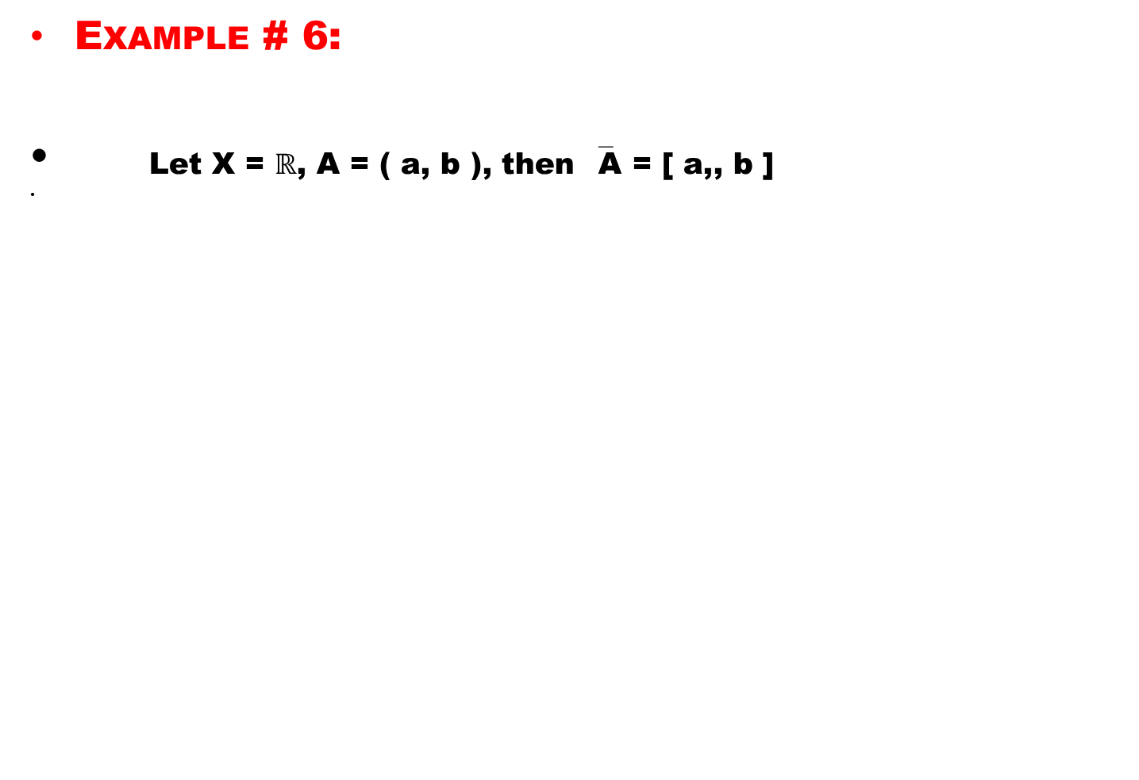
Example # 6:
Let X = $ℝ$, A = ( a, b ), then ‾A = [ a,, b ]

Slide 29
Example # 7:
Let X = R², A = { z ∈ R² | | z | < 1 }, then
‾A = { z ∈ R² | | z | ≤ 1 }.

Slide 30
Theorem # 6:
a). A is closed if and only if‾A = A ;
b). ‾A is the smallest closed superset of A;
c). ‾A equals the intersection of all closed supersets of A.

Slide 31
Lecture Summery
In this Lecture we have discussed
Limit point of a set.
We have defined Closed set
Discussed some examples related to limit points and closed sets
We have defined Closure of a set
Proved that:
A subset F of X is closed if and only if its complement F′ = X – F is open.

Slide 32
Good Luck

