Slide 1
Set Topology
MTH 251
Lecture # 7

Slide 2
Lecture Outline
Arbitrary union and finite Intersection of open sets.
Interior point of a set.
Interior of a set.
Neighbourhood of a point of a set.
Theorems on open sets in metric space

Slide 3
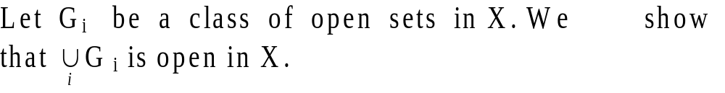
Theorem # 1: Let (X, d) be a metric space, then
Union of any ( arbitrary ) number of open sets is open.
Proof.

Slide 4
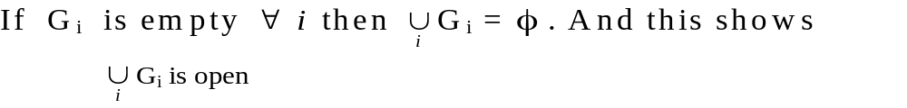
Theorem # 1: Let (X, d) be a metric space, then
Union of any ( arbitrary ) number of open sets is open.
Proof.

Slide 5

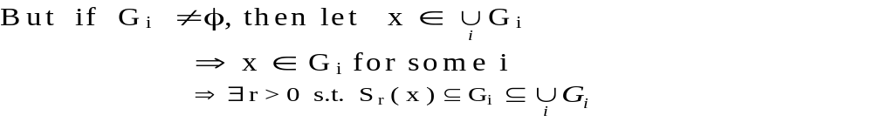
Theorem # 1: Let (X, d) be a metric space, then
Union of any ( arbitrary ) number of open sets is open.
Proof.

Slide 6
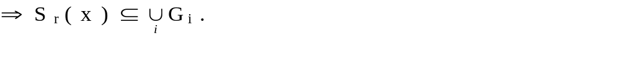
Theorem # 1: Let (X, d) be a metric space, then
Union of any ( arbitrary ) number of open sets is open.
Proof.

Slide 7
Theorem # 1: Let (X, d) be a metric space, then
Union of any ( arbitrary ) number of open sets is open.
Proof.

Slide 8
Theorem # 2: Let (X, d) be a metric space, then Intersection of finite number of open sets is open.
Proof.

Slide 9
Theorem # 2: Let (X, d) be a metric space, then Intersection of finite number of open sets is open.
Proof.

Slide 10
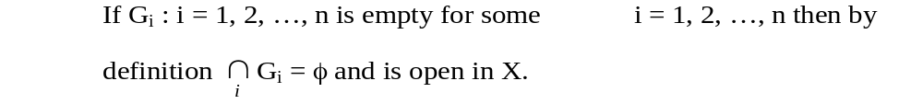
Theorem # 2: Let (X, d) be a metric space, then Intersection of finite number of open sets is open.
Proof.

Slide 11
Theorem # 2: Let (X, d) be a metric space, then Intersection of finite number of open sets is open.
Proof.

Slide 12
Theorem # 2: Let (X, d) be a metric space, then Intersection of finite number of open sets is open.
Proof.

Slide 14
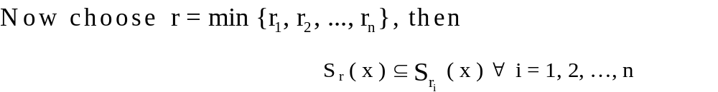

Slide 15
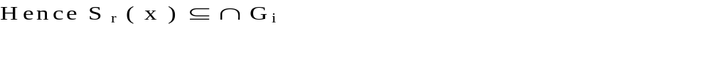

Slide 16
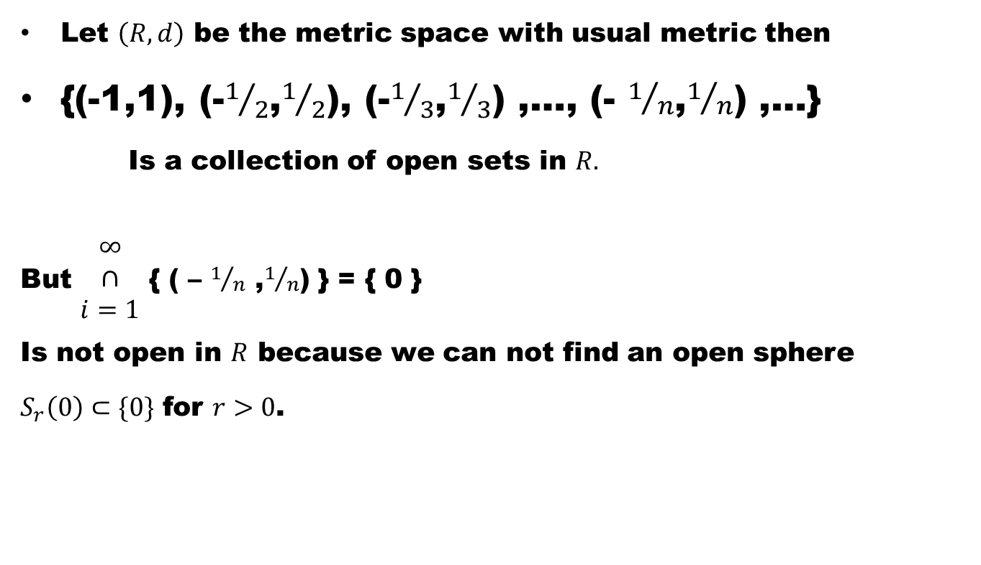
Example # 3: In general, intersection of arbitrary number of open sets is not necessarily open. It is clear from the following
Let $\left(R,d\right)$ be the metric space with usual metric then
{(-1,1), (-$1/2$,$1/2$), (-$1/3$,$1/3$) ,…, (- $1/n$,$1/n$) ,…}
Is a collection of open sets in $R.$
But $\begin{matrix}∞ \\ ∩ \\ i=1\end{matrix}$ { ( – $1/n$ ,$1/n$) } = { 0 }
Is not open in $R$ because we can not find an open sphere
$S_{r}\left(0\right)⊂\{0\}$ for $r>0$.

Slide 17
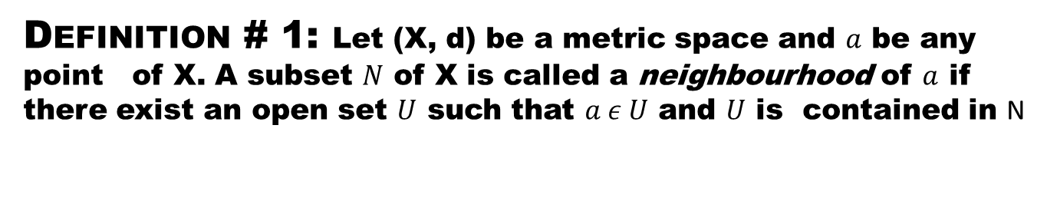
Definition # 1: Let (X, d) be a metric space and $a$be any point of X. A subset $N$of X is called a neighbourhood of $a$if there exist an open set $U$such that $a ε U$ and $U$is contained in N
Explanation.

Slide 18
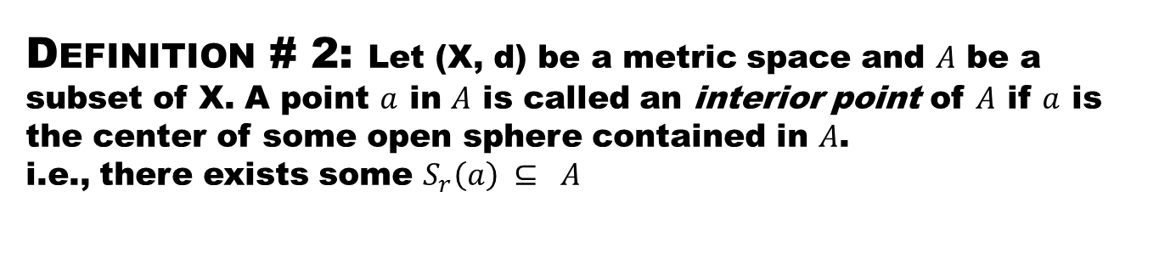
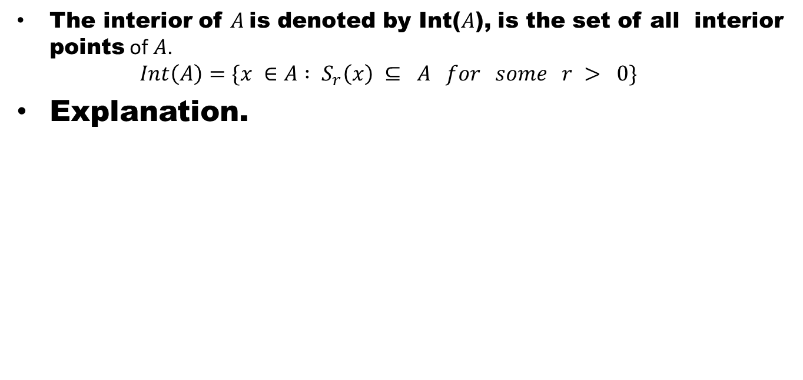
Definition # 2: Let (X, d) be a metric space and $A$be a subset of X. A point $a$in $A$is called an interior point of $A$if $a$is the center of some open sphere contained in $A$. i.e., there exists some $S_{r}\left(a\right) ⊆ A$
The interior of $A$is denoted by Int($A$), is the set of all interior points of $A$.
$Int\left(A\right)=\{x ∈A : S_{r}\left(x\right) ⊆ A for some r > 0\}$
Explanation.

Slide 19
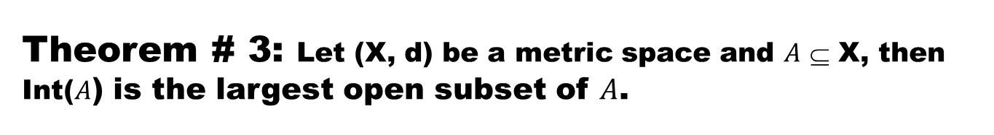
Theorem # 3: Let (X, d) be a metric space and $A$⊆ X, thenInt($A$) is the largest open subset of $A$.
Proof

Slide 20
Theorem # 3: Let (X, d) be a metric space and $A$⊆ X, thenInt($A$) is the largest open subset of $A$.
Proof. Since,
Int(A)={x| x∈A and S_{r} (x) ⊆ A for some r > 0 }.

Slide 21
Theorem # 3: Let (X, d) be a metric space and $A$⊆ X, thenInt($A$) is the largest open subset of $A$.
Proof. Since,
Int(A)={x| x∈A and S_{r} (x) ⊆ A for some r > 0 }.
To prove that Int (A) is open,

Slide 22
Theorem # 3: Let (X, d) be a metric space and $A$⊆ X, thenInt($A$) is the largest open subset of $A$.
Proof. Since,
Int(A)={x| x∈A and S_{r} (x) ⊆ A for some r > 0 }.
To prove that Int (A) is open,
let y ∈ Int (A)

Slide 23
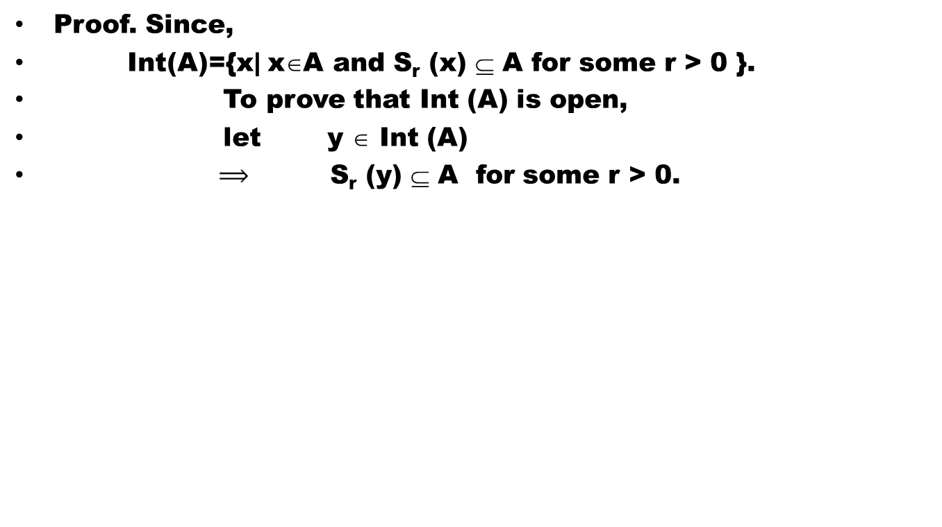
Theorem # 3: Let (X, d) be a metric space and $A$⊆ X, thenInt($A$) is the largest open subset of $A$.
Proof. Since,
Int(A)={x| x∈A and S_{r} (x) ⊆ A for some r > 0 }.
To prove that Int (A) is open,
let y ∈Int (A)
$⟹$S_{r}(y) ⊆ A for some r > 0.

Slide 24
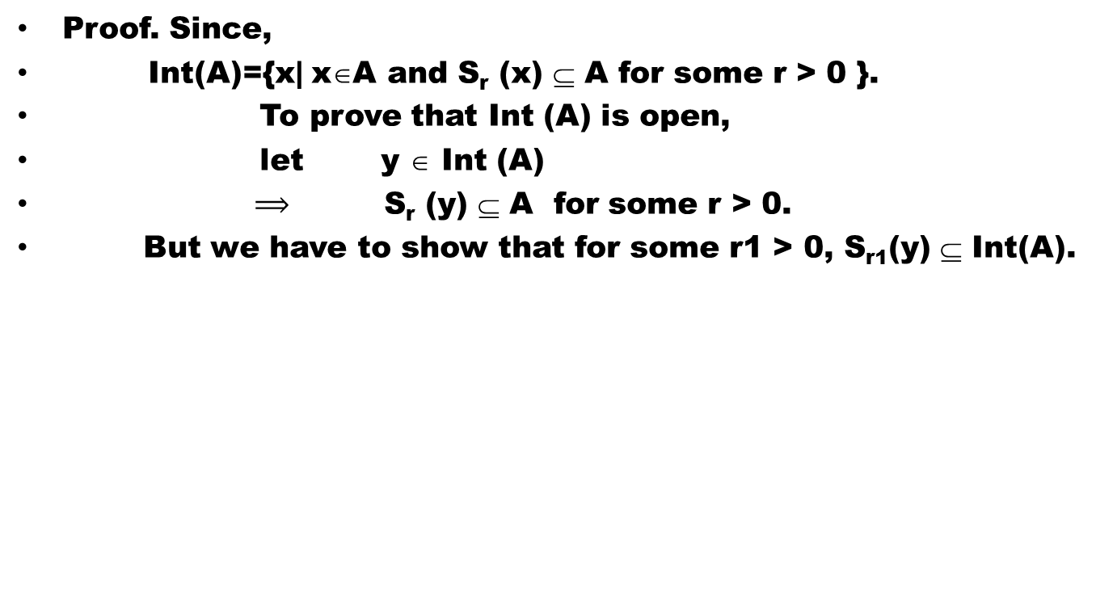
Theorem # 3: Let (X, d) be a metric space and $A$⊆ X, thenInt($A$) is the largest open subset of $A$.
Proof. Since,
Int(A)={x| x∈A and S_{r} (x) ⊆ A for some r > 0 }.
To prove that Int (A) is open,
let y ∈Int (A)
$⟹$S_{r}(y) ⊆ A for some r > 0.
But we have to show that for some r1 >0, S_{r1}(y) ⊆Int(A).

Slide 25
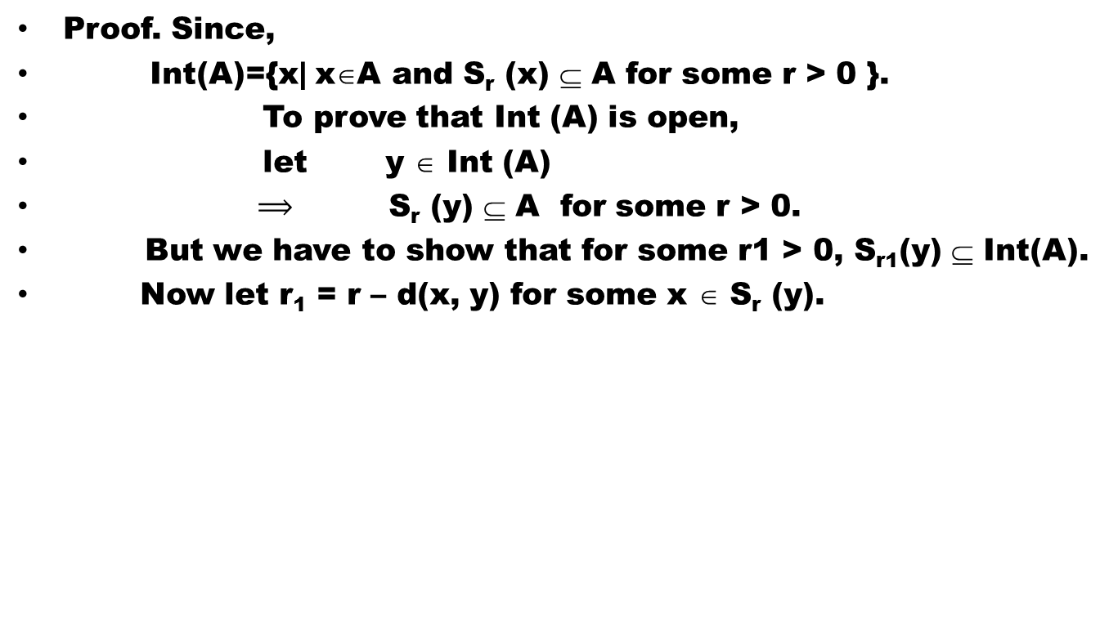
Theorem # 3: Let (X, d) be a metric space and $A$⊆ X, thenInt($A$) is the largest open subset of $A$.
Proof. Since,
Int(A)={x| x∈A and S_{r} (x) ⊆ A for some r > 0 }.
To prove that Int (A) is open,
let y ∈Int (A)
$⟹$S_{r}(y) ⊆ A for some r > 0.
But we have to show that for some r1 >0, S_{r1}(y) ⊆Int(A).
Now let r₁ = r – d(x, y) for some x ∈ S_{r} (y).

Slide 26
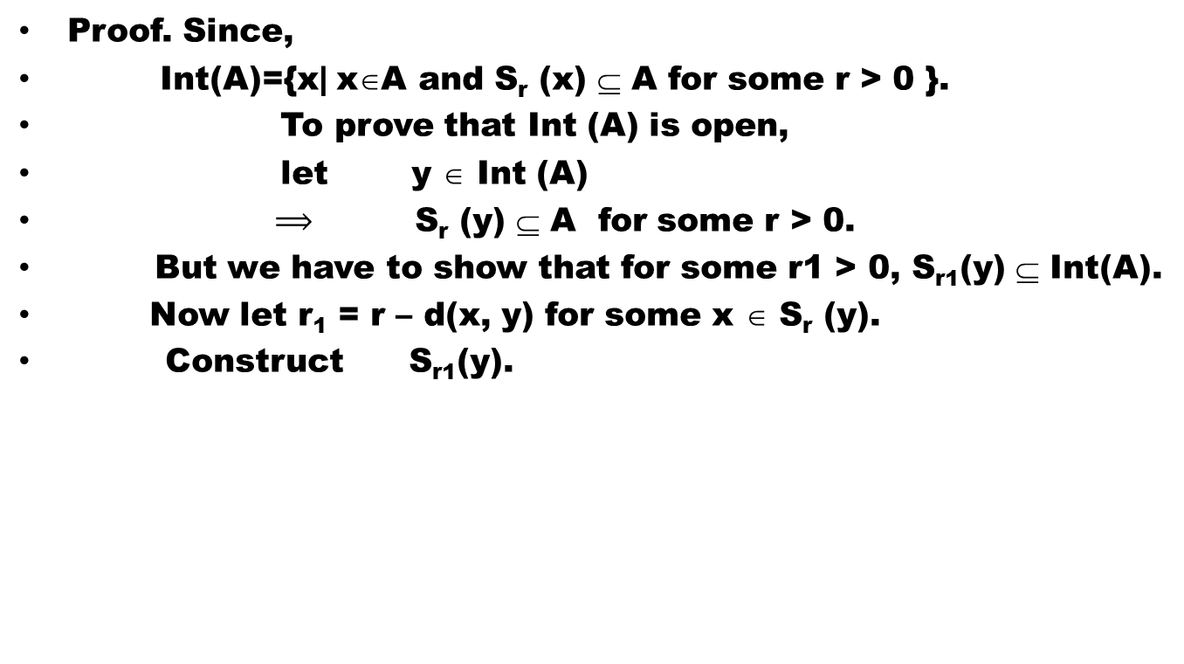
Theorem # 3: Let (X, d) be a metric space and $A$⊆ X, thenInt($A$) is the largest open subset of $A$.
Proof. Since,
Int(A)={x| x∈A and S_{r} (x) ⊆ A for some r > 0 }.
To prove that Int (A) is open,
let y ∈Int (A)
$⟹$S_{r}(y) ⊆ A for some r > 0.
But we have to show that for some r1 >0, S_{r1}(y) ⊆Int(A).
Now let r₁ = r – d(x, y) for some x ∈ S_{r} (y).
Construct S_{r1}(y).

Slide 27
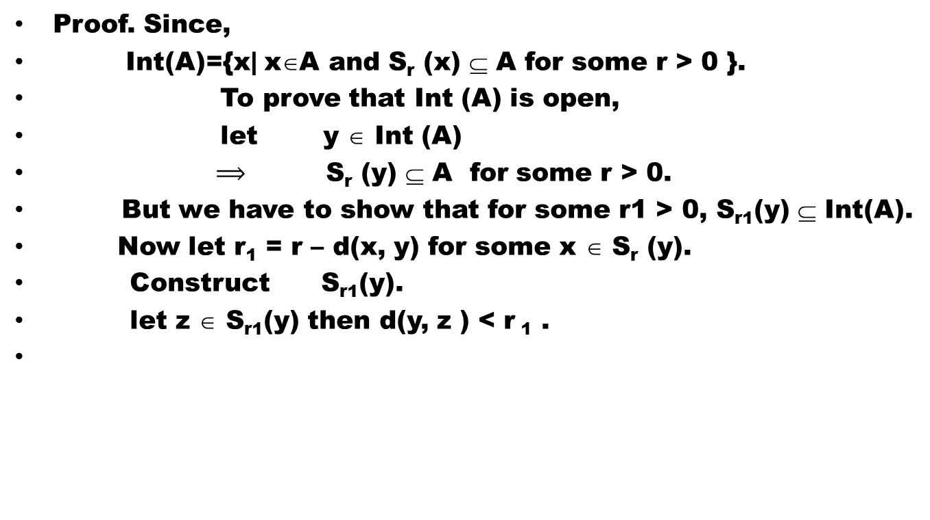
Theorem # 3: Let (X, d) be a metric space and $A$⊆ X, thenInt($A$) is the largest open subset of $A$.
Proof. Since,
Int(A)={x| x∈A and S_{r} (x) ⊆ A for some r > 0 }.
To prove that Int (A) is open,
let y ∈Int (A)
$⟹$S_{r}(y) ⊆ A for some r > 0.
But we have to show that for some r1 >0, S_{r1}(y) ⊆Int(A).
Now let r₁ = r – d(x, y) for some x ∈ S_{r} (y).
Construct S_{r1}(y).
let z ∈S_{r1}(y) then d(y, z ) < r ₁ .

Slide 28
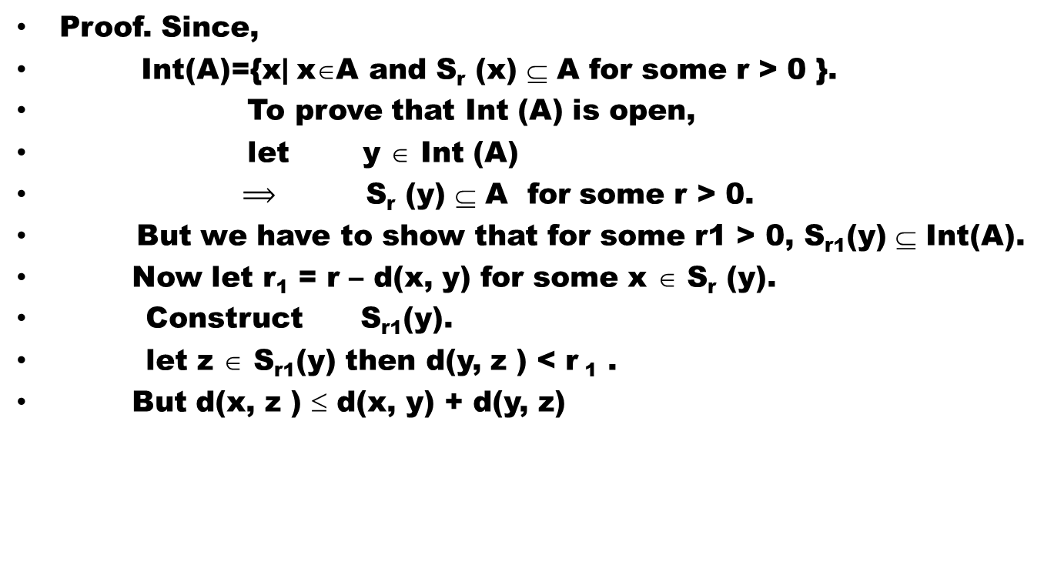
Theorem # 3: Let (X, d) be a metric space and $A$⊆ X, thenInt($A$) is the largest open subset of $A$.
Proof. Since,
Int(A)={x| x∈A and S_{r} (x) ⊆ A for some r > 0 }.
To prove that Int (A) is open,
let y ∈Int (A)
$⟹$S_{r}(y) ⊆ A for some r > 0.
But we have to show that for some r1 >0, S_{r1}(y) ⊆Int(A).
Now let r₁ = r – d(x, y) for some x ∈ S_{r} (y).
Construct S_{r1}(y).
let z ∈S_{r1}(y) then d(y, z ) < r ₁ .
But d(x, z ) ≤ d(x, y) + d(y, z)

Slide 29
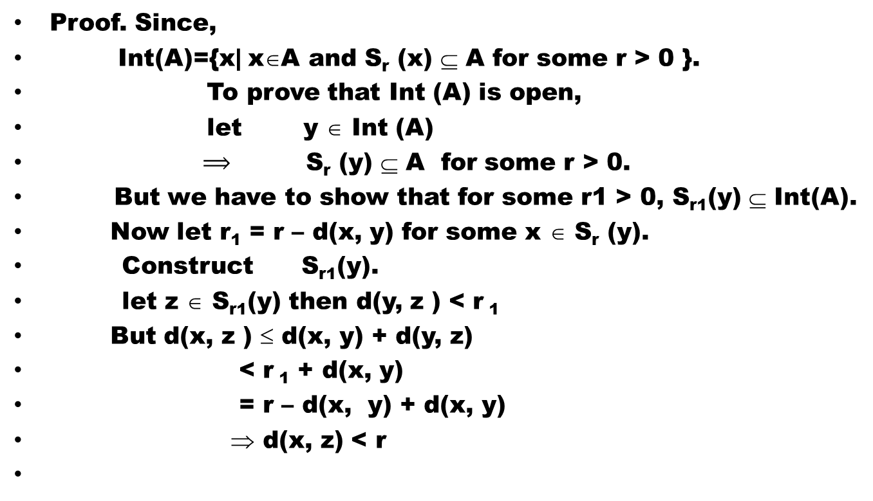
Theorem # 3: Let (X, d) be a metric space and $A$⊆ X, thenInt($A$) is the largest open subset of $A$.
Proof. Since,
Int(A)={x| x∈A and S_{r} (x) ⊆ A for some r > 0 }.
To prove that Int (A) is open,
let y ∈Int (A)
$⟹$S_{r}(y) ⊆ A for some r > 0.
But we have to show that for some r1 >0, S_{r1}(y) ⊆Int(A).
Now let r₁ = r – d(x, y) for some x ∈ S_{r} (y).
Construct S_{r1}(y).
let z ∈S_{r1}(y) then d(y, z ) < r ₁
But d(x, z ) ≤ d(x, y) + d(y, z)
<r ₁ + d(x, y)
= r – d(x, y) + d(x, y)
⇒d(x, z) < r

Slide 30
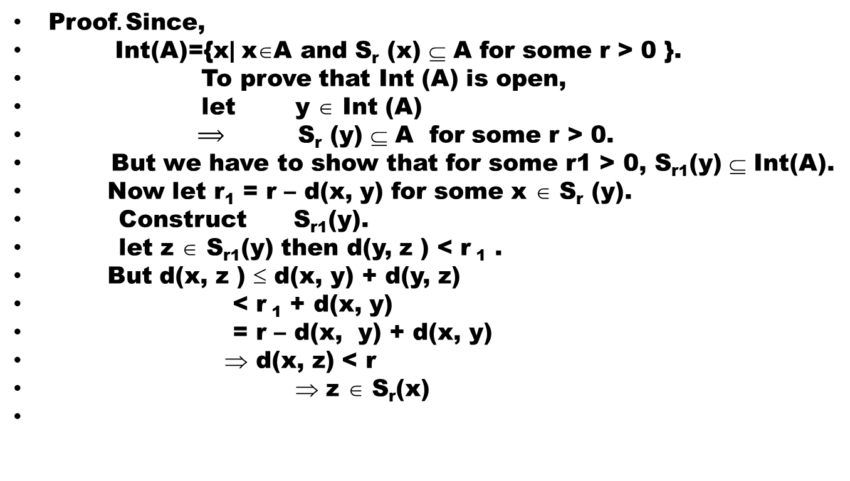
Theorem # 3: Let (X, d) be a metric space and $A$⊆ X, thenInt($A$) is the largest open subset of $A$.
Proof. Since,
Int(A)={x| x∈A and S_{r} (x) ⊆ A for some r > 0 }.
To prove that Int (A) is open,
let y ∈Int (A)
$⟹$S_{r}(y) ⊆ A for some r > 0.
But we have to show that for some r1 >0, S_{r1}(y) ⊆Int(A).
Now let r₁ = r – d(x, y) for some x ∈ S_{r} (y).
Construct S_{r1}(y).
let z ∈S_{r1}(y) then d(y, z ) < r ₁ .
But d(x, z ) ≤ d(x, y) + d(y, z)
<r ₁ + d(x, y)
= r – d(x, y) + d(x, y)
⇒d(x, z) < r
⇒z ∈ S_{r}(x)

Slide 31
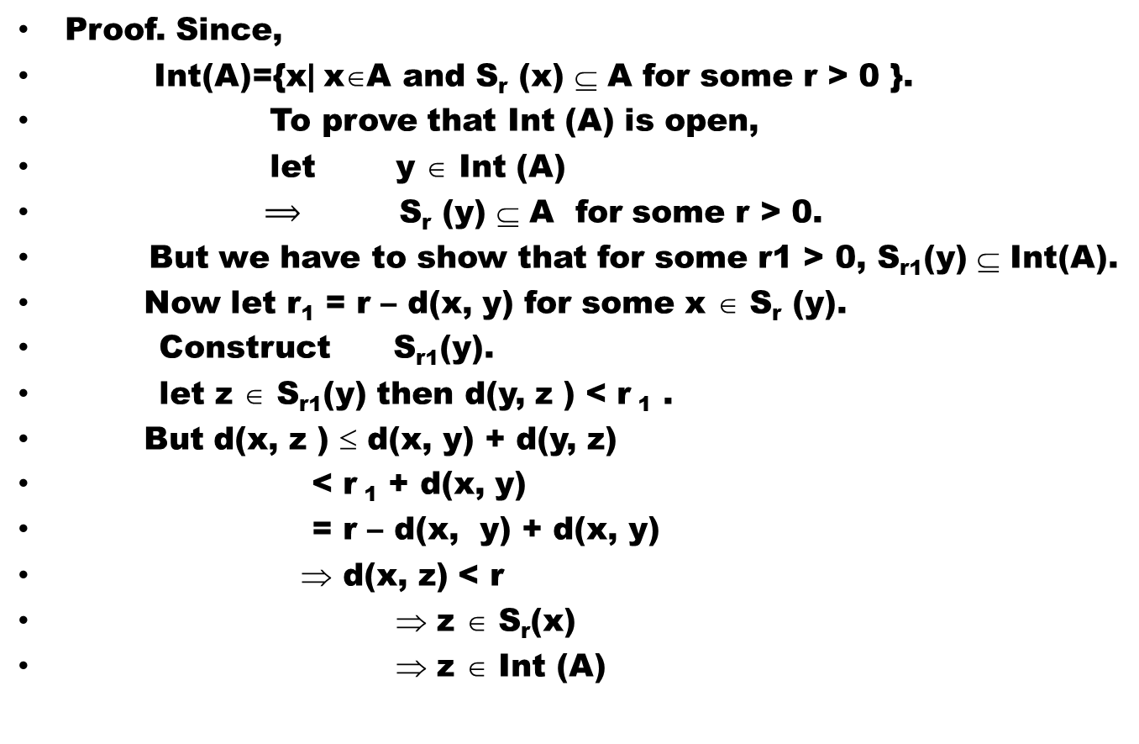
Proof. Since,
Int(A)={x| x∈A and S_{r} (x) ⊆ A for some r > 0 }.
To prove that Int (A) is open,
let y ∈Int (A)
$⟹$S_{r}(y) ⊆ A for some r > 0.
But we have to show that for some r1 >0, S_{r1}(y) ⊆Int(A).
Now let r₁ = r – d(x, y) for some x ∈ S_{r} (y).
Construct S_{r1}(y).
let z ∈S_{r1}(y) then d(y, z ) < r ₁ .
But d(x, z ) ≤ d(x, y) + d(y, z)
<r ₁ + d(x, y)
= r – d(x, y) + d(x, y)
⇒d(x, z) < r
⇒z ∈ S_{r}(x)
⇒ z ∈Int (A)

Slide 32
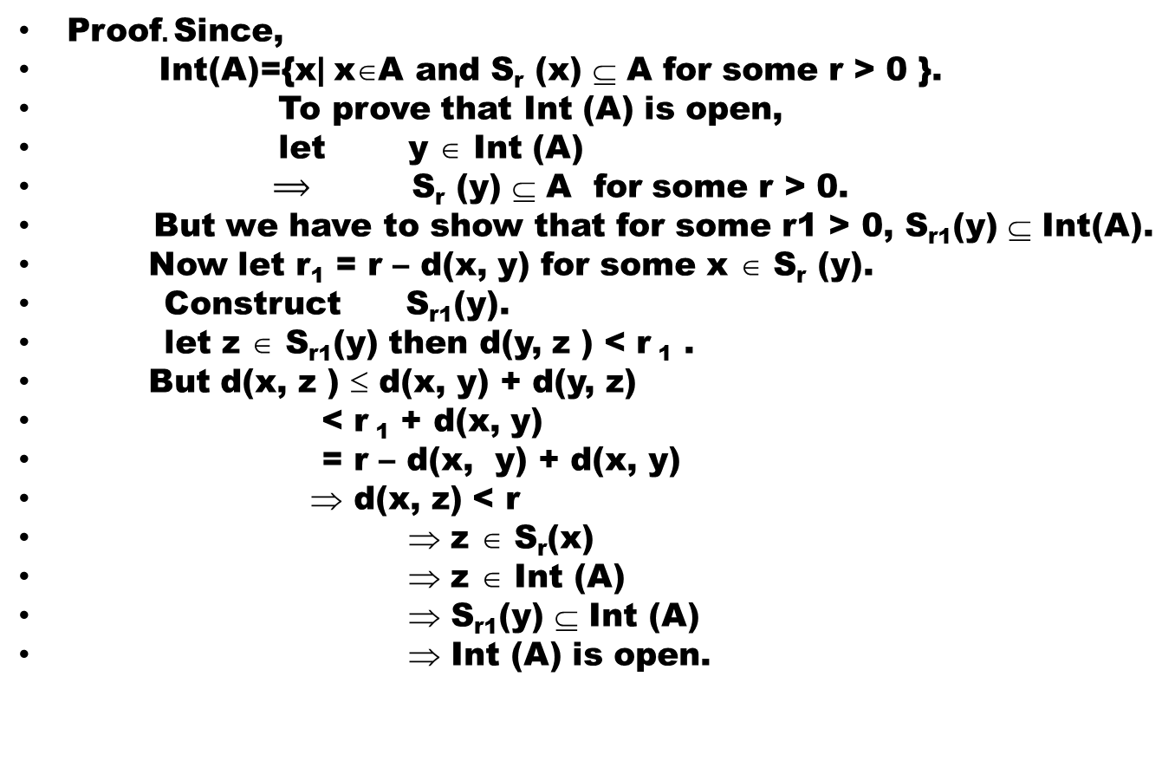
Proof. Since,
Int(A)={x| x∈A and S_{r} (x) ⊆ A for some r > 0 }.
To prove that Int (A) is open,
let y ∈Int (A)
$⟹$S_{r}(y) ⊆ A for some r > 0.
But we have to show that for some r1 >0, S_{r1}(y) ⊆Int(A).
Now let r₁ = r – d(x, y) for some x ∈ S_{r} (y).
Construct S_{r1}(y).
let z ∈S_{r1}(y) then d(y, z ) < r ₁ .
But d(x, z ) ≤ d(x, y) + d(y, z)
<r ₁ + d(x, y)
= r – d(x, y) + d(x, y)
⇒d(x, z) < r
⇒z ∈ S_{r}(x)
⇒ z ∈Int (A)
⇒ S_{r1}(y) ⊆Int (A)
⇒Int (A) is open.

Slide 33
It remains to show that Int(A) is the largest open subset of A. For this,
let B be any other open subset of A.
Then every x ∈ B is a centre of some open sphere S_{r}(x) contained in B.
But x ∈ A, so x is an interior point of A.
⇒ x ∈ Int(A).
⇒ B ⊆ Int(A).
So Int(A) is the largest open subset of A.

Slide 34
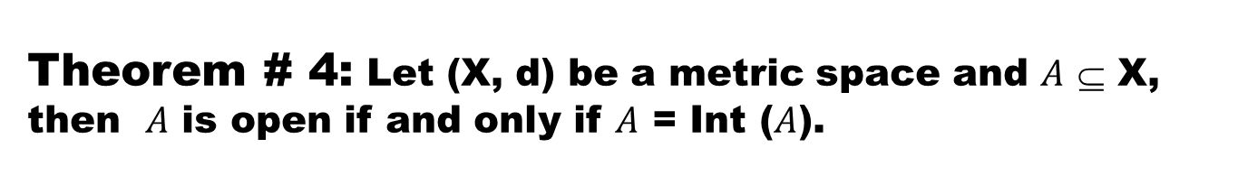
Theorem # 4:Let (X, d) be a metric space and $A$⊆ X, then $A$is open if and only if $A$= Int($A$).
Proof. Suppose A is open.
We have to prove that A = Int(A).
Since A is open subset of A, therefore A⊆ Int(A).
But Int(A) ⊆ A ( by definition )
So, Int(A) = A.
Converse is obvious.

Slide 35
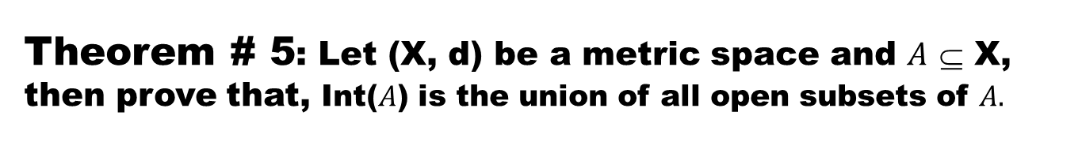
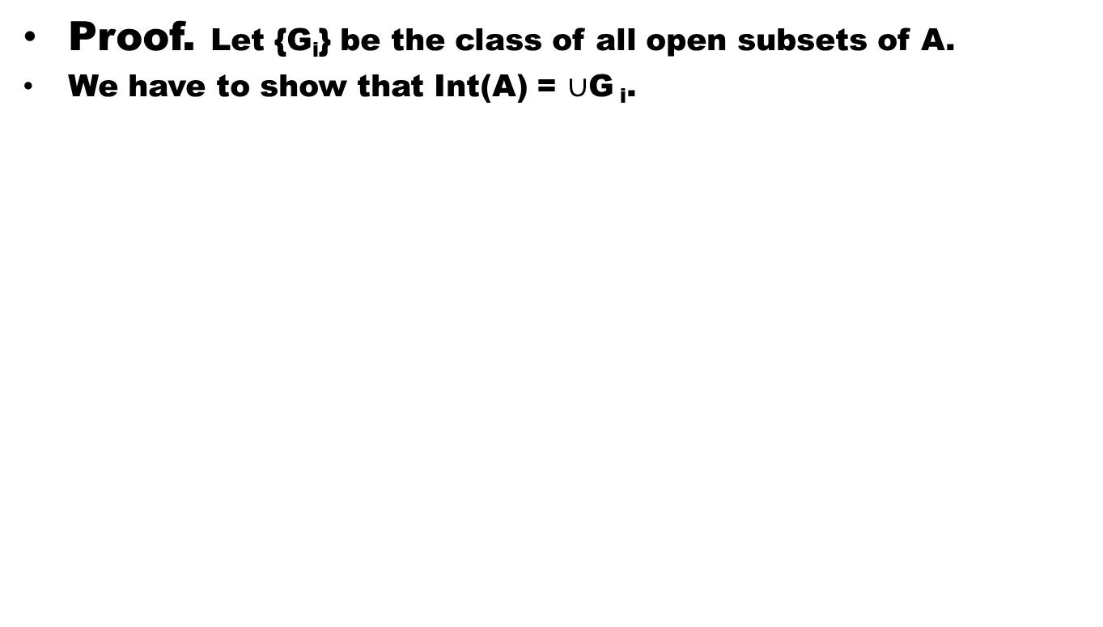
Theorem # 5: Let (X, d) be a metric space and $A$⊆ X, then prove that, Int($A$) is the union of all open subsets of $A.$
Proof. Let {G_{i}} be the class of all open subsets of A.
We have to show that Int(A) = $∪$G_{i}.

Slide 36
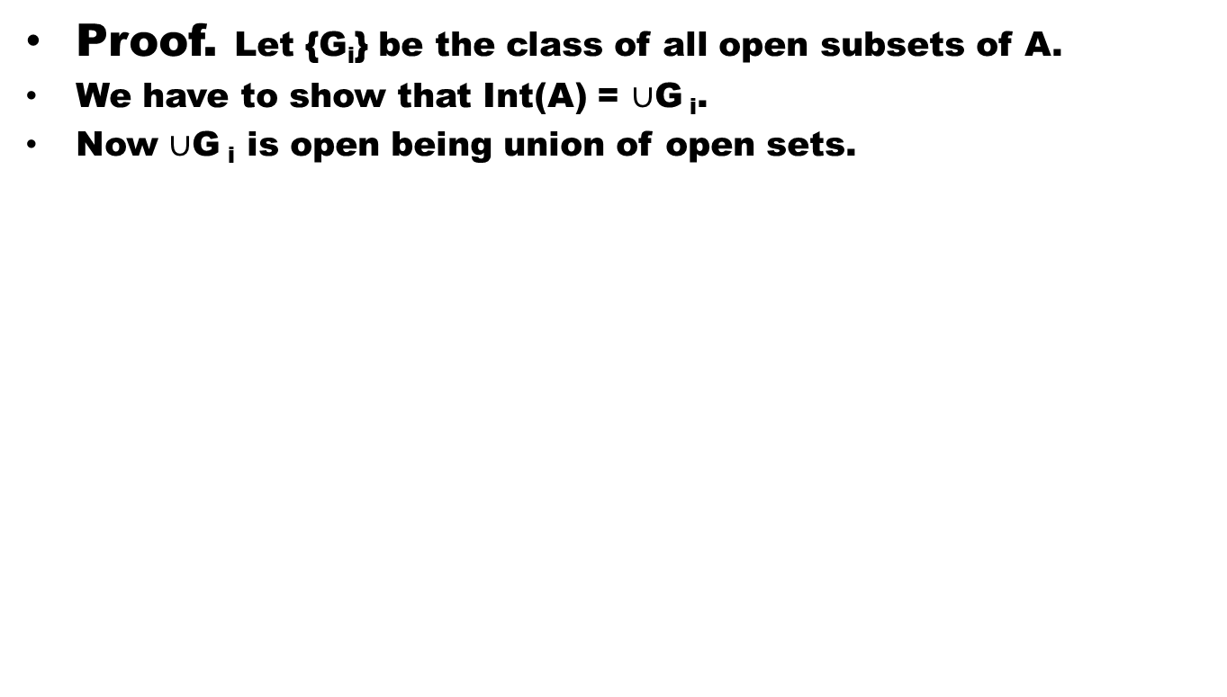
Theorem # 5: Let (X, d) be a metric space and $A$⊆ X, then prove that, Int($A$) is the union of all open subsets of $A.$
Proof. Let {G_{i}} be the class of all open subsets of A.
We have to show that Int(A) = $∪$G_{i}.
Now $∪$G_{i} is open being union of open sets.

Slide 37
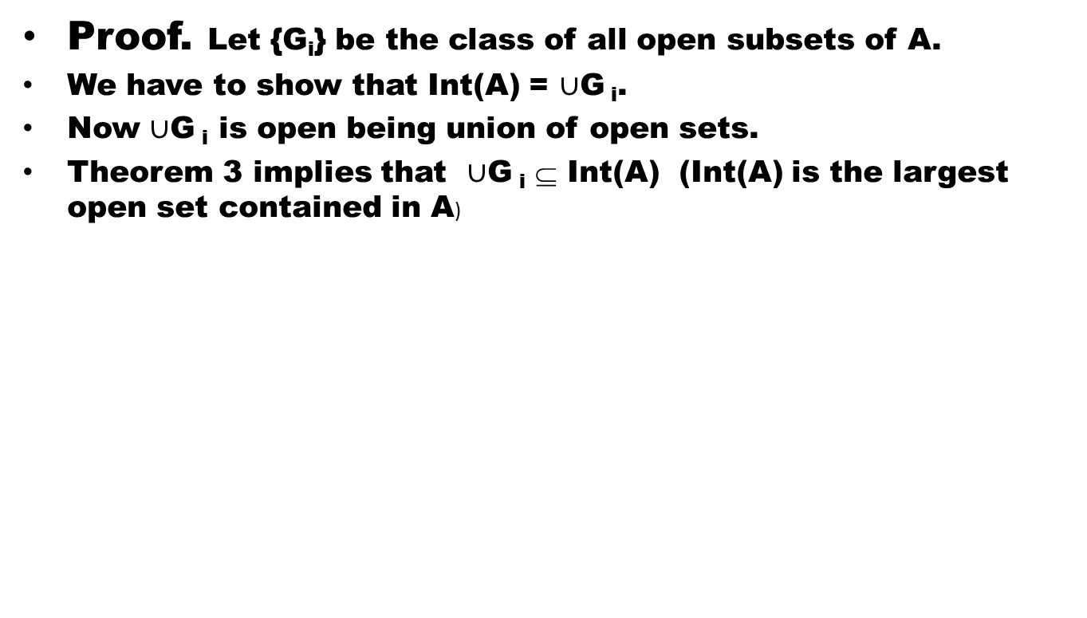
Theorem # 5: Let (X, d) be a metric space and $A$⊆ X, then prove that, Int($A$) is the union of all open subsets of $A.$
Proof. Let {G_{i}} be the class of all open subsets of A.
We have to show that Int(A) = $∪$G_{i}.
Now $∪$G_{i} is open being union of open sets.
Theorem 3 implies that $∪$G_{i}⊆Int(A) (Int(A) is the largest open set contained in A)

Slide 38
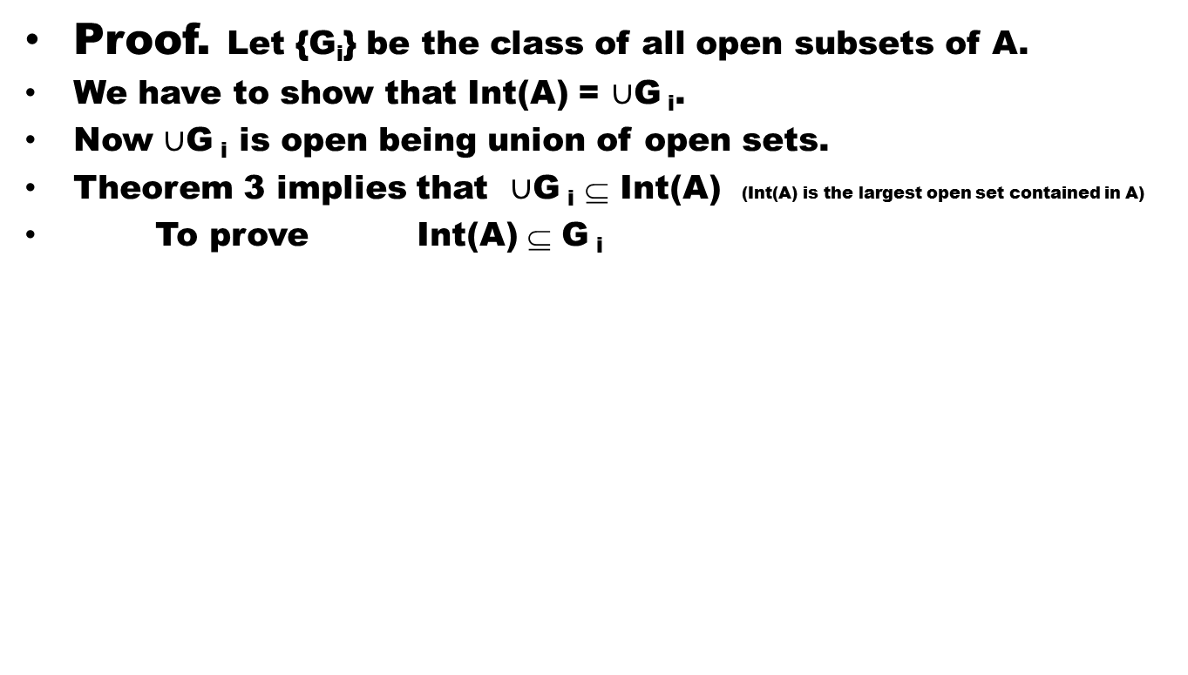
Theorem # 5: Let (X, d) be a metric space and $A$⊆ X, then prove that, Int($A$) is the union of all open subsets of $A.$
Proof. Let {G_{i}} be the class of all open subsets of A.
We have to show that Int(A) = $∪$G_{i}.
Now $∪$G_{i} is open being union of open sets.
Theorem 3 implies that $∪$G_{i}⊆Int(A) (Int(A) is the largest open set contained in A)
To prove Int(A) ⊆ G_{i}

Slide 39
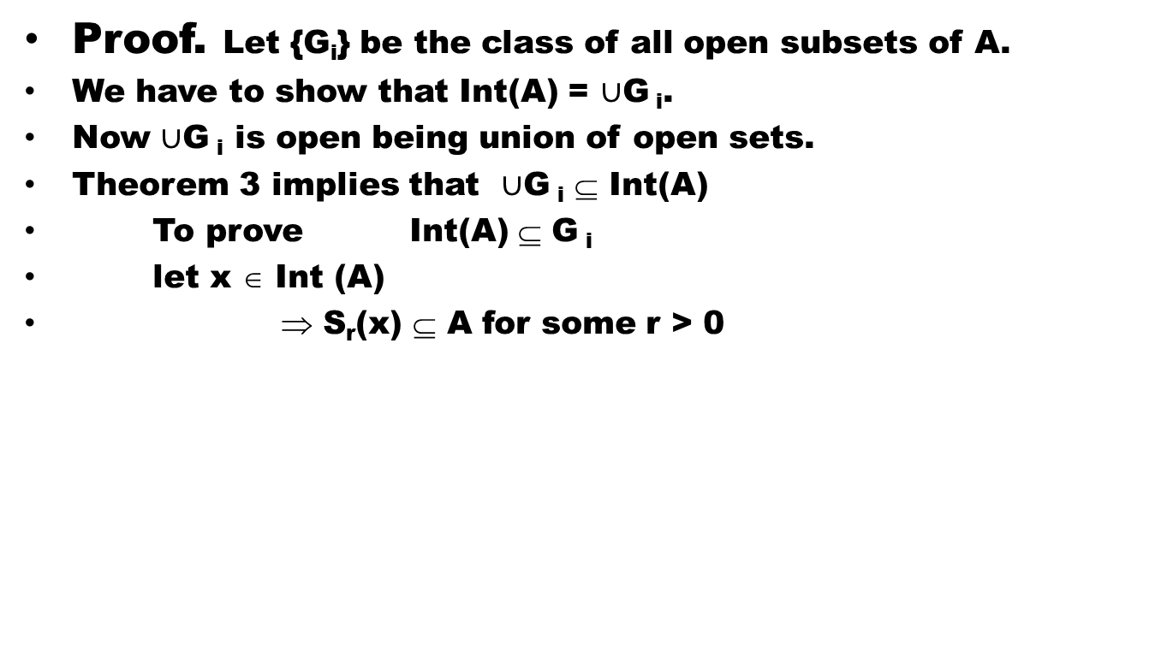
Theorem # 5: Let (X, d) be a metric space and $A$⊆ X, then prove that, Int($A$) is the union of all open subsets of $A.$
Proof. Let {G_{i}} be the class of all open subsets of A.
We have to show that Int(A) = $∪$G_{i}.
Now $∪$G_{i} is open being union of open sets.
Theorem 3 implies that $∪$G_{i}⊆Int(A)
To prove Int(A) ⊆ G_{i}
let x ∈Int (A)
⇒ S_{r}(x) ⊆ A for some r > 0

Slide 40
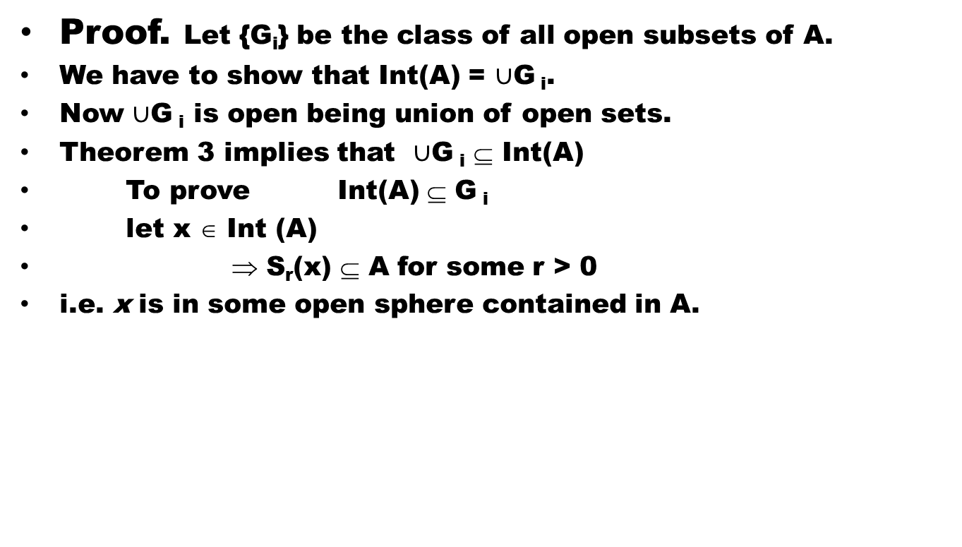
Theorem # 5: Let (X, d) be a metric space and $A$⊆ X, then prove that, Int($A$) is the union of all open subsets of $A.$
Proof. Let {G_{i}} be the class of all open subsets of A.
We have to show that Int(A) = $∪$G_{i}.
Now $∪$G_{i} is open being union of open sets.
Theorem 3 implies that $∪$G_{i}⊆Int(A)
To prove Int(A) ⊆ G_{i}
let x ∈Int (A)
⇒ S_{r}(x) ⊆ A for some r > 0
i.e. x is in some open sphere contained in A.

Slide 41
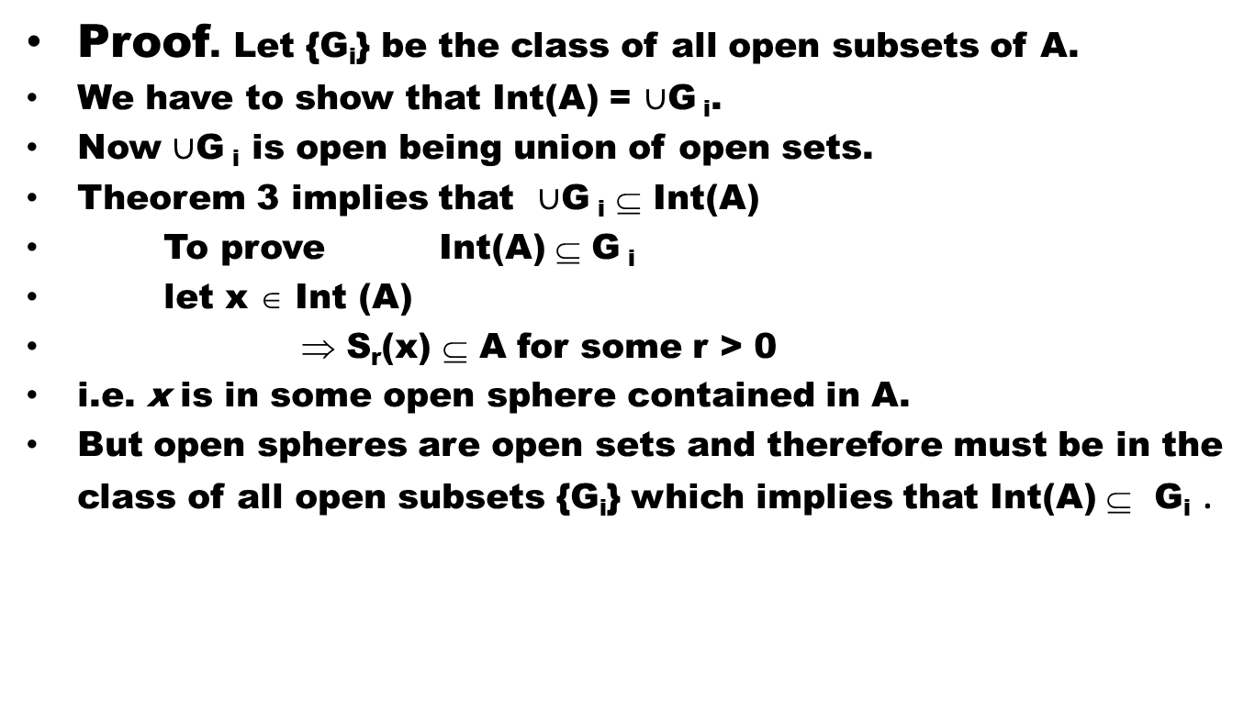
Theorem # 5: Let (X, d) be a metric space and $A$⊆ X, then prove that, Int($A$) is the union of all open subsets of $A.$
Proof. Let {G_{i}} be the class of all open subsets of A.
We have to show that Int(A) = $∪$G_{i}.
Now $∪$G_{i} is open being union of open sets.
Theorem 3 implies that $∪$G_{i}⊆Int(A)
To prove Int(A) ⊆ G_{i}
let x ∈Int (A)
⇒ S_{r}(x) ⊆ A for some r > 0
i.e. x is in some open sphere contained in A.
But open spheres are open sets and therefore must be in the class of all open subsets {G_{i}} which implies that Int(A) ⊆G_{i}.

Slide 42
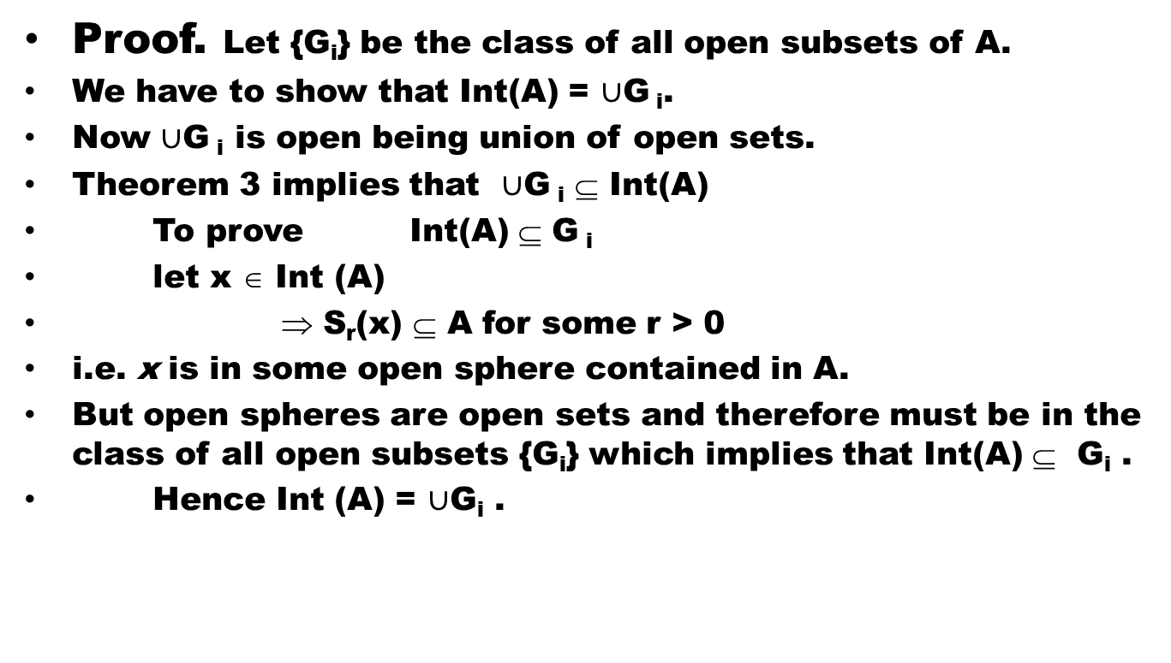
Theorem # 5: Let (X, d) be a metric space and $A$⊆ X, then prove that, Int($A$) is the union of all open subsets of $A.$
Proof. Let {G_{i}} be the class of all open subsets of A.
We have to show that Int(A) = $∪$G_{i}.
Now $∪$G_{i} is open being union of open sets.
Theorem 3 implies that $∪$G_{i}⊆Int(A)
To prove Int(A) ⊆ G_{i}
let x ∈Int (A)
⇒ S_{r}(x) ⊆ A for some r > 0
i.e. x is in some open sphere contained in A.
But open spheres are open sets and therefore must be in the class of all open subsets {G_{i}} which implies that Int(A) ⊆G_{i} .
Hence Int (A) = $∪$G_{i}.

Slide 43
Lesson’s Summery
Today we have:
Defined Interior of a set in a metric space(X,d)
Proved:
Int(A) is the largest open subset of A.
A is open iff A = Int(A).
Int(A) is the union of all open subsets of A.

Slide 44
Good Luck dear Students

