Slide 1
Set Topology
MTH 251
Lecture # 6

Slide 2
Lecture Outline
In this Lecture we will define Open set in metric space and give examples of open sets.
We Prove That:
: Let (X, d) be a metric space. Then empty set and X (ground set) are open sets
Let (X, d) be a metric space. Then each open sphere is an open set.
Let (X, d) be a metric space. A subset G of X is open if and only if it is the union of open spheres.
Let (X, d) be a metric space, then
1). Union of any ( arbitrary ) number of open sets is open.
2). Intersection of finite number of open sets is open.

Slide 3
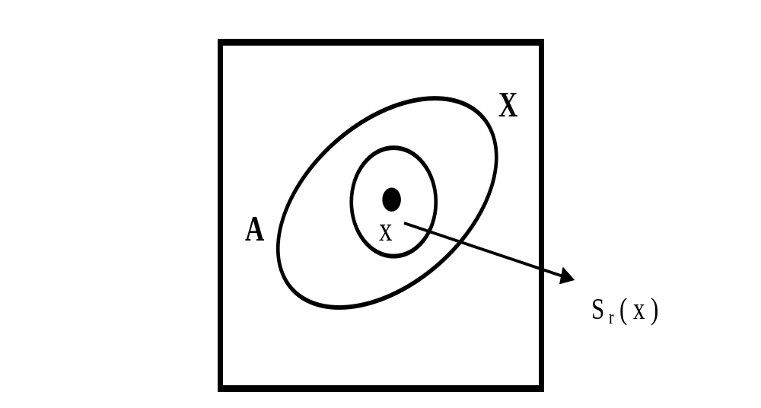
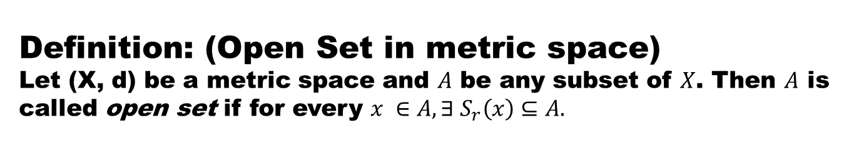
Definition: (Open Set in metric space)
Let (X, d) be a metric space and $A$be any subset of $X$. Then $A$is called open setif for every $x ∈A, ∃ S_{r}\left(x\right)⊆A.$

Slide 4
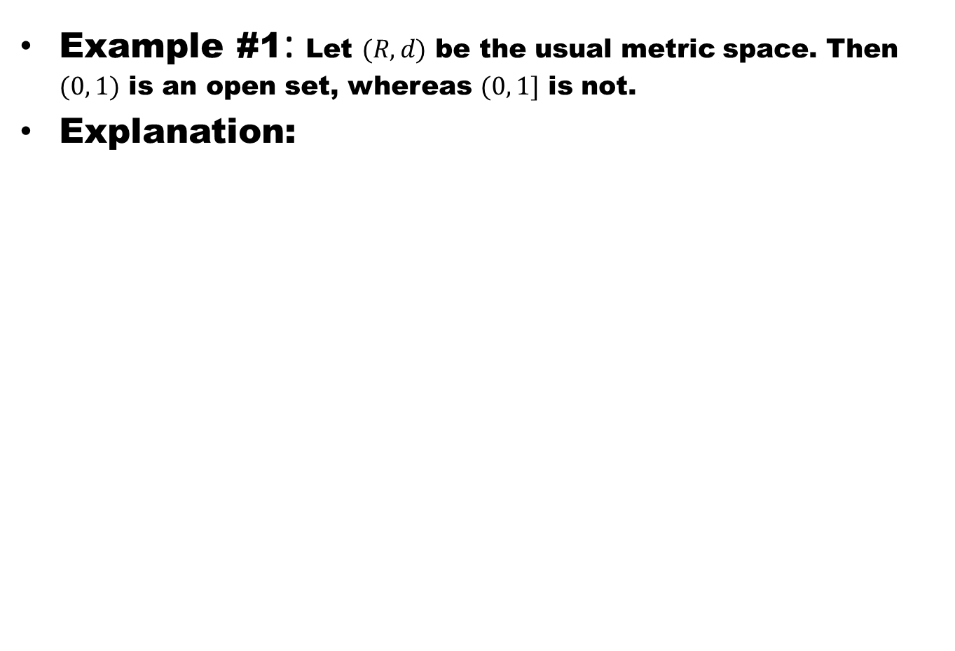
Example #1: Let $(R, d)$ be the usual metric space. Then $(0, 1)$ is an open set, whereas $(0, 1]$ is not.
Explanation:

Slide 5
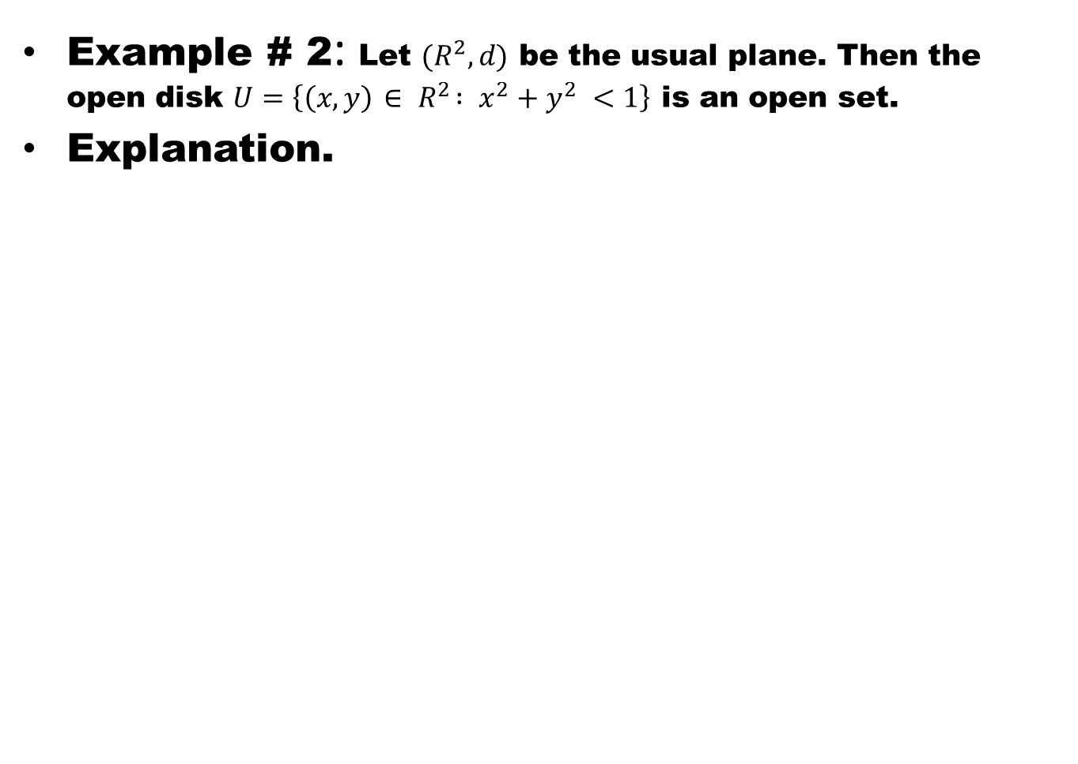
Example # 2: Let $(R^{2}, d)$ be the usual plane. Then the open disk $U=\left\{\left(x,y\right){ ∈ R}^{2} : x^{2}+y^{2} <1\right\}$ is an open set.
Explanation.

Slide 7
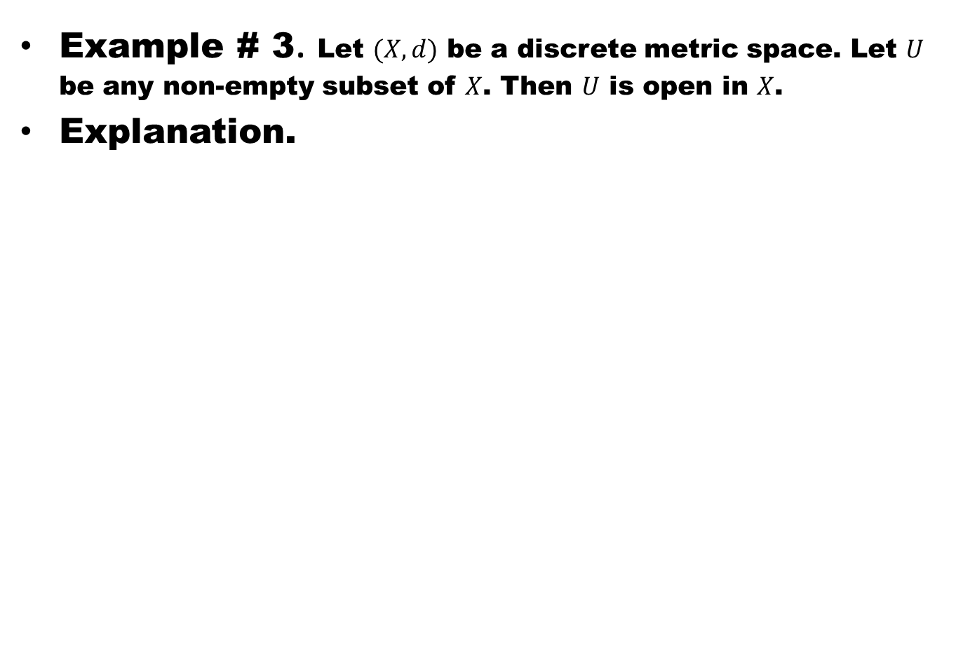
Example # 3. Let $(X,d)$ be a discrete metric space. Let $U$ be any non-empty subset of $X$. Then $U$ is open in $X$.
Explanation.

Slide 8
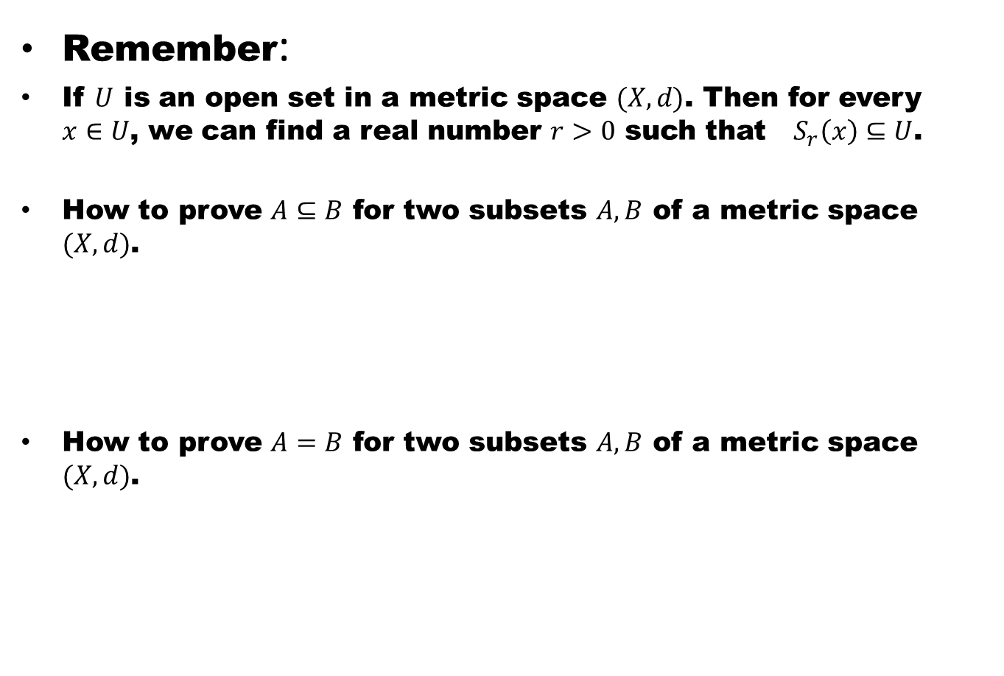
Remember:
If $U$ is an open set in a metric space $(X,d)$. Then for every $x∈U$, we can find a real number $r>0$ such that $S_{r}\left(x\right)⊆U$.
How to prove $A⊆B$ for two subsets $A, B$ of a metric space $(X,d)$.
How to prove $A=B$ for two subsets $A, B$ of a metric space $(X,d)$.

Slide 9
Theorem # 1 : Let (X, d) be a metric space. Then φ and X are open sets.
Proof: To prove that φ is open we have to show that each point of φ is a centre of some open sphere which is contained in φ.
Since there is no element in φ therefore the condition is automatically satisfied. Hence φ in open.
X is clearly open because every open sphere centred on each of its points must be a subset of X.

Slide 10
Theorem # 2 : Let (X, d) be a metric space. Then each open sphere is an open set.
Proof.

Slide 13
Theorem # 3: Let (X, d) be a metric space. A subset G of X is open if and only if it is the union of open spheres.
Proof.

Slide 15
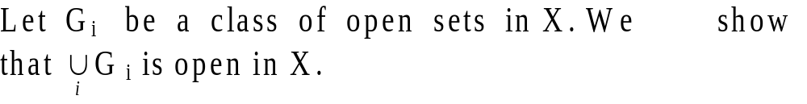
Theorem # 4: Let (X, d) be a metric space, then
Union of any ( arbitrary ) number of open sets is open.
Proof.

Slide 16
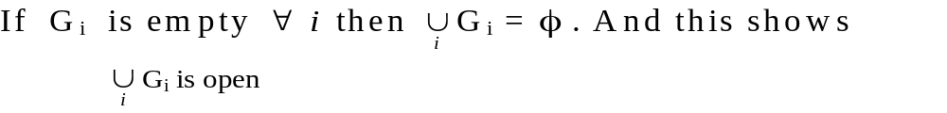
Theorem # 4: Let (X, d) be a metric space, then
Union of any ( arbitrary ) number of open sets is open.
Proof.

Slide 17

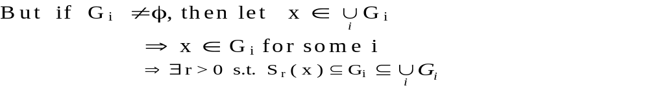
Theorem # 4: Let (X, d) be a metric space, then
Union of any ( arbitrary ) number of open sets is open.
Proof.

Slide 18
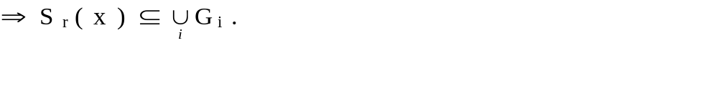
Theorem # 4: Let (X, d) be a metric space, then
Union of any ( arbitrary ) number of open sets is open.
Proof.

Slide 19
Theorem # 4: Let (X, d) be a metric space, then
Union of any ( arbitrary ) number of open sets is open.
Proof.

Slide 20
Theorem # 5: Let (X, d) be a metric space, then Intersection of finite number of open sets is open.
Proof.

Slide 21
Theorem # 5: Let (X, d) be a metric space, then Intersection of finite number of open sets is open.
Proof.

Slide 22
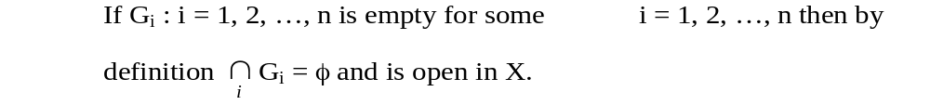
Theorem # 5: Let (X, d) be a metric space, then Intersection of finite number of open sets is open.
Proof.

Slide 23
Theorem # 5: Let (X, d) be a metric space, then Intersection of finite number of open sets is open.
Proof.

Slide 24
Theorem # 5: Let (X, d) be a metric space, then Intersection of finite number of open sets is open.
Proof.

Slide 26
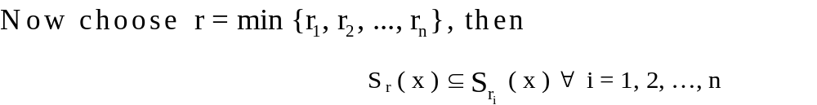

Slide 27
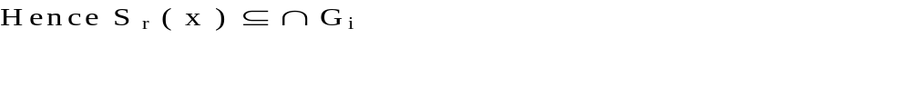

Slide 28
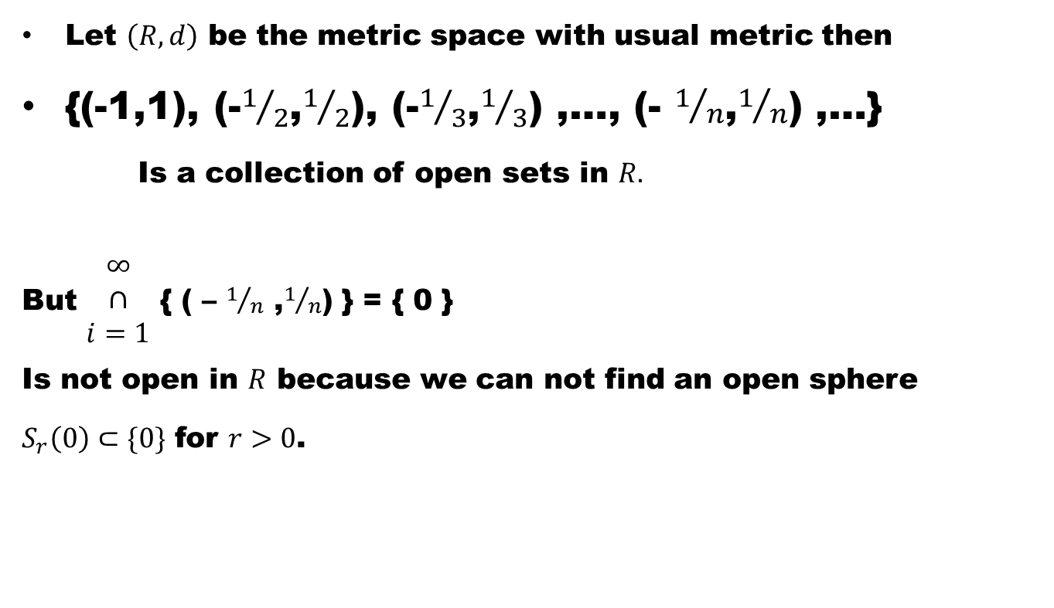
Example # 3: In general, intersection of arbitrary number of open sets is not necessarily open. It is clear from the following
Let $\left(R,d\right)$ be the metric space with usual metric then
{(-1,1), (-$1/2$,$1/2$), (-$1/3$,$1/3$) ,…, (- $1/n$,$1/n$) ,…}
Is a collection of open sets in $R.$
But $\begin{matrix}∞ \\ ∩ \\ i=1\end{matrix}${ ( – $1/n$ ,$1/n$) } = { 0 }
Is not open in $R$ because we can not find an open sphere
$S_{r}\left(0\right)⊂\{0\}$ for $r>0$.

Slide 29
Good Luck

