Slide 1
SET TOPOLOGY
Course Code MTH 251

Slide 2
SET TOPOLOGY
Course Code MTH 251
By
Dr. Moiz ud Din khan

Slide 3
SET TOPOLOGY
Course Code MTH 251
By
Dr. Moiz ud Din khan
Professor of Mathematics

Slide 4
SET TOPOLOGY
Course Code MTH 251
By
Dr. Moiz ud Din khan
Professor of Mathematics
Department of Mathematics

Slide 5
SET TOPOLOGY
Course Code MTH 251
By
Dr. Moiz ud Din khan
Professor of Mathematics
Department of Mathematics
COMSATS Institute of Information Technology,
Islamabad, Pakistan

Slide 6
Course Contents
We will cover the following topics:

Slide 7
Course Contents
We will cover the following topics:
Metric spaces

Slide 8
Course Contents
We will cover the following topics:
Metric spaces
Point-set topology:

Slide 9
Course Contents
We will cover the following topics:
Metric spaces
Point-set topology:
topological spaces and basic operations with them,

Slide 10
Course Contents
We will cover the following topics:
Metric spaces
Point-set topology:
topological spaces and basic operations with them,
seperation axioms,

Slide 11
Course Contents
We will cover the following topics:
Metric spaces
Point-set topology:
topological spaces and basic operations with them,
seperation axioms,
continuous maps,

Slide 12
Course Contents
We will cover the following topics:
Metric spaces
Point-set topology:
topological spaces and basic operations with them,
seperation axioms,
continuous maps,
compact and connected spaces,

Slide 13
Course Contents
We will cover the following topics:
Metric spaces
Point-set topology:
topological spaces and basic operations with them,
seperation axioms,
continuous maps,
compact and connected spaces,
Normal spaces, Local compactness,

Slide 14
Course Contents
We will cover the following topics:
Metric spaces
Point-set topology:
topological spaces and basic operations with them,
seperation axioms,
continuous maps,
compact and connected spaces,
Normal spaces, Local compactness,
Local connectedness and path-wise connectedness.

Slide 15
Learning objectives

Slide 16
Learning objectives
MTH 251 is an introduction to topology.

Slide 17
Learning objectives
MTH 251 is an introduction to topology.
Topology studies geometrical properties of objects that are preserved under continuous deformations.

Slide 18
Learning objectives
MTH 251 is an introduction to topology.
Topology studies geometrical properties of objects that are preserved under continuous deformations.
At the end of the course you should be able to...

Slide 19
Learning objectives
MTH 251 is an introduction to topology.
Topology studies geometrical properties of objects that are preserved under continuous deformations.
At the end of the course you should be able to...
recognise metric spaces;

Slide 20
Learning objectives
MTH 251 is an introduction to topology.
Topology studies geometrical properties of objects that are preserved under continuous deformations.
At the end of the course you should be able to...
recognise metric spaces;
utilize metric space arguments to obtain a variety of results;

Slide 21
Learning objectives
MTH 251 is an introduction to topology.
Topology studies geometrical properties of objects that are preserved under continuous deformations.
At the end of the course you should be able to...
recognise metric spaces;
utilize metric space arguments to obtain a variety of results;
recognise topological spaces;

Slide 22
Learning objectives
MTH 251 is an introduction to topology.
Topology studies geometrical properties of objects that are preserved under continuous deformations.
At the end of the course you should be able to...
recognise metric spaces;
utilize metric space arguments to obtain a variety of results;
recognise topological spaces;
understand the distinction between topological and metric properties, and handle a variety of topological invariants.

Slide 23
Recommended Books

Slide 24
Recommended Books
Metric Spaces By
Aftab Khan, Muhammad Naeem Qureshi and Moiz ud Din Khan

Slide 25
Recommended Books
Metric Spaces By
Aftab Khan, Muhammad Naeem Qureshi and Moiz ud Din Khan
Introduction to General Topology By
Bashir Ahmad

Slide 26
Recommended Books
Metric Spaces By
Aftab Khan, Muhammad Naeem Qureshi and Moiz ud Din Khan
Introduction to General Topology By
Bashir Ahmad
Introduction to Set Topology By
S. M. Yahya; The Times Press, Sadar, Karachi

Slide 27
Lecture # 01

Slide 28
Preliminiries

Slide 29
Preliminiries
In this Lecture we will recall the basic definitions and concepts which will be used in sequel.

Slide 30
Preliminiries
In this Lecture we will recall the basic definitions and concepts which will be used in sequel.
Sets

Slide 31
Preliminiries
In this Lecture we will recall the basic definitions and concepts which will be used in sequel.
Sets
Subsets

Slide 32
Preliminiries
In this Lecture we will recall the basic definitions and concepts which will be used in sequel.
Sets
Subsets
Algebra of Sets

Slide 33
Preliminiries
In this Lecture we will recall the basic definitions and concepts which will be used in sequel.
Sets
Subsets
Algebra of Sets
Functions

Slide 34
Preliminiries
In this Lecture we will recall the basic definitions and concepts which will be used in sequel.
Sets
Subsets
Algebra of Sets
Functions
Sets and functions are important concepts in almost all branches of mathematics. It is why we are starting with a brief introduction to the subject.

Slide 35
Sets: A well defined collection of distinct objects is called a set. The objects are called elements or members of the set.

Slide 36
Sets: A well defined collection of distinct objects is called a set. The objects are called elements or members of the set.
Usually sets are denoted by capital letters A, B, X, Y, ... and elements by small letters a, b, x, y, ....

Slide 37
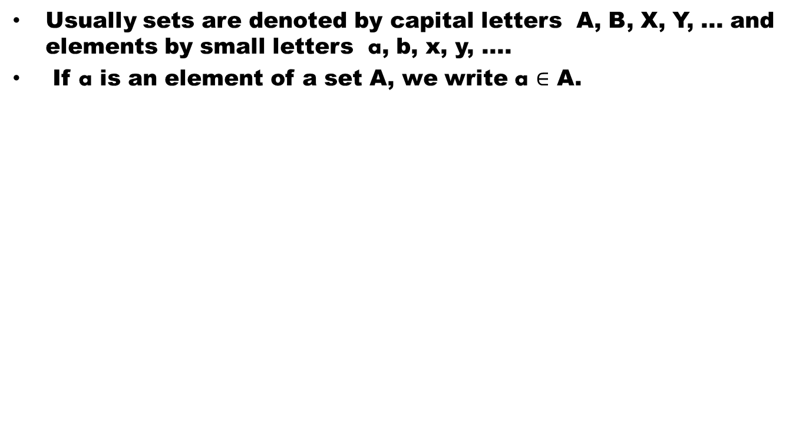
Sets: A well defined collection of distinct objects is called a set. The objects are called elements or members of the set.
Usually sets are denoted by capital letters A, B, X, Y, ... and elements by small letters a, b, x, y, ....
If a is an element of a set A, we write a$∈$ A.

Slide 38
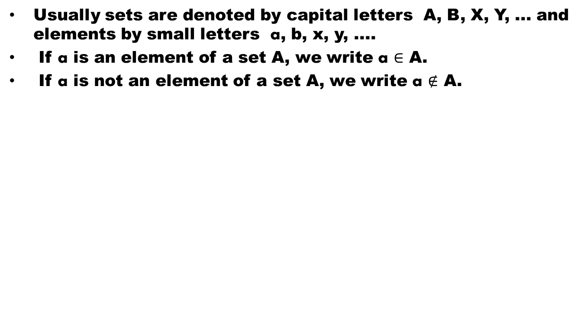
Sets: A well defined collection of distinct objects is called a set. The objects are called elements or members of the set.
Usually sets are denoted by capital letters A, B, X, Y, ... and elements by small letters a, b, x, y, ....
If a is an element of a set A, we write a$∈$ A.
If a is not an element of a set A, we write a$∉$ A.

Slide 39
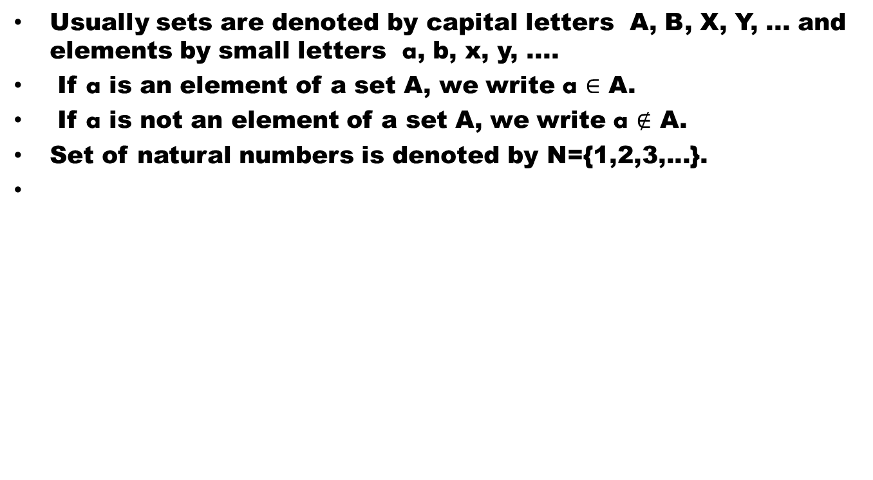
Sets: A well defined collection of distinct objects is called a set. The objects are called elements or members of the set.
Usually sets are denoted by capital letters A, B, X, Y, ... and elements by small letters a, b, x, y, ....
If a is an element of a set A, we write a$∈$ A.
If a is not an element of a set A, we write a$∉$ A.
Set of natural numbers is denoted by N={1,2,3,...}.

Slide 40
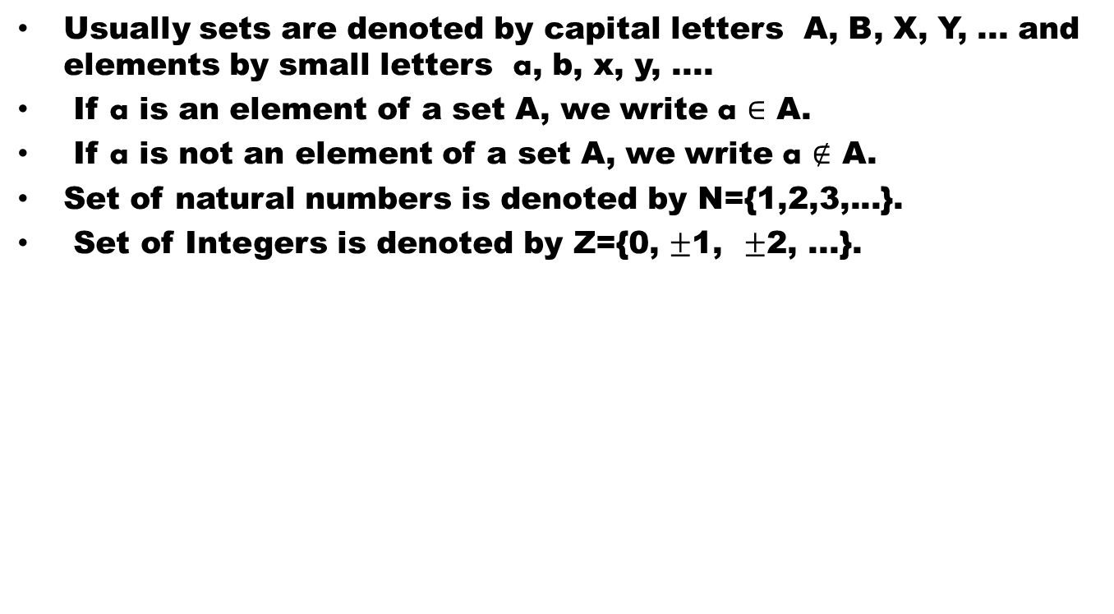
Sets: A well defined collection of distinct objects is called a set. The objects are called elements or members of the set.
Usually sets are denoted by capital letters A, B, X, Y, ... and elements by small letters a, b, x, y, ....
If a is an element of a set A, we write a$∈$ A.
If a is not an element of a set A, we write a$∉$ A.
Set of natural numbers is denoted by N={1,2,3,...}.
Set of Integers is denoted by Z={0, $±$1, $±$2, ...}.

Slide 41
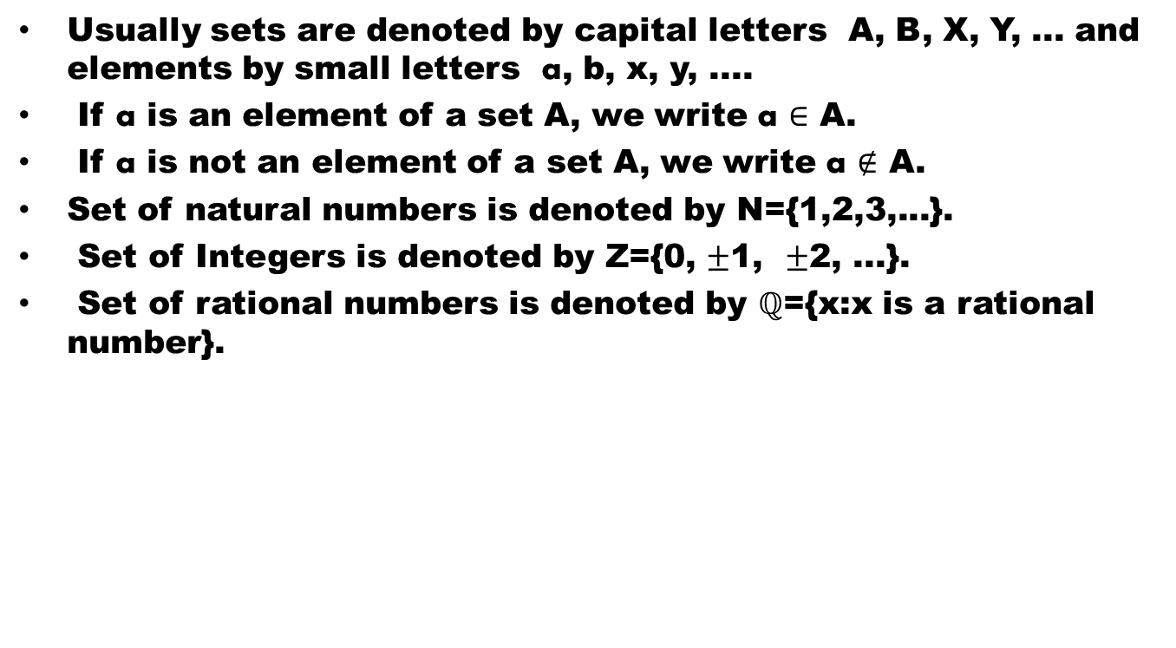
Sets: A well defined collection of distinct objects is called a set. The objects are called elements or members of the set.
Usually sets are denoted by capital letters A, B, X, Y, ... and elements by small letters a, b, x, y, ....
If a is an element of a set A, we write a$∈$ A.
If a is not an element of a set A, we write a$∉$ A.
Set of natural numbers is denoted by N={1,2,3,...}.
Set of Integers is denoted by Z={0, $±$1, $±$2, ...}.
Set of rational numbers is denoted by $ℚ$={x:x is a rational number}.

Slide 42
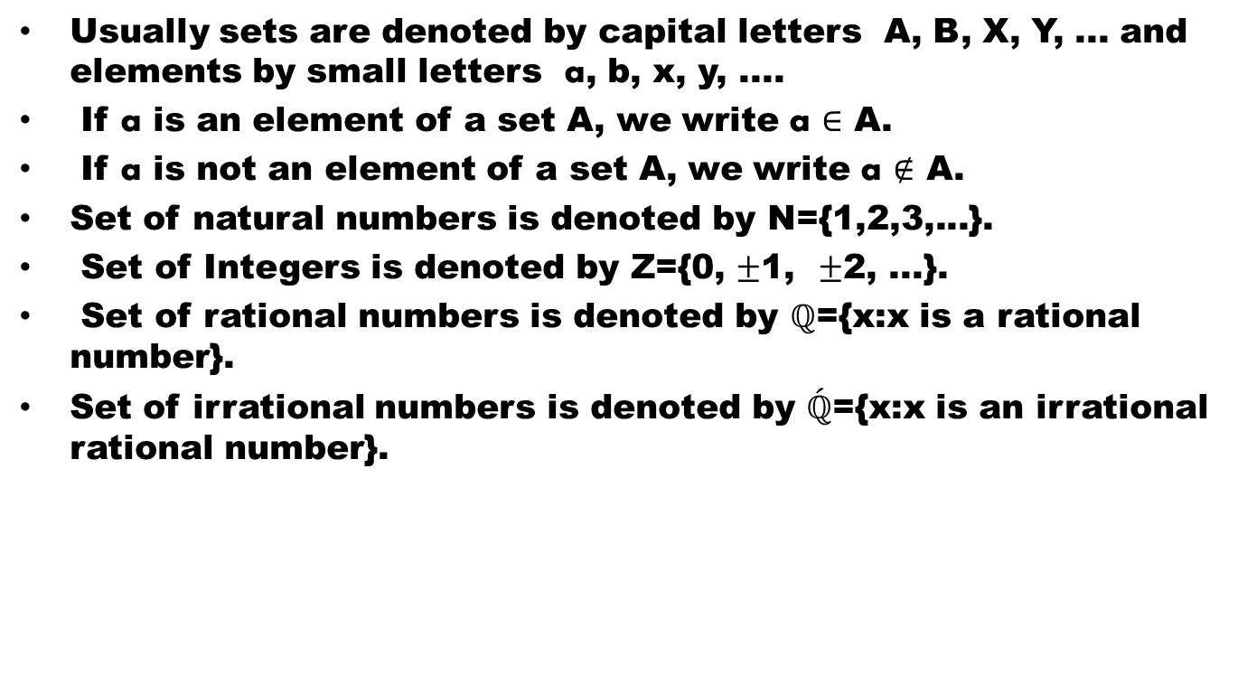
Sets: A well defined collection of distinct objects is called a set. The objects are called elements or members of the set.
Usually sets are denoted by capital letters A, B, X, Y, ... and elements by small letters a, b, x, y, ....
If a is an element of a set A, we write a$∈$ A.
If a is not an element of a set A, we write a$∉$ A.
Set of natural numbers is denoted by N={1,2,3,...}.
Set of Integers is denoted by Z={0, $±$1, $±$2, ...}.
Set of rational numbers is denoted by $ℚ$={x:x is a rational number}.
Set of irrational numbers is denoted by $\acute{ℚ}$={x:x is an irrational rational number}.

Slide 43
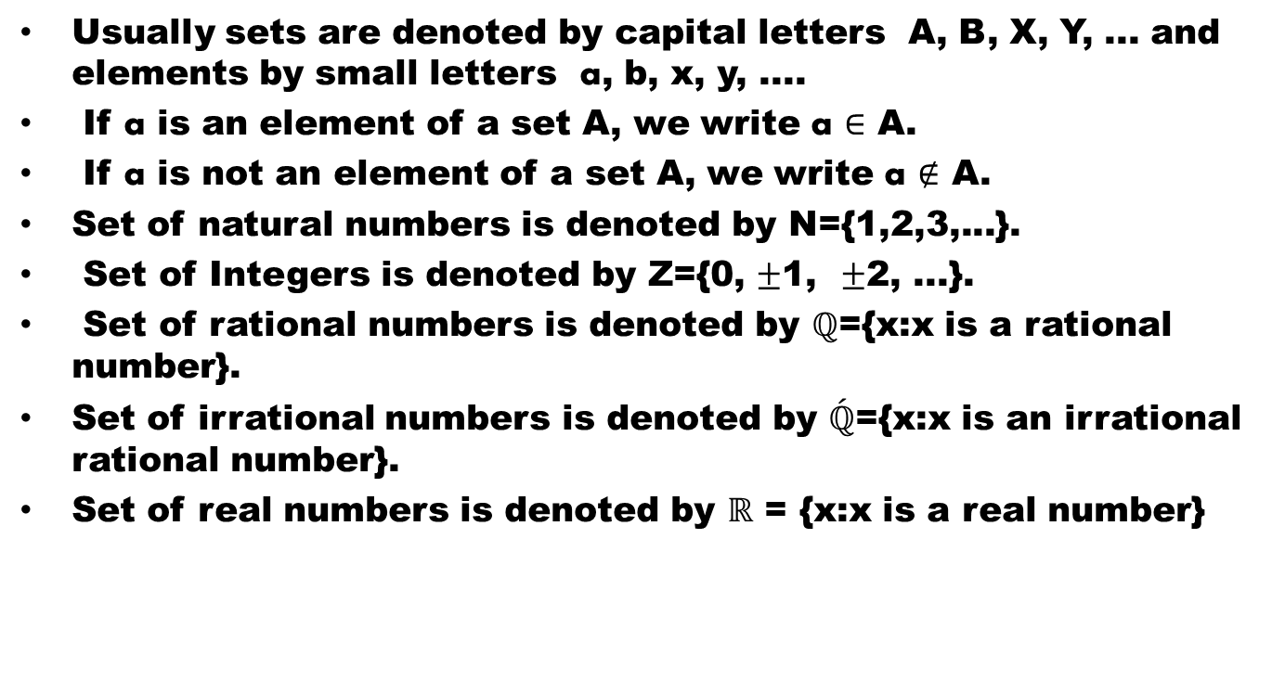
Sets: A well defined collection of distinct objects is called a set. The objects are called elements or members of the set.
Usually sets are denoted by capital letters A, B, X, Y, ... and elements by small letters a, b, x, y, ....
If a is an element of a set A, we write a$∈$ A.
If a is not an element of a set A, we write a$∉$ A.
Set of natural numbers is denoted by N={1,2,3,...}.
Set of Integers is denoted by Z={0, $±$1, $±$2, ...}.
Set of rational numbers is denoted by $ℚ$={x:x is a rational number}.
Set of irrational numbers is denoted by $\acute{ℚ}$={x:x is an irrational rational number}.
Set of real numbers is denoted by $ℝ$ = {x:x is a real number}

Slide 44
Notation

Slide 45
Notation
Sometimes it is possible to list elements of a set for example set of all integers Z, can be written as

Slide 46
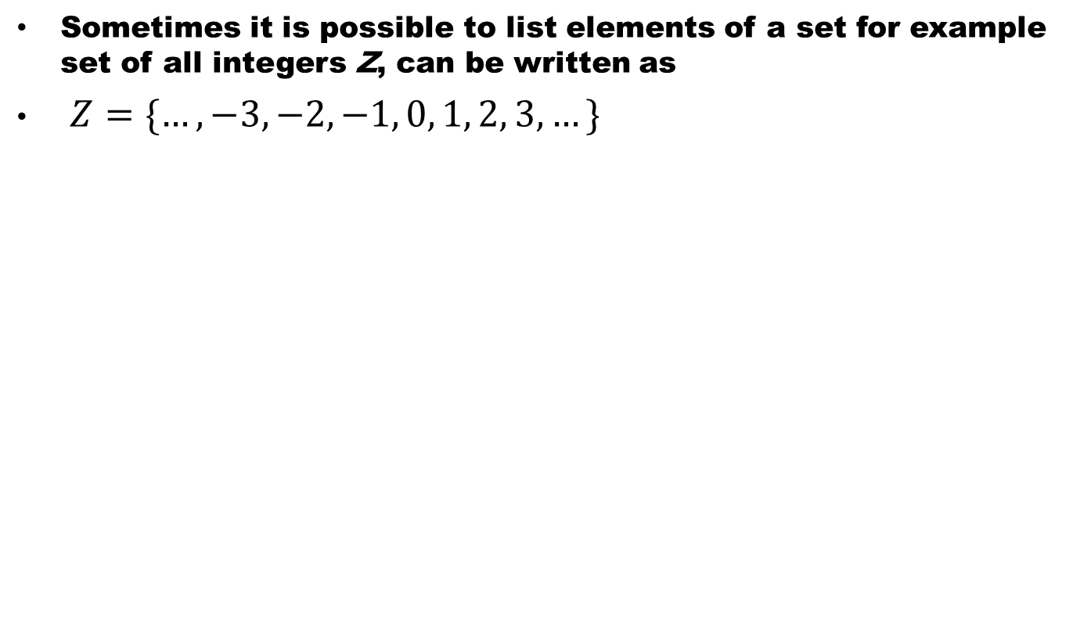
Notation
Sometimes it is possible to list elements of a set for example set of all integers Z, can be written as
$Z=\{…, −3, −2, −1, 0, 1, 2, 3, …\}$

Slide 47
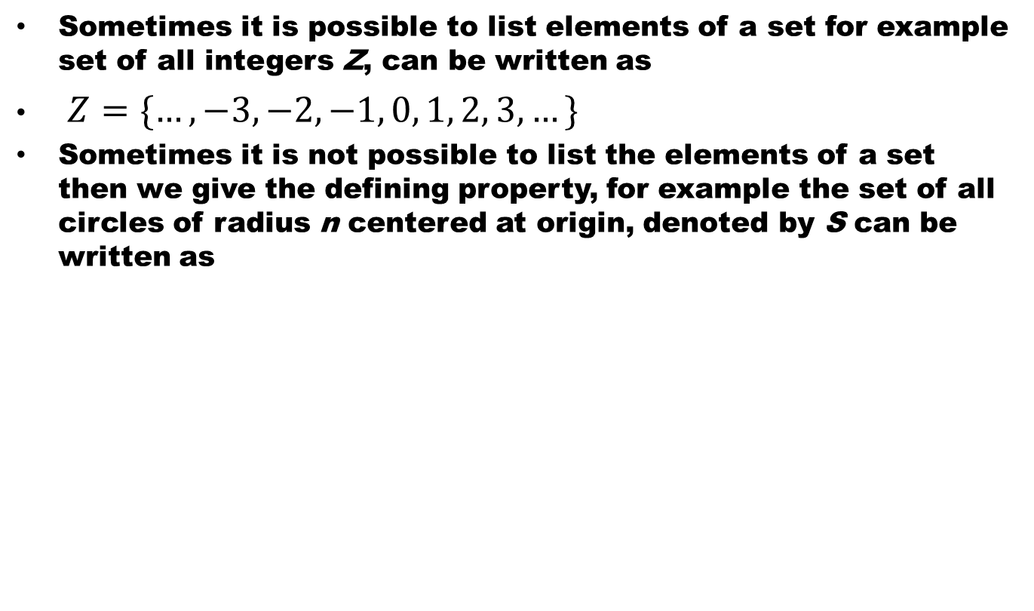
Notation
Sometimes it is possible to list elements of a set for example set of all integers Z, can be written as
$Z=\{…, −3, −2, −1, 0, 1, 2, 3, …\}$
Sometimes it is not possible to list the elements of a set then we give the defining property, for example the set of all circles of radius n centered at origin, denoted by S can be written as

Slide 48
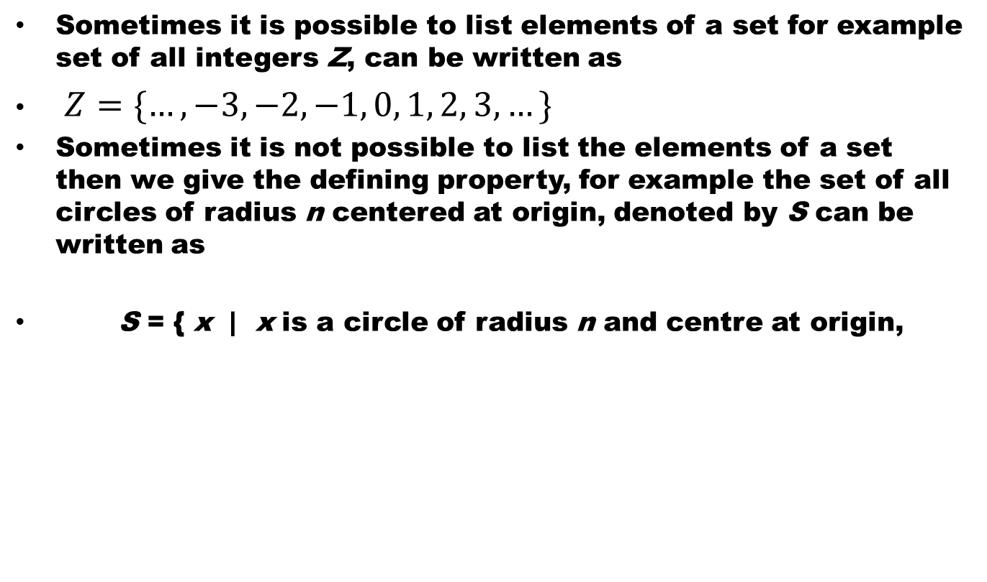
Notation
Sometimes it is possible to list elements of a set for example set of all integers Z, can be written as
$Z=\{…, −3, −2, −1, 0, 1, 2, 3, …\}$
Sometimes it is not possible to list the elements of a set then we give the defining property, for example the set of all circles of radius n centered at origin, denoted by S can be written as
S = { x | x is a circle of radius n and centre at origin,

Slide 49
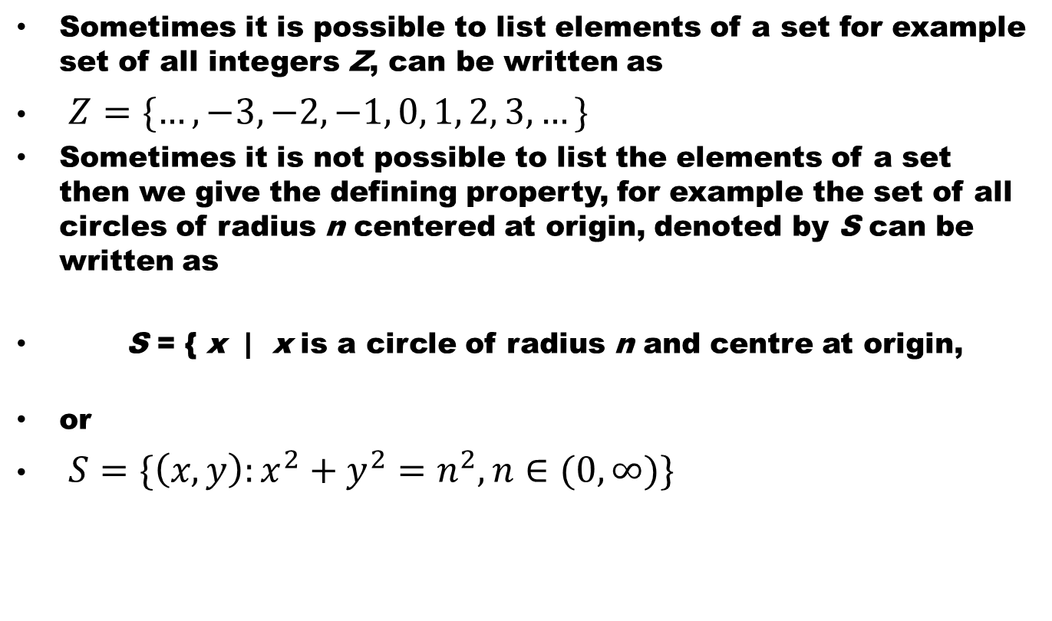
Notation
Sometimes it is possible to list elements of a set for example set of all integers Z, can be written as
$Z=\{…, −3, −2, −1, 0, 1, 2, 3, …\}$
Sometimes it is not possible to list the elements of a set then we give the defining property, for example the set of all circles of radius n centered at origin, denoted by S can be written as
S = { x | x is a circle of radius n and centre at origin,
or
$S=\{\left(x,y\right):x^{2}+y^{2}=n^{2}, n∈(0,∞)\}$

Slide 50
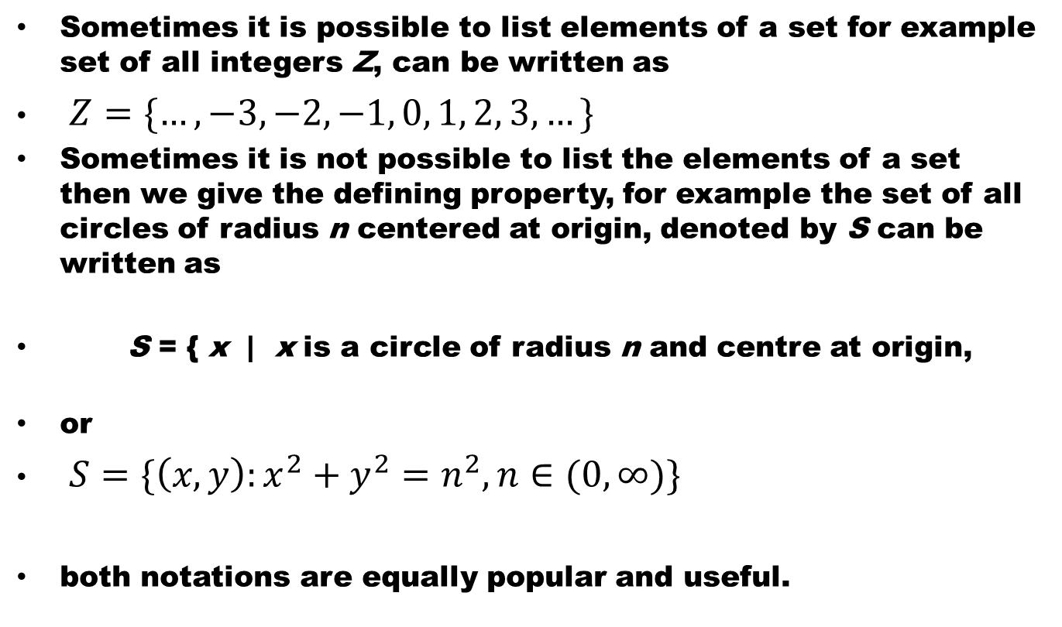
Notation
Sometimes it is possible to list elements of a set for example set of all integers Z, can be written as
$Z=\{…, −3, −2, −1, 0, 1, 2, 3, …\}$
Sometimes it is not possible to list the elements of a set then we give the defining property, for example the set of all circles of radius n centered at origin, denoted by S can be written as
S = { x | x is a circle of radius n and centre at origin,
or
$S=\{\left(x,y\right):x^{2}+y^{2}=n^{2}, n∈(0,∞)\}$
both notations are equally popular and useful.

Slide 51
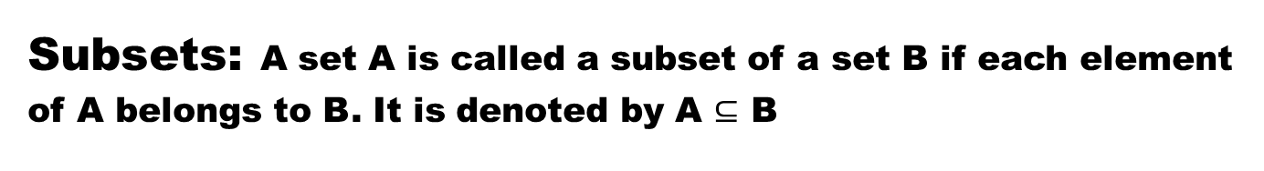
Subsets:A set A is called a subset of a set B if each element of A belongs to B. It is denoted by A $⊆$ B

Slide 52
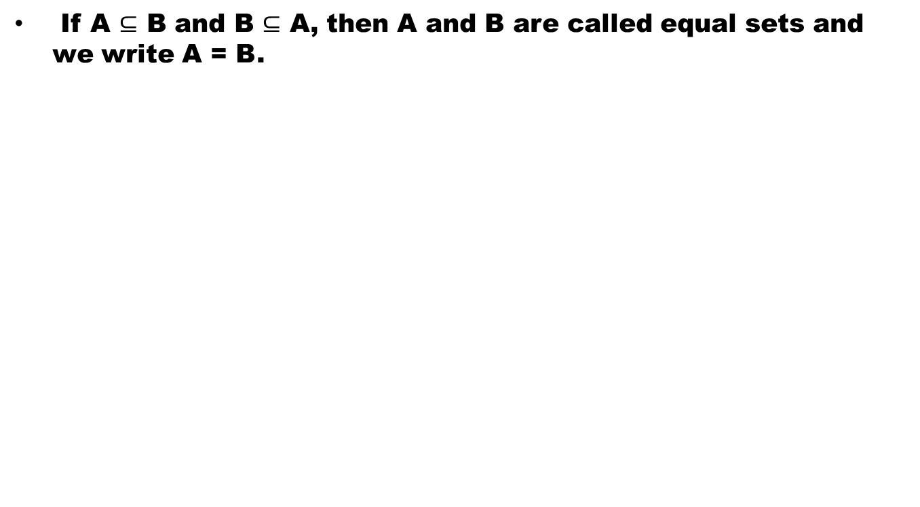
Subsets:A set A is called a subset of a set B if each element of A belongs to B. It is denoted by A $⊆$ B
If A $⊆$ B and B $⊆$ A, then A and B are called equal sets and we write A = B.

Slide 53
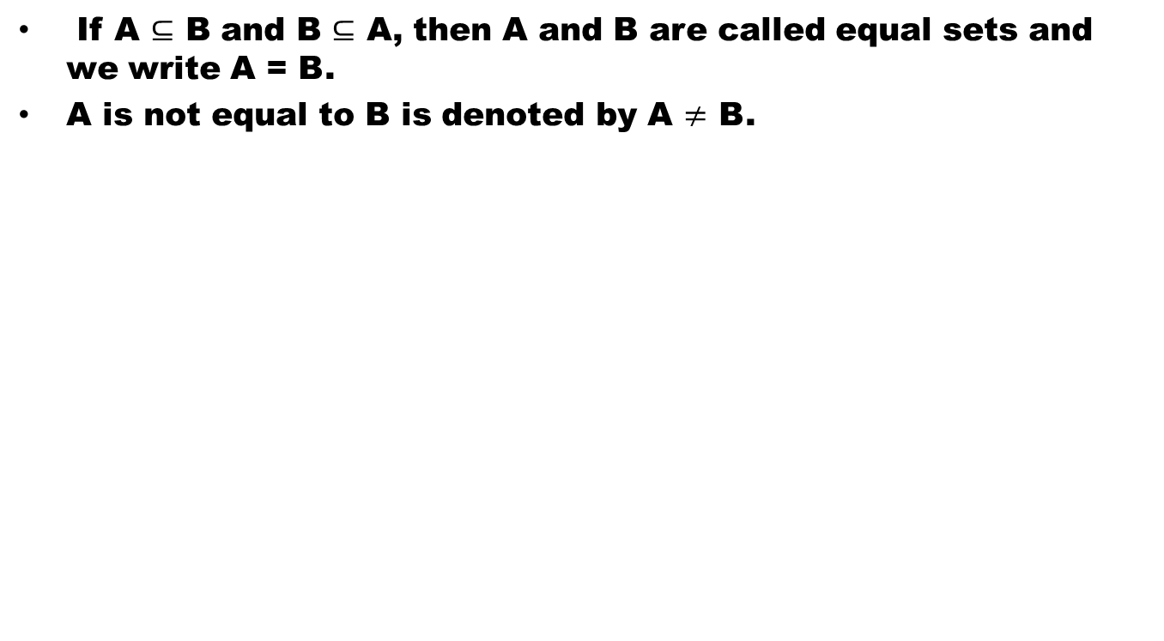
Subsets:A set A is called a subset of a set B if each element of A belongs to B. It is denoted by A $⊆$ B
If A $⊆$ B and B $⊆$ A, then A and B are called equal sets and we write A = B.
A is not equal to B is denoted by A $≠$ B.

Slide 54
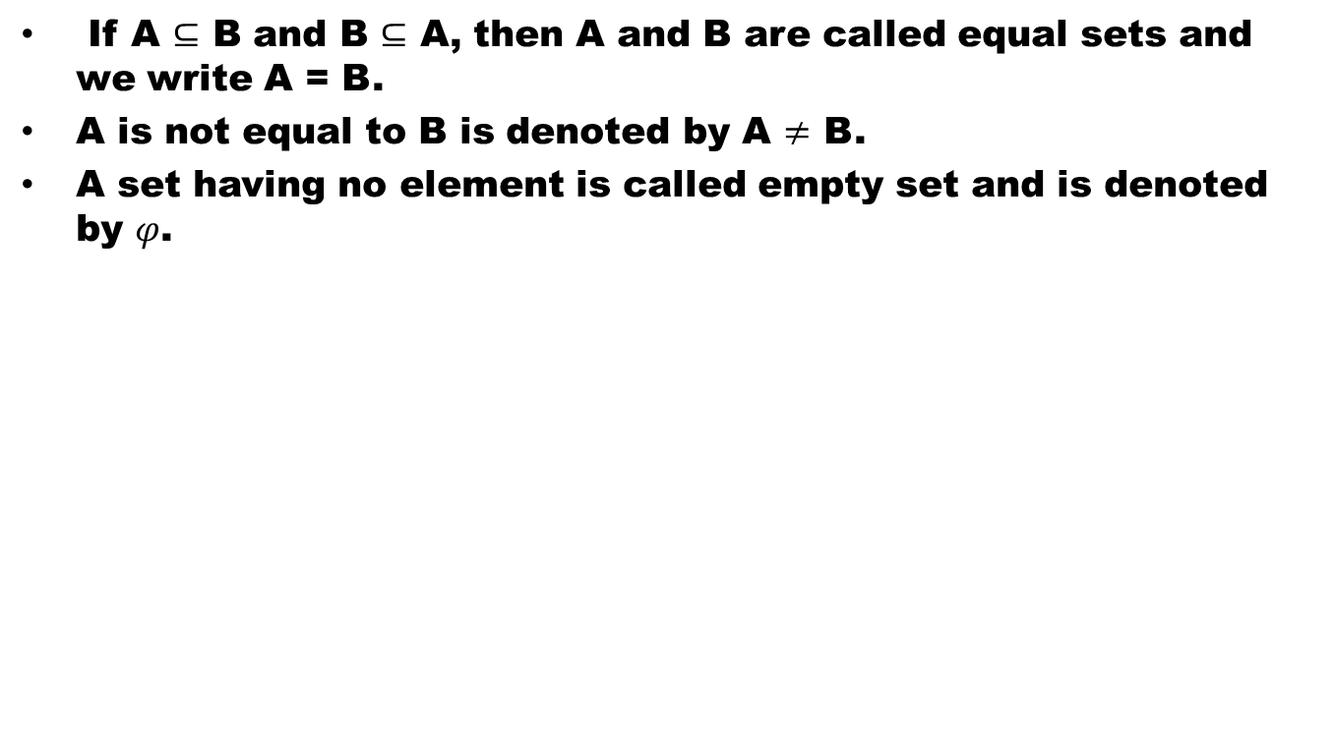
Subsets:A set A is called a subset of a set B if each element of A belongs to B. It is denoted by A $⊆$ B
If A $⊆$ B and B $⊆$ A, then A and B are called equal sets and we write A = B.
A is not equal to B is denoted by A $≠$ B.
A set having no element is called empty set and is denoted by $φ$.

Slide 55
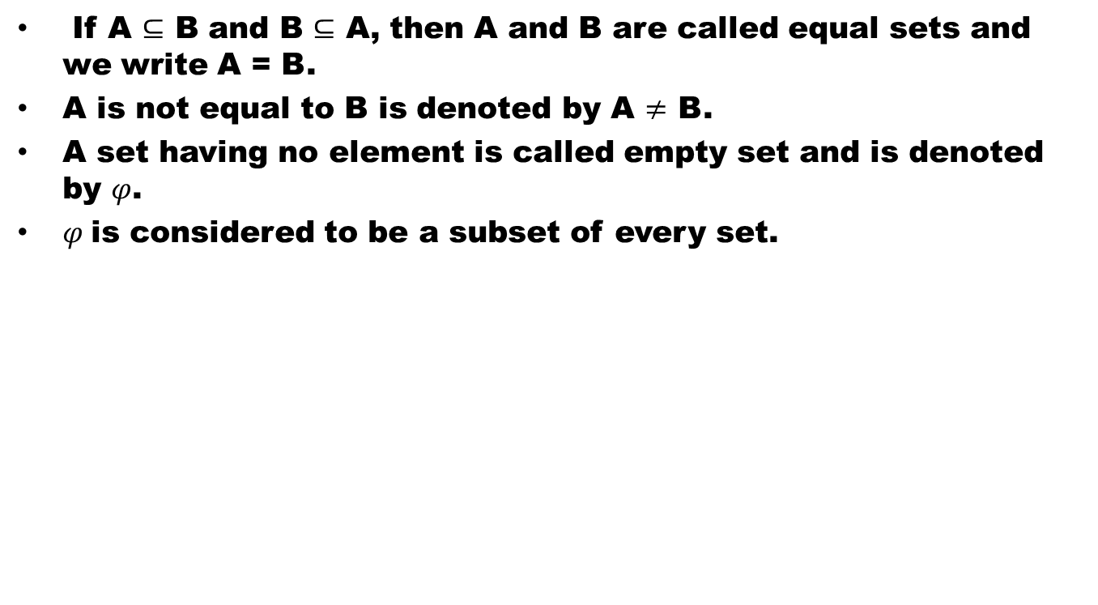
Subsets:A set A is called a subset of a set B if each element of A belongs to B. It is denoted by A $⊆$ B
If A $⊆$ B and B $⊆$ A, then A and B are called equal sets and we write A = B.
A is not equal to B is denoted by A $≠$ B.
A set having no element is called empty set and is denoted by $φ$.
$φ$is considered to be a subset of every set.

Slide 56
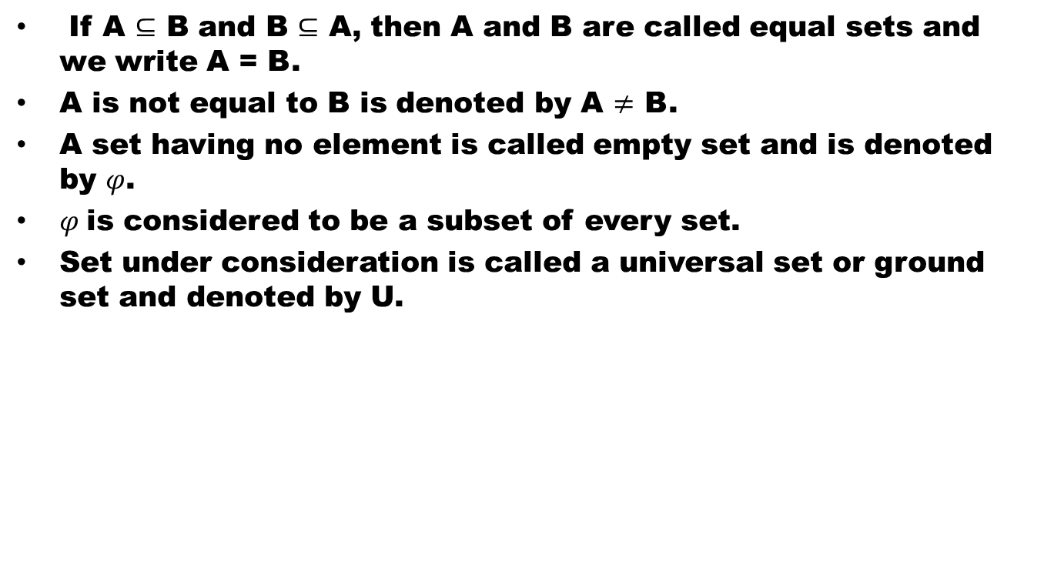
Subsets:A set A is called a subset of a set B if each element of A belongs to B. It is denoted by A $⊆$ B
If A $⊆$ B and B $⊆$ A, then A and B are called equal sets and we write A = B.
A is not equal to B is denoted by A $≠$ B.
A set having no element is called empty set and is denoted by $φ$.
$φ$is considered to be a subset of every set.
Set under consideration is called a universal set or ground set and denoted by U.

Slide 57
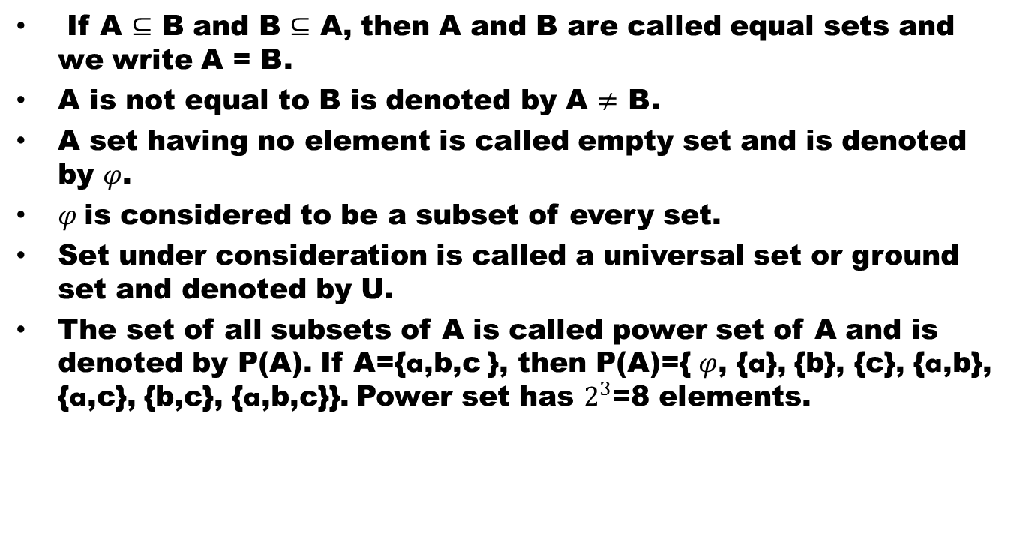
Subsets:A set A is called a subset of a set B if each element of A belongs to B. It is denoted by A $⊆$ B
If A $⊆$ B and B $⊆$ A, then A and B are called equal sets and we write A = B.
A is not equal to B is denoted by A $≠$ B.
A set having no element is called empty set and is denoted by $φ$.
$φ$is considered to be a subset of every set.
Set under consideration is called a universal set or ground set and denoted by U.
The set of all subsets of A is called power set of A and is denoted by P(A). If A={a,b,c }, then P(A)={ $φ$, {a}, {b}, {c}, {a,b}, {a,c}, {b,c}, {a,b,c}}. Power set has $2^{3}$=8 elements.

Slide 58
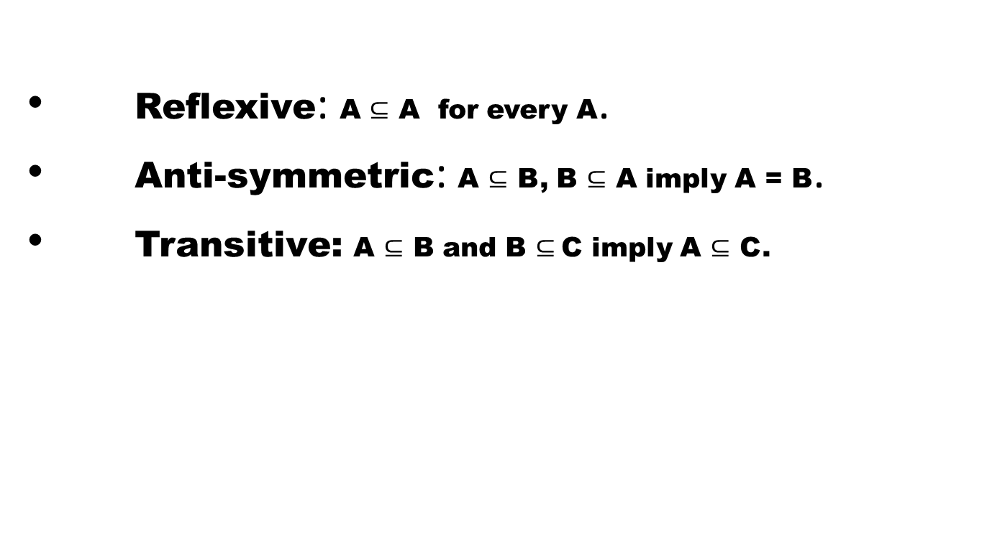
main properties of set inclusion are
Reflexive: A $⊆$ A for every A.
Anti-symmetric: A $⊆$ B, B $⊆$ A imply A = B.
Transitive:A $⊆$ B and B $⊆$C imply A $⊆$ C.

Slide 59
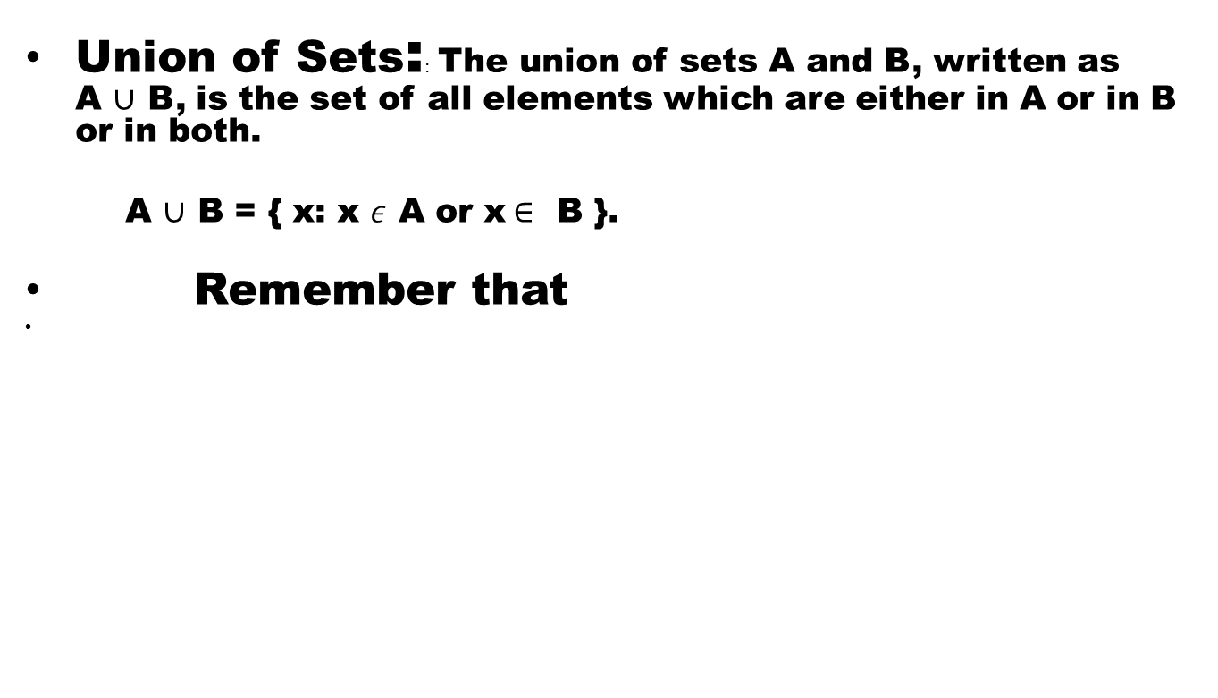
Algebra of Sets
Union of Sets:: The union of sets A and B, written as A $∪$ B, is the set of all elements which are either in A or in B or in both.
A $∪$ B = { x: x$ε$ A or x$∈$ B }.
Remember that

Slide 60
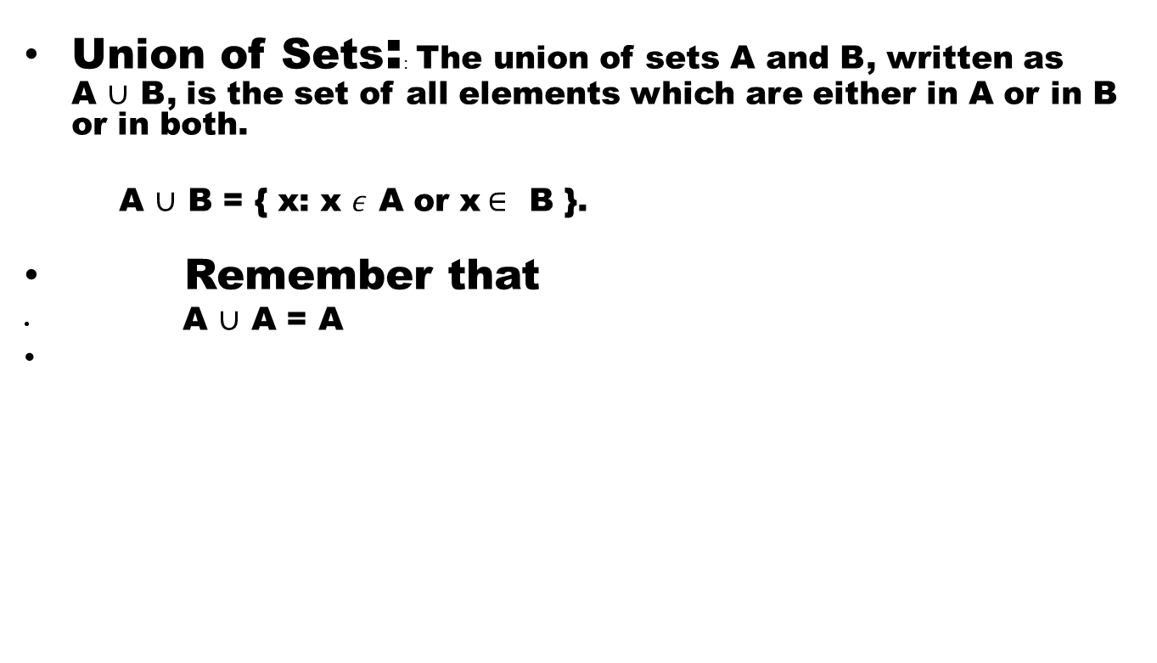
Algebra of Sets
Union of Sets:: The union of sets A and B, written as A $∪$ B, is the set of all elements which are either in A or in B or in both.
A $∪$ B = { x: x$ε$ A or x$∈$ B }.
Remember that
A $∪$ A = A

Slide 61
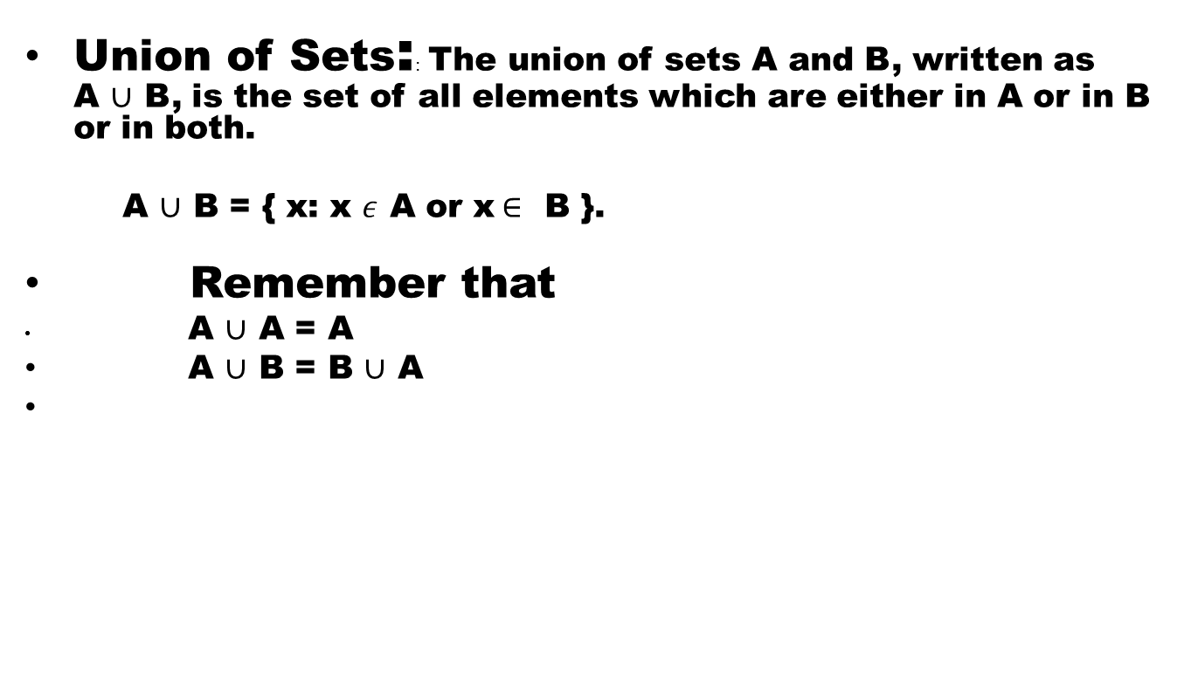
Algebra of Sets
Union of Sets:: The union of sets A and B, written as A $∪$ B, is the set of all elements which are either in A or in B or in both.
A $∪$ B = { x: x$ε$ A or x$∈$ B }.
Remember that
A $∪$ A = A
A $∪$ B = B $∪$ A

Slide 62
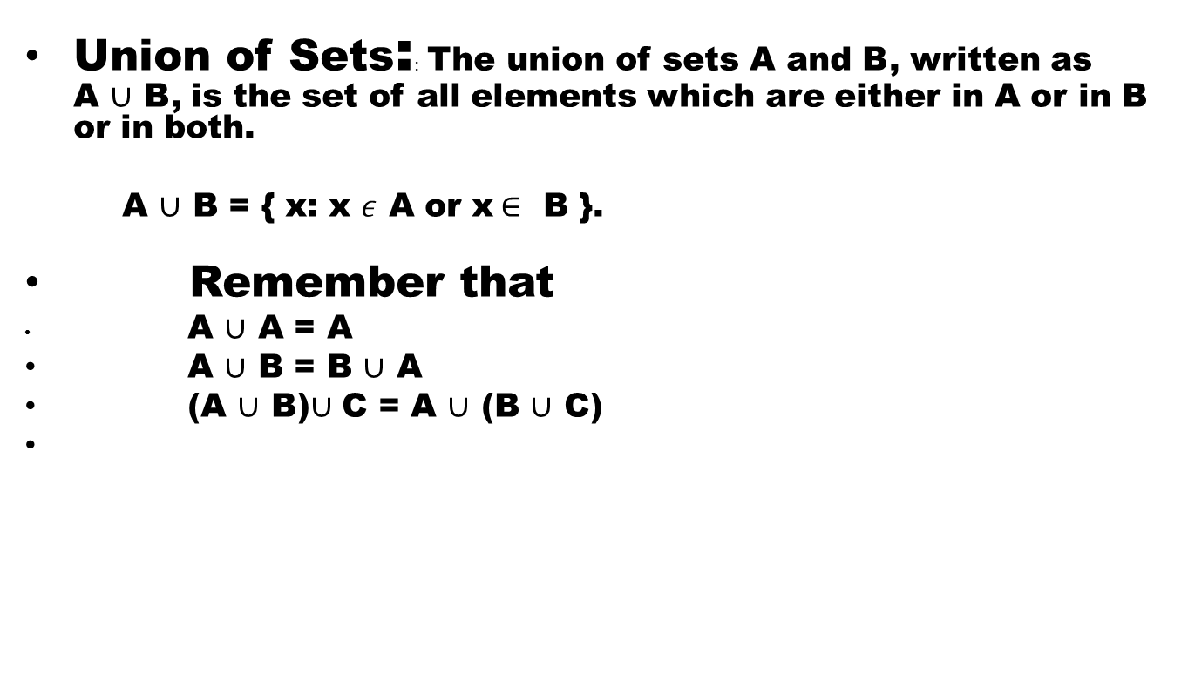
Algebra of Sets
Union of Sets:: The union of sets A and B, written as A $∪$ B, is the set of all elements which are either in A or in B or in both.
A $∪$ B = { x: x$ε$ A or x$∈$ B }.
Remember that
A $∪$ A = A
A $∪$ B = B $∪$ A
(A $∪$ B)$∪$ C = A $∪$ (B $∪$ C)

Slide 63
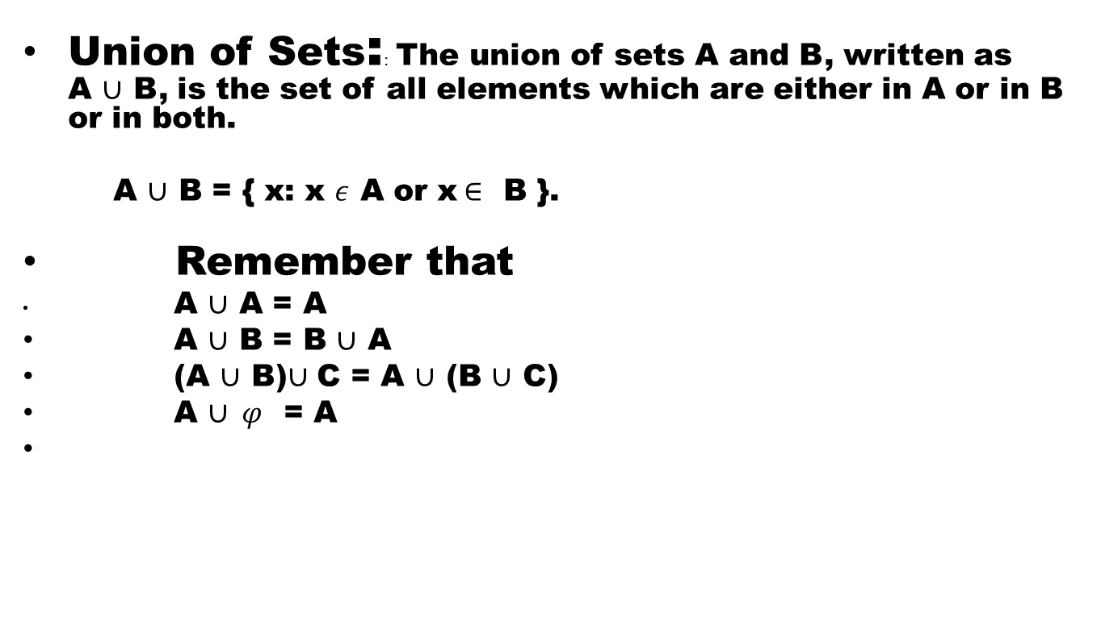
Algebra of Sets
Union of Sets:: The union of sets A and B, written as A $∪$ B, is the set of all elements which are either in A or in B or in both.
A $∪$ B = { x: x$ε$ A or x$∈$ B }.
Remember that
A $∪$ A = A
A $∪$ B = B $∪$ A
(A $∪$ B)$∪$ C = A $∪$ (B $∪$ C)
A $∪ φ$ = A

Slide 64
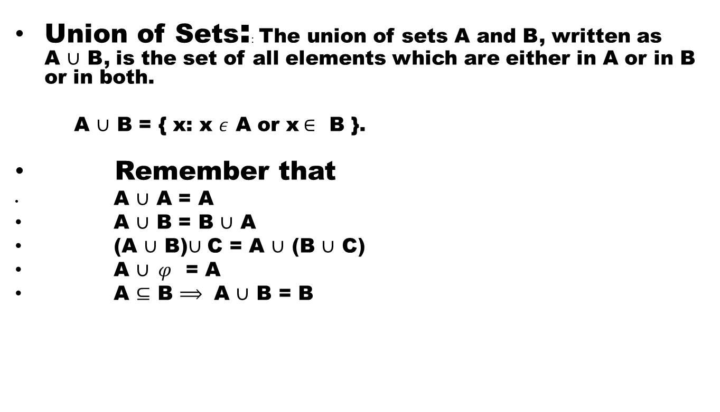
Algebra of Sets
Union of Sets:: The union of sets A and B, written as A $∪$ B, is the set of all elements which are either in A or in B or in both.
A $∪$ B = { x: x$ε$ A or x$∈$ B }.
Remember that
A $∪$ A = A
A $∪$ B = B $∪$ A
(A $∪$ B)$∪$ C = A $∪$ (B $∪$ C)
A $∪ φ$ = A
A $⊆$ B $⟹$ A $∪$ B = B

Slide 65
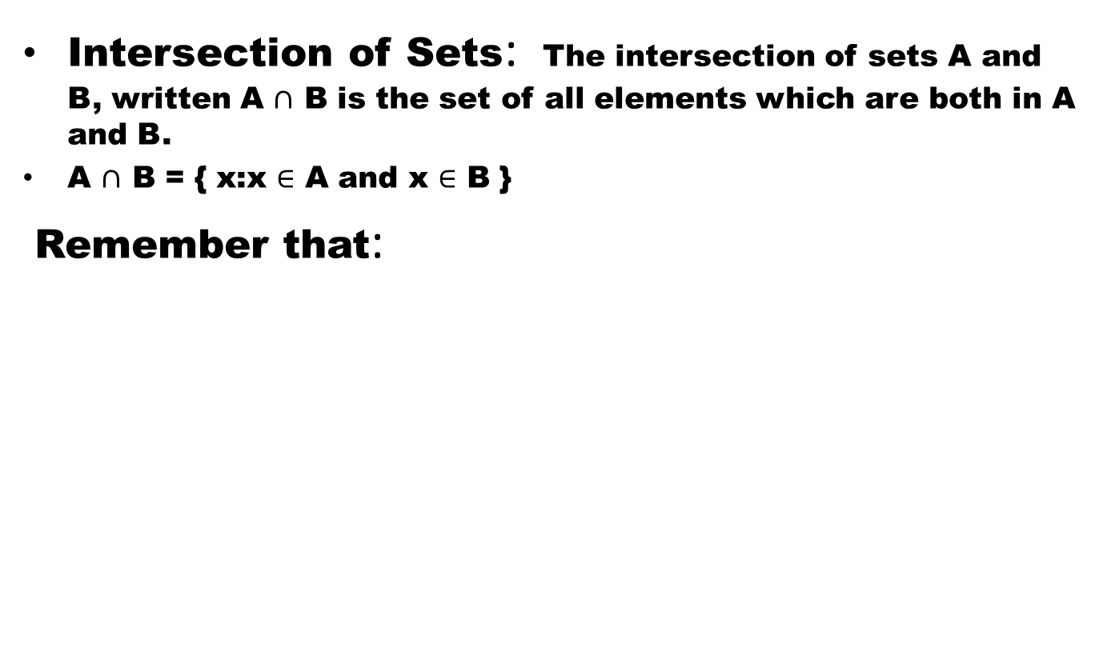
Algebra of Sets
Intersection of Sets: The intersection of sets A and B, written A $∩$ B is the set of all elements which are both in A and B.
A $∩$ B = { x:x $∈$ A and x $∈$ B }
Remember that:

Slide 66
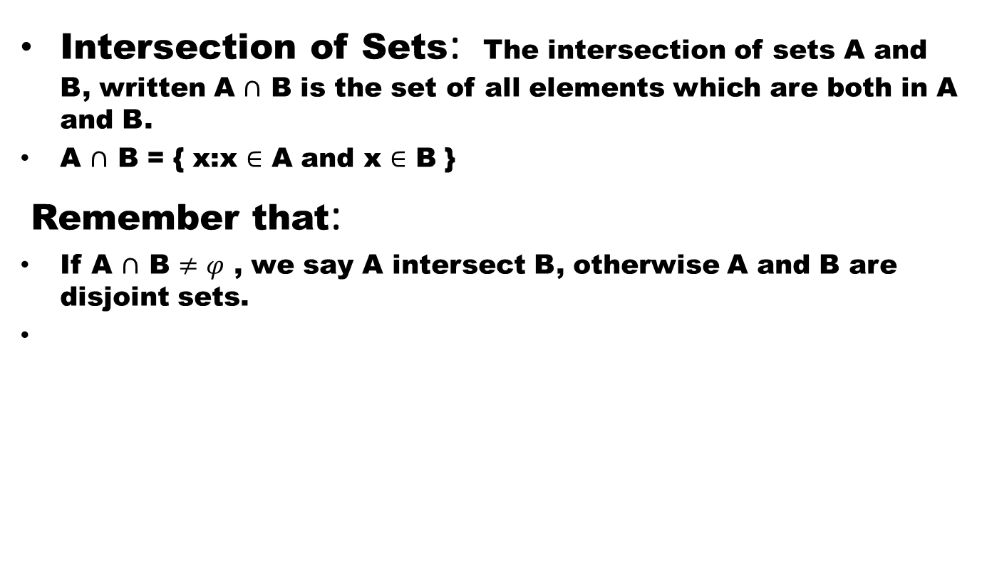
Algebra of Sets
Intersection of Sets: The intersection of sets A and B, written A $∩$ B is the set of all elements which are both in A and B.
A $∩$ B = { x:x $∈$ A and x $∈$ B }
Remember that:
If A $∩$ B $≠φ$ , we say A intersect B, otherwise A and B are disjoint sets.

Slide 67
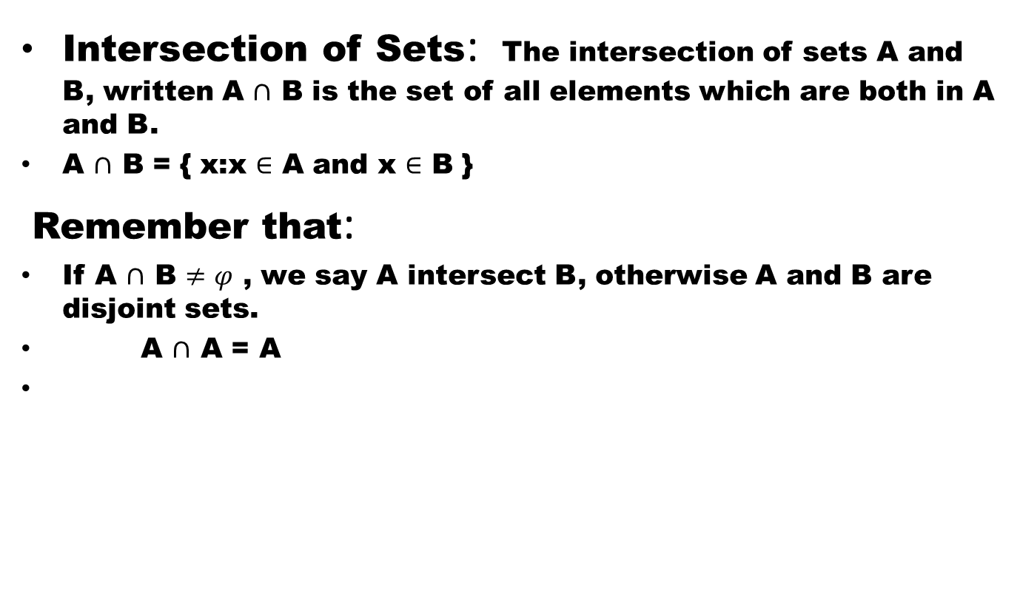
Algebra of Sets
Intersection of Sets: The intersection of sets A and B, written A $∩$ B is the set of all elements which are both in A and B.
A $∩$ B = { x:x $∈$ A and x $∈$ B }
Remember that:
If A $∩$ B $≠φ$ , we say A intersect B, otherwise A and B are disjoint sets.
A $∩$ A = A

Slide 68
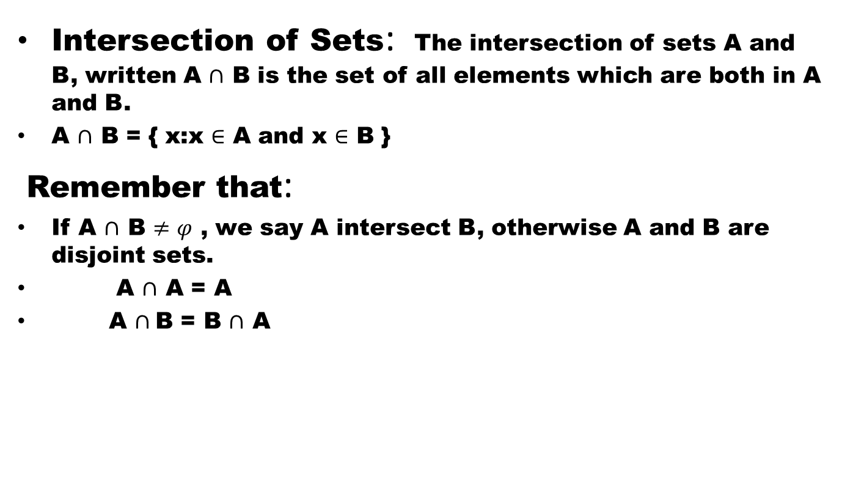
Algebra of Sets
Intersection of Sets: The intersection of sets A and B, written A $∩$ B is the set of all elements which are both in A and B.
A $∩$ B = { x:x $∈$ A and x $∈$ B }
Remember that:
If A $∩$ B $≠φ$ , we say A intersect B, otherwise A and B are disjoint sets.
A $∩$ A = A
A $∩$B = B $∩$ A

Slide 69
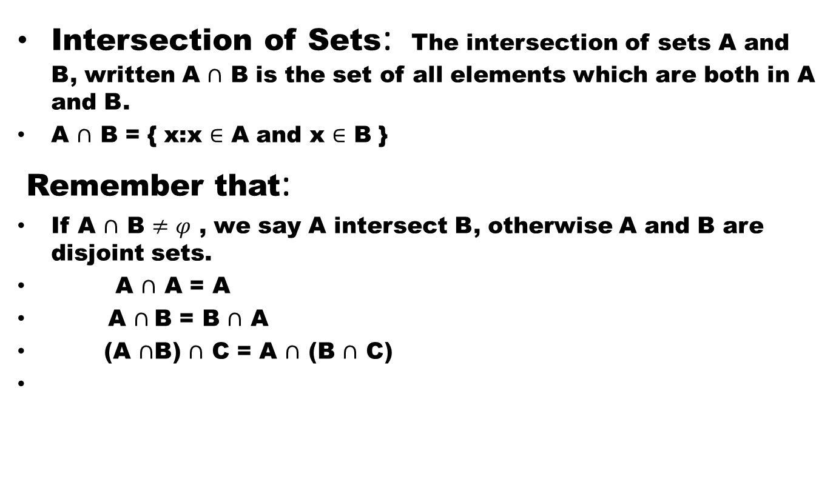
Algebra of Sets
Intersection of Sets: The intersection of sets A and B, written A $∩$ B is the set of all elements which are both in A and B.
A $∩$ B = { x:x $∈$ A and x $∈$ B }
Remember that:
If A $∩$ B $≠φ$ , we say A intersect B, otherwise A and B are disjoint sets.
A $∩$ A = A
A $∩$B = B $∩$ A
(A $∩$B) $∩$ C = A $∩$ (B $∩$ C)

Slide 70
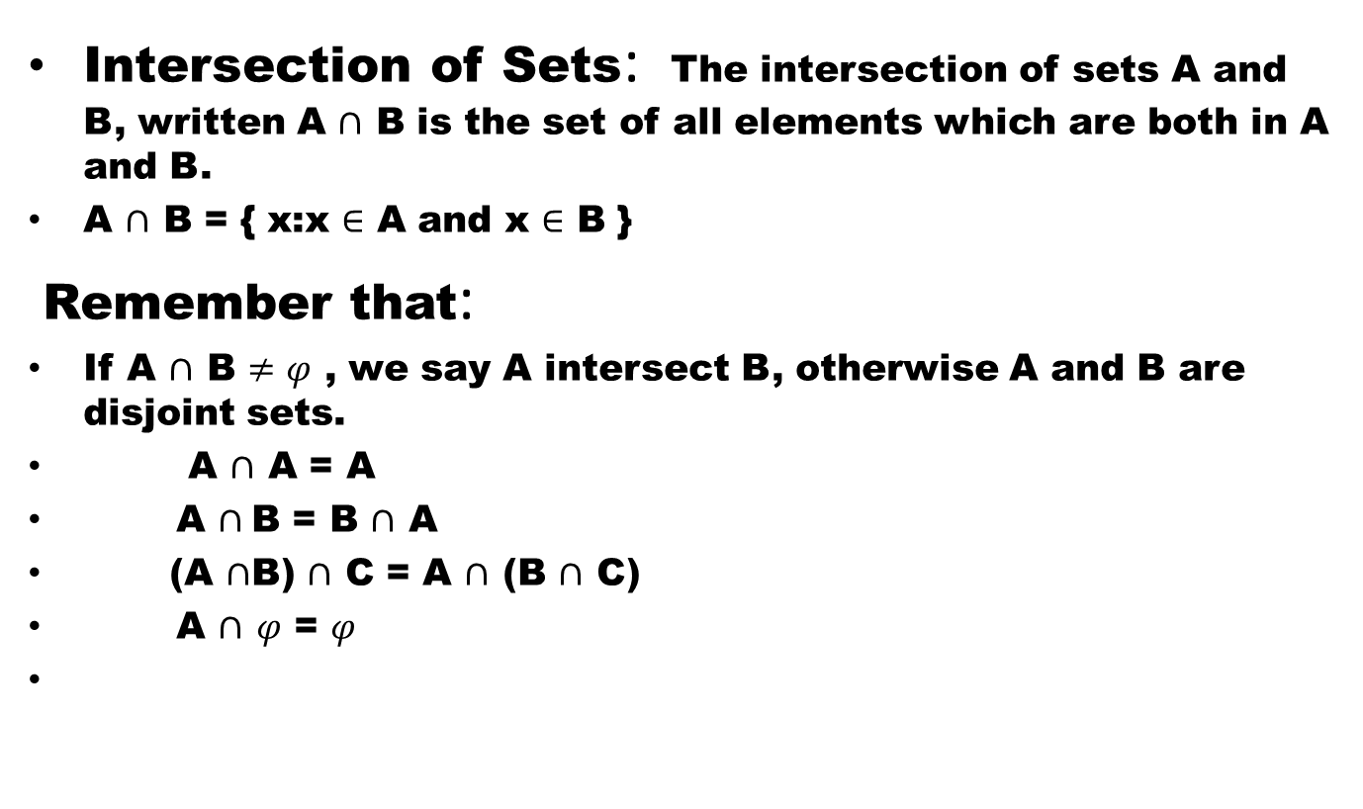
Algebra of Sets
Intersection of Sets: The intersection of sets A and B, written A $∩$ B is the set of all elements which are both in A and B.
A $∩$ B = { x:x $∈$ A and x $∈$ B }
Remember that:
If A $∩$ B $≠φ$ , we say A intersect B, otherwise A and B are disjoint sets.
A $∩$ A = A
A $∩$B = B $∩$ A
(A $∩$B) $∩$ C = A $∩$ (B $∩$ C)
A $∩$$φ$ = $φ$

Slide 71
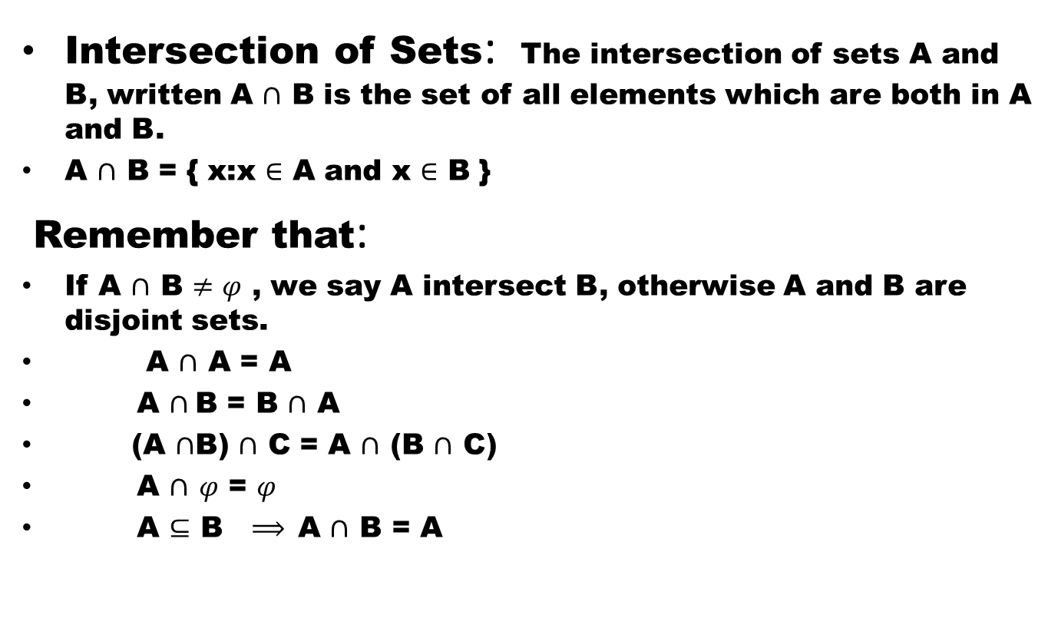
Algebra of Sets
Intersection of Sets: The intersection of sets A and B, written A $∩$ B is the set of all elements which are both in A and B.
A $∩$ B = { x:x $∈$ A and x $∈$ B }
Remember that:
If A $∩$ B $≠φ$ , we say A intersect B, otherwise A and B are disjoint sets.
A $∩$ A = A
A $∩$B = B $∩$ A
(A $∩$B) $∩$ C = A $∩$ (B $∩$ C)
A $∩$$φ$ = $φ$
A $⊆$ B $⟹$A $∩$ B = A

Slide 72
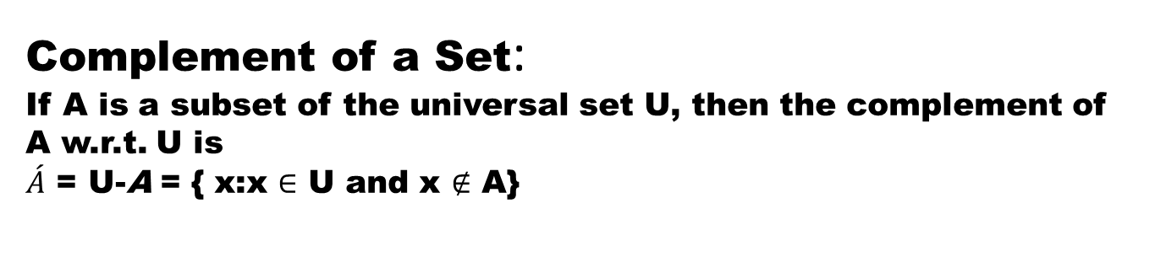
Complement of a Set:
If A is a subset of the universal set U, then the complement of A w.r.t. U is
$\acute{A}$ = U-A = { x:x $∈$ U and x $∉$ A}
Remember:

Slide 73
De-Morgan’s Laws

Slide 74
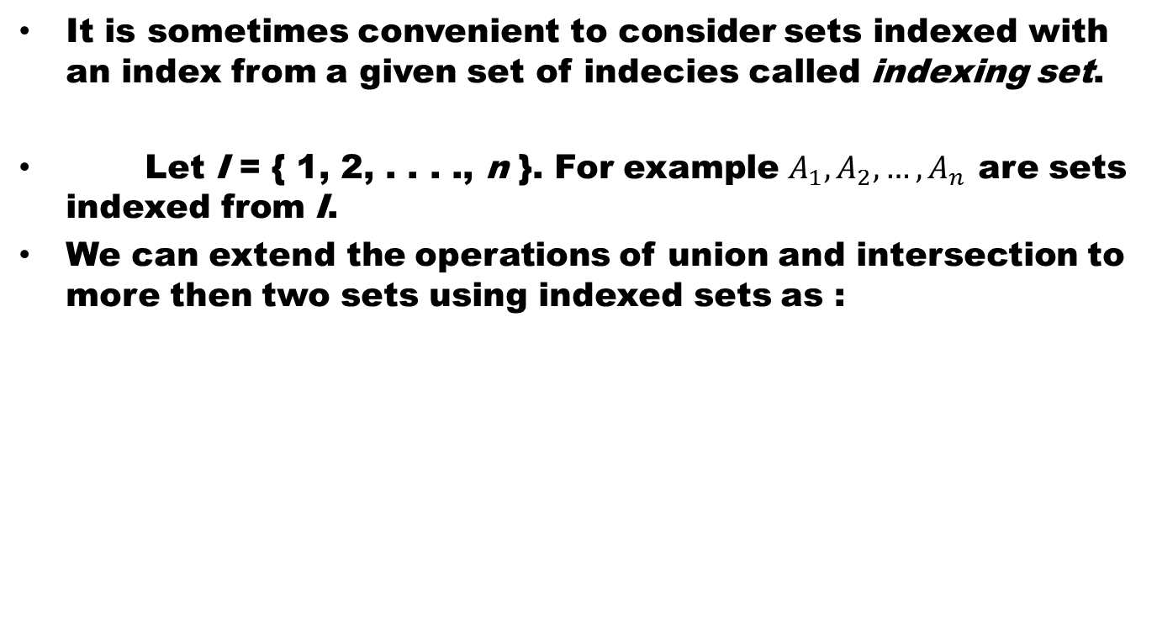
Indexed SETS
It is sometimes convenient to consider sets indexed with an index from a given set of indecies called indexing set.
Let I = { 1, 2, . . . ., n }. For example $A_{1}, A_{2}, …, A_{n}$are sets indexed from I.
We can extend the operations of union and intersection to more then two sets using indexed sets as :

Slide 75
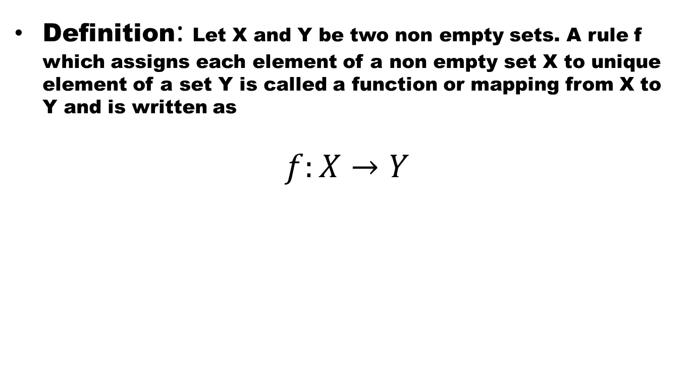
Functions
Definition: Let X and Y be two non empty sets. A rule f which assigns each element of a non empty set X to unique element of a set Y is called a function or mapping from X to Y and is written as
$$f:X→Y$$

Slide 76
Example 1:

Slide 77
Example 2:

Slide 78
Example 3:

Slide 79
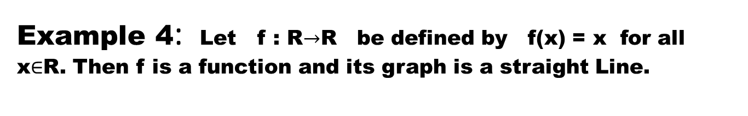
Example 4: Let f : R$→$R be defined by f(x) = x for all x$∈$R. Then f is a function and its graph is a straight Line.

Slide 80
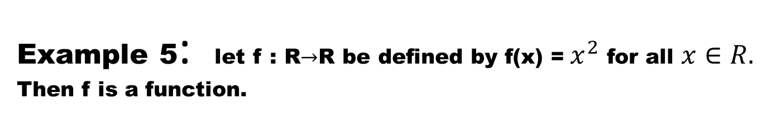
Example 5: let f : R$→$R be defined by f(x) =${ x}^{2}$ for all $x∈R.$ Then f is a function.

Slide 81
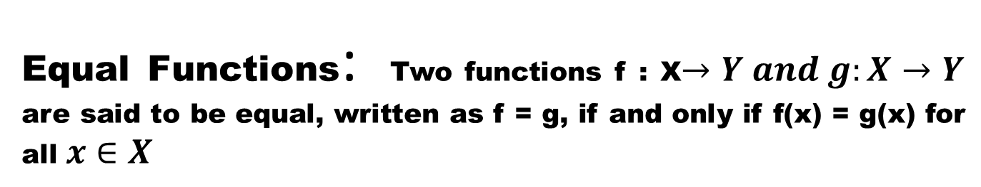
Equal Functions: Two functions f : X$→Y and g:X→Y$are said to be equal, written as f = g, if and only if f(x) = g(x) for all $x∈X$

Slide 82
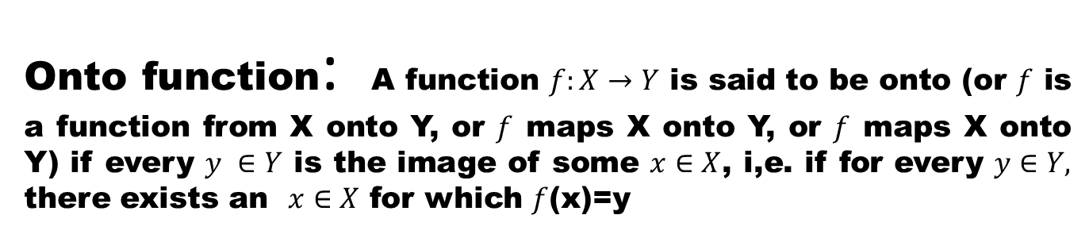
Onto function: A function $f:X→Y$ is said to be onto (or $f$ is a function from X onto Y, or $f$ maps X onto Y, or $f$ maps X onto Y) if every $y ∈Y$ is the image of some $x∈X$, i,e. if for every $y∈Y,$ there exists an $x∈X$ for which $f$(x)=y

Slide 83
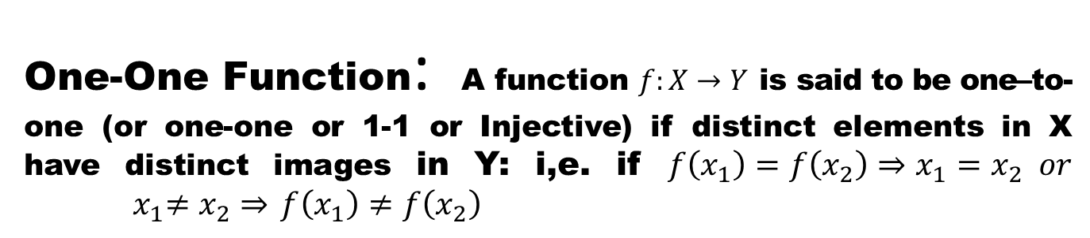
One-One Function: A function $f:X→Y$ is said to be one–to-one (or one-one or 1-1 or Injective) if distinct elements in X have distinct images in Y: i,e. if $f\left(x_{1}\right)=f\left(x_{2}\right)⇒x_{1}=x_{2} or$
${ x}_{1}≠x_{2}⇒$$f\left(x_{1}\right)≠f\left(x_{2}\right)$

Slide 84
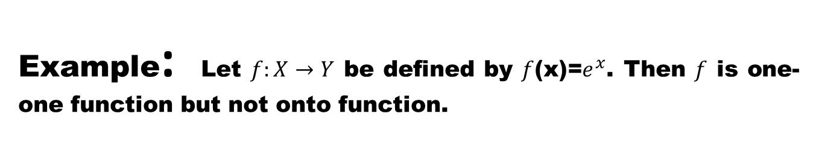
Example: Let $f:X→Y$ be defined by $f$(x)=$e^{x}$. Then $f$ is one-one function but not onto function.

Slide 85
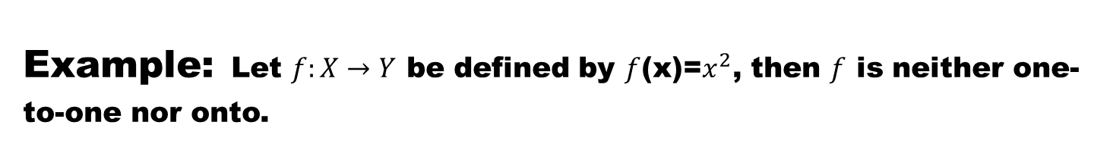
Example:Let $f:X→Y$ be defined by $f$(x)=$x^{2}$, then $f$ is neither one-to-one nor onto.

Slide 86

Bijective function: A function $f:X→Y$is said to be bijective if it is one-to-one as well as onto.

