Slide 1
(MTH 250)
Calculus
Lecture 32

Slide 2
Previous Lecture’s Summary
    Orientation of non-parametric surfaces
    Green’s theorem for line integrals
    Stoke’s theorem
    Relationship b/w Green & Stoke’s theorem

Slide 3
Today’s Lecture
    Recalls
    Triple integrals
    Evaluating triple integrals
    Volume as triple integral
    Divergence theorem

Slide 4
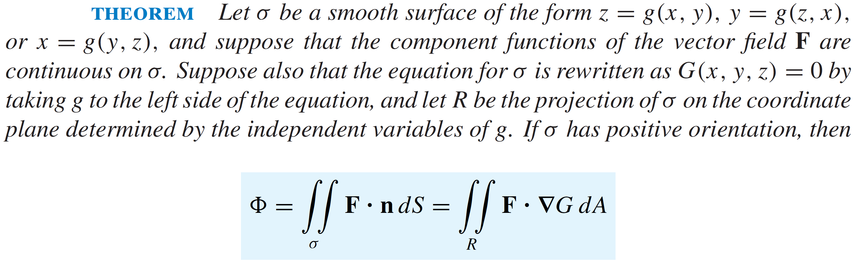
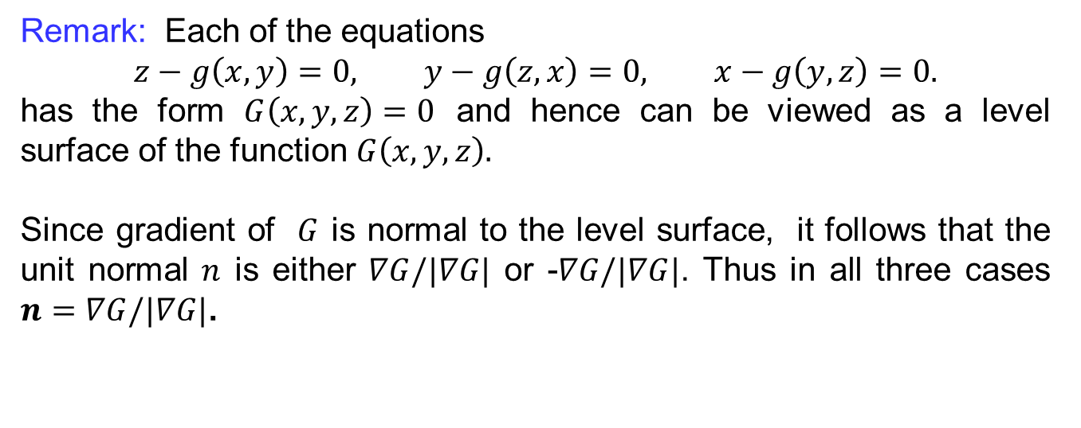
Recall
Remark: Each of the equations
$$z−g\left(x,y\right)=0, y−g\left(z,x\right)=0, x−g\left(y,z\right)=0.$$
has the form $G\left(x,y,z\right)=0$ and hence can be viewed as a level surface of the function $G\left(x,y,z\right).$
Since gradient of $G$is normal to the level surface, itfollowsthat the unit normal $n$iseither$∇G/|∇G|$ or -$∇G/|∇G|$.Thus in all three cases $n=∇G/|∇G|$.

Slide 5
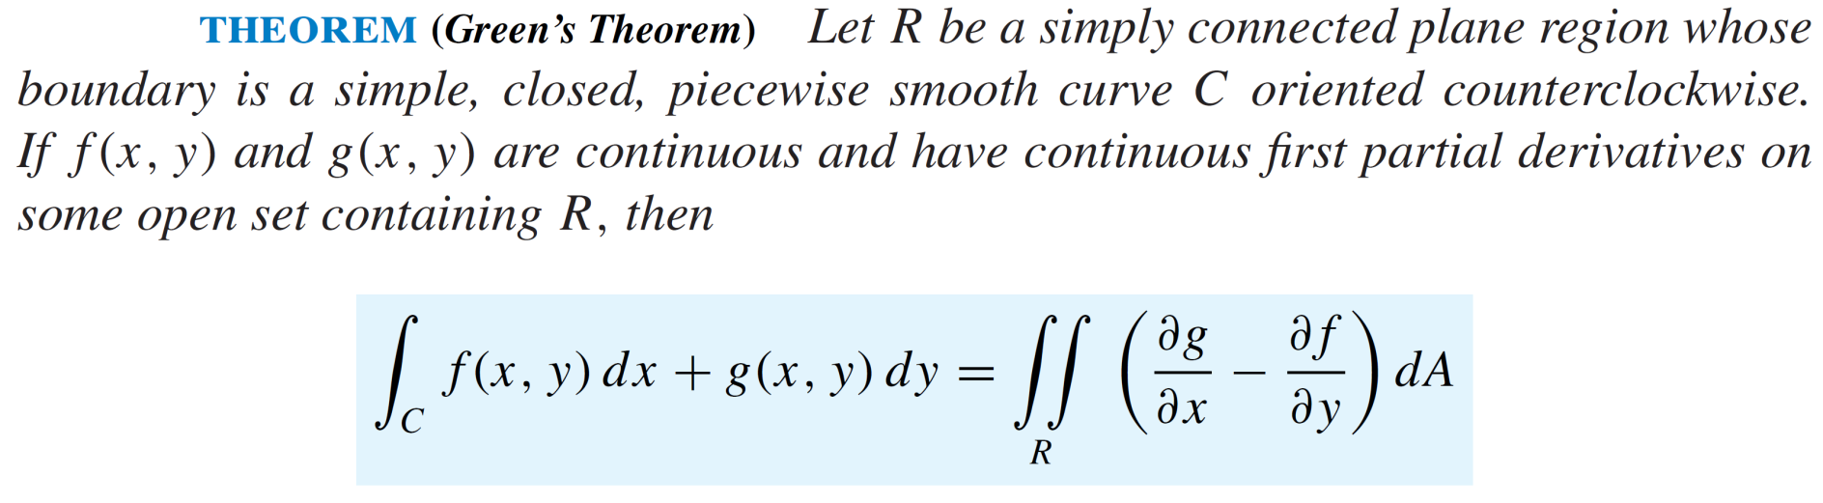
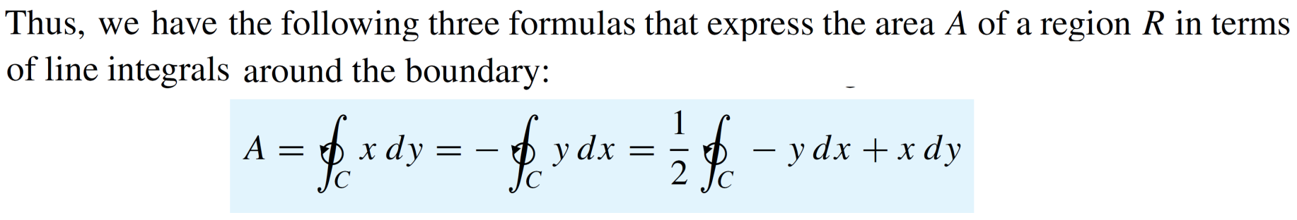
Recall

Slide 6
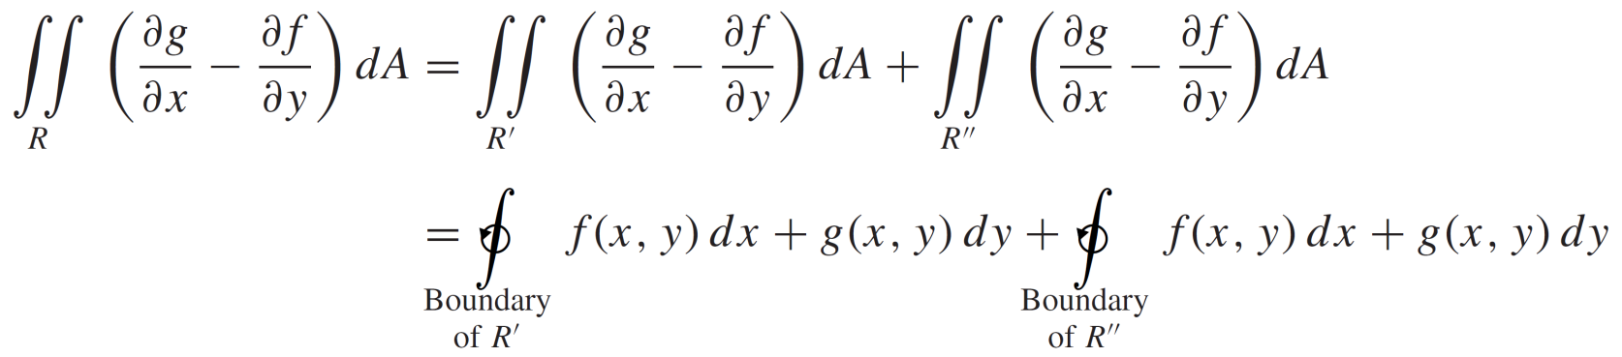
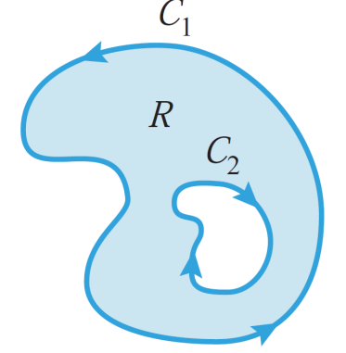
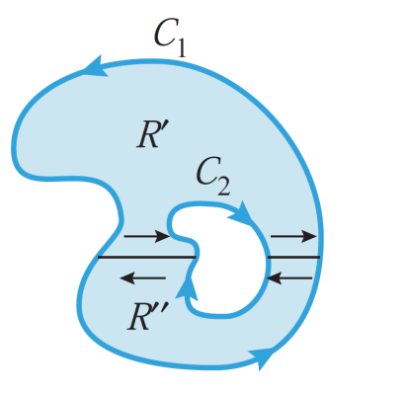
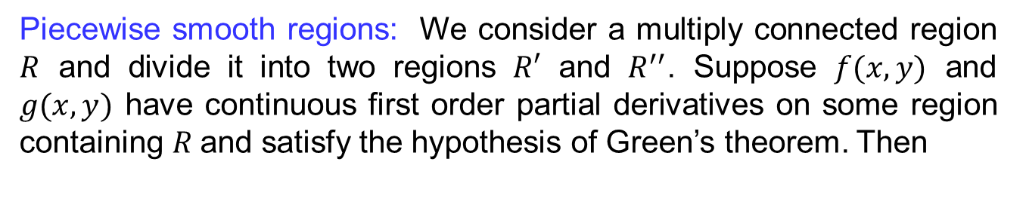
Recall
Piecewise smooth regions:Weconsider a multiplyconnectedregion$R$ and divide it into two regions $R′$ and $R^{′′}$. Suppose $f(x,y)$ and $g(x,y)$ have continuous first order partial derivatives on some region containing $R$and satisfy the hypothesis of Green’s theorem. Then

Slide 7
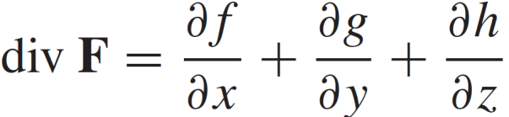
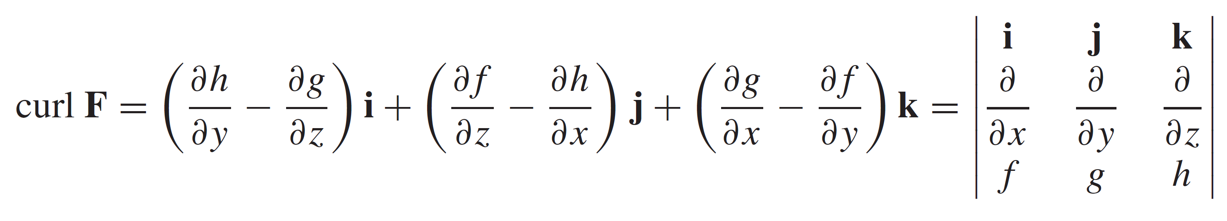
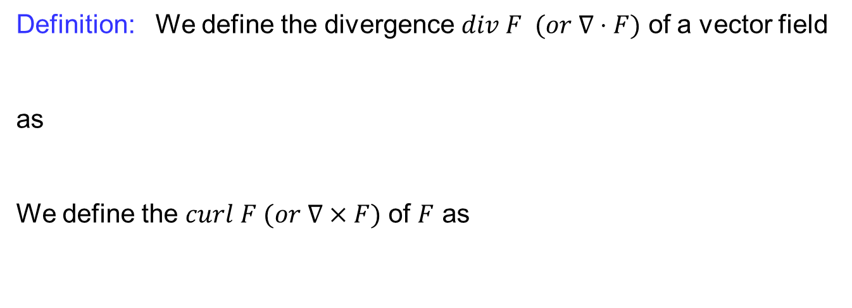
Recall
Definition:Wedefine the divergence $div F (or ∇⋅F)$ of a vectorfield
as
Wedefine the $curl F (or ∇×F)$ of $F$ as

Slide 8
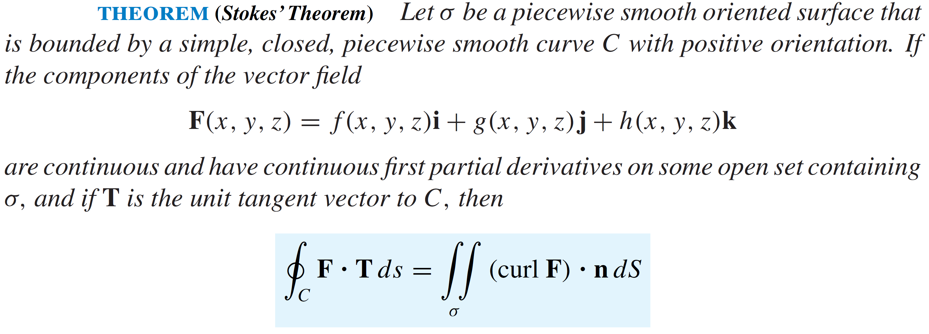
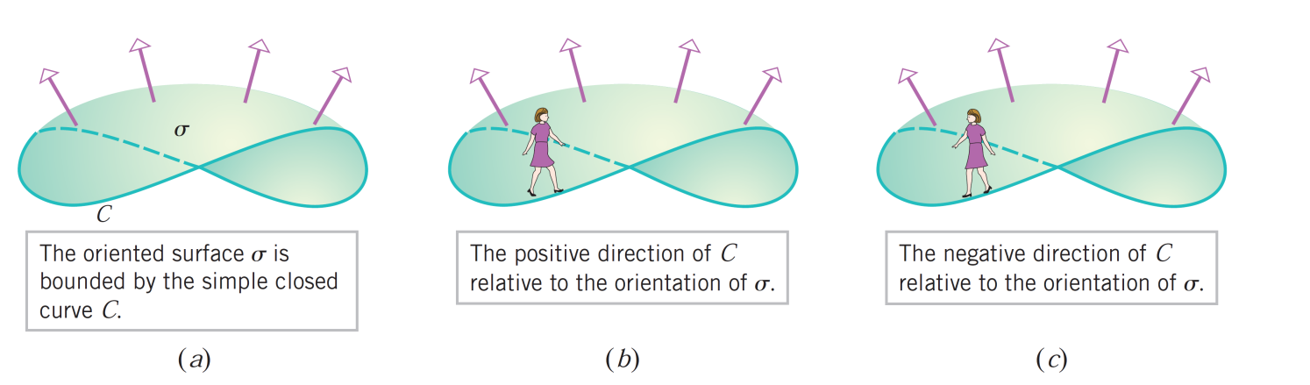
Recall

Slide 9
Recall
  Stokes’ theorem states that: The line integral around the boundary curve of S of the tangential component of F is equal to the surface integral of the normal component of the curl of F.

Slide 10
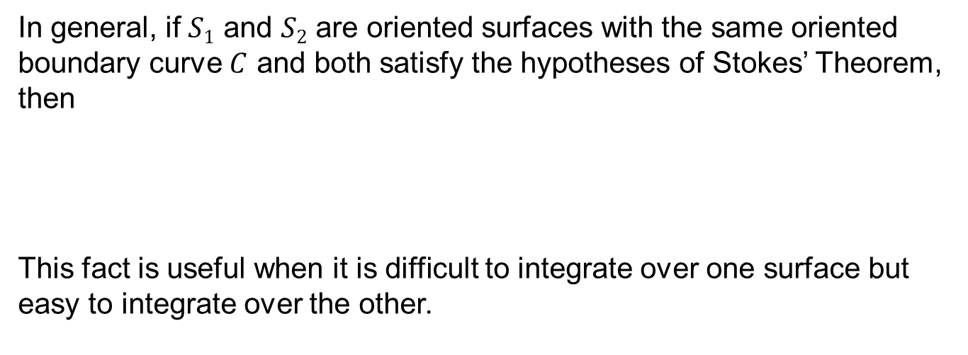
Recall
In general, if $S1$ and $S2$ are oriented surfaces with the same oriented boundary curve $C$ and both satisfy the hypotheses of Stokes’ Theorem, then
This fact is useful when it is difficult to integrate over one surface but easy to integrate over the other.

Slide 11
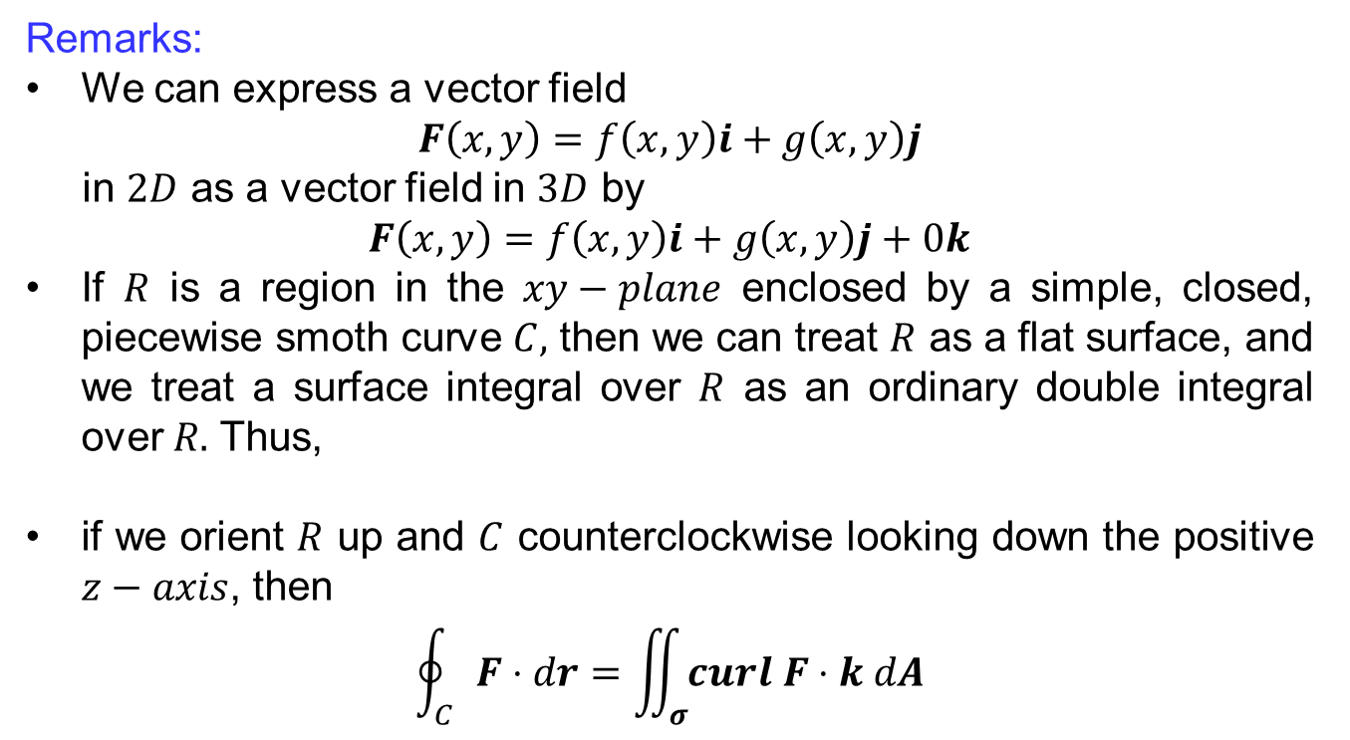
Recall
Remarks:
Wecan express a vectorfield
$$F\left(x,y\right)=f\left(x,y\right)i+g\left(x,y\right)j$$
in $2D$ as a vectorfield in $3D$ by
$$F\left(x,y\right)=f\left(x,y\right)i+g\left(x,y\right)j+0k$$
If $R$is a region in the $xy−plane$enclosed by a simple, closed, piecewisesmothcurve$C,$thenwecantreat$R$ as a flat surface, and wetreat a surface integral over $R$ as an ordinary double integral over $R.$Thus,
if we orient $R$ up and $C$counterclockwiselooking down the positive $z−axis$, then
$$\oint_{C}{F⋅dr}=\iint_{σ}{curl F⋅k dA}$$

Slide 12
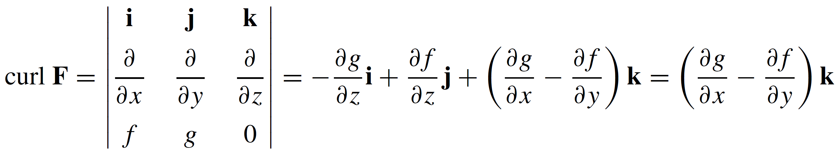
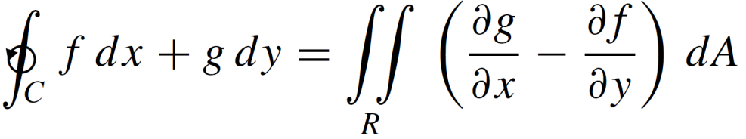
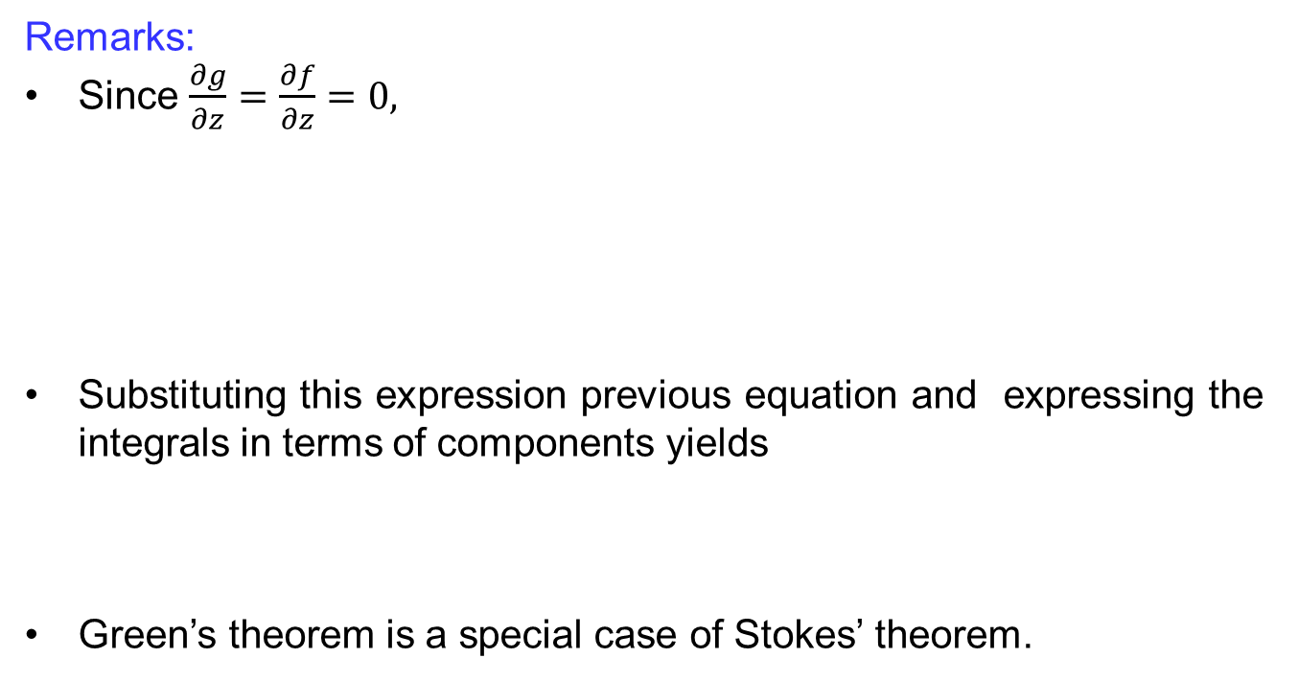
Recall
Remarks:
Since$\frac{∂g}{∂z}=\frac{∂f}{∂z}=0,$
Substitutingthis expression previousequation and expressing the integrals in terms of components yields
Green’stheoremis a special case of Stokes’theorem.

Slide 13
Recall
Remarks:
Stokes’ Theorem can be regarded as a higher-dimensional version of Green’s Theorem.
Green’s Theorem relates a double integral over a plane region D to a line integral around its plane boundary curve.
Stokes’ Theorem relates a surface integral over a surface S to a line integral around the boundary curve of S (a space curve).

Slide 14
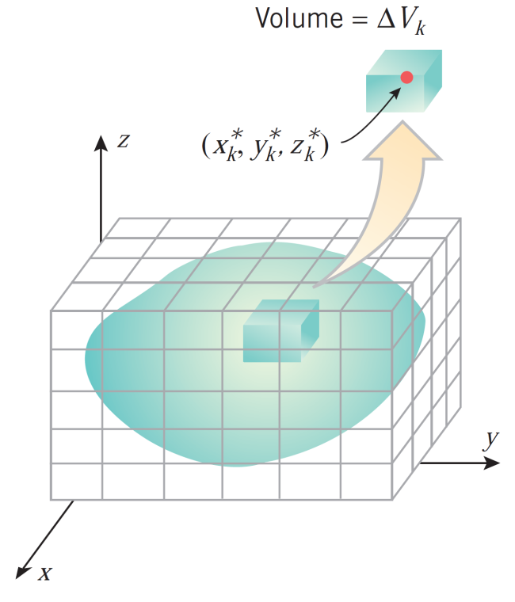
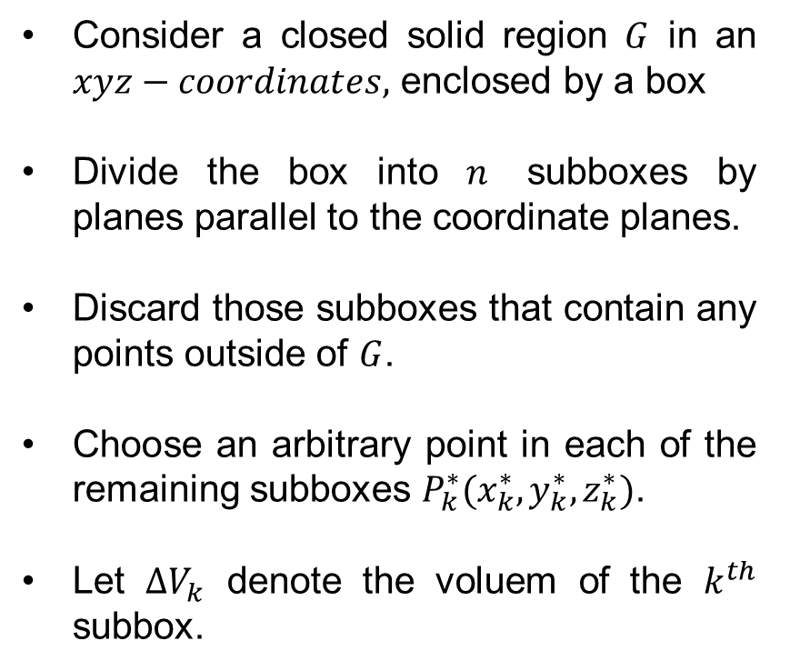
Triple Integrals
Consider a closed solid region $G$ in an $xyz−coordinates,$enclosed by a box
Divide the box into $n$subboxes by planes parallel to the coordinate planes.
Discard those subboxes that contain any points outside of $G$.
Choose an arbitrary point in each of the remaining subboxes$P_{k}^{∗}(x_{k}^{∗},y_{k}^{∗},z_{k}^{∗})$.
Let $∆V_{k}$ denote the voluem of the $k^{th}$subbox.

Slide 15
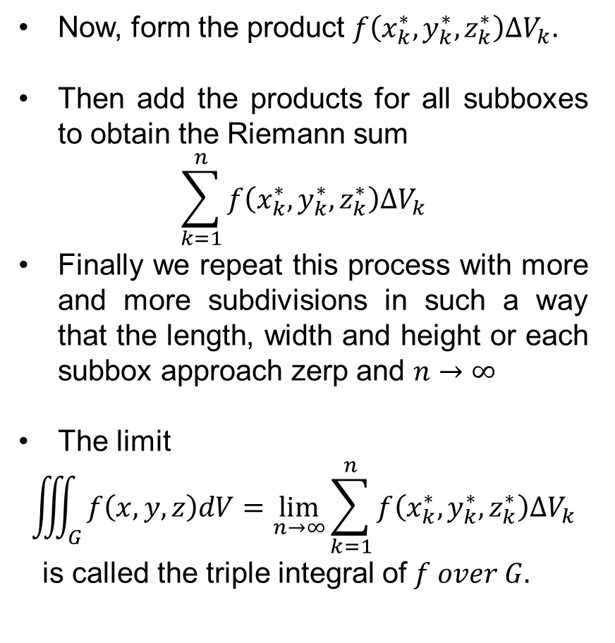
Triple Integrals
Now, form the product $f\left(x_{k}^{∗},y_{k}^{∗},z_{k}^{∗}\right)∆V_{k}.$
Then add the products for all subboxes to obtain the Riemann sum
$$\sum_{k=1}^{n}{f\left(x_{k}^{∗},y_{k}^{∗},z_{k}^{∗}\right)∆V_{k}}$$
Finally we repeat this process with more and more subdivisions in such a way that the length, width and height or each subbox approach zerp and $n→∞$
The limit
$$\iiint_{G}{f\left(x,y,z\right)dV=\lim_{n→∞}{\sum_{k=1}^{n}{f\left(x_{k}^{∗},y_{k}^{∗},z_{k}^{∗}\right)∆V_{k}}}}$$
is called the triple integral of$f over G.$

Slide 16
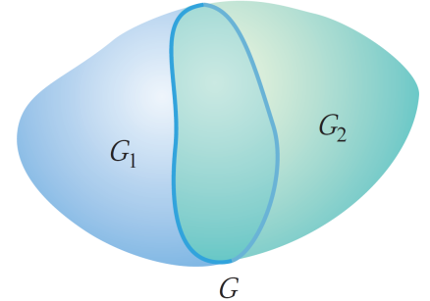
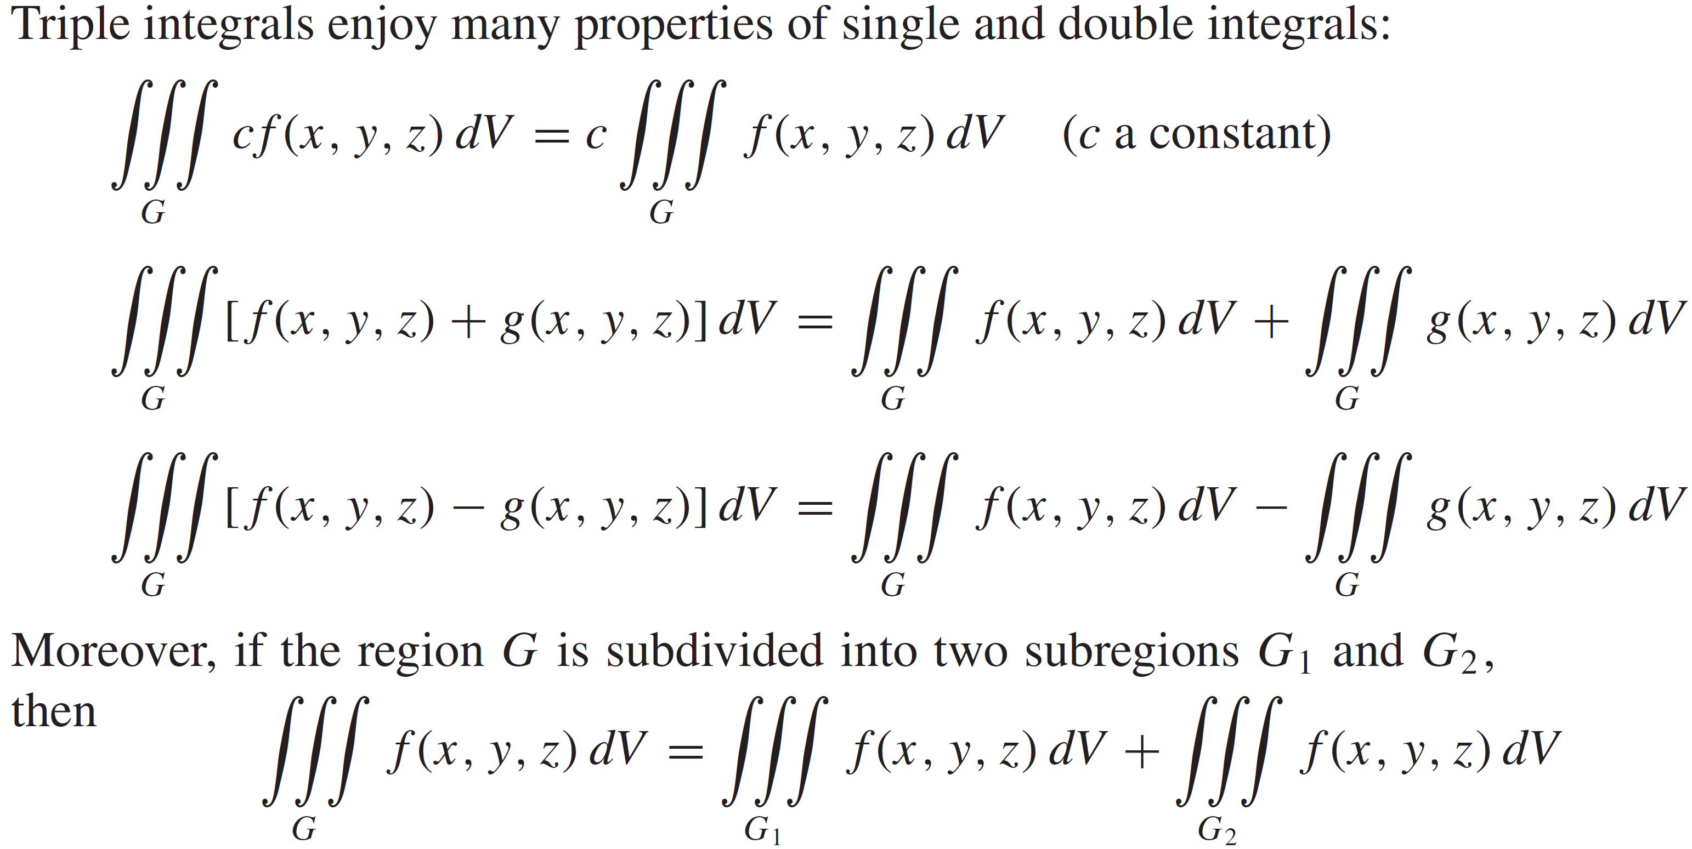
Triple Integrals
Properties of Triple integrals

Slide 17
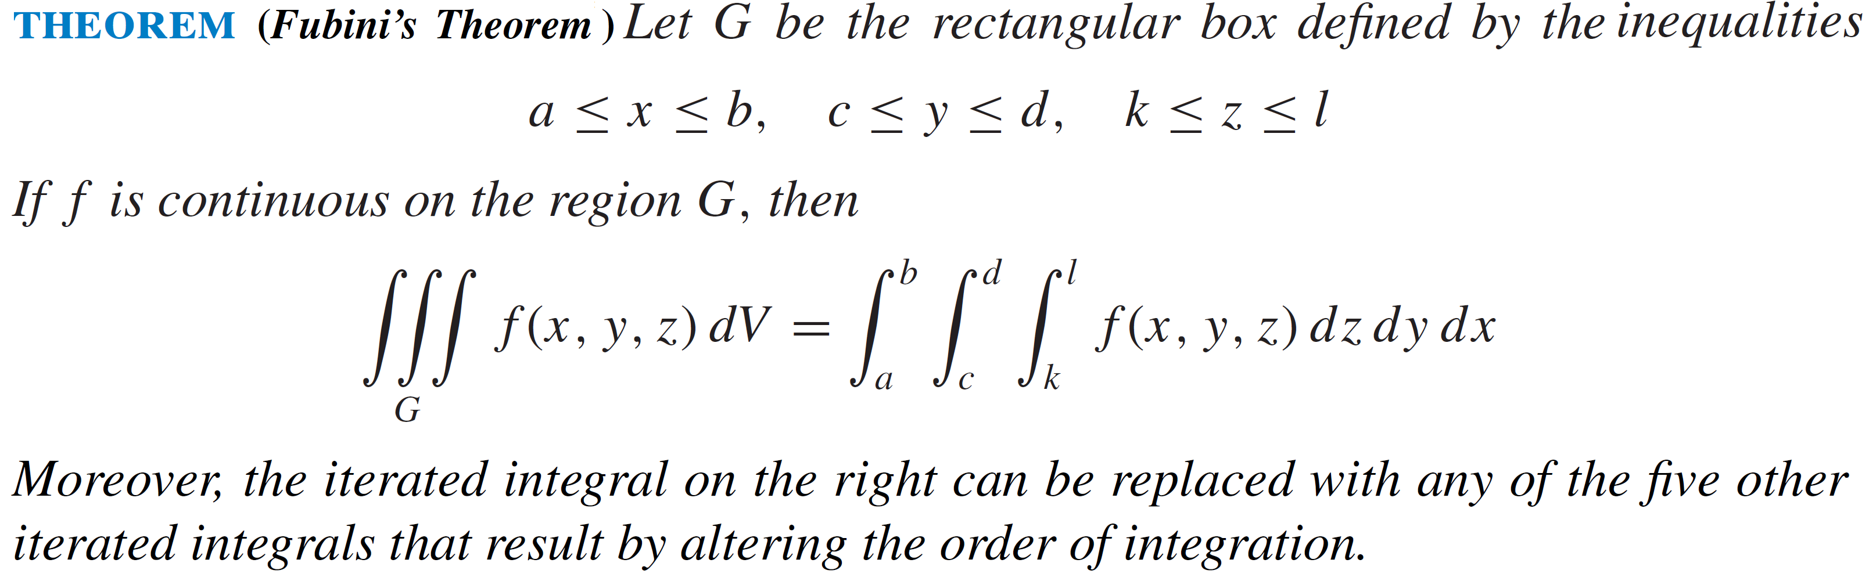
Evaluating triple Integrals

Slide 18
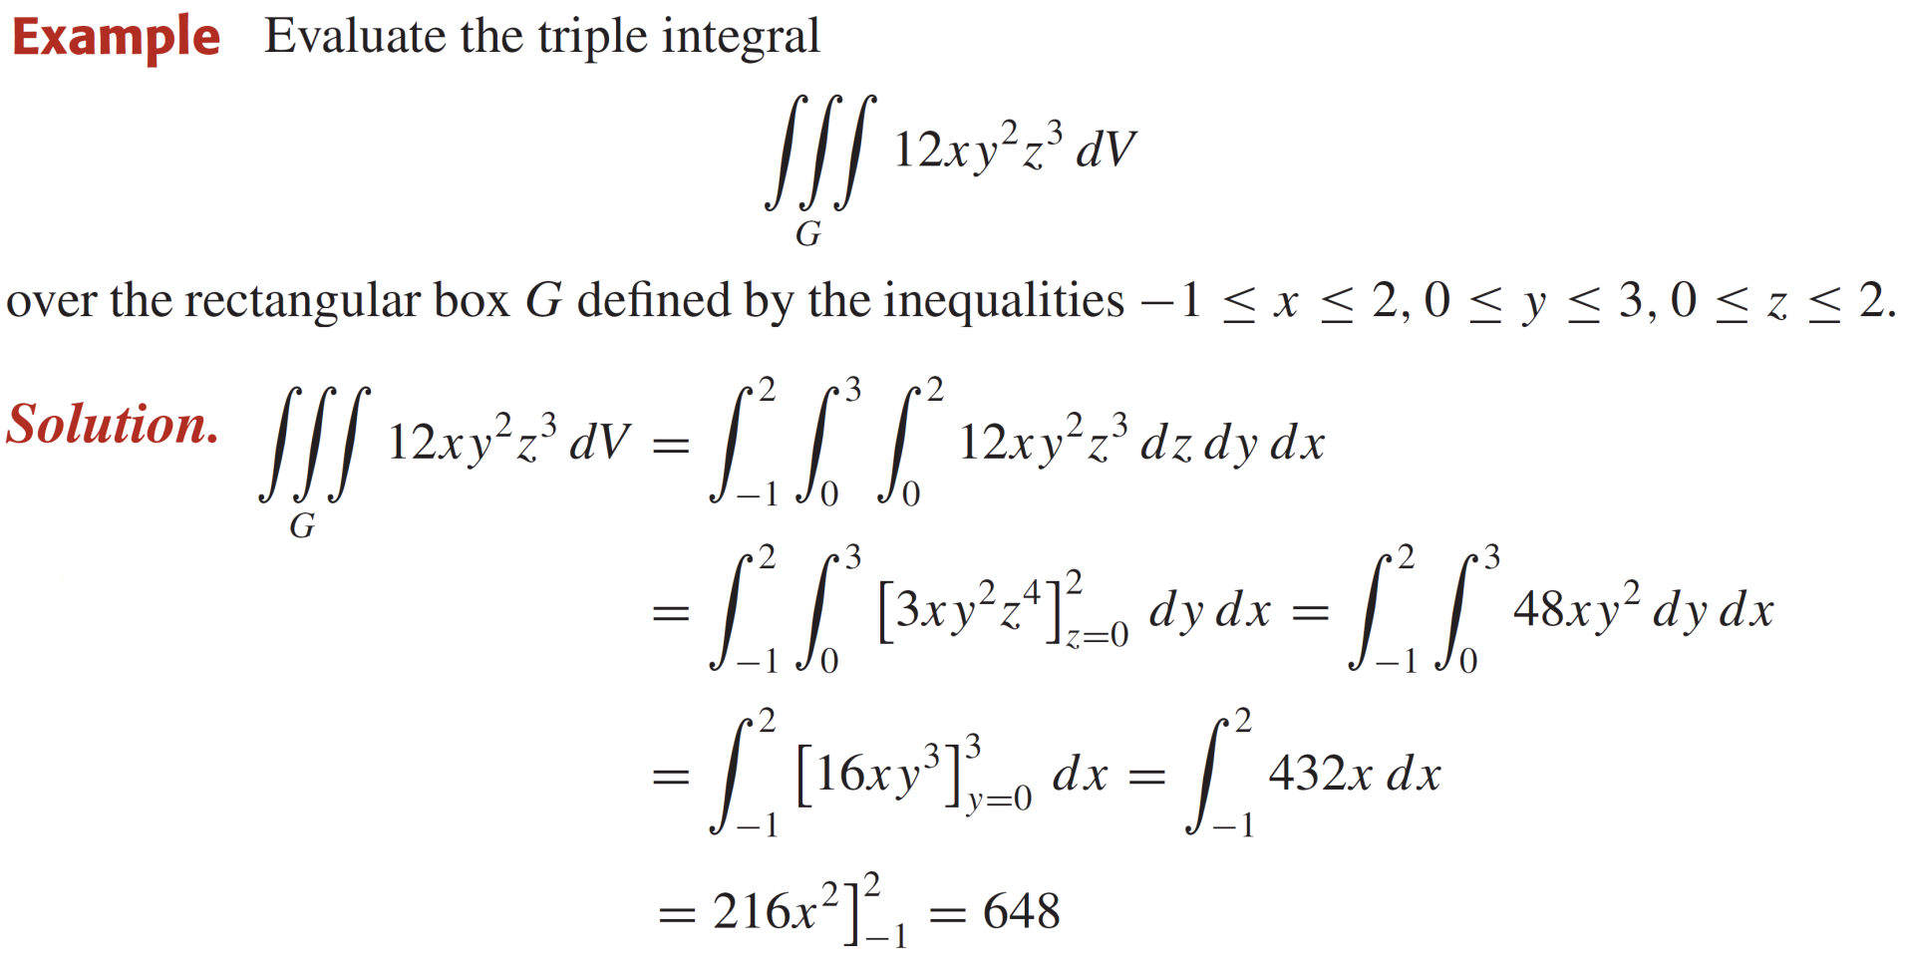
Evaluating triple Integrals

Slide 19
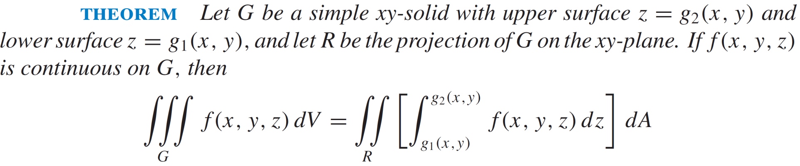
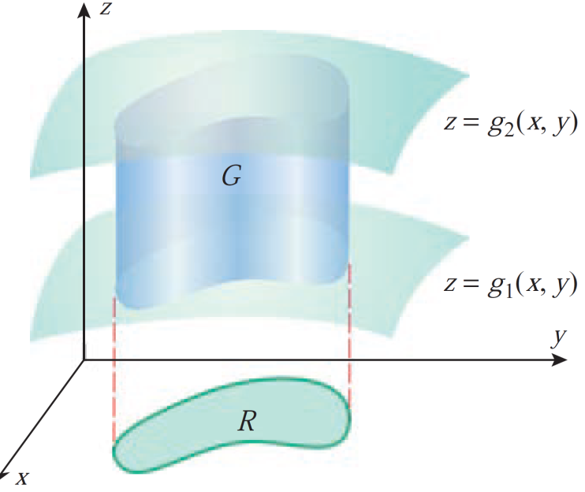
Evaluating triple Integrals

Slide 20
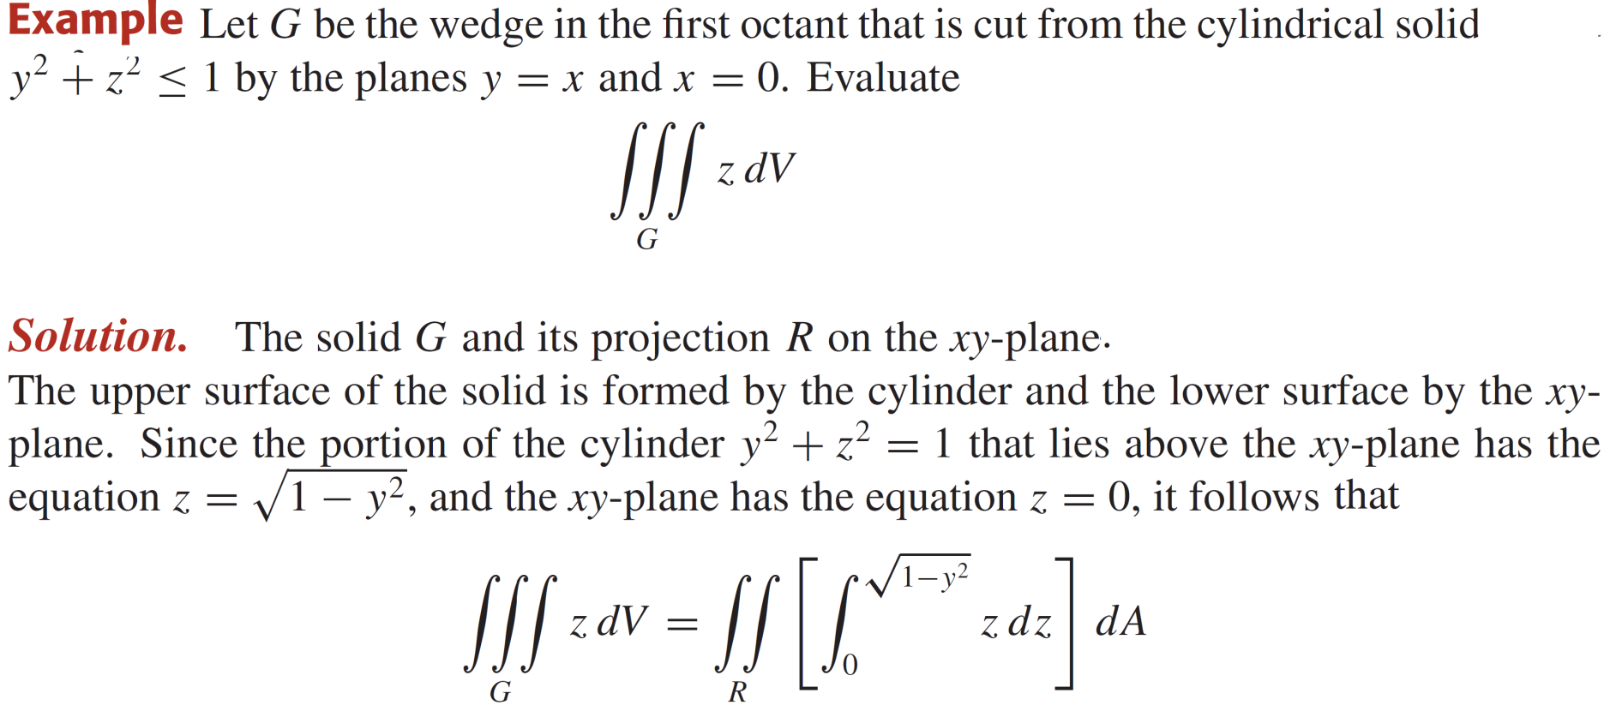
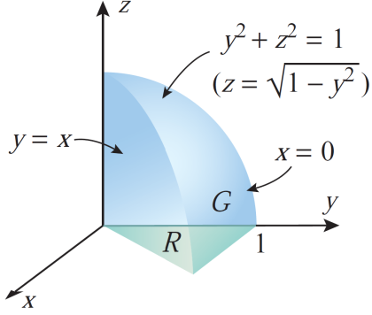
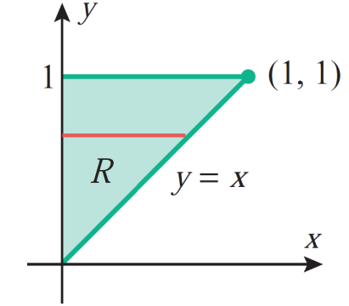
Evaluating triple Integrals

Slide 21
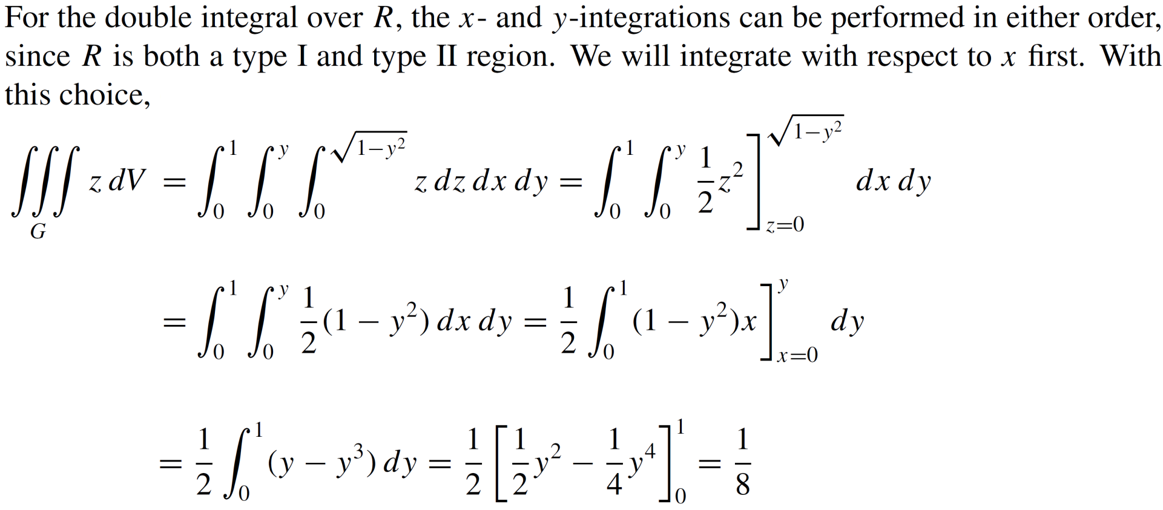
Evaluating triple Integrals

Slide 22
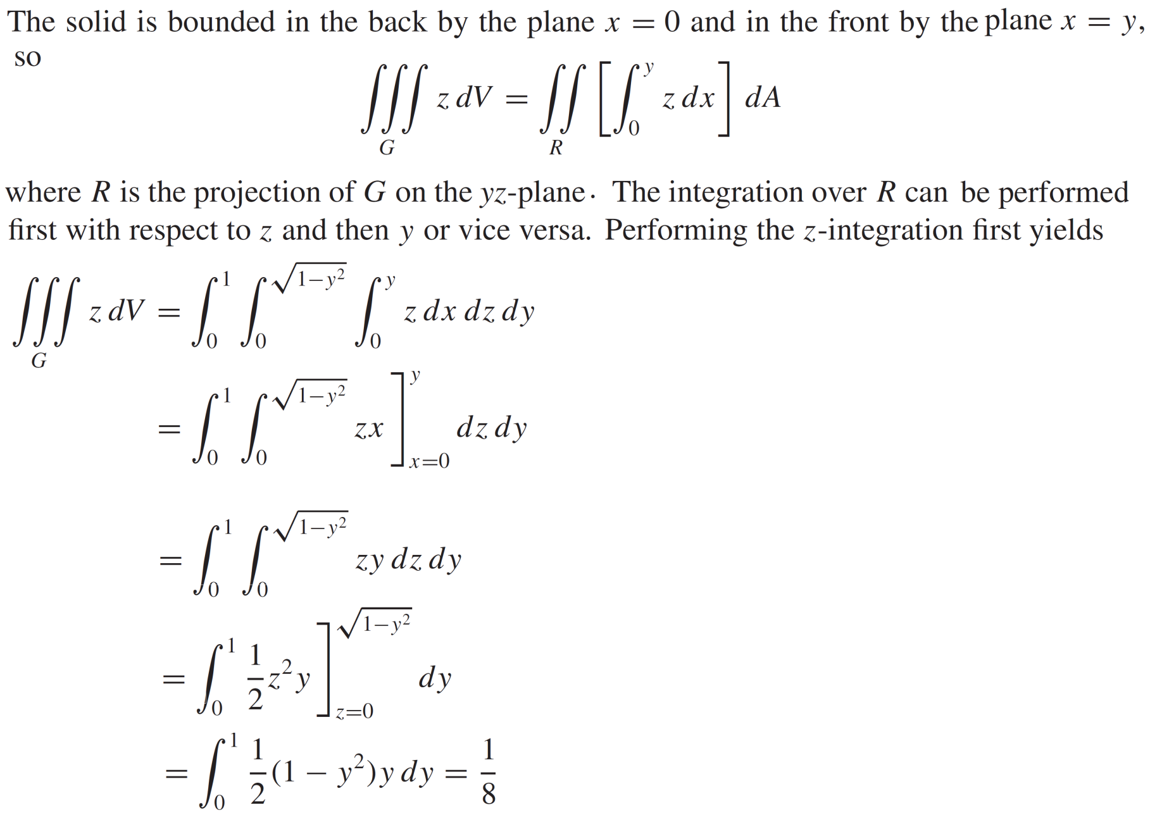
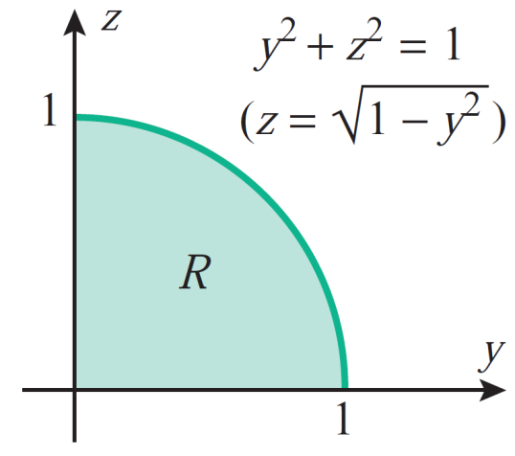
Evaluating triple Integrals

Slide 23
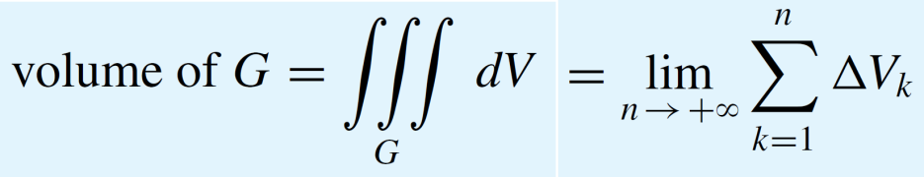
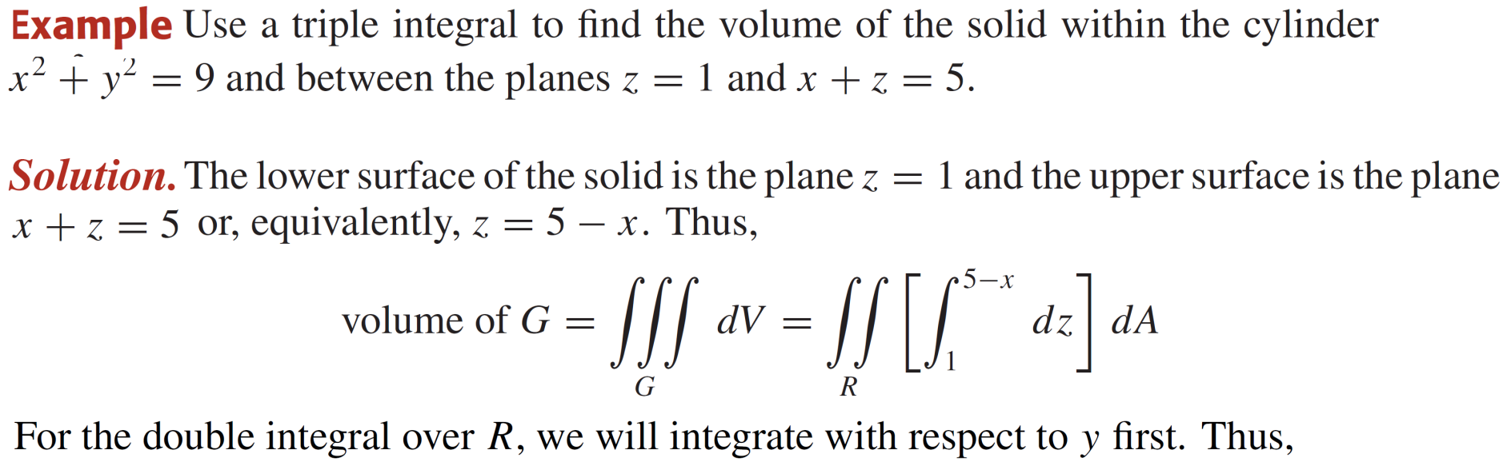
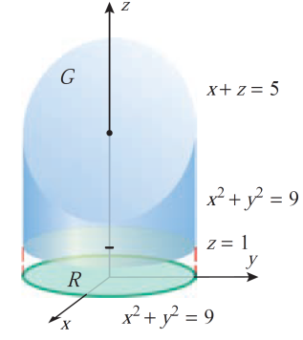
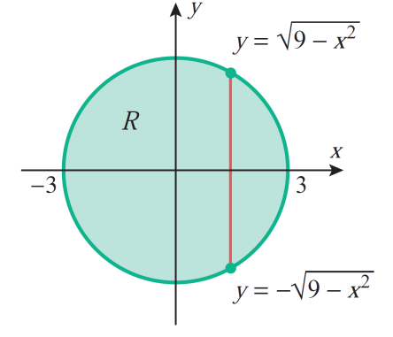
Volume calculated as triple Integrals

Slide 24
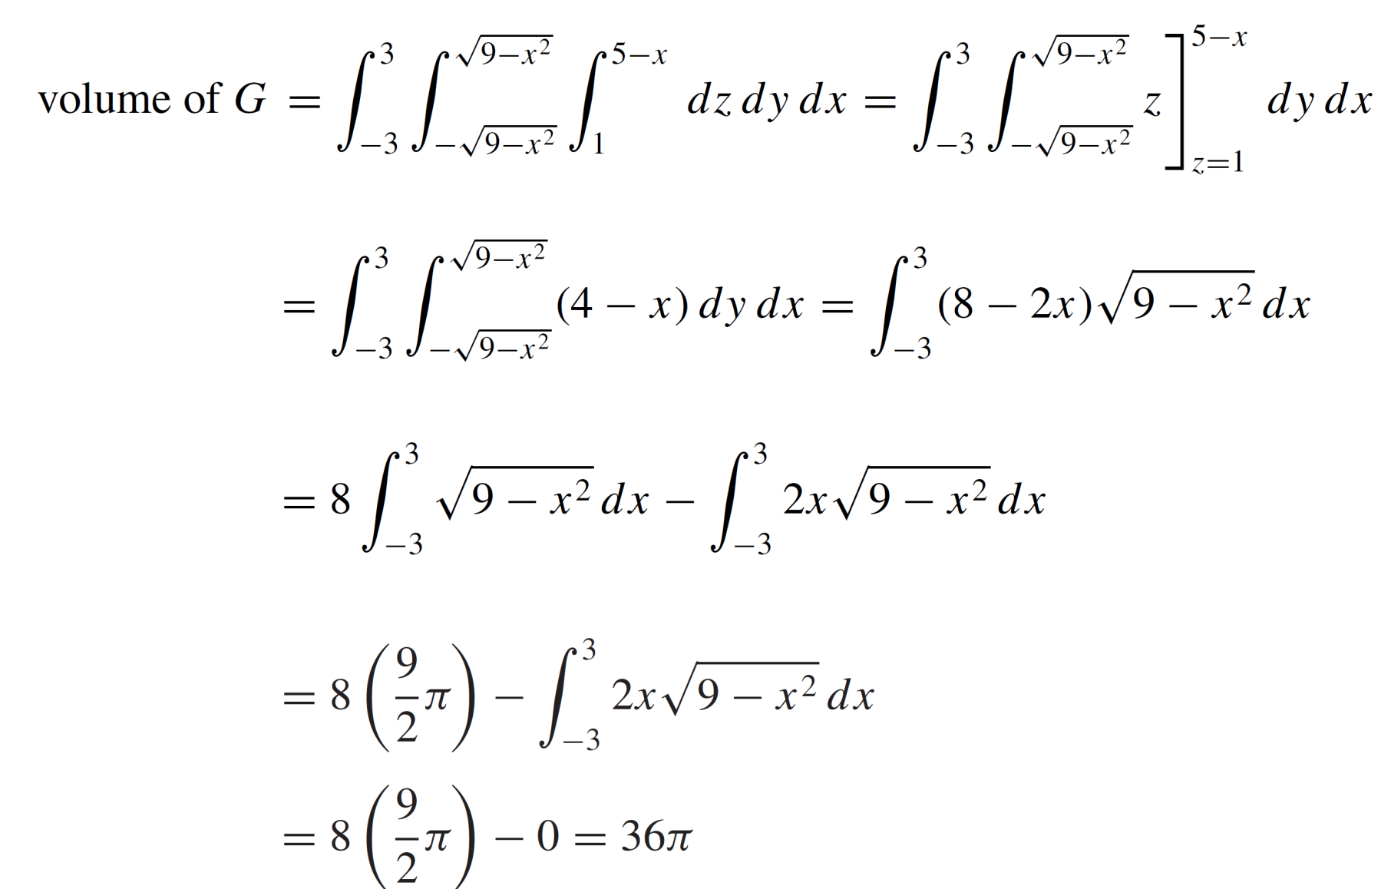
Volume calculated as triple Integrals

Slide 25
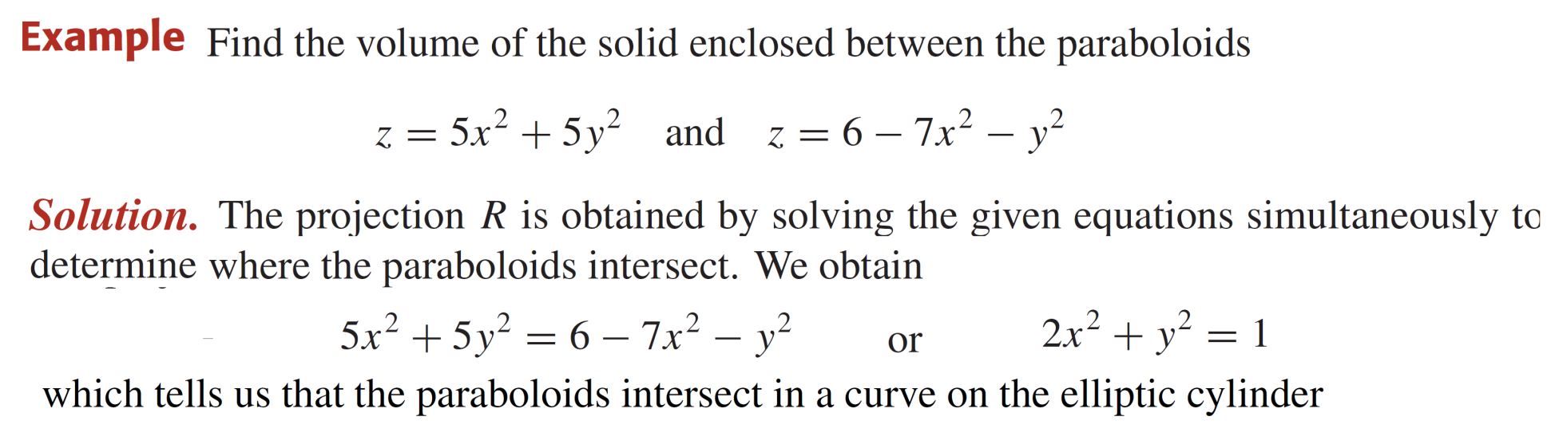
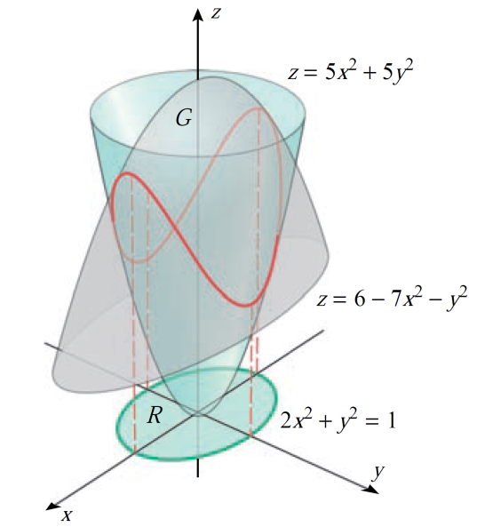
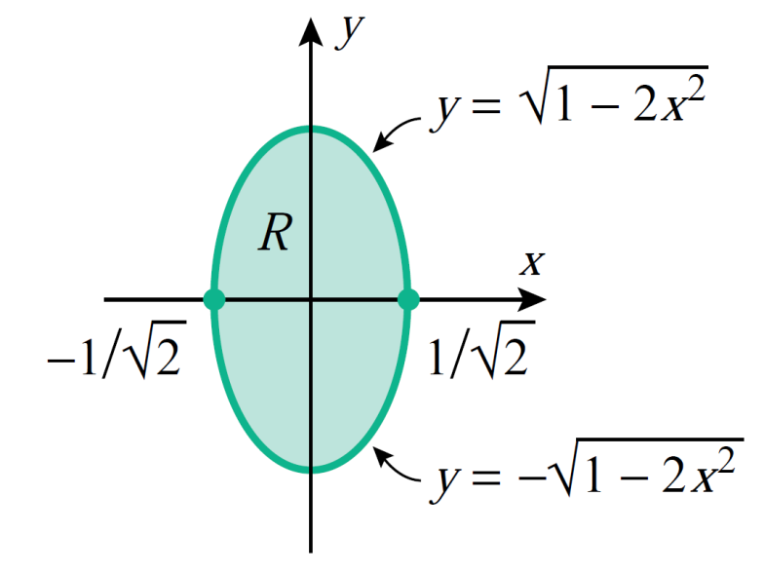
Volume calculated as triple Integrals

Slide 26
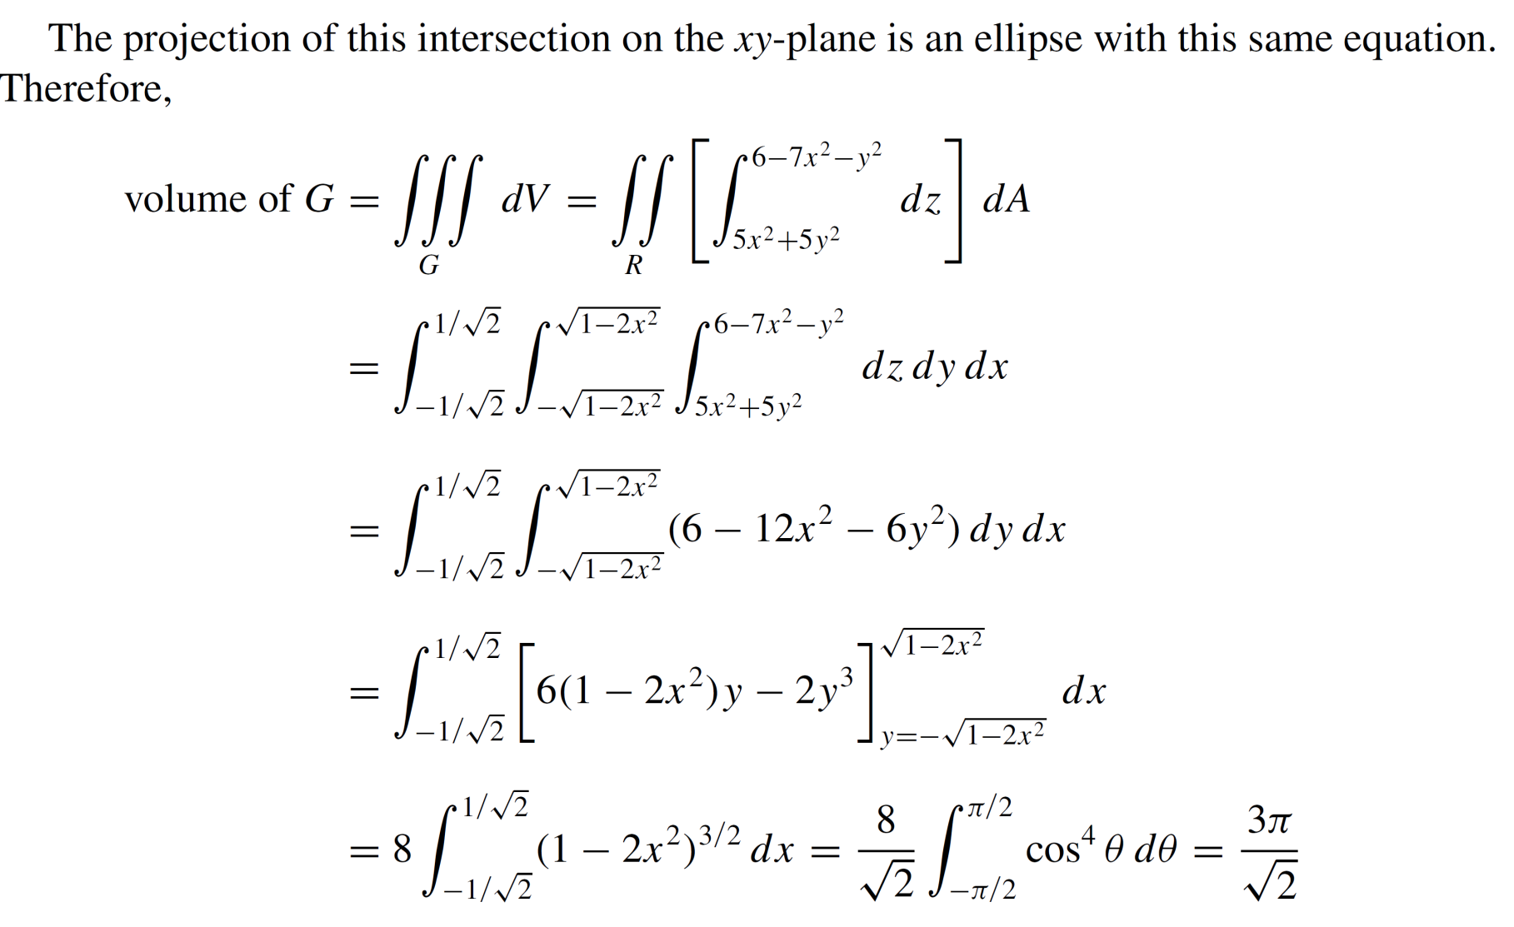
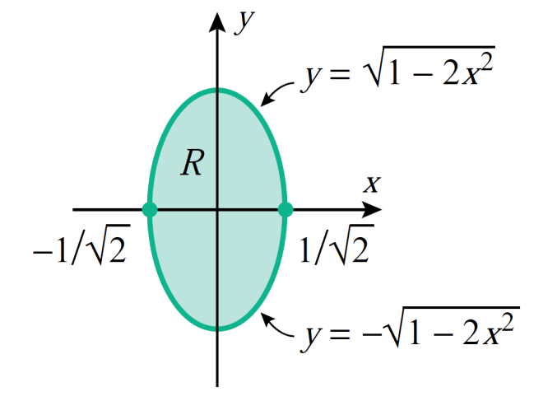
Volume calculated as triple Integrals

Slide 27
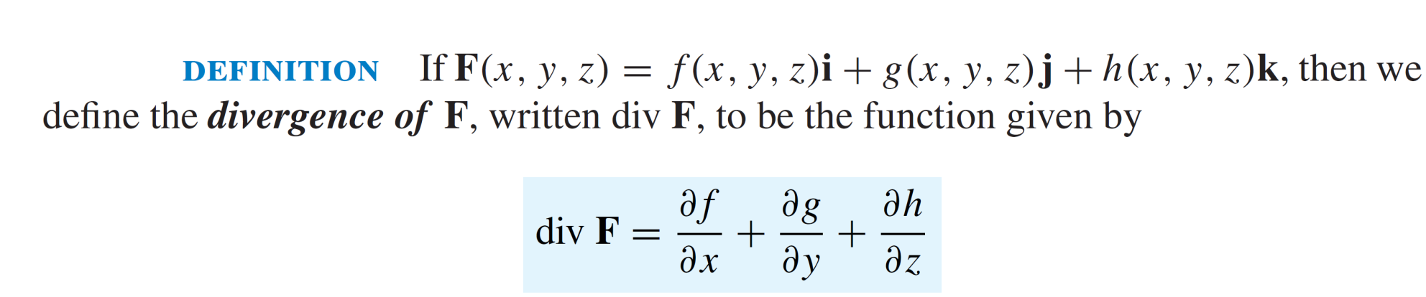
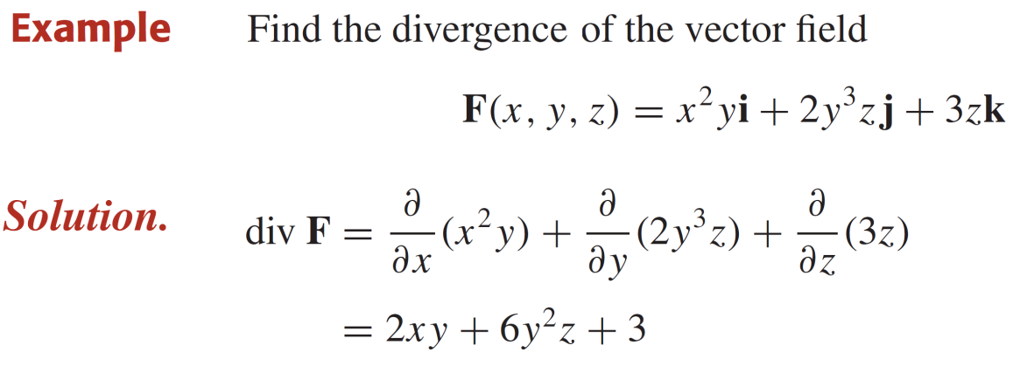
Divergence theorem

Slide 28
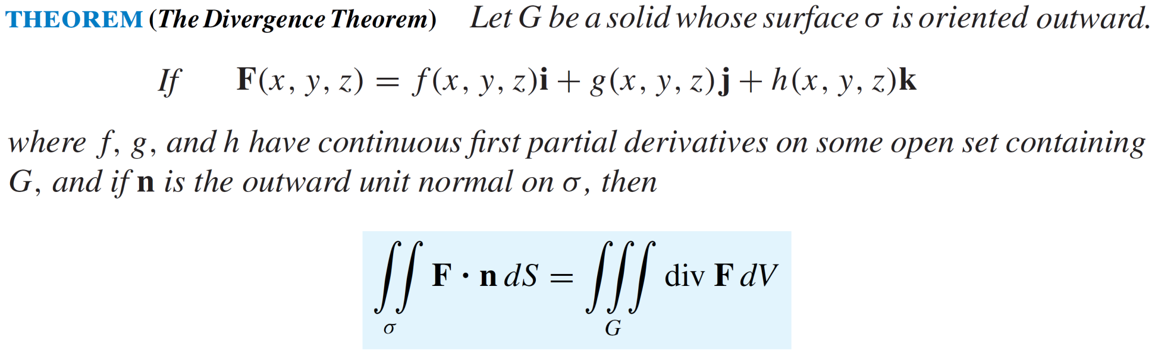
Divergence theorem

Slide 29
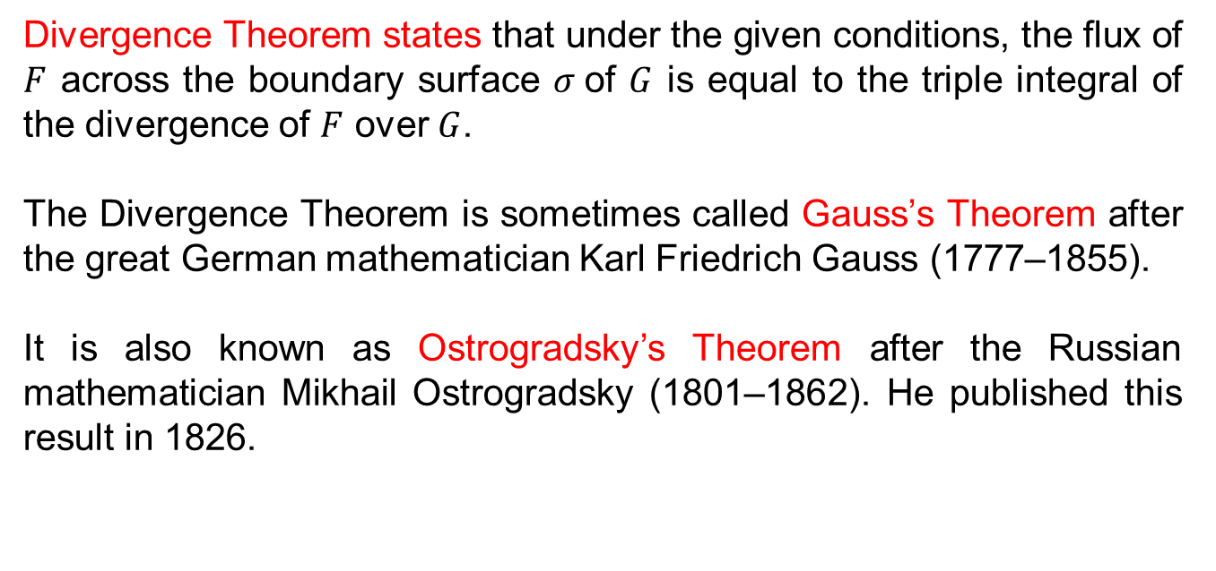
Divergence theorem
Divergence Theorem states that under the given conditions, the flux of $F$ across the boundary surface $σ$of $G$ is equal to the triple integral of the divergence of $F$over $G$.
The Divergence Theorem is sometimes called Gauss’s Theorem after the great German mathematician Karl Friedrich Gauss (1777–1855).
It is also known as Ostrogradsky’s Theorem after the Russian mathematician Mikhail Ostrogradsky(1801–1862). He published this result in 1826.

Slide 30
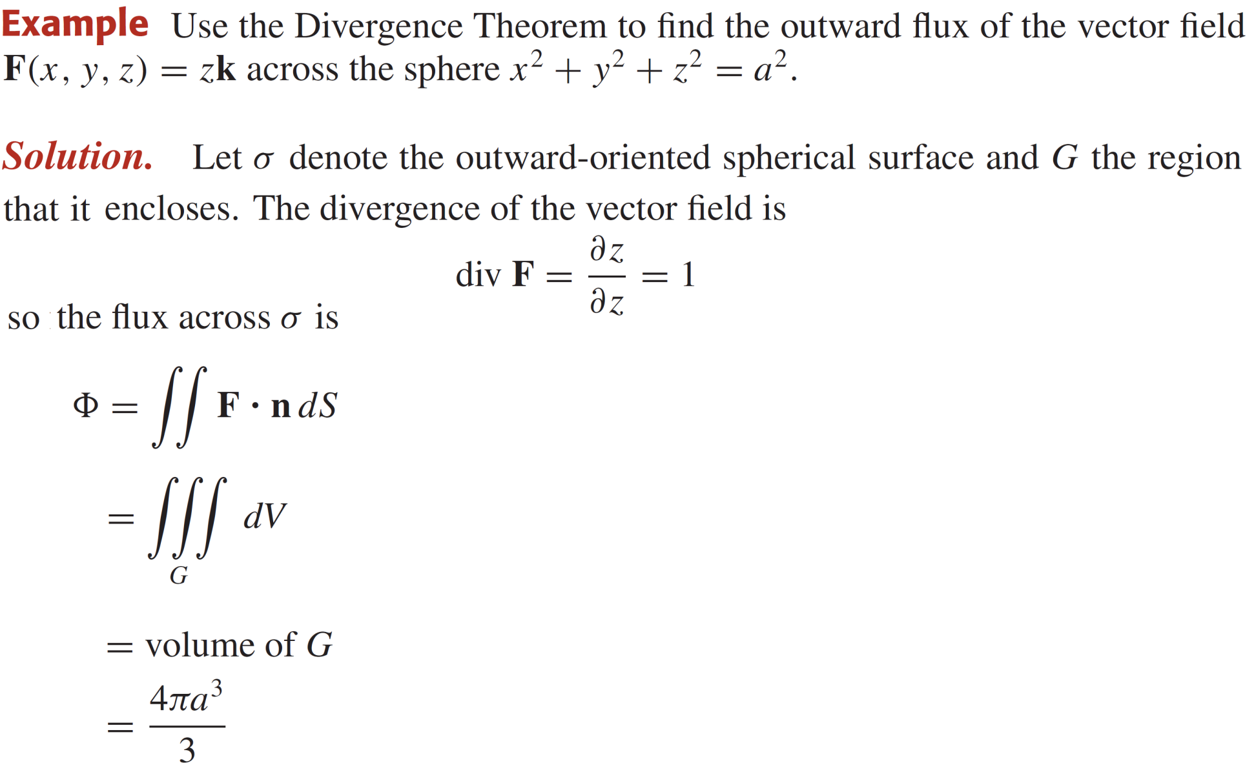
Divergence theorem

Slide 31
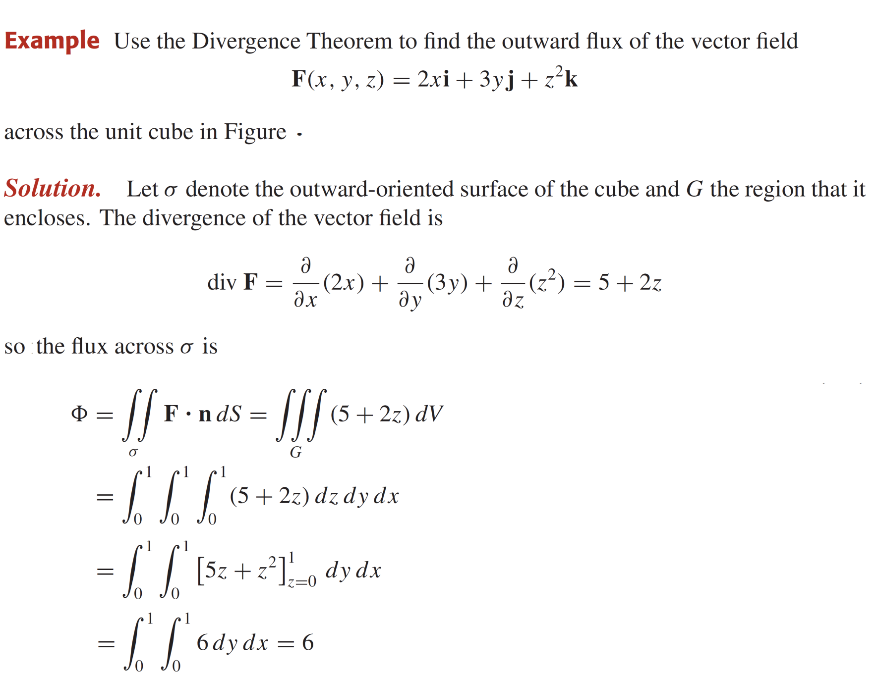
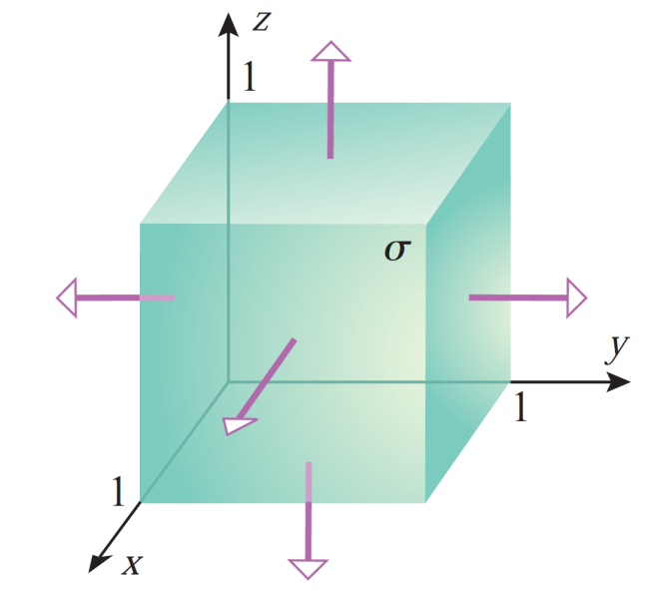
Divergence theorem

Slide 32


Divergence theorem

Slide 33


Divergence theorem

Slide 34


Divergence theorem

Slide 35


Divergence theorem

Slide 36
Lecture Summary
    Triple integrals
    Evaluating triple integrals
    Volume calculated as triple integral
    Divergence theorem

