Slide 1
(MTH 250)
Calculus
Lecture 31

Slide 2
Previous Lecture’s Summary
    Surfaces area & parametric representations
    Introduction to surface integrals
    Evaluating surface integrals
    Piecewise smooth surfaces
    Oriented surfaces
    Flux

Slide 3
Today’s Lecture
    Recalls
    Orientation of non-parametric surfaces
    Green’s theorem for line integrals
    Stokes’ theorem
    Relationship b/w Green & Stokes’ theorem

Slide 4
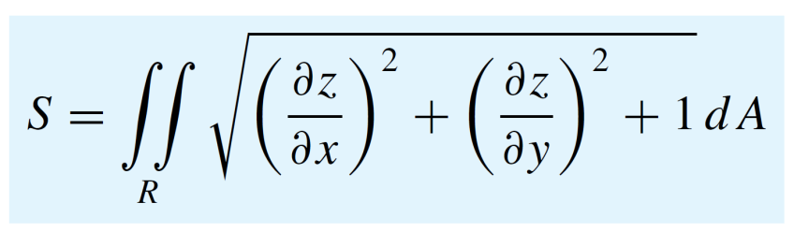
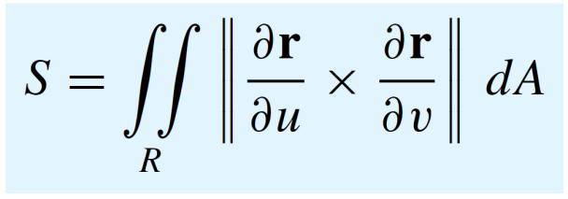
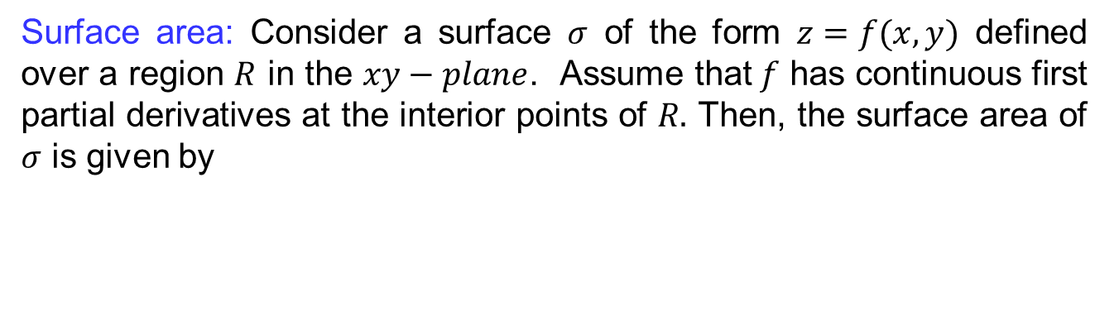
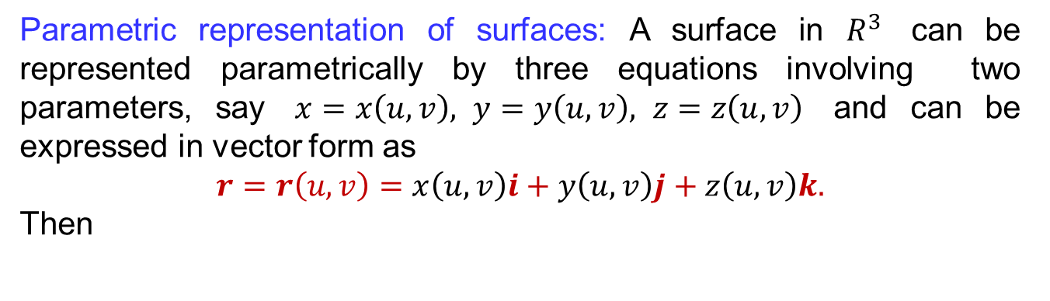
Recalls
Surface area: Consider a surface $σ$ of the form $z=f(x,y)$ defined over a region $R$ in the $xy−plane$. Assume that$f$ has continuous first partial derivatives at the interior points of $R.$ Then, the surface area of $σ$ is given by
Parametric representation of surfaces: A surface in $R^{3}$canberepresentedparametrically by threeequationsinvolvingtwoparameters, say$x=x\left(u,v\right), y=y\left(u,v\right), z=z\left(u,v\right)$ and can beexpressed in vectorform as
$$r=r\left(u,v\right)=x\left(u,v\right)i+y\left(u,v\right)j+z\left(u,v\right)k.$$
Then

Slide 5
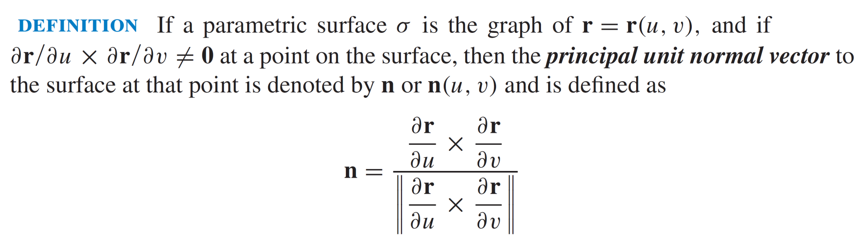
Recalls

Slide 6
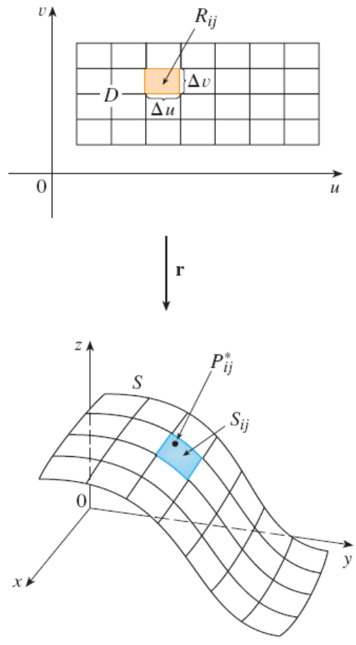
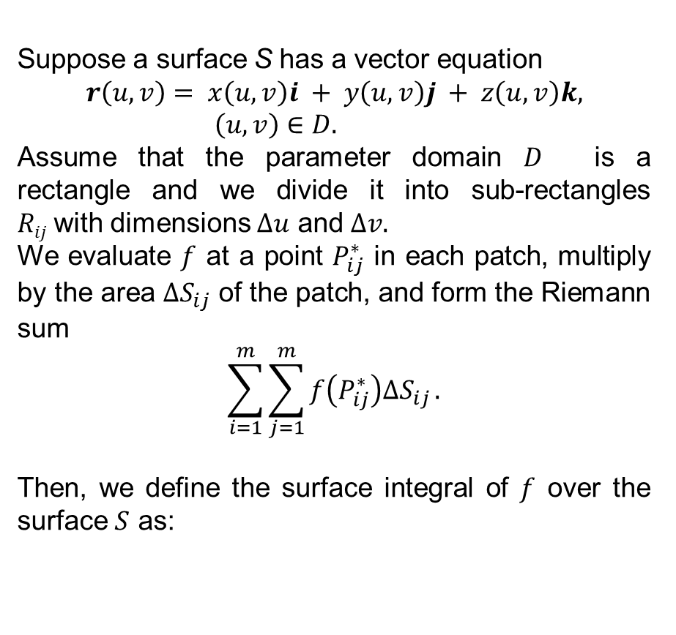
Recalls
Suppose a surface S has a vector equation
$$r\left(u, v\right)= x\left(u, v\right)i + y\left(u, v\right)j + z\left(u, v\right)k, \left(u, v\right)∈D.$$
Assume that the parameter domain $D$ is a rectangle and we divide it into sub-rectangles $Rij$with dimensions $∆u$and $∆v.$
We evaluate $f$ at a point $P_{ij}^{∗}$ in each patch, multiply by the area $∆S_{ij}$of the patch, and form the Riemann sum
$$\sum_{i=1}^{m}{\sum_{j=1}^{m}{f\left(P_{ij}^{∗}\right)∆S_{ij}}}.$$
Then, we define the surface integral of $f$over the surface $S$as:

Slide 7

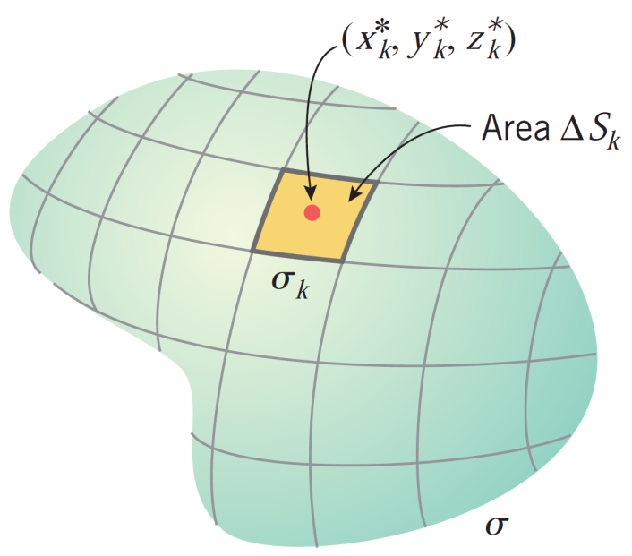
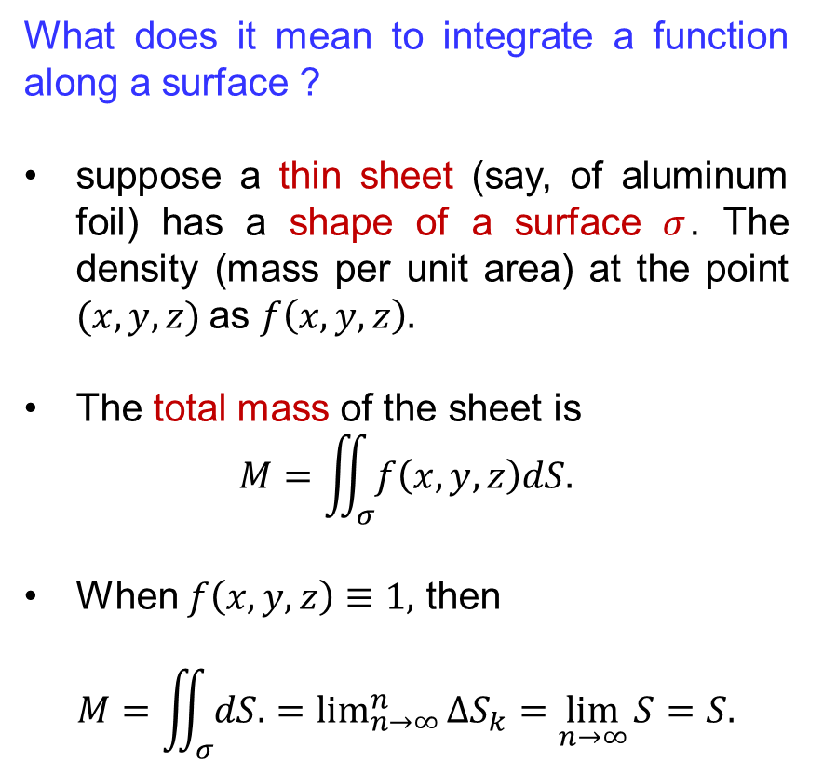
Recalls
What does it mean to integrate a function along a surface ?
suppose a thin sheet (say, of aluminum foil) has a shape of a surface $σ$. The density (mass per unit area) at the point $(x, y, z)$as $f\left(x, y, z\right).$
The total mass of the sheet is
$$M=\iint_{σ}{f\left(x,y,z\right)dS.}$$
When $f\left(x,y,z\right)≡1,$ then
$$M=\iint_{σ}{dS.}=\lim_{n→∞}^{n}{∆S_{k}}=\lim_{n→∞}{S}=S.$$

Slide 8
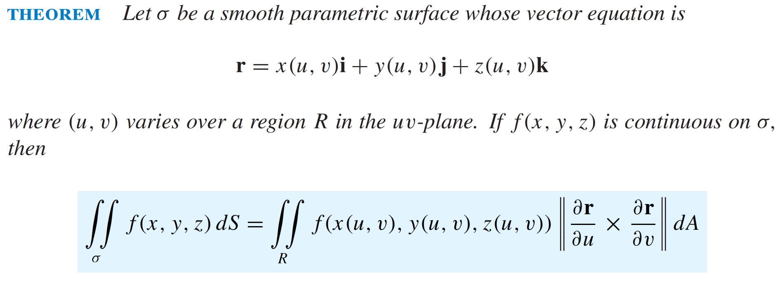
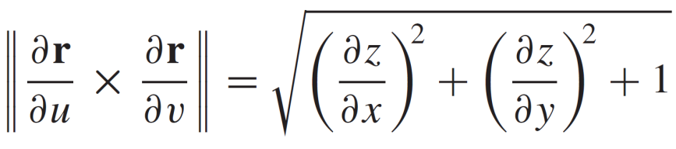
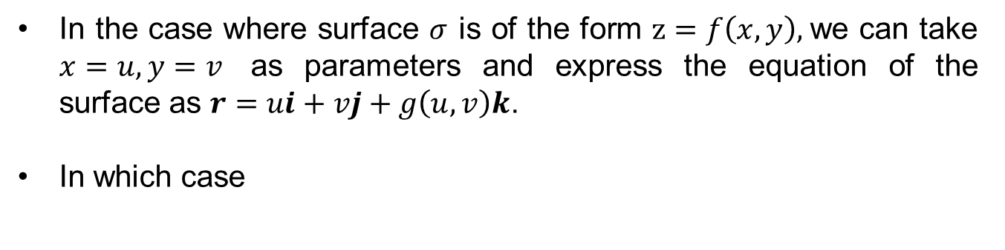
Recalls
In the case where surface $σ$ is of the form $z=f\left(x, y\right),$we can take $x=u, y=v$ as parameters and express the equation of the surface as $r=ui+vj+g\left(u,v\right)k$.
In which case

Slide 9
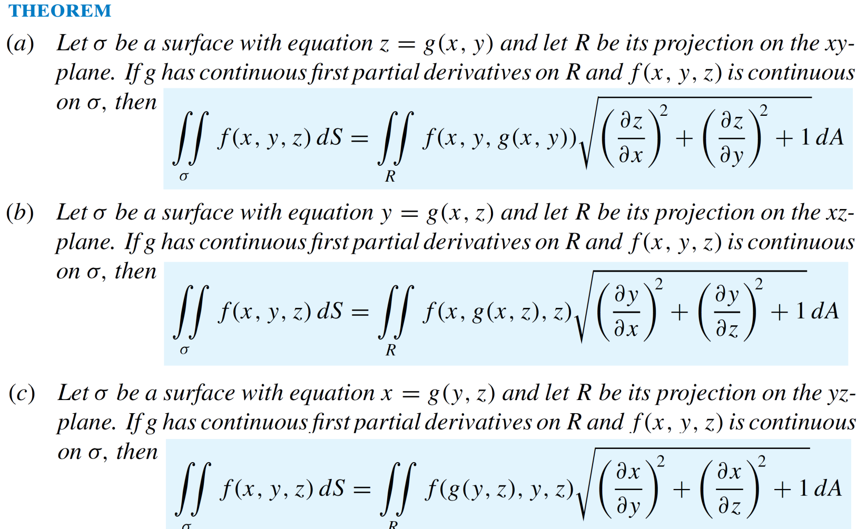
Recalls

Slide 10
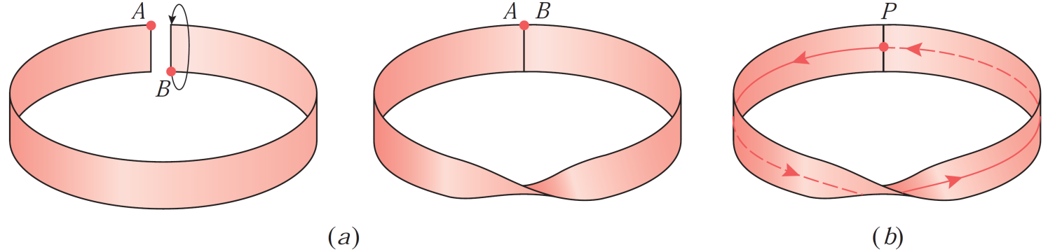
Recalls
Most surfaces that we encounter in applications have two sides e.g. a sphere has an inside and an outside.
There exist mathematical surfaces with only one side e.g. Möbius strip, which has only one side in the sense that a bug can travaerse the entire surface without crossing an edge.
Definition: A two sided surface is said to be orientable and a one sided surface is said to be nonorientable.

Slide 11
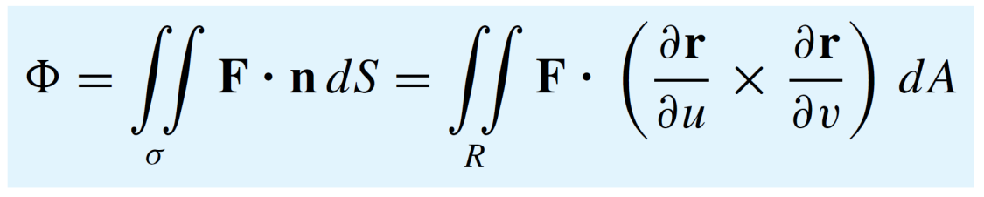
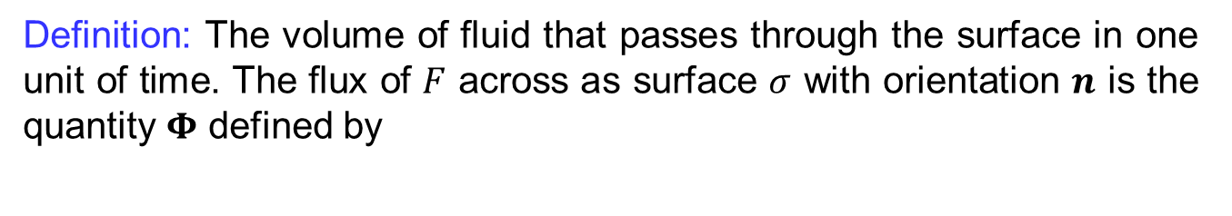
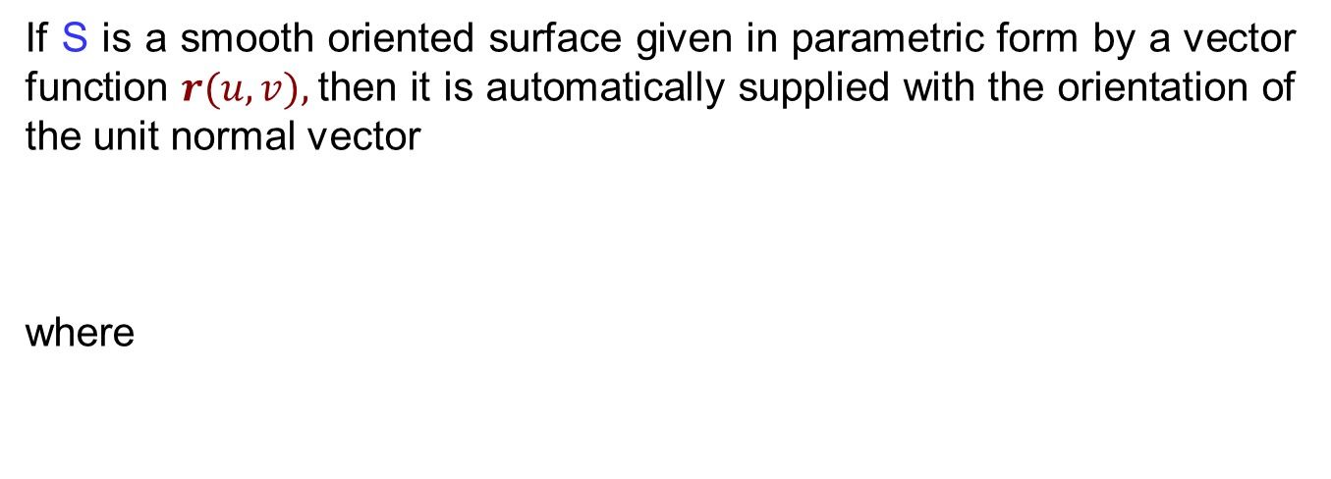
Recalls
If S is a smooth oriented surface given in parametric form by a vector function $r(u, v),$then it is automatically supplied with the orientation of the unit normal vector
where
Definition: The volume of fluid that passes through the surface in one unit of time. The flux of $F$ across as surface $σ$ with orientation $n$is the quantity $Φ$defined by

Slide 12
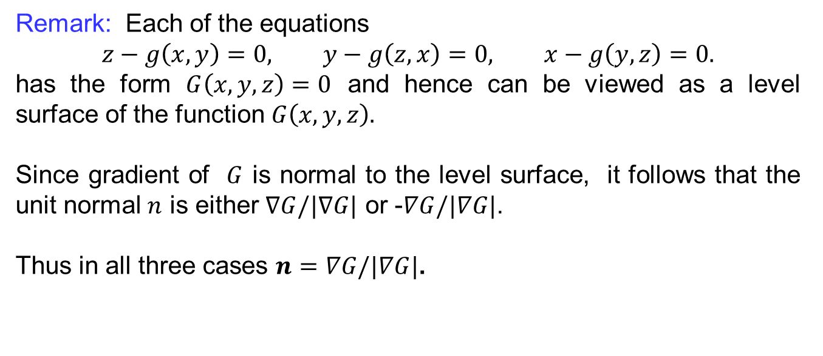
Orientation of non-parametric surfaces
Remark: Each of the equations
$$z−g\left(x,y\right)=0, y−g\left(z,x\right)=0, x−g\left(y,z\right)=0.$$
has the form $G\left(x,y,z\right)=0$ and hence can be viewed as a level surface of the function $G\left(x,y,z\right).$
Since gradient of $G$is normal to the level surface, itfollowsthat the unit normal $n$iseither$∇G/|∇G|$ or -$∇G/|∇G|$.
Thus in all three cases $n=∇G/|∇G|$.

Slide 13
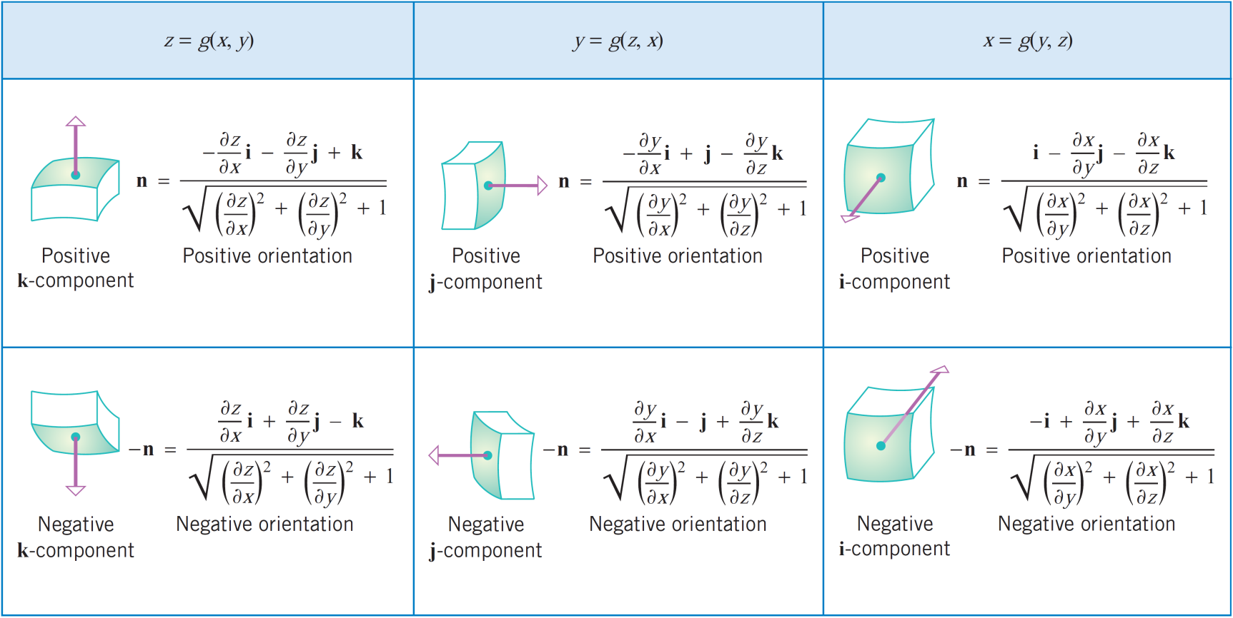
Orientation of non-parametric surfaces

Slide 14
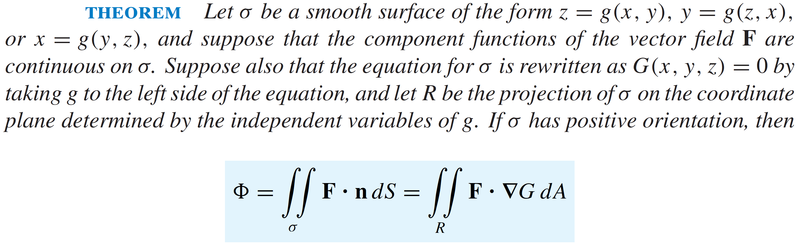
Orientation of non-parametric surfaces

Slide 15
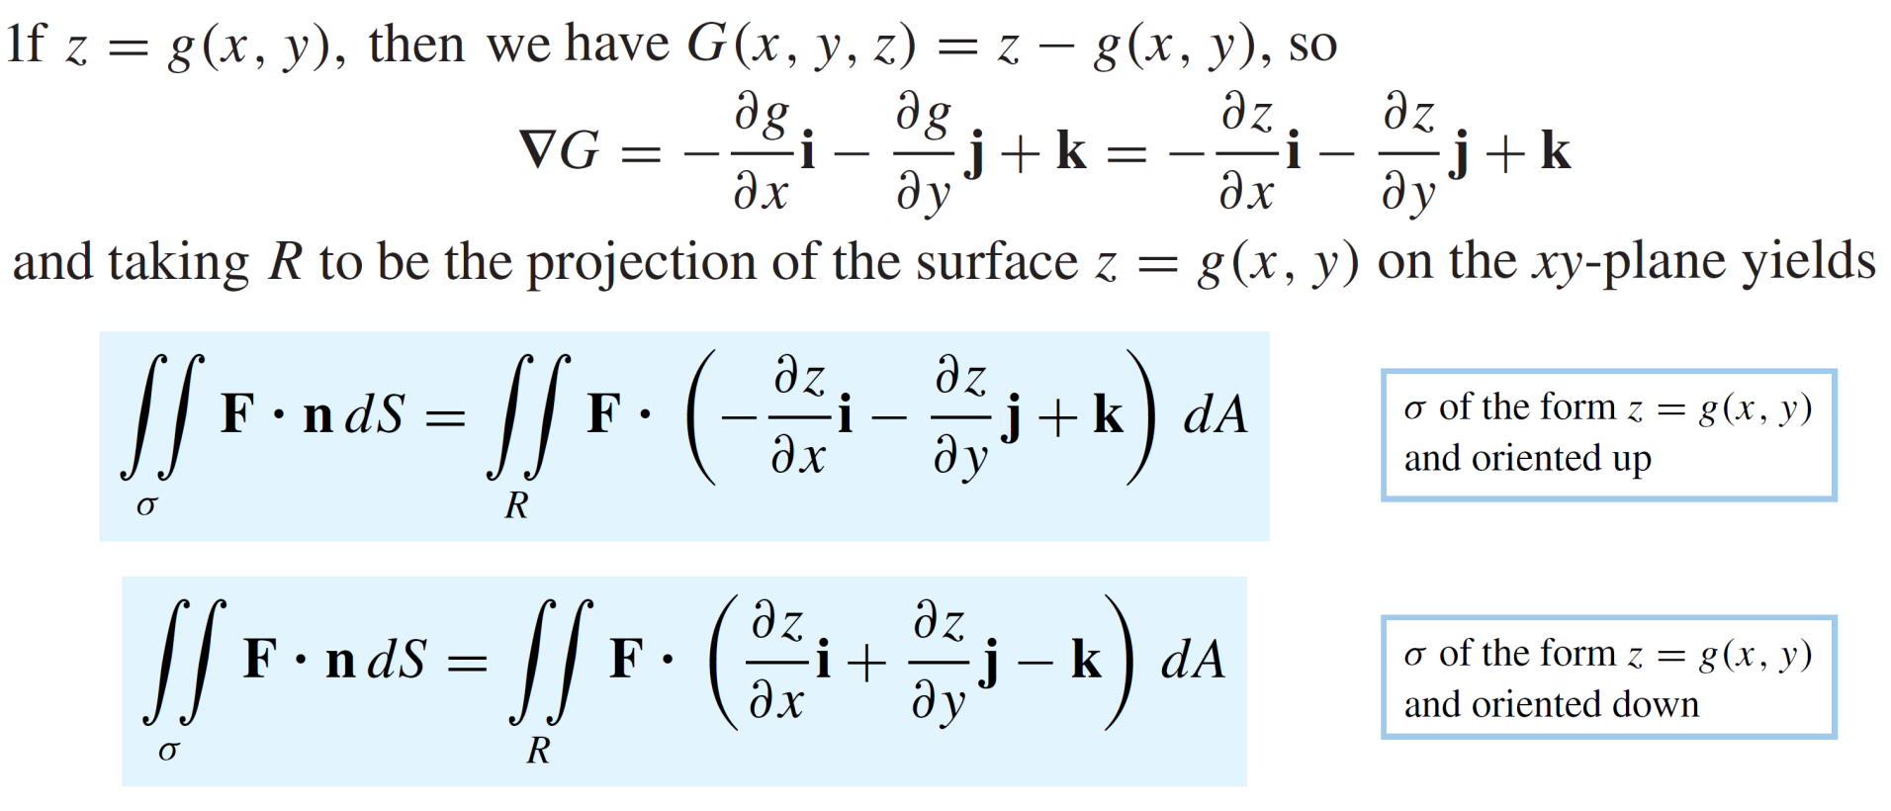
Orientation of non-parametric surfaces

Slide 16
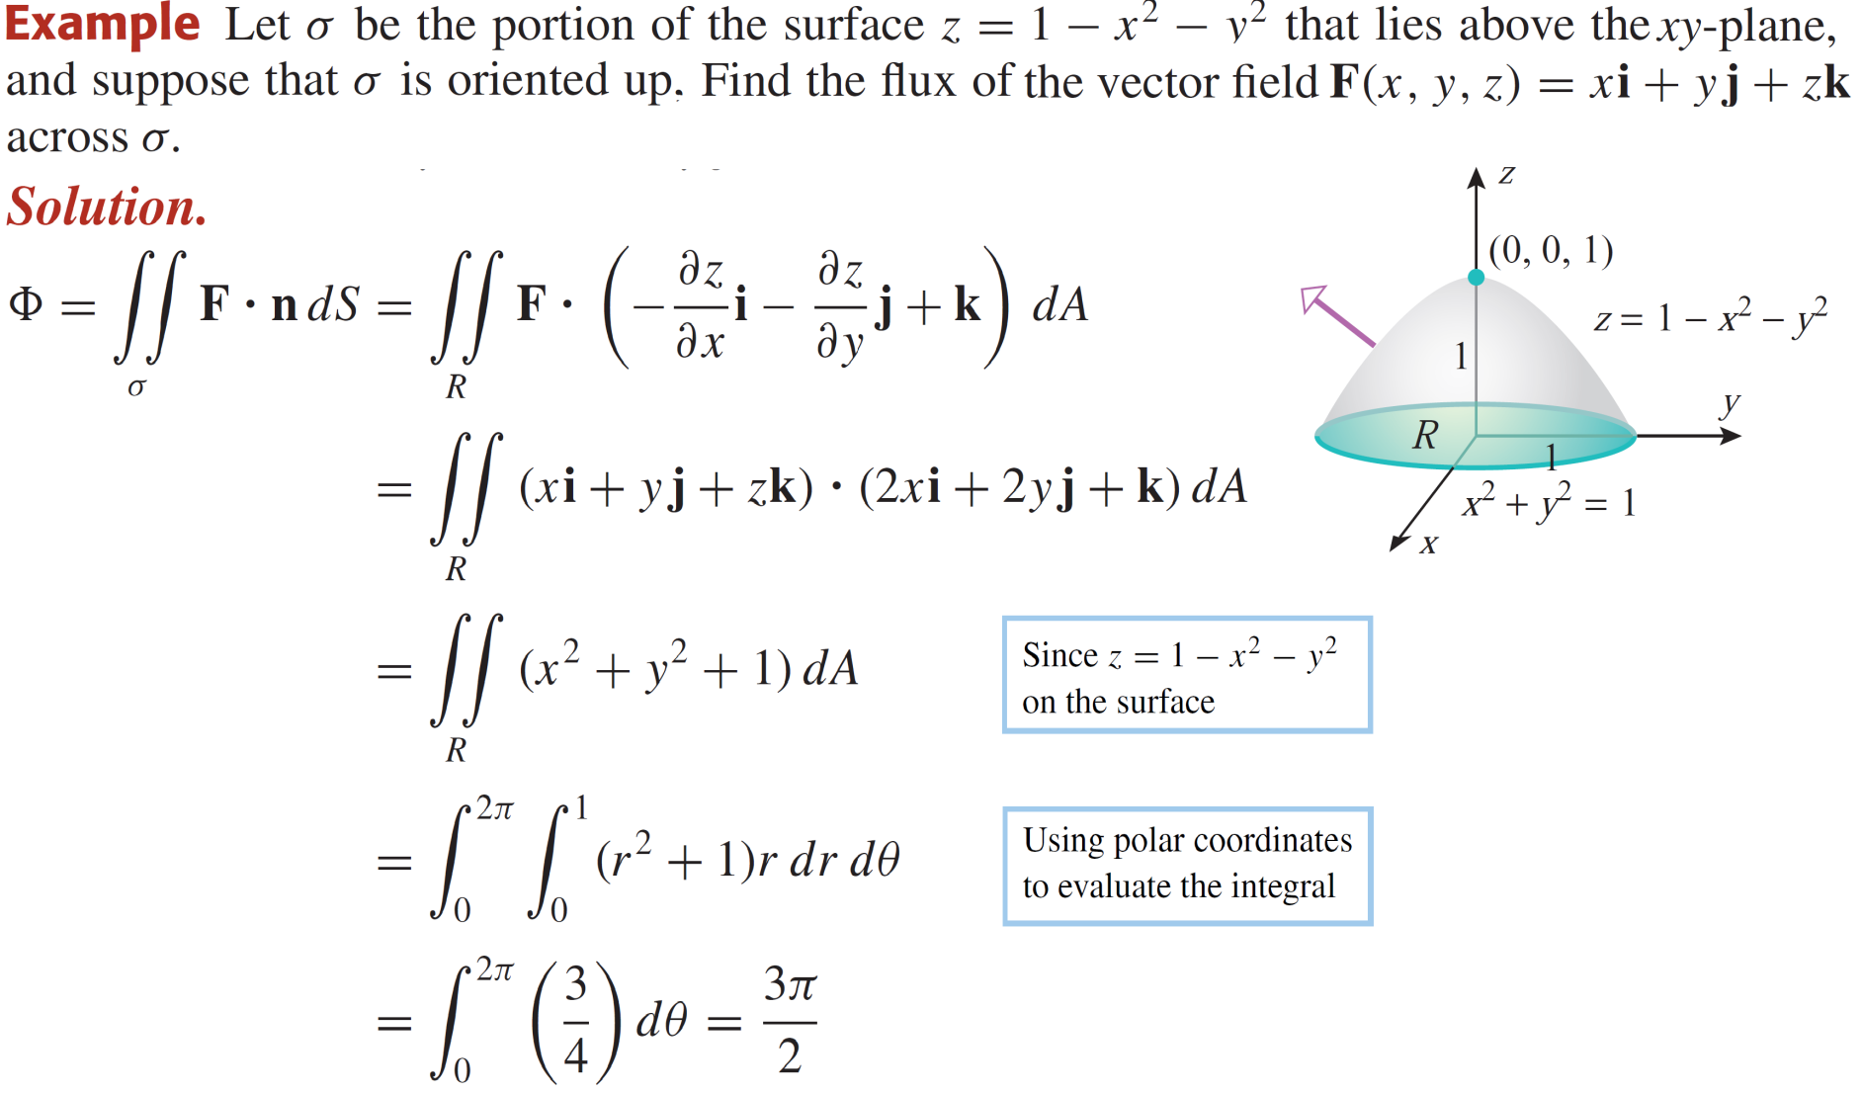
Orientation of non-parametric surfaces

Slide 17
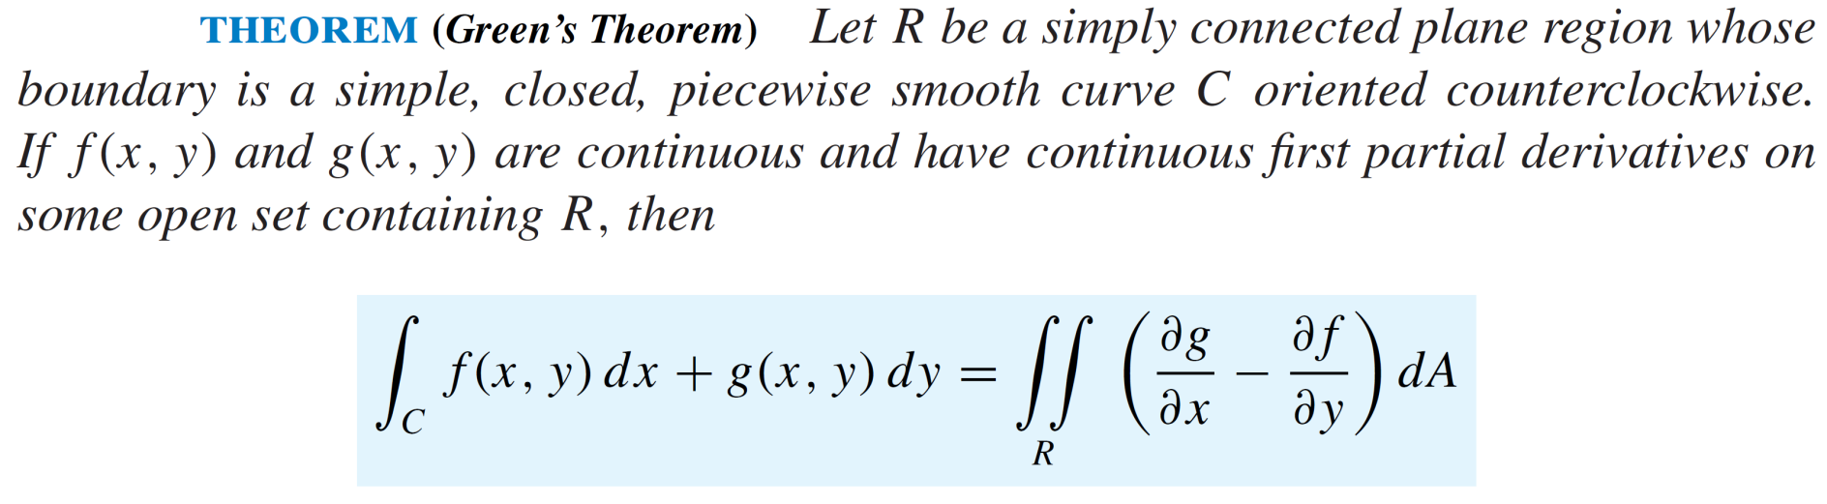
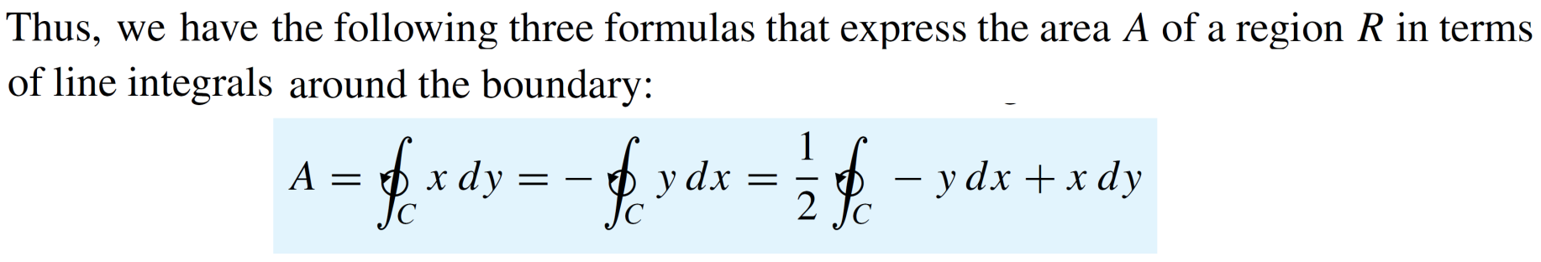
Green’s theorem for line integrals

Slide 18
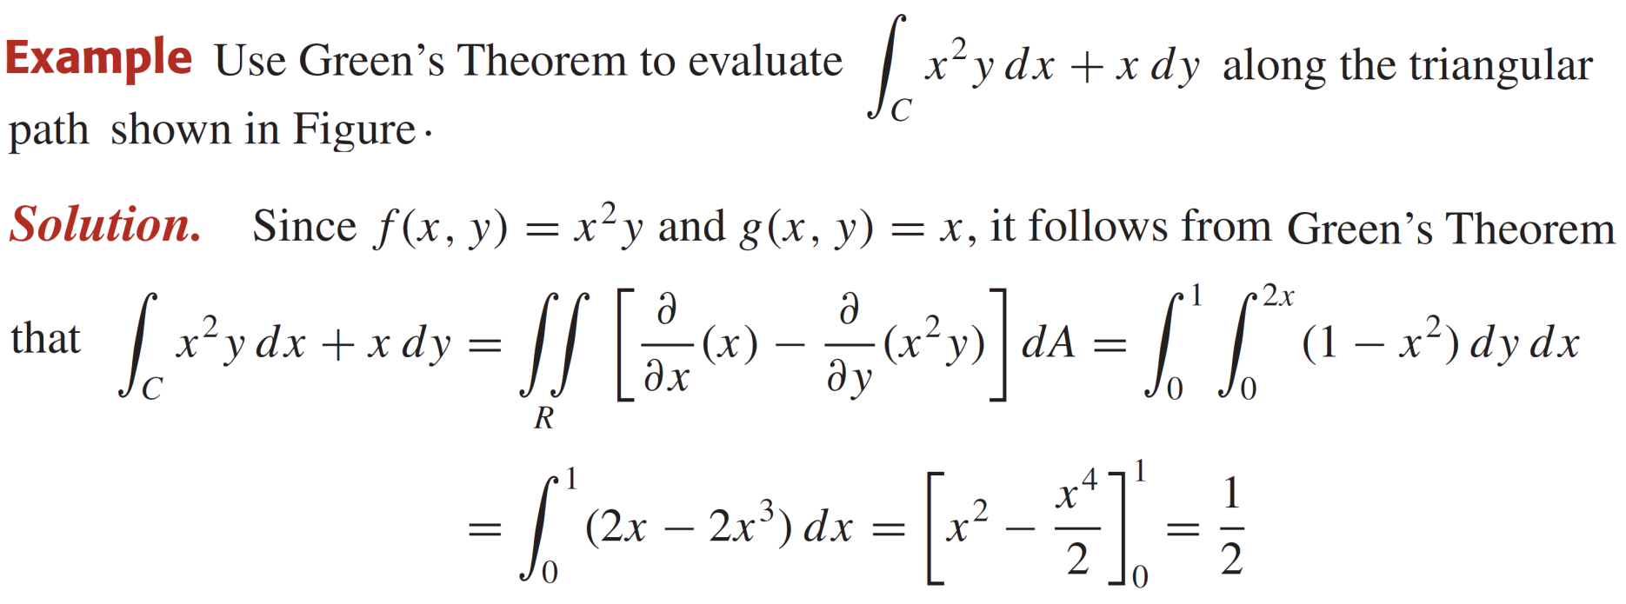
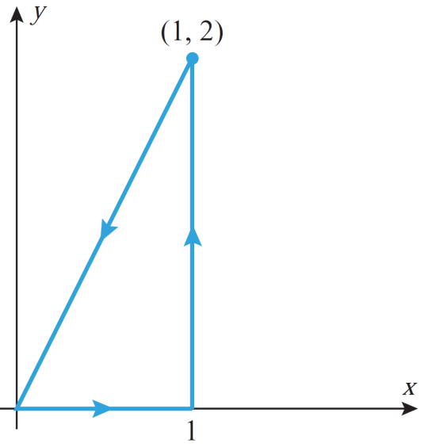
Green’s theorem for line integrals

Slide 19
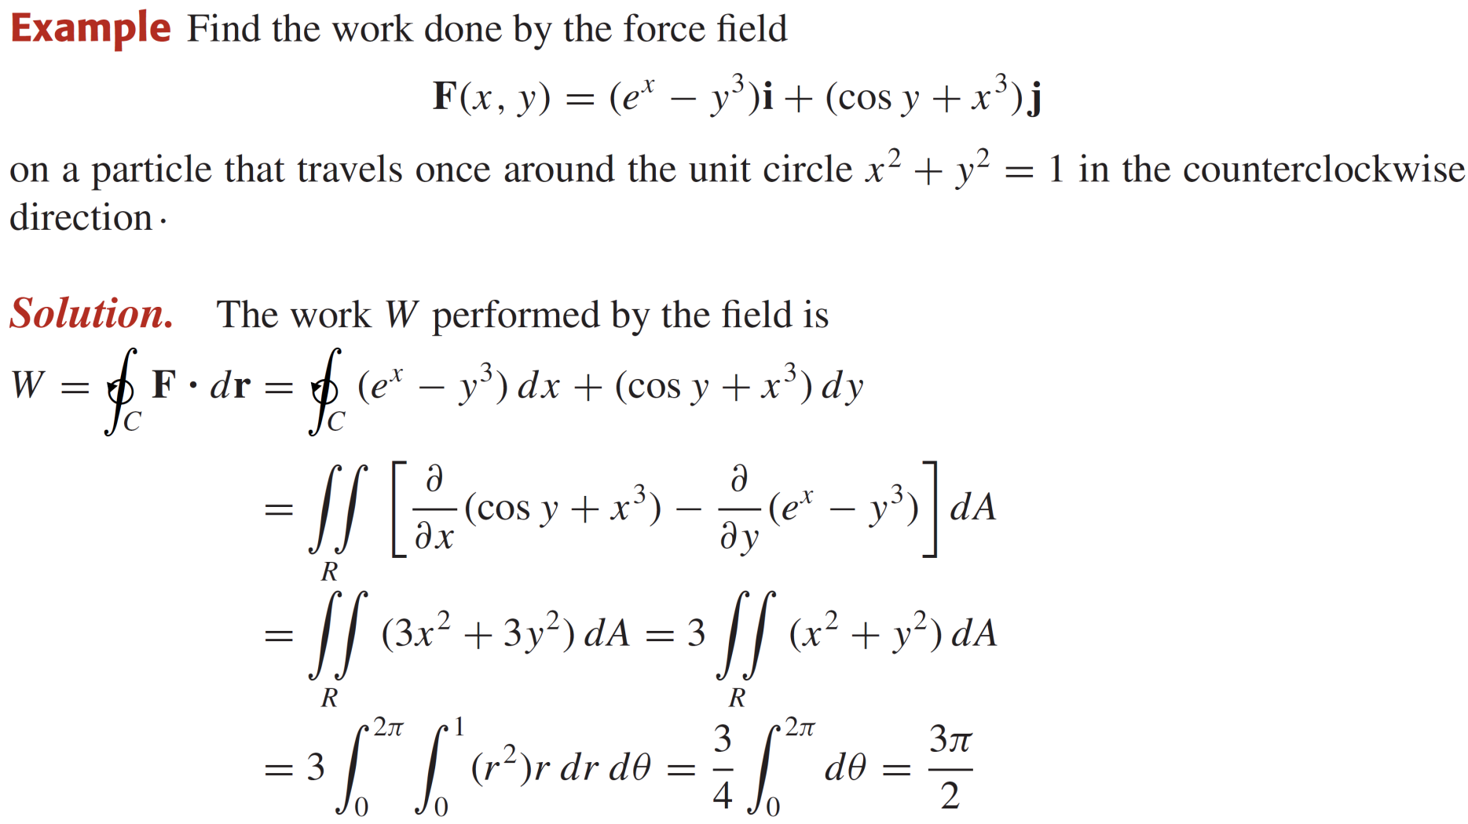
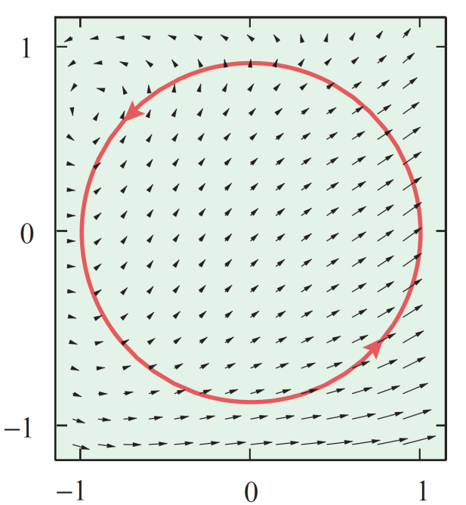
Green’s theorem for line integrals

Slide 20
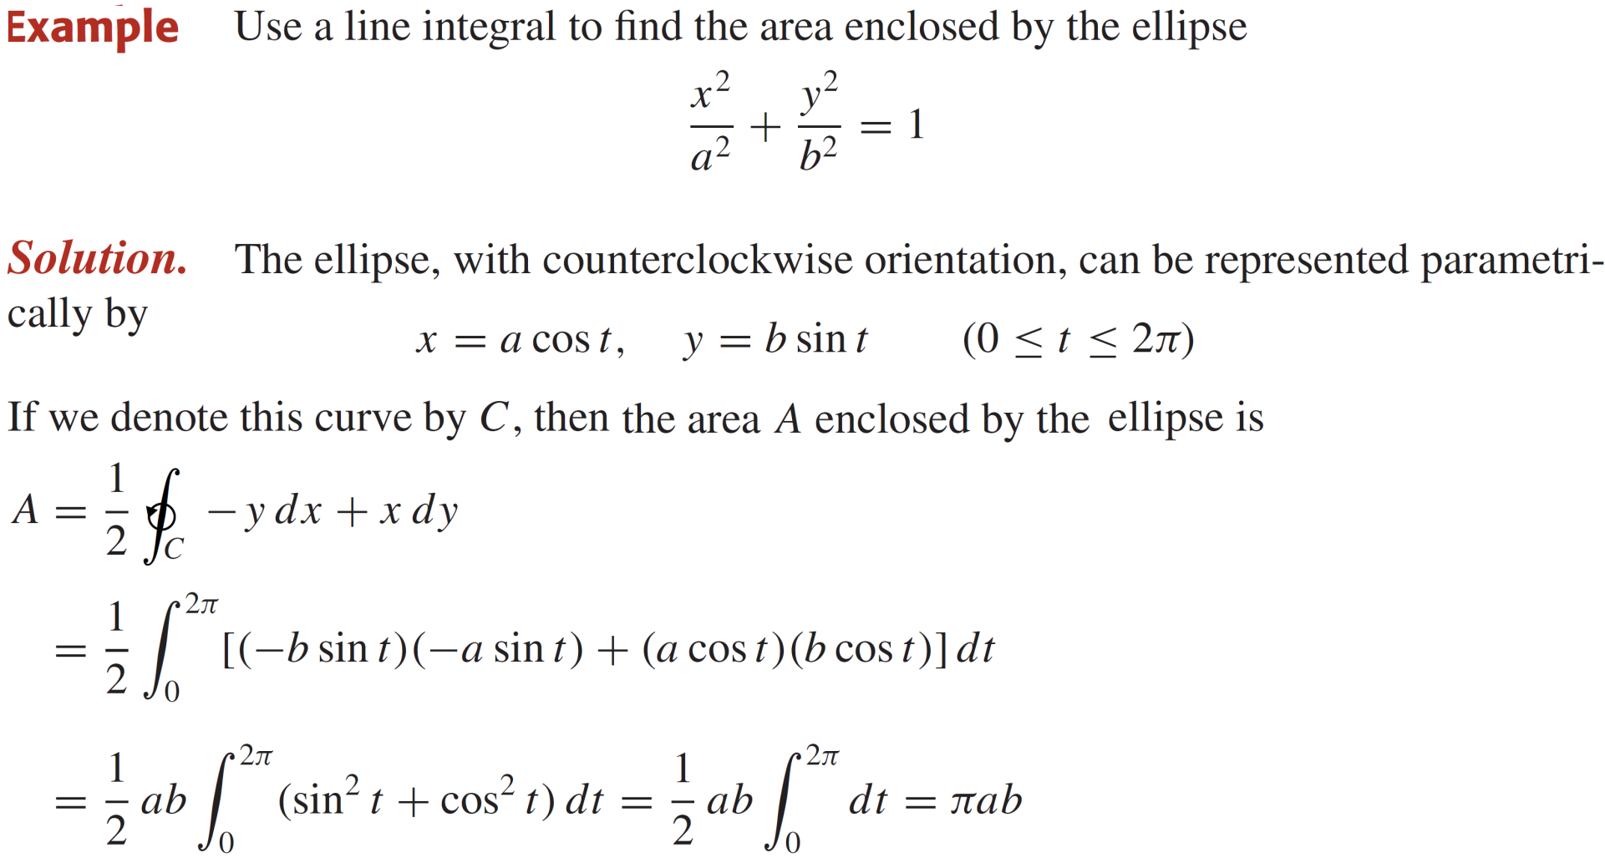
Green’s theorem for line integrals

Slide 21
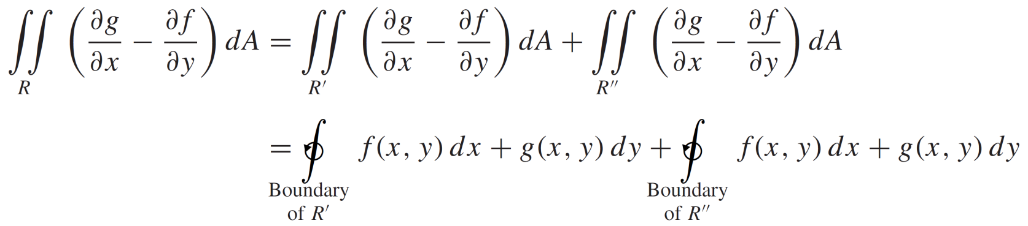
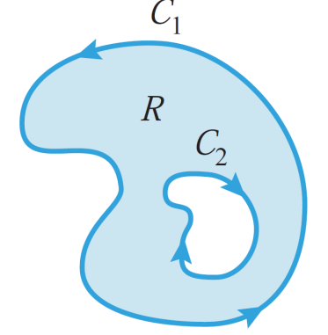
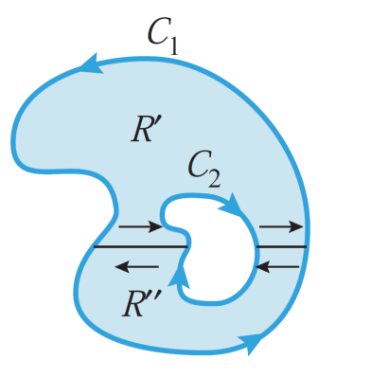
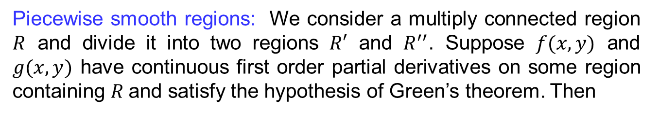
Green’s theorem for line integrals
Piecewise smooth regions:Weconsider a multiplyconnectedregion$R$ and divide it into two regions $R′$ and $R^{′′}$. Suppose $f(x,y)$ and $g(x,y)$ have continuous first order partial derivatives on some region containing $R$and satisfy the hypothesis of Green’s theorem. Then

Slide 22
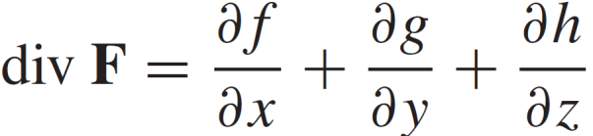
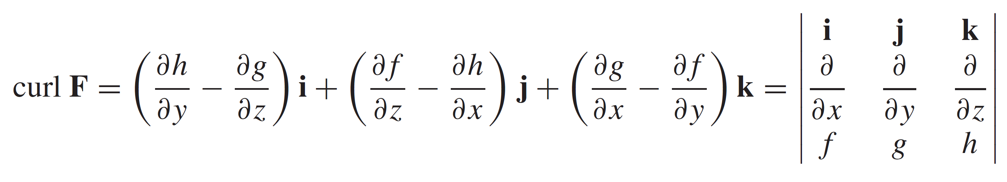
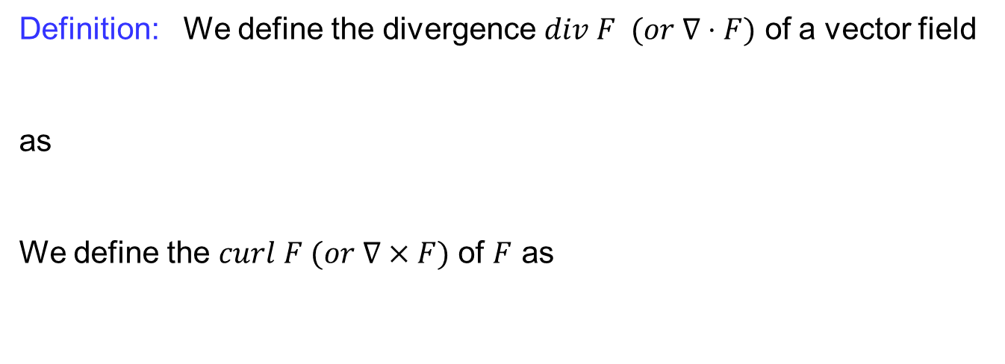
Stokes’ theorem
Definition:Wedefine the divergence $div F (or ∇⋅F)$ of a vectorfield
as
Wedefine the $curl F (or ∇×F)$ of $F$ as

Slide 23
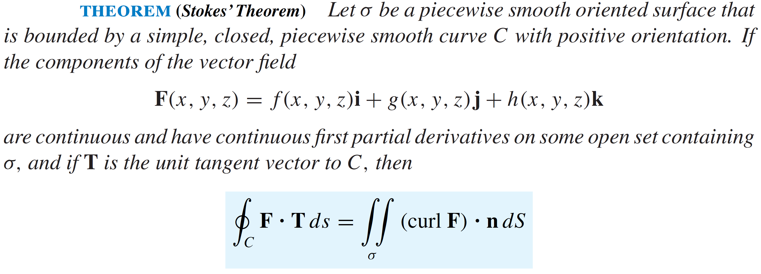
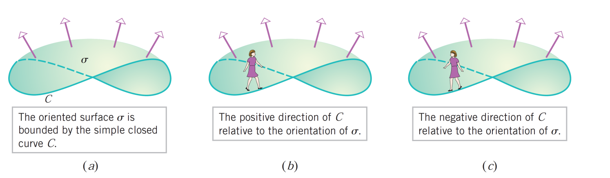
Stokes’ theorem

Slide 24
Stokes’ theorem
  Stokes’ theorem states that: The line integral around the boundary curve of S of the tangential component of F is equal to the surface integral of the normal component of the curl of F.

Slide 25
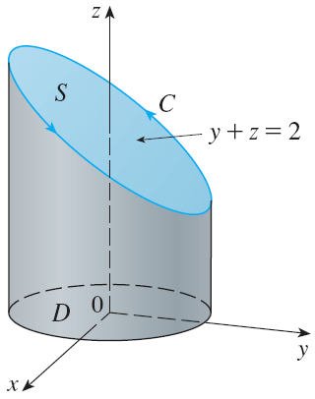
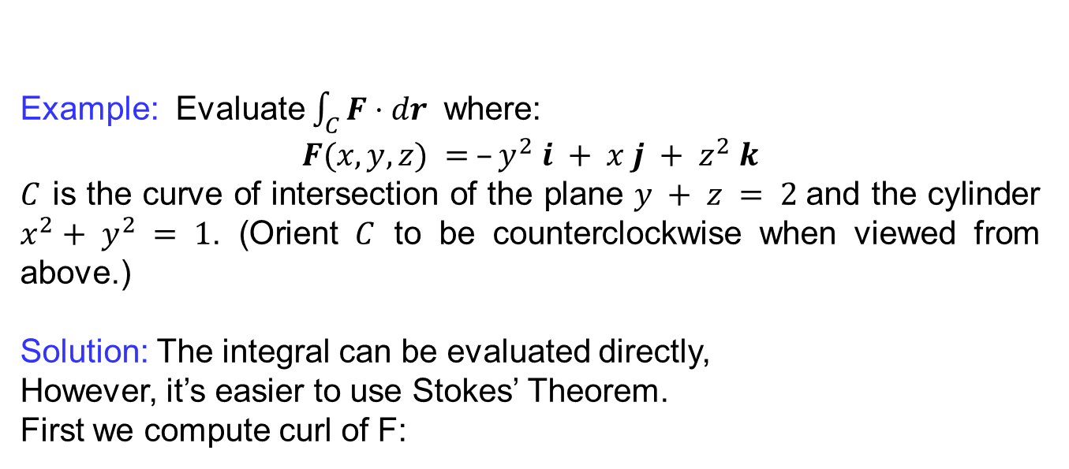
Stokes’ theorem
  Example:Evaluate $\int_{C}{F⋅dr }$ where:
  $$F(x, y, z) = –y^{2} i + x j + z^{2} k$$
  $C$is the curve of intersection of the plane $y + z = 2$and the cylinder $x^{2}+ y^{2} = 1$. (Orient $C$ to be counterclockwise when viewed from above.)
  Solution: The integral can be evaluated directly,
  However, it’s easier to use Stokes’ Theorem.
  First we compute curl of F:

Slide 26
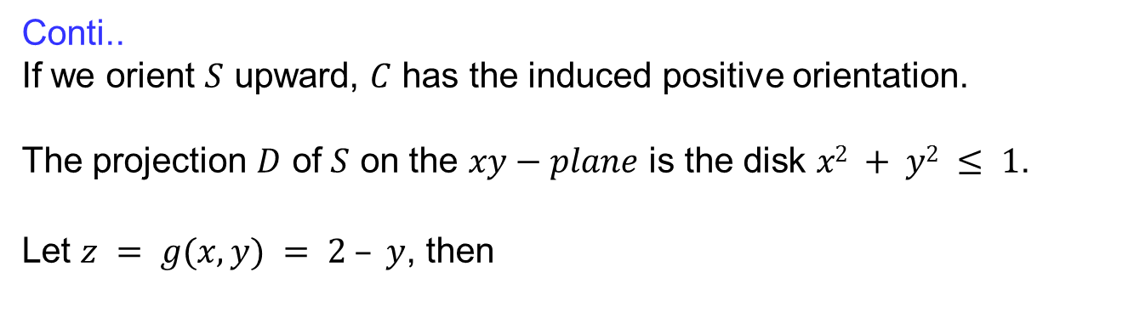
Stokes’ theorem
  Conti..
  If we orient $S$ upward, $C$has the induced positive orientation.
  The projection $D$ of $S$ on the $xy−plane$is the disk $x2 + y2 ≤ 1$.
  Let $z = g(x, y) = 2 – y$, then

Slide 27
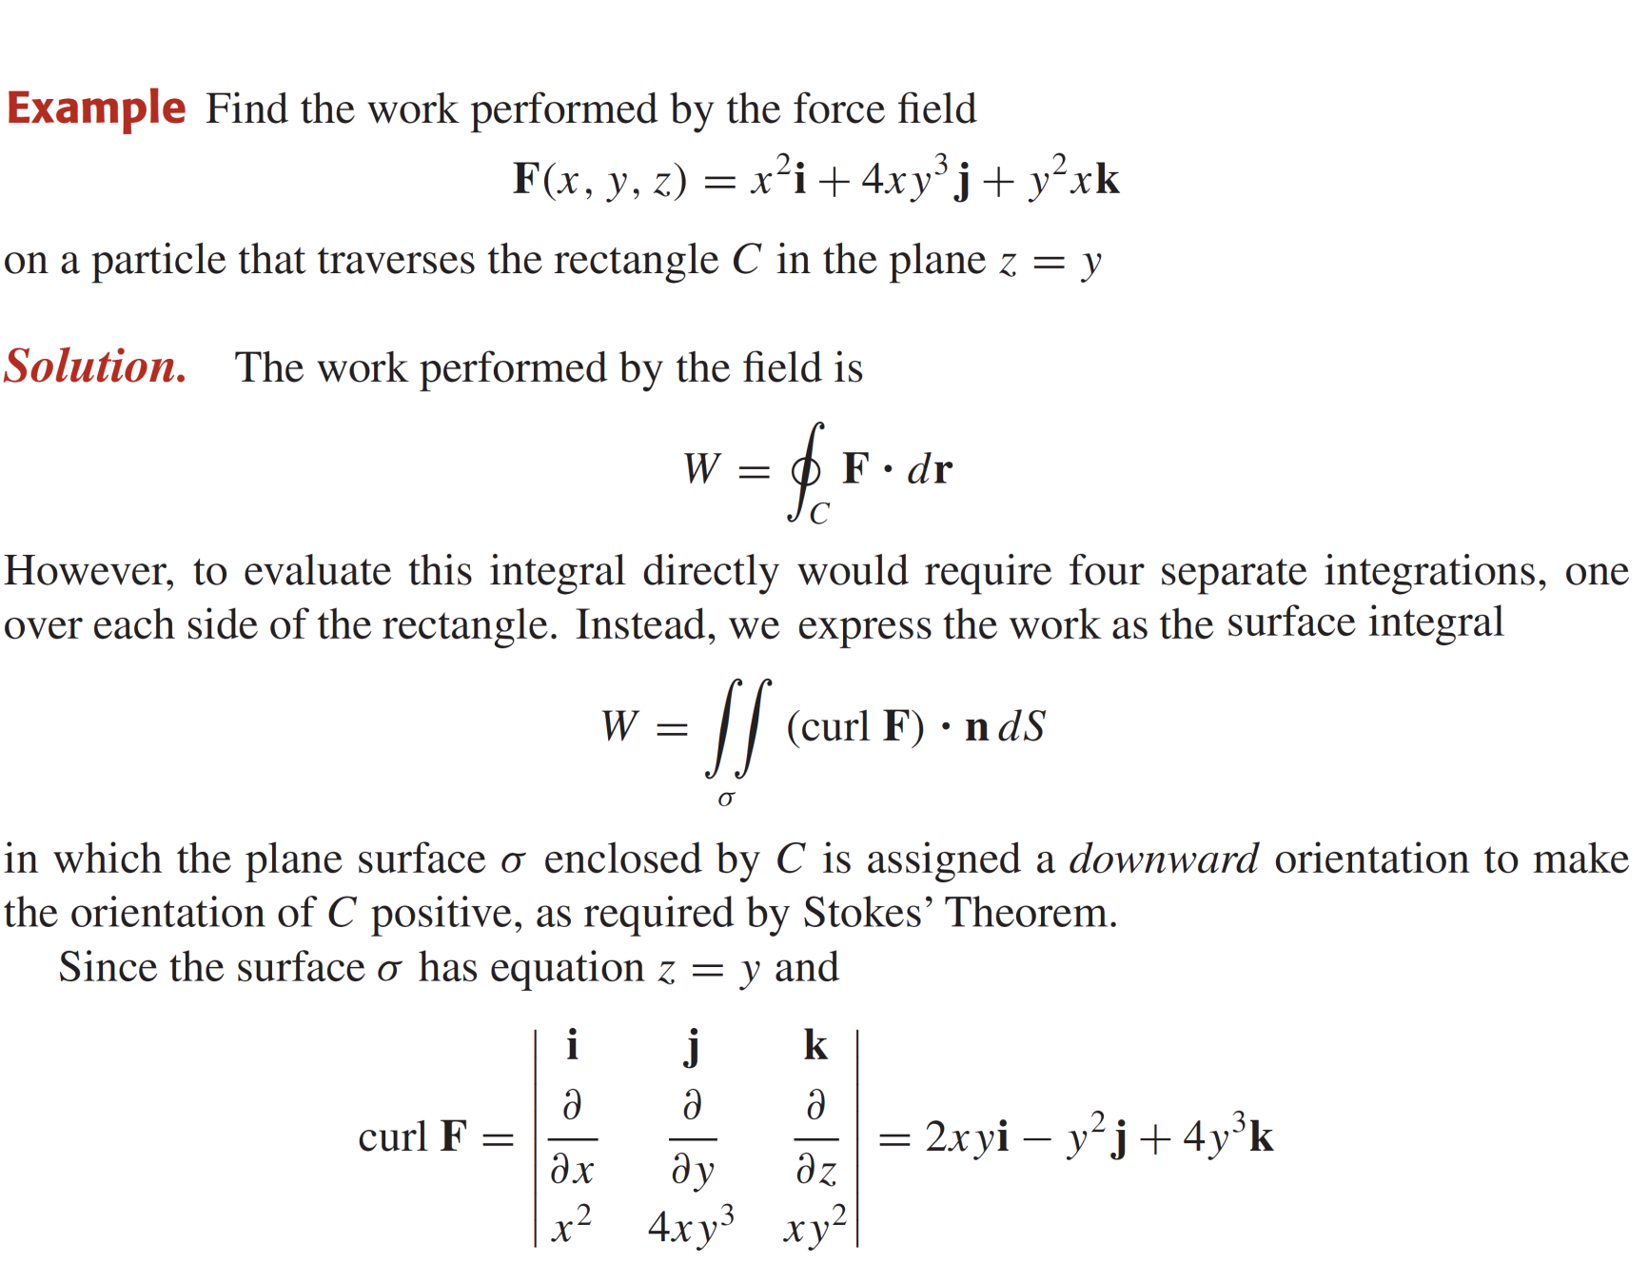
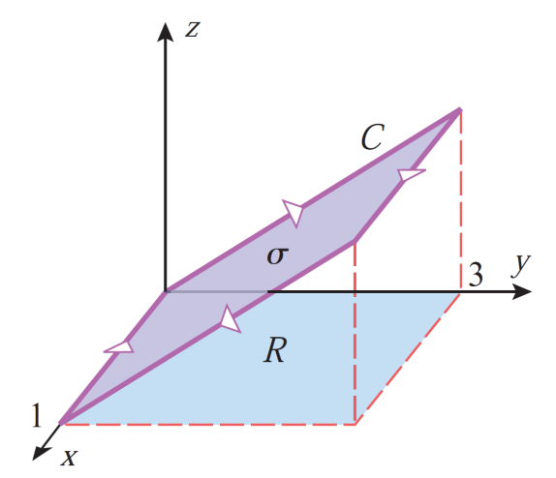
Stokes’ theorem

Slide 28
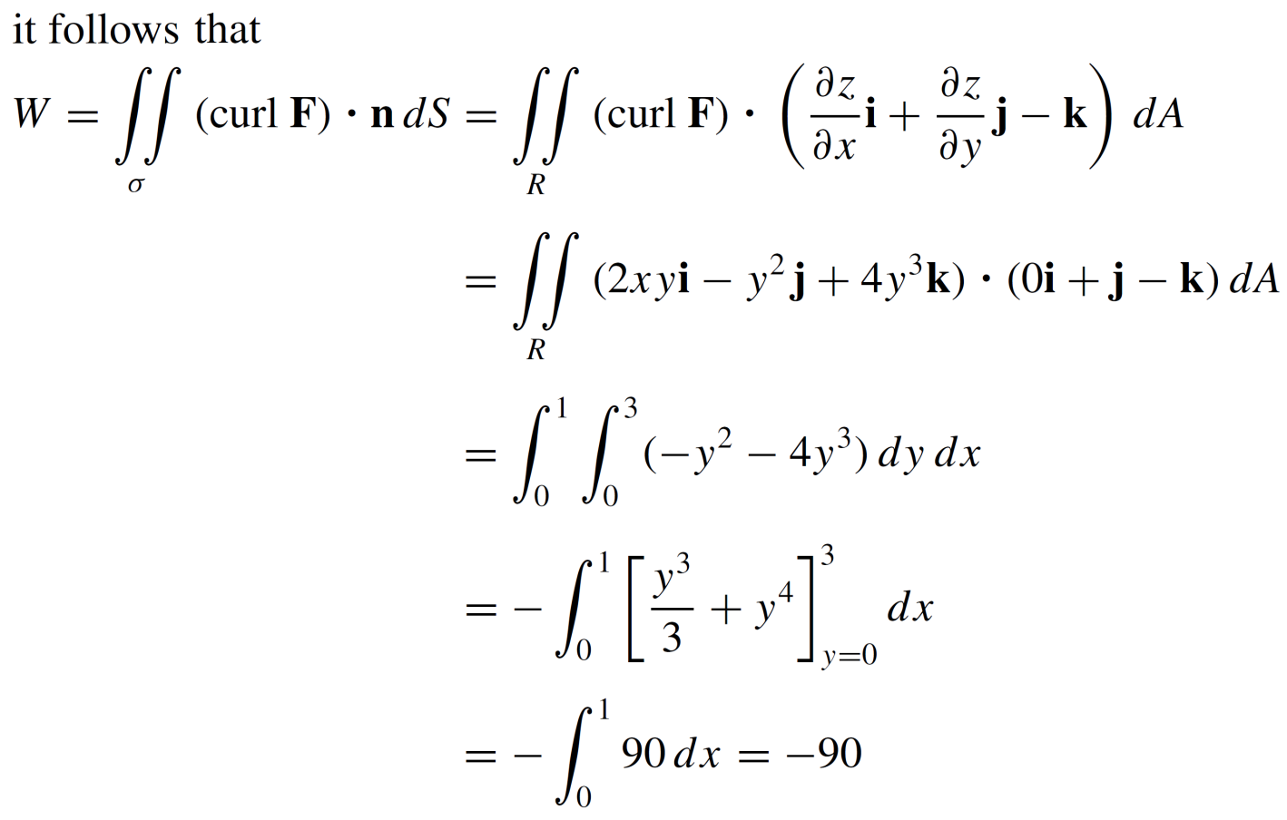

Stokes’ theorem

Slide 29
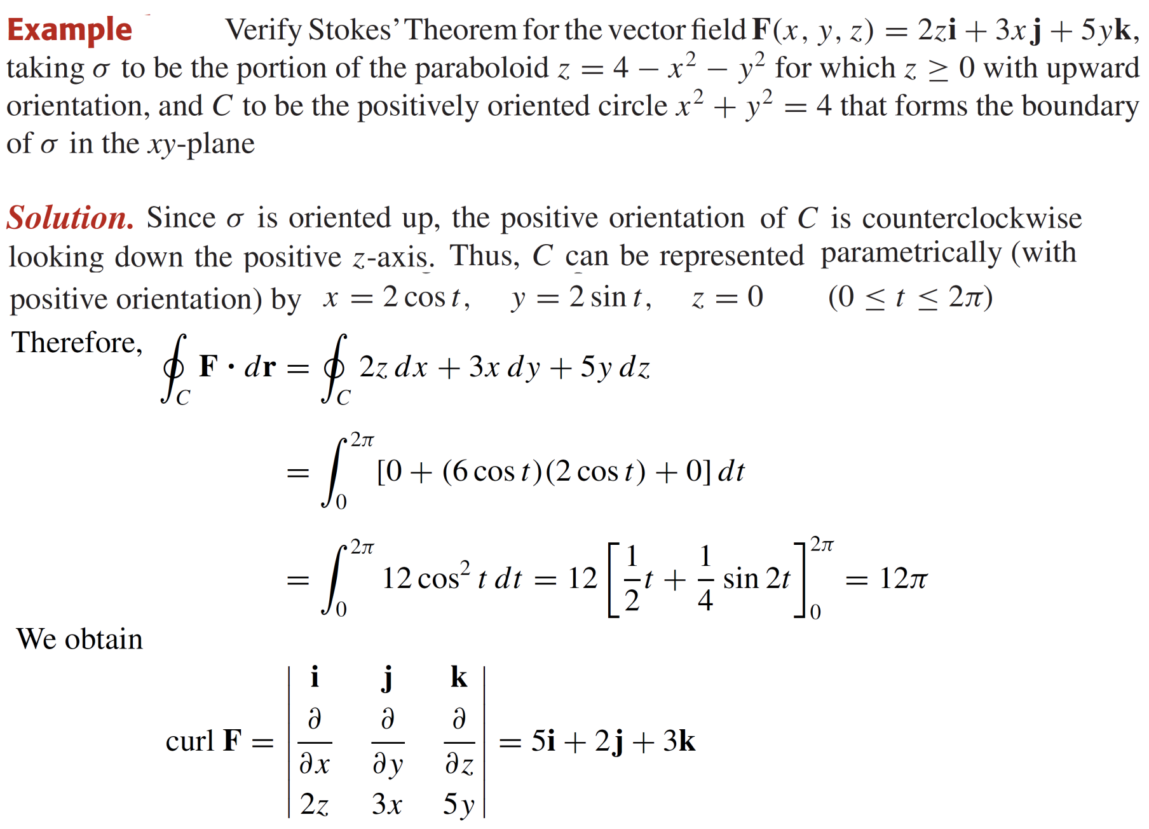
Stokes’ theorem

Slide 30
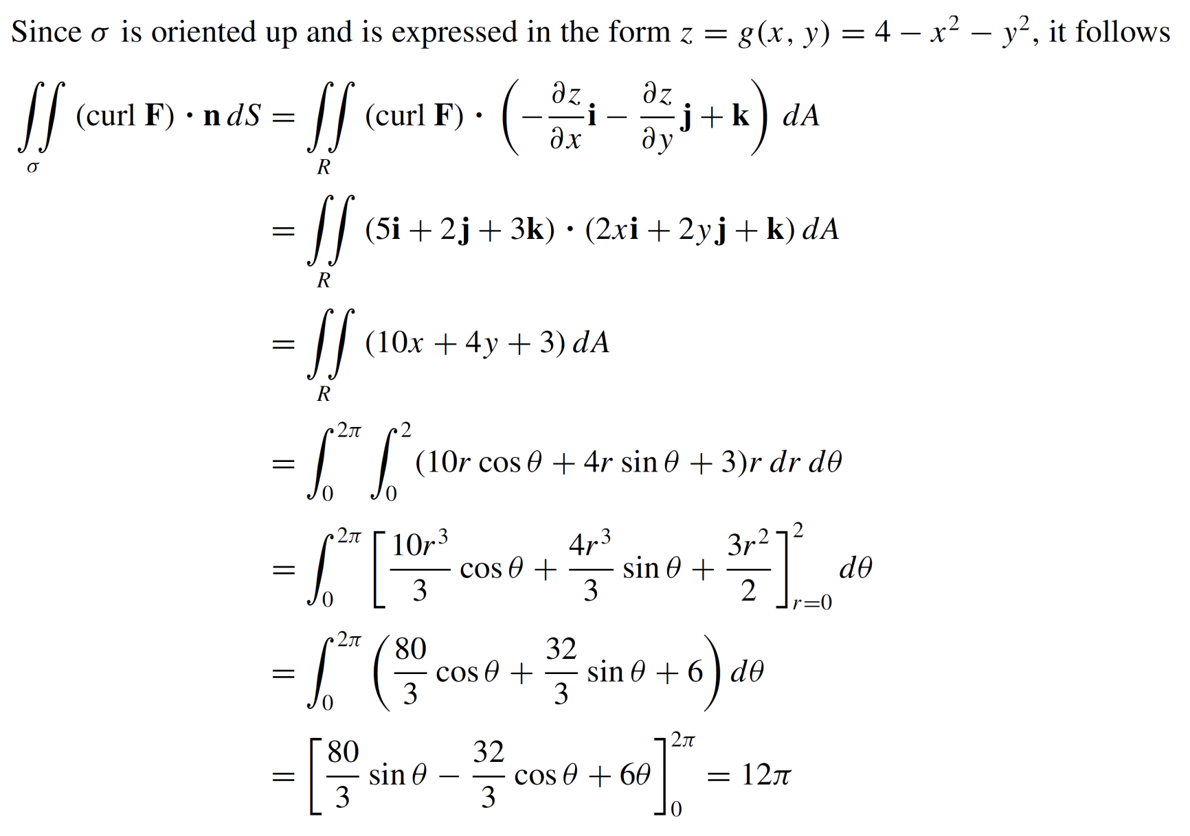
Stokes’ theorem

Slide 31
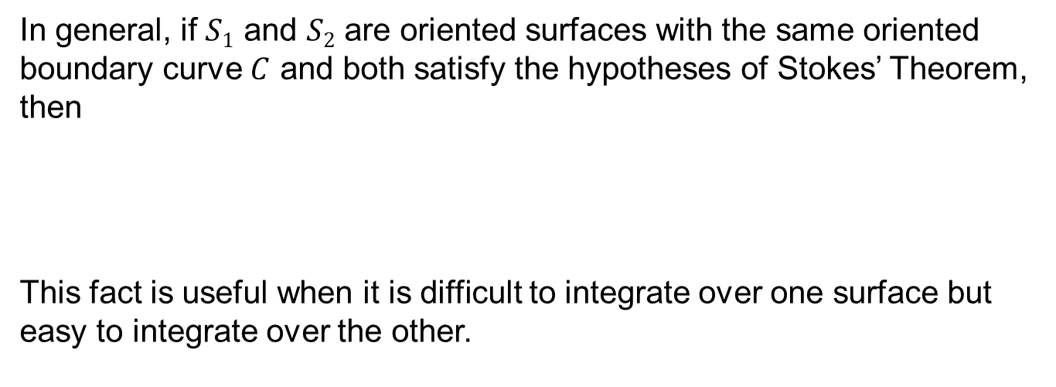
Stokes’ theorem
In general, if $S1$ and $S2$ are oriented surfaces with the same oriented boundary curve $C$ and both satisfy the hypotheses of Stokes’ Theorem, then
This fact is useful when it is difficult to integrate over one surface but easy to integrate over the other.

Slide 32
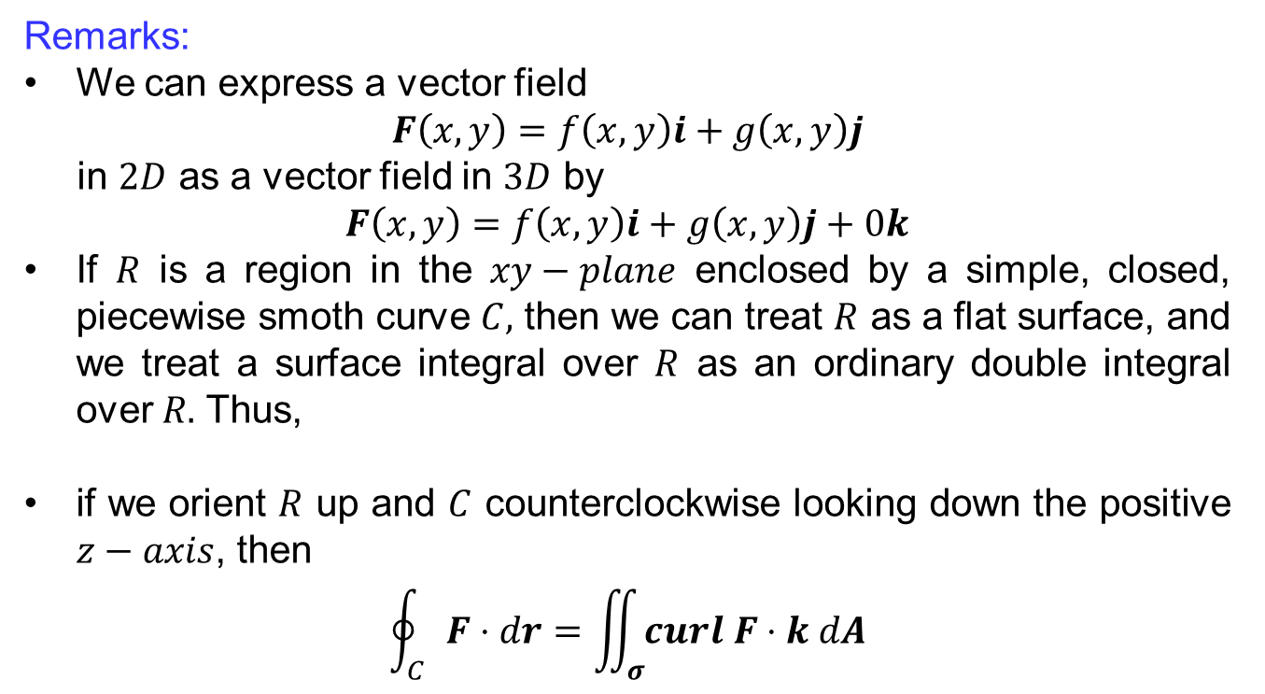
Relationship b/w Green & Stokes’ theorem
Remarks:
Wecan express a vectorfield
$$F\left(x,y\right)=f\left(x,y\right)i+g\left(x,y\right)j$$
in $2D$ as a vectorfield in $3D$ by
$$F\left(x,y\right)=f\left(x,y\right)i+g\left(x,y\right)j+0k$$
If $R$is a region in the $xy−plane$enclosed by a simple, closed, piecewisesmothcurve$C,$thenwecantreat$R$ as a flat surface, and wetreat a surface integral over $R$ as an ordinary double integral over $R.$Thus,
if we orient $R$ up and $C$counterclockwiselooking down the positive $z−axis$, then
$$\oint_{C}{F⋅dr}=\iint_{σ}{curl F⋅k dA}$$

Slide 33
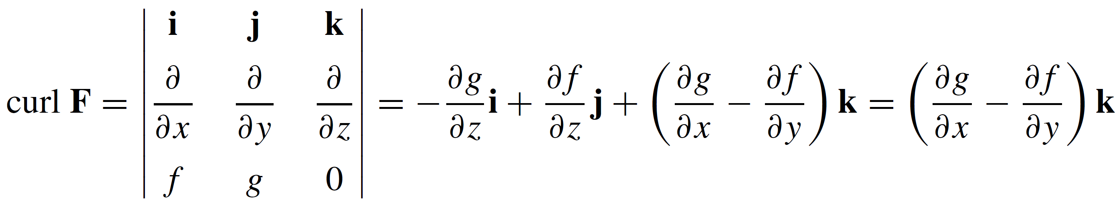
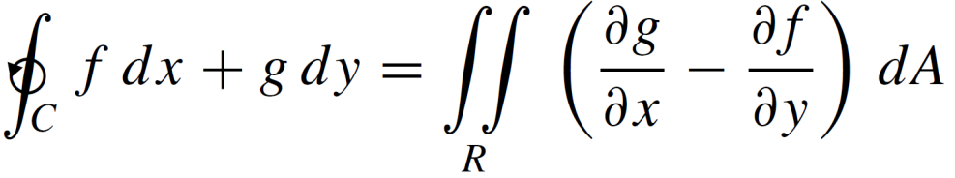

Relationship b/w Green & Stokes’ theorem
Remarks:
Since$\frac{∂g}{∂z}=\frac{∂f}{∂z}=0,$
Substitutingthis expression previousequation and expressing the integrals in terms of components yields
Green’stheoremis a special case of Stokes’theorem.

Slide 34
Relationship b/w Green & Stokes’ theorem
Remarks:
Stokes’ Theorem can be regarded as a higher-dimensional version of Green’s Theorem.
Green’s Theorem relates a double integral over a plane region D to a line integral around its plane boundary curve.
Stokes’ Theorem relates a surface integral over a surface S to a line integral around the boundary curve of S (a space curve).

Slide 35
Lecture Summary
    Orientation of non-parametric surfaces
    Green’s theorem for line integrals
    Stokes’ theorem
    Relationship b/w Green & Stokes’ theorem

