Slide 1
(MTH 250)
Calculus
Lecture 30

Slide 2
Previous Lecture’s Summary
    Integrating vector fields along curves
    Work done by a force
    Fundamental theorem of Calculus
    Independence of path
    Integration along closed path
    Test for conservative fields

Slide 3
Today’s Lecture
    Recalls
    Surfaces area & parametric representations
    Introduction to surface integrals
    Evaluating surface integrals
    Piecewise smooth surfaces
    Oriented surfaces
    Flux

Slide 4
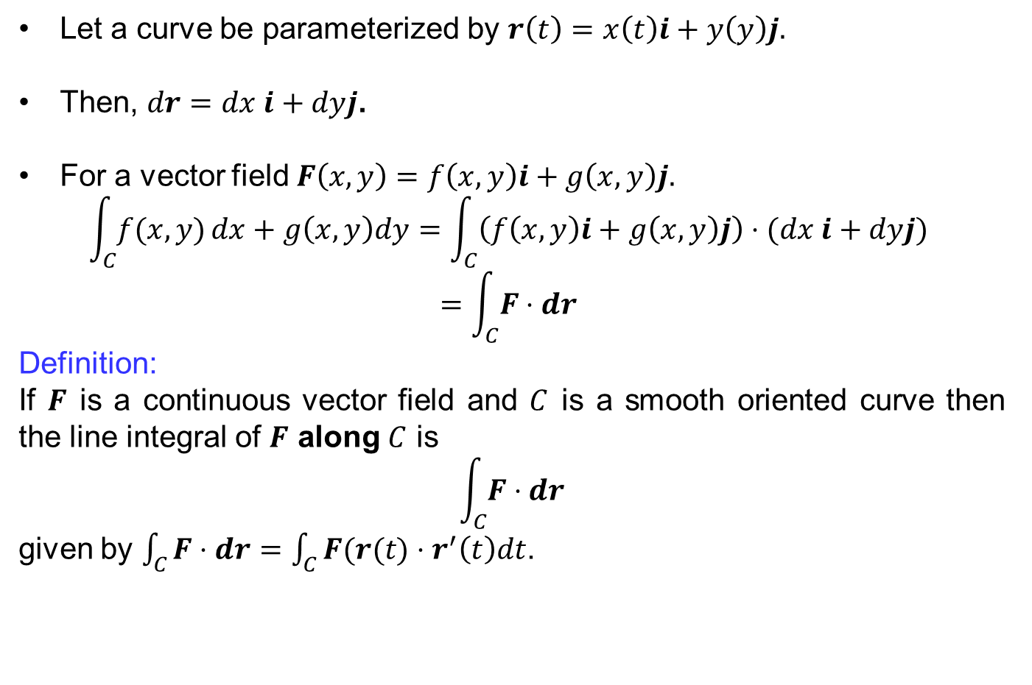
Recalls
Let a curve be parameterized by $r\left(t\right)=x\left(t\right)i+y\left(y\right)j.$
Then, $dr=dx i+dyj$.
For a vector field $F\left(x,y\right)=f\left(x,y\right)i+g\left(x,y\right)j.$
$$\int_{C}{f(x,y)}dx+g\left(x,y\right)dy=\int_{C}{\left(f\left(x,y\right)i+g\left(x,y\right)j\right)⋅(dx i+dyj)}$$
$$=\int_{C}{F⋅dr}$$
Definition:
If $F$is a continuous vector field and $C$is a smooth oriented curve then the line integral of $F$ along $C$ is
$$\int_{C}{F⋅dr}$$
given by $\int_{C}{F⋅dr}=\int_{C}{F(r(t)⋅r^{′}\left(t\right)dt}$.

Slide 5
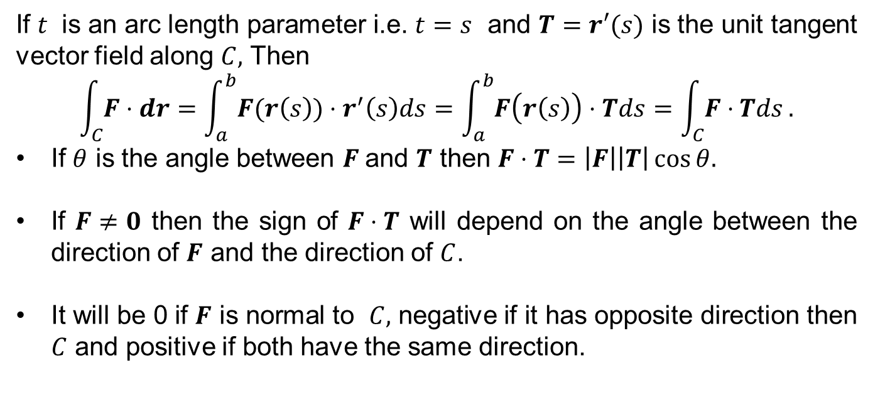
Recalls
If $t$ is an arc length parameter i.e. $t=s$ and $T=r′(s)$is the unit tangent vector field along $C,$Then
$$\int_{C}{F⋅dr}=\int_{a}^{b}{F(r\left(s\right))⋅r^{′}\left(s\right)ds}=\int_{a}^{b}{F\left(r\left(s\right)\right)⋅Tds}=\int_{C}{F⋅Tds}.$$
If $θ$is the angle between$F$and $T$ then $F⋅T=\left|F\right|\left|T\right|\cos{θ.}$
If $F≠0$then the sign of $F⋅T$will depend on the angle between the direction of $F$and the direction of $C$.
It will be 0 if $F$is normal to $C,$ negative if it has opposite direction then $C$ and positive if both have the same direction.

Slide 6
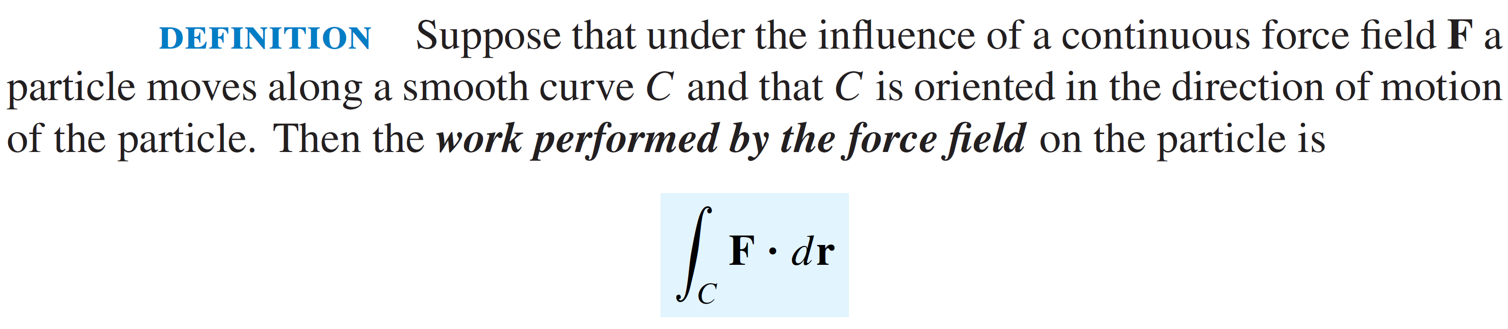
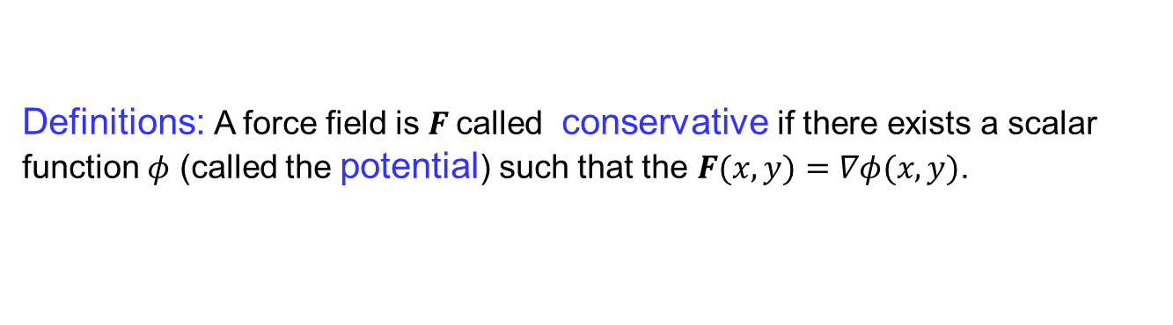
Recalls
Definitions: A force field is $F$called conservative if there exists a scalar function $φ$ (called the potential) such that the $F(x,y)=∇φ(x,y)$.

Slide 7
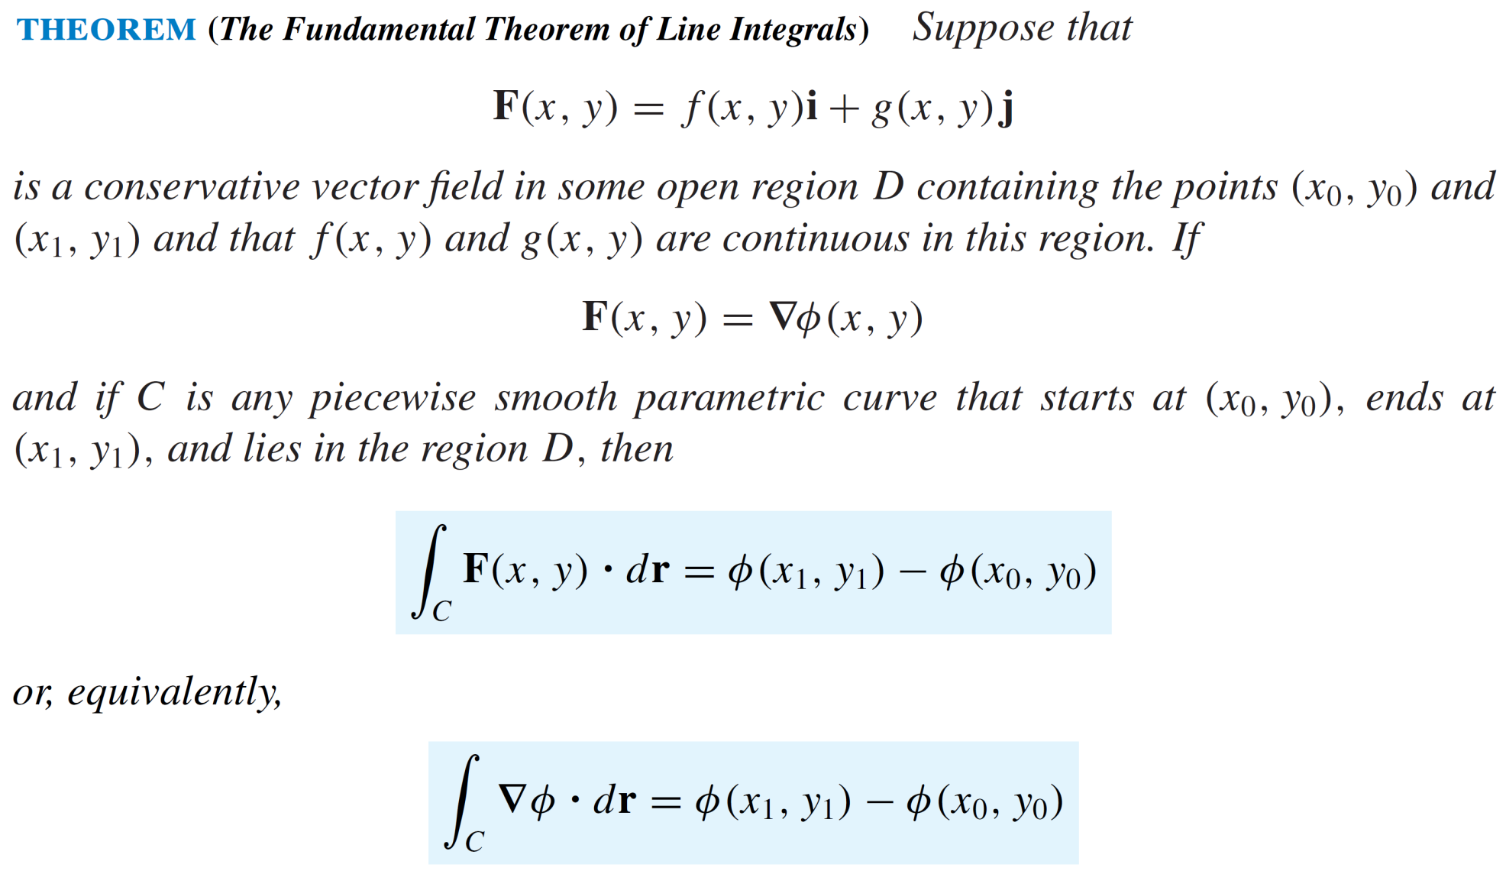
Recalls

Slide 8
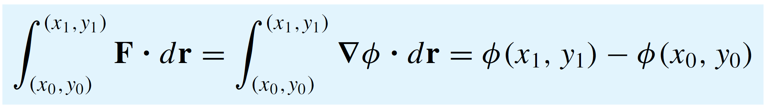
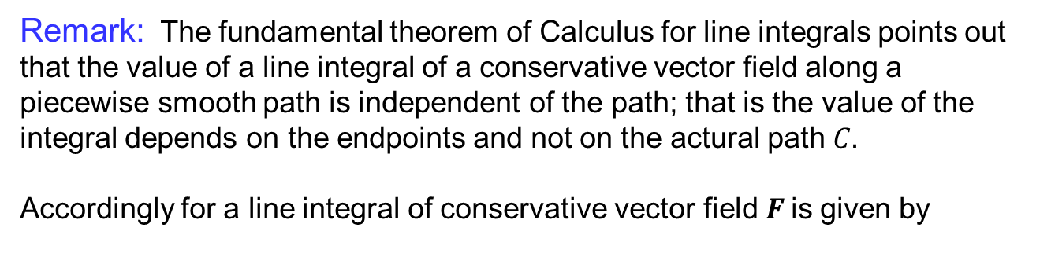
Recalls
Remark: The fundamentaltheorem of Calculus for line integrals points out that the value of a line integral of a conservative vectorfieldalong a piecewisesmoothpathisindependent of the path; thatis the value of the integraldepends on the endpoints and not on the acturalpath$C.$
Accordingly for a line integral of conservative vector field $F$is given by

Slide 9
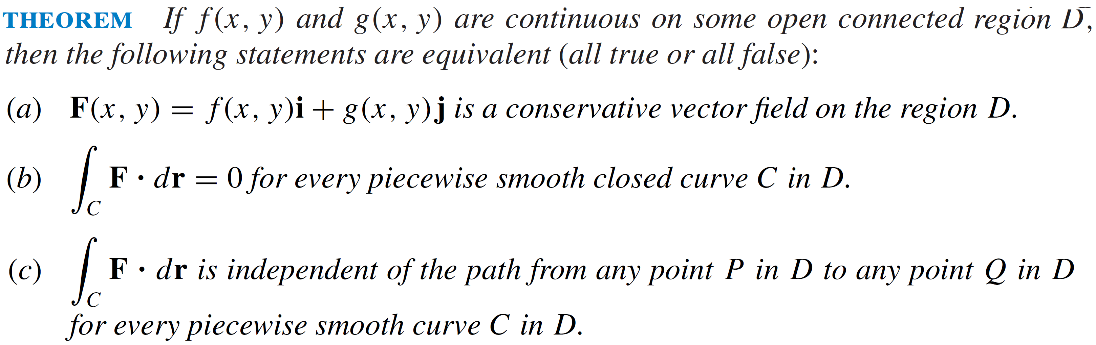
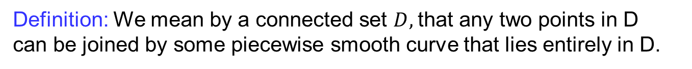
Recalls
Definition: We mean by a connected set $D,$that any two points in D can be joined by some piecewise smooth curve that lies entirely in D.

Slide 10
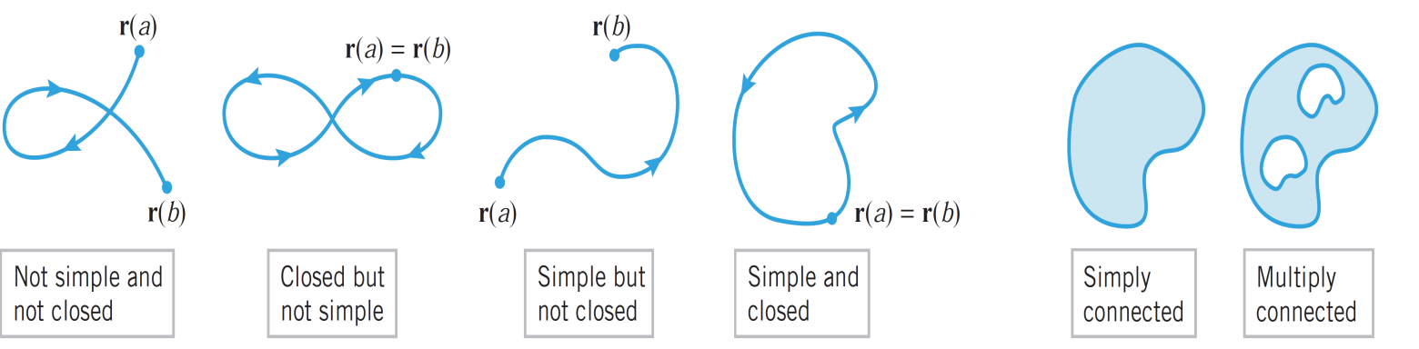
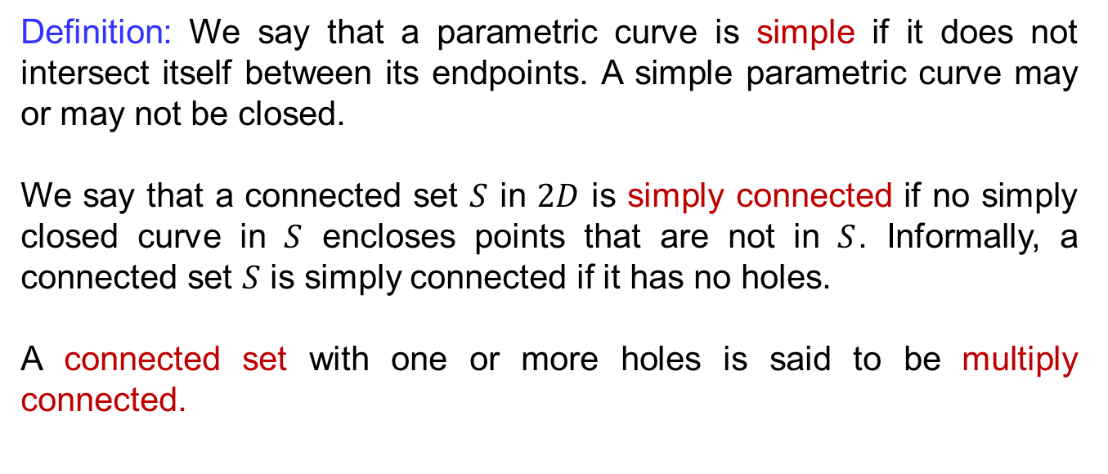
Recalls
Definition: We saythat a parametriccurveissimple if itdoes not intersectitselfbetweenitsendpoints. A simple parametriccurvemay or may not beclosed.
Wesaythat a connected set $S$ in $2D$issimplyconnectedif no simplyclosedcurve in $S$ encloses points that are not in $S$. Informally, a connected set $S$issimplyconnected if it has no holes.
A connected set with one or more holesissaid to bemultiplyconnected.

Slide 11
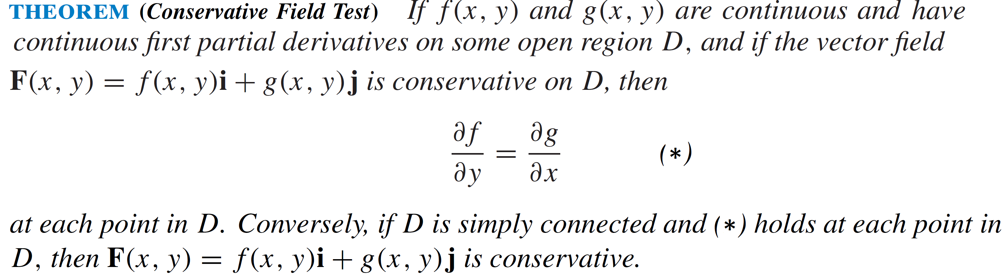
Recalls

Slide 12
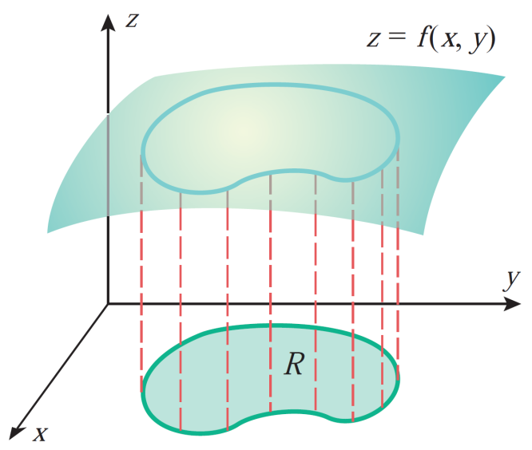
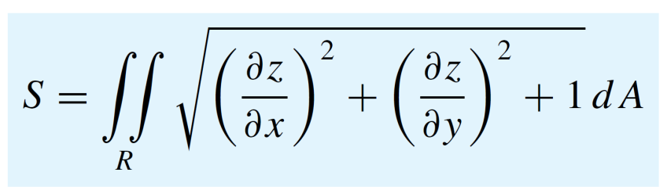
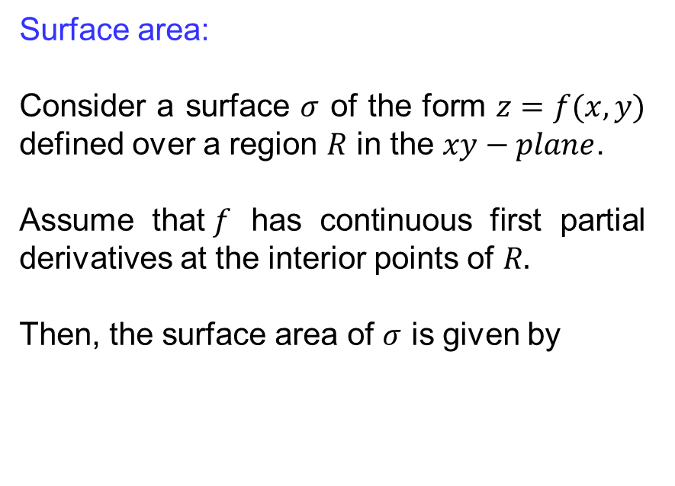
Surface area & parametric representations
Surface area:
Consider a surface $σ$ of the form $z=f(x,y)$ defined over a region $R$ in the $xy−plane$.
Assume that$f$ has continuous first partial derivatives at the interior points of $R.$
Then, the surface area of $σ$ is given by

Slide 13
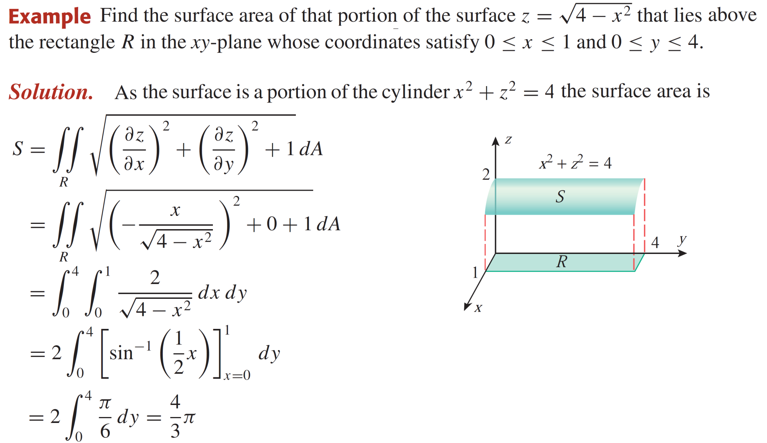
Surface area & parametric representations

Slide 14
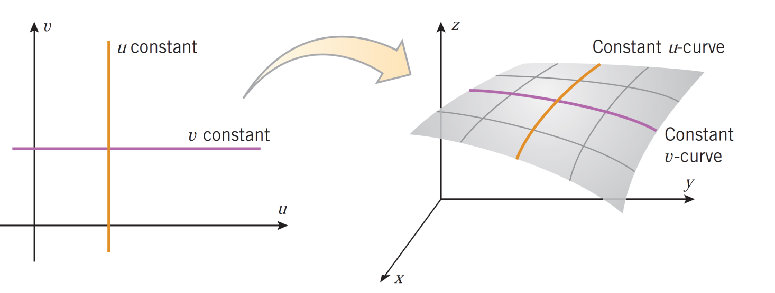
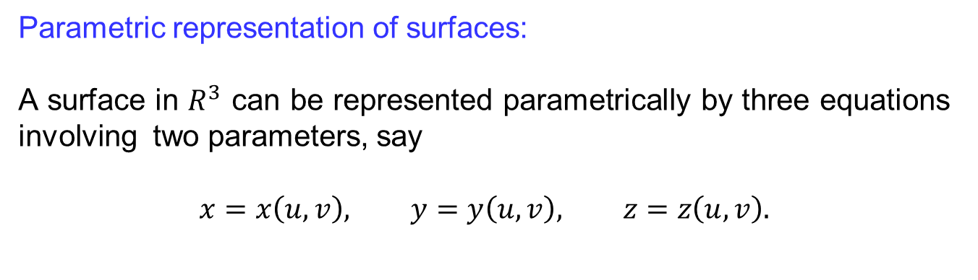
Surface area & parametric representations
Parametric representation of surfaces:
A surface in $R^{3}$canberepresentedparametrically by threeequationsinvolvingtwoparameters, say
$$x=x\left(u,v\right), y=y\left(u,v\right), z=z\left(u,v\right).$$

Slide 15
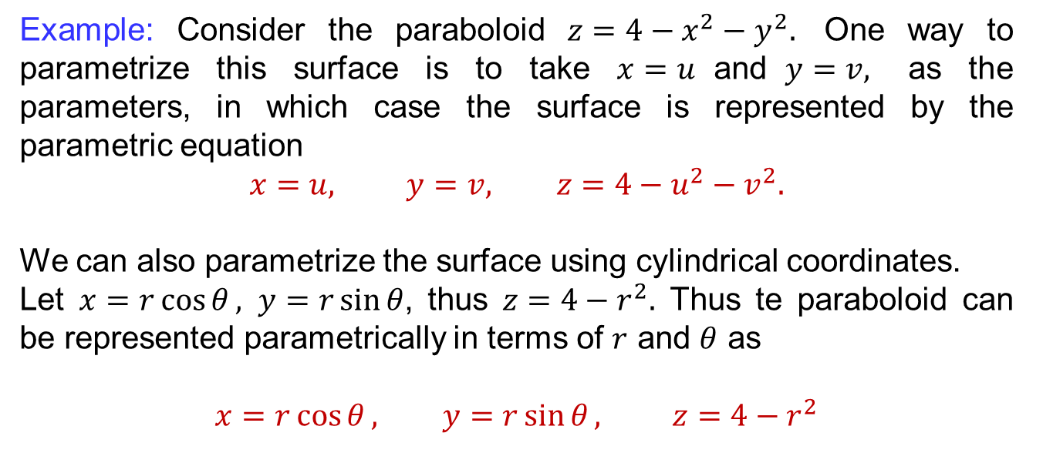
Surface area & parametric representations
Example: Consider the paraboloid$z=4−x^{2}−y^{2}.$ One way to parametrize this surface is to take $x=u$and$y=v,$ as the parameters, in which case the surface is represented by the parametric equation
$$x=u, y=v, z=4−u^{2}−v^{2}.$$
Wecanalsoparametrize the surface usingcylindricalcoordinates.
Let $x=r\cos{θ}, y=r\sin{θ}$, thus$z=4−r^{2}.$Thus te paraboloidcanberepresentedparametrically in terms of $r$ and $θ$ as
$$x=r\cos{θ}, y=r\sin{θ}, z=4−r^{2}$$

Slide 16
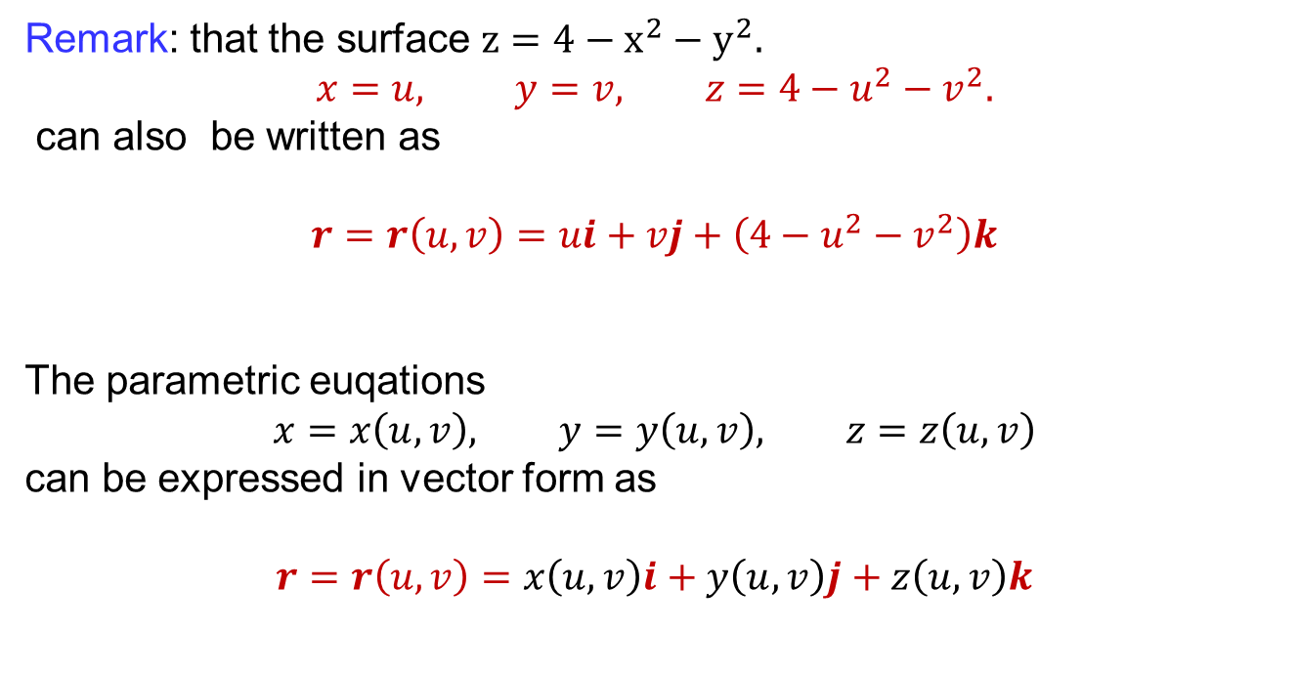
Surface area & parametric representations
Remark: that the surface $z=4−x^{2}−y^{2}.$
$$x=u, y=v, z=4−u^{2}−v^{2}.$$
canalsobewritten as
$$r=r\left(u,v\right)=ui+vj+\left(4−u^{2}−v^{2}\right)k$$
The parametriceuqations
$$x=x\left(u,v\right), y=y\left(u,v\right), z=z\left(u,v\right)$$
canbeexpressed in vectorform as
$$r=r\left(u,v\right)=x\left(u,v\right)i+y\left(u,v\right)j+z\left(u,v\right)k$$

Slide 17
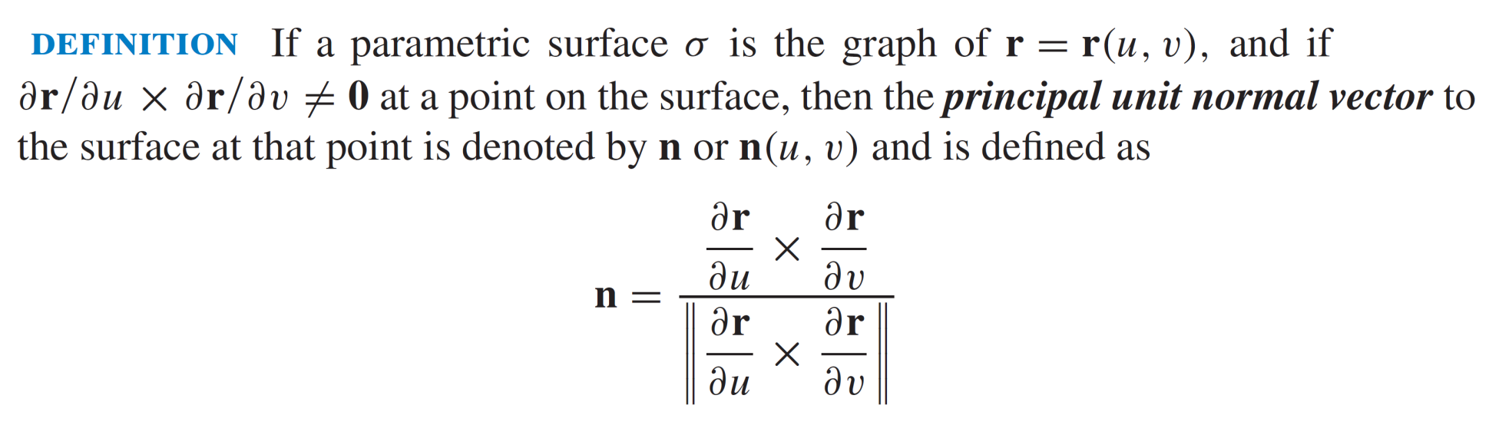
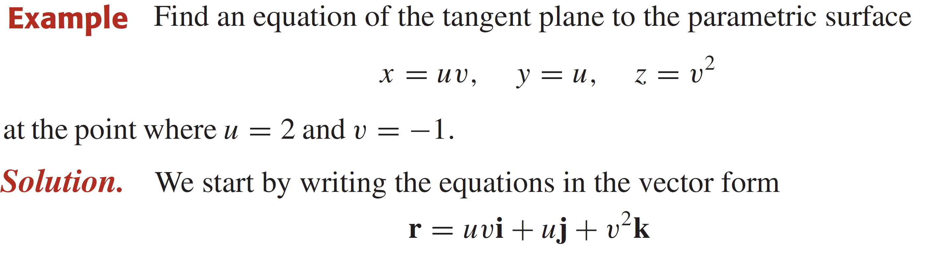
Surface area & parametric representations

Slide 18
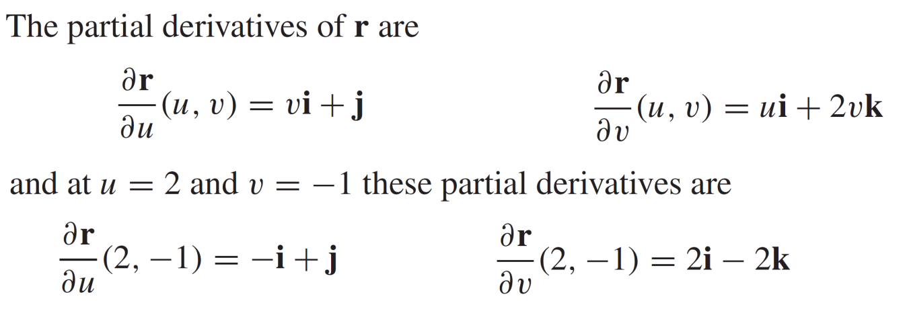
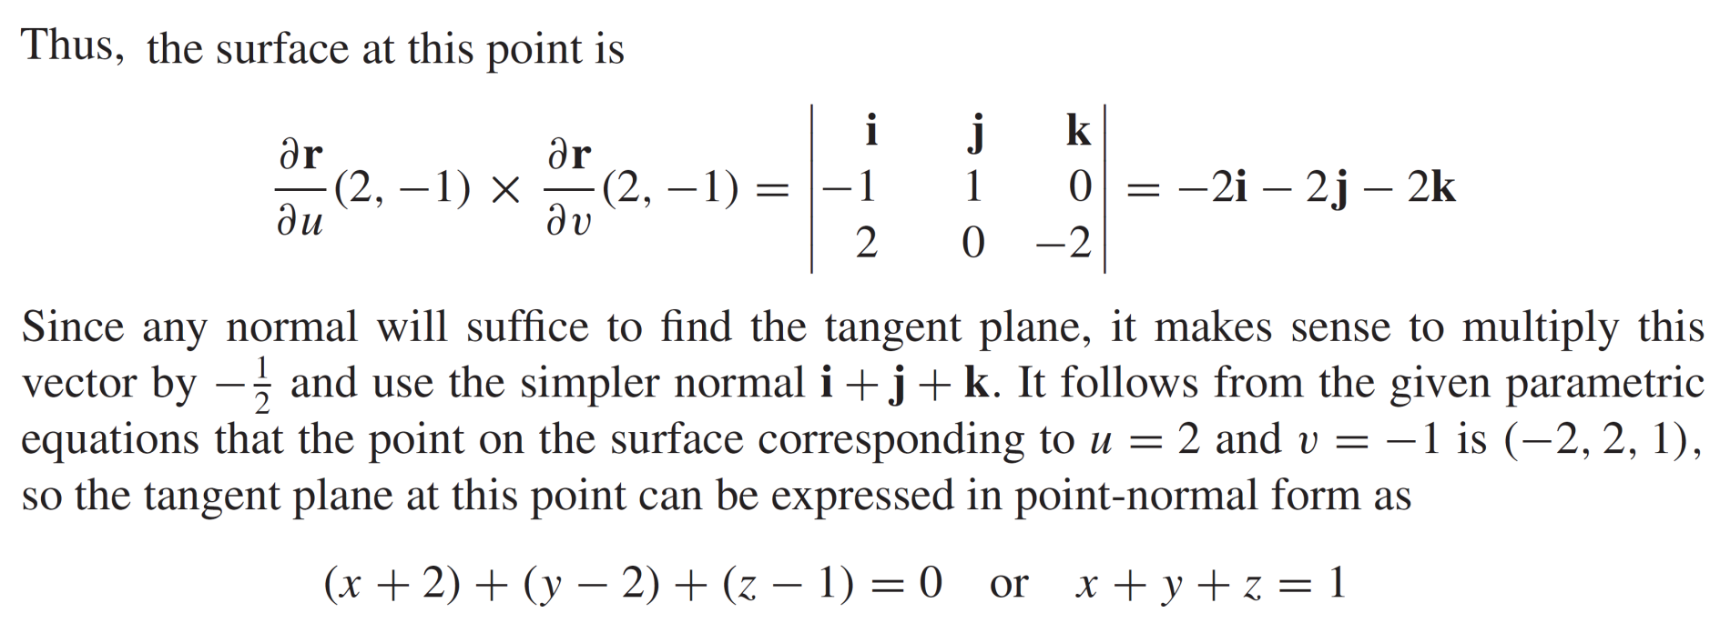
Surface area & parametric representations

Slide 19
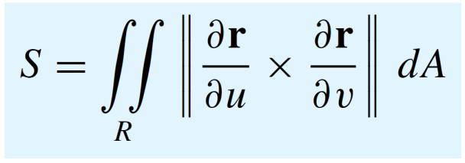
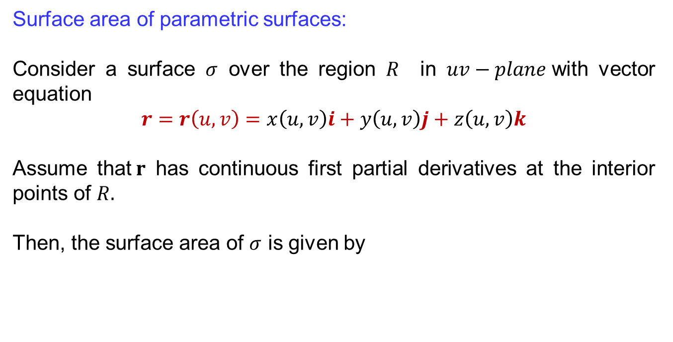
Surface area & parametric representations
Surface area of parametric surfaces:
Consider a surface $σ$ over the region$R$ in $uv−plane$with vectorequation
$$r=r\left(u,v\right)=x\left(u,v\right)i+y\left(u,v\right)j+z\left(u,v\right)k$$
Assume that$r$ has continuous first partial derivatives at the interior points of $R.$
Then, the surface area of $σ$ is given by

Slide 20
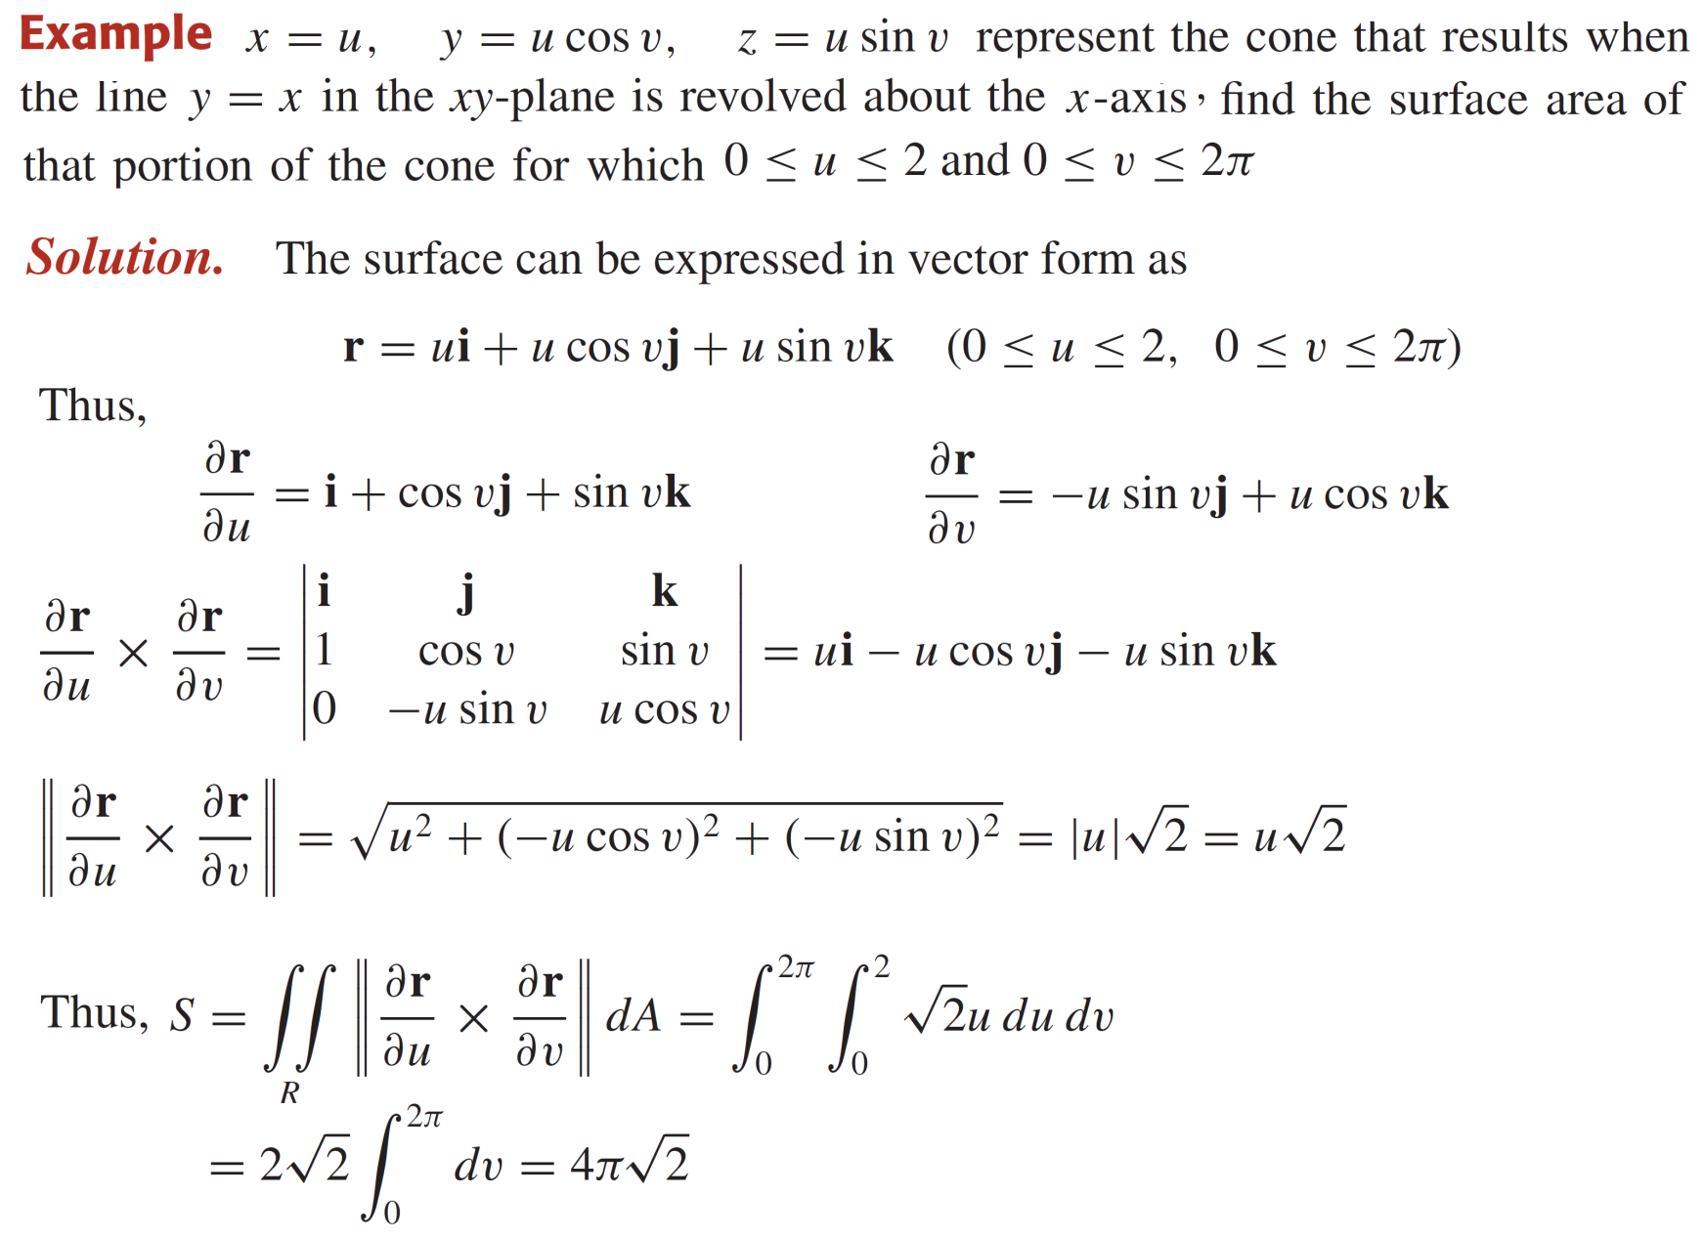
Surface area & parametric representations

Slide 21
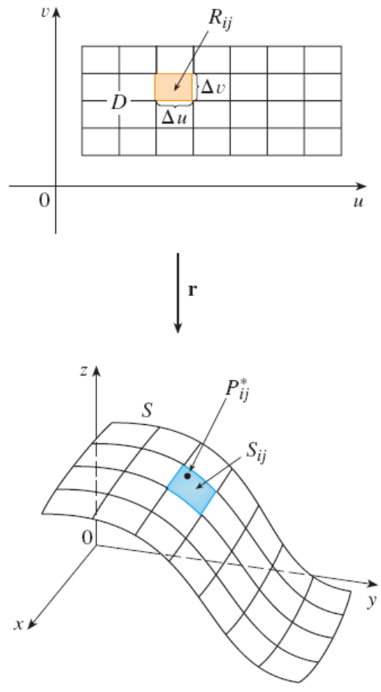
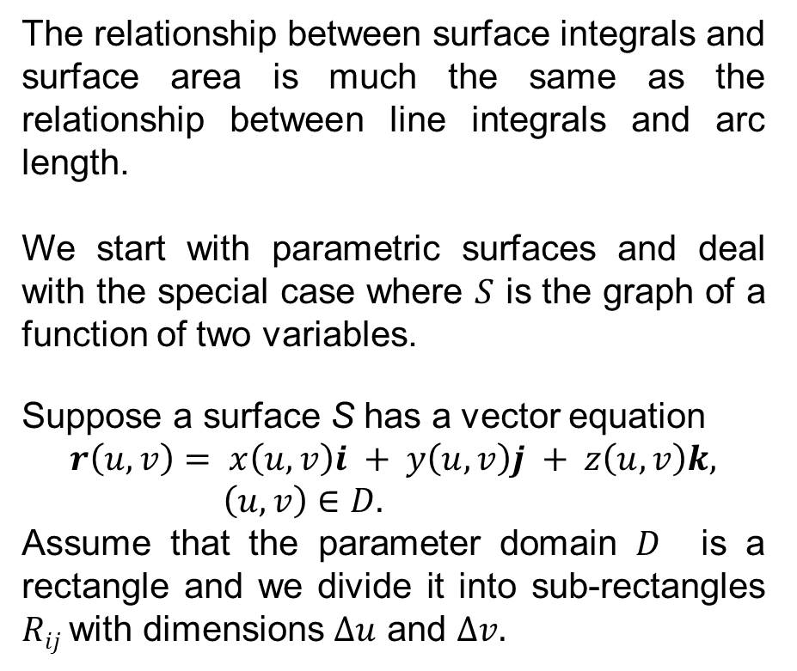
Introduction to surface integrals
The relationship between surface integrals and surface area is much the same as the relationship between line integrals and arc length.
We start with parametric surfaces and deal with the special case where $S$ is the graph of a function of two variables.
Suppose a surface S has a vector equation
$$r\left(u, v\right)= x\left(u, v\right)i + y\left(u, v\right)j + z\left(u, v\right)k, \left(u, v\right)∈D.$$
Assume that the parameter domain $D$ is a rectangle and we divide it into sub-rectangles $Rij$with dimensions $∆u$and $∆v.$

Slide 22
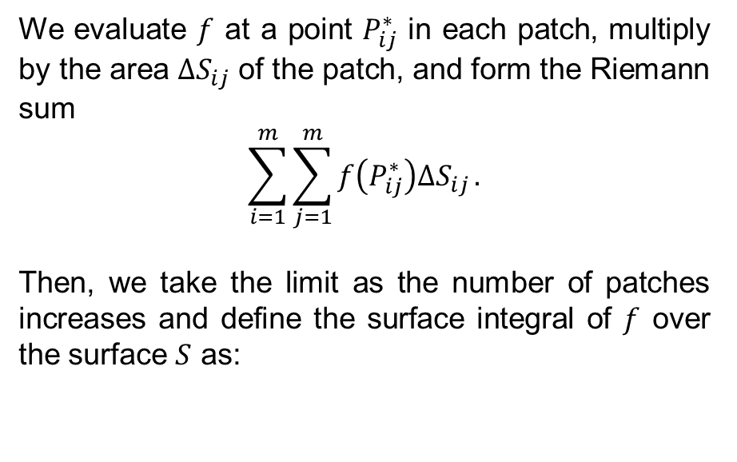
Introduction to surface integrals
We evaluate $f$ at a point $P_{ij}^{∗}$ in each patch, multiply by the area $∆S_{ij}$of the patch, and form the Riemann sum
$$\sum_{i=1}^{m}{\sum_{j=1}^{m}{f\left(P_{ij}^{∗}\right)∆S_{ij}}}.$$
Then, we take the limit as the number of patches increases and define the surface integral of $f$over the surface $S$as:

Slide 23

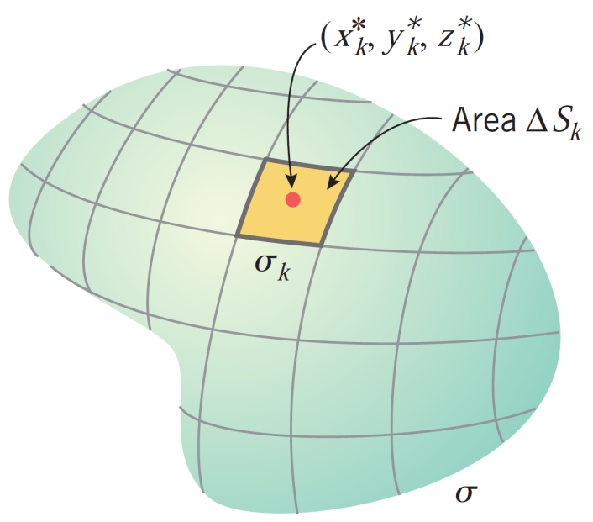
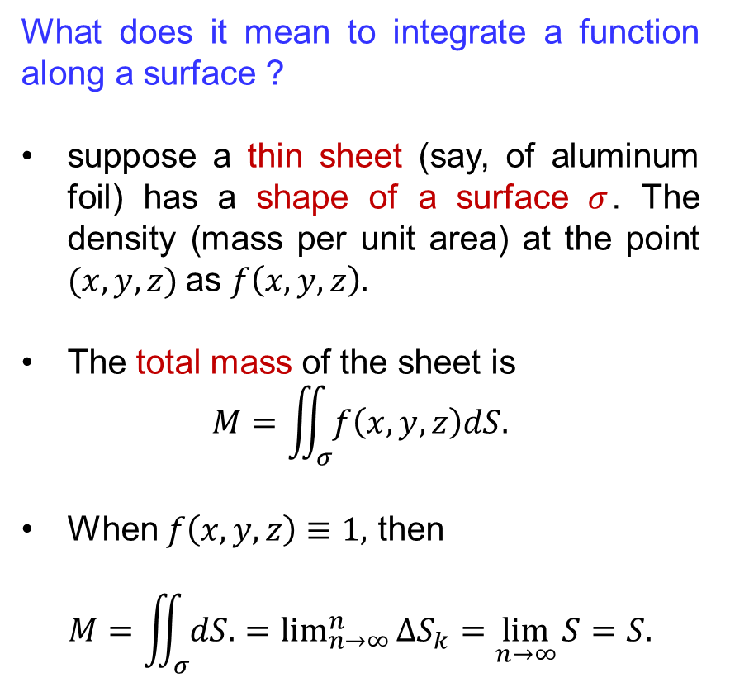
Introduction to surface integrals
What does it mean to integrate a function along a surface ?
suppose a thin sheet (say, of aluminum foil) has a shape of a surface $σ$. The density (mass per unit area) at the point $(x, y, z)$as $f\left(x, y, z\right).$
The total mass of the sheet is
$$M=\iint_{σ}{f\left(x,y,z\right)dS.}$$
When $f\left(x,y,z\right)≡1,$ then
$$M=\iint_{σ}{dS.}=\lim_{n→∞}^{n}{∆S_{k}}=\lim_{n→∞}{S}=S.$$

Slide 24
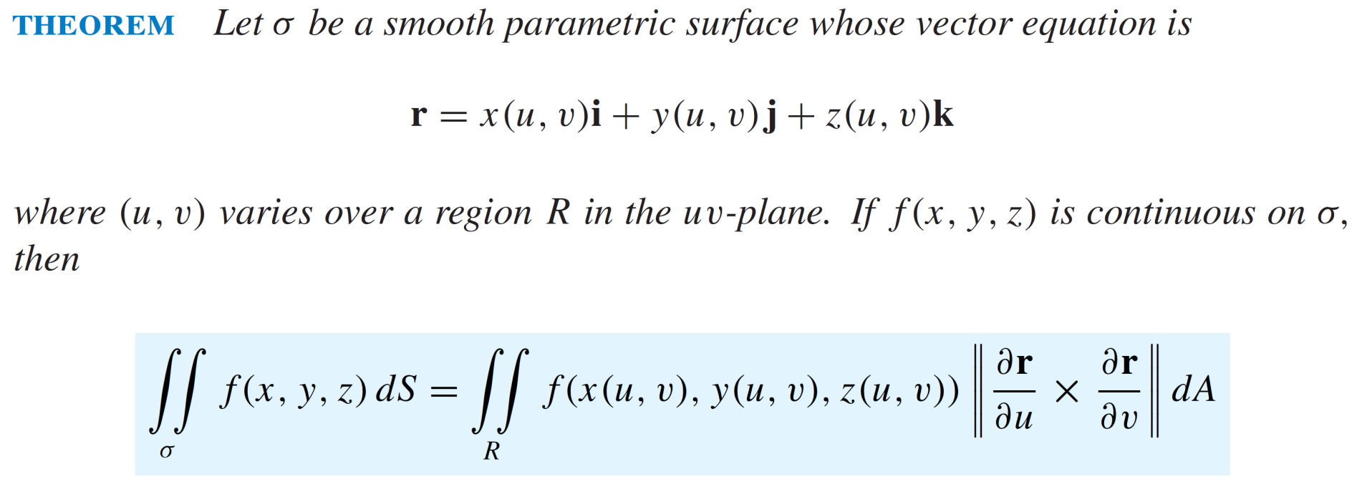
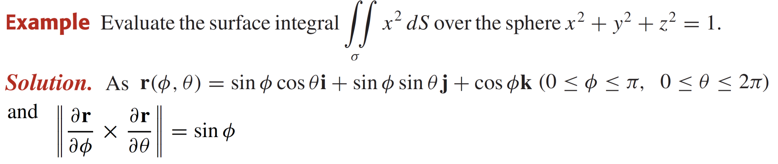
Evaluating surface integrals

Slide 25
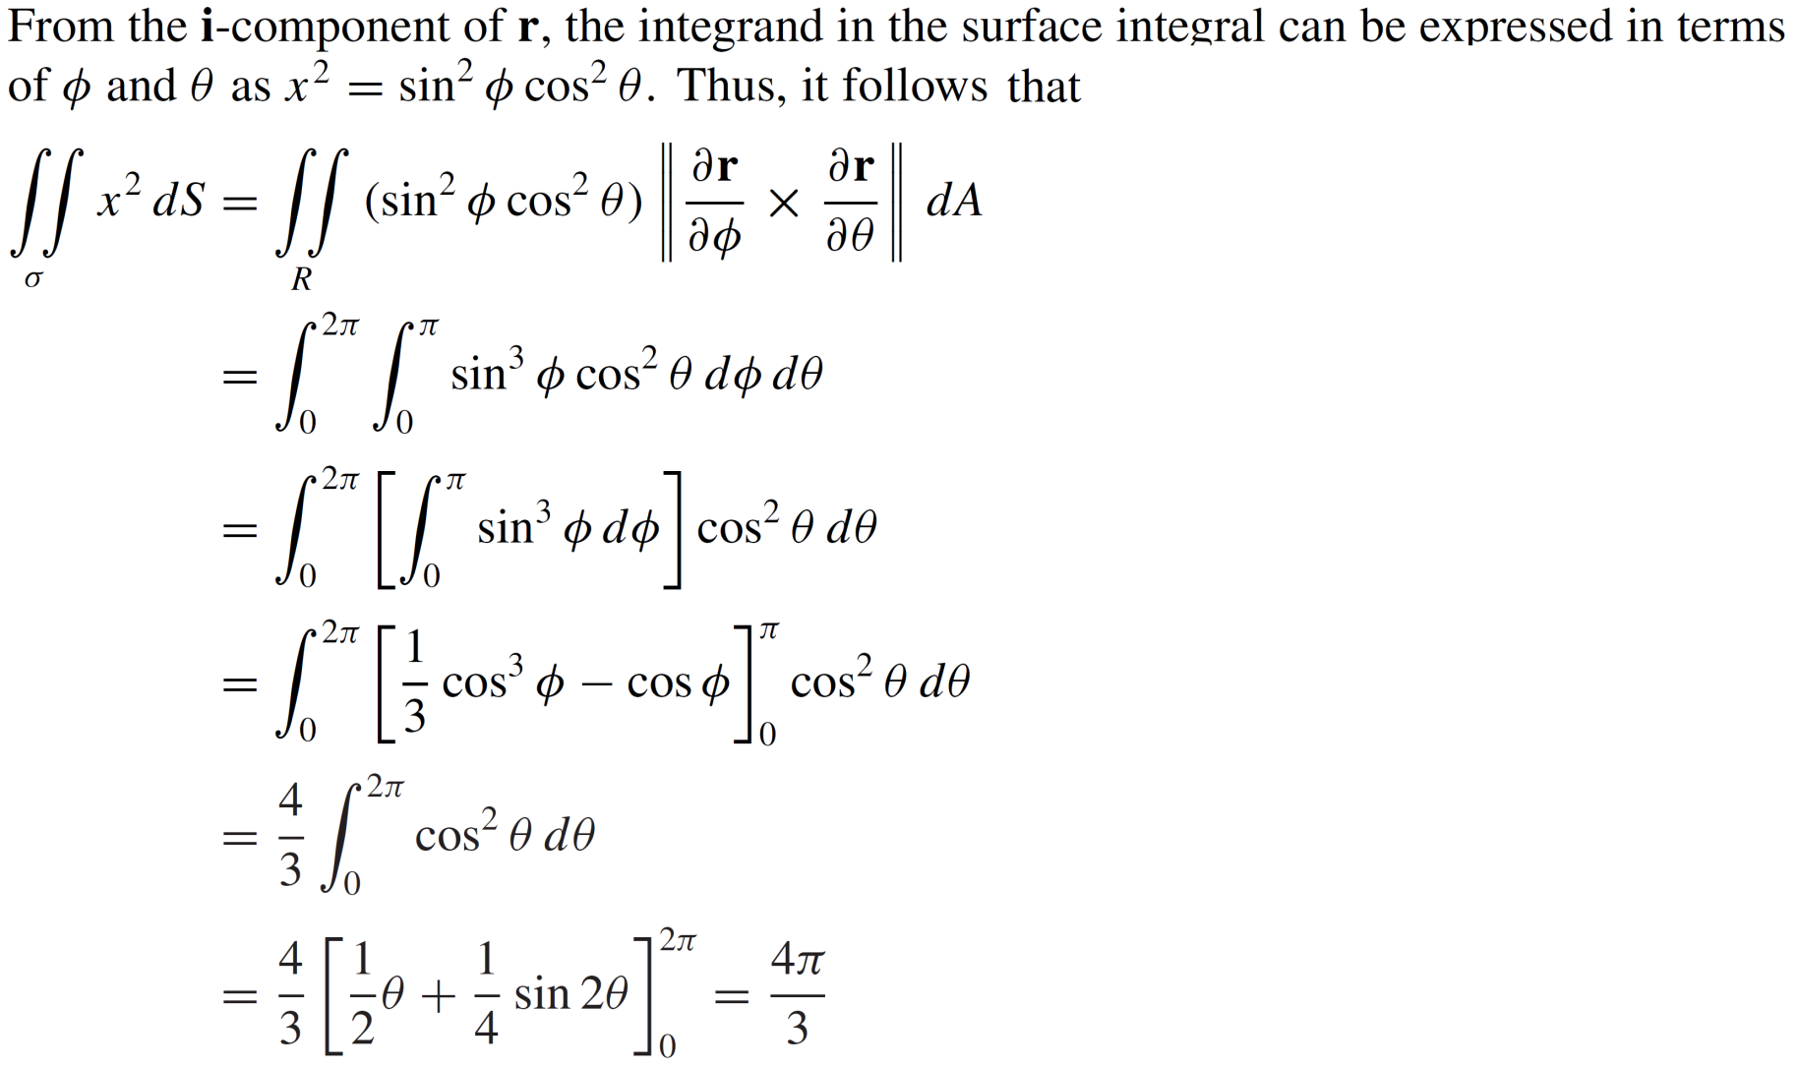
Evaluating surface integrals

Slide 26
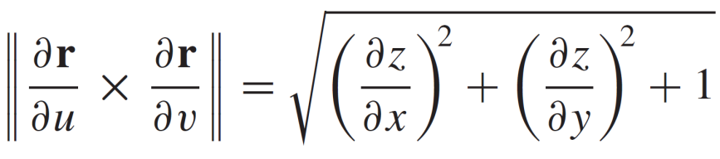
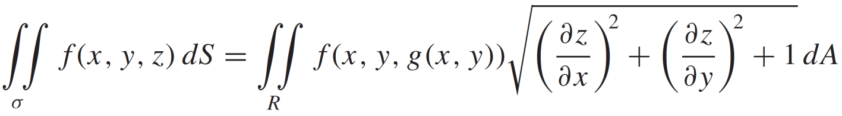
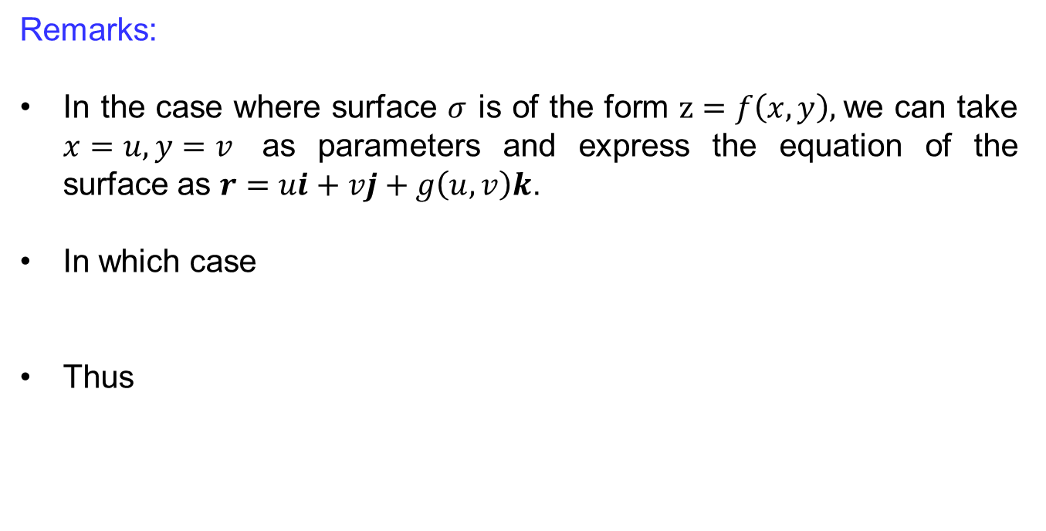
Evaluating surface integrals
Remarks:
In the case where surface $σ$ is of the form $z=f\left(x, y\right),$we can take $x=u, y=v$ as parameters and express the equation of the surface as $r=ui+vj+g\left(u,v\right)k$.
In which case
Thus

Slide 27
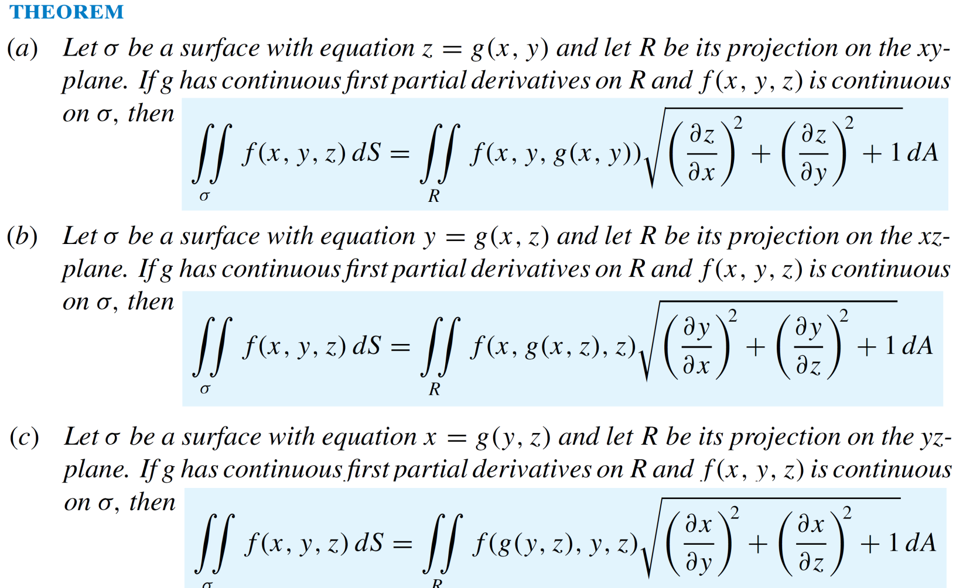
Evaluating surface integrals

Slide 28
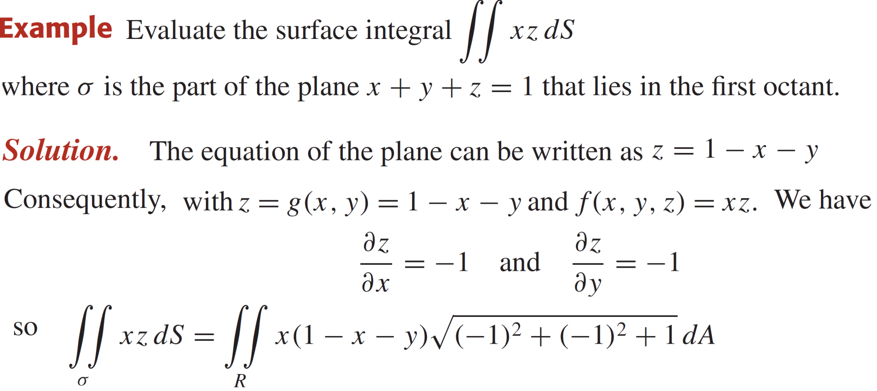
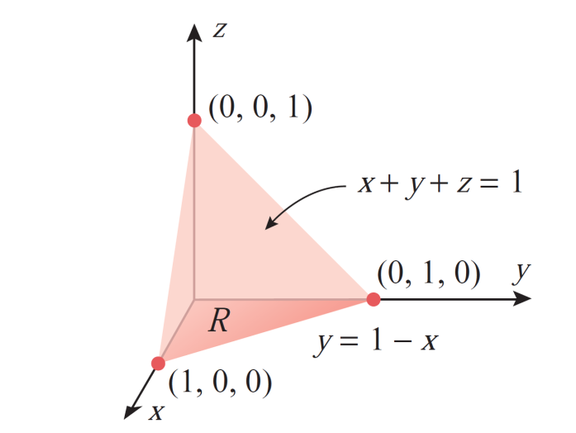
Evaluating surface integrals

Slide 29
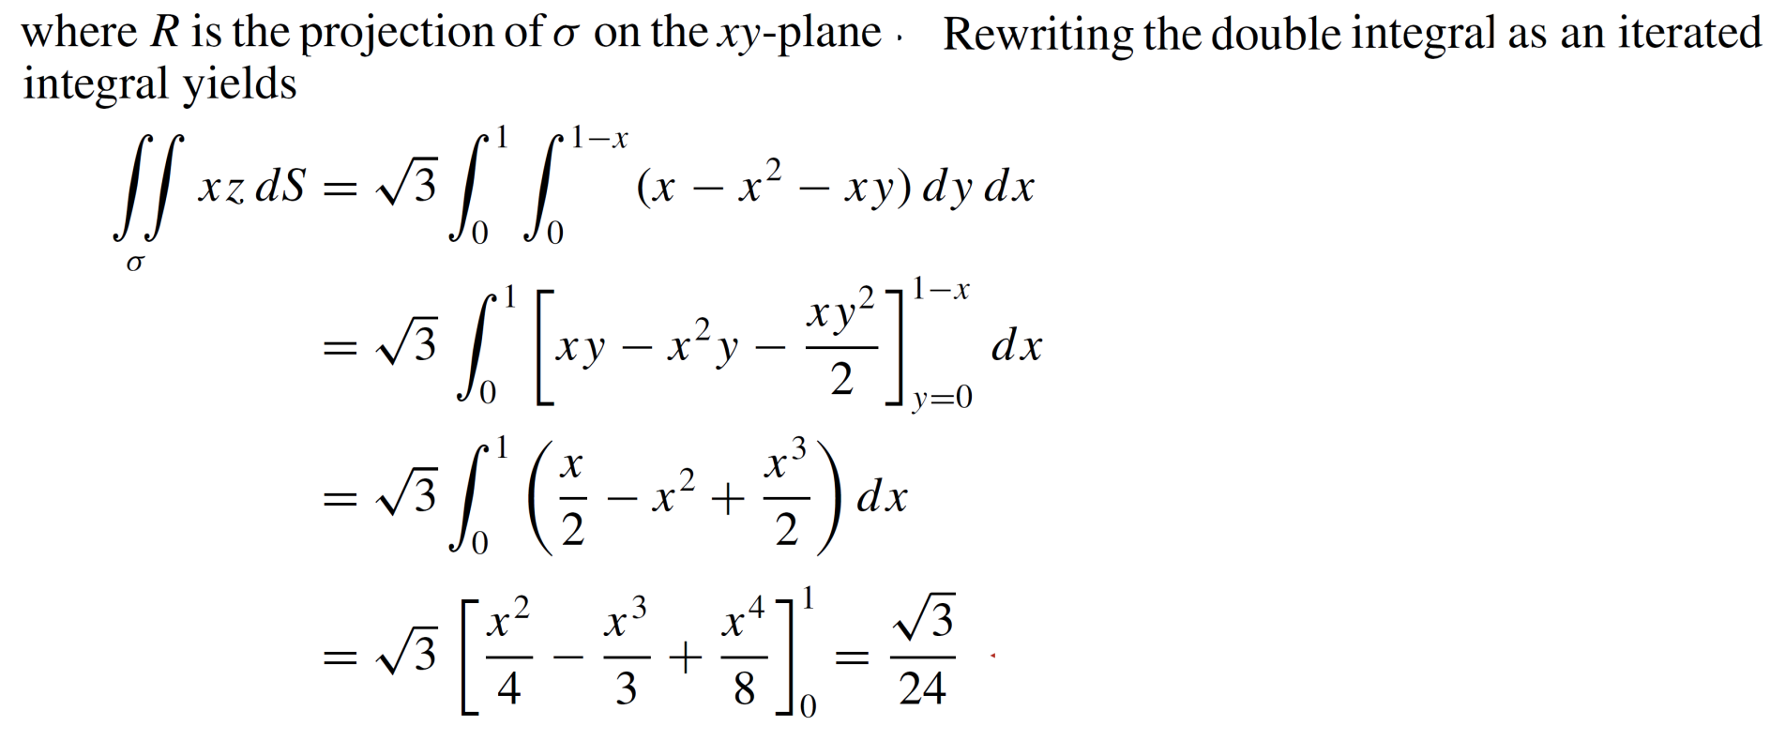
Evaluating surface integrals

Slide 30
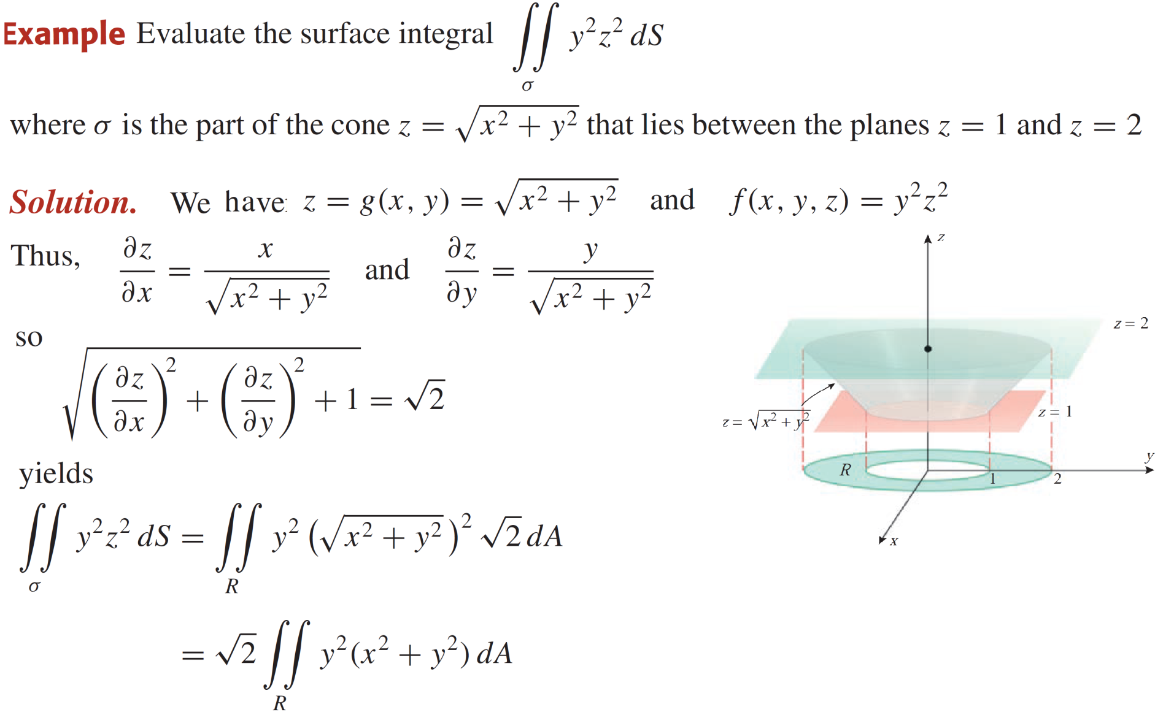
Evaluating surface integrals

Slide 31
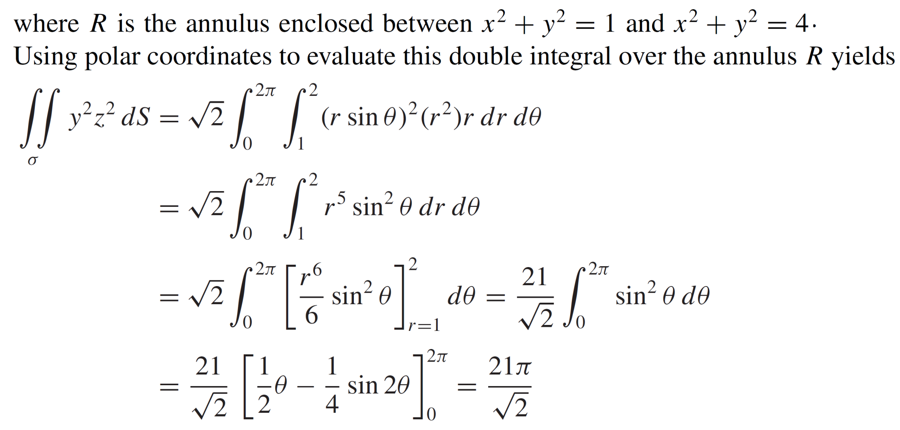
Evaluating surface integrals

Slide 32
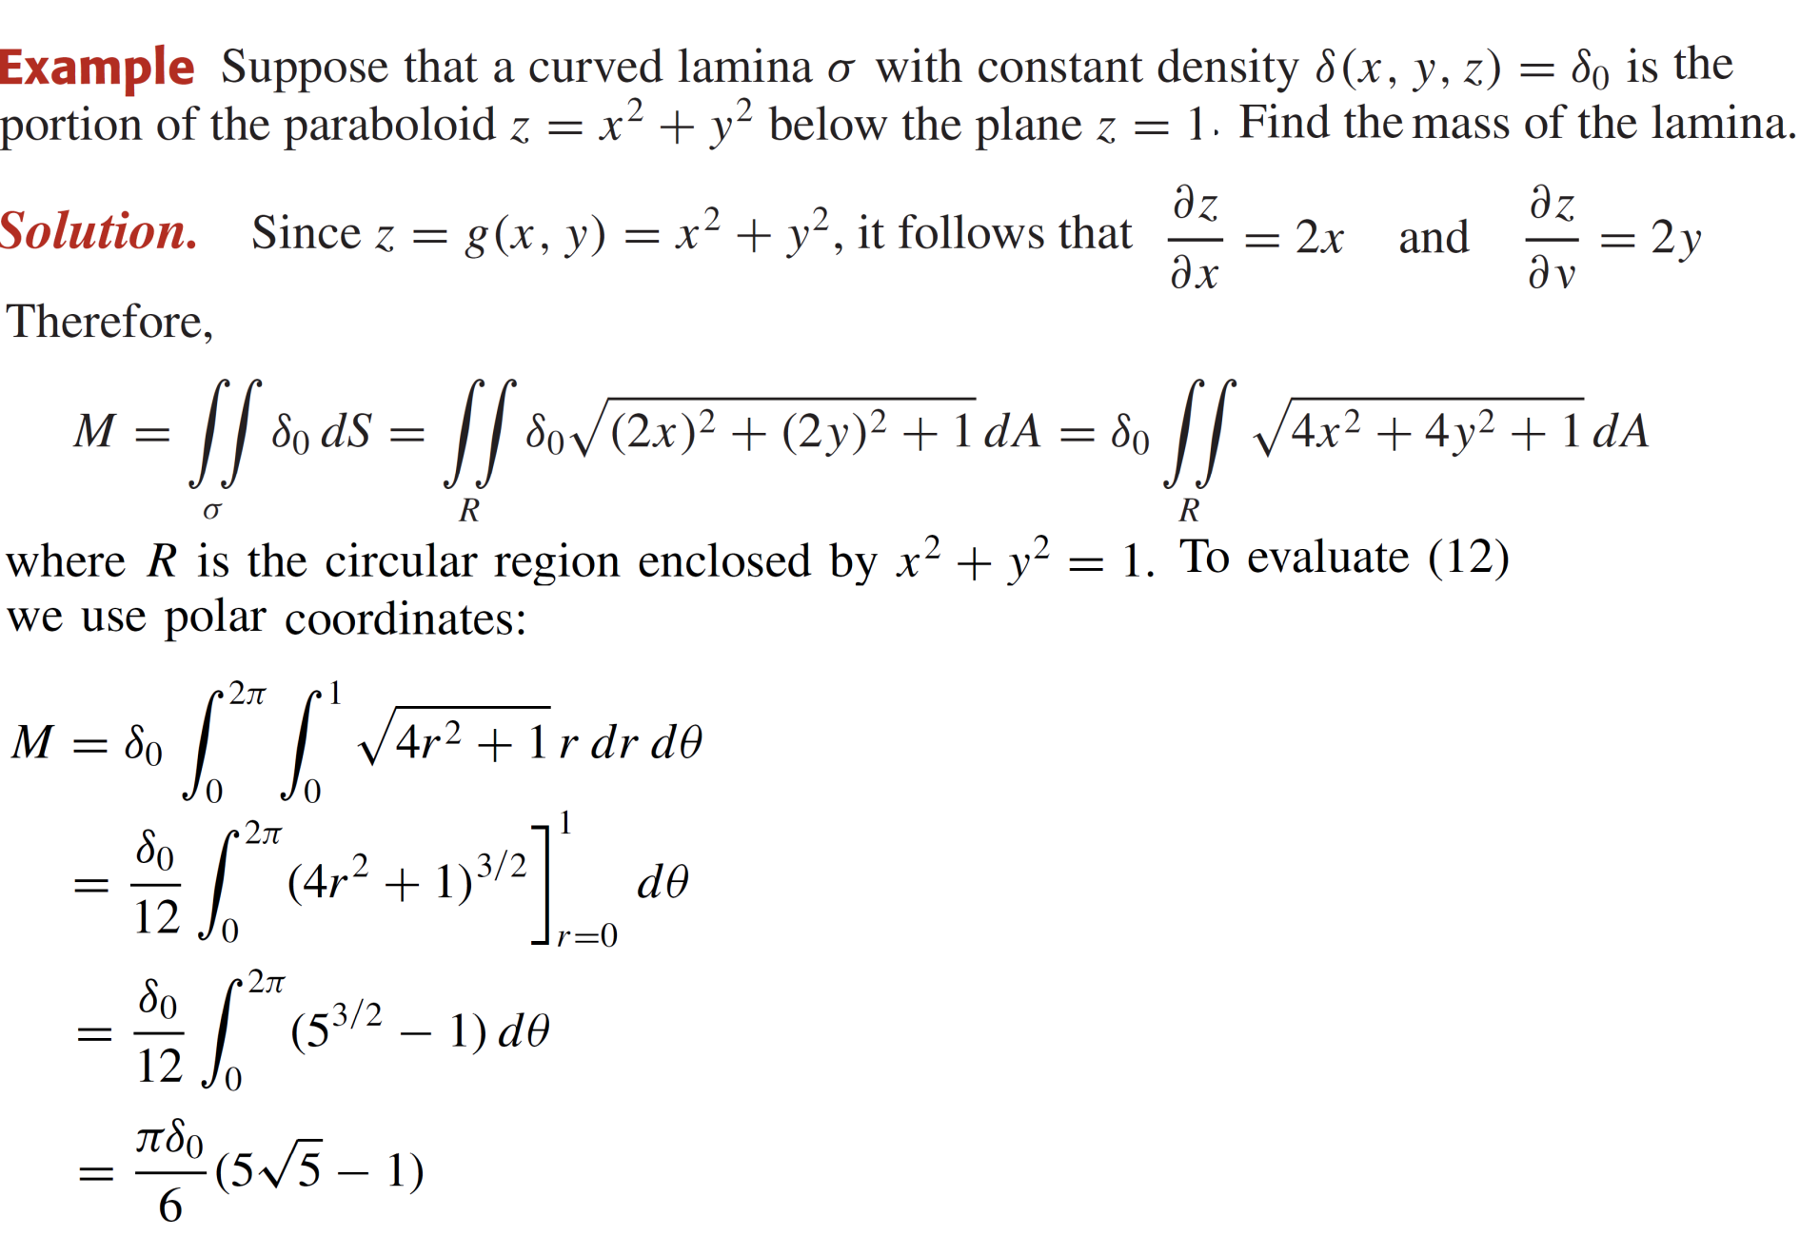
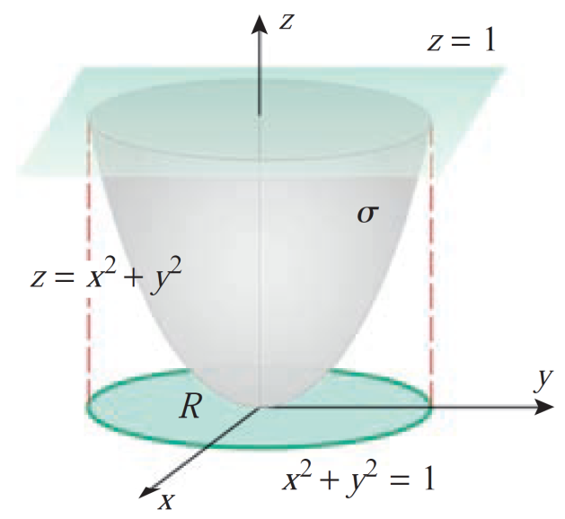
Evaluating surface integrals

Slide 33
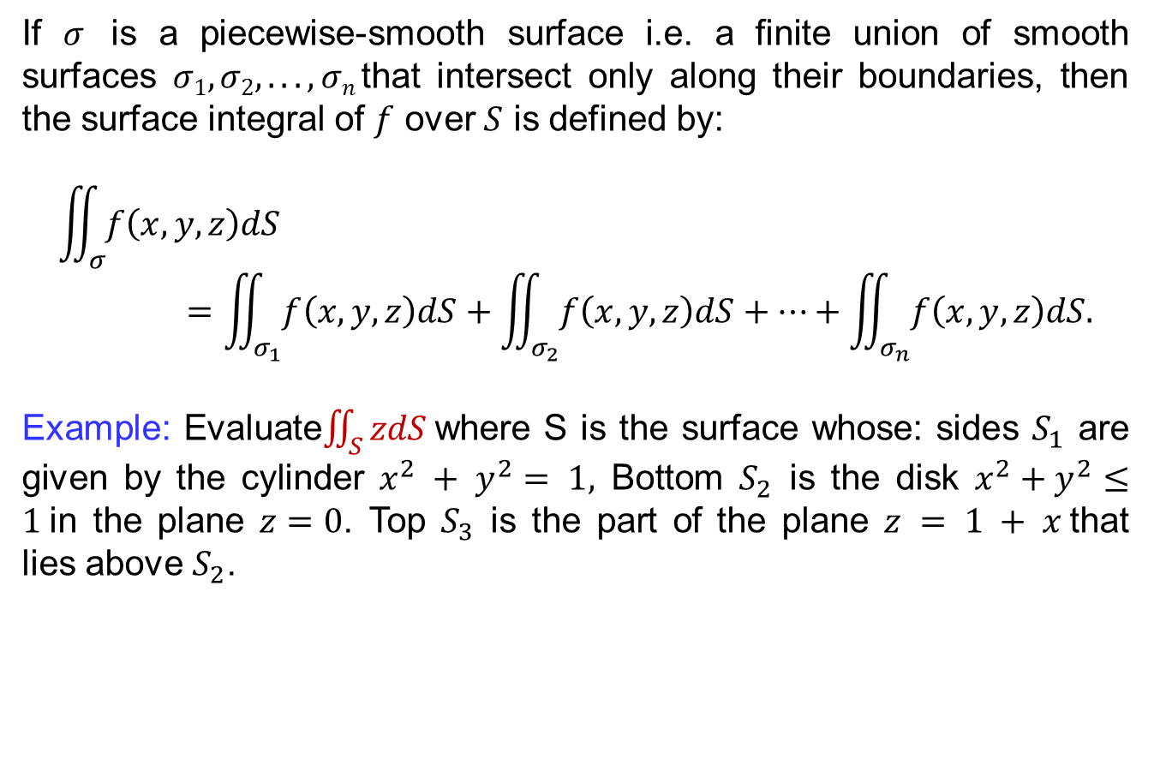
Piecewise smooth surfaces
If $σ$is a piecewise-smooth surface i.e. a finite union of smooth surfaces $σ1, σ2, . . . , σn$that intersect only along their boundaries, then
the surface integral of $f$over $S$ is defined by:
$$\iint_{σ}{f\left(x,y,z\right)dS}=\iint_{σ_{1}}{f\left(x,y,z\right)dS}+\iint_{σ_{2}}{f\left(x,y,z\right)dS}+…+\iint_{σ_{n}}{f\left(x,y,z\right)dS.}$$
Example: Evaluate$\iint_{S}{zdS }$where S is the surface whose: sides $S_{1}$ are given by the cylinder $x^{2} + y^{2}= 1,$Bottom $S_{2}$ is the disk $x^{2}+y^{2}≤1$in the plane $z=0$. Top $S_{3}$ is the part of the plane $z = 1 + x$that
lies above $S_{2}$.

Slide 34
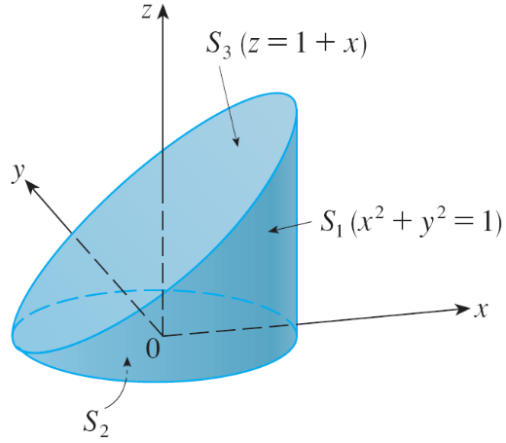
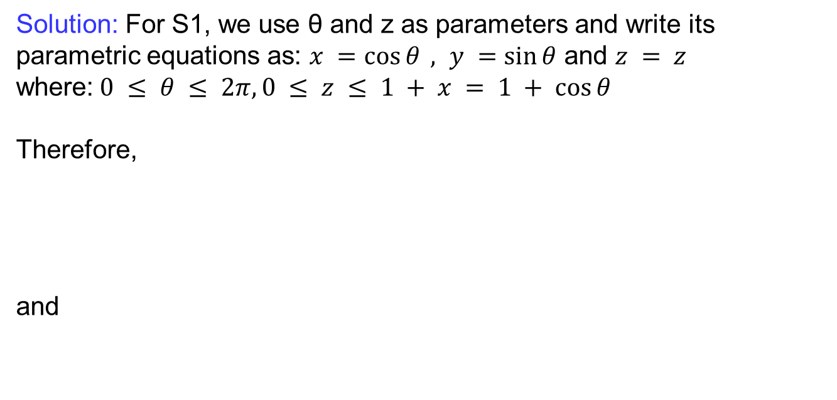
Piecewise smooth surfaces
Solution: For S1, we use θ and z as parameters and write its parametric equations as: $x =\cos{θ}, y =\sin{θ}$ and $z = z$
where:$0 ≤ θ ≤ 2π, 0 ≤ z ≤ 1 + x = 1 + cos⁡θ$
Therefore,
and

Slide 35
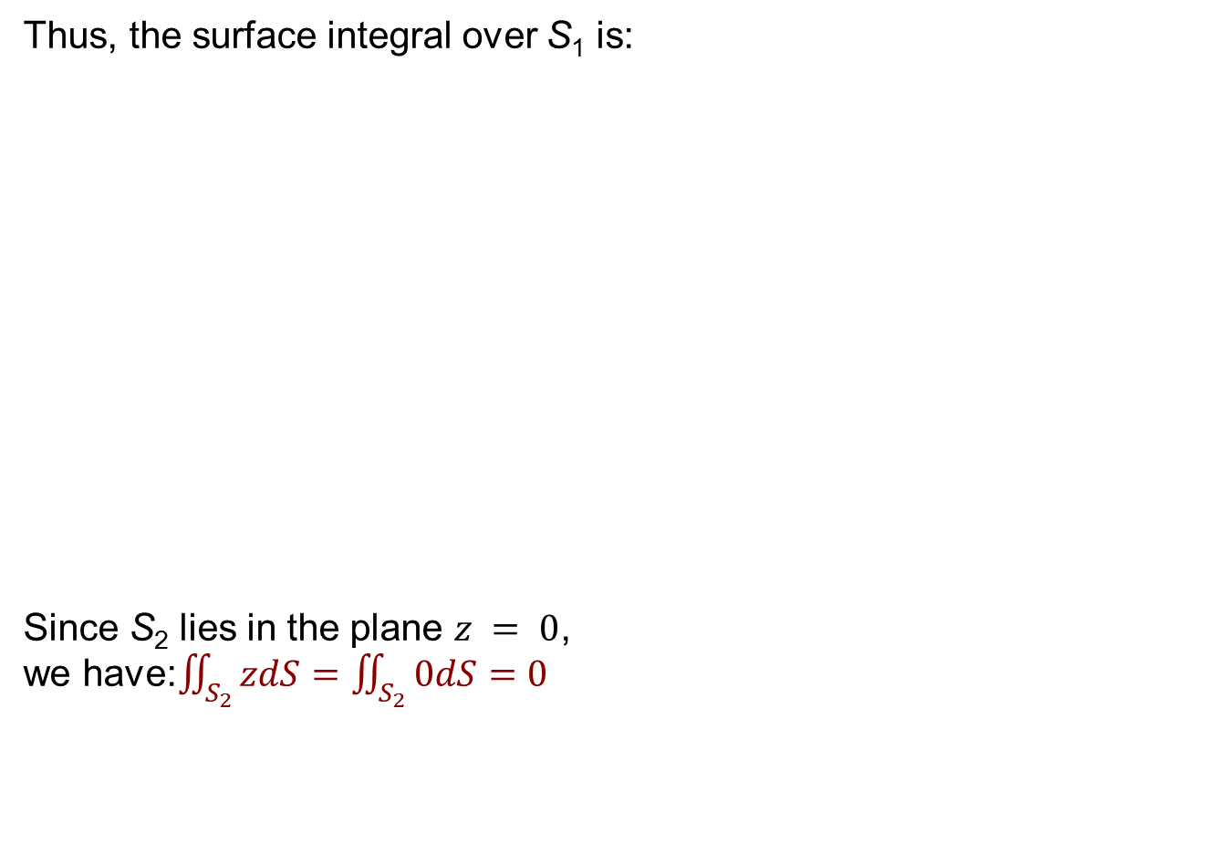
Piecewise smooth surfaces
Thus, the surface integral over S₁ is:
Since S₂ lies in the plane $z = 0$,
we have:$\iint_{S_{2}}{zdS}=\iint_{S_{2}}{0dS}=0$

Slide 36

Piecewise smooth surfaces
$S_{3}$lies above the unit disk $D$ and is part of the plane $z = 1 + x.$
So, taking $g(x, y) = 1 + x$in converting to polar coordinates, we have:
Therefore,

Slide 37

Oriented surfaces
Most surfaces that we encounter in applications have two sides e.g. a sphere has an inside and an outside.
There exist mathematical surfaces with only one side e.g. Möbius strip, which has only one side in the sense that a bug can travaerse the entire surface without crossing an edge.
A sphere is two-sided in the sense that a bug walking on the sphere can traverse the inside surface or the outside surface but cannot traverse both without somehow passing through the sphere.

Slide 38

Oriented surfaces
Definition: A twosided surface issaid to beorientable and a one sided surface issaid to benonorientable.
If $σ$is an orientable surface that has a unit normal vector$n$ateach point. Then, the vectors$n$ and $−n$ point to opposite sides of the surface and distinguishbetween the twosides.
If $σ$is a smooth orientable surface, thenitisalways possible to choose the direction of $n$ateach point sothat$n=n(x,y,z)$ varies continuously over the surface.
These unit vectors are said to form the orientation of the surface.

Slide 39

Oriented surfaces
If S is a smooth orientable surface given in parametric form by a vector function $r(u, v),$then it is automatically supplied with the orientation of the unit normal vector
Where
We call this the positive orientation of the parametric surface and we say that n points in the positive direction from the surface.

Slide 40

Oriented surfaces
Example:The sphere $x2 + y2 + z2 = a2$has the parametric equation
$$r\left(Φ, θ\right)= a\sin{Φ}\cos{θ}i + a\sin{Φ}\sin{θ}j + a\cos{Φ}k.$$
Therefore, we found that:
$$rΦ× rθ = a2 sin2 Φ cos⁡θ i + a2 sin2 Φ sin⁡θ j + a2 sin⁡Φ cos⁡Φ k$$
and
$|rΦ×rθ| = a2 sin⁡Φ$.
So, the orientation induced by $r(Φ, θ)$is defined by the unit normal vector

Slide 41


Flux
Definition: The volume of fluid that passes through the surface in one unit of time. The flux of $F$ across as surface $σ$ with orientation $n$is the quantity $Φ$defined by

Slide 42

Flux

Slide 43

Flux

Slide 44

Flux

Slide 45
Lecture Summary
    Surfaces area & parametric representations
    Introduction to surface integrals
    Evaluating surface integrals
    Piecewise smooth surfaces
    Oriented surfaces
    Flux

