Slide 1
(MTH 250)
Calculus
Lecture 29

Slide 2
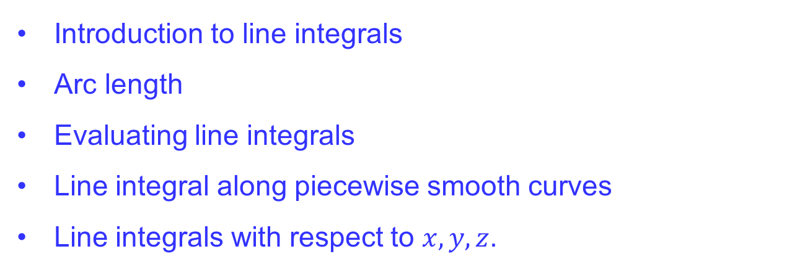
Previous Lecture’s Summary
    Introduction to line integrals
    Arc length
    Evaluating line integrals
    Line integral along piecewise smooth curves
    Line integrals with respect to $x,y,z$.

Slide 3
Today’s Lecture
    Recalls
    Integrating vector fields along curves
    Work done by a force
    Fundamental theorem of Calculus
    Independence of path
    Integration along closed path
    Test for conservative fields

Slide 4
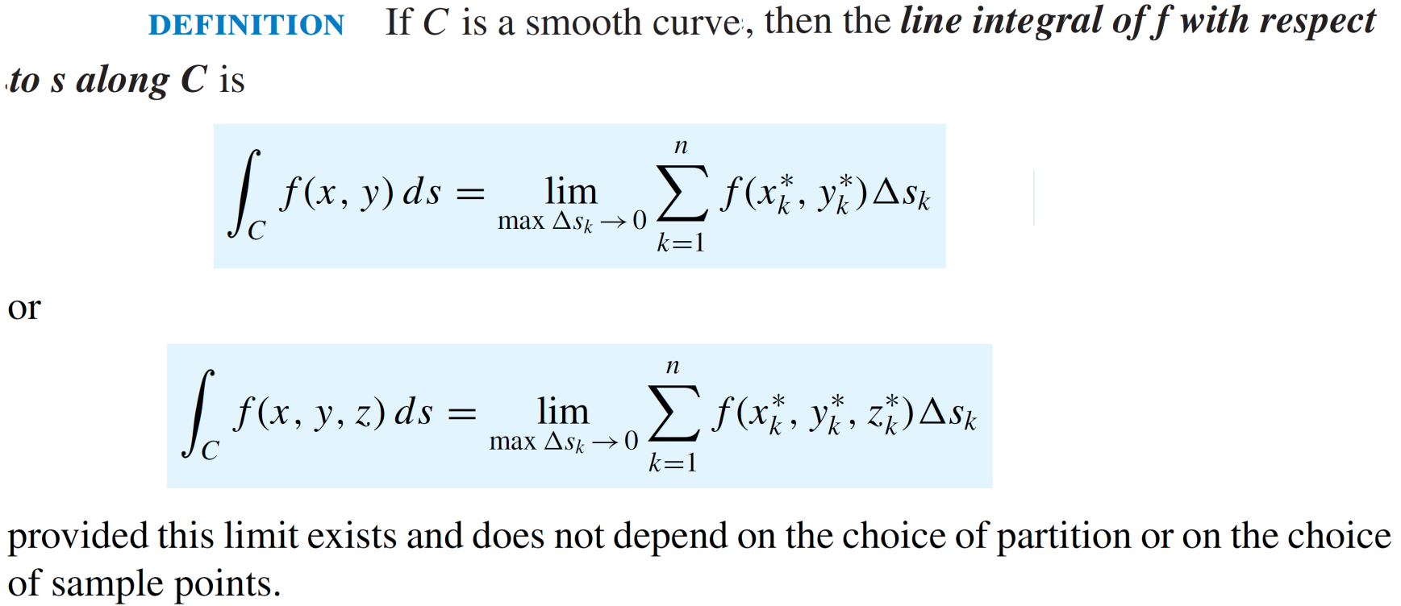
Recalls

Slide 5
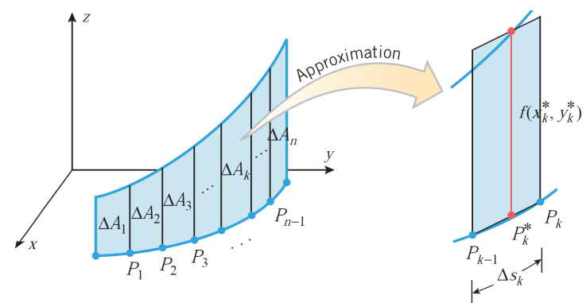
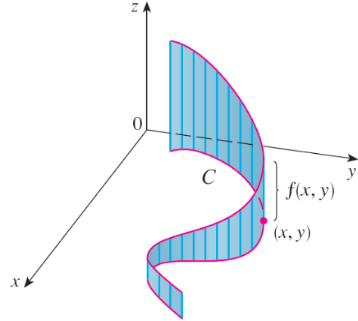
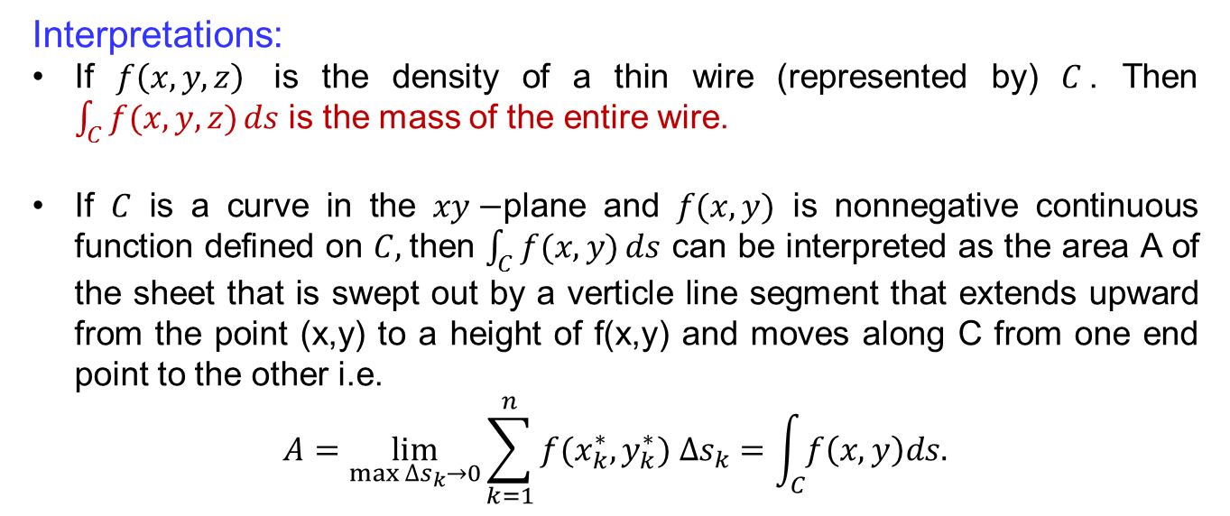
Recalls
Interpretations:
If $f\left(x,y,z\right)$ is the density of a thin wire (represented by) $C$. Then $\int_{C}{f(x,y,z)}ds$ is the mass of the entire wire.
If $C$ is a curve in the $xy−$plane and $f(x,y)$ is nonnegative continuous function defined on $C,$then $\int_{C}{f(x,y)}ds$ can be interpreted as the area A of the sheet that is swept out by a verticle line segment that extends upward from the point (x,y) to a height of f(x,y) and moves along C from one end point to the other i.e.
$$A=\lim_{\max{∆s_{k}→0}}\sum_{k=1}^{n}{f(x_{k}^{∗},y_{k}^{∗}}) ∆s_{k}=\int_{C}{f\left(x,y\right)ds.}$$

Slide 6
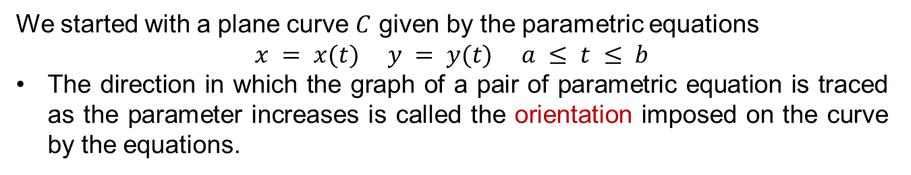
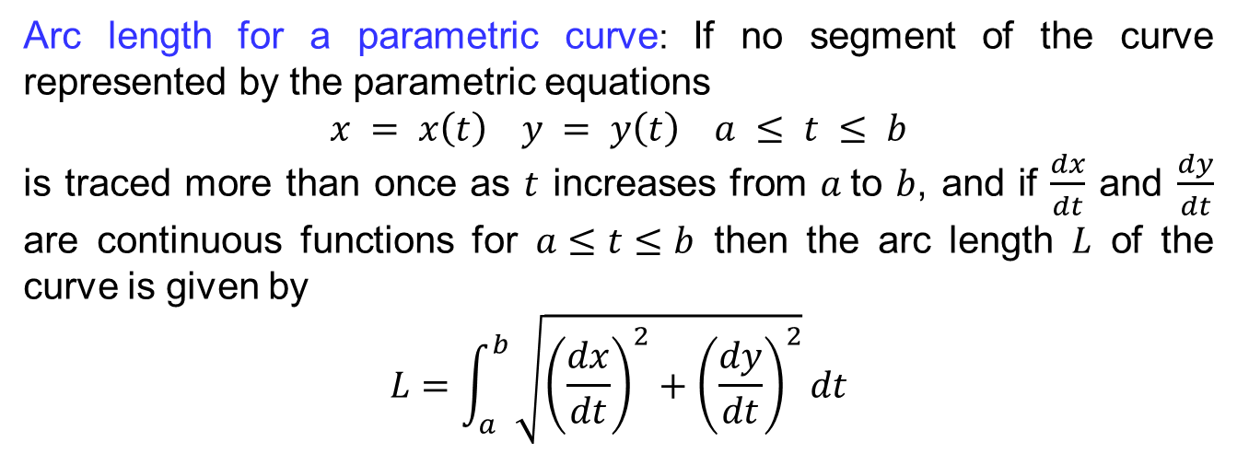
Recalls
We started with a plane curve $C$ given by the parametric equations
$$x = x(t) y = y(t) a ≤ t ≤ b$$
The direction in which the graph of a pair of parametric equation is traced as the parameter increases is called the orientation imposed on the curve by the equations.
Arc length for a parametric curve: If no segment of the curve represented by the parametric equations
$$x = x\left(t\right) y = y\left(t\right) a ≤ t ≤ b$$
is traced more than once as $t$ increases from $a$to $b$, and if $\frac{dx}{dt}$ and $\frac{dy}{dt}$ are continuous functions for $a≤t≤b$ then the arc length $L$ of the curve is given by
$$L=\int_{a}^{b}{\sqrt{{\left(\frac{dx}{dt}\right)}^{2}+{\left(\frac{dy}{dt}\right)}^{2}}}dt$$

Slide 7
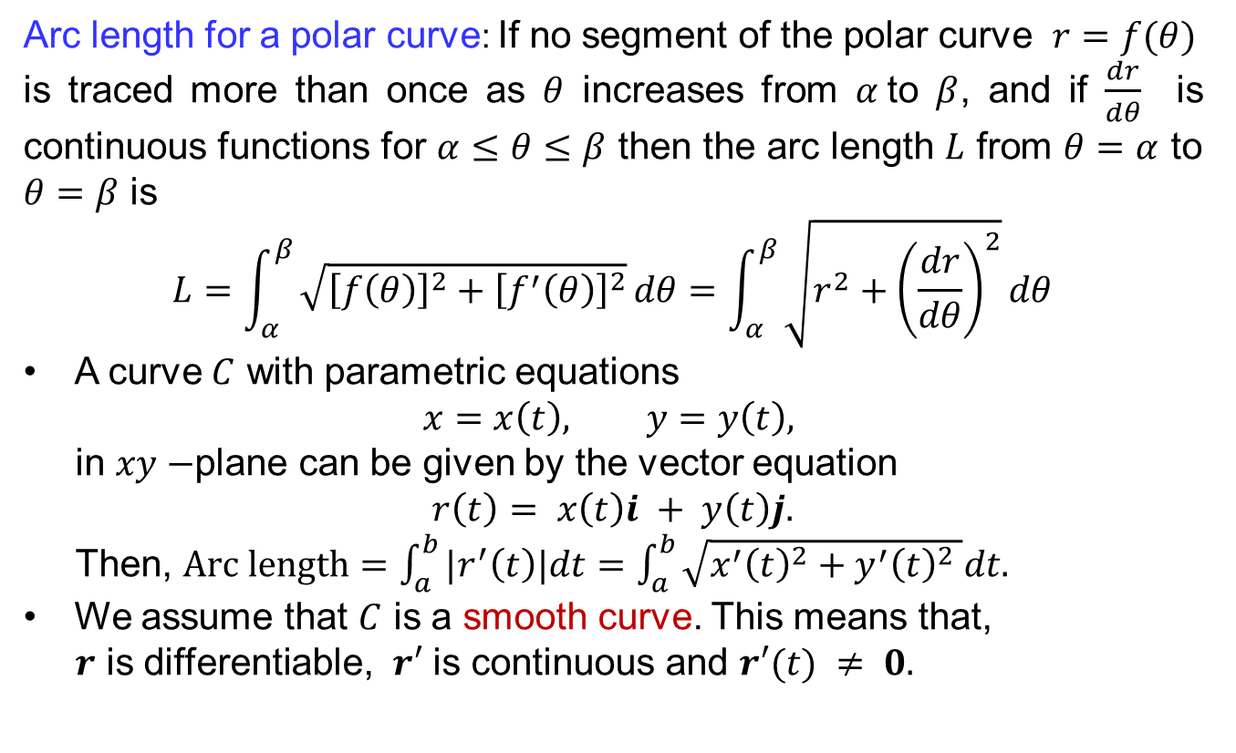
Recalls
Arc length for a polar curve: If no segment of the polar curve $r=f(θ)$
is traced more than once as $θ$ increases from $α$to $β$, and if $\frac{dr}{dθ}$ is continuous functions for $α≤θ≤β$ then the arc length $L$ from $θ=α$ to $θ=β$ is
$$L=\int_{α}^{β}{\sqrt{{\left[f\left(θ\right)\right]}^{2}+{\left[f^{′}\left(θ\right)\right]}^{2}}}dθ=\int_{α}^{β}{\sqrt{r^{2}+{\left(\frac{dr}{dθ}\right)}^{2}}}dθ$$
A curve $C$ with parametric equations
$$x=x\left(t\right), y=y\left(t\right),$$
in $xy−$plane can be given by the vector equation
$$r\left(t\right)= x\left(t\right)i + y\left(t\right)j.$$
Then, $Arc length=\int_{a}^{b}{|r^{′}\left(t\right)|dt}=\int_{a}^{b}{\sqrt{x^{′}{\left(t\right)}^{2}+y^{′}{\left(t\right)}^{2} }dt.}$
We assume that $C$ is a smooth curve. This means that,
$r$ is differentiable, $r′$ is continuous and $r′(t) ≠ 0.$

Slide 8
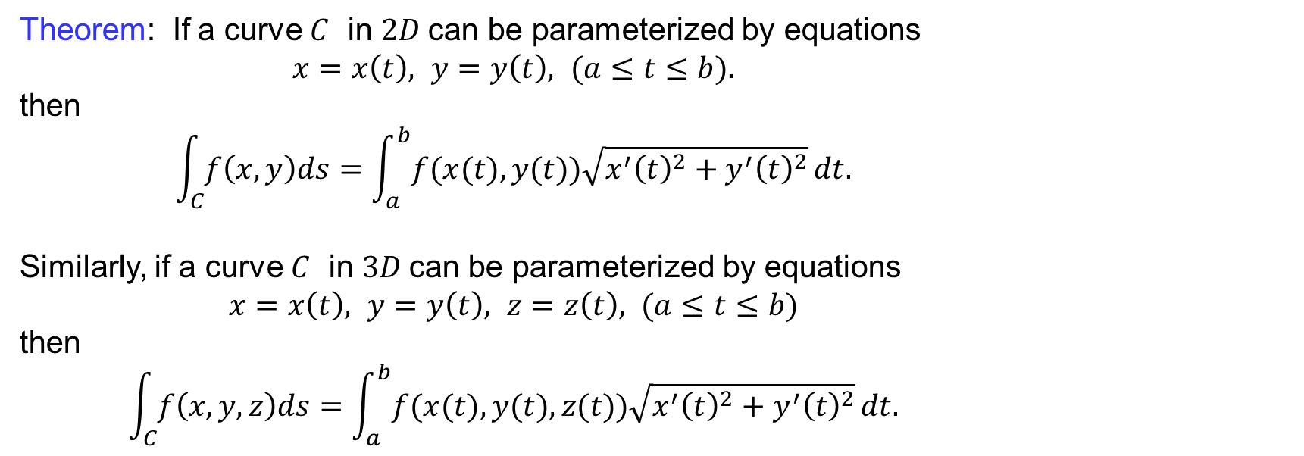
Recalls
Theorem: If a curve $C$ in $2D$can be parameterized by equations
$x=x\left(t\right), y=y\left(t\right), (a≤t≤b).$
then
$$\int_{C}{f\left(x,y\right)ds}=\int_{a}^{b}{f(x(t),y(t))\sqrt{x^{′}{\left(t\right)}^{2}+y^{′}{\left(t\right)}^{2}}}dt.$$
Similarly, if a curve $C$ in $3D$can be parameterized by equations
$x=x\left(t\right), y=y\left(t\right), z=z\left(t\right), (a≤t≤b)$
then
$$\int_{C}{f\left(x,y,z\right)ds}=\int_{a}^{b}{f(x(t),y(t),z(t))\sqrt{x^{′}{\left(t\right)}^{2}+y^{′}{\left(t\right)}^{2}}}dt.$$

Slide 9
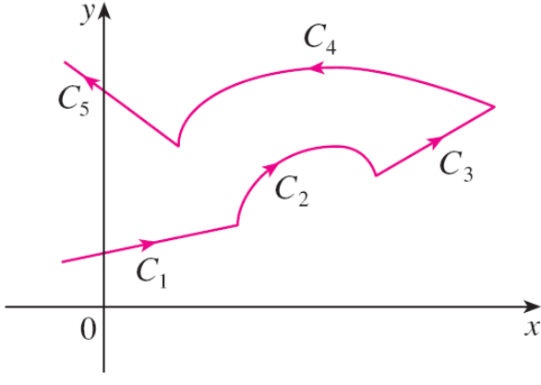
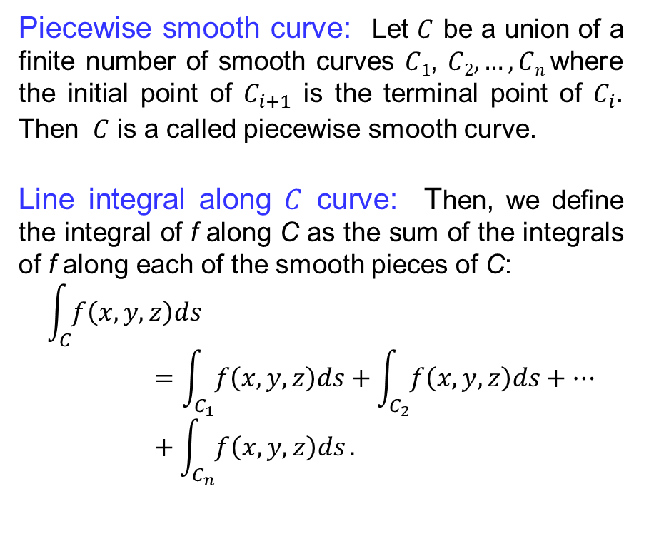
Recalls
Piecewise smooth curve: Let $C$ be a union of a finite number of smooth curves $C1$, $C2, …, Cn$where the initial point of $C_{i+1}$ is the terminal point of $C_{i}$. Then $C$ is a called piecewise smooth curve.
Line integral along $C$ curve: Then, we define the integral of f along C as the sum of the integrals of f along each of the smooth pieces of C:
$$\int_{C}{f\left(x,y,z\right)ds}=\int_{C_{1}}{f\left(x,y,z\right)ds}+\int_{C_{2}}{f\left(x,y,z\right)ds}+…+\int_{C_{n}}{f\left(x,y,z\right)ds}.$$

Slide 10
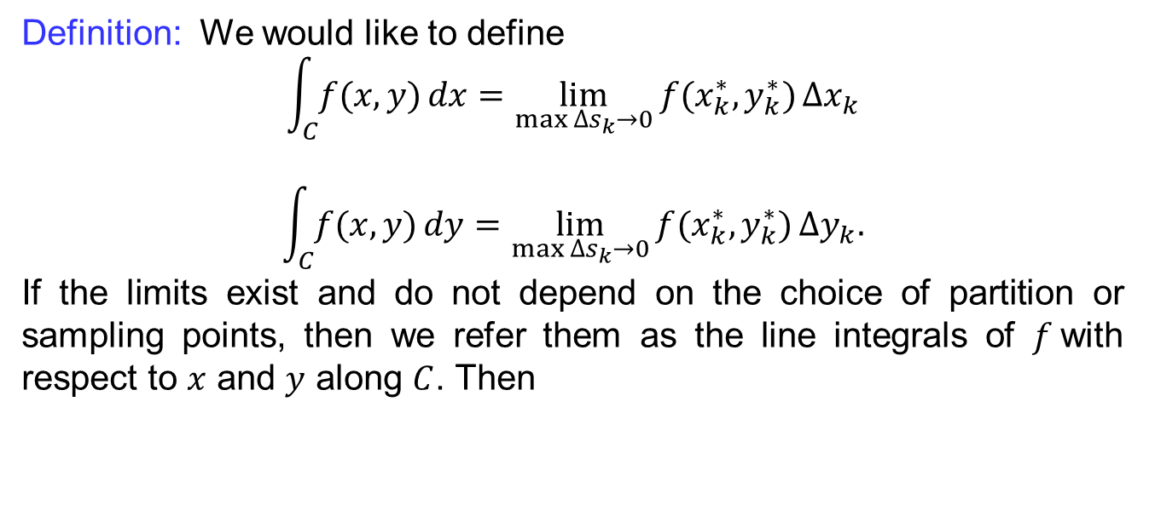
Recalls
Definition: We would like to define
$$\int_{C}{f(x,y)}dx=\lim_{\max{∆s_{k}→0}}{f(x_{k}^{∗},y_{k}^{∗})}∆x_{k}$$
$$\int_{C}{f(x,y)}dy=\lim_{\max{∆s_{k}→0}}{f(x_{k}^{∗},y_{k}^{∗})}∆y_{k}.$$
If the limits exist and do not depend on the choice of partition or sampling points, then we refer them as the line integrals of $f$with respect to $x$ and $y$ along $C$. Then

Slide 11
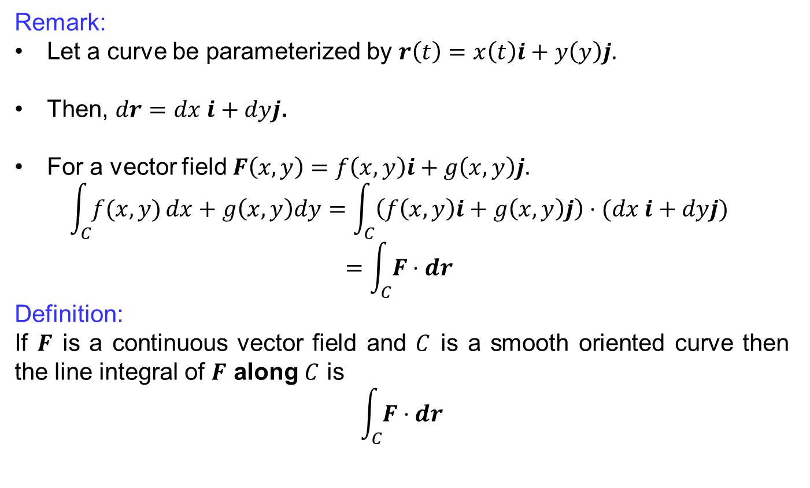
Integrating vector fields along curves
Remark:
Let a curve be parameterized by $r\left(t\right)=x\left(t\right)i+y\left(y\right)j.$
Then, $dr=dx i+dyj$.
For a vector field $F\left(x,y\right)=f\left(x,y\right)i+g\left(x,y\right)j.$
$$\int_{C}{f(x,y)}dx+g\left(x,y\right)dy=\int_{C}{\left(f\left(x,y\right)i+g\left(x,y\right)j\right)⋅(dx i+dyj)}$$
$$=\int_{C}{F⋅dr}$$
Definition:
If $F$ is a continuous vector field and $C$ is a smooth oriented curve then the line integral of $F$ along $C$ is
$$\int_{C}{F⋅dr}$$

Slide 12
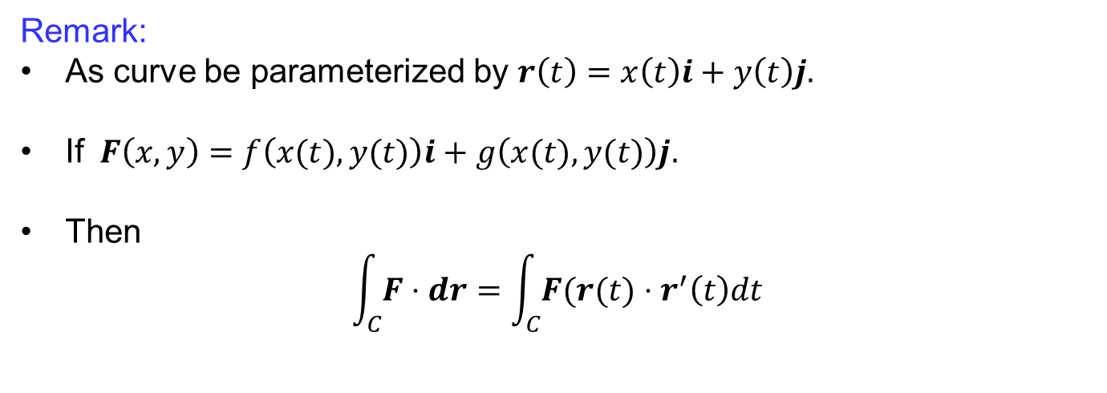
Integrating vector fields along curves
Remark:
As curve be parameterized by $r\left(t\right)=x\left(t\right)i+y\left(t\right)j.$
If $F\left(x,y\right)=f\left(x(t),y(t)\right)i+g\left(x(t),y(t)\right)j.$
Then
$$\int_{C}{F⋅dr}=\int_{C}{F(r(t)⋅r^{′}\left(t\right)dt}$$

Slide 13
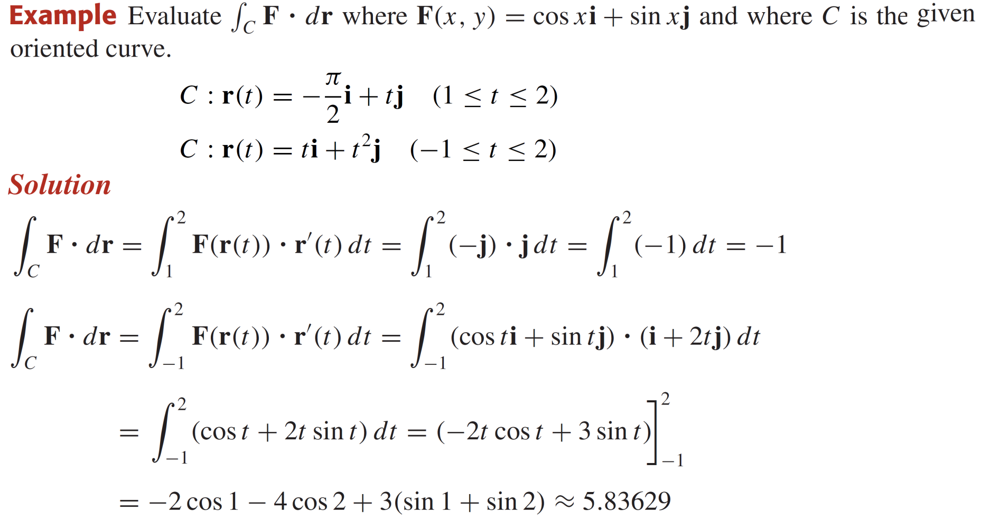
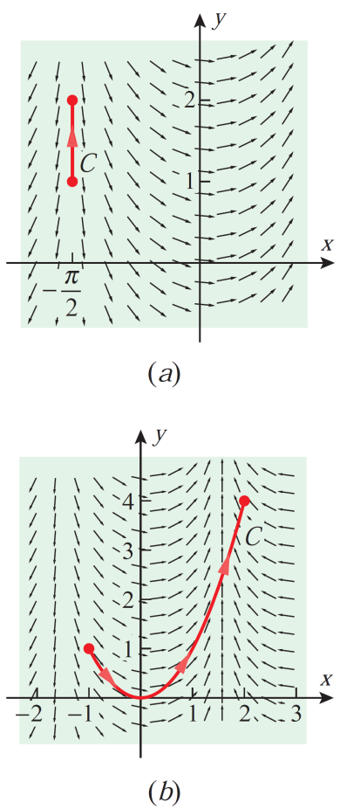
Integrating vector fields along curves

Slide 14
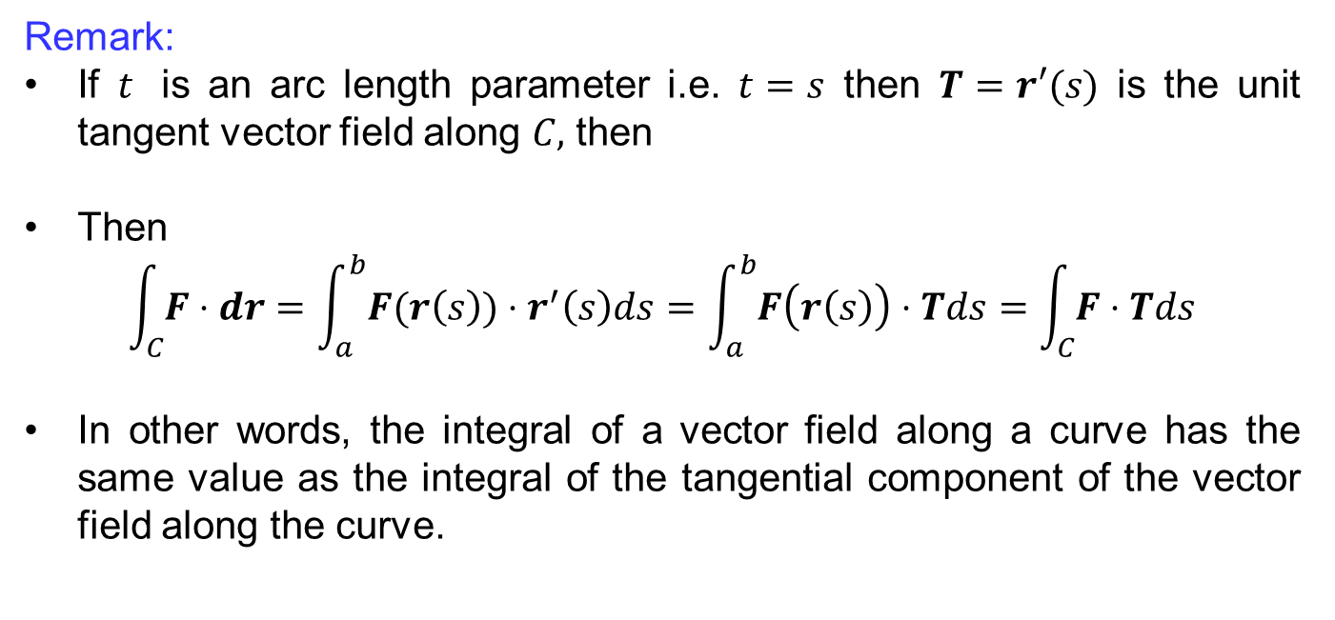
Integrating vector fields along curves
Remark:
If $t$ is an arc length parameter i.e. $t=s$ then $T=r′(s)$ is the unit tangent vector field along $C,$ then
Then
$$\int_{C}{F⋅dr}=\int_{a}^{b}{F(r\left(s\right))⋅r^{′}\left(s\right)ds}=\int_{a}^{b}{F\left(r\left(s\right)\right)⋅Tds}=\int_{C}{F⋅Tds}$$
In other words, the integral of a vector field along a curve has the same value as the integral of the tangential component of the vector field along the curve.

Slide 15
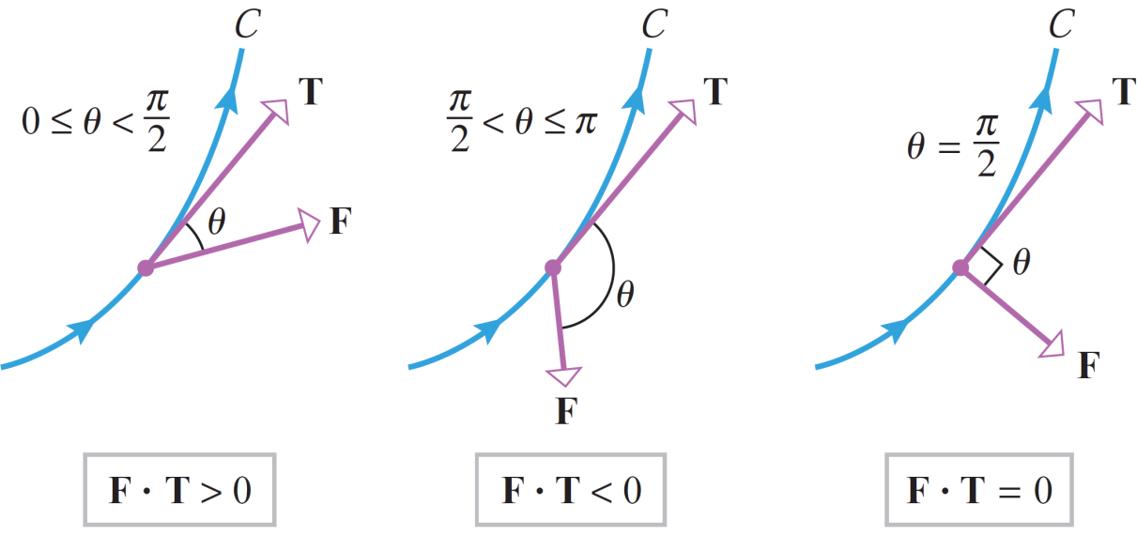
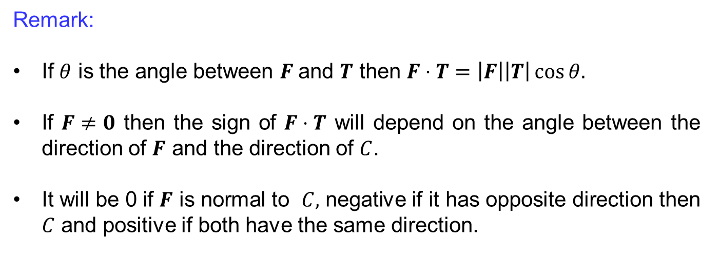
Integrating vector fields along curves
Remark:
If $θ$ is the angle between $F$and $T$ then $F⋅T=\left|F\right|\left|T\right|\cos{θ.}$
If $F≠0$ then the sign of $F⋅T$ will depend on the angle between the direction of $F$ and the direction of $C$.
It will be 0 if $F$ is normal to $C,$ negative if it has opposite direction then $C$ and positive if both have the same direction.

Slide 16
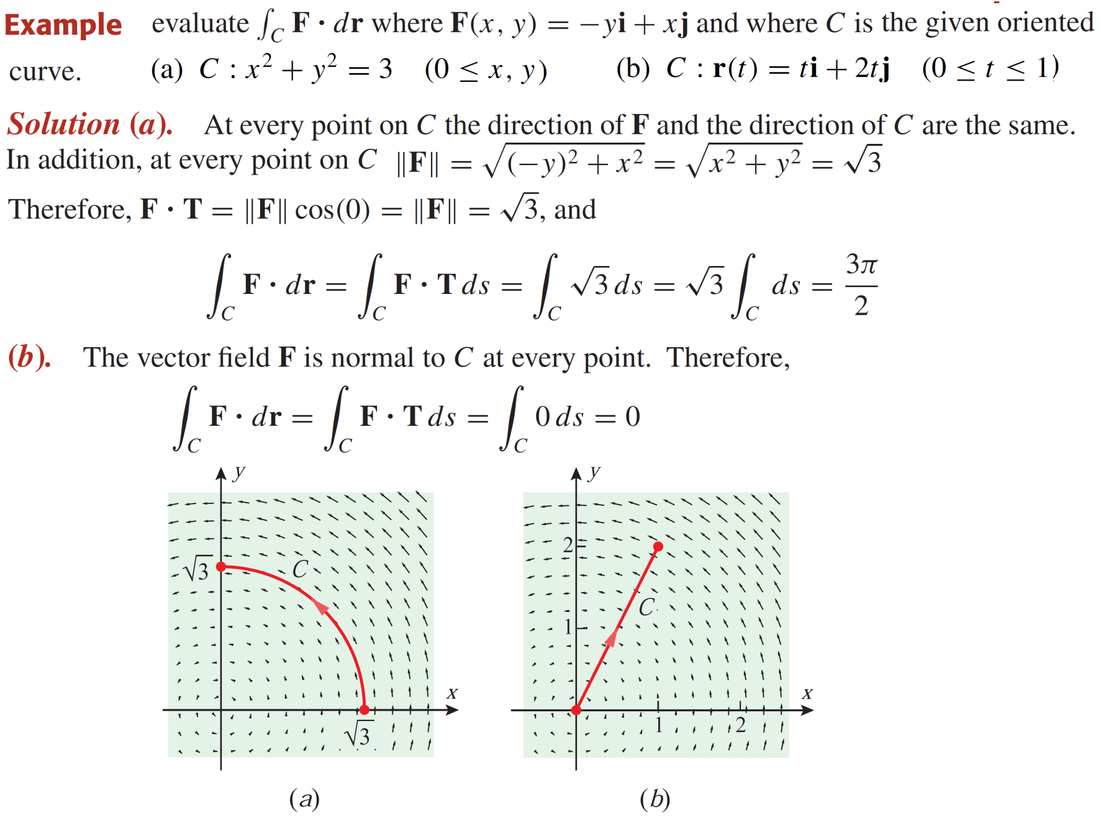
Integrating vector fields along curves

Slide 17
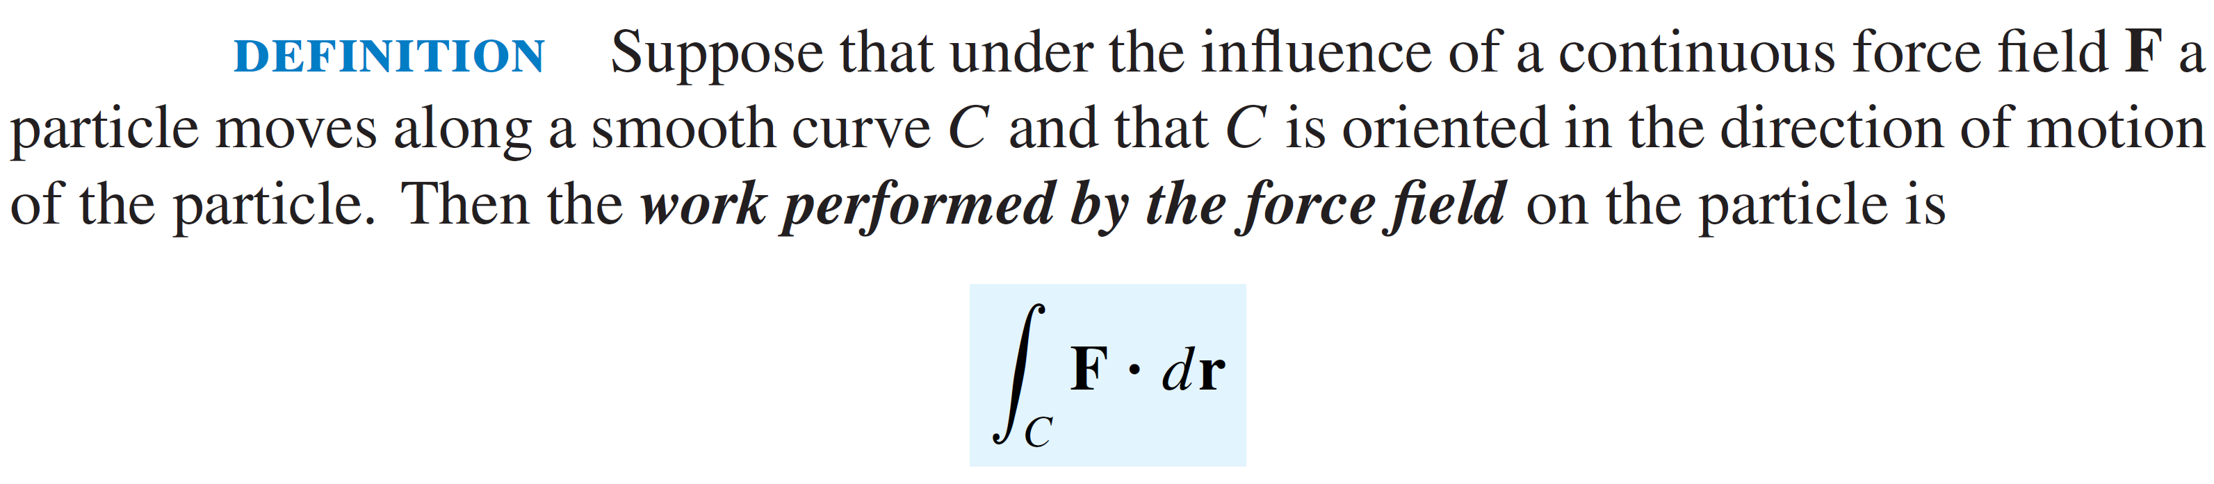
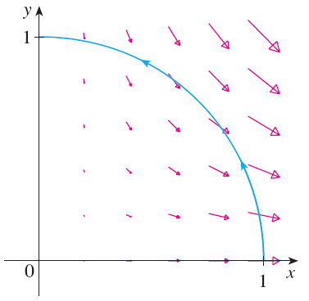
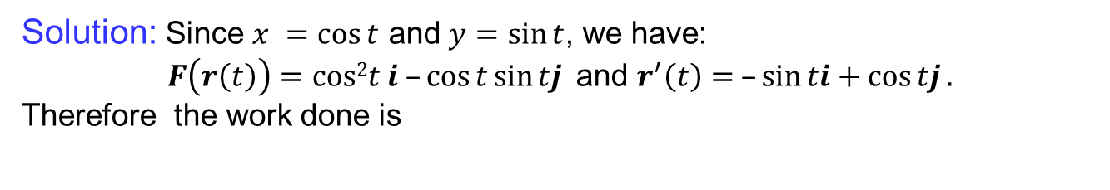
Work done by a Force.
Example: Find the work done by the force field $F(x, y)=x2i –xyj$in moving a particle along the quarter-circle $r\left(t\right)=\cos{t}i+ sin⁡t j, 0≤t≤π/2$.
Solution: Since $x =cos⁡t$ and $y=sin⁡t$, we have:
$F\left(r\left(t\right)\right)=cos2t i –\cos{t}\sin{tj}$and $r^{′}\left(t\right)= –\sin{ti}+\cos{tj}.$
Therefore the work done is

Slide 18
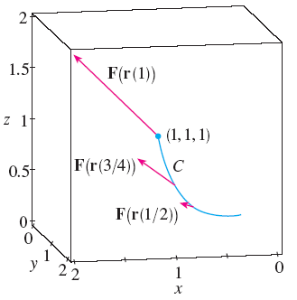

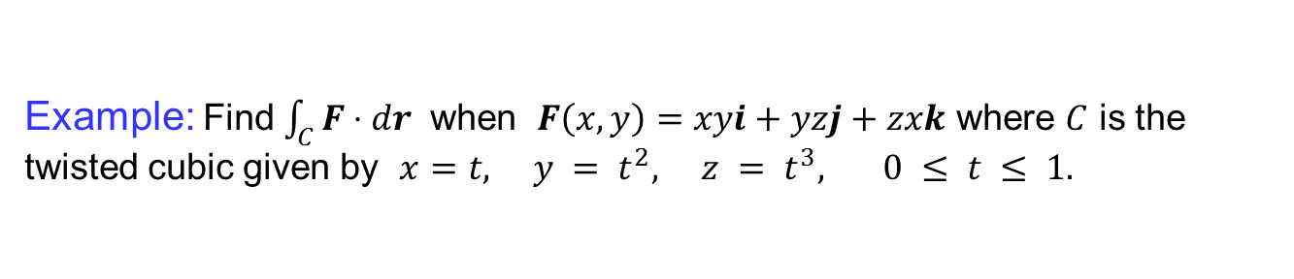
Work done by a Force.
Example: Find $\int_{C}{F⋅dr}$ when $F\left(x, y\right)=xyi+yzj+zxk$ where $C$ is the twisted cubic given by $x=t, y = t^{2}, z = t^{3}, 0 ≤ t ≤ 1.$
Solution: We have
$$r(t) = t i + t2 j + t3 k$$
$$r′(t) = i + 2t j + 3t2 k$$
$$F(r(t)) = t3 i + t5 j + t4 k$$
Therefore,

Slide 19
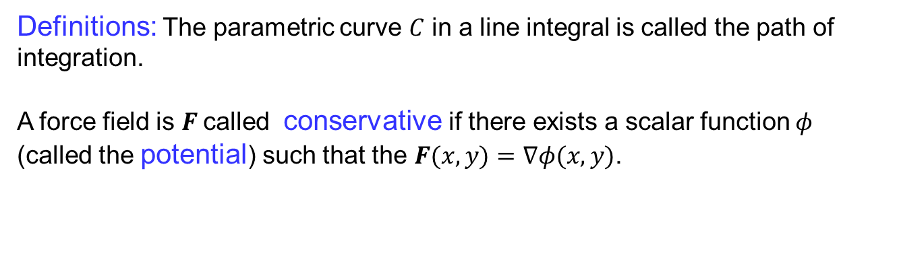
Fundamental theorem of Calculus
Definitions: The parametric curve $C$ in a line integral is called the path of integration.
A force field is $F$called conservative if there exists a scalar function $φ$ (called the potential) such that the $F(x,y)=∇φ(x,y)$.

Slide 20
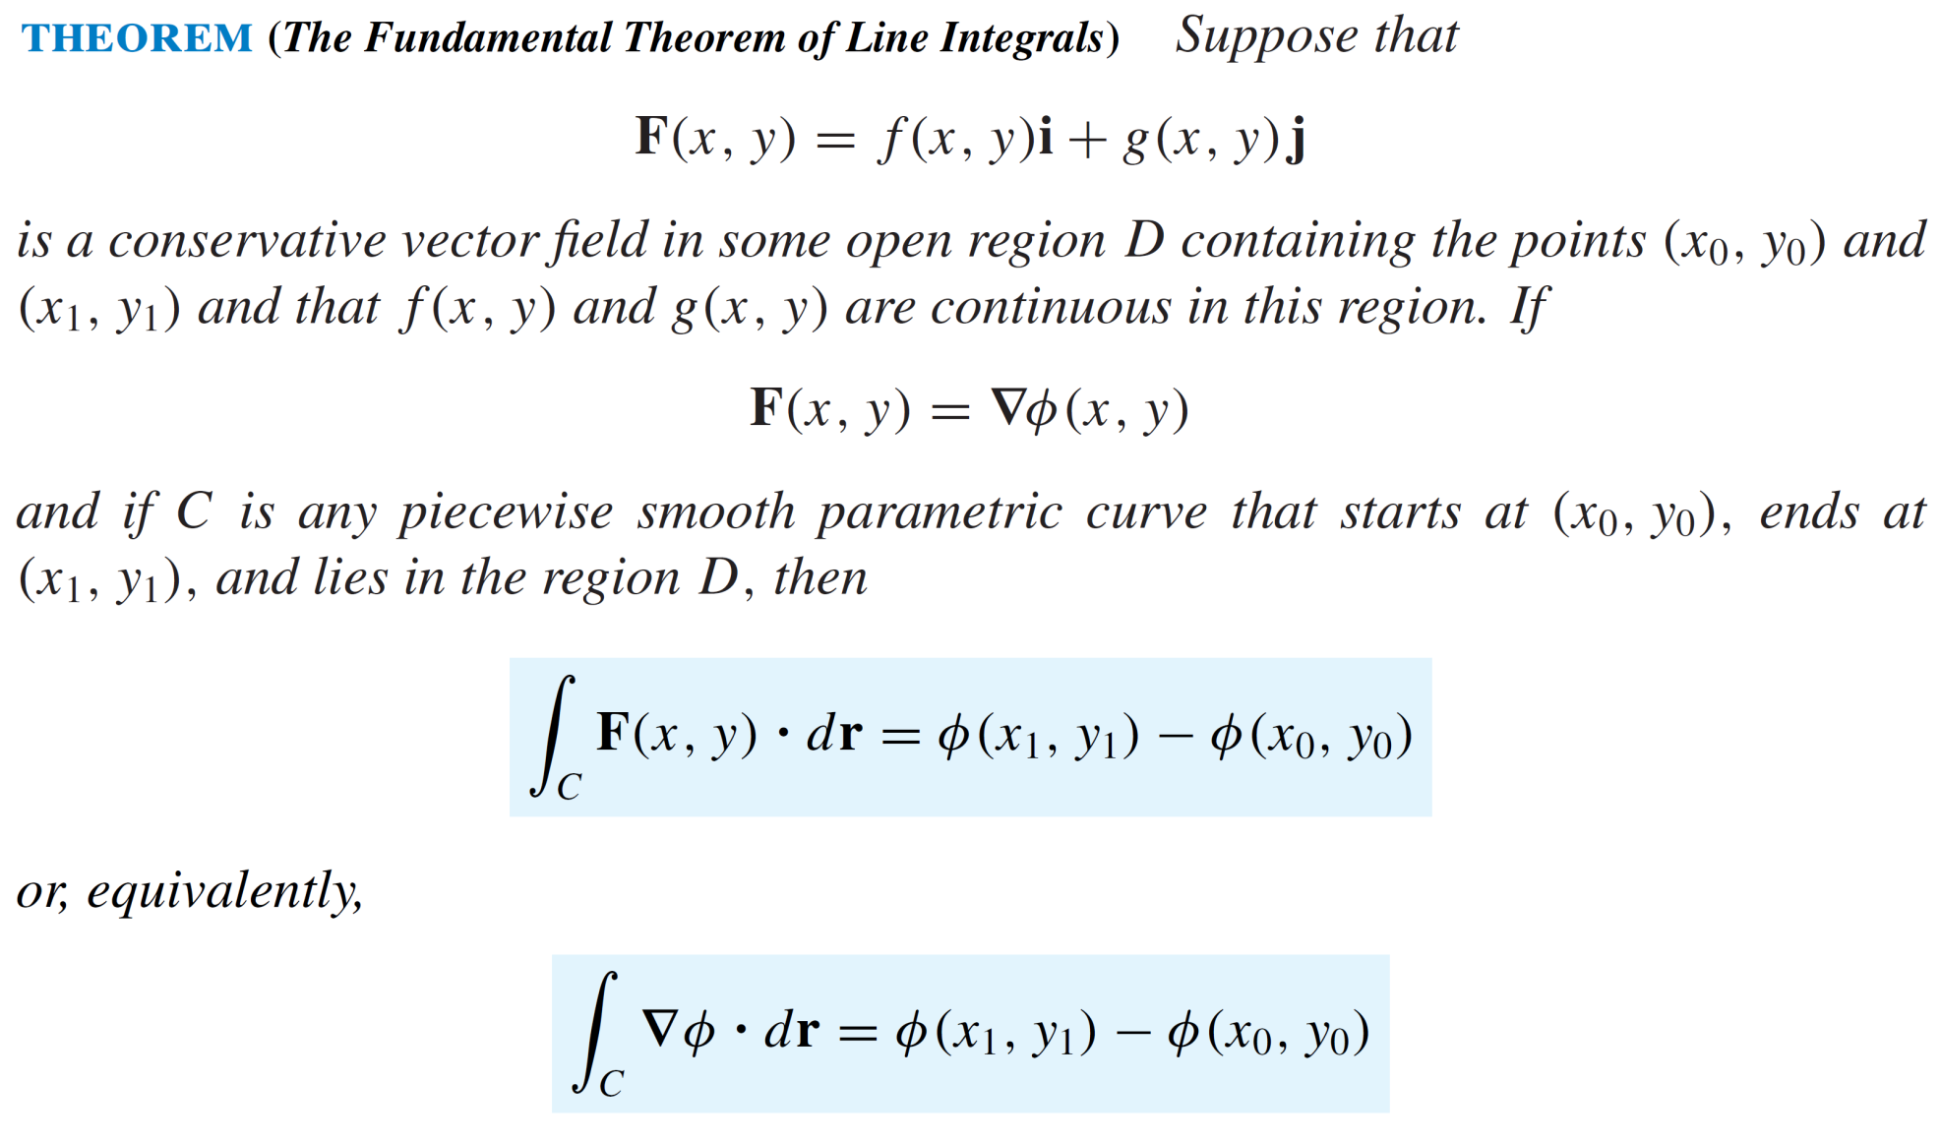
Fundamental theorem of Calculus

Slide 21
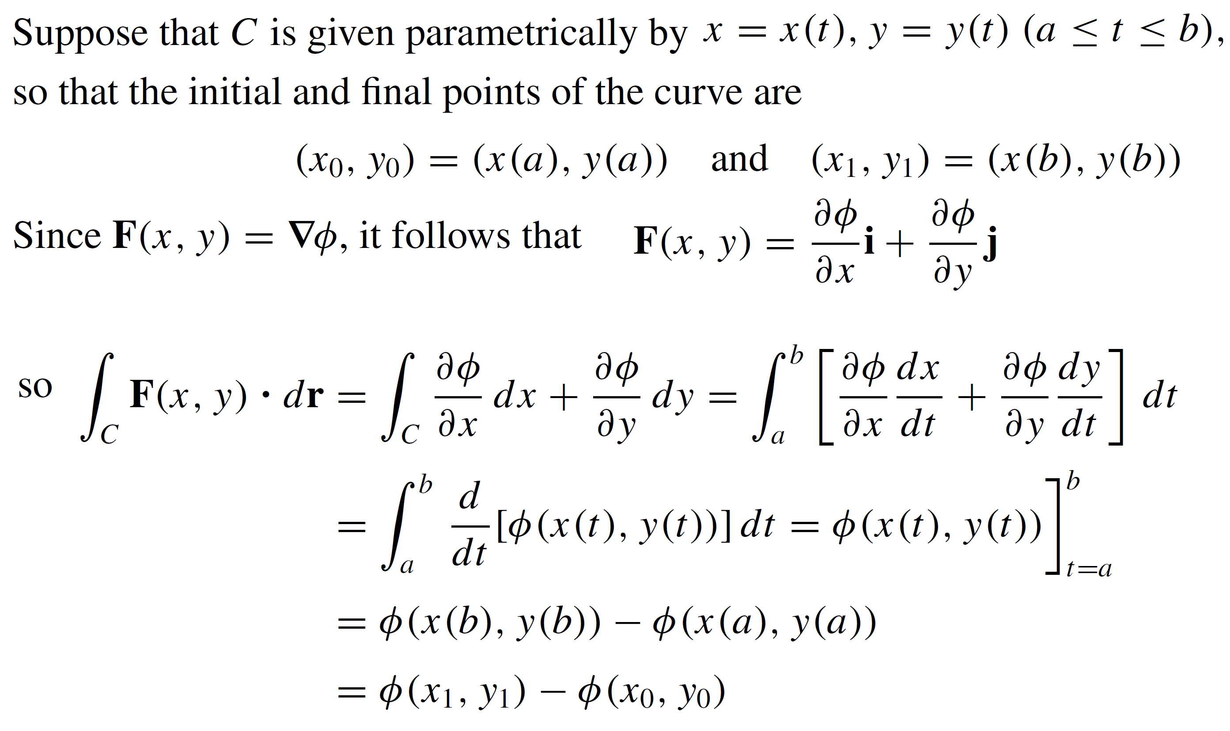
Fundamental theorem of Calculus
Proof:

Slide 22
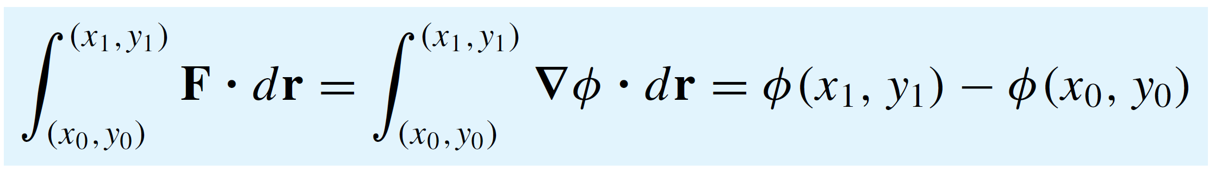
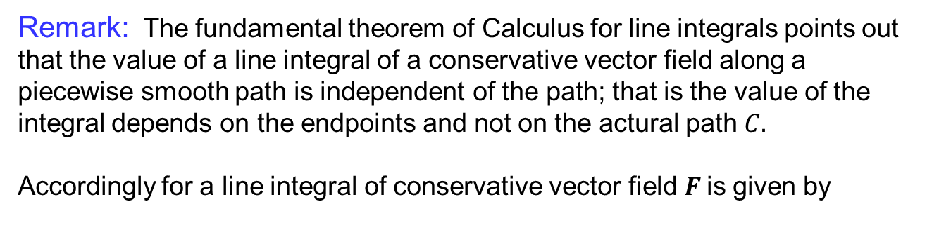
Independence of Path
Remark: The fundamental theorem of Calculus for line integrals points out that the value of a line integral of a conservative vector field along a piecewise smooth path is independent of the path; that is the value of the integral depends on the endpoints and not on the actural path $C.$
Accordingly for a line integral of conservative vector field $F$is given by

Slide 23
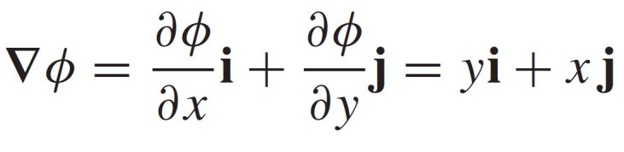
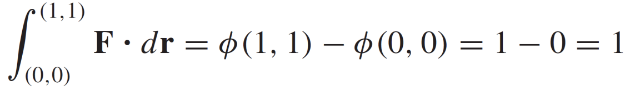
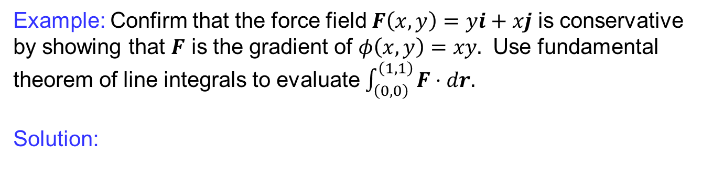
Independence of Path
Example: Confirm that the force field $F\left(x,y\right)=yi+xj$ is conservative by showing that $F$ is the gradient of $φ\left(x,y\right)=xy.$ Use fundamental theorem of line integrals to evaluate $\int_{\left(0,0\right)}^{\left(1,1\right)}{F⋅dr.}$
Solution:

Slide 24
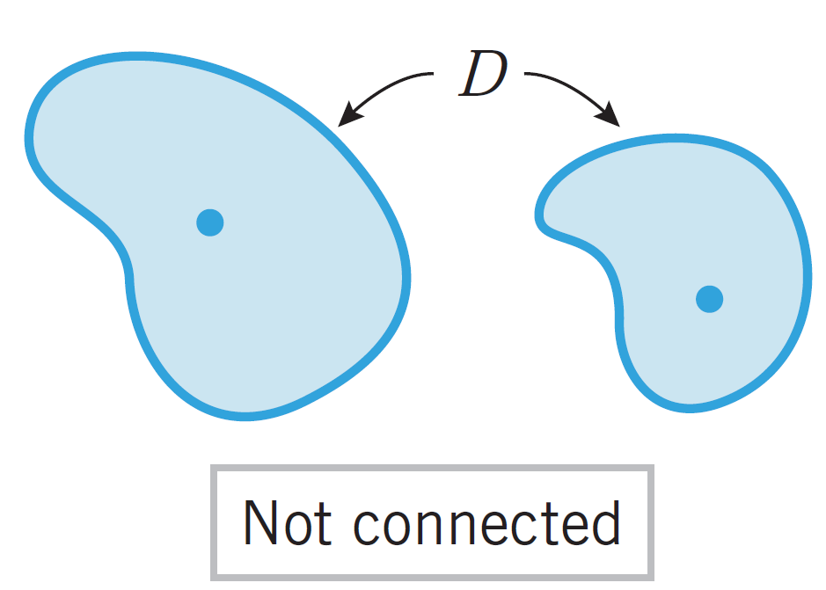
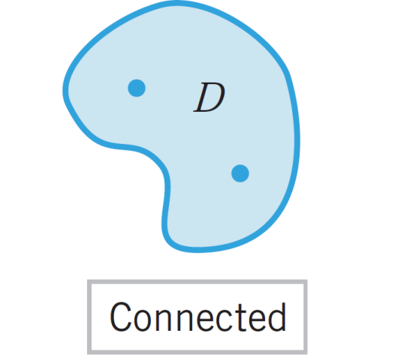
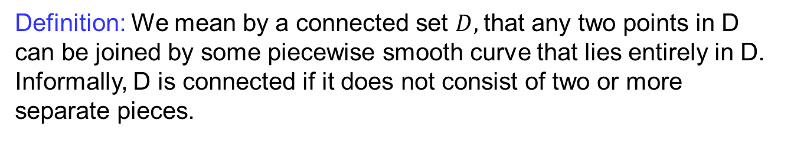
Integration along closed path
Definition: We mean by a connected set $D,$that any two points in D can be joined by some piecewise smooth curve that lies entirely in D. Informally, D is connected if it does not consist of two or more separate pieces.

Slide 25
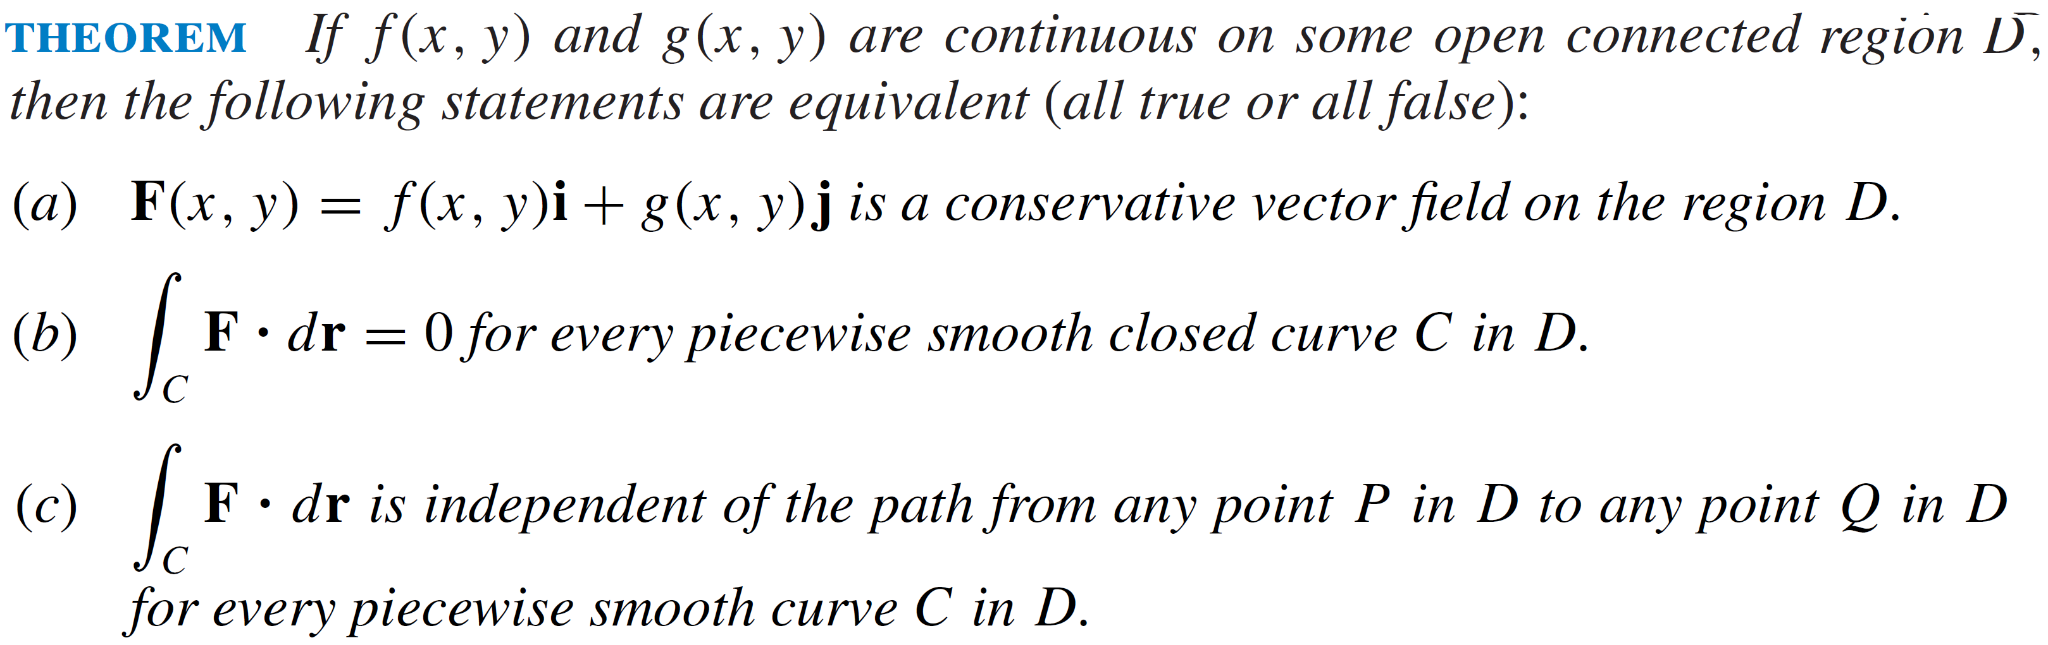
Integration along closed path

Slide 26
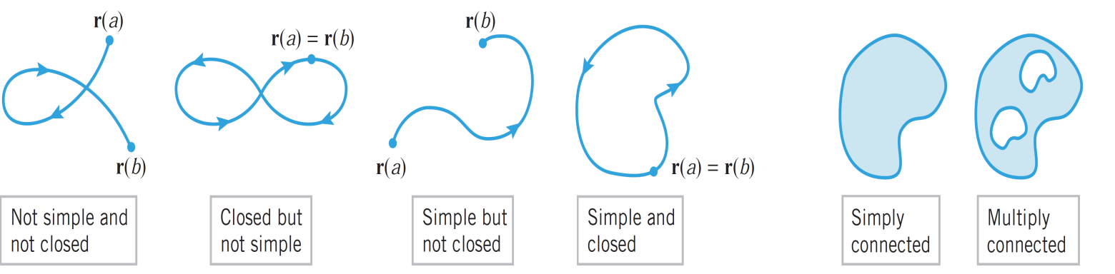
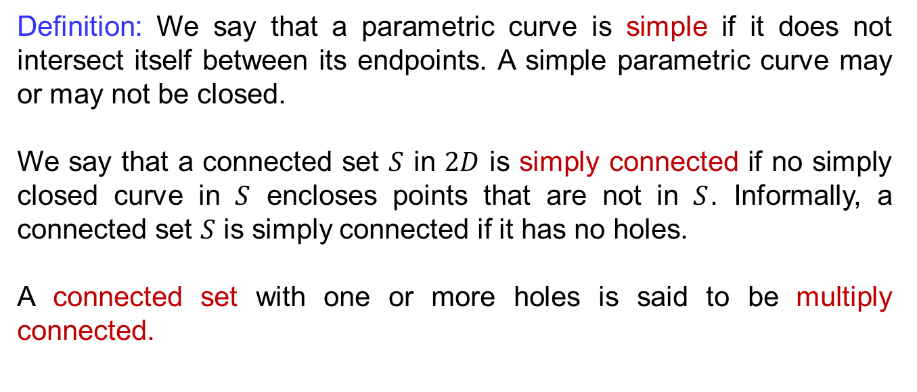
Test for conservative fields
Definition: We say that a parametric curve is simple if it does not intersect itself between its endpoints. A simple parametric curve may or may not be closed.
We say that a connected set $S$ in $2D$ is simply connected if no simply closed curve in $S$ encloses points that are not in $S$. Informally, a connected set $S$ is simply connected if it has no holes.
A connected set with one or more holes is said to be multiply connected.

Slide 27
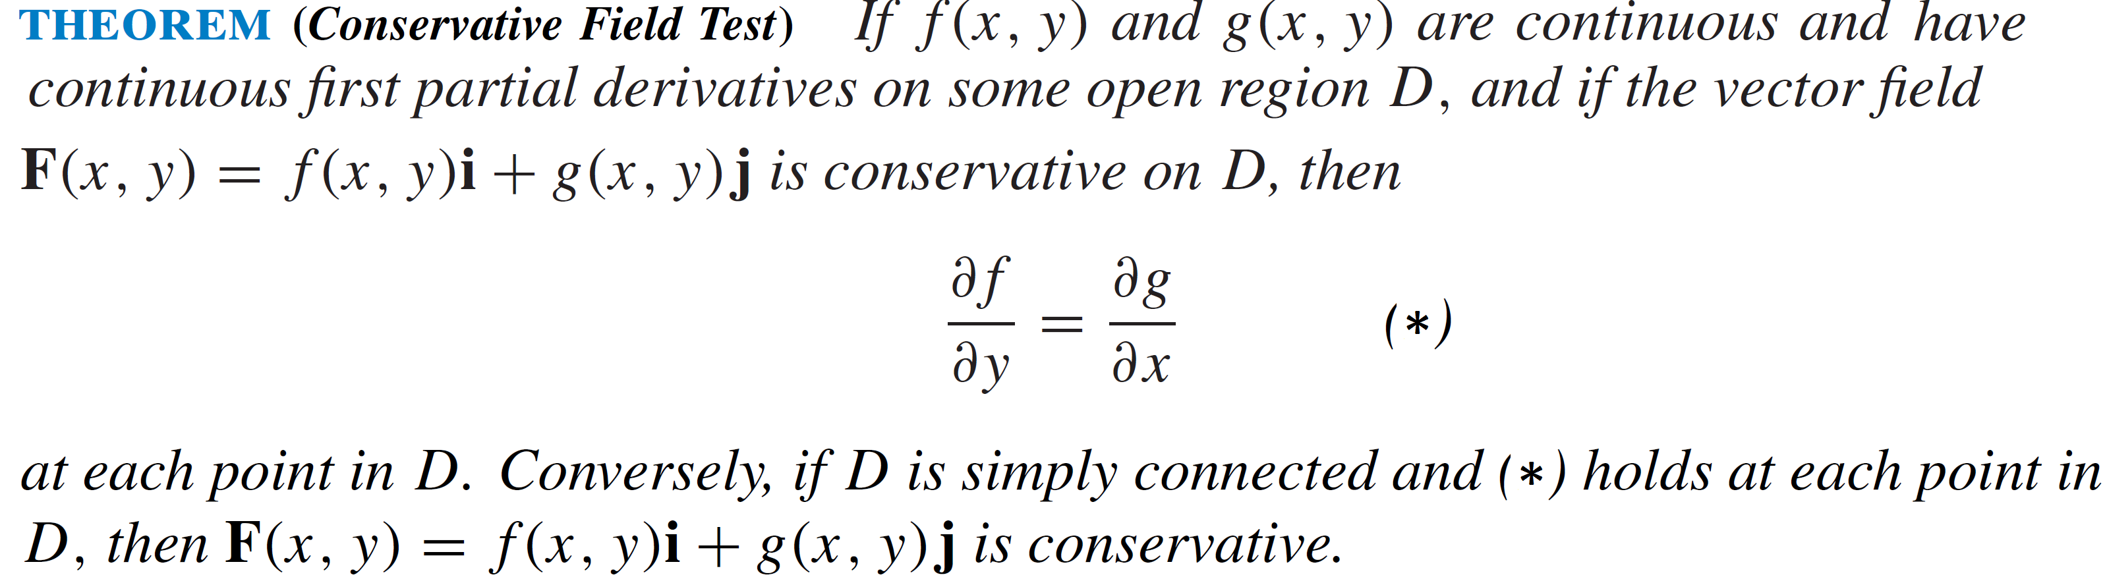
Test for conservative fields

Slide 28
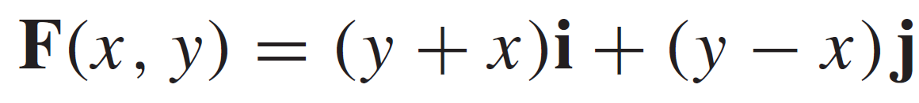
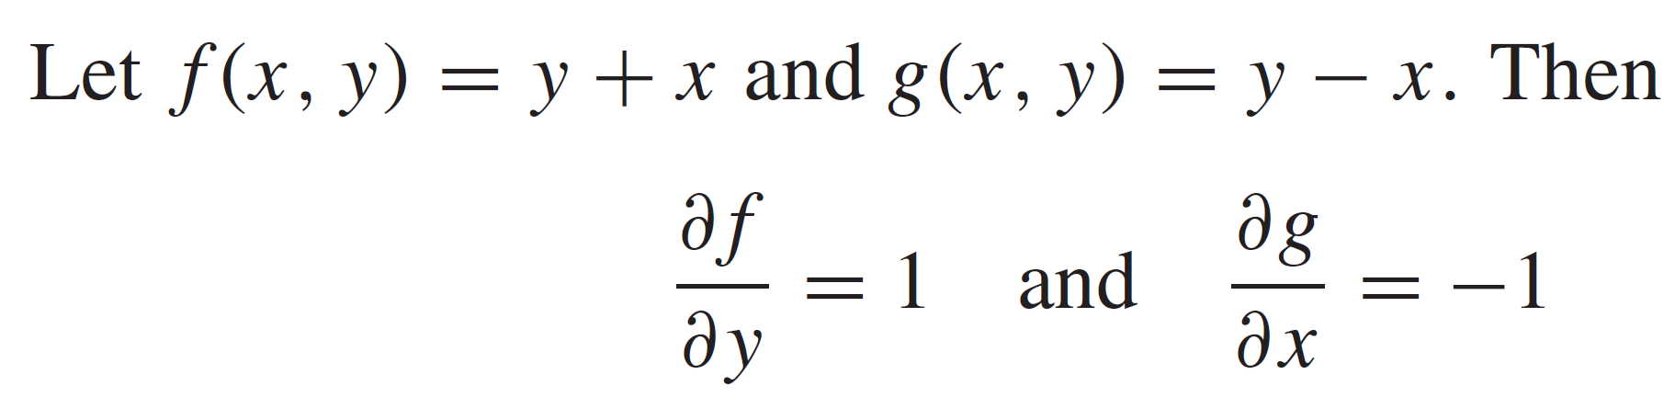
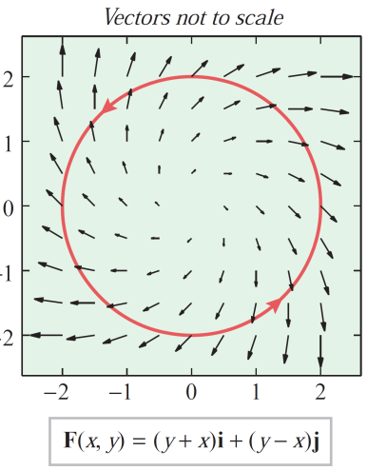
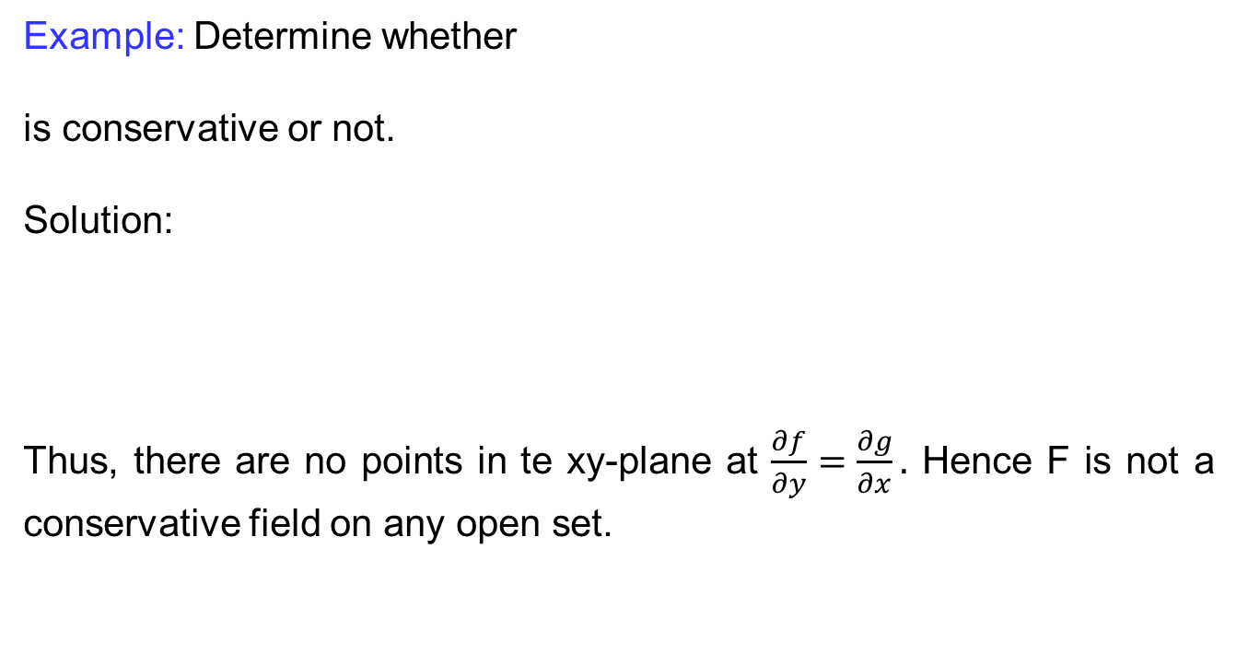
Test for conservative fields
Example: Determine whether
is conservative or not.
Solution:
Thus, there are no points in te xy-plane at $\frac{∂f}{∂y}=\frac{∂g}{∂x}.$ Hence F is not a conservative field on any open set.

Slide 29
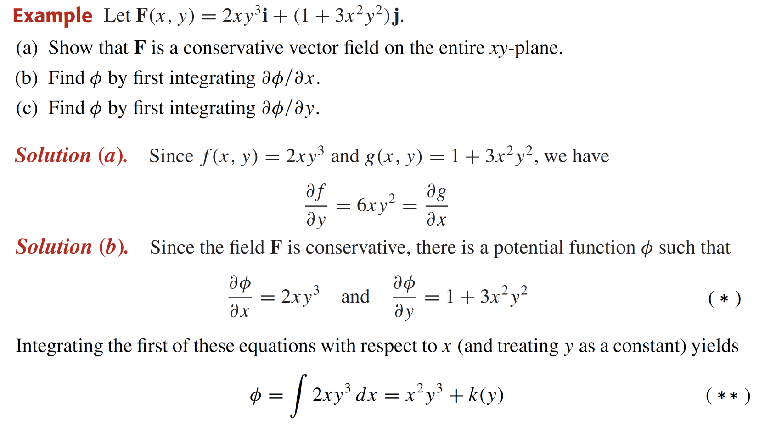
Test for conservative fields

Slide 30
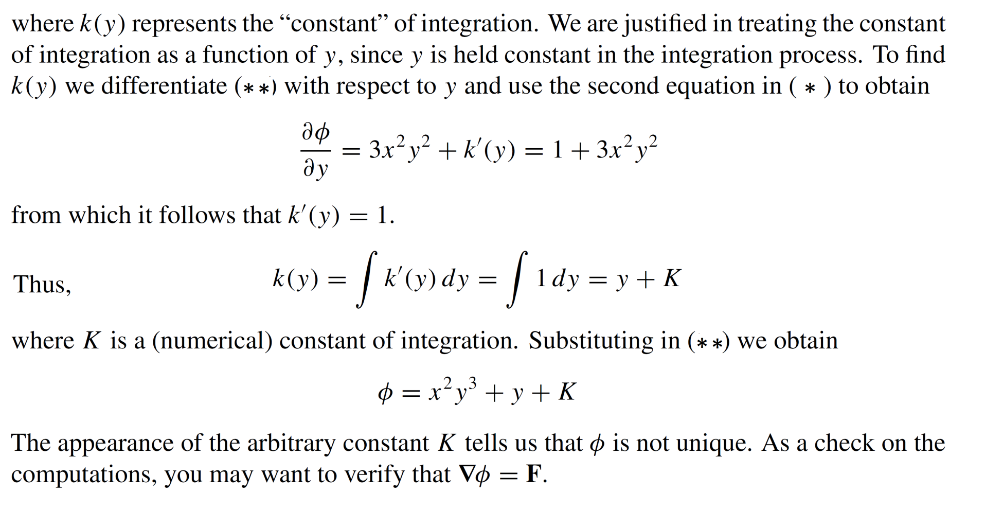
Test for conservative fields

Slide 31
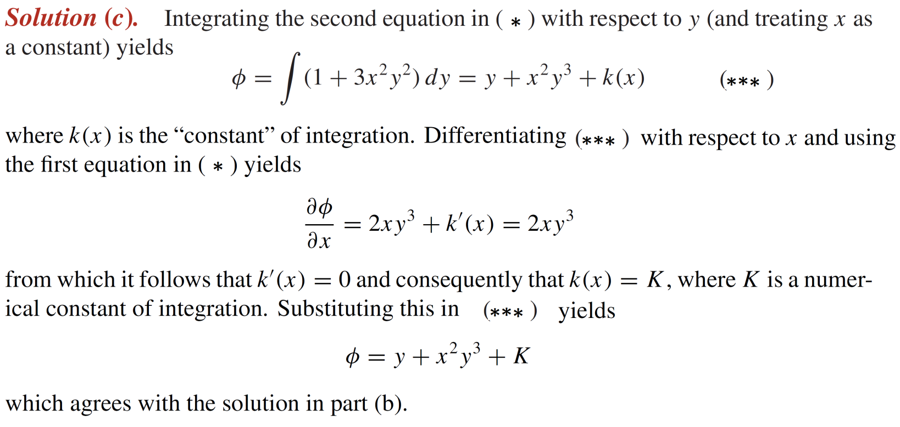
Test for conservative fields

Slide 32
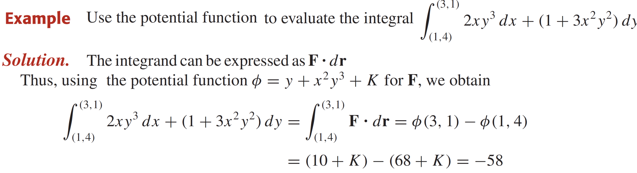
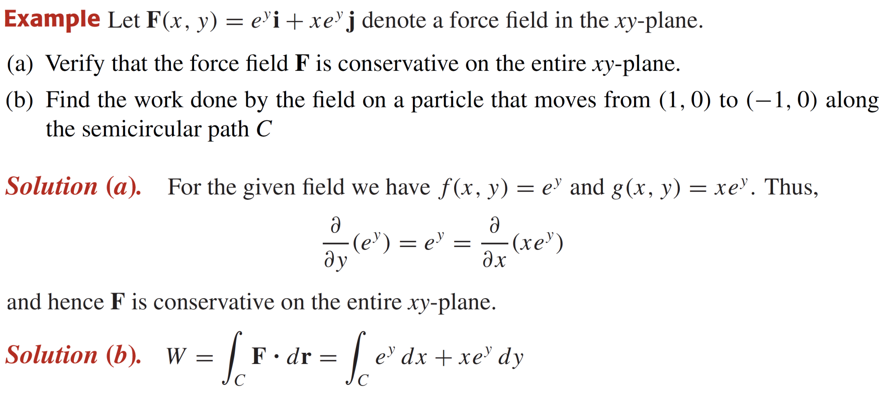
Test for conservative fields

Slide 33
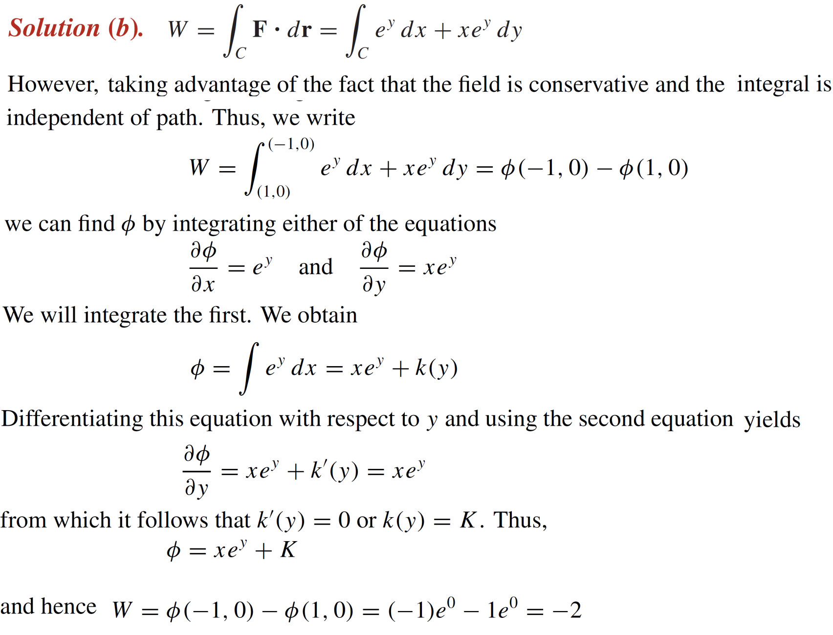
Test for conservative fields

Slide 34
Lecture Summary
    Integrating vector fields along curves
    Work done by a force
    Fundamental theorem of Calculus
    Independence of path
    Integration along closed path
    Test for conservative fields

