Slide 1
(MTH 250)
Calculus
Lecture 28

Slide 2
Previous Lecture’s Summary
    Simple polar regions
    Double integrals in polar coordinates
    Finding area using polar double integrals
    Changing coordinates in integrals
    Introduction to line integrals

Slide 3
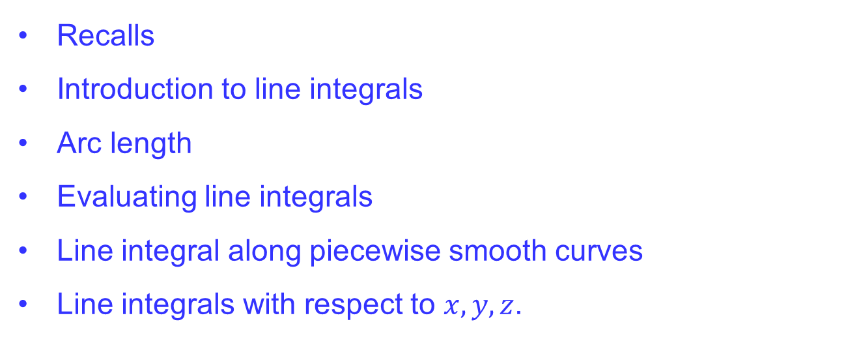
Today’s Lecture
    Recalls
    Introduction to line integrals
    Arc length
    Evaluating line integrals
    Line integral along piecewise smooth curves
    Line integrals with respect to $x,y,z$.

Slide 4
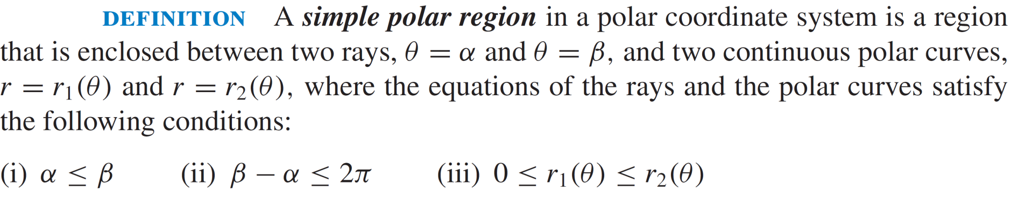
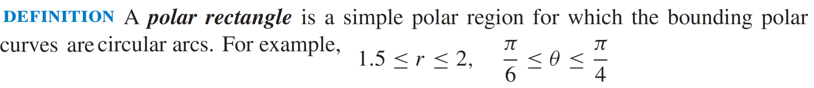
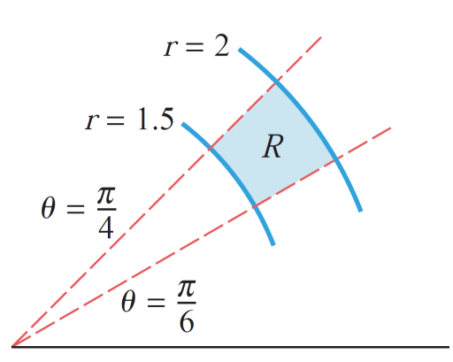
Recalls

Slide 5
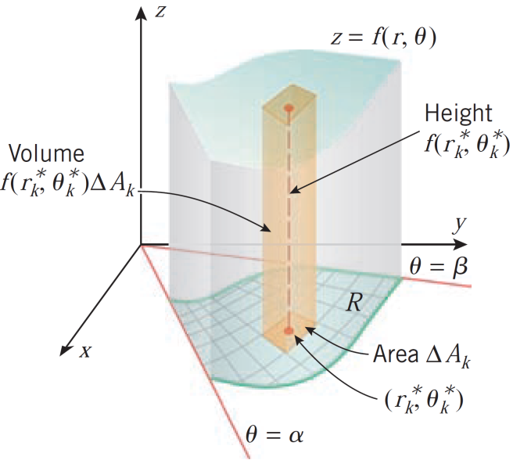
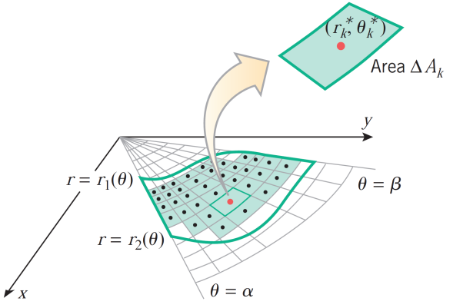
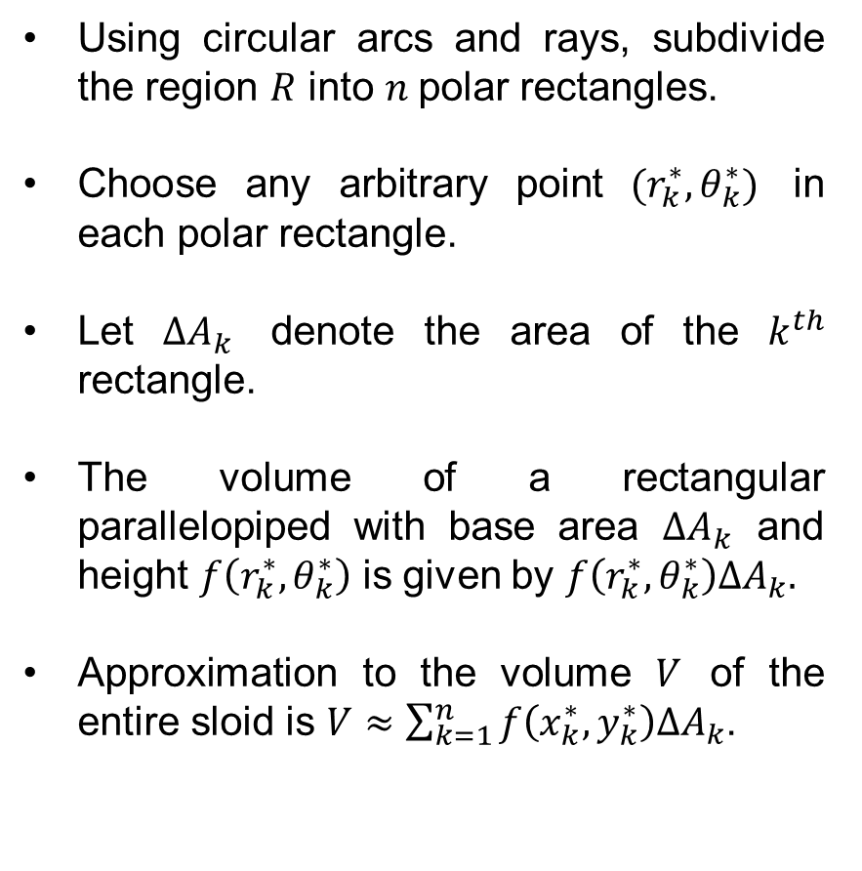
Recalls
Using circular arcs and rays, subdivide the region $R$ into $n$polar rectangles.
Choose any arbitrary point $(r_{k}^{∗},θ_{k}^{∗})$ in each polar rectangle.
Let $∆A_{k}$ denote the area of the $k^{th}$ rectangle.
The volume of a rectangular parallelopiped with base area $∆A_{k}$ and height $f\left(r_{k}^{∗},θ_{k}^{∗}\right)$ is given by $f\left(r_{k}^{∗},θ_{k}^{∗}\right)∆A_{k}.$
Approximation to the volume $V$ of the entire sloid is $V≈\sum_{k=1}^{n}{f\left(x_{k}^{∗},y_{k}^{∗}\right)∆A_{k}}$.

Slide 6
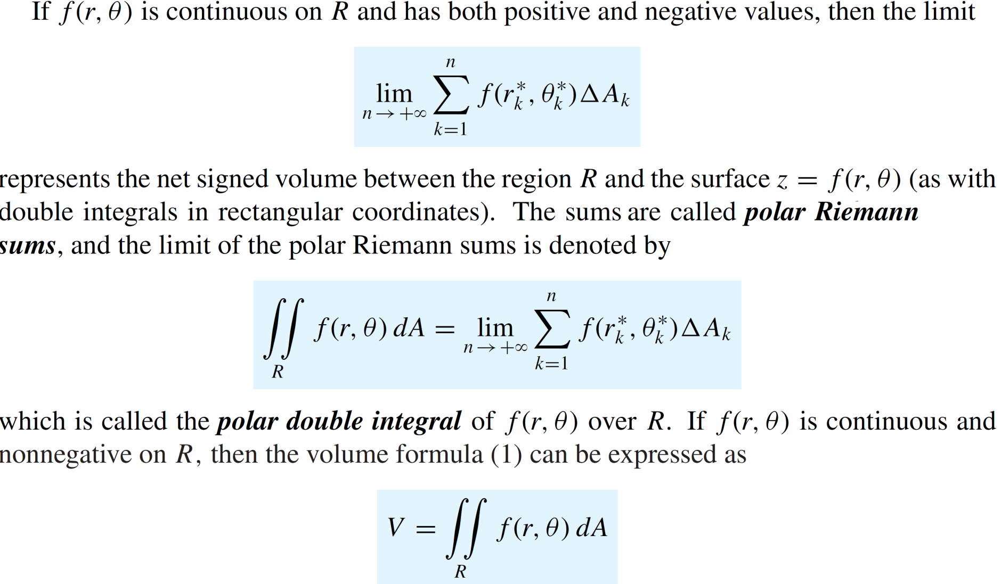
Recalls

Slide 7
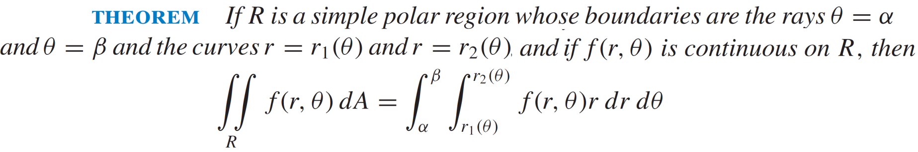
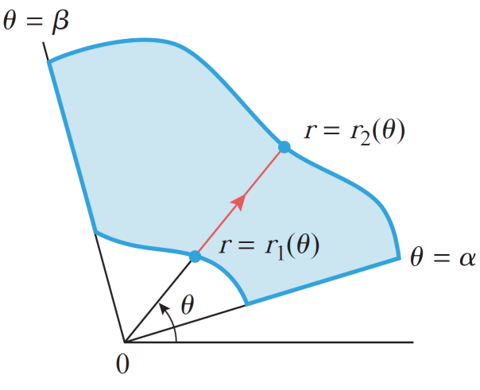
Recalls

Slide 8
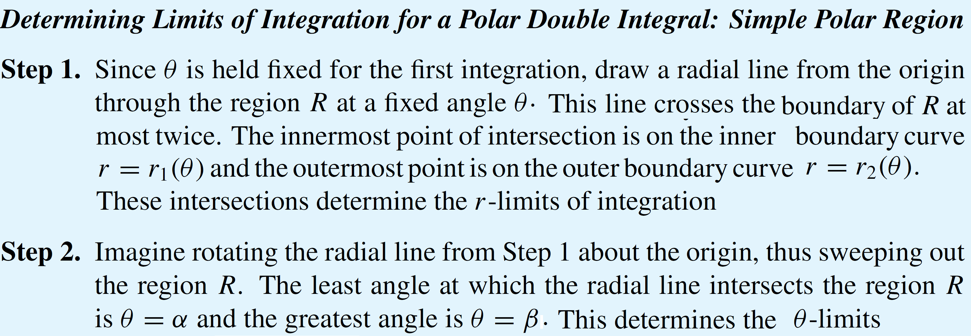
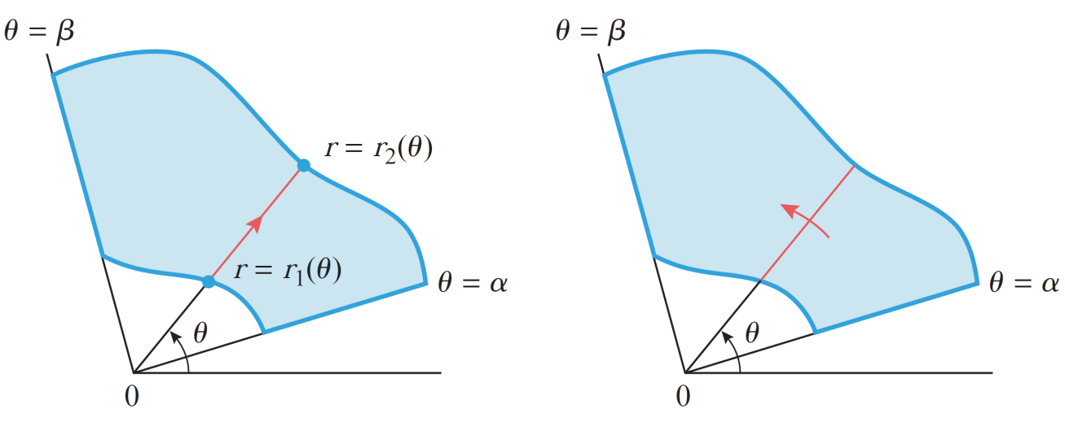
Recalls

Slide 9
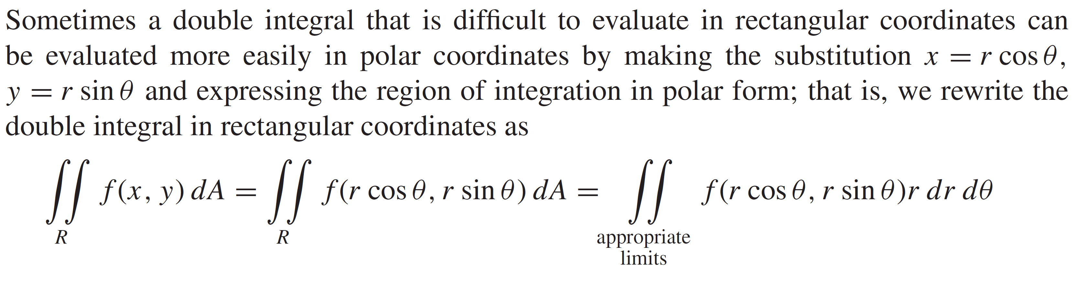
Recalls

Slide 10
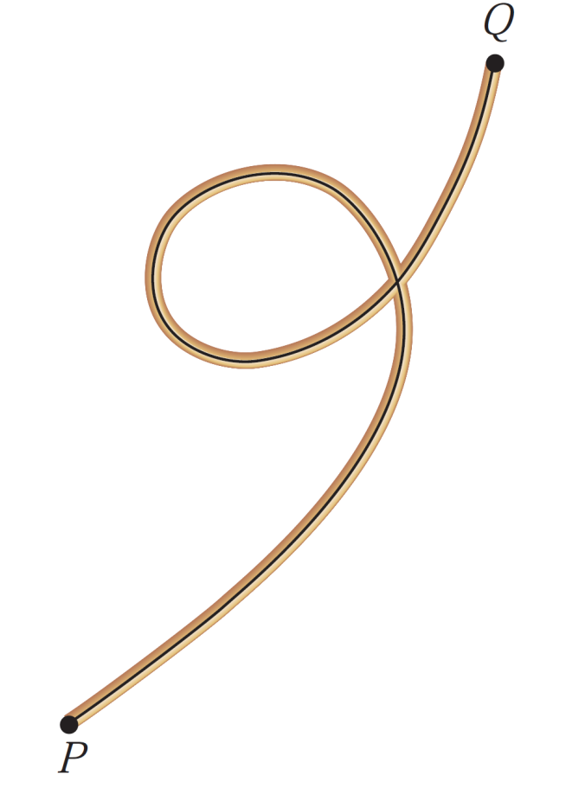
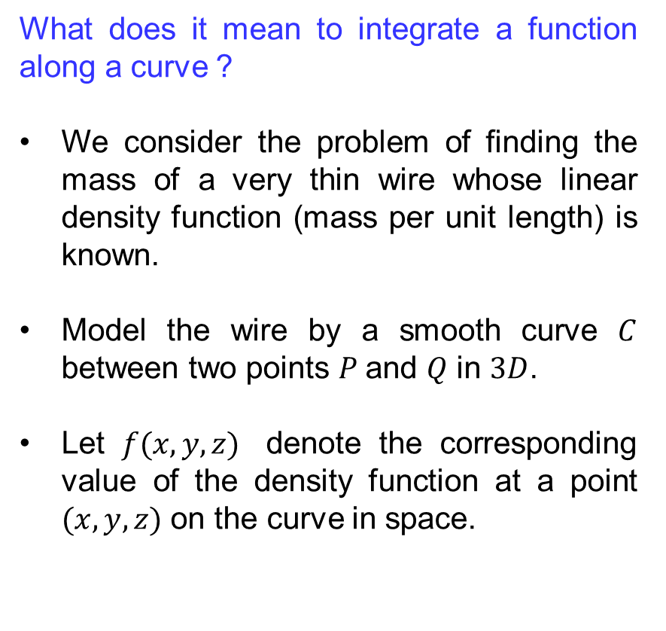
Introduction to line integrals
What does it mean to integrate a function along a curve ?
We consider the problem of finding the mass of a very thin wire whose linear density function (mass per unit length) is known.
Model the wire by a smooth curve $C$ between two points $P$and $Q$ in $3D$.
Let $f(x,y,z)$ denote the corresponding value of the density function at a point $(x,y,z)$ on the curve in space.

Slide 11
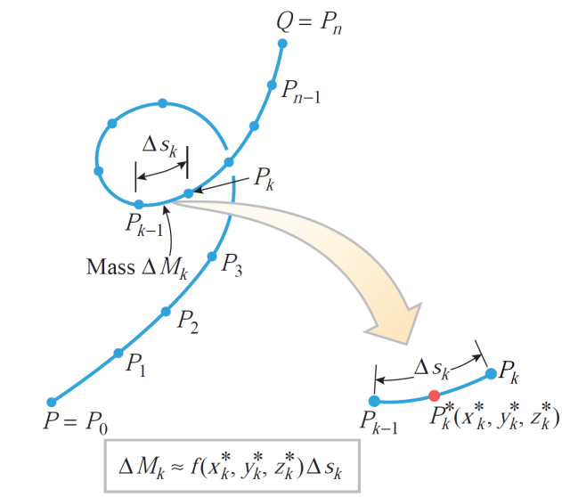
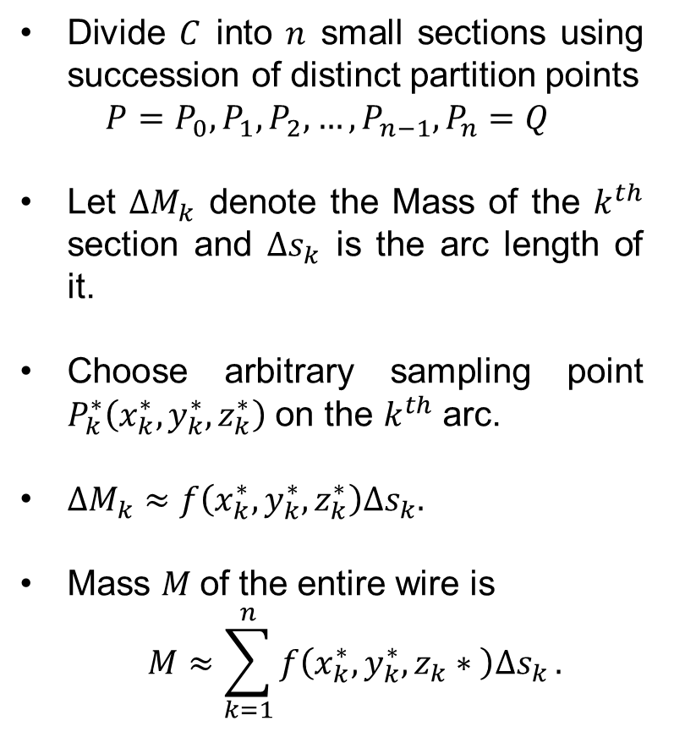
Introduction to line integrals
Divide $C$ into $n$ small sections using succession of distinct partition points
$$P=P_{0}, P_{1}, P_{2}, …, P_{n−1}, P_{n}=Q$$
Let $∆M_{k}$ denote the Mass of the $k^{th}$ section and $∆s_{k}$ is the arc length of it.
Choose arbitrary sampling point $P_{k}^{∗}\left(x_{k}^{∗}, y_{k}^{∗},z_{k}^{∗}\right)$ on the $k^{th}$ arc.
$∆M_{k}≈f\left(x_{k}^{∗},y_{k}^{∗},z_{k}^{∗}\right)∆s_{k}.$
Mass $M$of the entire wire is
$$M≈\sum_{k=1}^{n}{f\left(x_{k}^{∗},y_{k}^{∗},z_{k}∗ \right)∆s_{k}}.$$

Slide 12
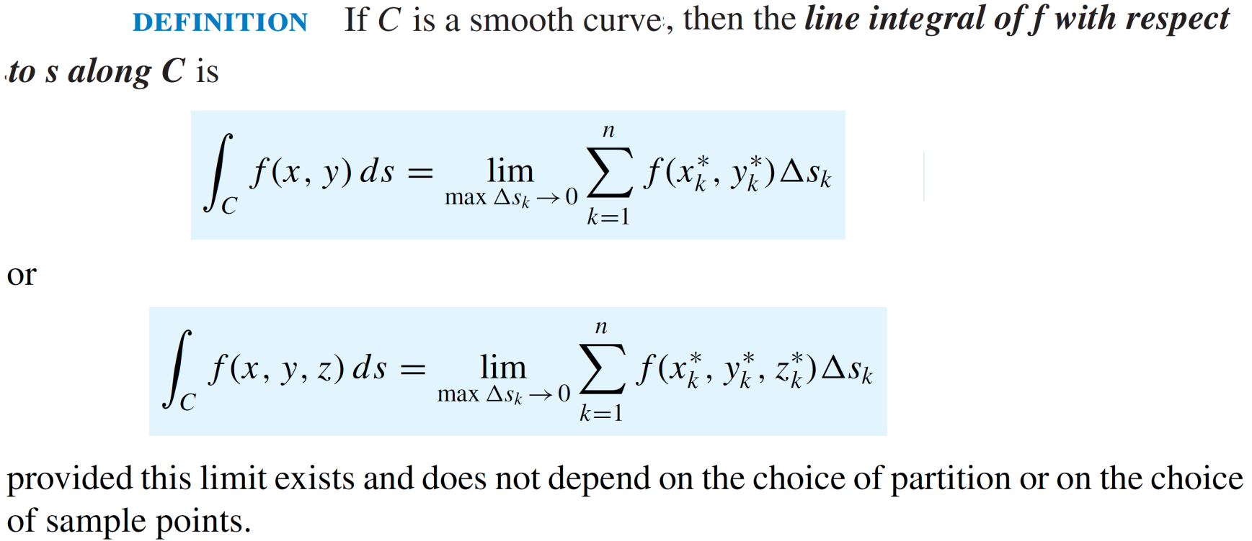
Introduction to line integrals

Slide 13
Introduction to line integrals
Remark:
  We define an integral that is similar to a single integral except that, instead of integrating over an interval [a, b], we integrate over a curve C. Such integrals are called line integrals.
Applications:
Fluid flow
Forces
Electricity
Magnetism

Slide 14
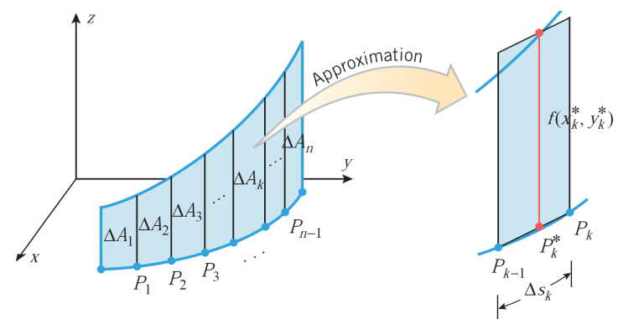
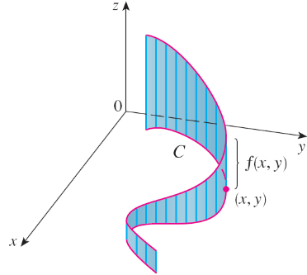
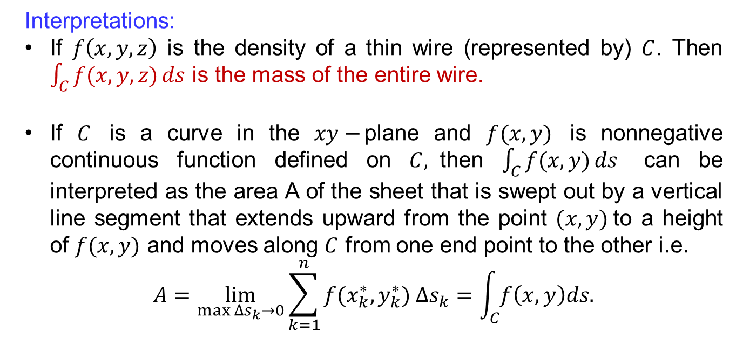
Introduction to line integrals
Interpretations:
If $f\left(x,y,z\right)$ is the density of a thin wire (represented by) $C$. Then $\int_{C}{f(x,y,z)}ds$ is the mass of the entire wire.
If $C$ is a curve in the $xy−$plane and $f(x,y)$ is nonnegative continuous function defined on $C,$then $\int_{C}{f(x,y)}ds$ can be interpreted as the area A of the sheet that is swept out by a vertical line segment that extends upward from the point $(x,y)$to a height of $f(x,y)$ and moves along $C$ from one end point to the other i.e.
$$A=\lim_{\max{∆s_{k}→0}}\sum_{k=1}^{n}{f(x_{k}^{∗},y_{k}^{∗}}) ∆s_{k}=\int_{C}{f\left(x,y\right)ds.}$$

Slide 15
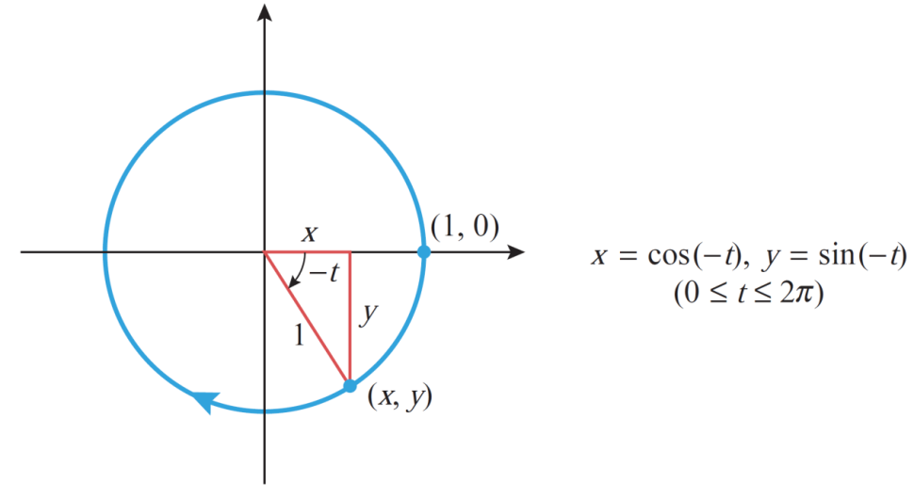
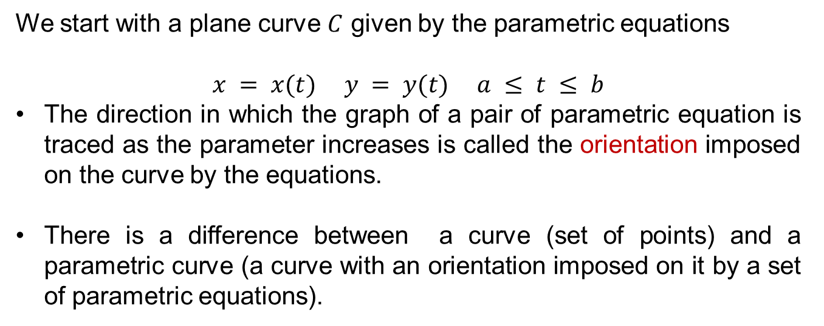
Arc length
We start with a plane curve $C$ given by the parametric equations
$$x = x(t) y = y(t) a ≤ t ≤ b$$
The direction in which the graph of a pair of parametric equation is traced as the parameter increases is called the orientation imposed on the curve by the equations.
There is a difference between a curve (set of points) and a parametric curve (a curve with an orientation imposed on it by a set of parametric equations).

Slide 16
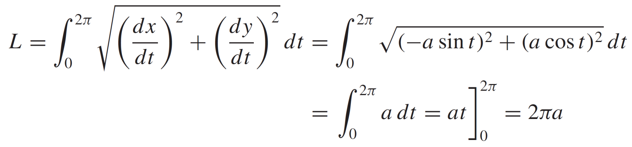
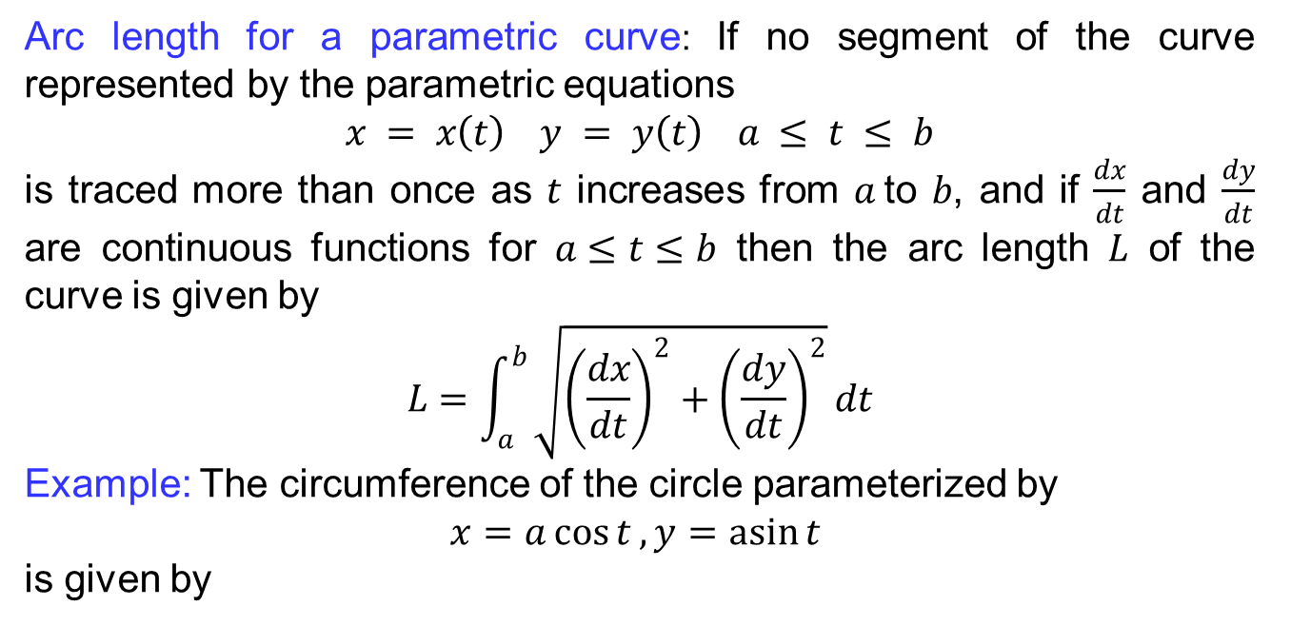
Arc length
Arc length for a parametric curve: If no segment of the curve represented by the parametric equations
$$x = x\left(t\right) y = y\left(t\right) a ≤ t ≤ b$$
is traced more than once as $t$ increases from $a$to $b$, and if $\frac{dx}{dt}$ and $\frac{dy}{dt}$ are continuous functions for $a≤t≤b$ then the arc length $L$ of the curve is given by
$$L=\int_{a}^{b}{\sqrt{{\left(\frac{dx}{dt}\right)}^{2}+{\left(\frac{dy}{dt}\right)}^{2}}}dt$$
Example: The circumference of the circle parameterized by
$x=a\cos{t}, y=\operatorname{asin}{t }$
is given by

Slide 17
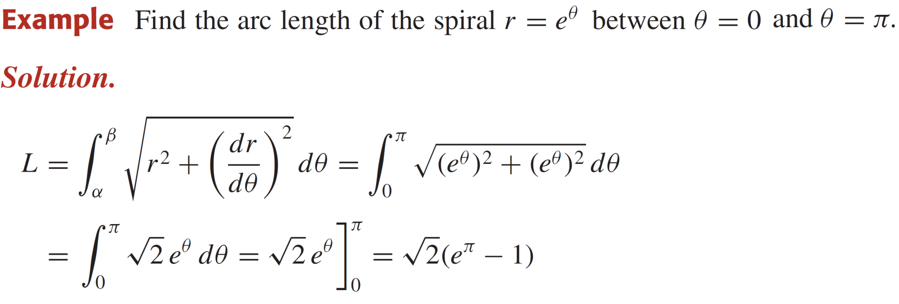
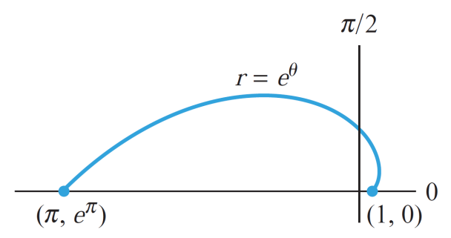
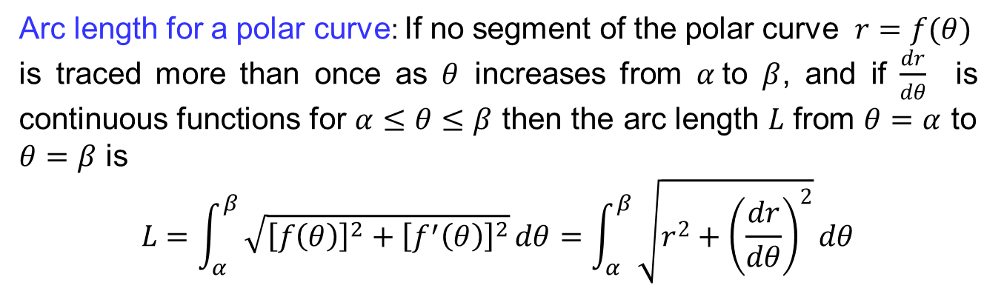
Arc length
Arc length for a polar curve: If no segment of the polar curve $r=f(θ)$
is traced more than once as $θ$ increases from $α$to $β$, and if $\frac{dr}{dθ}$ is continuous functions for $α≤θ≤β$ then the arc length $L$ from $θ=α$ to $θ=β$ is
$$L=\int_{α}^{β}{\sqrt{{\left[f\left(θ\right)\right]}^{2}+{\left[f^{′}\left(θ\right)\right]}^{2}}}dθ=\int_{α}^{β}{\sqrt{r^{2}+{\left(\frac{dr}{dθ}\right)}^{2}}}dθ$$

Slide 18
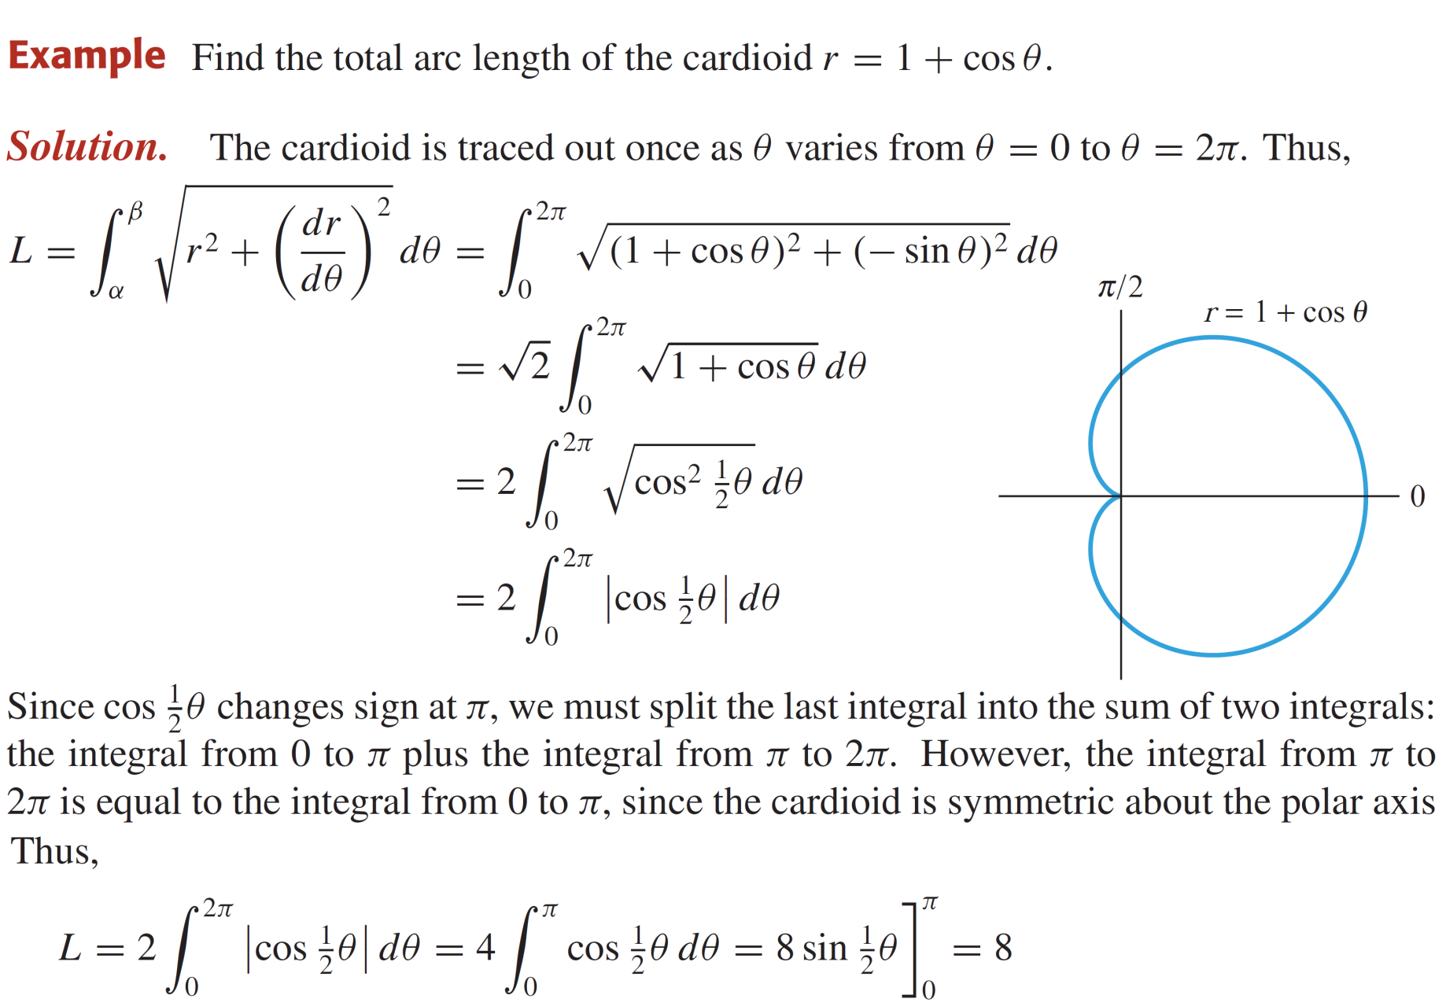
Arc length

Slide 19
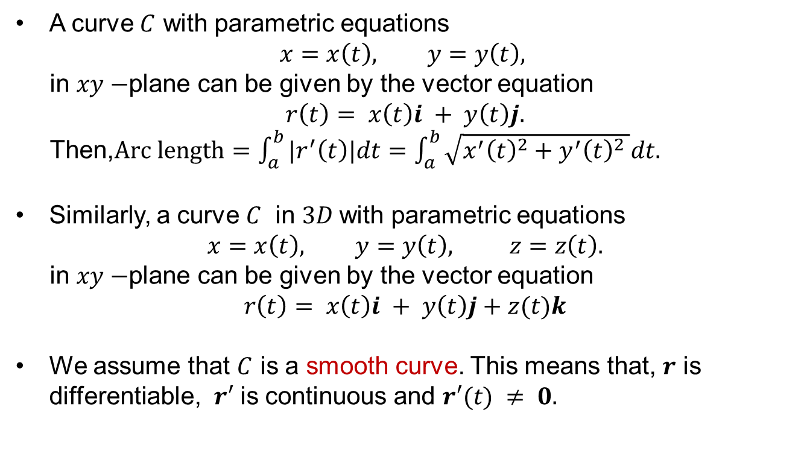
Arc length
A curve $C$ with parametric equations
$$x=x\left(t\right), y=y\left(t\right),$$
in $xy−$plane can be given by the vector equation
$$r\left(t\right)= x\left(t\right)i + y\left(t\right)j.$$
Then,$Arc length=\int_{a}^{b}{|r^{′}\left(t\right)|dt}=\int_{a}^{b}{\sqrt{x^{′}{\left(t\right)}^{2}+y^{′}{\left(t\right)}^{2} }dt.}$
Similarly, a curve $C$ in $3D$with parametric equations
$$x=x\left(t\right), y=y\left(t\right), z=z\left(t\right).$$
in $xy−$plane can be given by the vector equation
$$r\left(t\right)= x\left(t\right)i + y\left(t\right)j+z(t)k$$
We assume that $C$ is a smooth curve. This means that, $r$ is differentiable, $r′$ is continuous and $r′(t) ≠ 0.$

Slide 20
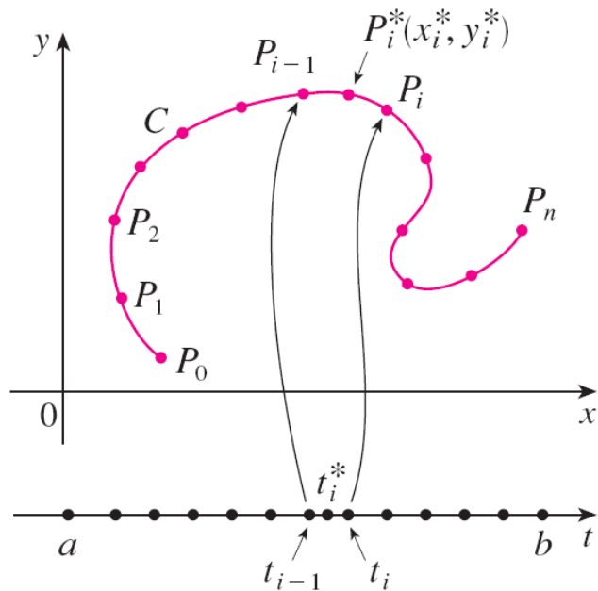
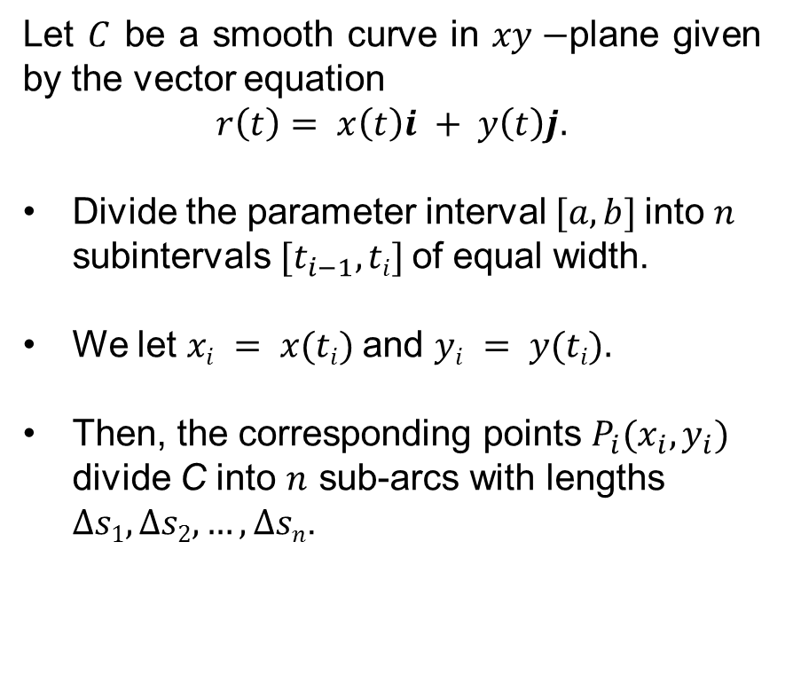
Evaluating line integrals
Let $C$ be a smooth curve in $xy−$plane given by the vector equation
$$r\left(t\right)= x\left(t\right)i + y\left(t\right)j.$$
Divide the parameter interval $[a, b]$into $n$ subintervals $[t_{i−1}, ti]$of equal width.
We let $xi = x(ti)$and $yi = y(ti).$
Then, the corresponding points $P_{i}(x_{i},y_{i})$
divide C into $n$ sub-arcs with lengths
$∆s1, ∆s2, …, ∆sn$.

Slide 21
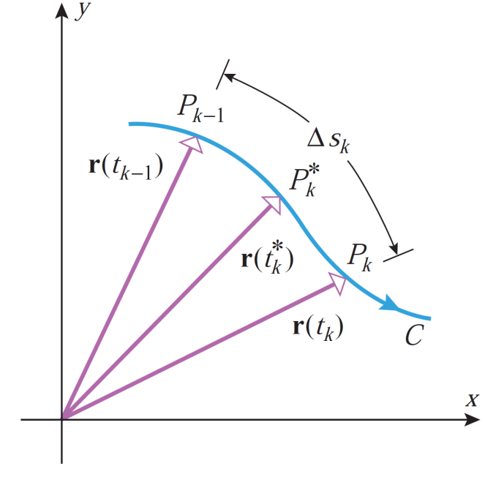
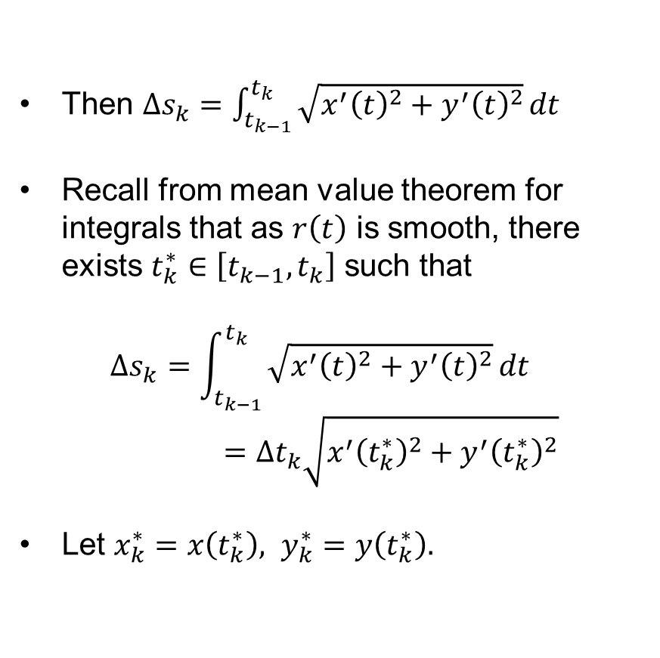
Evaluating line integrals
Then $∆s_{k}=\int_{t_{k−1}}^{t_{k}}{\sqrt{x^{′}{\left(t\right)}^{2}+y^{′}{\left(t\right)}^{2}}}dt$
Recall from mean value theorem for integrals that as $r\left(t\right)$ is smooth, there exists $t_{k}^{∗}∈\left[t_{k−1},t_{k}\right]$ such that
$$∆s_{k}=\int_{t_{k−1}}^{t_{k}}{\sqrt{x^{′}{\left(t\right)}^{2}+y^{′}{\left(t\right)}^{2}}}dt=∆t_{k}\sqrt{x^{′}{\left(t_{k}^{∗}\right)}^{2}+y^{′}{\left(t_{k}^{∗}\right)}^{2}}$$
Let $x_{k}^{∗}=x\left(t_{k}^{∗}\right), y_{k}^{∗}=y\left(t_{k}^{∗}\right).$

Slide 22
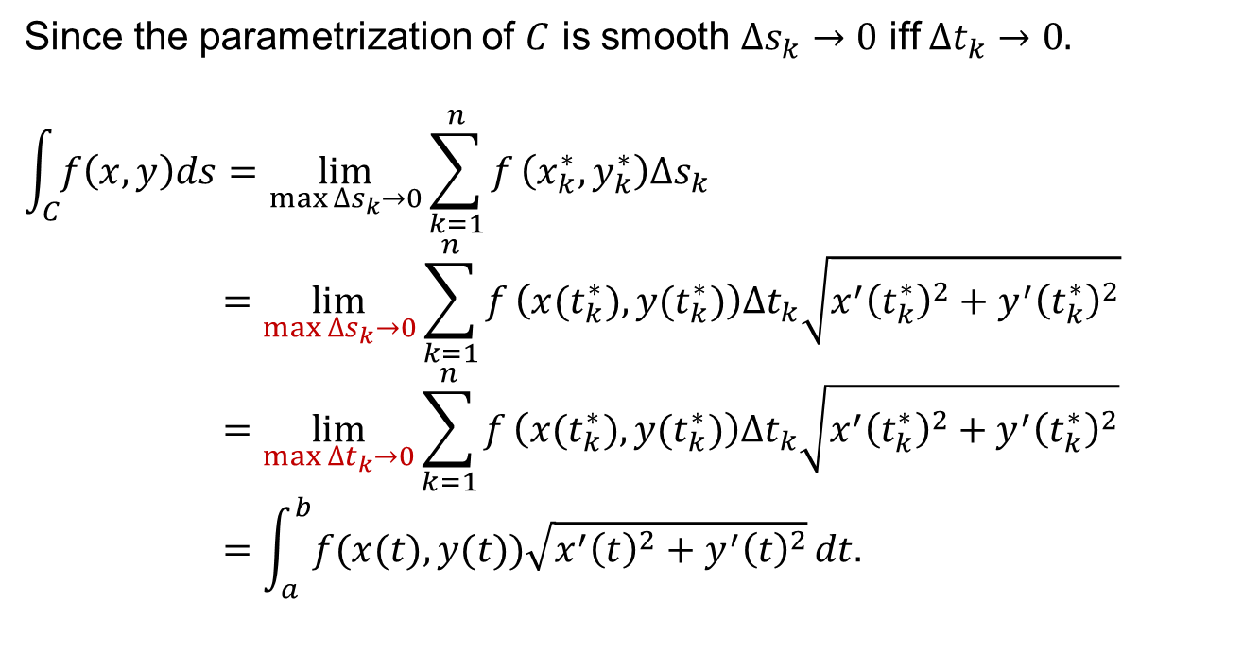
Evaluating line integrals
Since the parametrization of $C$ is smooth $∆s_{k}→0$ iff $∆t_{k}→0.$
$$\int_{C}{f\left(x,y\right)ds}=\lim_{\max{∆s_{k}}→0}{\sum_{k=1}^{n}{f}\left(x_{k}^{∗}, y_{k}^{∗}\right)∆s_{k}}$$
$$=\lim_{\max{∆s_{k}}→0}{\sum_{k=1}^{n}{f}\left({x(t}_{k}^{∗}), {y(t}_{k}^{∗})\right)∆t_{k}\sqrt{x^{′}{\left(t_{k}^{∗}\right)}^{2}+y^{′}{\left(t_{k}^{∗}\right)}^{2}}}$$
$$=\lim_{\max{∆t_{k}}→0}{\sum_{k=1}^{n}{f}\left({x(t}_{k}^{∗}), {y(t}_{k}^{∗})\right)∆t_{k}\sqrt{x^{′}{\left(t_{k}^{∗}\right)}^{2}+y^{′}{\left(t_{k}^{∗}\right)}^{2}}}$$
$$=\int_{a}^{b}{f(x(t),y(t))\sqrt{x^{′}{\left(t\right)}^{2}+y^{′}{\left(t\right)}^{2}}}dt.$$

Slide 23
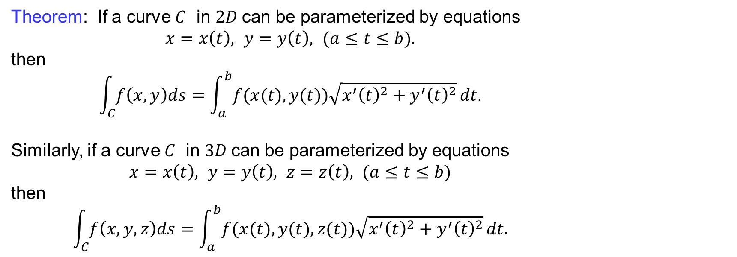
Evaluating line integrals
Theorem: If a curve $C$ in $2D$can be parameterized by equations
$x=x\left(t\right), y=y\left(t\right), (a≤t≤b).$
then
$$\int_{C}{f\left(x,y\right)ds}=\int_{a}^{b}{f(x(t),y(t))\sqrt{x^{′}{\left(t\right)}^{2}+y^{′}{\left(t\right)}^{2}}}dt.$$
Similarly, if a curve $C$ in $3D$can be parameterized by equations
$x=x\left(t\right), y=y\left(t\right), z=z\left(t\right), (a≤t≤b)$
then
$$\int_{C}{f\left(x,y,z\right)ds}=\int_{a}^{b}{f(x(t),y(t),z(t))\sqrt{x^{′}{\left(t\right)}^{2}+y^{′}{\left(t\right)}^{2}}}dt.$$

Slide 24
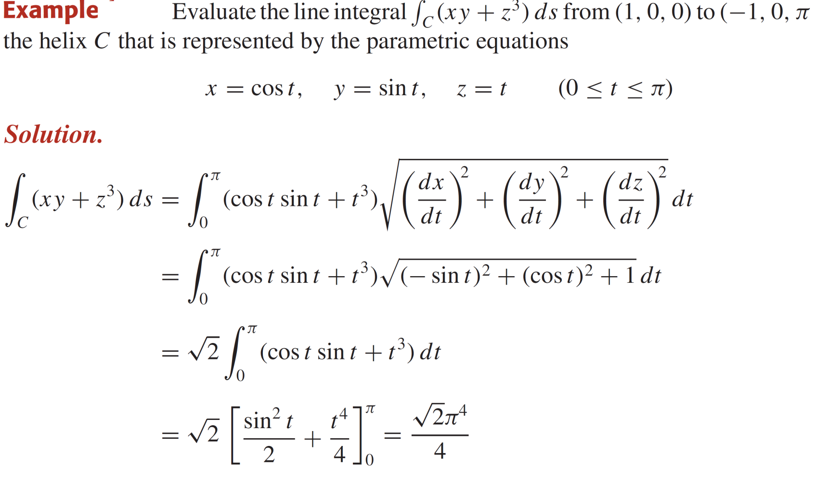
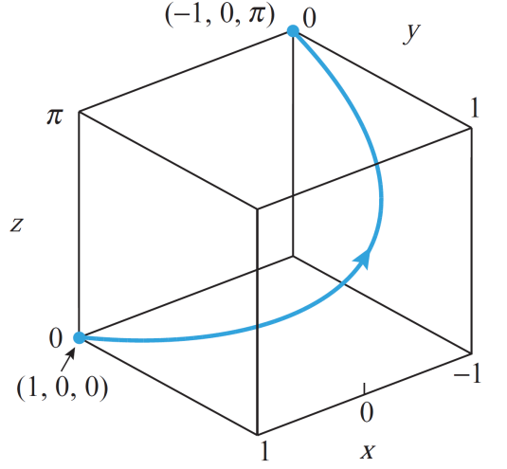
Evaluating line integrals

Slide 25
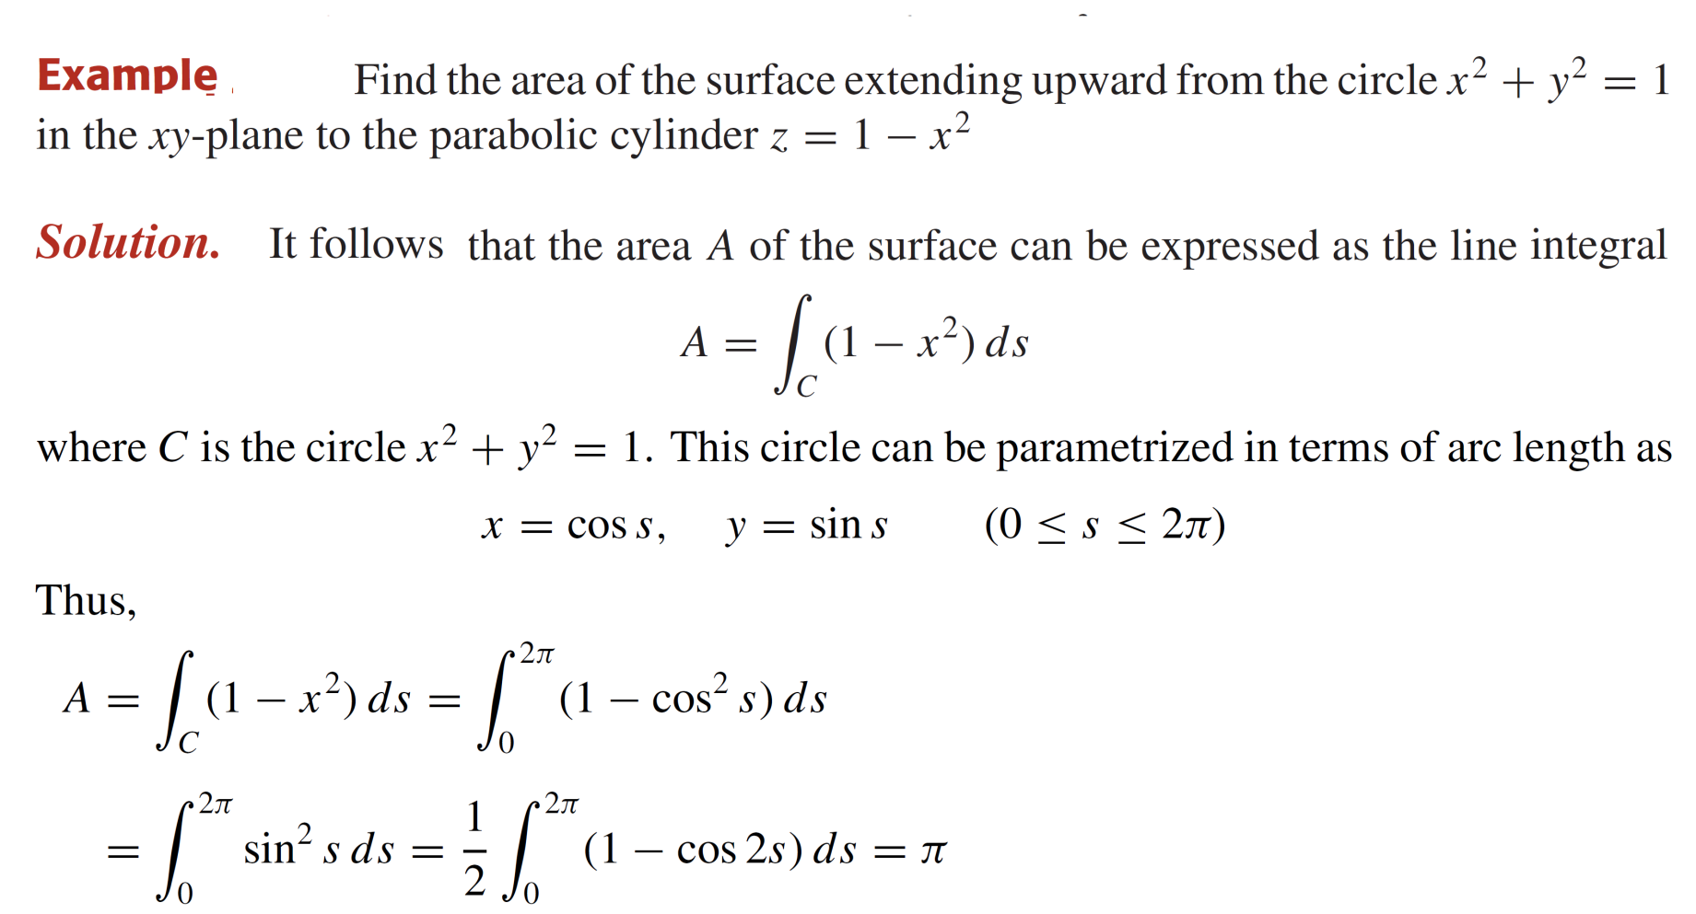
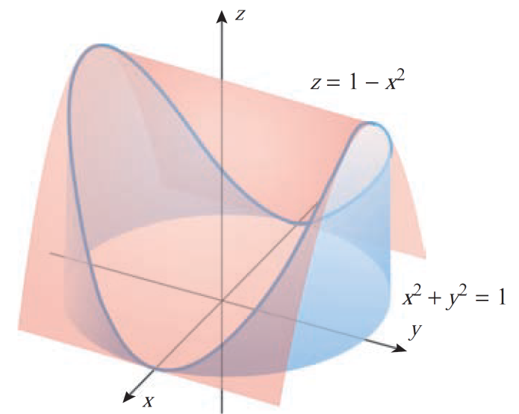
Evaluating line integrals

Slide 26
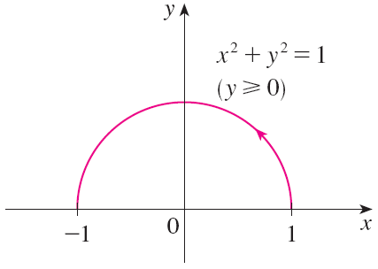
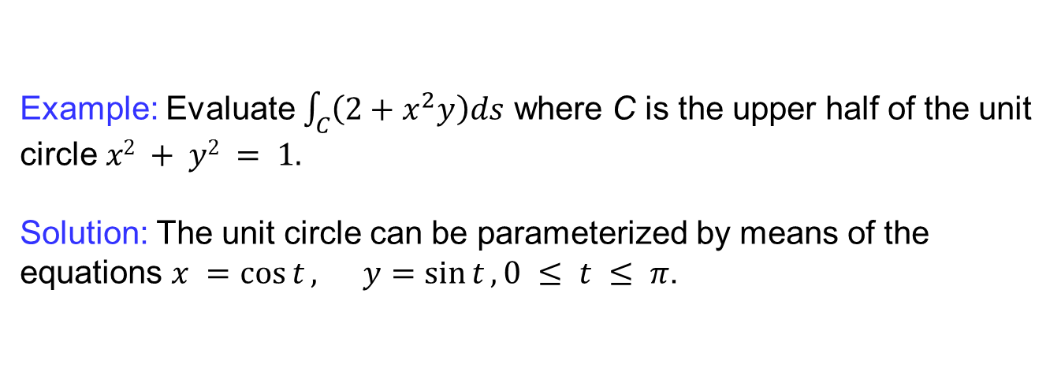
Evaluating line integrals
Example: Evaluate $\int_{C}{\left(2+x^{2}y\right)ds}$ where C is the upper half of the unit circle $x2 + y2 = 1.$
Solution: The unit circle can be parameterized by means of the equations $x =\cos{t}, y=\sin{t}, 0 ≤ t ≤ π$.

Slide 27
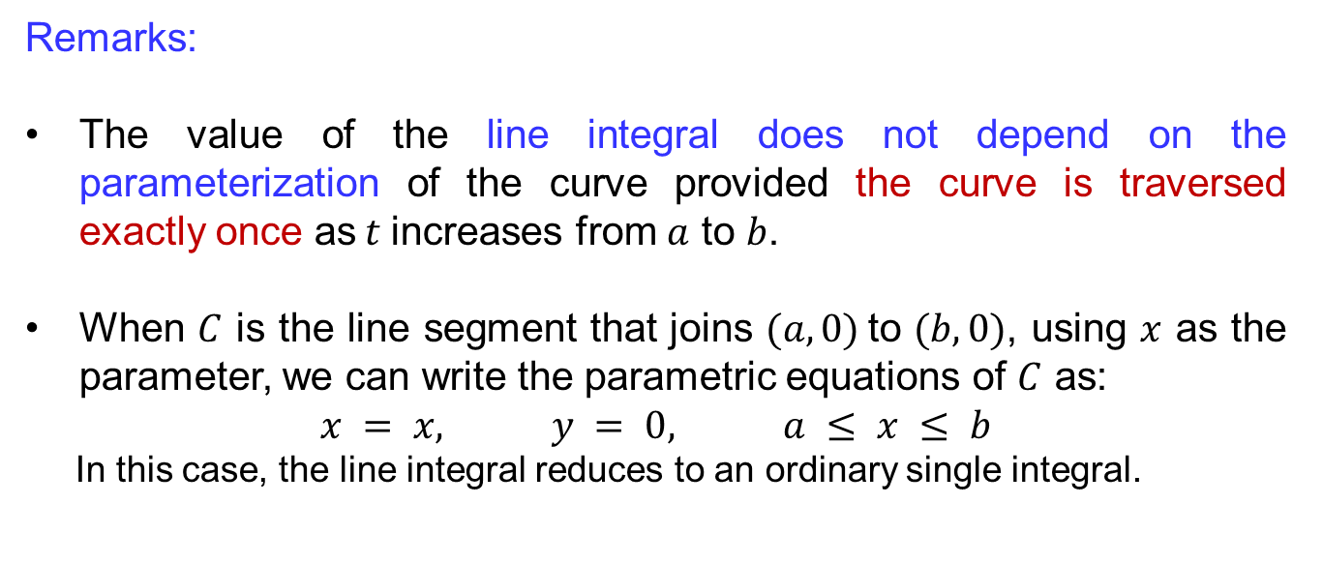
Evaluating line integrals
Remarks:
The value of the line integral does not depend on the parameterization of the curve provided the curve is traversed exactly once as$t$increases from $a$ to $b$.
When $C$ is the line segment that joins $(a, 0)$to $(b, 0)$, using $x$ as the parameter, we can write the parametric equations of $C$ as:
$$x = x, y = 0, a ≤ x ≤ b$$
In this case, the line integral reduces to an ordinary single integral.

Slide 28
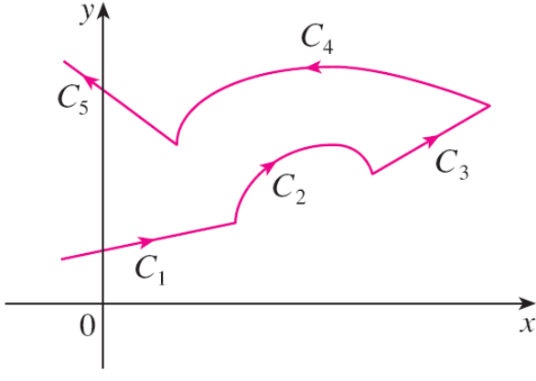
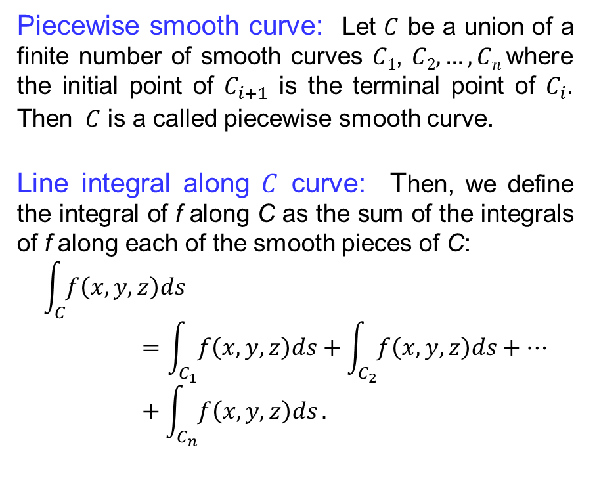
Line integral along piecewise smooth curves
Piecewise smooth curve: Let $C$ be a union of a finite number of smooth curves $C1$, $C2, …, Cn$where the initial point of $C_{i+1}$ is the terminal point of $C_{i}$. Then $C$ is a called piecewise smooth curve.
Line integral along $C$ curve: Then, we define the integral of f along C as the sum of the integrals of f along each of the smooth pieces of C:
$$\int_{C}{f\left(x,y,z\right)ds}=\int_{C_{1}}{f\left(x,y,z\right)ds}+\int_{C_{2}}{f\left(x,y,z\right)ds}+…+\int_{C_{n}}{f\left(x,y,z\right)ds}.$$

Slide 29
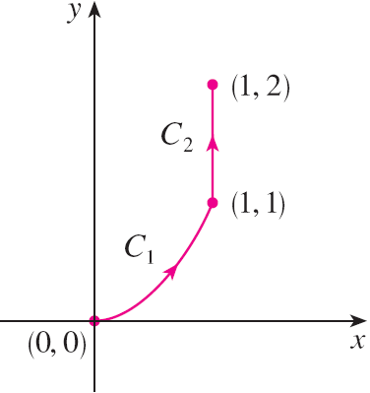
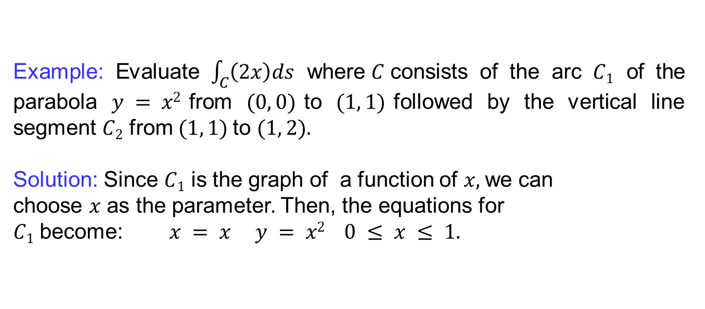
Line integral along piecewise smooth curves
Example: Evaluate $\int_{C}{\left(2x\right)ds}$ where$C$consists of the arc $C1$ of the parabola $y = x2$from $(0, 0)$to $(1, 1)$followed by the vertical line segment $C2$ from $(1, 1)$to $(1, 2).$
Solution: Since $C1$ is the graph of a function of $x,$we can
choose $x$ as the parameter. Then, the equations for
$C1$ become: $x = x y = x2 0 ≤ x ≤ 1.$

Slide 30
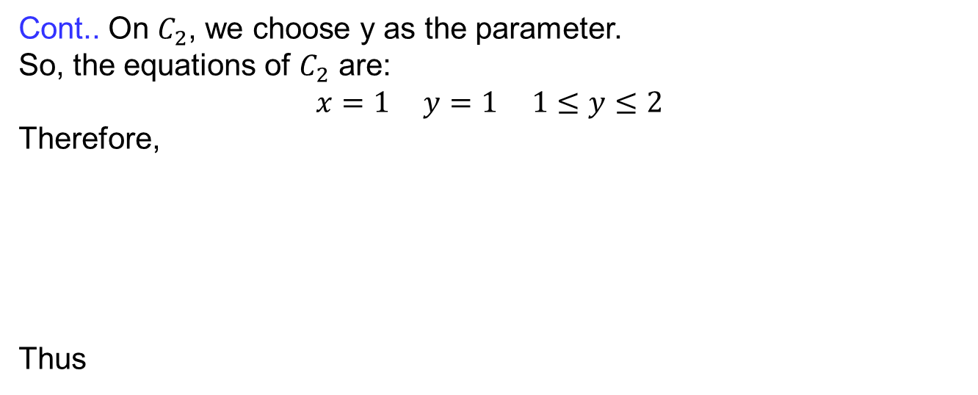
Line integral along piecewise smooth curves
Cont.. On $C_{2}$, we choose y as the parameter.
So, the equations of $C_{2}$ are:
$$x=1 y=1 1≤y≤2$$
Therefore,
Thus

Slide 31

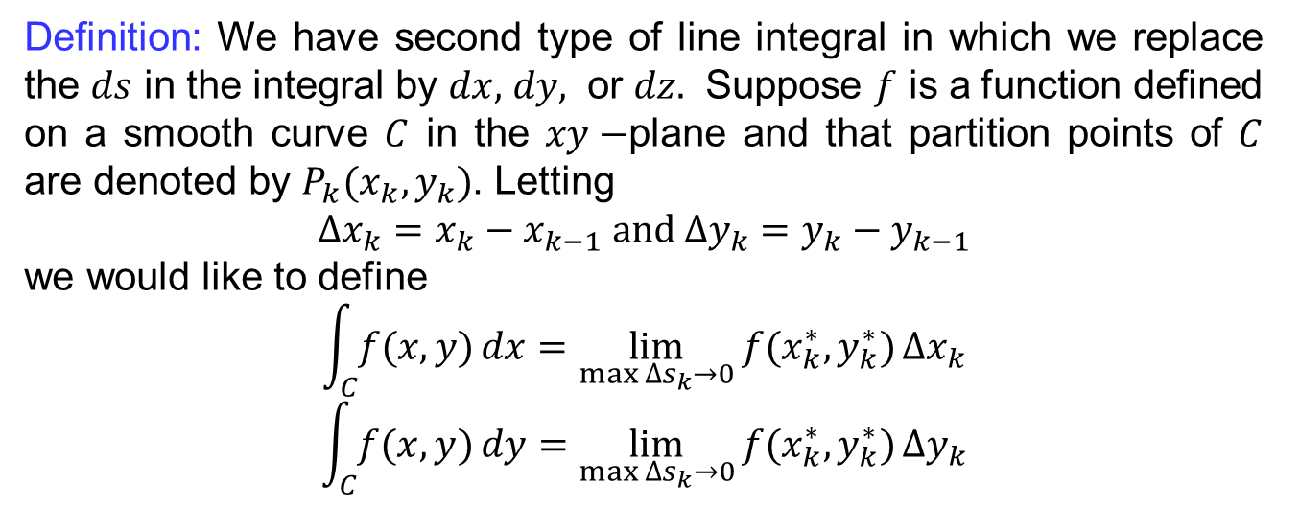
Line integrals with respect to $x, y, z$
Definition: We have second type of line integral in which we replace the $ds$ in the integral by $dx,$ $dy,$ or $dz.$ Suppose $f$ is a function defined on a smooth curve $C$ in the $xy−$plane and that partition points of $C$ are denoted by $P_{k}(x_{k},y_{k})$. Letting
$$∆x_{k}=x_{k}−x_{k−1} and ∆y_{k}=y_{k}−y_{k−1}$$
we would like to define
$$\int_{C}{f(x,y)}dx=\lim_{\max{∆s_{k}→0}}{f(x_{k}^{∗},y_{k}^{∗})}∆x_{k}$$
$$\int_{C}{f(x,y)}dy=\lim_{\max{∆s_{k}→0}}{f(x_{k}^{∗},y_{k}^{∗})}∆y_{k}$$

Slide 32
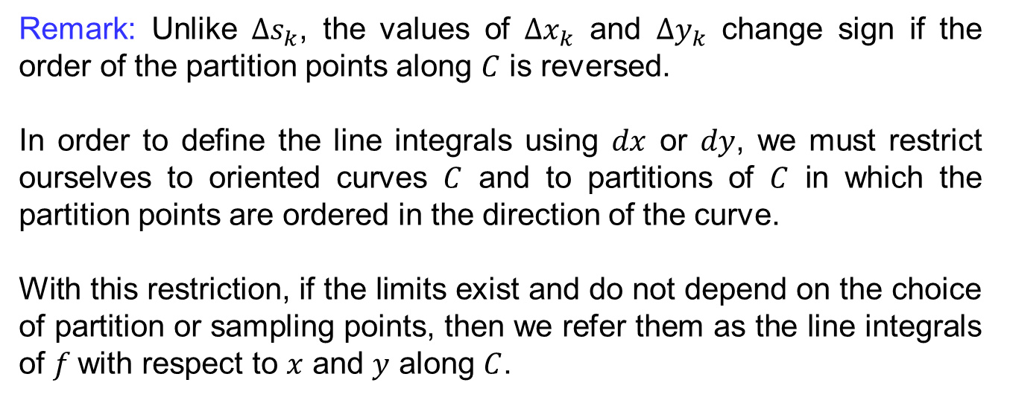
Line integrals with respect to $x, y, z$
Remark: Unlike $∆s_{k}$, the values of $∆x_{k}$ and $∆y_{k}$ change sign if the order of the partition points along $C$ is reversed.
In order to define the line integrals using $dx$ or $dy$, we must restrict ourselves to oriented curves $C$ and to partitions of $C$ in which the partition points are ordered in the direction of the curve.
With this restriction, if the limits exist and do not depend on the choice of partition or sampling points, then we refer them as the line integrals of $f$with respect to $x$ and $y$ along $C$.

Slide 33

Line integrals with respect to $x, y, z$
Evaluating line integrals with respect to $x,y,z$:
The following formulas say that line integrals with respect to $x$ and $y$ can also be evaluated by expressing everything in terms of $t$:
$$x = x\left(t\right), y = y\left(t\right), dx = x^{′\left(t\right)}dt, dy = y^{′}\left(t\right)dt.$$
Therefore,
And
Sometimes we write

Slide 34



Line integrals with respect to $x, y, z$

Slide 35


Line integrals with respect to $x, y, z$

Slide 36






Line integrals with respect to $x, y, z$

Slide 37

Lecture Summary
    Introduction to line integrals
    Arc length
    Evaluating line integrals
    Line integral along piecewise smooth curves
    Line integrals with respect to $x,y,z$

