Slide 1
(MTH 250)
Calculus
Lecture 27

Slide 2
Previous Lecture’s Summary
    Polar Coordinates
    Rectangular Coordinates.
    Cylindrical Coordinates
    Spherical Coordinates
    Equations of Surfaces
    Conversion of Coordinate Systems
    Directional Derivatives
    Gradients.

Slide 3
Today’s Lecture
    Recalls
    Simple polar regions
    Double integrals in polar coordinates
    Finding area using polar double integrals
    Changing coordinates in integrals
    Introduction to line integrals

Slide 4
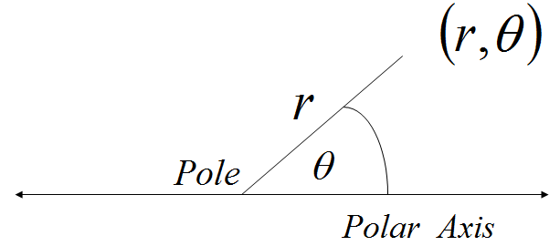
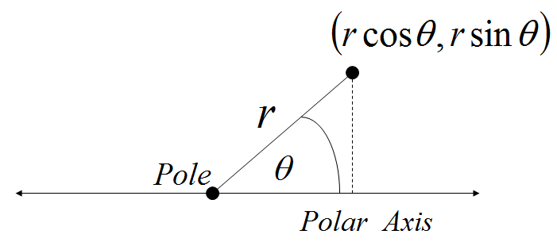
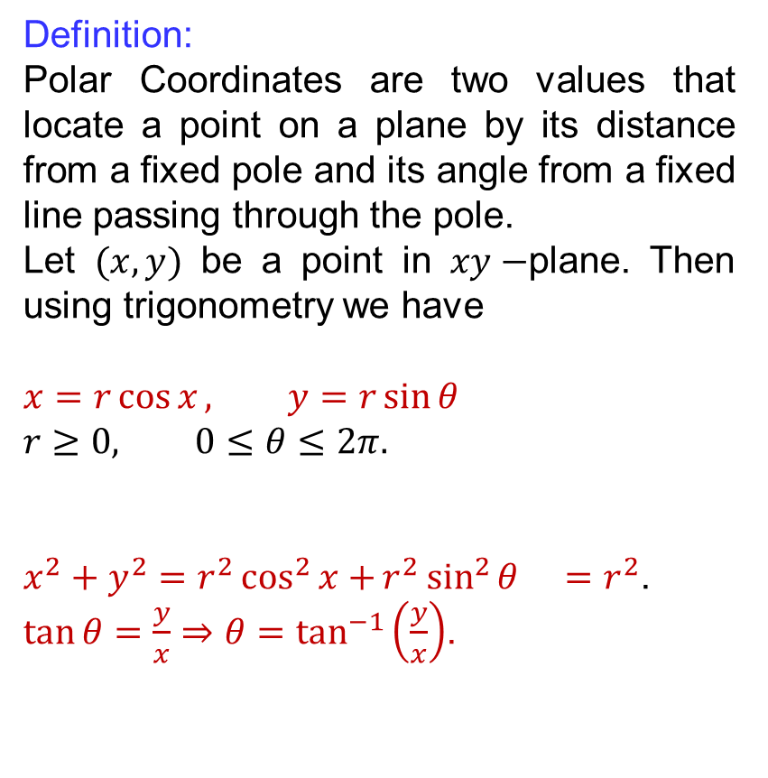
Racalls
Definition:
Polar Coordinates are two values that locate a point on a plane by its distance from a fixed pole and its angle from a fixed line passing through the pole.
Let $(x,y)$ be a point in $xy−$plane. Then using trigonometry we have
$$x=r\cos{x}, y=r\sin{θ}$$
$$r≥0, 0≤θ≤2π.$$
$x^{2}+y^{2}=r^{2}\cos^{2}{x+}r^{2}\sin^{2}{θ}$$=r^{2}$.
$\tan{θ}=\frac{y}{x}⇒θ=\tan^{−1}\left(\frac{y}{x}\right)$.

Slide 5
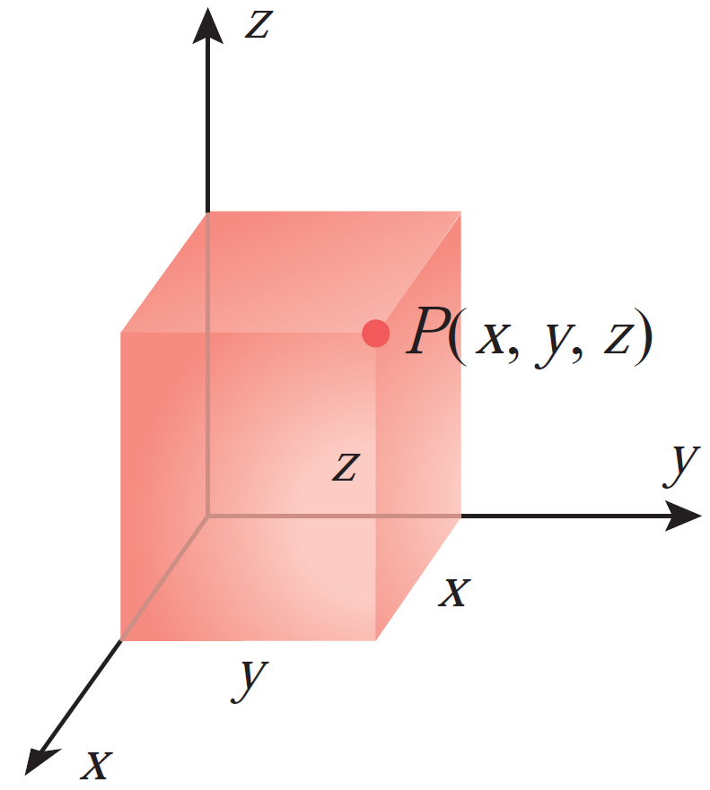
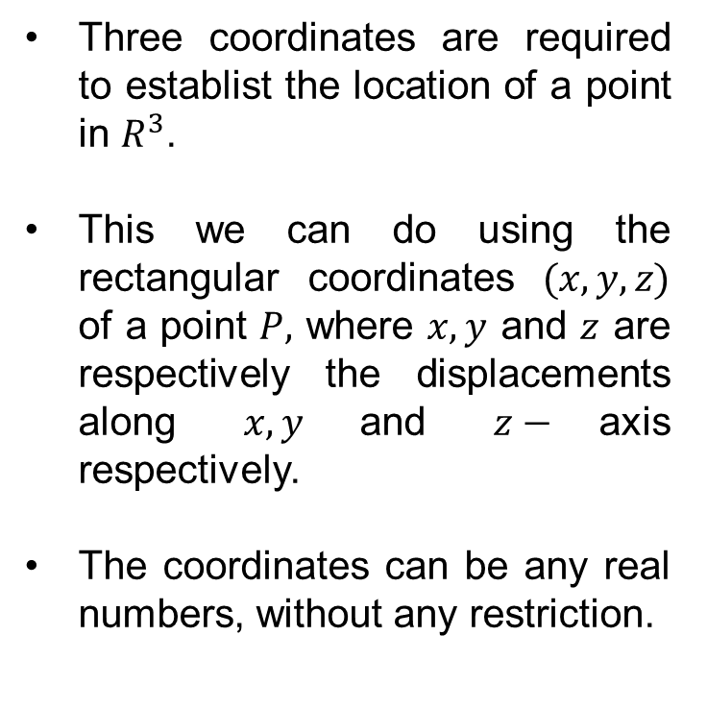
Racalls
Three coordinates are required to establist the location of a point in $R^{3}$.
This wecan do using the rectangularcoordinates$(x,y,z)$ of a point $P,$where$x,y$ and $z$ are respectively the displacementsalong$x, y$and $z−$axis respectively.
The coordinatescanbeany real numbers, withoutany restriction.

Slide 6
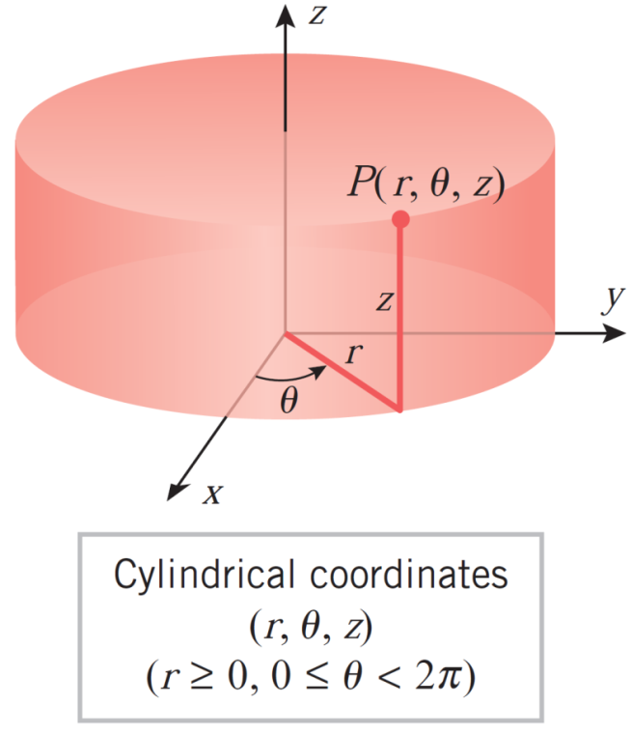
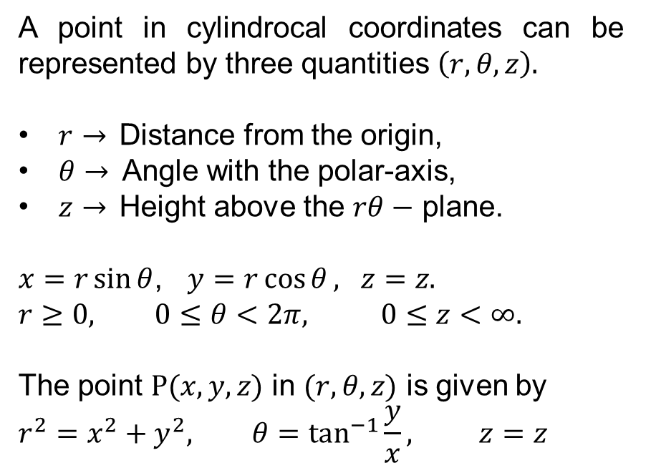
Racalls
A point in cylindrocalcoordinatescanberepresented by threequantities$\left(r,θ, z\right).$
$r→$Distance from the origin,
$θ→$Angle with the polar-axis,
$z→$Heightabove the $rθ−$ plane.
$x=r\sin{θ}$, $y=r\cos{θ}, z=z.$
$$r≥0, 0≤θ<2π, 0≤z<∞.$$
The point $P(x,y,z)$ in $(r,θ,z)$ is given by
$$r^{2}=x^{2}+y^{2}, θ=\tan^{−1}{\frac{y}{x}}, z=z$$

Slide 7
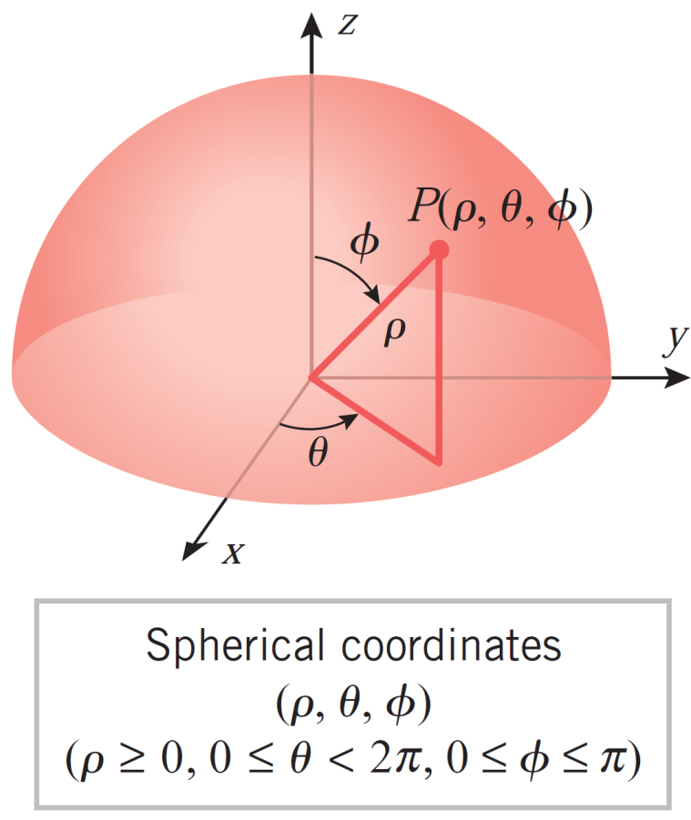
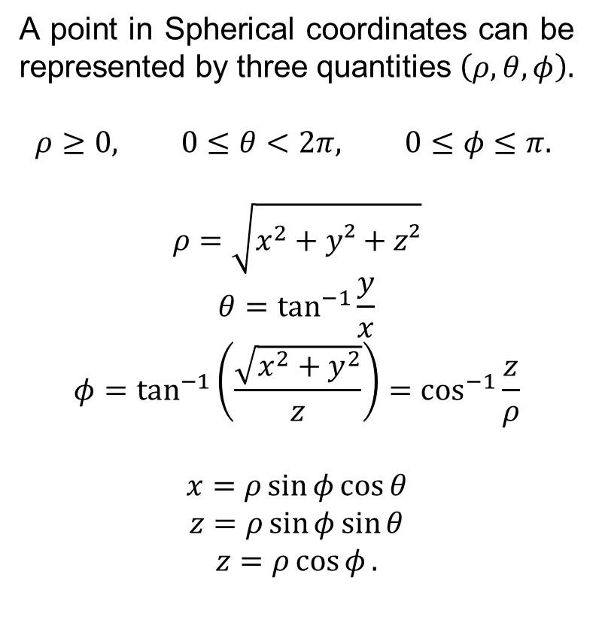
Racalls
A point in Sphericalcoordinatescanberepresented by threequantities$\left(ρ,θ, φ\right).$
$$ρ≥0, 0≤θ<2π, 0≤φ≤π.$$
$$ρ=\sqrt{x^{2}+y²+z²}$$
$$θ=\tan^{−1}{\frac{y}{x}}$$
$$φ=\tan^{−1}\left(\frac{\sqrt{x^{2}+y^{2}}}{z}\right)=\cos^{−1}{\frac{z}{ρ}}$$
$$x=ρ\sin{φ}\cos{θ}$$
$$z=ρ\sin{φ}\sin{θ}$$
$$z=ρ\cos{φ}.$$

Slide 8
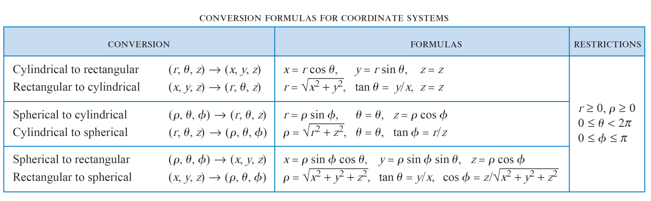
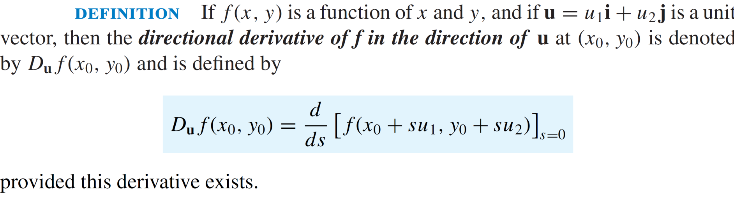
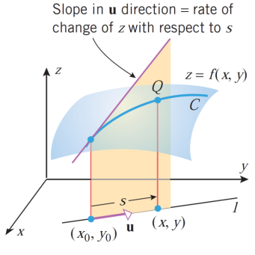
Racalls

Slide 9
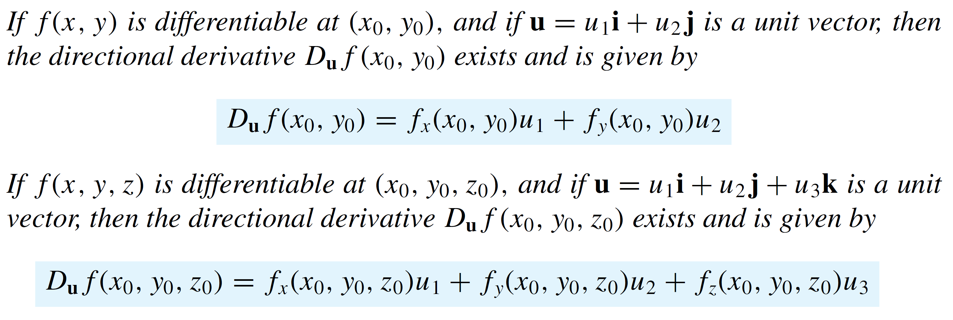
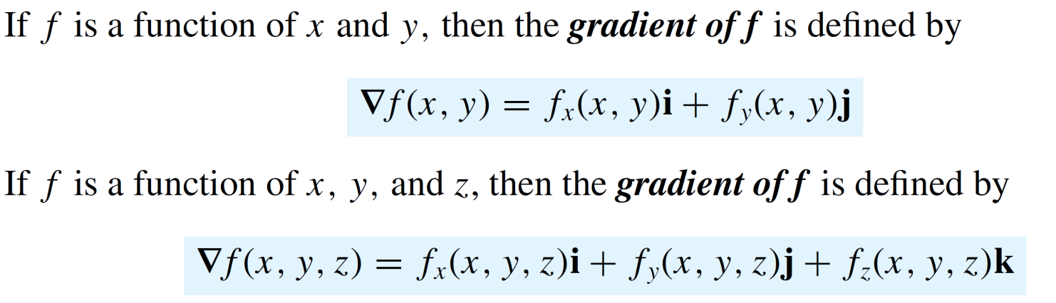
Racalls
Theorem:
Def.

Slide 10
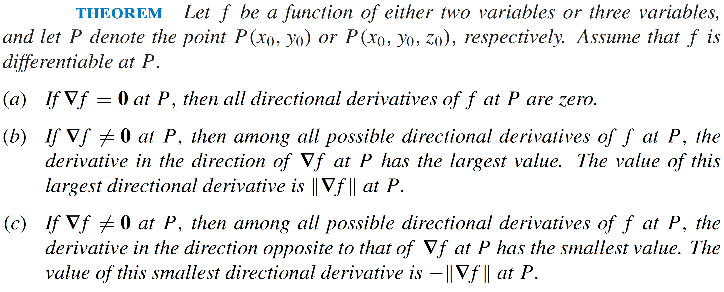
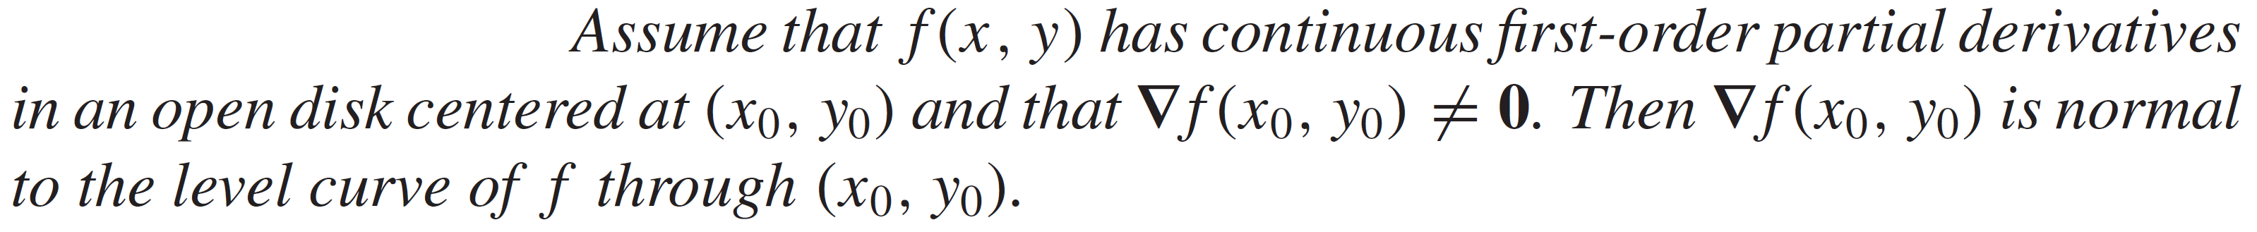
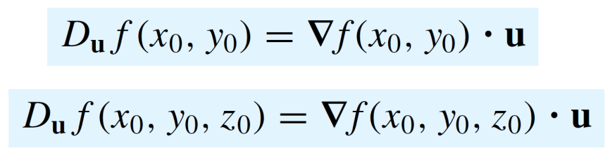
Racalls
Theorem

Slide 11
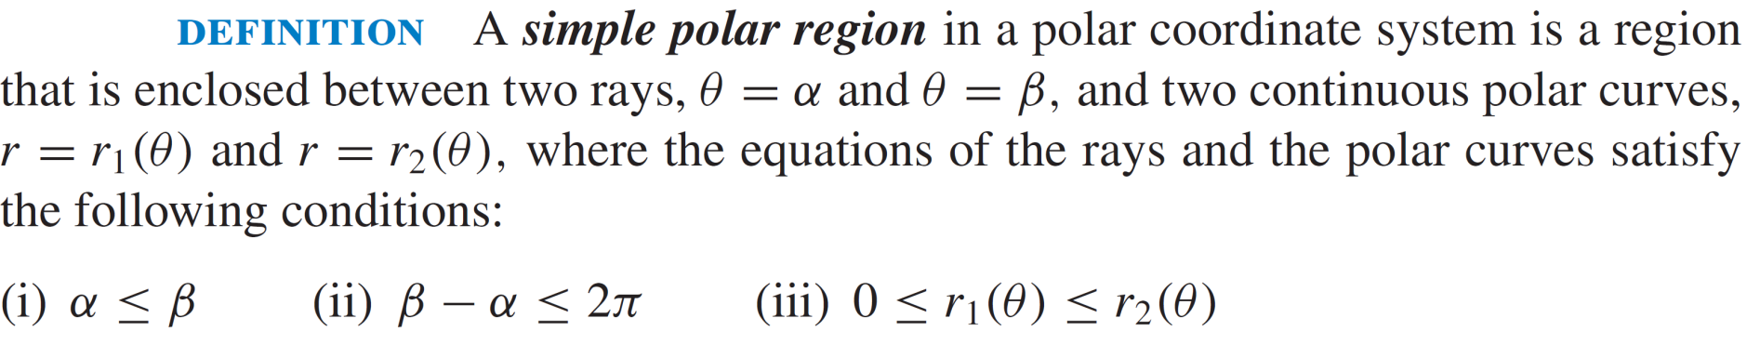
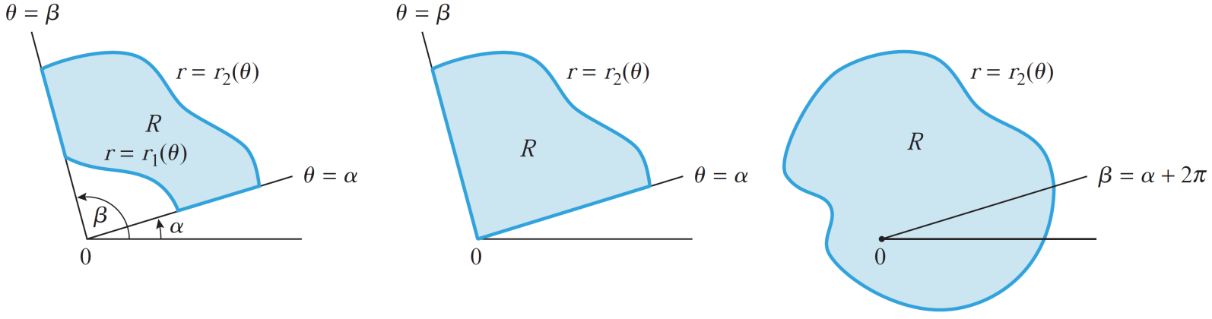
Simple polar regions

Slide 12
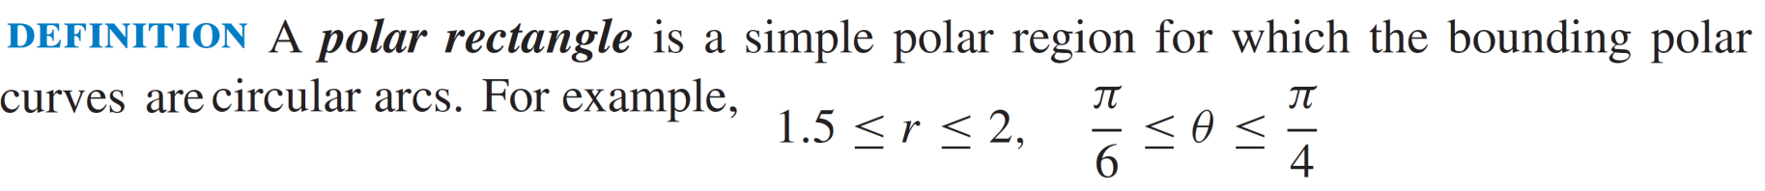
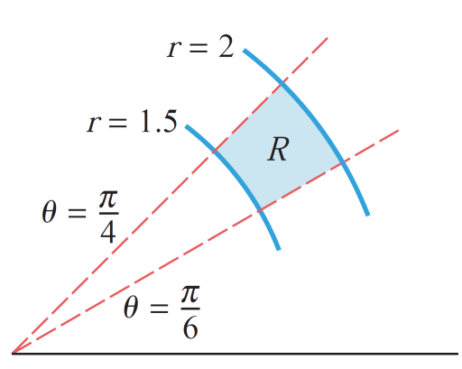
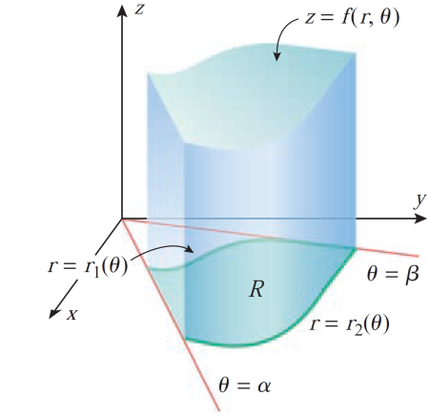
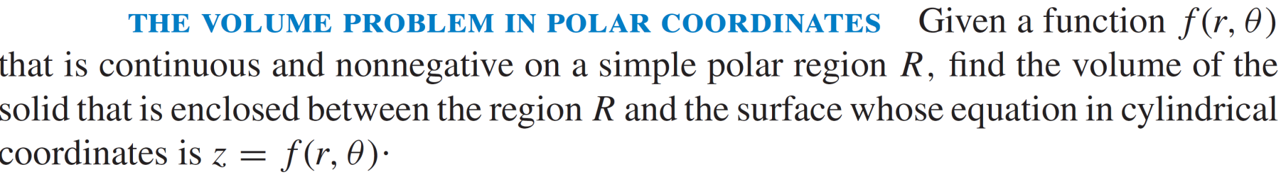
Simple polar regions

Slide 13
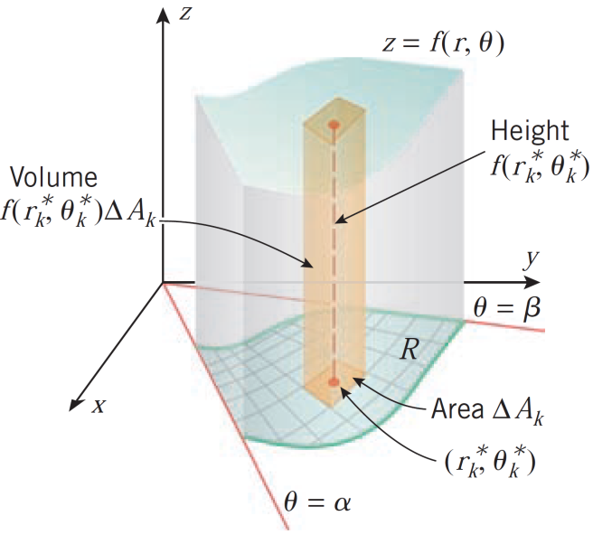
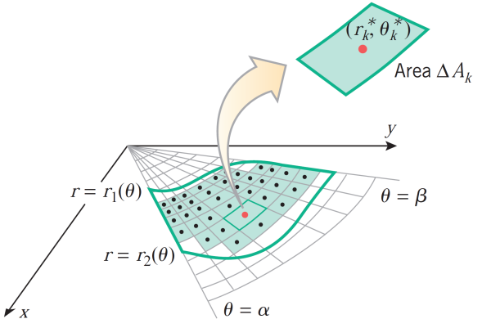
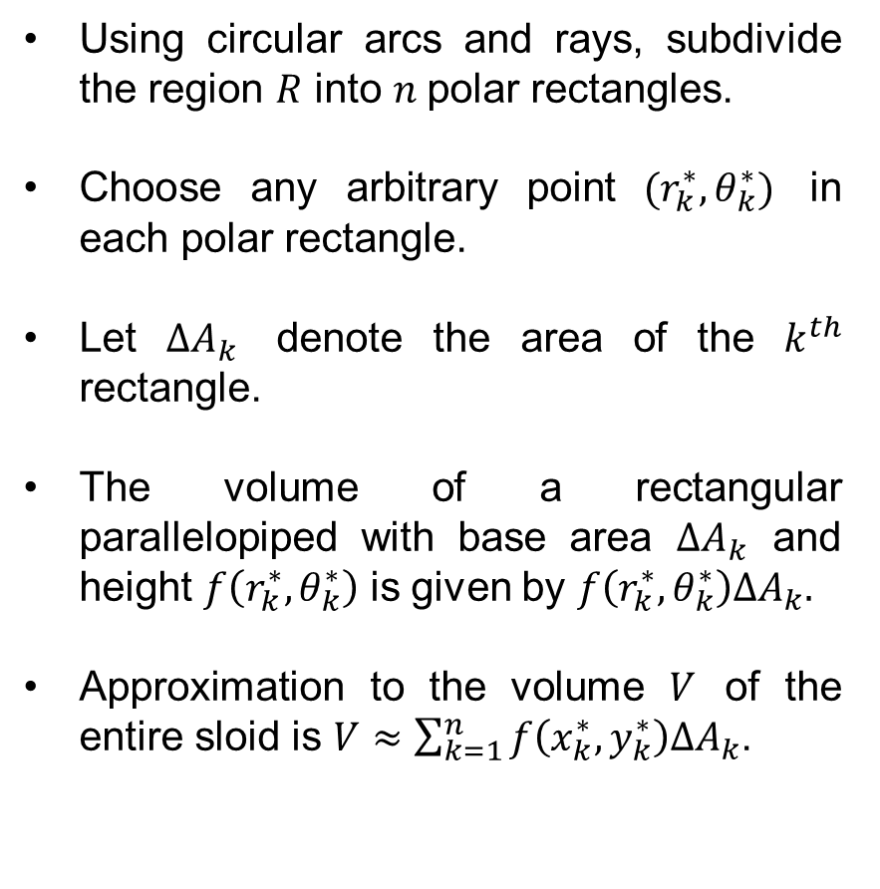
Double integrals in polar coordinates
Usingcircular arcs and rays, subdivide the region$R$into$n$polar rectangles.
Chooseanyarbitrary point $(r_{k}^{∗},θ_{k}^{∗})$ in eachpolar rectangle.
Let $∆A_{k}$denote the area of the $k^{th}$ rectangle.
The volume of a rectangularparallelopipedwith base area $∆A_{k}$ and height$f\left(r_{k}^{∗},θ_{k}^{∗}\right)$isgiven by $f\left(r_{k}^{∗},θ_{k}^{∗}\right)∆A_{k}.$
Approximation to the volume $V$ of the entiresloidis$V≈\sum_{k=1}^{n}{f\left(x_{k}^{∗},y_{k}^{∗}\right)∆A_{k}}$.

Slide 14
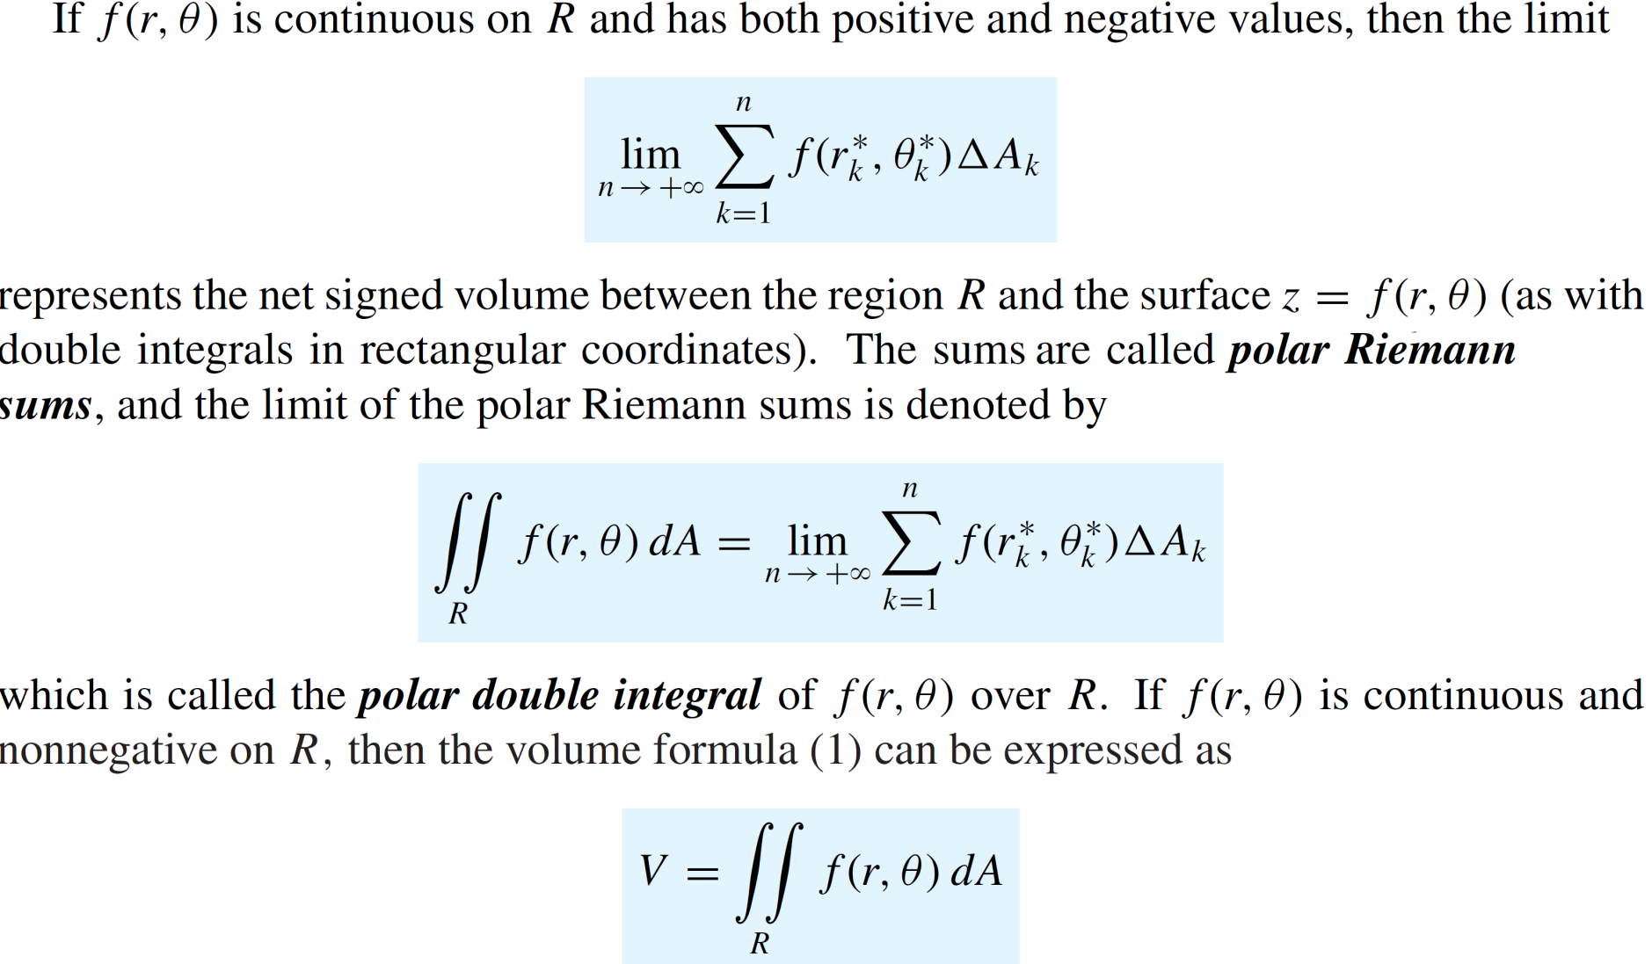
Double integrals in polar coordinates

Slide 15
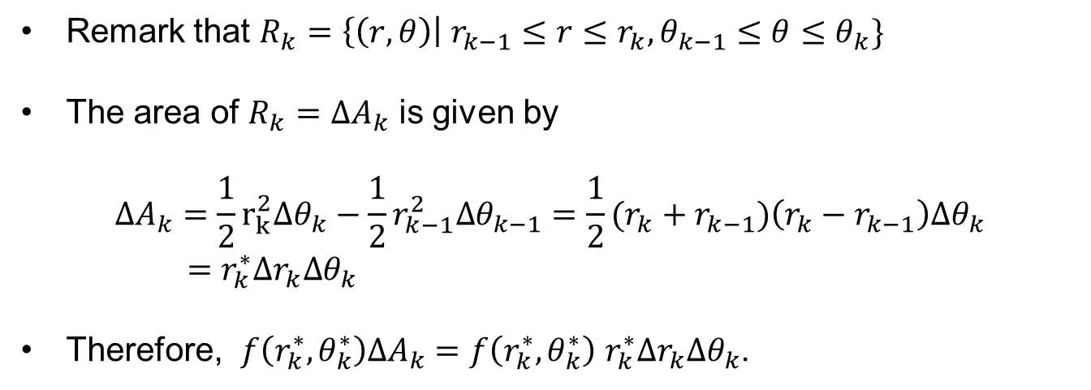
Double integrals in polar coordinates
Remark that$R_{k}=\left\{\left(r,θ\right)\right| r_{k−1}≤r≤r_{k}, θ_{k−1}≤θ≤θ_{k}\}$
The area of $R_{k}=∆A_{k}$isgiven by
$$∆A_{k}=\frac{1}{2}r_{k}^{2}∆θ_{k}−\frac{1}{2}r_{k−1}^{2}∆θ_{k−1}=\frac{1}{2}(r_{k}+r_{k−1})\left(r_{k}−r_{k−1}\right)∆θ_{k}$$
$=$$r_{k}^{∗}∆r_{k}∆θ_{k}$
Therefore, $f\left(r_{k}^{∗},θ_{k}^{∗}\right)∆A_{k}=f\left(r_{k}^{∗},θ_{k}^{∗}\right)$$r_{k}^{∗}∆r_{k}∆θ_{k}$.

Slide 16
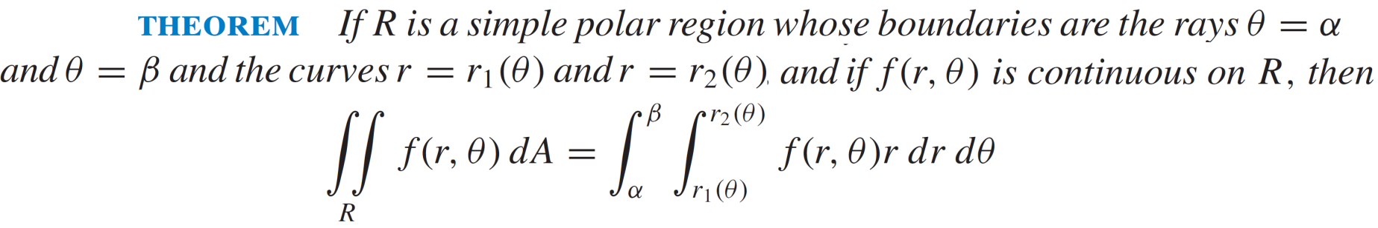
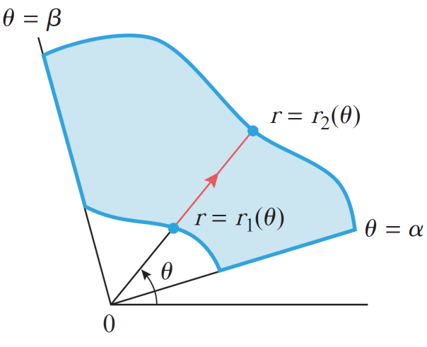
Double integrals in polar coordinates

Slide 17
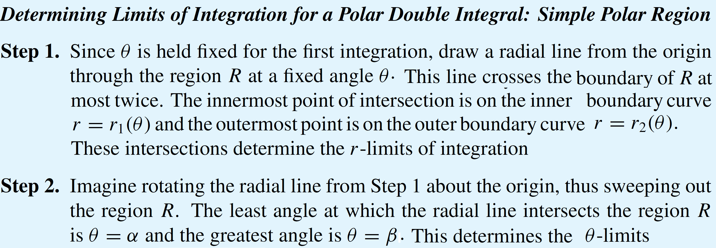
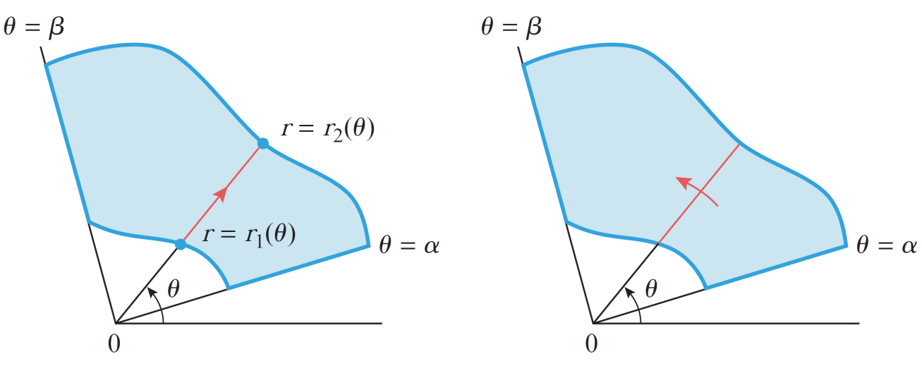
Double integrals in polar coordinates

Slide 18
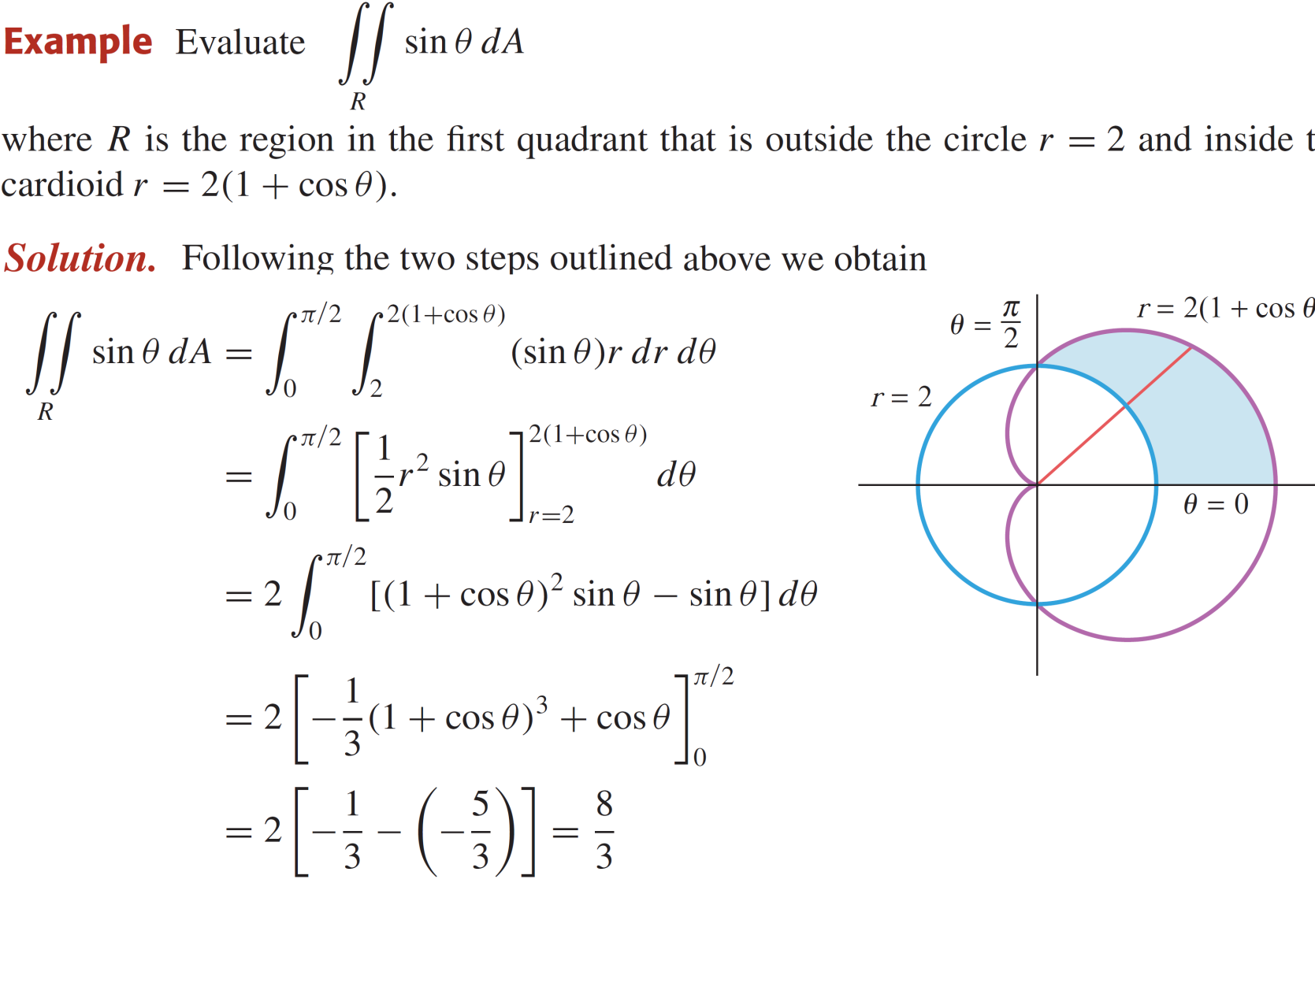
Double integrals in polar coordinates

Slide 19
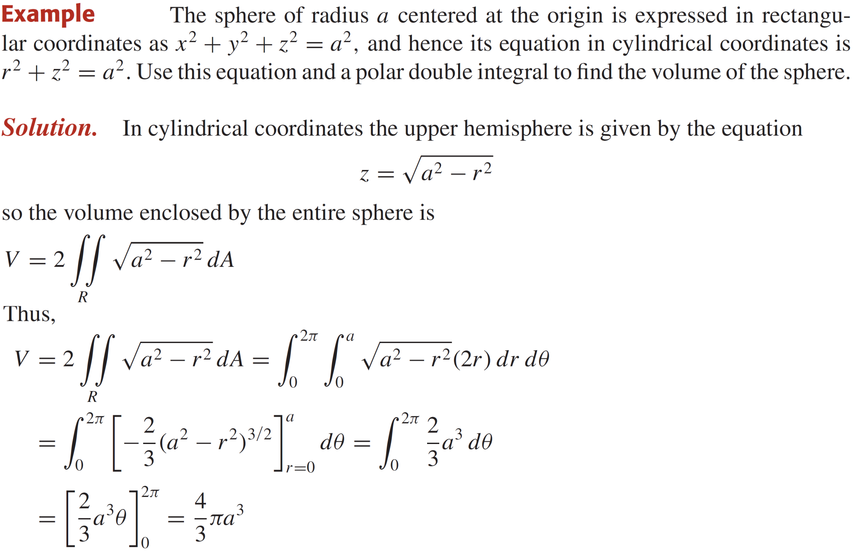
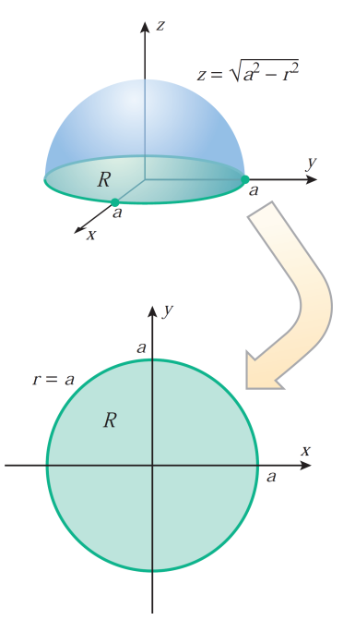
Double integrals in polar coordinates

Slide 20
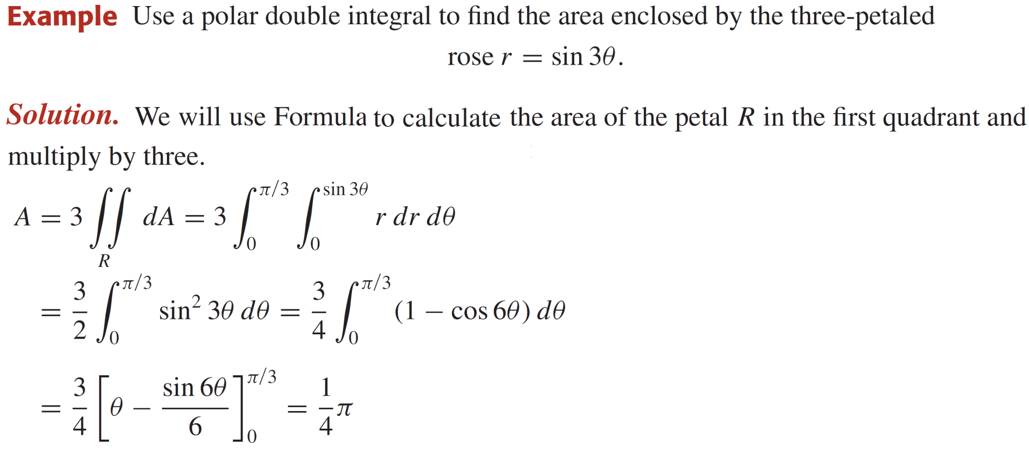
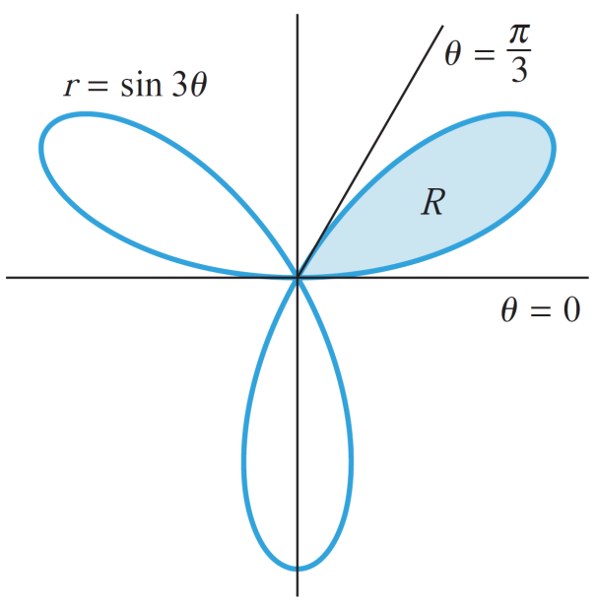
Finding area using polar double integrals

Slide 21
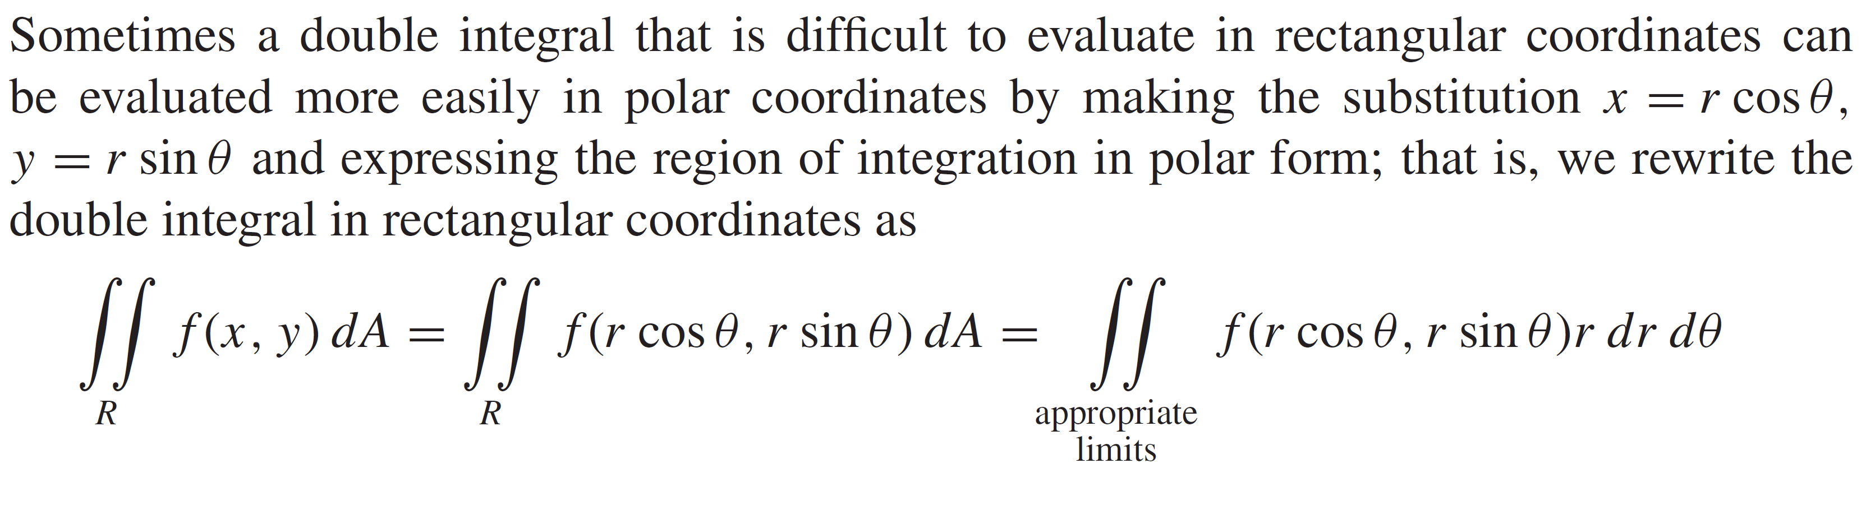
Changing coordinates in integrals

Slide 22
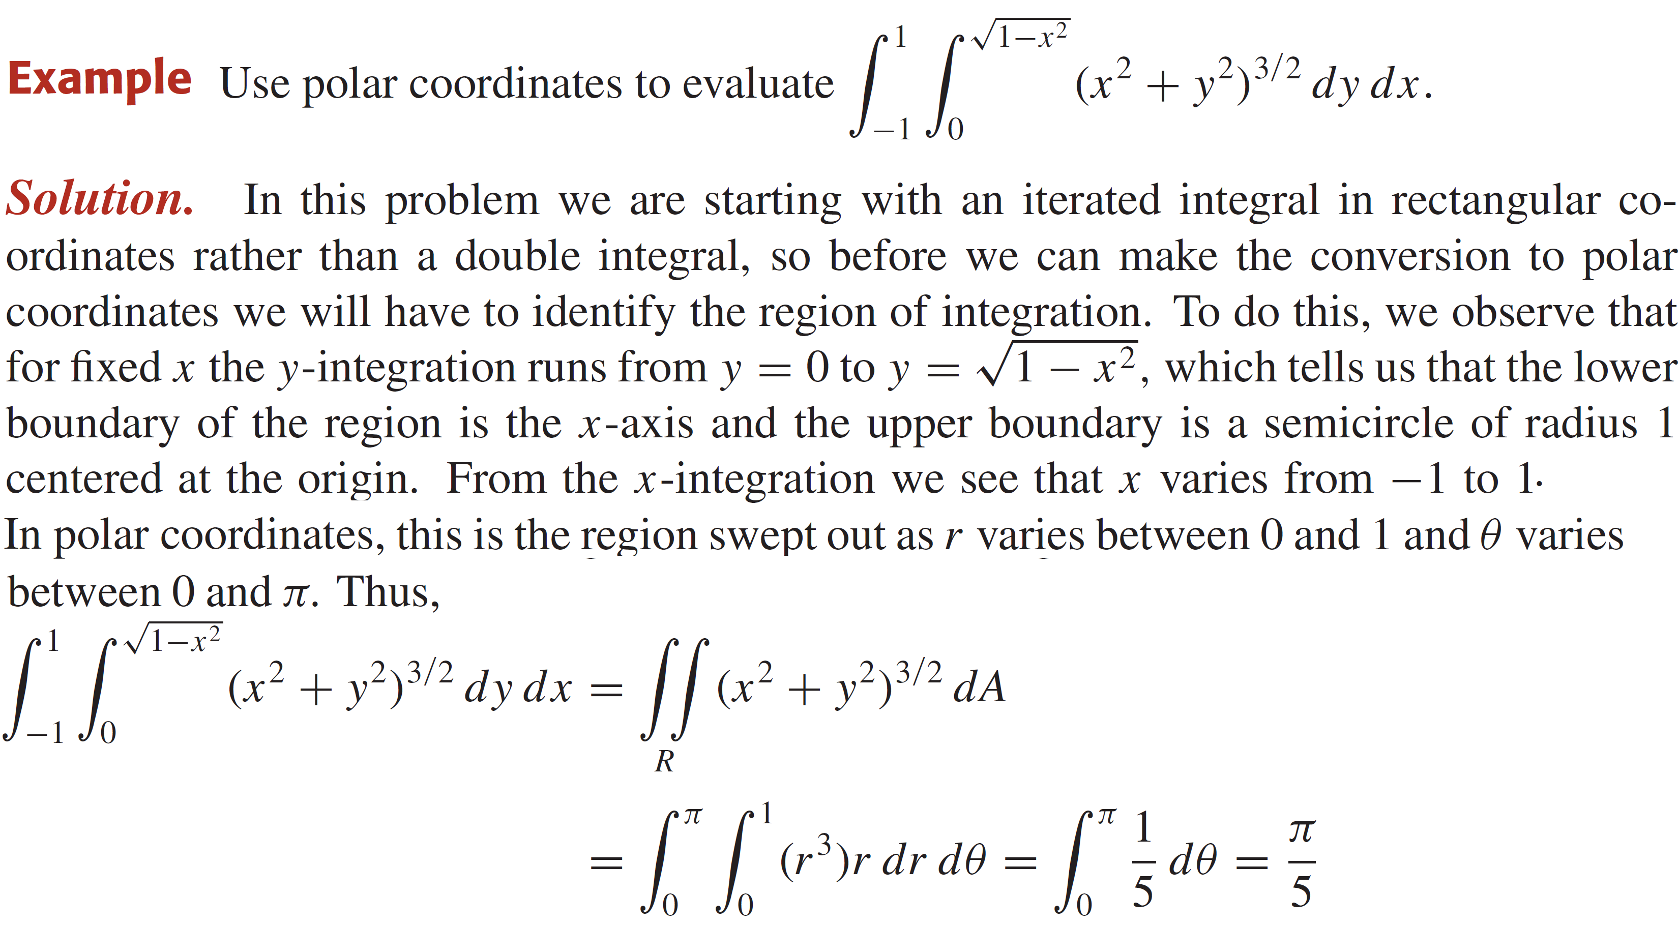
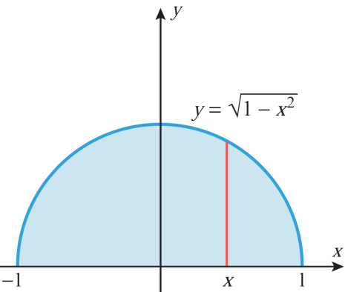
Changing coordinates in integrals

Slide 23
Changing coordinates in integrals

Slide 24
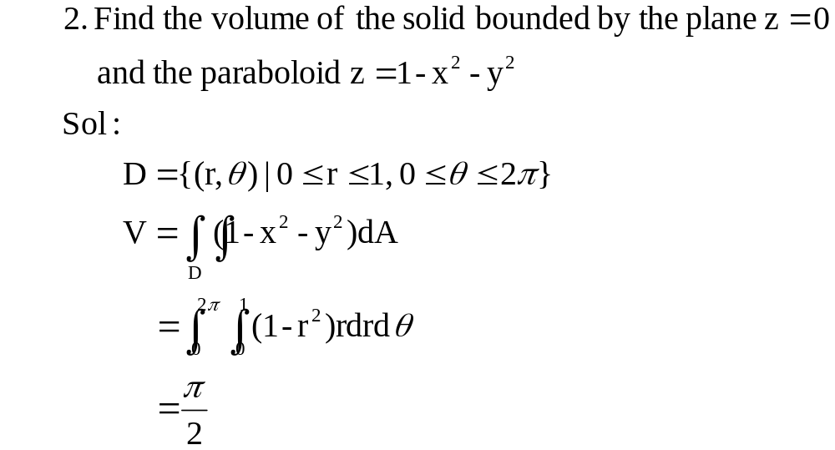
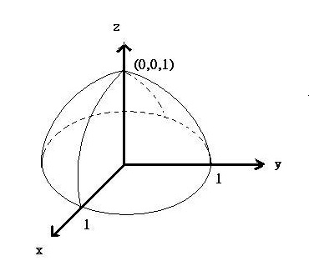
Changing coordinates in integrals

Slide 25
Changing coordinates in integrals

Slide 26
Changing coordinates in integrals

Slide 27
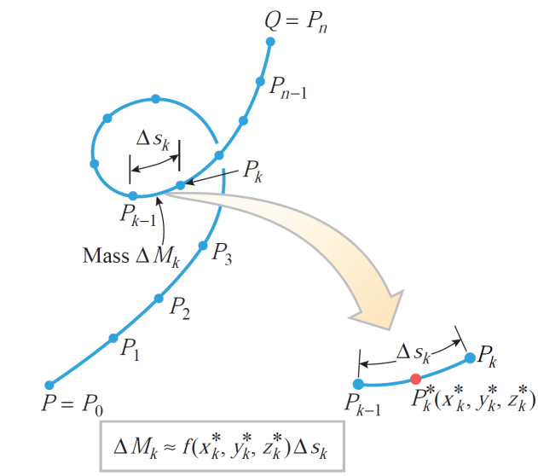
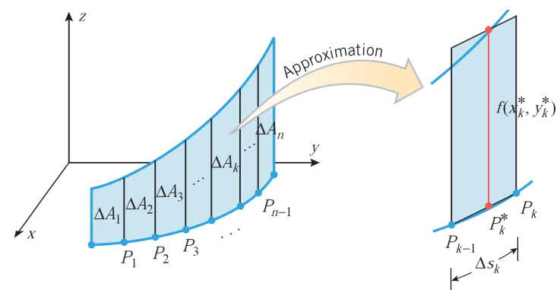
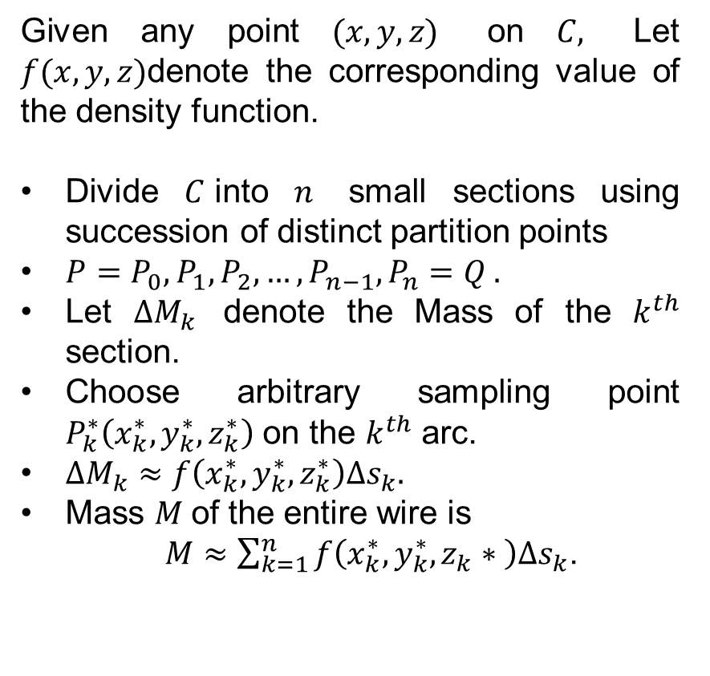
Introduction to line integrals
Given any point $(x,y,z)$ on $C,$ Let $f(x,y,z)$denote the corresponding value of the densityfunction.
Divide$C$into$n$small sections using succession of distinct partition points
$P=P_{0}, P_{1}, P_{2}, …, P_{n−1}, P_{n}=Q .$
Let $∆M_{k}$denote the Mass of the $k^{th}$section.
Choosearbitrarysampling point $P_{k}^{∗}\left(x_{k}^{∗}, y_{k}^{∗},z_{k}^{∗}\right)$ on the $k^{th}$ arc.
$∆M_{k}≈f\left(x_{k}^{∗},y_{k}^{∗},z_{k}^{∗}\right)∆s_{k}.$
Mass $M$of the entirewireis
$M≈\sum_{k=1}^{n}{f\left(x_{k}^{∗},y_{k}^{∗},z_{k}∗ \right)∆s_{k}}$.

Slide 28
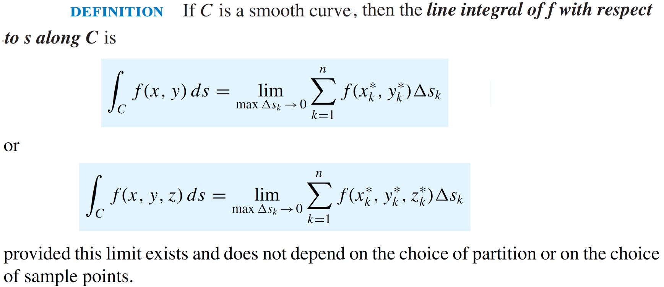
Introduction to line integrals

Slide 29
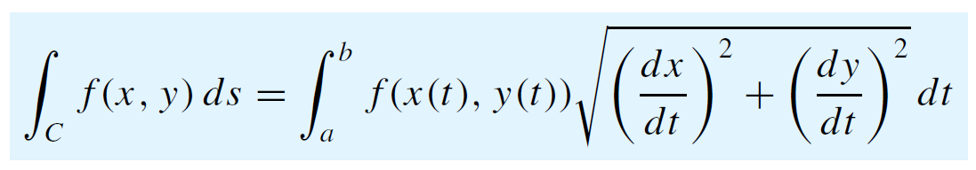
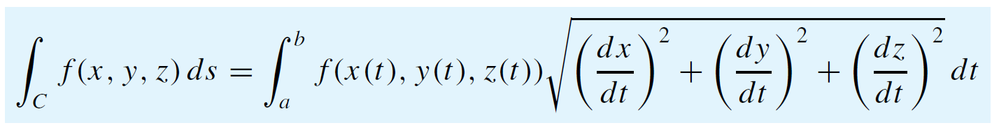
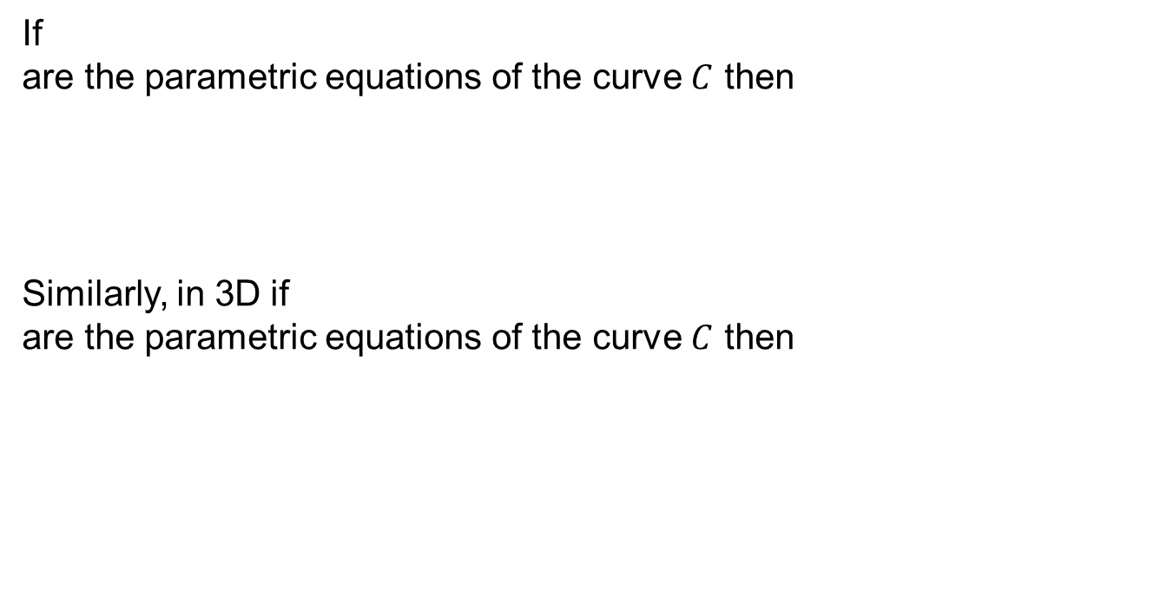
Introduction to line integrals
If
are the parametricequations of the curve$C$then
Similarly, in 3D if
are the parametricequations of the curve$C$then

Slide 30
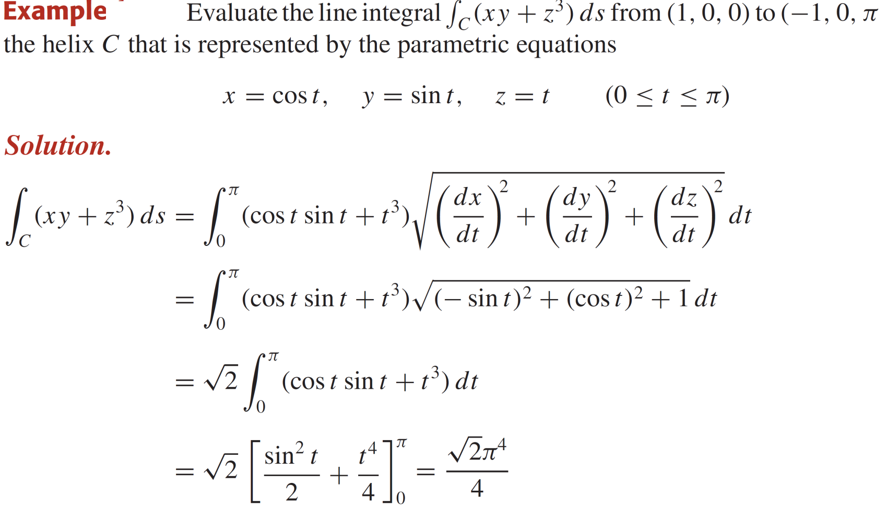

Introduction to line integrals

Slide 31


Introduction to line integrals

Slide 32


Introduction to line integrals

Slide 33
Lecture Summary
    Recalls
    Simple polar regions
    Double integrals in polar coordinates
    Finding area using polar double integrals
    Changing coordinates in integrals
    Introduction to line integrals

