Slide 1
(MTH 250)
Calculus
Lecture 26

Slide 2
Previous Lecture’s Summary
    Recalls
    Introduction to double integrals
    Iterated integrals
    Theorem of Fubini
    Properties of double integrals
    Integrals over non-rectangular regions
    Reversing the order of integration

Slide 3
Today’s Lecture
    Recalls
    Polar Coordinates
    Rectangular Coordinates.
    Cylindrical Coordinates
    Spherical Coordinates
    Equations of Surfaces
    Conversion of Coordinate Systems
    Directional Derivatives
    Gradients.

Slide 4
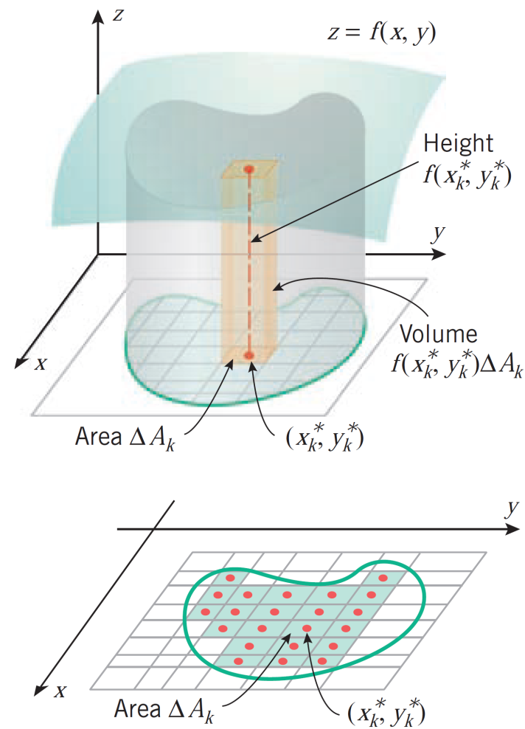
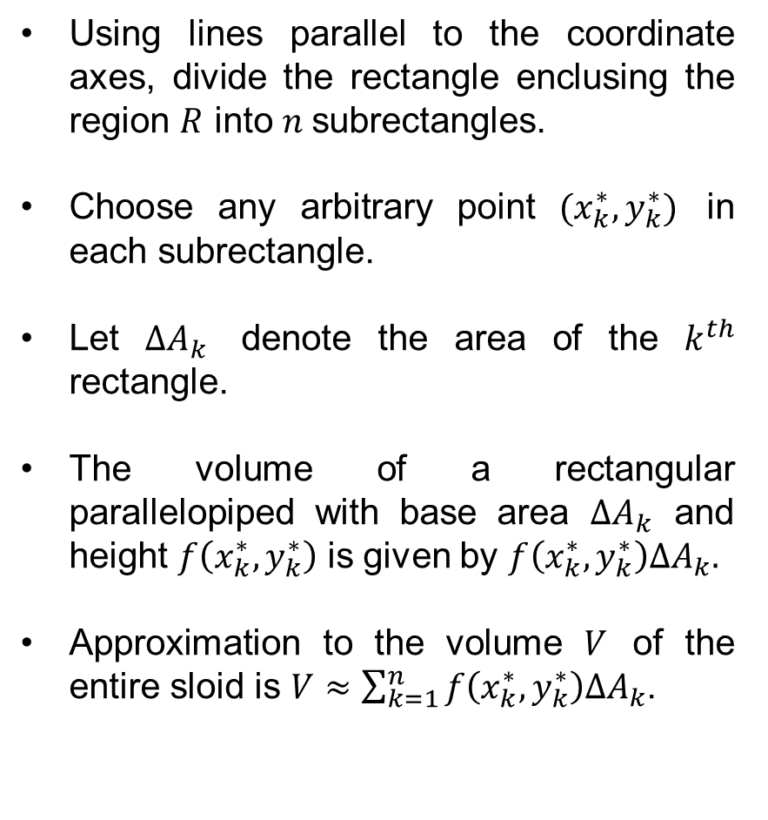
Recalls
Using linesparallel to the coordinate axes, divide the rectangle enclusing the region$R$into$n$subrectangles.
Chooseanyarbitrary point $(x_{k}^{∗},y_{k}^{∗})$ in eachsubrectangle.
Let $∆A_{k}$denote the area of the $k^{th}$ rectangle.
The volume of a rectangularparallelopipedwith base area $∆A_{k}$ and height$f\left(x_{k}^{∗},y_{k}^{∗}\right)$isgiven by $f\left(x_{k}^{∗},y_{k}^{∗}\right)∆A_{k}.$
Approximation to the volume $V$ of the entiresloidis$V≈\sum_{k=1}^{n}{f\left(x_{k}^{∗},y_{k}^{∗}\right)∆A_{k}}$.

Slide 5
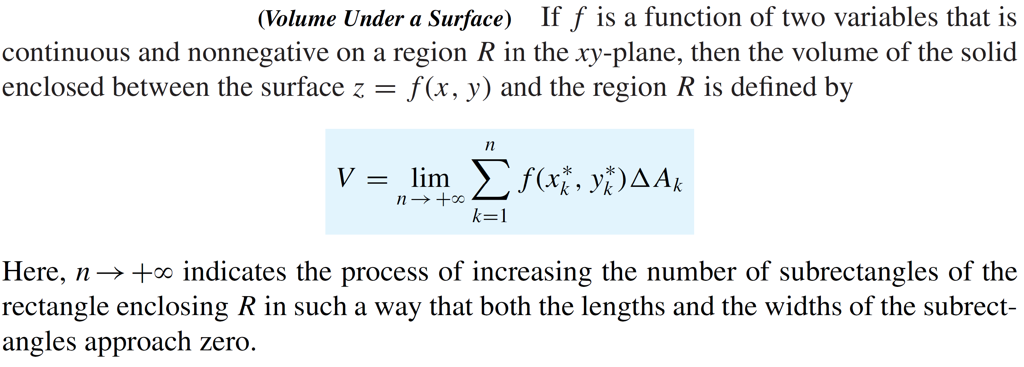
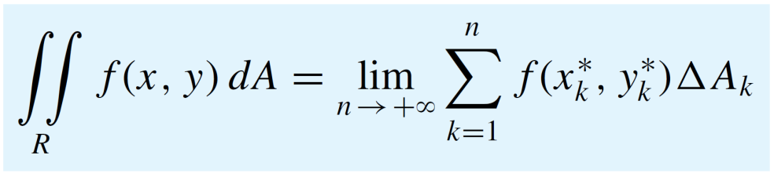
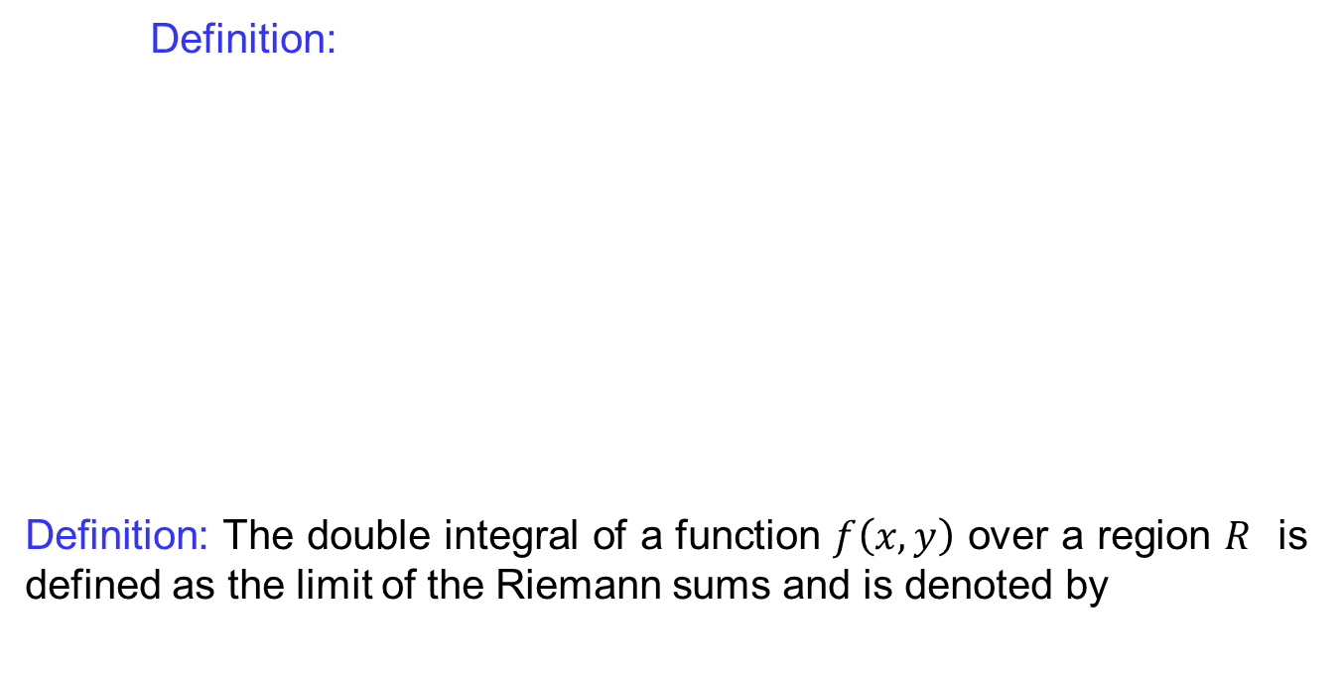
Recalls
Definition:
Definition: The double integral of a function$f\left(x,y\right)$ over a region$R$isdefined as the limit of the Riemann sums and isdenoted by

Slide 6
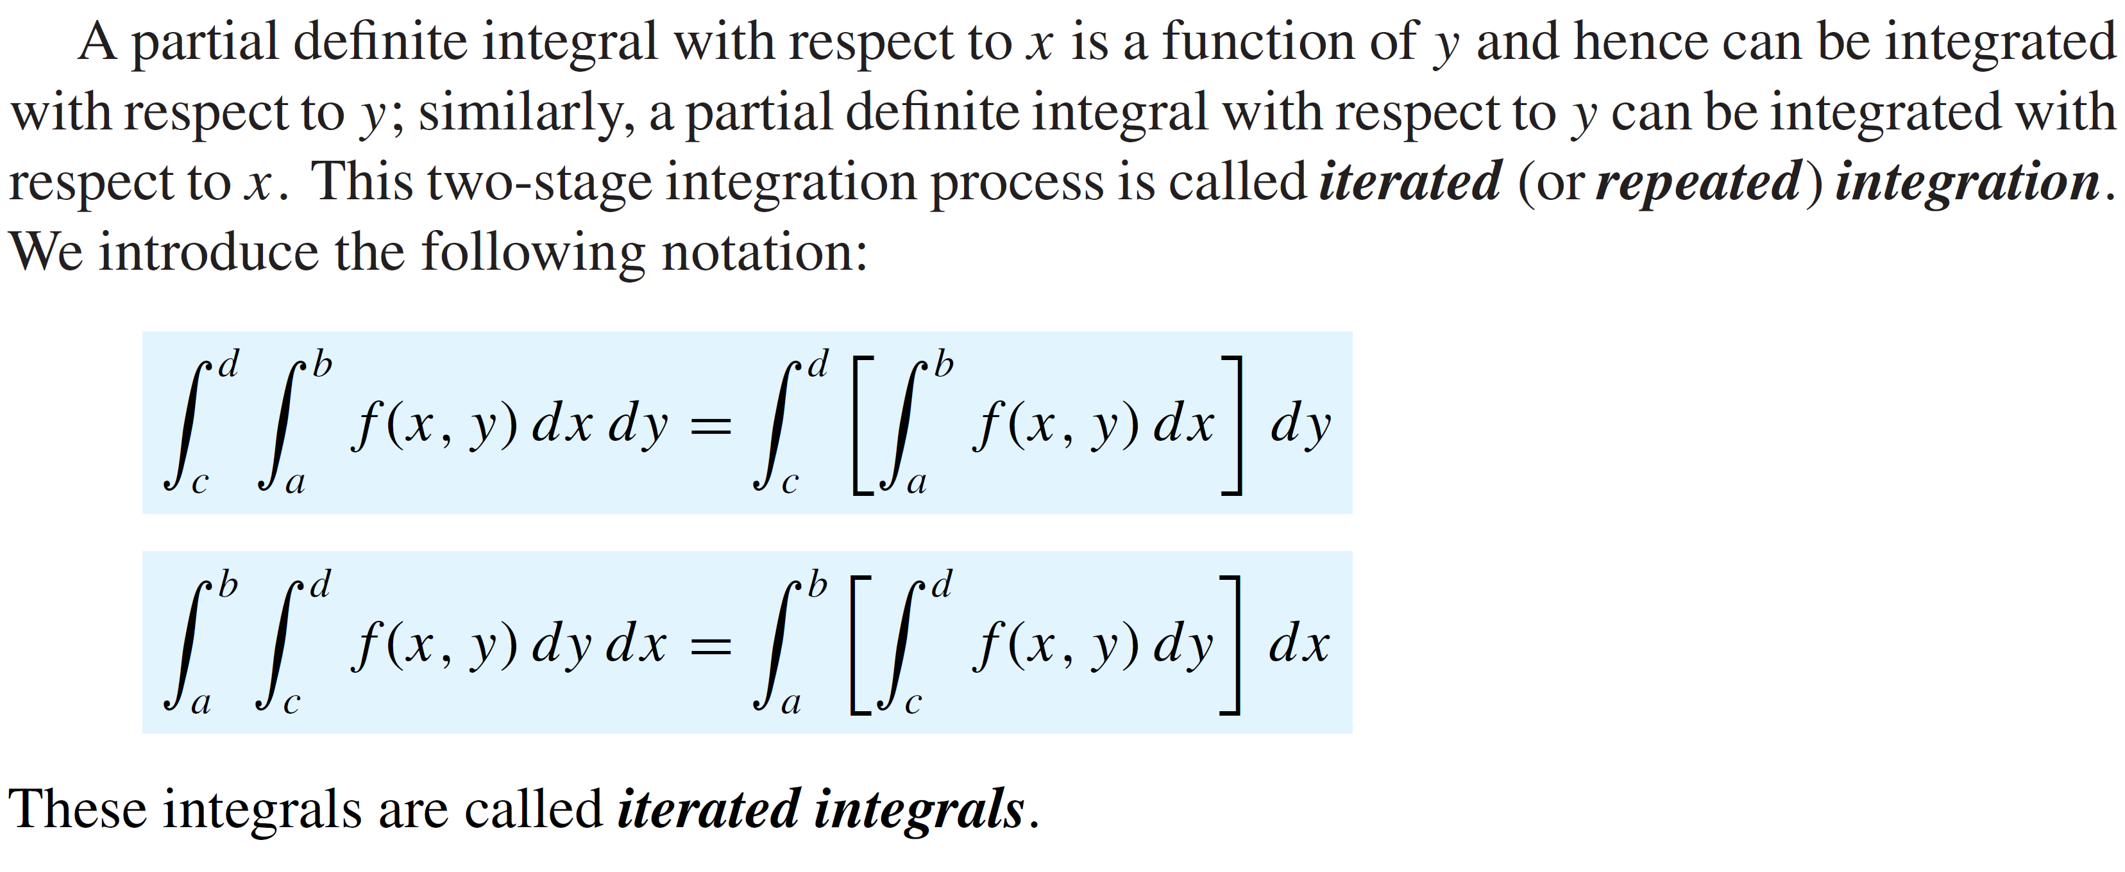
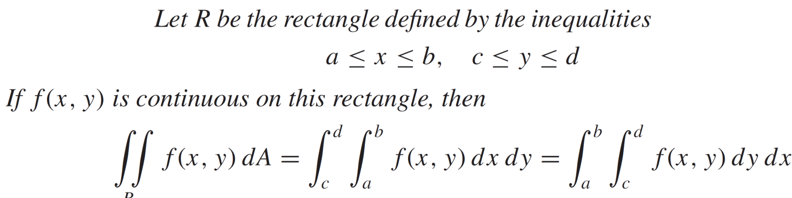
Recalls
Definition:
Definition:

Slide 7
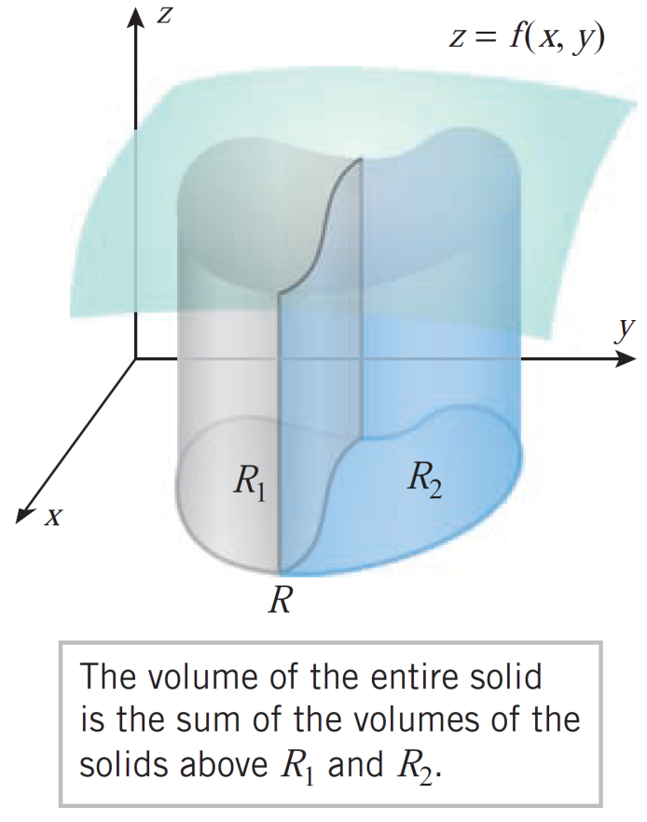
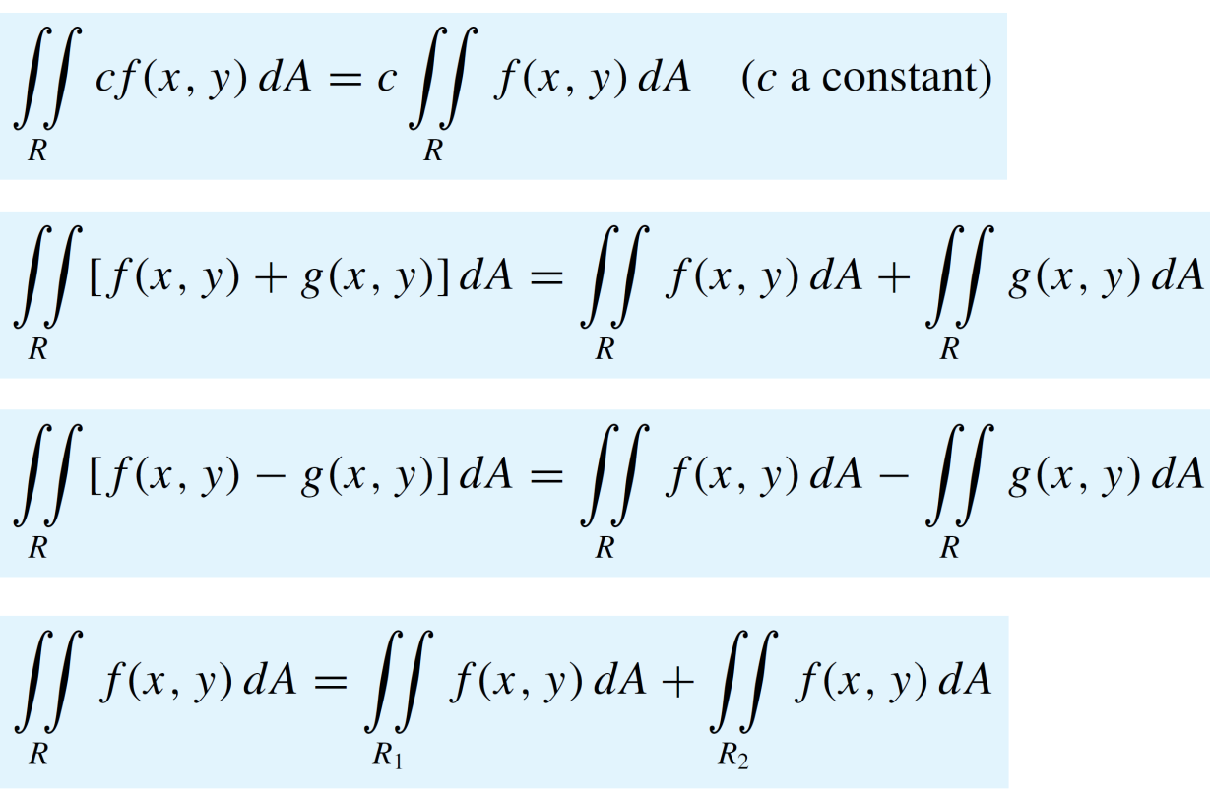
Recalls
Theorem:

Slide 8
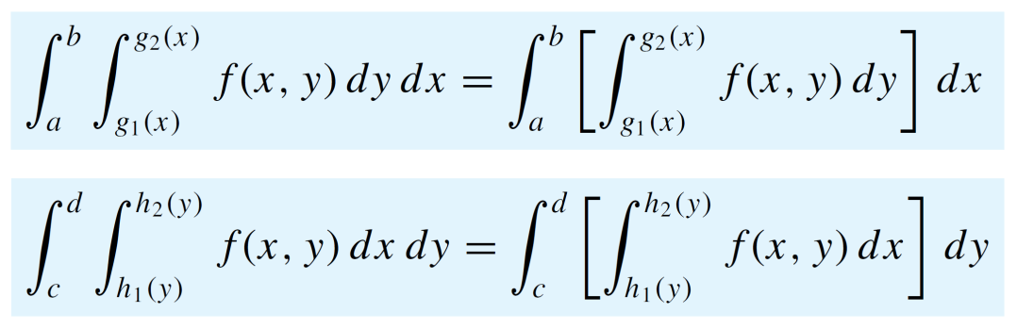
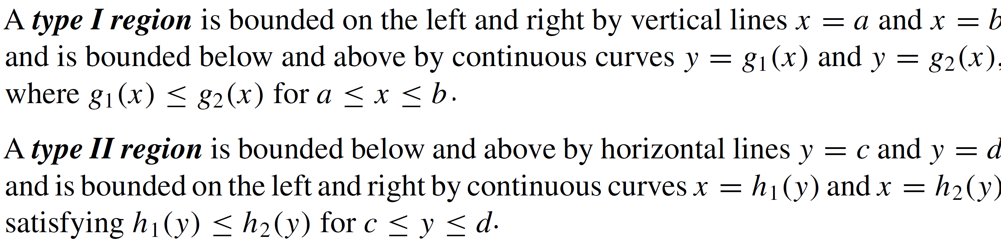
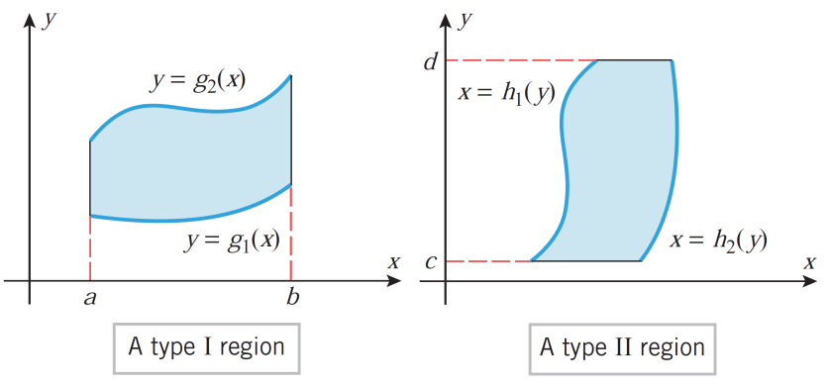
Recalls
Definition:

Slide 9
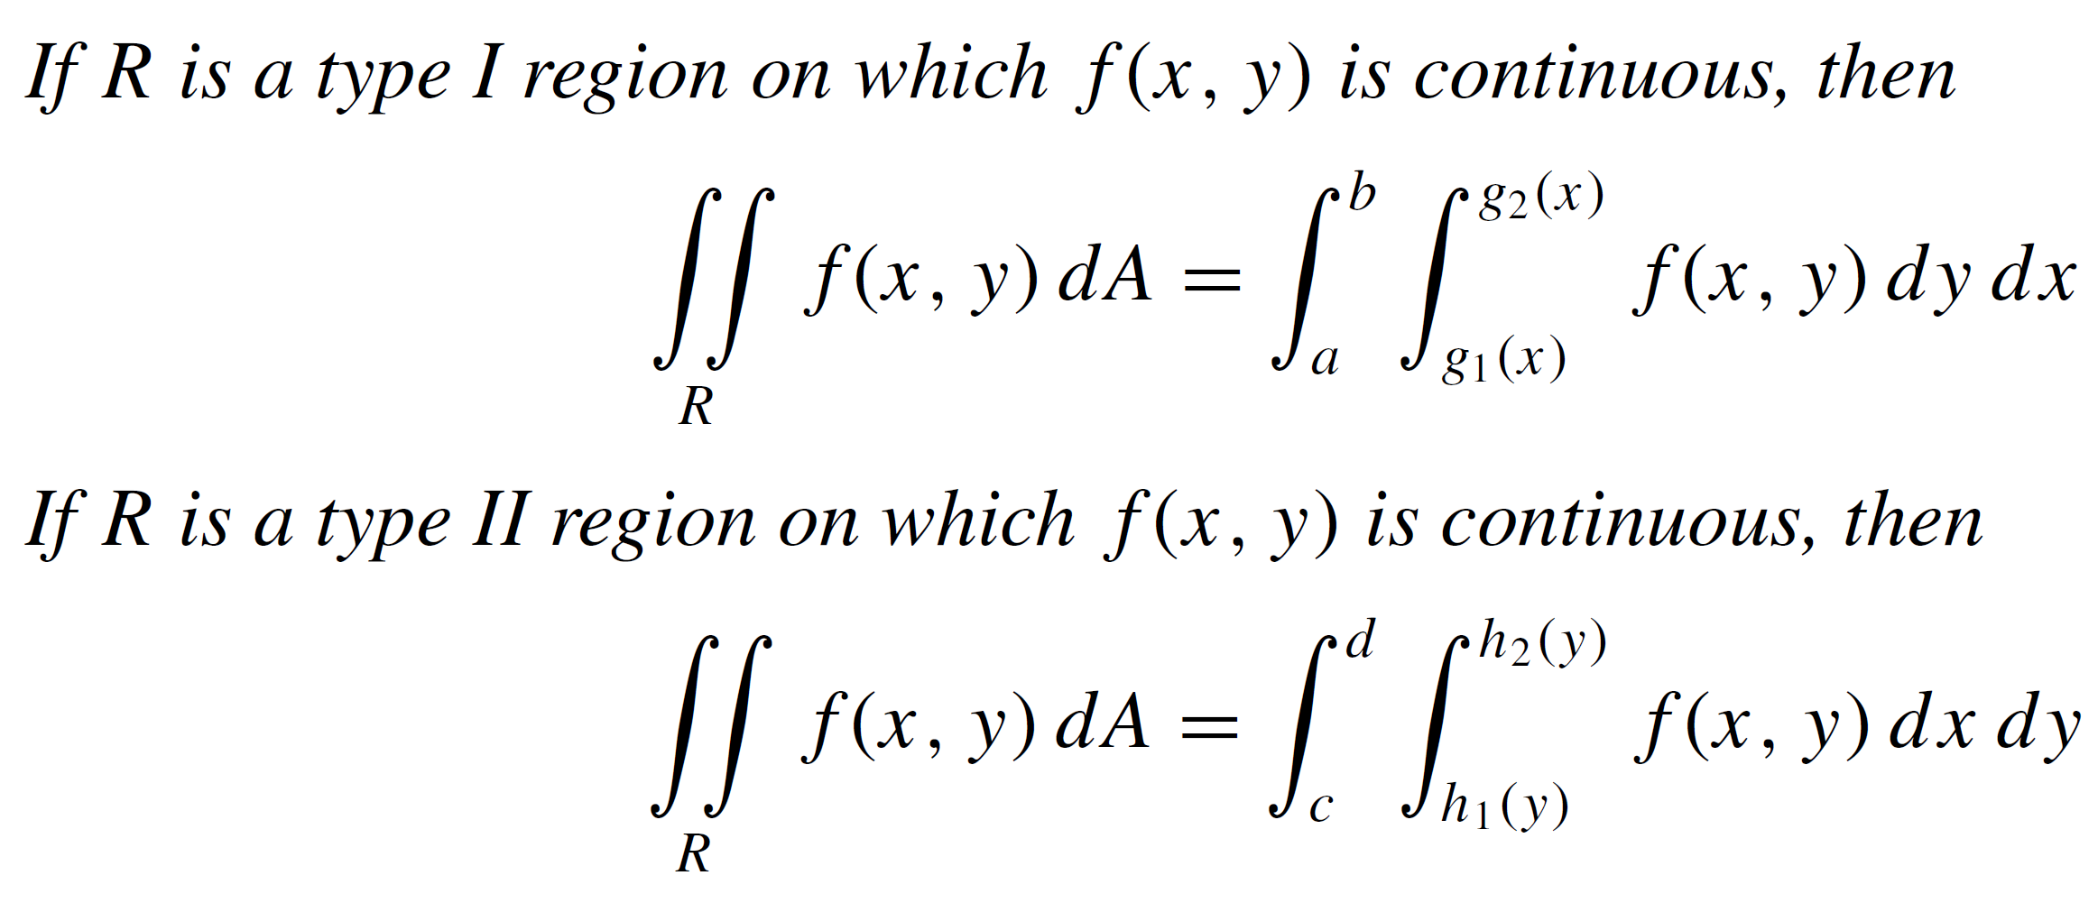
Properties of double integrals
Theorem:

Slide 10
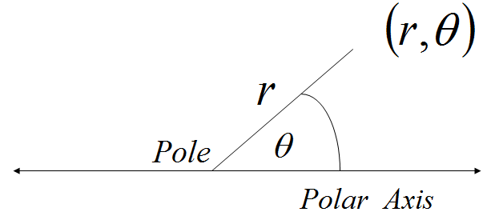
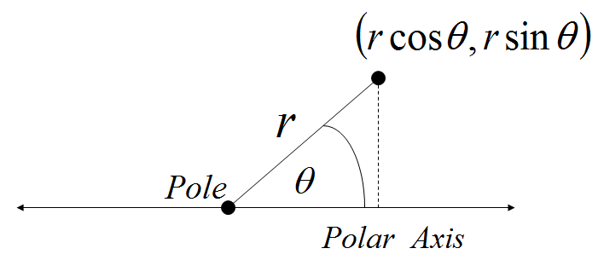
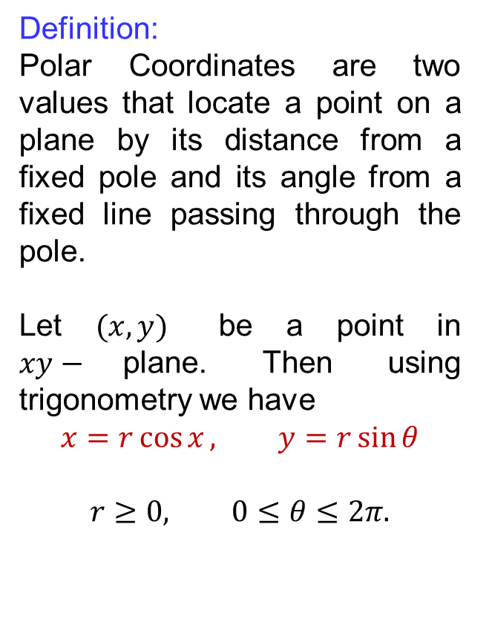
Polar coordinates
Definition:
Polar Coordinates are two values that locate a point on a plane by its distance from a fixed pole and its angle from a fixed line passing through the pole.
Let $(x,y)$ be a point in $xy−$plane. Then using trigonometry we have
$$x=r\cos{x}, y=r\sin{θ}$$
$$r≥0, 0≤θ≤2π.$$

Slide 11
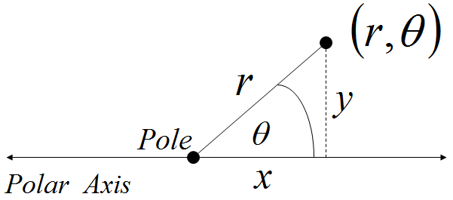
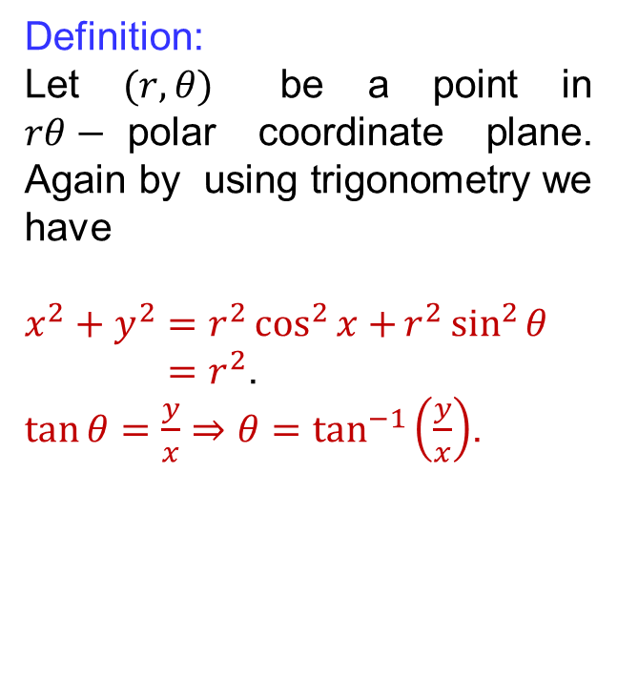
Polar coordinates
Definition:
Let $(r,θ)$ be a point in $rθ−$polar coordinate plane. Again by using trigonometry we have
$$x^{2}+y^{2}=r^{2}\cos^{2}{x+}r^{2}\sin^{2}{θ}$$
$=r^{2}$.
$\tan{θ}=\frac{y}{x}⇒θ=\tan^{−1}\left(\frac{y}{x}\right)$.

Slide 12
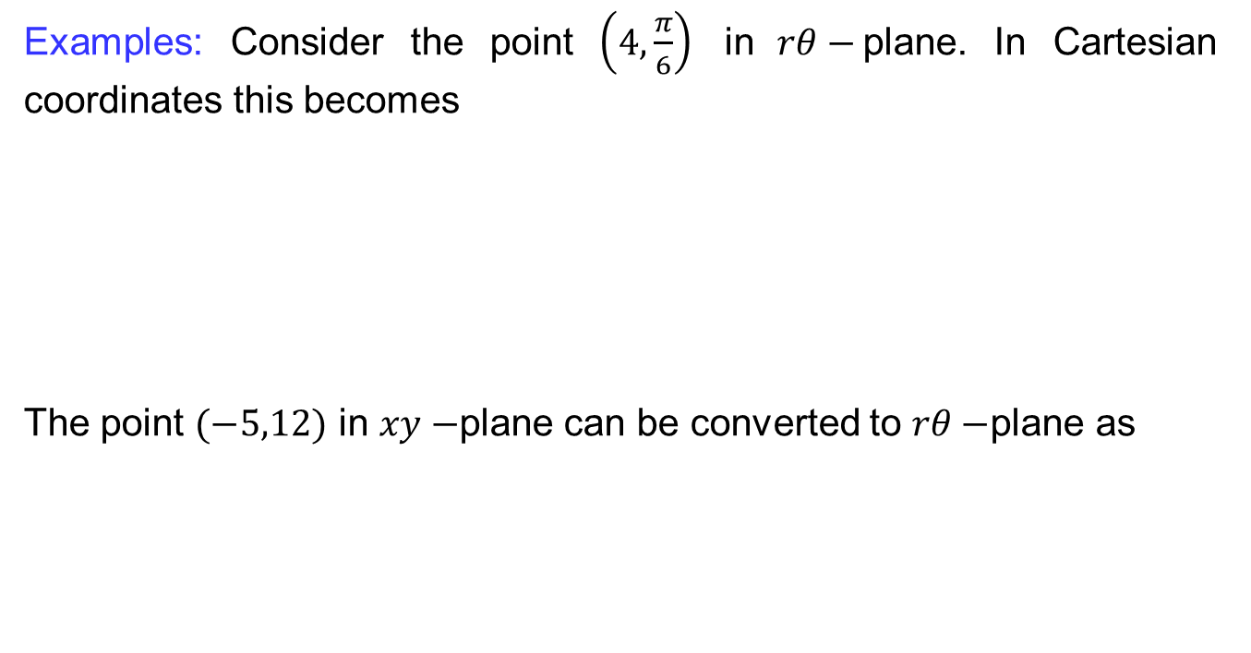
Polar coordinates
Examples: Consider the point $\left(4,\frac{π}{6}\right)$ in$rθ−$plane. In Cartesiancoordinatesthisbecomes
The point $(−5,12)$ in $xy−$plane canbeconverted to $rθ−$plane as

Slide 13
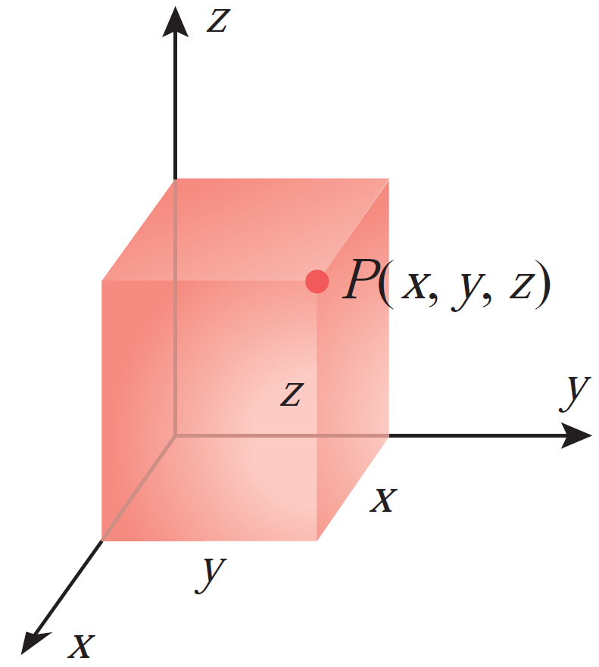
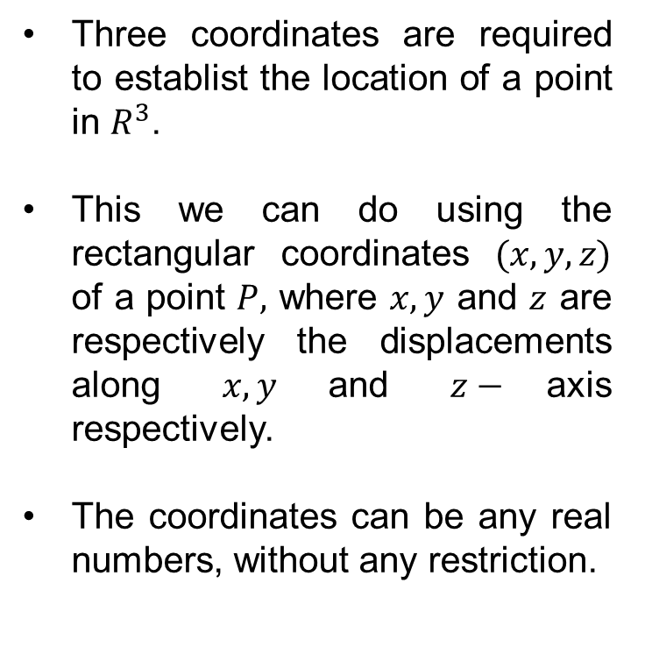
Rectangular coordinates
Three coordinates are required to establist the location of a point in $R^{3}$.
This wecan do using the rectangularcoordinates$(x,y,z)$ of a point $P,$where$x,y$ and $z$ are respectively the displacementsalong$x, y$and $z−$axis respectively.
The coordinatescanbeany real numbers, withoutany restriction.

Slide 14
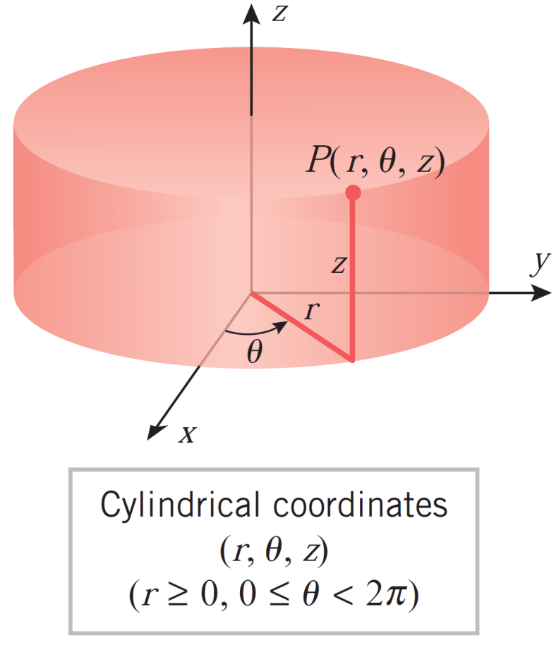
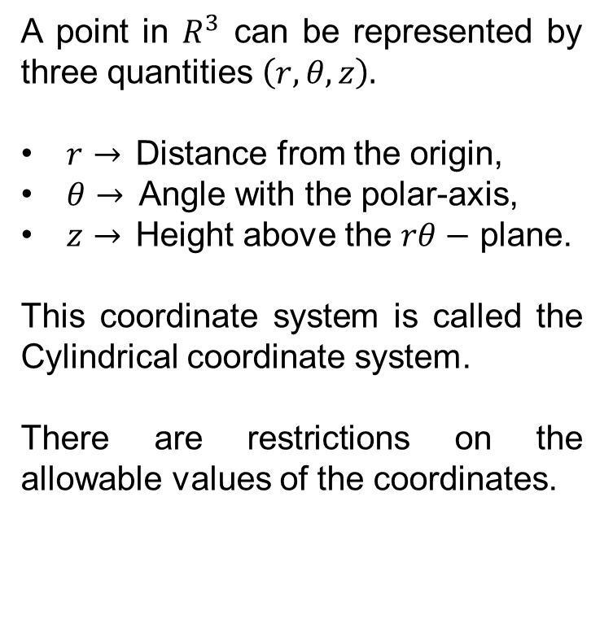
Cylindrical coordinates
A point in $R^{3}$canberepresented by threequantities$\left(r,θ, z\right).$
$r→$Distance from the origin,
$θ→$Angle with the polar-axis,
$z→$Heightabove the $rθ−$ plane.
This coordinate system iscalled the Cylindricalcoordinate system.
There are restrictions on the allowable values of the coordinates.

Slide 15
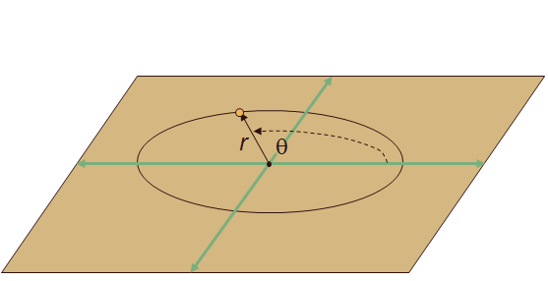
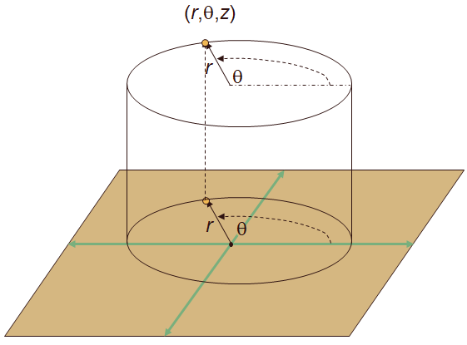
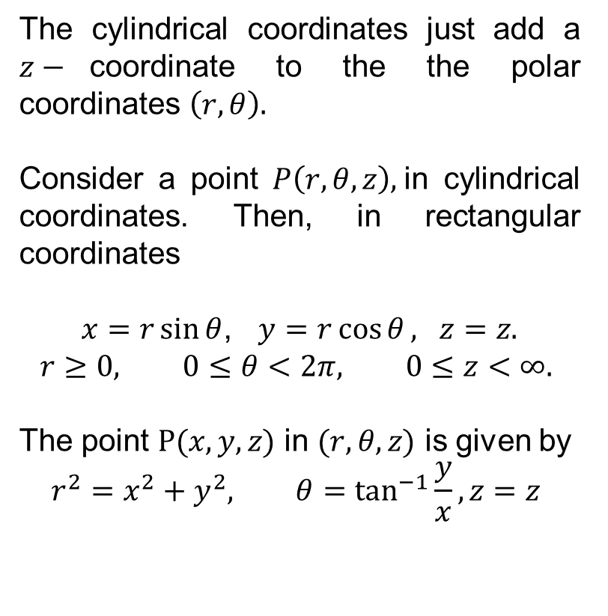
Cylindrical coordinates
The cylindricalcoordinatesjustadd a $z−$coordinate to the the polar coordinates$\left(r,θ\right).$
Consider a point $P\left(r,θ,z\right),$in cylindricalcoordinates. Then, in rectangularcoordinates
$x=r\sin{θ}$, $y=r\cos{θ}, z=z.$
$$r≥0, 0≤θ<2π, 0≤z<∞.$$
The point $P(x,y,z)$ in $(r,θ,z)$ is given by
$$r^{2}=x^{2}+y^{2}, θ=\tan^{−1}{\frac{y}{x}}, z=z$$

Slide 16
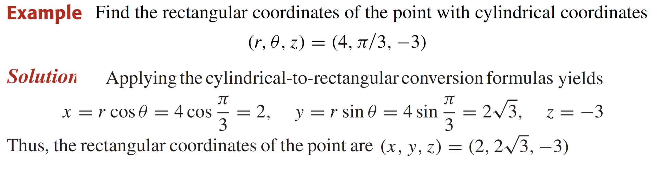
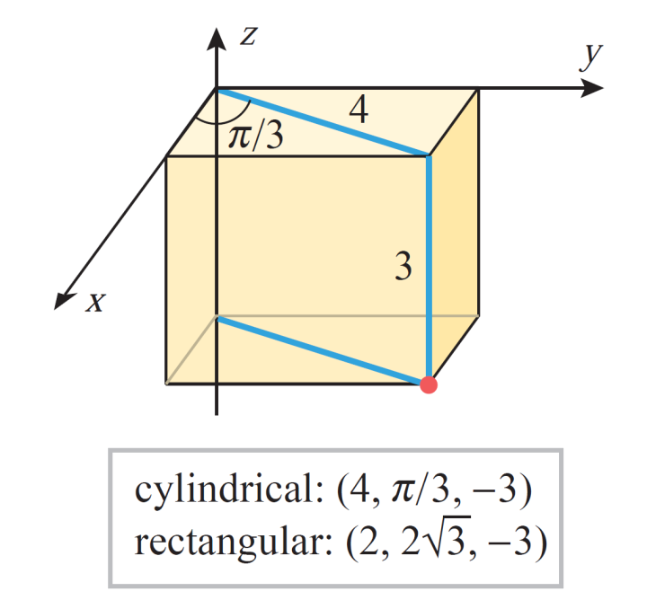
Cylindrical coordinates

Slide 17
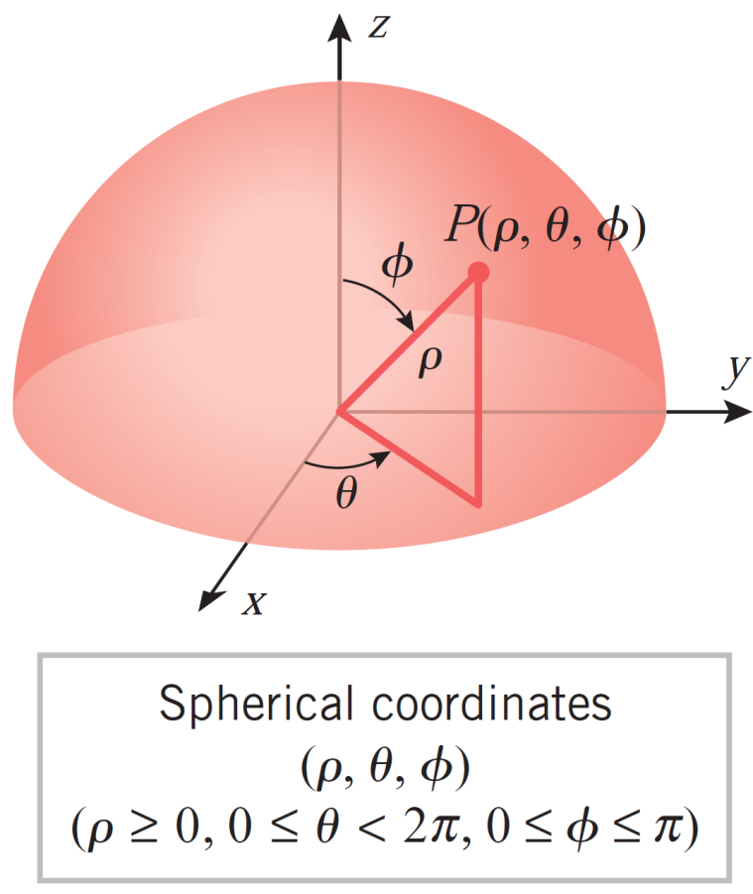
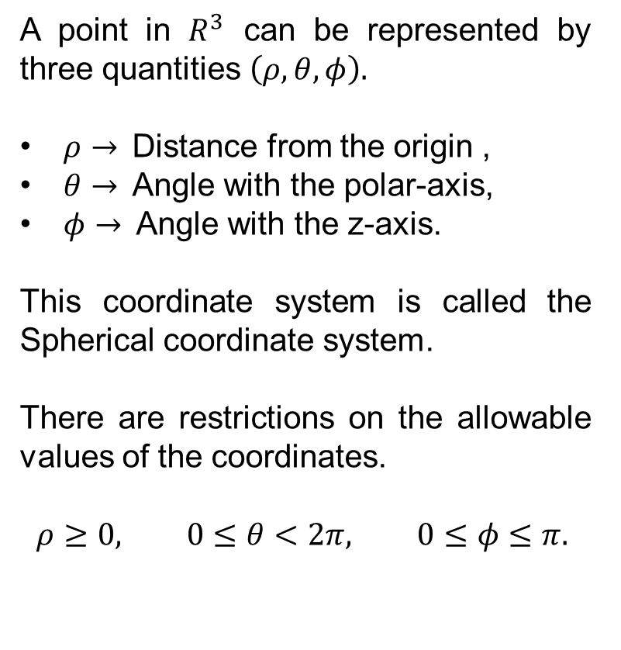
Spherical coordinates
A point in $R^{3}$canberepresented by threequantities$\left(ρ,θ, φ\right).$
$ρ→$Distance from the origin ,
$θ→$Angle with the polar-axis,
$φ→$Angle with the z-axis.
This coordinate system iscalled the Sphericalcoordinate system.
There are restrictions on the allowable values of the coordinates.
$$ρ≥0, 0≤θ<2π, 0≤φ≤π.$$

Slide 18
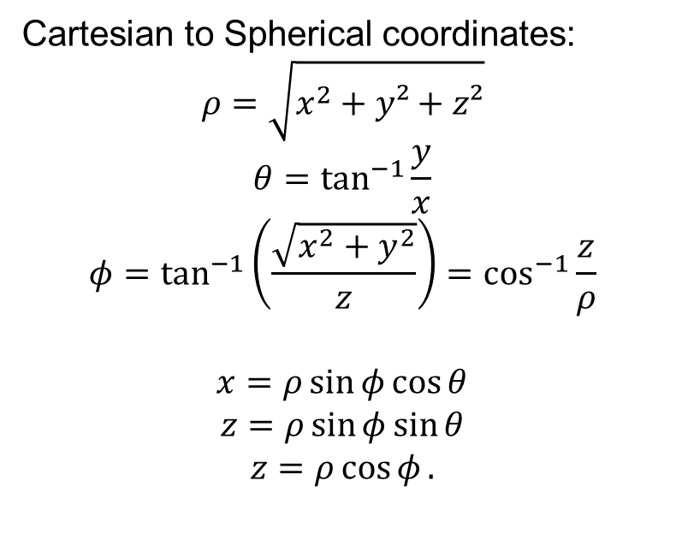
Spherical coordinates
Cartesian to Sphericalcoordinates:
$$ρ=\sqrt{x^{2}+y²+z²}$$
$$θ=\tan^{−1}{\frac{y}{x}}$$
$$φ=\tan^{−1}\left(\frac{\sqrt{x^{2}+y^{2}}}{z}\right)=\cos^{−1}{\frac{z}{ρ}}$$
$$x=ρ\sin{φ}\cos{θ}$$
$$z=ρ\sin{φ}\sin{θ}$$
$$z=ρ\cos{φ}.$$

Slide 19
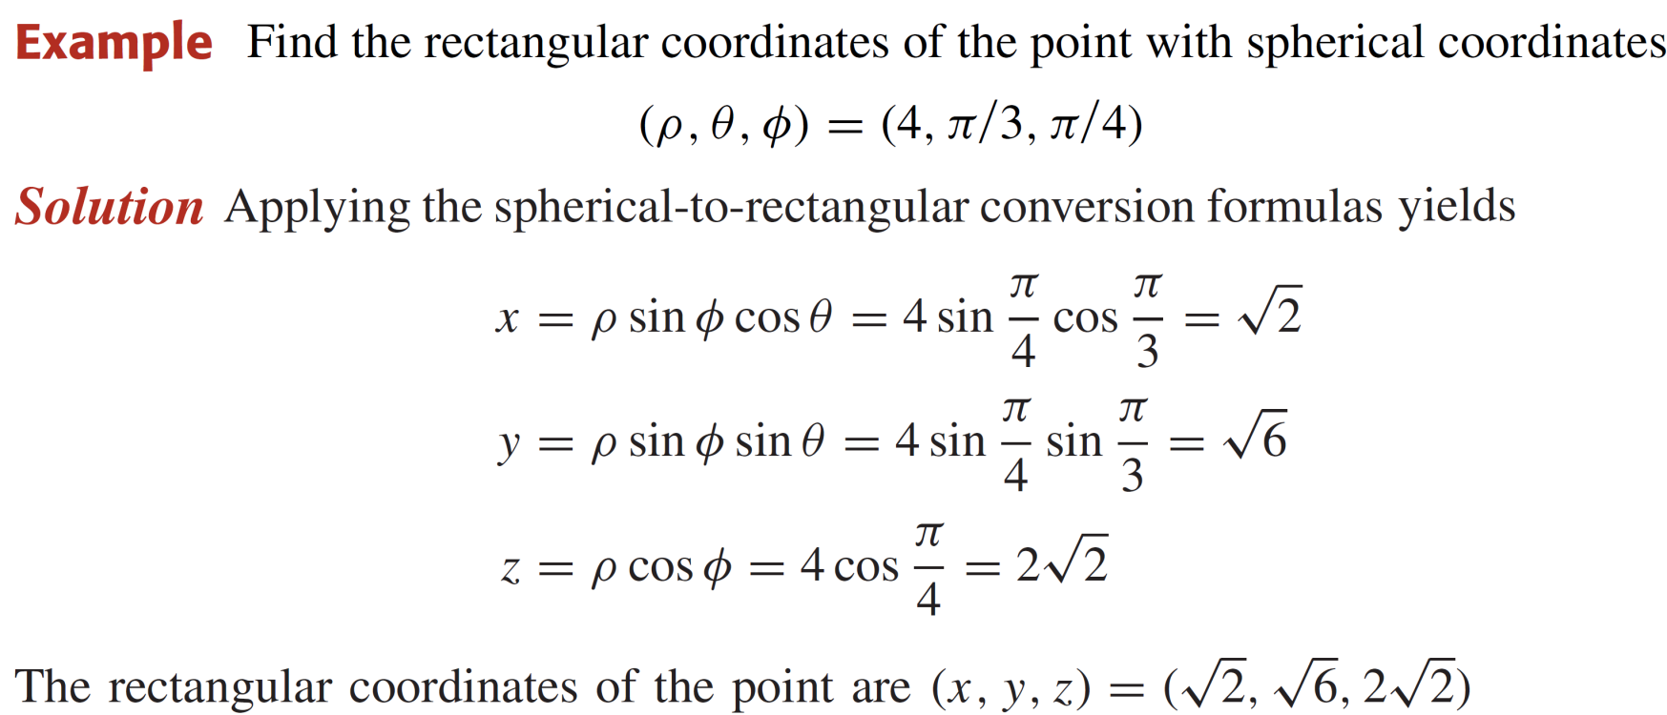
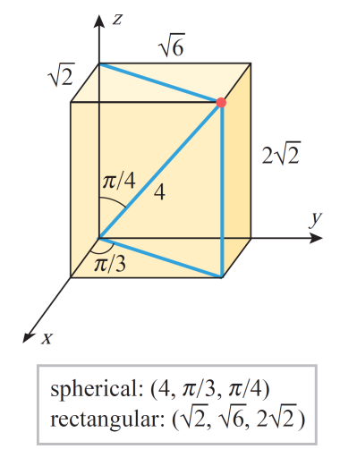
Spherical coordinates

Slide 20
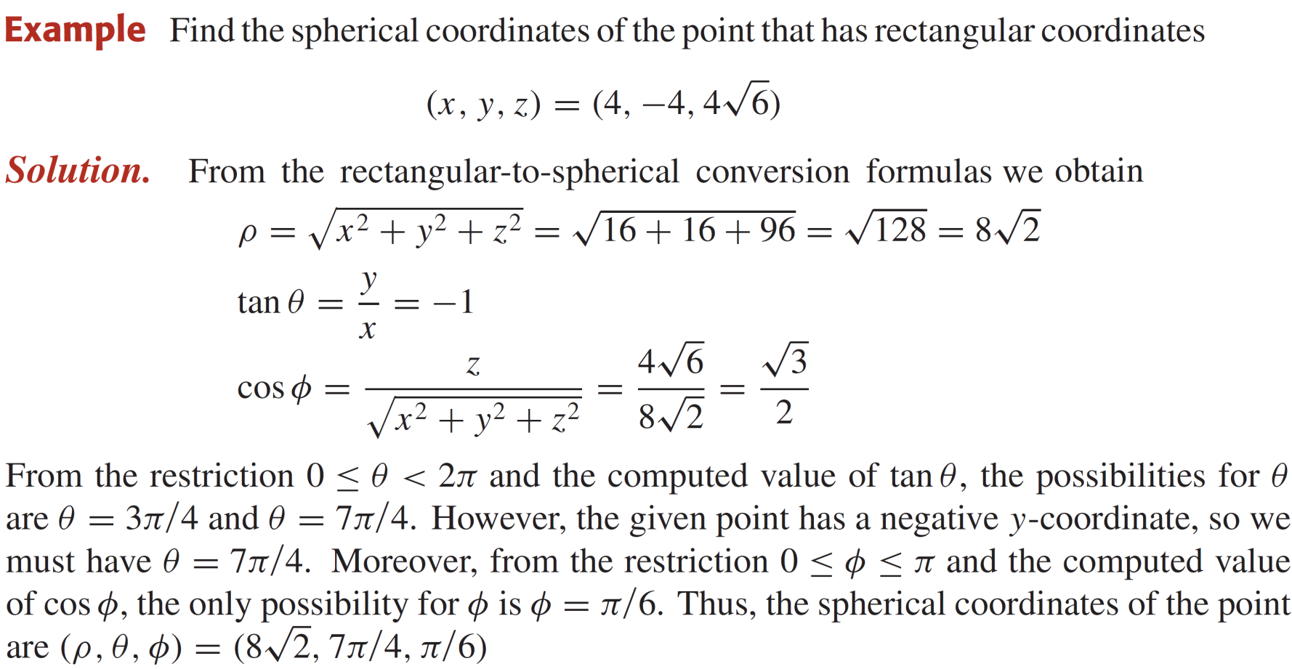
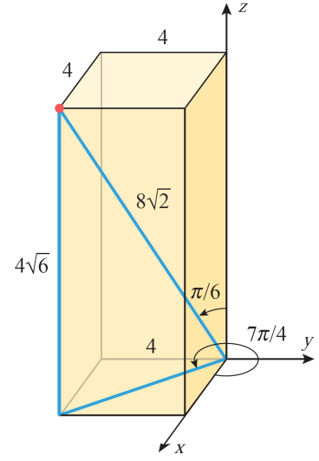
Spherical coordinates

Slide 21
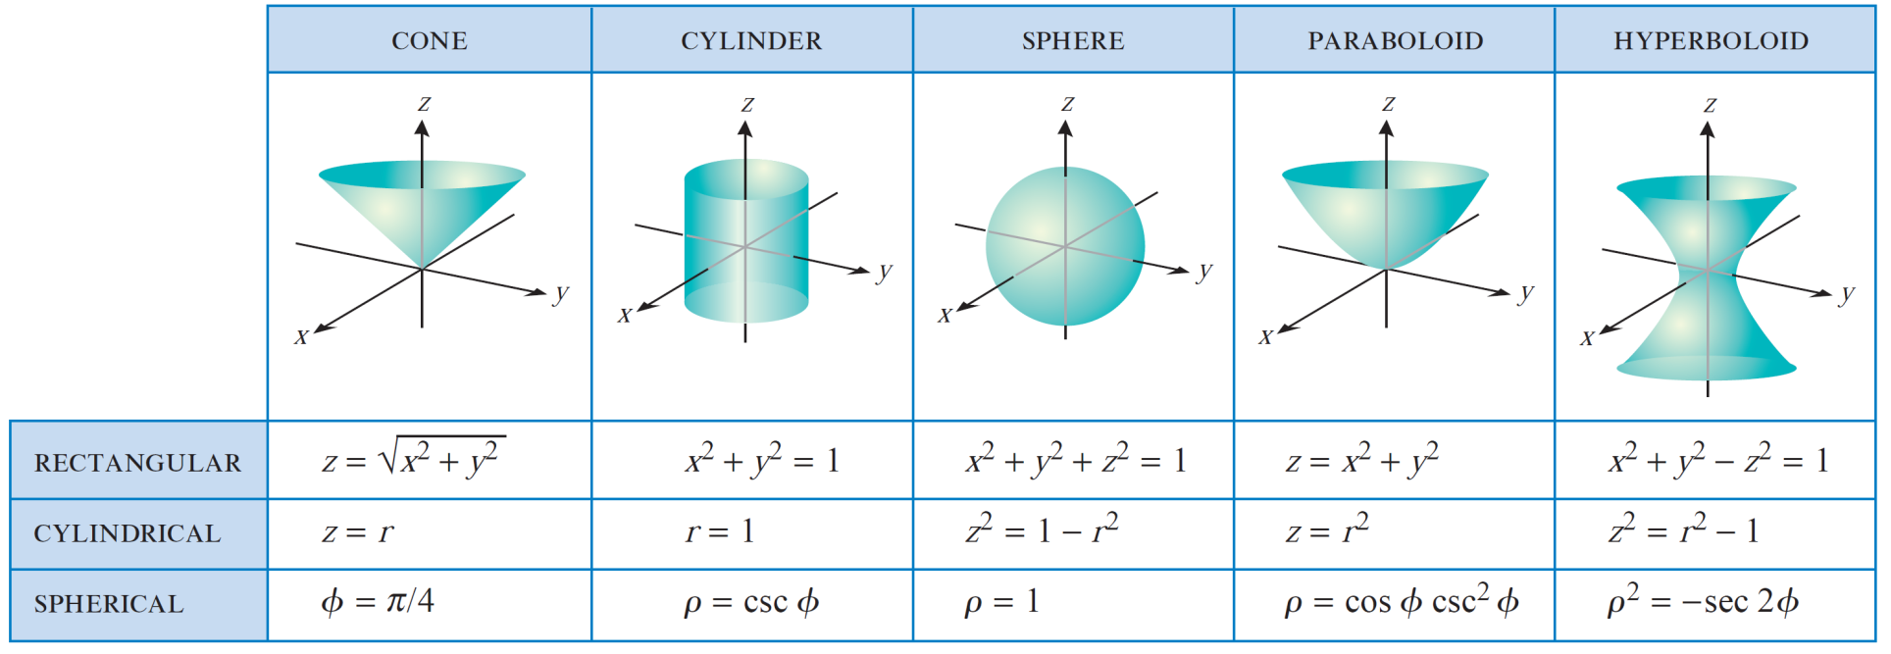
Equations of surfaces

Slide 22
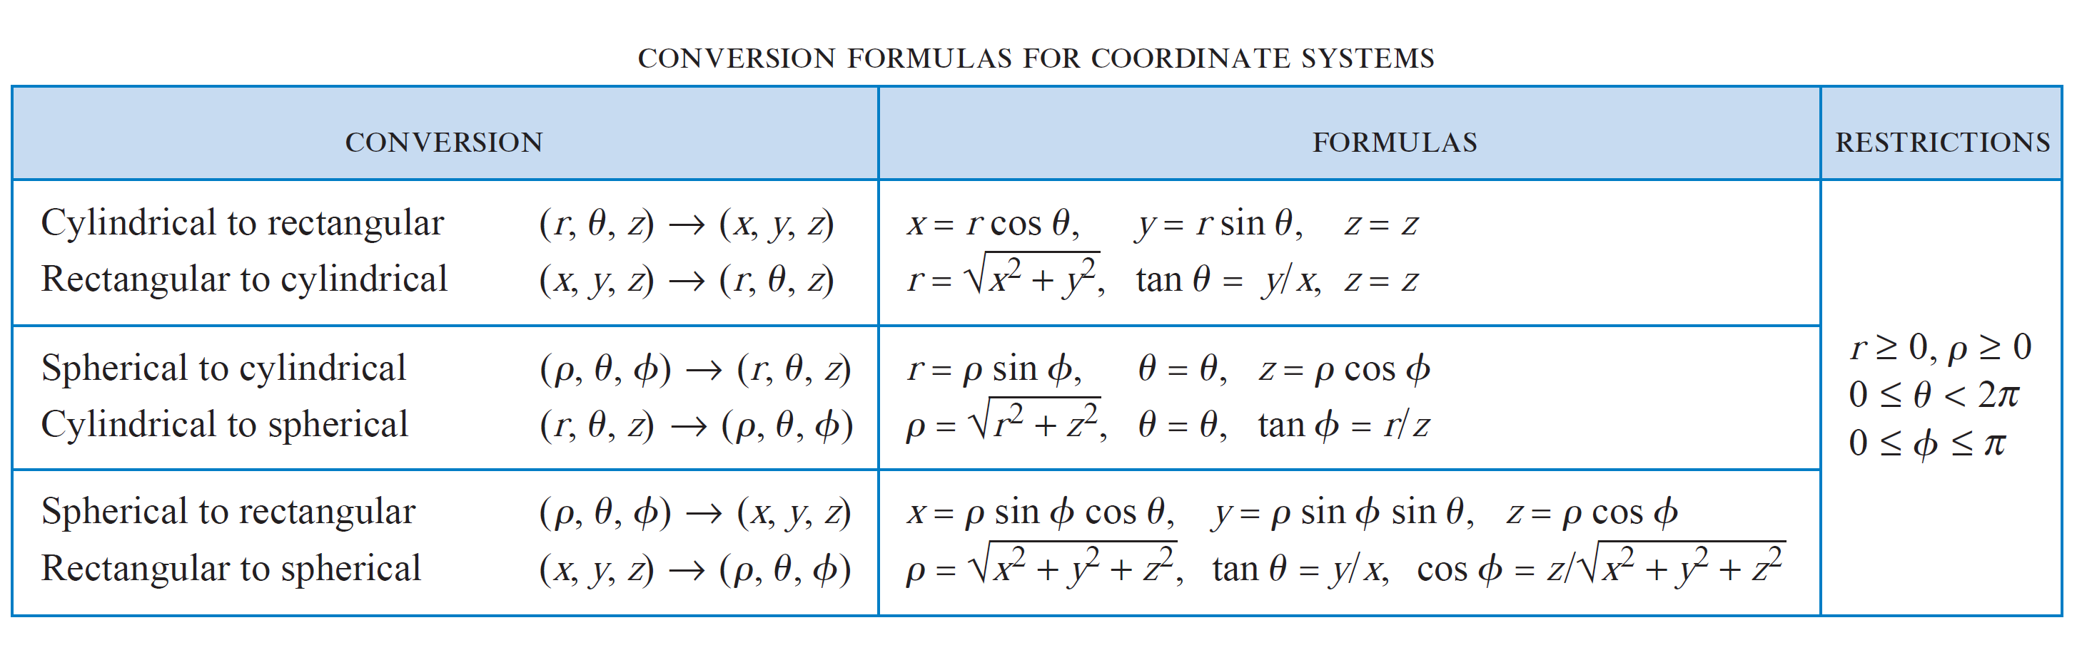
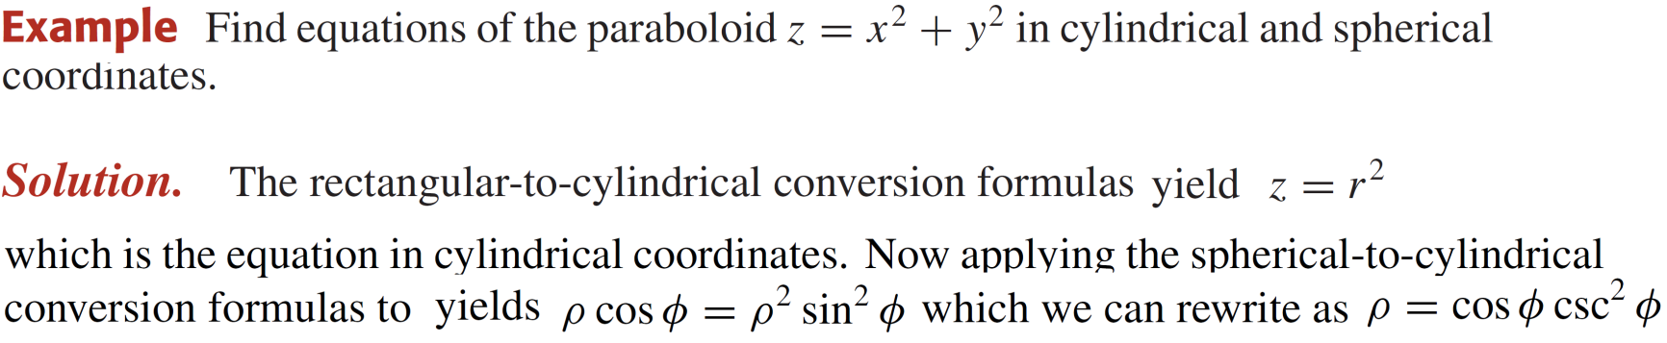
Conversion of Coordinate systems

Slide 23
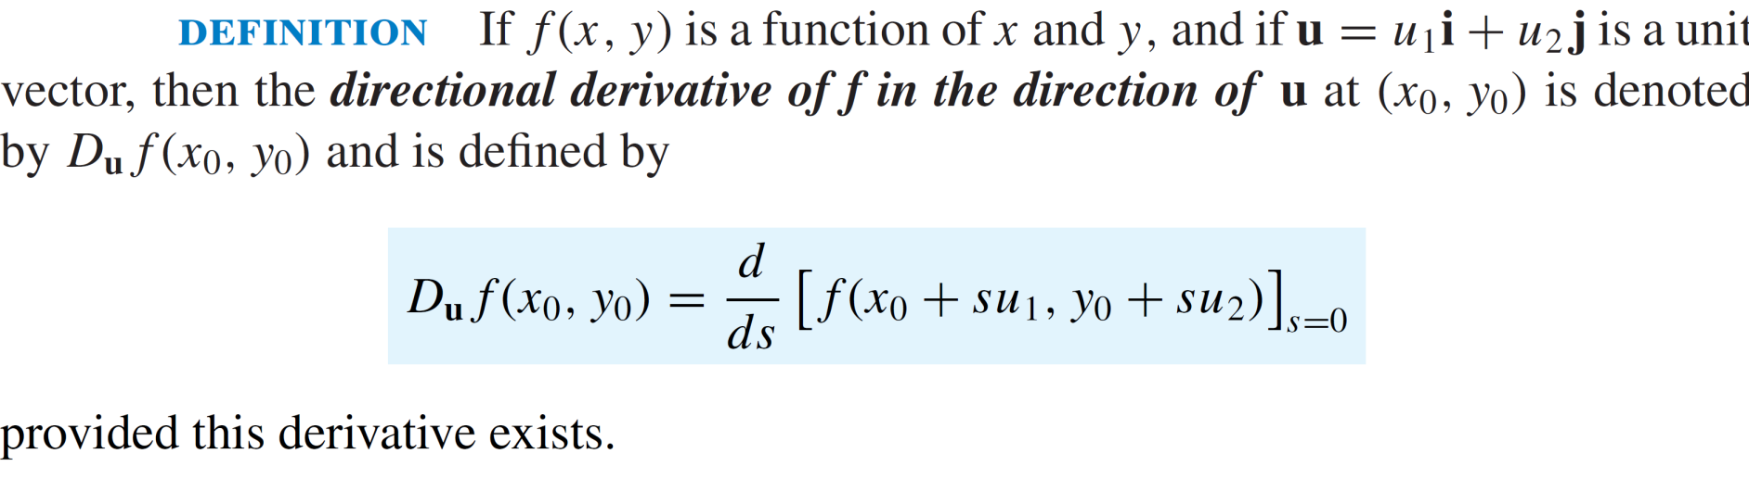
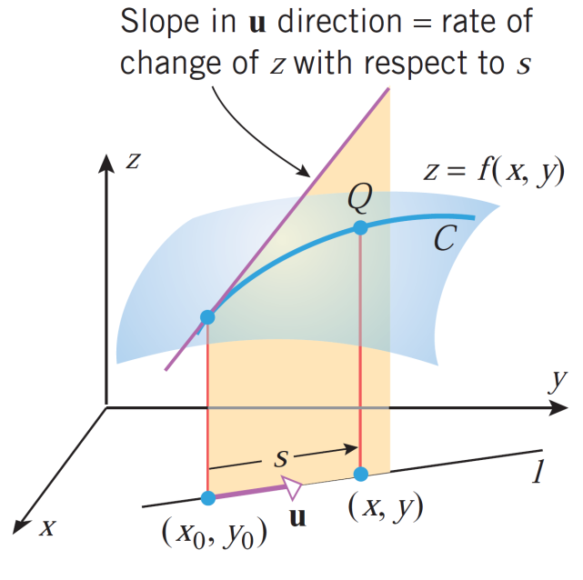
Directional Derivatives

Slide 24
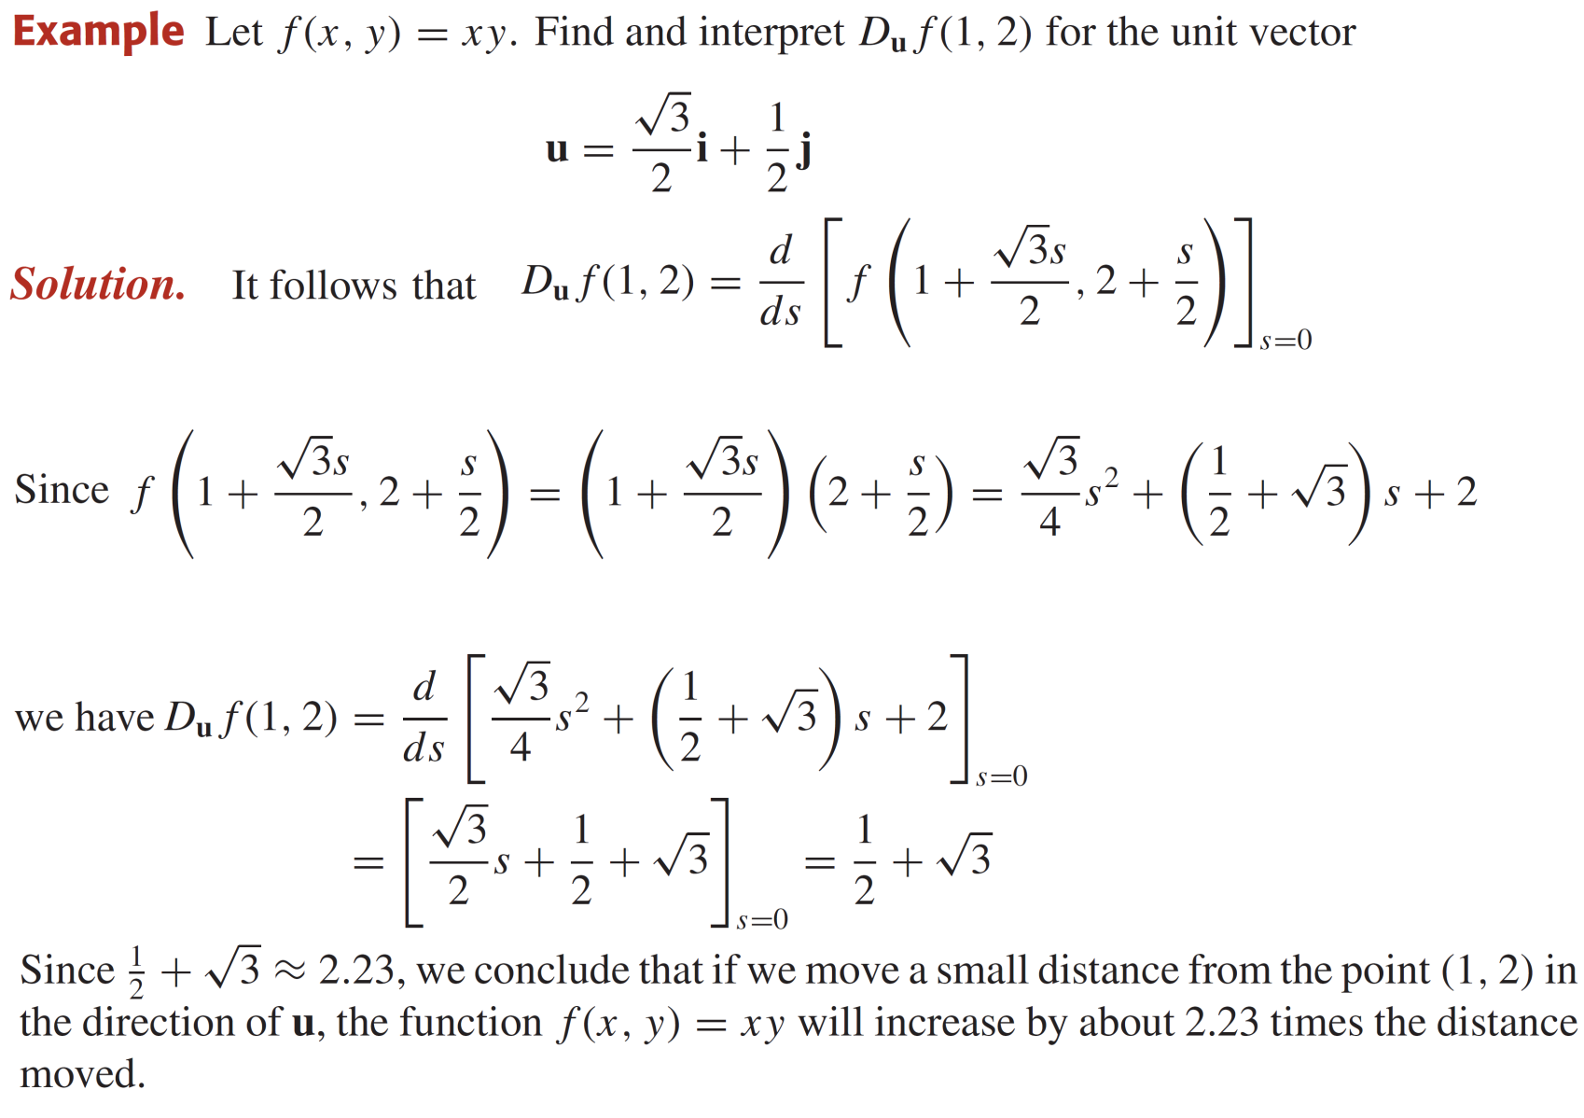
Directional Derivatives

Slide 25
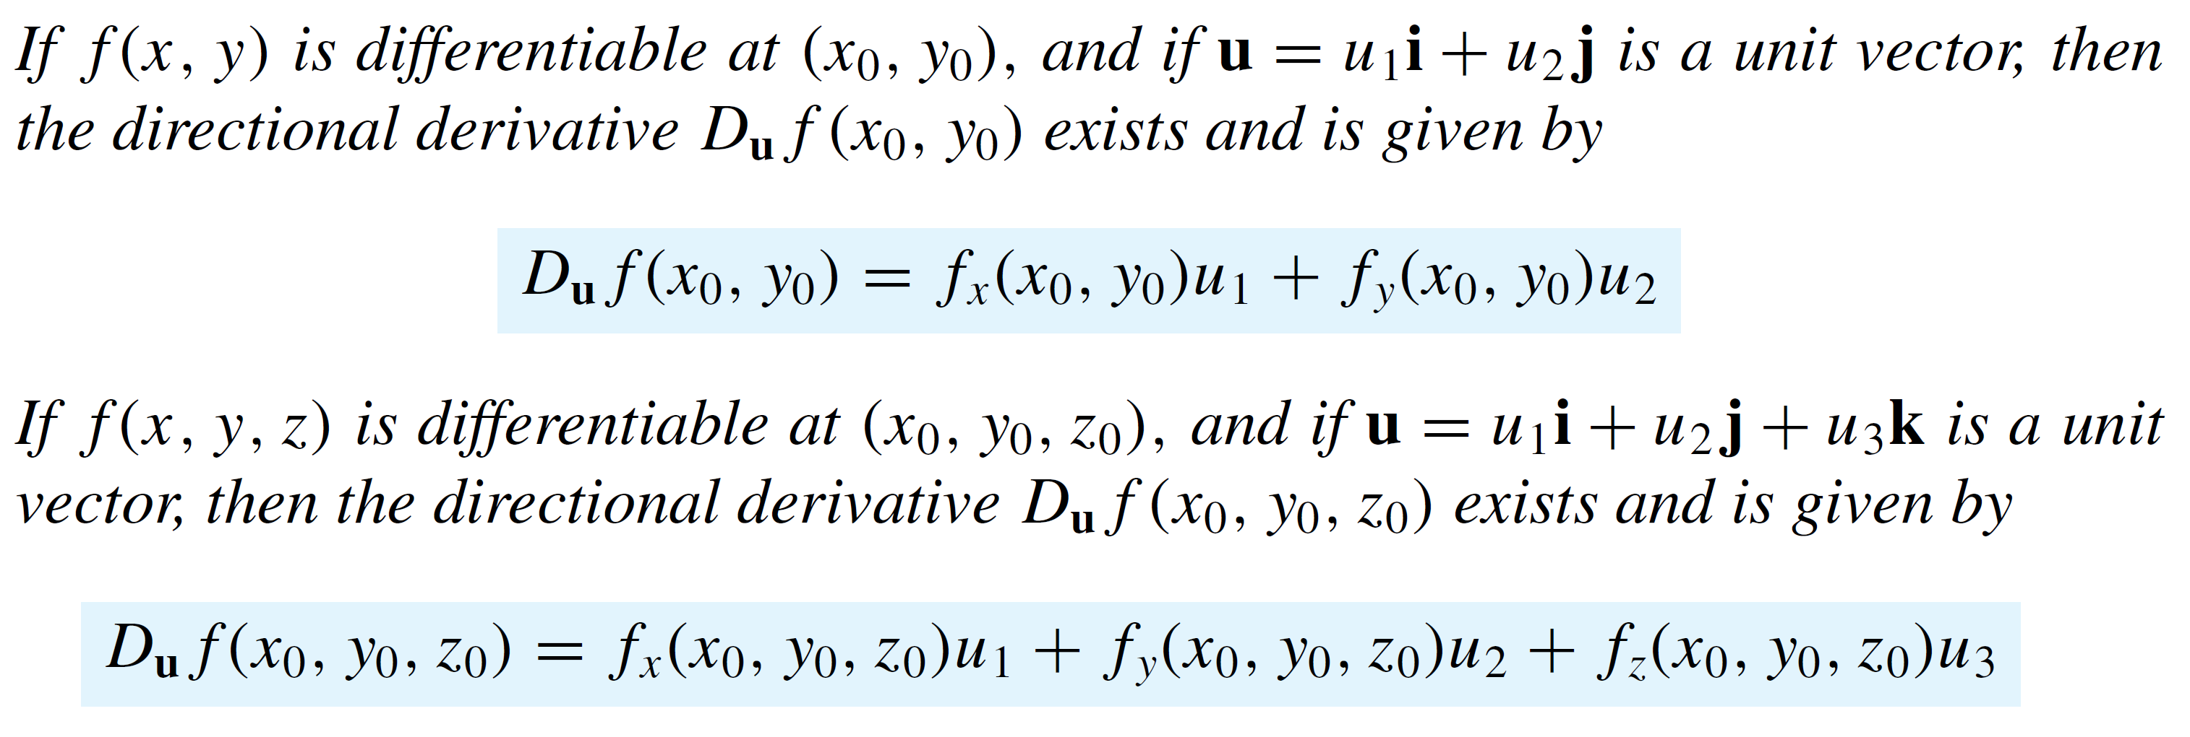
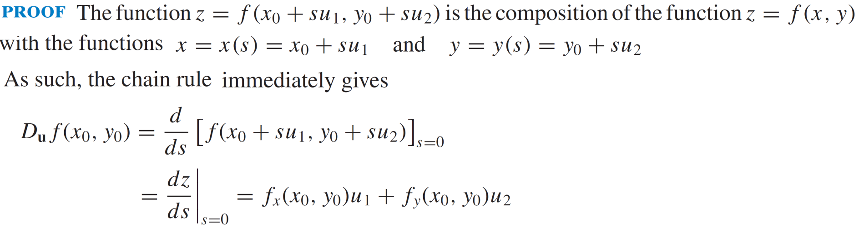
Directional Derivatives
Theorem:

Slide 26
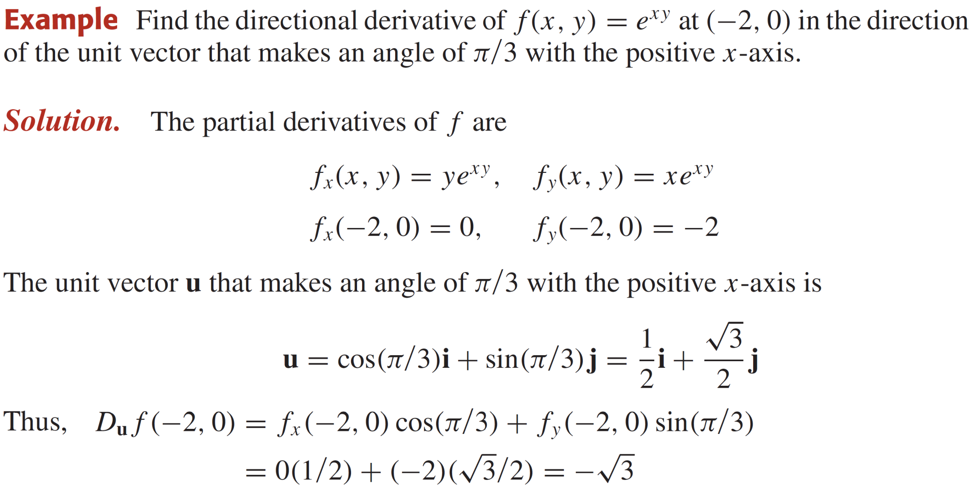
Directional Derivatives

Slide 27
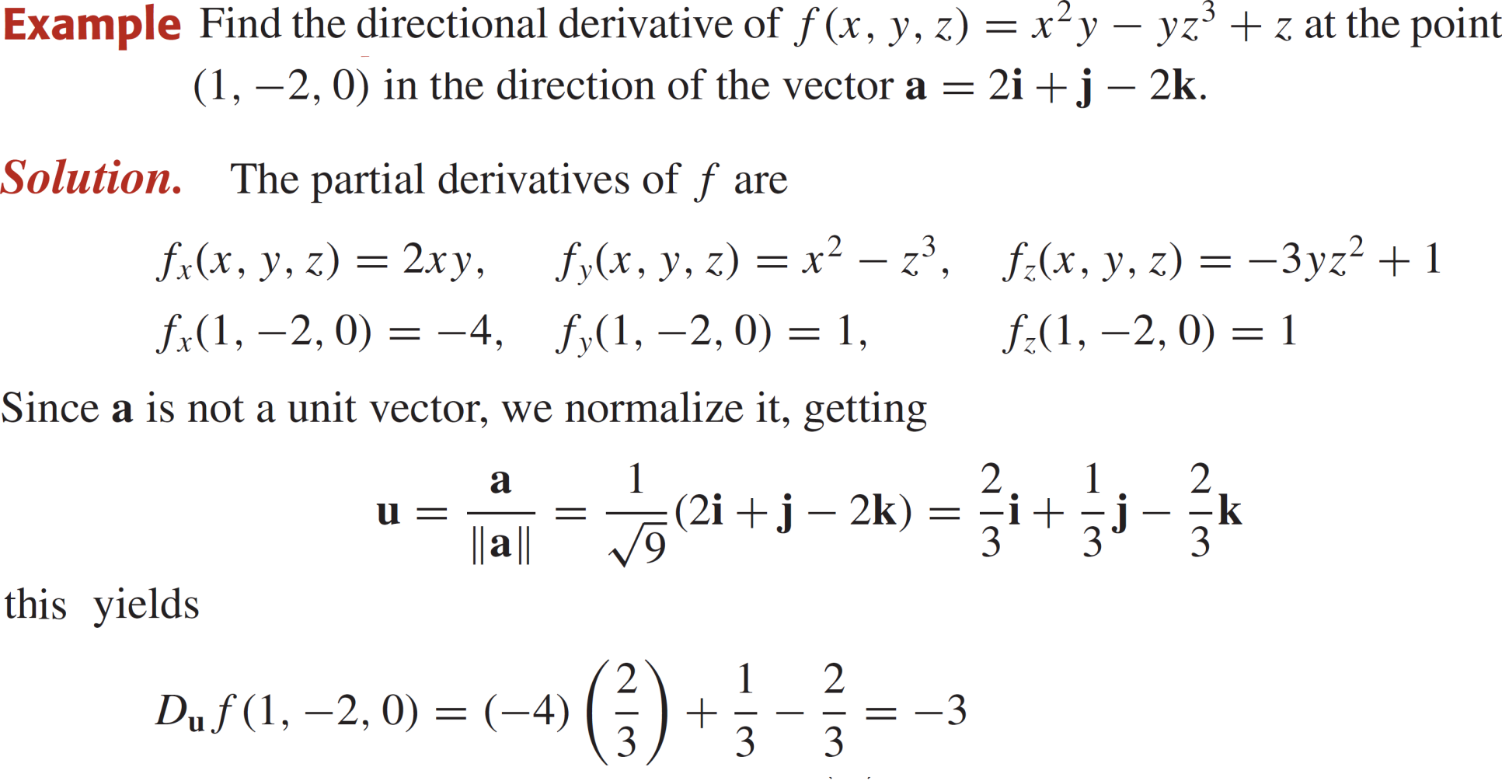
Directional Derivatives

Slide 28
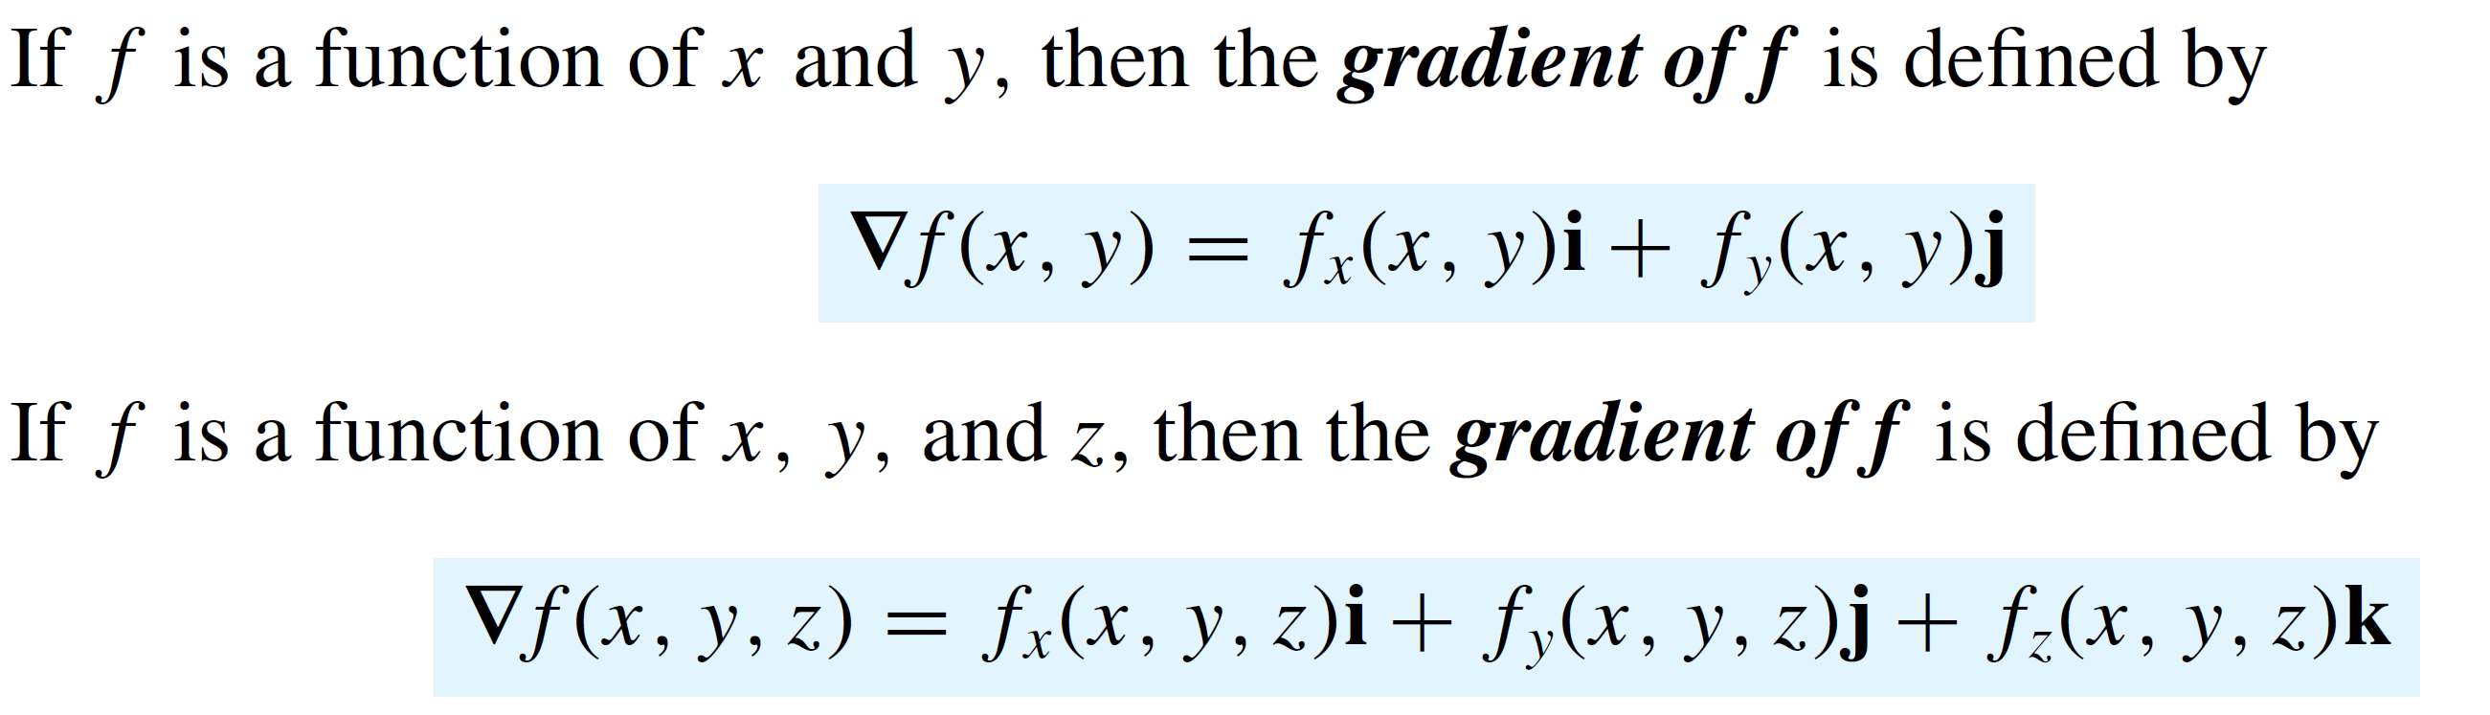
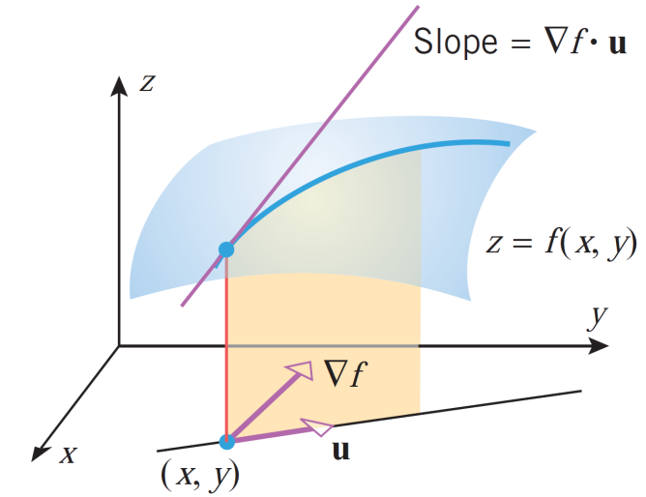
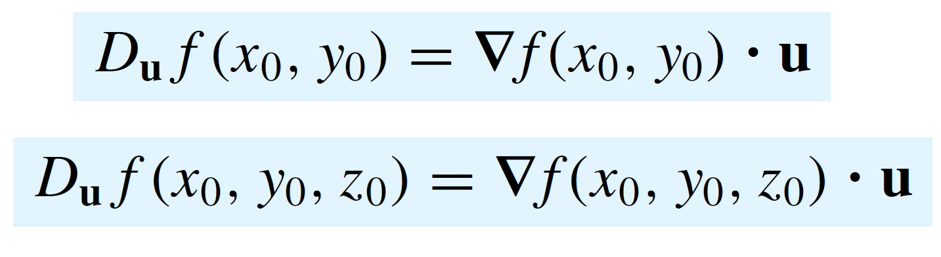
Gradient
Definition:
Remark:

Slide 29
Gradient
Properties:

Slide 30
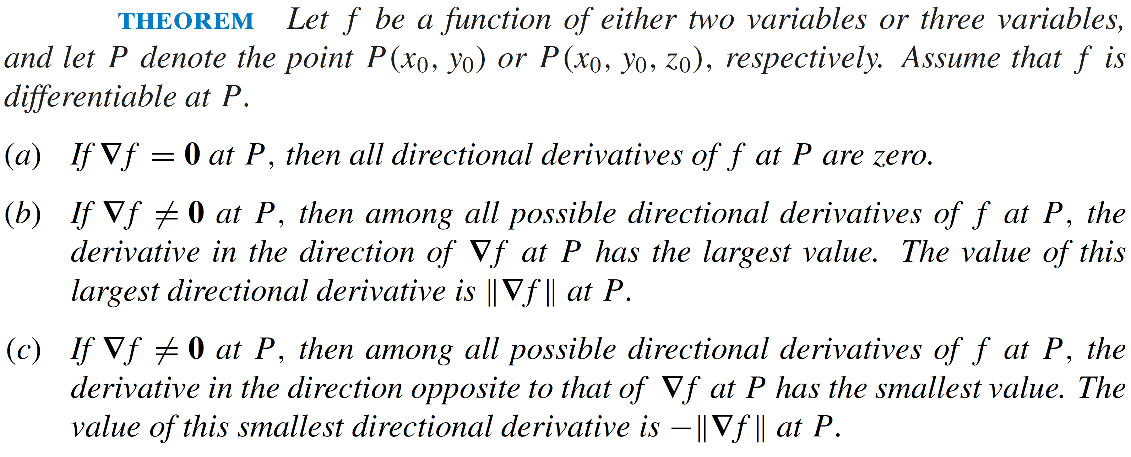
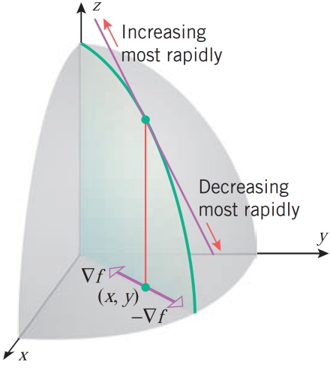
Gradient

Slide 31

Gradient

Slide 32


Gradient
Remarks:
Let $\left(x_{0},y_{0}\right)$be a point on a levelcurve$f\left(x,y\right)=c$ and the curvecanbesmoothlyparametrized as $x=x\left(s\right), y=y\left(s\right).$
The the tangent vectoris$T\left(s\right)=x^{′}\left(s\right)i+y^{′}\left(s\right)j$.
Differentiatiing the levelcurveweobtain
$T$gives a direction alongwhich$f$isnearly constant and so
$$D_{T}f\left(x,y\right)=∇f\left(x,y\right)⋅T\left(s\right)=0.$$

Slide 33


Gradient
Theorem:
Remark:

Slide 34

Gradient

Slide 35

Gradient

Slide 36
Lecture Summary
    Polar Coordinates
    Rectangular Coordinates.
    Cylindrical Coordinates
    Spherical Coordinates
    Equations of Surfaces
    Conversion of Coordinate Systems
    Directional Derivatives
    Gradients.

