Slide 1
(MTH 250)
Calculus
Lecture 25

Slide 2
Previous Lecture’s Summary
    Differentiability of multivariable functions
    Differentials & linear approximations
    Chain rules for partial differentiation
    Implicit differentiation
    Extrema of multivariable functions

Slide 3
Today’s Lecture
    Recalls
    Introduction to double integrals
    Iterated integrals
    Theorem of Fubini
    Properties of double integrals
    Integrals over non-rectangular regions
    Reversing the order of integration

Slide 4
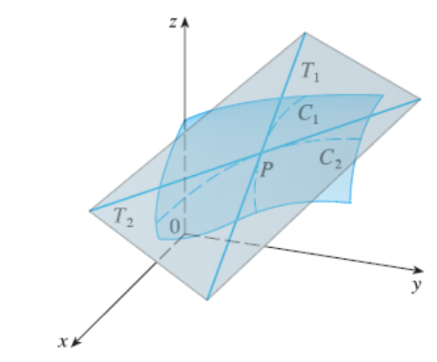
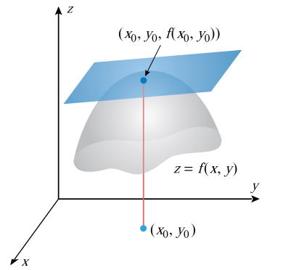
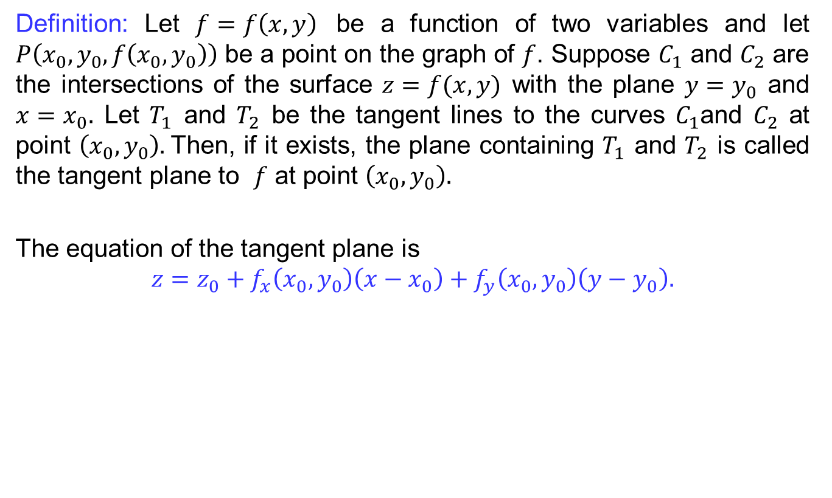
Recalls
Definition: Let $f=f\left(x,y\right)$ be a function of two variables and let $P\left(x_{0},y_{0},f\left(x_{0},y_{0}\right)\right)$ be a point on the graph of $f$. Suppose $C_{1}$and $C_{2}$are the intersections of the surface $z=f(x,y)$ with the plane $y=y_{0}$ and $x=x_{0}.$ Let $T_{1}$ and $T_{2}$be the tangent lines to the curves$C_{1}$and $C_{2}$at point $\left(x_{0},y_{0}\right).$Then, if itexists, the plane containing$T_{1}$ and $T_{2}$iscalled the tangent plane to $f$at point $\left(x_{0},y_{0}\right).$
The equation of the tangent plane is
$$z={z_{0}+f}_{x}\left(x_{0},y_{0}\right)\left(x−x_{0}\right)+f_{y}\left(x_{0},y_{0}\right)\left(y−y_{0}\right).$$

Slide 5
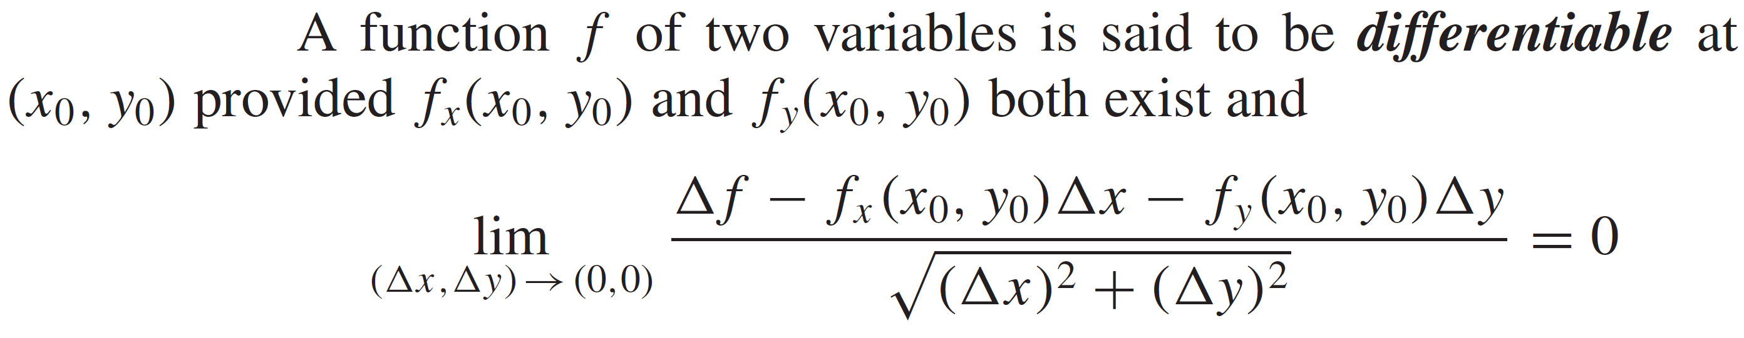
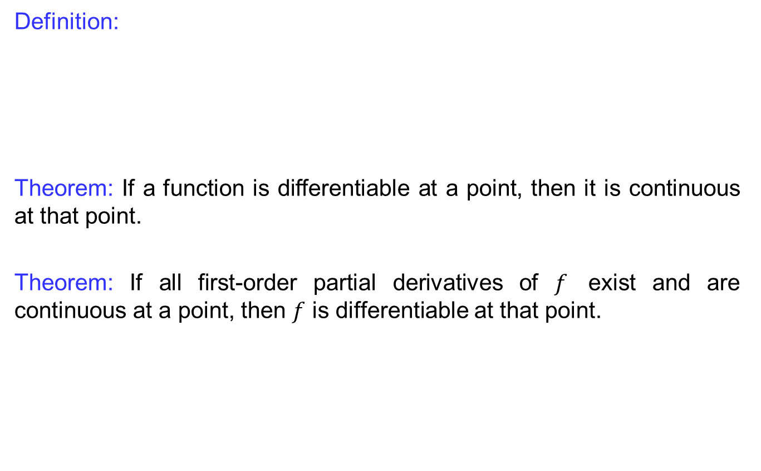
Recalls
Definition:
Theorem: If a functionisdifferentiableat a point, thenitiscontinuousatthat point.
Theorem: If all first-order partial derivatives of $f$ exist and are continuous at a point, then $f$ is differentiable at that point.

Slide 6
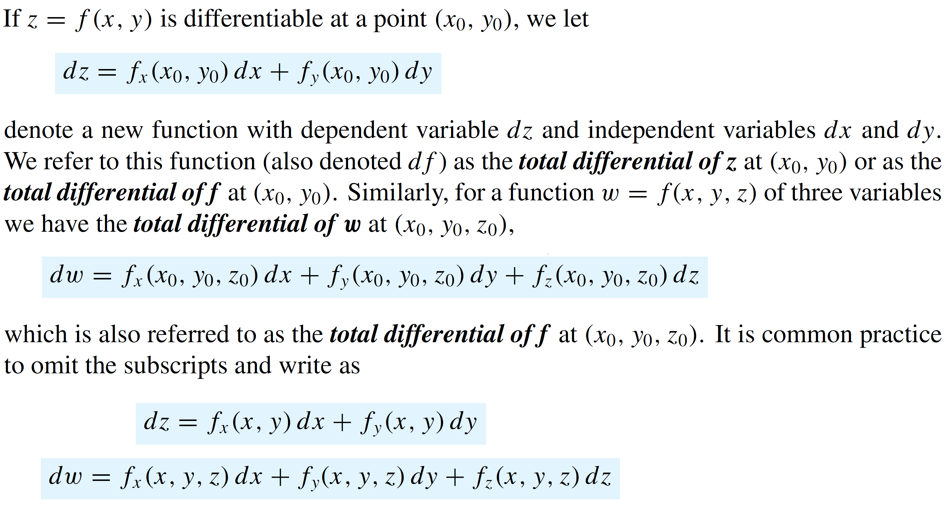
Recalls
Definition (Total differential):

Slide 7
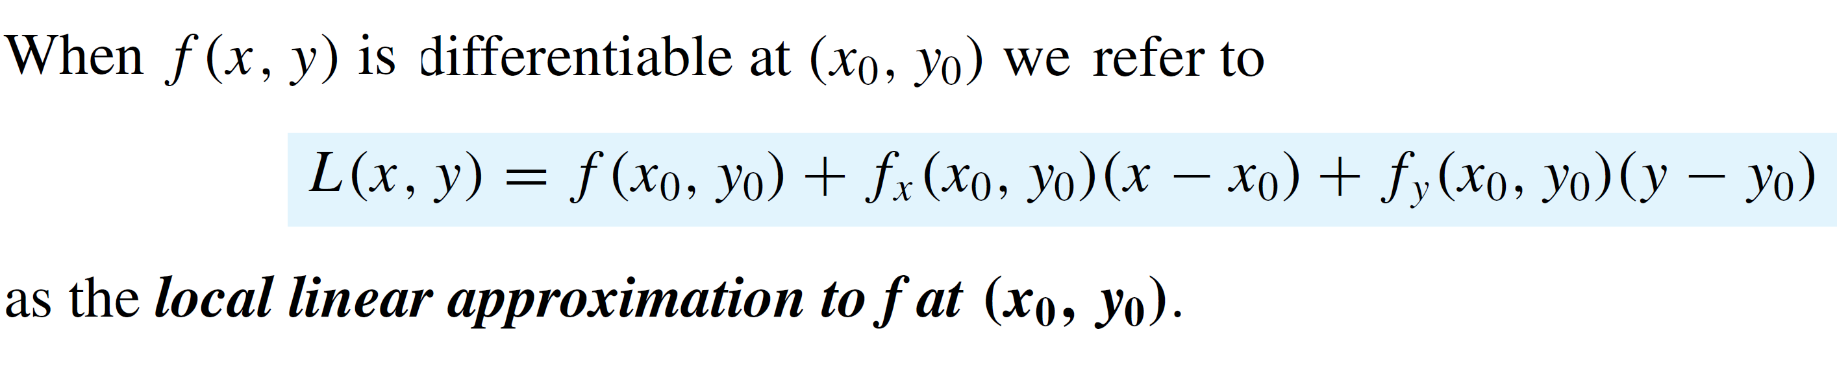
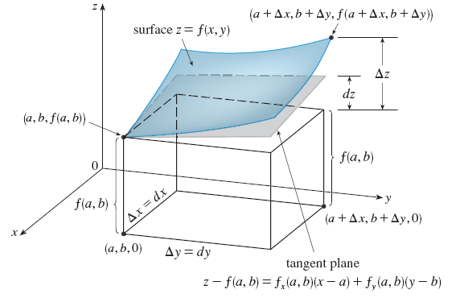
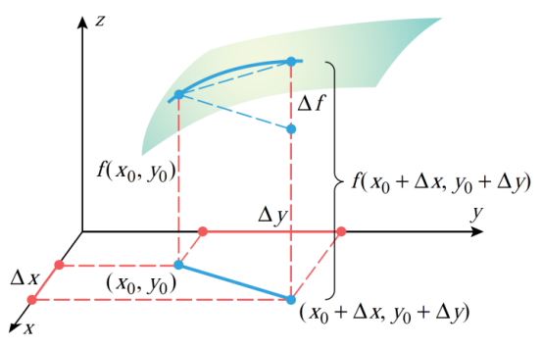
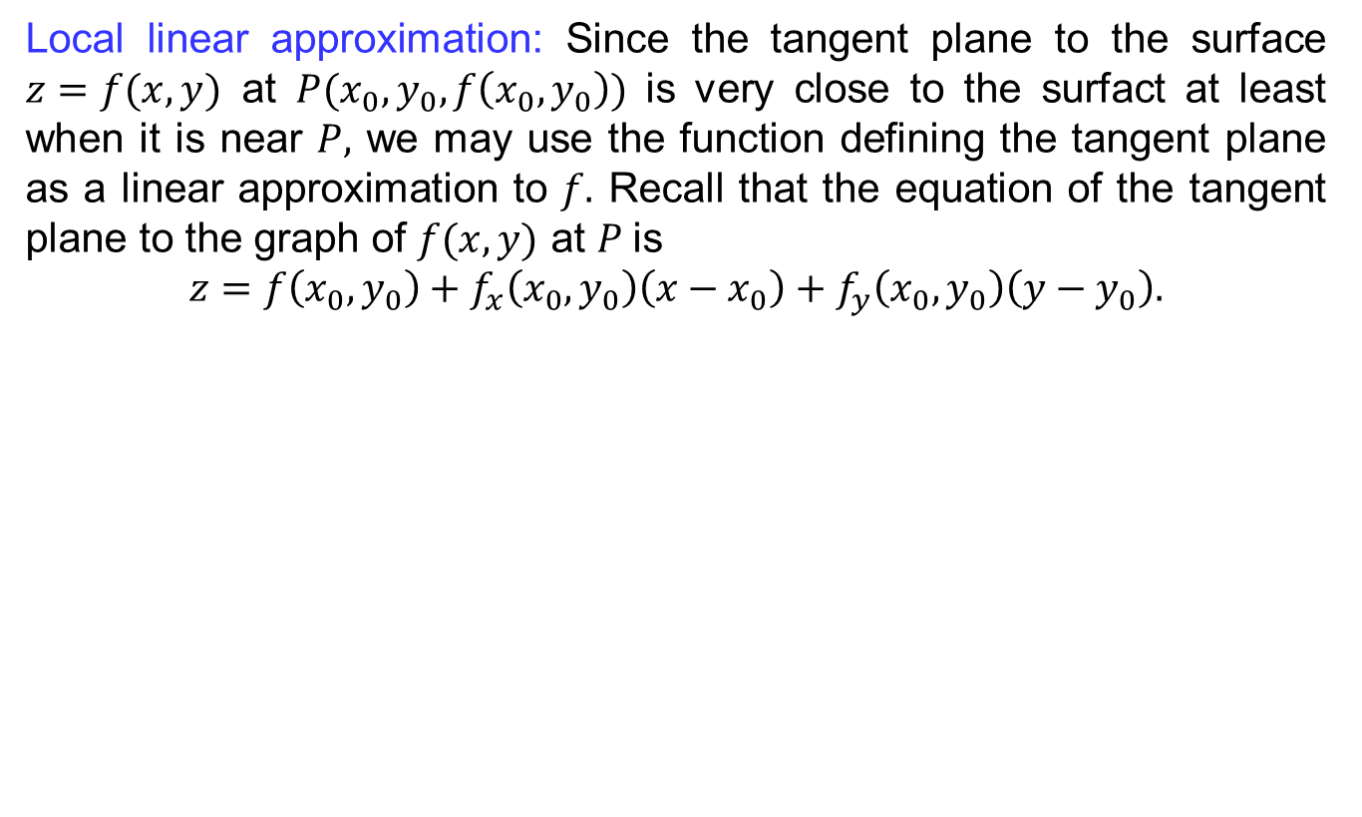
Recalls
Local linear approximation: Since the tangent plane to the surface $z=f(x,y)$ at $P(x_{0},y_{0}, f\left(x_{0},y_{0}\right))$ is very close to the surfact at least when it is near $P,$ we may use the function defining the tangent plane as a linear approximation to $f.$ Recall that the equation of the tangent plane to the graph of $f(x,y)$ at $P$is
$$z=f\left(x_{0},y_{0}\right)+f_{x}\left(x_{0},y_{0}\right)\left(x−x_{0}\right)+f_{y}\left(x_{0},y_{0}\right)\left(y−y_{0}\right).$$

Slide 8
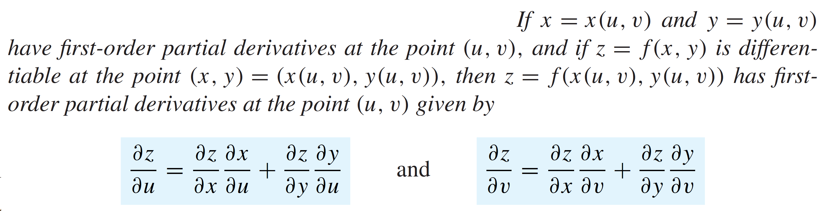
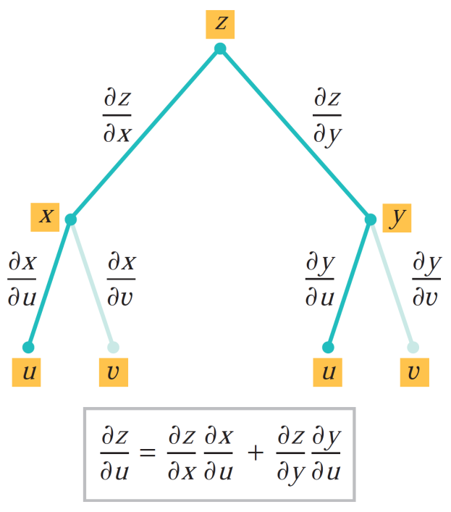
Recalls
Definition (chain rules) for partial derivatives:

Slide 9
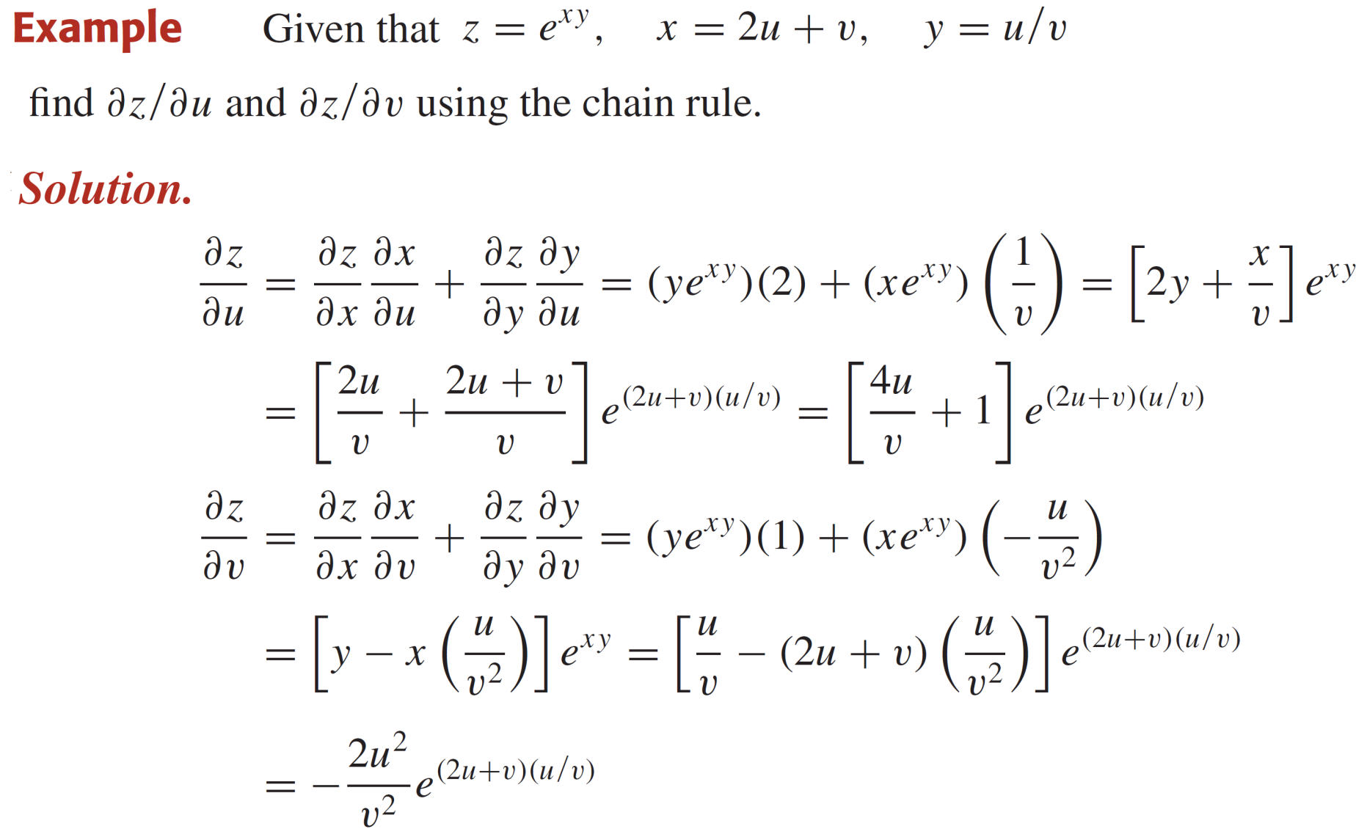
Recalls

Slide 10
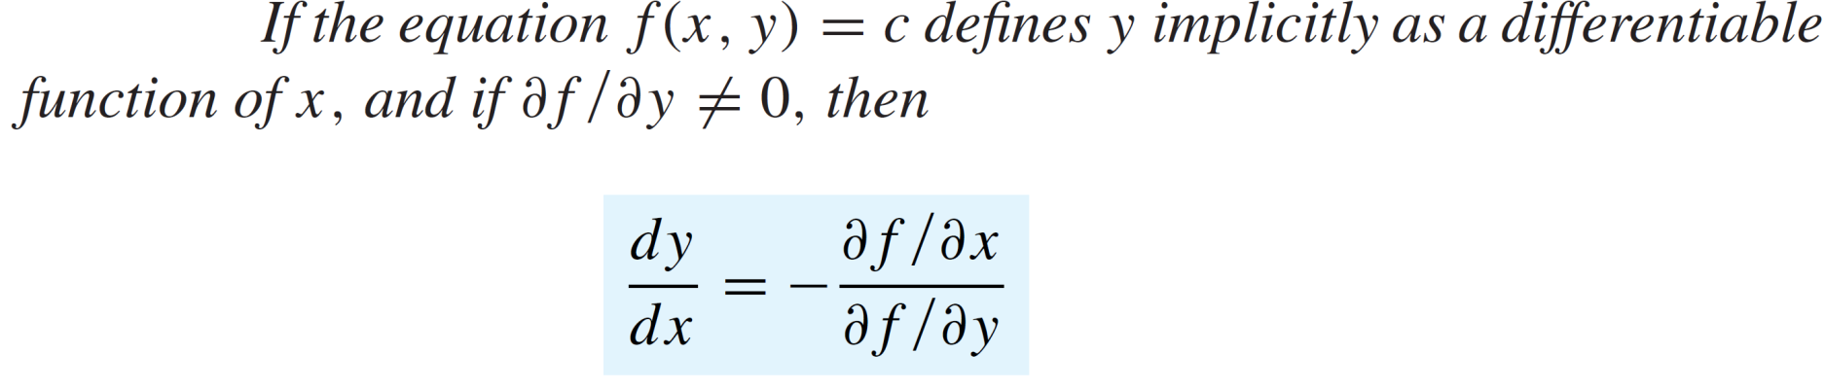
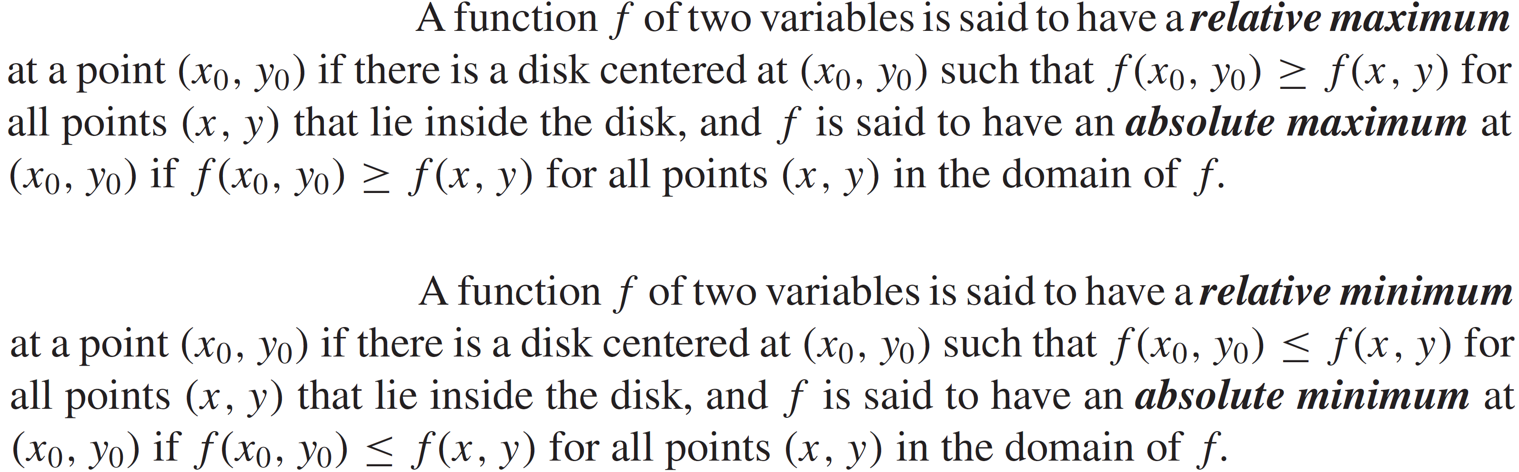
Recalls
Theorem:
Definitions:

Slide 11
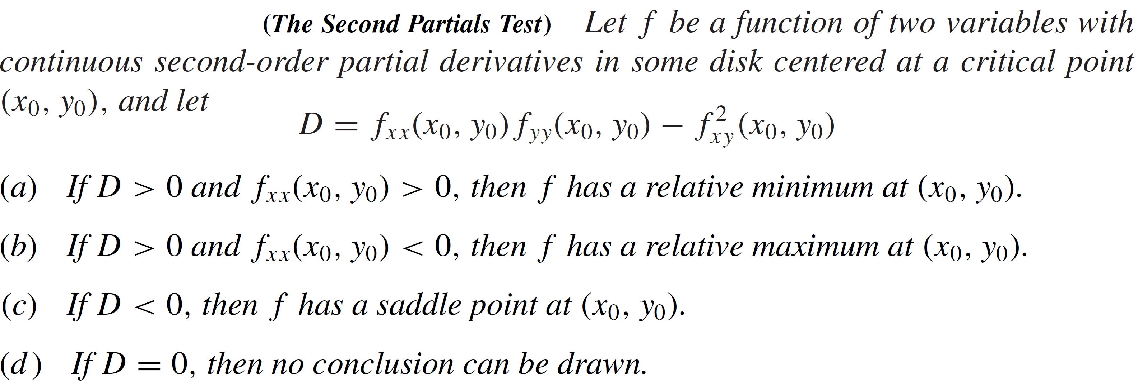
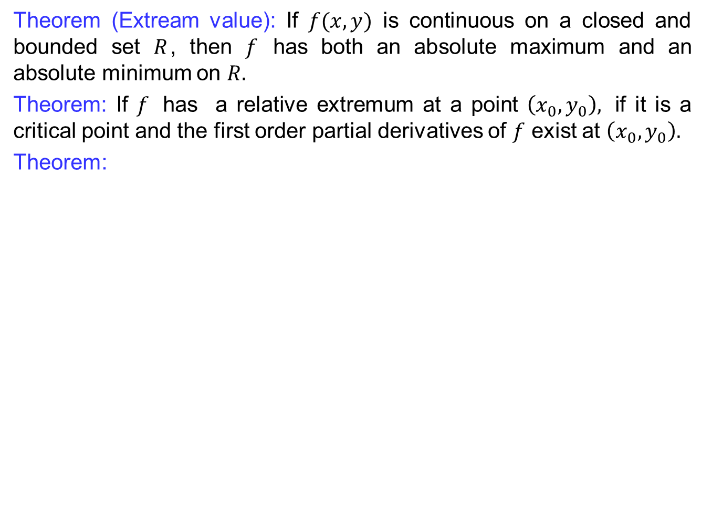
Recalls
Theorem (Extream value): If $f(x,y)$ is continuous on a closed and bounded set $R$, then $f$ has both an absolute maximum and an absolute minimum on $R.$
Theorem: If $f$ has a relative extremum at a point $\left(x_{0},y_{0}\right),$ if it is a critical point and the first order partial derivatives of $f$ exist at$\left(x_{0}, y_{0}\right).$
Theorem:

Slide 12
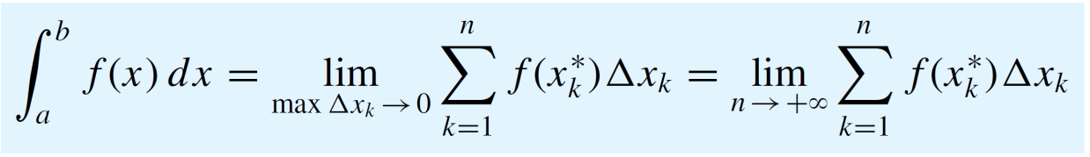
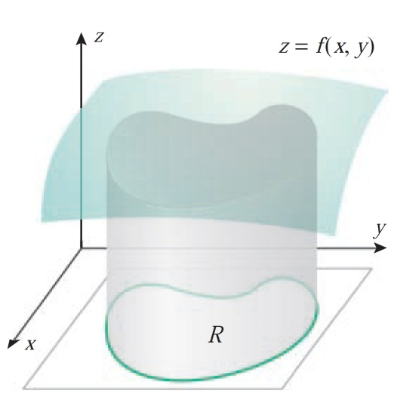
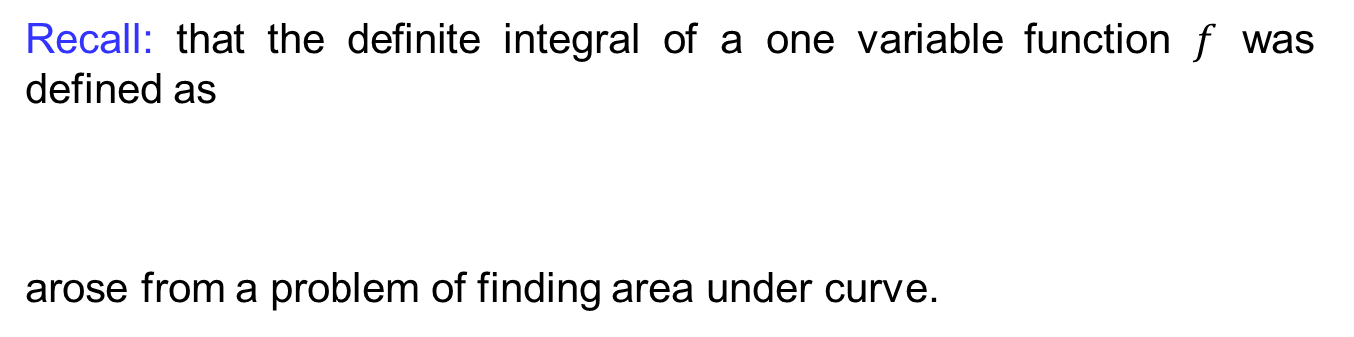
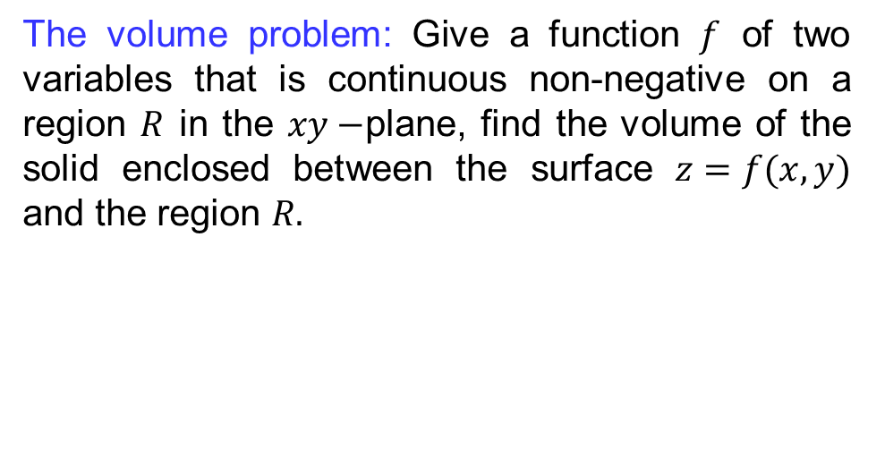
Introduction to double integrals
Recall: that the definiteintegral of a one variable function$f$ was defined as
arose from a problem of finding area under curve.
The volume problem: Give a function $f$ of two variables that is continuous non-negative on a region $R$ in the $xy−$plane, find the volume of the solid enclosed between the surface $z=f(x,y)$ and the region $R.$

Slide 13
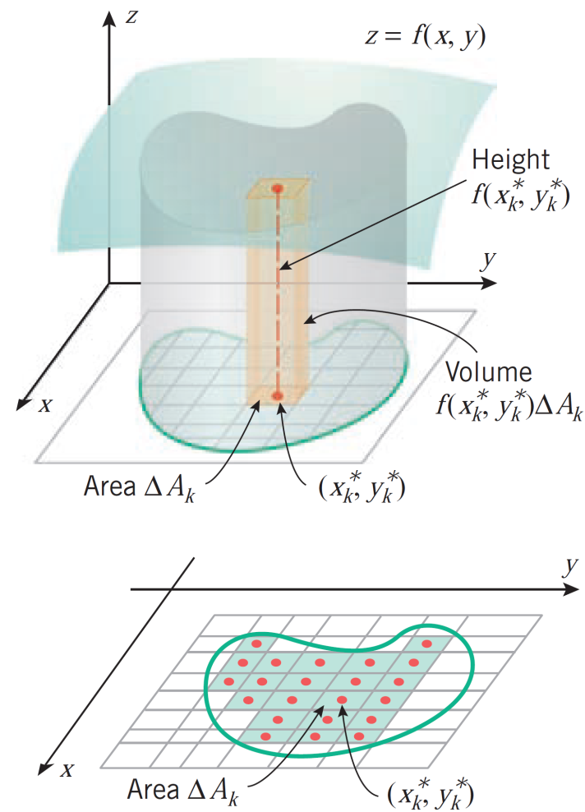
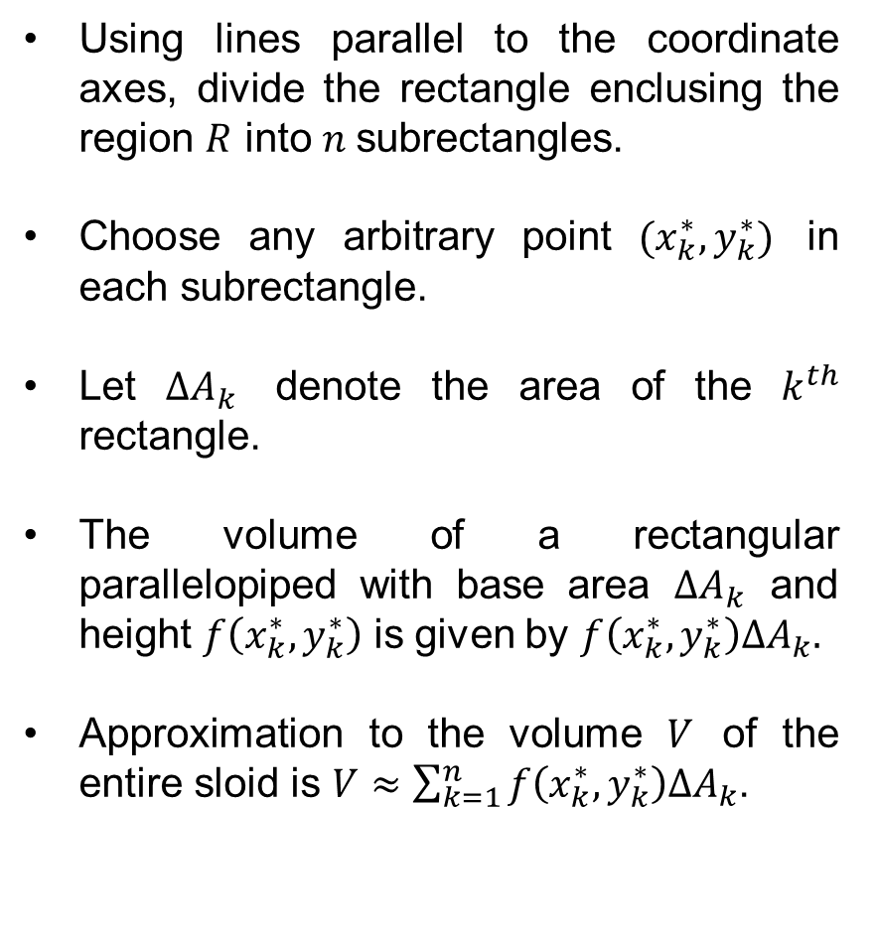
Introduction to double integrals
Using linesparallel to the coordinate axes, divide the rectangle enclusing the region$R$into$n$subrectangles.
Chooseanyarbitrary point $(x_{k}^{∗},y_{k}^{∗})$ in eachsubrectangle.
Let $∆A_{k}$denote the area of the $k^{th}$ rectangle.
The volume of a rectangularparallelopipedwith base area $∆A_{k}$ and height$f\left(x_{k}^{∗},y_{k}^{∗}\right)$isgiven by $f\left(x_{k}^{∗},y_{k}^{∗}\right)∆A_{k}.$
Approximation to the volume $V$ of the entiresloidis$V≈\sum_{k=1}^{n}{f\left(x_{k}^{∗},y_{k}^{∗}\right)∆A_{k}}$.

Slide 14
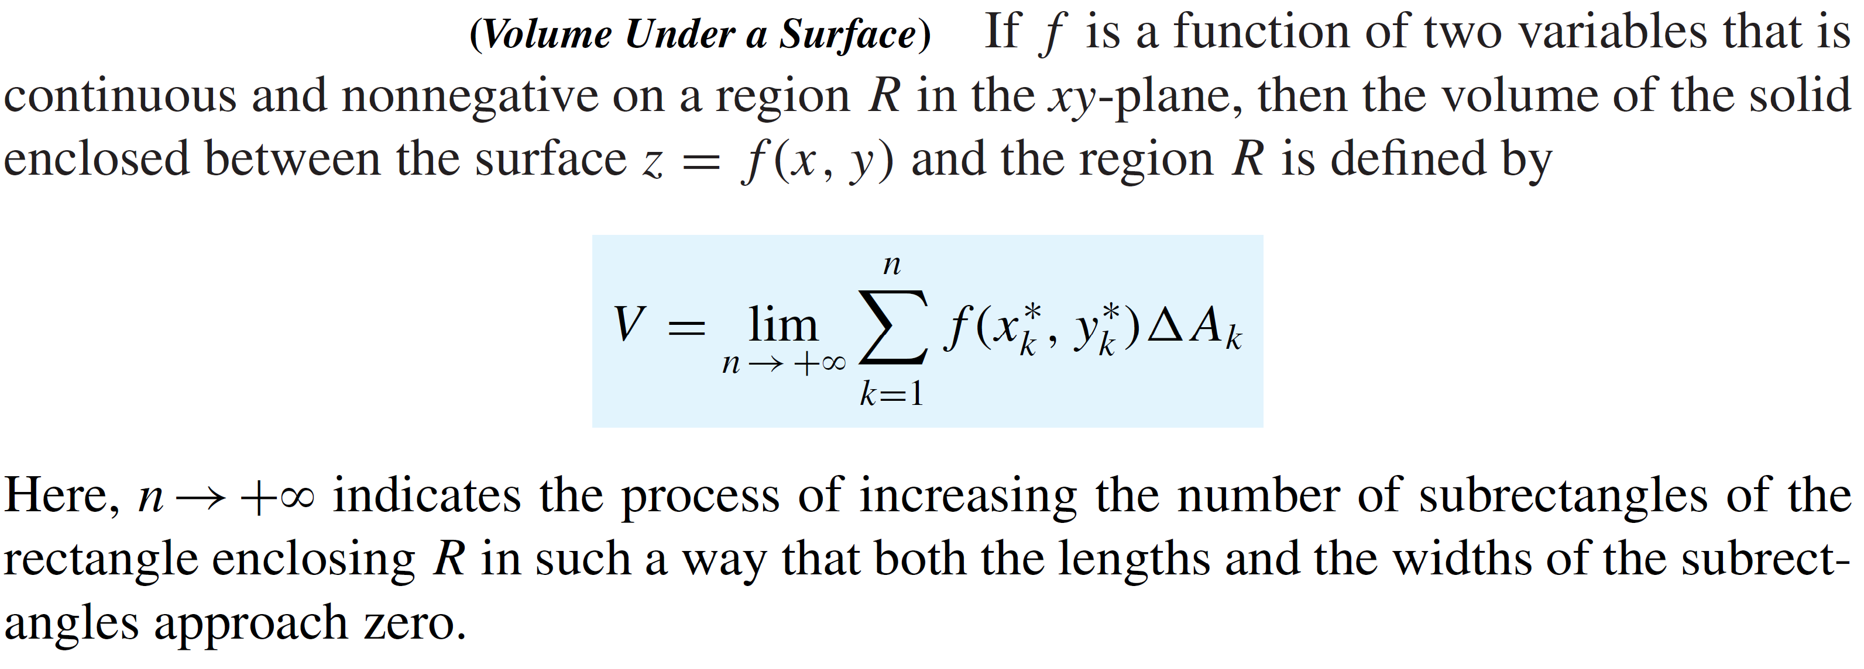
Introduction to double integrals
Definition:
Definition: The sum in the limit is called the Riemann sum.

Slide 15
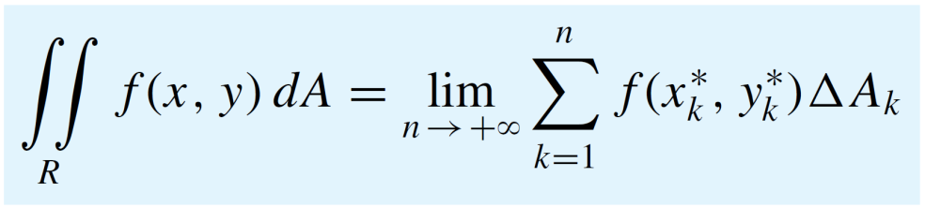
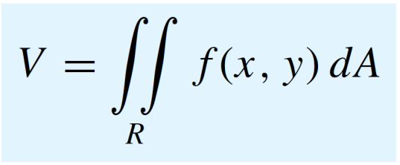
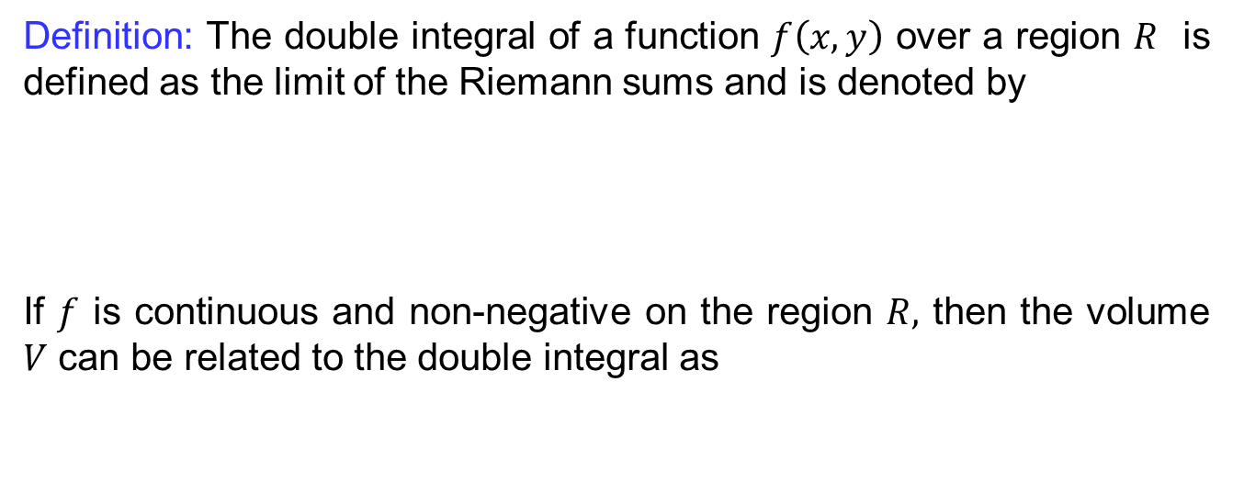
Introduction to double integrals
Definition: The double integral of a function$f\left(x,y\right)$ over a region$R$isdefined as the limit of the Riemann sums and isdenoted by
If $f$iscontinuous and non-negative on the region$R,$then the volume $V$canberelated to the double integral as

Slide 16
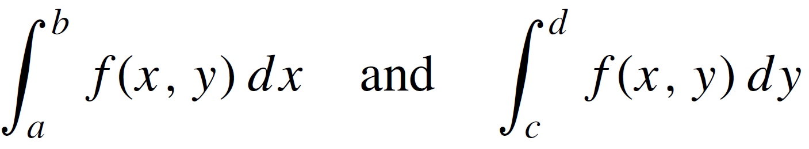
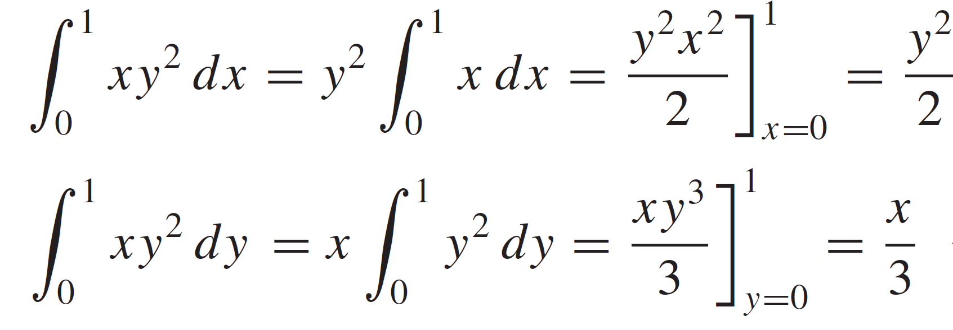
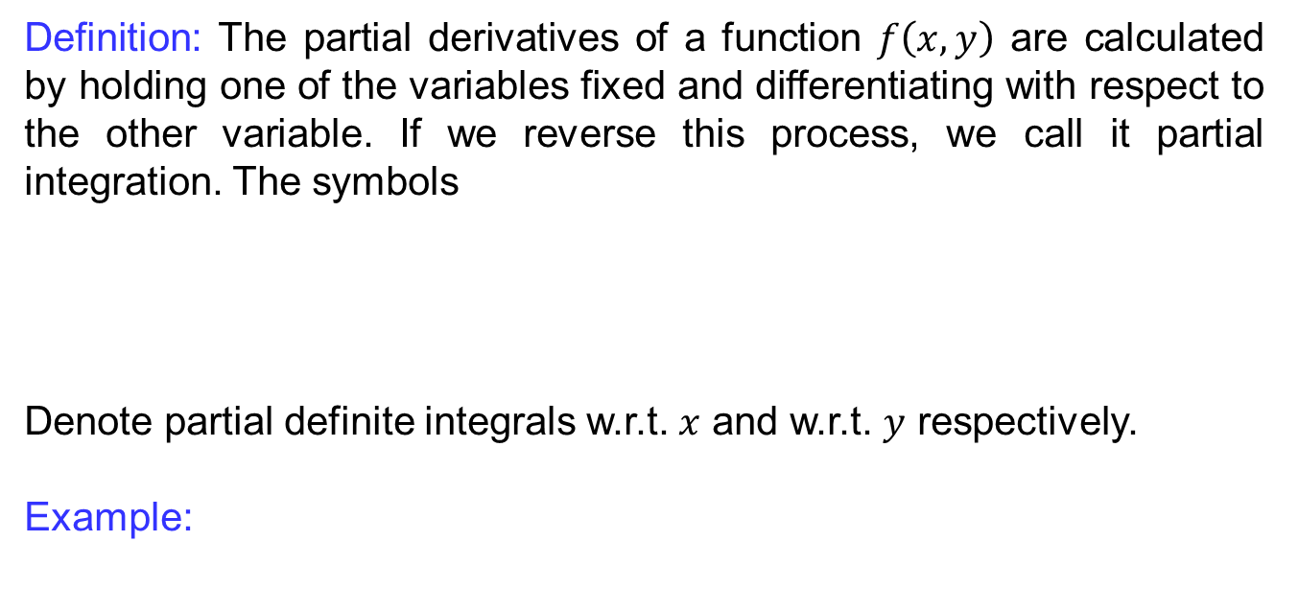
Introduction to double integrals
Definition: The partial derivatives of a function$f\left(x,y\right)$ are calculated by holding one of the variables fixed and differentiatingwith respect to the other variable. If we reverse thisprocess, we call it partial integration. The symbols
Denote partial definiteintegrals w.r.t. $x$ and w.r.t. $y$respectively.
Example:

Slide 17
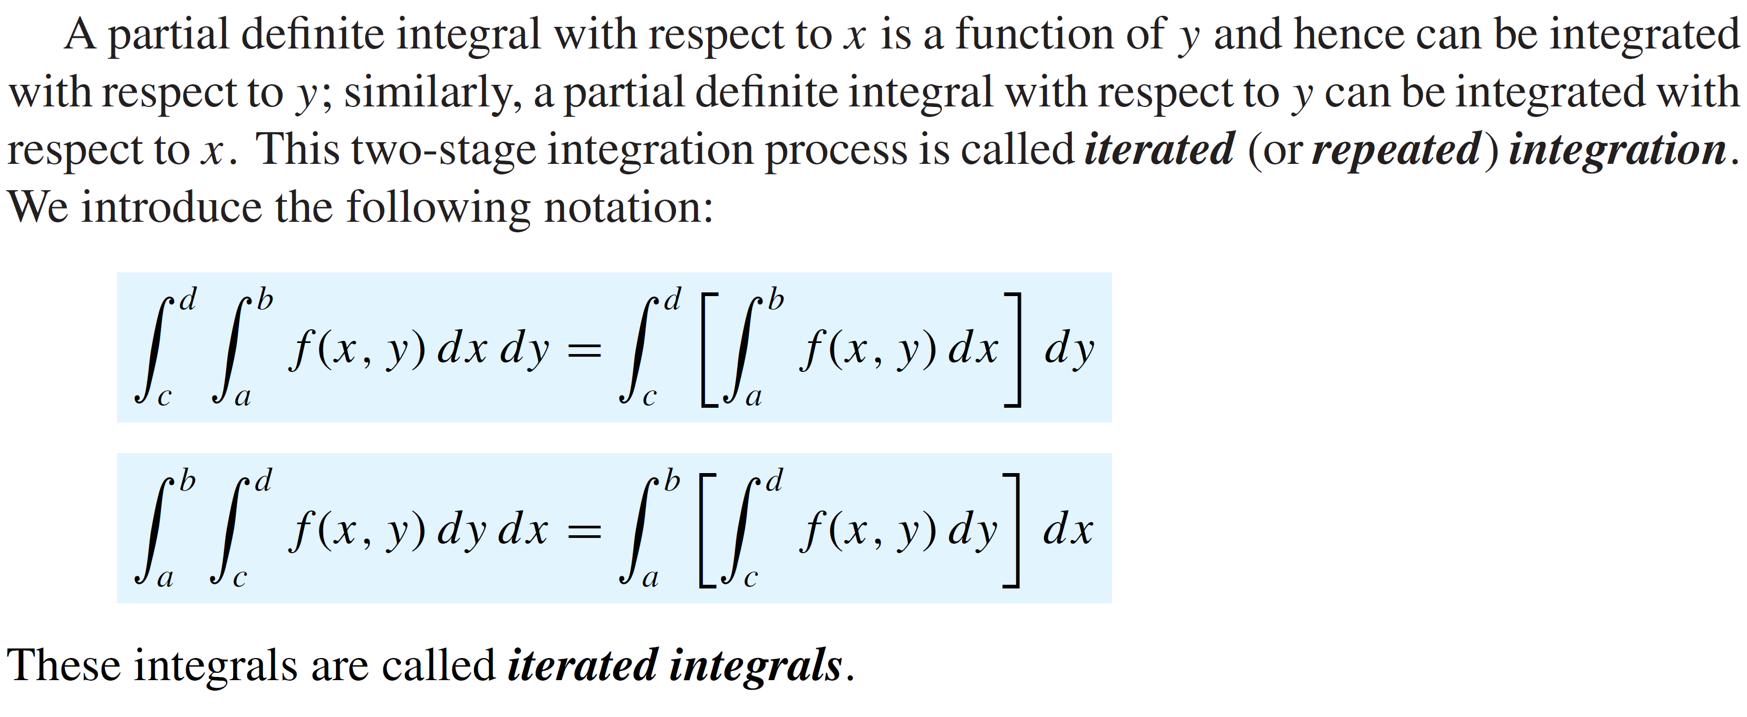
Iterated integrals
Definition:

Slide 18
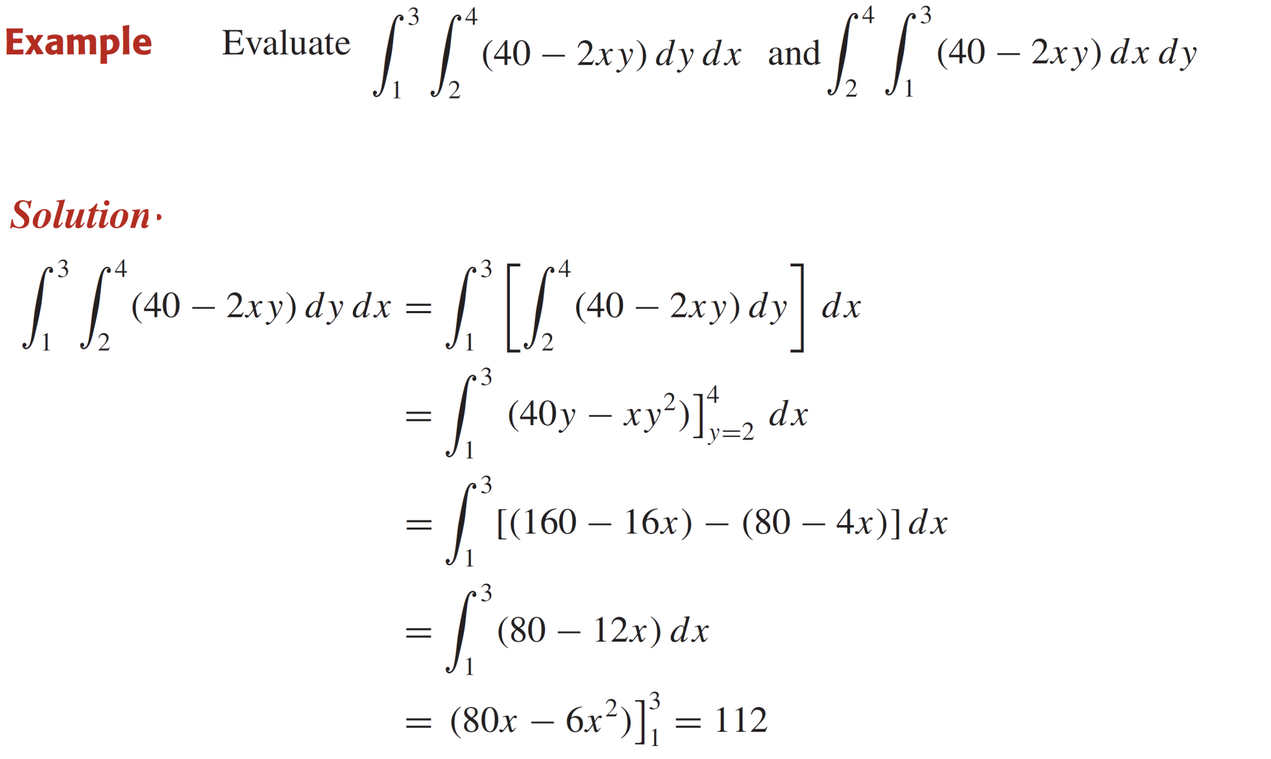
Iterated integrals

Slide 19
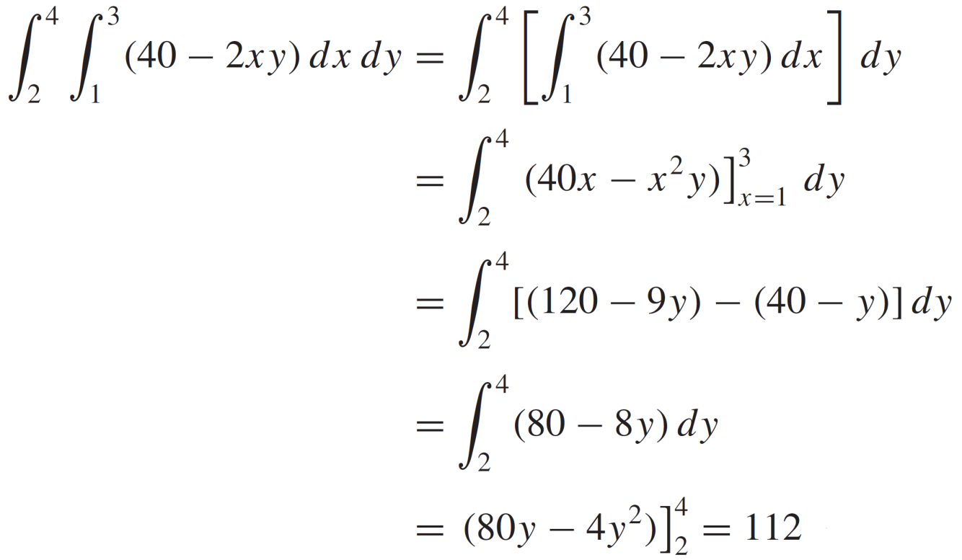
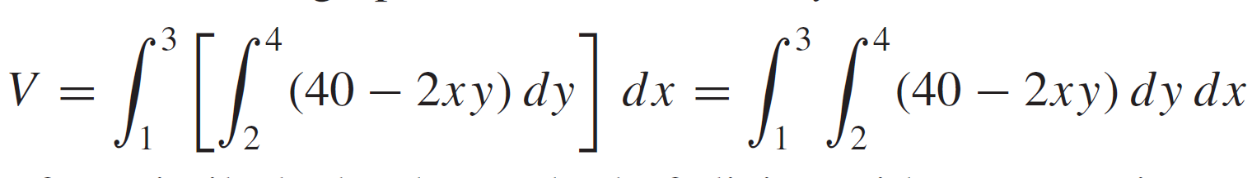
Iterated integrals

Slide 20
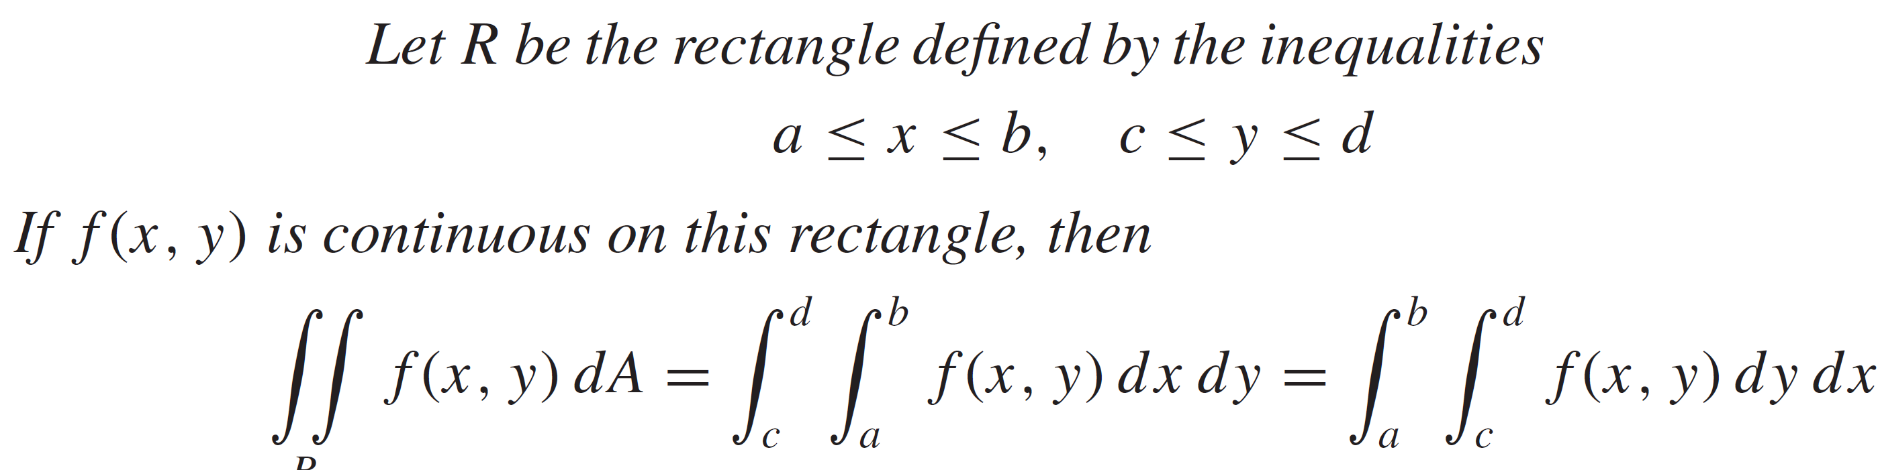
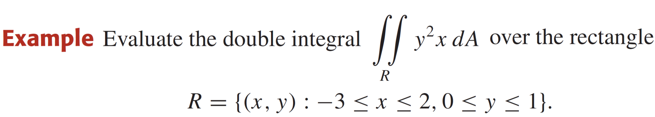
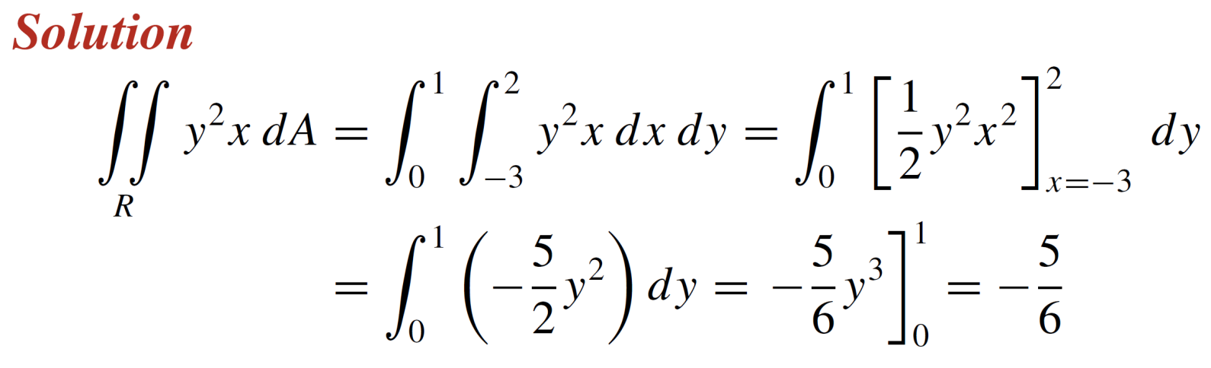
Theorem of Fubini
Theorem:

Slide 21
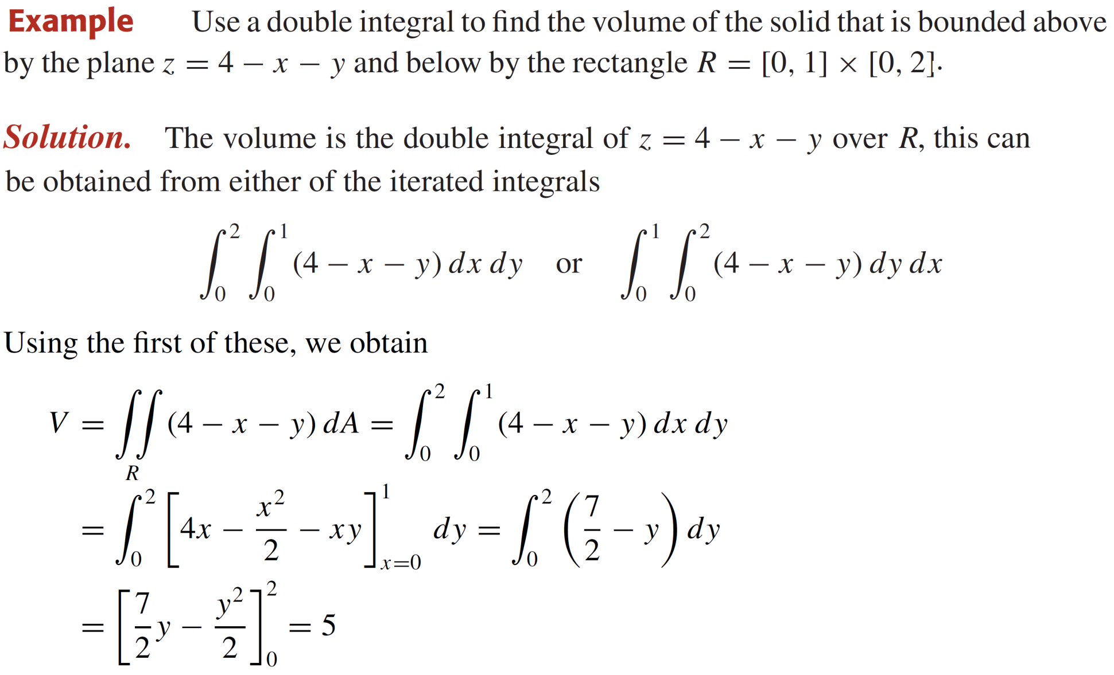
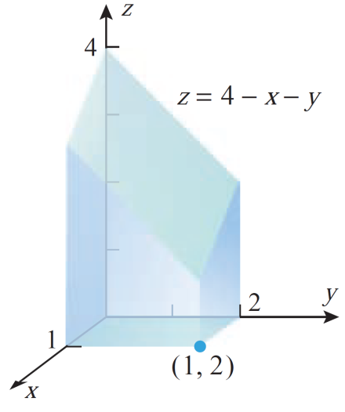
Theorem of Fubini

Slide 22
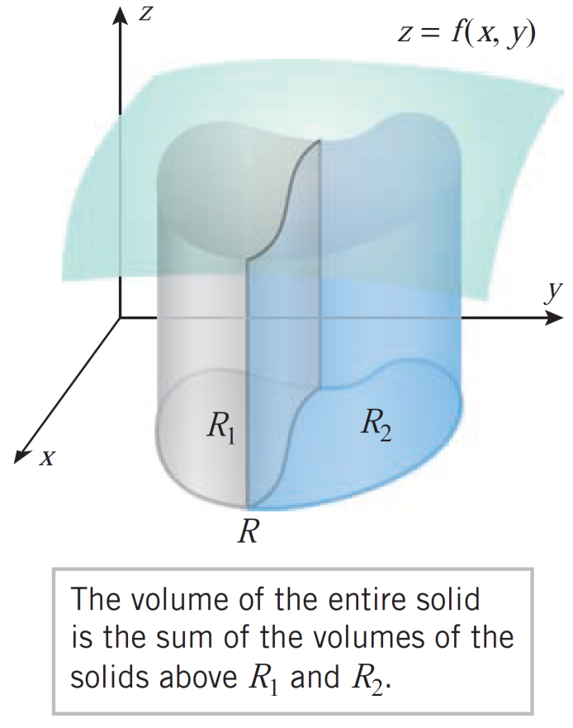
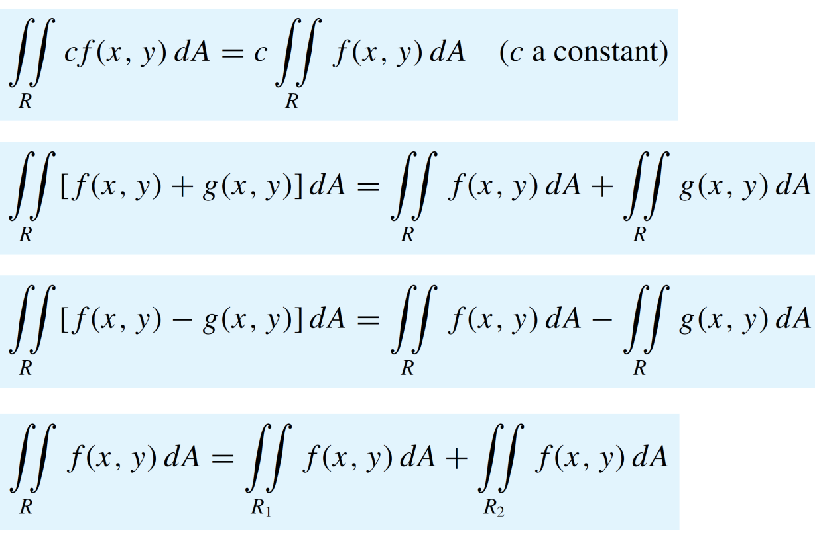
Properties of double integrals
Theorem:

Slide 23
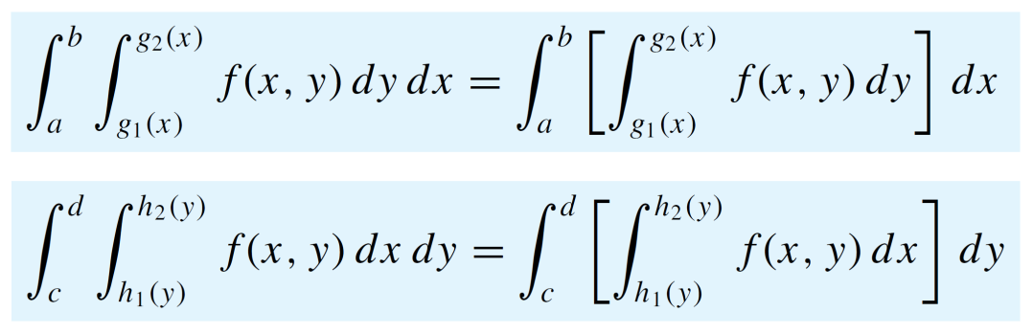
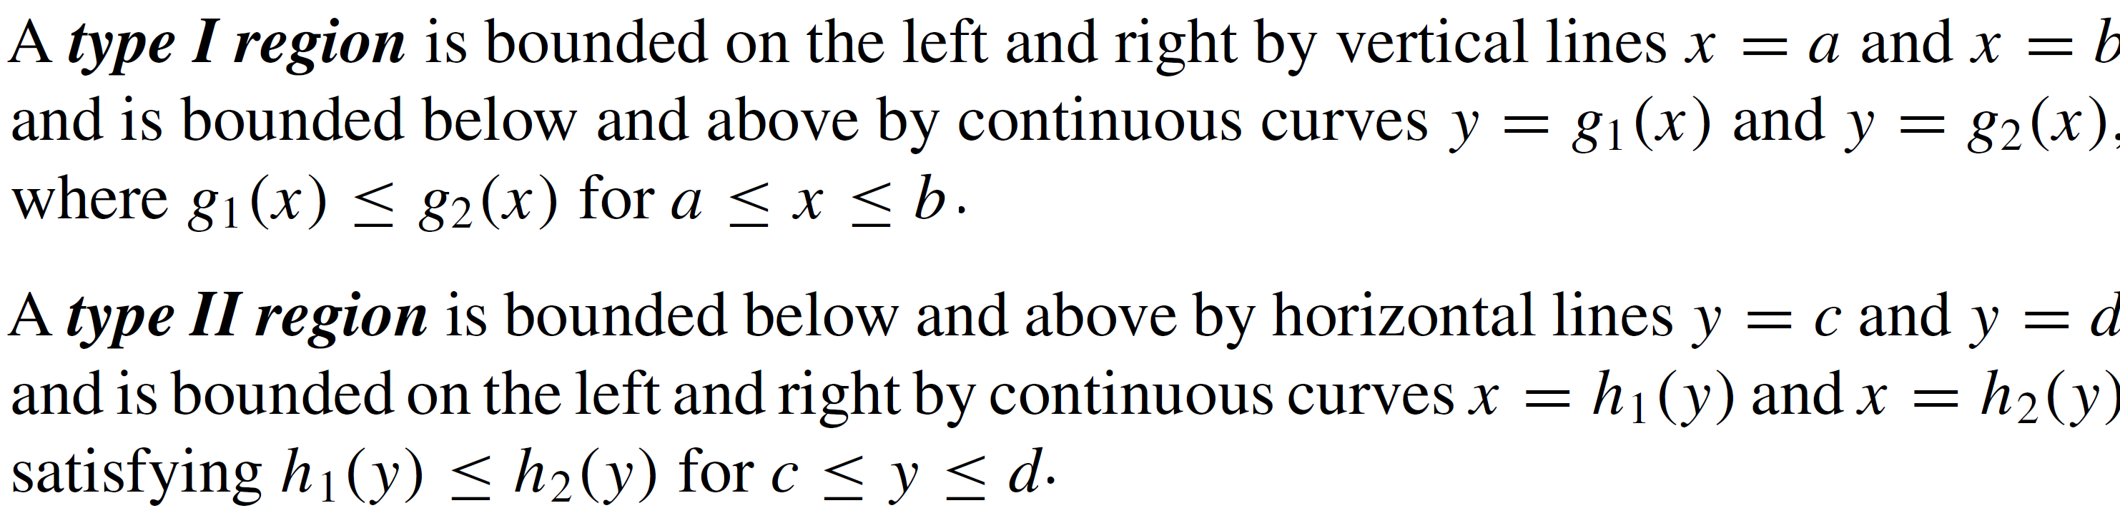
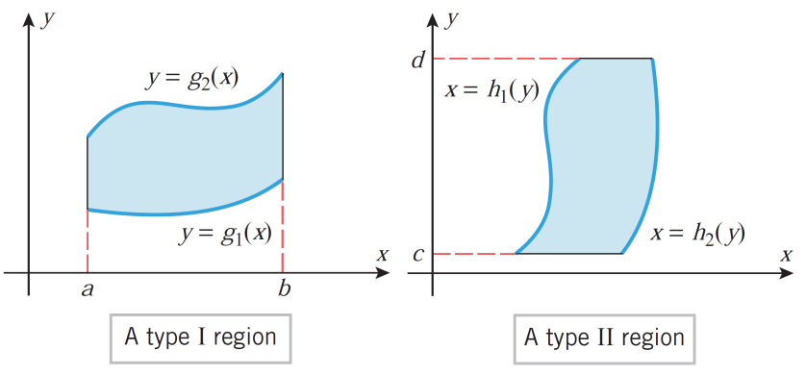
Integrals on non-rectangular regions
Definition:

Slide 24
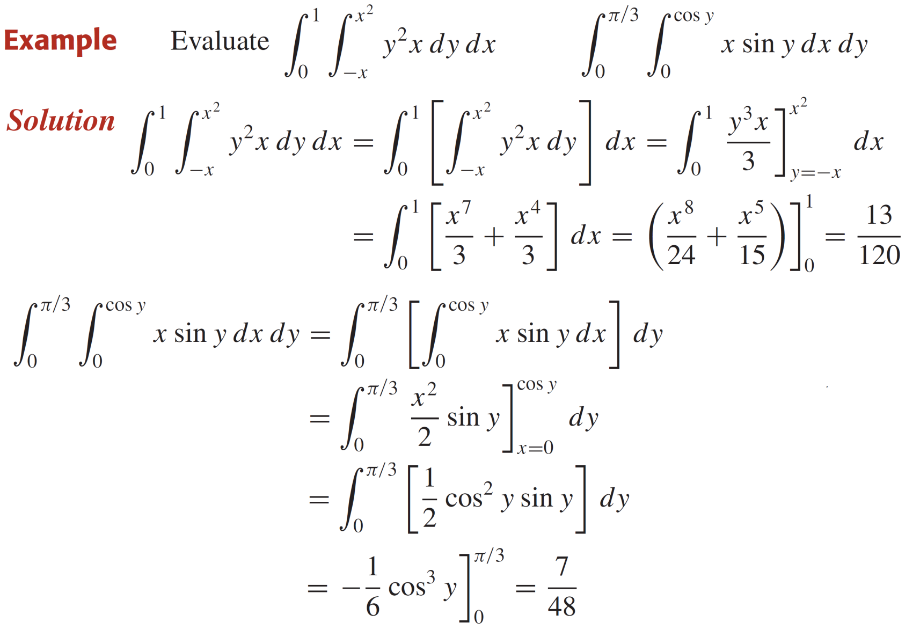
Integrals on non rectangular regions

Slide 25
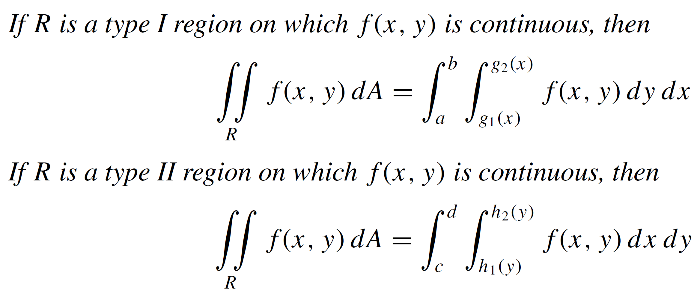
Properties of double integrals
Theorem:

Slide 26
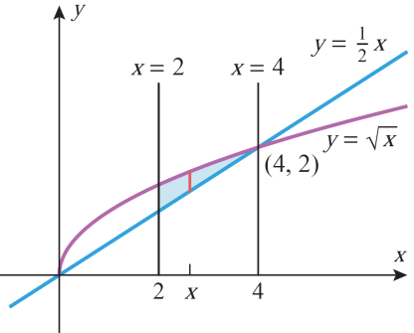
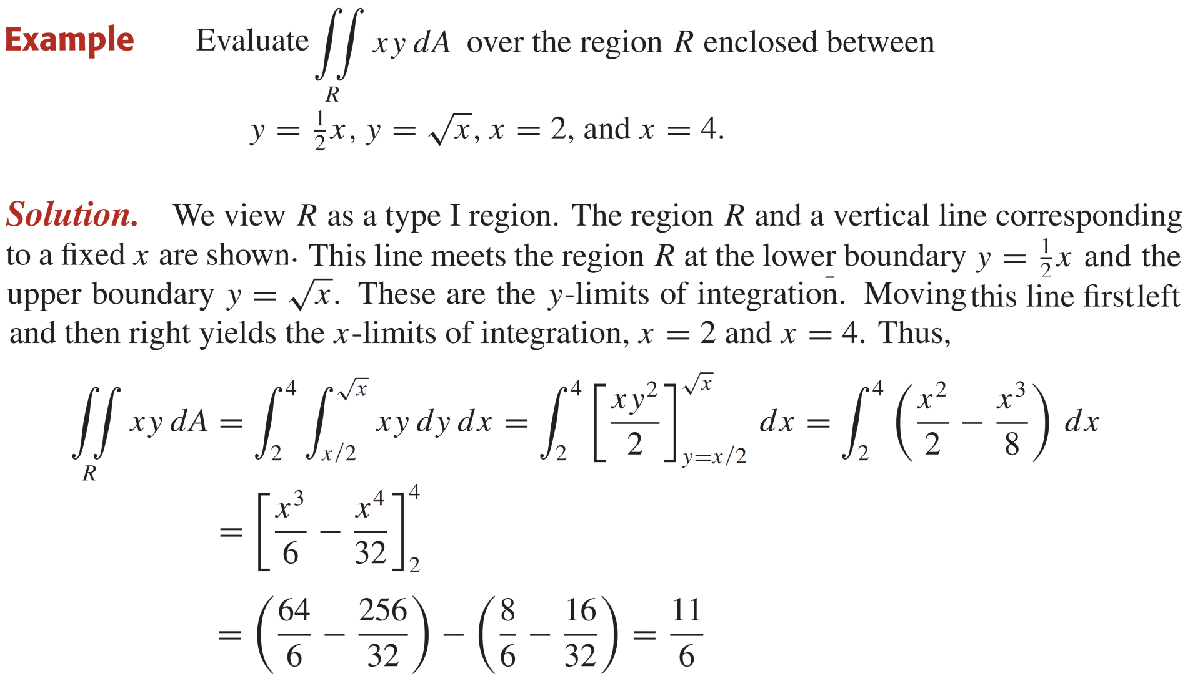
Properties of double integrals

Slide 27
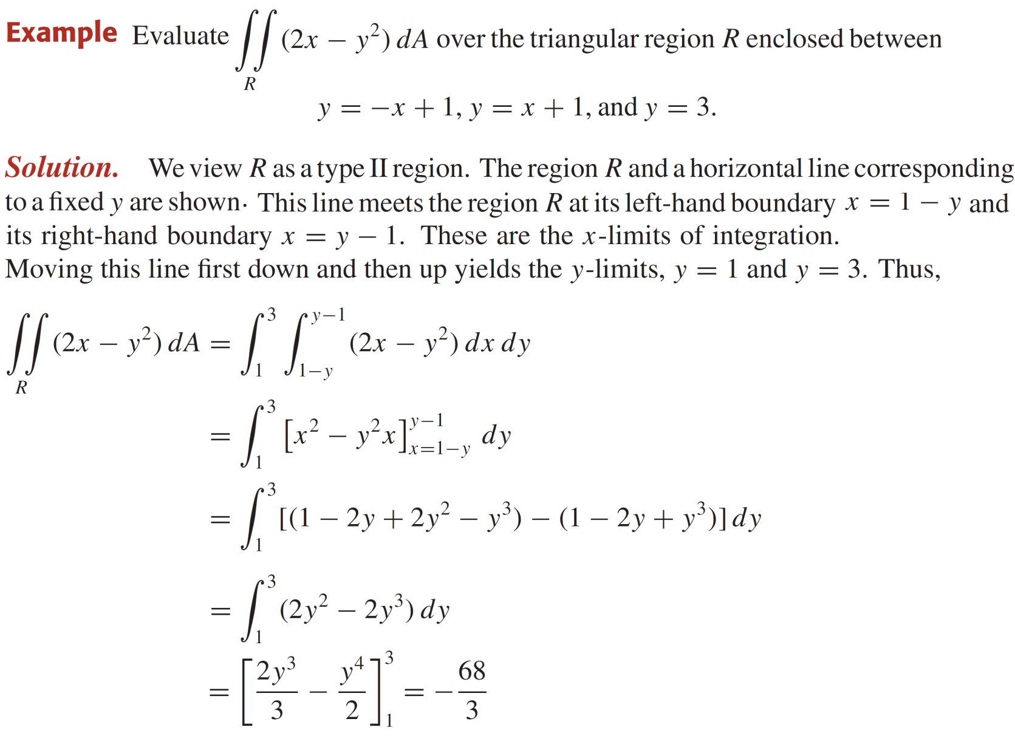
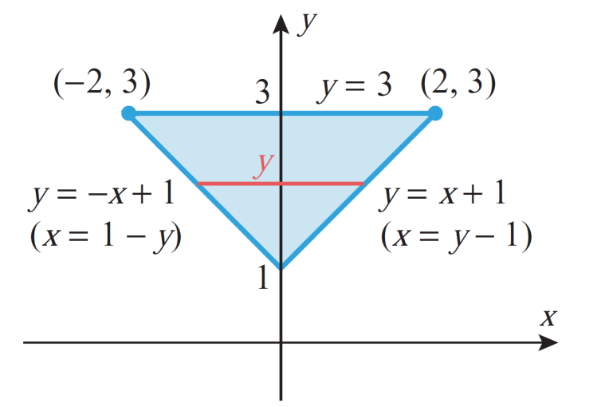
Properties of double integrals

Slide 28


Properties of double integrals

Slide 29


Properties of double integrals

Slide 30


Reversing the order of integration

Slide 31


Reversing the order of integration

Slide 32
Lecture Summary
    Introduction to double integrals
    Iterated integrals
    Theorem of Fubini
    Properties of double integrals
    Integrals over non-rectangular regions
    Reversing the order of integration

