Slide 1
(MTH 250)
Calculus
Lecture 24

Slide 2
Previous Lecture’s Summary
    Multivariable functions
    Limits along smooth curves
    Limits of multivariable functions
    Continuity of multivariable functions
    Partial differentiation

Slide 3
Today’s Lecture
    Recalls
    Differentiability of multivariable functions
    Differentials & linear approximations
    Chain rules for partial differentiation
    Implicit differentiation
    Extrema of multivariable functions

Slide 4
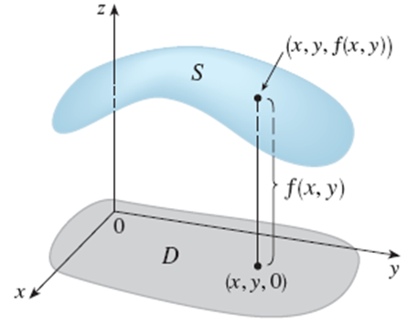
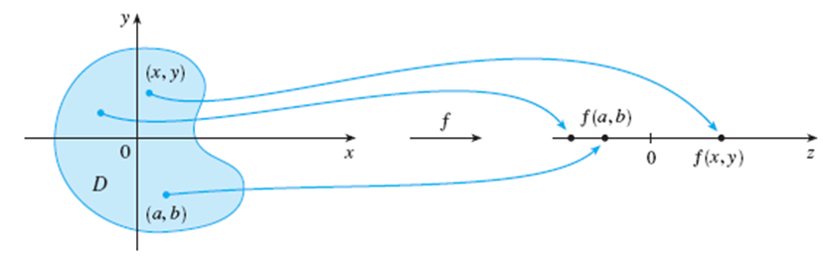
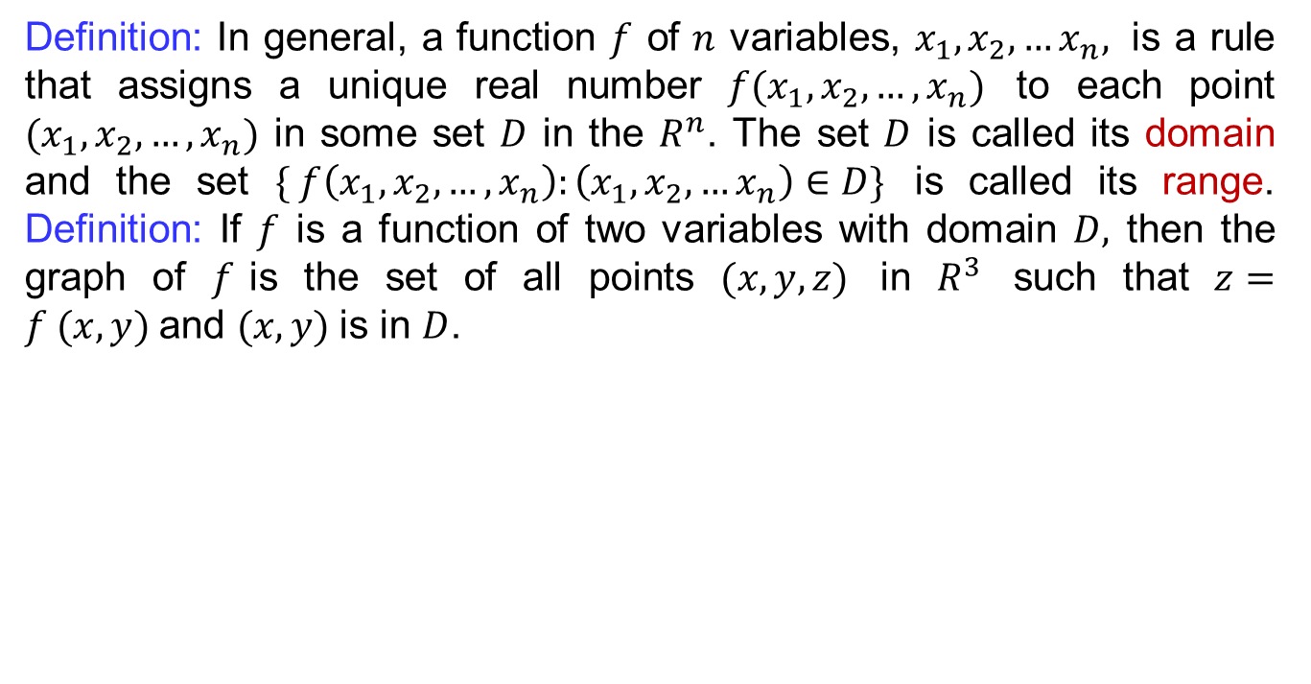
Recalls
Definition: In general, a function$f$ of $n$variables, $x_{1}, x_{2},…x_{n},$ is a rule that assigns a unique real number $f(x_{1},x_{2}, …, x_{n})$ to each point $(x_{1},x_{2}, …,x_{n})$ in some set $D$ in the $R^{n}$. The set $D$ is called its domain and the set $\{ f\left(x_{1},x_{2},…,x_{n}\right):\left(x_{1},x_{2},…x_{n}\right)∈D\}$ is called its range. Definition: If $f$ is a function of two variables with domain $D,$ then the graph of $f$is the set of all points $(x, y, z)$ in $R^{3}$ such that $z=f (x, y)$and $(x, y)$is in $D$.

Slide 5
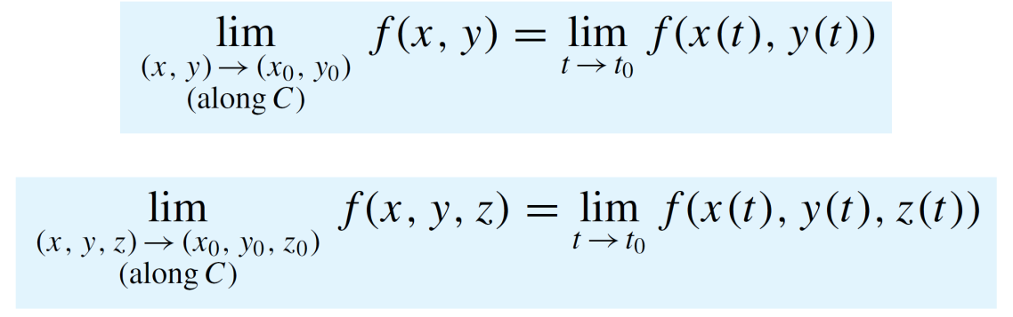
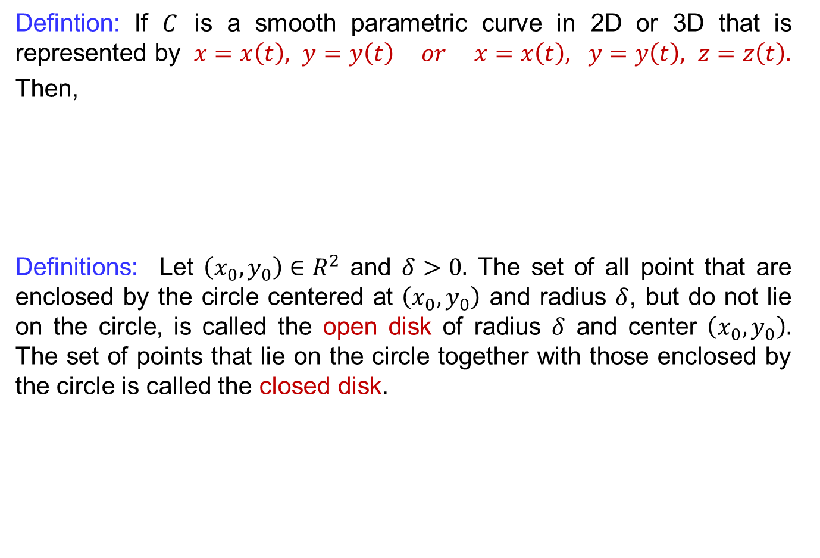
Recalls
Defintion: If $C$ is a smooth parametric curve in 2D or 3D that is represented by $x=x\left(t\right), y=y\left(t\right) or x=x\left(t\right), y=y\left(t\right), z=z\left(t\right).$
Then,
Definitions: Let $\left(x_{0},y_{0}\right)∈R^{2}$ and $δ>0.$ The set of all point that are enclosed by the circle centered at $\left(x_{0},y_{0}\right)$ and radius $δ$, but do not lie on the circle, is called the open disk of radius $δ$ and center $\left(x_{0},y_{0}\right).$ The set of points that lie on the circle together with those enclosed by the circle is called the closed disk.

Slide 6
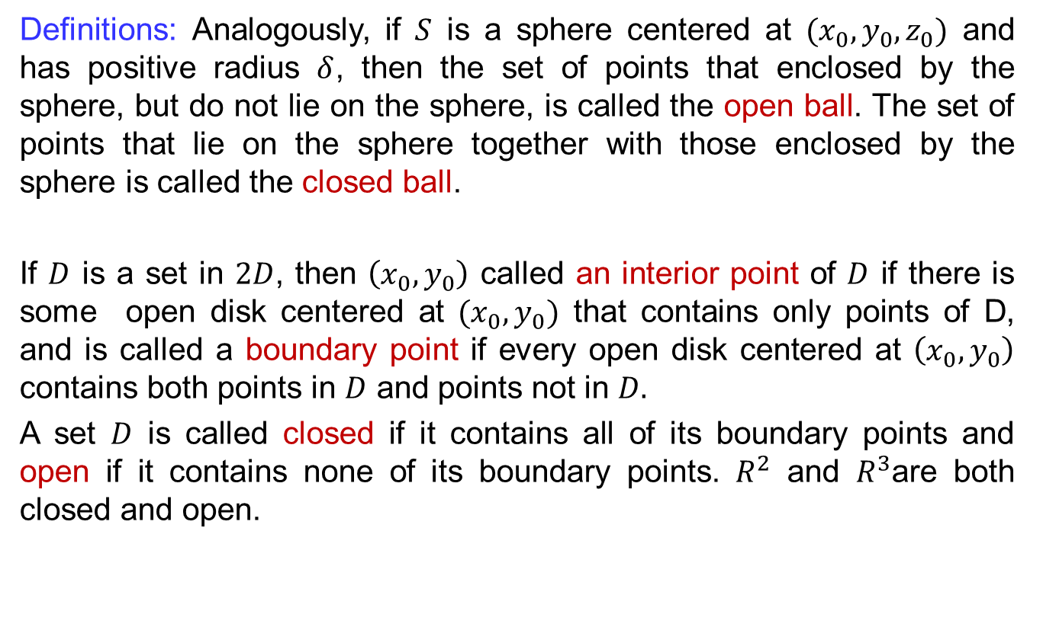
Recalls
Definitions: Analogously, if $S$ is a sphere centered at $(x_{0},y_{0},z_{0})$ and has positive radius $δ$, then the set of points that enclosed by the sphere, but do not lie on the sphere, is called the open ball. The set of points that lie on the sphere together with those enclosed by the sphere is called the closed ball.
If $D$ is a set in $2D$, then $\left(x_{0},y_{0}\right)$ called an interior point of $D$ if there is some open disk centered at $(x_{0},y_{0})$ that contains only points of D, and is called a boundary point if every open disk centered at $\left(x_{0},y_{0}\right)$ contains both points in $D$ and points not in $D.$
A set $D$ is called closed if it contains all of its boundary points and open if it contains none of its boundary points. $R^{2}$ and $R^{3}$are both closed and open.

Slide 7
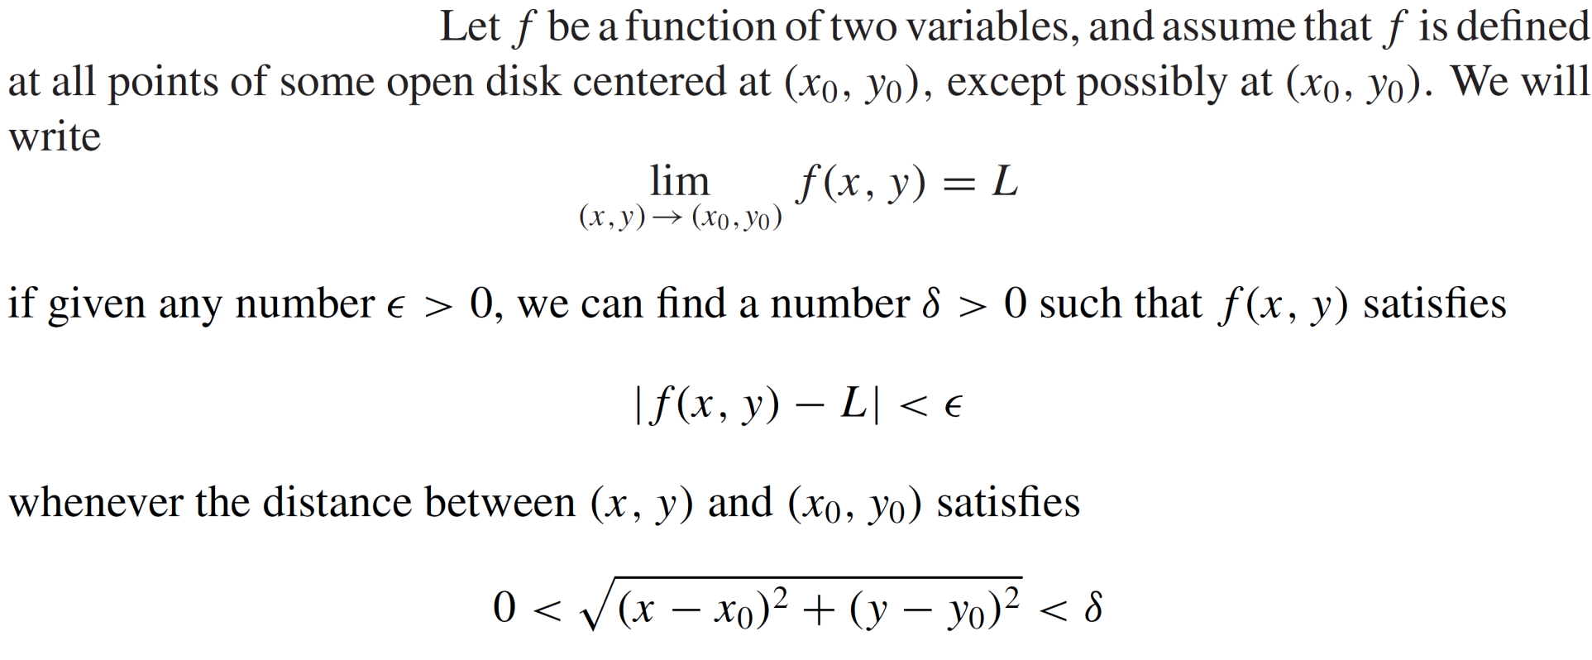
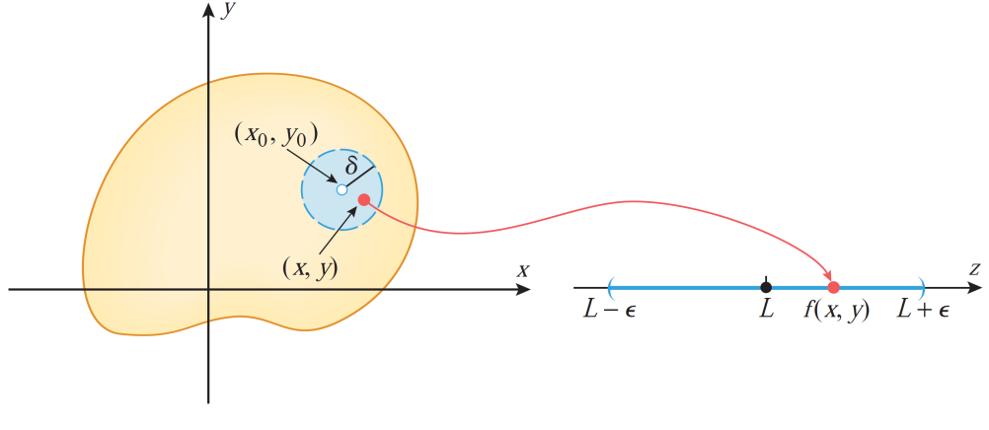
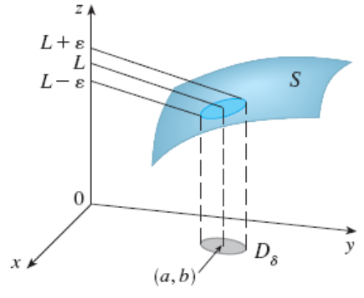
Recalls
Definition (formal):

Slide 8
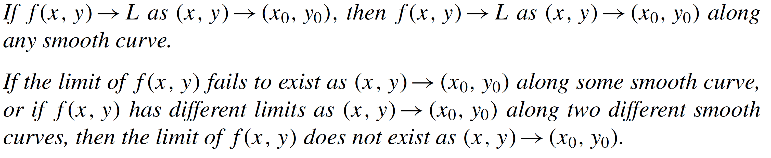
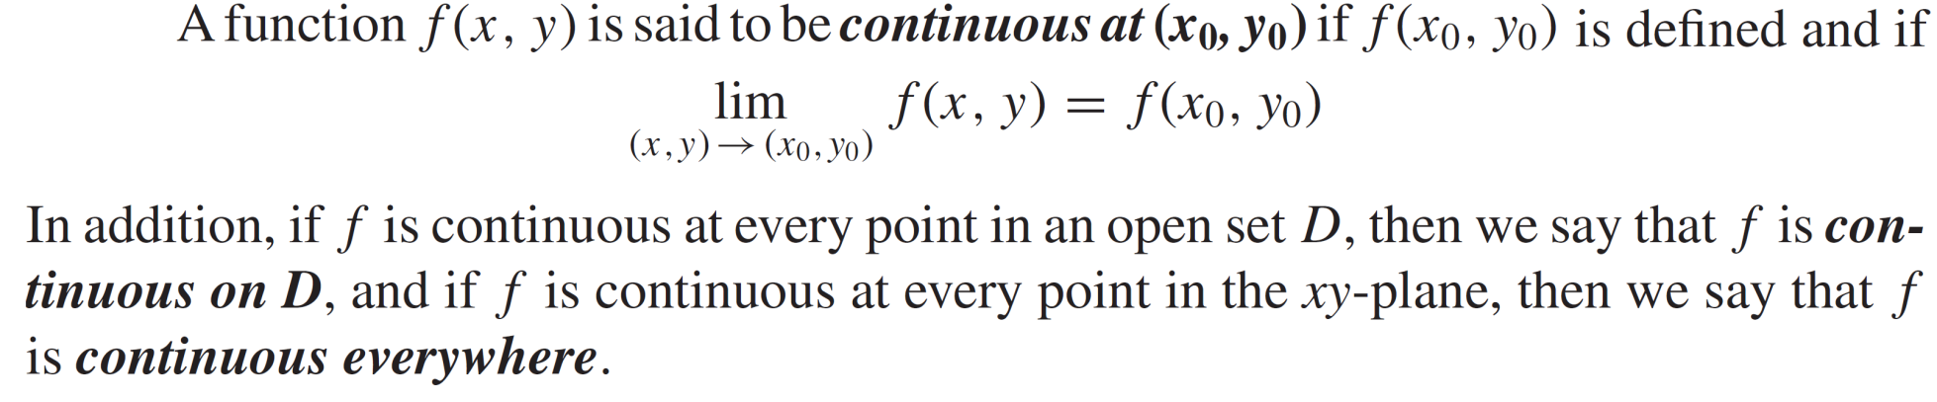
Recalls
Theorem:
Def:

Slide 9
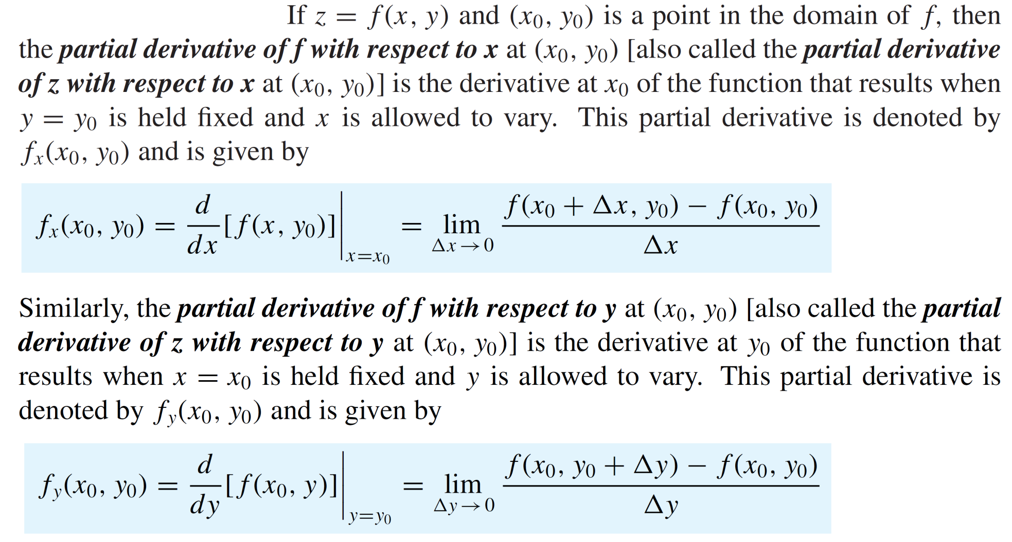
Recalls

Slide 10
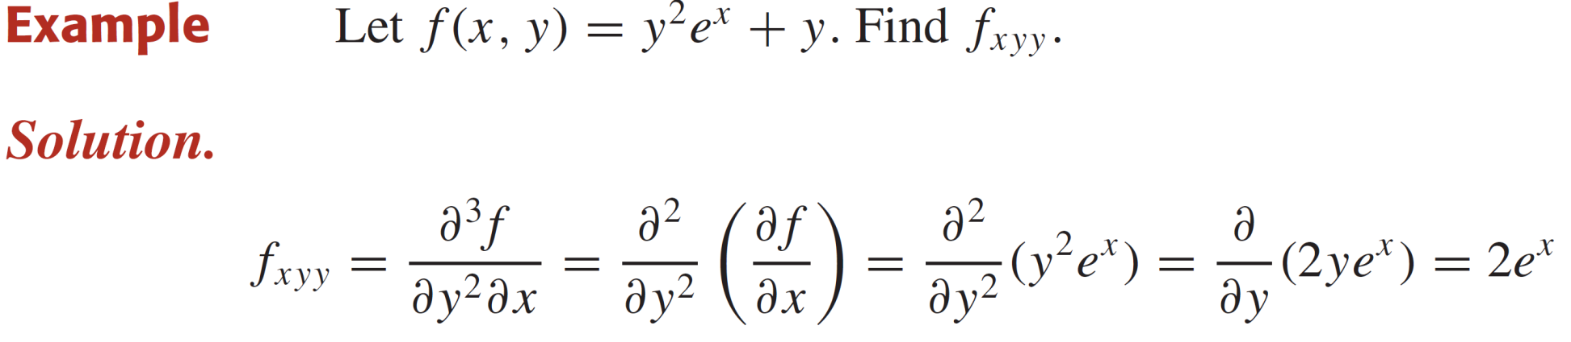
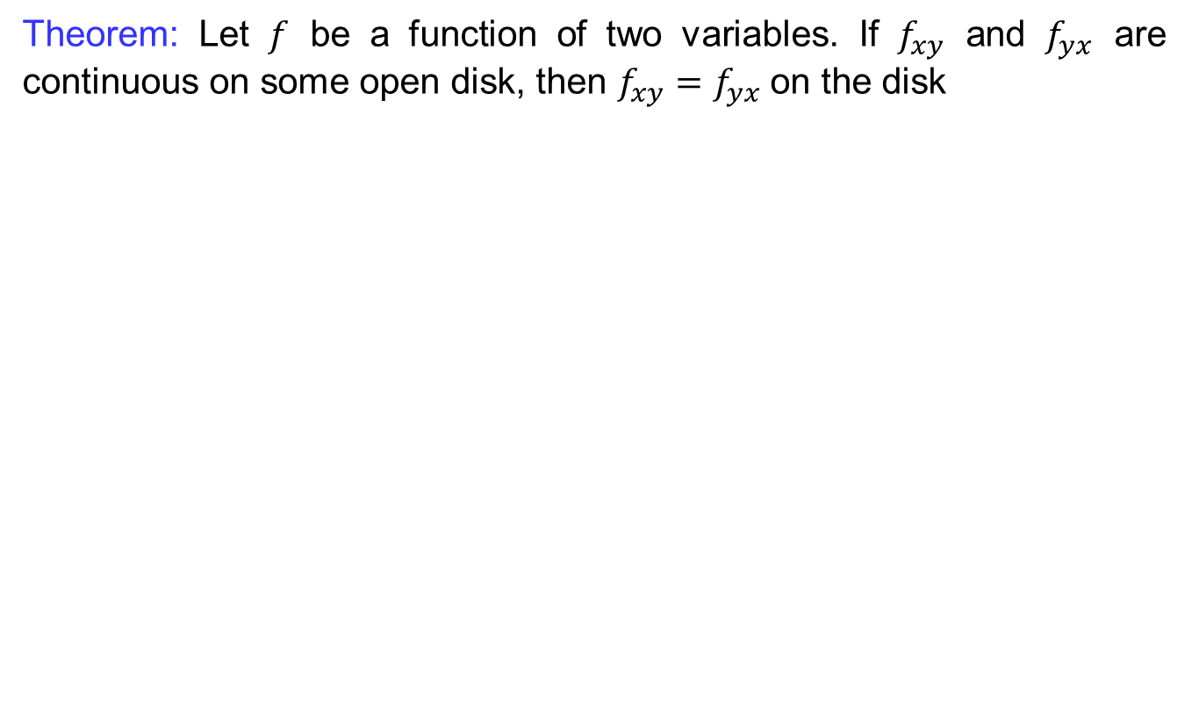
Recalls
Theorem: Let $f$ be a function of two variables. If $f_{xy}$ and $f_{yx}$ are continuous on some open disk, then $f_{xy}=f_{yx}$ on the disk

Slide 11
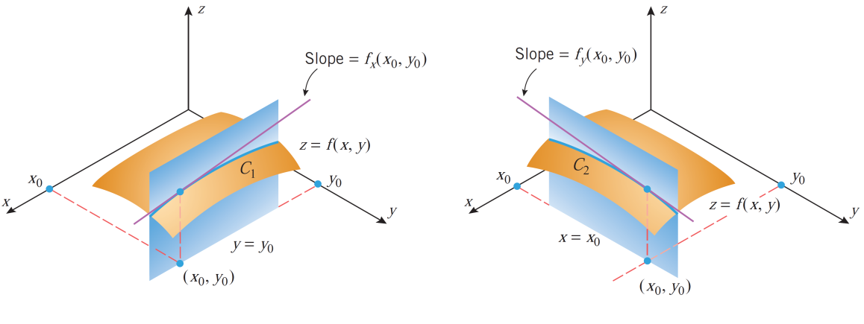
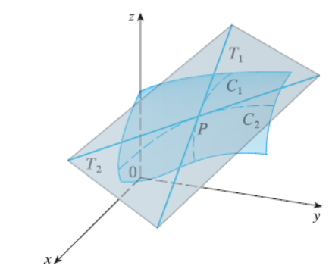
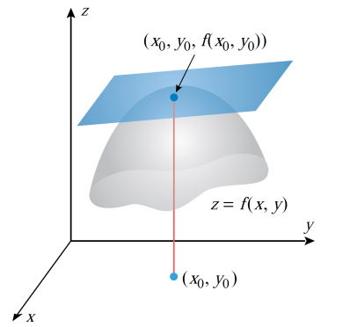
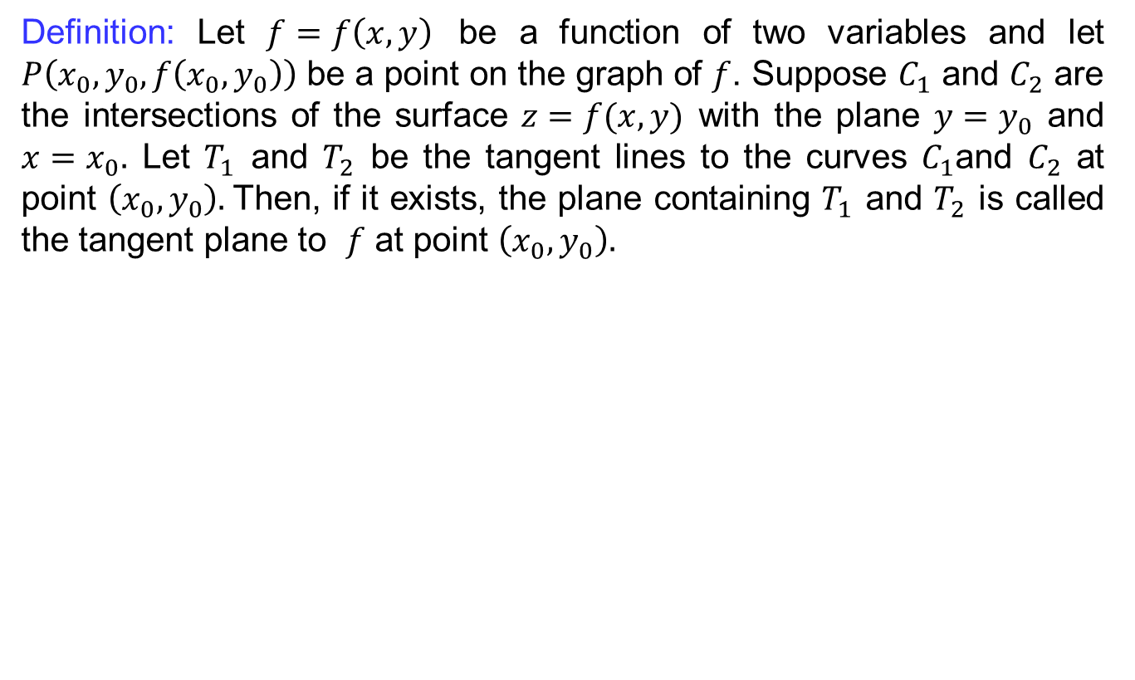
Tangent plane
Definition: Let $f=f\left(x,y\right)$ be a function of two variables and let $P\left(x_{0},y_{0},f\left(x_{0},y_{0}\right)\right)$ be a point on the graph of $f$. Suppose $C_{1}$and $C_{2}$are the intersections of the surface $z=f(x,y)$ with the plane $y=y_{0}$ and $x=x_{0}.$ Let $T_{1}$ and $T_{2}$be the tangent lines to the curves$C_{1}$and $C_{2}$at point $\left(x_{0},y_{0}\right).$Then, if itexists, the plane containing$T_{1}$ and $T_{2}$iscalled the tangent plane to $f$at point $\left(x_{0},y_{0}\right).$

Slide 12
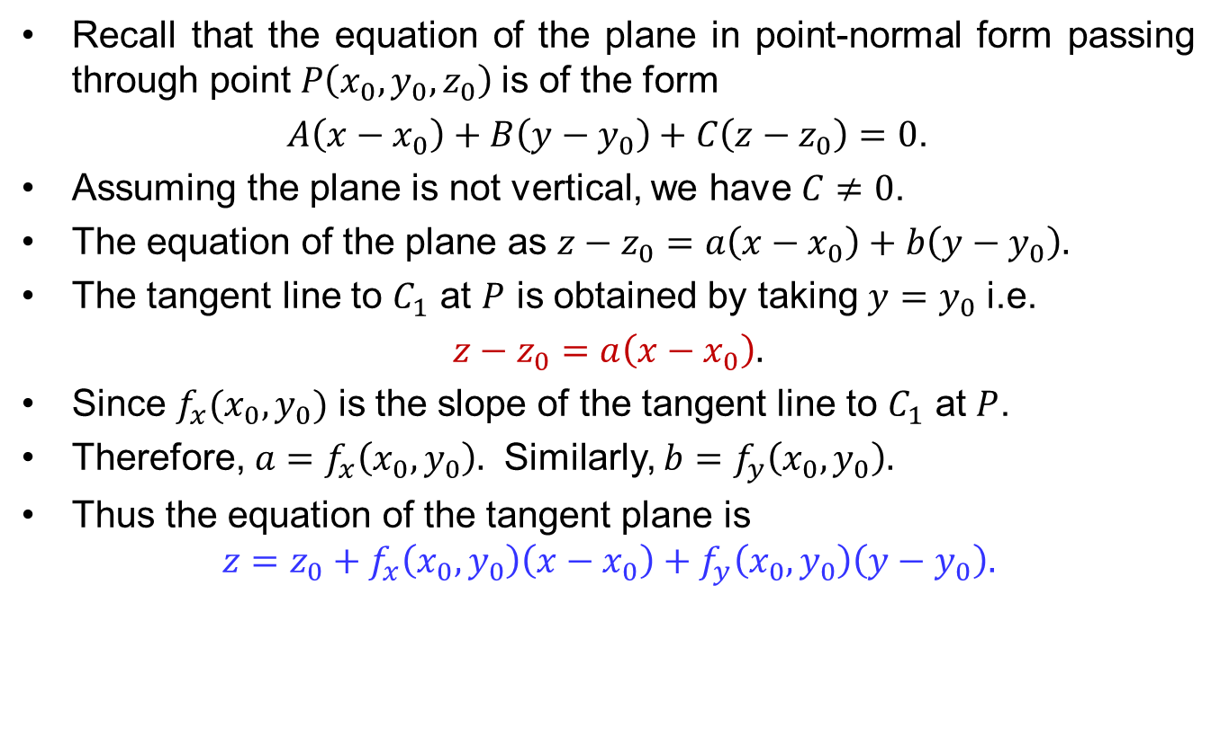
Tangent plane
Recall that the equation of the plane in point-normal form passing through point $P\left(x_{0},y_{0},z_{0}\right)$is of the form
$A\left(x−x_{0}\right)+B\left(y−y_{0}\right)+C\left(z−z_{0}\right)=0$.
Assuming the plane is not vertical, we have $C≠0$.
The equation of the plane as $z−z_{0}=a\left(x−x_{0}\right)+b\left(y−y_{0}\right).$
The tangent line to $C_{1}$at$P$isobtained by taking$y=y_{0}$ i.e.
$z−z_{0}=a\left(x−x_{0}\right).$
Since$f_{x}(x_{0},y_{0})$ is the slope of the tangent line to $C_{1}$ at $P$.
Therefore, $a=f_{x}\left(x_{0},y_{0}\right).$ Similarly, $b=f_{y}\left(x_{0},y_{0}\right).$
Thus the equation of the tangent plane is
$$z={z_{0}+f}_{x}\left(x_{0},y_{0}\right)\left(x−x_{0}\right)+f_{y}\left(x_{0},y_{0}\right)\left(y−y_{0}\right).$$

Slide 13
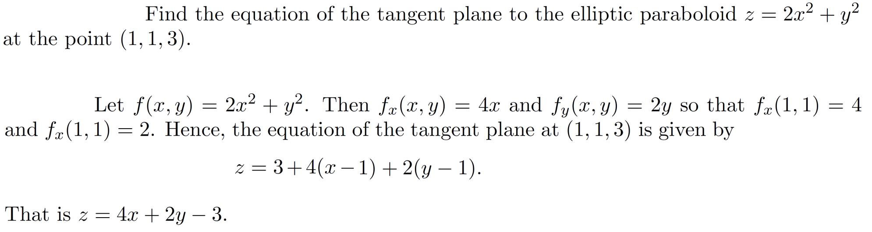
Tangent plane
Example:
Sol.

Slide 14
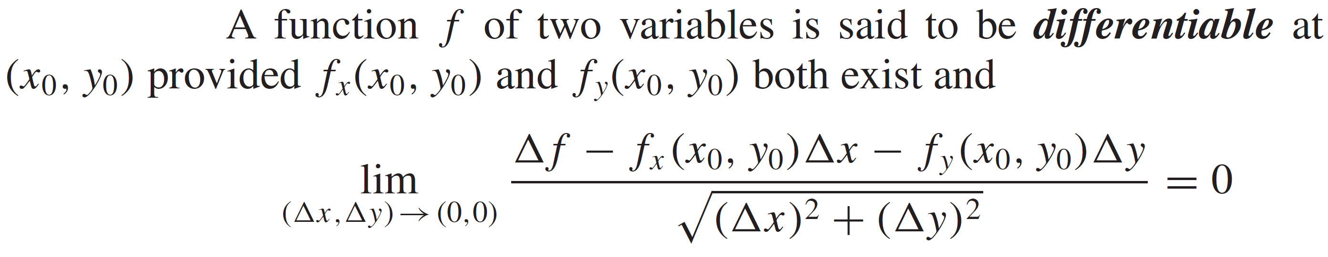
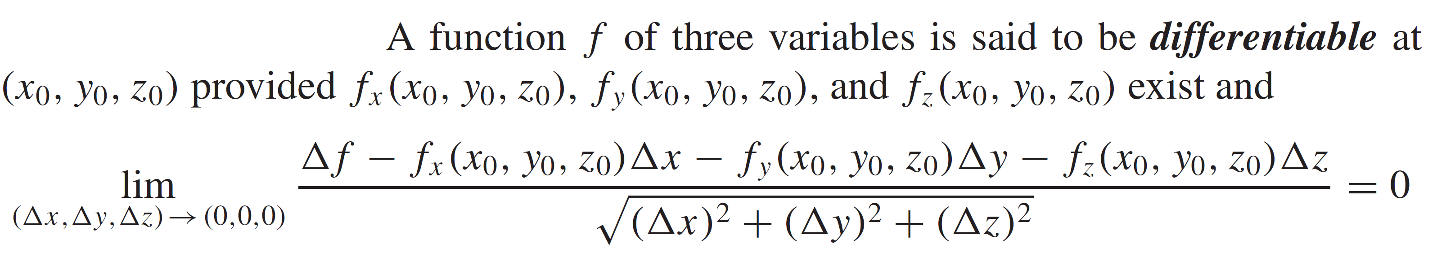
Differentiability of multivariable functions
Definition:
Definition:

Slide 15
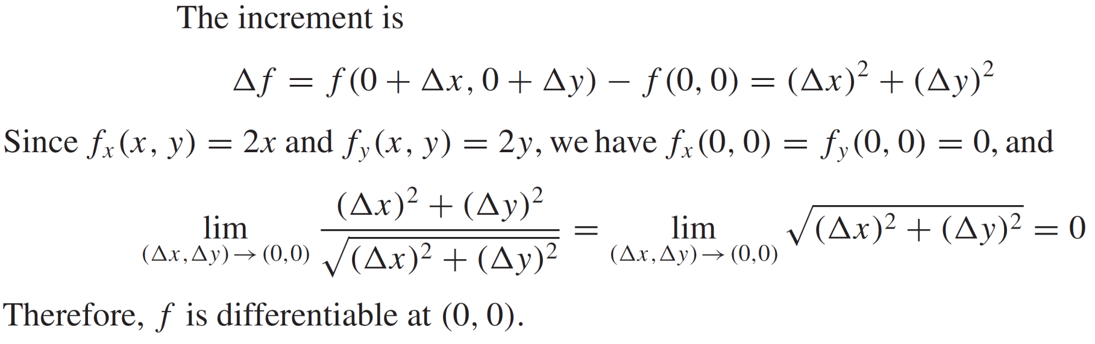
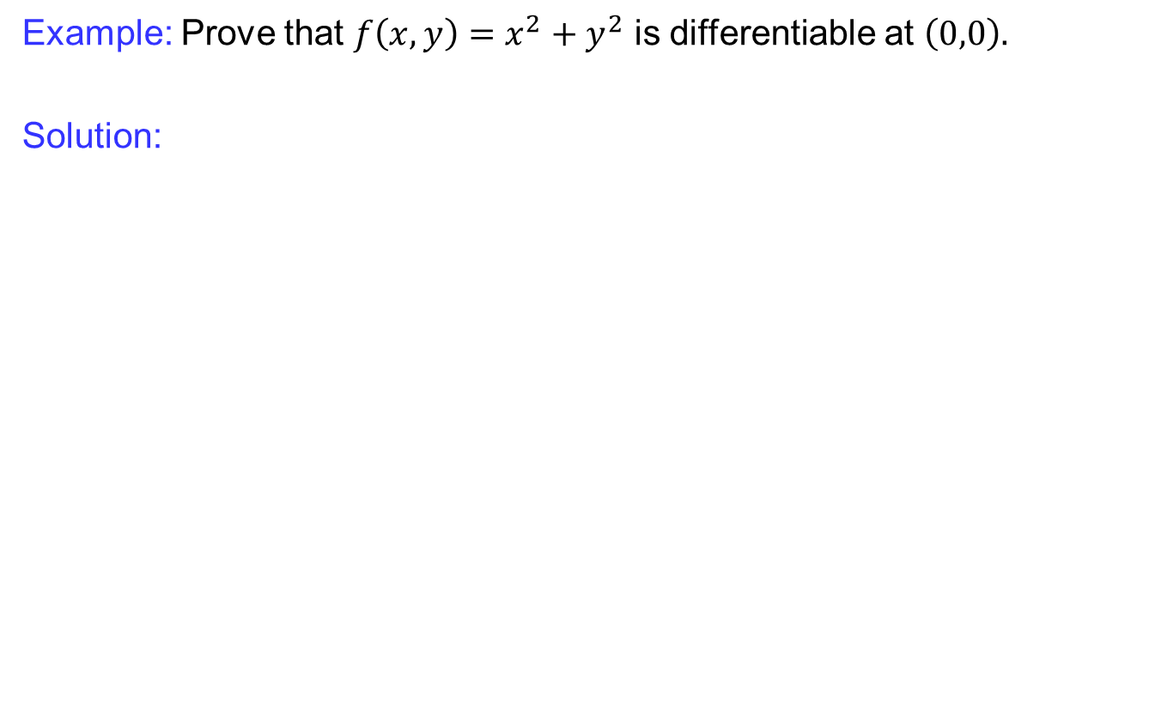
Differentiability of multivariable functions
Example: Prove that $f\left(x,y\right)=x^{2}+y^{2}$ is differentiable at $\left(0,0\right).$
Solution:

Slide 16
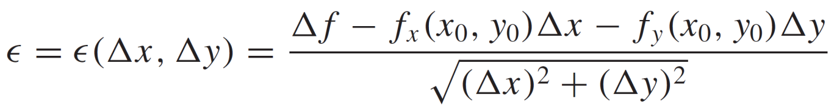
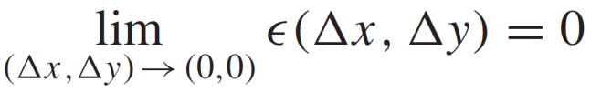
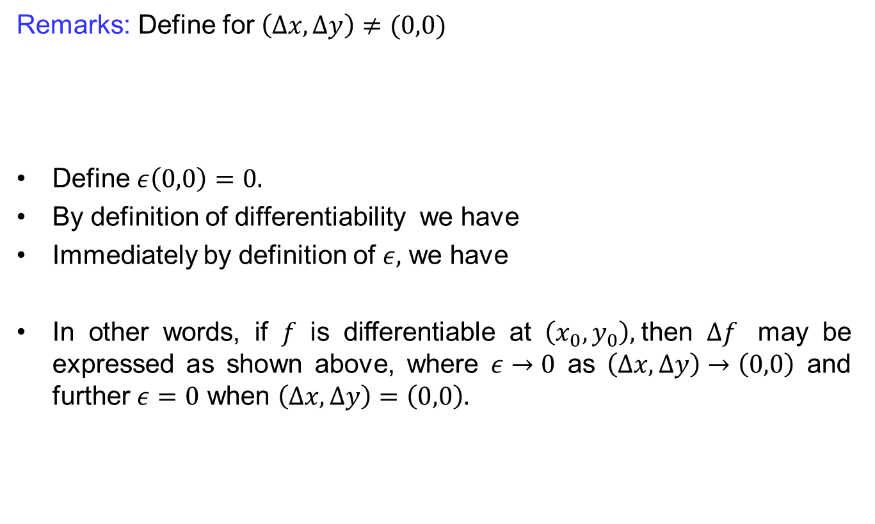
Differentiability of multivariable functions
Remarks: Define for $\left(∆x, ∆y\right)≠(0,0)$
Define $ε\left(0,0\right)=0.$
By definition of differentiability we have
Immediately by definition of $ε,$ we have
In other words, if $f$ is differentiable at $\left(x_{0},y_{0}\right),$then $∆f$ may be expressed as shown above, where $ε→0$ as $\left(∆x, ∆y\right)→\left(0,0\right)$ and further $ε=0$ when $\left(∆x,∆y\right)=\left(0,0\right).$

Slide 17
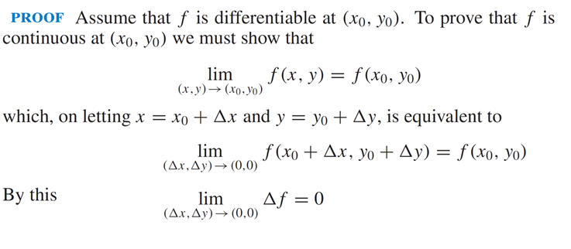
Differentiability of multivariable functions
Theorem: If a function is differentiable at a point, then it is continuous at that point.

Slide 18
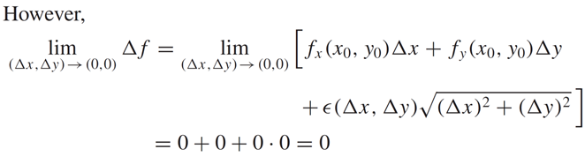
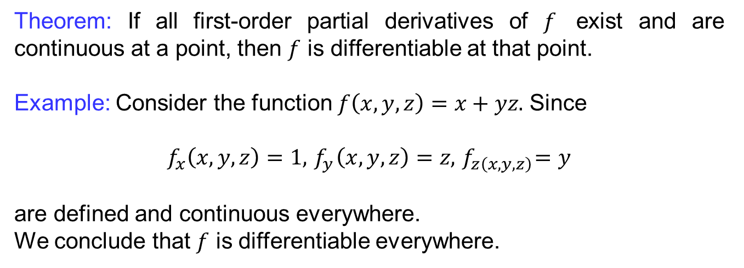
Differentiability of multivariable functions
Theorem: If all first-order partial derivatives of $f$ exist and are continuous at a point, then $f$ is differentiable at that point.
Example: Consider the function $f\left(x,y,z\right)=x+yz.$ Since
$$f_{x}\left(x,y,z\right)=1, { f}_{y}\left(x,y,z\right)=z, { f}_{z\left(x,y,z\right)}=y$$
are defined and continuous everywhere.
We conclude that $f$ is differentiable everywhere.

Slide 19
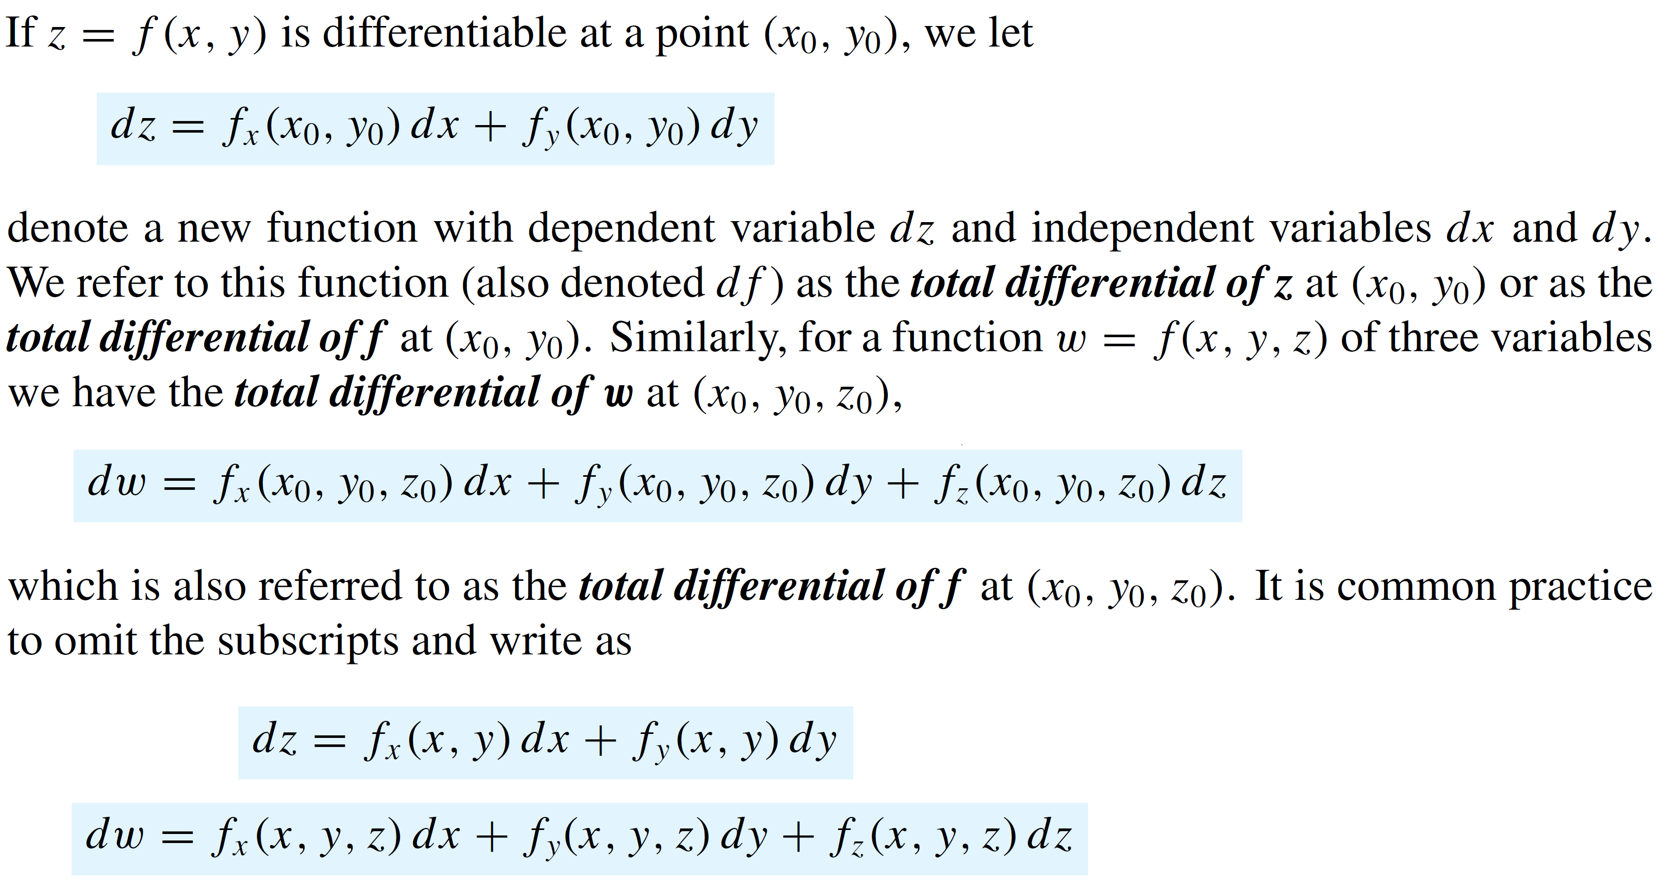
Differentials & linear approximations
Definition (Total differential):

Slide 20
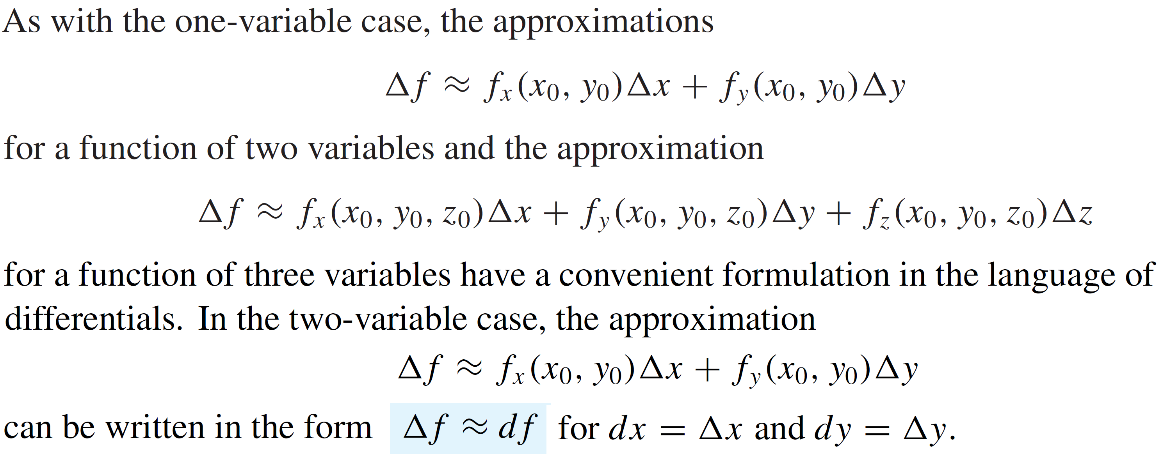
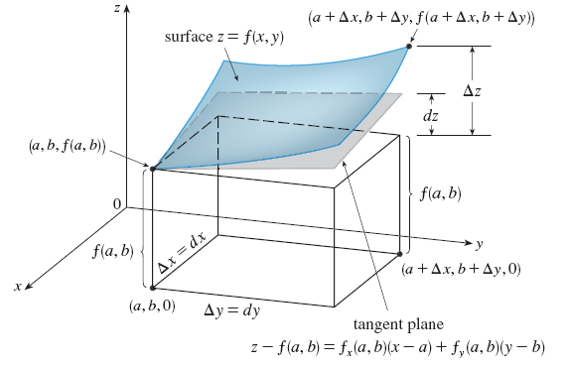
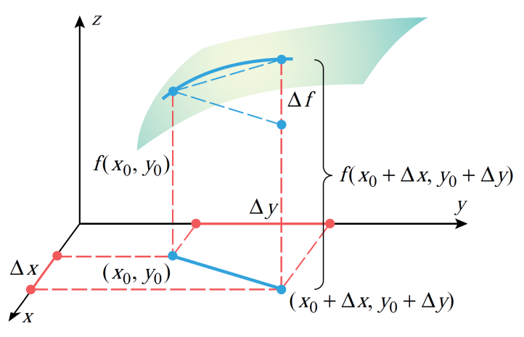
Differentials & linear approximations

Slide 21
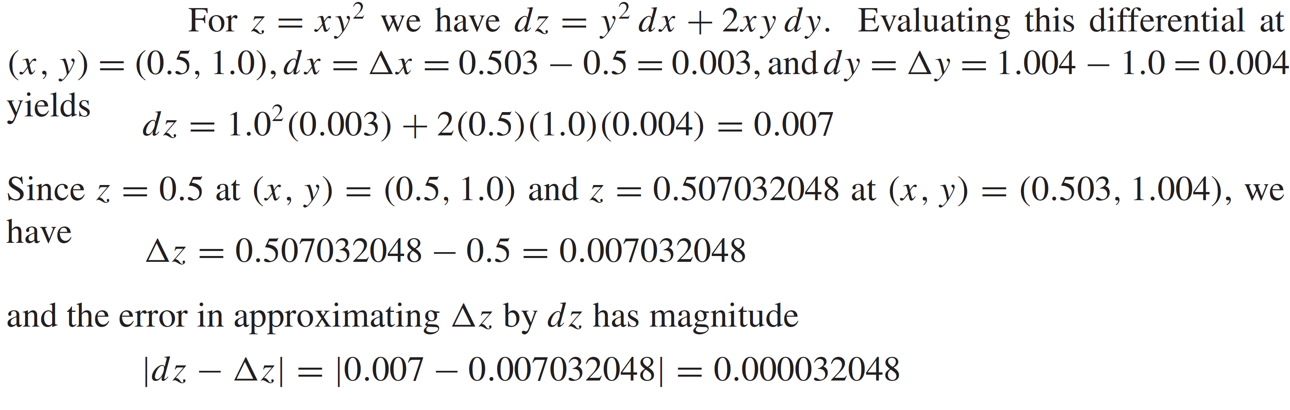
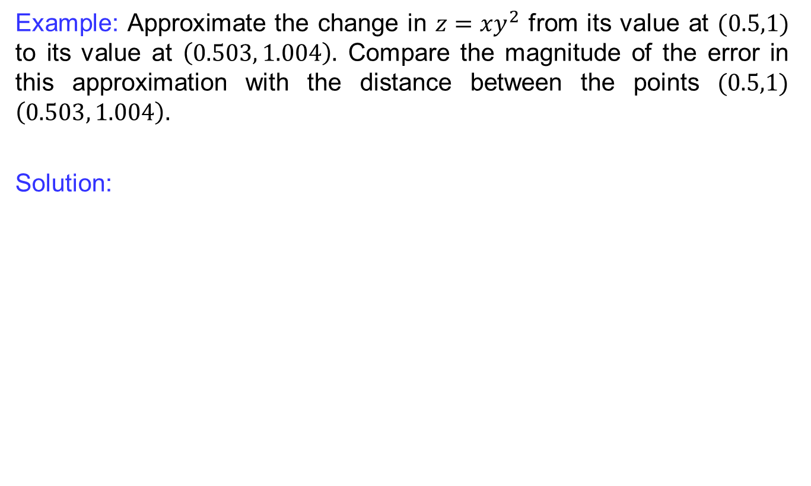
Differentials & linear approximations
Example: Approximate the change in $z=xy^{2}$fromits value at$(0.5,1)$ to its value at$\left(0.503, 1.004\right).$ Compare the magnitude of the error in this approximation with the distance between the points $(0.5,1)$$\left(0.503, 1.004\right).$
Solution:

Slide 22
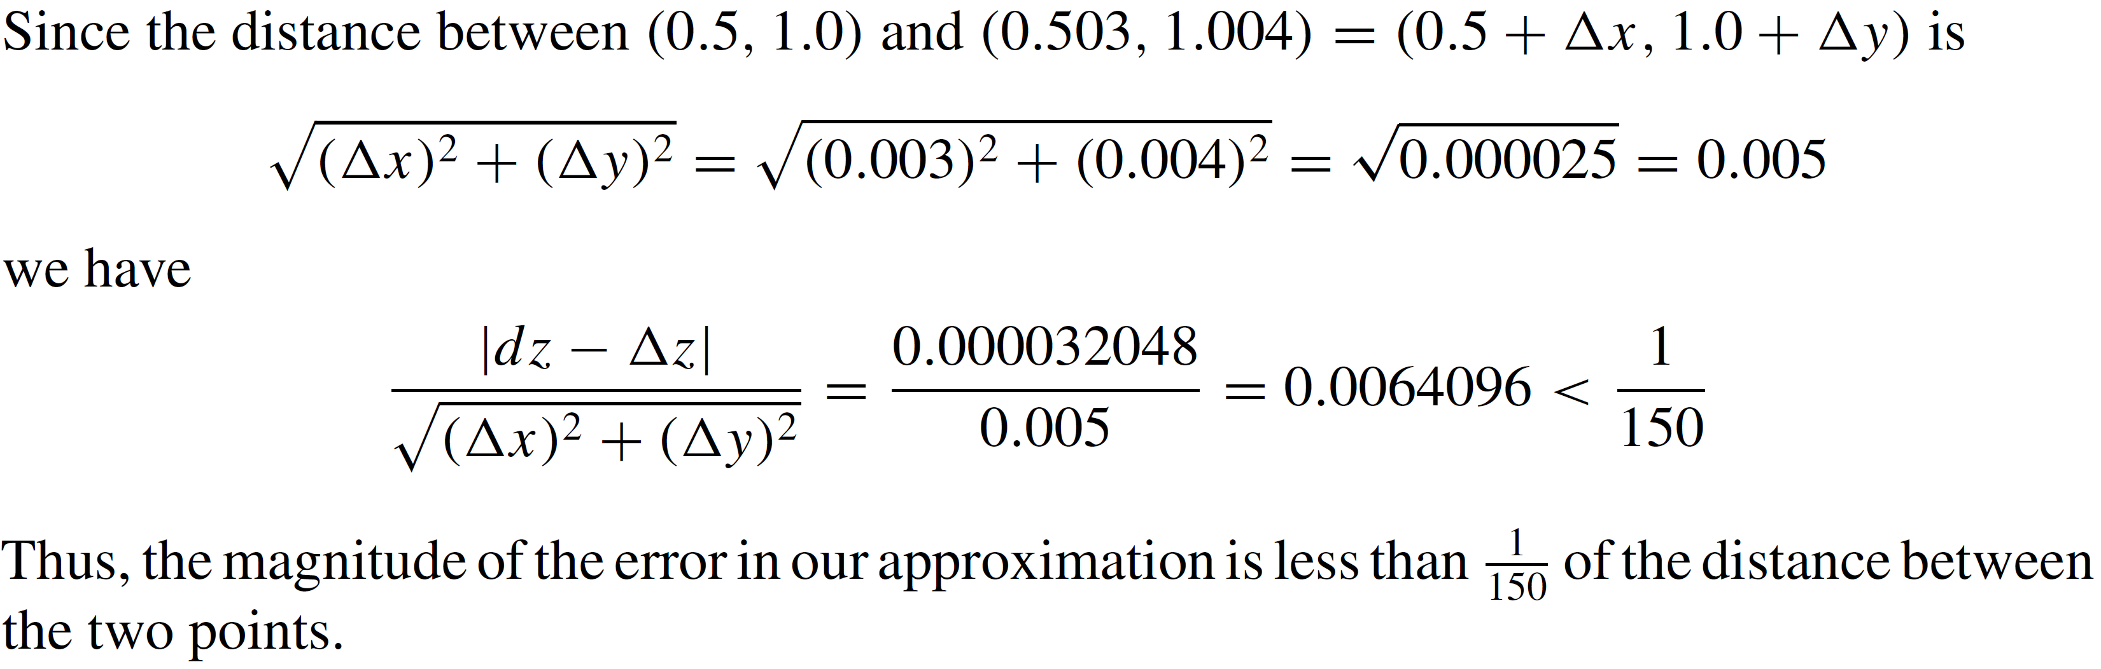
Differentials & linear approximations
Cont:

Slide 23
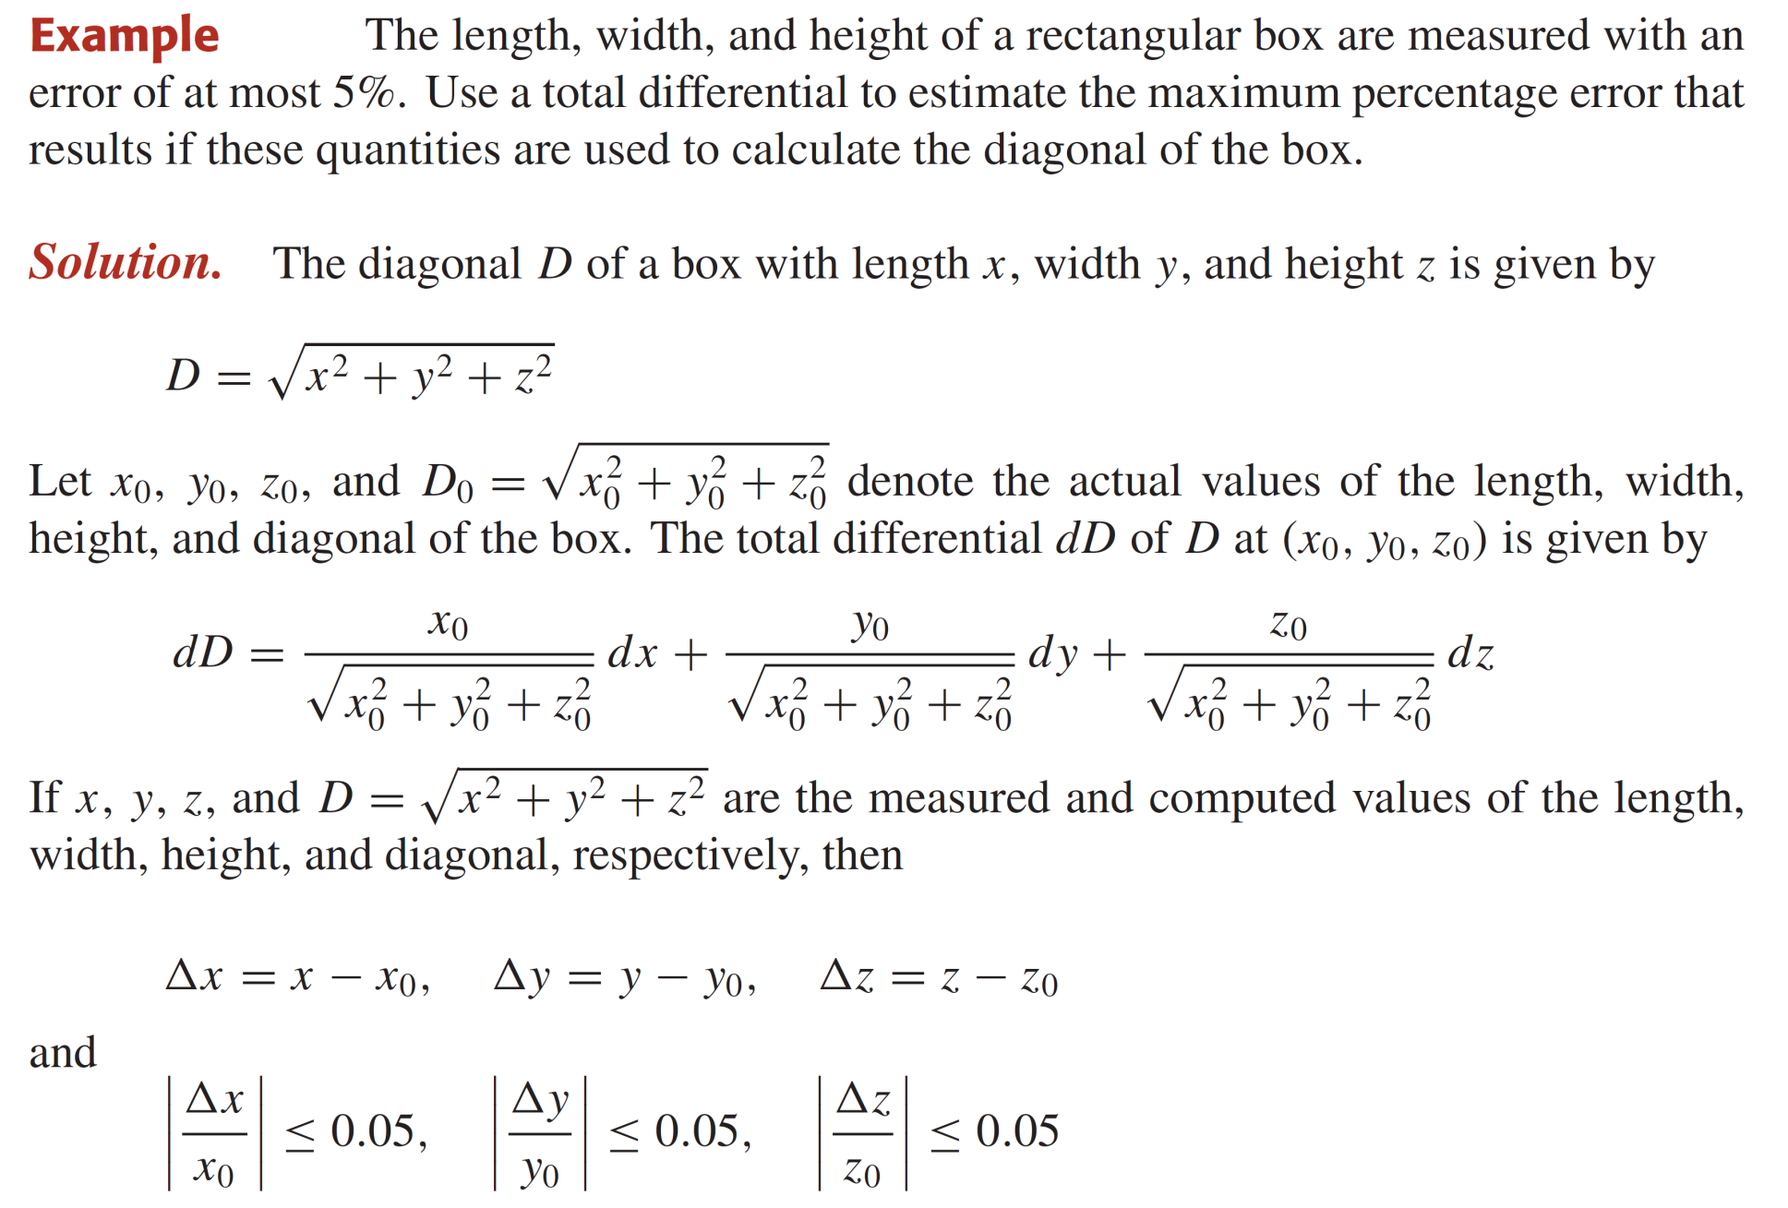
Differentials & linear approximations

Slide 24
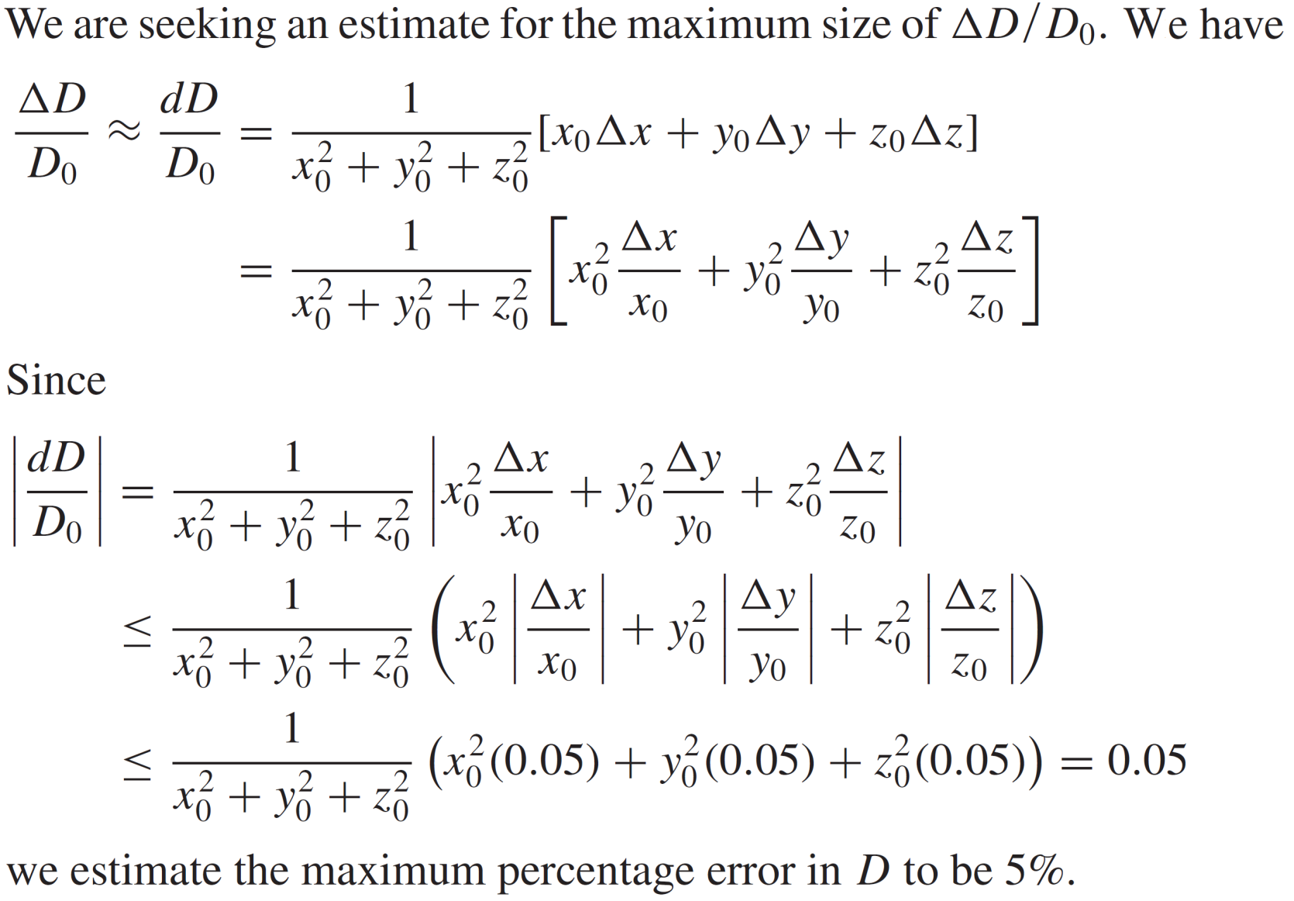
Differentials & linear approximations

Slide 25
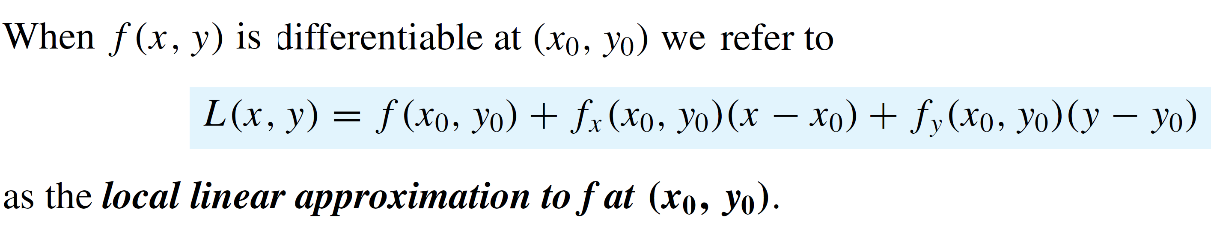
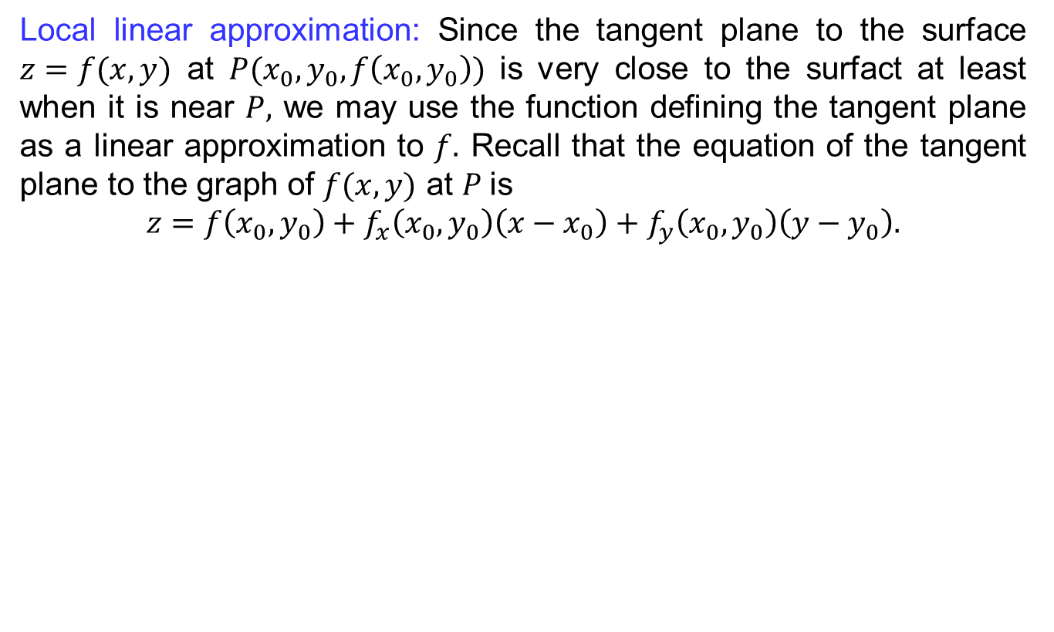
Differentials & linear approximations
Local linear approximation: Since the tangent plane to the surface $z=f(x,y)$ at $P(x_{0},y_{0}, f\left(x_{0},y_{0}\right))$ is very close to the surfact at least when it is near $P,$ we may use the function defining the tangent plane as a linear approximation to $f.$ Recall that the equation of the tangent plane to the graph of $f(x,y)$ at $P$is
$$z=f\left(x_{0},y_{0}\right)+f_{x}\left(x_{0},y_{0}\right)\left(x−x_{0}\right)+f_{y}\left(x_{0},y_{0}\right)\left(y−y_{0}\right).$$

Slide 26
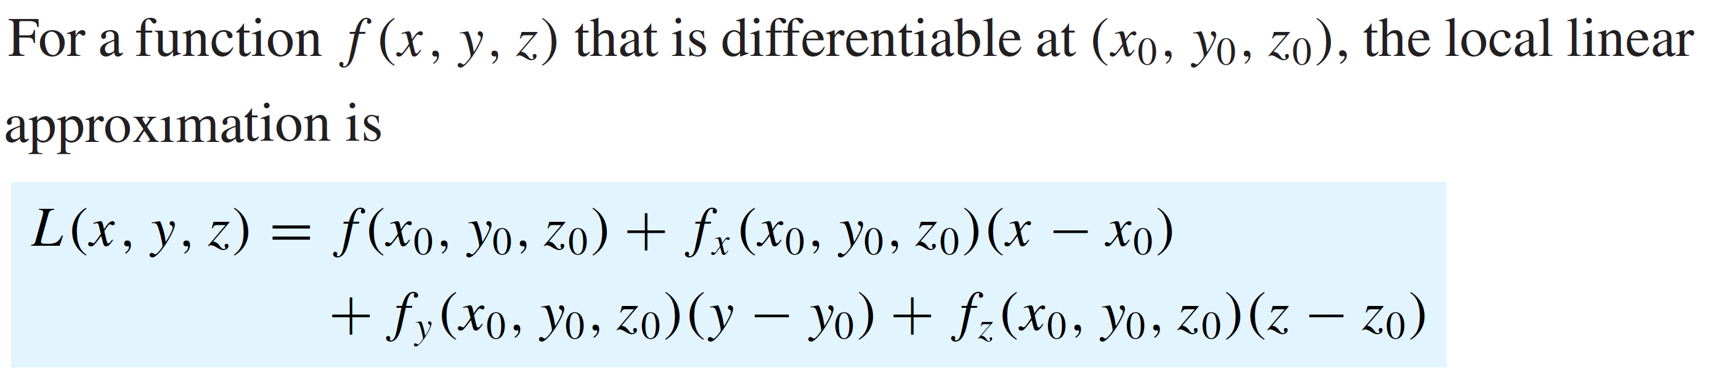
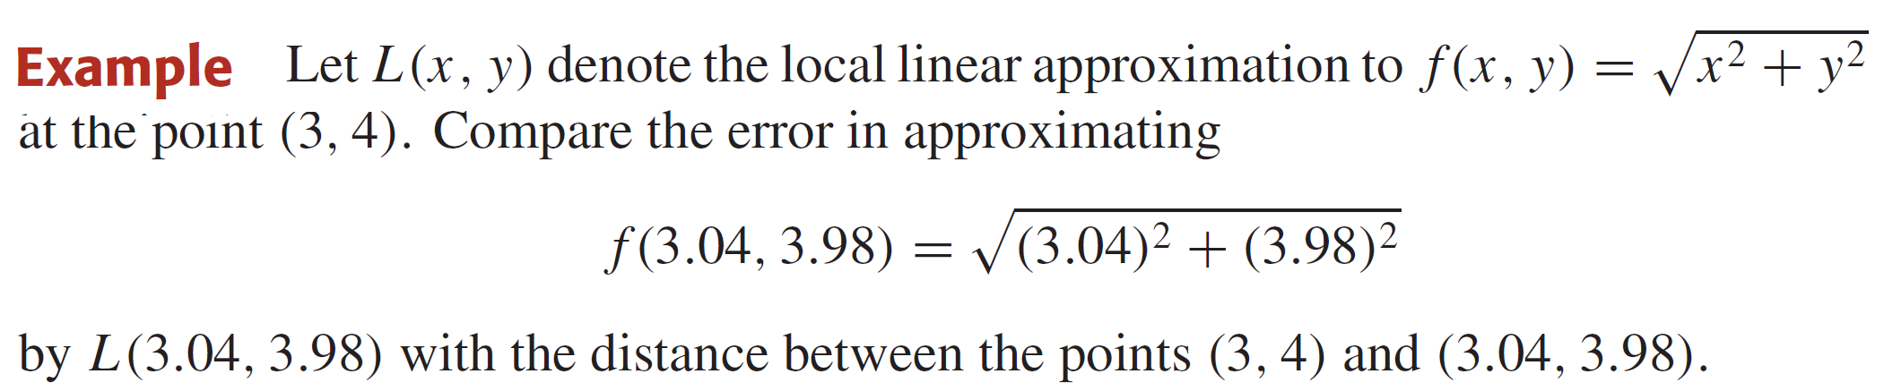
Differentials & linear approximations
Local linear approximation

Slide 27
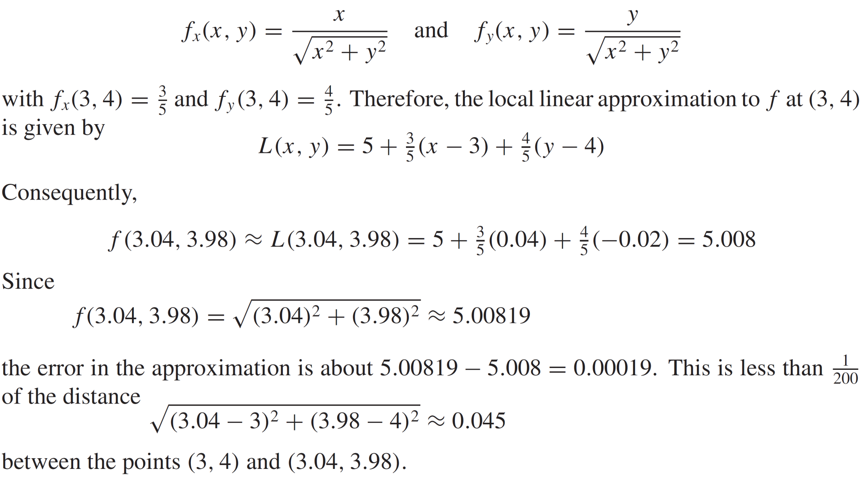
Differentials & linear approximations
Solution:

Slide 28
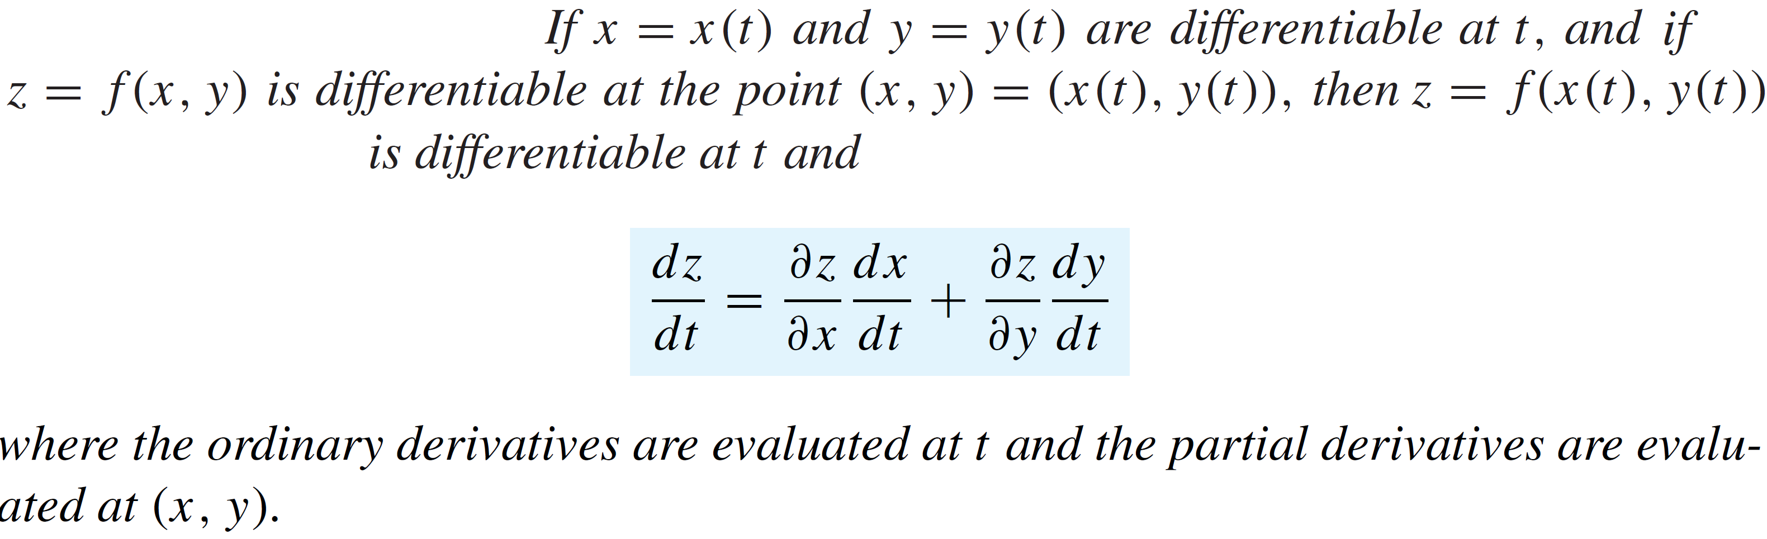
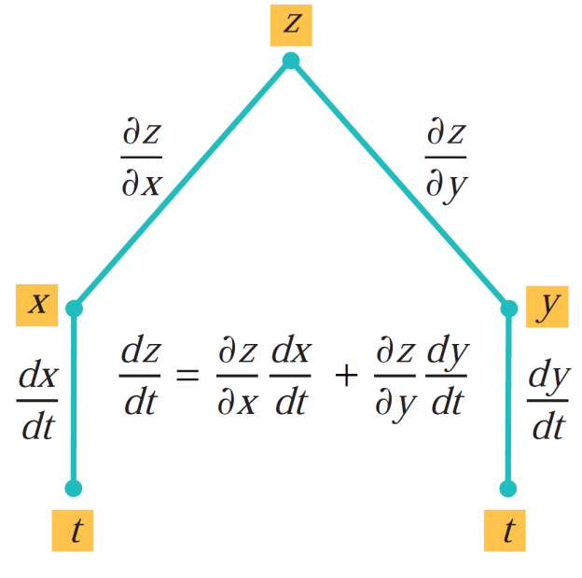
Chain rules for partial differentiation
Definition (chain rules):

Slide 29
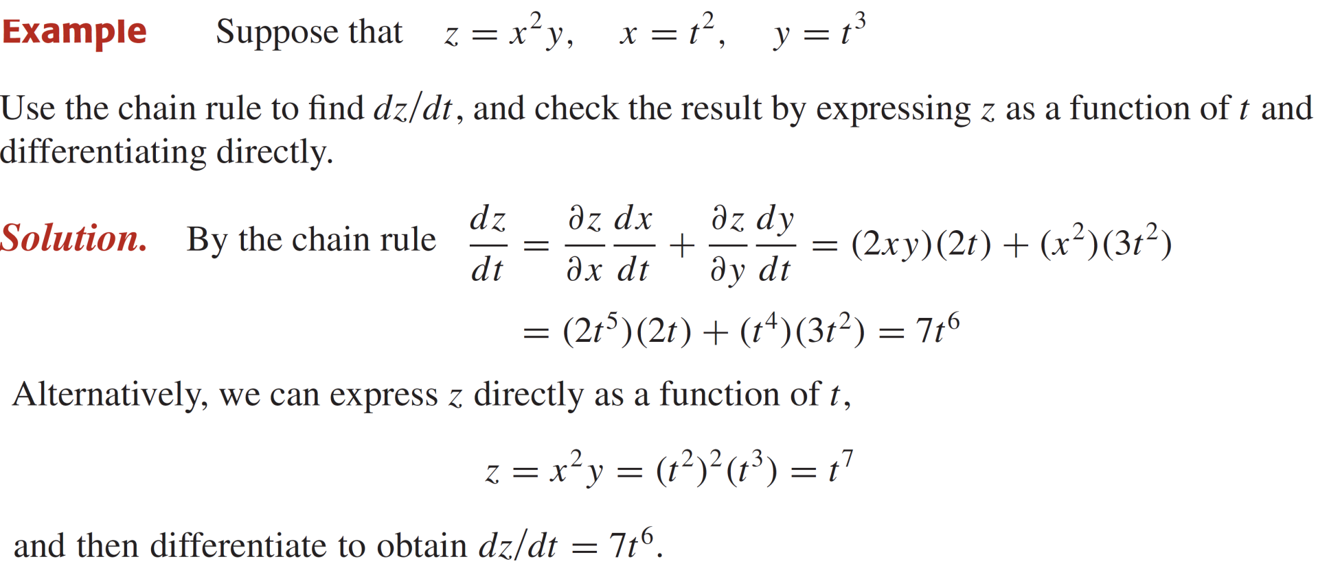
Chain rules for partial differentiation

Slide 30
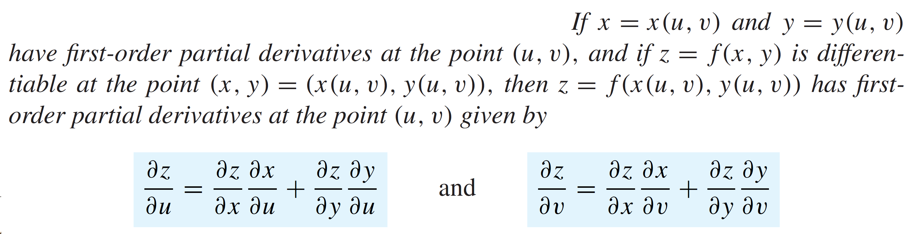
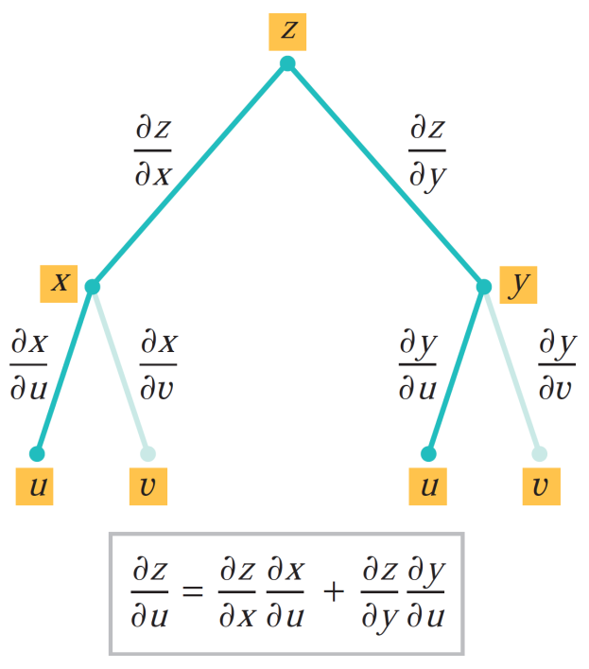
Chain rules for partial differentiation
Definition (chain rules) for partial derivatives:

Slide 31
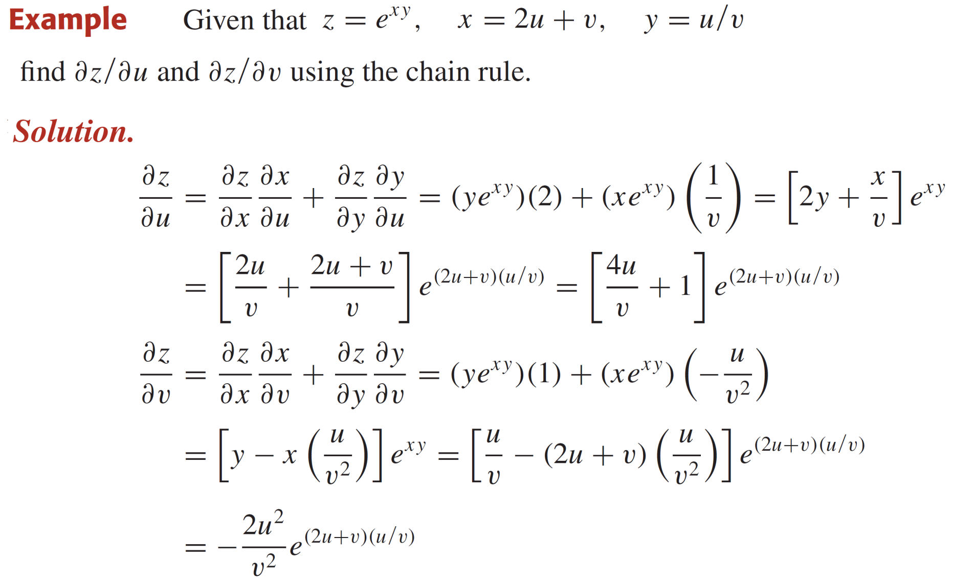
Chain rules for partial differentiation

Slide 32



Chain rules for partial differentiation

Slide 33




Chain rules for partial differentiation
Remarks: Let $z=f(x,y)$ is differentiable function of $x.$ Then
.
When $f\left(x,y\right)=c,$then
Theorem:

Slide 34

Chain rules for partial differentiation

Slide 35



Extrema of multivariable functions
Definitions:

Slide 36

Extrema of multivariable functions
Theorem (Extream value): If $f(x,y)$ is continuous on a closed and bounded set $R$, then $f$ has both an absolute maximum and an absolute minimum on $R.$
Definition: A point $(x_{0},y_{0})$ in the domain of a function $f(x,y)$ is called a critical point of the function if $f_{x}\left(x_{0},y_{0}\right)=0=f_{y}\left(x_{0},y_{0}\right)$ if one or both partial derivatives do not exist at $\left(x_{0},y_{0}\right).$
Theorem: If $f$ has a relative extremum at a point $\left(x_{0},y_{0}\right),$ if it is a critical point and the first order partial derivatives of $f$ exist at$\left(x_{0}, y_{0}\right).$

Slide 37


Extrema of multivariable functions
Saddle point: If $f(x,y)$ has neither a relative maximums nor a relative minimum at a critical point $(x_{0},y_{0})$, then it is called a saddle point of $f.$
In general, the surface $z=f(x,y)$ has a saddle point at $(x_{0},y_{0})$ if there are two distinct vertical planes through this point such that the trace of the surface in on of the planes has a relative maximum and the trace in the other has a relative minimum at $\left(x_{0},y_{0}\right).$

Slide 38

Extrema of multivariable functions
Theorem:

Slide 39

Extrema of multivariable functions

Slide 40

Extrema of multivariable functions

Slide 41

Extrema of multivariable functions

Slide 42
Lecture Summary
    Recalls
    Differentiability of multivariable functions
    Differentials & linear approximations
    Chain rules for partial differentiation
    Implicit differentiation
    Extrema of multivariable functions

