Slide 1
(MTH 250)
Calculus
Lecture 23

Slide 2
Previous Lecture’s Summary
    Direction cosines
    Scalar triple product
    Parametric equations of lines
    Vector equations of lines
    Vector equations of planes
    Vector-valued functions
    Limits, continuity & differentiability
    Integration

Slide 3
Today’s Lecture
    Recalls
    Multivariable functions
    Limits along smooth curves
    Limits of multivariable functions
    Continuity of multivariable functions
    Partial differentiation

Slide 4
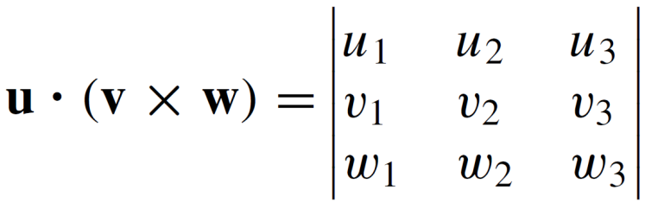
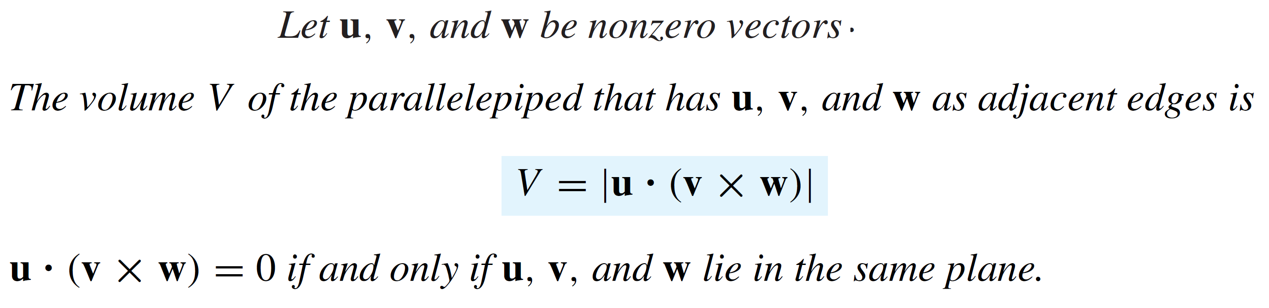
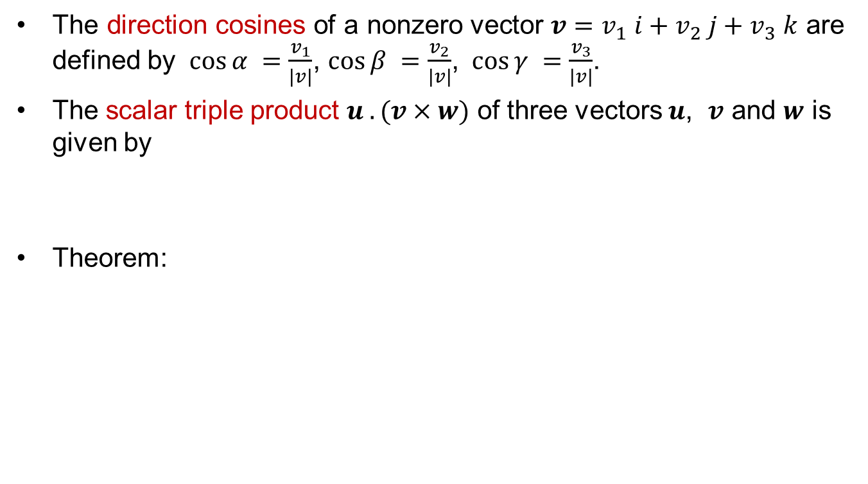
Recalls
The direction cosines of a nonzero vector $v=v_{1} i+v_{2} j+v_{3} k$ are defined by $\cos{α }=\frac{v_{1}}{|v|}$, $\cos{β }=\frac{v_{2}}{|v|}$, $\cos{γ }=\frac{v_{3}}{|v|}$.
The scalar triple product $u . (v×w)$ of three vectors $u$, 𝒗 and $w$ is given by
Theorem:

Slide 5
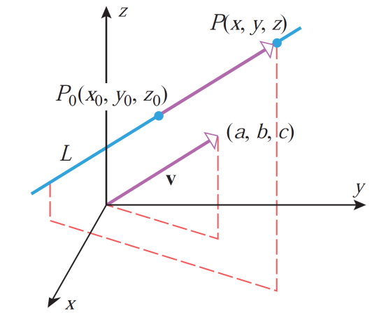
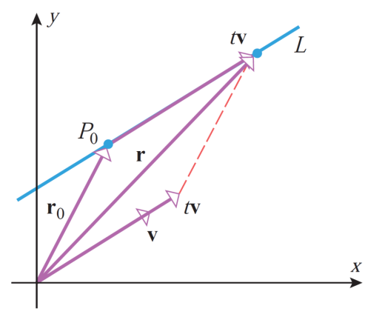
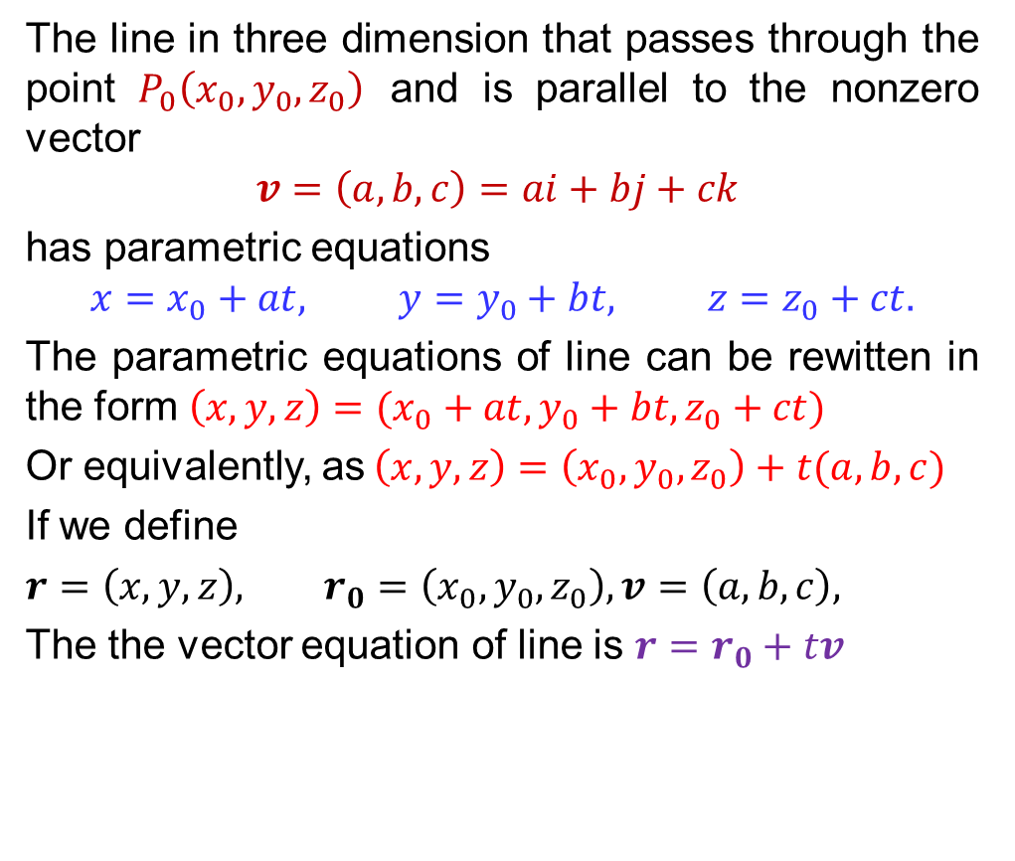
Recalls
The line in three dimension that passes through the point $P_{0}\left(x_{0},y_{0},z_{0}\right)$ and is parallel to the nonzero vector
$$v=\left(a,b,c\right)=ai+bj+ck$$
has parametric equations
$$x=x_{0}+at, y=y_{0}+bt, z=z_{0}+ct.$$
The parametric equations of line can be rewitten in the form $\left(x,y,z\right)=(x_{0}+at, y_{0}+bt, z_{0}+ct)$
Or equivalently, as$\left(x,y,z\right)=\left(x_{0}, y_{0}, z_{0}\right)+t(a,b,c)$
If we define
$r=\left(x,y,z\right),$ $r_{0}=\left(x_{0},y_{0},z_{0}\right), v=\left(a,b,c\right),$
The the vector equation of line is $r=r_{0}+tv$

Slide 6
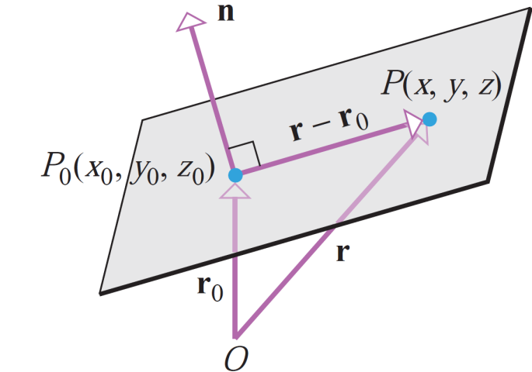
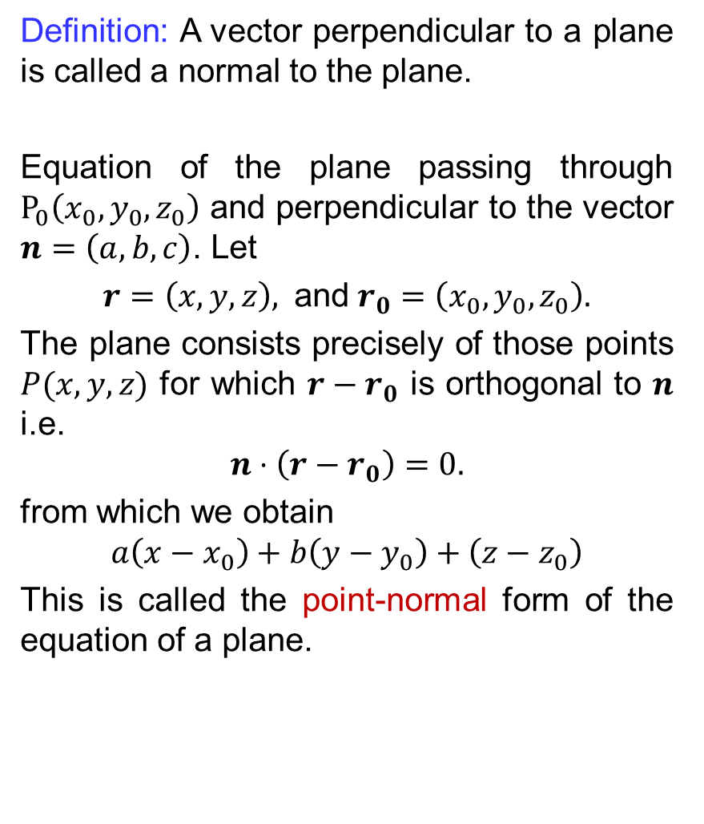
Recalls
Definition: A vector perpendicular to a plane is called a normal to the plane.
Equation of the plane passing through $P_{0}\left(x_{0}, y_{0}, z_{0}\right)$ and perpendicular to the vector $n=\left(a,b,c\right)$. Let
$r=\left(x,y,z\right),$ and$r_{0}=\left(x_{0},y_{0},z_{0}\right).$
The plane consists precisely of those points $P(x,y,z)$ for which $r−r_{0}$ is orthogonal to $n$ i.e.
$$n⋅\left(r−r_{0}\right)=0.$$
from which we obtain
$$a\left(x−x_{0}\right)+b\left(y−y_{0}\right)+\left(z−z_{0}\right)$$
This is called the point-normal form of the equation of a plane.

Slide 7
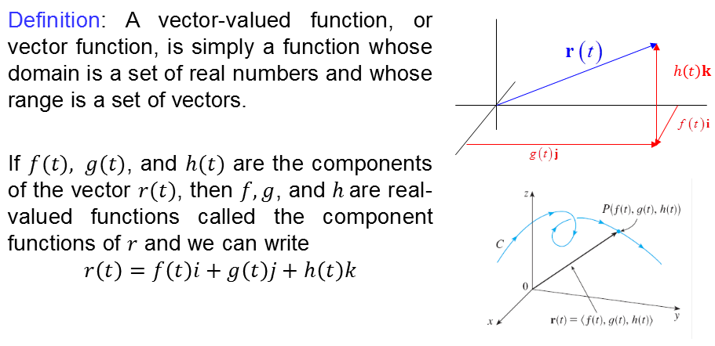
Recalls

Slide 8
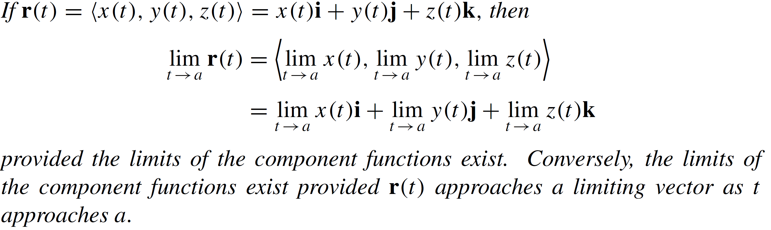
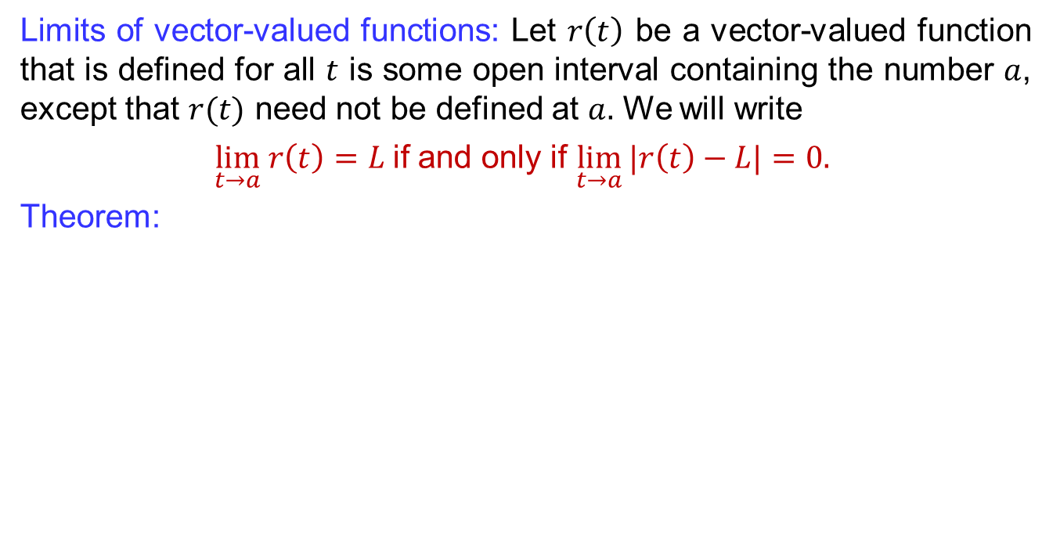
Recalls
Limits of vector-valued functions: Let $r\left(t\right)$ be a vector-valued function that is defined for all $t$ is some open interval containing the number $a$, except that $r(t)$ need not be defined at $a.$ We will write
$\lim_{t→a} r\left(t\right)=L$if and only if $\lim_{t→a}{|r\left(t\right)−L|}=0.$
Theorem:

Slide 9
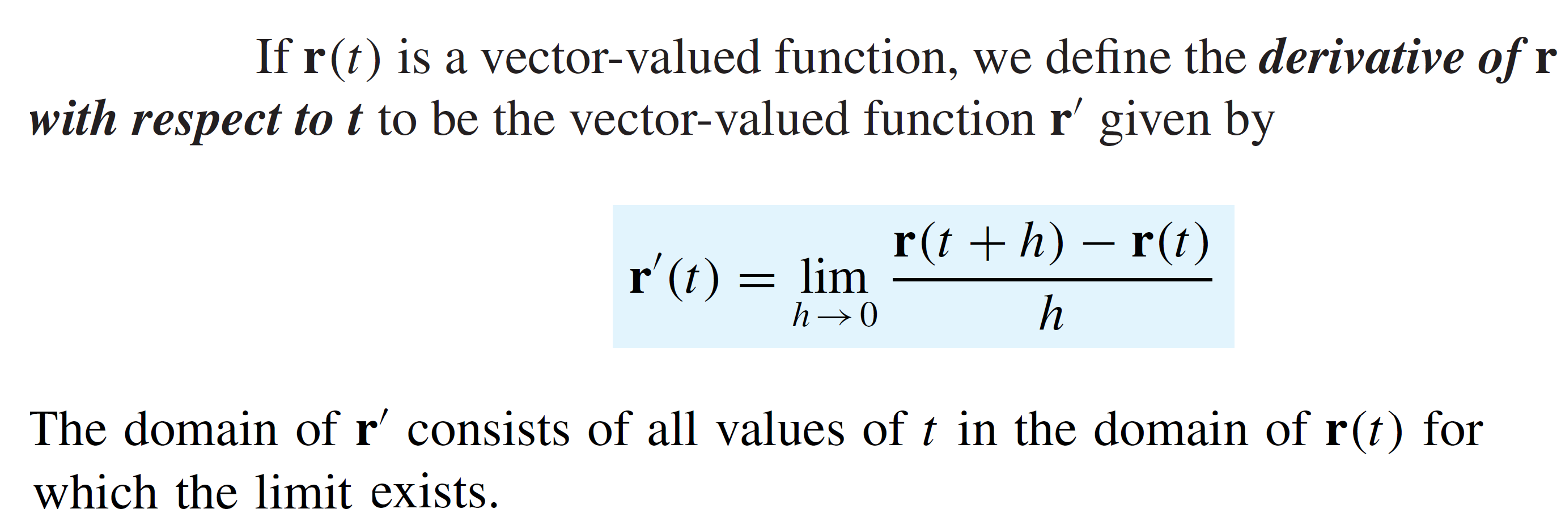
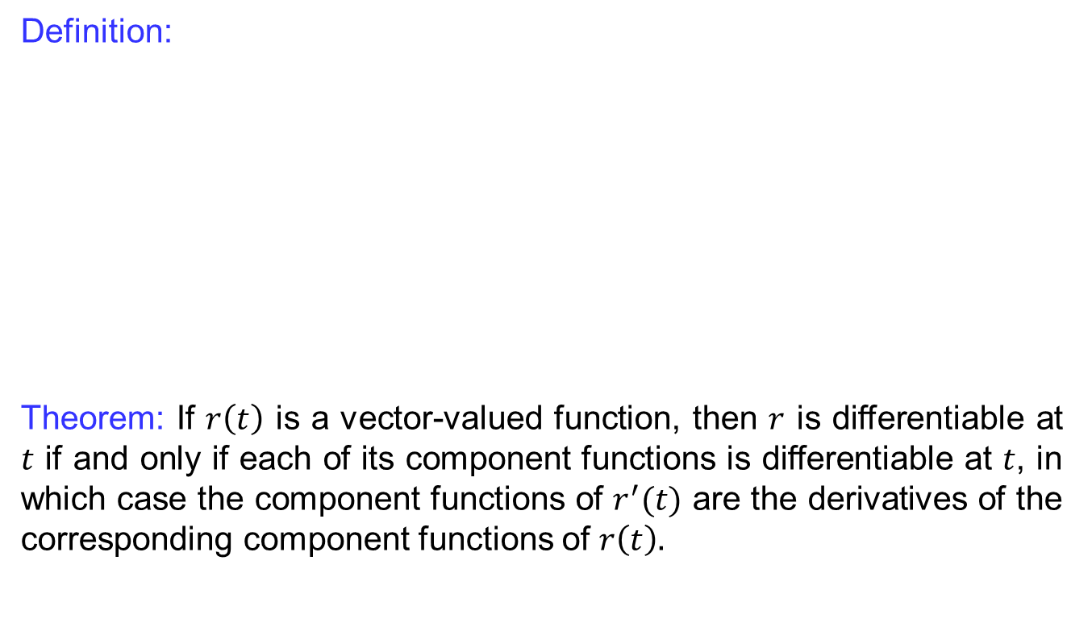
Recalls
Definition:
Theorem: If $r\left(t\right)$ is a vector-valued function, then $r$ is differentiable at $t$ if and only if each of its component functions is differentiable at $t$, in which case the component functions of $r^{′}(t)$ are the derivatives of the corresponding component functions of $r\left(t\right).$

Slide 10
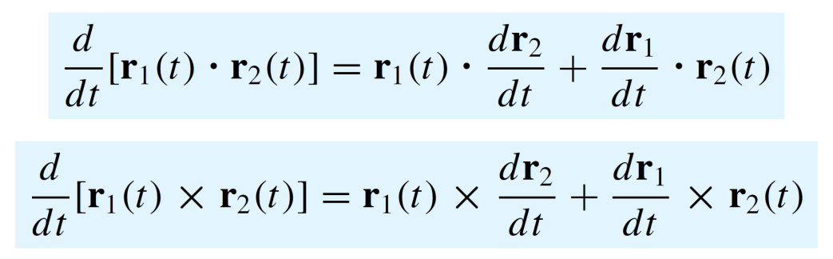
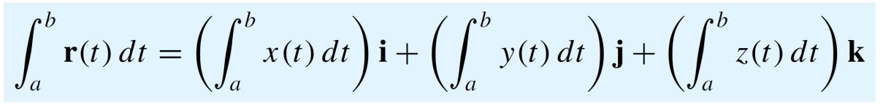
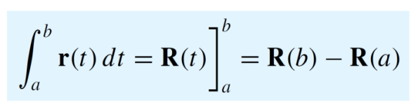
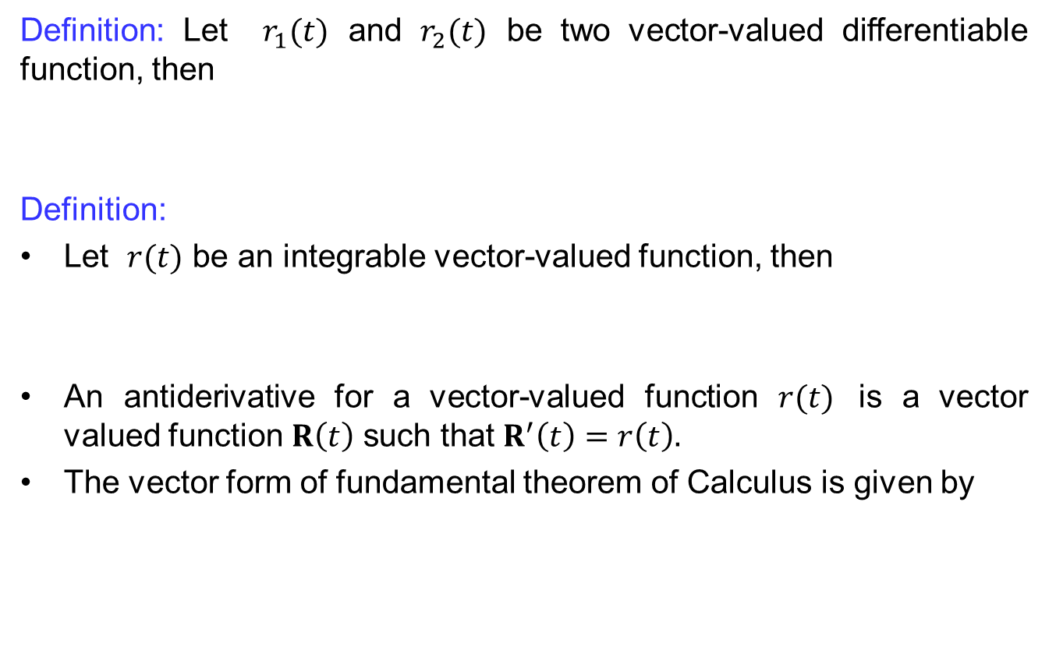
Recalls
Definition: Let $r_{1}(t)$ and $r_{2}(t)$ be two vector-valued differentiable function, then
Definition:
Let $r(t)$ be an integrable vector-valued function, then
An antiderivative for a vector-valued function $r(t)$ is a vector valued function $R\left(t\right)$ such that $R^{′}\left(t\right)=r\left(t\right).$
The vector form of fundamental theorem of Calculus is given by

Slide 11
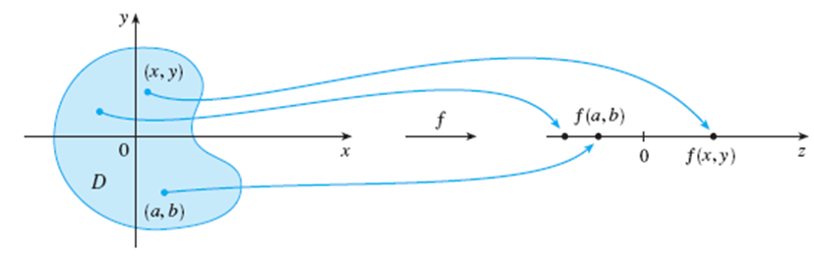
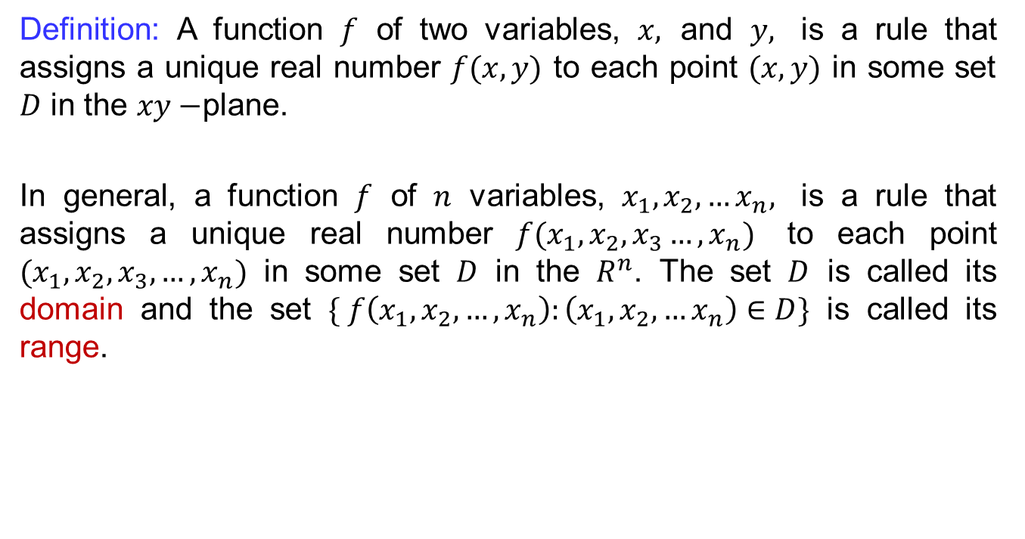
Multivariable functions
Definition: A function $f$ of two variables, $x,$ and $y,$ is a rule that assigns a unique real number $f(x,y)$ to each point $(x,y)$ in some set $D$ in the $xy−$plane.
In general, a function $f$ of $n$ variables, $x_{1}, x_{2},…x_{n},$ is a rule that assigns a unique real number $f(x_{1},x_{2},x_{3}…, x_{n})$ to each point $(x_{1},x_{2},x_{3}, …,x_{n})$ in some set $D$ in the $R^{n}$. The set $D$ is called its domain and the set $\{ f\left(x_{1},x_{2},…,x_{n}\right):\left(x_{1},x_{2},…x_{n}\right)∈D\}$ is called its range.

Slide 12
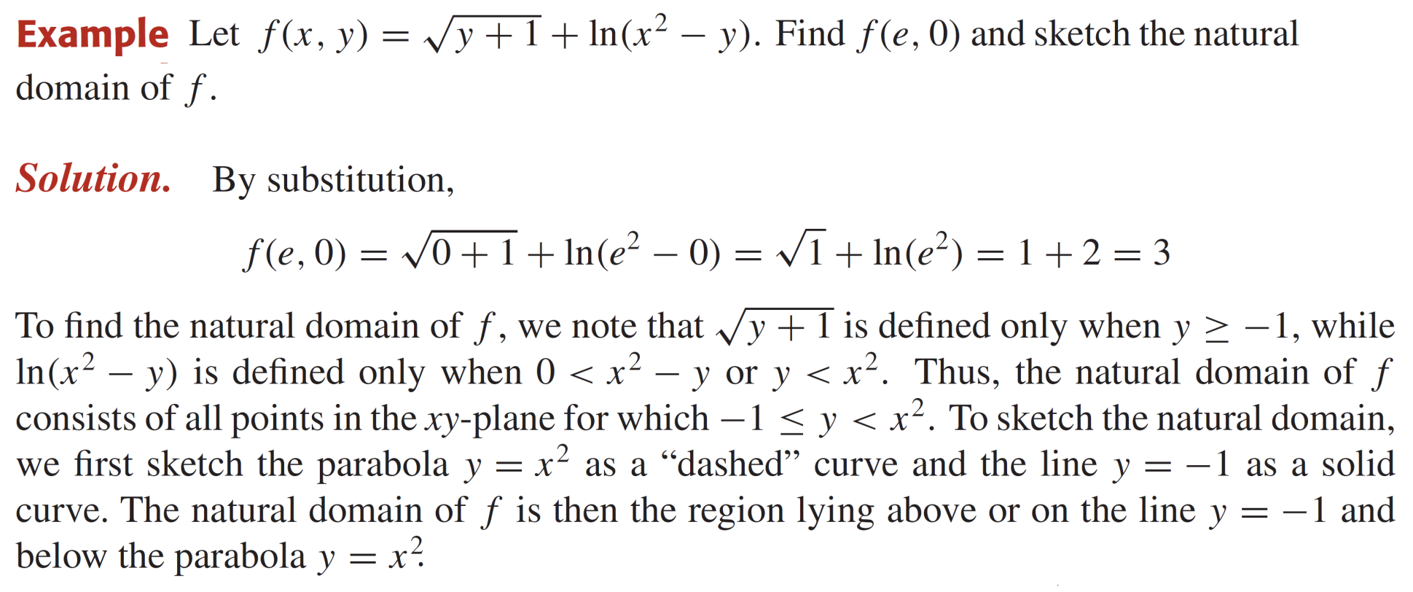
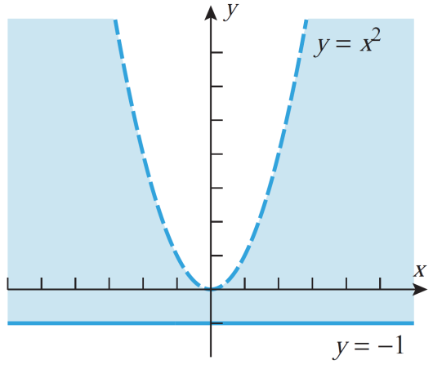
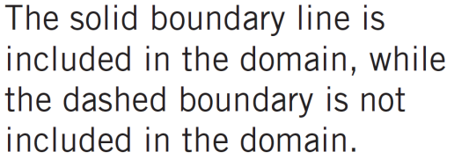
Multivariable functions

Slide 13
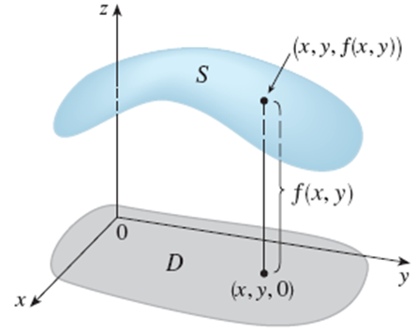
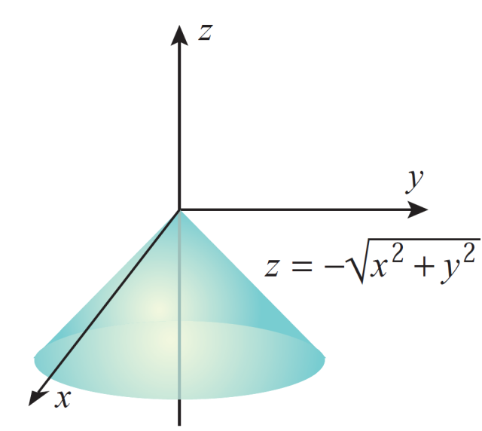
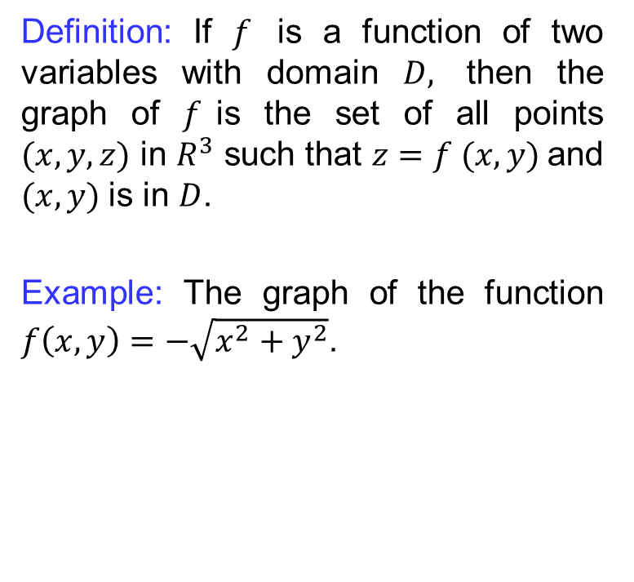
Multivariable functions
Definition: If $f$ is a function of two variables with domain $D,$ then the graph of $f$is the set of all points $(x, y, z)$ in $R^{3}$ such that $z=f (x, y)$and $(x, y)$is in $D$.
Example: The graph of the function $f\left(x,y\right)=−\sqrt{x^{2}+y^{2}}$.

Slide 14
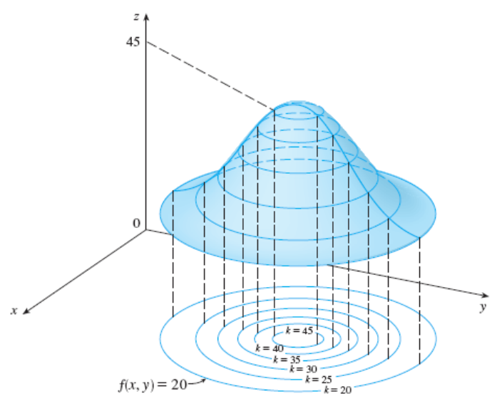
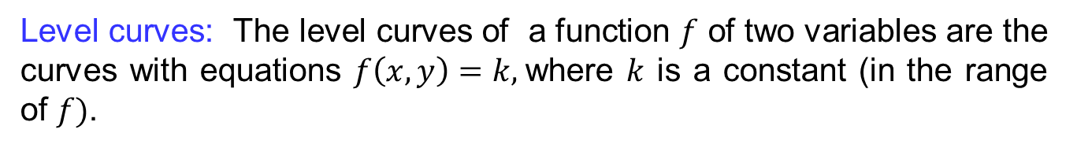
Multivariable functions
Level curves: The level curves of a function $f$ of two variables are the curves with equations $f\left(x,y\right)=k,$where $k$ is a constant (in the range of $f)$.

Slide 15
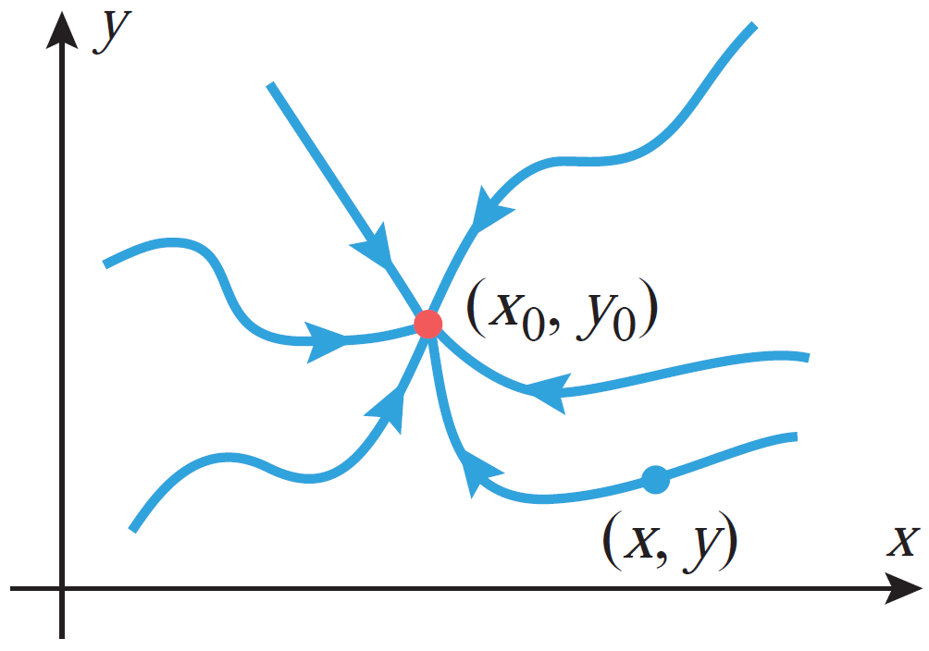
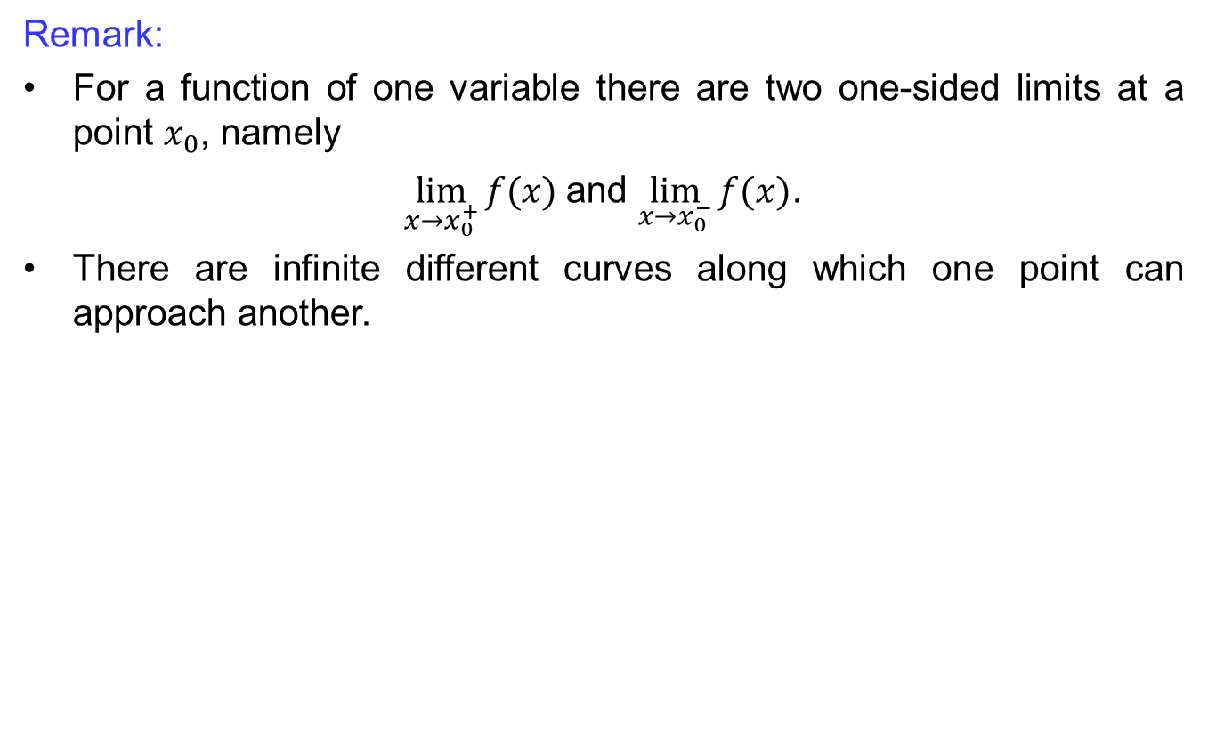
Limits along smooth curves
Remark:
For a function of one variable there are two one-sided limits at a point $x_{0}$, namely
$\lim_{x→x_{0}^{+}}{f(x)}$and $\lim_{x→x_{0}^{−}}{f(x)}$.
There are infinite different curves along which one point can approach another.

Slide 16
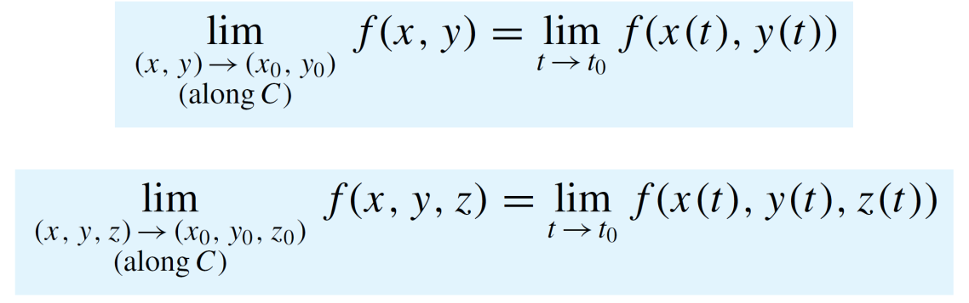
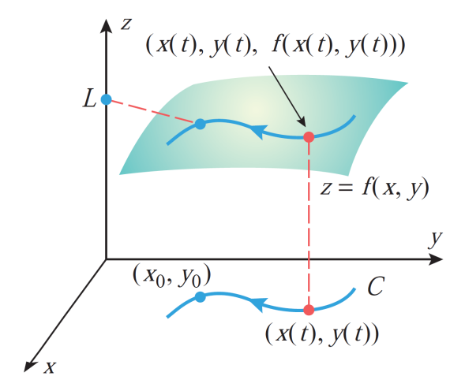
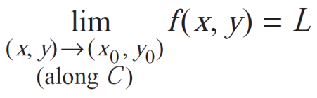
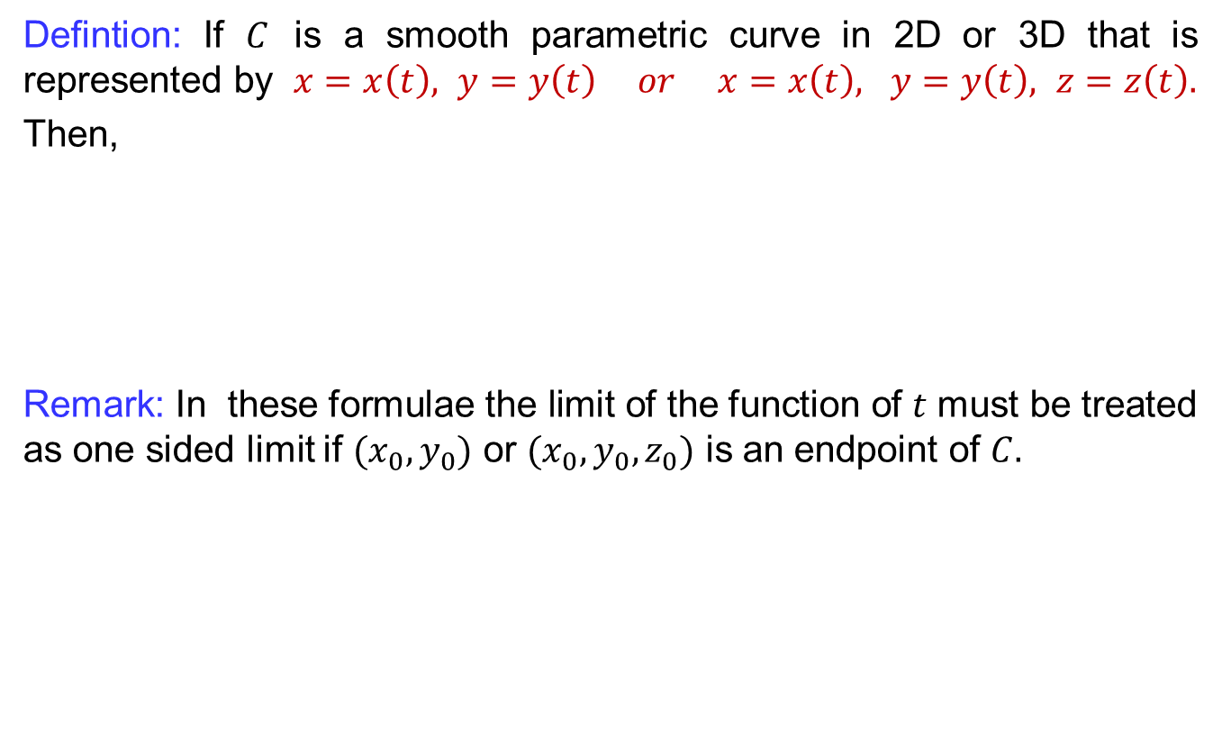
Limits along smooth curves
Defintion: If $C$ is a smooth parametric curve in 2D or 3D that is represented by $x=x\left(t\right), y=y\left(t\right) or x=x\left(t\right), y=y\left(t\right), z=z\left(t\right).$
Then,
Remark: In these formulae the limit of the function of $t$ must be treated as one sided limit if $(x_{0},y_{0})$ or $(x_{0},y_{0},z_{0})$ is an endpoint of $C.$

Slide 17
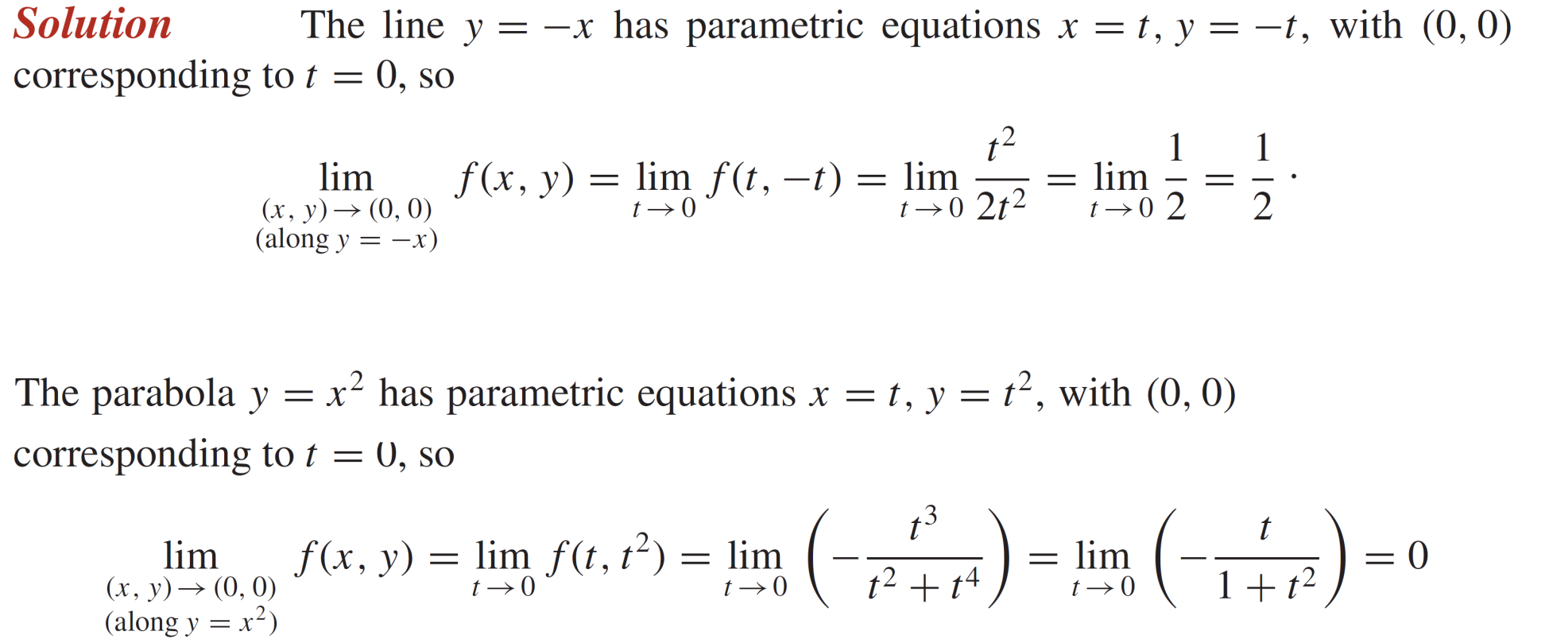
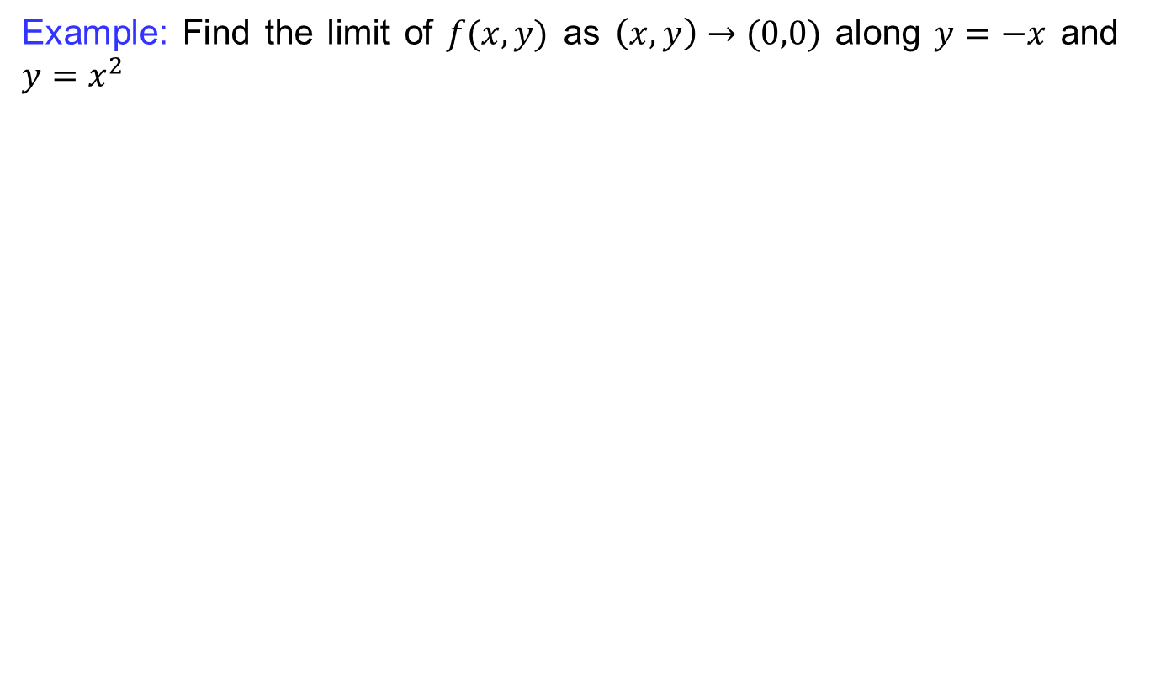
Limits along smooth curves
Example: Find the limit of $f(x,y)$ as $\left(x,y\right)→(0,0)$ along $y=−x$ and $y=x^{2}$

Slide 18
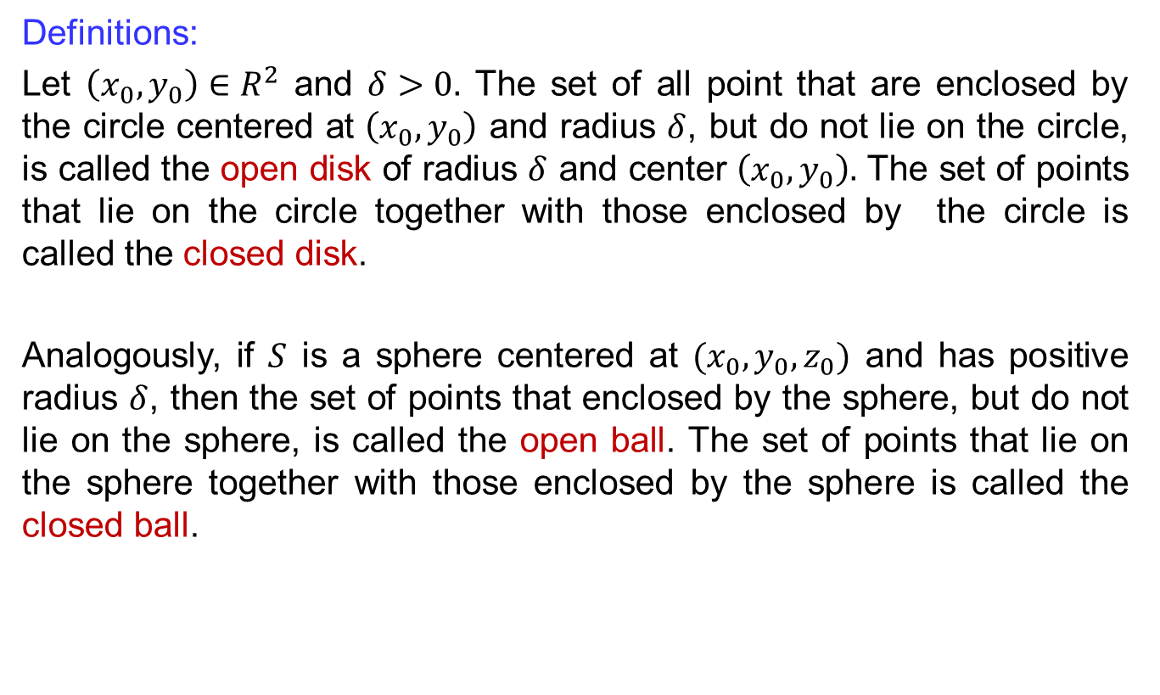
Limits of multivariable functions
Definitions:
Let $\left(x_{0},y_{0}\right)∈R^{2}$ and $δ>0.$ The set of all point that are enclosed by the circle centered at $\left(x_{0},y_{0}\right)$ and radius $δ$, but do not lie on the circle, is called the open disk of radius $δ$ and center $\left(x_{0},y_{0}\right).$ The set of points that lie on the circle together with those enclosed by the circle is called the closed disk.
Analogously, if $S$ is a sphere centered at $(x_{0},y_{0},z_{0})$ and has positive radius $δ$, then the set of points that enclosed by the sphere, but do not lie on the sphere, is called the open ball. The set of points that lie on the sphere together with those enclosed by the sphere is called the closed ball.

Slide 19
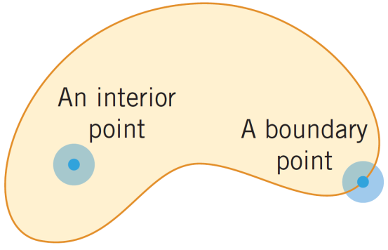
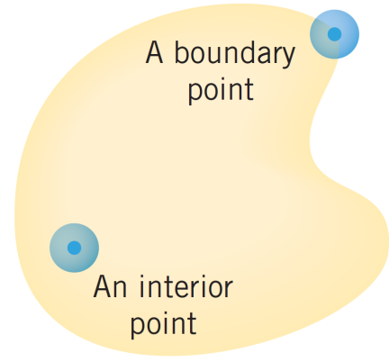
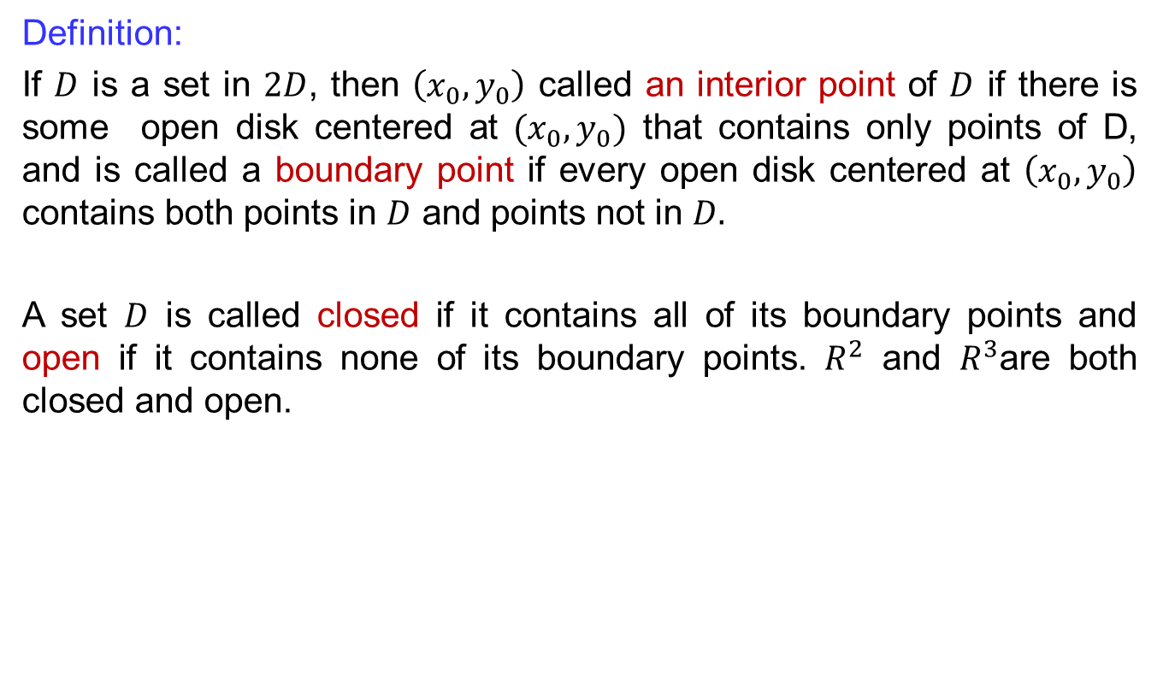
Limits of multivariable functions
Definition:
If $D$ is a set in $2D$, then $\left(x_{0},y_{0}\right)$ called an interior point of $D$ if there is some open disk centered at $(x_{0},y_{0})$ that contains only points of D, and is called a boundary point if every open disk centered at $\left(x_{0},y_{0}\right)$ contains both points in $D$ and points not in $D.$
A set $D$ is called closed if it contains all of its boundary points and open if it contains none of its boundary points. $R^{2}$ and $R^{3}$are both closed and open.

Slide 20
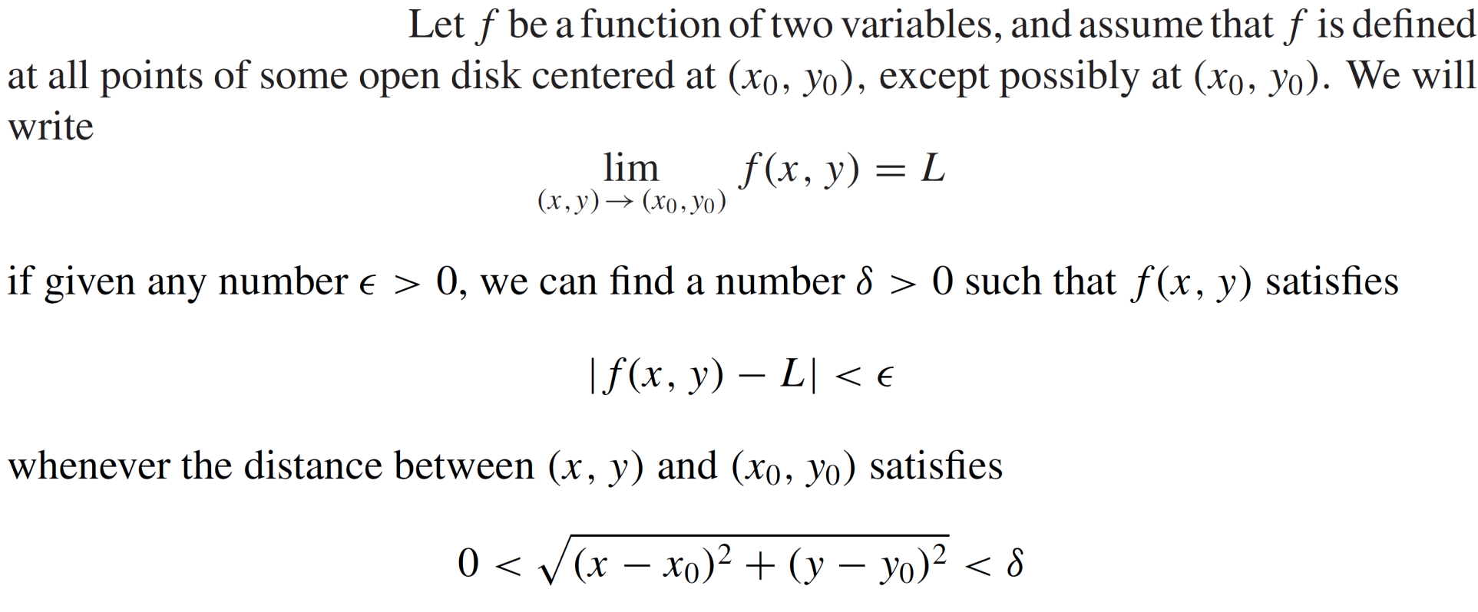
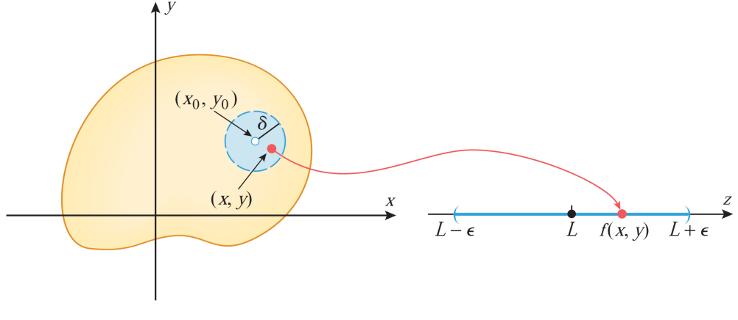
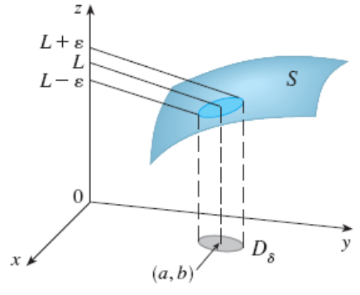
Limits of multivariable functions
Definition (formal):

Slide 21

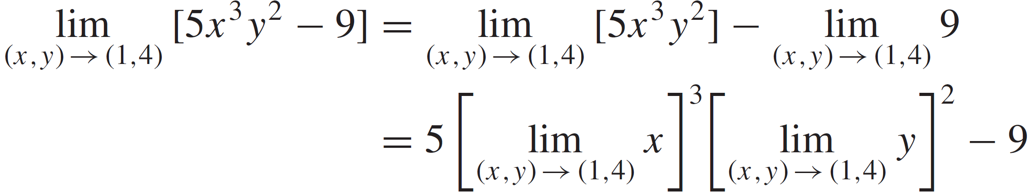

Limits of multivariable functions
Example: Find
Solution:

Slide 22
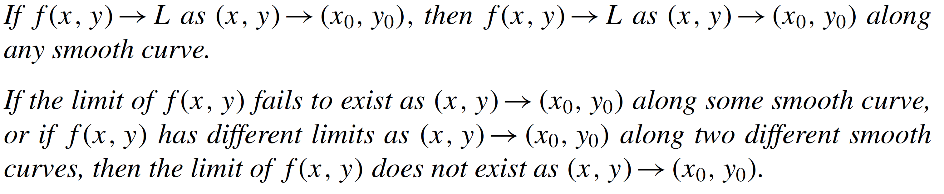
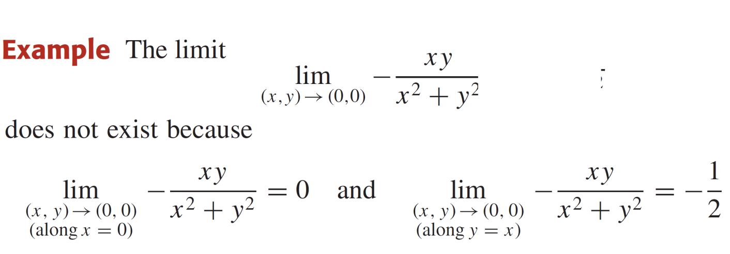
Limits of multivariable functions
Theorem:

Slide 23
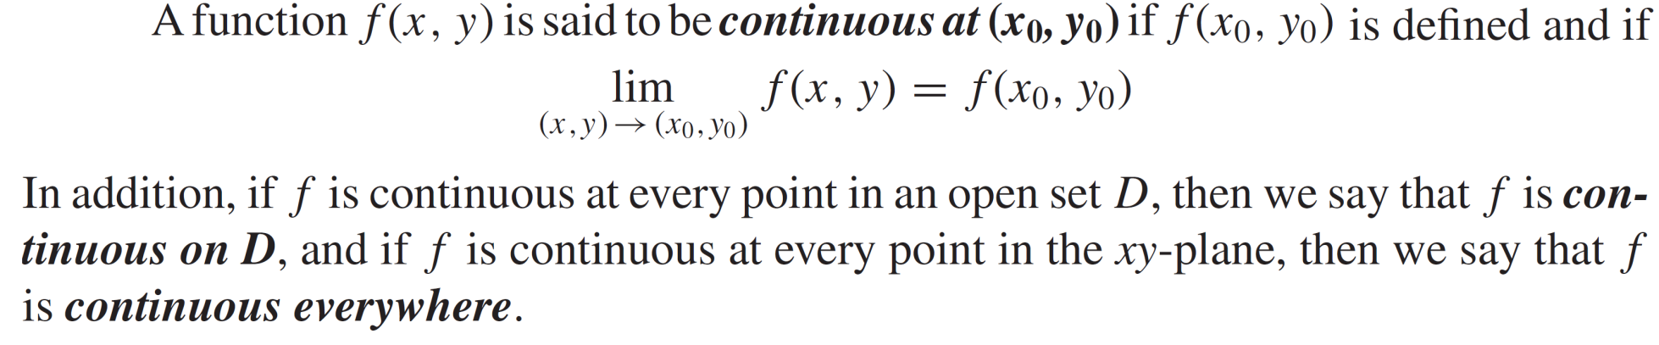
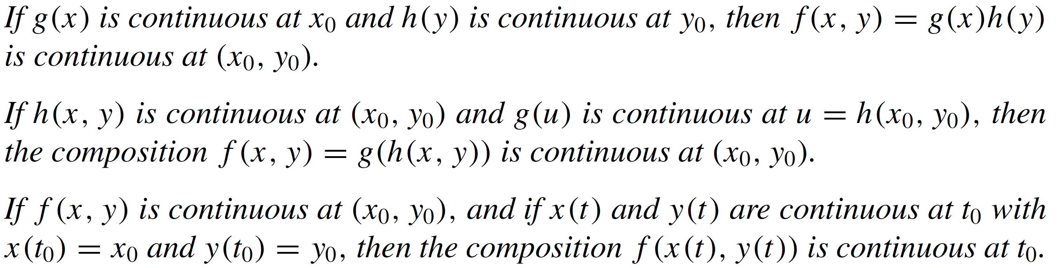
Continuity of multivariable functions
Def:
Theorem:

Slide 24
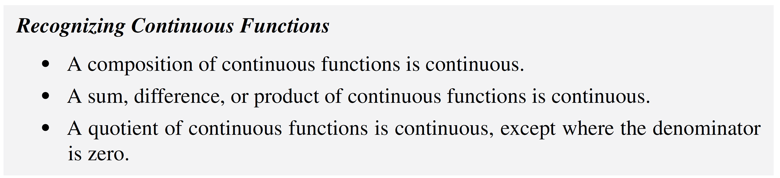
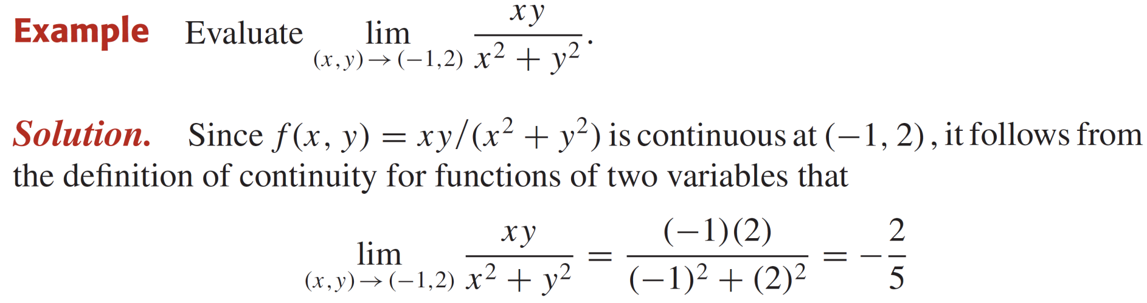
Continuity of multivariable functions

Slide 25
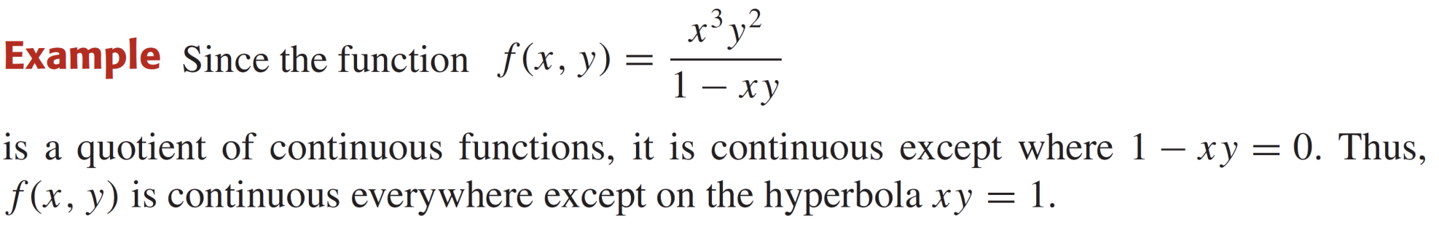

Continuity of multivariable functions
Limit & continuity in 3D:

Slide 26

Partial differentiation

Slide 27

Partial differentiation

Slide 28


Partial differentiation

Slide 29


Partial differentiation
Partial differentiation as rate of change and slope of the tangent:
Recall that for $y=f\left(x\right),$ the value $f^{′}\left(x_{0}\right)$ is interpreted either as the rate of change of y with respect to $x$ at $x_{0}$, or the slope of the tangent line at $x=x_{0}.$
The partial derivatives have an analogous interpretations.
Suppose $C_{1}$ is the intersection of the surface $z=f(x,y)$ with the plane $y=y_{0}.$
Then, $f_{x}\left(x,y_{0}\right)$ can be interpreted as the rate of change of $z$ with respect to $x$ along the curve $C_{1}$.
In particular, $f_{x}\left(x_{0},y_{0}\right)$ is the rate pf change of z with respect to $x$ along the curve $C_{1}$ at point $\left(x_{0},y_{0}\right).$

Slide 30

Partial differentiation

Slide 31


Partial differentiation

Slide 32

Partial differentiation

Slide 33


Partial differentiation
Example: Find $f_{x}$, $f_{y}$and $f_{z}$ when $f\left(x,y,z\right)=x^{3}y^{2}z^{4}+2xy+z.$
Solution:

Slide 34

Partial differentiation
Example: Find $f_{xy}$ and $f_{yx}$ when $f\left(x,y\right)=x\cos{y}+ye^{x}$
Solution:

Slide 35

Partial differentiation

Slide 36


Partial differentiation
Theorem: Let $f$ be a function of two variables. If $f_{xy}$ and $f_{yx}$ are continuous on some open disk, then $f_{xy}=f_{yx}$ on the disk

Slide 37
Lecture Summary
    Recalls
    Multivariable functions
    Limits along smooth curves
    Limits of multivariable functions
    Continuity of multivariable functions
    Partial differentiation

