Slide 1
(MTH 250)
Calculus
Lecture 22

Slide 2
Previous Lecture’s Summary
    Improper integrals
    Introduction to vectors
    Dot product of vectors
    Cross product of vectors

Slide 3
Today’s Lecture
    Recalls
    Direction cosines
    Scalar triple product
    Parametric equations of lines
    Vector equations of lines
    Vector equations of planes
    Vector-valued functions
    Limits, continuity & differentiability
    Integration

Slide 4
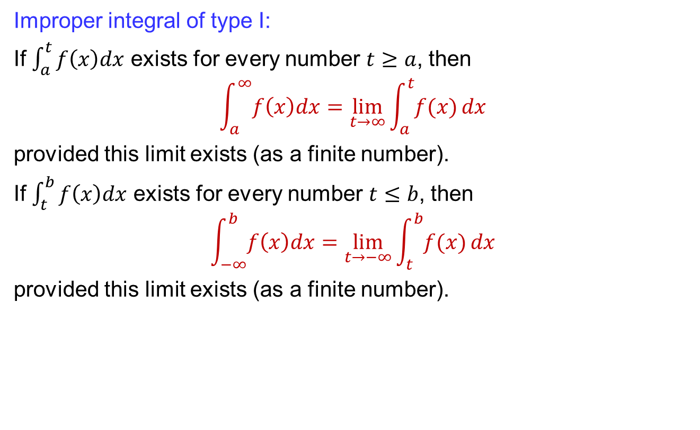
Recalls
Improper integral of type I:
If $\int_{a}^{t}{f\left(x\right)dx}$ exists for every number $t≥a$, then
$$\int_{a}^{∞}{f\left(x\right)dx}=\lim_{t→∞}{\int_{a}^{t}{f(x)}}dx$$
provided this limit exists (as a finite number).
If $\int_{t}^{b}{f\left(x\right)dx}$ exists for every number $t≤b$, then
$$\int_{−∞}^{b}{f\left(x\right)dx}=\lim_{t→−∞}{\int_{t}^{b}{f(x)}}dx$$
provided this limit exists (as a finite number).

Slide 5
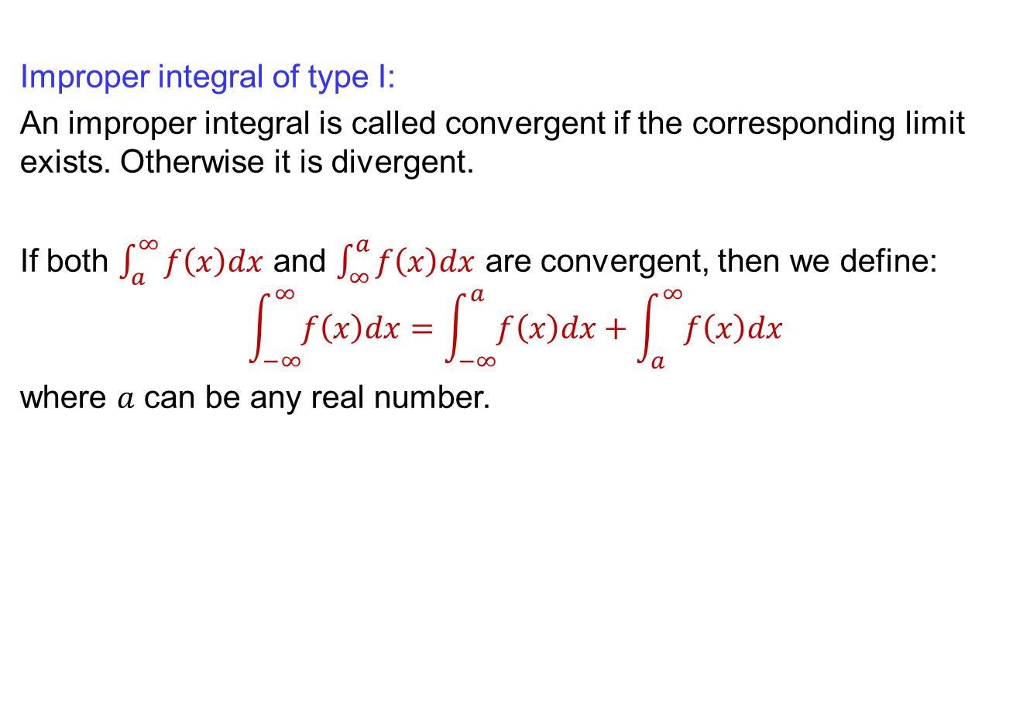
Recalls
Improper integral of type I:
An improper integral is called convergent if the corresponding limit exists. Otherwise it is divergent.
If both $\int_{a}^{∞}{f\left(x\right)dx}$ and $\int_{∞}^{a}{f\left(x\right)dx}$ are convergent, then we define:
$$\int_{−∞}^{∞}{f\left(x\right)dx}=\int_{−∞}^{a}{f\left(x\right)dx}+\int_{a}^{∞}{f\left(x\right)dx}$$
where $a$ can be any real number.

Slide 6
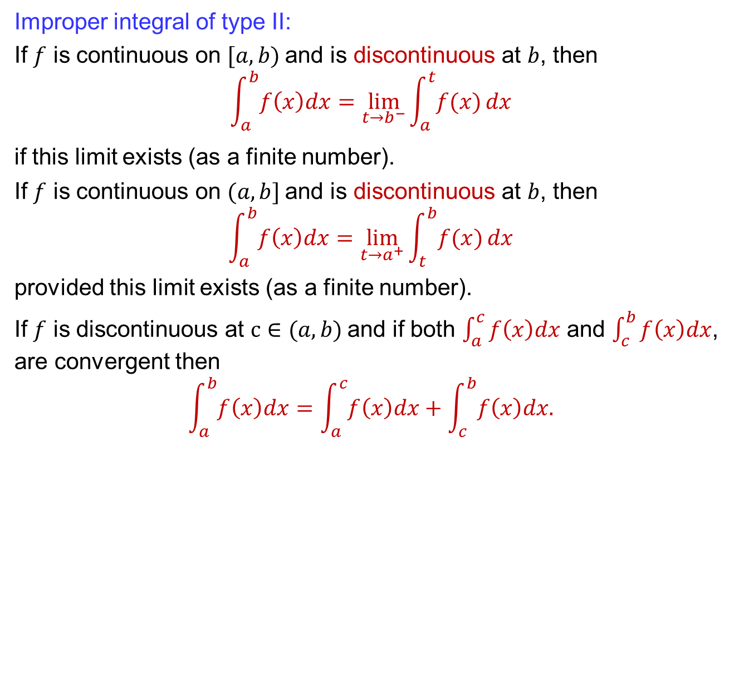
Recalls
Improper integral of type II:
If $f$ is continuous on $[a, b)$and is discontinuous at $b$, then
$$\int_{a}^{b}{f\left(x\right)dx}=\lim_{t→b^{−}}{\int_{a}^{t}{f(x)}}dx$$
if this limit exists (as a finite number).
If $f$ is continuous on $(a, b]$and is discontinuous at $b$, then
$$\int_{a}^{b}{f\left(x\right)dx}=\lim_{t→a^{+}}{\int_{t}^{b}{f(x)}}dx$$
provided this limit exists (as a finite number).
If $f$ is discontinuous at $c∈(a, b)$and if both $\int_{a}^{c}{f\left(x\right)dx}$ and $\int_{c}^{b}{f\left(x\right)dx}$, are convergent then
$$\int_{a}^{b}{f\left(x\right)dx}=\int_{a}^{c}{f\left(x\right)dx}+\int_{c}^{b}{f\left(x\right)dx.}$$

Slide 7
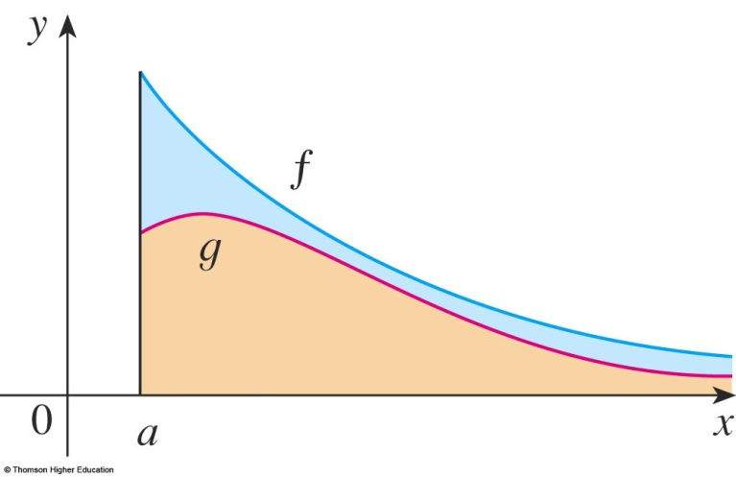
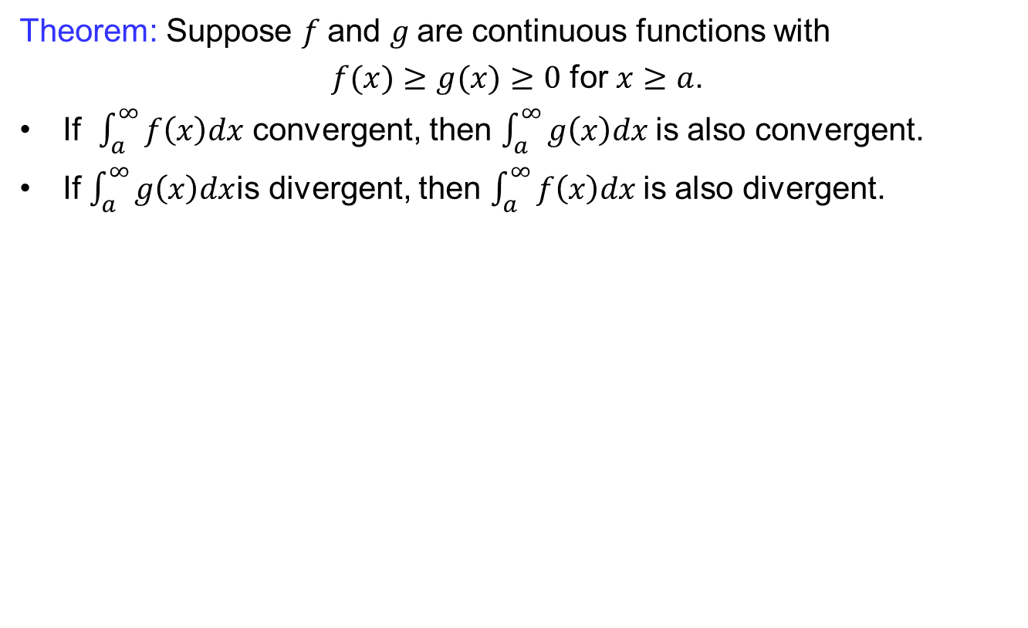
Recalls
Theorem: Suppose $f$and $g$are continuous functions with
$f(x)≥g(x)≥0$ for $x≥a$.
If $\int_{a}^{∞}{f\left(x\right)dx}$ convergent, then $\int_{a}^{∞}{g\left(x\right)dx}$is also convergent.
If $\int_{a}^{∞}{g\left(x\right)dx}$is divergent, then $\int_{a}^{∞}{f\left(x\right)dx}$is also divergent.

Slide 8
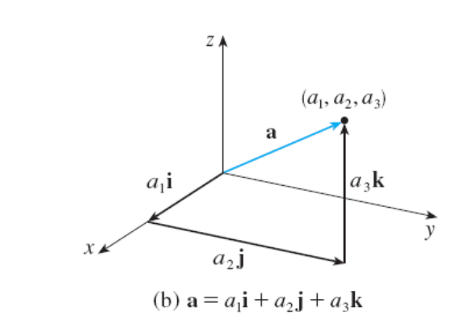
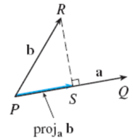
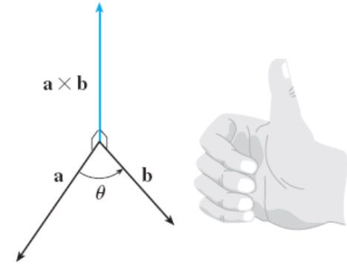
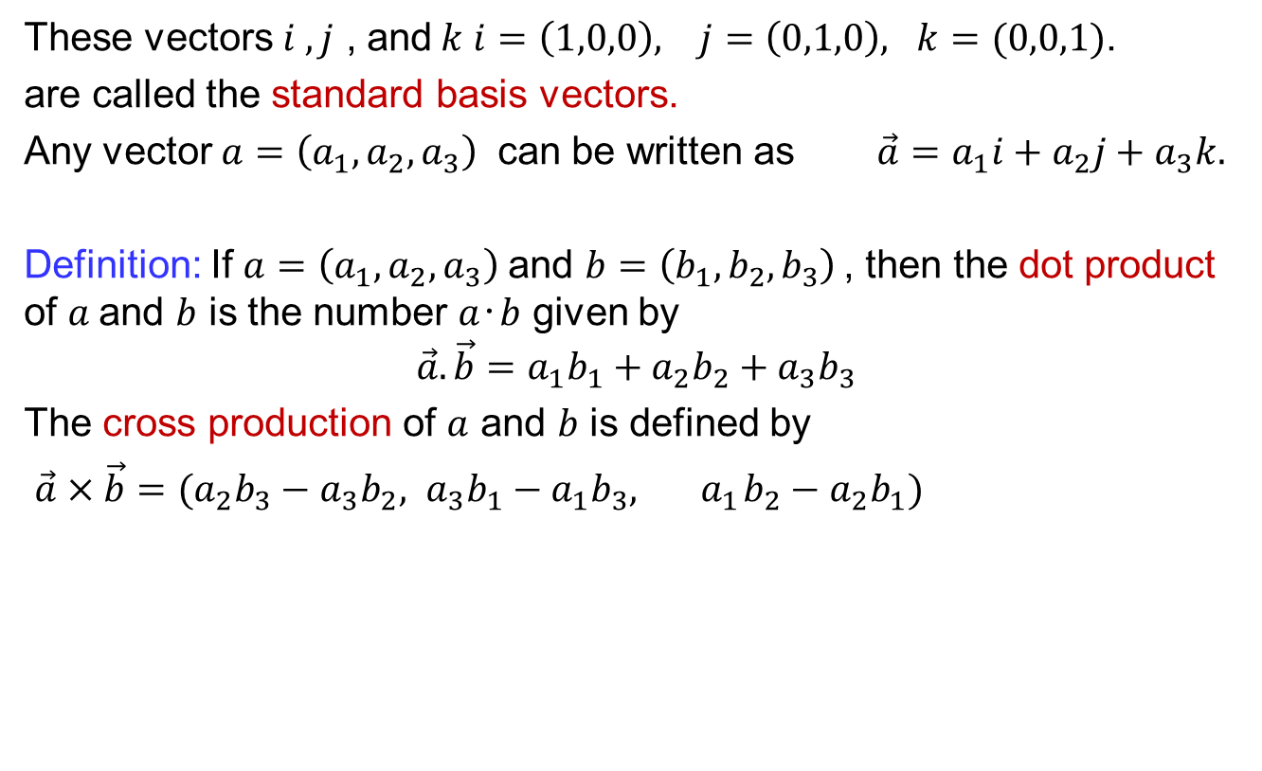
Recalls
These vectors $i , j$ , and$k$ $i=\left(1,0,0\right), j=\left(0,1,0\right), k=(0,0,1)$.
are called the standard basis vectors.
Any vector $a=\left(a_{1},a_{2},a_{3}\right)$ can be written as $\vec{a}=a_{1}i+a_{2}j+a_{3}k.$
Definition: If $a=\left(a_{1},a_{2},a_{3}\right)$and $b=\left(b_{1},b_{2},b_{3}\right)$, then the dot product of $a$and $b$ is the number $a‧b$ given by
$$\vec{a}.\vec{b}=a_{1}b_{1}+a_{2}b_{2}+a_{3}b_{3}$$
The cross production of $a$ and $b$ is defined by
$\vec{a}×\vec{b}={(a}_{2}b_{3}−a_{3}b_{2}, a_{3}b_{1}−a_{1}b_{3}, { a}_{1}b_{2}−a_{2}b_{1})$

Slide 9
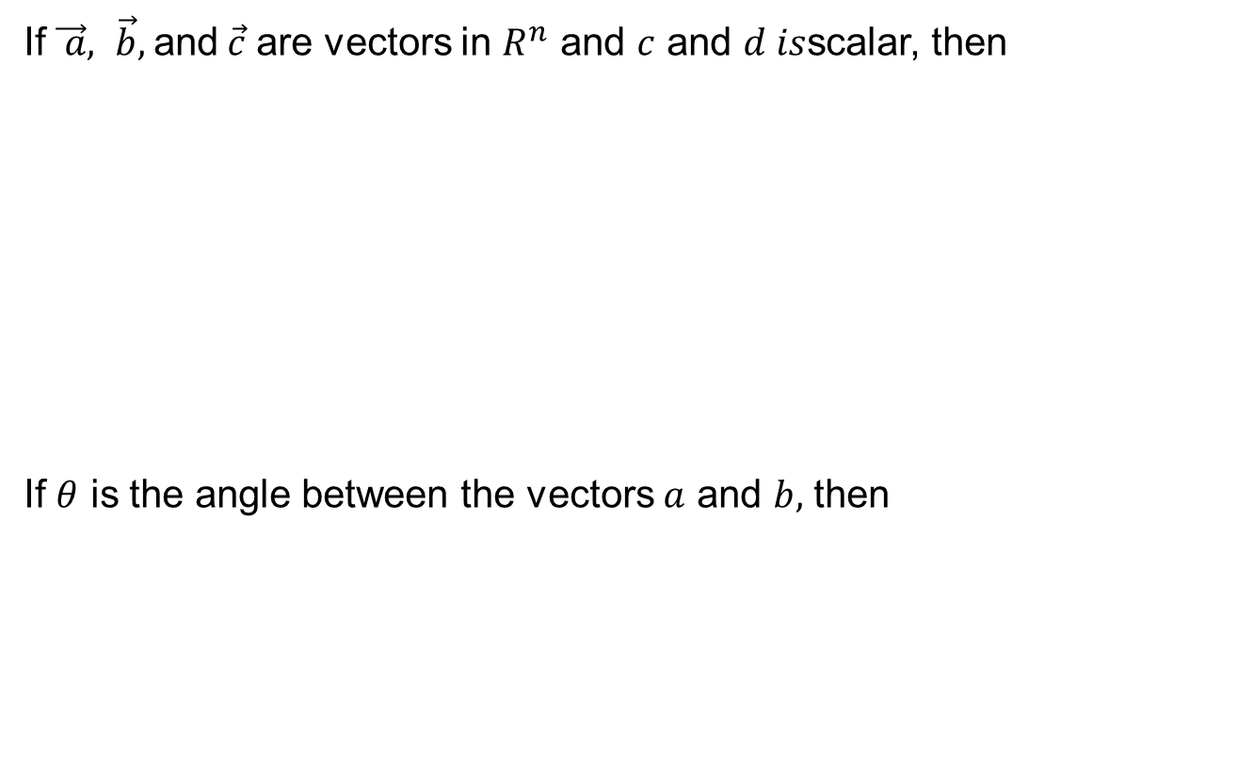
Recalls
If$\vec{ a}, \vec{b},$and$\vec{c}$ are vectors in $R^{n}$ and $c$ and $d is$scalar, then
If $θ$ is the angle between the vectors $a$ and $b,$ then

Slide 10
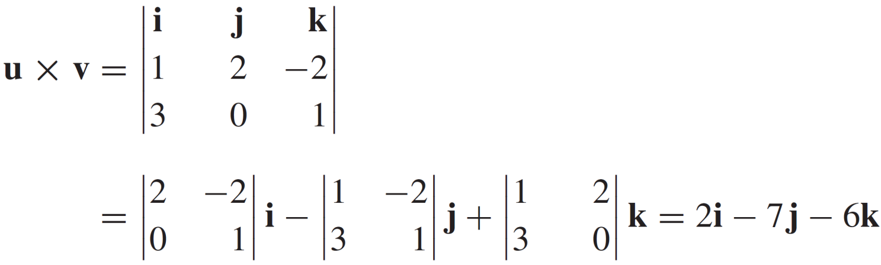
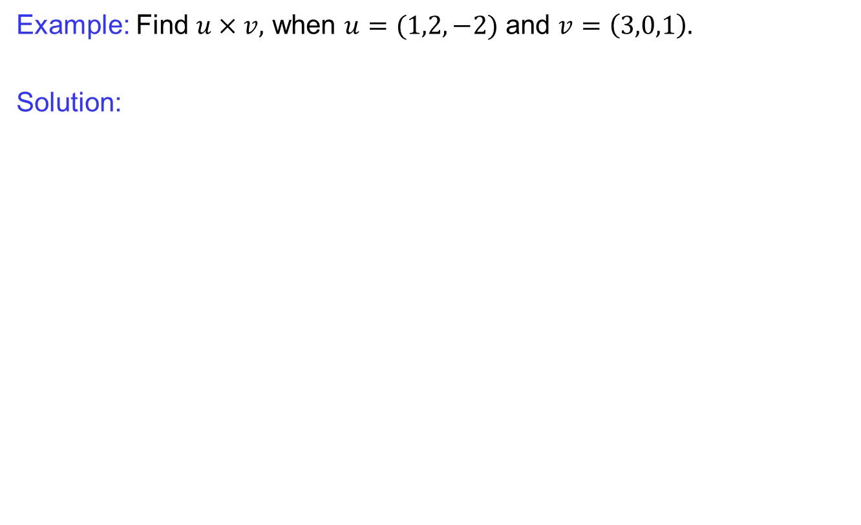
Recalls
Example: Find $u×v,$ when $u=(1,2,−2)$ and $v=\left(3,0,1\right).$
Solution:

Slide 11
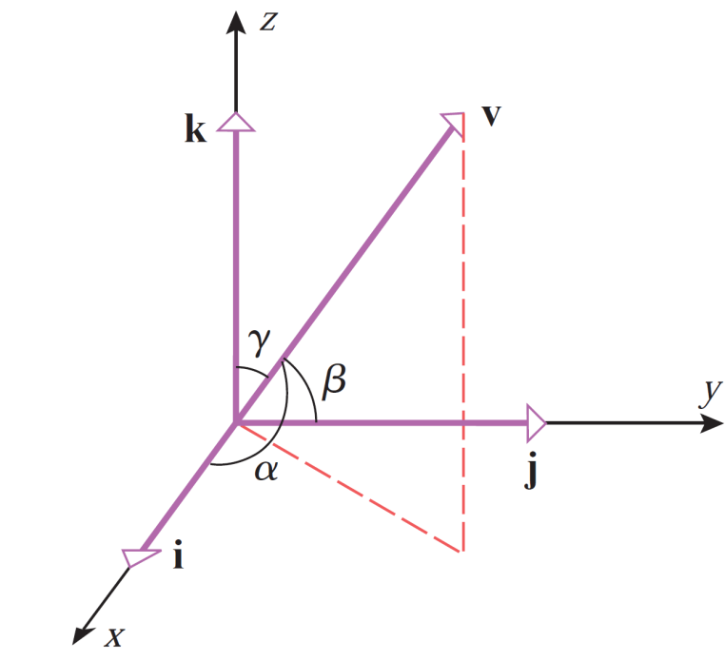


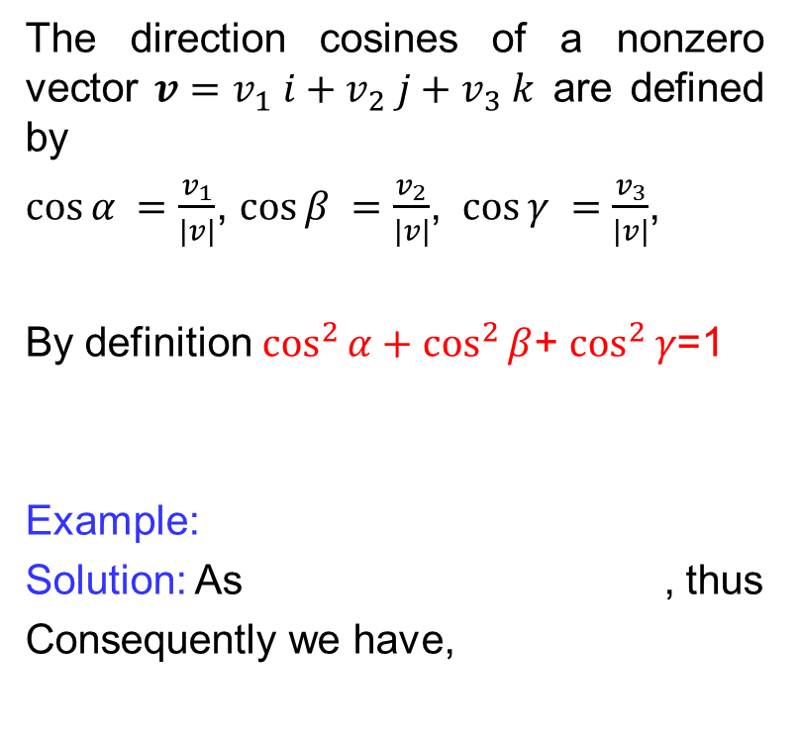
Direction Cosines
The direction cosines of a nonzero vector $v=v_{1} i+v_{2} j+v_{3} k$ are defined by
$\cos{α }=\frac{v_{1}}{|v|}$, $\cos{β }=\frac{v_{2}}{|v|}$, $\cos{γ }=\frac{v_{3}}{|v|}$,
By definition $\cos^{2}{α}+\cos^{2}{β}$+ $\cos^{2}{γ}$=1
Example:
Solution: As , thus
Consequently we have,

Slide 12
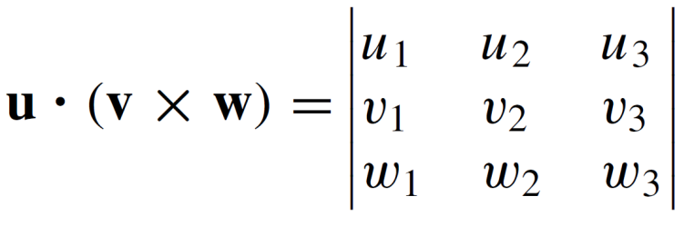
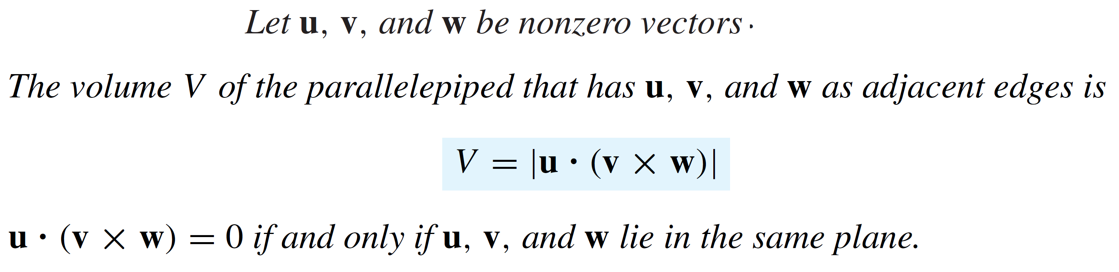
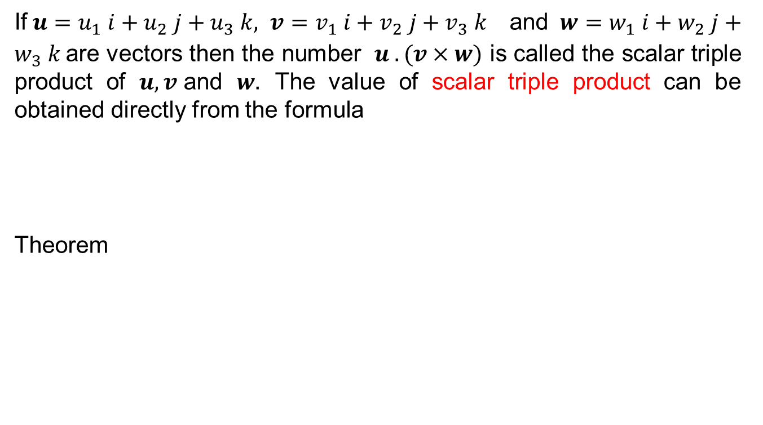
Scalar triple product
If$u=u_{1} i+u_{2} j+u_{3} k, v=v_{1} i+v_{2} j+v_{3} k$ and $w=w_{1} i+w_{2} j+w_{3} k$are vectors then the number $u . (v×w)$ is called the scalar triple product of $u, v$and $w.$ The value of scalar triple product can be obtained directly from the formula
Theorem

Slide 13
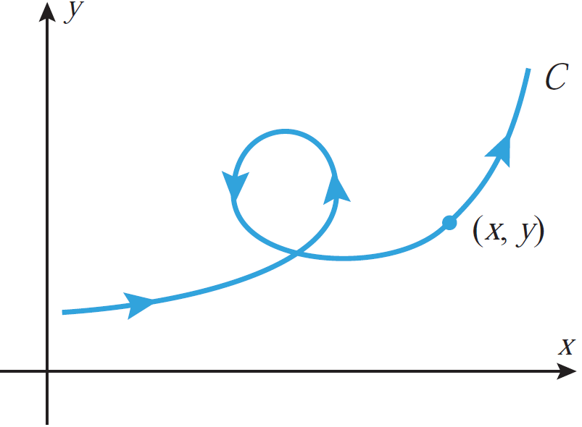
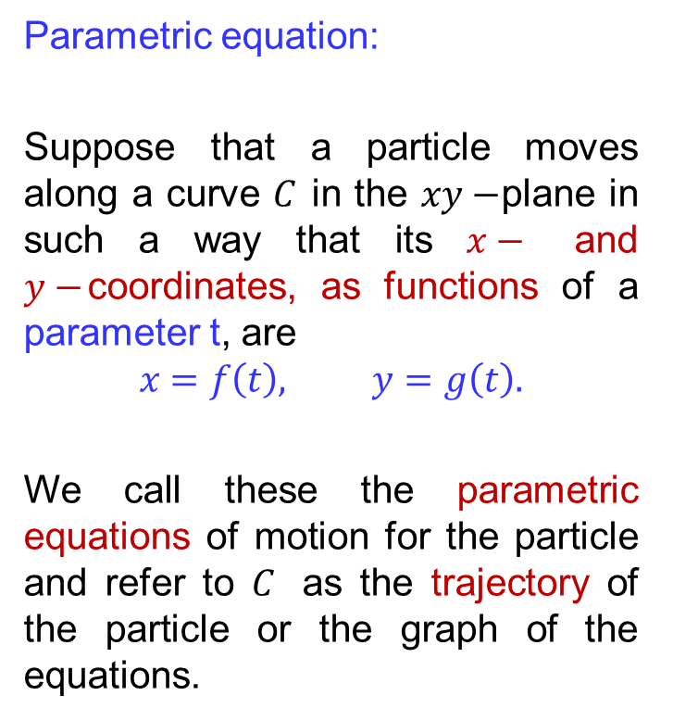
Parametric equations of lines
Parametric equation:
Suppose that a particle moves along a curve $C$ in the $xy−$plane in such a way that its $x−$ and $y−$coordinates, as functions of a parameter t, are
$$x=f\left(t\right), y=g\left(t\right).$$
We call these the parametric equations of motion for the particle and refer to $C$ as the trajectory of the particle or the graph of the equations.

Slide 14
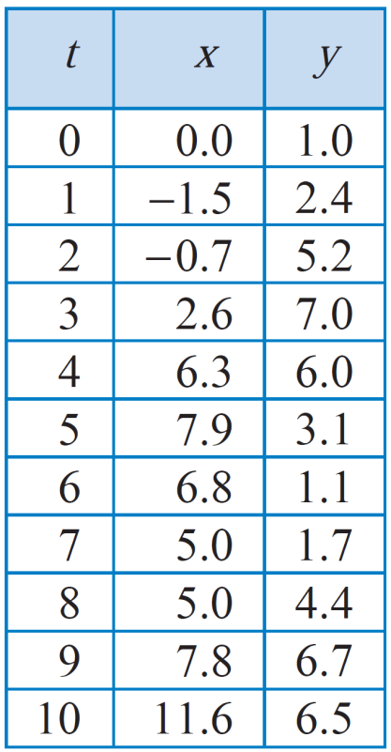
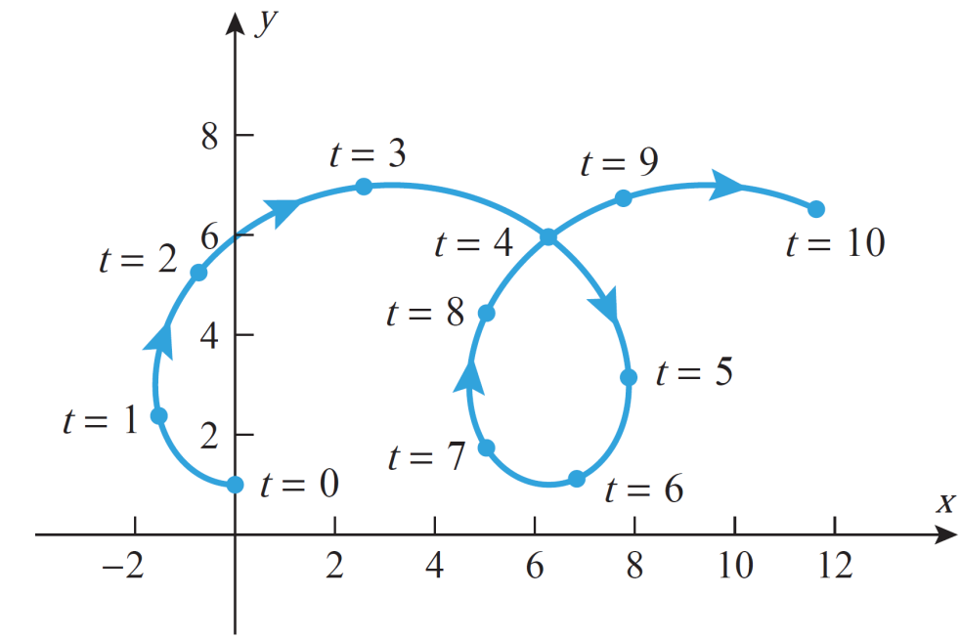
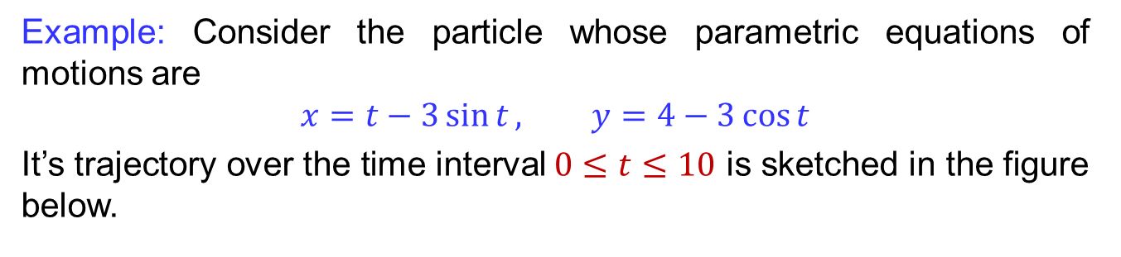
Parametric equations of lines
Example: Consider the particle whose parametric equations of motions are
$$x=t−3\sin{t}, y=4−3\cos{t}$$
It’s trajectory over the time interval$0≤t≤10$ is sketched in the figure below.

Slide 15
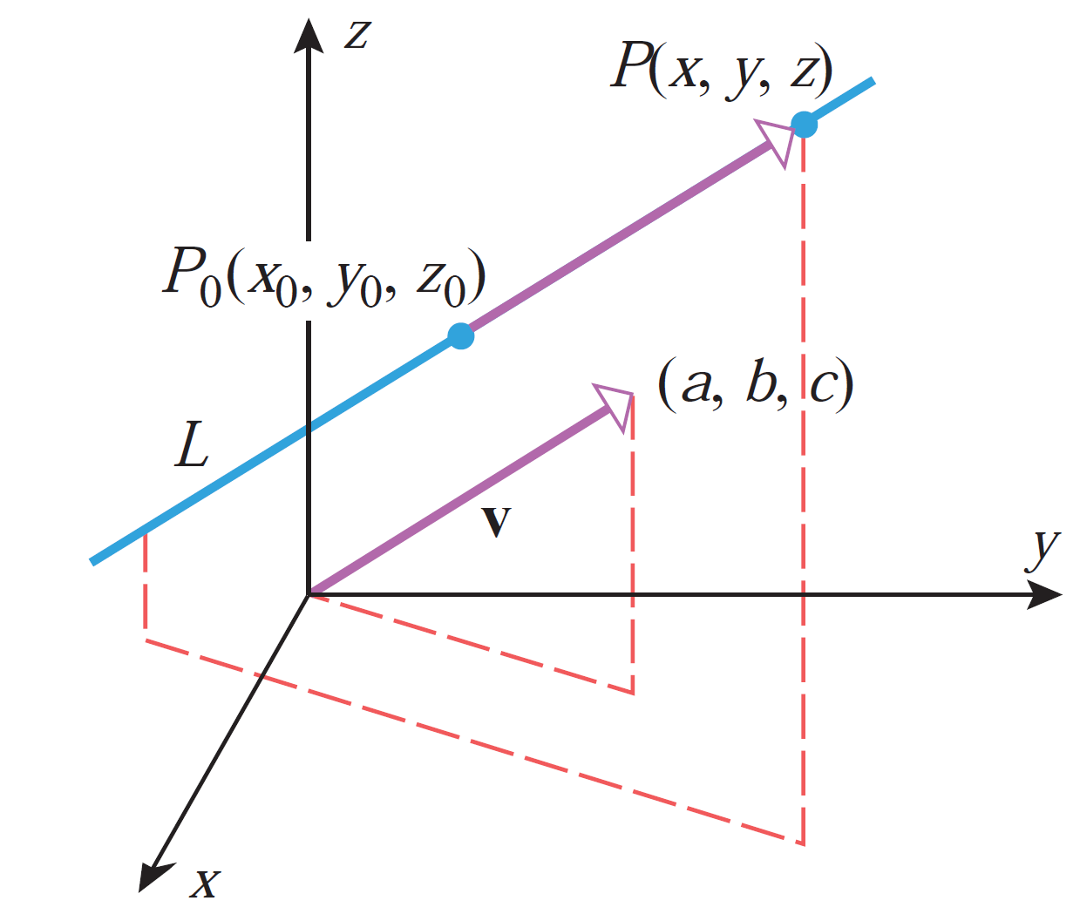
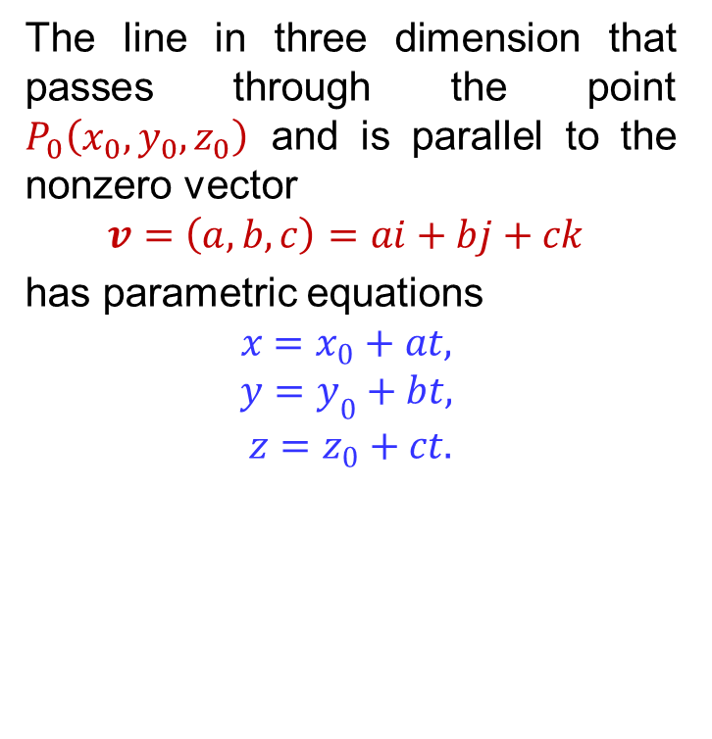
Parametric equations of lines
The line in three dimension that passes through the point $P_{0}\left(x_{0},y_{0},z_{0}\right)$ and is parallel to the nonzero vector
$$v=\left(a,b,c\right)=ai+bj+ck$$
has parametric equations
$$x=x_{0}+at,$$
$$y=y_{0}+bt,$$
$$z=z_{0}+ct.$$

Slide 16
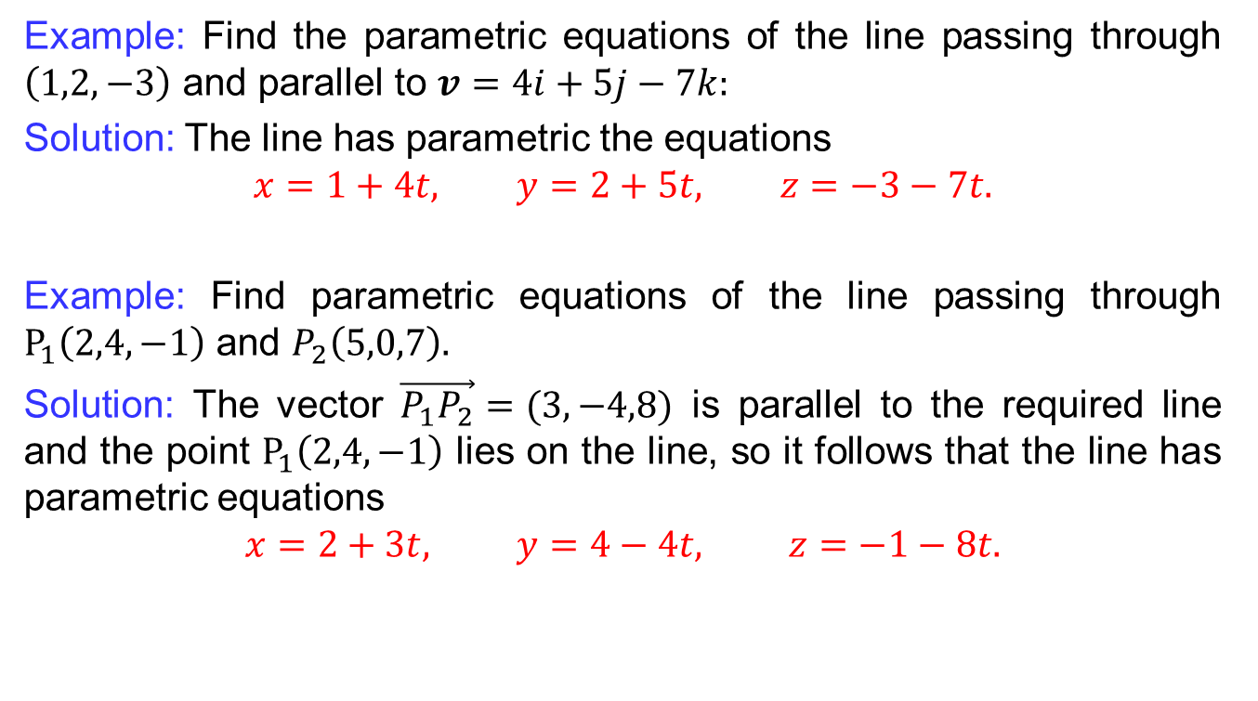
Parametric equations of lines
Example: Find the parametric equations of the line passing through $\left(1,2,−3\right)$ and parallel to $v=4i+5j−7k:$
Solution: The line has parametric the equations
$$x=1+4t, y=2+5t, z=−3−7t.$$
Example: Find parametric equations of the line passing through $P_{1}\left(2,4,−1\right)$ and $P_{2}\left(5,0,7\right).$
Solution: The vector $\vec{P_{1}P_{2}}=(3,−4,8)$ is parallel to the required line and the point $P_{1}\left(2,4,−1\right)$ lies on the line, so it follows that the line has parametric equations
$$x=2+3t, y=4−4t, z=−1−8t.$$

Slide 17
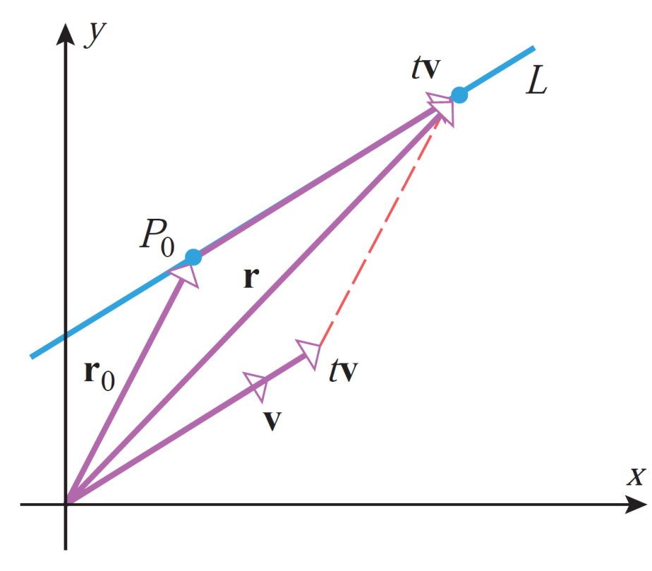

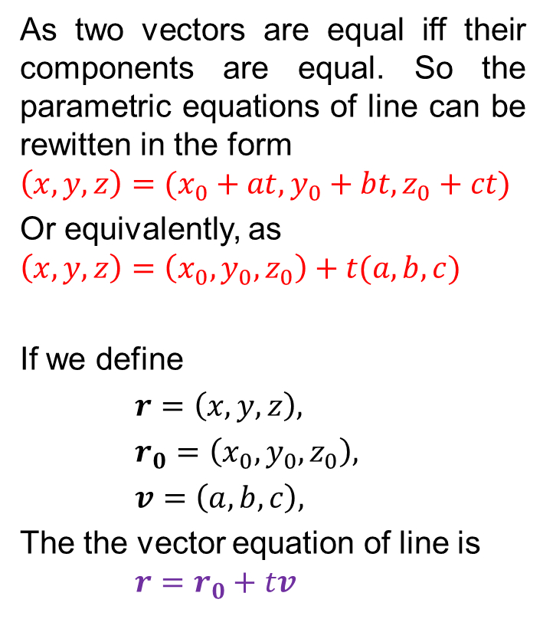
Vector equations of lines
As two vectors are equal iff their components are equal. So the parametric equations of line can be rewitten in the form
$$\left(x,y,z\right)=(x_{0}+at, y_{0}+bt, z_{0}+ct)$$
Or equivalently, as
$$\left(x,y,z\right)=\left(x_{0}, y_{0}, z_{0}\right)+t(a,b,c)$$
If we define
$r=\left(x,y,z\right),$
$r_{0}=\left(x_{0},y_{0},z_{0}\right),$
$v=\left(a,b,c\right),$
The the vector equation of line is $r=r_{0}+tv$

Slide 18
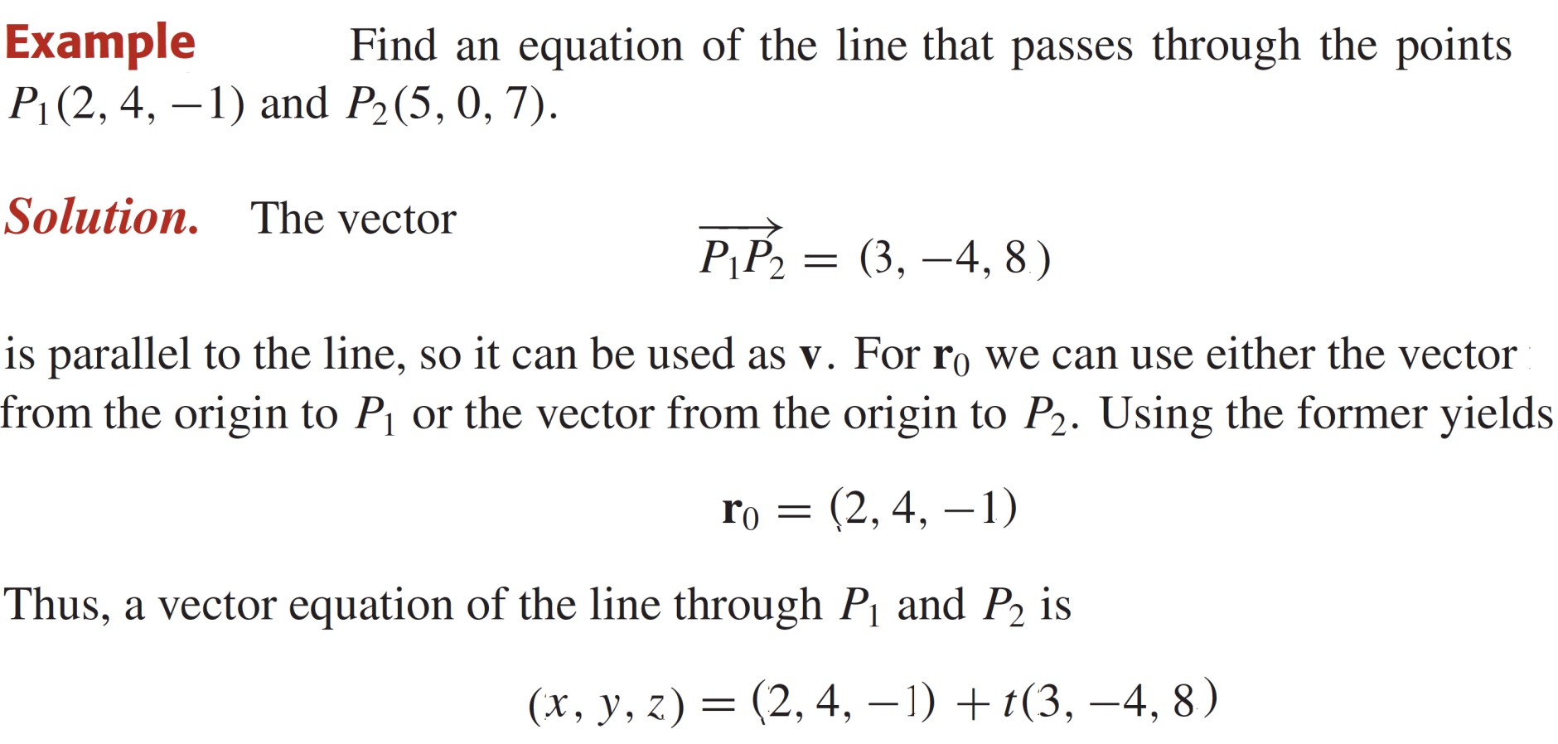
Vector equations of lines

Slide 19
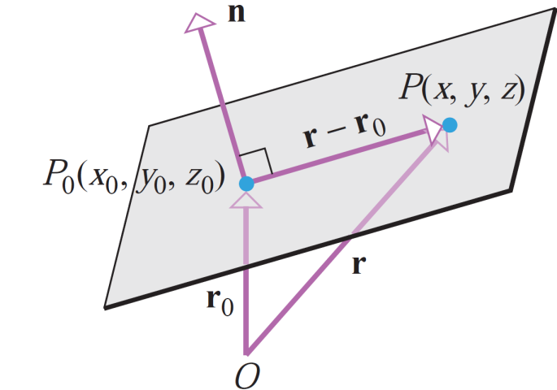
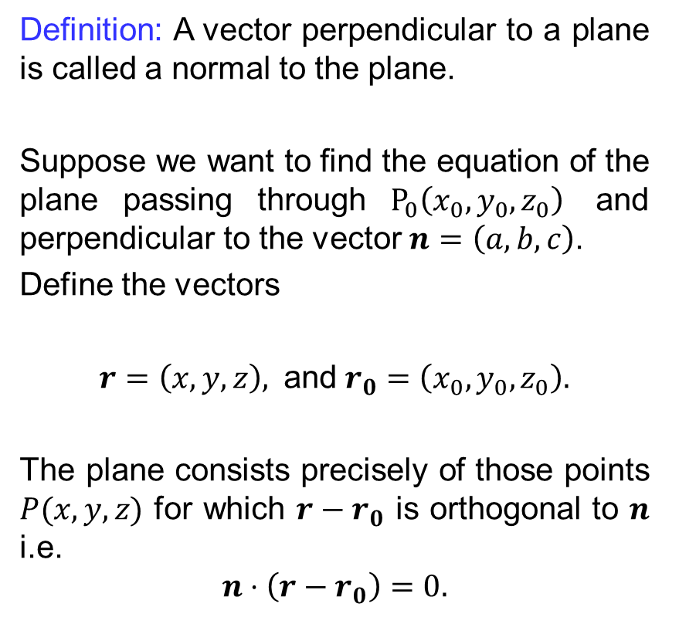
Vector equations of planes
Definition: A vector perpendicular to a plane is called a normal to the plane.
Suppose we want to find the equation of the plane passing through $P_{0}\left(x_{0}, y_{0}, z_{0}\right)$ and perpendicular to the vector $n=\left(a,b,c\right)$.
Define the vectors
$r=\left(x,y,z\right),$ and$r_{0}=\left(x_{0},y_{0},z_{0}\right).$
The plane consists precisely of those points $P(x,y,z)$ for which $r−r_{0}$ is orthogonal to $n$ i.e.
$$n⋅\left(r−r_{0}\right)=0.$$

Slide 20
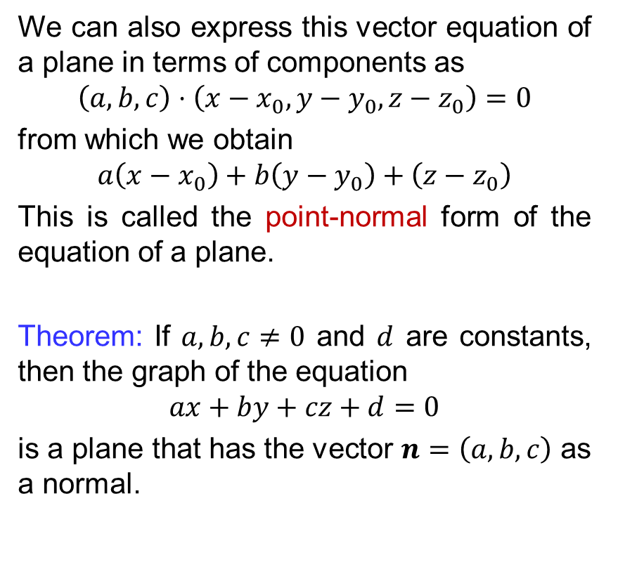
Vector equations of planes
We can also express this vector equation of a plane in terms of components as
$$\left(a,b,c\right)⋅\left(x−x_{0},y−y_{0}, z−z_{0}\right)=0$$
from which we obtain
$$a\left(x−x_{0}\right)+b\left(y−y_{0}\right)+\left(z−z_{0}\right)$$
This is called the point-normal form of the equation of a plane.
Theorem: If $a,b,c≠0$ and $d$ are constants, then the graph of the equation
$$ax+by+cz+d=0$$
is a plane that has the vector $n=\left(a,b,c\right)$ as a normal.

Slide 21
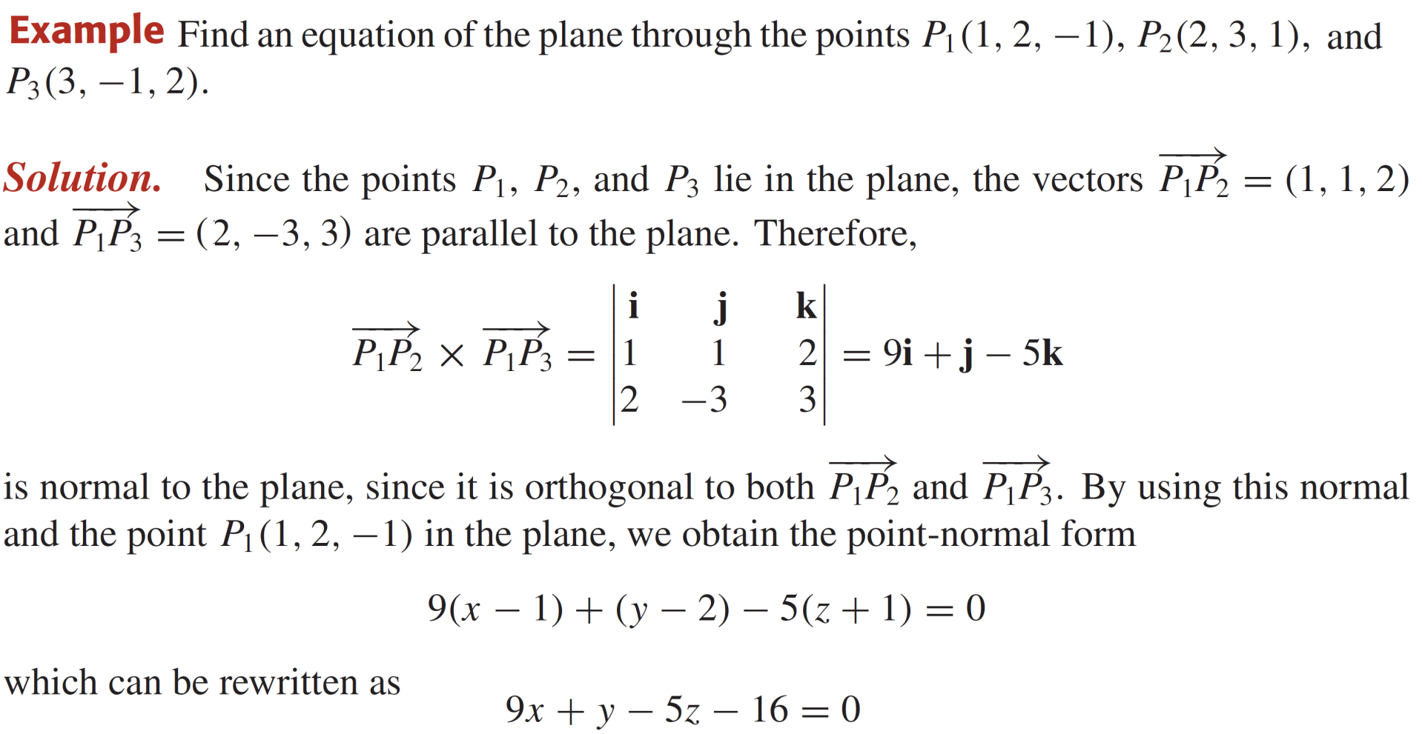
Vector equations of planes

Slide 22
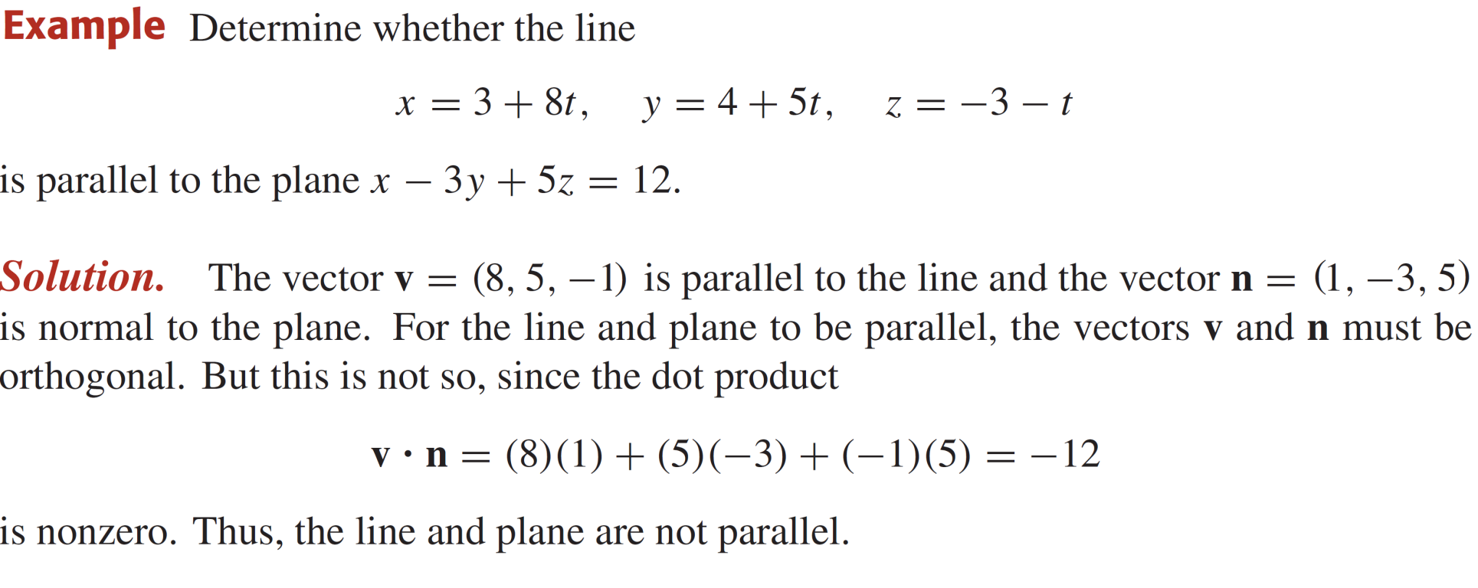
Vector equations of planes

Slide 23



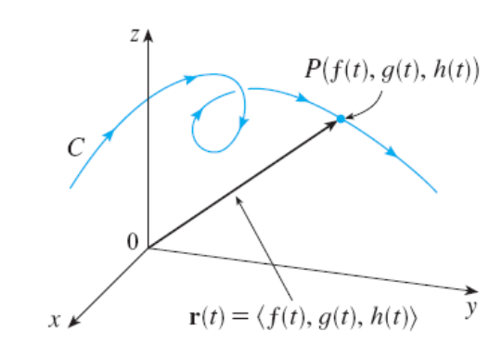
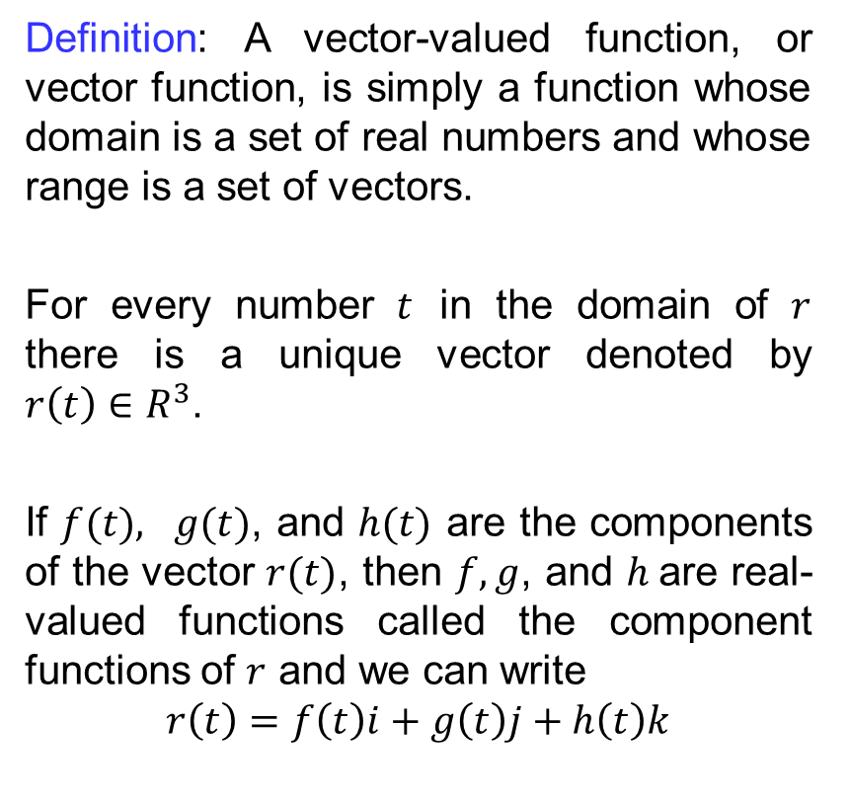

Vector-valued functions
Definition: A vector-valued function, or vector function, is simply a function whose domain is a set of real numbers and whose range is a set of vectors.
For every number $t$ in the domain of $r$ there is a unique vector denoted by $r\left(t\right)∈R^{3}$.
If $f(t), g(t)$, and $h(t)$ are the components of the vector $r(t)$, then $f, g$, and $h$are real-valued functions called the component functions of $r$ and we can write
$$r\left(t\right)=f\left(t\right)i+g\left(t\right)j+h\left(t\right)k$$
$$h\left(t\right)k$$

Slide 24
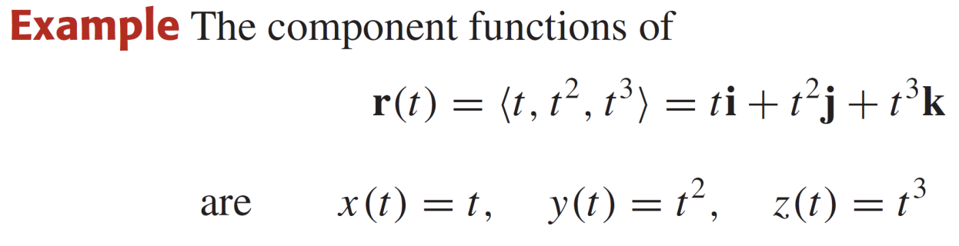
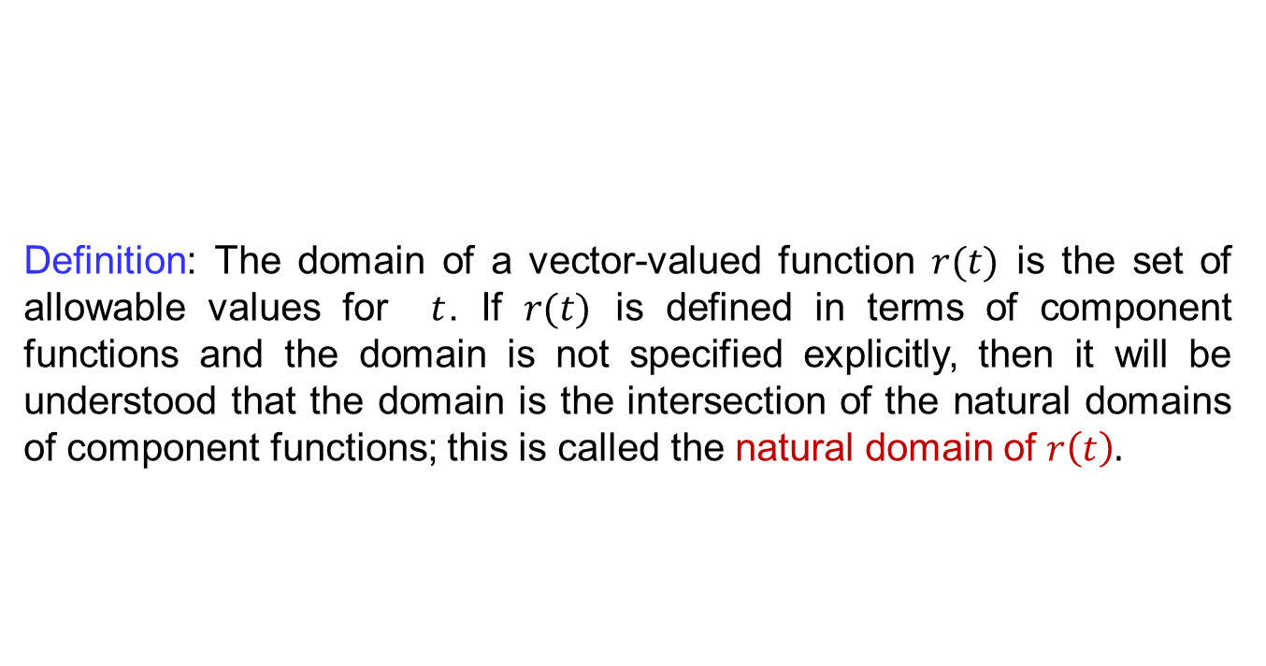
Vector-valued functions
Definition: The domain of a vector-valued function $r(t)$ is the set of allowable values for $t$. If $r(t)$ is defined in terms of component functions and the domain is not specified explicitly, then it will be understood that the domain is the intersection of the natural domains of component functions; this is called the natural domain of $r\left(t\right).$

Slide 25
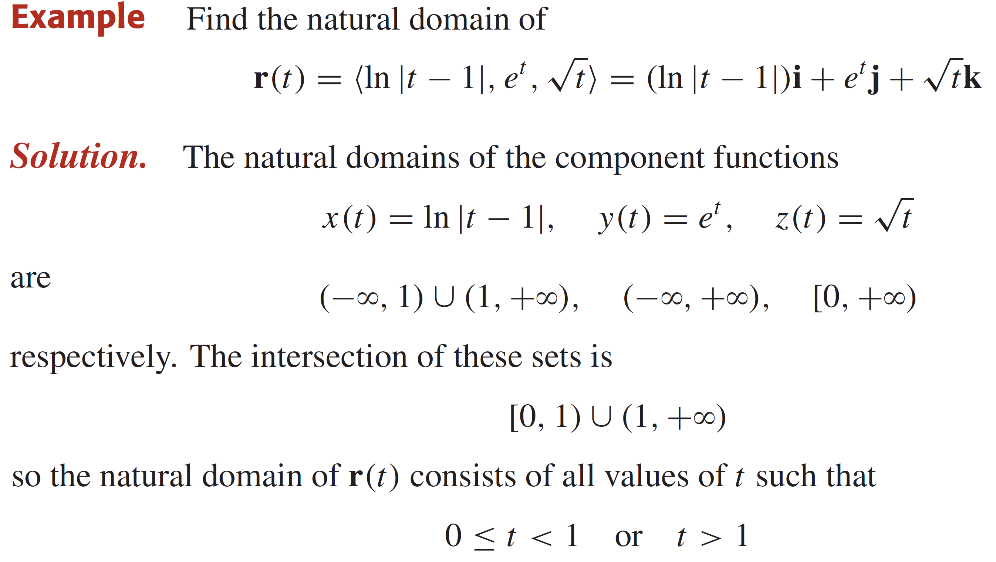
Vector-valued functions

Slide 26
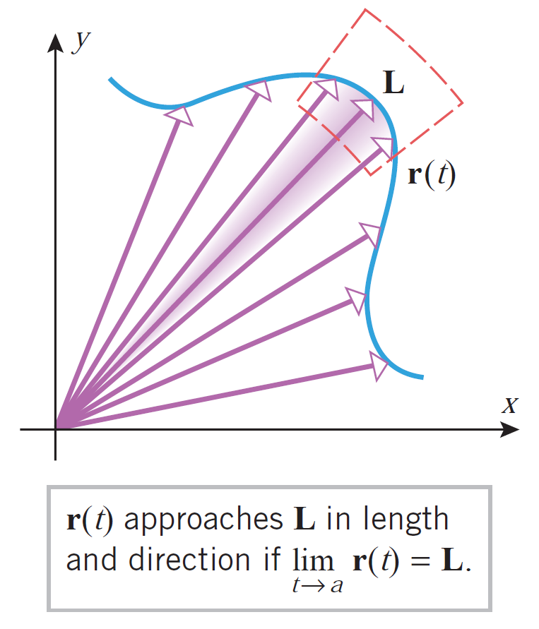
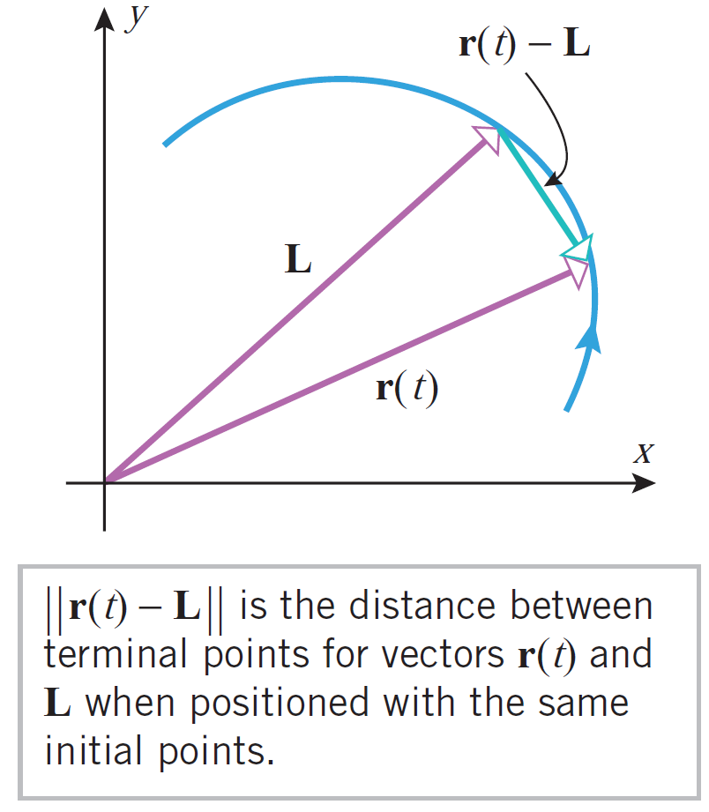
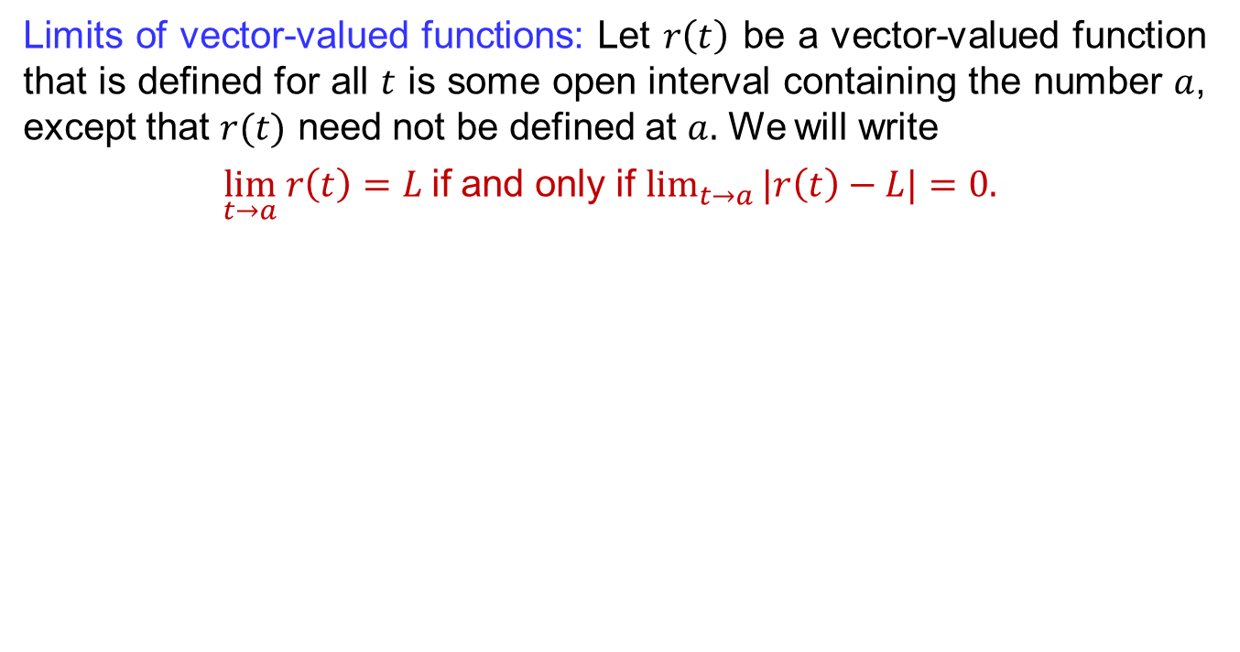
Limits, continuity & differentiability
Limits of vector-valued functions: Let $r\left(t\right)$ be a vector-valued function that is defined for all $t$ is some open interval containing the number $a$, except that $r(t)$ need not be defined at $a.$ We will write
$\lim_{t→a} r\left(t\right)=L$if and only if $\lim_{t→a}{|r\left(t\right)−L|}=0.$

Slide 27
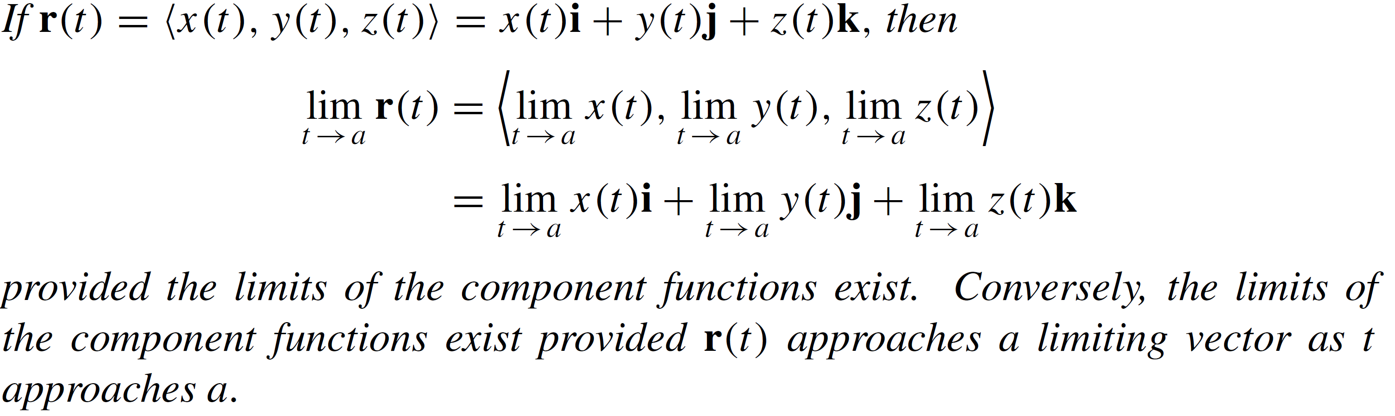
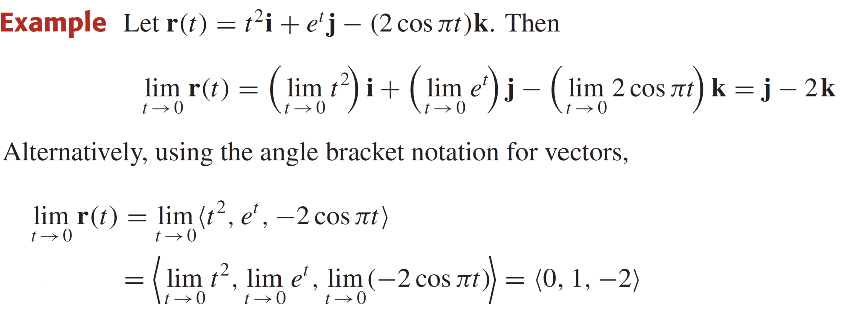
Limits, continuity & differentiability
Theorem:

Slide 28
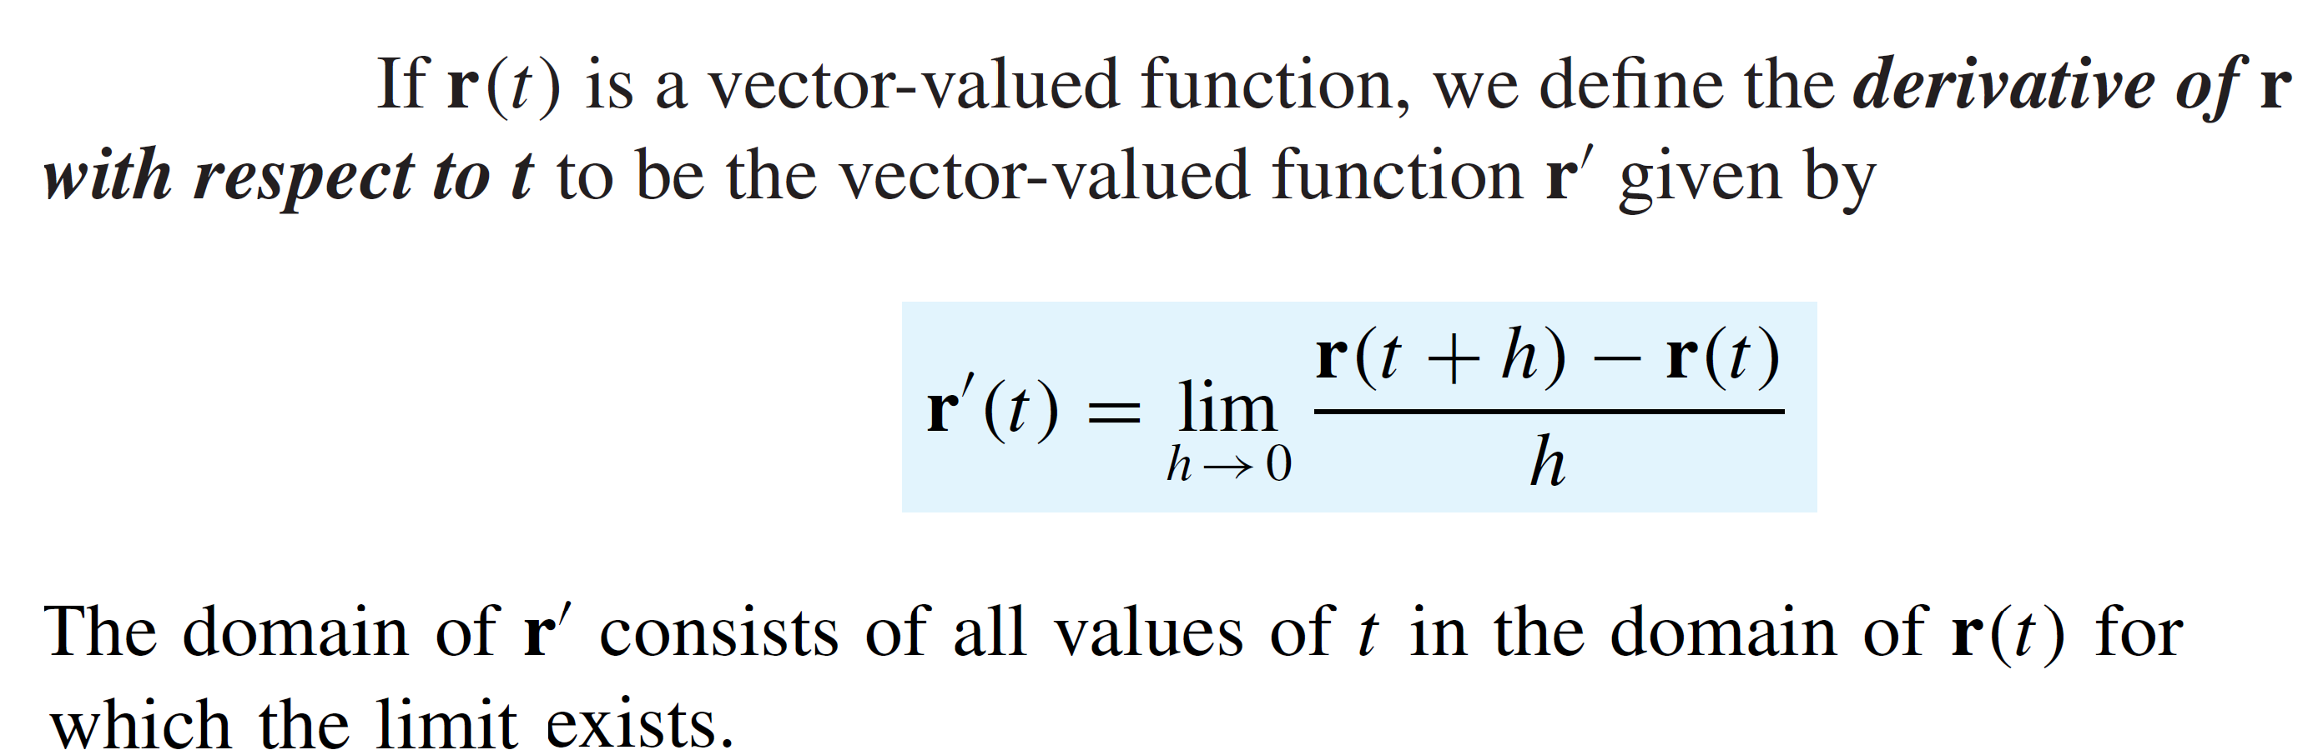
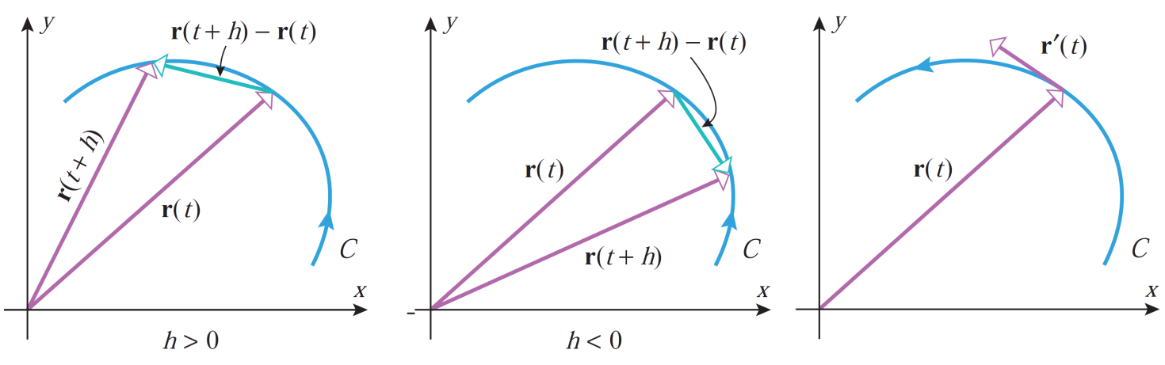
Limits, continuity & differentiability
Definition:

Slide 29
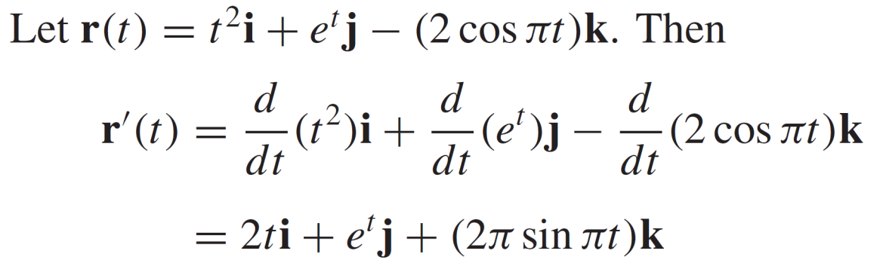
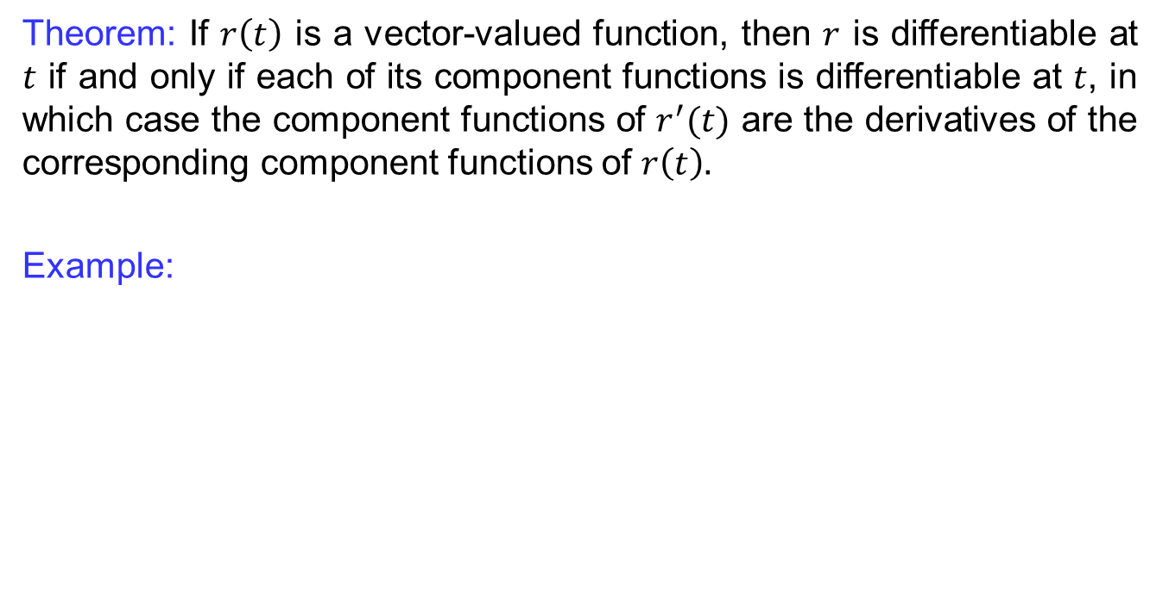
Limits, continuity & differentiability
Theorem: If $r\left(t\right)$ is a vector-valued function, then $r$ is differentiable at $t$ if and only if each of its component functions is differentiable at $t$, in which case the component functions of $r^{′}(t)$ are the derivatives of the corresponding component functions of $r\left(t\right).$
Example:

Slide 30
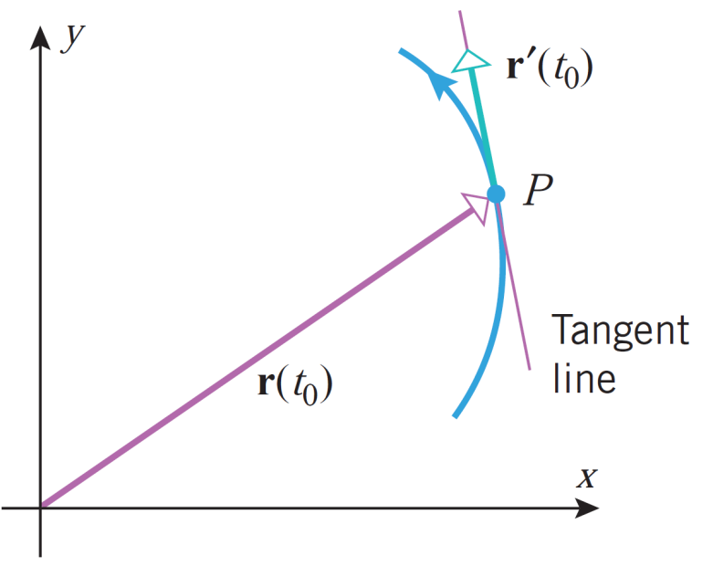
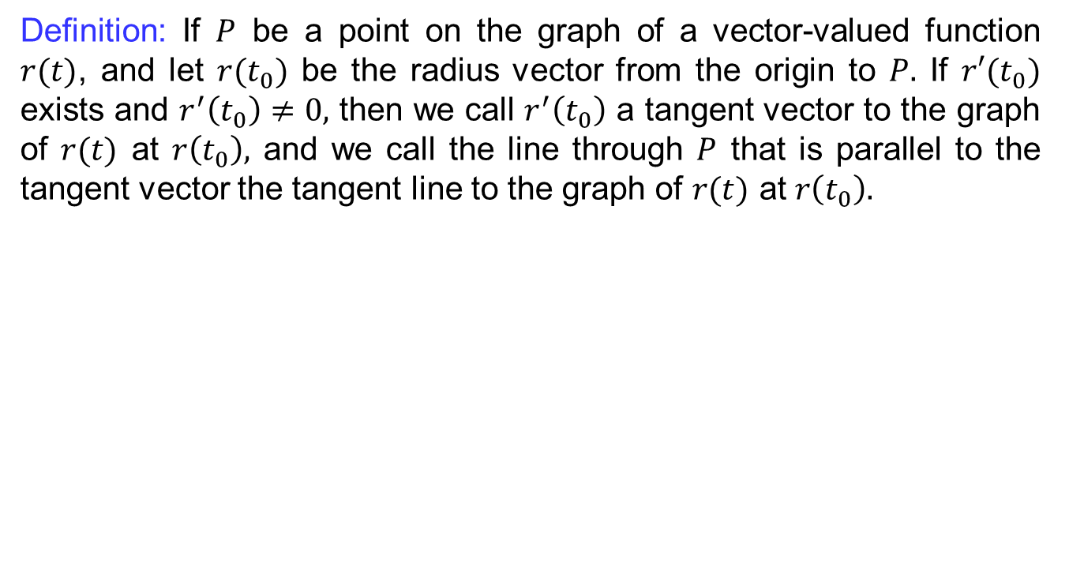
Limits, continuity & differentiability
Definition: If $P$ be a point on the graph of a vector-valued function $r(t)$, and let $r(t_{0})$ be the radius vector from the origin to $P.$ If $r′(t_{0})$ exists and $r^{′}\left(t_{0}\right)≠0,$ then we call $r^{′}\left(t_{0}\right)$ a tangent vector to the graph of $r(t)$ at $r\left(t_{0}\right),$ and we call the line through $P$ that is parallel to the tangent vector the tangent line to the graph of $r(t)$ at $r\left(t_{0}\right).$

Slide 31
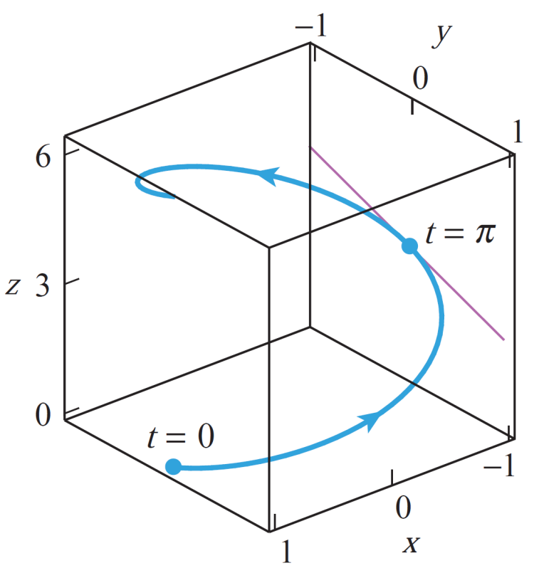

Limits, continuity & differentiability
Example: Find parametric equations of the tangent line to the circular helix
$$x=\cos{t}, y=\sin{t}, z=t$$
where $t=t_{0}$, and find parametric equations for the tangent line at $t=π.$
Solution: The vector equation of the helix is
$$r\left(t\right)=\cos{t}i+\sin{t}j+tk.$$
Therefore,
$r\left(t_{0}\right)=\cos{t_{0}}i+\sin{t_{0}}j+t_{0}k$
and
$$v_{0}=r^{′}\left(t_{0}\right)=\left(−\sin{t_{0}}\right)i+\cos{t_{0}}j+k.$$

Slide 32

Limits, continuity & differentiability
Cont.. It follows that the vector equation of the tangent line at $t=t_{0}$ is
$$r=(cos{t_{0}}i+\sin{t_{0}}j+t_{0}k)+t\left[\left(−\sin{t_{0}}\right)i+\cos{t_{0}}j+k\right]=(cos{t_{0}−t\sin{t_{0}})i}+\left(\sin{t_{0}}+t\cos{t_{0}}\right)j+\left(t_{0}+t\right)k.$$
Thus the parametric equations of the tangent line at $t=t_{0}$ are
$x=\cos{t_{0}−t\sin{t_{0}}}, y=\sin{t_{0}+t\cos{t_{0}}}, z=t_{0}+t.$
In particular, the tangent line at $t=π$ has parametric equations
$$x=−1, y=−t, z=π+t.$$

Slide 33

Limits, continuity & differentiability

Slide 34


Limits, continuity & differentiability
Definition: Let $r_{1}(t)$ and $r_{2}(t)$ be two vector-valued differentiable function, then
Theorem: If $r(t)$ is a differentiable vector-valued function and $\left|r\left(t\right)\right|$ is constant for all $t,$then
$$r\left(t\right)⋅r^{′}\left(t\right)=0$$
that is , $r\left(t\right)$ and $r′(t)$ are orthogonal vectors for all $t.$

Slide 35



Integration
Definition:
Let $r(t)$ be an integrable vector-valued function, then
An antiderivative for a vector-valued function $r(t)$ is a vector valued function $R\left(t\right)$ such that $R^{′}\left(t\right)=r\left(t\right).$
The vector form of fundamental theorem of Calculus is given by

Slide 36


Integration

Slide 37
Lecture Summary
    Recalls
    Direction cosines
    Scalar triple product
    Parametric equations of lines
    Vector equations of lines
    Vector equations of planes
    Vector-valued functions
    Limits, continuity & differentiability
    Integration

