Slide 1
(MTH 250)
Calculus
Lecture 21

Slide 2
Previous Lecture’s Summary
    Trigonometric integrals
    Trigonometric substitutions
    Partial fractions

Slide 3
Today’s Lecture
    Recalls
    Improper integrals
    Introduction to vectors
    Dot product of vectors
    Cross product of vectors

Slide 4
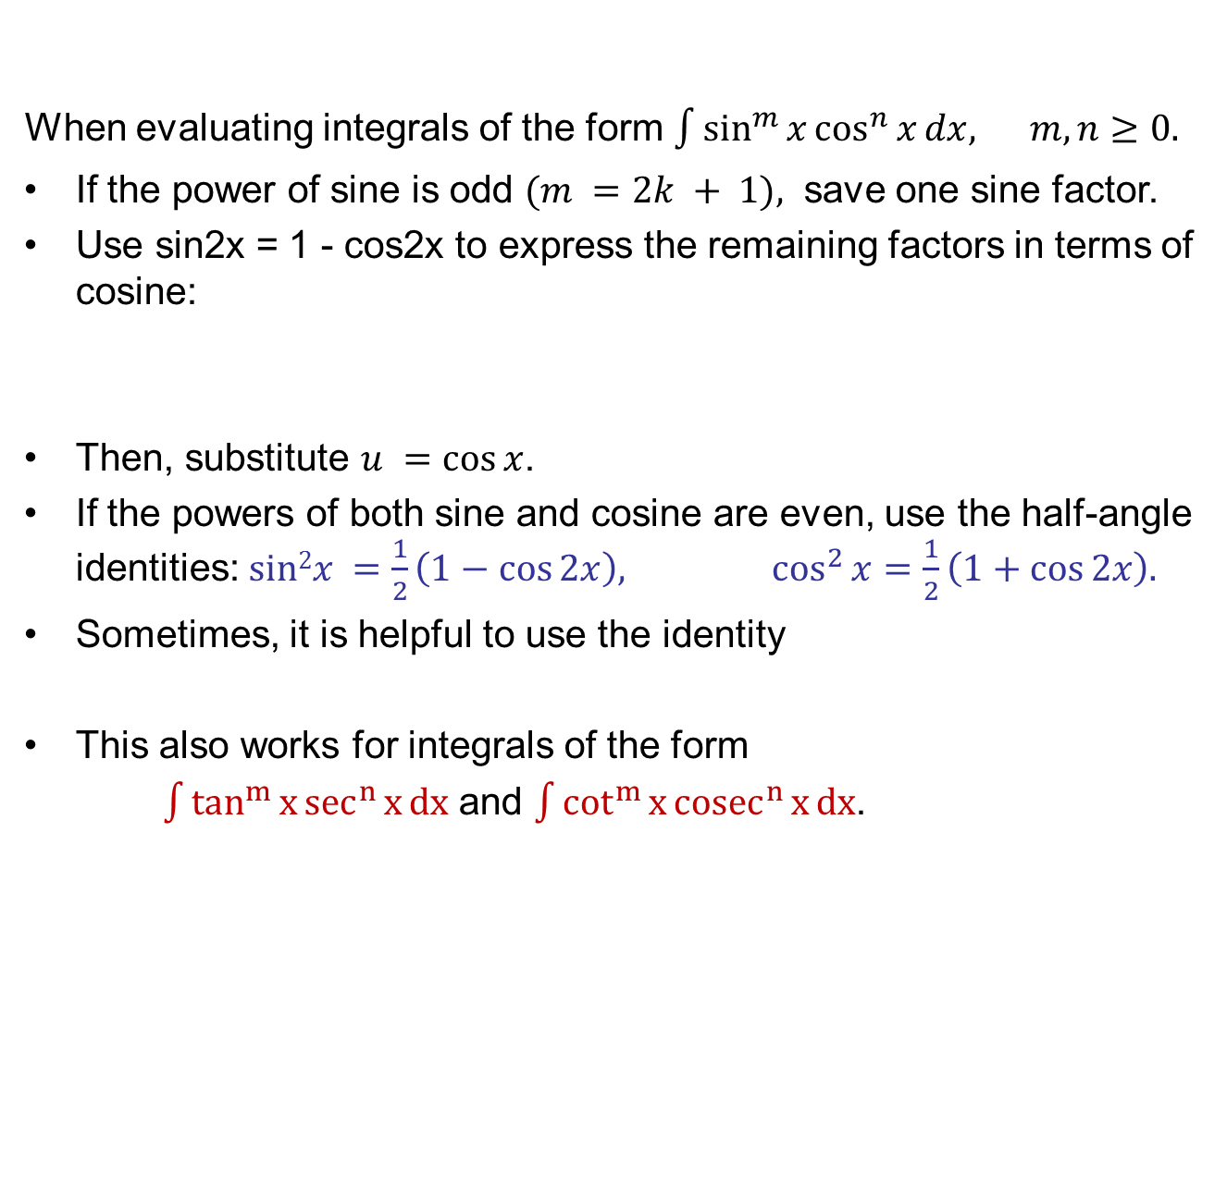
Recalls
When evaluating integrals of the form $\int{\sin^{m}{x}\cos^{n}{x}dx, m,n≥0.}$
If the power of sine is odd $(m =2k + 1),$ save one sine factor.
Use sin2x = 1 - cos2x to express the remaining factors in terms of cosine:
Then, substitute $u =cos⁡x$.
If the powers of both sine and cosine are even, use the half-angle identities: $sin2x =\frac{1}{2}\left(1−\cos{2x}\right), \cos^{2}{x}=\frac{1}{2}\left(1+\cos{2x}\right).$
Sometimes, it is helpful to use the identity
This also works for integrals of the form
$\int{\tan^{m}{x}\sec^{n}{x}dx}$ and $\int{\cot^{m}{x}{cosec}^{n}{x}dx}$.

Slide 5
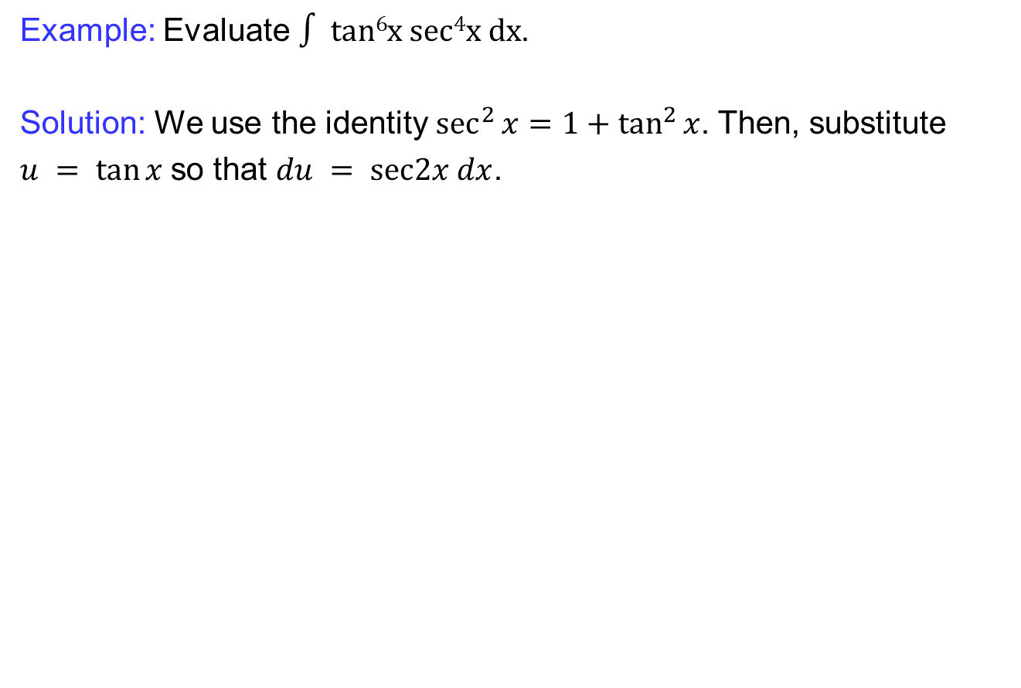
Recalls
Example: Evaluate$∫ tan6x sec4x dx$.
Solution: We use the identity $\sec^{2}{x}=1+\tan^{2}{x}$. Then, substitute
$u = tan⁡x$so that $du = sec2x dx$.

Slide 6
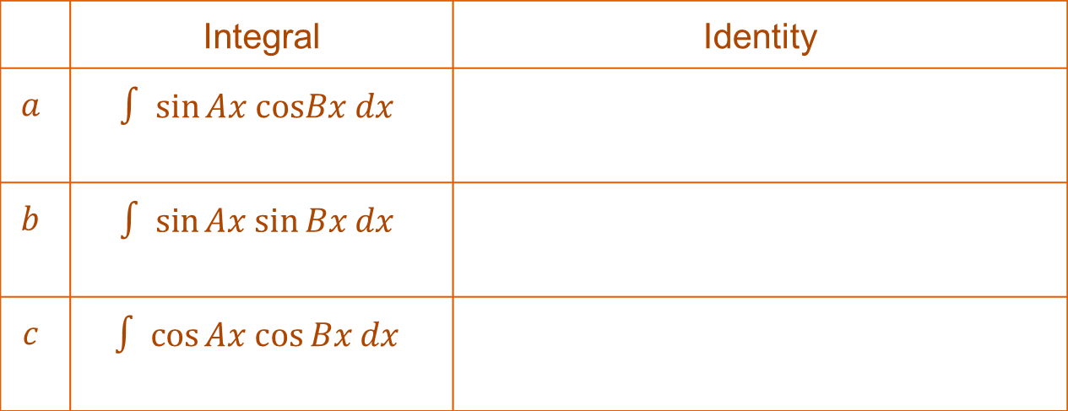
Recalls
We use the following identities to evaluate special of trigonometric integrals.
 | Integral | Identity
$$a$$ | $$∫ sin⁡Ax cosBx dx$$
$$b$$ | $$∫ sin⁡Ax sin⁡Bx dx$$
$$c$$ | $$∫ cos⁡Ax cos⁡Bx dx$$

Slide 7
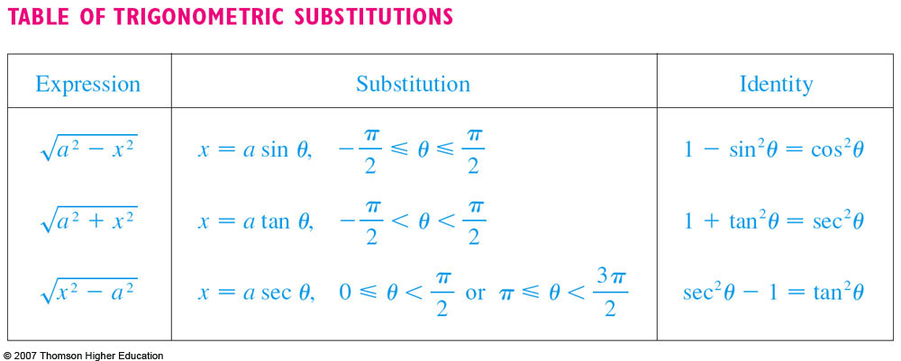
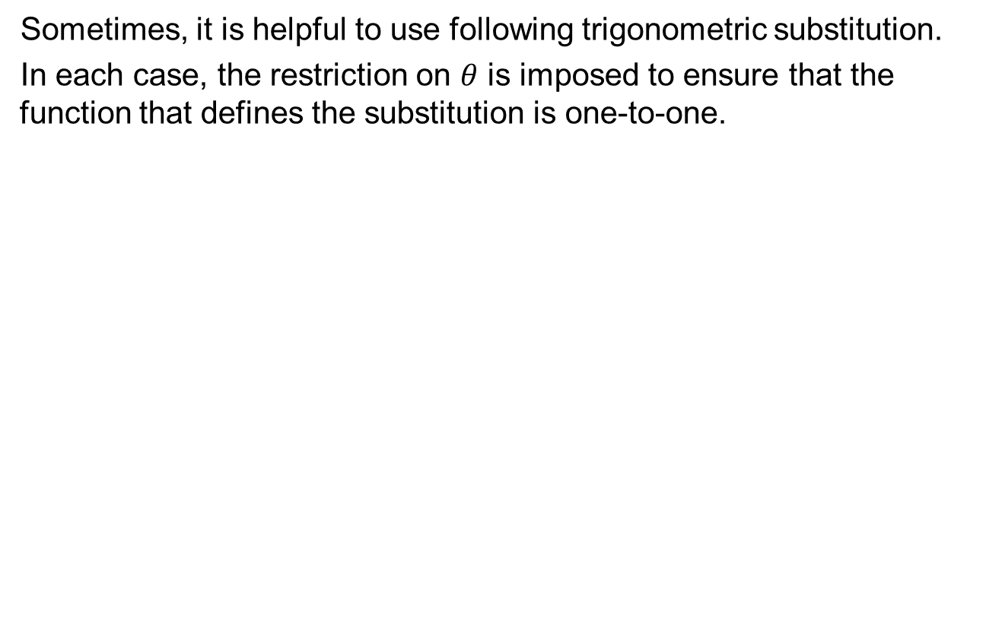
Recalls
Sometimes, it is helpful to use following trigonometric substitution.
In each case, the restriction on $θ$ is imposed to ensure that the function that defines the substitution is one-to-one.

Slide 8
Recalls
How to find partial fractions:
Linear factors
Power of a linear factor
Quadratic factor, we break it down to partial fractions as follows:

Slide 9
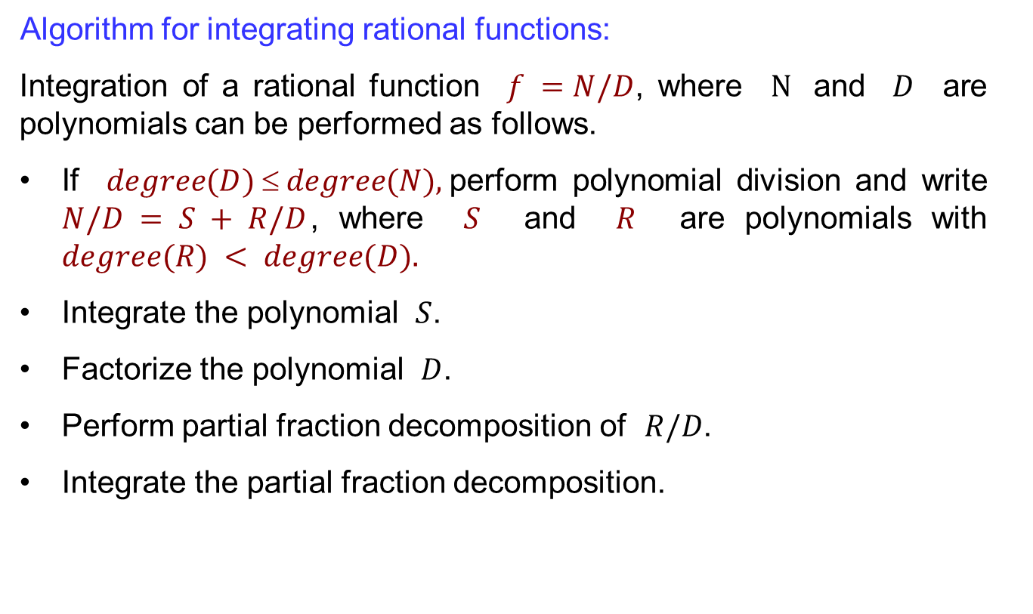
Recalls
Algorithm for integrating rational functions:
Integration of a rational function $f =N/D$, where $N$ and $D$ are polynomials can be performed as follows.
If $degree(D)  degree(N),$perform polynomial division and write
$N/D = S + R/D$, where $S$ and $R$ are polynomials with $degree(R) < degree(D).$
Integrate the polynomial $S$.
Factorize the polynomial $D$.
Perform partial fraction decomposition of $R/D$.
Integrate the partial fraction decomposition.

Slide 10
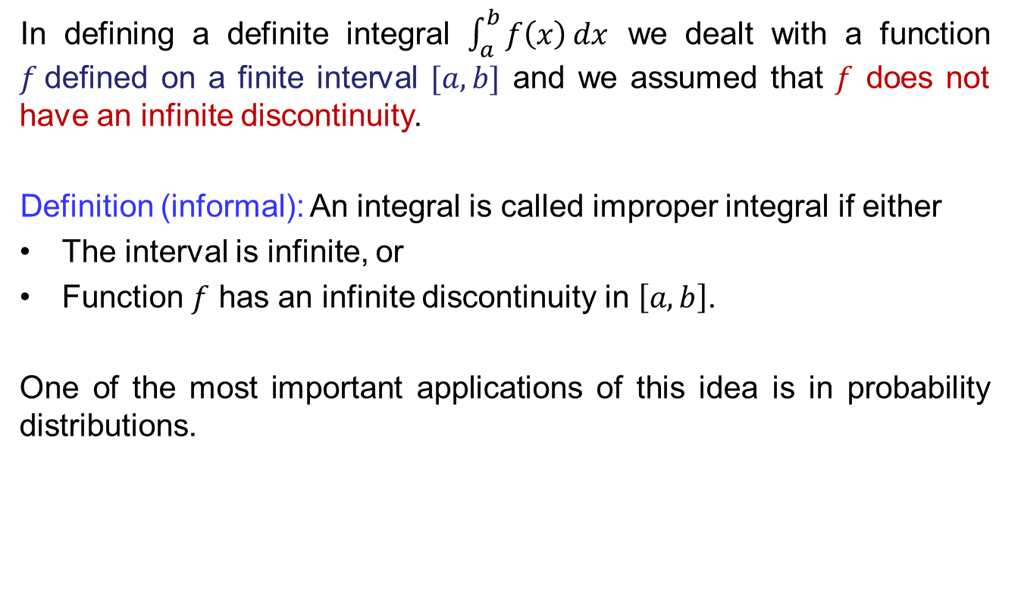
Improper integrals
In defining a definite integral $\int_{a}^{b}{f\left(x\right)}dx$ we dealt with a function $f$defined on a finite interval $[a, b]$and we assumed that $f$ does not have an infinite discontinuity.
Definition (informal): An integral is called improper integralif either
The interval is infinite, or
Function $f$ has an infinite discontinuity in $\left[a, b\right]$.
One of the most important applications of this idea is in probability distributions.

Slide 11
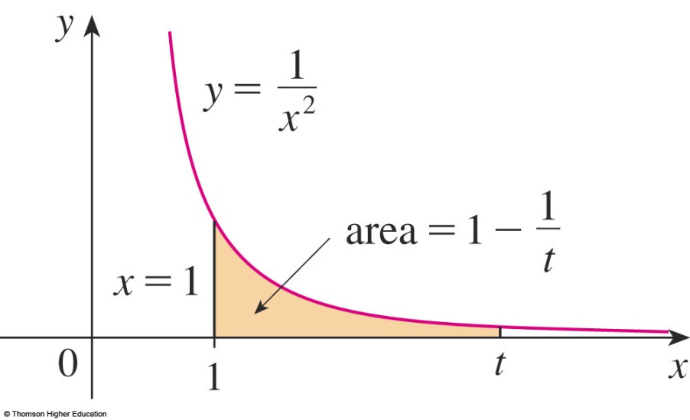
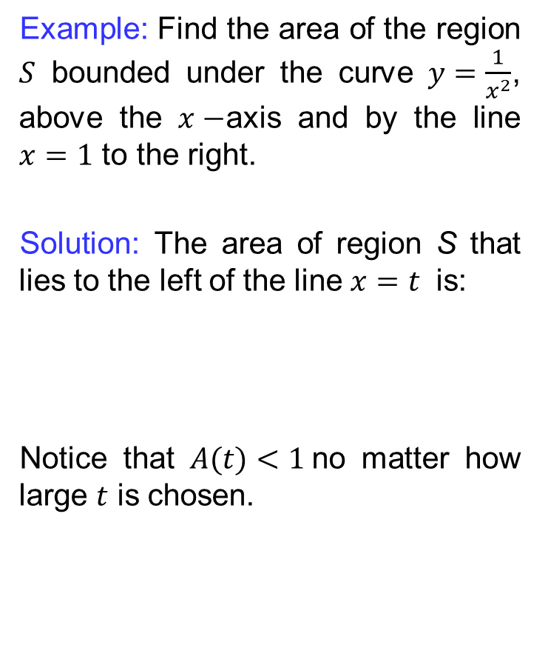
Improper integrals
Example: Find the area of the region $S$ bounded under the curve $y=\frac{1}{x^{2}}$, above the $x−$axis and by the line $x=1$ to the right.
Solution: The area of region S that lies to the left of the line $x=t$is:
Notice that $A(t)<1$no matter how large $t$ is chosen.

Slide 12
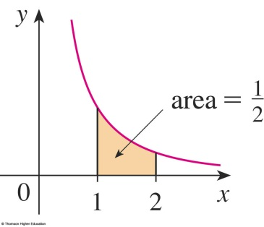
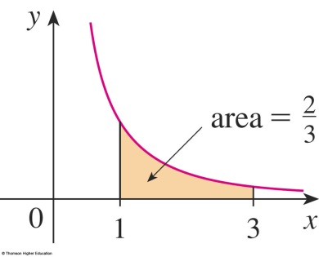
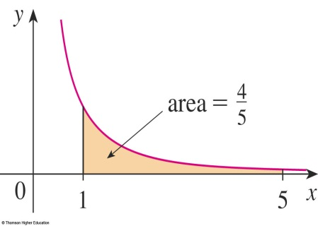

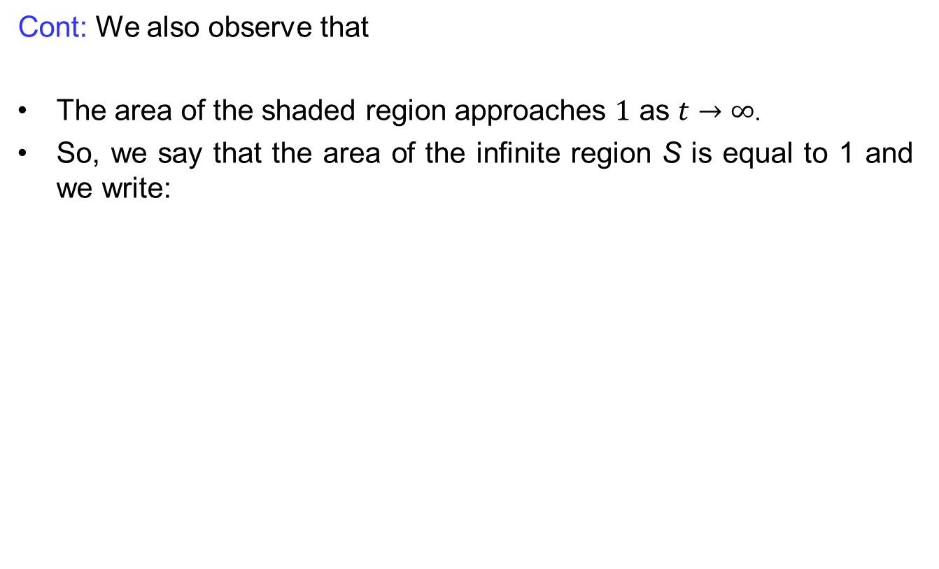
Improper integrals
Cont: We also observe that
The area of the shaded region approaches $1$ as $t→∞$.
So, we say that the area of the infinite region S is equal to 1 and we write:

Slide 13
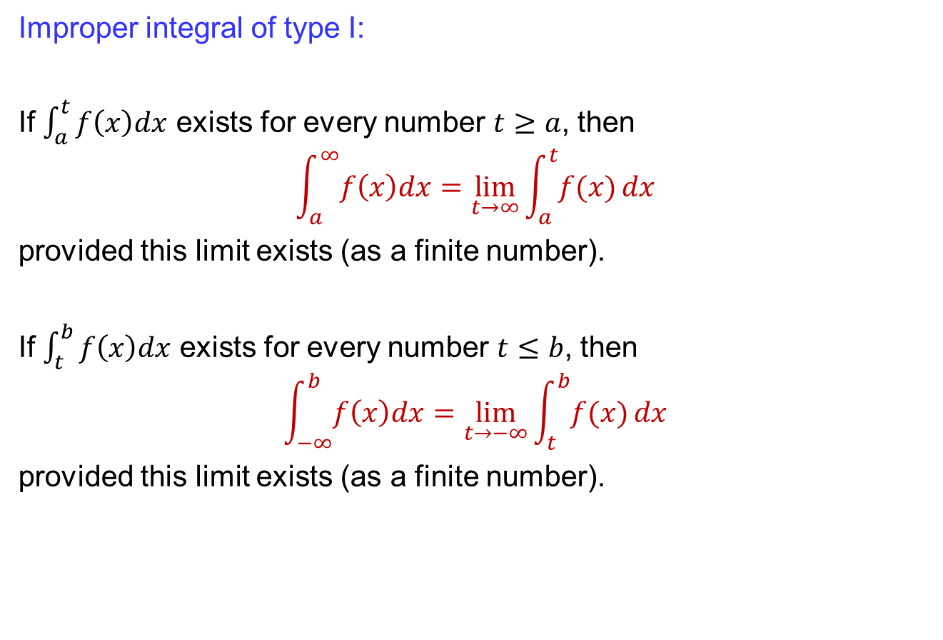
Improper integrals
Improper integral of type I:
If $\int_{a}^{t}{f\left(x\right)dx}$ exists for every number $t≥a$, then
$$\int_{a}^{∞}{f\left(x\right)dx}=\lim_{t→∞}{\int_{a}^{t}{f(x)}}dx$$
provided this limit exists (as a finite number).
If $\int_{t}^{b}{f\left(x\right)dx}$ exists for every number $t≤b$, then
$$\int_{−∞}^{b}{f\left(x\right)dx}=\lim_{t→−∞}{\int_{t}^{b}{f(x)}}dx$$
provided this limit exists (as a finite number).

Slide 14
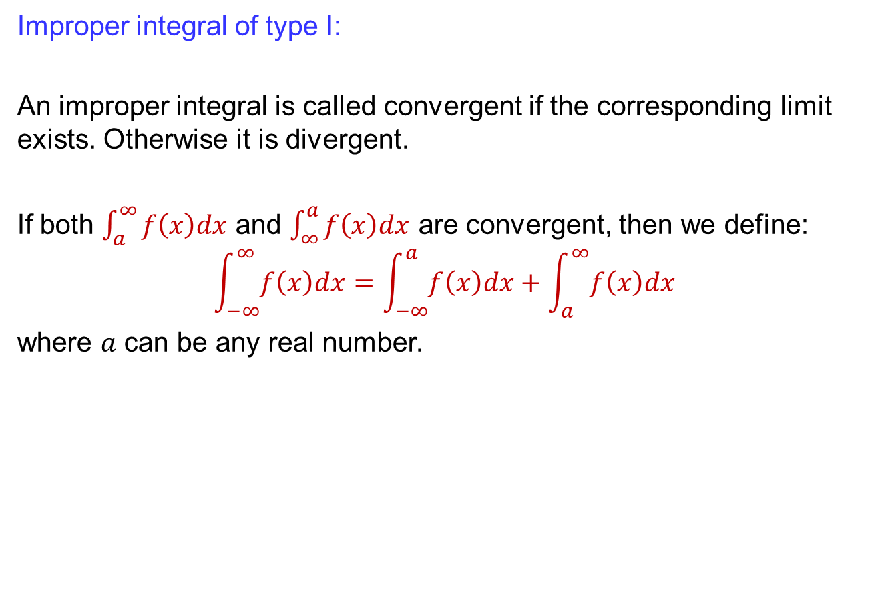
Improper integrals
Improper integral of type I:
An improper integral is called convergent if the corresponding limit exists. Otherwise it is divergent.
If both $\int_{a}^{∞}{f\left(x\right)dx}$ and $\int_{∞}^{a}{f\left(x\right)dx}$are convergent, then we define:
$$\int_{−∞}^{∞}{f\left(x\right)dx}=\int_{−∞}^{a}{f\left(x\right)dx}+\int_{a}^{∞}{f\left(x\right)dx}$$
where $a$ can be any real number.

Slide 15
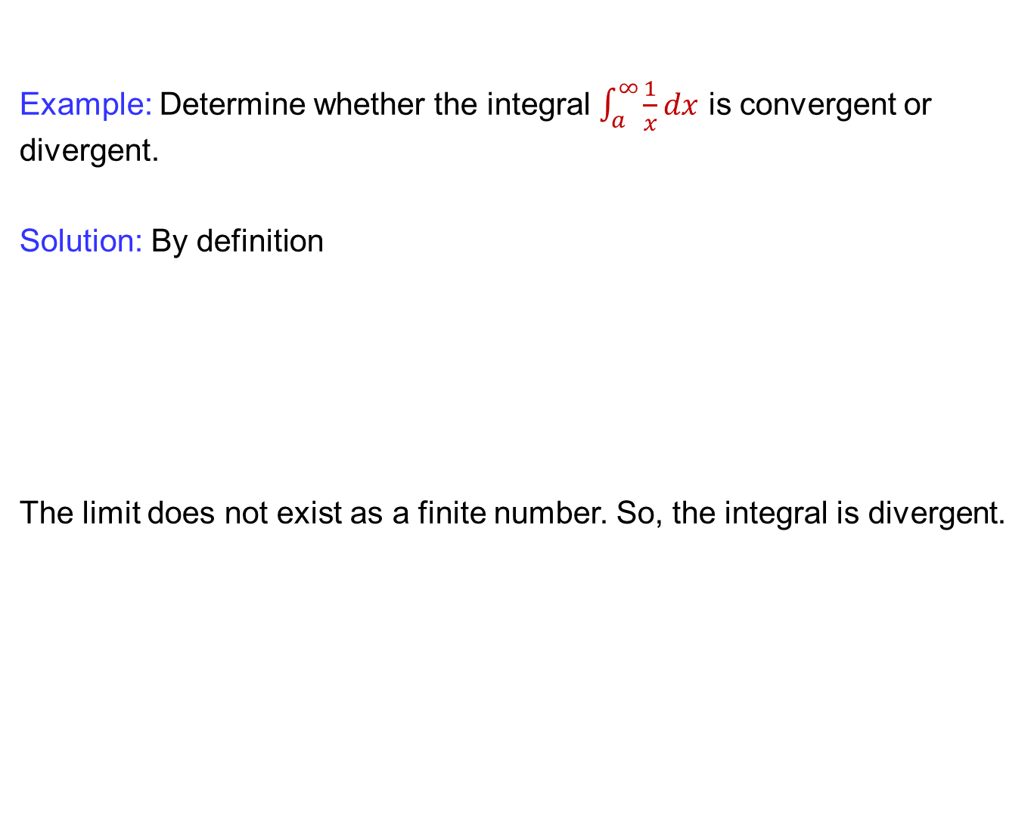
Improper integrals
Example: Determine whether the integral $\int_{a}^{∞}{\frac{1}{x}dx}$is convergent or divergent.
Solution: By definition
The limit does not exist as a finite number. So, the integral is divergent.

Slide 16
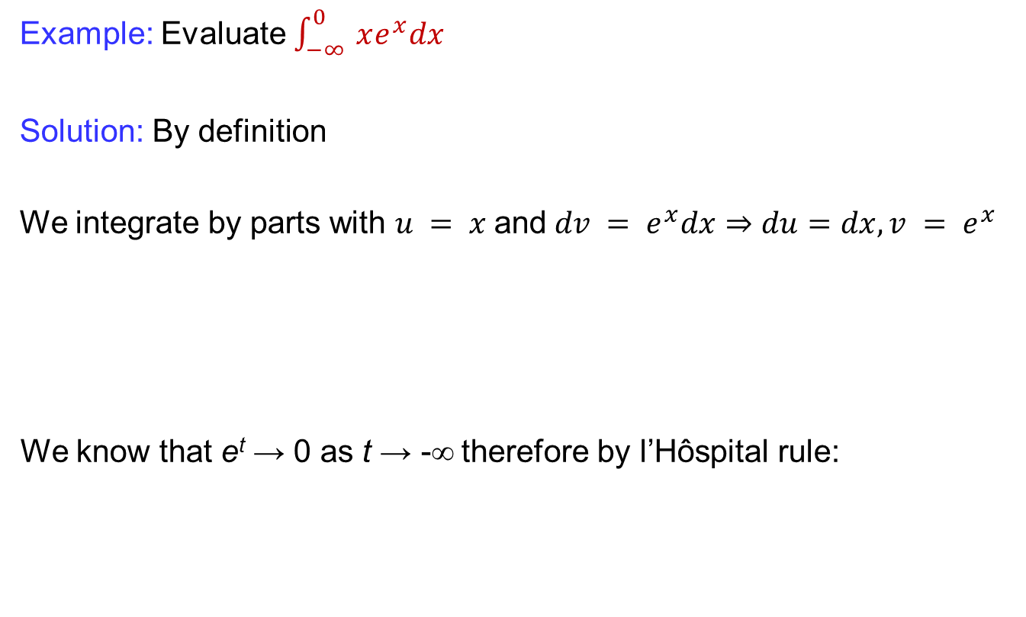
Improper integrals
Example: Evaluate $\int_{−∞}^{0}{ xe^{x}dx}$
Solution: By definition
We integrate by parts with $u = x$and$dv = e^{x}dx⇒du=dx, v = e^{x}$
We know that e^{t}→ 0 as t → -∞ therefore by l’Hôspital rule:

Slide 17
Improper integrals
Conti..
Therefore,

Slide 18
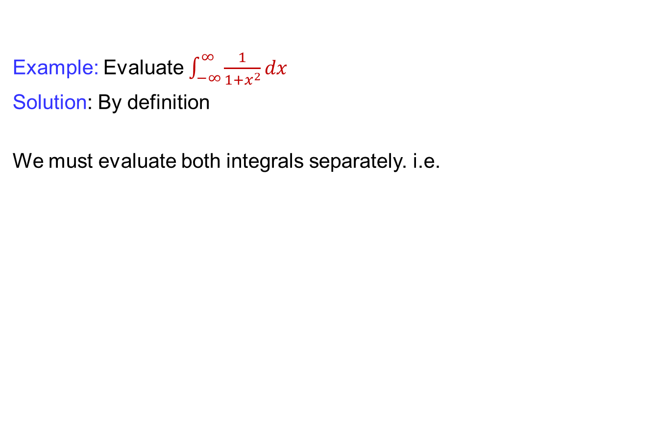
Improper integrals
Example: Evaluate $\int_{−∞}^{∞}{\frac{1}{1+x^{2}}dx}$
Solution: By definition
We must evaluate both integrals separately. i.e.

Slide 19
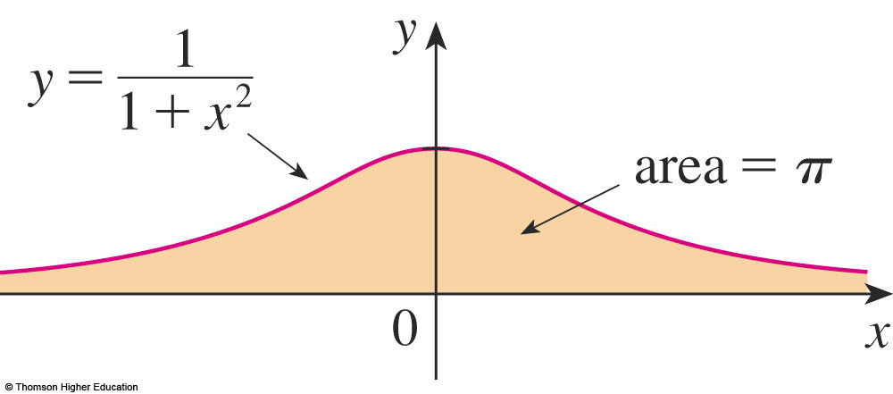
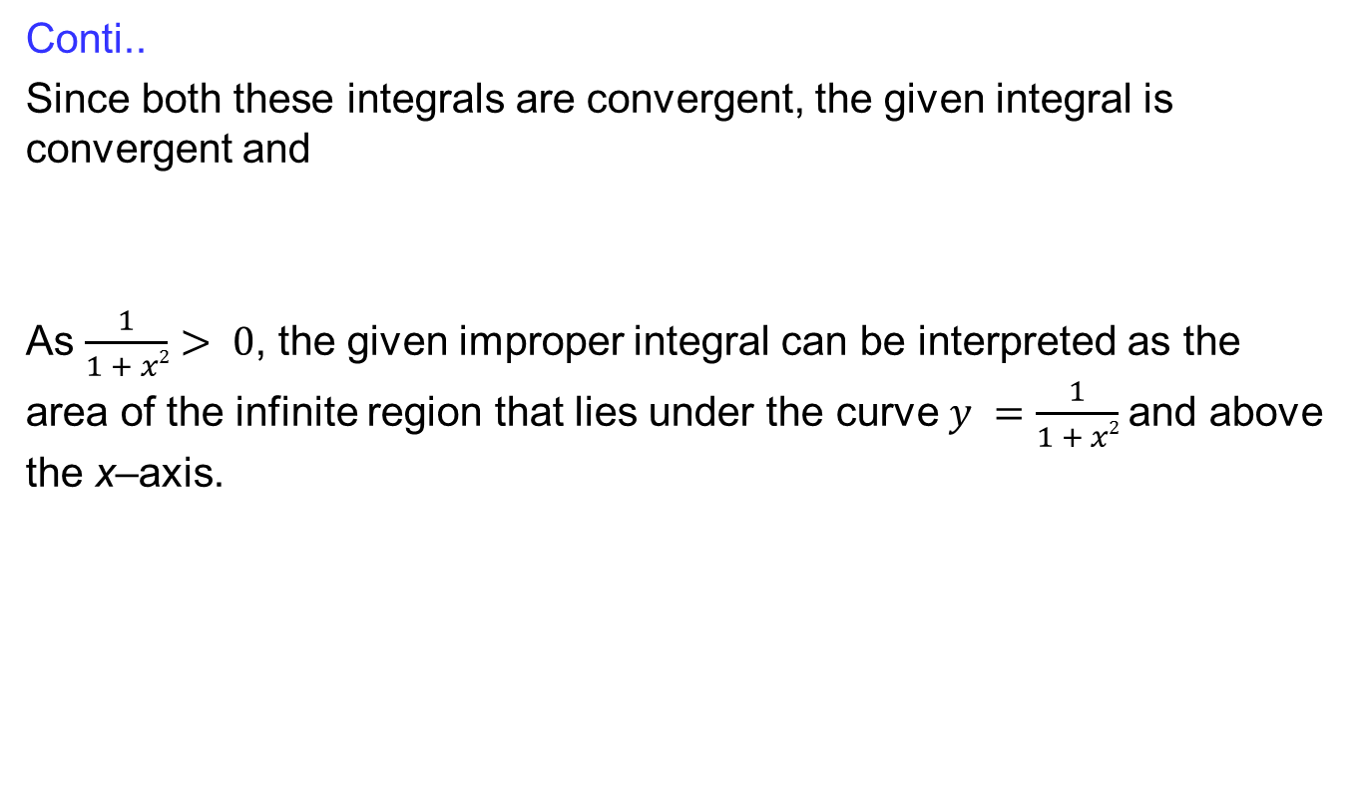
Improper integrals
Conti..
Since both these integrals are convergent, the given integral is convergent and
As $\frac{1}{1 + x2}> 0$, the given improper integral can be interpreted as the area of the infinite region that lies under the curve $y =\frac{1}{1 + x2}$and above the x–axis.

Slide 20
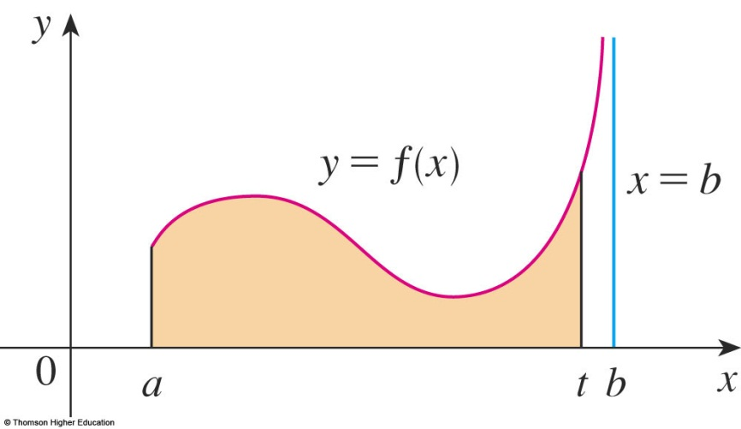
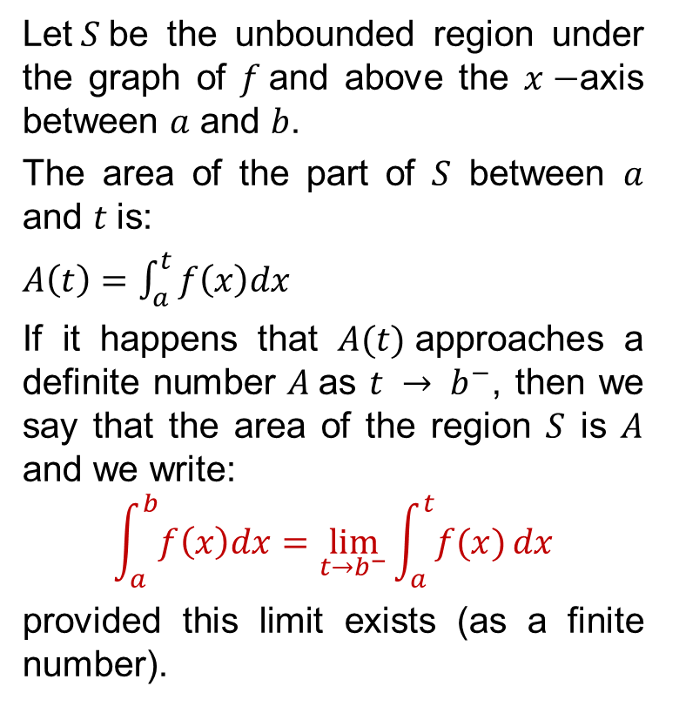
Improper integrals
Let$S$be the unbounded region under
the graph of $f$and above the $x−$axis between $a$ and $b$.
The area of the part of $S$ between $a$ and $t$is:
$A\left(t\right)=\int_{a}^{t}{f\left(x\right)dx}$
If it happens that $A(t)$approaches a definite number $A$as $t → b^{−}$, then we say that the area of the region $S$ is $A$ and we write:
$$\int_{a}^{b}{f\left(x\right)dx}=\lim_{t→b^{−}}{\int_{a}^{t}{f(x)}}dx$$
provided this limit exists (as a finite number).

Slide 21
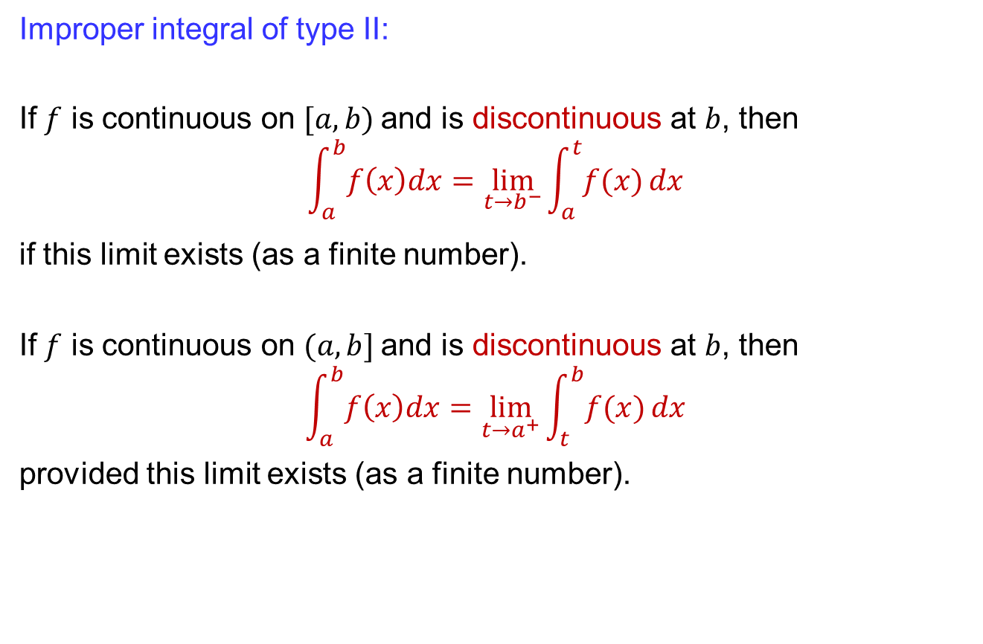
Improper integrals
Improper integral of type II:
If $f$ is continuous on $[a, b)$and is discontinuous at $b$, then
$$\int_{a}^{b}{f\left(x\right)dx}=\lim_{t→b^{−}}{\int_{a}^{t}{f(x)}}dx$$
if this limit exists (as a finite number).
If $f$ is continuous on $(a, b]$and is discontinuous at $b$, then
$$\int_{a}^{b}{f\left(x\right)dx}=\lim_{t→a^{+}}{\int_{t}^{b}{f(x)}}dx$$
provided this limit exists (as a finite number).

Slide 22
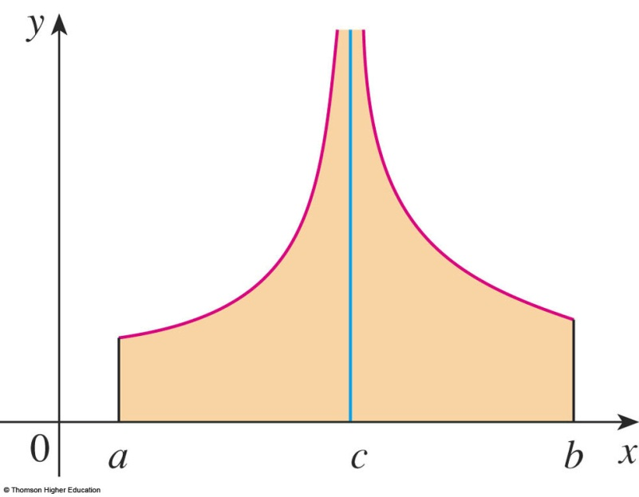
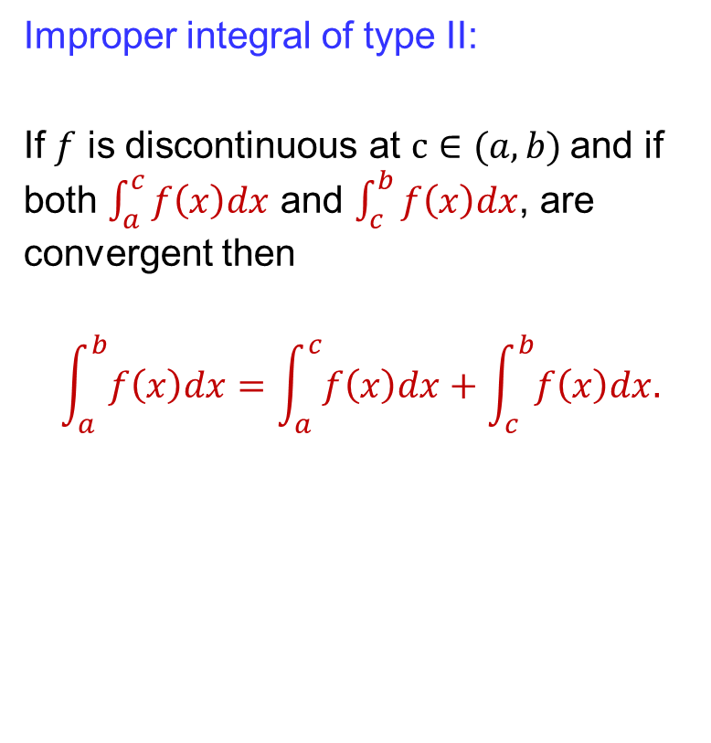
Improper integrals
Improper integral of type II:
If $f$ is discontinuous at $c∈(a, b)$and if both $\int_{a}^{c}{f\left(x\right)dx}$ and $\int_{c}^{b}{f\left(x\right)dx}$, are convergent then
$$\int_{a}^{b}{f\left(x\right)dx}=\int_{a}^{c}{f\left(x\right)dx}+\int_{c}^{b}{f\left(x\right)dx.}$$

Slide 23
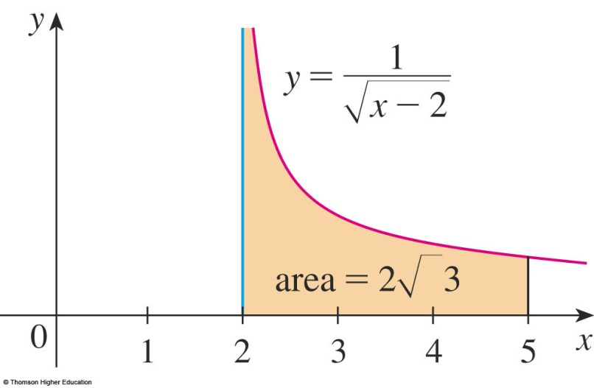
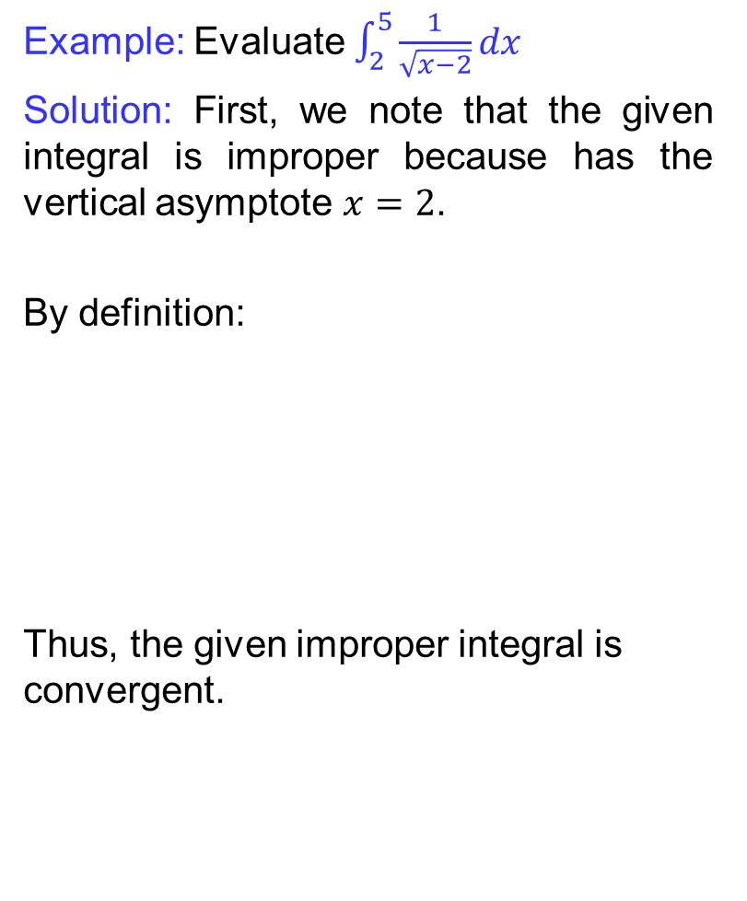
Improper integrals
Example: Evaluate$\int_{2}^{5}{\frac{1}{\sqrt{x−2}}dx}$
Solution: First, we note that the given integral is improper because has the vertical asymptote $x=2$.
By definition:
Thus, the given improper integral is convergent.

Slide 24
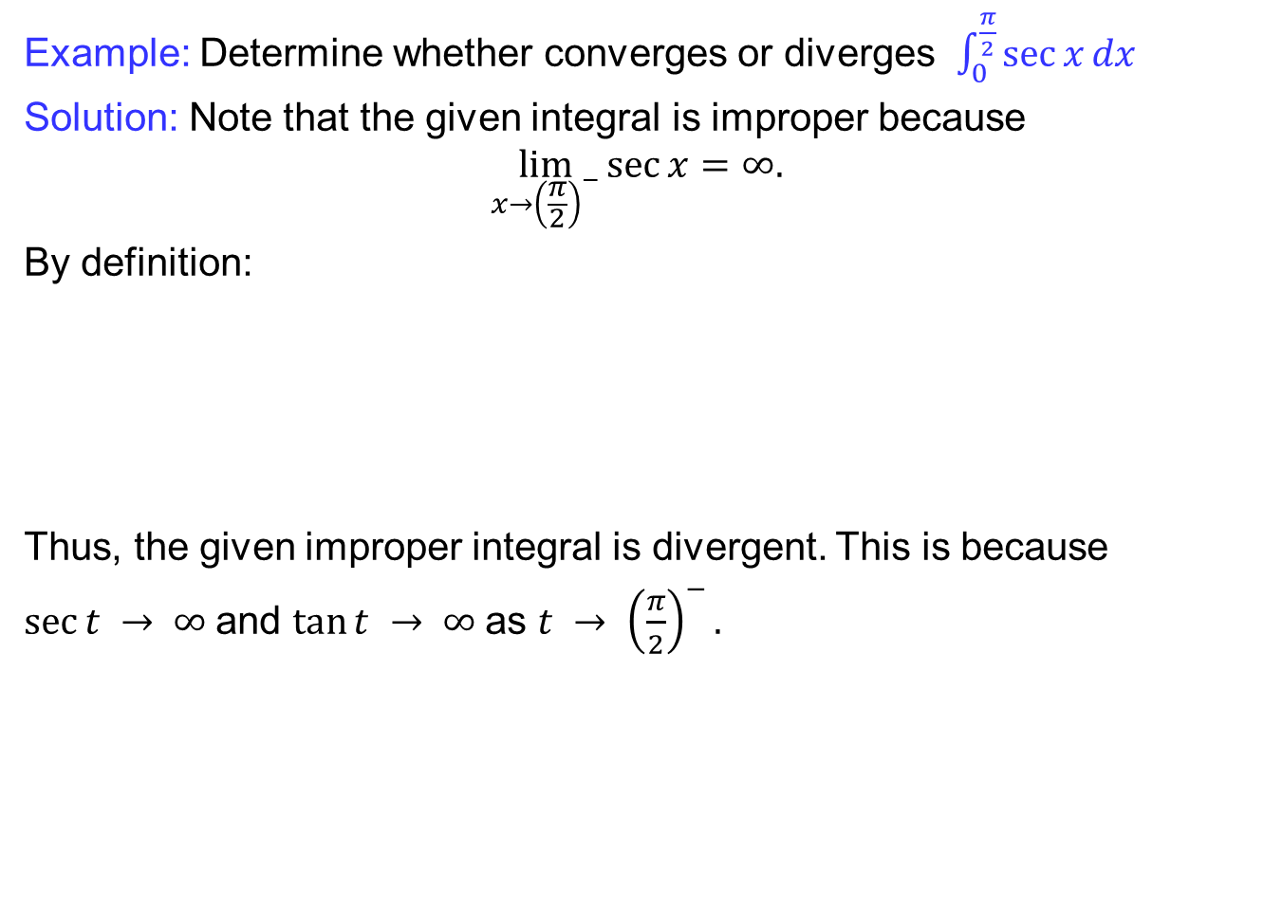
Improper integrals
Example: Determine whether converges or diverges$\int_{0}^{\frac{π}{2}}{\sec{x}dx}$
Solution: Note that the given integral is improper because
$$\lim_{x→{\left(\frac{π}{2}\right)}^{−}}{\sec{x}=∞.}$$
By definition:
Thus, the given improper integral is divergent. This is because
$sec⁡t → ∞$and $tan⁡t → ∞$as $t → {\left(\frac{π}{2}\right)}^{−}.$

Slide 25
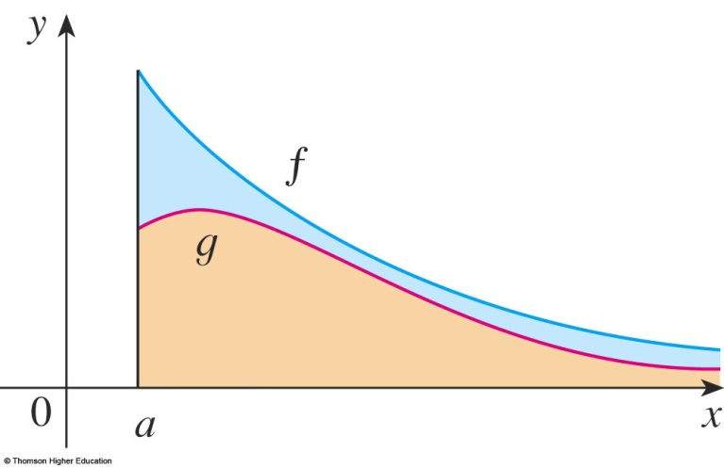
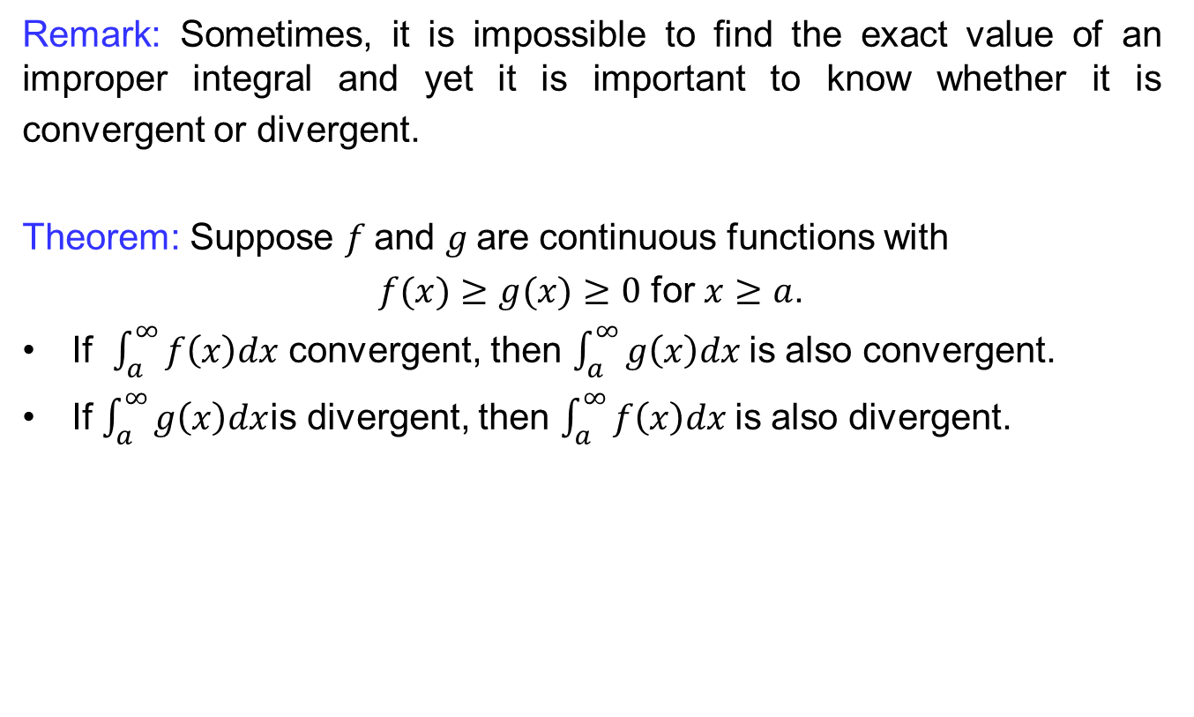
Improper integrals
Remark: Sometimes, it is impossible to find the exact value of an improper integral and yet it is important to know whether it is convergent or divergent.
Theorem: Suppose $f$and$g$are continuous functions with
$f(x)≥g(x)≥0$ for $x≥a$.
If $\int_{a}^{∞}{f\left(x\right)dx}$ convergent, then $\int_{a}^{∞}{g\left(x\right)dx}$is also convergent.
If $\int_{a}^{∞}{g\left(x\right)dx}$is divergent, then $\int_{a}^{∞}{f\left(x\right)dx}$is also divergent.

Slide 26
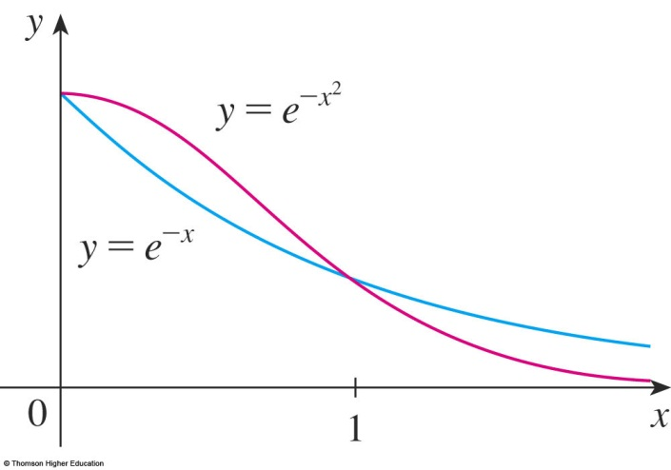
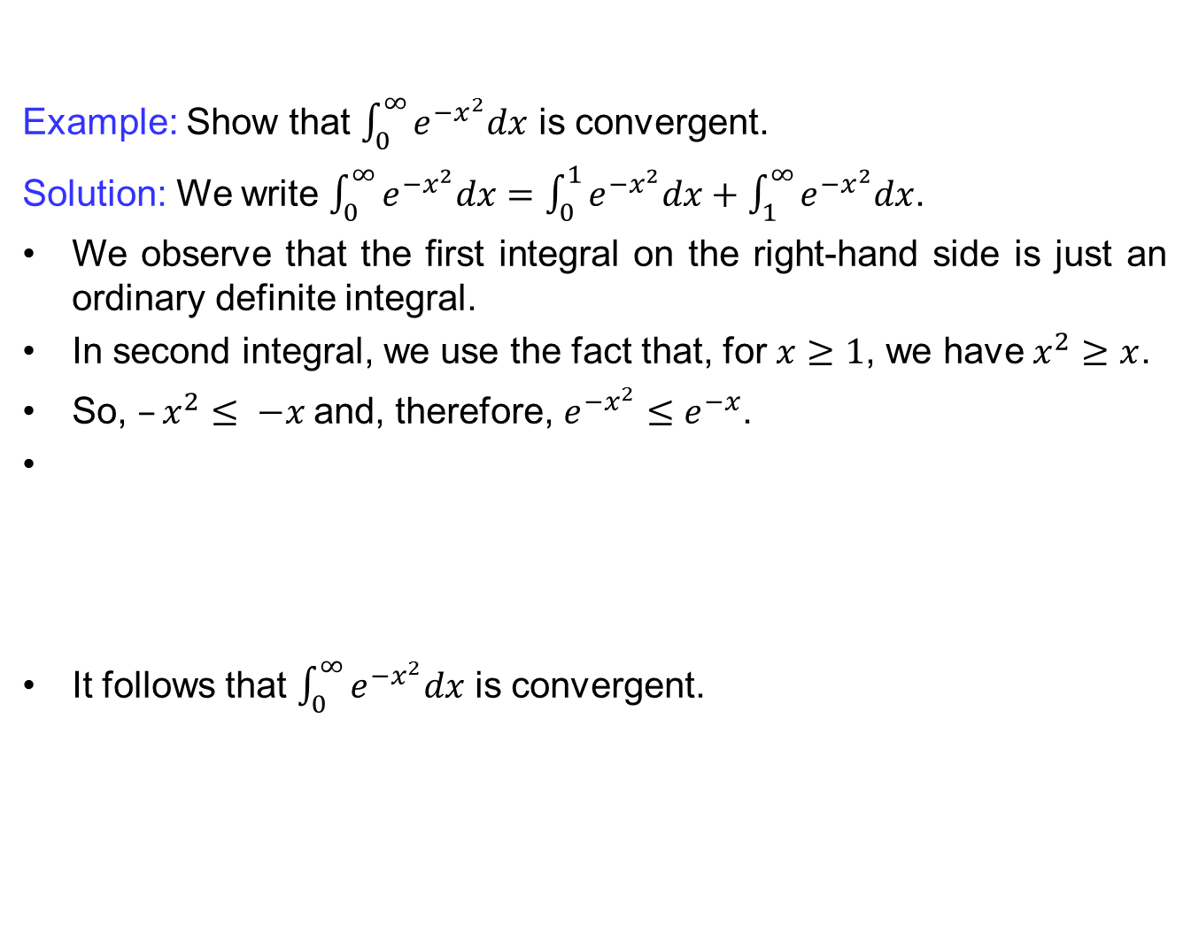
Improper integrals
Example: Show that $\int_{0}^{∞}{e^{−x^{2}}dx}$ is convergent.
Solution: We write $\int_{0}^{∞}{e^{−x^{2}}dx}=\int_{0}^{1}{e^{−x^{2}}dx}+\int_{1}^{∞}{e^{−x^{2}}dx}$.
We observe that the first integral on the right-hand side is just an ordinary definite integral.
In second integral, we use the fact that, for $x≥1$, we have $x^{2}≥x$.
So, $–x^{2}≤ −x$and, therefore, $e^{−x^{2}}≤e^{−x}$.
It follows that $\int_{0}^{∞}{e^{−x^{2}}dx}$is convergent.

Slide 27
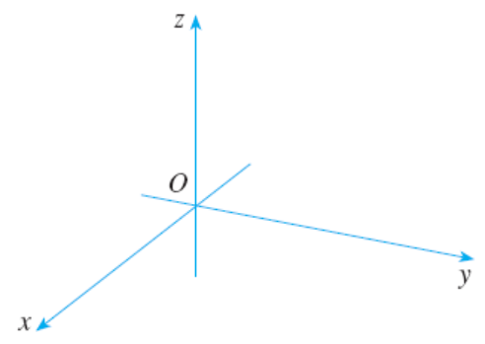
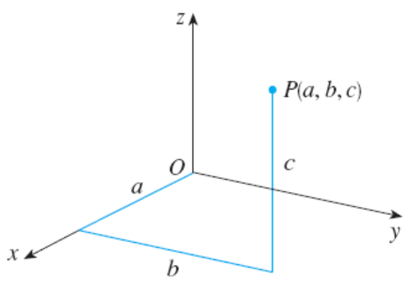
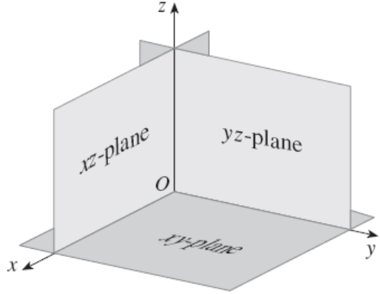
Introduction to vectors
Coordinate axes and planes.:

Slide 28
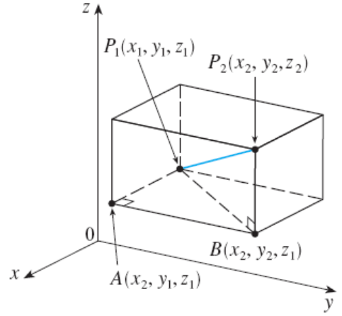
Introduction to vectors
Distance formula in three dimensions:
The distance │P₁P₂│between the points P₁(x₁,y₁,z₁) and P₂(x₂,y₂,z₂) is

Slide 29
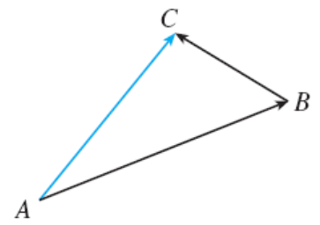
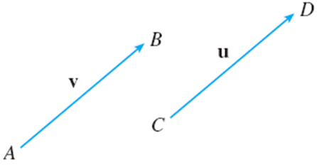
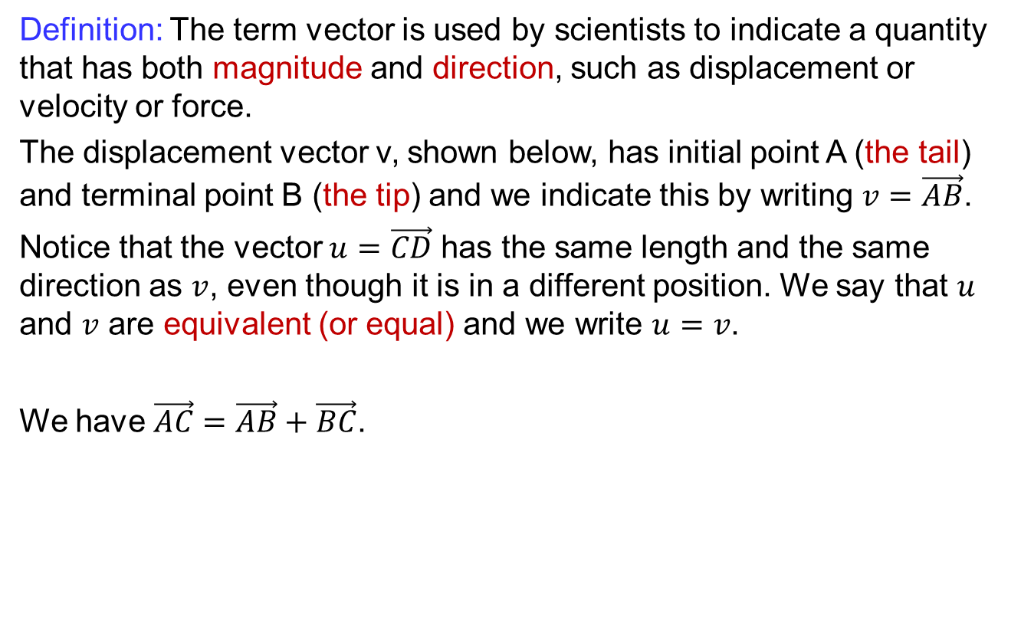
Introduction to vectors
Definition: The term vector is used by scientists to indicate a quantity that has both magnitude and direction, such as displacement or velocity or force.
The displacement vector v, shown below, has initial point A (the tail) and terminal point B (the tip) and we indicate this by writing $v=\vec{AB}$.
Notice that the vector $u=\vec{CD}$ has the same length and the same direction as $v$, even though it is in a different position. We say that $u$ and $v$ are equivalent (or equal) and we write $u=v$.
We have $\vec{AC}=\vec{AB}+\vec{BC}$.

Slide 30
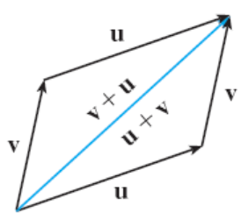
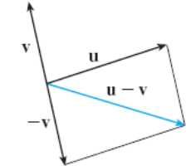
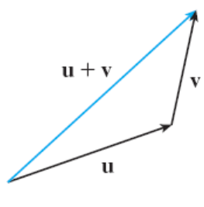
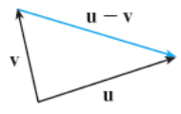
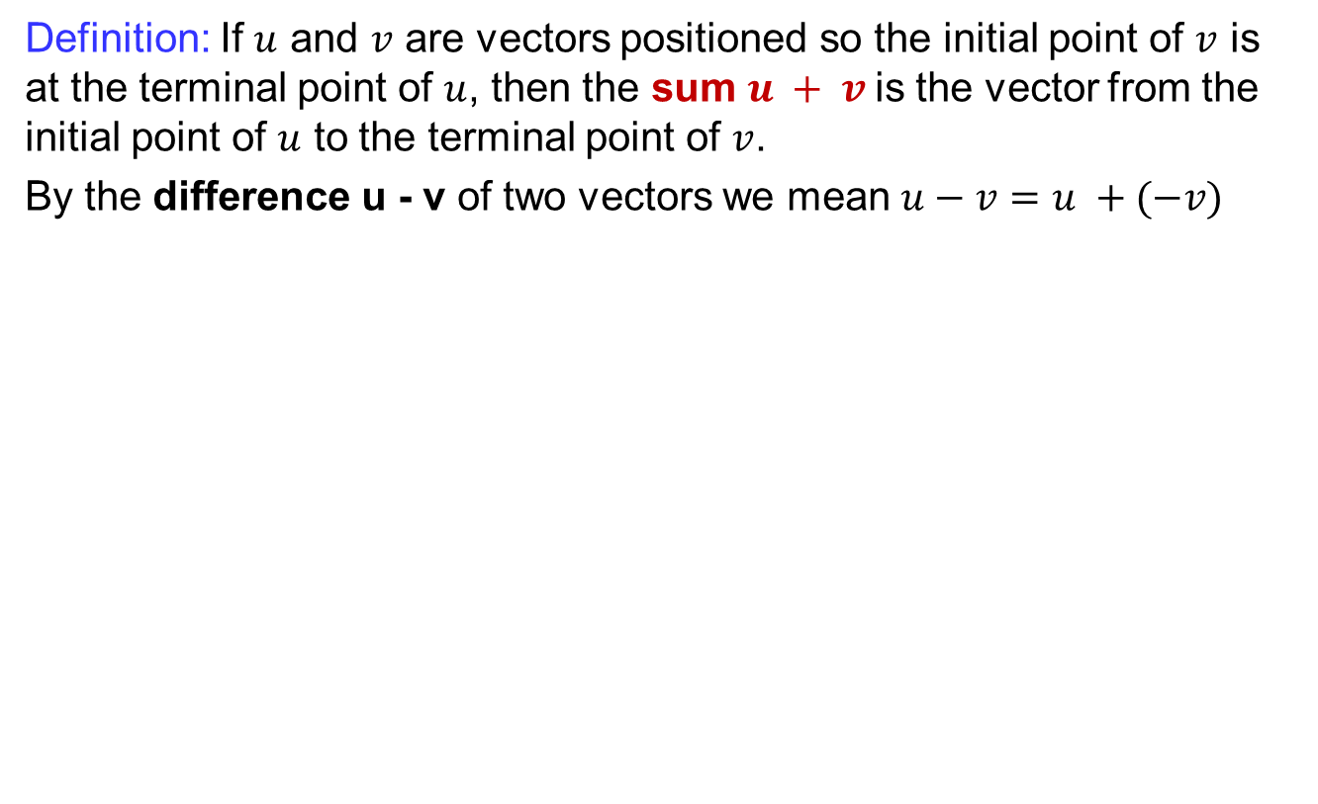
Introduction to vectors
Definition: If $u$ and $v$ are vectors positioned so the initial point of $v$ is at the terminal point of $u$, then the sum $u + v$is the vector from the initial point of $u$ to the terminal point of $v$.
By the difference u - v of two vectors we mean $u−v=u +(−v)$

Slide 31
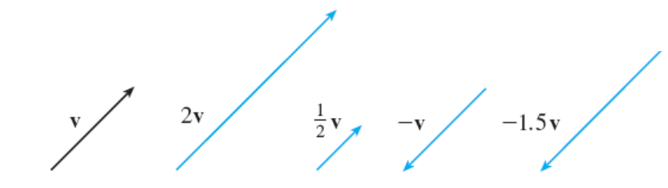
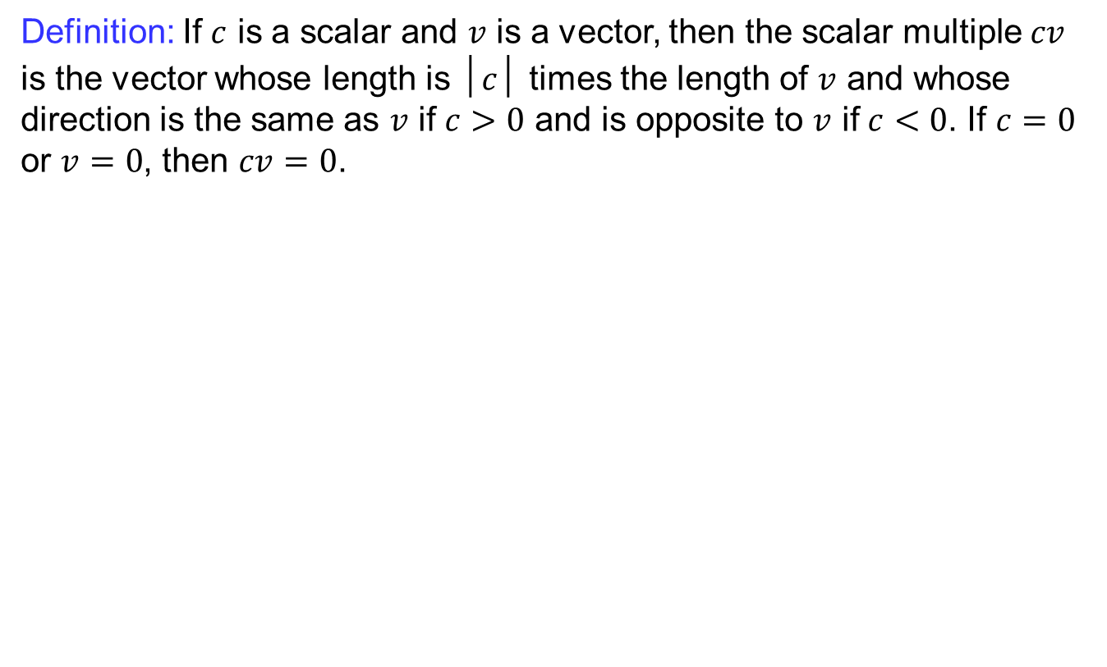
Introduction to vectors
Definition: If$c$ is a scalar and $v$ is a vector, then the scalar multiple $cv$ is the vector whose length is $│c│$ times the length of $v$ and whose direction is the same as $v$ if $c>0$ and is opposite to $v$ if $c<0$. If $c=0$ or $v=0$, then $cv=0$.

Slide 32
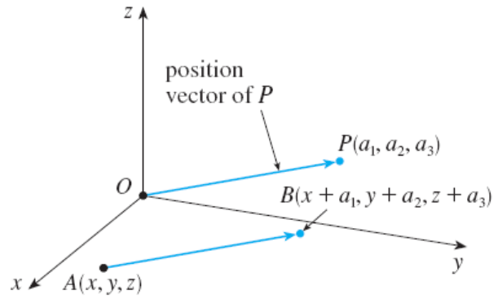
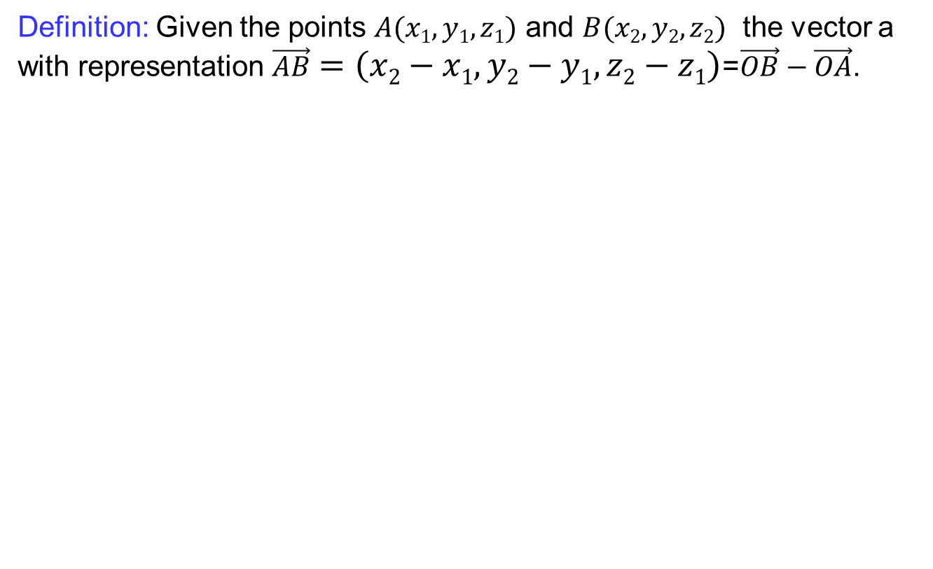
Introduction to vectors
Definition: Given the points $A(x1,y1,z1)$ and $B(x2,y2,z2)$the vector a with representation $\vec{AB}=\left(x2−x1,y2−y1,z2−z1\right)$=$\vec{OB}−\vec{OA}$.

Slide 33
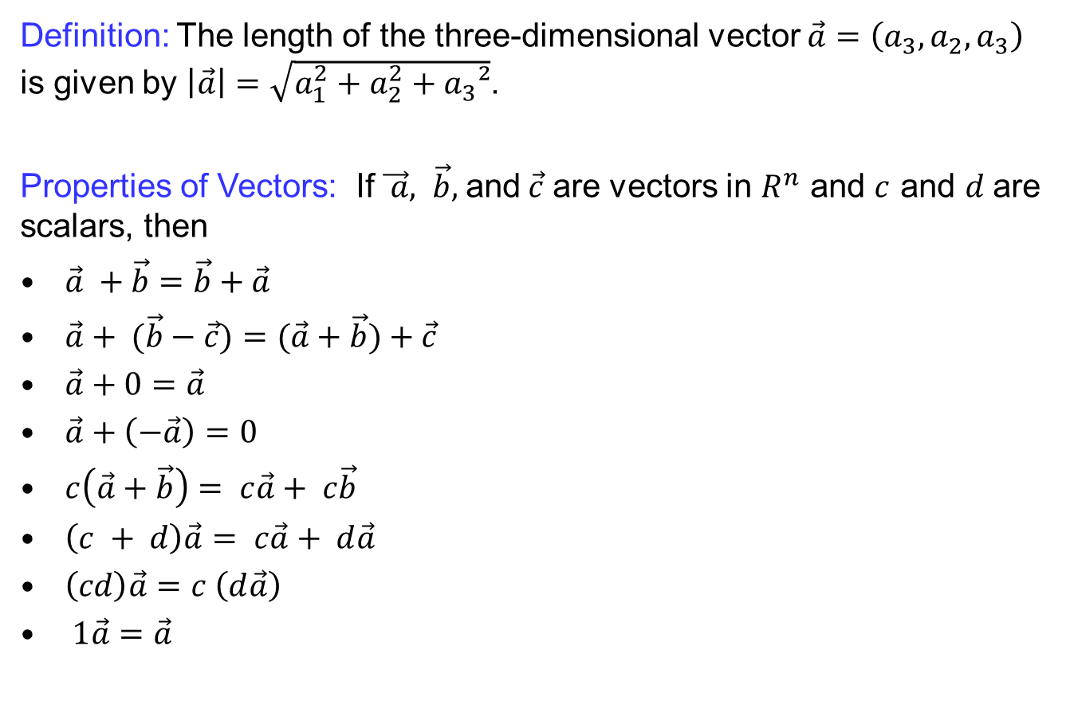
Introduction to vectors
Definition: The length of the three-dimensional vector $\vec{a}=\left(a_{3},a_{2},a_{3}\right)$ is given by $\left|\vec{a}\right|=\sqrt{a_{1}^{2}+a_{2}^{2}+a_{3}²}$.
Properties of Vectors: If$\vec{ a}, \vec{b},$and$\vec{c}$are vectors in $R^{n}$ and $c$ and $d$are scalars, then
$\vec{a} +\vec{b}=\vec{b}+\vec{a}$
$\vec{a}+ (\vec{b}−\vec{c})=(\vec{a}+\vec{b})+\vec{c}$
$\vec{a}+0=\vec{a}$
$\vec{a}+\left(−\vec{a}\right)=0$
$c\left(\vec{a}+\vec{b}\right)= c\vec{a}+ c\vec{b}$
$\left(c + d\right)\vec{a}= c\vec{a}+ d\vec{a}$
$\left(cd\right)\vec{a}=c \left(d\vec{a}\right)$
$1\vec{a}=\vec{a}$

Slide 34
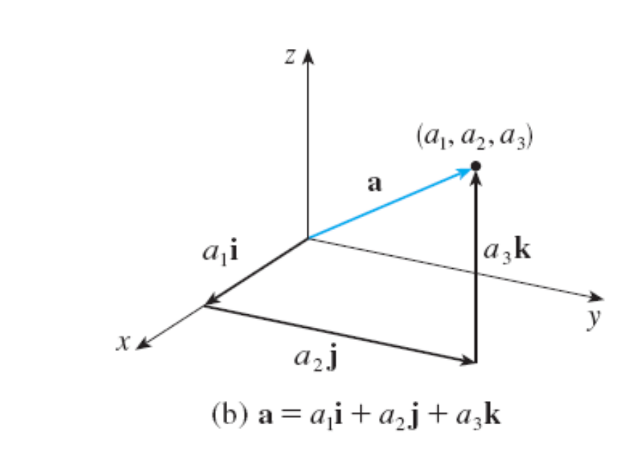

Introduction to vectors
Definition: A vector $v$ is called unit vector if it has unit length i.e. $\left|v\right|=1$. The unit vectors along $x,y,z−$axes are respectively denoted by $i,j$ and $k.$
$$i=\left(1,0,0\right),$$
$$j=\left(0,1,0\right),$$
$k=(0,0,1)$.
These vectors $i , j$ , and$k$are
called the standard basis vectors.
Any vector $a=\left(a_{1},a_{2},a_{3}\right)$ can be written as
$$\vec{a}=a_{1}i+a_{2}j+a_{3}k.$$

Slide 35

Dot product of vectors
Definition: If $a=\left(a_{1},a_{2},a_{3}\right)$and $b=\left(b_{1},b_{2},b_{3}\right)$, then the dot product of $a$and $b$ is the number $a‧b$given by
$$\vec{a}.\vec{b}=a_{1}b_{1}+a_{2}b_{2}+a_{3}b_{3}.$$
Properties of dot production: If$\vec{ a}, \vec{b},$and$\vec{c}$are vectors in $R^{n}$ and $c$ and $d is$scalar, then

Slide 36


Dot product of vectors
Theorems:
If $θ$ is the angle between the vectors $a$ and $b,$ then
Two vectors aand bare orthogonal if and only if $a‧b = 0.$
If S is the foot of the perpendicular from R to the line containing PQ, then the vector with representation PSis called the vector projection of b onto a and is denoted by prjo_{a}b
$i.i=j.j=k.k=1$ and $i.j=j.k=k.i=0$

Slide 37


Cross product of vectors
Determinant:
Definition: If $a=\left(a_{1},a_{2},a_{3}\right)$and $b=\left(b_{1},b_{2},b_{3}\right)$, then the dot product of $a$and $b$ is the number $a‧b$given by
$$\vec{a} X \vec{b}={(a}_{2}b_{3}−a_{3}b_{2}, a_{3}b_{1}−a_{1}b_{3}, { a}_{1}b_{2}−a_{2}b_{1})$$
In determinant form

Slide 38

Cross product of vectors
Theorems:
If $θ$ is the angle between the vectors $a$ and $b,$ then
Two vectors aand bare parallel if and only if $aXb = 0.$
$iXi=jXj=kXk=0$ and $iXj=k, jXk=i, kXi=j$

Slide 39

Cross product of vectors
Properties of Cross product: If$\vec{ a}, \vec{b},$and$\vec{c}$ are vectors in $R^{n}$ and $c$ and $d$is scalar, then

Slide 40
Lecture Summary
    Recalls
    Improper integrals
    Introduction to vectors
    Dot product of vectors
    Cross product of vectors

