Slide 1
(MTH 250)
Calculus
Lecture 20

Slide 2
Previous Lecture’s Summary
    Substitution for definite integrals
    Integration by parts
    Area bounded by curves

Slide 3
Today’s Lecture
    Recalls
    Trigonometric integrals
    Trigonometric substitutions
    Partial fractions

Slide 4
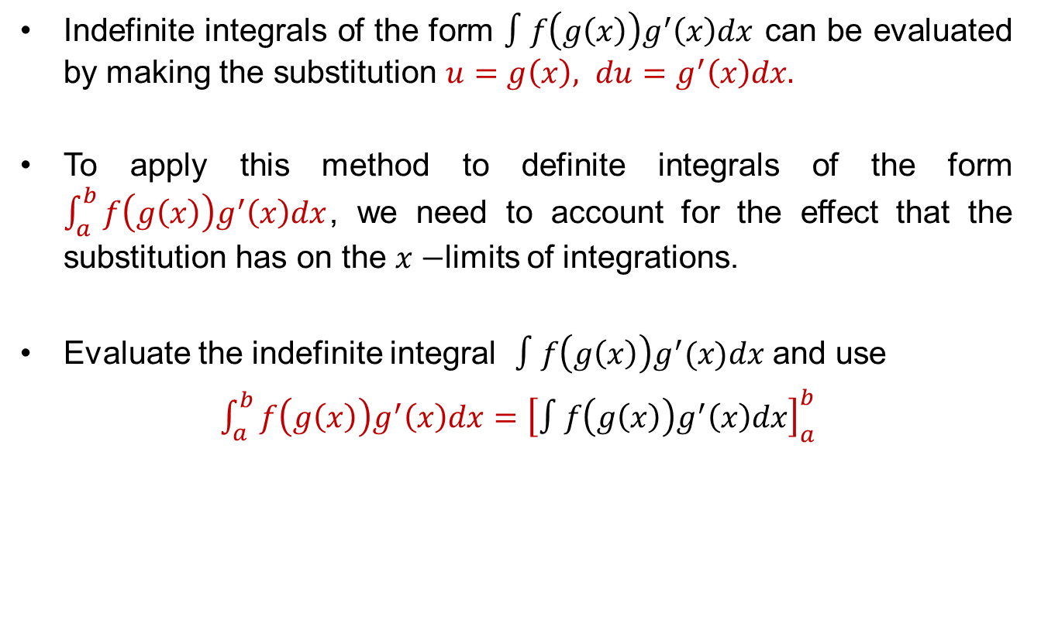
Recalls
Indefiniteintegrals of the form$∫f\left(g\left(x\right)\right)g^{′}\left(x\right)dx$can beevaluated by making the substitution $u=g\left(x\right), du=g^{′}\left(x\right)dx.$
To applythismethod to definiteintegrals of the form$\int_{a}^{b}{f\left(g\left(x\right)\right)g^{′}\left(x\right)dx}$, weneed to account for the effectthat the substitution has on the $x−$limits of integrations.
Evaluate the indefinite integral$∫f\left(g\left(x\right)\right)g^{′}(x)dx$ and use
$\int_{a}^{b}{f\left(g\left(x\right)\right)g^{′}\left(x\right)dx}={\left[∫f\left(g\left(x\right)\right)g^{′}\left(x\right)dx\right]}_{a }^{b}$

Slide 5
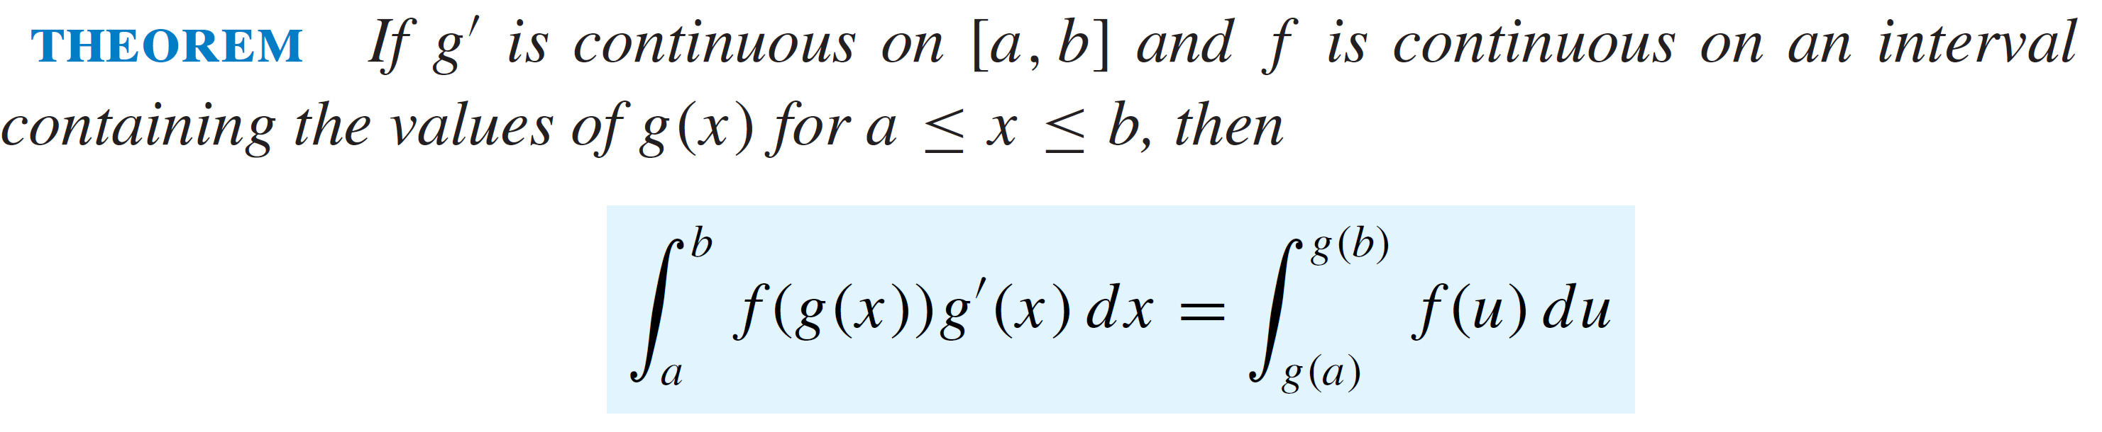
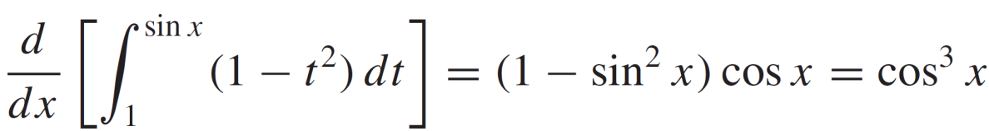
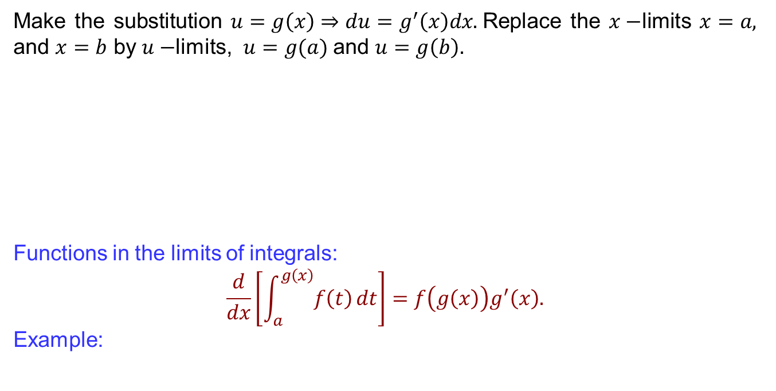
Recalls
Make the substitution $u=g\left(x\right)⇒du=g^{′}\left(x\right)dx.$Replace the $x−$limits$x=a,$ and $x=b$ by $u−$limits, $u=g(a)$ and $u=g\left(b\right).$
Functionsin the limits of integrals:
$$\frac{d}{dx}\left[\int_{a}^{g\left(x\right)}{f\left(t\right)}dt\right]=f\left(g\left(x\right)\right)g^{′}\left(x\right).$$
Example:

Slide 6
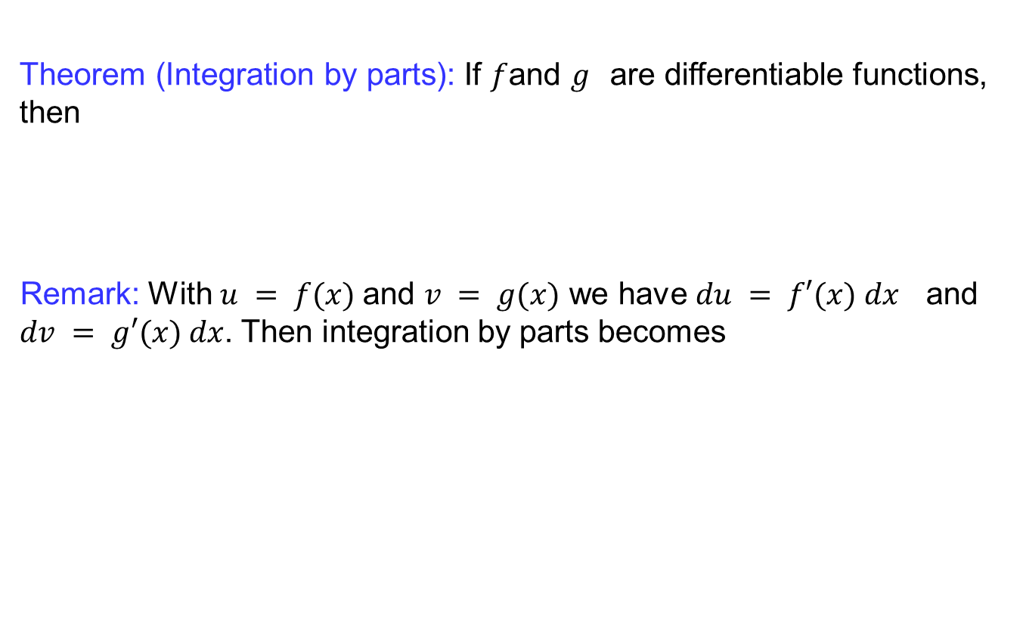
Recalls
Theorem (Integration by parts): If $f$and $g$are differentiable functions, then
Remark: With $u = f(x)$and $v = g(x)$ we have $du = f′(x) dx$and $dv = g′(x) dx$. Then integration by parts becomes

Slide 7
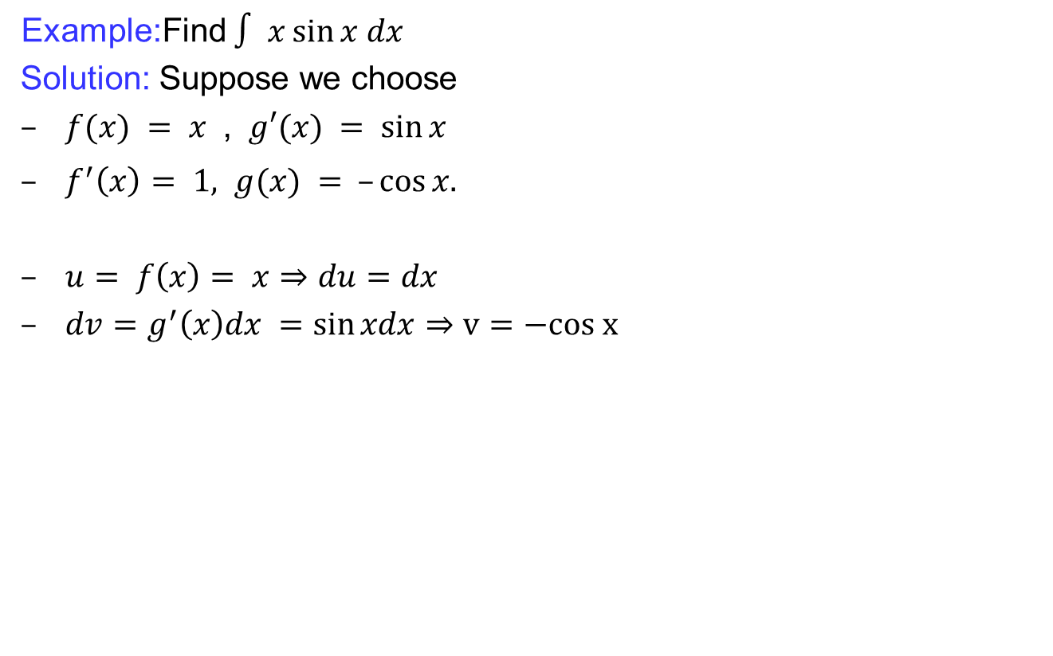
Recalls
Example:Find $∫ x sin⁡x dx$
  Solution: Suppose we choose
  $f(x) = x$, $g′(x) = sin⁡x$
  $f^{′}\left(x\right)= 1, g(x) = –cos⁡x.$
  $u= f\left(x\right)= x⇒du=dx$
  $dv=g^{′}\left(x\right)dx =\sin{xdx}⇒v=−cos x$

Slide 8
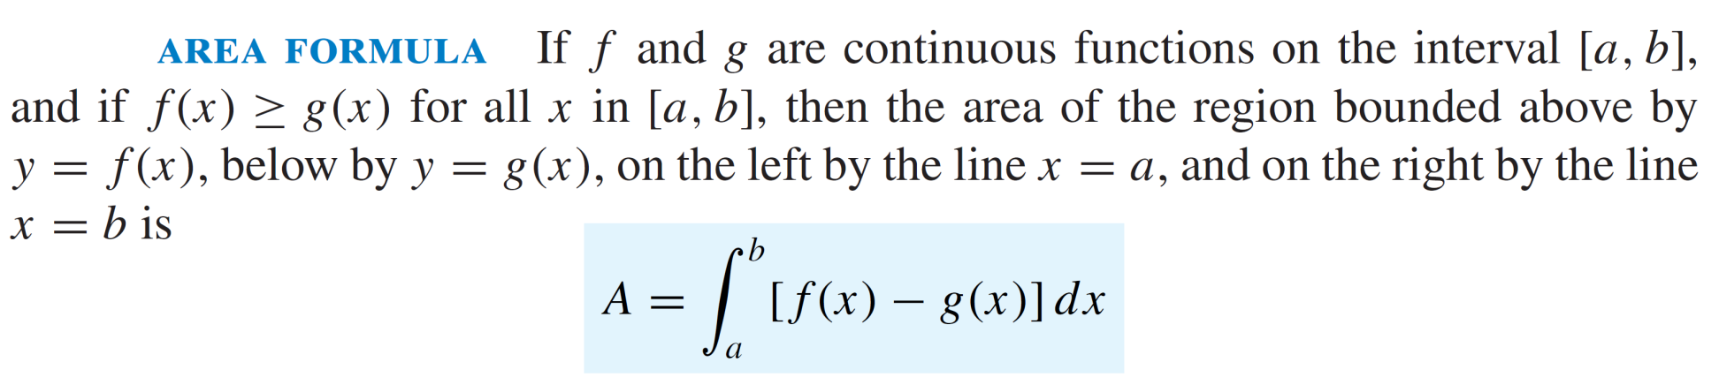
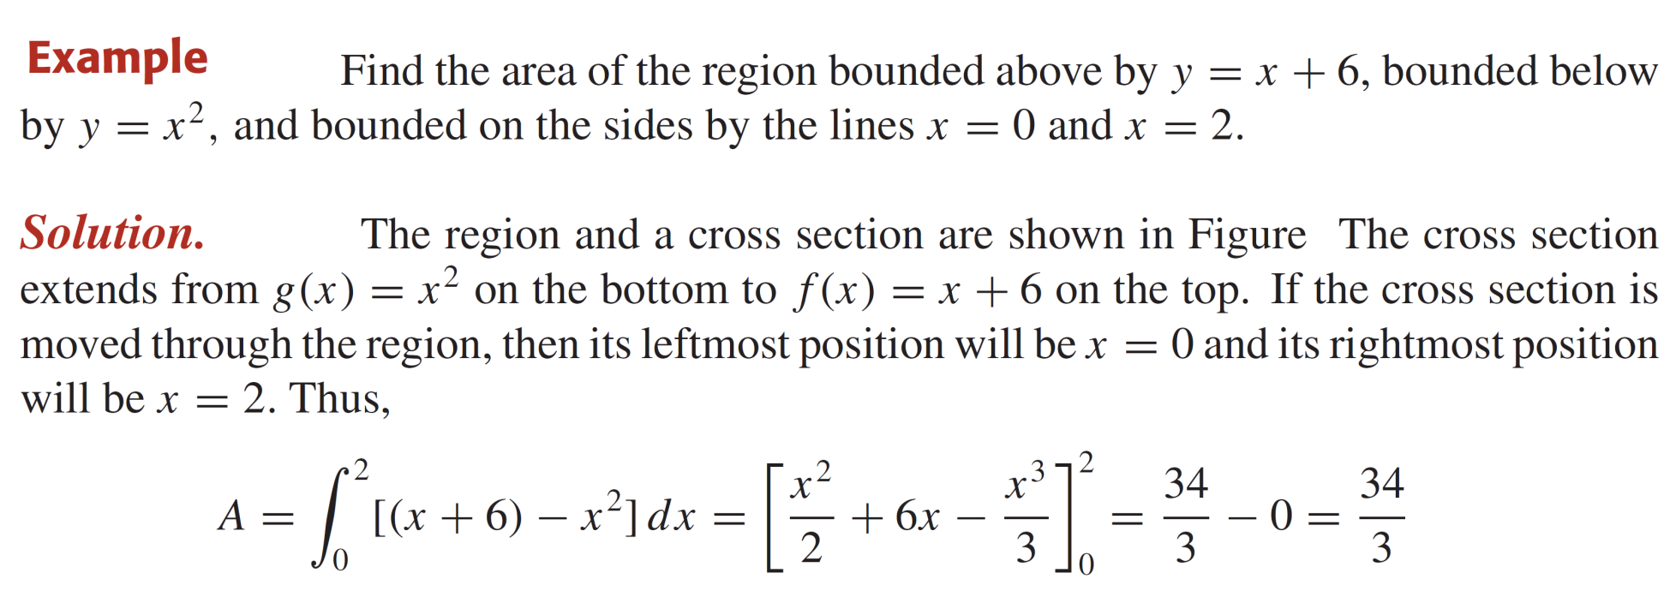
Recalls

Slide 9
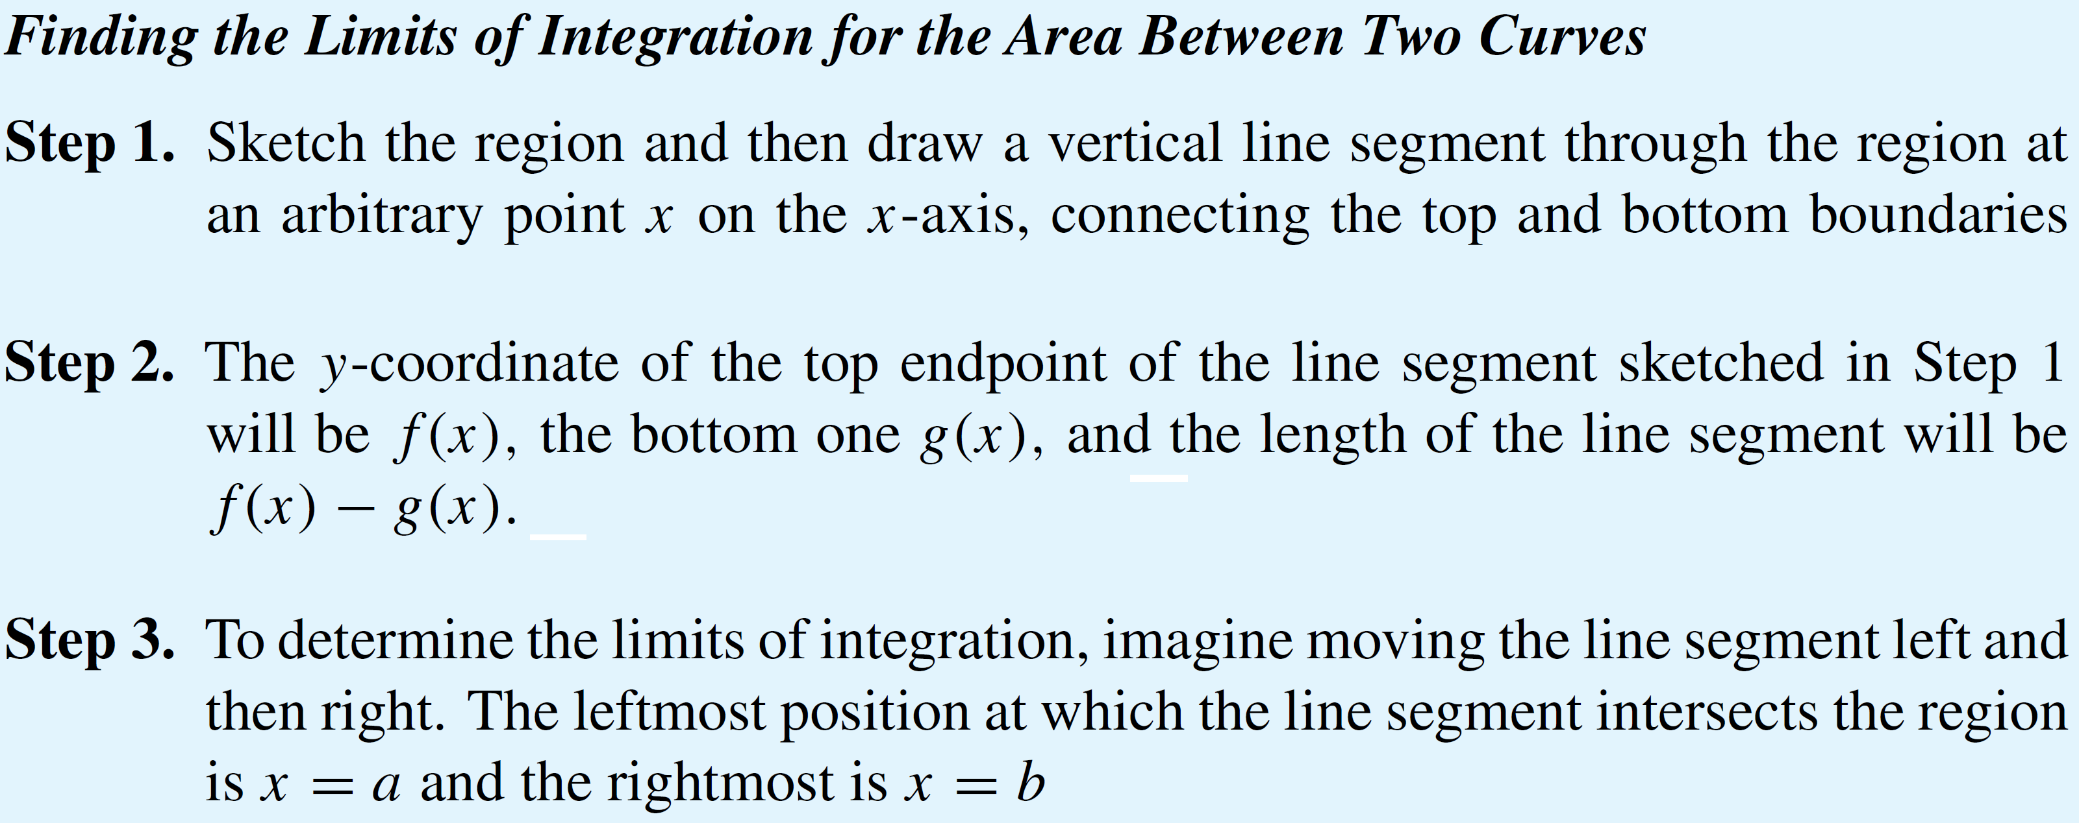
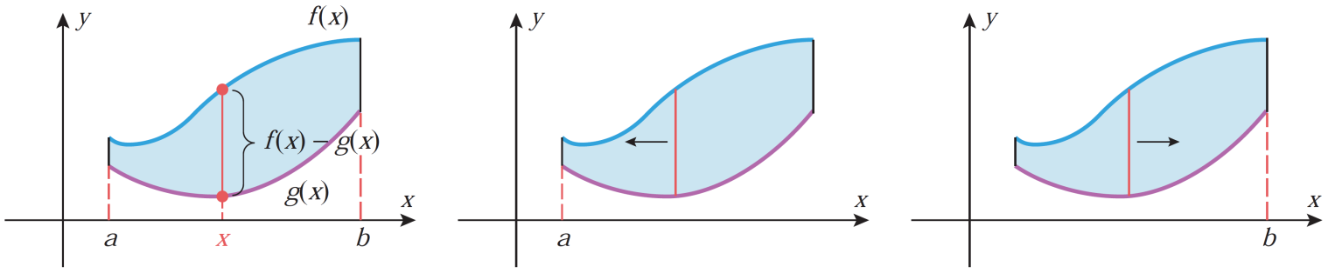
Recalls

Slide 10
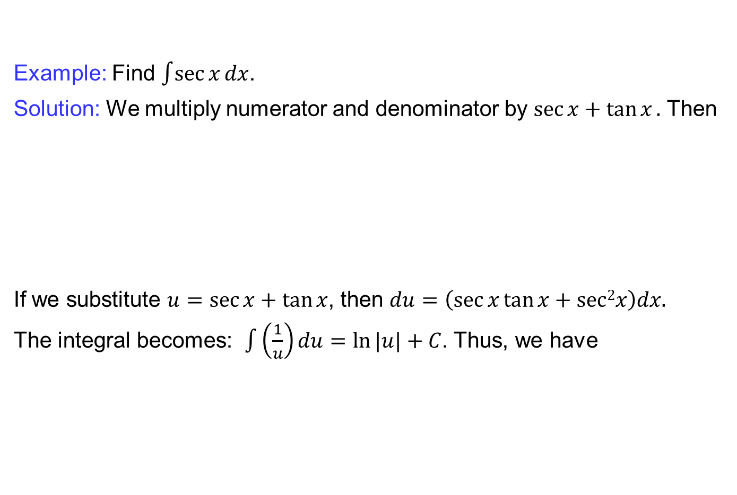
Trigonometric integrals
Example: Find $\int{\sec{x}}dx$.
Solution: Wemultiply numerator and denominator by $\sec{x}+\tan{x}.$ Then
If we substitute $u=sec⁡x+tan⁡x$, then $du=\left(\sec{x\tan{x}}+sec2x\right)dx.$
The integral becomes: $\int{\left(\frac{1}{u}\right)}du=ln⁡|u|+C$. Thus, we have

Slide 11
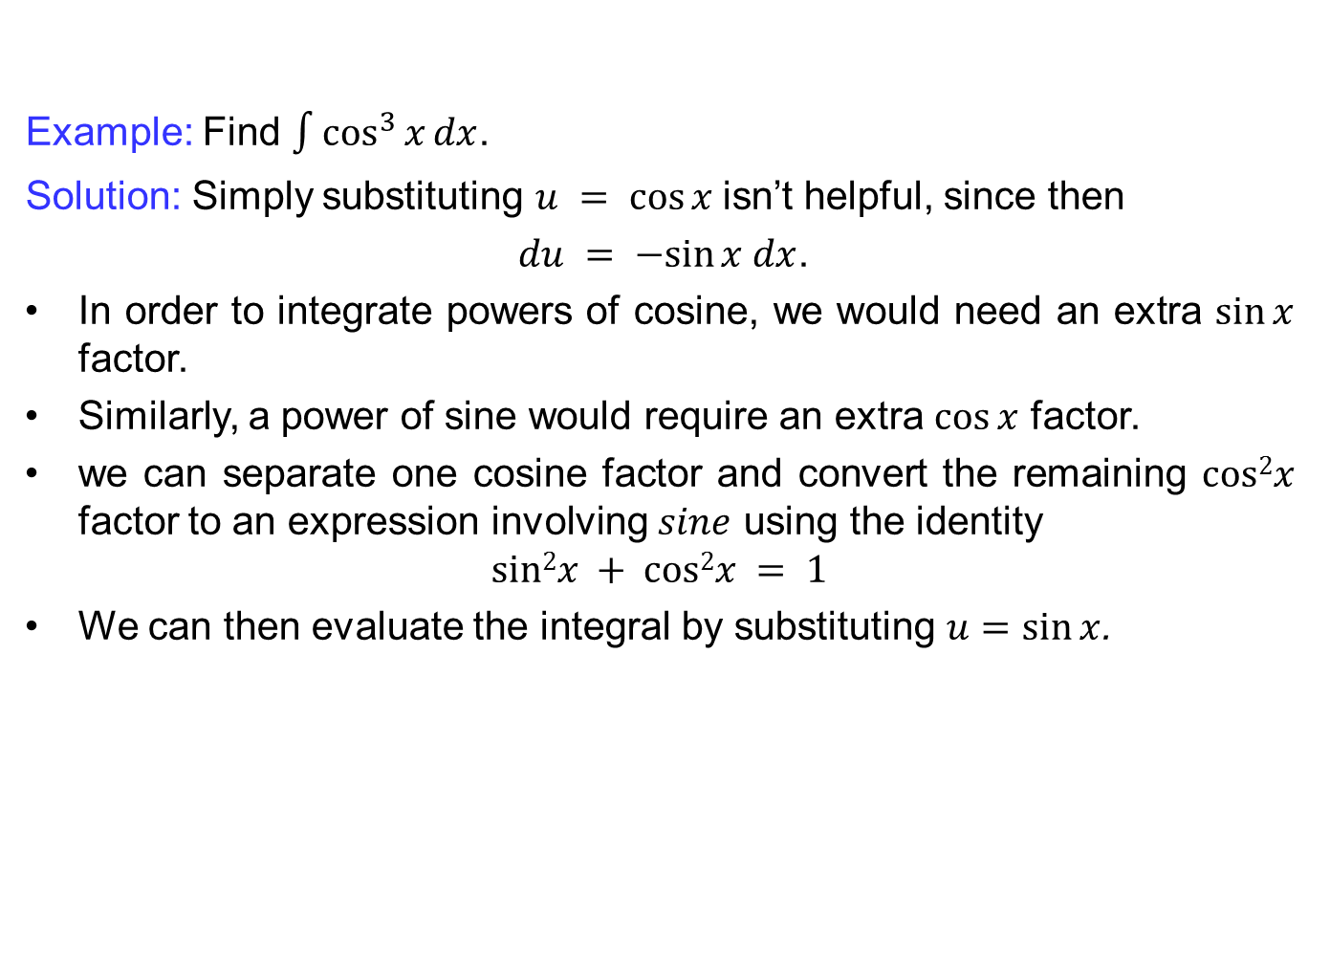
Trigonometric integrals
Example: Find $\int{\cos^{3}{x}}dx$.
Solution: Simply substituting $u = cos⁡x$isn’t helpful, since then
$du = −sin⁡x dx$.
In order to integrate powers of cosine, we would need an extra $sin⁡x$factor.
Similarly, a power of sine would require an extra $cos⁡x$ factor.
we can separate one cosine factor and convert the remaining $cos2x$factor to an expression involving $sine$ using the identity
$$sin2x + cos2x = 1$$
We can then evaluate the integral by substituting $u=\sin{x}$.

Slide 12
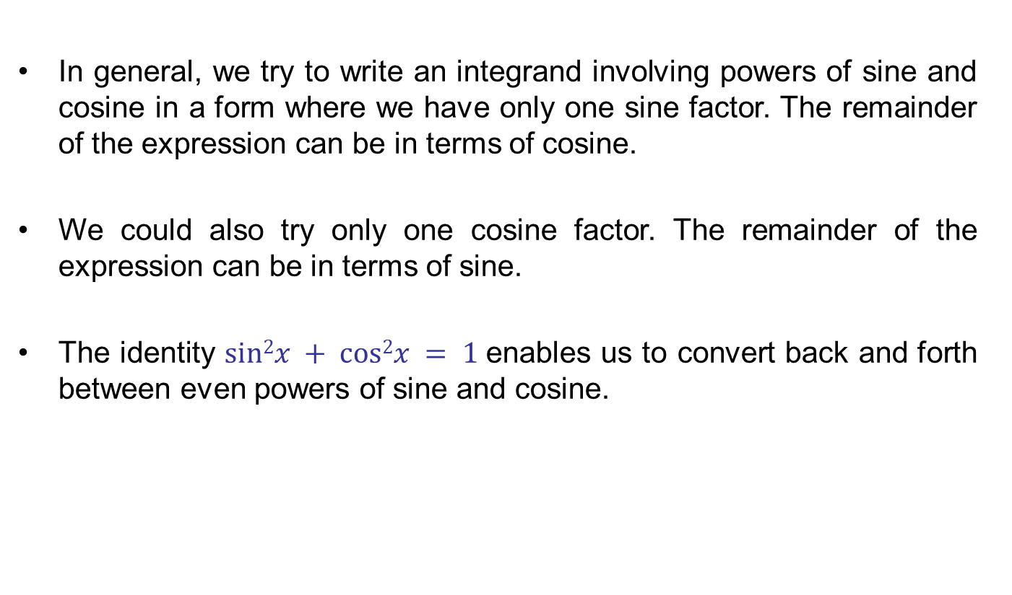
Trigonometric integrals
In general, we try to write an integrand involving powers of sine and cosine in a form where we have only one sine factor. The remainder of the expression can be in terms of cosine.
We could also try only one cosine factor. The remainder of the expression can be in terms of sine.
The identity $sin2x + cos2x = 1$enables us to convert back and forth
between even powers of sine and cosine.

Slide 13
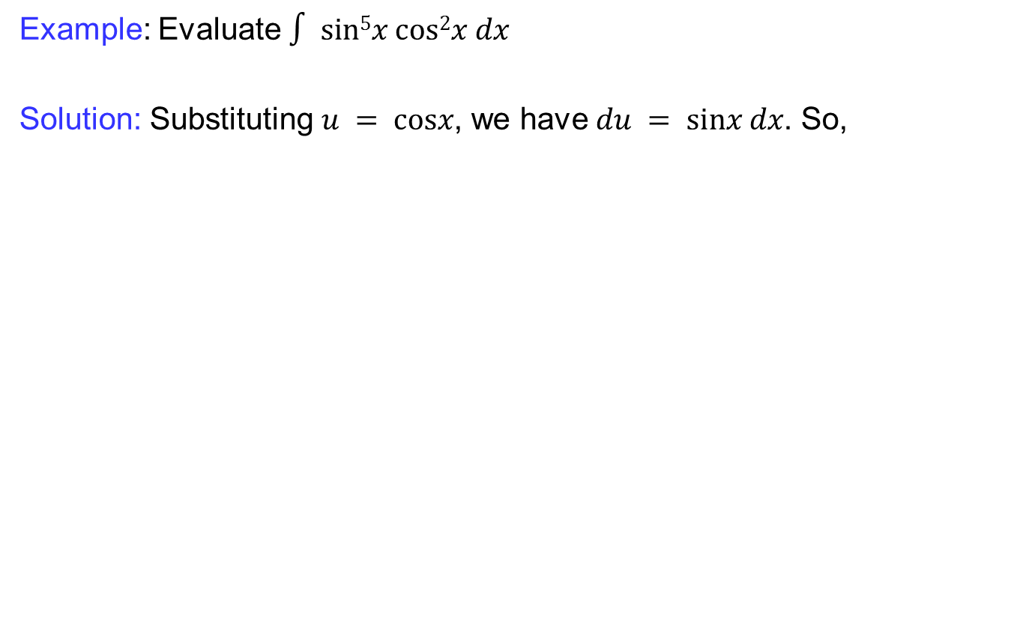
Trigonometric integrals
Example: Evaluate $∫ sin5x cos2x dx$
Solution: Substituting $u = cosx$, we have $du = sinx dx$. So,

Slide 14
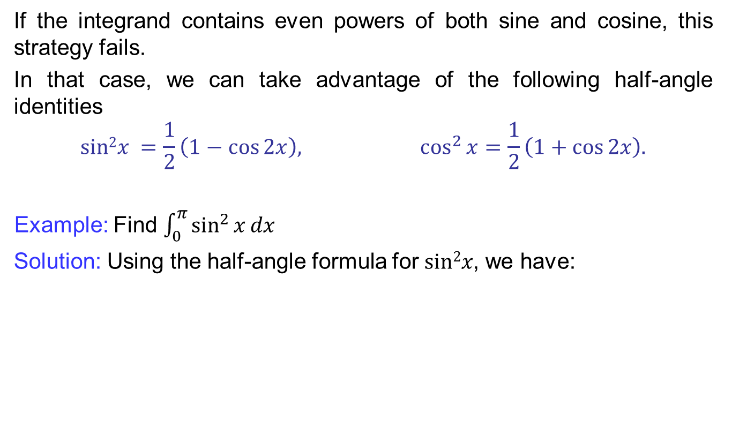
Trigonometric integrals
If the integrand contains even powers of both sine and cosine, this strategy fails.
In that case, we can take advantage of the following half-angle identities
$$sin2x =\frac{1}{2}\left(1−\cos{2x}\right), \cos^{2}{x}=\frac{1}{2}\left(1+\cos{2x}\right).$$
Example: Find $\int_{0}^{π}{\sin^{2}{x}}dx$
  Solution: Using the half-angle formula for $sin2x$, we have:

Slide 15
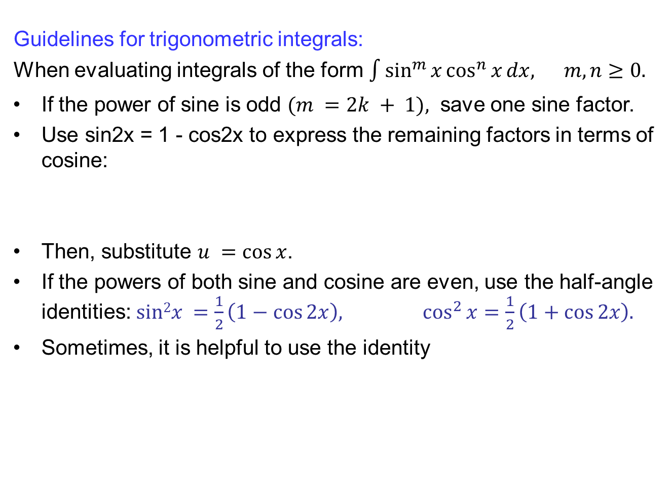
Trigonometric integrals
Guidelines for trigonometric integrals:
When evaluating integrals of the form $\int{\sin^{m}{x}\cos^{n}{x}dx, m,n≥0.}$
If the power of sine is odd $(m =2k + 1),$ save one sine factor.
Use sin2x = 1 - cos2x to express the remaining factors in terms of cosine:
Then, substitute $u =cos⁡x$.
If the powers of both sine and cosine are even, use the half-angle identities: $sin2x =\frac{1}{2}\left(1−\cos{2x}\right), \cos^{2}{x}=\frac{1}{2}\left(1+\cos{2x}\right).$
Sometimes, it is helpful to use the identity

Slide 16
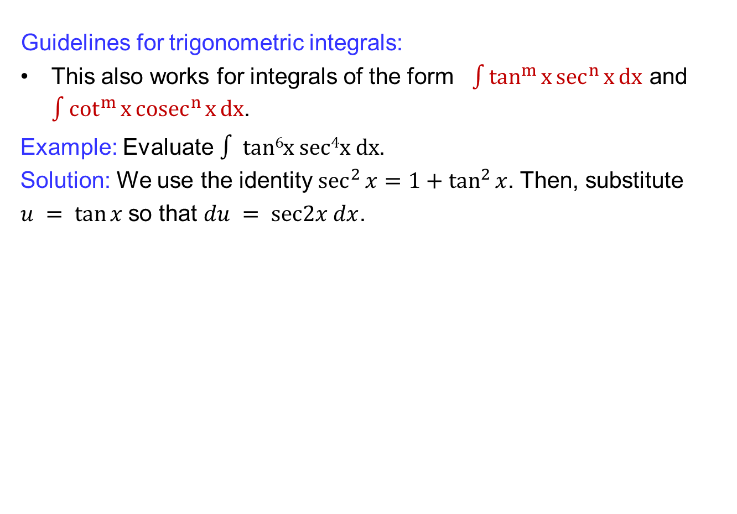
Trigonometric integrals
Guidelines for trigonometric integrals:
This also works for integrals of the form $\int{\tan^{m}{x}\sec^{n}{x}dx}$ and $\int{\cot^{m}{x}{cosec}^{n}{x}dx}$.
Example: Evaluate$∫ tan6x sec4x dx$.
Solution: We use the identity $\sec^{2}{x}=1+\tan^{2}{x}$. Then, substitute
$u = tan⁡x$so that $du = sec2x dx$.

Slide 17
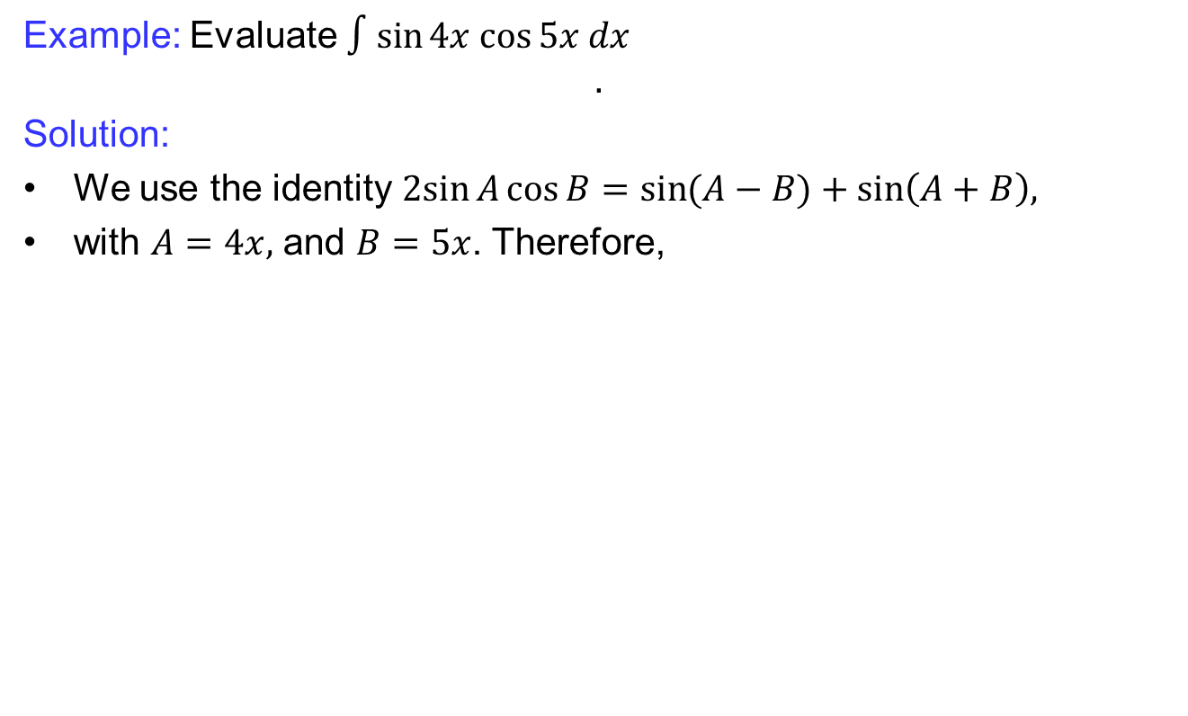
Trigonometric integrals
Example: Evaluate $∫sin⁡4x cos⁡5x dx$
$$.$$
Solution:
We use the identity $2sin{A}\cos{B}=\sin{(A−B)}+\sin\left(A+B\right),$
with $A=4x,$ and $B=5x$. Therefore,

Slide 18
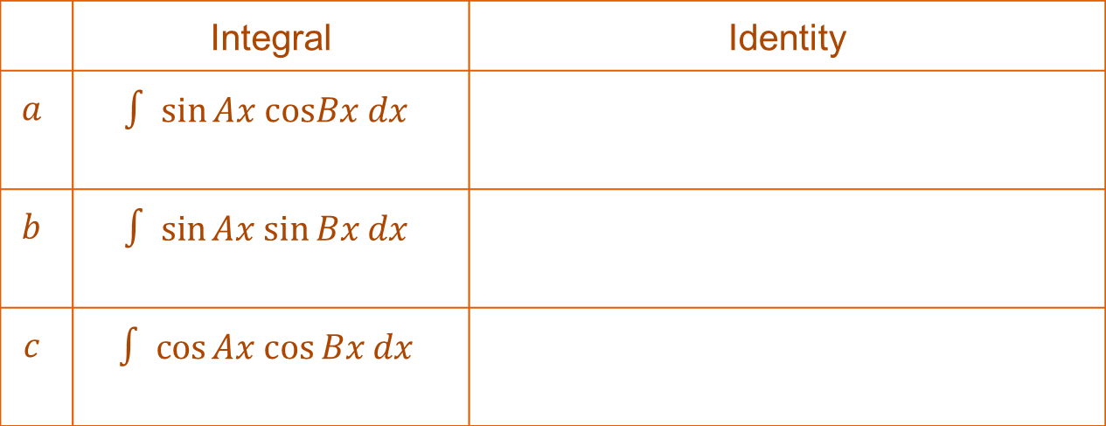
Trigonometric integrals
In general: We use the following identities to evaluate special types of trigonometric integrals.
 | Integral | Identity
$$a$$ | $$∫ sin⁡Ax cosBx dx$$
$$b$$ | $$∫ sin⁡Ax sin⁡Bx dx$$
$$c$$ | $$∫ cos⁡Ax cos⁡Bx dx$$

Slide 19
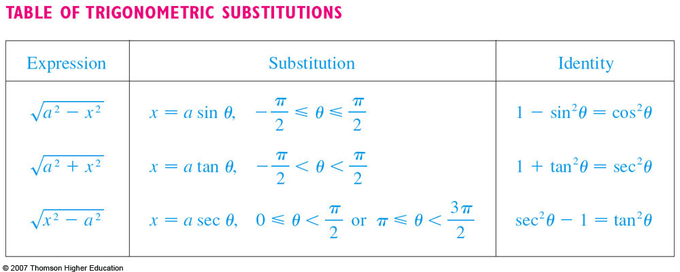
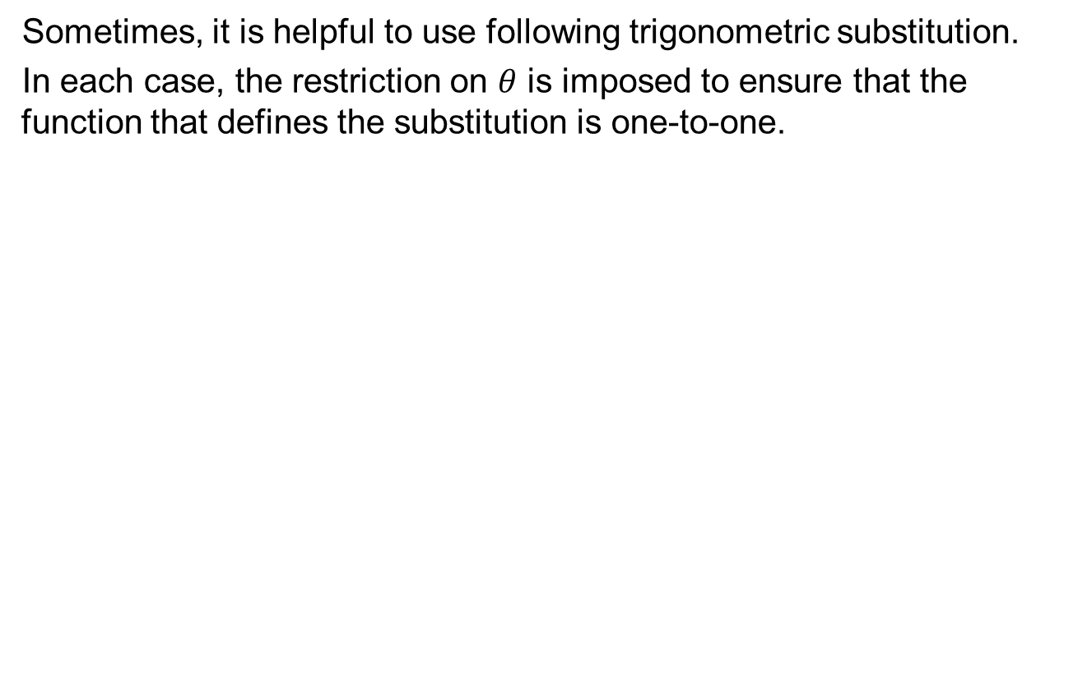
Trigonometric substitutions
Sometimes, it is helpful to use following trigonometric substitution.
In each case, the restriction on $θ$ is imposed to ensure that the function that defines the substitution is one-to-one.

Slide 20
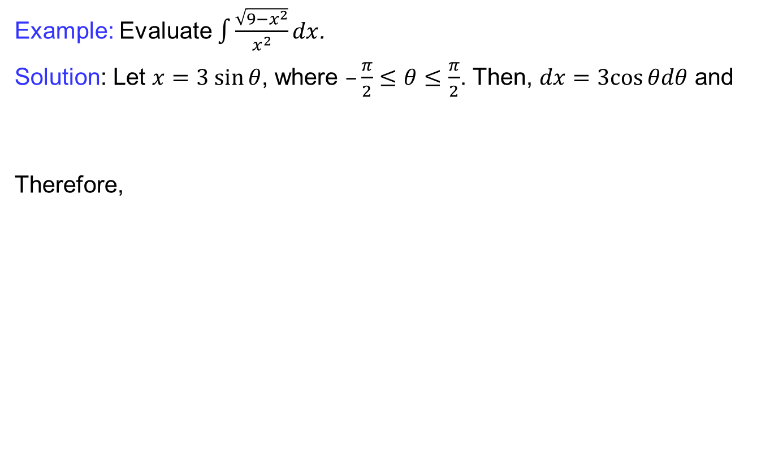
Trigonometric substitutions
Example: Evaluate $\int{\frac{\sqrt{9−x^{2}}}{x^{2}}}dx$.
Solution: Let $x=3 sin⁡θ$, where$–\frac{π}{2}≤θ≤\frac{π}{2}$.Then, $dx=3cos⁡θdθ$and
Therefore,

Slide 21
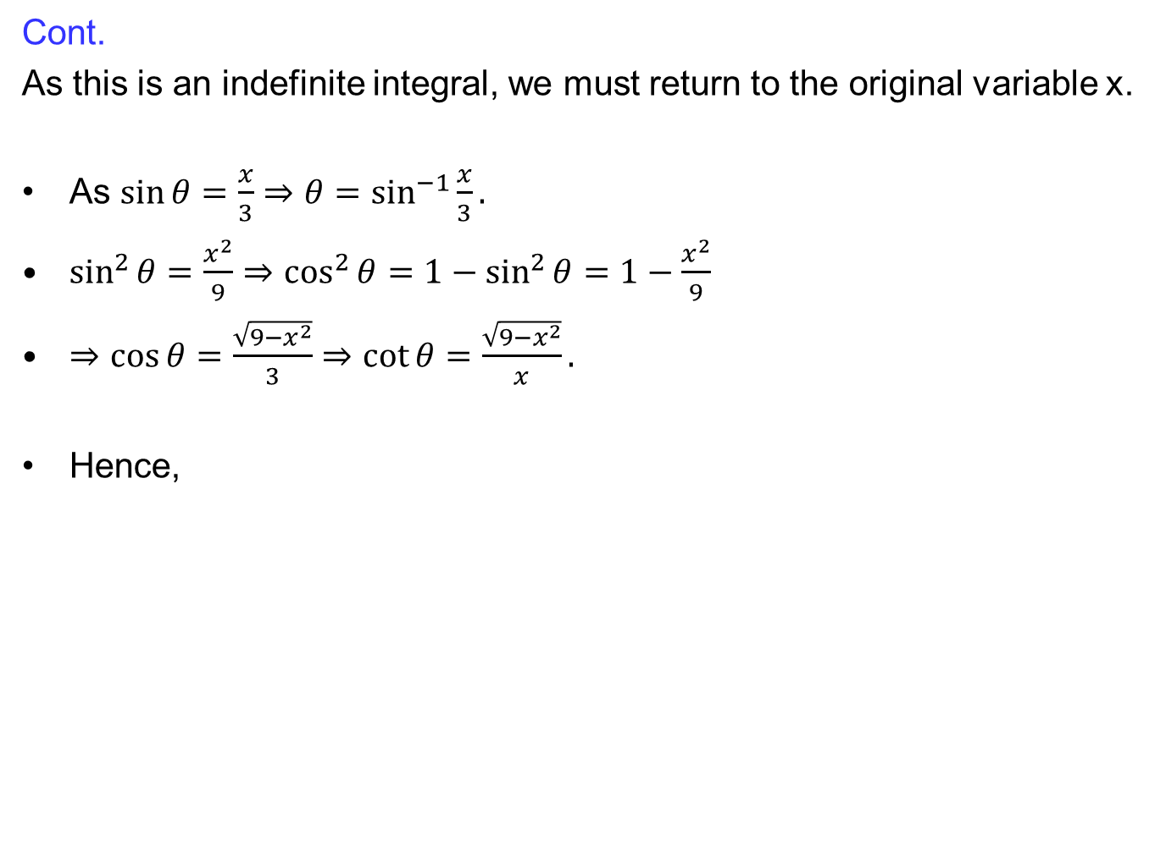
Trigonometric substitutions
Cont.
As this is an indefinite integral, we must return to the original variable x.
As $\sin{θ}=\frac{x}{3}⇒θ=\sin^{−1}{\frac{x}{3}}.$
$\sin^{2}{θ}=\frac{x^{2}}{9}⇒\cos^{2}{θ}=1−\sin^{2}{θ}=1−\frac{x^{2}}{9}$
$⇒\cos{θ=\frac{\sqrt{9−x^{2}}}{3}}⇒\cot{θ}=\frac{\sqrt{9−x^{2}}}{x}.$
Hence,

Slide 22
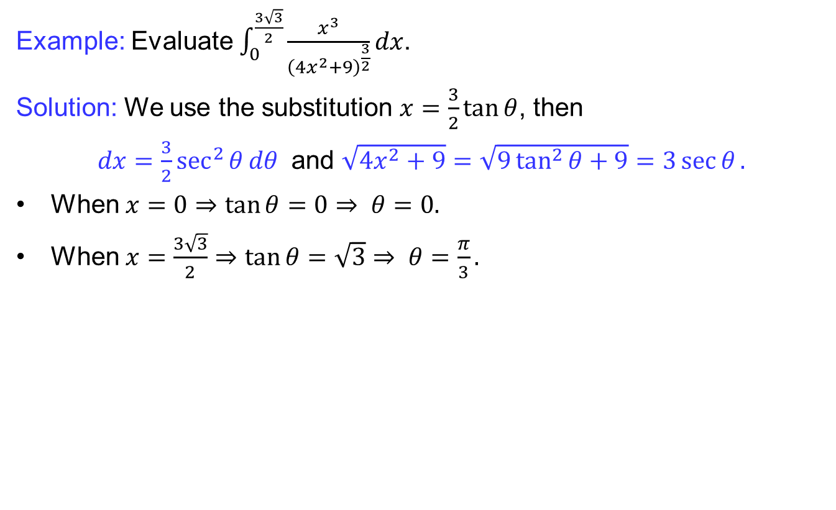
Trigonometric substitutions
Example: Evaluate $\int_{0}^{\frac{3\sqrt{3}}{2}}{\frac{x^{3}}{{\left(4x^{2}+9\right)}^{\frac{3}{2}}}}dx$.
Solution: We use the substitution $x=\frac{3}{2}\tan{θ}$, then
$dx=\frac{3}{2}\sec^{2}{θ}dθ$and$\sqrt{4x^{2}+9}=\sqrt{9\tan^{2}{θ}+9}=3\sec{θ}.$
When$x=0⇒\tan{θ}=0⇒ θ=0.$
When$x=\frac{3\sqrt{3}}{2}⇒\tan{θ}=\sqrt{3}⇒ θ=\frac{π}{3}.$

Slide 23
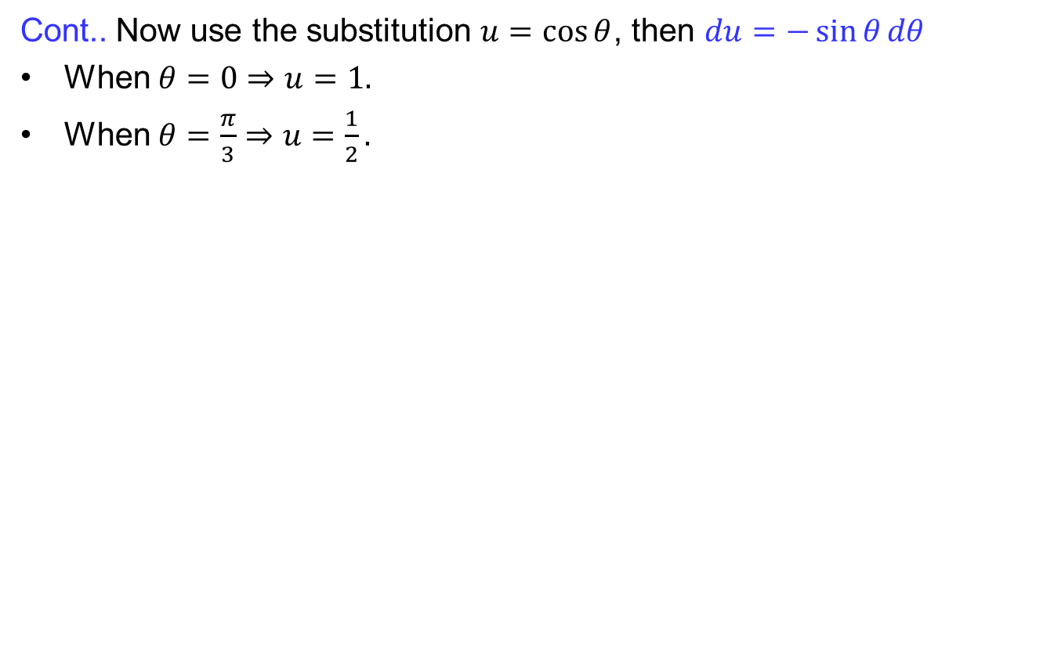
Trigonometric substitutions
Cont.. Now use the substitution $u=\cos{θ}$, then$du=−\sin{θ}dθ$
When$θ=0⇒u=1.$
When$θ=\frac{π}{3}⇒u=\frac{1}{2}.$

Slide 24
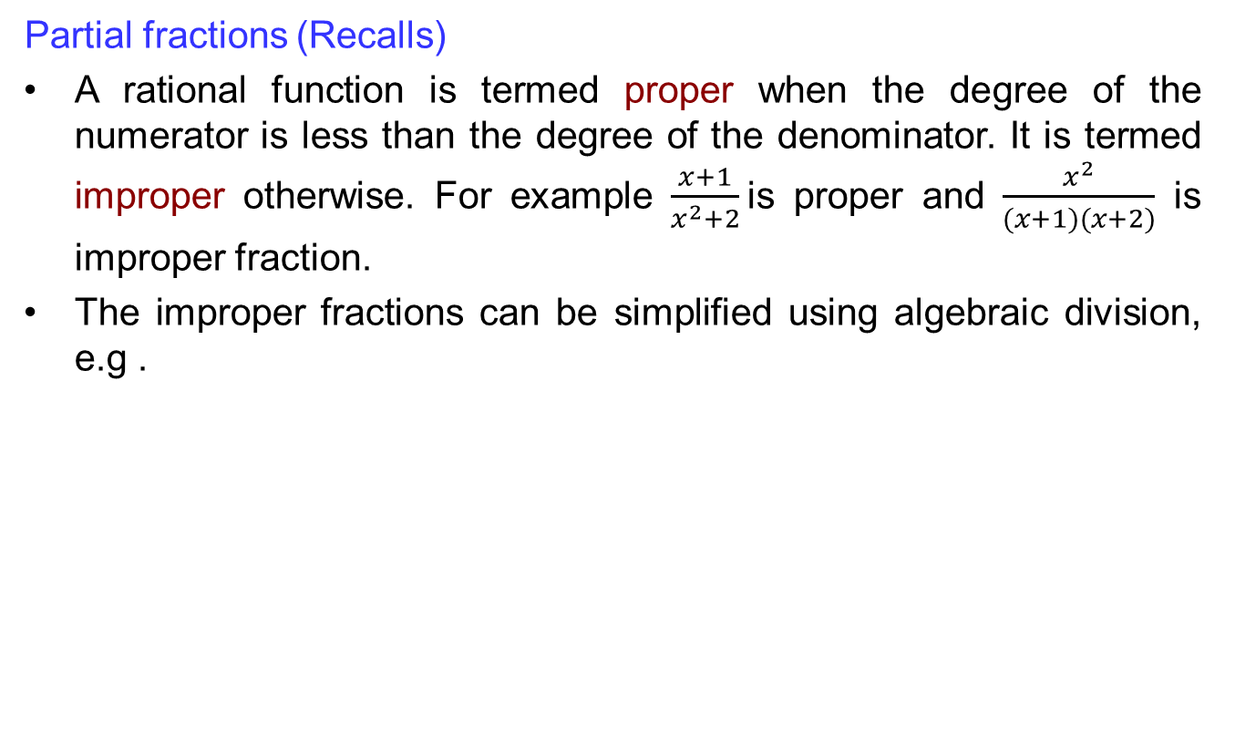
Integration by partial fraction
Partial fractions (Recalls)
A rational function is termed proper when the degree of the numerator is less than the degree of the denominator. It is termed improper otherwise. For example $\frac{x+1}{x^{2}+2}$is proper and $\frac{x^{2}}{(x+1)(x+2)}$ is improper fraction.
The improper fractions can be simplified using algebraic division, e.g .

Slide 25
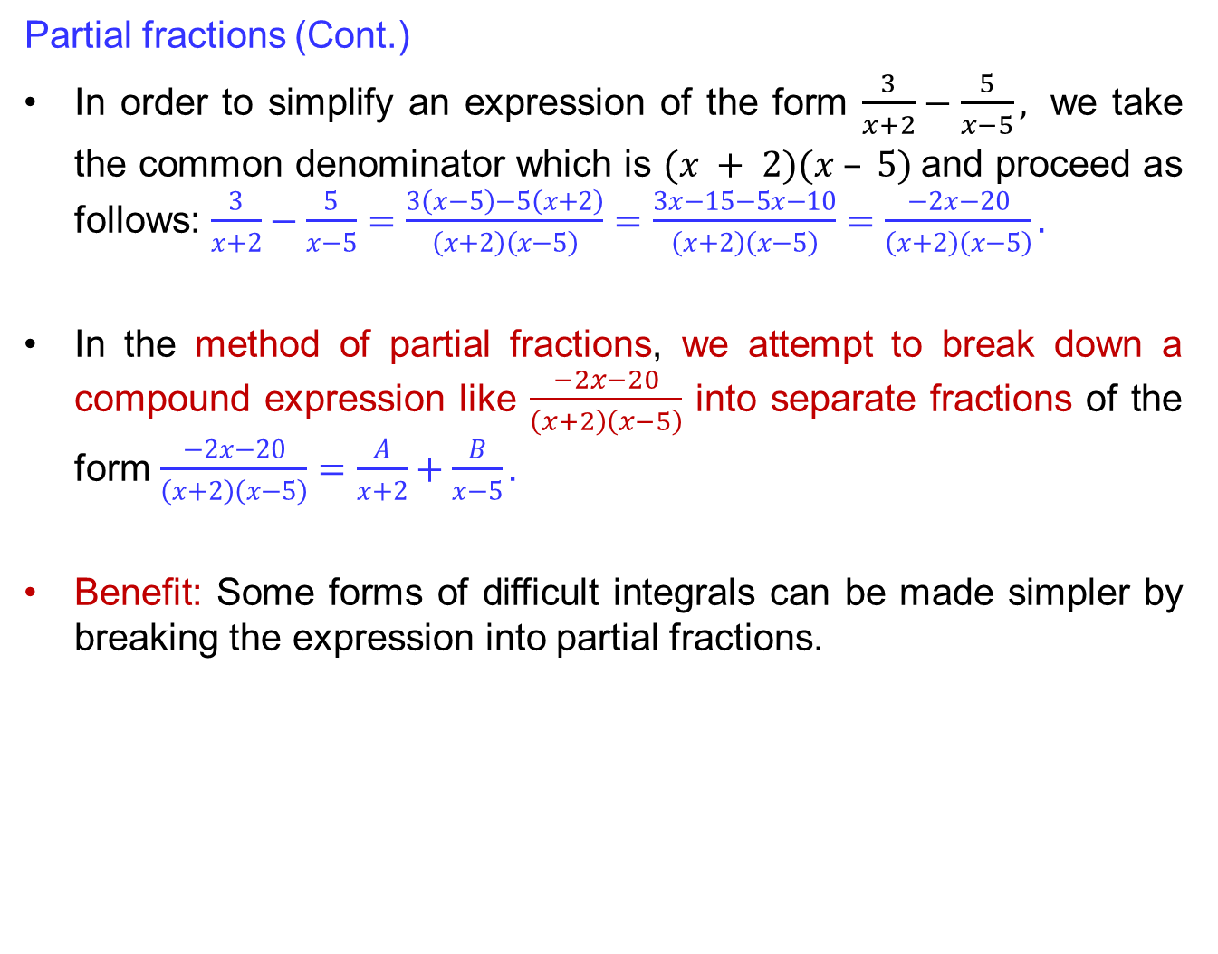
Integration by partial fraction
Partial fractions (Cont.)
In order to simplify an expression of the form $\frac{3}{x+2}−\frac{5}{x−5},$ we take the common denominator which is $(x + 2)(x – 5)$and proceed as follows: $\frac{3}{x+2}−\frac{5}{x−5}=\frac{3\left(x−5\right)−5\left(x+2\right)}{\left(x+2\right)\left(x−5\right)}=\frac{3x−15−5x−10}{\left(x+2\right)\left(x−5\right)}=\frac{−2x−20}{\left(x+2\right)\left(x−5\right)}.$
In the method of partial fractions, we attempt to break down a compound expressionlike $\frac{−2x−20}{\left(x+2\right)\left(x−5\right)}$ into separate fractions of the form$\frac{−2x−20}{\left(x+2\right)\left(x−5\right)}=\frac{A}{x+2}+\frac{B}{x−5}.$
Benefit: Some forms of difficult integrals can be made simpler by breaking the expression into partial fractions.

Slide 26
Integration by partial fraction
How to find partial fractions:
Factor the denominator if it is not already in the factored form.
If the denominator contains two linear factors, break it into two partial fractions using constant A and B as follows:
If the denominator contains some power of a linear factor, we break it down to partial fractions as follows:
If the denominator contains a quadratic factor, we break it down to partial fractions as follows:

Slide 27
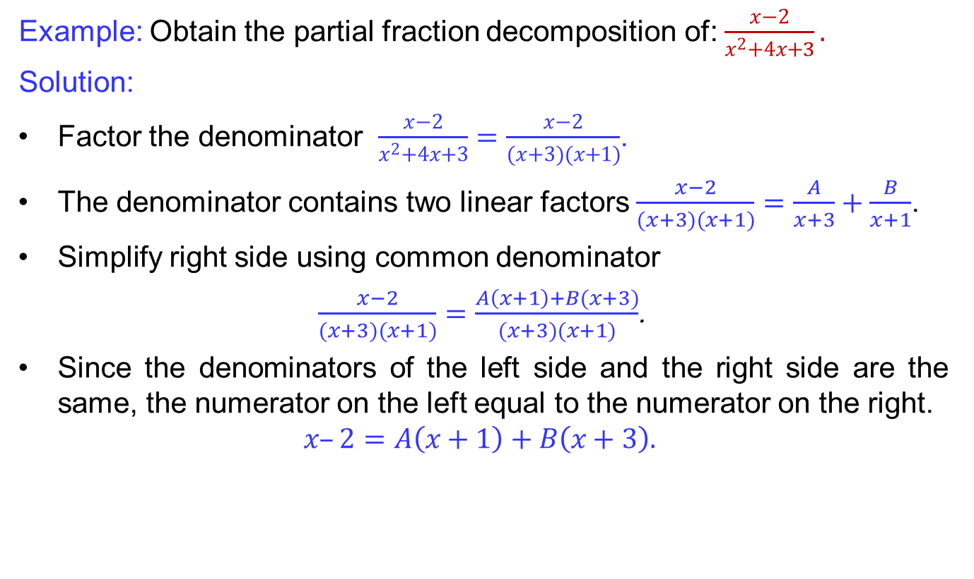
Integration by partial fraction
Example: Obtain the partial fraction decomposition of: $\frac{x−2}{x^{2}+4x+3}.$
Solution:
Factor the denominator $\frac{x−2}{x^{2}+4x+3}=\frac{x−2}{(x+3)(x+1)}$.
The denominator contains two linear factors $\frac{x−2}{(x+3)(x+1)}=\frac{A}{x+3}+\frac{B}{x+1}$.
Simplify right side using common denominator
$\frac{x−2}{(x+3)(x+1)}=\frac{A\left(x+1\right)+B(x+3)}{(x+3)(x+1)}$.
Since the denominators of the left side and the right side are the same, the numerator on the left equal to the numerator on the right.
$$x–2=A\left(x+1\right)+B\left(x+3\right).$$

Slide 28
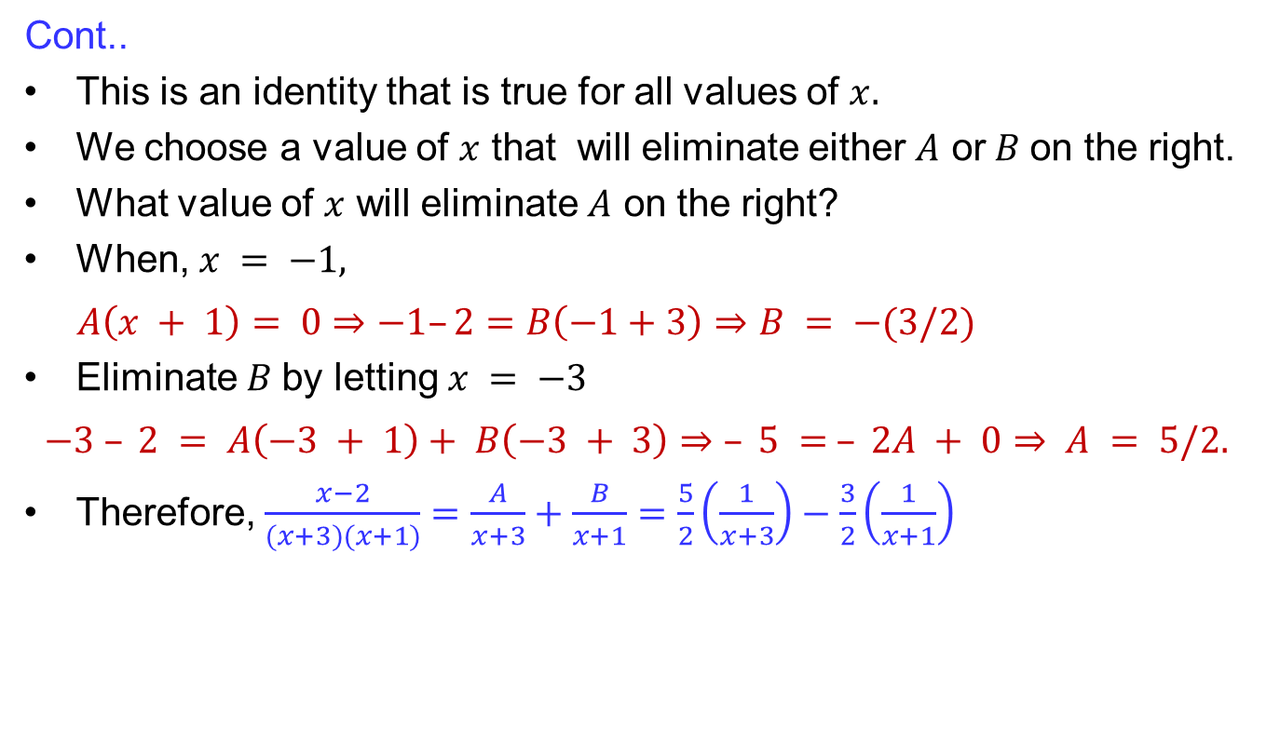
Integration by partial fraction
Cont..
This is an identity that is true for all values of $x.$
We choose a value of $x$ that will eliminate either $A$ or$B$on the right.
What value of $x$ will eliminate $A$ on the right?
When, $x = −1,$
$A\left(x + 1\right)= 0⇒−1–2=B\left(−1+3\right)⇒B = −(3/2)$
Eliminate $B$by letting $x = −3$
$−3 – 2 = A\left(−3 + 1\right)+ B\left(−3 + 3\right)⇒$$– 5 = – 2A + 0⇒ A = 5/2.$
Therefore, $\frac{x−2}{(x+3)(x+1)}=\frac{A}{x+3}+\frac{B}{x+1}=\frac{5}{2}\left(\frac{1}{x+3}\right)−\frac{3}{2}\left(\frac{1}{x+1}\right)$

Slide 29
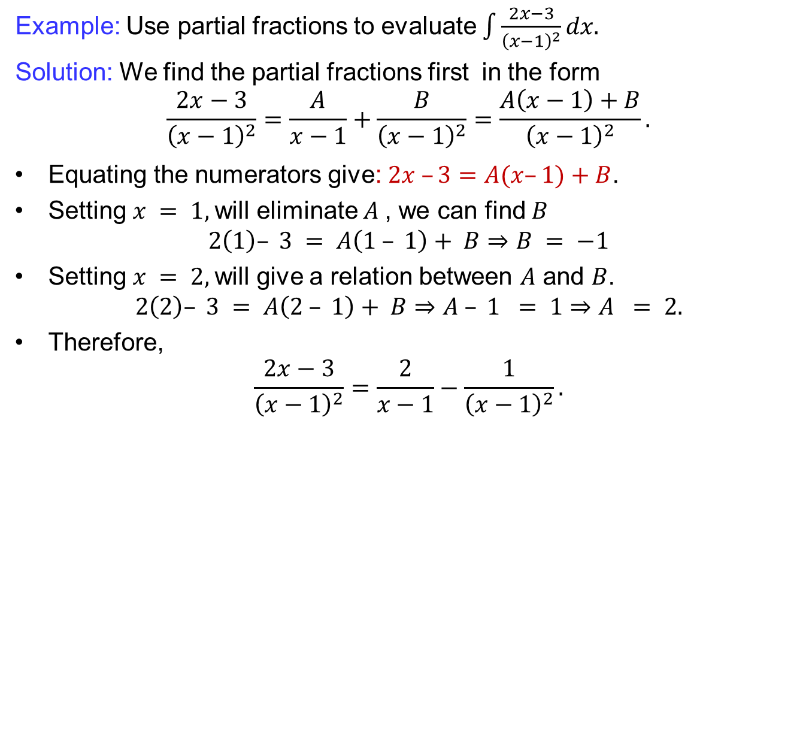
Integration by partial fraction
Example: Use partial fractions to evaluate $\int{\frac{2x−3}{{\left(x−1\right)}^{2}}}dx.$
Solution: We find the partial fractions first in the form
$$\frac{2x−3}{{\left(x−1\right)}^{2}}=\frac{A}{x−1}+\frac{B}{{\left(x−1\right)}^{2}}=\frac{A\left(x−1\right)+B}{{\left(x−1\right)}^{2}}.$$
Equating the numeratorsgive: $2x –3=A(x–1)+B$.
Setting $x = 1,$will eliminate $A$, we can find $B$
$$2\left(1\right)– 3 = A\left(1 – 1\right)+ B⇒B = −1$$
Setting $x = 2,$will give a relation between $A$ and $B$.
$$2\left(2\right)– 3 = A\left(2 – 1\right)+ B⇒A – 1 = 1⇒A = 2.$$
Therefore,
$$\frac{2x−3}{{\left(x−1\right)}^{2}}=\frac{2}{x−1}−\frac{1}{{\left(x−1\right)}^{2}}.$$

Slide 30
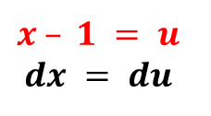
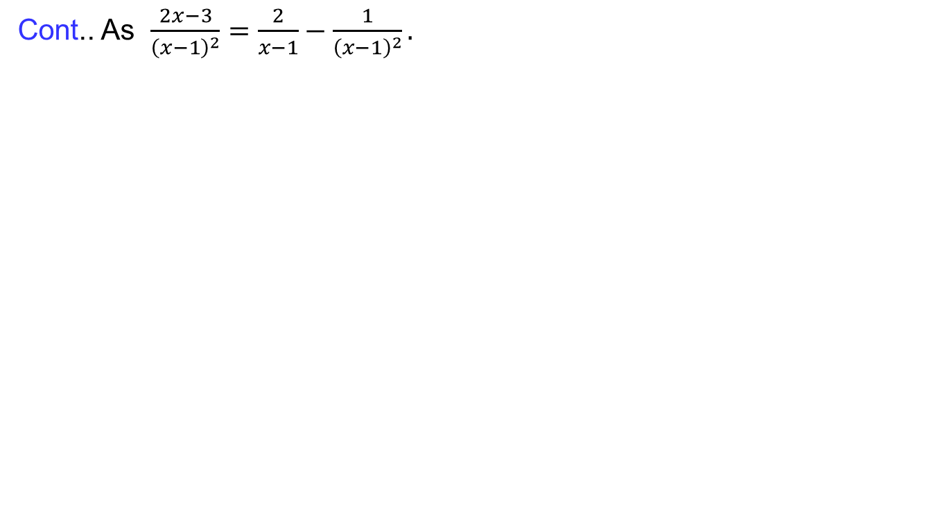
Integration by partial fraction
Cont.. As $\frac{2x−3}{{\left(x−1\right)}^{2}}=\frac{2}{x−1}−\frac{1}{{\left(x−1\right)}^{2}}.$
$$x – 1 = u$$
$$dx = du$$

Slide 31
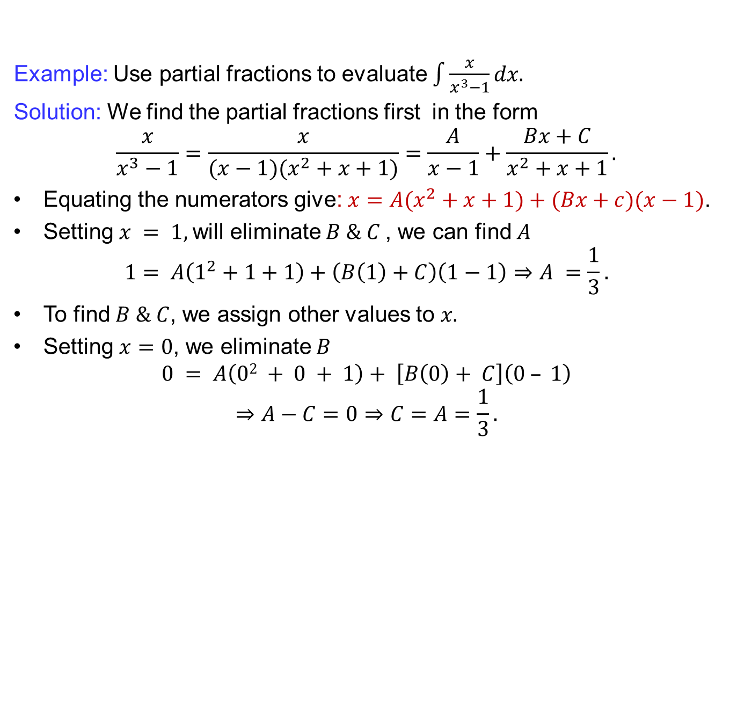
Integration by partial fraction
Example: Use partial fractions to evaluate $\int{\frac{x}{x^{3}−1}}dx.$
Solution: We find the partial fractions first in the form
$$\frac{x}{x^{3}−1}=\frac{x}{(x−1)(x^{2}+x+1)}=\frac{A}{x−1}+\frac{Bx+C}{x^{2}+x+1}.$$
Equating the numeratorsgive: $x=A(x^{2}+x+1)+(Bx+c)(x−1)$.
Setting $x = 1,$will eliminate $B \& C$, we can find $A$
$$1= A\left(1^{2}+1+1\right)+\left(B\left(1\right)+C\right)\left(1−1\right)⇒A =\frac{1}{3}.$$
To find $B \& C$, we assign other values to $x.$
Setting $x=0$, we eliminate $B$
$$0 = A\left(02 + 0 + 1\right)+ \left[B\left(0\right)+ C\right]\left(0 – 1\right)$$
$$⇒A−C=0⇒C=A=\frac{1}{3}.$$

Slide 32
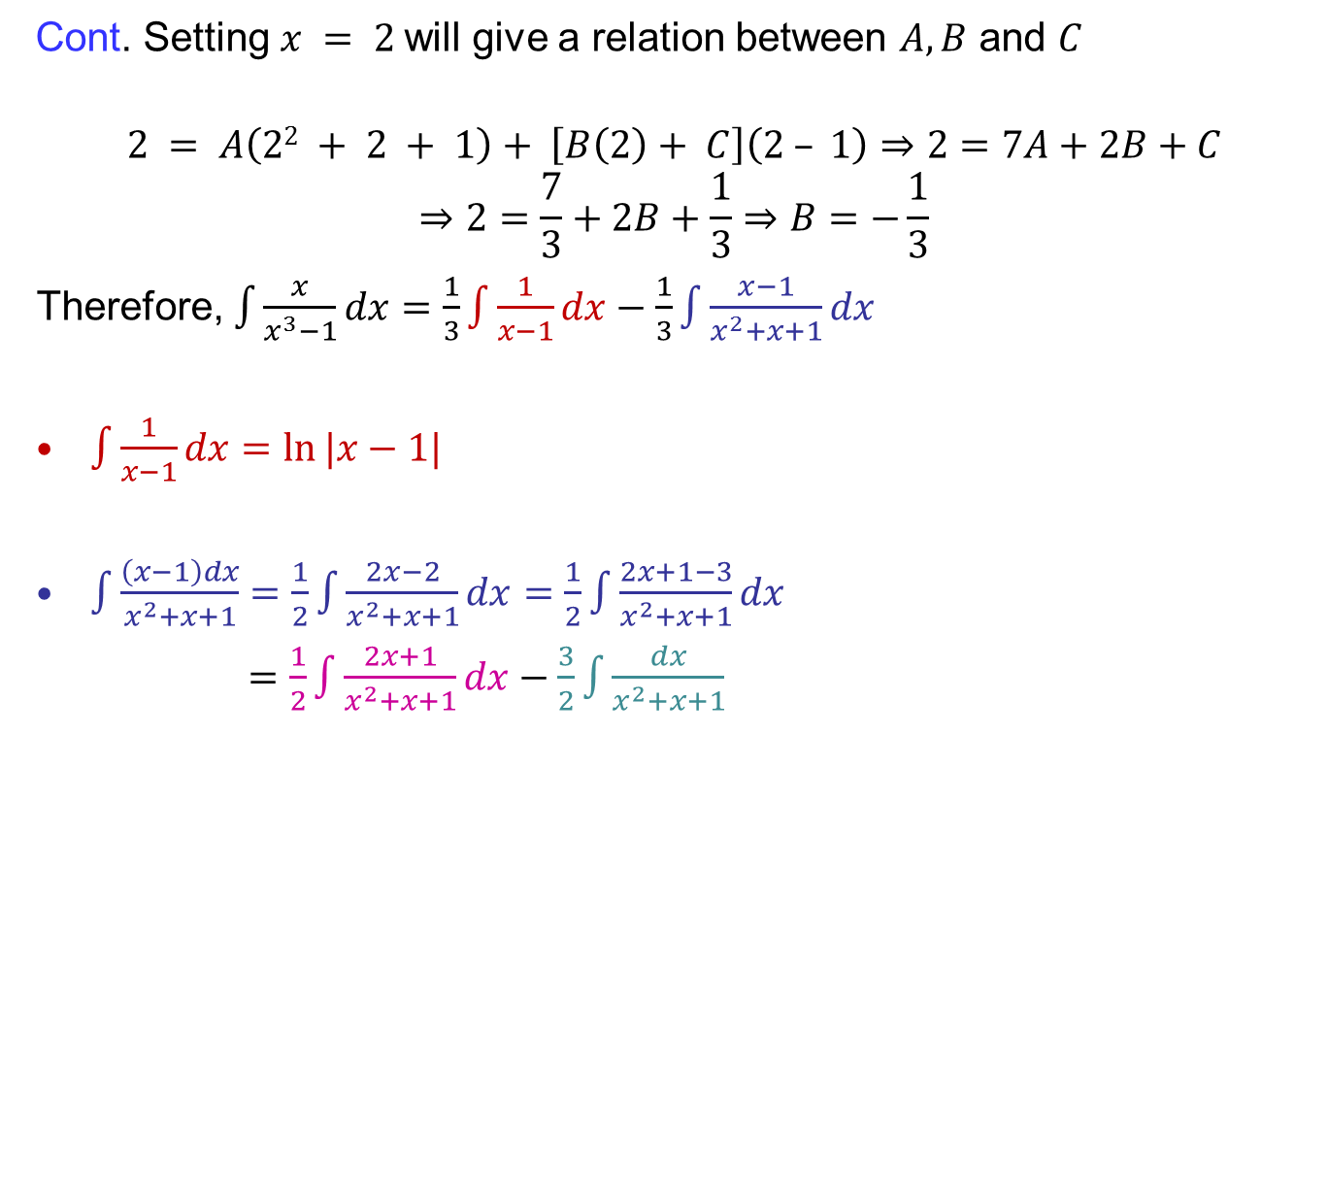
Integration by partial fraction
Cont. Setting $x = 2$will give a relation between $A, B$ and $C$
$$2 = A\left(22 + 2 + 1\right)+ \left[B\left(2\right)+ C\right]\left(2 – 1\right)⇒2=7A+2B+C$$
$$⇒2=\frac{7}{3}+2B+\frac{1}{3}⇒B=−\frac{1}{3}$$
Therefore, $\int{\frac{x}{x^{3}−1}dx}=\frac{1}{3}\int{\frac{1}{x−1}dx}−\frac{1}{3}\int{\frac{x−1}{x^{2}+x+1}dx}$
$\int{\frac{1}{x−1}dx}=\ln{|x−1|}$
$\int{\frac{\left(x−1\right)dx}{x^{2}+x+1}}=\frac{1}{2}\int{\frac{2x−2}{x^{2}+x+1}dx=\frac{1}{2}\int{\frac{2x+1−3}{x^{2}+x+1}dx}}$
$=\frac{1}{2}\int{\frac{2x+1}{x^{2}+x+1}dx}−\frac{3}{2}\int{\frac{dx}{x^{2}+x+1}}$

Slide 33
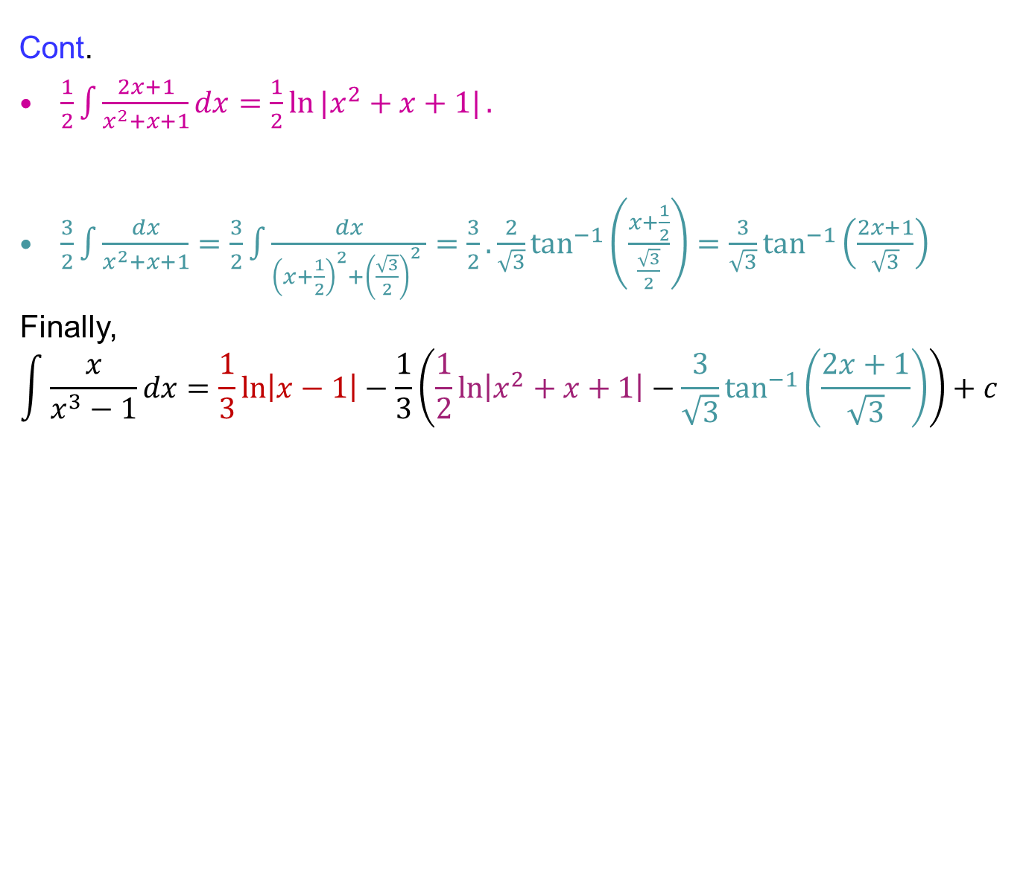
Integration by partial fraction
Cont.
$\frac{1}{2}\int{\frac{2x+1}{x^{2}+x+1}dx}=\frac{1}{2}\ln{|x^{2}+x+1|}.$
$\frac{3}{2}\int{\frac{dx}{x^{2}+x+1}}=\frac{3}{2}\int{\frac{dx}{{\left(x+\frac{1}{2}\right)}^{2}+{\left(\frac{\sqrt{3}}{2}\right)}^{2} }}=\frac{3}{2}.\frac{2}{\sqrt{3}}\tan^{−1}\left(\frac{x+\frac{1}{2}}{\frac{\sqrt{3}}{2}}\right)=\frac{3}{\sqrt{3}}\tan^{−1}\left(\frac{2x+1}{\sqrt{3}}\right)$
Finally,
$$\int{\frac{x}{x^{3}−1}dx}=\frac{1}{3}\ln\left|x−1\right|−\frac{1}{3}\left(\frac{1}{2}\ln\left|x^{2}+x+1\right|−\frac{3}{\sqrt{3}}\tan^{−1}\left(\frac{2x+1}{\sqrt{3}}\right)\right)+c$$

Slide 34
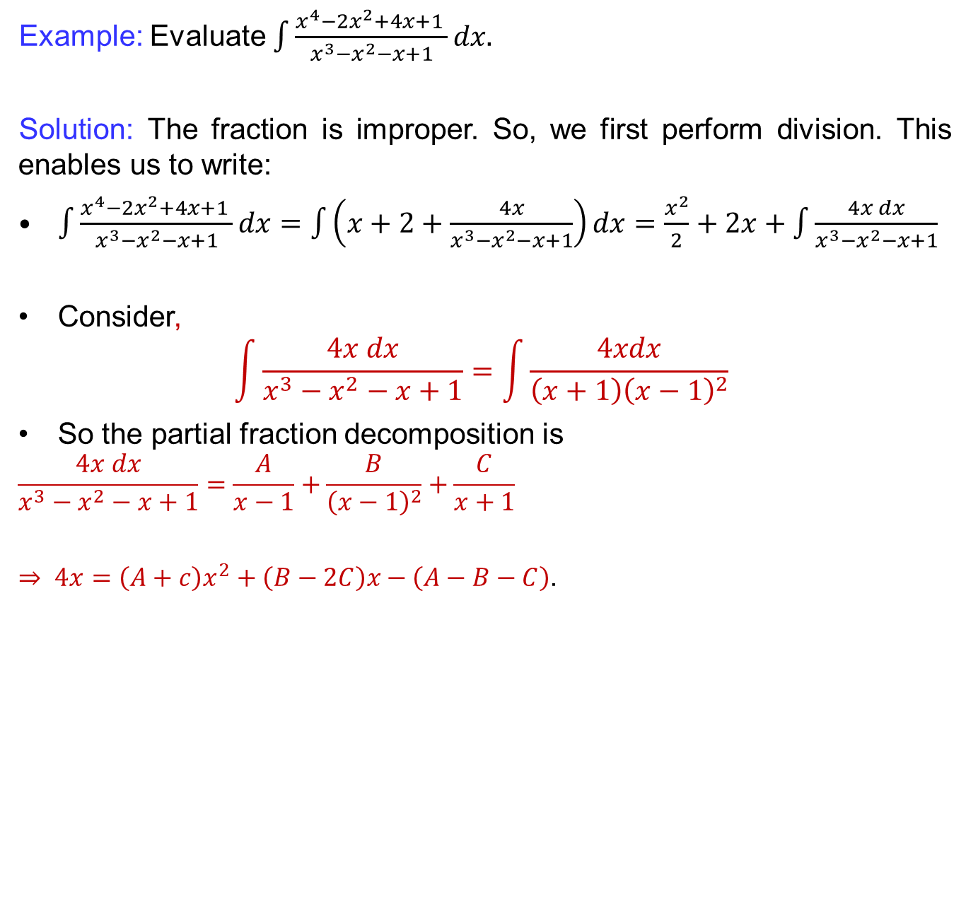
Integration by partial fraction
Example: Evaluate $\int{\frac{x^{4}−2x^{2}+4x+1 }{x^{3}−x^{2}−x+1}}dx.$
Solution: The fraction is improper. So, we first perform division. This enables us to write:
$\int{\frac{x^{4}−2x^{2}+4x+1 }{x^{3}−x^{2}−x+1}dx}=\int{\left(x+2+\frac{4x}{x^{3}−x^{2}−x+1}\right)dx}=\frac{x^{2}}{2}+2x+\int{\frac{4x dx}{x^{3}−x^{2}−x+1}}$
Consider,
$$\int{\frac{4x dx}{x^{3}−x^{2}−x+1}}=\int{\frac{4xdx}{\left(x+1\right){\left(x−1\right)}^{2}}}$$
So the partial fraction decomposition is
$$\frac{4x dx}{x^{3}−x^{2}−x+1}=\frac{A}{x−1}+\frac{B}{{\left(x−1\right)}^{2}}+\frac{C}{x+1}$$
$⇒ 4x=\left(A+c\right)x^{2}+\left(B−2C\right)x−\left(A−B−C\right)$.

Slide 35
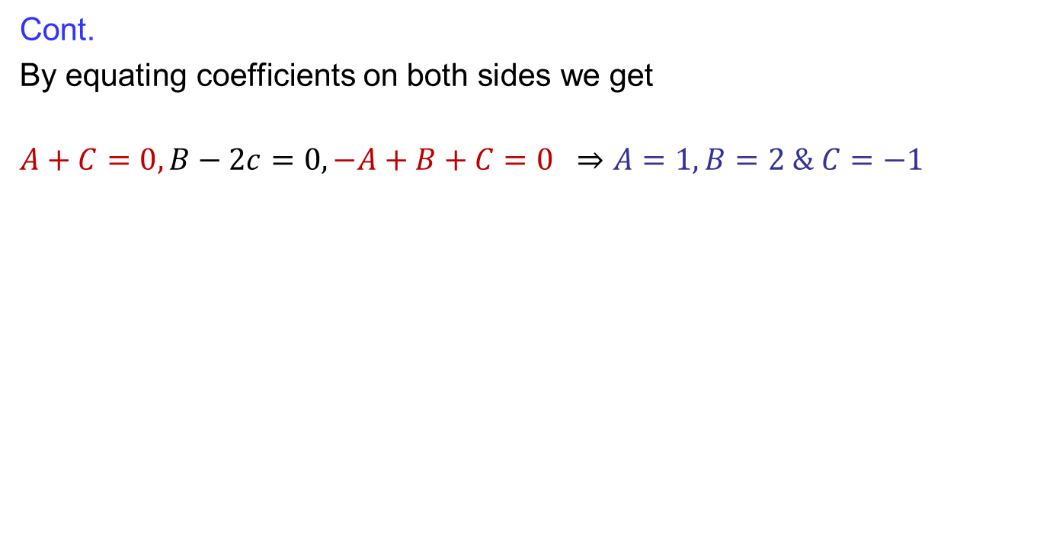
Integration by partial fraction
Cont.
By equating coefficients on both sides we get
$$A+C=0, B−2c=0, −A+B+C=0 ⇒A=1, B=2 \& C=−1$$

Slide 36
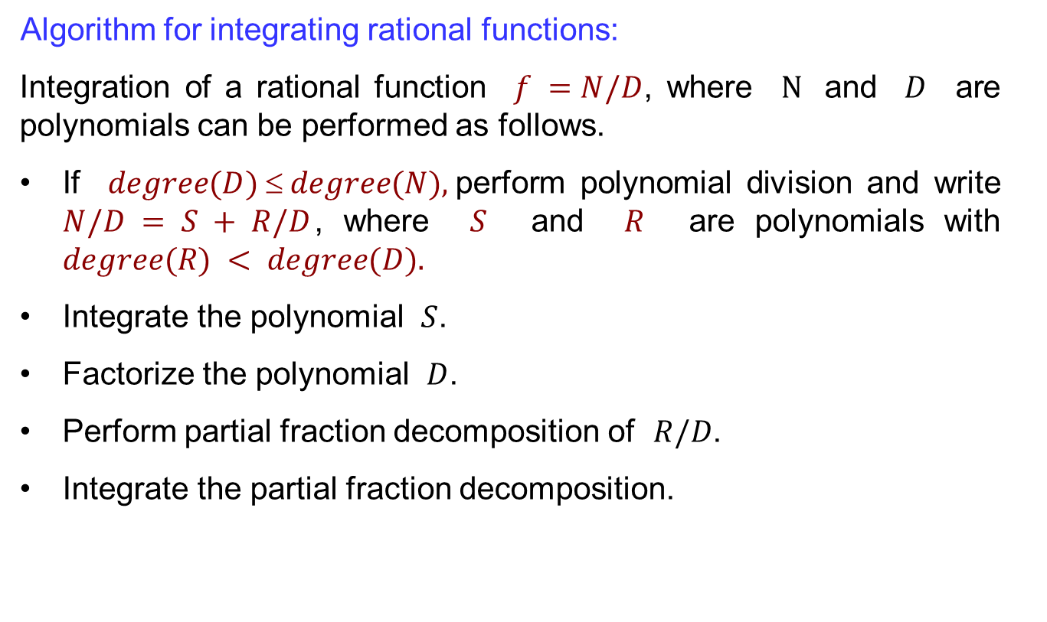
Integration by partial fraction
Algorithm for integrating rational functions:
Integration of a rational function $f =N/D$, where $N$ and $D$ are polynomials can be performed as follows.
If $degree(D)  degree(N),$perform polynomial division and write
$N/D = S + R/D$, where $S$ and $R$ are polynomials with $degree(R) < degree(D).$
Integrate the polynomial $S$.
Factorize the polynomial $D$.
Perform partial fraction decomposition of $R/D$.
Integrate the partial fraction decomposition.

Slide 37
Lecture Summary
    Recalls
    Trigonometric integrals
    Trigonometric substitutions
    Partial fractions,

