Slide 1
(MTH 250)
Calculus
Lecture 19

Slide 2
Previous Lecture’s Summary
    Definite integrals
    Fundamental theorem of calculus
    Mean value theorem for integrals
    Fundamental theorem of calculus II
    Integrating a rate of change

Slide 3
Today’s Lecture
    Recalls
    Substitution for definite integrals
    Integration by parts
    Area bounded by curves

Slide 4
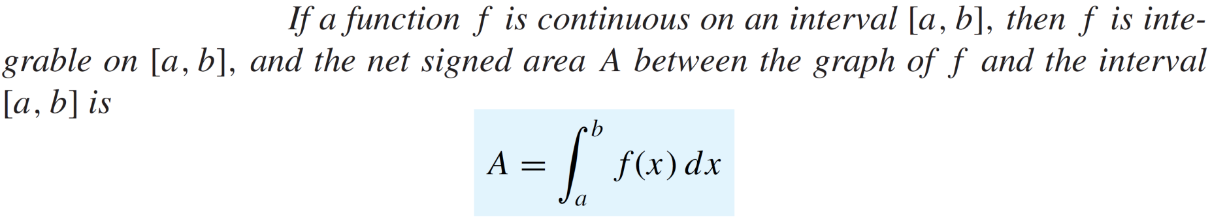
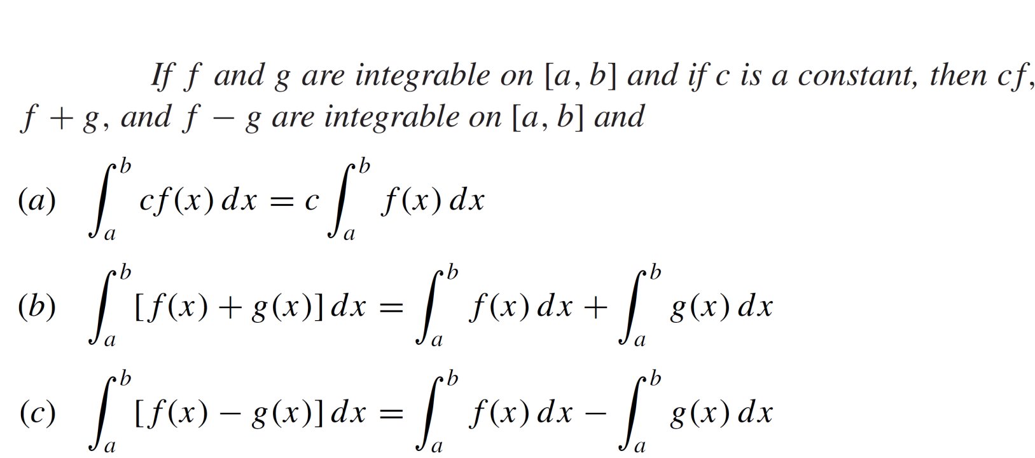
Recalls
Theorem:
Theorem:

Slide 5
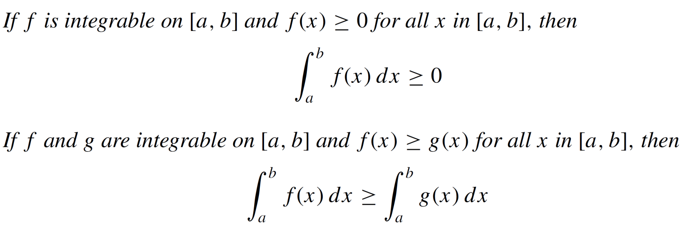
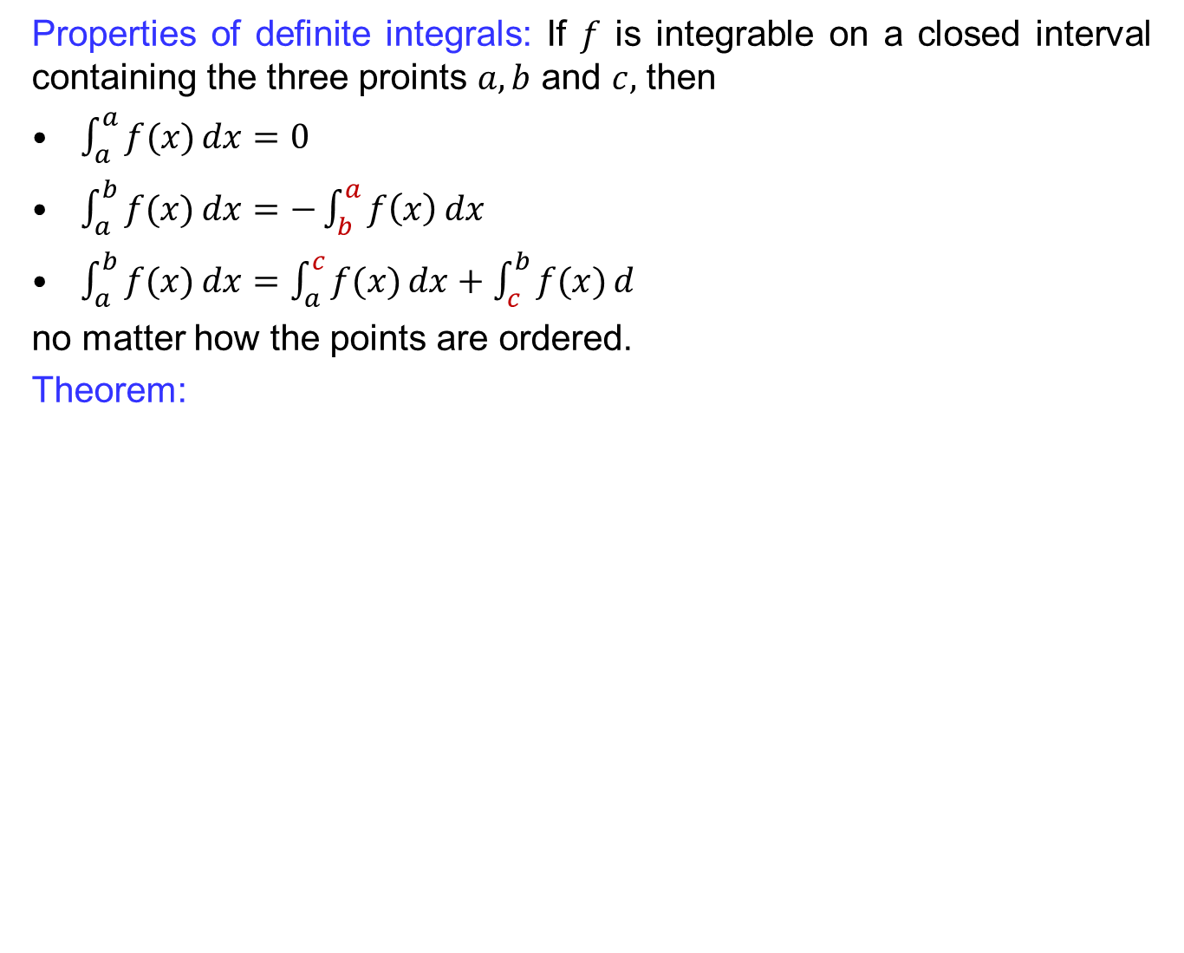
Recalls
Properties of definiteintegrals: If $f$is integrable on a closedintervalcontaining the threeproints$a,b$ and $c,$then
$\int_{a}^{a}{f(x)}dx=0$
$\int_{a}^{b}{f(x)}dx=−\int_{b}^{a}{f\left(x\right)}dx$
$\int_{a}^{b}{f(x)}dx=\int_{a}^{c}{f(x)}dx+\int_{c}^{b}{f(x)}d$
no matter how the points are ordered.
Theorem:

Slide 6
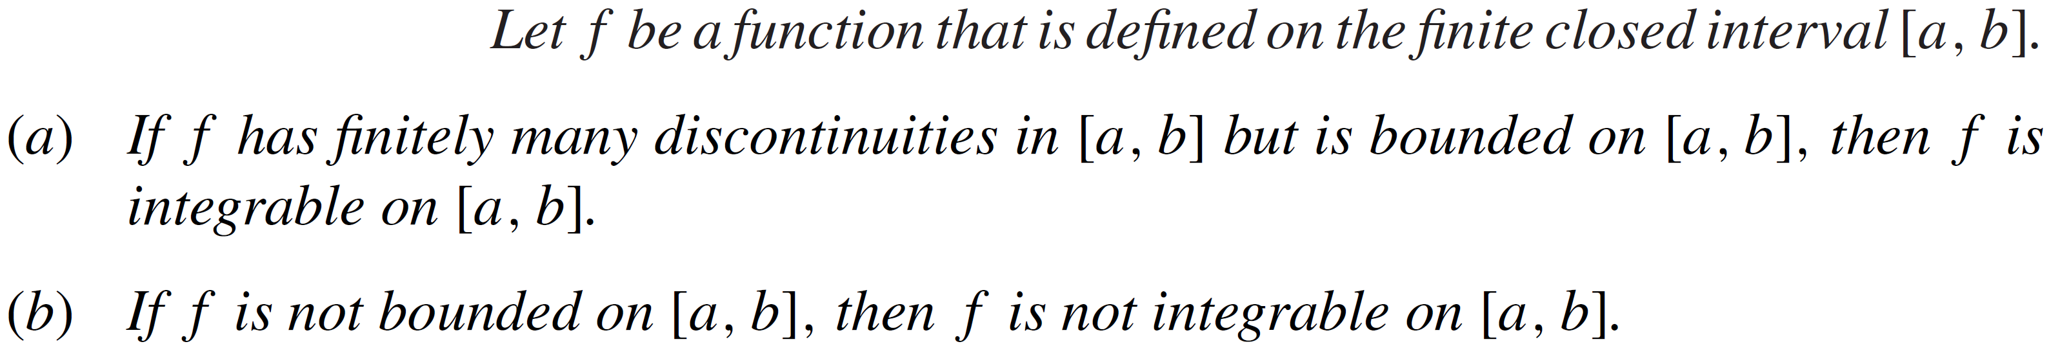
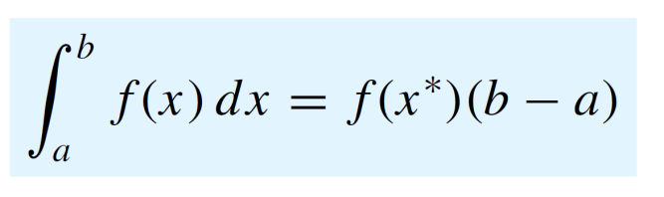
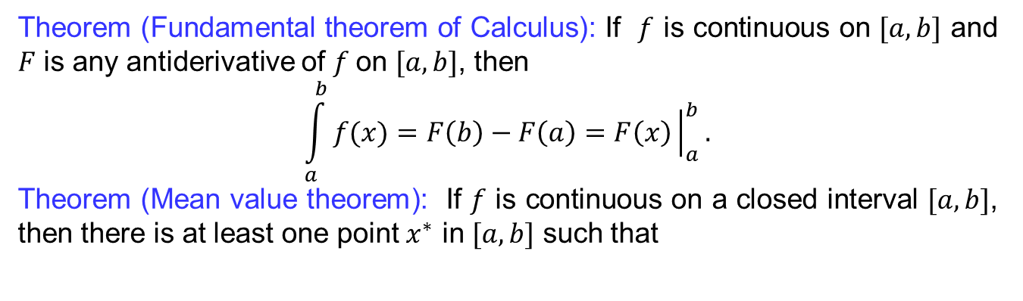
Recalls
Theorem:
Theorem (Fundamentaltheorem of Calculus): If $f$iscontinuous on $[a,b]$ and $F$isanyantiderivative of $f$on $[a,b]$, then
$$\int_{a}^{b}{f(x)}=F\left(b\right)−F\left(a\right)=F\left(x\right){\left.​\right|}_{a}^{b}.$$
Theorem (Mean value theorem): If $f$iscontinuous on a closedinterval$[a,b]$, thenthereisat least one point $x^{∗}$ in $[a,b]$suchthat

Slide 7
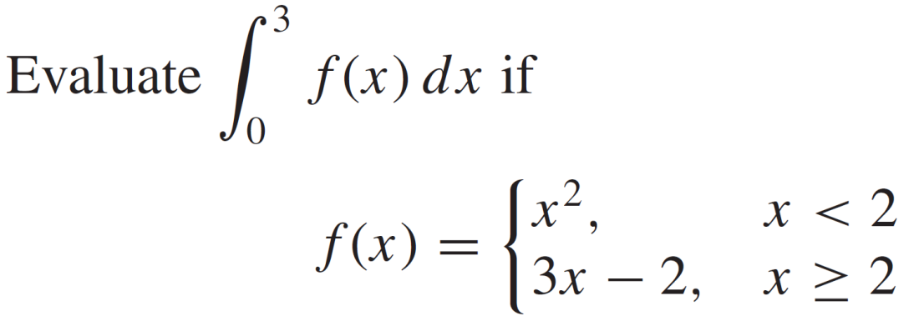
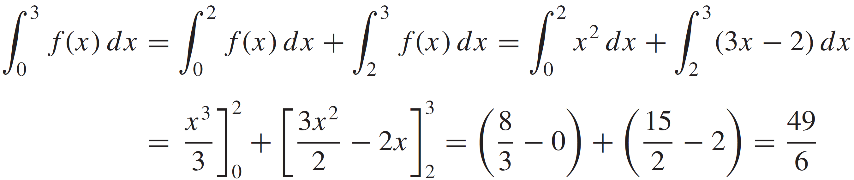
Recalls
Examples:
Solution:

Slide 8
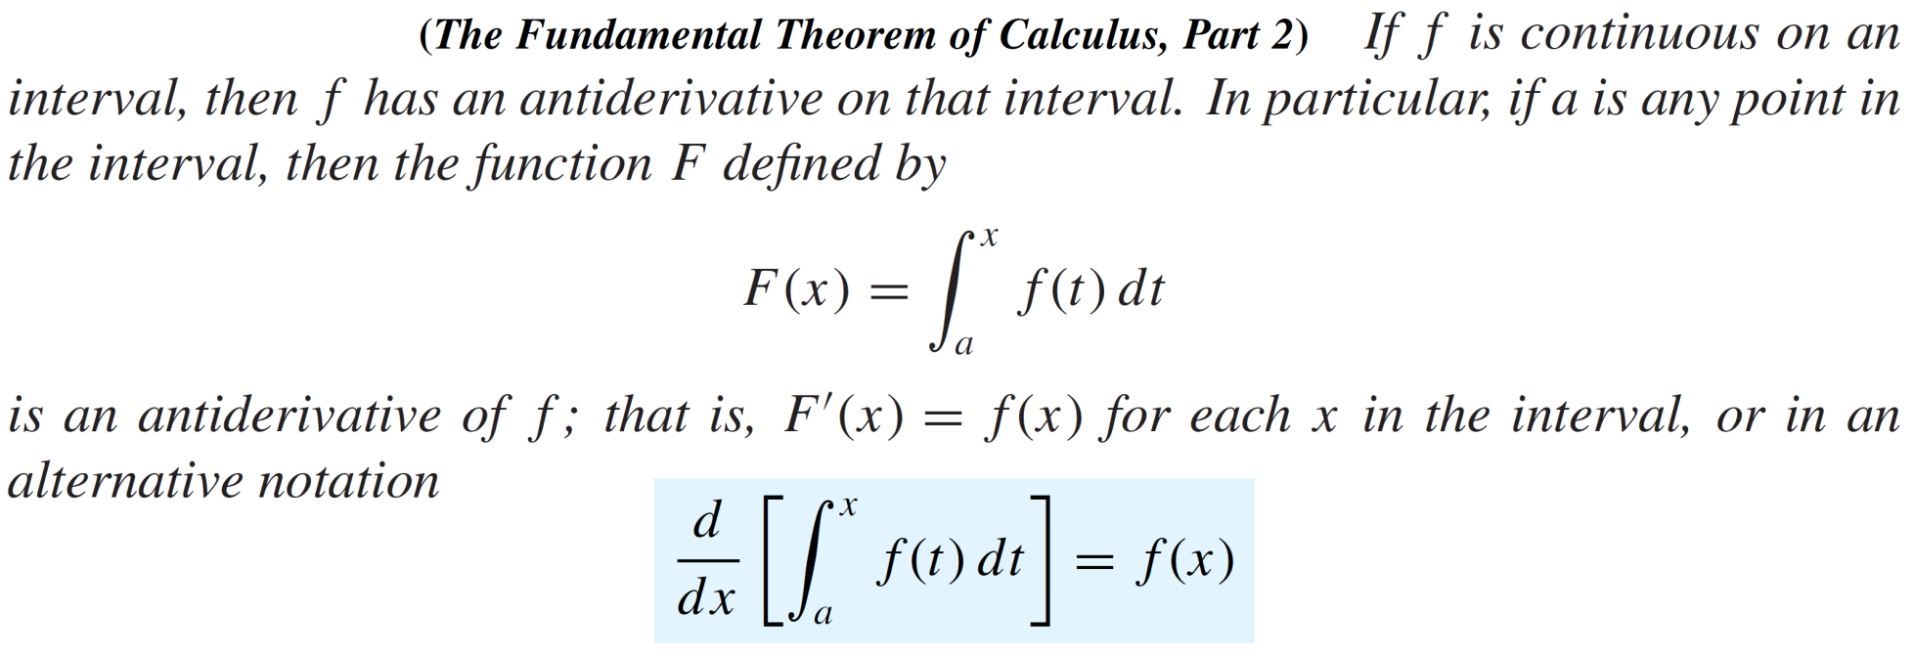
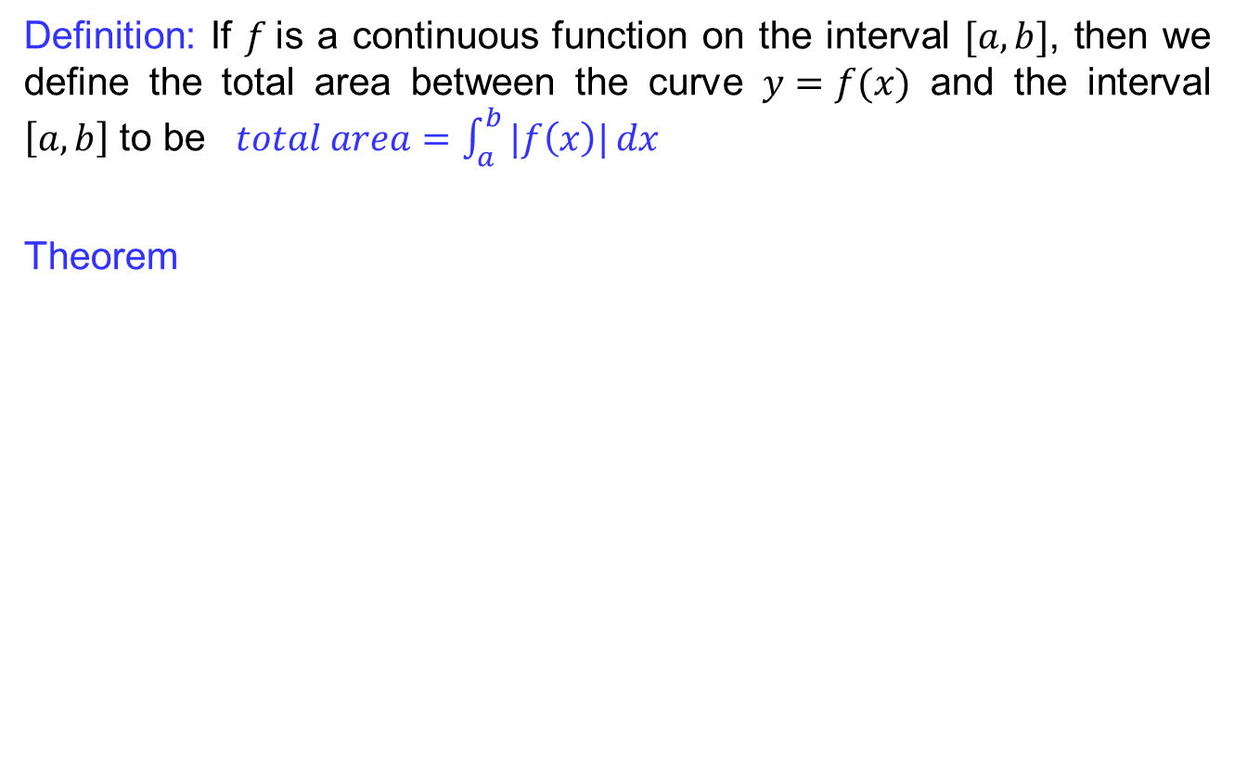
Recalls
Definition: If $f$is a continuousfunction on the interval$[a,b]$, thenwedefine the total area between the curve$y=f(x)$ and the interval$\left[a,b\right]$ to be$total area=\int_{a}^{b}{|f\left(x\right)|}dx$
Theorem

Slide 9
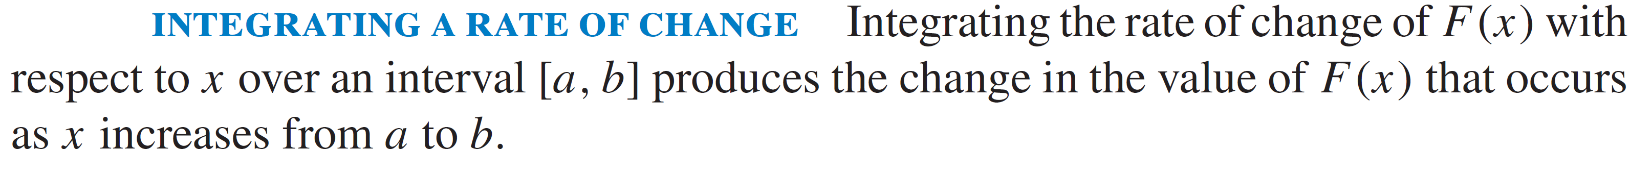
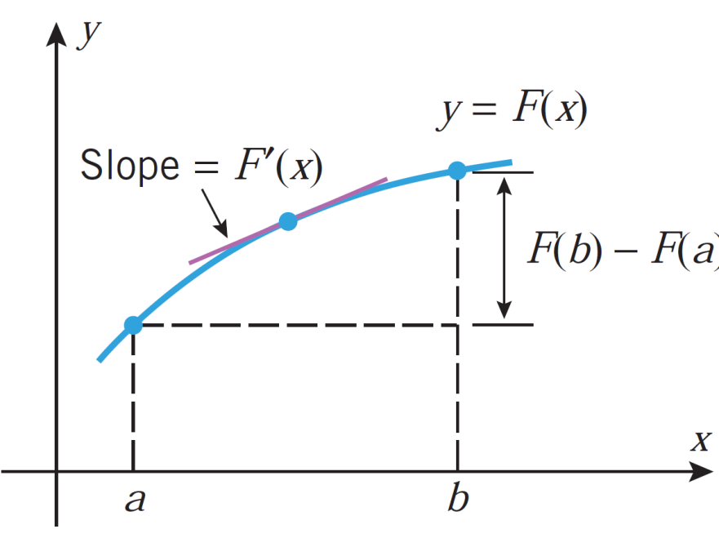
Recalls

Slide 10
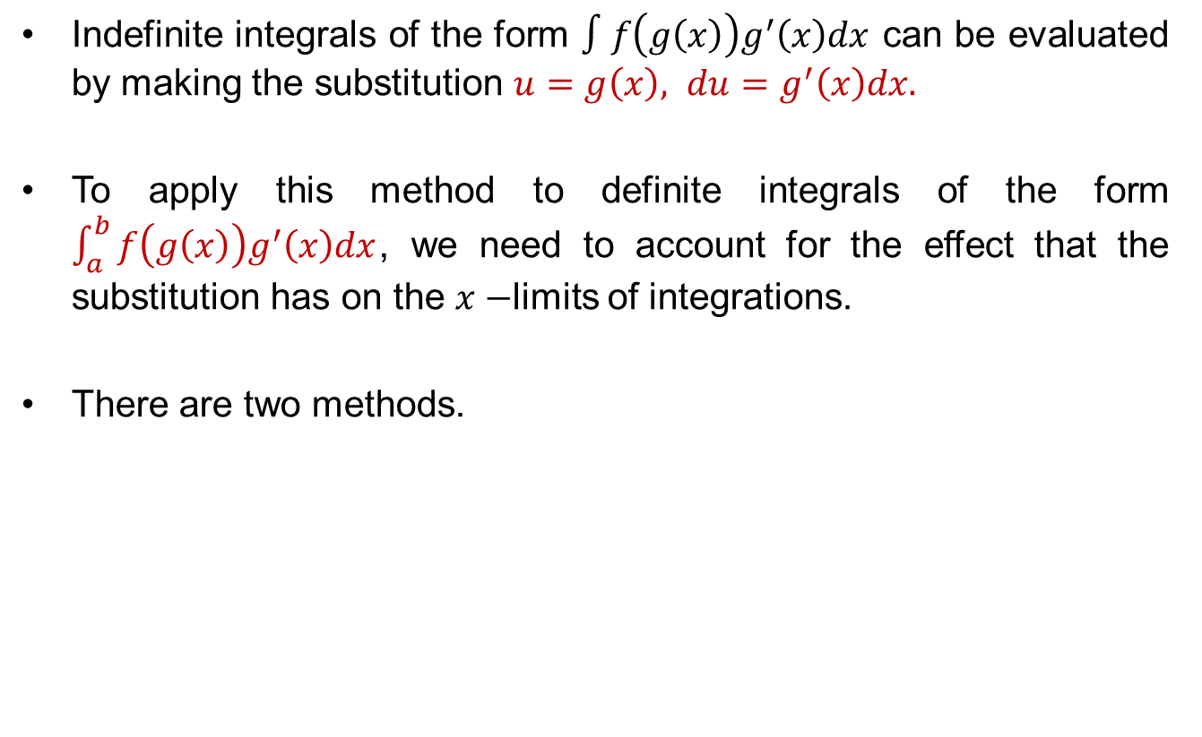
Substitutions for definite integrals
Indefiniteintegrals of the form$∫f\left(g\left(x\right)\right)g^{′}\left(x\right)dx$can beevaluated by making the substitution $u=g\left(x\right), du=g^{′}\left(x\right)dx.$
To applythismethod to definiteintegrals of the form$\int_{a}^{b}{f\left(g\left(x\right)\right)g^{′}\left(x\right)dx}$, weneed to account for the effectthat the substitution has on the $x−$limits of integrations.
There are twomethods.

Slide 11
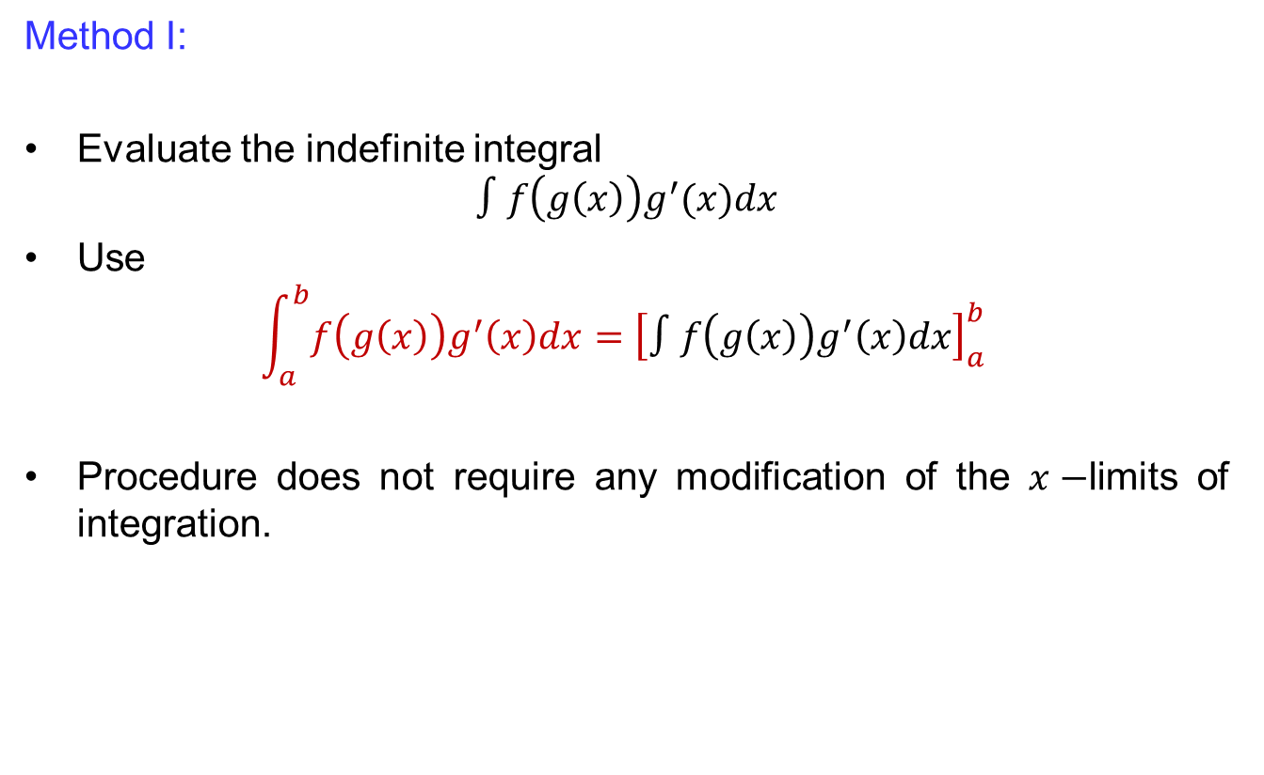
Substitutions for definite integrals
Method I:
Evaluate the indefinite integral
$$∫f\left(g\left(x\right)\right)g^{′}(x)dx$$
Use
$$\int_{a}^{b}{f\left(g\left(x\right)\right)g^{′}\left(x\right)dx}={\left[∫f\left(g\left(x\right)\right)g^{′}\left(x\right)dx\right]}_{a }^{b}$$
Proceduredoes not requireany modification of the $x−$limits of integration.

Slide 12
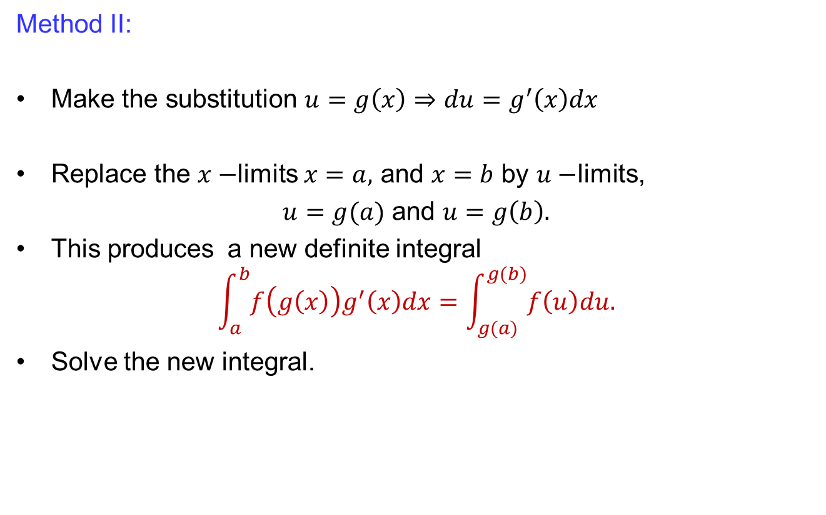
Substitutions for definite integrals
MethodII:
Make the substitution $u=g\left(x\right)⇒du=g^{′}\left(x\right)dx$
Replace the $x−$limits$x=a,$ and $x=b$ by $u−$limits,
$u=g(a)$ and $u=g\left(b\right).$
This produces a new definiteintegral
$$\int_{a}^{b}{f\left(g\left(x\right)\right)g^{′}\left(x\right)dx}=\int_{g(a)}^{g(b)}{f\left(u\right)du.}$$
Solve the new integral.

Slide 13
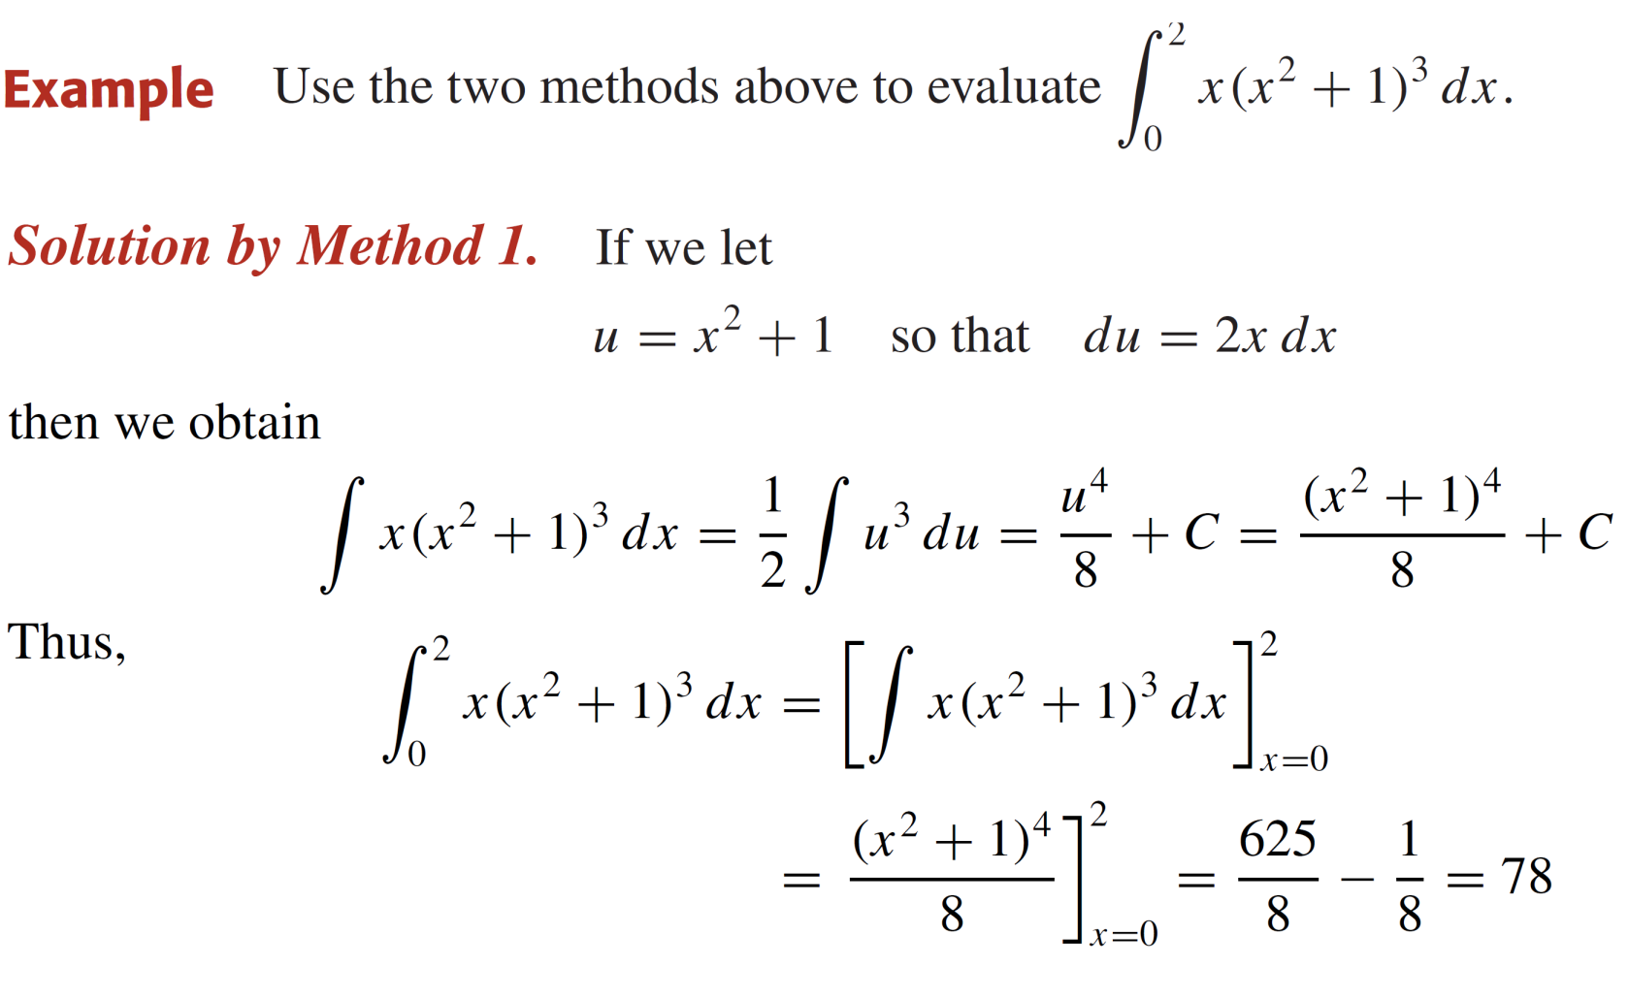
Substitutions for definite integrals

Slide 14
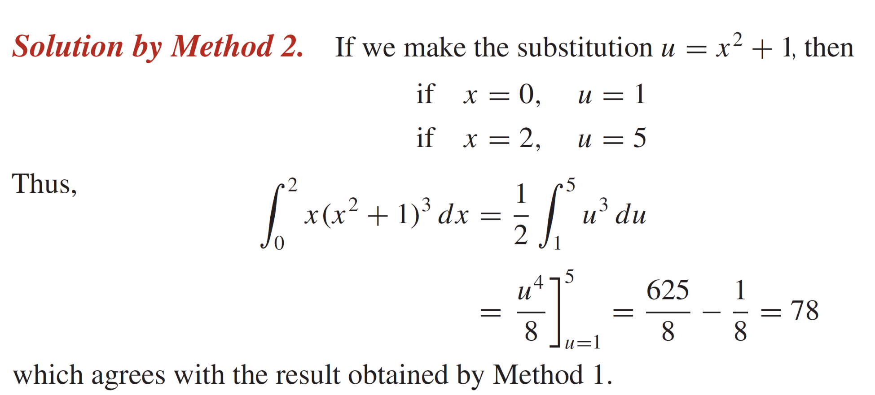
Substitutions for definite integrals

Slide 15
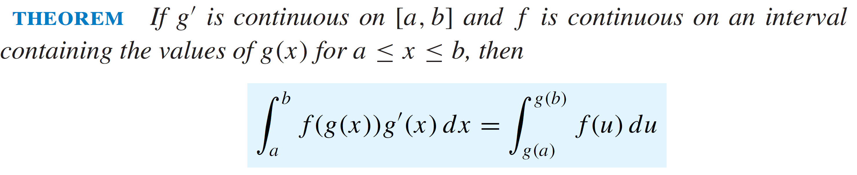
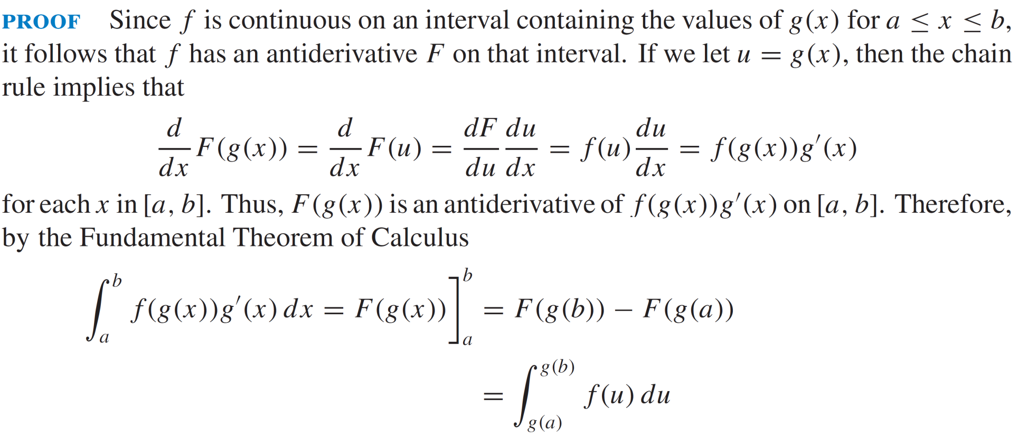
Substitutions for definite integrals

Slide 16
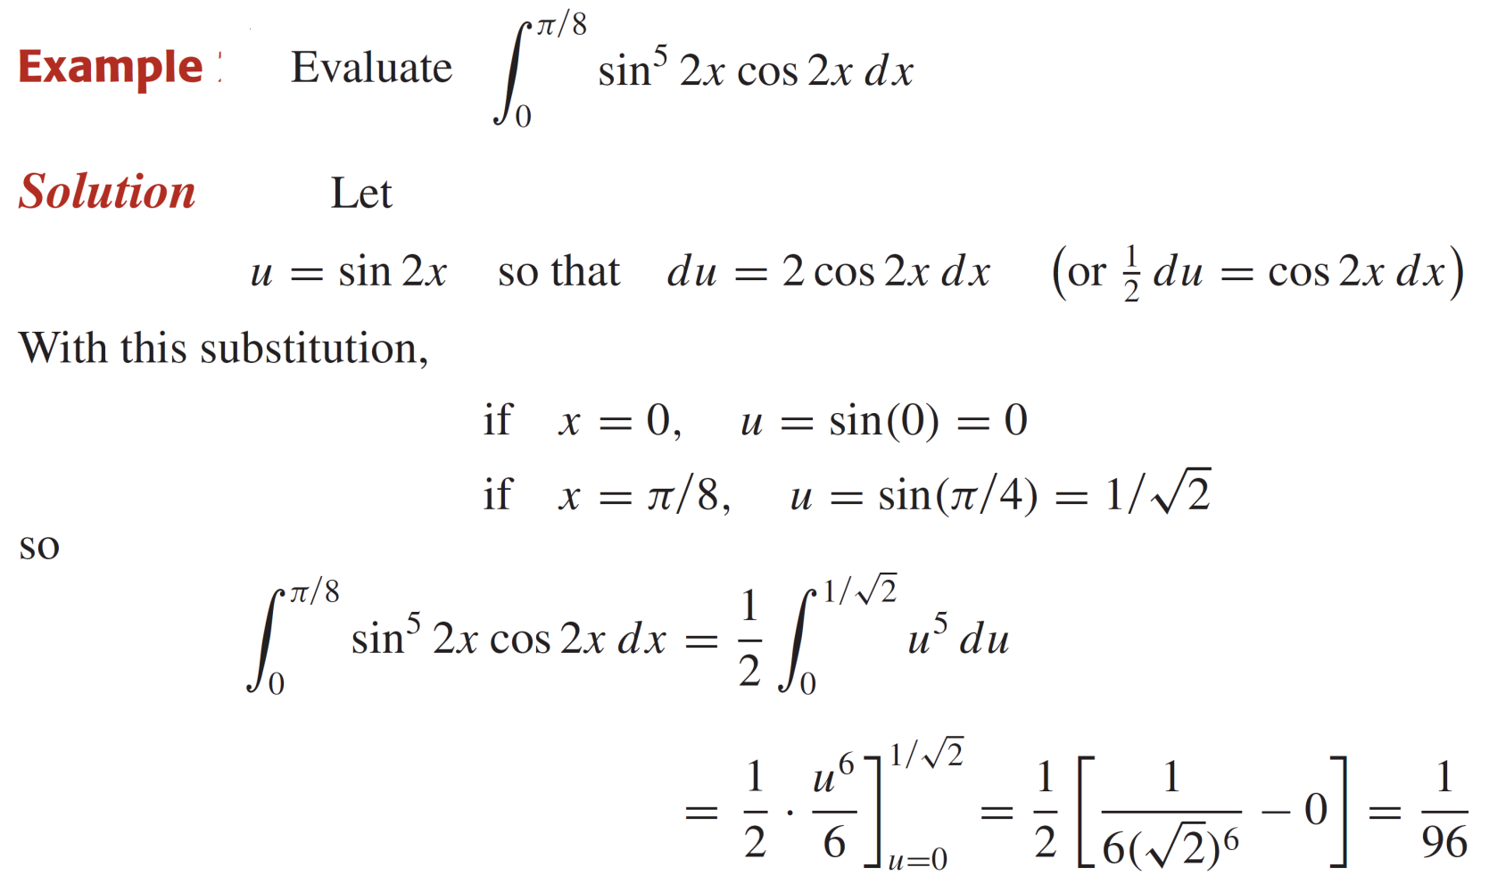
Substitutions for definite integrals

Slide 17
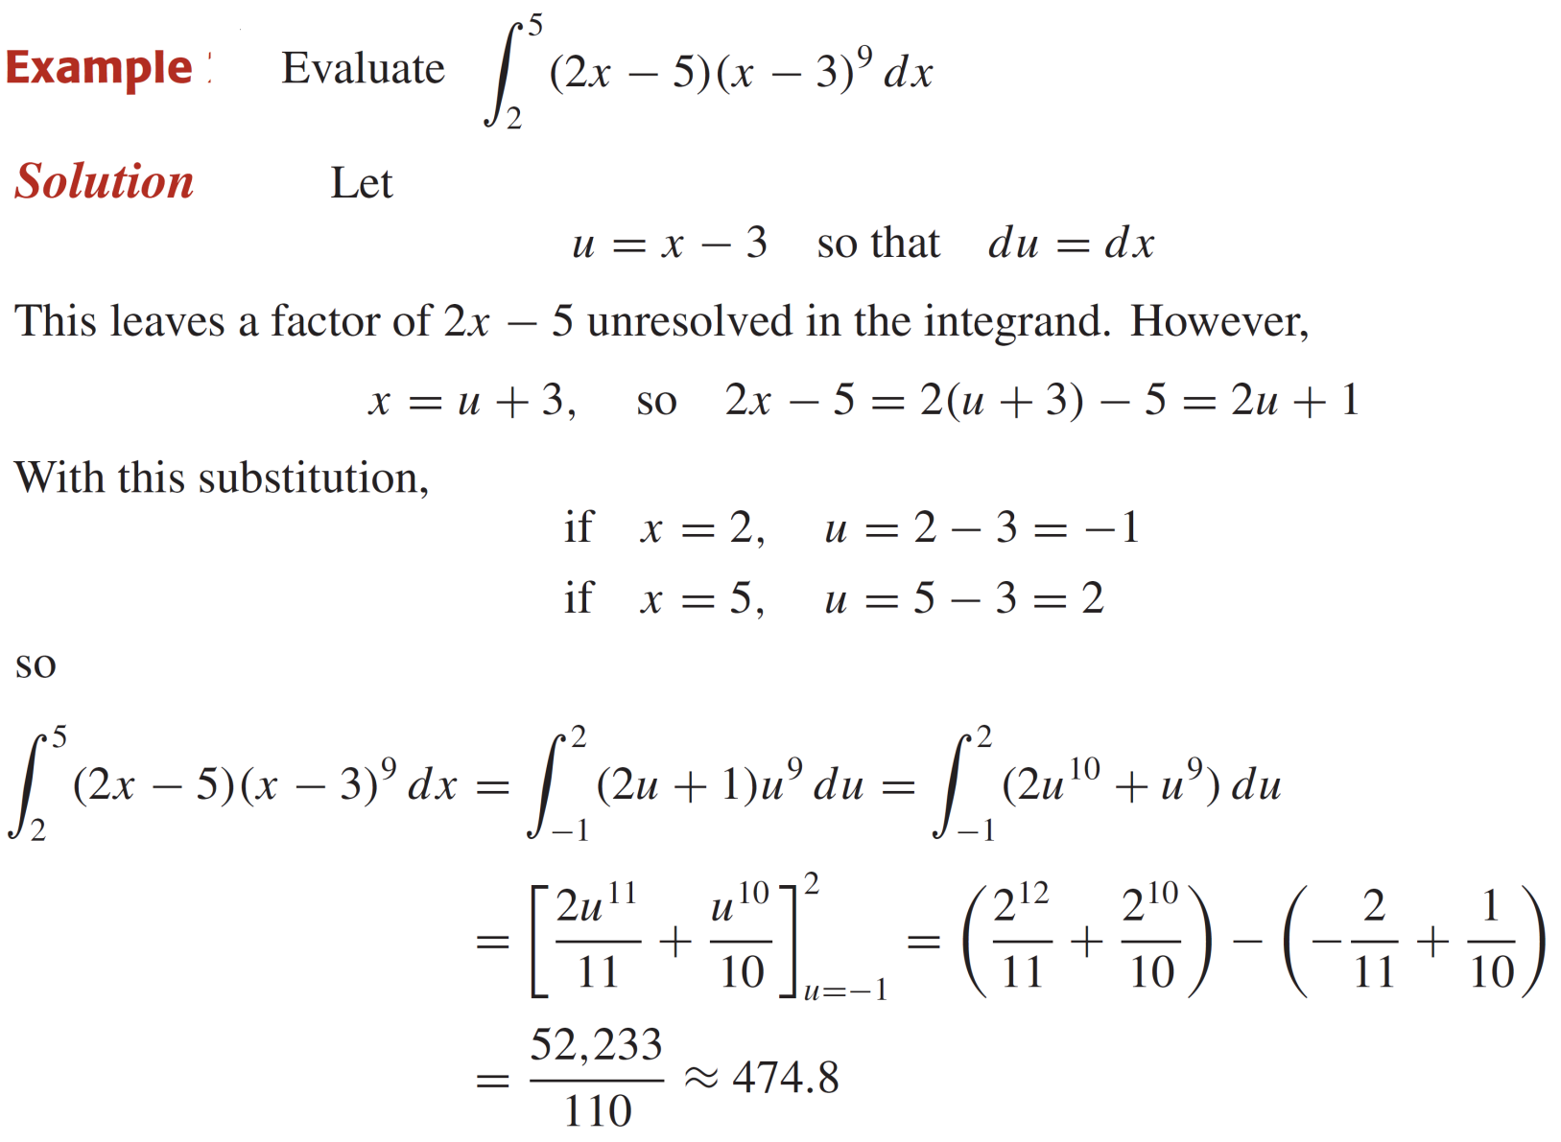
Substitutions for definite integrals

Slide 18
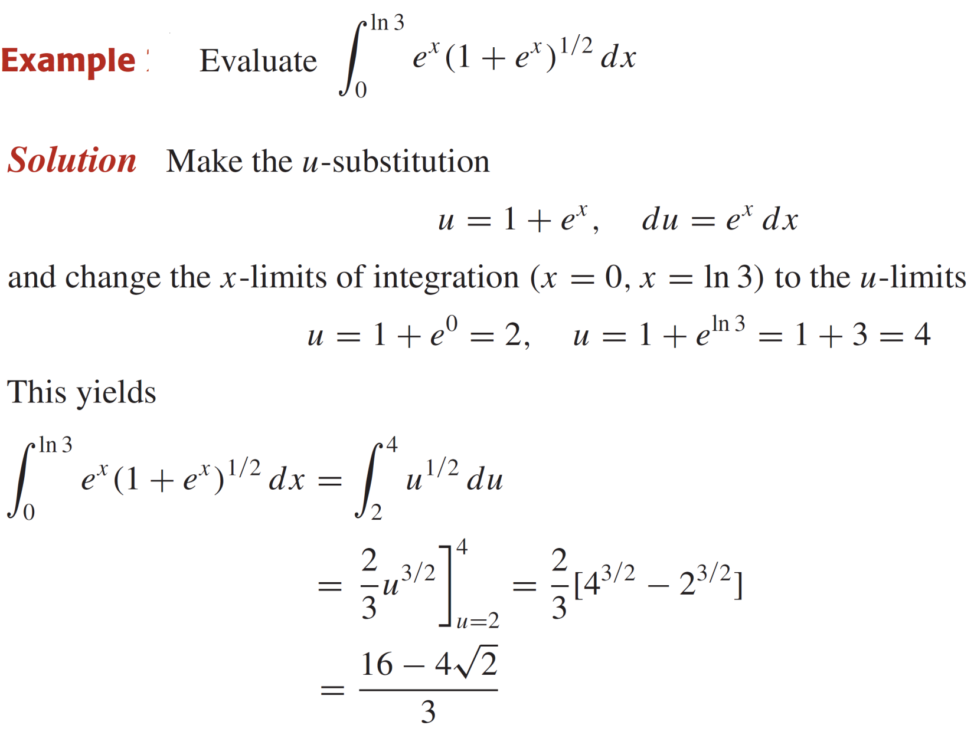
Substitutions for definite integrals

Slide 19
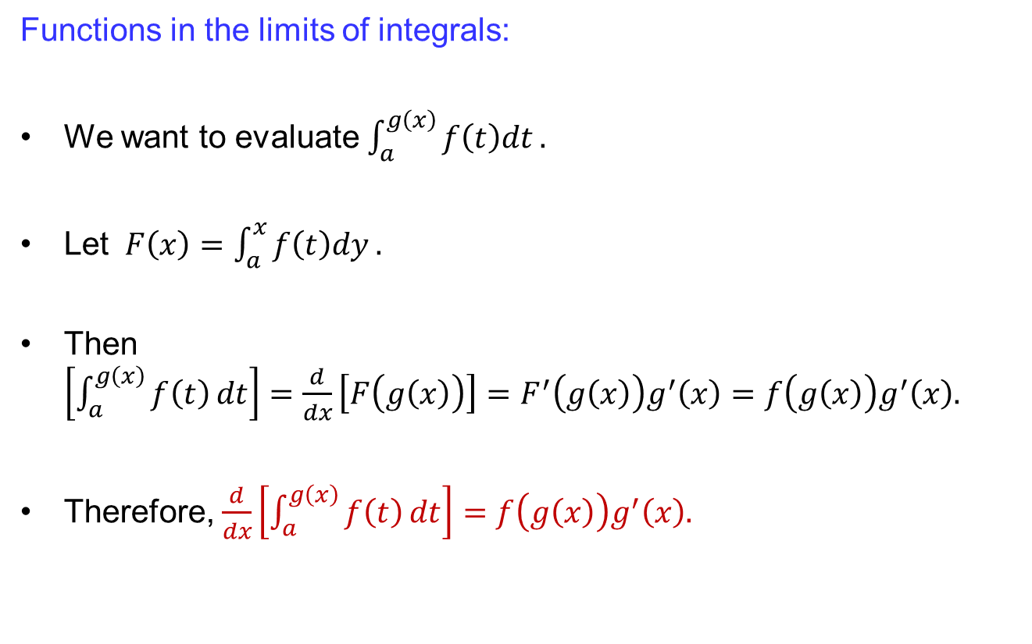
Substitutions for definite integrals
Functions in the limits of integrals:
Wewant to evaluate$\int_{a}^{g\left(x\right)}{f\left(t\right)dt}.$
Let $F\left(x\right)=\int_{a}^{x}{f\left(t\right)dy}.$
Then $\left[\int_{a}^{g\left(x\right)}{f\left(t\right)}dt\right]=\frac{d}{dx}\left[F\left(g\left(x\right)\right)\right]=F^{′}\left(g\left(x\right)\right)g^{′}\left(x\right)=f\left(g\left(x\right)\right)g^{′}\left(x\right).$
Therefore, $\frac{d}{dx}\left[\int_{a}^{g\left(x\right)}{f\left(t\right)}dt\right]=f\left(g\left(x\right)\right)g^{′}\left(x\right).$

Slide 20
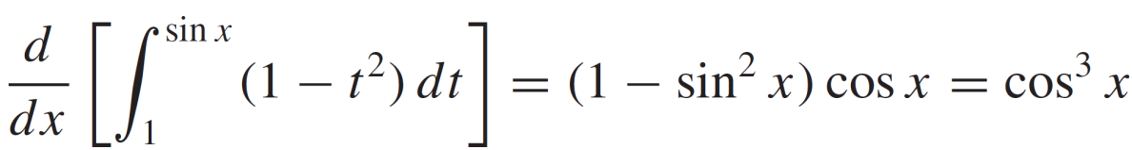
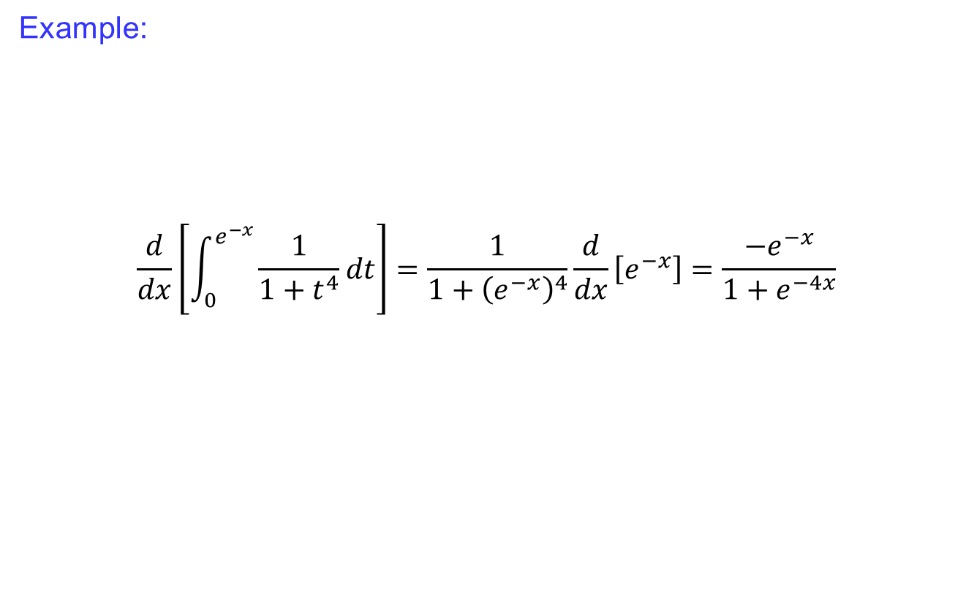
Substitutions for definite integrals
Example:
$$\frac{d}{dx}\left[\int_{0}^{e^{−x}}{\frac{1}{1+t^{4}}dt}\right]=\frac{1}{1+{\left(e^{−x}\right)}^{4}}\frac{d}{dx}\left[e^{−x}\right]=\frac{−e^{−x}}{1+e^{−4x}}$$

Slide 21
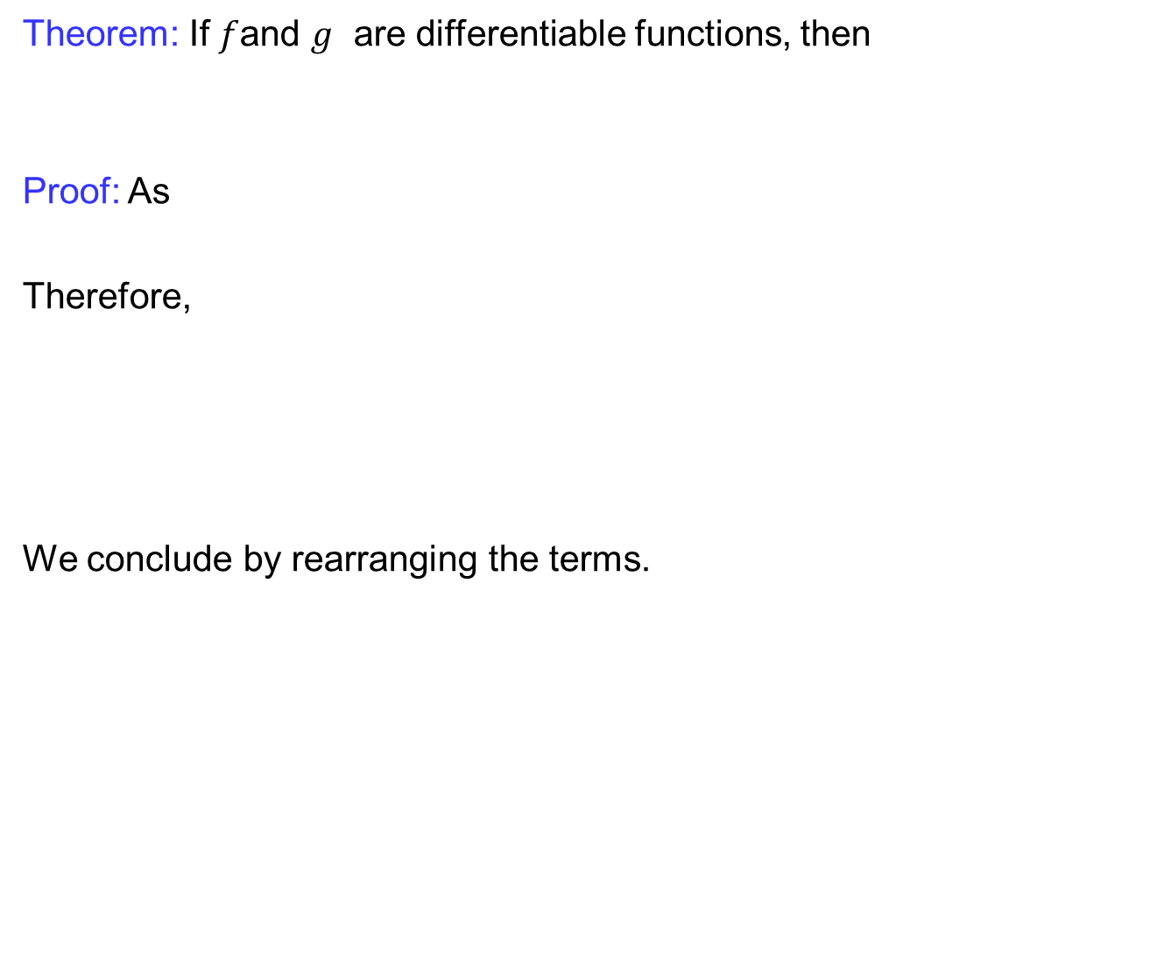
Integration by parts
Theorem: If $f$and $g$are differentiable functions, then
Proof: As
Therefore,
Weconclude by rearranging the terms.

Slide 22
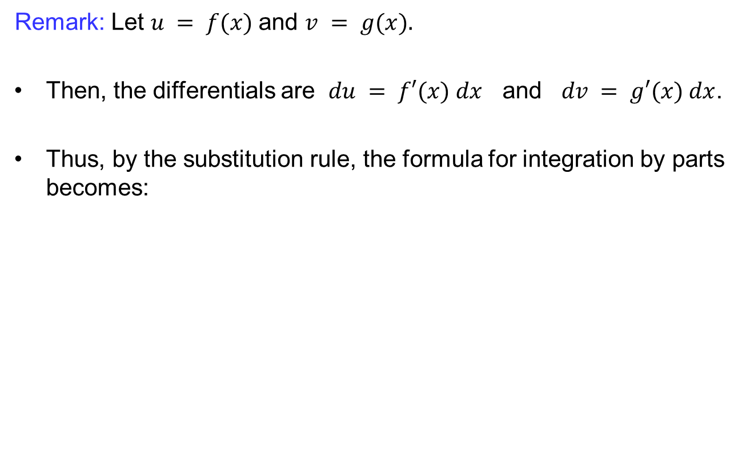
Integration by parts
Remark: Let $u = f(x)$and $v = g(x).$
Then, the differentials are $du = f′(x) dx$and $dv = g′(x) dx$.
Thus, by the substitution rule, the formula for integration by parts becomes:

Slide 23
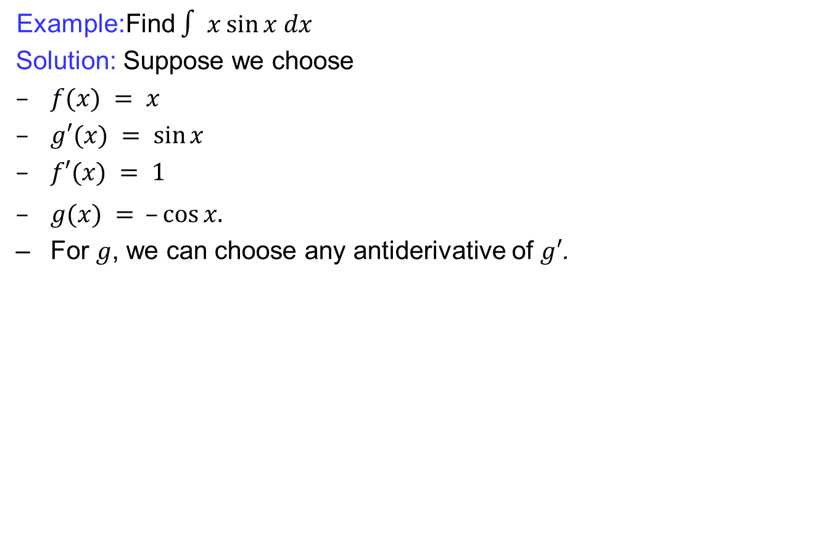
Integration by parts
Example:Find $∫ x sin⁡x dx$
  Solution: Suppose we choose
  $f(x) = x$
  $g′(x) = sin⁡x$
  $f′(x) = 1$
  $g(x) = –cos⁡x.$
  For$g$, we can choose any antiderivative of $g′$.

Slide 24
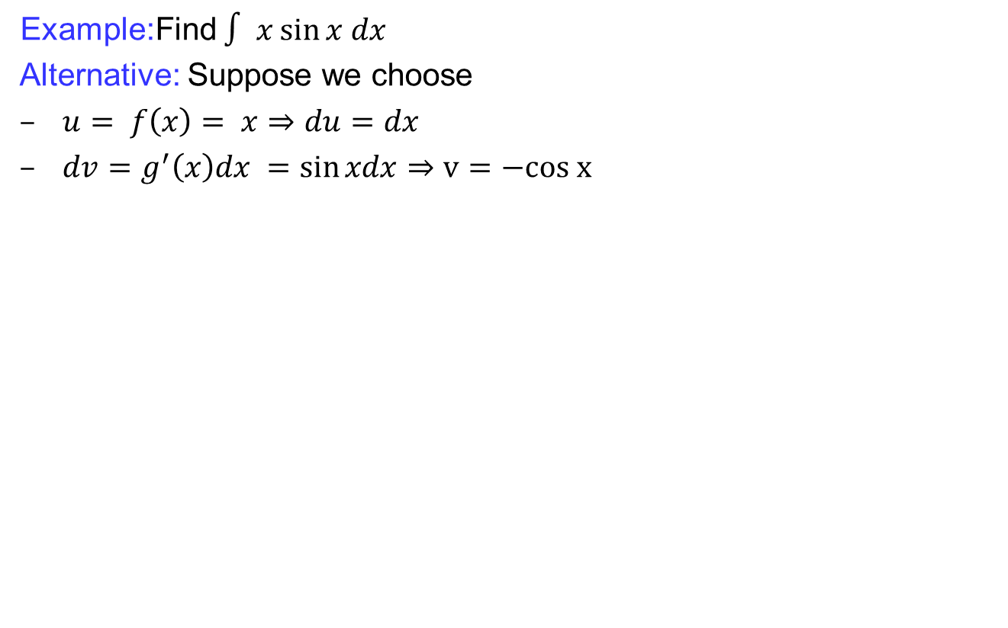
Integration by parts
Example:Find $∫ x sin⁡x dx$
  Alternative: Suppose we choose
  $u= f\left(x\right)= x⇒du=dx$
  $dv=g^{′}\left(x\right)dx =\sin{xdx}⇒v=−cos x$

Slide 25
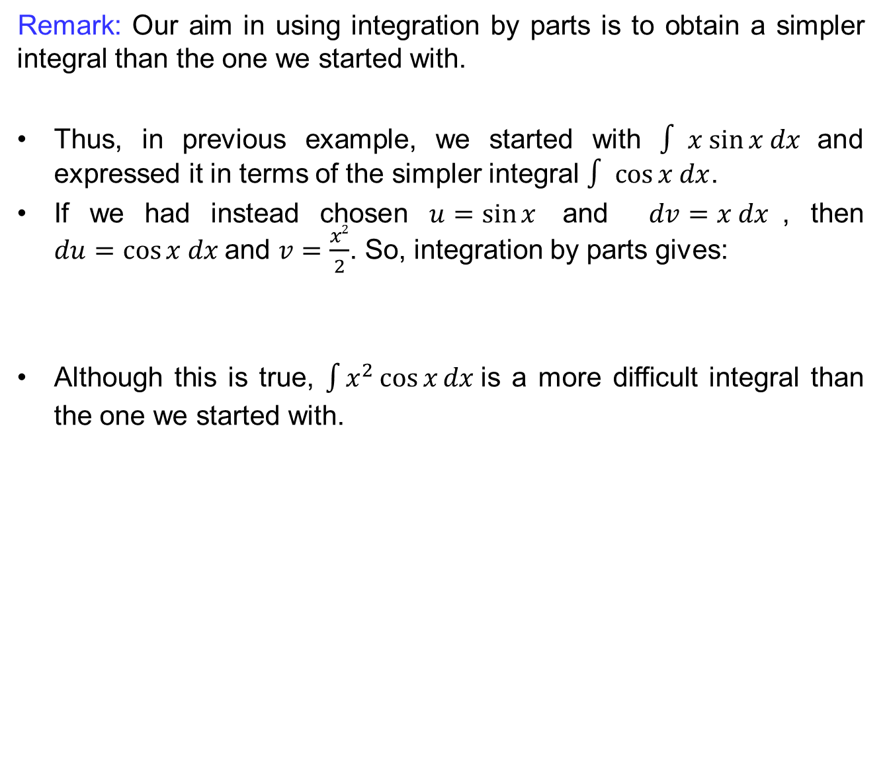
Integration by parts
Remark:Our aim in using integration by parts is to obtain a simpler integral than the one we started with.
Thus, in previous example, we started with $∫ x sin⁡x dx$and expressed it in terms of the simpler integral $∫ cos⁡x dx$.
If we had instead chosen $u=sin⁡x$and $dv=x dx$, then $du=cos⁡x dx$and $v=\frac{x2}{2}$. So, integration by parts gives:
Although this is true, $\int{x^{2}\cos{x}dx }$is a more difficult integral than the one we started with.

Slide 26
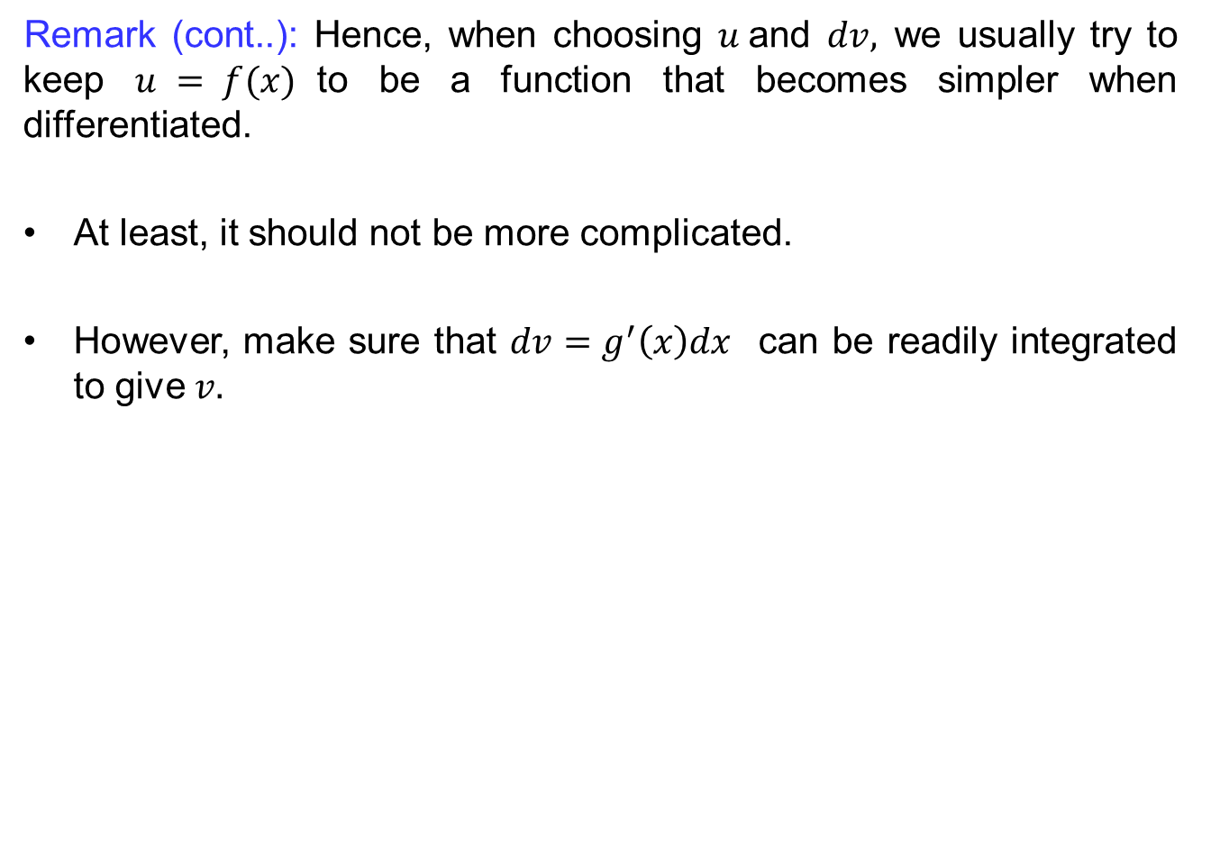
Integration by parts
Remark (cont..): Hence, when choosing $u$and $dv,$ we usually try to keep $u = f(x)$to be a function that becomes simpler when differentiated.
At least, it should not be more complicated.
However, make sure that $dv=g^{′}\left(x\right)dx$ can be readily integrated to give $v.$

Slide 27
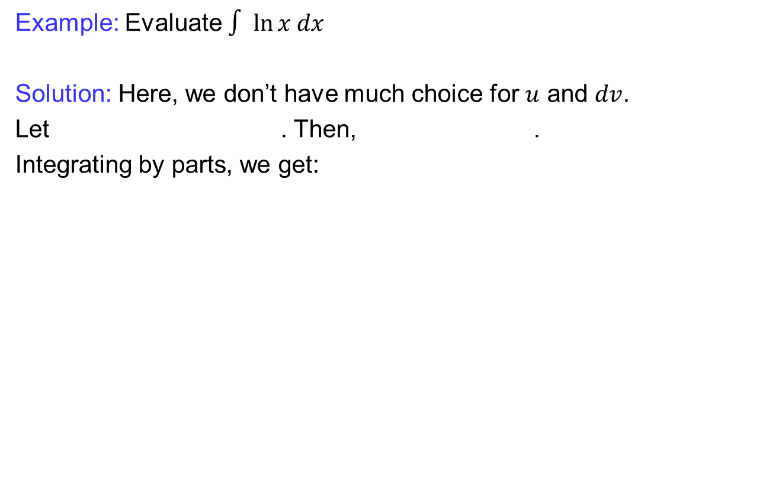
Integration by parts
Example: Evaluate $∫ ln⁡x dx$
Solution: Here, we don’t have much choice for $u$ and $dv$.
Let . Then, .
Integrating by parts, we get:

Slide 28
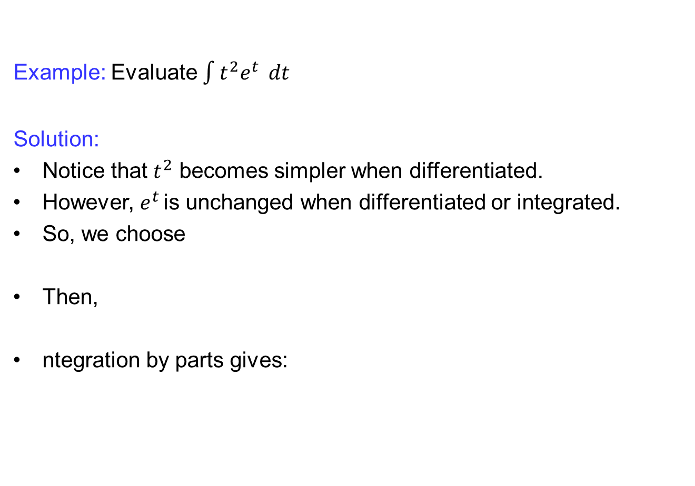
Integration by parts
Example: Evaluate $\int{t^{2}e^{t}} dt$
Solution:
Notice that $t^{2}$becomes simpler when differentiated.
However, $e^{t }$is unchanged when differentiated or integrated.
So, we choose
Then,
ntegrationby parts gives:

Slide 29
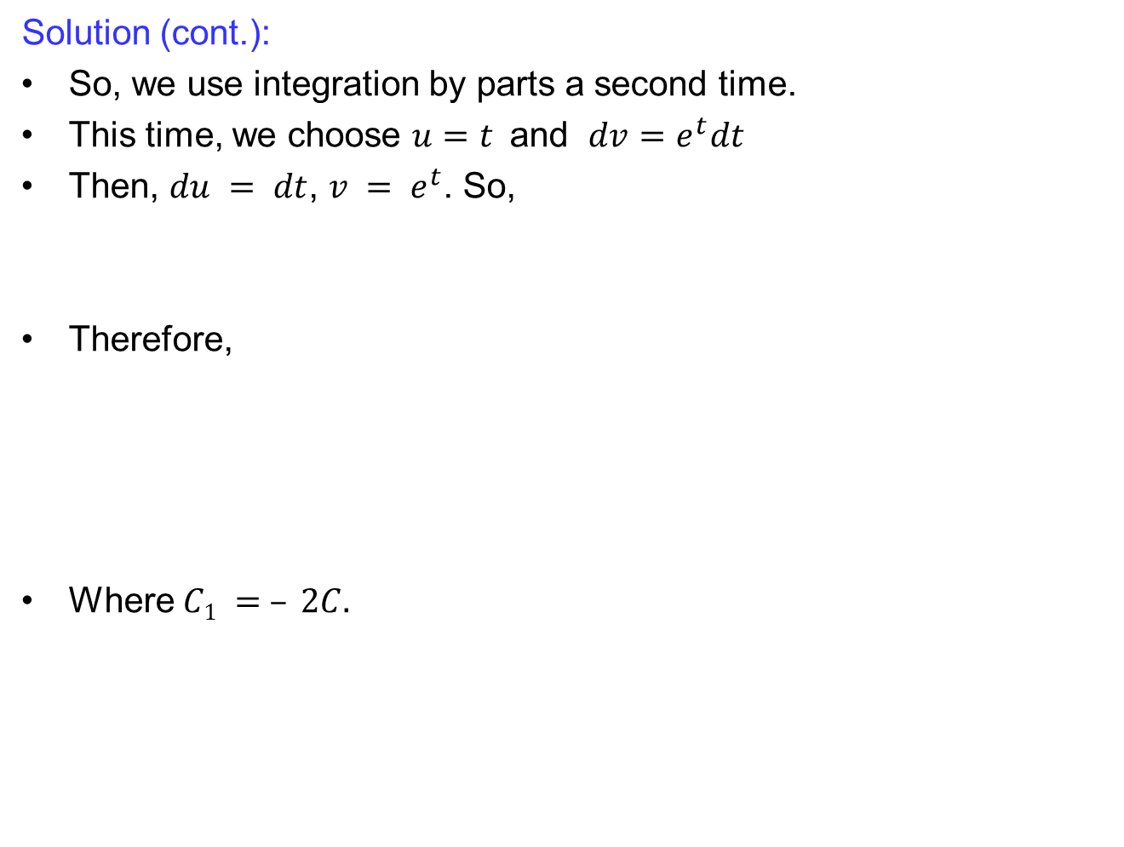
Integration by parts
Solution (cont.):
So, we use integration by parts a second time.
This time, we choose $u=t$and $dv=e^{t}dt$
Then, $du = dt$, $v = e^{t}$. So,
Therefore,
Where $C1 = – 2C.$

Slide 30
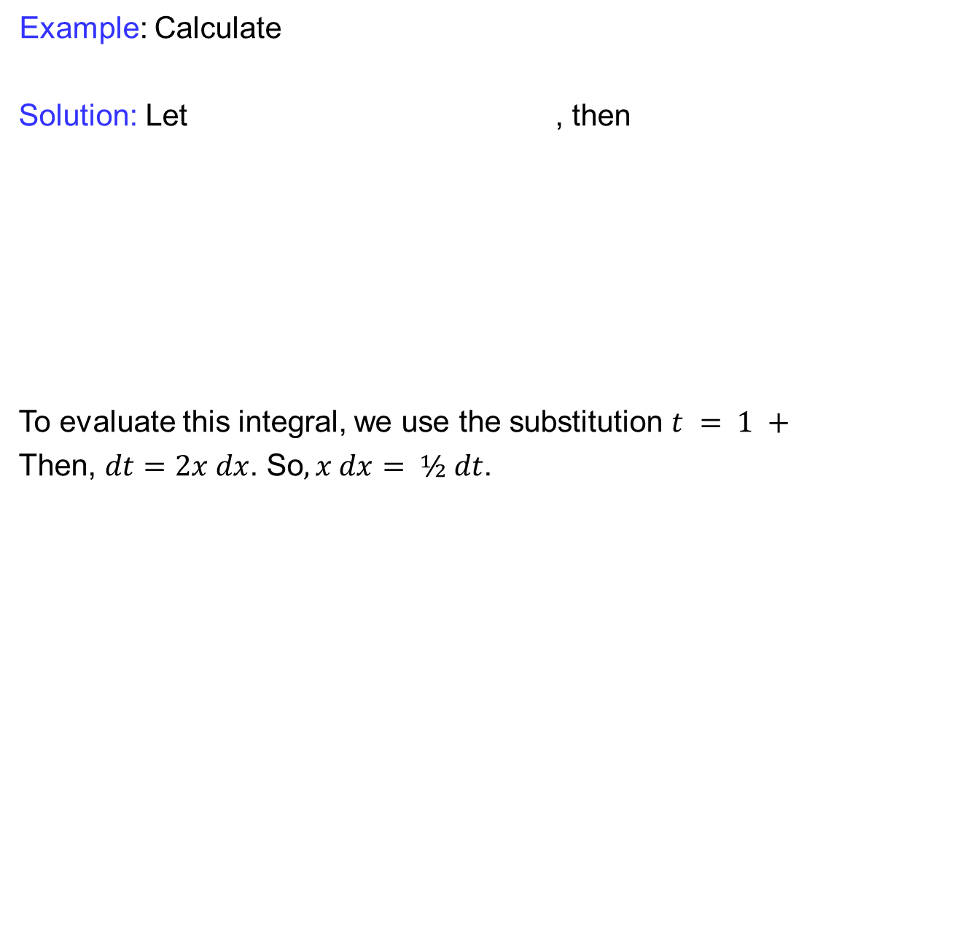
Integration by parts
Example: Calculate
Solution: Let , then
To evaluate this integral, we use the substitution $t = 1 +$
Then, $dt=2x dx$. So$, x dx= ½ dt$.

Slide 31
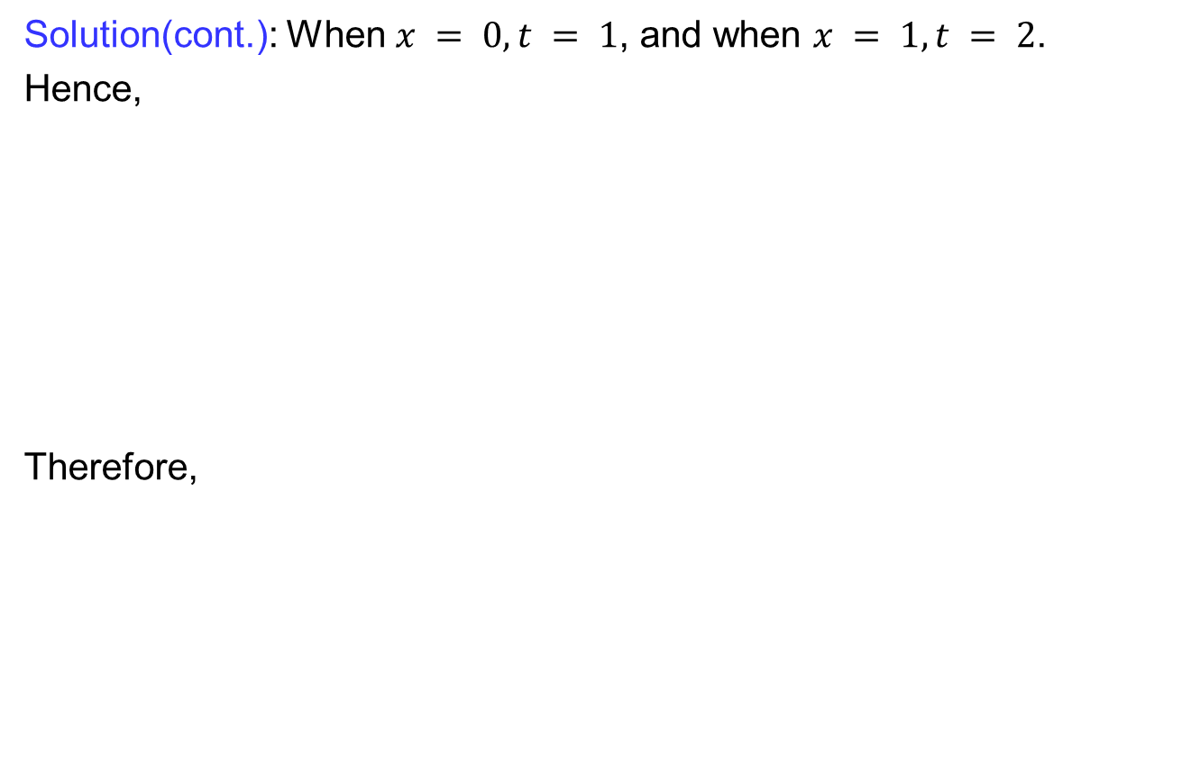
Integration by parts
Solution(cont.): When $x = 0, t = 1$, and when $x = 1, t = 2$.
Hence,
Therefore,

Slide 32
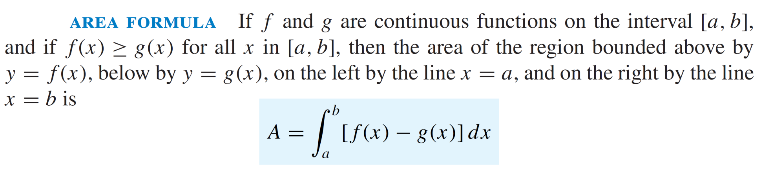
Area bounded by curves

Slide 33
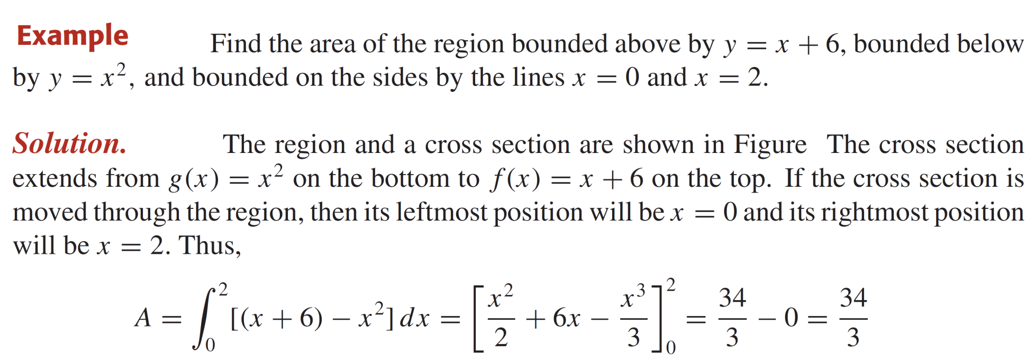
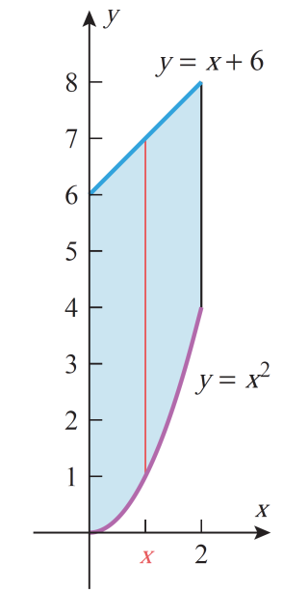
Area bounded by curves

Slide 34
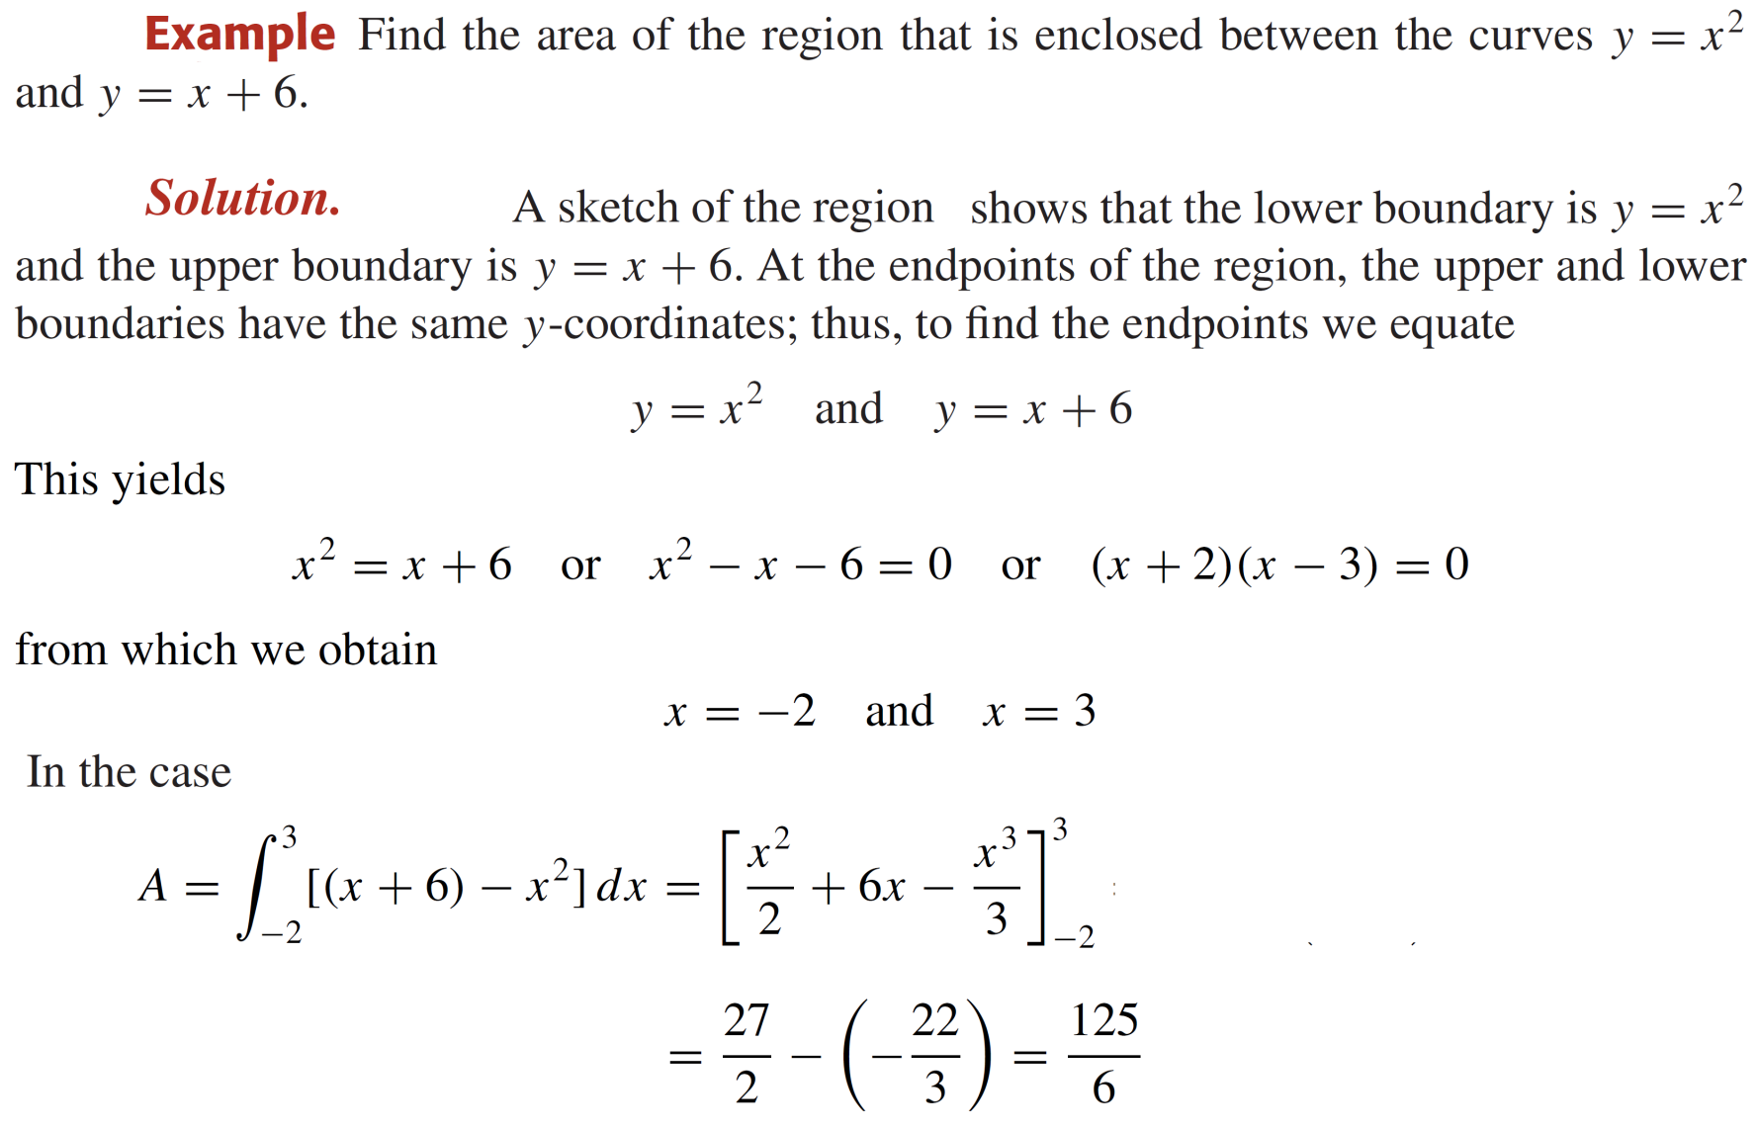
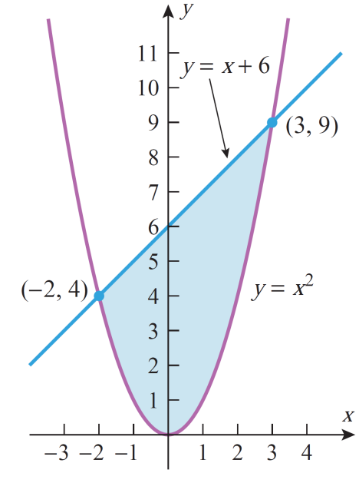
Area bounded by curves

Slide 35
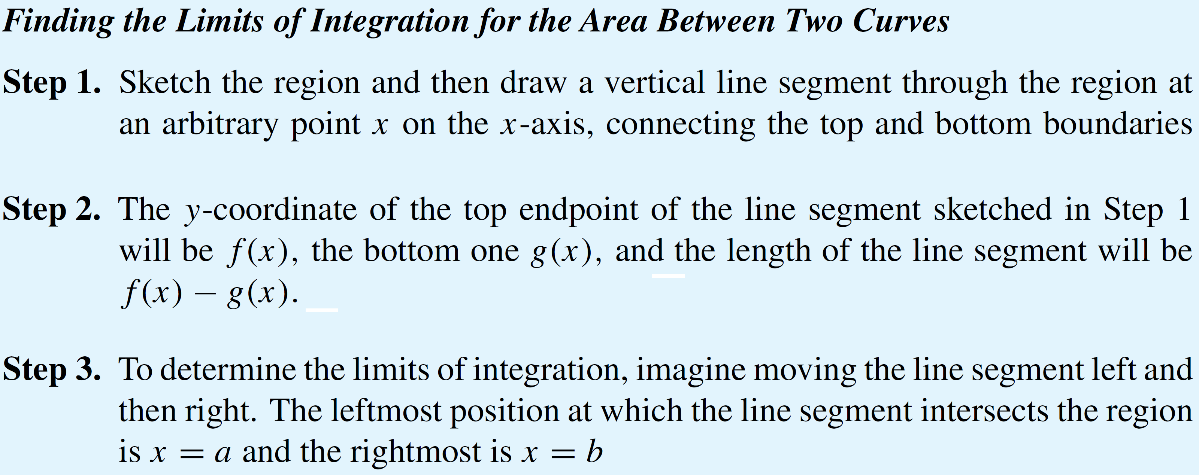
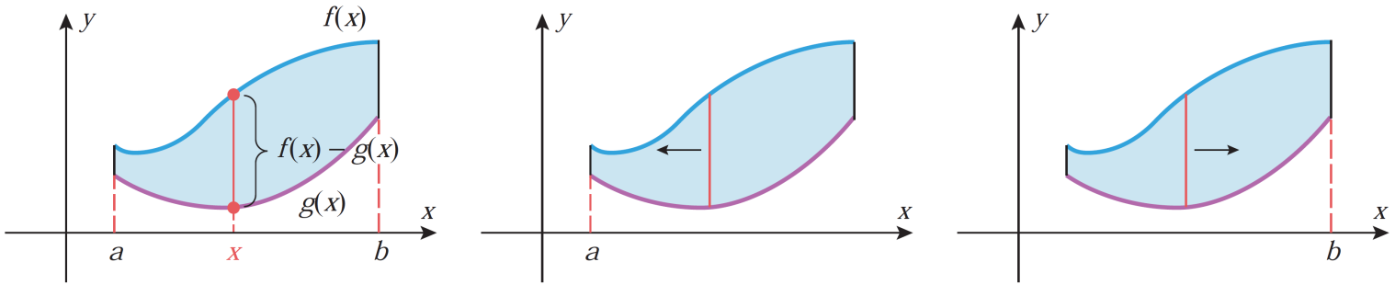
Area bounded by curves

Slide 36
Lecture Summary
    Substitution for definite integrals
    Integration by parts
    Area bounded by curves

