Slide 1
(MTH 250)
Calculus
Lecture 18

Slide 2
Previous Lecture’s Summary
    Introduction to integration,
    Anti-derivatives
    Basic rules and properties
    Integral curves
    Methods of substitution
    Summary of basic rules.

Slide 3
Today’s Lecture
    Recalls
    Definite integrals
    Fundamental theorem of calculus
    Mean value theorem for integrals
    Fundamental theorem of calculus II
    Integrating a rate of change
    Summary of results

Slide 4
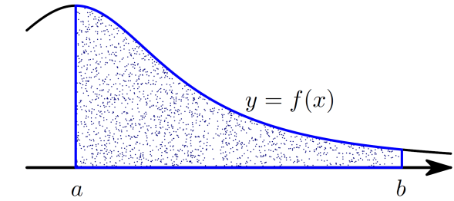
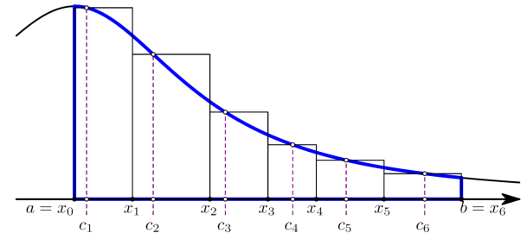
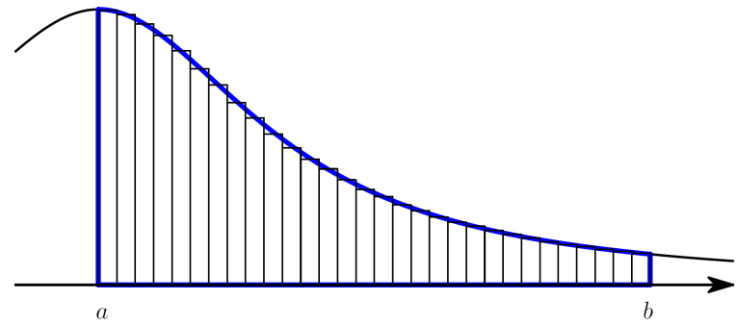
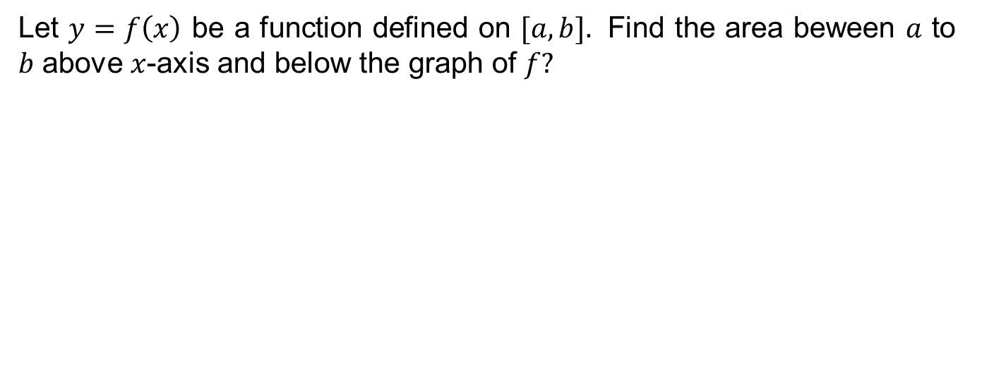

Recalls
Let $y=f\left(x\right)$be a functiondefined on $[a,b].$Find the area beween$a$ to $b$above$x$-axis and below the graph of $f?$
Pick ${\left\{x_{k}\right\}}_{k=0}^{n}$suchthat
Then the total area isapproximately$R,$ the Riemann sum , where
The area is the limit of Riemann sums like R as the partition becomes finer and finer.

Slide 5
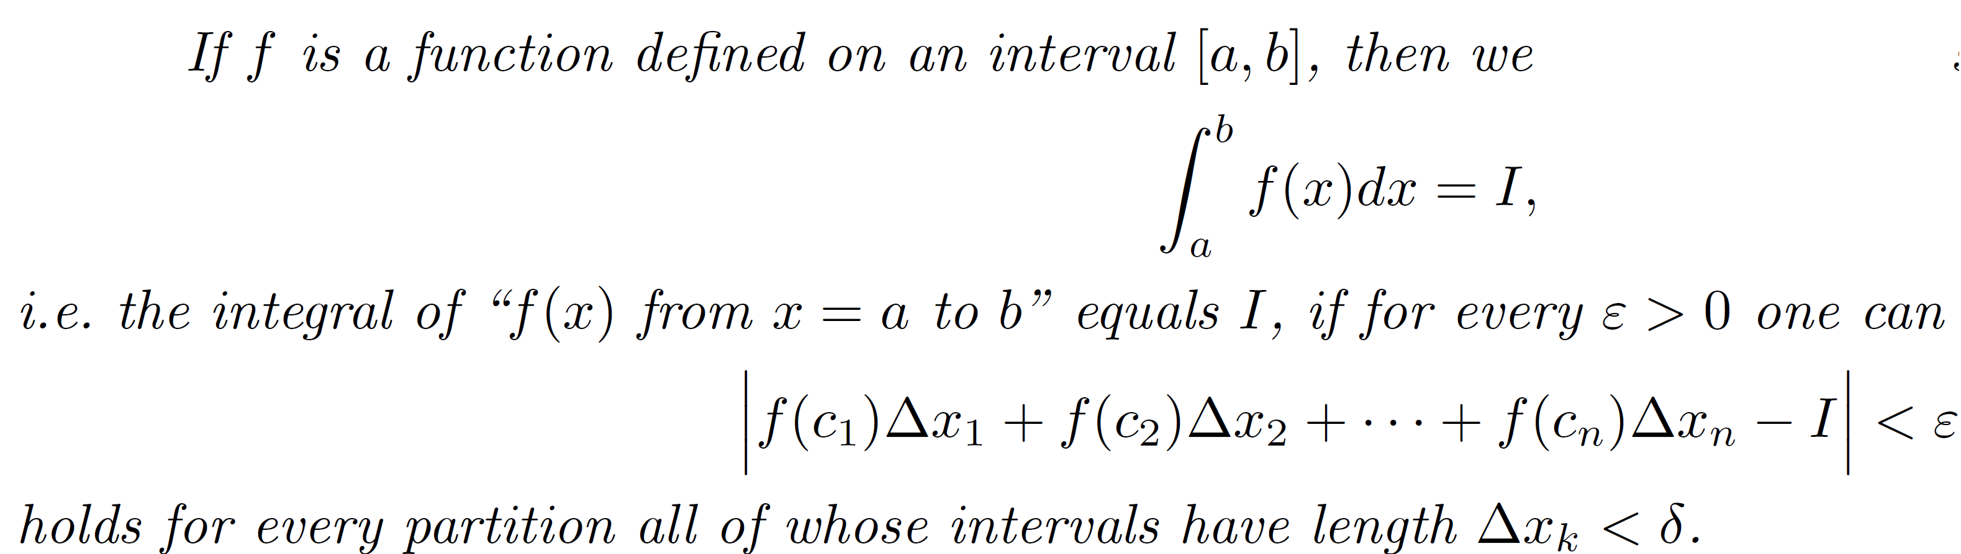
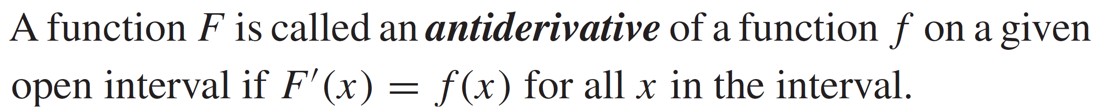
Recalls
Definition (Integral)
Definition (Anti-derivative)

Slide 6
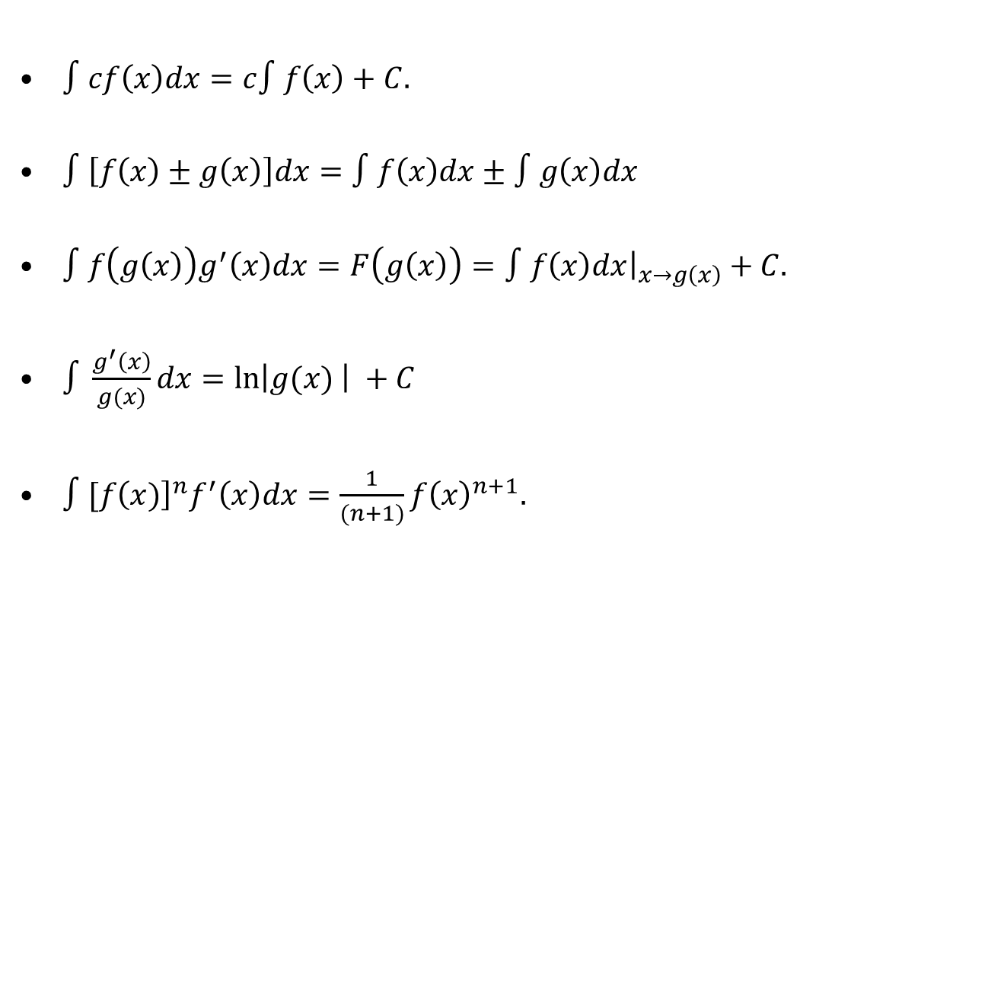
Recalls
$∫cf\left(x\right)dx=c∫f\left(x\right)+C.$
$∫\left[f\left(x\right)±g\left(x\right)\right]dx=∫f\left(x\right)dx±∫g\left(x\right)dx$
$∫f\left(g\left(x\right)\right)g^{′}\left(x\right)dx=F\left(g\left(x\right)\right)=∫f\left(x\right)dx{\left.​\right|}_{x→g\left(x\right)}+C.$
$∫\frac{g^{′}\left(x\right)}{g(x)}dx=\ln\left|g(x) \right| +C$
$∫[f{\left(x)\right]}^{n}f^{′}\left(x\right)dx=\frac{1}{(n+1)}f{\left(x\right)}^{n+1}.$

Slide 7
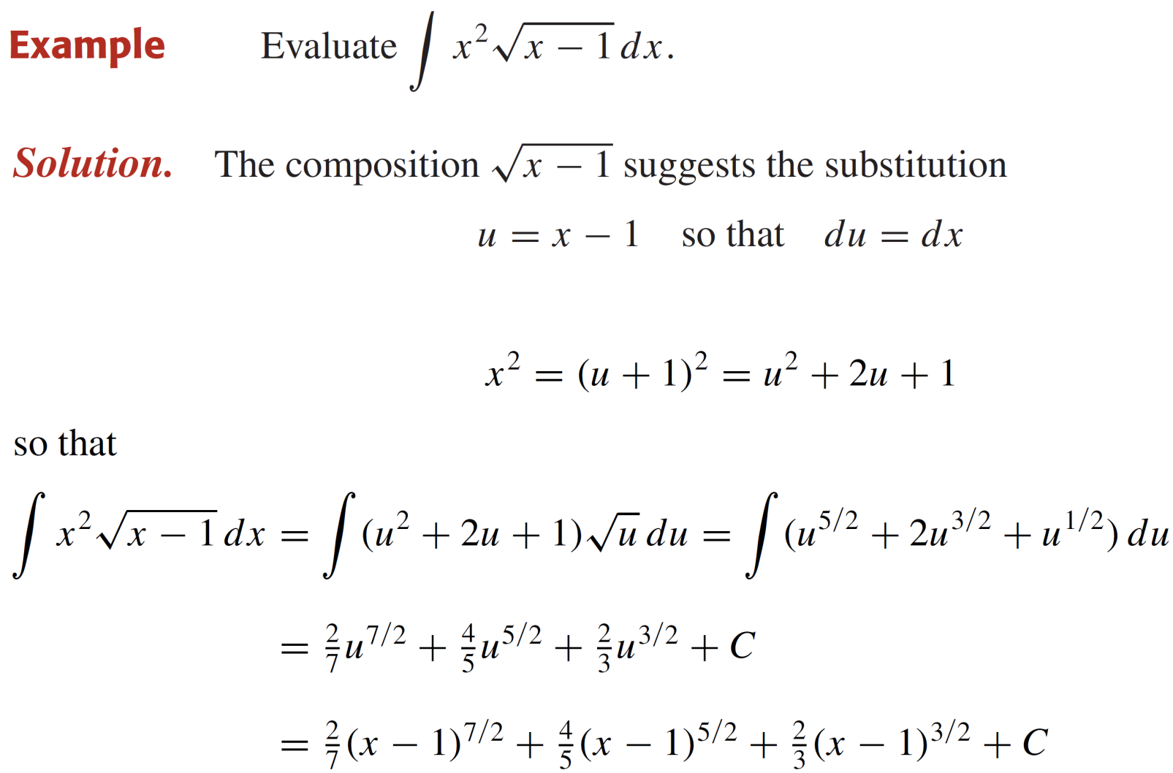
Recalls

Slide 8
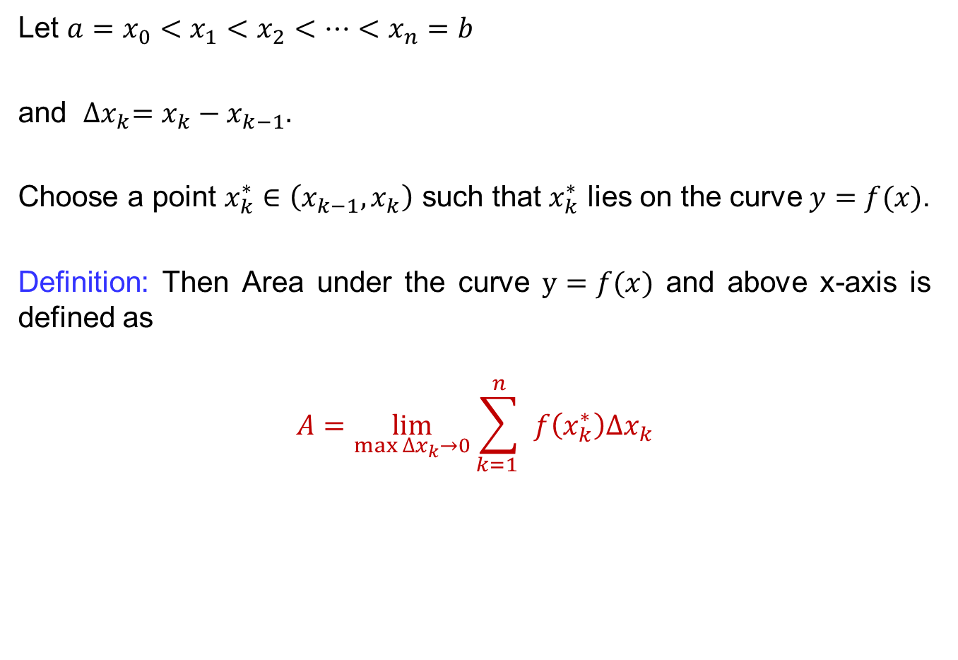
Definite Integrals
Let $a=x_{0}<x_{1}<x_{2}<…<x_{n}=b$
and ${∆x}_{k}={x_{k}−x}_{k−1}.$
Choose a point $x_{k}^{∗}∈\left(x_{k−1}, x_{k}\right)$suchthat$x_{k}^{∗}$ lies on the curve$y=f(x)$.
Definition: Then Area under the curve$y=f(x)$ and above x-axis isdefined as
$$A=\lim_{\max{{∆x}_{k}→0}}{\sum_{k=1 }^{n}{ f\left(x_{k}^{∗}\right){∆x}_{k}}}$$

Slide 9
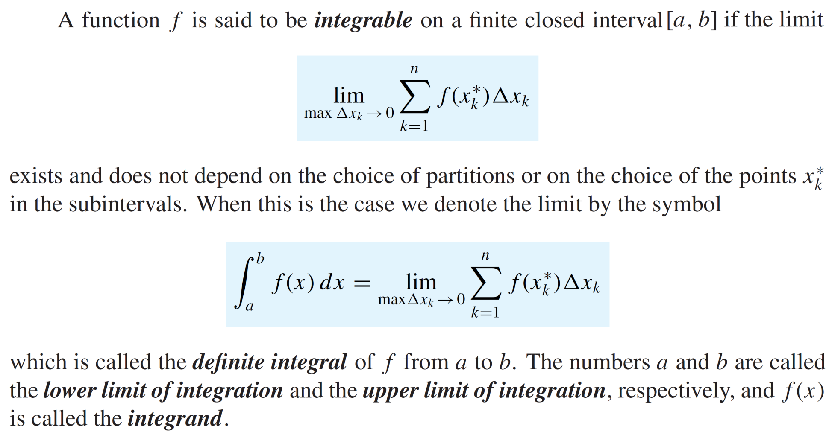
Definite Integrals
Def:

Slide 10
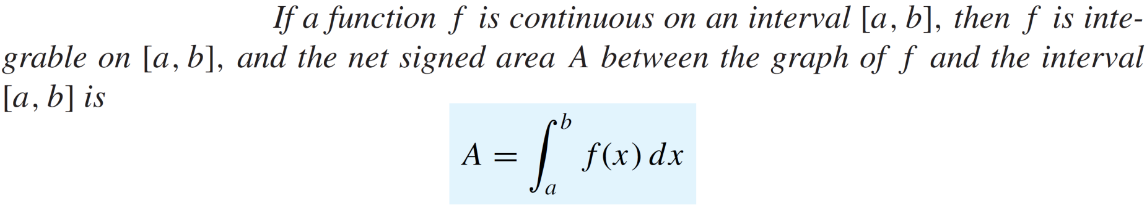
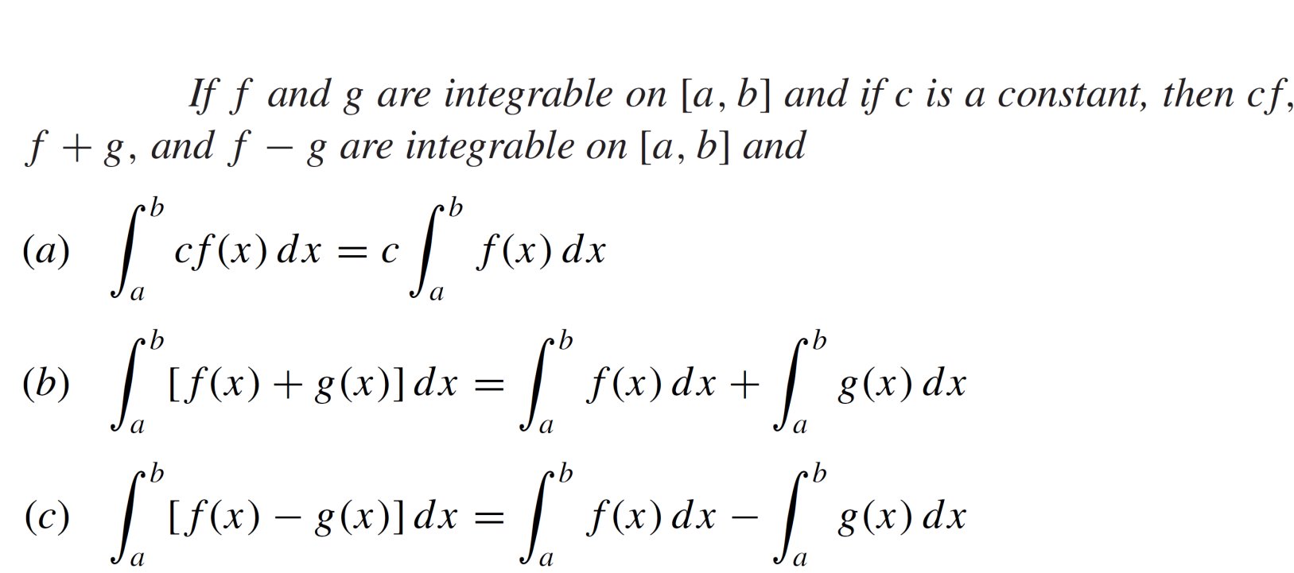
Definite Integrals
Theorem:
Theorem:

Slide 11
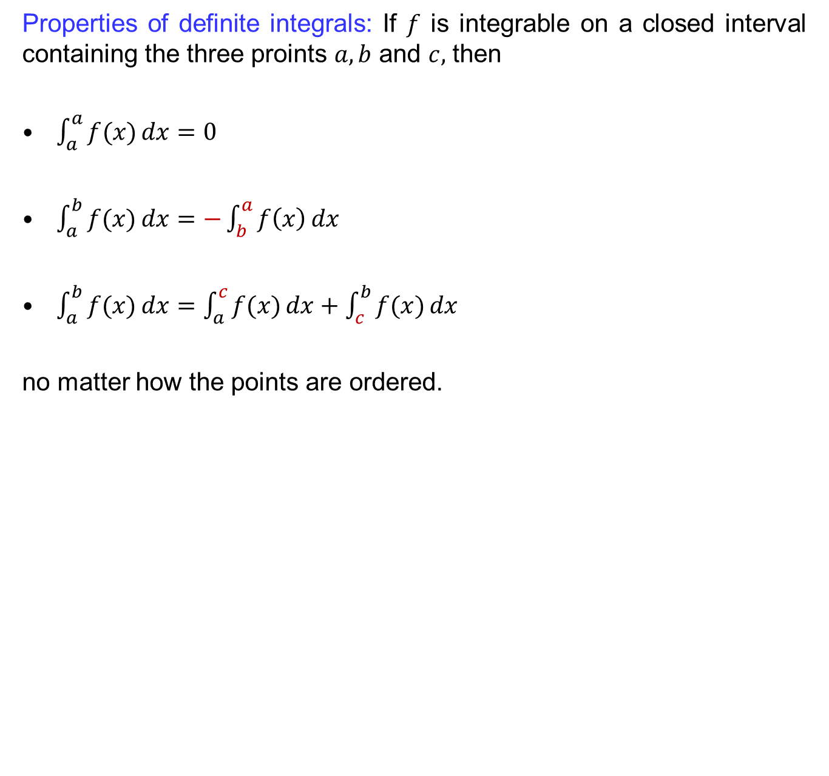
Definite Integrals
Properties of definiteintegrals: If $f$is integrable on a closedintervalcontaining the threeproints$a,b$ and $c,$then
$\int_{a}^{a}{f(x)}dx=0$
$\int_{a}^{b}{f(x)}dx=−\int_{b}^{a}{f\left(x\right)}dx$
$\int_{a}^{b}{f(x)}dx=\int_{a}^{c}{f(x)}dx+\int_{c}^{b}{f(x)}dx$
no matter how the points are ordered.

Slide 12
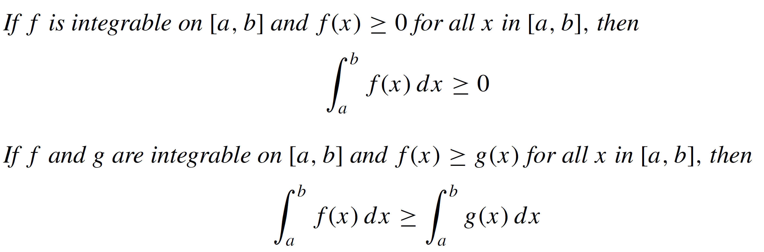
Definite Integrals
Theorem:

Slide 13
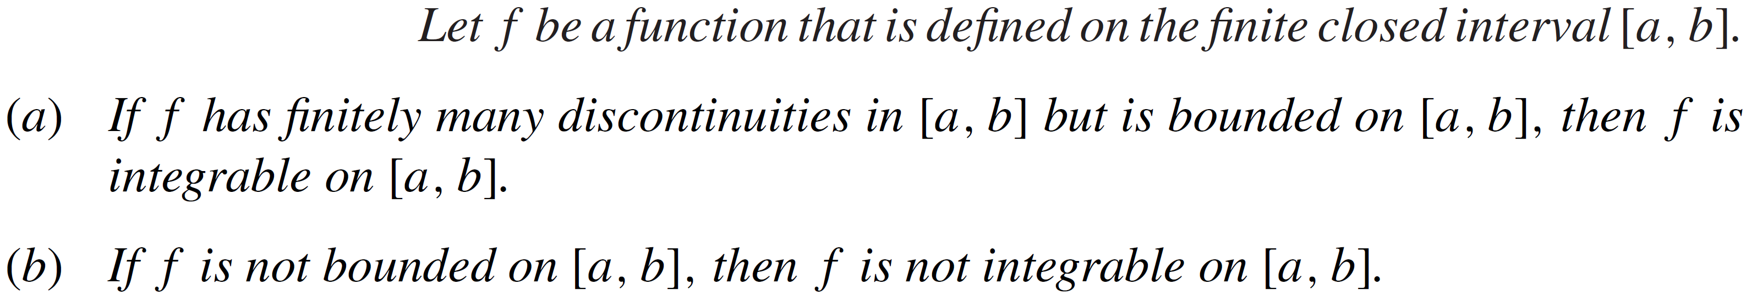
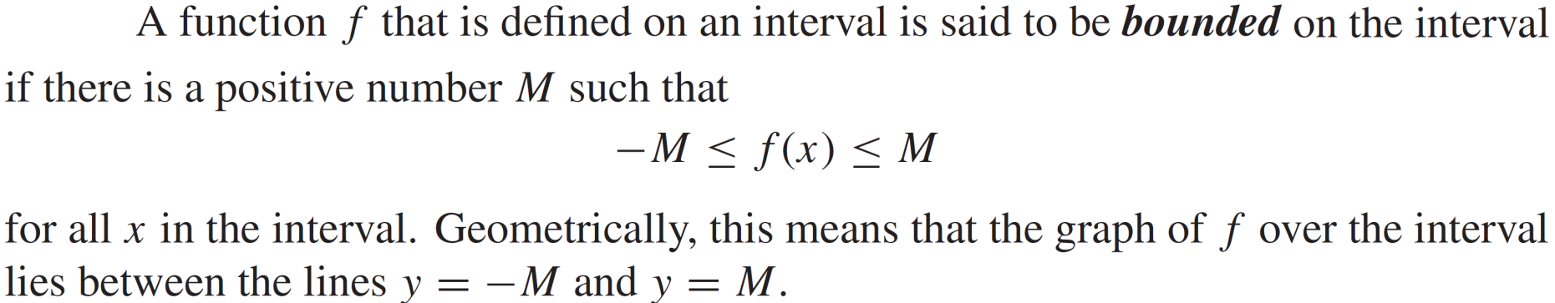
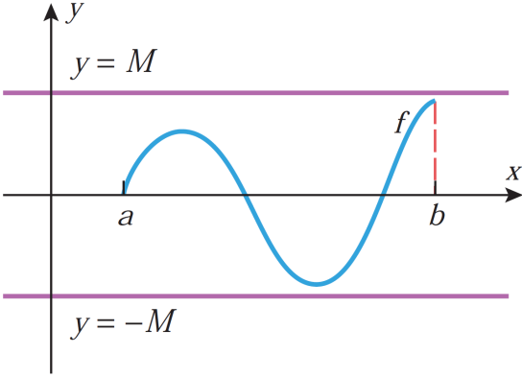
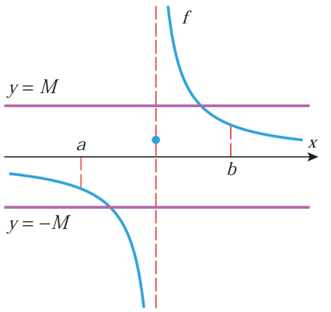
Definite Integrals
Theorem:
Recall:

Slide 14
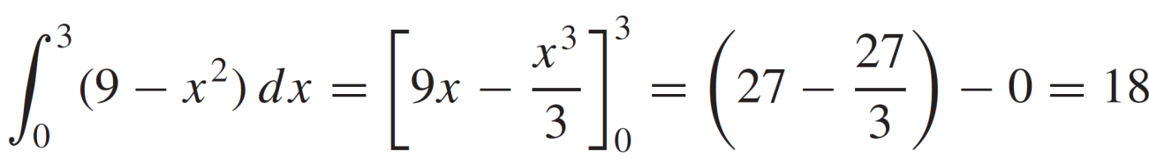
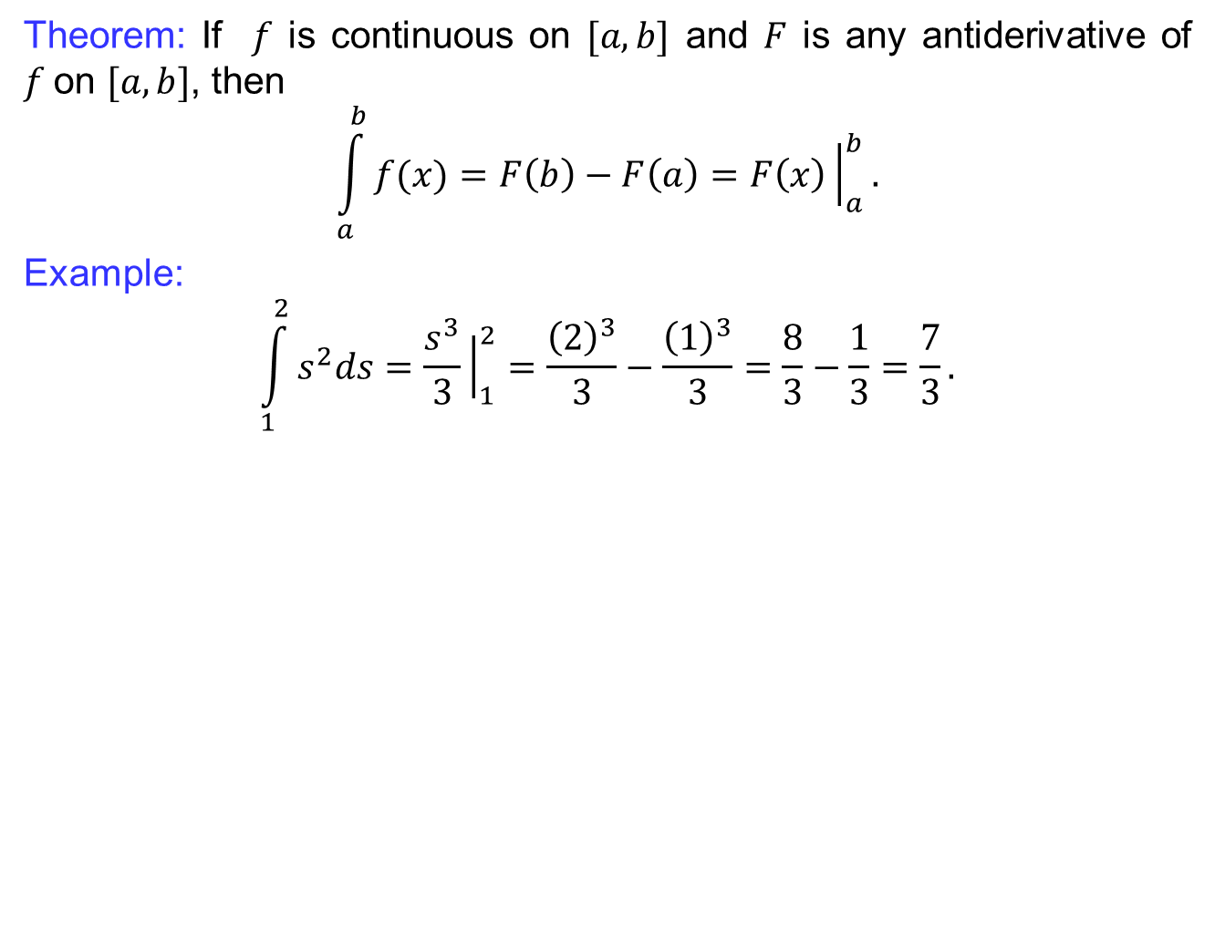
Fundamental theorem of Calculus
Theorem: If $f$iscontinuous on $[a,b]$ and $F$isanyantiderivative of $f$on $[a,b]$, then
$$\int_{a}^{b}{f(x)}=F\left(b\right)−F\left(a\right)=F\left(x\right){\left.​\right|}_{a}^{b}.$$
Example:
$$\int_{1}^{2}{s^{2}ds}=\frac{s^{3}}{3}{\left.​\right|}_{1}^{2}=\frac{{\left(2\right)}^{3}}{3}−\frac{{\left(1\right)}^{3}}{3}=\frac{8}{3}−\frac{1}{3}=\frac{7}{3}.$$

Slide 15
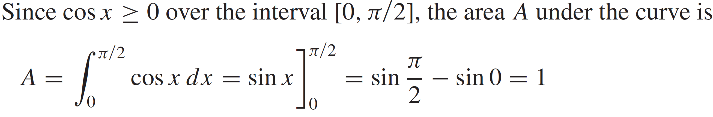
Fundamental theorem of Calculus
Example:
Solution:

Slide 16
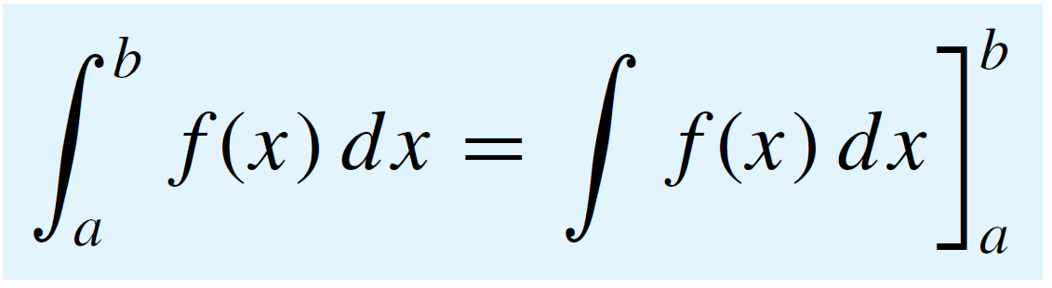
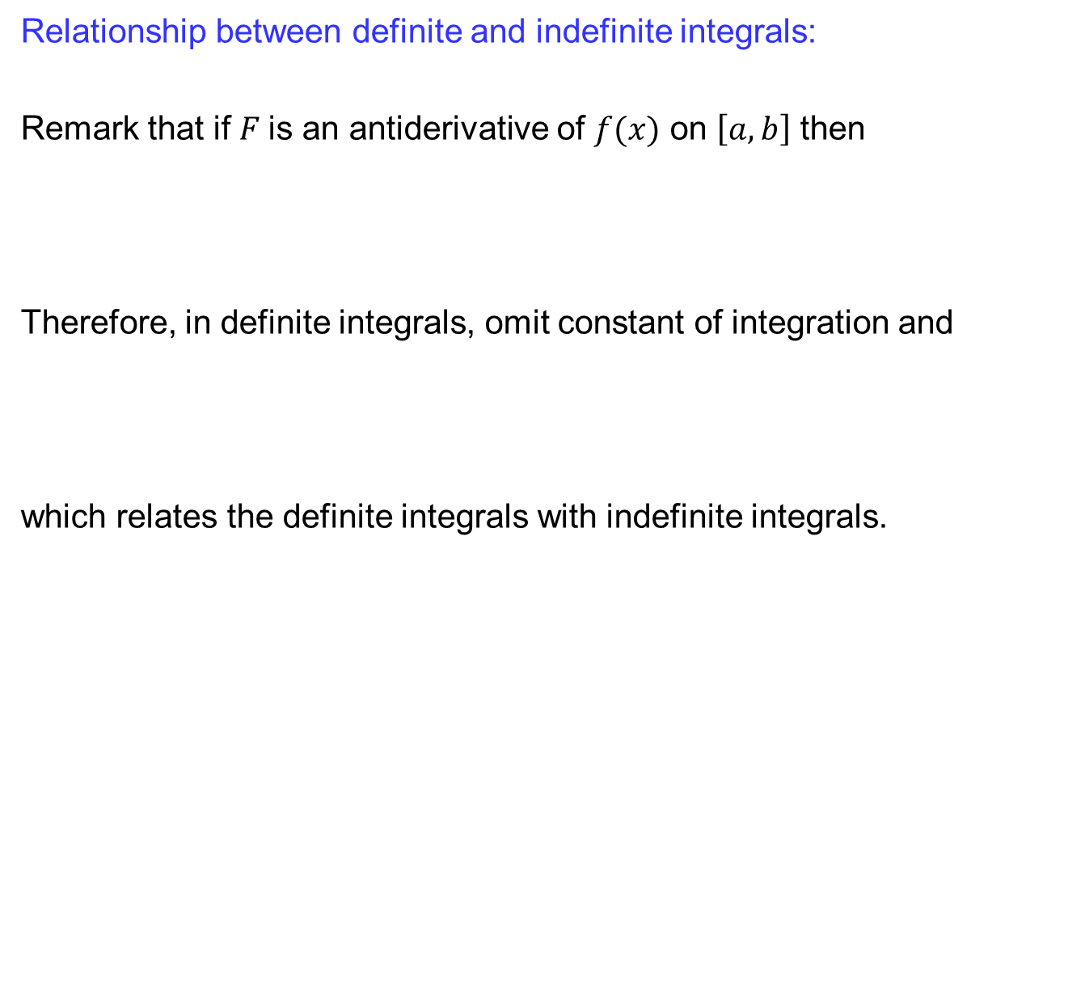
Fundamental theorem of Calculus
Relationship betweendefinite and indefiniteintegrals:
Remarkthat if$F$is an antiderivative of $f(x)$ on $\left[a,b\right]$ then
Therefore, in definiteintegrals, omit constant of integrationand
which relates the definiteintegralswithindefiniteintegrals.

Slide 17
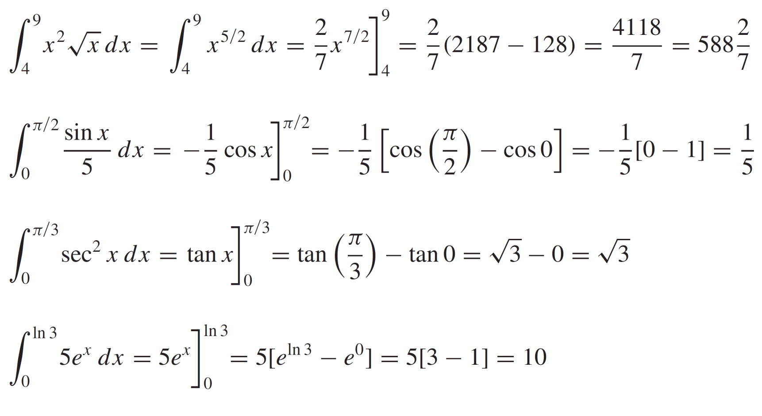
Fundamental theorem of Calculus
Examples:

Slide 18
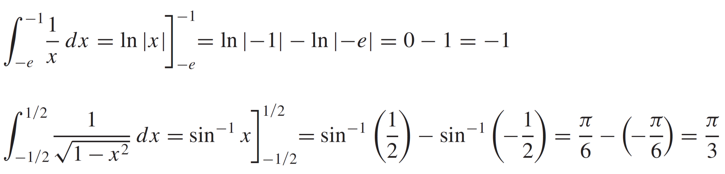
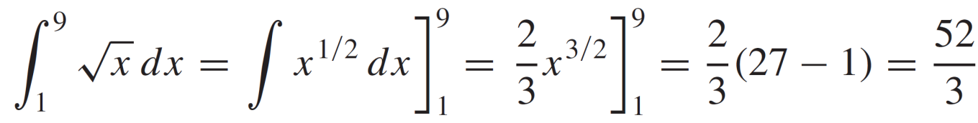
Fundamental theorem of Calculus
Examples:

Slide 19
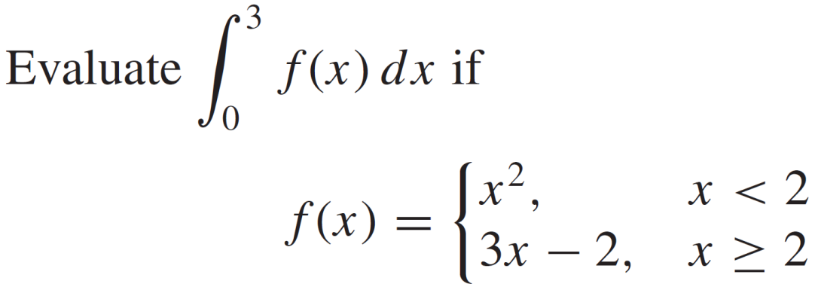
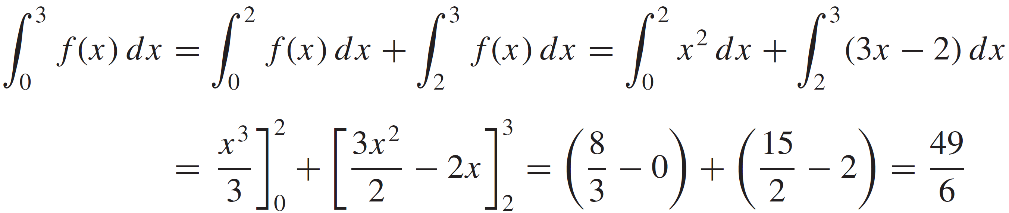
Fundamental theorem of Calculus
Examples:
Solution:

Slide 20
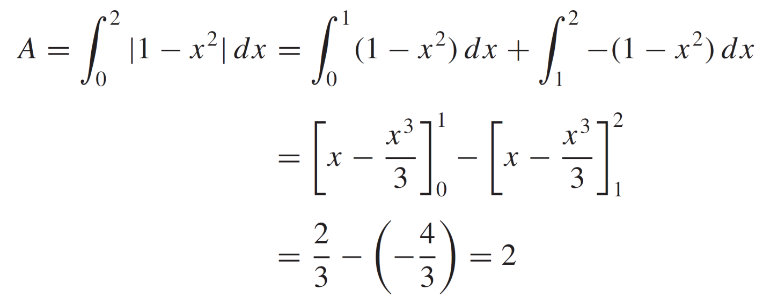
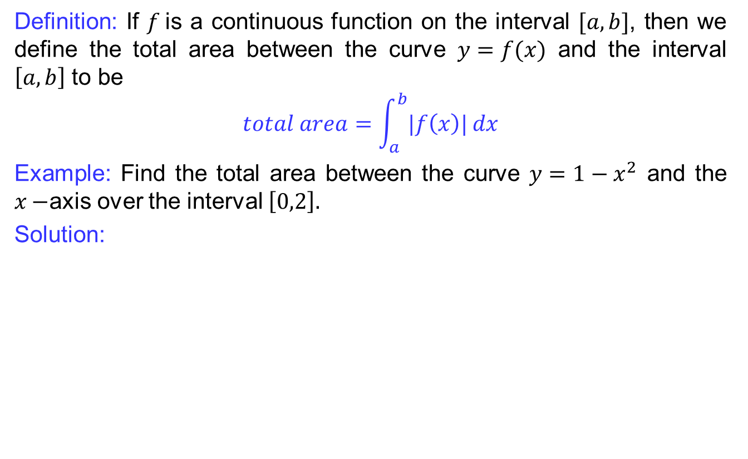
Fundamental theorem of Calculus
Definition: If $f$is a continuousfunction on the interval$[a,b]$, thenwedefine the total area between the curve$y=f(x)$ and the interval$\left[a,b\right]$ to be
$$total area=\int_{a}^{b}{|f\left(x\right)|}dx$$
Example: Find the total area between the curve$y=1−x^{2}$ and the $x−$axis over the interval$\left[0,2\right].$
Solution:

Slide 21
Fundamental theorem of Calculus
Remark that:
Because the variable of integration in a definite integral plays no role in the end result, it is reffered to as a dummy variable.

Slide 22
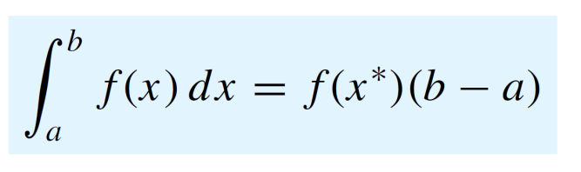
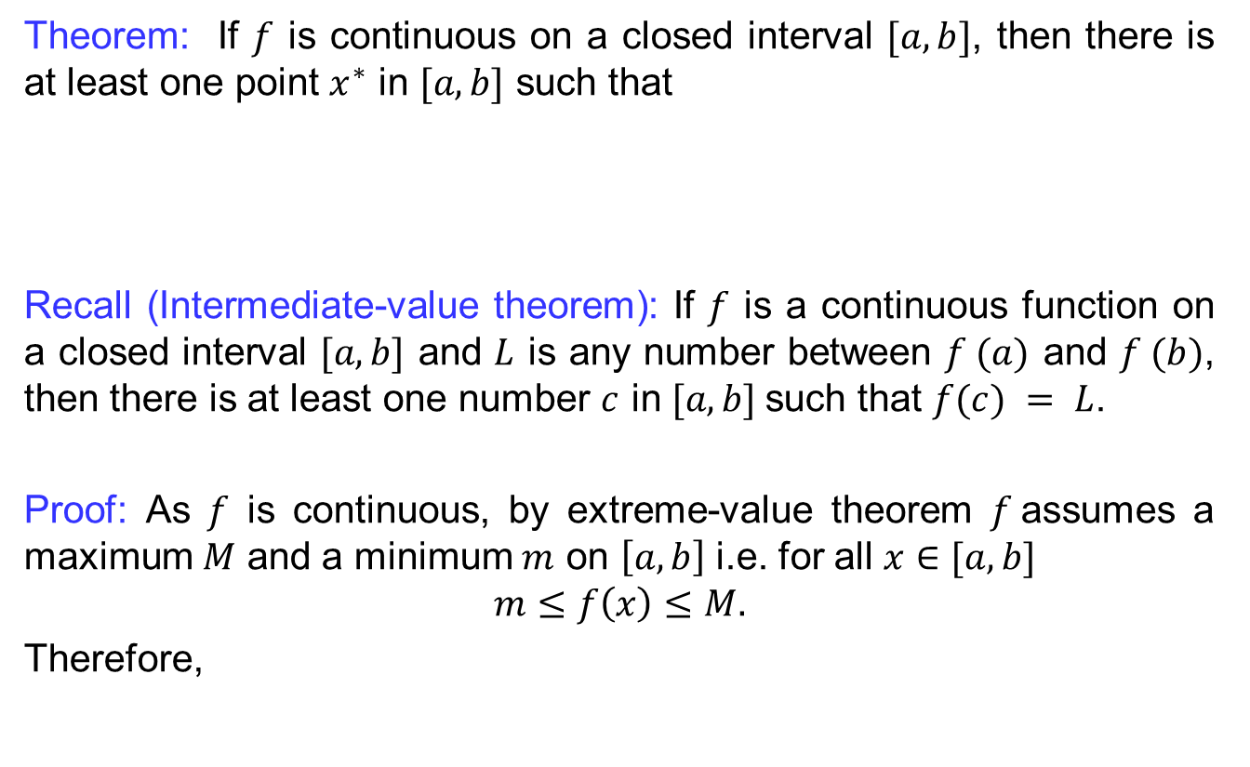
Mean value theorem
Theorem: If $f$iscontinuous on a closedinterval$[a,b]$, thenthereisat least one point $x^{∗}$ in $[a,b]$suchthat
Recall (Intermediate-value theorem):If $f$ is a continuous function on a closed interval $[a, b]$ and $L$ is any number between $f (a)$ and $f (b)$, then there is at least one number $c$ in $[a, b]$such that $f(c) = L$.
Proof: As $f$iscontinuous, by extreme-value theorem$f$assumes a maximum $M$ and a minimum $m$ on $\left[a,b\right]$ i.e. for all $x∈[a,b]$
$$m≤f\left(x\right)≤M.$$
Therefore,

Slide 23
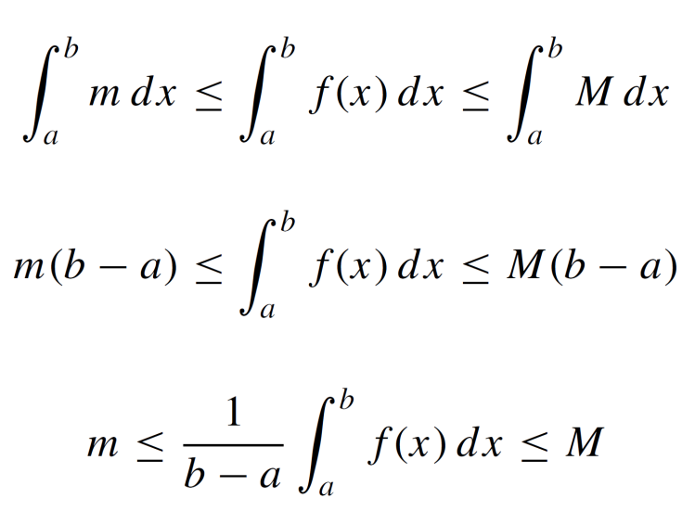
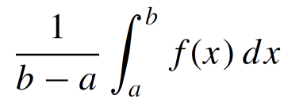
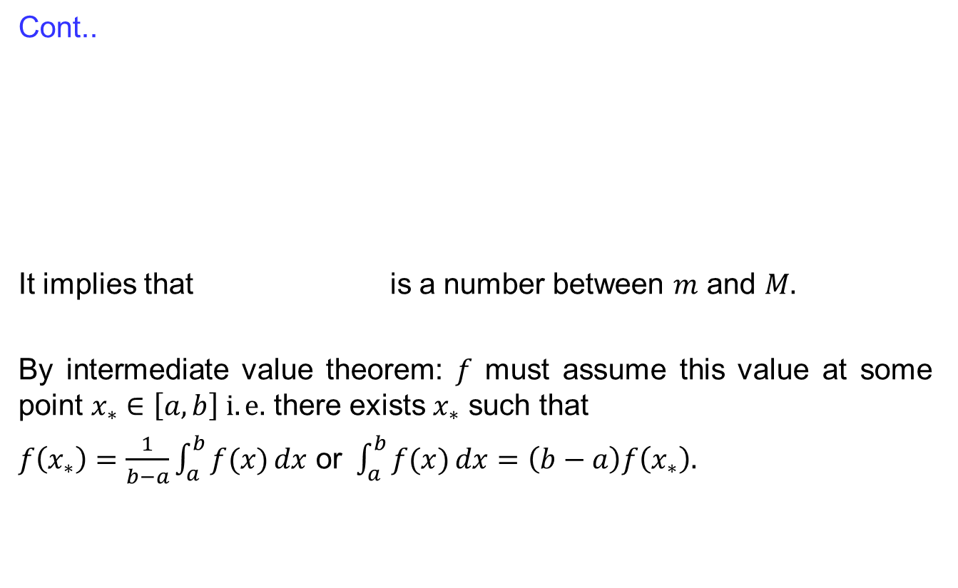
Mean value theorem
Cont..
It impliesthatis a numberbetween$m$ and $M.$
By intermediate value theorem: $f$ must assume this value atsome point $x_{∗}∈\left[a,b\right] i.e.$thereexists$x_{∗}$suchthat
$f\left(x_{∗}\right)=\frac{1}{b−a}\int_{a}^{b}{f(x)}dx$ or$\int_{a}^{b}{f(x)}dx=\left(b−a\right)f\left(x_{∗}\right).$

Slide 24
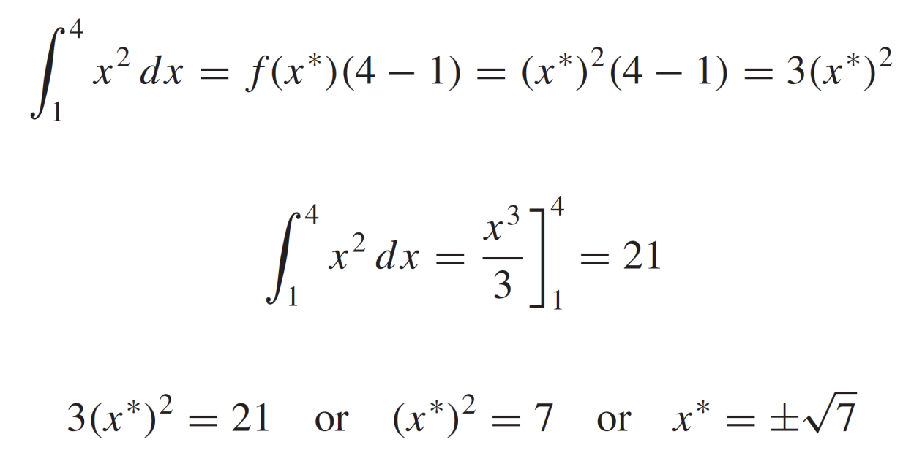
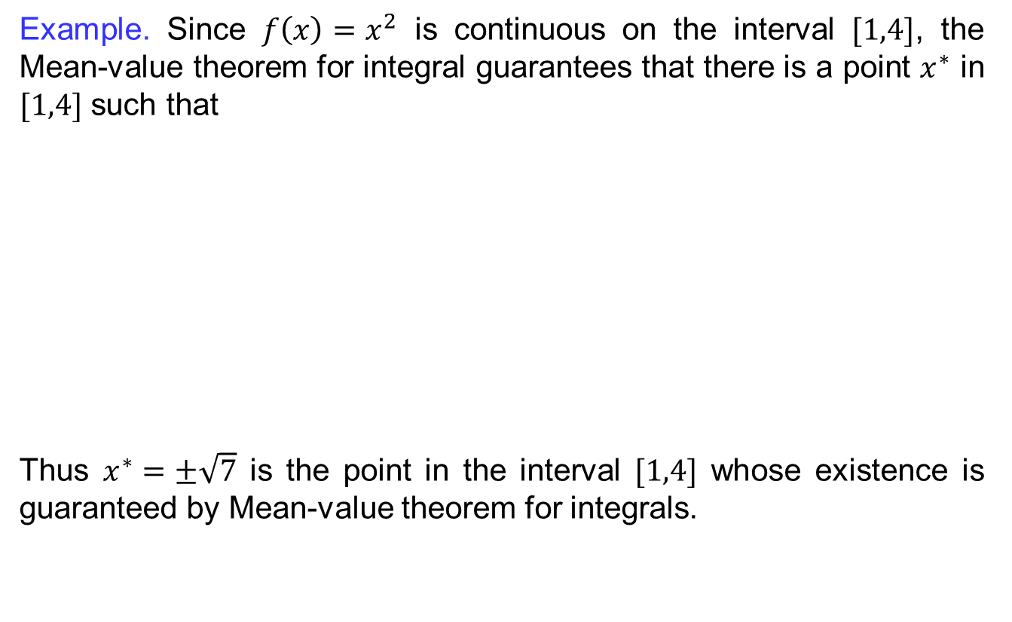
Mean value theorem
Example. Since$f\left(x\right)=x^{2}$iscontinuous on the interval$[1,4]$, the Mean-value theorem for integralguaranteesthatthereis a point $x^{∗}$ in $[1,4]$suchthat
Thus$x^{∗}=±\sqrt{7}$is the point in the interval$[1,4]$whose existence isguaranteed by Mean-value theorem for integrals.

Slide 25
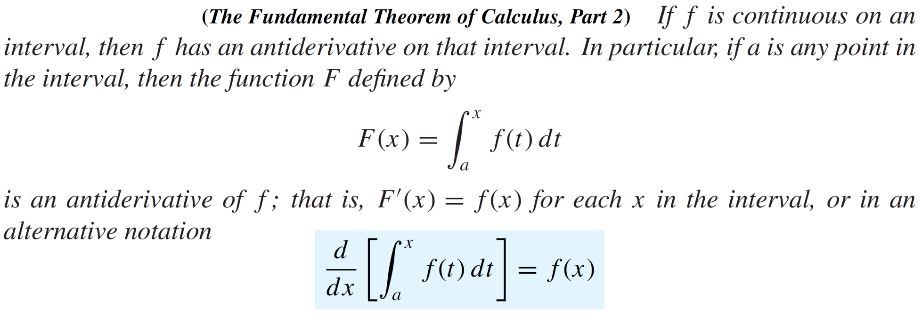
Fundamental theorem of Calculus II
Theorem:

Slide 26
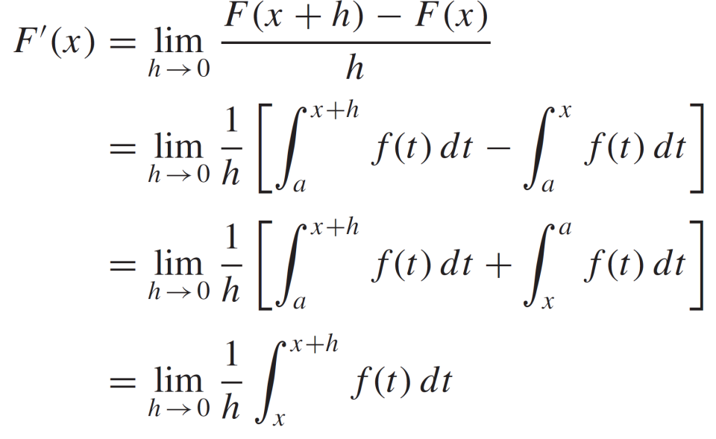
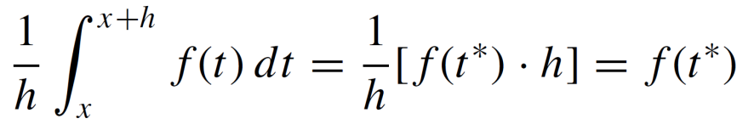
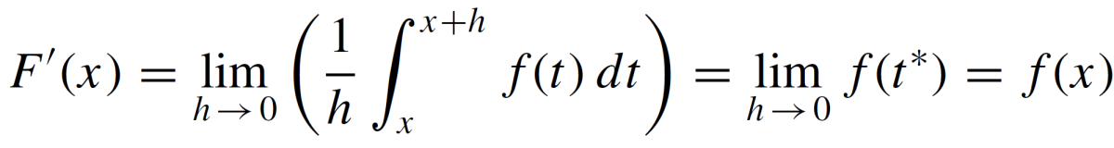
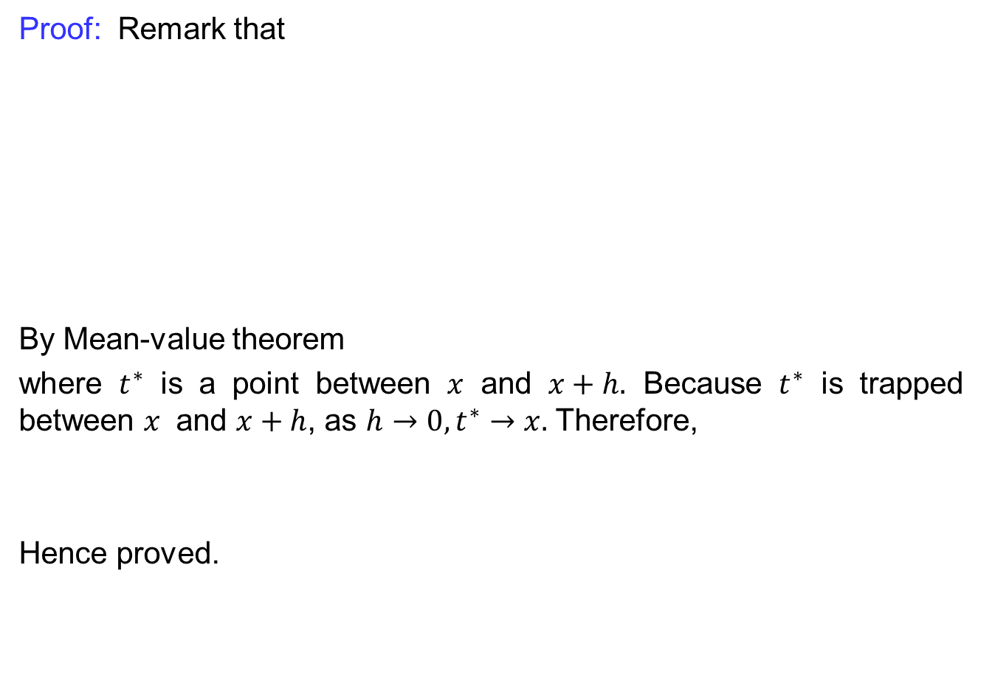
Fundamental theorem of Calculus II
Proof: Remarkthat
By Mean-value theorem
where$t^{∗}$is a point between$x$ and $x+h.$Because$t^{∗}$istrappedbetween$x$ and $x+h$, as $h→0, t^{∗}→x.$Therefore,
Henceproved.

Slide 27
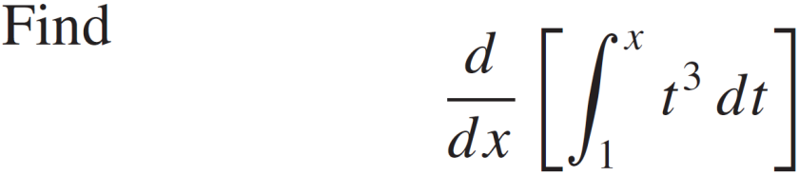
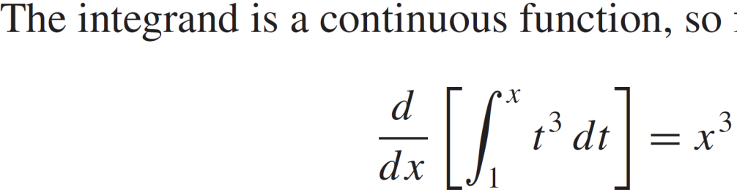
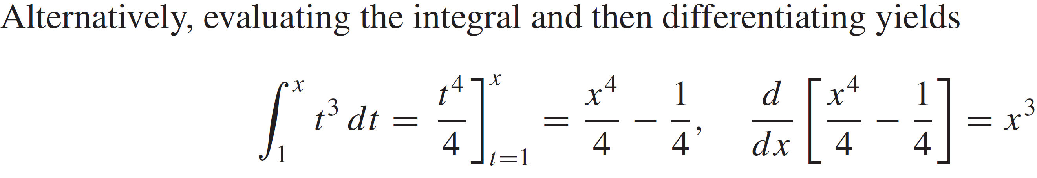
Fundamental theorem of Calculus II
Example:
Solution:

Slide 28
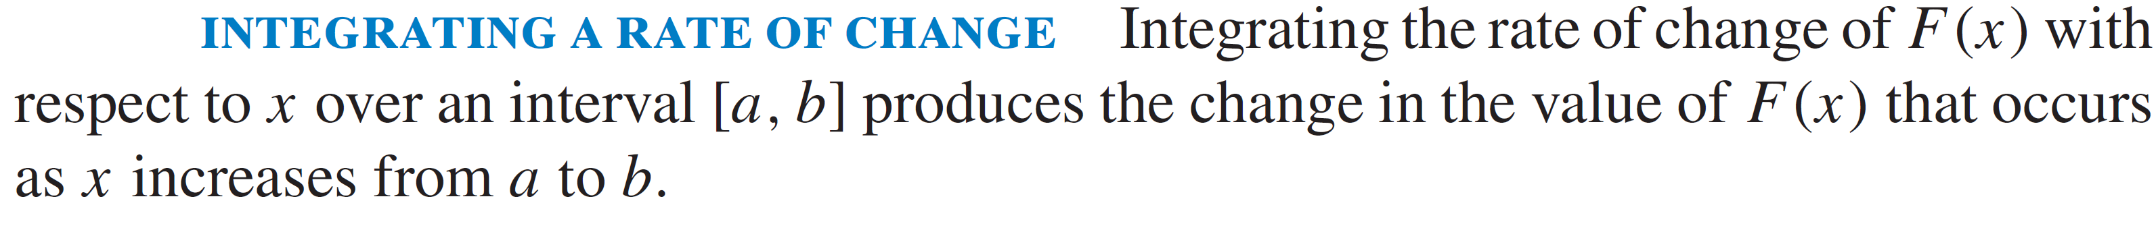
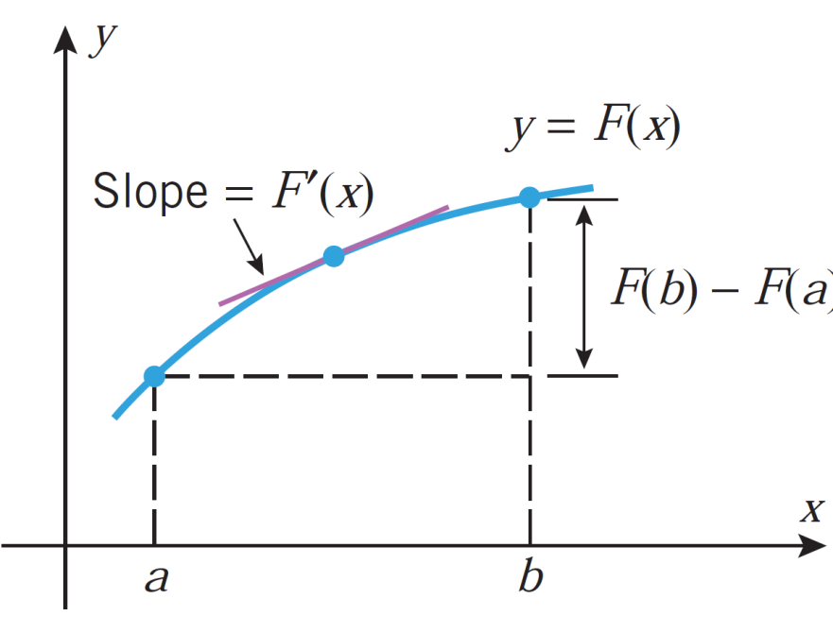
Integrating a rate of change

Slide 29
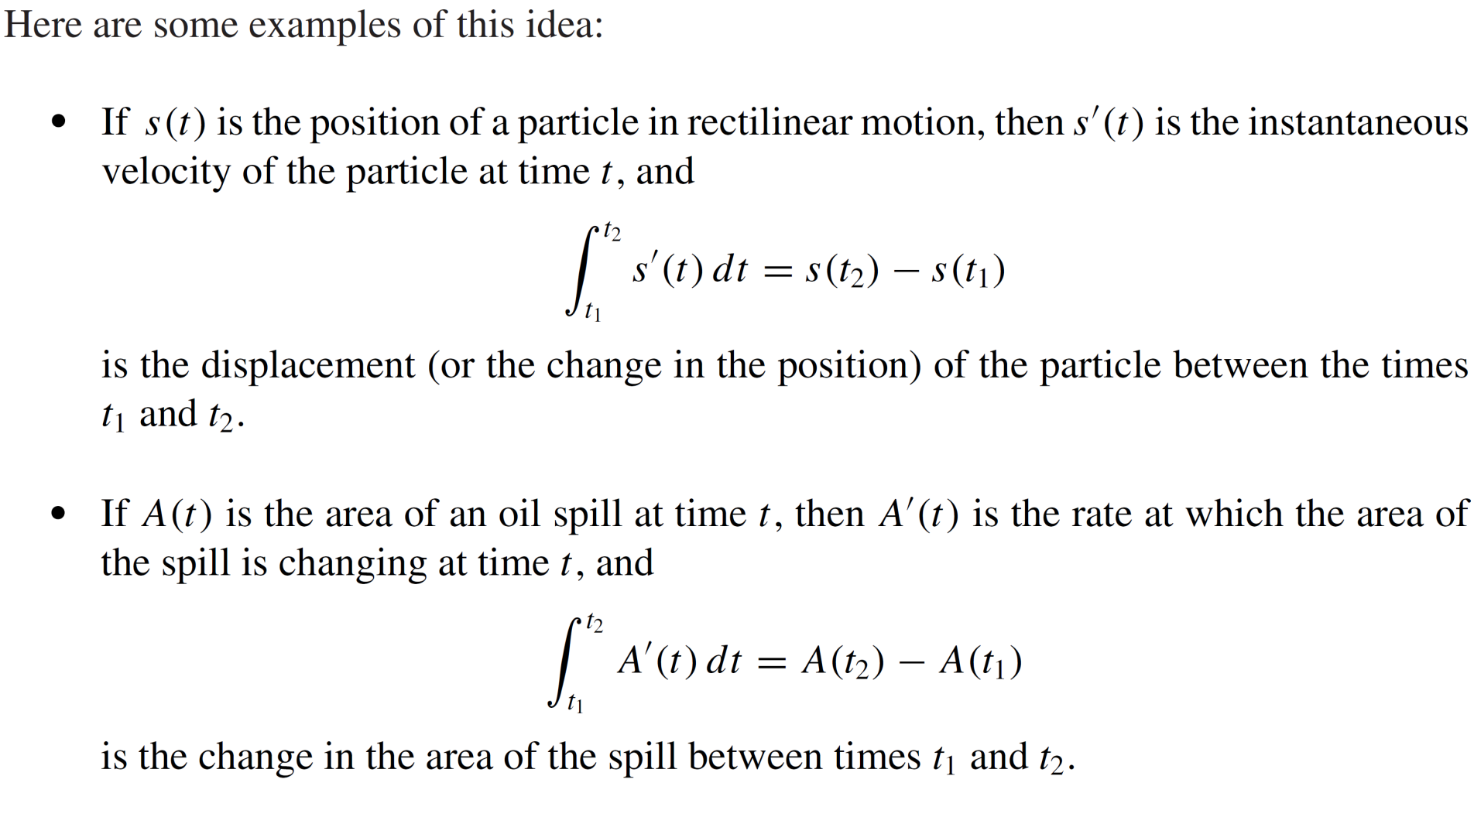
Integrating a rate of change

Slide 30
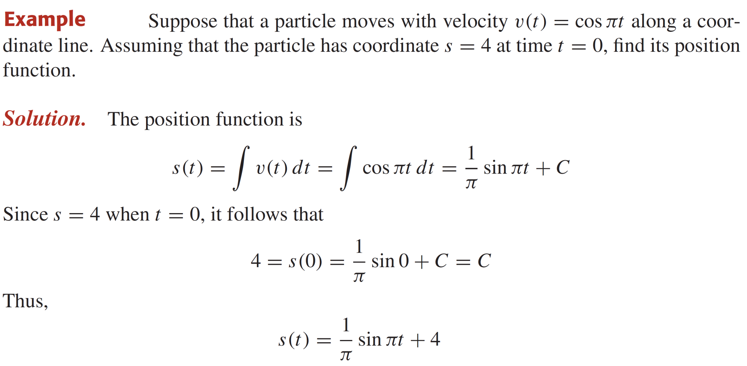
Integrating a rate of change

Slide 31
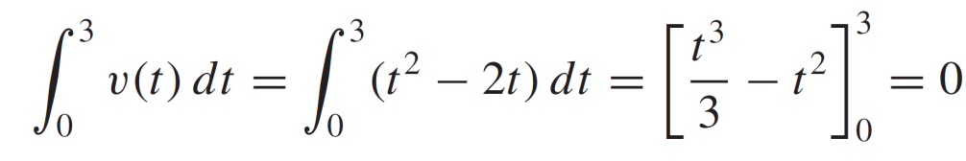


Integrating a rate of change
Example: Suppose that a particle moves on a coordinate line sothat its velocityat time $t$is$v(t)=t^{2} −2t m/s.$
The thedisplacement of the particleduring$0≤t≤3$ is
The distance traveled by the particleduring$0≤t≤3$ is

Slide 32


Integrating a rate of change
Remark Let$s\left(t\right)$be the displacement of a particleat time t and $v\left(t\right)$beitsvelocity, then the averagevelocity over the interval$[t_{0},t_{1}]$ is
$v_{ave}=\frac{s\left(t_{1}\right)−s\left(t_{0}\right)}{t_{1}−t_{0}}=\frac{1}{t_{1}−t_{0}}\int_{t_{0}}^{t_{1}}{v\left(t\right)dt}$ (1)

Slide 33



Integrating a rate of change

Slide 34

Summary of results
$\int_{a}^{a}{f(x)}dx=0$
$\int_{a}^{b}{f(x)}dx=−\int_{b}^{a}{f\left(x\right)}dx$
$\int_{a}^{b}{f(x)}dx=\int_{a}^{c}{f(x)}dx+\int_{c}^{b}{f(x)}d$

Slide 35


Summary of results
$\int_{a}^{b}{f(x)}=F\left(b\right)−F\left(a\right)=F\left(x\right){\left.​\right|}_{a}^{b}$
$F\left(x\right)=\int_{a}^{x}{f\left(t\right)dt⇒}\frac{d}{dx}\left[\int_{a}^{x}{f\left(t\right)dt}\right]=f(x)$

Slide 36
Lecture Summary
    Definite integrals
    Fundamental theorem of calculus
    Mean value theorem for integrals
    Fundamental theorem of calculus II
    Integrating a rate of change
    Summary of results.

