Slide 1
(MTH 250)
Calculus
Lecture 17

Slide 2
Previous Lecture’s Summary
    Polynomial approximations
    Maclaurin polynomials
    Taylor polynomials
    Taylor and Maclaurin series
    Convergence
    Some important series

Slide 3
Today’s Lecture
    Recalls
    Introduction to integration,
    Anti-derivatives
    Basic rules and properties
    Integral curves
    Methods of substitution
    Summary of basic rules.

Slide 4
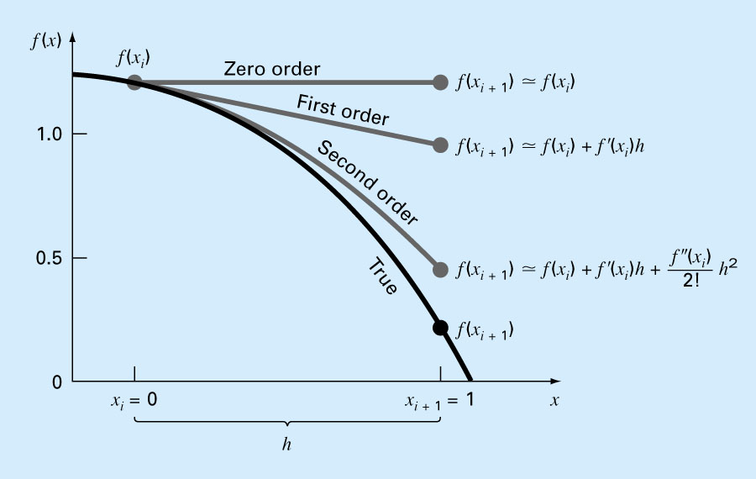
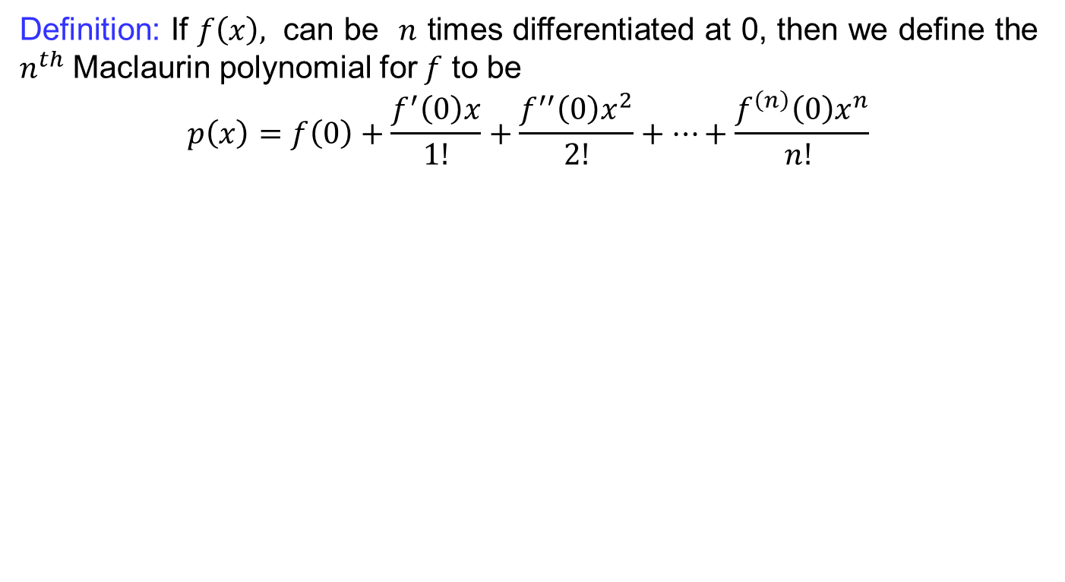
Recalls
Definition:If $f\left(x\right),$ can be $n$ times differentiated at 0, then we define the $n^{th}$ Maclaurinpolynomial for $f$ to be
$$p\left(x\right)=f\left(0\right)+\frac{f^{′}\left(0\right)x}{1!}+\frac{f^{′′}\left(0\right)x^{2}}{2!}+…+\frac{f^{\left(n\right)}\left(0\right)x^{n}}{n! }$$

Slide 5
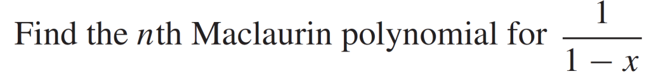
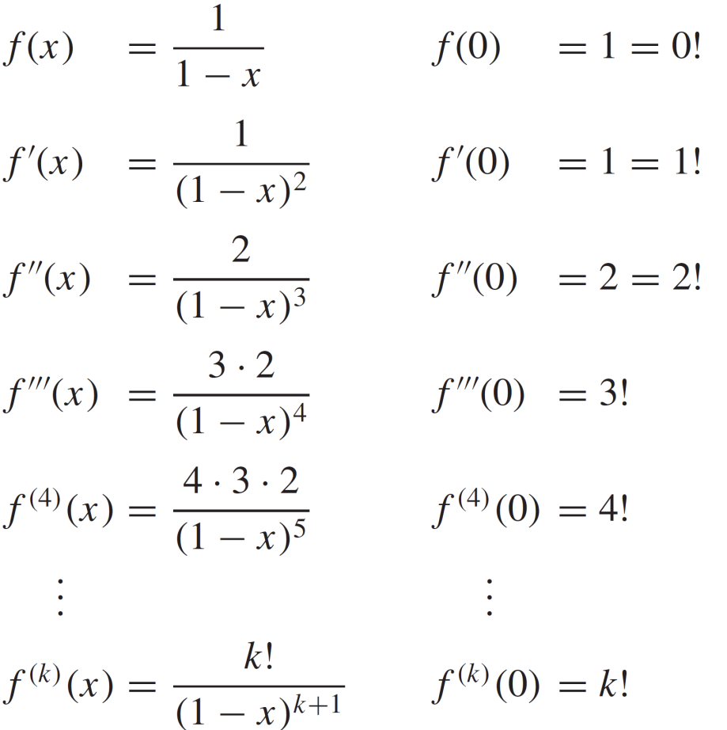
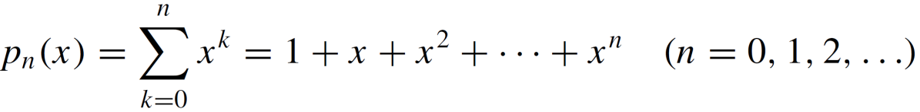
Recalls
Example:
Solution:

Slide 6
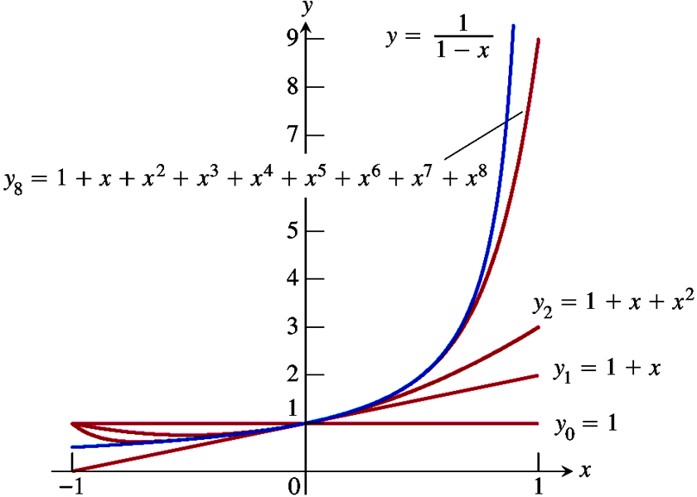
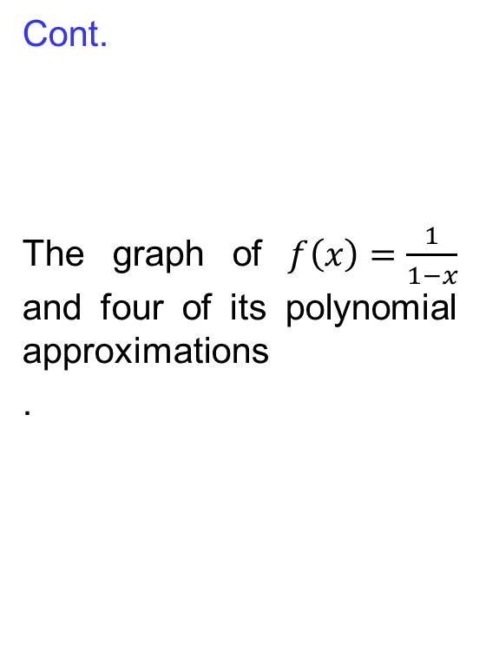
Recalls
Cont.
The graph of $f\left(x\right)=\frac{1}{1−x}$ and four of its polynomial approximations
.

Slide 7
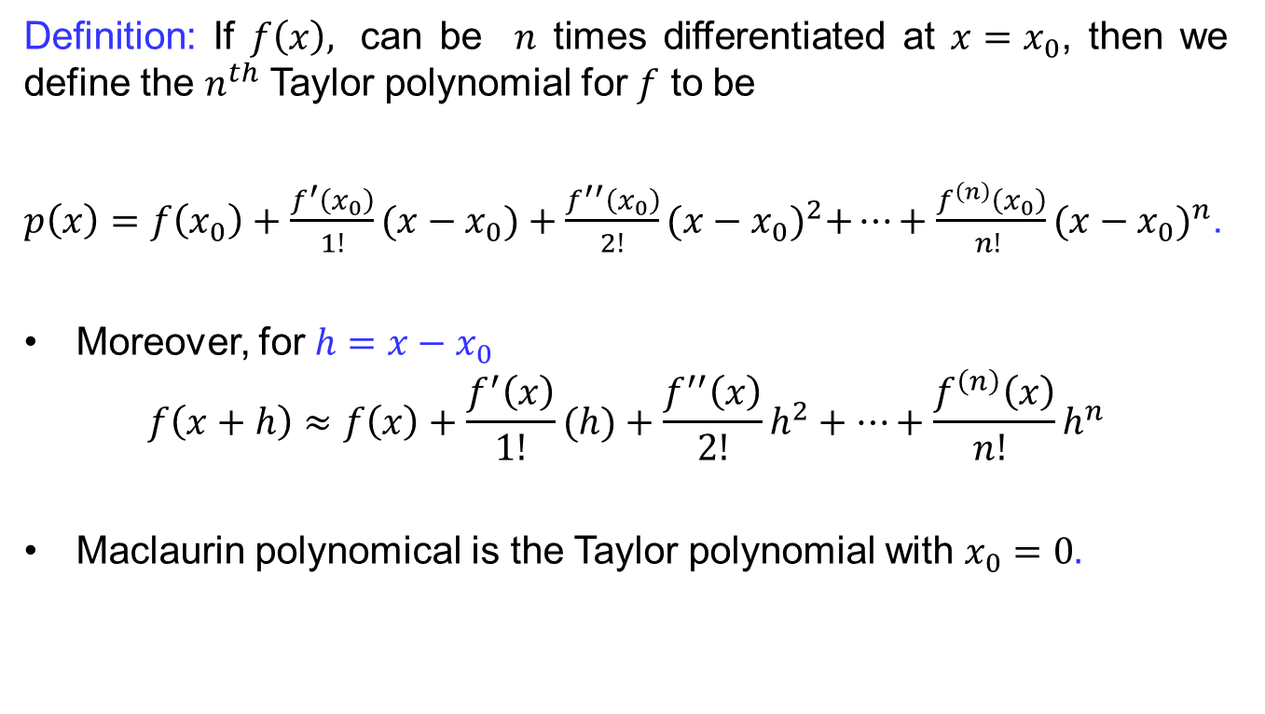
Recalls
Definition:If $f\left(x\right),$ can be $n$ times differentiated at ${x=x}_{0}$, then we define the $n^{th}$ Taylor polynomial for $f$ to be
$p\left(x\right)=f\left(x_{0}\right)+\frac{f^{′}\left(x_{0}\right)}{1!}(x−x_{0})+\frac{f^{′′}\left(x_{0}\right)}{2!}{(x−x_{0})}^{2}+…+\frac{f^{\left(n\right)}\left(x_{0}\right)}{n! }{(x−x_{0})}^{n}$.
Moreover, for $h=x−x_{0}$
$$f\left(x+h\right)≈f\left(x\right)+\frac{f^{′}\left(x\right)}{1!}(h)+\frac{f^{′′}\left(x\right)}{2!}h^{2}+…+\frac{f^{\left(n\right)}\left(x\right)}{n! }h^{n}$$
Maclaurin polynomicalis the Taylor polynomial with$x_{0}=0.$

Slide 8
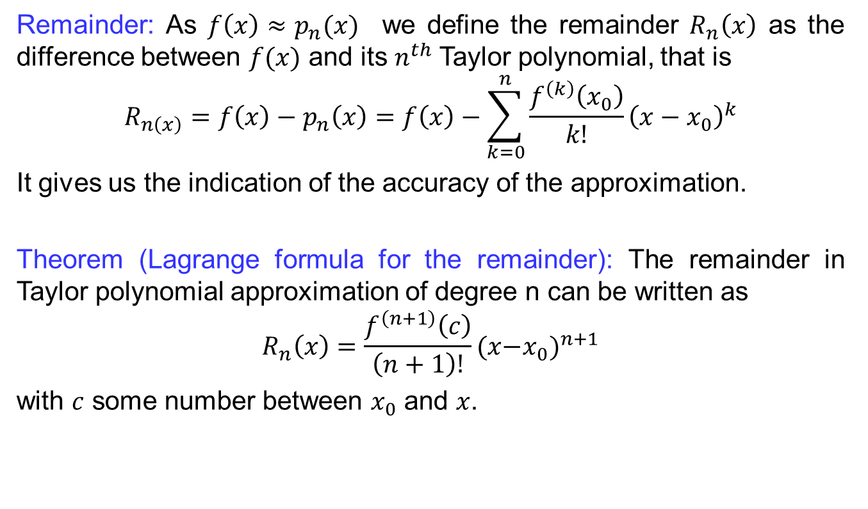
Taylor Polynomials
Remainder: As $f\left(x\right)≈p_{n}(x)$wedefine the remainder$R_{n}\left(x\right)$ as the differencebetween$f(x)$ and its $n^{th}$ Taylor polynomial, that is
$$R_{n\left(x\right)}=f\left(x\right)−p_{n}\left(x\right)=f\left(x\right)−\sum_{k=0}^{n}{\frac{f^{\left(k\right)}\left(x_{0}\right)}{k!}{\left(x−x_{0}\right)}^{k}}$$
It gives us the indication of the accuracy of the approximation.
Theorem (Lagrange formula for the remainder): The remainder in Taylor polynomial approximation of degree n can be written as
$$R_{n}\left(x\right)=\frac{f^{\left(n+1\right)}\left(c\right)}{\left(n+1\right)!}({x{−x}_{0})}^{n+1}$$
with $c$ some number between $x_{0}$ and $x$.

Slide 9
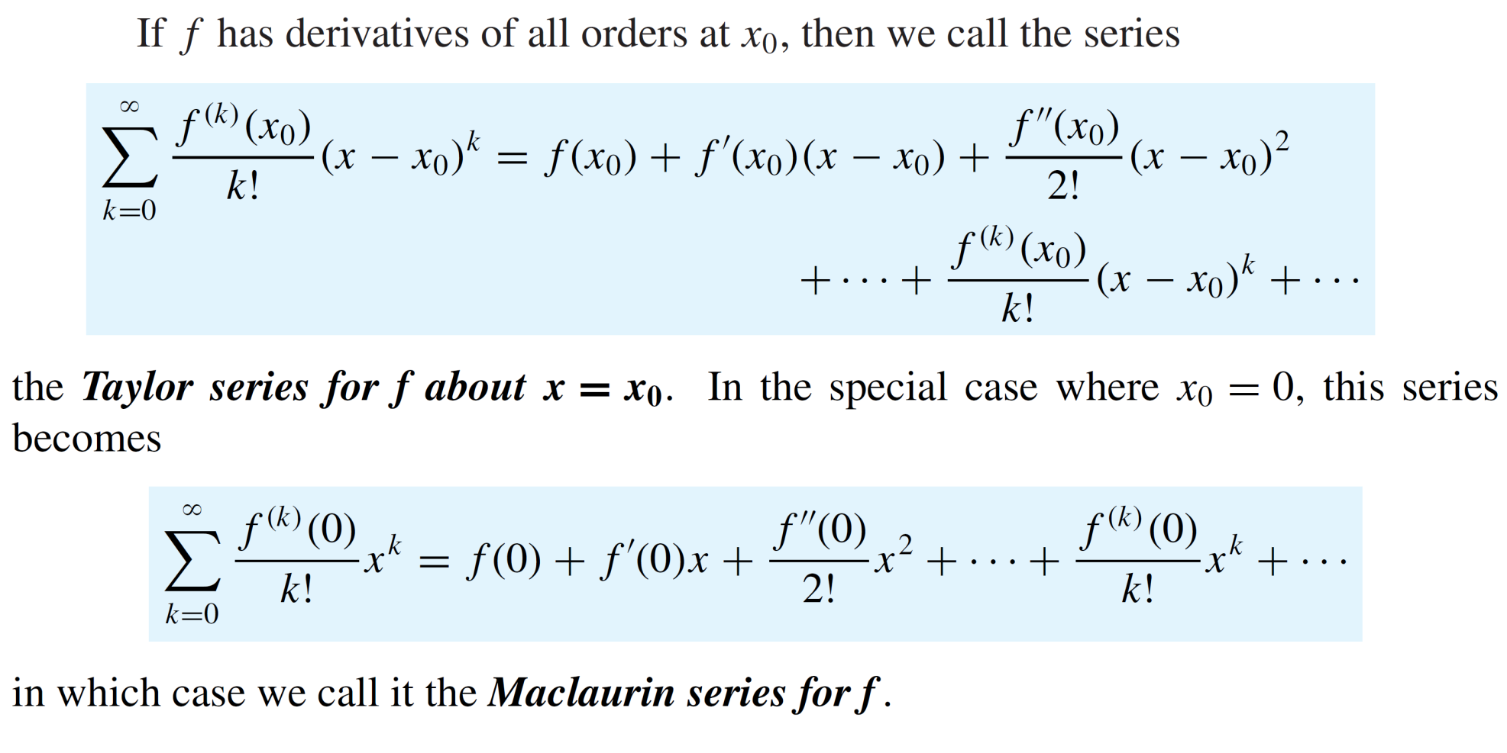
Recalls
Definition:

Slide 10
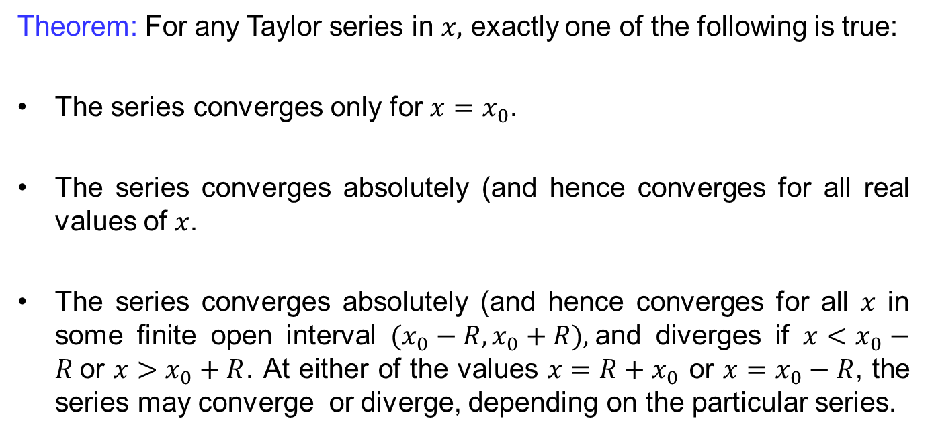
Recalls
Theorem: For any Taylor seriesin $x,$exactly one of the followingistrue:
The series converges only for $x=x_{0}$.
The series converges absolutely (and hence converges for all real values of $x$.
The series converges absolutely (and hence converges for all $x$ in somefinite open interval$(x_{0}−R,x_{0}+R),$and diverges if $x<x_{0}−R$or $x>x_{0}+R$. Ateither of the values $x=R+x_{0}$ or $x=x_{0}−R$, the seriesmay converge or diverge, depending on the particularseries.

Slide 11
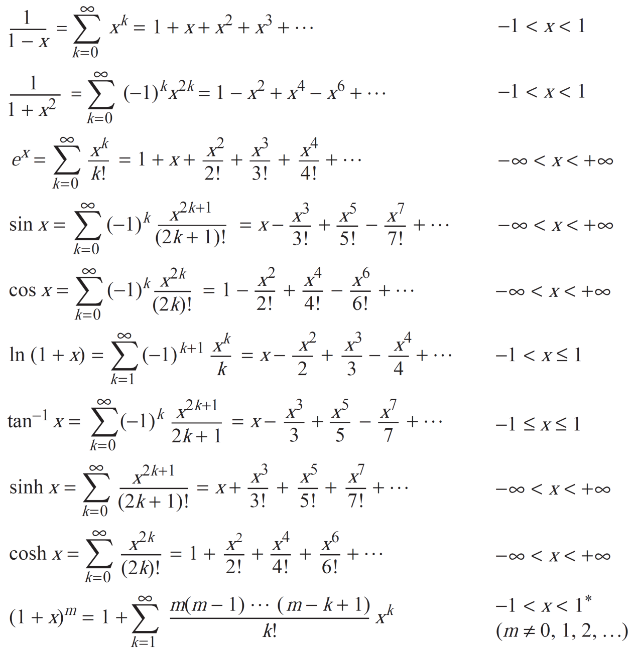
Recalls

Slide 12
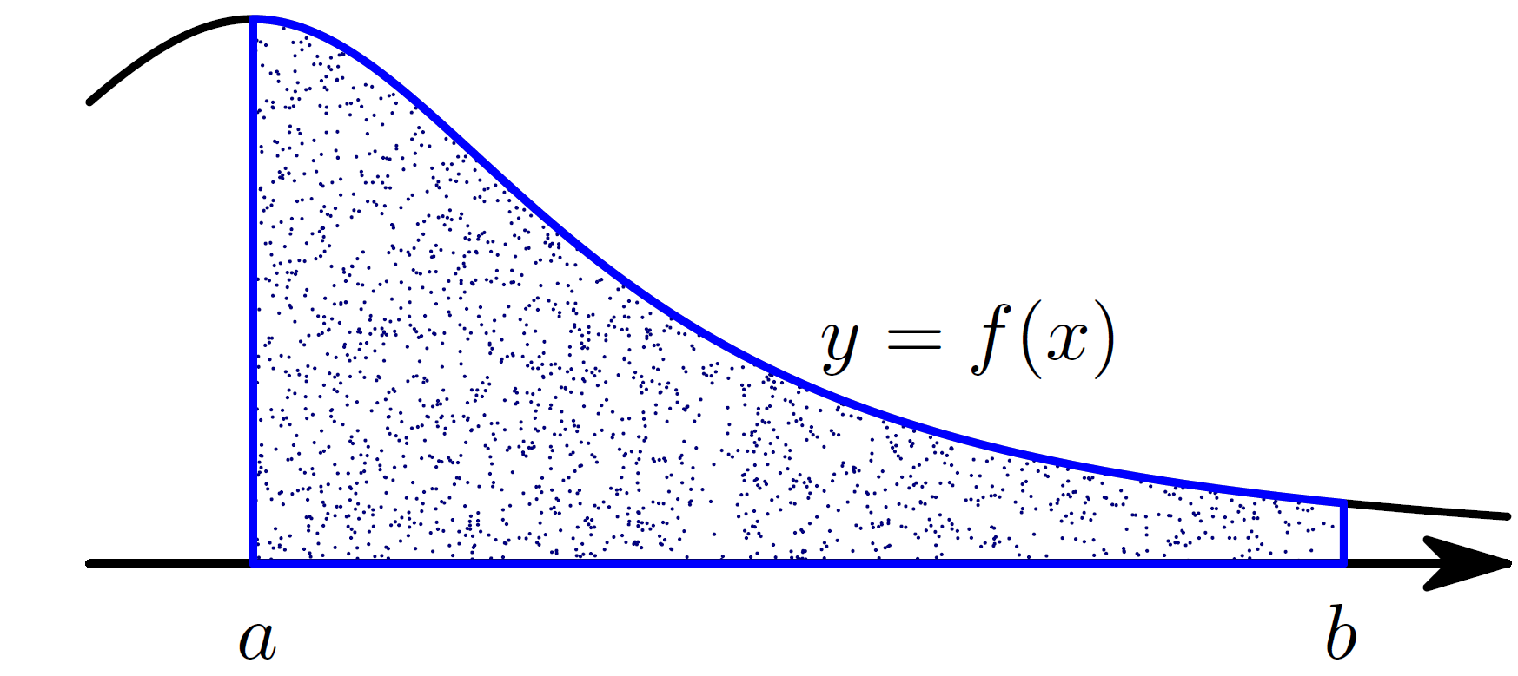
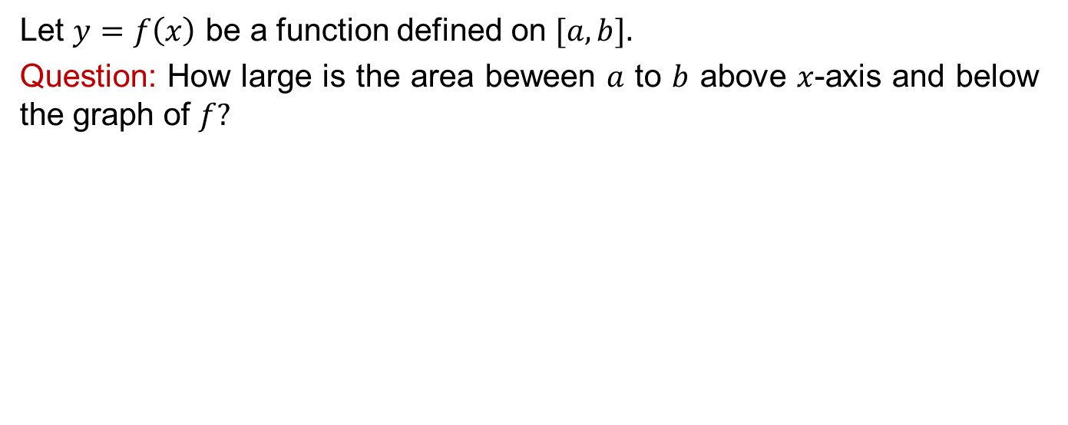
Introduction to Integrals
Let $y=f\left(x\right)$be a functiondefined on $[a,b].$
Question: How large is the area beween$a$ to $b$above$x$-axis and below the graph of $f?$

Slide 13
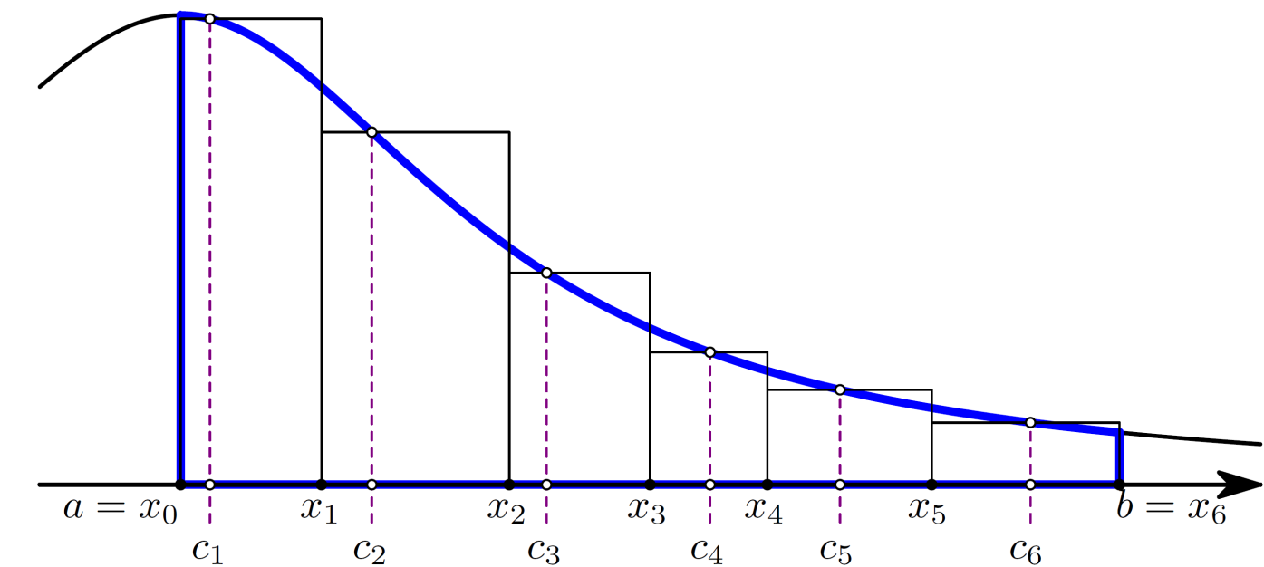
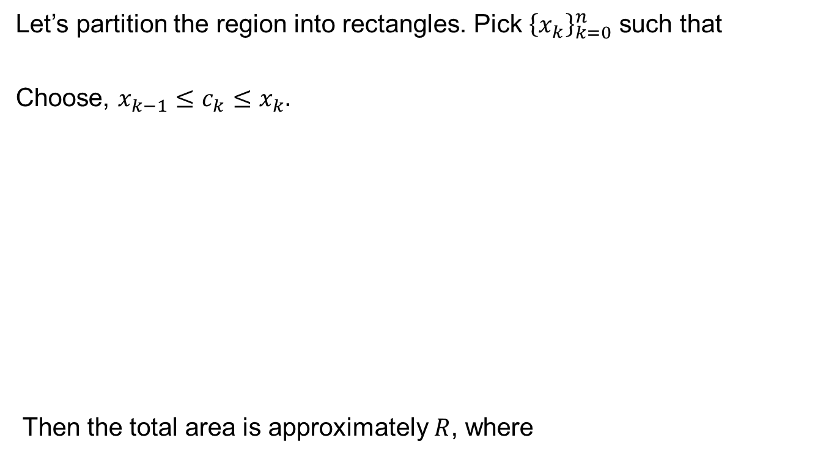
Introduction to Integrals
Let’s partition the regioninto rectangles. Pick${\left\{x_{k}\right\}}_{k=0}^{n}$suchthat
Choose, ${x_{k−1}≤c}_{k}≤x_{k}.$
Then the total area isapproximately$R$, where

Slide 14
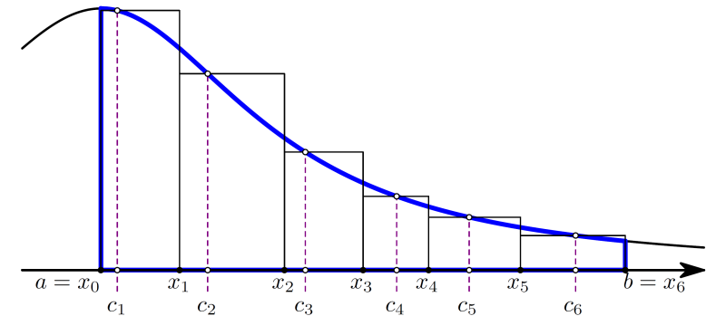
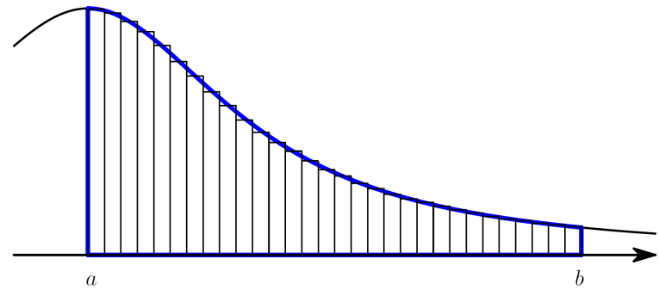
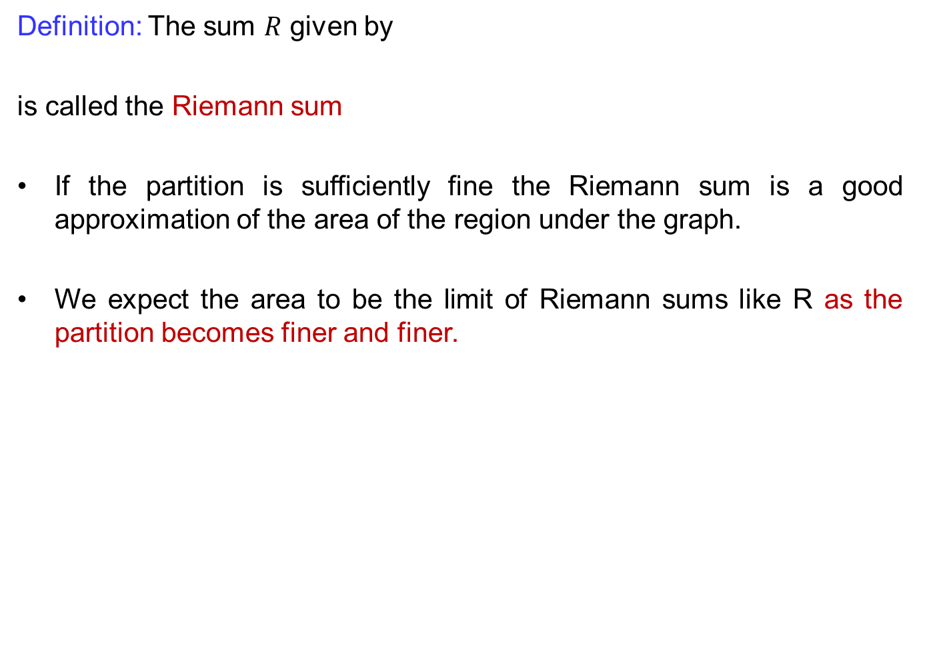
Introduction to Integrals
Definition: The sum$R$given by
iscalled the Riemann sum
If the partition issufficiently fine the Riemann sumis a good approximation of the area of the regionunder the graph.
Weexpect the area to be the limit of Riemann sumslike R as the partition becomesfiner and finer.

Slide 15
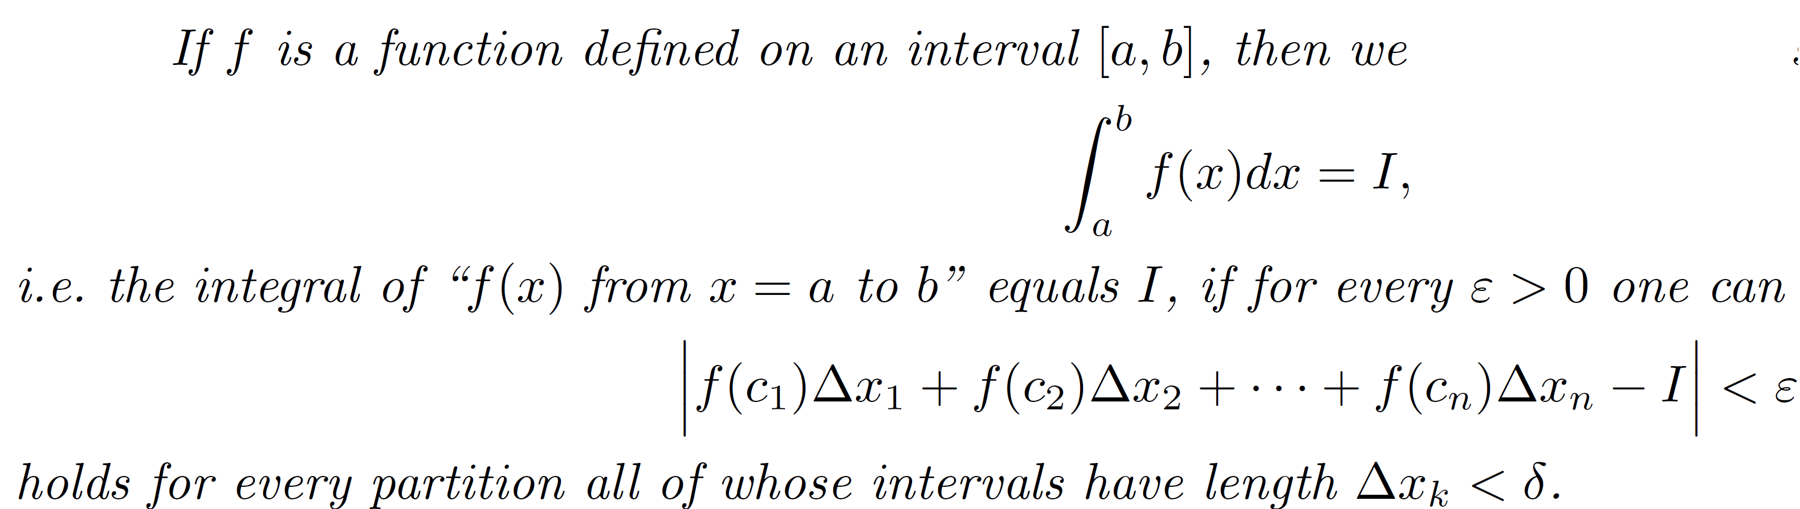
Introduction to Integrals
Definition (Integral)

Slide 16
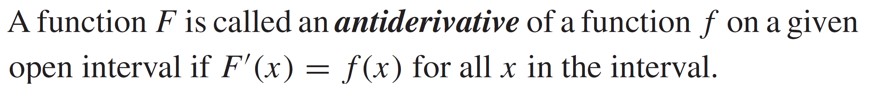
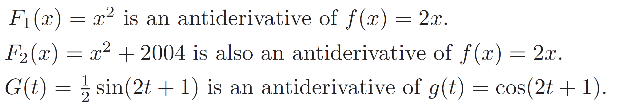
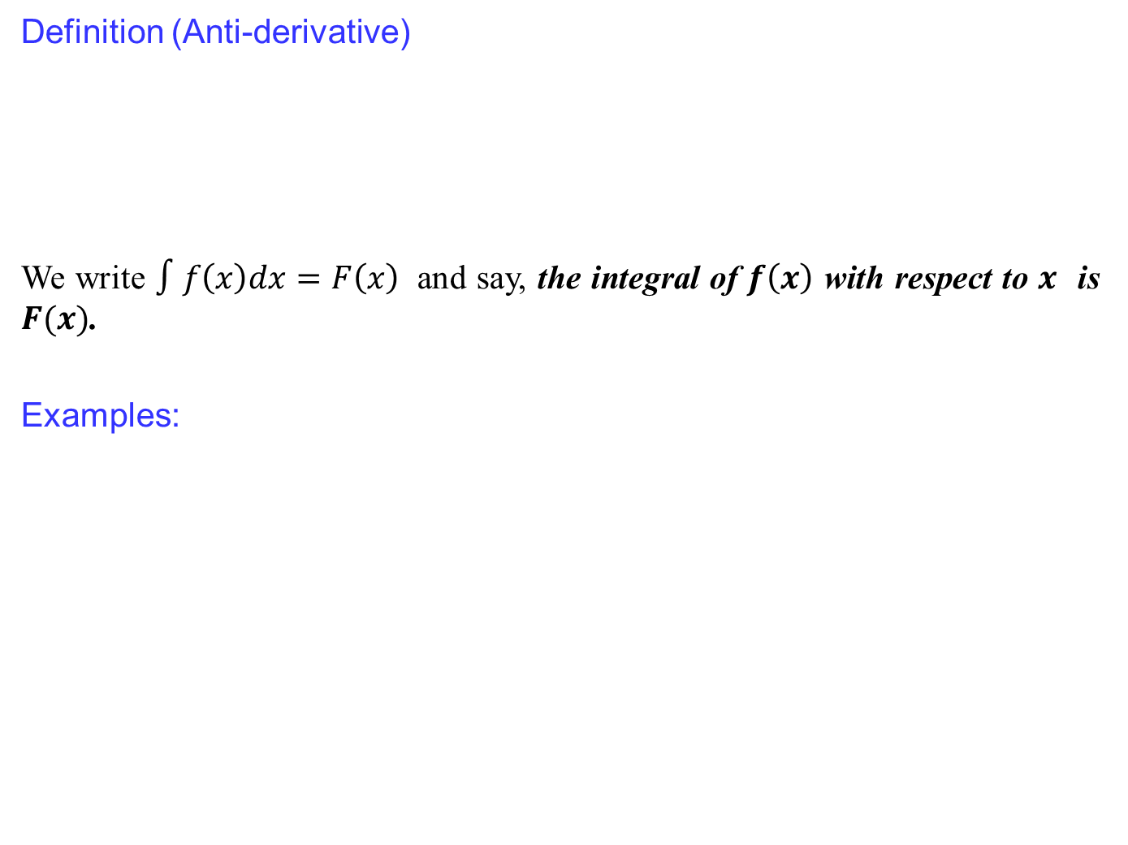
Anti-derivatives
Definition(Anti-derivative)
We write$∫f\left(x\right)dx=F\left(x\right)$ and say, the integral of $f\left(x\right)$with respect to $x$is$F(x)$.
Examples:

Slide 17
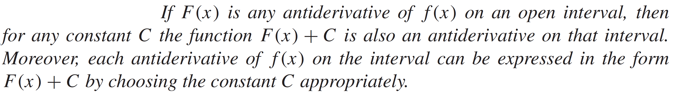
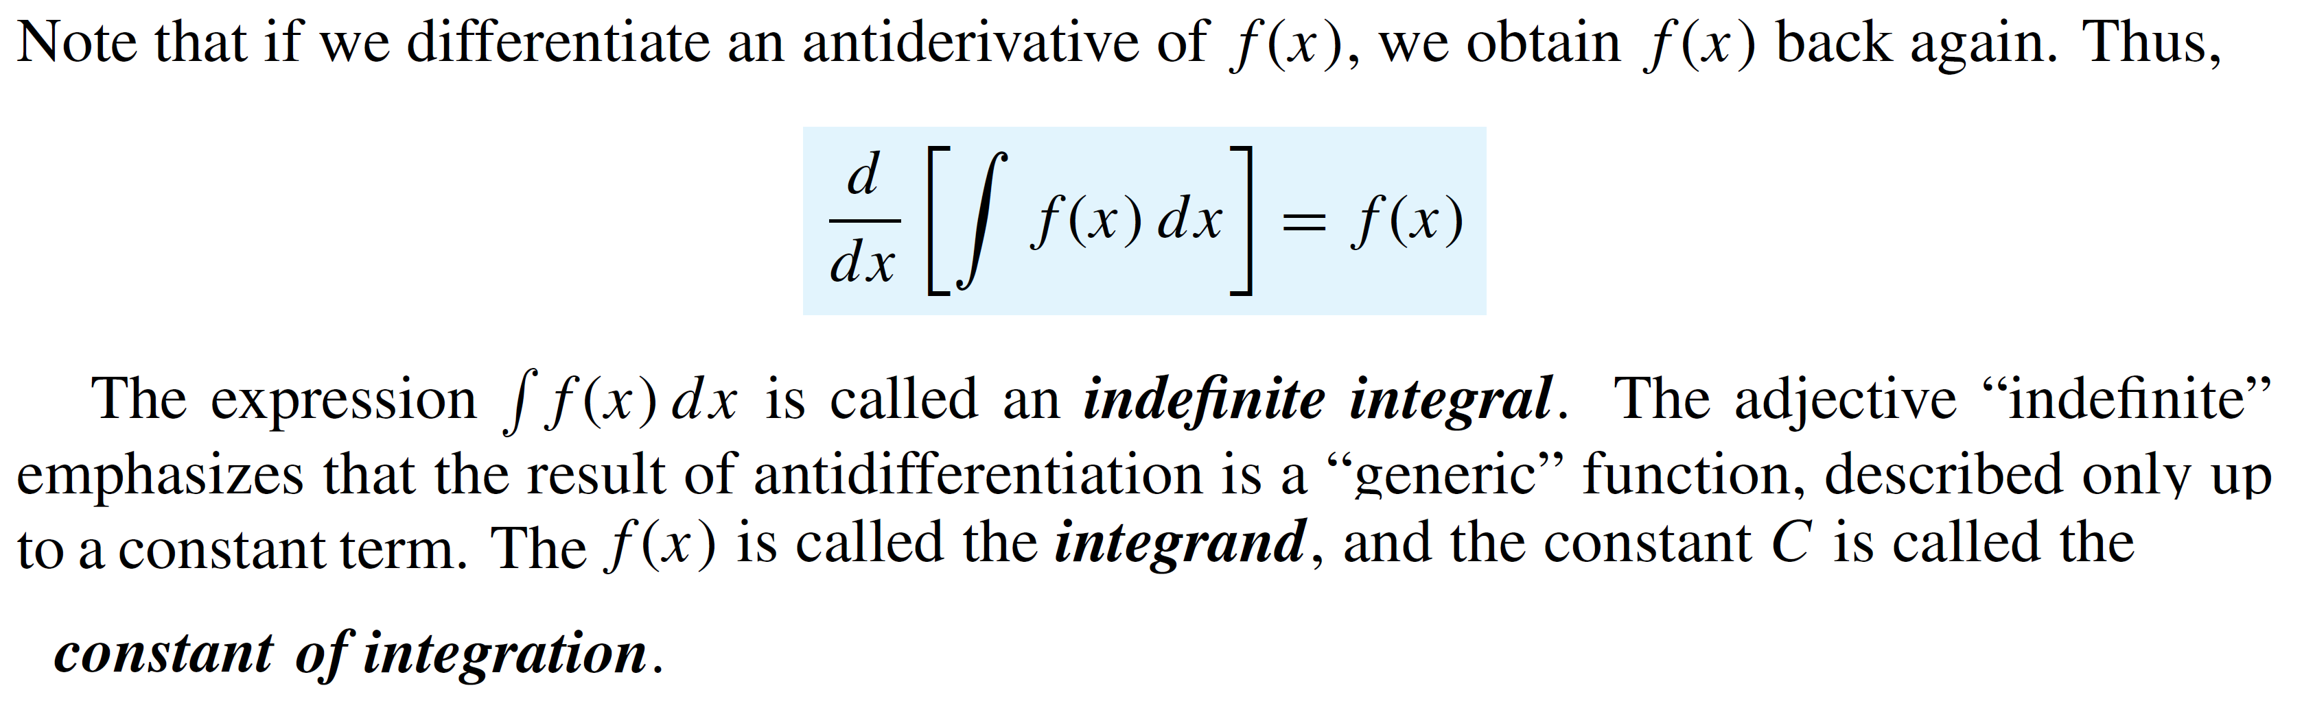
Anti-derivatives
Remark:

Slide 18
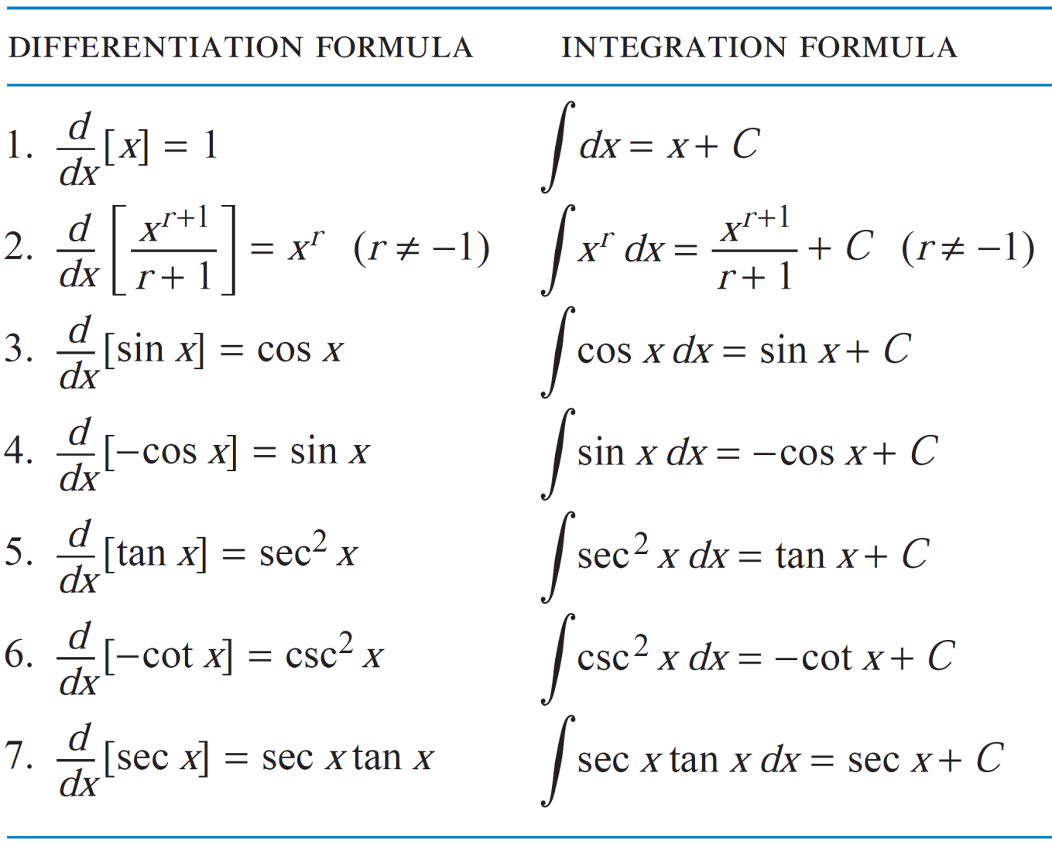
Basic rules and properties
Some anti-derivatives:

Slide 19
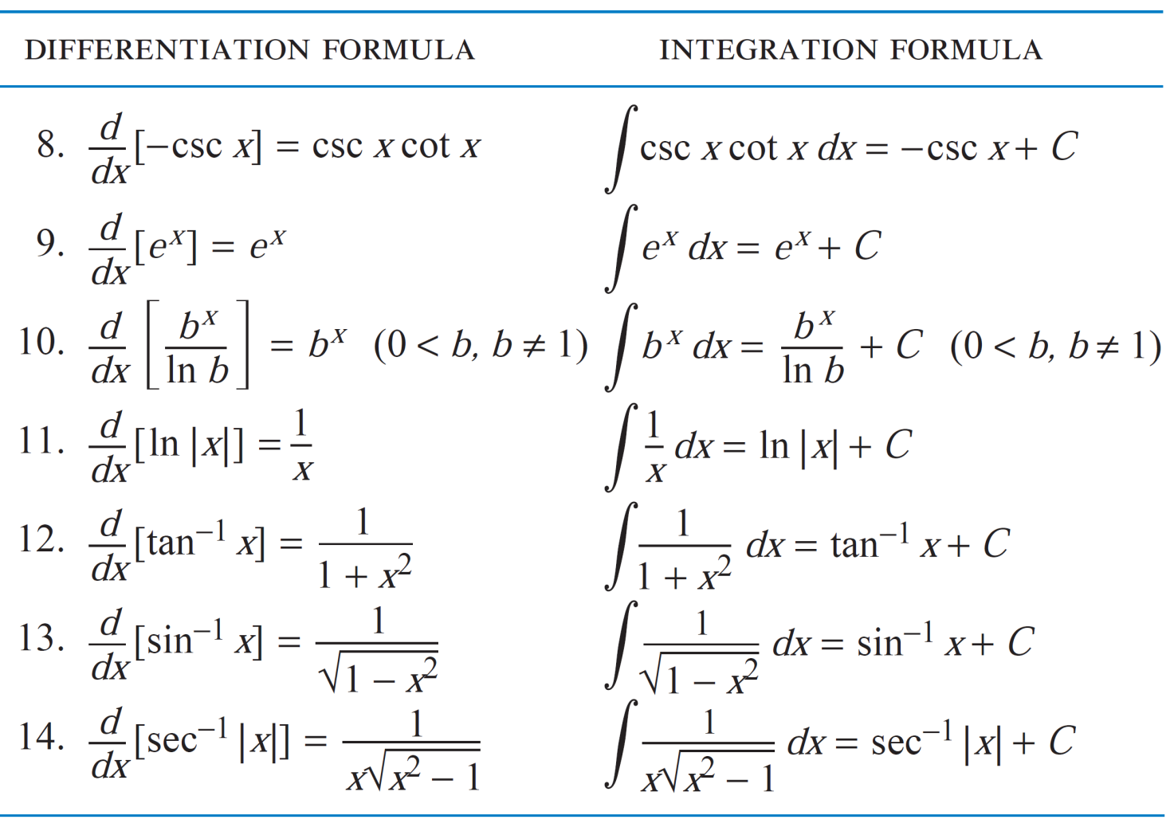
Basic rules and properties
Some anti-derivatives: cont..

Slide 20
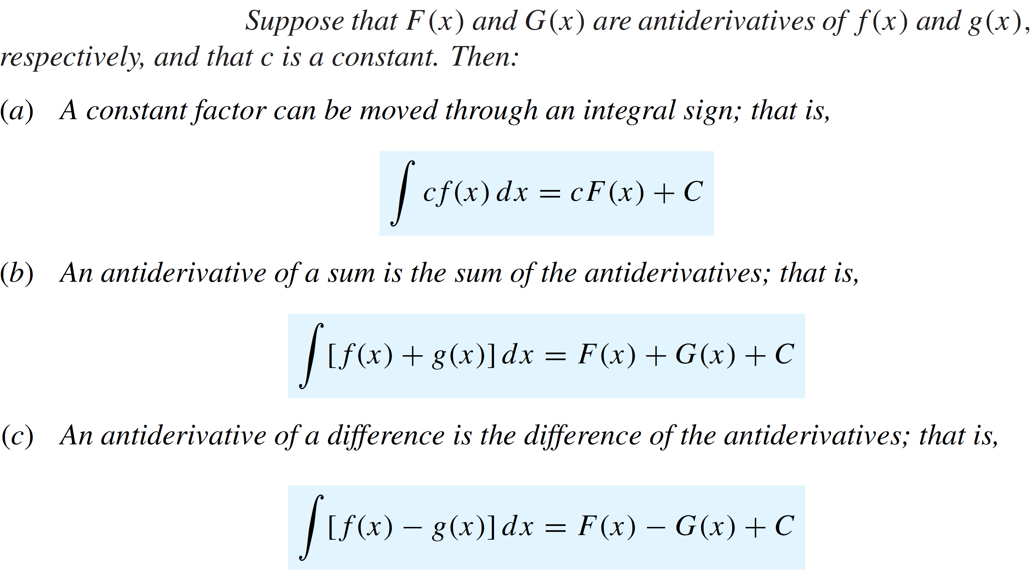
Basic rules and properties
Theorem:

Slide 21
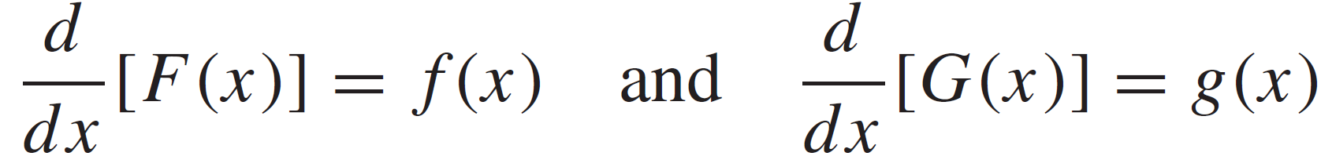
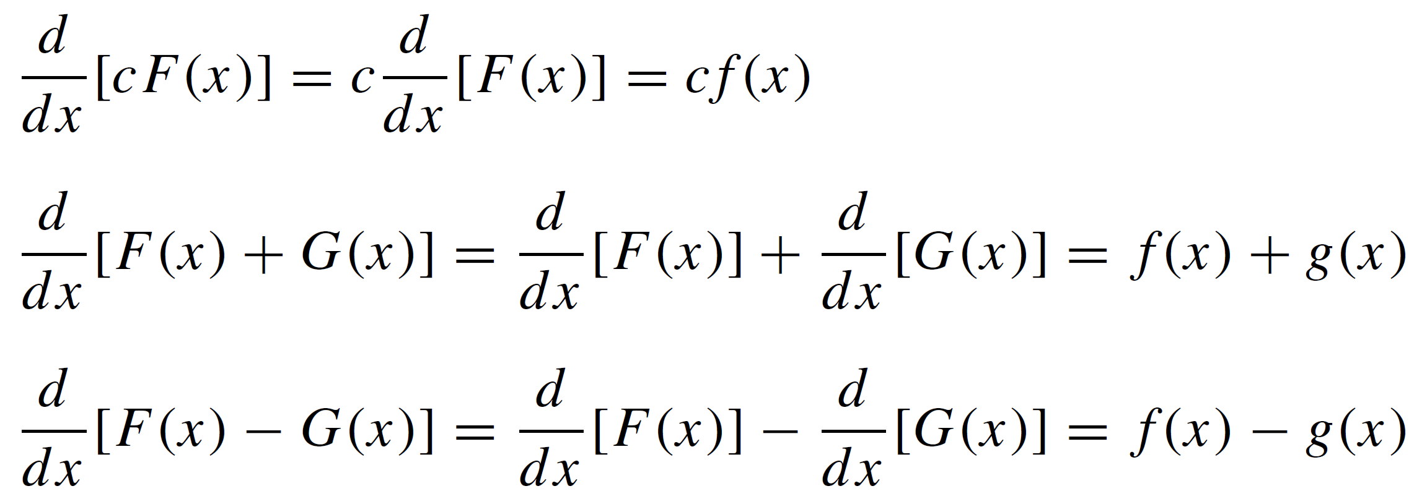
Basic rules and properties
Proof: Let
As
Hence proved.

Slide 22
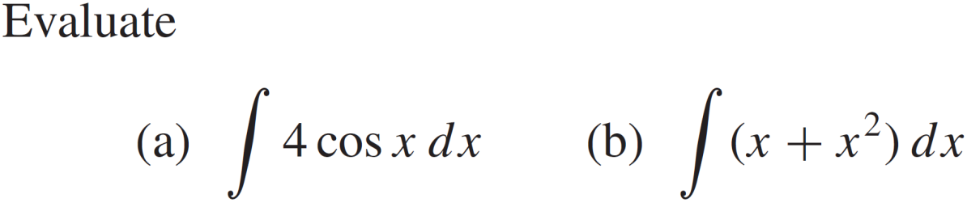
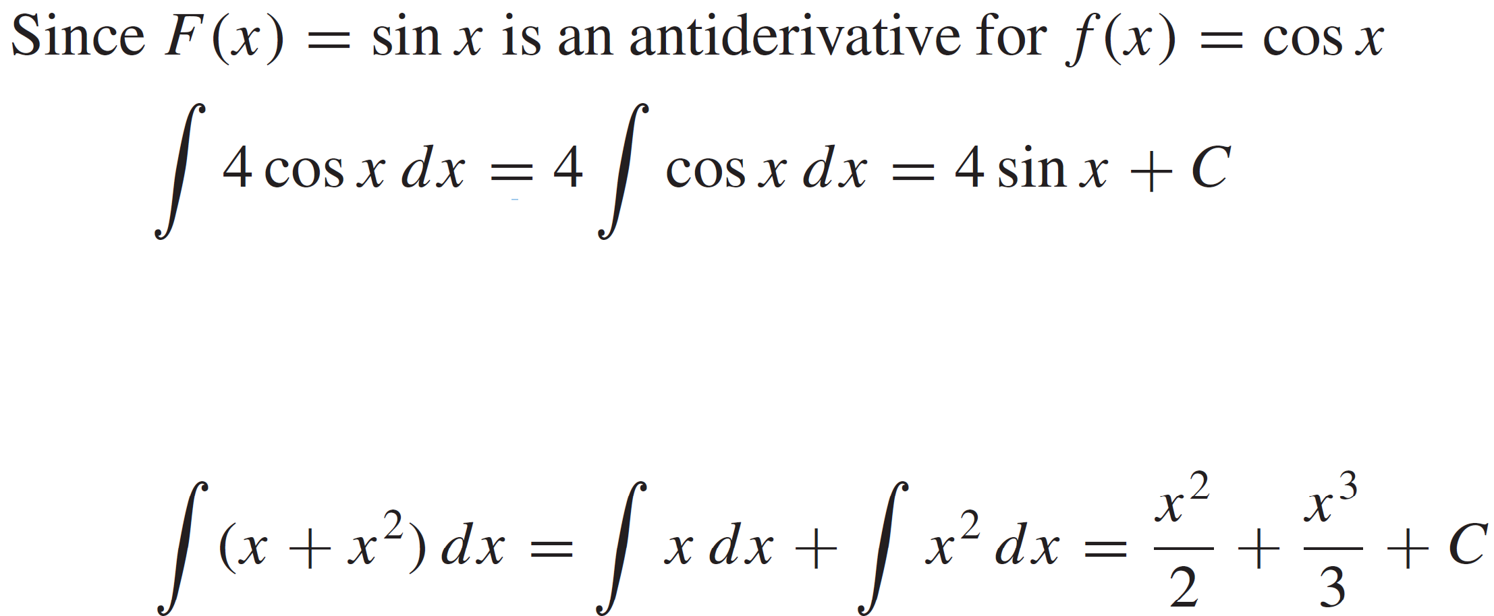
Basic rules and properties
Example:
Solution:
And

Slide 23
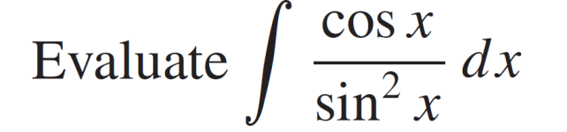
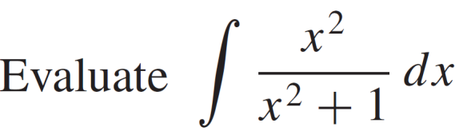
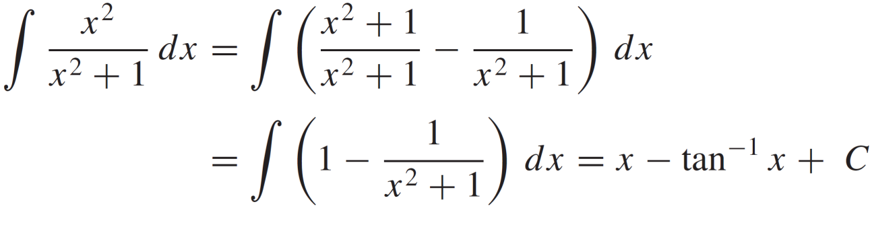
Basic rules and properties
Example:
Solution:
Example:
Solution:

Slide 24
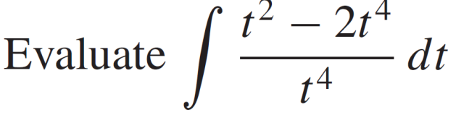
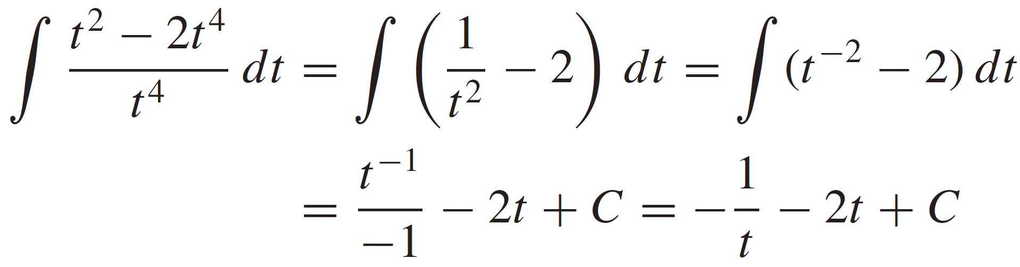
Basic rules and properties
Example:
Solution:

Slide 25
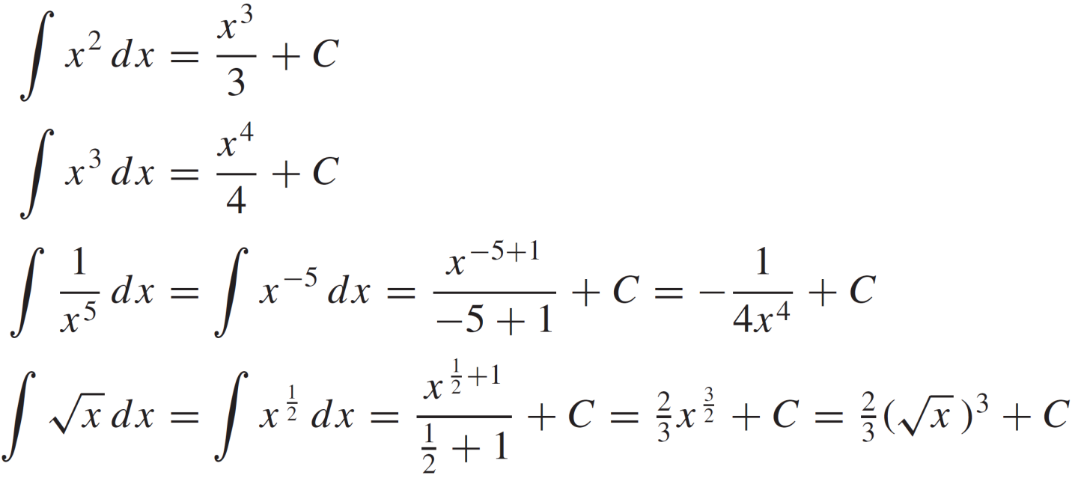
Basic rules and properties
Examples:

Slide 26
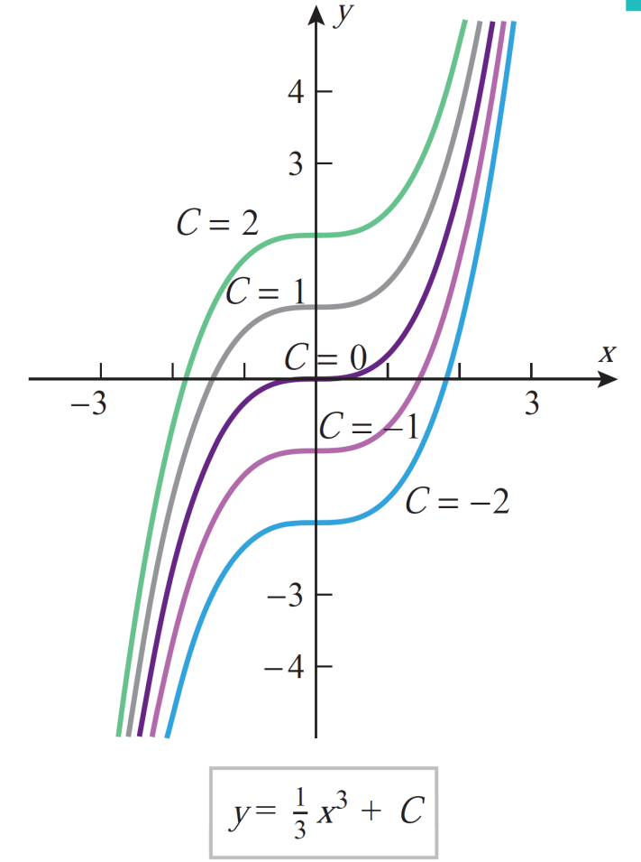
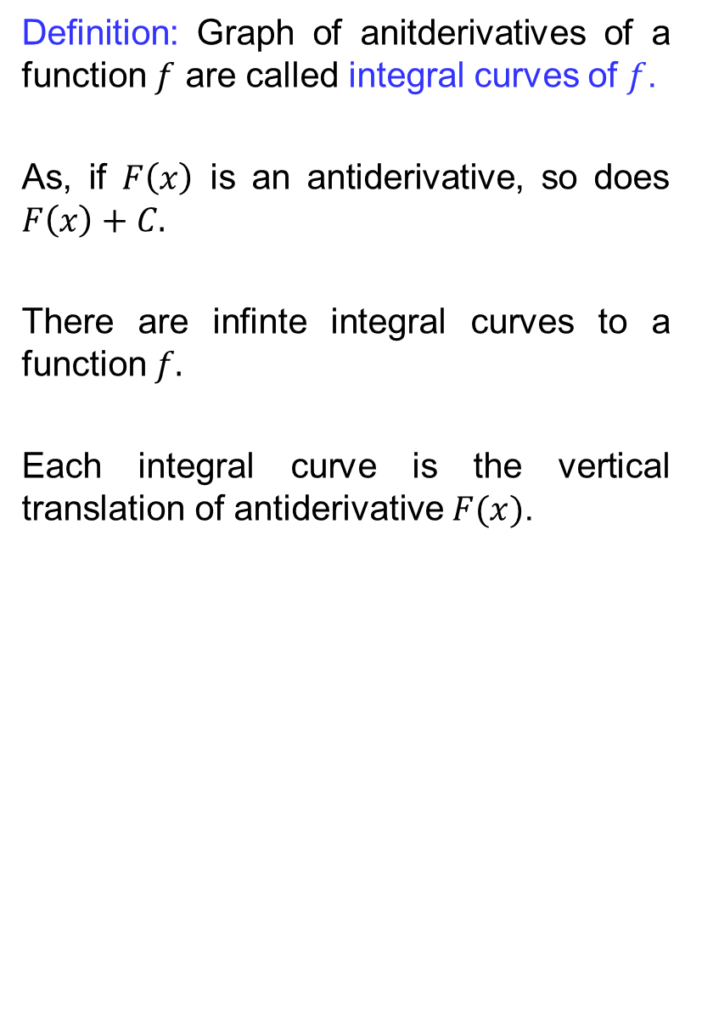
Integral curves
Definition: Graph of anitderivatives of a function$f$are calledintegralcurves of $f$.
As, if $F\left(x\right)$is an antiderivative, sodoes$F\left(x\right)+C.$
There are infinteintegralcurves to a function$f.$
Eachintegralcurveis the vertical translation of antiderivative $F(x)$.

Slide 27
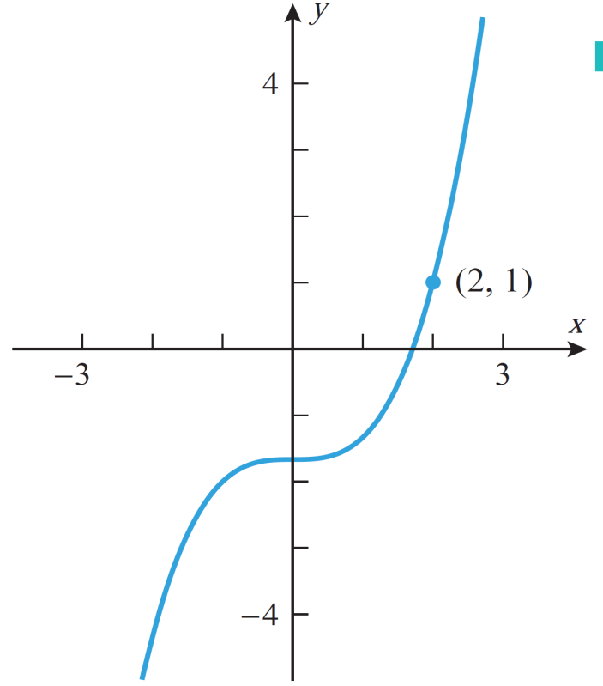

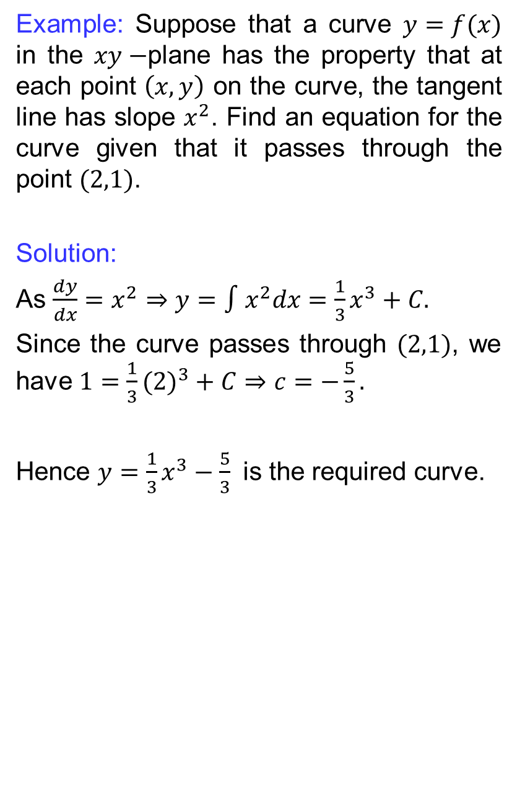
Integral curves
Example: Suppose that a curve$y=f(x)$ in the $xy−$plane has the propertythatateach point $\left(x,y\right)$ on the curve, the tangent line has slope$x^{2}$. Find an equation for the curvegiventhatit passes through the point $(2,1)$.
Solution:
As $\frac{dy}{dx}=x^{2}⇒y=∫x^{2}dx=\frac{1}{3}x^{3}+C.$
Since the curve passes through$(2,1)$, we have $1=\frac{1}{3}({2)}^{3}+C⇒c=−\frac{5}{3}.$
Hence$y=\frac{1}{3}x^{3}−\frac{5}{3}$is the requiredcurve.

Slide 28
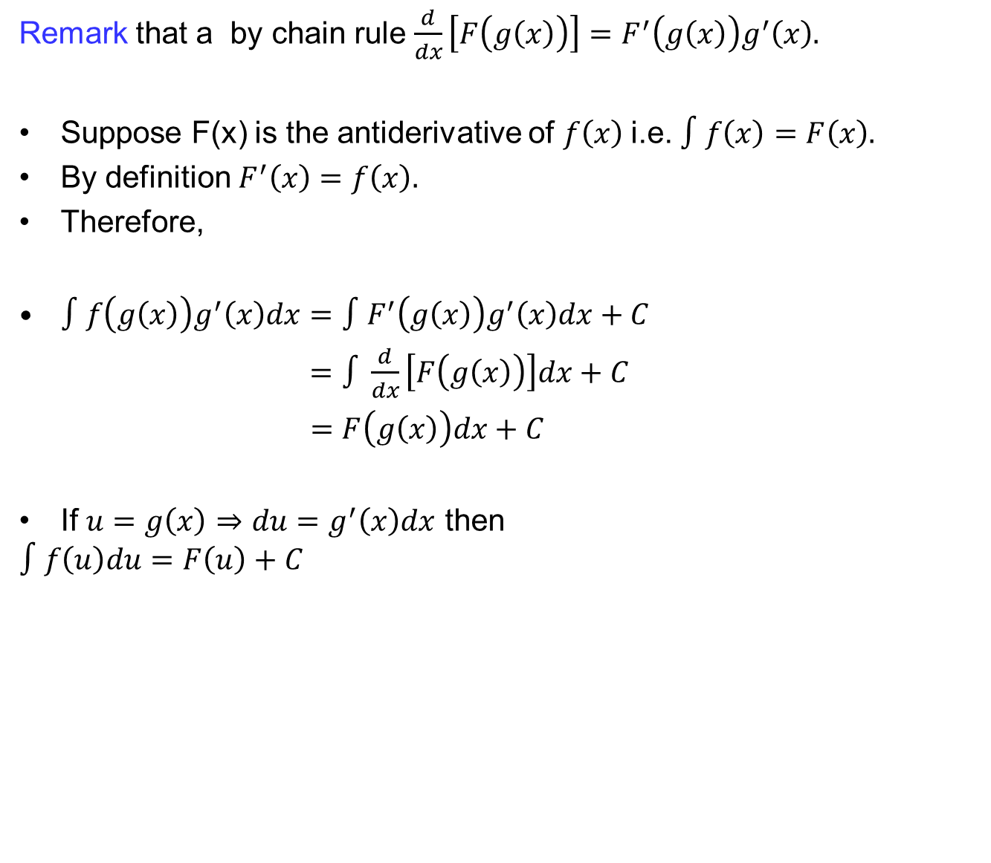
Method of substitution
Remark that a by chainrule$\frac{d}{dx}\left[F\left(g\left(x\right)\right)\right]=F^{′}\left(g\left(x\right)\right)g^{′}\left(x\right).$
Suppose F(x) is the antiderivative of $f\left(x\right)$i.e. $∫f\left(x\right)=F\left(x\right).$
By definition$F^{′}\left(x\right)=f\left(x\right).$
Therefore,
$∫f\left(g\left(x\right)\right)g^{′}\left(x\right)dx=∫F^{′}\left(g\left(x\right)\right)g^{′}\left(x\right)dx+C$
$=∫\frac{d}{dx}\left[F\left(g\left(x\right)\right)\right]dx+C$
$=F\left(g\left(x\right)\right)dx+C$
If $u=g\left(x\right)⇒du=g^{′}\left(x\right)dx$then
$$∫f\left(u\right)du=F\left(u\right)+C$$

Slide 29
Method of substitution
Remark that a by chainrule$\frac{d}{dx}\left[F\left(g\left(x\right)\right)\right]=F^{′}\left(g\left(x\right)\right)g^{′}\left(x\right).$
Suppose F(x) is the antiderivative of $f\left(x\right)$i.e. $∫f\left(x\right)=F\left(x\right).$
By definition$F^{′}\left(x\right)=f\left(x\right).$
Therefore,
$∫f\left(g\left(x\right)\right)g^{′}\left(x\right)dx=∫F^{′}\left(g\left(x\right)\right)g^{′}\left(x\right)dx+C$
$=∫\frac{d}{dx}\left[F\left(g\left(x\right)\right)\right]dx+C$
$=F\left(g\left(x\right)\right)dx+C$
If $u=g\left(x\right)⇒du=g^{′}\left(x\right)dx$then
$$∫f\left(u\right)du=F\left(u\right)+C$$

Slide 30
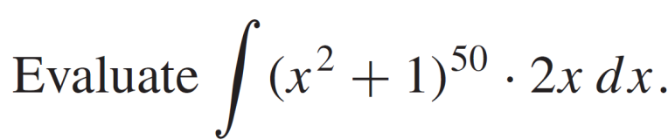
Method of substitution
Example:
Solution:

Slide 31
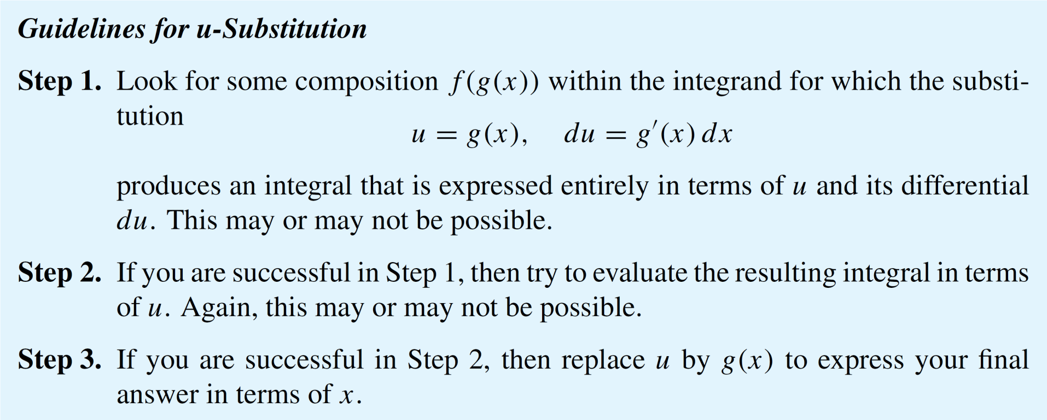
Method of substitution

Slide 32
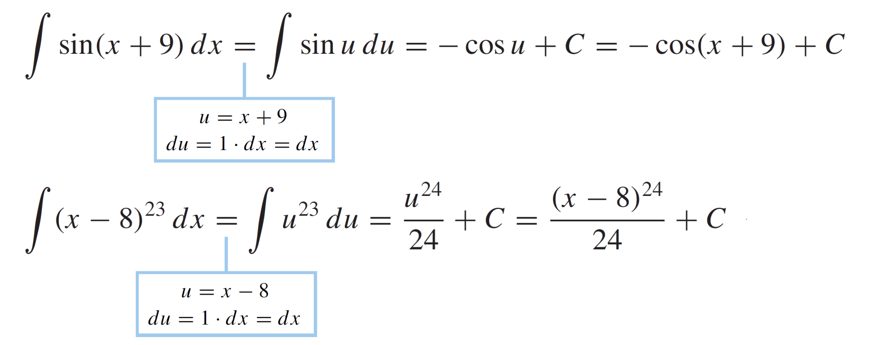
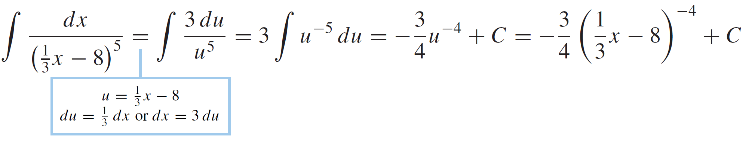
Method of substitution
Examples:

Slide 33
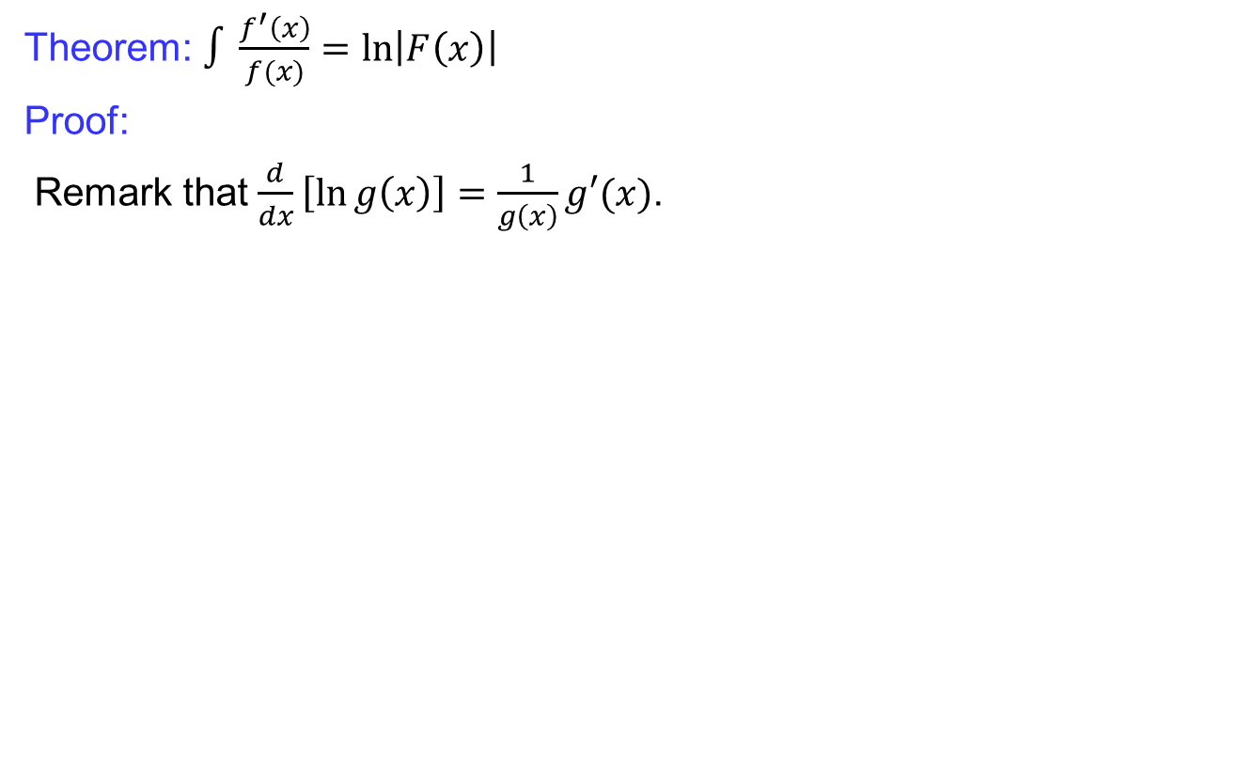
Method of substitution
Theorem: $∫\frac{f^{′}\left(x\right)}{f(x)}=\ln\left|F\left(x\right)\right|$
Proof:
Remark that $\frac{d}{dx}\left[\ln{g\left(x\right)}\right]=\frac{1}{g\left(x\right)}g′(x)$.

Slide 34
Basic rules and properties
Some anti-derivatives:

Slide 35
Basic rules and properties
Some anti-derivatives: cont..

Slide 36
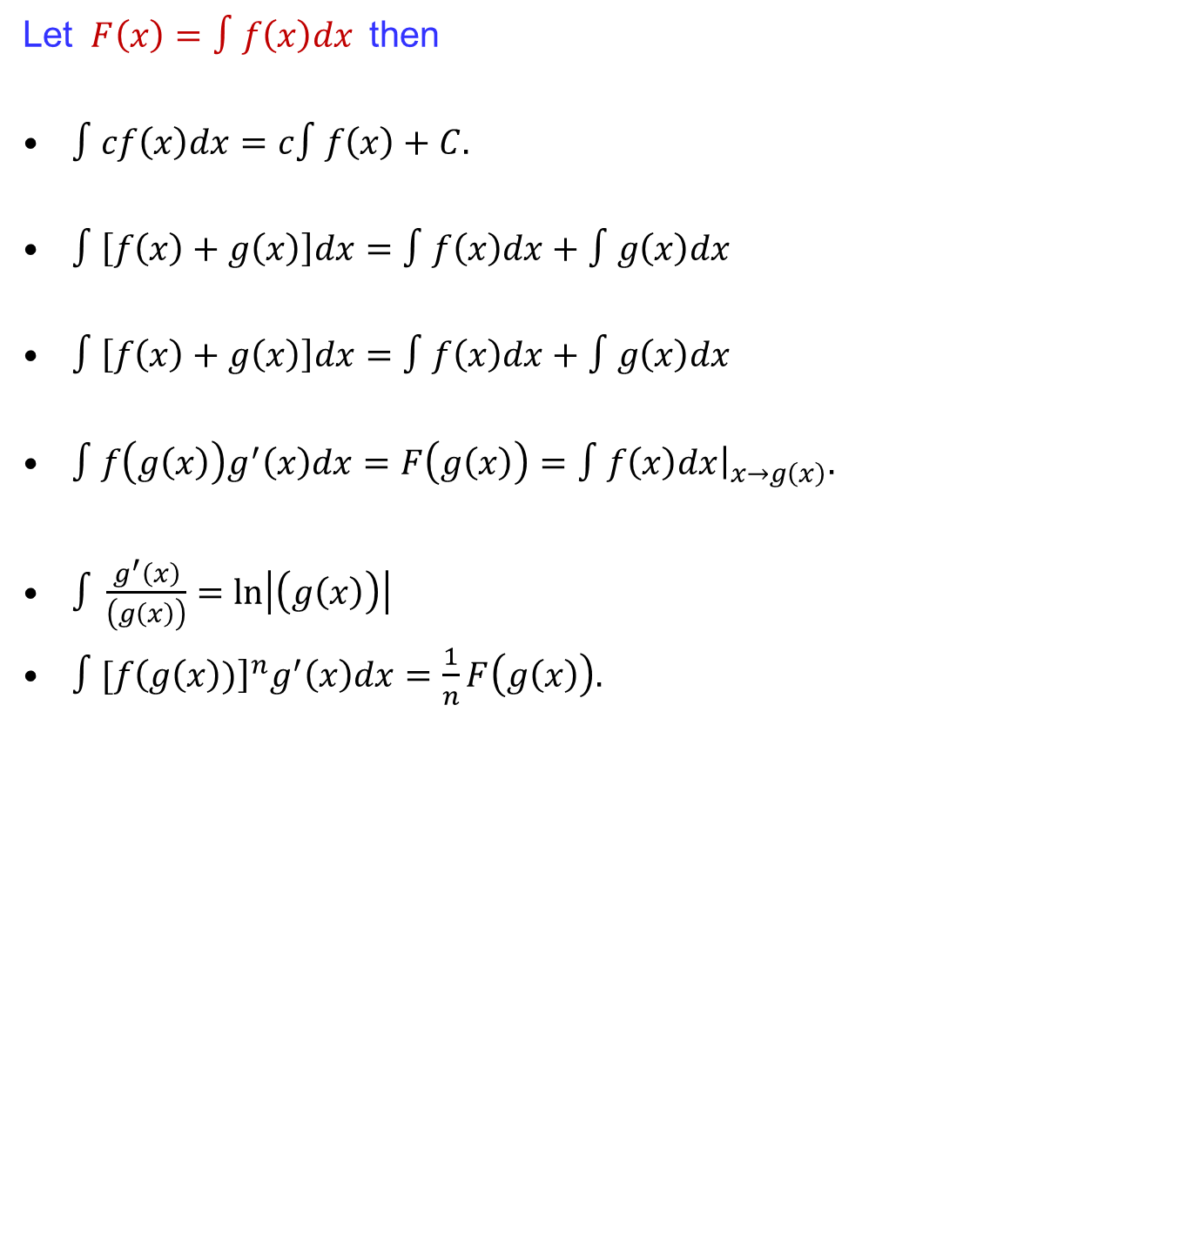
Summary of basic rules
Let $F\left(x\right)=∫f\left(x\right)dx$then
$∫cf\left(x\right)dx=c∫f\left(x\right)+C.$
$∫\left[f\left(x\right)+g\left(x\right)\right]dx=∫f\left(x\right)dx+∫g\left(x\right)dx$
$∫\left[f\left(x\right)+g\left(x\right)\right]dx=∫f\left(x\right)dx+∫g\left(x\right)dx$
$∫f\left(g\left(x\right)\right)g^{′}\left(x\right)dx=F\left(g\left(x\right)\right)=∫f\left(x\right)dx{\left.​\right|}_{x→g\left(x\right)}.$
$∫\frac{g^{′}\left(x\right)}{\left(g\left(x\right)\right)}=\ln\left|\left(g\left(x\right)\right)\right|$
$∫[f{\left(g\left(x\right))\right]}^{n}g^{′}\left(x\right)dx=\frac{1}{n}F\left(g\left(x\right)\right).$

Slide 37
Lecture Summary
    Recalls
    Introduction to integration,
    Anti-derivatives
    Basic rules and properties
    Integral curves
    Methods of substitution
    Summary of basic rules.

