Slide 1
(MTH 250)
Calculus
Lecture 16

Slide 2
Previous Lecture’s Summary
    Subsequences
    Limit superior and limit inerior
    Cauchy sequences
    Infinite series
    Convergence of infinite series.
    Absolutely convergent series

Slide 3
Today’s Lecture
    Recalls
    Polynomial approximations
    Maclaurin polynomials
    Taylor polynomials
    Taylor and Maclaurin series
    Convergence
    Some important series

Slide 4
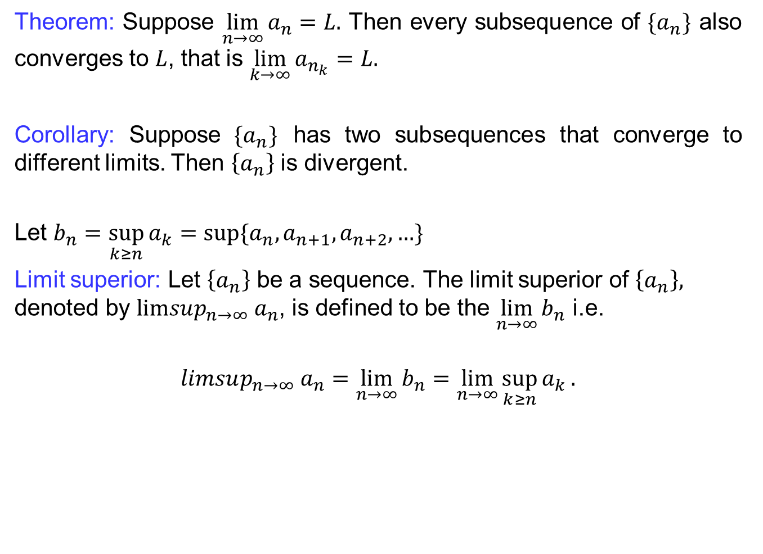
Recalls
  Theorem: Suppose $\lim_{n→∞}{a_{n}}=L.$ Then every subsequence of $\{a_{n}\}$ also converges to $L$, that is $\lim_{k→∞}{a_{n_{k}}}=L.$
  Corollary: Suppose$\{a_{n}\}$ has two subsequences that converge to different limits. Then $\left\{a_{n}\right\}$ is divergent.
  Let $b_{n}=\sup_{k≥n}{a_{k}}=\sup{\{a_{n},a_{n+1},a_{n+2}, …}\}$
  Limit superior: Let $\left\{a_{n}\right\}$ be a sequence. The limit superior of $\left\{a_{n}\right\},$ denoted by $limsup_{n→∞} a_{n}$, is defined to be the $\lim_{n→∞}{b_{n}}$ i.e.
  $$limsup_{n→∞} a_{n}=\lim_{n→∞}{b_{n}}=\lim_{n→∞}{\sup_{k≥n}{a_{k}}}.$$

Slide 5
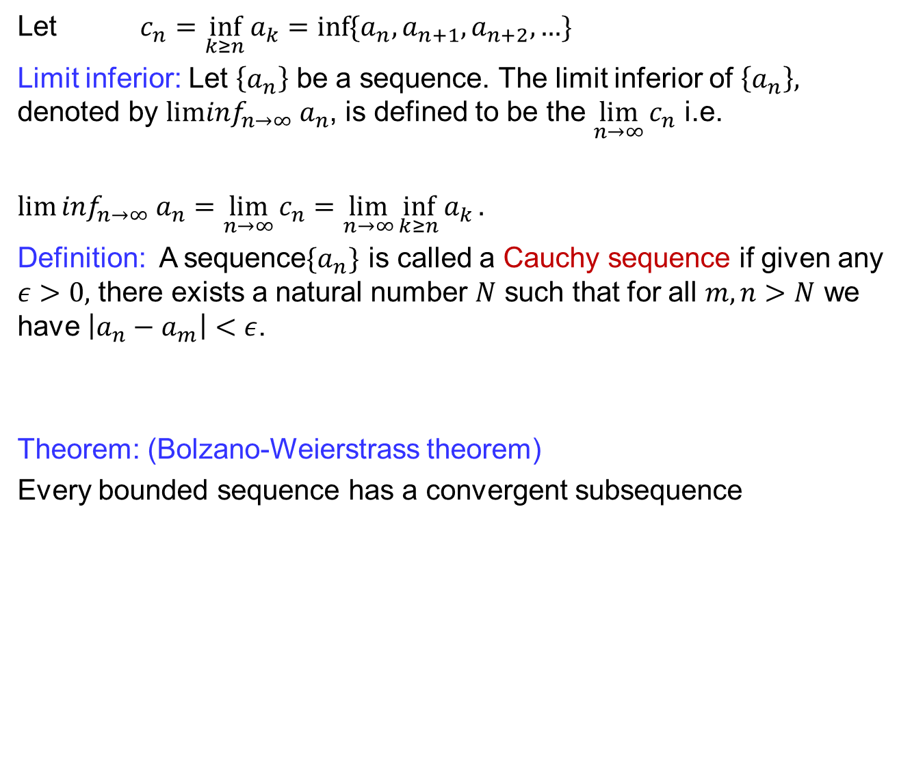
Recalls
  Let $c_{n}=\inf_{k≥n}{a_{k}}=\inf{\{a_{n},a_{n+1},a_{n+2}, …}\}$
  Limit inferior: Let $\left\{a_{n}\right\}$ be a sequence. The limit inferior of $\left\{a_{n}\right\},$ denoted by $lim\inf_{n→∞} a_{n}$, is defined to be the $\lim_{n→∞}{c_{n}}$ i.e.
  $lim⁡\inf_{n→∞} a_{n}=\lim_{n→∞}{c_{n}}=\lim_{n→∞}{\inf_{k≥n}{a_{k}}}.$
  Definition: A sequence$\{a_{n}\}$ is called a Cauchy sequence if given any $ε>0,$ there exists a natural number $N$ such that for all $m,n>N$ we have $\left|a_{n}−a_{m}\right|<ε$.
  Theorem: (Bolzano-Weierstrass theorem)
  Every bounded sequence has a convergent subsequence

Slide 6
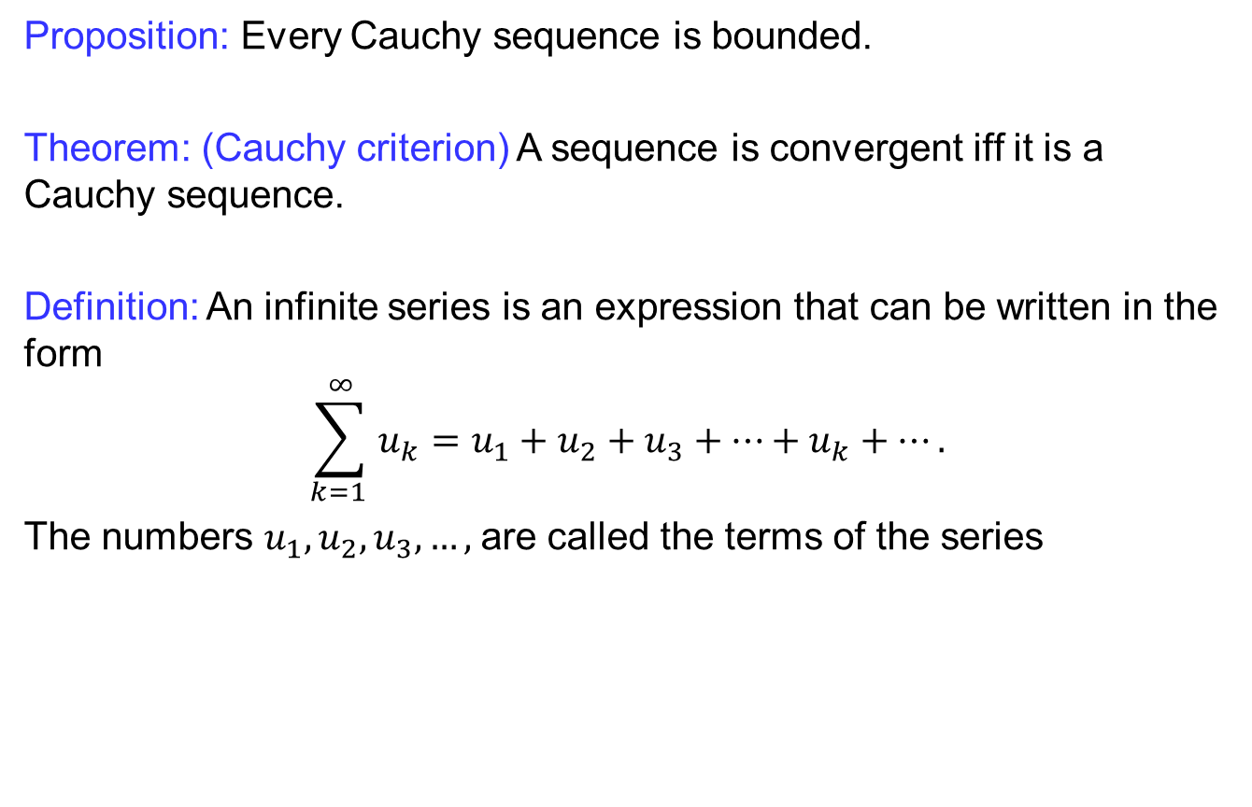
Recalls
  Proposition: Every Cauchy sequence is bounded.
  Theorem: (Cauchy criterion) A sequence is convergent iff it is a Cauchy sequence.
Definition: An infiniteseriesis an expression thatcanbewritten in the form
$$\sum_{k=1 }^{∞}{u_{k}}=u_{1}+u_{2}+u_{3}+…+u_{k}+….$$
The numbers $u_{1},u_{2}, u_{3}, …,$are called the terms of the series

Slide 7
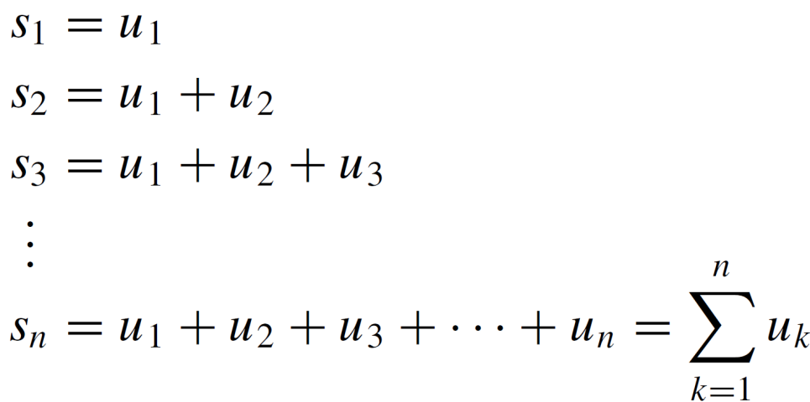
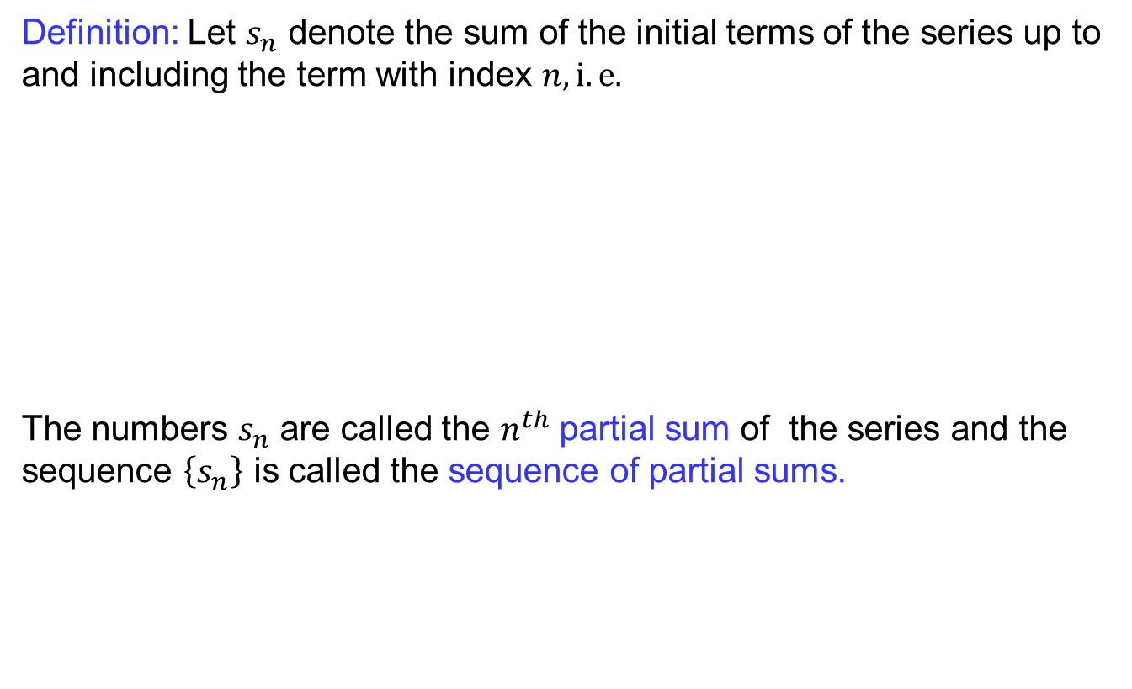
Recalls
Definition:Let $s_{n}$denote the sum of the initial terms of the series up to and including the termwith index $n, i.e.$
The numbers $s_{n}$ are called the $n^{th}$partial sum of the series and the sequence $\left\{s_{n}\right\}$is called the sequence of partial sums.

Slide 8
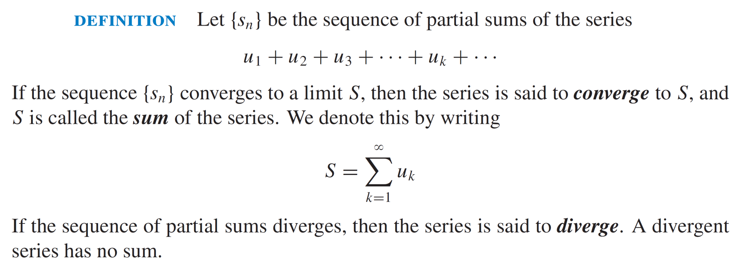
Recalls
  Definition: E

Slide 9
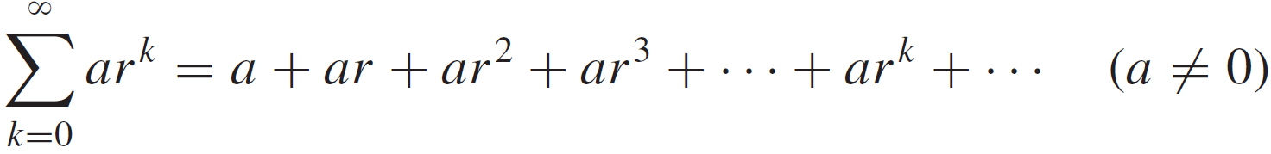
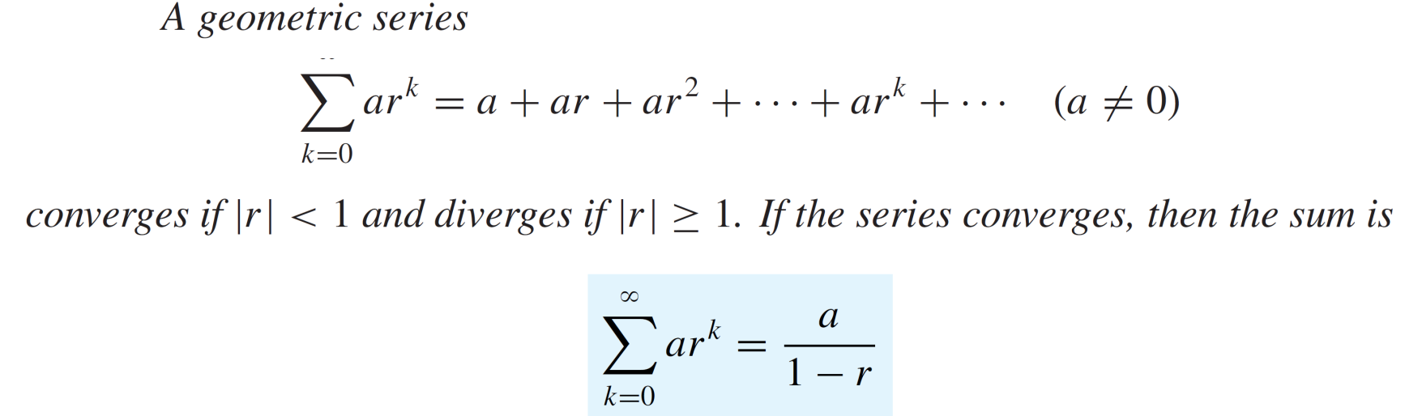
Recalls
Geometric series: A series of the form
  …
  is called the geometric series.
  Theorem

Slide 10
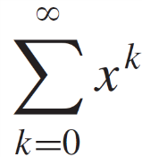
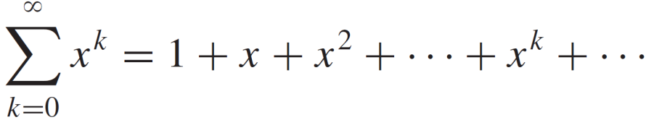
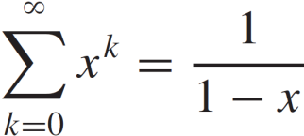
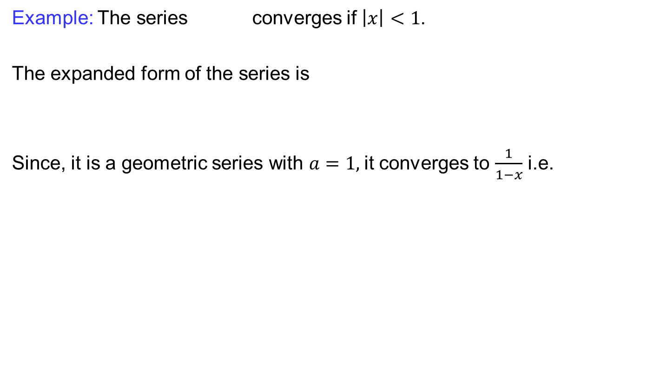
Recalls
Example: The series converges if $\left|x\right|<1$.
The expanded form of the series is
Since, it is a geometric series with $a=1,$it converges to $\frac{1}{1−x}$i.e.

Slide 11
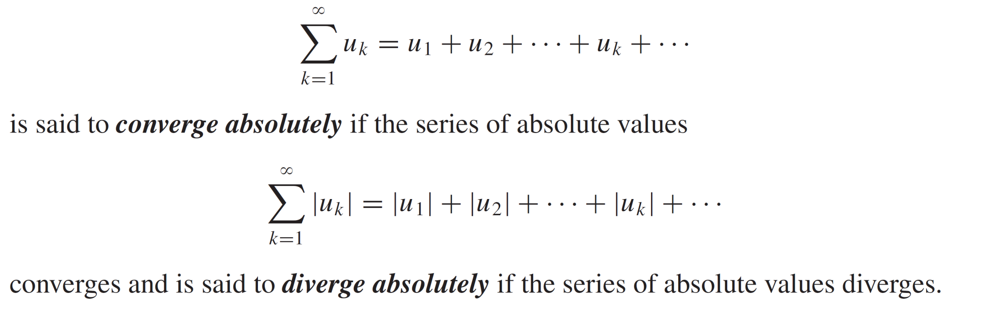
Recalls
Definition:

Slide 12
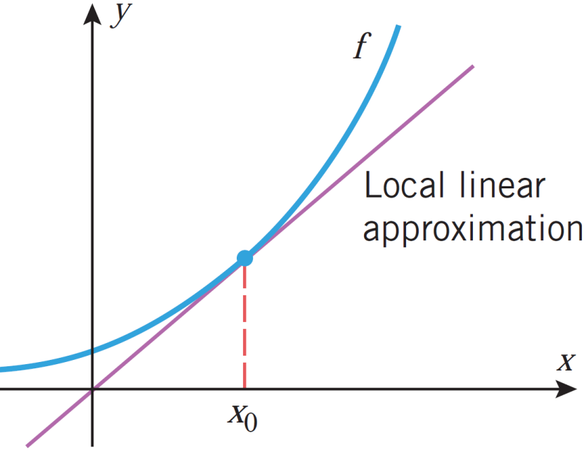

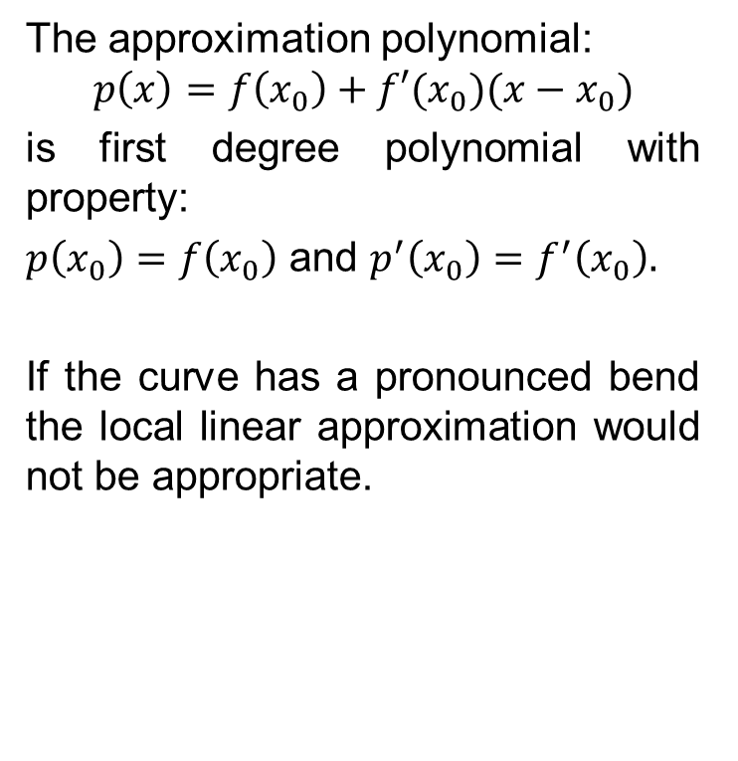
Polynomial approximations
Local linear approximation: $f\left(x\right)≈f\left(x_{0}\right)+f′(x_{0})(x−x_{0})$
The approximation polynomial:
$$p\left(x\right)=f\left(x_{0}\right)+f′(x_{0})(x−x_{0})$$
is first degree polynomial with property:
$p\left(x_{0}\right)=f\left(x_{0}\right)$ and $p^{′}\left(x_{0}\right)=f^{′}\left(x_{0}\right).$
If the curve has a pronounced bend the local linear approximation would not be appropriate.

Slide 13
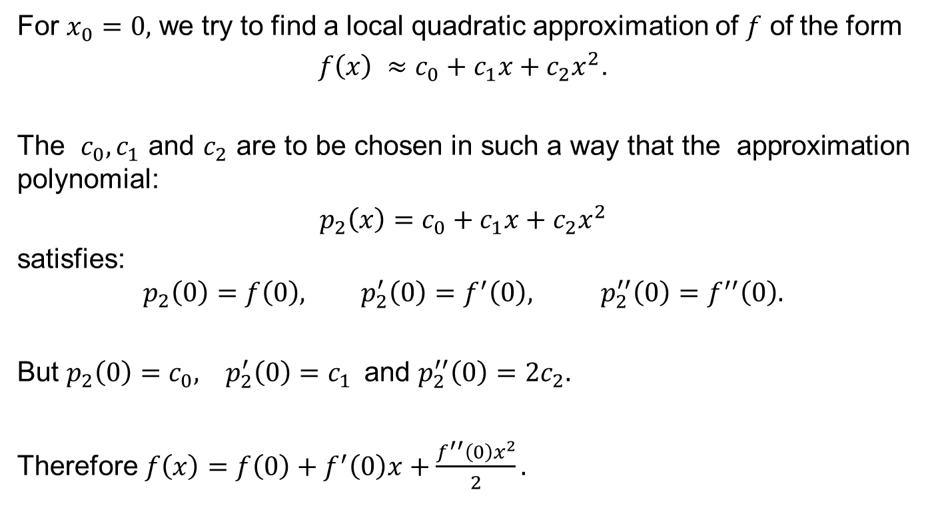
Polynomial approximations
For $x_{0}=0,$ we try to find a local quadratic approximation of $f$ of the form
$f\left(x\right) ≈c_{0}+c_{1}x+c_{2}x^{2}$.
The $c_{0}, c_{1}$ and $c_{2}$ are to be chosen in such a way that the approximation polynomial:
$p_{2}\left(x\right)=$$c_{0}+c_{1}x+c_{2}x^{2}$
satisfies:
$$p_{2}\left(0\right)=f\left(0\right), p_{2}^{′}\left(0\right)=f^{′}\left(0\right), p_{2}^{′′}\left(0\right)=f^{′′}\left(0\right).$$
But $p_{2}\left(0\right)=c_{0}, p_{2}^{′}\left(0\right)=c_{1}$and $p_{2}^{′′}\left(0\right)=2c_{2}.$
Therefore $f\left(x\right)=f\left(0\right)+f^{′}\left(0\right)x+\frac{f^{′′}\left(0\right)x^{2}}{2}.$

Slide 14
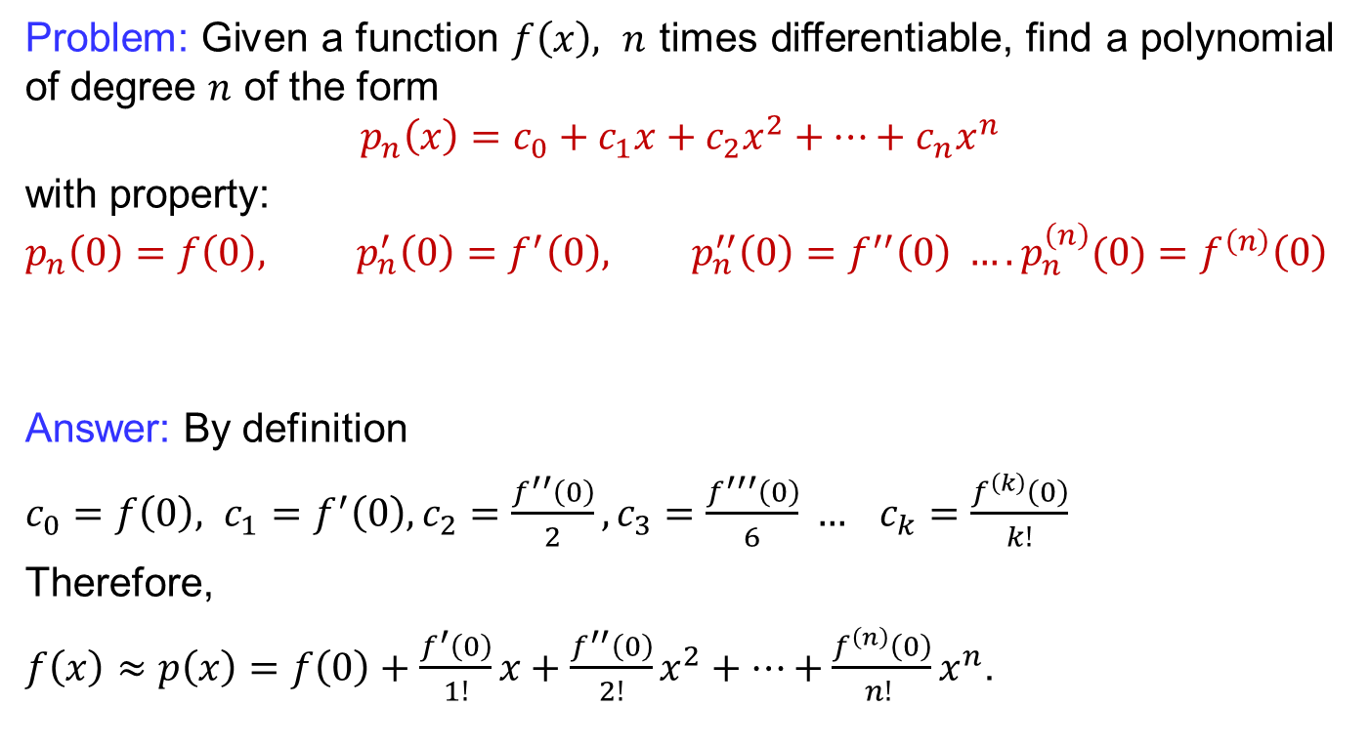
Polynomial approximations
Problem:Given a function$f\left(x\right),$$n$ times differentiable, find a polynomial of degree $n$ of the form
$$p_{n}\left(x\right)=c_{0}+c_{1}x+c_{2}x^{2}+…+c_{n}x^{n}$$
with property:
$$p_{n}\left(0\right)=f\left(0\right), p_{n}^{′}\left(0\right)=f^{′}\left(0\right), p_{n}^{′′}\left(0\right)=f^{′′}\left(0\right) …. p_{n}^{\left(n\right)}(0)=f^{\left(n\right)}\left(0\right)$$
Answer: By definition
$c_{0}=f\left(0\right), c_{1}=f^{′}\left(0\right), c_{2}=\frac{f^{′′}\left(0\right)}{2}, c_{3}=\frac{f^{′′′}\left(0\right)}{6} … c_{k}=\frac{f^{\left(k\right)}\left(0\right)}{k!}$
Therefore,
$f\left(x\right)≈p\left(x\right)=f\left(0\right)+\frac{f^{′}\left(0\right)}{1!}x+\frac{f^{′′}\left(0\right)}{2!}x^{2}+…+\frac{f^{\left(n\right)}\left(0\right)}{n! }x^{n}$.

Slide 15
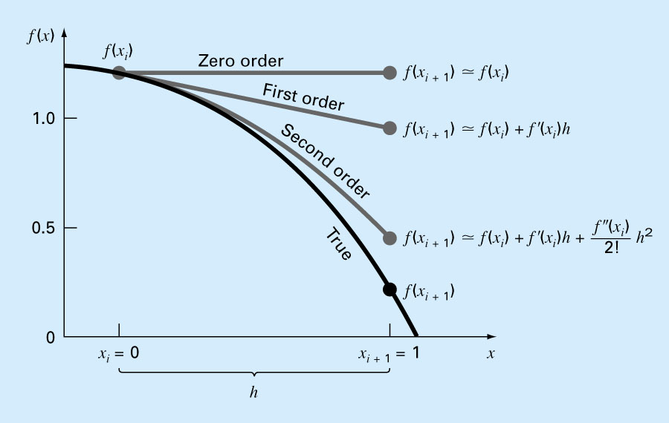
Polynomial approximations

Slide 16
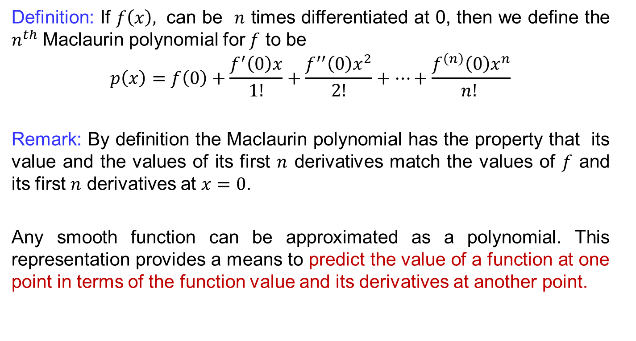
Maclaurin Polynomials
Definition:If $f\left(x\right),$can be $n$ times differentiated at 0, then we define the $n^{th}$ Maclaurinpolynomial for $f$ to be
$$p\left(x\right)=f\left(0\right)+\frac{f^{′}\left(0\right)x}{1!}+\frac{f^{′′}\left(0\right)x^{2}}{2!}+…+\frac{f^{\left(n\right)}\left(0\right)x^{n}}{n! }$$
Remark: By definition the Maclaurin polynomial has the property that its value and the values of its first $n$ derivatives match the values of $f$ and its first $n$ derivatives at $x=0$.
Any smooth function can be approximated as a polynomial. This representation provides a means to predict the value of a function at one point in terms of the function value and its derivatives at another point.

Slide 17
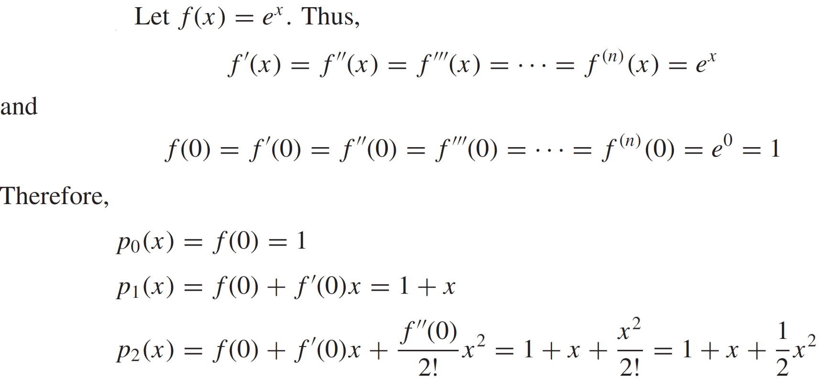
Maclaurin Polynomials
Example:
Solution:

Slide 18
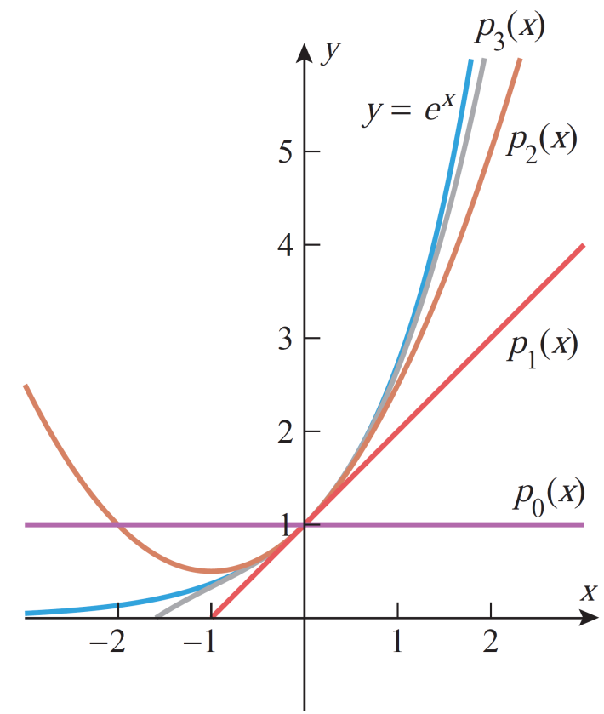
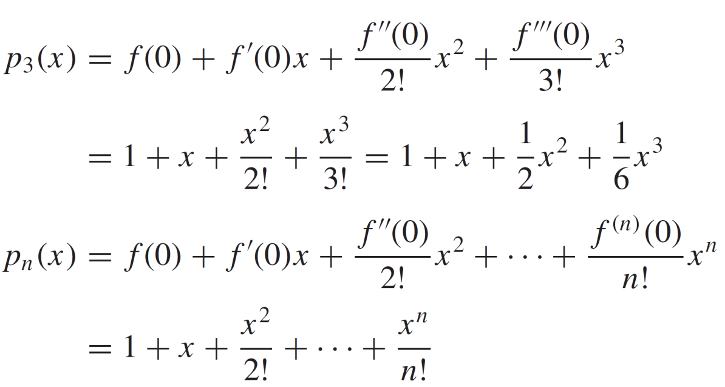
Maclaurin Polynomials
Cont..

Slide 19
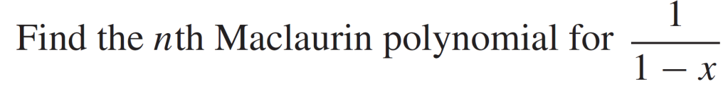
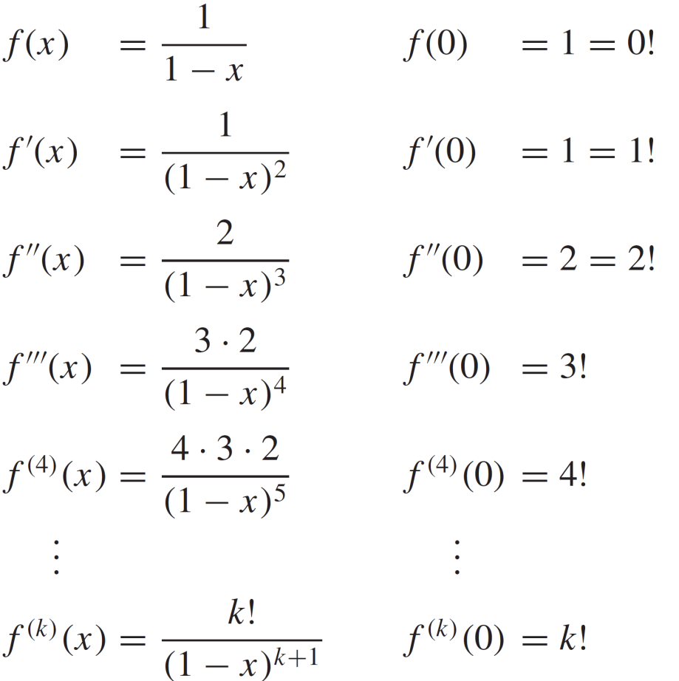
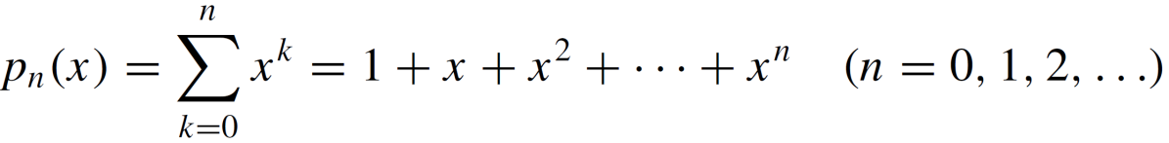
Maclaurin Polynomials
Example:
Solution:
Thus:

Slide 20
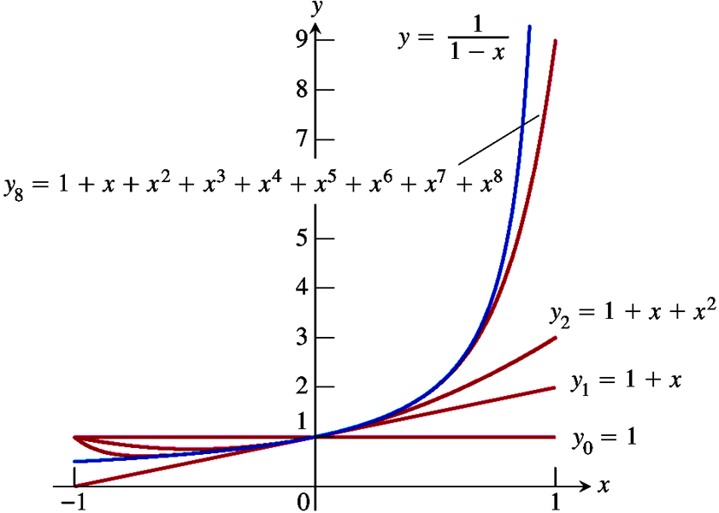
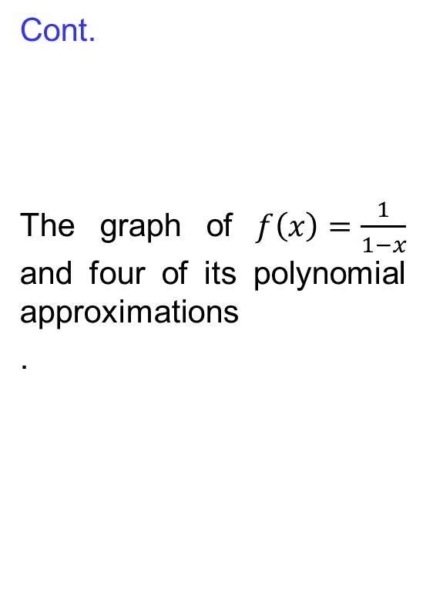
Maclaurin Polynomials
Cont.
The graph of $f\left(x\right)=\frac{1}{1−x}$ and four of its polynomial approximations
.

Slide 21
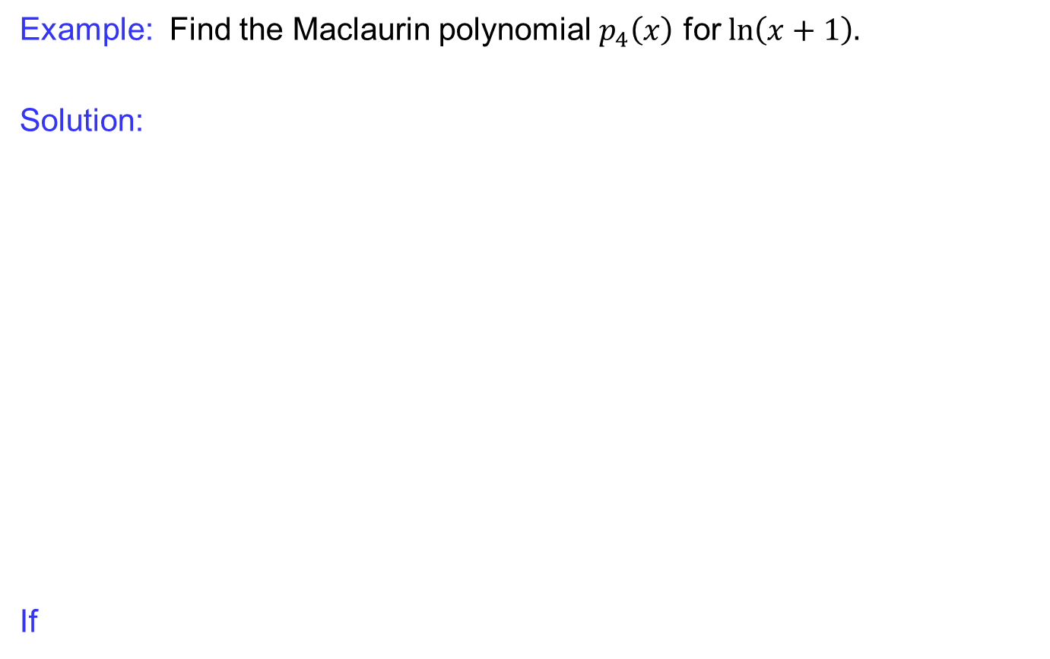
Maclaurin Polynomials
Example:Find the Maclaurin polynomial $p_{4}\left(x\right)$ for $\ln\left(x+1\right).$
Solution:
If

Slide 22
Maclaurin Polynomials
Cont:
Consequently,

Slide 23
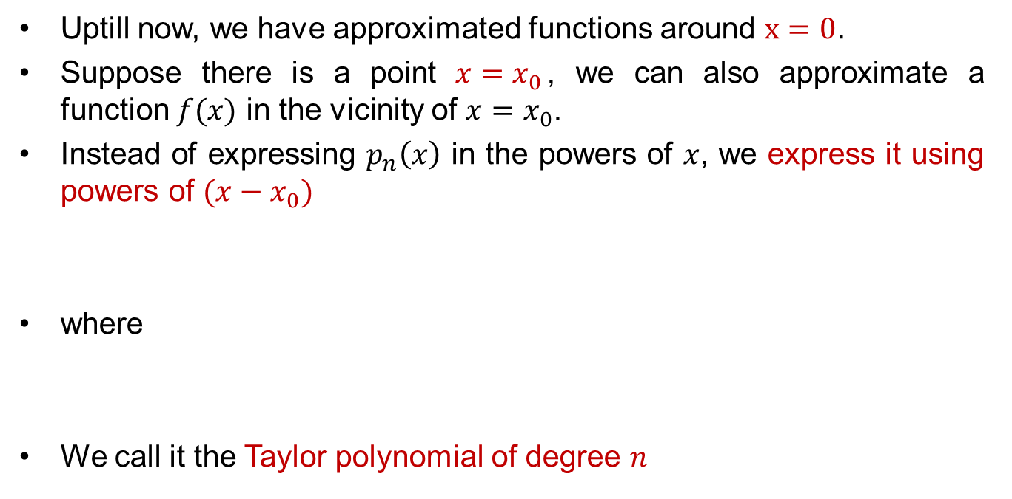
Taylor Polynomials
Uptill now, we have approximatedfunctionsaround$x=0$.
Suppose there is a point $x=x_{0}$, we can also approximate a function $f(x)$ in the vicinity of $x=x_{0}$.
Instead of expressing $p_{n}\left(x\right)$ in the powers of $x$, we express it using powers of $(x−x_{0})$
where
We call it the Taylor polynomial of degree $n$

Slide 24
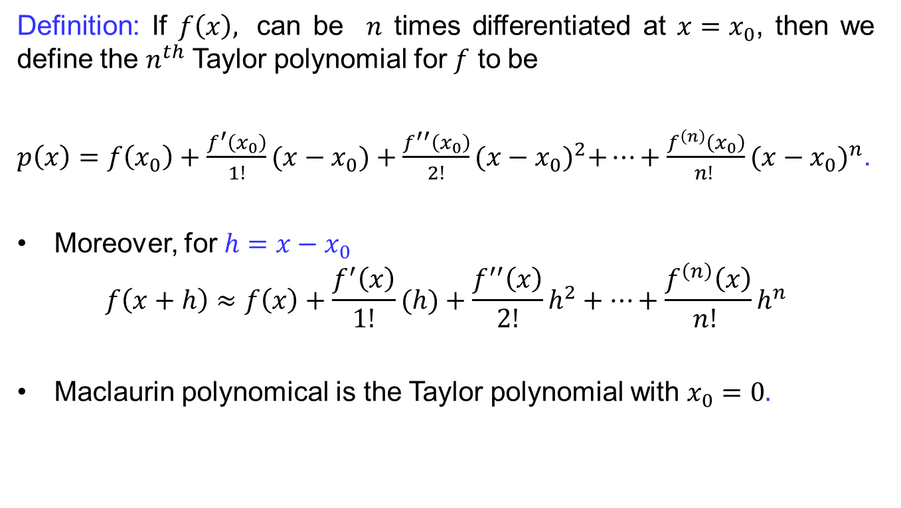
Taylor Polynomials
Definition:If $f\left(x\right),$can be $n$ times differentiated at ${x=x}_{0}$, then we define the $n^{th}$ Taylorpolynomial for $f$ to be
$p\left(x\right)=f\left(x_{0}\right)+\frac{f^{′}\left(x_{0}\right)}{1!}(x−x_{0})+\frac{f^{′′}\left(x_{0}\right)}{2!}{(x−x_{0})}^{2}+…+\frac{f^{\left(n\right)}\left(x_{0}\right)}{n! }{(x−x_{0})}^{n}$.
Moreover, for $h=x−x_{0}$
$$f\left(x+h\right)≈f\left(x\right)+\frac{f^{′}\left(x\right)}{1!}(h)+\frac{f^{′′}\left(x\right)}{2!}h^{2}+…+\frac{f^{\left(n\right)}\left(x\right)}{n! }h^{n}$$
Maclaurin polynomicalis the Taylor polynomial with$x_{0}=0.$

Slide 25
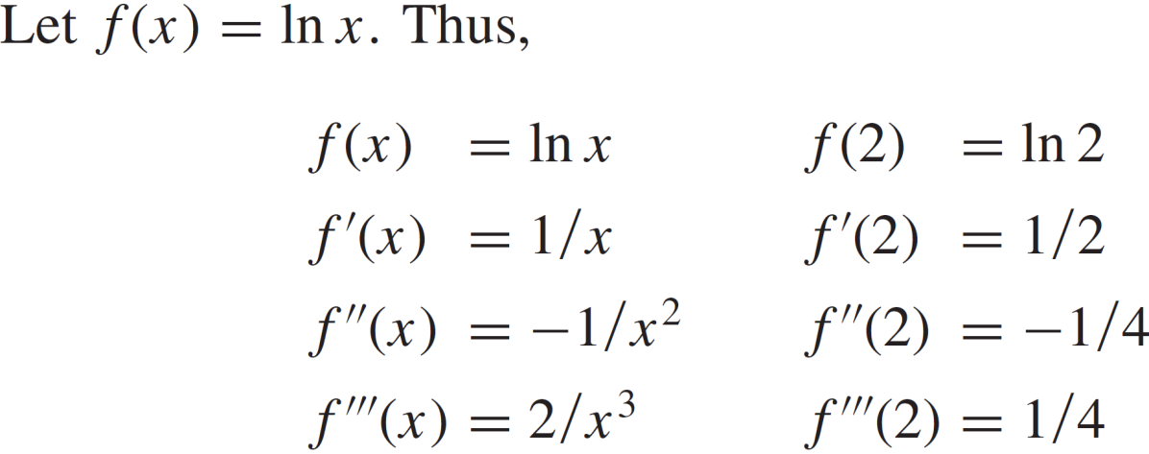
Taylor Polynomials
Example:
Solution:

Slide 26
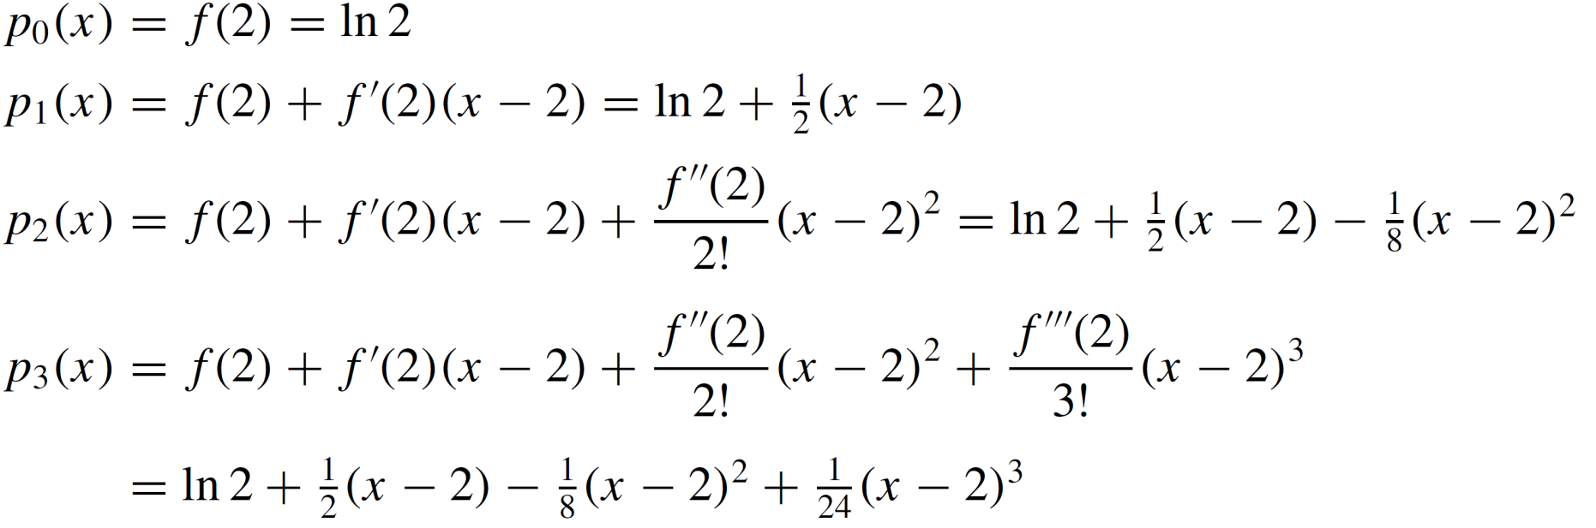
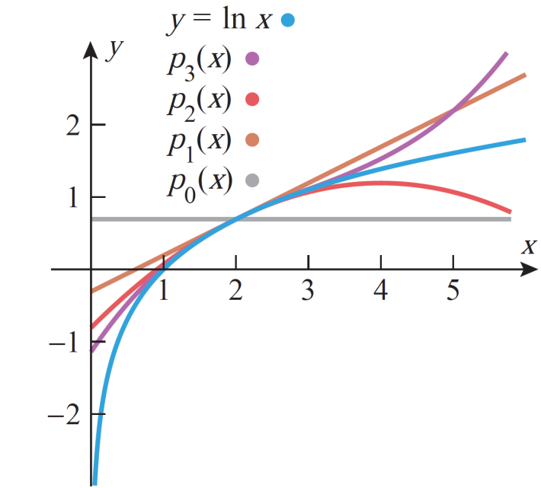
Taylor Polynomials

Slide 27
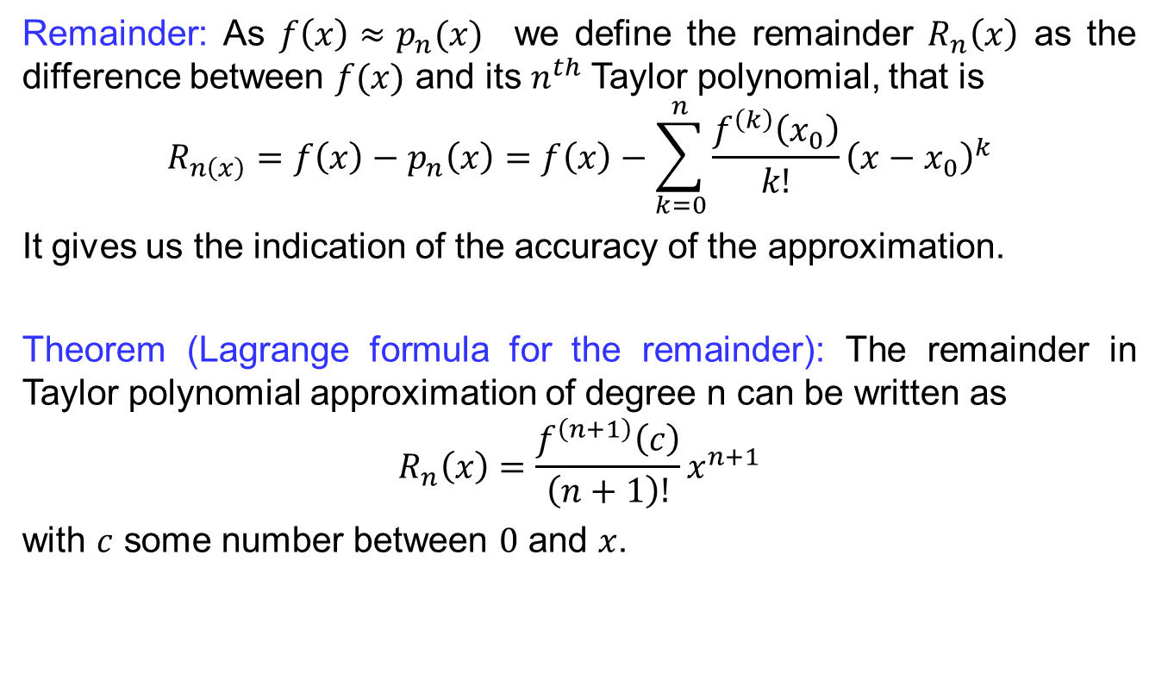
Taylor Polynomials
Remainder: As $f\left(x\right)≈p_{n}(x)$wedefine the remainder$R_{n}\left(x\right)$ as the differencebetween$f(x)$ and its $n^{th}$ Taylor polynomial, that is
$$R_{n\left(x\right)}=f\left(x\right)−p_{n}\left(x\right)=f\left(x\right)−\sum_{k=0}^{n}{\frac{f^{\left(k\right)}\left(x_{0}\right)}{k!}{\left(x−x_{0}\right)}^{k}}$$
It gives us the indication of the accuracy of the approximation.
Theorem (Lagrange formula for the remainder): The remainder in Taylor polynomial approximation of degree n can be written as
$$R_{n}\left(x\right)=\frac{f^{\left(n+1\right)}\left(c\right)}{\left(n+1\right)!}x^{n+1}$$
with $c$ some number between $0$ and $x$.

Slide 28
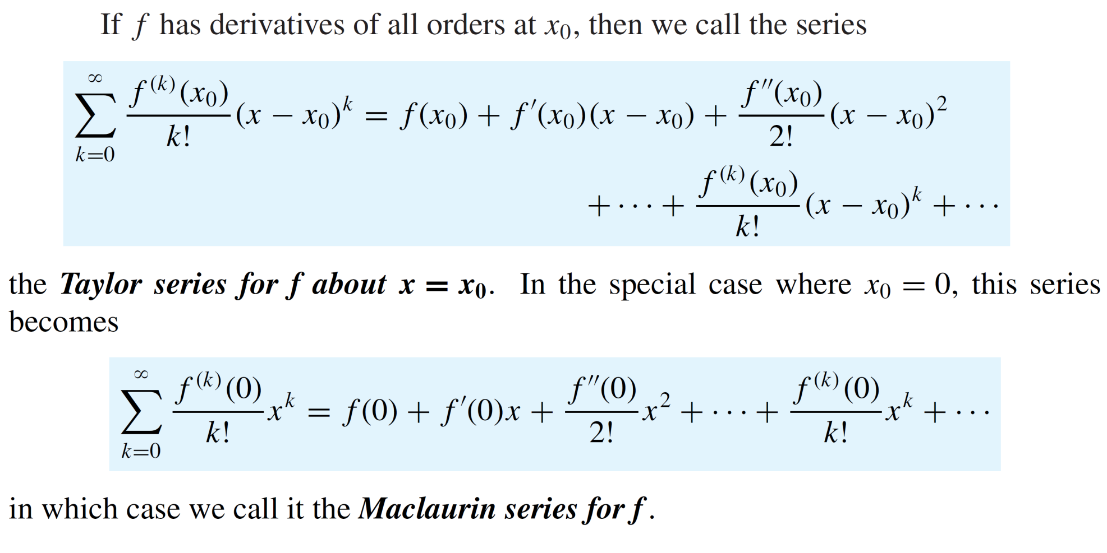
Taylor & Maclaurin Series
Definition:

Slide 29
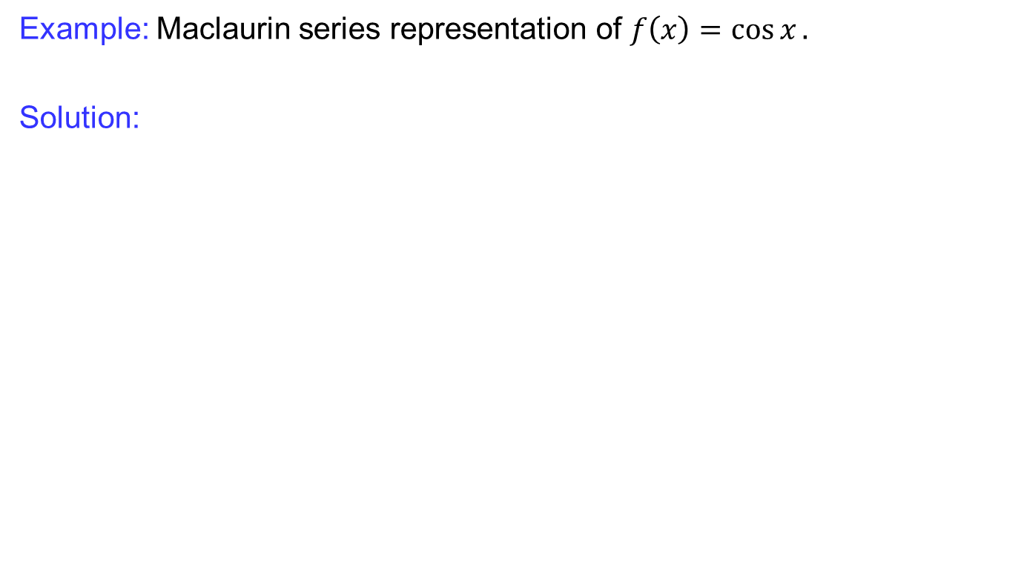
Taylor & Maclaurin Series
Example: Maclaurin seriesrepresentation of $f\left(x\right)=\cos{x}.$
Solution:

Slide 30
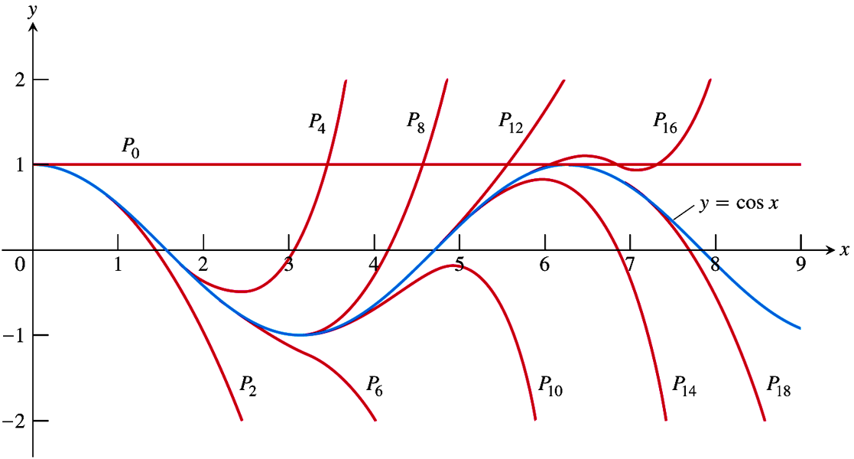
Taylor & Maclaurin Series
Cont:

Slide 31
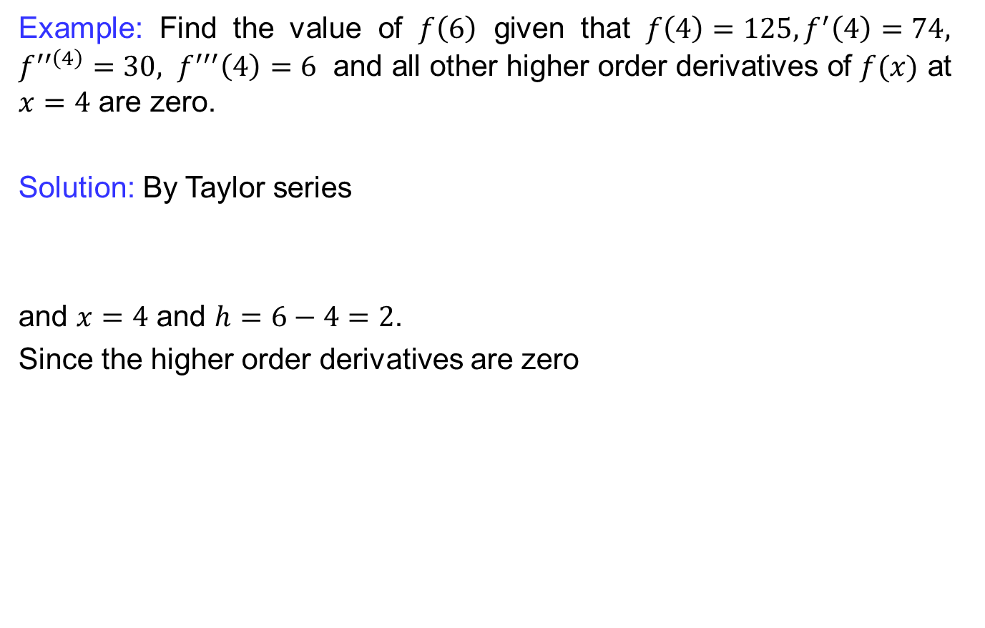
Taylor & Maclaurin Series
Example: Find the value of $f\left(6\right)$ given that $f\left(4\right)=125, f^{′}\left(4\right)=74,$$f^{′′\left(4\right)}=30, f^{′′′}\left(4\right)=6$ and all other higher order derivatives of $f(x)$ at $x=4$ are zero.
Solution: By Taylor series
and $x=4$ and $h=6−4=2$.
Since the higherorderderivatives are zero

Slide 32
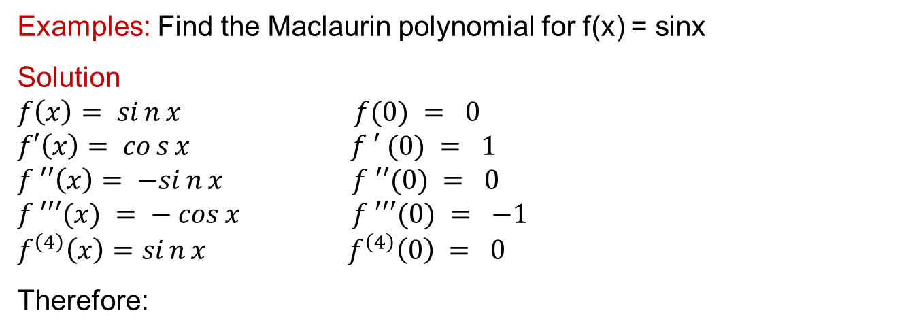
Taylor & Maclaurin Series
Examples: Find the Maclaurin polynomial for f(x) = sinx
Solution
$$f\left(x\right)= sin{x} f(0) = 0$$
$$f′\left(x\right)= cos{x} f ′ (0) = 1$$
$$f ′′\left(x\right)= −sin{x} f ′′(0) = 0$$
$$f ′′′(x) = − cos⁡x f ′′′(0) = −1$$
$$f^{\left(4\right)}\left(x\right)=sin{x} f^{\left(4\right)}\left(0\right) = 0$$
Therefore:

Slide 33
Taylor & Maclaurin Series
Example:
Solution:

Slide 34
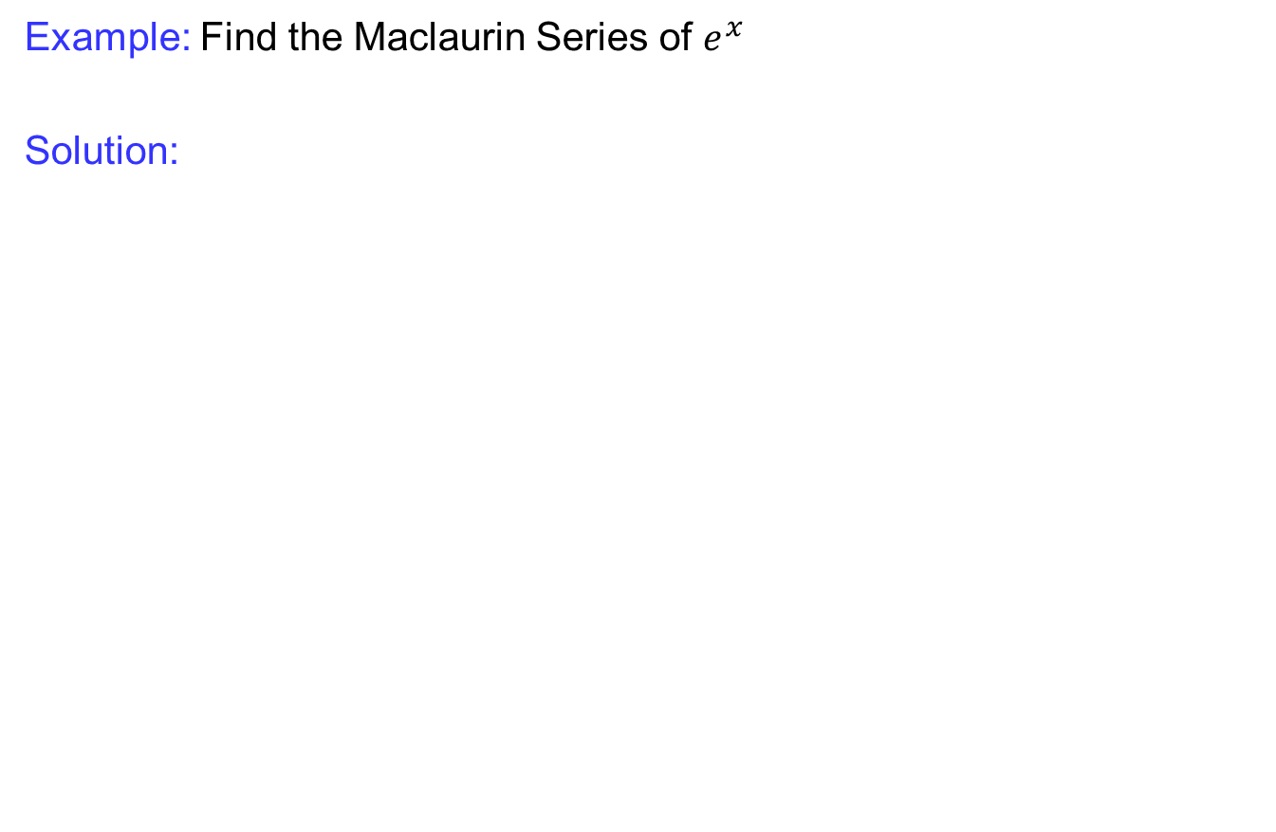
Taylor & Maclaurin Series
Example: Find the Maclaurin Series of $e^{x}$
Solution:

Slide 35
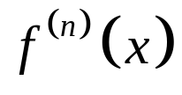
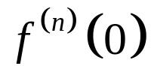
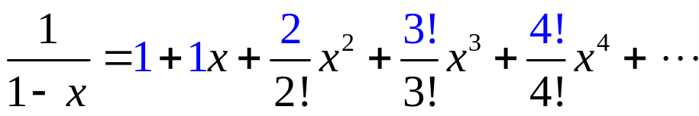
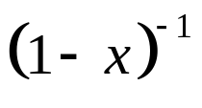

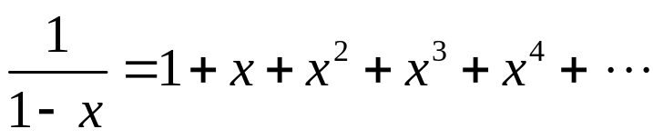

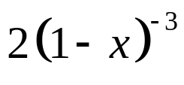

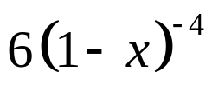

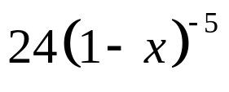

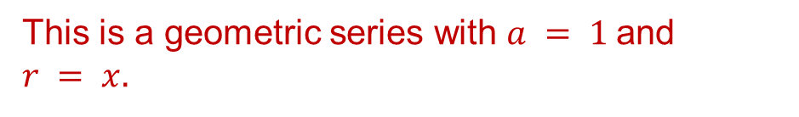
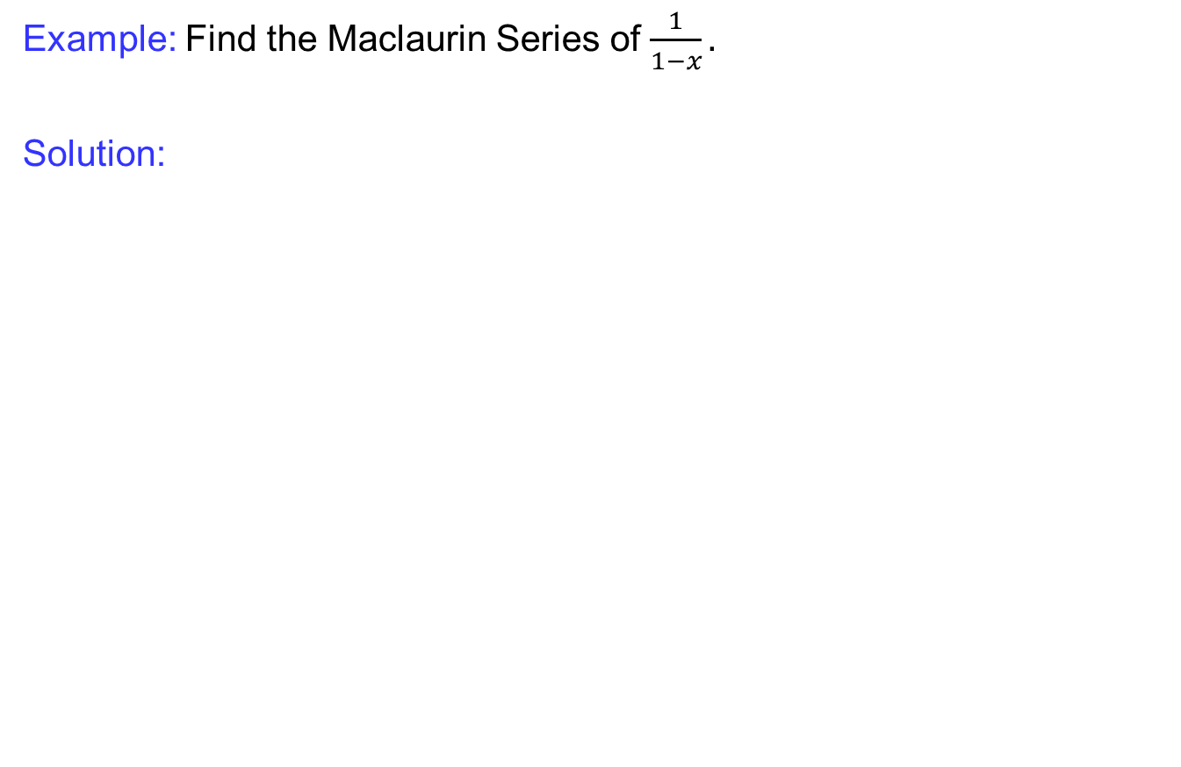
Taylor & Maclaurin Series
Example: Find the Maclaurin Series of $\frac{1}{1−x}.$
Solution:
This is a geometric series with $a = 1$and $r = x.$

Slide 36
Taylor & Maclaurin Series
Example: Find the Maclaurin polynomial for f(x) = cos² x.
Solution: Since
Write the Maclaurin series for cos x and replace x by 2x, and then simplify. The Maclaurin series of cos x is

Slide 37

Convergence
Taylor series work very well for polynomials; the exponential function e^{x} and the sine and cosine functions. (They are all examples of entire functions –i.e., f(x) equals its Taylor series everywhere).
Taylor series do not always work well. For example, for the logarithm function, the Taylor series do not converge if x is far from x₀. For example: Log approximation around 0:

Slide 38

Convergence
Theorem: For any Taylor seriesin $x,$exactly one of the followingistrue:
The series converges only for $x=x_{0}$.
The series converges absolutely (and hence converges for all real values of $x$.
The series converges absolutely (and hence converges for all x in somefinite open interval$(−R,R),$and diverges if $x<−R$or $x>R$. Ateither of the values $x=R$ or $x=−R$, the seriesmay converge or diverge, depending on the particularseries.

Slide 39


Convergence
Let
Example:
It’s hard to see that it even exists, but$f\left(x\right)$ at $a=0$ and $f^{\left(n\right)}\left(0\right)$ are all 0.
Thus the coefficients in the Taylor series for

Slide 40

Convergence
Example: What is the interval of convergence?
Solution: Since $r = x$, the series converges $|x| <1$, or $−1 < x < 1$. In interval notation $(−1,1).$
Test endpoints of –1 and 1.
Series diverges
Series diverges

Slide 41

Some important series

Slide 42
Lecture Summary
    Recalls
    Polynomial approximations
    Maclaurin polynomials
    Taylor polynomials
    Taylor and Maclaurin series
    Convergence
    Some important series

