Slide 1
(MTH 250)
Calculus
Lecture 15

Slide 2
Previous Lecture’s Summary
    Introduction to sequences
    Limit of sequences
    Limits laws for sequences
    Monotone sequences
    Bounded sequences
    Some standard limits

Slide 3
Today’s Lecture
    Recalls
    Subsequences
    Limit superior and limit inerior
    Cauchy sequences
    Infinite series
    Convergence of infinite series.
    Absolutely convergent series

Slide 4


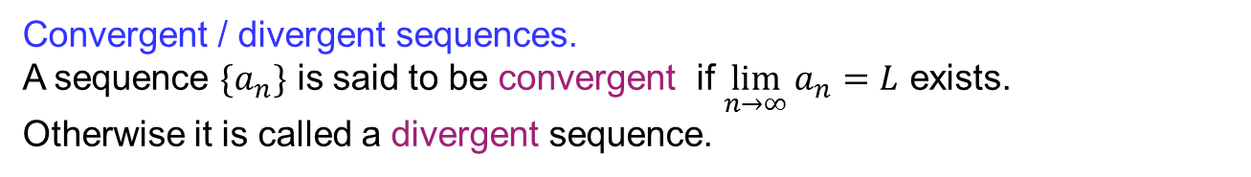
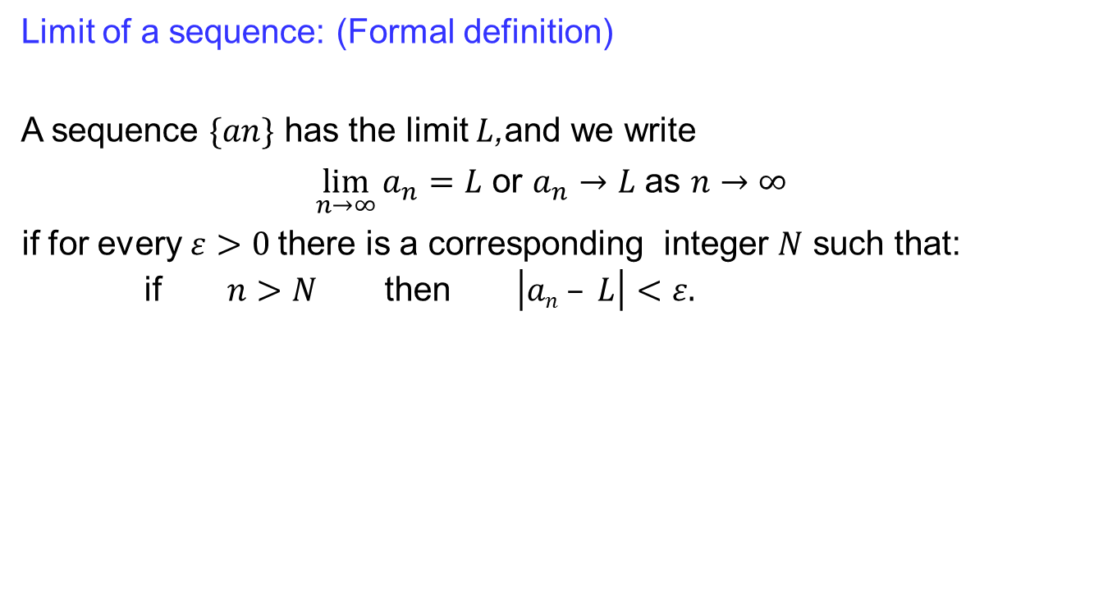












Recalls
Limit of a sequence: (Formal definition)
A sequence $\{an\}$ has the limit $L$,and we write
$\lim_{n→∞}{a_{n}}=L$ or $a_{n}→L$ as $n→∞$
if for every $ε>0$there is a corresponding integer $N$ such that:
if $n>N$ then $\left|an – L\right|<ε.$
$a_{1}$
$a_{3}$
$a_{2}$
$a_{8}$
$a_{N+1}$
$a_{N+2}$
$a_{9}$
$a_{6}$
$a_{5}$
$a_{4}$
$a_{7}$
$$( )$$
$$L−ε L L+ε$$
$0$
Convergent / divergent sequences.
A sequence $\{a_{n}\}$ is said to be convergent if $\lim_{n→∞}{a_{n}}=L$ exists.
Otherwise it is called a divergent sequence.

Slide 5
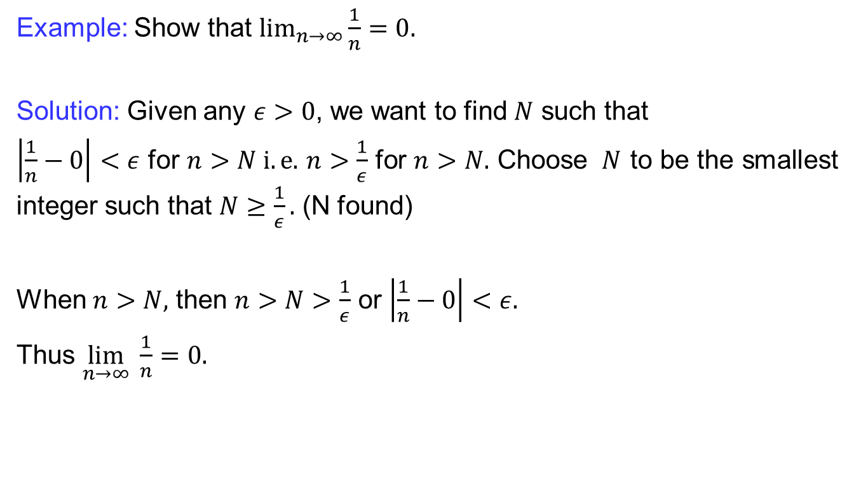
Recalls
  Example: Show that$\lim_{n→∞}{\frac{1}{n}}=0.$
Solution: Given any $ε>0$, we want to find $N$ such that
$\left|\frac{1}{n}−0\right|<ε$ for $n>N i.e.$$n>\frac{1}{ε}$ for $n>N.$ Choose $N$ to be the smallest integer such that $N≥\frac{1}{ε}.$ (N found)
When $n>N,$ then $n>N>\frac{1}{ε}$ or $\left|\frac{1}{n}−0\right|<ε.$
Thus $\lim_{n→∞} \frac{1}{n}=0.$

Slide 6
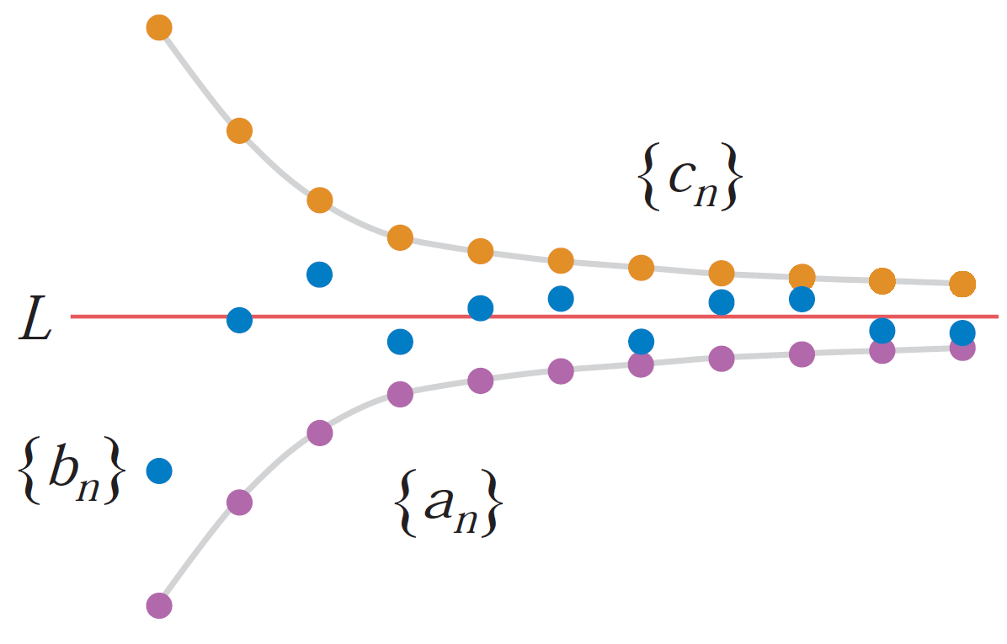
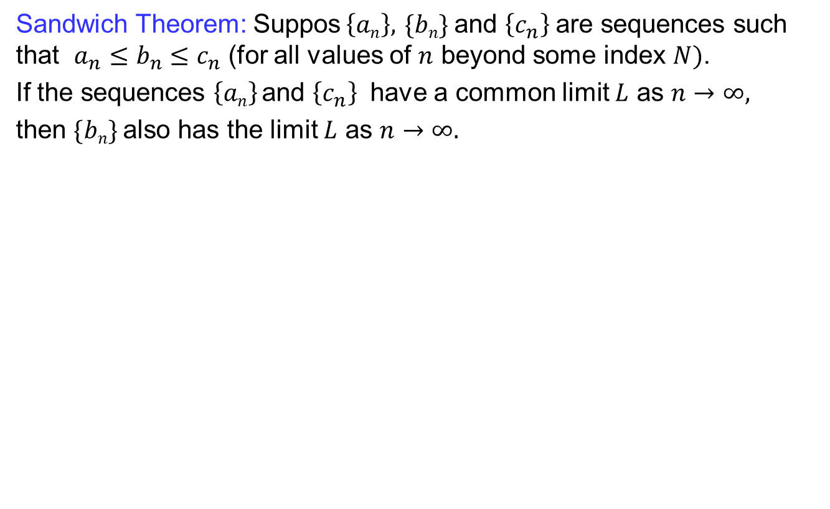
Recalls
  Sandwich Theorem: Suppos$\left\{an\right\},$$\{bn\}$and $\left\{c_{n}\right\}$are sequences such that $a_{n}≤b_{n}≤c_{n}$ (for all values of $n$ beyond some index $N)$.
  If the sequences $\left\{an\right\}$and $\left\{c_{n}\right\}$ have a common limit $L$ as $n→∞,$
  then $\{bn\}$also has the limit $L$ as $n→∞.$

Slide 7
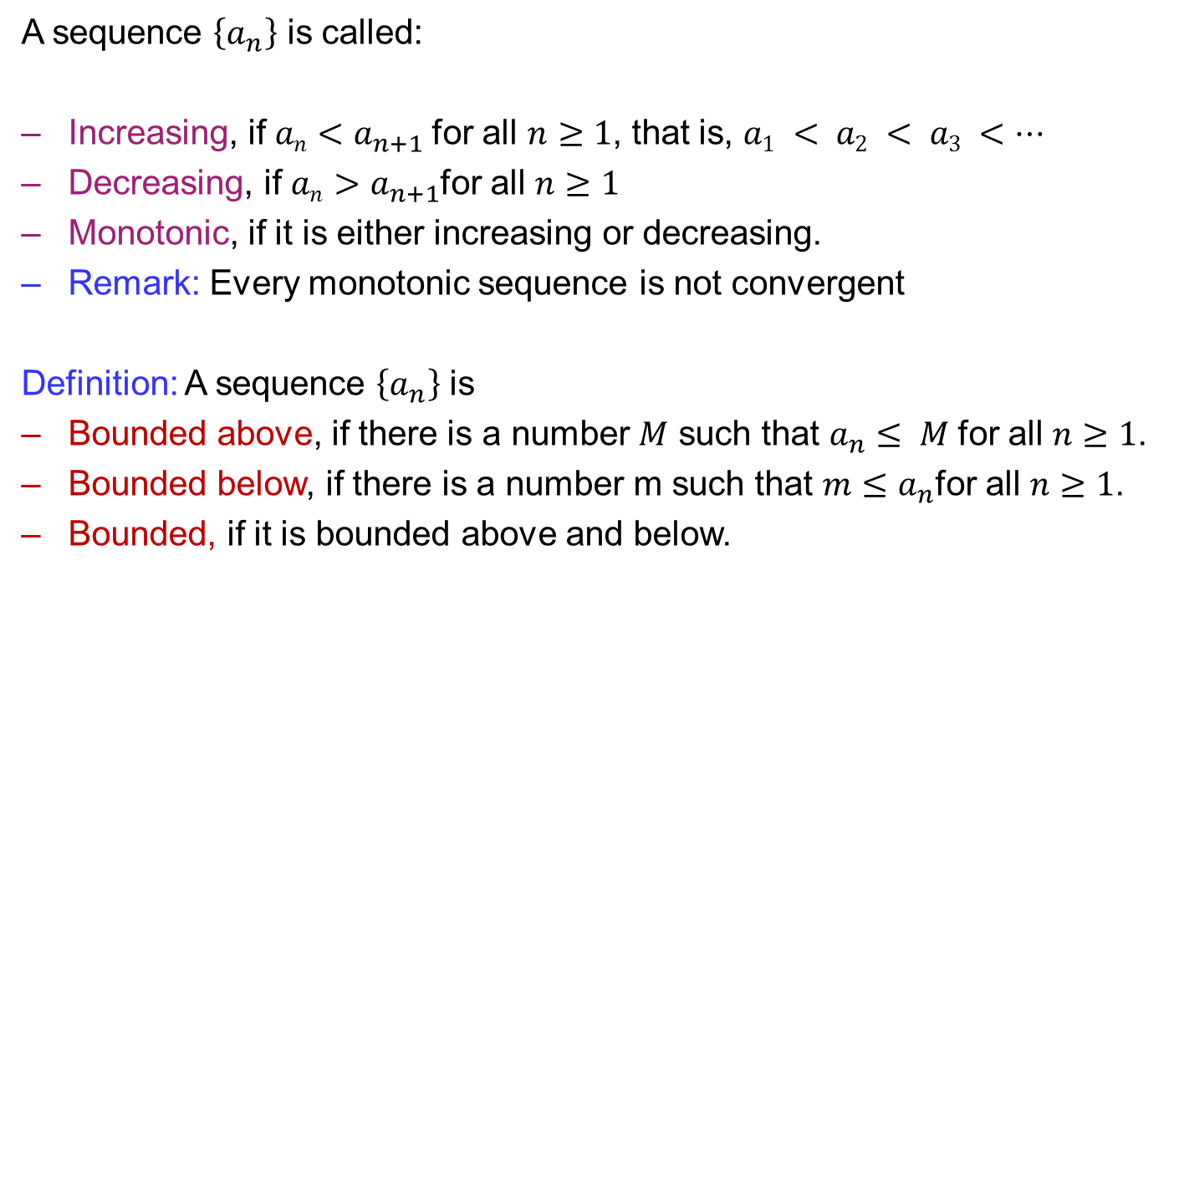
Recalls
  A sequence$\left\{a_{n}\right\}$iscalled:
  Increasing, if $an<a_{n+1}$for all $n≥1$, that is, $a1 < a2 < a3 <…$
  Decreasing, if $an>a_{n+1}$for all $n≥1$
  Monotonic,if it is either increasing or decreasing.
  Remark: Every monotonic sequence is not convergent
  Definition: A sequence $\left\{a_{n}\right\}$ is
  Bounded above, if there is a number $M$ such that $a_{n}≤ M$for all $n≥1$.
  Bounded below, if there is a number m such that $m≤a_{n}$for all $n≥1$.
  Bounded, if it is bounded above and below.

Slide 8
Recalls
  Theorem: Every convergent sequence is bounded
  Corollary: If a sequence is unbounded, it diverges.
  Remark: Every bounded sequence is not onvergent.
  Theorem: Every bounded, monotonic sequence is convergent.

Slide 9
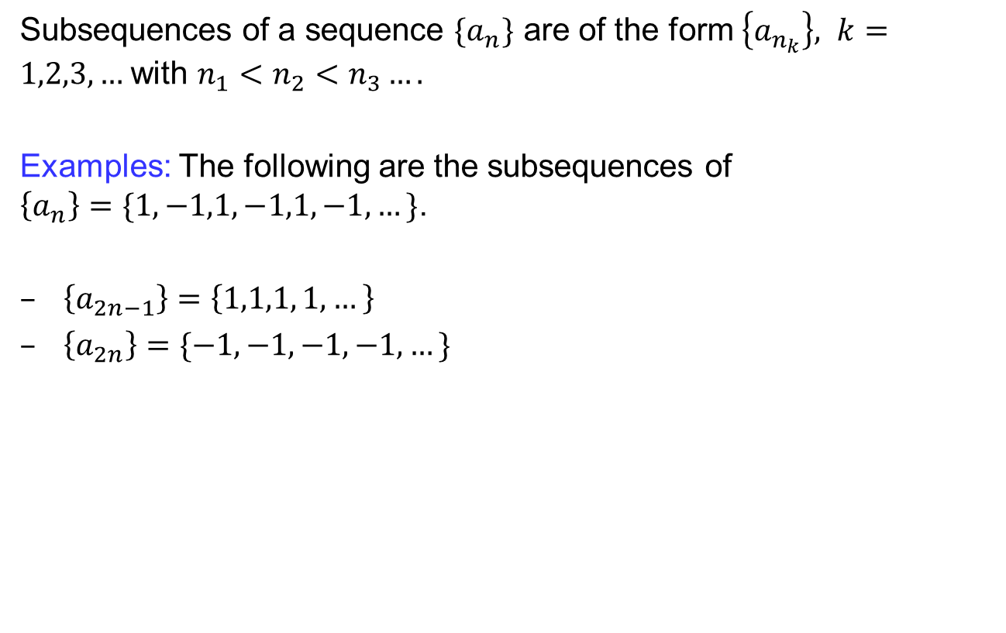
Subsequences
  Subsequences of a sequence $\{a_{n}\}$ are of the form $\left\{a_{n_{k}}\right\}, k=1,2,3,…$with $n_{1}<n_{2}<n_{3}….$
  Examples: The following are the subsequences of $\left\{a_{n}\right\}=\{1,−1,1,−1,1,−1,…\}$.
  $\left\{a_{2n−1}\right\}=\left\{1,1,1, 1, …\right\}$
  $\left\{a_{2n}\right\}=\{−1,−1,−1,−1, …\}$

Slide 10
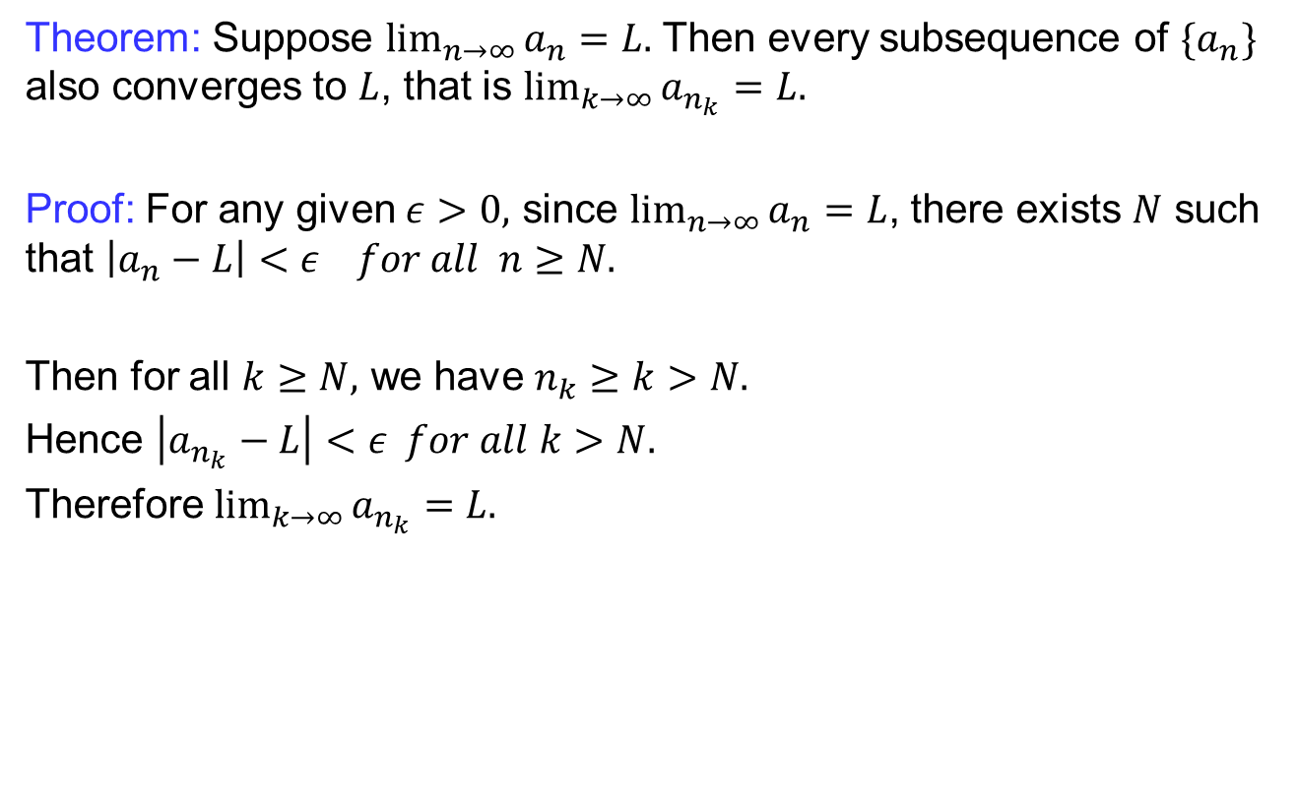
Subsequences
  Theorem: Suppose $\lim_{n→∞}{a_{n}}=L.$ Then every subsequence of $\{a_{n}\}$ also converges to $L$, that is $\lim_{k→∞}{a_{n_{k}}}=L.$
  Proof: For any given $ε>0,$since $\lim_{n→∞}{a_{n}}=L$, there exists $N$ such that $\left|a_{n}−L\right|<ε for all n≥N.$
  Then for all $k≥N,$ we have $n_{k}≥k>N.$
  Hence $\left|a_{n_{k}}−L\right|<ε for all k>N.$
  Therefore $\lim_{k→∞}{a_{n_{k}}}=L.$

Slide 11
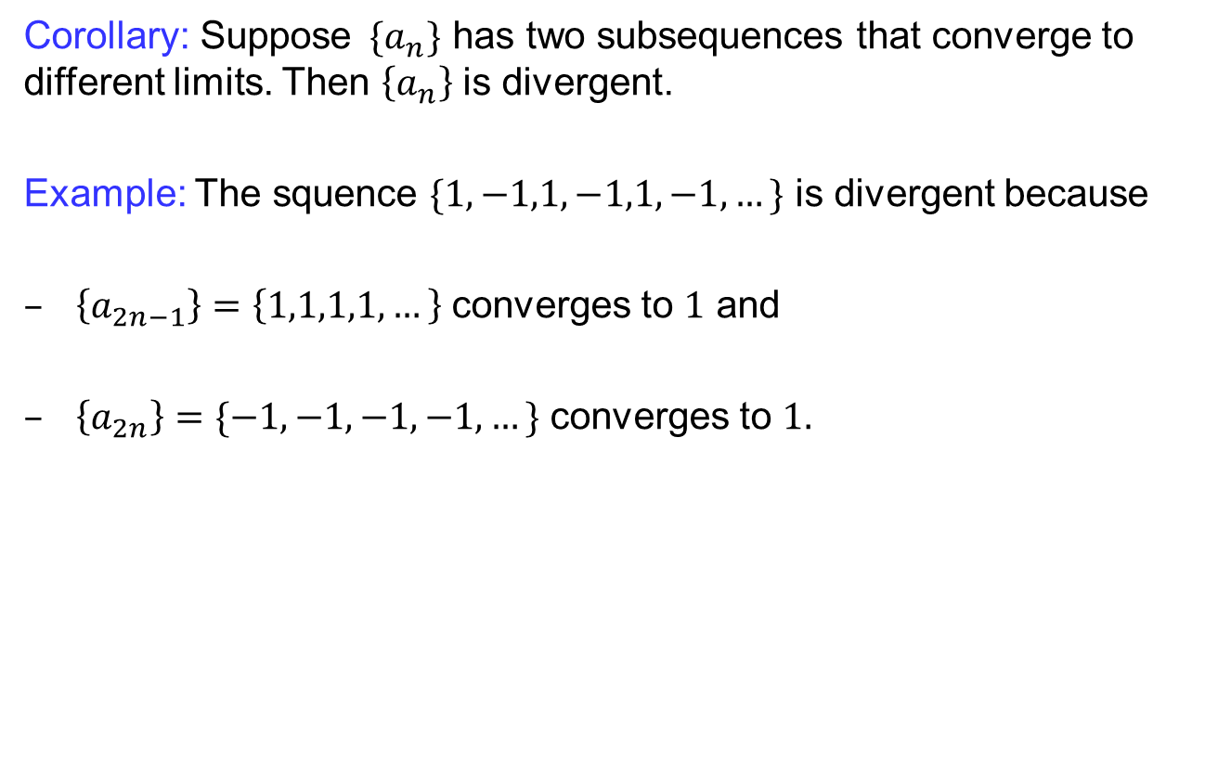
Subsequences
  Corollary: Suppose$\{a_{n}\}$ has two subsequences that converge to different limits. Then $\left\{a_{n}\right\}$ is divergent.
  Example: The squence$\{1,−1,1,−1,1,−1,…\}$ is divergent because
  $\left\{a_{2n−1}\right\}=\left\{1,1,1,1,…\right\}$ converges to $1$ and
  $\left\{a_{2n}\right\}=\{−1,−1,−1,−1,…\}$ converges to $1.$

Slide 12
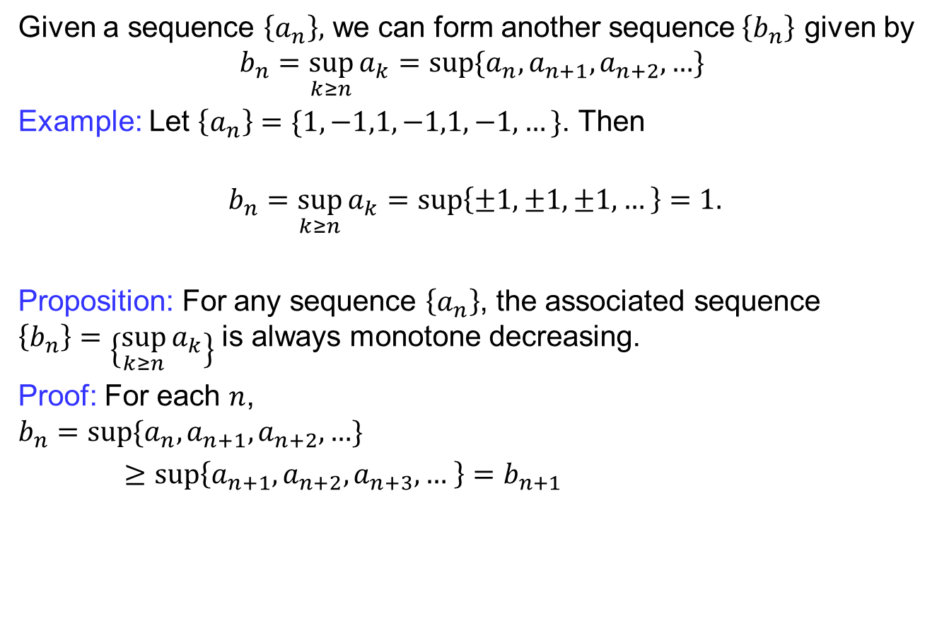
Limit superior & limit inferior
  Given a sequence $\left\{a_{n}\right\},$ we can form another sequence$\left\{b_{n}\right\}$ given by
  $$b_{n}=\sup_{k≥n}{a_{k}}=\sup{\{a_{n},a_{n+1},a_{n+2}, …}\}$$
  Example: Let $\left\{a_{n}\right\}=\{1,−1,1,−1,1,−1,…\}$. Then
  $$b_{n}=\sup_{k≥n}{a_{k}}=\sup\left\{±1,±1,±1,…\right\}=1.$$
  Proposition: For any sequence $\left\{a_{n}\right\}$, the associated sequence $\left\{b_{n}\right\}=\left\{\sup_{k≥n}{a_{k}}\right\}$ is always monotone decreasing.
  Proof: For each $n$,
  $$b_{n}=\sup{\{a_{n},a_{n+1}, a_{n+2}, …}\}$$
  $≥\sup\left\{a_{n+1},a_{n+2}, a_{n+3}, … \right\}=b_{n+1}$

Slide 13
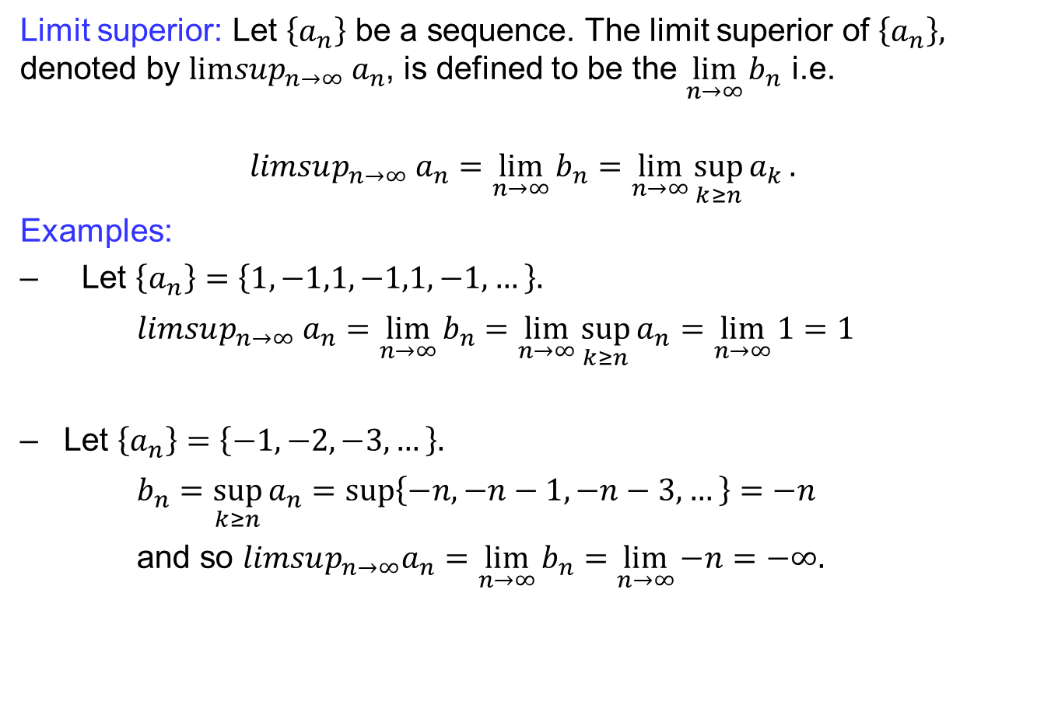
Limit superior & limit inferior
  Limit superior: Let $\left\{a_{n}\right\}$ be a sequence. The limit superior of $\left\{a_{n}\right\},$ denoted by $limsup_{n→∞} a_{n}$, is defined to be the $\lim_{n→∞}{b_{n}}$ i.e.
  $$limsup_{n→∞} a_{n}=\lim_{n→∞}{b_{n}}=\lim_{n→∞}{\sup_{k≥n}{a_{k}}}.$$
  Examples:
  Let $\left\{a_{n}\right\}=\left\{1,−1,1,−1,1,−1,…\right\}.$
  $limsup_{n→∞} a_{n}=\lim_{n→∞}{b_{n}}=\lim_{n→∞}{\sup_{k≥n}{a_{n}}}=\lim_{n→∞}{1}=1$
  Let $\left\{a_{n}\right\}=\left\{−1,−2,−3, …\right\}.$
  $b_{n}=\sup_{k≥n}{a_{n}}=\sup\left\{−n, −n−1, −n−3, …\right\}=−n$
  and so $limsup_{n→∞}a_{n}=\lim_{n→∞}{b_{n}}=\lim_{n→∞}{−n}=−∞.$

Slide 14
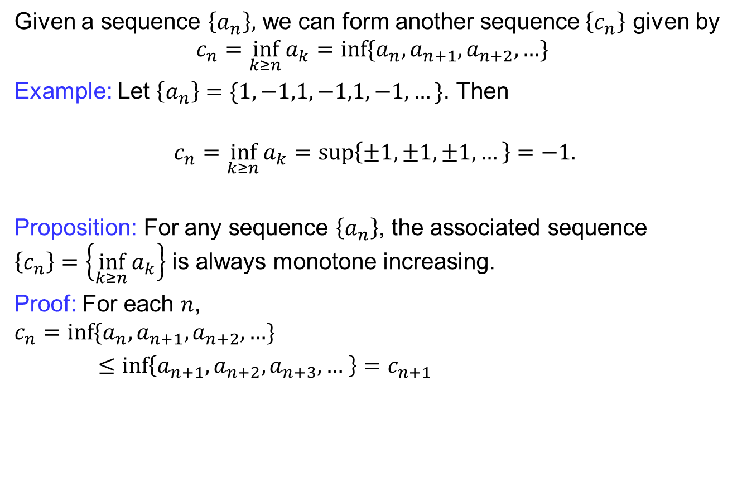
Limit superior & limit inferior
  Given a sequence $\left\{a_{n}\right\},$ we can form another sequence$\left\{c_{n}\right\}$ given by
  $$c_{n}=\inf_{k≥n}{a_{k}}=\inf{\{a_{n},a_{n+1},a_{n+2}, …}\}$$
  Example: Let $\left\{a_{n}\right\}=\{1,−1,1,−1,1,−1,…\}$. Then
  $$c_{n}=\inf_{k≥n}{a_{k}}=\sup\left\{±1,±1,±1,…\right\}=−1.$$
  Proposition: For any sequence $\left\{a_{n}\right\}$, the associated sequence $\left\{c_{n}\right\}=\left\{\inf_{k≥n}{a_{k}}\right\}$ is always monotone increasing.
  Proof: For each $n$,
  $$c_{n}=\inf{\{a_{n},a_{n+1}, a_{n+2}, …}\}$$
  $≤\inf\left\{a_{n+1},a_{n+2}, a_{n+3}, … \right\}=c_{n+1}$

Slide 15
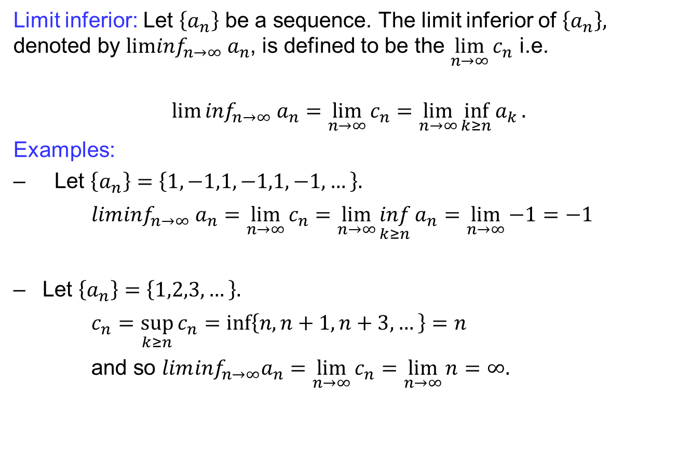
Limit superior & limit inferior
  Limit inferior: Let $\left\{a_{n}\right\}$ be a sequence. The limit inferior of $\left\{a_{n}\right\},$ denoted by $lim\inf_{n→∞} a_{n}$, is defined to be the $\lim_{n→∞}{c_{n}}$ i.e.
  $$lim⁡\inf_{n→∞} a_{n}=\lim_{n→∞}{c_{n}}=\lim_{n→∞}{\inf_{k≥n}{a_{k}}}.$$
  Examples:
  Let $\left\{a_{n}\right\}=\left\{1,−1,1,−1,1,−1,…\right\}.$
  $lim\inf_{n→∞} a_{n}=\lim_{n→∞}{c_{n}}=\lim_{n→∞}{\inf_{k≥n}{a_{n}}}=\lim_{n→∞}{−1}=−1$
  Let $\left\{a_{n}\right\}=\left\{1,2,3, …\right\}.$
  $c_{n}=\sup_{k≥n}{c_{n}}=\inf\left\{n, n+1, n+3, …\right\}=n$
  and so $lim\inf_{n→∞}a_{n}=\lim_{n→∞}{c_{n}}=\lim_{n→∞}{n}=∞.$

Slide 16
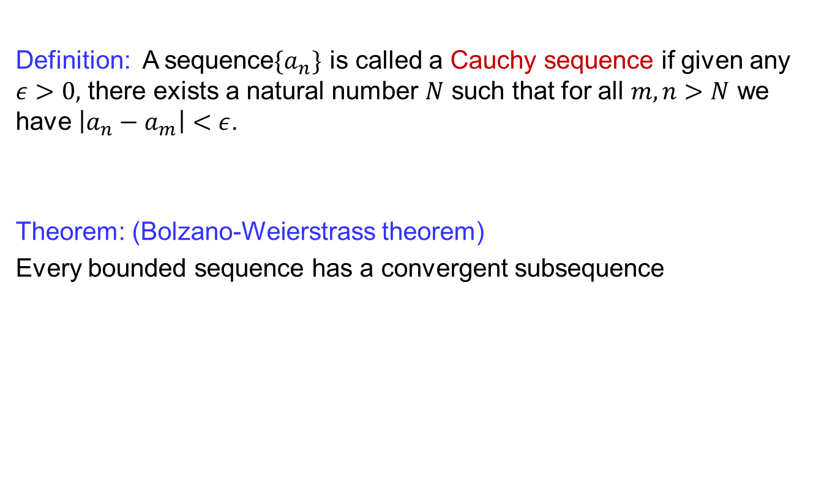
Cauchy sequences
  Definition: A sequence$\{a_{n}\}$ is called a Cauchy sequence if given any $ε>0,$ there exists a natural number $N$ such that for all $m,n>N$ we have $\left|a_{n}−a_{m}\right|<ε$.
  Theorem: (Bolzano-Weierstrass theorem)
  Every bounded sequence has a convergent subsequence

Slide 17
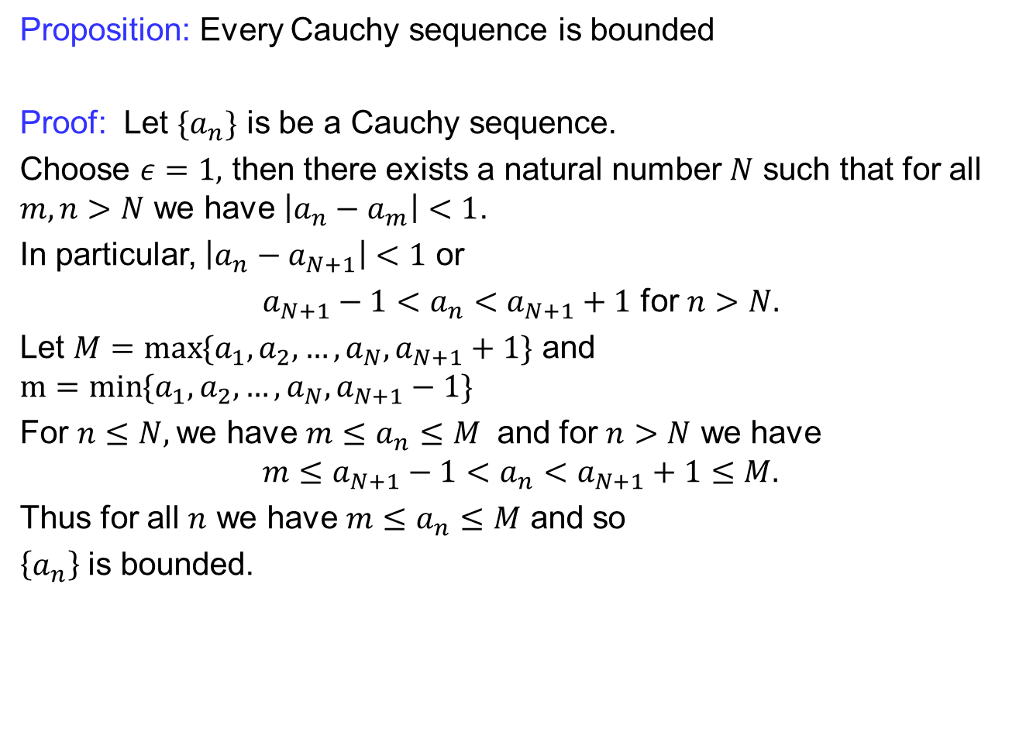
Cauchy sequences
  Proposition: Every Cauchy sequence is bounded
  Proof: Let $\{a_{n}\}$ is be a Cauchy sequence.
  Choose $ε=1,$ then there exists a natural number $N$ such that for all $m,n>N$ we have $\left|a_{n}−a_{m}\right|<1$.
  In particular, $\left|a_{n}−a_{N+1}\right|<1$ or
  $a_{N+1}−1<a_{n}<a_{N+1}+1$ for $n>N.$
  Let $M=\max{\{a_{1},a_{2},…, a_{N}, a_{N+1}+1\}}$ and $m=\min{\{a_{1},a_{2},…, a_{N}, a_{N+1}−1\}}$
  For $n≤N,$we have $m≤a_{n}≤M$ and for $n>N$ we have
  $$m≤a_{N+1}−1<a_{n}<a_{N+1}+1≤M.$$
  Thus for all $n$ we have $m≤a_{n}≤M$ and so
  $\left\{a_{n}\right\}$ is bounded.

Slide 18
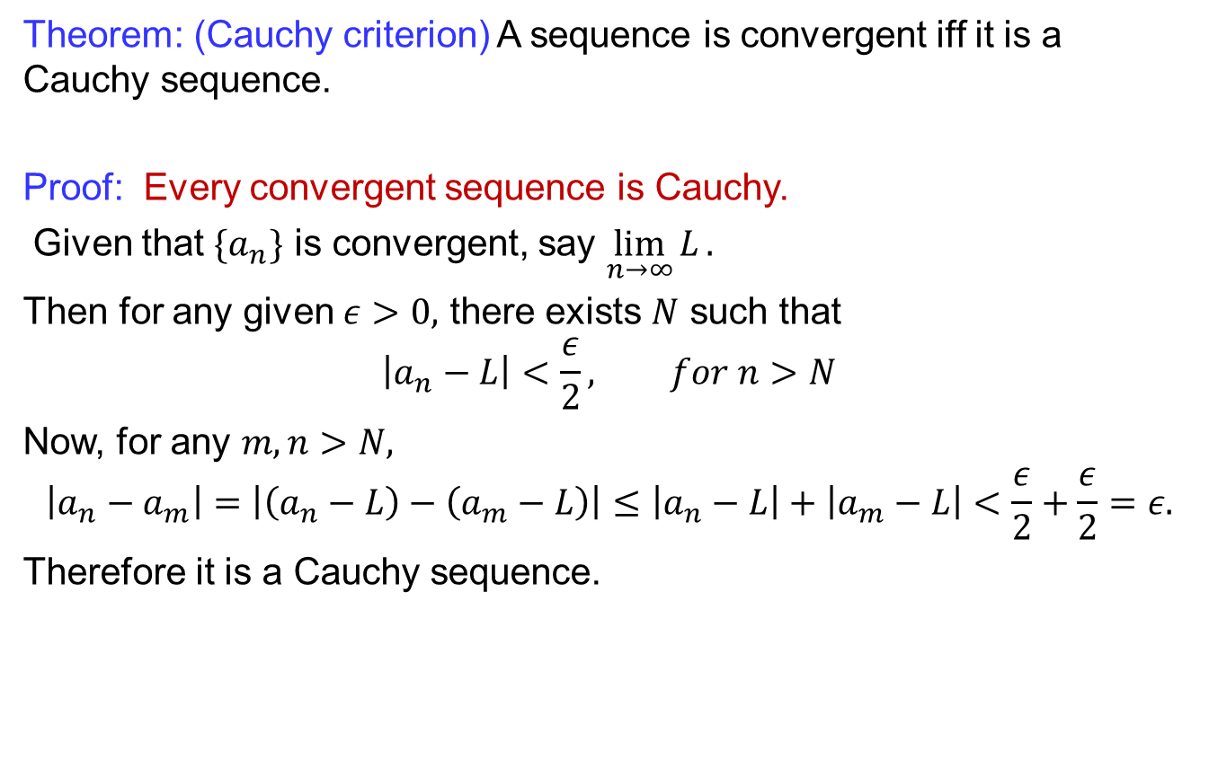
Cauchy sequences
  Theorem: (Cauchy criterion) A sequence is convergent iff it is a Cauchy sequence.
  Proof: Every convergent sequenceis Cauchy.
  Given that $\{a_{n}\}$ is convergent, say $\lim_{n→∞}{L}.$
  Then for any given $ε>0,$ there exists $N$ such that
  $$\left|a_{n}−L\right|<\frac{ε}{2}, for n>N$$
  Now, for any $m,n>N,$
  $$\left|a_{n}−a_{m}\right|=\left|\left(a_{n}−L\right)−\left(a_{m}−L\right)\right|≤\left|a_{n}−L\right|+\left|a_{m}−L\right|<\frac{ε}{2}+\frac{ε}{2}=ε.$$
  Therefore it is a Cauchy sequence.

Slide 19
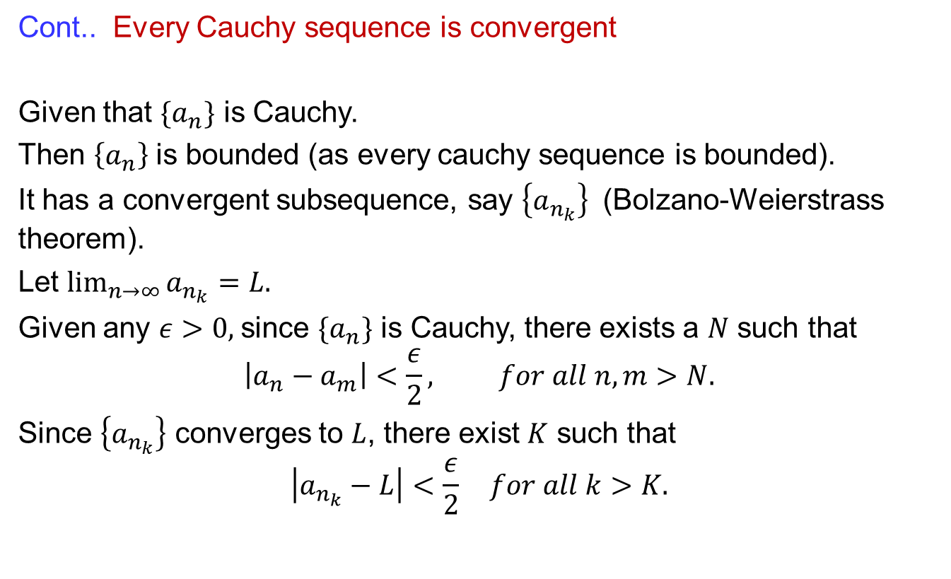
Cauchy sequences
  Cont.. Every Cauchy sequenceis convergent
  Given that $\{a_{n}\}$ is Cauchy.
  Then $\left\{a_{n}\right\}$ is bounded (as every cauchy sequence is bounded).
  It has a convergent subsequence, say $\left\{a_{n_{k}}\right\}$ (Bolzano-Weierstrass theorem).
  Let $\lim_{n→∞}{a_{n_{k}}}=L.$
  Given any $ε>0,$since $\{a_{n}\}$ is Cauchy, there exists a $N$ such that
  $$\left|a_{n}−a_{m}\right|<\frac{ε}{2}, for all n,m>N.$$
  Since $\left\{a_{n_{k}}\right\}$ converges to $L$, there exist $K$ such that
  $$\left|a_{n_{k}}−L\right|<\frac{ε}{2} for all k>K.$$

Slide 20
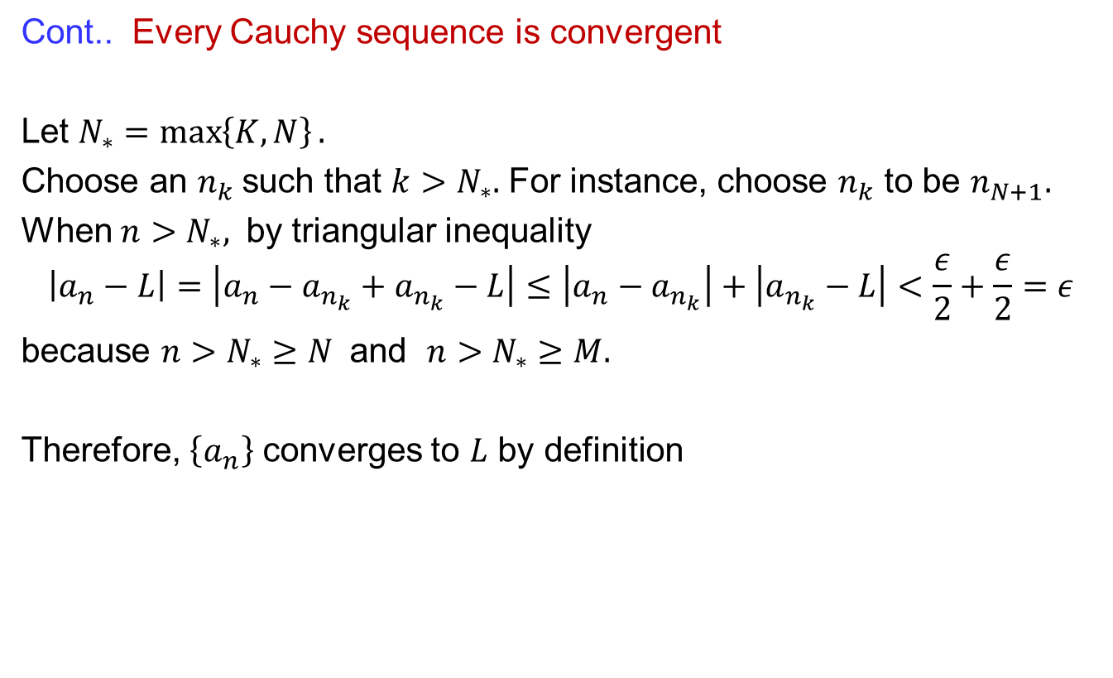
Cauchy sequences
  Cont.. Every Cauchy sequenceis convergent
  Let $N_{∗}=\max\left\{K,N\right\}.$
  Choose an $n_{k}$such that $k>N_{∗}.$ For instance, choose $n_{k}$ to be $n_{N+1}.$
  When $n>N_{∗},$ by triangular inequality
  $$\left|a_{n}−L\right|=\left|a_{n}−a_{n_{k}}+a_{n_{k}}−L\right|≤\left|a_{n}−a_{n_{k}}\right|+\left|a_{n_{k}}−L\right|<\frac{ε}{2}+\frac{ε}{2}=ε$$
  because $n>N_{∗}≥N$ and $n>N_{∗}≥M.$
  Therefore, $\left\{a_{n}\right\}$ converges to $L$ by definition

Slide 21
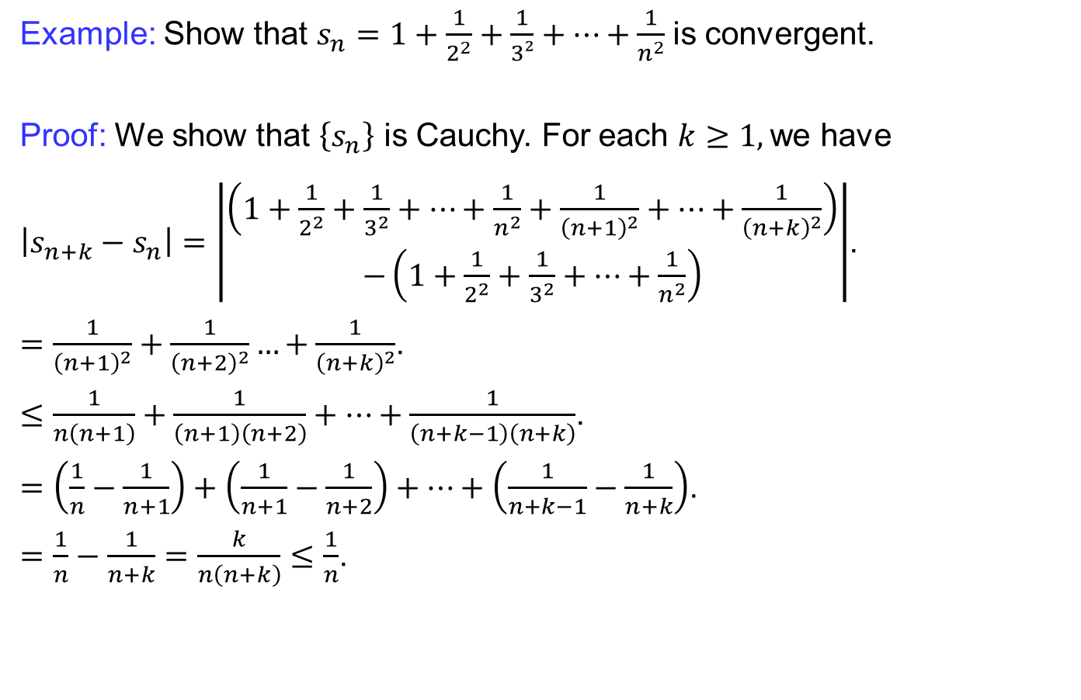
Cauchy sequences
  Example: Show that $s_{n}=1+\frac{1}{2^{2}}+\frac{1}{3²}+…+\frac{1}{n^{2}}$is convergent.
  Proof: We show that $\left\{s_{n}\right\}$ is Cauchy. For each $k≥1,$we have
  $\left|s_{n+k}−s_{n}\right|=\left|\begin{aligned}\left(1+\frac{1}{2^{2}}+\frac{1}{3^{2}}+…+\frac{1}{n^{2}}+\frac{1}{{\left(n+1\right)}^{2}}+…+\frac{1}{{\left(n+k\right)}^{2}}\right) \\ −\left(1+\frac{1}{2^{2}}+\frac{1}{3^{2}}+…+\frac{1}{n^{2}}\right)\end{aligned}\right|$.
  $=\frac{1}{{\left(n+1\right)}^{2}}+\frac{1}{{\left(n+2\right)}^{2}}…+\frac{1}{{\left(n+k\right)}^{2}}$.
  $≤\frac{1}{n\left(n+1\right)}+\frac{1}{\left(n+1\right)\left(n+2\right)}+…+\frac{1}{\left(n+k−1\right)\left(n+k\right)}$.
  $=\left(\frac{1}{n}−\frac{1}{n+1}\right)+\left(\frac{1}{n+1}−\frac{1}{n+2}\right)+…+\left(\frac{1}{n+k−1}−\frac{1}{n+k}\right)$.
  $=\frac{1}{n}−\frac{1}{n+k}=\frac{k}{n\left(n+k\right)}≤\frac{1}{n}$.

Slide 22
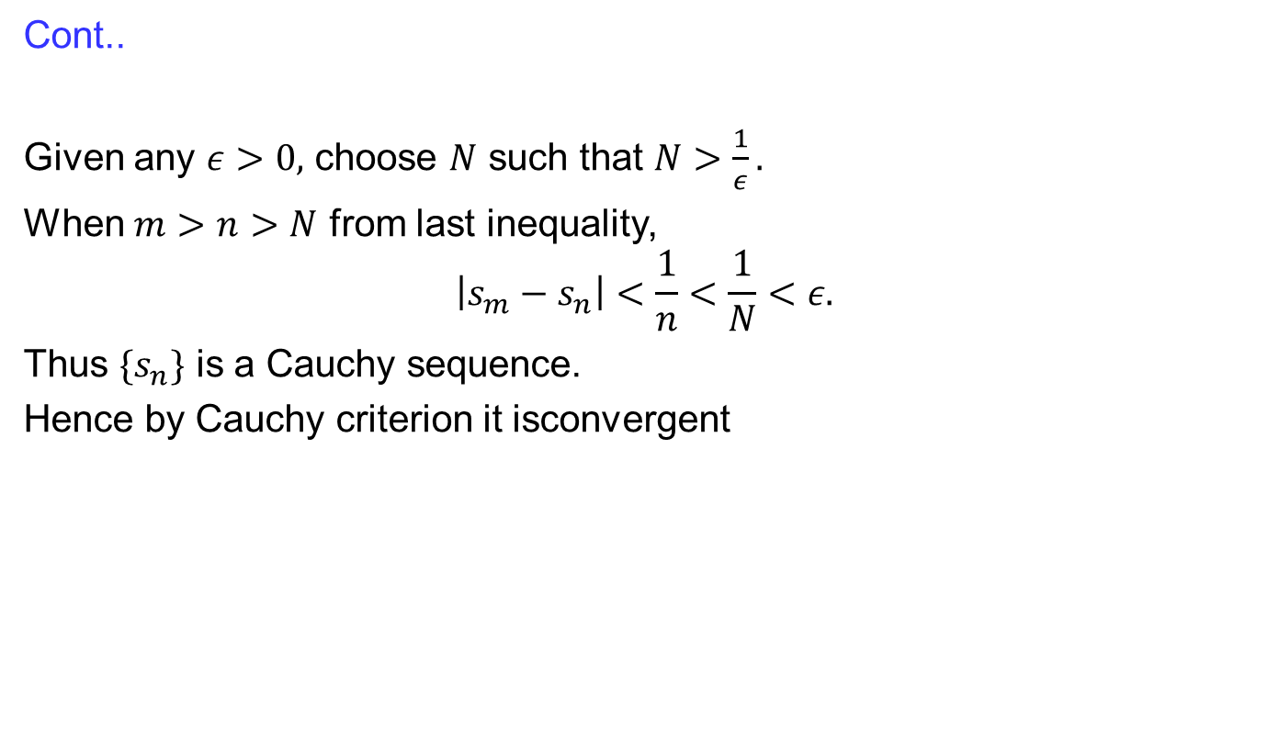
Cauchy sequences
  Cont..
  Givenany$ε>0,$choose$N$suchthat$N>\frac{1}{ε}.$
  When$m>n>N$from last inequality,
  $$\left|s_{m}−s_{n}\right|<\frac{1}{n}<\frac{1}{N}<ε.$$
  Thus$\{s_{n}\}$is a Cauchy sequence.
  Hence by Cauchy criterionitisconvergent

Slide 23
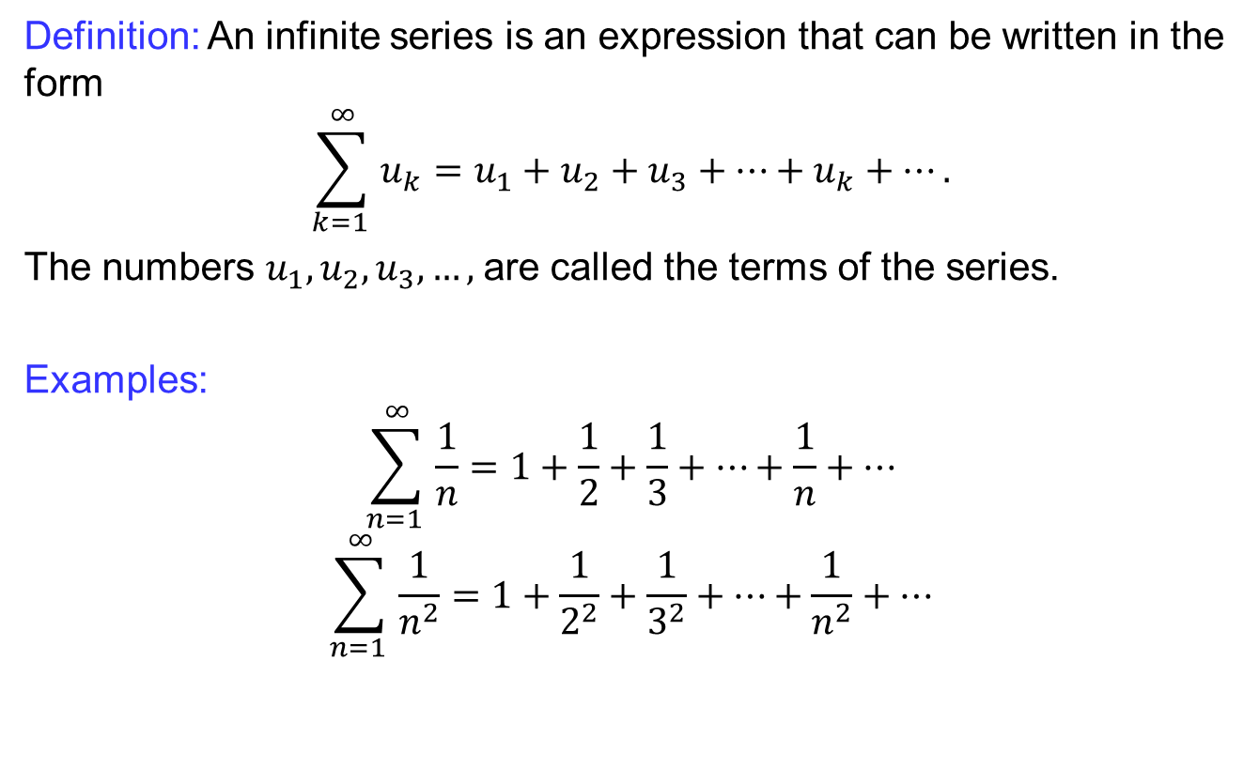
Infinite series
Definition: An infiniteseriesis an expression thatcanbewritten in the form
$$\sum_{k=1 }^{∞}{u_{k}}=u_{1}+u_{2}+u_{3}+…+u_{k}+….$$
The numbers $u_{1},u_{2}, u_{3}, …,$are called the terms of the series.
  Examples:
  $$\sum_{n=1 }^{∞}{\frac{1}{n}}=1+\frac{1}{2}+\frac{1}{3}+…+\frac{1}{n}+…$$
  $$\sum_{n=1 }^{∞}{\frac{1}{n^{2}}}=1+\frac{1}{2^{2}}+\frac{1}{3^{2}}+…+\frac{1}{n^{2}}+…$$

Slide 24
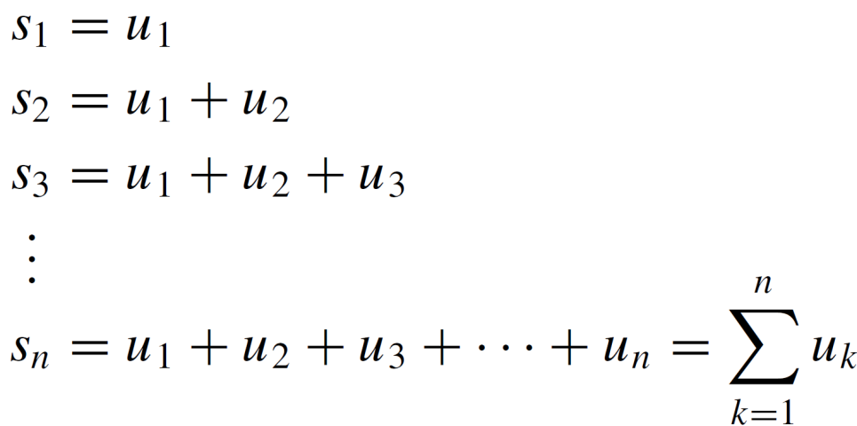
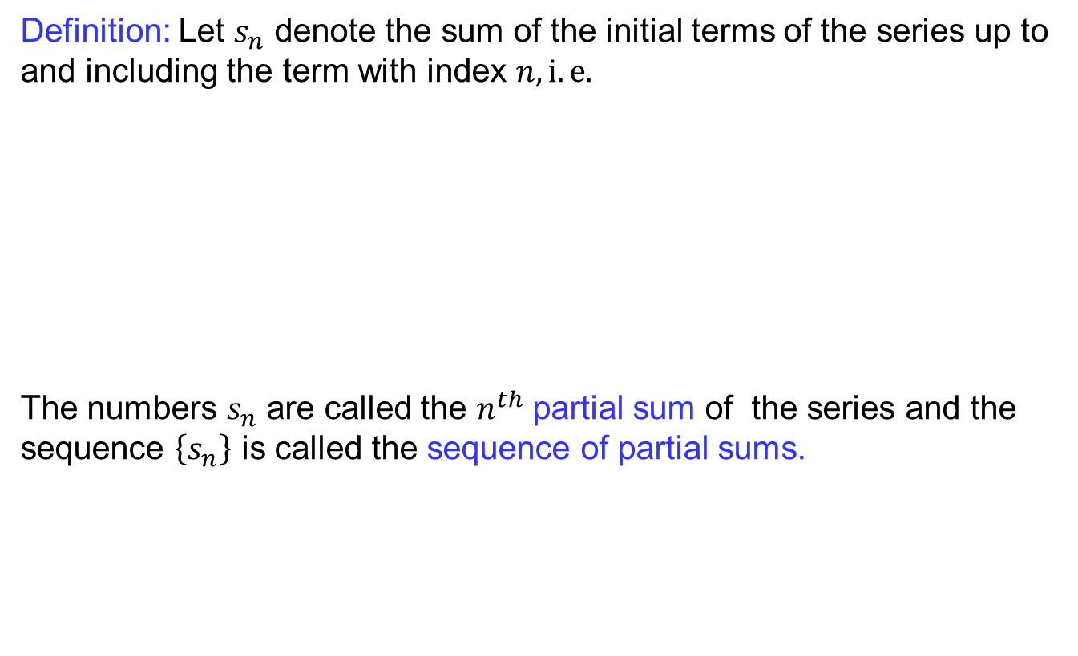
Infinite series
Definition:Let $s_{n}$denote the sum of the initial terms of the series up to and including the termwith index $n, i.e.$
The numbers $s_{n}$ are called the $n^{th}$partial sum of the series and the sequence $\left\{s_{n}\right\}$is called the sequence of partial sums.

Slide 25
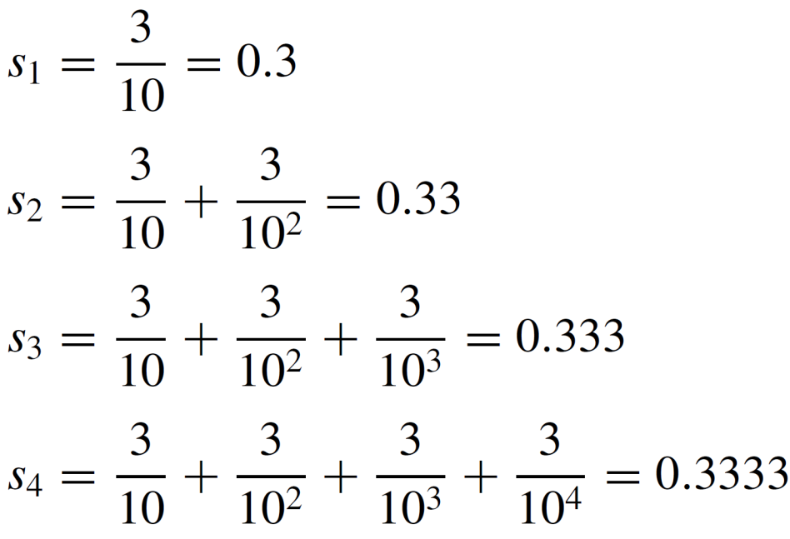
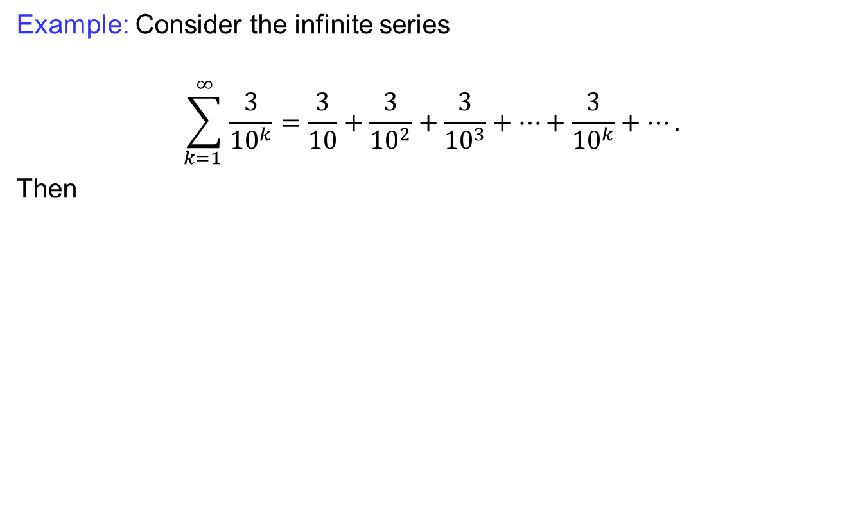
Infinite series
Example:Consider the infiniteseries
$$\sum_{k=1 }^{∞}{\frac{3}{{10}^{k}}}=\frac{3}{10}+\frac{3}{{10}^{2}}+\frac{3}{{10}^{3}}+…+\frac{3}{{10}^{k}}+….$$
Then

Slide 26
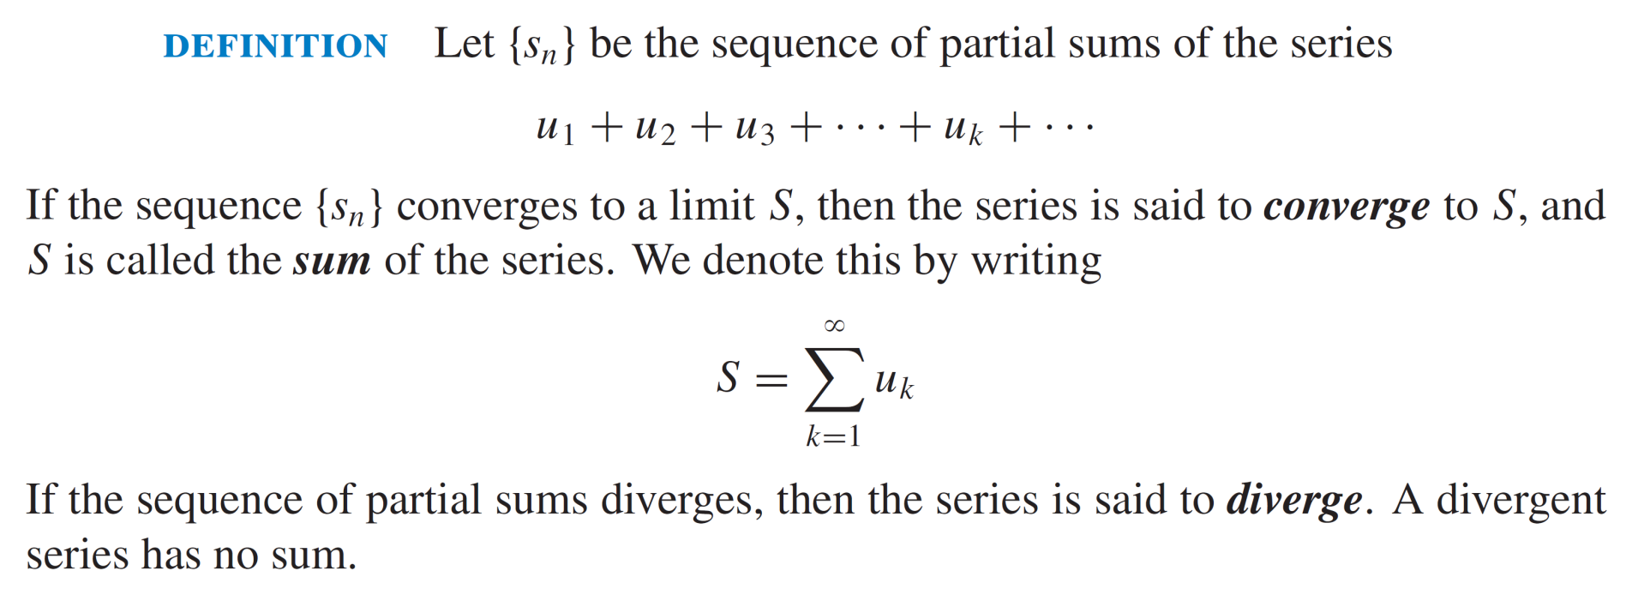
Convergence of infinite series
  Definition: E

Slide 27
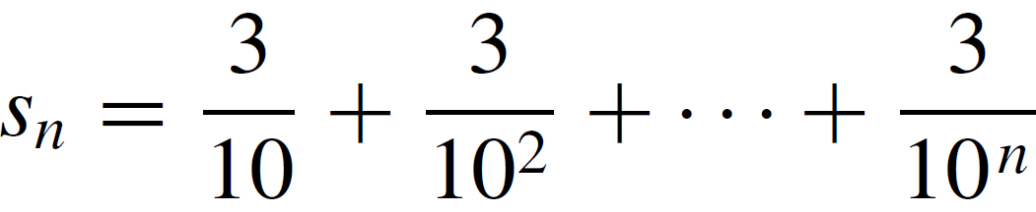
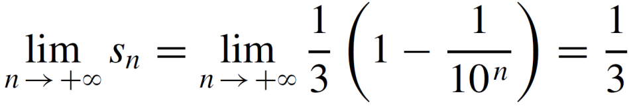
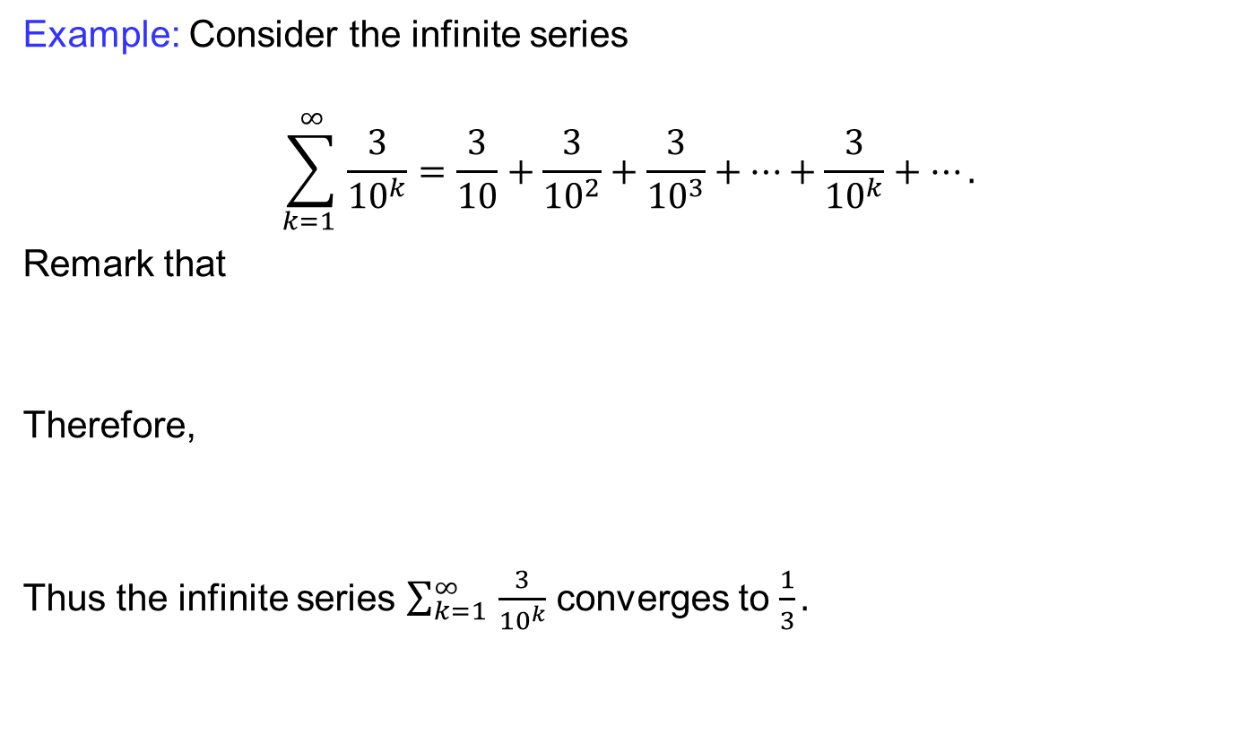
Convergence of infinite series
Example:Consider the infiniteseries
$$\sum_{k=1 }^{∞}{\frac{3}{{10}^{k}}}=\frac{3}{10}+\frac{3}{{10}^{2}}+\frac{3}{{10}^{3}}+…+\frac{3}{{10}^{k}}+….$$
Remarkthat
  Therefore,
  Thus the infinite series $\sum_{k=1 }^{∞}{\frac{3}{{10}^{k}}}$ converges to $\frac{1}{3}.$

Slide 28
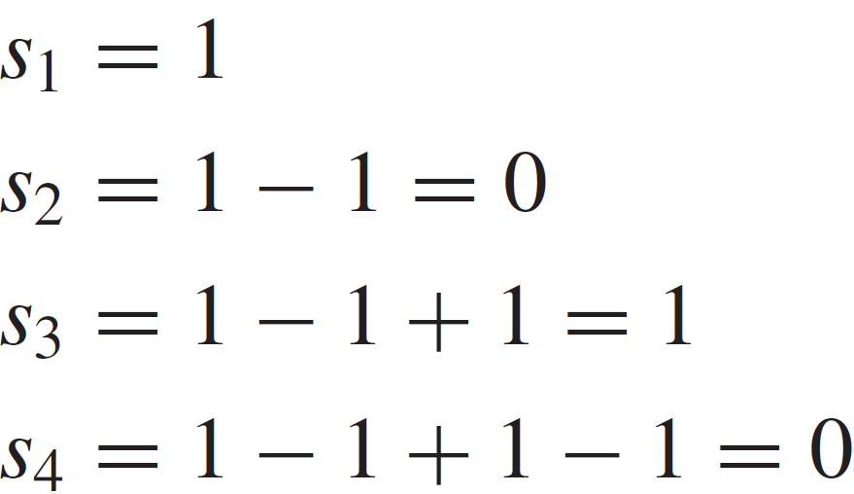

Convergence of infinite series
Example:Consider the infiniteseries
$$\sum_{k=1 }^{∞}{{\left(−1\right)}^{n−1}}=1−1+1−1−1+1…$$
  Since
  …
  The sequence of partial sum is $1,0,1,0,… .$
  Since the partial sums are not convergent the series diverges.

Slide 29
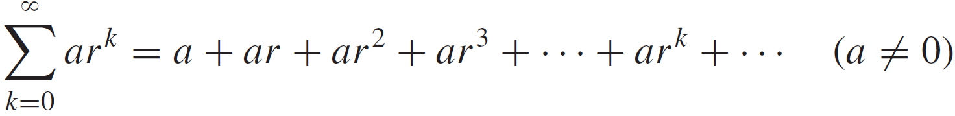
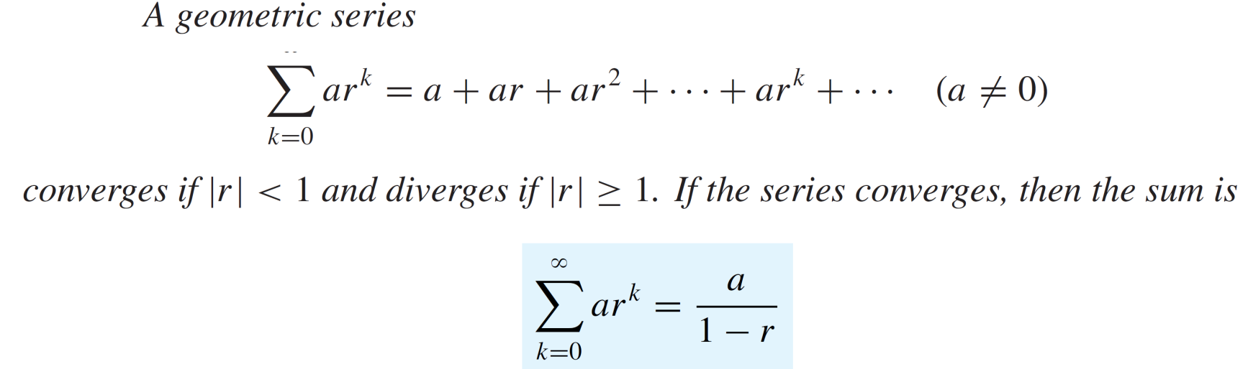
Convergence of infinite series
Geometric series: A series of the form
  …
  is called the geometric series.
  Theorem

Slide 30


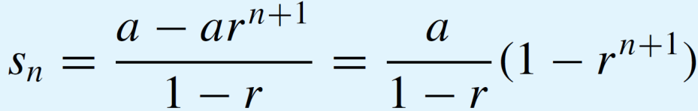
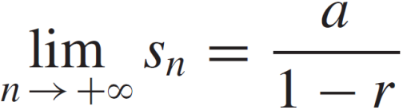
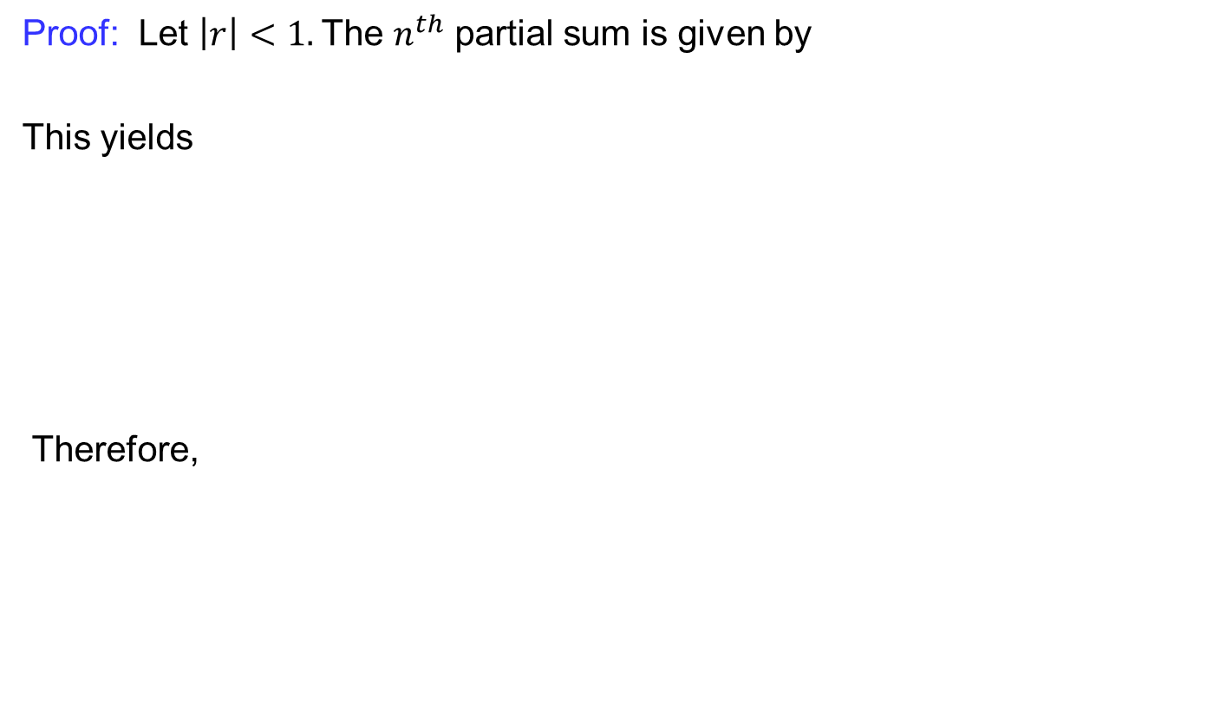
Convergence of infinite series
  Proof: Let $\left|r\right|<1.$The $n^{th}$partial sumisgiven by
  This yields
  Therefore,

Slide 31
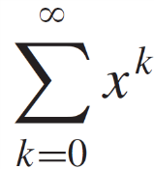
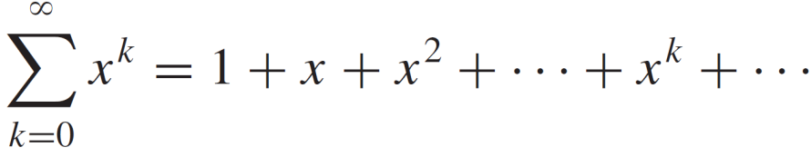
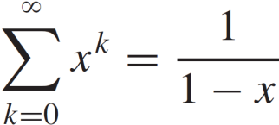
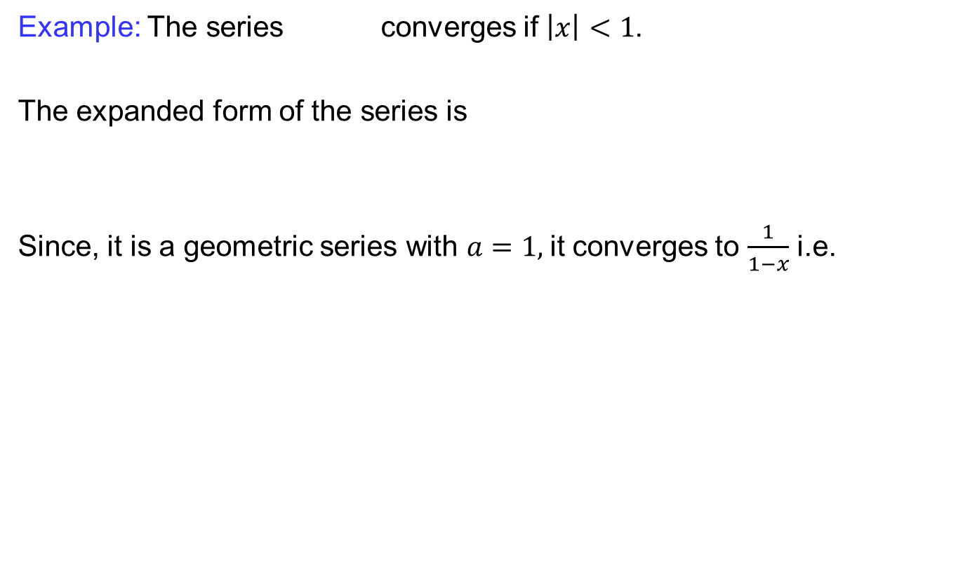
Convergence of infinite series
Example: The series converges if $\left|x\right|<1$.
The expanded form of the series is
Since, it is a geometric series with $a=1,$it converges to $\frac{1}{1−x}$i.e.

Slide 32
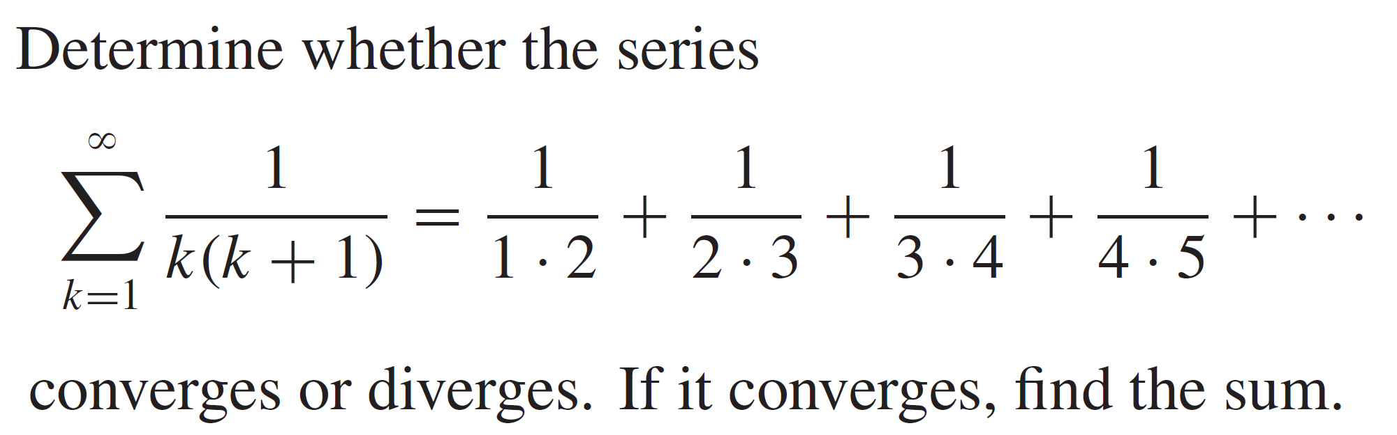
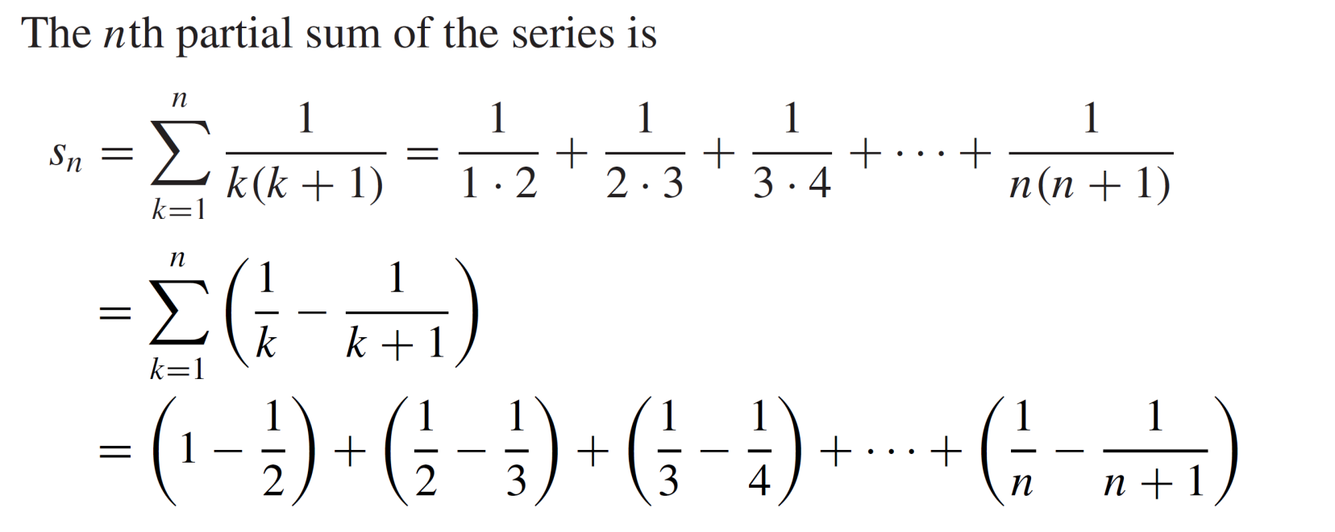
Convergence of infinite series
Example:
Proof:

Slide 33
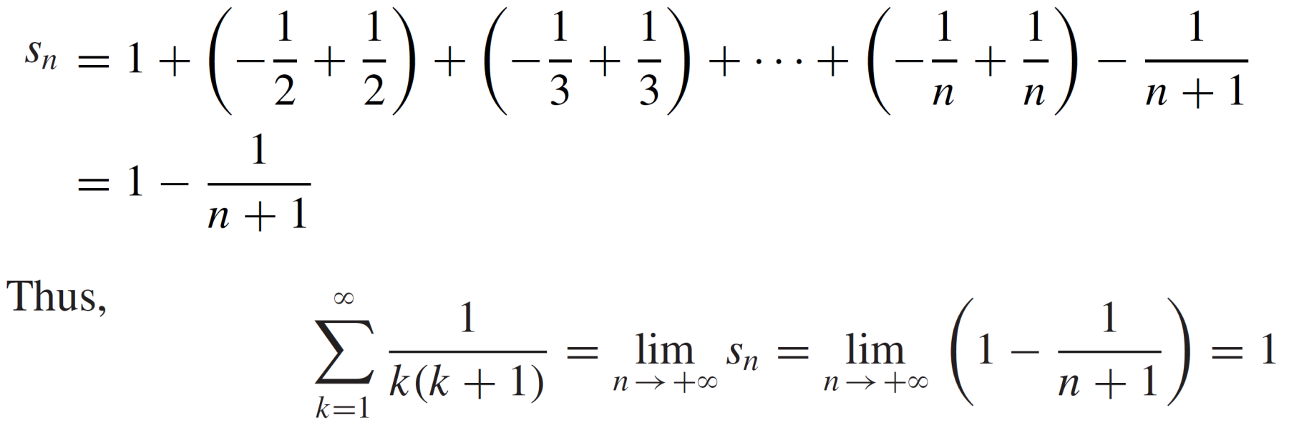
Convergence of infinite series
Cont…

Slide 34

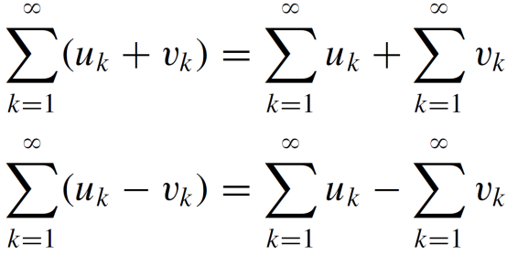
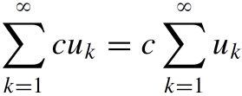
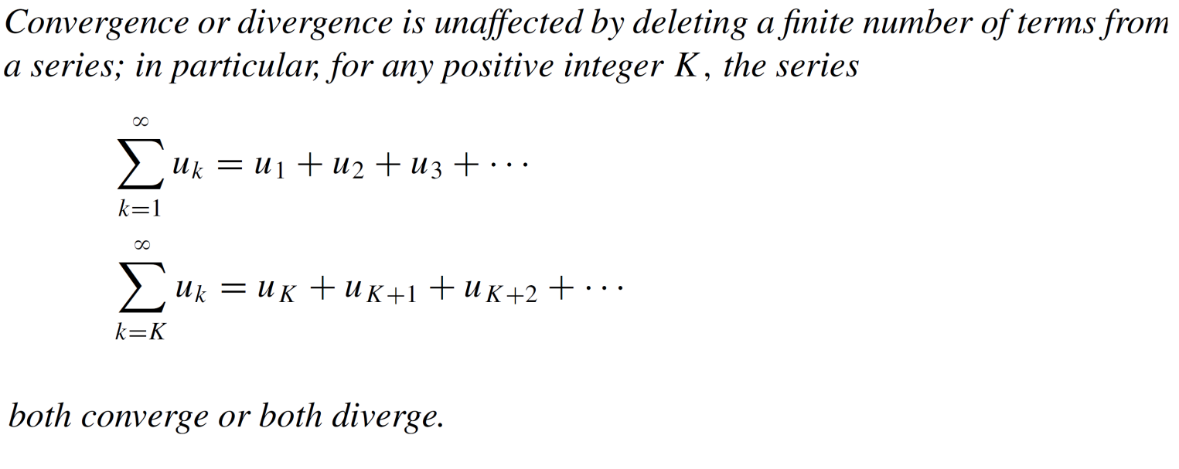
Convergence of infinite series
Theorem:

Slide 35
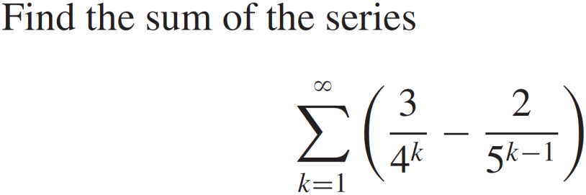
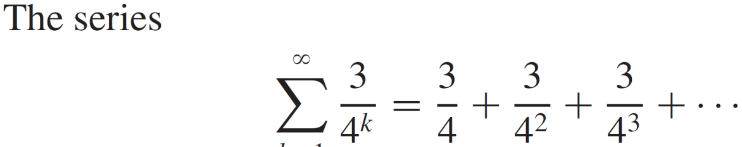
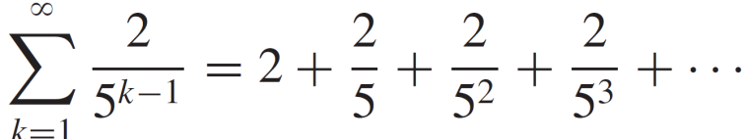
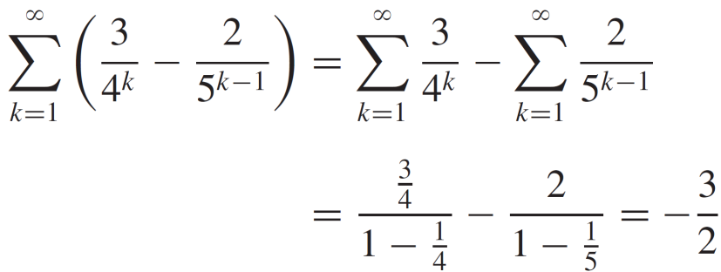
Convergence of infinite series
Example:
Solution:

Slide 36
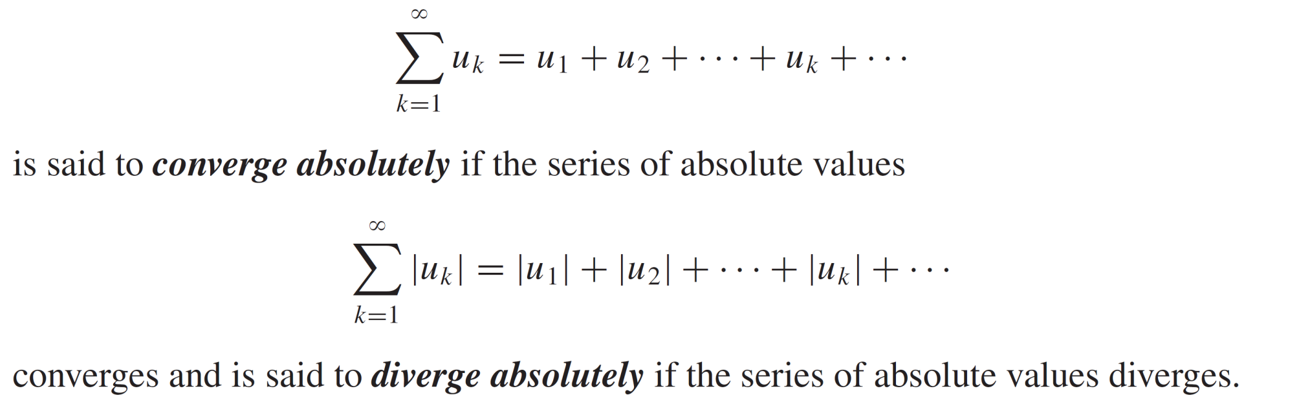
Convergence of infinite series
Definition:

Slide 37


Convergence of infinite series
Definition: Determine whether the series
converge absolutely or not ?
Solution

Slide 38

Convergence of infinite series
Theorem:

Slide 39
Lecture Summary
    Recalls
    Subsequences
    Limit superior and limit inerior
    Bolzano-Weierstrass theorem
    Cauchy sequences
    Infinite series
    Convergence of infinite series.
    Absolutely convergent series

