Slide 1
(MTH 250)
Calculus
Lecture 14

Slide 2
Previous Lecture’s Summary
Relative Extrema
Extreme Value Theorem
First Derivative Test
Second Derivative test
Rolle’s Theorem
Mean Value Theorem

Slide 3
Today’s Lecture
    Introduction to sequences
    Limit of sequences
    Limits laws for sequences
    Monotone sequences
    Bounded sequences
    Some standard limits

Slide 4
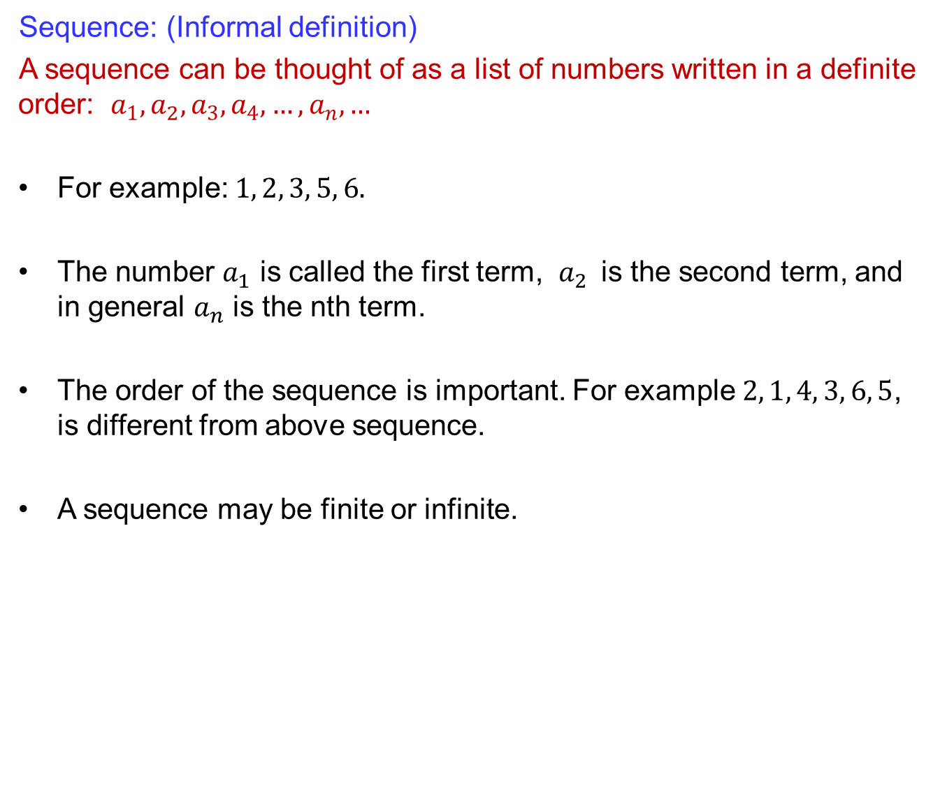
Introduction to sequences
Sequence: (Informal definition)
A sequence can be thought of as a list of numbers written in a definite order: $a_{1}, a_{2}, a_{3}, a_{4}, …, a_{n}, …$
For example: $1, 2, 3, 5, 6.$
The number $a_{1}$ is called the first term, $a_{2}$ is the second term, and in general $a_{n}$is the nth term.
The order of the sequence is important. For example $2, 1, 4, 3, 6, 5$, is different from above sequence.
A sequence may be finite or infinite.

Slide 5
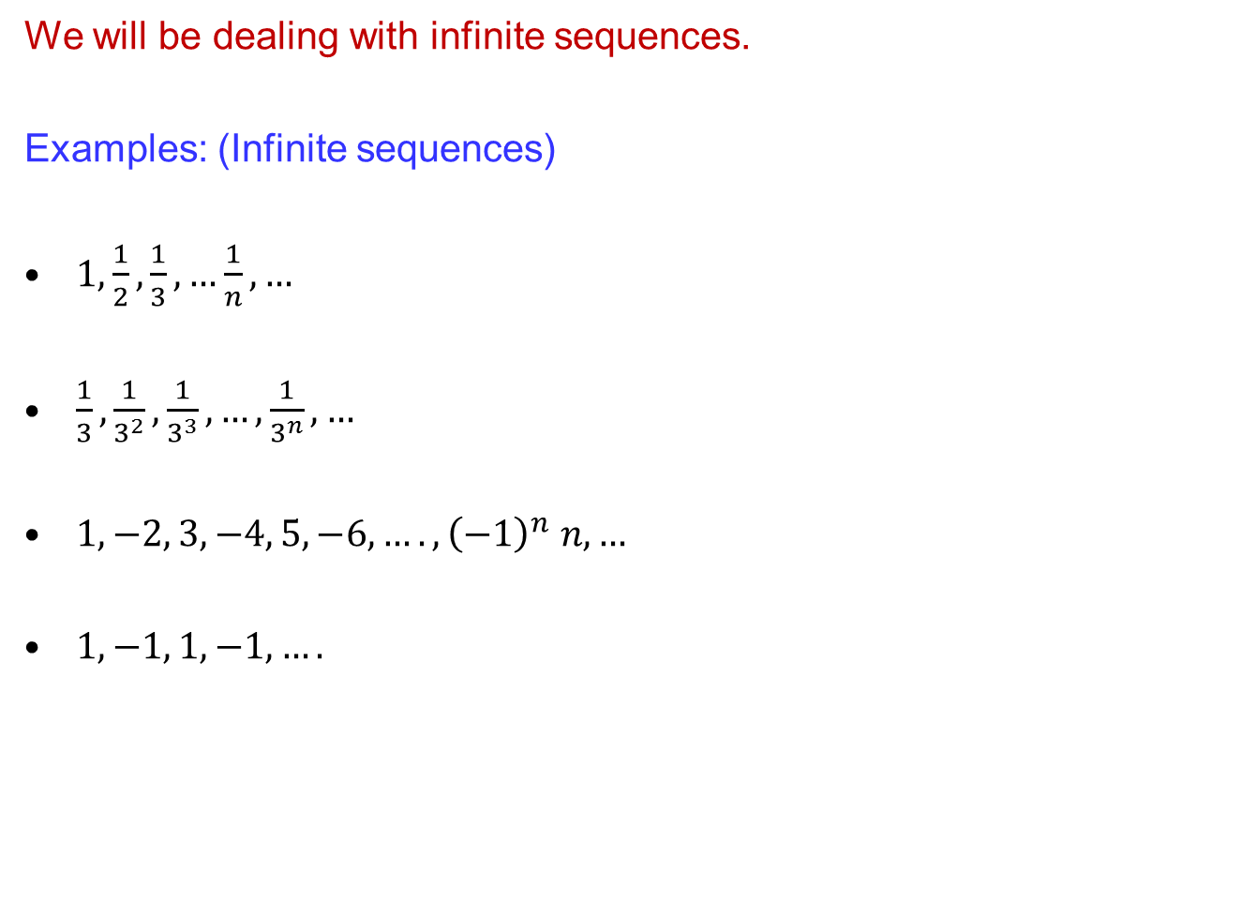
Introduction to sequences
Wewillbedealingwithinfinitesequences.
Examples: (Infinitesequences)
$1,\frac{1}{2},\frac{1}{3}, …\frac{1}{n}, …$
$\frac{1}{3},\frac{1}{3^{2}},\frac{1}{3^{3}}, …,\frac{1}{3^{n}}, …$
$1, −2, 3, −4, 5, −6, …. , {\left(−1\right)}^{n} n, …$
$1, −1, 1, −1, ….$

Slide 6
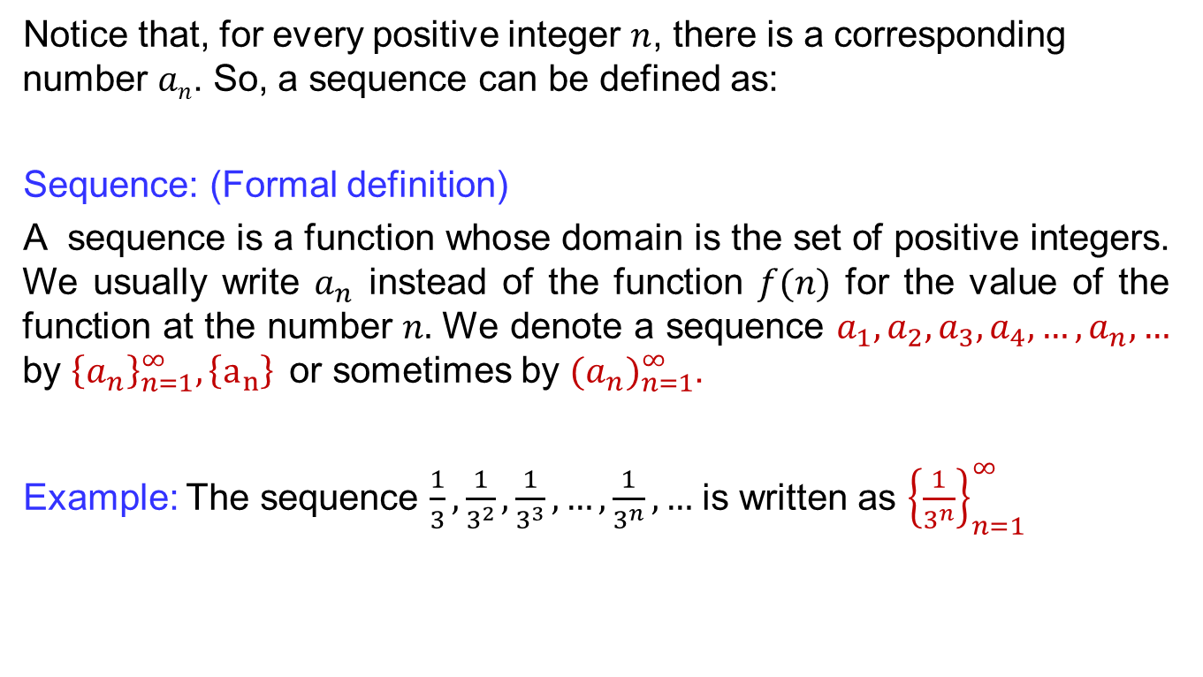
Introduction to sequences
Notice that, for every positive integer $n$, there is a corresponding number $an$. So, a sequence can be defined as:
Sequence: (Formal definition)
A sequence is a function whose domain is the set of positive integers. We usually write $a_{n}$ instead of the function $f(n)$ for the value of the function at the number $n.$ We denote a sequence $a_{1}, a_{2}, a_{3}, a_{4}, …, a_{n}, …$by${\left\{a_{n}\right\}}_{n=1}^{∞}, \left\{a_{n}\right\}$or sometimes by ${(a_{n})}_{n=1}^{∞}$.
Example: The sequence $\frac{1}{3},\frac{1}{3^{2}},\frac{1}{3^{3}}, …,\frac{1}{3^{n}}, …$ is written as ${\left\{\frac{1}{3^{n}}\right\}}_{n=1}^{∞}$

Slide 7
Introduction to sequences
Examples:
Preceding Notation | Defining Formula | Terms of Sequence

Slide 8
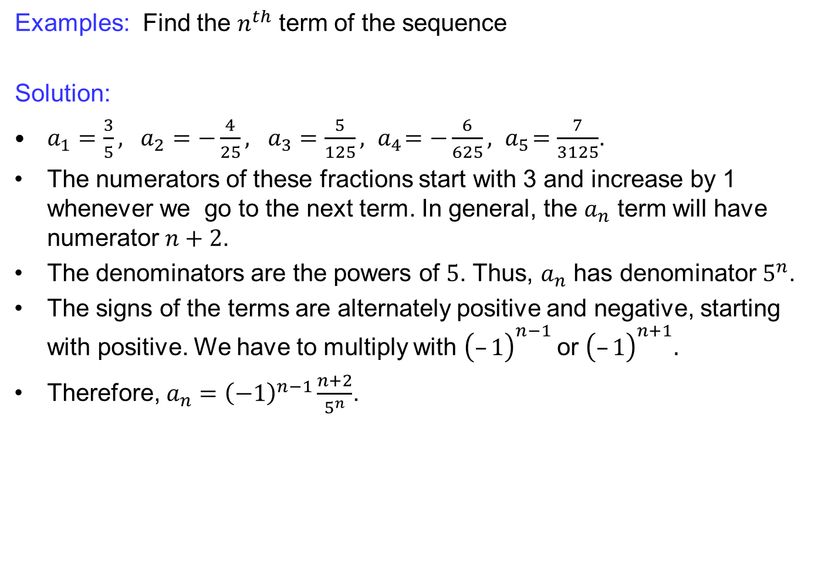
Introduction to sequences
Examples: Find the $n^{th}$ term of the sequence
Solution:
$a_{1}=\frac{3}{5}, a_{2}=−\frac{4}{25}, a_{3}=\frac{5}{125}, { a}_{4}=−\frac{6}{625}, { a}_{5}=\frac{7}{3125}$.
The numerators of these fractions start with 3 and increase by 1 whenever we go to the next term. In general, the $a_{n}$ term will have numerator $n+2$.
The denominators are the powers of $5$. Thus, $a_{n}$ has denominator $5^{n}$.
The signs of the terms are alternately positive and negative, starting with positive. We have to multiply with ${\left(–1\right)}^{n−1}$or ${\left(–1\right)}^{n+1}.$
Therefore, $a_{n}={\left(−1\right)}^{n−1}\frac{n+2}{5^{n}}$.

Slide 9
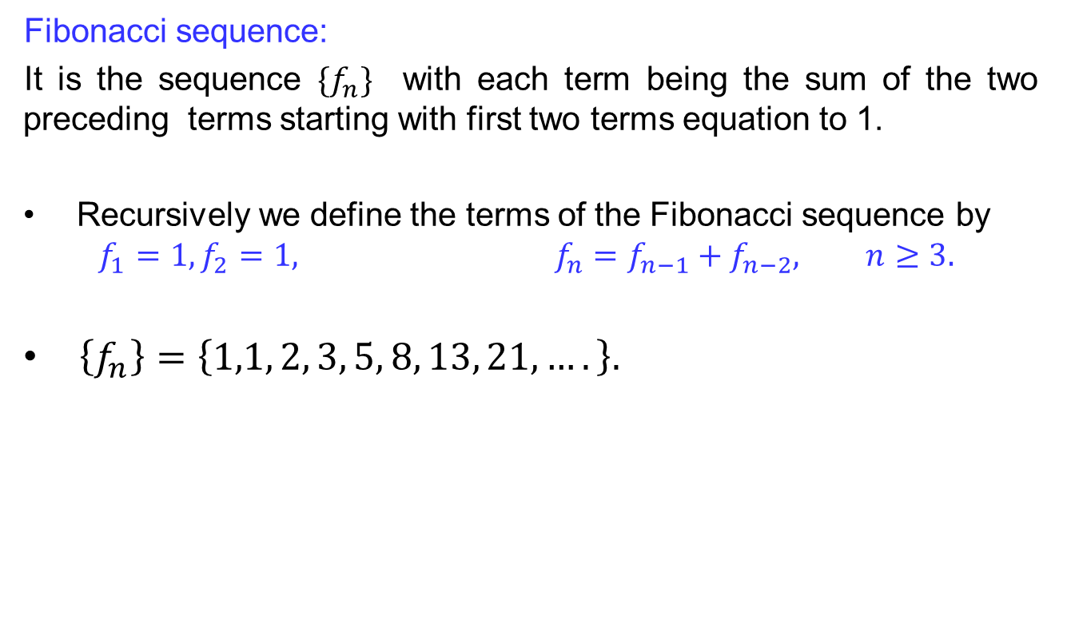
Introduction to sequences
Fibonacci sequence:
It is the sequence $\{f_{n}\}$with each term being the sum of the two preceding terms starting with first two terms equation to 1.
Recursively we define the terms of the Fibonacci sequence by
$$f_{1}=1, f_{2}=1, f_{n}=f_{n−1}+f_{n−2}, n≥3.$$
  $\left\{f_{n}\right\}=\left\{1,1, 2, 3, 5, 8, 13, 21, ….\right\}.$

Slide 10
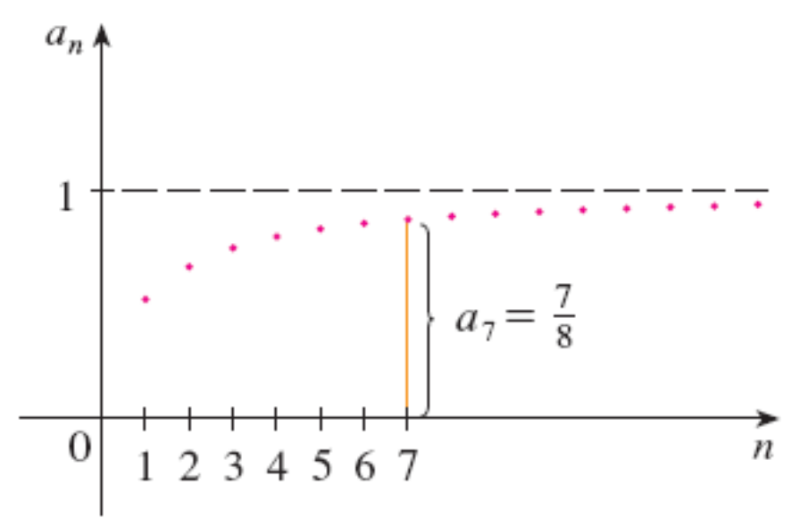
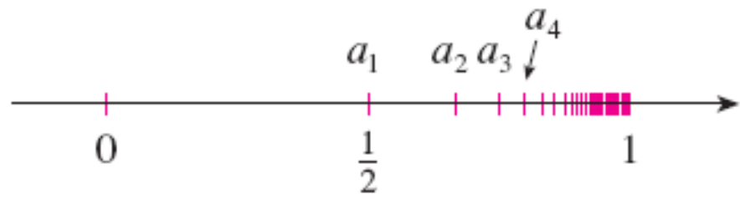

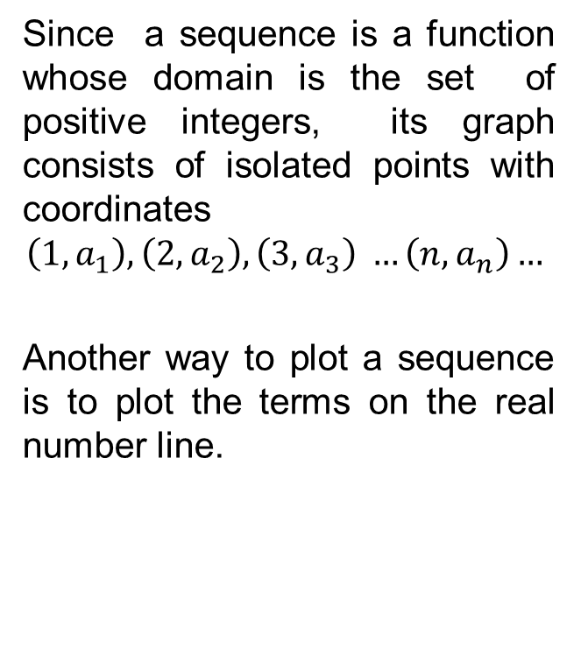
Limits of sequences
Since a sequence is a function whose domain is the set of positive integers, its graph consists of isolated points with coordinates
$$\left(1,a_{1}\right), \left(2, a_{2}\right), \left(3, a_{3}\right) …\left(n,a_{n}\right)…$$
Another way to plot a sequence is to plot the terms on the real number line.
$$an =\frac{n}{n + 1}$$

Slide 11
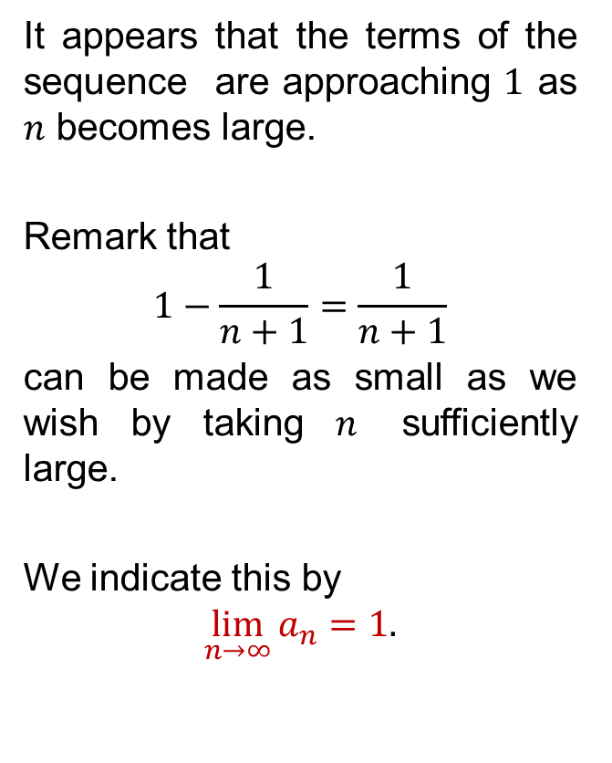
Limits of sequences
It appears that the terms of the sequence are approaching $1$ as $n$ becomes large.
Remark that
$$1−\frac{1}{n+1}=\frac{1}{n+1}$$
can be made as small as we wish by taking $n$ sufficiently large.
We indicate this by
$$\lim_{n→∞}{a_{n}}=1.$$
$$an =\frac{n}{n + 1}$$

Slide 12
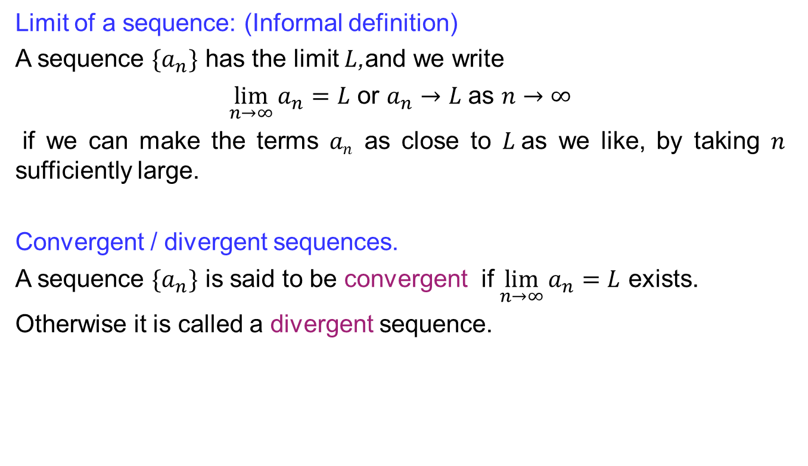
Limits of sequences
Limit of a sequence: (Informal definition)
A sequence $\{a_{n}\}$ has the limit $L$,and we write
$\lim_{n→∞}{a_{n}}=L$ or $a_{n}→L$ as $n→∞$
if we can make the terms $an$ as close to $L$as we like, by taking $n$ sufficiently large.
Convergent / divergent sequences.
A sequence $\{a_{n}\}$ is said to be convergent if $\lim_{n→∞}{a_{n}}=L$exists.
Otherwise it is called a divergent sequence.

Slide 13
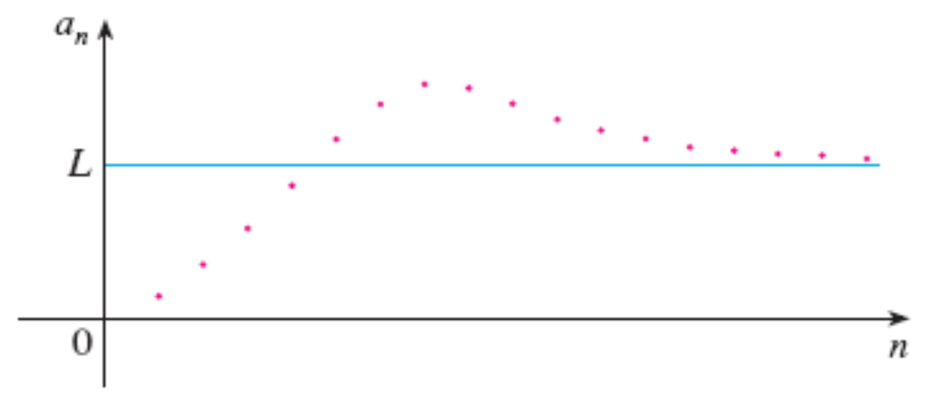
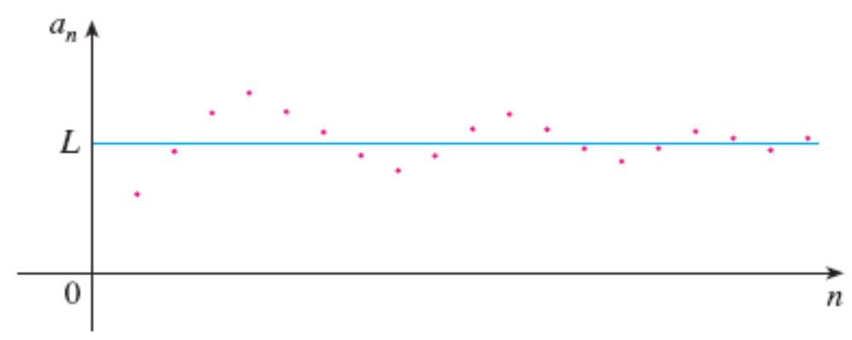
Limits of sequences

Slide 14
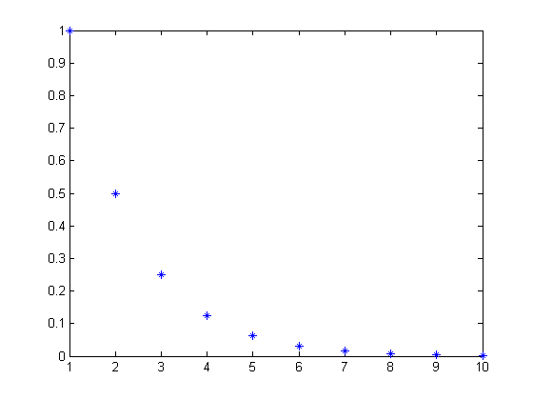
Limits of sequences
Example:

Slide 15


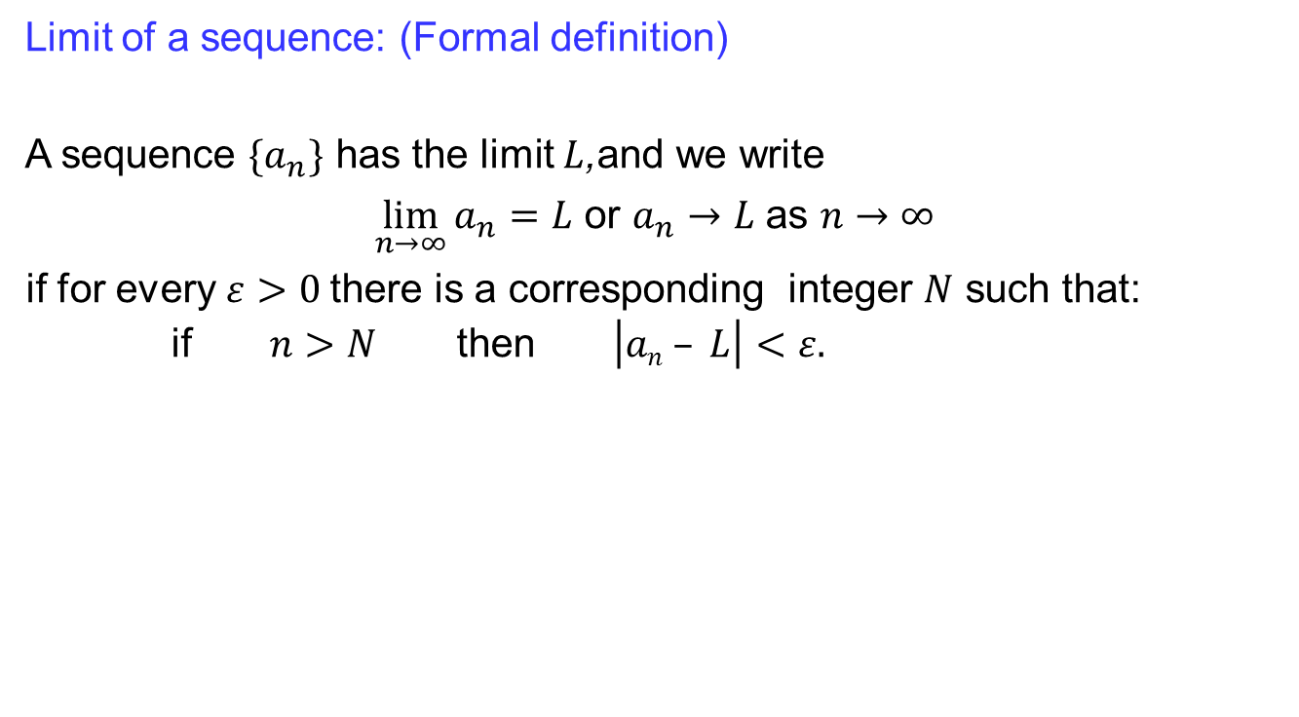









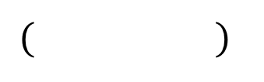


Limits of sequences
Limit of a sequence: (Formal definition)
A sequence $\{a_{n}\}$ has the limit $L$,and we write
$\lim_{n→∞}{a_{n}}=L$ or $a_{n}→L$ as $n→∞$
if for every $ε>0$there is a corresponding integer $N$ such that:
if $n>N$ then $\left|an – L\right|<ε.$
$a_{1}$
$a_{3}$
$a_{2}$
$a_{8}$
$a_{N+1}$
$a_{N+2}$
$a_{9}$
$a_{6}$
$a_{5}$
$a_{4}$
$a_{7}$
$$( )$$
$$L−ε L L+ε$$
$0$

Slide 16
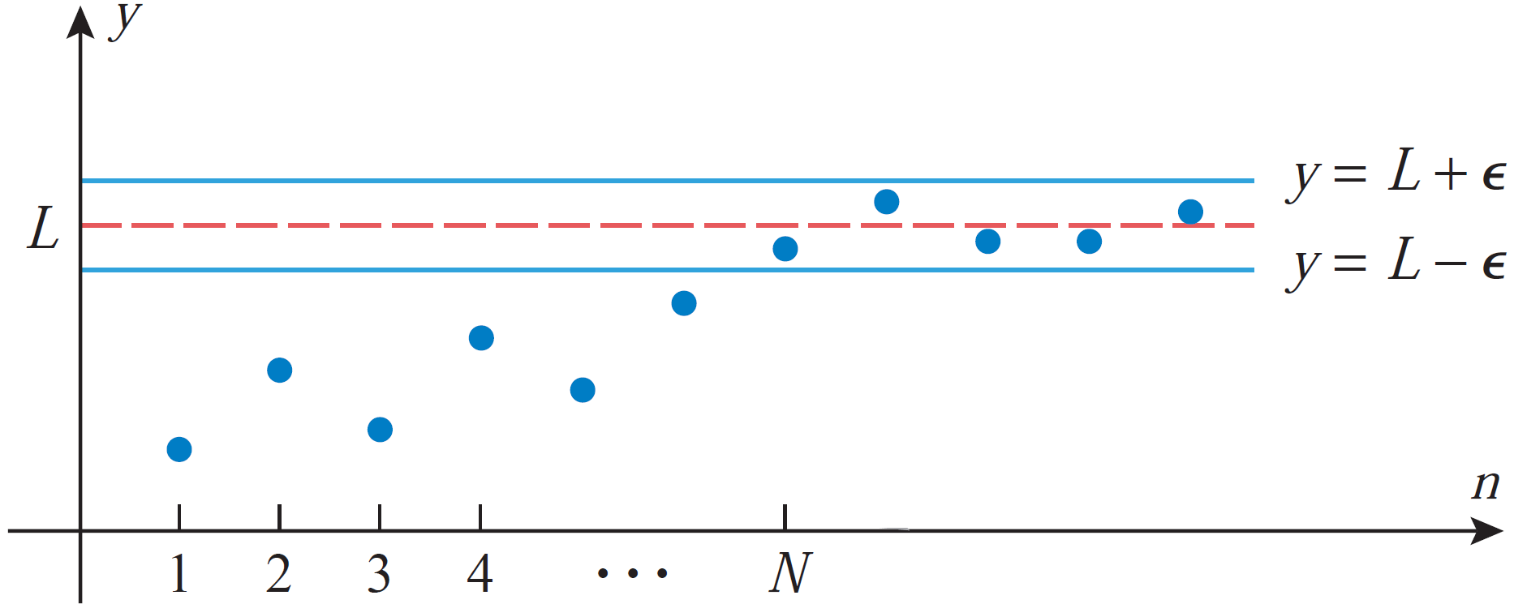
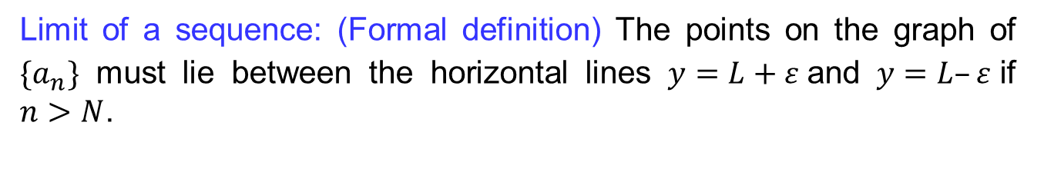
Limits of sequences
  Limit of a sequence: (Formal definition) The points on the graph of $\{a_{n}\}$ must lie between the horizontal lines $y=L+ε$and $y=L–ε$if $n>N$.

Slide 17
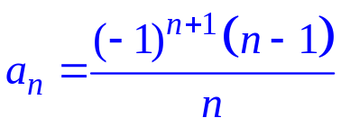
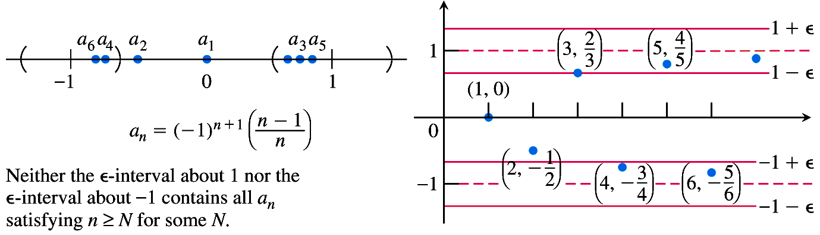
Limits of sequences
  A sequence that diverges:

Slide 18
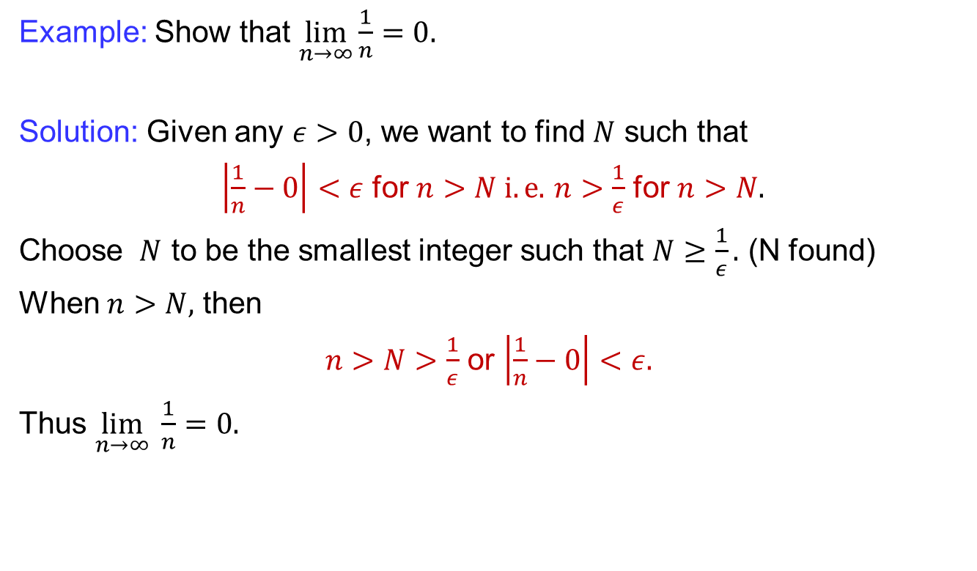
Limits of sequences
  Example: Show that$\lim_{n→∞}{\frac{1}{n}}=0.$
Solution: Given any $ε>0$, we want to find $N$ such that
$\left|\frac{1}{n}−0\right|<ε$ for $n>N i.e.$$n>\frac{1}{ε}$ for $n>N.$
Choose $N$ to be the smallest integer such that $N≥\frac{1}{ε}.$ (N found)
When $n>N,$ then
$n>N>\frac{1}{ε}$ or $\left|\frac{1}{n}−0\right|<ε.$
Thus $\lim_{n→∞} \frac{1}{n}=0.$

Slide 19
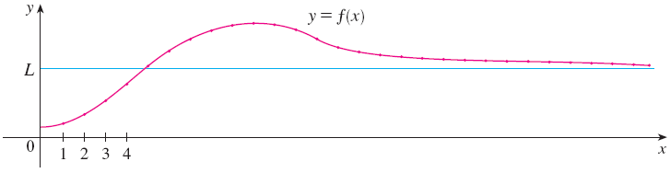
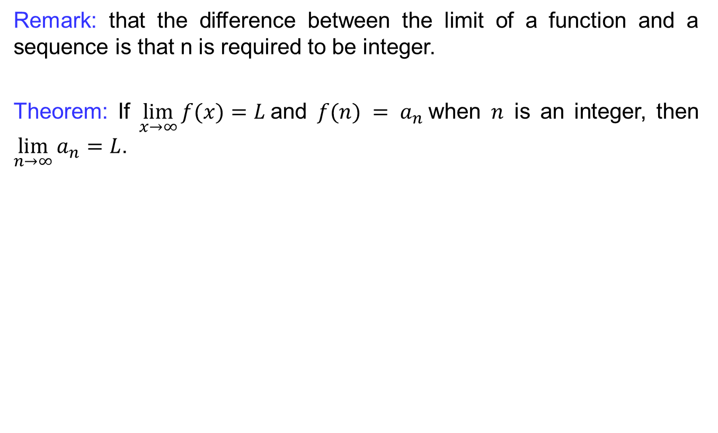
Limits of sequences
  Remark:that the differencebetween the limit of a function and a sequenceisthat n isrequired to beinteger.
  Theorem:If $\lim_{x→∞}{f(x)}=L$and $f(n) = a_{n}$when $n$is an integer, then $\lim_{n→∞}{a_{n}}=L$.

Slide 20
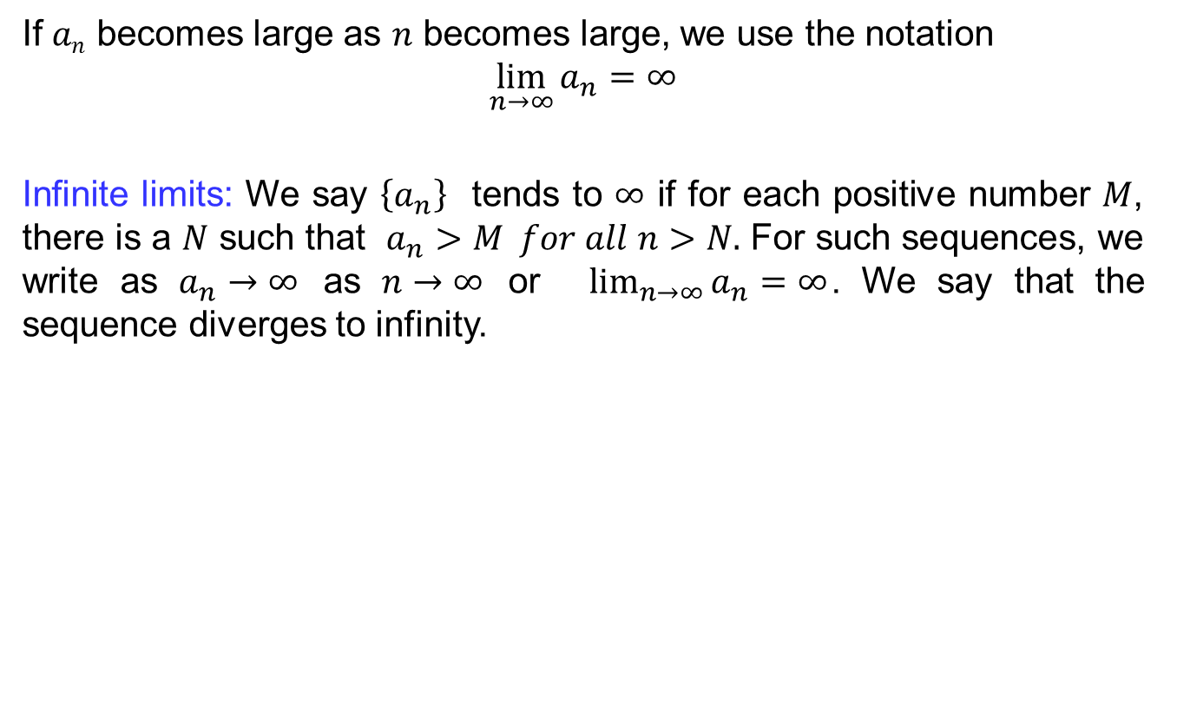
Limits of sequences
  If $an$ becomes large as $n$becomes large, we use the notation
  $$\lim_{n→∞}{a_{n}}=∞$$
  Infinite limits:We say $\left\{a_{n}\right\}$ tends to $∞$ if for each positive number $M$, there is a $N$ such that $a_{n}>M for all n>N.$ For such sequences, we write as $a_{n}→∞$ as $n→∞$ or $\lim_{n→∞}{a_{n}}=∞$. We say that the sequence diverges to infinity.

Slide 21
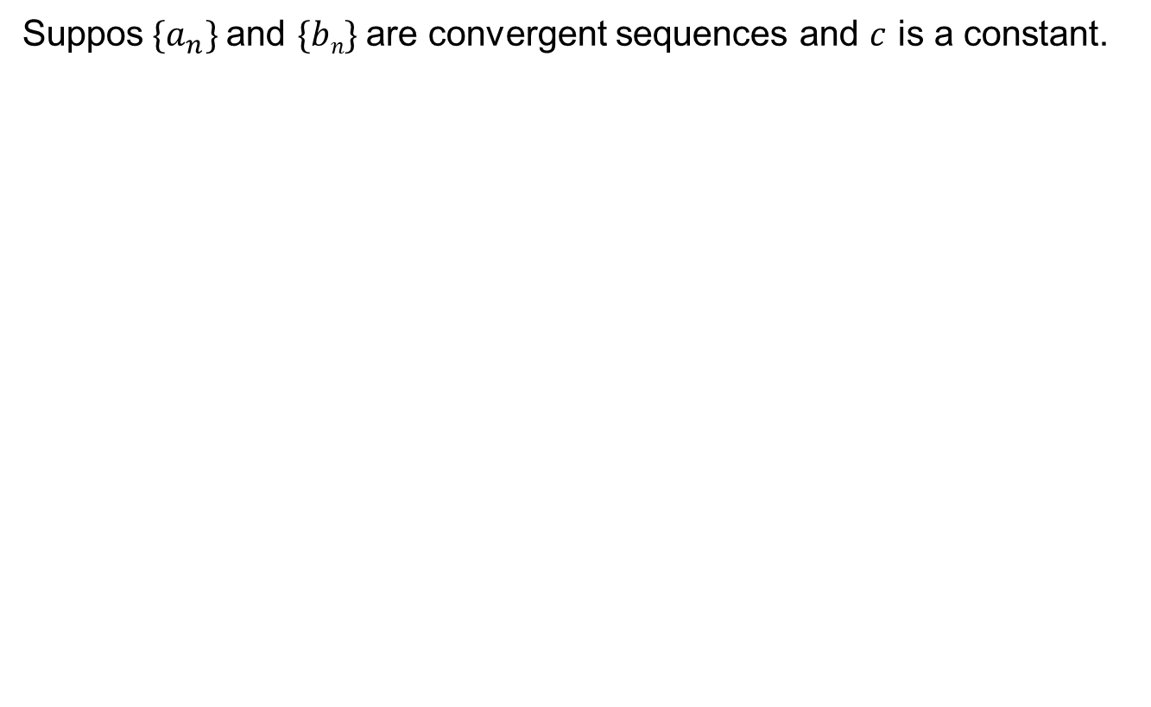
Limits of sequences
  Suppos$\{a_{n}\}$and $\{bn\}$are convergent sequences and $c$is a constant.

Slide 22
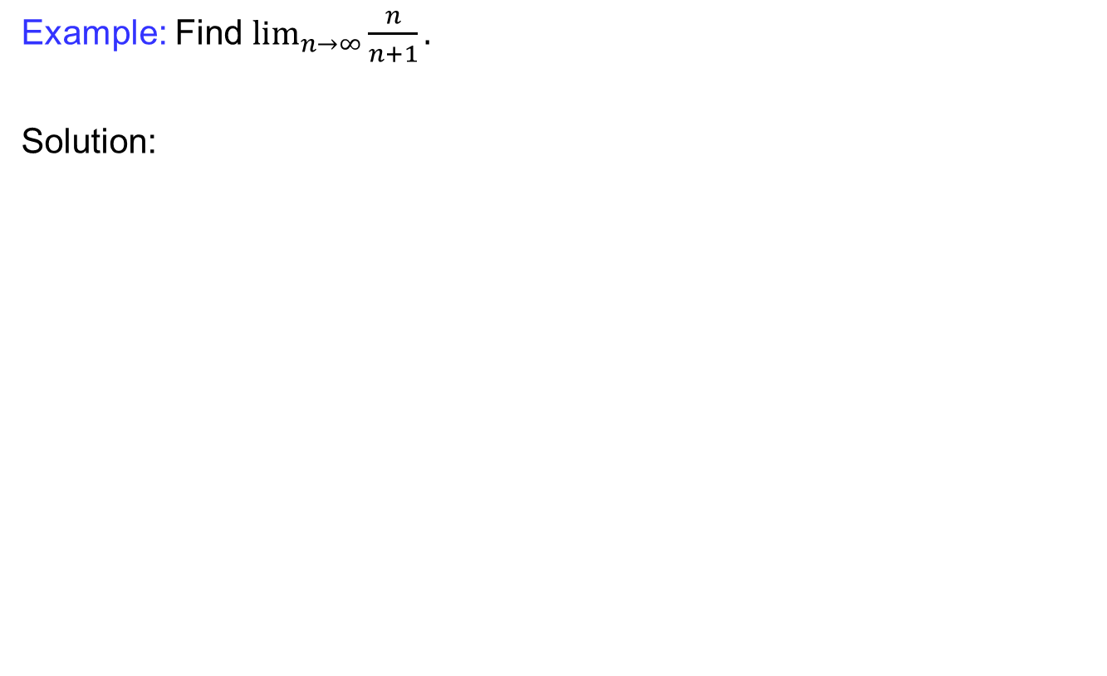
Limits of sequences
  Example: Find$\lim_{n→∞}{\frac{n}{n+1}}.$
  Solution:

Slide 23
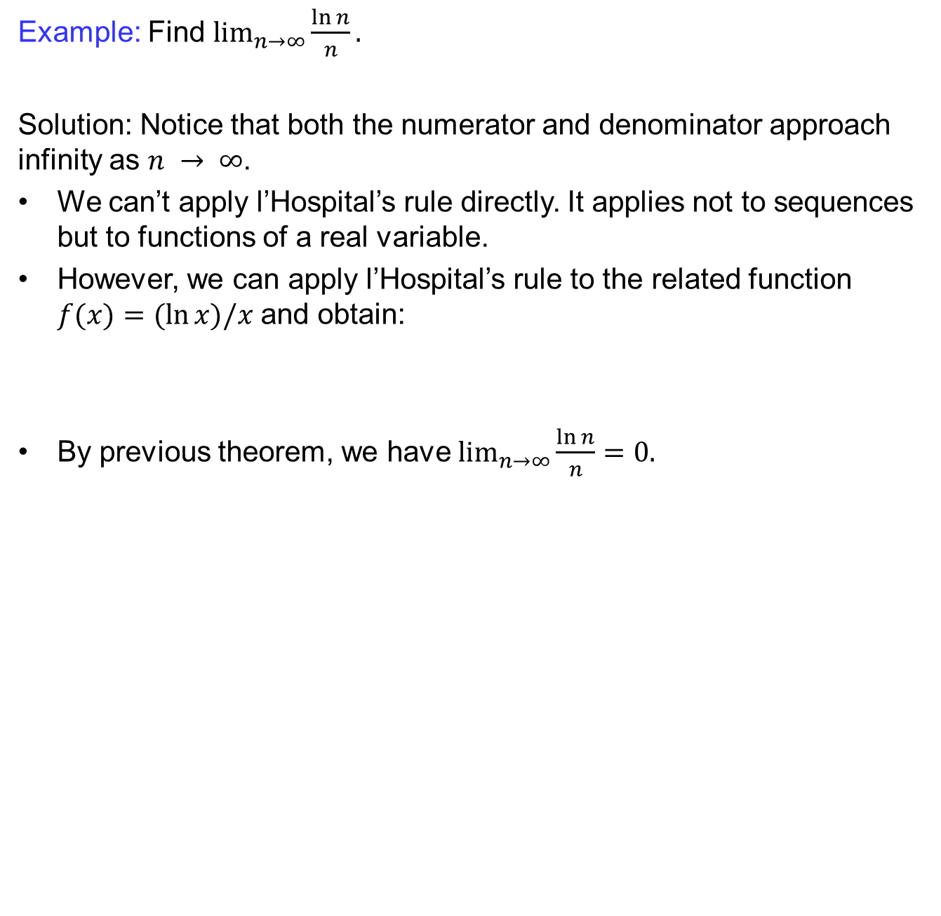
Limits laws for sequences
  Example: Find$\lim_{n→∞}{\frac{\ln{n}}{n}}.$
  Solution: Notice that both the numerator and denominator approach infinity as $n → ∞$.
  We can’t apply l’Hospital’srule directly. It applies not to sequences but to functions of a real variable.
  However, we can apply l’Hospital’srule to the related function $f(x)=(ln⁡x)/x$ and obtain:
  By previous theorem, we have $\lim_{n→∞}{\frac{\ln{n}}{n}}=0.$

Slide 24
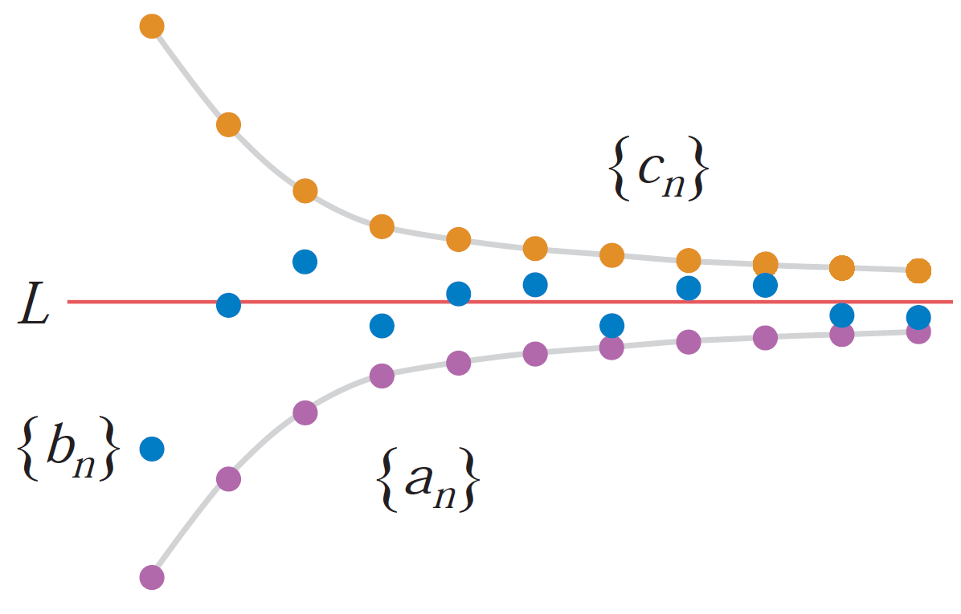
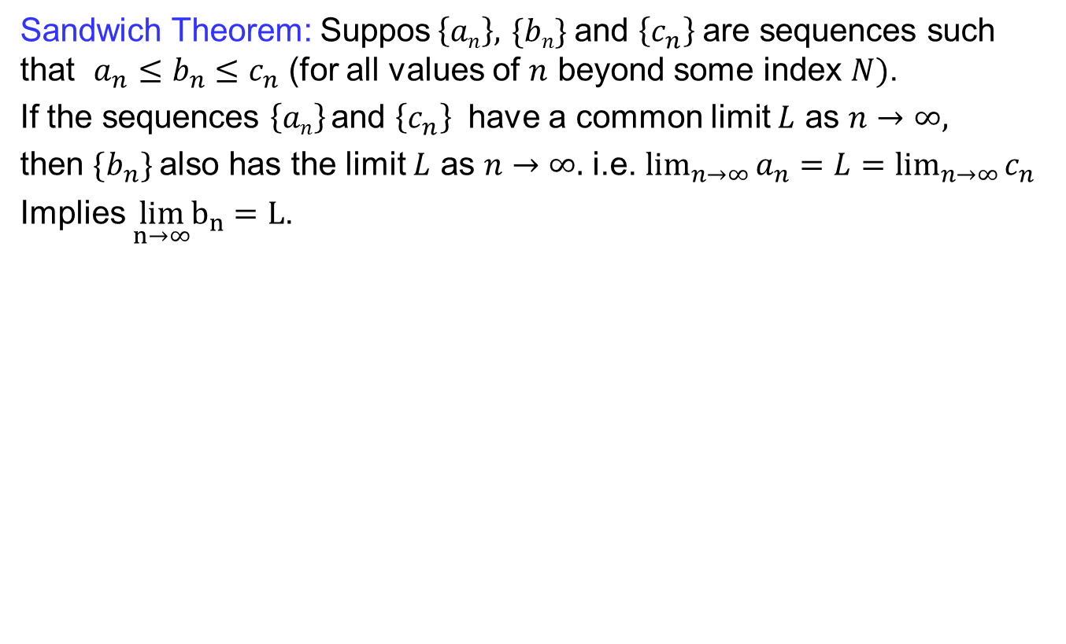
Limits laws for sequences
  Sandwich Theorem: Suppos$\left\{an\right\},$$\{bn\}$and $\left\{c_{n}\right\}$are sequences such that $a_{n}≤b_{n}≤c_{n}$ (for all values of $n$ beyond some index $N)$.
  If the sequences $\left\{an\right\}$and $\left\{c_{n}\right\}$ have a common limit $L$ as $n→∞,$
  then $\{b_{n}\}$also has the limit $L$ as $n→∞.$ i.e. $\lim_{n→∞}{a_{n}}=L=\lim_{n→∞}{c_{n}}$
  Implies $\lim_{n→∞}b_{n}=L$.

Slide 25
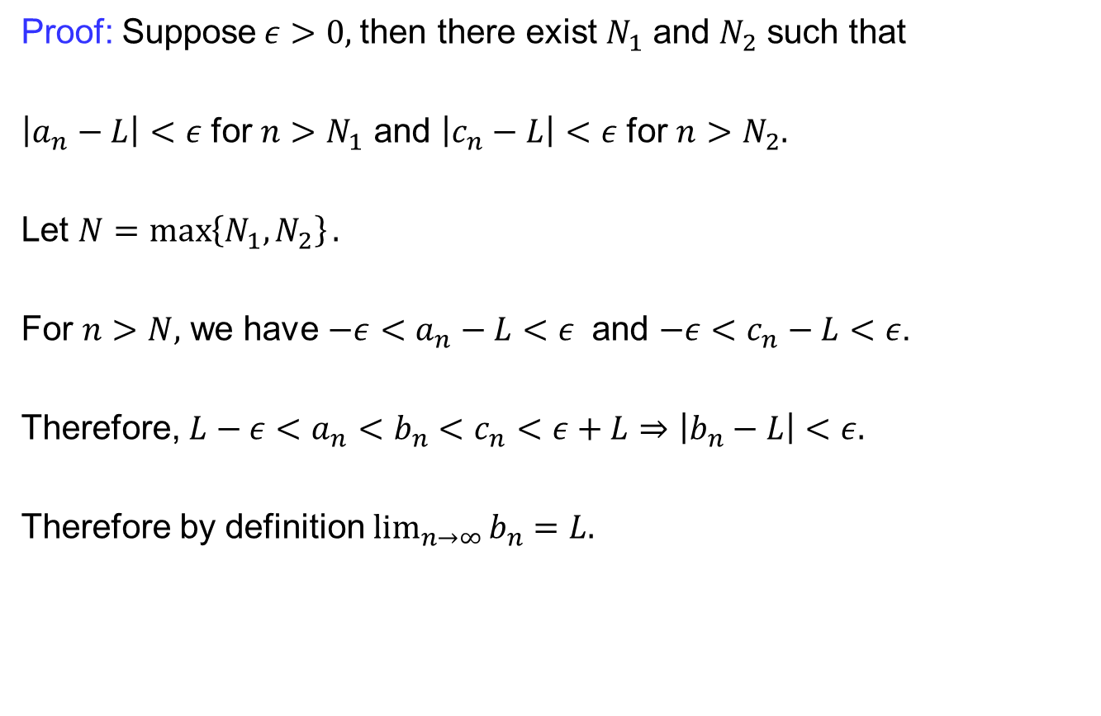
Limits laws for sequences
  Proof: Suppose$ε>0,$then there exist $N_{1}$ and $N_{2}$ such that
  $\left|a_{n}−L\right|<ε$ for $n>N_{1}$ and $\left|c_{n}−L\right|<ε$ for $n>N_{2}.$
  Let $N=\max\left\{N_{1},N_{2}\right\}.$
  For $n>N,$ we have $−ε<a_{n}−L<ε$ and $−ε<c_{n}−L<ε$.
  Therefore, $L−ε<a_{n}<b_{n}<c_{n}<ε+L⇒\left|b_{n}−L\right|<ε.$
  Therefore by definition $\lim_{n→∞}{b_{n}}=L.$

Slide 26
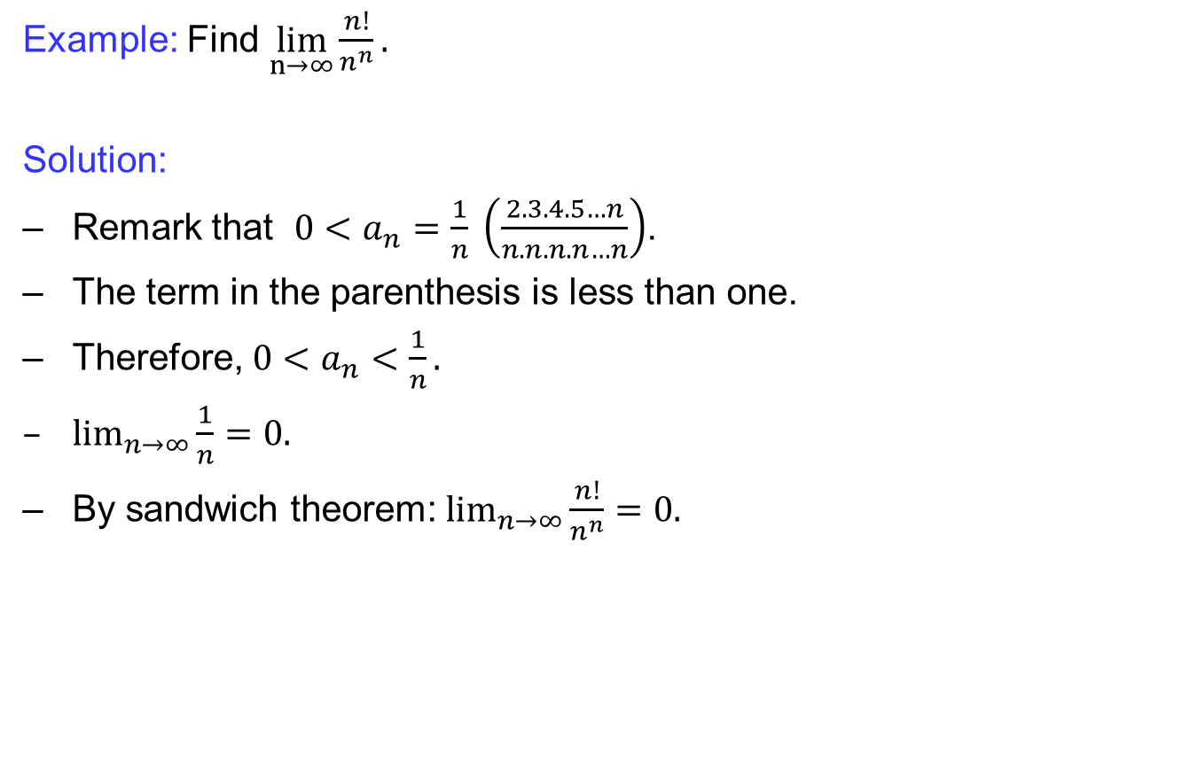
Limits laws for sequences
  Example: Find $\lim_{n→∞}\frac{n!}{n^{n}}.$
  Solution:
  Remark that $0<a_{n}=\frac{1}{n} \left(\frac{2.3.4.5…n}{n.n.n.n…n}\right)$.
  The term in the parenthesis is less than one.
  Therefore, $0<a_{n}<\frac{1}{n}.$
  $\lim_{n→∞}{\frac{1}{n}=0.}$
  By sandwich theorem: $\lim_{n→∞}{\frac{n!}{n^{n}}}=0.$

Slide 27
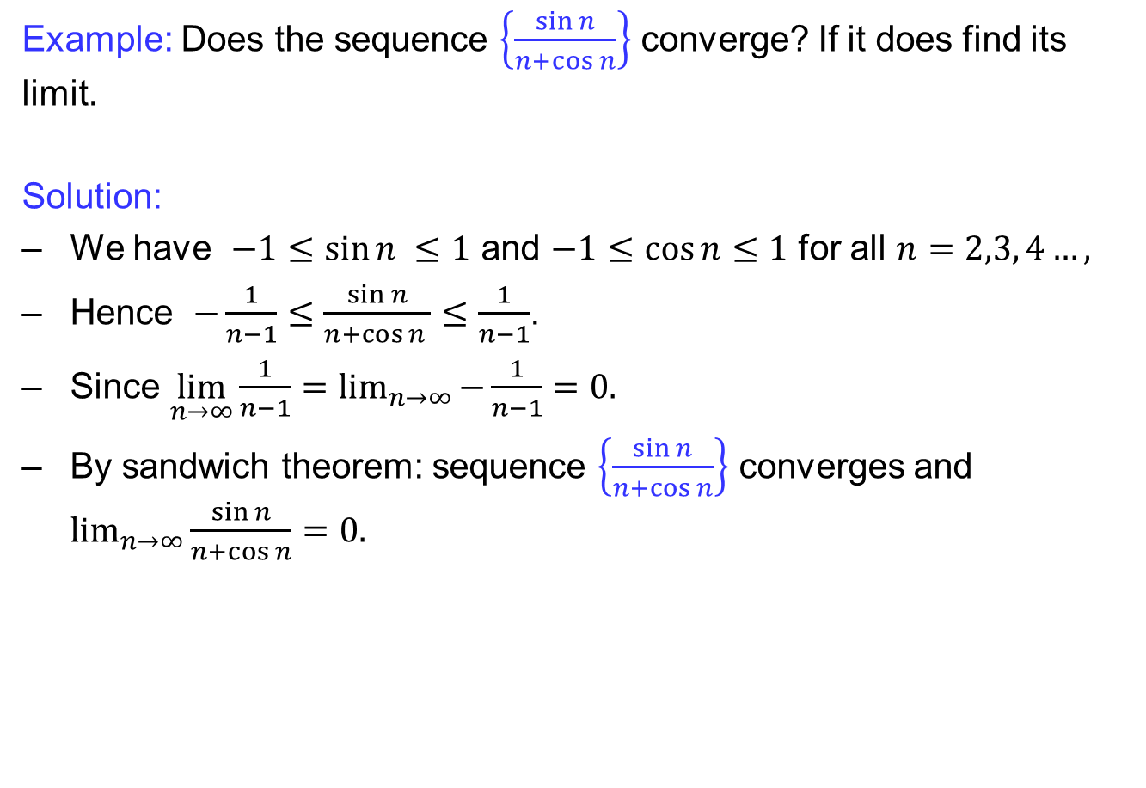
Limits laws for sequences
  Example: Does the sequence $\left\{\frac{\sin{n}}{n+\cos{n}}\right\}$converge? If it does find its limit.
  Solution:
  We have $−1≤\sin{n }≤1$ and $−1≤\cos{n≤1}$ for all $n=2,3, 4…,$
  Hence $−\frac{1}{n−1}≤\frac{\sin{n}}{n+\cos{n }}≤\frac{1}{n−1}$.
  Since $\lim_{n→∞}\frac{1}{n−1}=\lim_{n→∞}{−\frac{1}{n−1}}=0.$
  By sandwich theorem: sequence $\left\{\frac{\sin{n}}{n+\cos{n}}\right\}$ converges and $\lim_{n→∞}{\frac{\sin{n}}{n+\cos{n}}=0.}$

Slide 28
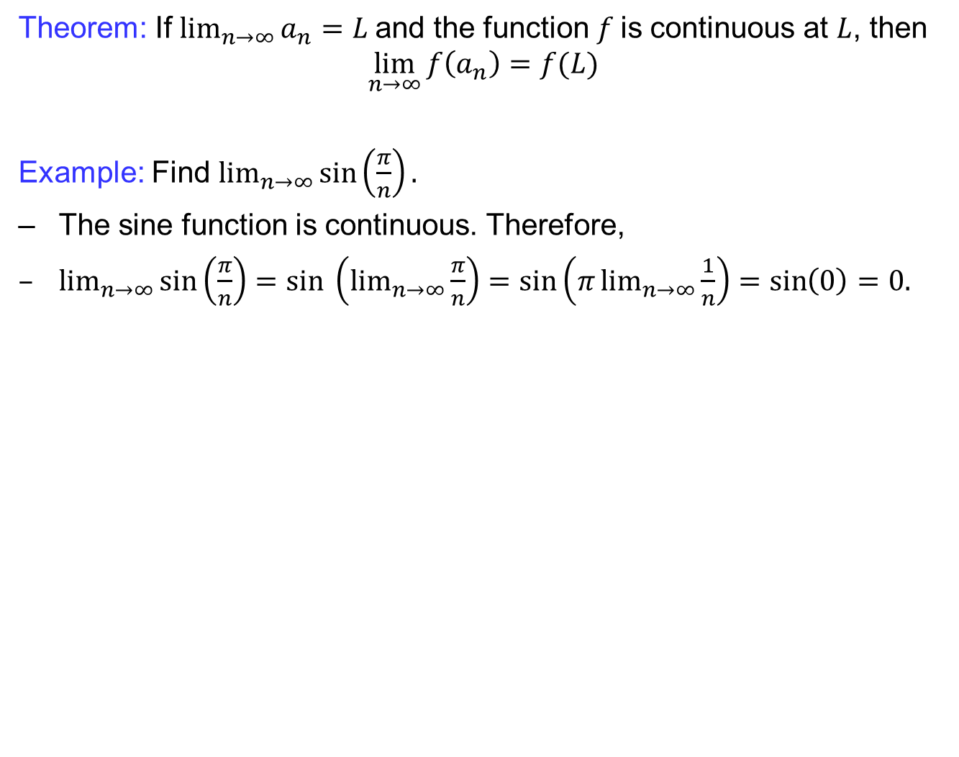
Limits laws for sequences
  Theorem: If ${lim⁡}_{n→∞}{a_{n}}=L$and the function $f$is continuous at $L$, then
  $$\lim_{n→∞}{f\left(a_{n}\right)=f(L)}$$
  Example: Find $\lim_{n→∞}{\sin\left(\frac{π}{n}\right)}.$
  The sine function is continuous. Therefore,
  $\lim_{n→∞}{\sin\left(\frac{π}{n}\right)=sin \left(\lim_{n→∞}{\frac{π}{n}}\right)=\sin\left(π\lim_{n→∞}{\frac{1}{n}}\right)=\sin\left(0\right)=0.}$

Slide 29
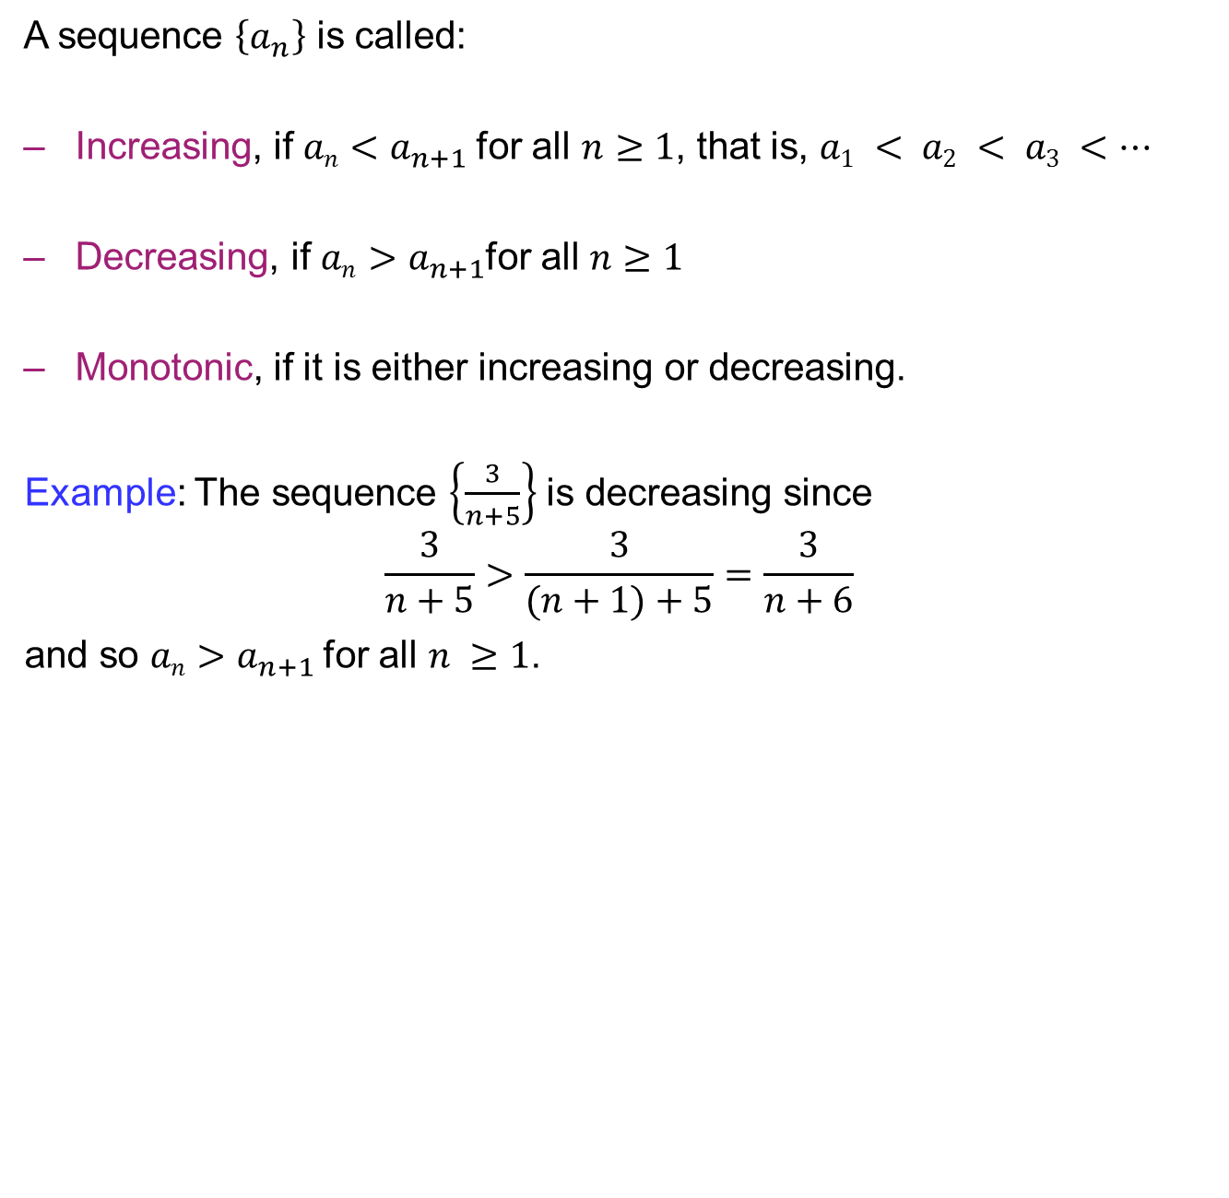
Monotone sequences
  A sequence$\left\{a_{n}\right\}$iscalled:
  Increasing, if $an<a_{n+1}$for all $n≥1$, that is, $a1 < a2 < a3 <…$
  Decreasing, if $an>a_{n+1}$for all $n≥1$
  Monotonic,if it is either increasing or decreasing.
Example: The sequence $\left\{\frac{3}{n+5}\right\}$ is decreasing since
$$\frac{3}{n+5}>\frac{3}{(n+1)+5}=\frac{3}{n+6}$$
and so $an>a_{n+1}$for all $n ≥1$.

Slide 30
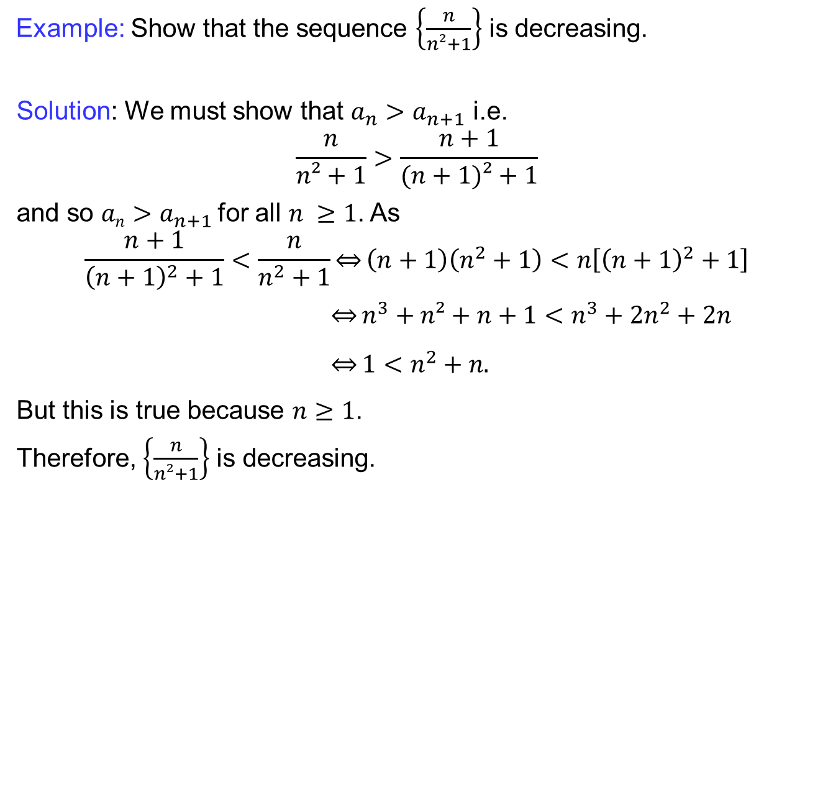
Monotone sequences
  Example: Show that the sequence$\left\{\frac{n}{n²+1}\right\}$isdecreasing.
Solution: We must show that$a_{n}>a_{n+1}$ i.e.
$$\frac{n}{n²+1}>\frac{n+1}{(n+1)²+1}$$
and so $an>a_{n+1}$for all $n ≥1$. As
$$\frac{n+1}{{\left(n+1\right)}^{2}+1}<\frac{n}{n^{2}+1}\overset{⇔}{}\left(n+1\right)\left(n^{2}+1\right)<n\left[{\left(n+1\right)}^{2}+1\right]$$
$\overset{⇔}{}n^{3}+n²+n+1<n^{3}+2n^{2}+2n$
$\overset{⇔}{}1<n^{2}+n.$
But this is true because $n≥1$.
Therefore, $\left\{\frac{n}{n²+1}\right\}$isdecreasing.

Slide 31
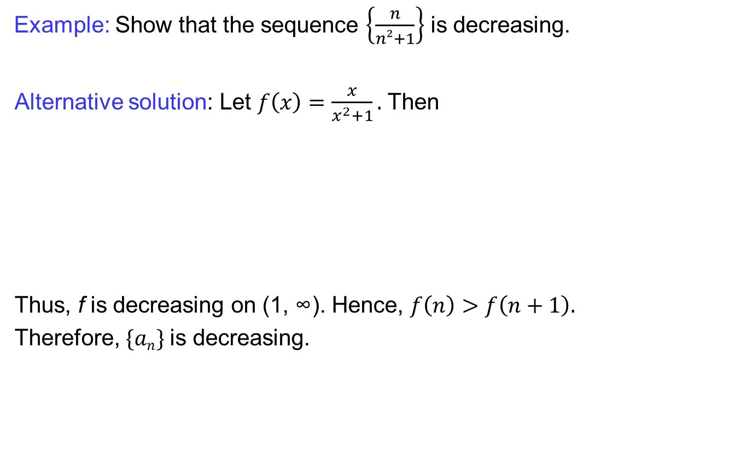
Monotone sequences
  Example: Show that the sequence$\left\{\frac{n}{n²+1}\right\}$isdecreasing.
Alternative solution: Let $f\left(x\right)=\frac{x}{x^{2}+1}.$ Then
Thus, f is decreasing on (1, ∞). Hence, $f\left(n\right)>f\left(n+1\right).$
Therefore, $\{an\}$is decreasing.

Slide 32
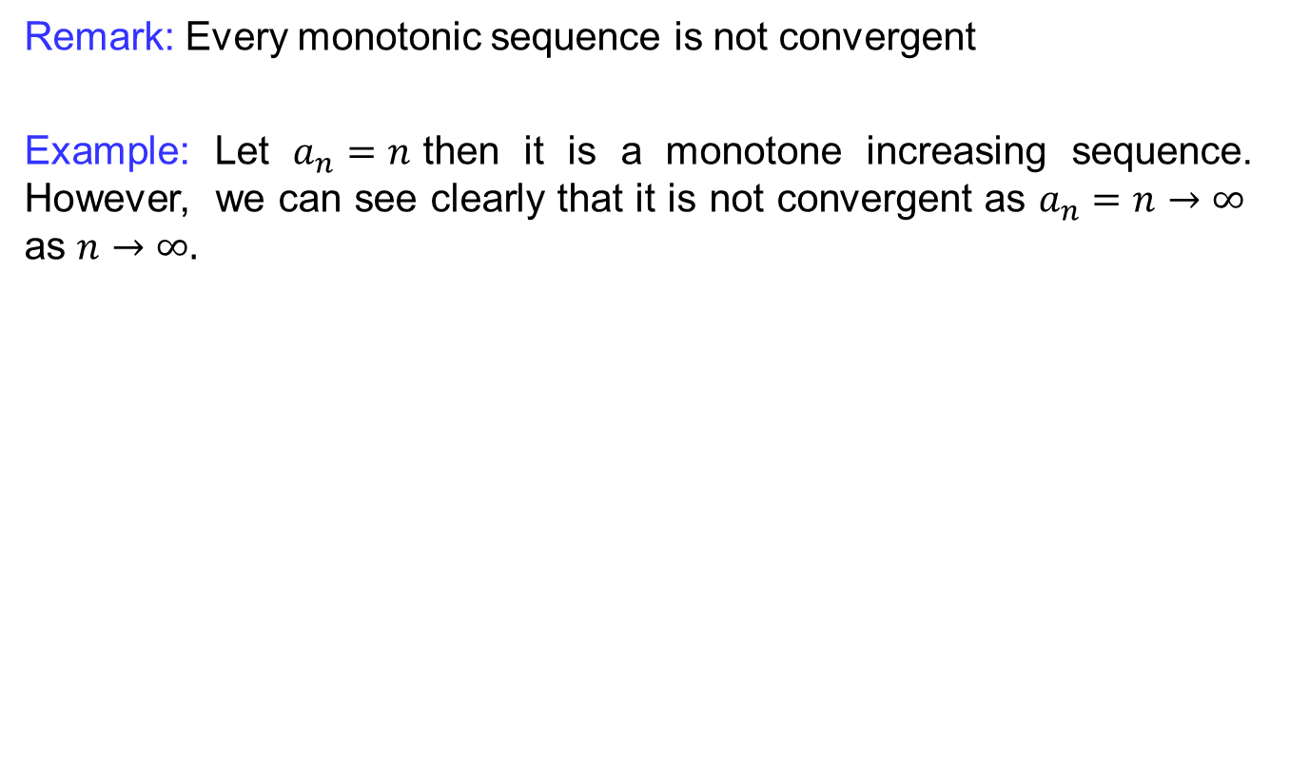
Monotone sequences
  Remark: Every monotonic sequence is not convergent
  Example: Let $a_{n}=n$then it is a monotone increasing sequence. However, we can see clearly that it is not convergent as $a_{n}=n→∞$ as $n→∞.$

Slide 33
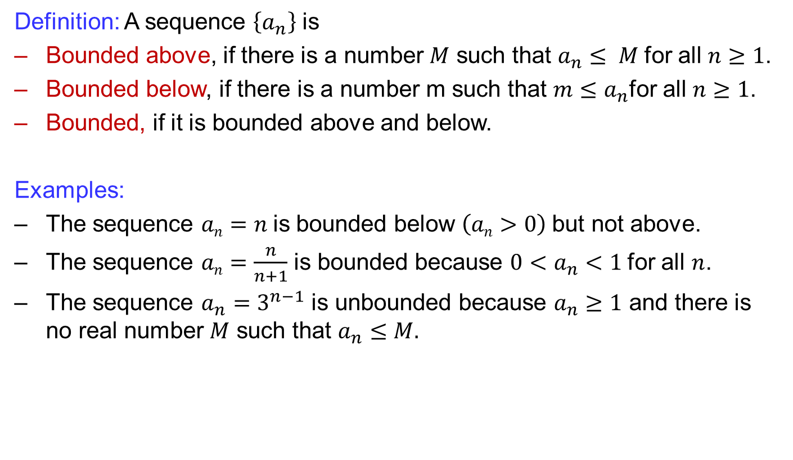
Bounded sequences
  Definition: A sequence $\left\{a_{n}\right\}$ is
  Bounded above, if there is a number $M$ such that $a_{n}≤ M$for all $n≥1$.
  Bounded below, if there is a number m such that $m≤a_{n}$for all $n≥1$.
  Bounded, if it is bounded above and below.
  Examples:
  The sequence $an=n$is bounded below $\left(an>0\right)$but not above.
  The sequence $an=\frac{n}{n+1}$ is bounded because $0<a_{n}<1$for all $n$.
  The sequence $a_{n}=3^{n−1}$ is unbounded because $a_{n}≥1$ and there is no real number $M$ such that $a_{n}≤M.$

Slide 34
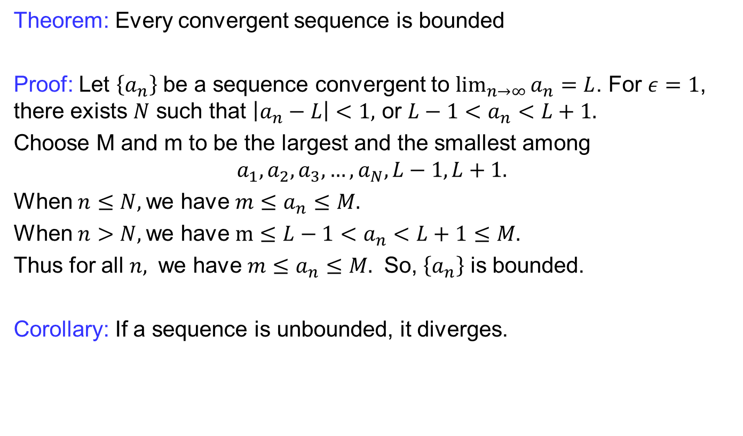
Bounded sequences
  Theorem: Every convergent sequence is bounded
  Proof: Let $\left\{a_{n}\right\}$ be a sequence convergent to $\lim_{n→∞}{a_{n}}=L$. For $ε=1$, there exists $N$ such that $\left|a_{n}−L\right|<1,$ or $L−1<a_{n}<L+1.$
  Choose M and m to be the largest and the smallest among
  $$a_{1}, a_{2}, a_{3}, …, a_{N}, L−1, L+1.$$
  When $n≤N,$we have $m≤a_{n}≤M.$
  When $n>N,$we have $m≤L−1<a_{n}<L+1≤M.$
  Thus for all $n,$ we have $m≤a_{n}≤M.$ So, $\left\{a_{n}\right\}$ is bounded.
  Corollary: If a sequence is unbounded, it diverges.

Slide 35
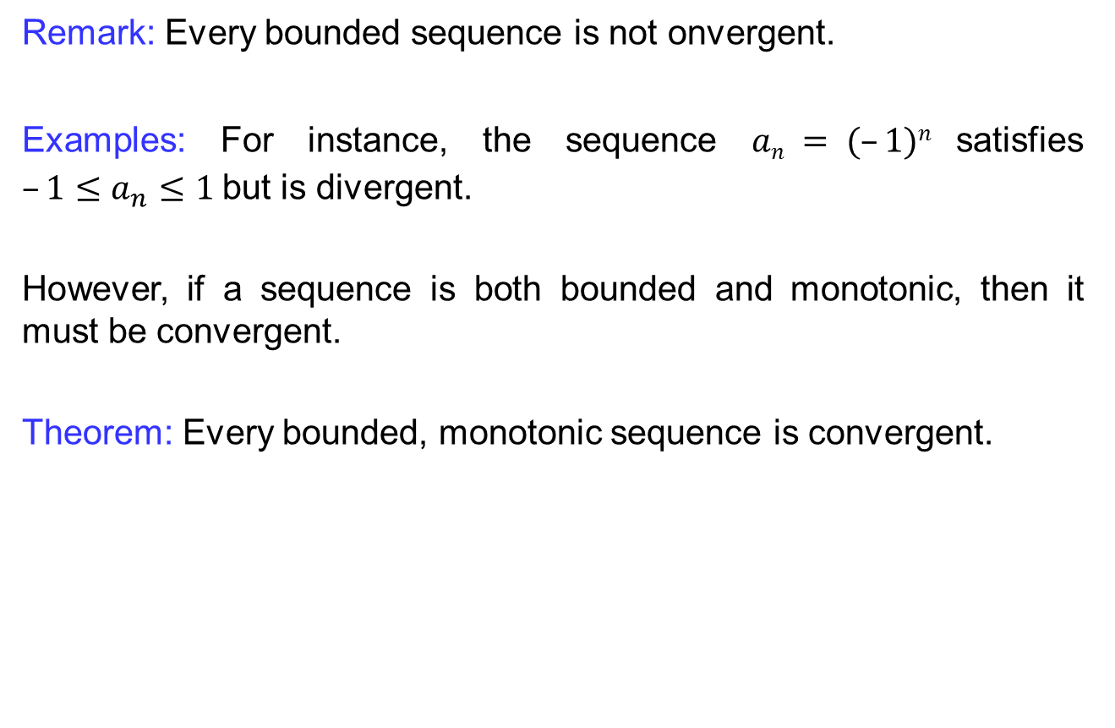
Bounded sequences
  Remark: Everyboundedsequenceis not onvergent.
  Examples: For instance, the sequence $an = (–1)n$satisfies $–1≤a_{n}≤1$but is divergent.
  However, if a sequence is both bounded and monotonic, then it must be convergent.
  Theorem: Every bounded, monotonic sequence is convergent.

Slide 36
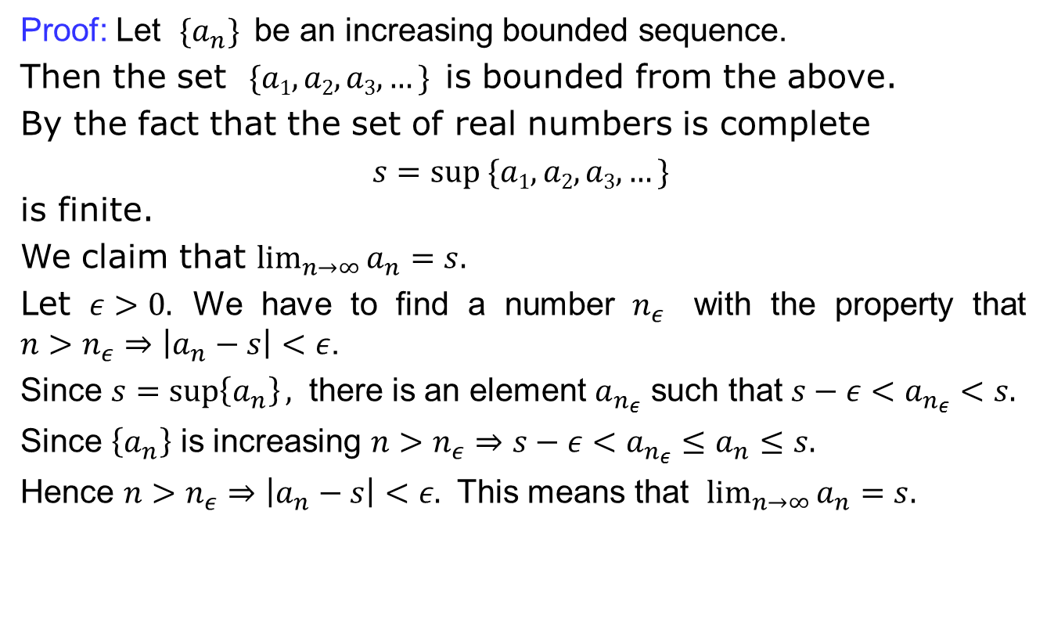
Bounded sequences
  Proof: Let $\{a_{n}\}$be an increasing bounded sequence.
  Then the set $\{a1,a2,a3,…\}$is bounded from the above.
  By the fact that the set of real numbers is complete
  $s=sup⁡ \{a1,a2,a3,…\}$
  is finite.
  We claim that $\lim_{n→∞}{a_{n}}=s.$
  Let $ε>0.$ We have to find a number $n_{ε}$ with the property that $n>n_{ε}⇒\left|a_{n}−s\right|<ε$.
  Since $s=\sup\left\{a_{n}\right\},$ there is an element $a_{n_{ε}}$ such that $s−ε<a_{n_{ε}}<s.$
  Since $\left\{a_{n}\right\}$ is increasing $n>n_{ε}⇒s−ε<a_{n_{ε}}≤a_{n}≤s.$
  Hence $n>n_{ε}⇒\left|a_{n}−s\right|<ε.$ This means that $\lim_{n→∞}{a_{n}=s.}$

Slide 37
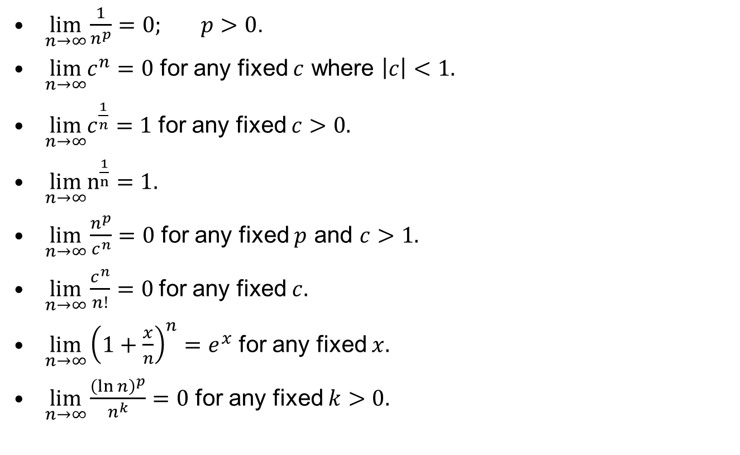
Some standard limits
$\lim_{n→∞}\frac{1}{n^{p}}=0; p>0$.
$\lim_{n→∞}c^{n}=0$ for any fixed $c$ where $\left|c\right|<1.$
$\lim_{n→∞}c^{\frac{1}{n}}=1$ for any fixed $c>0.$
$\lim_{n→∞}n^{\frac{1}{n}}=1.$
$\lim_{n→∞}\frac{n^{p}}{c^{n}}=0$ for any fixed $p$ and $c>1.$
$\lim_{n→∞}\frac{c^{n}}{n!}=0$for any fixed $c.$
$\lim_{n→∞}{\left(1+\frac{x}{n}\right)}^{n}=e^{x}$ for any fixed $x.$
$\lim_{n→∞}\frac{{\left(\ln{n}\right)}^{p}}{n^{k}}=0$ for any fixed $k>0.$

Slide 38
Lecture Summary
    Introduction to sequences
    Limit of sequences
    Limits laws for sequences
    Monotone sequences
    Bounded sequences
    Some standard limits

