Slide 1
(MTH 250)
Calculus
Lecture 13

Slide 2
Previous Lecture’s Summary
Critical points
Increasing & decreasing Functions
Concavity & inflection points
Strategy of Graphing

Slide 3
Today’s Lecture
Recalls:
Relative Extrema
Extreme Value Theorem
First Derivative Test
Second Derivative test
Rolle’s Theorem
Mean Value Theorem

Slide 4
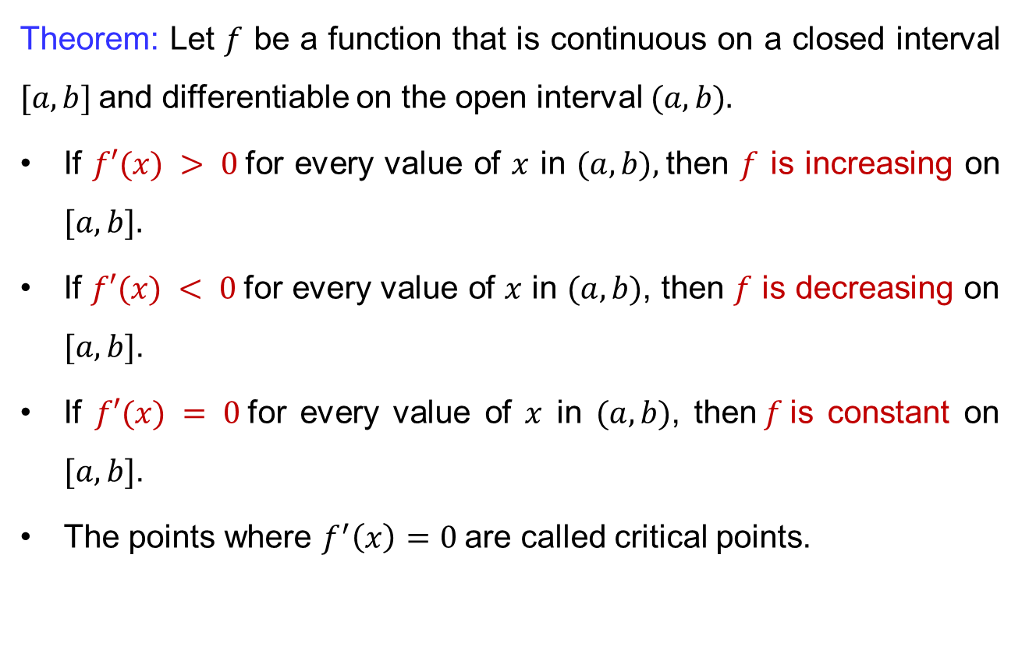
Recalls
Theorem: Let $f$ be a function that is continuous on a closed interval $[a, b]$and differentiable on the open interval $(a, b).$
If $f′(x) > 0$for every value of $x$ in $(a, b),$then $f$ is increasing on $[a, b].$
If $f′(x) < 0$for every value of $x$ in $(a, b)$, then $f$ is decreasing on $[a, b]$.
If $f′(x) = 0$for every value of $x$ in $(a, b)$, then$f$is constant on $[a, b]$.
The points where $f^{′}\left(x\right)=0$are called critical points.

Slide 5
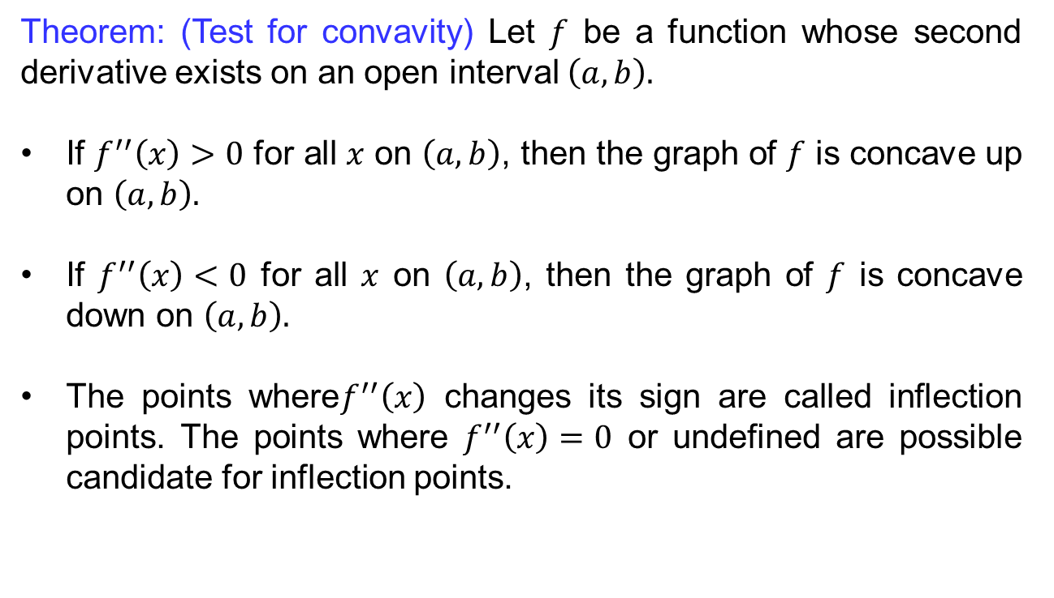
Recalls
Theorem: (Test for convavity) Let $f$ be a function whose second derivative exists on an open interval $\left(a,b\right).$
If $f^{′′}\left(x\right)>0$ for all $x$ on $\left(a,b\right)$, then the graph of $f$ is concave up on $\left(a,b\right).$
If $f^{′′}\left(x\right)<0$ for all $x$ on $\left(a,b\right)$, then the graph of $f$ is concave down on $\left(a,b\right).$
The points where$f^{′′}\left(x\right)$ changes its sign are called inflection points. The points where $f^{′′}\left(x\right)=0$ or undefined are possible candidate for inflection points.

Slide 6
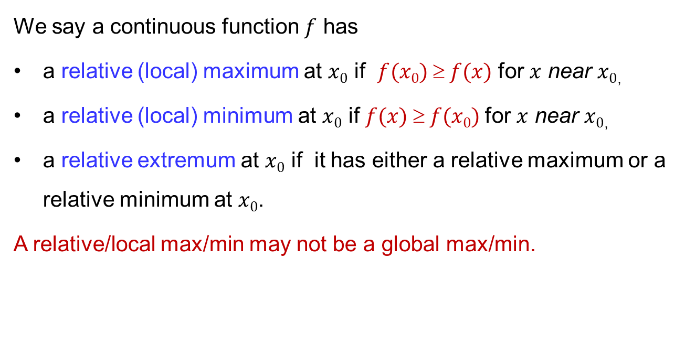
Relative extrema
We say a continuous function $f$has
a relative (local) maximum at $x0$ if $f(x0)  f(x)$for $x$near$x0$,
a relative (local) minimum at $x0$ if $f(x)  f(x0)$for $x$near$x0$,
a relative extremum at $x0$ if it has either a relative maximum or a relative minimum at $x0$.
A relative/local max/min may not be a global max/min.

Slide 7
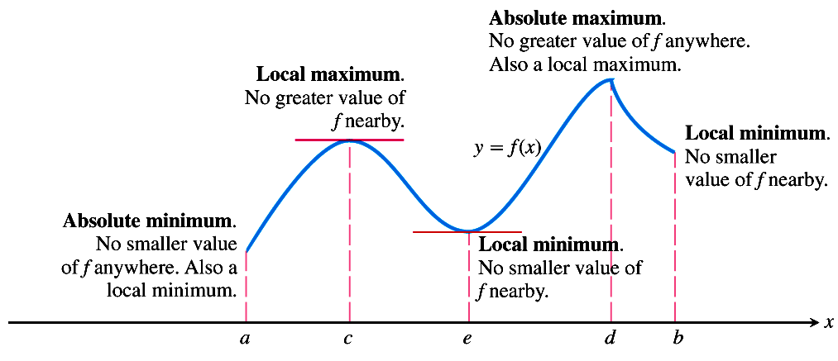
Relative extrema

Slide 8
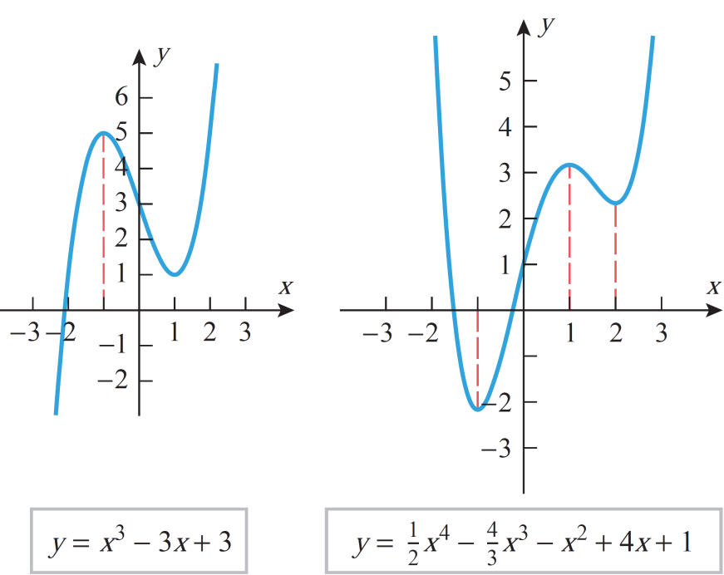
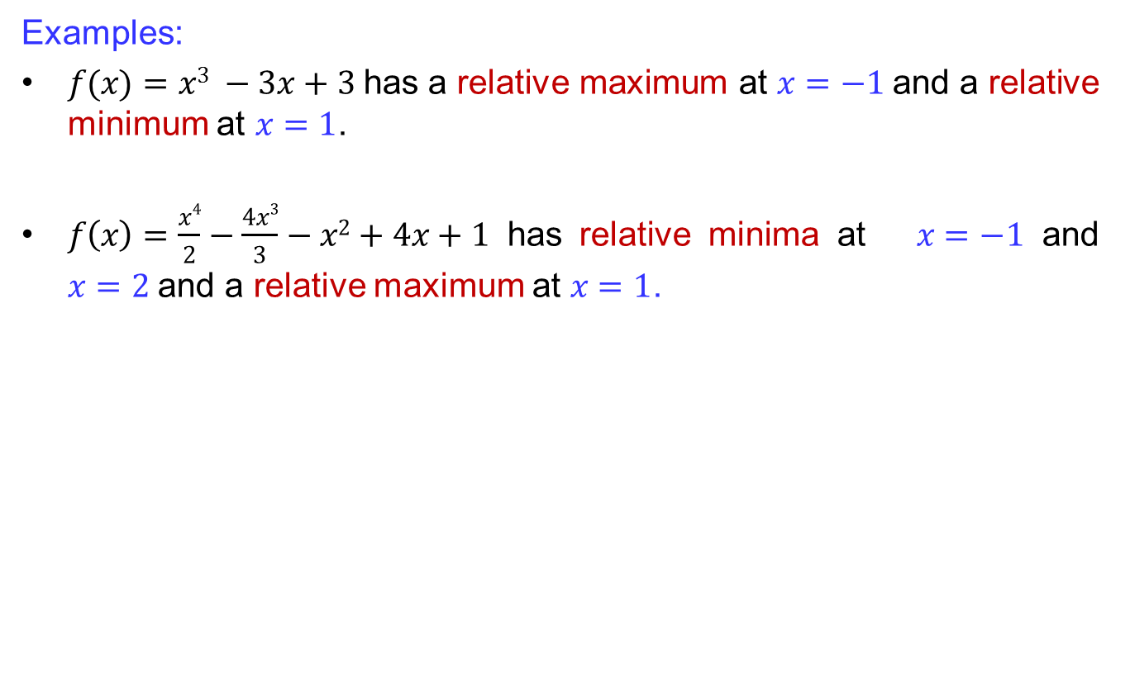
Relative extrema
Examples:
has a relative maximum at $x=−1$and a relative minimum at $x=1$.
$f\left(x\right)=\frac{x4}{2}−\frac{4x3}{3}−x2+4x+1$ has relative minima at $x=−1$and $x=2$and a relative maximum at $x=1$.

Slide 9
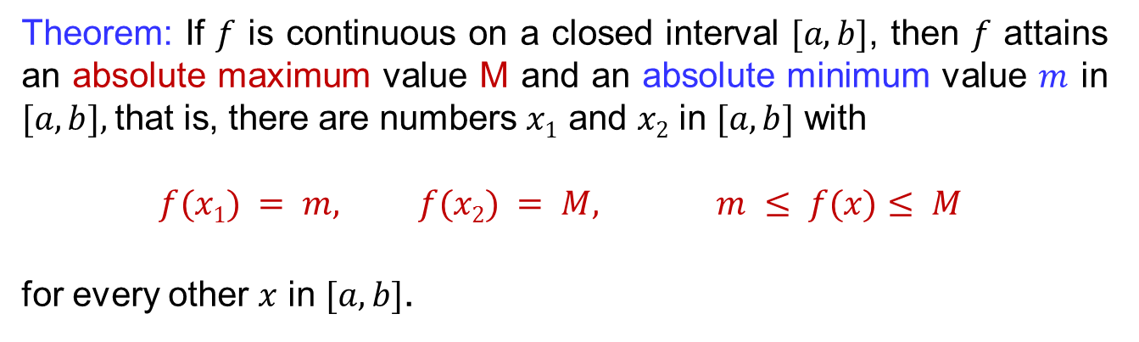
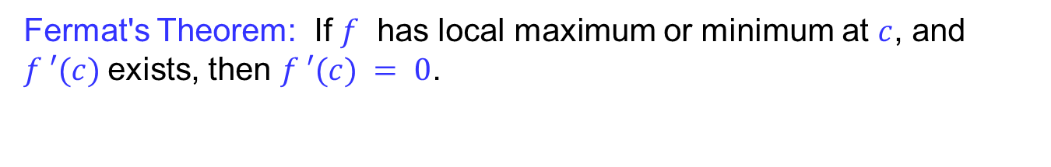
Extreme value theorem
Theorem: If $f$ is continuous on a closed interval $[a, b]$, then $f$ attains an absolute maximum value Mand an absolute minimum value $m$ in $[a, b],$that is, there are numbers $x1$ and $x2$ in $[a, b]$ with
$$f(x1) = m, f(x2) = M, m ≤ f(x)≤ M$$
for every other $x$ in $[a, b]$.
Fermat's Theorem: If $f$ has local maximum or minimum at $c$, and $f ′(c)$exists, then $f ′(c) = 0$.

Slide 10
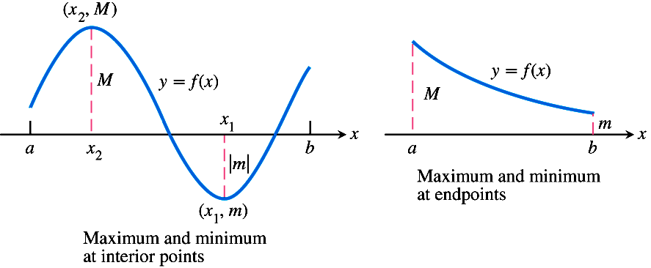
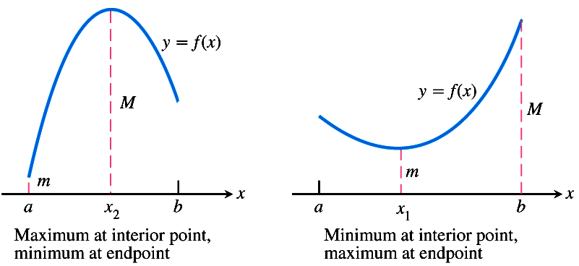
Extreme value theorem

Slide 11
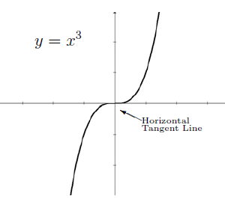
Extreme value theorem
A function might have derivative equal to zero at a number c, and therefore the function will have a horizontal tangent line at c, but the function will not have a local maximum or minimum at that point.

Slide 12
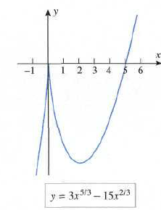
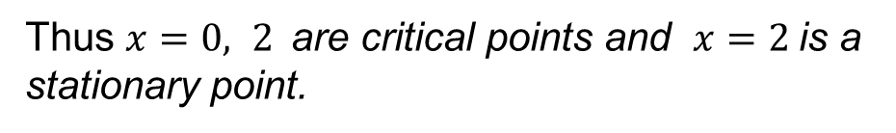
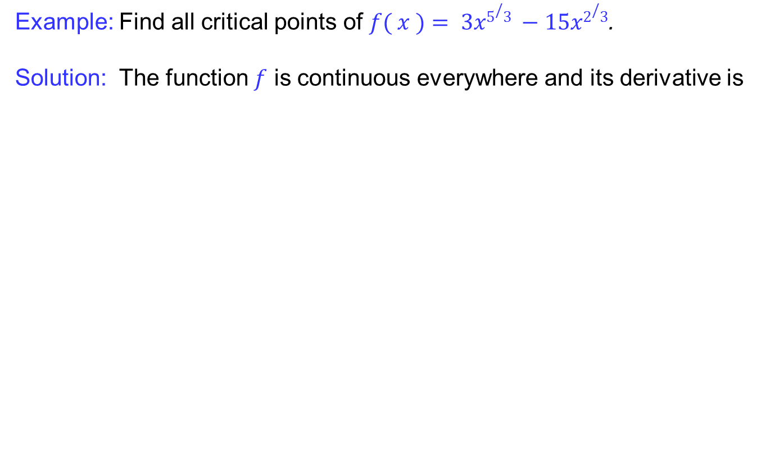
Extreme value theorem
Example: Find all critical points of $f( x )= 3x5/3 −15x2/3$.
Solution: The function $f$ is continuous everywhere and its derivative is
Thus $x=0, 2$are critical points and $x=2$is a stationary point.

Slide 13
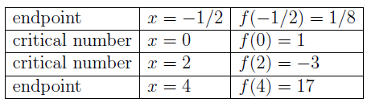
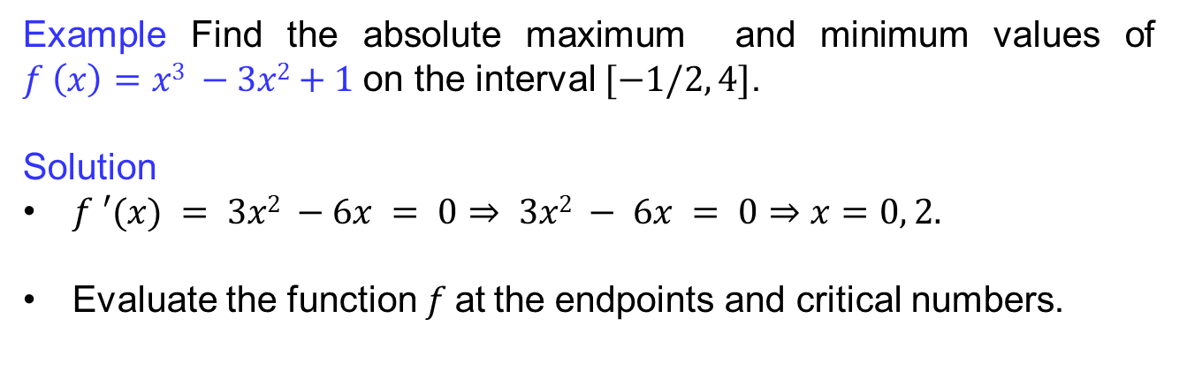

Extreme value theorem
Example Find the absolute maximum and minimum values of $f \left(x\right)=x3 −3x2+1$on the interval $[−1/2, 4]$.
Solution
$f ′(x) = 3x2 −6x = 0⇒ 3x2 − 6x = 0⇒x=0, 2.$
Evaluate the function$f$at the endpoints and critical numbers.
We can conclude that the absolute minimum is $−3$and the absolute maximum is $17$

Slide 14
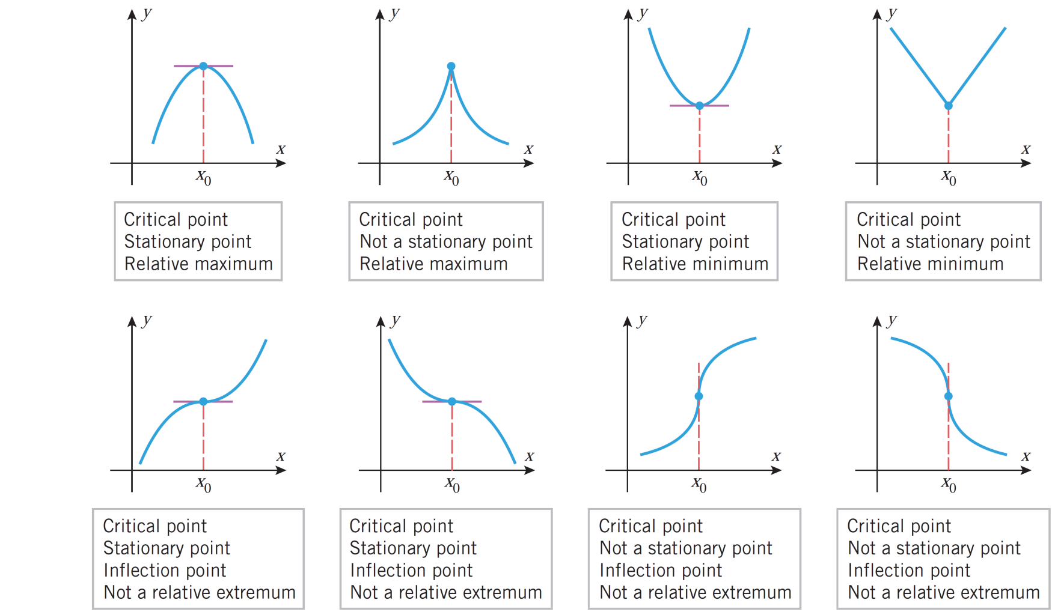
Extreme value theorem

Slide 15
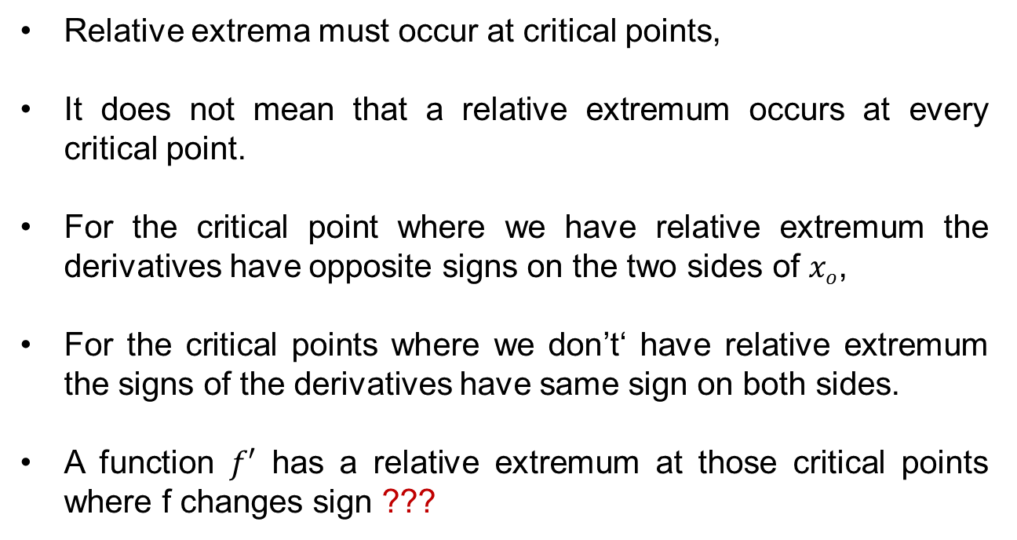
Extreme value theorem
Relative extremamust occur at critical points,
It does not meanthat a relative extremum occurs at every critical point.
For the critical point where we have relative extremum the derivatives have opposite signs on the two sides of $xo$,
For the critical points where we don’t‘ have relative extremum the signs of the derivatives have same sign on both sides.
A function $f′$ has a relative extremum at those critical points where f changes sign ???

Slide 16
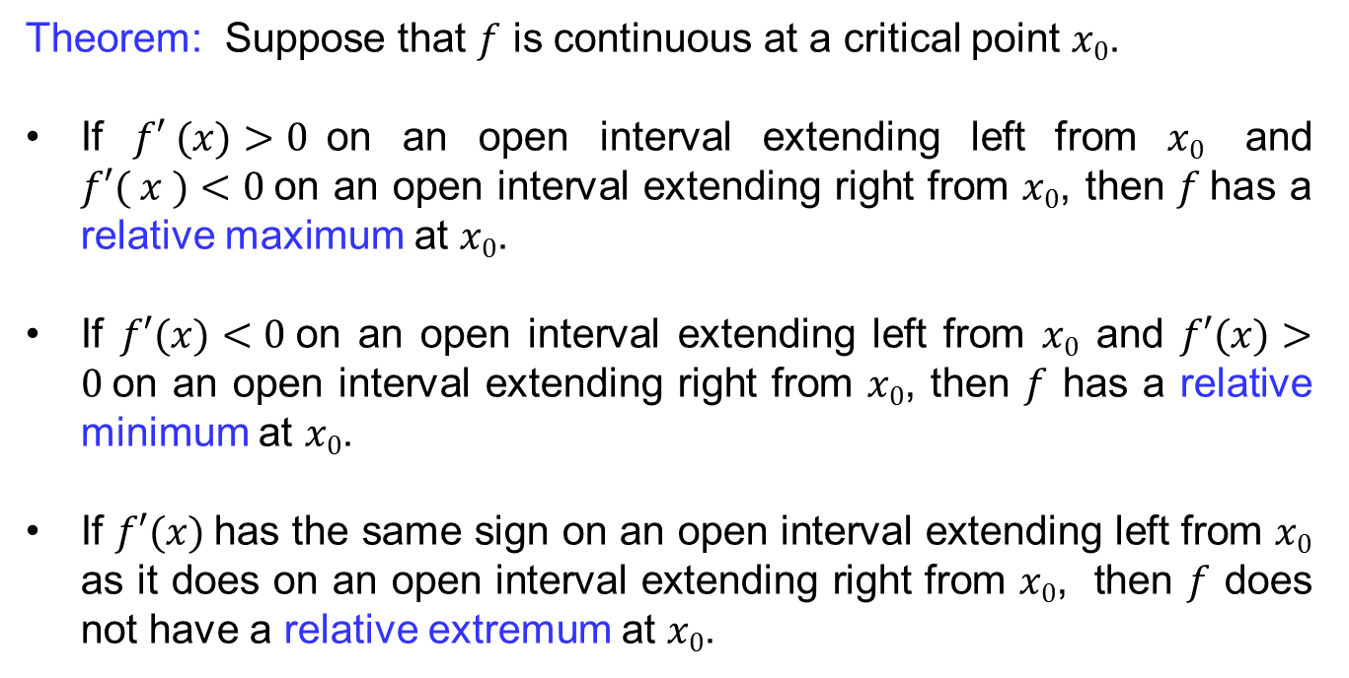
First derivative test
Theorem: Suppose that $f$ is continuous at a critical point $x0$.
If $f′ (x)>0$on an open interval extending left from $x0$ and $f′( x )<0$on an open interval extending right from $x0$, then $f$has a relative maximum at $x0$.
If $f′(x)<0$on an open interval extending left from $x0$ and $f′(x)>0$on an open interval extending right from $x0$, then $f$ has a relative minimum at $x0$.
If $f′(x)$has the same sign on an open interval extending left from $x0$ as it does on an open interval extending right from $x0$, then $f$ does not have a relative extremum at $x0$.

Slide 17
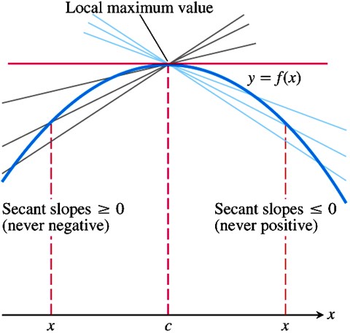
First derivative test

Slide 18
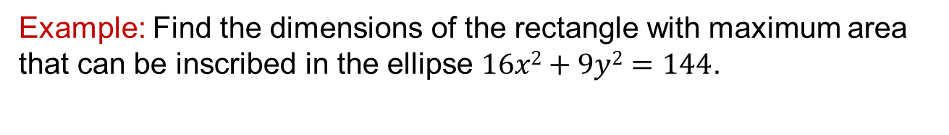
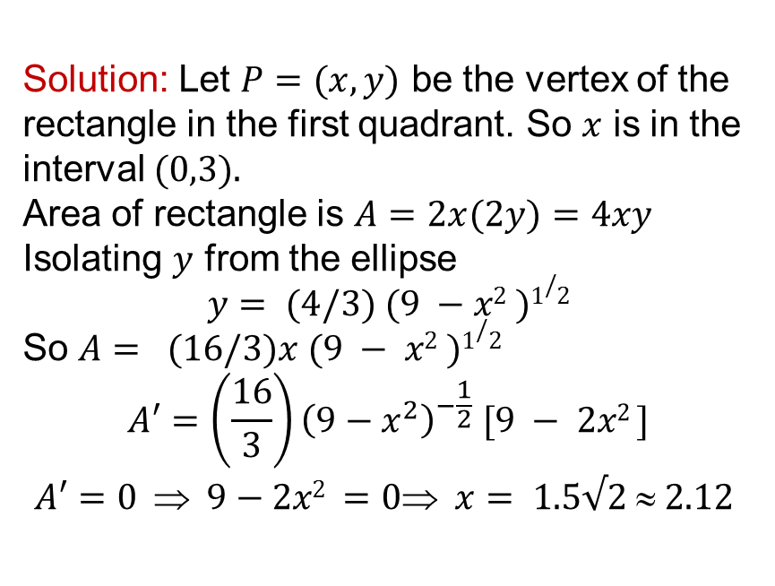
First derivative test
Example: Find the dimensions of the rectangle with maximum area that can be inscribed in the ellipse $16x2+9y2=144$.
Solution: Let $P=(x,y)$ be the vertex of the rectangle in the first quadrant. So $x$ is in the interval $(0,3).$
Area of rectangle is $A=2x(2y)=4xy$
Isolating $y$ from the ellipse
$$y= (4/3) (9 −x2 )1/2$$
So $A= (16/3)x (9 − x2 )1/2$
$$A′=\left(\frac{16}{3}\right){\left(9−x^{2}\right)}^{−\frac{1}{2}} [9 − 2x2 ]$$
$$A′=0  9−2x2 =0 x= 1.5√2  2.12$$
y
16x²+9y²=144
P(x,y)
x

Slide 19
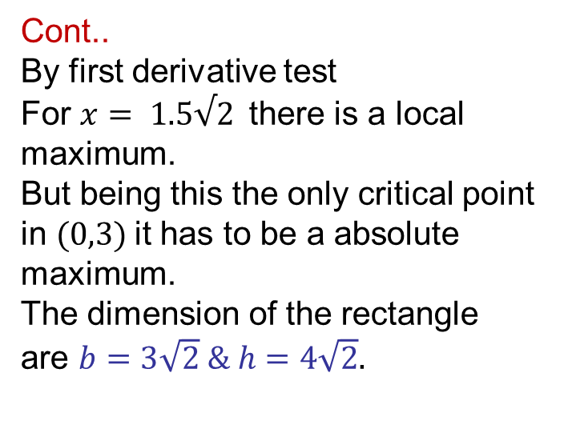
First derivative test
Cont..
By first derivative test
For $x= 1.5√2$there is a local maximum.
But being this the only critical point in $(0,3)$it has to be a absolute maximum.
The dimension of the rectangle are $b=3\sqrt{2} \& h=4\sqrt{2}.$
+ -
2 2.12 2.2

Slide 20
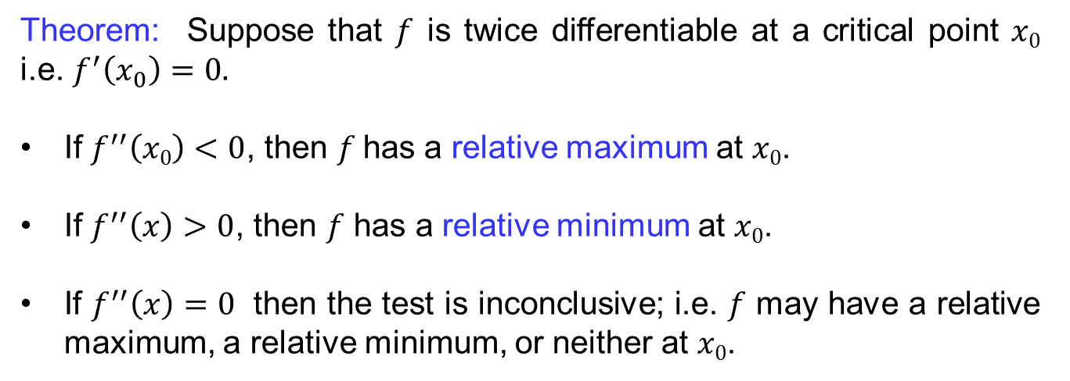
Second derivative test
Theorem: Suppose that $f$ is twice differentiableat a critical point $x0$ i.e. $f^{′}\left(x_{0}\right)=0.$
If $f^{′′}\left(x0\right)<0$, then $f$has a relative maximum at $x0$.
If $f^{′′}\left(x\right)>0$, then $f$ has a relative minimum at $x0$.
If $f^{′′}\left(x\right)=0$ then the test is inconclusive; i.e. $f$ may have a relative maximum, a relative minimum, or neitherat $x0$.

Slide 21
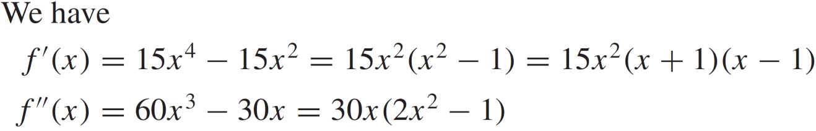

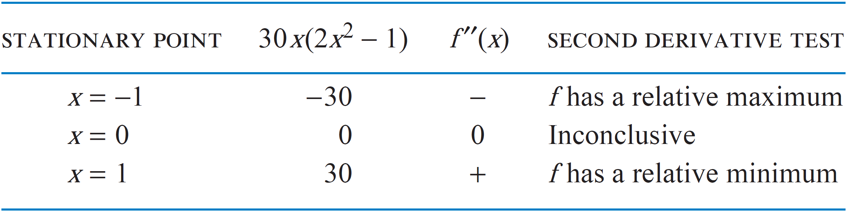
Second derivative test
Example:
Proof:

Slide 22
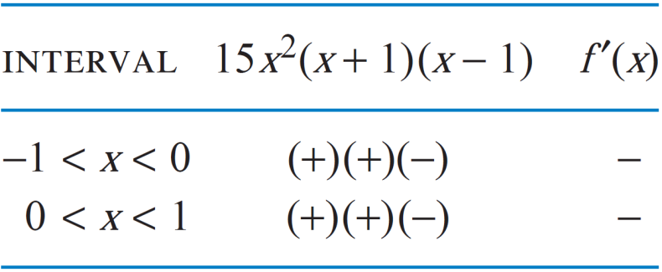
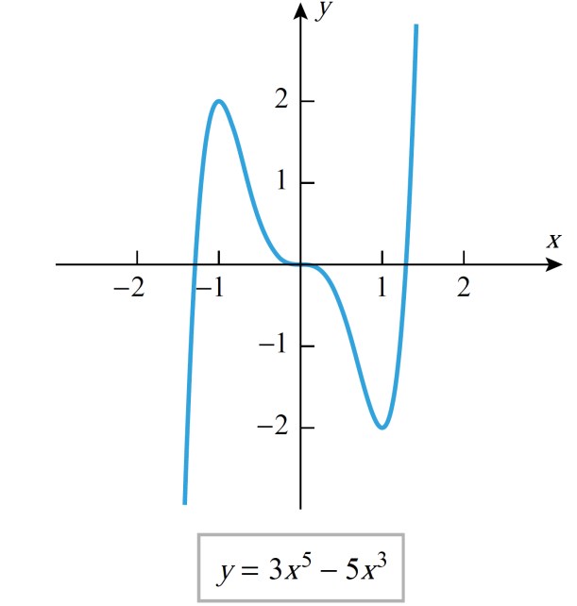
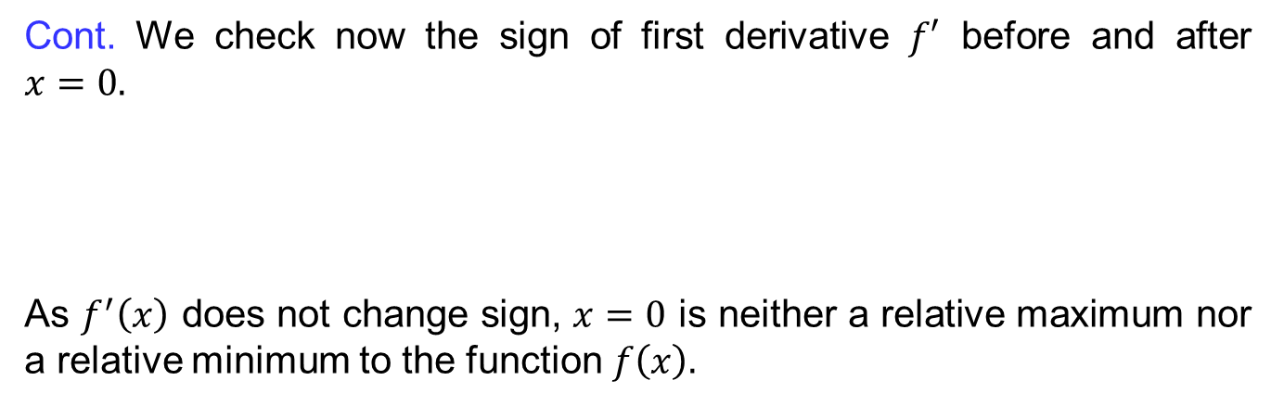
Second derivative test
Cont. We check now the sign of first derivative $f′$ before and after $x=0.$
As $f^{′}\left(x\right)$ does not change sign, $x=0$ is neither a relative maximum nor a relative minimum to the function $f\left(x\right).$

Slide 23
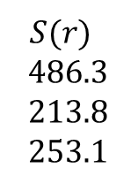
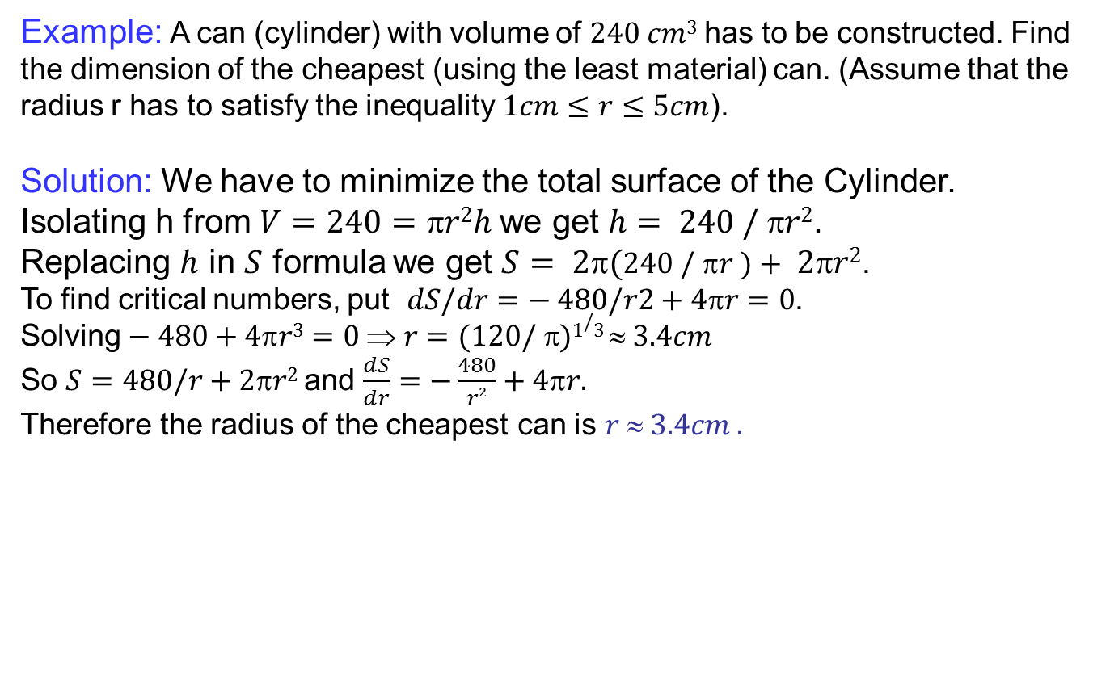




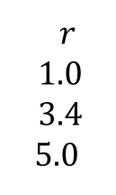
Second derivative test
Example: A can (cylinder) with volume of $240 cm3$has to be constructed. Find the dimension of the cheapest (using the least material) can. (Assume that the radius r has to satisfy the inequality $1cm≤r≤5cm$).
Solution: We have to minimize the total surface of the Cylinder.
Isolating h from $V=240=r2h$we get $h= 240 / r2$.
Replacing $h$ in $S$ formula we get $S= 2(240 / r )+ 2r2$.
To find critical numbers, put $dS/dr=− 480/r2+4r=0$.
Solving $− 480+4r3=0  r=(120/ )1/3  3.4cm$
So $S=480/r+2r2$and $\frac{dS}{dr}=−\frac{480}{r2}+4πr.$
Therefore the radius of the cheapest can is $r  3.4cm .$
$$r$$
$$h$$
$$r$$
$$1.0$$
$$3.4$$
$$5.0$$
$S(r)$
$$486.3$$
$$213.8$$
$$253.1$$
$$V= r2h$$
$$S=2rh+2r2$$

Slide 24
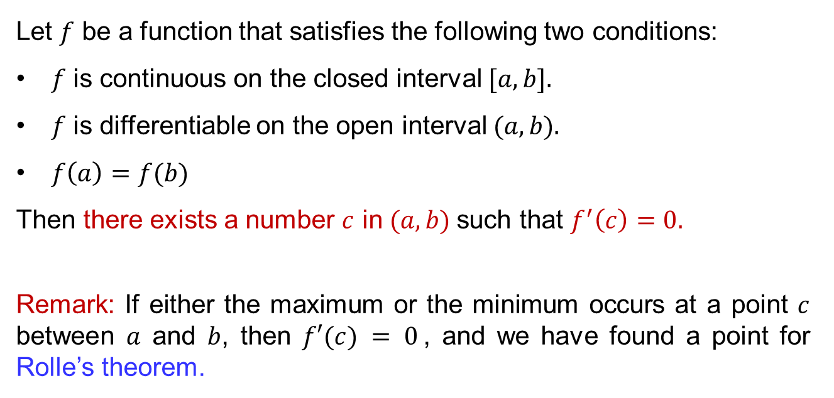
Rolle’s theorem
Let $f$ be a function that satisfies the following two conditions:
$f$is continuous on the closed interval $[a, b].$
$f$is differentiable on the open interval $(a, b).$
$f\left(a\right)=f(b)$
Then there exists a number $c$ in $(a, b)$such that $f^{′}\left(c\right)=0.$
Remark: If either the maximum or the minimum occurs at a point $c$between $a$ and $b$, then $f′(c) = 0$, and we have found a point for Rolle’s theorem.

Slide 25
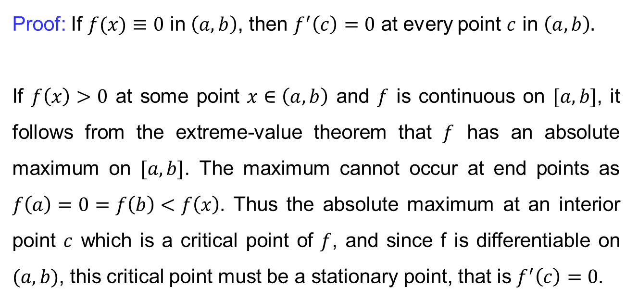
Rolle’s theorem
Proof: If$f(x)≡0$ in $\left(a,b\right)$, then $f^{′}\left(c\right)=0$ at every point $c$ in $\left(a,b\right).$
If $f\left(x\right)>0$ at some point $x∈\left(a,b\right)$ and $f$ is continuous on $[a,b]$, it follows from the extreme-value theorem that $f$ has an absolute maximum on $[a,b]$. The maximum cannot occur at end points as $f\left(a\right)=0=f\left(b\right)<f\left(x\right).$ Thus the absolute maximum at an interior point $c$ which is a critical point of $f$, and since f is differentiable on $(a,b)$, this critical point must be a stationary point, that is $f^{′}\left(c\right)=0.$

Slide 26
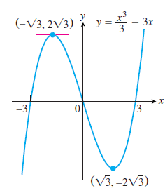
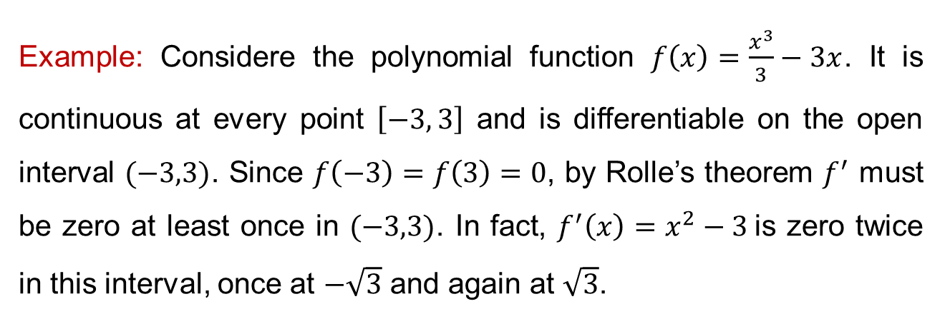
Rolle’s theorem
Example: Considere the polynomial function $f\left(x\right)=\frac{x^{3}}{3}−3x$. It is continuous at every point $\left[−3, 3\right]$ and is differentiable on the open interval $(−3,3)$. Since $f\left(−3\right)=f\left(3\right)=0$, by Rolle’s theorem $f^{′}$ must be zero at least once in $(−3,3)$. In fact, $f^{′}\left(x\right)=x^{2}−3$is zero twice in this interval, once at $−\sqrt{3}$ and again at $\sqrt{3}$.

Slide 27
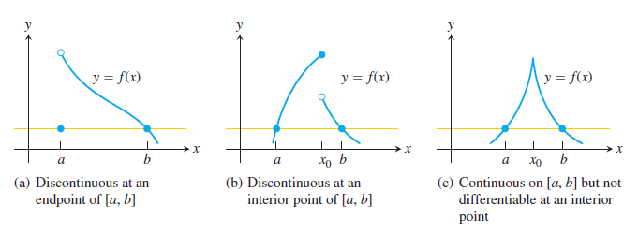
Rolle’s theorem
The conditions of Rolle’s theorem are essential. If they fail at even one point, the graph may not have a horizontal tangent

Slide 28
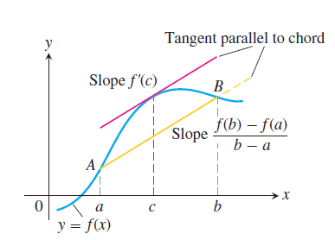
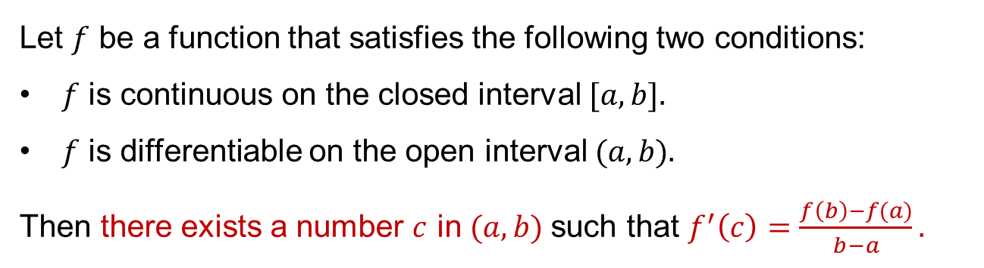
Mean value theorem
Let $f$ be a function that satisfies the following two conditions:
$f$is continuous on the closed interval $[a, b].$
$f$is differentiable on the open interval $(a, b).$
Then there exists a number $c$ in $(a, b)$such that $f^{′}\left(c\right)=\frac{f\left(b\right)−f(a)}{b−a}.$

Slide 29
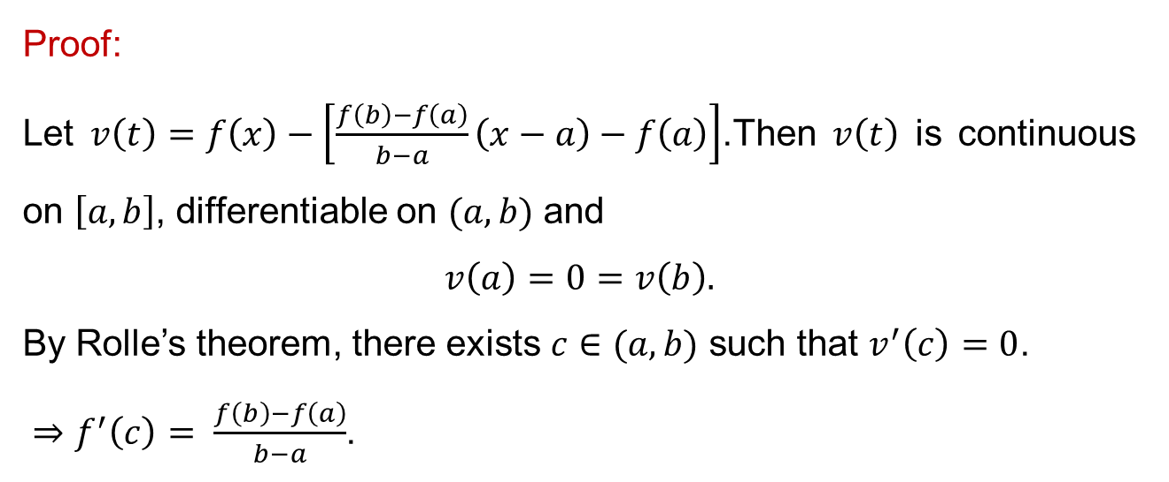
Mean value theorem
Proof:
Let $v\left(t\right)=f\left(x\right)−\left[\frac{f\left(b\right)−f\left(a\right)}{b−a}\left(x−a\right)−f\left(a\right)\right]$.Then $v\left(t\right)$ is continuous on $\left[a,b\right]$, differentiable on $(a,b)$ and
$$v\left(a\right)=0=v\left(b\right).$$
By Rolle’s theorem, there exists $c∈(a,b)$ such that $v^{′}\left(c\right)=0$.
$⇒f^{′}\left(c\right)= \frac{f\left(b\right)−f\left(a\right)}{b−a}$.

Slide 30
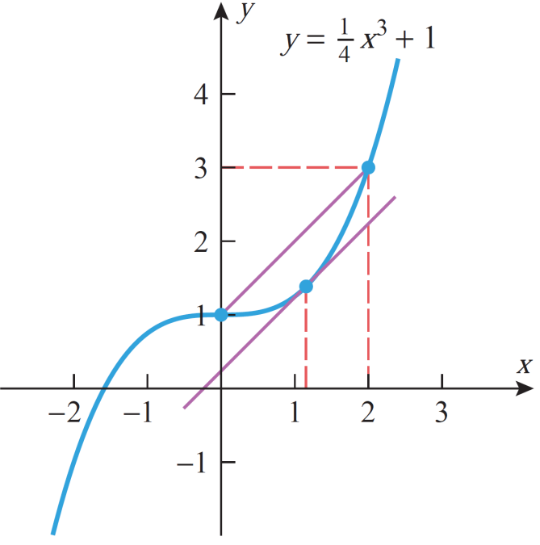
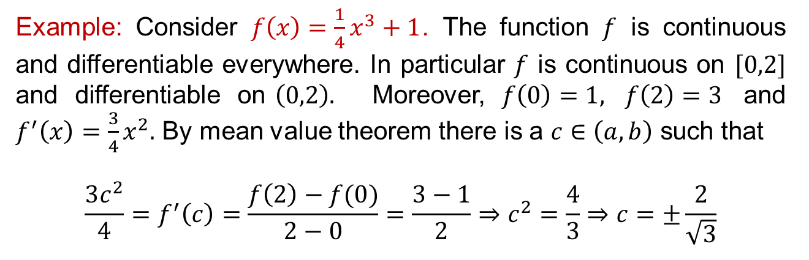
Mean value theorem
Example: Consider$f\left(x\right)=\frac{1}{4}x^{3}+1$. The function$f$iscontinuous and differentiableeverywhere. In particular$f$iscontinuous on $[0,2]$ and differentiable on$\left(0,2\right).$Moreover, $f\left(0\right)=1,$$f\left(2\right)=3$ and $f^{′}\left(x\right)=\frac{3}{4}x^{2}.$By mean value theoremthereis a $c∈\left(a,b\right)$suchthat
$$\frac{3c^{2}}{4}=f^{′}\left(c\right)=\frac{f\left(2\right)−f(0)}{2−0}=\frac{3−1}{2}⇒c^{2}=\frac{4}{3}⇒c=±\frac{2}{\sqrt{3}}$$

Slide 31
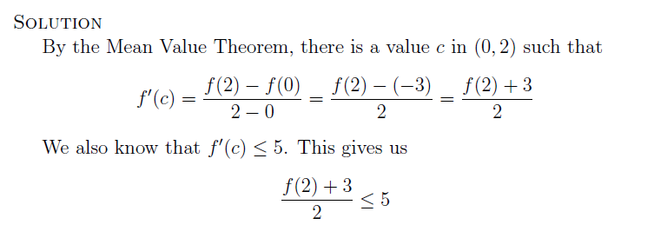
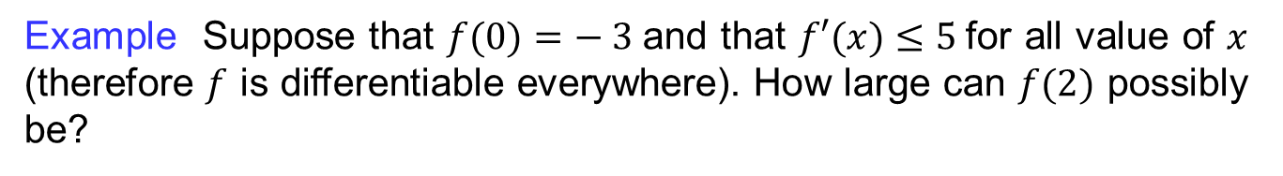
Mean value theorem
Example Suppose that $f(0)=− 3$and that $f′(x)≤5$for all value of $x$ (therefore $f$ is differentiable everywhere). How large can $f(2)$ possibly be?

Slide 32
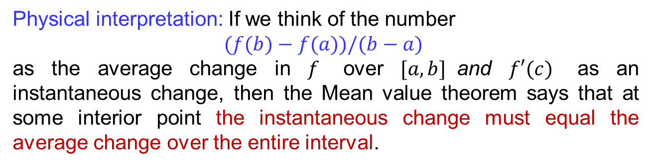
Mean value theorem
Physical interpretation: If we think of the number
$$(f(b)−f(a))/(b−a)$$
as the average change in $f$over $[a, b]$and $f′(c)$as an instantaneous change, then the Mean value theorem says that at some interior point the instantaneous change must equal the average change over the entire interval.

Slide 33
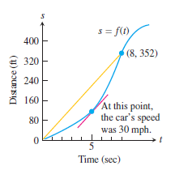
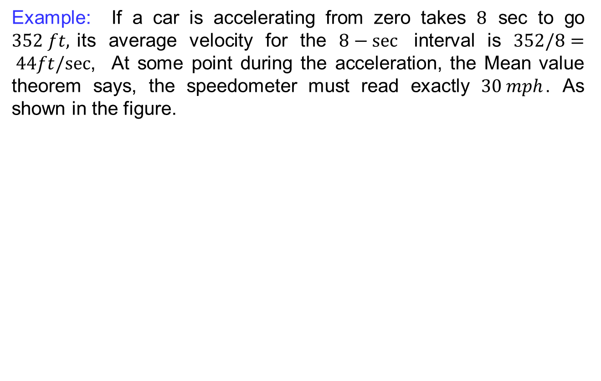
Mean value theorem
Example: If a car is accelerating from zero takes $8$ sec to go $352 ft,$its average velocity for the $8−sec$ interval is $352/8= 44ft/sec$, At some point during the acceleration, the Mean value theorem says, the speedometer must read exactly $30 mph$. As shown in the figure.

Slide 34
Lecture Summary
Relative Extremum
Extreme Value Theorem
First Derivative Test
Second Derivative test
Rolle’s Theorem
Mean Value Theorem

