Slide 1
(MTH 250)
Calculus
Lecture 12

Slide 2
Previous Lecture’s Summary
    Differentials
    Local linear approximations
    Indeterminate forms
    L’Hôpital rule

Slide 3
Today’s Lecture
L’Hôpital rule: Recalls
Critical points
Increasing and decreasing Functions
Concavity & inflection points
Strategy of Graphing

Slide 4
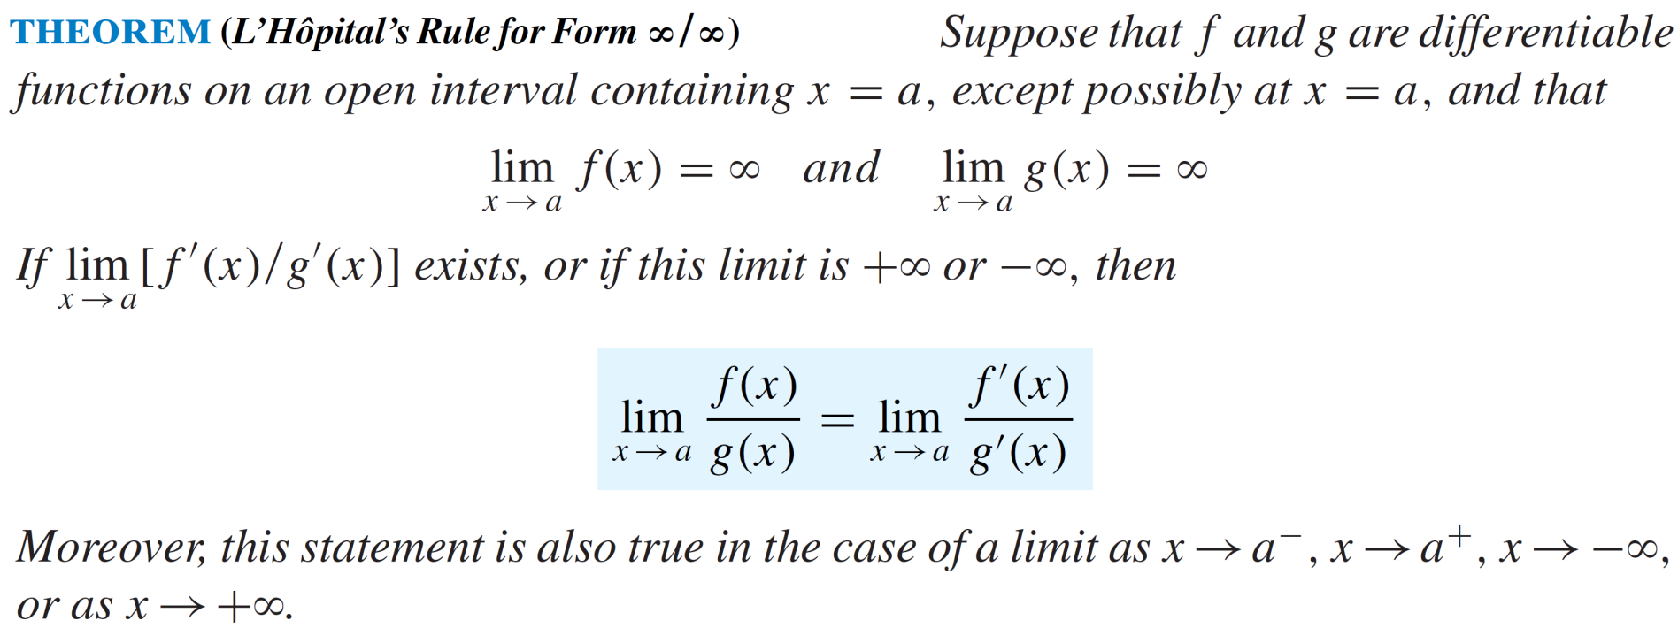
L’Hôpital rule: Recalls

Slide 5
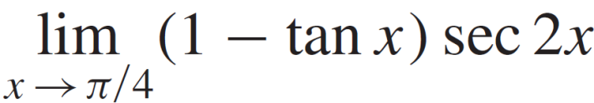
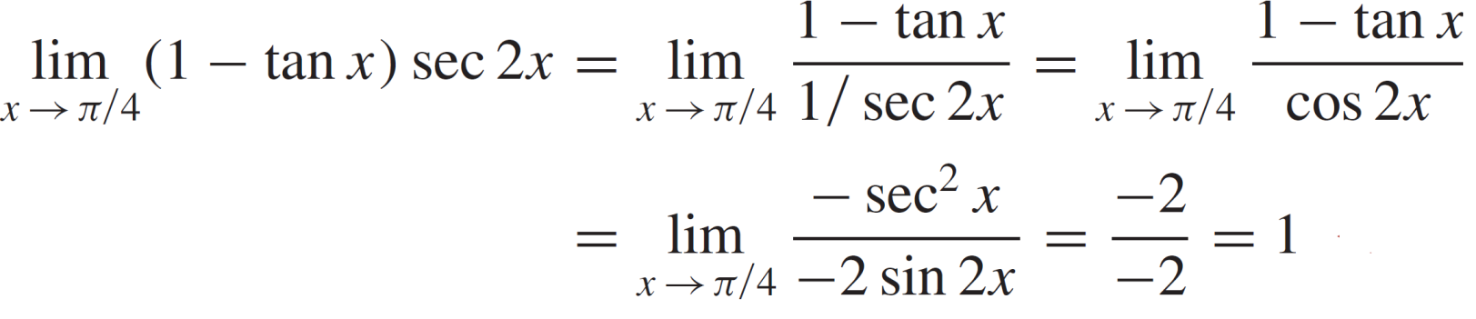
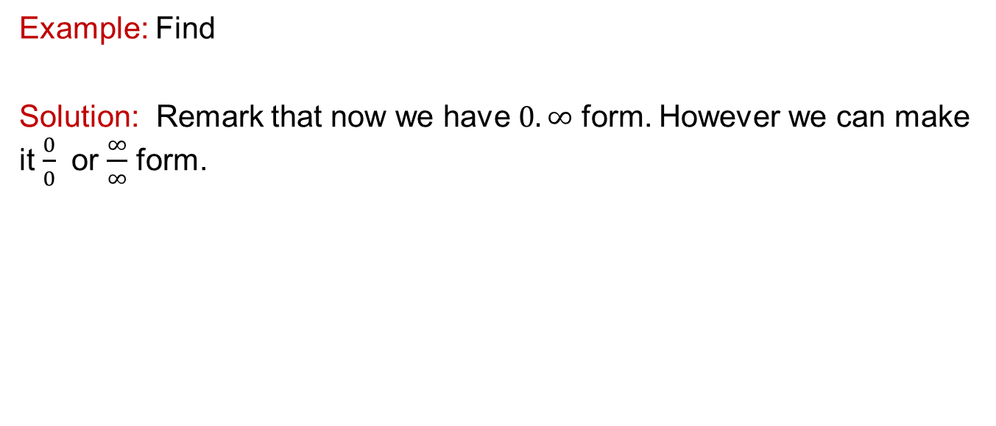
L’Hôpital rule: Recalls
Example: Find
Solution: Remark that now we have $0.∞$ form. However we can make it $\frac{0}{0}$ or $\frac{∞}{∞}$ form.

Slide 6
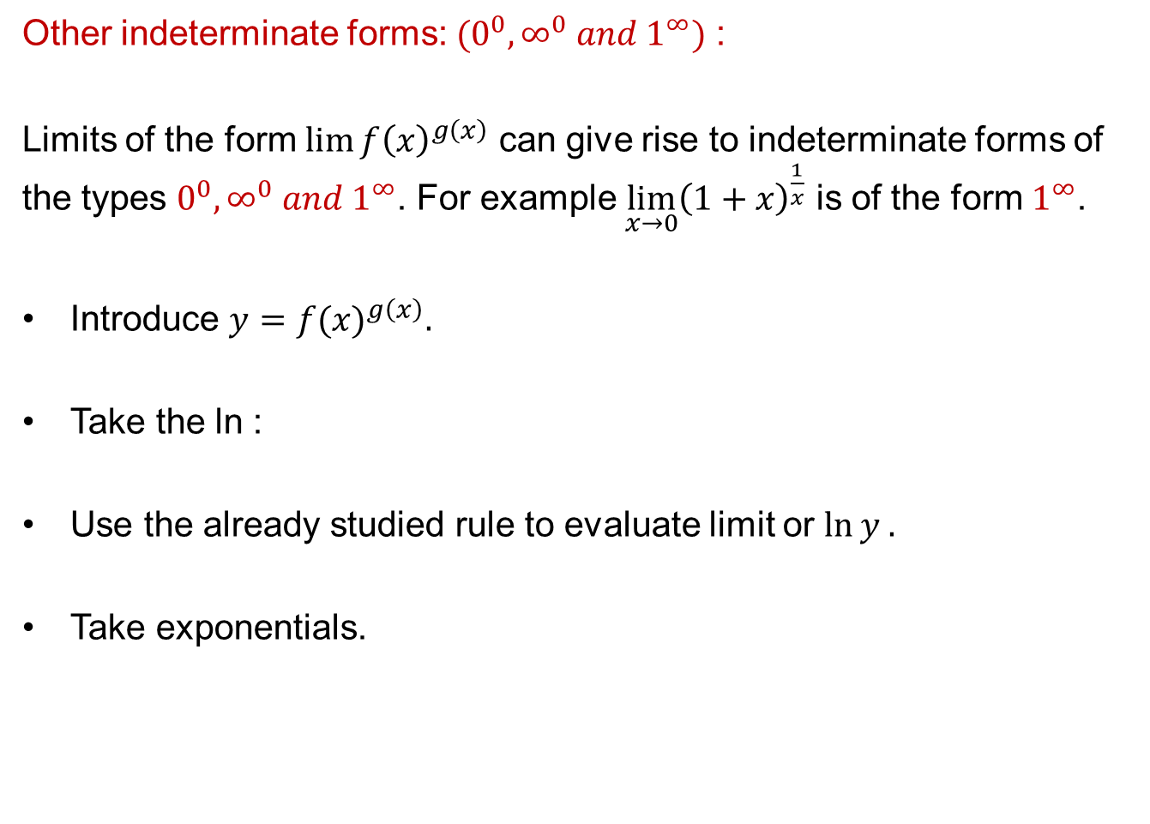
L’Hôpital rule: Recalls
Other indeterminateforms: $(0^{0}, ∞^{0} and 1^{∞})$ :
Limits of the form${\lim{f\left(x\right)}}^{g\left(x\right)}$ can give rise to indeterminate forms of the types $0^{0}, ∞^{0} and 1^{∞}$. For example $\lim_{x→0}{{\left(1+x\right)}^{\frac{1}{x}}}$ is of the form $1^{∞}$.
Introduce$y=$${f(x)}^{g\left(x\right)}.$
Take the ln :
Use the alreadystudiedruleto evaluatelimitor $\ln{y .}$
Takeexponentials.

Slide 7
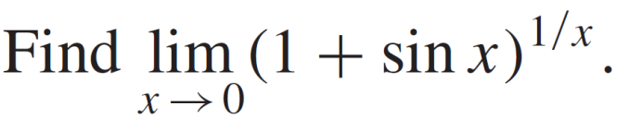

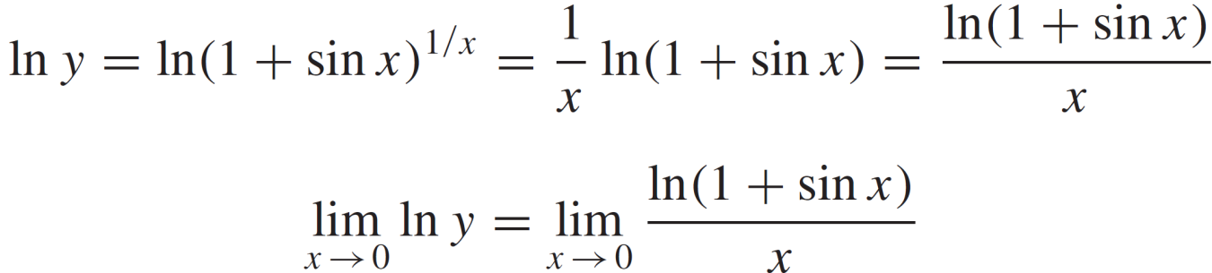
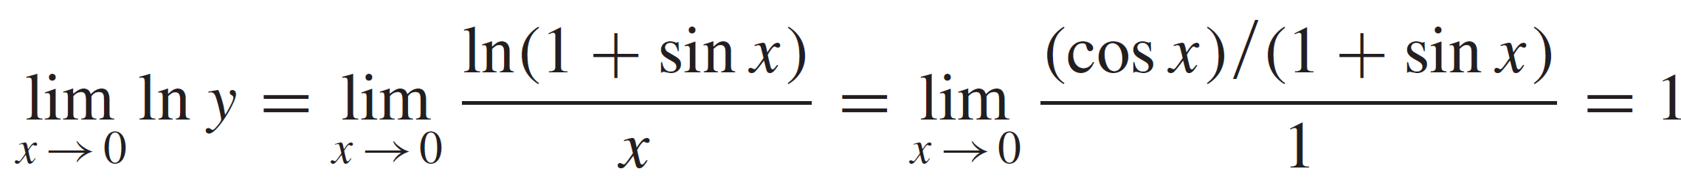
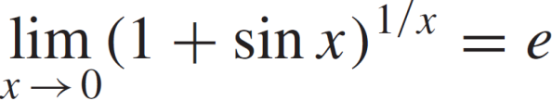
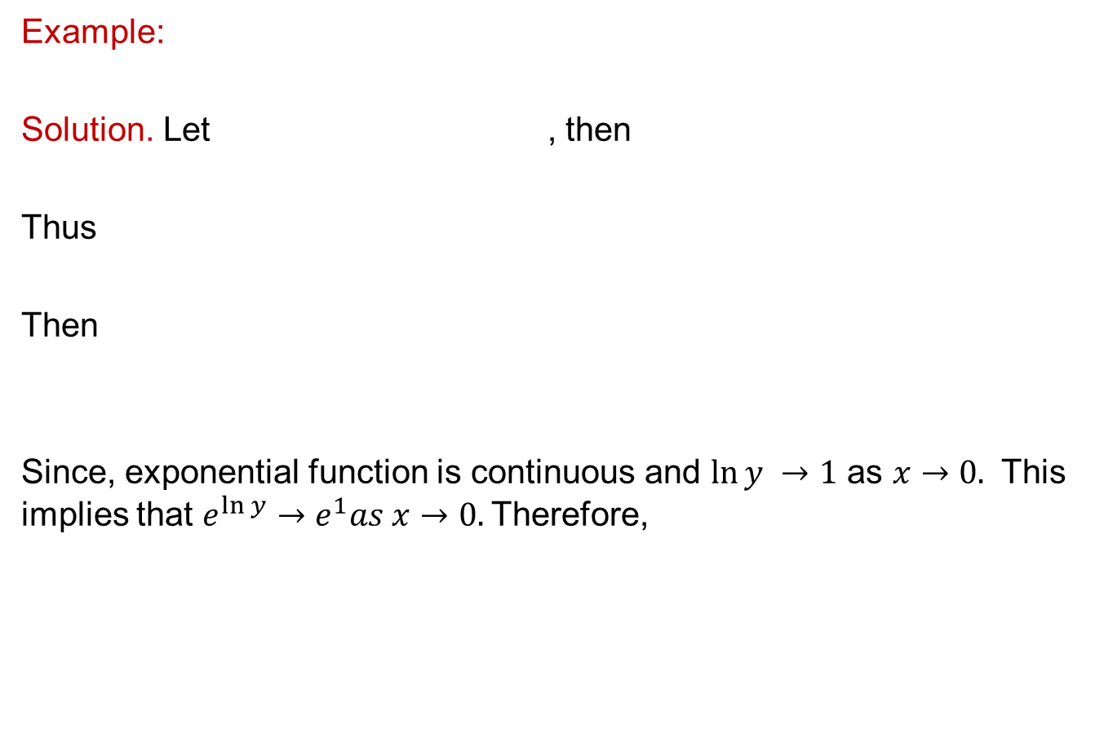
L’Hôpital rule: Recalls
Example:
Solution. Let , then
Thus
Then
Since, exponentialfunctioniscontinuous and $\ln{y →1}$ as $x→0.$ This impliesthat$e^{\ln{y}}→e^{1}as x→0.$Therefore,

Slide 8
L’Hôpital rule: Recalls
Example:
Solution. Let , then
Thus
Then
Since, exponentialfunctioniscontinuous and $\ln{y →1}$ as $x→0.$ This impliesthat$e^{\ln{y}}→e^{1}as x→0.$Therefore,

Slide 9
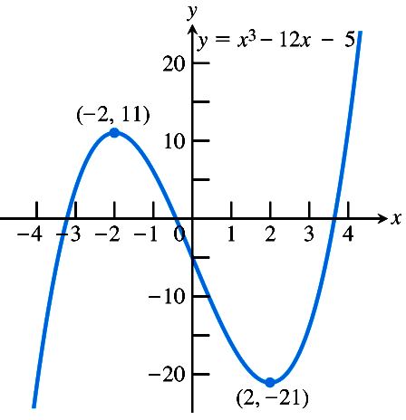
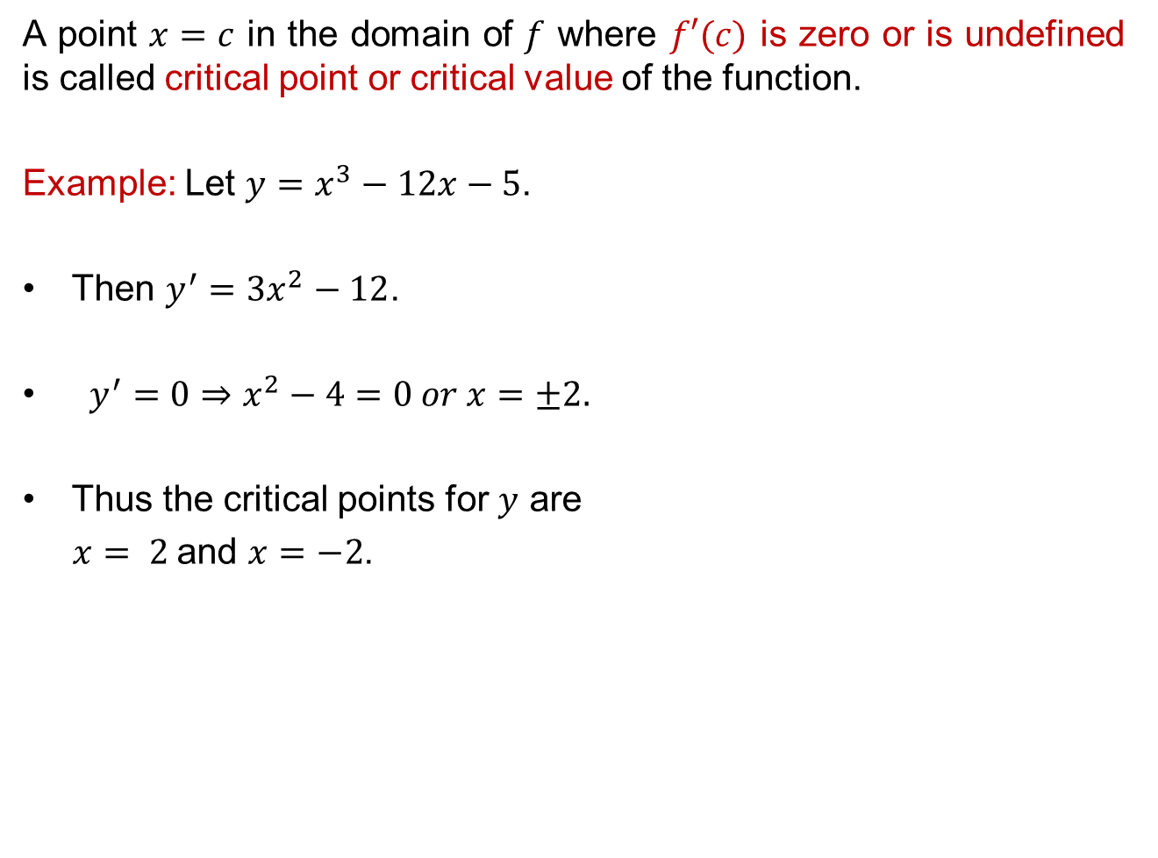
Critical Points
A point $x=c$ in the domain of $f$ where $f′(c)$ is zero or is undefined is called critical point or critical valueof the function.
Example: Let $y=x^{3}−12x−5$.
Then $y^{′}=3x^{2}−12$.
$y^{′}=0⇒x^{2}−4=0 or x=±2.$
Thus the critical points for $y$ are
$x= 2$and $x=−2$.

Slide 10
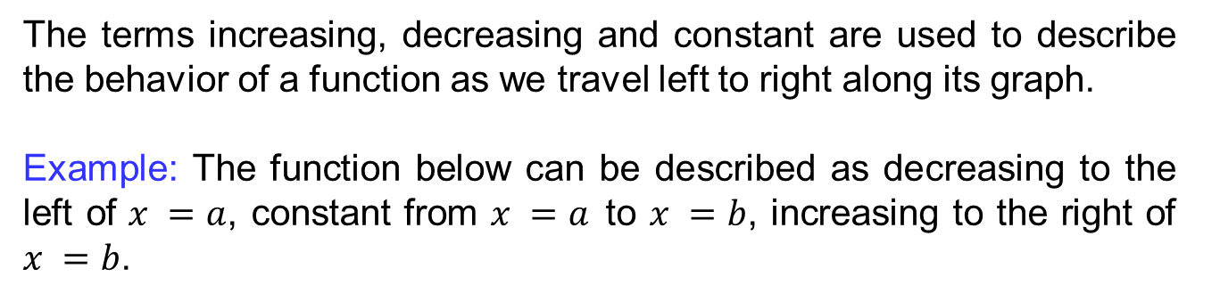
Increasing & decreasing functions
The terms increasing, decreasing and constant are used to describe the behavior of a function as we travel left to right along its graph.
Example: The function below can be described as decreasing to the left of $x =a$, constant from $x =a$to $x =b$, increasing to the right of $x =b$.

Slide 11
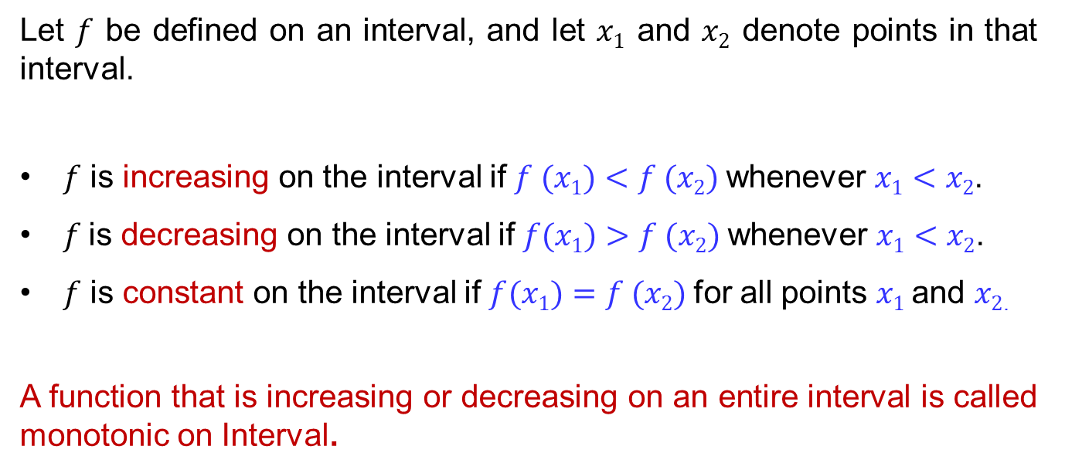
Increasing & decreasing functions
Let $f$ be defined on an interval, and let $x1$ and $x2$ denote points in that interval.
$f$ is increasing on the interval if $f (x1)<f (x2)$whenever$x1<x2$.
$f$is decreasing on the interval if $f(x1)>f (x2)$whenever $x1<x2$.
$f$is constant on the interval if $f(x1)=f (x2)$for all points $x1$and $x2$.
A function that is increasing or decreasing on an entire interval is called monotonic on Interval.

Slide 12
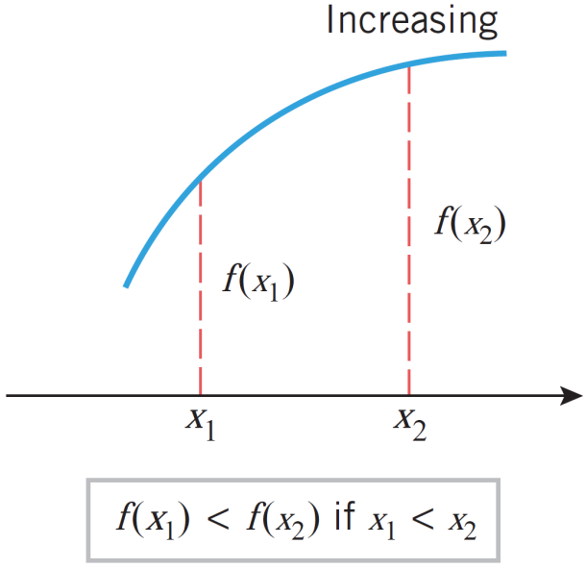
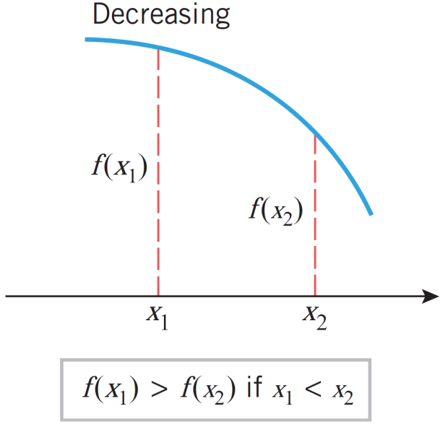
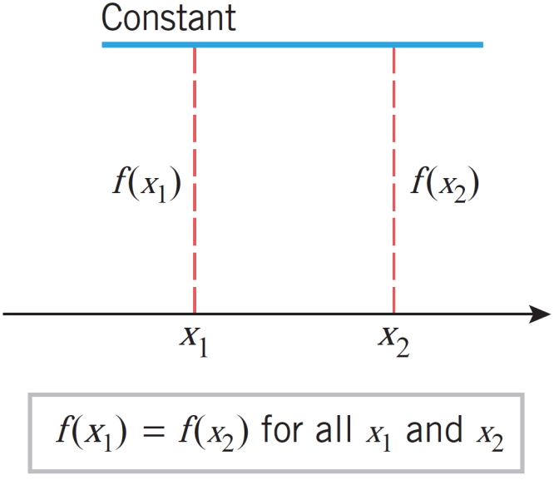
Increasing & decreasing functions
Example: Graphical behavior

Slide 13
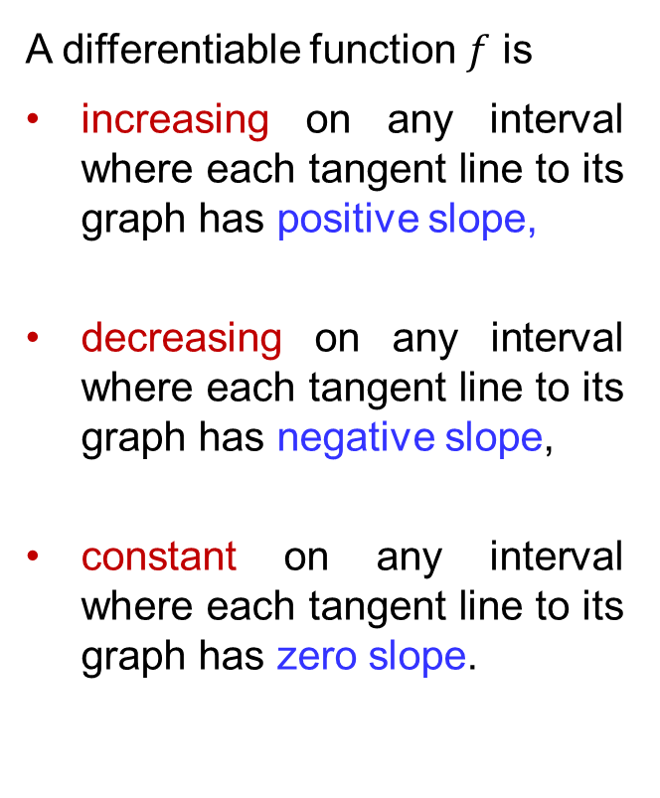
Increasing & decreasing functions
A differentiable function $f$ is
increasingon any interval where each tangent line to its graph has positive slope,
decreasingon any interval where each tangent line to its graph has negative slope,
constanton any interval where each tangent line to its graph has zero slope.

Slide 14
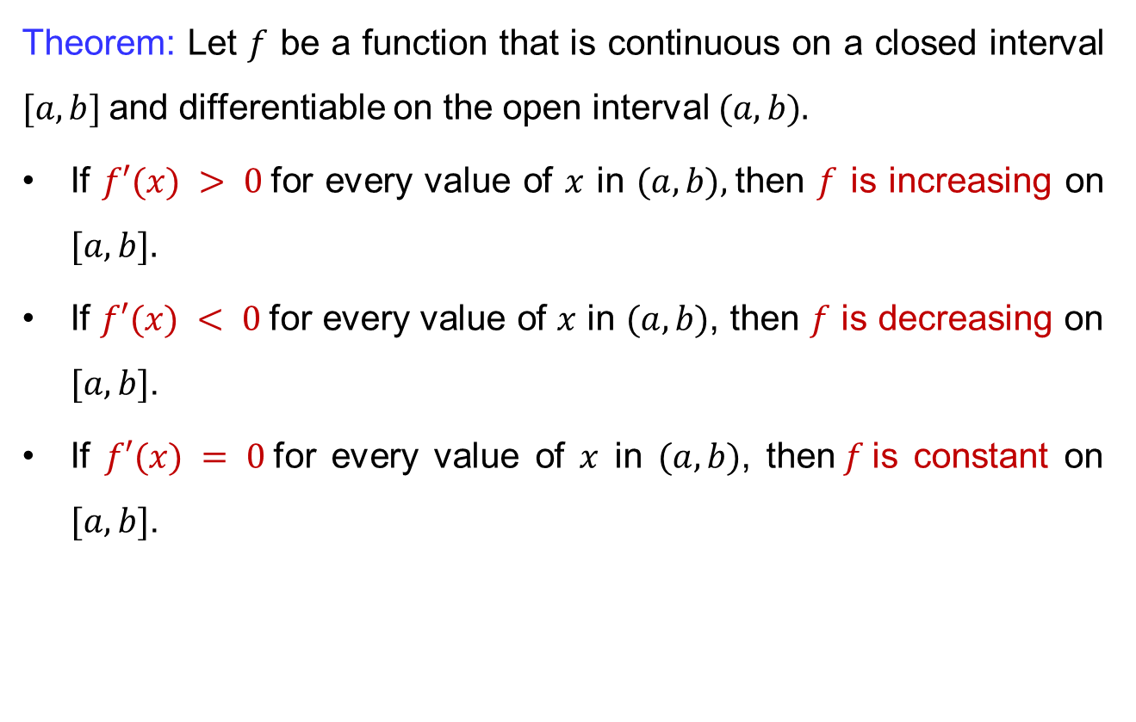
Increasing & decreasing functions
Theorem: Let $f$ be a function that is continuous on a closed interval $[a, b]$and differentiable on the open interval $(a, b).$
If $f′(x) > 0$for every value of $x$ in $(a, b),$then $f$ is increasing on $[a, b].$
If $f′(x) < 0$for every value of $x$ in $(a, b)$, then $f$ is decreasing on $[a, b]$.
If $f′(x) = 0$for every value of $x$ in $(a, b)$, then$f$is constant on $[a, b]$.

Slide 15
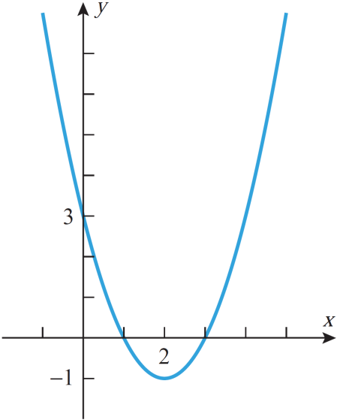
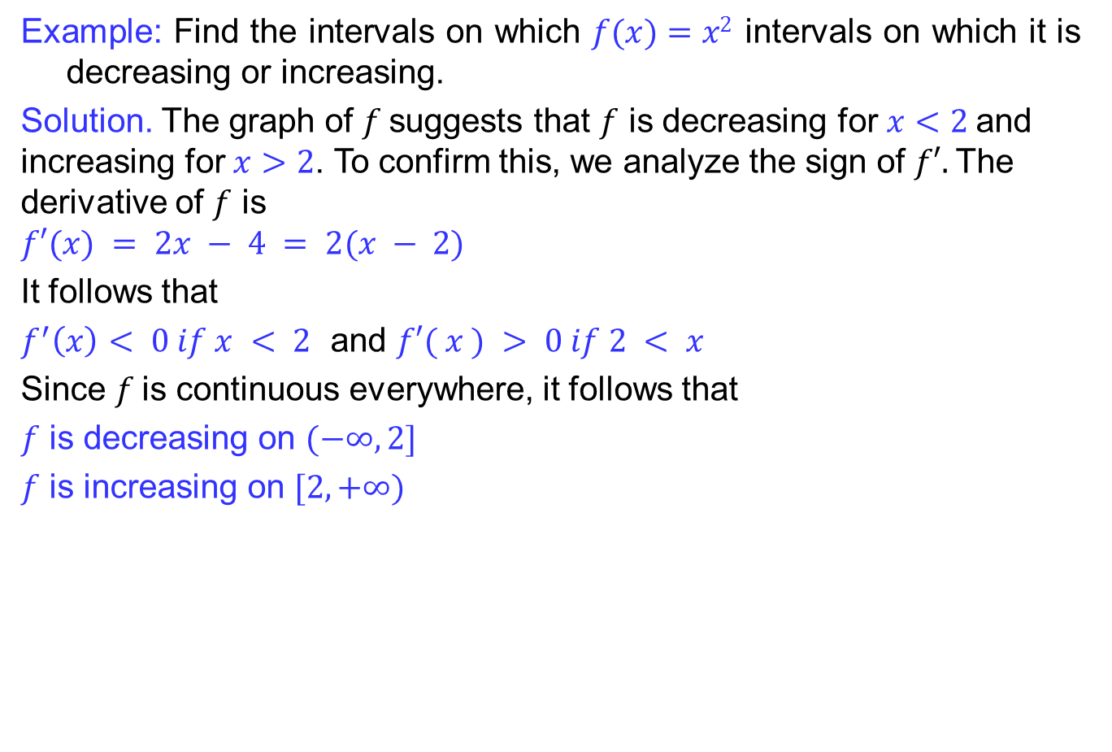
Increasing & decreasing functions
Example: Find the intervals on which $f(x)=x2$intervals on which it is decreasing or increasing.
Solution. The graph of $f$suggests that $f$ is decreasing for $x<2$and increasing for $x>2$. To confirm this, we analyze the sign of $f′.$The derivative of $f$ is
$$f′(x) = 2x − 4 = 2(x − 2)$$
It follows that
$f^{′}\left(x\right)< 0 if x < 2$and$f′( x ) > 0 if 2 < x$
Since $f$is continuous everywhere, it follows that
$f$ is decreasing on $(−∞, 2]$
$f$ is increasing on $[2, +∞)$

Slide 16
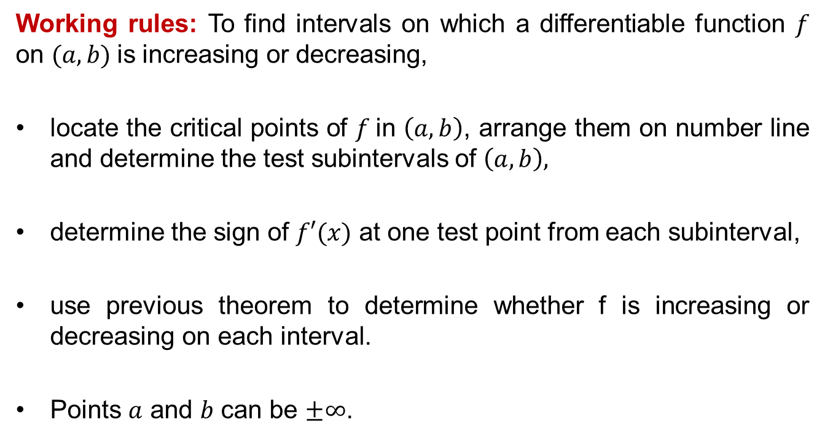
Increasing & decreasing functions
Working rules: To find intervals on which a differentiable function $f$ on $(a,b)$is increasing or decreasing,
locate the critical points of $f$in $\left(a,b\right)$, arrange them on number line and determine the test subintervals of $\left(a,b\right),$
determine the sign of $f′(x)$ at one test point from each subinterval,
use previous theorem to determine whether f is increasing or decreasing on each interval.
Points $a$ and $b$ can be $±∞$.

Slide 17
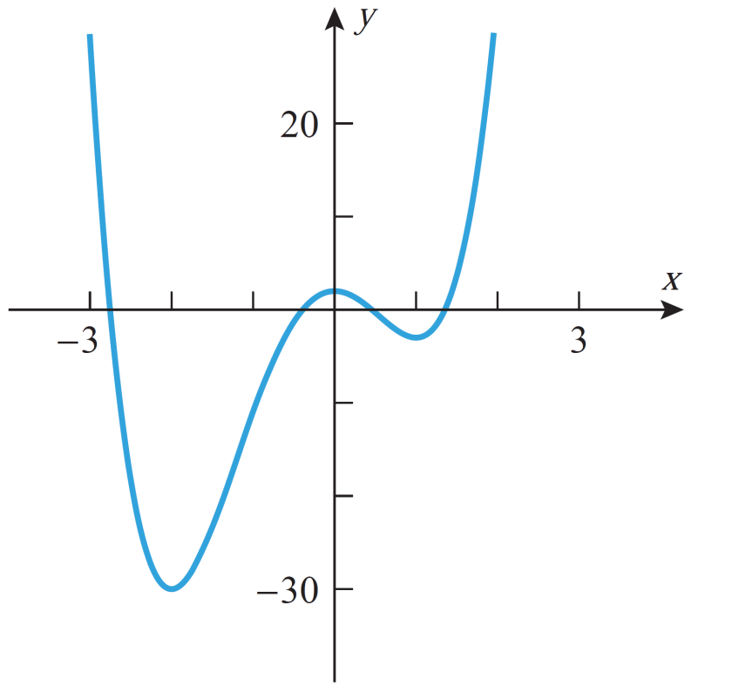
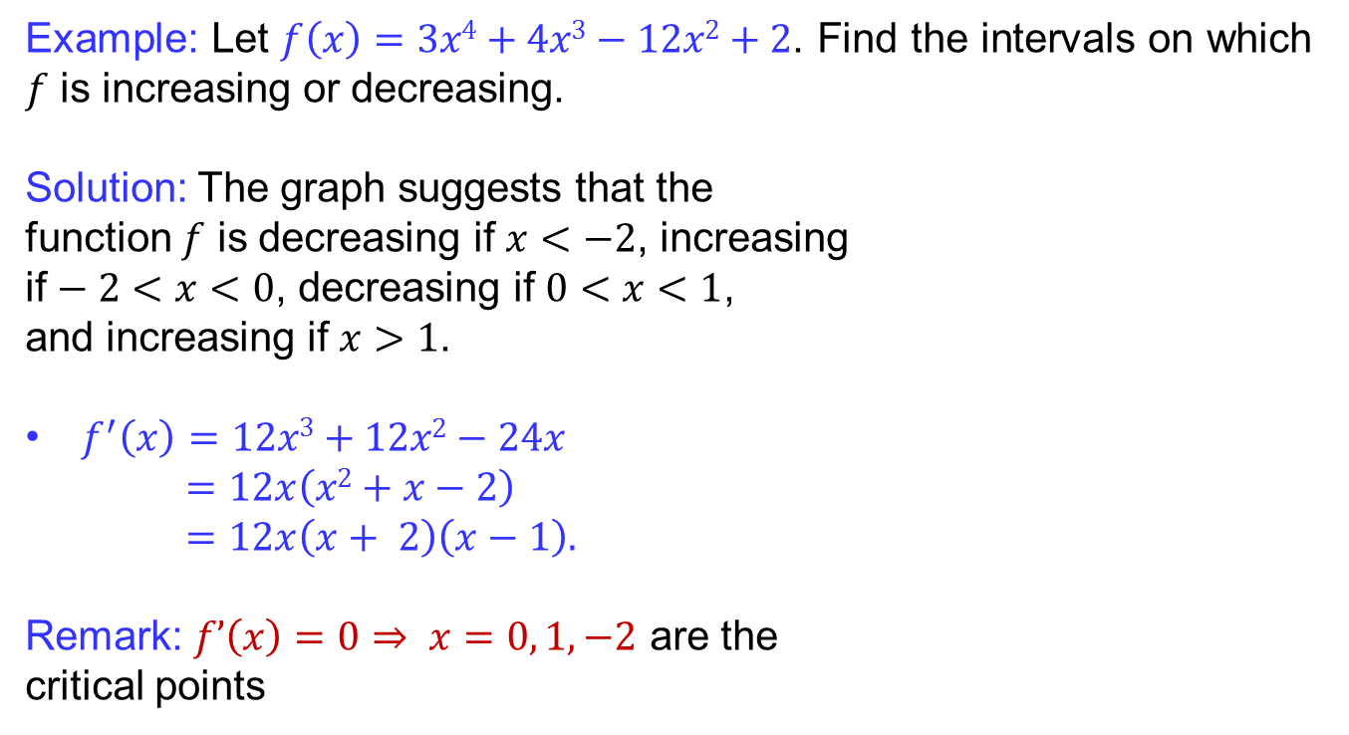
Increasing & decreasing functions
Example: Let$f\left(x\right)=3x4+4x3−12x2+2$. Find the intervals on which $f$ is increasing or decreasing.
Solution: The graph suggests that the
function $f$ is decreasing if $x<−2$, increasing
if $− 2<x<0$, decreasing if $0<x<1$,
and increasing if $x>1$.
$f^{′}\left(x\right)=12x3+12x2−24x$
$=12x\left(x2+x−2\right)$
$=12x\left(x+ 2\right)\left(x−1\right).$
Remark: $f’\left(x\right)=0⇒ x=0, 1, −2$are the
critical points

Slide 18
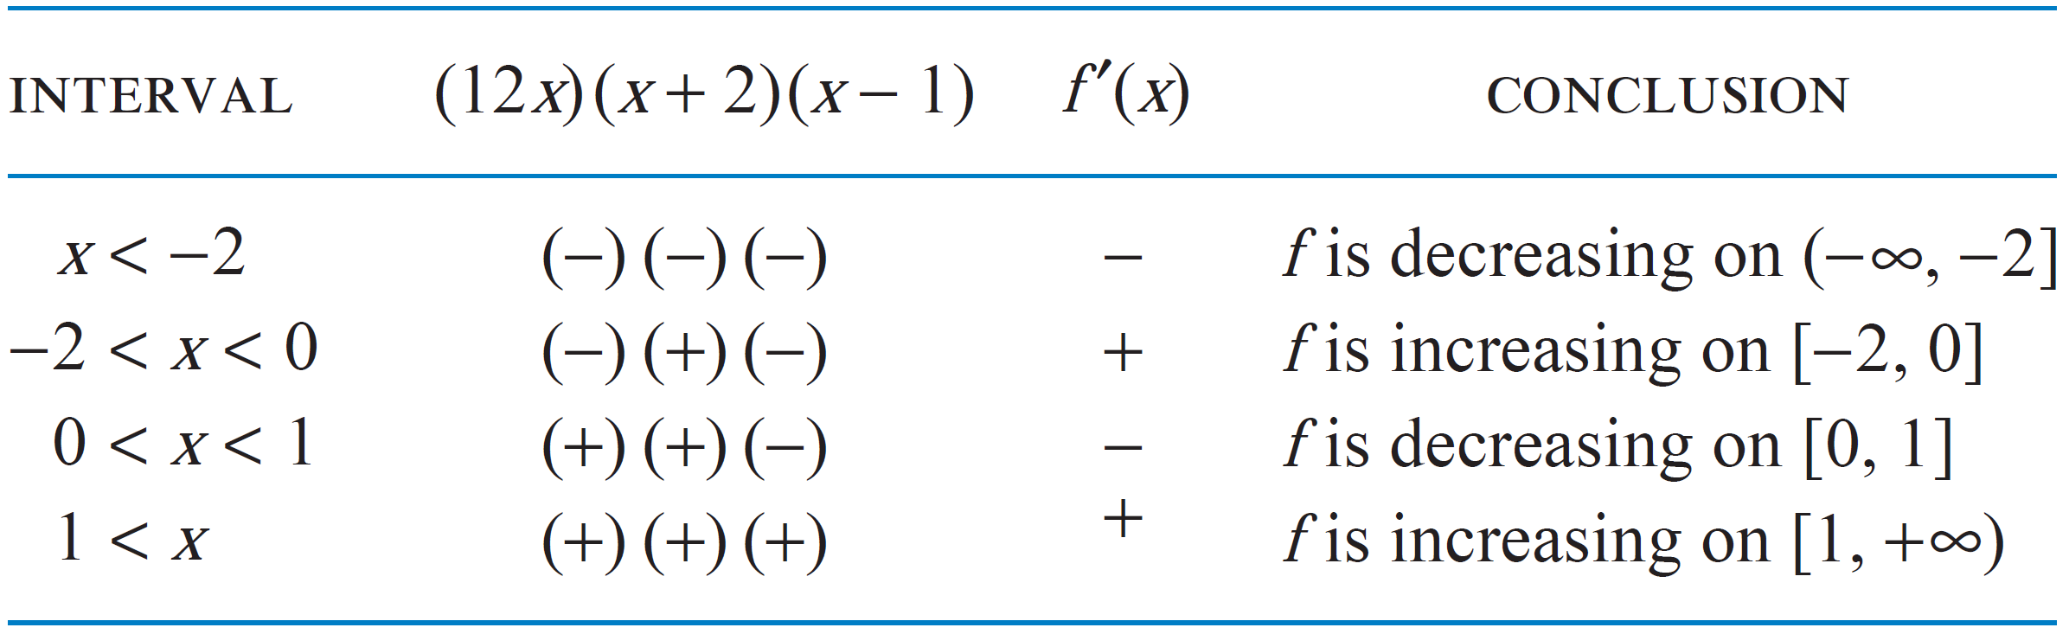
Increasing & decreasing functions

Slide 19
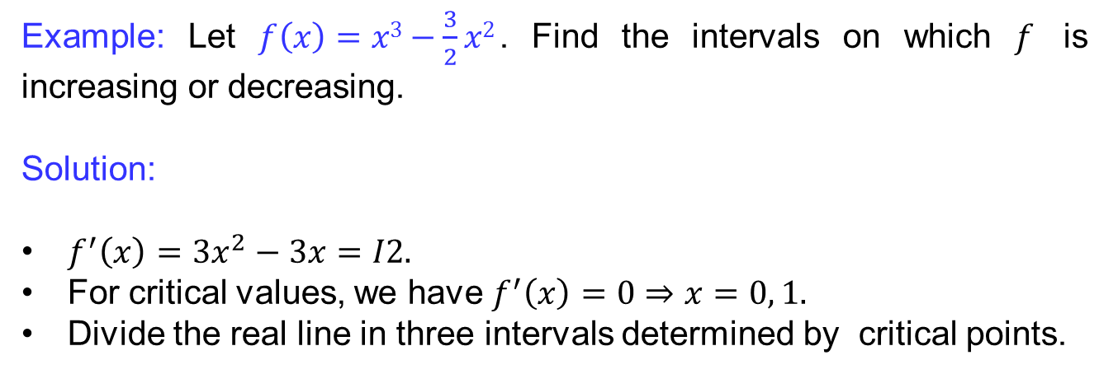
Increasing & decreasing functions
Example: Let$f\left(x\right)=x3−\frac{3}{2}x2$. Find the intervals on which $f$ is increasing or decreasing.
Solution:
$f^{′}\left(x\right)=3x^{2}−3x=I2.$
For critical values, we have $f^{′}\left(x\right)=0⇒x=0, 1.$
Divide the real line in three intervals determined by critical points.

Slide 20
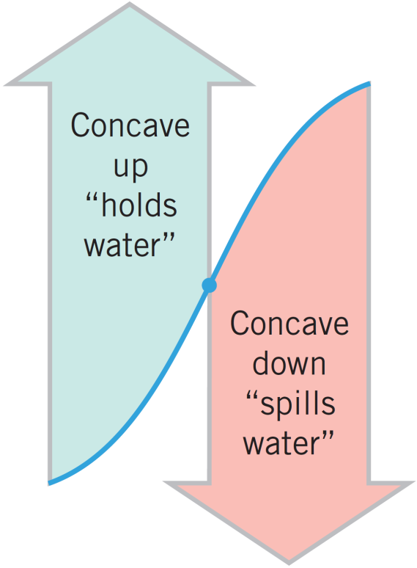
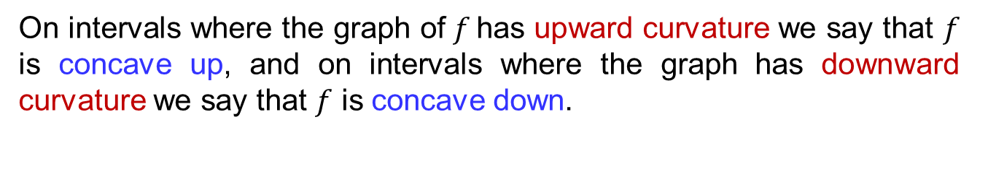
Concavity & points of inflection
On intervals where the graph of$f$has upward curvature we say that $f$ is concave up, and on intervals where the graph has downward curvature we say that $f$ is concave down.

Slide 21
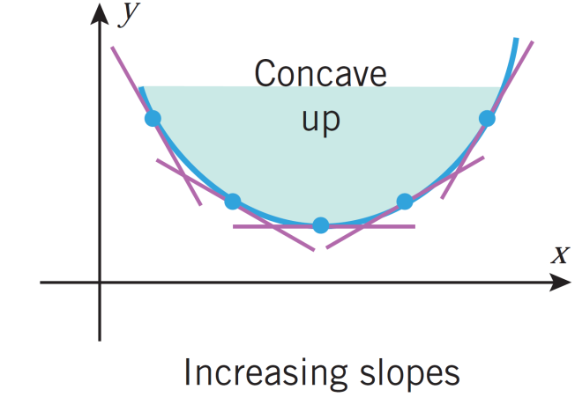
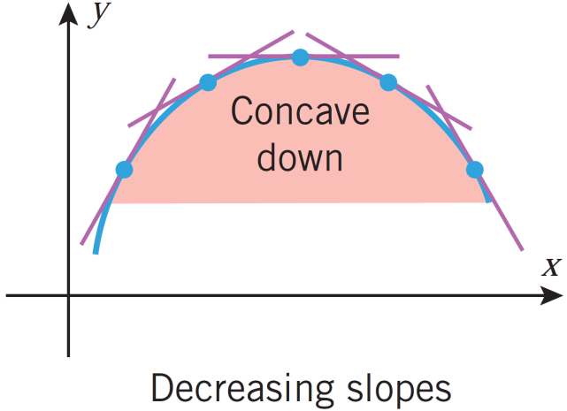
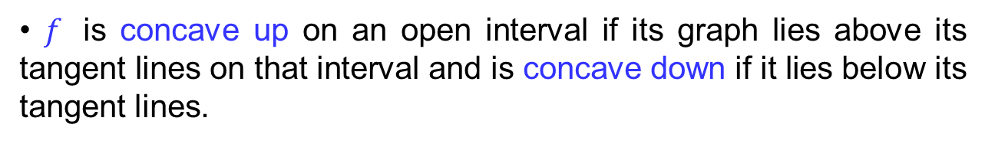
Concavity & points of inflection
•$f$ is concave up on an open interval if its graph lies above its tangent lines on that interval and is concave down if it lies below its tangent lines.

Slide 22
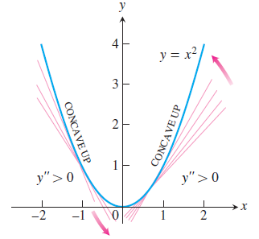
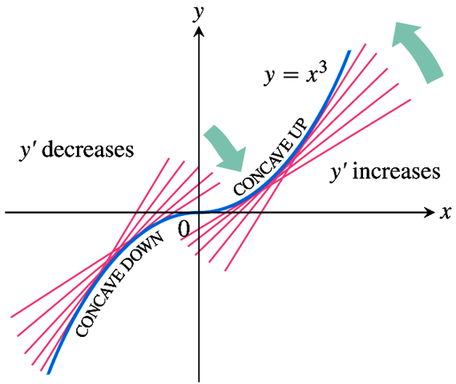
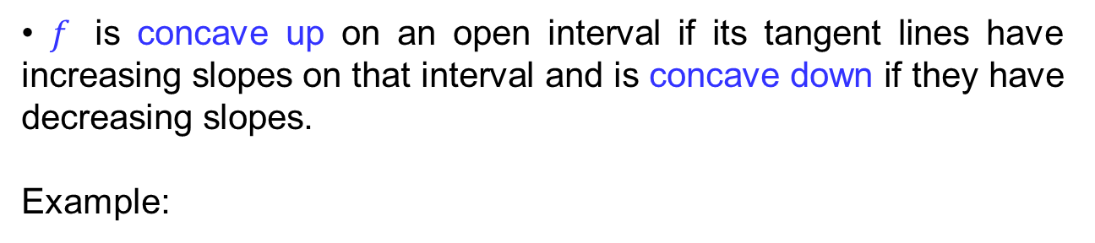
Concavity & points of inflection
•$f$ is concave up on an open interval if its tangent lines have increasing slopes on that interval and is concave down if they have decreasing slopes.
Example:

Slide 23
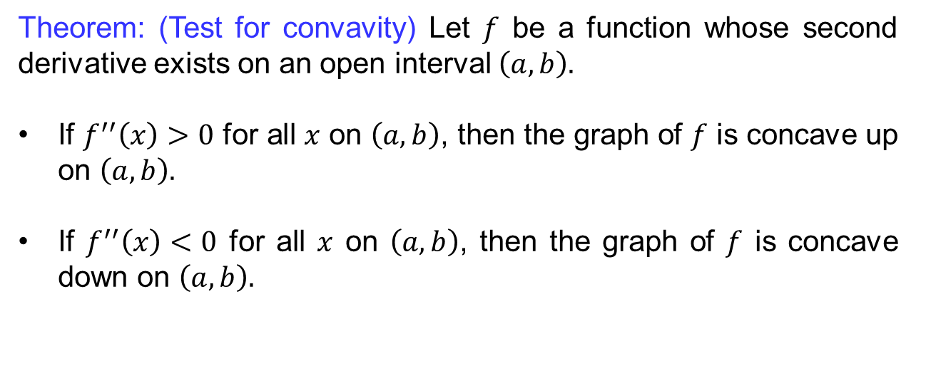
Concavity & points of inflection
Theorem: (Test for convavity) Let $f$ be a function whose second derivative exists on an open interval $\left(a,b\right).$
If $f^{′′}\left(x\right)>0$ for all $x$ on $\left(a,b\right)$, then the graph of $f$ is concave up on $\left(a,b\right).$
If $f^{′′}\left(x\right)<0$ for all $x$ on $\left(a,b\right)$, then the graph of $f$ is concave down on $\left(a,b\right).$

Slide 24
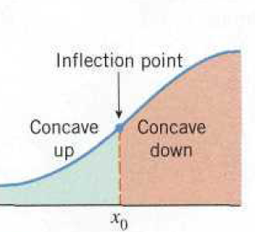
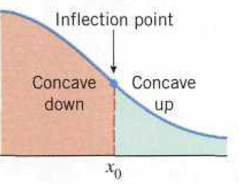
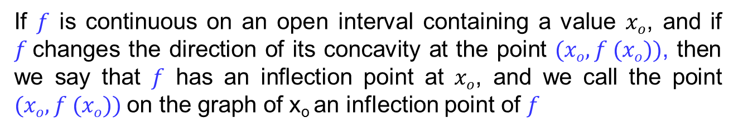
Concavity & points of inflection
If $f$ is continuous on an open interval containing a value $xo$, and if $f$changes the direction of its concavity at the point $(xo, f (xo))$, then we say that$f$ has an inflection point at $xo$, and we call the point $(xo, f (xo))$on the graph of x_{o} an inflection point of$f$

Slide 25
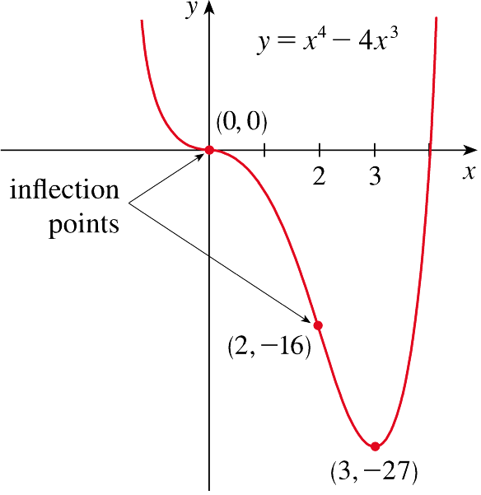
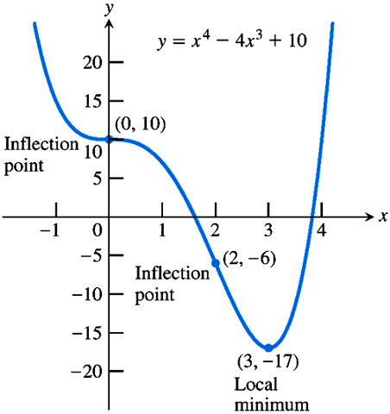
Concavity & points of inflection
Example:

Slide 26
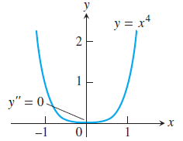
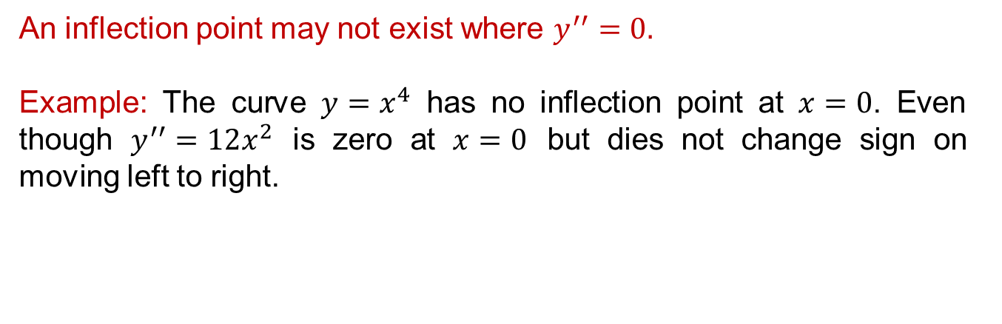
Concavity & points of inflection
An inflection point may not exist where $y^{′′}=0.$
Example: The curve $y=x^{4}$ has no inflection point at $x=0$. Even though $y^{′′}=12x^{2}$ is zero at $x=0$ but dies not change sign on moving left to right.

Slide 27
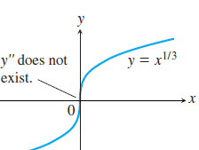
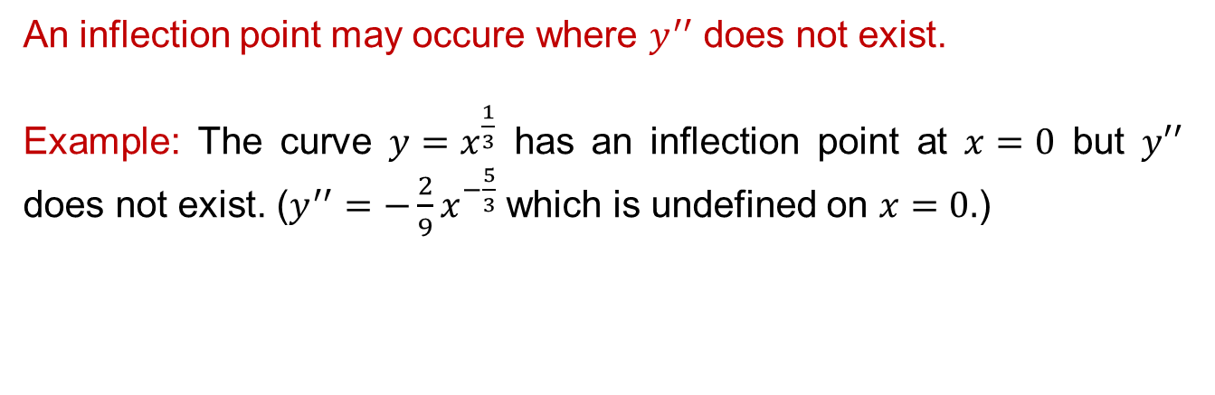
Concavity & points of inflection
An inflection point may occure where $y^{′′}$ does not exist.
Example: The curve $y=x^{\frac{1}{3}}$ has an inflection point at $x=0$ but $y′′$ does not exist. ($y^{′′}=−\frac{2}{9}x^{−\frac{5}{3}}$ which is undefined on $x=0.$)

Slide 28
Concavity & points of inflection
Guidelines for testing for concavity.
Determine the points of inflection (these occur when the second derivative is equal to zero or undefined).
Set up a table with intervals that correspond to the points of inflection.
Test each interval for concavity using concavity test theorem.

Slide 29
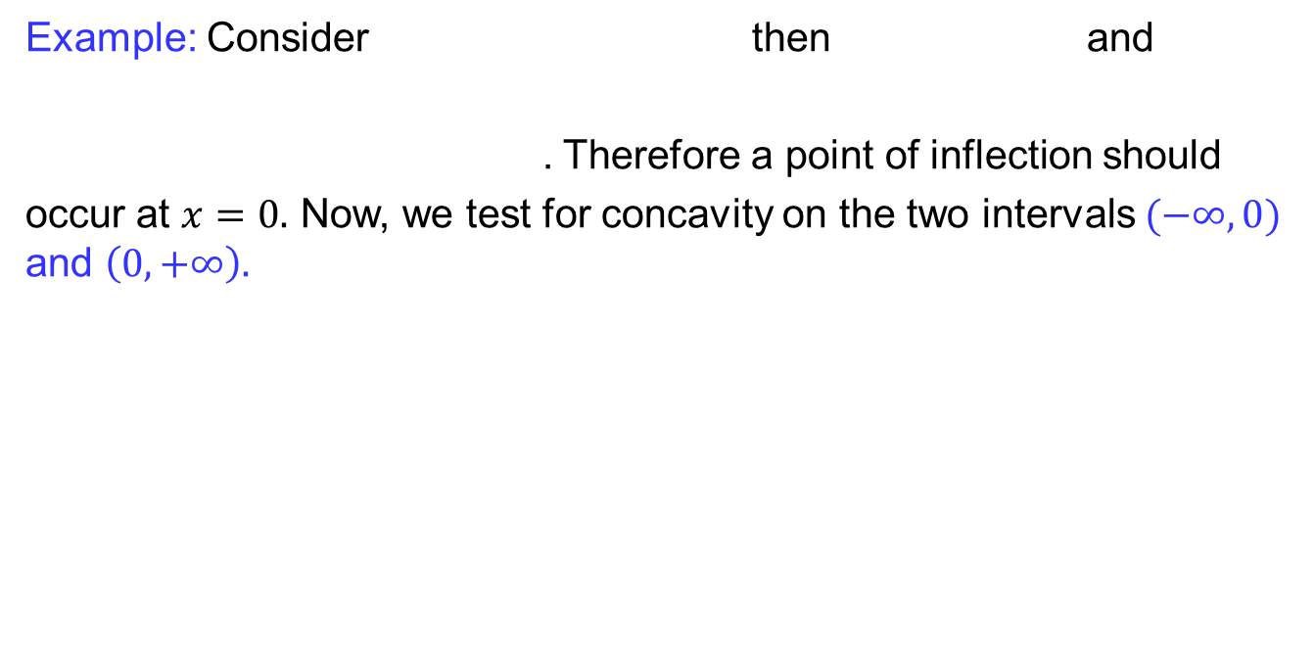
Concavity & points of inflection
Example: Consider then and
. Therefore a point of inflection should
occur at $x=0.$Now, we test for concavity on the two intervals $(−∞, 0)$and $\left(0,+∞\right).$

Slide 30
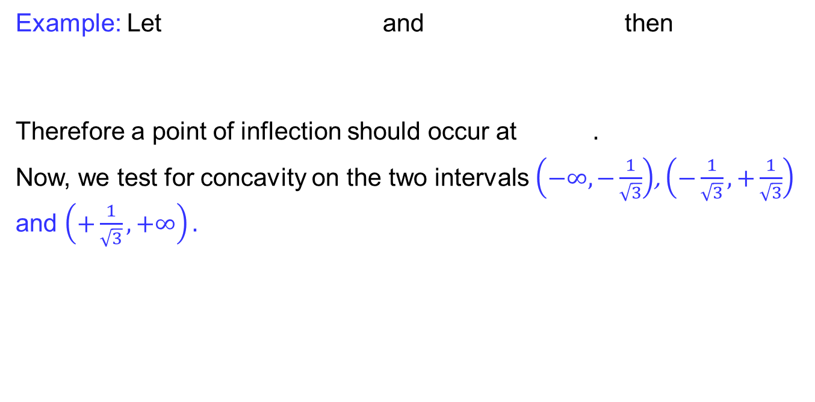
Concavity & points of inflection
Example: Let and then
Therefore a point of inflection should occur at$.$
Now, we test for concavity on the two intervals $\left(−∞, −\frac{1}{\sqrt{3}}\right)$, $\left(−\frac{1}{\sqrt{3}}, +\frac{1}{\sqrt{3}}\right)$and $\left(+\frac{1}{\sqrt{3}},+∞\right).$
-1
1
> 0 < 0 > 0
concaves up concaves down concaves up

Slide 31
Strategy for Graphing a function
Identify the domain of ƒ and any symmetries the curve may have.
Find and first derivative and second derivative
Find the critical points of ƒ, and identify the function’s behavior at each one.
Find where the curve is increasing and where it is decreasing.
Find the points of inflection, if any occur, and determine the concavity of the curve.

Slide 32
Lecture Summary
Critical points
Increasing and decreasing Functions
Concavity & inflection points
Strategy of Graphing

