Slide 1
(MTH 250)
Calculus
Lecture 11

Slide 2
Previous Lecture’s Summary
    Summary of differentiation rules: Recall
    Chain rules
    Implicit differentiation
    Derivatives of logrithemic functions
    Derivatives of hyperbolic functions.
    Derivatives of inverse trigonometric functions
    Derivatives of inverse hyperbolic functions
    Summary of results

Slide 3
Today’s Lecture
    Recalls
    Differentials
    Local linear approximations
    Indetermined forms
    L’Hopitâl rule

Slide 4
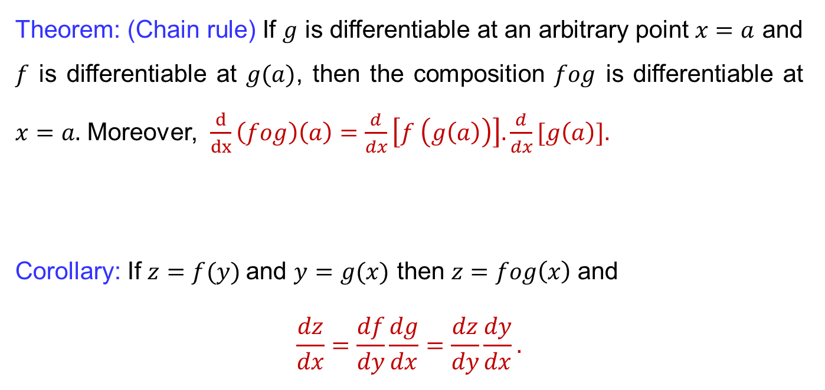
Recalls
Theorem: (Chain rule) If $g$ is differentiable at an arbitrary point $x=a$ and $f$ is differentiable at$g(a)$, then the composition $fog$ is differentiable at$x=a.$ Moreover, $\frac{d}{dx}\left(fog\right)\left(a\right)=\frac{d}{dx}\left[f \left(g\left(a\right)\right)\right]. \frac{d}{dx}[g\left(a\right)].$
Corollary: If $z=f(y)$and $y=g(x)$then$z=fog\left(x\right)$and
$$\frac{dz}{dx}=\frac{df}{dy}\frac{dg}{dx}=\frac{dz}{dy}\frac{dy}{dx}.$$

Slide 5
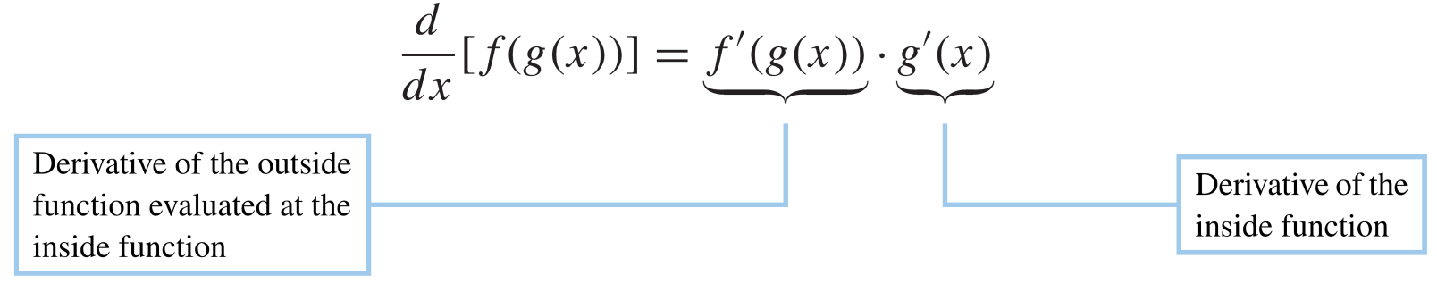
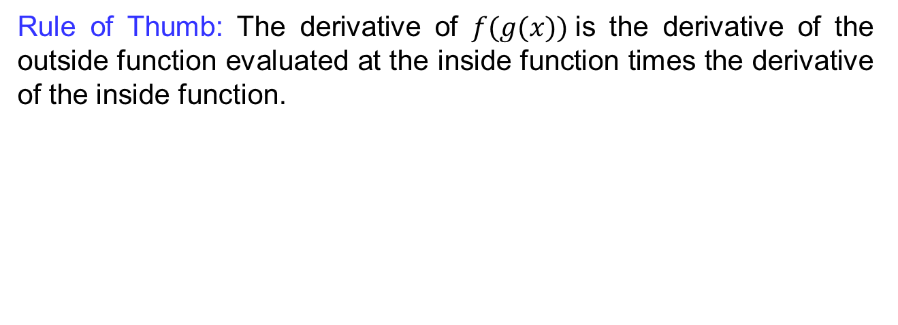
Recalls
Rule of Thumb: The derivative of $f(g(x))$is the derivative of the outsidefunctionevaluatedat the insidefunction times the derivative of the insidefunction.

Slide 6
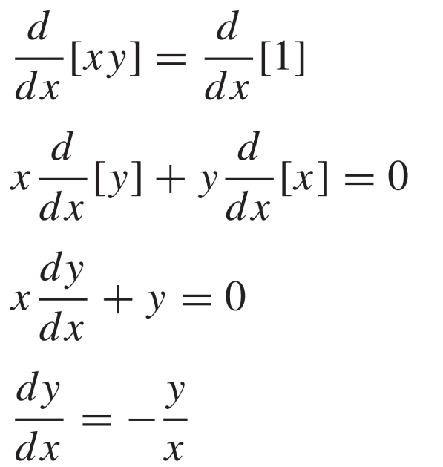
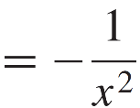
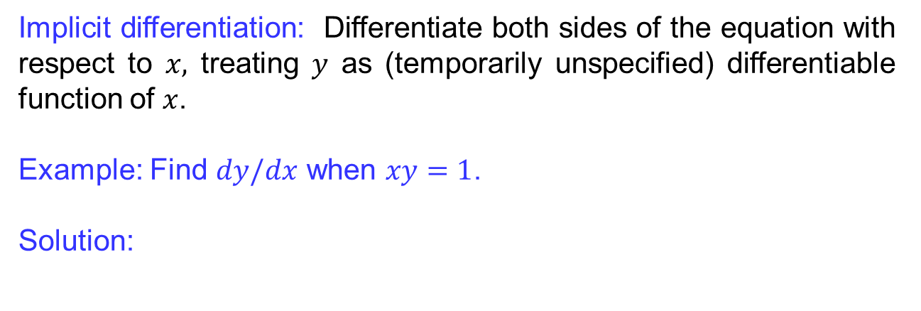
Recalls
Implicit differentiation: Differentiatebothsides of the equationwith respect to $x,$treating$y$ as (temporarilyunspecified) differentiablefunction of $x$.
Example: Find$dy/dx$ when $xy=1$.
Solution:

Slide 7
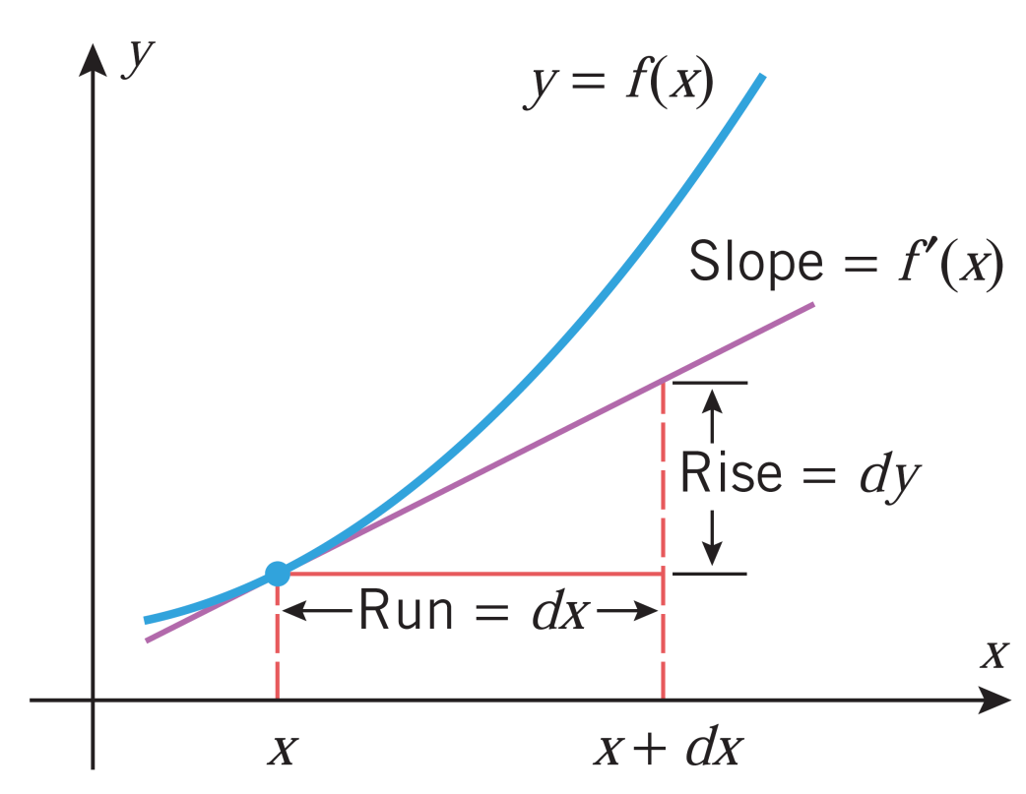
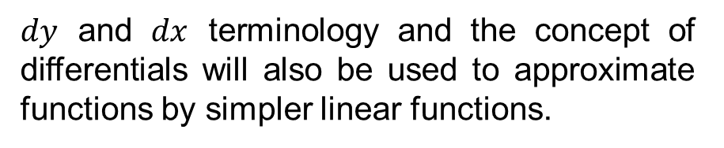
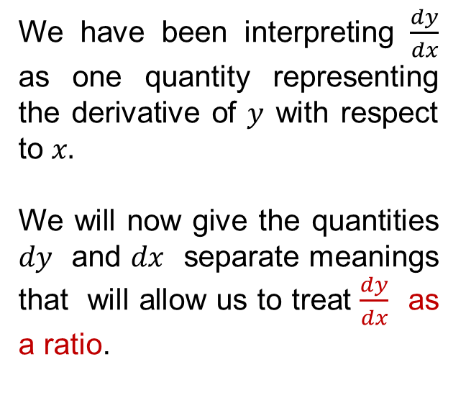
Differentials
We have been interpreting$\frac{dy}{dx}$ as one quantityrepresenting the derivative of $y$with respect to $x.$
We will now give the quantities $dy$ and $dx$ separate meanings that will allow us to treat $\frac{dy}{dx}$ as a ratio.
$dy$and $dx$ terminology and the concept of differentials will also be used to approximate functions by simpler linear functions.

Slide 8
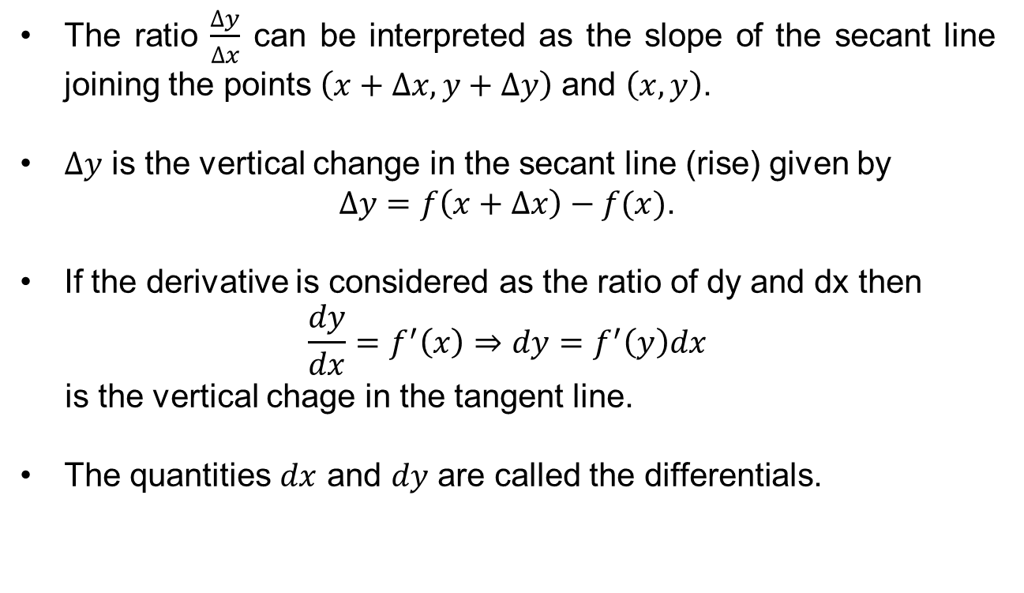
Differentials
The ratio $\frac{∆y}{∆x}$canbeinterpreted as the slope of the secant line joining the points $\left(x+∆x,y+∆y\right)$ and $\left(x,y\right)$.
$∆y$is the vertical change in the secant line (rise) given by
$∆y=f\left(x+∆x\right)−f(x)$.
If the derivativeisconsidered as the ratio of dy and dx then
$$\frac{dy}{dx}=f^{′}\left(x\right)⇒dy=f^{′}\left(y\right)dx$$
is the vertical chage in the tangent line.
The quantities$dx$ and $dy$ are called the differentials.

Slide 9
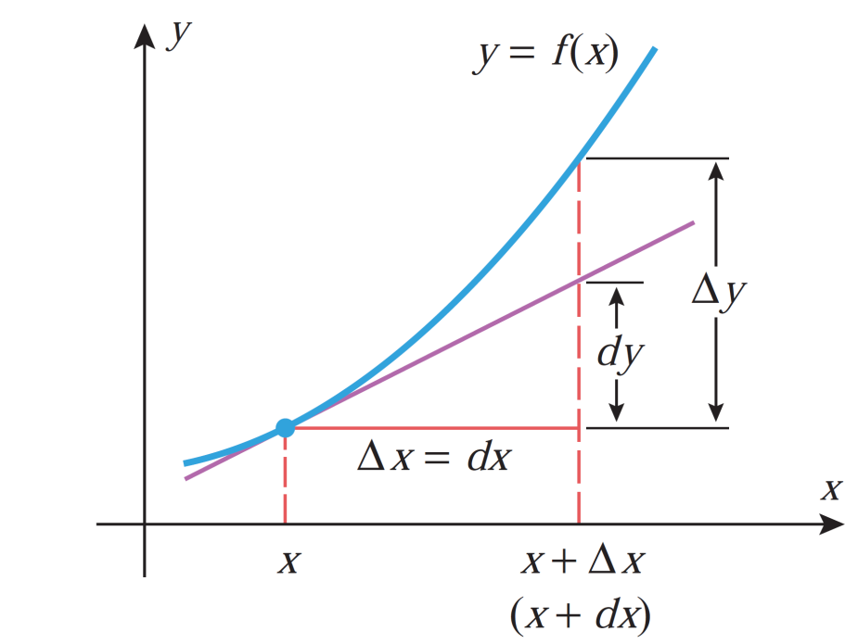
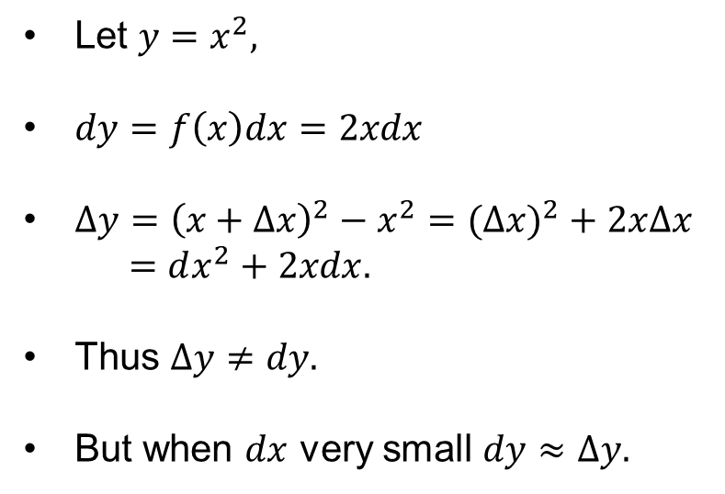
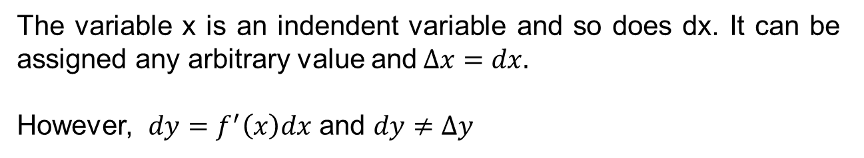
Differentials
The variable x is an indendent variable and sodoes dx. It canbeassignedanyarbitrary value and$∆x=dx.$
However, $dy=f^{′}\left(x\right)dx$ and $dy≠∆y$
Let $y=x^{2},$
$dy=f\left(x\right)dx=2xdx$
$∆y={\left(x+∆x\right)}^{2}−x^{2}=(∆{x)}^{2}+2x∆x$
$=dx^{2}+2xdx.$
Thus$∆y≠dy.$
But when$dx$verysmall$dy≈∆y.$

Slide 10
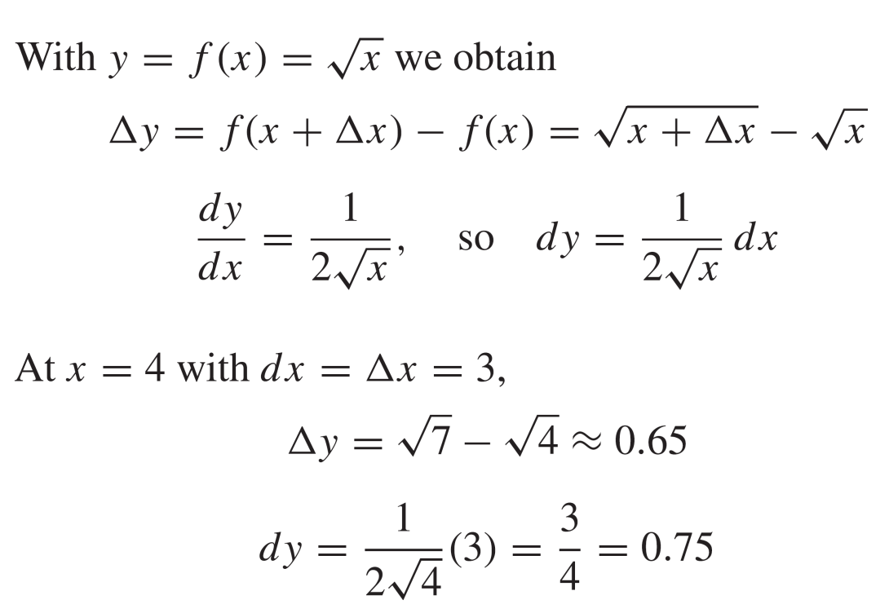
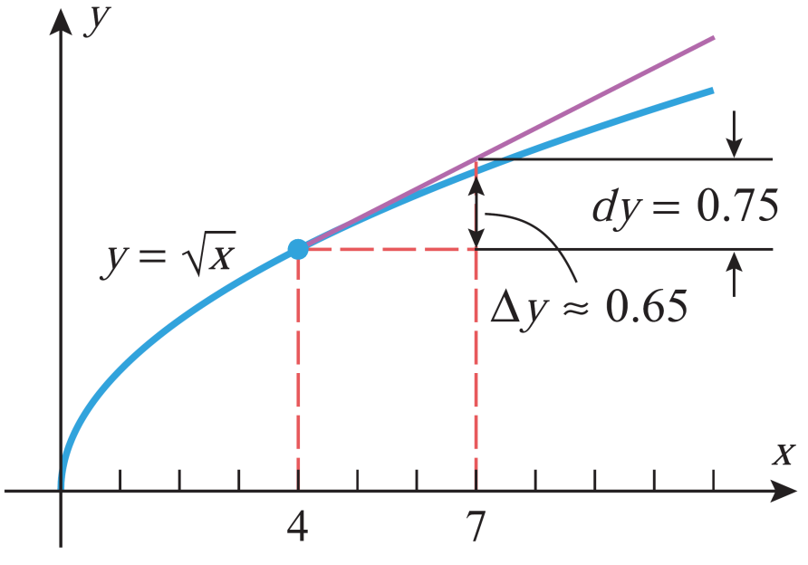
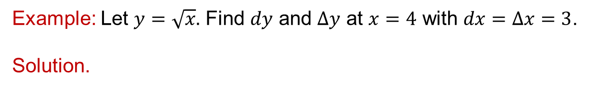
Differentials
Example: Let $y=\sqrt{x}.$Find$dy$ and $∆y$at$x=4$with$dx=∆x=3$.
Solution.

Slide 11
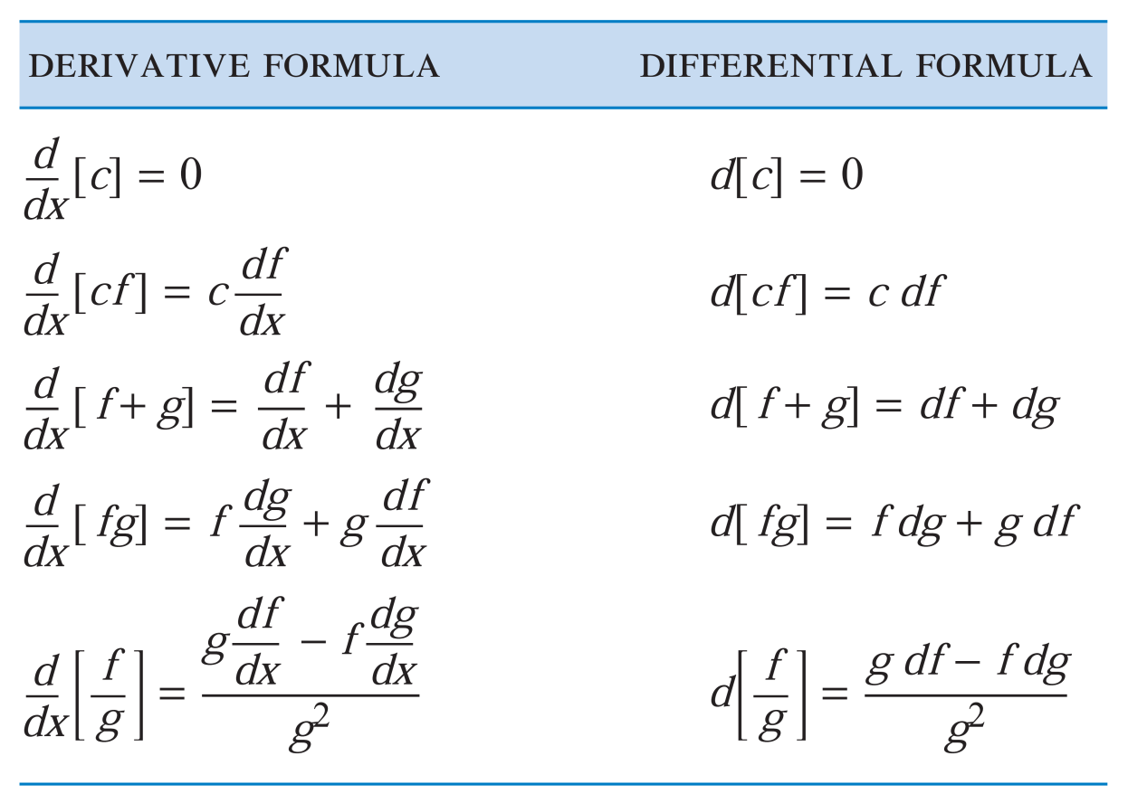
Differentials

Slide 12
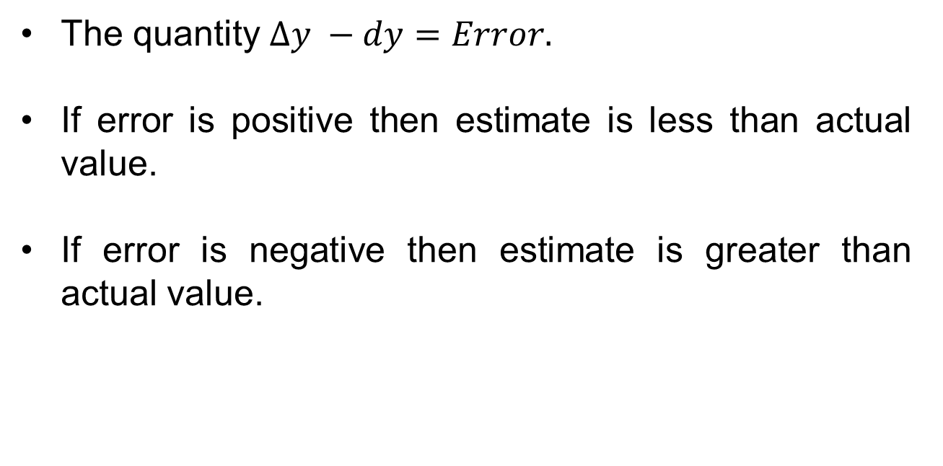
Differentials
The quantity$∆y −dy=Error.$
If erroris positive thenestimateislessthanactual value.
If errorisnegativethenestimateisgreaterthanactual value.

Slide 13
Local linear approximations
If the graph of a function is magnified at a point P that is differentiable, the function is said to be locally linear at P.
The tangent line through P closely approximates the graph.
A technique called local linear approximation is used to evaluate function at a particular value.
When measurements of independent variables have small errors then the computed functions will also be affected. This is known as error propagation.
Our goal is to estimate errors in the function using local linear appraoximation and differentials.

Slide 14
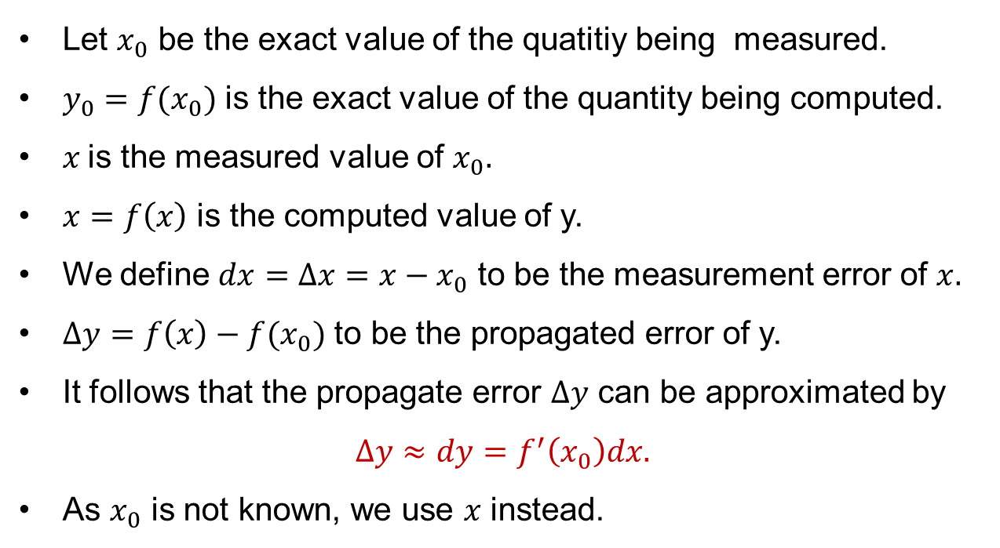
Local linear approximations
Let $x_{0}$ be the exact value of the quatitiybeingmeasured.
$y_{0}=f(x_{0})$is the exact value of the quantitybeingcomputed.
$x$is the measured value of $x_{0}.$
$x=f\left(x\right)$is the computed value of y.
Wedefine$dx=∆x=x−x_{0}$ to be the measurementerror of $x.$
$∆y=f\left(x\right)−f(x_{0})$ to be the propagatederror of y.
It followsthat the propagateerror$∆y$canbeapproximated by
$∆y≈dy=f^{′}\left(x_{0}\right)dx.$
As $x_{0}$is not known, we use $x$instead.

Slide 15
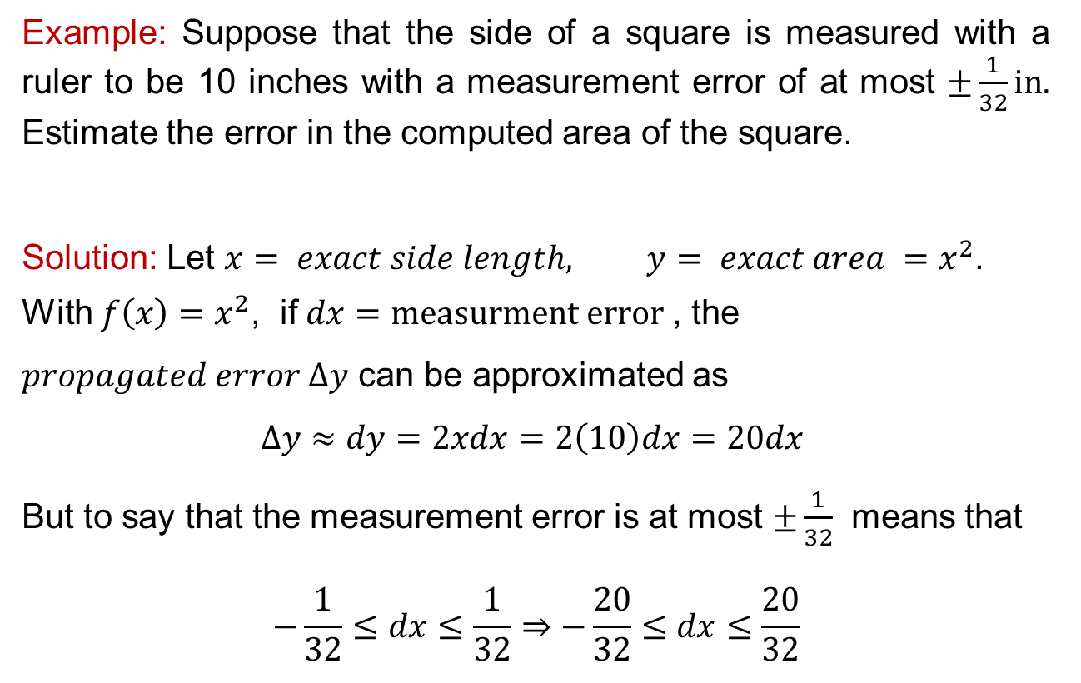
Local linear approximations
Example: Suppose that the side of a square ismeasuredwith a ruler to be 10 incheswith a measurementerror of atmost$±\frac{1}{32}in.$Estimate the error in the computed area of the square.
Solution: Let $x= exact side length,$$y= exact area =x^{2}$.
With$f\left(x\right)=x^{2}$, if $dx=measurment error$, the $propagated error ∆y$canbeapproximated as
$$∆y≈dy=2xdx=2\left(10\right)dx=20dx$$
But to saythat the measurementerrorisatmost$±\frac{1}{32}$meansthat
$$−\frac{1}{32}≤dx≤\frac{1}{32}⇒−\frac{20}{32}≤dx≤\frac{20}{32}$$

Slide 16
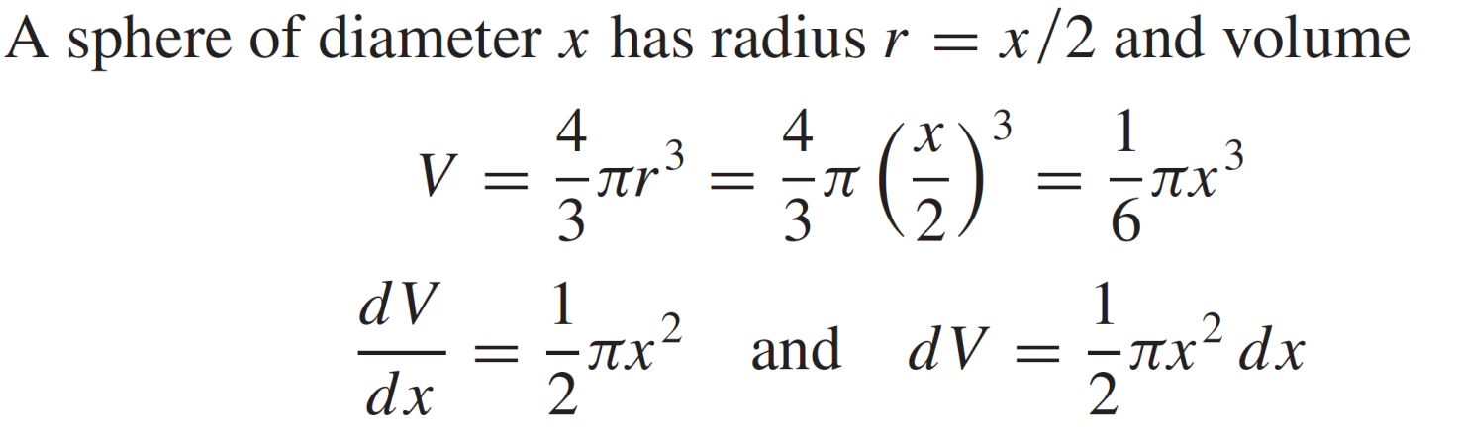
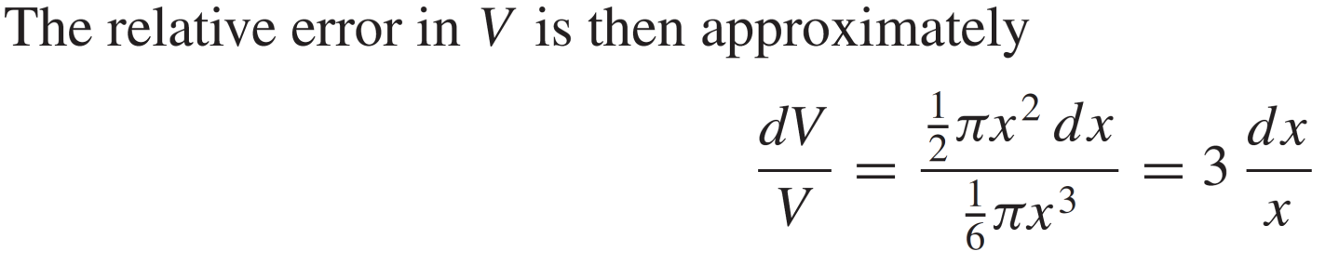
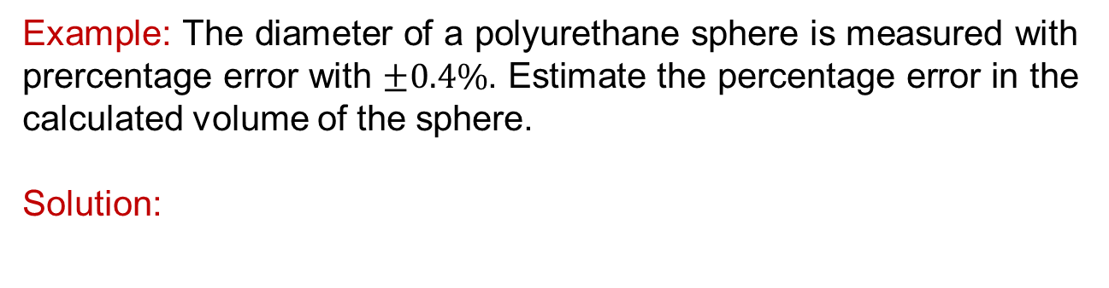
Local linear approximations
Example: The diameter of a polyurethanesphereismeasuredwithprercentageerrorwith$±0.4\%$. Estimate the percentageerror in the calculated volume of the sphere.
Solution:

Slide 17
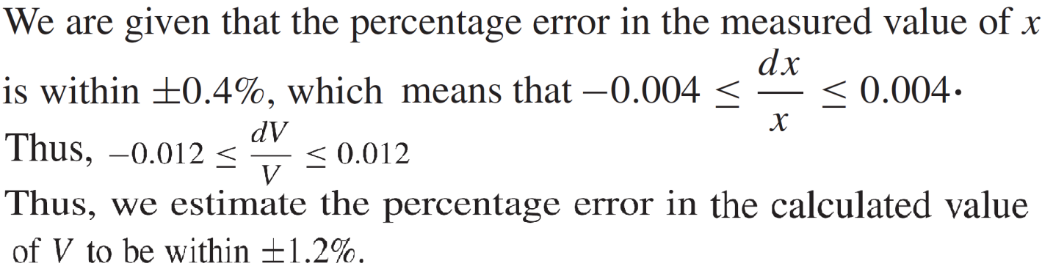
Local linear approximations
Example: The diameter of a polyurethanesphereismeasuredwithprercentageerrorwith$±0.4\%$. Estimate the percentageerror in the calculated volume of the sphere.
Solution:

Slide 18
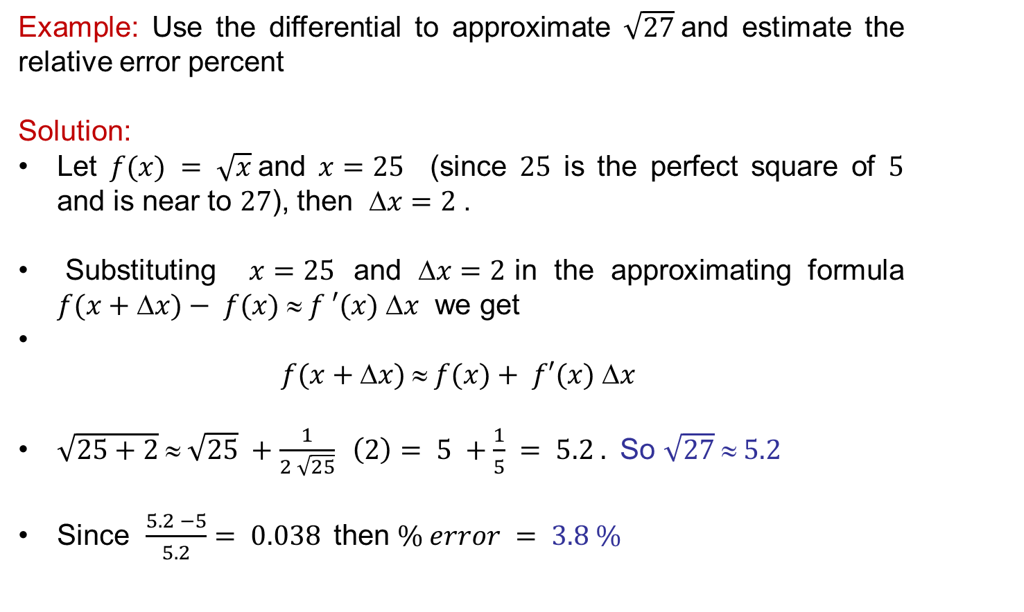
Local linear approximations
Example: Use the differential to approximate $\sqrt{27}$and estimate the relative error percent
Solution:
Let $f(x) = \sqrt{x}$and $x=25$ (since $25$ is the perfect square of $5$ and is near to $27$), then $x=2$.
Substituting $x=25$ and $x=2$in the approximating formula $f(x+x)− f(x)  f ′(x) x$ we get
$$f(x+x)  f(x)+ f′(x) x$$
$\sqrt{25+2} ≈ \sqrt{25} +\frac{1}{2 \sqrt{25}} \left(2\right)= 5 +\frac{1}{5} = 5.2 .$ So $\sqrt{27} ≈ 5.2$
Since $\frac{5.2 −5}{5.2}= 0.038$then $\% error = 3.8 \%$

Slide 19
Indeterminate From
There are times when we need to evaluate functions which are rational
We end up with the indeterminate form
At a specific point it may evaluate to an indeterminate form
Note why this is indeterminate

Slide 20
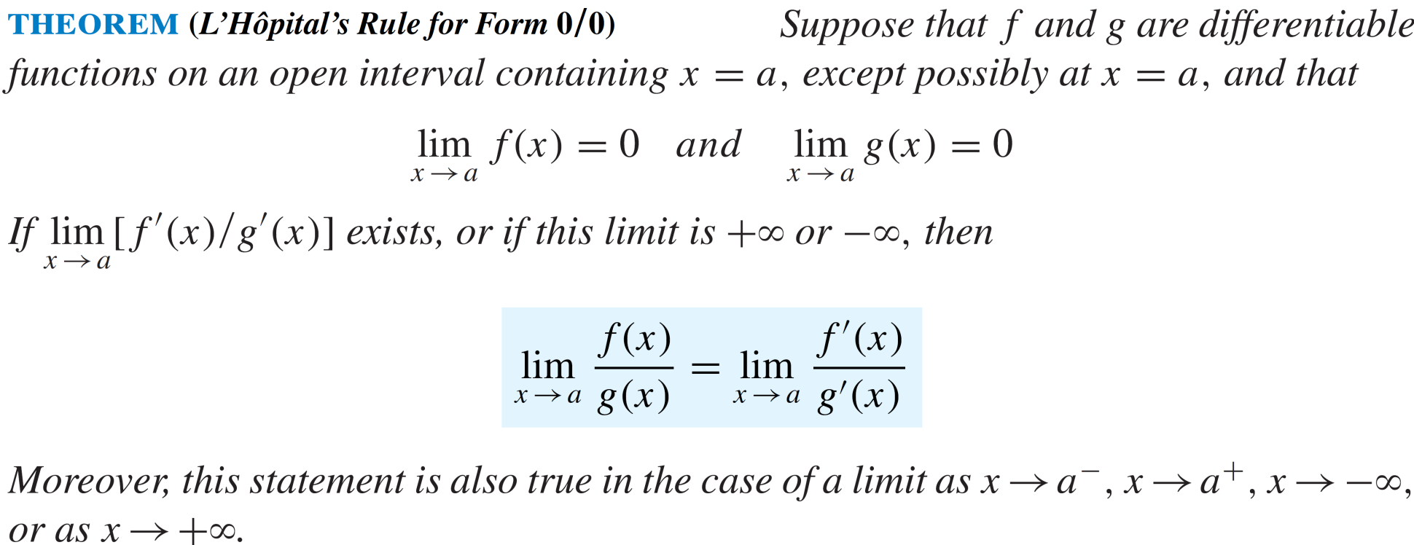
L’Hôpital Rule

Slide 21
L’Hôpital Rule
We can confirm L’Hôpital’s rule by working backwards, and using the definition of derivative:

Slide 22
L’Hôpital Rule
Suppose gives an indeterminate form (and the limit exists)
It is possible to find a limit by
Note: this only works when the original limit gives an indeterminate form.

Slide 23
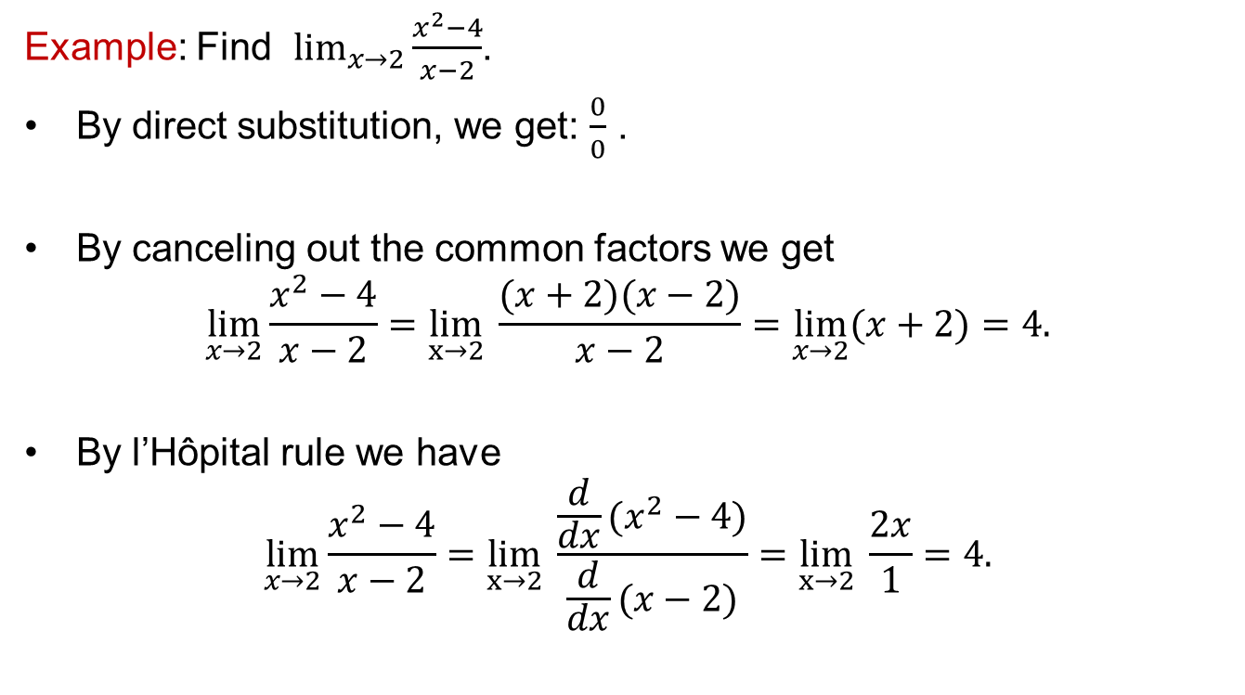
L’Hôpital Rule
Example: Find$\lim_{x→2}{\frac{x^{2}−4}{x−2}}$.
By direct substitution, we get: $\frac{0}{0}$ .
By canceling out the commonfactorsweget
$$\lim_{x→2}{\frac{x^{2}−4}{x−2}}=\lim_{x→2}{ \frac{(x+2)(x−2)}{x−2}}=\lim_{x→2}{(x+2)}=4.$$
By l’Hôpital rulewe have
$$\lim_{x→2}{\frac{x^{2}−4}{x−2}}=\lim_{x→2}{ \frac{\frac{d}{dx}(x^{2}−4)}{\frac{d}{dx}(x−2)}}=\lim_{x→2}{ \frac{2x}{1}}=4.$$

Slide 24
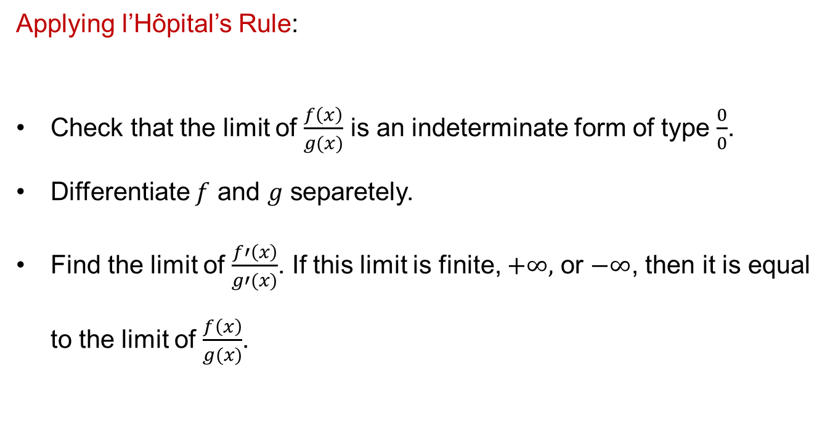
L’Hôpital Rule
Applying l’Hôpital’s Rule:
Check that the limit of $\frac{f\left(x\right)}{g(x)}$is an indeterminateform of type $\frac{0}{0}$.
Differentiate$f$ and $g$separetely.
Find the limit of $\frac{f′\left(x\right)}{g′(x)}$. If this limit is finite, $+∞,$ or $−∞$, then it is equal to the limit of $\frac{f\left(x\right)}{g(x)}$.

Slide 25
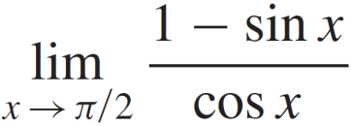
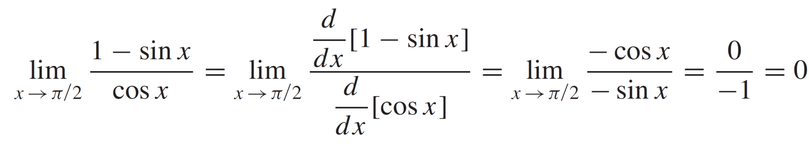
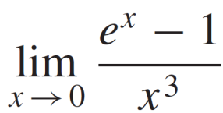
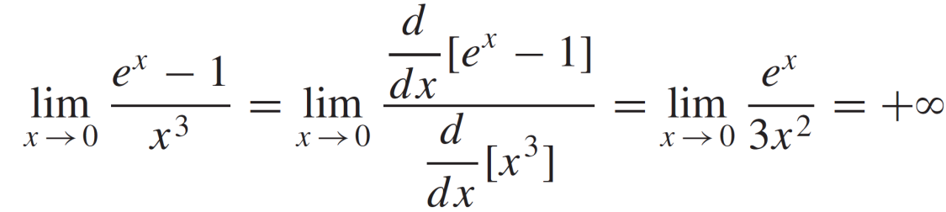
L’Hôpital Rule
Example: Find
Solution:
Example: Find
Solution:

Slide 26
L’Hôpital Rule
Use apply L’Hôpital’s rule as many times as necessary as long as the fraction is still indeterminate. For example.
This is indeterminate form
Now it is in the form
L’Hôpital’s rule applied once.
Fractions cleared. Still
L’Hôpital again.

Slide 27
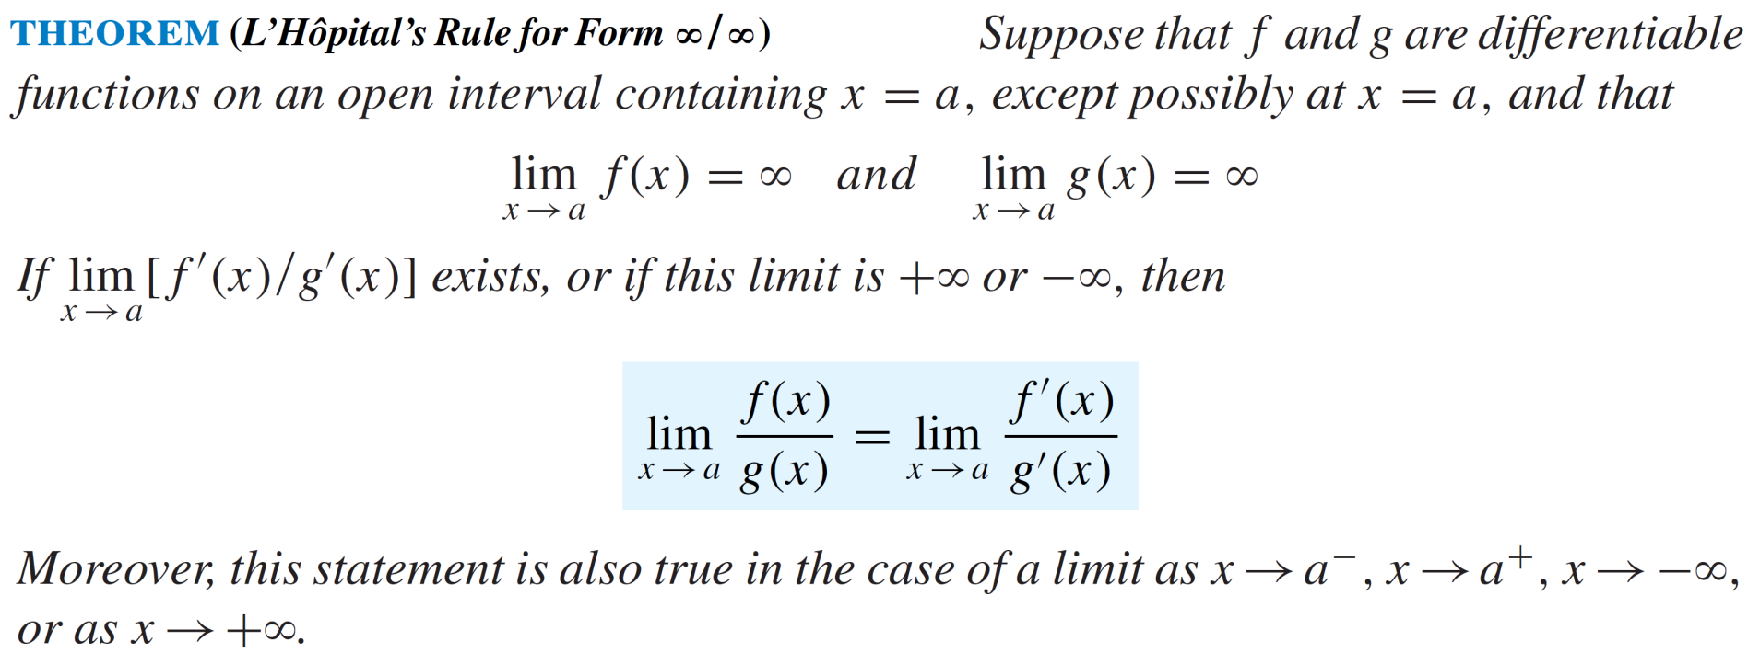
L’Hôpital Rule

Slide 28
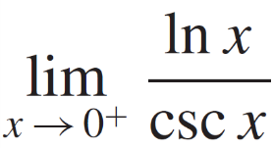
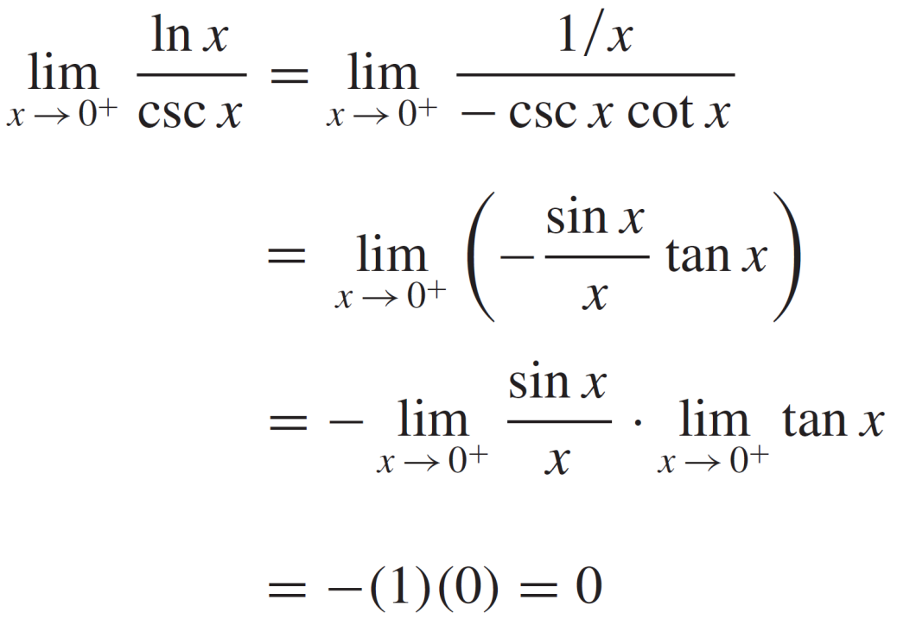
L’Hôpital Rule
Example: Find
Solution:

Slide 29
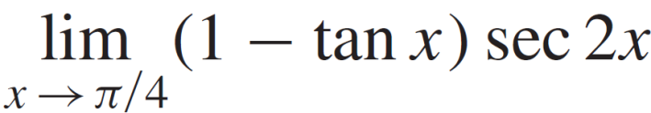
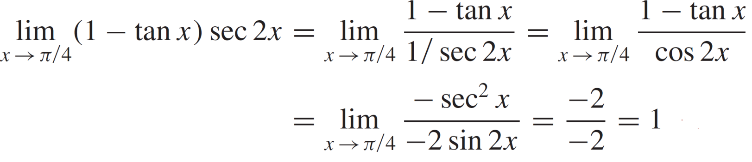
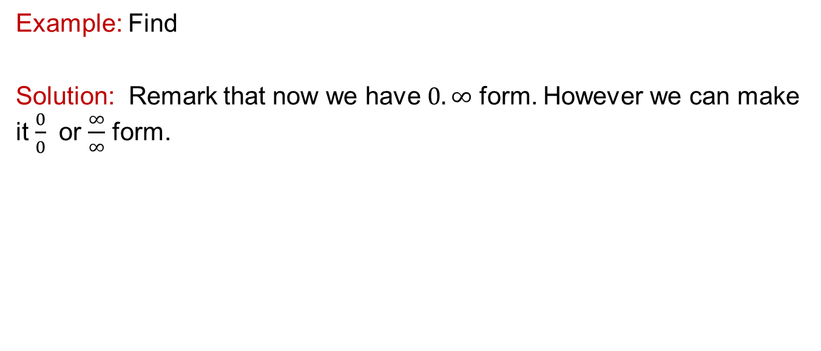
L’Hôpital Rule
Example: Find
Solution: Remark that now we have $0.∞$ form. However we can make it $\frac{0}{0}$ or $\frac{∞}{∞}$ form.

Slide 30
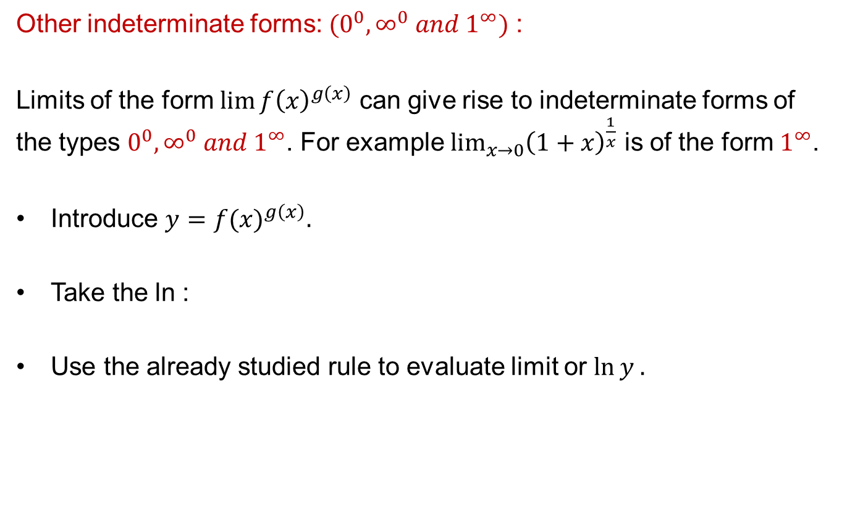
L’Hôpital Rule
Other indeterminateforms: $(0^{0}, ∞^{0} and 1^{∞})$ :
Limits of the form${\lim{f\left(x\right)}}^{g\left(x\right)}$ can give rise to indeterminate forms of the types $0^{0}, ∞^{0} and 1^{∞}$. For example $\lim_{x→0}{{\left(1+x\right)}^{\frac{1}{x}}}$ is of the form $1^{∞}$.
Introduce$y=$${f(x)}^{g\left(x\right)}.$
Take the ln :
Use the alreadystudiedruleto evaluatelimitor $\ln{y .}$

Slide 31
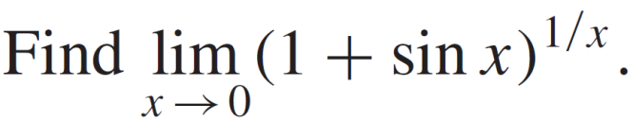

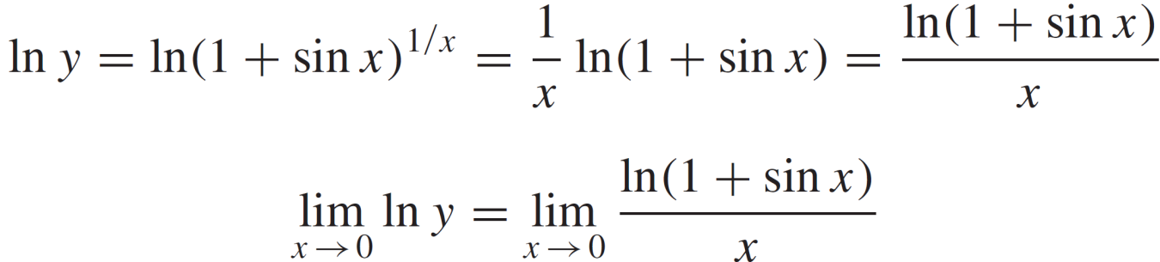
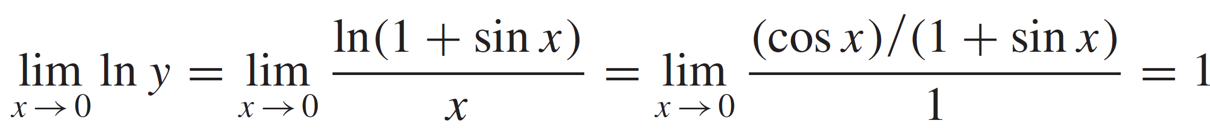
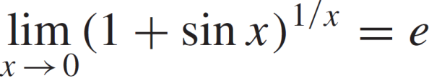
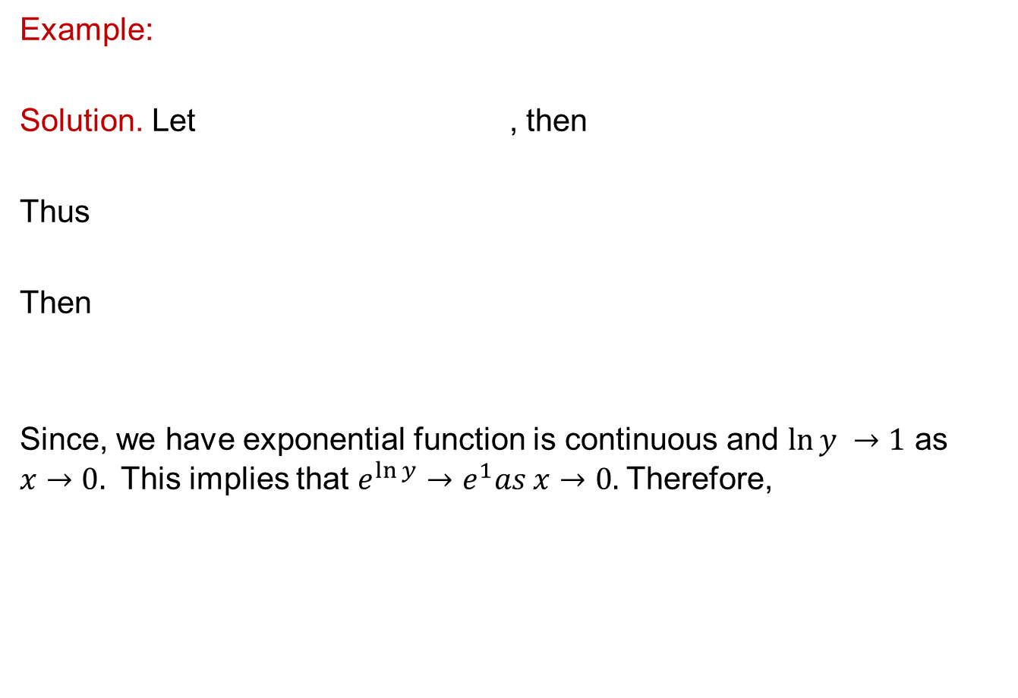
L’Hôpital Rule
Example:
Solution. Let , then
Thus
Then
Since, we have exponentialfunctioniscontinuous and $\ln{y →1}$ as $x→0.$ This impliesthat$e^{\ln{y}}→e^{1}as x→0.$Therefore,

Slide 32
L’Hôpital Rule
Example: Find
Solution:
L’Hôpital
applied

Slide 33
Lecture Summary
    Recalls
    Differentials
    Local linear approximations
    Indetermined forms
    L’Hopitâl rule

