Slide 1
(MTH 250)
Calculus
Lecture 10

Slide 2
Previous Lecture’s Summary
    Derivatives: Recall.
    Derivatives of exponential functions
    Rules of differentiation
    Differentiation of trigonometric function
    Summary of differentiation rules

Slide 3
Today’s Lecture
    Summary of differentiation rules: Recall
    Chain rules
    Implicit differentiation
    Derivatives of logrithemic functions
    Derivatives of hyperbolic functions.
    Derivatives of inverse trigonometric functions
    Derivatives of inverse hyperbolic functions
    Summary of results

Slide 4
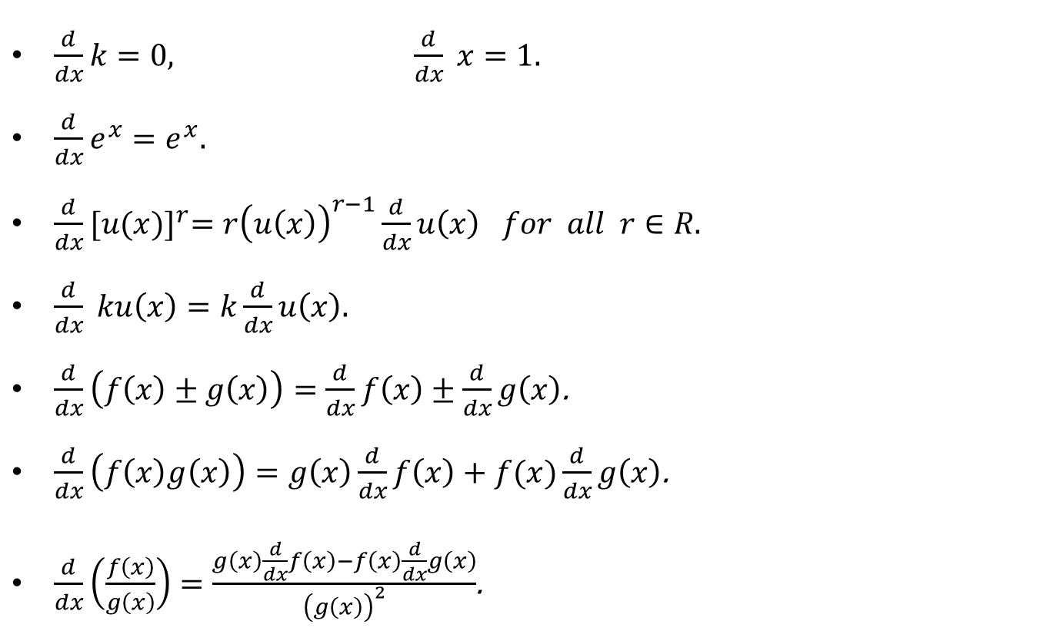
Summary of differentiation rules: Recall
$\frac{d}{dx}k=0, \frac{d}{dx} x=1.$
$\frac{d}{dx}e^{x}=e^{x}.$
$\frac{d}{dx}{[u(x)]}^{r}=r{\left(u\left(x\right)\right)}^{r−1}\frac{d}{dx}u\left(x\right) for all r∈R.$
$\frac{d}{dx} ku\left(x\right)=k\frac{d}{dx}u\left(x\right).$
$\frac{d}{dx}\left(f\left(x\right)±g\left(x\right)\right)=\frac{d}{dx}f\left(x\right)±\frac{d}{dx}g\left(x\right)$.
$\frac{d}{dx}\left(f\left(x\right)g\left(x\right)\right)=g\left(x\right)\frac{d}{dx}f\left(x\right)+f(x)\frac{d}{dx}g\left(x\right)$.
$\frac{d}{dx}\left(\frac{f\left(x\right)}{g\left(x\right)}\right)=\frac{g\left(x\right)\frac{d}{dx}f\left(x\right)−f\left(x\right)\frac{d}{dx}g\left(x\right)}{{\left(g\left(x\right)\right)}^{2}}$.

Slide 5
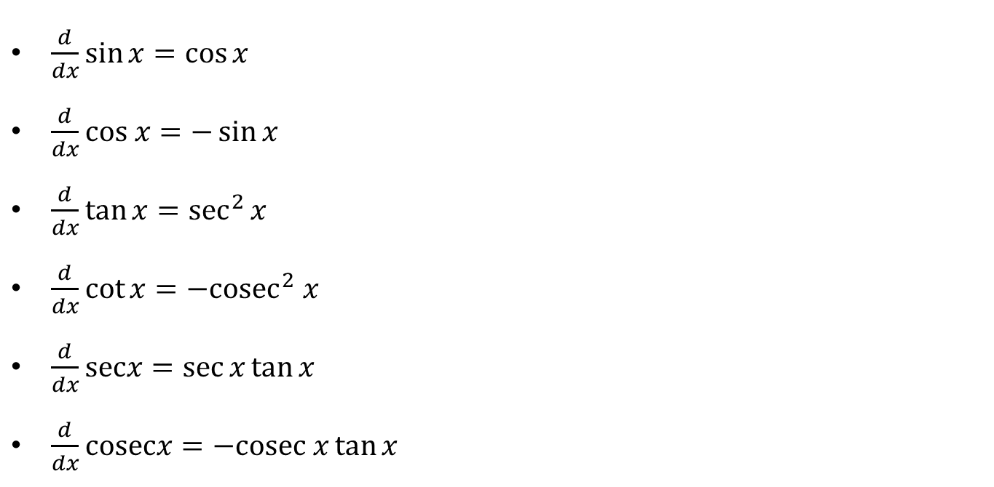
Summary of differentiation rules: Recall
$\frac{d}{dx}\sin{x}=\cos{x}$
$\frac{d}{dx}cos x=−\sin{x}$
$\frac{d}{dx}\tan{x}=\sec^{2}{x}$
$\frac{d}{dx}\cot{x}=−{cosec}^{2} x$
$\frac{d}{dx}\operatorname{secx}{=\sec{x}}\tan{x}$
$\frac{d}{dx}cosecx=−cosec x\tan{x }$

Slide 6
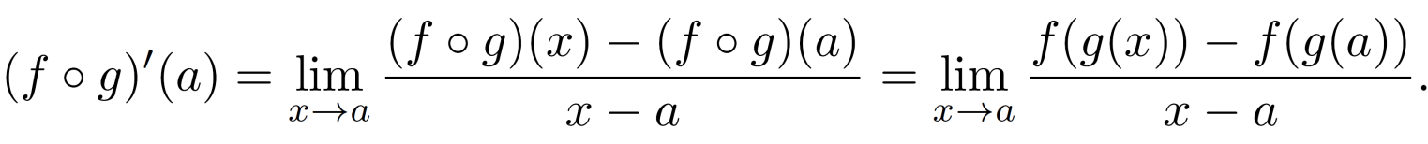
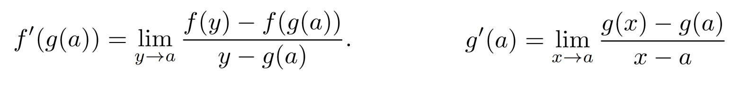
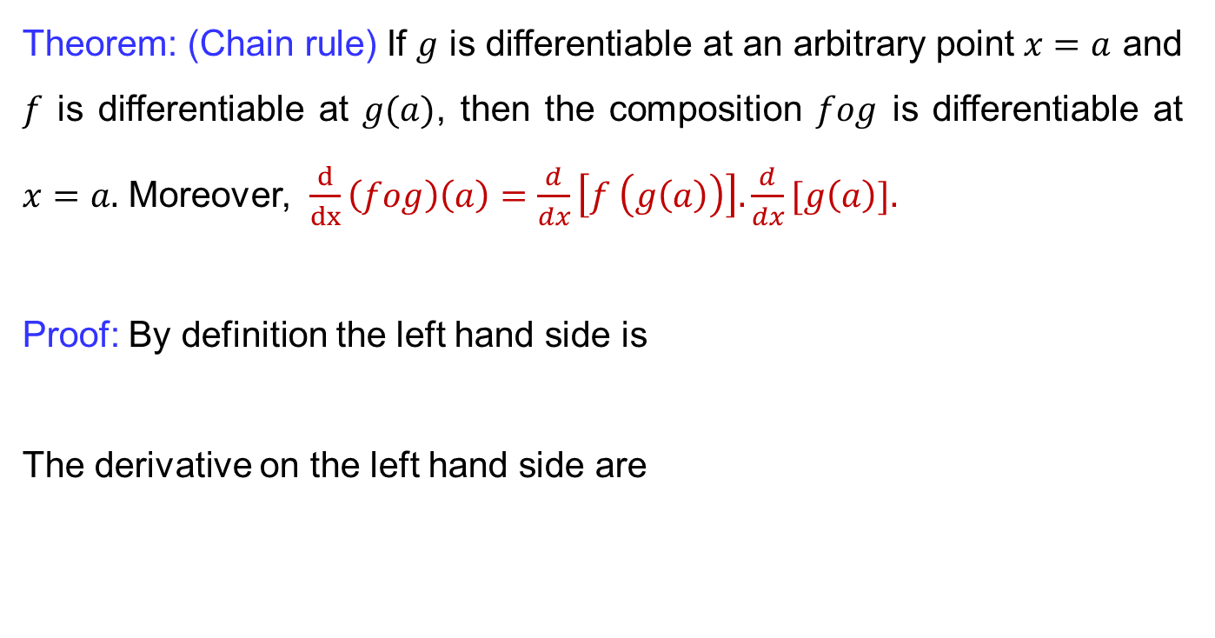
Chain rules
Theorem: (Chain rule) If $g$ is differentiable at an arbitrary point $x=a$ and $f$ is differentiable at$g(a)$, then the composition $fog$ is differentiable at$x=a.$ Moreover, $\frac{d}{dx}\left(fog\right)\left(a\right)=\frac{d}{dx}\left[f \left(g\left(a\right)\right)\right]. \frac{d}{dx}[g\left(a\right)].$
Proof: By definition the left hand sideis
The derivative on the left hand side are

Slide 7
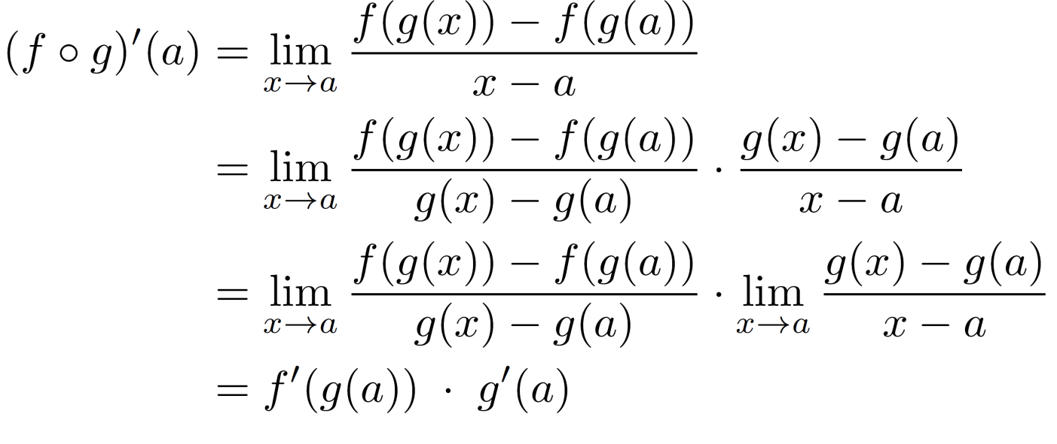
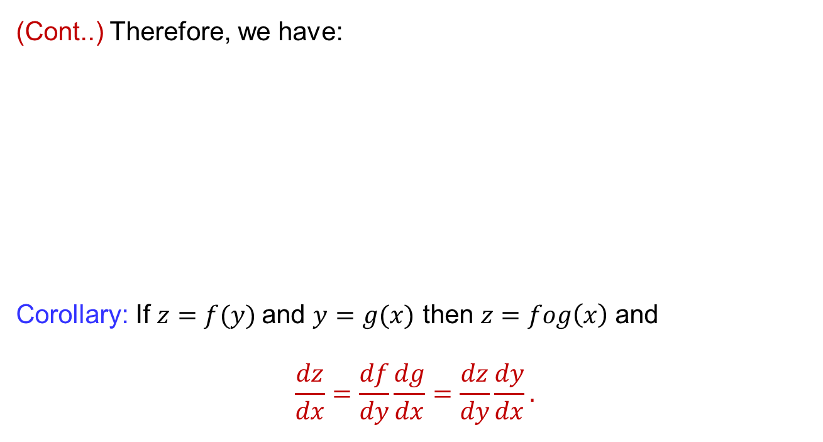
Chain rules
(Cont..) Therefore, we have:
Corollary: If $z=f(y)$and $y=g(x)$then$z=fog\left(x\right)$and
$$\frac{dz}{dx}=\frac{df}{dy}\frac{dg}{dx}=\frac{dz}{dy}\frac{dy}{dx}.$$

Slide 8

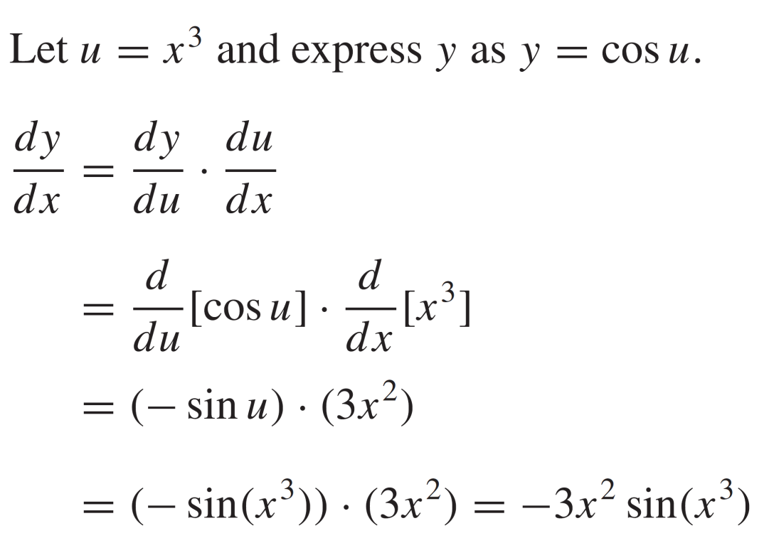
Chain rules
Example:
Solution:

Slide 9
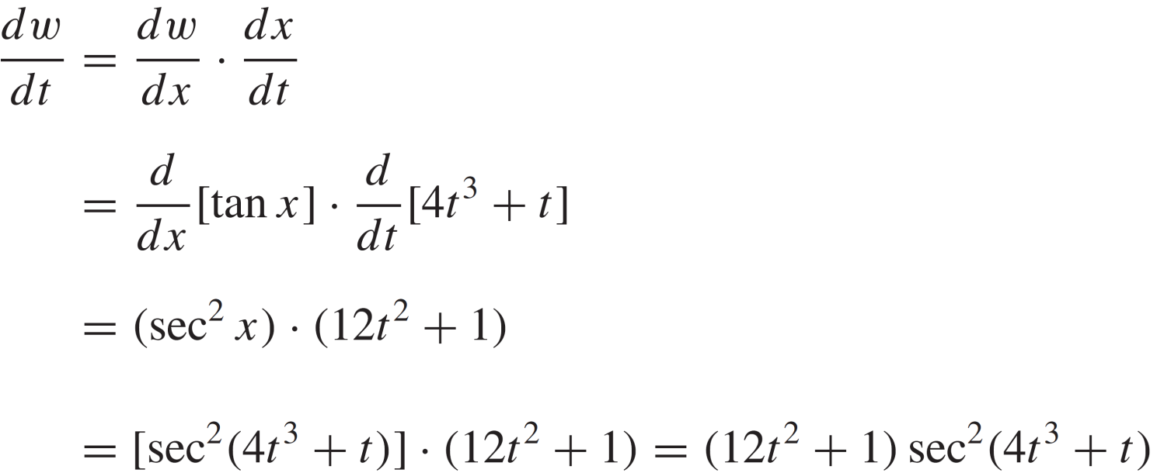
Chain rules
Example:
Solution:

Slide 10
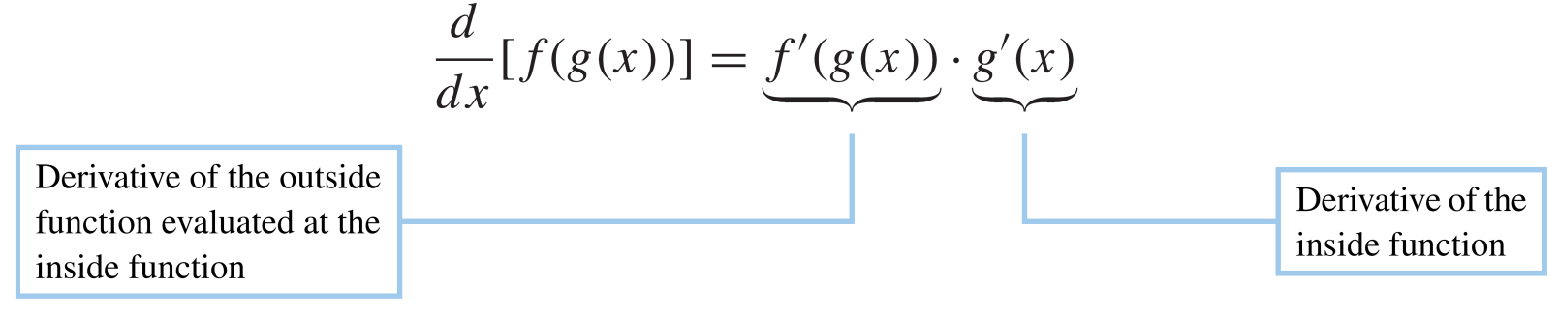
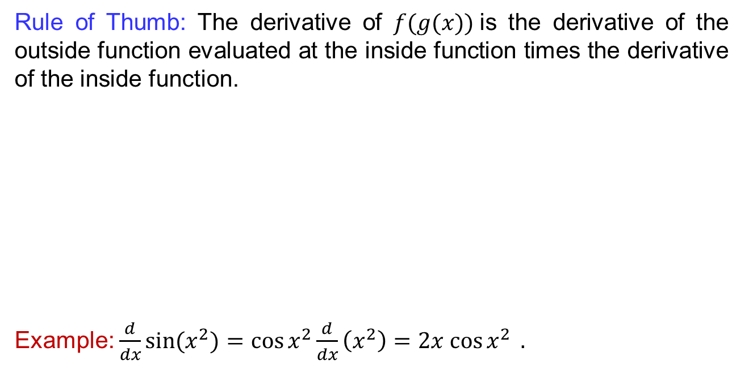
Chain rules
Rule of Thumb: The derivative of $f(g(x))$is the derivative of the outsidefunctionevaluatedat the insidefunction times the derivative of the insidefunction.
Example:$\frac{d}{dx}\sin{(x^{2})}=\cos{x^{2}}\frac{d}{dx}\left(x^{2}\right)=2x cos{x^{2} }.$

Slide 11
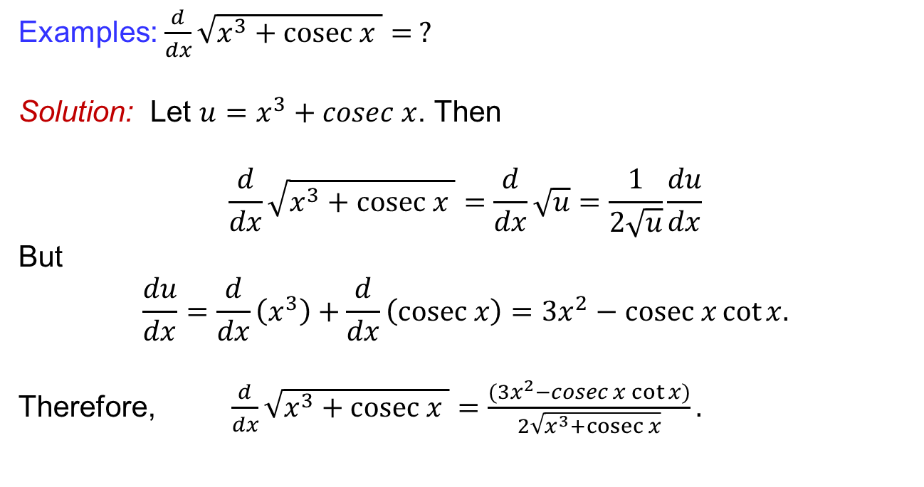
Chain rules
Examples: $\frac{d}{dx}\sqrt{x^{3}+cosec x }= ?$
Solution: Let $u=x^{3}+cosec x$. Then
$$\frac{d}{dx}\sqrt{x^{3}+cosec x }=\frac{d}{dx}\sqrt{u}=\frac{1}{2\sqrt{u}}\frac{du}{dx}$$
But
$$\frac{du}{dx}=\frac{d}{dx}\left(x^{3}\right)+\frac{d}{dx}\left(cosec x\right)=3x^{2}−cosec x\cot{x.}$$
Therefore,$\frac{d}{dx}\sqrt{x^{3}+cosec x }=\frac{(3x^{2}−cosec x\cot{x})}{2\sqrt{x^{3}+cosec x}}.$

Slide 12
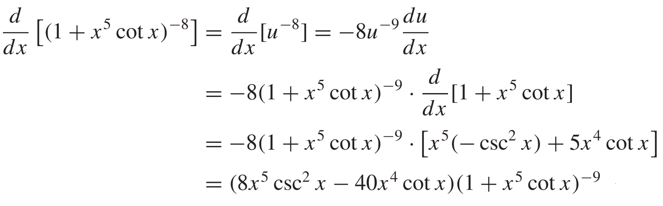
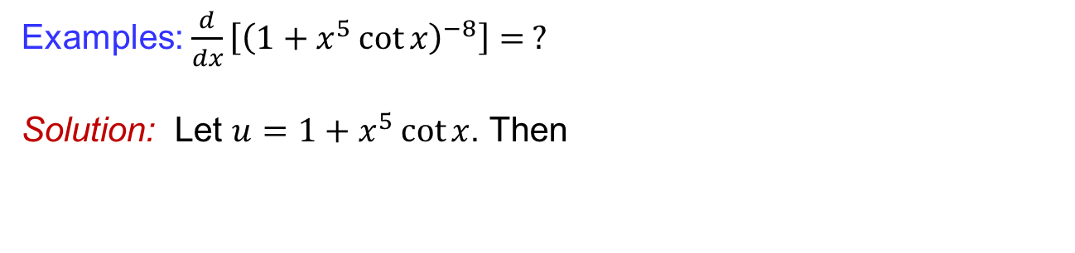
Chain rules
Examples: $\frac{d}{dx}\left[{\left(1+x^{5}\cot{x}\right)}^{−8}\right]= ?$
Solution: Let $u=1+x^{5}\cot{x}$. Then

Slide 13
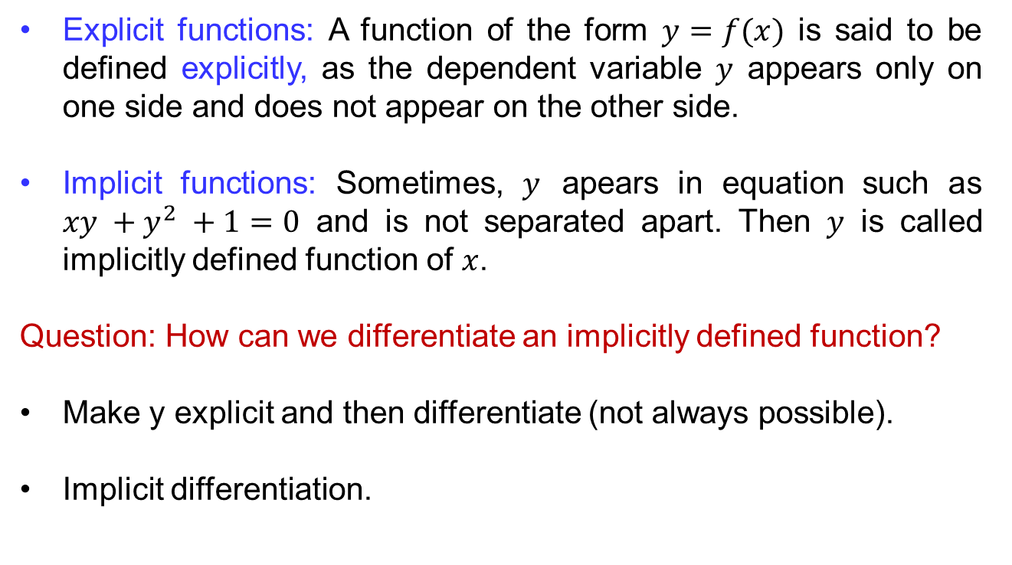
Implicit differentiation
Explicit functions: A function of the form$y=f(x)$issaid to bedefinedexplicitly, as the dependent variable $y$appearsonly on one side and does not appear on the otherside.
Implicitfunctions: Sometimes, $y$apears in equationsuch as $xy +y^{2} +1=0$ and is not separatedapart. Then$y$iscalledimplicitlydefinedfunction of $x$.
Question: How canwedifferentiate an implicitlydefinedfunction?
Make y explicit and thendifferentiate (not always possible).
Implicitdifferentiation.

Slide 14
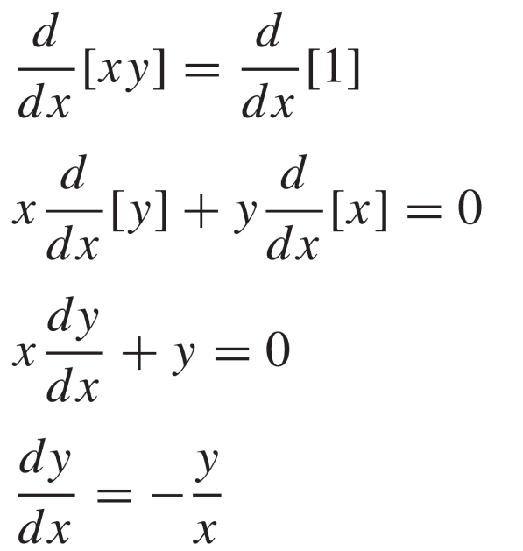
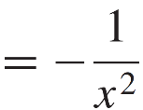
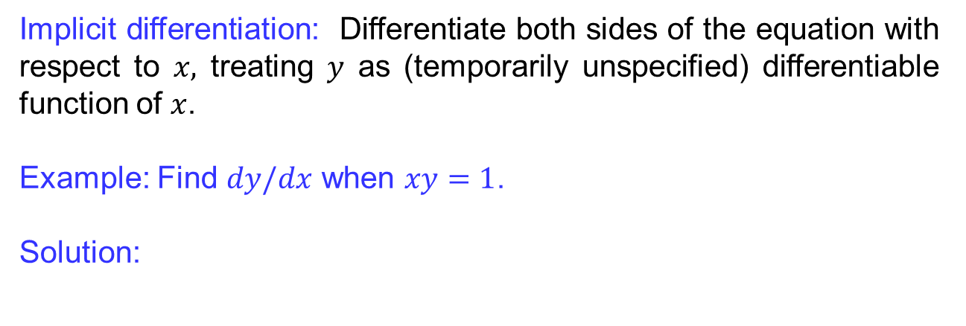
Implicit differentiation
Implicit differentiation: Differentiatebothsides of the equationwith respect to $x,$treating$y$ as (temporarilyunspecified) differentiablefunction of $x$.
Example: Find$dy/dx$ when $xy=1$.
Solution:

Slide 15
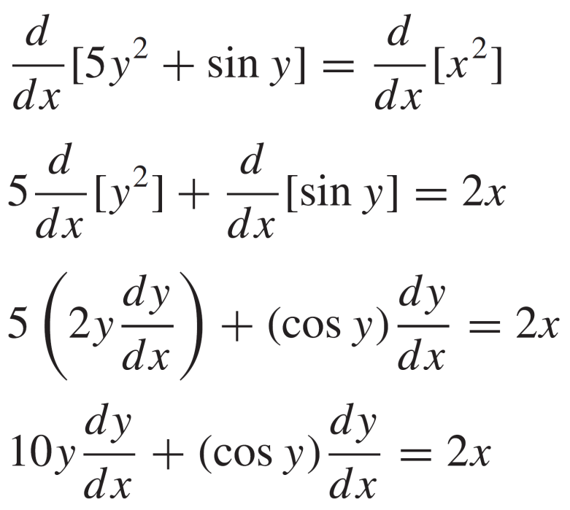
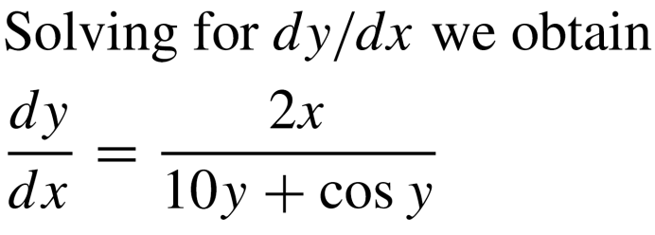
Implicit differentiation
Example:
Solution:

Slide 16
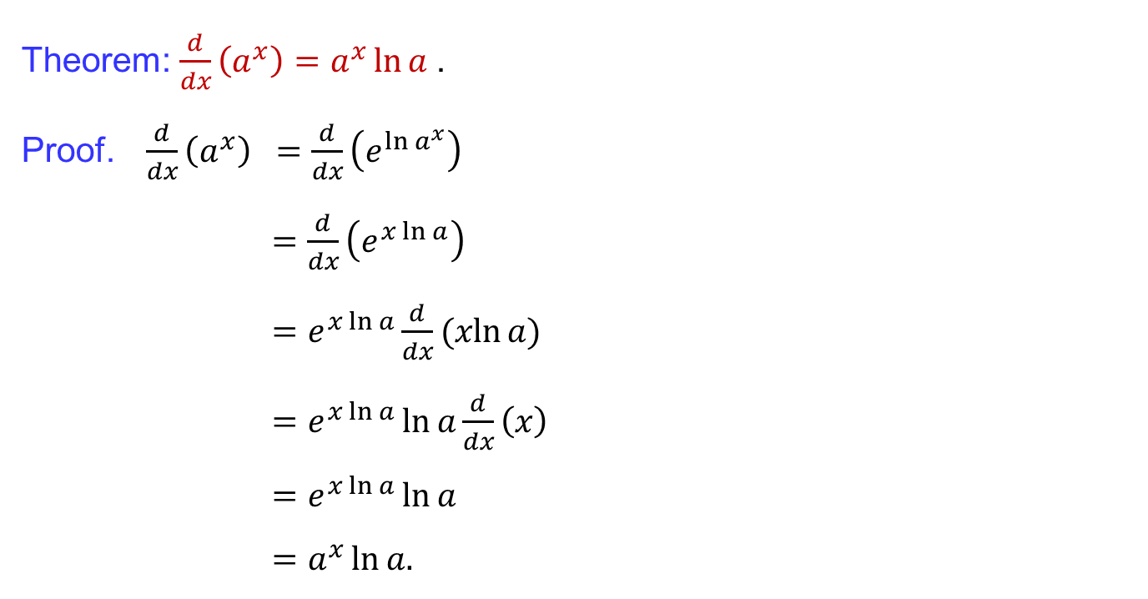
Derivatives of logarithmic functions
Theorem: $\frac{d}{dx}\left(a^{x}\right)=a^{x}\ln{a }$.
Proof. $\frac{d}{dx}\left(a^{x}\right) =\frac{d}{dx}\left(e^{\ln{a^{x}}}\right)$
$=\frac{d}{dx}\left(e^{x\ln{a}}\right)$
$=e^{x\ln{a}}\frac{d}{dx}(xln{a})$
$=e^{x\ln{a}}\ln{a}\frac{d}{dx}\left(x\right)$
$=e^{x\ln{a}}\ln{a}$
$=a^{x}\ln{a.}$

Slide 17
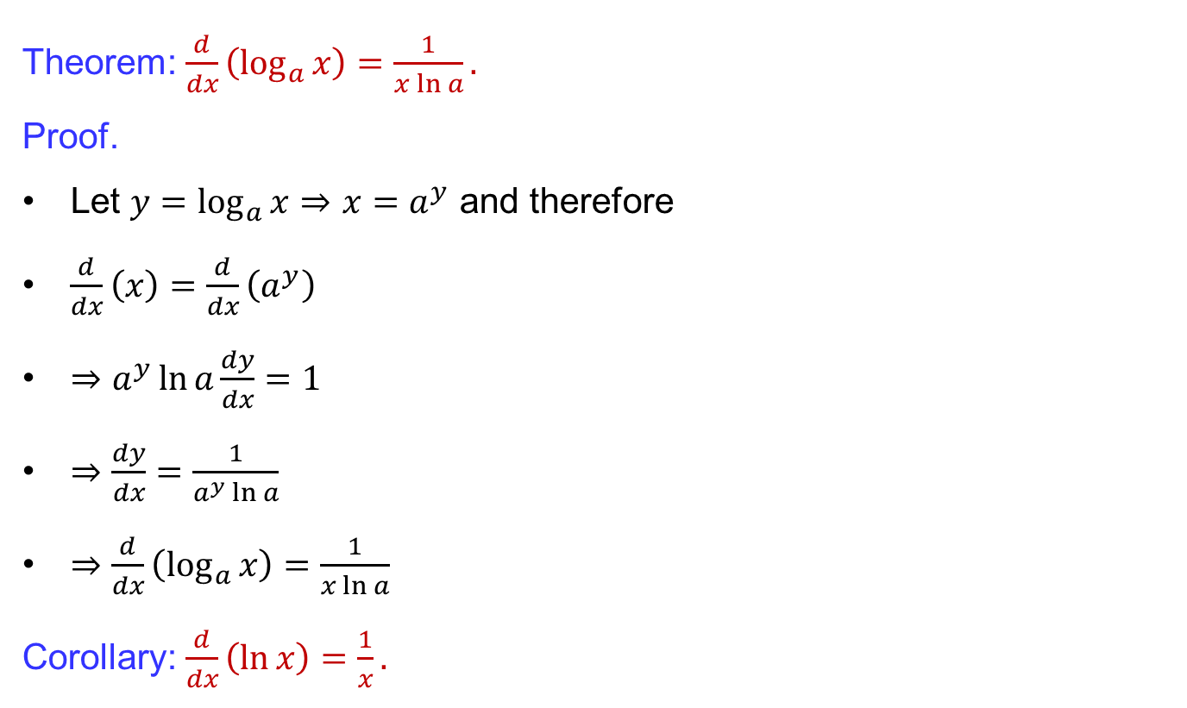
Derivatives of logarithmic functions
Theorem: $\frac{d}{dx}\left(\log_{a}{x}\right)=\frac{1}{x\ln{a}}.$
Proof.
Let $y=\log_{a}{x}⇒$$x=a^{y}$ and therefore
$\frac{d}{dx}\left(x\right)=\frac{d}{dx}\left(a^{y}\right)$
$⇒a^{y}\ln{a}\frac{dy}{dx}=1$
$⇒\frac{dy}{dx}=\frac{1}{a^{y}\ln{a}}$
$⇒\frac{d}{dx}\left(\log_{a}{x}\right)=\frac{1}{x\ln{a}}$
Corollary: $\frac{d}{dx}\left(\ln{x}\right)=\frac{1}{x}.$

Slide 18
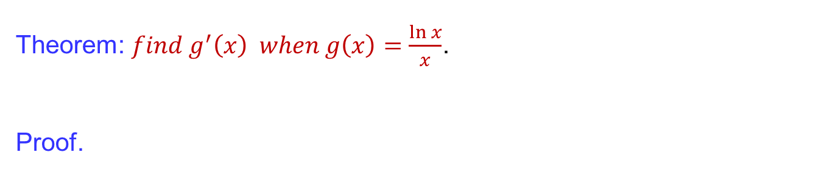
Derivatives of logarithmic functions
Theorem: $find g^{′}\left(x\right) when g\left(x\right)=\frac{\ln{x}}{x}$.
Proof.

Slide 19
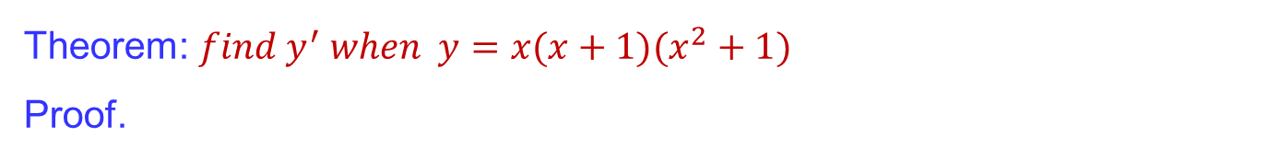
Derivatives of logarithmic functions
Theorem: $find y^{′} when y=x(x+1)(x^{2}+1)$
Proof.

Slide 20
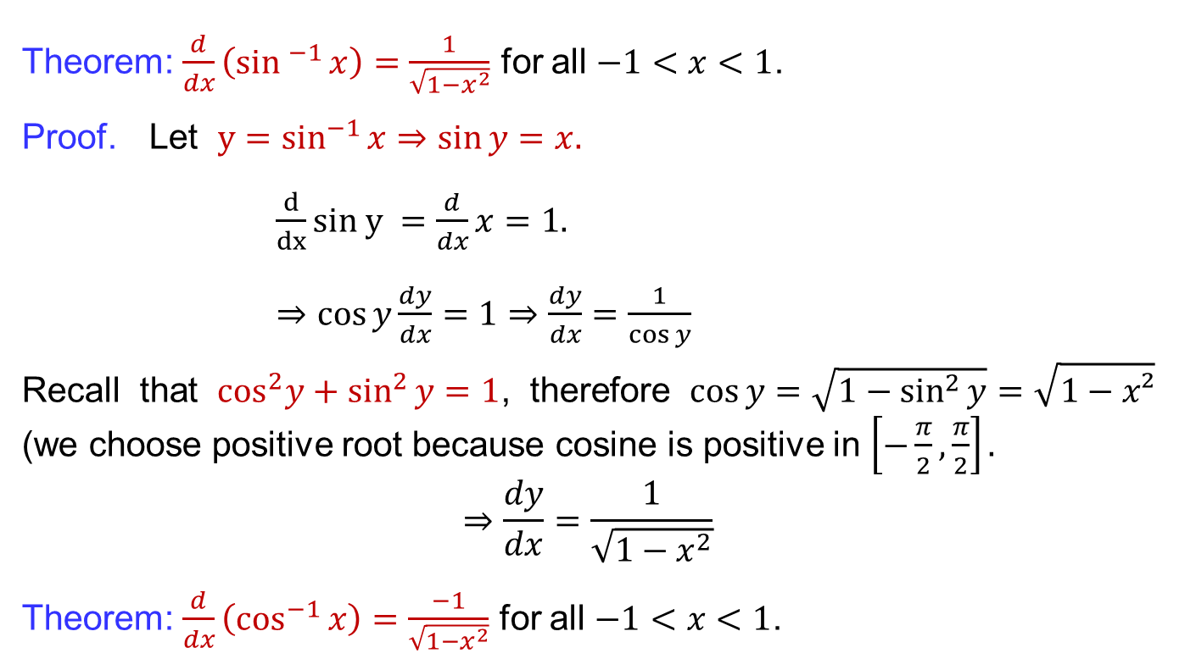
Derivatives of inverse trigonometric functions
Theorem: $\frac{d}{dx}\left(\sin^{−1}{x}\right)=\frac{1}{\sqrt{1−x^{2}}}$ for all $−1<x<1$.
Proof. Let${y=sin}^{−1}{x⇒\sin{y}=x.}$
$\frac{d}{dx}sin y =\frac{d}{dx}x=1.$
$⇒\cos{y}\frac{dy}{dx}=1$$⇒\frac{dy}{dx}=\frac{1}{\cos{y}}$
Recallthat$\cos^{2}y+\sin^{2}{y}=1$, therefore $\cos{y}=\sqrt{1−\sin^{2}{y}}=\sqrt{1−x²}$ (wechoose positive rootbecausecosineis positive in $\left[−\frac{π}{2},\frac{π}{2}\right].$
$$⇒\frac{dy}{dx}=\frac{1}{\sqrt{1−x^{2}}}$$
Theorem: $\frac{d}{dx}\left(\cos^{−1}{x}\right)=\frac{−1}{\sqrt{{1−x}^{2}}}$for all $−1<x<1$.

Slide 21
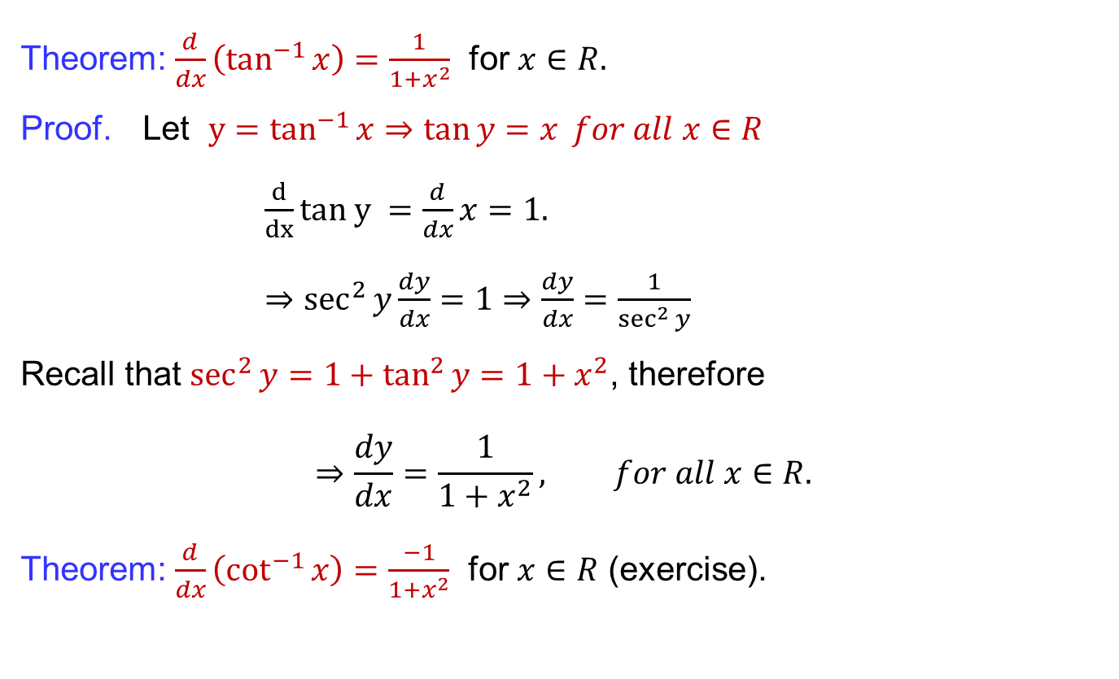
Derivatives of inverse trigonometric functions
Theorem: $\frac{d}{dx}\left(\tan^{−1}{x}\right)=\frac{1}{1+x^{2}}$ for $x∈R.$
Proof. Let${y=tan}^{−1}{x⇒\tan{y}=x} for all x∈R$
$\frac{d}{dx}tan y =\frac{d}{dx}x=1.$
$⇒\sec^{2}{y}\frac{dy}{dx}=1⇒\frac{dy}{dx}=\frac{1}{\sec^{2}{y}}$
Recallthat$\sec^{2}{y}=1+\tan^{2}{y}=1+x^{2}$, therefore
$$⇒\frac{dy}{dx}=\frac{1}{1+x^{2}}, for all x∈R.$$
Theorem: $\frac{d}{dx}\left(\cot^{−1}{x}\right)=\frac{−1}{1+x^{2}}$ for $x∈R$(exercise).

Slide 22
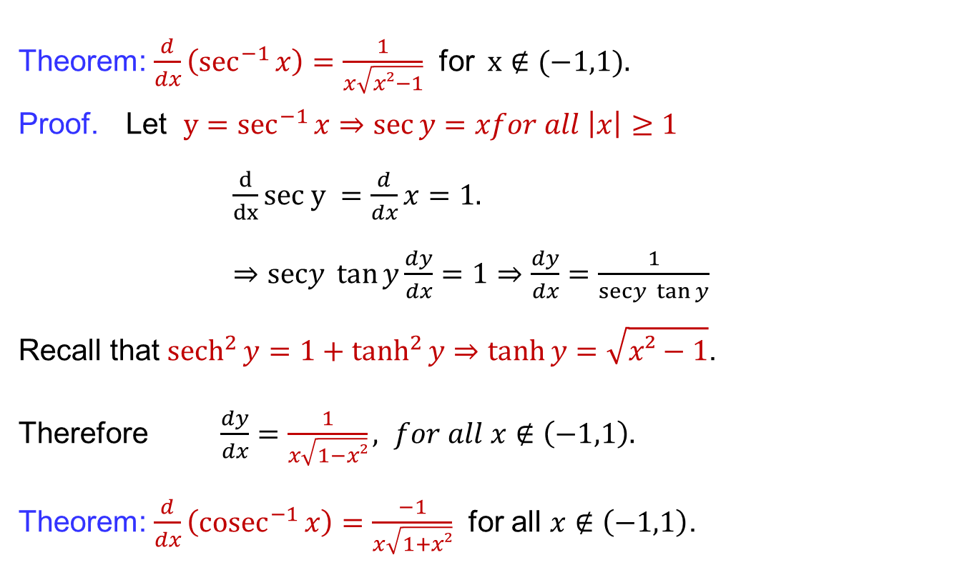
Derivatives of inverse trigonometric functions
Theorem: $\frac{d}{dx}\left(\sec^{−1}{x}\right)=\frac{1}{x\sqrt{x²−1}}$ for$x∉(−1,1).$
Proof. Let${y=sec}^{−1}{x}⇒\sec{y}=xfor all \left|x\right|≥1$
$\frac{d}{dx}sec y =\frac{d}{dx}x=1.$
$⇒\operatorname{secy}{\tan{y}}\frac{dy}{dx}=1⇒\frac{dy}{dx}=\frac{1}{\operatorname{secy}{\tan{y}}}$
Recall that${sech}^{2}{y}={1+tanh}^{2}{y}⇒\tanh{y}=\sqrt{x²−1}$.
Therefore$\frac{dy}{dx}=\frac{1}{x\sqrt{1−x²}}, for all x∉\left(−1,1\right).$
Theorem: $\frac{d}{dx}\left({cosec}^{−1}{x}\right)=\frac{−1}{x\sqrt{1+x²}}$ for all $x∉\left(−1,1\right)$.

Slide 23
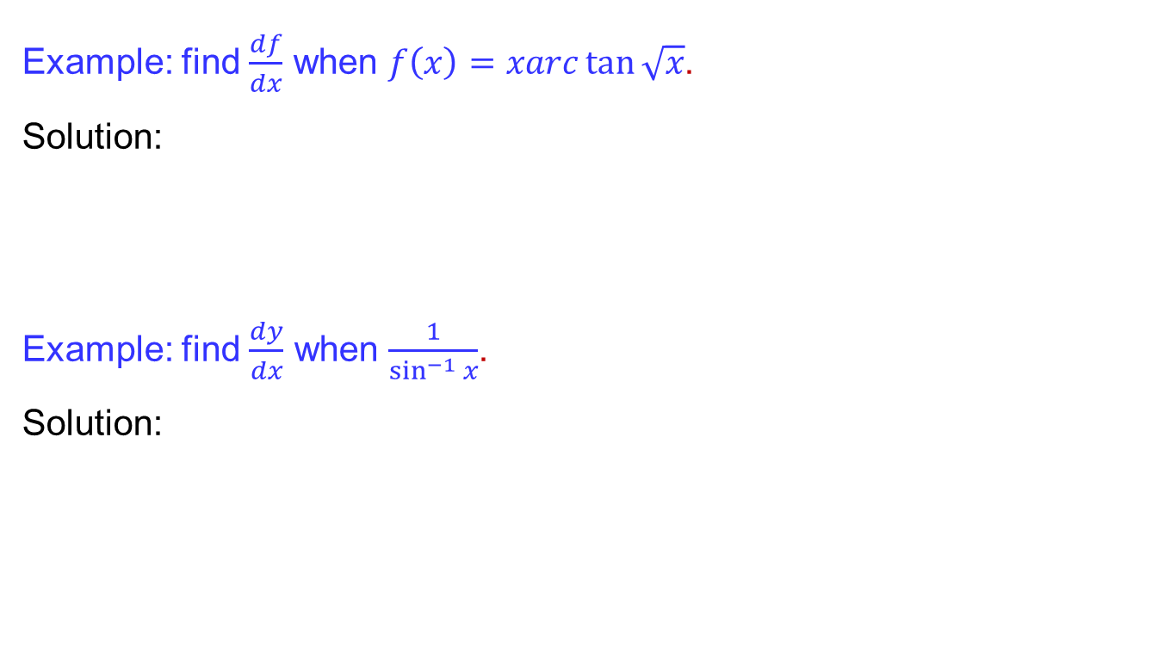
Derivatives of inverse trigonometric functions
Example: find $\frac{df}{dx}$ when $f\left(x\right)=xarc\tan{\sqrt{x}}$.
Solution:
Example: find $\frac{dy}{dx}$ when $\frac{1}{\sin^{−1}{x}}$.
Solution:

Slide 24
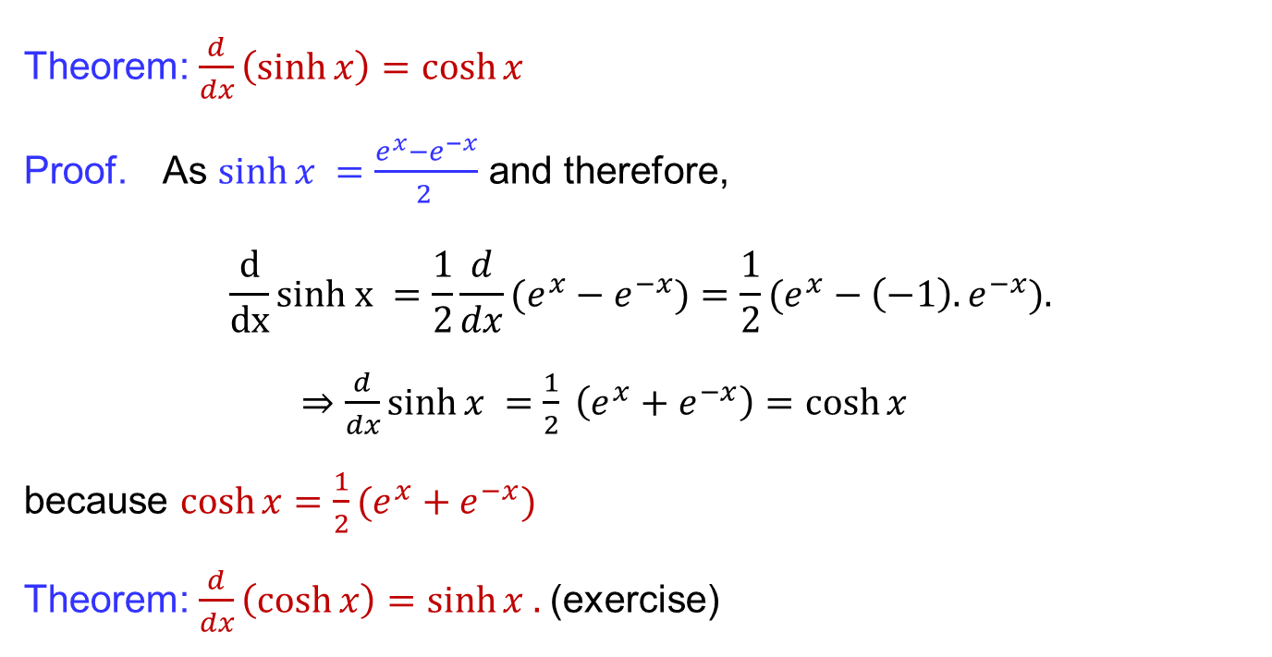
Derivatives of hyperbolic functions
Theorem: $\frac{d}{dx}\left(\sinh{x}\right)=\cosh{x}$
Proof. As$\sinh{x }=\frac{e^{x}−e^{−x}}{2 }$ and therefore,
$$\frac{d}{dx}sinh x =\frac{1}{2}\frac{d}{dx}(e^{x}−e^{−x})=\frac{1}{2}(e^{x}−\left(−1\right).e^{−x}).$$
$⇒\frac{d}{dx}\sinh{x }=\frac{1}{2} \left(e^{x}+e^{−x}\right)=\cosh{x}$
because$\cosh{x=\frac{1}{2}(e^{x}+e^{−x})}$
Theorem: $\frac{d}{dx}\left(\cosh{x}\right)=\sinh{x . }$(exercise)

Slide 25
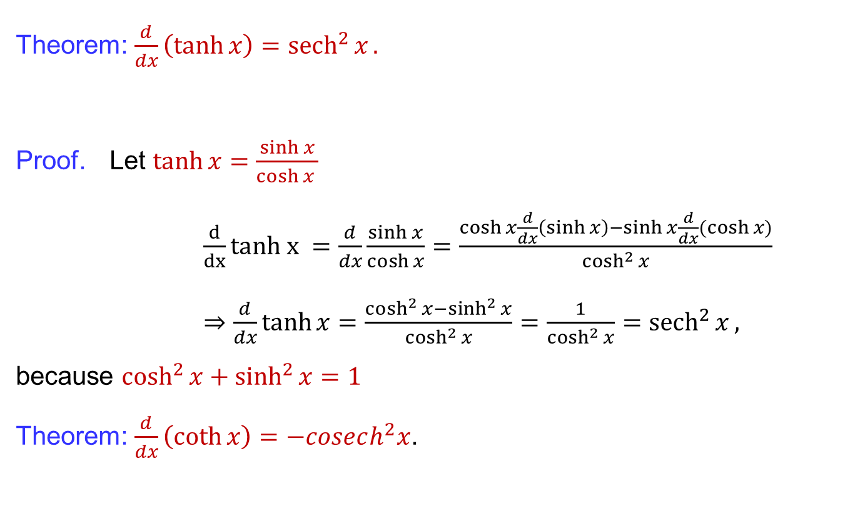
Derivatives of hyperbolic functions
Theorem: $\frac{d}{dx}\left(\tanh{x}\right)={sech}^{2}{x}.$
Proof. Let$\tanh{x}=\frac{\sinh{x}}{\cosh{x }}$
$\frac{d}{dx}tanh x =\frac{d}{dx}\frac{\sinh{x}}{\cosh{x}}=\frac{\cosh{x}\frac{d}{dx}\left(\sinh{x}\right)−\sinh{x}\frac{d}{dx}(\cosh{x)}}{\cosh^{2}{x}}$
$⇒\frac{d}{dx}\tanh{x}=\frac{\cosh^{2}{x}−\sinh^{2}{x}}{\cosh^{2}{x}}=\frac{1}{\cosh^{2}{x}}={sech}^{2}{x},$
because$\cosh^{2}{x}+\sinh^{2}{x}=1$
Theorem: $\frac{d}{dx}\left(\coth{x}\right)=−cosech^{2}x$.

Slide 26
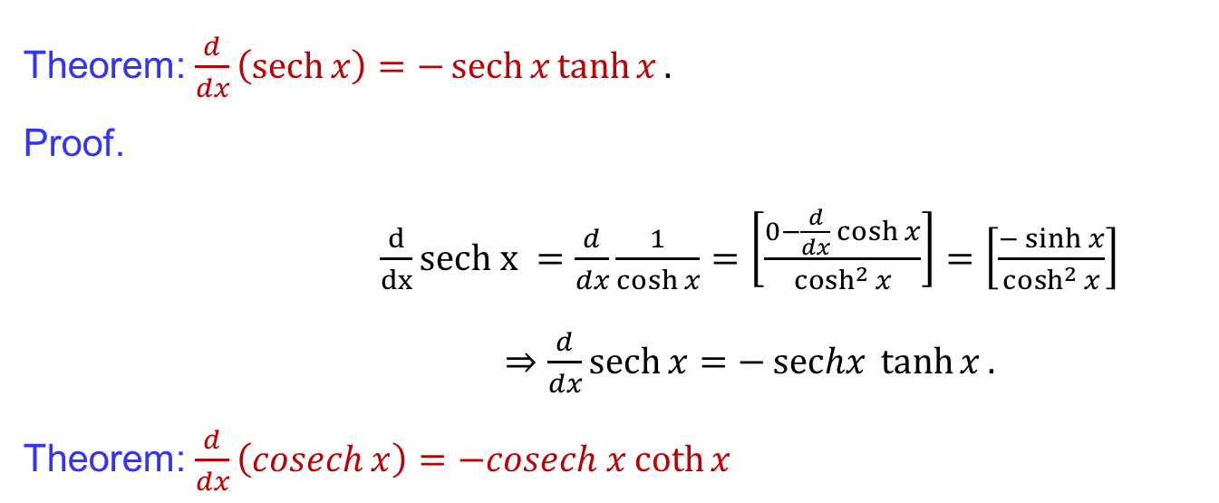
Derivatives of hyperbolic functions
Theorem: $\frac{d}{dx}\left(\operatorname{sech}{x}\right)=−\operatorname{sech}{x}\tanh{x}.$
Proof.
$\frac{d}{dx}sech x =\frac{d}{dx}\frac{1}{\cosh{x}}=\left[\frac{0−\frac{d}{dx}\cosh{x}}{\cosh^{2}{x}}\right]=\left[\frac{−\sinh{x}}{\cosh^{2}{x}}\right]$
$⇒\frac{d}{dx}\operatorname{sech}{x}=−\operatorname{sechx}{\tanh{x}}.$
Theorem: $\frac{d}{dx}\left(\operatorname{cosech}{x}\right)=−cosech x\coth{x }$

Slide 27
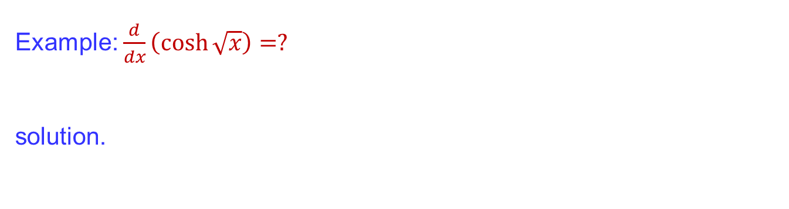
Derivatives of hyperbolic functions
Example: $\frac{d}{dx}\left(\cosh{\sqrt{x}}\right)=?$
solution.

Slide 28
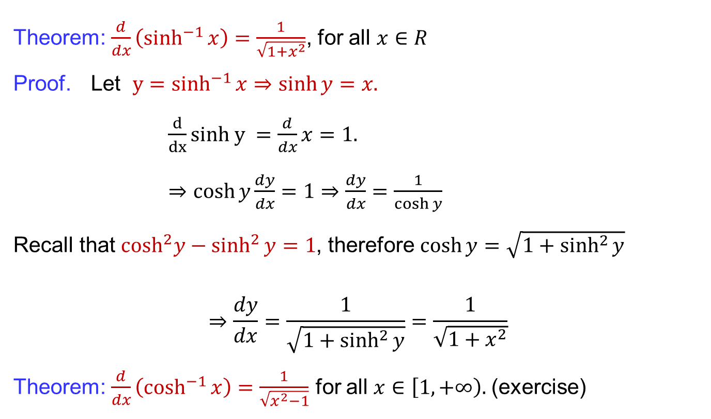
Derivatives of inverse hyperbolic functions
Theorem: $\frac{d}{dx}\left(\sinh^{−1}{x}\right)=\frac{1}{\sqrt{1+x^{2}}}$, for all $x∈R$
Proof. Let${y=sinh}^{−1}{x⇒\sinh{y}=x.}$
$\frac{d}{dx}sinh y =\frac{d}{dx}x=1.$
$⇒\cosh{y}\frac{dy}{dx}=1$$⇒\frac{dy}{dx}=\frac{1}{\cosh{y}}$
Recallthat$\cosh^{2}y−\sinh^{2}{y}=1$, therefore $\cosh{y}=\sqrt{1+\sinh^{2}{y}}$
$$⇒\frac{dy}{dx}=\frac{1}{\sqrt{1+\sinh^{2}{y}}}=\frac{1}{\sqrt{1+x^{2}}}$$
Theorem: $\frac{d}{dx}\left(\cosh^{−1}{x}\right)=\frac{1}{\sqrt{x^{2}−1}}$for all $x∈\left[1,+∞\right).$(exercise)

Slide 29
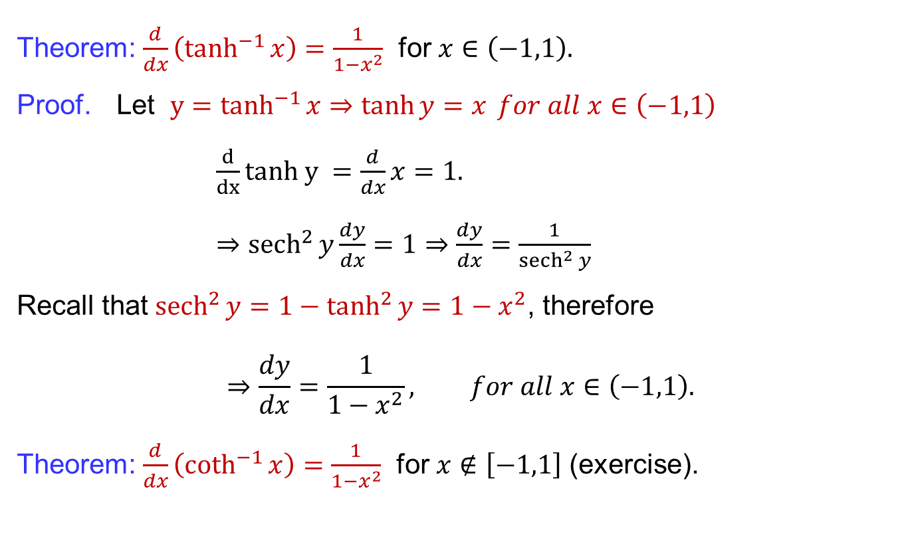
Derivatives of inverse hyperbolic functions
Theorem: $\frac{d}{dx}\left(\tanh^{−1}{x}\right)=\frac{1}{1−x^{2}}$ for $x∈\left(−1,1\right).$
Proof. Let${y=tanh}^{−1}{x⇒\tanh{y}=x} for all x∈\left(−1,1\right)$
$\frac{d}{dx}tanh y =\frac{d}{dx}x=1.$
$⇒sech^{2}{y}\frac{dy}{dx}=1⇒\frac{dy}{dx}=\frac{1}{{sech}^{2}{y}}$
Recallthat${sech}^{2}{y}=1−\tanh^{2}{y}=1−x^{2}$, therefore
$$⇒\frac{dy}{dx}=\frac{1}{1−x^{2}}, for all x∈\left(−1,1\right).$$
Theorem: $\frac{d}{dx}\left(\coth^{−1}{x}\right)=\frac{1}{1−x^{2}}$ for $x∉\left[−1,1\right]$(exercise).

Slide 30
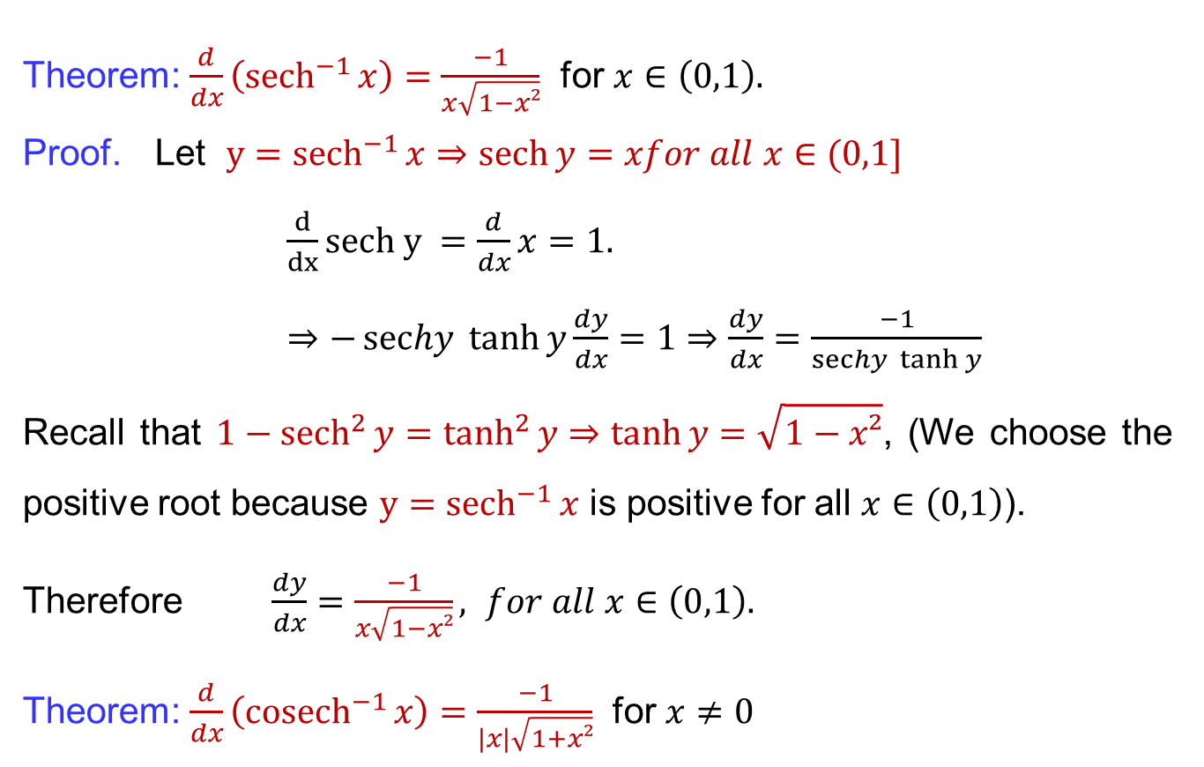
Derivatives of inverse hyperbolic functions
Theorem: $\frac{d}{dx}\left({sech}^{−1}{x}\right)=\frac{−1}{x\sqrt{1−x²}}$ for $x∈\left(0,1\right).$
Proof. Let${y=sech}^{−1}{x}⇒\operatorname{sech}{y}=xfor all x∈(0,1]$
$\frac{d}{dx}sech y =\frac{d}{dx}x=1.$
$⇒−\operatorname{sechy}{\tanh{y}}\frac{dy}{dx}=1⇒\frac{dy}{dx}=\frac{−1}{\operatorname{sechy}{\tanh{y}}}$
Recall that$1−{sech}^{2}{y}=\tanh^{2}{y}⇒\tanh{y}=\sqrt{1−x²}$, (We choose the positive root because ${y=sech}^{−1}{x}$ is positive for all $x∈\left(0,1\right)$).
Therefore$\frac{dy}{dx}=\frac{−1}{x\sqrt{1−x²}}, for all x∈\left(0,1\right).$
Theorem: $\frac{d}{dx}\left({cosech}^{−1}{x}\right)=\frac{−1}{|x|\sqrt{1+x²}}$ for $x≠0$

Slide 31
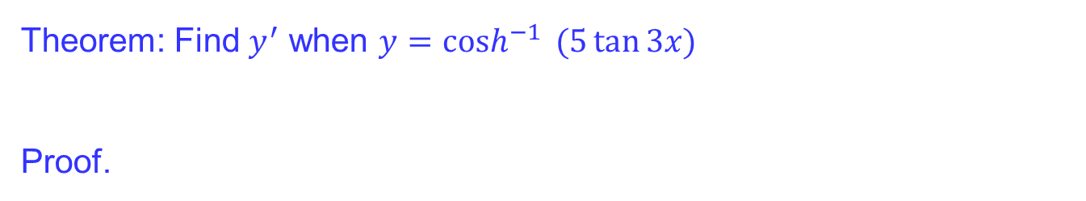
Derivatives of inverse hyperbolic functions
Theorem: Find $y^{′}$ when $y=cosh^{−1}{ (5\tan{3x})}$
Proof.

Slide 32
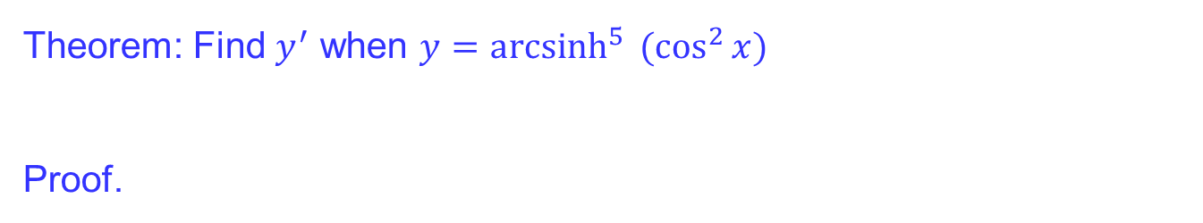
Derivatives of inverse hyperbolic functions
Theorem: Find $y^{′}$ when $y={arcsinh}^{5}{ (\cos^{2}{x})}$
Proof.

Slide 33
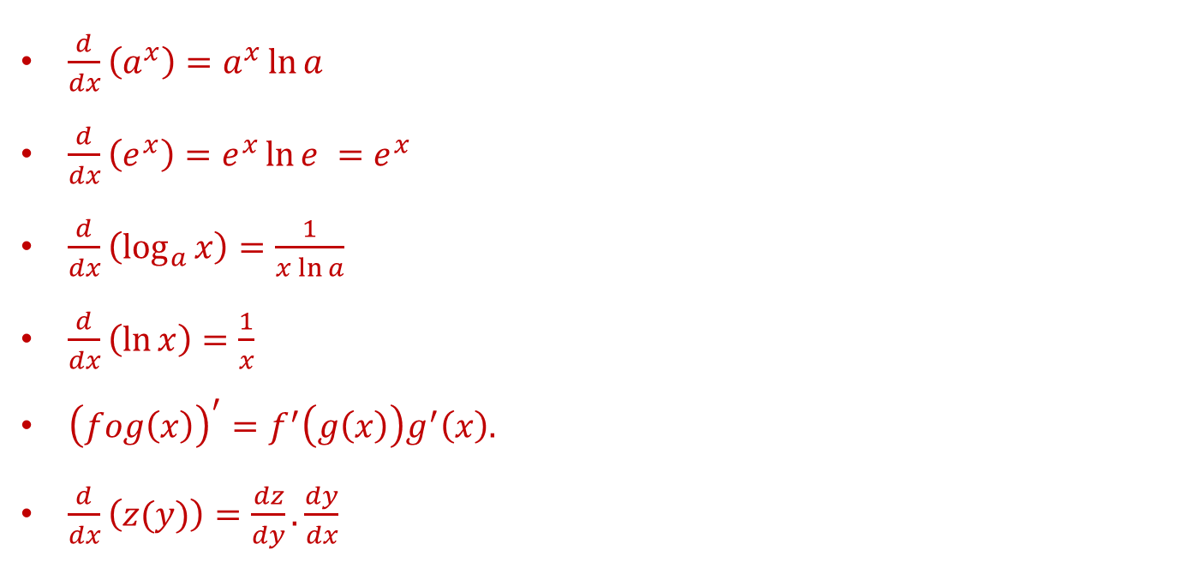
Summary of the results
$\frac{d}{dx}\left(a^{x}\right)=a^{x}\ln{a}$
$\frac{d}{dx}\left(e^{x}\right)=e^{x}\ln{e }=e^{x}$
$\frac{d}{dx}\left(\log_{a}{x}\right)=\frac{1}{x\ln{a}}$
$\frac{d}{dx}\left(\ln{x}\right)=\frac{1}{x}$
${\left(fog\left(x\right)\right)}^{′}=f^{′}\left(g\left(x\right)\right)g^{′}\left(x\right).$
$\frac{d}{dx}\left(z(y)\right)=\frac{dz}{dy}.\frac{dy}{dx}$

Slide 34
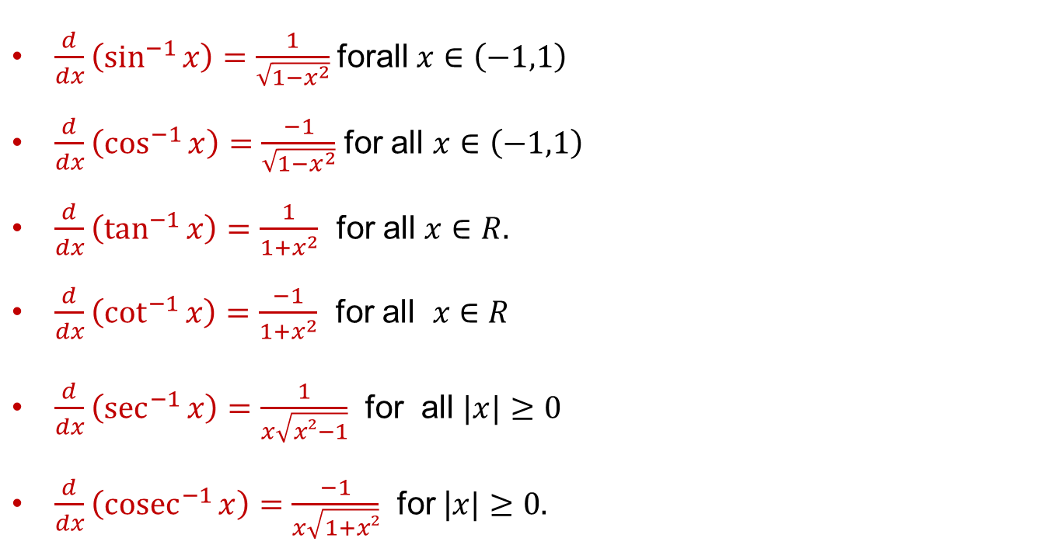
Summary of the results
$\frac{d}{dx}\left(\sin^{−1}{x}\right)=\frac{1}{\sqrt{1−x^{2}}}$forall $x∈\left(−1,1\right)$
$\frac{d}{dx}\left(\cos^{−1}{x}\right)=\frac{−1}{\sqrt{{1−x}^{2}}}$ for all $x∈\left(−1,1\right)$
$\frac{d}{dx}\left(\tan^{−1}{x}\right)=\frac{1}{1+x^{2}}$for all $x∈R.$
$\frac{d}{dx}\left(\cot^{−1}{x}\right)=\frac{−1}{1+x^{2}}$for all $x$$∈R$
$\frac{d}{dx}\left(\sec^{−1}{x}\right)=\frac{1}{x\sqrt{x²−1}}$ for all $|x|≥0$
$\frac{d}{dx}\left({cosec}^{−1}{x}\right)=\frac{−1}{x\sqrt{1+x²}}$ for |$x|≥0.$

Slide 35
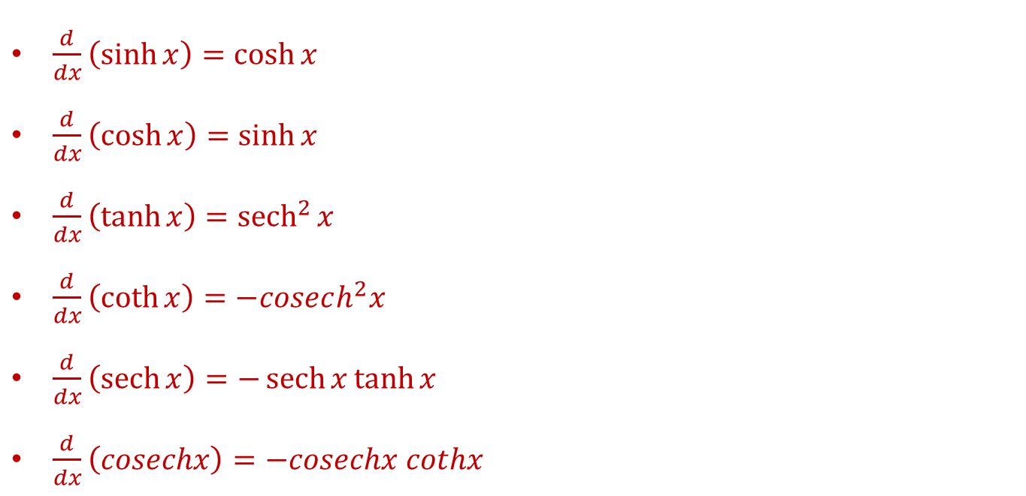
Summary of the results
$\frac{d}{dx}\left(\sinh{x}\right)=\cosh{x }$
$\frac{d}{dx}\left(\cosh{x}\right)=\sinh{x}$
$\frac{d}{dx}\left(\tanh{x}\right)={sech}^{2}{x}$
$\frac{d}{dx}\left(\coth{x}\right)=−cosech^{2}x$
$\frac{d}{dx}\left(\operatorname{sech}{x}\right)=−\operatorname{sech}{x}\tanh{x}$
$\frac{d}{dx}\left(cosechx\right)=−cosechx cothx$

Slide 36
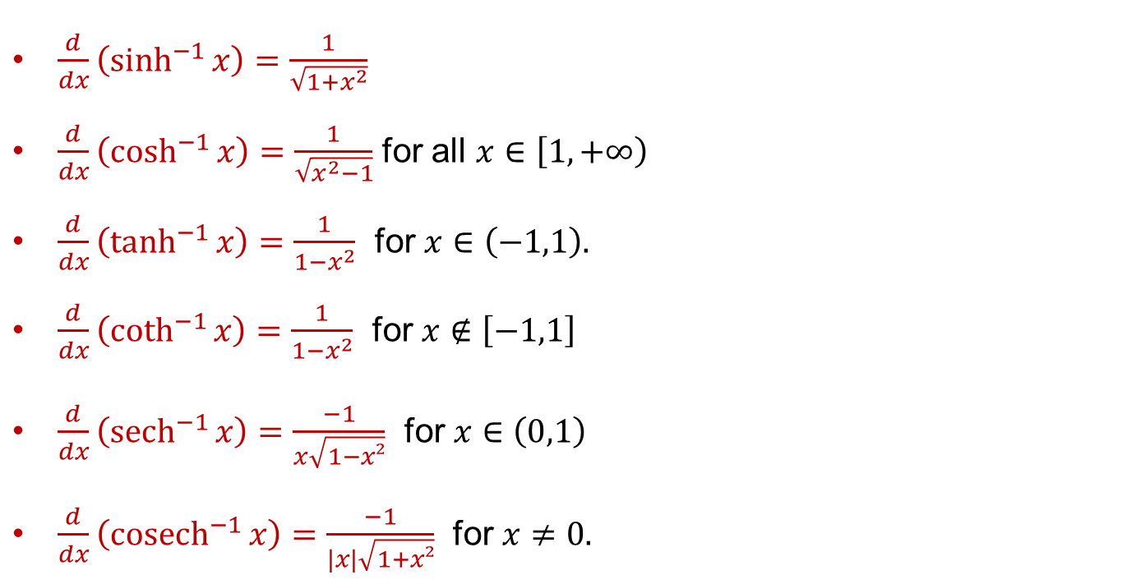
Summary of the results
$\frac{d}{dx}\left(\sinh^{−1}{x}\right)=\frac{1}{\sqrt{1+x^{2}}}$
$\frac{d}{dx}\left(\cosh^{−1}{x}\right)=\frac{1}{\sqrt{x^{2}−1}}$ for all $x∈\left[1,+∞\right)$
$\frac{d}{dx}\left(\tanh^{−1}{x}\right)=\frac{1}{1−x^{2}}$ for $x∈\left(−1,1\right).$
$\frac{d}{dx}\left(\coth^{−1}{x}\right)=\frac{1}{1−x^{2}}$ for $x∉\left[−1,1\right]$
$\frac{d}{dx}\left({sech}^{−1}{x}\right)=\frac{−1}{x\sqrt{1−x²}}$ for $x∈\left(0,1\right)$
$\frac{d}{dx}\left({cosech}^{−1}{x}\right)=\frac{−1}{|x|\sqrt{1+x²}}$ for $x≠0.$

Slide 37
Lecture Summary
    Summary of differentiation rules: Recall
    Chain rules
    Implicit differentiation
    Derivatives of logrithemic functions
    Derivatives of hyperbolic functions
    Derivatives of inverse trigonometric functions
    Derivatives of inverse hyperbolic functions
    Summary of the results

