Slide 1
(MTH 250)
Calculus
Lecture 9

Slide 2
Previous Lecture’s Summary
    Tangent lines: Recalls
    Introduction to derivatives
    Derivatives as rate of change
    Differentiability and continuity
    Non-differentiable functions
    Useful derivatives

Slide 3
Today’s Lecture
    Derivatives: Recall.
    Derivatives of exponential functions
    Rules of differentiation
    Differentiation of trigonometric function
    Summary of differentiation rules

Slide 4
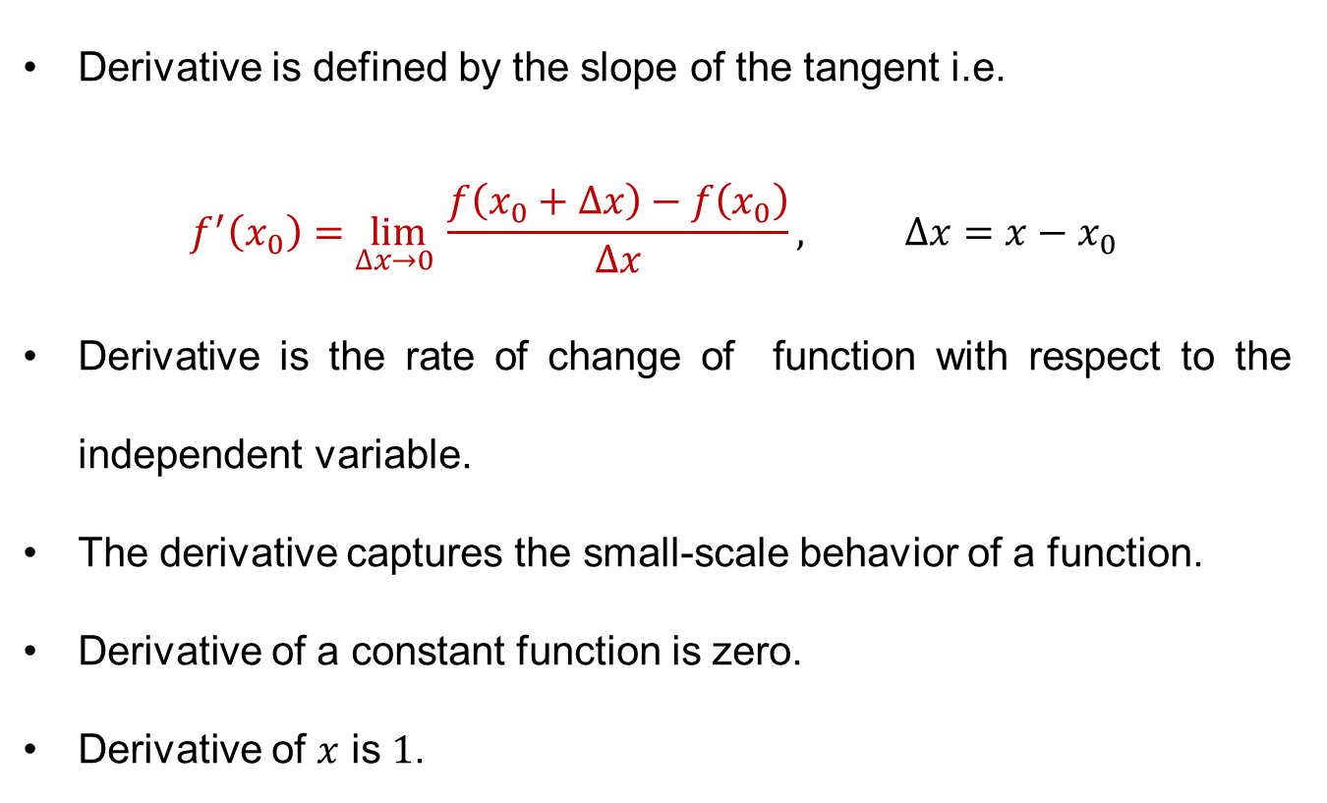
Derivatives: Recall
Derivativeisdefined by the slope of the tangent i.e.
$$f^{′}\left(x_{0}\right)=\lim_{∆x→0 }\frac{f\left(x_{0}+∆x\right)−f\left(x_{0}\right)}{∆x}, ∆x=x−x_{0}$$
Derivativeis the rate of change of functionwith respect to the independent variable.
The derivative captures the small-scale behavior of a function.
Derivative of a constant functioniszero.
Derivative of $x$is$1$.

Slide 5
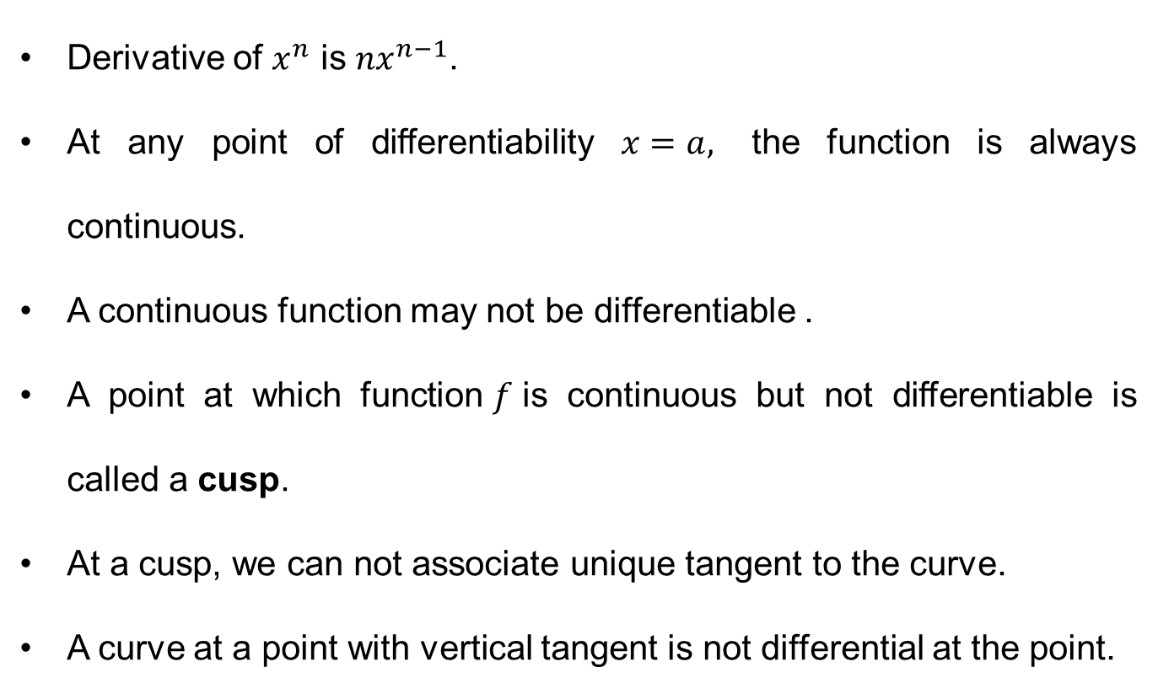
Derivatives: Recall
Derivative of $x^{n}$is$nx^{n−1}$.
Atany point of differentiability$x=a,$ the functionisalwayscontinuous.
A continuousfunctionmay not bedifferentiable .
A point atwhichfunction$f$iscontinuous but not differentiableiscalled a cusp.
At a cusp, wecan not associate unique tangent to the curve.
A curveat a point with vertical tangent is not differentialat the point.

Slide 6
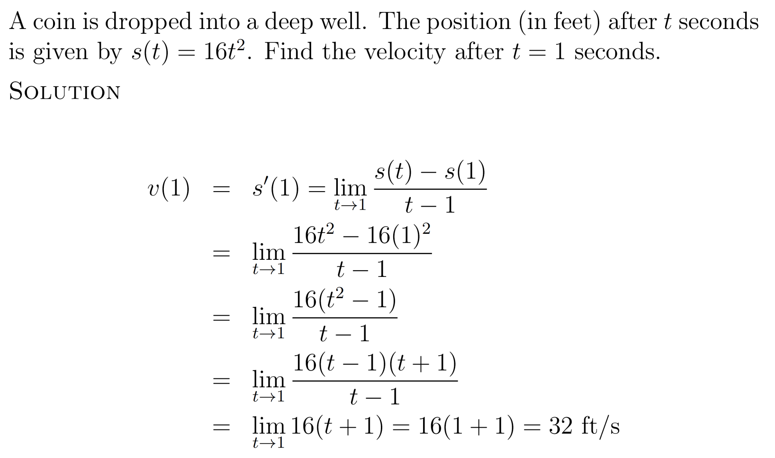
Derivatives: Recalls

Slide 7
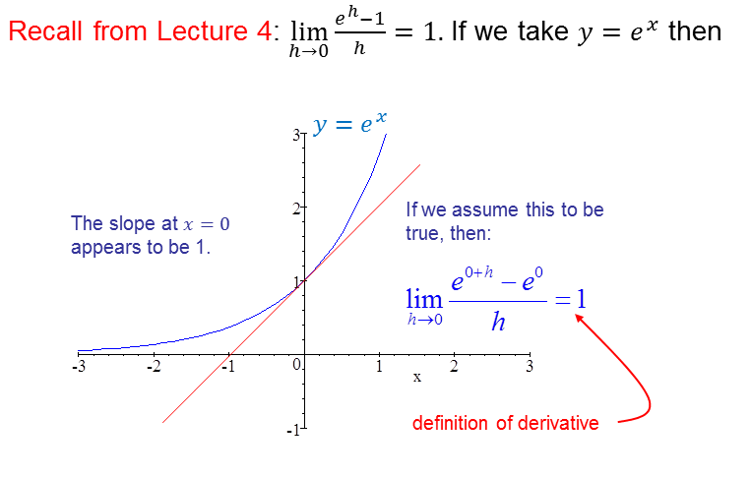
Derivative of exponential functions

Slide 8
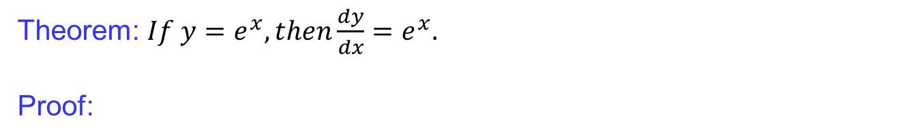
Derivative of exponential functions
Theorem: $If y=e^{x}, then\frac{dy}{dx}=e^{x}.$
Proof:

Slide 9
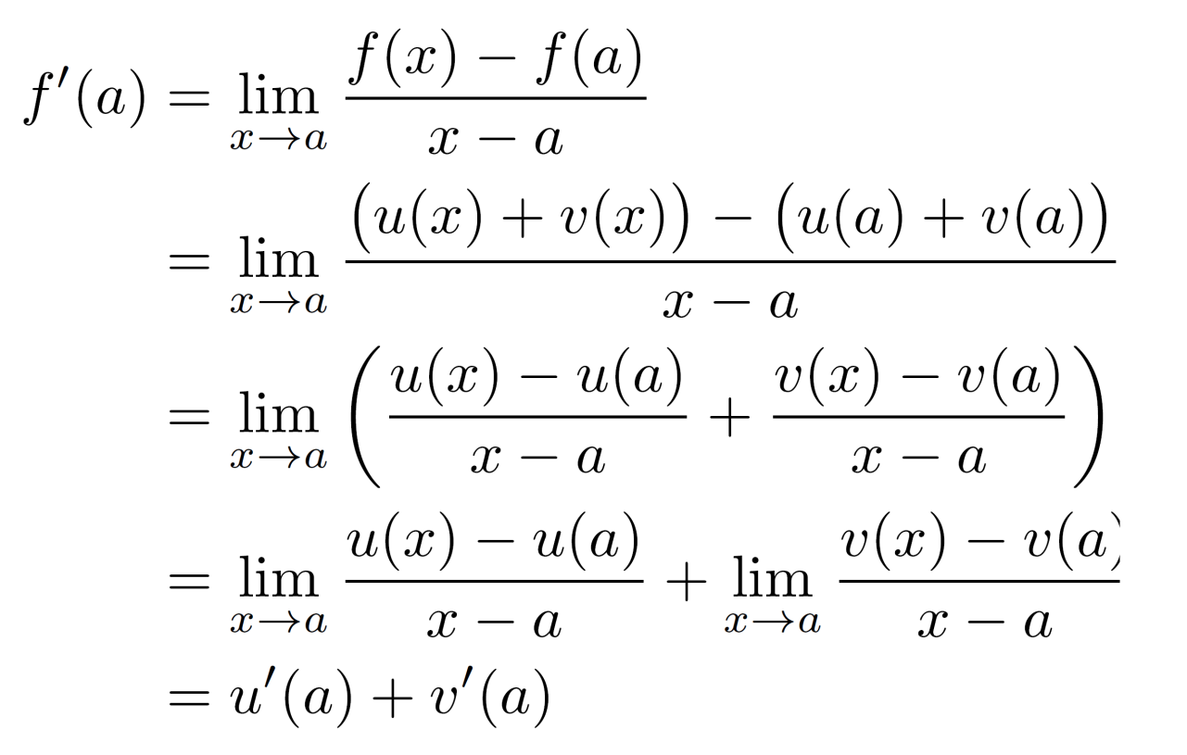
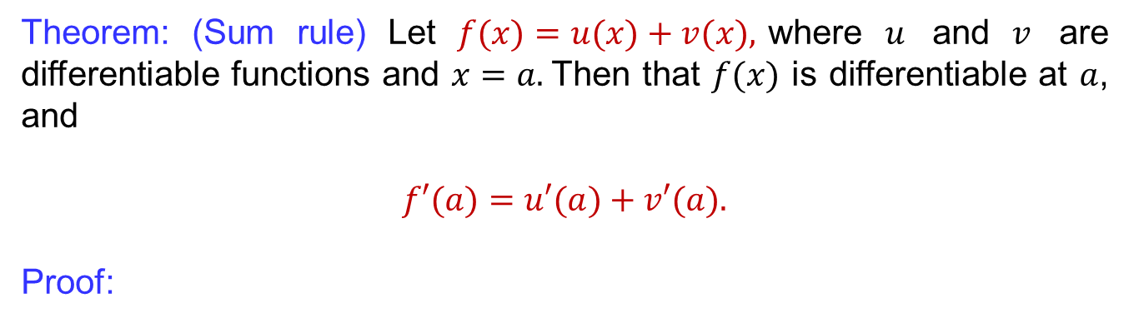
Rules of differentiation
Theorem: (Sumrule)Let $f(x)=u(x)+v(x),$where$u$ and $v$ are differentiablefunctionsand $x=a.$Then that$f(x)$isdifferentiableat$a$, and
$$f′(a)=u′(a)+v′(a).$$
Proof:

Slide 10
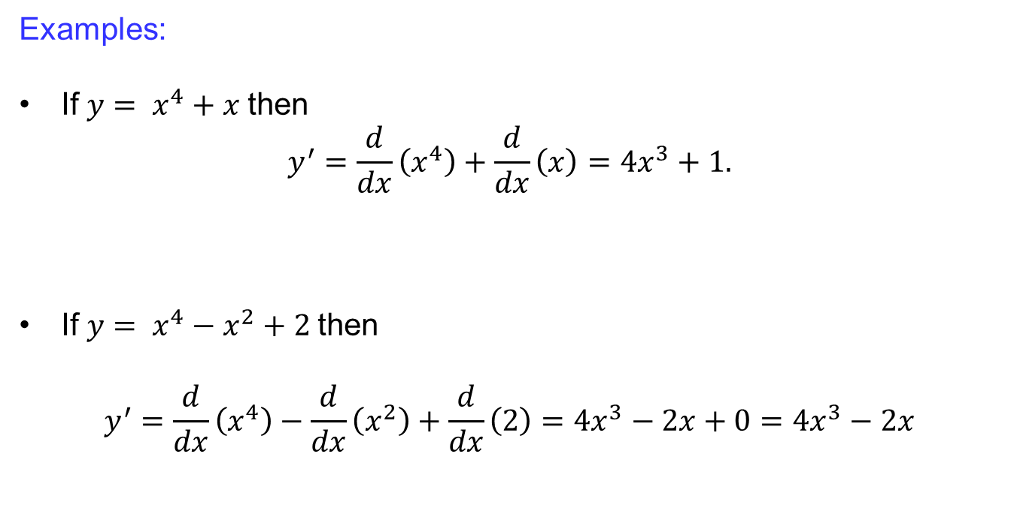
Rules of differentiation
Examples:
If $y= x^{4}+x$then
$$y^{′}=\frac{d}{dx}\left(x^{4}\right)+\frac{d}{dx}\left(x\right)=4x^{3}+1.$$
If $y= x^{4}−x^{2}+2$then
$$y^{′}=\frac{d}{dx}\left(x^{4}\right)−\frac{d}{dx}\left(x^{2}\right)+\frac{d}{dx}\left(2\right)=4x^{3}−2x+0=4x^{3}−2x$$

Slide 11
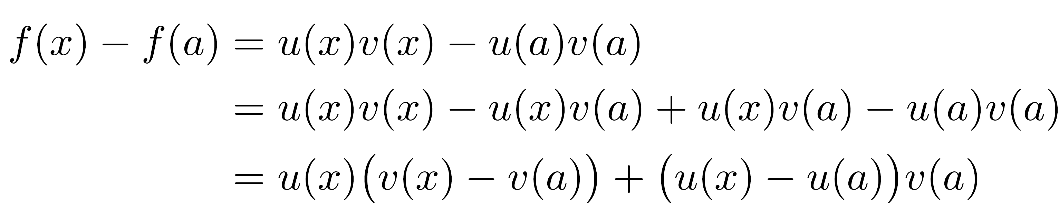
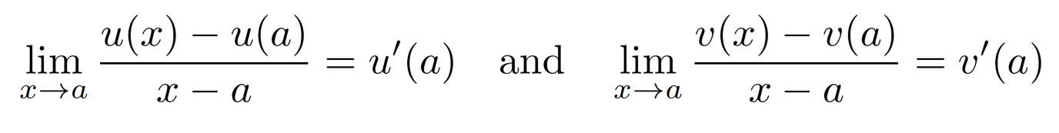
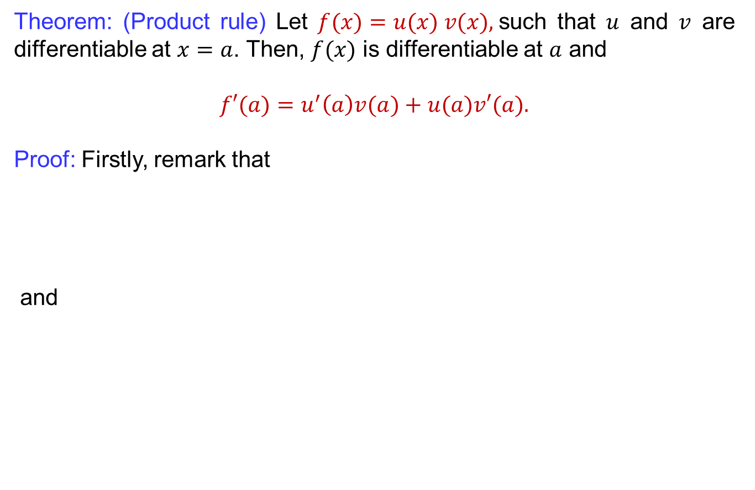
Rules of differentiation
Theorem: (Productrule) Let $f(x)=u(x) v(x),$suchthat$u$ and $v$ are differentiableat$x=a$. Then, $f(x)$isdifferentiableat$a$ and
$$f′(a)=u^{′}\left(a\right)v(a)+u(a)v′(a).$$
Proof: Firstly, remark that
and

Slide 12
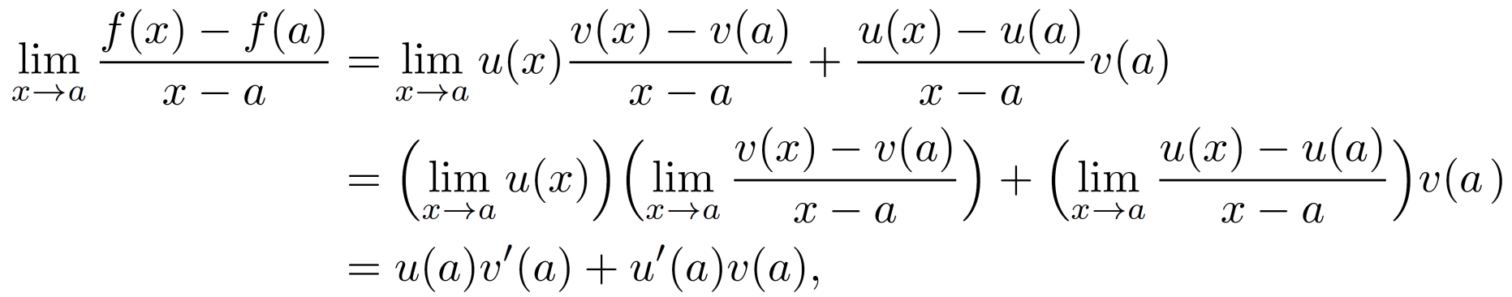
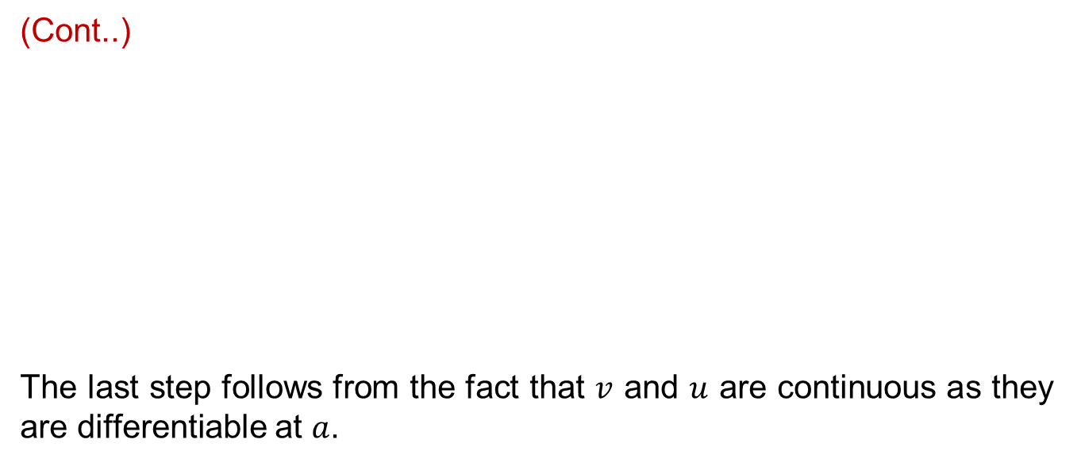
Rules of differentiation
(Cont..)
The last step follows from the fact that $v$ and $u$ are continuous as they are differentiable at $a$.

Slide 13
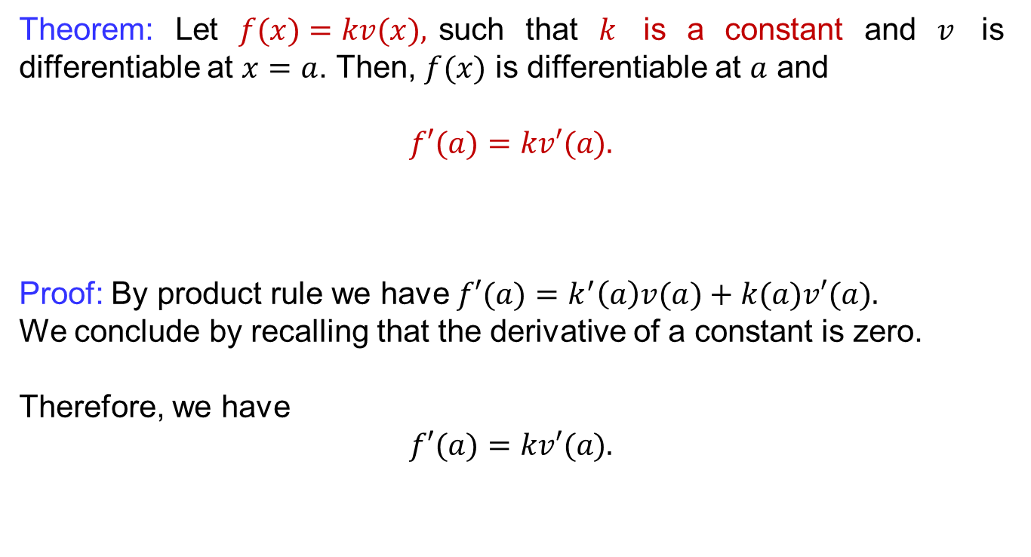
Rules of differentiation
Theorem: Let $f(x)=kv(x),$suchthat$k$is a constant and $v$ is differentiableat$x=a$. Then, $f(x)$isdifferentiableat$a$ and
$$f′(a)=kv′(a).$$
Proof: By product rule we have $f′(a)=k^{′}\left(a\right)v(a)+k(a)v′(a).$
Weconclude by recallingthat the derivative of a constant iszero.
Therefore, we have
$$f′(a)=kv′(a).$$

Slide 14
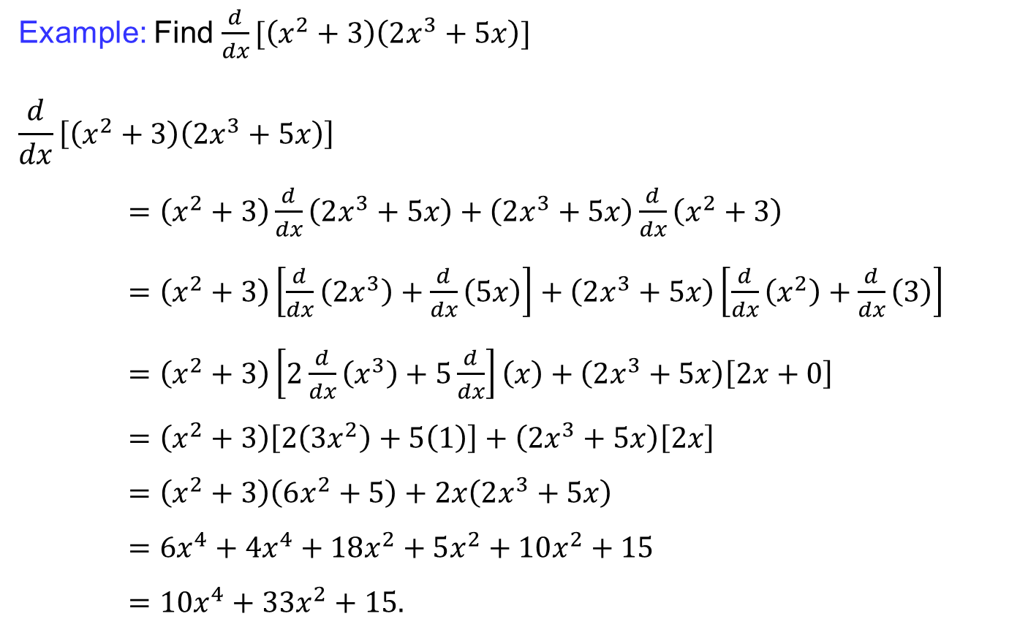
Rules of differentiation
Example:Find$\frac{d}{dx}[\left(x^{2}+3\right)\left(2x^{3}+5x\right)]$
$$\frac{d}{dx}\left[\left(x^{2}+3\right)\left(2x^{3}+5x\right)\right]$$
$=\left(x^{2}+3\right)\frac{d}{dx}\left(2x^{3}+5x\right)+\left(2x^{3}+5x\right)\frac{d}{dx}\left(x^{2}+3\right)$
$=\left(x^{2}+3\right)\left[\frac{d}{dx}\left(2x^{3}\right)+\frac{d}{dx}\left(5x\right)\right]+\left(2x^{3}+5x\right)\left[\frac{d}{dx}\left(x^{2}\right)+\frac{d}{dx}\left(3\right)\right]$
$=\left(x^{2}+3\right)\left[2\frac{d}{dx}\left(x^{3}\right)+5\frac{d}{dx}\right]\left(x\right)+\left(2x^{3}+5x\right)\left[2x+0\right]$
$=\left(x^{2}+3\right)\left[2\left(3x^{2}\right)+5\left(1\right)\right]+\left(2x^{3}+5x\right)\left[2x\right]$
$=\left(x^{2}+3\right)\left(6x^{2}+5\right)+2x\left(2x^{3}+5x\right)$
$=6x^{4}+4x^{4}+18x^{2}+5x^{2}+10x^{2}+15$
$=10x^{4}+33x^{2}+15.$

Slide 15
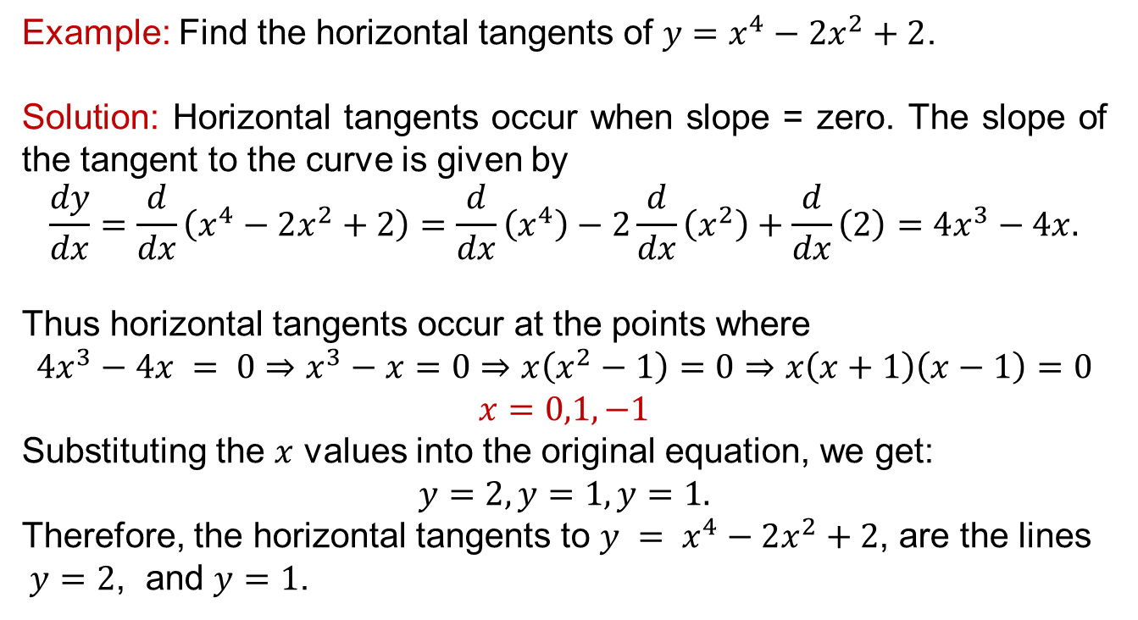
Rules of differentiation
Example: Find the horizontal tangents of $y=x^{4}−2x^{2}+2$.
Solution: Horizontal tangents occur when slope = zero. The slope of the tangent to the curve is given by
$$\frac{dy}{dx}=\frac{d}{dx}\left(x^{4}−2x^{2}+2\right)=\frac{d}{dx}\left(x^{4}\right)−2\frac{d}{dx}\left(x^{2}\right)+\frac{d}{dx}\left(2\right)=4x^{3}−4x.$$
Thus horizontal tangents occurat the points where
$$4x^{3}−4x = 0⇒x^{3}−x=0⇒x\left(x^{2}−1\right)=0⇒x\left(x+1\right)\left(x−1\right)=0$$
$$x=0,1,−1$$
Substituting the $x$ values into the original equation, we get:
$$y=2, y=1, y=1.$$
Therefore, the horizontal tangents to $y = x^{4}−2x^{2}+2$, are the lines
$y=2$, and $y=1$.

Slide 16
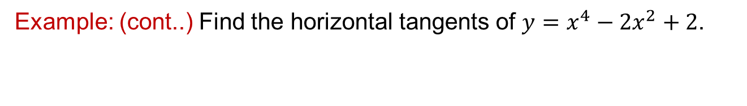
Rules of differentiation
Example: (cont..) Find the horizontal tangents of $y=x^{4}−2x^{2}+2$.
Slope is zero at:

Slide 17
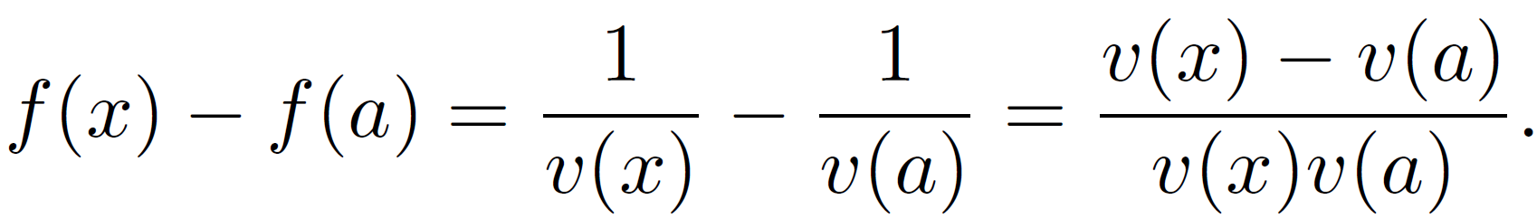
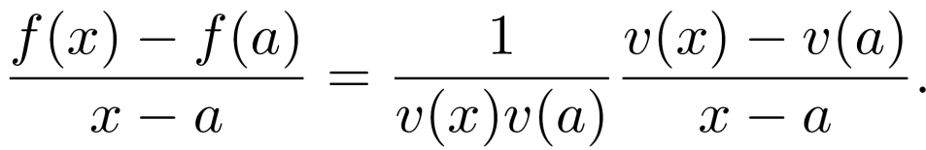
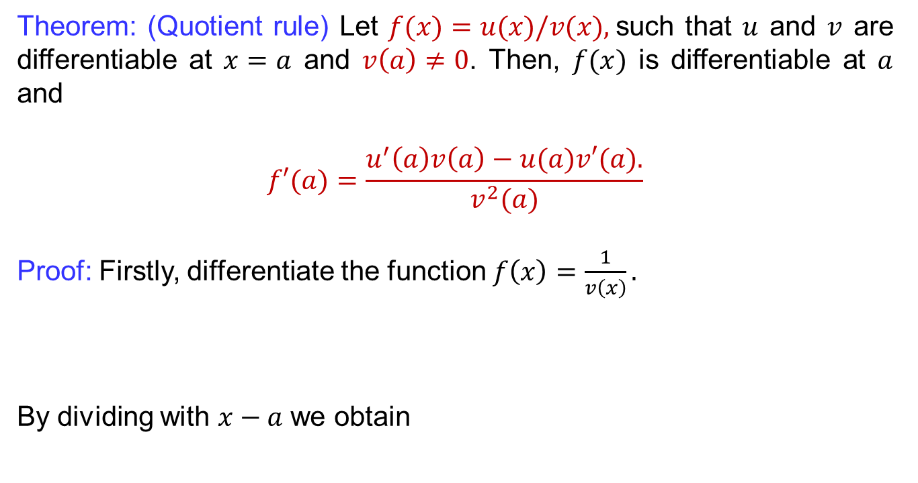
Rules of differentiation
Theorem: (Quotientrule) Let $f(x)=u(x)/v(x),$suchthat$u$ and $v$ are differentiableat$x=a$ and $v\left(a\right)≠0$. Then, $f(x)$isdifferentiableat$a$ and
$$f′(a)=\frac{u^{′}\left(a\right)v\left(a\right)−u(a)v′(a).}{v^{2}(a)}$$
Proof: Firstly, differentiate the function $f\left(x\right)=\frac{1}{v\left(x\right)}.$
By dividingwith$x−a$weobtain

Slide 18

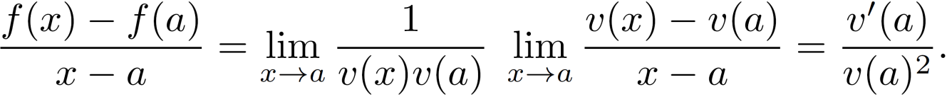
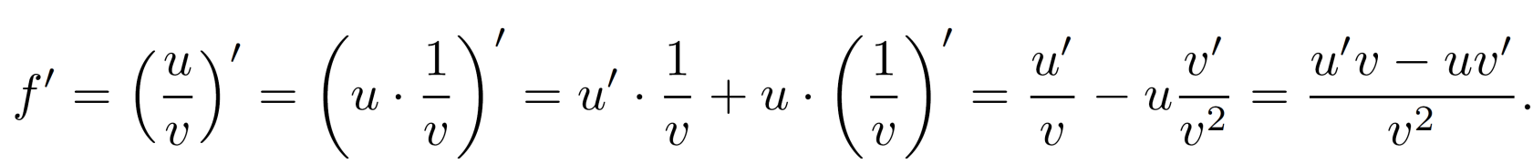
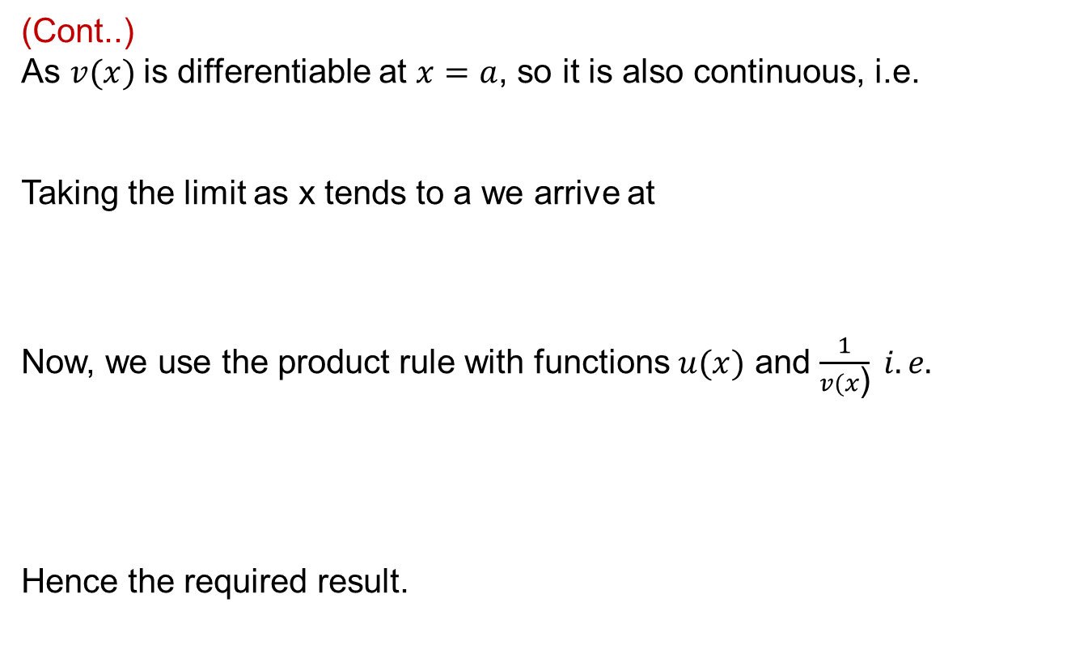
Rules of differentiation
(Cont..)
As $v(x)$is differentiable at $x=a$, so it is also continuous, i.e.
Taking the limit as x tends to a we arrive at
Now, we use the productrulewithfunctions$u(x)$ and $\frac{1}{v(x\text{)}} i.e.$
Hence the requiredresult.

Slide 19
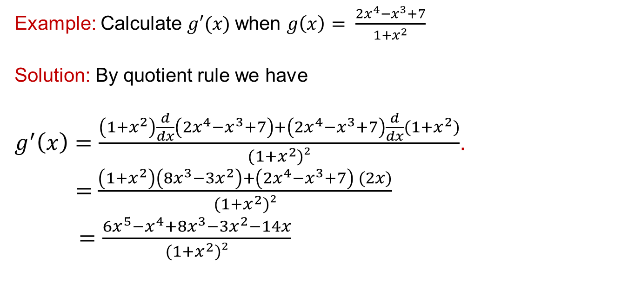
Rules of differentiation
Example: Calculate $g′(x)$when $g\left(x\right)= \frac{2x^{4}−x^{3}+7}{1+x^{2}}$
Solution: By quotient rulewe have
$g^{′}\left(x\right)=\frac{\left(1+x^{2}\right)\frac{d}{dx}\left(2x^{4}−x^{3}+7\right)+\left(2x^{4}−x^{3}+7\right)\frac{d}{dx}(1+x^{2})}{(1+x^{2})²}$.
= $\frac{\left(1+x^{2}\right)\left(8x^{3}−3x^{2}\right)+\left(2x^{4}−x^{3}+7\right) (2x)}{(1+x^{2})²}$
$=\frac{6x^{5}−x^{4}+8x^{3}−3x^{2}−14x}{(1+x^{2})²}$

Slide 20
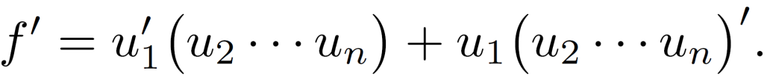
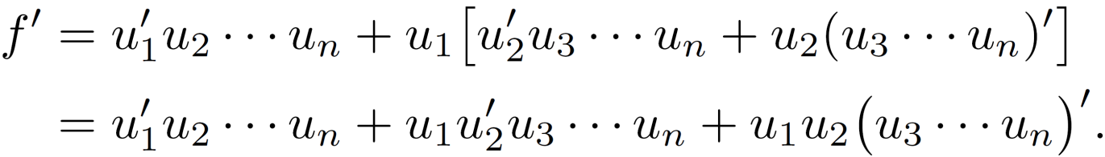
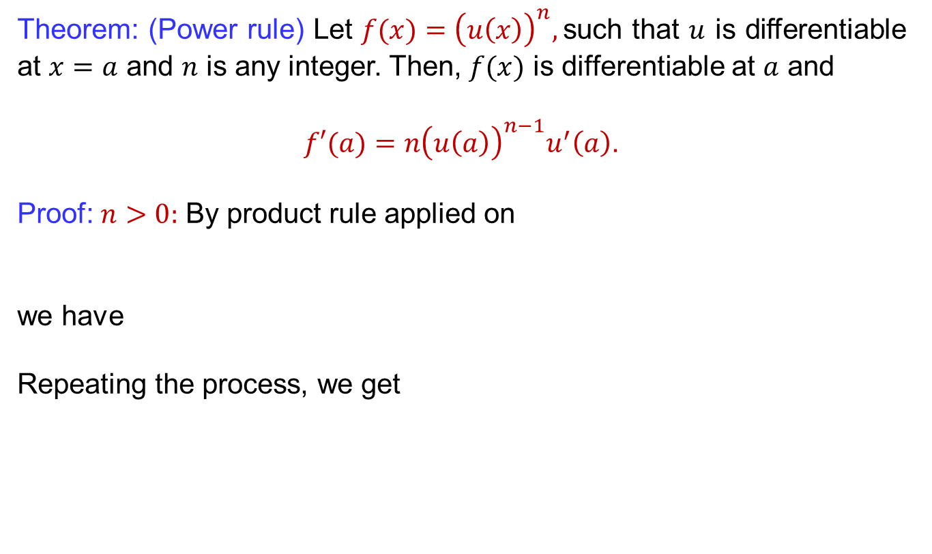
Rules of differentiation
Theorem: (Power rule) Let $f(x)={\left(u\left(x\right)\right)}^{n},$suchthat$u$ is differentiable at$x=a$ and $n$isanyinteger. Then, $f(x)$isdifferentiableat$a$ and
$f′(a)=n{\left(u\left(a\right)\right)}^{n−1}u^{′}\left(a\right)$.
Proof: $n>0:$By product rule applied on
we have
Repeating the process, weget

Slide 21
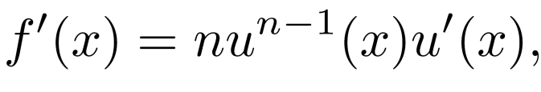
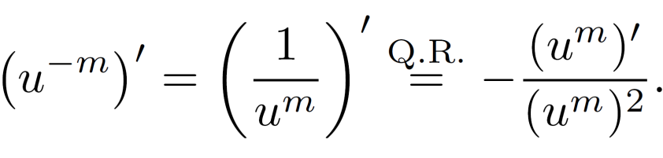
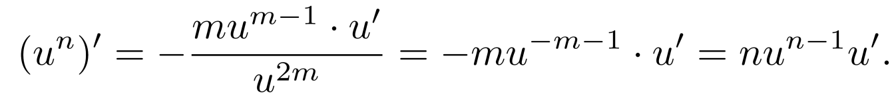
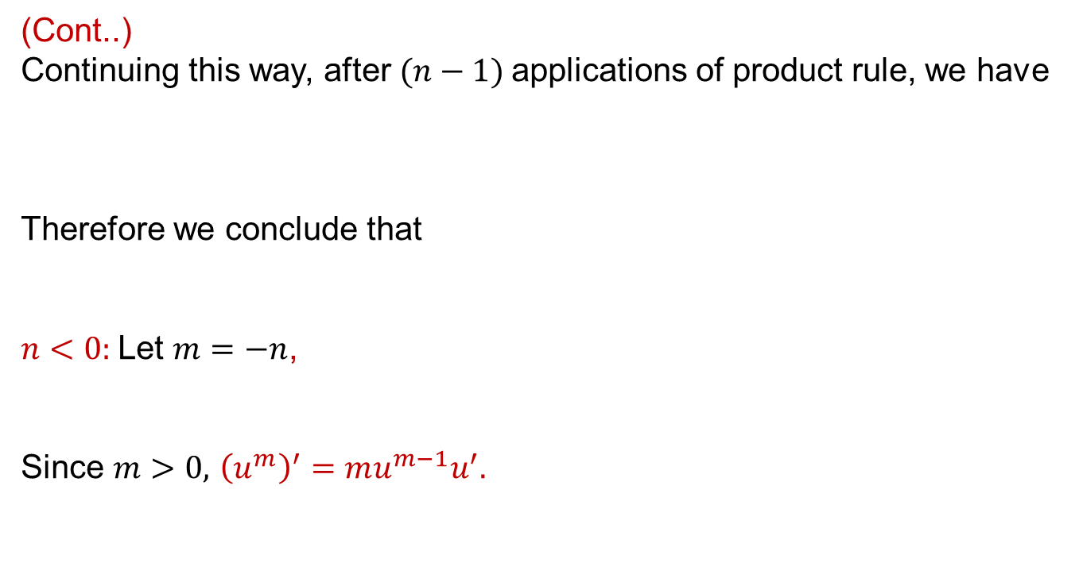
Rules of differentiation
(Cont..)
Continuing this way, after $(n−1)$applications of product rule, we have
Thereforeweconcludethat
$n<0:$Let $m=−n$,
Since$m>0,$${\left(u^{m}\right)}^{′}=mu^{m−1}u^{′}.$

Slide 22
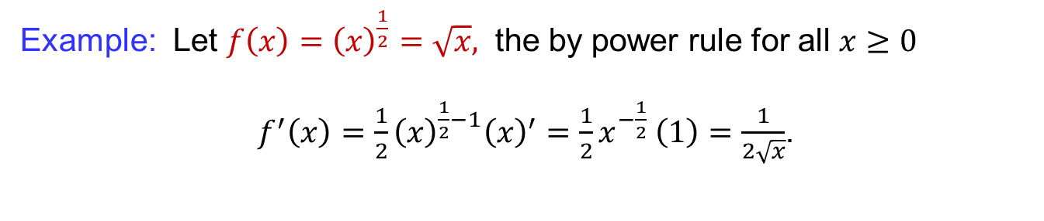
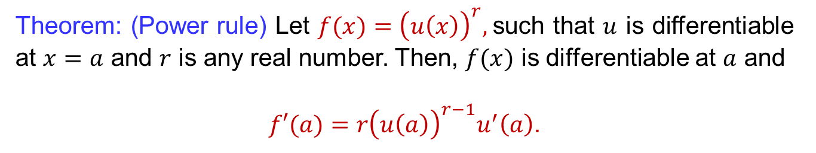
Rules of differentiation
Theorem: (Power rule) Let $f(x)={\left(u\left(x\right)\right)}^{r},$suchthat$u$ is differentiable at$x=a$ and $r$isany real number. Then, $f(x)$isdifferentiableat$a$ and
$f′(a)=r{\left(u\left(a\right)\right)}^{r−1}u^{′}\left(a\right)$.
Example: Let $f\left(x\right)={\left(x\right)}^{\frac{1}{2}}=\sqrt{x},$ the by power rule for all $x≥0$
$f^{′}\left(x\right)=\frac{1}{2}{\left(x\right)}^{\frac{1}{2}−1}{\left(x\right)}^{′}=\frac{1}{2}x^{−\frac{1}{2}} \left(1\right)=\frac{1}{2\sqrt{x}}$.

Slide 23
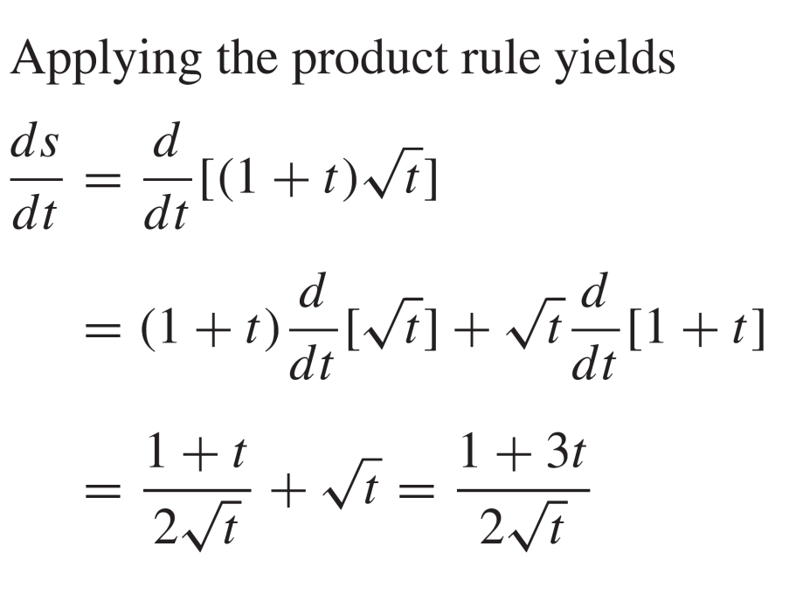
Rules of differentiation
Example:
Solution:

Slide 24
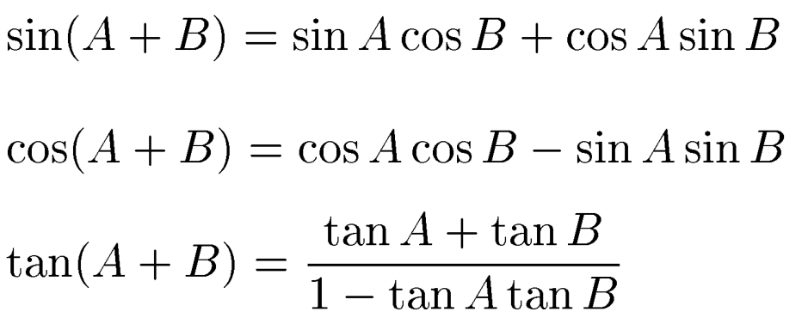
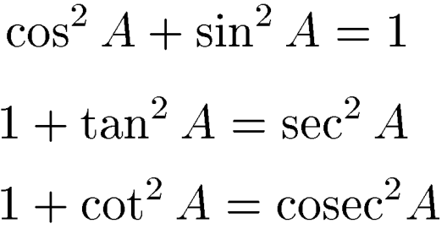
Differentiation of trigonometric functions
Trigonometric identities:

Slide 25
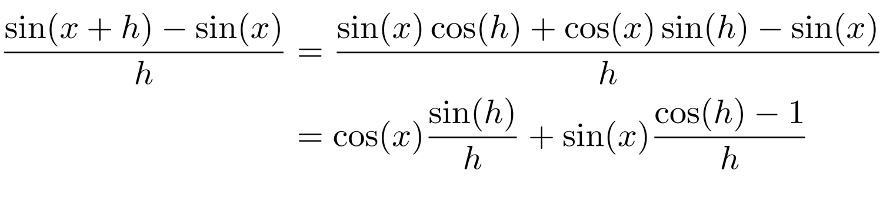
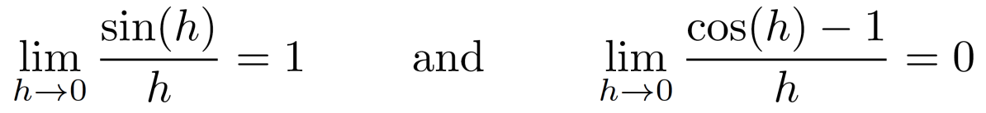
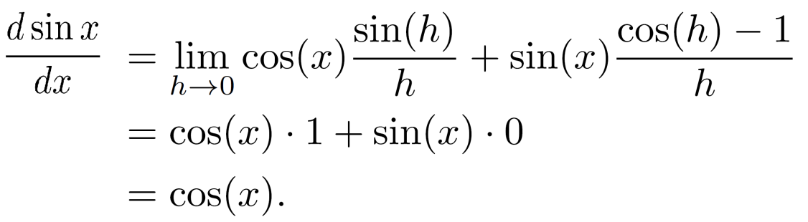
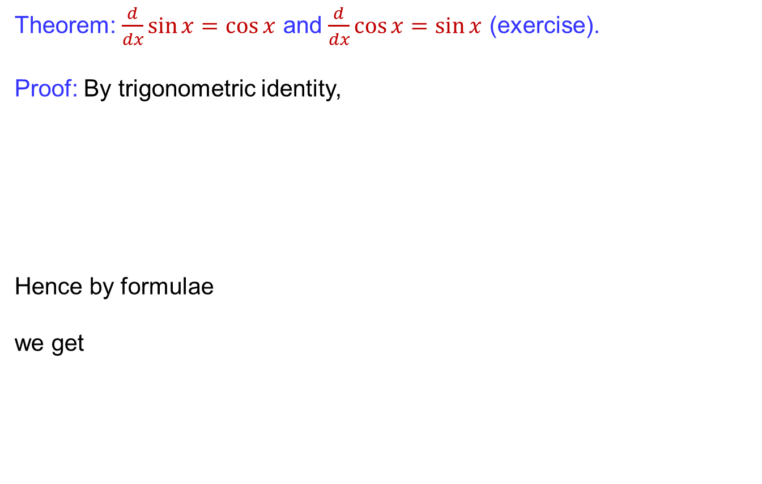
Differentiation of trigonometric functions
Theorem: $\frac{d}{dx}\sin{x}=\cos{x}$ and $\frac{d}{dx}\cos{x}=\sin{x}$ (exercise).
Proof: By trigonometricidentity,
Hence by formulae
weget

Slide 26
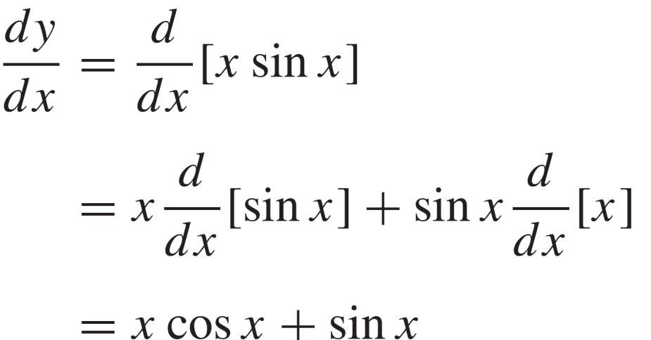

Differentiation of trigonometric functions
Example:
Solution:

Slide 27
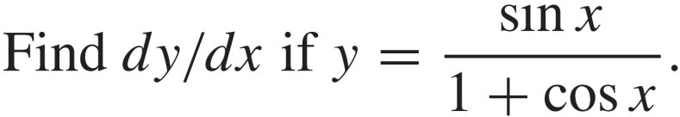
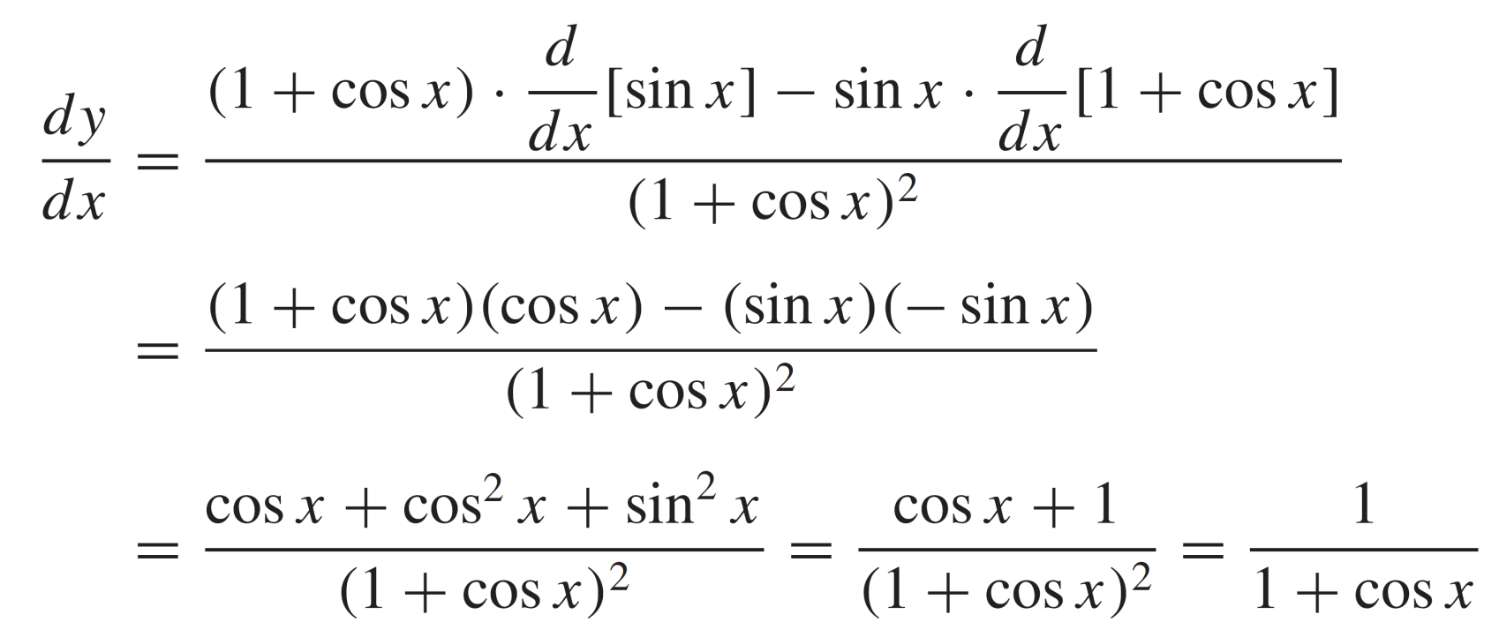

Differentiation of trigonometric functions
Example:
Solution:

Slide 28
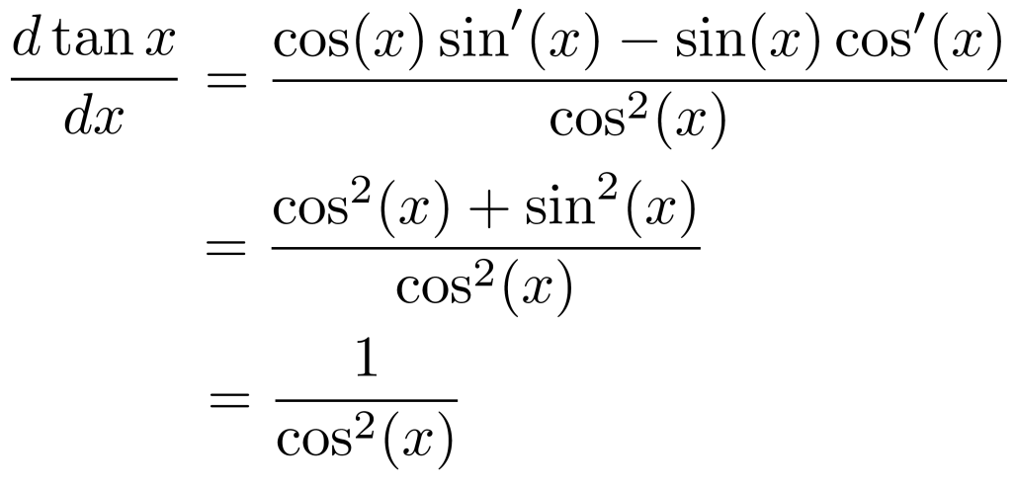
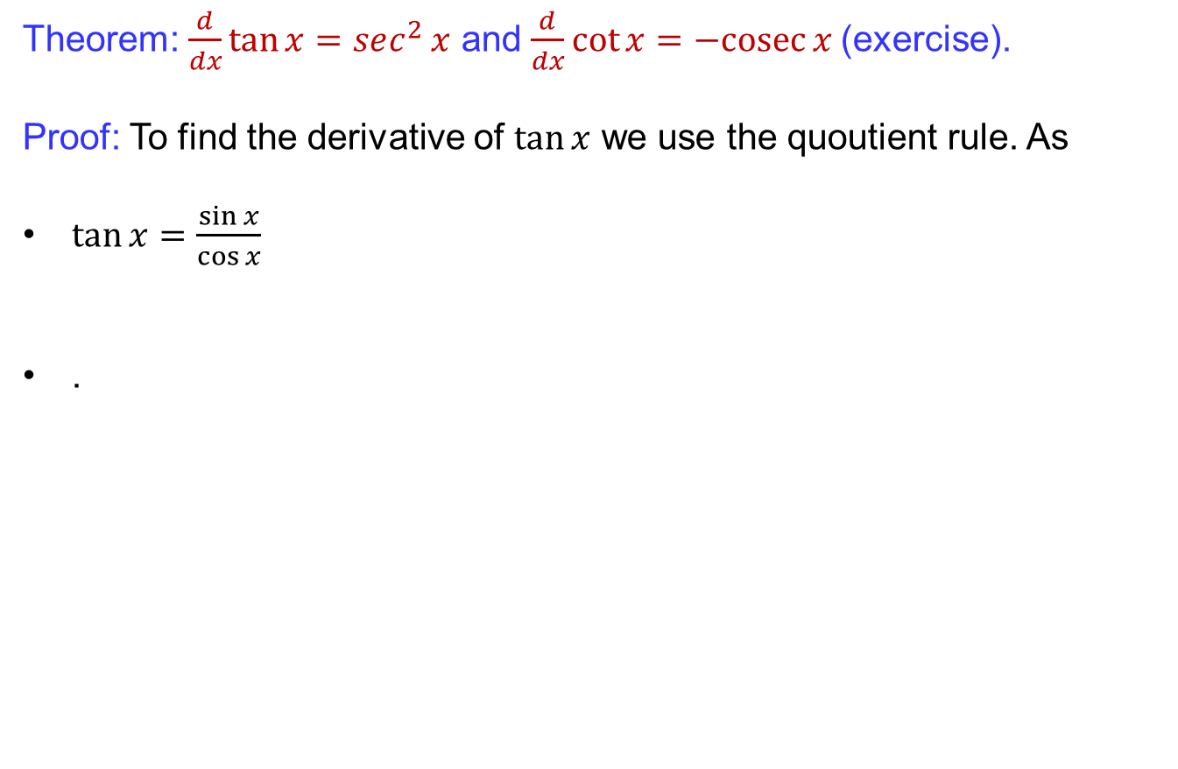
Differentiation of trigonometric functions
Theorem: $\frac{d}{dx}\tan{x}=sec^{2}{x}$ and $\frac{d}{dx}\cot{x}=−cosec{x}$(exercise).
Proof: To find the derivative of $\tan{x}$we use the quoutientrule. As
$\tan{x=\frac{\sin{x}}{\cos{x}}}$
.

Slide 29
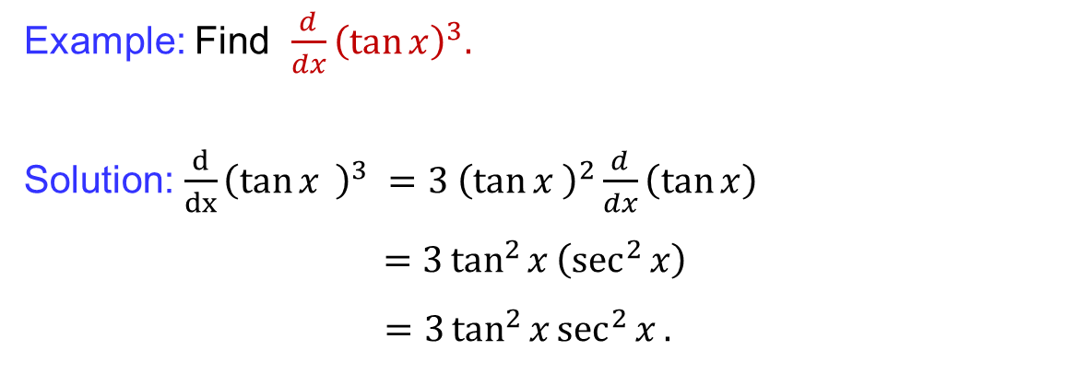
Differentiation of trigonometric functions
Example: Find$\frac{d}{dx}{\left(\tan{x}\right)}^{3}.$
Solution:$\frac{d}{dx}{\left(\tan{x}{ }\right)}^{3} =3 {\left(\tan{x }\right)}^{2}\frac{d}{dx}\left(\tan{x}\right)$
$=3\tan^{2}{x}\left(\sec^{2}{x}\right)$
$=3\tan^{2}{x}\sec^{2}{x}.$

Slide 30
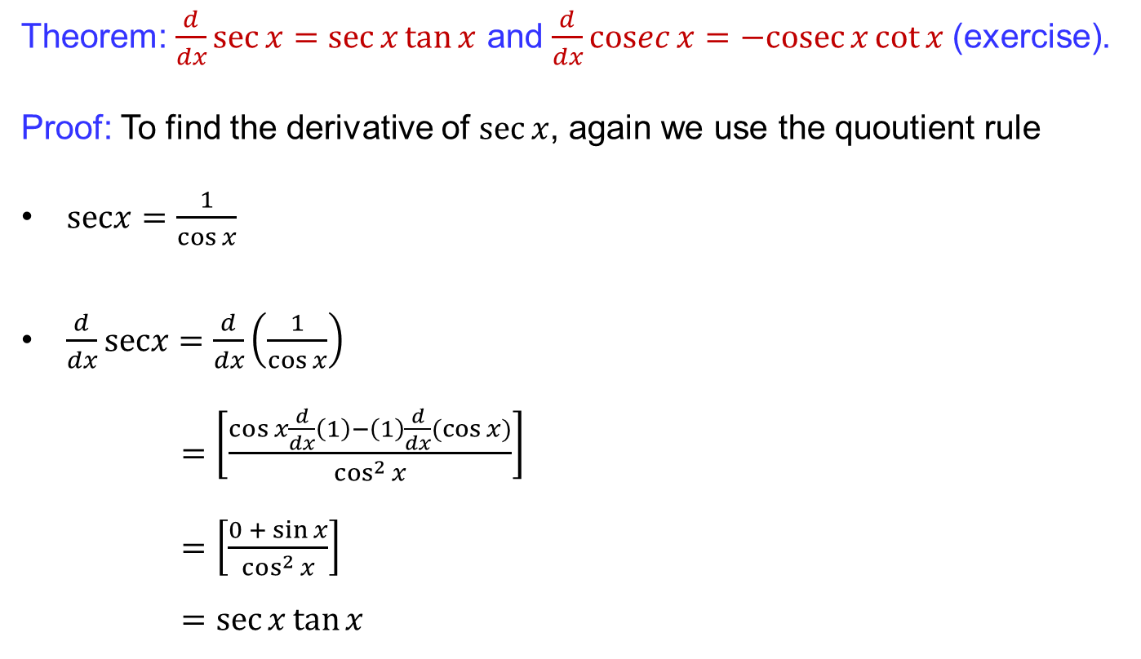
Differentiation of trigonometric functions
Theorem: $\frac{d}{dx}\sec{x}=\sec{x}\tan{x}$ and $\frac{d}{dx}\operatorname{cosec}{x}=−cosec{x\cot{x}}$(exercise).
Proof: To find the derivative of $\sec{x}$, again we use the quoutientrule
$\operatorname{secx}{=\frac{1}{\cos{x}}}$
$\frac{d}{dx}secx=\frac{d}{dx}\left(\frac{1}{\cos{x}}\right)$
$=\left[\frac{\cos{x\frac{d}{dx}\left(1\right)−\left(1\right)\frac{d}{dx}(\cos{x)}}}{\cos^{2}{x}}\right]$
$=\left[\frac{0{+}\sin{x}}{\cos^{2}{x}}\right]$
$=\sec{x}\tan{x}$

Slide 31
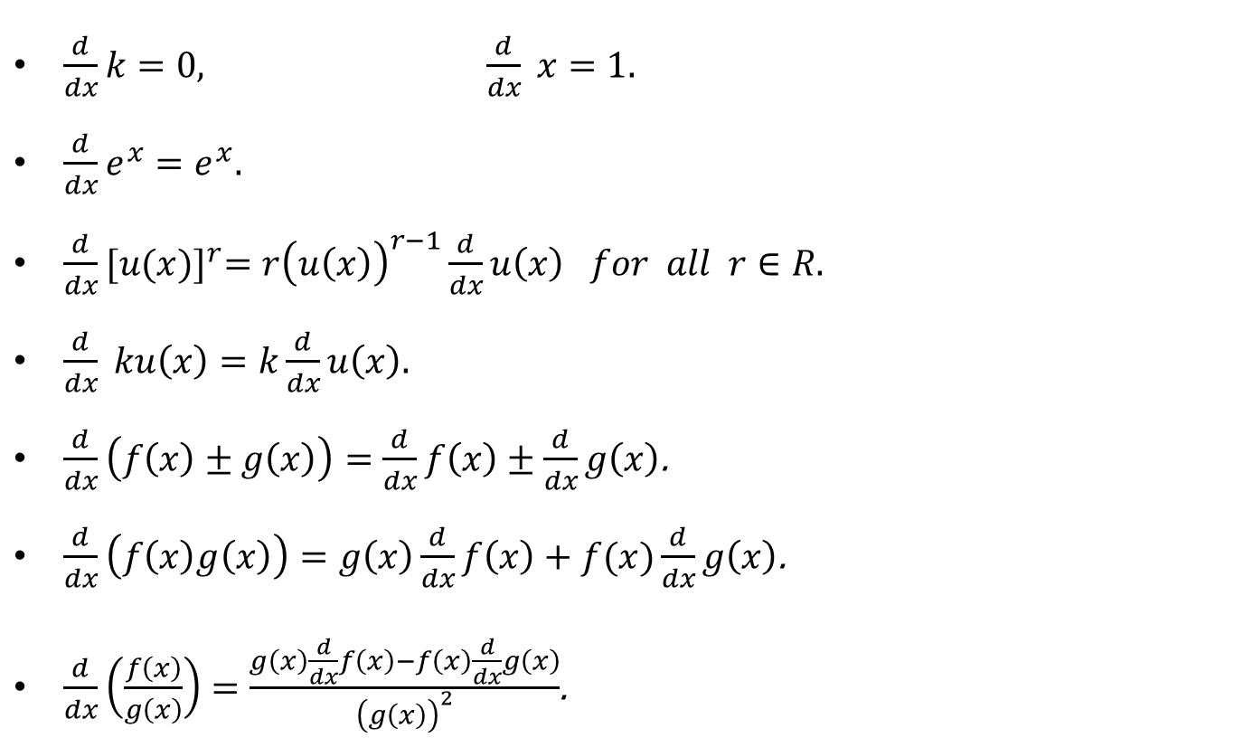
Summary of differentiation rules
$\frac{d}{dx}k=0, \frac{d}{dx} x=1.$
$\frac{d}{dx}e^{x}=e^{x}.$
$\frac{d}{dx}{[u(x)]}^{r}=r{\left(u\left(x\right)\right)}^{r−1}\frac{d}{dx}u\left(x\right) for all r∈R.$
$\frac{d}{dx} ku\left(x\right)=k\frac{d}{dx}u\left(x\right).$
$\frac{d}{dx}\left(f\left(x\right)±g\left(x\right)\right)=\frac{d}{dx}f\left(x\right)±\frac{d}{dx}g\left(x\right)$.
$\frac{d}{dx}\left(f\left(x\right)g\left(x\right)\right)=g\left(x\right)\frac{d}{dx}f\left(x\right)+f(x)\frac{d}{dx}g\left(x\right)$.
$\frac{d}{dx}\left(\frac{f\left(x\right)}{g\left(x\right)}\right)=\frac{g\left(x\right)\frac{d}{dx}f\left(x\right)−f\left(x\right)\frac{d}{dx}g\left(x\right)}{{\left(g\left(x\right)\right)}^{2}}$.

Slide 32
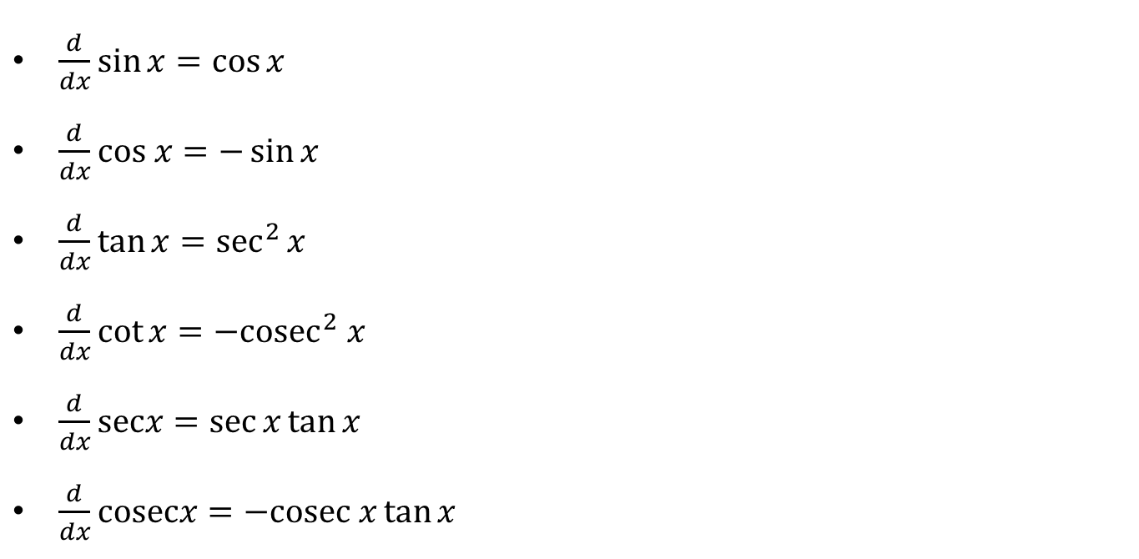
Summary of differentiation rules
$\frac{d}{dx}\sin{x}=\cos{x}$
$\frac{d}{dx}cos x=−\sin{x}$
$\frac{d}{dx}\tan{x}=\sec^{2}{x}$
$\frac{d}{dx}\cot{x}=−{cosec}^{2} x$
$\frac{d}{dx}\operatorname{secx}{=\sec{x}}\tan{x}$
$\frac{d}{dx}cosecx=−cosec x\tan{x }$

Slide 33
Lecture Summary
    Derivatives: Recall.
    Derivatives of exponential functions
    Rules of differentiation
    Differentiation of trigonometric function
    Summary of differentiation rules

